Slide 1
Statistics – O. R. 881
Object Oriented Data Analysis
Steve Marron
Dept. of Statistics and Operations Research
University of North Carolina

Slide 2
Last Class: Administrative Info
Details on Course Web Page
https://marron.web.unc.edu/course-homepage-stor-881-object-oriented-data-analysis-fall-2025
Or access from Canvas page
Or:
  Google: “Marrons teaching material”
  Choose This Course

Slide 3
Administrative Info
Forgotten Last Class: Personal Info
Email: marron@unc.edu
Phones:
  Office: 919-962-2188
  Cell: 919-308-7890
  Home: 919-493-2844
Office: Hanes 352
(back hall off central area)
Hours: By email appointment (Zoom is Fine)

Slide 4

Administrative Info
Typo on Canvas Page:

Slide 5
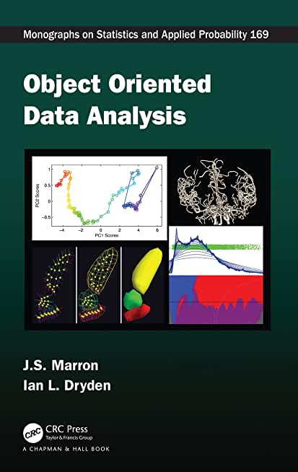

Object Oriented Data Analysis
Textbook:
Object Oriented Data Analysis
Marron and Dryden (2021)

Slide 6
Current Sections in Textbook
Today:
Sections 3.1, 3.3, 4.1
Next Class:
Section 3.3, 4.1, 6.4, 13.1

Slide 7
Last Class: Course Context
Currently Fashionable Topic:
Big Data Science
Many Important Issues.
But More Challenging (& Important?):
Complex Data
( )

Slide 8
Last Class: OODA
What is it?
A Sound-Bite Explanation:
What is the “atom of the statistical analysis”?
1st Course: Numbers
Multivariate Analysis Course : Vectors
Functional Data Analysis: Curves
More generally: Data Objects

Slide 9
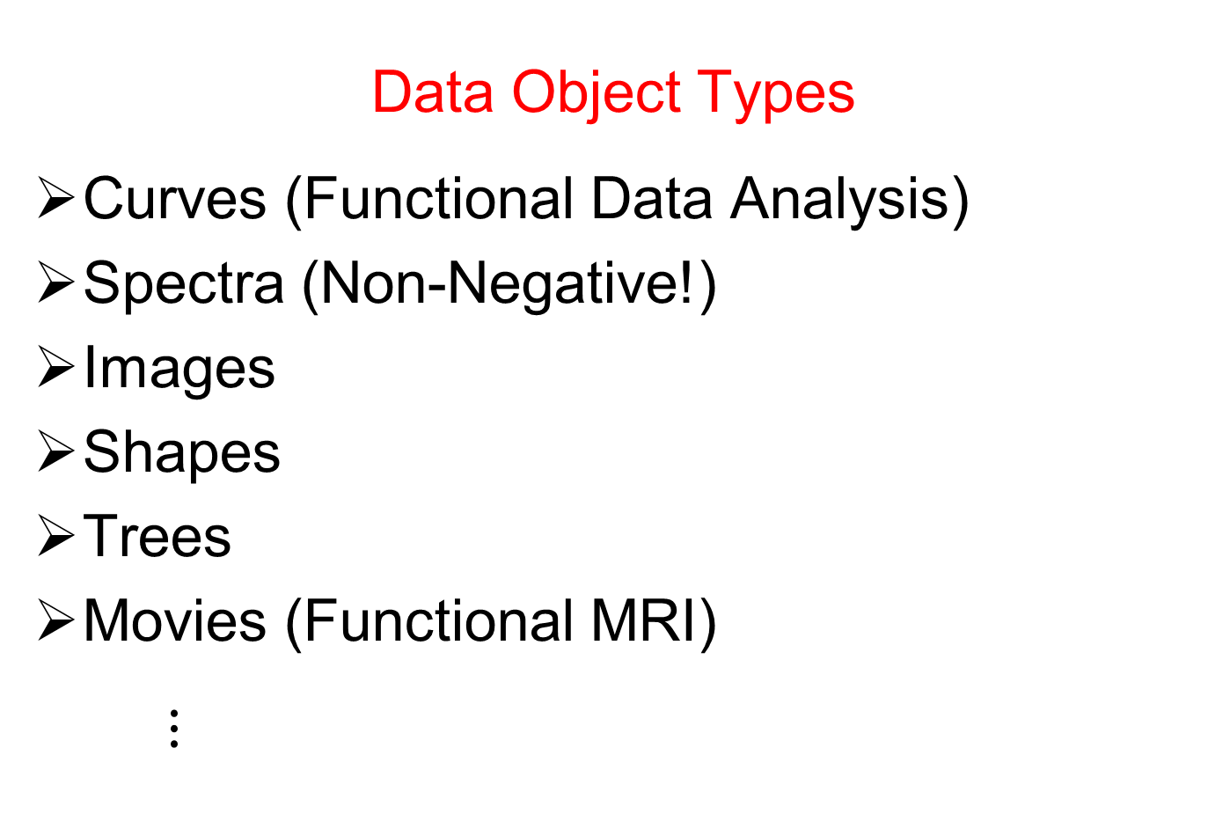
Last Class: OODA
Data Object Types
Curves (Functional Data Analysis)
Spectra (Non-Negative!)
Images
Shapes
Trees
Movies (Functional MRI)
$⋮$

Slide 10
Last Class: OODA
Current Motivation (of OODA terminology):
In Complicated Data Analyses
Fundamental (Non-Obvious) Question Is:
“What Should We Take as Data Objects?”
Key to Focusing Needed Analyses

Slide 11
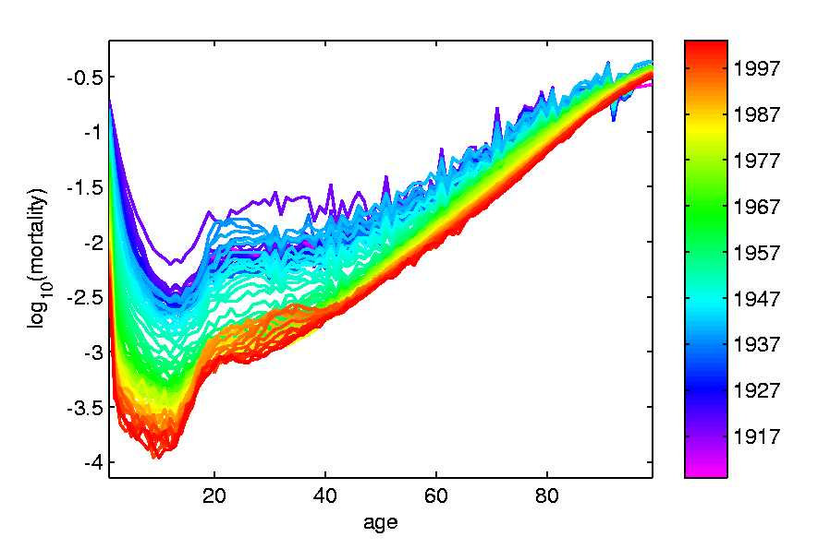
Last Class: Taste of OODA
Spanish Male Mortality Curves
Enhancement: Color by Year
1908
1931
1964
1987
2002

Slide 12
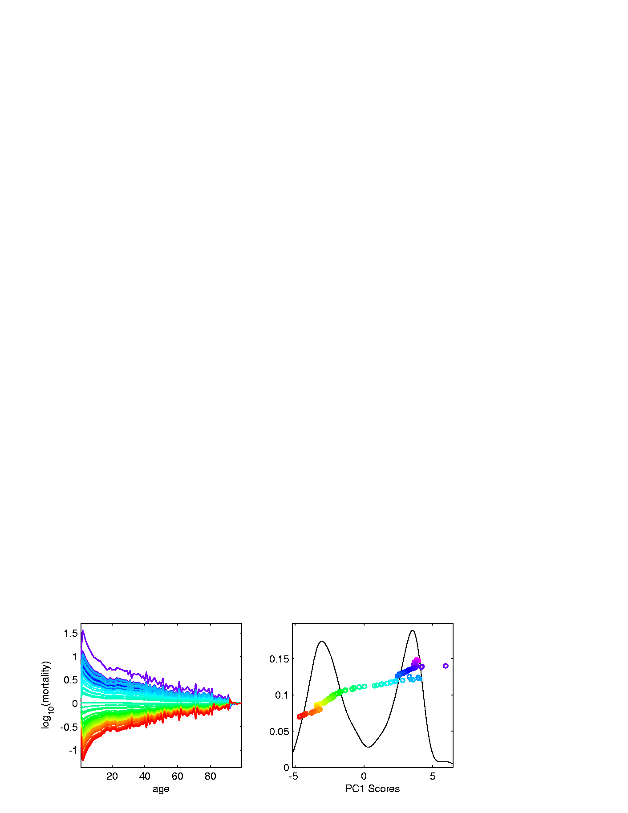
Last Class: Taste of OODA
Spanish Male Mortality Curves
1918 Flu Pandemic
Spanish Civil War
1st Mode of
Variation

Slide 13
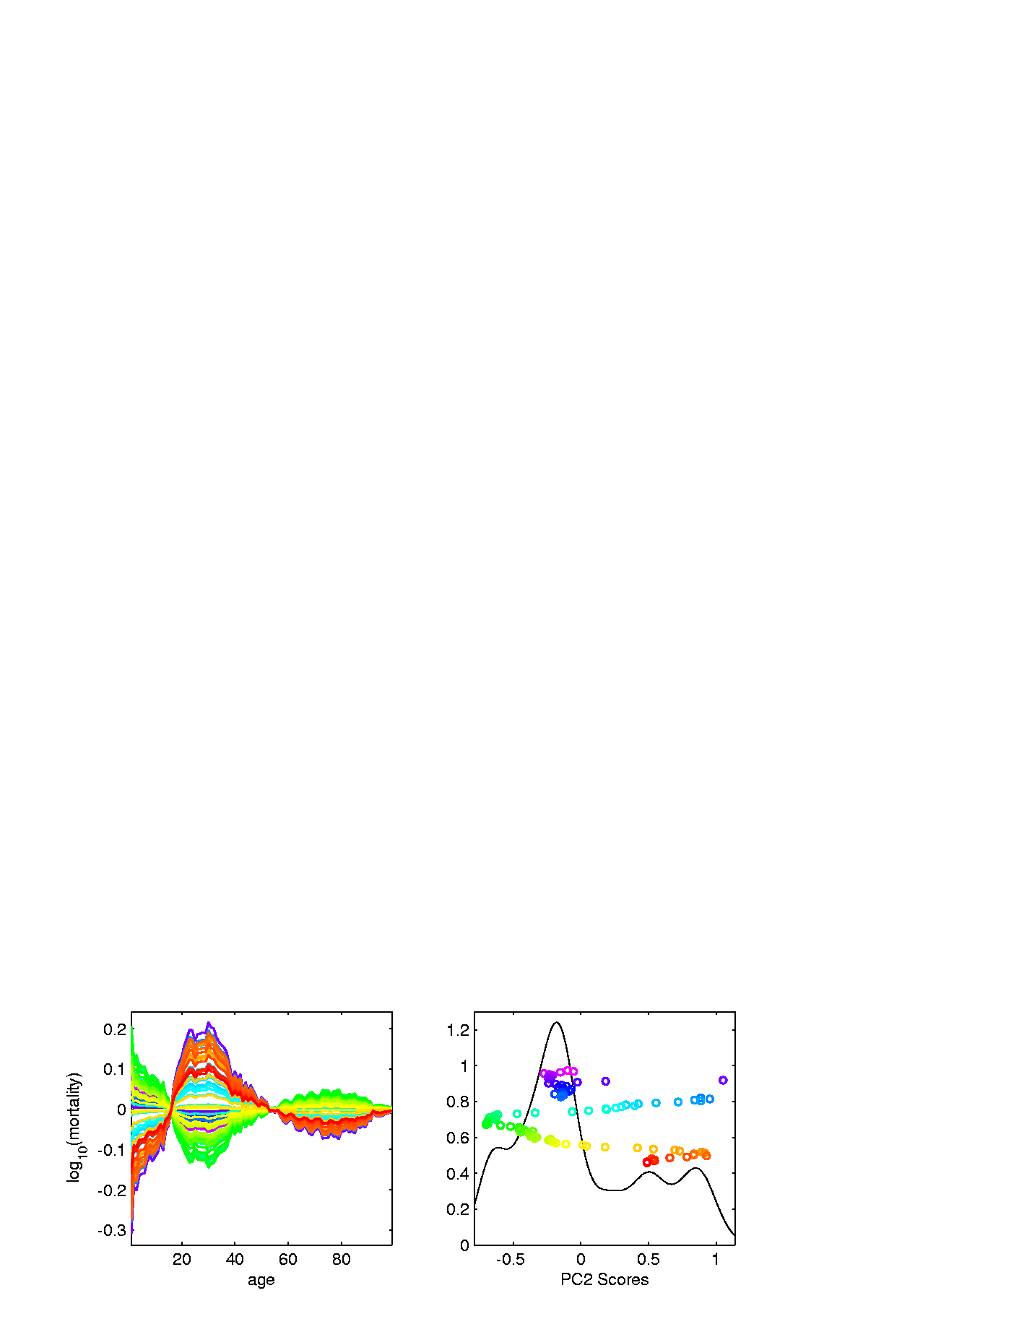
Last Class: Taste of OODA
Spanish Male Mortality Curves
Flu Pandemic, Civil War
2nd Mode of
Variation
Intro of Automobile,
Improved Safety

Slide 14
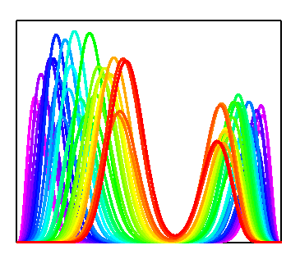
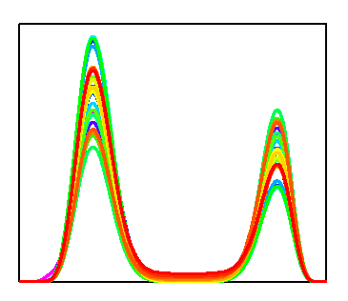

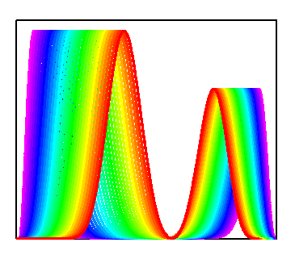
Last Class: Taste of OODA
Phase and Amplitude Curves
Raw
Data
Ampl’de
Varia’n
Interesting
Modes of
Variation!
Phase
Varia’n
Warps

Slide 15
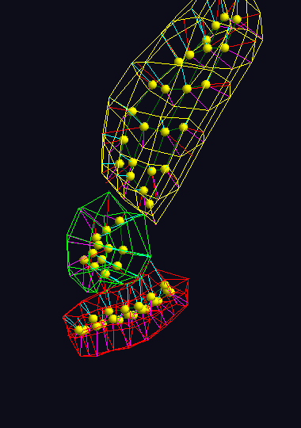
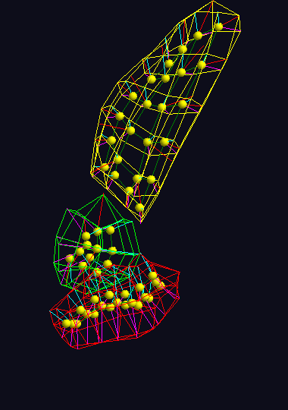
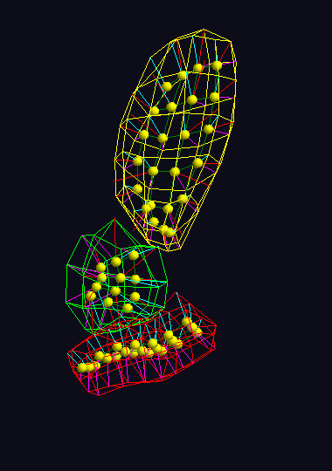



Last Class: Taste of OODA
Note: Different Display of Modes of Variation
Shapes in Image Analysis (3-d)
Analysis of Variation (Princ. Geod. Anal.)
Mode 1: Rectum
Mode 2: Twisting
Mode 3: Bladder
$$μ−2×{PC}_{1}$$
$$μ−2×{PC}_{1}$$
$$μ−2×{PC}_{1}$$

Slide 16
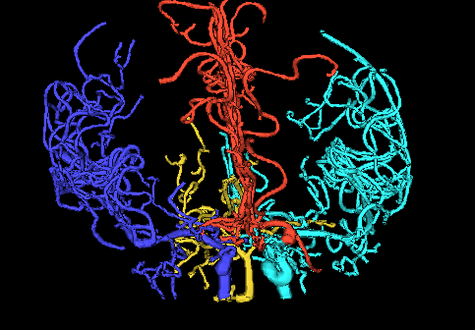
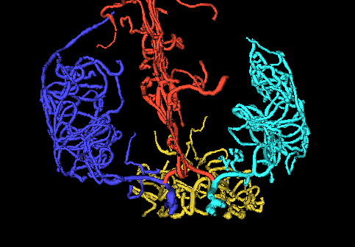
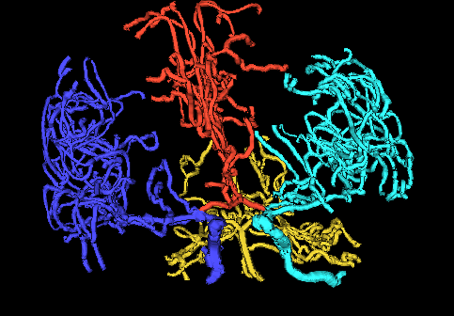
Last Class: Taste of OODA
Tree Structured Data Objects
Brain Artery Data,
Analyze Sample of n=100
Average? Variation About Average???
Modes of Variation???
,
, ... ,

Slide 17
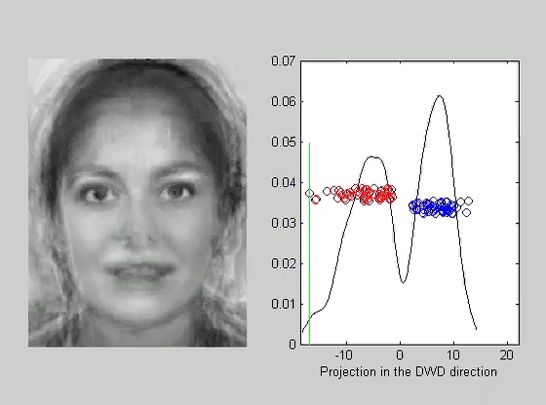
Last Class: Taste of OODA
Faces as Data Objects
Classify
Males vs.
Females

Slide 18
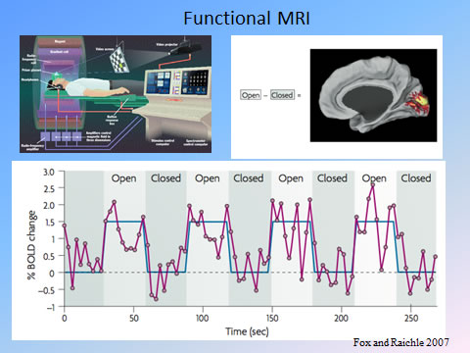
Last Class: Taste of OODA
Functional Magnetic Resonance Imaging
3-d Maps of
Brain Activity
Collected
Over Time
Data Objects?
Heat Map at
One Time?
Time Series at
One Location?

Slide 19
Last Class: OODA
Three Major Phases of OODA:
I. Object Definition
“What are the Data Objects?”
Exploratory Analysis
“What Is Data Structure / Drivers?”
III. Confirmatory Analysis / Validation
Is it Really There (vs. Noise Artifact)?

Slide 20

Last Class: Basics of OODA
Convenient Organizational Structure:
Data Matrix
$$\left[\begin{matrix}x_{11} & ⋯ & x_{1n} \\ ⋮ & ⋱ & ⋮ \\ x_{d1} & ⋯ & x_{dn}\end{matrix}\right]$$
Convention Here:
Columns are Data Objects
(Indexed by $j=1,⋯,n$)

Slide 21

Last Class: Basics of OODA
Convenient Organizational Structure:
Data Matrix
$$\left[\begin{matrix}x_{11} & ⋯ & x_{1n} \\ ⋮ & ⋱ & ⋮ \\ x_{d1} & ⋯ & x_{dn}\end{matrix}\right]$$
Terminology:
Numbers in Rows are called “Traits”
(Indexed by $i=1,⋯,d$)
OODA Continually Evolving
Note: ~Post-Text
Terminology

Slide 22
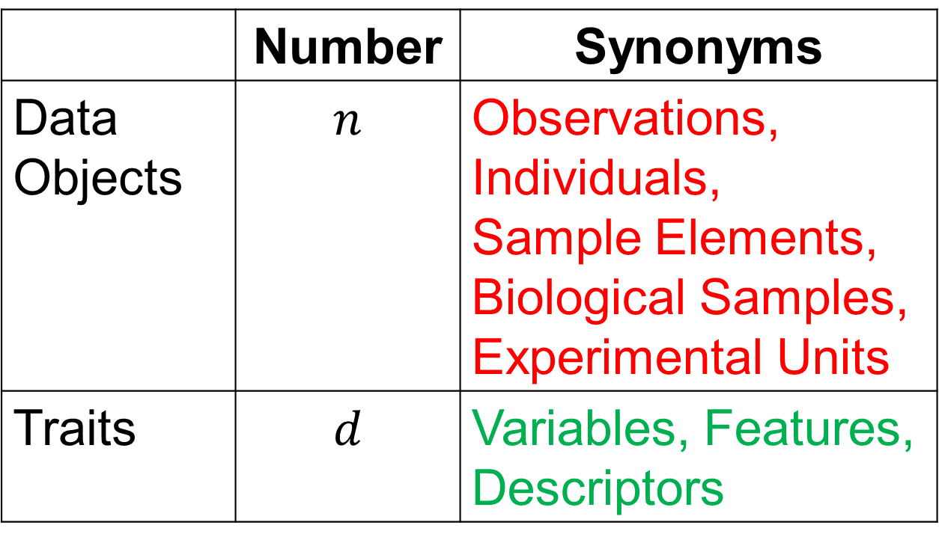
Last Class: Basics of OODA
Common Synonyms:
 | Number | Synonyms
Data Objects | $$n$$ | Observations, Individuals, Sample Elements, Biological Samples, Experimental Units
Traits | $$d$$ | Variables, Features, Descriptors

Slide 23
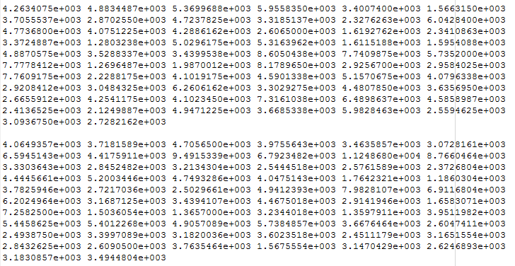
Last Class: Visualization
Terrible Approach: Look at .txt file
Hard to Keep More Than 5-10 in Mind at Once

Slide 24
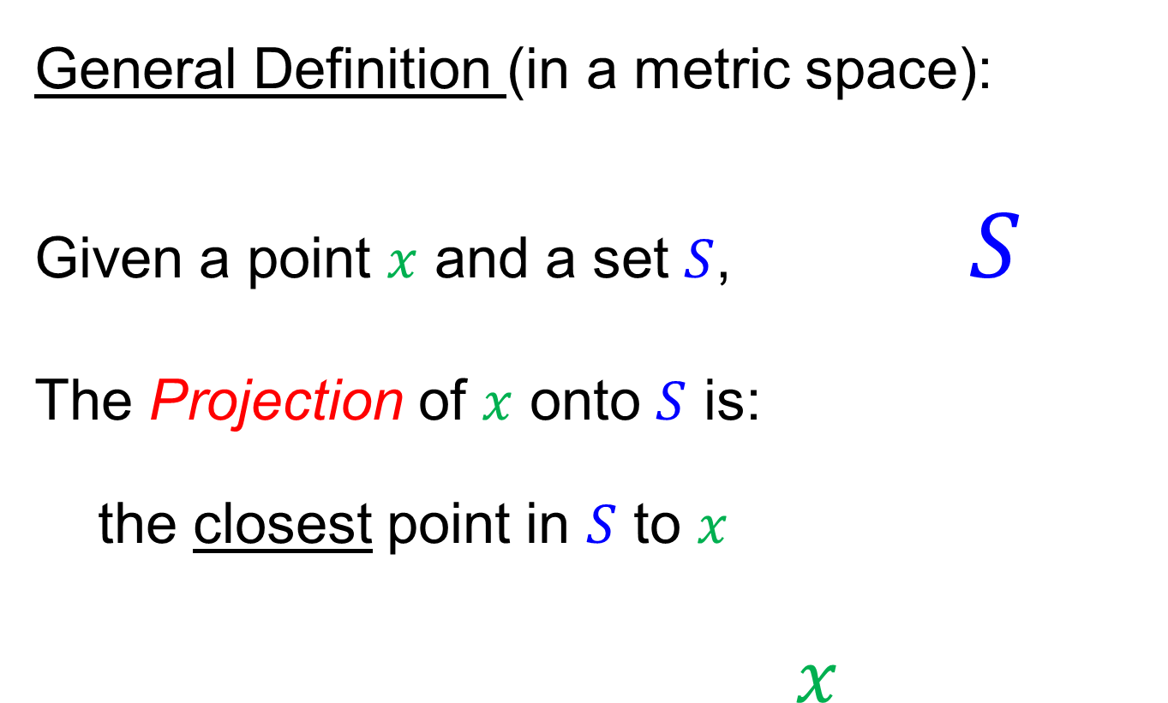
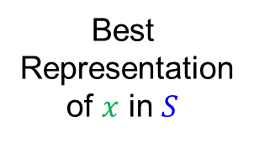
Last Class: Projection
General Definition (in a metric space):
Given a point $x$ and a set $S$, $S$
The Projection of $x$ onto $S$ is:
the closest point in $S$ to $x$
$x$
Best
Representation
of $x$ in $S$

Slide 25
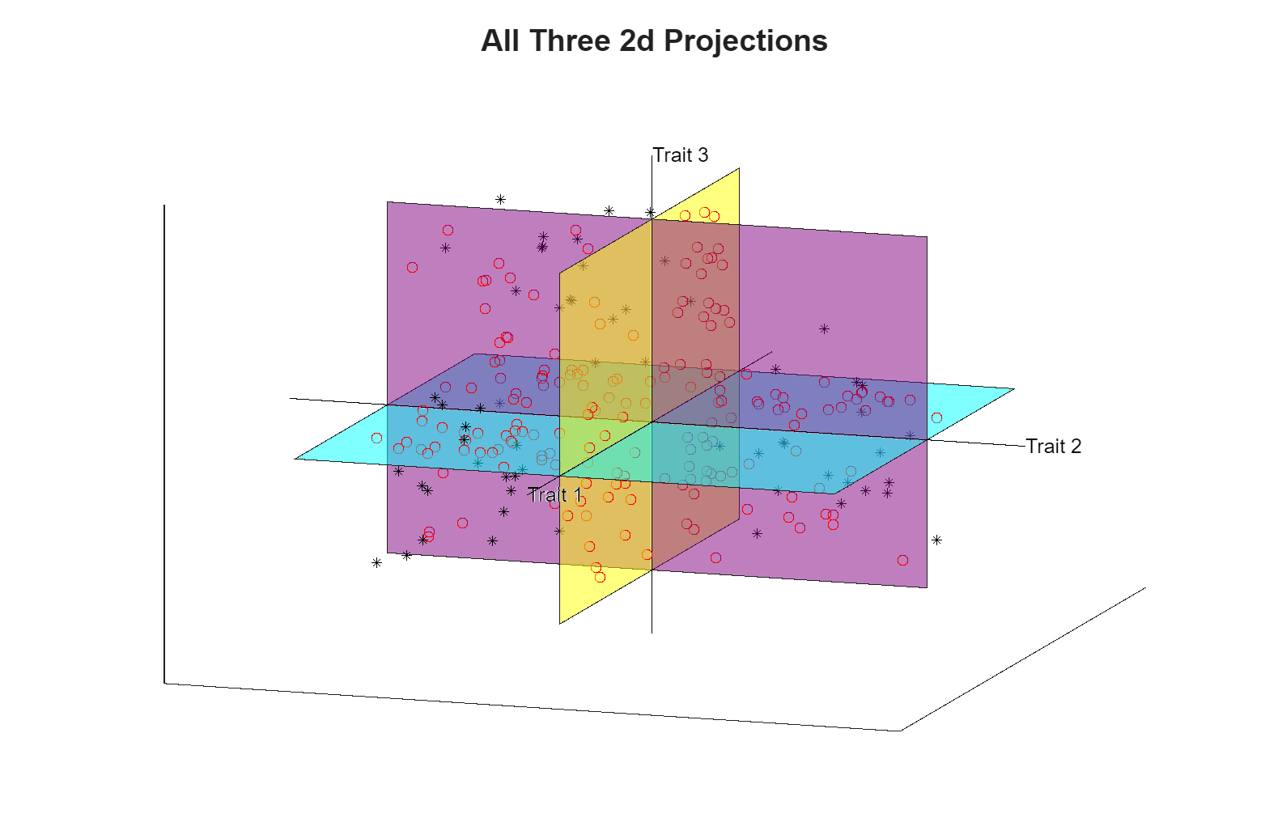
Last Class: Illust’n of Multivar. View
Think:
Front
Top
Side
Views
Keep These Colors in Mind
Notes:
EgView1p38proj1n2Dcolor.ps

Slide 26
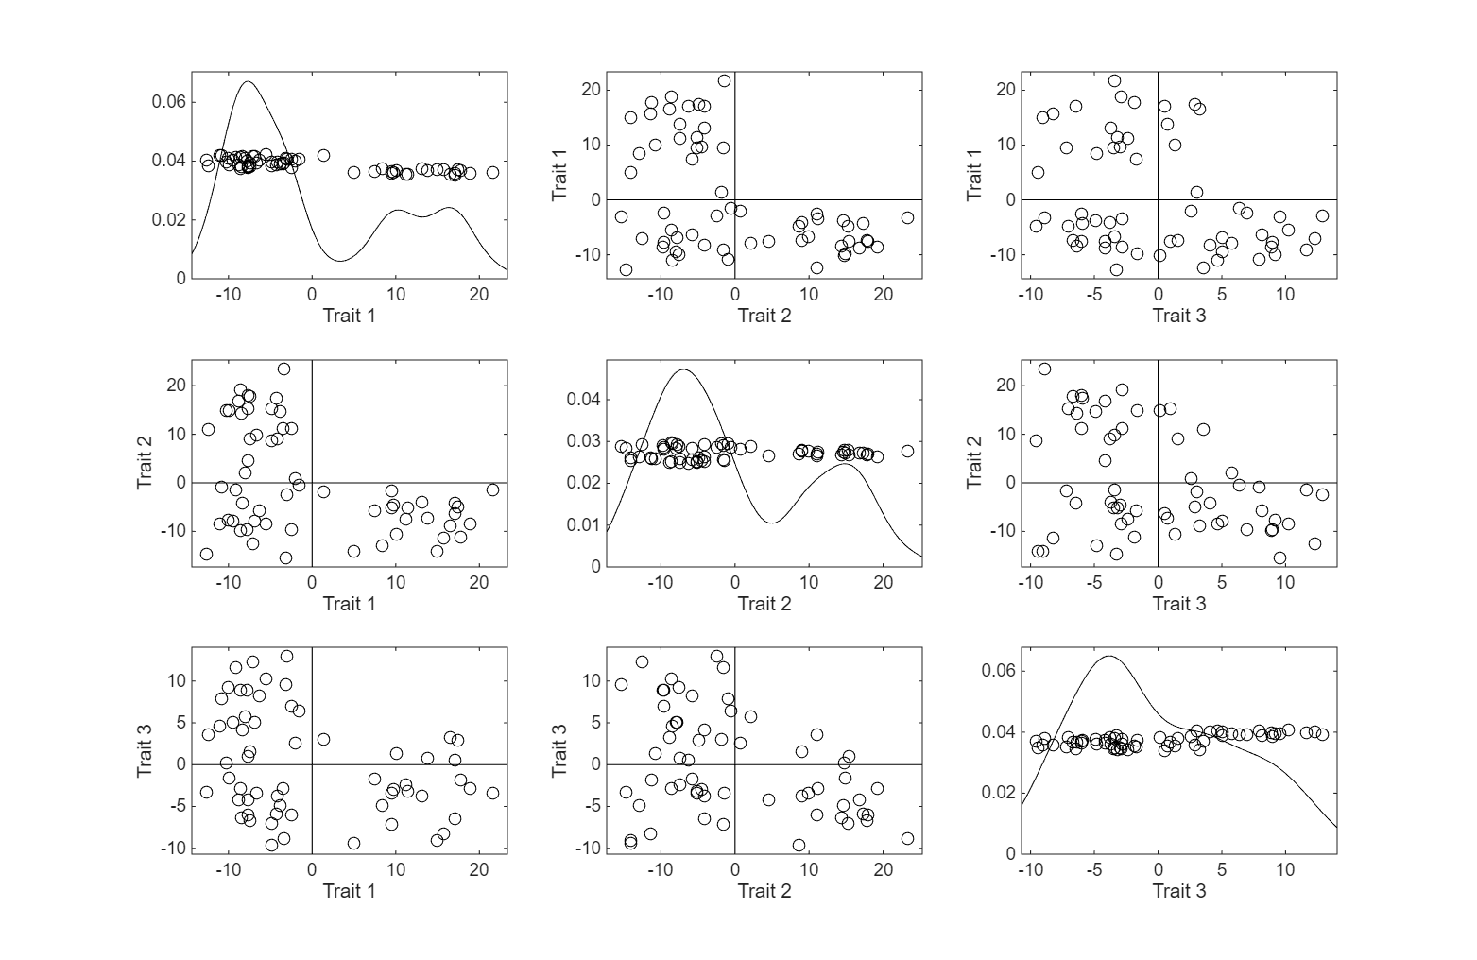
Last Class: Illust’n of Multivar. View
Recall careful pattern of axes
Notes:
EgView1p38proj1n2Dcolor.ps

Slide 27
Homework 1
Make a 3-d Trait by Trait Scatterplot Matrix
of the Apple – Banana – Pear Data
Assignment Details in:
Canvas / Assignments / HW 1

Slide 28
Homework 1
Make a 3-d Trait by Trait Scatterplot Matrix
of the Apple – Banana – Pear Data
Data in File: AppleBananaPearSetI.xlsx
In: Canvas / Files / HW Assignments

Slide 29
Homework 1
Make a 3-d Trait by Trait Scatterplot Matrix
of the Apple – Banana – Pear Data
Goals:
Visualize Data
Explain Data Set Name
Turn In .pdf Graphic (With Text Expl’n)
Due: Aug. 28,
11:00AM

Slide 30
Homework Policy
Fine to collaborate with others
In fact this is encouraged
About “understanding” not “testing”
But everybody please turn in something

Slide 31
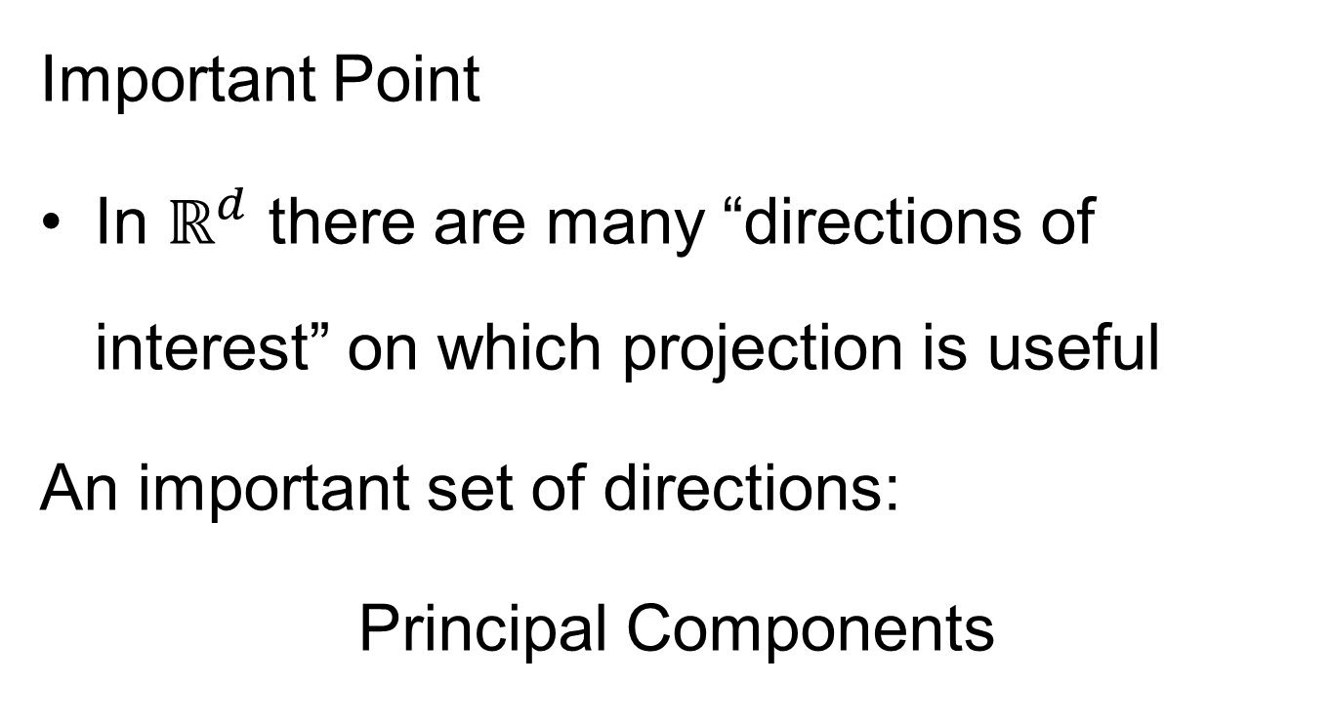
Projection
Important Point
In $ℝ^{d}$ there are many “directions of interest” on which projection is useful
An important set of directions:
Principal Components

Slide 32
Principal Components
Find Directions of:
“Maximal (Projected) Variation”
Compute Sequentially
On Orthogonal Subspaces
Will take careful look at mathematics later
Results in Useful
“Modes of Variation”

Slide 33
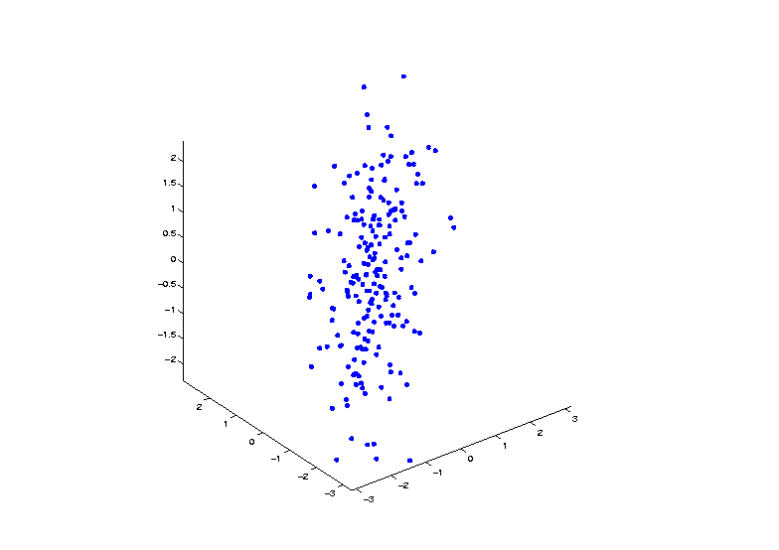

Principal Components
Raw Toy Data Set in $ℝ^{3}$
Notes:
33

Slide 34
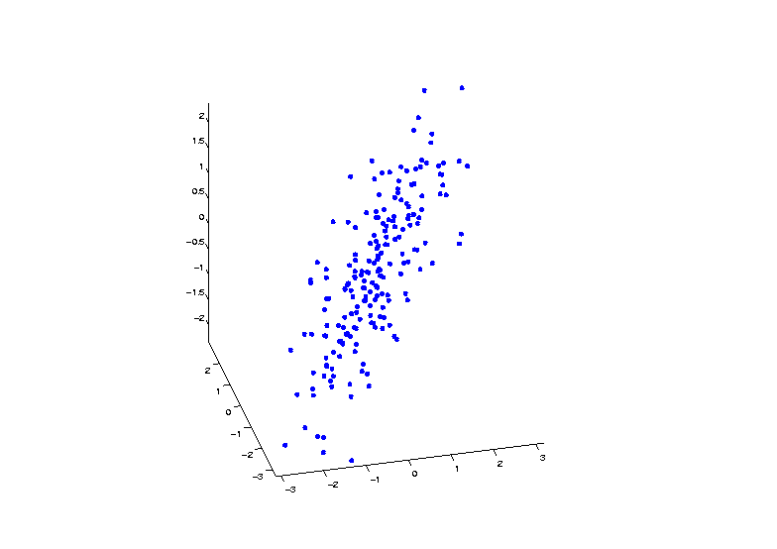
Principal Components
Raw Toy Data Set in $ℝ^{3}$
Notes:
34

Slide 35
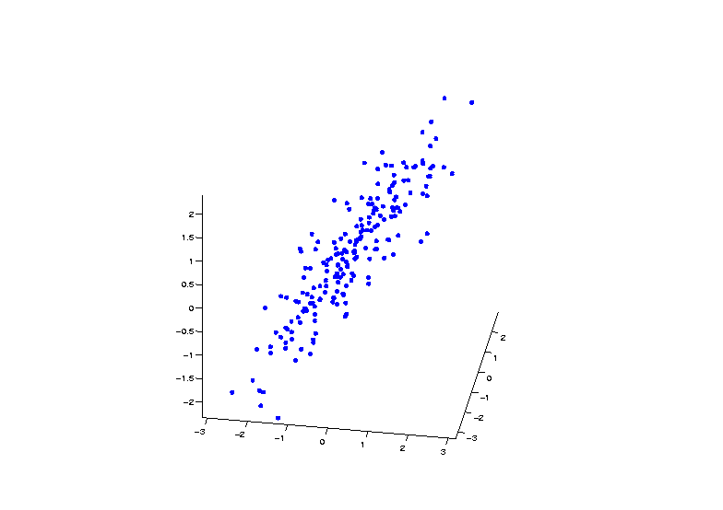
Principal Components
Raw Toy Data Set in $ℝ^{3}$
Notes:
35

Slide 36
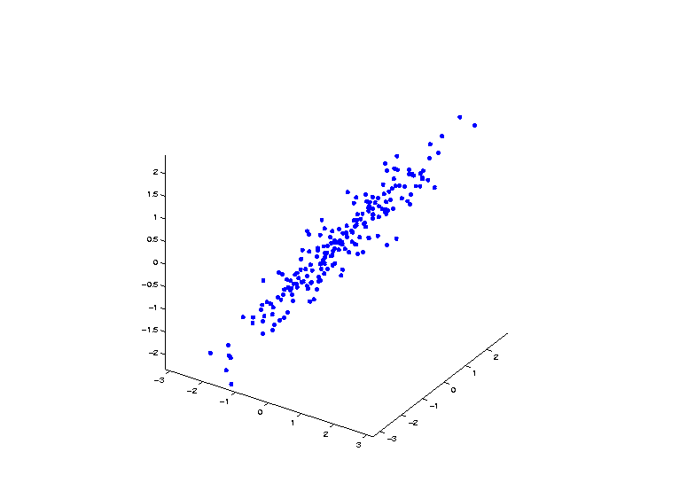
Principal Components
Raw Toy Data Set in $ℝ^{3}$
Notes:
36

Slide 37
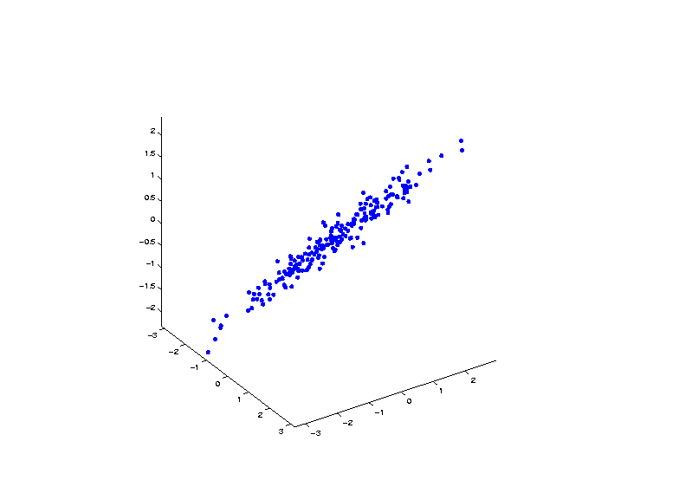
Principal Components
Raw Toy Data Set in $ℝ^{3}$
Notes:
37

Slide 38
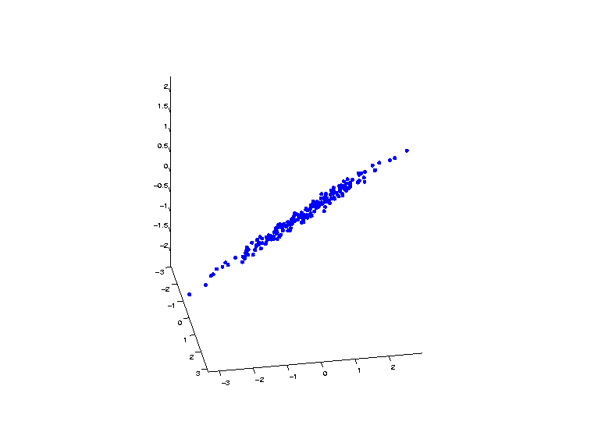
Principal Components
Raw Toy Data Set in $ℝ^{3}$
Notes:
38

Slide 39
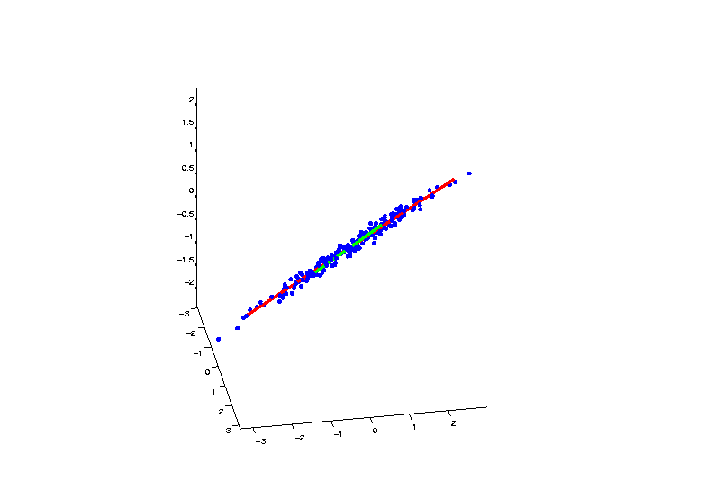
Principal Components
SVD Gives Modes of Variation
Notes:
39

Slide 40
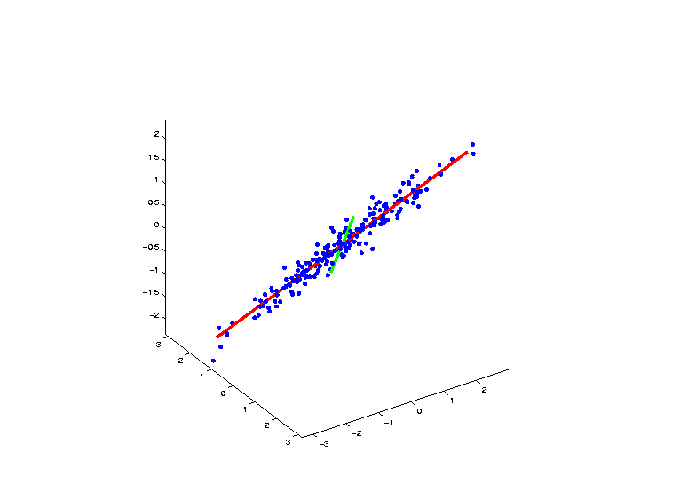
Principal Components
SVD Gives Modes of Variation
Notes:
40

Slide 41
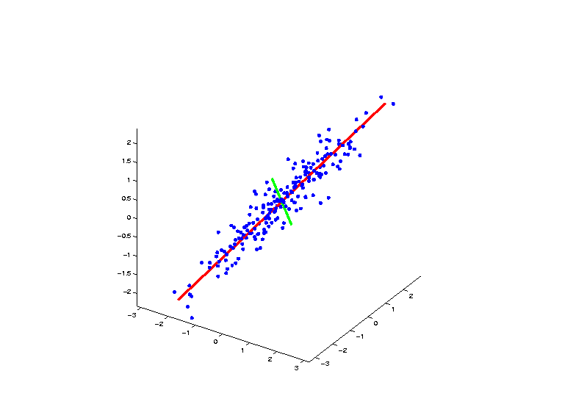
Principal Components
SVD Gives Modes of Variation
Notes:
41

Slide 42
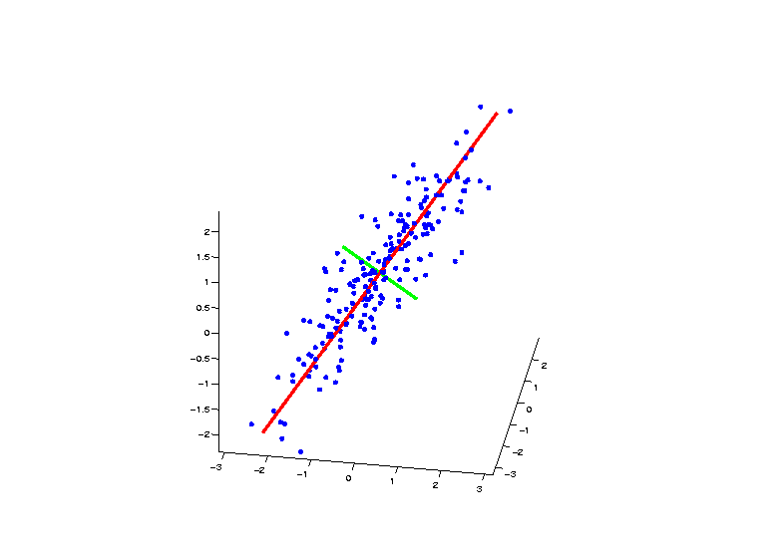
Principal Components
SVD Gives Modes of Variation
Notes:
42

Slide 43
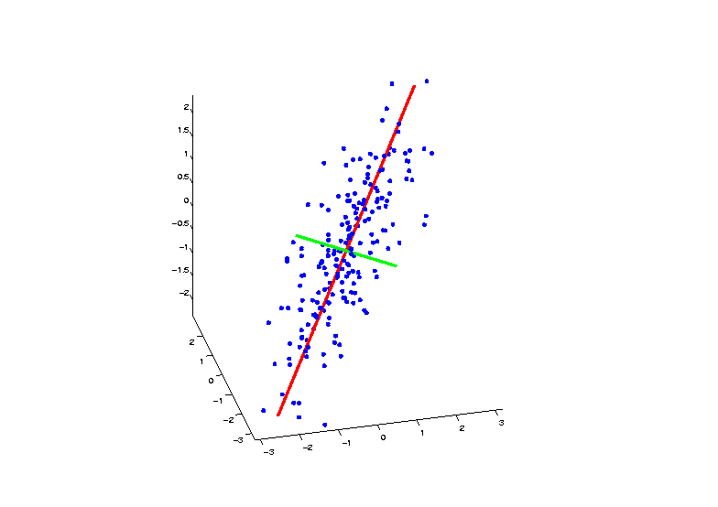
Principal Components
SVD Gives Modes of Variation
Notes:
43

Slide 44
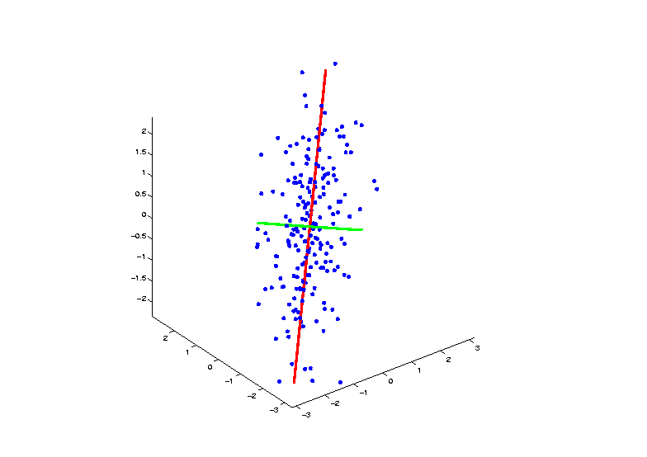
Principal Components
SVD Gives Modes of Variation
Notes:
44

Slide 45
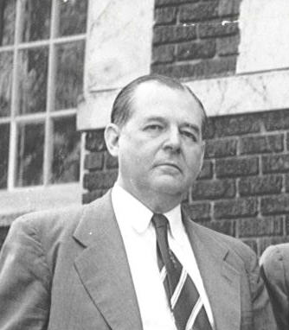
Principal Components
Early References:
Pearson (1901)
Hotelling (1933)
Founder of UNC Statistics Dept.
Notes:
45

Slide 46
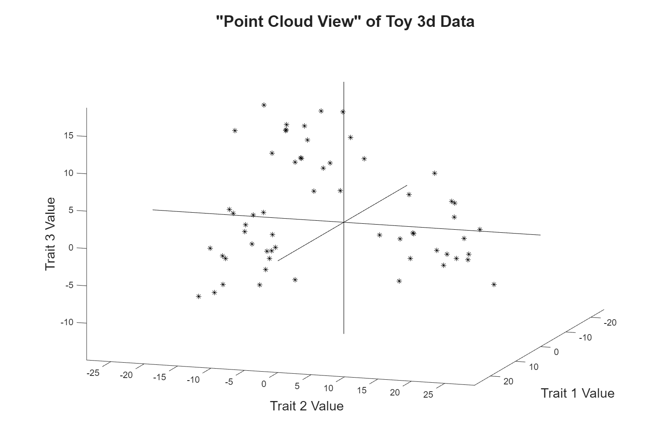
Illust’n of PCA View: Recall Raw Data
Notes:
EgView1p1RawData.ps

Slide 47
Illust’n of PCA View: Recall Trait by Trait Views
Notes:
EgView1p1RawData.ps

Slide 48
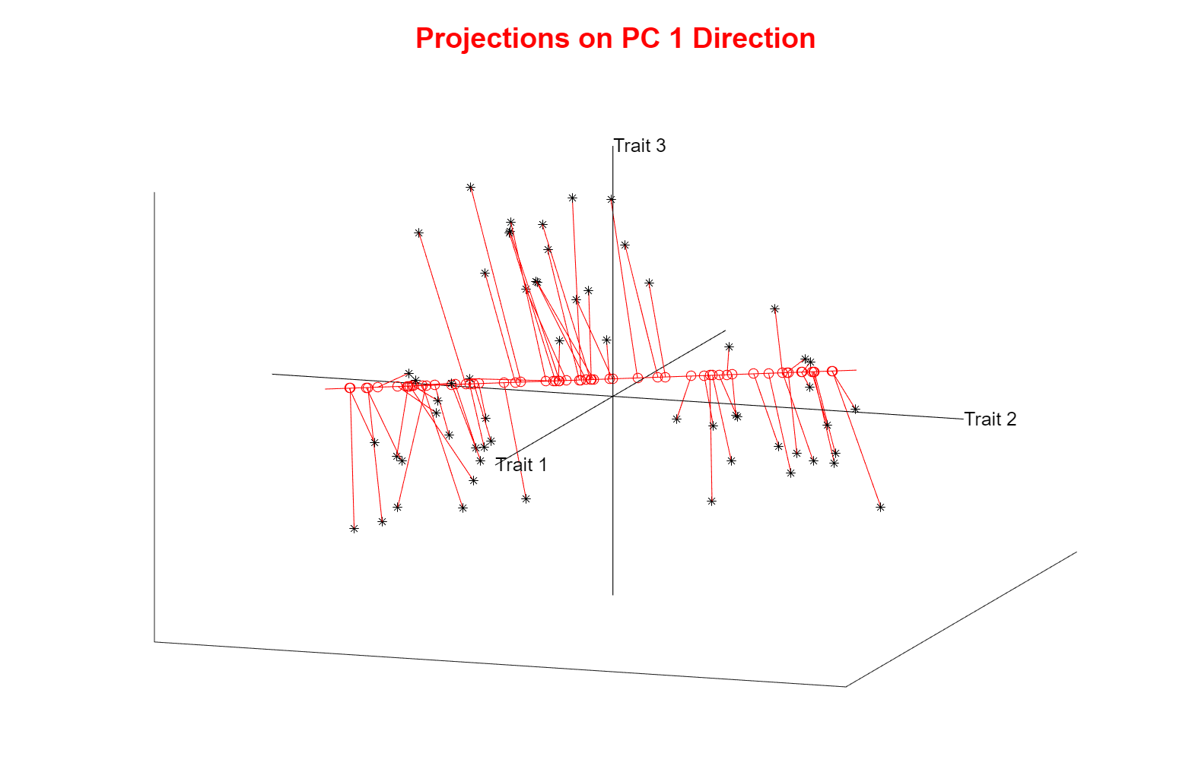
Illust’n of PCA View: PC1 Projections
Note Different Axis
Chosen to
Maximize Spread
Over Lines Through
The Sample Mean
Notes:
EgView1p1RawData.ps

Slide 49
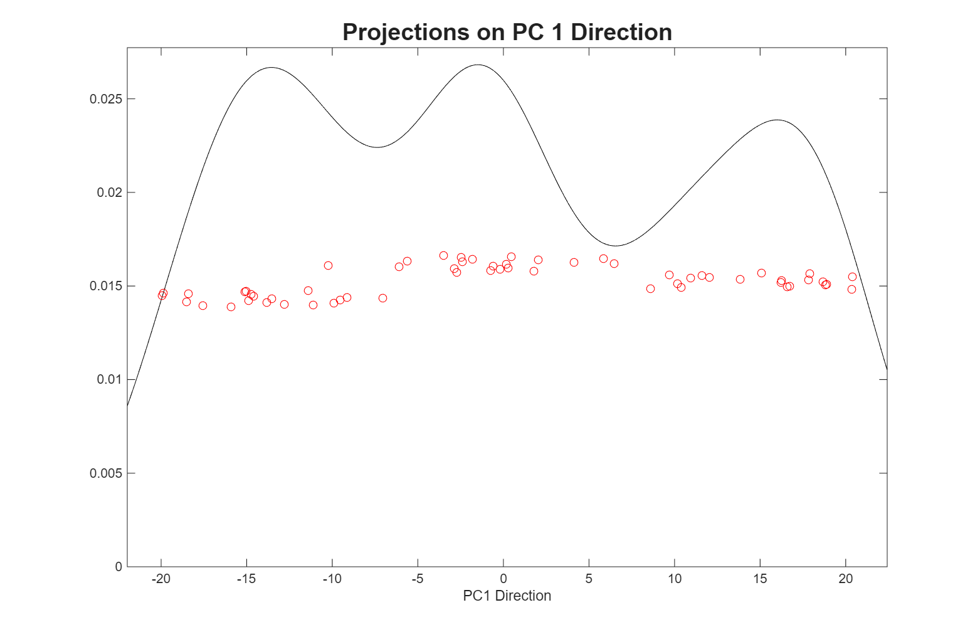
Illust’n of PCA View: PC1 Projections, 1-d View
All 3 Clusters Now Appear
Now See Value of Order in Data Set on Vertical Axis
Notes:
EgView1p1RawData.ps

Slide 50
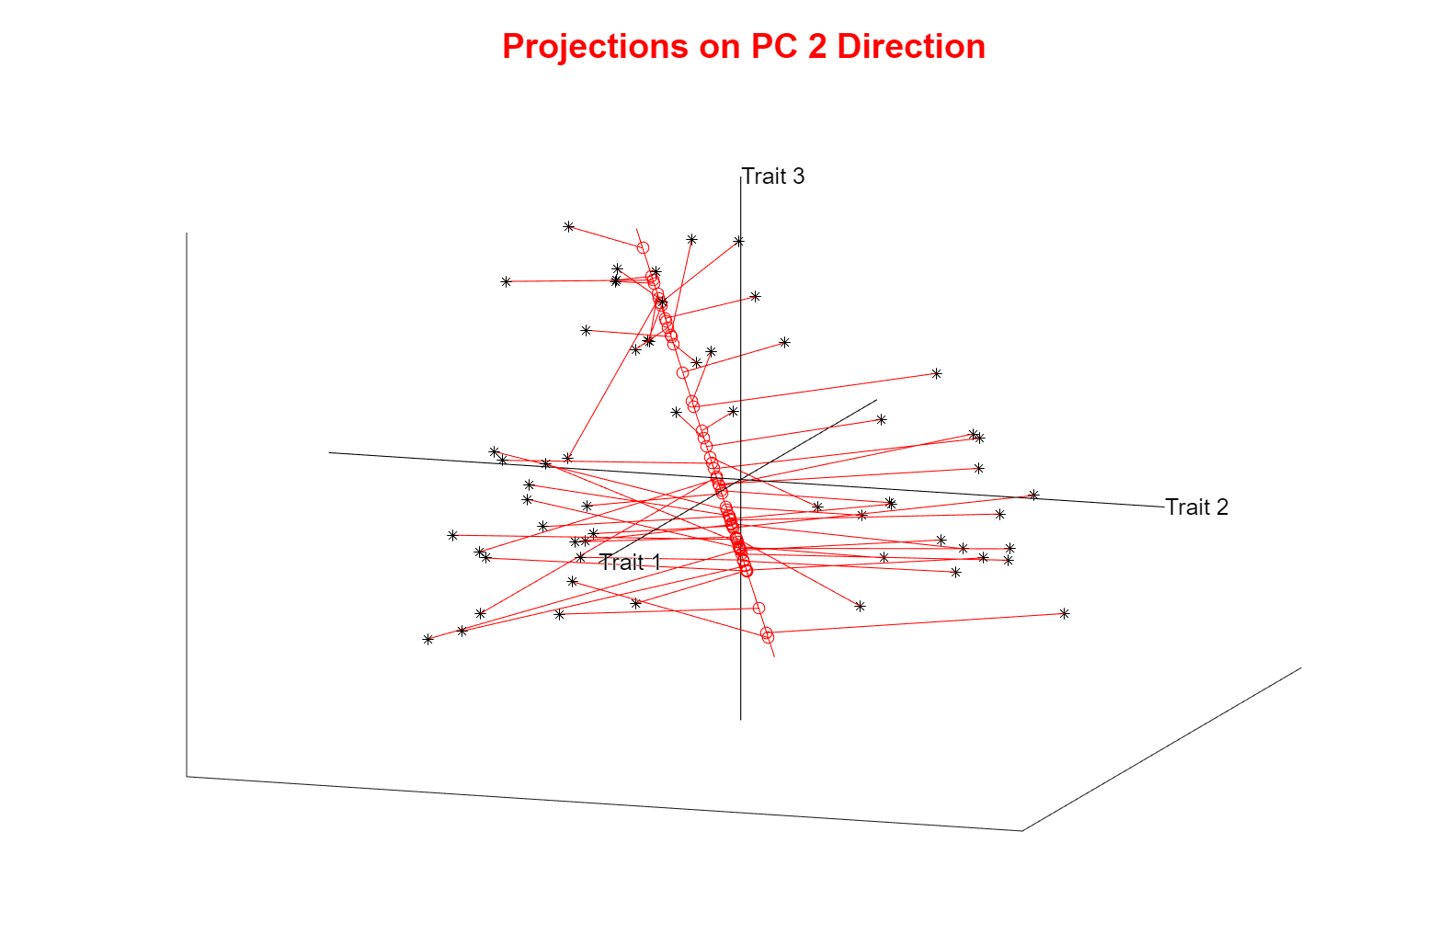
Illust’n of PCA View: PC2 Projections
Max’s Projected Variation Orthogonal to PC1
Notes:
EgView1p1RawData.ps

Slide 51
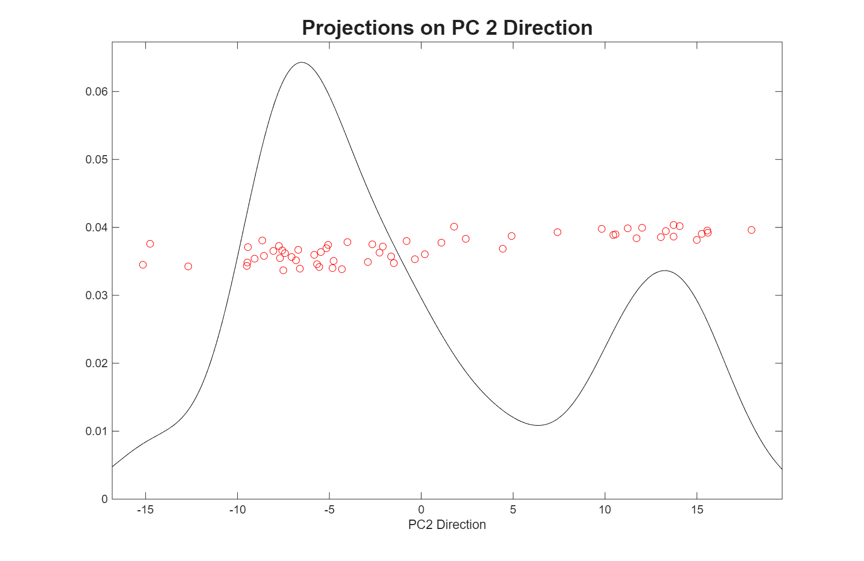
Illust’n of PCA View: PC2 Projections, 1-d View
Separates 1 cluster from others
Notes:
EgView1p1RawData.ps

Slide 52
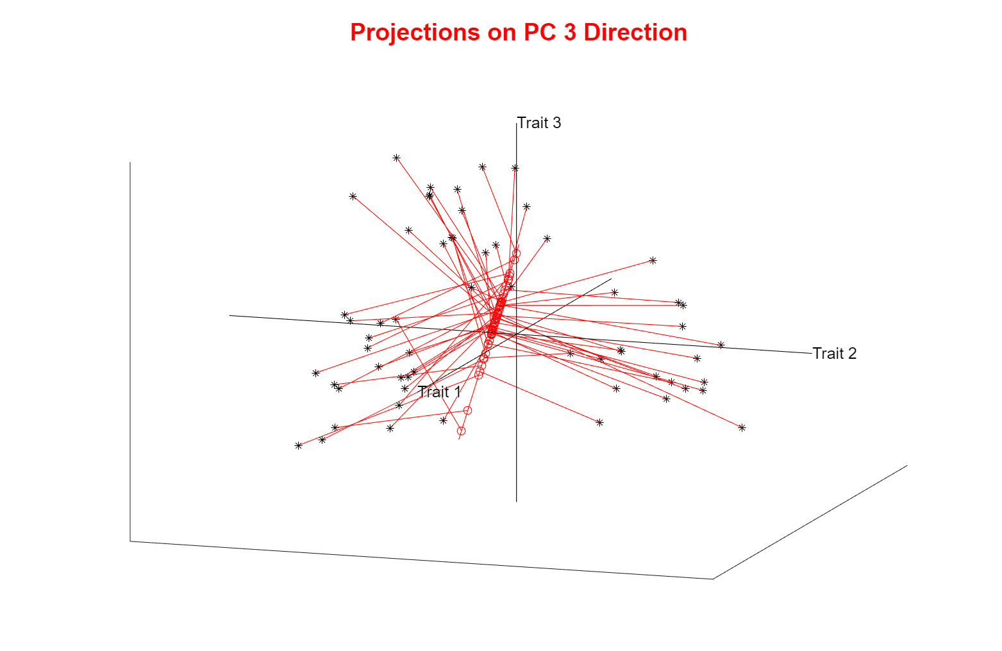
Illust’n of PCA View: PC3 Projections
Notes:
EgView1p1RawData.ps

Slide 53
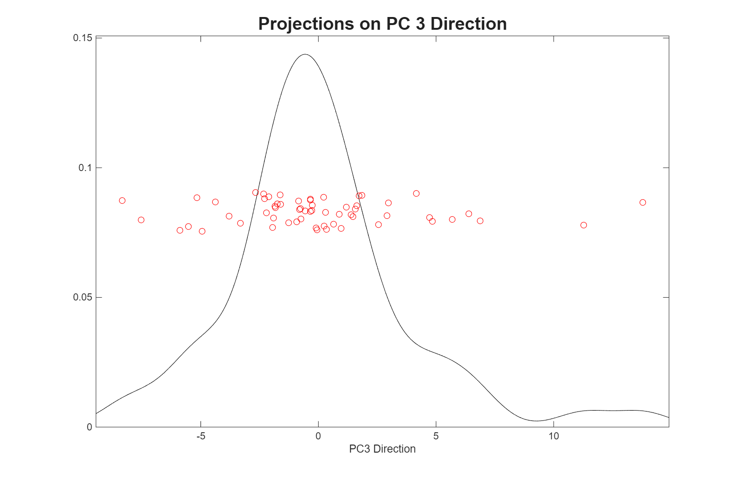
Illust’n of PCA View: PC3 Projections, 1-d View
Don’t See Clusters ???
Notes:
EgView1p1RawData.ps

Slide 54
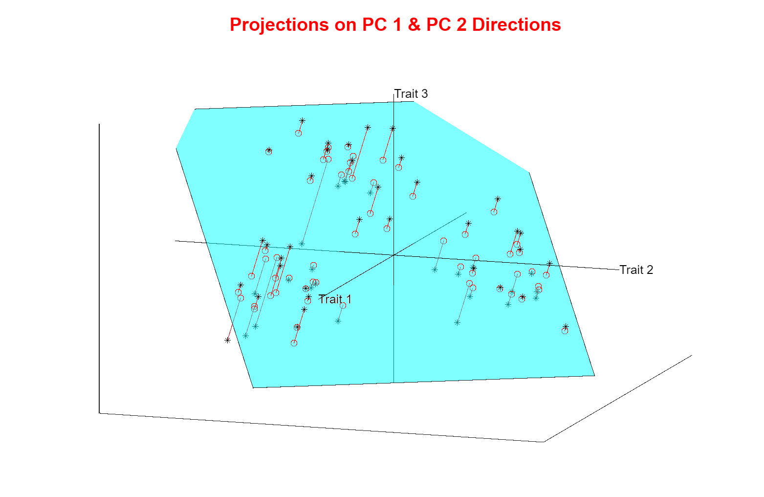
Illust’n of PCA View: Projections on PC1,2 plane
Excellent
Separation
of Clusters
Notes:
EgView1p1RawData.ps

Slide 55
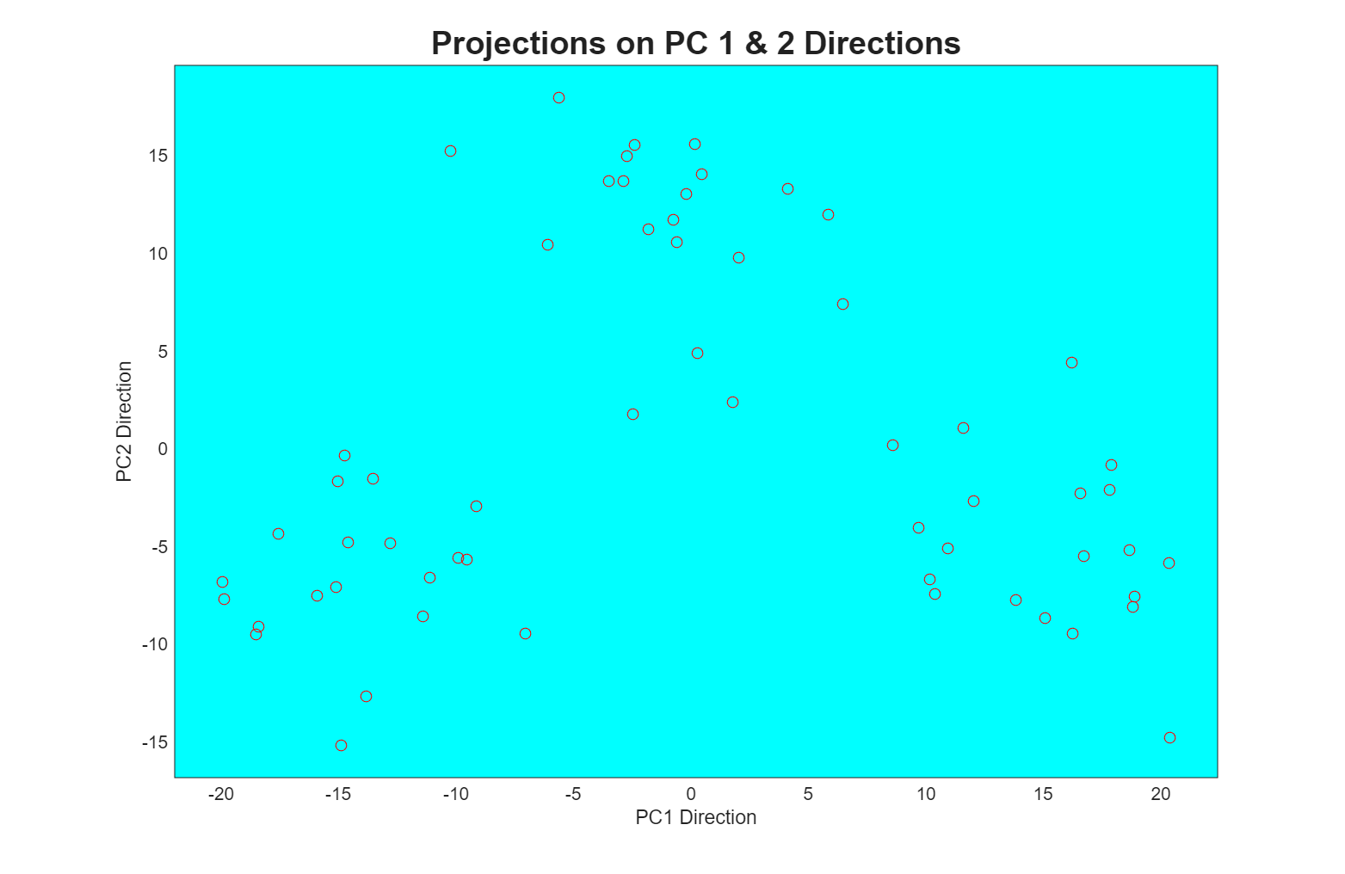
Illust’n of PCA View: PC1 & 2 Proj’n Scatterplot
Another
View of
Separation
of Clusters
Now See “Airspace” Between
Clusters in This Projection
Notes:
EgView1p1RawData.ps

Slide 56
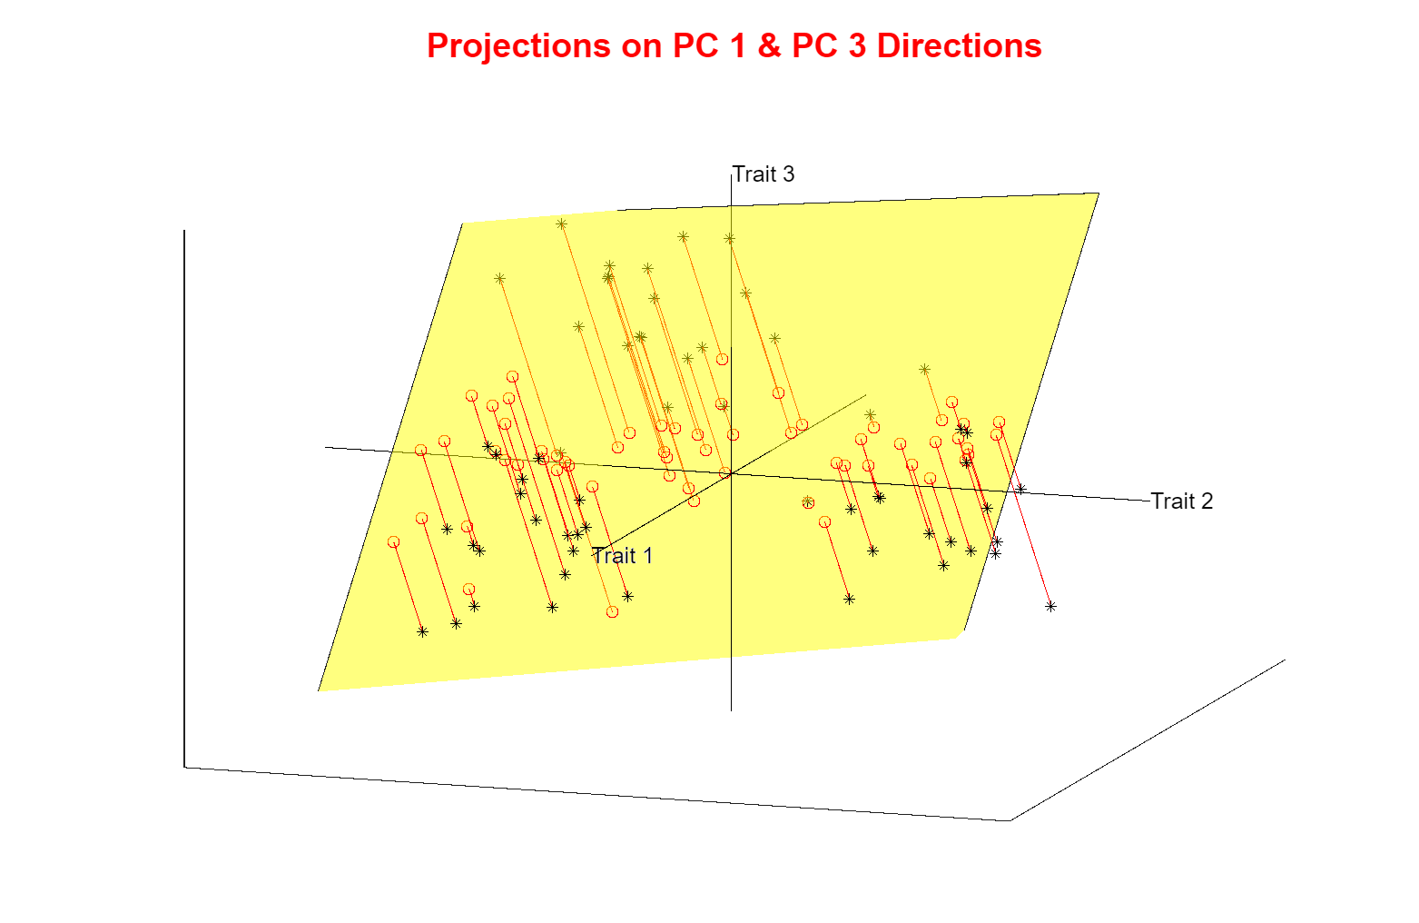
Illust’n of PCA View: Projections on PC1,3 plane
Notes:
EgView1p1RawData.ps

Slide 57
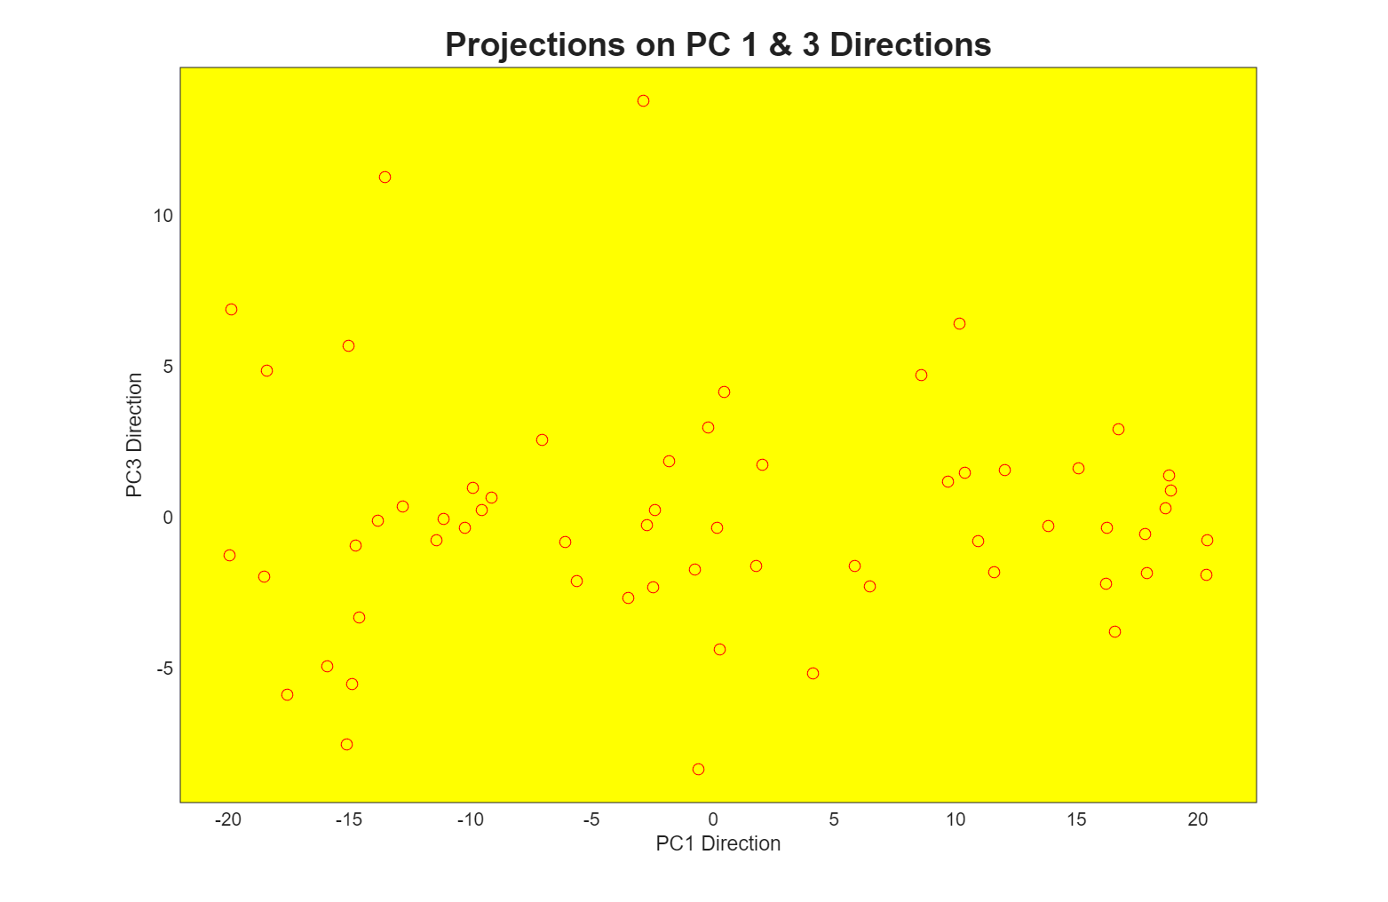
Illust’n of PCA View: PC1 & 3 Proj’n Scatterplot
PC 3 Does Not
Pull Out Clusters
Notes:
EgView1p1RawData.ps

Slide 58

Illust’n of PCA View: Projections on PC2,3 plane
Notes:
EgView1p1RawData.ps

Slide 59

Illust’n of PCA View: PC2 & 3 Proj’n Scatterplot
Even Less Clusters Separation
Notes:
EgView1p1RawData.ps

Slide 60

Illust’n of PCA View: Recall Raw Data
Still Think
Front, Top,
Side Views
But Strong
Rotation of
Coordinate
Axes
Notes:
EgView1p1RawData.ps

Slide 61

Illust’n of PCA View: Matrix with 1-d proj’ns on diag.
Working on Scatterplot Matrix, as Above
Notes:
EgView1p1RawData.ps

Slide 62

Illust’n of PCA: Add off-diagonals to matrix
Constructing Scatterplot Matrix, as Above
Notes:
EgView1p1RawData.ps

Slide 63

Illust’n of PCA: Switch Off Spurious Colors
Notes:
EgView1p1RawData.ps

Slide 64

Illust’n of PCA: Put Transpose Plots In
Notes:
EgView1p1RawData.ps

Slide 65
Illustration of PCA Scatterplot Matrix
Recall “3-d” Interpretation
Front View
Side View
Top View
Notes:
EgView1p1RawData.ps

Slide 66
Illustration of PCA Scatterplot Matrix
Best View of
Clusters???
3 Cluster Centers Generate 2-d Plane
Essentially Discovered (Highlighted) by PCA
Signal “Compressed” into 2-d
Notes:
EgView1p1RawData.ps

Slide 67
Comparison of Views
Highlight 3 Clusters
  In Previous 3-d Example
  Using Colors

Slide 68

Illust’n of PCA View: Trait by Trait View
Note Colors Enhance
Impressions of Clusters
Cluster “Signal” spread over 3-d
Notes:
EgView1p1RawData.ps

Slide 69
Comparison of Views
Highlight 3 clusters (in previous 3-d example)
Trait by Trait View (above scatterplot matrix)
  Clusters appear in all 3 scatterplots
  But never very separated

Slide 70

Illust’n of PCA View: PCA View
No Clusters in 3rd
Direction is Good,
Since Important
Aspects Appear
In Earlier Comp’ts
Clusters are “more distinct”
Since more “air space”
In between
Cluster “Signal” Compressed into 2-d
Notes:
EgView1p1RawData.ps

Slide 71
Comparison of Views
Highlight 3 clusters (in previous 3-d example)
Trait by Trait View (above scatterplot matrix)
  Clusters appear in all 3 scatterplots
  But never very separated
PCA View
  1st shows three distinct clusters
  Better separated than in gene view
  Clustering concentrated in 1st scatterplot
Effect is small, since only 3-d

Slide 72





Another Comparison of Views
Much higher dimension, $d=4000$
Trait by Trait View
Simulation:
$n_{+}=30$ $N_{d}\left(0.1∙1_{d},I_{d}\right)$ Random Vectors
$n_{−}=30$ $N_{d}\left(−0.1∙1_{d},I_{d}\right)$ Random Vectors
$d$ dimensional
Vector of all $1$s
$d$ dimensional
Normal Distribution
$d×d$ Identity
Matrix
Question: How
Overlapped Are
These Clusters?
Non-$0_{d}$ Means, In
Opposite Directions

Slide 73

Another Comparison: Trait by Trait View
Made Example
For Bioinformatics,
So Traits Are
Called “Genes”
Sub-Densities =
Densities of
Subsets
Suggest Reds
Slightly < Blues
1st three of 4000 directions
Notes:
EgView2p1dat1GeneView.ps

Slide 74
Another Comparison: Trait by Trait View
Clusters Seem Quite Overlapped?
Very Small Differences
Between Means
Notes:
EgView2p1dat1GeneView.ps

Slide 75

Another Comparison of Views
Much higher dimension, $d=4000$
Trait by Trait View
  Clusters very nearly the same
  Very slight difference in means

Slide 76

Another Comparison: PCA View
Clusters Really Far From Overlapped?
High
Dimensional
Space Is
Strange
Note Directions of
Much More Variation
Notes:
EgView2p2dat1PCAView.ps

Slide 77

Another Comparison of Views
Much higher dimension, $d=4000$
Trait by Trait View
  Clusters very nearly the same
  Very slight difference in means
PCA View
  Huge difference in 1st PC Direction
  Magnification of clustering
  Lesson: Alternate views can show much more
  (especially in high dimensions, i.e. for many traits)
  Shows PC view can be much more useful
Why so big???

Slide 78


Another Comparison: PCA View
Another Viewpoint:
Consider Vectors
$μ_{+}=\left(\begin{matrix}+0.1 \\ ⋮ \\ +0.1\end{matrix}\right)$
$$μ_{−}=\left(\begin{matrix}−0.1 \\ ⋮ \\ −0.1\end{matrix}\right)$$
Difference points in direction $1_{d}=\left(\begin{matrix}1 \\ ⋮ \\ 1\end{matrix}\right)$
Notes:
EgView2p2dat1PCAView.ps

Slide 79

Another Comparison: PCA View
High Dimensional
Space Is Slippery!
Interesting Issue:
How close is $\left(\begin{matrix}1 \\ ⋮ \\ 1\end{matrix}\right)$ to coordinate axes in $ℝ^{d}$?
Angle $= \cos^{−1}\left[\left(\begin{matrix}\frac{1}{\sqrt{d}} & ⋯ & \frac{1}{\sqrt{d}}\end{matrix}\right)\left(\begin{matrix}1 \\ 0 \\ \begin{matrix}⋮ \\ 0\end{matrix}\end{matrix}\right)\right]$
Which for $d=4000$ is ${89.1}^{°}$
Notes:
EgView2p2dat1PCAView.ps

Slide 80
Another Comparison: PCA View
Question for Later:
Why so Big???
Notes:
EgView2p2dat1PCAView.ps

Slide 81
Homework 2
For the Rotated Apple-Banana-Pear Data,
in Canvas/Files/AppleBananaPearSetII.xlsx
Make a trait by trait scatterplot matrix.
Make a PC scores scatterplot matrix.
Explain difference between those
Upload .pdf to Canvas
Due: Aug. 28,
11:00AM

Slide 82
Object Oriented Data Analysis
Three Major Phases of OODA:
I. Object Definition
“What are the Data Objects?”
Exploratory Analysis
“What Is Data Structure / Drivers?”
III. Confirmatory Analysis / Validation
Is it Really There (vs. Noise Artifact)?

Slide 83
Fundamental OODA Concept
Text, Sec. 3.1.4
Modes of Variation
(of a sample of data objects)
Definition:
A Set of Members of the Object Space That:
Summarize One Component of Variation
Is in Some Sense “One Dimensional”
(e.g. Indexed by a Single Real Parameter)

Slide 84
Fundamental OODA Concept
Text, Sec. 3.1.4
Modes of Variation
Example: Principal Component Analysis
Several (Similar) “Modes of Variation”:
Projections of data
Approximating Lines
Discretizations (equally spaced points)
Useful for Some Visualizations

Slide 85

Fundamental OODA Concept
Modes of Variation: 2-d Example

Slide 86

Fundamental OODA Concept
Modes of Variation: 2-d Example
Blue Projections on
Line Are a
Mode Of Variation

Slide 87

Fundamental OODA Concept
Modes of Variation: 2-d Example
Entire Black
Line is a
Mode Of Variation

Slide 88

Fundamental OODA Concept
Modes of Variation: 2-d Example
Green Points
on Line are a
Mode Of Variation

Slide 89
Modes of Variation
Recall Spanish Male Mortality Data
Multiples Of A Single Curve

Slide 90
Modes of Variation
Non-Linear Mode
of Variation
Recall Amplitude Phase Example
1-d Families of Curves

Slide 91


Modes of Variation
More Non-Linear
Modes of Variation
Recall Bladder Prostate Rectum Data
Shows Value of Equally Spaced Discretization for Visualization
1-d Set of Members of Object Space

Slide 92
Fundamental OODA Concept
Modes of Variation: 2-d Example
Now Focus on
Difference Between
x signs and + signs
PCA Mode had
Strong Overlap
Better Insights From
Mode That Separates
x signs and + signs

Slide 93

Fundamental OODA Concept
Modes of Variation: 2-d Example
Will Describe Later
Good
Separation
Of Type
Projections

Slide 94

Fundamental OODA Concept
Modes of Variation: 2-d Example

Slide 95

Fundamental OODA Concept
Modes of Variation: 2-d Example

Slide 96
Modes of Variation
Recall Faces as Data Objects
Again Shows Value of Equally Spaced
Discretization for Visualization
1-d Set of
Members of
Object Space,
So Also a “Mode Of
Variation”
Mode of Variation
That “Best Separates”

Slide 97
Object Oriented Data Analysis
Three Major Phases of OODA:
I. Object Definition
“What are the Data Objects?”
Exploratory Analysis
“What Is Data Structure / Drivers?”
III. Confirmatory Analysis / Validation
Is it Really There (vs. Noise Artifact)?

Slide 98

Representing Vectors as Curves
Visualization of Vectors as Data Objects:
$\left(\begin{matrix}x_{1} \\ ⋮ \\ x_{d}\end{matrix}\right)$

Slide 99


Representing Vectors as Curves
Visualization of Vectors as Data Objects:
$\left(\begin{matrix}x_{1} \\ ⋮ \\ x_{d}\end{matrix}\right)$
Called Parallel Coordinate View
by Inselberg (1985, 2005)
Connect with piece-wise lines
This Was Used for Spanish Mortality Data

Slide 100

Parallel Coordinates
Proposed for Multivariate Data Visualization:
by Inselberg (1985, 2005)
E.g. Fisher Iris Data
d = 4
Named Variables
(thanks to Wikipedia)
Notes:
100

Slide 101
Parallel Coordinates
Proposed for Multivariate Data Visualization:
by Inselberg (1985, 2005)
E.g. Fisher Iris Data
d = 4
Named Variables
Curves are Data Objects
Vectors → Curves
Notes:
101

Slide 102
Representing Vectors as Curves
Summary of Approaches:
Parallel Coordinates
Fourier Basis
Orthogonal Polynomials
B-Splines
Wavelet Bases
Text, Sec. 3.3
Notes:
102

Slide 103

Representing Curves as Vectors
Summary of Approaches:
Parallel Coordinates
Fourier Basis
Orthogonal Polynomials
B-Splines
Wavelet Bases
Foundation of
Functional Data Analysis
Useful Duality: Vectors $↔$ Curves
Notes:
103

Slide 104
Object Oriented Data Analysis
Three Major Phases of OODA:
I. Object Definition
“What are the Data Objects?”
Exploratory Analysis
“What Is Data Structure / Drivers?”
III. Confirmatory Analysis / Validation
Is it Really There (vs. Noise Artifact)?

Slide 105
Basics of OODA
Useful Conceptual Framework:
Object Space ←→ Trait Space
Text, Sec. 3.1.2
Update From Text Which Uses “Feature Space”
(Where data
objects live)
(How they are
represented)

Slide 106

Basics of OODA
Object Space ←→ Trait Space
Curves $ℝ^{d}$
Images $ℝ^{d×d}$
Shapes Manifolds
Trees Graph Space
Movies

Slide 107


Basics of OODA
Object Space ←→ Trait Space
Simple $d=2$ Toy Example:
Enables Visualization of BOTH Spaces

Slide 108

Basics of OODA
Simple $d=2$ Toy Example:
Each Curve is a Point

Slide 109


Basics of OODA
Simple $d=2$ Toy Example:
Each Curve is a Point
Mean is shown as well (part of analysis)
Can Compute
Mean in $ℝ^{2}$
Or Equivalently Pointwise in Object Space

Slide 110


Basics of OODA
Simple $d=2$ Toy Example:
Best Rank 1 Approximation (PC 1)
As Curves
and as Points

Slide 111

Basics of OODA
Simple $d=2$ Toy Example:
Computed as Projections onto
Eigen-direction centered at Mean

Slide 112

Basics of OODA
Simple $d=2$ Toy Example:
Interpretation:
1st Mode of Variation

Slide 113


Basics of OODA
Simple $d=2$ Toy Example:
Second Best Rank 1 Approximation (PC 2)
As Curves
and as Points
Use Purple Because
Lengths are PC1
Projection Coefficients
Similar with Cyan in
Previous PC1 Graphic

Slide 114

Basics of OODA
Simple $d=2$ Toy Example:
Computed as Projections onto
Eigen-direction centered at Mean

Slide 115

Basics of OODA
Simple $d=2$ Toy Example:
Interpretation:
2nd Mode of Variation

Slide 116

Basics of OODA
Decomposition into Modes of Variation
Note Much More
Variation Here
Than Here

Slide 117
Basics of OODA
Decomposition into Modes of Variation
Sum of Squares
After Mean
Centering
Variance (not s.d.)
To Reflect Energy
Just as in ANOVA
Usual Quantification: Variance of Each, Expressed as %
98.3% of
Variation
1.7% of
Variation

Slide 118

Scree Plot
Text, Sec. 3.1.3
Idea: Visually Summarize Dist’n of Variance
Sometimes Also Useful
To Display Cumulative
98.3% of
Variation
1.7% of
Variation

Slide 119
Scree Plot
More Examples
Spanish Male
Mortality Data
2-d Toy Data

Slide 120

Scree Plot
Recall Spanish Male Mortality Data

Slide 121

Scree Plot
Recall Spanish Male Mortality Decomposition
95.8% of Variation
2.7% of
Variation
Don’t Believe It?
Check Axes!

Slide 122
Scree Plot
More Examples
95.8% of Variation
Spanish Male
Mortality Data
2-d Toy Data
2.7% of
Variation

Slide 123
Scree Plot
More Examples
Spanish Male
Mortality Data
2-d Toy Data
10-d Toy Data
Genetic Data
(Will Show Data Later)

Slide 124
Scree Plot
More Examples
Illustrates Common Use of Scree:
Separate “Signal” From “Noise”
Spanish Male
Mortality Data
2-d Toy Data
Look for “Elbow” (or “Knee”)
10-d Toy Data
Genetic Data
Common for Strong – Low d Signal + Noise

Slide 125
Scree Plot
More Examples
Spanish Male
Mortality Data
2-d Toy Data
Much More Common for Complex Data
Where Signal Appears in Many Comp’s
Really Not Much
Elbow or Knee!
10-d Toy Data
Genetic Data

Slide 126

Scree Plot
Etymology of term Scree:
Geological Feature
Pile Up of Rock
Fragments
(from Wikipedia)
Cattell (1966)

Slide 127
Object Oriented Data Analysis
Three Major Phases of OODA:
I. Object Definition
“What are the Data Objects?”
Exploratory Analysis
“What Is Data Structure / Drivers?”
III. Confirmatory Analysis / Validation
Is it Really There (vs. Noise Artifact)?
Deeper Look at
Visualization

Slide 128
Basics of OODA
Recall Decomposition into Modes of Variation
& Elsewhere
As Well
Study Deeper
Examples

Slide 129

E.g. Curves As Data
“Tilted Parabolas” Example
10-d family of (digitized) curves
Object Space: bundles of curves
Trait Space = $ℝ^{10}$
(harder to visualize as point cloud,
but keep point cloud in mind)
PCA Modes of Variation:
Reveal “population structure”
Text, Sec. 4.1.1

Slide 130

Functional Data Analysis, Tilted Parabolas Data
Terminology:
“Modes of Variation” “Scores Plots”
Notes:
EGCD1Parabs.ps

Slide 131
Functional Data Analysis, Tilted Parabolas Data
OODA Conceptual Framework
Object
Space
Views
Trait
Space
Views
Notes:
EGCD1Parabs.ps

Slide 132
Functional Data Analysis, Tilted Parabolas Data
Get Quantitative With Sums of Squares
SS Explained
By Mean
Mean resid SS
PC1 Resid SS
(from Mean)
PC1 SS
(from Mean)
PC2 SS
(from Mean)
PC2 Resid SS
(from Above)
Notes:
EGCD1Parabs.ps

Slide 133
Functional Data Analysis, Tilted Parabolas Data
PC2 Resid SS
(from Above)
PC2 SS
(from Mean)
Simulated As:
Parabola
+Random Shift
PC3 Resid SS
(from Above)
PC3 SS
(from Mean)
+Random Tilt
+Gaussian Noise
PC4 SS
(from Mean)
PC4 Resid SS
(from Above)
Notes:
EGCD1Parabs.ps

Slide 134
Functional Data Analysis, Tilted Parabolas Data
Get Quantitative With Sums of Squares
SS Explained
By Mean
Mean resid SS
PC1 Resid SS
(from Mean)
PC1 SS
(from Mean)
Note Scree Plot, Already Shown Above,
To Summarize Distribution of Variation
PC2 SS
(from Mean)
PC2 Resid SS
(from Above)
Notes:
EGCD1Parabs.ps

Slide 135
Scree Plot
More Examples
Spanish Male
Mortality Data
2-d Toy Data
10-d Toy Data
Genetic Data

