Slide 1
Statistics – O. R. 881
Object Oriented Data Analysis
Steve Marron
Dept. of Statistics and Operations Research
University of North Carolina

Slide 2
Last Class: Administrative Info
Details on Course Web Page
https://marron.web.unc.edu/course-home-page-stor-881-object-oriented-data-analysis-spring-2024/
Or access from Canvas page
Or:
  Google: “Marrons teaching material”
  Choose This Course

Slide 3
Current Sections in Textbook
Today:
Sections 3.3, 4.1, 6.4, 13.118.1
Next Class:
Sections 18.1, 18.2, 5.1, 5.2, 5.3

Slide 4
Participant Presentations
Please Prepare to Sign Up (next class):
Name
Onyen (or Email Address)
Tentative Title (“????” Is OK)
Dept. & Advisor (Lab?)
ENRolled or AUDitor?
Level (MS or PHD stud, Postdoc, Faculty?)
When:
  Next Week, Early, September, October, Late

Slide 5
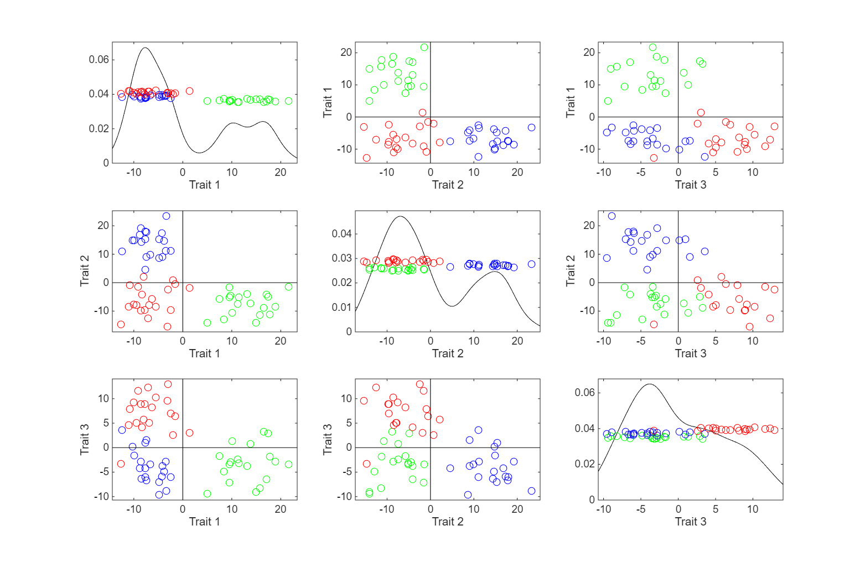
Last Class: Trait by Trait View
Recall Colors Enhance
Impressions of Clusters
Notes:
EgView1p71GeneViewClustColor.ps

Slide 6
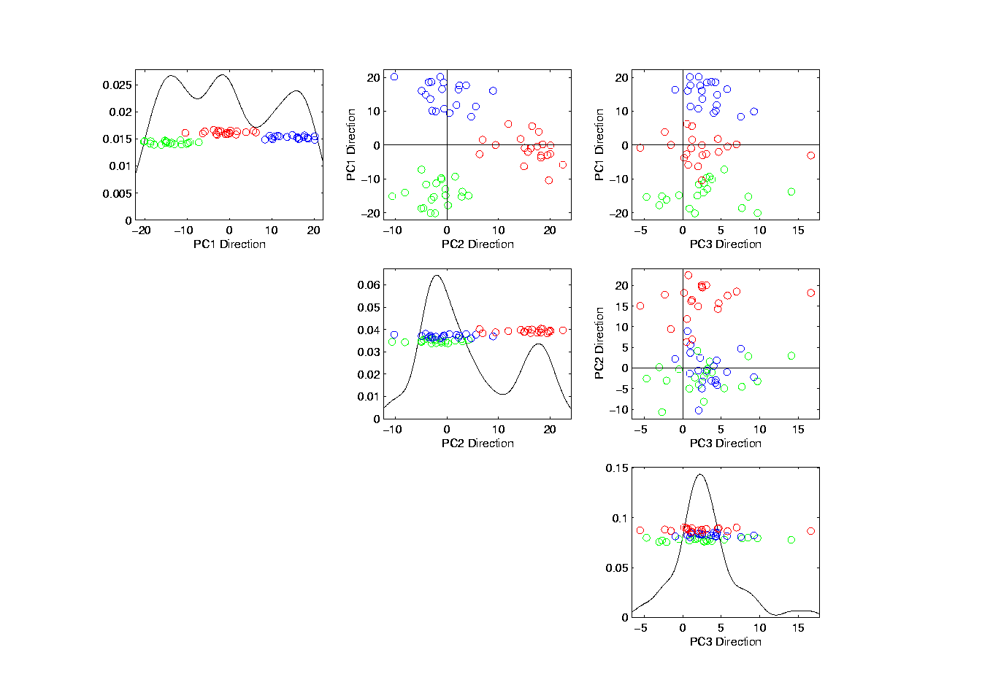
Last Class: PCA View
No Clusters in 3rd
Direction is Good,
Since Important
Aspects Appear
In Earlier Comp’ts
Clusters are “more distinct”
Since more “air space”
In between
Notes:
EgView1p72PCAViewClustColor.ps

Slide 7
Last Class: OODA
Three Major Phases of OODA:
I. Object Definition
“What are the Data Objects?”
Exploratory Analysis
“What Is Data Structure / Drivers?”
III. Confirmatory Analysis / Validation
Is it Really There (vs. Noise Artifact)?

Slide 8
Last Class: Basics of OODA
Useful Conceptual Framework:
Object Space ←→ Trait Space
(Where data
objects live)
(How they are
represented)

Slide 9
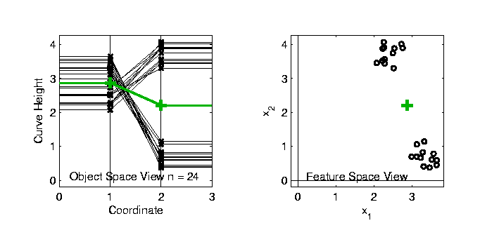

Last Class: Basics of OODA
Simple $d=2$ Toy Example:
Each Curve is a Point

Slide 10
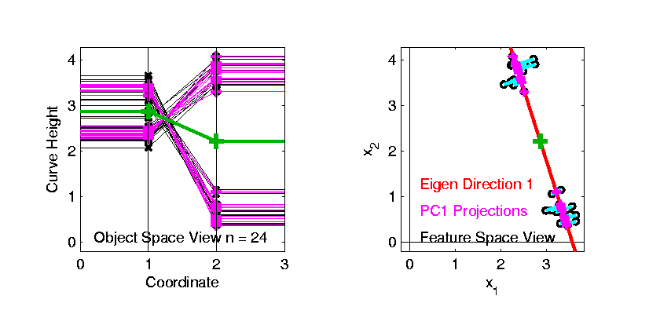
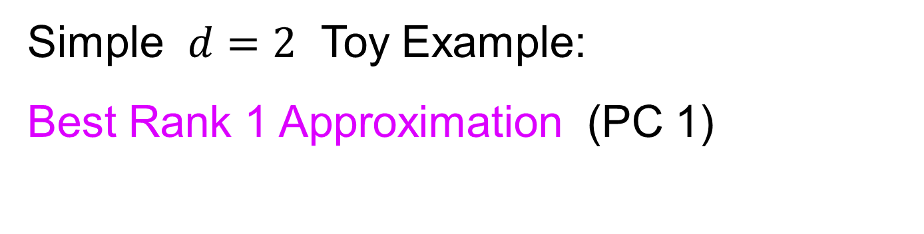
Last Class: Basics of OODA
Simple $d=2$ Toy Example:
Best Rank 1 Approximation (PC 1)
As Curves
and as Points

Slide 11
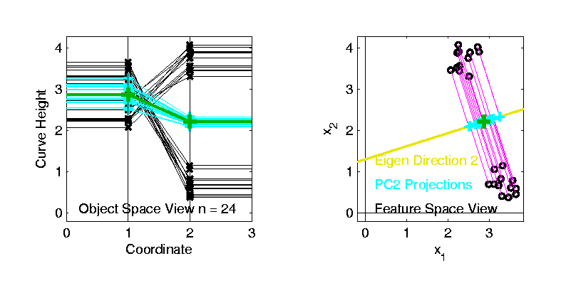
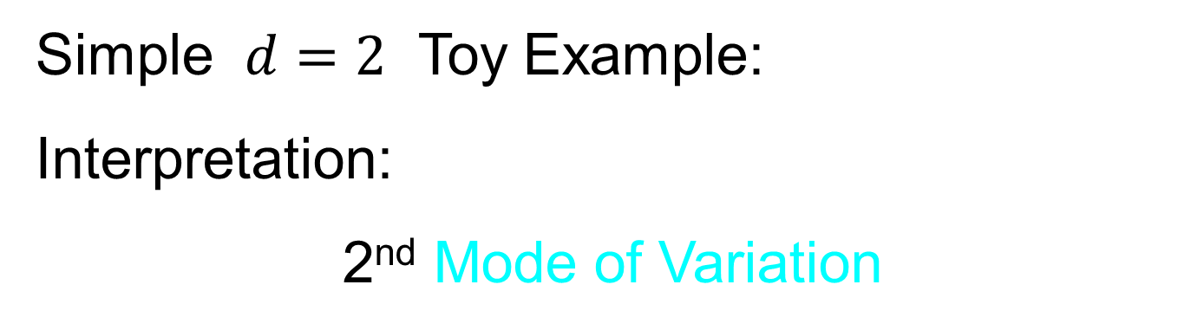
Last Class: Basics of OODA
Simple $d=2$ Toy Example:
Interpretation:
2nd Mode of Variation

Slide 12
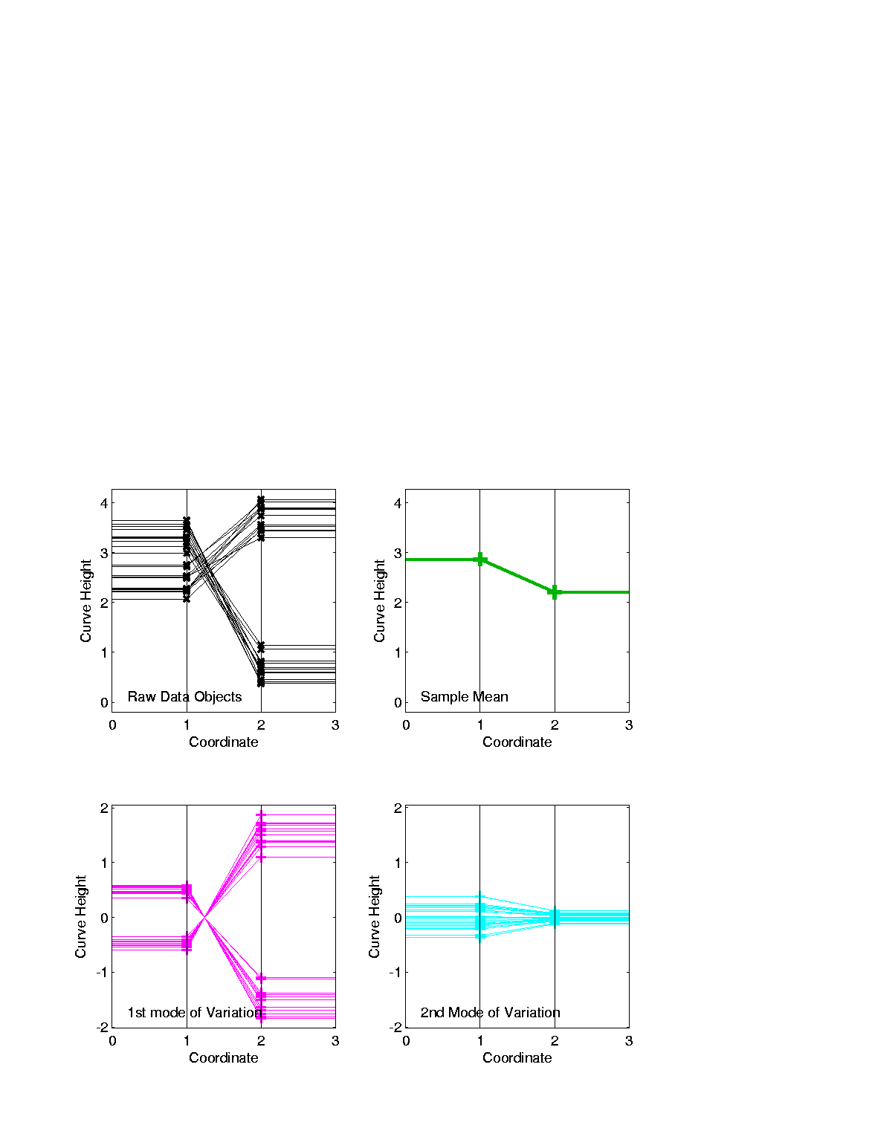
Last Class: Basics of OODA
Decomposition into Modes of Variation
Sum of Squares
After Mean
Centering
Variance (not s.d.)
To Reflect Energy
Just as in ANOVA
Usual Quantification: Variance of Each, Expressed as %
98.3% of
Variation
1.7% of
Variation

Slide 13
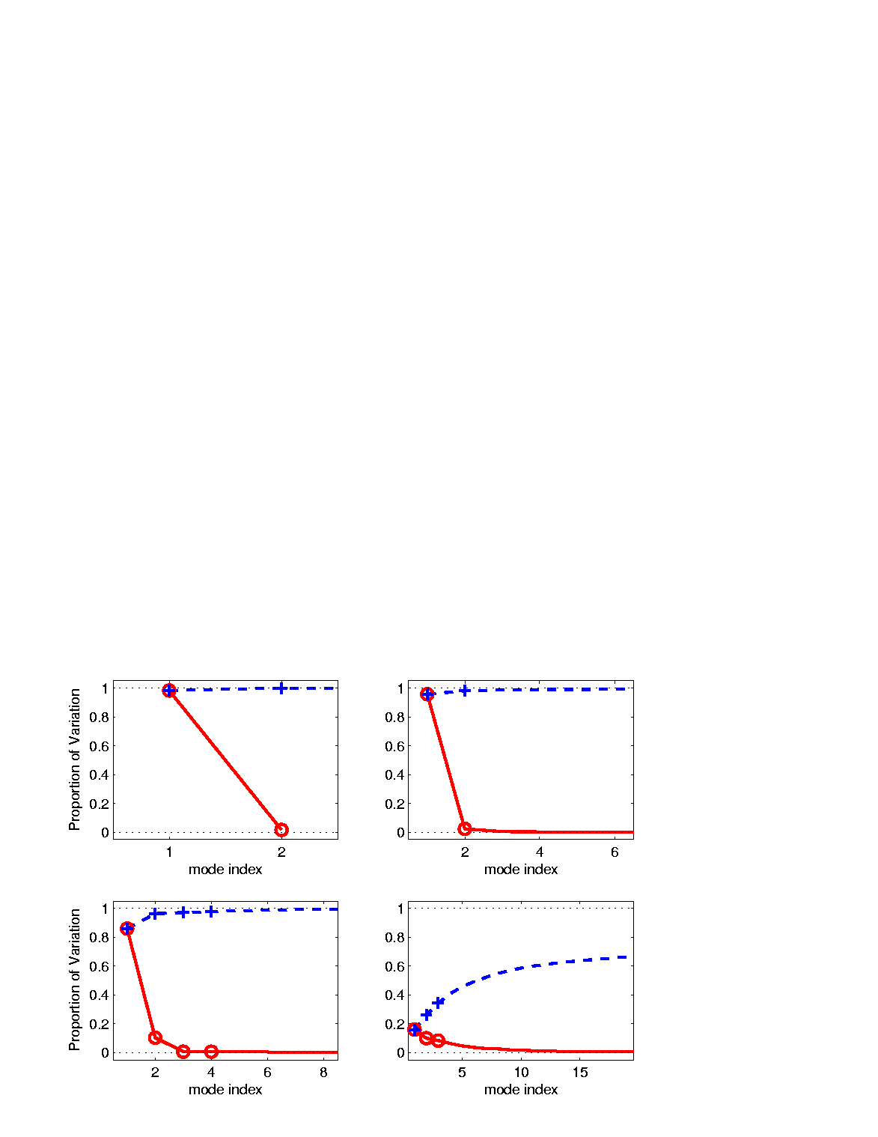
Last Class: Scree Plot
Idea: Visually Summarize Dist’n of Variance
Sometimes Also Useful
To Display Cumulative
98.3% of
Variation
1.7% of
Variation

Slide 14
Last Class: Scree Plot
More Examples
Spanish Male
Mortality Data
2-d Toy Data
10-d Toy Data
“TiltedParabolas”
Genetic Data

Slide 15
Last Class: Tilted Parabolas
PCA: reveals “population structure”
Mean → Parabolic Structure
PC1 → Vertical Shift
PC2 → Tilt
higher PCs → Gaussian (spherical)
Decomposition into modes of variation

Slide 16

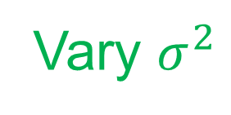
E.g. Tilted Parabolas Data
Useful Exploration:
Study “Signal vs. Noise” Issues
By Adding Differing Levels of Gaussian Noise
$$+N\left(0,σ^{2}\right)$$
(Independent)
Vary $σ^{2}$

Slide 17
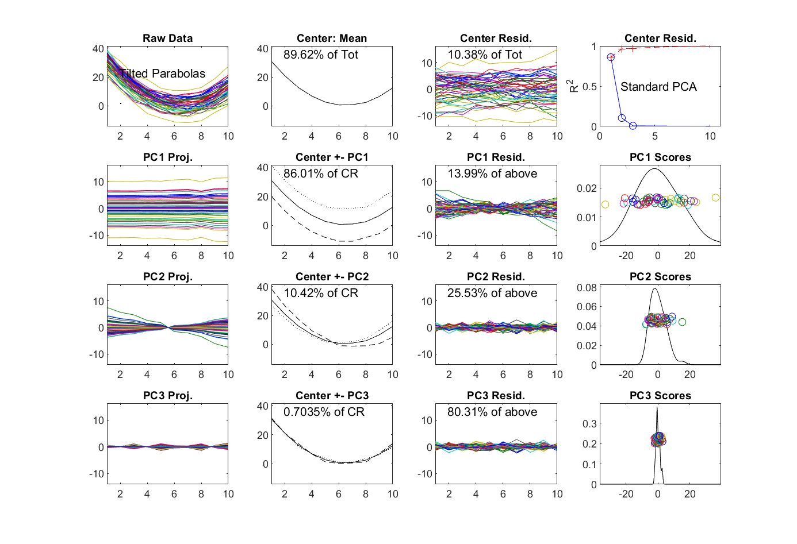
Original Tilted Parabolas
Very Strong
PC1 Signal
Shape Comes
From Mean
Weaker
PC2 Signal
PC1 Mode is
Vertical Shift
“Flat Mode”
PC2 Mode is
Random Tilt
PC3 Mode
Is Noise

Slide 18
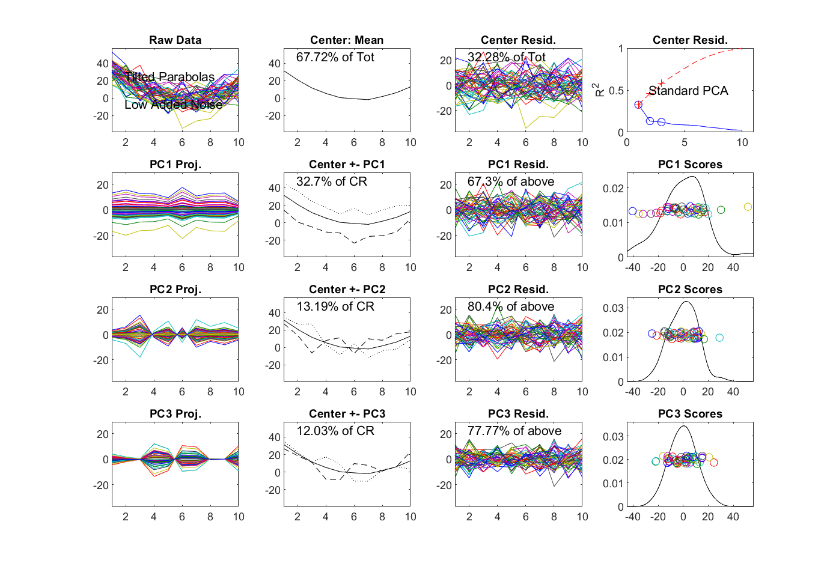
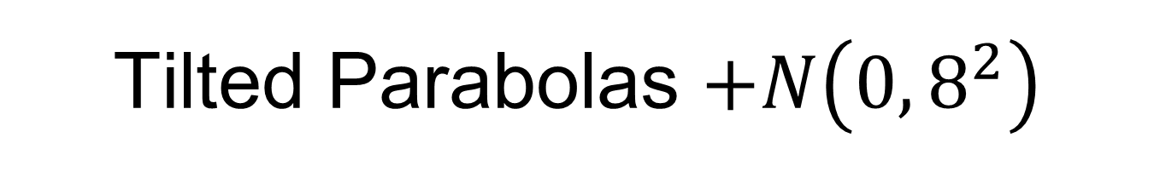
Tilted Parabolas $+N\left(0,8^{2}\right)$
PC1 Now
Weaker
Heavy Noise,
Hard to See
Parabolas
Mean
Remains
PC1 Mode is
Mostly There
PC2 Mode Now
Drowned Out

Slide 19
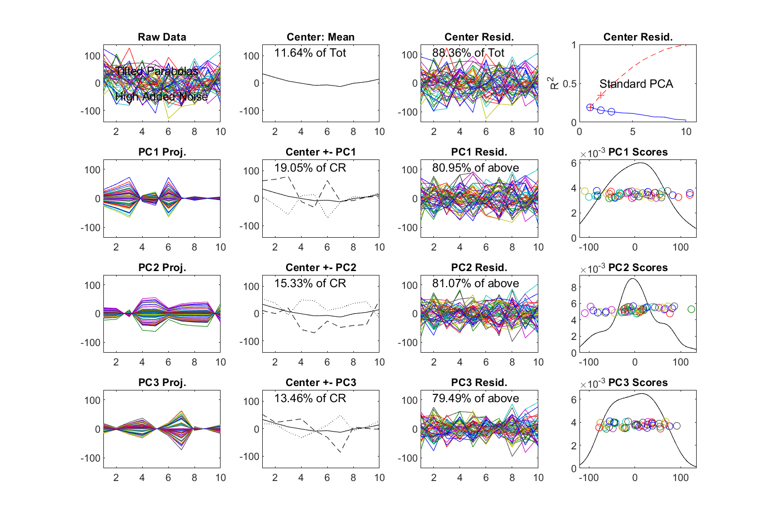
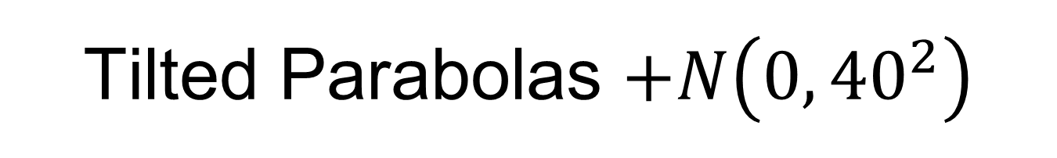
Tilted Parabolas $+N\left(0,{40}^{2}\right)$
Very High
Noise Level
Mean is
Impacted
Now Pure Noise
PC1 Mode Now
Drowned Out

Slide 20
E.g. Curves As Data
Two Clusters Example
10-d curves again

Slide 21
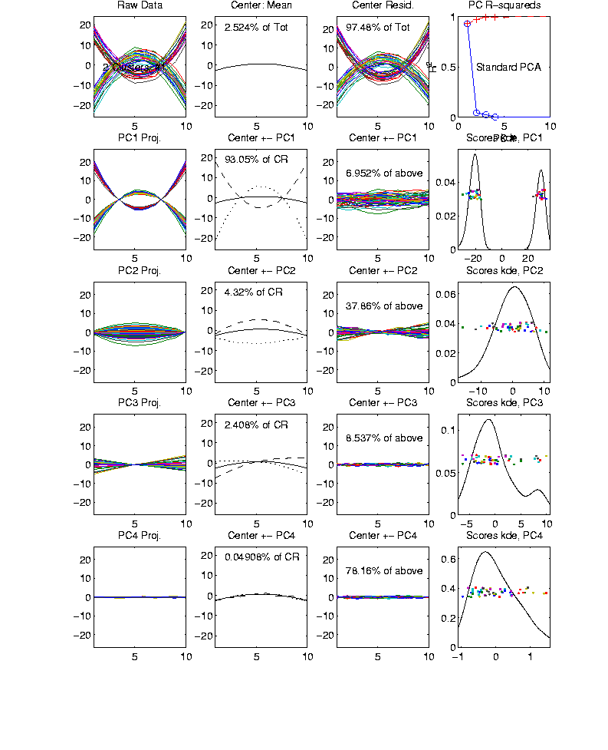
Functional Data Analysis, Two Clusters
Mean Is
Essentially 0
Clusters Show
Up Here
Flat Mode
Clipped Since
Not Orthogonal
Tilt Mode Again
Only Visible
Through PCA
Notes:
EGCD1Clust2.ps

Slide 22
E.g. Curves As Data
Two Clusters Example
10-d curves again
Two big clusters
Revealed by 1-d scores plot (right side)
Note: Cluster Difference is not orthogonal
to Vertical Shift
PCA Modes of Variation:
Reveal “population structure”

Slide 23
E.g. Curves As Data
“Twin Arches” Example
50-d curves
Text, Sec. 4.1.2

Slide 24
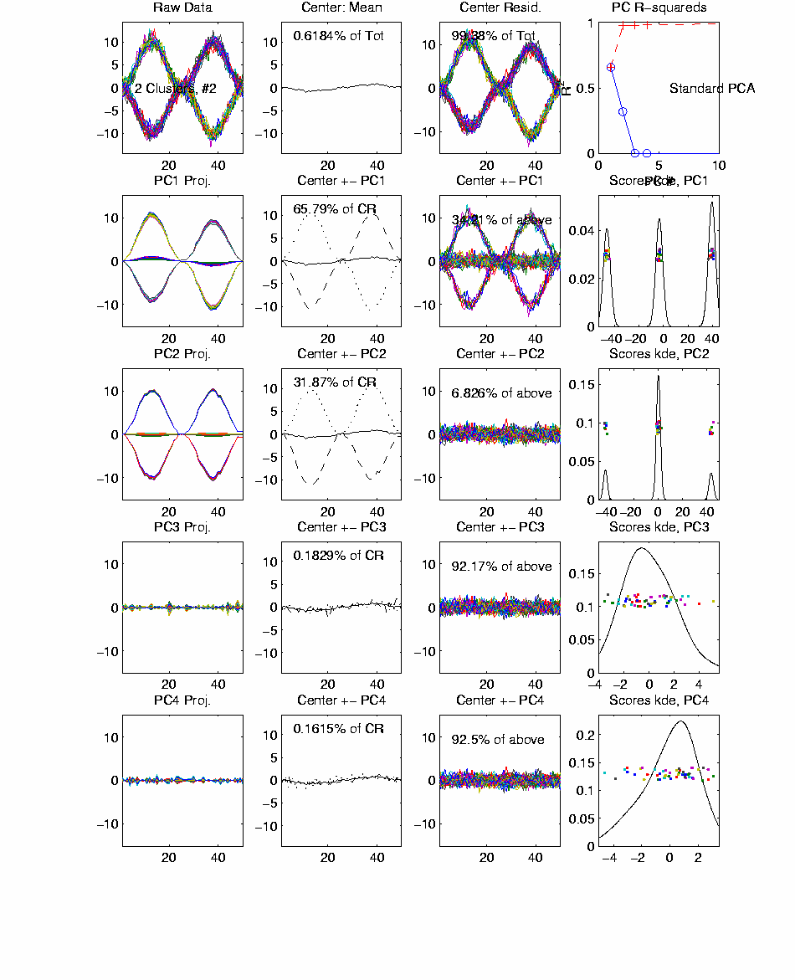
Functional Data Analysis, Twin Arches
Mean Again
Essentially 0
Modes
Look
Same?
Look
Here
Note 0
Scores
Must Be
Orthogonal
Notes:
EGCD1Clust4a.ps

Slide 25
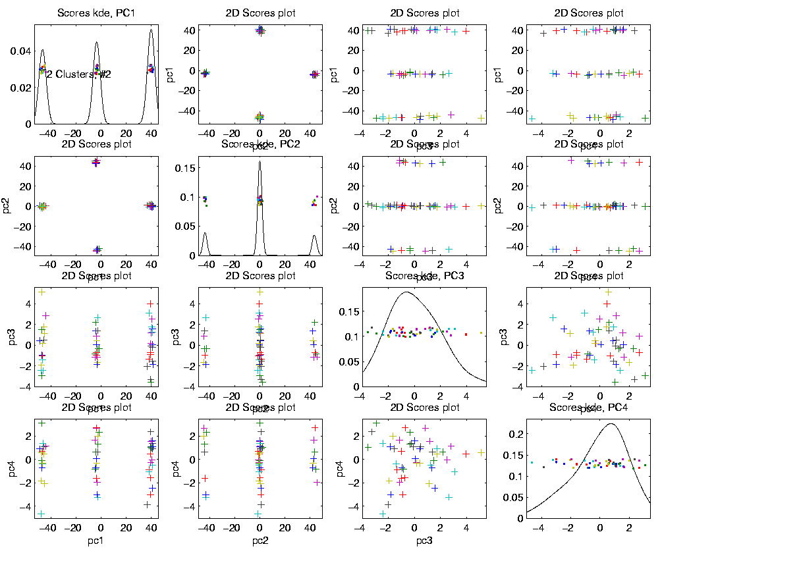
Functional Data Analysis, Twin Arches
Project Here as 3
Now See
4 Clusters
Note Smaller Scale
Multi-Variate Analysis: Joint Distribution More Than Just Marginals
And Here as 3
Notes:
EGCD1Clust4aDP2d.ps

Slide 26
E.g. Curves As Data
Twin Arches Example
50-d curves
Pop’n structure hard to see in 1-d
2-d projections make structure clear
Joint Dist’ns More than Marginals
PCA: reveals “population structure”

Slide 27
Real Data Curve Objects
Text, Sec. 4.1.3
Lung Cancer Data Example
Genetics (Cancer Research)
Bulk RNAseq (Next Gener’n Sequen’g)
Deep look at “gene components”
Microarrays: Single number (per gene)
RNAseq: Thousands of measurements
I. Object Definition

Slide 28

Real Data Curve Objects
Lung Cancer Data Example
Genetics (Cancer Research)
Bulk RNAseq (Next Gener’n Sequen’g)
Deep look at “gene components”
Gene studied here: CDKN2A
Goal: Study Alternate Splicing
Sample Size, $n = 180$
Dimension, $d = 1709$

Slide 29
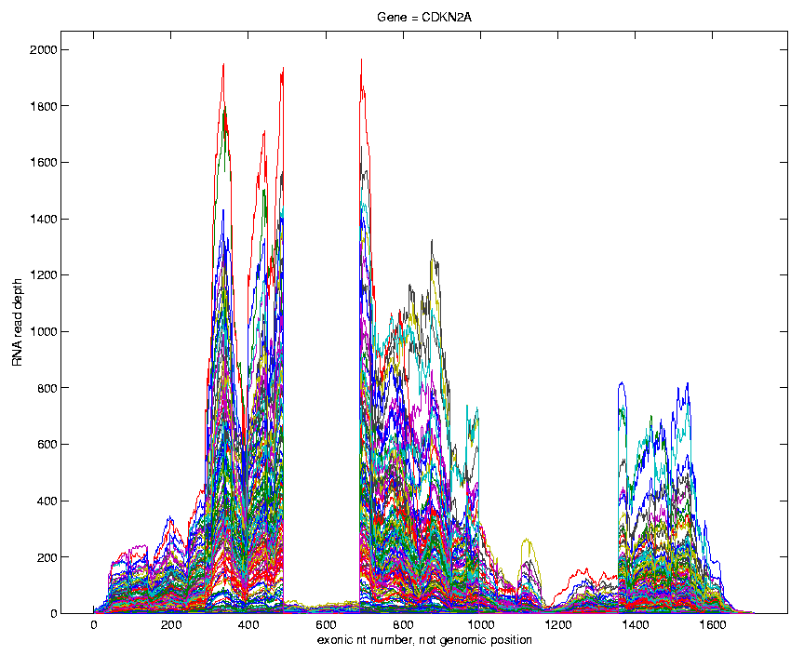
Lung Cancer Curve Objects
Simple
1st
View:
Curve
Overlay
(counts
scale)
Note: Data Set
Structure May
Be Hidden In
Low Areas
I. Object Representation

Slide 30
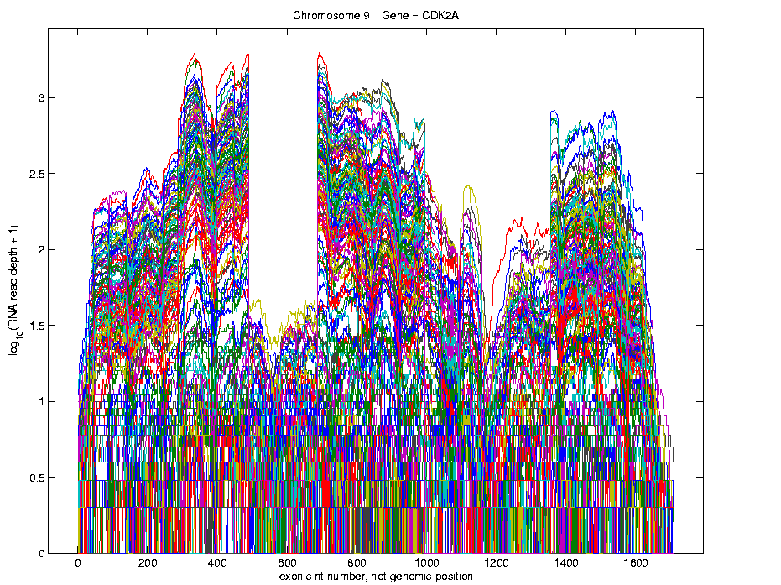
Lung Cancer Curve Objects
Simple
1st
View:
Curve
Overlay
(log
scale)
I. Object Representation

Slide 31
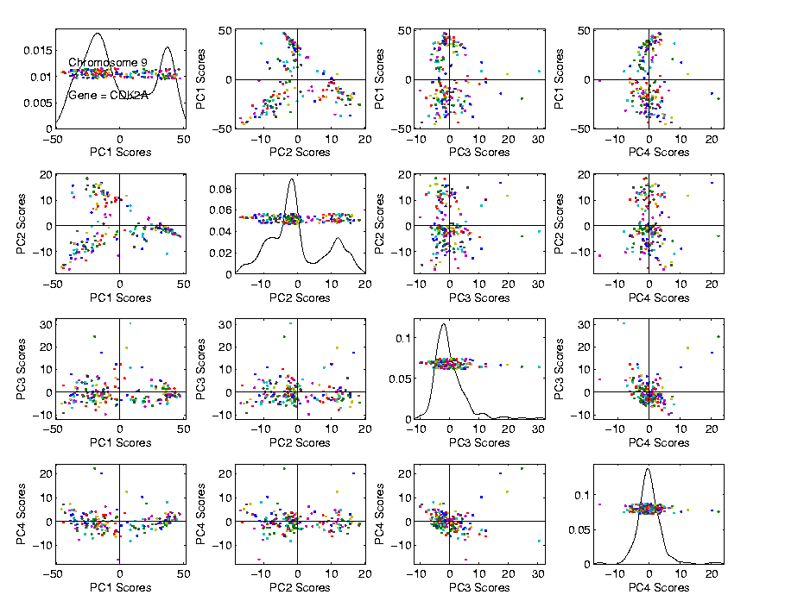
Lung Cancer Curve Objects
Visualization in Trait Space
PCA
Scores
View
Outliers?
Rare Cancer Types!

Slide 32
Lung Cancer Curve Objects
Suggestion
Of
Clusters
???
Suggested
By Smooth
Histograms

Slide 33
Lung Cancer Curve Objects
Suggestion
Of
Clusters
Which
Are
These?

Slide 34
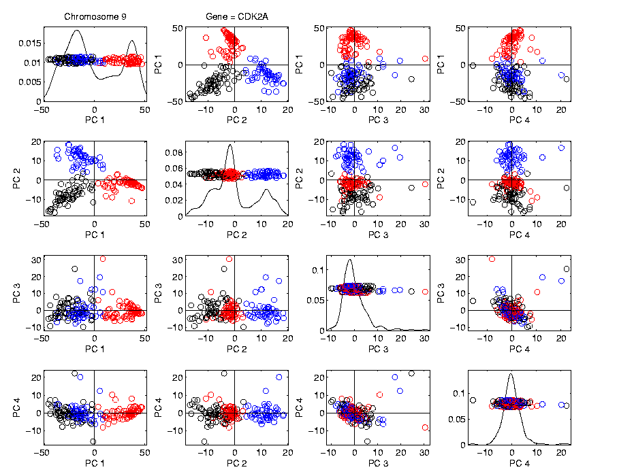
Lung Cancer Curve Objects
Visualization in Trait Space, Next Look in Object Space
Manually
“Brush”
Clusters
II. Exploratory
Analysis

Slide 35
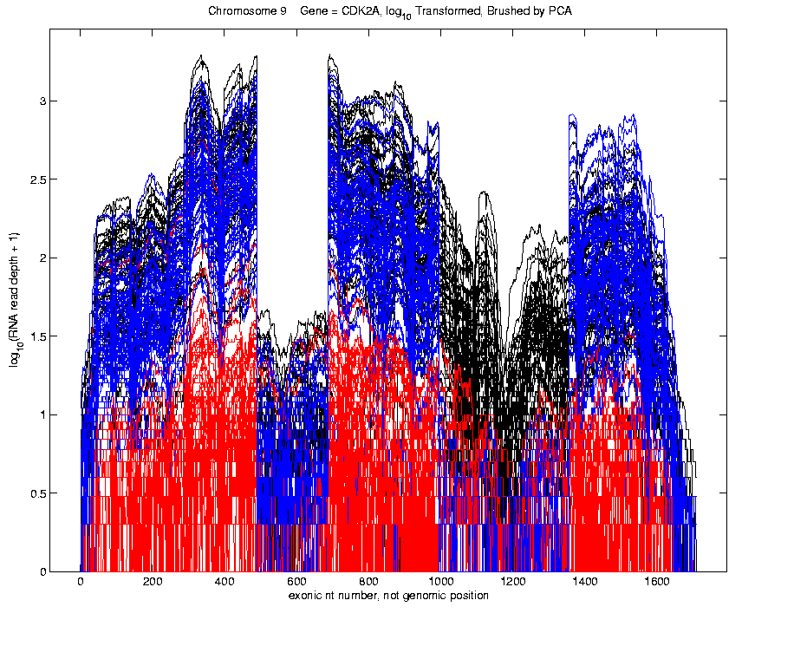
Lung Cancer Curve Objects
Manually
Brush
Clusters
Clear
Alternate
Splicing

Slide 36
Lung Cancer Curve Objects
Modes of Variation?
In “Genetics Data”
(Bulk RNAseq Lung Cancer)

Slide 37
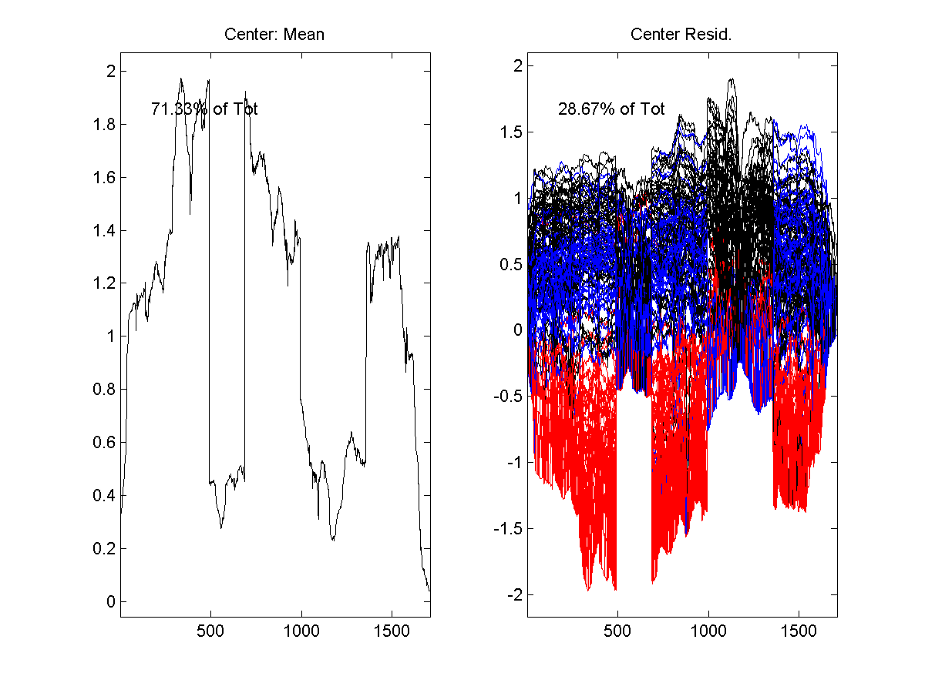
Lung Cancer Curve Objects
Object Mean Centering (Cluster Colors)
Variation
About
Origin
(After
Shifting
Point
Cloud)

Slide 38
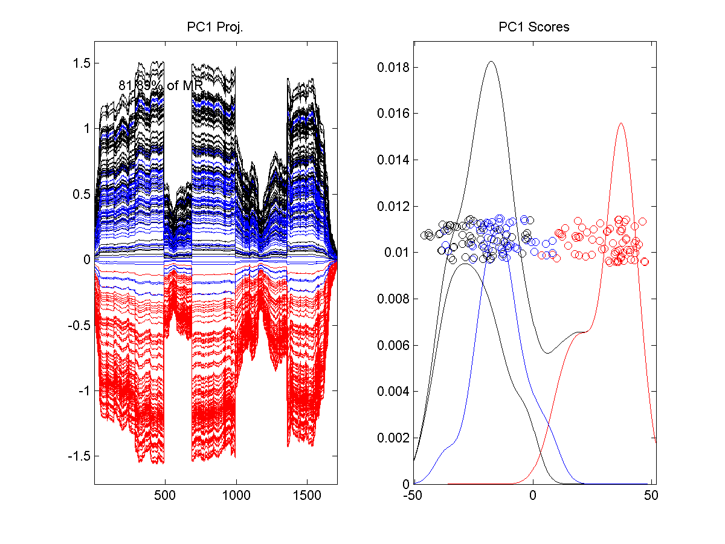
Lung Cancer Curve Objects
1st PC Mode of Variation
PC1
Projections
Corresponding
Scores
(Coefficients)
Separates
“Unexpressed”
From Rest

Slide 39
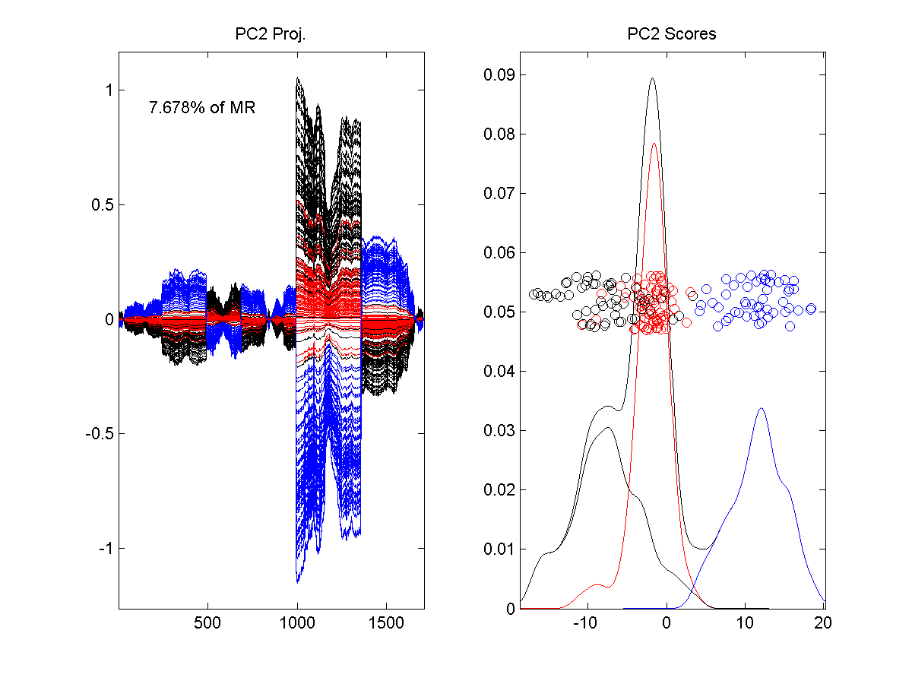
Lung Cancer Curve Objects
2nd PC Mode of Variation
Separates
Other Two
Clusters
Showing
Alternate
Splicing

Slide 40

Lung Cancer Curve Objects
Important Points
PCA found Important Structure
In High Dimensional Data Analysis
$$d = 1709$$
(Will Come Back To This Point)

Slide 41
Lung Cancer Curve Objects
Consequences:
Led to Development of SigFuge
Whole Genome Scan Found Interesting Genes
Wet Lab Experiment Verified Discoveries
Published in Kimes, et al (2014)

Slide 42
Lung Cancer Curve Objects
Interesting Question:
When are clusters really there?
(will study later)
III. Confirmatory Analysis

Slide 43
Lung Cancer Curve Objects
Manually
Brush
Clusters
Clear
Alternate
Splicing

Slide 44
Scree Plot
This was data illustrating
fallacy of “knee-finding”
for finding # of PCs
More Examples
Spanish Male
Mortality Data
2-d Toy Data
10-d Toy Data
Genetic Data

Slide 45
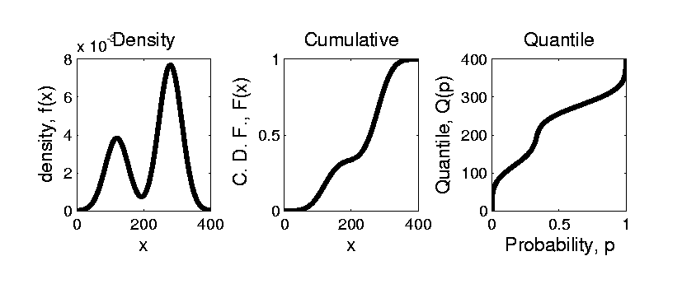


Prob. Dist’ns as Data Objects
Text, Sec. 3.3.1
How to Represent?
Several Common Choices:
$$F\left(x\right)=\int_{−∞}^{x}{f\left(t\right)dt}$$
$$Q\left(p\right)=F^{−1}(p)$$
Most Useful For
Computing
p-Values
Most Useful For
Computing
Confidence Intervals

Slide 46
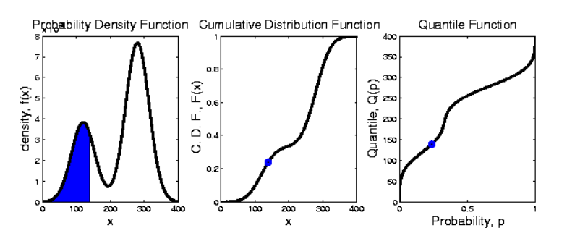
Prob. Dist’ns as Data Objects
Graphical Relationships:

Slide 47
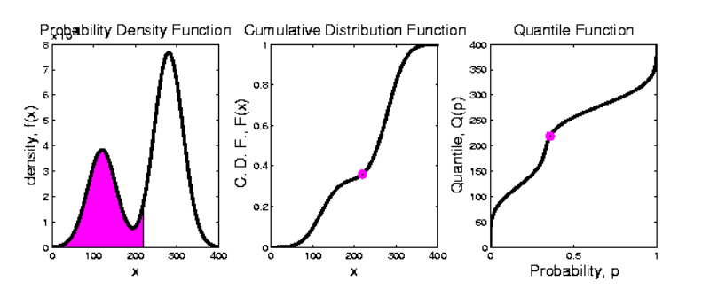
Prob. Dist’ns as Data Objects
Graphical Relationships:

Slide 48
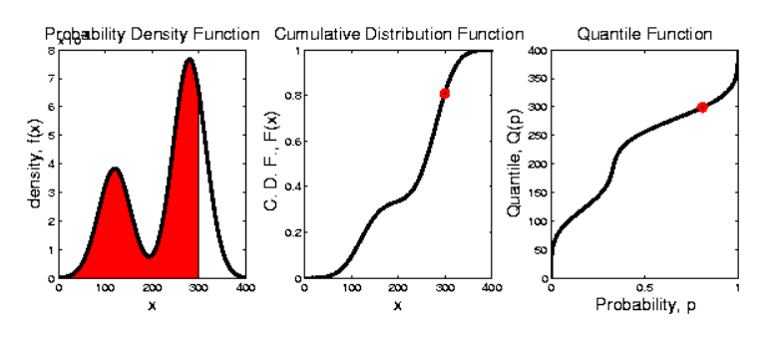
Prob. Dist’ns as Data Objects
Graphical Relationships:

Slide 49
Prob. Dist’ns as Data Objects
How to Represent?
Several Common Choices:
Density:
Good Intuition of Prob. Mass
Cumulative:
Can Read Off Probs.
Quantile:
Best Modes of Variation
Ideal for Visual Understanding
Of Probability Mass
Hence Good for Hypothesis Test p-Values

Slide 50
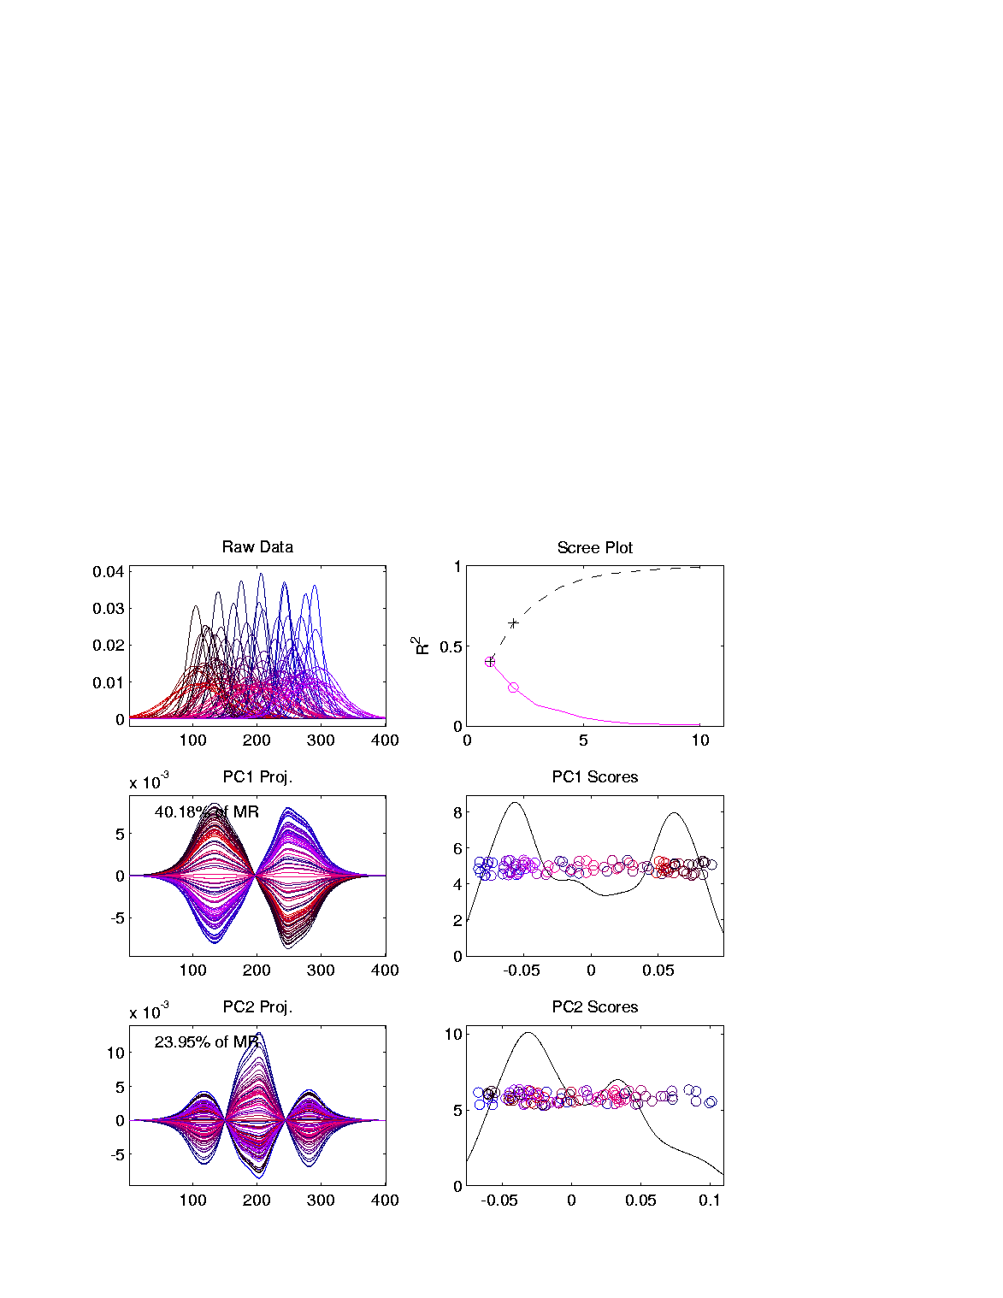
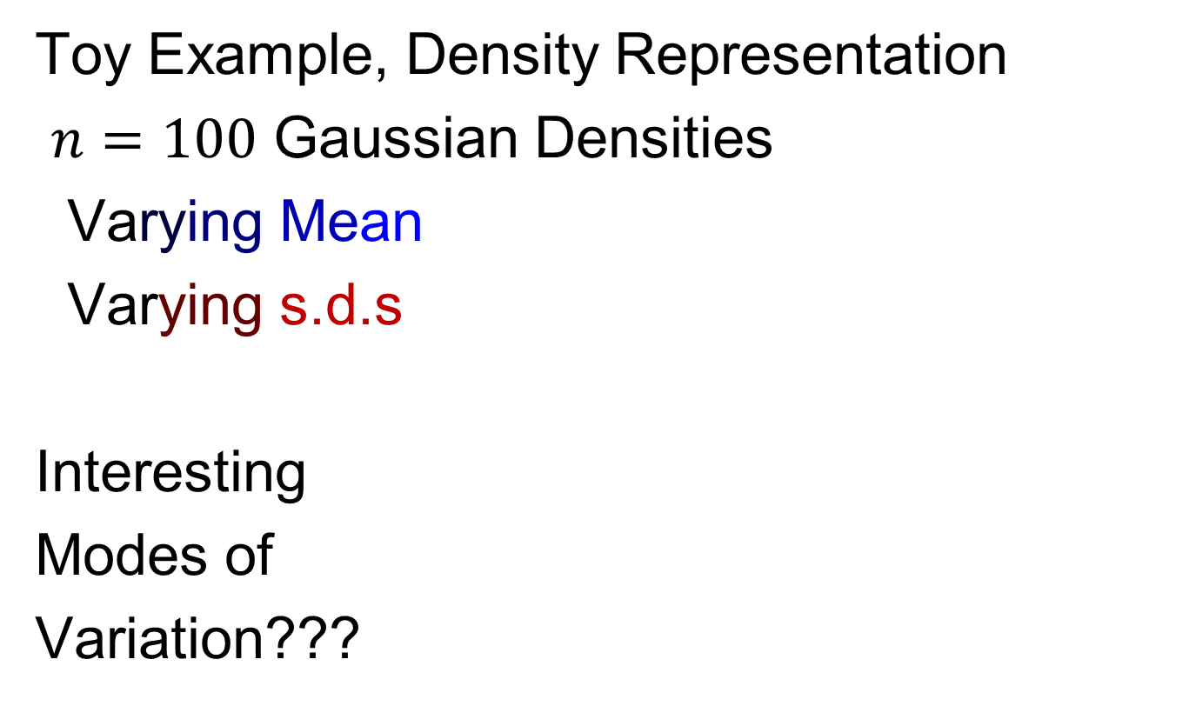
Prob. Dist’ns as Data Objects
Toy Example, Density Representation
$n=100$ Gaussian Densities
Varying Mean
Varying s.d.s
Interesting
Modes of
Variation???
Indicated with Black to Blue Color Scheme
Indicated with Black to Red Color Scheme
Note:
Purple
= Red
+ Blue

Slide 51
Prob. Dist’ns as Data Objects
Energy Spread
Widely Across
The Spectrum
Toy Example, Density Representation
Try
Standard
PCA
Unintuitive
Modes of
Variation
Which Don’t
Explain Much
Variation

Slide 52
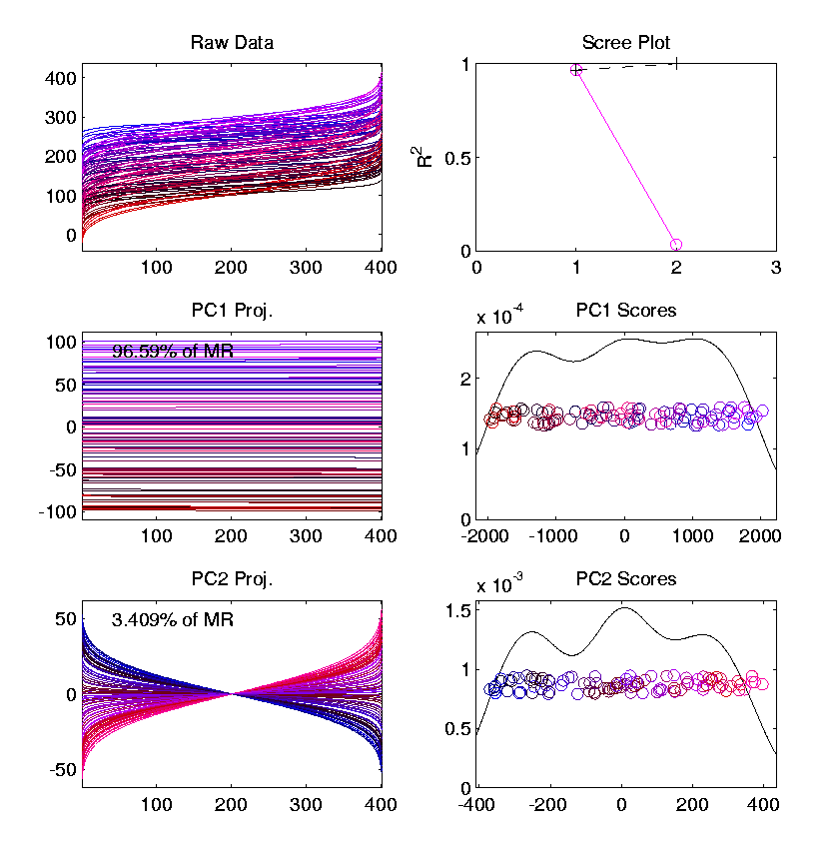
Prob. Dist’ns as Data Objects
Energy Entirely
Expressed In
Just 2 Modes
Toy Example, Quantile Representation
Try
Standard
PCA
0 1
1st Mode Is
Mean Var’n
Black to Blue Mean Coloring
Flat Mode
0 1
Both Much More Interpretable!
2nd Mode Is
S.D. Var’n
~ Tilt Mode
Black to Red Variance Coloring
0 1

Slide 53
Prob. Dist’ns as Data Objects
For More Discussion of the Usefulness of Quantile Representations of Dist’ns, see
Parzen (2004)

Slide 54
Prob. Dist’ns as Data Objects
How to Represent?
Alternative Choices:
Aitchison (1982)
Hron et al. (2016)
Menagfolio et al. (2018)

Slide 55

Matlab Software
OODA Software

Slide 56

Matlab Software
Download .zip file

Slide 57
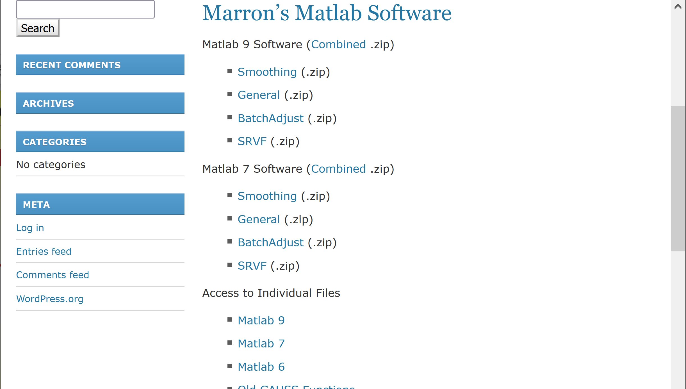
Matlab Software
Github Site with Individual Files

Slide 58
Introductory Slides
Slides 64 – 108 of 8-29-2019 Notes
of Previous OODA Course:
https://marronwebfiles.sites.oasis.unc.edu/Teaching/OODA-STOR881-Fall2019/STOR881-08-29-2019.pptx
Link also accessible in current HW 1
Includes Above Example of Lung Cancer Data

Slide 59
Scatterplot Matrix Graphics
Matlab Software:
scatplotSM.m
In General Directory

Slide 60
FDA Modes of Variation
Matlab Software:
curvdatSM.m
In General Directory

Slide 61
Limitation of PCA
PCA can provide useful projection directions
But can’t “see everything”…
Reason:
  PCA finds dir’ns of maximal variation
  Which may obscure interesting structure

Slide 62
Limitation of PCA
Toy Example:
Apple – Banana – Pear
Obscured by “noisy dimensions”
1st 3 PC directions only show noise
Study some rotations, to find structure
6 Dimenional,
Not HW1 or HW2

Slide 63
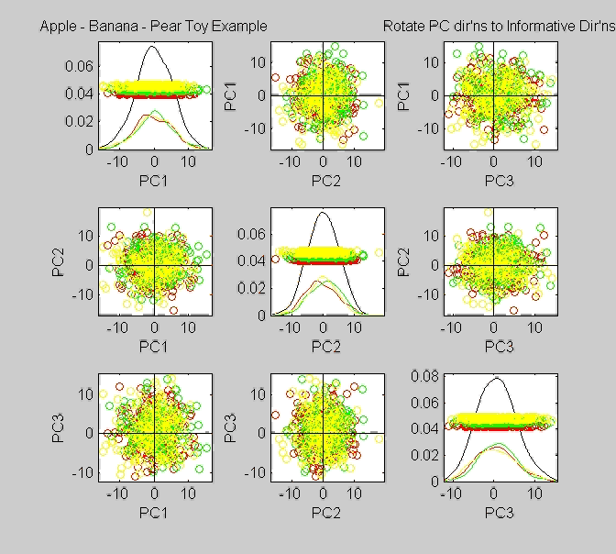
Limitation of PCA, Toy E.g.

Slide 64
Limitation of PCA
Toy Example:
Rotation shows Apple – Banana – Pear
Example constructed as:
  1st make these in 3-d
  Add 3 dimensions of high s.d. noise
Carefully watch axis labels

Slide 65
Limitation of PCA
Main Point:
May be Important Data Structure
Not Visible in 1st Few PCs

Slide 66
Limitation of PCA, E.g.
Interesting Data Set: NCI-60
NCI = National Cancer Institute
60 Cell Lines (cancer treatment targets)
For Different Cancer Types
Measured “Gene Expression”
= “Gene Activity”
Several Thousand Genes (Simultaneously)
Data Objects = Vectors of Gene Exp’n
Lots of Preprocessing (study later)
Example from:
Liu et al (2009)
Microarrays:
1 # per Gene

Slide 67
NCI 60 Data
Important Aspect: 8 Cancer Types
Renal Cancer (Kidneys)
Non Small Cell Lung Cancer
Central Nervous System Cancer
Ovarian Cancer
Leukemia (Blood)
Colon Cancer
Breast Cancer
Melanoma (Skin)
Notes:
67

Slide 68
PCA Visualization of NCI 60 Data
Can we find classes:
(Renal, CNS, Ovar, Leuk, Colon, Melan)
Using PCA Visualization??
First try “unsupervised view”
I.e. switch off class colors
Then turn on colors, to identify clusters
I.e. look at “supervised view”
II. Exploratory
Analysis
Notes:
68

Slide 69
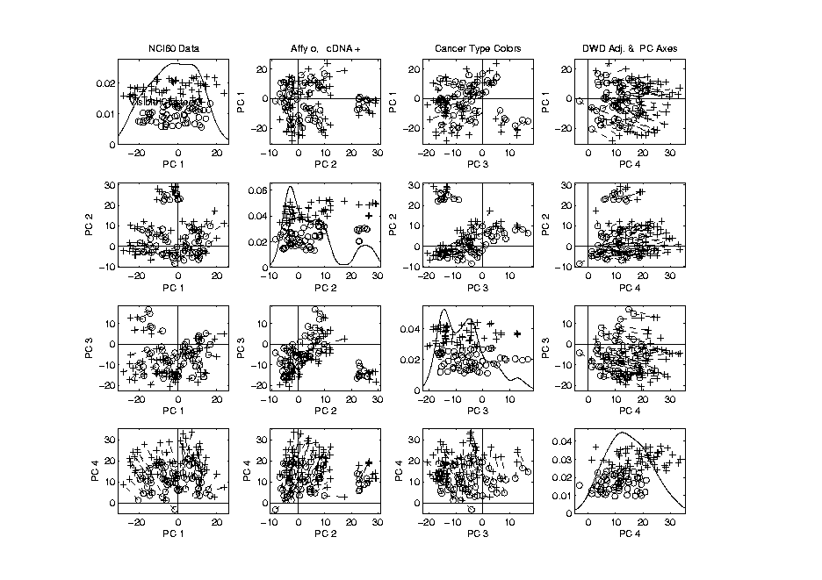
NCI 60: Can we find classes
Using PCA view?
Notes:
69

Slide 70
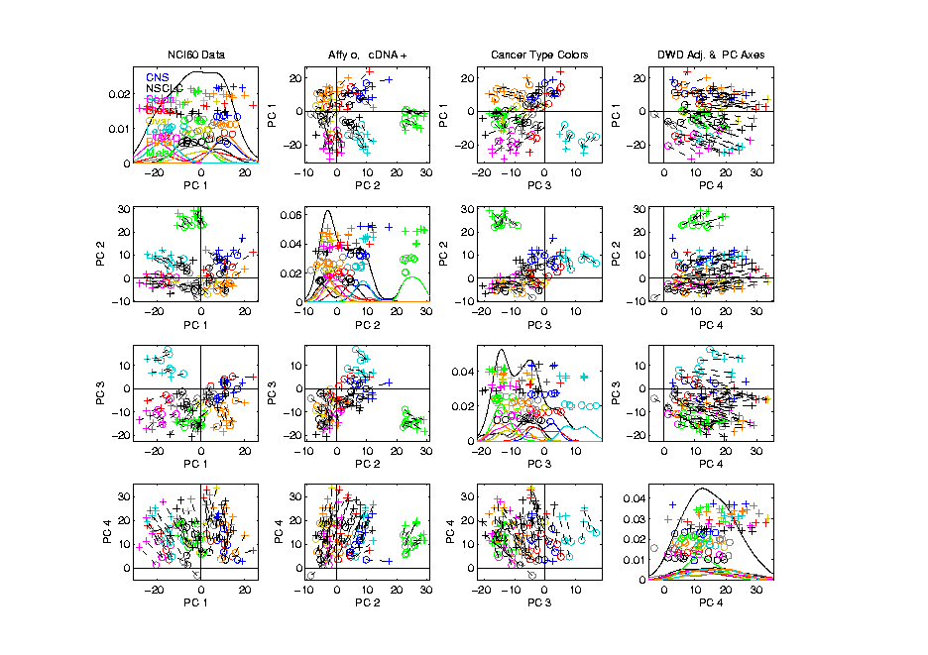
NCI 60: Can we find classes
Using PCA view?
Notes:
70

Slide 71
PCA Visualization of NCI 60 Data
Maybe need to look at more PCs?
Study array of such PCA projections:
Notes:
71

Slide 72
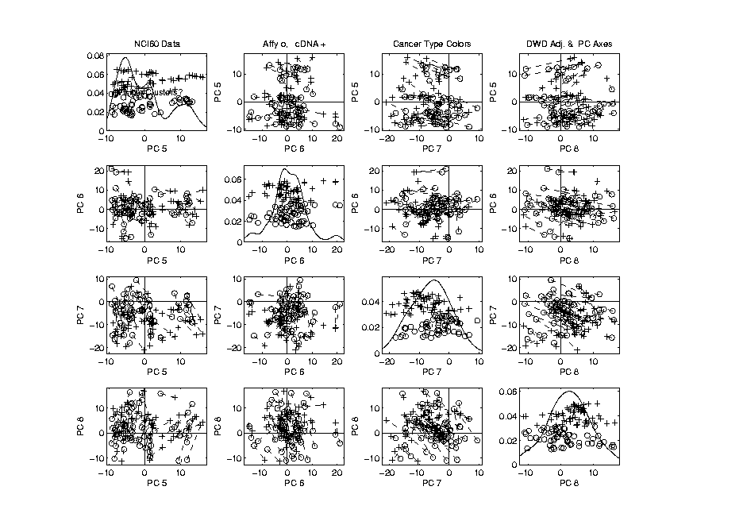
NCI 60: Can we find classes
Using PCA 5-8?
Notes:
72

Slide 73
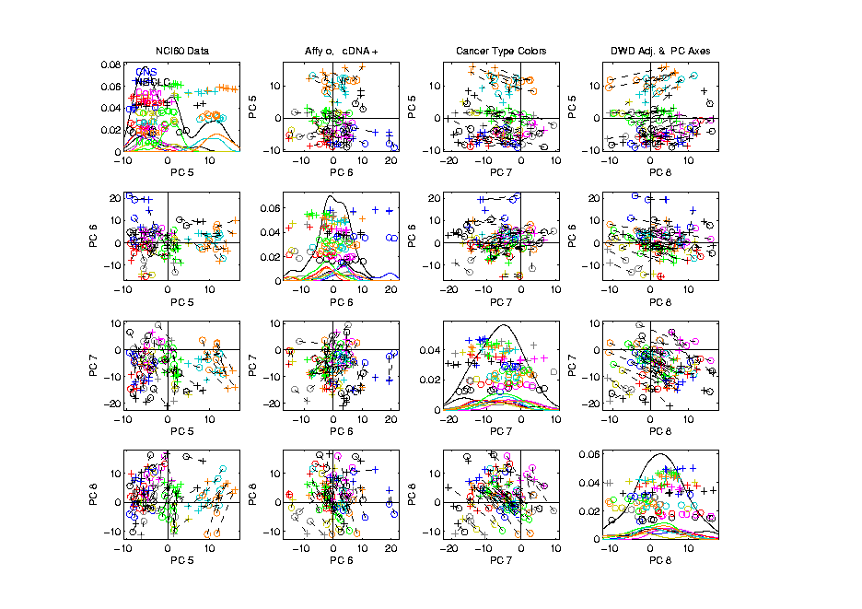
NCI 60: Can we find classes
Using PCA 5-8?
Notes:
73

Slide 74
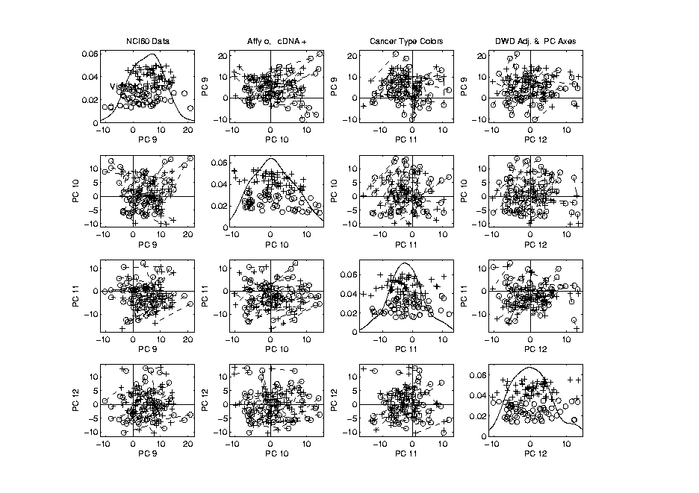
NCI 60: Can we find classes
Using PCA 9-12?
Notes:
74

Slide 75
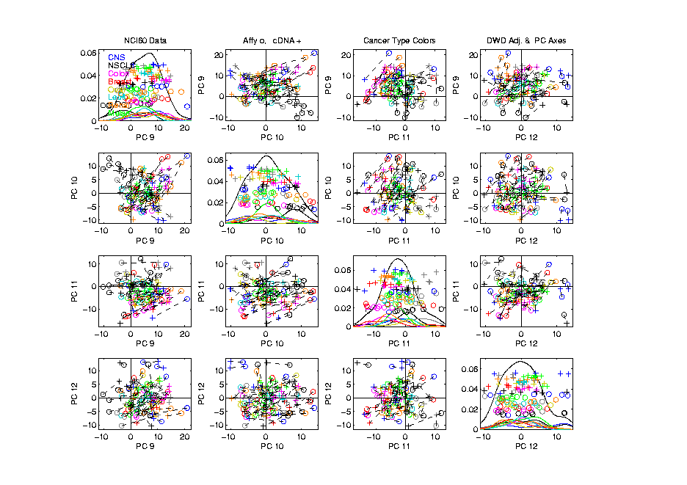
NCI 60: Can we find classes
Using PCA 9-12?
Notes:
75

Slide 76
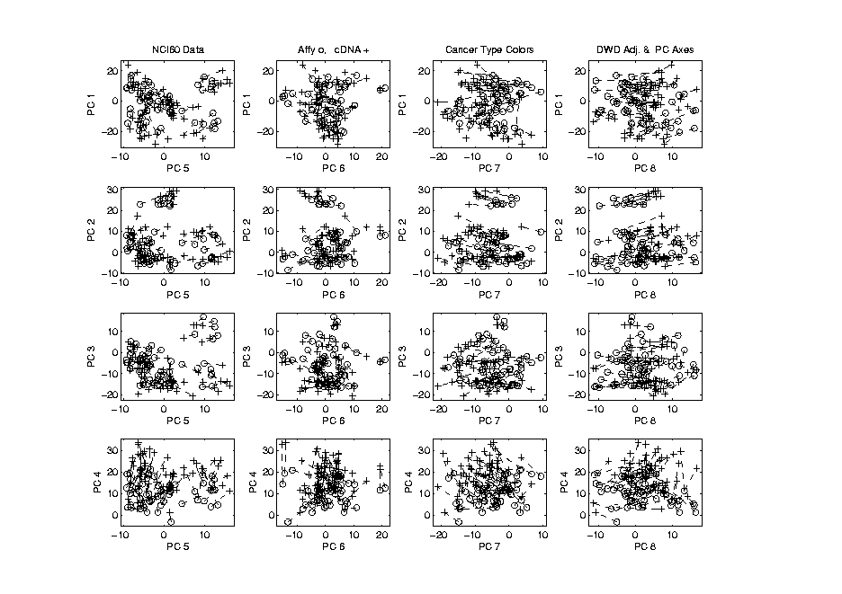
NCI 60: Can we find classes
Using PCA 1-4 vs. 5-8?
Notes:
76

Slide 77
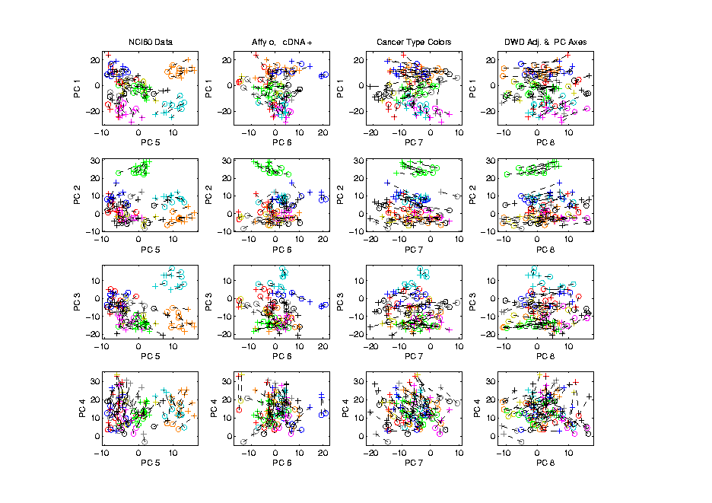
NCI 60: Can we find classes
Using PCA 1-4 vs. 5-8?
Notes:
77

Slide 78
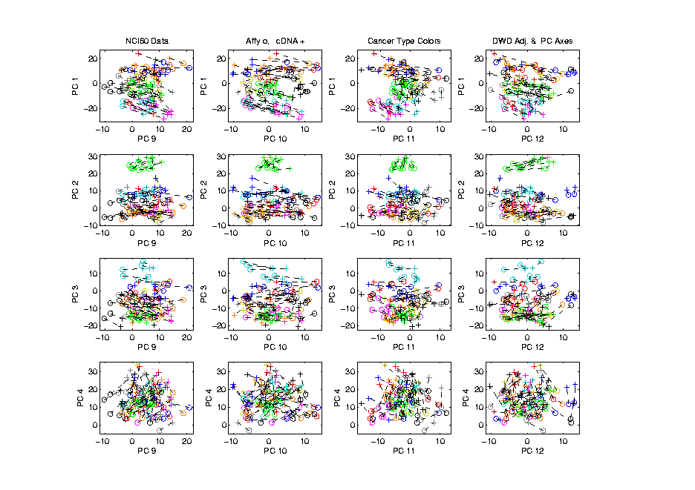
NCI 60: Can we find classes
Using PCA 1-4 vs. 9-12?
Notes:
78

Slide 79
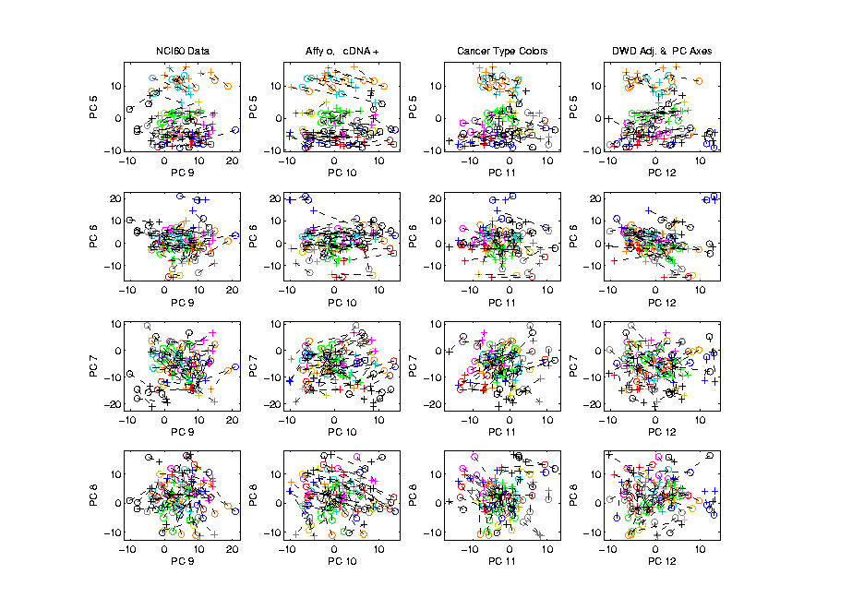
NCI 60: Can we find classes
Using PCA 5-8 vs. 9-12?
Notes:
79

Slide 80
PCA Visualization of NCI 60 Data
Can we find classes using PC directions??
Found some, but not others
Nothing after 1st five - six PCs
Rest seem to have other drivers
Are There Better Directions?
PCA only “feels” maximal variation
Ignores Class Labels
How Can We Use Class Labels?
Notes:
80

Slide 81
Visualization of NCI 60 Data
How Can We Use Class Labels?
Approach:
Find Directions to “Best Separate” Classes
In Disjoint Pairs (thus 4 Directions)
Use DWD:
Distance Weighted Discrimination
Defined (& Motivated) Later
Project All Data on These 4 Directions
Recall: Very Useful with Male-Female Faces Data
Notes:
81

Slide 82
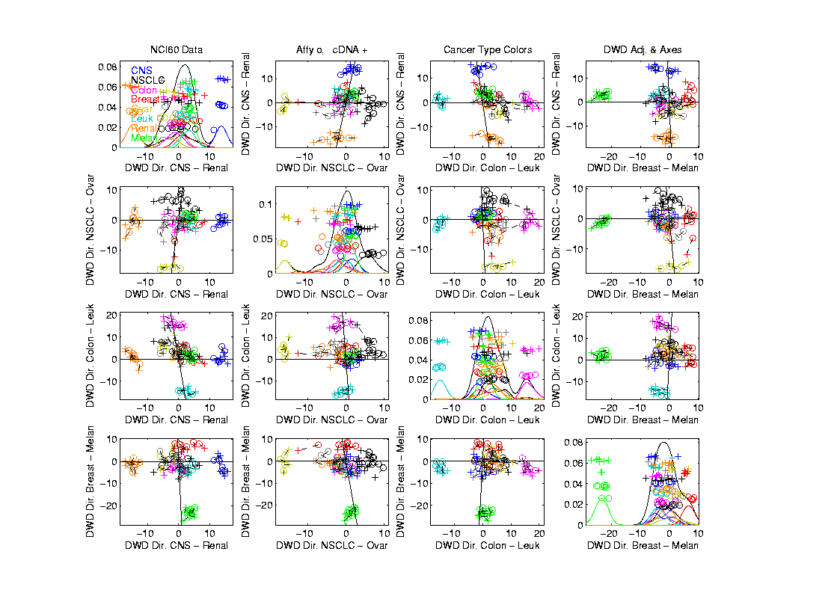
NCI 60: Views using DWD Dir’ns (focus on biology)
Ovarian Nicely Separated
But not Lung Cancer
Since Several Subtypes
Great Separation
Of Renal & CNS
Big Enough
Separation
That Others
Project In
Between
With Space
Breast
Cancer
Again Has
Subtypes
Similar for Leukemia,Colon & Melanoma
Notes:
82

Slide 83
DWD Visualization of NCI 60 Data
Most cancer types clearly distinct
(Renal, CNS, Ovar, Leuk, Colon, Melan)
Using these carefully chosen directions
Others less clear cut
  NSCLC (at least 3 subtypes)
  Breast (4 published subtypes)

Slide 84
DWD Visualization
Recall PCA limitations
DWD uses class info
Hence can “better separate known classes”
Do this for pairs of classes
(DWD just on those, ignore others)
Carefully choose pairs in NCI 60 data
Note DWD Directions Not Orthogonal
(PCA orthogonality may be
too strong a constraint)

Slide 85
NCI 60: Views using DWD Dir’ns (focus on biology)
Note: Off-Diagonal Plots Are No Longer
Transposes
Construction of Non-Orthogonal
Views Discussed
In Text, Fig. 6.14

Slide 86
Object Oriented Data Analysis
Three Major Phases of OODA:
I. Object Definition
“What are the Data Objects?”
Exploratory Analysis
“What Is Data Structure / Drivers?”
III. Confirmatory Analysis / Validation
Is it Really There (vs. Noise Artifact)?

Slide 87
Caution
Text, Sec. 4.1.2
DWD Separation Can Be Deceptive
Since DWD is Really Good at Separation
Important Concept:
Statistical Inference is Essential

Slide 88
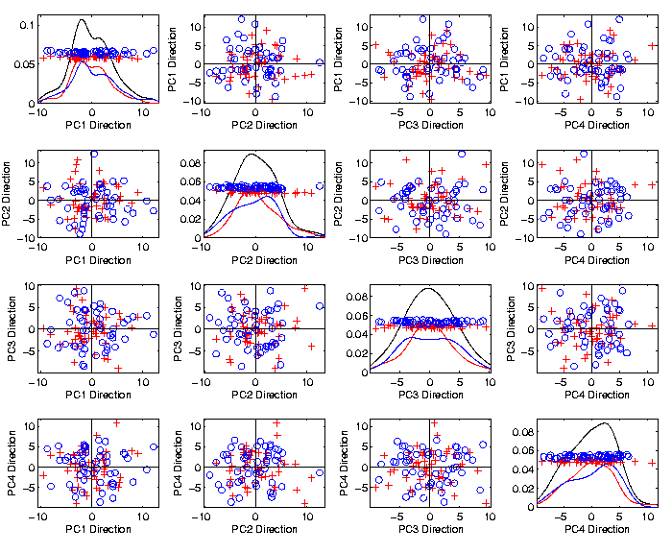
Caution
Toy 2-Class
Example
See
Structure?
Careful,
Only PC1-4

Slide 89

Caution
Toy 2-Class
Example
DWD &
Ortho PCA
Finds Big
Separation

Slide 90
Caution
Toy 2-Class
Example
Not in 1ST
3 PCs
Since
Smaller Scale

Slide 91

Caution
Toy 2-Class
Example
Actually
Both
Classes
Are $N_{d}\left(0_{d},I_{d}\right)$
$$d=1000$$

Slide 92
Caution
Toy 2-Class
Example
Separation
Is Natural
Sampling
Variation
(Will Study in Detail Later)

Slide 93
Caution
Main Lesson Again:
DWD Separation Can Be Deceptive
Since DWD is Really Good at Separation
Important Concept:
Statistical Inference is Essential
III. Confirmatory Analysis

Slide 94

DiProPerm Hypothesis Test
Text, Sec. 13.1
Context: 2 – sample means
$H_{0}: μ_{+1}=μ_{−1}$ vs. $H_{1}: μ_{+1}≠μ_{−1}$
(in High Dimensions)
$∃$ A Large Literature. Some Highlights:
Bai & Sarandasa (2006)
Chen & Qin (2010)
Srivastava et al (2013)
Cai et al (2014)

Slide 95

DiProPerm Hypothesis Test
Context: 2 – sample means
$H_{0}: μ_{+1}=μ_{−1}$ vs. $H_{1}: μ_{+1}≠μ_{−1}$
(in High Dimensions)
Approach taken here:
Wei et al (2013)
Focus on Visualization via Projection
(Thus Test Related to Exploration)

Slide 96

DiProPerm Hypothesis Test
Context: 2 – sample means
$H_{0}: μ_{+1}=μ_{−1}$ vs. $H_{1}: μ_{+1}≠μ_{−1}$
Challenges:
Distributional Assumptions
Parameter Estimation
HDLSS space is slippery
High Dimension Low Sample Size

Slide 97

DiProPerm Hypothesis Test
Context: 2 – sample means
$H_{0}: μ_{+1}=μ_{−1}$ vs. $H_{1}: μ_{+1}≠μ_{−1}$
Challenges:
Distributional Assumptions
Parameter Estimation
Suggested Approach:
Permutation test
(A flavor of classical “non-parametrics”)

Slide 98
DiProPerm Hypothesis Test
Suggested Approach:
Find a DIrection
(separating classes)
PROject the data
(reduces to 1 dim)
PERMute
(class labels, to assess significance,
with recomputed direction)

Slide 99


DiProPerm Hypothesis Test
Toy 2-Class Example
Separated DWD
Projections
(Again $N_{d}\left(0_{d},I_{d}\right)$, $d=1000$)

Slide 100
DiProPerm Hypothesis Test
Toy 2-Class Example
Separated DWD
Projections
Measure Separation of Classes Using:
Mean Difference = 6.209

Slide 101
DiProPerm Hypothesis Test
Toy 2-Class Example
Separated DWD
Projections
Measure Separation of Classes Using:
Mean Difference = 6.209
Record as Vertical Line

Slide 102
DiProPerm Hypothesis Test
Toy 2-Class Example
Separated DWD
Projections
Measure Separation of Classes Using:
Mean Difference = 6.209
Statistically Significant???

Slide 103
DiProPerm Hypothesis Test
Toy 2-Class Example
Permuted
Class Labels

Slide 104
DiProPerm Hypothesis Test
Toy 2-Class Example
Permuted
Class Labels
Recompute DWD
& Projections

Slide 105
DiProPerm Hypothesis Test
Toy 2-Class Example
Measure Class
Separation
Using Mean
Difference
= 6.26

Slide 106
DiProPerm Hypothesis Test
Toy 2-Class Example
Measure Class
Separation
Using Mean
Difference
= 6.26
Record as Dot

Slide 107

DiProPerm Hypothesis Test
Toy 2-Class Example
Generate 2nd
Permutation

Slide 108
DiProPerm Hypothesis Test
Toy 2-Class Example
Measure Class
Separation
Using Mean
Difference
= 6.15

Slide 109
DiProPerm Hypothesis Test
Toy 2-Class Example
Record as
Second Dot

Slide 110
DiProPerm Hypothesis Test
.
.
.
Repeat This 1,000 Times
To Generate Null Distribution

Slide 111

DiProPerm Hypothesis Test
Toy 2-Class Example
Generate Null
Distribution

Slide 112
DiProPerm Hypothesis Test
Toy 2-Class Example
Generate Null
Distribution
Compare With
Original Value

Slide 113
DiProPerm Hypothesis Test
Toy 2-Class Example
Generate Null
Distribution
Compare With
Original Value
Take Proportion
Larger as P-Value

Slide 114
DiProPerm Hypothesis Test
Toy 2-Class Example
Generate Null
Distribution
Compare With
Original Value
Not Significant

Slide 115


DiProPerm Hypothesis Test
Another Example
$N_{1000}\left(+0.05∗1_{d},I_{d}\right)$
$N_{1000}\left(−0.05∗1_{d},I_{d}\right)$
PCA View
Can’t See in PCA
Add a
Small
Signal

Slide 116


DiProPerm Hypothesis Test
Another Example
$N_{1000}\left(+0.05∗1_{d},I_{d}\right)$
$N_{1000}\left(−0.05∗1_{d},I_{d}\right)$
DWD View
(Similar to
$N_{d}\left(0_{d},I_{d}\right)$?)

Slide 117


DiProPerm Hypothesis Test
Prop’n > is 0, so more precise is “p-value < 0.001”
Another Example
$N_{1000}\left(+0.05∗1_{d},I_{d}\right)$
$N_{1000}\left(−0.05∗1_{d},I_{d}\right)$
DiProPerm Now
Quite Significant

Slide 118


DiProPerm Hypothesis Test
Stronger Example
$N_{1000}\left(+0.2∗1_{d},I_{d}\right)$
$N_{1000}\left(−0.2∗1_{d},I_{d}\right)$
Even PCA
Shows Class
Difference

Slide 119


DiProPerm Hypothesis Test
Stronger Example
$N_{1000}\left(+0.2∗1_{d},I_{d}\right)$
$N_{1000}\left(−0.2∗1_{d},I_{d}\right)$
DiProPerm Very
Significant

Slide 120

DiProPerm Hypothesis Test
=(MD – Xbar) / s
Stronger Example
$N_{1000}\left(+0.2∗1_{d},I_{d}\right)$
$N_{1000}\left(−0.2∗1_{d},I_{d}\right)$
DiProPerm Very
Significant
Z-Score Allows
Comparison
>> 5.4 above

Slide 121
DiProPerm Hypothesis Test
Text, Sec. 13.1
Deeper Look at Important Concept:
Statistical Inference is Essential
Slippery Visualization Comparisons:
Autism Data Example
Breast Cancer Data Example

Slide 122
DiProPerm Hypothesis Test
Real Data Example: Autism
Caudate Shape
(sub-cortical brain structure)
Shape summarized by 3-d locations of 1032 corresponding points
E.g. 1a: Autistic vs. Typically Developing
E.g. 1b: Development Delayed vs. Typ. Dev.
(Thanks to Josh Cates)
Cates et al. (2007)

Slide 123

DiProPerm Hypothesis Test
Example 1: Autism Data
Autism
Spectrum
Disorder
Typically
Developing
Develop’ly
Delayed
E.g. 1a
Some Difference,
But “Not Very Strong”?
E.g. 1b
Looks “Stronger”?

Slide 124
DiProPerm Hypothesis Test
Example 1: Autism Data
Actually Strongly
Stat’ly Significant
Not Quite
Stat’ly Significant
Visual Impression Can Be Slippery

Slide 125

DiProPerm Hypothesis Test
Example 2: Breast Cancer Data
Again 2
Comp’sons
Top Looks Like
“Strong Diff.”?
Bottom “More
Overlapped”?

Slide 126
DiProPerm Hypothesis Test
Example 2: Breast Cancer Data
Yet DiProPerm
Gives Opposite
Result!

Slide 127
DiProPerm Hypothesis Test
What is going on?
Is Visualization Useless?
Key Point:
Sample Sizes
Smaller Sample Size ←→ Weaker Inference
E.g. 1a | 88 vs. 34 | Strongly Stat’ly Significant
E.g. 1b | 13 vs. 34 | Not Stat’ly Significant
E.g. 2a | 16 vs. 34 | Not Stat’ly Significant
E.g. 2b | 36 vs. 44 | Strongly Stat’ly Significant

Slide 128
DiProPerm Hypothesis Test
Main Lessons:
Important to Do Inference
Intuition Can Be Slippery
Note: Cherry Picked These From
Larger Set of Examples
Opposite Results Not That Common

Slide 129

DiProPerm Hypothesis Test
Recent Discovery:
Yang et al. (2023)
Not in Text
For Very Strong Signal,
Test Power Can Decrease!

Slide 130

DiProPerm Hypothesis Test
Cause of Power Loss:
Use of “All Permutations”

Slide 131

DiProPerm Hypothesis Test
Use of “All Permutations”
Big Power Loss from Spread Null Distribution

Slide 132
DiProPerm Hypothesis Test
Solution:
Only Consider “Balanced Permutations”

Slide 133
DiProPerm Hypothesis Test
Only Consider “Balanced Permutations”
Much Tighter Null Distribution

Slide 134
DiProPerm Hypothesis Test
Recommendation:
Always Use “Balanced Permutations”

Slide 135
Matlab Software
Recall OODA Software

Slide 136
DiProPerm in Matlab
Matlab Software:
DiProPermXY.m
In General Directory

