Slide 1
Statistics – O. R. 881
Object Oriented Data Analysis
Steve Marron
Dept. of Statistics and Operations Research
University of North Carolina

Slide 2
Current Sections in Textbook
Today:
Sections 13.1, 18.1, 18.2, 5.1
Next Class:
Sections 5.2, 5.3

Slide 3
Participant Presentations
Please Sign Up:
Name
Dept. & Advisor (Lab?)
Onyen (or Email Address)
ENRolled or AUDitor?
Tentative Title (“????” Is OK)
When:
  Next Week, Early, September, October, Late

Slide 4
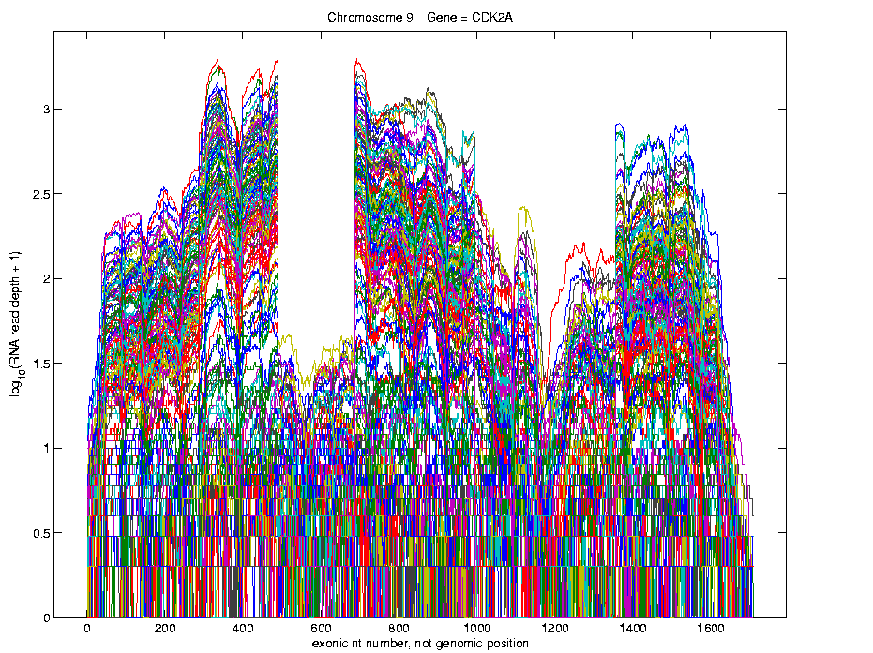
Last Class: Lung Cancer Curve Obj’s
Simple
1st
View:
Curve
Overlay
(log
scale)
I. Object Representation

Slide 5
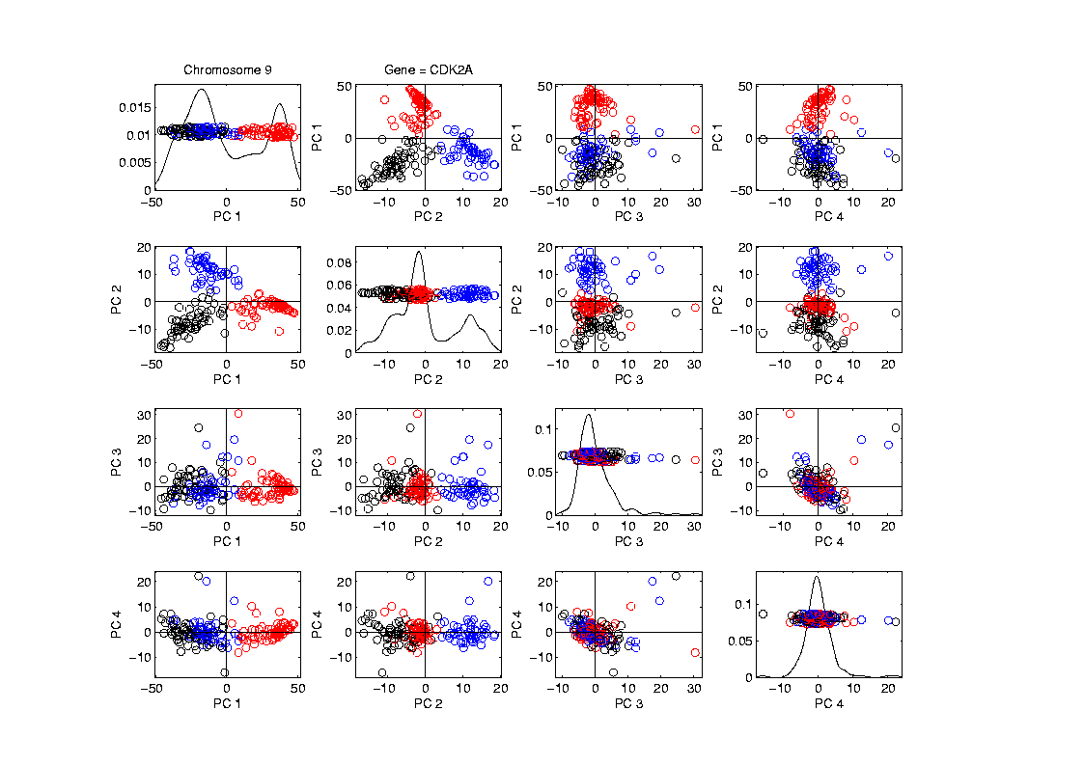
Last Class: Lung Cancer Curve Obj’s
Visualization in Feature Space, Next Look in Object Space
Manually
“Brush”
Clusters
II. Exploratory
Analysis

Slide 6
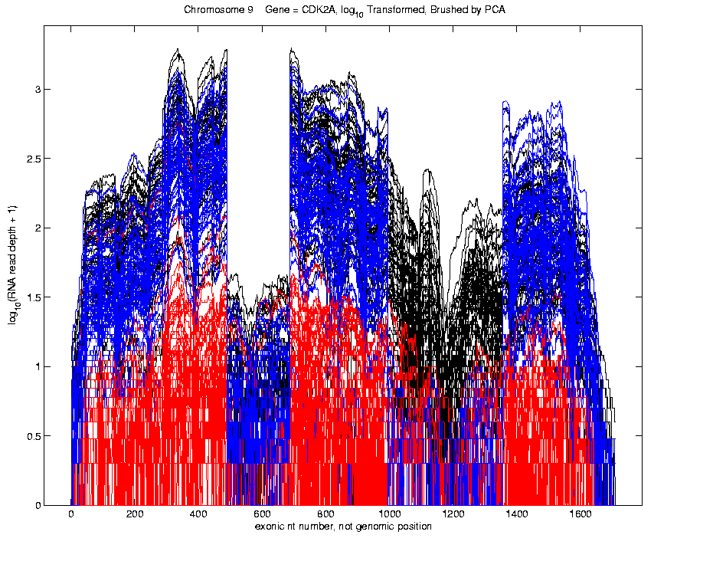
Last Class: Lung Cancer Curve Obj’s
Visualization in Object Space
Manually
Brush
Clusters
Clear
Alternate
Splicing
II. Exploratory
Analysis

Slide 7
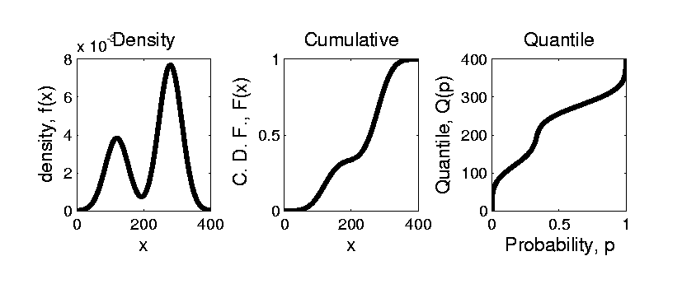


Last Class: Prob. Dist’ns
How to Represent?
Several Common Choices:
$$F\left(x\right)=\int_{−∞}^{x}{f\left(t\right)dt}$$
$$Q\left(p\right)=F^{−1}(p)$$

Slide 8
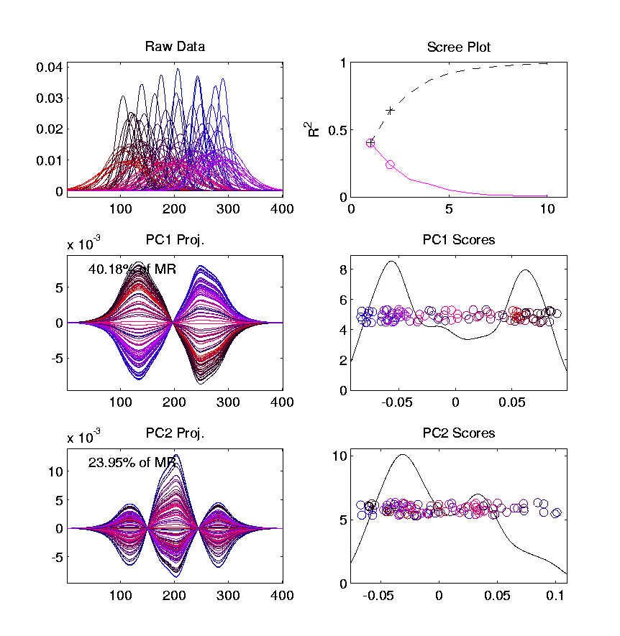
Last Class: Prob. Dist’ns
Energy Spread
Widely Across
The Spectrum
Toy Example, Density Representation
Try
Standard
PCA
Unintuitive
Modes of
Variation
Which Don’t
Explain Much
Variation

Slide 9
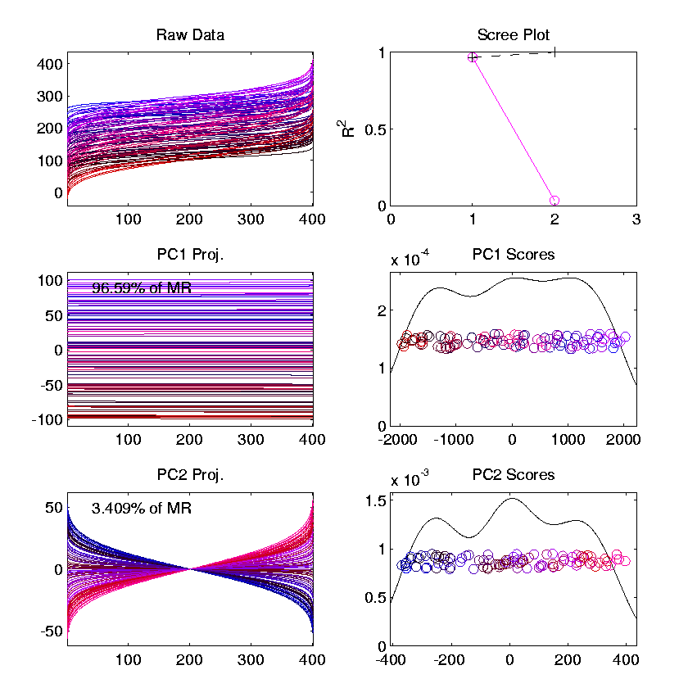
Last Class: Prob. Dist’ns
Energy Entirely
Expressed In
Just 2 Modes
Toy Example, Quantile Representation
Try
Standard
PCA
1st Mode Is
Mean Var’n
Both Much More Interpretable!
2nd Mode Is
S.D. Var’n

Slide 10
Last Class: Limitation of PCA
PCA can provide useful projection directions
But can’t “see everything”…
Reason:
  PCA finds dir’ns of maximal variation
  Which may obscure interesting structure

Slide 11
Last Class: Limitation of PCA
Toy Example:
Apple – Banana – Pear
Obscured by “noisy dimensions”
1st 3 PC directions only show noise
Study some rotations, to find structure

Slide 12
Last Class: Limitation of PCA
Interesting Data Set: NCI-60
NCI = National Cancer Institute
60 Cell Lines (cancer treatment targets)
For Different Cancer Types
Measured “Gene Expression”
= “Gene Activity”
Several Thousand Genes (Simultaneously)
Data Objects = Vectors of Gene Exp’n
Lots of Preprocessing (study later)
Example from:
Liu et al (2009)

Slide 13
Last Class: NCI 60 Data
Important Aspect: 8 Cancer Types
Renal Cancer (Kidneys)
Non Small Cell Lung Cancer
Central Nervous System Cancer
Ovarian Cancer
Leukemia (Blood)
Colon Cancer
Breast Cancer
Melanoma (Skin)
Notes:
13

Slide 14
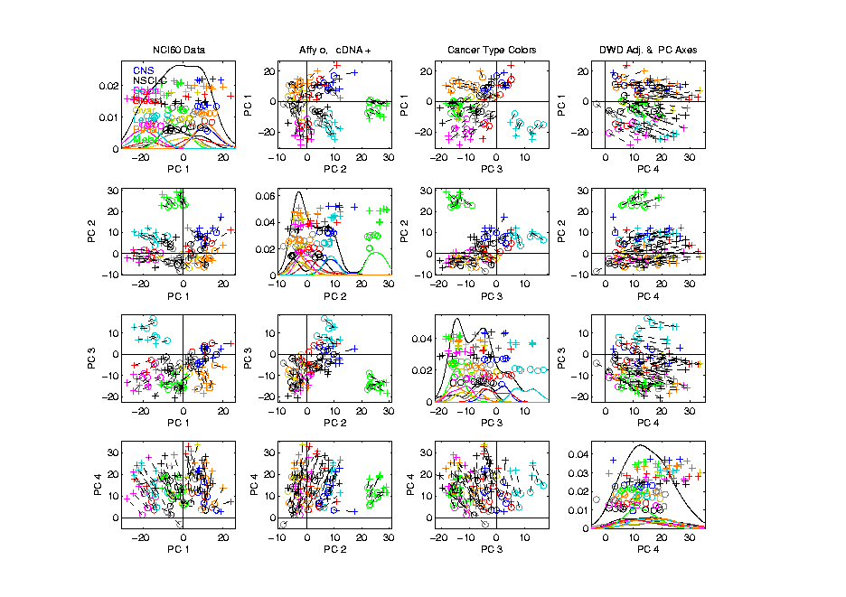
Last Class: NCI 60 Data
Using PCA view?
Notes:
14

Slide 15
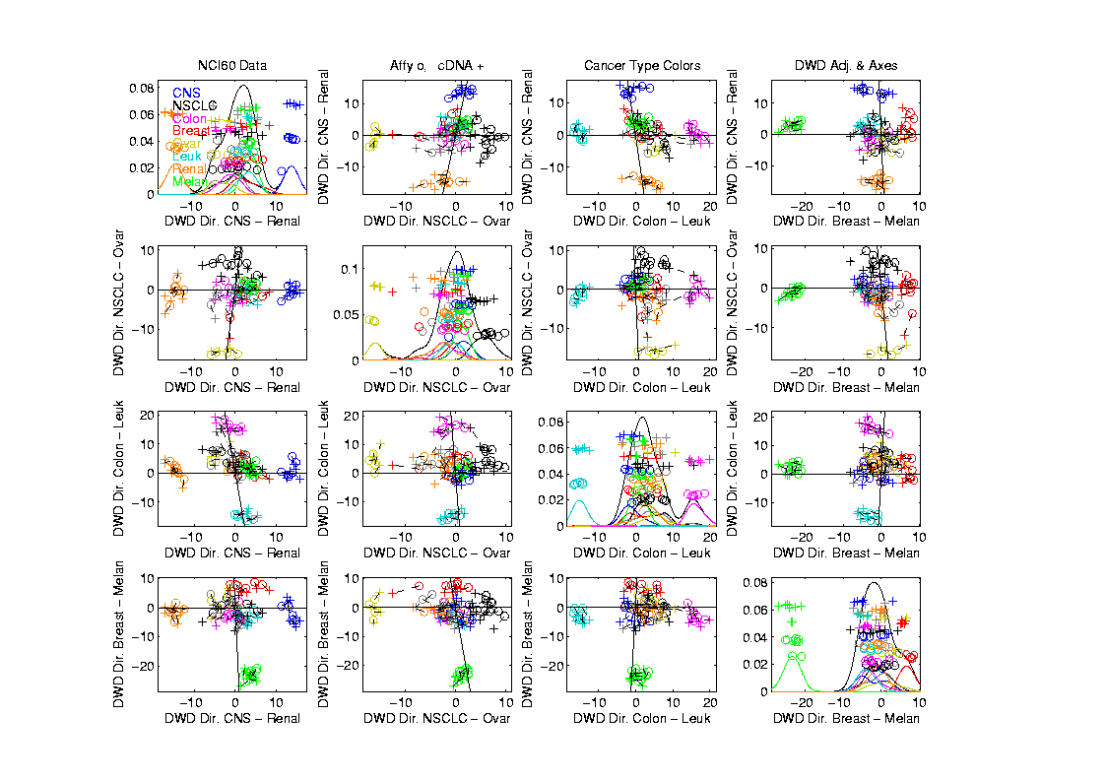
Last Class: NCI 60 Data
Views using DWD Dir’ns
Notes:
15

Slide 16
Last Class: NCI 60 Data
Views using DWD Dir’ns
Main Lessons:
PCA Finds Dir’ns of Maximal Variation
Often Shows Interesting Sturcture
But No Guarantees
Other Directions Also Important & Useful
Distance Weight Discrimination Targets
Subgroup Differences
Notes:
16

Slide 17
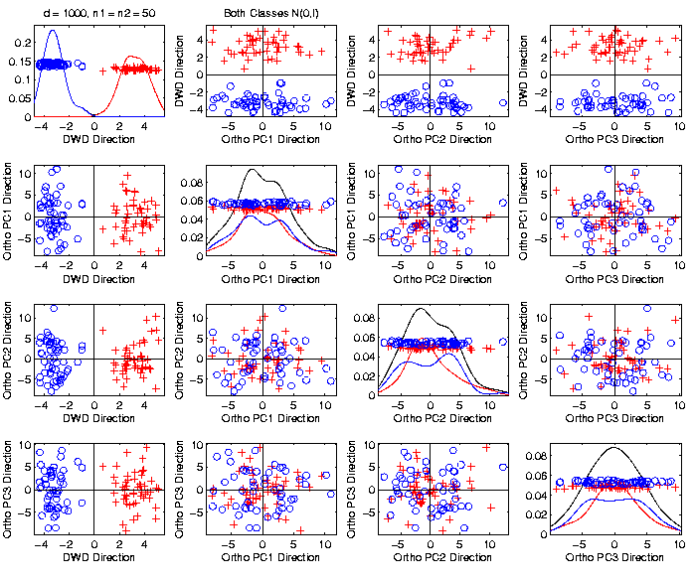

Last Class: Caution
Toy 2-Class
Example
Actually
Both
Classes
Are $N\left(0,I\right)$
$$d=1000$$

Slide 18
Last Class: Caution
Toy 2-Class
Example
Separation
Is Natural
Sampling
Variation
(Will Study in Detail Later)

Slide 19
Last Class: Caution
Main Lesson Again:
DWD Separation Can Be Deceptive
Since DWD is Really Good at Separation
Important Concept:
Statistical Inference is Essential
III. Confirmatory Analysis

Slide 20
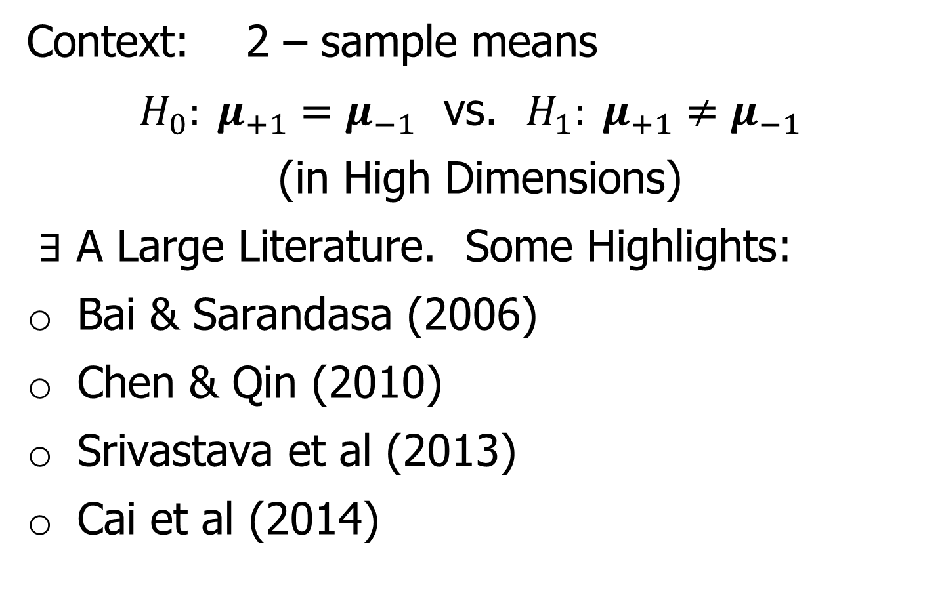
DiProPerm Hypothesis Test
Text, Sec. 13.1
Context: 2 – sample means
$H_{0}: μ_{+1}=μ_{−1}$ vs. $H_{1}: μ_{+1}≠μ_{−1}$
(in High Dimensions)
$∃$ A Large Literature. Some Highlights:
Bai & Sarandasa (2006)
Chen & Qin (2010)
Srivastava et al (2013)
Cai et al (2014)

Slide 21
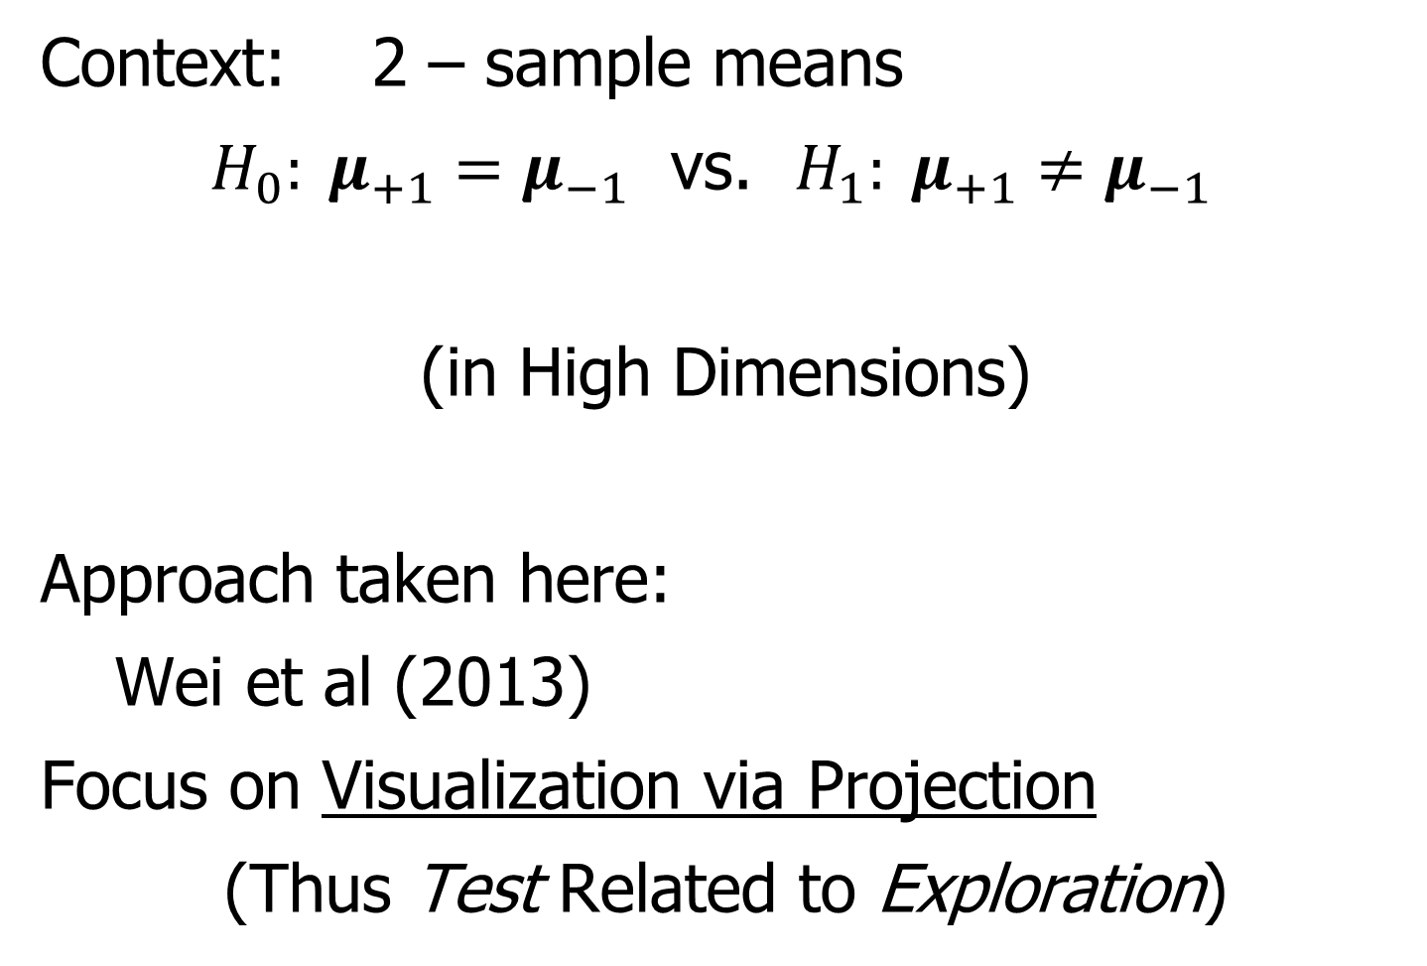
DiProPerm Hypothesis Test
Context: 2 – sample means
$H_{0}: μ_{+1}=μ_{−1}$ vs. $H_{1}: μ_{+1}≠μ_{−1}$
(in High Dimensions)
Approach taken here:
Wei et al (2013)
Focus on Visualization via Projection
(Thus Test Related to Exploration)

Slide 22
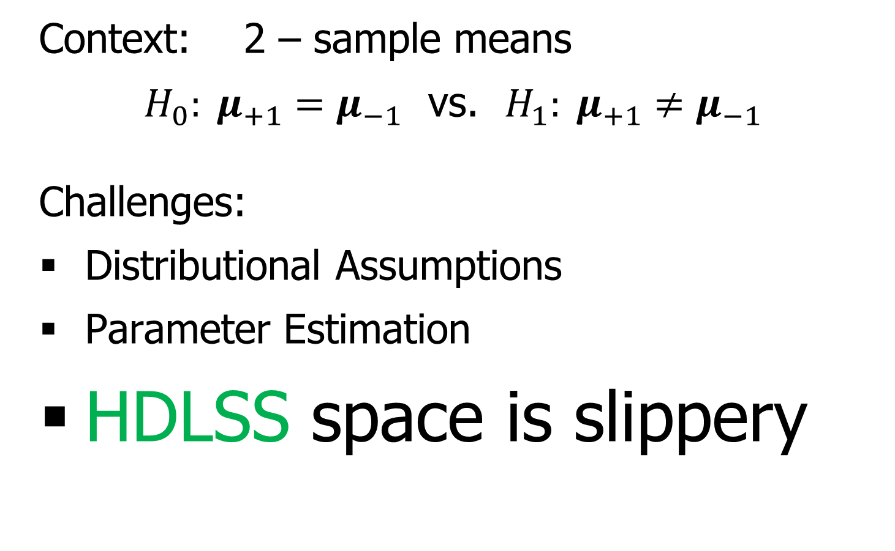
DiProPerm Hypothesis Test
Context: 2 – sample means
$H_{0}: μ_{+1}=μ_{−1}$ vs. $H_{1}: μ_{+1}≠μ_{−1}$
Challenges:
Distributional Assumptions
Parameter Estimation
HDLSS space is slippery
High Dimension Low Sample Size

Slide 23
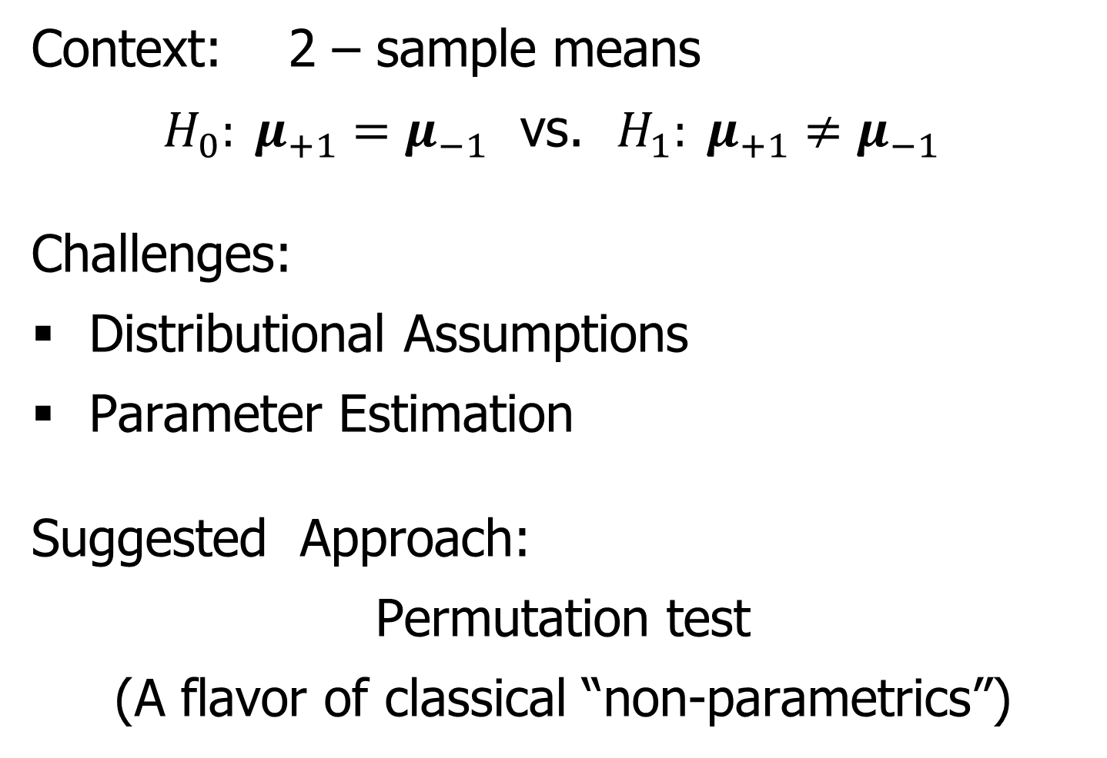
DiProPerm Hypothesis Test
Context: 2 – sample means
$H_{0}: μ_{+1}=μ_{−1}$ vs. $H_{1}: μ_{+1}≠μ_{−1}$
Challenges:
Distributional Assumptions
Parameter Estimation
Suggested Approach:
Permutation test
(A flavor of classical “non-parametrics”)

Slide 24
DiProPerm Hypothesis Test
Suggested Approach:
Find a DIrection
(separating classes)
PROject the data
(reduces to 1 dim)
PERMute
(class labels, to assess significance,
with recomputed direction)

Slide 25
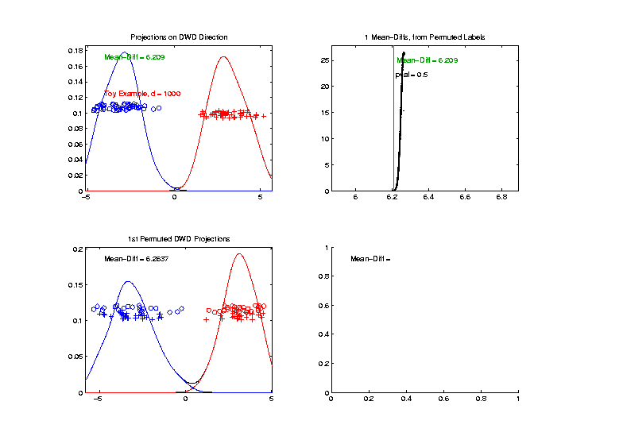
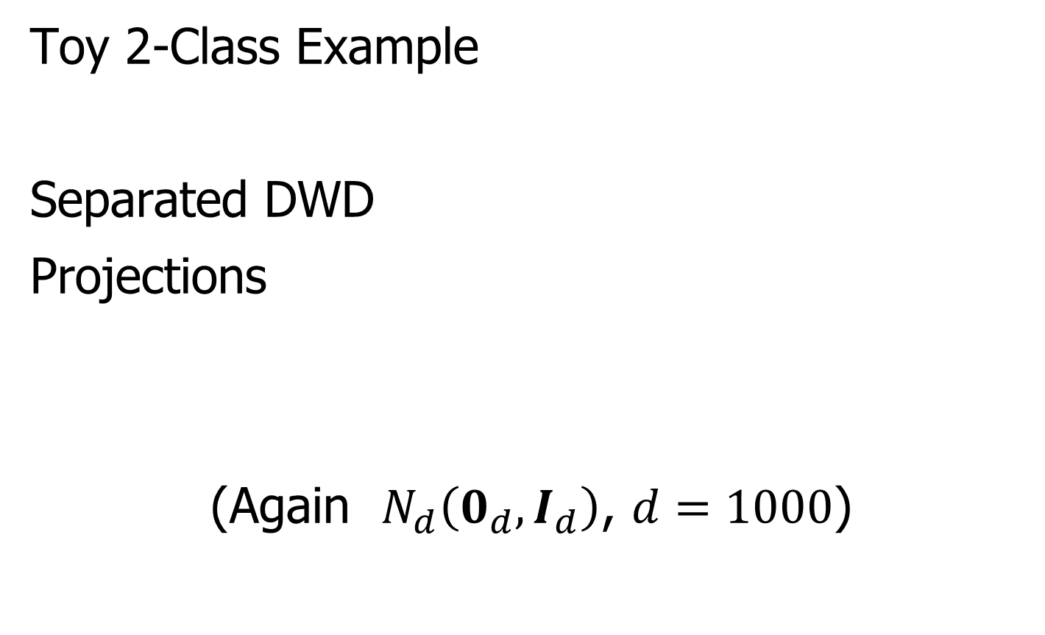
DiProPerm Hypothesis Test
Toy 2-Class Example
Separated DWD
Projections
(Again $N_{d}\left(0_{d},I_{d}\right)$, $d=1000$)

Slide 26
DiProPerm Hypothesis Test
Toy 2-Class Example
Separated DWD
Projections
Measure Separation of Classes Using:
Mean Difference = 6.209
Student’s t-test Would be Highly Significant
Not Appropriate, Since DWD Separates Classes

Slide 27
DiProPerm Hypothesis Test
Toy 2-Class Example
Separated DWD
Projections
Measure Separation of Classes Using:
Mean Difference = 6.209
Record as Vertical Line

Slide 28
DiProPerm Hypothesis Test
Toy 2-Class Example
Separated DWD
Projections
Measure Separation of Classes Using:
Mean Difference = 6.209
Statistically Significant???

Slide 29
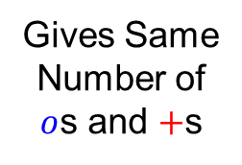

DiProPerm Hypothesis Test
Toy 2-Class Example
Permuted
Class Labels
Order As:
$$o⋯o+⋯+$$
And Randomly
Permute
(Reorder) Full
Collection
Gives Same
Number of
$o$s and $+$s

Slide 30
DiProPerm Hypothesis Test
Toy 2-Class Example
Permuted
Class Labels
Recompute DWD
& Projections

Slide 31
DiProPerm Hypothesis Test
Toy 2-Class Example
Measure Class
Separation
Using Mean
Difference
= 6.26

Slide 32
DiProPerm Hypothesis Test
Toy 2-Class Example
Measure Class
Separation
Using Mean
Difference
= 6.26
Record as Dot

Slide 33
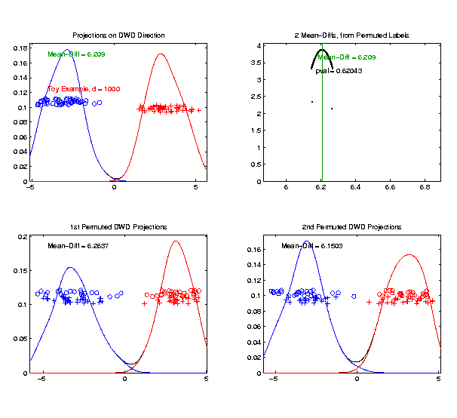
DiProPerm Hypothesis Test
Toy 2-Class Example
Generate 2nd
Permutation

Slide 34
DiProPerm Hypothesis Test
Toy 2-Class Example
Measure Class
Separation
Using Mean
Difference
= 6.15

Slide 35
DiProPerm Hypothesis Test
Toy 2-Class Example
Record as
Second Dot

Slide 36
DiProPerm Hypothesis Test
.
.
.
Repeat This 1,000 Times
To Generate Null Distribution

Slide 37
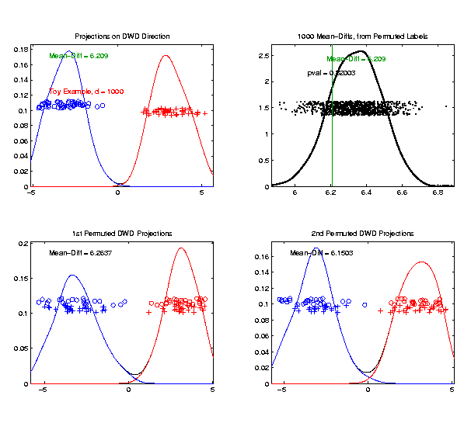
DiProPerm Hypothesis Test
Toy 2-Class Example
Generate Null
Distribution

Slide 38
DiProPerm Hypothesis Test
Toy 2-Class Example
Generate Null
Distribution
Compare With
Original Value

Slide 39
DiProPerm Hypothesis Test
Toy 2-Class Example
Generate Null
Distribution
Compare With
Original Value
Take Proportion
Larger as P-Value

Slide 40
DiProPerm Hypothesis Test
Toy 2-Class Example
Generate Null
Distribution
Compare With
Original Value
Not Significant

Slide 41
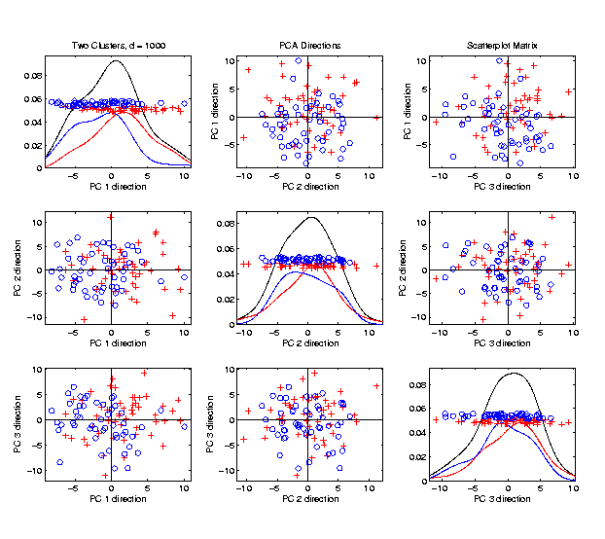

DiProPerm Hypothesis Test
Another Example
$N_{1000}\left(+0.05∗1_{d},I_{d}\right)$
$N_{1000}\left(−0.05∗1_{d},I_{d}\right)$
PCA View
Can’t See in PCA
Add a
Small
Signal

Slide 42
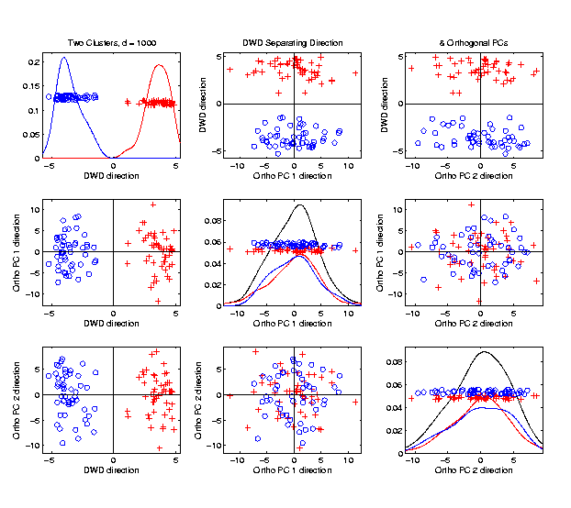

DiProPerm Hypothesis Test
Another Example
$N_{1000}\left(+0.05∗1_{d},I_{d}\right)$
$N_{1000}\left(−0.05∗1_{d},I_{d}\right)$
DWD View
(Similar to
$N_{d}\left(0_{d},I_{d}\right)$?)

Slide 43
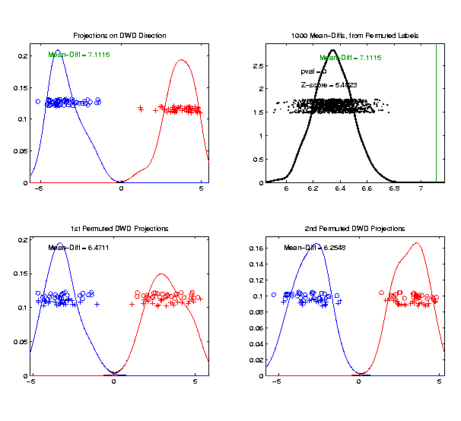

DiProPerm Hypothesis Test
Prop’n > is 0, so more precise is “p-value < 0.001”
Another Example
$N_{1000}\left(+0.05∗1_{d},I_{d}\right)$
$N_{1000}\left(−0.05∗1_{d},I_{d}\right)$
DiProPerm Now
Quite Significant

Slide 44
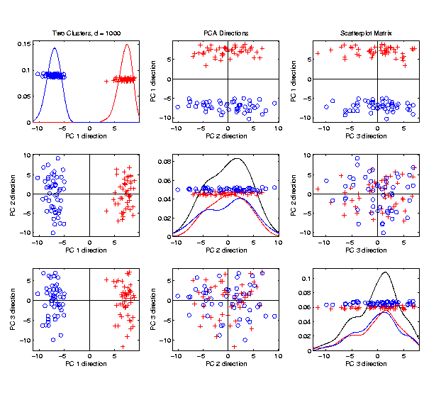

DiProPerm Hypothesis Test
Stronger Example
$N_{1000}\left(+0.2∗1_{d},I_{d}\right)$
$N_{1000}\left(−0.2∗1_{d},I_{d}\right)$
Even PCA
Shows Class
Difference

Slide 45
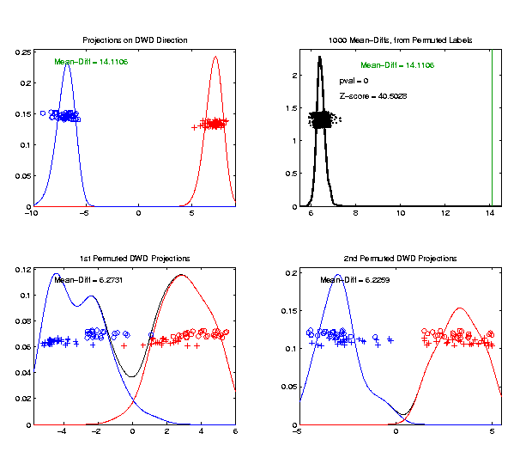

DiProPerm Hypothesis Test
Stronger Example
$N_{1000}\left(+0.2∗1_{d},I_{d}\right)$
$N_{1000}\left(−0.2∗1_{d},I_{d}\right)$
DiProPerm Very
Significant

Slide 46

DiProPerm Hypothesis Test
Called PDC = “Population Difference Criterion” in Yang et al. (2023)
=(MD – Xbar) / s
Stronger Example
$N_{1000}\left(+0.2∗1_{d},I_{d}\right)$
$N_{1000}\left(−0.2∗1_{d},I_{d}\right)$
DiProPerm Very
Significant
Z-Score Allows
Comparison
>> 5.4 above

Slide 47
DiProPerm Hypothesis Test
Text, Sec. 13.1
Deeper Look at Important Concept:
Statistical Inference is Essential
Slippery Visualization Comparisons:
Autism Data Example
Breast Cancer Data Example

Slide 48
DiProPerm Hypothesis Test
Real Data Example: Autism
Caudate Shape
(sub-cortical brain structure)
Shape summarized by 3-d locations of 1032 corresponding points
E.g. 1a: Autistic vs. Typically Developing
E.g. 1b: Development Delayed vs. Typ. Dev.
(Thanks to Josh Cates)
Cates et al. (2007)

Slide 49
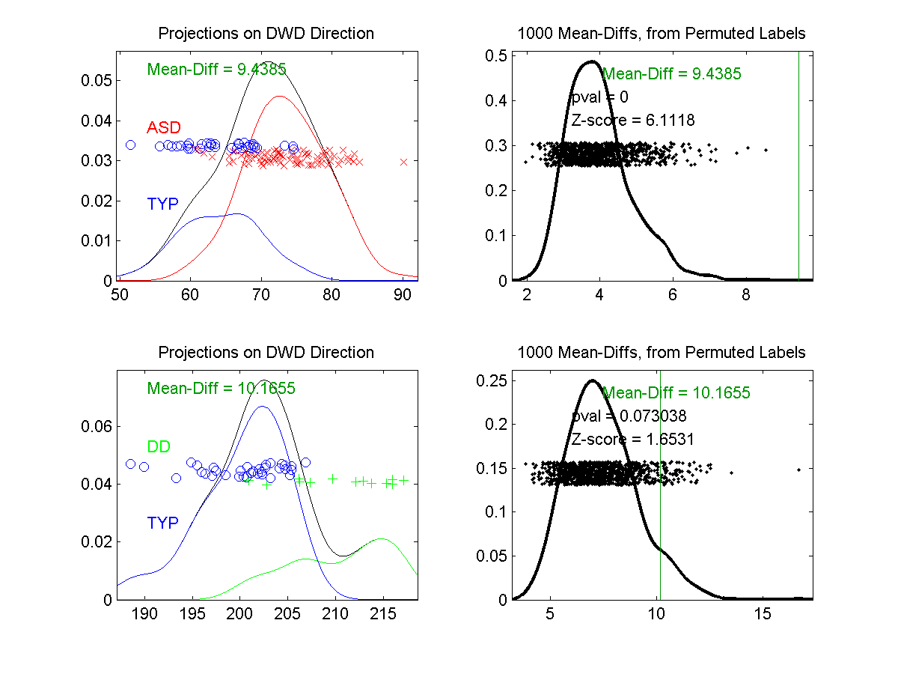
DiProPerm Hypothesis Test
Example 1: Autism Data
Autism
Spectrum
Disorder
Typically
Developing
Develop’ly
Delayed
E.g. 1a
Some Difference,
But “Not Very Strong”?
E.g. 1b
Looks “Stronger”?

Slide 50
DiProPerm Hypothesis Test
Example 1: Autism Data
Actually Strongly
Stat’ly Significant
Not Quite
Stat’ly Significant
Visual Impression Can Be Slippery

Slide 51
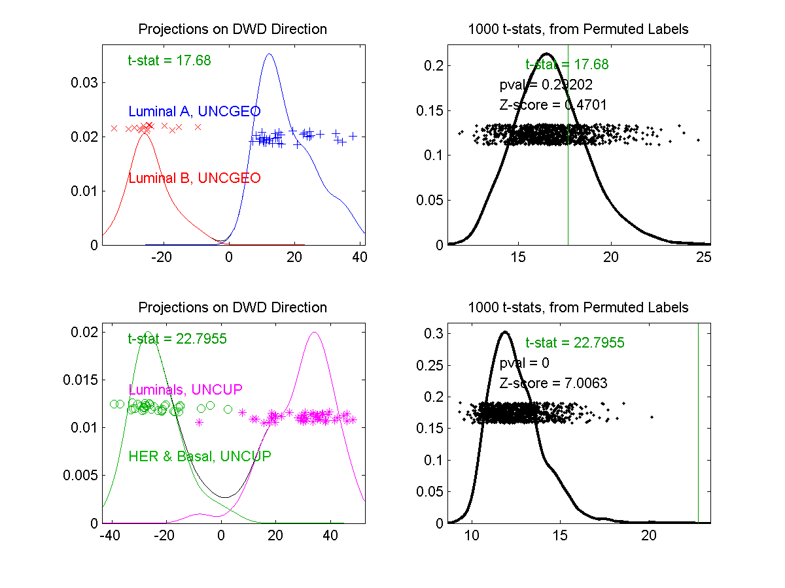
DiProPerm Hypothesis Test
Example 2: Breast Cancer Data
Again 2
Comp’sons
Top Looks Like
“Strong Diff.”?
Bottom “More
Overlapped”?

Slide 52
DiProPerm Hypothesis Test
Example 2: Breast Cancer Data
Yet DiProPerm
Gives Opposite
Result!

Slide 53
DiProPerm Hypothesis Test
What is going on?
Is Visualization Useless?
Key Point:
Sample Sizes
Smaller Sample Size ←→ Weaker Inference
E.g. 1a | 88 vs. 34 | Strongly Stat’ly Significant
E.g. 1b | 13 vs. 34 | Not Stat’ly Significant
E.g. 2a | 16 vs. 34 | Not Stat’ly Significant
E.g. 2b | 36 vs. 44 | Strongly Stat’ly Significant

Slide 54
DiProPerm Hypothesis Test
Main Lessons:
Important to Do Inference
Intuition Can Be Slippery
Note: Cherry Picked These From
Larger Set of Examples
Opposite Results Not That Common

Slide 55
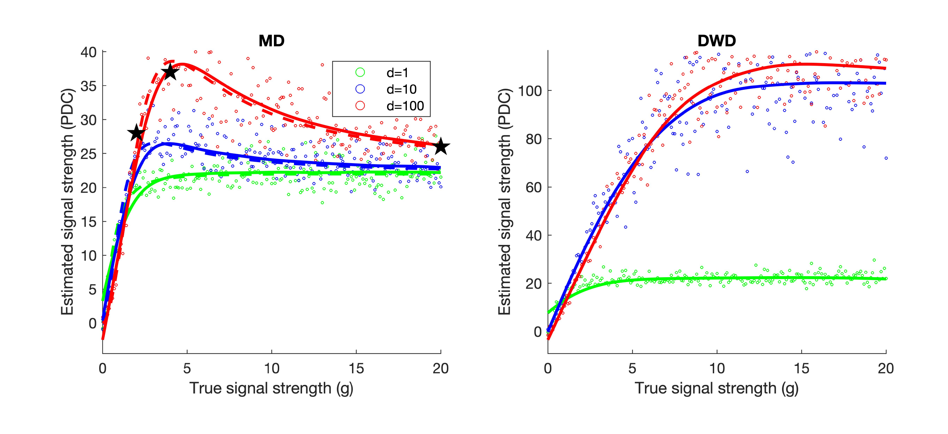
DiProPerm Hypothesis Test
Recent Discovery:
Yang et al. (2023)
Not in Text
Called “Z-Score”
In Last Slides
For Very Strong Signal,
Test Power Can Decrease!
Separation of Normal Distributions

Slide 56
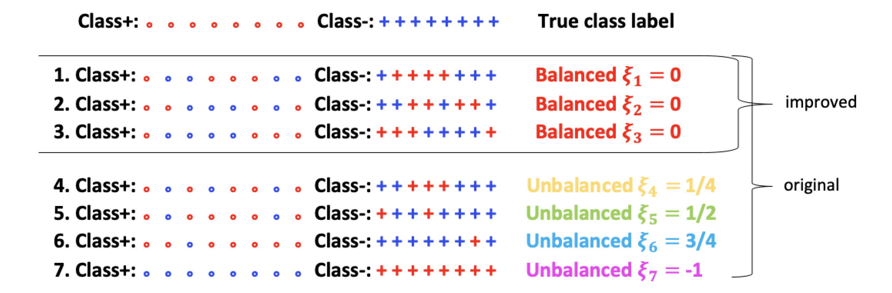
DiProPerm Hypothesis Test
Cause of Power Loss:
Use of “All Permutations”
Recall Random Re-ordering (Permutation) of $o⋯o+⋯+$

Slide 57
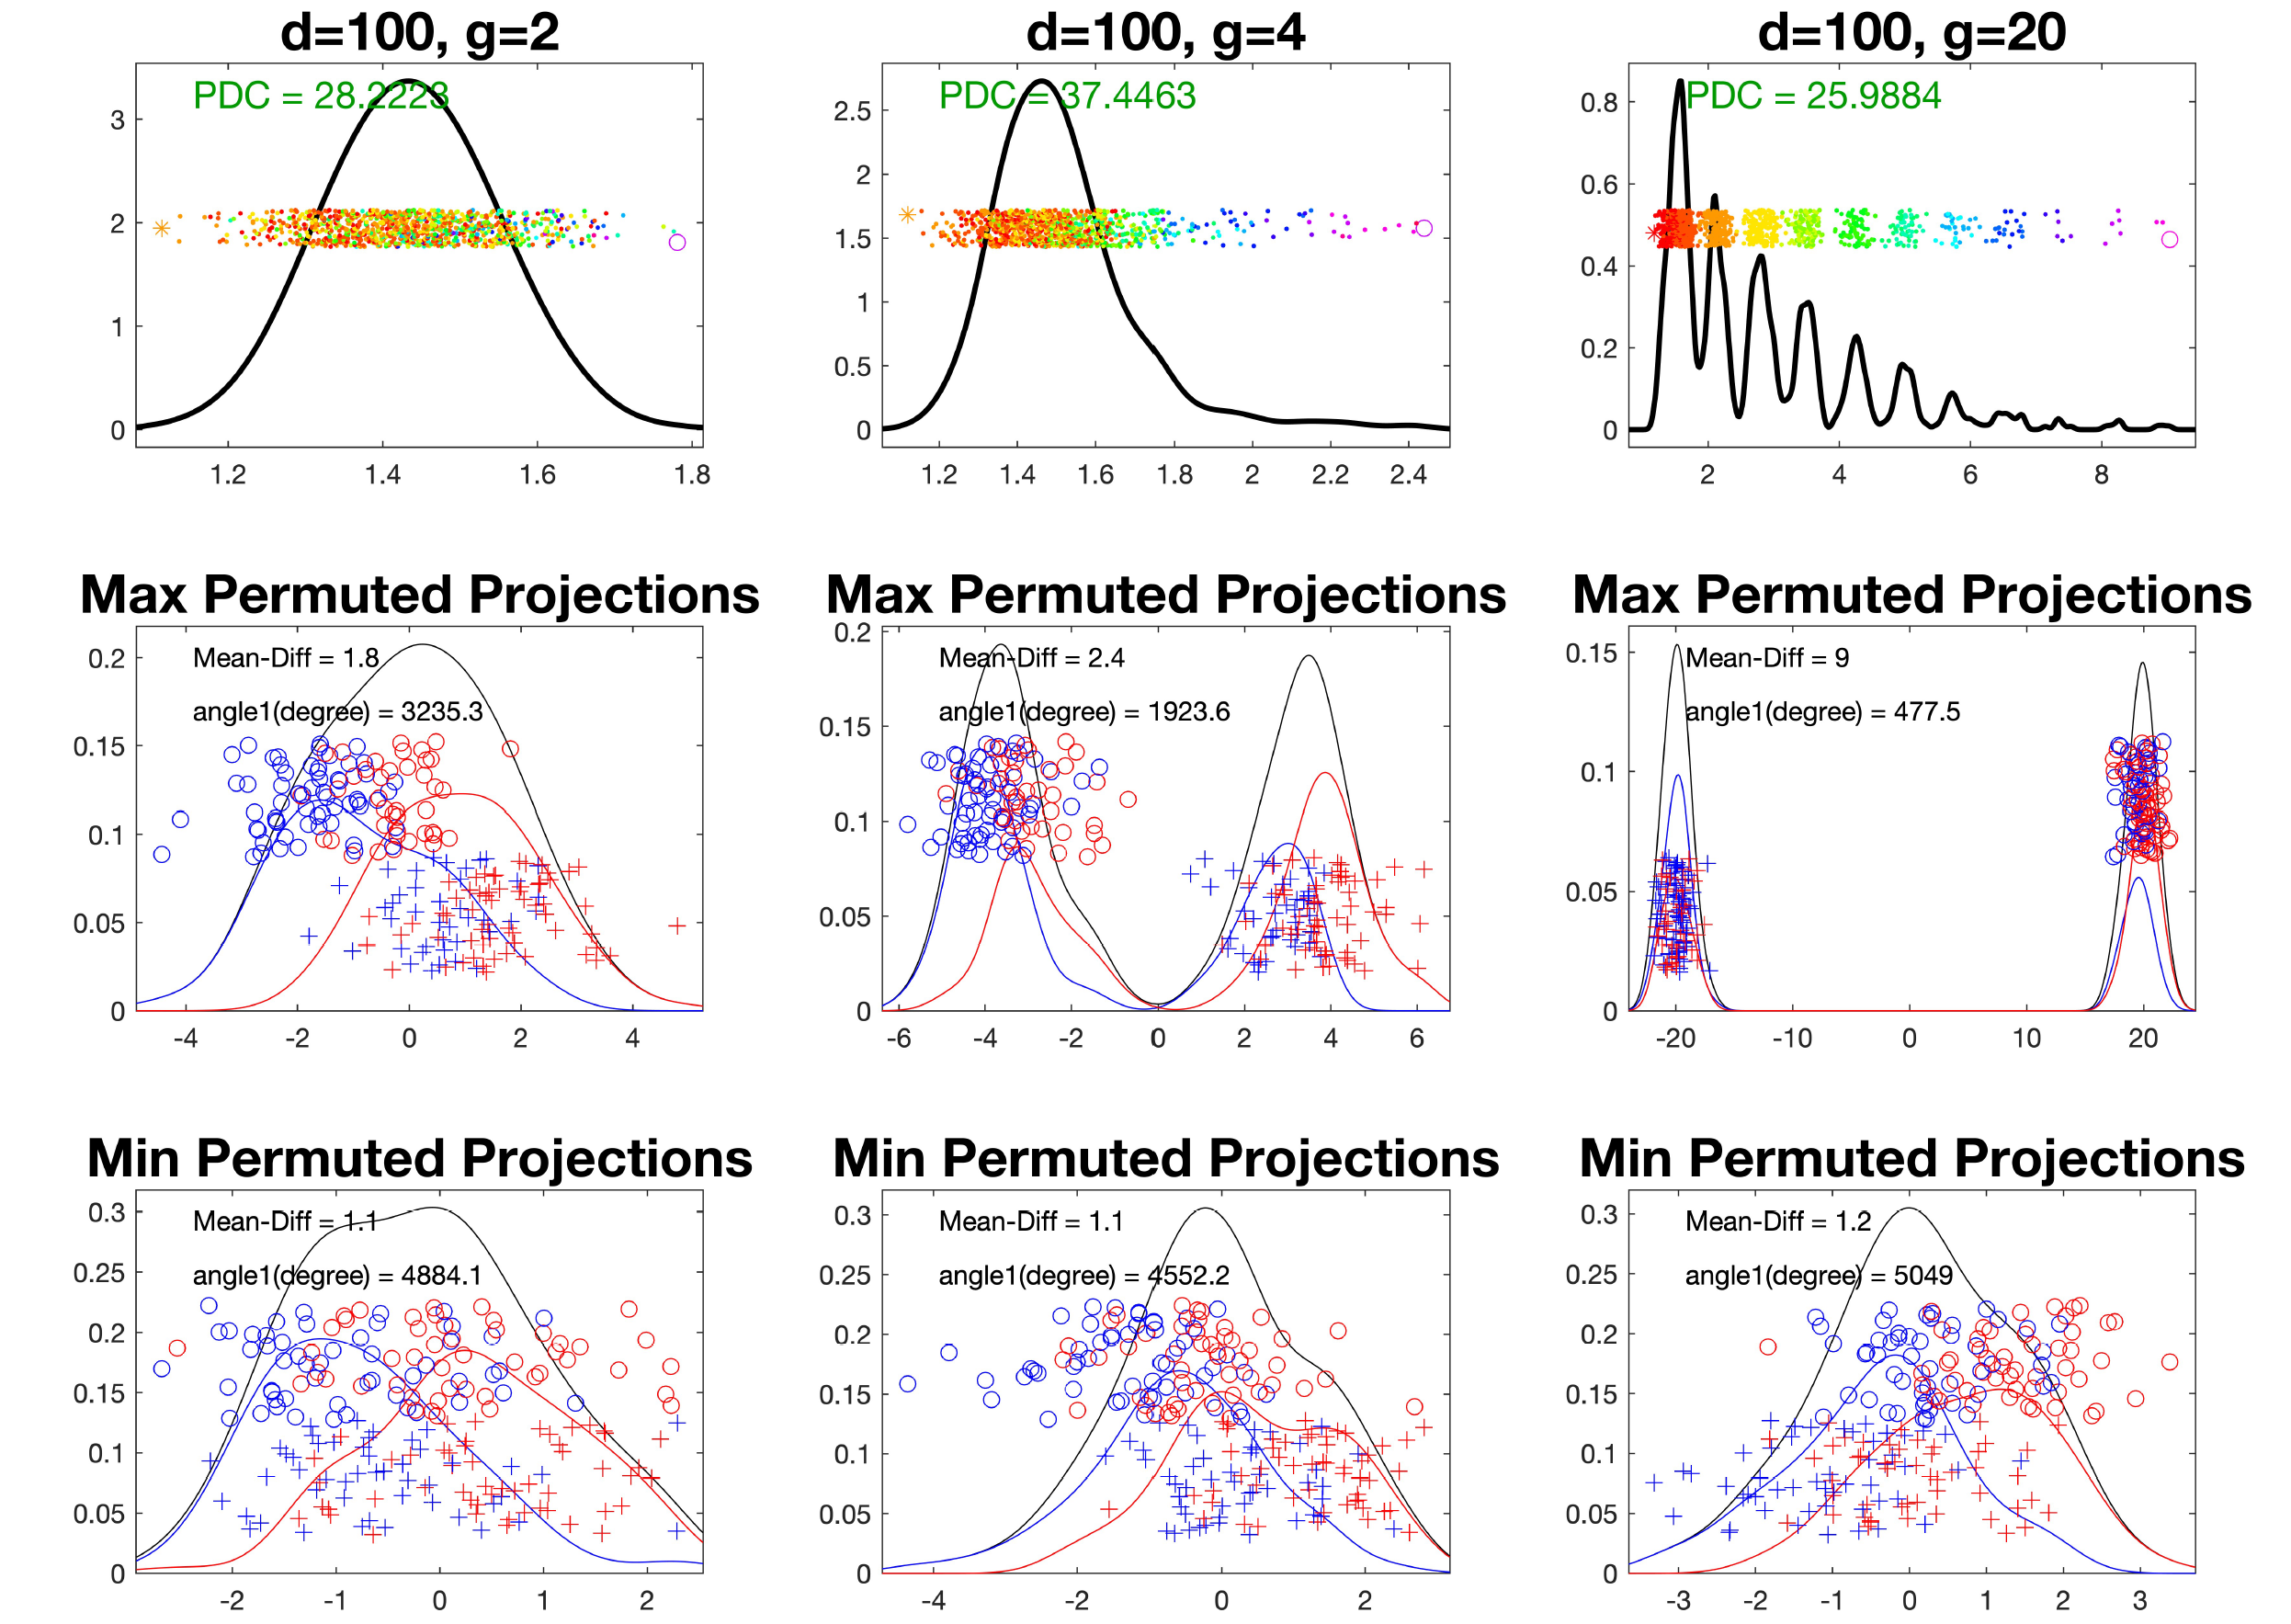
DiProPerm Hypothesis Test
Use of “All Permutations”
Big Power Loss from Spread Null Distribution

Slide 58
DiProPerm Hypothesis Test
Solution:
Only Consider “Balanced Permutations”

Slide 59
DiProPerm Hypothesis Test
Only Consider “Balanced Permutations”
Much Tighter Null Distribution

Slide 60
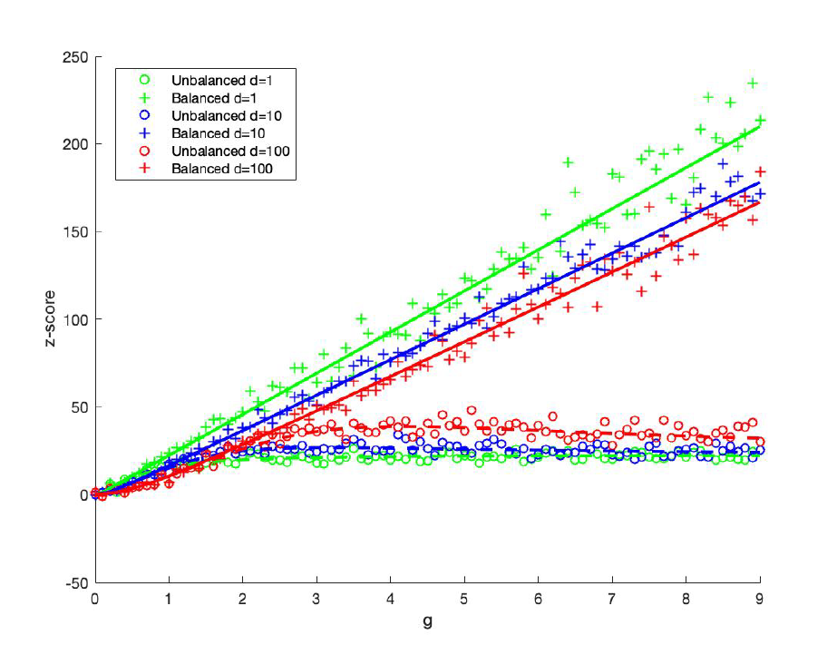
DiProPerm Hypothesis Test
Revisit Above with Balanced Permutations
Balanced Perms
Grow Linearly
All Permutations
Level Off
Separation of Normal Distributions

Slide 61
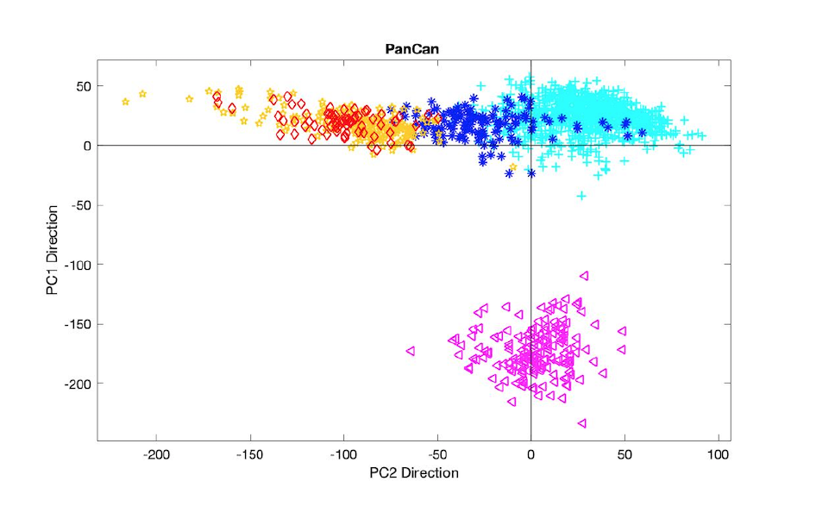
DiProPerm Hypothesis Test
Compare All vs. Balanced on Real Data?
The Cancer Genome Atlas (TCGA)
Pan-Cancer Data, Liu et al. (2018)
Colors Are Cancer Types:
COAD, READ, BLCA, BRCA, LAML
Digestive System, So Similar
Leukemia, Very Different

Slide 62
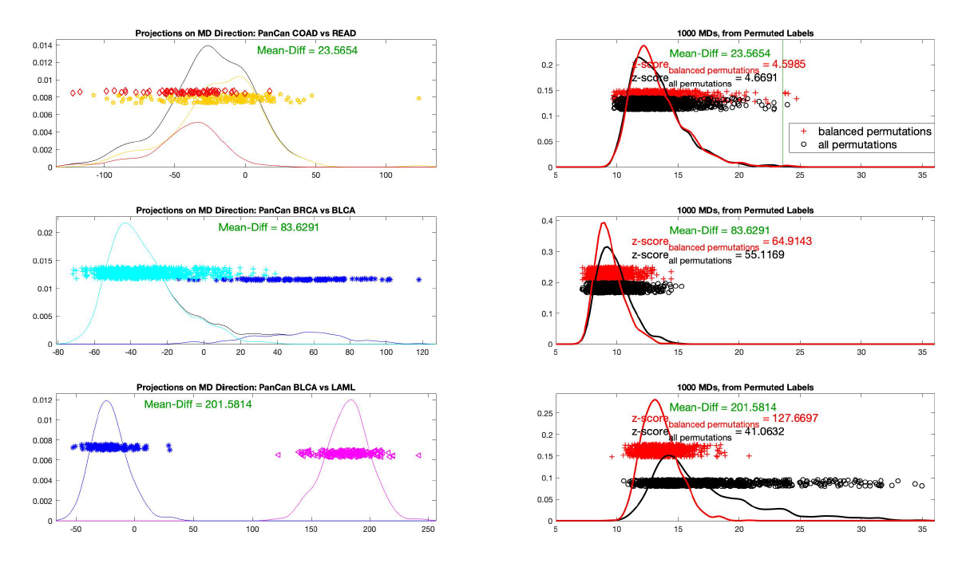
DiProPerm Hypothesis Test
Compare All vs. Balanced on Real Data?
Significant Difference
Similar Z-scores
Rather Overlapped
Stronger Z-scores
Better Separation
Balanced Somewhat
More Powerful
Balanced Much
More Powerful
Much More Separation

Slide 63
DiProPerm Hypothesis Test
Recommendation:
Always Use “Balanced Permutations”

Slide 64

Matlab Software
Recall OODA Software

Slide 65
DiProPerm in Matlab
Matlab Software:
DiProPermXY.m
In General Directory

Slide 66
Object Oriented Data Analysis
Three Major Phases of OODA:
I. Object Definition
“What are the Data Objects?”
Exploratory Analysis
“What Is Data Structure / Drivers?”
III. Confirmatory Analysis / Validation
Is it Really There (vs. Noise Artifact)?

Slide 67
Object Oriented Data Analysis
Nomenclature Clash?
Computer Science View:
Object Oriented Programming:
Programming that supports encapsulation, inheritance, and polymorphism
(from Google: define object oriented programming,
my favorite: www.innovatia.com/software/papers/com.htm)
Text, Sec. 18.1
Text, Sec. 18.2 Discusses Deeper Connections

Slide 68
Object Oriented Data Analysis
Some statistical history:
John Chambers Idea (1960s - ):
Object Oriented approach to statistical computation
Developed as software package S
  Basis of S-plus (commerical product)
  And of R (free-ware, current favorite of Chambers)
Reference for more on this:
Venables & Ripley (2013)
Notes:
68

Slide 69

Object Oriented Data Analysis
Another take: J. O. Ramsay
http://www.psych.mcgill.ca/faculty/ramsay/ramsay.html
“Functional Data Objects”
(closer to C. S. meaning)
Personal Objection:
“Functional” in mathematics is:
“Function that operates on functions”

Slide 70


Object Oriented Data Analysis
More Terminology:
SAMSI Program (2010-2011):
OODA → Analysis of Object Oriented Data
→ Analysis of Object Data
Leland Wilkinson
Notes:
70

Slide 71
Object Oriented Data Analysis
More Terminology:
SAMSI Program (2010-2011):
OODA → Analysis of Object Oriented Data
→ Analysis of Object Data
“Object Data Analysis” Terminology Used in
Patrangenaru and Ellingson (2019)
Notes:
71

Slide 72
Object Oriented Data Analysis
Three Major Phases of OODA:
I. Object Definition
“What are the Data Objects?”
Exploratory Analysis
“What Is Data Structure / Drivers?”
III. Confirmatory Analysis / Validation
Is it Really There (vs. Noise Artifact)?

Slide 73

Big Picture Data Visualization
For a Matrix of Data:
$${\left(\begin{matrix}x_{11} & ⋯ & x_{1n} \\ ⋮ & ⋱ & ⋮ \\ x_{d1} & ⋯ & x_{dn}\end{matrix}\right)}_{d×n}$$

Slide 74
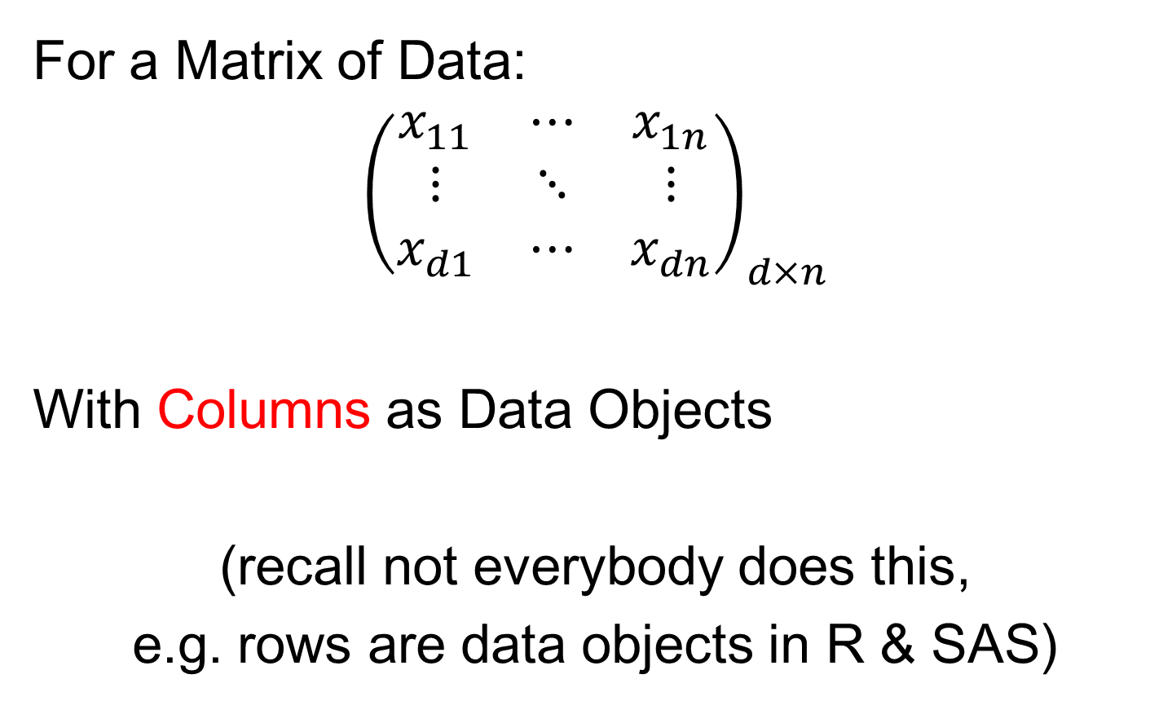
Big Picture Data Visualization
For a Matrix of Data:
$${\left(\begin{matrix}x_{11} & ⋯ & x_{1n} \\ ⋮ & ⋱ & ⋮ \\ x_{d1} & ⋯ & x_{dn}\end{matrix}\right)}_{d×n}$$
With Columns as Data Objects
(recall not everybody does this,
e.g. rows are data objects in R & SAS)

Slide 75
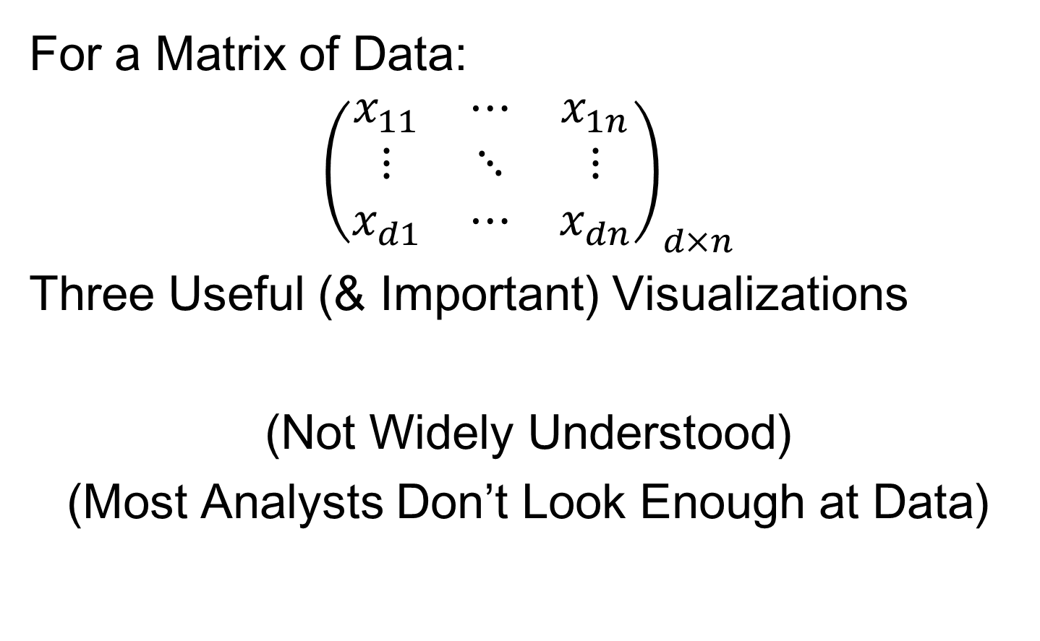
Big Picture Data Visualization
For a Matrix of Data:
$${\left(\begin{matrix}x_{11} & ⋯ & x_{1n} \\ ⋮ & ⋱ & ⋮ \\ x_{d1} & ⋯ & x_{dn}\end{matrix}\right)}_{d×n}$$
Three Useful (& Important) Visualizations
(Not Widely Understood)
(Most Analysts Don’t Look Enough at Data)

Slide 76
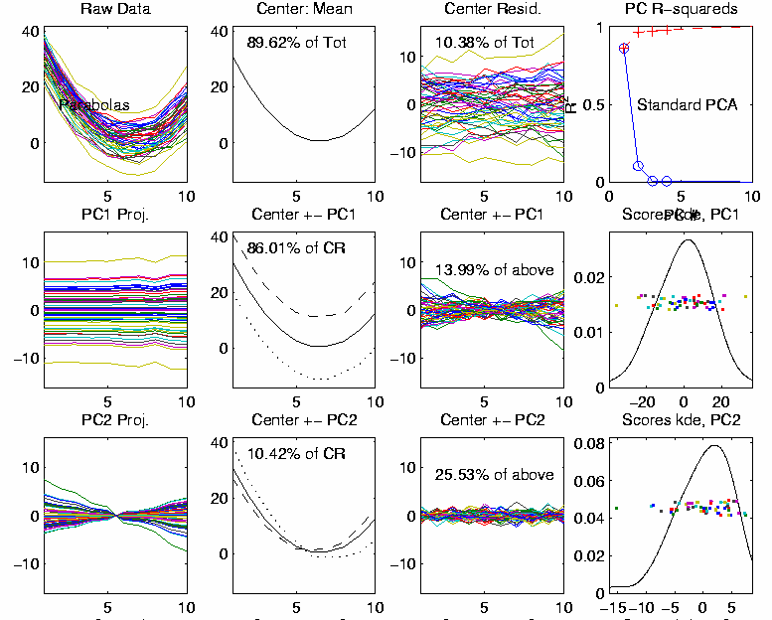

Big Picture Data Visualization
For a Matrix of Data:
$${\left(\begin{matrix}x_{11} & ⋯ & x_{1n} \\ ⋮ & ⋱ & ⋮ \\ x_{d1} & ⋯ & x_{dn}\end{matrix}\right)}_{d×n}$$
Three Useful (& Important) Visualizations
Curve Objects

Slide 77

Big Picture Data Visualization
For a Matrix of Data:
$${\left(\begin{matrix}x_{11} & ⋯ & x_{1n} \\ ⋮ & ⋱ & ⋮ \\ x_{d1} & ⋯ & x_{dn}\end{matrix}\right)}_{d×n}$$
Three Useful (& Important) Visualizations
Curve Objects
Relationships Between Objects
(e.g. scatterplot matrices)

Slide 78
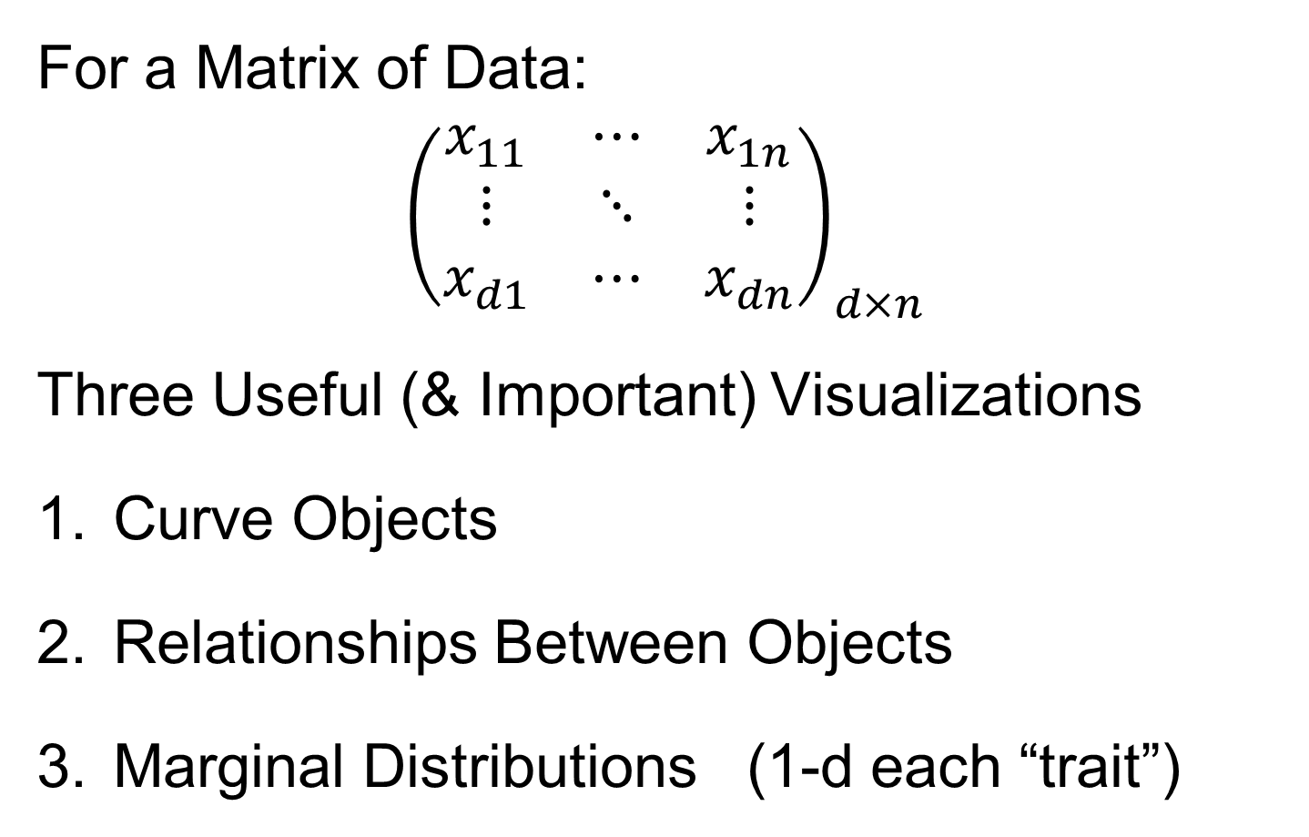
Big Picture Data Visualization
For a Matrix of Data:
$${\left(\begin{matrix}x_{11} & ⋯ & x_{1n} \\ ⋮ & ⋱ & ⋮ \\ x_{d1} & ⋯ & x_{dn}\end{matrix}\right)}_{d×n}$$
Three Useful (& Important) Visualizations
Curve Objects
Relationships Between Objects
Marginal Distributions (1-d each “trait”)

Slide 79
Marginal Distribution Plots
Ideas:
For Each Trait (i.e. Variable)
Study 1-d Distributions
Simultaneous Views:
  Jitter Plots
  Smooth Histograms (Kernel Density Est’s)

Slide 80
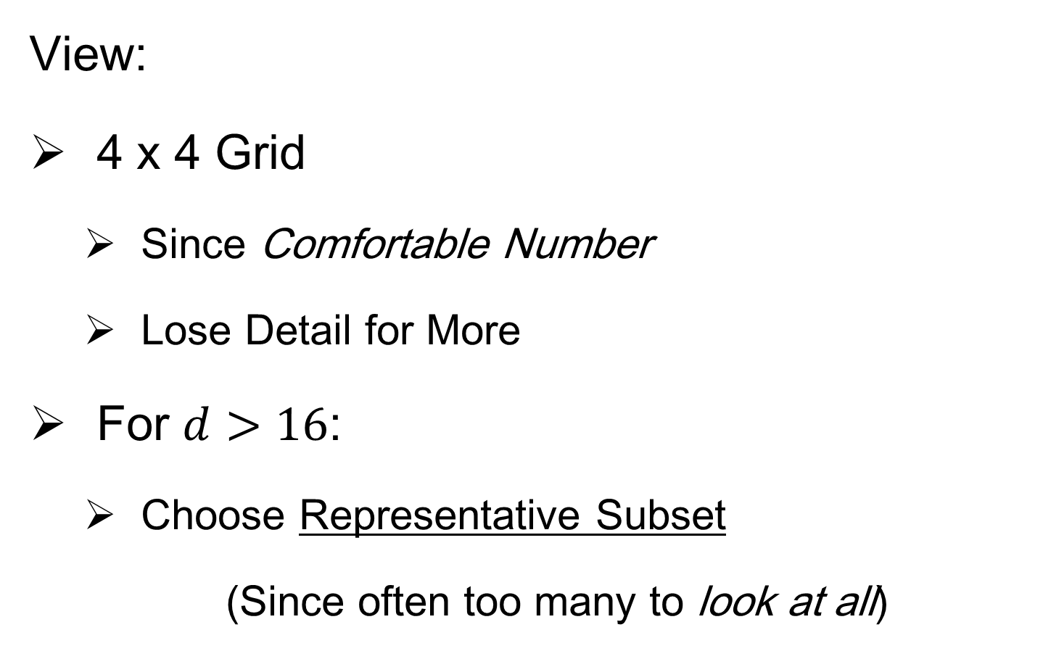
Marginal Distribution Plots
View:
4 x 4 Grid
  Since Comfortable Number
  Lose Detail for More
For $d>16$:
  Choose Representative Subset
  (Since often too many to look at all)
Text, Sec. 5.1

Slide 81
Marginal Distribution Plots
Representative Subset of Traits:
Sort Traits on a Data Summary
  E.g Mean, S.D., Skewness, Median, …
Usually Take Nearly Equally Spaced Grid
  Sometimes Specify Traits
  E.g. All Largest (or Smallest) Summaries

Slide 82
Marginal Distribution Plots
Note Often Useful for:
Object Determination / Representation
Which Traits to Include?
How to Scale Traits?
Need to Transform (e.g. log) Traits?

Slide 83

Marginal Distribution Plots
Toy Example: $n=200$, $d=50$,
i.i.d. Poisson, with parameters $λ=0.2,⋯,20$
Each Row,
i.e. Trait
Logarithmically Equally Spaced

Slide 84
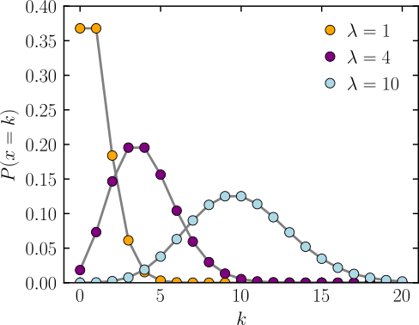
Marginal Distribution Plots
Toy Example: $n=200$, $d=50$,
i.i.d. Poisson, with parameters $λ=0.2,⋯,20$
Probability of a given
number of events
occurring in a fixed
interval of time
Broad Range of Shapes
Thanks to Wikipedia

Slide 85


Marginal Distribution Plots
Toy Example: $n=200$, $d=50$,
i.i.d. Poisson, with parameters $λ=0.2,⋯,20$
Sort Traits
On Sample
Mean
Summary
Plot with
Equal
Spacing

Slide 86
Marginal Distribution Plots
Toy Example: $n=200$, $d=50$,
i.i.d. Poisson, with parameters $λ=0.2,⋯,20$
Sort Traits
On Sample
Mean
Dashed Lines
Correspond
To 1-d Distn’s

Slide 87
Marginal Distribution Plots
Toy Example: $n=200$, $d=50$,
i.i.d. Poisson, with parameters $λ=0.2,⋯,20$
Sort Traits
On Sample
Mean
Wide Range
Of Poissons

Slide 88


Marginal Distribution Plots
Toy Example: Normal Mean Mixture
$$ωN\left(4,1\right)+\left(1−ω\right)N\left(−4,1\right)$$
Sort on
Mean
Useful
Ordering

Slide 89


Marginal Distribution Plots
Toy Example: Normal Mean Mixture
$$ωN\left(4,1\right)+\left(1−ω\right)N\left(−4,1\right)$$
Sort on
Standard
Deviation
Less Useful
Ordering

Slide 90

Marginal Distribution Plots
Additional Summaries: Skewness
Measure Asymmetry
Left Skewed Right Skewed
(Thanks to Wikipedia)

Slide 91

Marginal Distribution Plots
Additional Summaries: Skewness
Quantification: Based on “Moments”
$$E\left[{\left(\frac{X−μ}{σ}\right)}^{3}\right]=\frac{E\left[{\left(X−μ\right)}^{3}\right]}{{\left(E\left[{\left(X−μ\right)}^{2}\right]\right)}^{3/2}}$$
“Central 3rd Moment” (Also Rescaled)
Note: 0 at Gaussian

Slide 92


Marginal Distribution Plots
Toy Example: Normal Mean Mixture
$$ωN\left(4,1\right)+\left(1−ω\right)N\left(−4,1\right)$$
Sort on
Skewness
Useful
Ordering

Slide 93

Marginal Distribution Plots
Additional Summaries: Kurtosis
4-th Moment Summary
$$E\left[{\left(\frac{X−μ}{σ}\right)}^{4}\right]−3=\frac{E\left[{\left(X−μ\right)}^{4}\right]}{{\left(E\left[{\left(X−μ\right)}^{2}\right]\right)}^{2}}−3$$
Centered (and Scaled) 4th Moment

Slide 94

Marginal Distribution Plots
Additional Summaries: Kurtosis
4-th Moment Summary
$$E\left[{\left(\frac{X−μ}{σ}\right)}^{4}\right]−3=\frac{E\left[{\left(X−μ\right)}^{4}\right]}{{\left(E\left[{\left(X−μ\right)}^{2}\right]\right)}^{2}}−3$$
Makes 0 at Gaussian
Think of Departures From Gaussian
(not always done)

Slide 95

Marginal Distribution Plots
Additional Summaries: Kurtosis
4-th Moment Summary
Nice Graphic
(from mvpprograms.com)

Slide 96
Marginal Distribution Plots
Additional Summaries: Kurtosis
4-th Moment Summary
Positive
Big at Peak
And Tails
(with controlled
variance)

Slide 97
Marginal Distribution Plots
Additional Summaries: Kurtosis
4-th Moment Summary
Negative
Big in Flanks

Slide 98


Marginal Distribution Plots
Toy Example: Normal Mean Mixture
$$ωN\left(4,1\right)+\left(1−ω\right)N\left(−4,1\right)$$
Sort on
Kurtosis
Less Useful
Ordering

Slide 99

Marginal Distribution Plots
Some Useful Summaries:
Mean, SD, Skewness, Kurtosis
# Unique, # Most Frequent, # 0s
Robust Measures
L-statistics
Entropy
Continuity Measure
$⋮$

Slide 100

Marginal Distribution Plots
Spanish Male Mortality Data
Recall Value of Log Transform
Now Focus on Marginals
Text, Sec. 5.1.1
E. g. Just These Values
Or Just These

Slide 101

Marginal Distribution Plots
Spanish Male Mortality Data (Raw)
Note Many
Skewed
Marginals
Poor “Use
of Range”

Slide 102

Marginal Distribution Plots
Spanish Male Mortality Data (log₁₀ scale)
Much Less
Skewness
Now Focus
On (Important)
Bimodality
Much Better
“Use of Range”

Slide 103


Marg. Dist. Plot Data Example
Drug Discovery Data
$n = 262$, Chemical Compounds
$d = 2489$, Chemical “Descriptors” (Traits)
Discrete Response:
0 – blue o, 1 – red +
Text, Sec. 5.1.2
(Thanks to Alex Tropsha Lab)

Slide 104

Marg. Dist. Plot Data Example
Drug Discovery – PCA Scatterplot
Dominated
By Few
Large
Compounds
Not Good
Blue - Red
Separation

