Slide 1
Statistics – O. R. 881 Object Oriented Data Analysis
Steve Marron
Dept. of Statistics and Operations Research
University of North Carolina

Slide 2
Current Sections in Textbook
Today:
Sections 5.1, 5.2, 5.3
Next Class:
Sections 5.3, 6.1, 6.5, 6.3, 17.1

Slide 3
Participant Presentations
Please Sign Up:
Name
Email (Onyen is fine, or …)
Are You ENRolled?
Dept. & Advisor (Lab?)
Tentative Title (“????” Is OK)
When:
Next Week, Early, Oct., Nov., Late

Slide 4
Last Class: DiProPerm
Suggested Approach:
Find a DIrection
(separating classes)
PROject the data
(reduces to 1 dim)
PERMute
(class labels, to assess significance,
with recomputed direction)

Slide 5
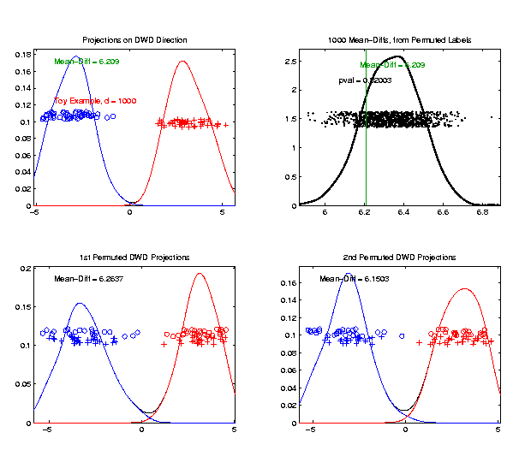
Last Class: DiProPerm
Toy 2-Class Example
Generate Null
Distribution
Compare With
Original Value

Slide 6
Last Class: DiProPerm
Toy 2-Class Example
Generate Null
Distribution
Compare With
Original Value
Take Proportion
Larger as P-Value

Slide 7
Last Class: DiProPerm
Toy 2-Class Example
Generate Null
Distribution
Compare With
Original Value
Not Significant

Slide 8
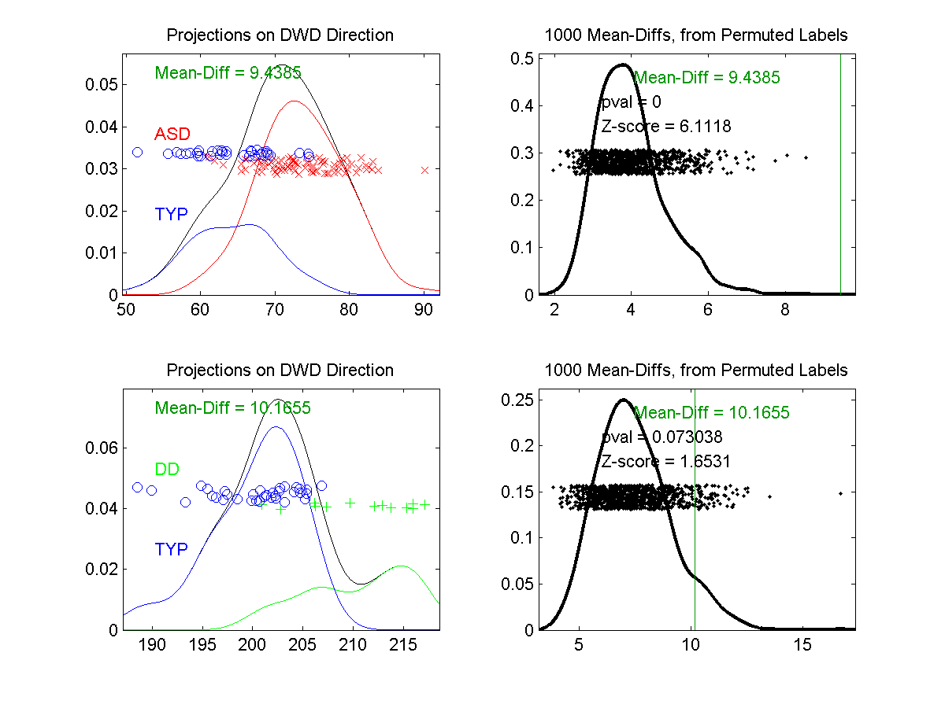
Last Class: DiProPerm
Example 1: Autism Data
Actually Strongly
Stat’ly Significant
Not Quite
Stat’ly Significant
Visual Impression Can Be Slippery

Slide 9
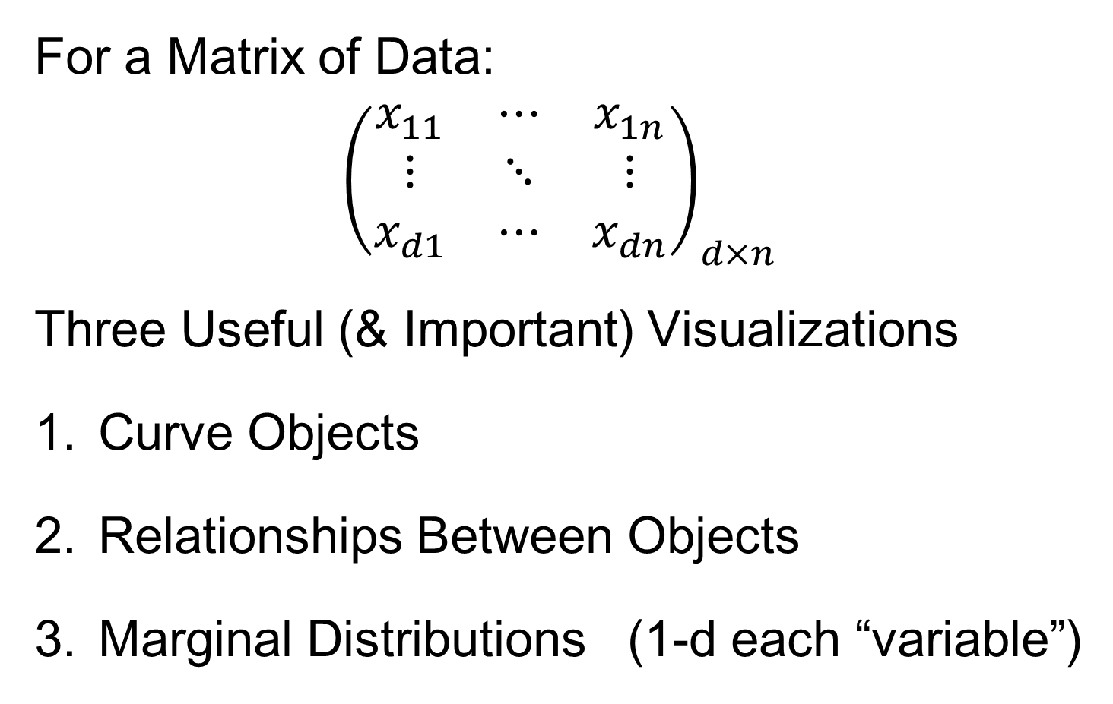
Last Class: Data Visualization
For a Matrix of Data:
$${\left(\begin{matrix}x_{11} & ⋯ & x_{1n} \\ ⋮ & ⋱ & ⋮ \\ x_{d1} & ⋯ & x_{dn}\end{matrix}\right)}_{d×n}$$
Three Useful (& Important) Visualizations
Curve Objects
Relationships Between Objects
Marginal Distributions (1-d each “variable”)

Slide 10
Last Class: Marg. Dist. Plots
Ideas:
For Each Variable (i.e. Trait)
Study 1-d Distributions
Simultaneous Views:
Jitter Plots
Smooth Histograms (Kernel Density Est’s)

Slide 11
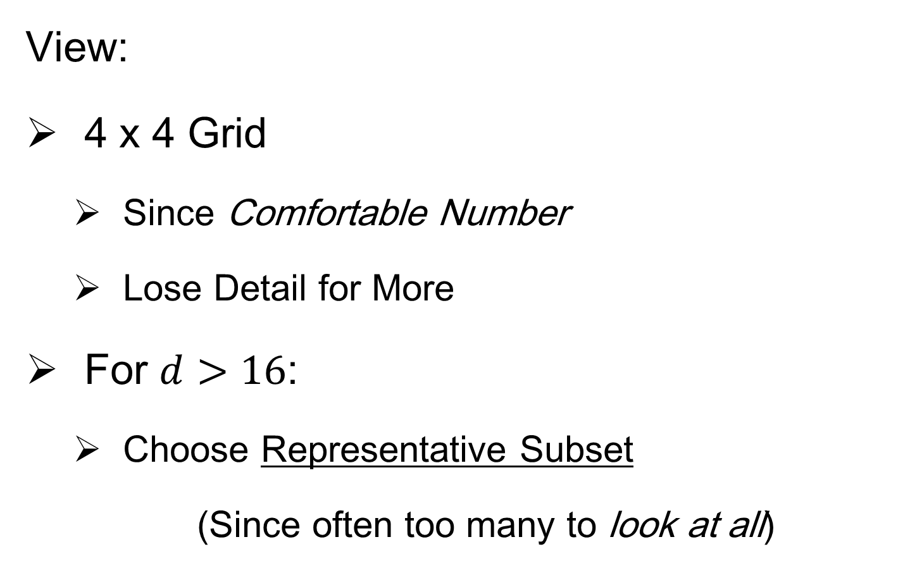
Last Class: Marg. Dist. Plots
View:
4 x 4 Grid
Since Comfortable Number
Lose Detail for More
For $d>16$:
Choose Representative Subset
(Since often too many to look at all)
Text, Sec. 5.1

Slide 12
Last Class: Marg. Dist. Plots
Representative Subset of Variables:
Sort Variables on a Data Summary
E.g Mean, S.D., Skewness, Median, …
Usually Take Nearly Equally Spaced Grid
Sometimes Specify Variables
E.g. All Largest (or Smallest) Summaries

Slide 13
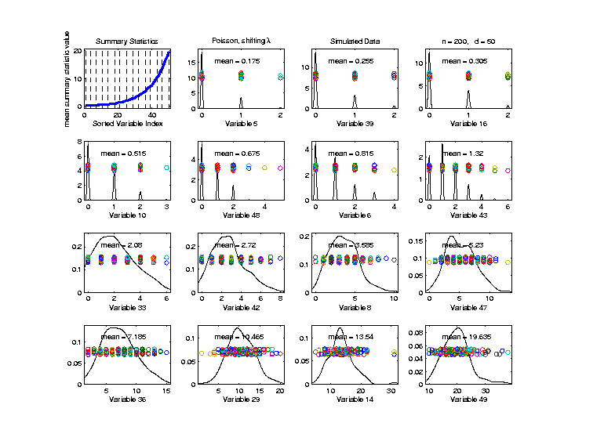

Last Class: Marg. Dist. Plots
Toy Example: $n=200$, $d=50$,
i.i.d. Poisson, with parameters $λ=0.2,⋯,20$
Sort Variables
On Sample
Mean
Summary
Plot with
Equal
Spacing

Slide 14
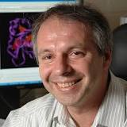
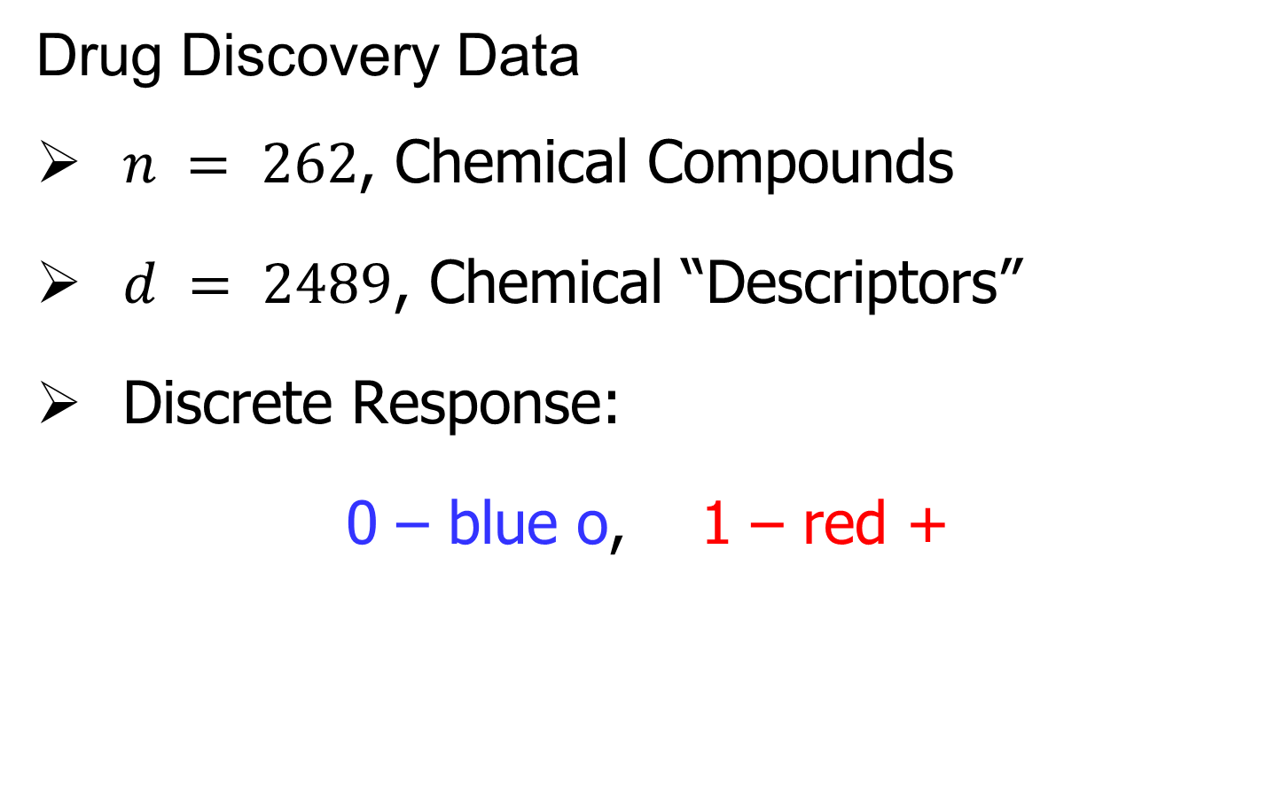
Last Class: Marg. Dist. Plot
Drug Discovery Data
$n = 262$, Chemical Compounds
$d = 2489$, Chemical “Descriptors”
Discrete Response:
0 – blue o, 1 – red +
(Thanks to Alex Tropsha Lab)

Slide 15
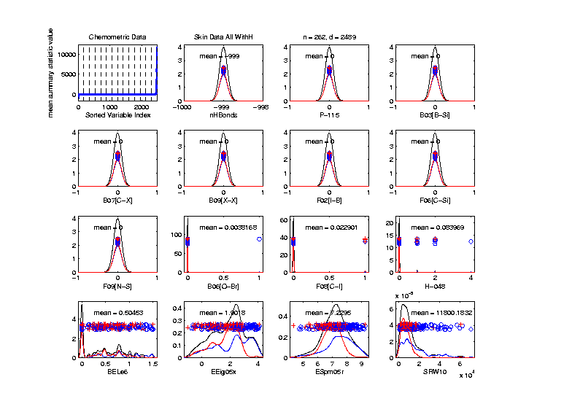
Last Class: Marg. Dist. Plot
Drug Discovery – Sort on Means
Note: Many
With No
Variation???

Slide 16
Marg. Dist. Plot Data Example
Drug Discovery – Sort on Means
Very Few
Are Crazy
Big
Will They
Dominate
PCA???

Slide 17
Marg. Dist. Plot Data Example
Drug Discovery – Sort on Means
Note: Many
With No
Variation???

Slide 18
Marg. Dist. Plot Data Example
Drug Discovery – Sort on Means
Suspicious
Value ???

Slide 19
Marg. Dist. Plot Data Example
Drug Discovery – Sort on Means
Note:
Sub-Densities
Highlight
Blue – Red
Differences

Slide 20
Marg. Dist. Plot Data Example
Drug Discovery – Sort on Means
Note:
Variable
(i.e. Trait
Or Feature)
Names

Slide 21
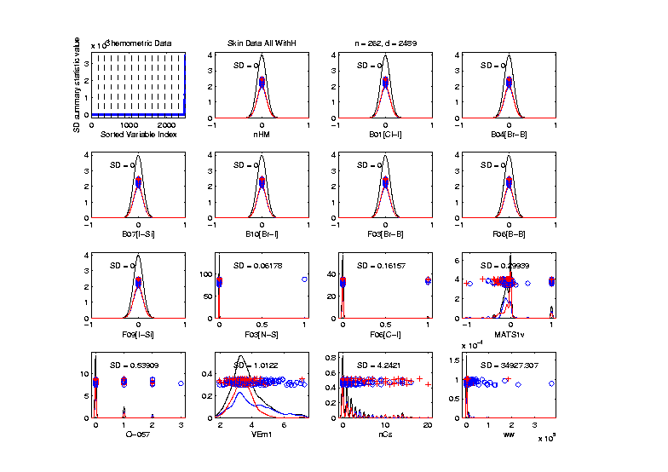
Marg. Dist. Plot Data Example
Drug Discovery – Sort on Standard Deviation
Very Large
Number of
0-Variation
Traits
(No Useful
Info…)

Slide 22
Marg. Dist. Plot Data Example
Drug Discovery – Sort on Means
Investigate Weird -999 Values
Note: Sometimes Such Values Are Used To Code Missing Values
(And Nobody Remembers to Say So)
(Not Too Bad Until Big Values Added In)

Slide 23
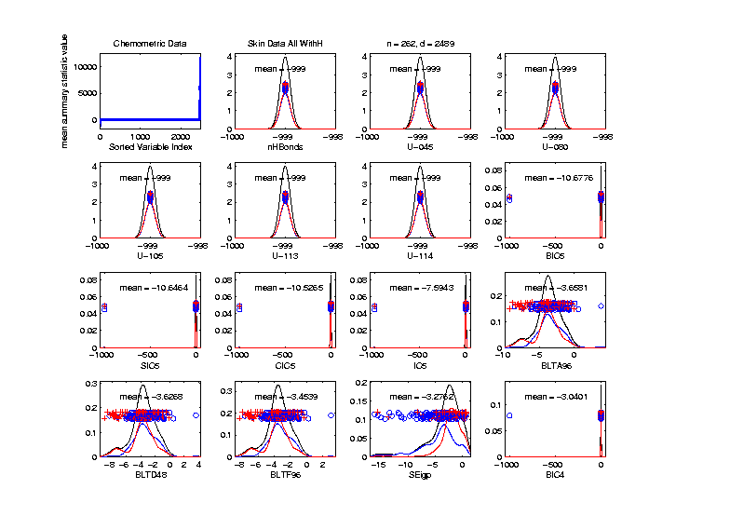
Marg. Dist. Plot Data Example
Drug Discovery – Sort on Means
Investigate Weird -999 Values, Via Mean
Look at
Smallest
Mean Values
(All Dashed
Bars On Left)

Slide 24
Marg. Dist. Plot Data Example
Drug Discovery – Sort on Means
Investigate Weird -999 Values, Via Mean,
Smallest
6 Traits
Are All -999

Slide 25
Marg. Dist. Plot Data Example
Drug Discovery – Sort on Means
Investigate Weird -999 Values, Via Mean,
Smallest
6 Traits
Are All -999
Other Have
Some -999

Slide 26
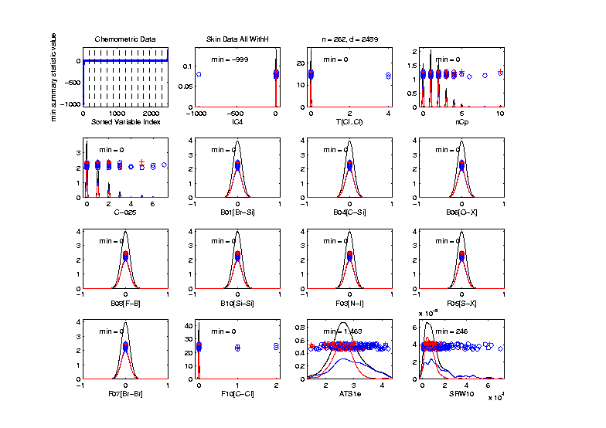
Marg. Dist. Plot Data Example
Drug Discovery
Focus on -999 Values, Using Minimum,
Equally
Spaced
Not Too
Many Such
Traits

Slide 27
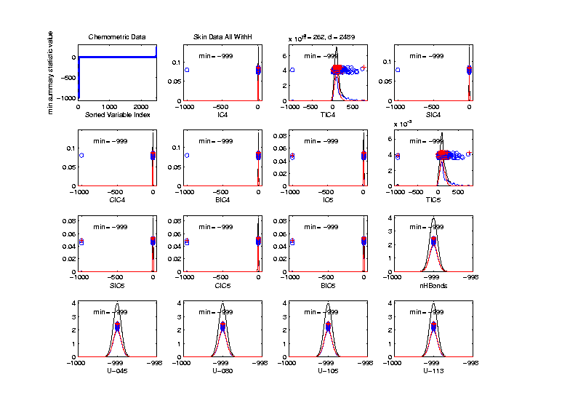
Marg. Dist. Plot Data Example
Drug Discovery
Focus More on -999 Values, Using Minimum,
Smallest 15
(Again All
Dashed
Bars On
Left)

Slide 28
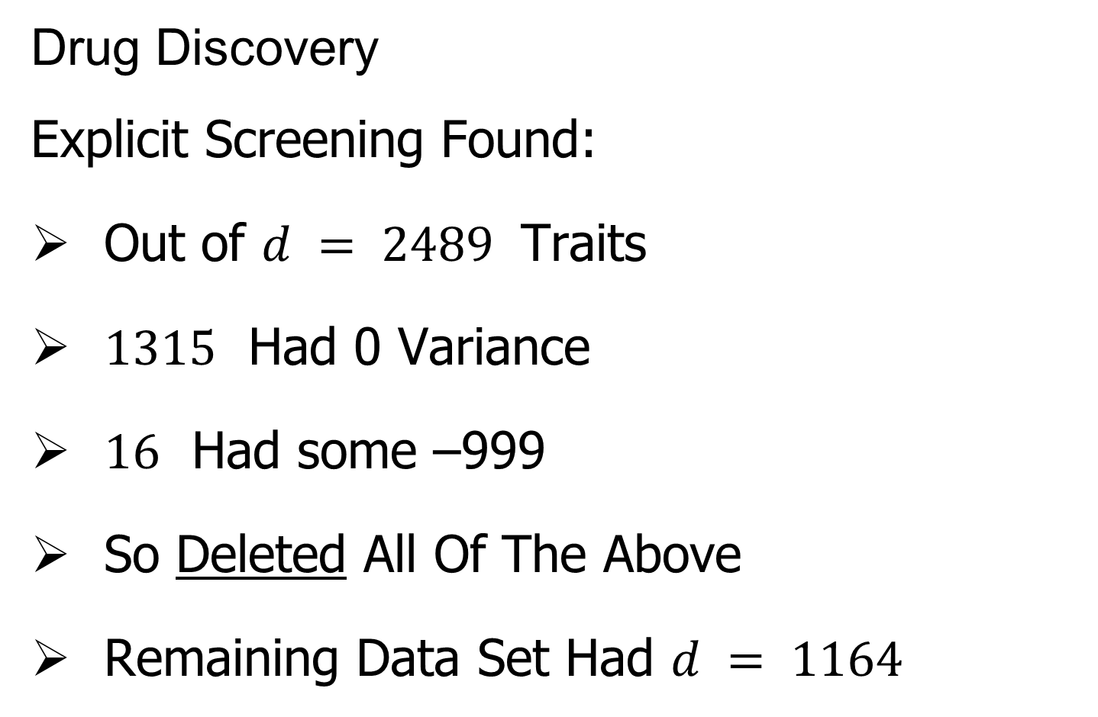
Marg. Dist. Plot Data Example
Drug Discovery
Explicit Screening Found:
Out of $d = 2489$ Traits
$1315$ Had 0 Variance
$16$ Had some –999
So Deleted All Of The Above
Remaining Data Set Had $d = 1164$

Slide 29
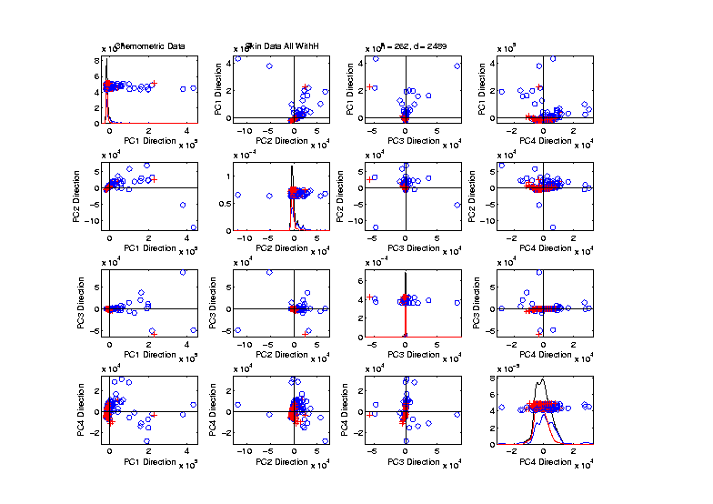
Marg. Dist. Plot Data Example
Drug Discovery - Full Data PCA from Above
(Include
To Show
Contrast)

Slide 30

Marg. Dist. Plot Data Example
Drug Discovery - PCA After Trait Deletion
Looks Very
Similar!

Slide 31
Marg. Dist. Plot Data Example
Drug Discovery - PCA After Trait Deletion
Makes
Sense
For 0-Var
Traits

Slide 32
Marg. Dist. Plot Data Example
Drug Discovery - PCA After Trait Deletion
-999s Have
No Impact
Since Others
Much Bigger!

Slide 33
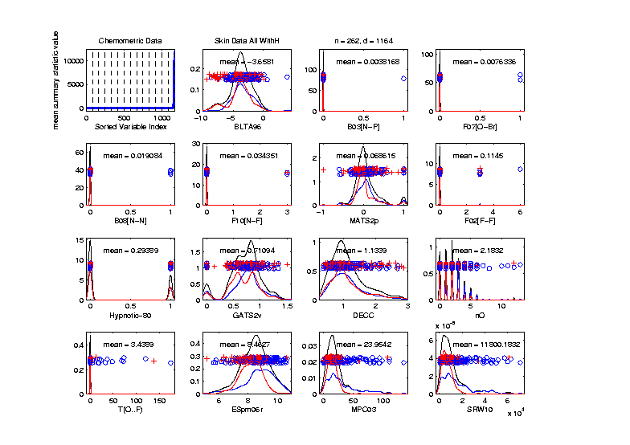
Marg. Dist. Plot Data Example
Drug Discovery - After Trait Deletion
Sort Marginals On Means, Equally Spaced
Still Have
Massive
Variation
In Types

Slide 34
Marg. Dist. Plot Data Example
Drug Discovery - After Trait Deletion
Sort Marginals On Means, Equally Spaced
Still Have
Very Few
That Are
Very Big

Slide 35
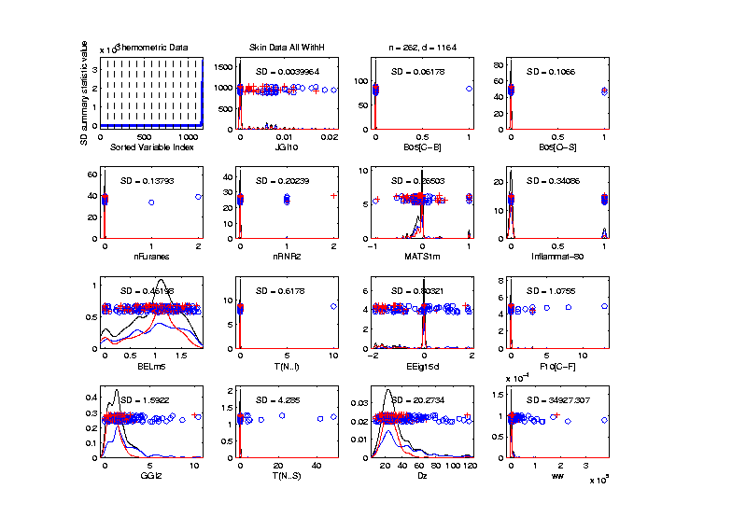
Marg. Dist. Plot Data Example
Drug Discovery - Sort Marginals On SDs,
Equally Spaced To Study Variation
Very Wide
Range
Standardization
May Be Useful

Slide 36
Marg. Dist. Plot Data Example
Drug Discovery - Sort Marginals On SDs,
Equally Spaced To Study Variation
Now See
Some
Very Small
How Many?

Slide 37
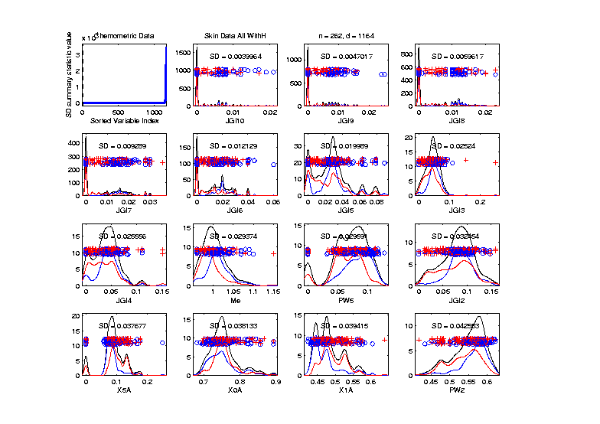
Marg. Dist. Plot Data Example
Drug Discovery - Sort Marginals On SDs,
Smallest
Several
Very Small
Traits
Some Very
Skewed???

Slide 38
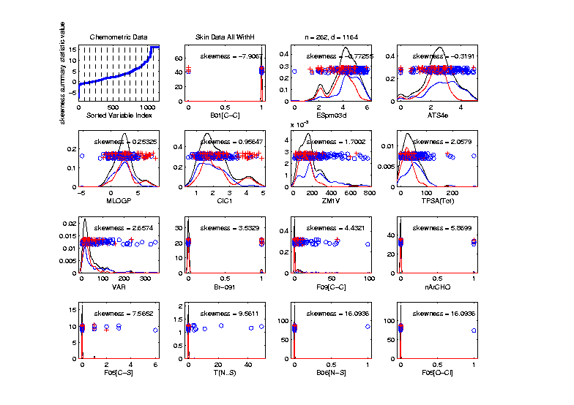
Marg. Dist. Plot Data Example
Drug Discovery - Sort On Skewness
Wide Range
(Consider
Transform-
ation)
0-1s Very
Prominent

Slide 39
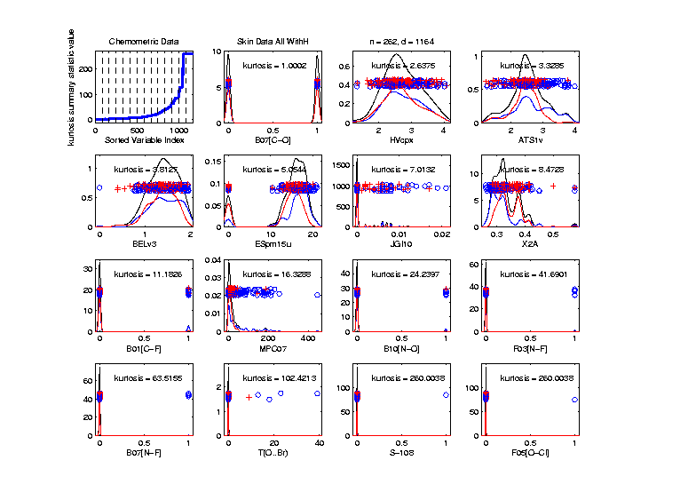
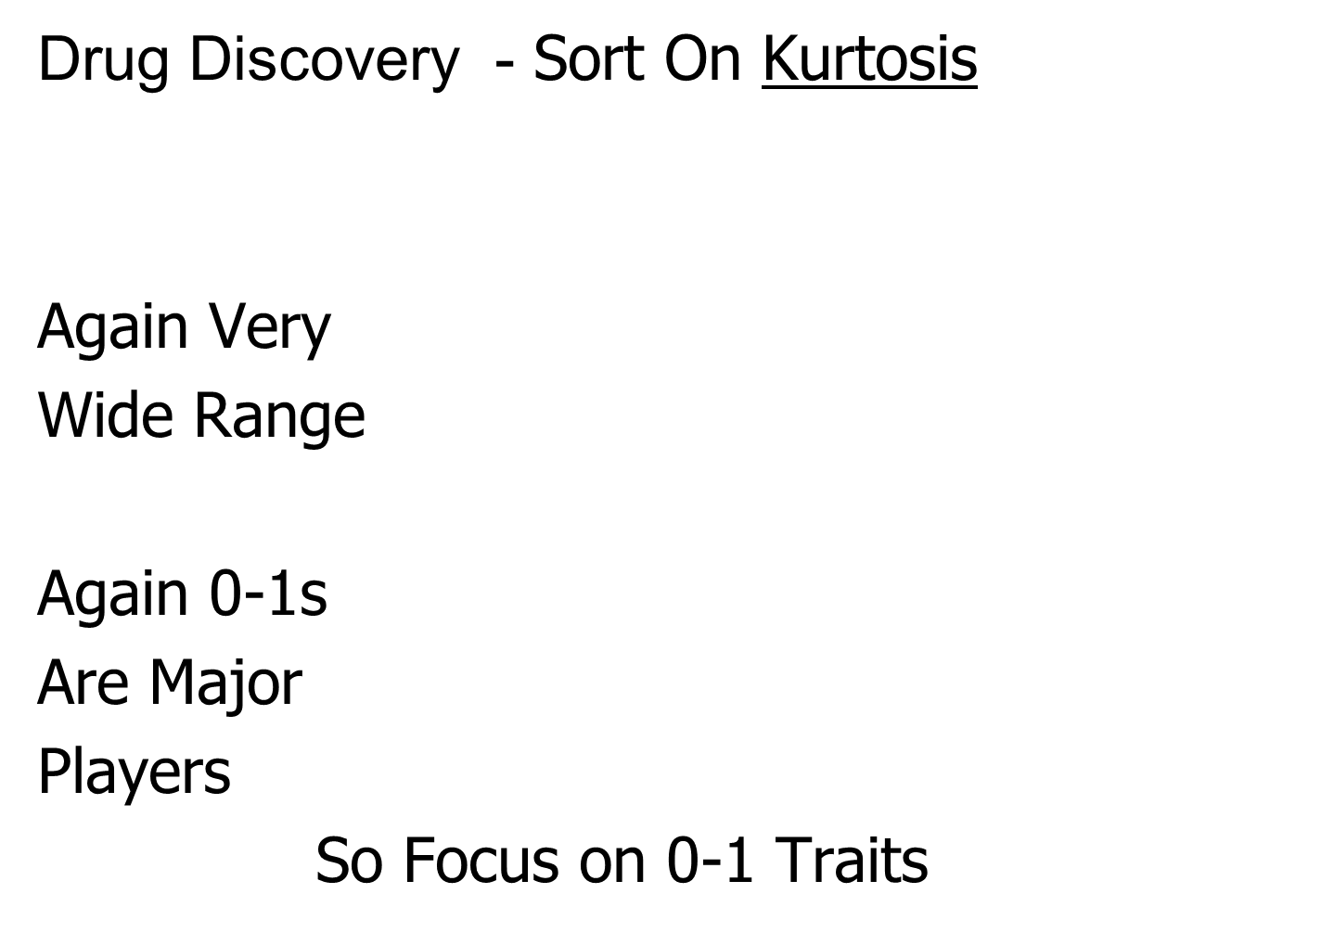
Marg. Dist. Plot Data Example
Drug Discovery - Sort On Kurtosis
Again Very
Wide Range
Again 0-1s
Are Major
Players
So Focus on 0-1 Traits

Slide 40
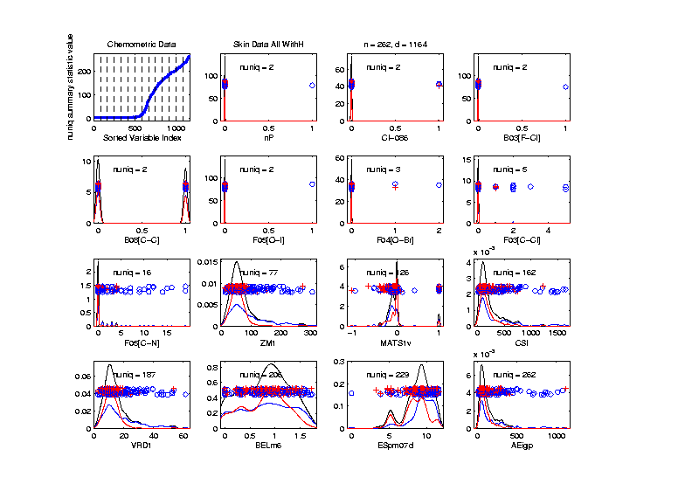
Marg. Dist. Plot Data Example
Drug Discovery - Sort On Number Unique
Shows
Many
Binary

Slide 41
Marg. Dist. Plot Data Example
Drug Discovery - Sort On Number Unique
Shows
Many
Binary
Few Truly
Continuous

Slide 42
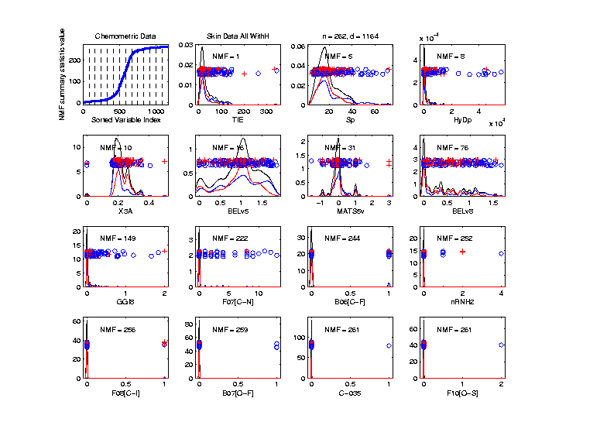
Marg. Dist. Plot Data Example
Drug Discovery - Sort On Number of Most Frequent
Shows Many
Have a Very
Common
Value
(Often 0)

Slide 43
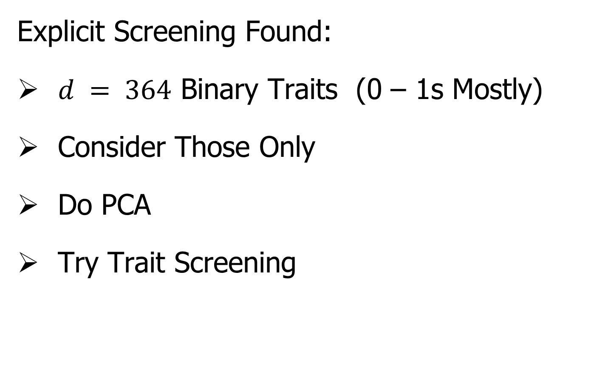
Marg. Dist. Plot Data Example
Explicit Screening Found:
$d = 364$ Binary Traits (0 – 1s Mostly)
Consider Those Only
Do PCA
Try Trait Screening

Slide 44
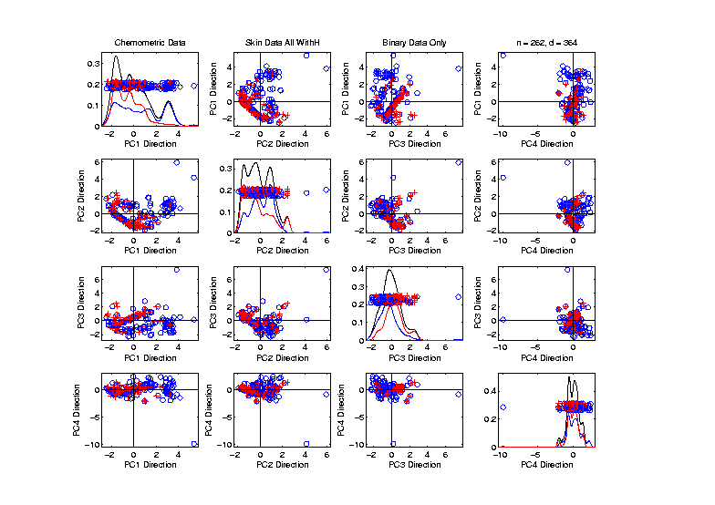
Marg. Dist. Plot Data Example
Drug Discovery - PCA on Binary Traits
Interesting
Structure?

Slide 45
Marg. Dist. Plot Data Example
Drug Discovery - PCA on Binary Traits
Interesting
Structure?
Clusters?

Slide 46
Marg. Dist. Plot Data Example
Drug Discovery - PCA on Binary Traits
Interesting
Structure?
Clusters?
Stronger
Red vs. Blue

Slide 47
Marg. Dist. Plot Data Example
Drug Discovery - PCA on Binary Traits
Interesting
Structure?
Can See
“Activity
Cliffs”
Maggiora (2006)

Slide 48
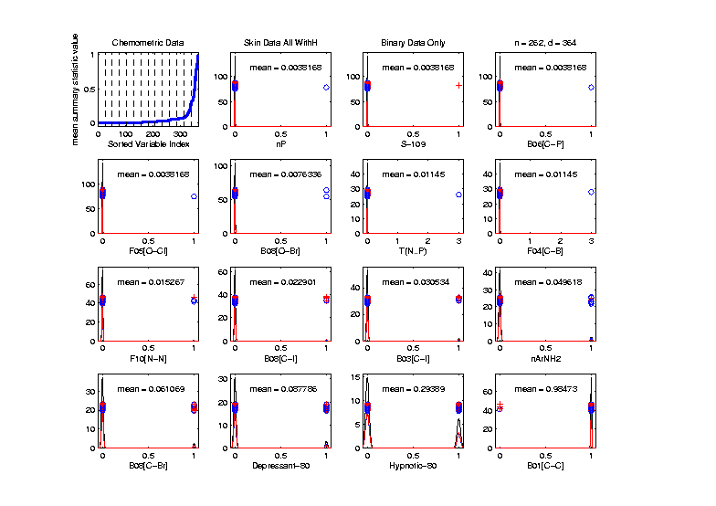
Marg. Dist. Plot Data Example
Drug Discovery - Binary Traits, Mean Sort
Shows
Many Are
Mostly 0s

Slide 49
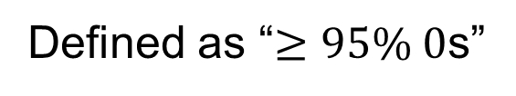
Marg. Dist. Plot Data Example
Common Practice:
Delete “Mostly 0” Traits (little information)
More Careful Look, Borysov et al (2016)
These Can Contain Useful Info
(Especially When So Many)
Not Clear What This Means!
Defined as “$≥95\% 0$s”

Slide 50
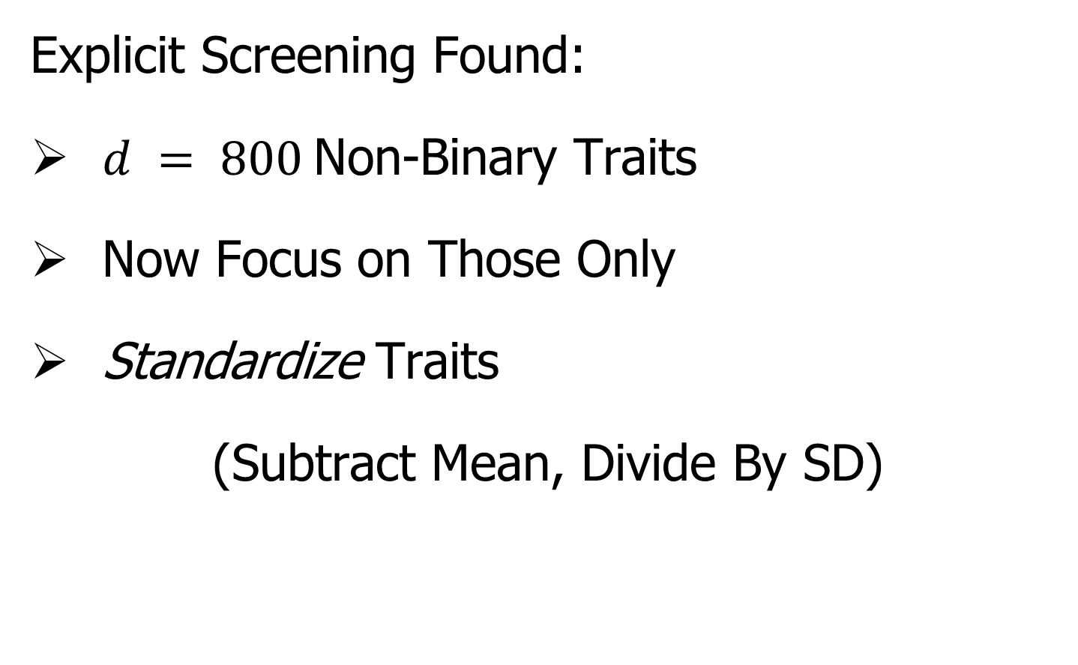
Marg. Dist. Plot Data Example
Explicit Screening Found:
$d = 800$Non-Binary Traits
Now Focus on Those Only
Standardize Traits
(Subtract Mean, Divide By SD)
An Approach to Wildly
Different Trait Scaling

Slide 51
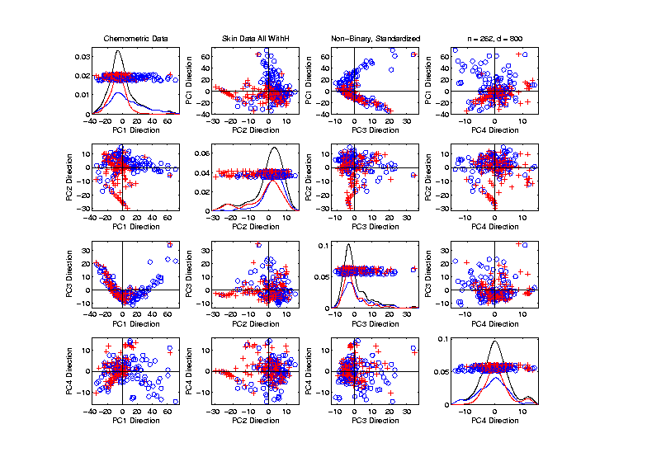
Marg. Dist. Plot Data Example
Drug Discovery - PCA on non-Binary Traits
Interesting
Structure?

Slide 52
Marg. Dist. Plot Data Example
Drug Discovery - PCA on non-Binary Traits
Interesting
Structure?
Suggests
Subtypes

Slide 53
Marg. Dist. Plot Data Example
Drug Discovery - PCA on non-Binary Traits
Interesting
Structure?
Suggests
Subtypes
Reds Only?

Slide 54
Marg. Dist. Plot Data Example
Drug Discovery - PCA on non-Binary Traits
Again
Suggestion
Of “Activity
Cliffs”
Maggiora (2006)

Slide 55
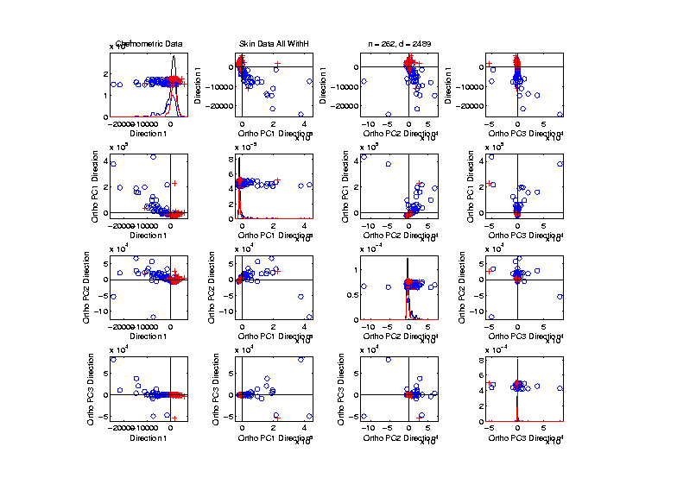
Inference for Drug Discovery Data
Raw Data – DWD & Ortho PCs Scatterplot
Some
Blue - Red
Separation
But Dominated
By Few Large
Compounds
Will Do Confimatory Analysis

Slide 56
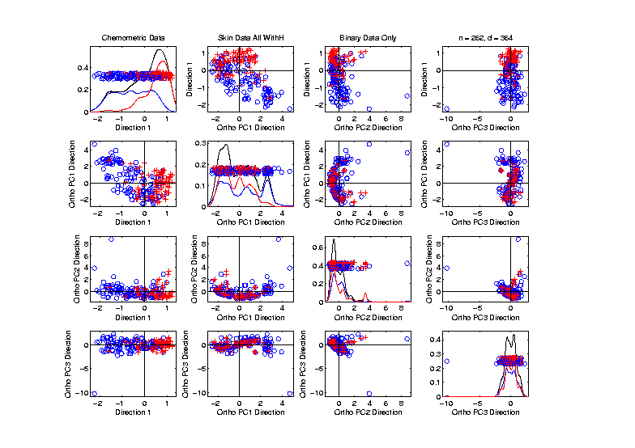
Inference for Drug Discovery Data
Binary Data – DWD & Ortho PCs Scatterplot
Better
Blue - Red
Separation
And
Visualization

Slide 57
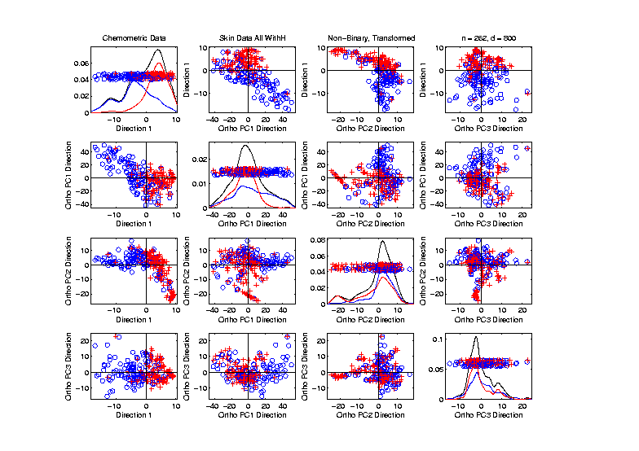
Inference for Drug Discovery Data
Standard’d Non-Binary Data – DWD & OPCA
Better
Blue - Red
Separation
???
Very Useful
Visualization

Slide 58
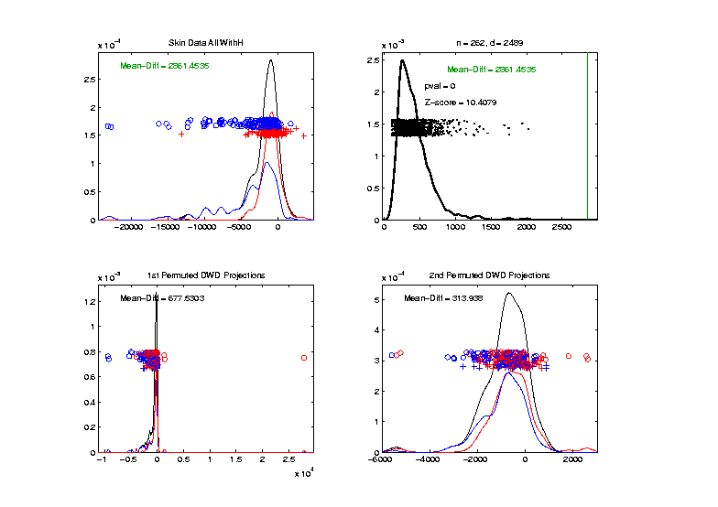
Inference for Drug Discovery Data
DiProPerm test of Blue vs. Red
Full Raw Data
Z = 10.4
Reasonable
Difference
Note Strange
Permutations

Slide 59
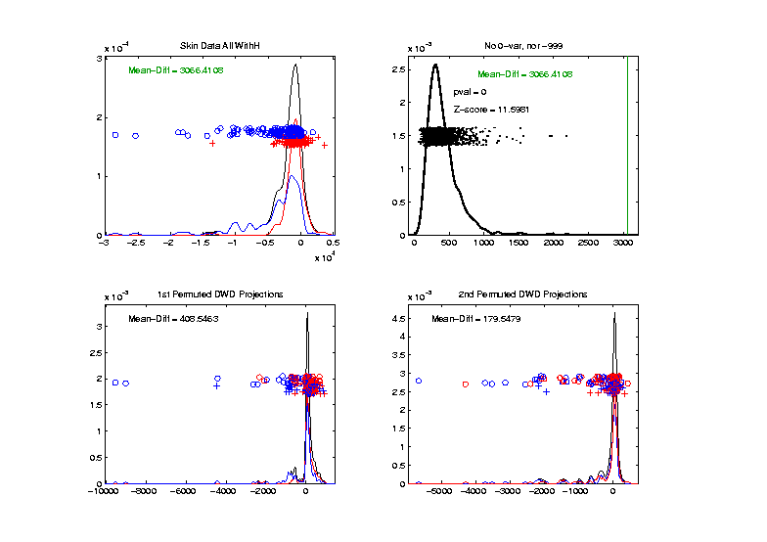
Inference for Drug Discovery Data
DiProPerm test of Blue vs. Red
Delete var = 0 & -999 Traits
Z = 11.6
Slightly
Stronger
No Visual Diff.
Yet DiProPerm
Finds Some
Or Is Difference Within
Simulation Variation???

Slide 60
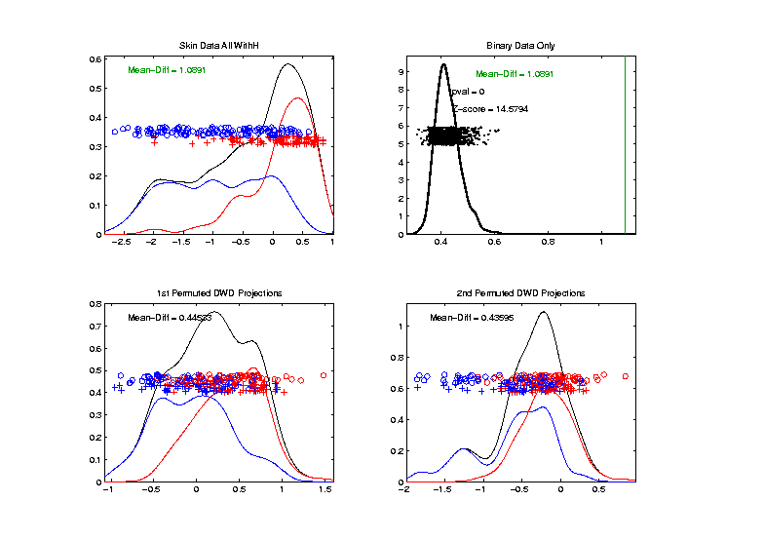
Inference for Drug Discovery Data
DiProPerm test of Blue vs. Red
Binary Traits Only
Z = 14.6
More Than
Raw Data
Much Nicer
Permutations

Slide 61
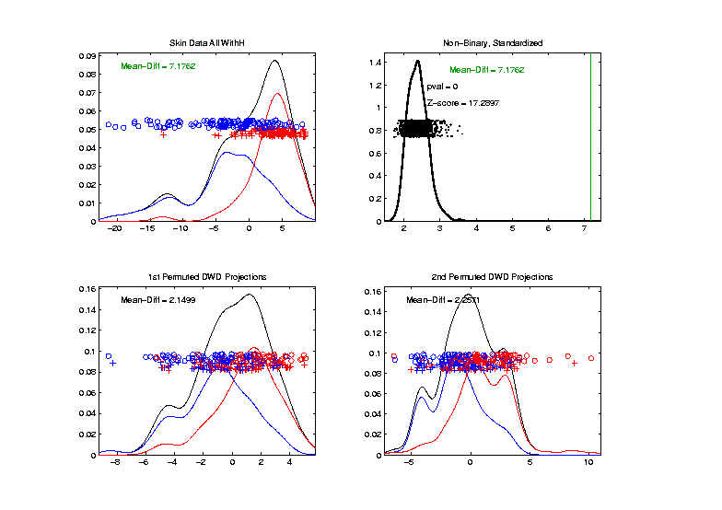
Inference for Drug Discovery Data
DiProPerm test of Blue vs. Red
Non-Binary – Standardized
Z = 17.3
Stronger
Reflects
More Info
In Data

Slide 62
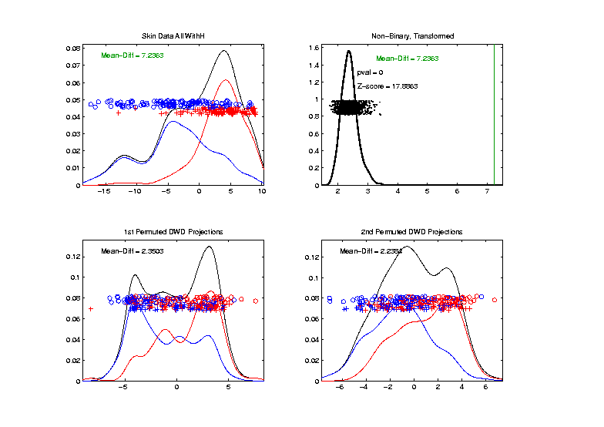
Inference for Drug Discovery Data
Introduced
Very Soon
DiProPerm test of Blue vs. Red
Non-Binary – Shifted Log Transforms
Z = 17.9
Slightly
Stronger

Slide 63
Inference for Drug Discovery Data
Summary of DiProPerm Z-scores after each Processing Step:
Data | Z-score
Raw | 10.4
No Missings | 11.6
Binary Only | 14.6
Standardized | 17.3
Auto-log Trans’d | 17.8

Slide 64

Matlab Software
Recall OODA Software

Slide 65
Marginal Distribution Plots
Matlab Software:
MargDistPlotSM.m
In General Directory

Slide 66
Object Oriented Data Analysis
Three Major Phases of OODA:
I. Object Definition
“What are the Data Objects?”
Exploratory Analysis
“What Is Data Structure / Drivers?”
III. Confirmatory Analysis / Validation
Is it Really There (vs. Noise Artifact)?

Slide 67
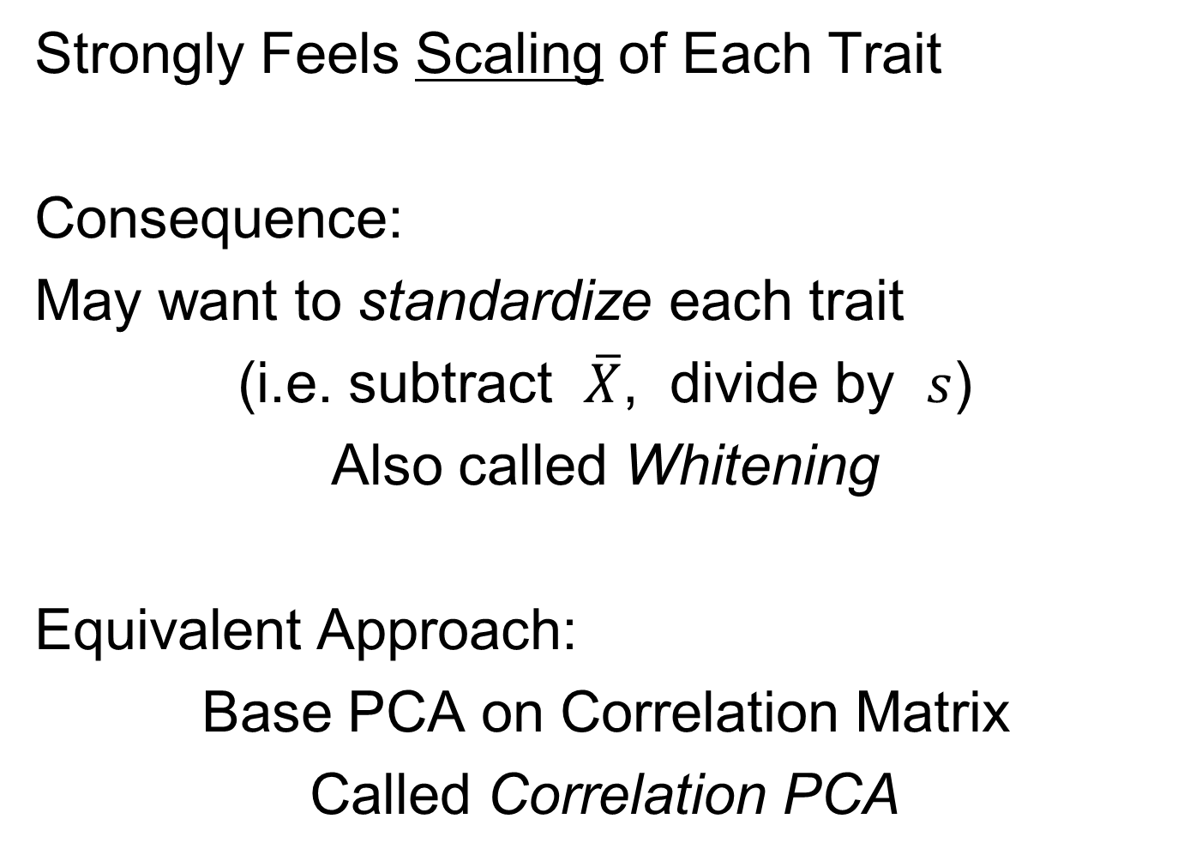
Limitation of PCA
Strongly Feels Scaling of Each Trait
Consequence:
May want to standardize each trait
(i.e. subtract $\overline{X}$, divide by $s$)
Also called Whitening
Equivalent Approach:
Base PCA on Correlation Matrix
Called Correlation PCA
Instead of Usual
Covariance Matrix

Slide 68
Correlation PCA
Why use correlation matrix?
Makes traits (variables, features) “unit free”
e.g. Height, Weight, Age, $, …
Are “directions in point cloud” meaningful or useful?
Will unimportant directions dominate?
Text Section 5.2

Slide 69
Correlation PCA
A related (& better known?) variation of PCA:
Replace cov. matrix with correlation matrix
I.e. do eigen analysis of
Where

Slide 70
Correlation PCA
Personal Thoughts on Correlation PCA:
Can be very useful
(especially with noncommensurate units)
Not always, can hide important structure
To make choice:
Decide whether whitening is useful
My personal use of correlat’n PCA is rare
Other people use it most of the time

Slide 71
Correlation PCA
Personal Thoughts on Correlation PCA:
Can be very useful
(especially with noncommensurate units)
Not always, can hide important structure
Illustrate with example

Slide 72
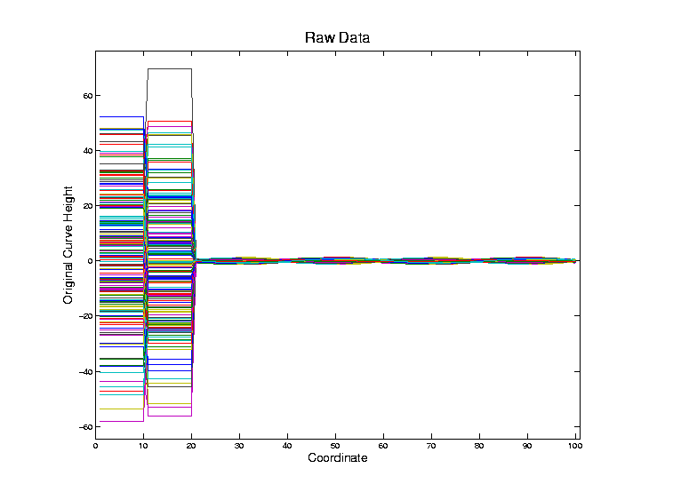
Correlation PCA
Toy Example Contrasting Cov. vs. Corr.

Slide 73
Correlation PCA
Toy Example Contrasting Cov. vs. Corr.
Big Var’n
Part

Slide 74
Correlation PCA
Toy Example Contrasting Cov. vs. Corr.
Big Var’n
Part
Small
Var’n
Part

Slide 75
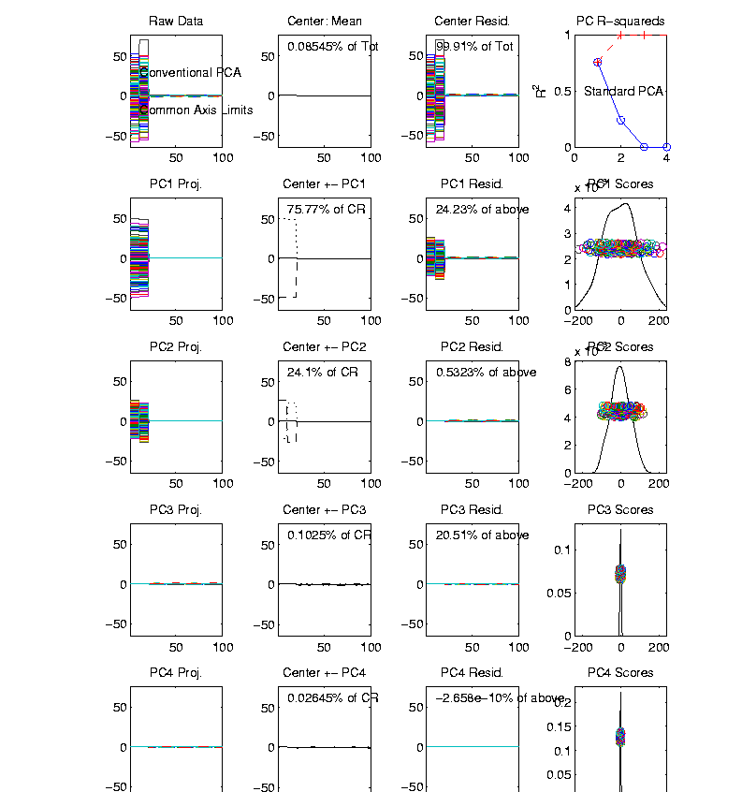
Correlation PCA
Toy Example Contrasting Cov. vs. Corr.
1st Mode:
Nearly Flat
Look at PCA Modes of Variation

Slide 76
Correlation PCA
Toy Example Contrasting Cov. vs. Corr.
1st Mode:
Nearly Flat
2nd Mode:
Contrast
Note: Another
Case Where
This View Is
Very Informative

Slide 77
Correlation PCA
Toy Example Contrasting Cov. vs. Corr.
1st Mode:
Nearly Flat
2nd Mode:
Contrast
3rd & 4th:
Very Small

Slide 78
Correlation PCA
Toy Example Contrasting Cov. vs. Corr.
1st Mode:
Nearly Flat
2nd Mode:
Contrast
3rd & 4th:
Look Very
Small Since
Common Axes

Slide 79
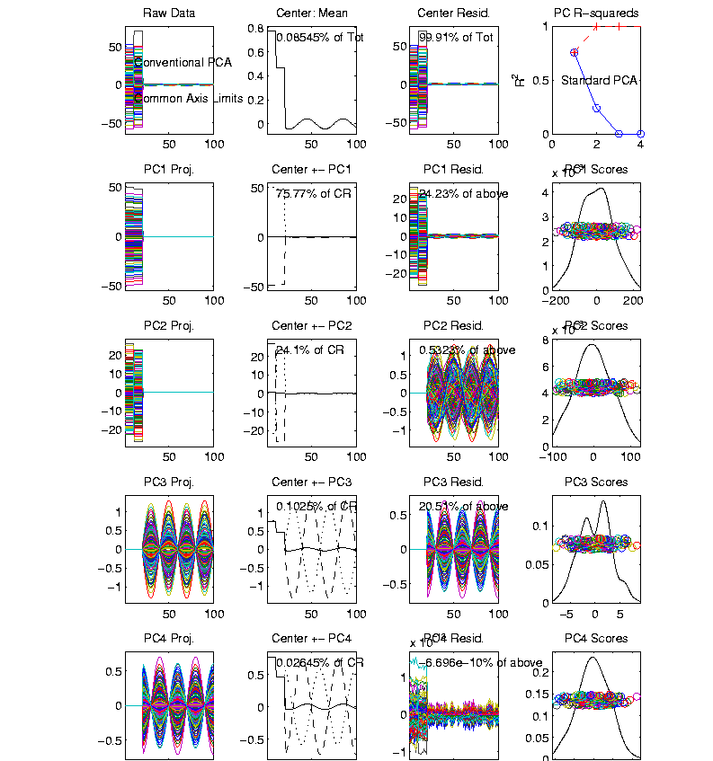
Correlation PCA
Toy Example Contrasting Cov. vs. Corr.
Use Rescaled
Axes (Typical
Default)
Now Can
See Mean

Slide 80
Correlation PCA
Toy Example Contrasting Cov. vs. Corr.
Use Rescaled
Axes (Typical
Default)
All Comp’s
Visible
(sin & cos)

Slide 81
Correlation PCA
Toy Example Contrasting Cov. vs. Corr.
Use Rescaled
Axes (Typical
Default)
All Comp’s
Visible
Good or
Bad ???

Slide 82
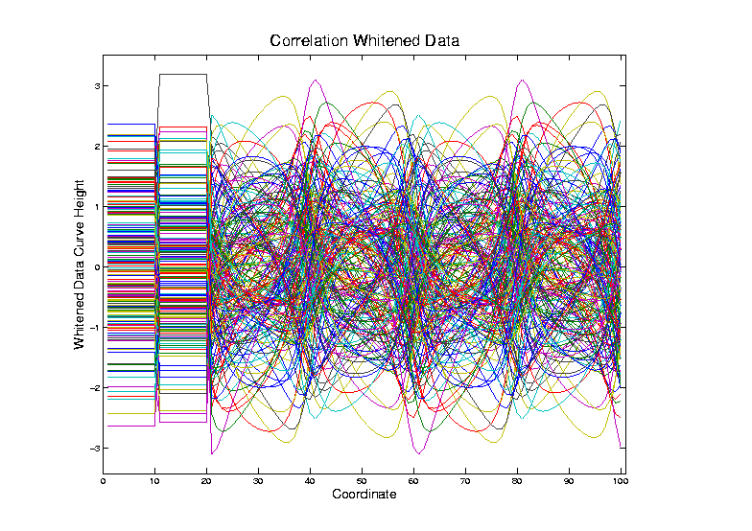
Correlation PCA
Toy Example Contrasting Cov. vs. Corr.
Correlation
“Whitened”
Version
Each Coord.
Rescaled
By Its S.D.

Slide 83
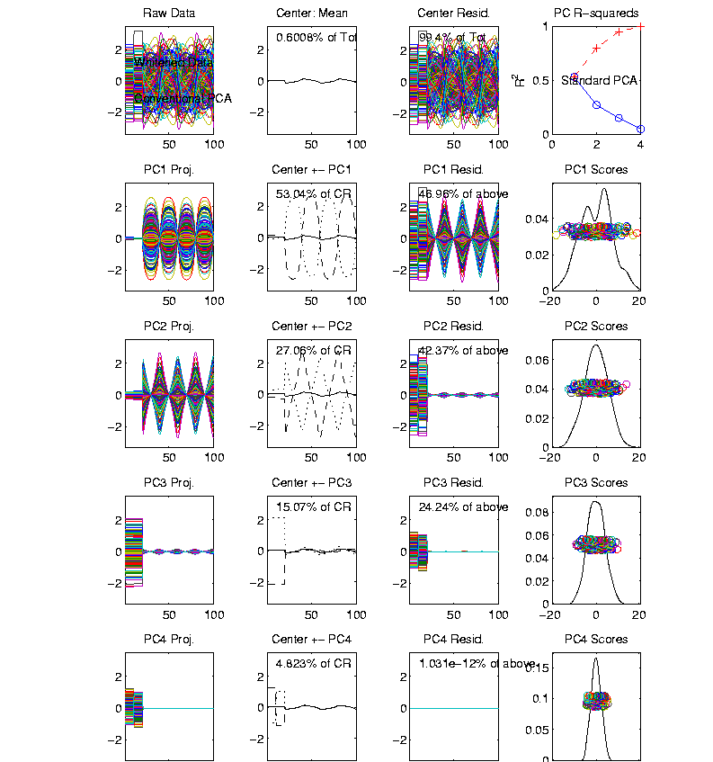
Correlation PCA
Toy Example Contrasting Cov vs. Corr.
Correlation
“Whitened”
Version
All Much
Different

Slide 84
Correlation PCA
Toy Example Contrasting Cov. vs. Corr.
Correlation
“Whitened”
Version
All Much
Different
Which Is
“Right” ???

Slide 85
Transformations
Text: Sec. 5.3
Useful Method for Data Analysis
Apply to Marginal Distributions
(i.e. to Individual Variables)
Idea: Put Data on Right Scale
Common Example:
Data Orders of Magnitude Different
Log₁₀ Puts Data on More Analyzable Scale
Recall Log for
Mortality and
RNAseq Data
Most Interpretable? Others are Just Multiples

Slide 86
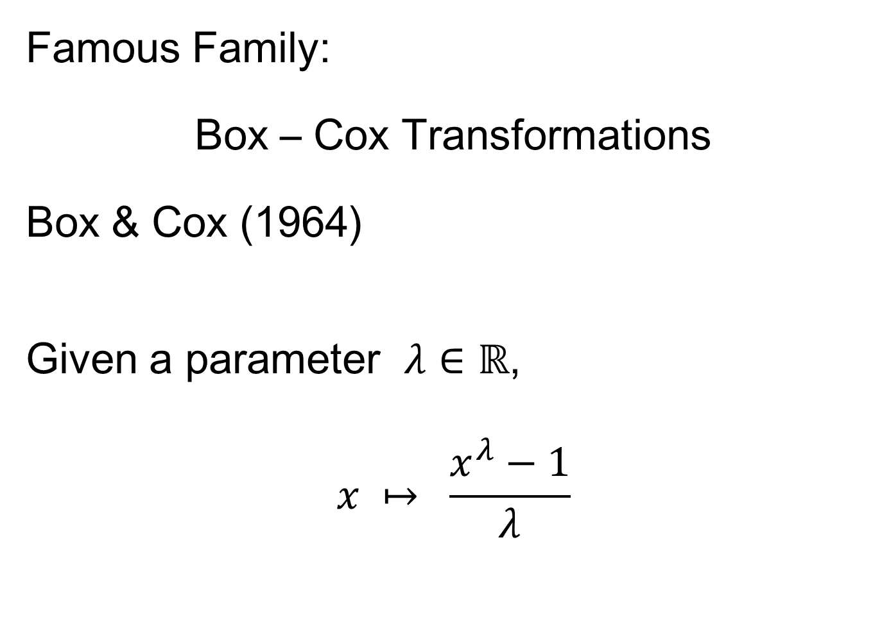
Transformations
Famous Family:
Box – Cox Transformations
Box & Cox (1964)
Given a parameter $λ∈ℝ$,
$$x ↦ \frac{x^{λ}−1}{λ}$$

Slide 87
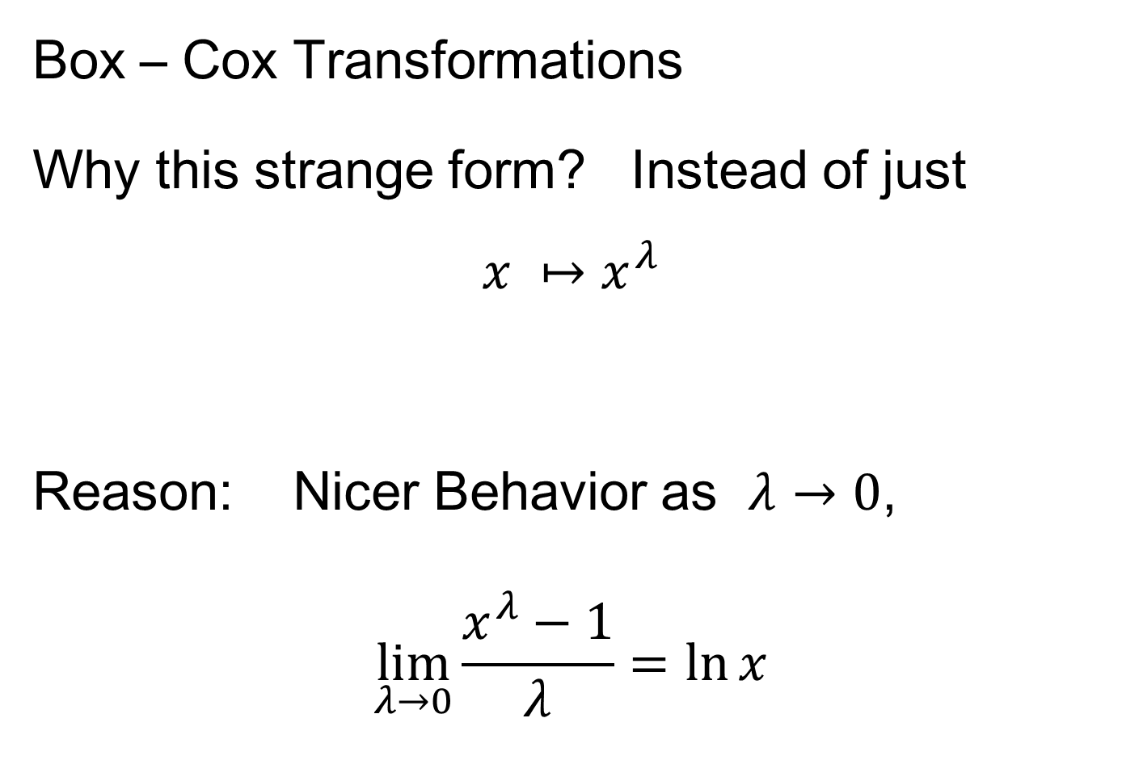
Transformations
Box – Cox Transformations
Why this strange form? Instead of just
$$x ↦x^{λ}$$
Reason: Nicer Behavior as $λ→0$,
$$\lim_{λ→0}{\frac{x^{λ}−1}{λ}}=\ln{x}$$

Slide 88
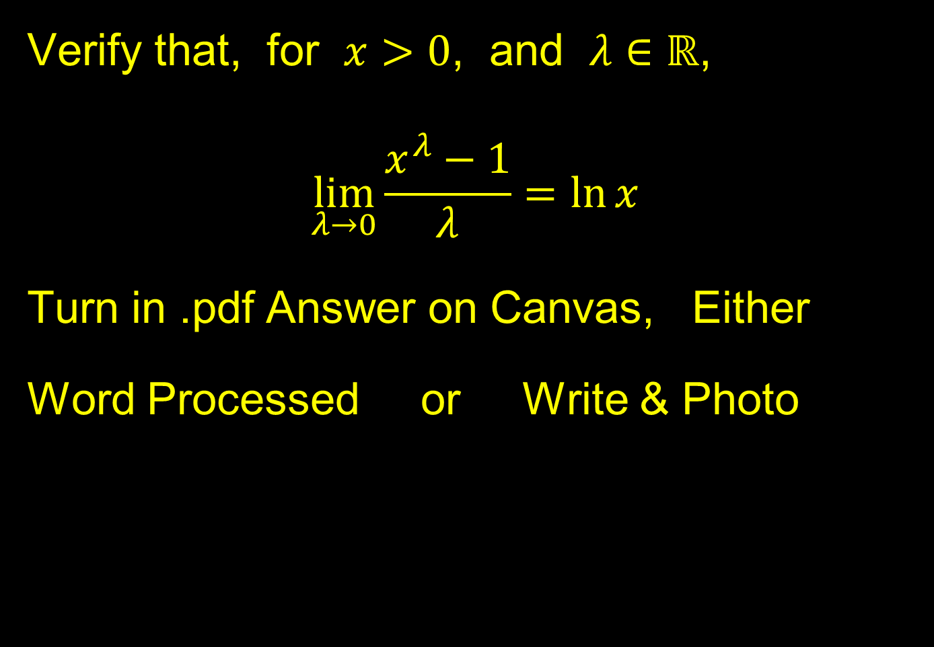
Homework 3
Verify that, for $x>0$, and $λ∈ℝ$,
$$\lim_{λ→0}{\frac{x^{λ}−1}{λ}}=\ln{x}$$
Turn in .pdf Answer on Canvas, Either
Word Processed or Write & Photo
Due: Sept. 11,
11:00AM

Slide 89
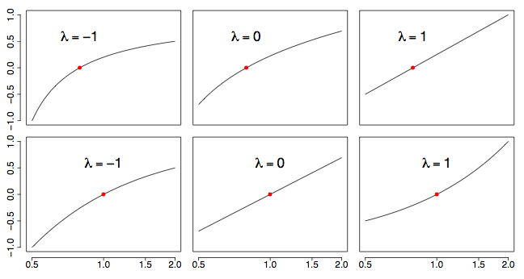

Transformations
Box – Cox Transformations
(vs. $x$)
(graphics from http://onlinestatbook.com/2/transformations/box-cox.html)

Slide 90

Transformations
Box – Cox Transformations
(vs. $x$)
(vs. $\ln{x}$)
(graphics from http://onlinestatbook.com/2/transformations/box-cox.html)

Slide 91
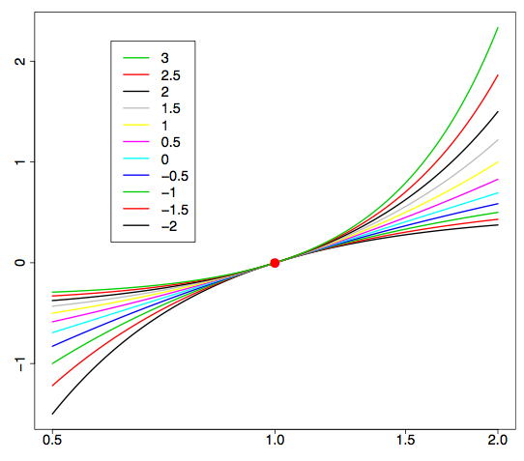

Transformations
Box – Cox Transformations (vs. $\ln{x}$)
(graphics from http://onlinestatbook.com/2/transformations/box-cox.html)
Lots of Flexibility
to Address Either
Positive or Negative
Skewness

Slide 92

Transformations
Another useful family:
Shifted Log Transformations
Given a parameter $δ∈ℝ$,
$$x ↦ \log\left(x+δ\right)$$
(Will use more below)

Slide 93
Transformations
Example: Melanoma Data Analysis
Miedema, et al (2012)

Slide 94


Introduction
Background
Clinical diagnosis

Slide 95




Background
Goal
Image Analysis of Histology Slides
Image: www.melanoma.ca
Benign
Melanoma
1 in 75 North Americans will develop a
malignant melanoma in their lifetime.
Initial goal: Automatically segment nuclei.
Challenge: Dense packing of nuclei.
Ultimately: Cancer grading and patient survival.
Image: melanoma.blogsome.com

Slide 96



Segmentation
Cell Nuclei from Histology
Cutting Cell Clusters
Without subdivision
With subdivision
Our segmentation
Commercial seg.
Not perfect, but improved over standard algorithm (rq. validation).

Slide 97
Feature Extraction
Features from Cell Nuclei
Feature Extraction
Extract various features based on color and morphology
Example “high-level” concepts:
Stain intensity
Nuclear area
Density of nuclei
Regularity of nuclear shape
Called “Hand Crafted Features”
Currently Obsolete: Replaced by Deep Learning Features
But Transformation Point (of this) Still Applies

Slide 98


Feature Extraction
Features from Cell Nuclei
Original Image
Conventional Nevus
Superficial Spreading Melanoma

Slide 99


Feature Extraction
Features from Cell Nuclei
Restained Image
1. Color Normalization,
Addresses Different Staining & Fading
Conventional Nevus
Superficial Spreading Melanoma

Slide 100

Feature Extraction
Features from Cell Nuclei
Masked Region
2. Focus on “Region of Interest”
Conventional Nevus
Conventional Nevus
Superficial Spreading Melanoma
Superficial Spreading Melanoma
Masks generated by pathologist

Slide 101


Feature Extraction
Features from Cell Nuclei
Segmented Nuclei
3. Nuclei “Segmentation”
Find “Boundaries”
Conventional Nevus
Superficial Spreading Melanoma

Slide 102


Feature Extraction
Features from Cell Nuclei
Labeled Nuclei
4. Highlight Nuclei
Conventional Nevus
Superficial Spreading Melanoma

Slide 103


Feature Extraction
Features from Cell Nuclei
Nuclear Regions
5. Expand to Generate Cell Regions
Conventional Nevus
Superficial Spreading Melanoma
Generated by growing nuclei out from boundary
Used for various color and density features:
Region Stain 2, Region Area Ratio, etc.

Slide 104


Feature Extraction
Features from Cell Nuclei
Delaunay Triangulation
6. Delauney Triangulation Quantifies Relations
Conventional Nevus
Superficial Spreading Melanoma
Triangulation of nuclear centers
Used for various density features:
Mean Delaunay, Max. Delaunay, etc.

Slide 105
Transformations
Statistical Challenge:
Some Features Spread Over Several Orders of Magnitude
Few Big Values Can Dominate Analysis

Slide 106

Transformations
Few Large Values Can Dominate Analysis

Slide 107

Transformations
Log Scale Gives All More Appropriate Weight
Note:
Orders
Of
Magnitude
Log₁₀ most
Interpretable

Slide 108

Transformations
Note That Order Matters:
Log Transform First
Standardize ($∙−\overline{X}$ / $s$) Second
Since Mean, $\overline{X}$, and Standard Deviation, $s$
Hard to Interpret for Skewed Data
Most Sensible for ~ Gaussian Data

Slide 109

Transformations
Another Feature with Large Values
Problem
For This
Feature:
0 Values
(no log)

Slide 110

Transformations
Another Feature with Large Values
Approach:
Shifted
Log:
$$log\left(∙+δ\right)$$
Need to
Tune

Slide 111

Transformations
Much Nicer Distribution

Slide 112

Transformations
Different Direction (Negative) of Skewness

Slide 113

Transformations
Use Log Difference Transformation

Slide 114
Transformations
Major Challenge:
Hard to Visually Choose
Transformation of Many Variables
Motivates Automatic Transformation
Approach: Feng et al (2016)
Notes:
For a high dimensional data set, automation is important!
The parameterizations of the shift parameter strongly depend on knowledge of the data e.g. data range, data distribution, so user intervention is usually required. However, modern high-output data sets usually have a very large number of variables, i.e. features, so there is a strong need to automate the selection of shift parameter
What is the challenge here?
First challenge comes from tuning the shift parameter value
variables may range from different magnitude
It depends on the data magnitude (to make valid log function)
You have different optimal shift parameter value for different variables given a target
How to handle positive and negative skewness at same time
2. Address outliers which are also quite different from variable to variable

Slide 115

Automatic Transformations
Approach: Shifted log transform
Challenges Addressed:
Tune the shift parameter for each variable
$\log\left(∙+δ\right)$: Independent of data magnitude
Handle both positive and negative skewness
Address influential data points
Text: Sec. 5.3
Notes:
For a high dimensional data set, automation is important!
The parameterizations of the shift parameter strongly depend on knowledge of the data e.g. data range, data distribution, so user intervention is usually required. However, modern high-output data sets usually have a very large number of variables, i.e. features, so there is a strong need to automate the selection of shift parameter
What is the challenge here?
First challenge comes from tuning the shift parameter value
variables may range from different magnitude
It depends on the data magnitude (to make valid log function)
You have different optimal shift parameter value for different variables given a target
How to handle positive and negative skewness at same time
2. Address outliers which are also quite different from variable to variable

Slide 116

Automatic Transformations
Outline
A new parameterized transformation function
Appropriate reparametrization of $\log\left(∙+δ\right)$
Standardization and Winsorization
Selection of $δ$
Notes:
Based on these challenges we propose an automatic transformation scheme
The new scheme consists of three parts
1. A new parametrized family of transformation functions
This re-parametrization facilitate the automation by making the selection of shift tuning parameter independent of data magnitude.
Beside, it put transformation function for handling both positive and negative skewness in the same family
2. A robust way for standardization and also an option for winsorizing the influential points (winsorization means that given a vector of data values and a threshold, when the absolute data values are larger than the threshold, you will pull these values back to the threshold)
3. The parameter value selection
How to use an algorithm for optimal value

Slide 117




Automatic Transformations
Form of Transformation Function
Based on 1-d data set: $x_{1}, ⋯,x_{n}$
For positive skewness want: $\log\left(x_{i}\right)$
For negative skewness want: $−\log\left(−x_{i}\right)$
Preserves Order of Data
But Need Valid Inputs!
i.e. $\log{x}$ needs $x>0$
Handle with Shift $η$
Notes:
We start with the new re-parametrized function and we will start from the very basic
Deal both positive and negative skewness + maintain the order of data values
Given a feature vector in the data set, we need to first calculate its skewness
Based on the sign of the skewness we will have different log transformation (applying convex transformation function will increase the skewness and concave will decrease)
For negative one, we add negative sign to keep the same order of the data values

Slide 118



Automatic Transformations
Transformation Function
Modified log transforms
Positive skewness
$log⁡(x_{i}−min\left(x_{1}, ⋯,x_{n}\right)+η$)
Negative skewness
$−log⁡(\max\left(x_{1}, ⋯,x_{n}\right)− x_{i}+η$)
These are $≥0$
So Shift $η>0$ Controls Distortion by log
Notes:
One big concern is that logarithm functions require positive inputs
Therefore it is important to modify the functions for both positive and negative cases to be valid for any element value.
Substract the minimal value and add a positive shift parameter
use max value to minus each data value and add with a positive shift parameter

Slide 119

Automatic Transformations
Transformation Function
Modified log transforms
Positive skewness
$log⁡(x_{i}−min\left(x_{1}, ⋯,x_{n}\right)+η$)
Negative skewness
$−log⁡(\max\left(x_{1}, ⋯,x_{n}\right)− x_{i}+η$)
Note: For $g\left(t\right)=\log{t}$, $g^{′′}\left(t\right)=\frac{−1}{t^{2}}≈0$ for Large $t$
So Transformation $≈$ Linear for Large $η$
Notes:
One big concern is that logarithm functions require positive inputs
Therefore it is important to modify the functions for both positive and negative cases to be valid for any element value.
Substract the minimal value and add a positive shift parameter
use max value to minus each data value and add with a positive shift parameter

Slide 120

Automatic Transformations
Reparametrization (Nicer Format):
Based on Range of Data, $R=\max_{i}{x_{i}}−\min_{i}{x_{i}}$
For Positive Skewness: $β=\frac{R}{η}$
For Negative Skewness: $β=\frac{−R}{η}$
This Gives $β∈\left(−∞,+∞\right)$
Where Sign Determines Skewness Type
Notes:
Thus, we further parametrize the parameter eta in terms of the multiples of the range
of the feature vectors
This makes the selection of parameter values beta independent of the data magnitude
The beta ranges from negative inf to positive inf
Now we note that the functions for pos and negative are both symmetric around zero
Thus we can take advantage of it and combine them into one family of functions.

