Slide 1
Statistics – O. R. 881 Object Oriented Data Analysis
Steve Marron
Dept. of Statistics and Operations Research
University of North Carolina

Slide 2
Current Sections in Textbook
Today:
Section 5.3, 6.1, 6.5, 6.3, 17.1
Next Class:
Sections 17.1, 3.1.3, 6.5

Slide 3
Participant Presentations
Starting Next Thursday:
12:05 Coleman Ferrell
Relationship Between
Concussions and Symptoms
Notes:
Have Title Page With:
Your Name
Your Affiliation
Any Objections to 10
Minute Presentations?

Slide 4
Participant Presentations
Presentation Options:
Can Use USB Device
Or Your Computer (with HDMI)
Or Class Zoom Link, Notify Me Early
Or One Drive, Set Up Before Class
Or Remote Log-In, Set Up Before Class
Check Website
For Schedule

Slide 5

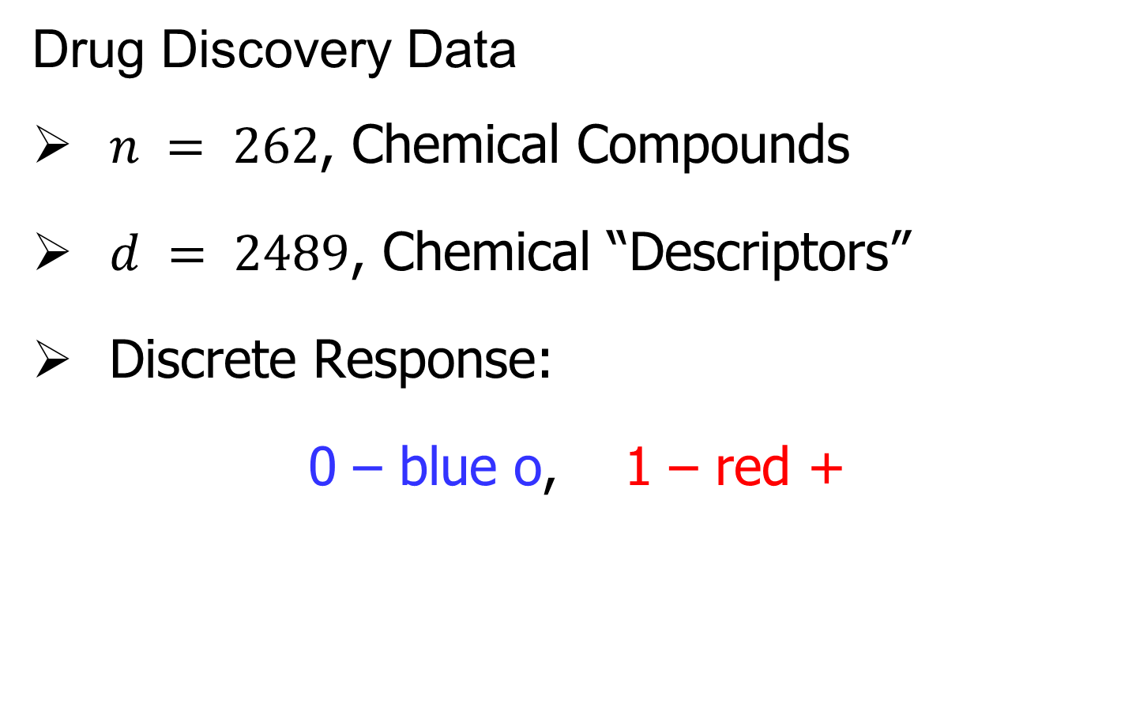
Last Class: Marg. Dist. Plot
Drug Discovery Data
$n = 262$, Chemical Compounds
$d = 2489$, Chemical “Descriptors”
Discrete Response:
0 – blue o, 1 – red +
(Thanks to Alex Tropsha Lab)

Slide 6
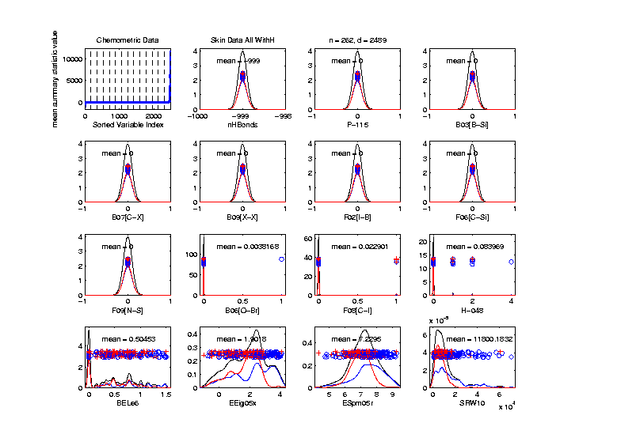
Last Class: Marg. Dist. Plot
Drug Discovery – Sort on Means
Note: Many
With No
Variation???

Slide 7
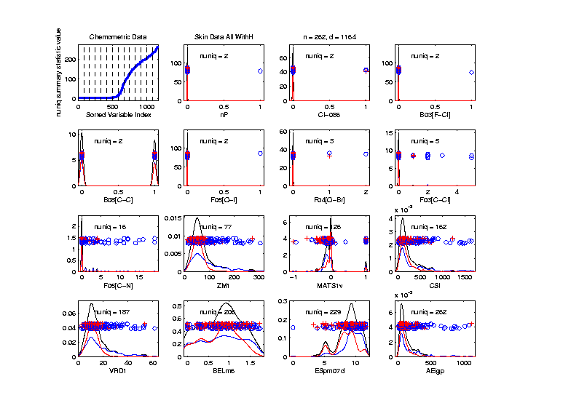
Last Class: Marg. Dist. Plot
Drug Discovery - Sort On Number Unique
Shows
Many
Binary
Few Truly
Continuous

Slide 8
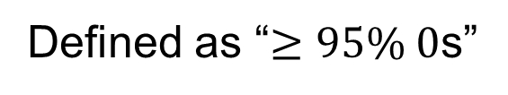
Last Class: Marg. Dist. Plot
Common Practice:
Delete “Mostly 0” Variables (little information)
More Careful Look, Borysov et al (2016)
These Can Contain Useful Info
(Especially When So Many)
Not Clear What This Means!
Defined as “$≥95\% 0$s”

Slide 9
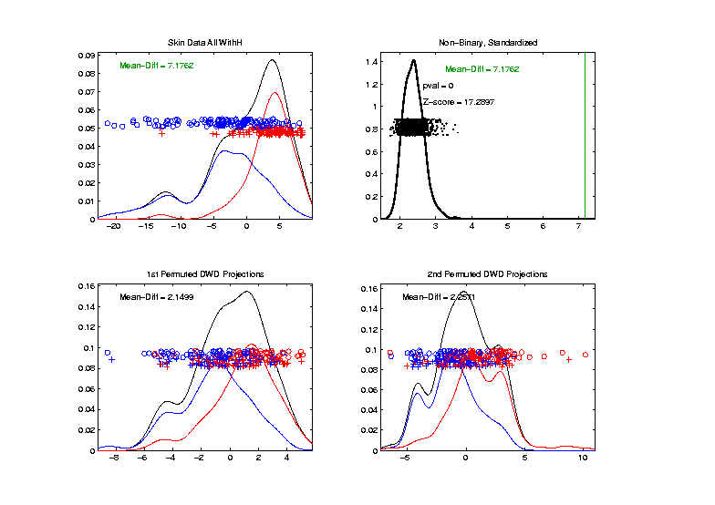
Last Class: Drug Discovery Data
DiProPerm test of Blue vs. Red
Non-Binary – Standardized
Z = 17.3
Stronger
Reflects
More Info
In Data

Slide 10
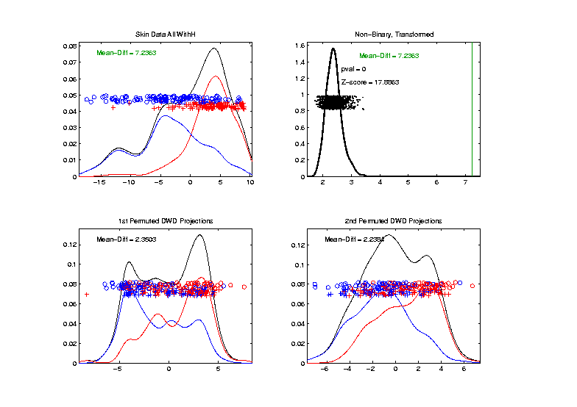
Last Class: Drug Discovery Data
Introduced
Very Soon
DiProPerm test of Blue vs. Red
Non-Binary – Shifted Log Transforms
Z = 17.9
Slightly
Stronger

Slide 11
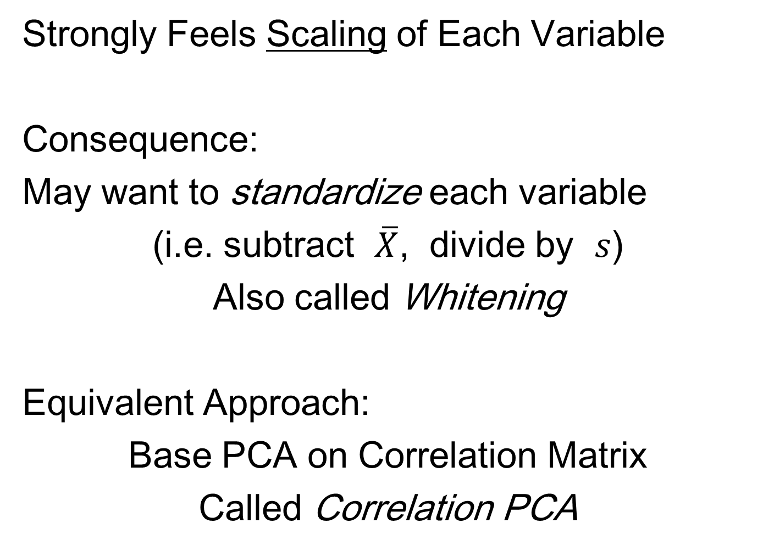
Last Class: Limitation of PCA
Strongly Feels Scaling of Each Variable
Consequence:
May want to standardize each variable
(i.e. subtract $\overline{X}$, divide by $s$)
Also called Whitening
Equivalent Approach:
Base PCA on Correlation Matrix
Called Correlation PCA
Instead of Usual
Covariance Matrix

Slide 12
Last Class: Correlation PCA
Why use correlation matrix?
Makes features “unit free”
e.g. Height, Weight, Age, $, …
Are “directions in point cloud” meaningful or useful?
Will unimportant directions dominate?

Slide 13
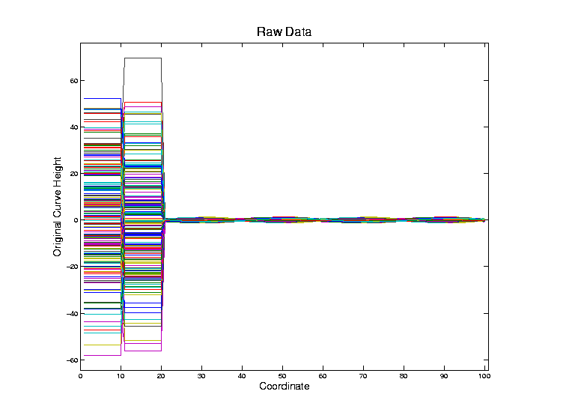
Last Class: Correlation PCA
Toy Example Contrasting Cov. vs. Corr.

Slide 14
Last Class: Correlation PCA
Toy Example Contrasting Cov. vs. Corr.
Big Var’n
Part

Slide 15
Last Class: Correlation PCA
Toy Example Contrasting Cov. vs. Corr.
Big Var’n
Part
Small
Var’n
Part

Slide 16
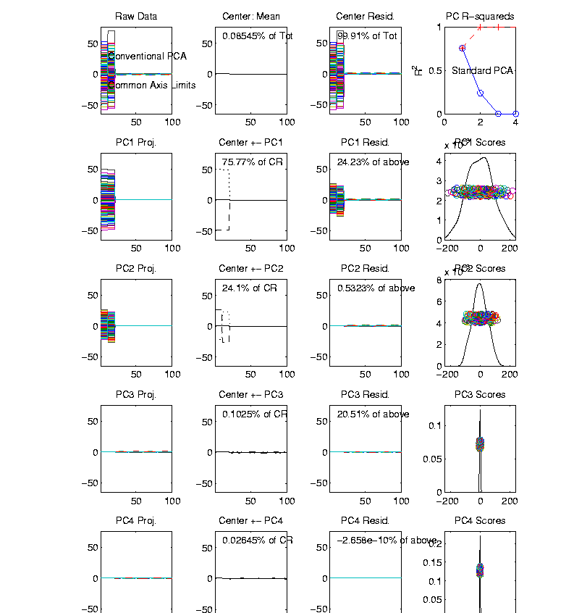
Last Class: Correlation PCA
Toy Example Contrasting Cov. vs. Corr.
1st Comp:
Nearly Flat
2nd Comp:
Contrast
3rd & 4th:
Very Small

Slide 17
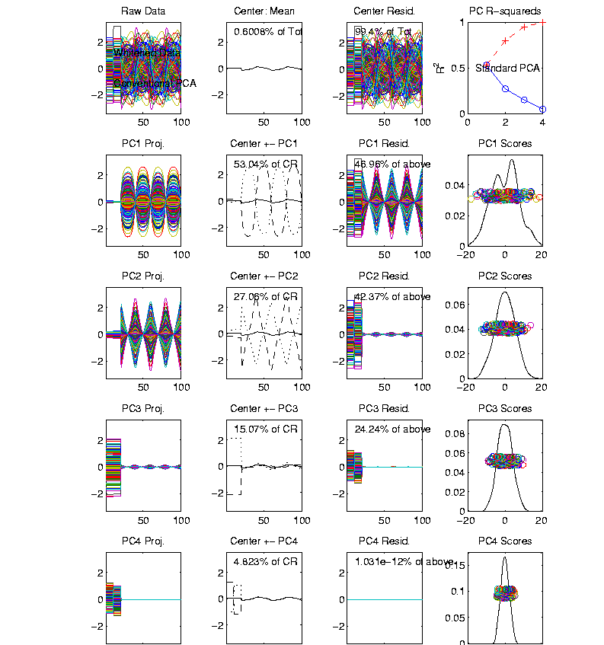
Last Class: Correlation PCA
Toy Example Contrasting Cov. vs. Corr.
Correlation
“Whitened”
Version
All Much
Different
Which Is
“Right” ???

Slide 18
Last Class: Correlation PCA
Personal Thoughts on Correlation PCA:
Can be very useful
(especially with noncommensurate units)
Not always, can hide important structure

Slide 19
Last Class: Transformations
Recall Log for
Mortality and
RNAseq Data
Useful Method for Data Analysis
Apply to Marginal Distributions
(i.e. to Individual Variables)
Idea: Put Data on Right Scale
Common Example:
Data Orders of Magnitude Different
Log₁₀ Puts Data on More Analyzable Scale

Slide 20
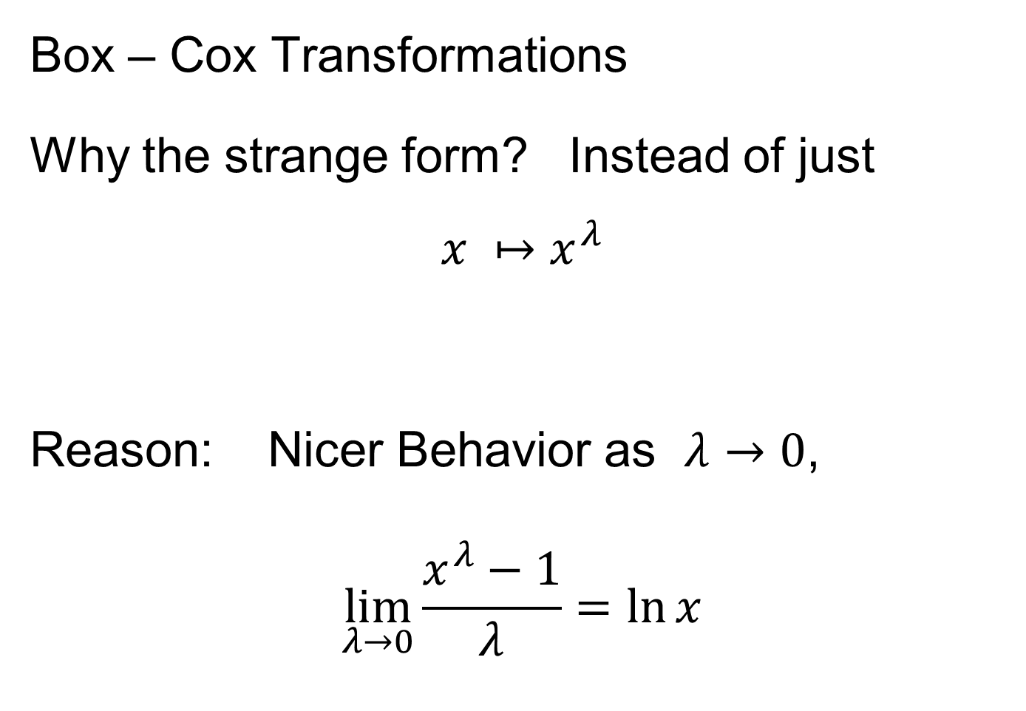
Last Class: Transformations
Box – Cox Transformations
Why the strange form? Instead of just
$$x ↦x^{λ}$$
Reason: Nicer Behavior as $λ→0$,
$$\lim_{λ→0}{\frac{x^{λ}−1}{λ}}=\ln{x}$$
Try It Out
in HW 3

Slide 21
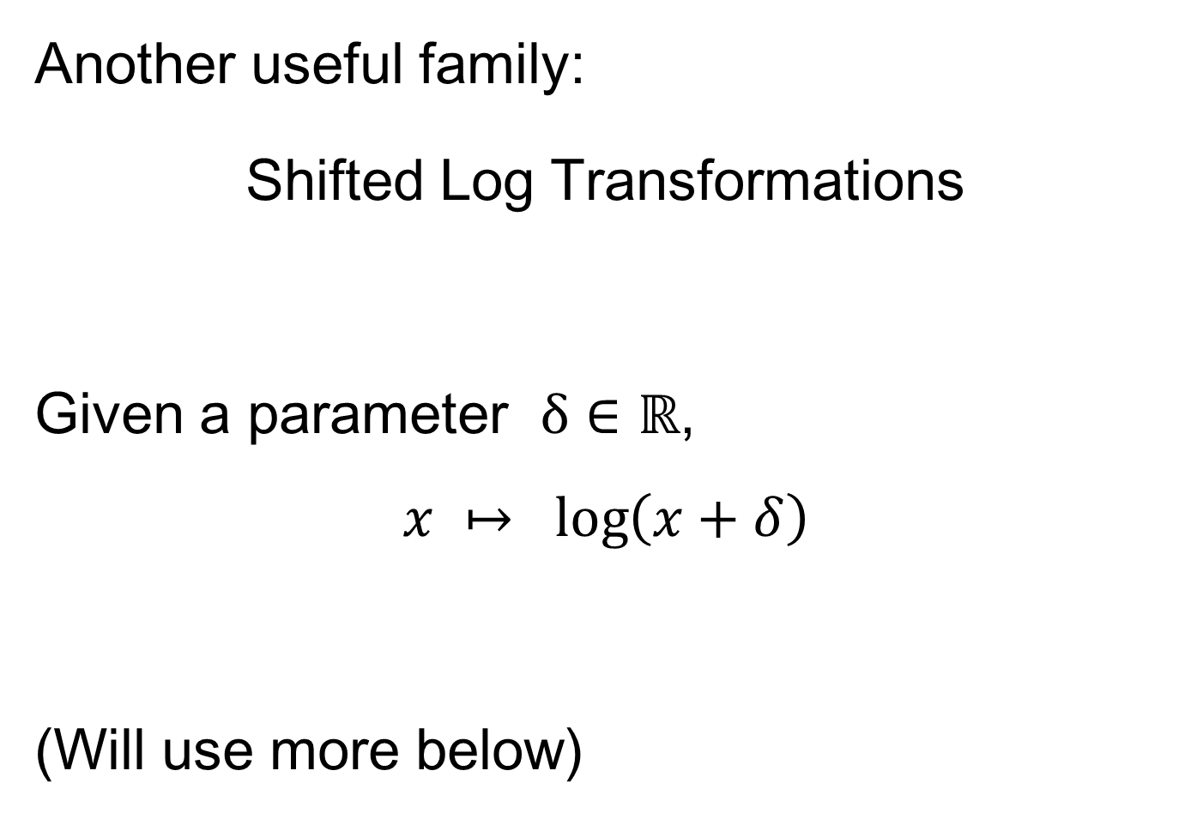
Last Class: Transformations
Another useful family:
Shifted Log Transformations
Given a parameter $δ∈ℝ$,
$$x ↦ \log\left(x+δ\right)$$
(Will use more below)

Slide 22
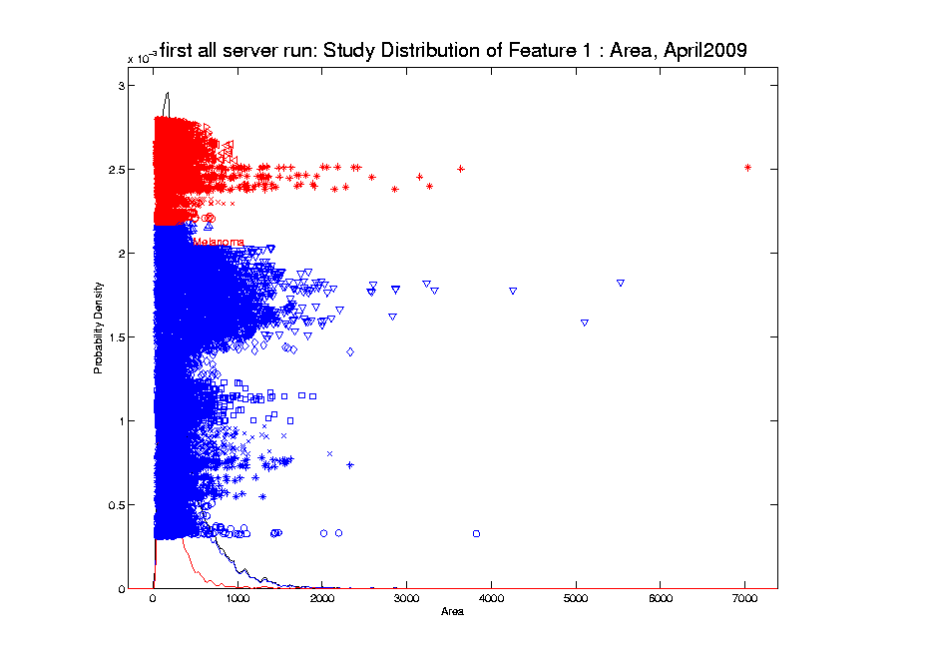
Last Class: Transformations
Few Large Values Can Dominate Analysis

Slide 23
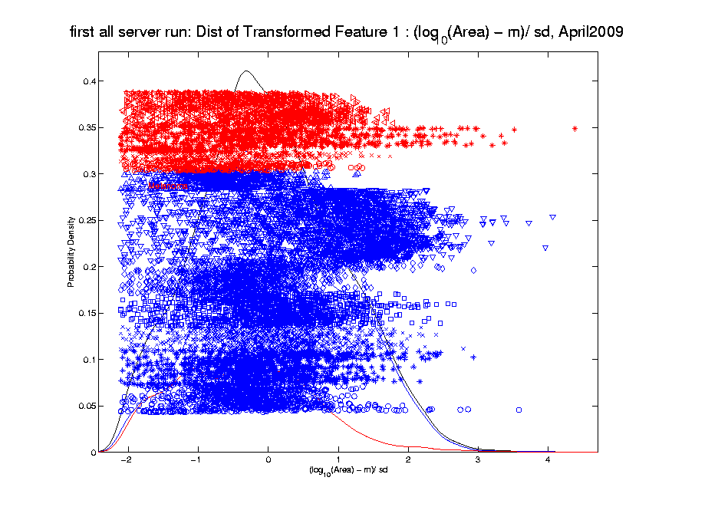
Last Class: Transformations
Log Scale Gives All More Appropriate Weight
Note:
Orders
Of
Magnitude
Log₁₀ most
Interpretable

Slide 24
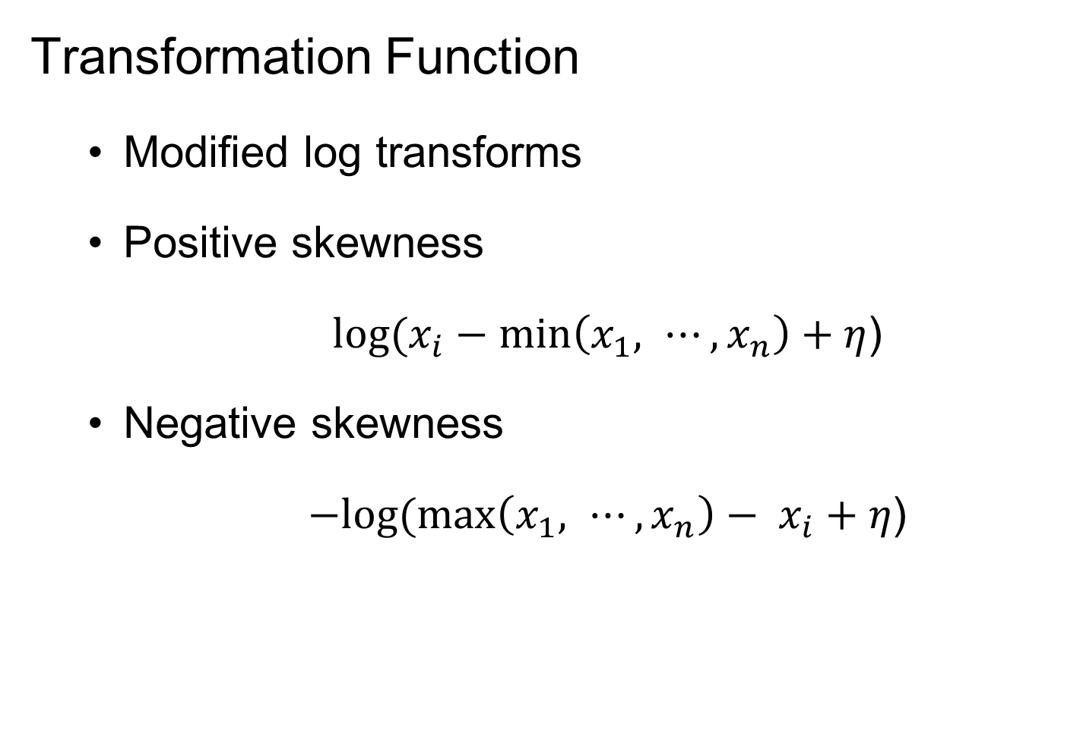
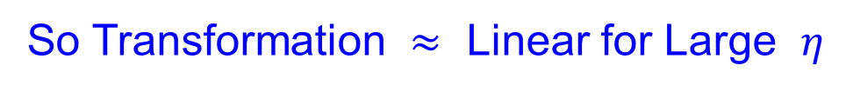
Last Class: Automatic Trans’s
Transformation Function
Modified log transforms
Positive skewness
$log⁡(x_{i}−min\left(x_{1}, ⋯,x_{n}\right)+η$)
Negative skewness
$−log⁡(\max\left(x_{1}, ⋯,x_{n}\right)− x_{i}+η$)
Note: For $g\left(t\right)=\log{t}$, $g^{′′}\left(t\right)=\frac{−1}{t^{2}}≈0$ for Large $t$
So Transformation $≈$ Linear for Large $η$
Notes:
One big concern is that logarithm functions require positive inputs
Therefore it is important to modify the functions for both positive and negative cases to be valid for any element value.
Substract the minimal value and add a positive shift parameter
use max value to minus each data value and add with a positive shift parameter

Slide 25
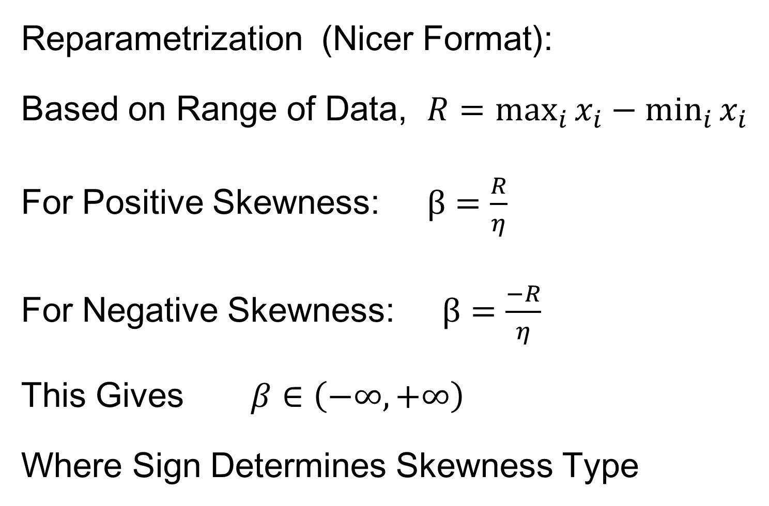
Last Class: Automatic Trans’s
Reparametrization (Nicer Format):
Based on Range of Data, $R=\max_{i}{x_{i}}−\min_{i}{x_{i}}$
For Positive Skewness: $β=\frac{R}{η}$
For Negative Skewness: $β=\frac{−R}{η}$
This Gives $β∈\left(−∞,+∞\right)$
Where Sign Determines Skewness Type
Notes:
Thus, we further parametrize the parameter eta in terms of the multiples of the range
of the feature vectors
This makes the selection of parameter values beta independent of the data magnitude
The beta ranges from negative inf to positive inf
Now we note that the functions for pos and negative are both symmetric around zero
Thus we can take advantage of it and combine them into one family of functions.

Slide 26
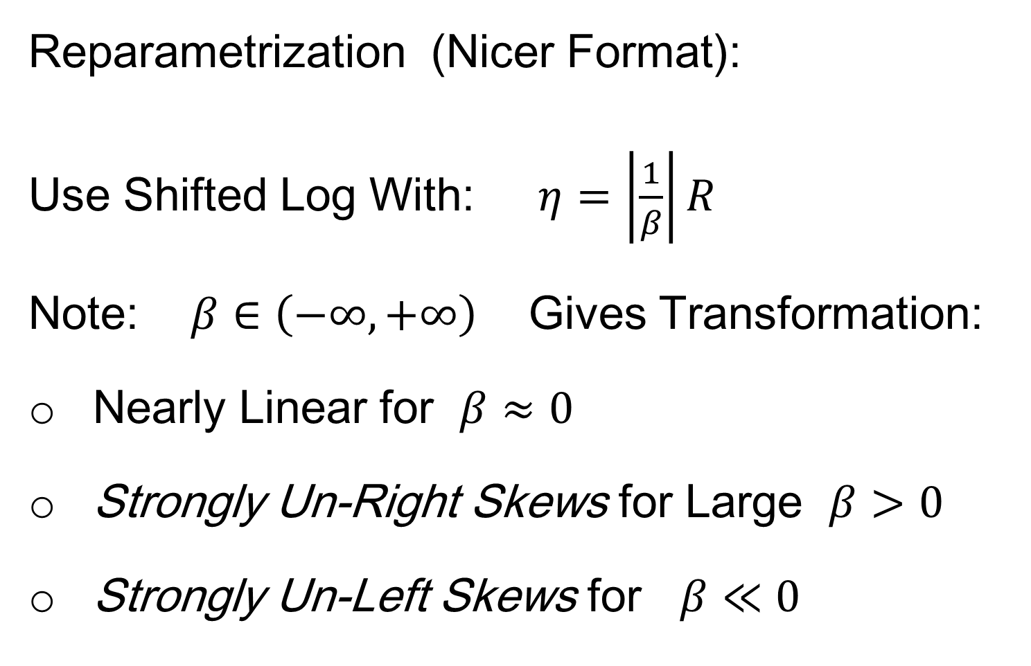
Automatic Transformations
Reparametrization (Nicer Format):
Use Shifted Log With: $η=\left|\frac{1}{β}\right|R$
Note: $β∈\left(−∞,+∞\right)$ Gives Transformation:
Nearly Linear for $β≈0$
Strongly Un-Right Skews for Large $β>0$
Strongly Un-Left Skews for $β≪0$
Notes:
Thus, we further parametrize the parameter eta in terms of the multiples of the range
of the feature vectors
This makes the selection of parameter values beta independent of the data magnitude
The beta ranges from negative inf to positive inf
Now we note that the functions for pos and negative are both symmetric around zero
Thus we can take advantage of it and combine them into one family of functions.

Slide 27
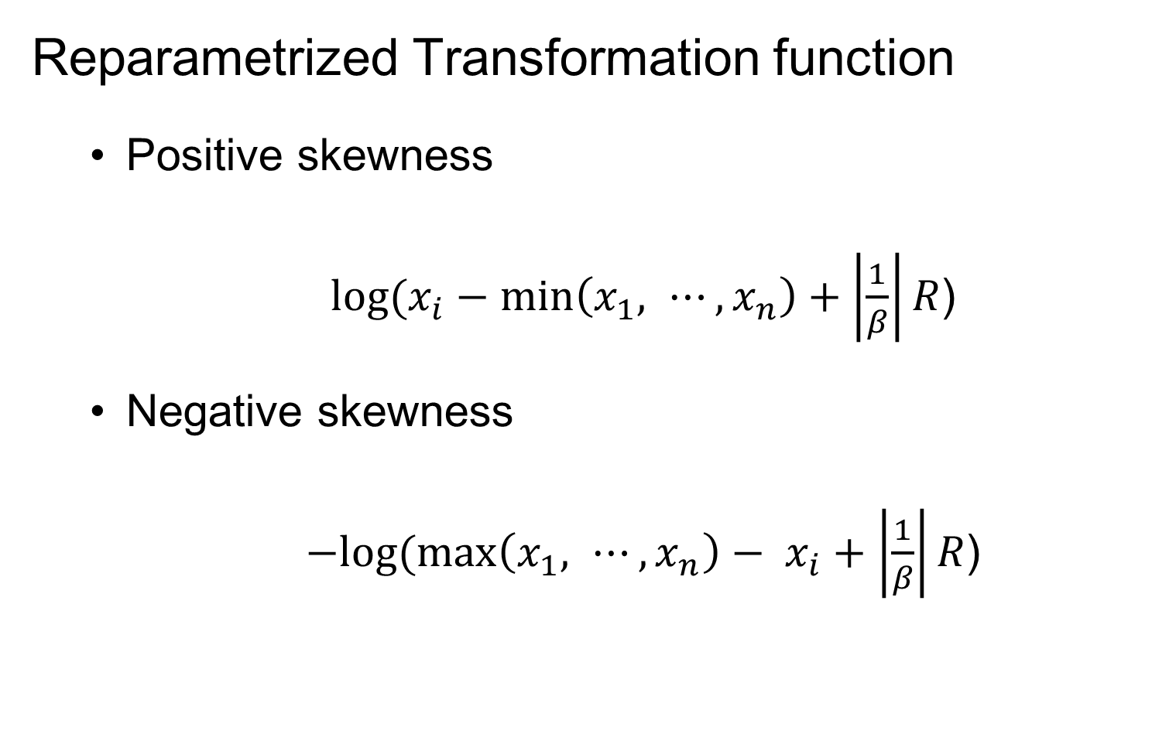
Automatic Transformations
Reparametrized Transformation function
Positive skewness
$log⁡(x_{i}−min\left(x_{1}, ⋯,x_{n}\right)+\left|\frac{1}{β}\right|R$)
Negative skewness
$−log⁡(\max\left(x_{1}, ⋯,x_{n}\right)− x_{i}+\left|\frac{1}{β}\right|R$)
Notes:
Thus, we further parametrize the parameter eta in terms of the multiples of the range
of the feature vectors
This makes the selection of parameter values beta independent of the data magnitude
The beta ranges from negative inf to positive inf
Now we note that the functions for pos and negative are both symmetric around zero
Thus we can take advantage of it and combine them into one family of functions.

Slide 28

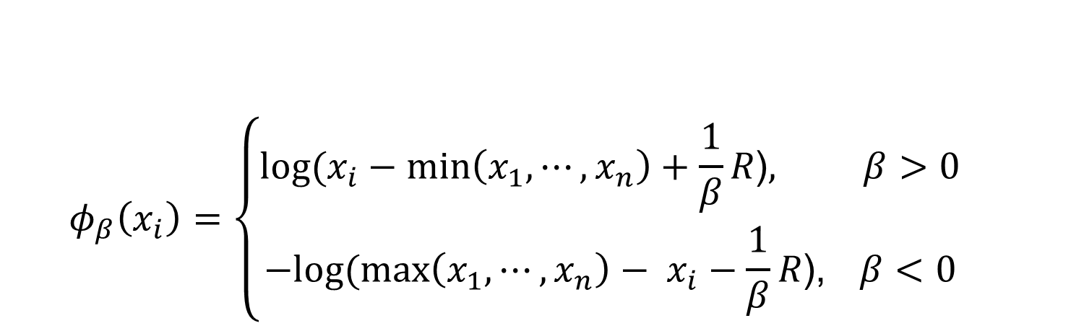
Automatic Transformations
$$φ_{β}\left(x_{i}\right)=\left\{\begin{aligned}log⁡(x_{i}−min\left(x_{1}, ⋯,x_{n}\right)+\frac{1}{β}R\text{)}, β>0 \\ −log⁡(\max\left(x_{1}, ⋯,x_{n}\right)− x_{i}−\frac{1}{β}R\text{)}\text{, }β<0\end{aligned}\right.$$
Family of transformation functions
Comments
Single family including both positive and negative skewness
Parameter value selection is independent of data magnitude
As $β→0$: transformation + standardization $→$
$→$ standardization only
Focus On Distributional Shape, Not Scale
Notes:
Finally incorporating all the elements we have discussed the new parameterized family of transformation functions
For beta is positive, transformation for positive skewness
For beta is negative, transformation for negative skewness
And the parameter value selection is independent of data magnitude

Slide 29
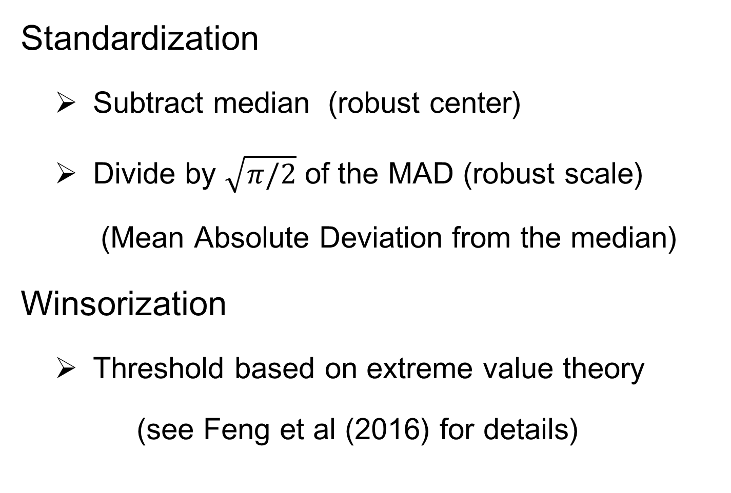
Automatic Transformations
Standardization
Subtract median (robust center)
Divide by $\sqrt{π/2}$ of the MAD (robust scale)
(Mean Absolute Deviation from the median)
Winsorization
Threshold based on extreme value theory
(see Feng et al (2016) for details)
Will Study
More Later
Puts on Scale of Standard Deviation
Move Biggest & Smallest to Quantiles
Notes:
After the shift log transformation, we need to deal with potential influential values by winsorization,
Before that we need a robust standardization ( and I will talk about it later)
To make standardization robust, we will use some robust statistics that is subtracting the median and divide based on the mean absolute deviation from median (not MAD which might be 0)

Slide 30
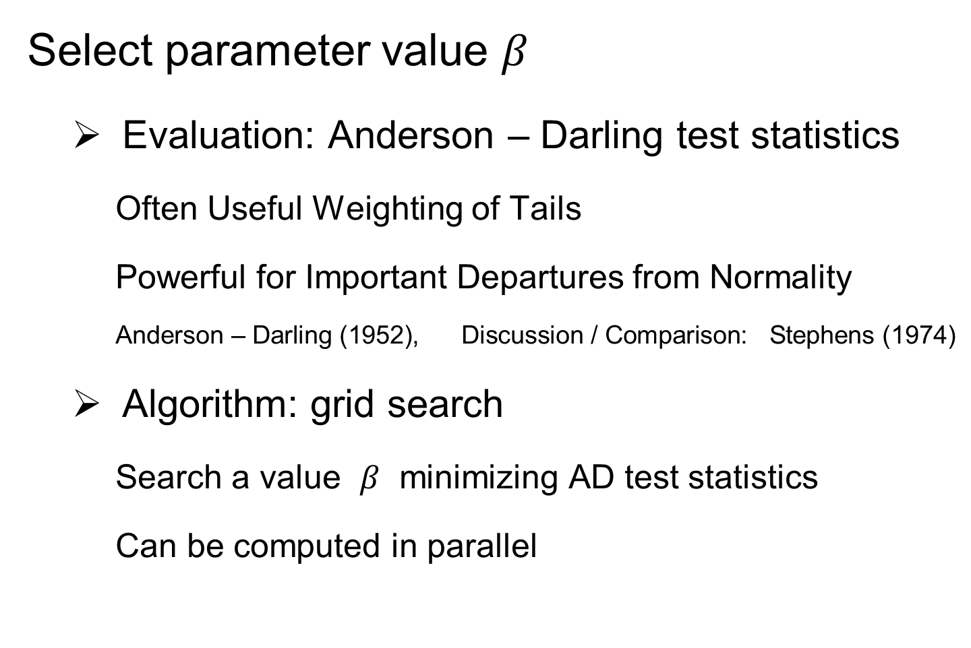
Automatic Transformations
Select parameter value $β$
Evaluation: Anderson – Darling test statistics
Often Useful Weighting of Tails
Powerful for Important Departures from Normality
Anderson – Darling (1952), Discussion / Comparison: Stephens (1974)
Algorithm: grid search
Search a value $β$ minimizing AD test statistics
Can be computed in parallel
Notes:
Here we a process for transformation which is controlled by the parameter beta
The last step is to deicide the optimal value of beta
To do that, we first need a criteria
A-D test stat is used which measures the distance between the empirical distribution function (EDF) of the transformed data and the cumulative distribution function (CDF) of the standard normal.
It give appropriate weight to the tails using a weighted L2 metric. It is more powerful for detecting
Given the evaluation, we adopt the grid search algorithm for minimizing the A-D test stat.
One major reason for using it is due to the simplicity of computing the stat and complexity of optimizing it. Besides, grid search is useful if the number of parameter to optimize is not large. Another advantage is that the computation of A-D test stat is independent with each other and thus is easy to be computed in parallel.

Slide 31
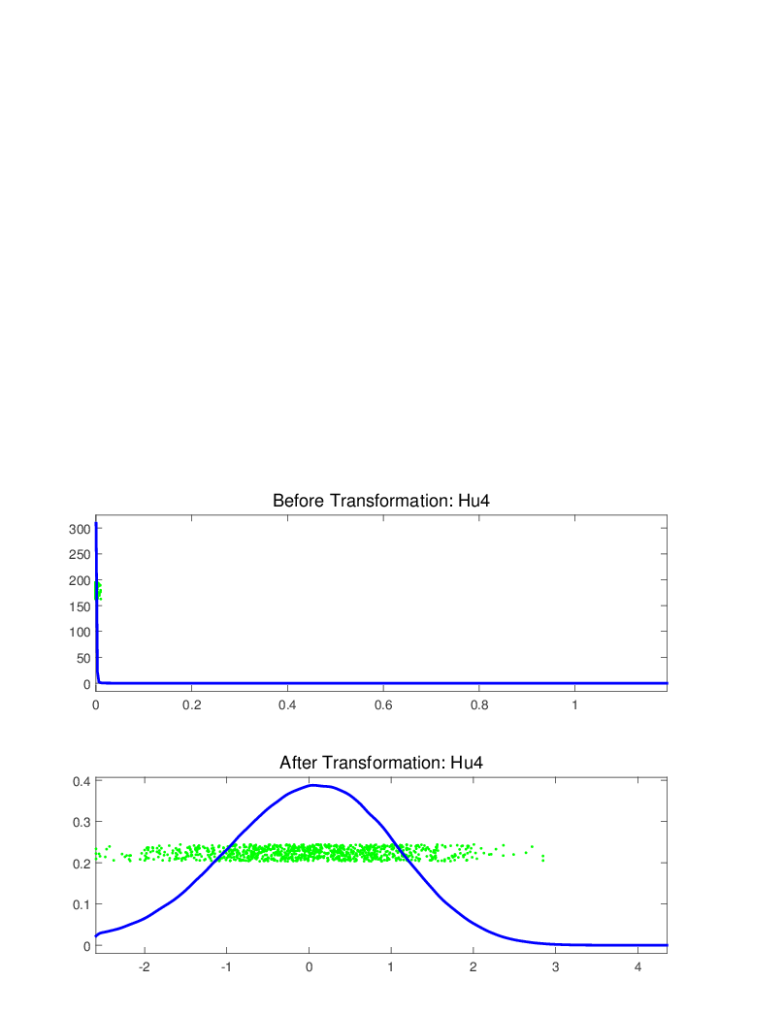
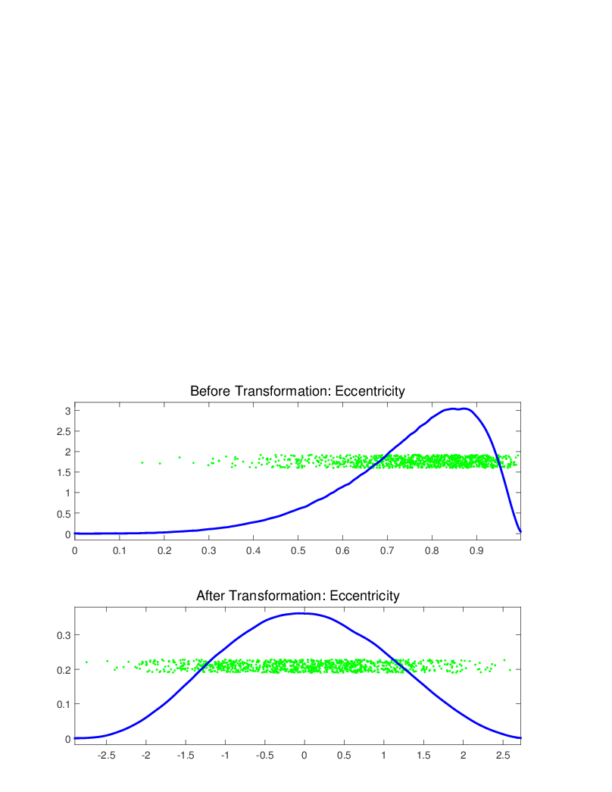
Melanoma Data
Notes:
We applied our automatic transformation on the same melanoma data

Slide 32
Melanoma Data
Much Nicer Distributions
Easily Handles Both Right
& Left Skewness
Notes:
We applied our automatic transformation on the same melanoma data

Slide 33
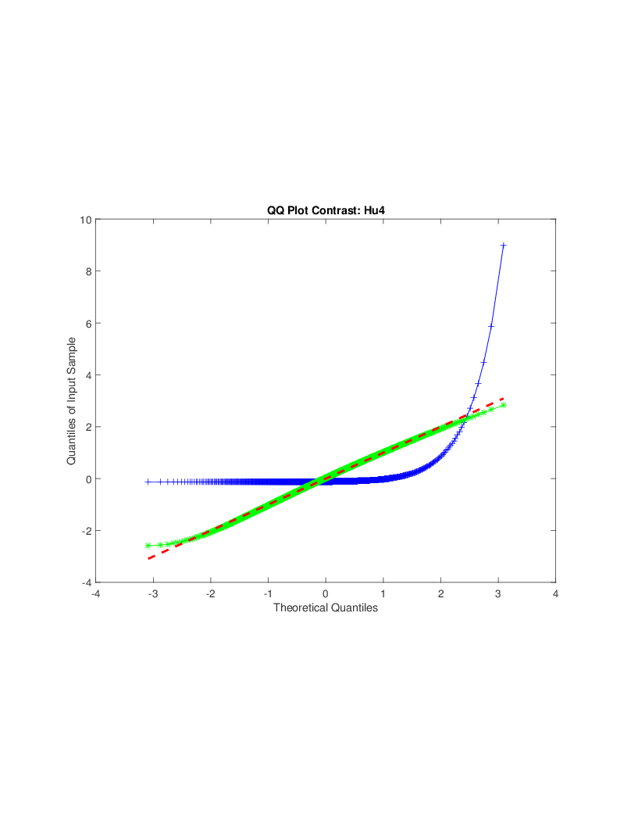
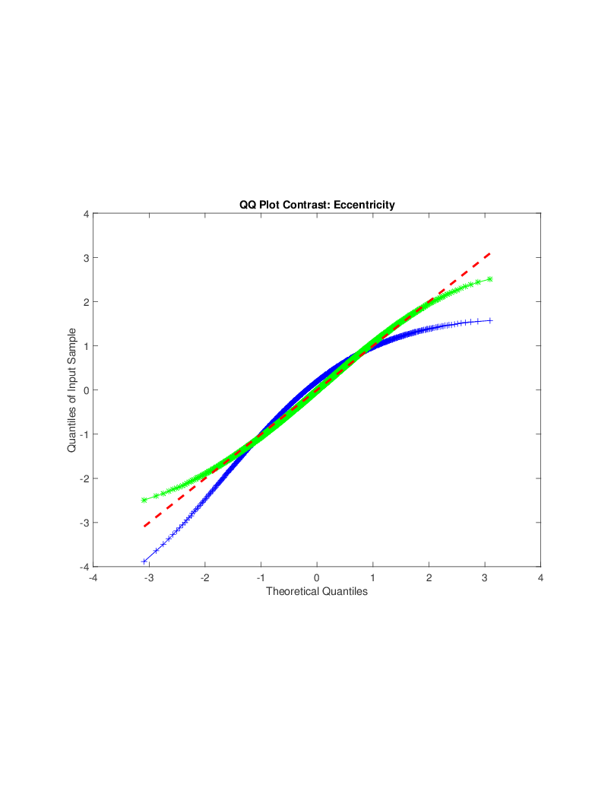

Melanoma Data
Q-Q plot Views (will study in detail later)
(before, after, ${45}^{°}$ line)
Notes:
Use QQ Plot to compare normality

Slide 34
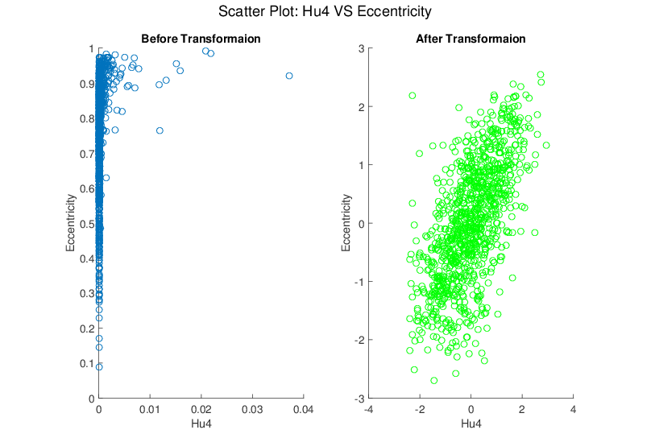
Melanoma Data
Much Nicer Distributions
Notes:
Besides, although the transformation targets at marginal dist
We see improvement of bivariate normality in many real data sets for example here.

Slide 35
Limitations
Shifted Log Transform Not Useful for:
Binary Variables
Symmetric but highly kurtotic distribution
Notes:
No benefit for binary variables.
not useful in modifying a symmetric, but highly kurtotic distribution.

Slide 36

Recall Matlab Software
Again Recall Posted Software for OODA

Slide 37
Automatic Shifted Log Trans.
Matlab Software:
AutoTransQF.m
In General Directory
There is an R Version
Under Development

Slide 38
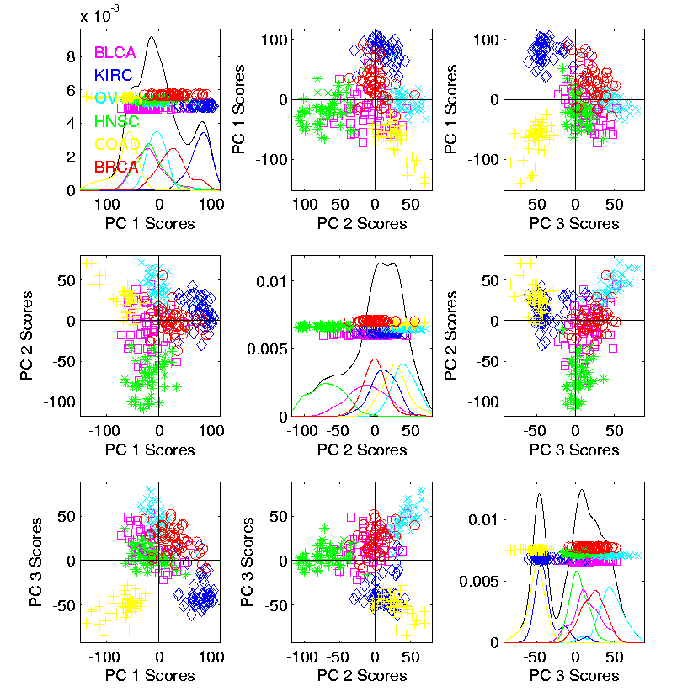
Revisit Gene Expression
More Cancer
Data
Focus On:
Ovarian &
Uterine Types

Slide 39
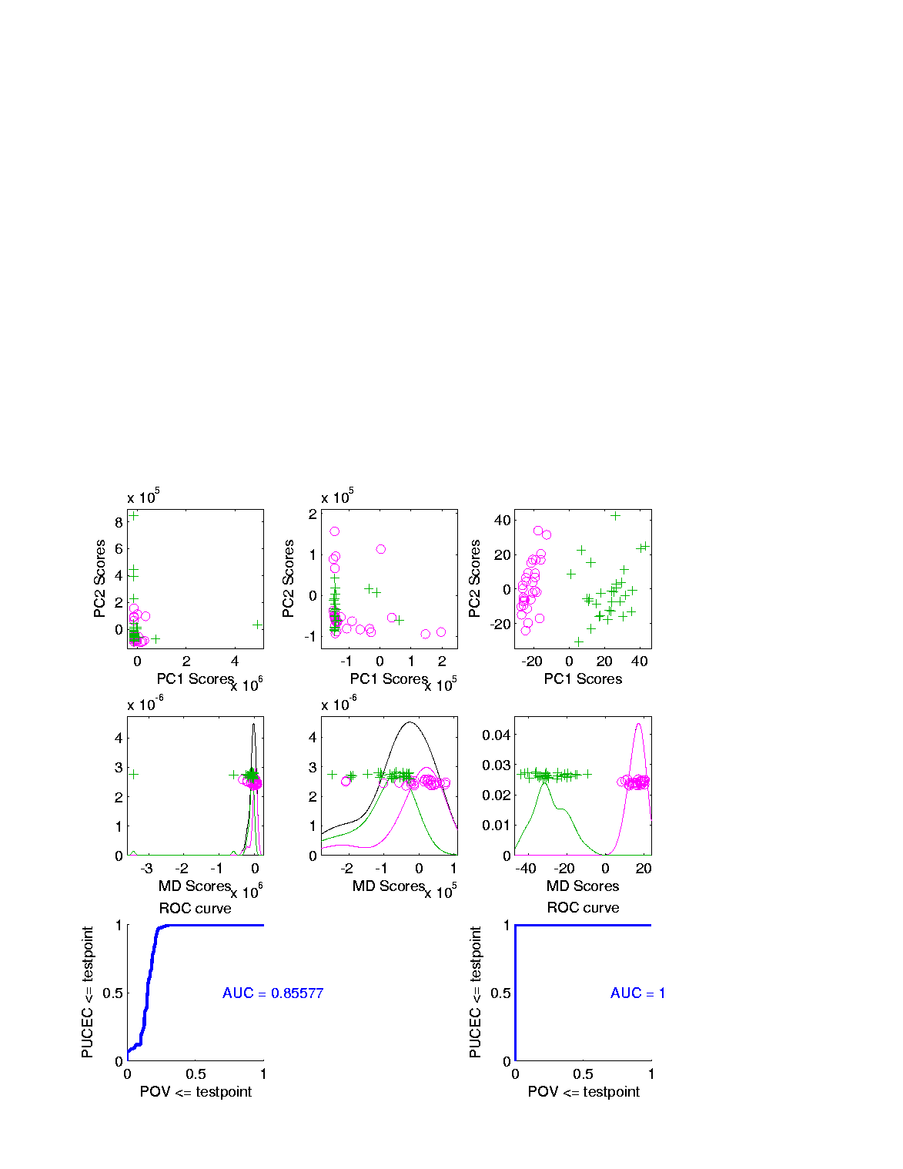
Revisit Gene Expression
Ovarian (o) & Uterine (+) Cancer Cases
Raw Data PCA
Zoom In
Proj’ns on Mean
Difference Dir’n
Zoom In

Slide 40
Revisit Gene Expression
Text: Fig. 5.16
Ovarian (o) & Uterine (+) Cancer Cases
Slide
Over
To Look
At Log
Trans.

Slide 41
Revisit Gene Expression
Text: Fig. 5.16
Ovarian (o) & Uterine (+) Cancer Cases
PC Directions Not
Driven By Outliers
Add In Automatic
Log Transformed PCA
Proj’ns on Mean
Difference Dir’n
Note Much
Better

Slide 42
Revisit Gene Expression
Text: Fig. 5.16
Ovarian (o) & Uterine (+) Cancer Cases
Quantification
Of Better
Separation???

Slide 43
Revisit Gene Expression
Text: Fig. 5.16
Quantify
Separation
Of Groups
Using
ROC Curves

Slide 44
ROC Curve
Challenge:
Measure “Goodness of Separation”
Approach from Signal Detection:
Receiver Operator Characteristic
(ROC) Curve
Developed in WWII, History in
Green and Swets (1966)
(Of Two 1-d Data Sets)

Slide 45
ROC Curve
Challenge:
Measure “Goodness of Separation”
Approach from Signal Detection:
Receiver Operator Characteristic
(ROC) Curve
Good Modern Treatment:
DeLong, DeLong & Clarke-Pearson (1988)

Slide 46
ROC Curve
Challenge:
Measure “Goodness of Separation”
Idea: For Range of Cutoffs
Plot:
Prop’n +1’s Smaller than Cutoff
Vs.
Prop’n -1s Smaller than Cutoff

Slide 47
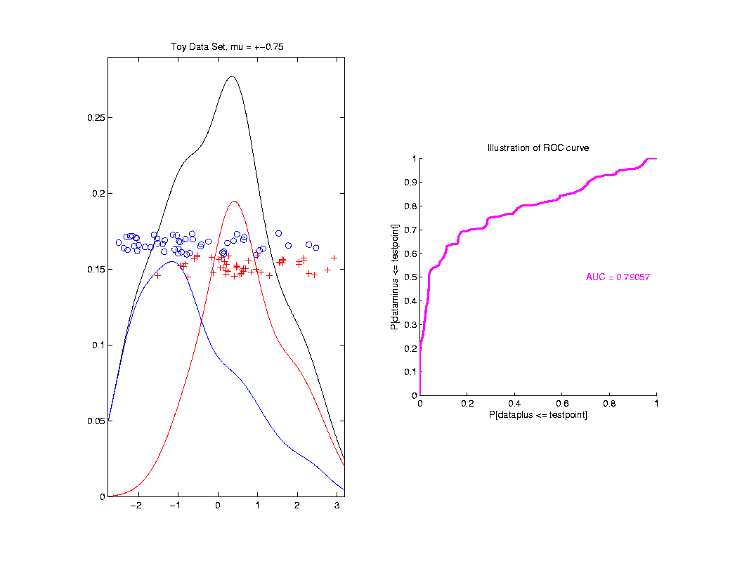
ROC Curve
Aim:
Quantify
“Overlap”
Approach
Consider
Series
Of Cutoffs

Slide 48
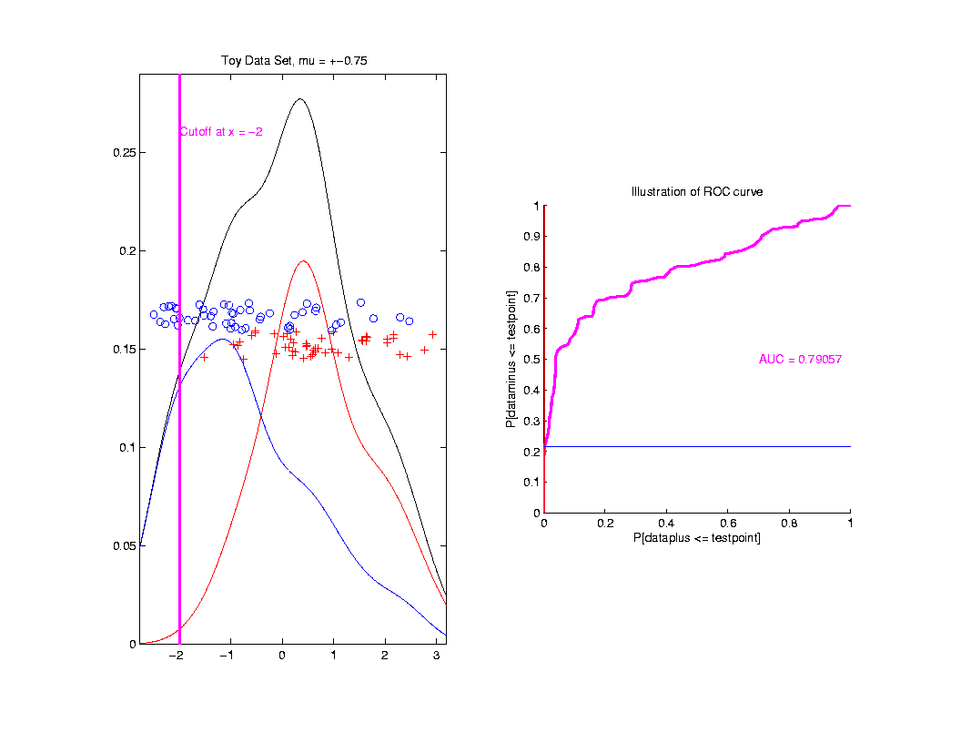
ROC Curve
Approach
Consider
Series
Of Cutoffs

Slide 49
ROC Curve
X-coord
Is Prop’n
Of Reds
Smaller

Slide 50
ROC Curve
X-coord
Is Prop’n
Of Reds
Smaller
Y-coord
Is Prop’n
Of Blues
Smaller

Slide 51
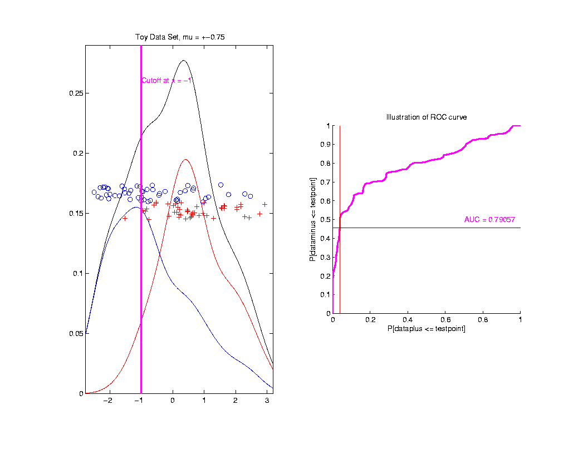
ROC Curve
Slide
Cutoff
To
Trace
Out
Curve

Slide 52
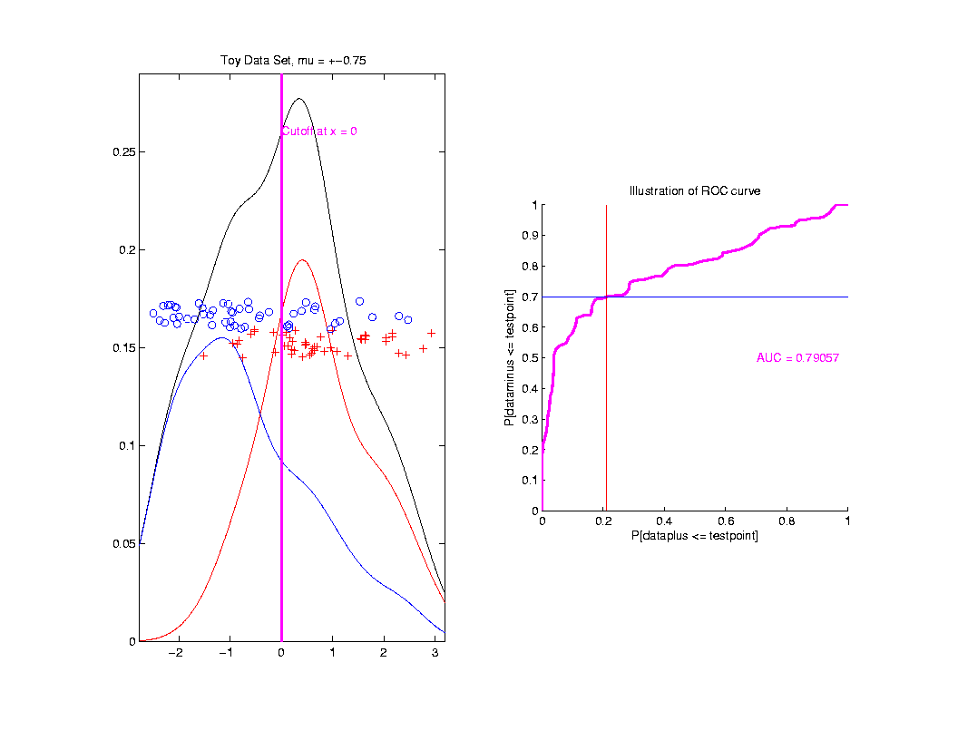
ROC Curve
Slide
Cutoff
To
Trace
Out
Curve

Slide 53
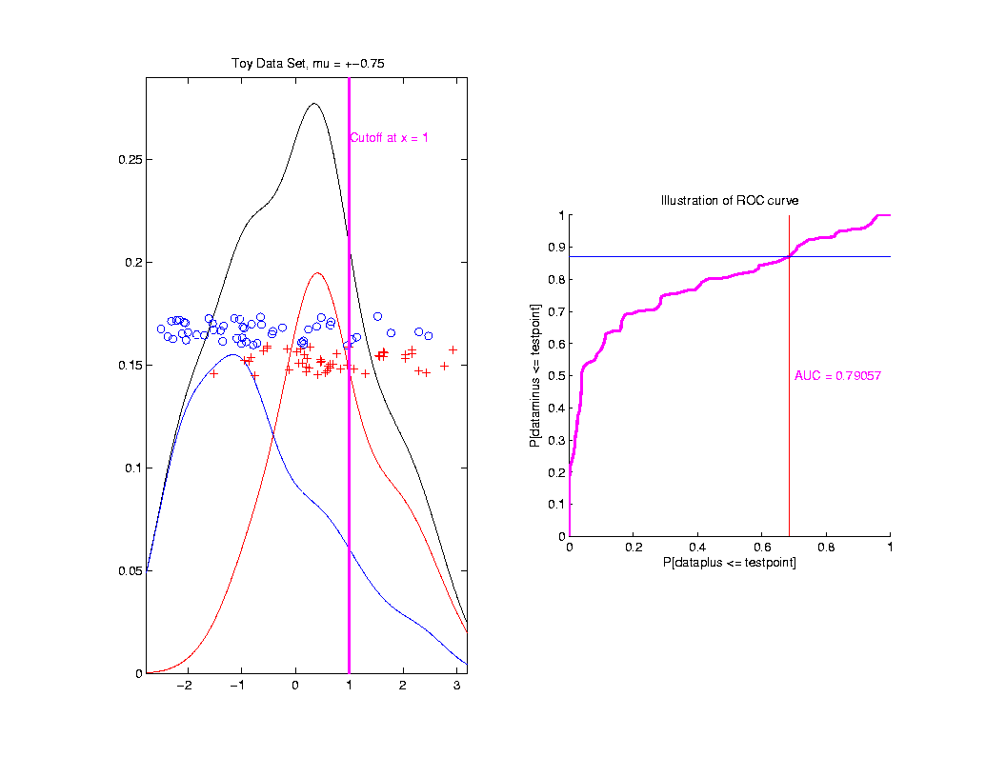
ROC Curve
Slide
Cutoff
To
Trace
Out
Curve

Slide 54
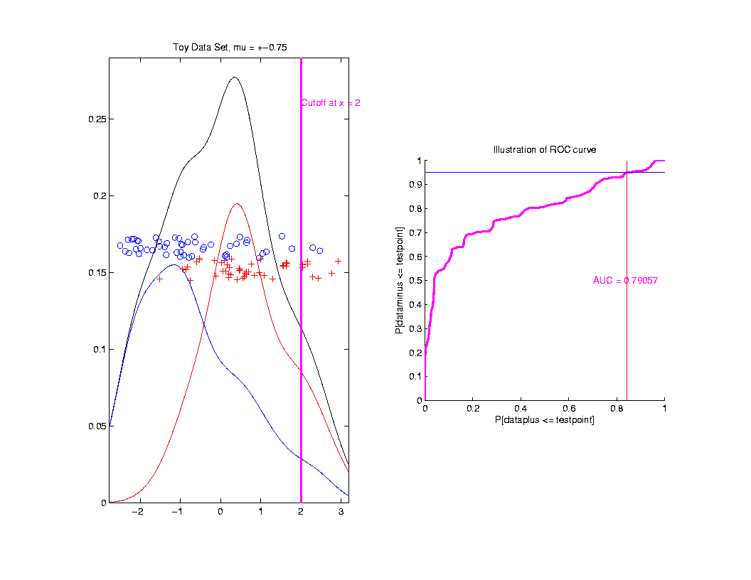
ROC Curve
Slide
Cutoff
To
Trace
Out
Curve

Slide 55
ROC Curve
Better
Separation
Is “More
To Upper
Left”
Useful Summary:
Area Under the Curve

Slide 56
ROC Curve
Alternate Interpretation
Given
Separating
Boundary
Between
Blue & Red
Prop’n
Blues
“Correct”
Prop’n
Reds
“Correct”
Called “True Positive” and “True Negative” Classification Rates
ROC Curve Summarizes Over Cutoffs

Slide 57
ROC Curve
Summarize
& Compare
Using
Area
Under
Curve
(AUC)

Slide 58
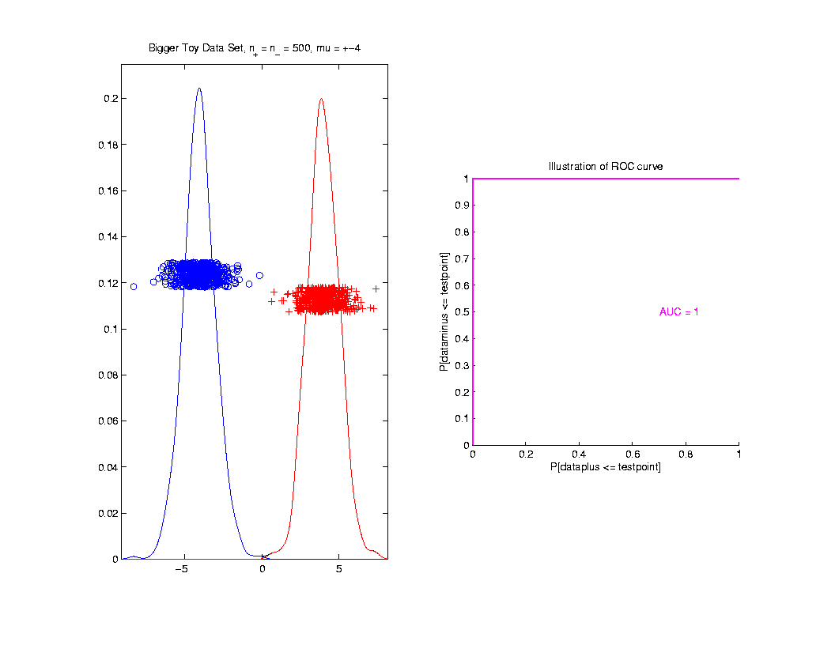
ROC Curve
Toy
Example
Perfect
Separation

Slide 59
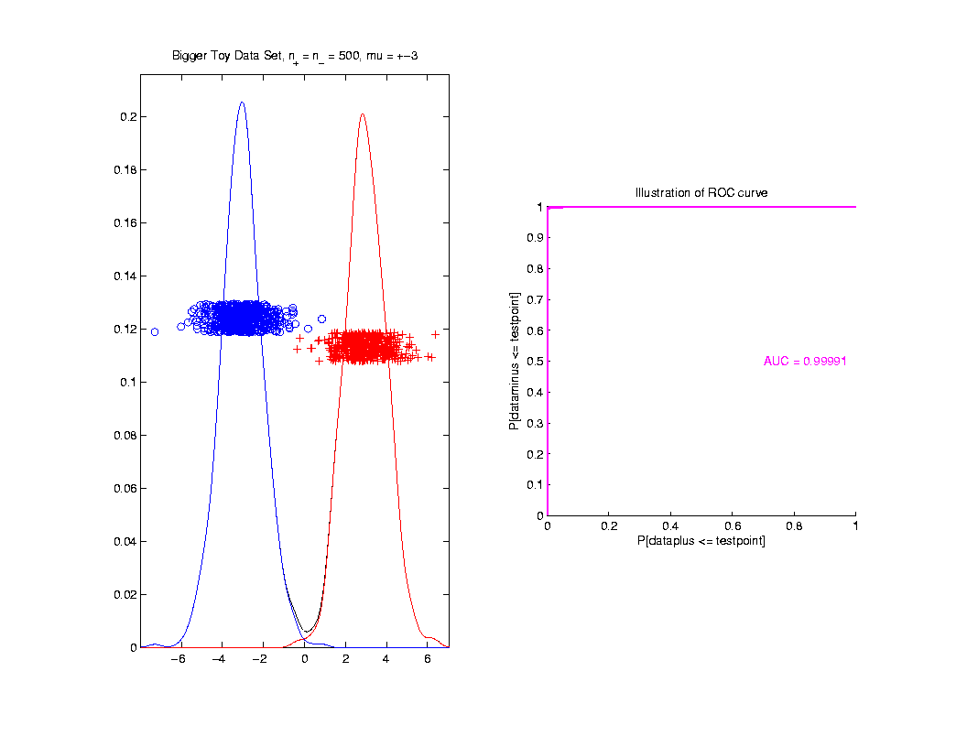
ROC Curve
Toy
Example
Very
Slight
Overlap

Slide 60
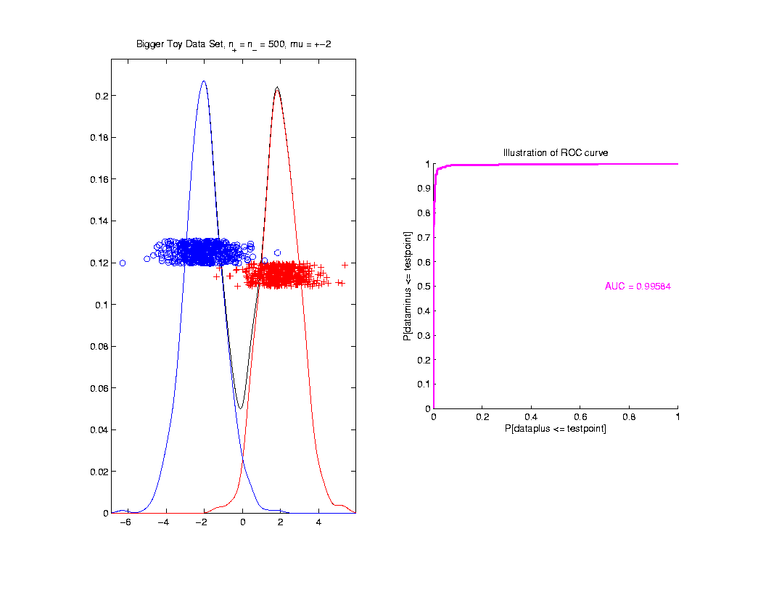
ROC Curve
Toy
Example
Little
More
Overlap

Slide 61
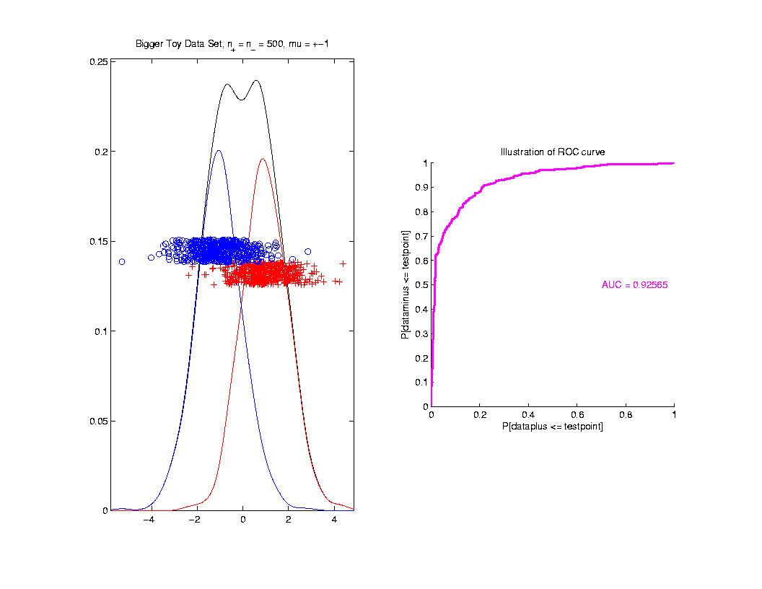
ROC Curve
Toy
Example
More
Overlap

Slide 62
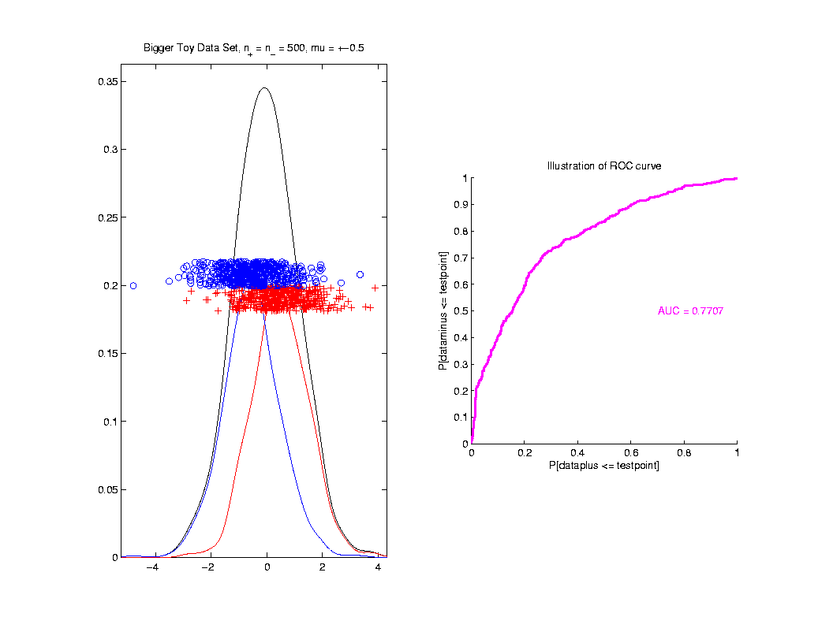
ROC Curve
Toy
Example
Much
More
Overlap

Slide 63
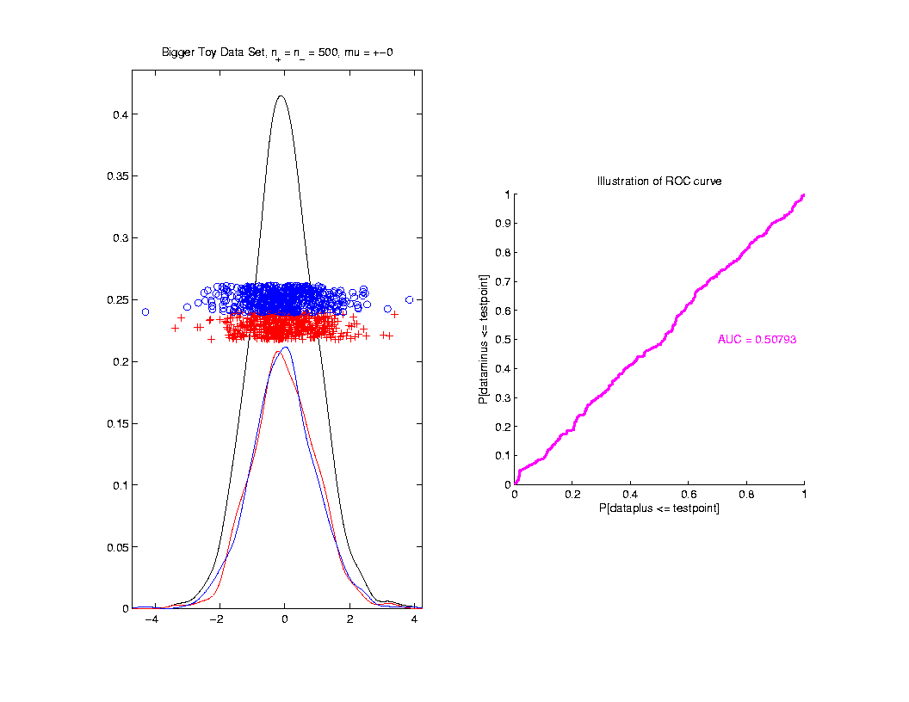
ROC Curve
Toy
Example
Complete
Overlap

Slide 64
ROC Curve
Toy
Example
Complete
Overlap
AUC ≈ 0.5 Reflects “Coin Tossing”

Slide 65
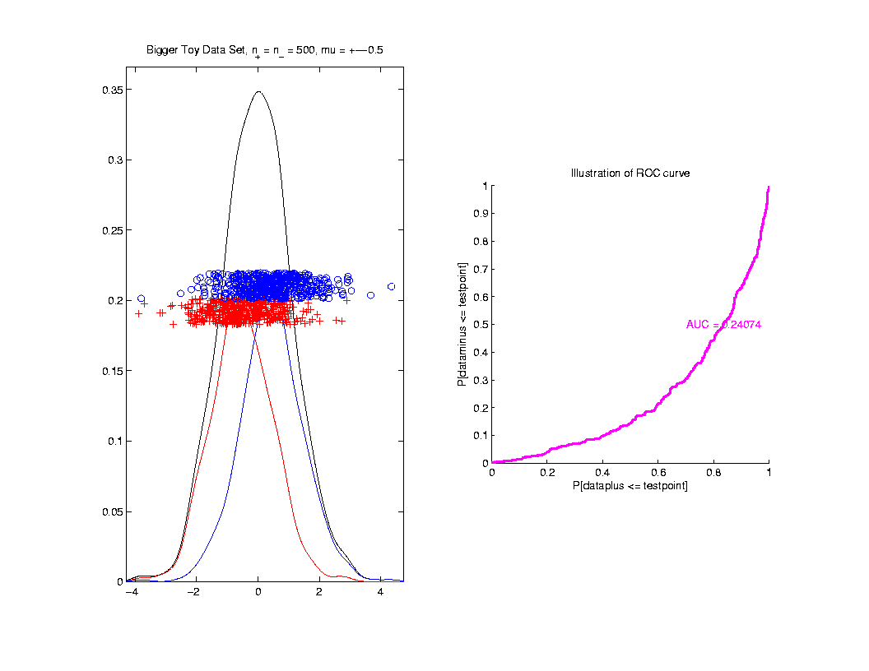
ROC Curve
Toy
Example
Can
Reflect
“Worse
Than Coin
Tossing”
Indication Should
Swap Class Labels

Slide 66
ROC Curve
Interpretation of AUC:
Very Context Dependent
Radiology:
“> 70% has Predictive Usefulness”
Varies Field by Field
Bigger is Better

Slide 67
Revisit Gene Expression
ROC Curve
Much Better
For Log
Transformations

Slide 68
Data Visualization
Overview of Visualization Methods:
Curve Views (Modes of Variation)
Scatterplot Matrices (Shows Relationships)
Marginal Distributions
Heat-Map Views

Slide 69
Heat-Map Views
Main Idea:
Look at Full Data Matrix
As an Image (Rectangular Array of “Pixels”)
Coding Values with Colors (Gray Levels)
Text: Sec. 6.1

Slide 70
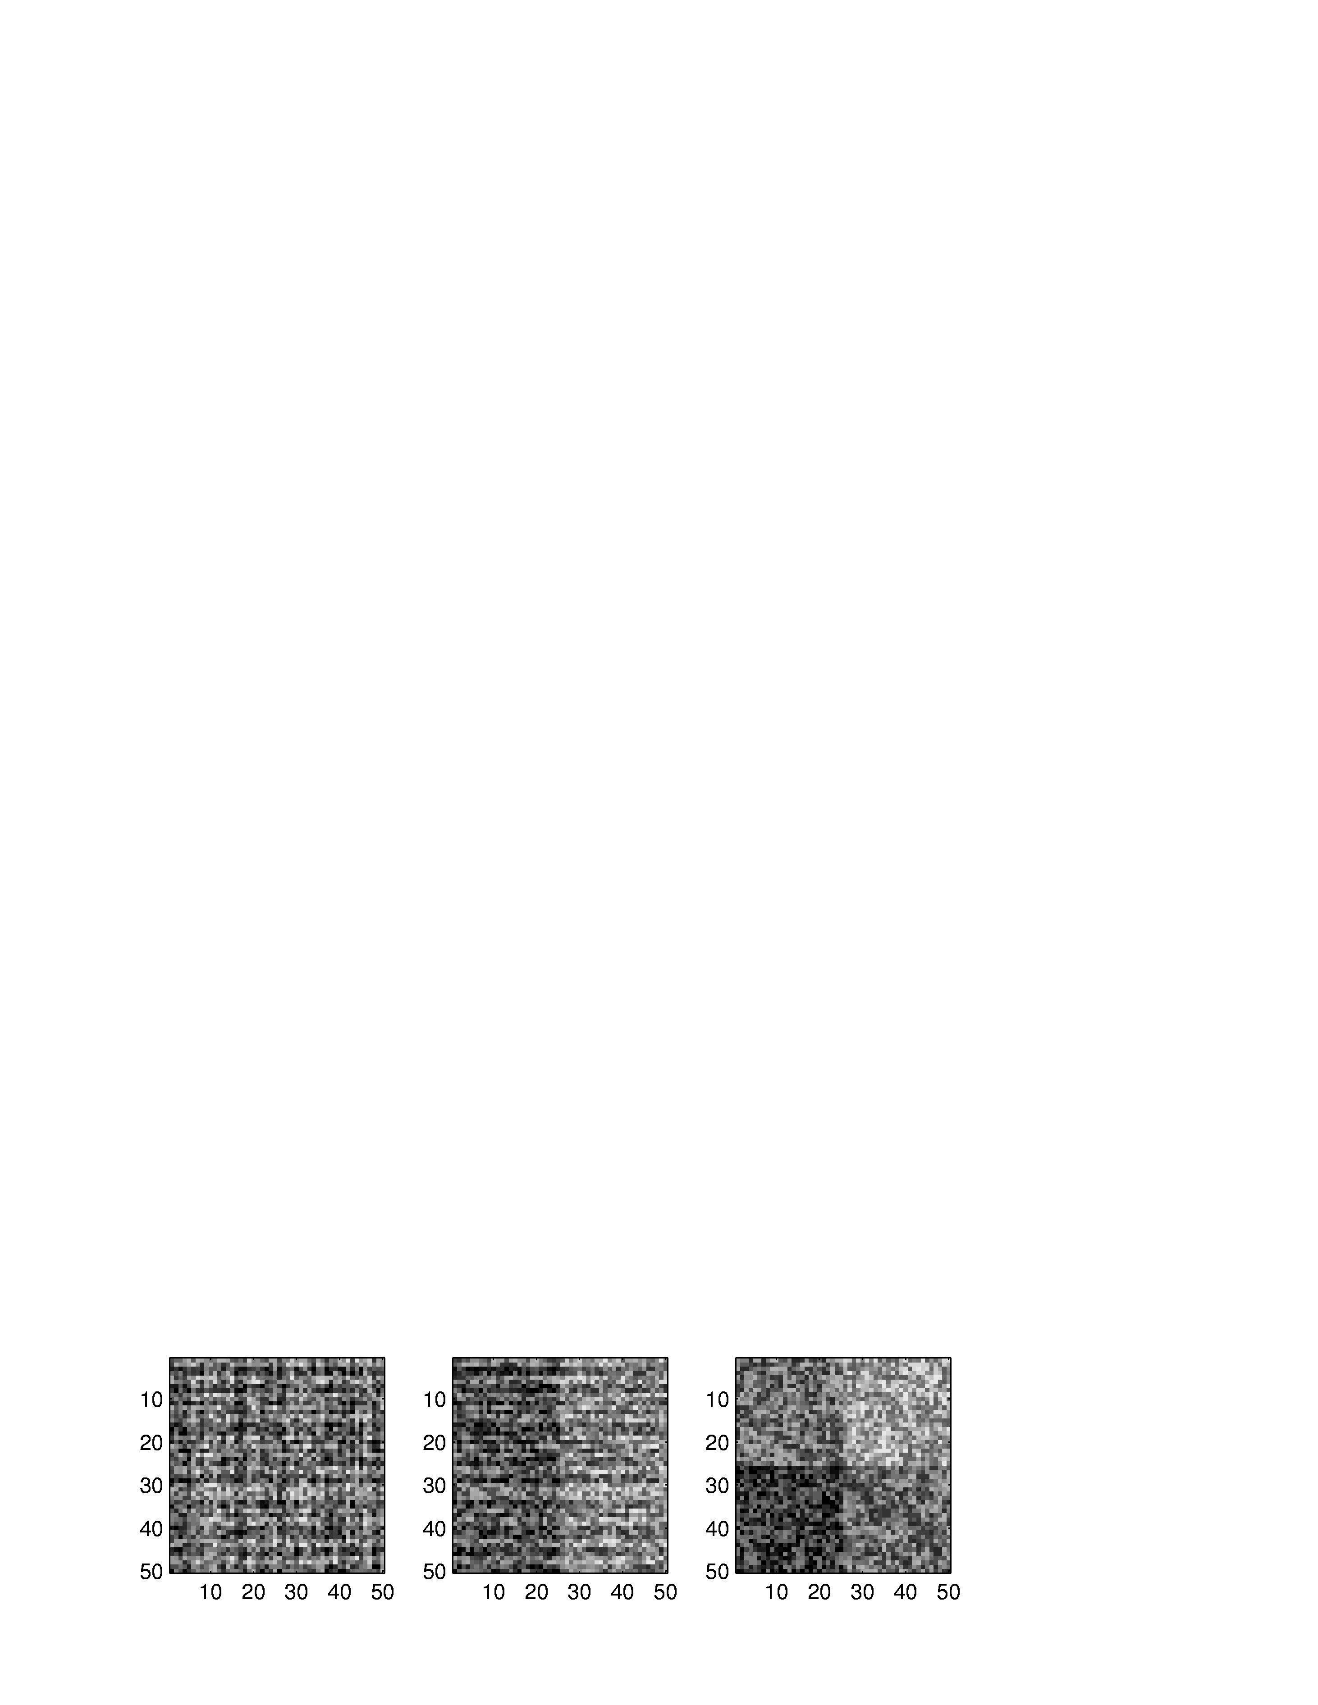
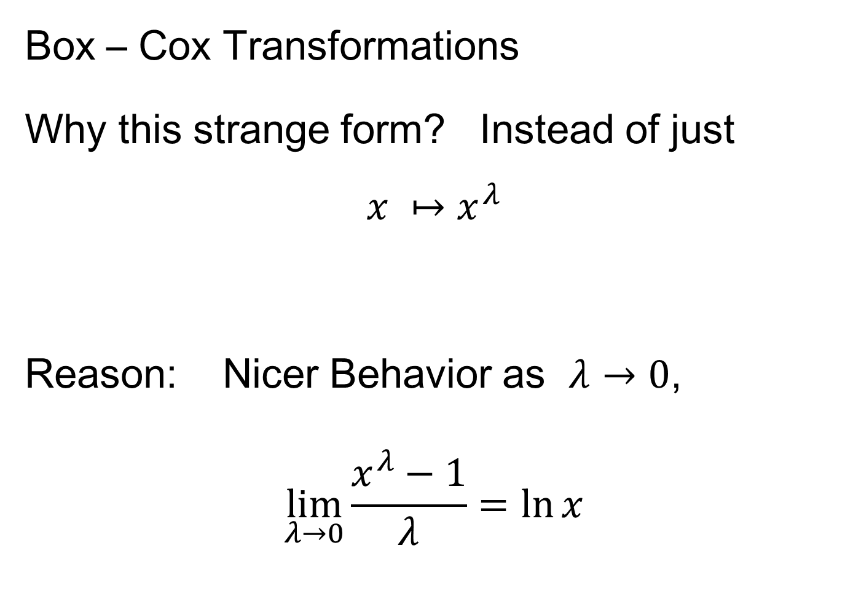
Heat-Map Views
Some Principles:
For Nonnegative Data (i. e. all $x_{i,j}≥0$)
Gray Level is Informative (& Not Distracting)
Actually Gray Level Is Also Good For:
“No Pivotal Value (e.g. 0) To HighLight”
Some Advocate a RAINBOW
Gives “Greater Range”???
Borland & Taylor (2007) Disagree
Over Perceptual Interpretation
(What Is Equally Spaced ???)

Slide 71
Heat-Map Views
Some Principles:
Ordering Rows and Columns Really Matters
Clustering Columns Highlights Relationships
Clustering “Knobs”:
Hierarchical with
Euclidean Distance
& Average Linkage

Slide 72
Heat-Map Views
Some Principles:
Ordering Rows and Columns Really Matters
Clustering Columns & Rows is Crucial
Population Structure
Invisible w/ Random Order

Slide 73
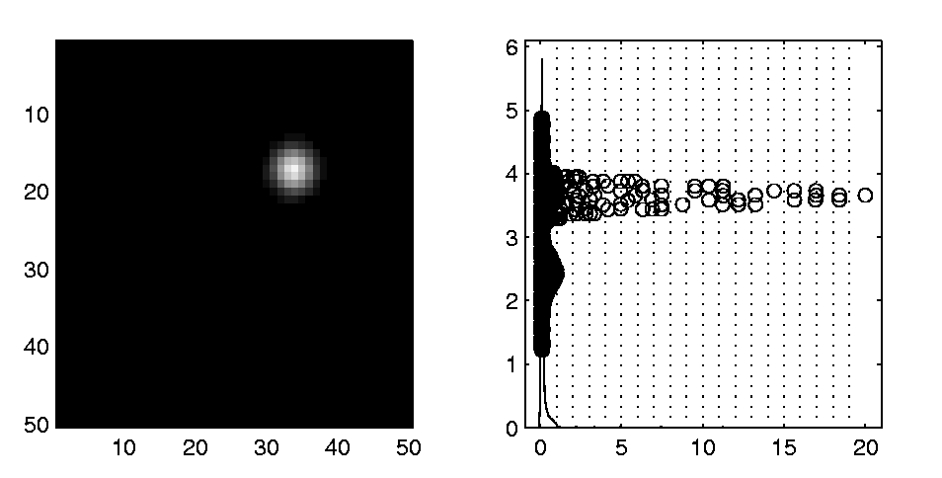
Heat-Map Views
Dist’n of Values, with Usual
Jitter Plot + Smooth Histo
Some Principles:
Color Scale is Also Critical
Equal Bin Spacing
Toy Example
Many Small
Values & Few
Large Ones
Results in Very
Poor Contrast

Slide 74
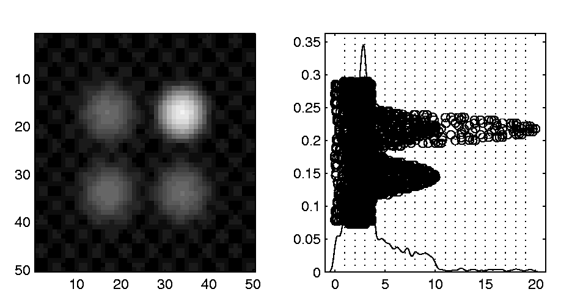
Heat-Map Views
Natural Approach (to Skewed Dist’n):
Log Transformation
Much Better
Scaling, Using
More of the
Color Range
Same Toy Example
Much Better
Contrast, Now
See 4 Peaks

Slide 75
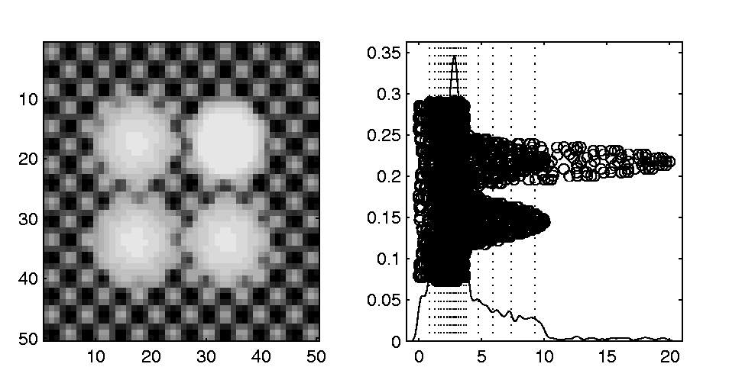
Heat-Map Views
Can Look at Either
Original Or Log View
Natural Approach (to Skewed Dist’n):
Quantile Scaling (= #s in Each Bin)
Same Toy Example
Non-Equally Spaced Bins
Far More
Contrast
Good or Bad?
Peaks Less
Prominent

Slide 76
Heat-Map Views
“Best” Choice of Color Scaling:
Context Dependent
Equally Spaced (Most Interpretable?)
Log Spacing (Can Be Very Useful)
Quantile Spacing (Also Useful)
Should Look At Several & Decide

Slide 77
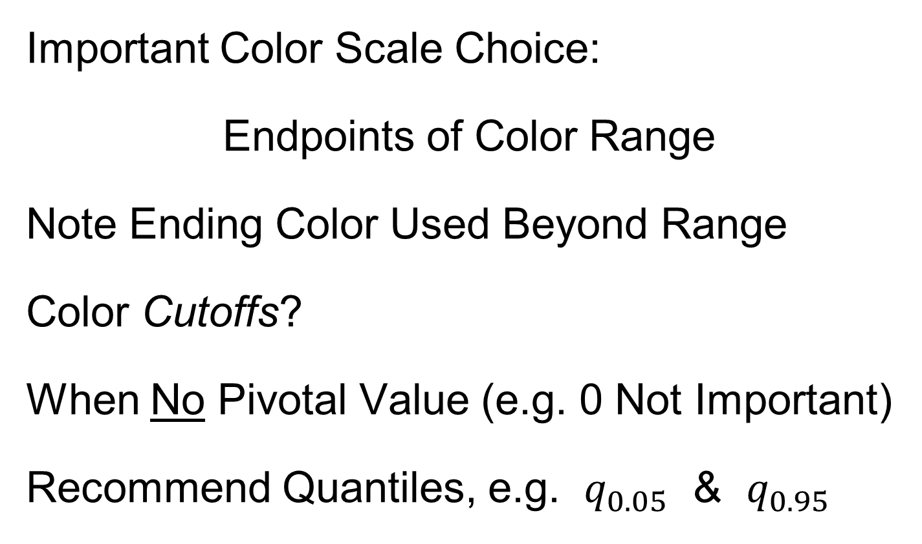
Heat-Map Views
Important Color Scale Choice:
Endpoints of Color Range
Note Ending Color Used Beyond Range
Color Cutoffs?
When No Pivotal Value (e.g. 0 Not Important)
Recommend Quantiles, e.g. $q_{0.05}$ & $q_{0.95}$
Often Worth
Twiddling These

Slide 78


Heat-Map Views
Color Choice When 0 Needs Highlighting
A Recommendation ($∃$ Many):
Important: Middle White Highlights 0
Shade Indicates Magnitude
Red for <0? (Econ.) for >0? (Climatology)

Slide 79

Heat-Map Views
Color Choice When 0 Needs Highlighting
A Recommendation ($∃$ Many):
Why Not Red-Green??? (Common in Bioinf.)
~10% of European (Ancestry) Males are Red-Green Colorblind
Most Other Choices as Good as This

Slide 80

Heat-Map Views
Caution: Many
Packages Do This!
Color Choice When 0 Needs Highlighting
Endpoints? ($q_{0.05}$ & $q_{0.95}$ Will Re-Center!)
Recommend Using Absolute Quantiles:
$±{\left|q\right|}_{0.90}$
Where ${\left|q\right|}_{α}$ is $α$-th Quantile of $\left|X_{1}\right|,⋯,\left|X_{n}\right|$
About Half
At Each End

Slide 81

Recall Real Data Curve Objects
Lung Cancer Data Example
Genetics (Cancer Research)
RNAseq (Next Gener’n Sequen’g)
Deep look at “gene components”
Gene studied here: CDKN2A
Goal: Study Alternate Splicing
Sample Size, $n = 180$
Dimension, $d = 1709$

Slide 82

Recall Lung Cancer Curve Objects
Simple
1st
View:
Curve
Overlay
(counts
scale)
Note: Data Set
Structure May
Be Hidden In
Low Areas
I. Object Representation

Slide 83

Recall Lung Cancer Curve Objects
Simple
1st
View:
Curve
Overlay
(log
scale)
I. Object Representation

Slide 84


Recall Lung Cancer Curve Objects
Heatmap View of $\log_{10}(∙+1)$ Counts
Interesting
Structure?
Recall Very Small Exon
Recall Exon With Alternate Splicing
Distribution of Colors
Previous Curves Are Vertical Lines

Slide 85

Recall Lung Cancer Curve Objects
Better
Sort?
Centered (Rows & Columns) Version
Harder to
Interpret?
Distribution of Colors

Slide 86

Recall Lung Cancer Curve Objects
A Better Sorting
Interpretation?
Low Expression Exon Accentuated
Alternate Splicing Appears Here
Distribution of Colors
Conclude Heatmap Worse
Than Modes of Variation Here

Slide 87

Heat-Map Views
Larger Example: $n=200$, $d=20,000$
Major Issue: Most Computer Displays Have Only a Few Thousand Pixels of Resolution
So Cannot See Full Matrix
Most Displays Compensate With Ad Hoc Rules Designed for Text and Natural Images
Can Miss Important Aspects of the Data

Slide 88

Heat-Map Views
Will See OK
For This Data
Larger Example: $n=200$, $d=20,000$
Simple Approach Here: Study 1st $200$ Rows
Looks Totally Random?
Have Done Both Column
And Row Clustering

Slide 89


Heat-Map Views
Larger Example: $n=200$, $d=20,000$
Revisit With Scatterplot Matrix View
Conclude: Heat
Map Worse
Than Scatterplot
In This Case
Colored 1st 100 & 2nd 100
Clear Cluster Structure
Hidden by Noise in
Heatmap View!
Is This Real (or Artifact)?
$N(−0.04,1)$ & $N(0.04,1)$

Slide 90


Heat-Map Views
For Opposite Answer Consider Another
Data Set ($n=d=50$) with Curve View:
Very Noisy
1st 25 Features
>> 2nd 25
Two Clear
Clusters
Understand Pop’n
Structure???

Slide 91
Heat-Map Views
Data Source is Above Example:
Gives Quicker Impression of Structure
More Natural View Than Curves
2 Clusters
1st Features Larger

Slide 92
Heat-Map Views
One More Point (From This Example):
Than Both Separated
Mean +/- Curves
Easier to Understand

Slide 93
Heat-Map Views
Which Data View Is “Best”???
Heat Maps?
Curves?
Scatterplots?

Slide 94

Heat-Map Views
Which Data View Is “Best”???
Simon Sheather Quote:
“Every Dog Has His Day”

Slide 95
Heat-Map Views
“Every Dog Has His Day”
Idea:
Any Data Analytic Method Somebody Likes Has Some Situations Where It Is “Best”
& Of Course Others Where It Is Poor
(Will See This Again)

Slide 96
Heat-Map Views
Some Overview Papers:
History:
Wilkinson & Friendly (2009)
Criticism of Common Color Choices:
Borland & Taylor (2007)

Slide 97
Scatterplot Views
All Based on Projections
Now Consider Other Directions
Beyond PCA
Text: Sec. 6.5

Slide 98

Scatterplot Views
Summarize Other Directions to Project On
Classification Directions (e.g. DWD or MD)
Independent Component Analysis
Fourier Basis Directions
Wavelet Basis Directions
Nonnegative Matrix Factorization
$⋮$
Might
Discuss
Later

Slide 99
Scatterplot Views
Summarize Other Directions to Project On
Known Modes of Variation
Izem & Kingsolver (2007), Izem & Marron (2007)
Maximal Smoothness Directions
Gaydos et. al (2013), Kingsolver et. al (2015), Zhang et al. (2014)
Maximal Data Piling
(Will Explore Later)

Slide 100



Centering
Formal Study
Text: Sec. 6.3, 17.1.1
Recall (from 8-21-25) Notation:
Data Matrix:
$\tilde{X}=\left[\begin{matrix}{\tilde{x}}_{1,1} & ⋯ & {\tilde{x}}_{1,n} \\ ⋮ & ⋱ & ⋮ \\ {\tilde{x}}_{d,1} & ⋯ & {\tilde{x}}_{d,n}\end{matrix}\right]$
Tilde ($\sim$) Denotes Random Quantities
Matrices as Bold Capitals
Recall Data Object
Vectors, $j=1,⋯,n$
Recall traits,
$i=1,⋯,d$

Slide 101

Centering
Notation:
Data Object Vectors:
$\tilde{X}=\left[\begin{matrix}{\tilde{x}}_{1,1} & ⋯ & {\tilde{x}}_{1,n} \\ ⋮ & ⋱ & ⋮ \\ {\tilde{x}}_{d,1} & ⋯ & {\tilde{x}}_{d,n}\end{matrix}\right]=\left[\begin{matrix}{\tilde{x}}_{1} & ⋯ & {\tilde{x}}_{n}\end{matrix}\right]$
Vectors, Bold Lowercase: ${\tilde{x}}_{j}=\left(\begin{matrix}{\tilde{x}}_{1,j} \\ ⋮ \\ {\tilde{x}}_{d,j}\end{matrix}\right)∈ℝ^{d}$
Again Tilde Denotes Random Quantities

Slide 102

Centering
Data Matrix:
$\tilde{X}=\left[\begin{matrix}{\tilde{x}}_{1,1} & ⋯ & {\tilde{x}}_{1,n} \\ ⋮ & ⋱ & ⋮ \\ {\tilde{x}}_{d,1} & ⋯ & {\tilde{x}}_{d,n}\end{matrix}\right]$
Column Object Mean:
$${\overline{x}}_{co}=\left(\begin{matrix}{\overline{x}}_{1,A} \\ ⋮ \\ {\overline{x}}_{d,A}\end{matrix}\right)$$
where ${\overline{x}}_{i,A}=\frac{1}{n}\sum_{j=1}^{n}{{\tilde{X}}_{i,j}}$
Objects are Vectors
So Mean Vector Objects
Hence “Object Mean”
Avoid Row-Column
Ambiguity Using
Object Oriented
Nomenclature
Finally Stress “Column”
Could Call This
the “Row Mean”

Slide 103


Centering
Data Matrix:
$\tilde{X}=\left[\begin{matrix}{\tilde{x}}_{1,1} & ⋯ & {\tilde{x}}_{1,n} \\ ⋮ & ⋱ & ⋮ \\ {\tilde{x}}_{d,1} & ⋯ & {\tilde{x}}_{d,n}\end{matrix}\right]$
Additional Notion: Row Trait Mean
${\overline{x}}_{RT}^{t}=\left(\begin{matrix}{\overline{x}}_{A,1} & ⋯ & {\overline{x}}_{A,n}\end{matrix}\right)$ for ${\overline{x}}_{RT}∈ℝ^{n}$
where ${\overline{x}}_{A,j}=\frac{1}{d}\sum_{i=1}^{d}{{\tilde{X}}_{i,j}}$
transpose
Disambiguates
“Row Mean” vs.
“Column Mean”
Space of
$n$-dimensional
Column Vectors

Slide 104
Centering
Much Deeper Discussion
Of Column Object Mean vs. Row Trait Mean
And Respective Centering:
Prothero, et al. (2023)

