Slide 1
Statistics – O. R. 881 Object Oriented Data Analysis
Steve Marron
Dept. of Statistics and Operations Research
University of North Carolina

Slide 2
Participant Presentations
Presentation Options:
Can Use USB Device
Or Your Computer (with HDMI)
Or Class Zoom Link, Notify Me Early
Or One Drive, Set Up Before Class
Or Remote Log-In, Set Up Before Class
Check Website
For Schedule
Thursday, 12:05: Coleman Ferrell

Slide 3
Current Sections in Textbook
Today:
Sections 17.1, 3.1.3, 6.5
Next Class:
Section 17.2

Slide 4

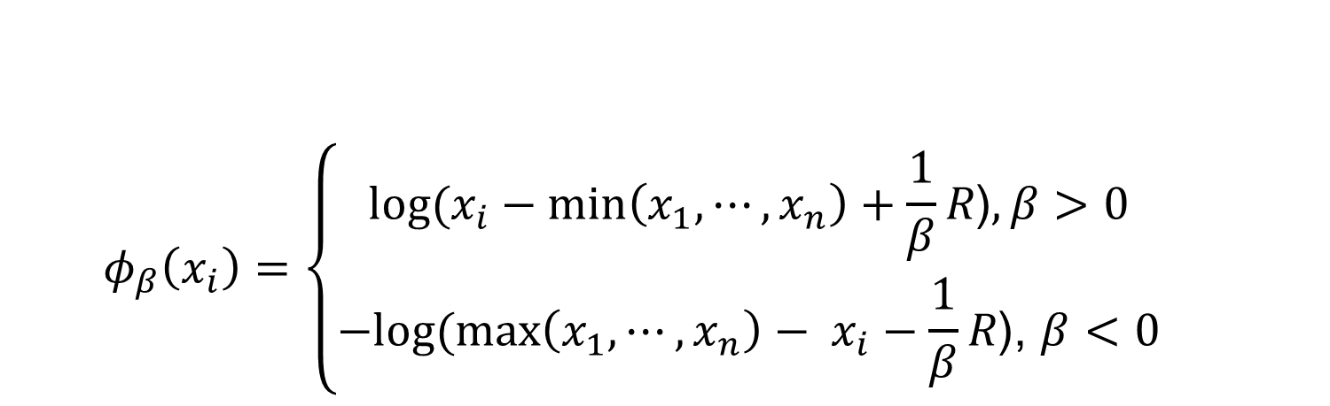
Last Class: Automatic Trans.
$$φ_{β}\left(x_{i}\right)=\left\{\begin{aligned}log⁡(x_{i}−min\left(x_{1}, ⋯,x_{n}\right)+\frac{1}{β}R\text{)}, β>0 \\ −log⁡(\max\left(x_{1}, ⋯,x_{n}\right)− x_{i}−\frac{1}{β}R\text{)}\text{, }β<0\end{aligned}\right.$$
Family of transformation functions
Comments
Single family for both positive and negative skewness
Parameter value selection is independent of data magnitude
As $β→0$: transformation + standardization $→$
$→$ standardization only
Notes:
Finally incorporating all the elements we have discussed the new parameterized family of transformation functions
For beta is positive, transformation for positive skewness
For beta is negative, transformation for negative skewness
And the parameter value selection is independent of data magnitude

Slide 5
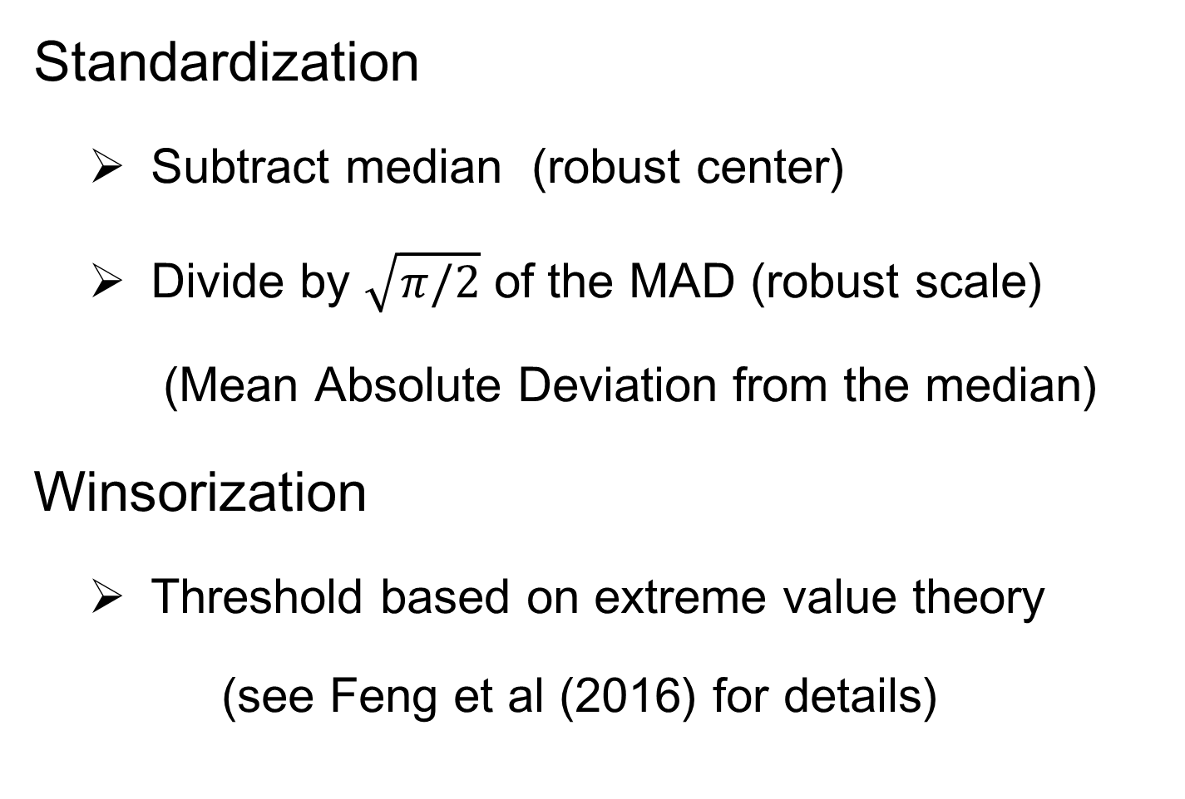
Last Class: Automatic Trans.
Standardization
Subtract median (robust center)
Divide by $\sqrt{π/2}$ of the MAD (robust scale)
(Mean Absolute Deviation from the median)
Winsorization
Threshold based on extreme value theory
(see Feng et al (2016) for details)
Notes:
After the shift log transformation, we need to deal with potential influential values by winsorization,
Before that we need a robust standardization ( and I will talk about it later)
To make standardization robust, we will use some robust statistics that is subtracting the median and divide based on the mean absolute deviation from median (not MAD which might be 0)

Slide 6
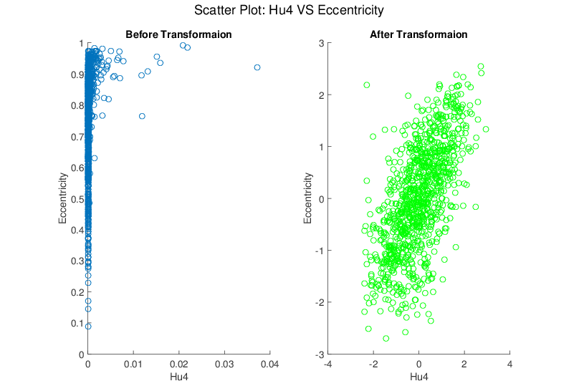
Last Class: Melanoma Data
Much Nicer Distributions
Notes:
Besides, although the transformation targets at marginal dist
We see improvement of bivariate normality in many real data sets for example here.

Slide 7
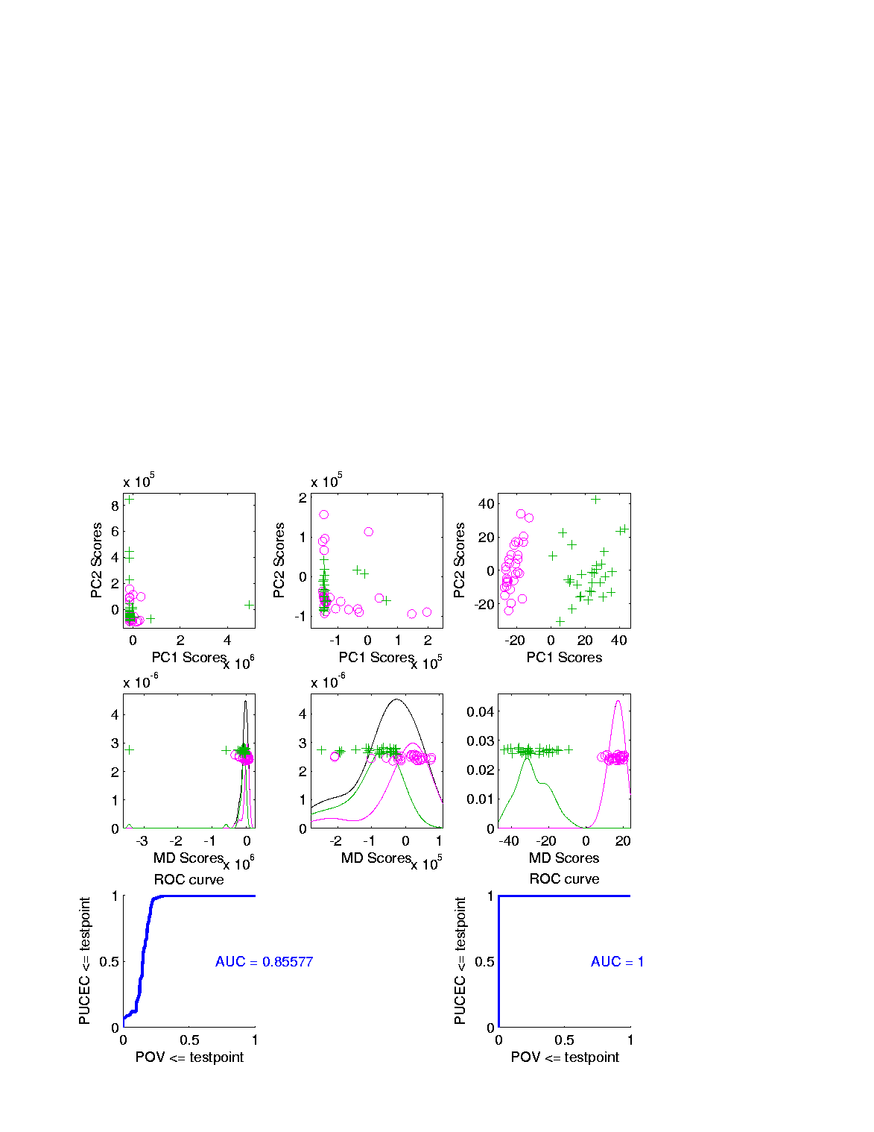
Last Class: Revisit Gene Exp.
Ovarian (o) & Uterine (+) Cancer Cases
Add In Automatic
Log Transformed PCA
Proj’ns on Mean
Difference Dir’n
Note Much
Better

Slide 8
Last Class: Revisit Gene Exp.
ROC Curve
Much Better
For Log
Transformations

Slide 9
Last Class: Heat-Map Views
Main Idea:
Look at Full Data Matrix
As an Image (Rectangular Array of “Pixels”)
Coding Values with Colors (Gray Levels)
Text: Sec. 6.1

Slide 10
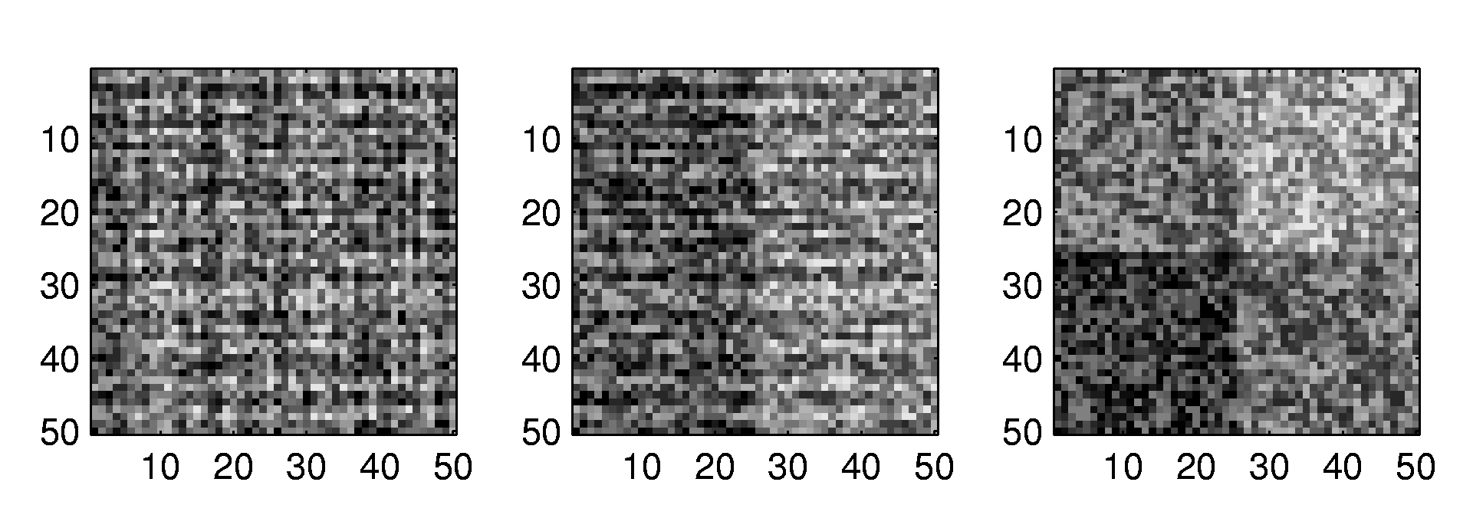
Last Class: Heat-Map Views
Some Principles:
Ordering Rows and Columns Really Matters
Clustering Columns & Rows is Crucial
Population Structure
Invisible w/ Random Order

Slide 11
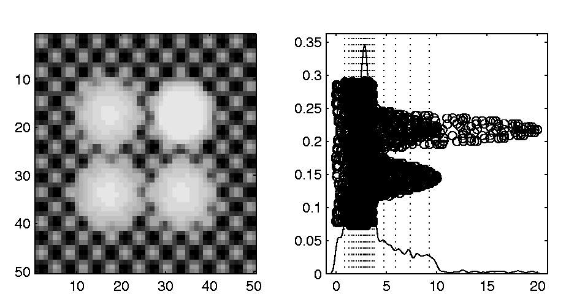
Last Class: Heat-Map Views
Can Look at Either
Original Or Log View
Natural Approach (to Skewed Dist’n):
Quantile Scaling (= #s in Each Bin)
Same Toy Example
Non-Equally Spaced Bins
Far More
Contrast
Good or Bad?
Peaks Less
Prominent

Slide 12
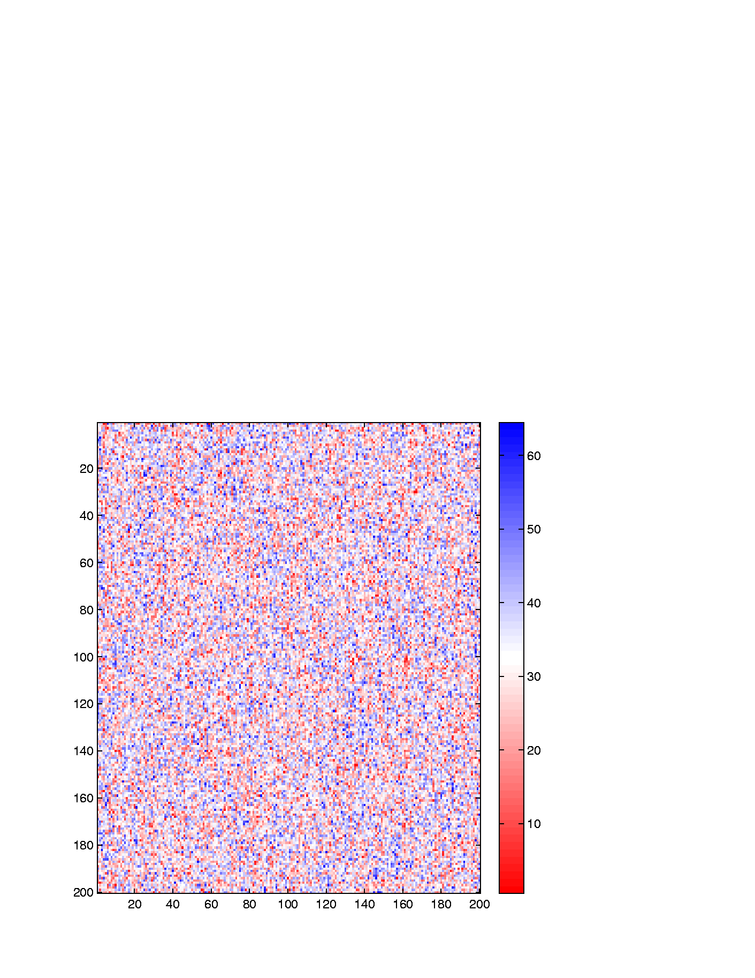
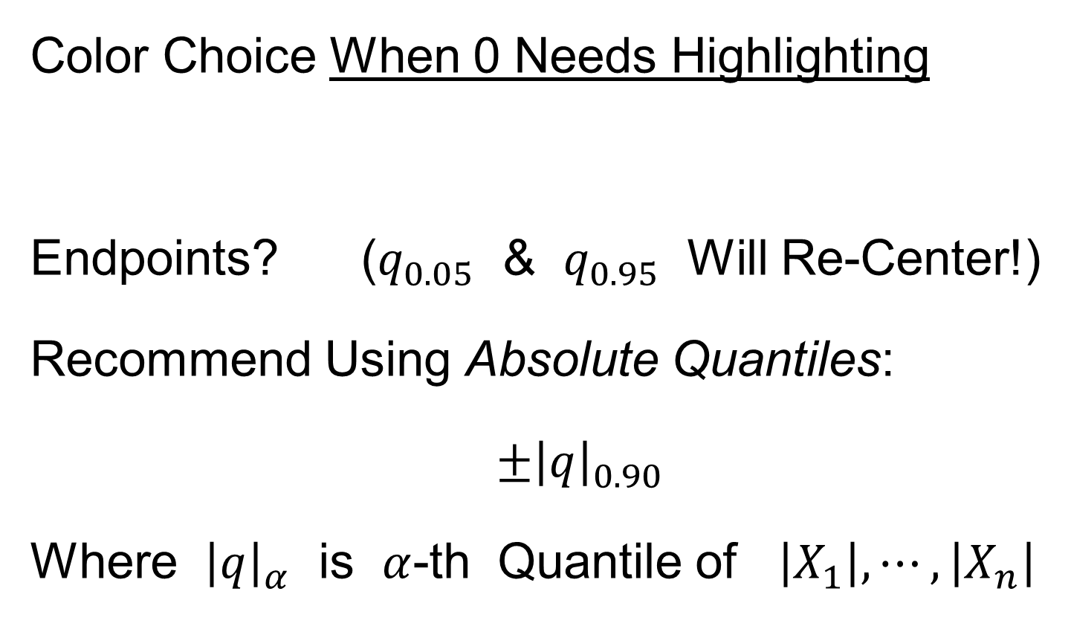
Last Class: Heat-Map Views
Caution: Many
Packages Do This!
Color Choice When 0 Needs Highlighting
Endpoints? ($q_{0.05}$ & $q_{0.95}$ Will Re-Center!)
Recommend Using Absolute Quantiles:
$±{\left|q\right|}_{0.90}$
Where ${\left|q\right|}_{α}$ is $α$-th Quantile of $\left|X_{1}\right|,⋯,\left|X_{n}\right|$

Slide 13
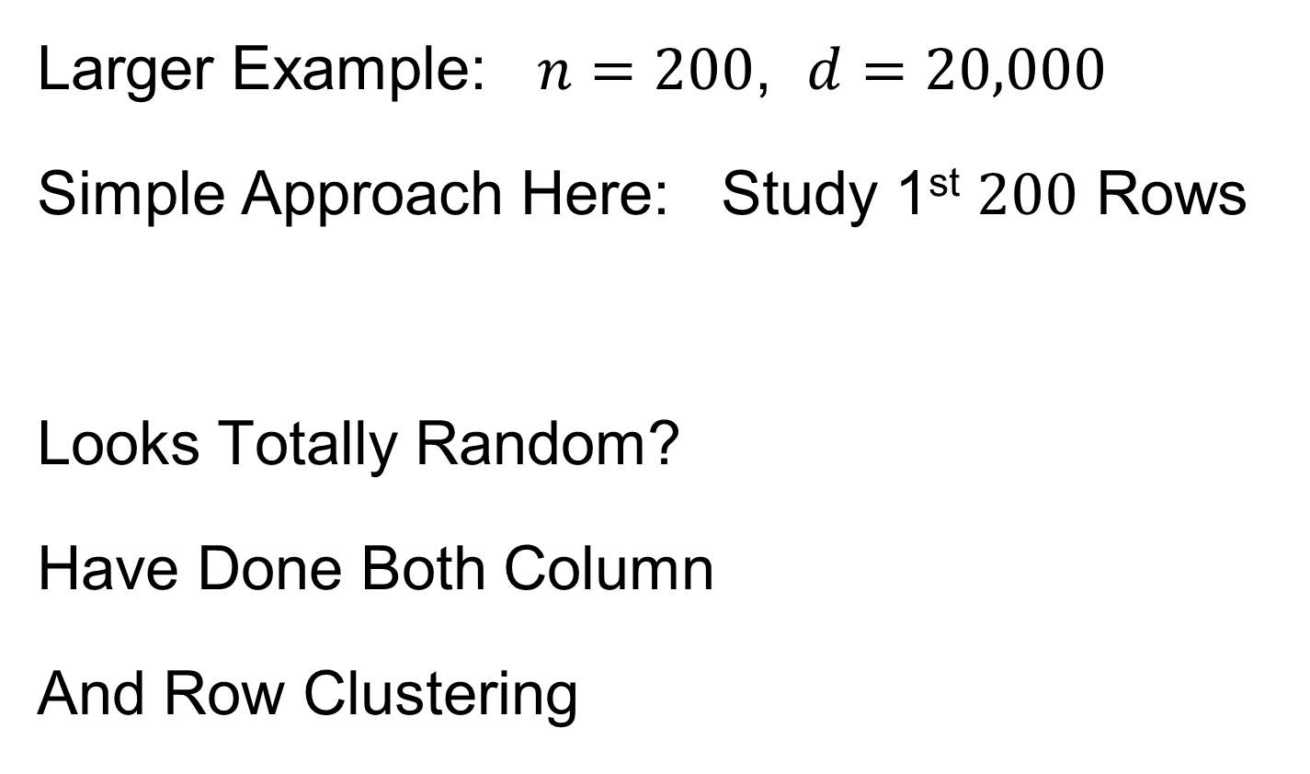
Last Class: Heat-Map Views
Will See OK
For This Data
Larger Example: $n=200$, $d=20,000$
Simple Approach Here: Study 1st $200$ Rows
Looks Totally Random?
Have Done Both Column
And Row Clustering

Slide 14
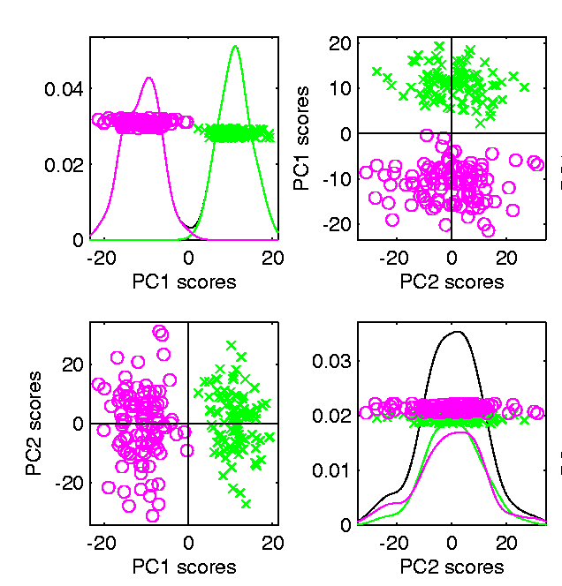

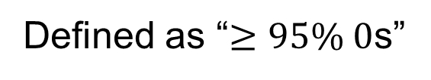
Last Class: Heat-Map Views
Larger Example: $n=200$, $d=20,000$
Revisit With Scatterplot Matrix View
Conclude: Heat
Map Worse
Than Scatterplot
In This Case
Colored 1st 100 & 2nd 100
Clear Cluster Structure
Hidden by Noise in
Heatmap View!
Is This Real (or Artifact)?
$N(−0.04,1)$ & $N(0.04,1)$

Slide 15
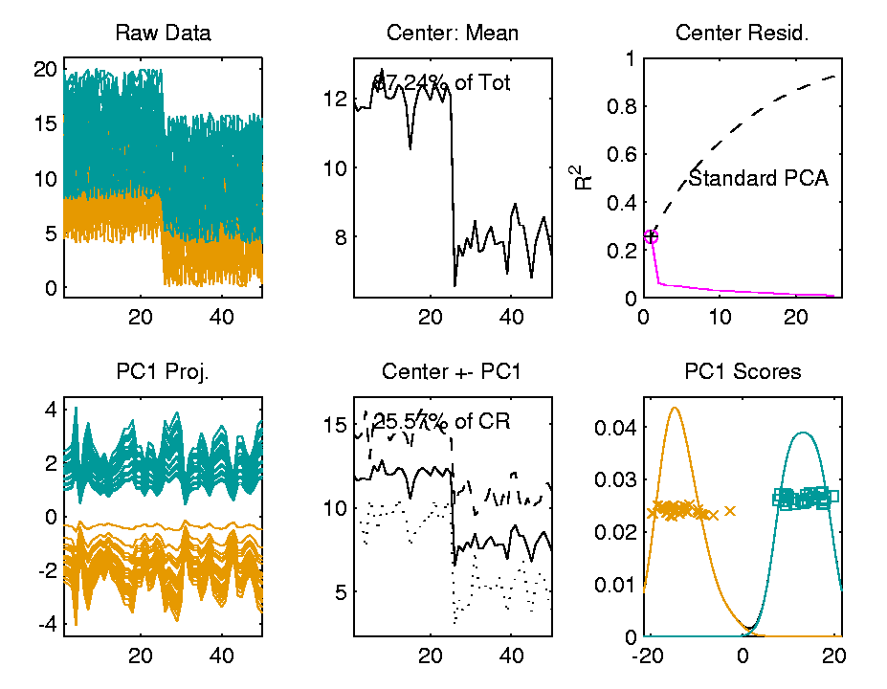

Last Class: Heat-Map Views
For Opposite Answer Consider Another
Data Set ($n=d=50$) with Curve View:
Very Noisy
1st 25 Features
>> 2nd 25
Two Clear
Clusters
Understand Pop’n
Structure???

Slide 16
Last Class: Heat-Map Views
Data Source is Above Example:
Gives Quicker Impression of Structure
More Natural View Than Curves
2 Clusters
1st Features Larger

Slide 17
Last Class: Heat-Map Views
“Every Dog Has His Day”
Idea:
Any Data Analytic Method Somebody Likes Has Some Situations Where It Is “Best”
& Of Course Others Where It Is Poor
(Will See This Again)

Slide 18

Last Class: Centering
Data Matrix:
$\tilde{X}=\left[\begin{matrix}{\tilde{x}}_{1,1} & ⋯ & {\tilde{x}}_{1,n} \\ ⋮ & ⋱ & ⋮ \\ {\tilde{x}}_{d,1} & ⋯ & {\tilde{x}}_{d,n}\end{matrix}\right]$
Column Object Mean:
$${\overline{x}}_{co}=\left(\begin{matrix}{\overline{x}}_{1,A} \\ ⋮ \\ {\overline{x}}_{d,A}\end{matrix}\right)$$
where ${\overline{x}}_{i,A}=\frac{1}{n}\sum_{j=1}^{n}{{\tilde{x}}_{i,j}}$
“,A” Means
“Average
Over 2nd
Index”
Avoid Row-Column
Ambiguity Using
Object Oriented
Nomenclature
Could Call This
the “Row Mean”

Slide 19

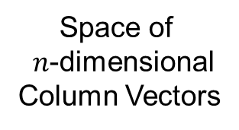
Last Class: Centering
Data Matrix:
$\tilde{X}=\left[\begin{matrix}{\tilde{x}}_{1,1} & ⋯ & {\tilde{x}}_{1,n} \\ ⋮ & ⋱ & ⋮ \\ {\tilde{x}}_{d,1} & ⋯ & {\tilde{x}}_{d,n}\end{matrix}\right]$
Additional Notion: Row Trait Mean
${\overline{x}}_{RT}^{t}=\left(\begin{matrix}{\overline{x}}_{A,1} & ⋯ & {\overline{x}}_{A,n}\end{matrix}\right)$ for ${\overline{x}}_{RT}∈ℝ^{n}$
where ${\overline{x}}_{A,j}=\frac{1}{d}\sum_{i=1}^{d}{{\tilde{X}}_{i,j}}$
transpose
Disambiguates
“Row Mean” vs.
“Column Mean”
Space of
$n$-dimensional
Column Vectors

Slide 20
Detailed Look at PCA
Text: Chapter 17
Now Study “Folklore” More Carefully
BackGround
History
(as noted on 8/21/25)
Early Use: Pearson (1901)
Name “PCA”: Hotelling (1935)

Slide 21
Detailed Look at PCA
Now Study “Folklore” More Carefully
BackGround
History
Underpinnings
(Mathematical & Computational)
Good Overall Reference: Jolliffe (2002)

Slide 22
PCA: Rediscovery – Renaming
Statistics:
Principal Component Analysis (PCA)
Social Sciences:
Factor Analysis (PCA is a subset)
Probability / Electrical Eng:
Karhunen – Loeve expansion
Applied Mathematics:
Proper Orthogonal Decomposition (POD)
Geo-Sciences:
Empirical Orthogonal Functions (EOF)

Slide 23

An Interesting Historical Note
The 1st (?) application of PCA to Functional Data Analysis:
Rao (1958)
1st Paper with “Curves as Data Objects” viewpoint

Slide 24
Factor Analysis
Finds Modes of Variation
Different Terminology:
“Directions of Variation”,
i.e. “Loadings Vectors”
Are Called
Latent Factors

Slide 25

Factor Analysis
Central Assumption:
$$\tilde{X}\sim L∙S^{t}+N\left(0, σ^{2}I\right)$$
Compute Maximum Likelihood Estimates
Of Rank $r$ Approximation, Based on:
$L_{d,r}$ and $S_{n,r}$
And of $σ^{2}$
“Factor Analysis”
Means PCA In
Other Fields
Full Model is Called
“Factor Analysis”
in Psychometrics
Turns Out Same as PCA

Slide 26
Detailed Look at PCA
Three Important (& Interesting) Viewpoints:
Mathematics
Numerics
Statistics
Goal: Study Interrelationships

Slide 27
Detailed Look at PCA
Three Important (& Interesting) Viewpoints:
Mathematics
Numerics
Statistics
1st: Review Linear Alg. and Multivar. Prob.

Slide 28
Course Background I
Linear Algebra
Please Check Familiarity
No? Read Up in Linear Algebra Text
Or Wikipedia?

Slide 29


Course Background I
Linear Algebra Key Concepts
Vector
Scalar
Vector Space (Subspace)
Basis
Dimension
Unit Vector Basis in $ℝ^{d}$
Linear Combo as Matrix Multiplication
$$\left\{\left(\begin{matrix}\begin{matrix}1 \\ 0\end{matrix} \\ \begin{matrix}⋮ \\ 0\end{matrix}\end{matrix}\right),⋯,\left(\begin{matrix}\begin{matrix}0 \\ ⋮\end{matrix} \\ \begin{matrix}0 \\ 1\end{matrix}\end{matrix}\right)\right\}$$

Slide 30
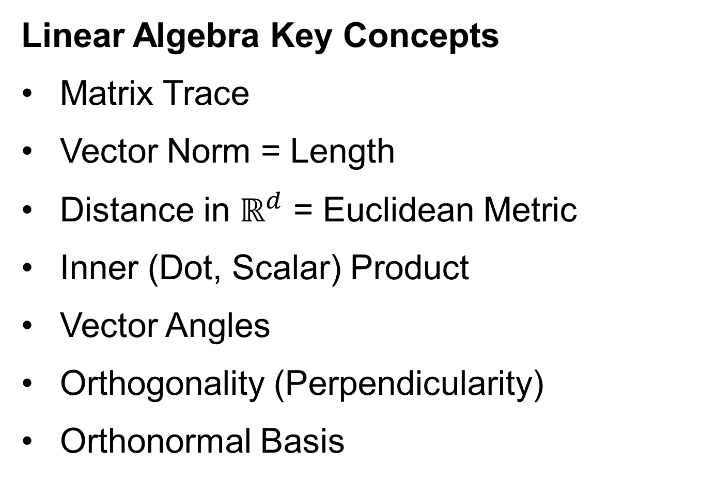
Course Background I
Linear Algebra Key Concepts
Matrix Trace
Vector Norm = Length
Distance in $ℝ^{d}$ = Euclidean Metric
Inner (Dot, Scalar) Product
Vector Angles
Orthogonality (Perpendicularity)
Orthonormal Basis

Slide 31
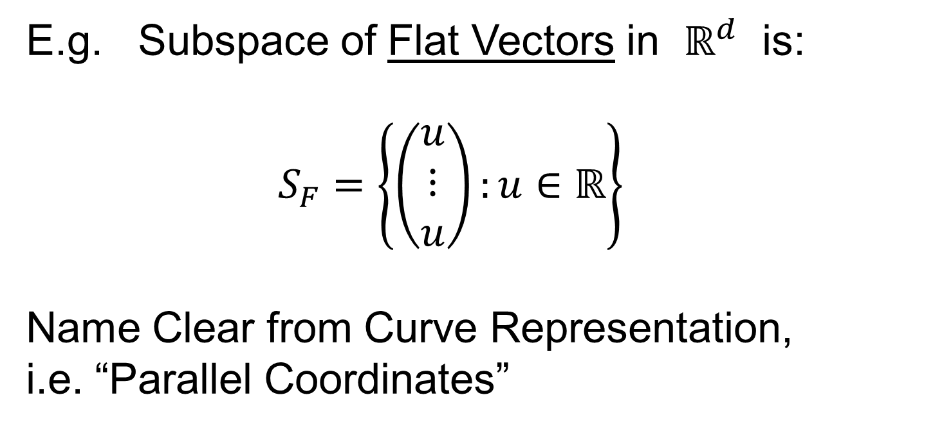

Linear Algebra of Centering
E.g. Subspace of Flat Vectors in $ℝ^{d}$ is:
$$S_{F}=\left\{\left(\begin{matrix}u \\ ⋮ \\ u\end{matrix}\right):u∈ℝ\right\}$$
Name Clear from Curve Representation,
i.e. “Parallel Coordinates”
Recall
Meaning
Sometimes Called 45 degree line Viewpoint,
Although Only Sensible for $d=2$

Slide 32
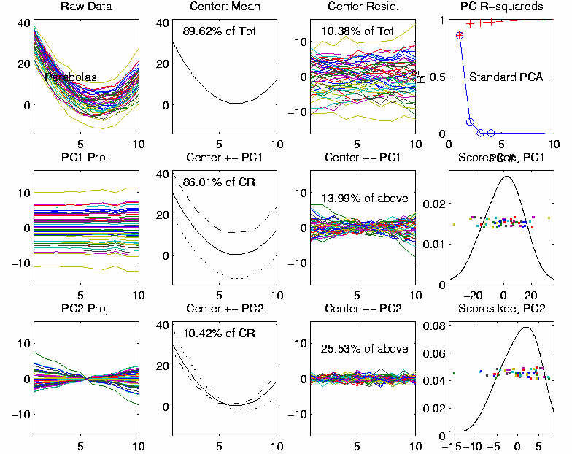
Linear Algebra of Centering
Recall
Shifted
Parabolas
Example
Nearly Flat
Mode of Variation
Flat Mode is
Frequently
Important

Slide 33

Linear Algebra of Centering
E.g. Subspace of Flat Vectors in $ℝ^{d}$ is:
$$S_{F}=\left\{\left(\begin{matrix}u \\ ⋮ \\ u\end{matrix}\right):u∈ℝ\right\}$$
Averages as Projection:
$$P_{S_{F}}\left(\begin{matrix}x_{1} \\ ⋮ \\ x_{d}\end{matrix}\right)=\left(\begin{matrix}\overline{x} \\ ⋮ \\ \overline{x}\end{matrix}\right)$$

Slide 34

Homework 4
Part (a): Show that the set of flat vectors $S_{F}$ is a subspace.
Part (b): Show that:
$$P_{S_{F}}\left(\begin{matrix}x_{1} \\ ⋮ \\ x_{d}\end{matrix}\right)=\left(\begin{matrix}\overline{x} \\ ⋮ \\ \overline{x}\end{matrix}\right)$$
(Hints On Canvas page)
Will Use This Later
Due: Sept. 18,
11:00AM

Slide 35

Linear Algebra of Centering
Much Richer Investigation of Centering
Appears in Section 17.1.1 of the Text
Main Point: Projections in the Matrix Space:
$ℝ^{d×n}=\left\{\left[\begin{matrix}x_{1,1} & ⋯ & x_{1,n} \\ ⋮ & ⋱ & ⋮ \\ x_{d,1} & ⋯ & x_{d,n}\end{matrix}\right]:x_{i,j}∈ℝ\right\}$
Note: NOT $ℝ^{dn}$

Slide 36
Course Background I
Linear Algebra Key Concepts
Singular Value Decomposition
(SVD)
Usually poorly taught in linear algebra,
but fundamental in many ways

Slide 37
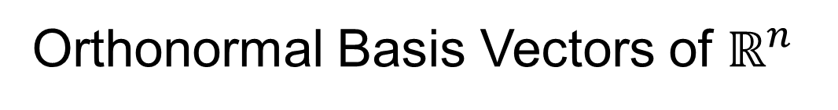
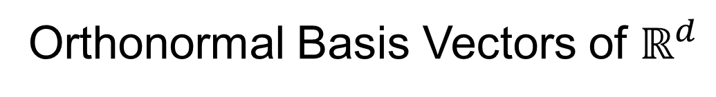




Review of Linear Algebra (Cont.)
SVD Full Representation:
=
$$V_{n×n}^{t}$$
$$X_{d×n}$$
$$U_{d×d}$$
$$S_{d×n}$$
Orthonormal Basis Vectors of $ℝ^{d}$
Diagonal Matrix of Singular Values
Orthonormal Basis Vectors of $ℝ^{n}$

Slide 38

Review of Linear Algebra (Cont.)
SVD Full Representation:
=
Intuition: For $X$ as Linear Operator ($ℝ^{d}→ℝ^{n}$):
Represent as:
$$V_{n×n}^{t}$$
$$X_{d×n}$$
$$U_{d×d}$$
$$S_{d×n}$$
Isometry (~Rotation)
Coordinate Rescaling
Isometry (~Rotation)

Slide 39
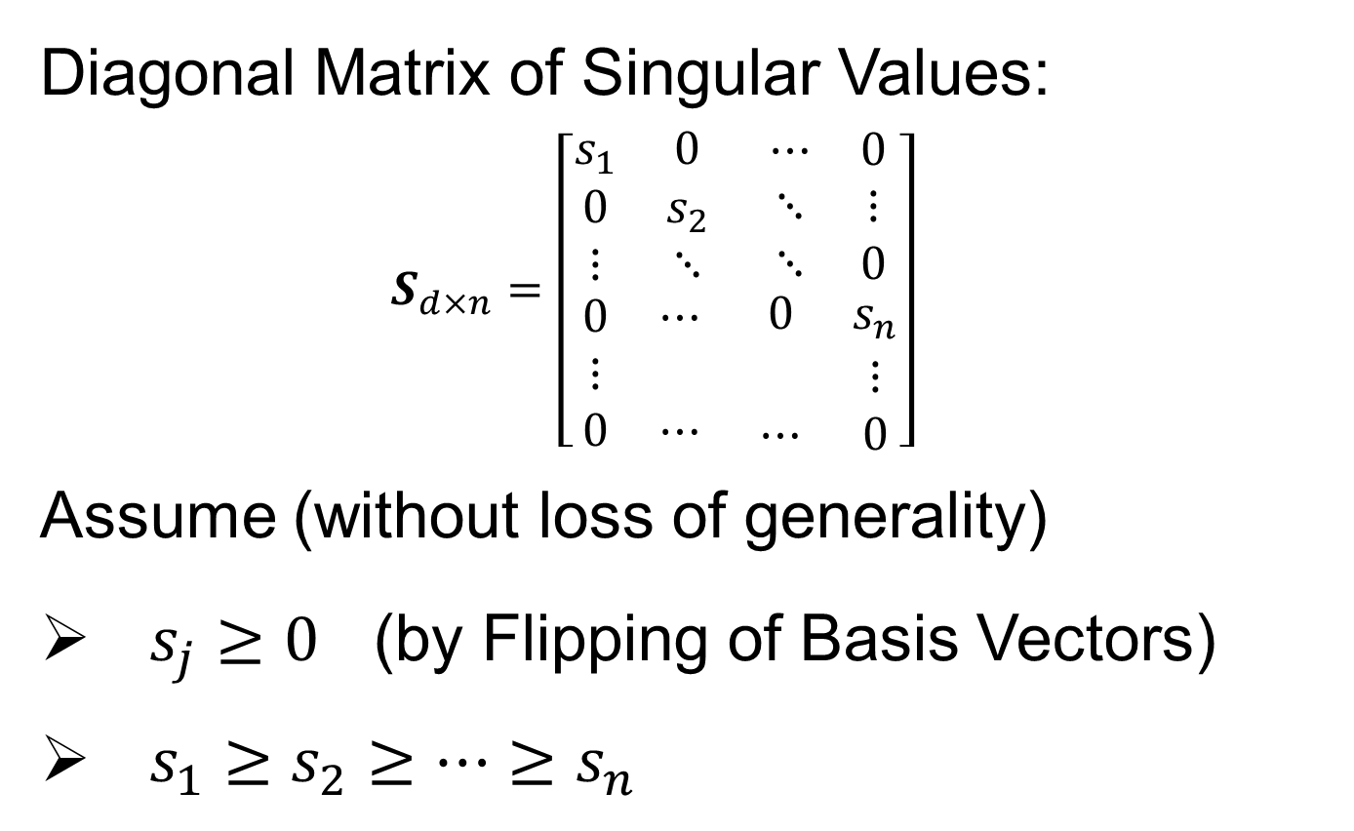
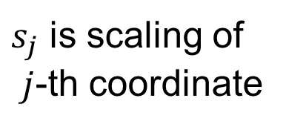

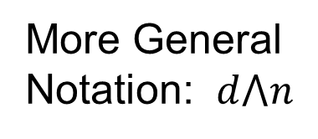
Review of Linear Algebra (Cont.)
Diagonal Matrix of Singular Values:
$$S_{d×n}=\left[\begin{matrix}\begin{matrix}s_{1} & 0 \\ 0 & s_{2} \\ ⋮ & ⋱\end{matrix} & \begin{matrix}⋯ & 0 \\ ⋱ & ⋮ \\ ⋱ & 0\end{matrix} \\ \begin{matrix}0 & ⋯ \\ ⋮ & \\ 0 & ⋯\end{matrix} & \begin{matrix}0 & s_{n} \\ & ⋮ \\ ⋯ & 0\end{matrix}\end{matrix}\right]$$
Assume (without loss of generality)
$s_{j}≥0$ (by Flipping of Basis Vectors)
$s_{1}≥s_{2}≥⋯≥s_{n}$
$s_{j}$ is scaling of
$j$-th coordinate
Uses Visual Case
Here: $d>n$
More General
Notation: $d⋀n$

Slide 40
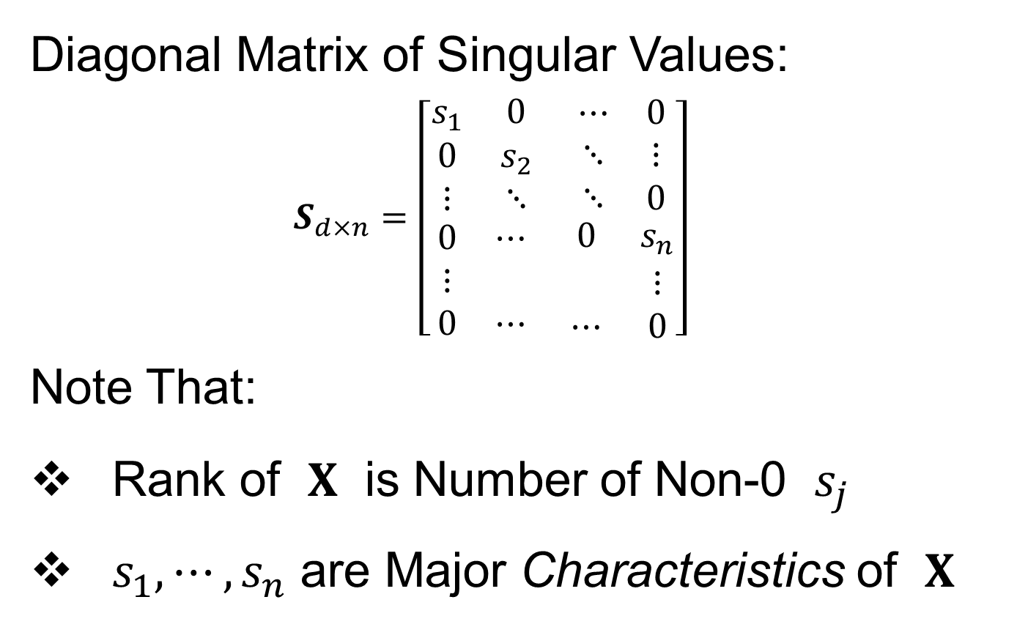
Review of Linear Algebra (Cont.)
Diagonal Matrix of Singular Values:
$$S_{d×n}=\left[\begin{matrix}\begin{matrix}s_{1} & 0 \\ 0 & s_{2} \\ ⋮ & ⋱\end{matrix} & \begin{matrix}⋯ & 0 \\ ⋱ & ⋮ \\ ⋱ & 0\end{matrix} \\ \begin{matrix}0 & ⋯ \\ ⋮ & \\ 0 & ⋯\end{matrix} & \begin{matrix}0 & s_{n} \\ & ⋮ \\ ⋯ & 0\end{matrix}\end{matrix}\right]$$
Note That:
Rank of $X$ is Number of Non-0 $s_{j}$
$s_{1},⋯,s_{n}$ are Major Characteristics of $X$

Slide 41
Review of Linear Algebra (Cont.)
SVD Full Representation:
=
Also Useful Are Smaller Representations
$$V_{n×n}^{t}$$
$$X_{d×n}$$
$$U_{d×d}$$
$$S_{d×n}$$

Slide 42


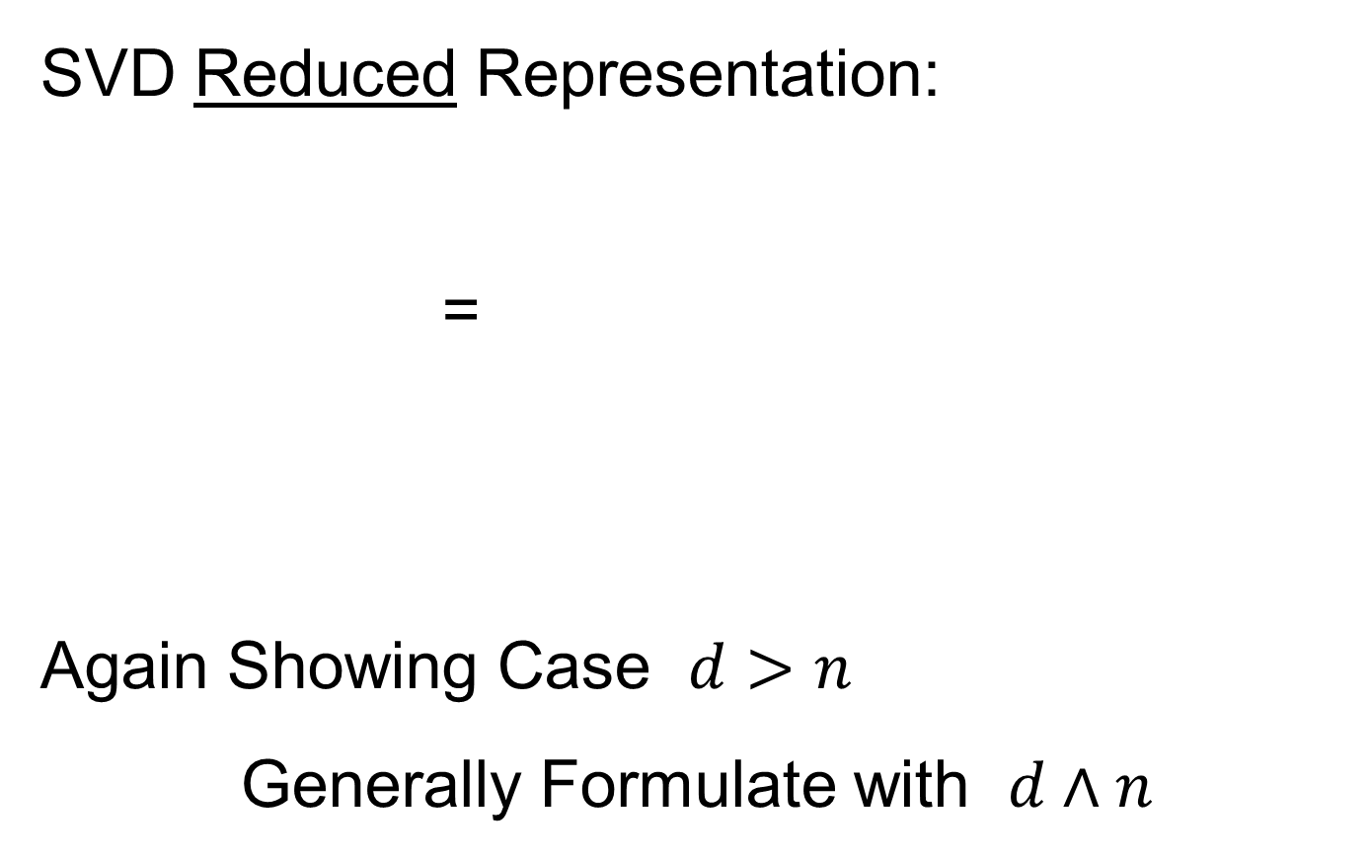
Review of Linear Algebra (Cont.)
SVD Reduced Representation:
=
Again Showing Case $d>n$
Generally Formulate with $d∧n$
$$S_{n×n}$$
$$V_{n×n}^{t}$$
$$X_{d×n}$$
$$U_{d×n}$$

Slide 43

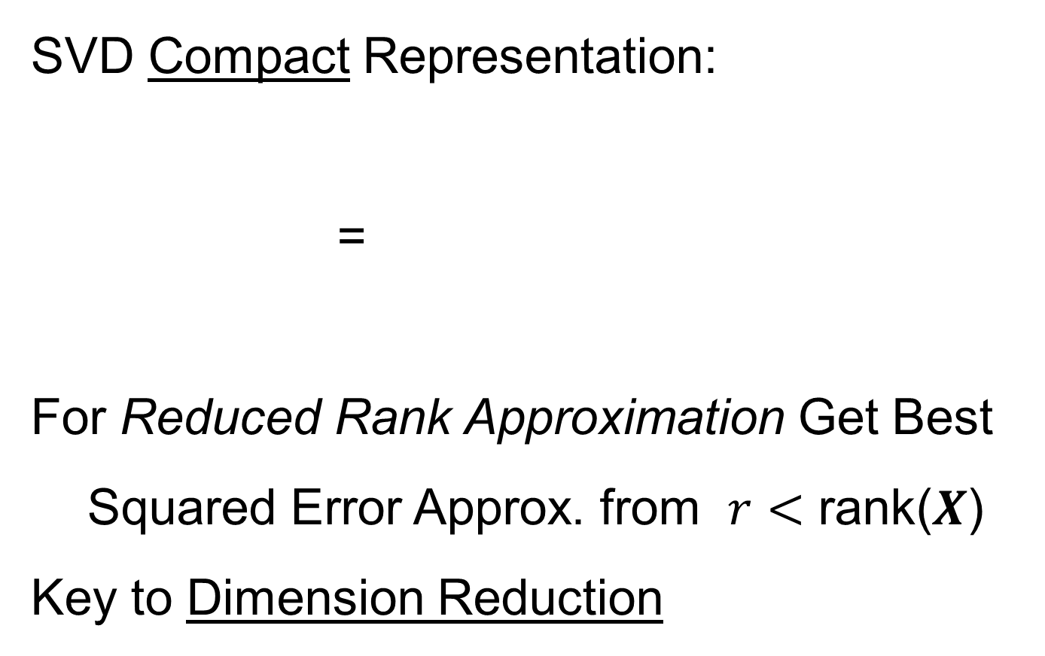


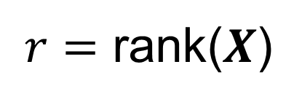
Review of Linear Algebra (Cont.)
SVD Compact Representation:
=
For Reduced Rank Approximation Get Best Squared Error Approx. from $r<$ rank($X$)
Key to Dimension Reduction
$$S_{r×r}$$
$$V_{r×n}^{t}$$
$$X_{d×n}$$
$$U_{d×r}$$
$r=$ rank($X$)

Slide 44



Covariance Matrices
Notation: Data Matrix
$$\tilde{X}=\left[\begin{matrix}{\tilde{x}}_{1,1} & ⋯ & {\tilde{x}}_{1,n} \\ ⋮ & ⋱ & ⋮ \\ {\tilde{x}}_{d,1} & ⋯ & {\tilde{x}}_{d,n}\end{matrix}\right]$$
Indexed by Rows $i=1,⋯,d$ Cols $j=1,⋯,n$
Empirical Covariance:
$$\hat{Σ}=\left[\begin{matrix}\frac{1}{n}\sum_{j=1}^{n}{{\left({\tilde{x}}_{1,j}−{\overline{x}}_{1,A}\right)}^{2}} & ⋯ & \frac{1}{n}\sum_{j=1}^{n}{\left({\tilde{x}}_{1,j}−{\overline{x}}_{1,A}\right)\left({\tilde{x}}_{d,j}−{\overline{x}}_{1,A}\right)} \\ ⋮ & ⋱ & ⋮ \\ \frac{1}{n}\sum_{j=1}^{n}{\left({\tilde{x}}_{d,j}−{\overline{x}}_{d,A}\right)\left({\tilde{x}}_{1,j}−{\overline{x}}_{1,A}\right)} & ⋯ & \frac{1}{n}\sum_{j=1}^{n}{{\left({\tilde{x}}_{d,j}−{\overline{x}}_{d,A}\right)}^{2}}\end{matrix}\right]$$
Are Data
Objects
Essentially Inner
Products of Rows
$$d×d$$
Use $\frac{1}{n}$ (MLE) form for simplicity

Slide 45
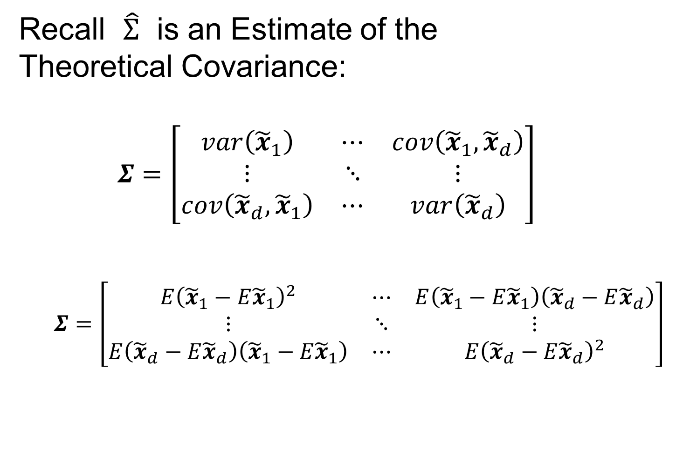
Covariance Matrices
Recall $\hat{Σ}$ is an Estimate of the
Theoretical Covariance:
$$Σ=\left[\begin{matrix}var\left({\tilde{x}}_{1}\right) & ⋯ & cov\left({\tilde{x}}_{1},{\tilde{x}}_{d}\right) \\ ⋮ & ⋱ & ⋮ \\ cov\left({\tilde{x}}_{d},{\tilde{x}}_{1}\right) & ⋯ & var\left({\tilde{x}}_{d}\right)\end{matrix}\right]$$
$$Σ=\left[\begin{matrix}E{\left({\tilde{x}}_{1}−E{\tilde{x}}_{1}\right)}^{2} & ⋯ & E\left({\tilde{x}}_{1}−E{\tilde{x}}_{1}\right)\left({\tilde{x}}_{d}−E{\tilde{x}}_{d}\right) \\ ⋮ & ⋱ & ⋮ \\ E\left({\tilde{x}}_{d}−E{\tilde{x}}_{d}\right)\left({\tilde{x}}_{1}−E{\tilde{x}}_{1}\right) & ⋯ & E{\left({\tilde{x}}_{d}−E{\tilde{x}}_{d}\right)}^{2}\end{matrix}\right]$$

Slide 46

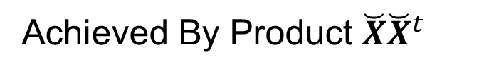
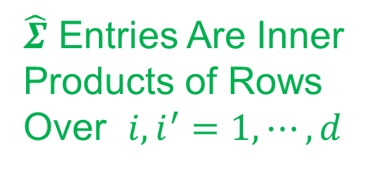
Covariance Matrices
Compact Representation of $\hat{Σ}$ Comes From
Centered & $\sqrt{n}$ - Scaled Version of Data:
$$\breve{X}=\left[\begin{matrix}\frac{1}{\sqrt{n}}\left({\tilde{x}}_{1,1}−{\overline{x}}_{1,A}\right) & ⋯ & \frac{1}{\sqrt{n}}\left({\tilde{x}}_{1,n}−{\overline{x}}_{1,A}\right) \\ ⋮ & ⋱ & ⋮ \\ \frac{1}{\sqrt{n}}\left({\tilde{x}}_{d,1}−{\overline{x}}_{d,A}\right) & ⋯ & \frac{1}{\sqrt{n}}\left({\tilde{x}}_{d,n}−{\overline{x}}_{d,A}\right)\end{matrix}\right]$$
Recall Average for Row $i=1,⋯,d$ is
$${\overline{x}}_{i,A}=\frac{1}{n}\sum_{j=1}^{n}{{\tilde{x}}_{i,j}}$$
Entries of Column
Object Mean Vector
$\hat{Σ}$ Entries Are Inner
Products of Rows
Over $i,i^{′}=1,⋯,d$
Achieved By Product $\breve{X}{\breve{X}}^{t}$

Slide 47
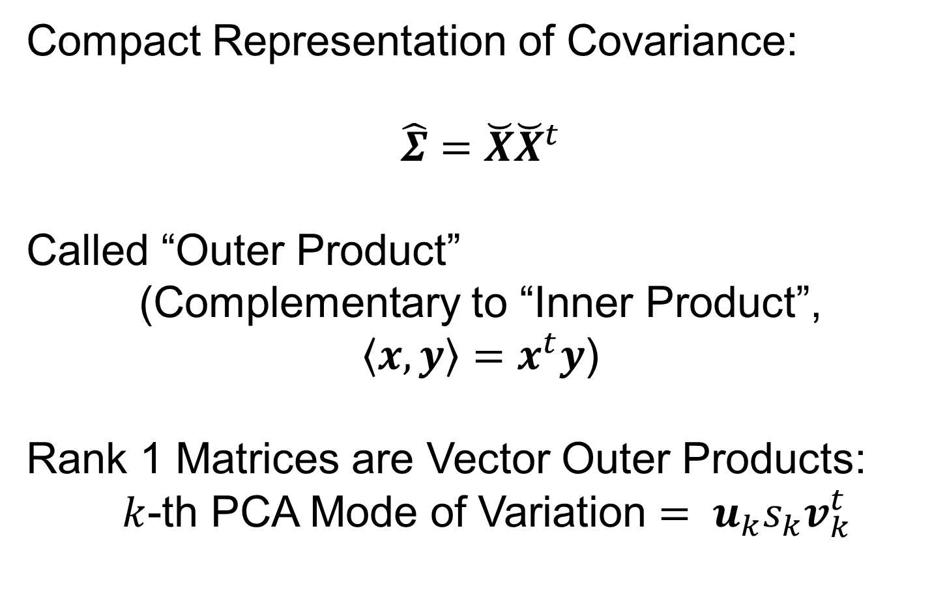
Covariance Matrices
Compact Representation of Covariance:
$$\hat{Σ}=\breve{X}{\breve{X}}^{t}$$
Called “Outer Product”
(Complementary to “Inner Product”,
$\left\langle x,y\right\rangle =x^{t}y$)
Rank 1 Matrices are Vector Outer Products:
$k$-th PCA Mode of Variation $= u_{k}s_{k}v_{k}^{t}$

Slide 48
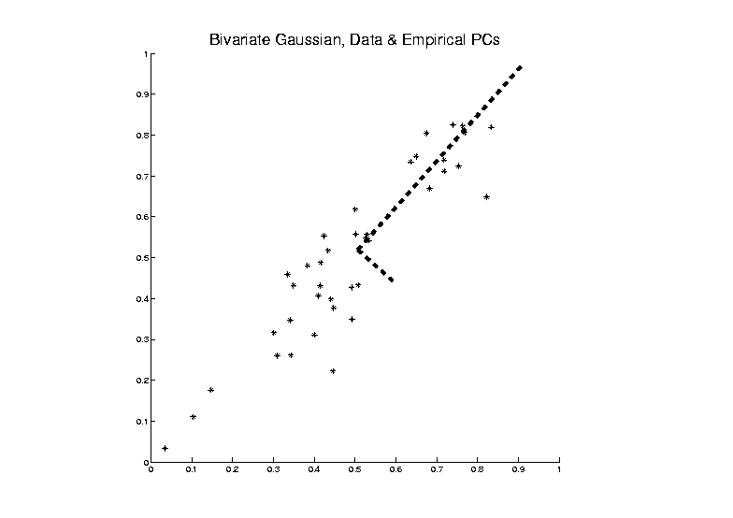
PCA as an Optimization Problem
Find Direction of Greatest Variability:
Centered At Mean

Slide 49


PCA as an Optimization Problem
Find Direction of Greatest Variability:
Approach to
Calculation:
And Optimize Over $u$, such that $\left\|u\right\|=1$
Start with
Candidate
Direction $u$

Slide 50


PCA as Optimization (Cont.)
Again Start With Data Matrix
$$\tilde{X}=\left[\begin{matrix}{\tilde{x}}_{1,1} & ⋯ & {\tilde{x}}_{1,n} \\ ⋮ & ⋱ & ⋮ \\ {\tilde{x}}_{d,1} & ⋯ & {\tilde{x}}_{d,n}\end{matrix}\right]$$
Columns as Data Objects, Indexed $j=1,⋯,n$
${\tilde{x}}_{j}=\left(\begin{matrix}{\tilde{x}}_{1,j} \\ ⋮ \\ {\tilde{x}}_{d,j}\end{matrix}\right)$
Same
Notation
as Above
With Column Object Mean Vector
${\overline{x}}_{CO}=\left(\begin{matrix}{\overline{x}}_{1,A} \\ ⋮ \\ {\overline{x}}_{d,A}\end{matrix}\right)$

Slide 51

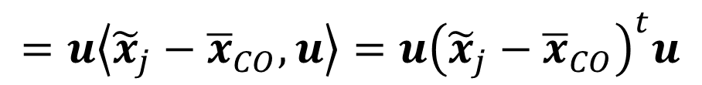
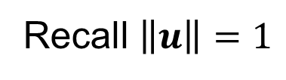
PCA as Optimization (Cont.)
Given a Candidate Direction $u∈ℝ^{d}$,
Projections of Centered Data Onto $u$ are:
$$P_{u}\left({\tilde{x}}_{j}−{\overline{x}}_{CO}\right)=\left\langle {\tilde{x}}_{j}−{\overline{x}}_{CO},u\right\rangle u, j=1,⋯,n$$
Quantify Variation in the Direction $u$:
$$\frac{1}{n}\sum_{j=1}^{n}{{\left\|P_{u}\left({\tilde{x}}_{j}−{\overline{x}}_{CO}\right)\right\|}^{2}}$$
Recall $\left\|u\right\|=1$
Sample
Variance
of Scores
$$=u\left\langle {\tilde{x}}_{j}−{\overline{x}}_{CO},u\right\rangle =u{\left({\tilde{x}}_{j}−{\overline{x}}_{CO}\right)}^{t}u$$

Slide 52

PCA as Optimization (Cont.)
Quantify Variation in the Direction $u$:
$$\frac{1}{n}\sum_{j=1}^{n}{{\left\|P_{u}\left({\tilde{x}}_{j}−{\overline{x}}_{CO}\right)\right\|}^{2}}=$$
$$=\frac{1}{n}\sum_{j=1}^{n}{{\left(u{\left({\tilde{x}}_{j}−{\overline{x}}_{CO}\right)}^{t}u\right)}^{t}u{\left({\tilde{x}}_{j}−{\overline{x}}_{CO}\right)}^{t}u}=$$
$$=u^{t}\left(\frac{1}{n}\sum_{j=1}^{n}{\left({\tilde{x}}_{j}−{\overline{x}}_{CO}\right){\left({\tilde{x}}_{j}−{\overline{x}}_{CO}\right)}^{t}}\right)u=$$
$$=u^{t}\breve{X}{\breve{X}}^{t}u=$$
$$=u^{t}\hat{Σ}u$$
Looks Like “Products
Of Rows” From Above
Cov. Matrix Repr’n

Slide 53


PCA as Optimization (Cont.)
Quantify Variation in the Direction $u$:
$$\frac{1}{n}\sum_{j=1}^{n}{{\left\|P_{u}\left({\tilde{x}}_{j}−{\overline{x}}_{CO}\right)\right\|}^{2}}=u^{t}\hat{Σ}u$$
Quadratic Form in the
Sample Covariance Matrix $\hat{Σ}$
Simple Solution Comes from the Eigenvalue Representation of $\hat{Σ}$:
$$\hat{Σ}=BDB^{t}$$
Orthonormal
Basis of $ℝ^{d}$
Diagonal Matrix of Eigenvalues

Slide 54

PCA as Optimization (Cont.)
Find Direction $u$ to Maximize:
$u^{t}\hat{Σ}u=u^{t}BDB^{t}u$,
Where $D=\left[\begin{matrix}\begin{matrix}λ_{1} & 0 & ⋯ \\ 0 & λ_{2} & ⋱ \\ ⋮ & ⋱ & ⋱\end{matrix} & \begin{matrix}0 \\ ⋮ \\ 0\end{matrix} \\ \begin{matrix}0 & ⋯ & 0\end{matrix} & λ_{d}\end{matrix}\right]$
For Eigenvalues $λ_{1}≥λ_{2}≥⋯≥λ_{d}≥0$

Slide 55


PCA as Optimization (Cont.)
Find Direction $u$ to Maximize:
$u^{t}\hat{Σ}u=u^{t}BDB^{t}u$,
And Where $B=\left[\begin{matrix}v_{1} & ⋯ & v_{d}\end{matrix}\right]$,
For $d×1$ Eigenvectors $v_{i}$,
Indexed by $i=1,⋯,d$
Now Define $w=\left(\begin{matrix}w_{1} \\ ⋮ \\ w_{d}\end{matrix}\right)=B^{t}u$
Orthonormal
Basis Vectors
Change of
Variable
(still have
$\left\|w\right\|=1$)

Slide 56



PCA as Optimization (Cont.)
Thus Need Direction $w$ to Maximize:
$$u^{t}\hat{Σ}u=w^{t}Dw=$$
$$=\sum_{i=1}^{d}{λ_{i}{w_{i}}^{2}}$$
Since $λ_{1}≥λ_{2}≥⋯≥λ_{d}$,
Max Is At $w=\left(\begin{matrix}\begin{matrix}1 \\ 0\end{matrix} \\ \begin{matrix}⋮ \\ 0\end{matrix}\end{matrix}\right)=B^{t}u$, i.e. $u=v_{1}$
Recall
$$B=\left[\begin{matrix}v_{1} & ⋯ & v_{d}\end{matrix}\right]$$
Unique When
$$λ_{1}>λ_{2}$$

Slide 57

PCA as Optimization (Cont.)
So Direction $u$ to Maximize:
$u^{t}\hat{Σ}u=u^{t}BDB^{t}u$,
Is First Eigenvector, $v_{1}$, of Sample Cov., $\hat{Σ}$

Slide 58

PCA as Optimization (Cont.)
Notes:
Projecting onto Subspace $⊥$ to $v_{1}$,
Gives $v_{2}$ as Next Direction
Continue Through $v_{3},⋯,v_{d}$

Slide 59

PCA as Optimization (Cont.)
Another Viewpoint of Eigenanalysis:
Recall Outer Product Representation
$$\hat{Σ}=\breve{X}{\breve{X}}^{t}$$
And Singular Value Decomposition
$$\breve{X}=\breve{U}\breve{S}{\breve{V}}^{t}$$
Resulting In
$$\hat{Σ}=\breve{U}\breve{S}{\breve{V}}^{t}{\left(\breve{U}\breve{S}{\breve{V}}^{t}\right)}^{t}=\breve{U}{\breve{S}}^{2}{\breve{U}}^{t}$$

Slide 60




PCA as Optimization (Cont.)
Relate Eigenanalysis of$\hat{Σ}$ and SVD of $\breve{X}$:
$$\hat{Σ}=\breve{U}\breve{S}{\breve{V}}^{t}{\left(\breve{U}\breve{S}{\breve{V}}^{t}\right)}^{t}=\breve{U}{\breve{S}}^{2}{\breve{U}}^{t}$$
Can Think of PCA Either as SVD Or Eigen-An.
Same Rotation Matrix $\breve{U}$ for Both
EigenValues $λ_{i}={s_{i}}^{2}$, $i=1,⋯,d$
Of $\breve{X}$, Centered, Scaled Version of $X$

Slide 61




PCA as Optimization (Cont.)
Terminology Relates to SVD View
For $r$ = Rank of $\breve{X}$:
$$\breve{X}=\breve{U}\breve{S}{\breve{V}}^{t}$$
$d×n$ (Centered, Scaled) Data Matrix
$d×r$ Matrix of (Scaled) Loadings
$r×r$ Matrix of (Scaled) Scores

Slide 62

PCA as Optimization (Cont.)
Connection to Modes of Variation:
Define:
(Scaled) Loadings Matrix, $\breve{U}=\left[\begin{matrix}u_{1} & ⋯ & u_{r}\end{matrix}\right]$
(Scaled) Scores Matrix, $\breve{S}{\breve{V}}^{t}=\left[\begin{matrix}s_{1}v_{1}^{t} \\ ⋮ \\ s_{r}v_{r}^{t}\end{matrix}\right]$

Slide 63


PCA as Optimization (Cont.)
Connection to Modes of Variation:
Thus:
$$\breve{X}=\breve{U}\breve{S}{\breve{V}}^{t}=\sum_{k=1}^{r}{u_{k}s_{k}v_{k}^{t}}$$
(Scaled) Modes of Variation
Successive Best
$L^{2}$ Approximations
Rank 1 Matrices

Slide 64

PCA Data Representation
Idea: Expand Data Matrix
in Terms of Inner Prod’ts & Eigenvectors
Recall Notation:
$$\breve{X}=\frac{1}{\sqrt{n}}{\left({\tilde{x}}_{1}−{\overline{x}}_{CO},⋯,{\tilde{x}}_{n}−{\overline{x}}_{CO}\right)}_{d×n}$$
(Mean Centered & Scaled Data)

Slide 65



PCA Data Representation
Idea: Expand Data Matrix
in Terms of Inner Prod’ts & Eigenvectors
Recall Notation:
$$\breve{X}=\frac{1}{\sqrt{n}}{\left({\tilde{x}}_{1}−{\overline{x}}_{CO},⋯,{\tilde{x}}_{n}−{\overline{x}}_{CO}\right)}_{d×n}$$
Spectral Representation (centered data):
$${\breve{X}}_{d×n}=\sum_{k=1}^{r}{u_{k}\left(s_{k}v_{k}^{t}\right)}$$
Just Sum of
Modes of
Variation
Recall: Loadings Vector $∈ℝ^{d}$
Scores Vector $∈ℝ^{n}$

Slide 66


PCA Data Represent’n (Cont.)
$1$ by $n$ matrix of $1$s
Now Using:
$$\tilde{X}={\overline{x}}_{CO}1_{1,n}+\sqrt{n}\breve{X}$$
Spectral Representation (Raw Data):
$$\tilde{X}={\overline{x}}_{CO}1_{1,n}+\sqrt{n}\sum_{k=1}^{r}{u_{k}\left(s_{k}v_{k}^{t}\right)}$$
Where:
Entries of $u_{k}$ $\left(d×1\right)$ are Loadings
Entries of $c_{k}^{t}=\sqrt{n}s_{k}v_{k}^{t}$ $\left(1×n\right)$ are Scores

Slide 67

PCA Data Represent’n (Cont.)
Can Focus on Individual Data Object Vectors:
$${\tilde{x}}_{i}={\overline{x}}_{CO}+\sum_{k=1}^{r}{u_{k}c_{i,k}}$$
($i=1,⋯,n$ Col. of Above Full Matrix Rep’n)
Terminology: $c_{i,k}$ are Called “PCs”
and are also Called Scores

Slide 68

PCA Data Represent’n (Cont.)
More Terminology:
Scores, $c_{i,k}$ are Coefficients in Spectral Representation:
$${\tilde{x}}_{i}={\overline{x}}_{CO}+\sum_{k=1}^{r}{u_{k}c_{i,k}}$$
Loadings are Entries $u_{ij}$ of Eigenvectors:
$$u_{k}=\left(\begin{matrix}u_{1,k} \\ ⋮ \\ u_{d,k}\end{matrix}\right)$$

Slide 69

Connect Math to Graphics
2-d Toy Example
From Earlier Class Meeting
2-d Curves as Data In Object Space
Simple, Visualizable Feature (Trait) Space

Slide 70



Connect Math to Graphics
2-d Toy Example
1st Eigenvector, $u_{1}$
1st Mode of Variation, $u_{1} c_{1}^{t}$

Slide 71



Connect Math to Graphics
2-d Toy Example
2nd Eigenvector, $u_{2}$
2nd Mode of Variation,$u_{2}{ c}_{2}^{t}$

Slide 72

PCA Data Represent’n (Cont.)
Recall: PCA Scatterplot Matrix Views
Provide a Rotation of Data,
Where Axes Are Directions of Max. Variation
By Plotting $c_{1,k},⋯,c_{n,k}$ on axis $k$

Slide 73


PCA Data Represent’n (Cont.)
E.g. Recall Raw Data,
Slightly
Mean
Shifted
Gaussian
Data

Slide 74



PCA Data Represent’n (Cont.)
PCA Rotation: Scatterplot Matrix View
$c_{1,1},⋯,c_{n,1}$
$c_{1,2},⋯,c_{n,2}$

Slide 75

PCA Data Represent’n (Cont.)
PCA Rotates to Directions of Max. Variation

Slide 76

PCA Data Represent’n (Cont.)
PCA Rotates to Directions of Max. Variation

Slide 77

PCA Data Represent’n (Cont.)
Reduced Rank Approximation:
$${\tilde{x}}_{i}≈{\overline{x}}_{CO}+\sum_{k=1}^{m}{u_{k}c_{i,k}}$$
Reconstruct Using Only $m (≪d)$ Terms
(Assuming Decreasing Eigenvalues)

Slide 78

PCA Data Represent’n (Cont.)
Reduced Rank Approximation:
$${\tilde{x}}_{i}≈{\overline{x}}_{CO}+\sum_{k=1}^{m}{u_{k}c_{i,k}}$$
Reconstruct Using Only $m (≪d)$ Terms
(Assuming Decreasing Eigenvalues)
Gives: Rank $m$ Approximation of Data
Key to PCA Dimension Reduction
And PCA for Data Compression (~ .jpeg)

Slide 79

PCA Data Represent’n (Cont.)
Choice of $m$ in Reduced Rank Approxim’n:
Generally Very Slippery Problem
Not Recommended:
Arbitrary Choice
E.g. % Variation Explained 90%? 95%?

Slide 80


PCA Data Represent’n (Cont.)
Choice of $m$ in Reduced Rank Approxim’n:
Generally Very Slippery Problem
SCREE Plot:
Find Knee in Power Spectrum

Slide 81

PCA Data Represent’n (Cont.)
SCREE Plot Drawbacks:
What is a Knee?
What if There are Several?
(Recall Lung
Cancer Data)

Slide 82
PCA Data Represent’n (Cont.)
SCREE Plot Drawbacks:
What is a Knee?
What if There are Several?
Knees Depend on Scaling (Power? log?)
Personal Suggestions:
Find Auxiliary Cutoffs (Inter-Rater Variation)
Use the Full Range

