Slide 1
Statistics – O. R. 881
Object Oriented Data Analysis
Steve Marron
Dept. of Statistics and Operations Research
University of North Carolina

Slide 2
Current Sections in Textbook
Today:
Section 3.1.3, 6.5,17.2
Next Class:
Section 17.2

Slide 3
Last Class: Detailed Look at PCA
Three Important (& Interesting) Viewpoints:
Mathematics
Numerics
Statistics
Goal: Study Interrelationships

Slide 4
Last Class: PCA: Rediscovery
Statistics:
Principal Component Analysis (PCA)
Social Sciences:
Factor Analysis (PCA is a subset)
Probability / Electrical Eng:
Karhunen – Loeve expansion
Applied Mathematics:
Proper Orthogonal Decomposition (POD)
Geo-Sciences:
Empirical Orthogonal Functions (EOF)

Slide 5
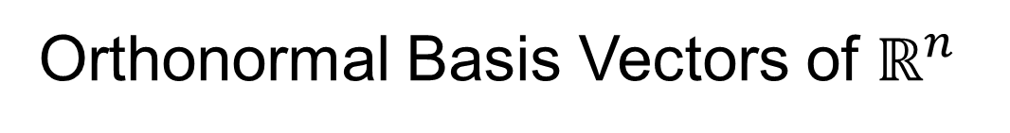
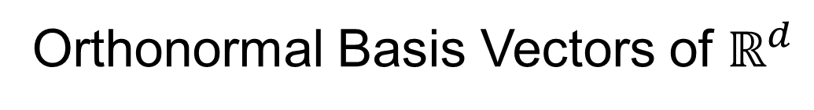




Last Class: Linear Algebra
SVD Full Representation:
=
$$V_{n×n}^{t}$$
$$X_{d×n}$$
$$U_{d×d}$$
$$S_{d×n}$$
Orthonormal Basis Vectors of $ℝ^{d}$
Diagonal Matrix of Singular Values
Orthonormal Basis Vectors of $ℝ^{n}$

Slide 6

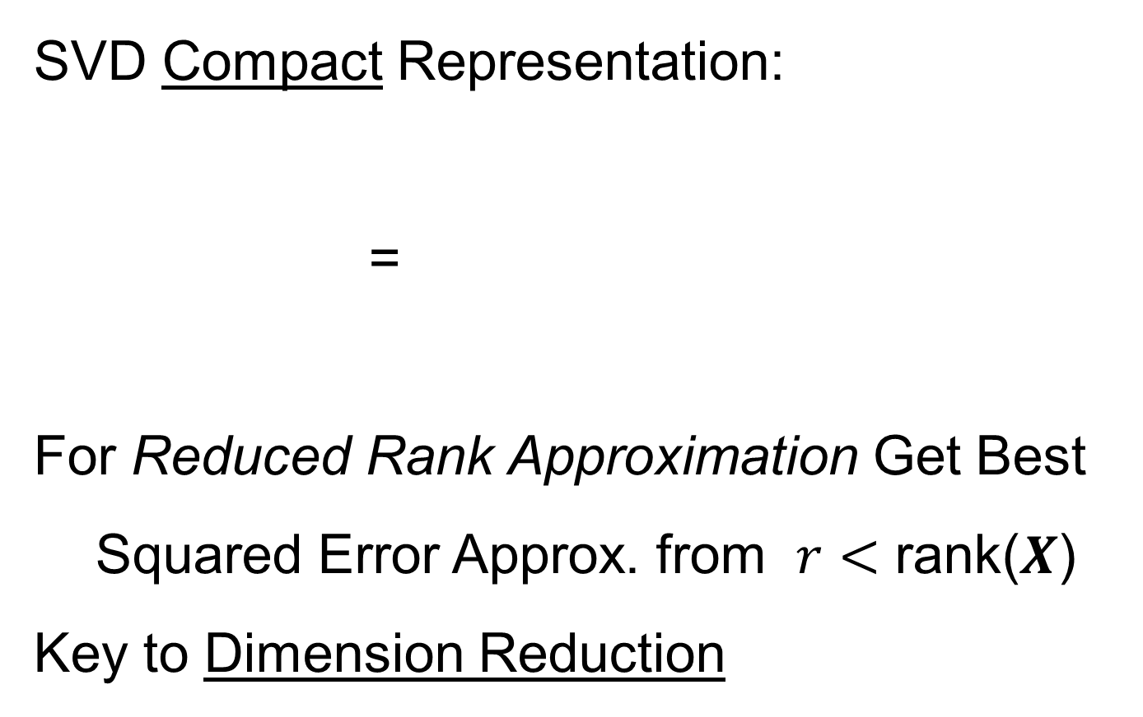


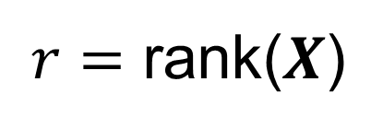
Last Class: Linear Algebra
SVD Compact Representation:
=
For Reduced Rank Approximation Get Best Squared Error Approx. from $r<$ rank($X$)
Key to Dimension Reduction
$$S_{r×r}$$
$$V_{r×n}^{t}$$
$$X_{d×n}$$
$$U_{d×r}$$
$r=$ rank($X$)

Slide 7
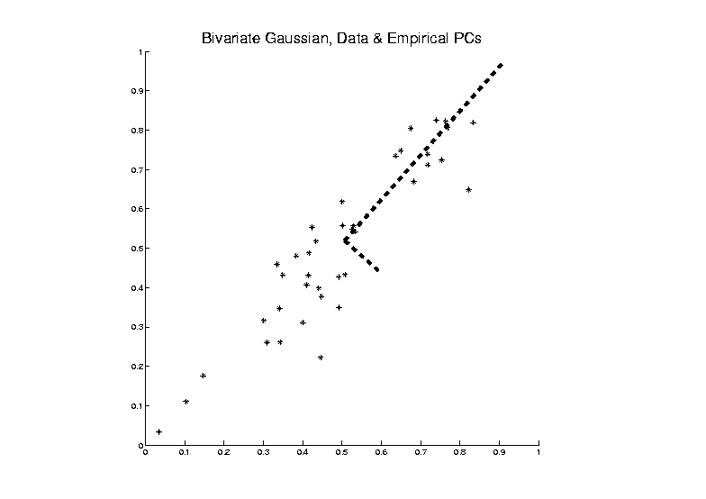


Last Class: PCA Optimization
Find Direction of Greatest Variability:
Approach to
Calculation:
And Optimize Over $u$, such that $\left\|u\right\|=1$
Start with
Candidate
Direction $u$

Slide 8
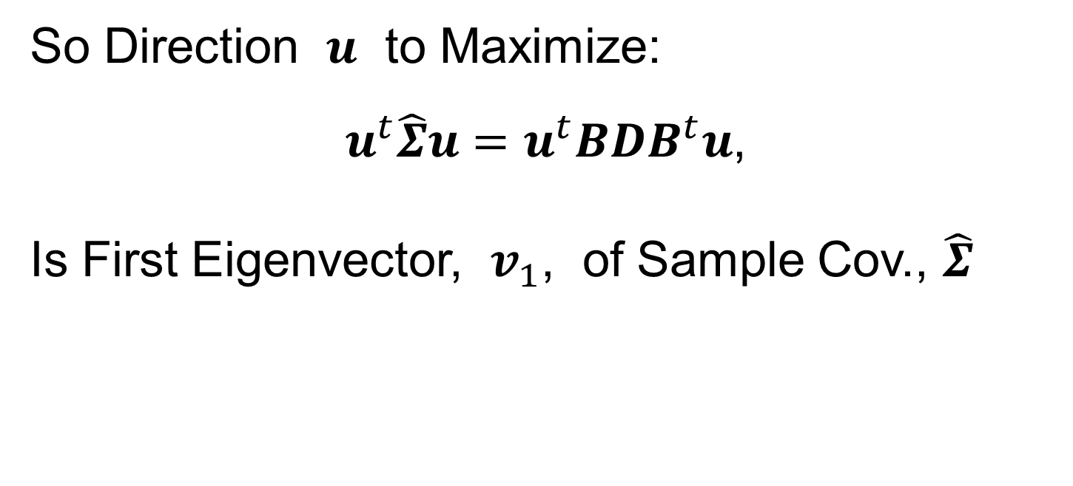
Last Class: PCA Optimization
So Direction $u$ to Maximize:
$u^{t}\hat{Σ}u=u^{t}BDB^{t}u$,
Is First Eigenvector, $v_{1}$, of Sample Cov., $\hat{Σ}$

Slide 9
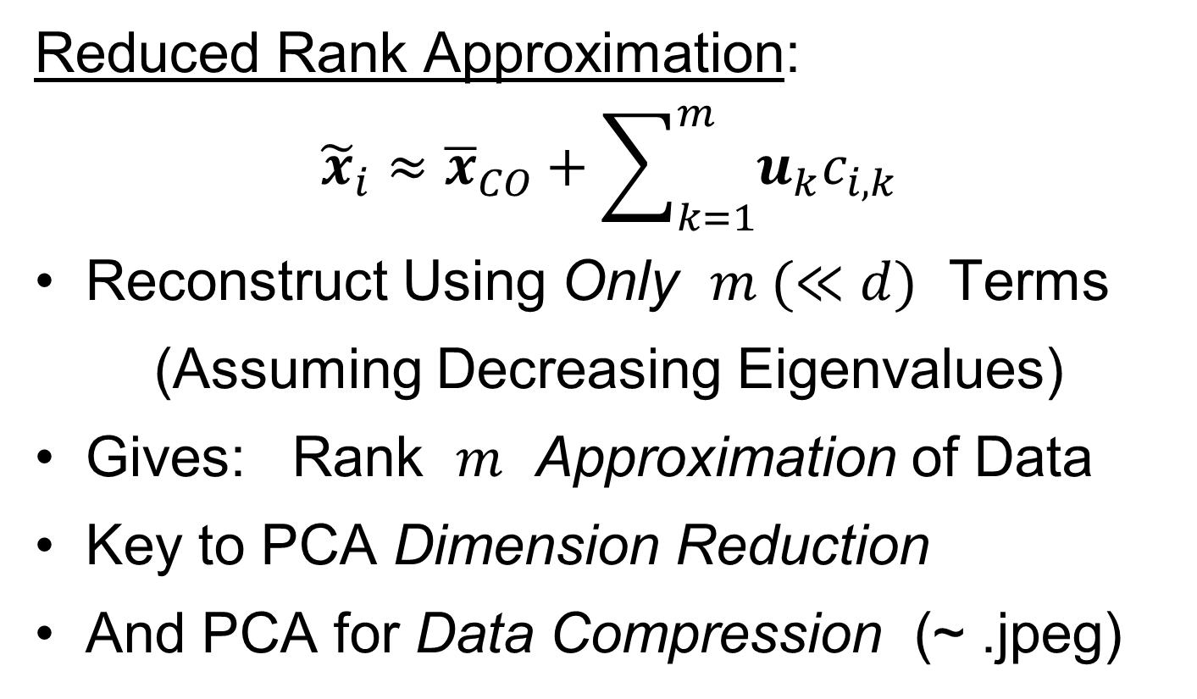
Last Class: PCA Data Rep’n
Reduced Rank Approximation:
$${\tilde{x}}_{i}≈{\overline{x}}_{CO}+\sum_{k=1}^{m}{u_{k}c_{i,k}}$$
Reconstruct Using Only $m (≪d)$ Terms
(Assuming Decreasing Eigenvalues)
Gives: Rank $m$ Approximation of Data
Key to PCA Dimension Reduction
And PCA for Data Compression (~ .jpeg)

Slide 10
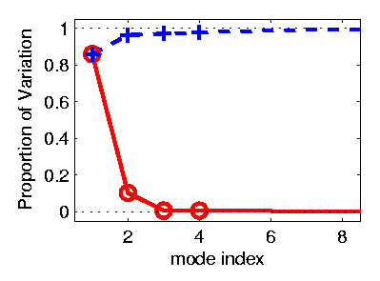
PCA Redistribution of Energy
Now for Scree Plots (Upper Right of FDA Anal.)
Carefully Look At:
Intuition
Relation to Eigenanalysis
Numerical Calculation

Slide 11
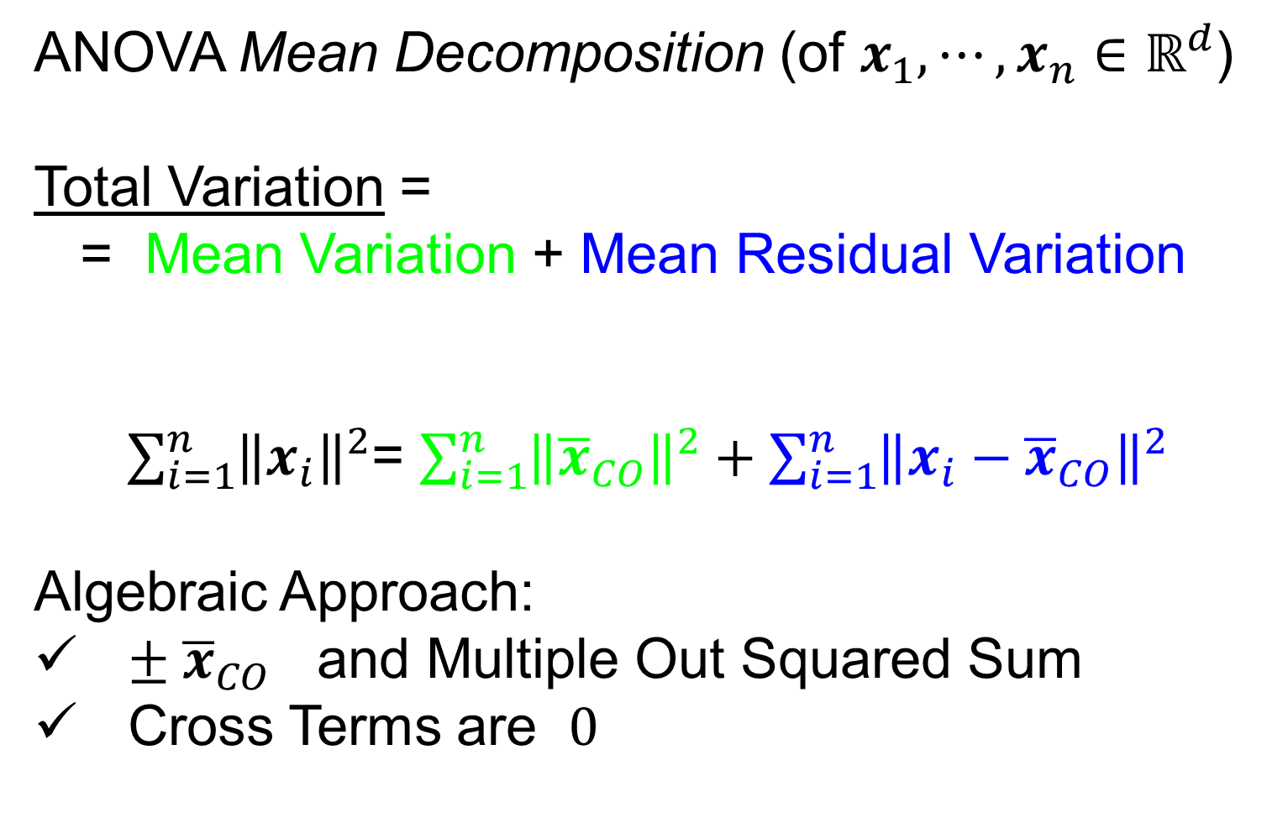
PCA Redist’n of Energy (Cont.)
ANOVA Mean Decomposition (of $x_{1},⋯,x_{n}∈ℝ^{d}$)
Total Variation =
= Mean Variation + Mean Residual Variation
$\sum_{i=1}^{n}{{\left\|x_{i}\right\|}^{2}}$= $\sum_{i=1}^{n}{{\left\|{\overline{x}}_{CO}\right\|}^{2}}+\sum_{i=1}^{n}{{\left\|x_{i}−{\overline{x}}_{CO}\right\|}^{2}}$
Algebraic Approach:
$± {\overline{x}}_{CO}$ and Multiple Out Squared Sum
Cross Terms are $0$

Slide 12

PCA Redist’n of Energy (Cont.)
ANOVA Mean Decomposition (of $x_{1},⋯,x_{n}∈ℝ^{d}$)
Total Variation =
= Mean Variation + Mean Residual Variation
$\sum_{i=1}^{n}{{\left\|x_{i}\right\|}^{2}}$= $\sum_{i=1}^{n}{{\left\|{\overline{x}}_{CO}\right\|}^{2}}+\sum_{i=1}^{n}{{\left\|x_{i}−{\overline{x}}_{CO}\right\|}^{2}}$
Geometric Approach:
Projection on
Flat Subspace
In 1-d (HW 4)
Projection on
Orthogonal
Complement

Slide 13
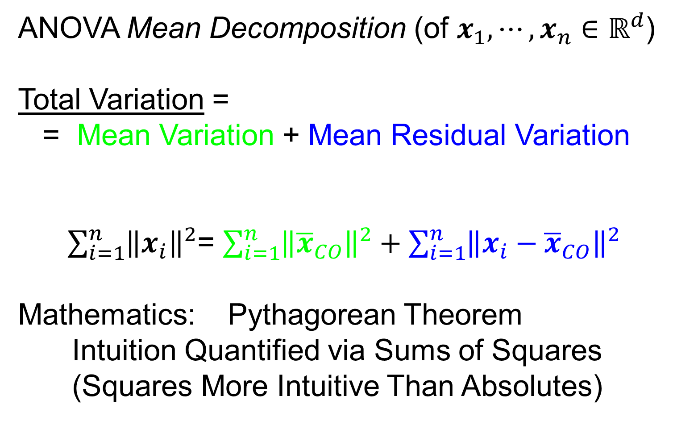
PCA Redist’n of Energy (Cont.)
ANOVA Mean Decomposition (of $x_{1},⋯,x_{n}∈ℝ^{d}$)
Total Variation =
= Mean Variation + Mean Residual Variation
$\sum_{i=1}^{n}{{\left\|x_{i}\right\|}^{2}}$= $\sum_{i=1}^{n}{{\left\|{\overline{x}}_{CO}\right\|}^{2}}+\sum_{i=1}^{n}{{\left\|x_{i}−{\overline{x}}_{CO}\right\|}^{2}}$
Mathematics: Pythagorean Theorem
Intuition Quantified via Sums of Squares
(Squares More Intuitive Than Absolutes)

Slide 14


PCA Redist’n of Energy (Cont.)
$n^{−1}$Last Term
$$\frac{1}{n}\sum_{i=1}^{n}{{\left\|{\tilde{x}}_{i}−{\overline{x}}_{CO}\right\|}^{2}}=tr\left(BDB^{t}\right)=tr\left(BB^{t}D\right)=tr\left(D\right)=\sum_{j=1}^{d}{λ_{j}}$$
Eigenvalues Provide Atoms of SS Decompos’n
Useful Plots are:
Power Spectrum: $λ_{j}$ vs. $j$
log Power Spectrum: $log\left(λ_{j}\right)$ vs. $j$
Cumulative Power Spectrum: $\sum_{j^{′}=1}^{j}{λ_{j′}}$ vs. $j$
Note PCA Gives SS’s for Free (As Eigenval’s),
But Watch Factors of $\sqrt{n}$
“Scree Plot”
Notes:
14

Slide 15
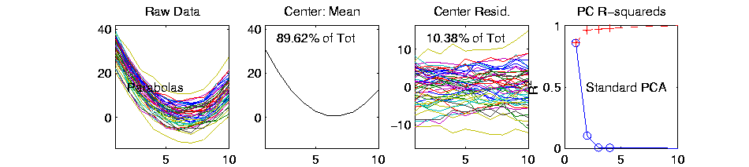
PCA Redist’n of Energy (Cont.)
Note, have already considered some of these Useful Plots:
Power Spectrum (as %s)
Cumulative Power Spectrum (%)
Recall Common Terminology:
Power Spectrum is Called
“Scree Plot”
Kruskal (1964) Cattell (1966)
(all but name “scree”) (1st Appearance of name???)
Notes:
15

Slide 16
PCA vs. SVD
Sometimes “SVD Analysis of Data”
= Uncentered PCA ≠ PCA Centered at 0

Slide 17
PCA vs. SVD
Sometimes “SVD Analysis of Data”
= Uncentered PCA ≠ PCA Centered at 0
Consequence: Skip this step

Slide 18
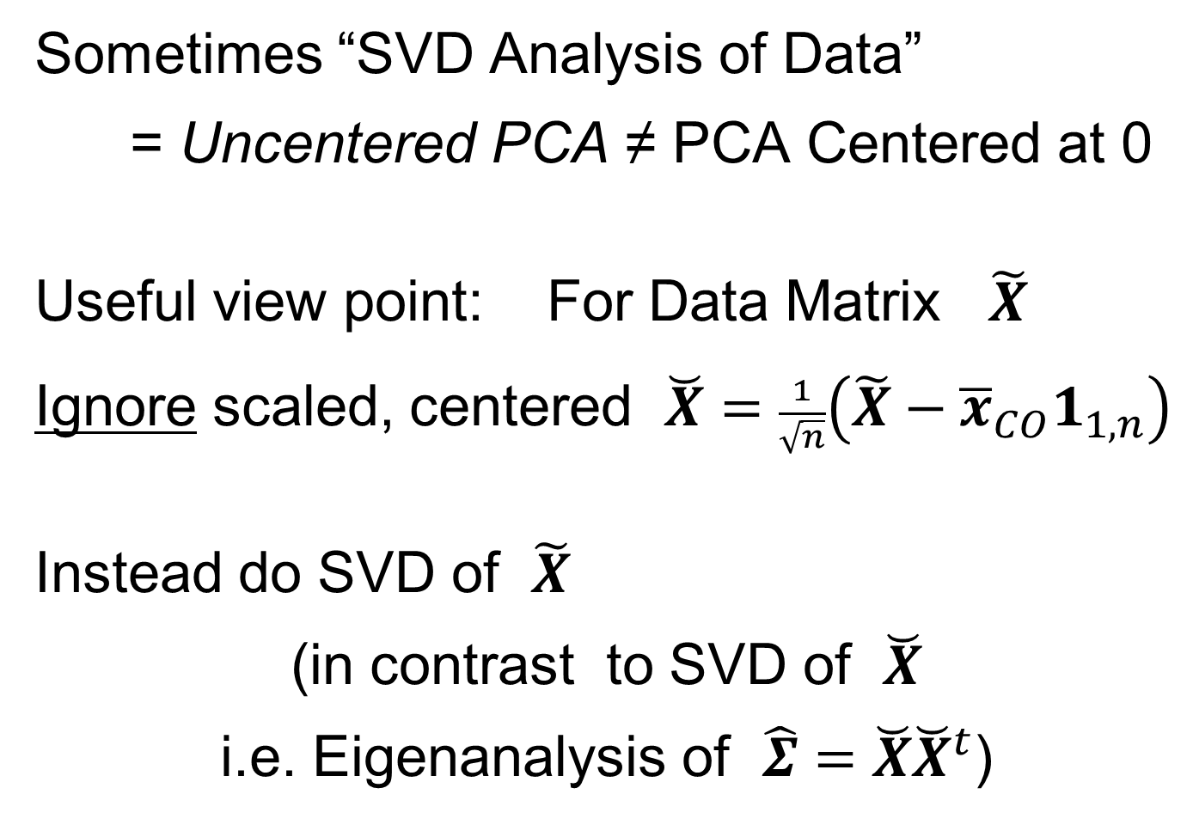
PCA vs. SVD
Sometimes “SVD Analysis of Data”
= Uncentered PCA ≠ PCA Centered at 0
Useful view point: For Data Matrix $\tilde{X}$
Ignore scaled, centered $\breve{X}=\frac{1}{\sqrt{n}}\left(\tilde{X}−{\overline{x}}_{CO}1_{1,n}\right)$
Instead do SVD of $\tilde{X}$
(in contrast to SVD of $\breve{X}$
i.e. Eigenanalysis of $\hat{Σ}=\breve{X}{\breve{X}}^{t}$)

Slide 19
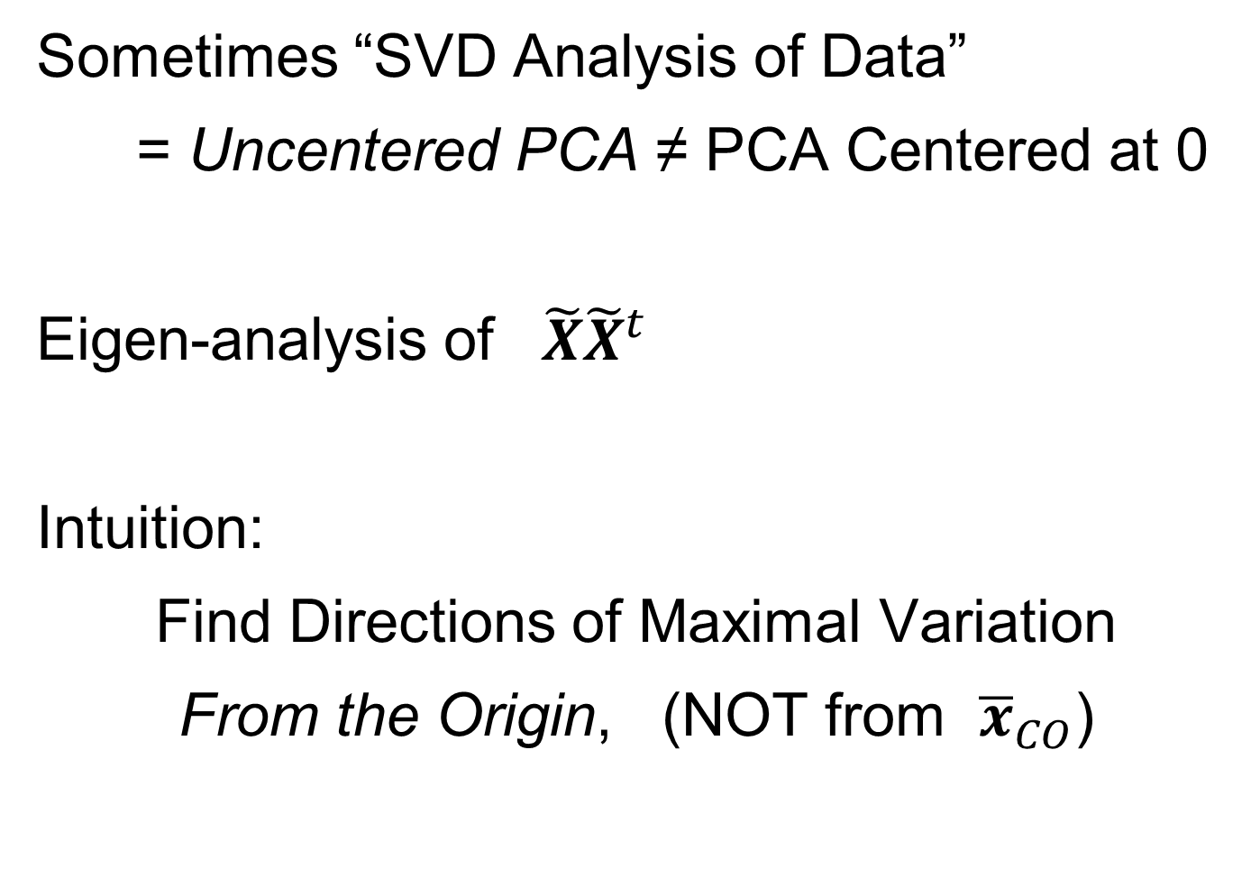
PCA vs. SVD
Sometimes “SVD Analysis of Data”
= Uncentered PCA ≠ PCA Centered at 0
Eigen-analysis of $\tilde{X}{\tilde{X}}^{t}$
Intuition:
Find Directions of Maximal Variation
From the Origin, (NOT from ${\overline{x}}_{CO}$)

Slide 20
PCA vs. SVD
Sometimes “SVD Analysis of Data”
= Uncentered PCA ≠ PCA Centered at 0
Investigate with Similar Toy Example

Slide 21
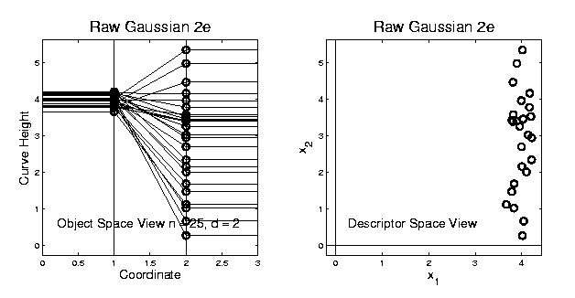
PCA vs. SVD
2-d Toy Example
Direction of “Maximal Variation”???

Slide 22
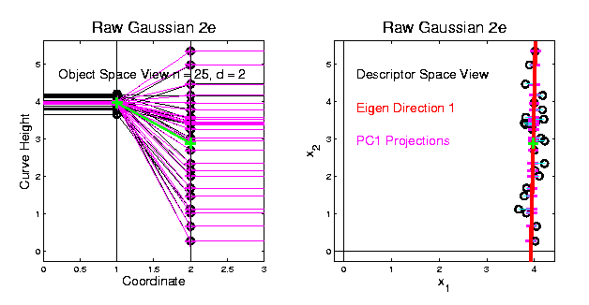
PCA vs. SVD
2-d Toy Example
Direction of “Maximal Variation”???
PC1 Solution (Mean Centered)
Very Good!

Slide 23
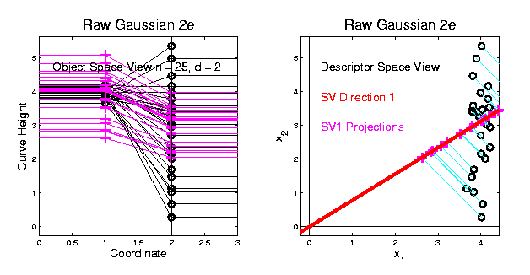
PCA vs. SVD
2-d Toy Example
Direction of “Maximal Variation”???
SV1 Solution (Origin Centered)
Poor Rep’n

Slide 24
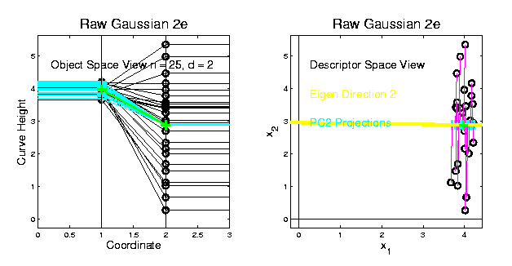
PCA vs. SVD
2-d Toy Example
Look in Orthogonal Direction:
PC2 Solution (Mean Centered) Very Good!

Slide 25
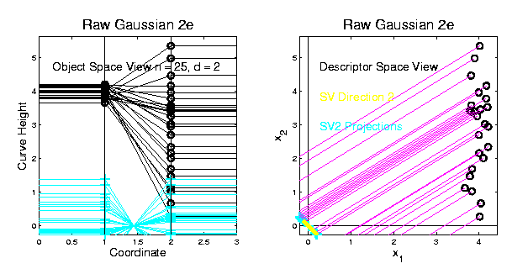
PCA vs. SVD
2-d Toy Example
Look in Orthogonal Direction:
SV2 Solution (Origin Centered) Off Map!

Slide 26
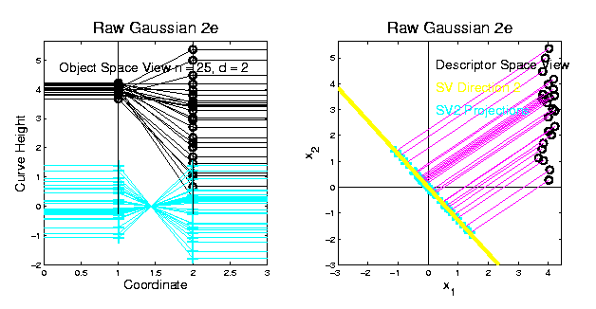
PCA vs. SVD
2-d Toy Example
SV2 Solution Larger Scale View:
Not Representative of Data
Note: Data = SV1 + SV2
But Noninformative
Decomposition

Slide 27
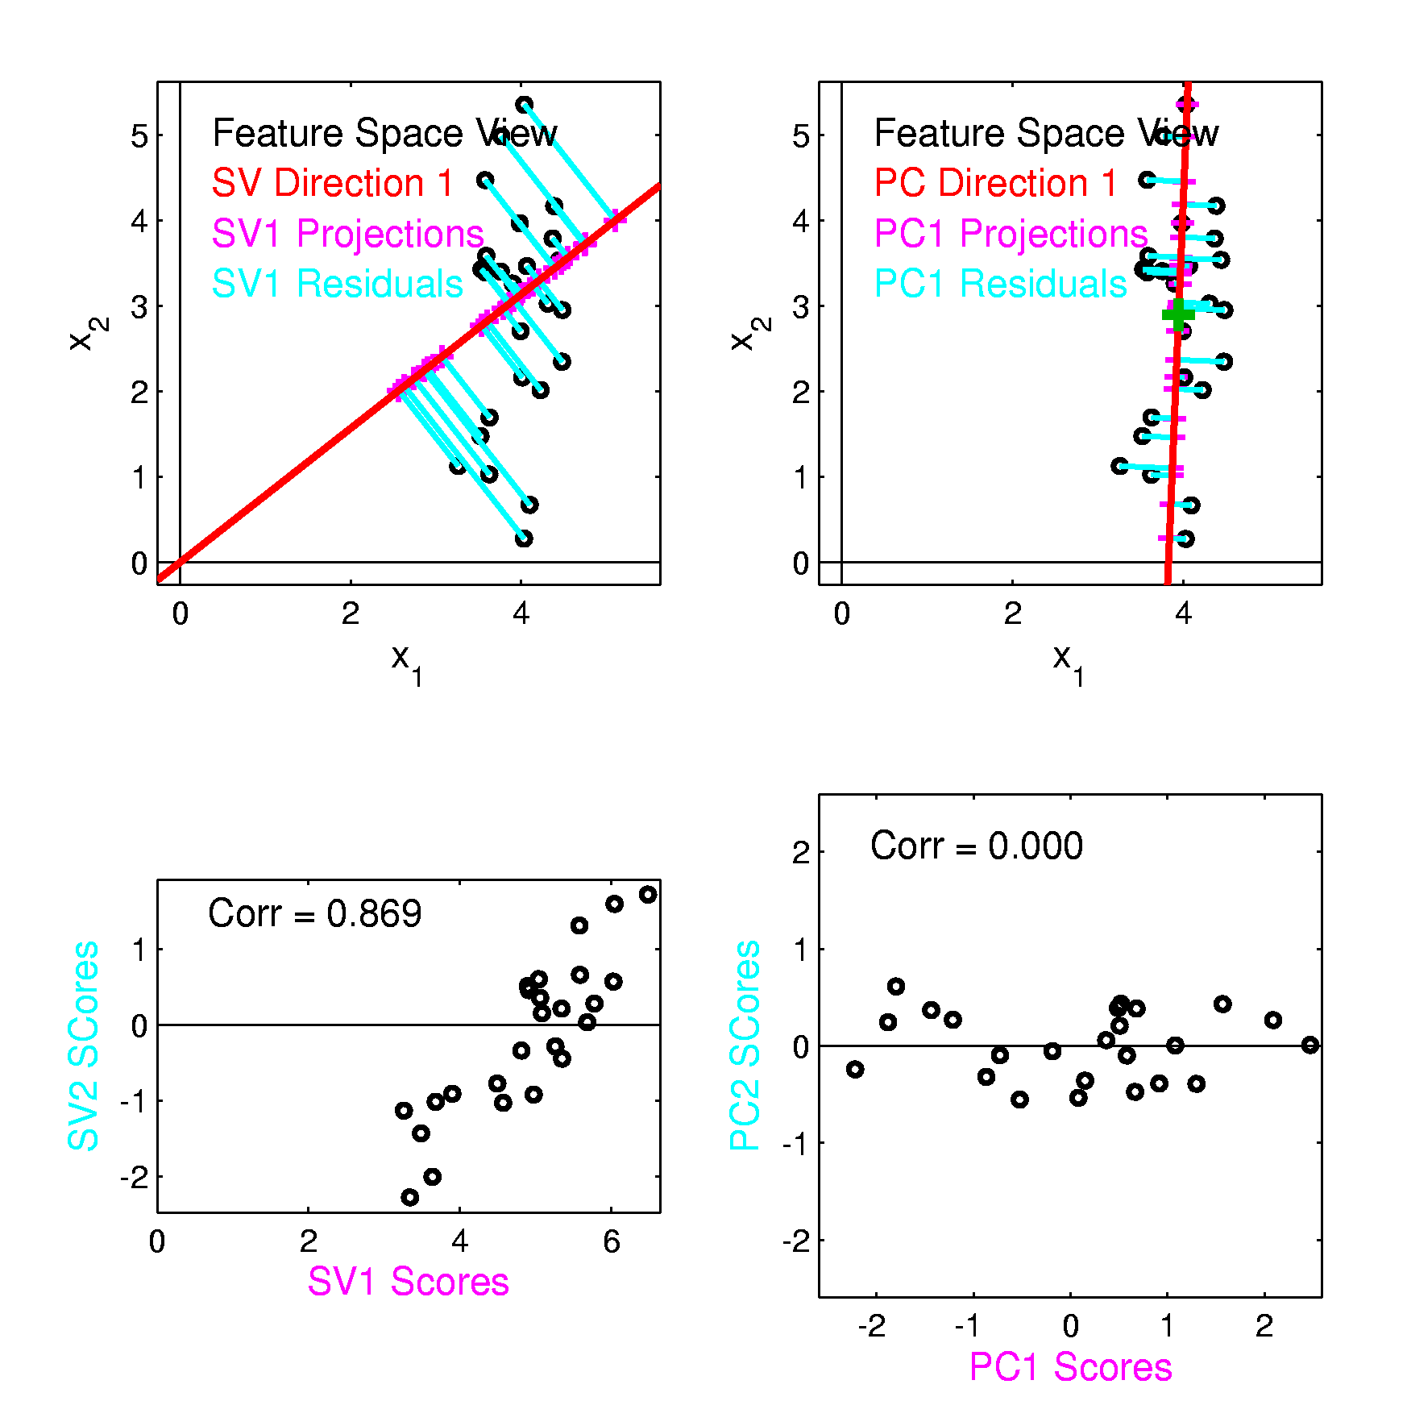
PCA vs. SVD
Similar 2-d
Toy Example
Now
Compare
Scores

Slide 28
PCA vs. SVD
Consequences
Of Centering:
PCA Scores Are
Mean Centered
Not SVD Scores
Useful Diagnostics
for PCA Scatterplots

Slide 29
PCA vs. SVD
Consequences
Of Centering:
PCA Scores Are
Uncorrelated
Not SVD Scores
Useful Diagnostics
for PCA Scatterplots

Slide 30
PCA vs. SVD
Sometimes “SVD Analysis of Data”
= Uncentered PCA
Investigated with Toy Examples:
Conclusions:
PCA Generally Better
Unless “Origin Is Important”
Deeper Look: Zhang et al (2007)

Slide 31
Different Views of PCA
Solves several optimization problems:
Direction to maximize SS of 1-d proj’d data
Notes:
31

Slide 32
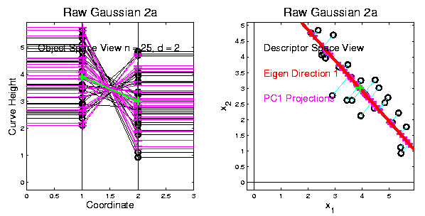
Different Views of PCA
2-d Toy Example
Max SS of Projected Data
Notes:
32

Slide 33
Different Views of PCA
Solves several optimization problems:
Direction to maximize SS of 1-d proj’d data
Direction to minimize SS of residuals
Notes:
33

Slide 34
Different Views of PCA
2-d Toy Example
Max SS of Projected Data
Min SS of Residuals
Notes:
34

Slide 35
Different Views of PCA
Solves several optimization problems:
Direction to maximize SS of 1-d proj’d data
Direction to minimize SS of residuals
(same, by Pythagorean Theorem)
“Best fit line” to data in “orthogonal sense”
(vs. regression of Y on X = vertical sense
& regression of X on Y = horizontal sense)
Notes:
35

Slide 36
Different Views of PCA
2-d Toy Example
Max SS of Projected Data
Min SS of Residuals
Best Fit Line
Notes:
36

Slide 37
Different Views of PCA
Toy Example Comparison of Fit Lines:
PC1
Regression of Y on X
Regression of X on Y
Notes:
37

Slide 38
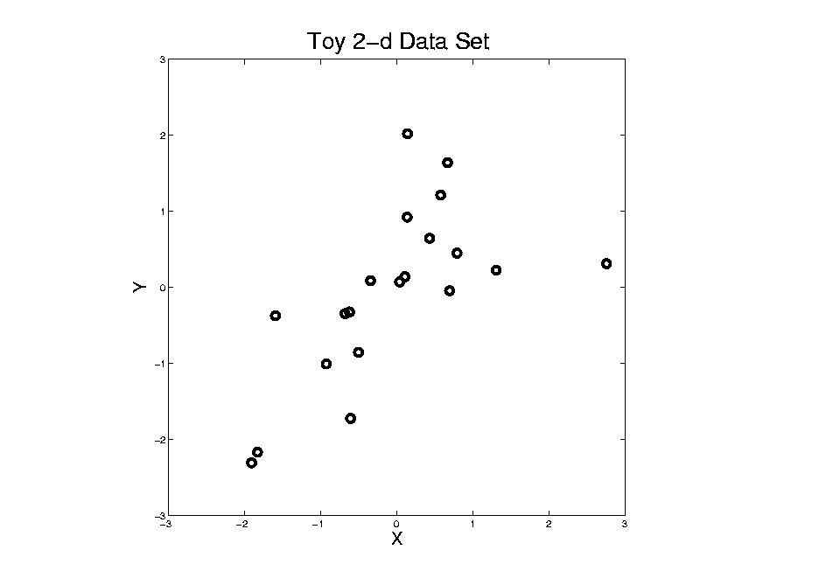
Different Views of PCA
Normal
Data
ρ = 0.3
Notes:
38

Slide 39
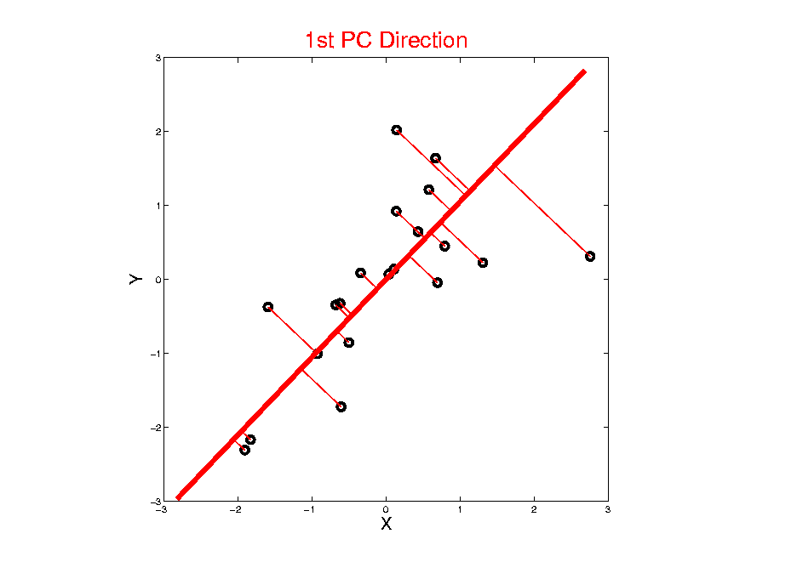
Different Views of PCA
Projected
Residuals
Notes:
39

Slide 40
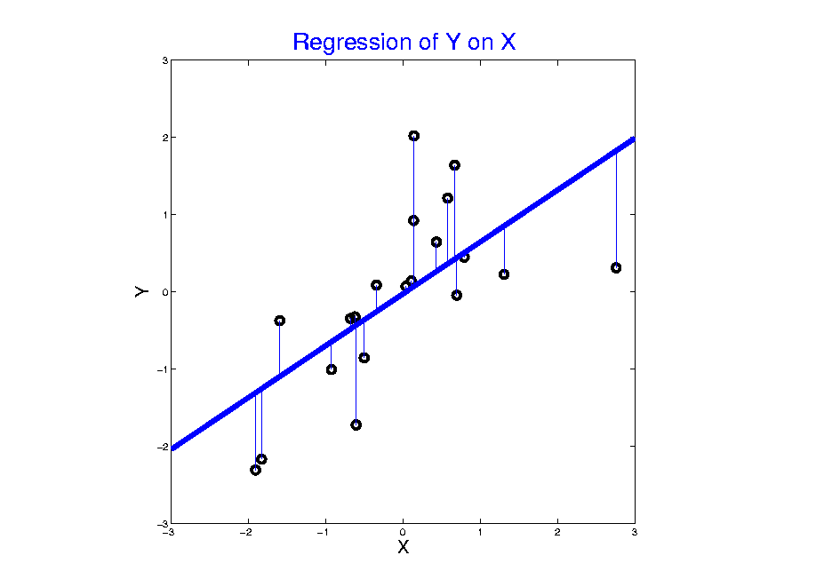

Different Views of PCA
Vertical
Residuals
(X predicts Y)
Note: Smaller Slope, Called
“Regression from Mean”
Slope Reduced
by a Factor of
$$ρ$$
Notes:
40

Slide 41
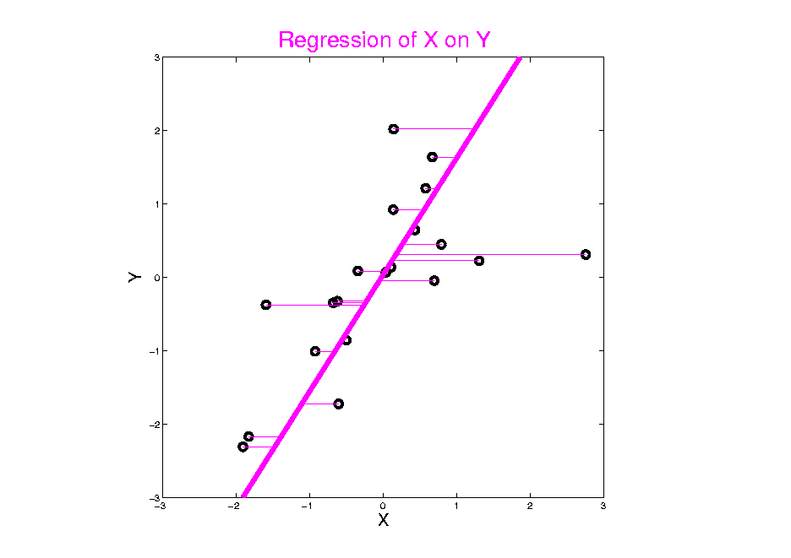
Different Views of PCA
Horizontal
Residuals
(Y predicts X)
Notes:
41

Slide 42
Different Views of PCA
Projected
Residuals
(Balanced
Treatment)
Notes:
42

Slide 43
Different Views of PCA
Toy Example Comparison of Fit Lines:
PC1
Regression of Y on X
Regression of X on Y
Note: Big Difference Prediction Matters
Notes:
43

Slide 44
Alternate “Relationship” Measures
Variations on Correlation:
“Concordance Correlation”
Lin (1989)
“Tetrachoric Correlation”
Brown (1977)
“Maximizing Agreement”
Bottai, et al. (2022)
Can do PCA
Variations Via
Corresponding
Eigen-Analyses
Of Matrices
Notes:
44

Slide 45
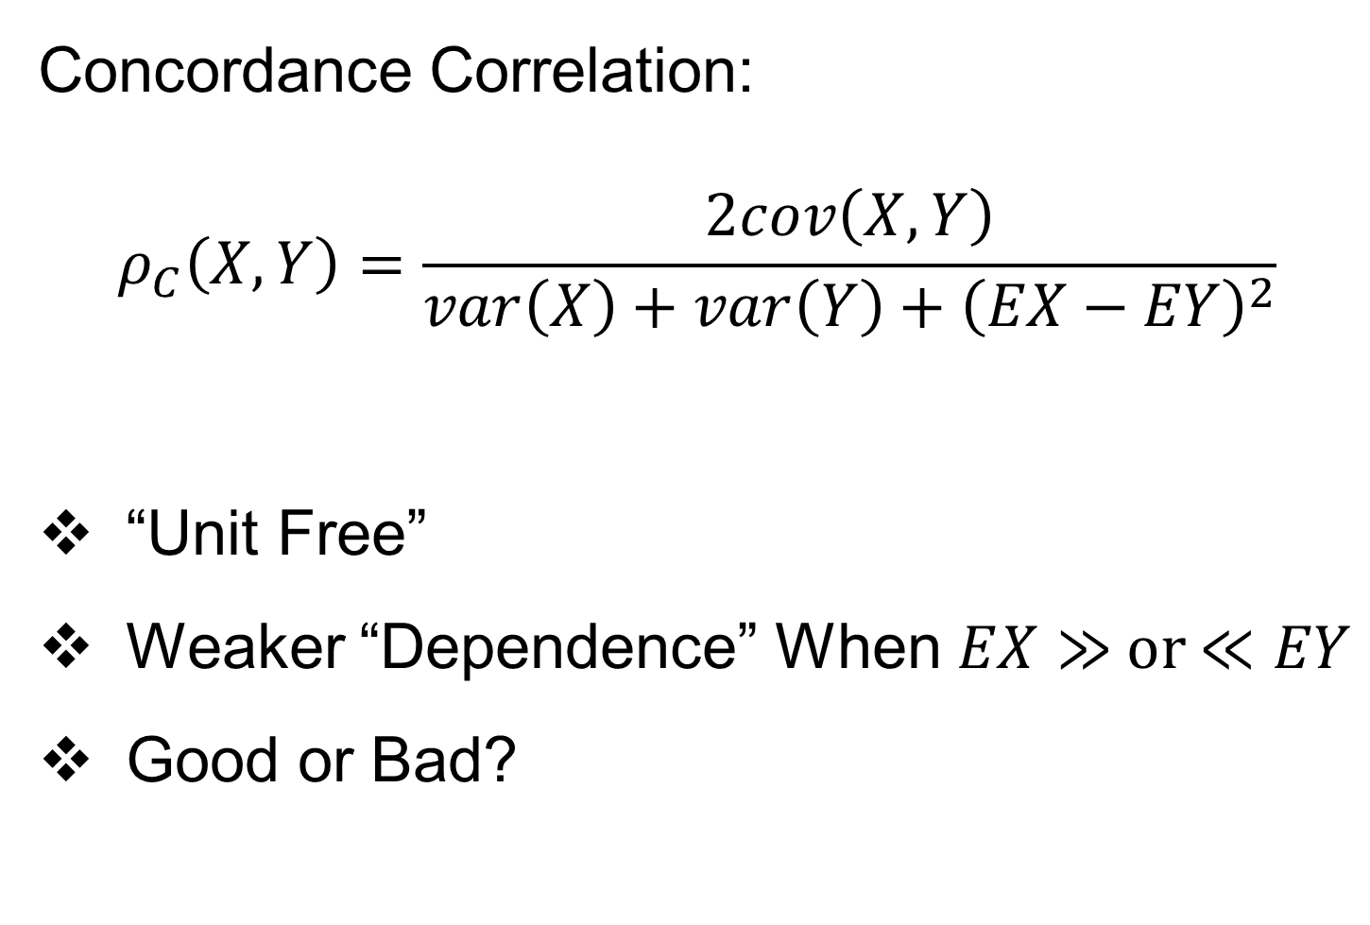
Alternate “Relationship” Measures
Concordance Correlation:
$$ρ_{C}\left(X,Y\right)=\frac{2cov\left(X,Y\right)}{var\left(X\right)+var\left(Y\right)+{\left(EX−EY\right)}^{2}}$$
“Unit Free”
Weaker “Dependence” When $EX≫$ or $≪EY$
Good or Bad?
Notes:
45

Slide 46


Alternate “Relationship” Measures
Tetrachoric Correlation:
For Joint Binary Variables:
Assume Thresholded Both $X$ and $Y$ in
$$\left(\begin{matrix}X \\ Y\end{matrix}\right)\sim N_{2}\left(\left(\begin{matrix}μ_{X} \\ μ_{Y}\end{matrix}\right),\left(\begin{matrix}σ_{X}^{2} & ρ \\ ρ & σ_{Y}^{2}\end{matrix}\right)\right)$$
Estimate $ρ_{T}$ by Maximum Likelihood
$$\begin{matrix}n_{0,0} & n_{0,1} \\ n_{1,0} & n_{1,1}\end{matrix}$$
Notes:
46

Slide 47
Alternate “Relationship” Measures
Polychoric Correlation:
Pearson (1900), Olsson (1979)
Generalize Main Idea to Ordinal Variables
Strength:
Often Better Than Pearson Correlation
Weakness:
Bad for Non-Gaussian Marginals
Notes:
47

Slide 48
Different Views of PCA
Solves several optimization problems:
Direction to maximize SS of 1-d proj’d data
Direction to minimize SS of residuals
(same, by Pythagorean Theorem)
“Best fit line” to data in “orthogonal sense”
(vs. regression of Y on X = vertical sense
& regression of X on Y = horizontal sense)
Use one that makes sense…
Notes:
48

Slide 49
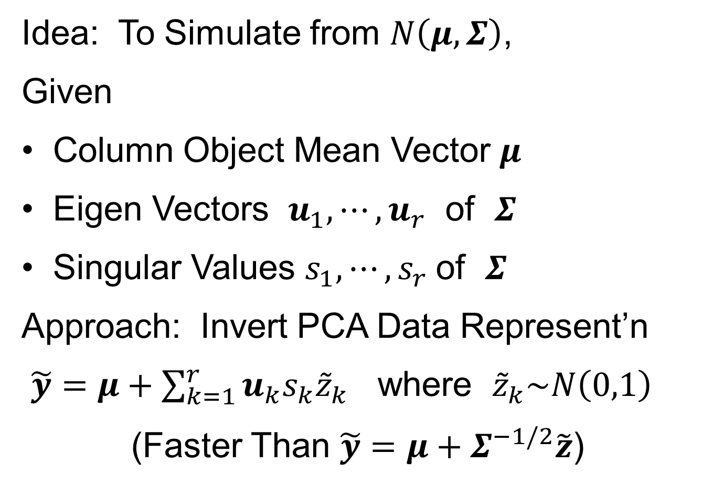
PCA Simulation
Idea: To Simulate from $N\left(μ,Σ\right)$,
Given
Column Object Mean Vector $μ$
Eigen Vectors $u_{1},⋯,u_{r}$ of $Σ$
Singular Values $s_{1},⋯,s_{r} \text{of} Σ$
Approach: Invert PCA Data Represent’n
$\tilde{y}=μ+\sum_{k=1}^{r}{u_{k}s_{k}{\tilde{z}}_{k}}$ where ${\tilde{z}}_{k}\sim N\left(0,1\right)$
(Faster Than $\tilde{y}=μ+Σ^{−1/2}\tilde{z}$)

Slide 50
PCA & Graphical Displays
Small caution on PC directions & plotting:
PCA directions (may) have sign flip
Mathematically no difference
Numerically caused artifact of round off
Can have large graphical impact

Slide 51
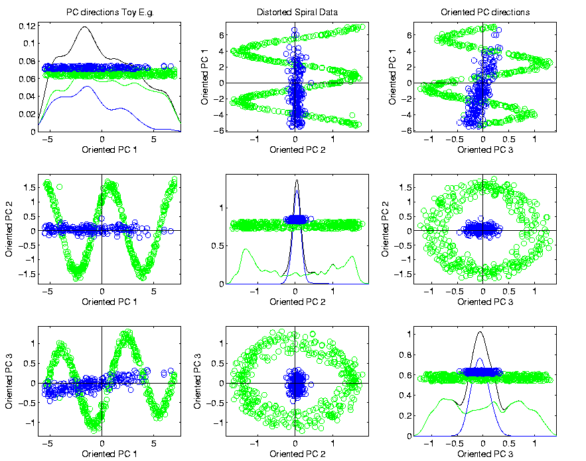
PCA & Graphical Displays
Toy Example (2 colored “clusters” in data)
Blues Form
Central Shaft
Sin and Cos
Waves
Indicate
Spiral

Slide 52
PCA & Graphical Displays
Toy Example (2 colored “clusters” in data)

Slide 53

PCA & Graphical Displays
Toy Example (1 point moved)
Important
Point:
Constant
Axes Allow
Convenient
Visualization

Slide 54
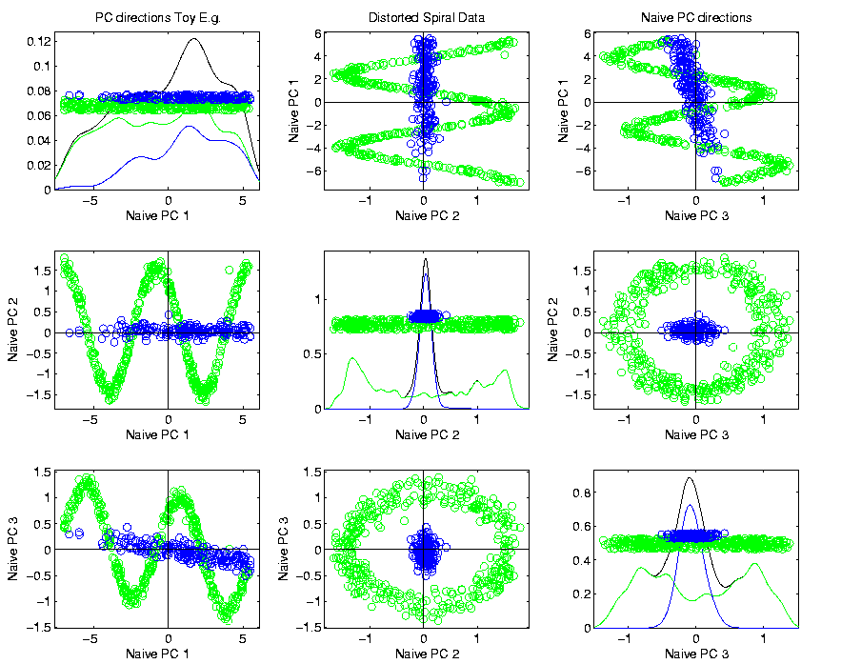
PCA & Graphical Displays
Original Data (arbitrary PC flip)

Slide 55
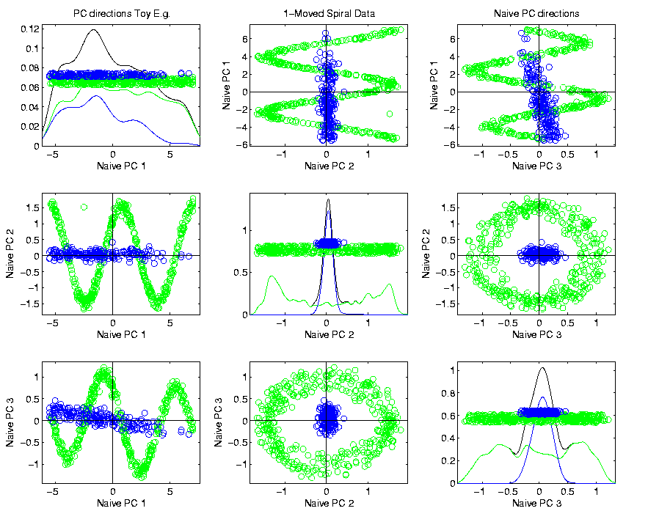
PCA & Graphical Displays
Point Moved Data (arbitrary PC flip)
Much
Harder
To See
Moving
Point

Slide 56

PCA & Graphical Displays
How to “fix directions”?
One Option:
Use ± 1 flip that gives:
$$\max_{i=1,⋯,n}{Proj\left({\tilde{x}}_{i}\right)}>\left|\min_{i=1,⋯,n}{Proj\left({\tilde{x}}_{i}\right)}\right|$$
(assumes 0 centered)
Doesn’t Work
In Unlikely
Case of Ties

Slide 57
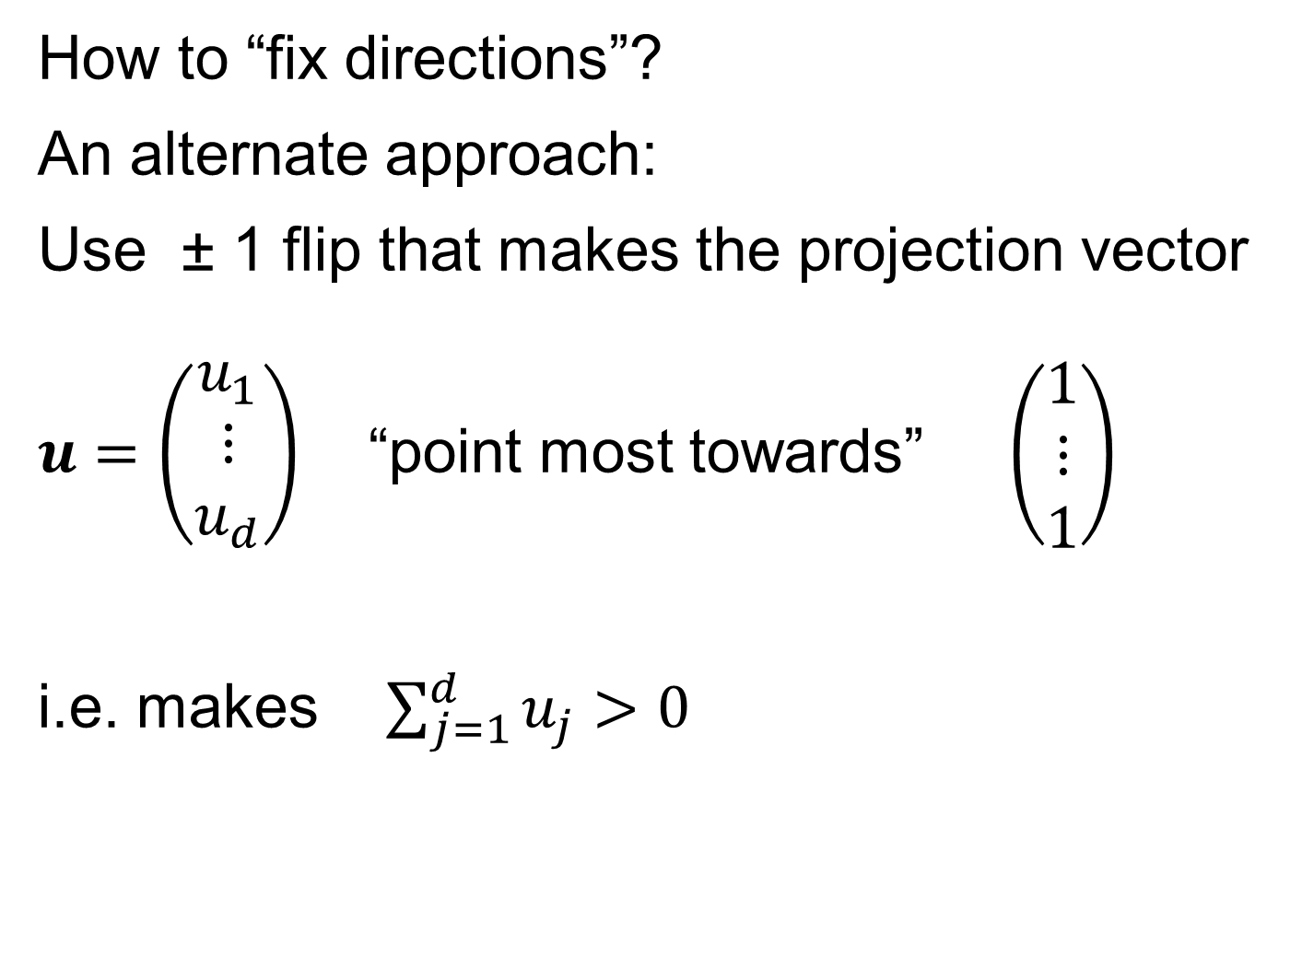
PCA & Graphical Displays
How to “fix directions”?
An alternate approach:
Use ± 1 flip that makes the projection vector
$u=\left(\begin{matrix}u_{1} \\ ⋮ \\ u_{d}\end{matrix}\right)$ “point most towards” $\left(\begin{matrix}1 \\ ⋮ \\ 1\end{matrix}\right)$
i.e. makes $\sum_{j=1}^{d}{u_{j}}>0$
Fails when Row Trait Mean
Has Been Subtracted Out
Recall: “Flat Direction”
Doesn’t Work
When Flat Vector
Is Explicitly Used
Inner Product with Flat Dir’n
Puts in “Positive Half Space”

Slide 58
Return to Big Picture
Main statistical goals of OODA:
Understanding population structure
  Low dim’al Projections, PCA …
Classification (i. e. Discrimination)
  Understanding 2+ populations
Time Series of Data Objects
  Chemical Spectra, Mortality Data
“Vertical Integration” of Data Types

Slide 59
Data Integration
Text, Sec. 17.2
Modern Data Collections Often Involve
Multiple Data Types
Important Analytical Task:
Understand How These Work Together
(And Work Separately)
But Very Limited, Will Do Much More Here

Slide 60
Data Integration
Important Example: Cancer Research
Late 1990s – early 2000s
Microarrays for gene expression
Hype: “Will Cure Cancer”
Hmm, afraid not…
Response:
Have $$$, so measure much more…

Slide 61
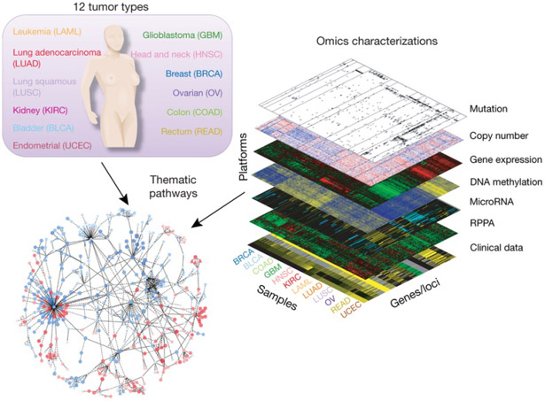
Data Integration
Deep Example:
The
Cancer
Genome
Atlas
(TCGA)
Figure : The Cancer Genome Atlas Research Network, Weinstein, J.N., Collisson, E.A., Mills, G.B., Shaw, K.M., Ozenberger, B.A., Ellrott, K., Shmulevich, I., Sander, C., and Stuart, J.M. (2013)
The Cancer Genome Atlas Pan-Cancer analysis project.

Slide 62


Data Integration
Deep Example:
Major UNC
Participants
Chuck Perou
Katie Hoadley
Figure : The Cancer Genome Atlas Research Network, Weinstein, J.N., Collisson, E.A., Mills, G.B., Shaw, K.M., Ozenberger, B.A., Ellrott, K., Shmulevich, I., Sander, C., and Stuart, J.M. (2013)
The Cancer Genome Atlas Pan-Cancer analysis project.

Slide 63
Data Integration
Modern Data Collections Often Involve
Multiple Data Types
Important Analytical Task:
Understand How These Work Together
(And Work Separately)

Slide 64
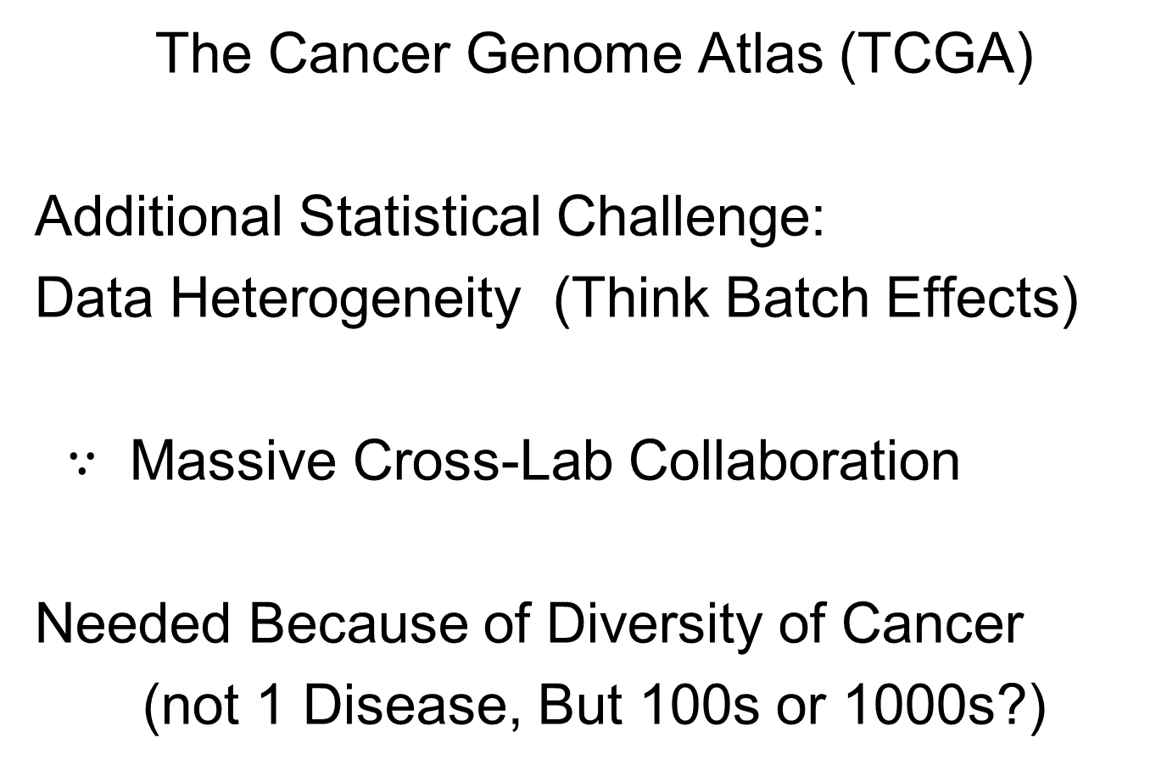
Data Integration
The Cancer Genome Atlas (TCGA)
Additional Statistical Challenge:
Data Heterogeneity (Think Batch Effects)
$∵$ Massive Cross-Lab Collaboration
Needed Because of Diversity of Cancer
(not 1 Disease, But 100s or 1000s?)

Slide 65

Data Integration
Common Data Structure:
Multi-Block Analysis
Synomyns:
Data Fusion
Multi-View (Machine Learning)
Multi-Modal Data
Functional Factor Models
$$⋮$$

Slide 66

Data Integration
Multi-Block Data Structure
Blocks are $\left(K\right)$ Data Matrices
Convention:
Columns as Data Objects
I.e. Common Patients,
Experimental Units…

Slide 67
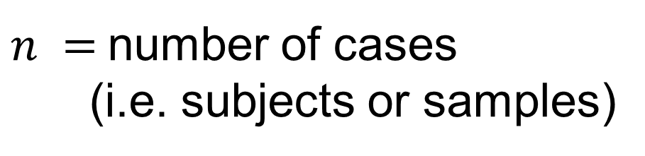




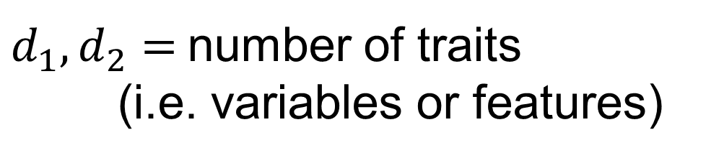

Data Integration
$K=2$ Block Notation
(Can Be Different)
$d_{1},d_{2}=$number of traits
(i.e. variables or features)
$$d_{1}$$
$$n$$
$n =$number of cases
(i.e. subjects or samples)
$$d_{2}$$
$$n$$
(Must Be Same)

Slide 68
Data Integration
Insightful Goal:
Modes of Variation
As in PCA
(Recall Spanish Mortality Data)

Slide 69
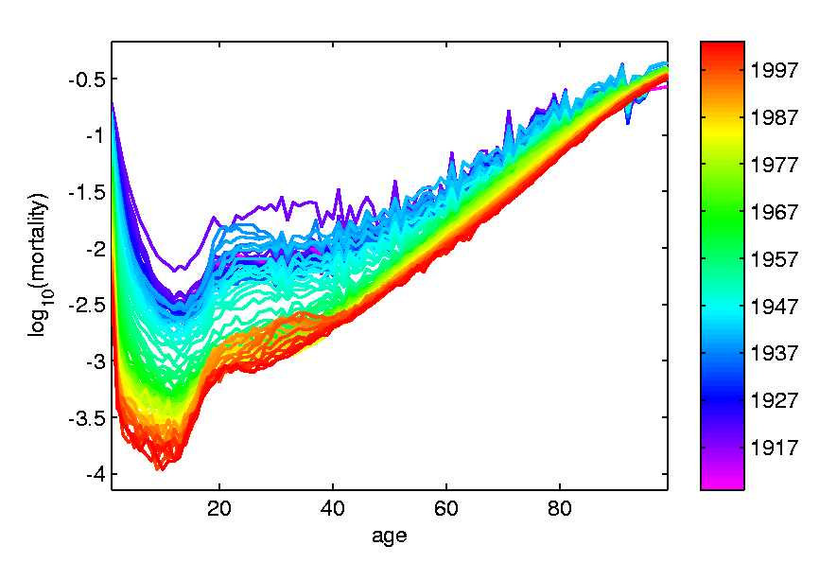
A Taste of OODA Examples
Spanish Male Mortality Curves
Enhancement: Color by Year
1908
1931
1964
1987
2002

Slide 70
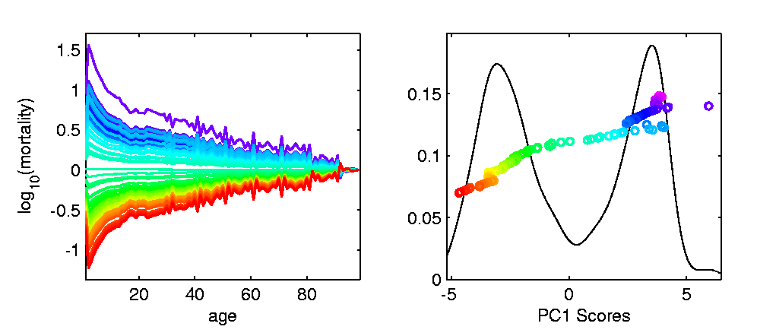
A Taste of OODA Examples
Spanish Male Mortality Curves
1918 Flu Pandemic
Spanish Civil War
1st Mode of
Variation

Slide 71
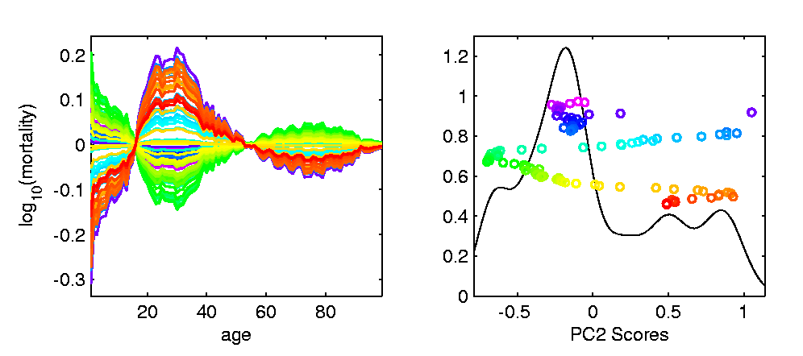
A Taste of OODA Examples
Spanish Male Mortality Curves
Flu Pandemic, Civil War
2nd Mode of
Variation
Intro of Automobile,
Improved Safety

Slide 72
Data Integration
Insightful Goal:
Modes of Variation
As in PCA
But Replace Maximal Variation
With Maximal Commonality
(& Maybe Maximal Difference)

Slide 73
Review of Linear Algebra (Cont.)
SVD Full Representation:
=
$$V_{n×n}^{t}$$
$$X_{d×n}$$
$$U_{d×d}$$
$$S_{d×n}$$
Orthonormal Basis Vectors of $ℝ^{d}$
Diagonal Matrix of Singular Values
Orthonormal Basis Vectors of $ℝ^{n}$

Slide 74
Review of Linear Algebra (Cont.)
SVD Compact Representation:
=
For Reduced Rank Approximation Get Best Squared Error Approx. from $r<$ rank($X$)
Key to Dimension Reduction
$$S_{r×r}$$
$$V_{r×n}^{t}$$
$$X_{d×n}$$
$$U_{d×r}$$
$r=$ rank($X$)

Slide 75
Data Integration
Centering: Common Assumption is
Column Object Mean Centered
(Subtract Column Mean Vectors)
Alternate View:
For Each Row,
Subtract Scalar Mean

Slide 76
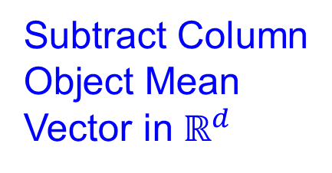
An Aside on Centering
Several Types:
Column Object Mean Centering
Not in
Text
Subtract Column
Object Mean
Vector in $ℝ^{d}$

Slide 77
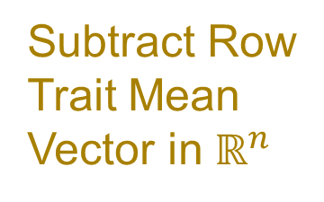
An Aside on Centering
Several Types:
Column Object Mean Centering
Row Trait Mean Centering
Subtract Row
Trait Mean
Vector in $ℝ^{n}$

Slide 78
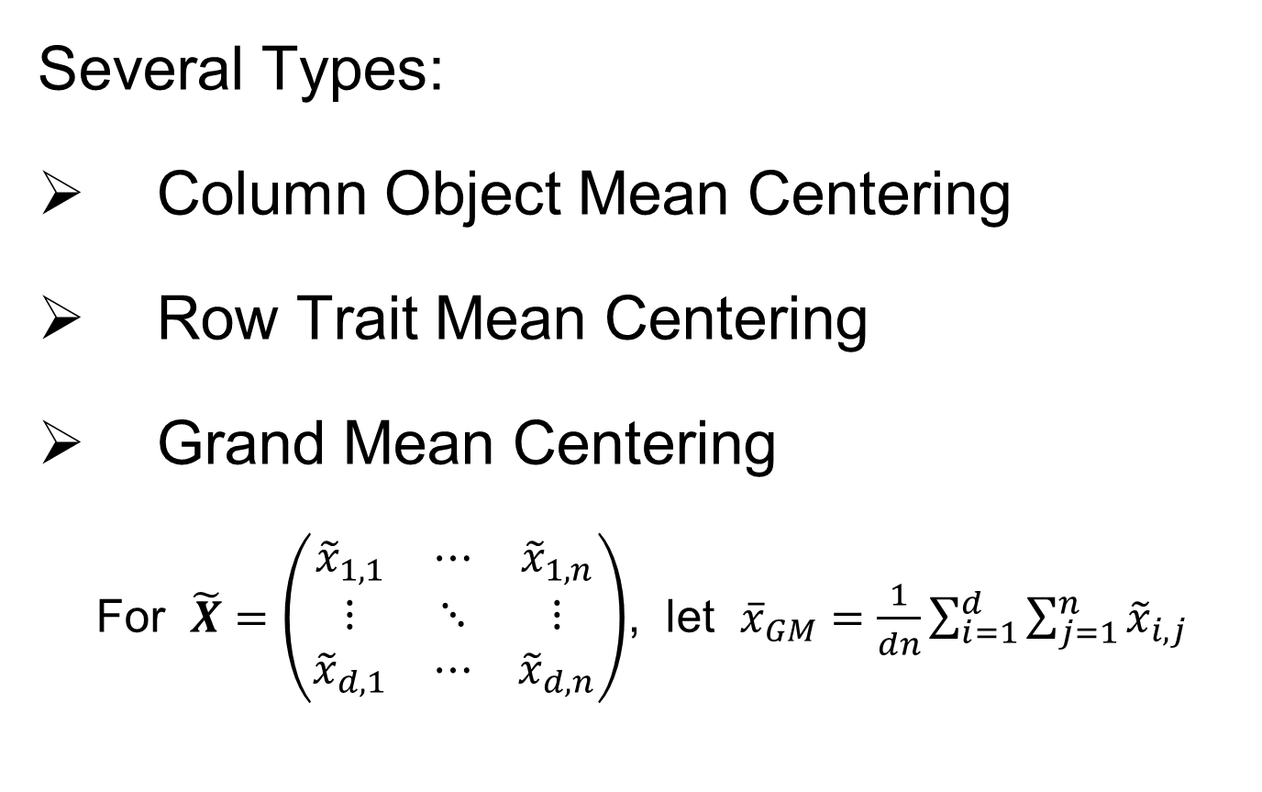
An Aside on Centering
Several Types:
Column Object Mean Centering
Row Trait Mean Centering
Grand Mean Centering
For $\tilde{X}=\left(\begin{matrix}{\tilde{x}}_{1,1} & ⋯ & {\tilde{x}}_{1,n} \\ ⋮ & ⋱ & ⋮ \\ {\tilde{x}}_{d,1} & ⋯ & {\tilde{x}}_{d,n}\end{matrix}\right)$, let ${\overline{x}}_{GM}=\frac{1}{dn}\sum_{i=1}^{d}{\sum_{j=1}^{n}{{\tilde{x}}_{i,j}}}$

Slide 79
An Aside on Centering
Several Types:
Column Object Mean Centering
Row Trait Mean Centering
Grand Mean Centering
Double Mean Centering (Apply Both)
Not as Intuitively Simple as One Might Think
Prothero et al. (2023)

Slide 80
Participant Presentation
Coleman Ferrell
Relationship Between
Concussions and Symptoms

