Slide 1
Statistics – O. R. 881
Object Oriented Data Analysis
Steve Marron
Dept. of Statistics and Operations Research
University of North Carolina

Slide 2
Current Sections in Textbook
Today:
Section 17.2
Next Class:
Section 17.2

Slide 3
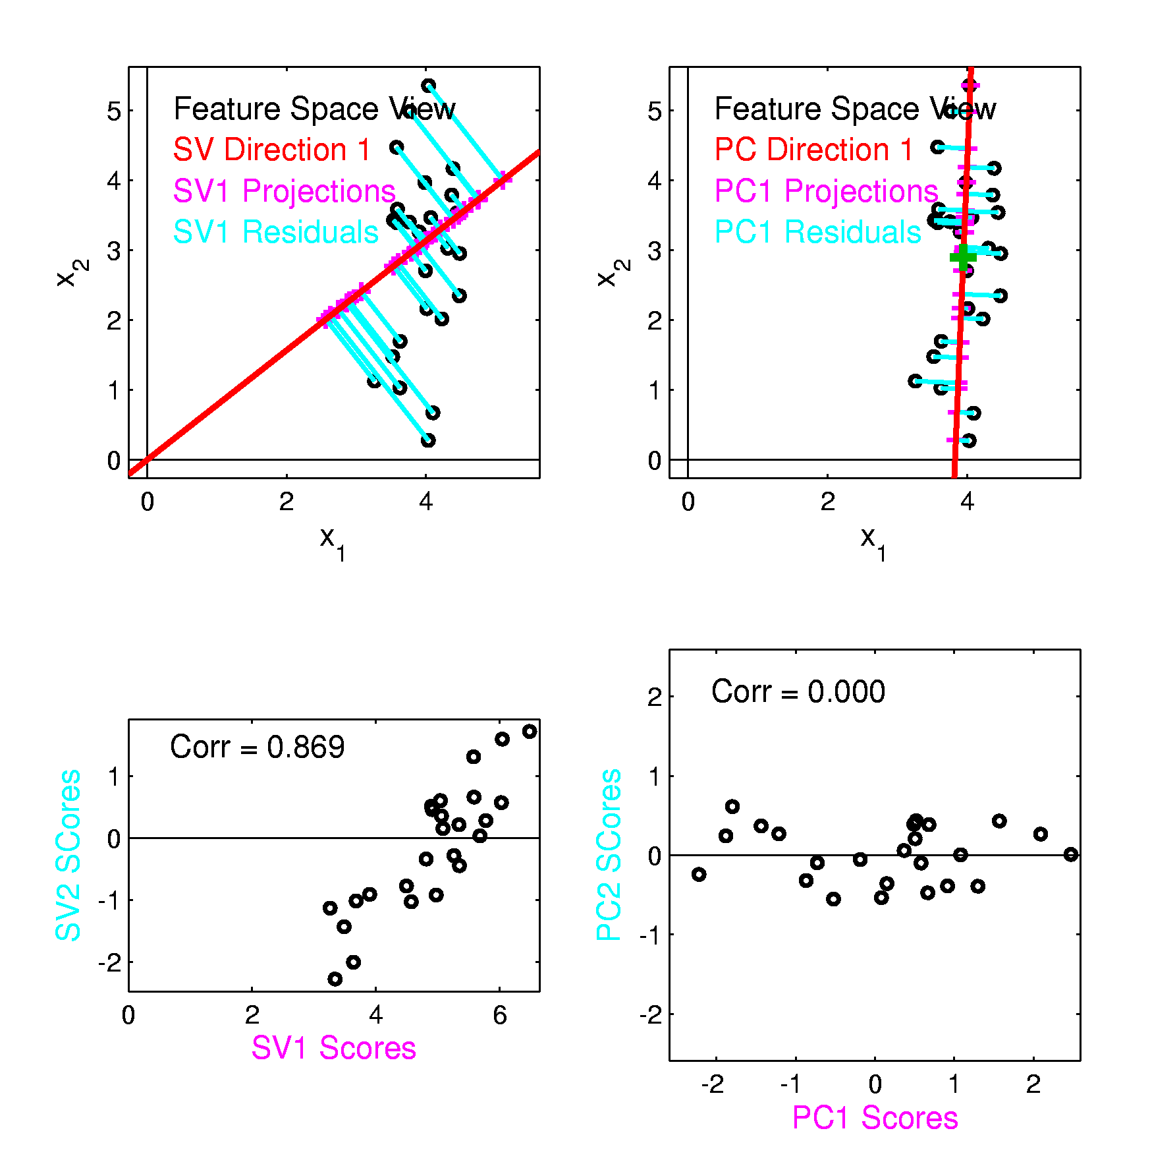
Last Class PCA vs. SVD
Consequences
Of Centering:
PCA Scores Are
Uncorrelated
Not SVD Scores

Slide 4
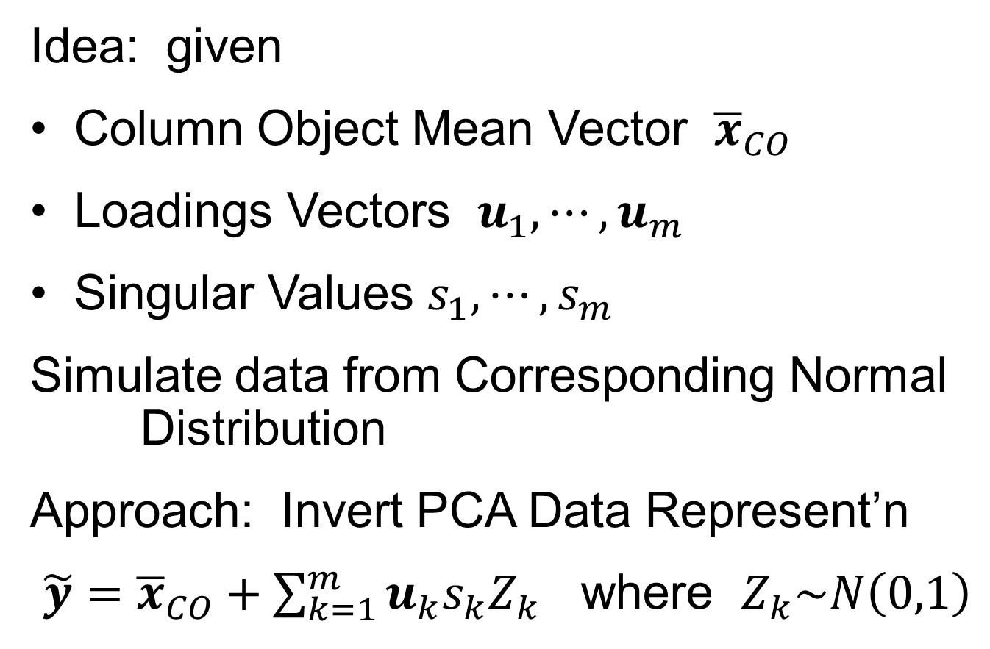
Last Class: PCA Simulation
Idea: given
Column Object Mean Vector ${\overline{x}}_{CO}$
Loadings Vectors $u_{1},⋯,u_{m}$
Singular Values $s_{1},⋯,s_{m}$
Simulate data from Corresponding Normal Distribution
Approach: Invert PCA Data Represent’n
$\tilde{y}={\overline{x}}_{CO}+\sum_{k=1}^{m}{u_{k}s_{k}Z_{k}}$ where $Z_{k}\sim N\left(0,1\right)$

Slide 5
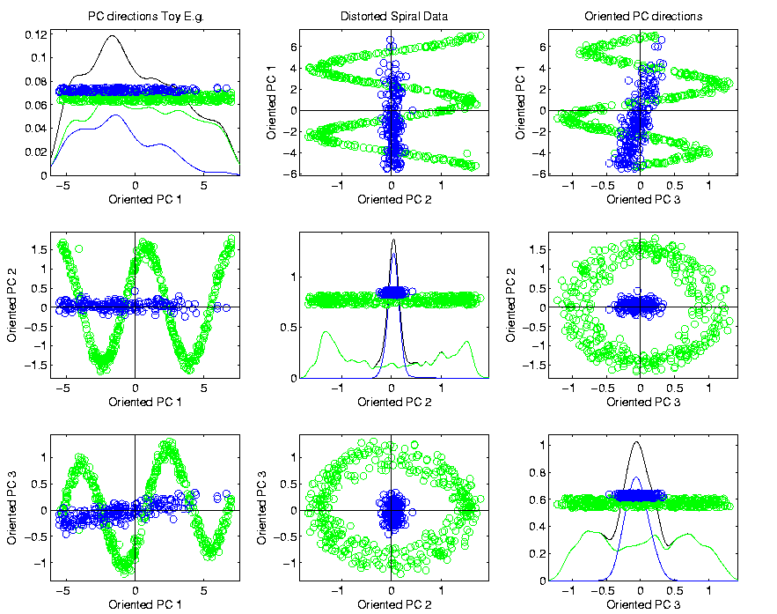
Last Class PCA & Displays
Toy Example (2 colored “clusters” in data)

Slide 6

Last Class PCA & Displays
Toy Example (1 point moved)
Important
Point:
Constant
Axes

Slide 7
Last Class: Data Integration
Text, Sec. 17.2
Modern Data Collections Often Involve
Multiple Data Types
Important Analytical Task:
Understand How These Work Together
(And Work Separately)

Slide 8
Last Class: Data Integration
Multi-Block Data Structure
Blocks are $\left(B\right)$ Data Matrices
Convention:
Columns as Data Objects
I.e. Common Patients,
Experimental Units…

Slide 9
Next time
B → K

Slide 10
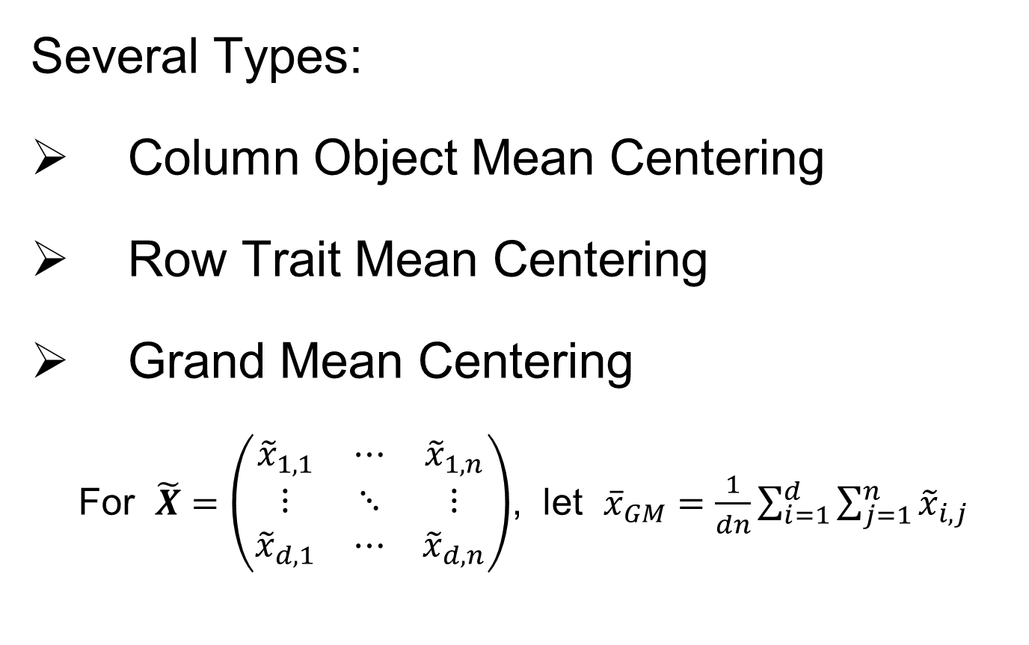
An Aside on Centering
Several Types:
Column Object Mean Centering
Row Trait Mean Centering
Grand Mean Centering
For $\tilde{X}=\left(\begin{matrix}{\tilde{x}}_{1,1} & ⋯ & {\tilde{x}}_{1,n} \\ ⋮ & ⋱ & ⋮ \\ {\tilde{x}}_{d,1} & ⋯ & {\tilde{x}}_{d,n}\end{matrix}\right)$, let ${\overline{x}}_{GM}=\frac{1}{dn}\sum_{i=1}^{d}{\sum_{j=1}^{n}{{\tilde{x}}_{i,j}}}$

Slide 11
An Aside on Centering
Several Types:
Column Object Mean Centering
Row Trait Mean Centering
Grand Mean Centering
Double Mean Centering (Apply Both)
Not as Intuitively Simple as One Might Think
Prothero et al. (2023)

Slide 12
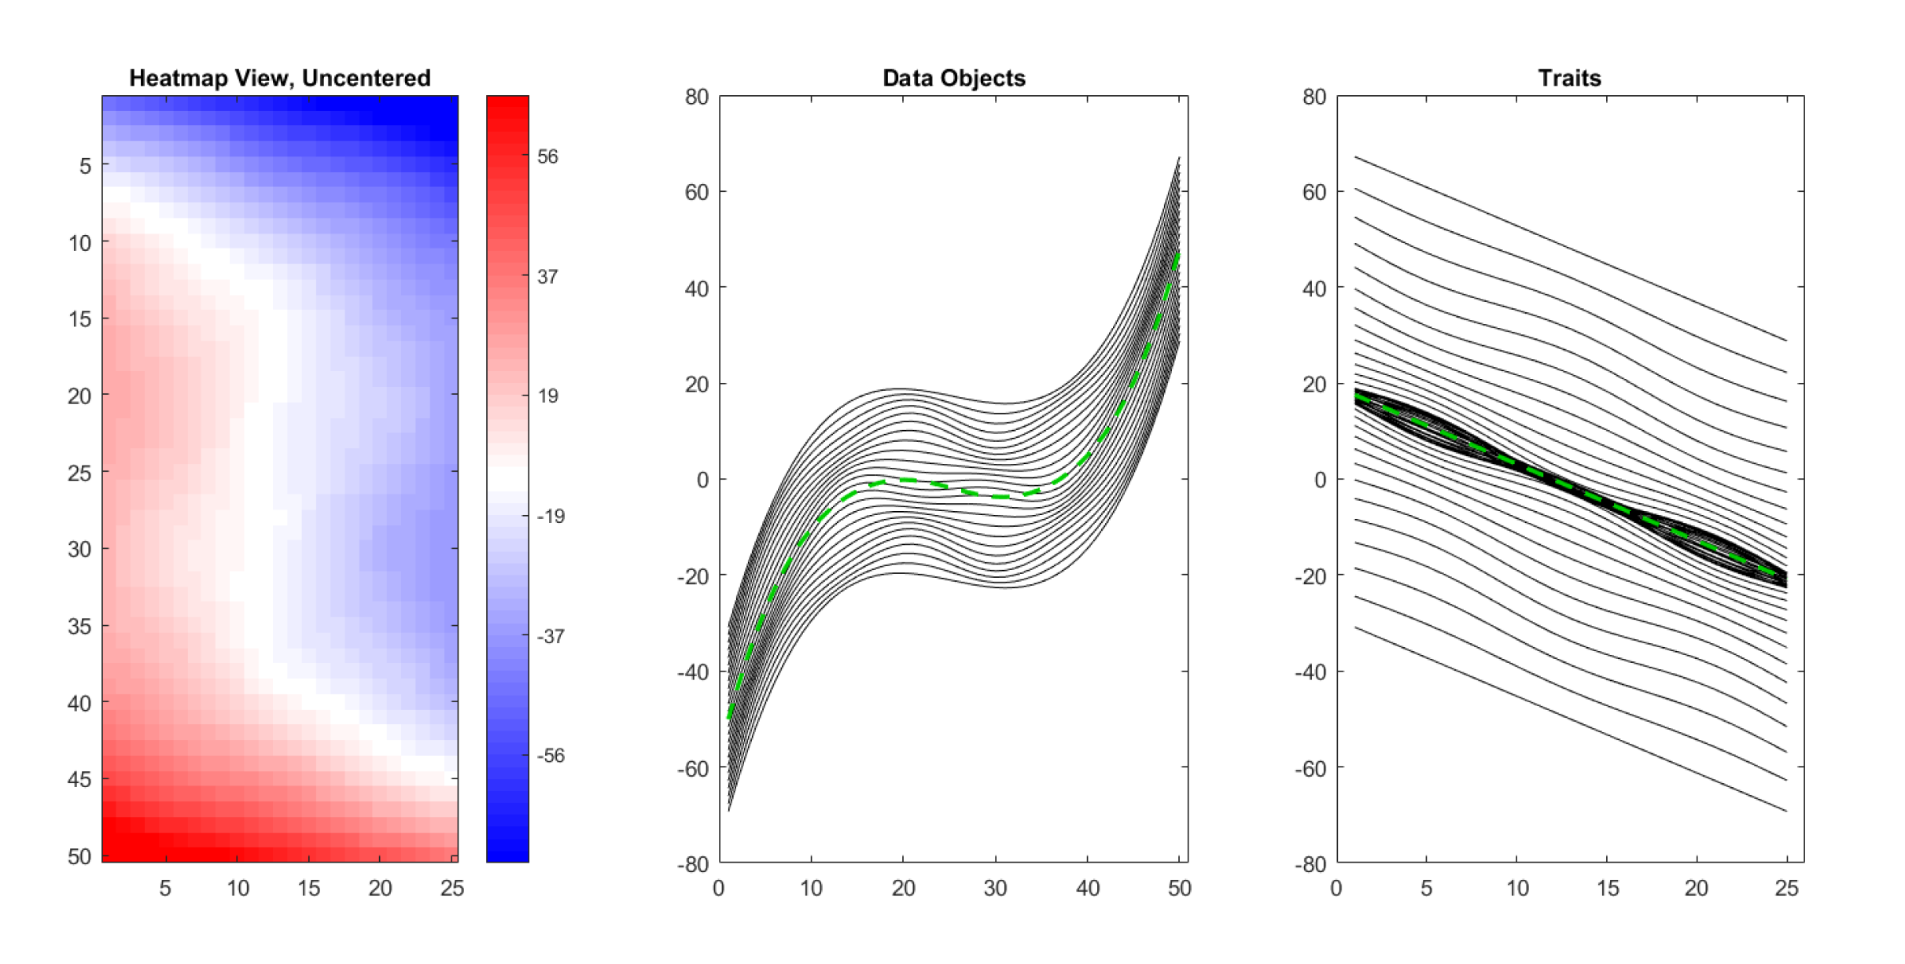
An Aside on Centering
Toy Data Set With 3 Views (Uncentered)
~Sigmoids Moving
Up and Down With
Linear Spacing
Similar to Dual Space
In Optimization
Will Become
Important Soon
~Lines Moving
Up and Down With
Sigmoid Spacing

Slide 13
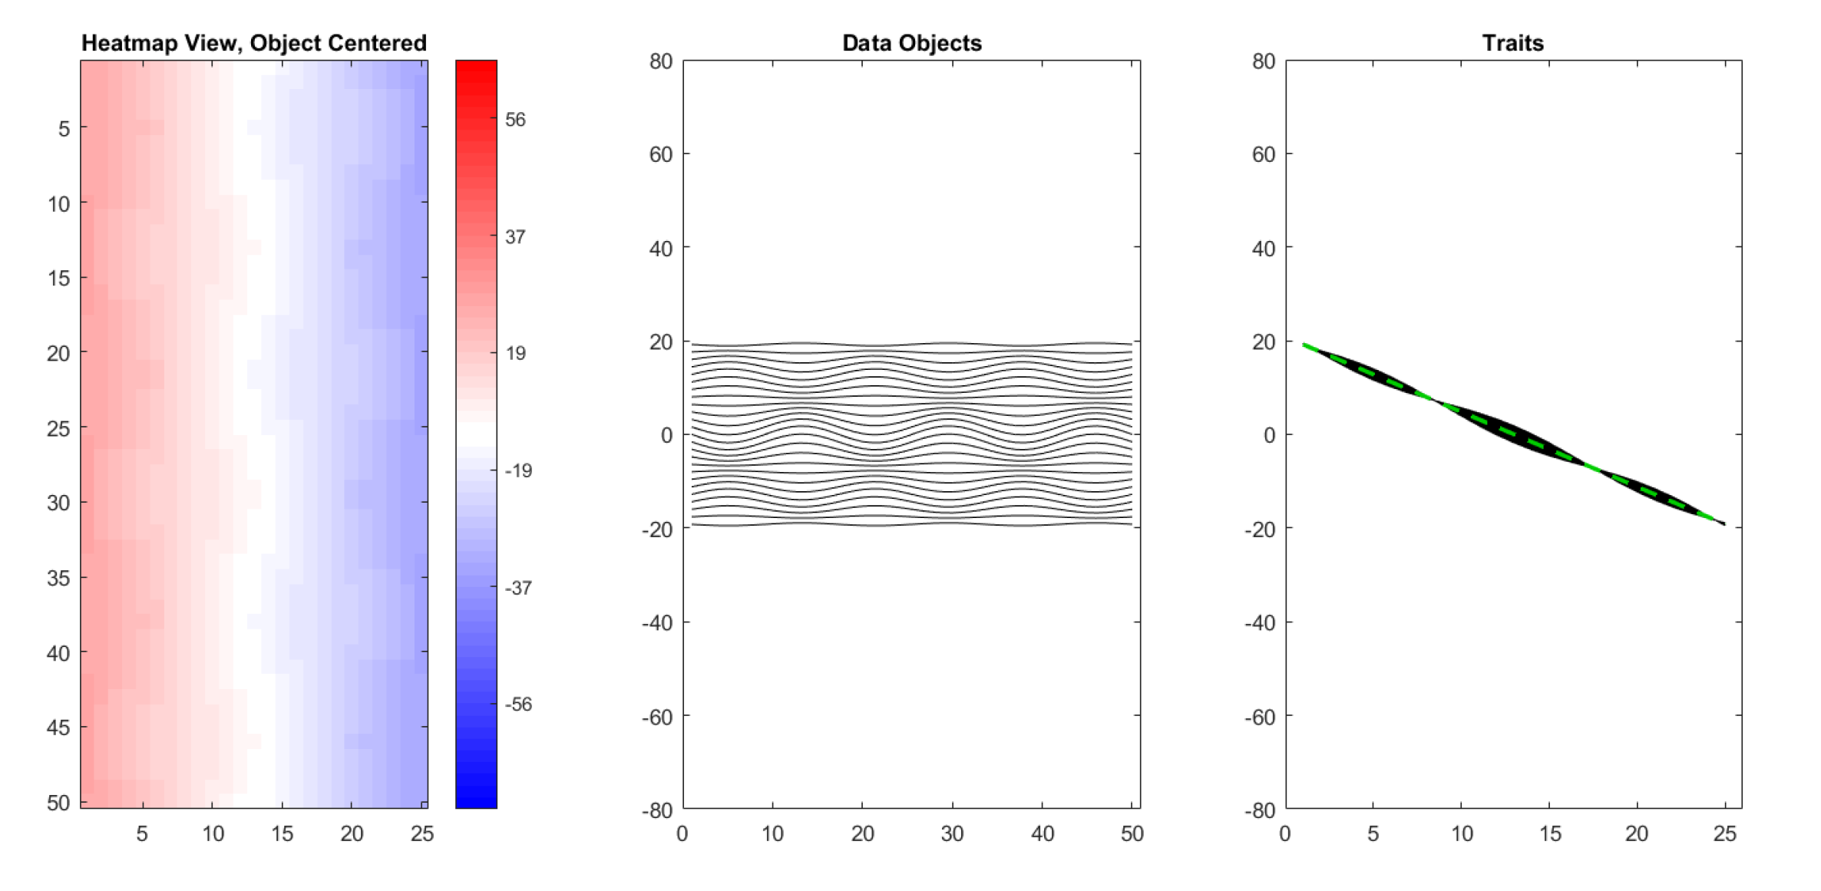
An Aside on Centering
Toy Data Set With 3 Views (Object Centered)
Variation, Which
Followed Sigmoid,
Has Disappeared
This Remainder Is
Nearly Flat Mode
Of Variation
~Sigmoid Shape
Is Now Gone

Slide 14
An Aside on Centering
Toy Data Set With 3 Views (Uncentered)

Slide 15
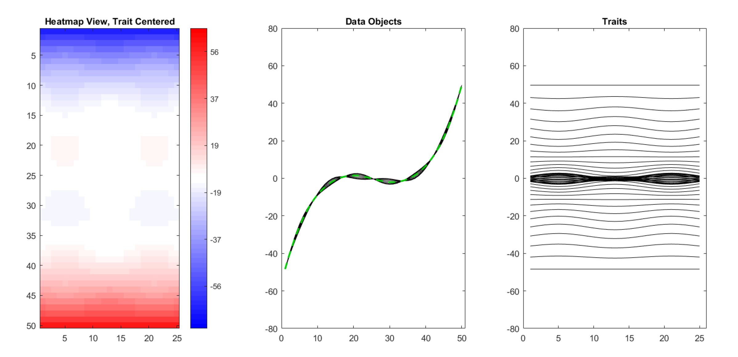
An Aside on Centering
Toy Data Set With 3 Views (Trait Centered)
Linear Slope
Has Disappeared
Note: Row Trait
Mean Centering
Has Removed
The Flat Mode
Of Variation
Which Was Most
Of This Variabiliy
Flat Line Following
Sigmoid

Slide 16
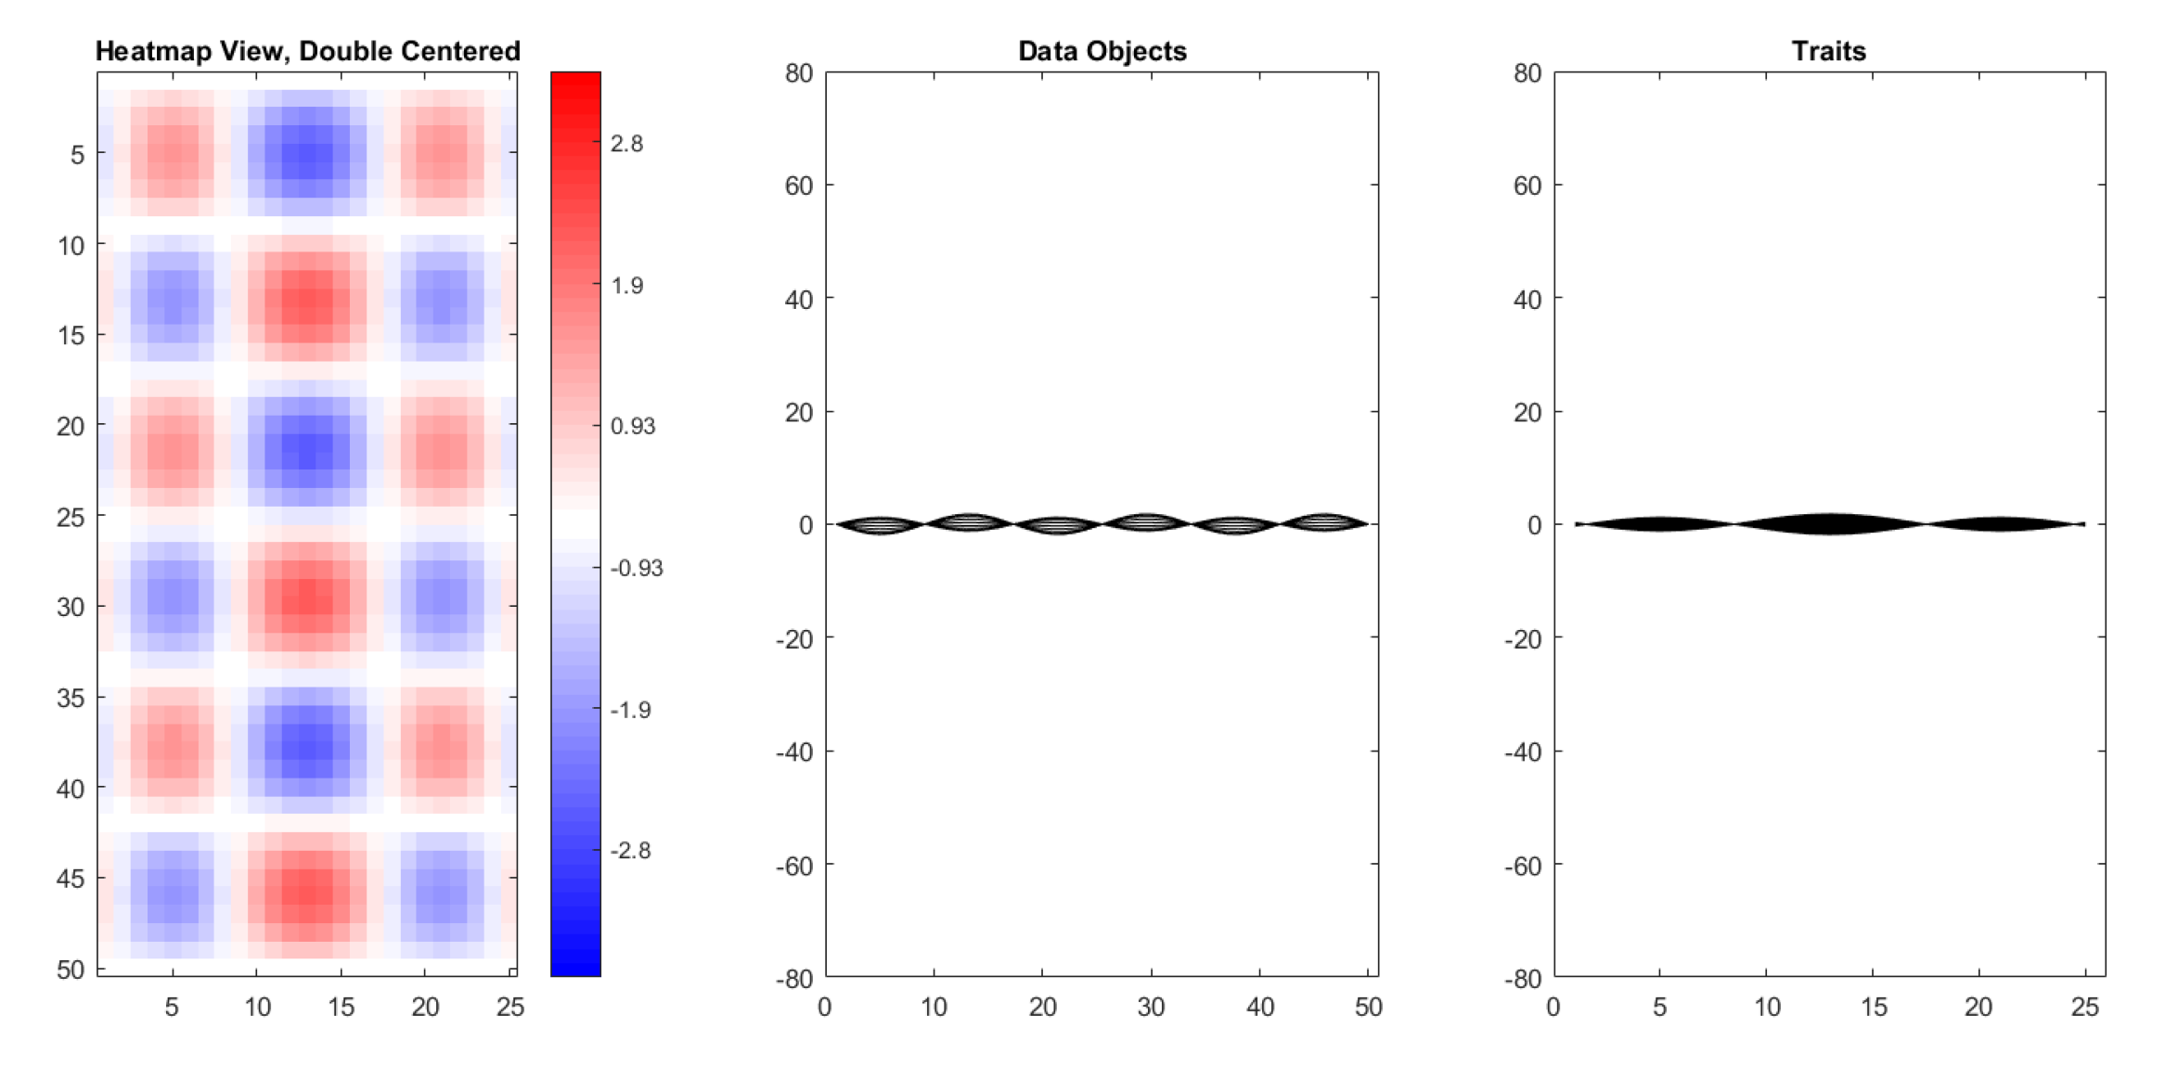
An Aside on Centering
Toy Data Set With 3 Views (Double Centered)
Most Variation Has Disappeared
Reveals Additional Structure
With Much Smaller Scale
Shows Trait Mean Centering Can
Remove A Large Amount of Variation

Slide 17
An Aside on Centering
Several Types:
Column Object Mean Centering
Row Trait Mean Centering
Grand Mean Centering
Double Mean Centering (Apply Both)
Not as Intuitively Simple as One Might Think

Slide 18
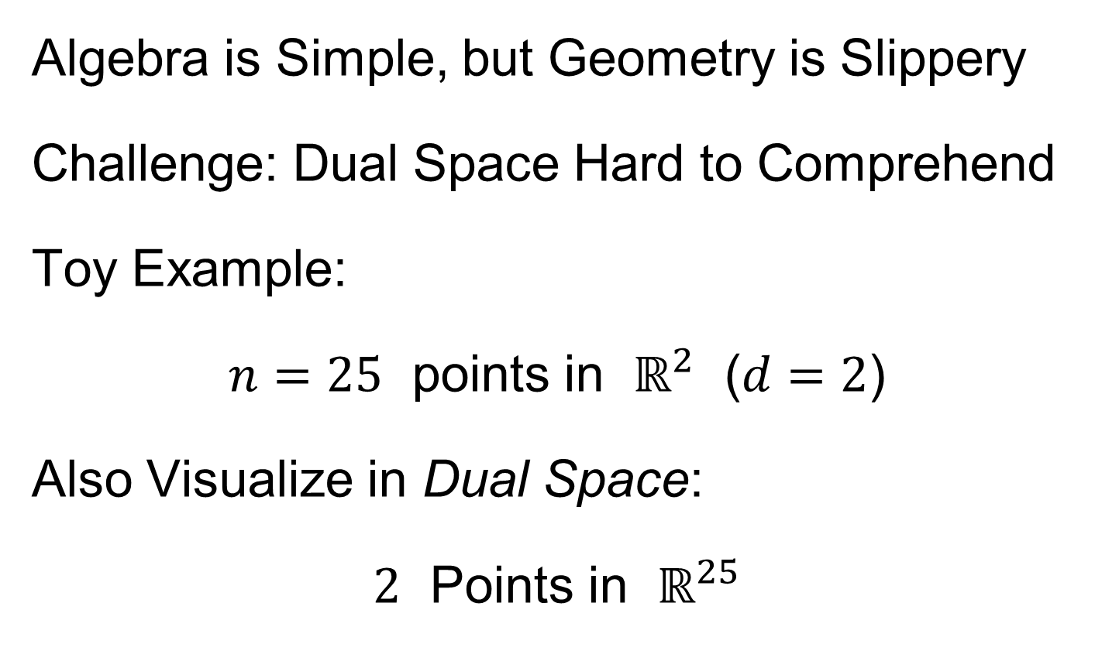
An Aside on Centering
Algebra is Simple, but Geometry is Slippery
Challenge: Dual Space Hard to Comprehend
Toy Example:
$n=25$ points in $ℝ^{2}$ ($d=2$)
Also Visualize in Dual Space:
$2$ Points in $ℝ^{25}$
How to Visualize?
Projection!

Slide 19
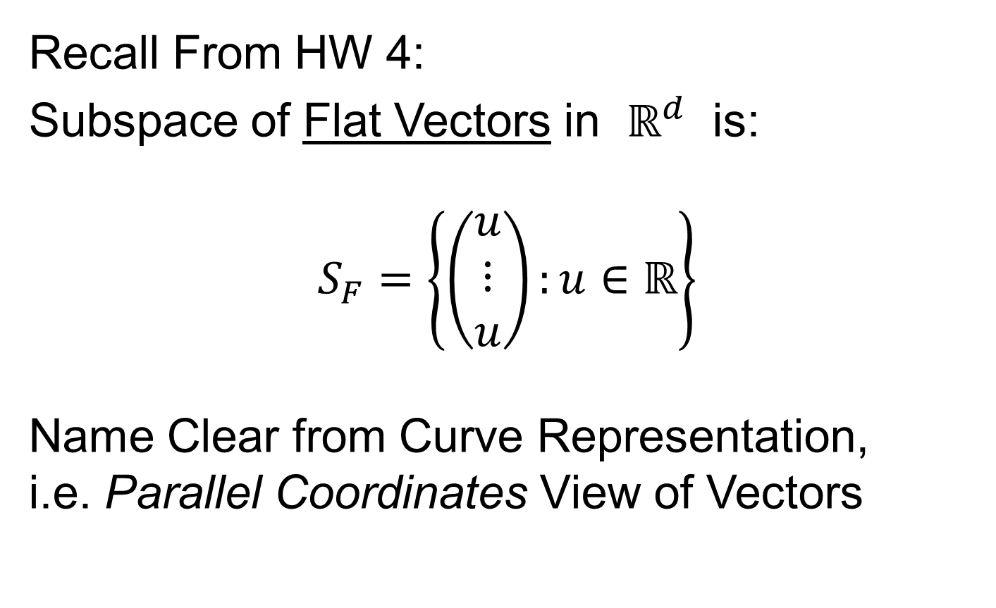
An Aside on Centering
Recall From HW 4:
Subspace of Flat Vectors in $ℝ^{d}$ is:
$$S_{F}=\left\{\left(\begin{matrix}u \\ ⋮ \\ u\end{matrix}\right):u∈ℝ\right\}$$
Name Clear from Curve Representation,
i.e. Parallel Coordinates View of Vectors

Slide 20
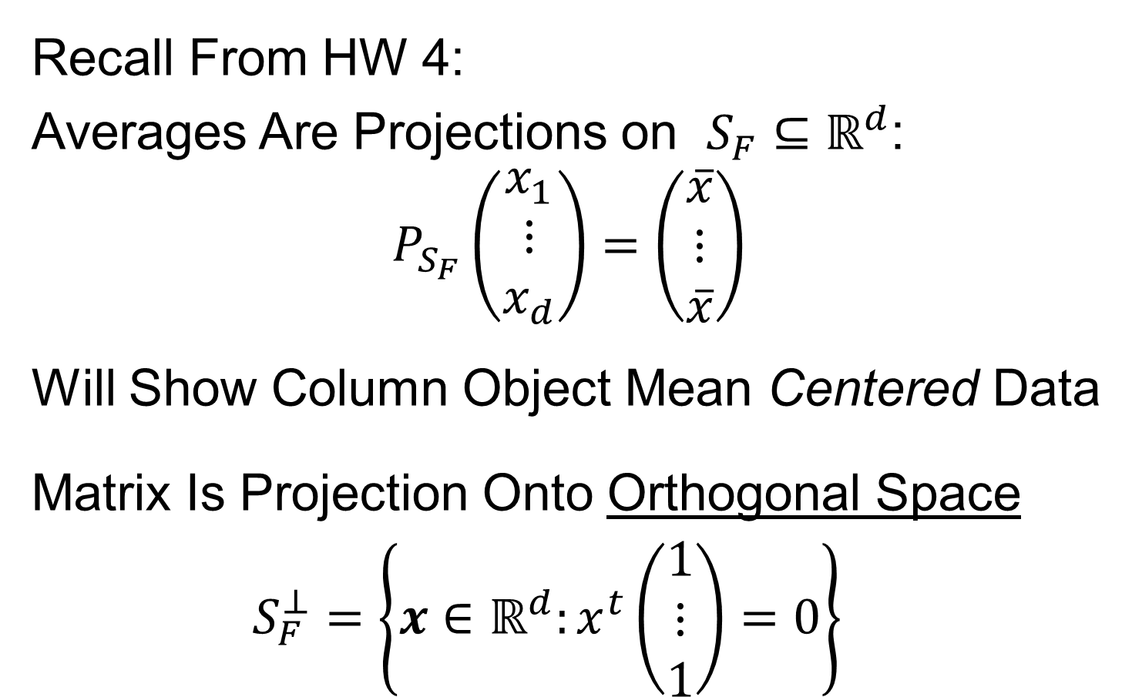
An Aside on Centering
Recall From HW 4:
Averages Are Projections on $S_{F}⊆ℝ^{d}$:
$$P_{S_{F}}\left(\begin{matrix}x_{1} \\ ⋮ \\ x_{d}\end{matrix}\right)=\left(\begin{matrix}\overline{x} \\ ⋮ \\ \overline{x}\end{matrix}\right)$$
Will Show Column Object Mean Centered Data
Matrix Is Projection Onto Orthogonal Space
$$S_{F}^{⊥}=\left\{x∈ℝ^{d}:x^{t}\left(\begin{matrix}1 \\ ⋮ \\ 1\end{matrix}\right)=0\right\}$$

Slide 21
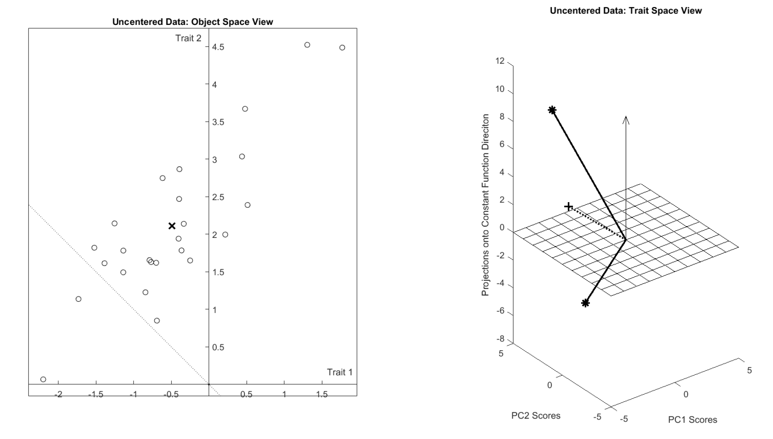







An Aside on Centering
Visualization of Toy Data
$$ℝ^{2}$$
$$ℝ^{25}$$
$$S_{F}$$
$$S_{F}^{⊥}$$
$${\overline{x}}_{RT}$$
$${\overline{x}}_{CO}$$
Rank 2 PC Approx’n of $S_{F}^{⊥}$

Slide 22
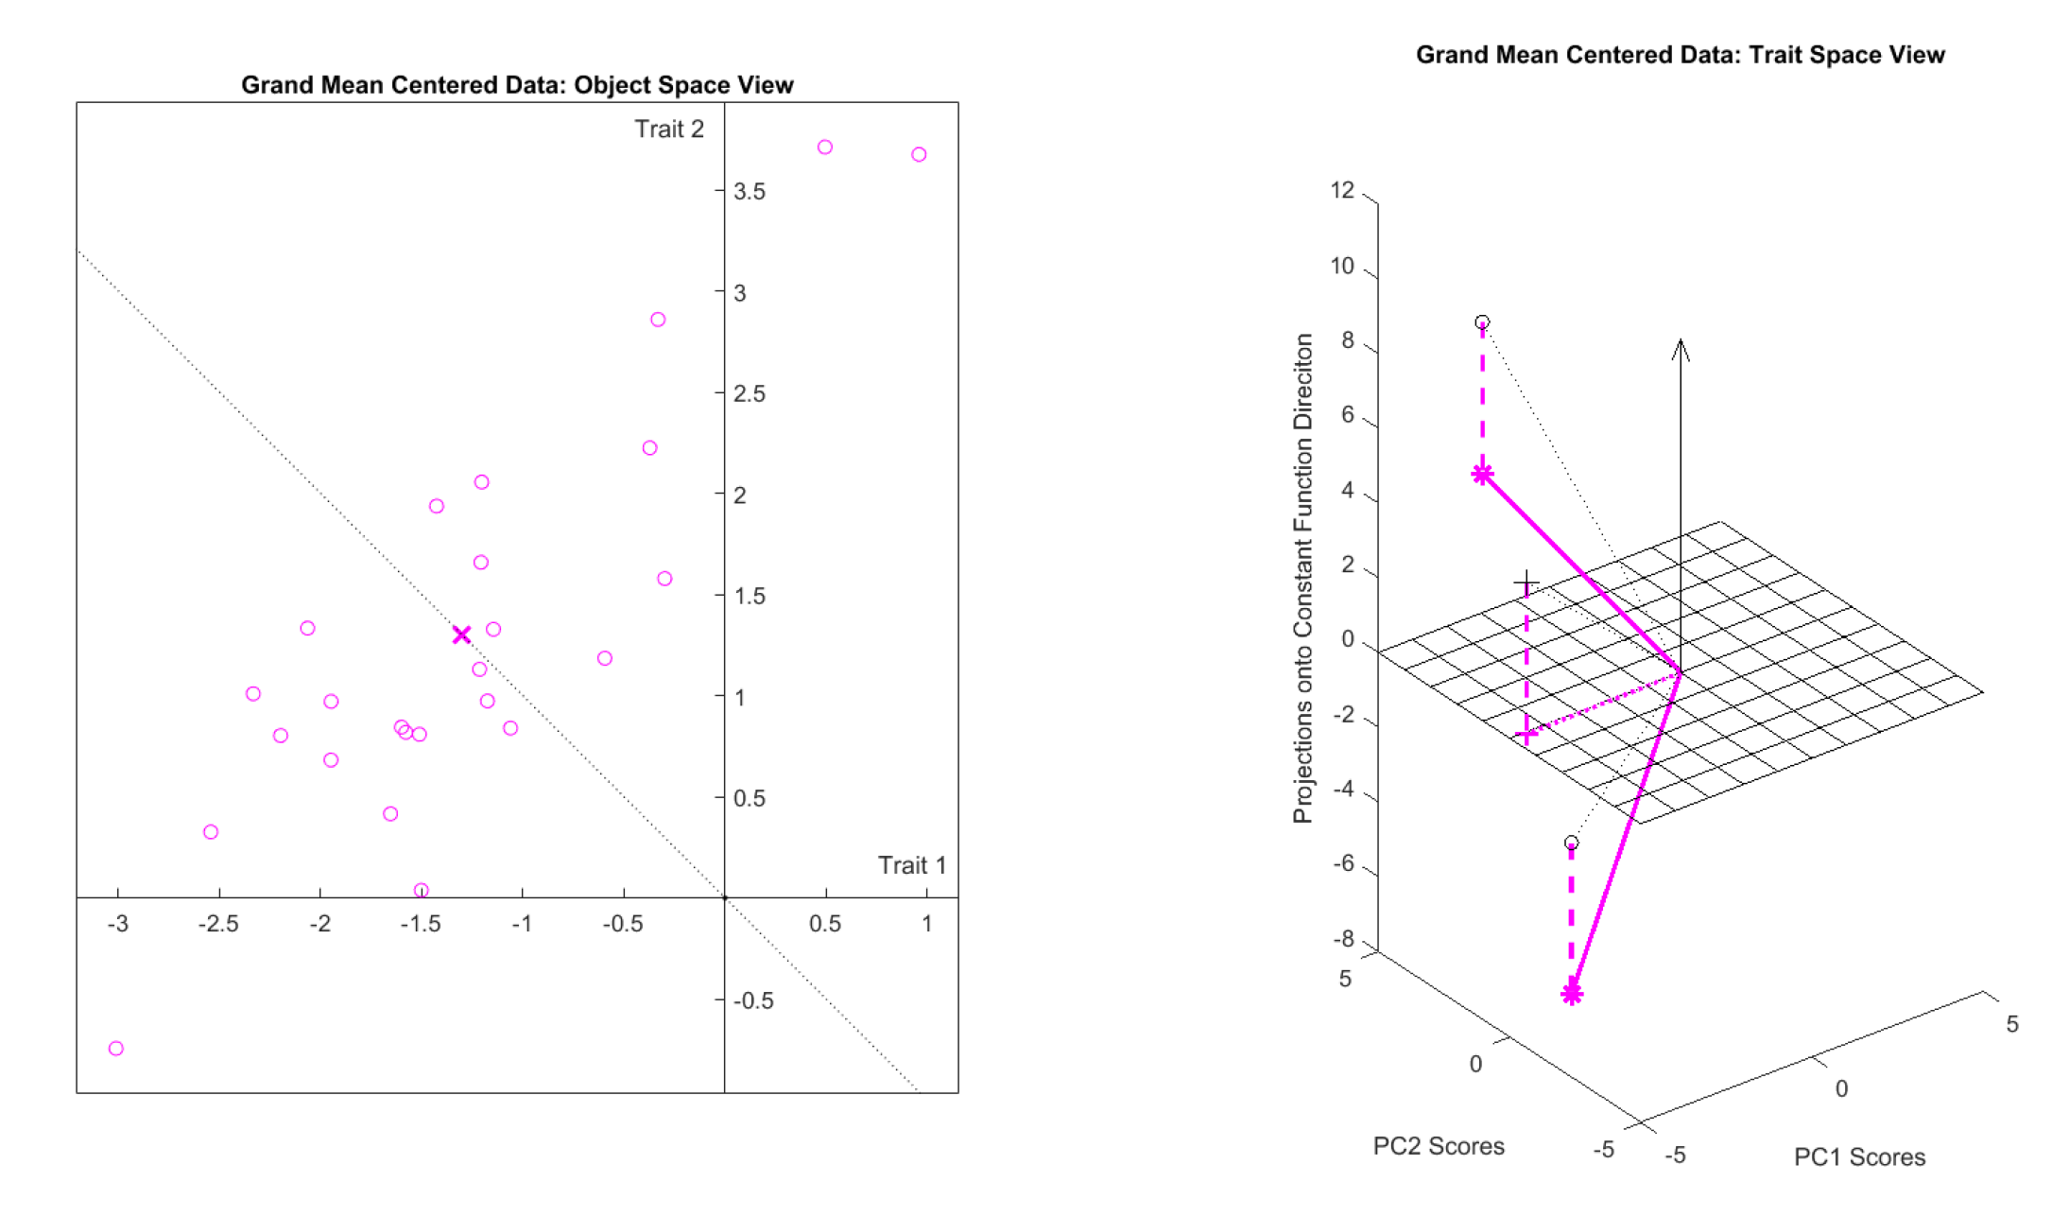
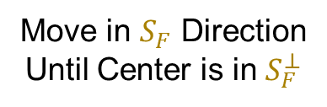
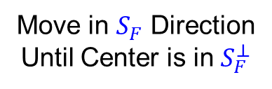


An Aside on Centering
Visualization of Grand Mean Centering
$$ℝ^{2}$$
$$ℝ^{25}$$
Move in $S_{F}$ Direction
Until Center is in $S_{F}^{⊥}$
Move in $S_{F}$ Direction
Until Center is in $S_{F}^{⊥}$
Geometric
Interpretation
Of Grand Mean
Centering

Slide 23
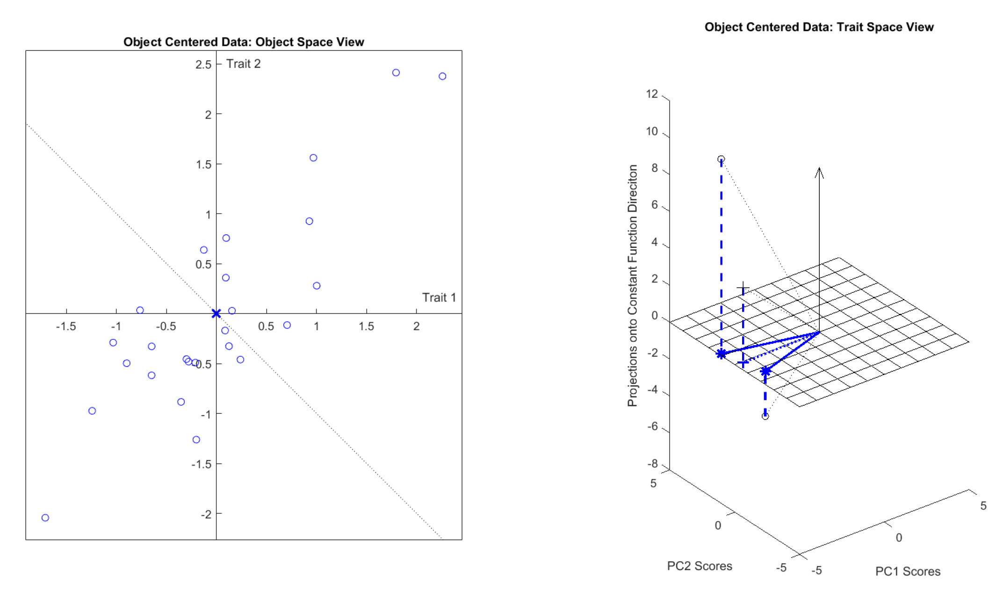

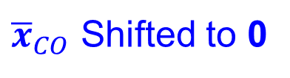


An Aside on Centering
Visualization of Column Object Centering
$$ℝ^{2}$$
$$ℝ^{25}$$
Data Projected to $S_{F}^{⊥}$
${\overline{x}}_{CO}$ Shifted to 0

Slide 24
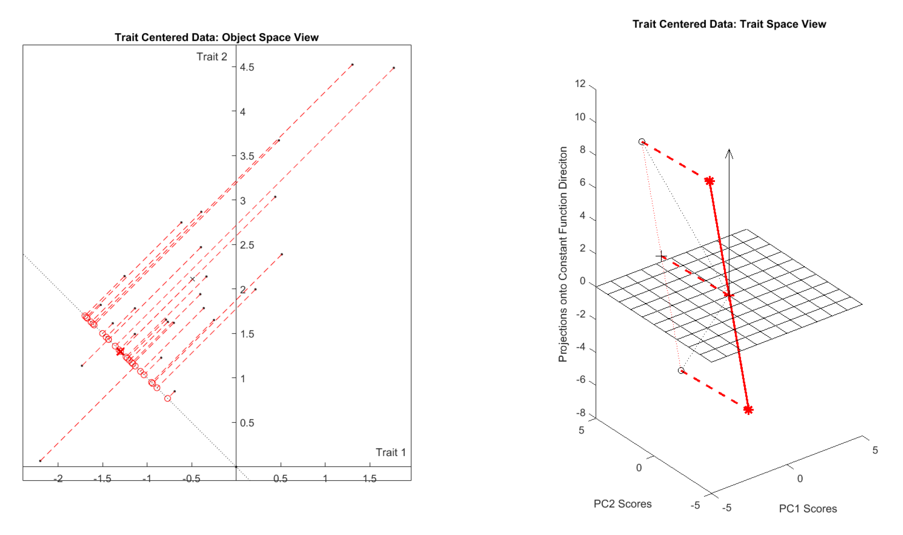
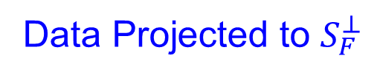


An Aside on Centering
Visualization of Row Trait Centering
$$ℝ^{2}$$
$$ℝ^{25}$$
Data Projected to $S_{F}^{⊥}$
${\overline{x}}_{CO}$ Shifted to 0

Slide 25
An Aside on Centering
Summary of Centerings:
Object Space Trait Space
Col. Obj. Cent.
Row Trait Cent.
Generally:
Centering is Shift in One, Projection in Other
Shift
Project
Project
Shift

Slide 26
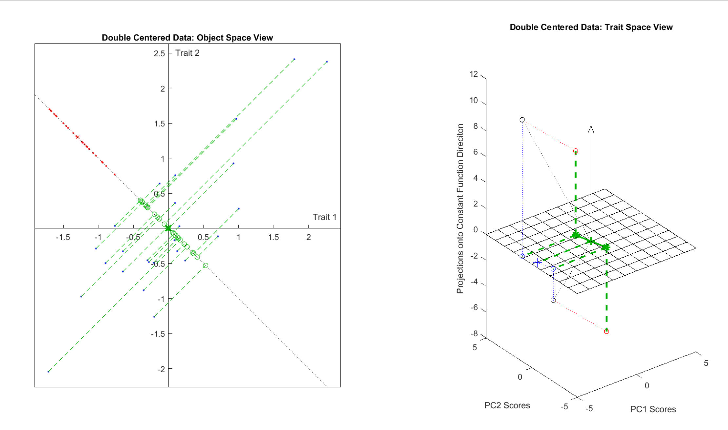
An Aside on Centering
Visualization of Double Centering
$$ℝ^{2}$$
$$ℝ^{25}$$
Shifted & Projected
Shifted & Projected

Slide 27
An Aside on Centering
Dual Space
Intuition
is Slippery
Several Types:
Column Object Mean Centering
Row Trait Mean Centering
Grand Mean Centering
Double Mean Centering (Apply Both)
Not as Intuitively Simple as One Might Think
Yet Elegant Projection – Mean Shift Duality

Slide 28
Data Integration
Centering: Common Assumption is
Column Object Mean Centered
(Subtract Column Mean Vectors)
Alternate View:
For Each Row,
Subtract Scalar Mean

Slide 29
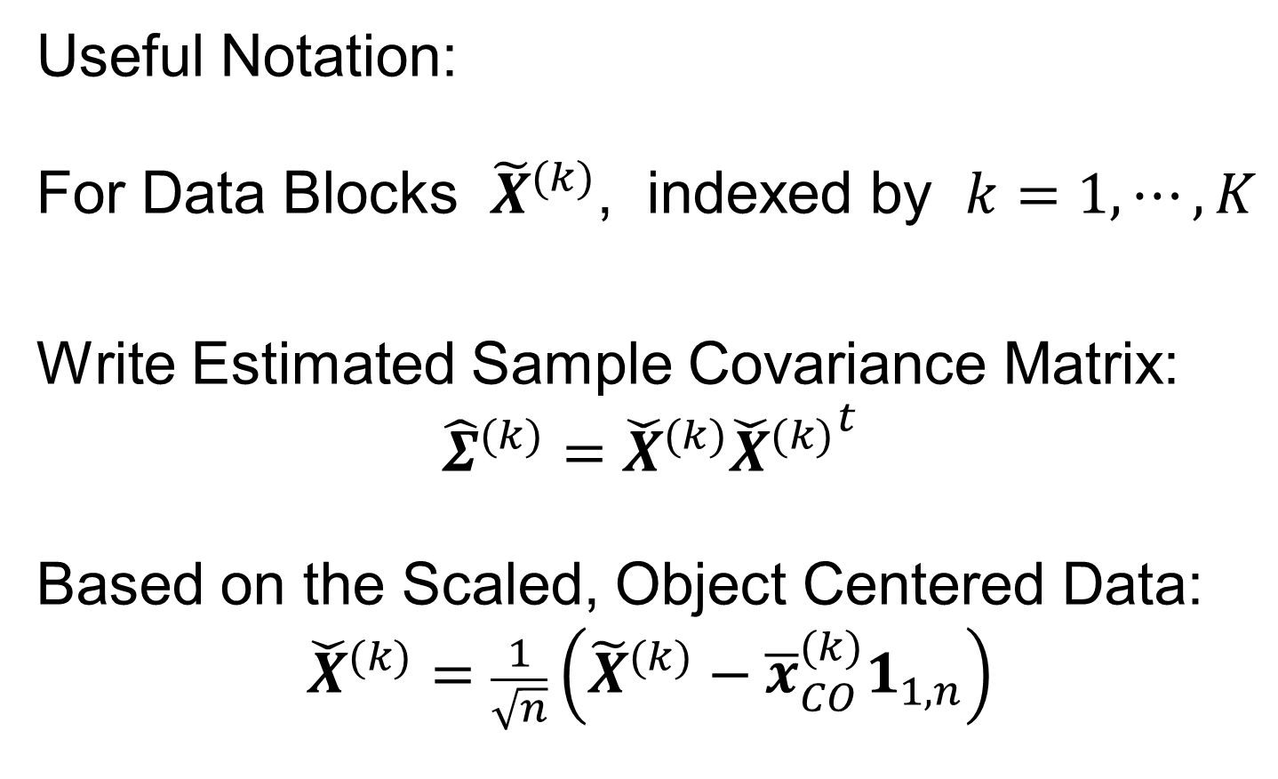



Data Integration
Recall Tilde Denotes Random Quantities
Useful Notation:
For Data Blocks ${\tilde{X}}^{(k)}$, indexed by $k=1,⋯,K$
Write Estimated Sample Covariance Matrix:
$${\hat{Σ}}^{(k)}={\check{X}}^{(k)}{{\check{X}}^{(k)}}^{t}$$
Based on the Scaled, Object Centered Data:
$${\check{X}}^{(k)}=\frac{1}{\sqrt{n}}\left({\tilde{X}}^{(k)}−{\overline{x}}_{CO}^{(k)}1_{1,n}\right)$$
Matrix of $n$ data objects of dim $d_{k}$
Recall $d_{k}×d_{k}$ Matrix
Recall “Outer Product”
Recall $d_{k}×n$ Matrix

Slide 30
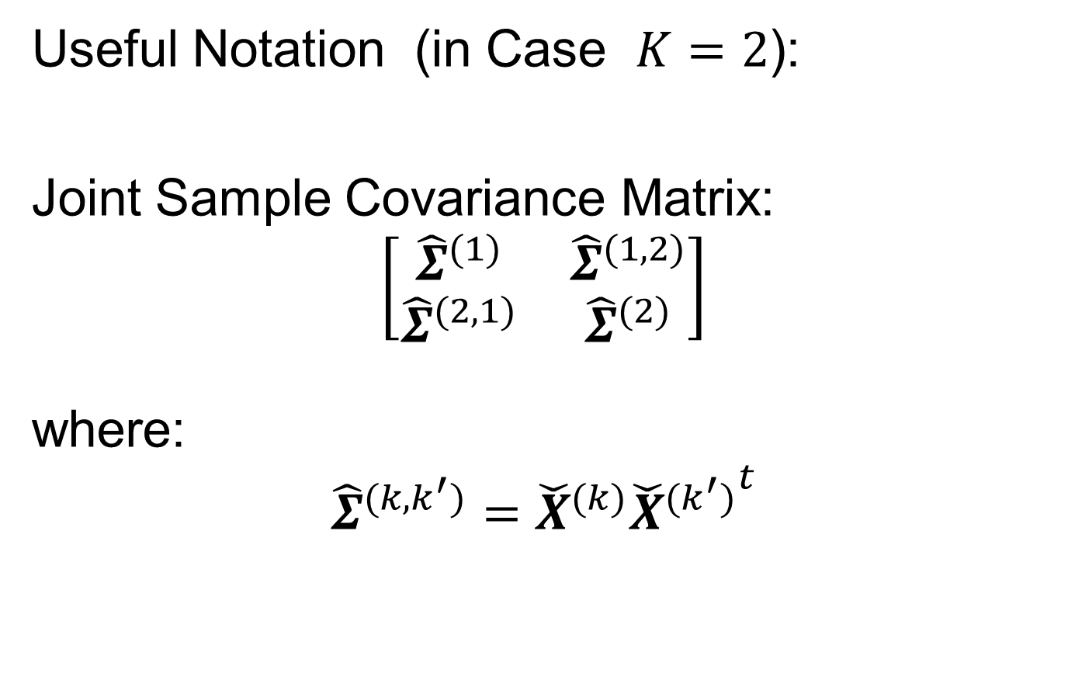

Data Integration
Useful Notation (in Case $K=2$):
Joint Sample Covariance Matrix:
$$\left[\begin{matrix}{\hat{Σ}}^{(1)} & {\hat{Σ}}^{(1,2)} \\ {\hat{Σ}}^{(2,1)} & {\hat{Σ}}^{(2)}\end{matrix}\right]$$
where:
$${\hat{Σ}}^{(k,k^{′})}={\check{X}}^{(k)}{{\check{X}}^{(k^{′})}}^{t}$$
Sample Covariance
Matrix of Concatenated
Data Object Vectors
Matrix of Sample Covariances
$d_{k}×d_{k^{′}}$ Matrix
Called Cross-Covariance

Slide 31
Next time
b, B → k, K

Slide 32
Data Integration
Major Approaches (to Modes of Variation):
Partial Least Squares
Canonical Correlations
JIVE & DIVAS

Slide 33
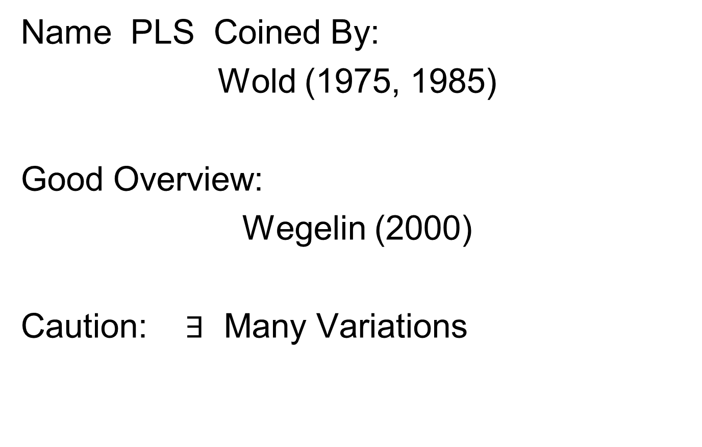
Partial Least Squares
Text: Sec, 17.2.1
Name PLS Coined By:
Wold (1975, 1985)
Good Overview:
Wegelin (2000)
Caution: $∃$ Many Variations

Slide 34
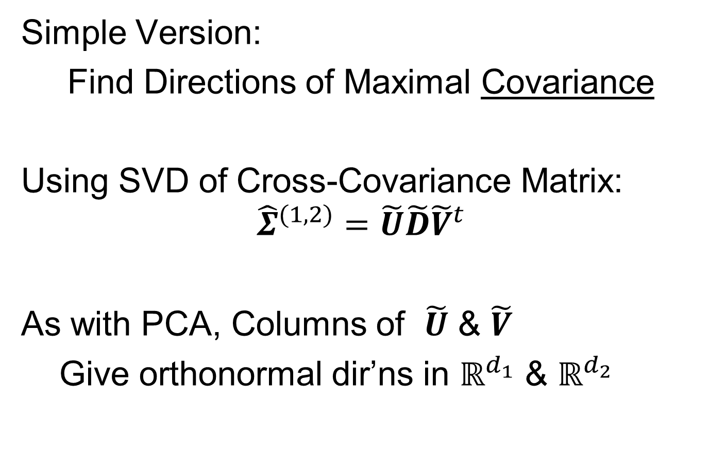
Partial Least Squares
Simple Version:
Find Directions of Maximal Covariance
Using SVD of Cross-Covariance Matrix:
$${\hat{Σ}}^{(1,2)}=\tilde{U}\tilde{D}{\tilde{V}}^{t}$$
As with PCA, Columns of $\tilde{U}$ & $\tilde{V}$
Give orthonormal dir’ns in $ℝ^{d_{1}}$ & $ℝ^{d_{2}}$
Hence are Loadings Vectors

Slide 35
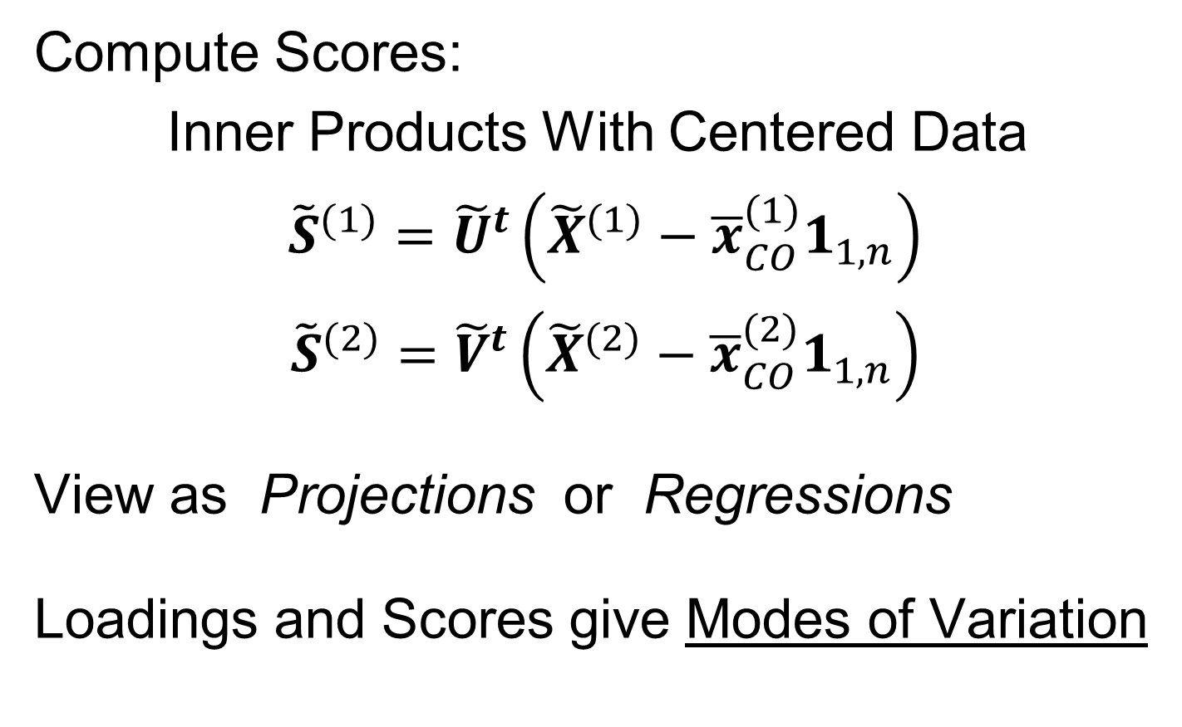
Partial Least Squares
Not Part of SVD, But
An Additional Operation
Compute Scores:
Inner Products With Centered Data
${\tilde{S}}^{(1)}={\tilde{U}}^{t}\left({\tilde{X}}^{(1)}−{\overline{x}}_{CO}^{(1)}1_{1,n}\right)$
${\tilde{S}}^{(2)}={\tilde{V}}^{t}\left({\tilde{X}}^{(2)}−{\overline{x}}_{CO}^{(2)}1_{1,n}\right)$
View as Projections or Regressions
Loadings and Scores give Modes of Variation
Since Projection
Minimizes
Sum of Squares
Recall One Dimensional Set of Data Objects

Slide 36
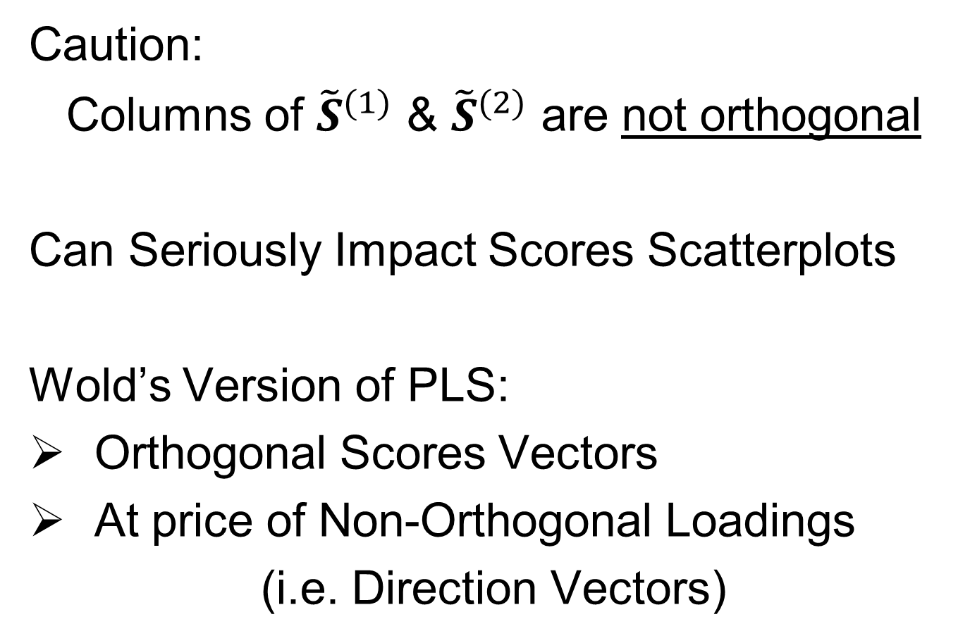
Partial Least Squares
Caution:
Columns of ${\tilde{S}}^{(1)}$ & ${\tilde{S}}^{(2)}$ are not orthogonal
Can Seriously Impact Scores Scatterplots
Wold’s Version of PLS:
Orthogonal Scores Vectors
At price of Non-Orthogonal Loadings
(i.e. Direction Vectors)
Compute by
Gram-Schmidt
Orthogonalization

Slide 37
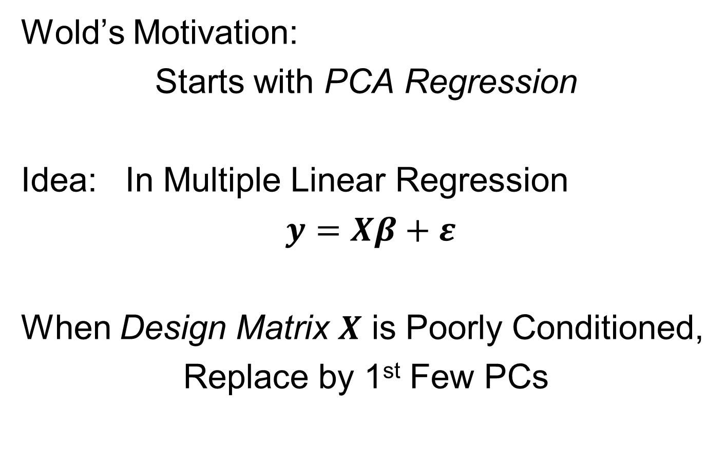
Partial Least Squares
Wold’s Motivation:
Starts with PCA Regression
Idea: In Multiple Linear Regression
$y=Xβ+ε$
When Design Matrix $X$ is Poorly Conditioned,
Replace by 1st Few PCs
E. g. Has
Co-Linearities
Often Called Latent Factors
Provides Stable Least Squares

Slide 38
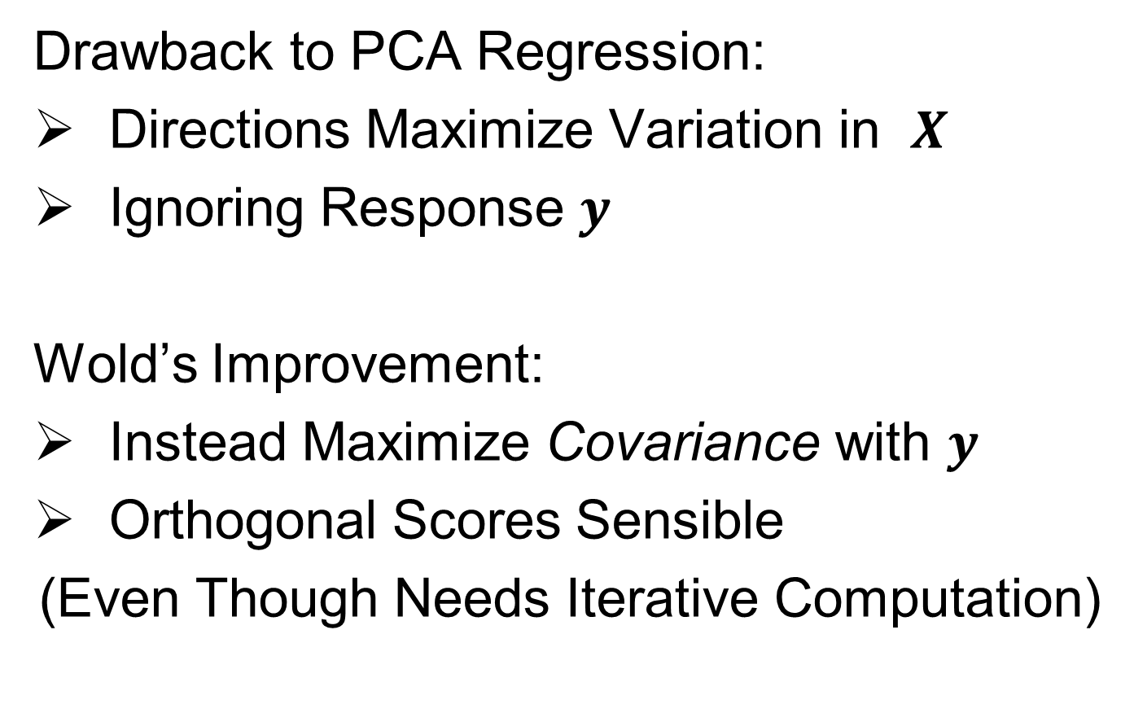
Partial Least Squares
Drawback to PCA Regression:
Directions Maximize Variation in $X$
Ignoring Response $y$
Wold’s Improvement:
Instead Maximize Covariance with $y$
Orthogonal Scores Sensible
(Even Though Needs Iterative Computation)
Parallel to Visualization Idea:
PCA Ignores Class Labels

Slide 39
Next Time
Can Wold’s scores just come from Inner Product of Appropriately centered-scaled data matrix?

Slide 40
Partial Least Squares
Aside: “PLS Regression” Seems to Dominate Searches for:
“Partial Least Squares”
Despite Value for Calculating
Modes of Variation

Slide 41
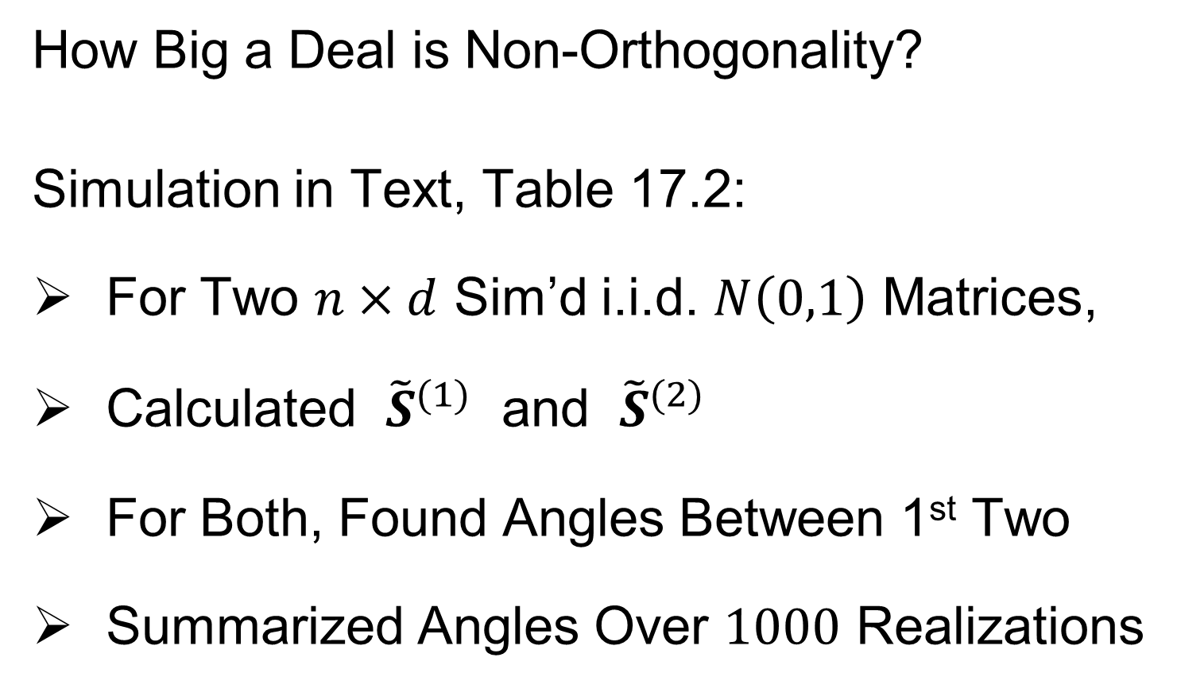
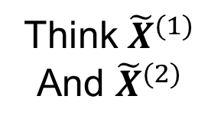
Partial Least Squares
How Big a Deal is Non-Orthogonality?
Simulation in Text, Table 17.2:
For Two $n×d$ Sim’d i.i.d. $N\left(0,1\right)$ Matrices,
Calculated ${\tilde{S}}^{(1)}$ and ${\tilde{S}}^{(2)}$
For Both, Found Angles Between 1st Two
Summarized Angles Over $1000$ Realizations
Think ${\tilde{X}}^{(1)}$
And ${\tilde{X}}^{(2)}$
1st Got SVD Loadings,
Projected For Scores

Slide 42
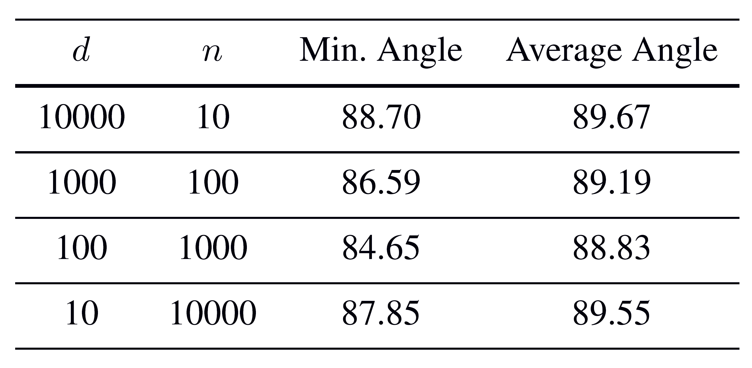

Partial Least Squares
How Big a Deal is Non-Orthogonality?
Simulation in Text, Table 17.2
Angles Between 1st Two Scores Vectors:
Conclusion: “Noise” ~ Orthogonal
All Close to ${90}^{°}$
Closer Near
Extremes
Will Soon
See Reason
For This

Slide 43
Data Integration
Major Approaches (to Modes of Variation):
Partial Least Squares
Canonical Correlations
JIVE & DIVAS

Slide 44
Canonical Correlations
Text: Sec, 17.2.2
Hotelling (1936):
Canonical Correlation Analysis (CCA)
Main Idea: Dir’ns to Maximize Correlation
(versus Covariance for PLS)
Founder of UNC STOR

Slide 45
Canonical Correlations
Essentially Handles
Cov. → Corr.
Type of Scaling
CCA Computation:
Change of Variable & SVD
Details in Section 17.2.2 of Text
Gives Orthogonal Scores, but Not Loadings
Another Consequence
Of Change of Variable

Slide 46

Canonical Correlations
Relationship between CCA, PLS and PCA:
Simple Toy Example:
`
$$\left(\begin{matrix}{\tilde{x}}_{1,1} \\ {\tilde{x}}_{2,1} \\ {\tilde{y}}_{1}\end{matrix}\right),⋯,\left(\begin{matrix}{\tilde{x}}_{1,n} \\ {\tilde{x}}_{2,n} \\ {\tilde{y}}_{n}\end{matrix}\right)∈ℝ^{3}$$

Slide 47

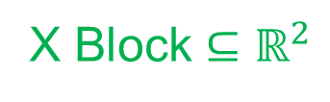
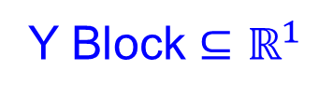
Canonical Correlations
Relationship between CCA, PLS and PCA:
Simple Toy Example:
`
$$\left(\begin{matrix}{\tilde{x}}_{1,1} \\ {\tilde{x}}_{2,1} \\ {\tilde{y}}_{1}\end{matrix}\right),⋯,\left(\begin{matrix}{\tilde{x}}_{1,n} \\ {\tilde{x}}_{2,n} \\ {\tilde{y}}_{n}\end{matrix}\right)$$
X Block $⊆ℝ^{2}$
Y Block $⊆ℝ^{1}$

Slide 48
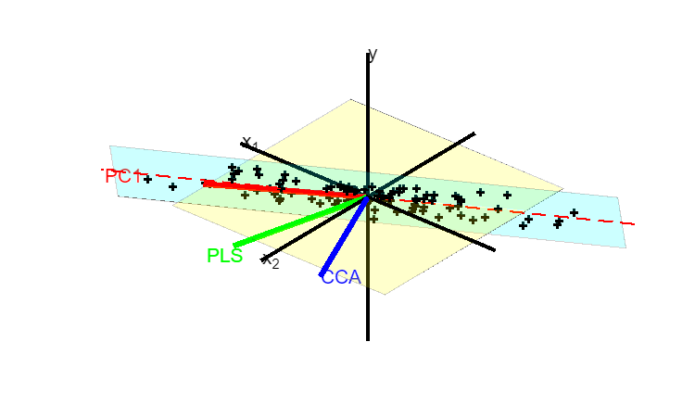
Canonical Correlations
Relationship between CCA, PLS and PCA:
Simple Toy Example:
`

Slide 49
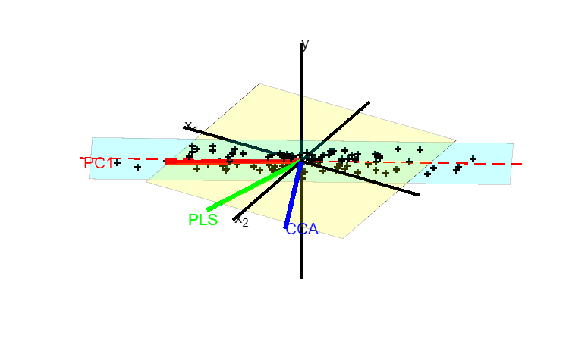
Canonical Correlations
Relationship between CCA, PLS and PCA:
Simple Toy Example:
`

Slide 50
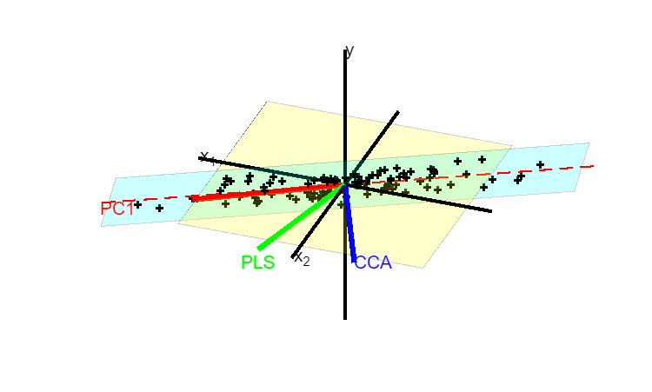
Canonical Correlations
Relationship between CCA, PLS and PCA:
Simple Toy Example:
`

Slide 51
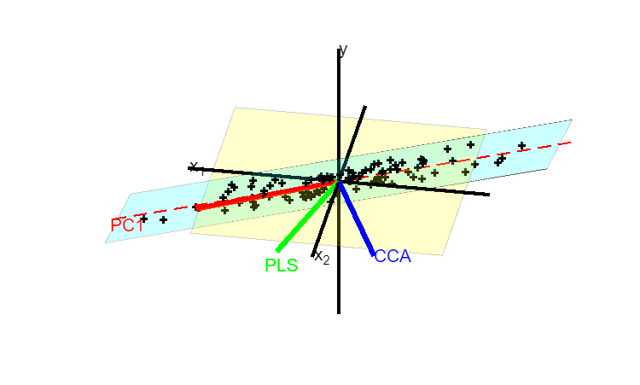
Canonical Correlations
Relationship between CCA, PLS and PCA:
Simple Toy Example:
`

Slide 52
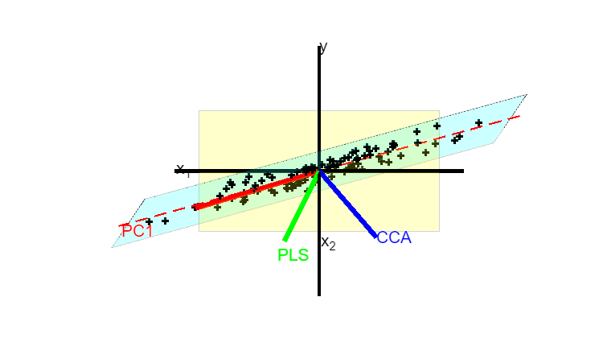
Canonical Correlations
Relationship between CCA, PLS and PCA:
Simple Toy Example:
`

Slide 53
Next time
Better angles
Show data entirely in cyan plane
Stress maximal slope orhtogonal to PC1 (in plane)

Slide 54
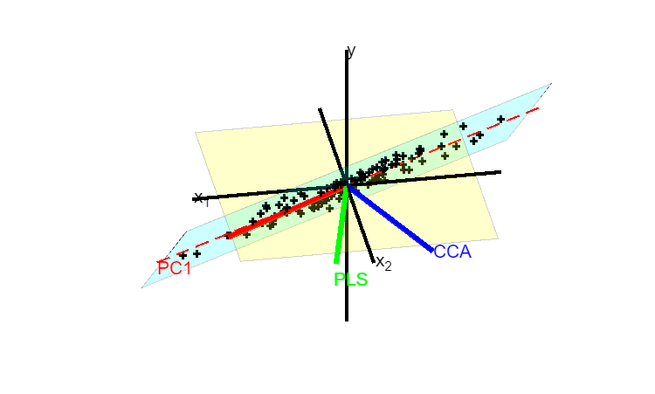
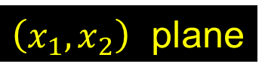
Canonical Correlations
Relationship between CCA, PLS and PCA:
Simple Toy Example:
`
Dashed Red is Intersection
$\left(x_{1},x_{2}\right)$ plane
~ PC1 Direction
Data Lie In Cyan Plane

Slide 55
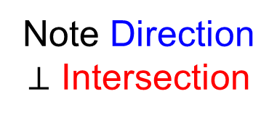
Canonical Correlations
Relationship between CCA, PLS and PCA:
Simple Toy Example:
`
Note Direction
$⊥$ Intersection
PLS is Compromise
Between PC1 & CCA
Direction in x-plane
With max y correlation

Slide 56
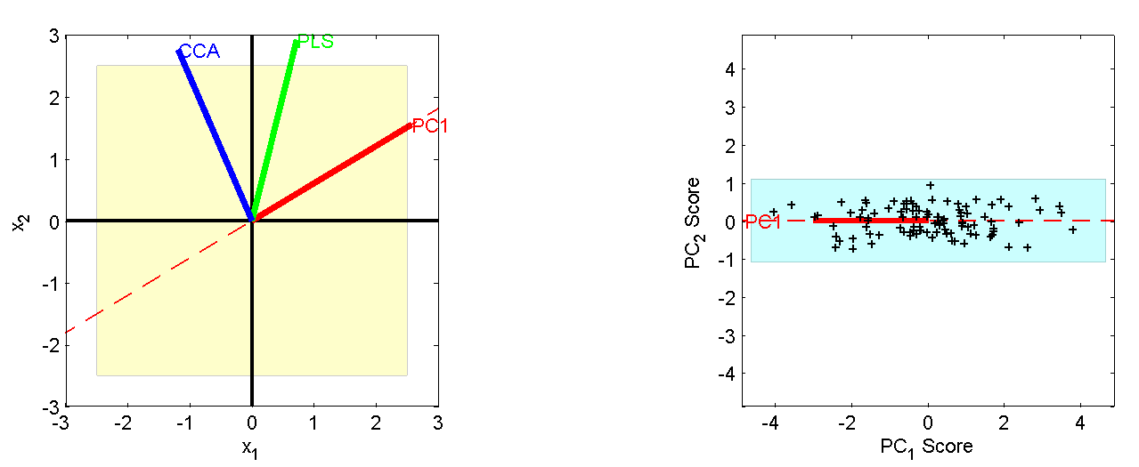
Canonical Correlations
Relationship between CCA, PLS and PCA:
Projection on x₁ - x₂ plane
Projection on PC₁ - PC₂ plane
Highlights
PC1 & CCA
Very Different
PLS Is a
Compromise
Since PLS
Feels Both
Corr & Var

Slide 57
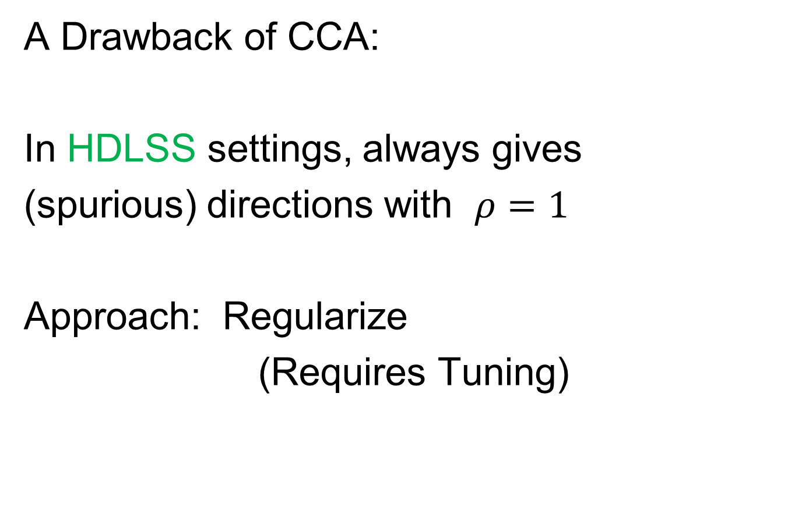
Canonical Correlations
A Drawback of CCA:
In HDLSS settings, always gives
(spurious) directions with $ρ=1$
Approach: Regularize
(Requires Tuning)

Slide 58
Data Integration
Major Approaches (to Modes of Variation):
Partial Least Squares
Canonical Correlations
JIVE & DIVAS

Slide 59



JIVE
Text: Sec, 17.2.3
But Very Superficial,
Will Do Much More Here
Joint and Individual Variation Explained
Lock, Hoadley, Marron & Nobel (2013)
Eric Lock
Andrew Nobel
Katie Hoadley

Slide 60
JIVE
Joint and Individual Variation Explained
Lock, Hoadley, Marron & Nobel (2013)
Joint Modes of Variation
Key Contribution: Individual Modes
Scores Only Maximally Correlated
Same Scores
Major Contrast with CCA
With Mathematical Definition

Slide 61
JIVE
Joint and Individual Variation Explained
Lock, Hoadley, Marron & Nobel (2013)
Joint Modes of Variation
Key Contribution: Individual Modes
Angle Based JIVE (AJIVE)
Feng, Jiang, Hannig & Marron (2018)
Same Scores

Slide 62



JIVE
Angle Based JIVE (AJIVE)
Feng, Jiang, Hannig & Marron (2018)
Non-Iterative Linear Algebra Calculation
Uses Intuitive Principal Angle Analysis
Qing Feng
Meilei Jiang
Jan Hannig

Slide 63

AJIVE Analytical Goals
Explore & Quantify Variation
Through Joint Variation
via Common Scores
(Signatures Among Cases)
Focus Away from PCA Directions in $ℝ^{d}$
Now On Scores in $ℝ^{n}$, Not Loadings
(As in PLS & CCA)
Since Commonality is Among Cases
Dual Space Linear Algebra,
Not Primal Space

Slide 64
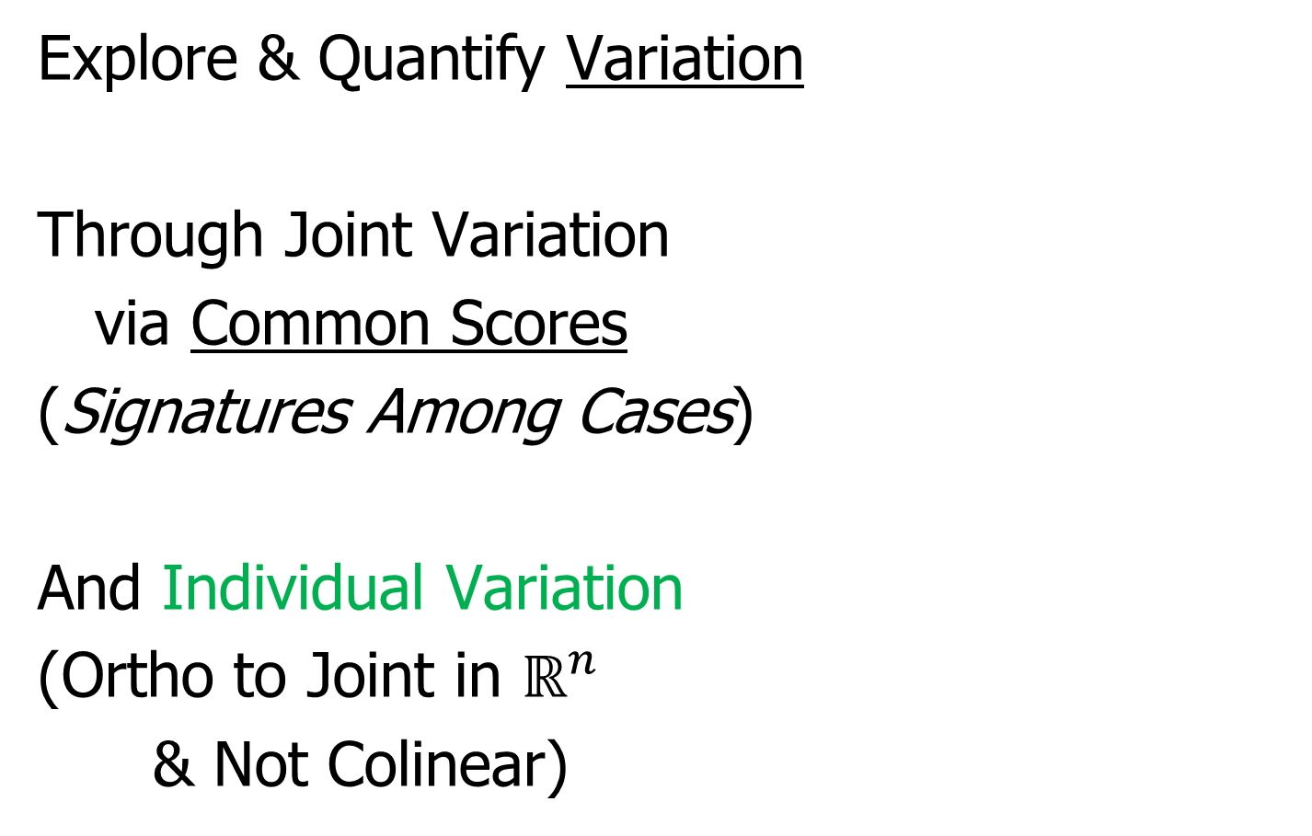
AJIVE Analytical Goals
Explore & Quantify Variation
Through Joint Variation
via Common Scores
(Signatures Among Cases)
And Individual Variation
(Ortho to Joint in $ℝ^{n}$
& Not Colinear)

Slide 65
AJIVE Analytical Goals
Then Understand Drivers
Of Variation Using:
Joint Loadings
Recall Modes of Variation
Are Rank 1 Matrices
= Loadings x Scores

Slide 66
AJIVE Analytical Goals
Then Understand Drivers
Of Variation Using:
Joint Loadings
Individual Loadings
Both Computed as
Projections Onto Scores
Best Rank 1
Approximations
Can Consider As Regression

Slide 67
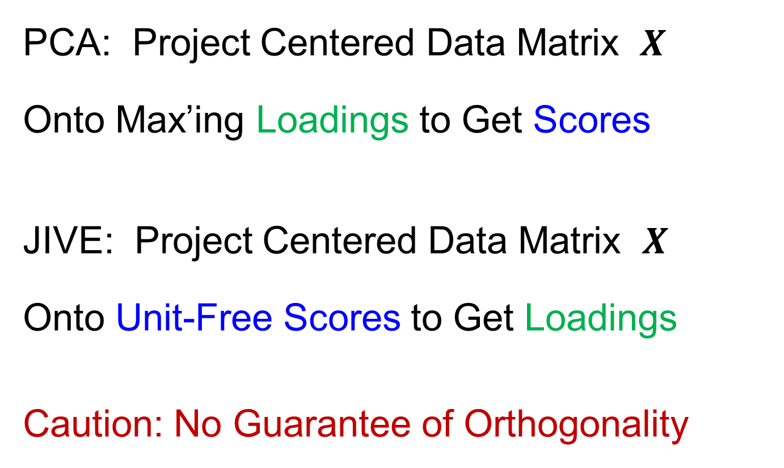
Interesting PCA - JIVE Counterpoint
PCA: Project Centered Data Matrix $X$
Onto Max’ing Loadings to Get Scores
JIVE: Project Centered Data Matrix $X$
Onto Unit-Free Scores to Get Loadings
Caution: No Guarantee of Orthogonality

Slide 68
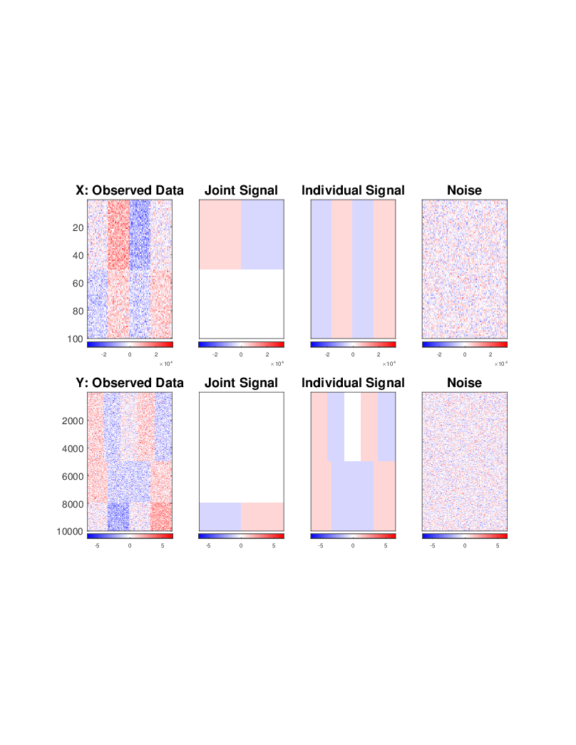
AJIVE Toy Example
“Heat Map” View
Based on Color Bar
Red for > 0
White for = 0
Blue for < 0
Intensity shows magnitude

Slide 69
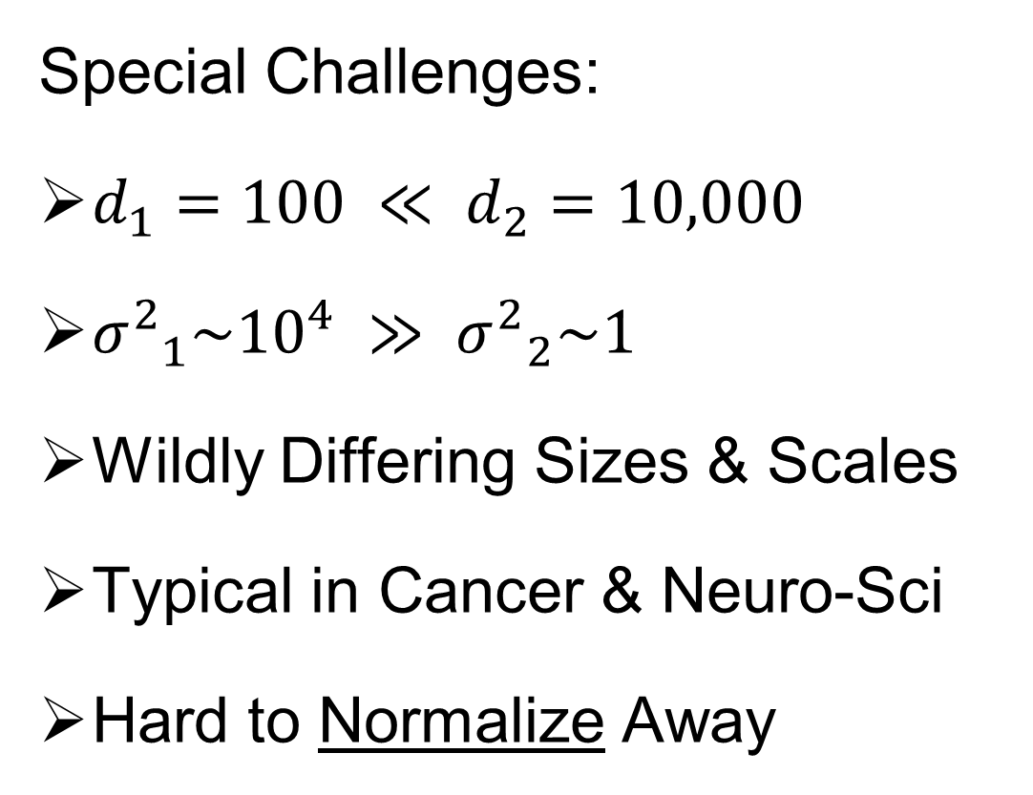
AJIVE Toy Example
Note: X and Y Labels Is Limiting to $K=2$ Two Block Case
Special Challenges:
$d_{1}=100 ≪ d_{2}=10,000$
${σ^{2}}_{1}\sim {10}^{4} ≫ {σ^{2}}_{2}\sim 1$
Wildly Differing Sizes & Scales
Typical in Cancer & Neuro-Sci
Hard to Normalize Away

Slide 70
AJIVE Toy Example
Underlying Components
(Additive
Signals +
+ Noise)
=
+
+
=
+
+

Slide 71
AJIVE Toy Example
Underlying Components:
Joint – Rank 1
Same
“Subject
Signal”
(linear combo)
=
+
+
=
+
+

Slide 72
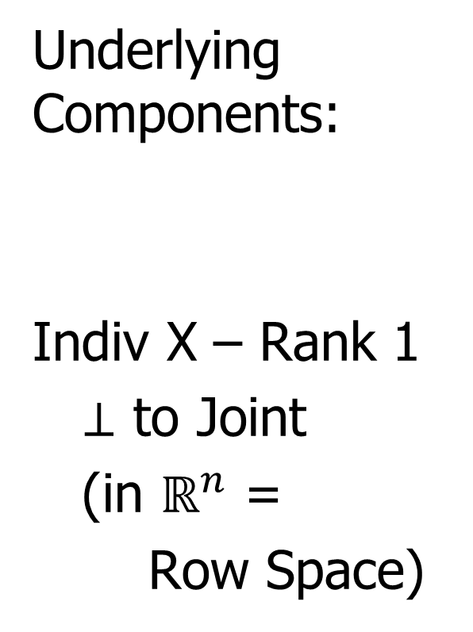
AJIVE Toy Example
Underlying Components:
Indiv X – Rank 1
$⊥$ to Joint
(in $ℝ^{n}$ =
Row Space)
=
+
+
=
+
+

Slide 73

AJIVE Toy Example
Orthogonality of Rows Comes From:
$$\left(\begin{matrix}\begin{matrix}1 & ⋯ & 1\end{matrix} & \begin{matrix}−1 & ⋯ & −1\end{matrix}\end{matrix}\right)\left(\begin{matrix}\begin{matrix}\begin{matrix}−1 \\ ⋮ \\ −1\end{matrix} \\ \begin{matrix}1 \\ ⋮ \\ 1\end{matrix}\end{matrix} \\ \begin{matrix}\begin{matrix}−1 \\ ⋮ \\ −1\end{matrix} \\ \begin{matrix}1 \\ ⋮ \\ 1\end{matrix}\end{matrix}\end{matrix}\right)=0$$

Slide 74

AJIVE Toy Example
Underlying Components:
Indiv Y – Rank 2
$⊥$ to Joint
$∩$ with
Indiv X = {0}
(don’t need $⊥$)
=
+
+
=
+
+

Slide 75


AJIVE Toy Example
To Check Non-Orthogonality:
For $v_{1}=\left(\begin{matrix}\begin{matrix}\begin{matrix}−1 \\ ⋮ \\ −1\end{matrix} \\ \begin{matrix}1 \\ ⋮ \\ 1\end{matrix}\end{matrix} \\ \begin{matrix}\begin{matrix}−1 \\ ⋮ \\ −1\end{matrix} \\ \begin{matrix}1 \\ ⋮ \\ 1\end{matrix}\end{matrix}\end{matrix}\right)$ and $v_{2}=\left(\begin{matrix}\begin{matrix}1 \\ ⋮ \\ 1\end{matrix} \\ \begin{matrix}\begin{matrix}−1 \\ ⋮ \\ −1\end{matrix} \\ \begin{matrix}0 \\ ⋮ \\ 0\end{matrix} \\ \begin{matrix}1 \\ ⋮ \\ 1\end{matrix}\end{matrix} \\ \begin{matrix}−1 \\ ⋮ \\ −1\end{matrix}\end{matrix}\right)$
Angle$\left(v_{1},v_{2}\right)=$
$$=\cos^{−1}{\frac{{v_{1}}^{T}v_{2}}{\left\|v_{1}\right\|\left\|v_{2}\right\|}}=$$
$$={47.9}^{°}$$

Slide 76


AJIVE Toy Example
Since Large Variance in X Block
Concatenate & SVD:
Only (Joint $∪$ X – Indiv), Lose Sep. & Y – Indiv

Slide 77

AJIVE Toy Example
Partial Least Squares:
Decent Rank 2 Approx., but no Indiv. Comp.
Y – Indiv. Completely Gone (Var. Too Low)

Slide 78


AJIVE Toy Example
Artifact of
Different
$n$-s and $σ^{2}$-s
Early JIVE (Lock et al, 2013):
Good 2-d Approx. – Missed Joint-Ind Decomp.

Slide 79

AJIVE Toy Example
Current AJIVE: Excellent Decomposition (Both Joint and Individual)

