Slide 1
Statistics – O. R. 881
Object Oriented Data Analysis
Steve Marron
Dept. of Statistics and Operations Research
University of North Carolina

Slide 2
Current Sections in Textbook
Today:
Section 17.2
Next Class:
Section 17.2

Slide 3

Last Class: Data Integration
Multi-Block Data Structure
Blocks are $\left(K\right)$ Data Matrices
Convention:
Columns as Data Objects
I.e. Common Patients,
Experimental Units…

Slide 4
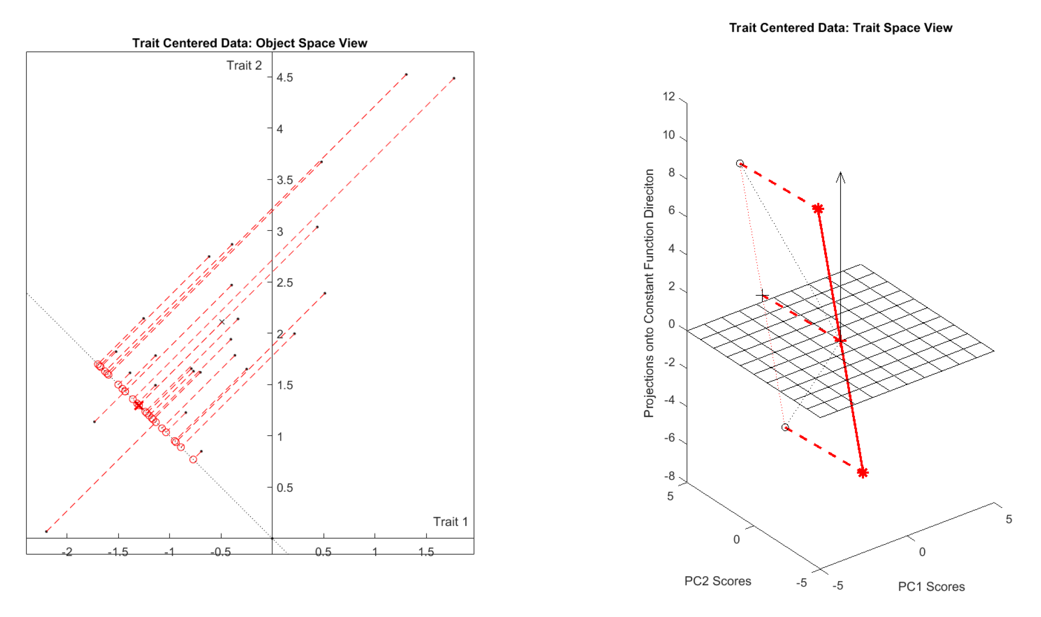
Last Class: Centering
Visualization of Row Trait Centering
$$ℝ^{2}$$
$$ℝ^{25}$$
Data Projected to $S_{F}^{⊥}$
${\overline{x}}_{CO}$ Shifted to 0

Slide 5
Last Class: Centering
Summary of Centerings:
Object Space Trait Space
Col. Obj. Cent.
Row Trait Cent.
Generally:
Centering is Shift in One, Projection in Other
Shift
Project
Project
Shift

Slide 6
Last Class: Data Integration
Useful Notation (in Case $B=2$):
Joint Sample Covariance Matrix:
$$\left[\begin{matrix}{\hat{Σ}}^{(1)} & {\hat{Σ}}^{(1,2)} \\ {\hat{Σ}}^{(2,1)} & {\hat{Σ}}^{(2)}\end{matrix}\right]$$
where:
$${\hat{Σ}}^{(b,b^{′})}={\check{X}}^{(b)}{{\check{X}}^{(b^{′})}}^{t}$$
$d_{b}×d_{b^{′}}$ Matrix
Called Cross-Covariance

Slide 7
Last Class: Data Integration
Major Approaches (to Modes of Variation):
Partial Least Squares
Canonical Correlations
JIVE & DIVAS

Slide 8
Last Class: Part. Least Squares
Simple Version:
Find Directions of Maximal Covariance
Using SVD of Cross-Covariance Matrix:
$${\hat{Σ}}^{(1,2)}=\tilde{U}\tilde{D}{\tilde{V}}^{t}$$
As with PCA, Columns of $\tilde{U}$ & $\tilde{V}$
Give orthonormal dir’ns in $ℝ^{d_{1}}$ & $ℝ^{d_{2}}$
Hence are Loadings Vectors

Slide 9
Last Class: Part. Least Squares
Compute Scores:
Inner Products With Centered Data
${\tilde{S}}^{(1)}={\tilde{U}}^{t}\left({\tilde{X}}^{(1)}−{\overline{x}}_{CO}^{(1)}1_{1,n}\right)$
${\tilde{S}}^{(2)}={\tilde{V}}^{t}\left({\tilde{X}}^{(2)}−{\overline{x}}_{CO}^{(2)}1_{1,n}\right)$
View as Projections or Regressions
Loadings and Scores give Modes of Variation

Slide 10
Last Class: Part. Least Squares
Caution:
Columns of ${\tilde{S}}^{(1)}$ & ${\tilde{S}}^{(2)}$ are not orthogonal
Can Seriously Impact Scores Scatterplots
Wold’s Version of PLS:
Orthogonal Scores Vectors
At price of Non-Orthogonal Loadings
(i.e. Direction Vectors)

Slide 11
Last Class: Canonical Corr’ns
Text: Sec, 17.2.2
Hotelling (1936):
Canonical Correlation Analysis (CCA)
Main Idea: Dir’ns to Maximize Correlation
(versus Covariance for PLS)
Founder of UNC STOR

Slide 12
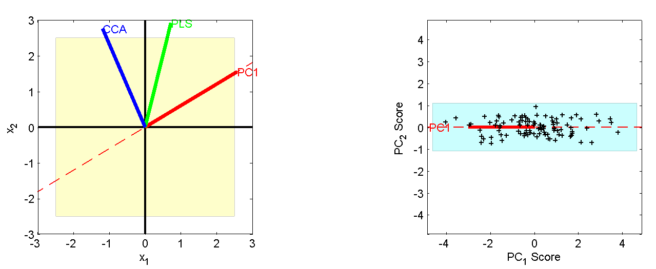
Last Class: Canonical Corr’ns
Relationship between CCA, PLS and PCA:
Projection on x₁ - x₂ plane
Projection on PC₁ - PC₂ plane
Highlights
PC1 & CCA
Very Different
PLS Is a
Compromise
Since PLS
Feels Both
Corr & Var

Slide 13
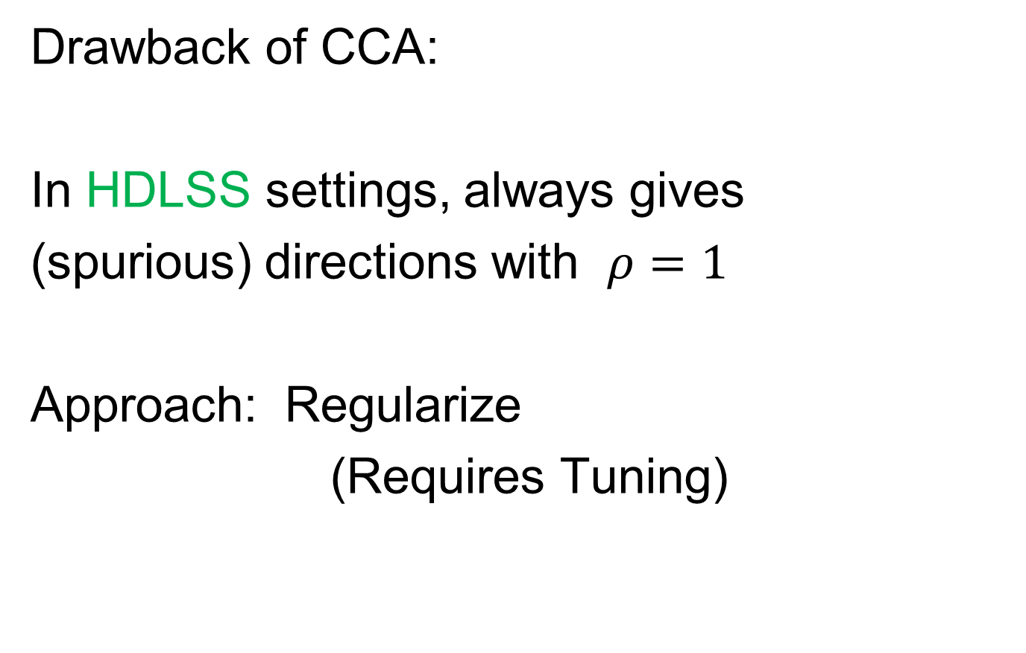
Last Class: Canonical Corr’ns
Drawback of CCA:
In HDLSS settings, always gives
(spurious) directions with $ρ=1$
Approach: Regularize
(Requires Tuning)

Slide 14
Last Class: JIVE
But Only Briefly Mentioned
Text: Sec, 17.2.3
Joint and Individual Variation Explained
Lock, Hoadley, Marron & Nobel (2013)
Joint Variation ~ CCA
Key Contribution: Individual Modes
Angle Based JIVE (AJIVE)
Feng, Jiang, Hannig & Marron (2018)
Non-Iterative Linear Algebra Calculation
Uses Intuitive Principal Angle Analysis

Slide 15
Last Class: AJIVE Goals
Explore & Quantify Variation
Through Joint Variation
via Common Scores
(Signatures Among Cases)
Focus Away from Directions in PCA
Now On Scores, Not Loadings
(As in PLS & CCA)
Since Commonality is Among Cases

Slide 16
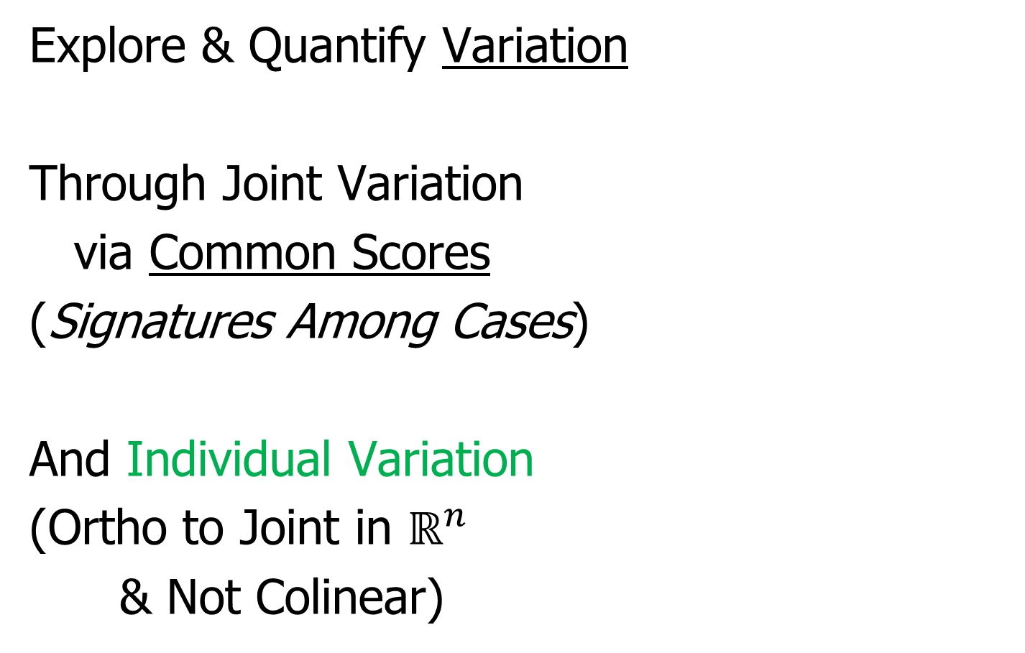
Last Class: AJIVE Goals
Explore & Quantify Variation
Through Joint Variation
via Common Scores
(Signatures Among Cases)
And Individual Variation
(Ortho to Joint in $ℝ^{n}$
& Not Colinear)

Slide 17
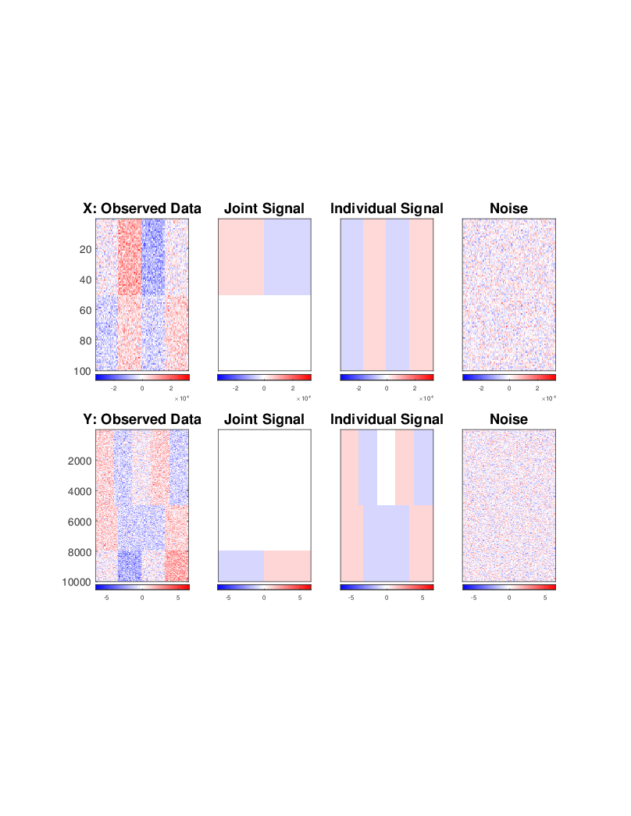
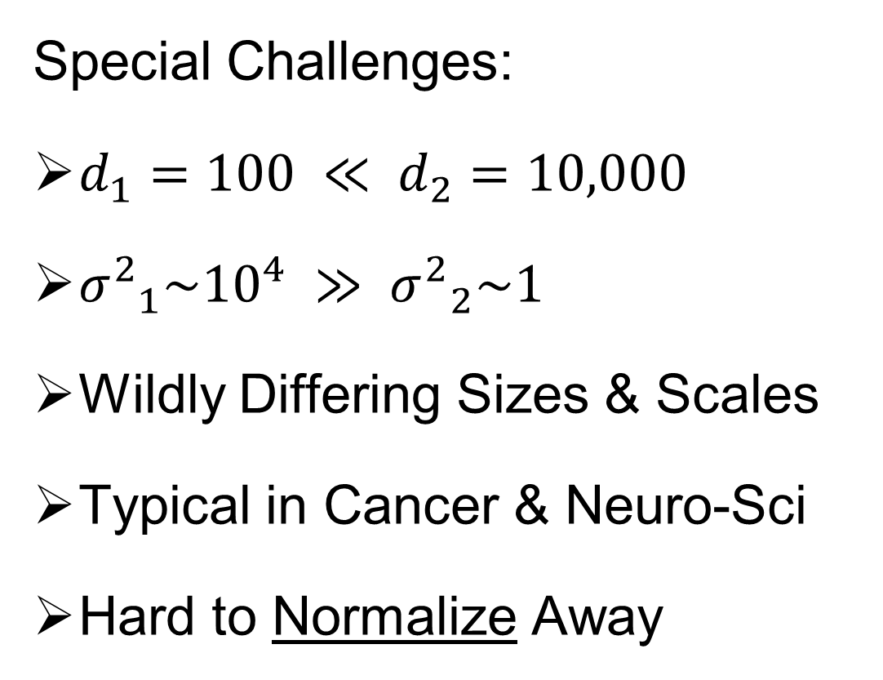
Last Class: AJIVE Toy Example
Special Challenges:
$d_{1}=100 ≪ d_{2}=10,000$
${σ^{2}}_{1}\sim {10}^{4} ≫ {σ^{2}}_{2}\sim 1$
Wildly Differing Sizes & Scales
Typical in Cancer & Neuro-Sci
Hard to Normalize Away

Slide 18
Last Class: AJIVE Toy Example
Underlying Components
(Additive
Signals +
+ Noise)
=
+
+
=
+
+

Slide 19
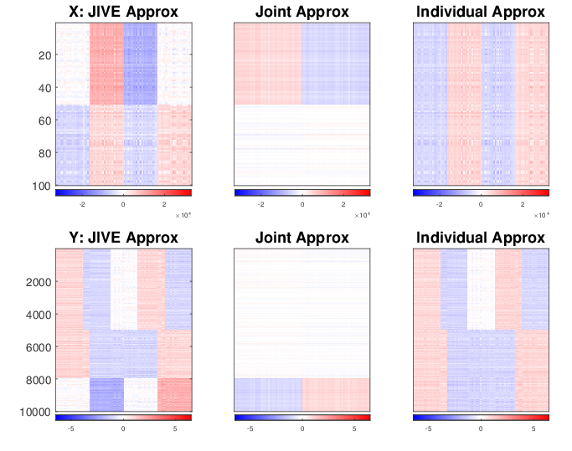
Last Class: AJIVE Toy Example
Current AJIVE: Excellent Decomposition (Both Joint and Individual)

Slide 20
AJIVE Analysis of FMRI Data
Functional Magnetic Resonance Imaging
Approach:
Measure “Brain Activity”
Over Both Location & Time
Via Blood Flow
Data Objects???

Slide 21



AJIVE Analysis of FMRI Data
Functional Magnetic Resonance Imaging
2015 SAMSI Program
On Neuroscience
Qunqun Yu Benjamin Risk
Yu, et al. (2017)

Slide 22
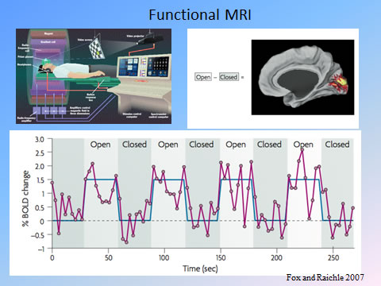
AJIVE Analysis of FMRI Data
Data
Objects?
3d- Movie?
Time Series
At Voxels?
Thanks to fmri.ucsd.edu

Slide 23

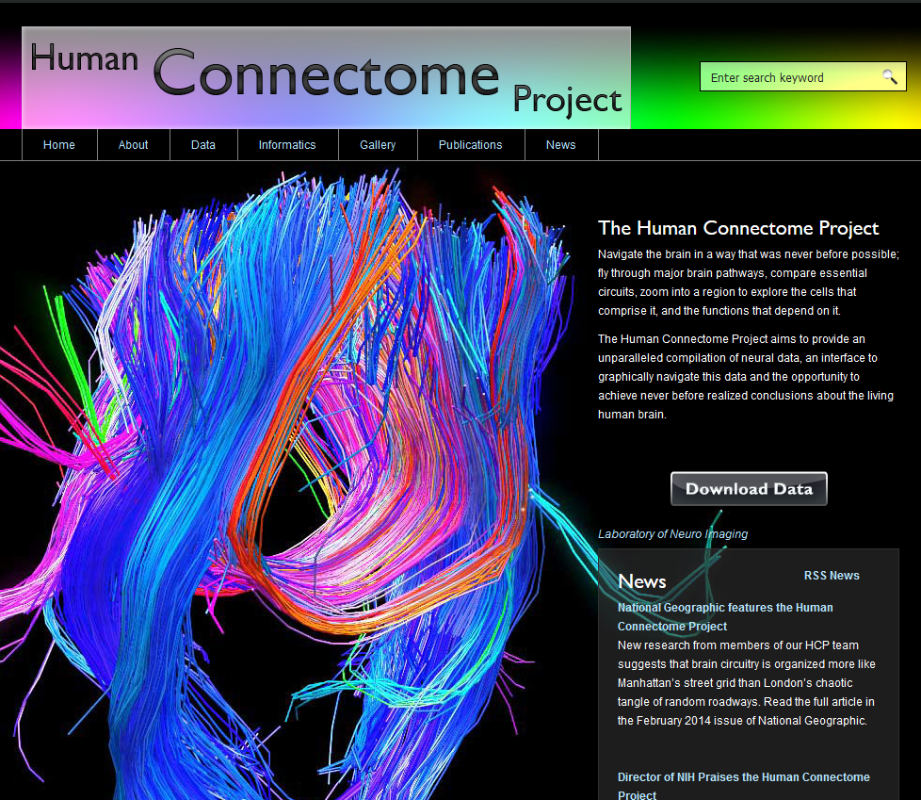
AJIVE Analysis of FMRI Data
Study Data From:
Posted Data With Huge
Amount of Pre-Processing
E.g. Registration

Slide 24
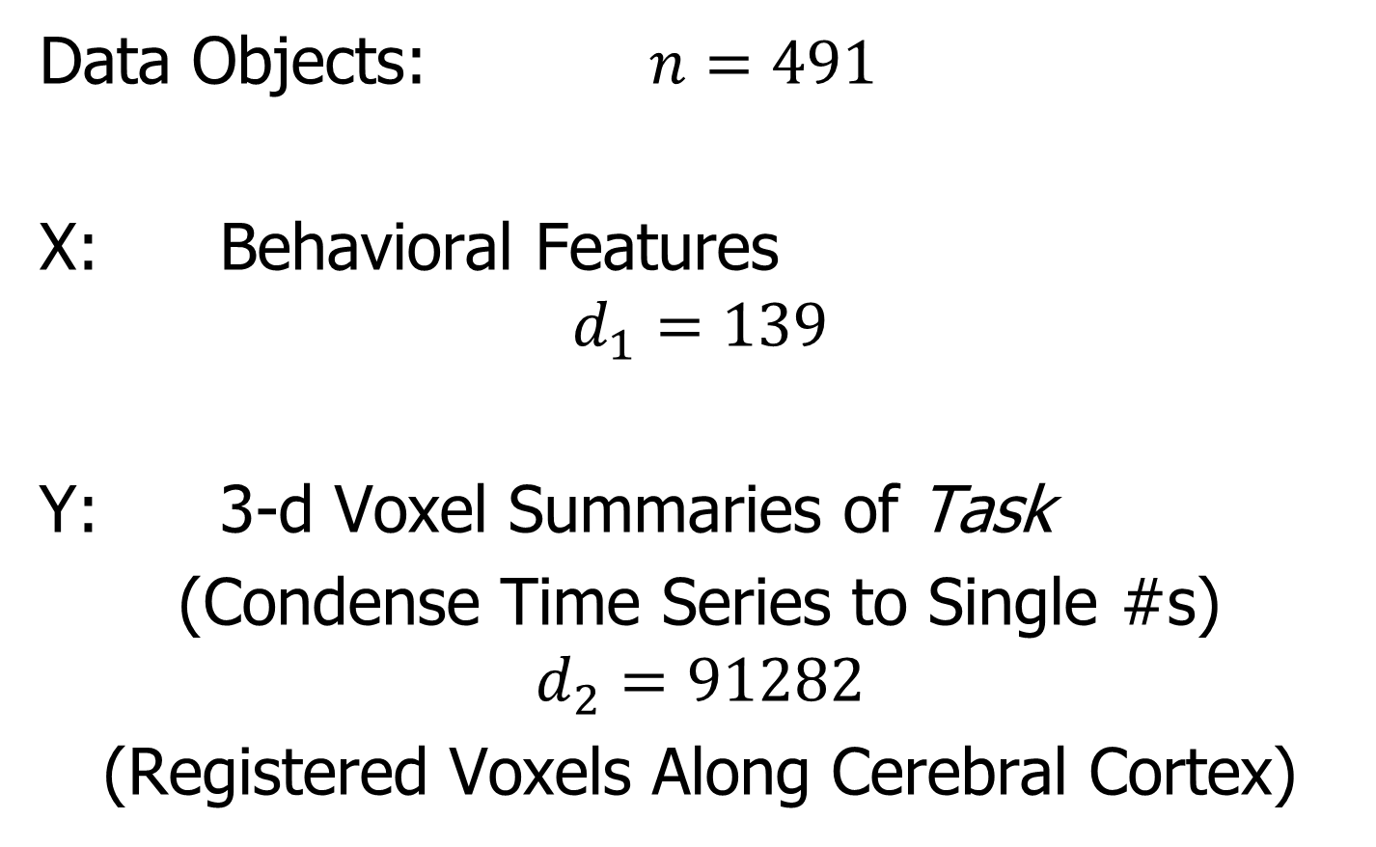
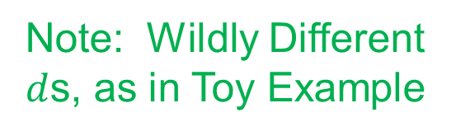
AJIVE Analysis of FMRI Data
Data Objects: $n=491$
X: Behavioral Features
$$d_{1}=139$$
Y: 3-d Voxel Summaries of Task
(Condense Time Series to Single #s)
$$d_{2}=91282$$
(Registered Voxels Along Cerebral Cortex)
Note: Wildly Different
$d$s, as in Toy Example

Slide 25
AJIVE Analysis of FMRI Data
Focus of Analysis:
Loadings (Drivers)
  Behavioral Features
  Lit Up Brain Regions
Since Scores All Gaussian
(Normal Population)
Which Work
Together?
Which Work
Separately?

Slide 26
AJIVE Analysis of FMRI Data
View Entries of Loading Vectors
Separate
PC1 of
Behavior
Feature
Loadings
Important
Groups

Slide 27
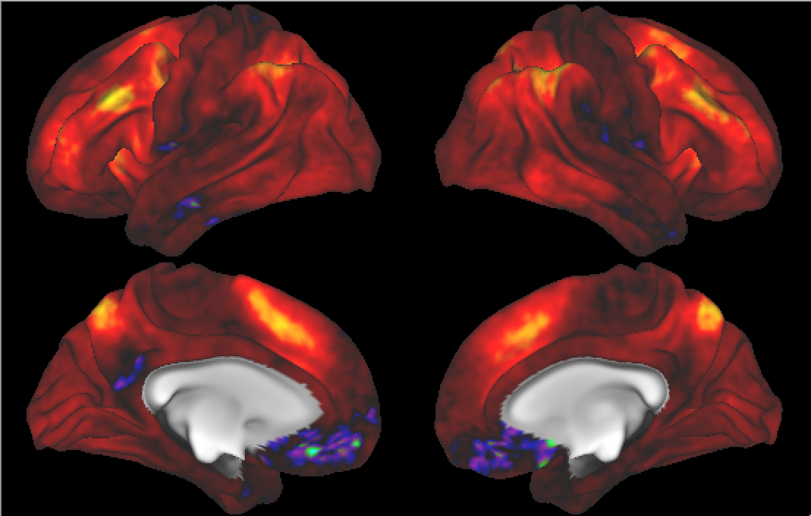

AJIVE Analysis of FMRI Data
Separate PC1 of Image Loadings
All Up
& Down
Together
(Flat Mode)
View Entries of Eigenvectors
Also Some
Hot Spots?
Mostly Uses Only Hot Colors

Slide 28
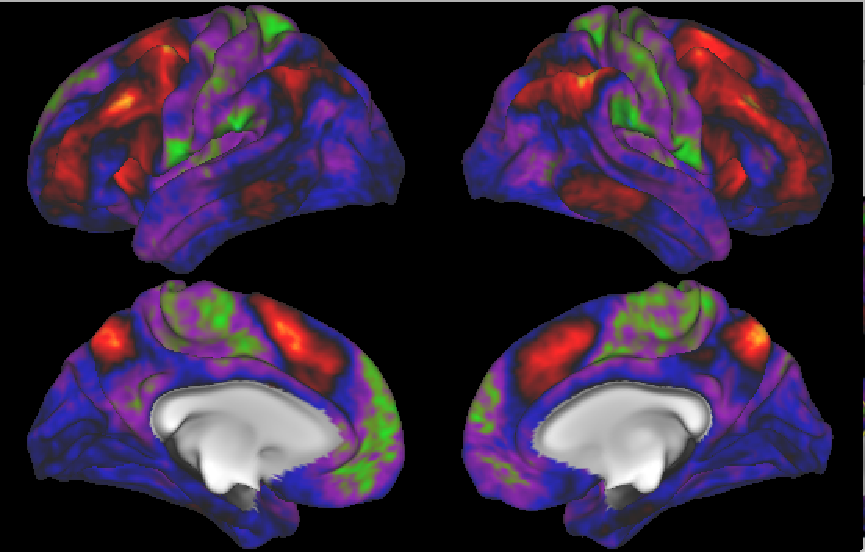
AJIVE Analysis of FMRI Data
Separate PC2 of Image Loadings
Interesting
Structure
???
And Same
Hot Spots?

Slide 29
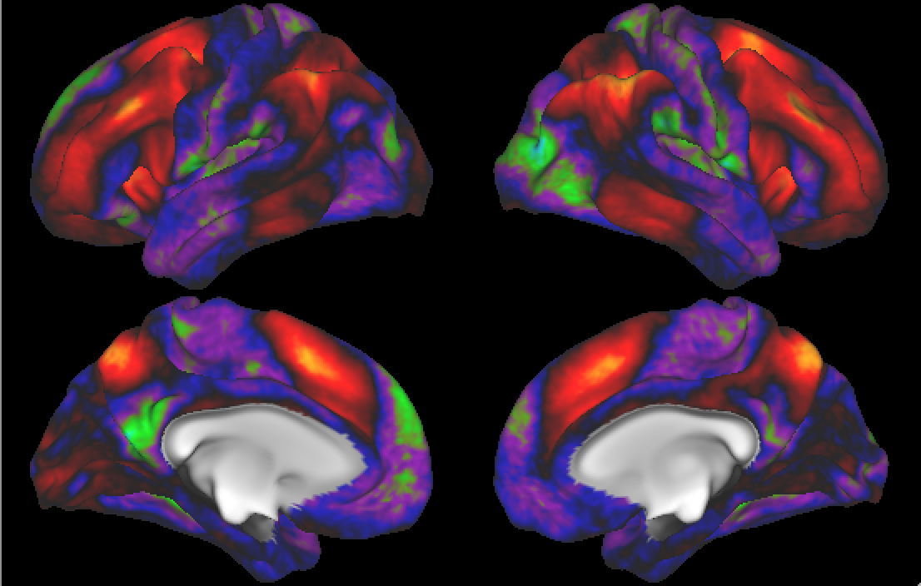
AJIVE Analysis of FMRI Data
Previous Mapping of Regions of Interest
Hot Spots
Are
Working
Memory
Related

Slide 30
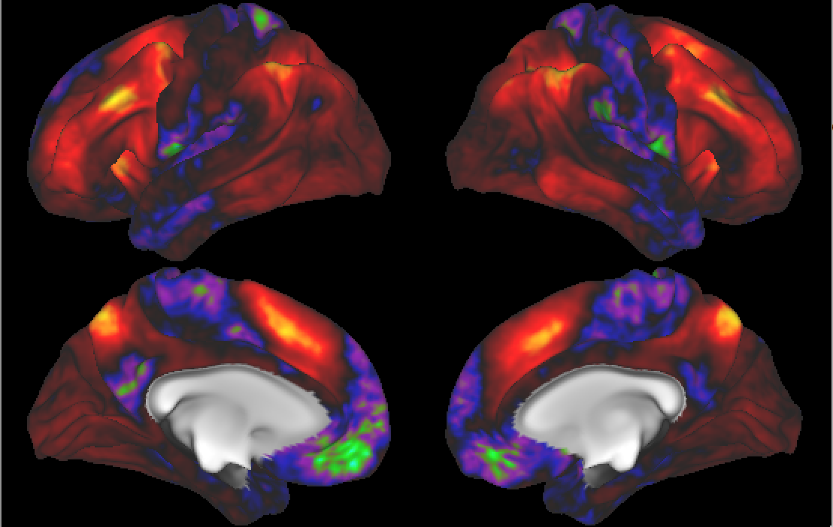
AJIVE Analysis of FMRI Data
Joint PC1 of Image Loadings
Using
Behavior
Combines
Hot Spots
From
Separate
PC1 & 2

Slide 31
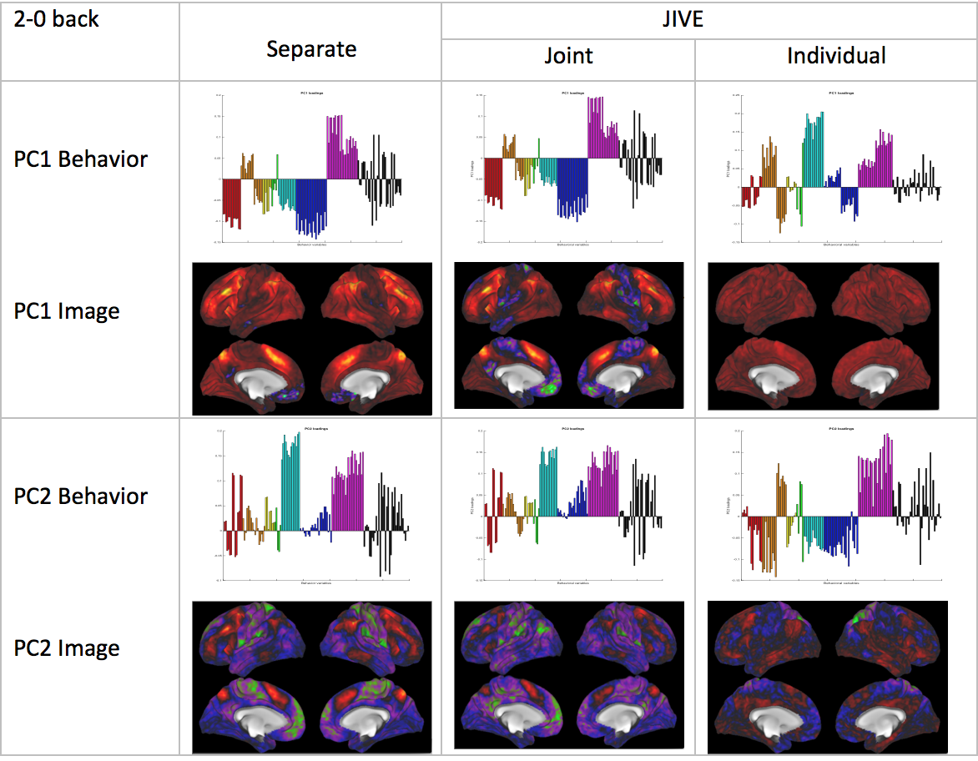
AJIVE Analysis of FMRI Data
Overall
Comparison

Slide 32
AJIVE Analysis of FMRI Data
Overall
Comparison
Earlier Showed
And Also

Slide 33
AJIVE Analysis of FMRI Data
Overall
Comparison
Sep. Beh. PC1
Assoc. w. Image
Joint Im. PC1
Concentrates
Relevant Parts
Of Sep.
PC1 & PC2

Slide 34
AJIVE Analysis of FMRI Data
Overall
Comparison
Flat Mode not
Assoc. w/
Behavior
New 2nd Mode
Of Joint Var’n
Behavior
~ Sep. PC2

Slide 35
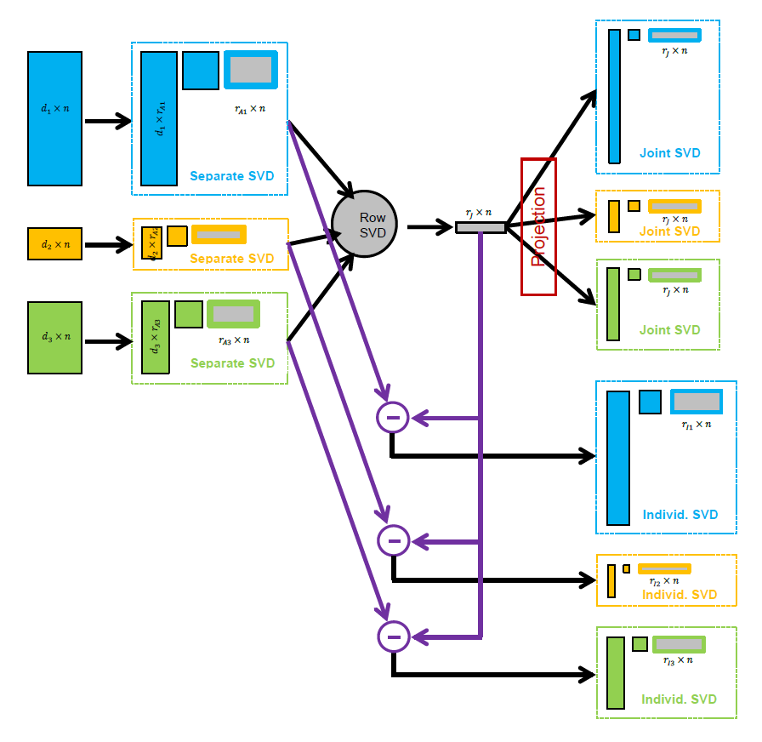
AJIVE Algorithm
Overview
Step 1

Slide 36
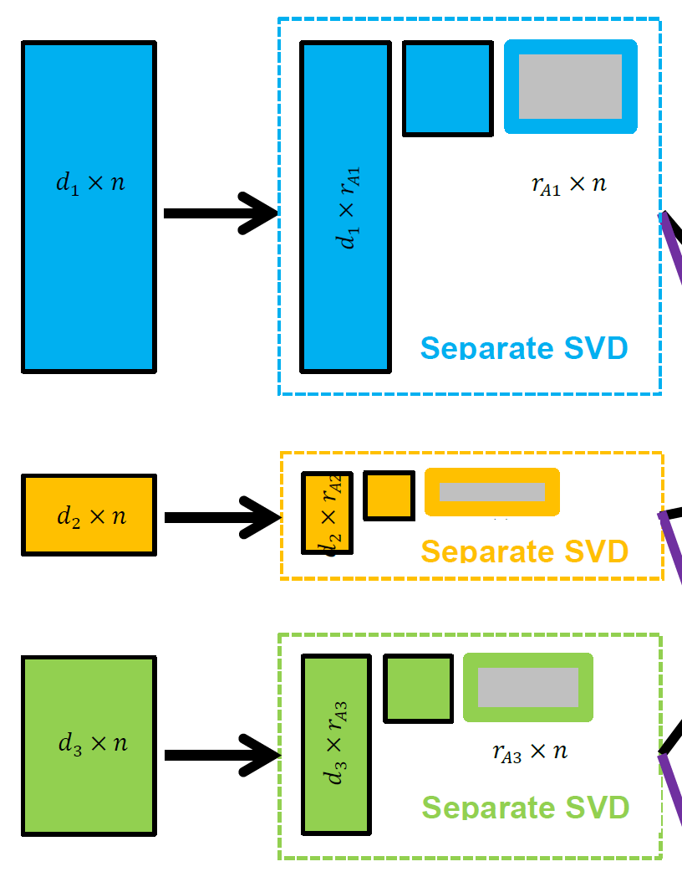

AJIVE Algorithm
Step 1:
Initial Low Rank
Approximations
Separate SVDs
Ranks: $r_{A1},r_{A2},$ $r_{A3}$
Motivation 1: Avoid Noise
Impacting Analysis
Motivation 2: Go Forward
With Scale Free Scores

Slide 37

AJIVE Algorithm
Step 1:
Initial Low Rank
Approximations
Separate SVDs
Ranks: $r_{A1},r_{A2},$ $r_{A3}$
Illustrate with Previous Toy Example

Slide 38
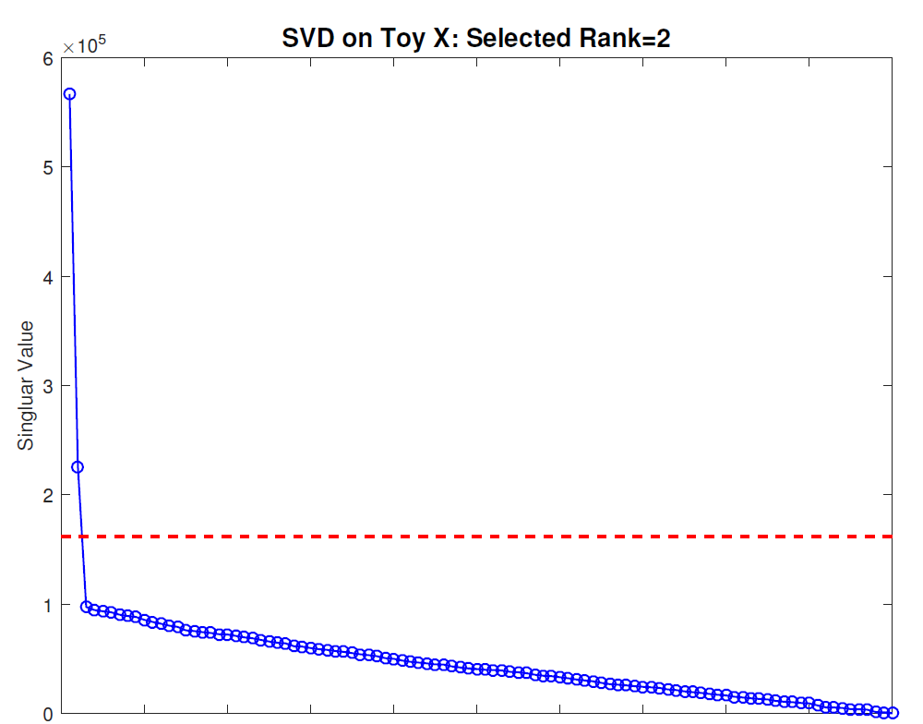
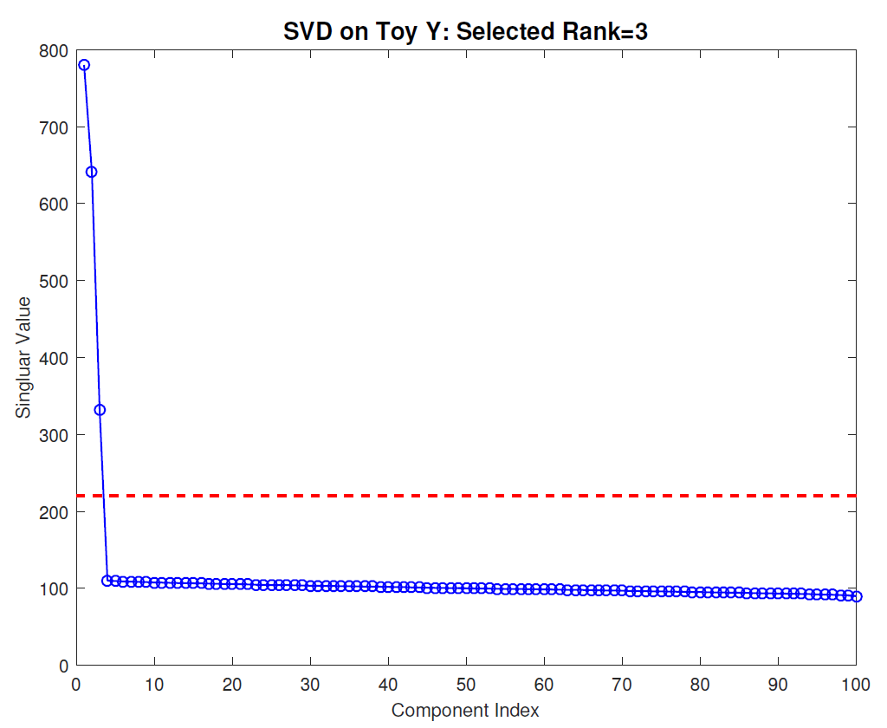
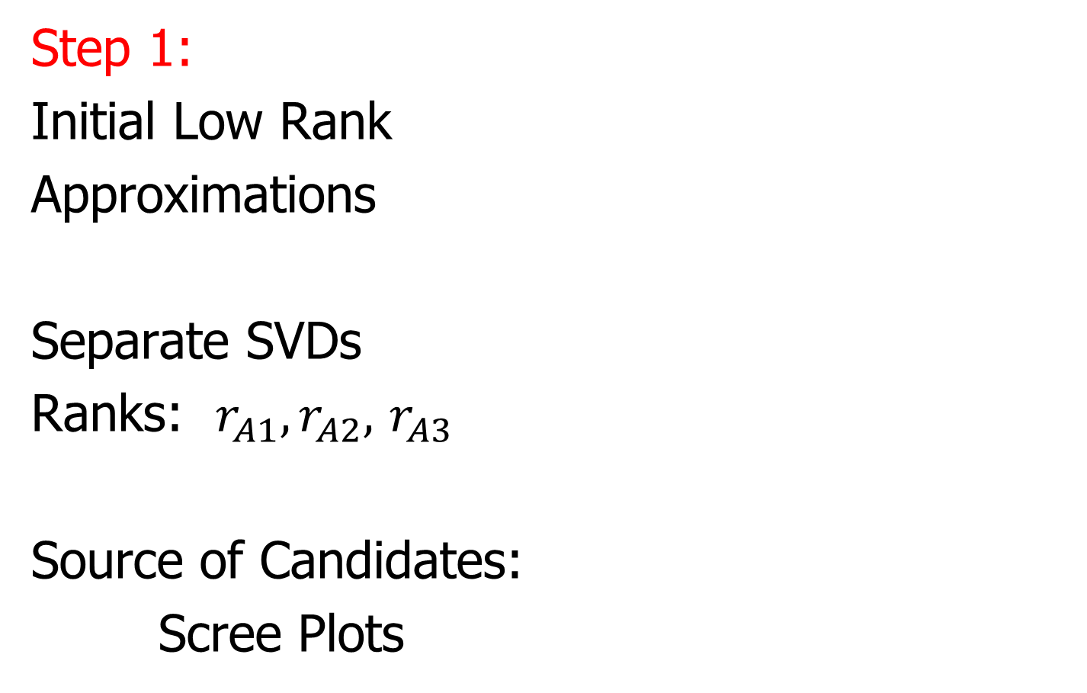
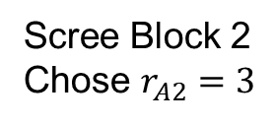
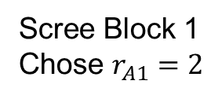
AJIVE Algorithm
Scree Block 1
Chose $r_{A1}=2$
Step 1:
Initial Low Rank
Approximations
Separate SVDs
Ranks: $r_{A1},r_{A2},$ $r_{A3}$
Source of Candidates:
Scree Plots
Scree Block 2
Chose $r_{A2}=3$

Slide 39
AJIVE Algorithm
Step 1:
Initial Low Rank
Approximations
Separate SVDs
Ranks: $r_{A1},r_{A2},$ $r_{A3}$
Source of Candidates:
Scree Plots
Assessment of Ranks:
Wedin Bounds
Random Subspaces
Diagnostic Plots
Directional Bounds
Solved by DIVAS

Slide 40
AJIVE Algorithm
Overview
Step 2

Slide 41
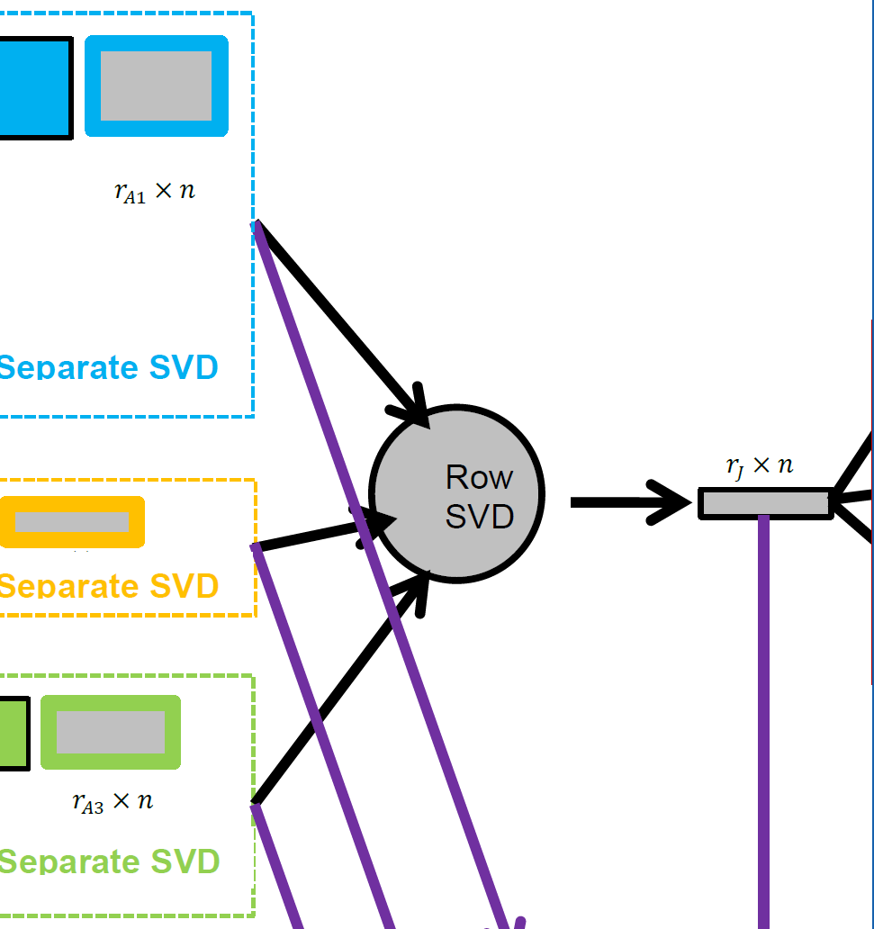
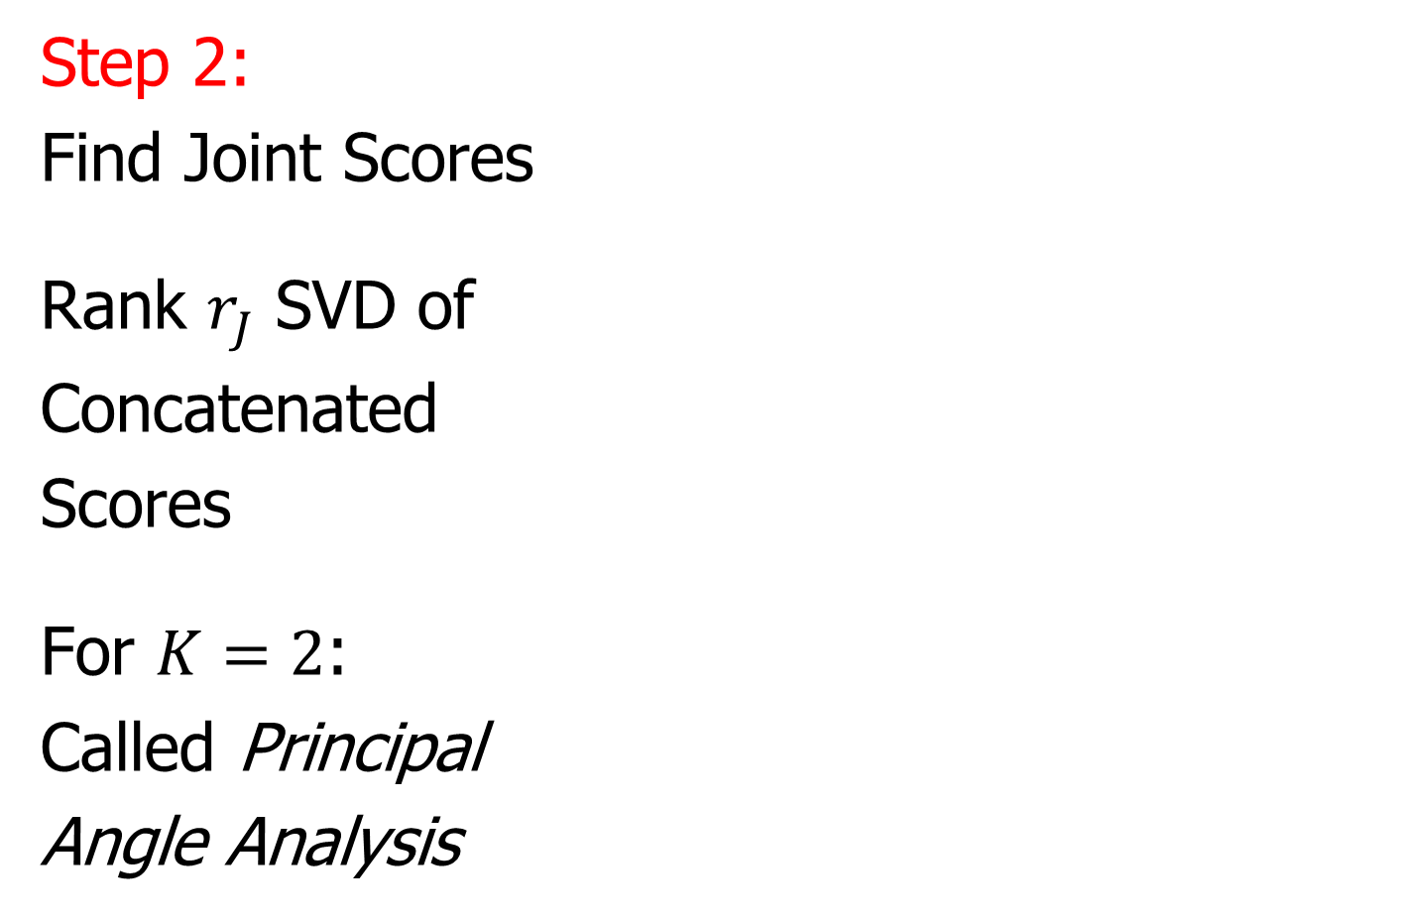
AJIVE Algorithm
Step 2:
Find Joint Scores
Rank $r_{J}$ SVD of
Concatenated
Scores
For $K=2$:
Called Principal
Angle Analysis
Main Product:
Scores Common
To All Data Blocks

Slide 42

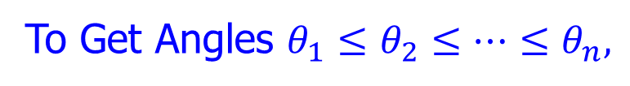
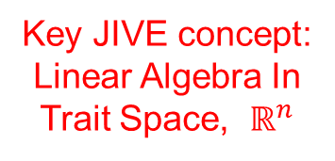


Aside: Principal Angle Analysis
Idea: Relate Subspaces $S_{1}$, $S_{2}$ of $ℝ^{n}$
Using Minimal Angles
$$θ_{1}=0$$
$$θ_{2}$$
Key JIVE concept:
Linear Algebra In
Trait Space, $ℝ^{n}$
And Iterate Orthogonally
To Get Angles $θ_{1}≤θ_{2}≤⋯≤θ_{n},$
PAA Computation: ~Concatenate & SVD

Slide 43
AJIVE Algorithm
Step 2:
Find Joint Scores
Same For All
Blocks!
Called “Common
Normalized Scores”

Slide 44
AJIVE Algorithm
Overview
Step 3

Slide 45
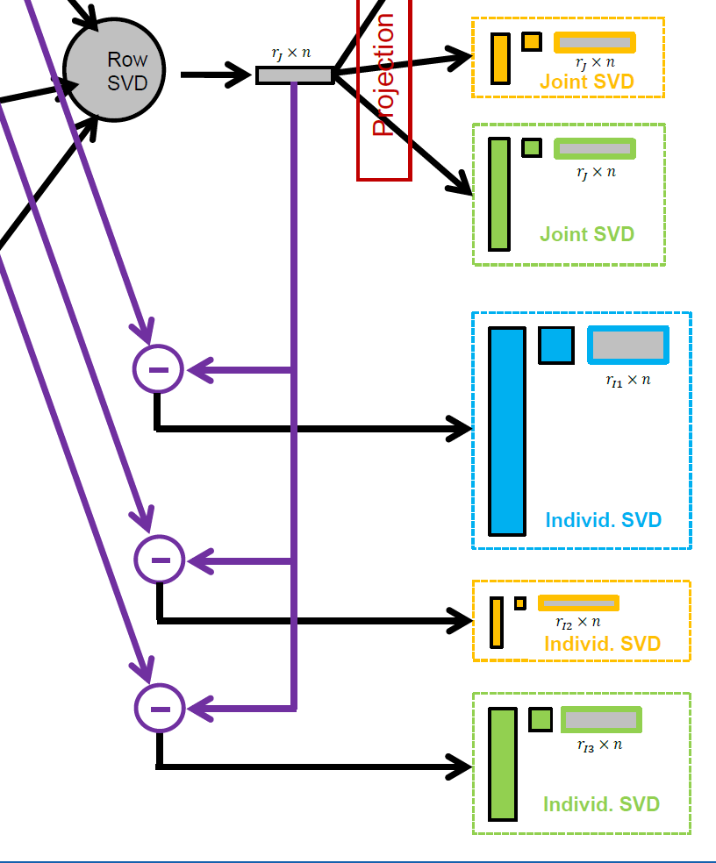

AJIVE Algorithm
Step 3:
Find Individual
Scores
By Orthogonal
Basis Subtraction
Guarantees
Joint $⊥$ Individual

Slide 46
AJIVE Algorithm
Overview
Step 4

Slide 47
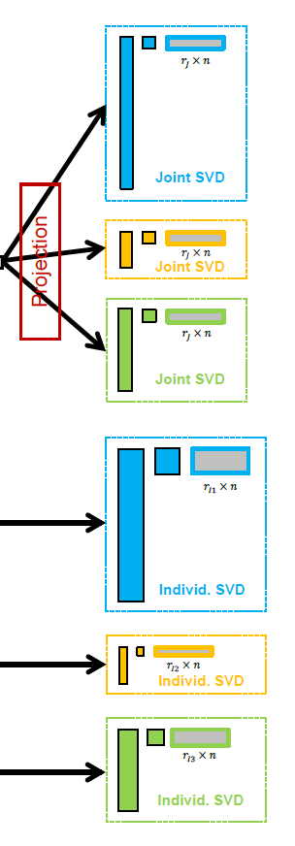
AJIVE Algorithm
Step 4:
Reproject Data
To Get Both
Joint and
Individual
Decompositions
Again Best Rank 1
Approximations

Slide 48
AJIVE Algorithm
Output Options (for Differing Purposes):
Common Normalized Scores
Block Specific Scores (Joint & Indiv.)
Full Matrices

Slide 49
AJIVE Algorithm
Output Options (for Differing Purposes):
Common Normalized Scores
Block Specific Scores (Joint & Indiv.)
Full Matrices

Slide 50
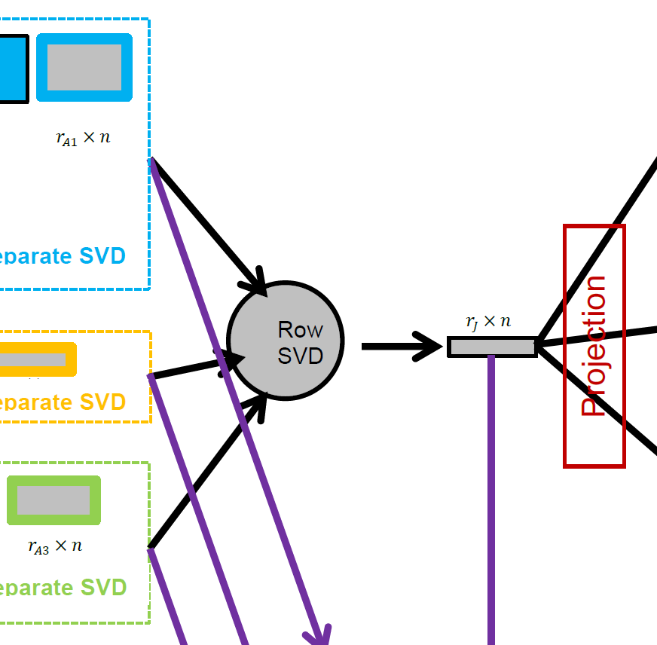
AJIVE Algorithm
Caution: Common
Normalized Loadings
Need Not Be Orthogonal
Common Normalized Scores
  Same for Each Block
  Scale Free (Length 1)
  Finds Joint Behavior
  Useful: Scatterplots
  Can Have Common
  Loadings By Projecting
  Gives Interpretation
  of Driving Features
E.g. FMRI Neuro Science Data

Slide 51
AJIVE Algorithm
Output Options (for Differing Purposes):
Common Normalized Scores
Block Specific Scores (Joint & Indiv.)
Full Matrices

Slide 52
AJIVE Algorithm
Block Specific Scores
(Joint & Indiv.)
  SVD Re-Ordered Basis
  Loadings Now Orthogonal
  Includes Magnitudes (SVs)
  Compact $r_{∗}×n$ Representation
  E.g. Input for Classification
  Interpretation via Loadings
  Lose Cross Block Interpretation

Slide 53
AJIVE Algorithm
Output Options (for Differing Purposes):
Common Normalized Scores
Block Specific Scores (Joint & Indiv.)
Full Matrices

Slide 54
AJIVE Algorithm
Full Matrices
  Size of Original Data
  Best Rank $r_{j}$ Approx’s
  Allows Heat Map View
  And Network Analysis

Slide 55
Revisit Toy Example
Consider Initial
Rank Selection
Joint Signal has Rank 1
Underlying Components
(Additive
Signals +
+ Noise)
=
+
+
1st Individual Signal
has Rank 1
=
+
+
2nd Individual Signal
has Rank 2

Slide 56
Revisit Toy Example
Recall Scree Plots
Easy in this Simple Case
Scree Block X
Chose $r_{A1}=2$
Scree Block Y
Chose $r_{A2}=3$

Slide 57
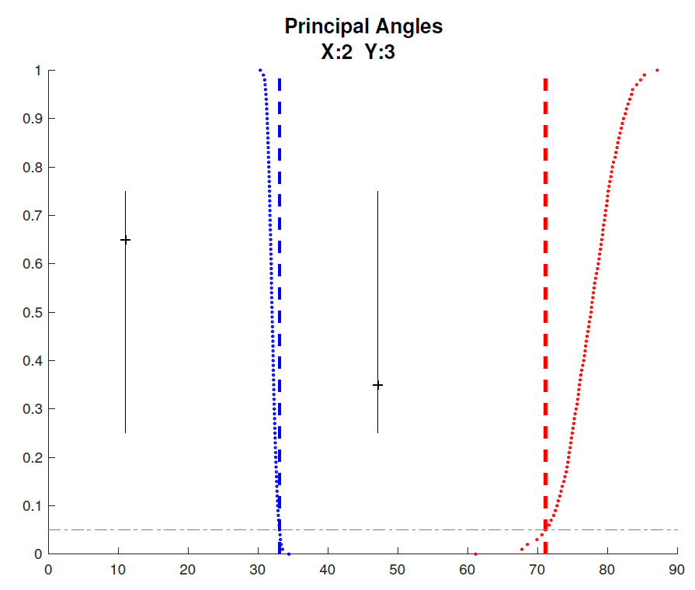
Revisit Toy Example
Well Chosen Initial Ranks, $r_{A1}=2$, $r_{A2}=3$
Diagnostic Plot:
1st Principal Angle
(Joint + noise)
Conclude
Neither Is
Random
Conclude
Larger
Not Joint
2nd Principal Angle
(Small Indiv. + )
Random Subspaces
Distribution & Quantile
Wedin Bound Estimates
Distribution & Quantile

Slide 58
Revisit Toy Example
=
+
+
Relatively Small
Angle Between
Row Spaces
Recall
Subspace
Angle ${47.9}^{°}$
=
+
+

Slide 59
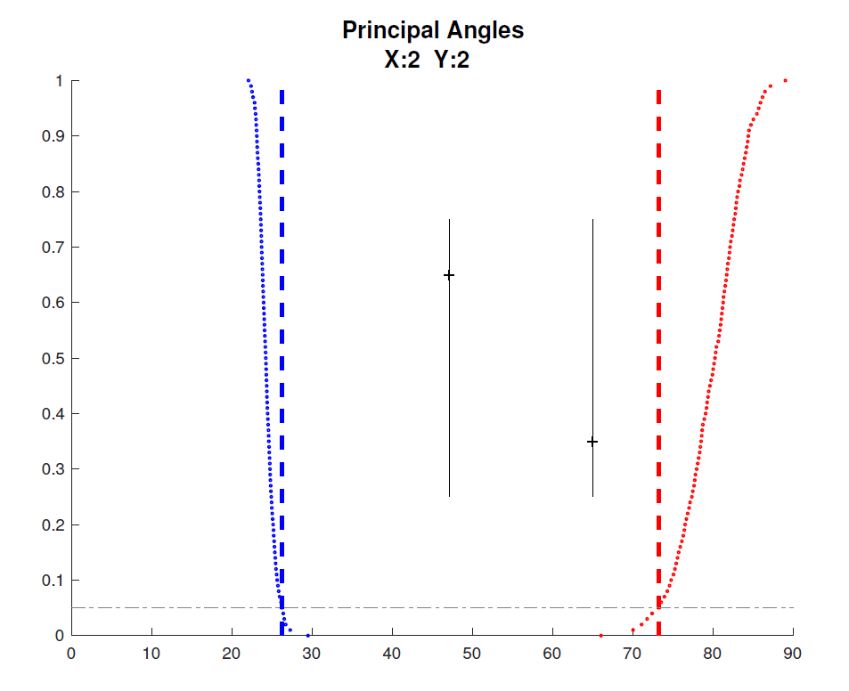
Revisit Toy Example
Choose $r_{A2}=2$, Too Small (Lose Info)
Diagnostic Plot:
Both Principal Angles
Larger (Lost Info)
Neither is Random
Neither is Joint
Since Joint Signal in Y
Relatively Small

Slide 60
Revisit Toy Example
=
+
+
Relatively
Less Signal
In Y Joint
Component
=
+
+

Slide 61
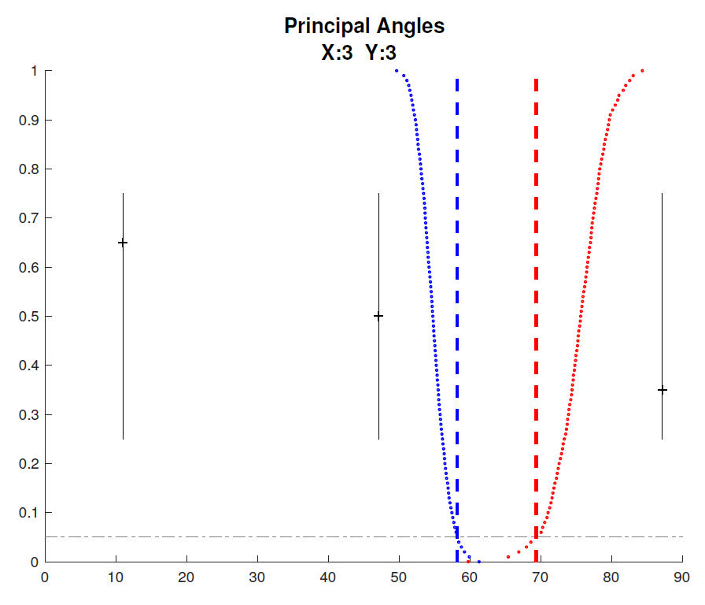
Revisit Toy Example
Choose $r_{A1}=3$, Too Big (Feels Noise)
Diagnostic Plot:
Now 3 Principal Angles
3rd Could be Random
(OK, Since True $r_{A1}=2$)
2nd Could be Joint
(Consequence of Poor
Wedin Approximation)

Slide 62
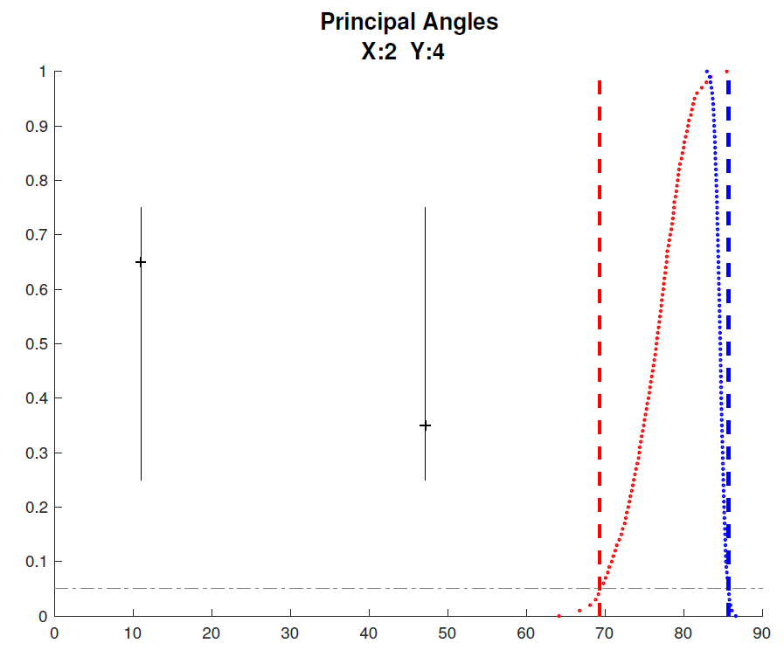
Revisit Toy Example
Choose $r_{A2}=4$, Too Big (Feels Noise)
Diagnostic Plot:
Wedin Bound Useless
$>$Random Subspace Bound
Due to High Noise
Neither Angle Random
Both Could Be Joint
Not Much Info Here

Slide 63


AJIVE Analysis of Cancer Data
Carolina Breast Cancer Study (CBCS)
Thanks to: Iain Carmichael (Deep Learning, AJIVE)
Melissa Troester (Head, CBCS)
Joseph Geradts, Benjamin Calhoun (Pathology)
Katie Hoadley, Chuck Perou (Genomics)
Carmichael, et al. (2021)

Slide 64
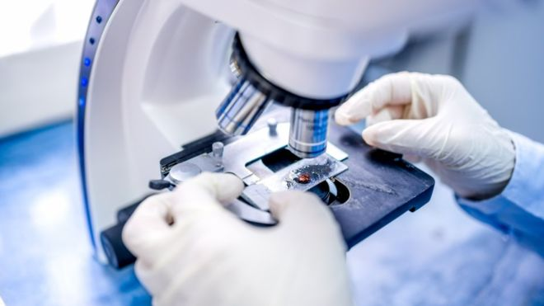
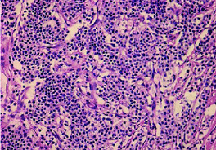
AJIVE Analysis of Cancer Data
Clinical Diagnosis of Cancer:
Pathologist Views Tissue Under Microscope,
Tissue Stained with Hematoxylin & Eosin (H&E)
Thanks to BBC.CO.UK
and Reseachgate.net

Slide 65
AJIVE Analysis of Cancer Data
Analysis Goal:
Understand How Images & Genomics
Work Together
Work Separately
Approach: AJIVE
Clinical Diagnostic Standard
Deep Insight &
New Treatments
As of Jan. 2020: ~70
Drugs Approved for
Breast Cancer Therapy

Slide 66
Participant Presentation
Ishita Pethkar
Extension of GRIDY

