Slide 1
Statistics – O. R. 881 Object Oriented Data Analysis
Steve Marron
Dept. of Statistics and Operations Research
University of North Carolina

Slide 2
Current Sections in Textbook
Today:
Sections 17.2
Next Class:
Sections 17.2, 7.1, 7.2

Slide 3
Last Class: AJIVE FMRI Data
Functional Magnetic Resonance Imaging
Approach:
Measure “Brain Activity”
Over Both Location & Time
Via Blood Flow
Data Objects???

Slide 4
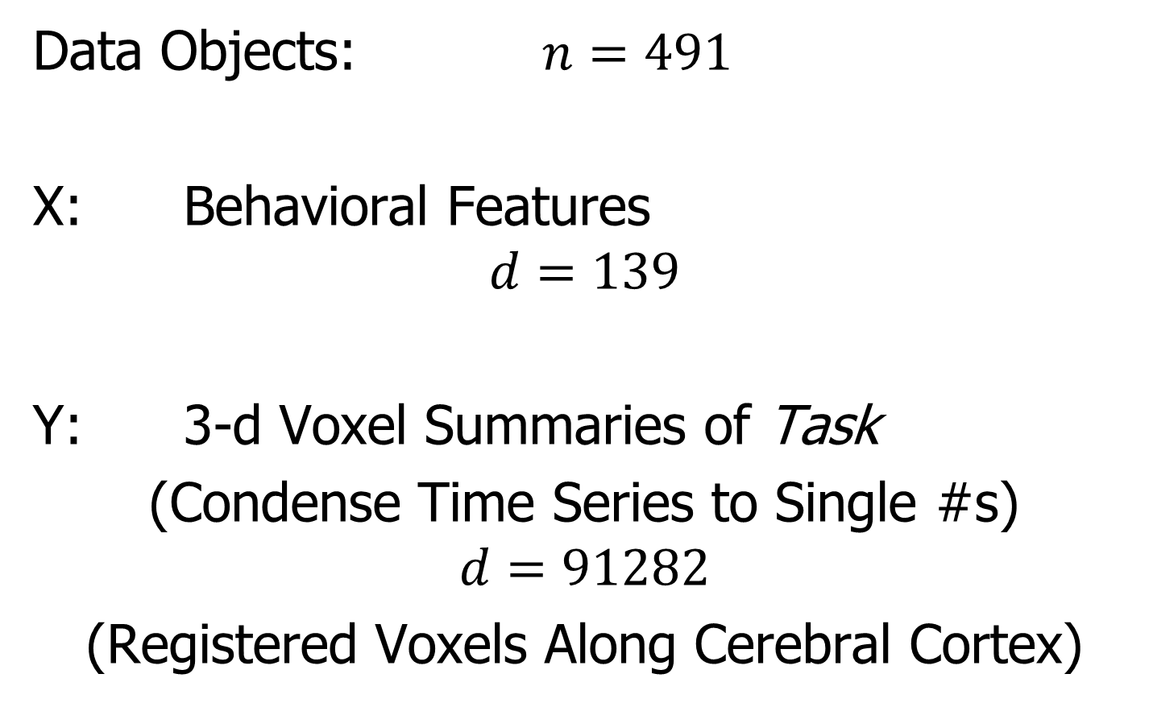
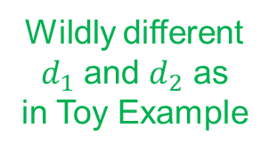
Last Class: AJIVE FMRI Data
Data Objects: $n=491$
X: Behavioral Features
$$d=139$$
Y: 3-d Voxel Summaries of Task
(Condense Time Series to Single #s)
$$d=91282$$
(Registered Voxels Along Cerebral Cortex)
Wildly different
$d_{1}$ and $d_{2}$ as
in Toy Example

Slide 5
Last Class: AJIVE FMRI Data
Focus of Analysis:
Loadings (Drivers)
Behavioral Features
Lit Up Brain Regions
Since Scores All Gaussian
(Normal Population)
Which Work
Together?
Which Work
Separately?

Slide 6
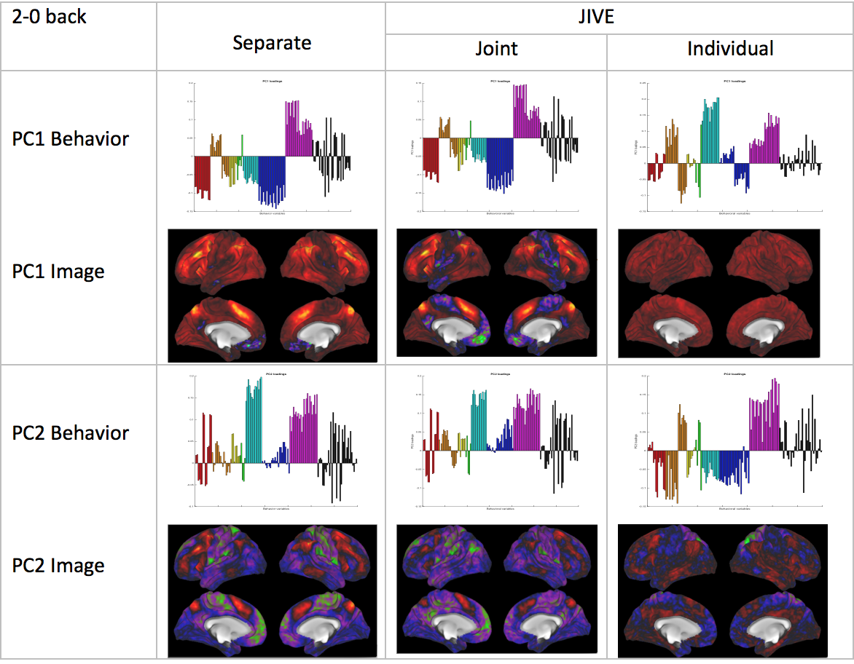
Last Class: AJIVE FMRI Data
Overall
Comparison
Sep. Beh. PC1
Assoc. w. Image
Joint Im. PC1
Concentrates
Relevant Parts
Of Sep.
PC1 & PC2

Slide 7
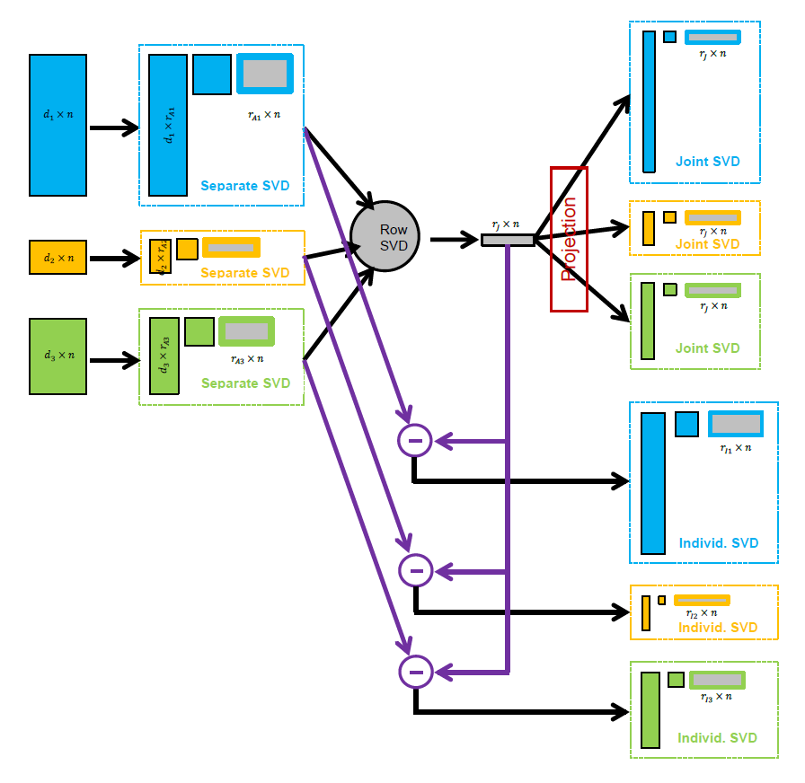
Last Class: AJIVE Algorithm
Overview

Slide 8




Last Class: Princ’l. Angle Anal.
Idea: Relate Subspaces $S_{1}$, $S_{2}$ of $ℝ^{n}$
Using Minimal Angles
$$θ_{1}=0$$
$$θ_{2}$$
Key JIVE concept:
Linear Algebra In
$n$ - Space
And Iterate Orthogonally
PAA Computation: ~Concatenate & SVD

Slide 9
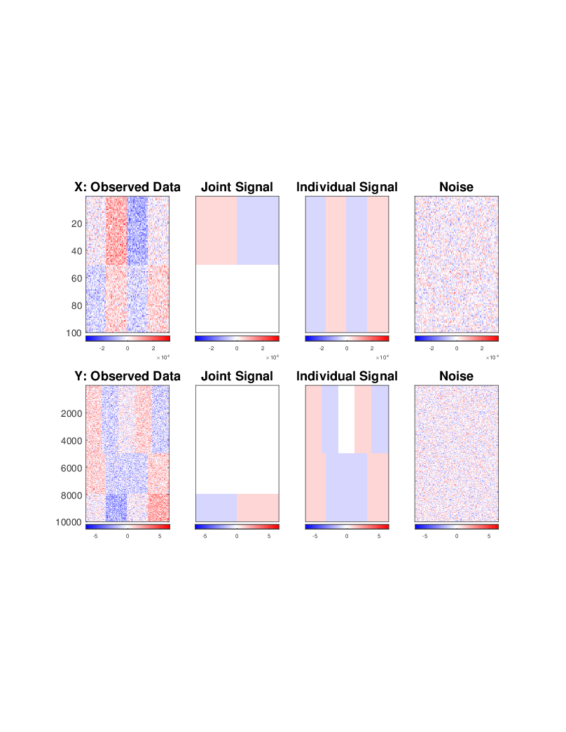
Last Class: Revisit Toy Example
Consider Initial
Rank Selection
Joint Signal has Rank 1
Underlying Components
(Additive
Signals +
+ Noise)
=
+
+
1st Individual Signal
has Rank 1
=
+
+
2nd Individual Signal
has Rank 2

Slide 10
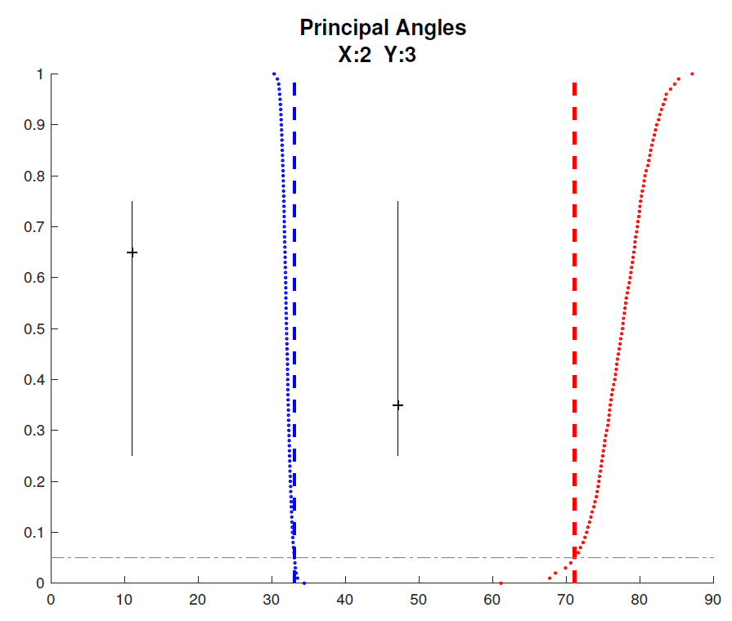
Last Class: Revisit Toy Example
Well Chosen Initial Ranks, $r_{A1}=2$, $r_{A2}=3$
Diagnostic Plot:
1st Principal Angle
(Joint + noise)
Conclude
Neither Is
Random
Conclude
Larger
Not Joint
2nd Principal Angle
(Small Indiv. + )
Random Subspaces
Distribution & Quantile
Wedin Bound Estimates
Distribution & Quantile

Slide 11


Last Class: AJIVE Cancer Data
Carolina Breast Cancer Study (CBCS)
Thanks to: Iain Carmichael (Deep Learning, AJIVE)
Melissa Troester (Head, CBCS)
Joseph Geradts, Benjamin Calhoun (Pathology)
Katie Hoadley, Chuck Perou (Genomics)
Carmichael, et al. (2021)

Slide 12
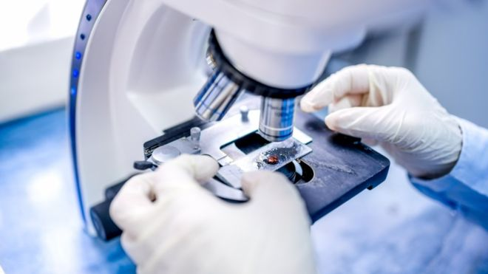
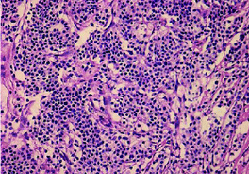
Last Class: AJIVE Cancer Data
Clinical Diagnosis of Cancer:
Pathologist Views Tissue Under Microscope,
Tissue Stained with Hematoxylin & Eosin (H&E)
Thanks to BBC.CO.UK
and Reseachgate.net

Slide 13
Last Class: AJIVE Cancer Data
Analysis Goal:
Understand How Images & Genomics
Work Together
Work Separately
Approach: AJIVE
Clinical Diagnostic Standard
Deep Insight &
New Treatments
As of Jan. 2020: ~70
Drugs Approved for
Breast Cancer Therapy

Slide 14
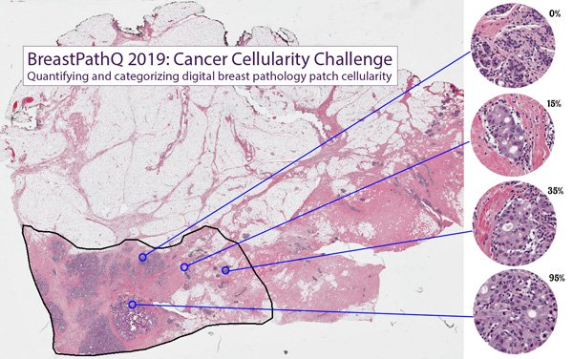
AJIVE Analysis of Cancer Data
Tissue Micro Array Data:
Extract Small
(1mm diam.)
“Cores”
Thanks to SPIE.ORG

Slide 15
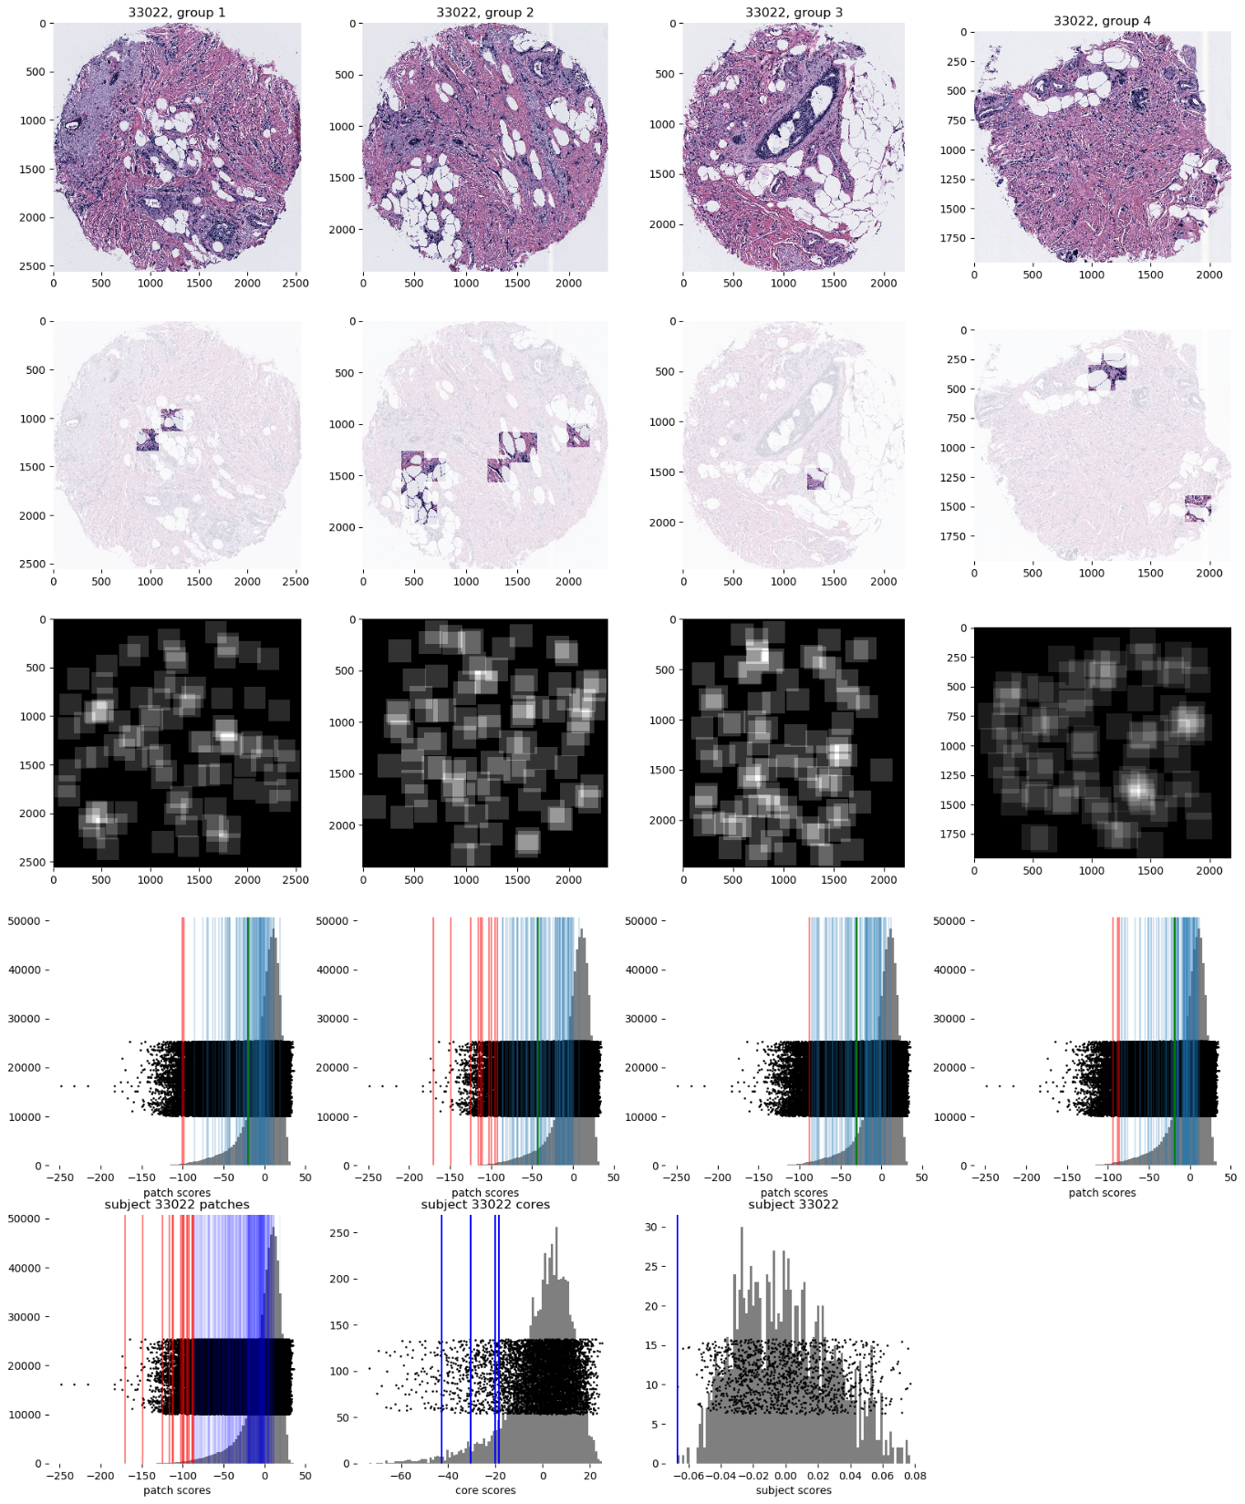
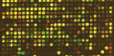

AJIVE Analysis of Cancer Data
Experimental Design: $n=1191$ people
For Each:
1 – 4 TMA Cores
PAM 50 Gene Expression:

Slide 16

AJIVE Analysis of Cancer Data
PAM 50 Gene Expression:
Set of 50 Genes
Measured mRNA Expression Level
Good at Separating SubTypes
Basal
Her2
Luminal A
Luminal B
Early Technology, More Recent
RNAseq → 10,000s Genes
Perou Discovery:
No Benefit From
Chemo-Therapy

Slide 17

AJIVE Analysis of Cancer Data
Deep Learning Image Representation
Each Core:
Randomly
Select 100
$224×224$
Patches

Slide 18
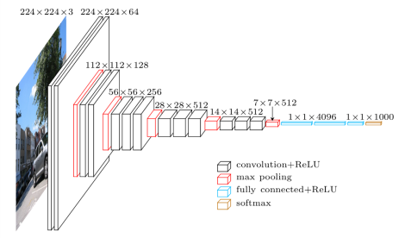
AJIVE Analysis of Cancer Data
Deep Learning Image Representation
Reduce Each Patch to 512 Features
Using Transfer Learning From VGG16:
(Trained on Many
Natural Images)
Thanks to pyimagesearch.com

Slide 19
AJIVE Analysis of Cancer Data
Deep Learning Image Representation
For Each Core:
Aggregate Patches by Averaging
(Damps Out “Location” Information)
Then Average Cores For Each Person

Slide 20
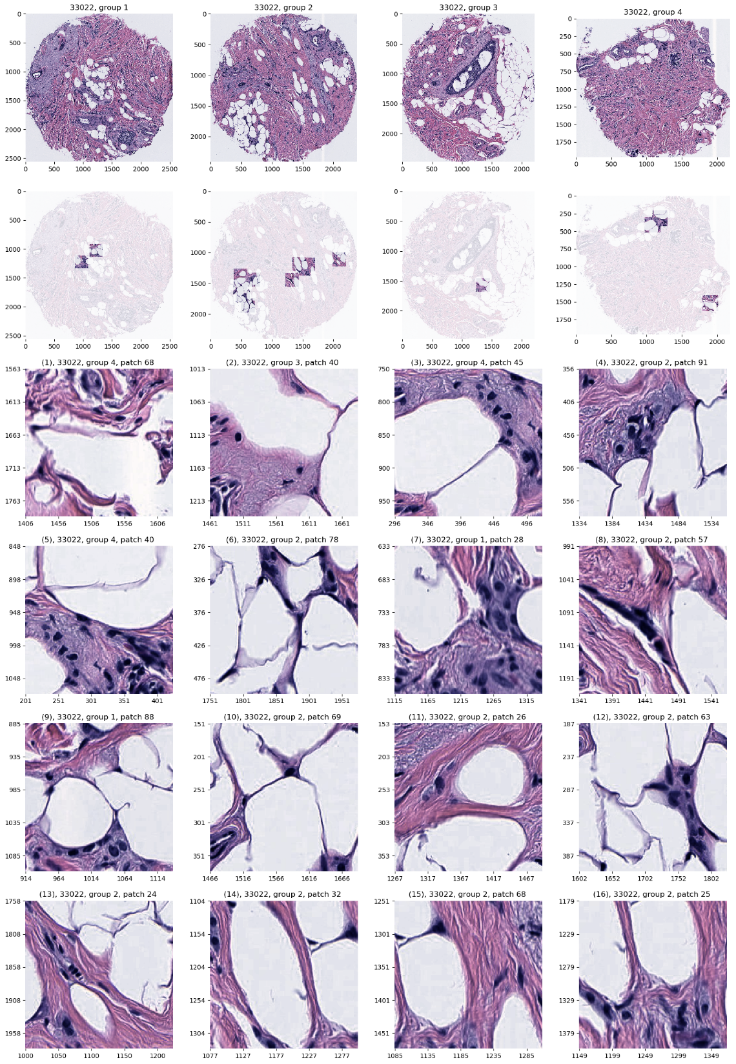
AJIVE Analysis of Cancer Data
JIVE: Common Normalized Scores 1
Look at Extremes
Negative End
Top Person
Top 16 Patches
Fat Cells & Stroma

Slide 21
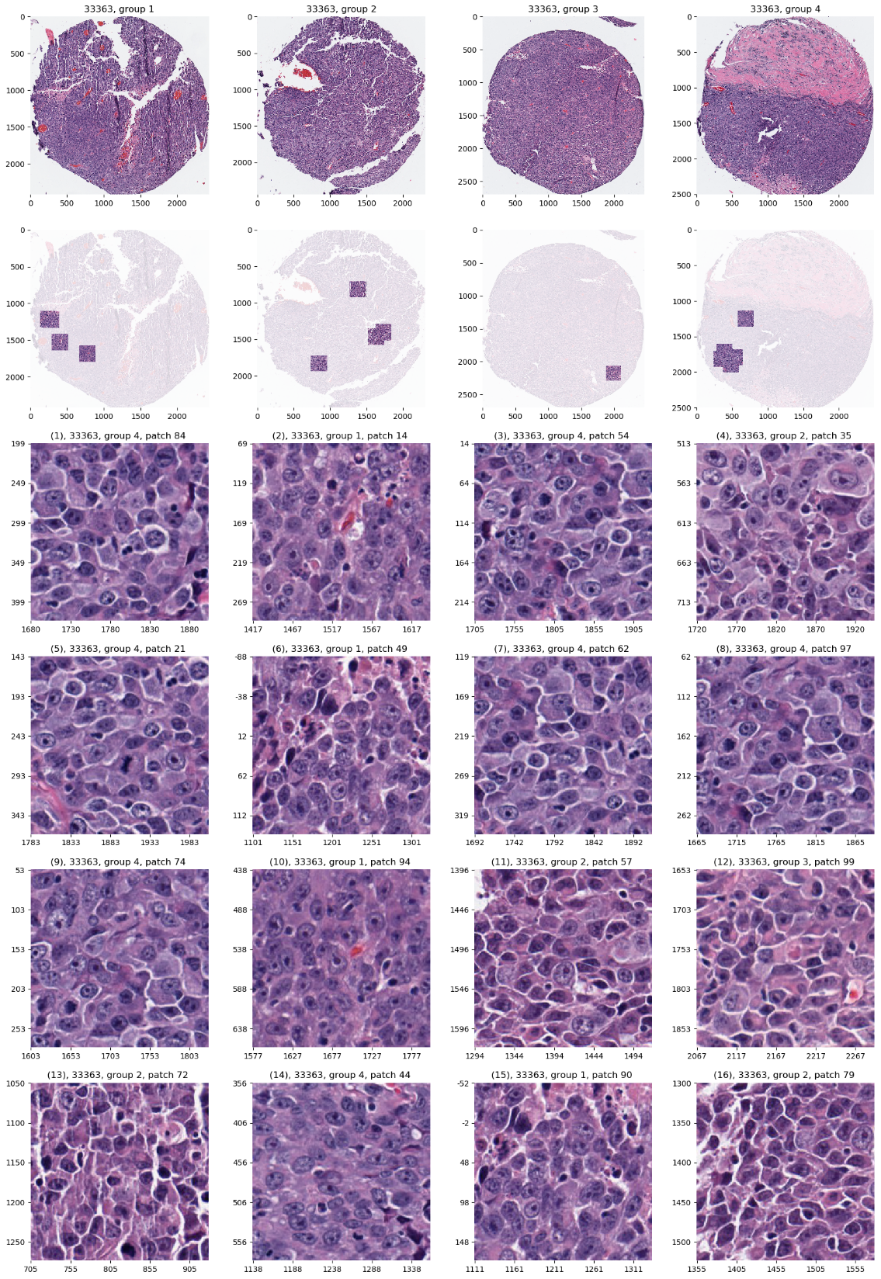
AJIVE Analysis of Cancer Data
JIVE: Common Normalized Scores 1
Look at Extremes
Positive End
Top Person
Top 16 Patches
Highly “Cellular”
Markedly Atypical Cells

Slide 22
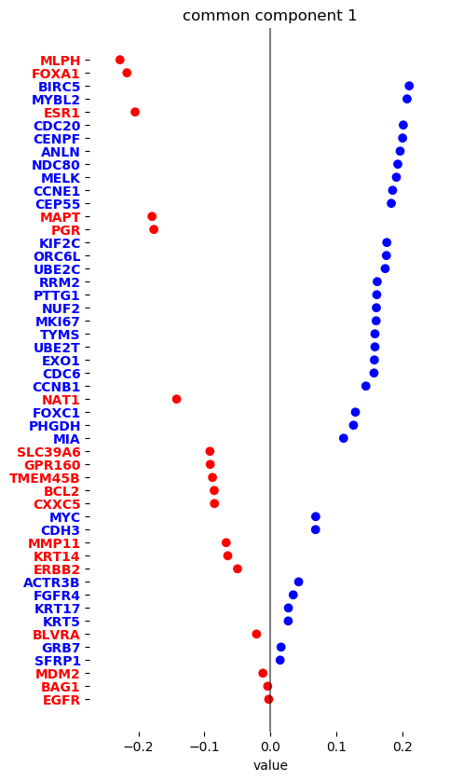
AJIVE Analysis of Cancer Data
JIVE: Gene Expression
Common Normalized
Loadings 1
Very Consistent w/ Image
“High Proliferation” Genes
“Low Prolif.” – Lum A Genes

Slide 23
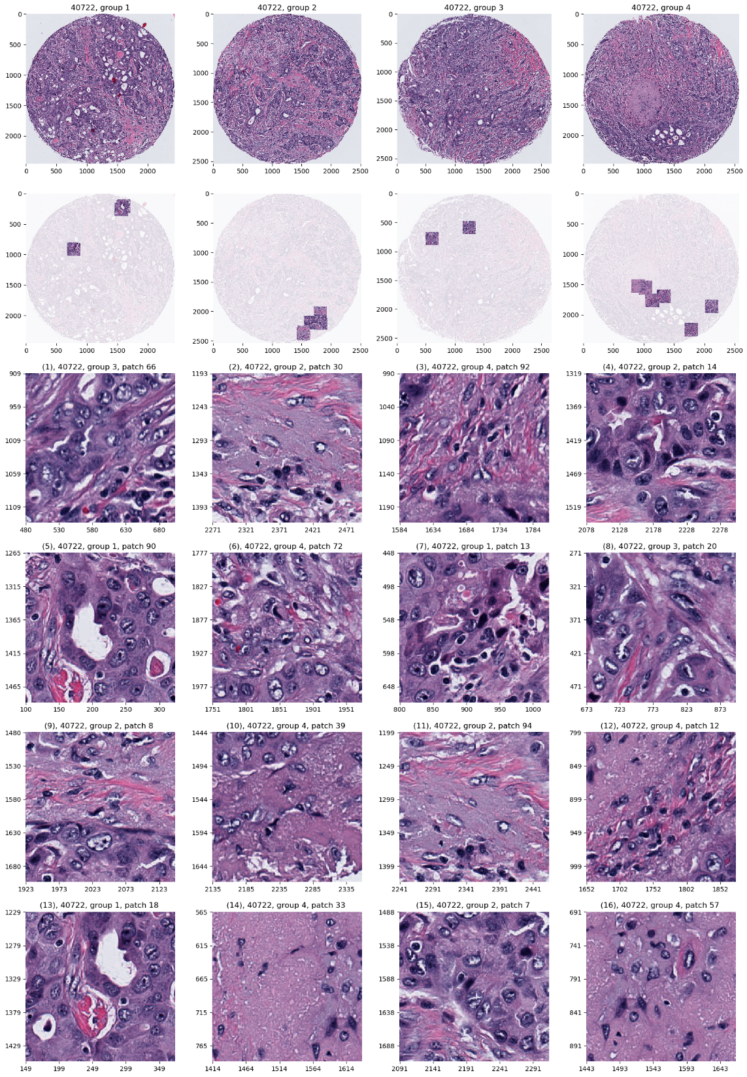
AJIVE Analysis of Cancer Data
JIVE: Common Normalized Scores 2
Look at Extremes
Negative, Top
Top 16 Patches
High Nuclear Grade
Atypical Cells

Slide 24
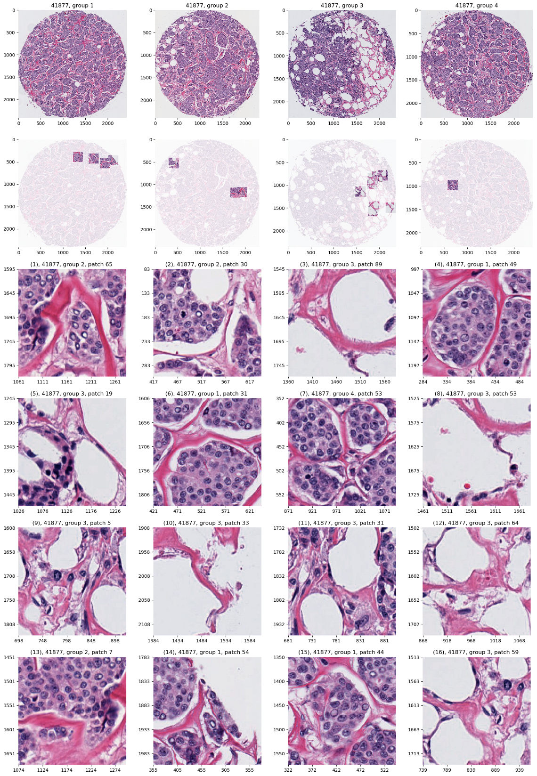
AJIVE Analysis of Cancer Data
JIVE: Common Normalized Scores 1
Look at Extremes
Positive, Top
Top 16 Patches
Lower Nuclear Grade
Stroma, Sclerosis

Slide 25
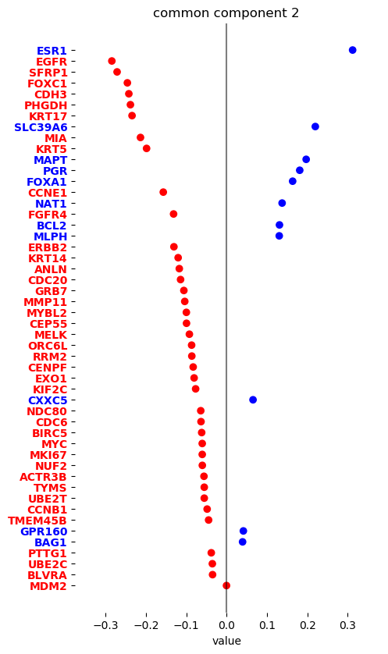
AJIVE Analysis of Cancer Data
JIVE: Gene Expression
Common Normalized
Loadings 2
Very Consistent w/ Image
Luminal Subtype Genes
Basal Subtype Genes

Slide 26
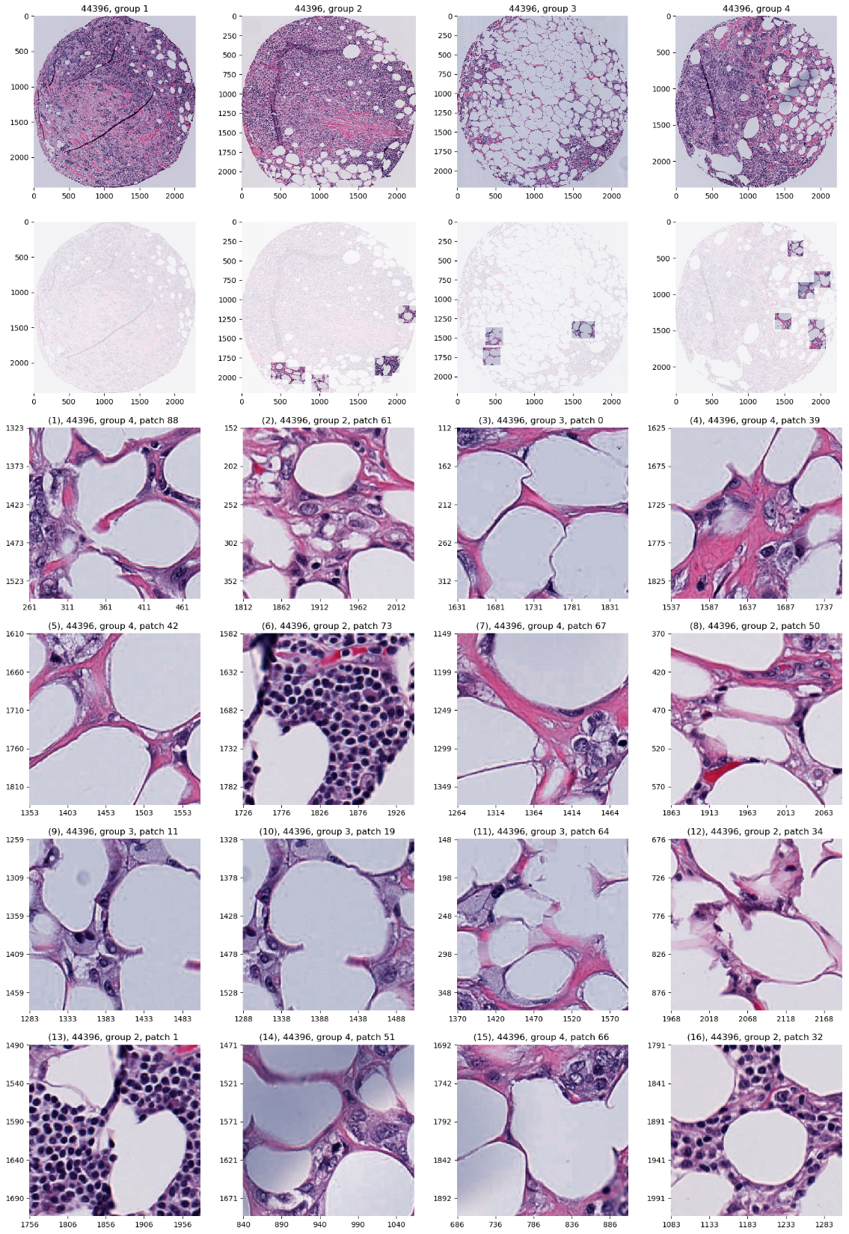
AJIVE Analysis of Cancer Data
JIVE, Images, Individual 1
Negative
Mostly Fat Cells
Few Nuclei

Slide 27
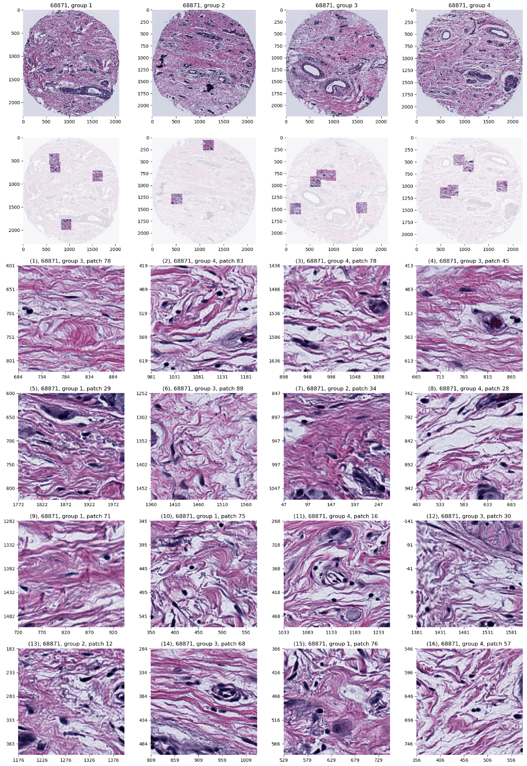
AJIVE Analysis of Cancer Data
JIVE, Images, Individual 1
Positive
Reactive Stroma,
Few Nuclei
Little Gene Connected

Slide 28
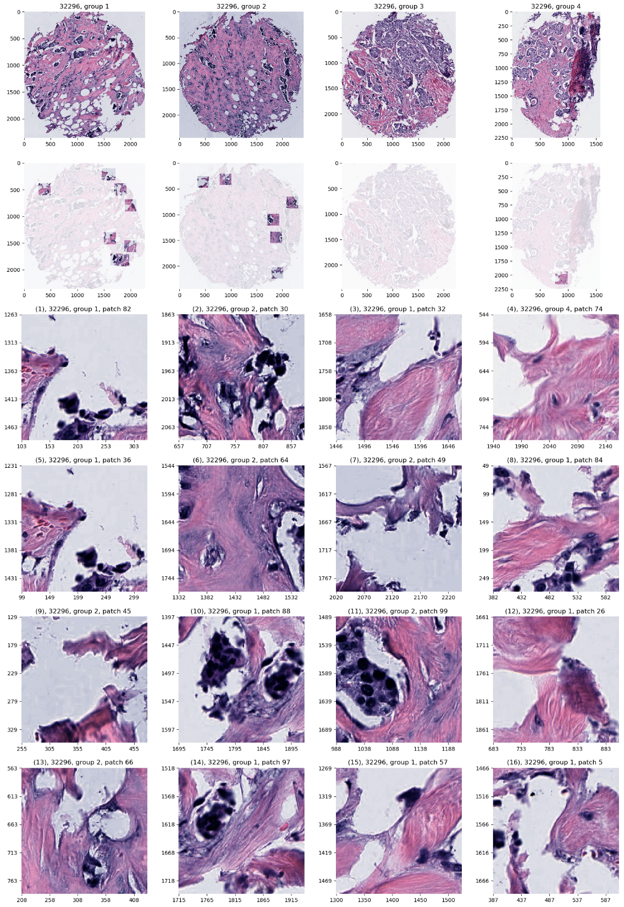
AJIVE Analysis of Cancer Data
JIVE, Images, Individual 2
Negative
Mucinous & Micro-
Papillary Carcinoma
Not PAM50 Related

Slide 29
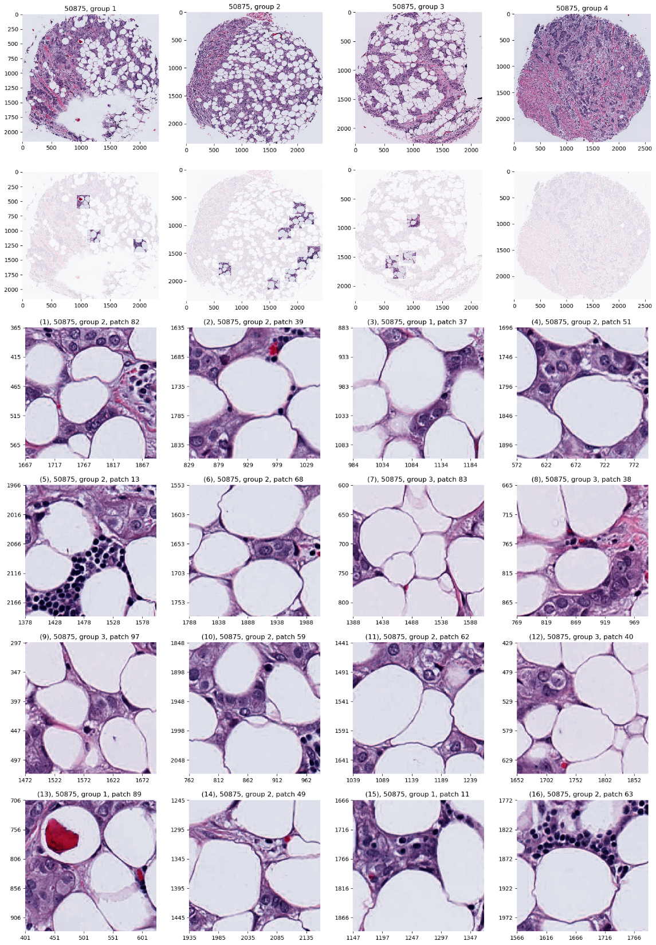
AJIVE Analysis of Cancer Data
JIVE, Images, Individual 2
Positive
Fat Cells
Common Endpoint?
“Center”?

Slide 30
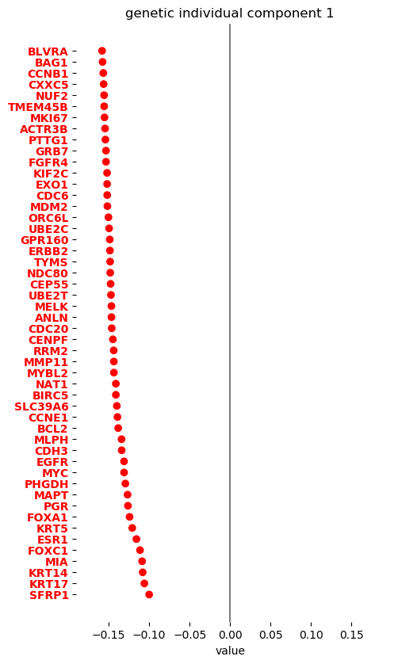
AJIVE Analysis of Cancer Data
JIVE, Genes, Individual 1
Overall Up & Down
Together
Flat Mode of Variation
Not Subtype Related!

Slide 31
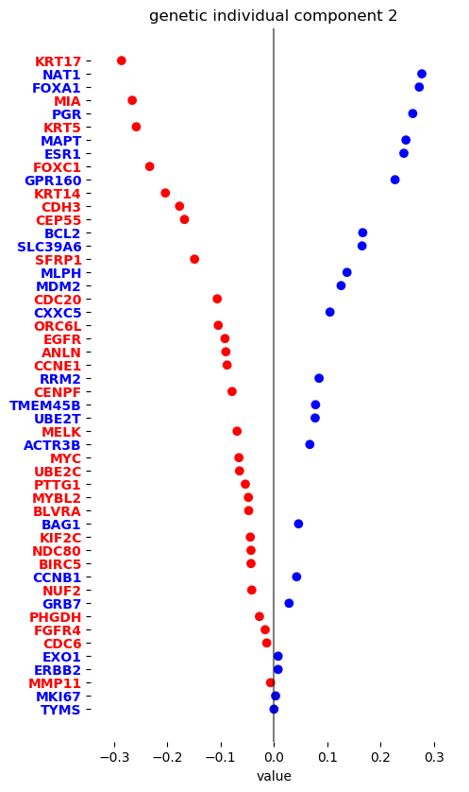
AJIVE Analysis of Cancer Data
JIVE, Genes, Individual 1
Basals vs. Luminal
Genomic Mode Not
Visible in Images

Slide 32
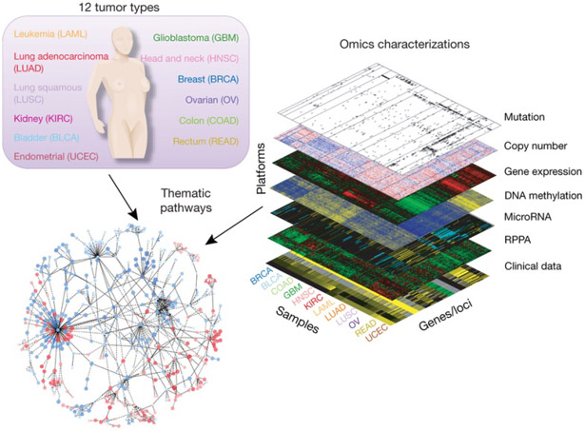
Cancer Genomics by AJIVE
Recall:
The Cancer
Genome Atlas
Subset Here:
Breast Cancer
Figure : The Cancer Genome Atlas Research Network, Weinstein, J.N., Collisson, E.A., Mills, G.B., Shaw, K.M., Ozenberger, B.A., Ellrott, K., Shmulevich, I., Sander, C., and Stuart, J.M. (2013)
The Cancer Genome Atlas Pan-Cancer analysis project.

Slide 33
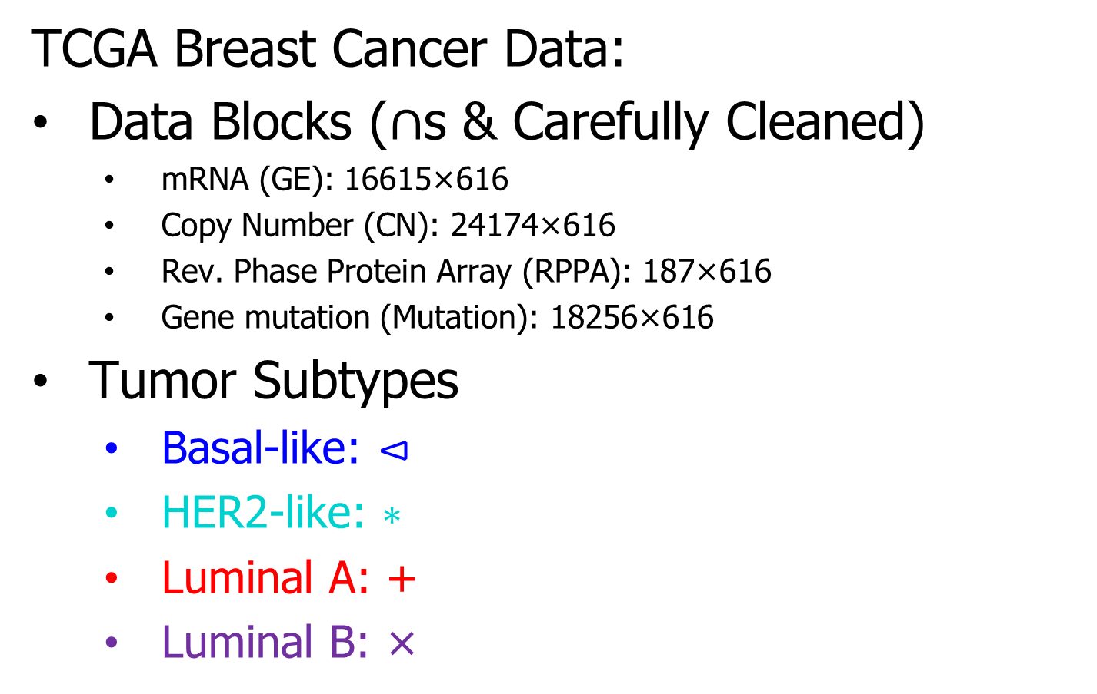
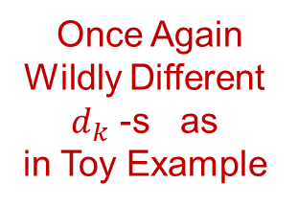
Cancer Genomics by AJIVE
TCGA Breast Cancer Data:
Data Blocks ($∩$s & Carefully Cleaned)
mRNA (GE): 16615×616
Copy Number (CN): 24174×616
Rev. Phase Protein Array (RPPA): 187×616
Gene mutation (Mutation): 18256×616
Tumor Subtypes
Basal-like: ⊲
HER2-like: ∗
Luminal A: +
Luminal B: ×
Once Again
Wildly Different
$d_{k}$ -s as
in Toy Example
Apologies for Non-Standard Colors

Slide 34
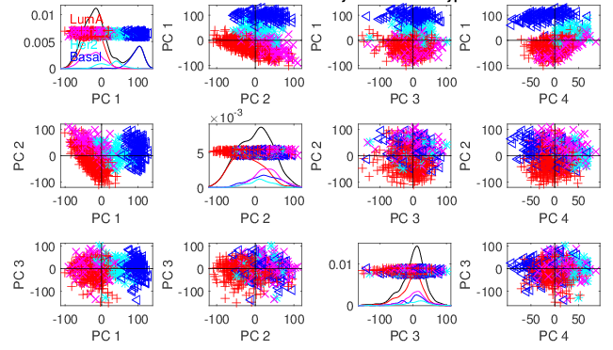
Cancer Genomics by AJIVE
Separate PCA on Gene Expression (GE)
Clear
Subtype
Effects
(Not
Surprising)

Slide 35
Cancer Genomics by AJIVE
Separate PCA on Gene Expression (GE)
PC1 Flags
Basals
PC2 Flags
LumAs

Slide 36
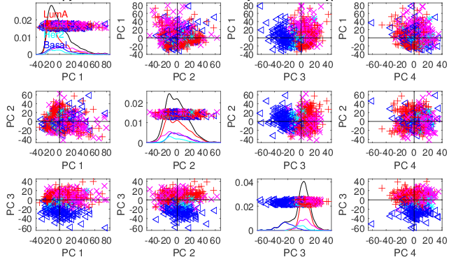
Cancer Genomics by AJIVE
Separate PCA on Copy Number (CN)
Other
Effects
+Subtypes

Slide 37
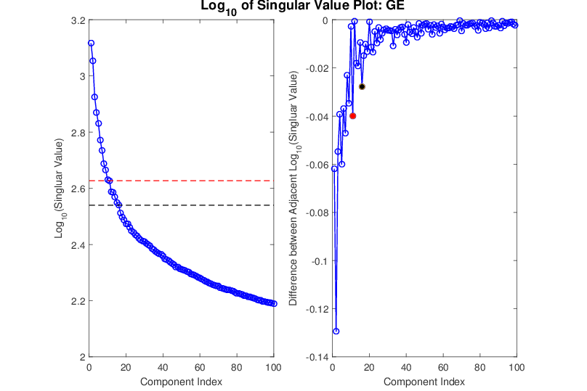
Cancer Genomics by AJIVE
Gene Expression (GE) 1st SVD Threshold
Suggested Ranks： 11 / 16
Log(Consecutive Differences)

Slide 38
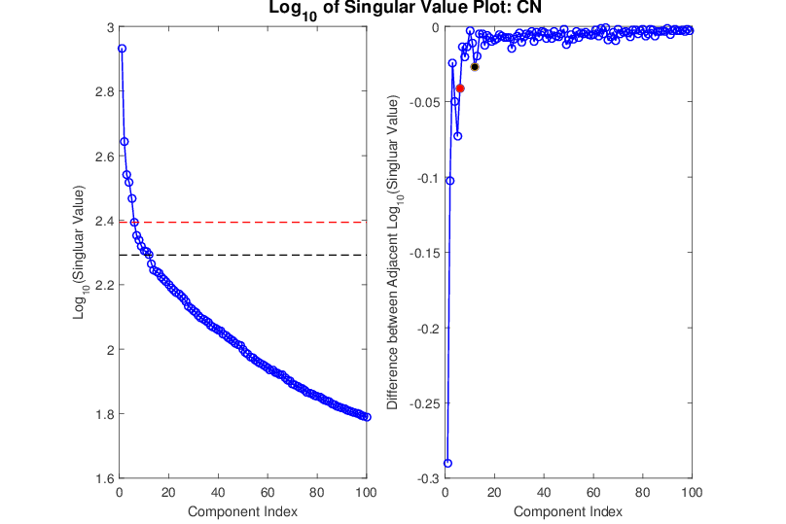
Cancer Genomics by AJIVE
Copy Number (CN) 1st SVD Threshold
Suggested Ranks： 6 / 12

Slide 39
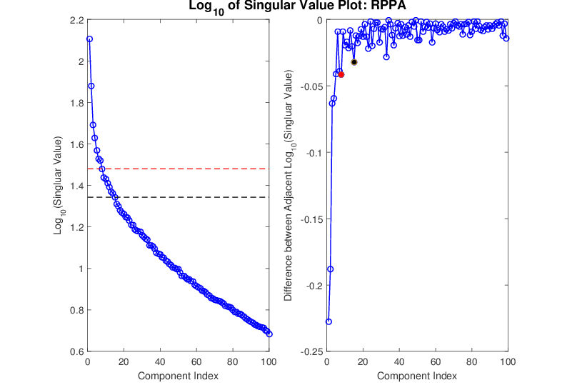
Cancer Genomics by AJIVE
Proteins (RPPA) 1st SVD Threshold
Suggested Ranks： 8 / 15

Slide 40
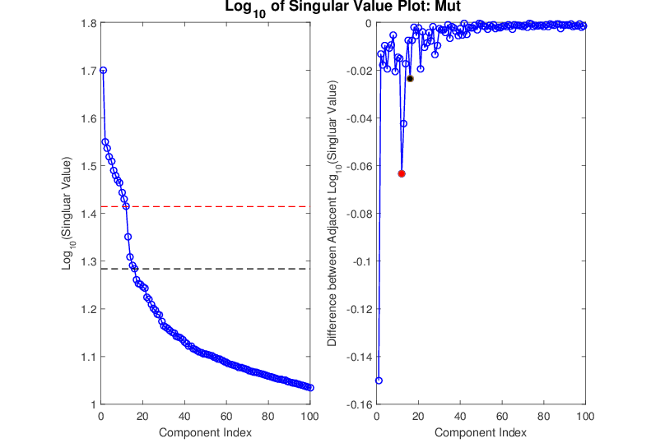
Cancer Genomics by AJIVE
Mutations (Mut) 1st SVD Threshold
Suggested Ranks： 12 / 16

Slide 41
Cancer Genomics by AJIVE
4-way Joint Threshold
After Step 3:
Only 1 Remaining Joint Component
(2nd Strong in all but Mut.)
(Fits w/ Biologist’s Impression of Mut. Data)

Slide 42
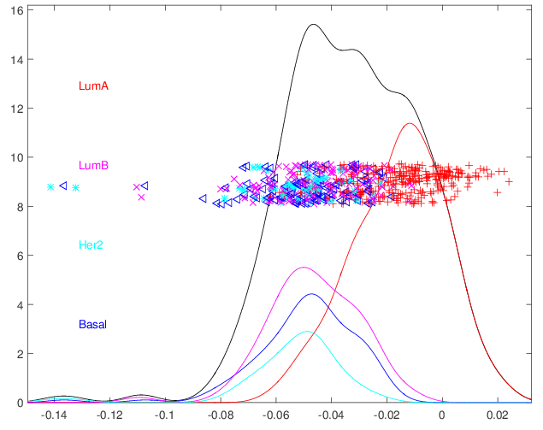
Cancer Genomics by AJIVE
In Contrast to PC1
Which Separated Basals
4-way Joint Scores (CNS)
Flags LumAs
Effect Driven
By All 4
Factors
Together
Interesting Point: Mutation Plays Role Here

Slide 43
Cancer Genomics by AJIVE
Next Issue: 3-way JIVE for GE-CN-RPPA
Approach: Use 3 Indiv. Blocks from above,
GE, CN, RPPA as inputs
Perform JIVE, Study Joint PC1
Something of a Kludge
Better Approach: DIVAS

Slide 44
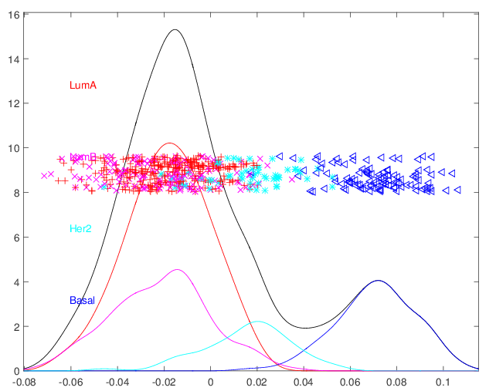
Cancer Genomics by AJIVE
Joint JIVE1 Scores for GE-CN-RPPA (CNS)
Great Separation
of Basals
Some Separation
of Her2s
LumAs & LumBs
Combined
All More Distinct
Than Raw Data

Slide 45
Cancer Genomics by AJIVE
Now Focus on Pair-Wise Comparisons:
JIVE on GE – CN only
Hypothesis Test of Basals vs. Others
(DiProPerm Z-scores Allow Quantitation)

Slide 46
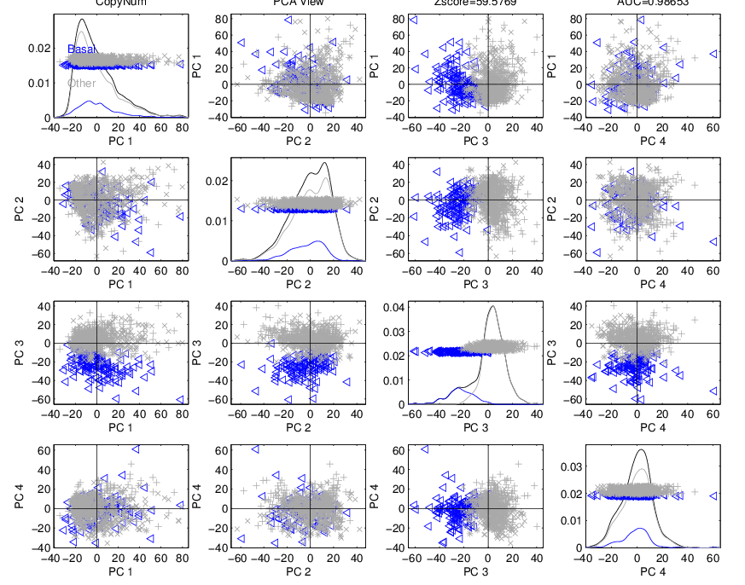
Cancer Genomics by AJIVE
JIVE on GE – CN, Test of Basals vs. Others
(SEPARATE!)
CN - PCA
View
Group
Coloring

Slide 47
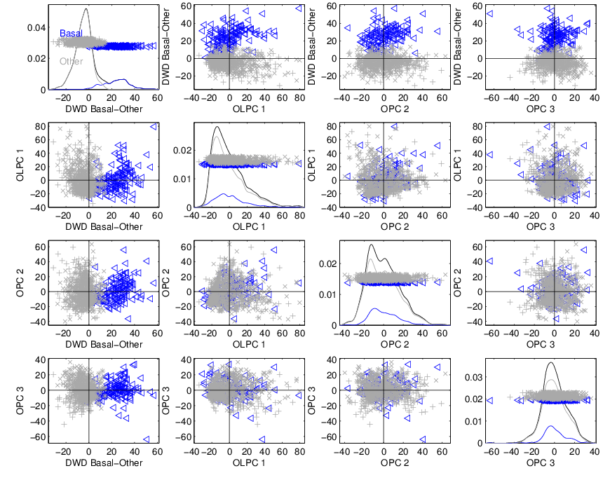
Cancer Genomics by AJIVE
JIVE on GE – CN, Test of Basals vs. Others
Rotate CN Data
Get Better
Separation
From DWD
& Ortho PC
Directions
How Separated???

Slide 48
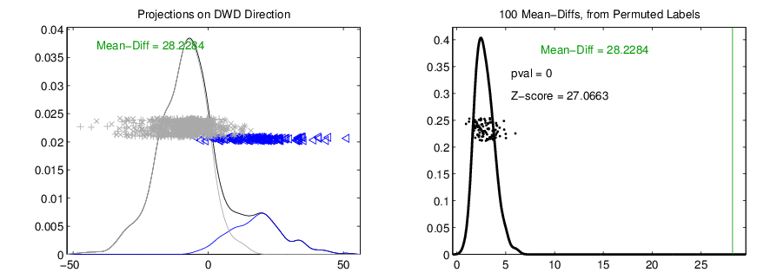
Cancer Genomics by AJIVE
JIVE on GE – CN, Test of Basals vs. Others
DiProPerm Hypothesis Test
Stat. Sig. ~ Z-score
Recall For
Separate CN

Slide 49
Cancer Genomics by AJIVE
JIVE on GE – CN, Test of Basals vs. Others
Summarize Z-scores
Separate PCA:
GE >> CN
(Not
Surprising)

Slide 50
Cancer Genomics by AJIVE
JIVE on GE – CN, Test of Basals vs. Others
Summarize Z-scores
Joint JIVE
>> Separate
JIVE Data
Combo Helps!

Slide 51
Cancer Genomics by AJIVE
JIVE on GE – CN, Test of Basals vs. Others
Summarize Z-scores
GE has info
Not in CN
But not CN

Slide 52
Early Single Cell RNAseq
Powerful Expression Technology
RNAseq for Separate Cells
Original Data: Grün et al (2014)
Challenge: Random RNA Amplification
Control: Spike In Measurements
scPLS Approach: Chen and Zhou (2016)

Slide 53
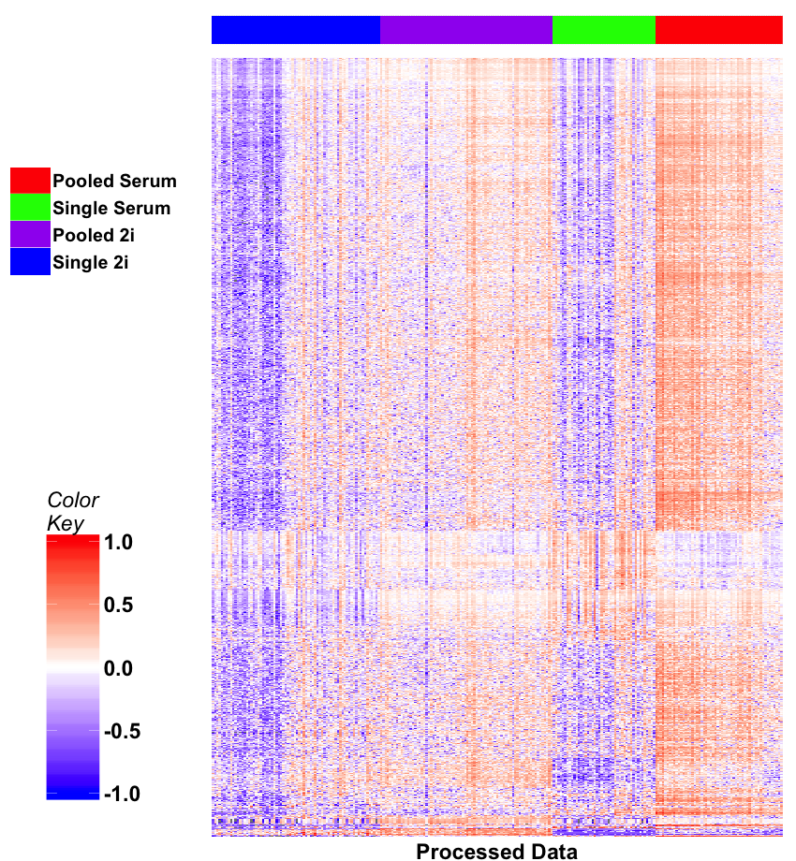
Early Single Cell RNAseq
Input Data
Clear Artifacts
Desired Groups

Slide 54
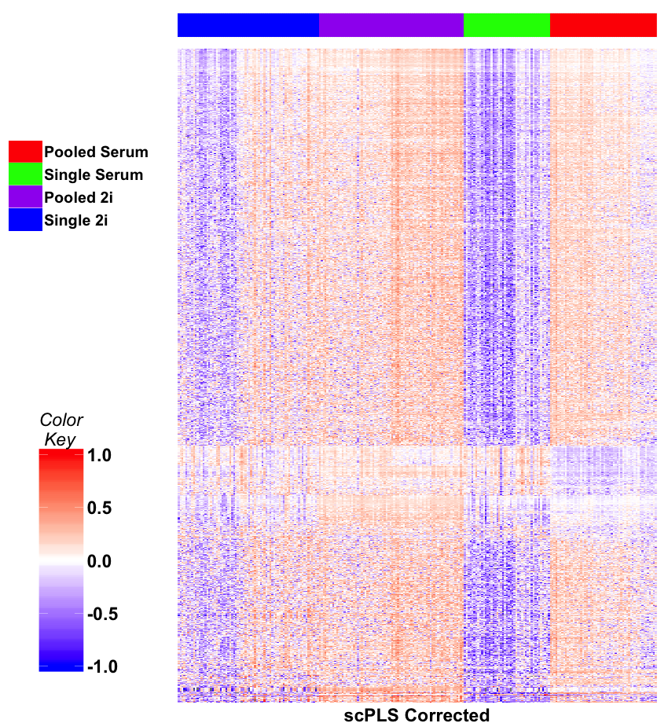
Early Single Cell RNAseq
scPLS
Some
Improvement
Desired Groups

Slide 55
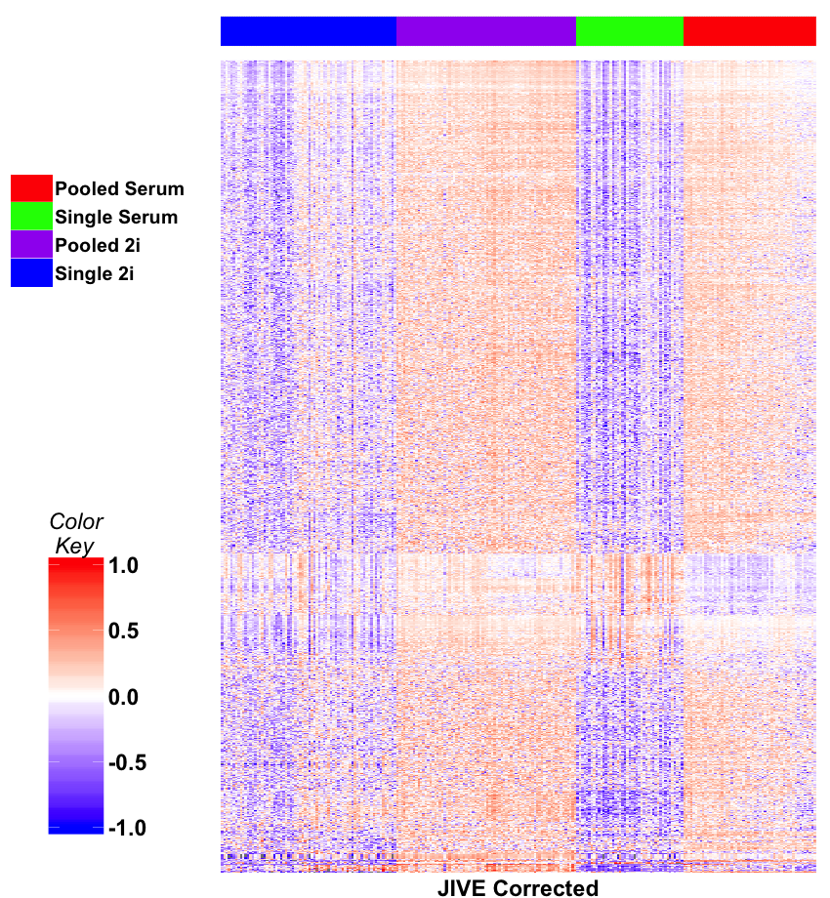
Early Single Cell RNAseq
JIVE Individual
Much Better
Desired Groups

Slide 56
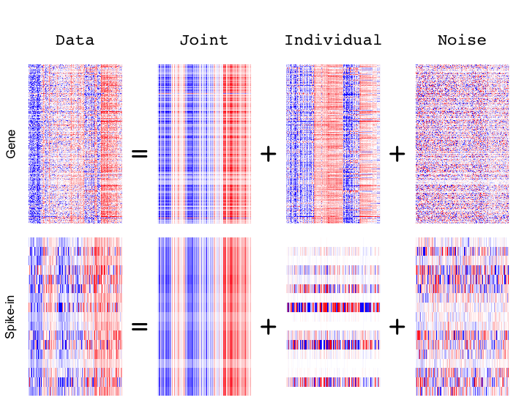
Early Single Cell RNAseq
Detail
View
of
JIVE
Analysis
Final Result
Ignore as Nuisance Variation

Slide 57





DIVAS
Data Integration Via Analysis of Subspaces (DIVAS)
Prothero, et al. (2024)
Jack Prothero
Meilei Jiang
Andy Ackerman
Quoc Tranh-Dinh
Jan Hannig

Slide 58
DIVAS
Improvements Over AJIVE:
3 Block JIVE Analysis
≈ +

Slide 59
DIVAS
Improvements Over AJIVE:
Partially Shared Blocks in DIVAS Analysis
≈ + + + +

Slide 60
DIVAS
Improvements Over AJIVE:
Partially Shared Blocks
Improved Initial Rank Choice
Inference Via Random Direction Bounds
Iterative Search Algorithm
Gives Better and More Precise Inference

Slide 61
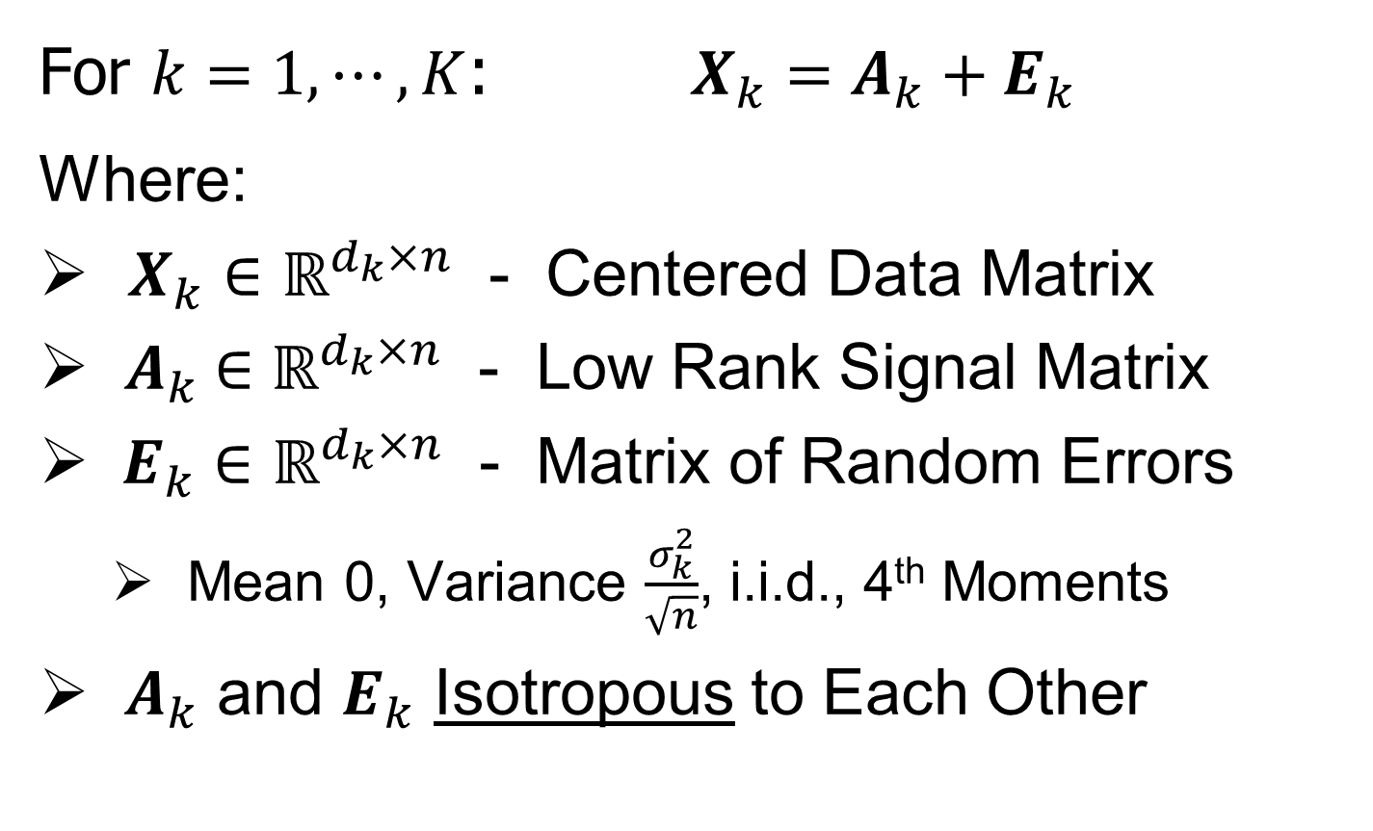
DIVAS Data Model
For $k=1,⋯,K$: $X_{k}=A_{k}+E_{k}$
Where:
$X_{k}∈ℝ^{d_{k}×n}$ - Centered Data Matrix
${ A}_{k} ∈ℝ^{d_{k}×n}$ - Low Rank Signal Matrix
$E_{k}∈ℝ^{d_{k}×n}$ - Matrix of Random Errors
Mean 0, Variance $\frac{σ_{k}^{2}}{\sqrt{n}}$, i.i.d., 4th Moments
${ A}_{k}$ and $E_{k}$ Isotropous to Each Other
Roughly: $E_{k}$ has Rotationally Invariant Variances, e.g. $N\left(0,σ_{k}^{2}I\right)$

Slide 62
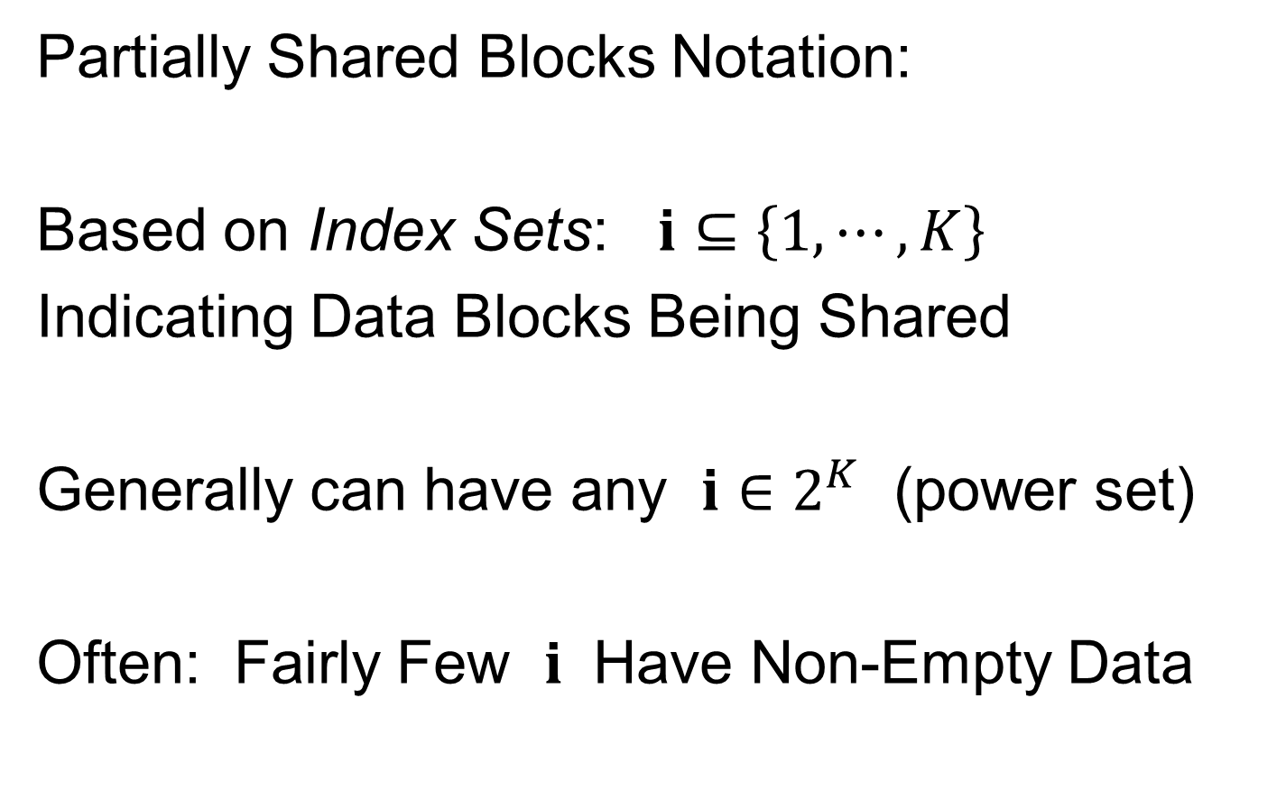

DIVAS Data Model
Partially Shared Blocks Notation:
Based on Index Sets: $i⊆\left\{1,⋯,K\right\}$
Indicating Data Blocks Being Shared
Generally can have any $i∈2^{K}$ (power set)
Often: Fairly Few $i$ Have Non-Empty Data
(Mode of Variation Types Appearing)
Shorthand for $2^{\left\{1,⋯.K\right\}}$
(Set of All Subsets)

Slide 63


DIVAS Data Model
Signal Matrix Notation, for $k=1,⋯,K$:
$A_{k}=\sum_{i|k∈i}{L_{i,k}V_{i}^{t}}$
$$k$$

