Slide 1
Statistics – O. R. 881 Object Oriented Data Analysis
Steve Marron
Dept. of Statistics and Operations Research
University of North Carolina

Slide 2
Current Sections in Textbook
Today:
Sections 17.2
Next Class:
Sections 7.1, 7.2, 1.2, 5.2, 8.4

Slide 3
Last Class: AJIVE Cancer Data
Analysis Goal:
Understand How Images & Genomics
Work Together
Work Separately
Approach: AJIVE
Clinical Diagnostic Standard
Deep Insight &
New Treatments
As of Jan. 2020: ~70
Drugs Approved for
Breast Cancer Therapy

Slide 4
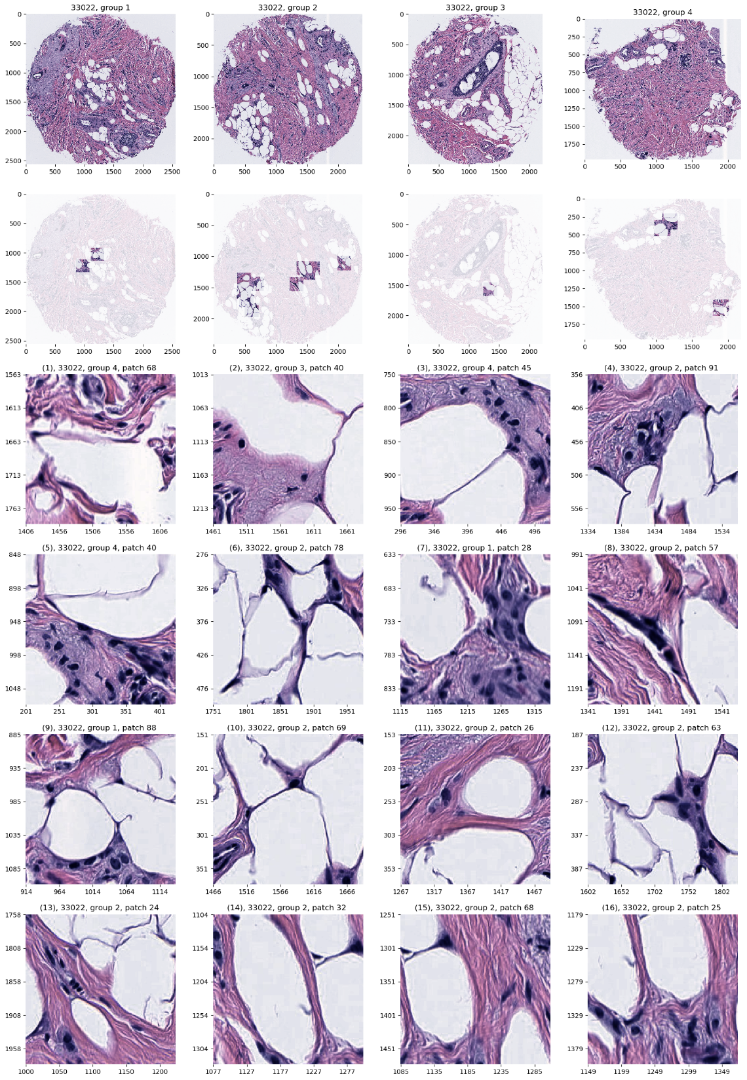
Last Class: AJIVE Cancer Data
JIVE: Common Normalized Scores 1
Look at Extremes
Negative End
Top Person
Top 16 Patches
Fat Cells & Stroma

Slide 5
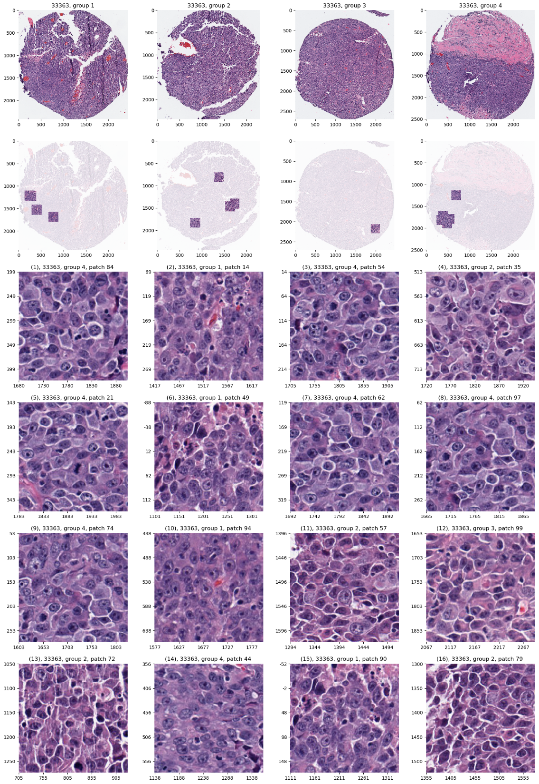
Last Class: AJIVE Cancer Data
JIVE: Common Normalized Scores 1
Look at Extremes
Positive End
Top Person
Top 16 Patches
Highly “Cellular”
Markedly Atypical Cells

Slide 6
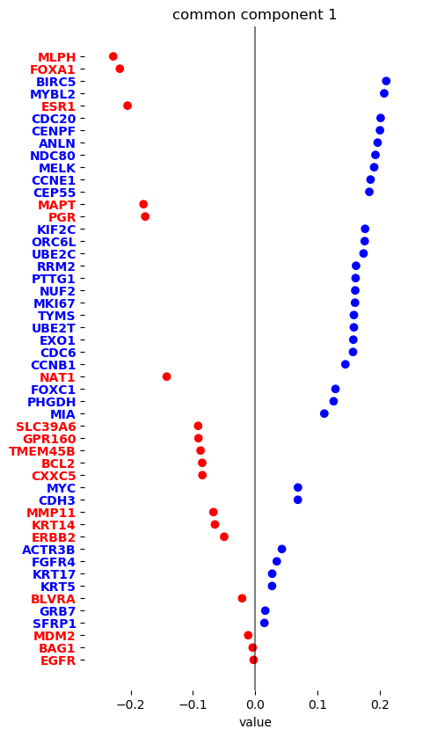
Last Class: AJIVE Cancer Data
JIVE: Gene Expression
Common Normalized
Loadings 1
Very Consistent w/ Image
“High Proliferation” Genes
“Low Prolif.” – Lum A Genes

Slide 7
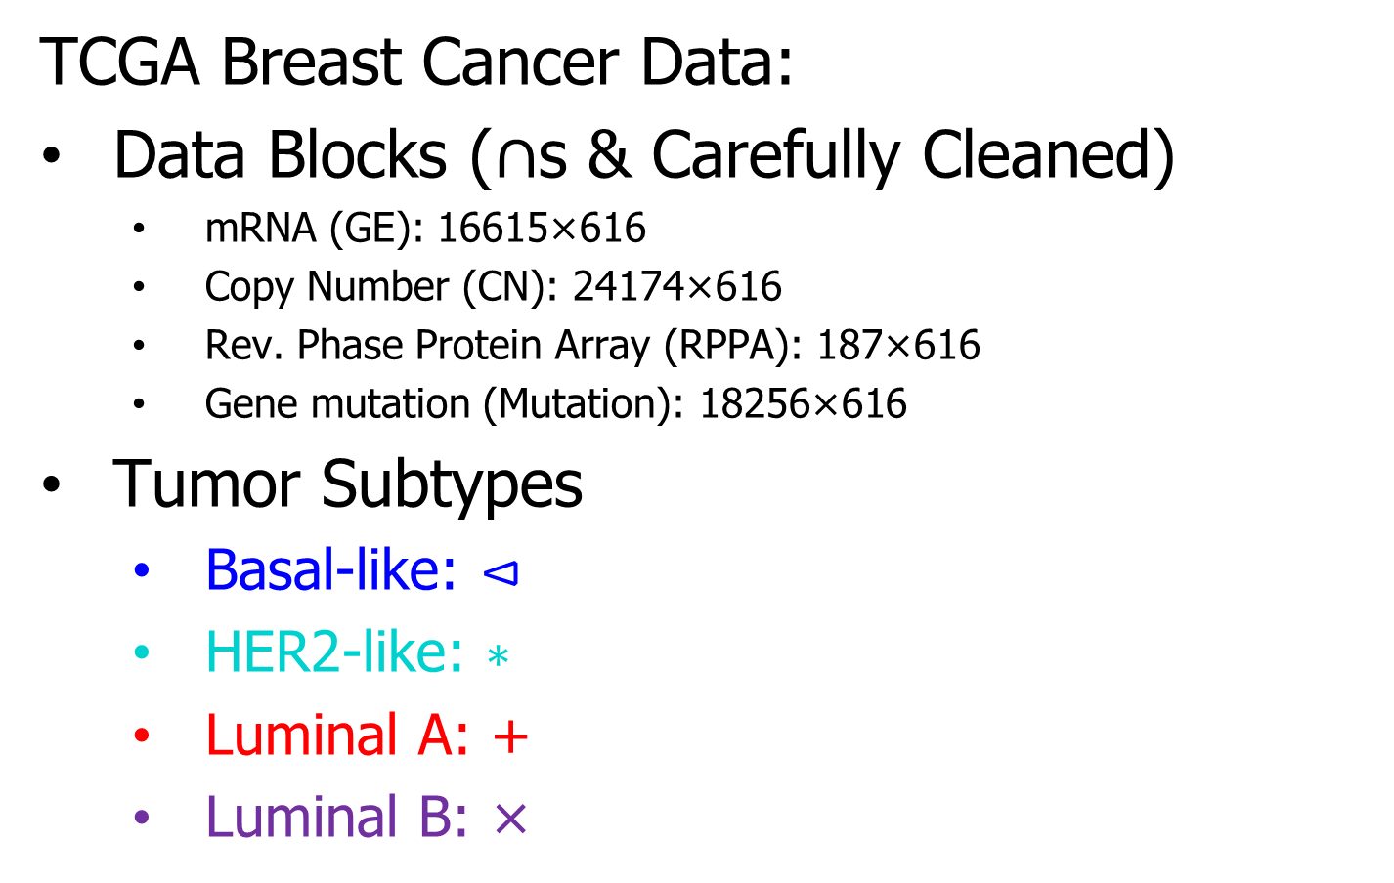
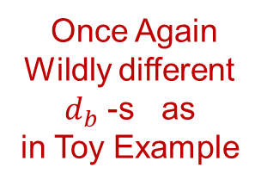
Last Class: Genomics by AJIVE
TCGA Breast Cancer Data:
Data Blocks ($∩$s & Carefully Cleaned)
mRNA (GE): 16615×616
Copy Number (CN): 24174×616
Rev. Phase Protein Array (RPPA): 187×616
Gene mutation (Mutation): 18256×616
Tumor Subtypes
Basal-like: ⊲
HER2-like: ∗
Luminal A: +
Luminal B: ×
Once Again
Wildly different
$d_{b}$ -s as
in Toy Example

Slide 8
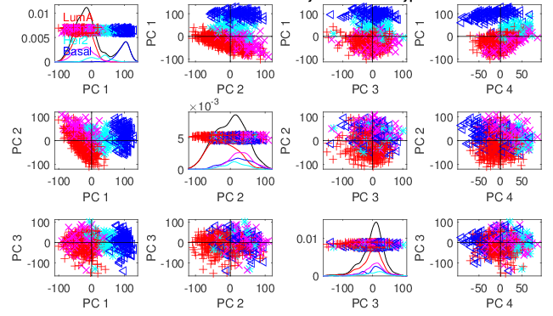
Last Class: Genomics by AJIVE
Separate PCA on Gene Expression (GE)
PC1 Flags
Basals
PC2 Flags
LumAs

Slide 9
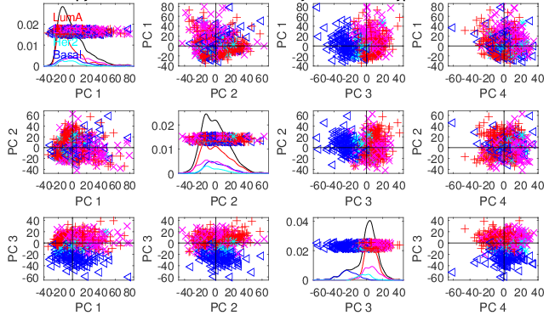
Last Class: Genomics by AJIVE
Separate PCA on Copy Number (CN)
Other
Effects
+Subtypes

Slide 10
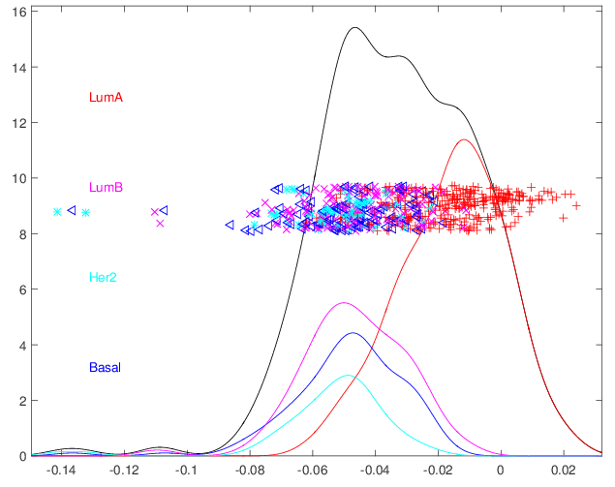
Last Class: Genomics by AJIVE
4-way Joint Scores (CNS)
Flags LumAs
Effect Driven
By All 4
Factors
Together
Interesting Point: Mutation Plays Role Here

Slide 11
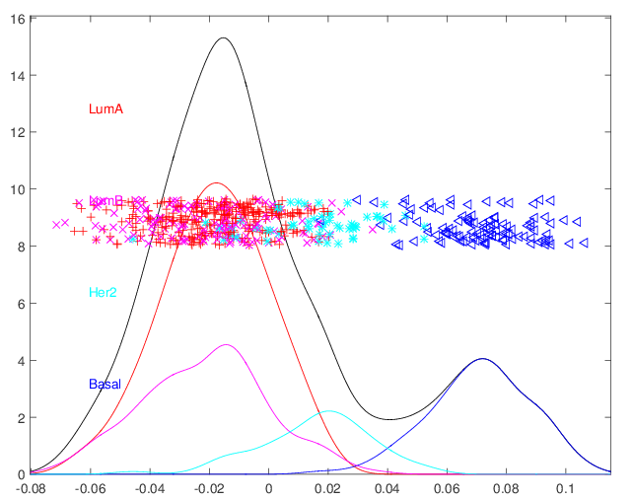
Last Class: Genomics by AJIVE
Joint JIVE PC1 for GE-CN-RPPA (CNS)
Great Separation
of Basals
Some Separation
of Her2s
LumAs & LumBs
Combined
All More Distinct
Than Raw Data

Slide 12
Last Class: Genomics by AJIVE
JIVE on GE – CN, Test of Basals vs. Others
Summarize Z-scores
Joint JIVE
>> Separate
JIVE Data
Combo Helps!

Slide 13
Last Class: Genomics by AJIVE
JIVE on GE – CN, Test of Basals vs. Others
Summarize Z-scores
GE has info
Not in CN
But not CN

Slide 14
Last Class: DIVAS
Improvements Over AJIVE:
3 Block JIVE Analysis
≈ +

Slide 15
Last Class: DIVAS
Improvements Over AJIVE:
Partially Shared Blocks in DIVAS Analysis
≈ + + + +

Slide 16
Last Class: DIVAS
Improvements Over AJIVE:
Partially Shared Blocks
Improved Initial Rank Choice
Inference Via Random Direction Bounds
Iterative Search Algorithm
Give Better and More Precise Inference

Slide 17
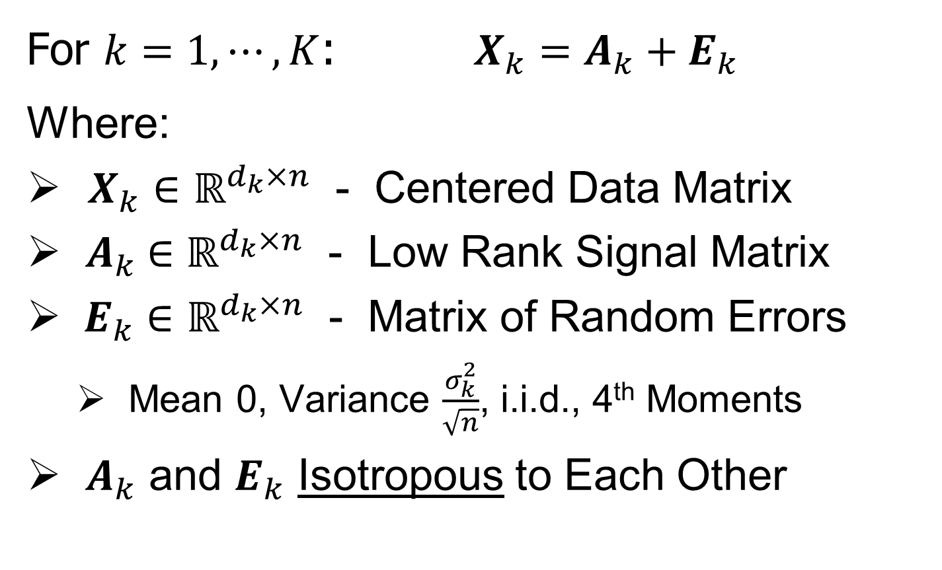
Last Class: DIVAS Data Model
For $k=1,⋯,K$: $X_{k}=A_{k}+E_{k}$
Where:
$X_{k}∈ℝ^{d_{k}×n}$ - Centered Data Matrix
${ A}_{k} ∈ℝ^{d_{k}×n}$ - Low Rank Signal Matrix
$E_{k}∈ℝ^{d_{k}×n}$ - Matrix of Random Errors
Mean 0, Variance $\frac{σ_{k}^{2}}{\sqrt{n}}$, i.i.d., 4th Moments
${ A}_{k}$ and $E_{k}$ Isotropous to Each Other
Roughly: $E_{k}$ has Rotationally Invariant Variances, e.g. $N\left(0,σ_{k}^{2}I\right)$

Slide 18
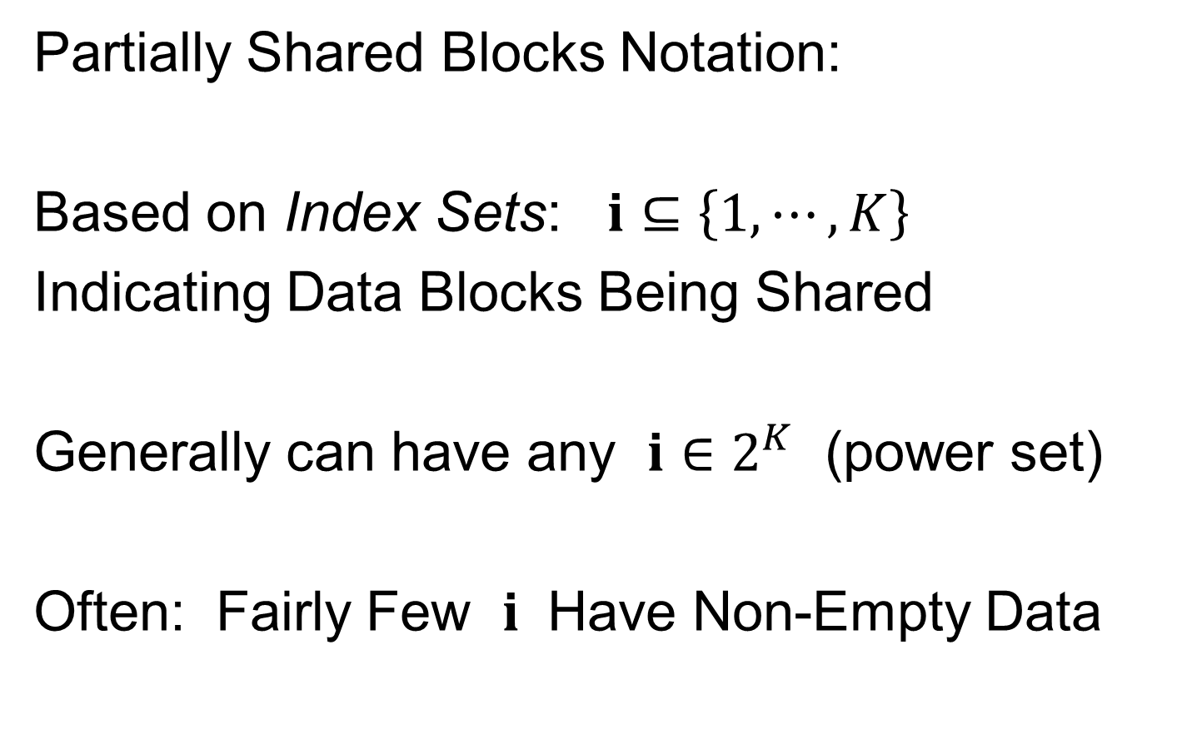

Last Class: DIVAS Data Model
Partially Shared Blocks Notation:
Based on Index Sets: $i⊆\left\{1,⋯,K\right\}$
Indicating Data Blocks Being Shared
Generally can have any $i∈2^{K}$ (power set)
Often: Fairly Few $i$ Have Non-Empty Data
(Mode of Variation Types Appearing)
Shorthand for $2^{\left\{1,⋯.K\right\}}$
(Set of All Subsets)

Slide 19

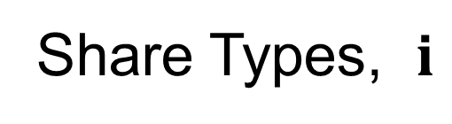

Last Class: DIVAS Data Model
Signal Matrix Notation, for $k=1,⋯,K$:
$A_{k}=\sum_{i|k∈i}{L_{i,k}V_{i}^{t}}$
Share Types, $i$
$$k$$

Slide 20
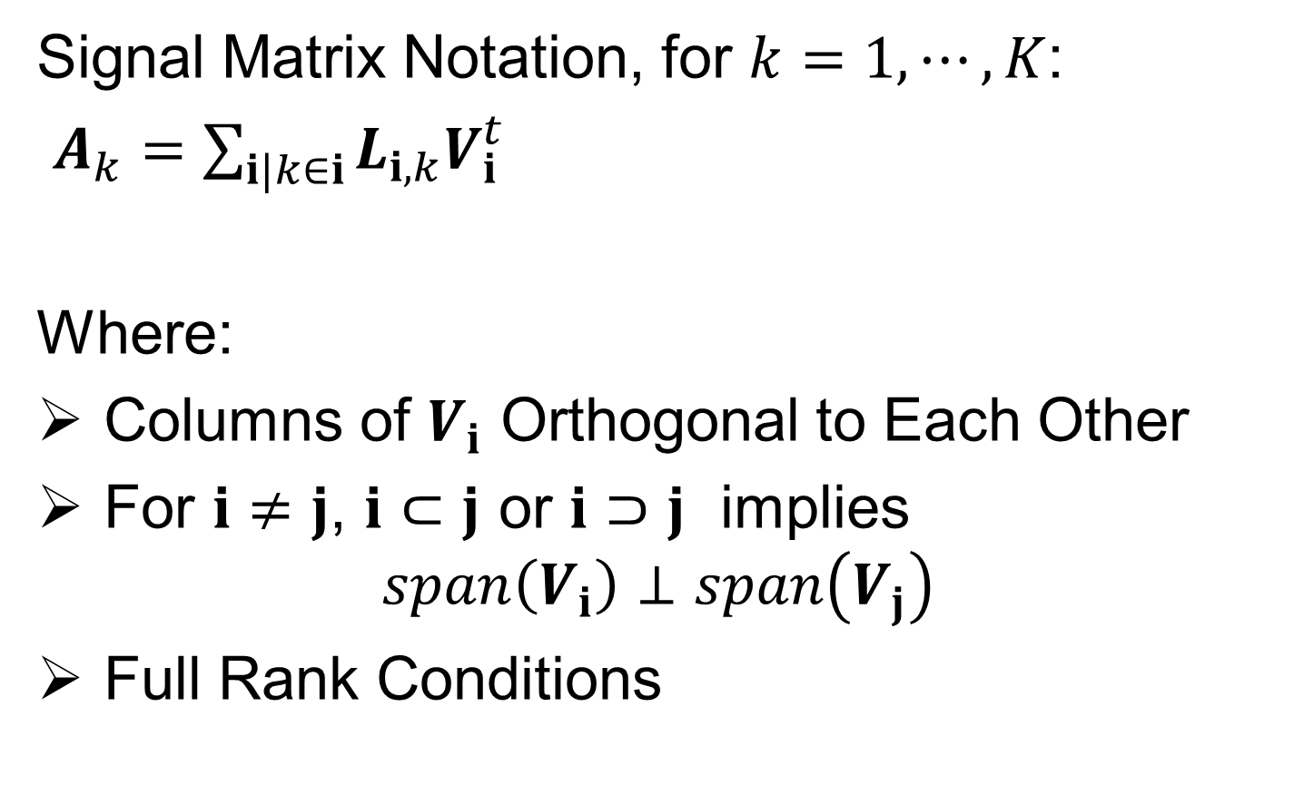
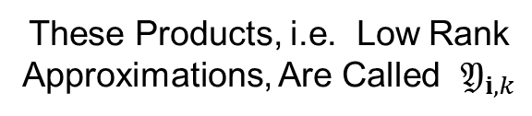
DIVAS Data Model
Signal Matrix Notation, for $k=1,⋯,K$:
$A_{k}=\sum_{i|k∈i}{L_{i,k}V_{i}^{t}}$
Where:
Columns of $V_{i}$ Orthogonal to Each Other
For $i≠j$, $i⊂j$ or $i⊃j$ implies
$$span\left(V_{i}\right)⊥span\left(V_{j}\right)$$
Full Rank Conditions
These Products, i.e. Low Rank
Approximations, Are Called $𝔜_{i,k}$
Loadings
Scores
Indexed Only by 𝐢

Slide 21
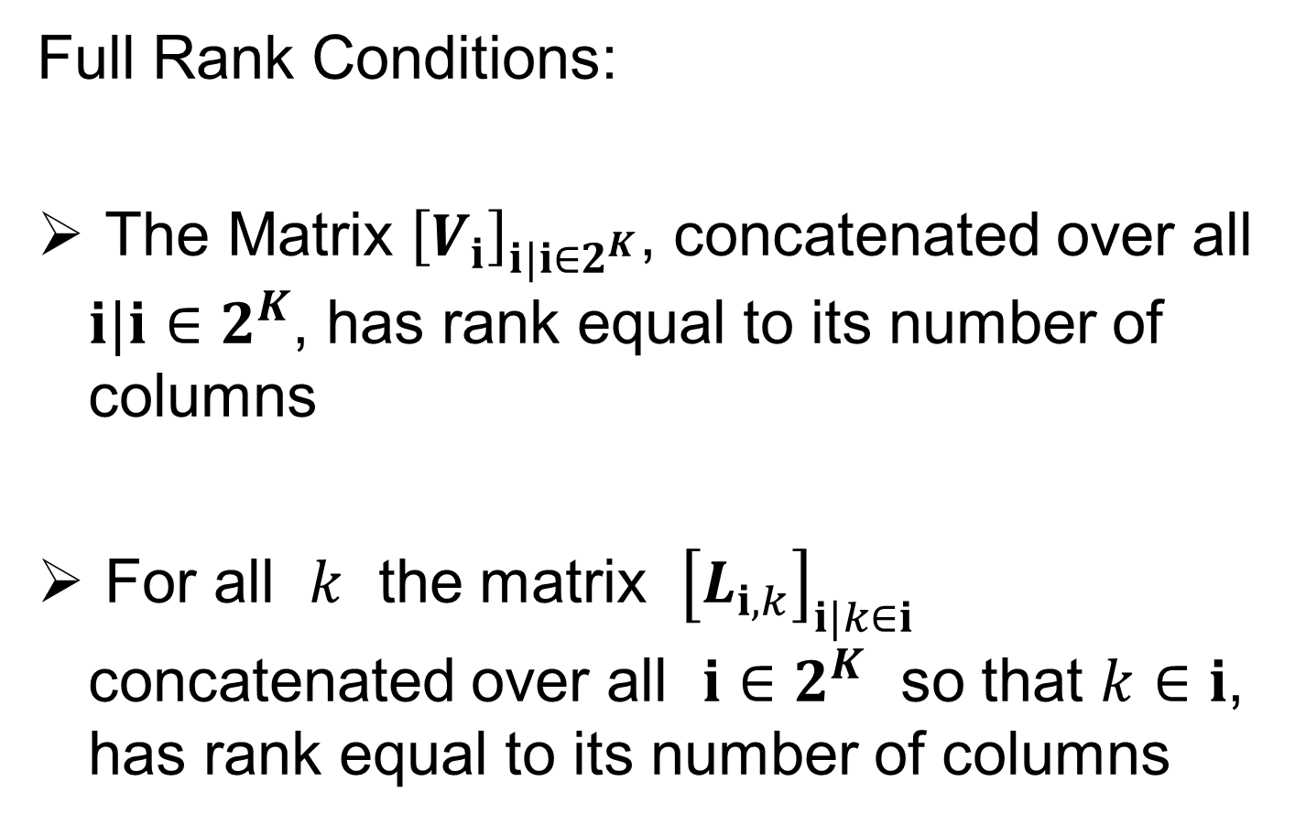
DIVAS Data Model
Full Rank Conditions:
The Matrix ${\left[V_{i}\right]}_{i|i∈2^{K}}$, concatenated over all $i|i∈2^{K}$, has rank equal to its number of columns
For all $k$ the matrix ${\left[L_{i,k}\right]}_{i|k∈i}$ concatenated over all $i∈2^{K}$ so that $k∈i$, has rank equal to its number of columns

Slide 22
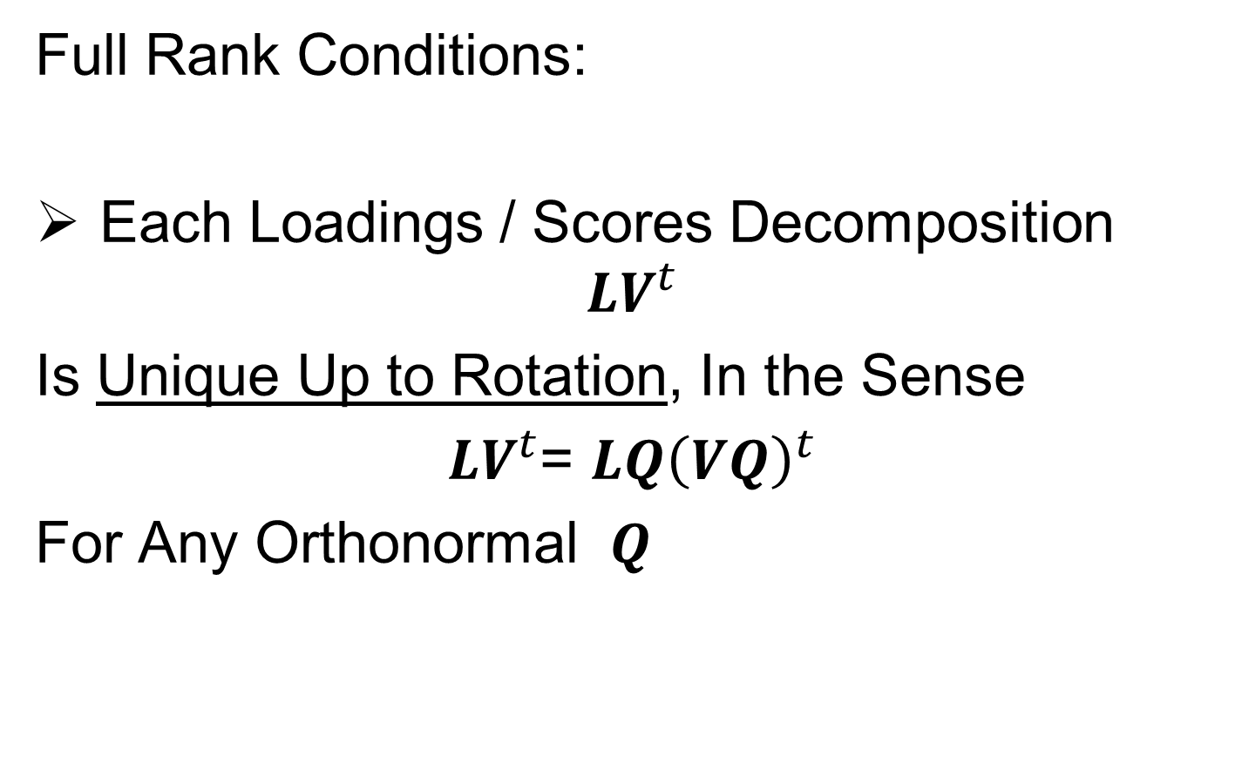
DIVAS Data Model
Full Rank Conditions:
Each Loadings / Scores Decomposition
$$LV^{t}$$
Is Unique Up to Rotation, In the Sense
$LV^{t}$= $L{Q\left(VQ\right)}^{t}$
For Any Orthonormal $Q$

Slide 23
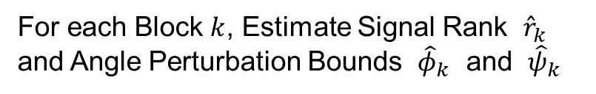

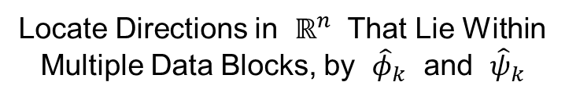
DIVAS Algorithm
Three Major Steps:
Signal Subspace Extraction
Joint Subspace Estimation
Signal Reconstruction
Something Like
Initial SVD in AJIVE,
But More Automatic
For each Block $k$, Estimate Signal Rank ${\hat{r}}_{k}$
and Angle Perturbation Bounds ${\hat{φ}}_{k}$ and ${\hat{ψ}}_{k}$
Locate Directions in $ℝ^{n}$ That Lie Within
Multiple Data Blocks, by ${\hat{φ}}_{k}$ and ${\hat{ψ}}_{k}$
In Spirit of Loadings
Projection in AJIVE
Reconstruct Partially Shared Joint
Components of $X_{k}$, Especially Loadings

Slide 24
DIVAS Algorithm
Three Major Steps:
Signal Subspace Extraction
Joint Subspace Estimation
Signal Reconstruction

Slide 25








1. Signal Subspace Extraction
SVD for each Block $k=1,⋯,K$:
$X_{k}≈\sum_{j=1}^{r_{k}}{u_{j}s_{j}{v_{j}}^{t}}=UDV^{t}$
Recall Matrix Representation:
Transpose of Trait
Space Basis Matrix
$$r_{k}$$
$$r_{k}$$
$$r_{k}$$
$$n$$
$$=$$
$$d_{k}$$
Object Space Basis Matrix
$$r_{k}$$

Slide 26
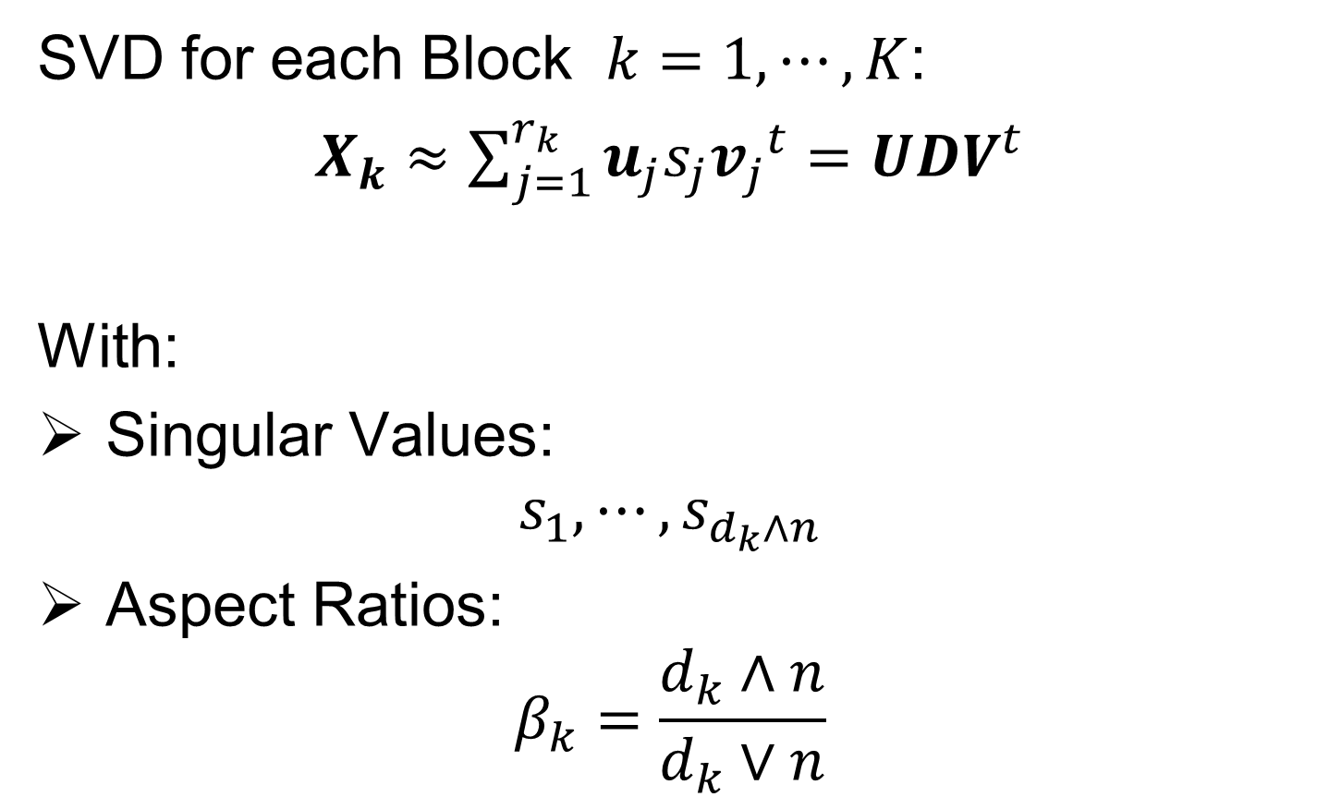
1. Signal Subspace Extraction
SVD for each Block $k=1,⋯,K$:
$X_{k}≈\sum_{j=1}^{r_{k}}{u_{j}s_{j}{v_{j}}^{t}}=UDV^{t}$
With:
Singular Values:
$$s_{1},⋯,s_{d_{k}∧n}$$
Aspect Ratios:
$$β_{k}=\frac{d_{k}∧n}{d_{k}∨n}$$
Will Study Later
Basic Marcenko-Pasteur
Parameter, 1 for Square

Slide 27
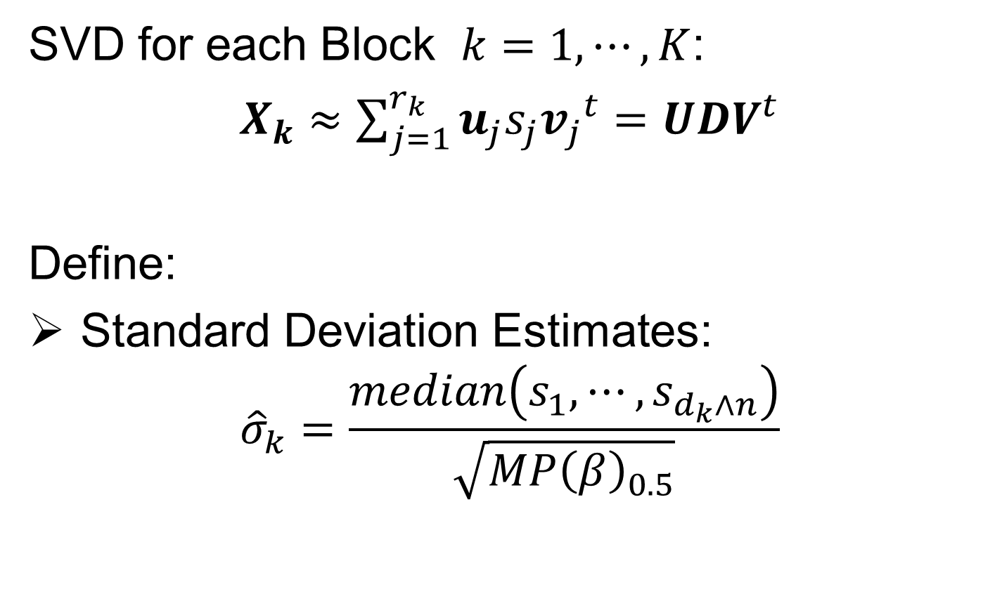
1. Signal Subspace Extraction
SVD for each Block $k=1,⋯,K$:
$X_{k}≈\sum_{j=1}^{r_{k}}{u_{j}s_{j}{v_{j}}^{t}}=UDV^{t}$
Define:
Standard Deviation Estimates:
$${\hat{σ}}_{k}=\frac{median\left(s_{1},⋯,s_{d_{k}∧n}\right)}{\sqrt{{MP\left(β\right)}_{0.5}}}$$
Low Rank Signal
Assumption Critical Here
Median of Marcenko-Pasteur Dist’n With Aspect Ratio $β$

Slide 28
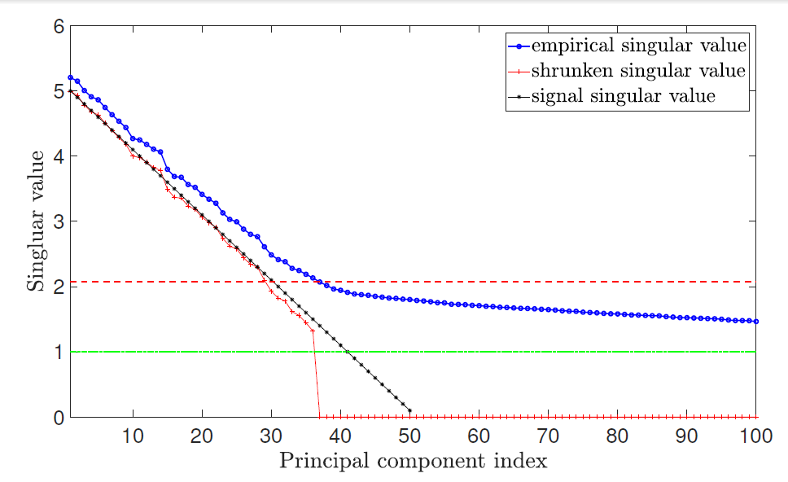
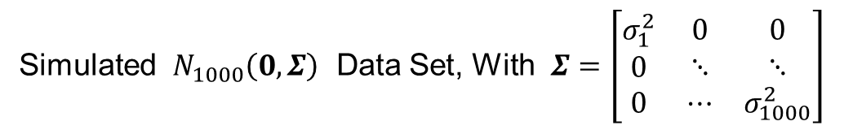
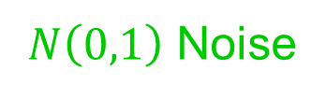


1. Signal Subspace Extraction
Simulated $N_{1000}\left(0,Σ\right)$ Data Set, With $Σ=\left[\begin{matrix}σ_{1}^{2} & 0 & 0 \\ 0 & ⋱ & ⋱ \\ 0 & ⋯ & σ_{1000}^{2}\end{matrix}\right]$
Improved (over AJIVE) Initial Rank Choice
Bigger since
= Signal + Noise
Similar to Scree Plot
(square root scale)
Underlying
Low Rank
Signal, $A_{b}$
Signal plus Gaussian
Noise, $d=1000$
$N\left(0,1\right)$ Noise
Impossible
To Recover

Slide 29

1. Signal Subspace Extraction
Simulated $N_{1000}\left(0,Σ\right)$ Data Set, With $Σ=\left[\begin{matrix}σ_{1}^{2} & 0 & 0 \\ 0 & ⋱ & ⋱ \\ 0 & ⋯ & σ_{1000}^{2}\end{matrix}\right]$
Improved (over AJIVE) Initial Rank Choice
Does Not Look Additive,
Since on Singular Value
(Not Energy) Scale
Similar to Scree Plot
(square root scale)
Signal plus Gaussian
Noise, $d=1000$
Bigger than $σ=1$, Since First $100$ In Sort

Slide 30

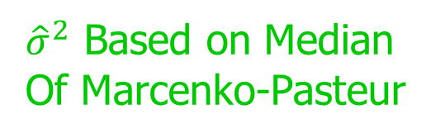
1. Signal Subspace Extraction
Simulated $N_{1000}\left(0,Σ\right)$ Data Set, With $Σ=\left[\begin{matrix}σ_{1}^{2} & 0 & 0 \\ 0 & ⋱ & ⋱ \\ 0 & ⋯ & σ_{1000}^{2}\end{matrix}\right]$
Improved (over AJIVE) Initial Rank Choice
Estimate Singular Values of Signal $A_{k}$
Appropriately
Shrinks Big Ones
Shabalin
Nobel (2013)
Shrinkage
Zeroes Out
Small Values
${\hat{σ}}^{2}$ Based on Median
Of Marcenko-Pasteur
Will Cover Soon

Slide 31
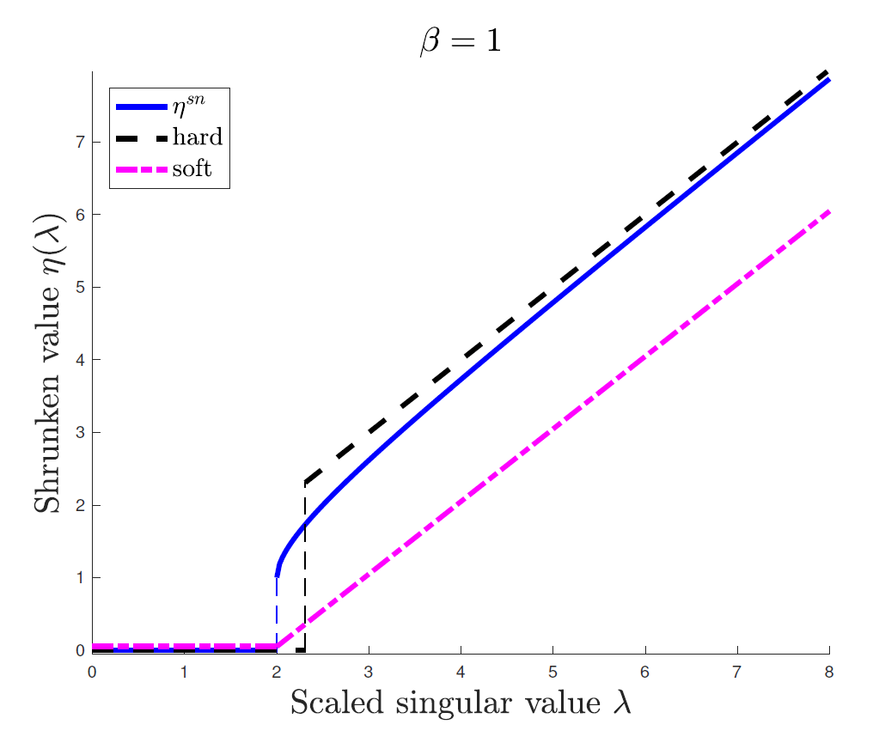
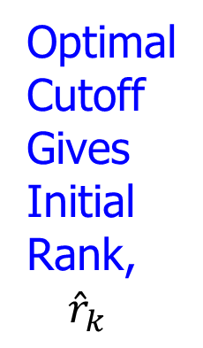
1. Signal Subspace Extraction
Shabalin Nobel Shrinkage (For Denoising)
Optimized
For
Marcenko
Pasteur
Optimal
Cutoff
Gives
Initial
Rank,
${\hat{r}}_{k}$
Vs. Trial & Error
And Crude
Bounds in AJIVE

Slide 32
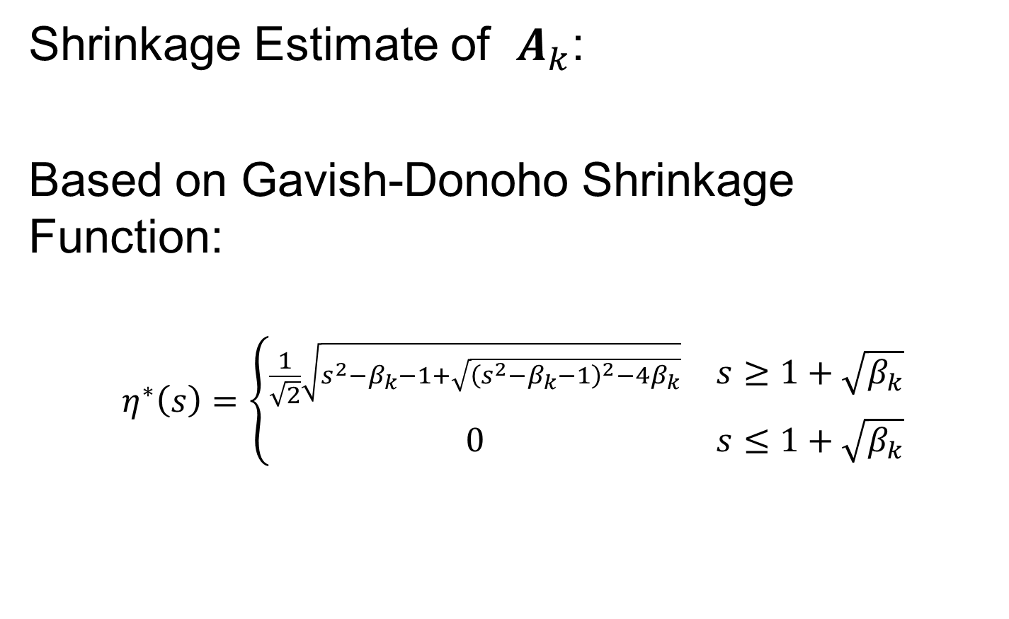
1. Signal Subspace Extraction
Shrinkage Estimate of $A_{k}$:
Based on Gavish-Donoho Shrinkage Function:
$$η^{∗}\left(s\right)=\left\{\begin{matrix}\frac{1}{\sqrt{2}}\sqrt{s^{2}−β_{k}−1+\sqrt{{\left(s^{2}−β_{k}−1\right)}^{2}−4β_{k}}} & s≥1+\sqrt{β_{k}} \\ 0 & s≤1+\sqrt{β_{k}}\end{matrix}\right.$$

Slide 33
1. Signal Subspace Extraction
Gavish-Donoho (2017) Shrinkage Function:
Large Ones “Shrunken”
Accounting for Noise
Small Singular
Values Set to 0
Optimal Choice for
Marcenko-Pasteur

Slide 34
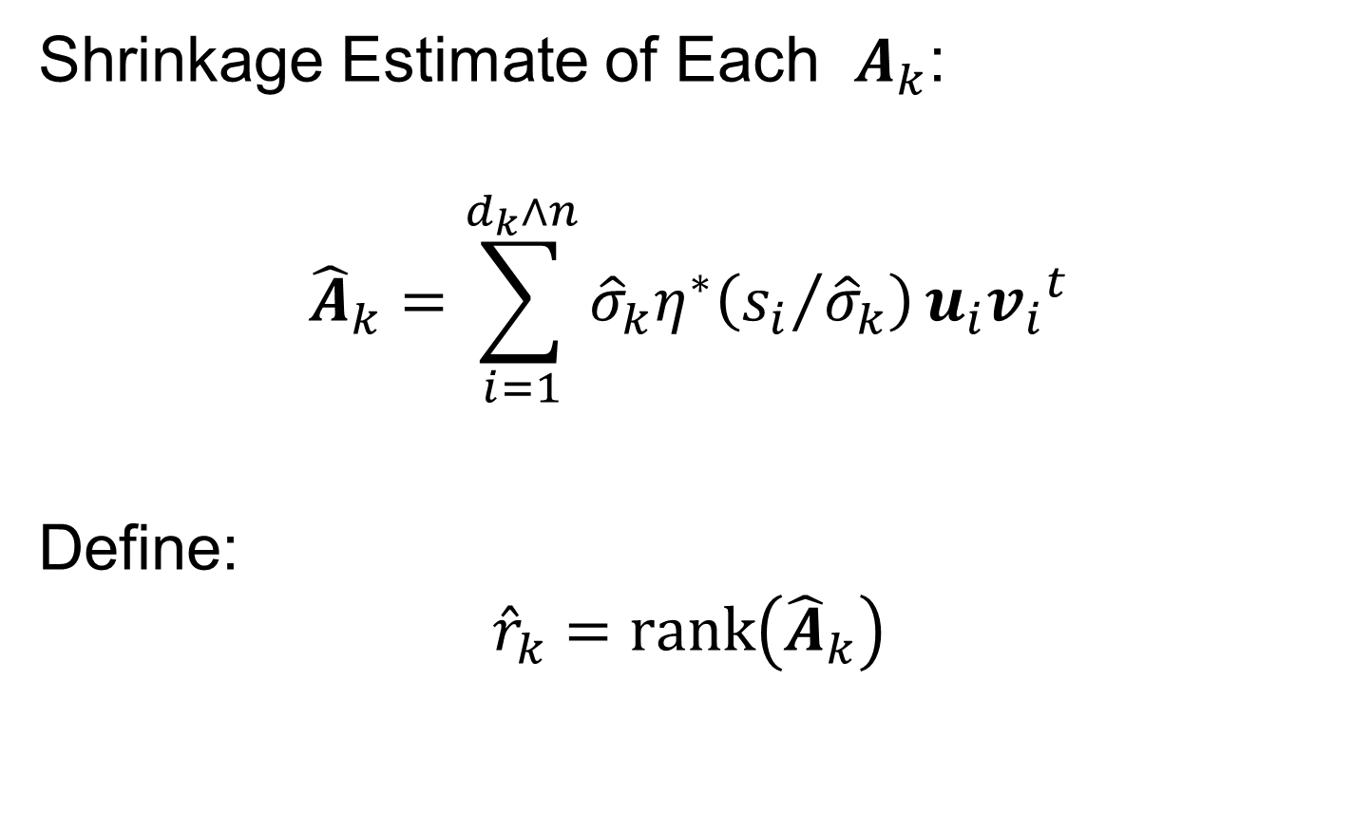
1. Signal Subspace Extraction
Shrinkage Estimate of Each $A_{k}$:
$${\hat{A}}_{k}=\sum_{i=1}^{d_{k}∧n}{{\hat{σ}}_{k}η^{∗}\left({s_{i}}/{{\hat{σ}}_{k}}\right)}u_{i}{v_{i}}^{t}$$
Define:
$${\hat{r}}_{k}=rank\left({\hat{A}}_{k}\right)$$
Put On Unit Scale For Shrinkage
Return to Original Scale
(Rank of Low Rank Approximation,
After 0-ing Out Small Values)

Slide 35
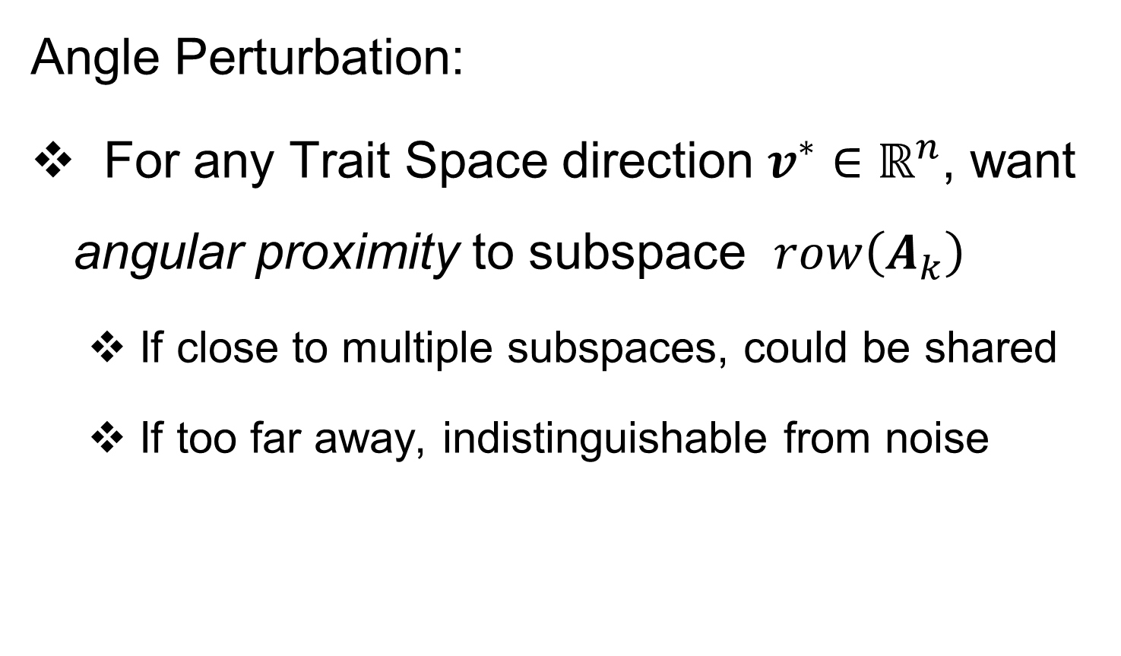
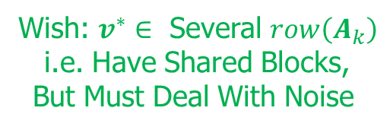
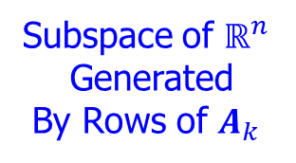
1. Signal Subspace Extraction
Wish: $v^{∗}∈$ Several $row\left(A_{k}\right)$
i.e. Have Shared Blocks,
But Must Deal With Noise
Angle Perturbation:
For any Trait Space direction $v^{∗}∈ℝ^{n}$, want angular proximity to subspace $row\left(A_{k}\right)$
If close to multiple subspaces, could be shared
If too far away, indistinguishable from noise
Subspace of $ℝ^{n}$
Generated
By Rows of $A_{k}$
Seek “Feasible Cone”
Around Each Model Subspace

Slide 36
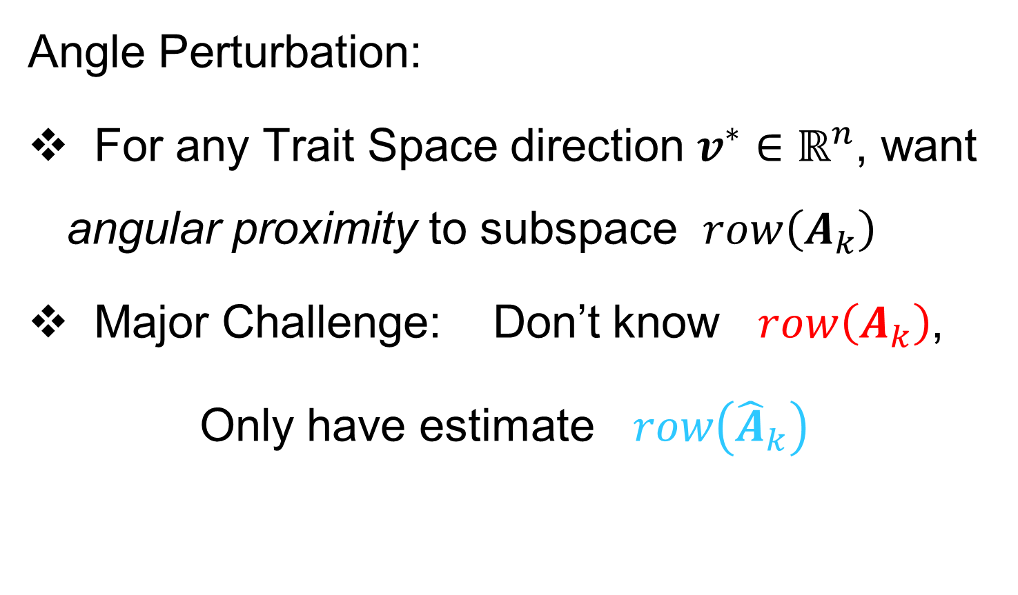
1. Signal Subspace Extraction
Angle Perturbation:
For any Trait Space direction $v^{∗}∈ℝ^{n}$, want angular proximity to subspace $row\left(A_{k}\right)$
Major Challenge: Don’t know $row\left(A_{k}\right)$,
Only have estimate $row\left({\hat{A}}_{k}\right)$
Will Use These
Colors to Keep
Straight Unknown
vs. Estimated

Slide 37
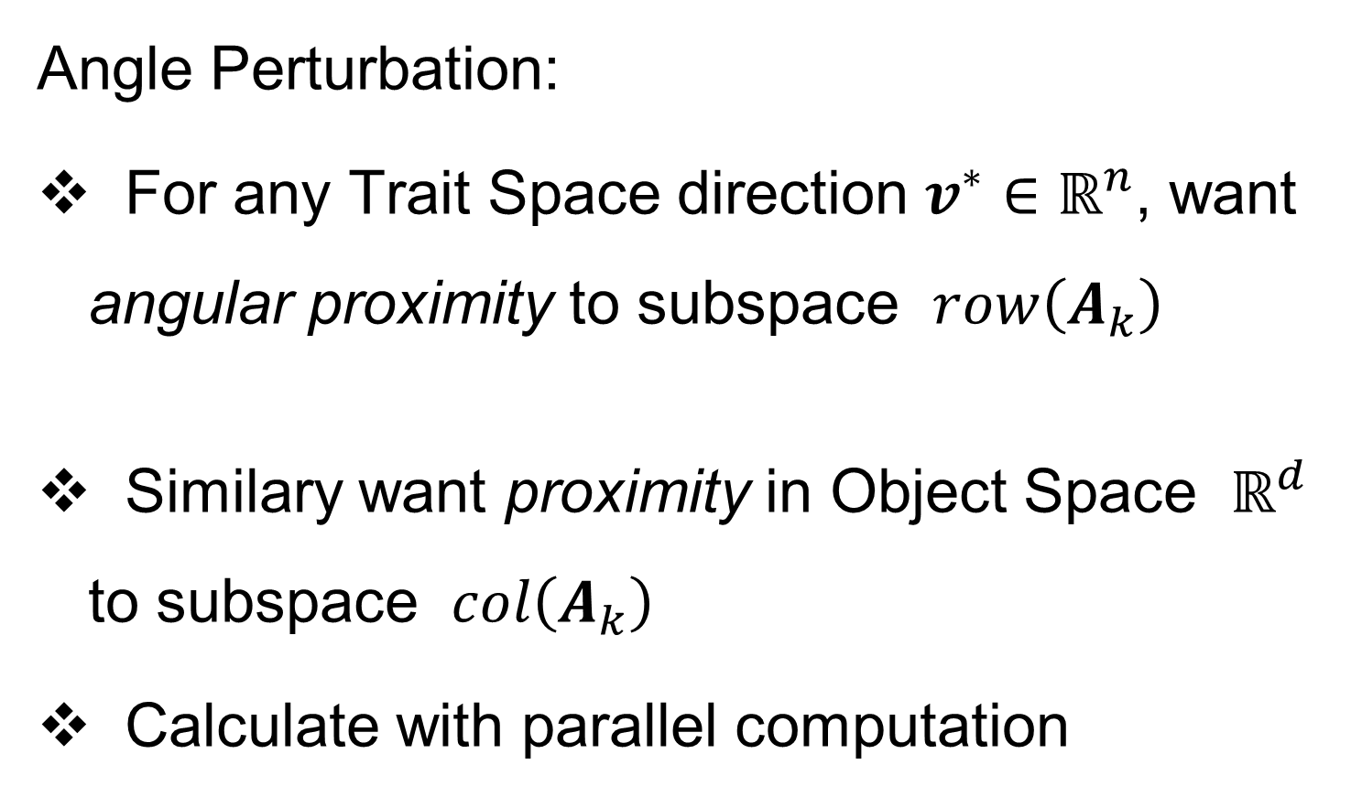
1. Signal Subspace Extraction
Angle Perturbation:
For any Trait Space direction $v^{∗}∈ℝ^{n}$, want angular proximity to subspace $row\left(A_{k}\right)$
Similary want proximity in Object Space $ℝ^{d}$ to subspace $col\left(A_{k}\right)$
Calculate with parallel computation

Slide 38
1. Signal Subspace Extraction
Angle Perturbation:
Two Major Parts:
Bootstrap Measure of Uncertainty
Random Direction Bound

Slide 39
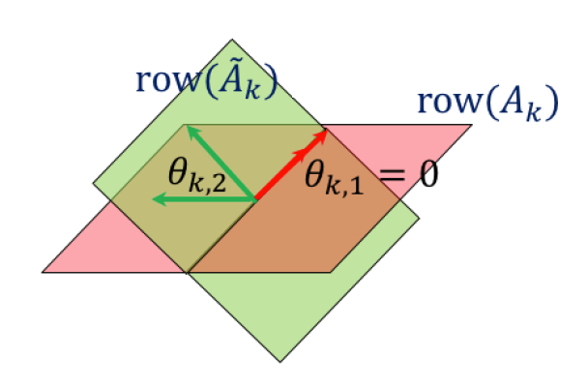

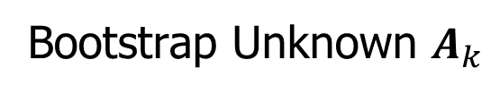
1. Signal Subspace Extraction
Bootstrap Principal Angles:
Goal: Relationship Between Subspaces
Signal $row\left(A_{k}\right)$ & Estimated $row\left({\hat{A}}_{k}\right)$
Useful Summary:
Principal Angle Analysis
Bootstrap Unknown $A_{k}$

Slide 40
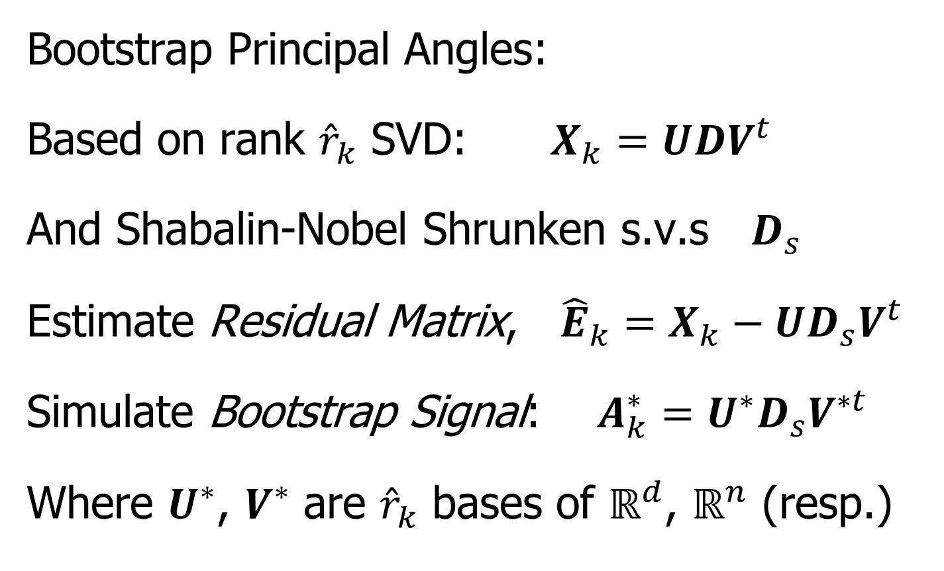

1. Signal Subspace Extraction
Bootstrap Principal Angles:
Based on rank ${\hat{r}}_{k}$ SVD: $X_{k}=UDV^{t}$
And Shabalin-Nobel Shrunken s.v.s $D_{s}$
Estimate Residual Matrix, ${\hat{E}}_{k}=X_{k}−UD_{s}V^{t}$
Simulate Bootstrap Signal: $A_{k}^{∗}=U^{∗}D_{s}V^{∗t}$
Where $U^{∗}$, $V^{∗}$ are ${\hat{r}}_{k}$ bases of $ℝ^{d}$, $ℝ^{n}$ (resp.)
Think Random Rotations
$B$ = # of Bootstrap Replications

Slide 41
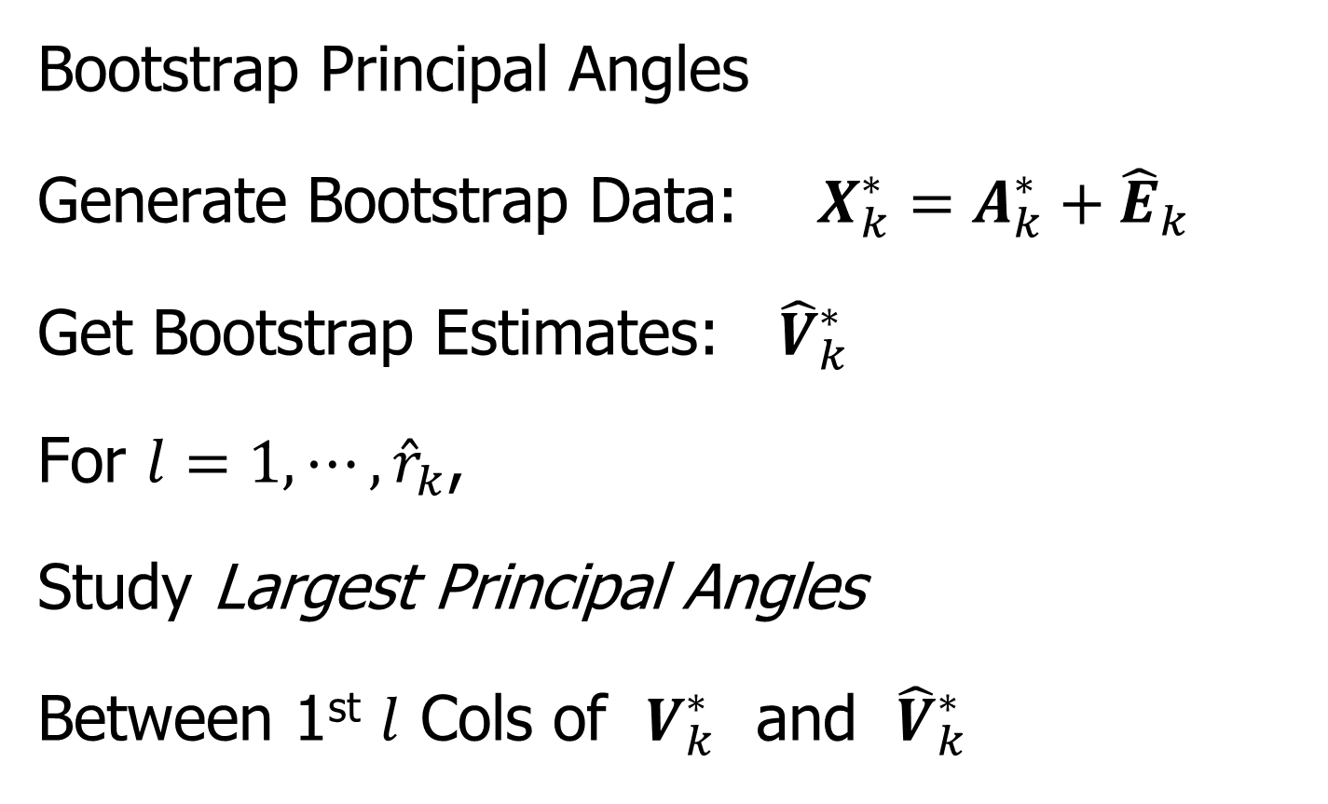
1. Signal Subspace Extraction
Bootstrap Principal Angles
Generate Bootstrap Data: $X_{k}^{∗}=A_{k}^{∗}+{\hat{E}}_{k}$
Get Bootstrap Estimates: ${\hat{V}}_{k}^{∗}$
For $l=1,⋯,{\hat{r}}_{k}$,
Study Largest Principal Angles
Between 1st $l$ Cols of $V_{k}^{∗}$ and ${\hat{V}}_{k}^{∗}$

Slide 42
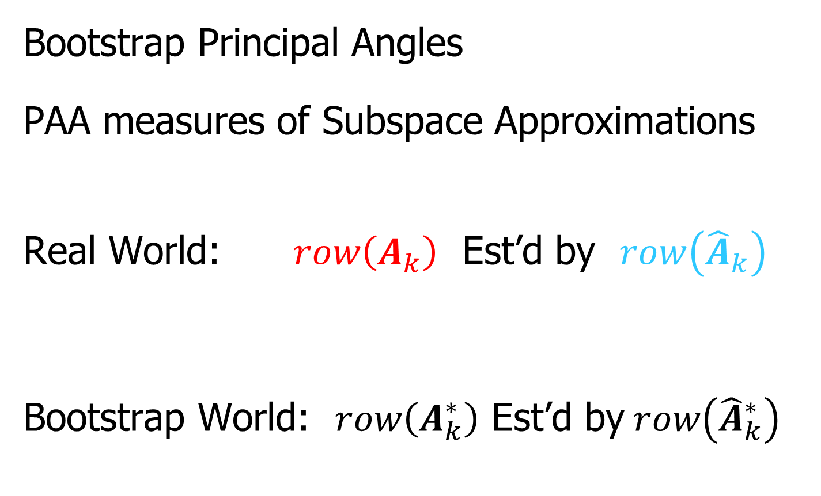
1. Signal Subspace Extraction
Bootstrap Principal Angles
PAA measures of Subspace Approximations
Real World: $row\left(A_{k}\right)$ Est’d by $row\left({\hat{A}}_{k}\right)$
Bootstrap World: $row\left(A_{k}^{∗}\right)$ Est’d by$row\left({\hat{A}}_{k}^{∗}\right)$
“Relative Isotropy” Makes This Work
≈

Slide 43
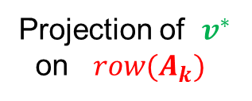

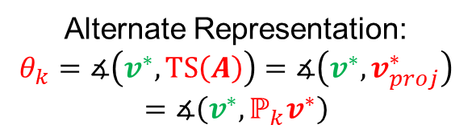
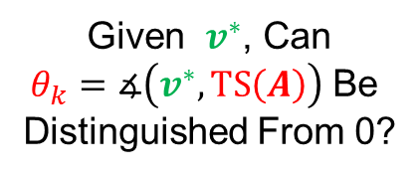
1. Signal Subspace Extraction
Consider Candidate Trait Direction $v^{∗}∈ℝ^{n}$:
To be “nearly in” Span of $A_{k}$ = $row(A_{k})$ = TS(A)
Alternate Representation:
$$θ_{k}=∡\left(v^{∗},TS\left(A\right)\right)=∡\left(v^{∗}, v_{proj}^{∗}\right)$$
$$=∡\left(v^{∗},ℙ_{k}v^{∗}\right)$$
Projection of $v^{∗}$
on $row(A_{k})$
Given $v^{∗}$, Can
$θ_{k}=∡\left(v^{∗},TS\left(A\right)\right)$ Be
Distinguished From 0?
Angles Computed Via Projection

Slide 44
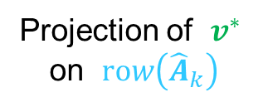
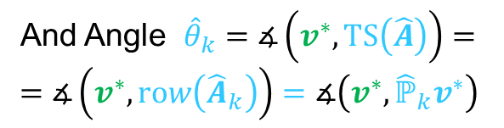
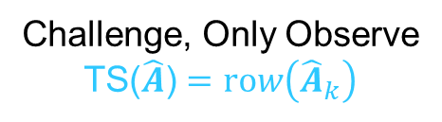
1. Signal Subspace Extraction
Consider Candidate Trait Direction $v^{∗}∈ℝ^{n}$:
Challenge, Only Observe
TS($\hat{A}$) $=row\left({\hat{A}}_{k}\right)$
And Angle ${\hat{θ}}_{k}=∡\left(v^{∗},TS\left(\hat{A}\right)\right)=$
$$=∡\left(v^{∗},row\left({\hat{A}}_{k}\right)\right)=∡\left(v^{∗},{\hat{ℙ}}_{k}v^{∗}\right)$$
Projection of $v^{∗}$
on $row\left({\hat{A}}_{k}\right)$

Slide 45






1. Signal Subspace Extraction
Find Bounds on Angles $θ_{k}$ and ${\hat{θ}}_{k}$:
Define$θ_{1}^{∗}=∡\left(v_{proj}^{∗},row\left({\hat{A}}_{k}\right)\right)=$
$$=∡\left(v_{proj}^{∗},{\hat{ℙ}}_{k}v_{proj}^{∗}\right)$$
Triangle Ineq.: ${\hat{θ}}_{k}≤θ_{k}+θ_{1}^{∗}$
Which Gives: ${\left({\hat{θ}}_{k}−θ_{1}^{∗}\right)}_{+}≤θ_{k}$
Lower Bound on $θ_{k}$
${\left({\hat{θ}}_{k}−θ_{1}^{∗}\right)}_{+}=0$ Indicates $v^{∗}$
Indistinguishable From Signal

Slide 46





1. Signal Subspace Extraction
Find Bounds on Angles $θ_{k}$ and ${\hat{θ}}_{k}$:
Next Find Upper Bound on $θ_{k}$
Define $θ_{2}^{∗}=∡\left({\hat{v}}_{proj}^{∗}, row(A_{k})\right)$
Triangle Ineq.: $θ_{k}≤{\hat{θ}}_{k}+θ_{2}^{∗}$
Lower & Upper Bounds on $θ_{k}$
$${\left({\hat{θ}}_{k}−θ_{1}^{∗}\right)}_{+}≤ θ_{k}≤{\hat{θ}}_{k}+θ_{2}^{∗}$$

Slide 47



1. Signal Subspace Extraction
Application of Inequalities:
$${\left({\hat{θ}}_{k}−θ_{1}^{∗}\right)}_{+}≤ θ_{k}≤{\hat{θ}}_{k}+θ_{2}^{∗}$$
Would Like to Estimate:
$$θ_{1}^{∗}=∡\left(ℙ_{k}v^{∗},row\left({\hat{A}}_{k}\right)\right)=\cos^{−1}{\frac{\left\|{\hat{V}}_{k}^{t}V_{k}ω_{v}\right\|}{\left\|ω_{v}\right\|}}$$
$$θ_{2}^{∗}=∡\left({\hat{ℙ}}_{k}v^{∗},row(A_{k}) \right)=\cos^{−1}{\frac{\left\|V_{k}^{t}{\hat{V}}_{k}{\hat{ω}}_{v}\right\|}{\left\|{\hat{ω}}_{v}\right\|}}$$
Where $ω_{v}=V_{k}^{t}v^{∗}$
Where ${\hat{ω}}_{v}={\hat{V}}_{k}^{t}v^{∗}$

Slide 48


1. Signal Subspace Extraction
$$θ_{1}^{∗}=∡\left(ℙ_{k}v^{∗},row\left({\hat{A}}_{k}\right)\right)=\cos^{−1}{\frac{\left\|{\hat{V}}_{k}^{t}V_{k}ω_{v}\right\|}{\left\|ω_{v}\right\|}}$$
$$θ_{2}^{∗}=∡\left({\hat{ℙ}}_{k}v^{∗},row(A_{k}) \right)=\cos^{−1}{\frac{\left\|V_{k}^{t}{\hat{V}}_{k}{\hat{ω}}_{v}\right\|}{\left\|{\hat{ω}}_{v}\right\|}}$$
The Distribution of $V_{k}^{t}{\hat{V}}_{k}$ is Approximated by the Bootstrap Distribution of $V_{k}^{∗t}{\hat{V}}_{k}^{∗}$. So Choose:
$θ_{2}^{∗}≈95 percentile of\cos^{−1}{\frac{\left\|V_{k}^{∗t}{\hat{V}}_{k}^{∗}{\hat{ω}}_{v}\right\|}{\left\|{\hat{ω}}_{v}\right\|}}$
$θ_{1}^{∗}≤{\hat{φ}}_{k}=\cos^{−1}\left(λ_{min}\left(V_{k}^{∗t}{\hat{V}}_{k}^{∗}\right)\right)$
Drawn from B (often 1000)
Bootstrap Replications
Smallest Singular Value,
Since${ ω}_{v}$ Is Not Observable

Slide 49


1. Signal Subspace Extraction
$θ_{2}^{∗}≈95 percentile of\cos^{−1}{\frac{\left\|V_{k}^{∗t}{\hat{V}}_{k}^{∗}{\hat{ω}}_{v}\right\|}{\left\|{\hat{ω}}_{v}\right\|}}$
$θ_{1}^{∗}≤{\hat{φ}}_{k}=\cos^{−1}\left(λ_{min}\left(V_{k}^{∗t}{\hat{V}}_{k}^{∗}\right)\right)$
Use Parallel Calculations to Get ${\hat{ψ}}_{k}$ in Object Space
Will Use Later in a Diagnostic
Determines Cone of Uncertainty
for “Joint” Directions in Trait Space
Determines Cone of Uncertainty
for “Joint” Directions in Object Space
Need to Replace Candidate Trait (Scores) Direction $v^{∗}∈ℝ^{n}$
With Corresponding Object (Loadings) Direction $X_{k}v^{∗}∈ℝ^{d}$

Slide 50

1. Signal Subspace Extraction
Summary of Main Ideas:
Principal angles between $A^{∗}$ and ${\hat{A}}^{∗}$ are drawn from the same distribution as principal angles between $A_{k}$ and ${\hat{A}}_{k}$
Generate empirical distributions of maximum principal angles from B Bootstrap replications
Choose perturbation angle bounds ${\hat{φ}}_{k}$ and ${\hat{ψ}}_{k}$ as 95th percentiles from empirical distributions of maximum principal angles

Slide 51
Participant Presentation
Yang Liu
Introduction to Targeted Learning

