Slide 1
Statistics – O. R. 881
Object Oriented Data Analysis
Steve Marron
Dept. of Statistics and Operations Research
University of North Carolina

Slide 2
Current Sections in Textbook
Today:
Sections 1.2, 8.1, 8.2, 8.3
Next Class:
Sections 8.6 , 8.7

Slide 3
Last Class: Distance Methods
Fréchet Means & Medians Allow Many Variations
Usually Studied in “Robust Statistics”
Might Look Deeper Later On (Text Chapter 16)
“Every Dog Has His Day”

Slide 4
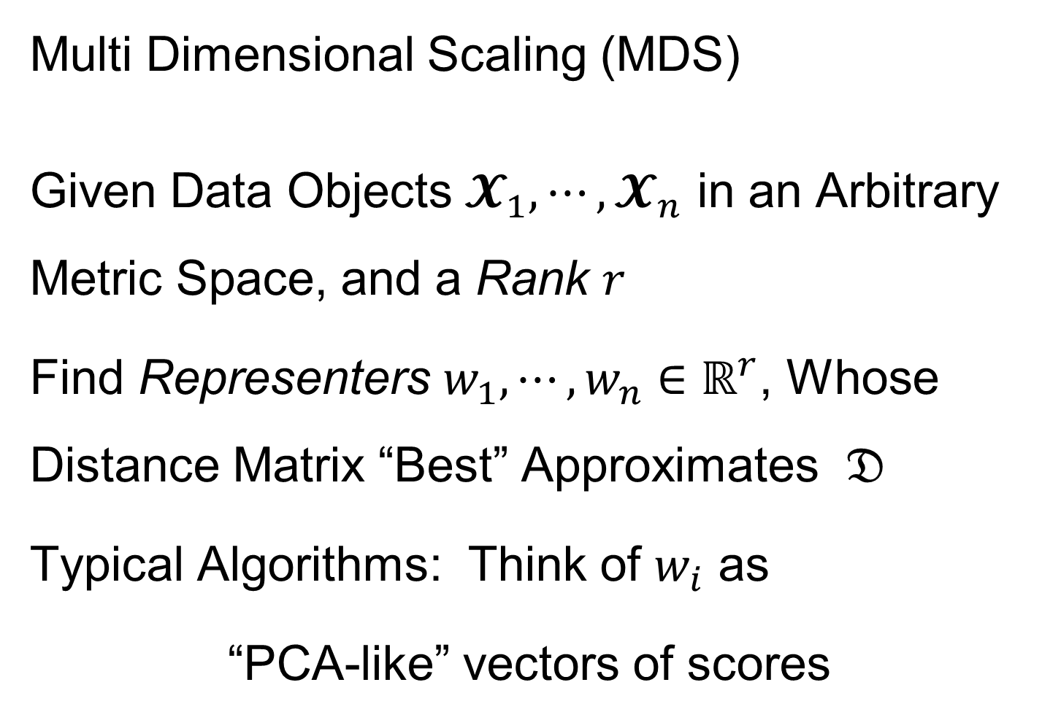
Last Class: Distance Methods
Note: This
Representation
Is Called
“Auto-Encoder”
In AI literature
Multi Dimensional Scaling (MDS)
Given Data Objects $𝓧_{1},⋯,𝓧_{n}$ in an Arbitrary Metric Space, and a Rank $r$
Find Representers $w_{1},⋯,w_{n}∈ℝ^{r}$, Whose Distance Matrix “Best” Approximates $𝔇$
Typical Algorithms: Think of $w_{i}$ as
“PCA-like” vectors of scores

Slide 5
Last Class: Shapes As Data Objects
Several Different Notions of Shape
Oldest and Best Known (in Statistics):
Landmark Based
Text, Sec. 1.2, 5.2

Slide 6





Last Class: Landmark Shape
Start by Representing Shapes by
Landmarks (points in $ℝ^{2}$ or $ℝ^{3}$)
$$\left(x_{1},y_{1}\right)$$
$$\left[\begin{matrix}\begin{matrix}x_{1} \\ y_{1}\end{matrix} \\ \begin{matrix}x_{2} \\ y_{2}\end{matrix} \\ \begin{matrix}x_{3} \\ y_{3}\end{matrix}\end{matrix}\right]∈ℝ^{6}$$
$$\left(x_{2},y_{2}\right)$$
$$\left(x_{3},y_{3}\right)$$
Trait (Feature) Vector

Slide 7
Last Class: Landmark Shape
Approach: Identify objects that are:
Translations
Rotations
Scalings
of each other
Mathematics: Equivalence Relation
Results in: Equivalence Classes (i.e. Orbits)
Which become the Data Objects

Slide 8
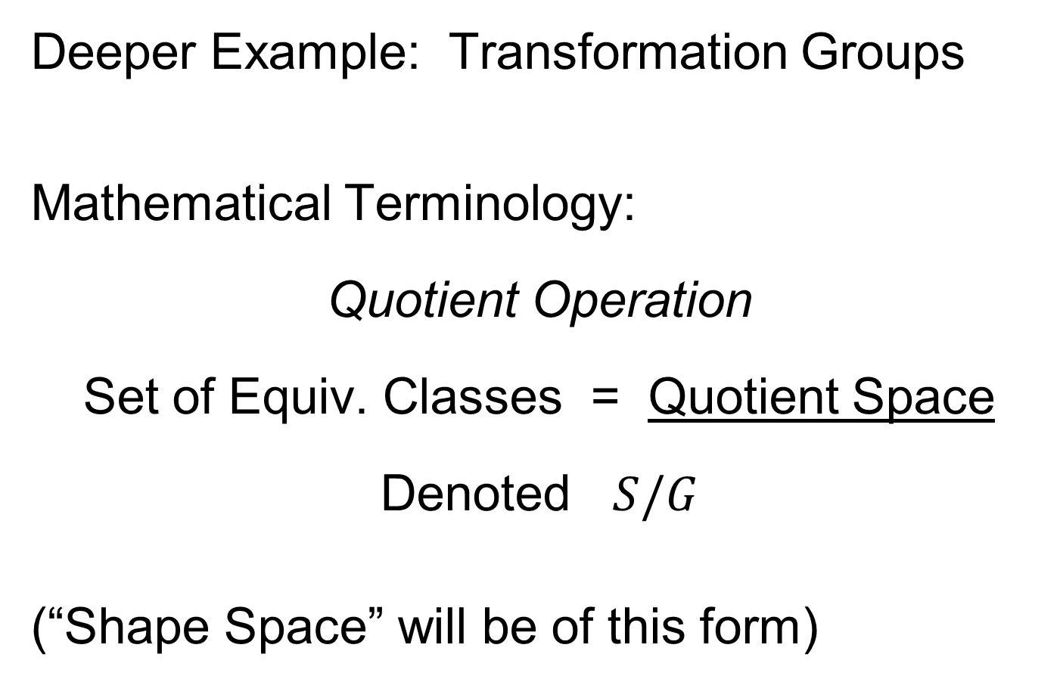
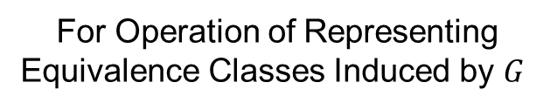
Last Class: Equivalence Relations
Deeper Example: Transformation Groups
Mathematical Terminology:
Quotient Operation
Set of Equiv. Classes = Quotient Space
Denoted $S/G$
(“Shape Space” will be of this form)
For Operation of Representing
Equivalence Classes Induced by $G$

Slide 9
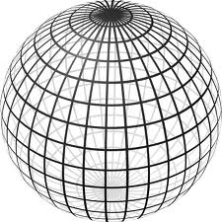

Last Class: Landmark Shape
Triangle Shape Space: Represent as Sphere
$ℝ^{6}$ → $ℝ^{4}$ → $ℝ^{3}$ →
scaling
(thanks to Wikipedia)

Slide 10
Last Class: Image Analysis
First Generation Problems:
Denoising
Segmentation
Registration
(all about single images,
still interesting challenges)

Slide 11
Last Class: Image Analysis
Second Generation Problems:
Populations of Images
  Understanding Population Variation
  Discrimination (a.k.a. Classification)
Complex Data Structures (& Spaces)
HDLSS Statistics
Text,
Chp. 11
Will Study,
Text Sec. 14.2
High Dimension, Low Sample Size

Slide 12
Last Class: Image Analysis
Common Goal in Image Analysis:
Focus on Shapes Within Images
I.e. Shapes Become the Data Objects
E.g. Organs Within a Medical Image

Slide 13
Last Class: Shape Repr’ns
Major Approaches for Shape Data Objects:
Landmark Representations
Boundary Representations
Skeletal Representations

Slide 14
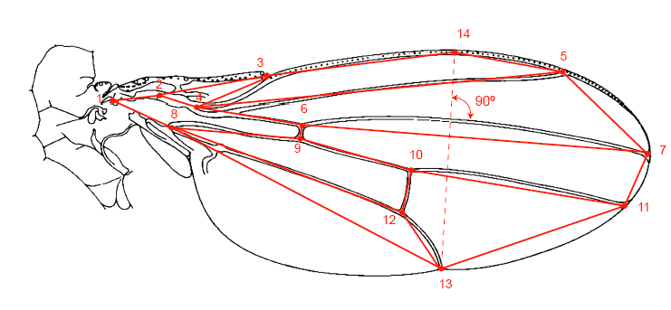
Last Class: Landmark Repr’ns
Landmarks for Fly Wing Data:
Thanks to George Gilchrist

Slide 15
Last Class: Shape Rep’ns
Major Approaches for Shape Data Objects:
Landmark Representations
Boundary Representations
Skeletal Representations

Slide 16
Last Class: Boundary Rep’ns
Traditional Major Sets of Ideas:
Triangular Meshes
  Survey: Owen (1998)
Active Shape Models
  Cootes, et al (1993)
Fourier Boundary Representations
  Keleman, et al (1997 & 1999)

Slide 17
Last Class: Shape Repr’ns
Major Approaches for Shape Data Objects:
Landmark Representations
Boundary Representations
Skeletal Representations

Slide 18
Skeletal Representations
Main Idea:
Represent Objects as:
Discretized skeletons (medial atoms)
Plus spokes from center to edge
Which imply a boundary
Very accessible early reference:
Yushkevich, et al (2001)
Volume Gives Better Representation
In 3d than Boundary Surface

Slide 19
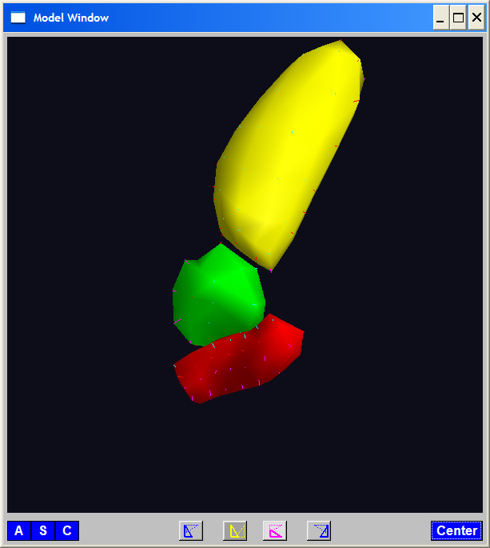
A Challenging Example
Text, Sec. 1.2
Male Pelvis
  Bladder – Prostate – Rectum

Slide 20
A Challenging Example
Male Pelvis
  Bladder – Prostate – Rectum
Attached to the Bladder
Common Area for Cancer in Males

Slide 21
A Challenging Example
Male Pelvis
  Bladder – Prostate – Rectum
Common Area for Cancer in Males
Useful Approach: Radiation
Challenge: Design Treatment
Hit Prostate
Miss Bladder & Rectum
Over Many Days

Slide 22
A Challenging Example
Radiation Treatment in Male Pelvis
  Bladder – Prostate – Rectum
  Central Question:
  How do they move over time (days)?
Work with 3-d CT
(“Computed Tomography”,
= 3d version of X-ray)

Slide 23
A Challenging Example
Radiation Treatment in Male Pelvis
  Bladder – Prostate – Rectum
  Central Question:
  How do they move over time (days)?
Work with 3-d CT
  Very Challenging to Segment
  Find boundary of each object?
  Represent each Object?

Slide 24
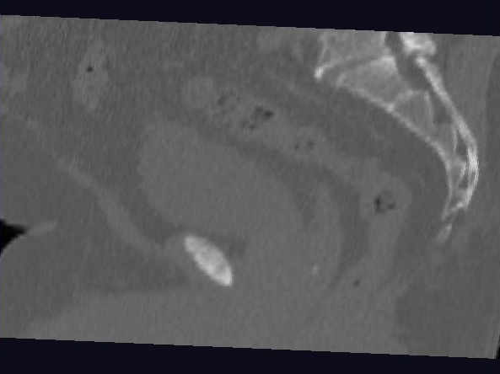
Male Pelvis – Raw Data
One CT Slice
(in 3d image)
Like X-ray:
White = Dense
(Bone)
Black = Gas

Slide 25
Male Pelvis – Raw Data
One CT Slice
(in 3d image)
Tail Bone

Slide 26
Male Pelvis – Raw Data
One CT Slice
(in 3d image)
Tail Bone
Rectum

Slide 27
Male Pelvis – Raw Data
One CT Slice
(in 3d image)
Tail Bone
Rectum
Bladder

Slide 28
Male Pelvis – Raw Data
One CT Slice
(in 3d image)
Tail Bone
Rectum
Bladder
Prostate

Slide 29
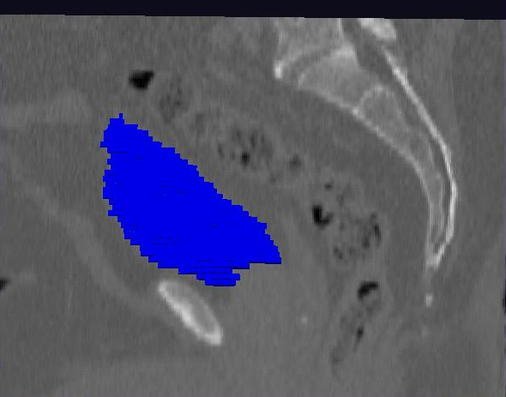
Male Pelvis – Raw Data
Bladder:
manual segmentation
Slice by slice
Reassembled

Slide 30
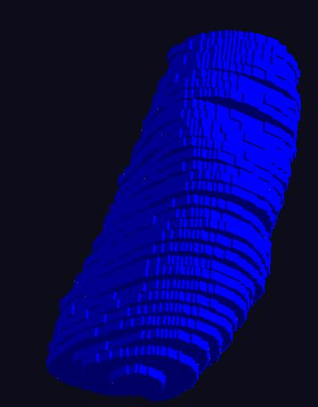
Male Pelvis – Raw Data
Bladder:
Slices:
Reassembled in 3d
How to represent?
Thanks: Ja-Yeon Jeong
Called Binary
Representation

Slide 31
Object Representation
Above Shape Approaches:
Landmarks (hard to find)
Boundary Rep’ns (no correspondence)
Skeletal Representations

Slide 32
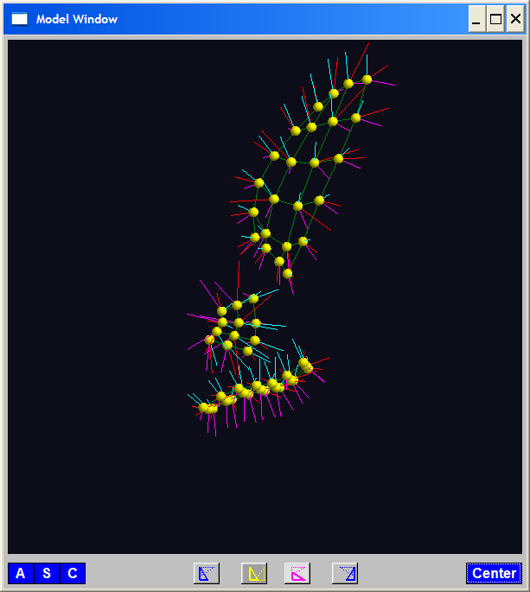
Skeletal Representations
3-d S-Rep Example: From Ja-Yeon Jeong
Bladder – Prostate - Rectum
Atoms (yellow dots)
Notes:
OODA.ppt

Slide 33
Skeletal Representations
3-d S-Rep Example: From Ja-Yeon Jeong
Bladder – Prostate - Rectum
Atoms - Spokes (line segments)
Notes:
OODA.ppt

Slide 34
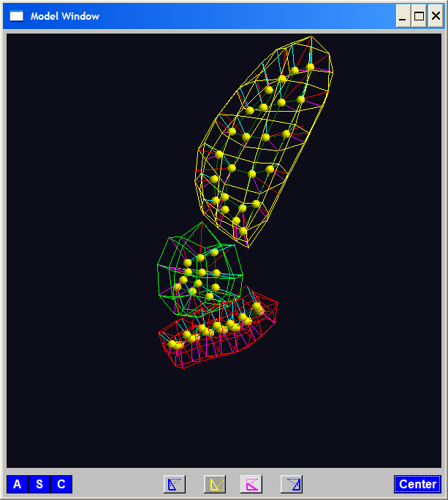
Skeletal Representations
3-d S-Rep Example: From Ja-Yeon Jeong
Bladder – Prostate - Rectum
Atoms - Spokes - Implied Boundary
Notes:
OODA.ppt

Slide 35
Skeletal Representations
3-d S-Rep Example: From Ja-Yeon Jeong
Bladder – Prostate - Rectum
Atoms - Spokes - Implied Boundary
Notes:
OODA.ppt

Slide 36
Skeletal Representations
Detailed discussion of mathematics of S-reps:
Siddiqi & Pizer (2007)
More Applications of S-reps in Imaging:
Pizer & Marron (2017), Pizer et al. (2020)
Notes:
fletcher_thesis.pdf

Slide 37
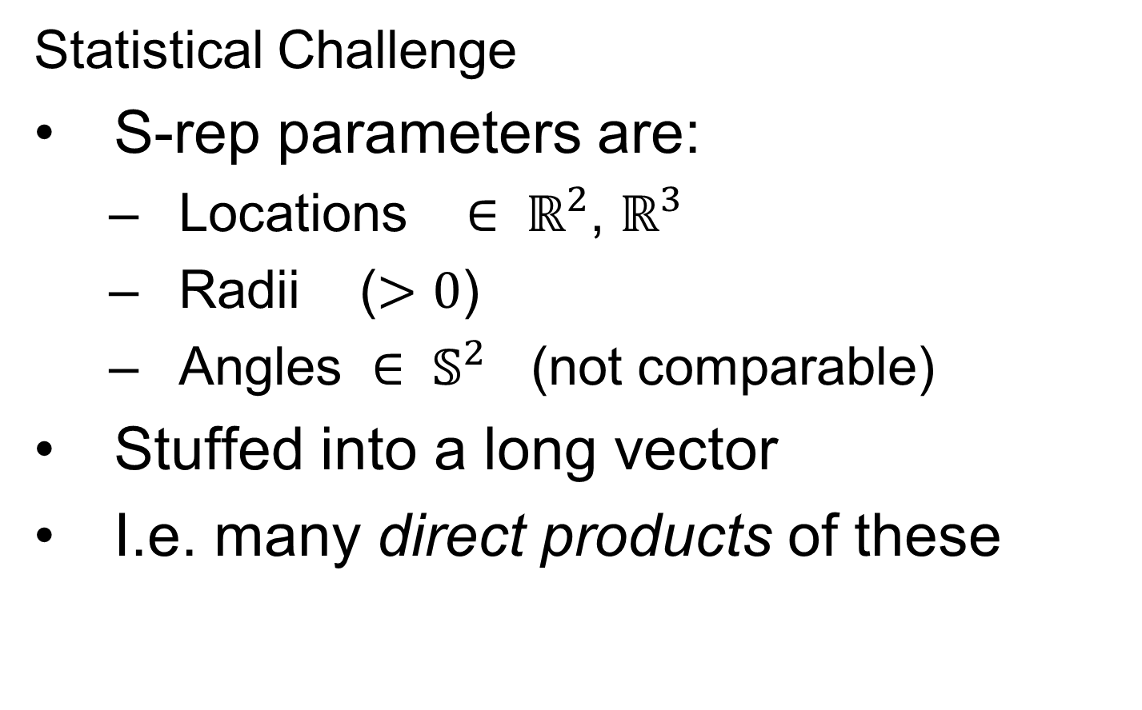
Skeletal Representations
Statistical Challenge
S-rep parameters are:
  Locations $∈ ℝ^{2}$, $ℝ^{3}$
  Radii ($>0$)
  Angles $∈ 𝕊^{2}$ (not comparable)
Stuffed into a long vector
I.e. many direct products of these

Slide 38
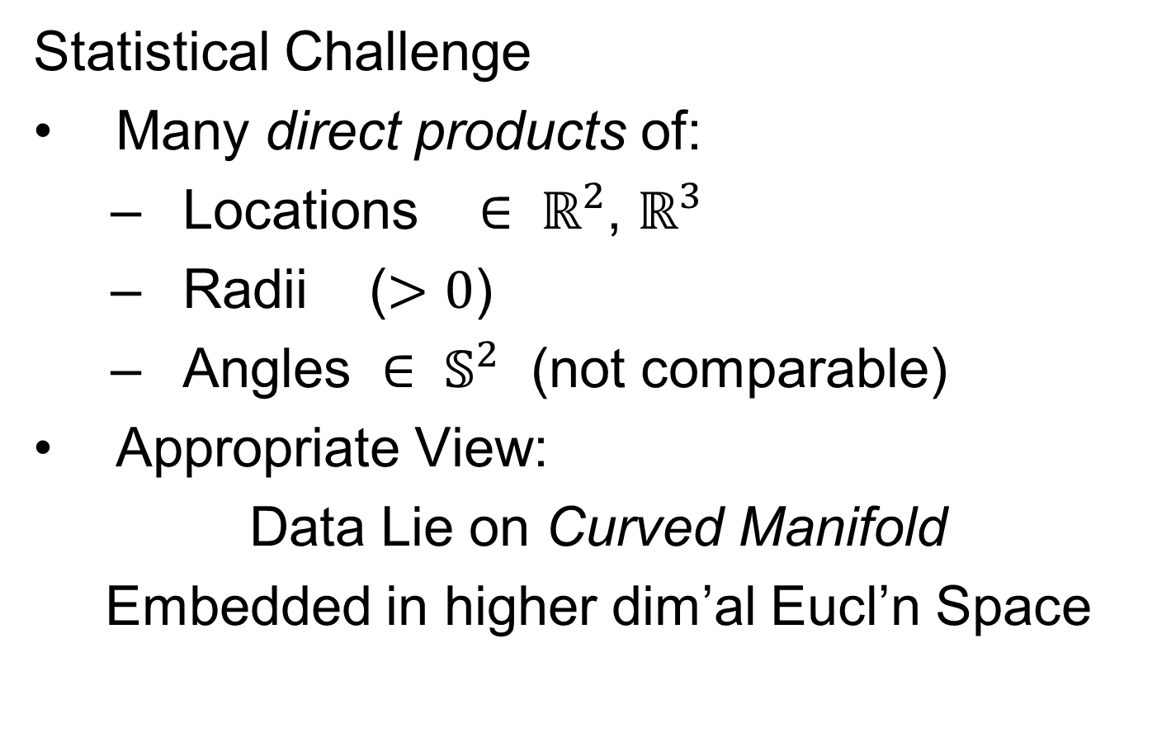
Skeletal Representations
Statistical Challenge
Many direct products of:
  Locations $∈ ℝ^{2}$, $ℝ^{3}$
  Radii ($>0$)
  Angles $∈ 𝕊^{2}$ (not comparable)
Appropriate View:
Data Lie on Curved Manifold
Embedded in higher dim’al Eucl’n Space

Slide 39
3-d s-reps
S-rep model fitting
Easy, when starting from binary (blue)
But very expensive (30 – 40 minutes technician’s time)
Want automatic approach
Challenging, because of poor contrast, noise, …
Need to borrow information across training sample
Use Bayes approach: prior & likelihood → posterior
(A surrogate for “anatomical knowledge”)

Slide 40
3-d s-reps
S-rep model fitting
Easy, when starting from binary (blue)
But very expensive (30 – 40 minutes technician’s time)
Want automatic approach
Challenging, because of poor contrast, noise, …
Need to borrow information across training sample
Use Bayes approach: prior & likelihood → posterior
~Conjugate Gaussians
(Embarassingly Straightforward?)

Slide 41
3-d s-reps
S-rep model fitting
Easy, when starting from binary (blue)
But very expensive (30 – 40 minutes technician’s time)
Want automatic approach
Challenging, because of poor contrast, noise, …
Need to borrow information across training sample
Use Bayes approach: prior & likelihood → posterior
~Conjugate Gaussians, but there are issues:
  Major HLDSS challenges
  Manifold aspect of data
Handle With Variation on PCA
Careful Handling Very Useful

Slide 42
3-d s-reps
S-rep model fitting
Very Successful
Jeong (2009, UNC CS PhD Dissertation)

Slide 43
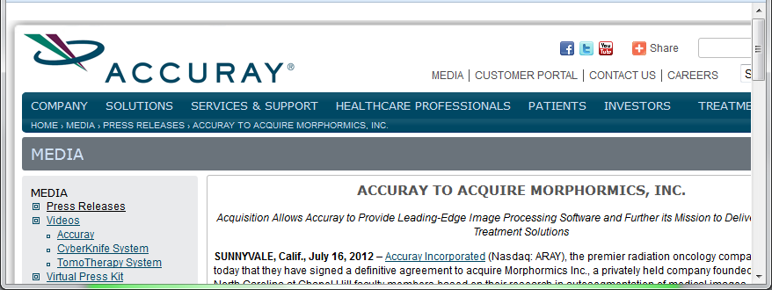
3-d s-reps
S-rep model fitting
Very Successful
Jeong (2009)
Basis of Startup Company: Morphormics
Since Purchased
By Accuray

Slide 44
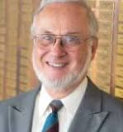
3-d s-reps
Course for Much More in This Direction:
CS 790, Sec. 6:
Shape Representation and Statistics
Spring 2026 (9 or 10 MW)
Stephen M. Pizer

Slide 45

Recommended Software
Slicer / SALT
By

Slide 46
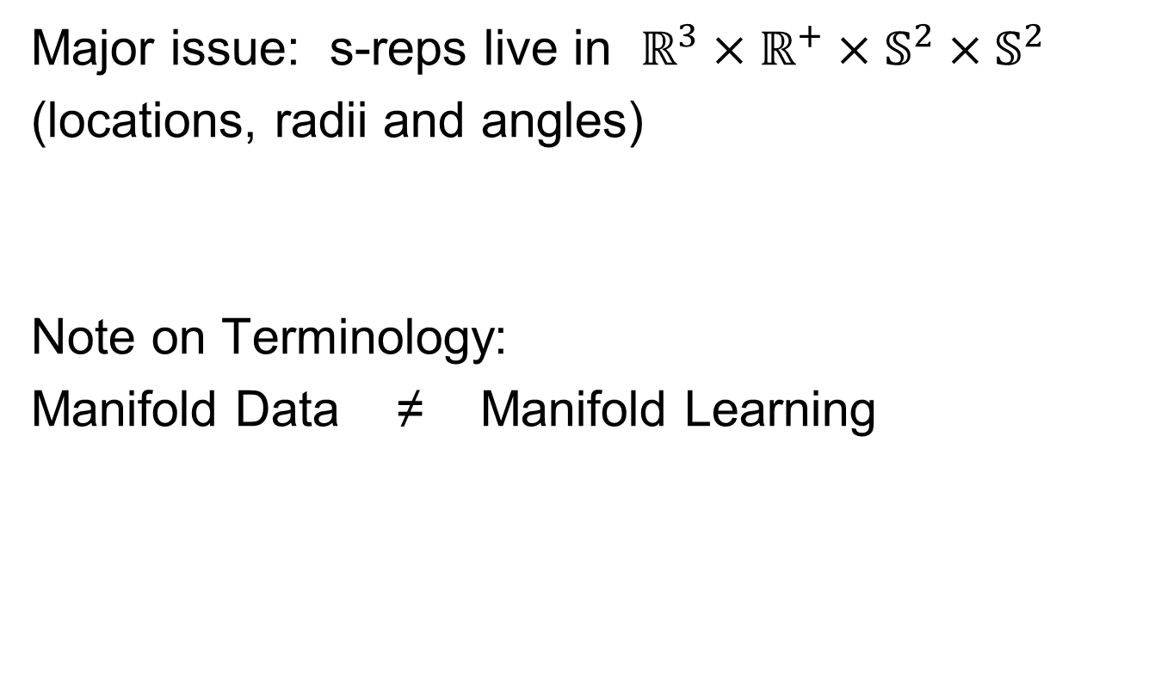
Data Lying On a Manifold
Major issue: s-reps live in $ℝ^{3}×ℝ^{+}×𝕊^{2}×𝕊^{2}$
(locations, radii and angles)
Note on Terminology:
Manifold Data ≠ Manifold Learning
Text, Chp. 8

Slide 47
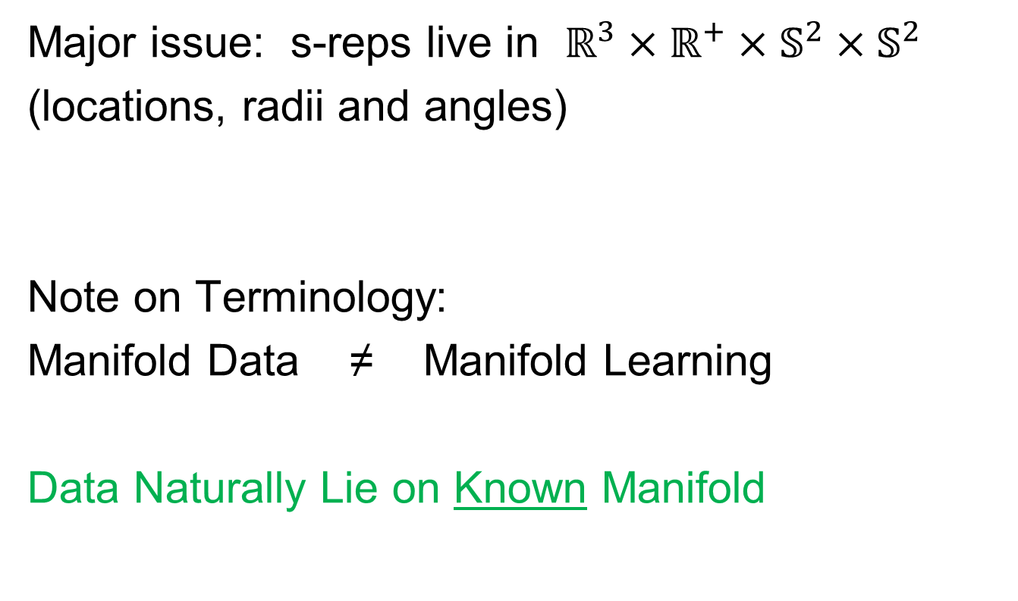
Data Lying On a Manifold
Major issue: s-reps live in $ℝ^{3}×ℝ^{+}×𝕊^{2}×𝕊^{2}$
(locations, radii and angles)
Note on Terminology:
Manifold Data ≠ Manifold Learning
Data Naturally Lie on Known Manifold

Slide 48
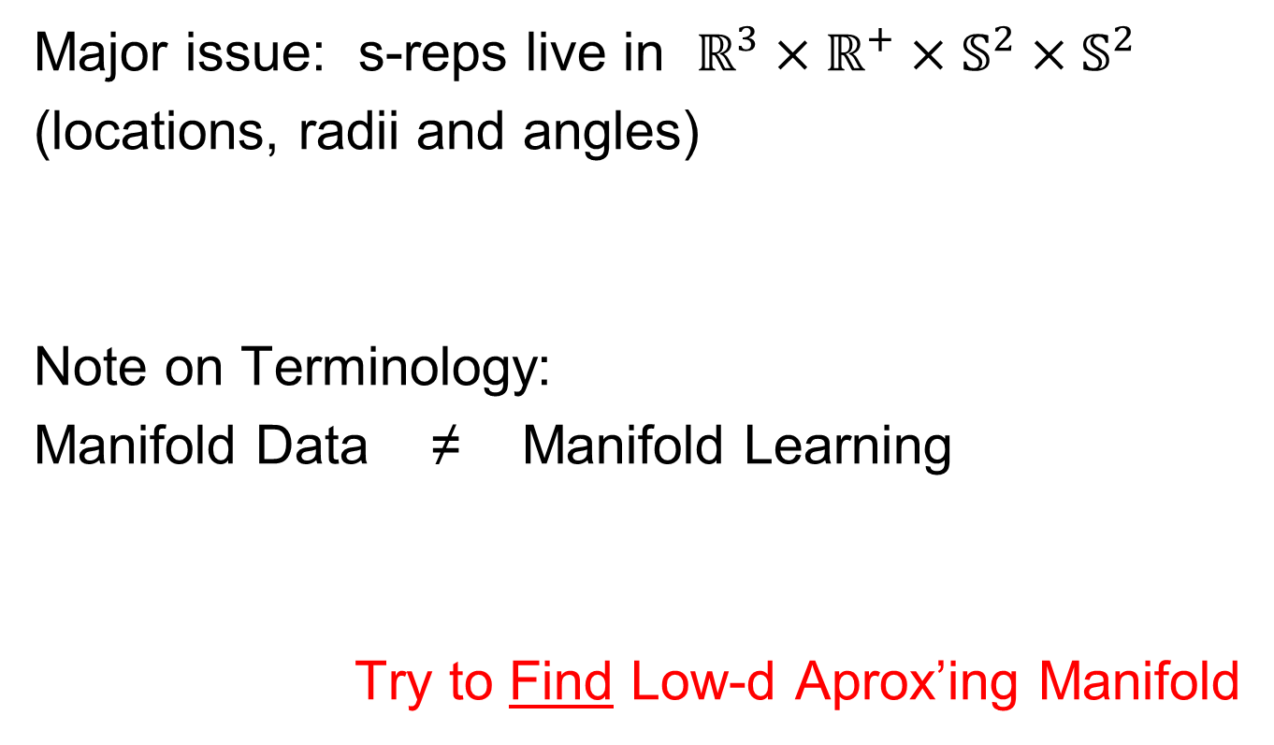
Data Lying On a Manifold
Major issue: s-reps live in $ℝ^{3}×ℝ^{+}×𝕊^{2}×𝕊^{2}$
(locations, radii and angles)
Note on Terminology:
Manifold Data ≠ Manifold Learning
Try to Find Low-d Aprox’ing Manifold

Slide 49
Manifold Learning
Tenenbaum, et al (2000)
Canonical Example:
Photographs (2-d) of Statue (3-d)
Different Viewpoints
Different Light Source Locations
Digitization of Photos is “Low-Dimensional”
But Not in a Subspace (Findable by PCA)
In a manifold (curved
surface) sense

Slide 50
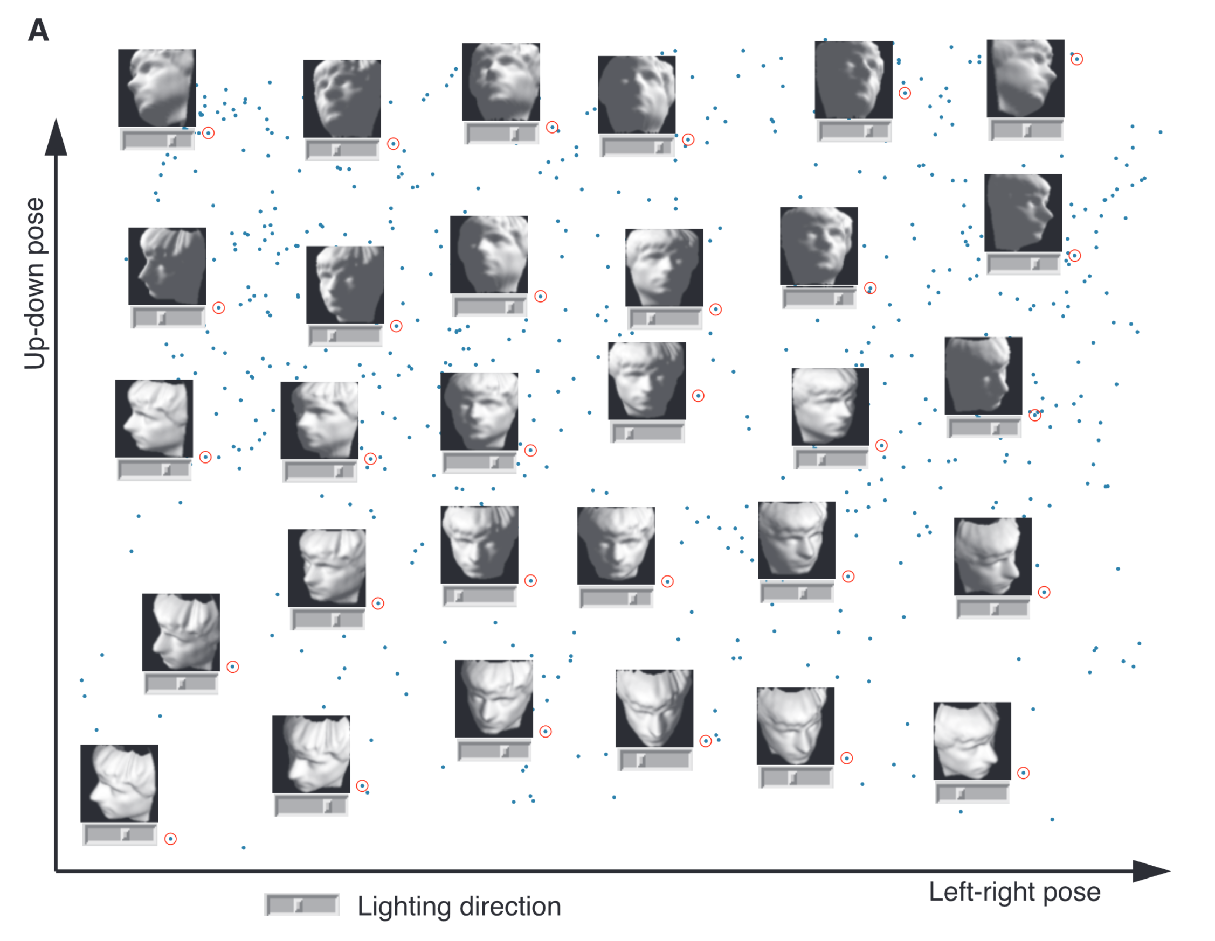
Manifold Learning
Tenenbaum, et al (2000)
Reveals
Two
Interesting
Modes Of
Variation

Slide 51
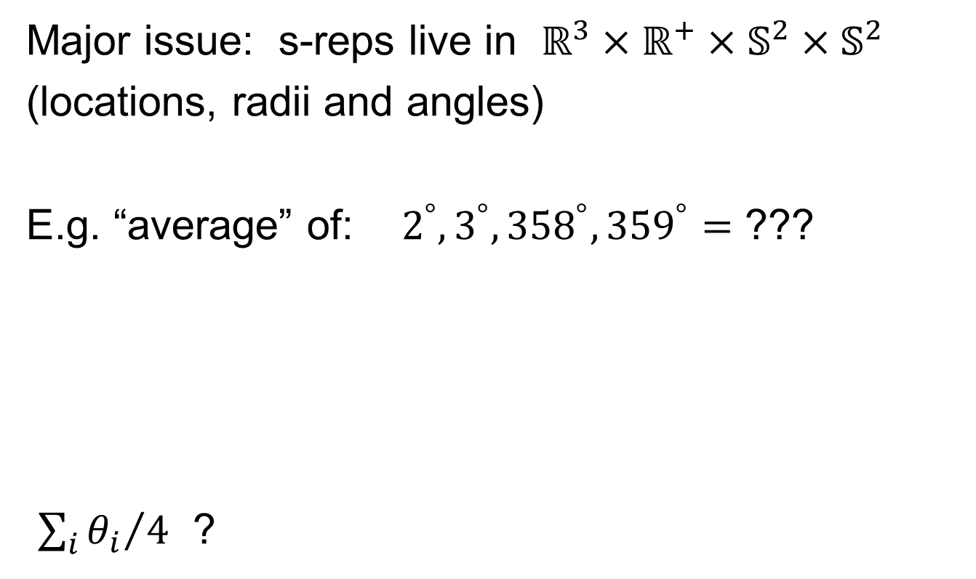
Data Lying On a Manifold
Major issue: s-reps live in $ℝ^{3}×ℝ^{+}×𝕊^{2}×𝕊^{2}$
(locations, radii and angles)
E.g. “average” of: $2^{°}, 3^{°}, {358}^{°}, {359}^{°}=$ ???
${\sum_{i}{θ_{i}}}/4$ ?

Slide 52
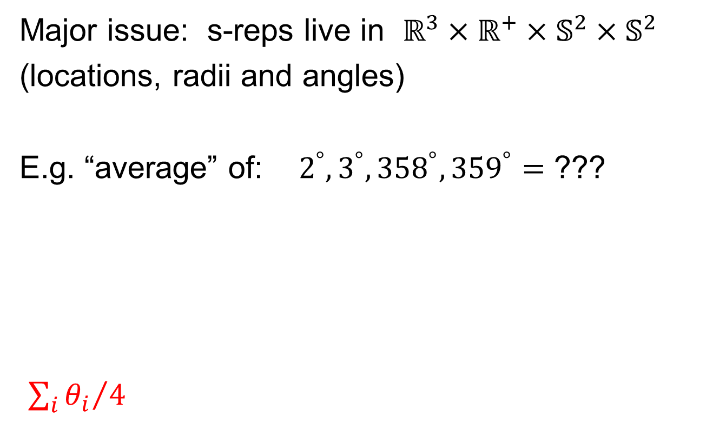
Data Lying On a Manifold
Major issue: s-reps live in $ℝ^{3}×ℝ^{+}×𝕊^{2}×𝕊^{2}$
(locations, radii and angles)
E.g. “average” of: $2^{°}, 3^{°}, {358}^{°}, {359}^{°}=$ ???
${\sum_{i}{θ_{i}}}/4$
x
x
x
x

Slide 53
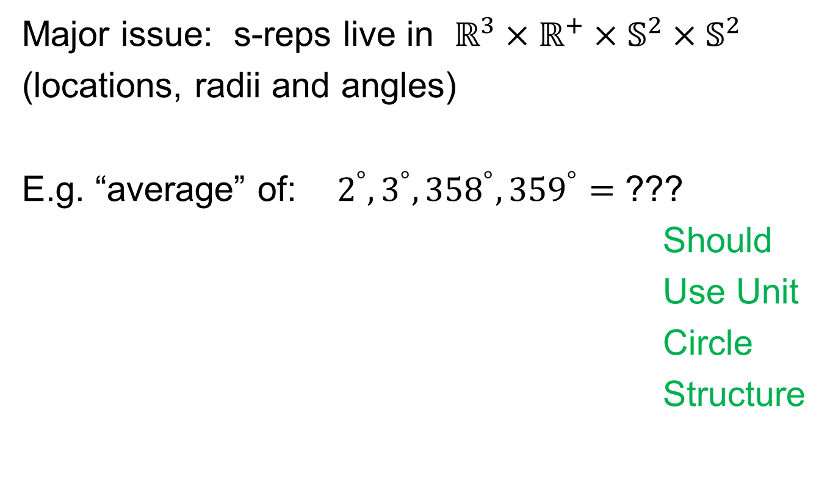
Data Lying On a Manifold
Major issue: s-reps live in $ℝ^{3}×ℝ^{+}×𝕊^{2}×𝕊^{2}$
(locations, radii and angles)
E.g. “average” of: $2^{°}, 3^{°}, {358}^{°}, {359}^{°}=$ ???
Should
Use Unit
Circle
Structure
x
x
x
x

Slide 54
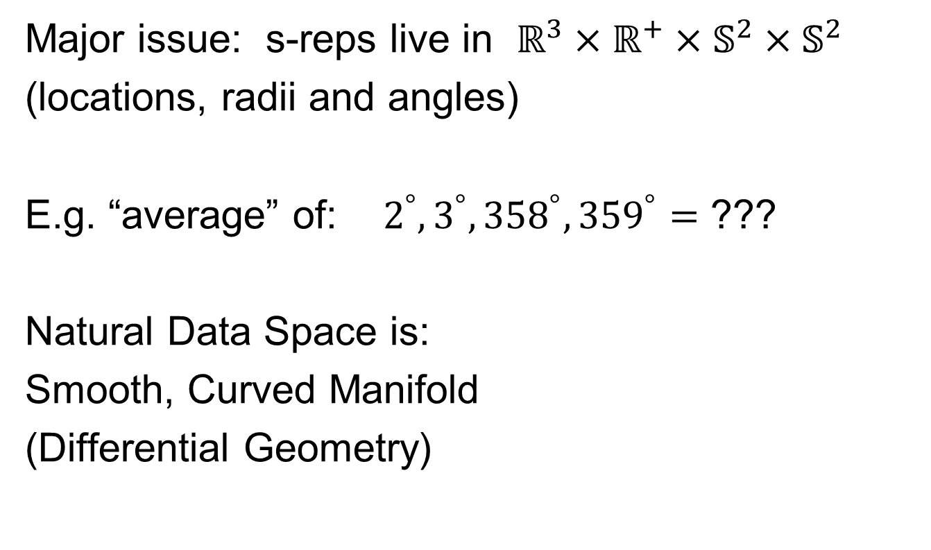
Data Lying On a Manifold
Major issue: s-reps live in $ℝ^{3}×ℝ^{+}×𝕊^{2}×𝕊^{2}$
(locations, radii and angles)
E.g. “average” of: $2^{°}, 3^{°}, {358}^{°}, {359}^{°}=$ ???
Natural Data Space is:
Smooth, Curved Manifold
(Differential Geometry)

Slide 55
Manifold Object Spaces
Standard Statistical Example:
Directional Data (aka Circular Data)
Idea: Angles as Data Objects
Wind Directions
Magnetic Compass Headings
Cracks in Mines
Text, Sec. 8.1

Slide 56
Manifold Object Spaces
Standard Statistical Example:
Directional Data (aka Circular Data)
Classical References:
Mardia & Jupp (2009), Fisher (1995),
Jammalamadaka & Sen Gupta (2001)

Slide 57
Manifold Object Spaces
Standard Statistical Example:
Directional Data (aka Circular Data)
Reasonable View:
Points on Unit Circle

Slide 58
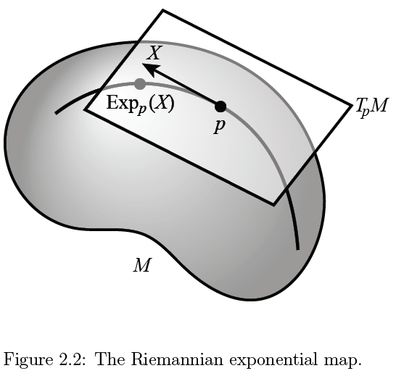
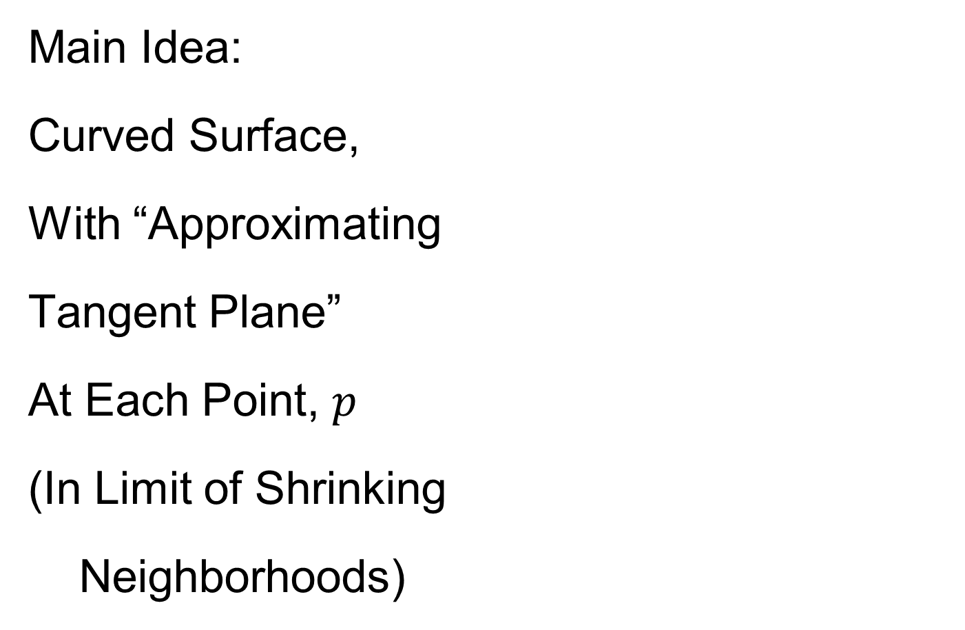
Manifold Object Spaces
Main Idea:
Curved Surface,
With “Approximating
Tangent Plane”
At Each Point, $p$
(In Limit of Shrinking
Neighborhoods)
Text, Sec. 8.2

Slide 59

Manifold Object Spaces
Important Mappings:
Plane → Surface:
$\exp_{p}$

Slide 60
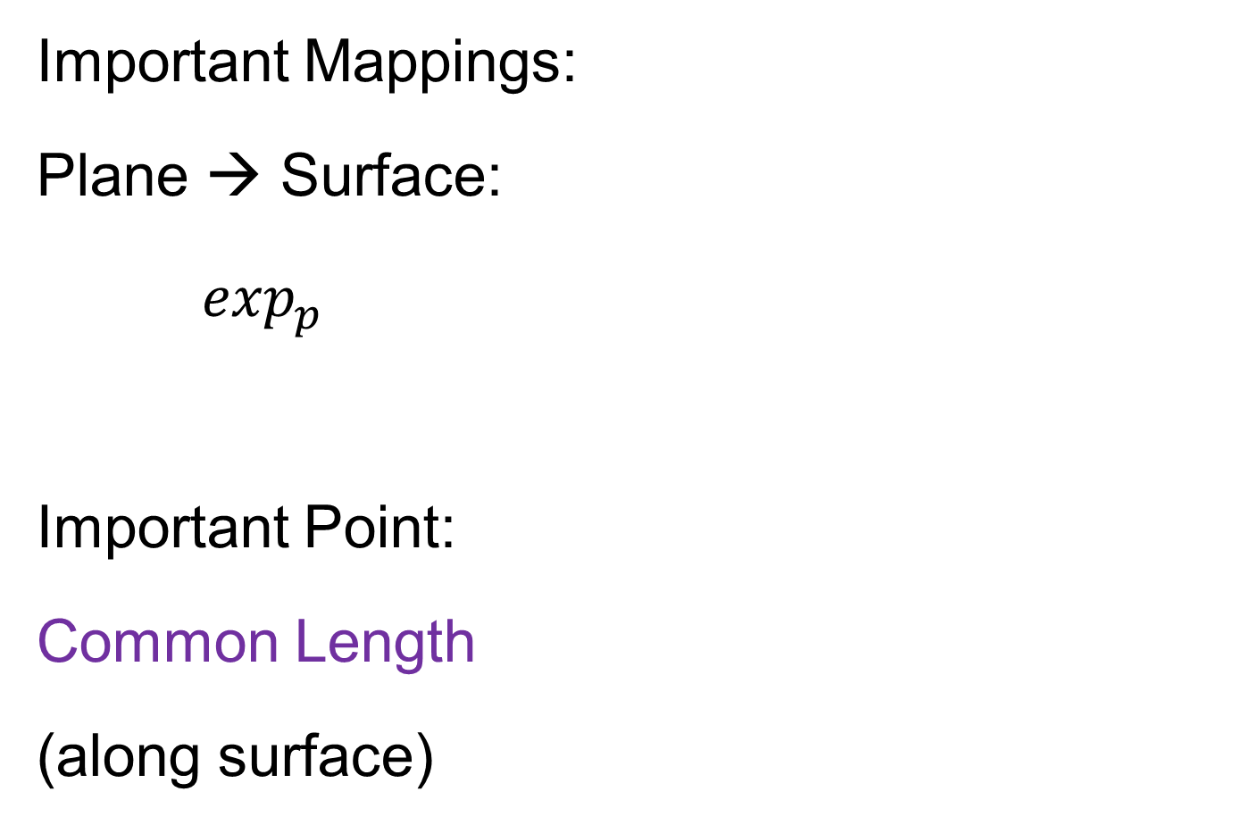
Manifold Object Spaces
Important Mappings:
Plane → Surface:
$\exp_{p}$
Important Point:
Common Length
(along surface)

Slide 61

Manifold Object Spaces
Important Mappings:
Plane → Surface:
$\exp_{p}$
Surface → Plane
$\log_{p}$

Slide 62
Manifold Object Spaces
Log & Exp Memory Device:
Complex Numbers
Exponential:
Tangent Plane → Manifold
(Note: Common Length)

Slide 63
Manifold Object Spaces
Log & Exp Memory Device:
Complex Numbers
Exponential:
Tangent Plane → Manifold
Logarithm:
Manifold → Tangent Plane

Slide 64
Manifold Object Spaces
Important Mappings:
Plane → Surface:
$\exp_{p}$
Surface → Plane
$\log_{p}$
(matrix versions)

Slide 65

Manifold Object Spaces
Natural Choice of $p$
For Data Analysis
A “Centerpoint”
Hard To Use:
$\overline{X}=\frac{1}{n}\sum_{i=1}^{n}{X_{i}}$

Slide 66

Manifold Object Spaces
Extrinsic Centerpoint
Compute:
$\overline{X}=\frac{1}{n}\sum_{i=1}^{n}{X_{i}}$
Anyway
And Project Back
To Manifold

Slide 67
Manifold Object Spaces
Intrinsic Centerpoint
Work “Really
Inside” The
Manifold

Slide 68
Manifold Object Spaces
Recall Useful Center in Metric Spaces
Fréchet Mean
Fréchet (1948)
Works in Any Metric Space (e.g. Manifolds)

Slide 69
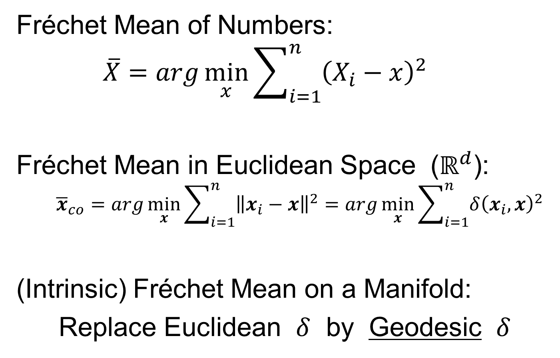
Manifold Object Spaces
Fréchet Mean of Numbers:
$$\overline{X}=arg\min_{x}{\sum_{i=1}^{n}{{\left(X_{i}−x\right)}^{2}}}$$
Fréchet Mean in Euclidean Space ($ℝ^{d}$):
$${\overline{x}}_{co}=arg\min_{x}{\sum_{i=1}^{n}{{\left\|x_{i}−x\right\|}^{2}}}=arg\min_{x}{\sum_{i=1}^{n}{{δ\left(x_{i},x\right)}^{2}}}$$
(Intrinsic) Fréchet Mean on a Manifold:
Replace Euclidean $δ$ by Geodesic $δ$

Slide 70
Manifold Object Spaces
Geodesics:
Idea:
March Along Manifold Without Turning
(Defined in Tangent Planes)

Slide 71
Manifold Object Spaces
Geodesics:
Idea:
March Along Manifold Without Turning
(Defined in Tangent Planes)
E.g. Surface of the Earth: Great Circle
E.g. Lines of Longitude (Not Latitude…)

Slide 72
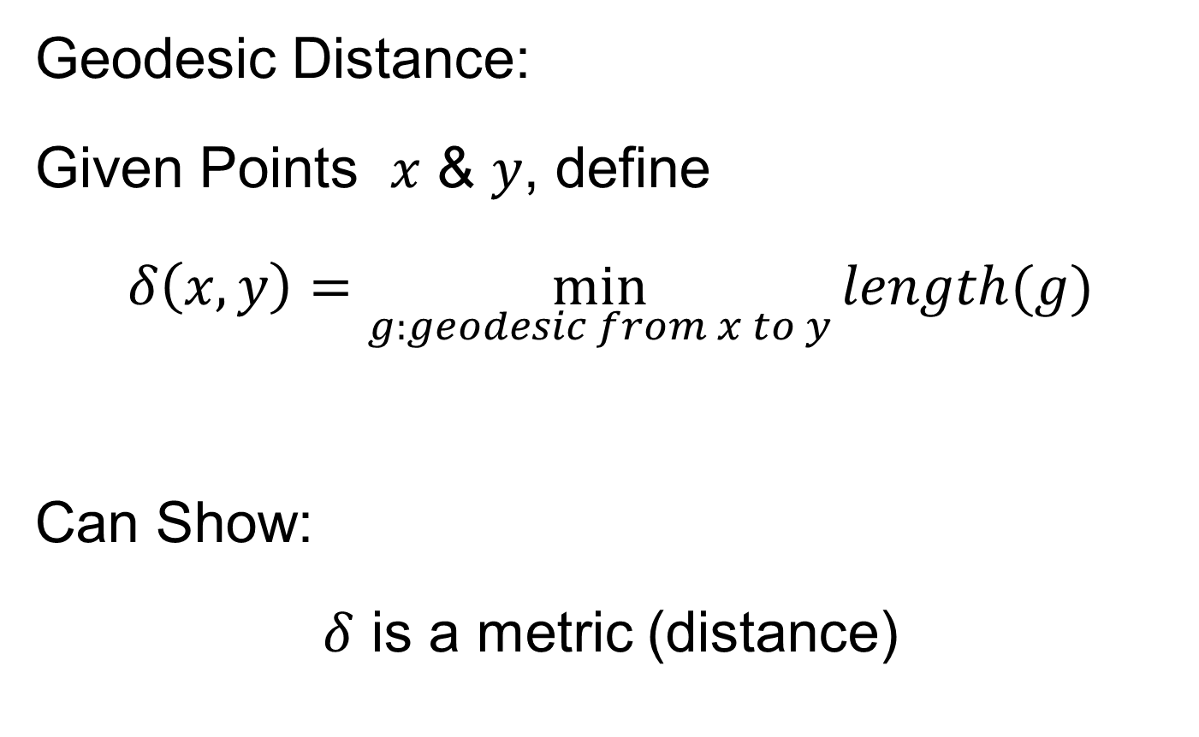
Manifold Object Spaces
Geodesic Distance:
Given Points $x$ & $y$, define
$$δ\left(x,y\right)=\min_{g:geodesic from x to y}{length(g)}$$
Can Show:
$δ$ is a metric (distance)

Slide 73
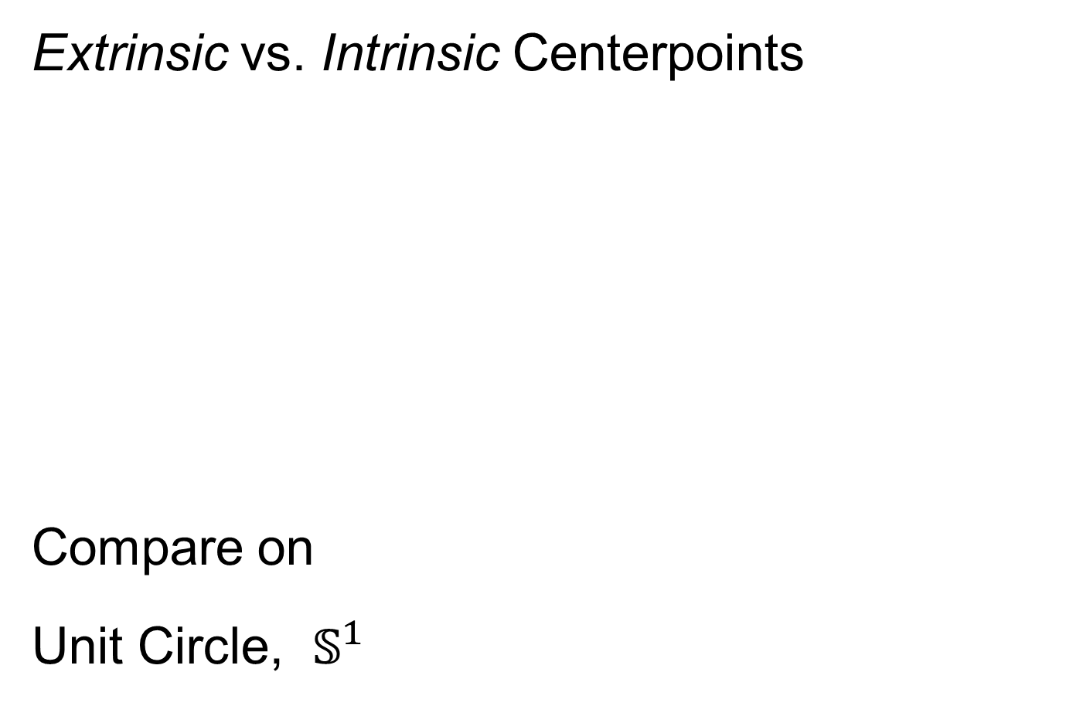
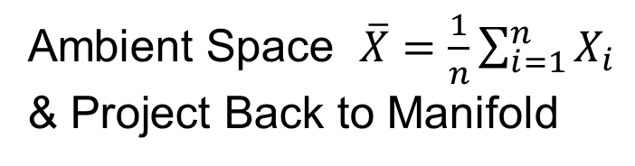
Manifold Object Spaces
Extrinsic vs. Intrinsic Centerpoints
Compare on
Unit Circle, $𝕊^{1}$
Ambient Space $\overline{X}=\frac{1}{n}\sum_{i=1}^{n}{X_{i}}$
& Project Back to Manifold
E.g. Fréchet Mean

Slide 74
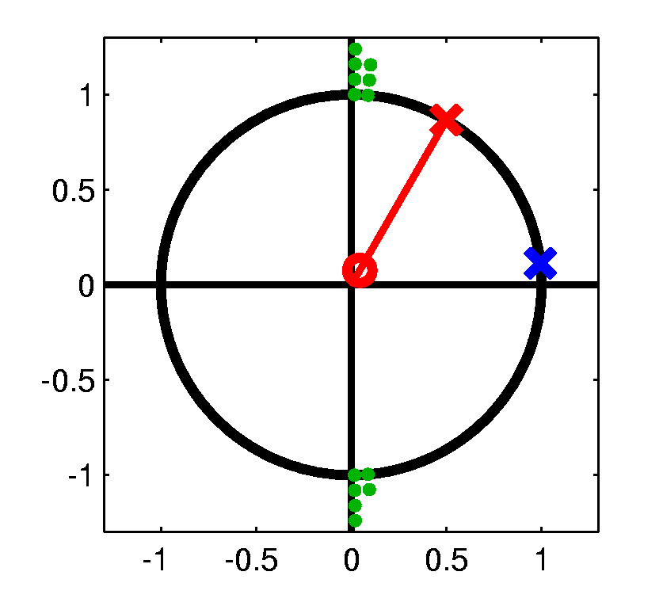
Manifold Object Spaces
Extrinsic vs. Intrinsic Centerpoints
Often Similar
Note Big Difference!
Which is Better?

Slide 75
Manifold Object Spaces
Extrinsic vs. Intrinsic Centerpoints
Which is Better?
Intrinsic “More Like Mean”?
Intrinsic More Stable
Shifting a Green Down
Extrinsic More Stable
Shifting Greens Left

Slide 76
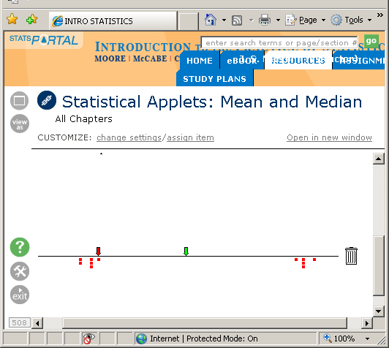

Manifold Object Spaces
Extrinsic vs. Intrinsic Centerpoints
Which is Better?
Problem as Hard as
“Center” of Bimodal
Distribution in $ℝ^{1}$
Median
Mean

Slide 77
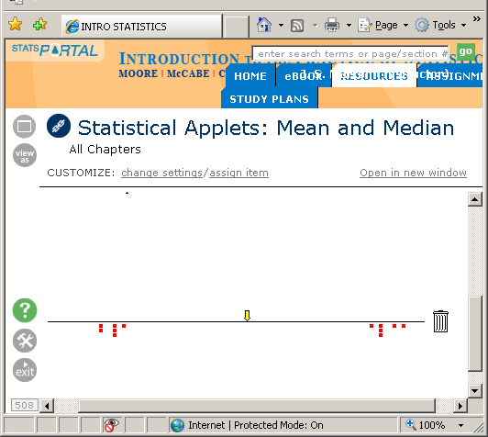
Manifold Object Spaces
Extrinsic vs. Intrinsic Centerpoints
Which is Better?
Problem as Hard as
“Center” of Bimodal
Distribution in $ℝ^{1}$

Slide 78

Manifold Object Spaces
Extrinsic vs. Intrinsic Centerpoints
Which is Better?
Problem as Hard as
“Center” of Bimodal
Distribution in $ℝ^{1}$

Slide 79
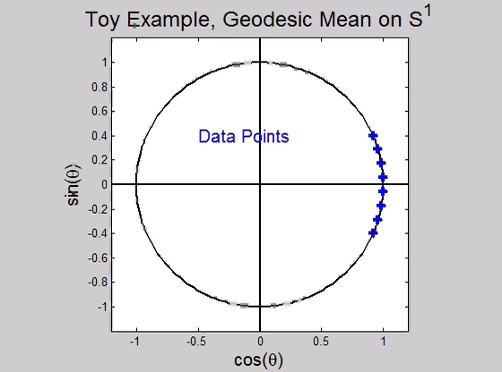
Manifold Object Spaces
Directional Data Examples of Fréchet Mean:
Not always easily interpretable

Slide 80
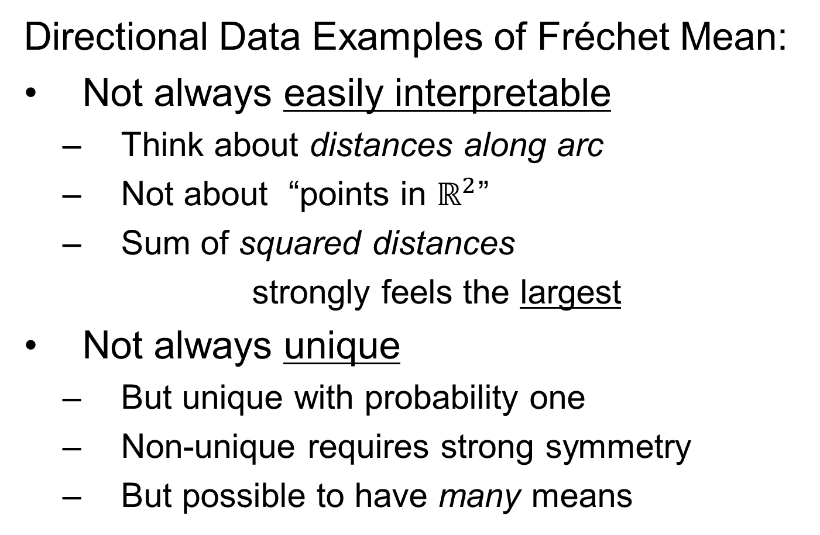
Manifold Object Spaces
Directional Data Examples of Fréchet Mean:
Not always easily interpretable
  Think about distances along arc
  Not about “points in $ℝ^{2}$”
  Sum of squared distances
  strongly feels the largest
Not always unique
  But unique with probability one
  Non-unique requires strong symmetry
  But possible to have many means

Slide 81
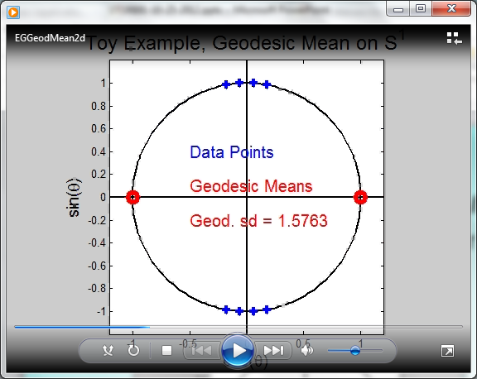
Manifold Object Spaces
Directional Data Examples of Fréchet Mean:
Not always sensible notion of center

Slide 82
Manifold Object Spaces
Directional Data Examples of Fréchet Mean:
Not always sensible notion of center
  Sometimes prefer top & bottom?
  At end: farthest points from data
Not continuous Function of Data
  Jump from 1 – 2
  Jump from 2 – 8
All False for Euclidean Mean
But all happen generally for Manifold Data
(for positively curved space)

Slide 83
Manifold Object Spaces
Notions of Center on Manifolds:
“Extrinsic” vs. “Intrinsic”
“Every Dog has Its Day”
For Further Discussion, See:
Patrangenaru & Ellingson (2016)

Slide 84
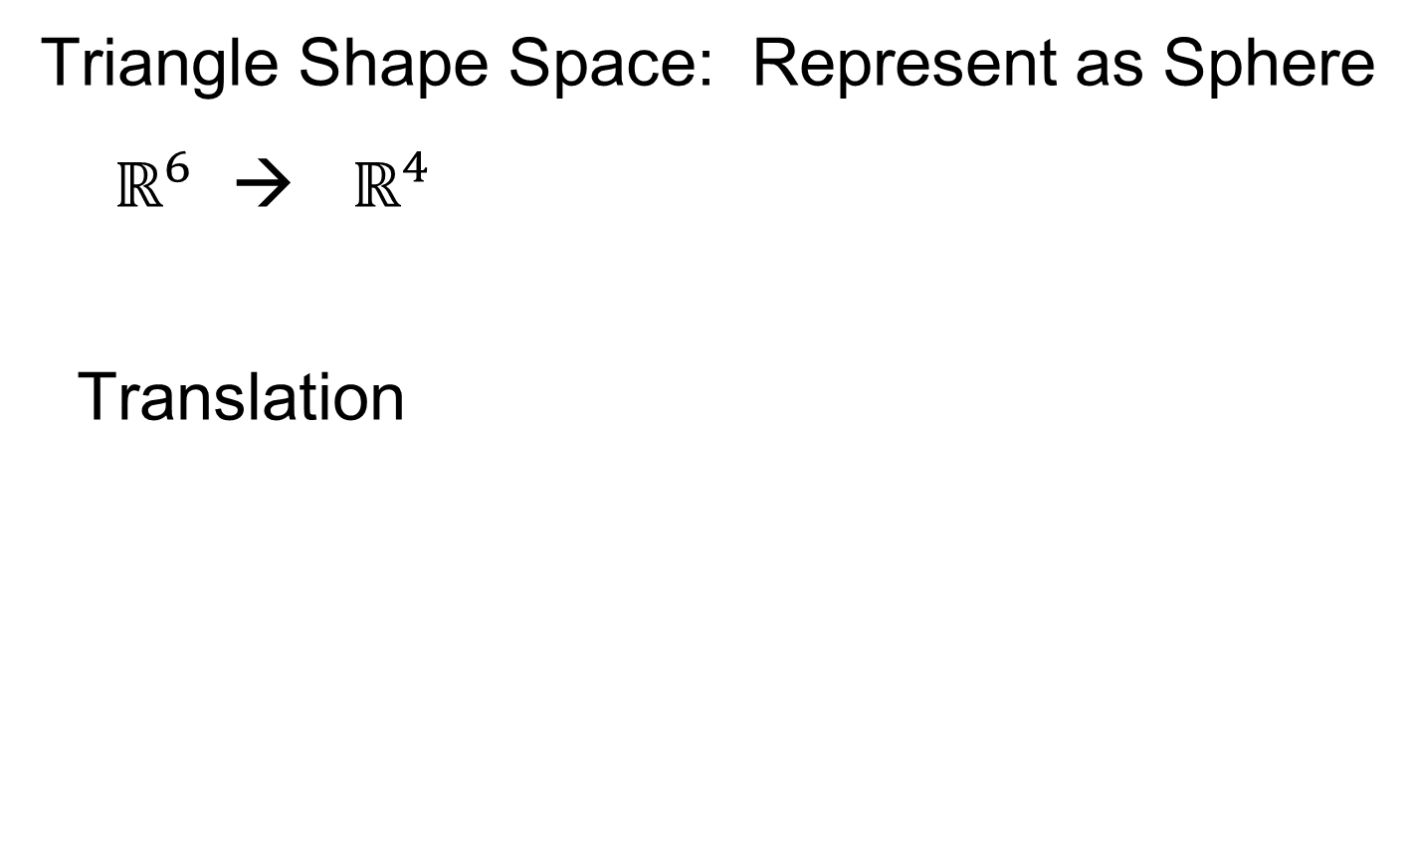
Manifold Object Spaces
Directional Data Examples of Fréchet Mean:
Also of interest is Fréchet Variance:
$${\hat{σ}}^{2}=\min_{\underline{x}}{\frac{1}{n}\sum_{i=1}^{n}{{d\left({\underline{X}}_{i},\underline{x}\right)}^{2}}}$$
Works like Euclidean sample variance
Note values in movie, reflecting spread in data
Note theoretical version:
$$σ^{2}=\min_{\underline{x}}{E_{\underline{X}}}{d\left(\underline{X},\underline{x}\right)}^{2}$$
Useful for Laws of Large Numbers, etc.

Slide 85
PCA for s-reps
Text: Sec. 8.3
PCA on manifold spaces?
(e.g. on Lie Groups / Symmetric Spaces)
T. Fletcher: Principal Geodesic Analysis
(2004 UNC CS PhD Dissertation
& Fletcher et al. (2004))

Slide 86
PCA for s-reps
PCA on manifold spaces?
(e.g. on Lie Groups / Symmetric Spaces)
T. Fletcher: Principal Geodesic Analysis
Idea: replace “linear summary of data”
With “geodesic summary of data”…

Slide 87

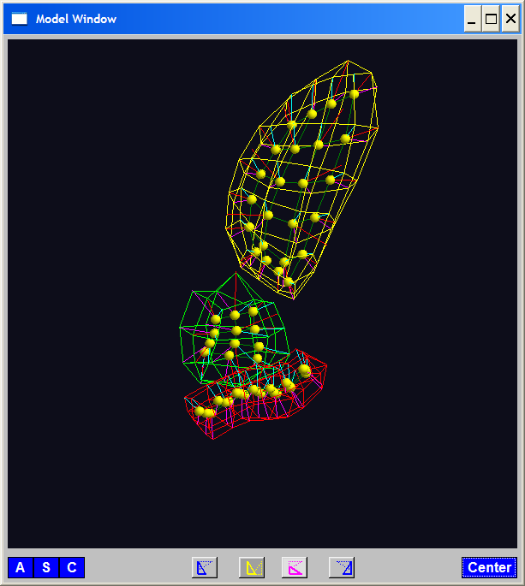
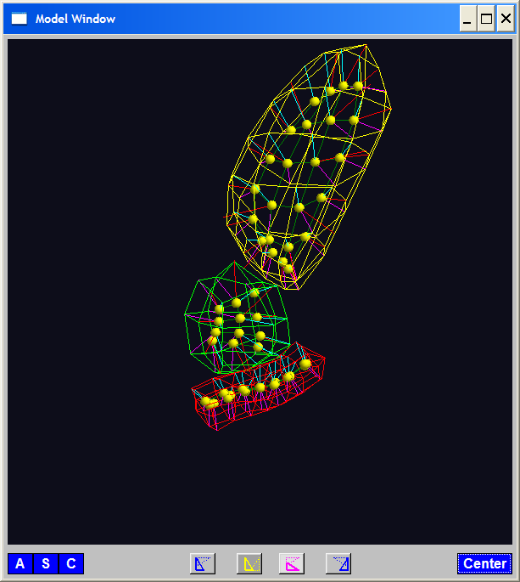
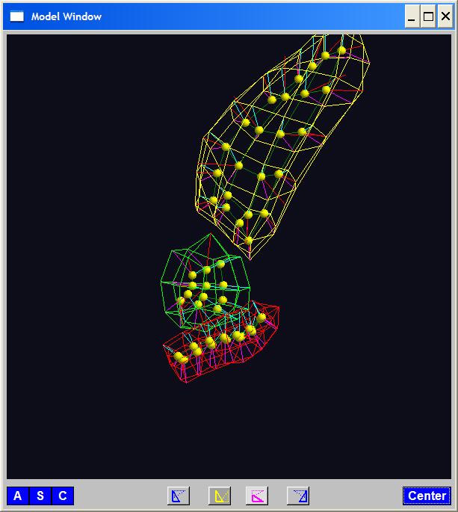
PGA for s-reps, Bladder-Prostate-Rectum
Bladder – Prostate – Rectum, 1 person, 17 days
PG 1 PG 2 PG 3
(analysis by Ja Yeon Jeong)

Slide 88
PGA for s-reps, Bladder-Prostate-Rectum
Bladder – Prostate – Rectum, 1 person, 17 days
PG 1 PG 2 PG 3
(analysis by Ja Yeon Jeong)

Slide 89
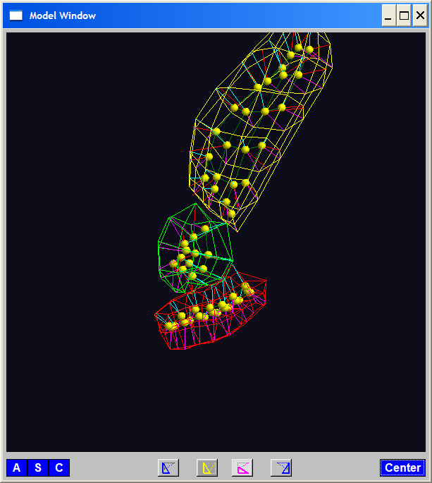
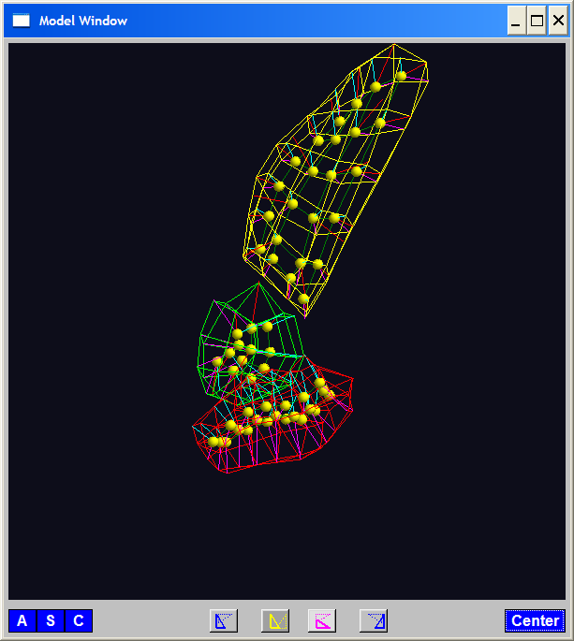

PGA for s-reps, Bladder-Prostate-Rectum
Bladder – Prostate – Rectum, 1 person, 17 days
PG 1 PG 2 PG 3
(analysis by Ja Yeon Jeong)

Slide 90

PCA Extensions for Data on Manifolds
Fletcher (Principal Geodesic Anal.)
  Best fit of geodesic to data

Slide 91
PCA Extensions for Data on Manifolds
Fletcher (Principal Geodesic Anal.)
  Best fit of geodesic to data
  Constrained to go through geodesic mean

Slide 92


PCA Extensions for Data on Manifolds
Fletcher (Principal Geodesic Anal.)
  Best fit of geodesic to data
  Constrained to go through geodesic mean
Happens
Naturally
in $ℝ^{d}$
Mean
Contained
in Best
Fit Line

Slide 93
Participant Presentation
Max van Fleet
Dimension Reduction of PDAL data

