Slide 1
Statistics – O. R. 881
Object Oriented Data Analysis
Steve Marron
Dept. of Statistics and Operations Research
University of North Carolina

Slide 2
Current Sections in Textbook
Today:
Section 8.6
Next Class:
Section 8.7, 7.3.5, 10.1.2, 8.5, 9.1

Slide 3
Last Class: Skeletal Repr’ns
Main Idea:
Represent Objects as:
Discretized skeletons (medial atoms)
Plus spokes from center to edge
Which imply a boundary
Very accessible early reference:
Yushkevich, et al (2001)
Volume Gives Better Representation
In 3d than Boundary Surface

Slide 4
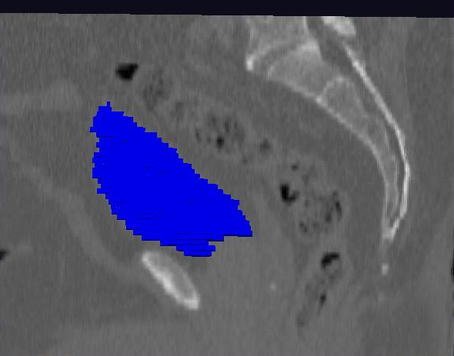
Last Class: Male Pelvis
Bladder:
manual segmentation
Slice by slice
Reassembled

Slide 5
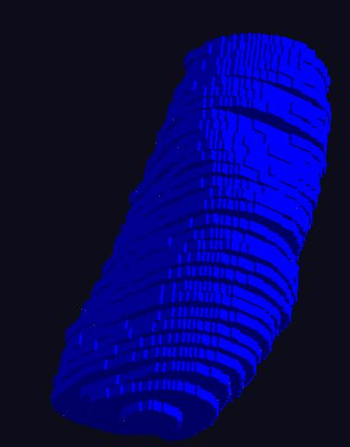
Last Class: Male Pelvis
Bladder:
Slices:
Reassembled in 3d
How to represent?
Thanks: Ja-Yeon Jeong
Called Binary
Representation

Slide 6
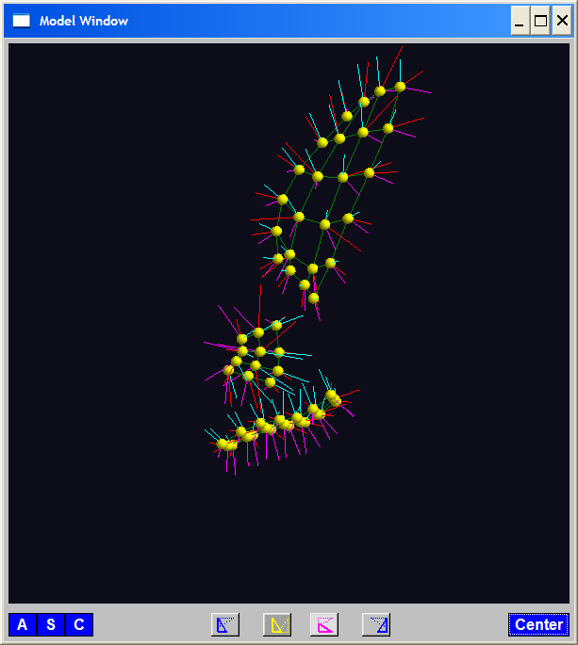
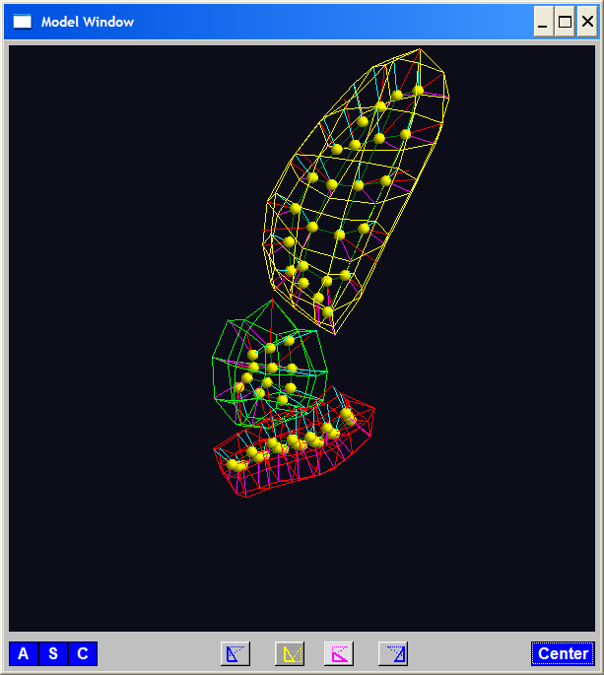
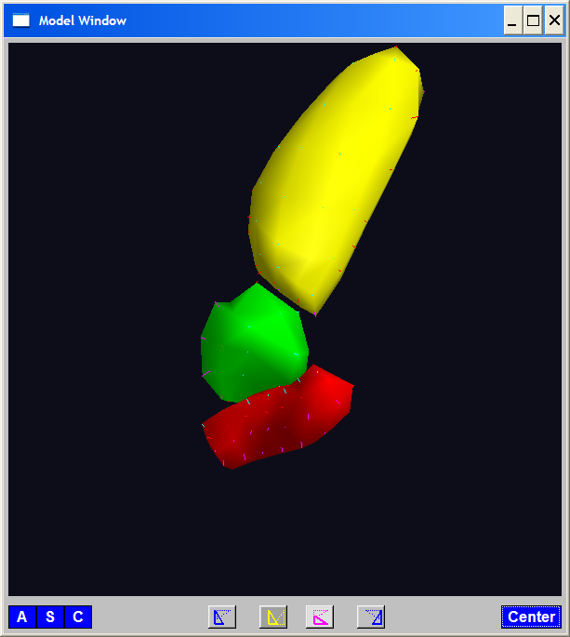
Last Class: Skeletal Repr’ns
3-d S-Rep Example: From Ja-Yeon Jeong
Bladder – Prostate - Rectum
Atoms - Spokes - Implied Boundary
Notes:
OODA.ppt

Slide 7
Last Class: 3-d s-reps
S-rep model fitting
Easy, when starting from binary (blue)
But very expensive (30 – 40 minutes technician’s time)
Want automatic approach
Challenging, because of poor contrast, noise, …
Need to borrow information across training sample
Use Bayes approach: prior & likelihood → posterior
~Conjugate Gaussians, but there are issues:
  Major HLDSS challenges
  Manifold aspect of data
Handle With Variation on PCA
Careful Handling Very Useful

Slide 8
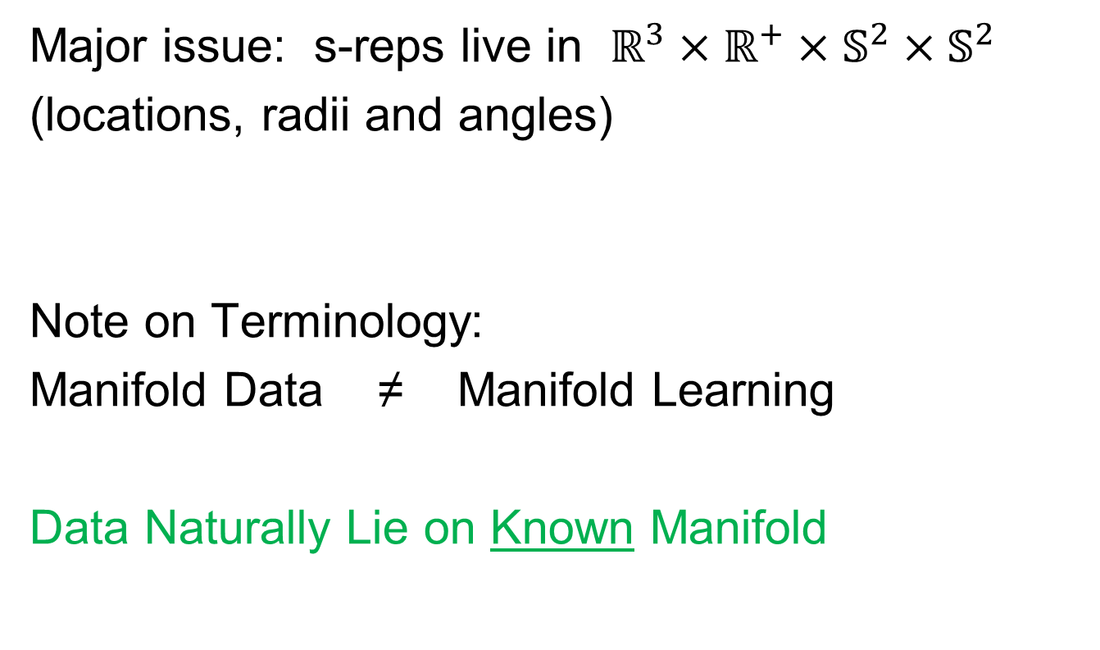
Last Class: Manifold Data
Major issue: s-reps live in $ℝ^{3}×ℝ^{+}×𝕊^{2}×𝕊^{2}$
(locations, radii and angles)
Note on Terminology:
Manifold Data ≠ Manifold Learning
Data Naturally Lie on Known Manifold

Slide 9
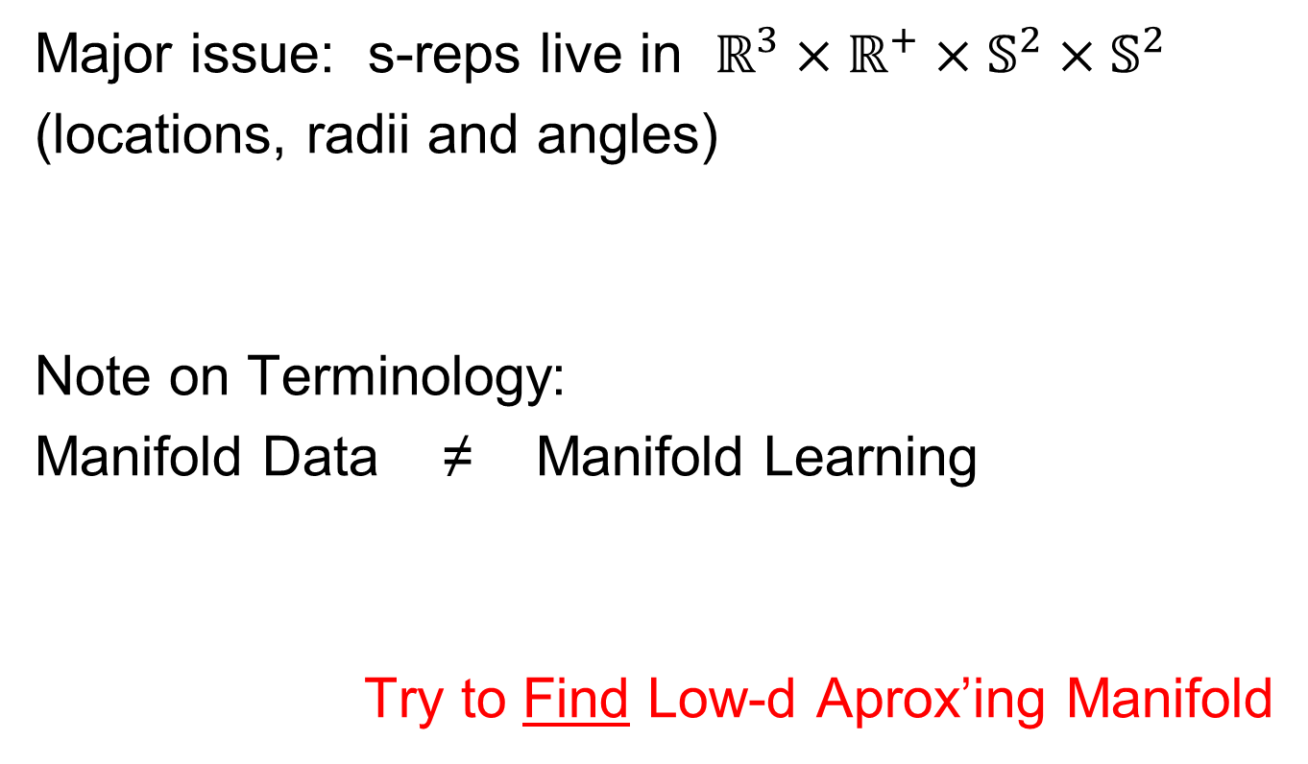
Last Class: Manifold Data
Major issue: s-reps live in $ℝ^{3}×ℝ^{+}×𝕊^{2}×𝕊^{2}$
(locations, radii and angles)
Note on Terminology:
Manifold Data ≠ Manifold Learning
Try to Find Low-d Aprox’ing Manifold

Slide 10
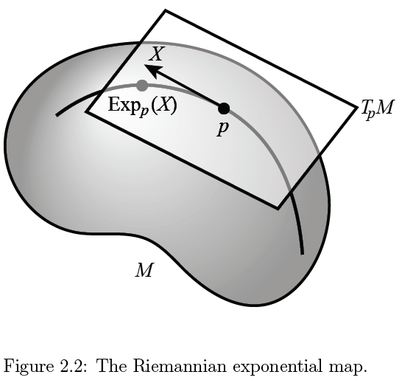
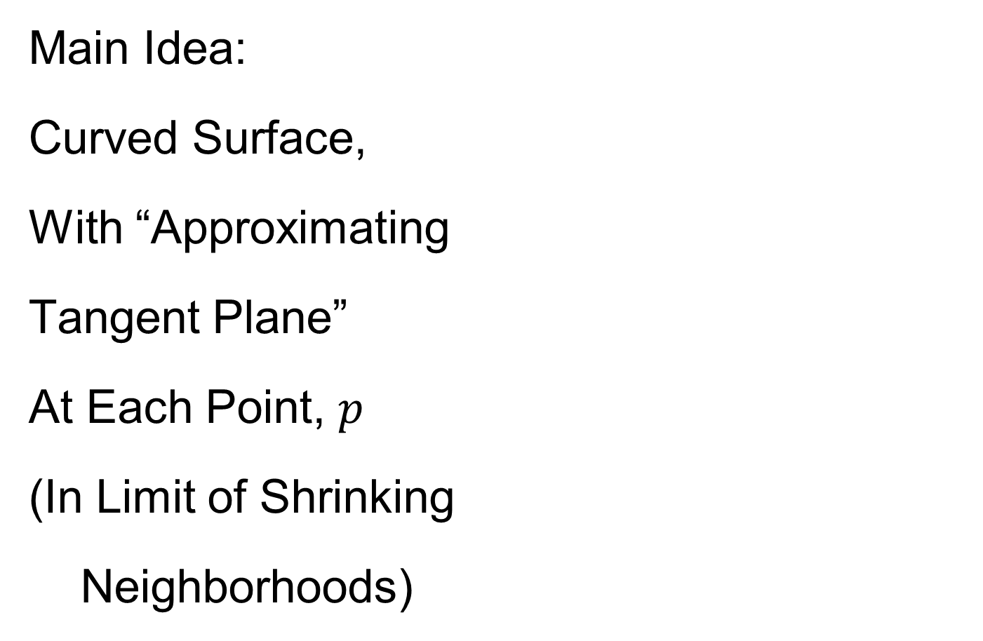
Last Class: Manifold Feature Spaces
Main Idea:
Curved Surface,
With “Approximating
Tangent Plane”
At Each Point, $p$
(In Limit of Shrinking
Neighborhoods)

Slide 11

Last Class: Manifold Feature Spaces
Important Mappings:
Plane → Surface:
$\exp_{p}$
Surface → Plane
$\log_{p}$

Slide 12
Last Class: Manifold Feature Spaces
Log & Exp Memory Device:
Complex Numbers
Exponential:
Tangent Plane → Manifold
Logarithm:
Manifold → Tangent Plane

Slide 13
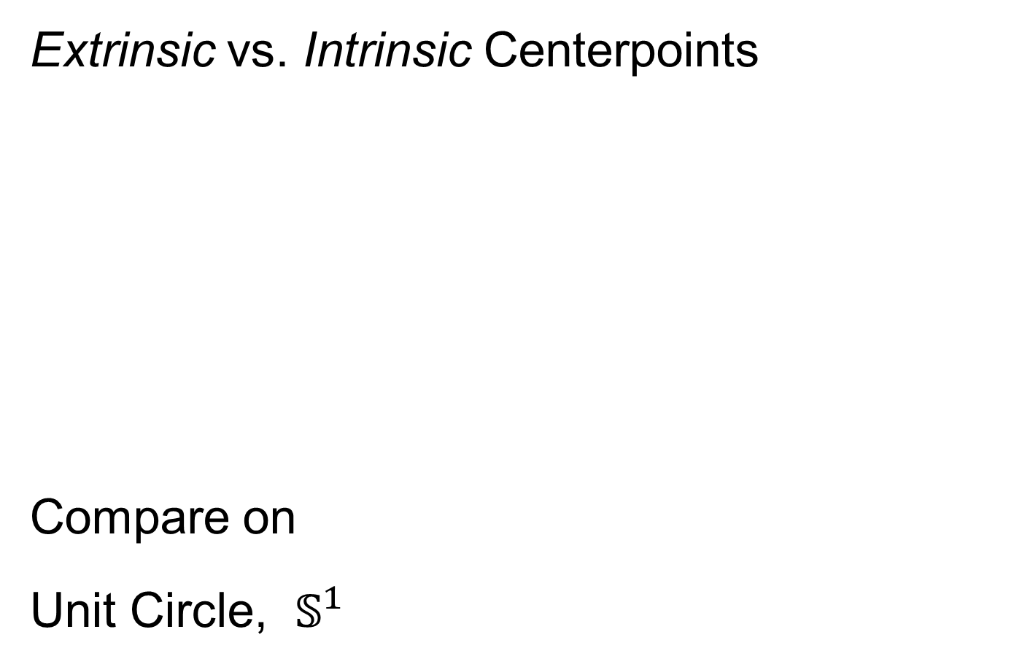
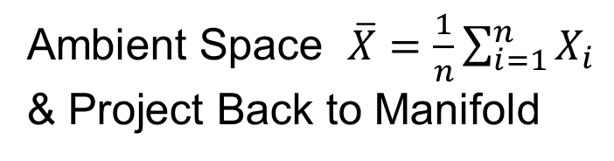
Last Class: Manifold Feature Spaces
Extrinsic vs. Intrinsic Centerpoints
Compare on
Unit Circle, $𝕊^{1}$
Ambient Space $\overline{X}=\frac{1}{n}\sum_{i=1}^{n}{X_{i}}$
& Project Back to Manifold
E.g. Fréchet Mean

Slide 14
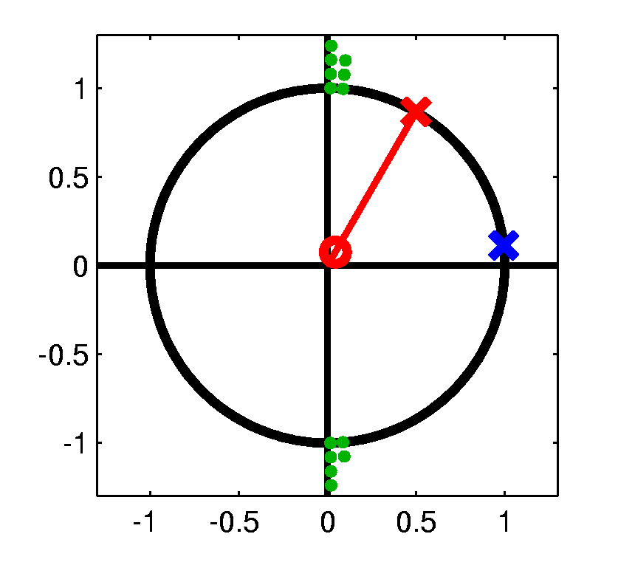
Last Class: Manifold Feature Spaces
Extrinsic vs. Intrinsic Centerpoints
Often Similar
Note Big Difference!
Which is Better?

Slide 15
Last Class: PCA for s-reps
PCA on manifold spaces?
(e.g. on Lie Groups / Symmetric Spaces)
T. Fletcher: Principal Geodesic Analysis
Idea: replace “linear summary of data”
With “geodesic summary of data”…

Slide 16
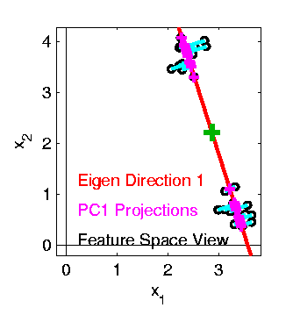

Last Class: PCA on Manifolds
Fletcher (Principal Geodesic Anal.)
  Best fit of geodesic to data
  Constrained to go through geodesic mean
Happens
Naturally
in $ℝ^{d}$
Mean
Contained
in Best
Fit Line

Slide 17
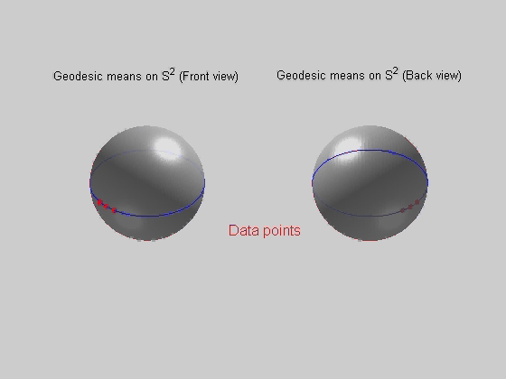
PCA Extensions for Data on Manifolds
Fletcher (Principal Geodesic Anal.)
  Best fit of geodesic to data
  Constrained to go through geodesic mean
Extreme
3 Point
Examples
Equator is Best Fitting Geodesic in All Frames
Yet Fréchet Mean(s) Often Far Away
By Sungkyu Jung

Slide 18
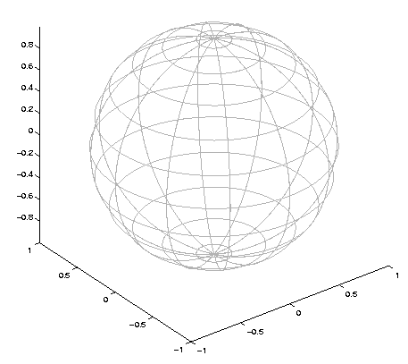

Challenge for Principal Geodesic Analysis
Data
On $𝕊^{2}$
(Sphere)
Scattered
Along
Equator
Somehow
Single
Mode of
Variation

Slide 19

Challenge for Principal Geodesic Analysis
Data
On $𝕊^{2}$
Geodesic
Mean(s)

Slide 20

Challenge for Principal Geodesic Analysis
Data
On $𝕊^{2}$
Geodesic
Mean(s)
Tangent Plane

Slide 21

Challenge for Principal Geodesic Analysis
Data
On $𝕊^{2}$
Geodesic
Mean(s)
Tangent Plane
Projections ($log$)
Requires 2
Modes of
Variation

Slide 22
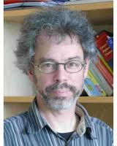
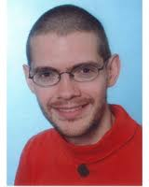

PCA Extensions for Data on Manifolds
Fletcher (Principal Geodesic Anal.)
  Best fit of geodesic to data
  Constrained to go through geodesic mean
Huckemann, Hotz & Munk (Geod. PCA)
Huckemann et al (2010)

Slide 23
PCA Extensions for Data on Manifolds
Fletcher (Principal Geodesic Anal.)
  Best fit of geodesic to data
  Constrained to go through geodesic mean
Huckemann, Hotz & Munk (Geod. PCA)
  Best fit of any geodesic to data

Slide 24
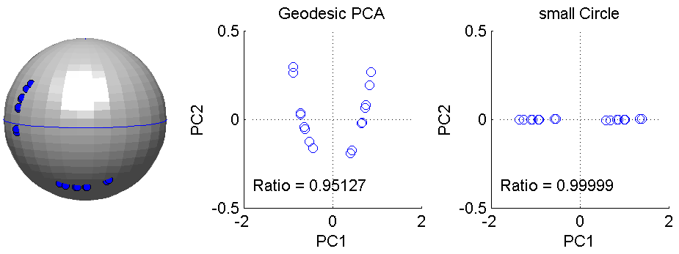
PCA Extensions for Data on Manifolds
Fletcher (Principal Geodesic Anal.)
  Best fit of geodesic to data
  Constrained to go through geodesic mean
Huckemann, Hotz & Munk (Geod. PCA)
  Best fit of any geodesic to data
Counterexample:
Data follows Tropic of Capricorn
Realizations of Spoke in
Blad.-Prost.-Rect. Simulator

Slide 25
PCA Extensions for Data on Manifolds
Fletcher (Principal Geodesic Anal.)
  Best fit of geodesic to data
  Constrained to go through geodesic mean
Huckemann, Hotz & Munk (Geod. PCA)
  Best fit of any geodesic to data
Jung, Foskey & Marron (Princ. Arc Anal.)
Jung et al (2011)

Slide 26
PCA Extensions for Data on Manifolds
Fletcher (Principal Geodesic Anal.)
  Best fit of geodesic to data
  Constrained to go through geodesic mean
Huckemann, Hotz & Munk (Geod. PCA)
  Best fit of any geodesic to data
Jung, Foskey & Marron (Princ. Arc Anal.)
  Best fit of any circle to data
  (motivated by conformal maps)

Slide 27
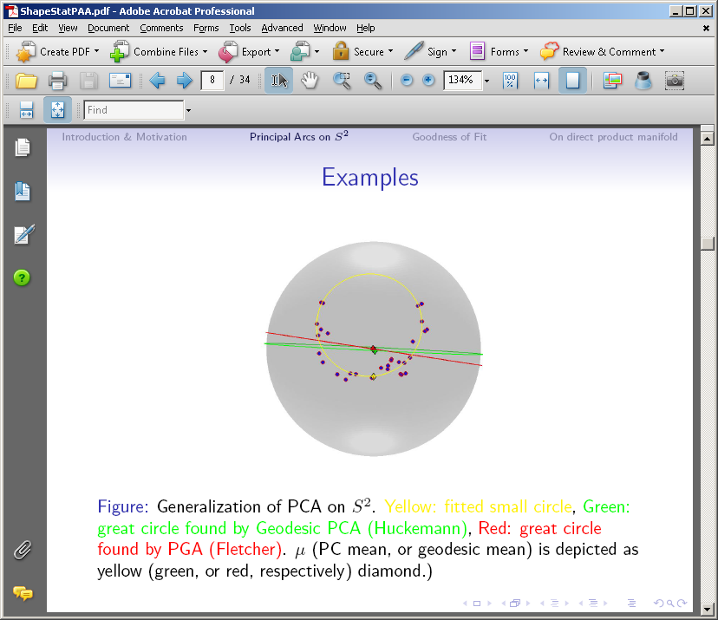

PCA Extensions for Data on Manifolds
Note:
“Backwards
Mean” of $𝕊^{1}$
Projections
Gives Better
“Center”
“Bad” Since
Require 2
Modes to
Represent
Data

Slide 28
Principal Arc Analysis
Jung, Foskey & Marron (2011)
  Best fit of any circle to data
  Can give better fit than geodesics

Slide 29
Principal Arc Analysis
Jung, Foskey & Marron (2011)
  Best fit of any circle to data
  Can give better fit than geodesics
  Observed for simulated s-rep example

Slide 30

Important Challenge
Interesting
Results:
Kim (2018)

Slide 31

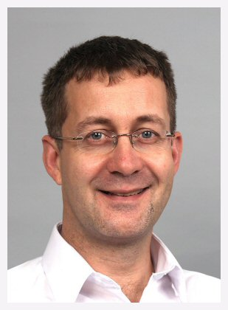

Principal Nested Spheres
Main Goal:
Extend Principal Arc Analysis ($𝕊^{2}$ to $𝕊^{k}$)
Jung, Dryden & Marron (2012)

Slide 32

Principal Nested Spheres
Main Goal:
Extend Principal Arc Analysis ($𝕊^{2}$ to $𝕊^{k}$)

Slide 33


Principal Nested Spheres
Jung et al (2012)
Context:
$d$ – dim
Sphere
(in $ℝ^{d+1}$)
$$𝕊^{d}$$

Slide 34

Principal Nested Spheres
For data $∈𝕊^{d}$
Consider an
$𝕊^{d−1}$ for a
“Rank $d−1$
Approxi’n”
$$𝕊^{d}$$
Determined by a Slicing Plane

Slide 35
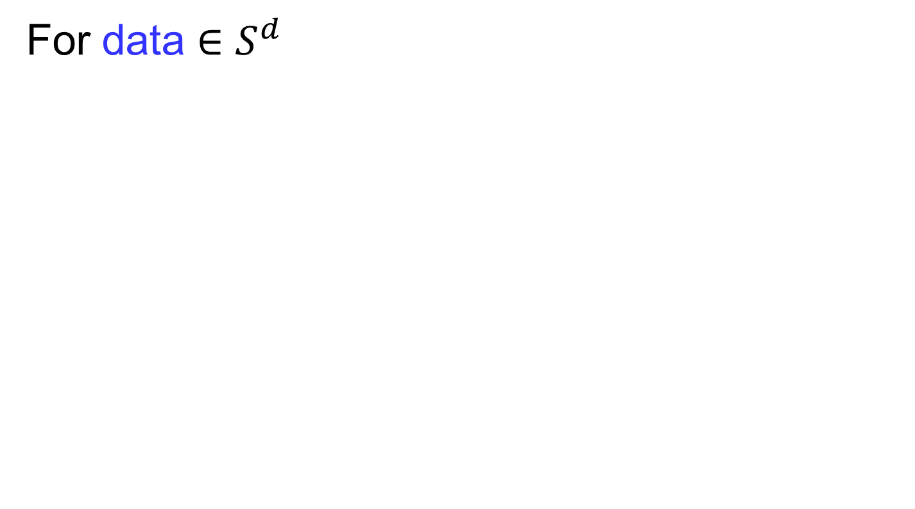

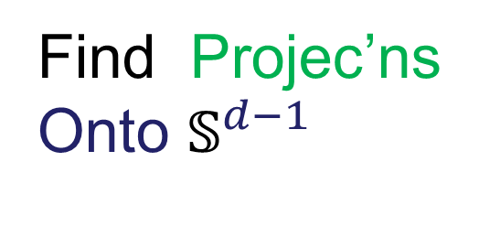
Principal Nested Spheres
For data $∈𝕊^{d}$
Find Projec’ns
Onto $𝕊^{d−1}$
$$𝕊^{d}$$
Along Surface (Geodesic Distance)

Slide 36

Principal Nested Spheres
Move plane
To Minimize
$\sum_{i}{{resid}_{i}^{2}}$
Keep signed
${resid}_{i}$ as
PNS-$d$ scores
$$𝕊^{d}$$
And Projections as Rank $d−1$ Approximations

Slide 37


Principal Nested Spheres
Now consider
Projections
As Data in
Subsphere
$𝕊^{d−1}$
Repeat for
PNS $d−1$
Scores
$$𝕊^{d−1}$$

Slide 38

Principal Nested Spheres
Revisit Notion of “Centerpoint”
Data Distributed
Around Equator
Recall Earlier $𝕊^{2}$ Example

Slide 39
Principal Nested Spheres
Revisit Notion of “Centerpoint”
Geodesic (Fréchet)
Mean(s) at Poles
Poor Notion of
“Center”
Far From All Data

Slide 40

Principal Nested Spheres
Revisit Notion of “Centerpoint”
Improved Notion:
Backwards Mean
Fréchet Mean of
Best Fitting $𝕊^{1}$

Slide 41
Principal Nested Spheres
Revisit Notion of “Centerpoint”
Fréchet Mean =
Center of Mass
PNS Backwards Mean
Stays Nicely in
“Bulk of Data”

Slide 42
Principal Nested Spheres
Modes of Variation:
Recall: 1-d Set
in Object Space
Giving Insights
About Variation
E.g. PCA, etc.

Slide 43

Principal Nested Spheres
Modes of Variation:
1st Mode:
Best Fitting $𝕊^{1}$
Recall: Proj’ns, Cont.
Or Discretization

Slide 44
Principal Nested Spheres
2nd Mode is a Line of Longitude,
for this data set,
Since 1st Mode is the Equator
Modes of Variation:
2nd Mode:
Orthogonal Great
Circle Through
Backwards Mean

Slide 45
Landmark Based Shape Analysis
Kendall
Bookstein
Dryden &
Mardia
(recall major monographs)

Slide 46
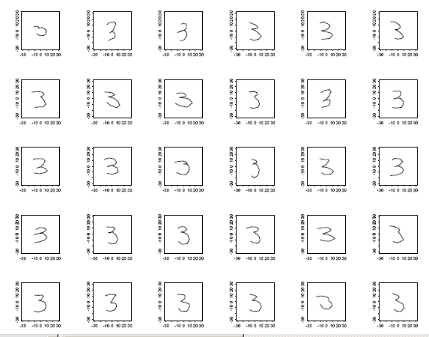
Landmark Based Shape Analysis
Kendall
Bookstein
Dryden &
Mardia
Digit 3 Data
Handwritten (by different people)
Goal: Automatic Recognition
Current Approach: Deep Learning, Early Attempt Was…

Slide 47
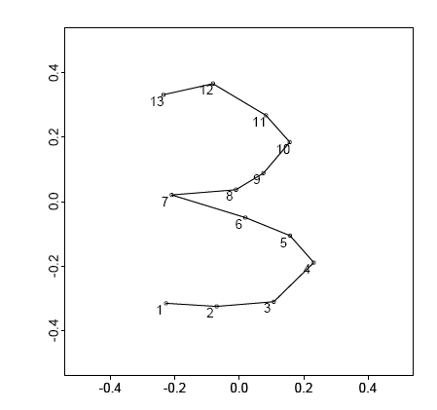
Landmark Based Shape Analysis
Kendall
Bookstein
Dryden &
Mardia
Digit 3 Data
(digitized to 13 landmarks)

Slide 48
Landmark Based Shape Analysis
Kendall
Bookstein
Dryden &
Mardia
Digit 3 Data

Slide 49
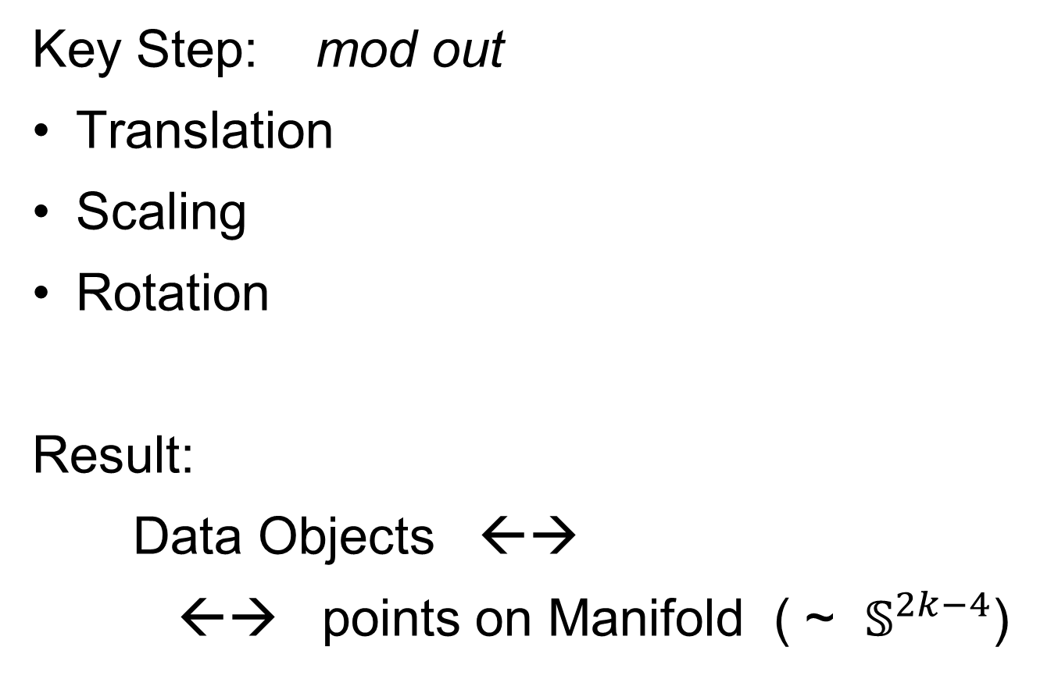

Landmark Based Shape Analysis
Key Step: mod out
Translation
Scaling
Rotation
Result:
Data Objects ←→
←→ points on Manifold ( ~ $𝕊^{2k−4}$)
Interesting Question:
Modes of Variation on $𝕊^{d}$

Slide 50
Digit 3 data: Principal variations of the shape
Recall Data
From Above

Slide 51
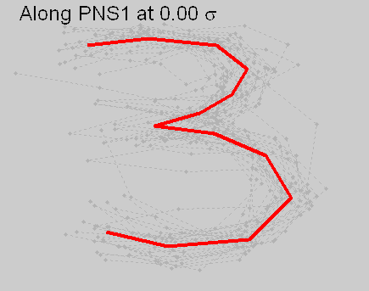
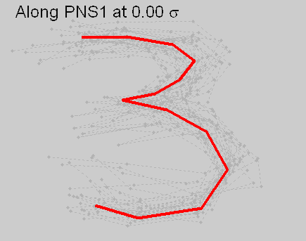


Digit 3 data: Principal variations of the shape
Princ. geodesics by PNS
Principal arcs by PNS

Slide 52
Digit 3 data: Principal variations of the shape
Principal Geodesics:
1st Mode: Center&Ends go Left&Right
2nd Mode: Fat vs. Skinny, Large Variation
Points Move Linearly
Principal Nested Spheres:
1st Mode: Traverses Long Curved Path
2nd Mode: Less Variation Left to Explain
Points Follow Curved Paths
Better “Signal Compression”

Slide 53
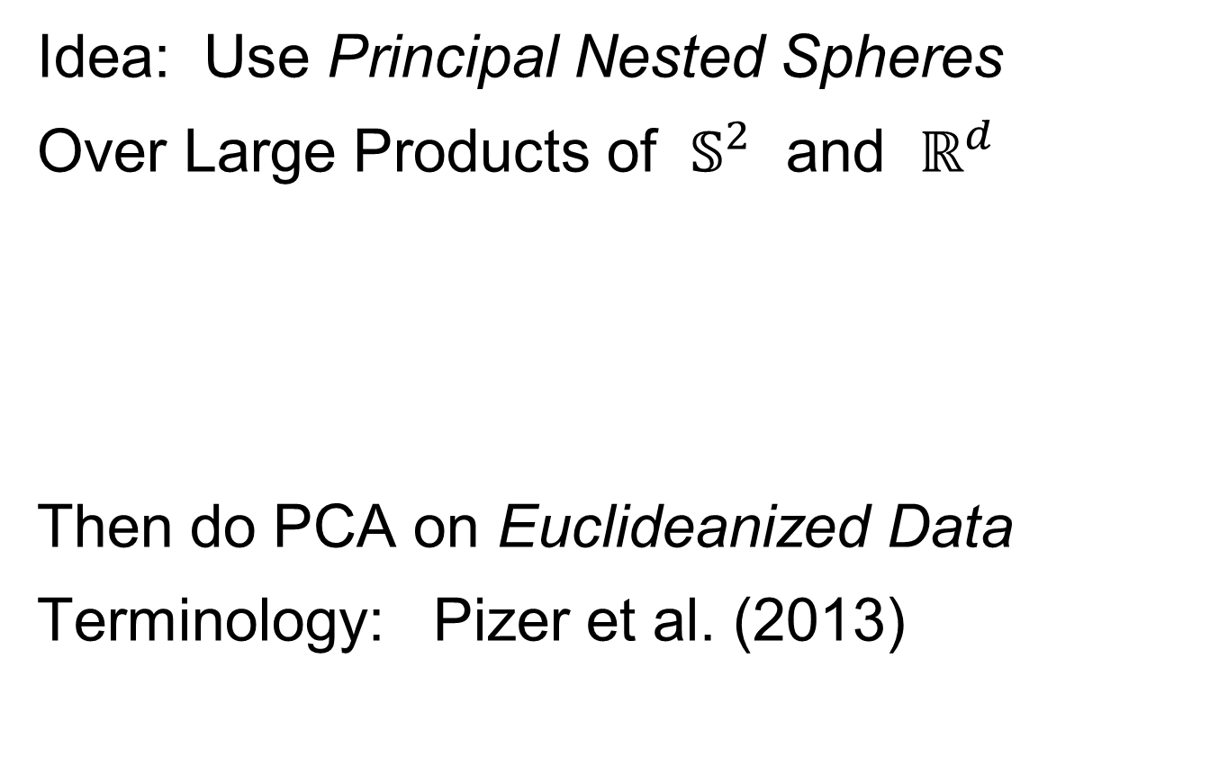
Composite Principal Nested Spheres
Idea: Use Principal Nested Spheres
Over Large Products of $𝕊^{2}$ and $ℝ^{d}$
Then do PCA on Euclideanized Data
Terminology: Pizer et al. (2013)
Vectors whose Entries are
Angles on Sphere and Reals

Slide 54
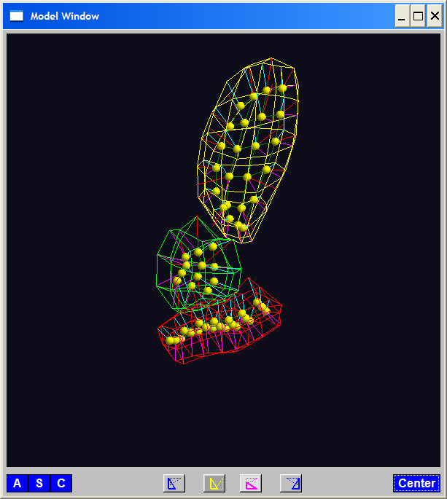
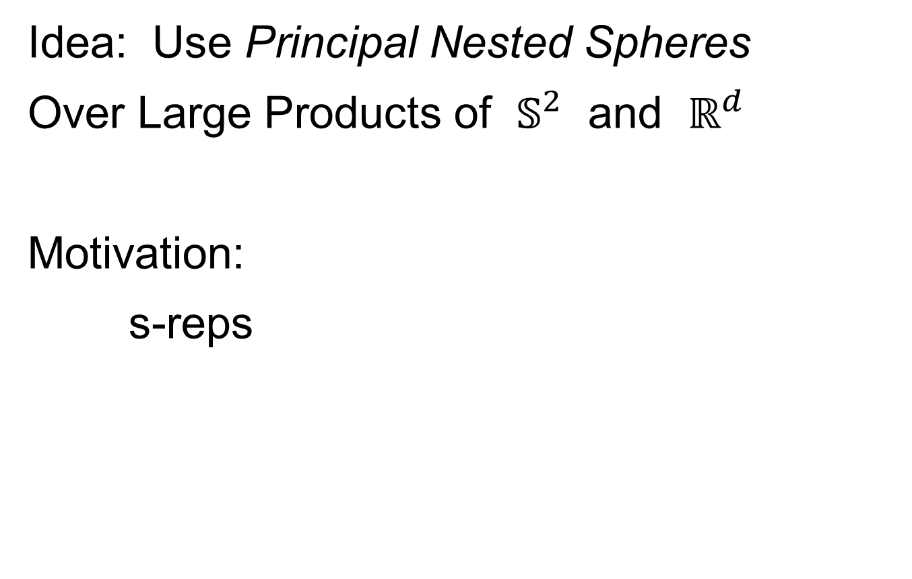
Composite Principal Nested Spheres
Idea: Use Principal Nested Spheres
Over Large Products of $𝕊^{2}$ and $ℝ^{d}$
Motivation:
s-reps

Slide 55

Composite Principal Nested Spheres
Idea: Use Principal Nested Spheres
Over Large Products of $𝕊^{2}$ and $ℝ^{d}$
Approach: Use Principal Nested Spheres
to Linearize $𝕊^{2}$ Components
Needs 2 Modes to
Capture Variation

Slide 56

Composite Principal Nested Spheres
Idea: Use Principal Nested Spheres
Over Large Products of $𝕊^{2}$ and $ℝ^{d}$
Approach: Use Principal Nested Spheres
to Linearize $S^{2}$ Components
PNS Explains All
With One Mode

Slide 57
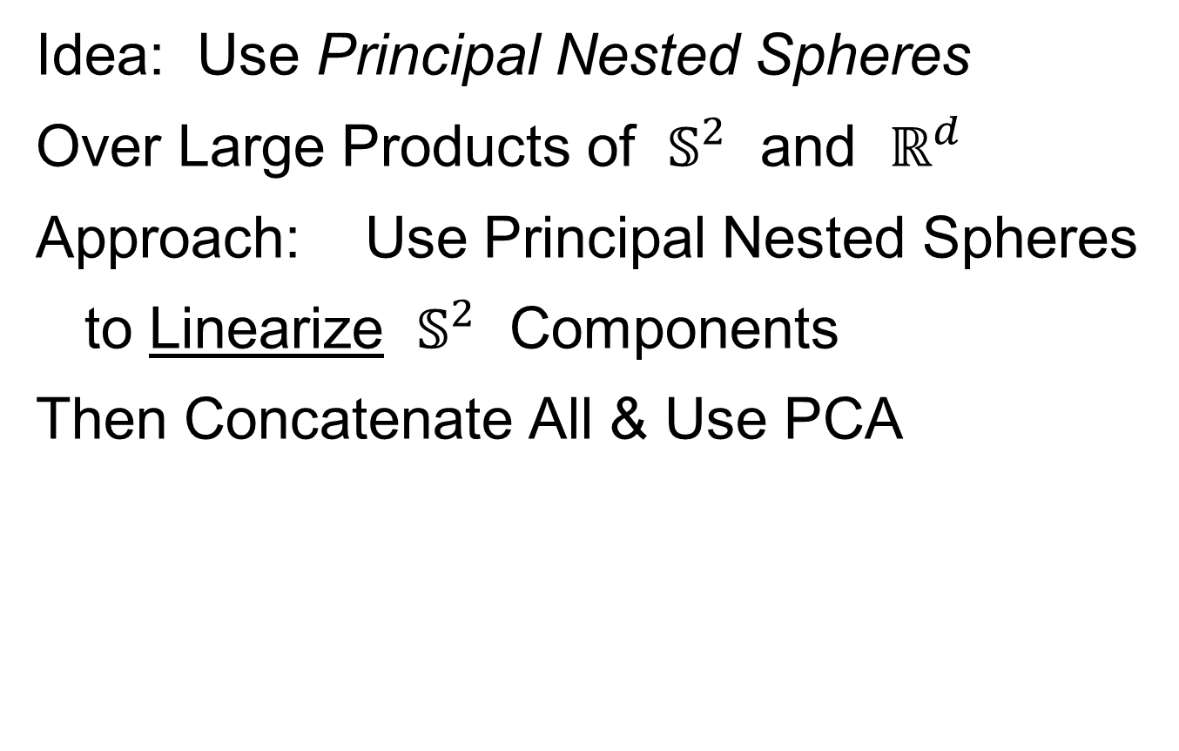
Composite Principal Nested Spheres
Idea: Use Principal Nested Spheres
Over Large Products of $𝕊^{2}$ and $ℝ^{d}$
Approach: Use Principal Nested Spheres
to Linearize $𝕊^{2}$ Components
Then Concatenate All & Use PCA

Slide 58
Composite Principal Nested Spheres
From Pizer et al. (2017, 2020) Impact on Segmentation:
PGA Segmentation: used ~20 comp’s
CPNS Segmentation: only need ~13
Resulted in visually better fits to data
Recall Bladder-Prostate-Rectum Data

Slide 59
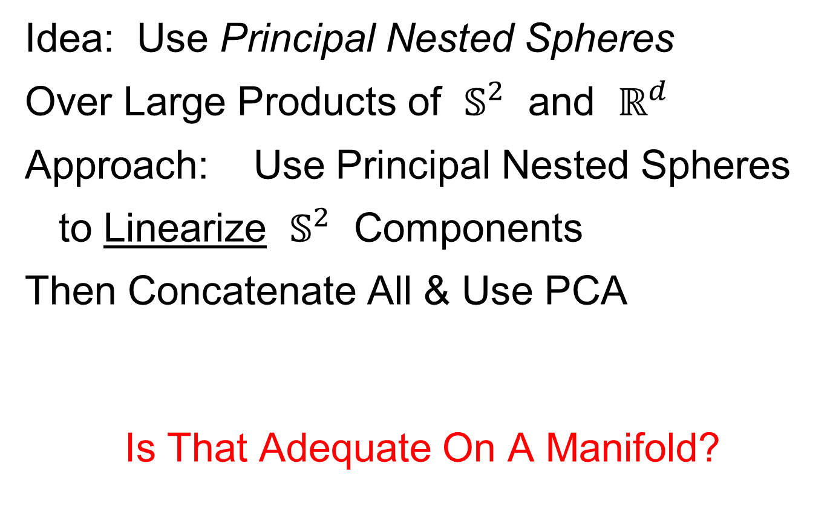
Composite Principal Nested Spheres
Idea: Use Principal Nested Spheres
Over Large Products of $𝕊^{2}$ and $ℝ^{d}$
Approach: Use Principal Nested Spheres
to Linearize $𝕊^{2}$ Components
Then Concatenate All & Use PCA
Is That Adequate On A Manifold?
Careful: Captures Linear Dependence!

Slide 60
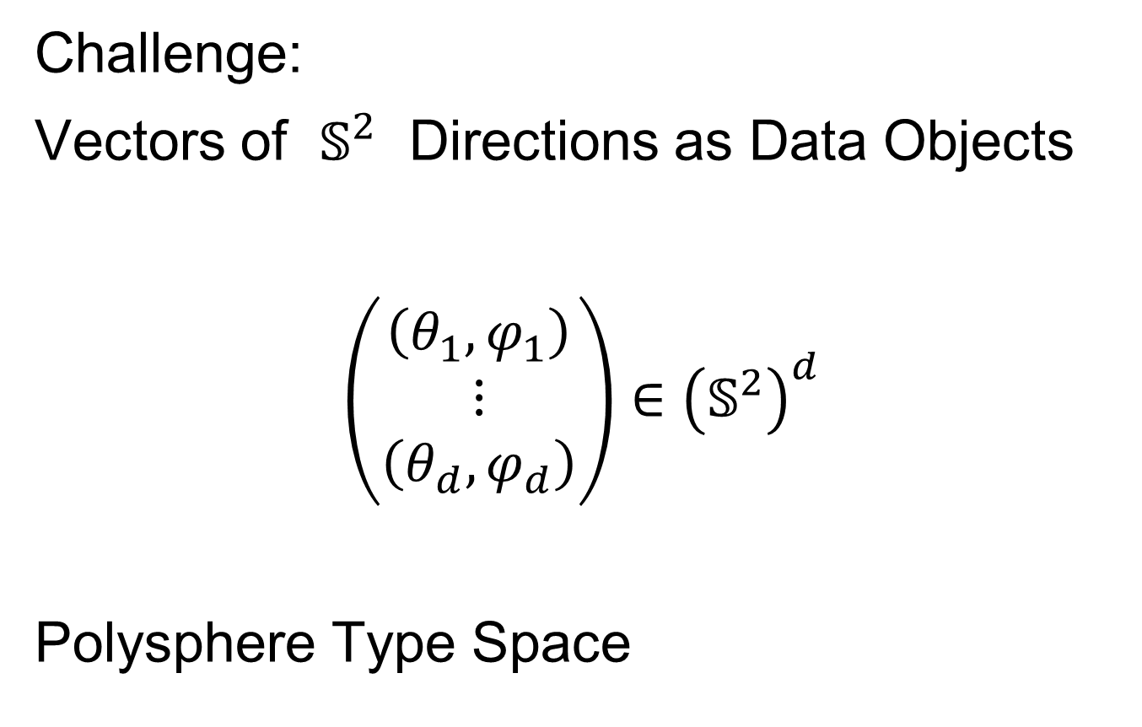
Extension to s-rep Space
Challenge:
Vectors of $𝕊^{2}$ Directions as Data Objects
$$\left(\begin{matrix}\left(θ_{1},φ_{1}\right) \\ ⋮ \\ \left(θ_{d},φ_{d}\right)\end{matrix}\right)∈{\left(𝕊^{2}\right)}^{d}$$
Polysphere Type Space

Slide 61




Extension to s-rep Space
Challenge: $𝕊^{2}×𝕊^{2}$ Polysphere Space
Generator Of
Toy Example
Wrap $x$ around
1st Copy of $𝕊^{2}$
Wrap $y$ around
2nd Copy of $𝕊^{2}$

Slide 62


Extension to s-rep Space
Challenge: $𝕊^{2}×𝕊^{2}$ Polysphere Space
Note Colors
From $x$ In
Generator

Slide 63


Extension to s-rep Space
Challenge: $𝕊^{2}×𝕊^{2}$ Polysphere Space
Note Colors
From $y$ In
Generator

Slide 64

Extension to s-rep Space
Challenge: $𝕊^{2}×𝕊^{2}$ Polysphere Space
Desired Answer
From a PCA

Slide 65


Extension to s-rep Space
Challenge: $𝕊^{2}×𝕊^{2}$ Polysphere Space
CPNS:
Gets 1-d Comps,
But Wrong
Dependence
(Strong Distortion)
Thanks to Sungkyu Jung

Slide 66

Polysphere PCA
Deeper New Methodology: PPCA
For Polysphere Spaces (e.g. s-reps)
Find Approximating (Higher $d$) Sphere
Then do PNS (Better Signal Compression)

Slide 67

Polysphere PCA
Deeper New Methodology: PPCA
For Polysphere Spaces (e.g. s-reps)
Reference: Eltzner et al (2015)
Benjamin Eltzner Stephan Huckemann Sungkyu Jung

Slide 68

Polysphere PCA-type Analysis
Deeper New Methodology: PPCA
For Polysphere
~Toy Example
Pretty Good But
Still Some
Distortion
Thanks to B. Eltzner

Slide 69

Topologically Different Space
Torus Type Spaces:
$$𝕋^{d}=\left\{\left(\begin{matrix}θ_{1} \\ ⋮ \\ θ_{d}\end{matrix}\right):θ_{1},⋯,θ_{d}∈𝕊^{1}\right\}={\left(𝕊^{1}\right)}^{d}$$
Applications:
Vectors of Angles as Data Objects

Slide 70
Torus Spaces
Vectors of Angles as Data Objects
Natural Examples Include:
Structural Chemistry
(Sequences of Bond Angles)
Meteorology
(Wind Directions at Multiple Sites)
Astronomy
(Sunspots Moving Over Time)

Slide 71




Torus Space Views
Toy Example in $𝕋^{2}$
${\left[−π,π\right]}^{2}$ Square Representation
Donut Representation
Edges are Identified
Use Different Radii
To View Topology
Thanks to Eduardo García-Portugués

Slide 72
Torus PCA
Motivation:
“Sphere is most perfect geometric shape”
Eltzner, Huckemann & Mardia (2018)
Approach:
Deform Data to Sphere & Use PNS

Slide 73

Torus PCA
Eltzner, Huckemann & Mardia (2018)
Approach:
Deform Data to Sphere & Use PNS

Slide 74
Torus PCA
Eltzner, Huckemann & Mardia (2018)
Approach:
Deform Data to Sphere & Use PNS
Major Challenges:
Find A Good Cutpoint
Heavy Distortion
Approach: Specifically
Minimize Distortion

Slide 75

Multi-Dimensional Scaling
For Data Objects $𝓧_{1},⋯,𝓧_{n}$ in Metric Space,
Given a rank $r$:
Find Representers $w_{1},⋯,w_{n}∈ℝ^{r}$, Whose Distance Matrix “Best” Approximates $𝔇$
Typical Algorithms: Think of $w_{i}$ as
“PCA-like” Vectors of Scores
Note: This Representation Is
Called “Auto-Encoder” In AI literature

Slide 76


Multi-Dimensional Scaling
Ezra Miller Idea
(SAMSI Program on OODA):
For Strongly Non-Euclidean Data Space,
Embed Representers $w_{1},⋯,w_{n}$
In a Space with Less Distortion

Slide 77

Multi-Dimensional Scaling
For Data Objects $𝓧_{1},⋯,𝓧_{n}$ in Torus $𝕋^{d}$
Find Representers $w_{1},⋯,w_{n}∈{C∙𝕊}^{d}$, Whose Distance Matrix “Best” Approx’s $𝔇$,
Then Apply PNS
Also Optimize Over Tuning Parameter: $C$
(For $C$ Large, ${C∙𝕊}^{d}≈ℝ^{d}$)

Slide 78


Scaled Torus PCA
Collaborators (Zoubouloglou et al. (2023)):
Pavlos Zoubouloglou
UNC, Statistics & OR
Eduardo García-Portugués
U. Carlos III, Madrid

Slide 79


Toy Example
Three Clusters in $𝕋^{3}$:
MDS
PNS
1st Mode Captures 3 Clusters,
Much Better Than PCA
Inverse Image of 1st Mode

Slide 80

Sunspots Data
Time Lagged Locations of Sunspots
Q: Linear
Relationship?
Recall Faces
Identified

Slide 81

Sunspots Data
TPCA Fit “Line”
TPCA Scores
Appears Clustered (Non-Linear)

Slide 82

Sunspots Data
STPCA Fit “Line”
STPCA Scores
Clearly Follows Line

Slide 83


RNA Torsion Angle Data
Goal: Find Clusters Here,
Using Only 7 Other Angles, i.e. in $𝕋^{7}$
Will Show
These Labels
As Colors
In PCAs

Slide 84


RNA Torsion Angle Data
Goal: Find Labelled Clusters in $𝕋^{7}$
STPCA Tends to Put
Clusters into 1st PC
TPCA-1 Scores
TPCA-2 Scores
STPCA Scores
PC1 - KDE Based Clustering
Much Better
Correspondence
of Target Labels

Slide 85

Principal Nested Spheres
Main Goal:
Extend Principal Arc Analysis ($𝕊^{2}$ to $𝕊^{k}$)
Jung et al (2012)
Important Landmark:
This Motivated Backwards PCA

Slide 86
Backwards PCA
Text: Sec. 8.6
Key Idea:
Replace usual forwards view of PCA
With a backwards approach to PCA

Slide 87
Terminology
Multiple linear regression:
Stepwise approaches:
Forwards: Start small, iteratively add variables to model
Backwards: Start with all, iteratively remove variables from model

Slide 88

Illust’n of PCA View: Recall Raw Data
Notes:
EgView1p1RawData.ps

Slide 89

Illust’n of PCA View: PC1 Projections
Notes:
EgView1p51proj3dPC1.ps

Slide 90

Illust’n of PCA View: PC2 Projections
Notes:
EgView1p52proj3dPC2.ps

Slide 91

Illust’n of PCA View: Projections on PC1,2 plane
Notes:
EgView1p54proj3dPC12.ps

Slide 92
Participant Presentation
Next Class:
Zhen Fang

