Slide 1
Statistics – O. R. 881
Object Oriented Data Analysis
Steve Marron
Dept. of Statistics and Operations Research
University of North Carolina

Slide 2
Current Sections in Textbook
Today:
Section 8.7, 7.3.5, 10.1.2, 8.5, 9.1
Next Class:
Section 9.1, 2.1, 9.2

Slide 3
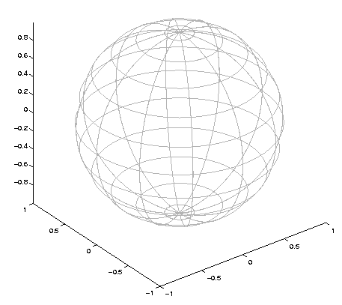

Last Class: Challenge for PGA
Data
On $𝕊^{2}$
Geodesic
Mean(s)
Tangent Plane
Projections ($log$)
Requires 2
Modes of
Variation

Slide 4
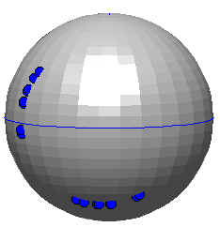
Last Class: PCA on Manifolds
Fletcher (Principal Geodesic Anal.)
  Best fit of geodesic to data
  Constrained to go through geodesic mean
Huckemann, Hotz & Munk (Geod. PCA)
  Best fit of any geodesic to data
Counterexample:
Data follows Tropic of Capricorn
Realizations of Spoke in
Blad.-Prost.-Rect. Simulator

Slide 5


Last Class: Princ. Nest. Spheres
Move plane
To Minimize
$\sum_{i}{{resid}_{i}^{2}}$
Keep signed
${resid}_{i}$ as
PNS-$d$ scores
$$𝕊^{d}$$
And Projections as Rank $d−1$ Approximations

Slide 6
Last Class: CPNS
From Pizer et al. (2017, 2020) Impact on Segmentation:
PGA Segmentation: used ~20 comp’s
CPNS Segmentation: only need ~13
Resulted in visually better fits to data
Recall Bladder-Prostate-Rectum Data

Slide 7
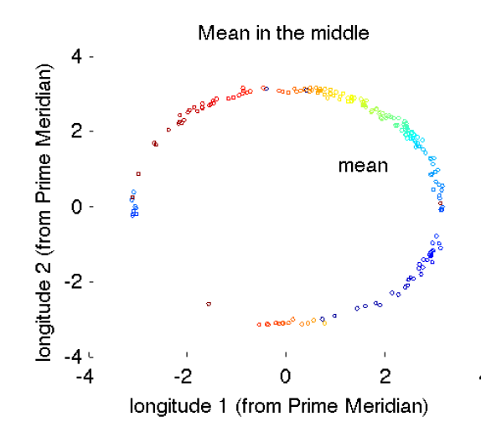
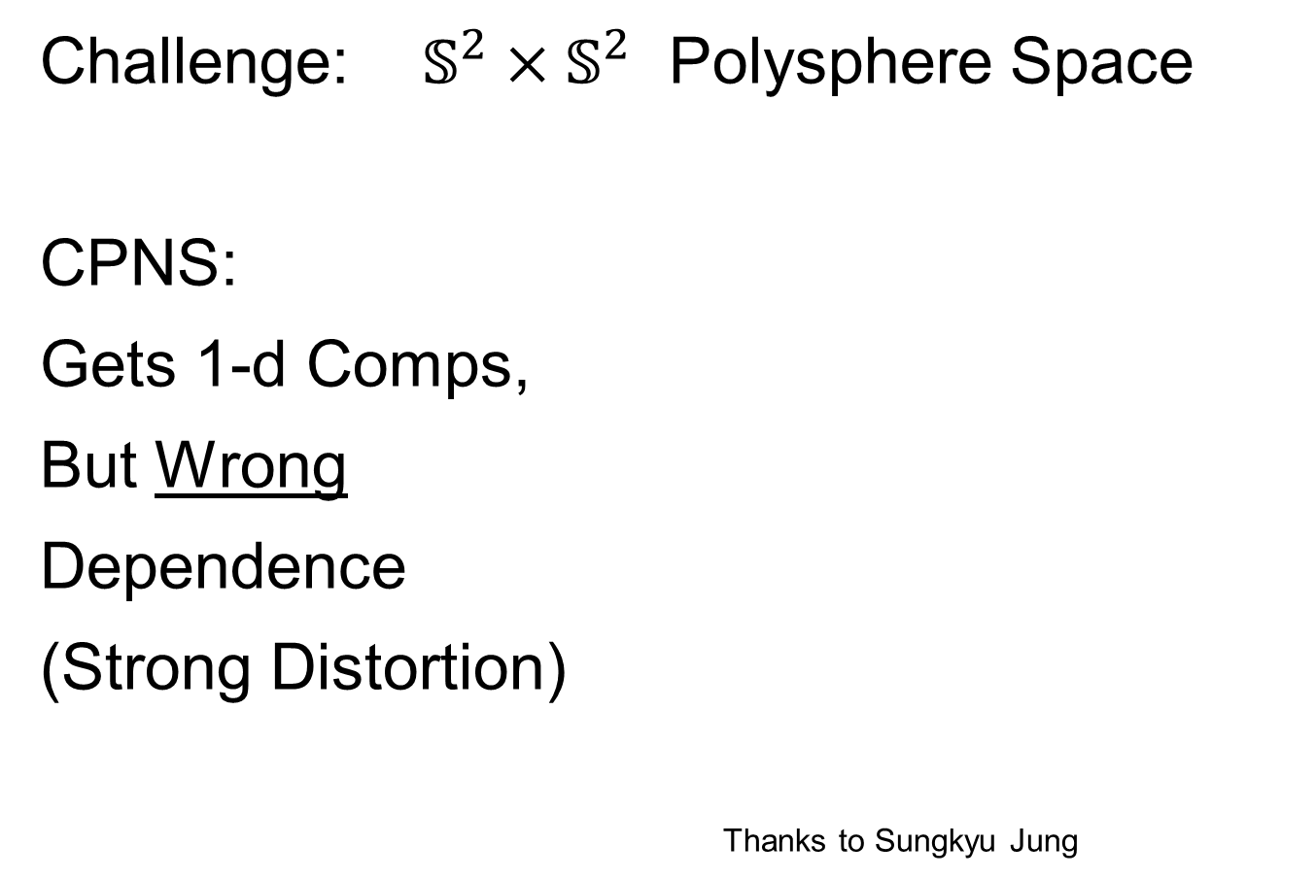
Last Class: s-rep Space
Challenge: $𝕊^{2}×𝕊^{2}$ Polysphere Space
CPNS:
Gets 1-d Comps,
But Wrong
Dependence
(Strong Distortion)
Thanks to Sungkyu Jung

Slide 8
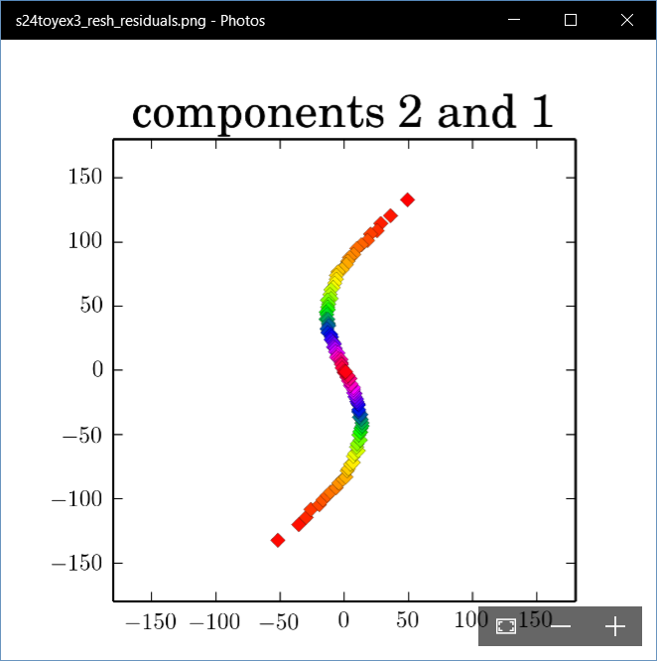
Last Class: Polysphere PCA
Deeper New Methodology: PPCA
For Polysphere
~Toy Example
Pretty Good But
Still Some
Distortion
Thanks to B. Eltzner

Slide 9
Last Class: Torus Spaces
Vectors of Angles as Data Objects
Natural Examples Include:
Structural Chemistry
(Sequences of Bond Angles)
Meteorology
(Wind Directions at Multiple Sites)
Astronomy
(Sunspots Moving Over Time)

Slide 10
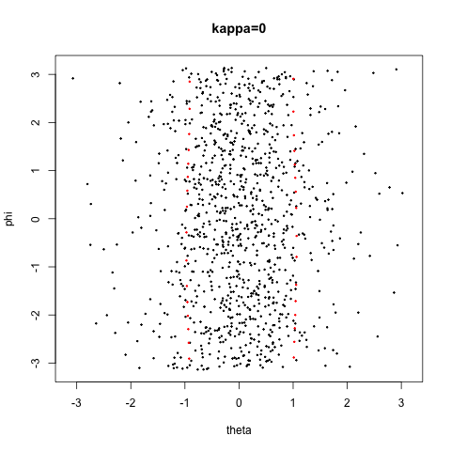
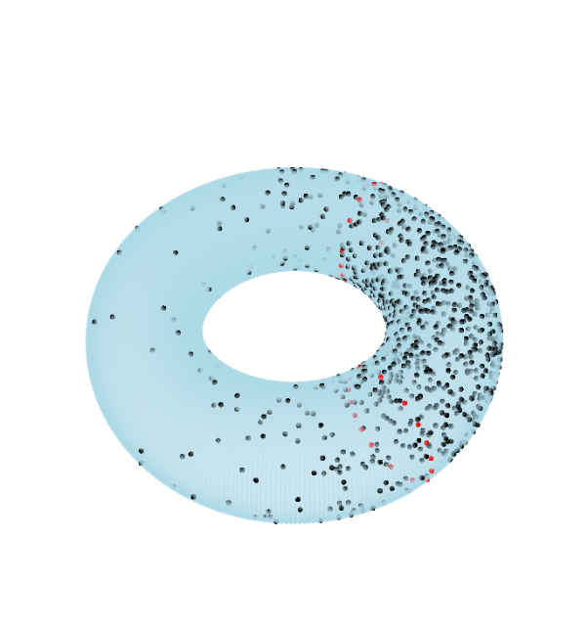

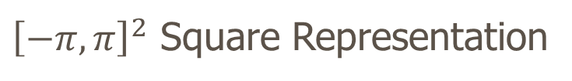
Last Class: Torus Space Views
Toy Example in $𝕋^{2}$
${\left[−π,π\right]}^{2}$ Square Representation
Donut Representation
Edges are Identified
Use Different Radii
To View Topology
Thanks to Eduardo García-Portugués

Slide 11
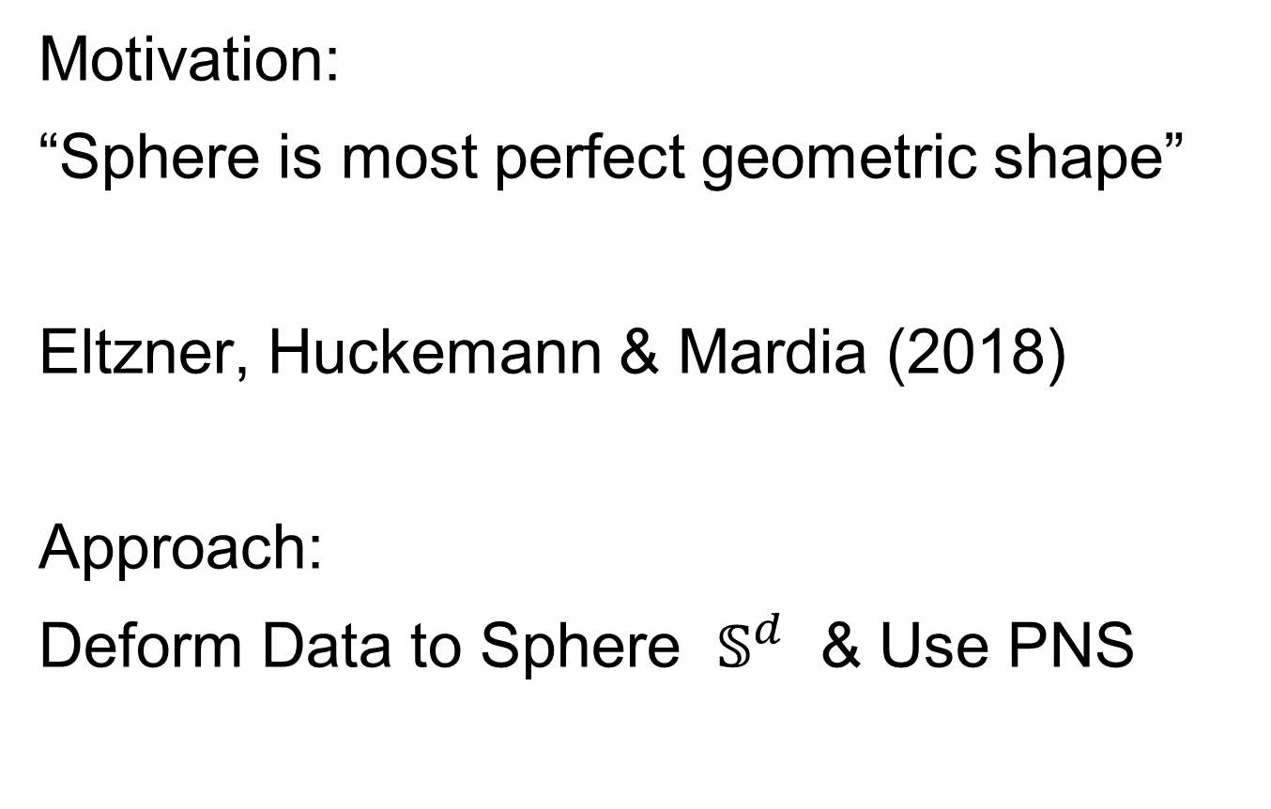
Last Class: Torus PCA
Motivation:
“Sphere is most perfect geometric shape”
Eltzner, Huckemann & Mardia (2018)
Approach:
Deform Data to Sphere $𝕊^{d}$ & Use PNS

Slide 12
Last Class: Torus PCA
Eltzner, Huckemann & Mardia (2018)
Approach:
Deform Data to Sphere & Use PNS
Major Challenges:
Find A Good Cutpoint
Heavy Distortion
Approach: Specifically
Minimize Distortion

Slide 13
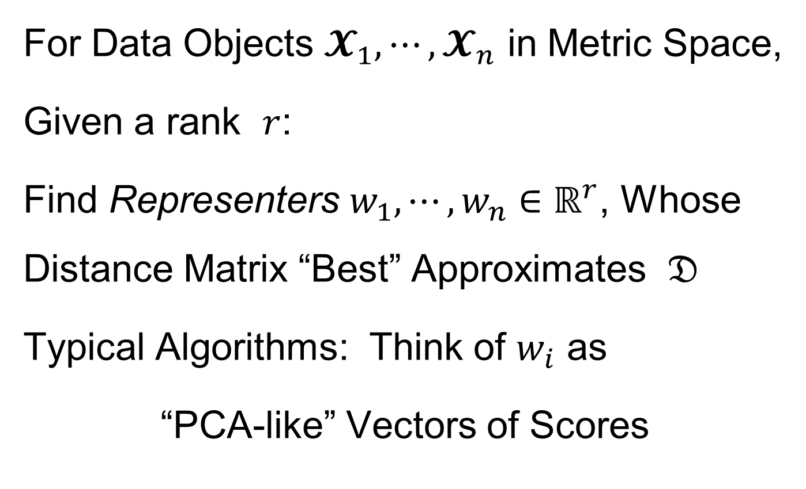
Last Class: MDS
For Data Objects $𝓧_{1},⋯,𝓧_{n}$ in Metric Space,
Given a rank $r$:
Find Representers $w_{1},⋯,w_{n}∈ℝ^{r}$, Whose Distance Matrix “Best” Approximates $𝔇$
Typical Algorithms: Think of $w_{i}$ as
“PCA-like” Vectors of Scores
Note: This Representation Is
Called “Auto-Encoder” In AI literature

Slide 14
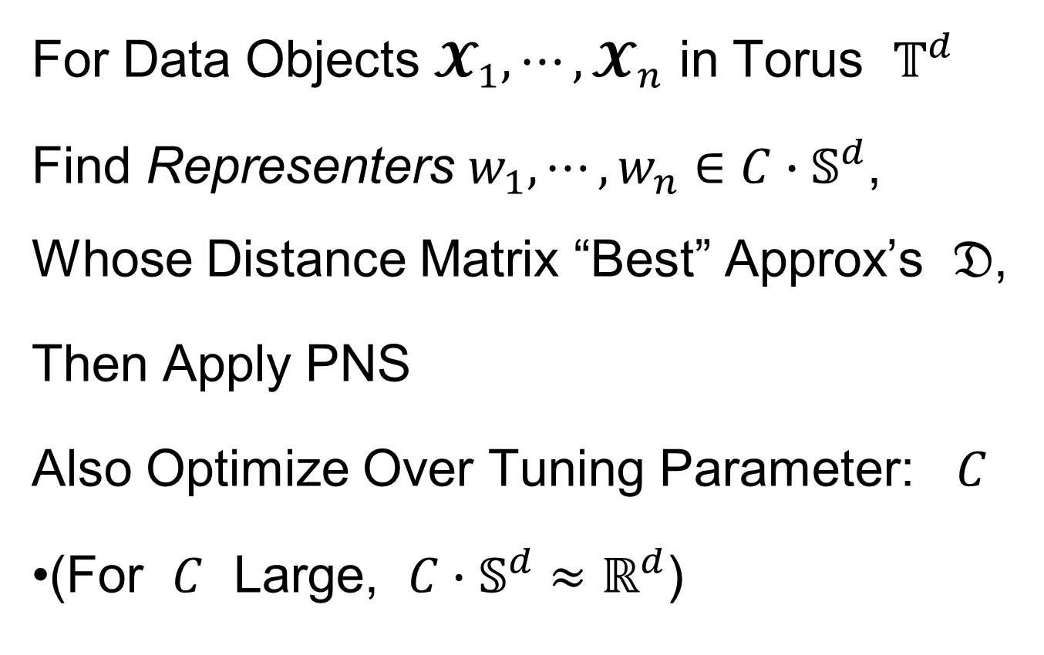
Last Class: MDS
For Data Objects $𝓧_{1},⋯,𝓧_{n}$ in Torus $𝕋^{d}$
Find Representers $w_{1},⋯,w_{n}∈{C∙𝕊}^{d}$, Whose Distance Matrix “Best” Approx’s $𝔇$,
Then Apply PNS
Also Optimize Over Tuning Parameter: $C$
(For $C$ Large, ${C∙𝕊}^{d}≈ℝ^{d}$)

Slide 15
Last Class: Backwards PCA
Text: Sec. 8.6
Key Idea:
Replace usual forwards view of PCA
With a backwards approach to PCA

Slide 16
Last Class: Backwards PCA
Euclidean Settings:
Forwards PCA = Backwards PCA
(Pythagorean Theorem,
ANOVA Decomposition)
So Not Interesting
But Very Different in Non-Euclidean Settings
(Backwards is Better !?!)

Slide 17
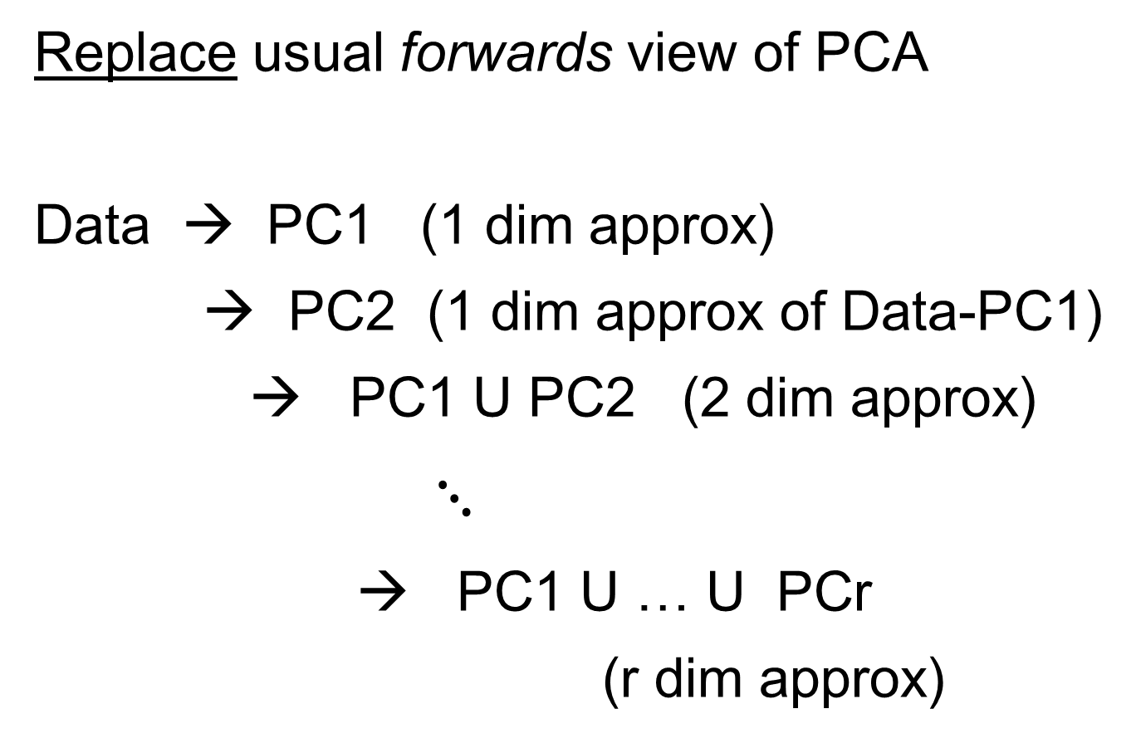
Backwards PCA
Replace usual forwards view of PCA
Data → PC1 (1 dim approx)
→ PC2 (1 dim approx of Data-PC1)
→ PC1 U PC2 (2 dim approx)
$⋱$
→ PC1 U … U PCr
(r dim approx)

Slide 18
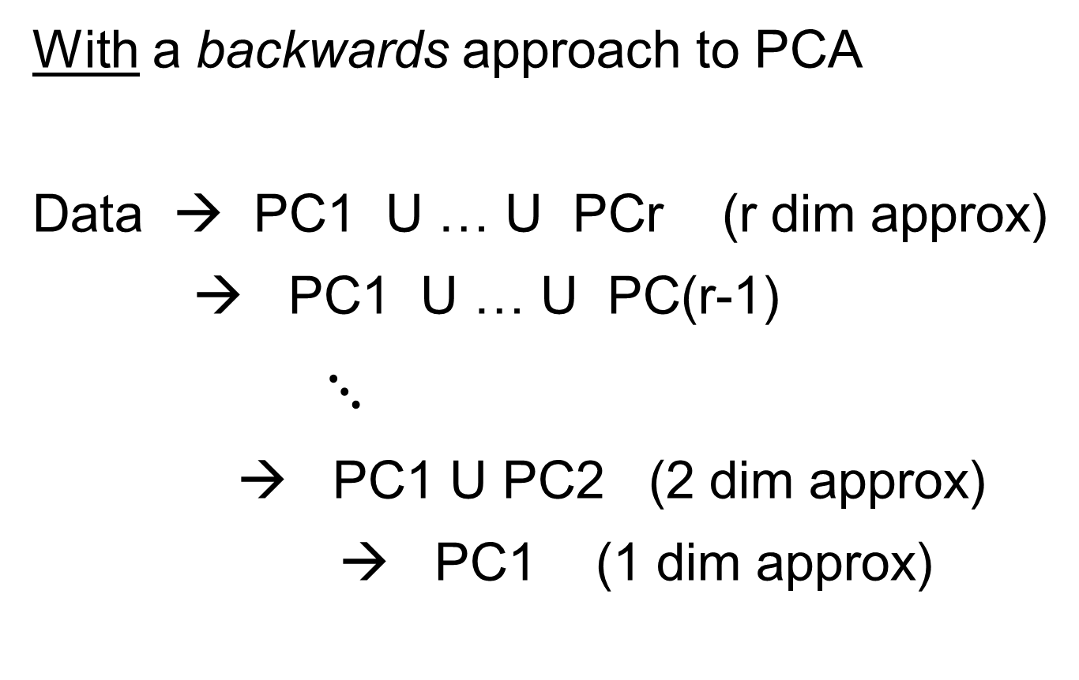
Backwards PCA
With a backwards approach to PCA
Data → PC1 U … U PCr (r dim approx)
→ PC1 U … U PC(r-1)
$⋱$
→ PC1 U PC2 (2 dim approx)
→ PC1 (1 dim approx)

Slide 19
Backwards PCA
Euclidean Settings:
Forwards PCA = Backwards PCA
(Pythagorean Theorem,
ANOVA Decomposition)
So Not Interesting
But Very Different in Non-Euclidean Settings
(Backwards is Better !?!)

Slide 20
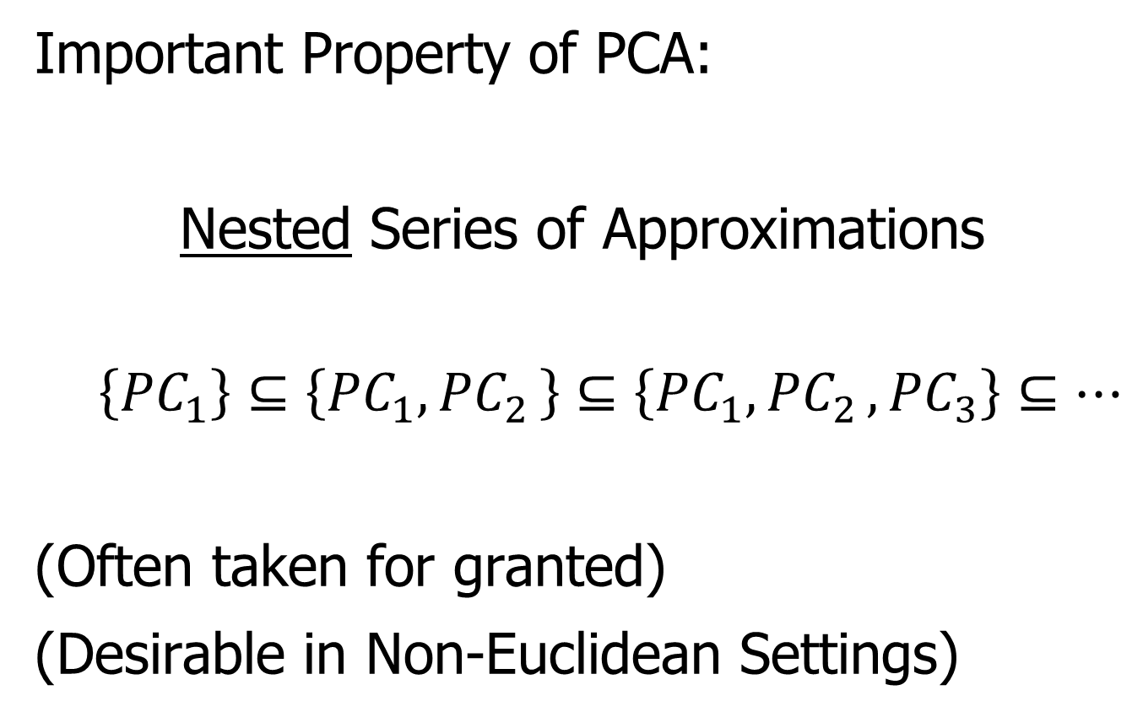
Backwards PCA
Important Property of PCA:
Nested Series of Approximations
$$\left\{{PC}_{1}\right\}⊆\left\{{PC}_{1}{,PC}_{2}\right\}⊆\left\{{PC}_{1}{,PC}_{2},{PC}_{3}\right\}⊆⋯$$
(Often taken for granted)
(Desirable in Non-Euclidean Settings)

Slide 21
Backwards PCA
Desirability of Nesting:
Multi-Scale Analysis Makes Sense
Scores Visualization Makes Sense
Since Scores = Residuals
at Each Stage

Slide 22
An Interesting Question
How generally applicable is
Backwards approach to PCA?
Discussion:
Pizer et al (2013)
Damon and Marron (2014)

Slide 23
An Interesting Question
How generally applicable is
Backwards approach to PCA?
Anywhere this is already being done???

Slide 24
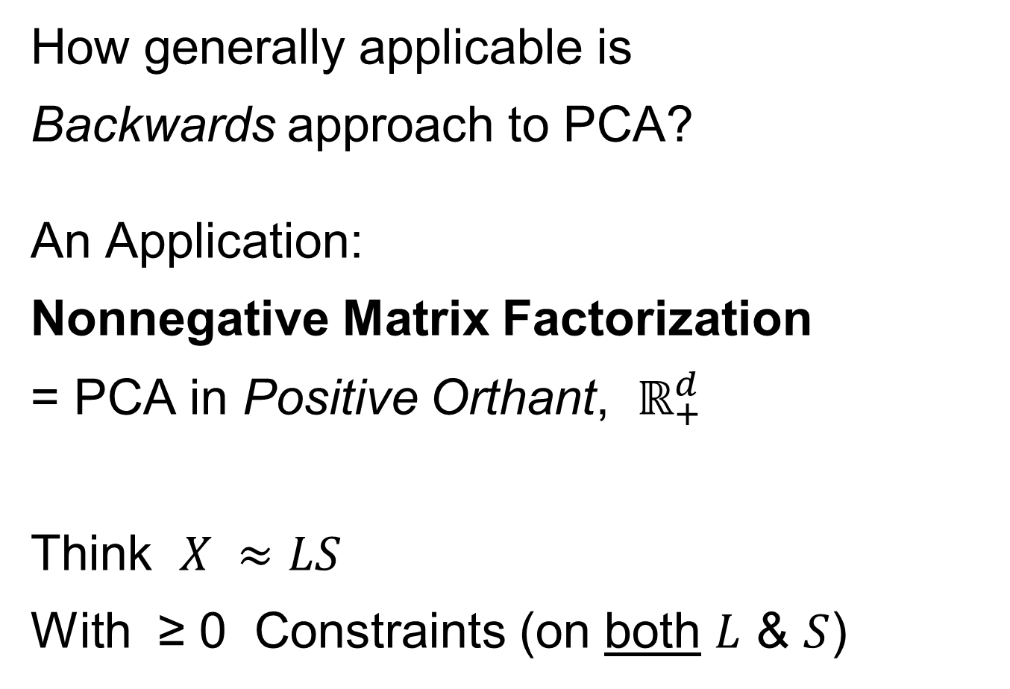
An Interesting Question
How generally applicable is
Backwards approach to PCA?
An Application:
Nonnegative Matrix Factorization
= PCA in Positive Orthant, $ℝ_{+}^{d}$
Think $X ≈LS$
With ≥ 0 Constraints (on both $L$ & $S$)

Slide 25
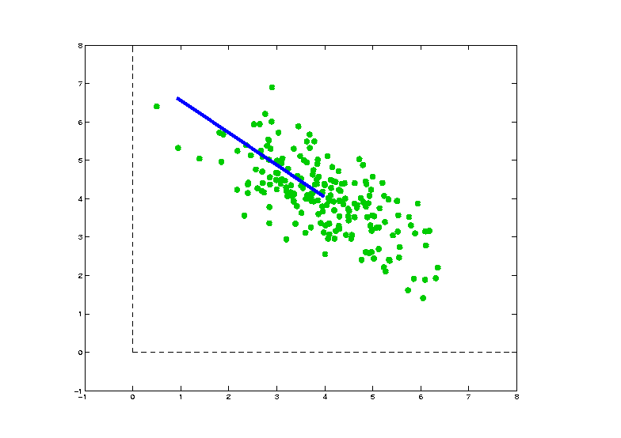
Nonnegative Matrix Factorization
Isn’t This
Just PCA?
In the
Nonnegative
Orthant?
No, Most PC Directions Leave Orthant

Slide 26
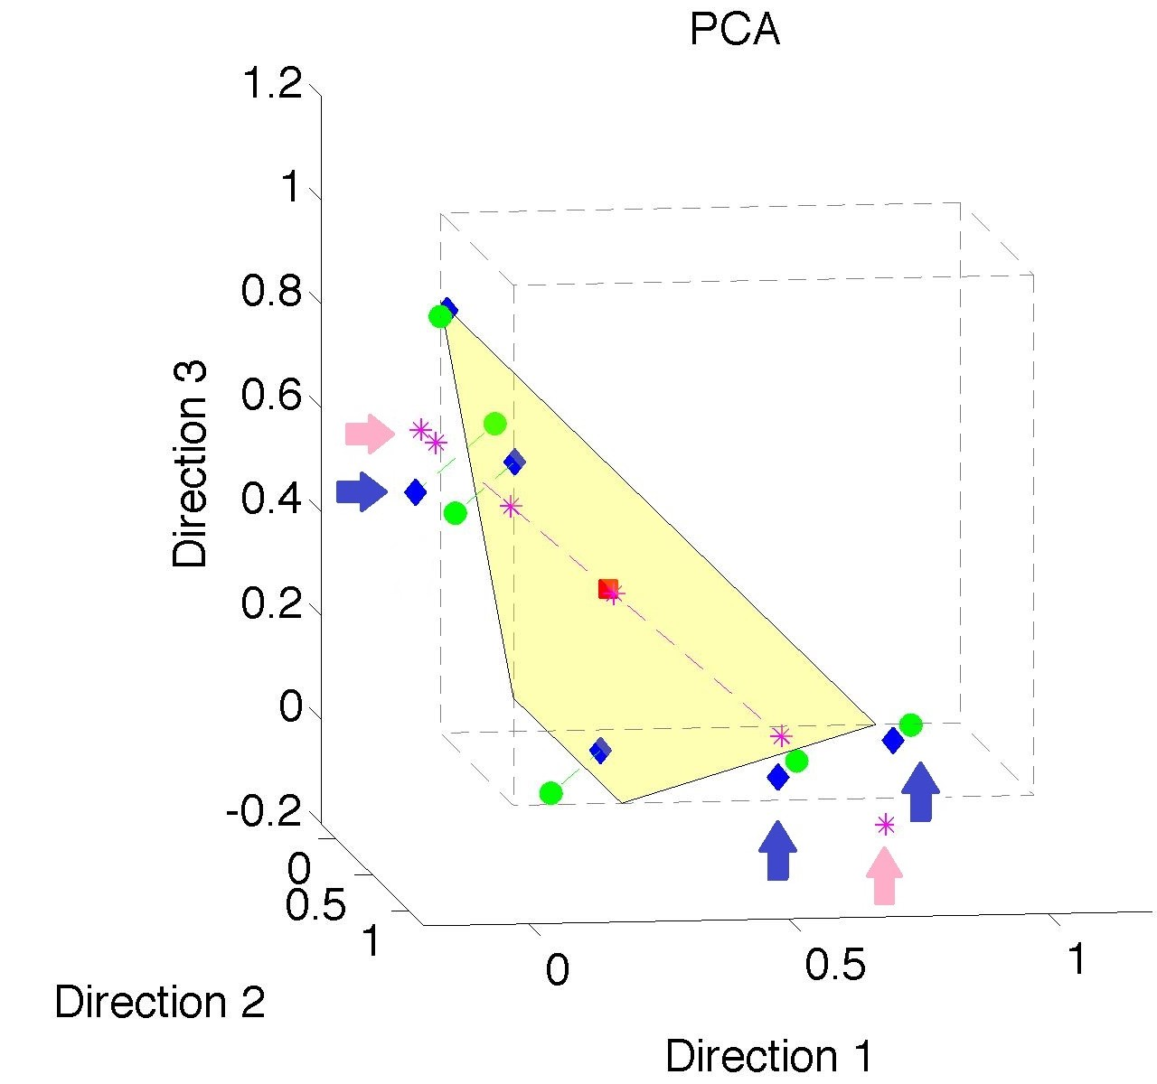
Nonnegative Matrix Factorization
Isn’t This
Just PCA?
Data
(Near
Orthant
Faces)
Thanks to Lingsong Zhang

Slide 27
Nonnegative Matrix Factorization
Isn’t This
Just PCA?
Data
Mean
(Centered
Analysis)

Slide 28
Nonnegative Matrix Factorization
Isn’t This
Just PCA?
Data
Mean
PC1 Projections
Leave Orthant!

Slide 29

Nonnegative Matrix Factorization
Isn’t This
Just PCA?
Data
Mean
PC1 Projections
PC1 $⋃$ 2 Proj’ns
Leave Orthant!

Slide 30
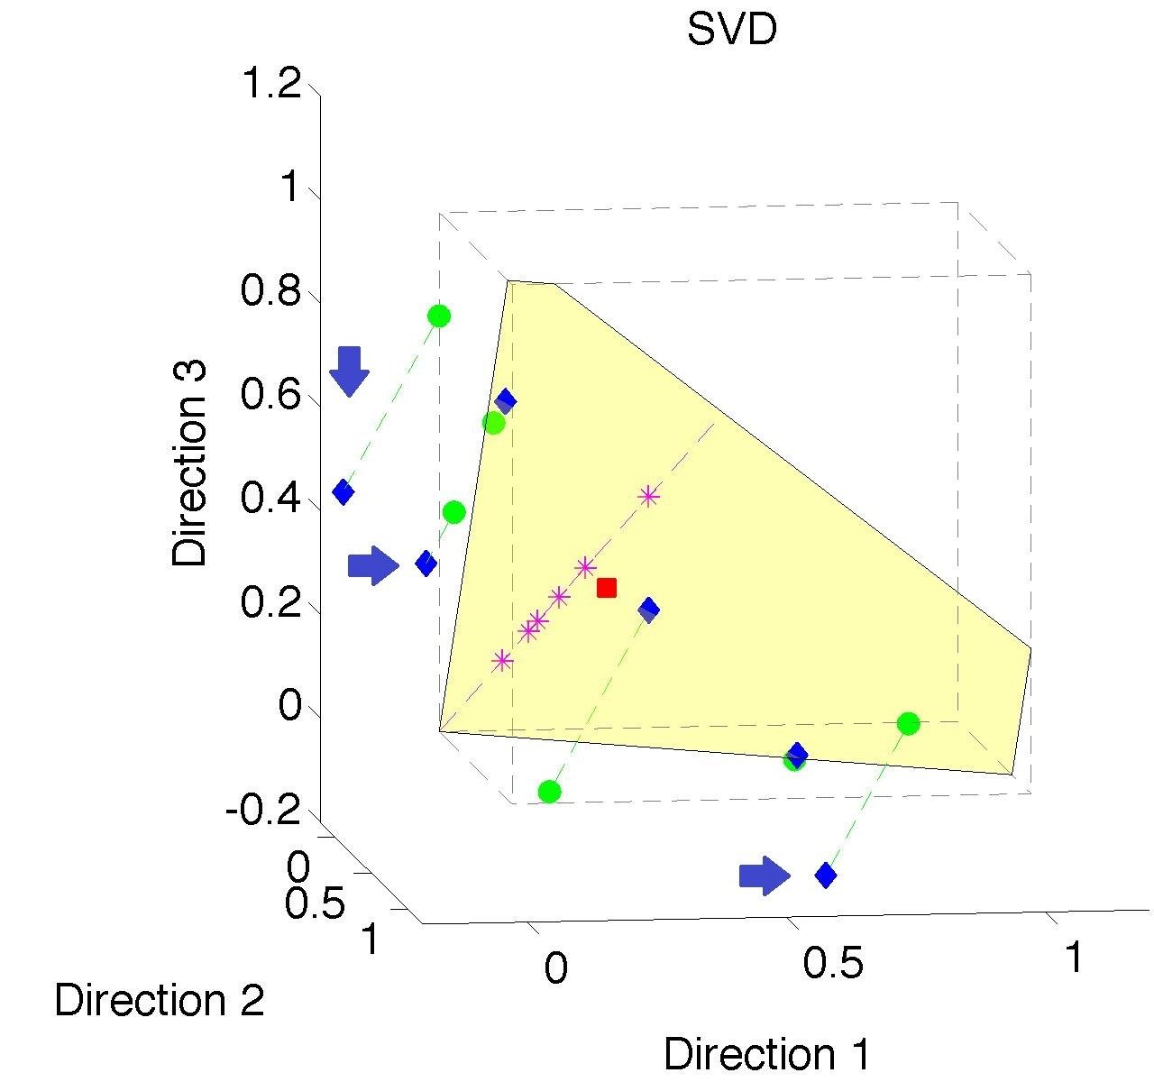
Nonnegative Matrix Factorization
Note:
Problem not
Fixed by
SVD
(“Uncentered
PCA”)
Orthant Leaving Gets Worse

Slide 31
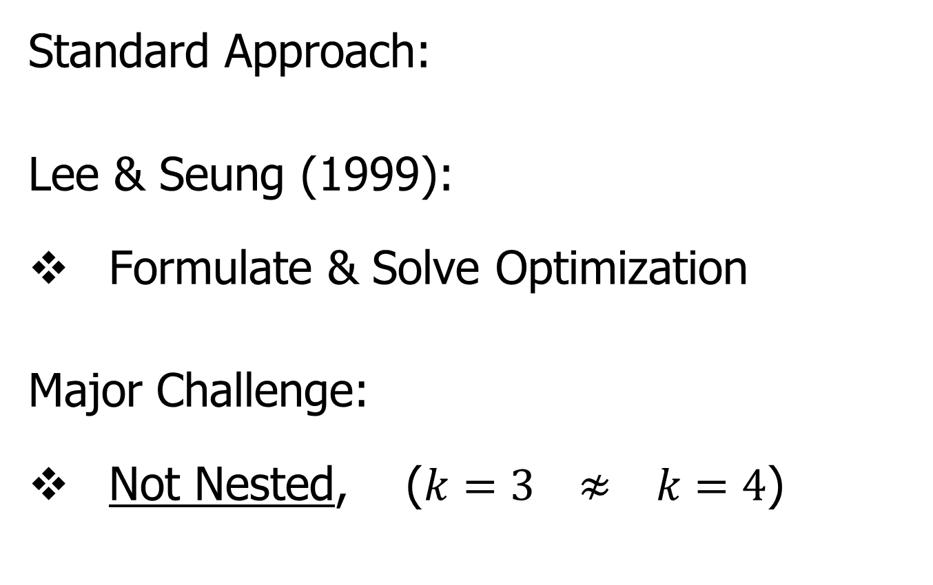
Nonnegative Matrix Factorization
Standard Approach:
Lee & Seung (1999):
Formulate & Solve Optimization
Major Challenge:
Not Nested, ($k=3 ≉ k=4$)

Slide 32
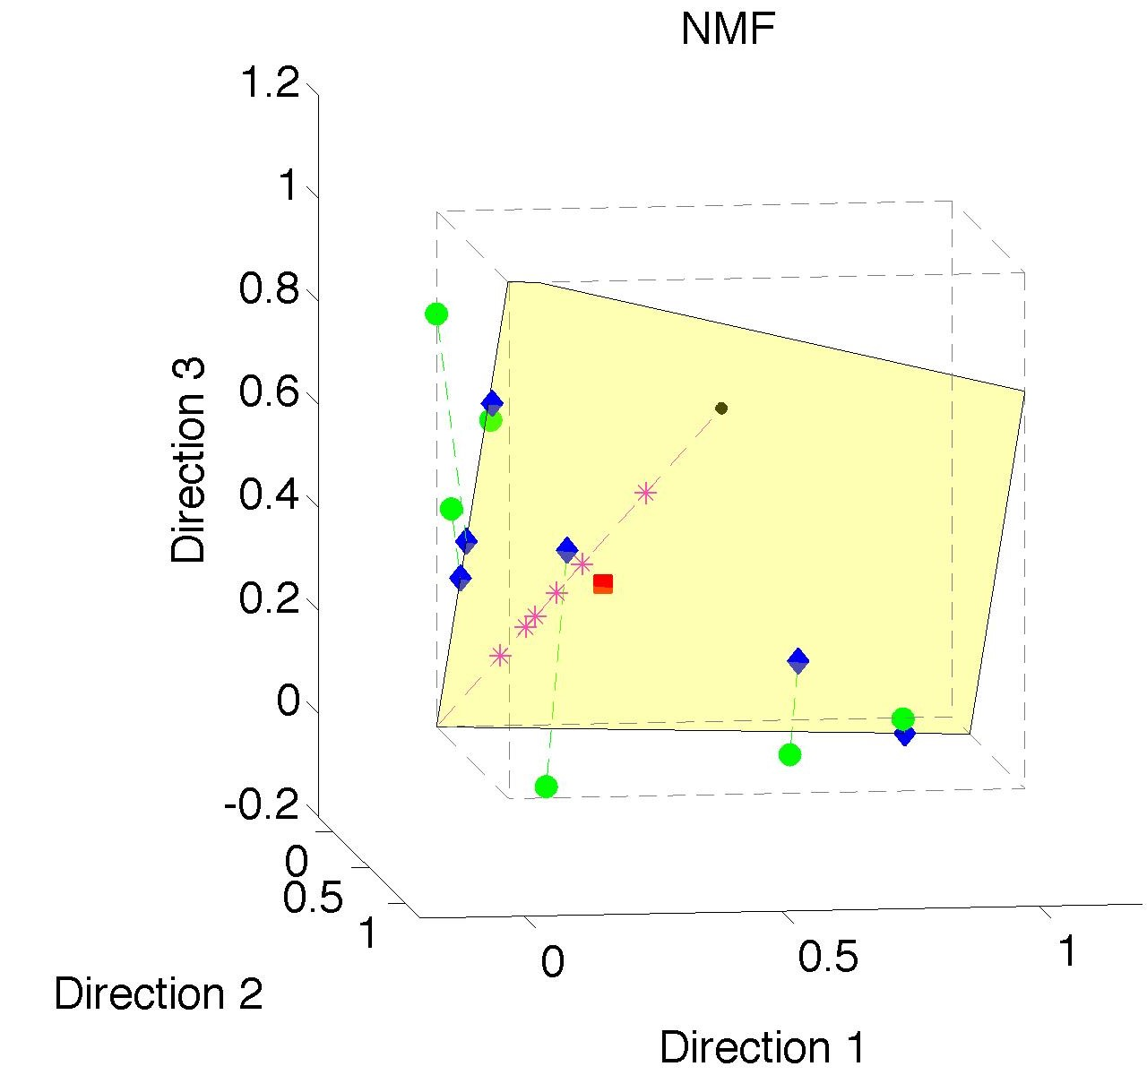
Nonnegative Matrix Factorization
Standard NMF
(Projections
All Inside
Orthant)

Slide 33
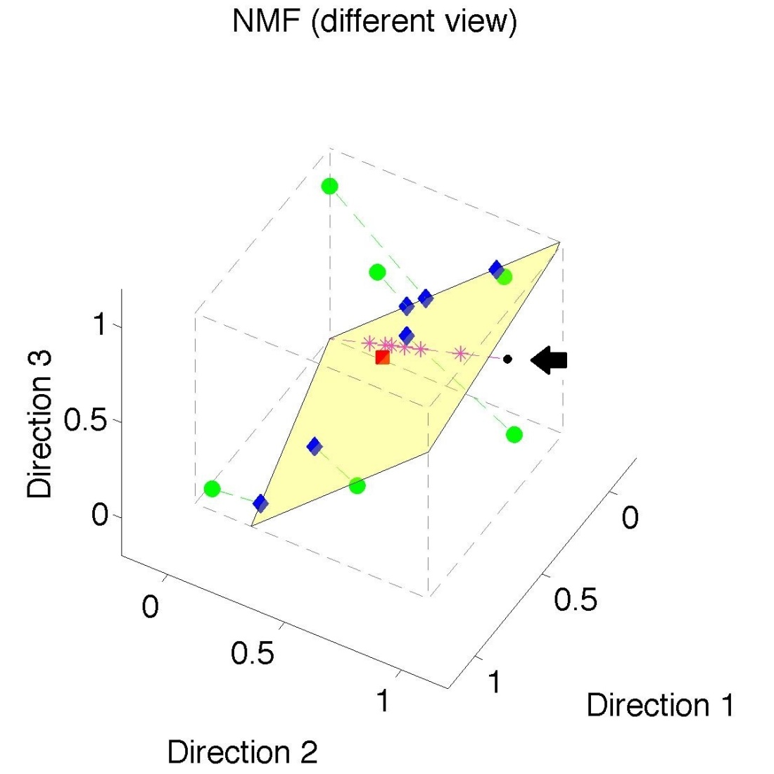
Nonnegative Matrix Factorization
Standard NMF
But Note
Not Nested
No “Multi-scale”
Analysis Possible
(Scores Plot?!?)

Slide 34
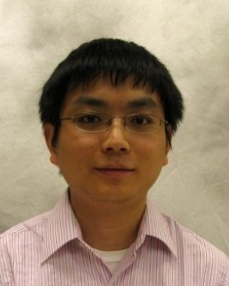
Nonnegative Matrix Factorization
Improved Version:
Use Backwards PCA Idea
“Nonnegative Nested Cone Analysis”
Collaborator:
Lingsong Zhang (Purdue)
Zhang, Lu, Marron (2015)

Slide 35
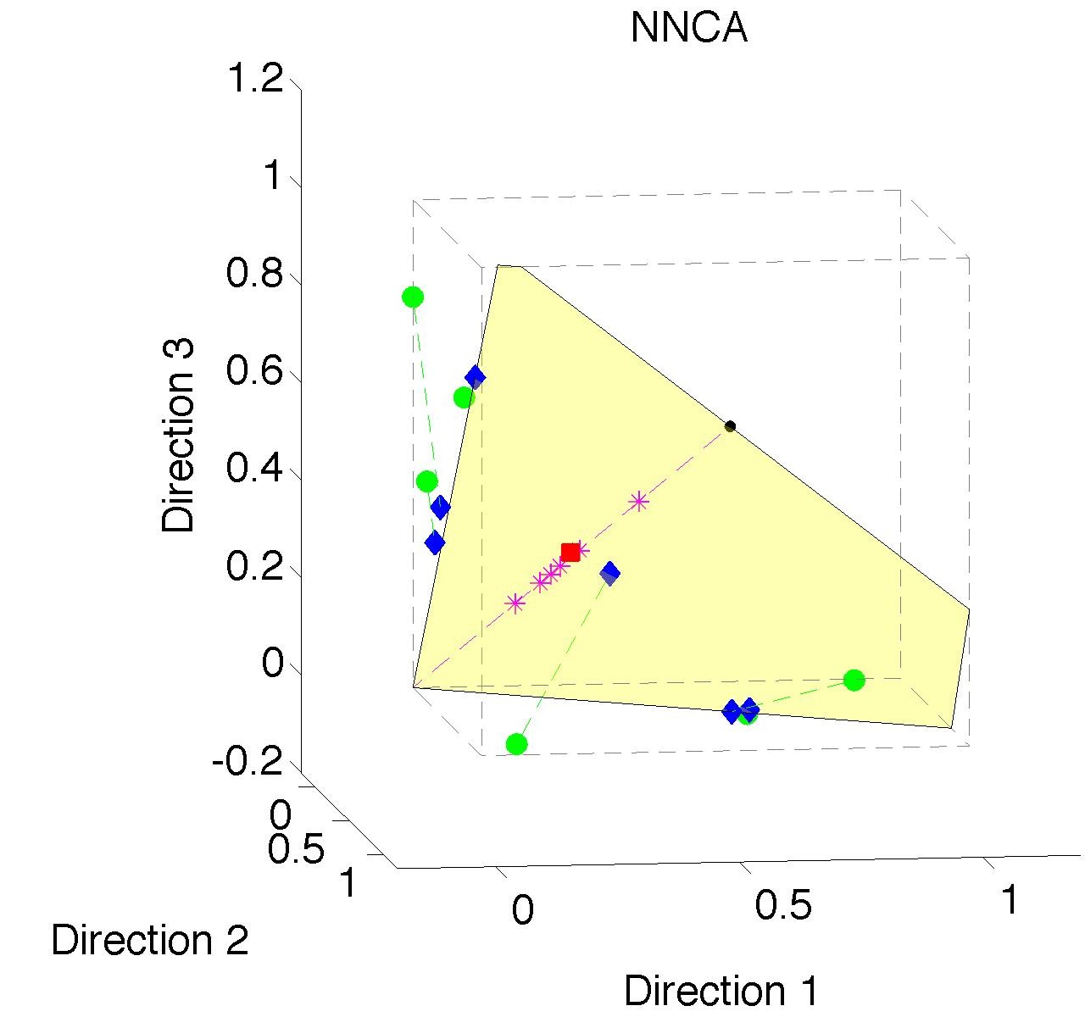
Nonnegative Nested Cone Analysis
Same Toy
Data Set
All
Projections
In Orthant

Slide 36
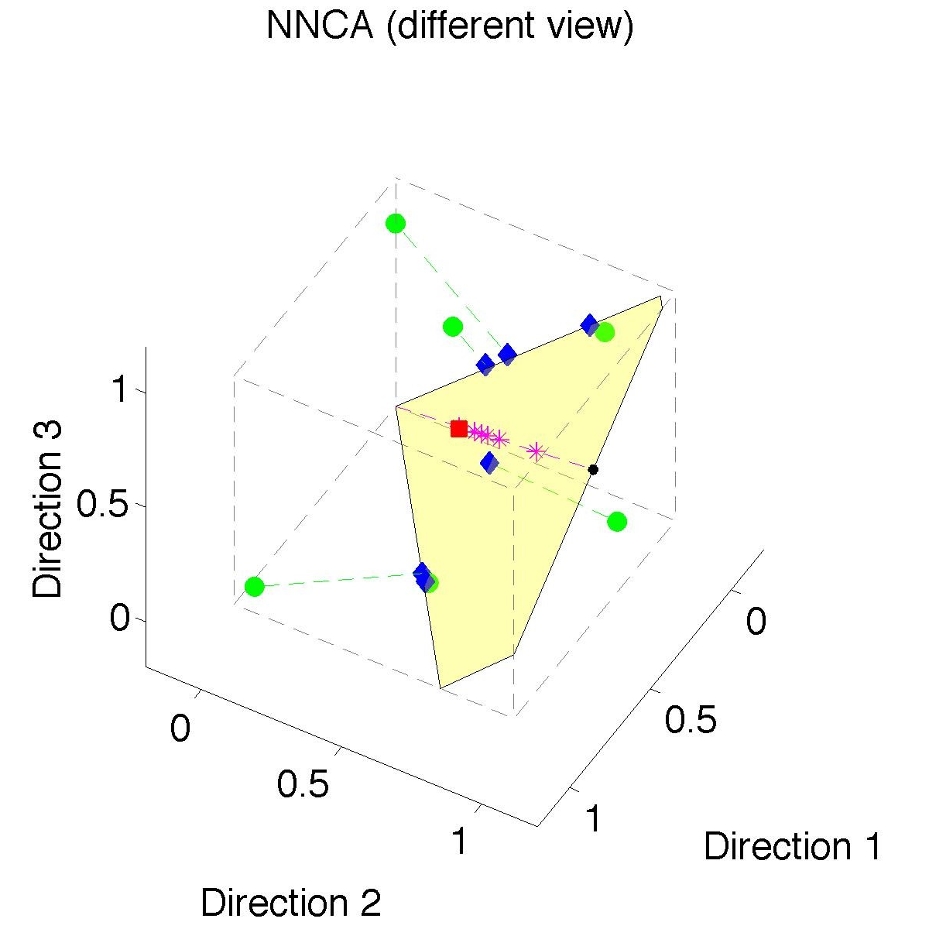
Nonnegative Nested Cone Analysis
Same Toy
Data Set
Rank 1
Approx.
Properly
Nested

Slide 37
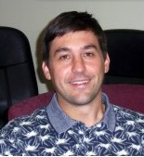


An Interesting Question
How generally applicable is
Backwards approach to PCA?
Another Application:
HDLSS Robust PCA
L¹ Backwards PCA:
Brooks, Dulá, Boone (2013)

Slide 38
An Interesting Question
How generally applicable is
Backwards approach to PCA?
Potential Application: Principal Curves
Hastie & Stuetzle, (1989)
(Foundation of Manifold Learning)

Slide 39
Manifold Learning
Goal: Find lower dimensional manifold that well approximates (high-dimensional) data
ISOmap
Tenenbaum, et al (2000)
Local Linear Embedding
Roweis & Saul (2000)

Slide 40
Manifold Learning
Tenenbaum, et al (2000)
Canonical Example:
Photographs (2-d) of Statue (3-d)
Different Viewpoints
Different Light Source Locations
Digitization of Photos is “Low-Dimensional”
But Not in a Subspace (Findable by PCA)
In a manifold (curved
surface) sense

Slide 41
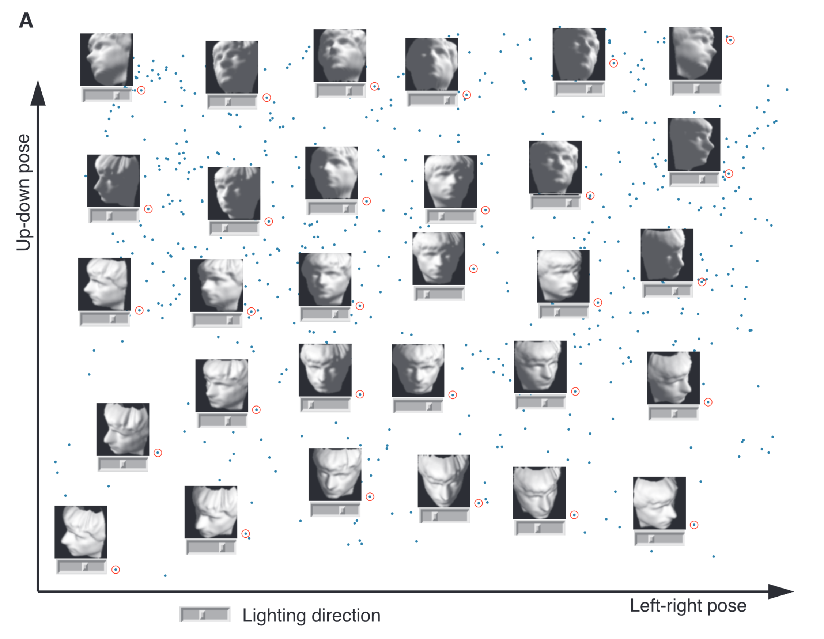
Manifold Learning
Tenenbaum, et al (2000)
Reveals
Two
Interesting
Modes Of
Variation

Slide 42
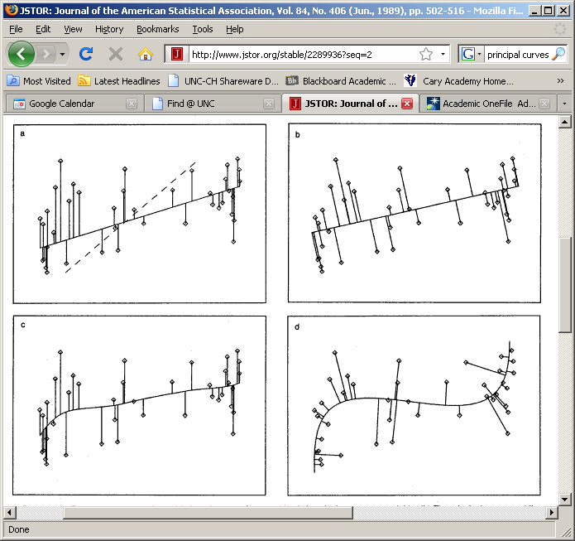
1st Principal Curve
Linear Reg’n
Usual Smooth

Slide 43
1st Principal Curve
Linear Reg’n
Proj’s Reg’n
Usual Smooth

Slide 44
1st Principal Curve
Linear Reg’n
Proj’s Reg’n
Usual Smooth
Princ’l Curve

Slide 45
Manifold Learning
How generally applicable is
Backwards approach to PCA?
Potential Application: Principal Curves
Perceived Major Challenge:
How to find 2nd Principal Curve?

Slide 46
Manifold Learning
Key Component:
Principal Surfaces
LeBlanc & Tibshirani (1996)
Challenge:
Can have any dimensional surface,
But how to nest???
Proposal: Backwards Approach

Slide 47
An Interesting Observation
In non-Euclidean cases,
Backwards PCA seems easier?
Why is that?
E.g. PNS, NNCA

Slide 48
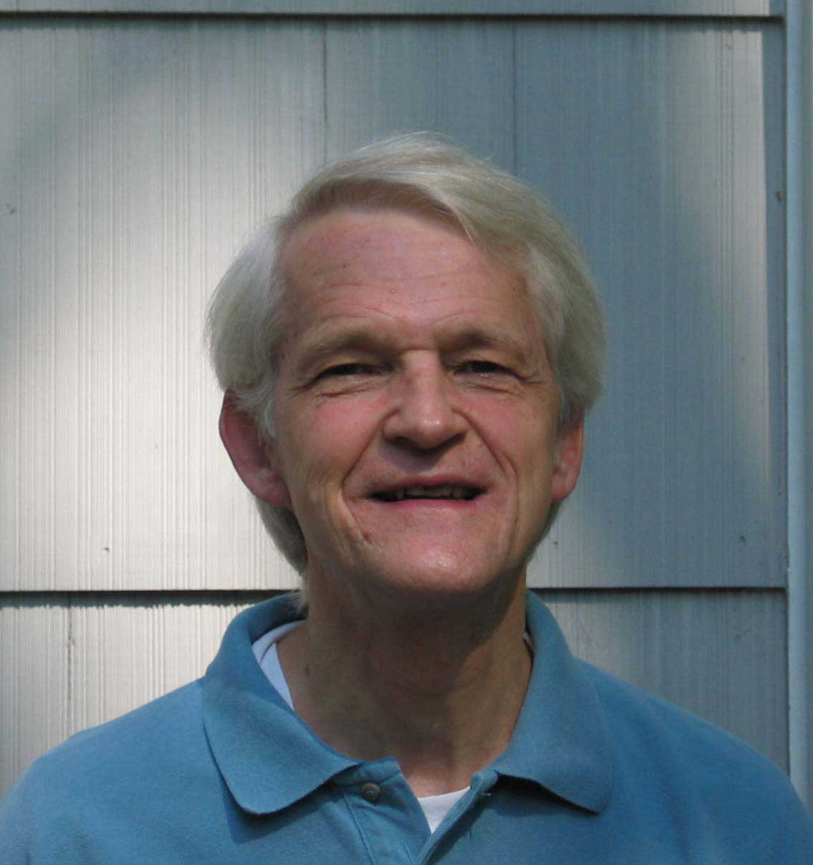
An Interesting Question
Why does backwards PC seem easier?
An Attractive Answer:
James Damon, UNC Mathematics
Geometry
Singularity
Theory

Slide 49
An Interesting Question
Why does backwards PC seem easier?
An Attractive Answer:
James Damon, UNC Mathematics
Damon and Marron (2014)

Slide 50
An Interesting Question
Why does backwards PC seem easier?
An Attractive Answer:
James Damon, UNC Mathematics
Key Idea: Express Backwards PCA as
Nested Series of Constraints

Slide 51

General View of Backwards PCA
Define Nested Spaces via Constraints
Satisfying More Constraints $⇒$
$⇒$ Smaller Subspaces

Slide 52
General View of Backwards PCA
Define Nested Spaces via Constraints
E.g. SVD
(Singular Value Decomposition =
= Not Mean Centered PCA)
(notationally very clean)

Slide 53
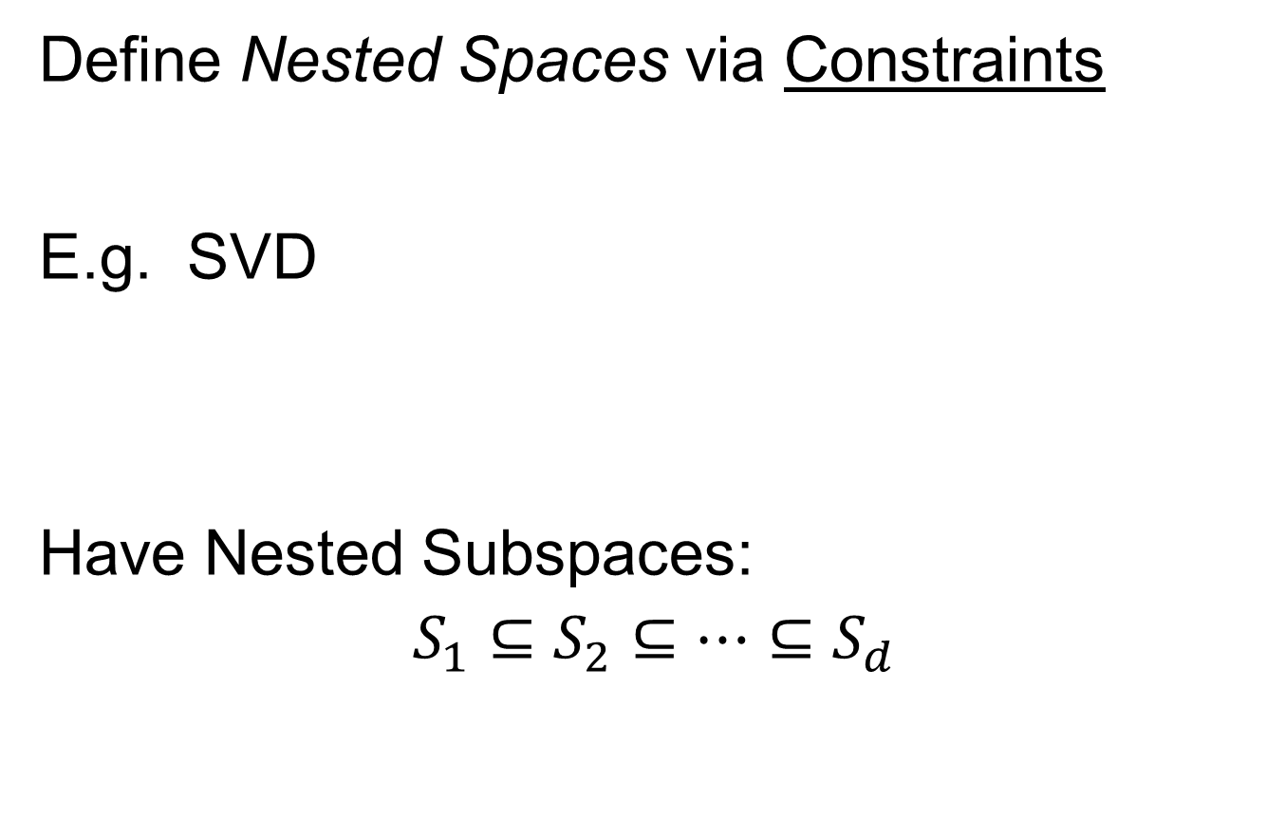
General View of Backwards PCA
Define Nested Spaces via Constraints
E.g. SVD
Have Nested Subspaces:
$$S_{1}⊆S_{2}⊆⋯⊆S_{d}$$

Slide 54


General View of Backwards PCA
Define Nested Spaces via Constraints
E.g. SVD $S_{k}=\left\{x :x=\sum_{j=1}^{k}{c_{j}u_{j}}\right\}$
$k$-th SVD Subspace
Scores
Loading Vectors (Basis Elements)

Slide 55
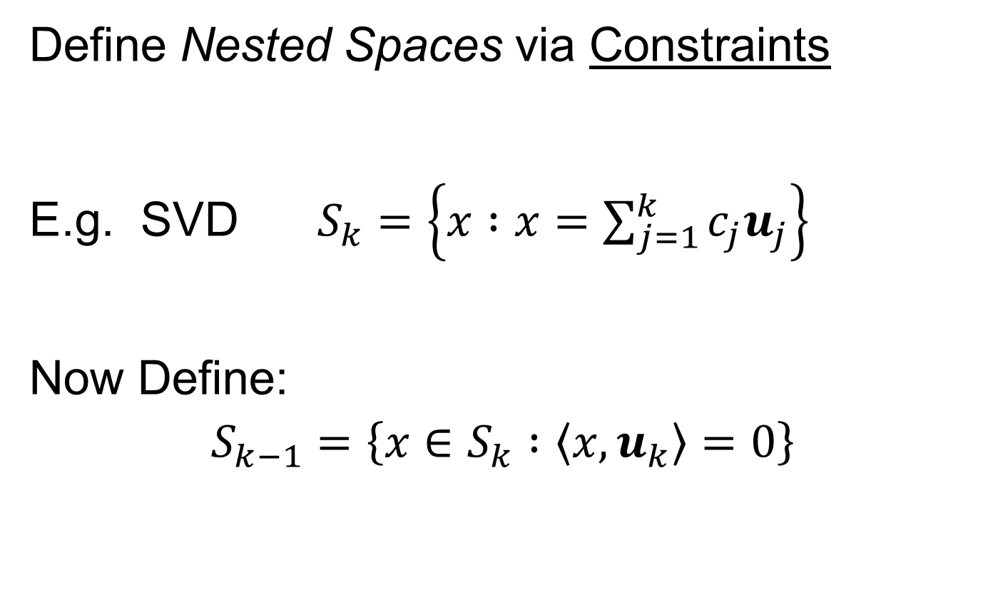
General View of Backwards PCA
Define Nested Spaces via Constraints
E.g. SVD $S_{k}=\left\{x :x=\sum_{j=1}^{k}{c_{j}u_{j}}\right\}$
Now Define:
$$S_{k−1}=\left\{x∈S_{k} :\left\langle x,u_{k}\right\rangle =0\right\}$$
Constraint Gives Nested Reduction of Dim’n

Slide 56
General View of Backwards PCA
Define Nested Spaces via Constraints
Backwards PCA
Reduce Using Affine Constraints

Slide 57
General View of Backwards PCA
Define Nested Spaces via Constraints
Backwards PCA
Principal Nested Spheres
Use Affine Constraints (Planar Slices)
In Ambient Space

Slide 58
General View of Backwards PCA
Define Nested Spaces via Constraints
Backwards PCA
Principal Nested Spheres
Principal Surfaces
Spline Constraint Within Previous?
{Been Done Already???}

Slide 59
General View of Backwards PCA
Define Nested Spaces via Constraints
Backwards PCA
Principal Nested Spheres
Principal Surfaces
Other Manifold Data Spaces
Sub-Manifold Constraints??
(Algebraic Geometry)

Slide 60
Covariance Matrices as Data Objects
Motivation: Diffusion Tensor Imaging (DTI)
Variation on Magnetic Resonance Imaging
Major Goal: Map Brain Connectivity
By Finding “Fibers”
Text: Sec 8.7
Basser et al. (1994)

Slide 61
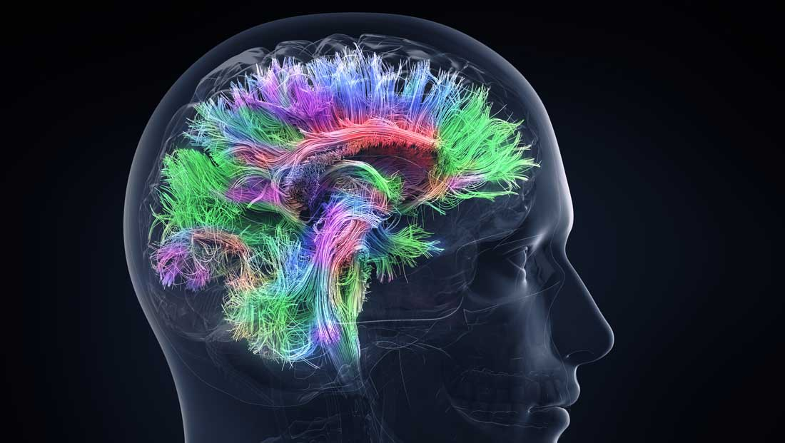
Covariance Matrices as Data Objects
Map Connectivity with Fiber Tracking
Thanks to DANA.ORG

Slide 62
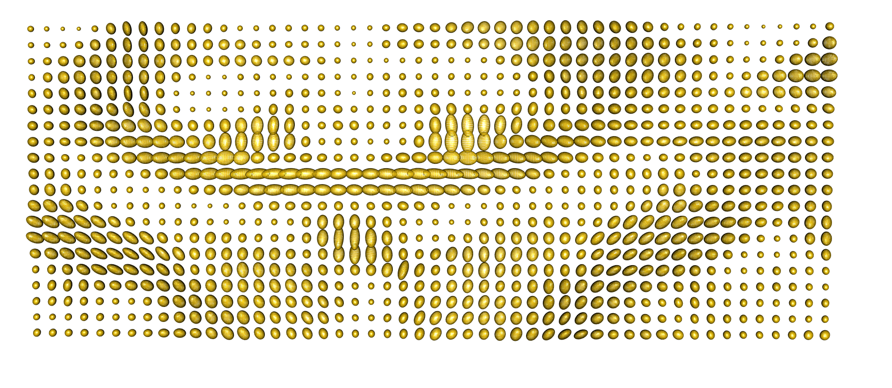
Covariance Matrices as Data Objects
DTI Approach: At 3-d “voxel grid”
Study Variation of Local Water Motion
Expressed as Covariance Matrices
Level Sets of
Corresponding
Gaussians
One Slice, from One Person’s Brain

Slide 63



Covariance Matrices as Data Objects
Variation Expressed as Covariance Matrices
Low Variation $≈$ Solid Region
Spherical $≈$ Pure Fluid
Stretched $≈$ Fiber
One Slice, from One Person’s Brain

Slide 64
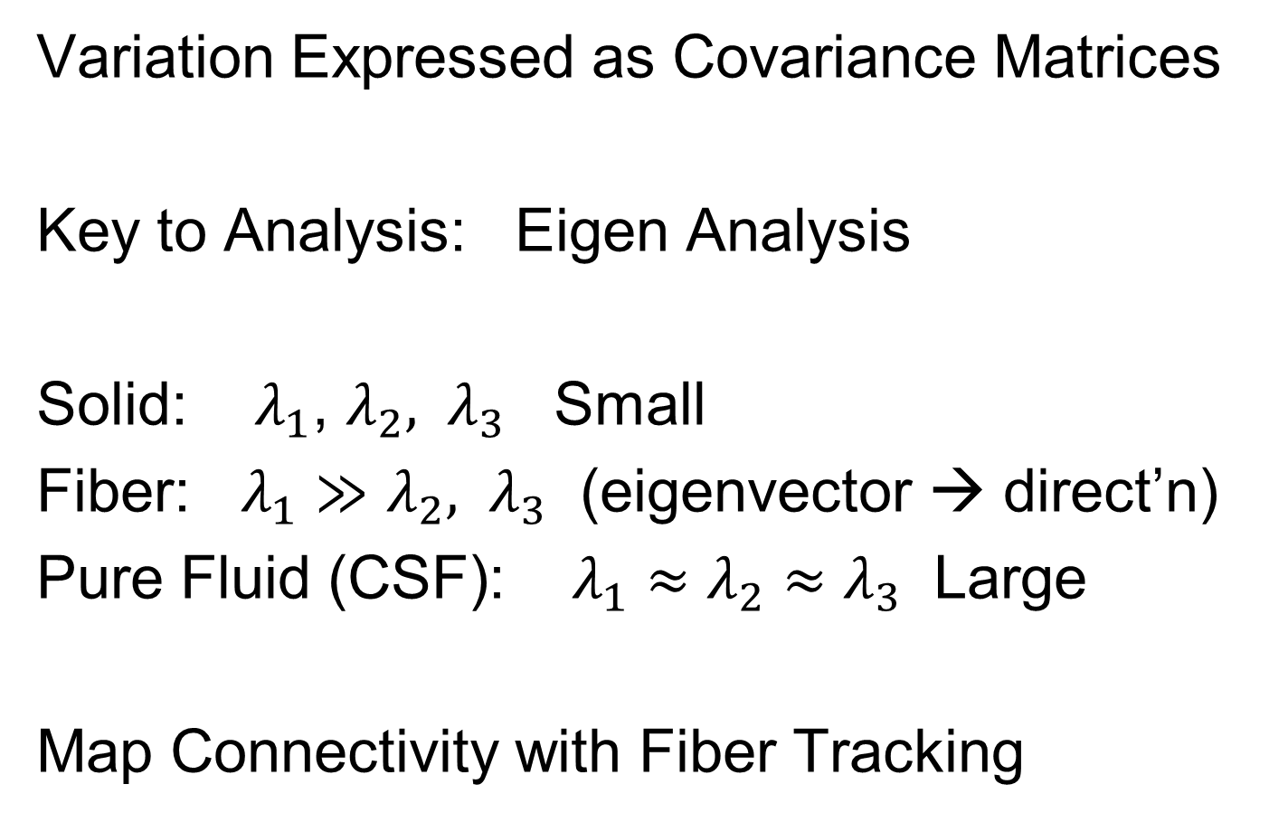
Covariance Matrices as Data Objects
Variation Expressed as Covariance Matrices
Key to Analysis: Eigen Analysis
Solid: $λ_{1}$, $λ_{2}, λ_{3}$ Small
Fiber: $λ_{1}≫$ $λ_{2}, λ_{3}$ (eigenvector → direct’n)
Pure Fluid (CSF): $λ_{1}≈$ $λ_{2}≈λ_{3}$ Large
Map Connectivity with Fiber Tracking

Slide 65
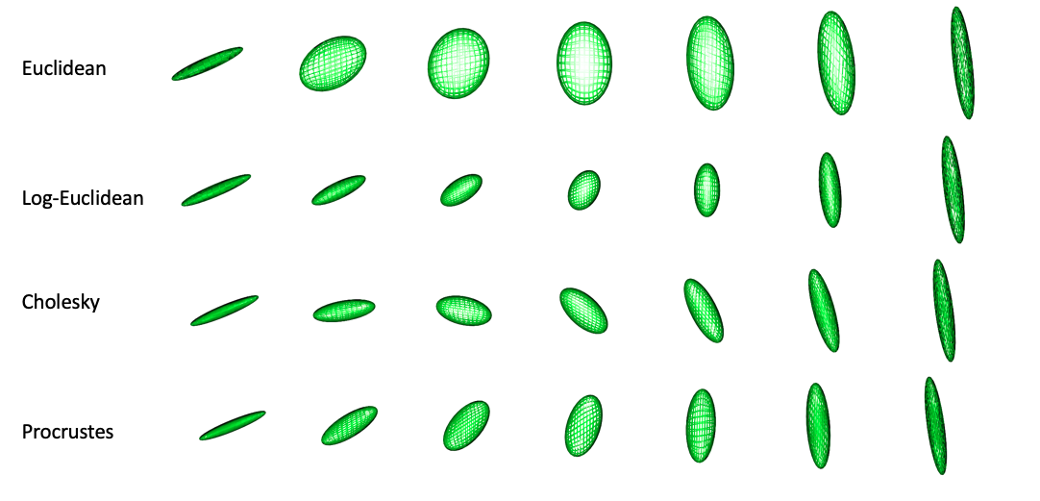
Covariance Matrices as Data Objects
Text: Sec 7.3.5
Important Point: Choice of Metric Matters
Geodesic from this fiber
To this fiber
For Interpolation of Fibers Want “Straight Line Path” (Geodesic)
Geodesic With Respect to Euclidean Distance = Frobenius Norm
Leaves Space of Fibers in a Strong Way
Clearly Need a
Better Metric

Slide 66
Covariance Matrices as Data Objects
Important Point: Choice of Metric Matters
Even Wildly Different Paths!

Slide 67
Covariance Matrices as Data Objects
Note on Metrics:
Each Induces a Manifold Structure
On the Set of Full Rank Covariance Matrices
Each Lower Rank also as a Manifold

Slide 68
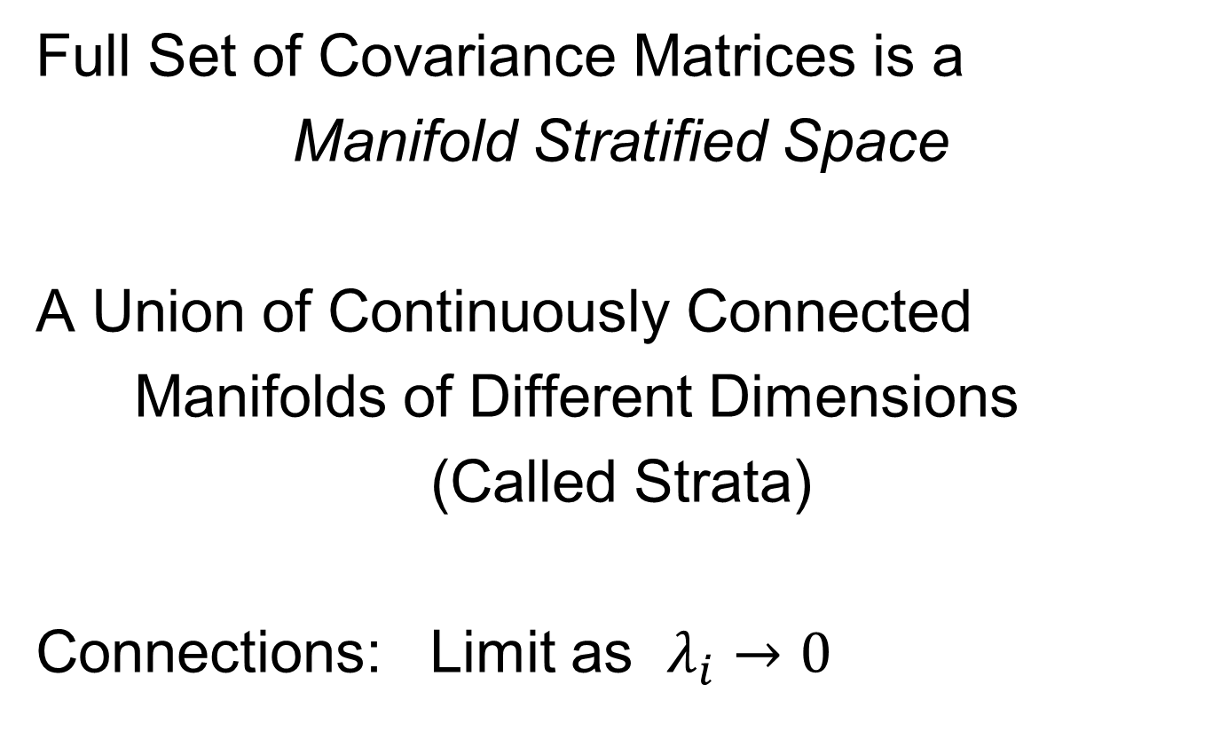
Covariance Matrices as Data Objects
Full Set of Covariance Matrices is a
Manifold Stratified Space
A Union of Continuously Connected
Manifolds of Different Dimensions
(Called Strata)
Connections: Limit as $λ_{i}→0$

Slide 69
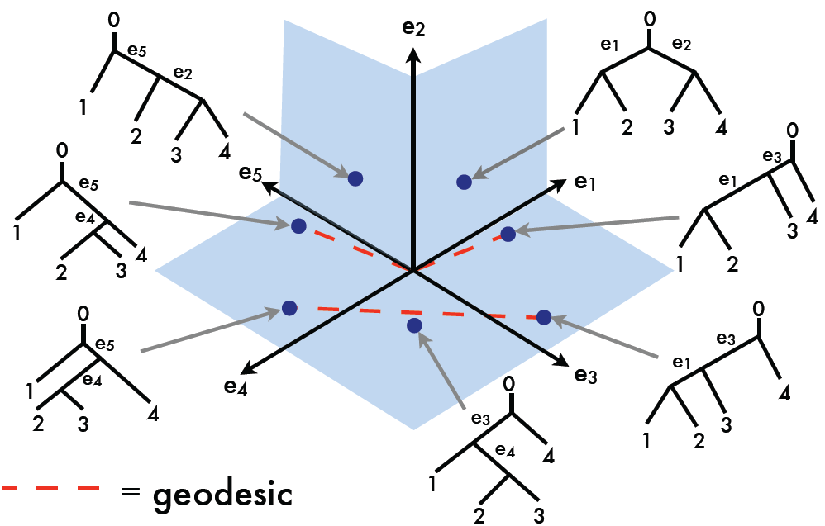
Manifold Stratified Spaces
Text: Sec 10.1.2
Another Important Example:
Phylogenetic Tree Space
Thanks to Megan Owen

Slide 70
Manifold Stratified Spaces
Another Example:
Projective Geometry
Important in Image Analysis
Good Source:
Patrangenaru & Ellingson (2016)
Chapters 21 and 22
Manifold Stratifications
Handle Occlusions

Slide 71
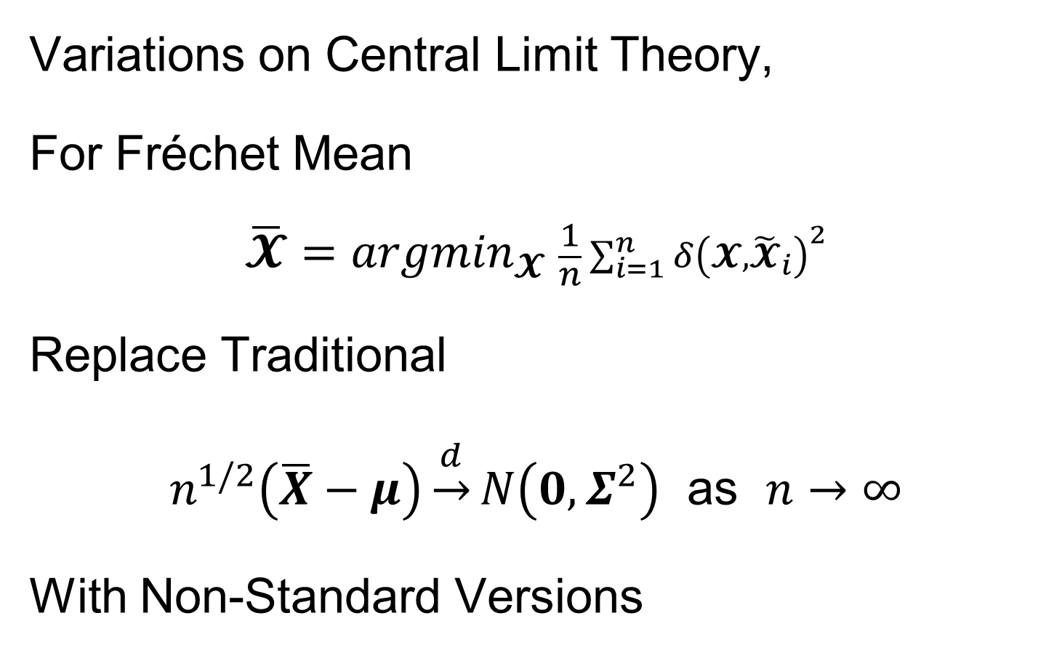
Non-Euclidean Probability Theory
Text, Sec. 8.5
Variations on Central Limit Theory,
For Fréchet Mean
$$\overline{𝓧}={argmin}_{𝓧} \frac{1}{n}\sum_{i=1}^{n}{{δ\left(𝓧,{\tilde{𝓧}}_{i}\right)}^{2}}$$
Replace Traditional
$n^{1/2}\left(\overline{X}−μ\right)\underset{→}{d}N\left(0,Σ^{2}\right)$ as $n→∞$
With Non-Standard Versions
Fun Variations: Different Rates of Convergence
Use Tangent Plane for Linear Ops
Sensible for Shrinking Neighborhoods

Slide 72
Non-Euclidean Probability Theory
Variations on Central Limit Theory,
Major Manifold References:
Terras (2012, 2013, 2016)
Patrangenaru & Ellingson (2015) Chp. 5
PNS Backwards Mean:
Huckemann & Eltzner (2018)
Better Than Fréchet Mean?

Slide 73
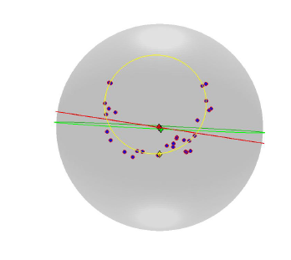

Principal Nested Spheres
Main Goal:
Extend Principal Arc Analysis ($𝕊^{2}$ to $𝕊^{k}$)
Fréchet Mean =
Center of Mass
PNS Backwards Mean

Slide 74
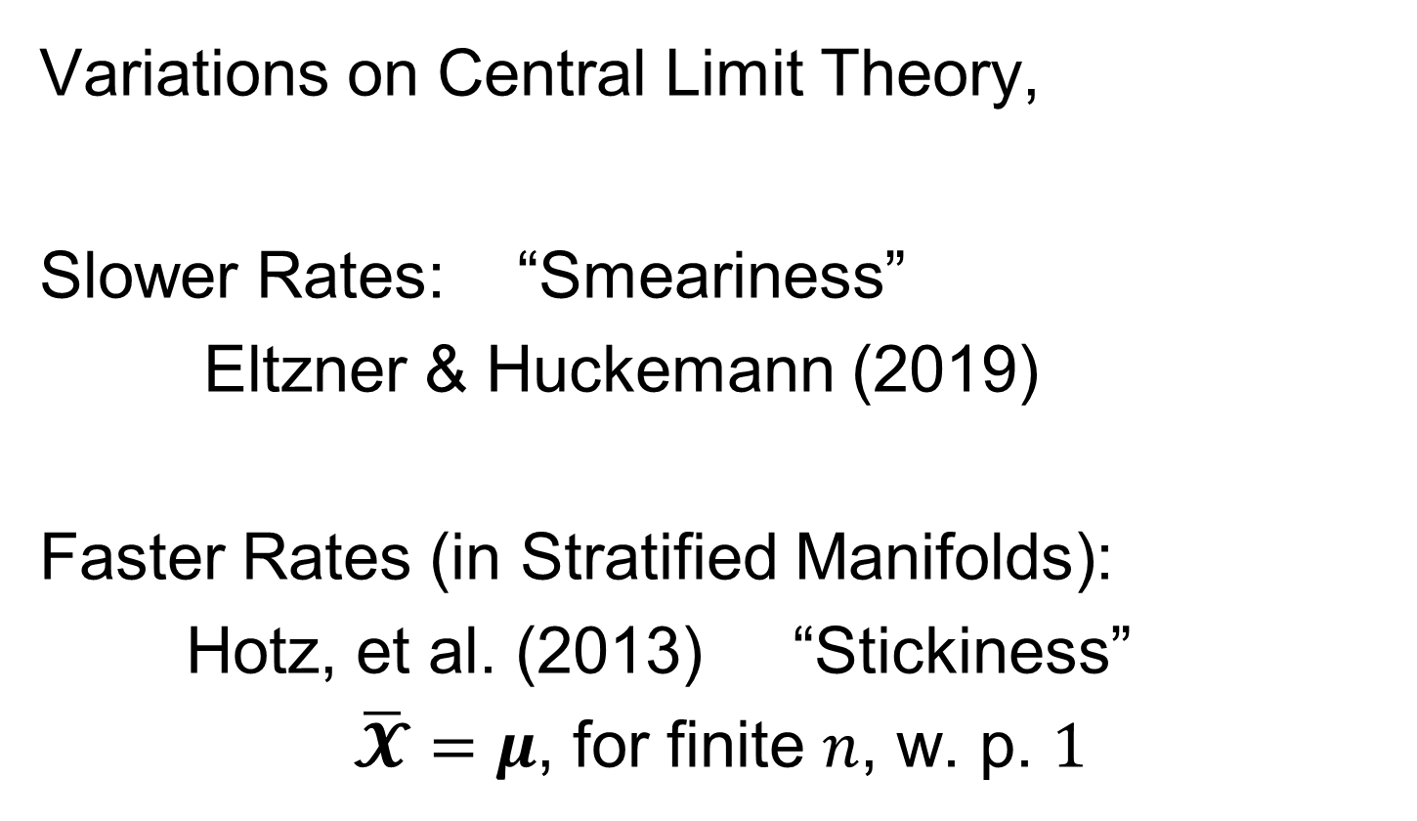
Non-Euclidean Probability Theory
Variations on Central Limit Theory,
Slower Rates: “Smeariness”
Eltzner & Huckemann (2019)
Faster Rates (in Stratified Manifolds):
Hotz, et al. (2013) “Stickiness”
$\overline{𝓧}=μ$, for finite $n$, w. p. $1$

Slide 75
Forgot to Say
During DIVAS Section:
Interesting Analysis:
Neuro-Science Data

Slide 76



Drug Abuse Neuro-Science
5 Block DIVAS Analysis
(Computationally Challenging)
Andy Ackerman
Zhengwu Zhang
Jan Hannig

Slide 77

Drug Abuse Neuro-Science
Previous Studies:
Pairwise
Human Connectome Project
Data Blocks:
Functional Connectivity (FMRI, 87 ROIs)
Structural Connectivity (DTI, 87 ROIs)
Cognition Scores (Delay Discounting, …)
Drug Abuse Survey
Genome Wide Association (SNPs)
$$n=375$$
DIVAS: Data Determines Interactions

Slide 78
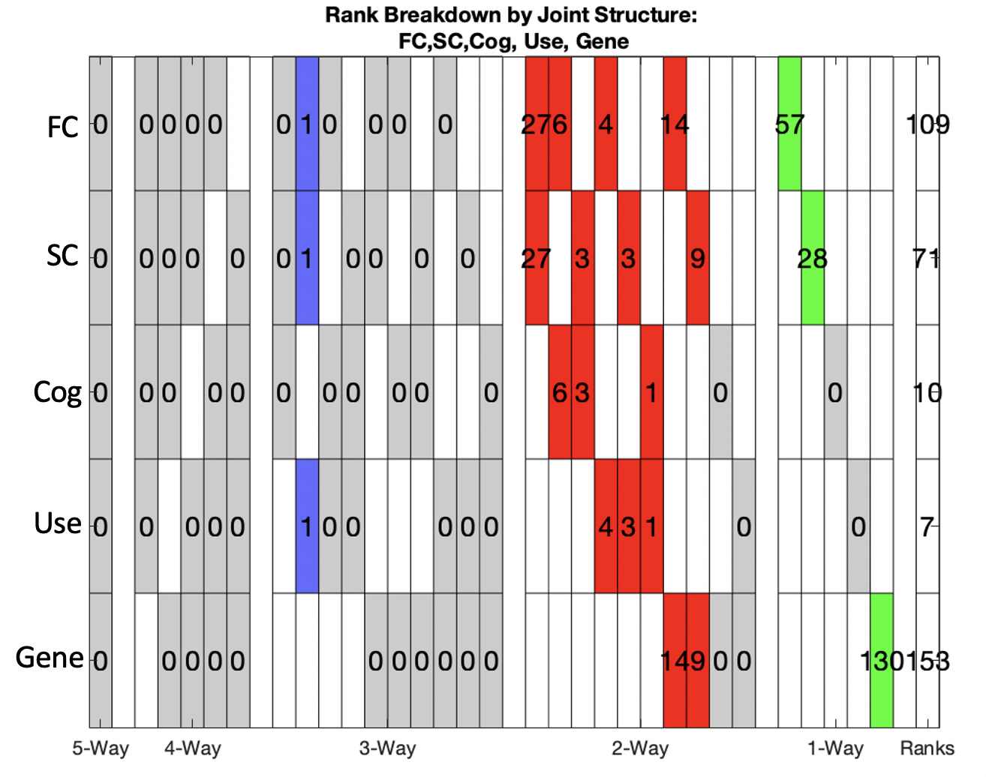
Drug Abuse Neuro-Science
DIVAS
Summary:
Single 3-way Mode
Others All Pairs
Many FC – SC Modes
No Individual Cog
Or Use Variation
Genomics Associated
With FC and SC,
Not Others
Lots of Individual
Genomic Variaition

Slide 79
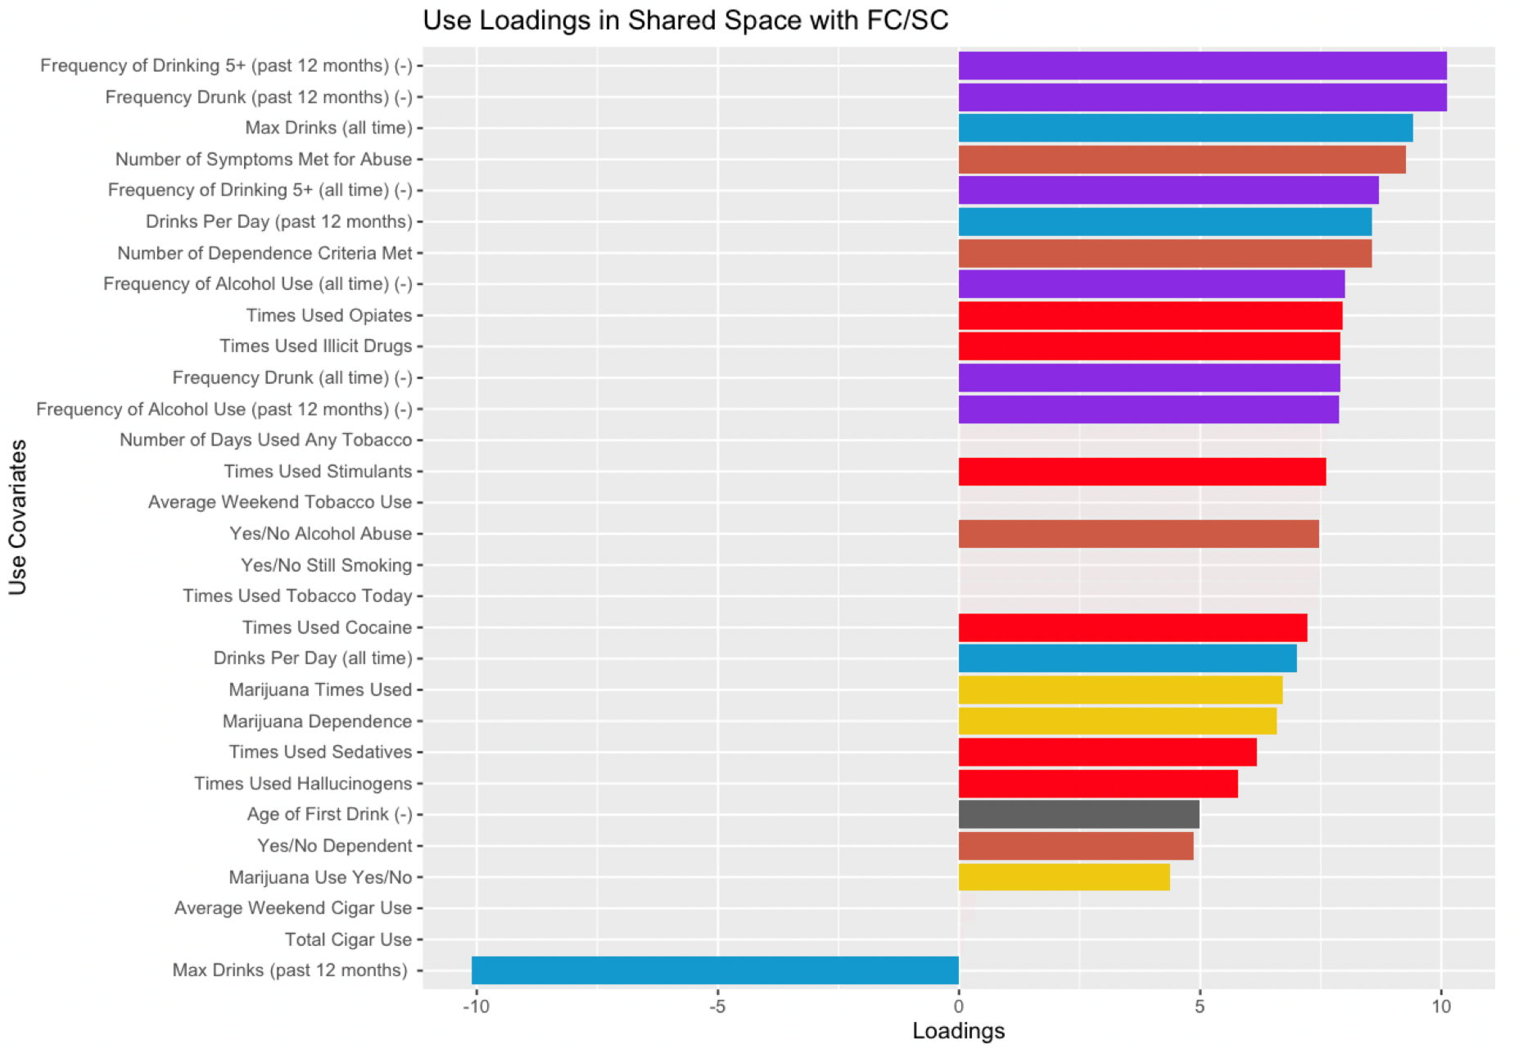
Drug Abuse Neuro-Science
Loadings
In 3-Way
Mode:
Not Jackstraw
Signficant

Slide 80
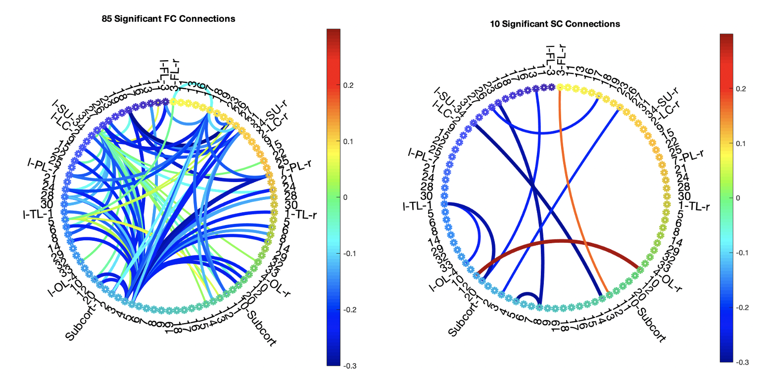
Drug Abuse Neuro-Science
Loadings In 3-Way Mode:
ROIs
Jackstraw Significant Connections

Slide 81
OODA Big Picture
Text: Chp. 9
New Topic:
Curve Registration
(Amplitude – Phase Variation)
Main Reference:
Srivastava et al (2011)
Interesting Aside: Never Published
Beyond ArXiv, yet 316 Google Citations

Slide 82
Curve Registration
Text: Chp. 9
Main Reference:
Srivastava et al (2011)
Source for Deeper Mathematics:
Srivastava and Klassen (2016)

Slide 83
Collaborators
Anuj Srivastava (Florida State U.)
Wei Wu (Florida State U.)
Derek Tucker (Sandia National Lab)
Xiaosun Lu (U. N. C.)
Inge Koch (U. Adelaide)
Peter Hoffmann (U. Adelaide)
J. O. Ramsay (McGill U.)
Laura Sangalli (Milano Polytech.)

Slide 84
Participant Presentation
Zhen Fang
Conformal Inference for Individual Treatment Effects

