Slide 1
Statistics – O. R. 881
Object Oriented Data Analysis
Steve Marron
Dept. of Statistics and Operations Research
University of North Carolina

Slide 2
Current Sections in Textbook
Today:
Section 9.1, 2.1, 9.2
Next Class:
Section 9.2, 14.2

Slide 3
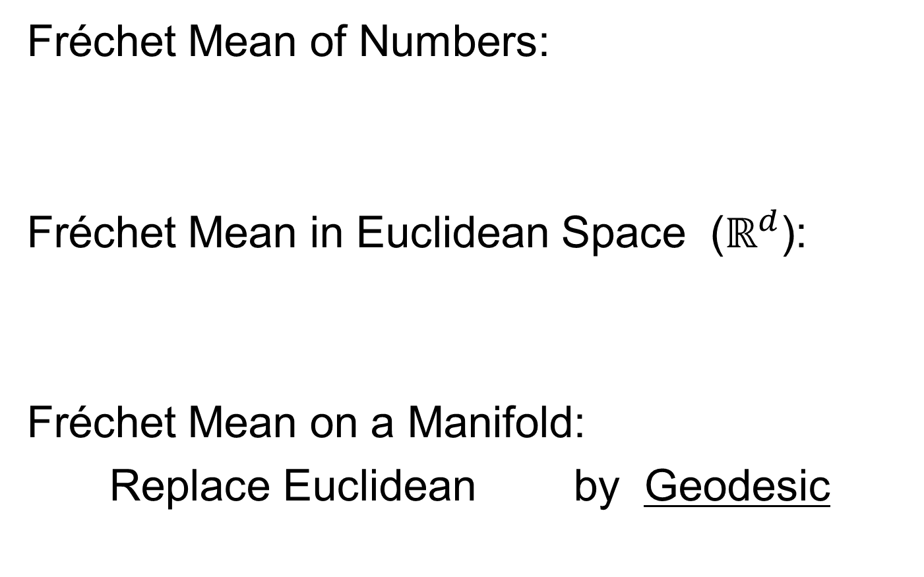
Last Class: Interesting Question
How generally applicable is
Backwards approach to PCA?
An Application:
Nonnegative Matrix Factorization
= PCA in Positive Orthant
Think $X ≈LS$
With ≥ 0 Constraints (on both $L$ & $S$)

Slide 4
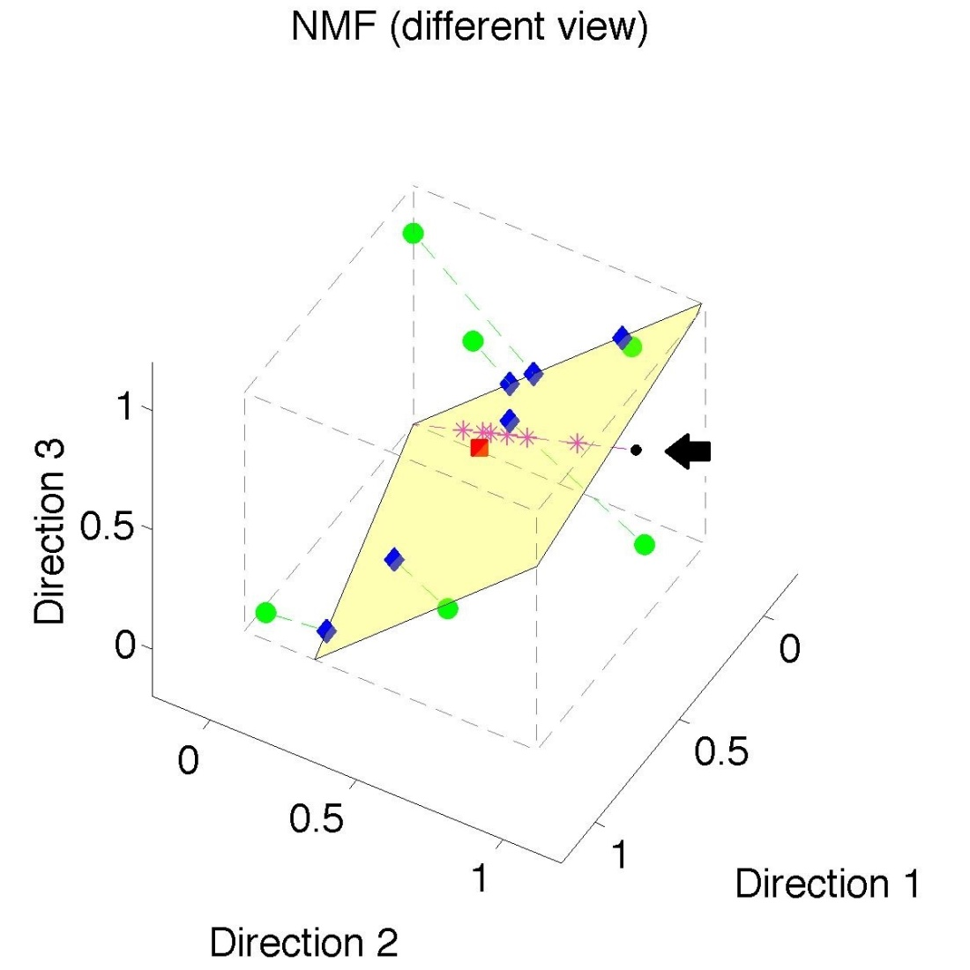
Last Class: Nonneg. Mat. Factor’n
Standard NMF
But Note
Not Nested
No “Multi-scale”
Analysis Possible
(Scores Plot?!?)

Slide 5
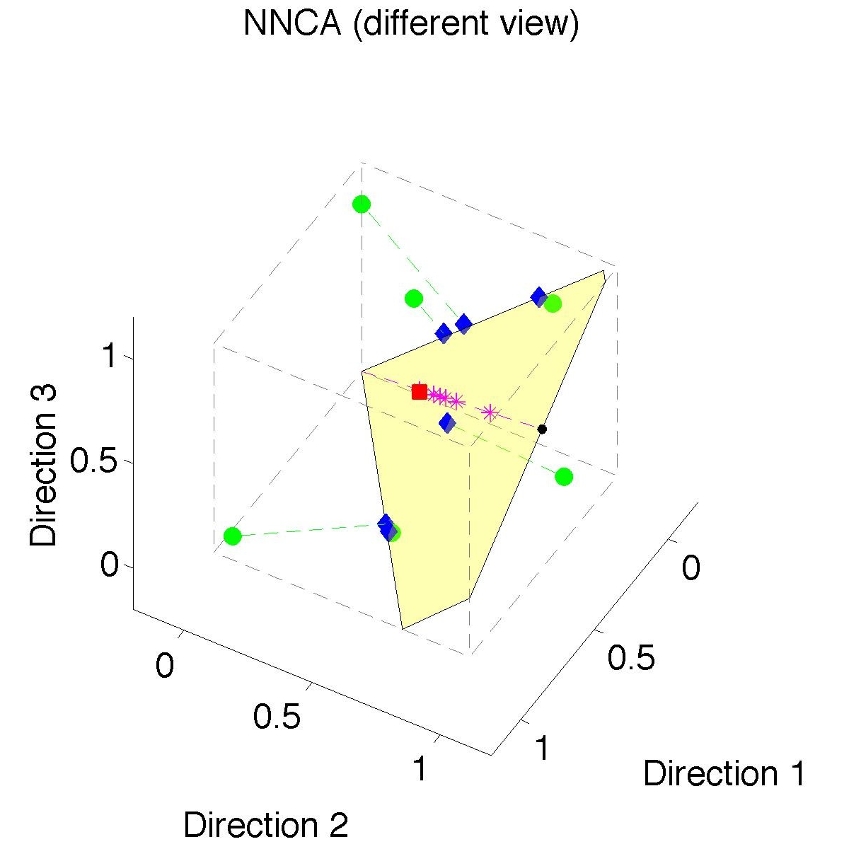
Last Class: Nonneg. Nested Cones
Same Toy
Data Set
Rank 1
Approx.
Properly
Nested

Slide 6
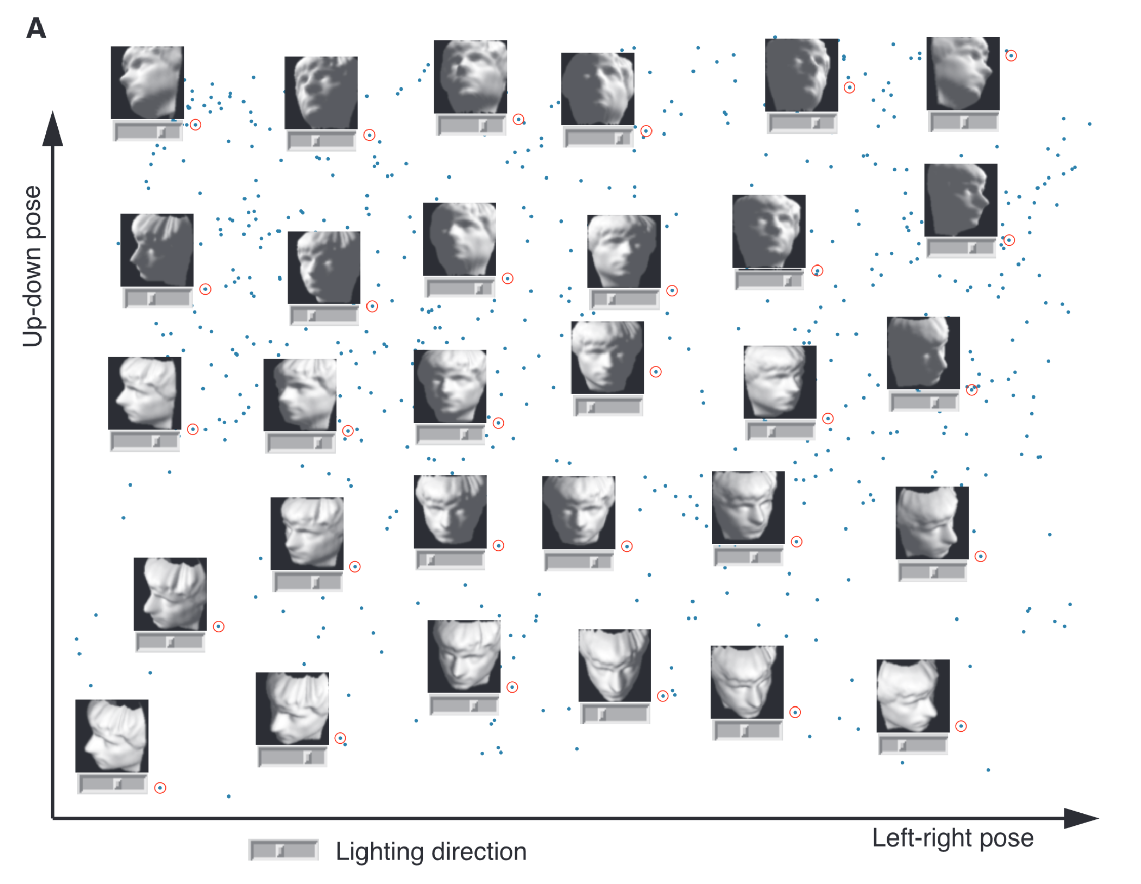
Last Class: Manifold Learning
Tenenbaum, et al (2000)
Reveals
Two
Interesting
Modes Of
Variation

Slide 7
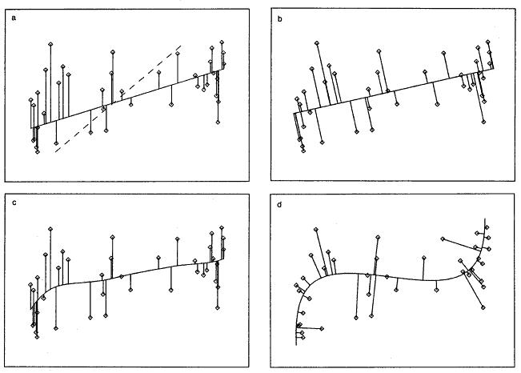
Last Class: 1st Principal Curve
Linear Reg’n
Proj’s Reg’n
Usual Smooth
Princ’l Curve

Slide 8
Last Class: Manifold Learning
Key Component:
Principal Surfaces
LeBlanc & Tibshirani (1996)
Challenge:
Can have any dimensional surface,
But how to nest???
Proposal: Backwards Approach

Slide 9
Last Class: Interesting Question
Why does backwards PC seem easier?
An Attractive Answer:
James Damon, UNC Mathematics
Key Idea: Express Backwards PCA as
Nested Series of Constraints

Slide 10
Last Class: Backwards PCA
Define Nested Spaces via Constraints
Backwards PCA
Principal Nested Spheres
Principal Surfaces
Other Manifold Data Spaces
Sub-Manifold Constraints??
(Algebraic Geometry)

Slide 11
Last Class: Cov. Mat. Data Objects
Motivation: Diffusion Tensor Imaging (DTI)
Variation on Magnetic Resonance Imaging
Major Goal: Map Brain Connectivity
By Finding “Fibers”
Text: Sec 8.7
Basser et al. (1994)

Slide 12
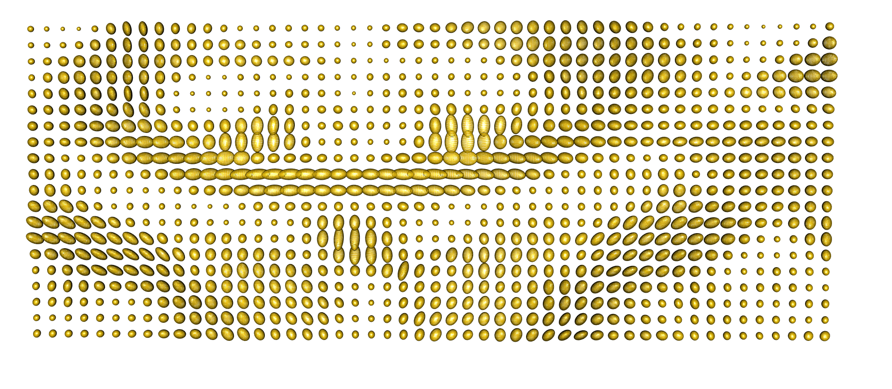



Last Class: Cov. Mat. Data Objects
Variation Expressed as Covariance Matrices
Low Variation $≈$ Solid Region
Spherical $≈$ Pure Fluid
Stretched $≈$ Fiber
One Slice, from One Person’s Brain

Slide 13
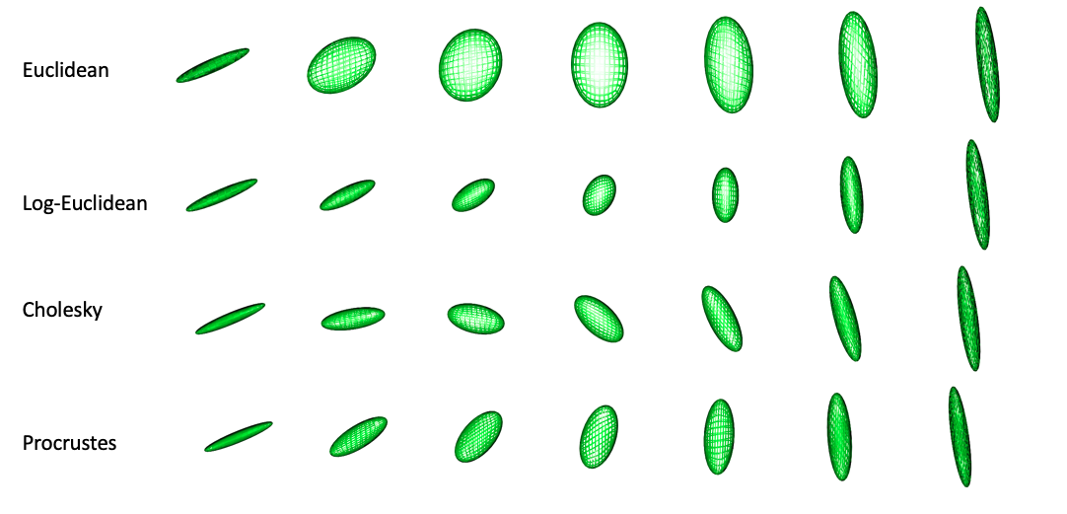
Last Class: Cov. Mat. Data Objects
Important Point: Choice of Metric Matters
Even Wildly Different Paths!

Slide 14
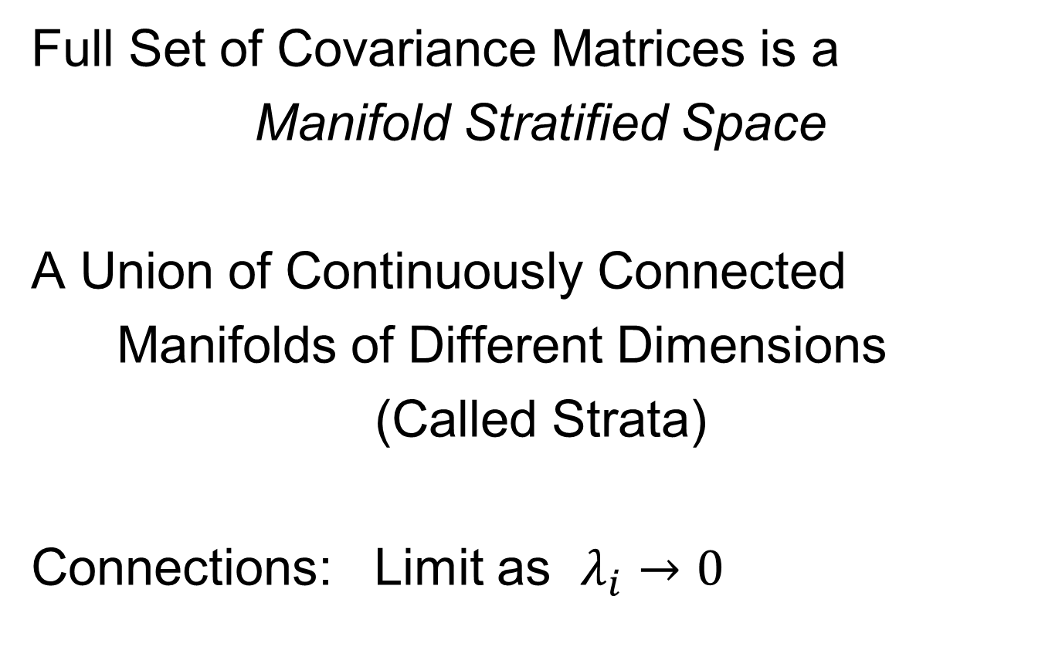
Last Class: Cov. Mat. Data Objects
Full Set of Covariance Matrices is a
Manifold Stratified Space
A Union of Continuously Connected
Manifolds of Different Dimensions
(Called Strata)
Connections: Limit as $λ_{i}→0$

Slide 15
Last Class: OODA Big Picture
Text: Chp. 9
New Topic:
Curve Registration
(Amplitude – Phase Variation)
Main Reference:
Srivastava et al (2011)
Interesting Aside: Never Published
Beyond ArXiv, yet 316 Google Citations

Slide 16
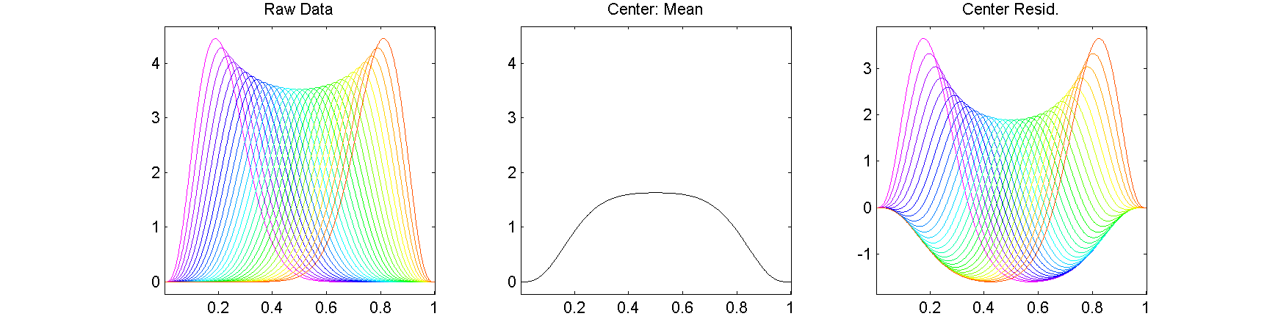


Motivating Example
Functional Data Analysis
i.e. Curves as Data Objects
Shifted Betas Example
How Amenable To
Classical PCA?
$$α+β=20$$
$$f_{α,β}\left(x\right)=\frac{Γ(α+β)}{Γ\left(α\right)Γ\left(β\right)}x^{α−1}{\left(1−x\right)}^{β−1}1_{\left(0,1\right)}(x)$$
Variation Explainable by Single Mode?

Slide 17
Motivating Example
Shifted Betas Example
Mean Not
Representative!
Centering Creates
Distortion?

Slide 18
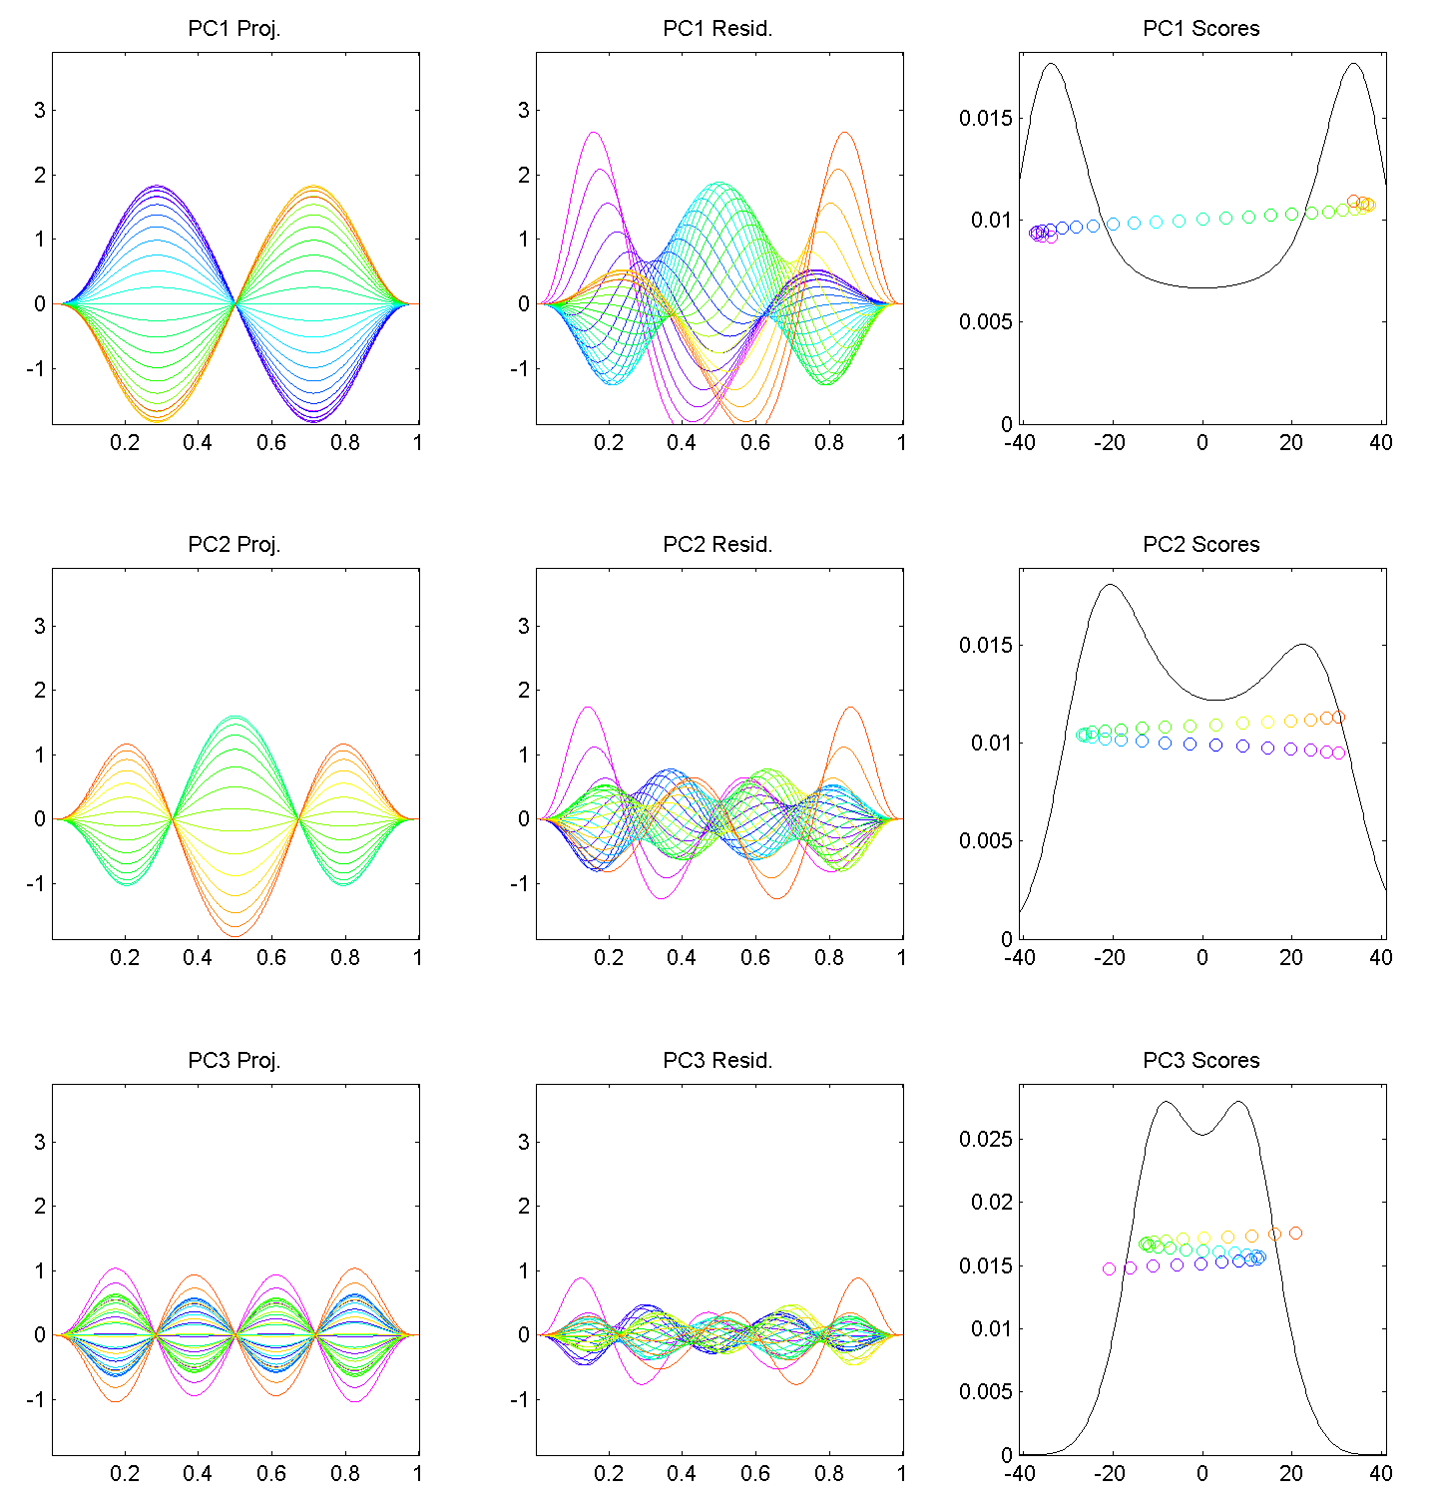
Motivating Example
Shifted Betas
Example PCA
Hard to Interpret 1st Mode
Yet Scores Seem Sensible
Conclusion: PCA
Modes of Variation
Yield Poor Insights
About Phase
Similar for Other Modes
Looks Like Harmonics
From Fourier Theory
Is There a Sturm-
Liouville Theory?

Slide 19
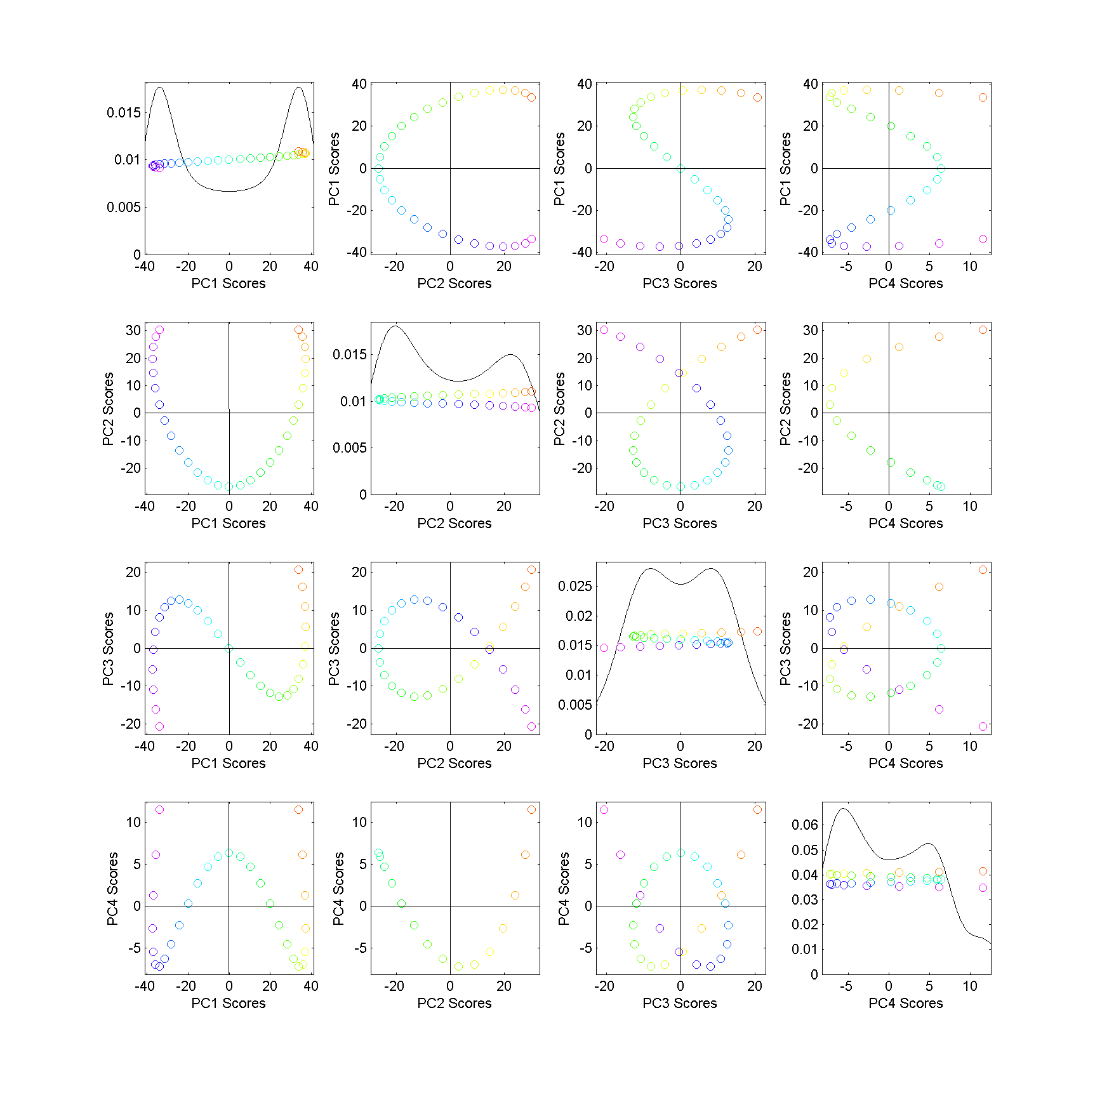
Motivating Example
Shifted
Betas
Example
PCA
Scores
Interesting
Patterns!
Variation
Follows
Single Curve
Bending
All Around
Very Poor Signal
Compression!

Slide 20
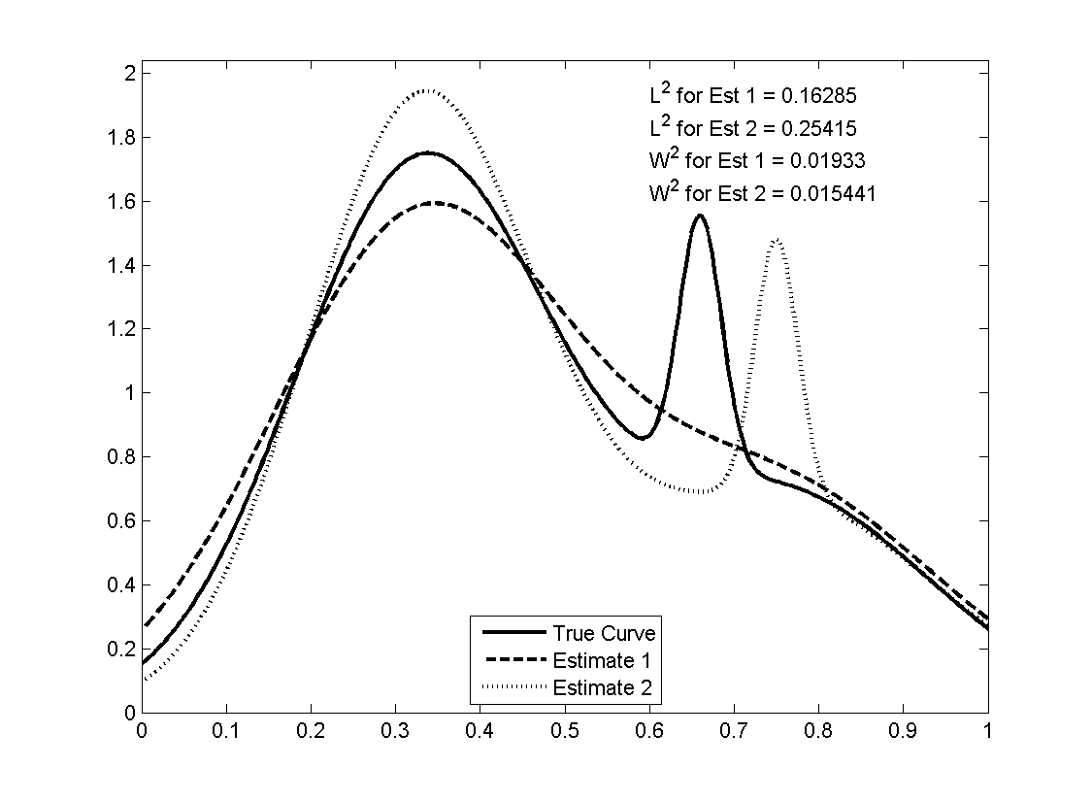
Motivating Example
Shifted Betas Example
Alternate
Approach:
Wasserstein
Distance
Based on
Optimal
Transport
Interesting Example

Slide 21
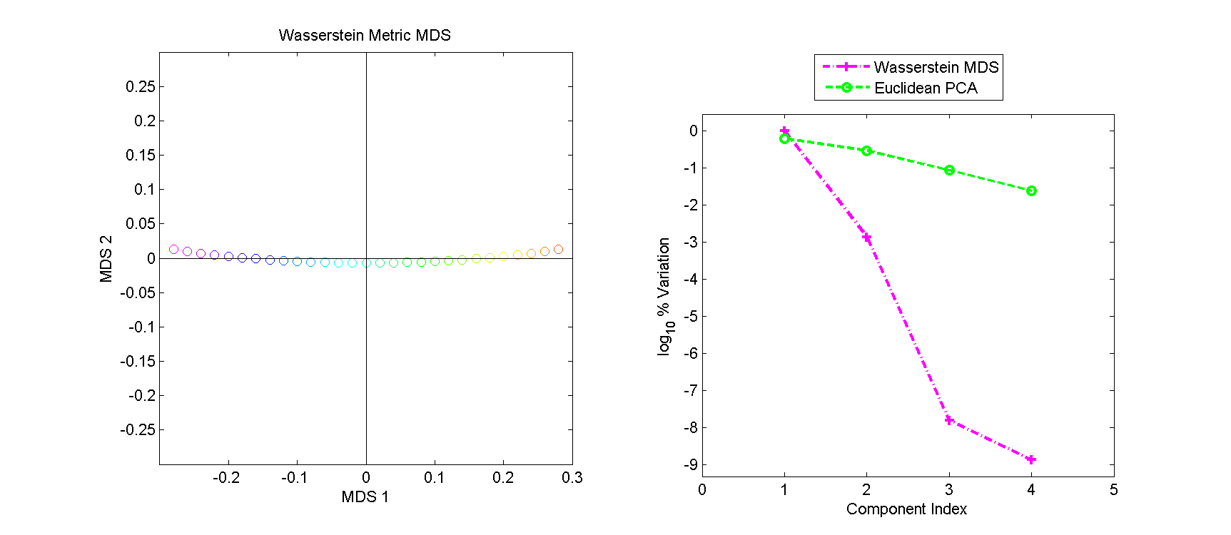
Motivating Example
Shifted Betas Example
Alternate Analysis: Wasserstein MDS
Gives Much More
Interpretable Scores
Small Amplitude Variation
Large Phase Variation
Challenge: Only
Scores, No Modes

Slide 22
Motivating Example
Shifted Betas Example
Alternate Analysis: Wasserstein MDS
Log₁₀ Scree Plot
Gives Much Better
Signal Compression
Conventional PCA
Spreads Power
Across Spectrum
Log₁₀ Scaling Very Revealing

Slide 23
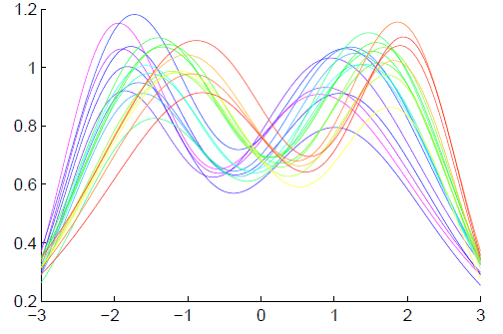
General Amp - Phase Context
Functional Data Analysis
Curves as Data Objects
Toy Example:

Slide 24
General Amp - Phase Context
Functional Data Analysis
Curves as Data Objects
Toy Example:
How Can We
Understand
Variation?

Slide 25
General Amp - Phase Context
Functional Data Analysis
Curves as Data Objects
Toy Example:
How Can We
Understand
Variation?

Slide 26
General Amp - Phase Context
Functional Data Analysis
Curves as Data Objects
Toy Example:
How Can We
Understand
Variation?

Slide 27
General Amp - Phase Context
Insightful
Decomposition

Slide 28
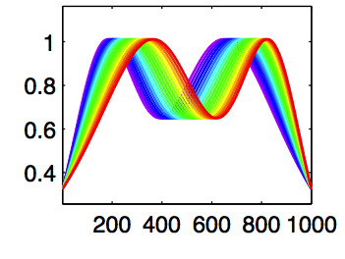
General Amp - Phase Context
Insightful
Decomposition
Horiz’l
Var’n

Slide 29
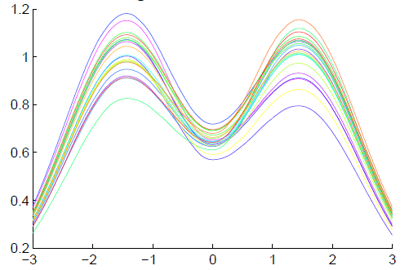
General Amp - Phase Context
Insightful
Decomposition
Vertical Variation
Horiz’l
Var’n
Amplitude Mode of Variation
Phase Mode of Variation

Slide 30
Challenge
Fairly Large Literature
Many (Diverse) Past Attempts
Limited Success (in General)
Surprisingly Slippery
(even mathematical formulation)

Slide 31
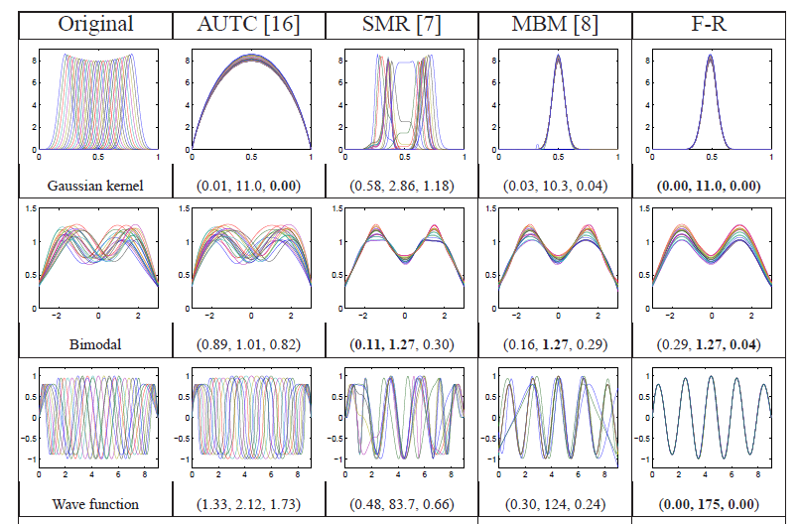
Challenge (Illustrated)
Thanks to Wei Wu

Slide 32
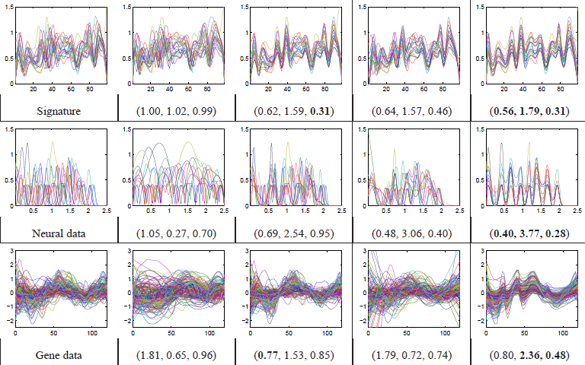
Challenge (Illustrated)
Thanks to Wei Wu

Slide 33
General Amp - Phase Context
Appropriate
Mathematical
Framework?
Vertical Variation
Horiz’l
Var’n

Slide 34
Time Warping
Foundational Concept for Curve Registration
Think Stretch & Compress Horizontal Axis
Mathematical Basis:
Diffeomorphisms

Slide 35
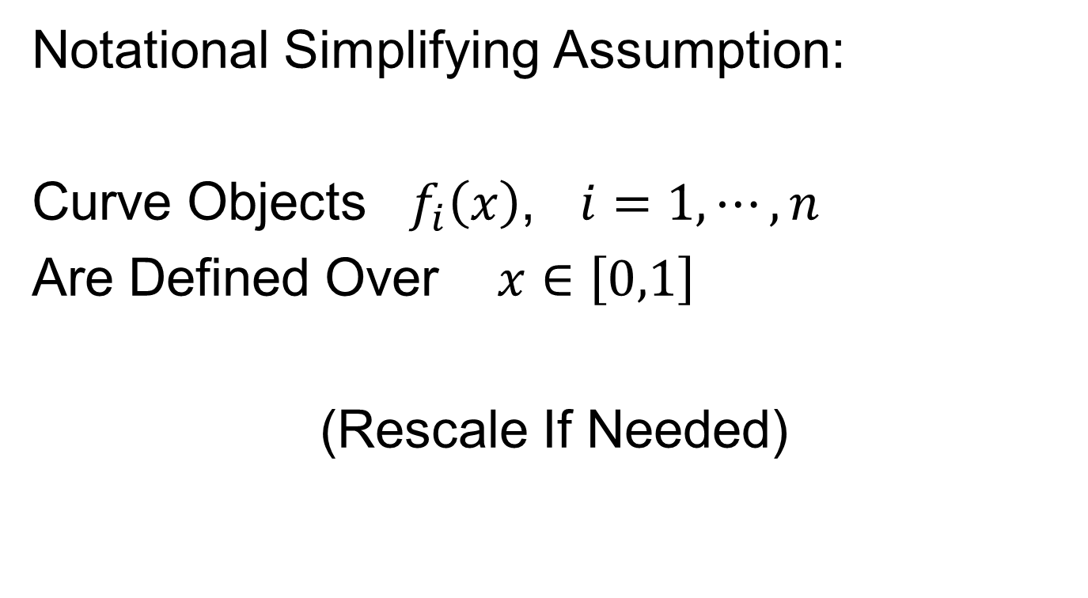
Time Warping
Notational Simplifying Assumption:
Curve Objects $f_{i}\left(x\right)$, $i=1,⋯,n$
Are Defined Over $x∈\left[0,1\right]$
(Rescale If Needed)

Slide 36
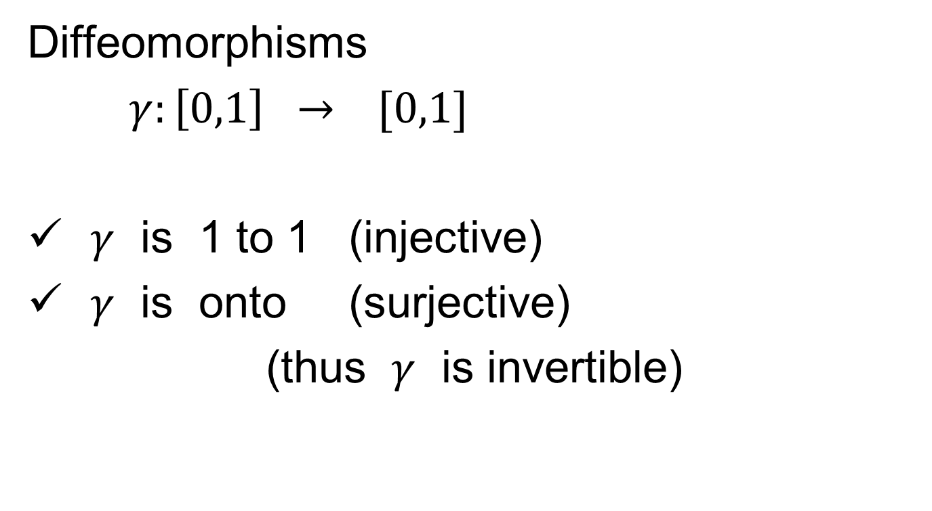
Time Warping
Diffeomorphisms
$γ:\left[0,1\right] → [0,1]$
$γ$ is 1 to 1 (injective)
$γ$ is onto (surjective)
(thus $γ$ is invertible)
Bijective

Slide 37

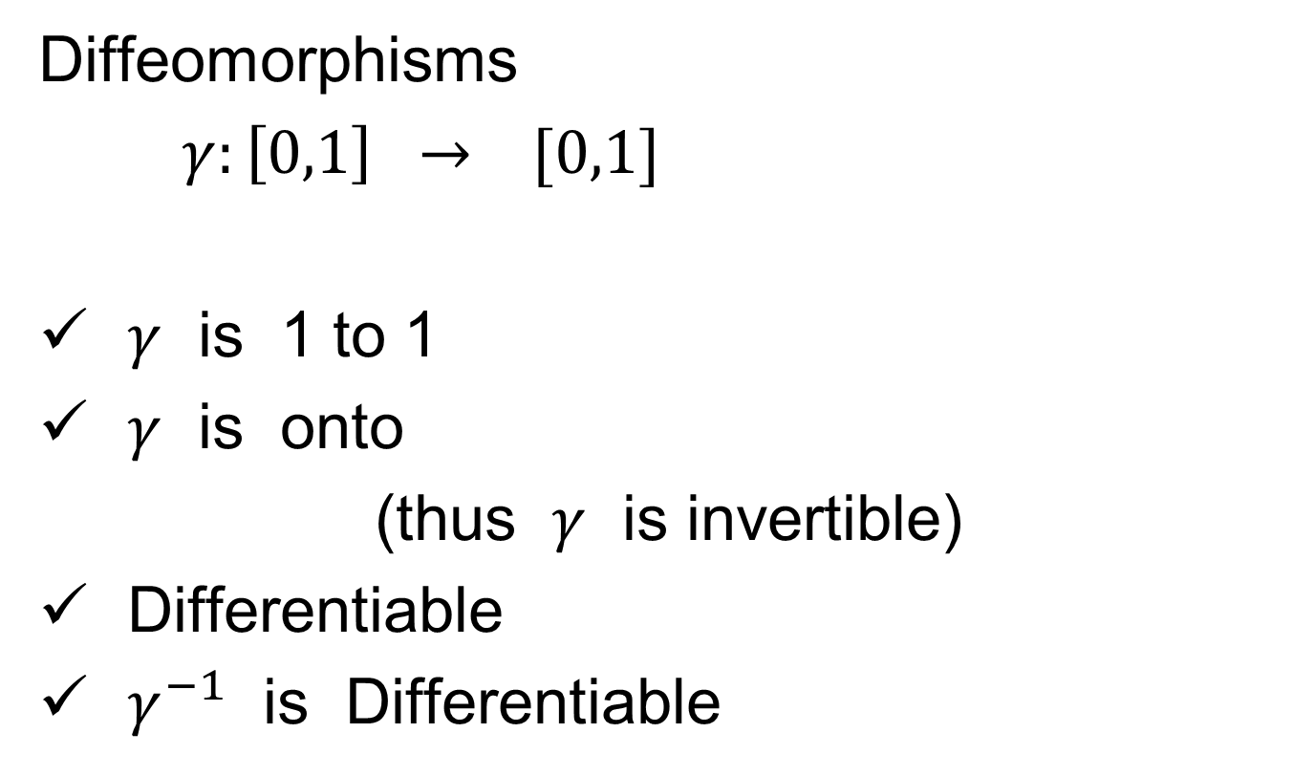
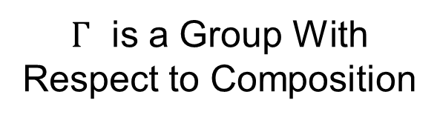
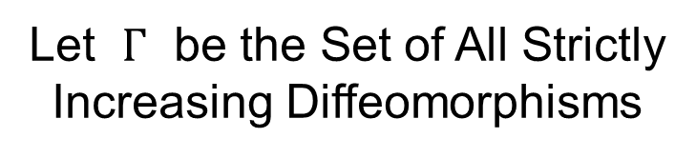
Time Warping
Let $Γ$ be the Set of All Strictly
Increasing Diffeomorphisms
Diffeomorphisms
$γ:\left[0,1\right] → [0,1]$
$γ$ is 1 to 1
$γ$ is onto
(thus $γ$ is invertible)
Differentiable
$γ^{−1}$ is Differentiable
$Γ$ is a Group With
Respect to Composition
Achieve by taking $γ$ strictly increasing

Slide 38
Time Warping Intuition
Elastically Stretch & Compress Axis

Slide 39
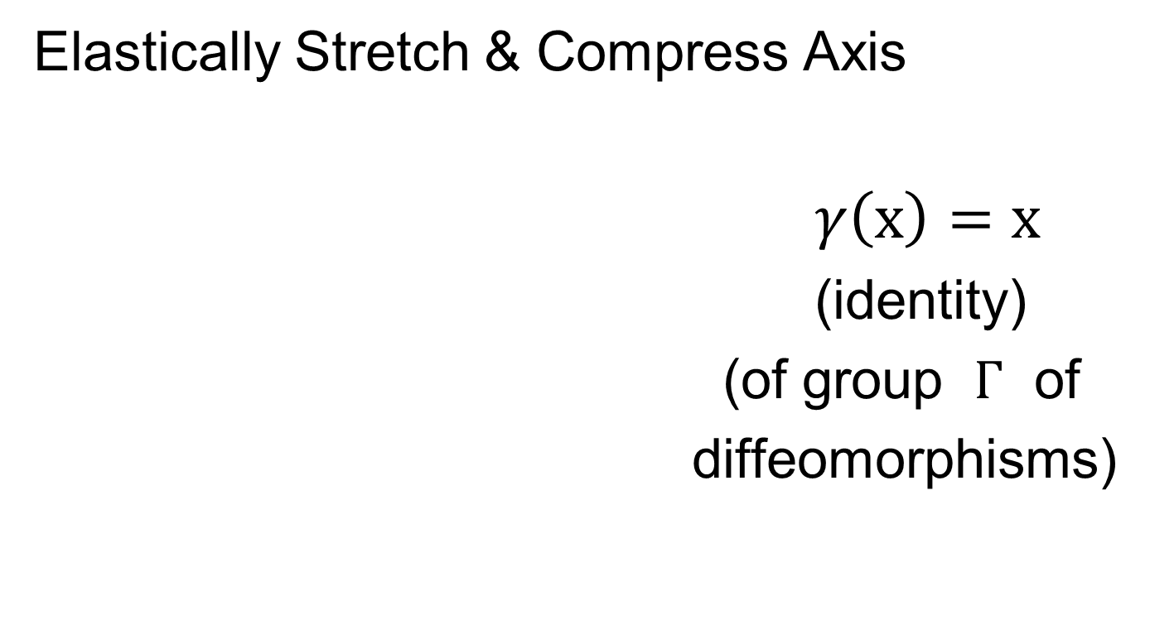
Time Warping Intuition
Elastically Stretch & Compress Axis
$γ\left(x\right)=x$
(identity)
(of group $Γ$ of
diffeomorphisms)

Slide 40

Time Warping Intuition
Elastically Stretch & Compress Axis
$γ\left(x\right)$

Slide 41

Time Warping Intuition
Elastically Stretch & Compress Axis
$γ\left(x\right)$

Slide 42

Time Warping Intuition
Elastically Stretch & Compress Axis
$γ\left(x\right)$

Slide 43
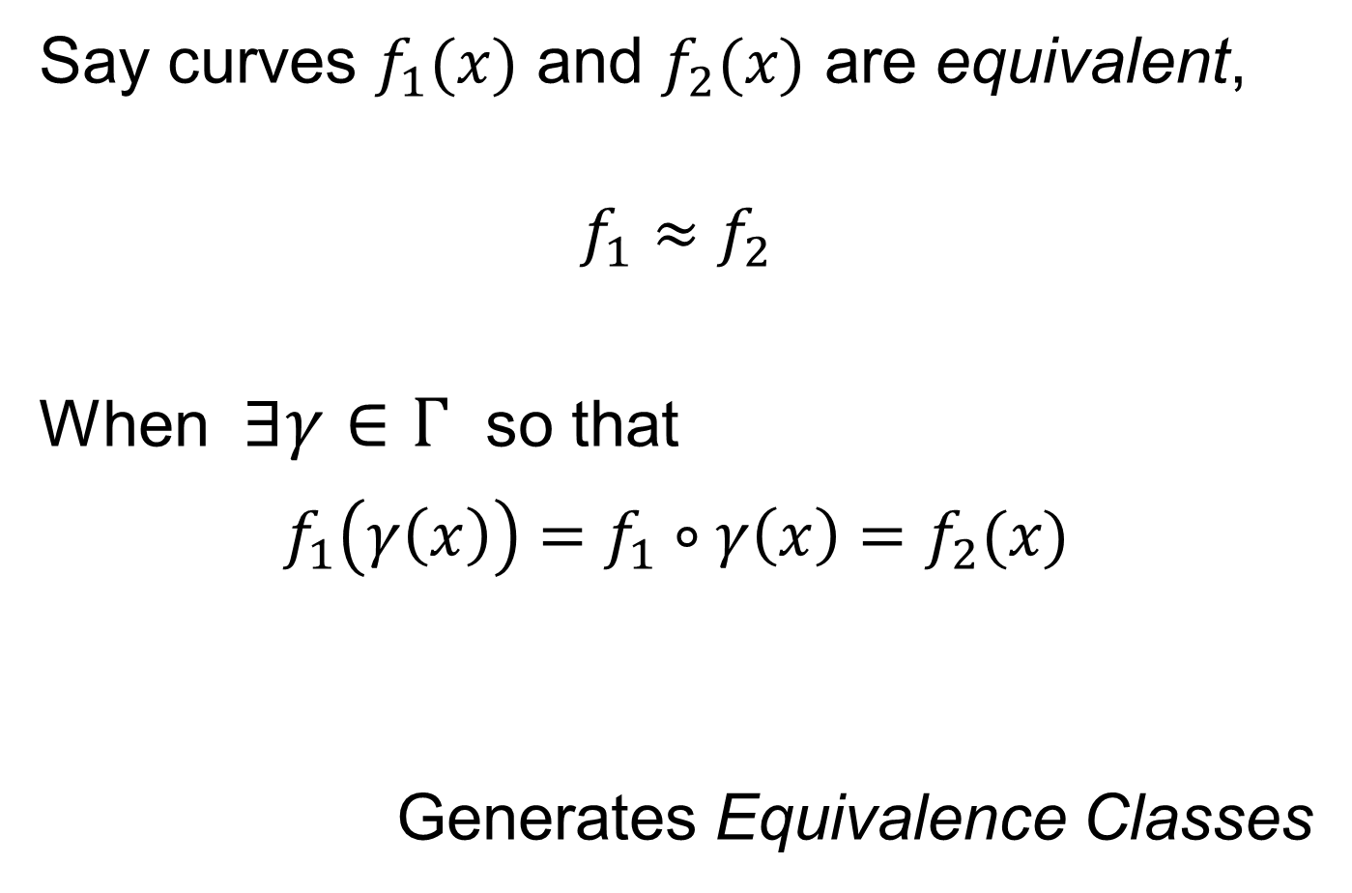
Time Warping Intuition
Say curves $f_{1}(x)$ and $f_{2}(x)$ are equivalent,
$$f_{1}≈f_{2}$$
When $∃γ∈Γ$ so that
$$f_{1}\left(γ\left(x\right)\right)=f_{1}∘γ\left(x\right)=f_{2}(x)$$
Generates Equivalence Classes
Stretch & Compress Before Plugging In

Slide 44
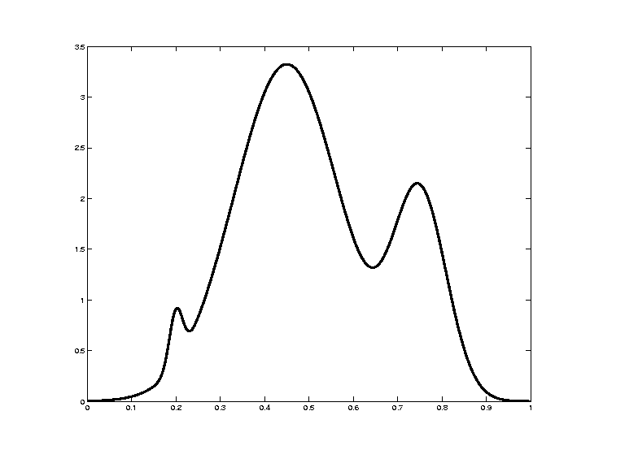

Time Warping Intuition
Toy Example: Starting Curve, $f\left(x\right)$

Slide 45
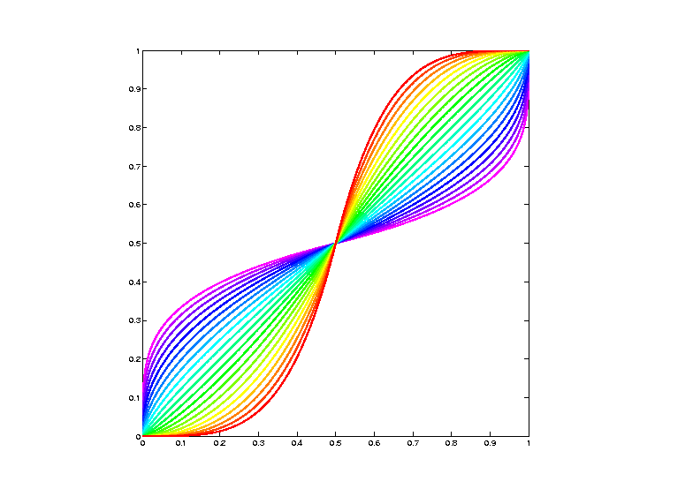

Time Warping Intuition
Toy Example: Warping Functions $γ_{i}(x)$

Slide 46
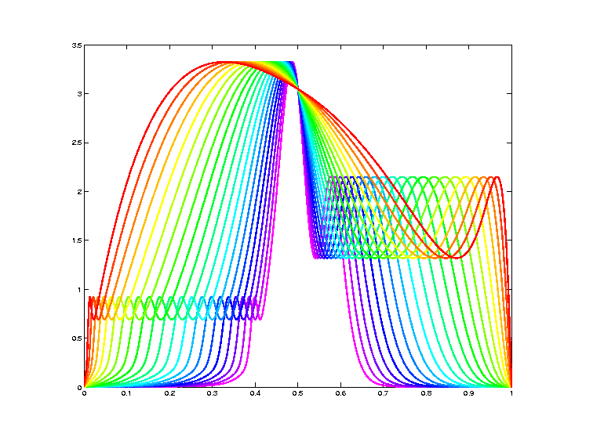

Time Warping Intuition
Toy Example: Time Warped Curves, $f\left(γ(x)\right)$

Slide 47
Curve Registration
What are the
Data Objects?
Vertical Variation
Horiz’l
Var’n

Slide 48
Recall Landmark Shape Analysis
Approach: Identify objects that are:
Translations
Rotations
Scalings
of each other
Mathematics: Equivalence Relation
Results in: Equivalence Classes
Which become the Data Objects

Slide 49
Recall Landmark Shape Analysis
Equivalence Classes become Data Objects
a.k.a. “Orbits”
Mathematics: Called “Quotient Space”
, , , , , ,

Slide 50
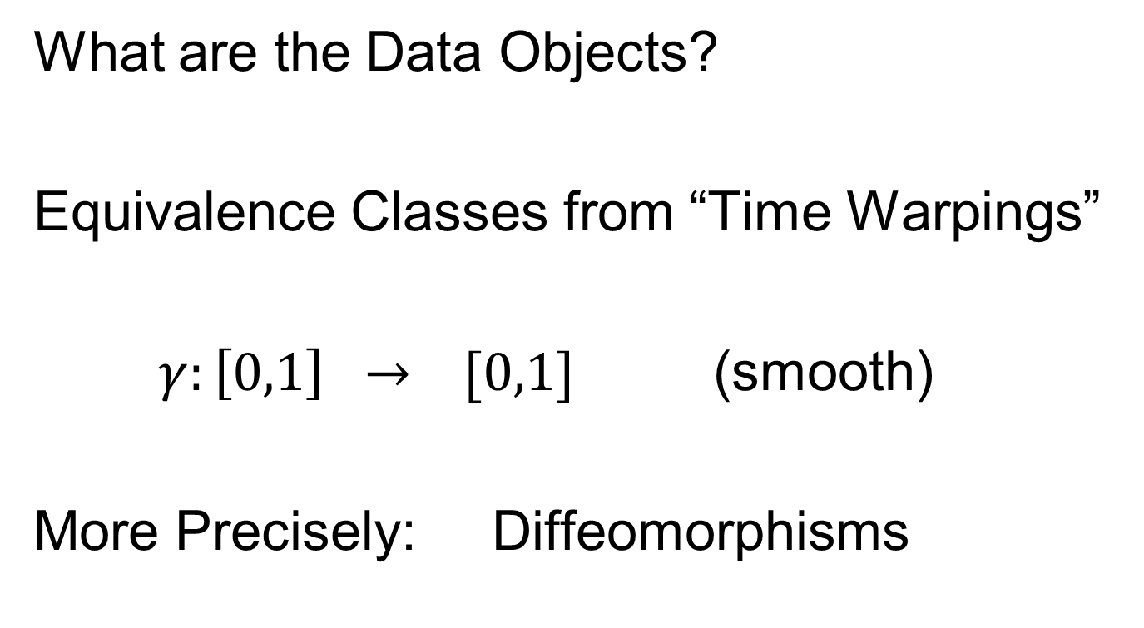
Curve Registration
What are the Data Objects?
Equivalence Classes from “Time Warpings”
$γ:\left[0,1\right] → [0,1]$ (smooth)
More Precisely: Diffeomorphisms

Slide 51
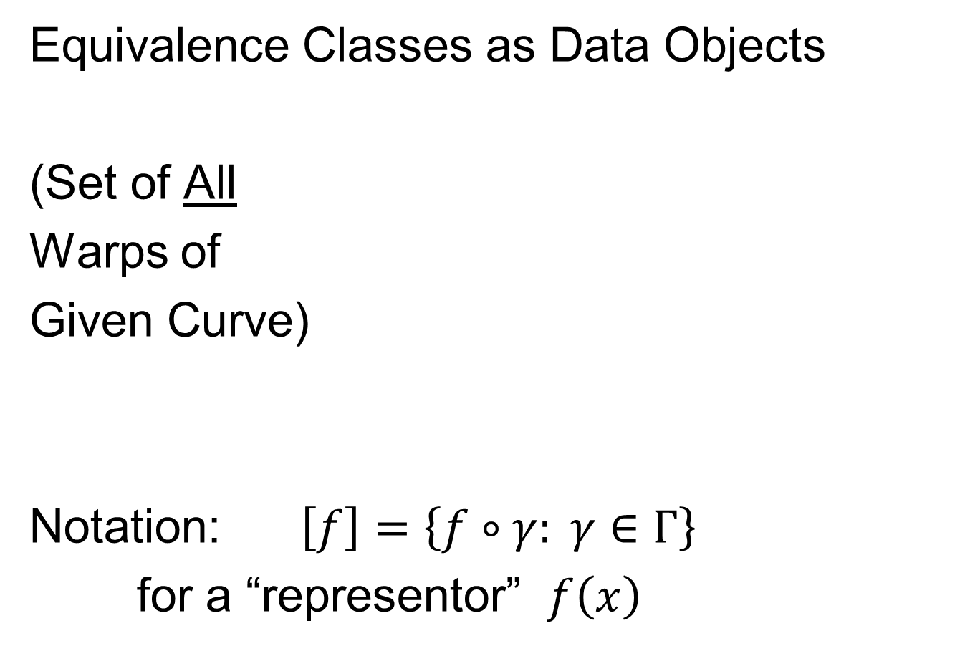
Data Objects I
Equivalence Classes as Data Objects
(Set of All
Warps of
Given Curve)
Notation: $\left[f\right]=\left\{f∘γ: γ∈Γ\right\}$
for a “representor” $f\left(x\right)$

Slide 52

Time Warping Intuition
Toy Example: Equivalent Curves, $\left[f\left(x\right)\right]$

Slide 53
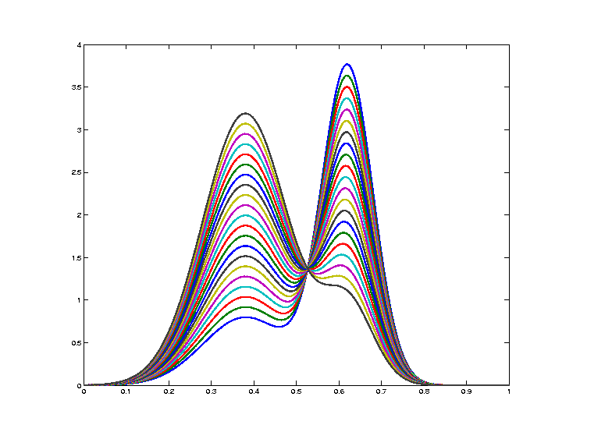
Curve Registration
Toy Example: Non-Equivalent Curves
Cannot
Warp
Into
Each
Other

Slide 54
Data Objects I
Equivalence Classes as Data Objects
(Set of All
Warps of
Given Curve)
Next Task:
Find Appropriate Metric

Slide 55
Metrics in Curve Space
General Strategy:
Find Metric on Equivalence Classes
Start with Warp Invariant Metric on Curves
& Extend

Slide 56
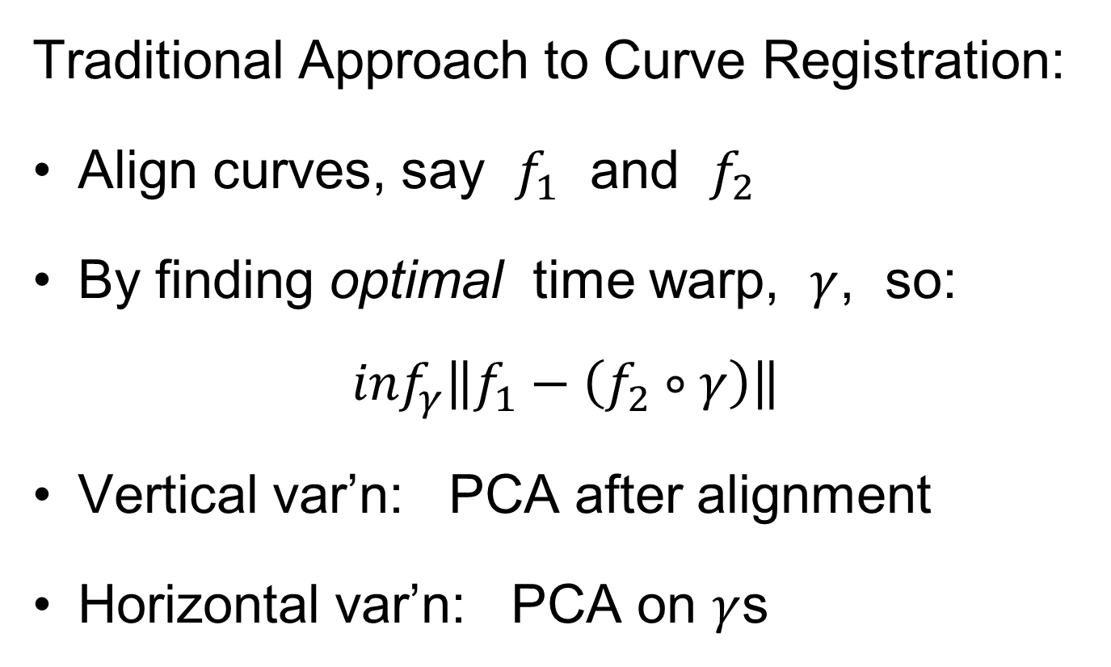
Metrics in Curve Space
Traditional Approach to Curve Registration:
Align curves, say $f_{1}$ and $f_{2}$
By finding optimal time warp, $γ$, so:
$$\inf_{γ}\left\|f_{1}−\left(f_{2}∘γ\right)\right\|$$
Vertical var’n: PCA after alignment
Horizontal var’n: PCA on $γ$s

Slide 57
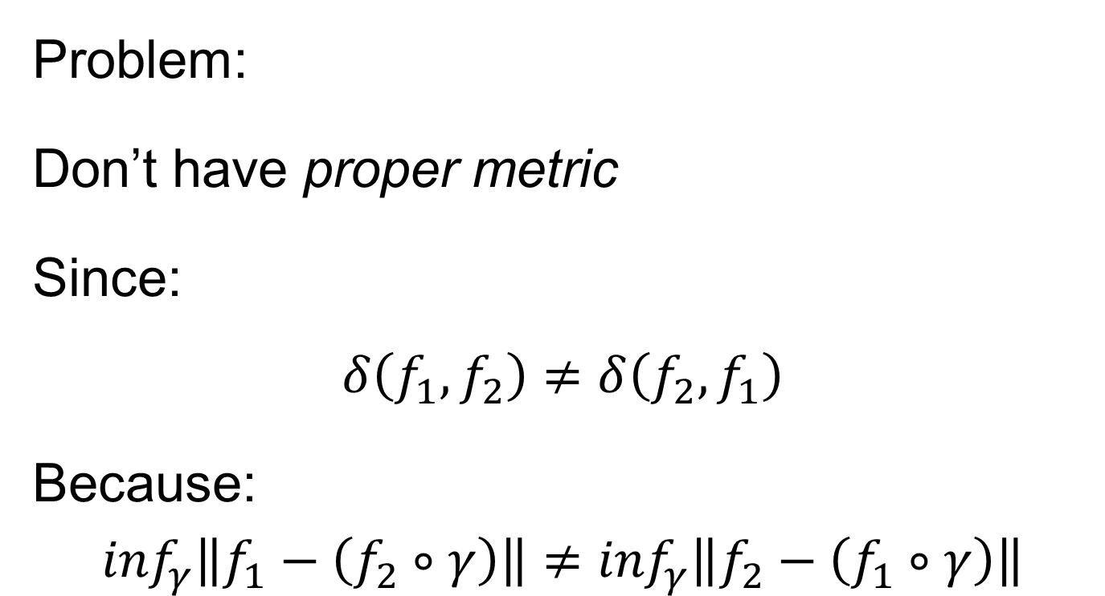
Metrics in Curve Space
Problem:
Don’t have proper metric
Since:
$$δ\left(f_{1},f_{2}\right)≠δ\left(f_{2},f_{1}\right)$$
Because:
$$\inf_{γ}\left\|f_{1}−\left(f_{2}∘γ\right)\right\|≠\inf_{γ}\left\|f_{2}−\left(f_{1}∘γ\right)\right\|$$

Slide 58
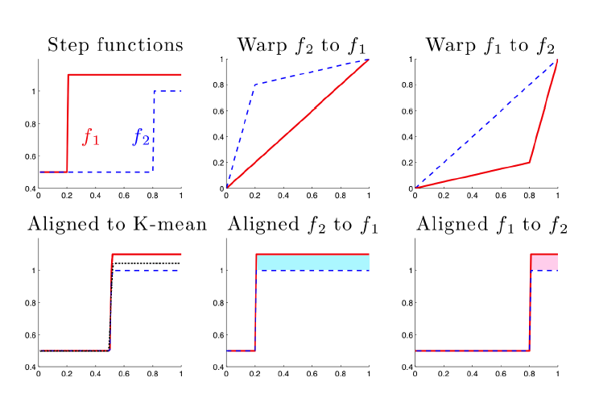





Metrics in Curve Space
$$\inf_{γ}\left\|f_{1}−\left(f_{2}∘γ\right)\right\|≠\inf_{γ}\left\|f_{2}−\left(f_{1}∘γ\right)\right\|$$
Thanks to
Xiaosun Lu
$$γ_{1}(x)$$
$$γ_{2}(x)$$
$$f_{2}(γ_{2}\left(x\right))$$
$$f_{1}(γ_{1}\left(x\right))$$

Slide 59

Metrics in Curve Space
$$\inf_{γ}\left\|f_{1}−\left(f_{2}∘γ\right)\right\|≠\inf_{γ}\left\|f_{2}−\left(f_{1}∘γ\right)\right\|$$
Note:
Very
Different
L² norms
Thanks to
Xiaosun Lu
But There is a
Good Answer,
Explained Later

Slide 60
Metrics in Curve Space
General Strategy Again:
Find Metric on Equivalence Classes
Start with Warp Invariant Metric on Curves
& Extend

Slide 61
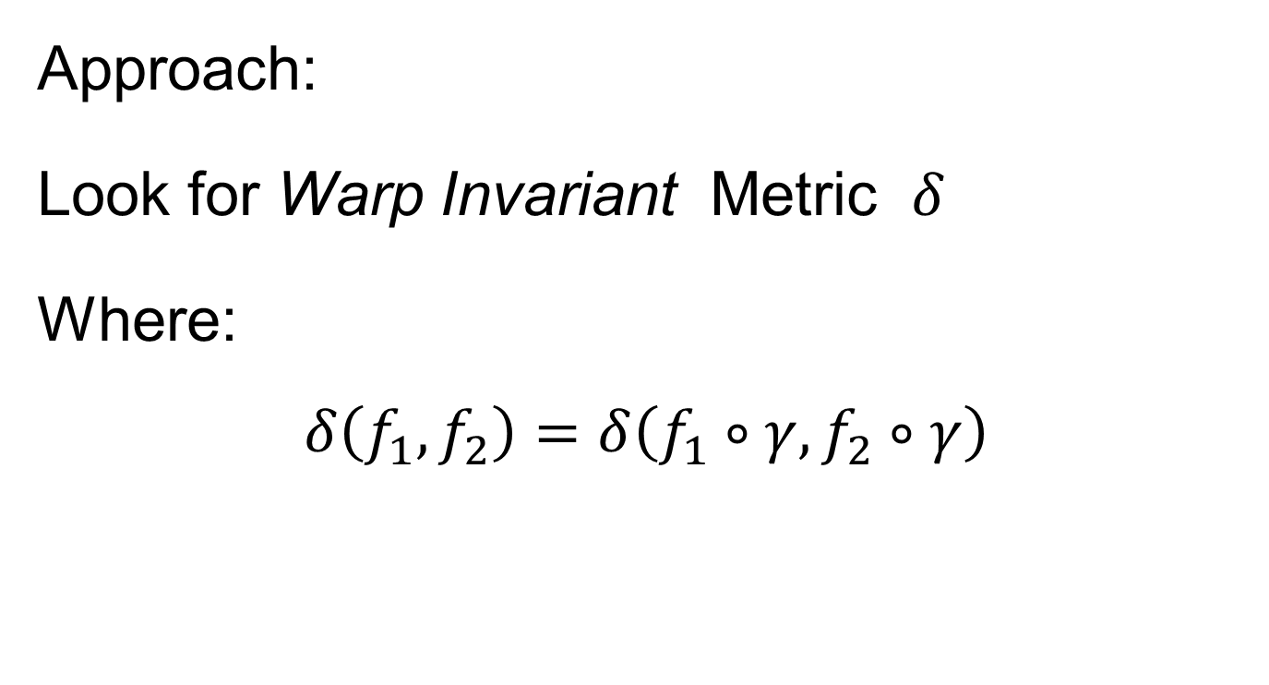
Metrics in Curve Space
Approach:
Look for Warp Invariant Metric $δ$
Where:
$$δ\left(f_{1},f_{2}\right)=δ\left(f_{1}∘γ,f_{2}∘γ\right)$$

Slide 62

Metrics in Curve Space
$$δ\left(f_{1},f_{2}\right)=δ\left(f_{1}∘γ,f_{2}∘γ\right)$$
I.e. Have “Parallel”
Representatives
Of Equivalence
Classes

Slide 63
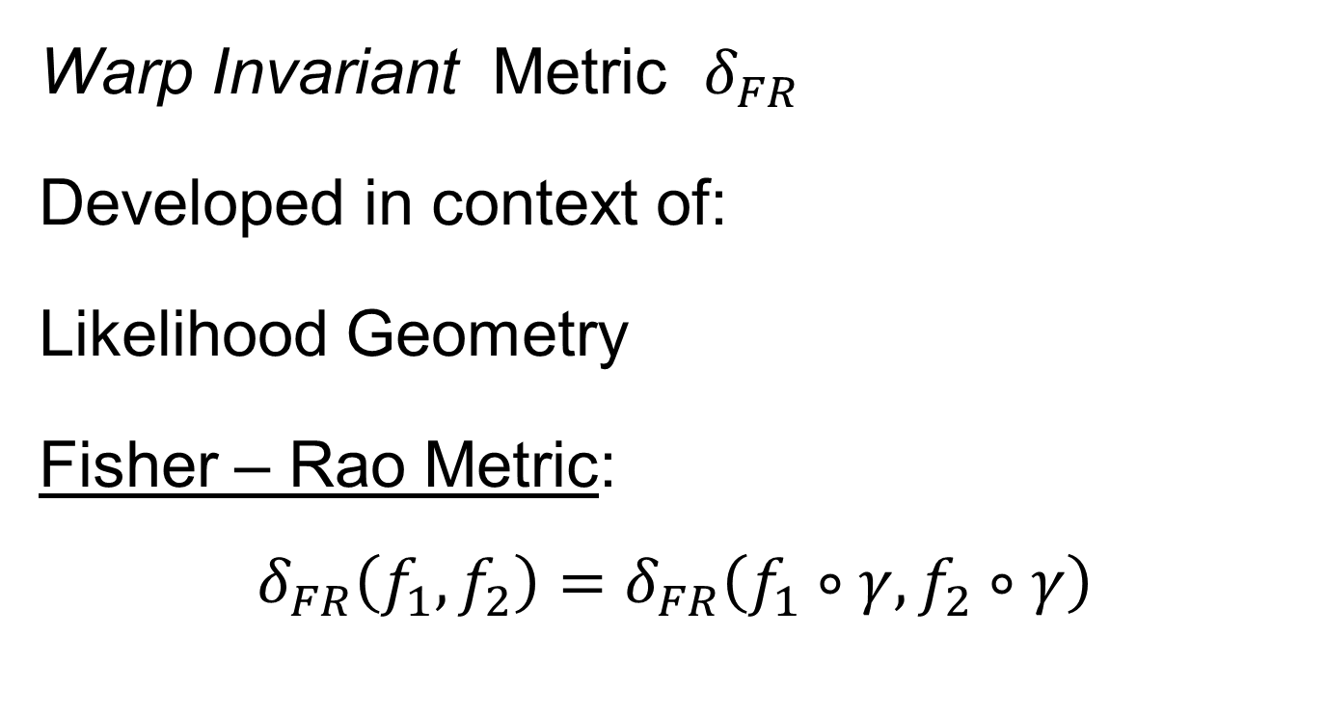
Metrics in Curve Space
Warp Invariant Metric $δ_{FR}$
Developed in context of:
Likelihood Geometry
Fisher – Rao Metric:
$$δ_{FR}\left(f_{1},f_{2}\right)=δ_{FR}\left(f_{1}∘γ,f_{2}∘γ\right)$$
Rao (1945)
Deeper Theory:
Amari (1985)

Slide 64

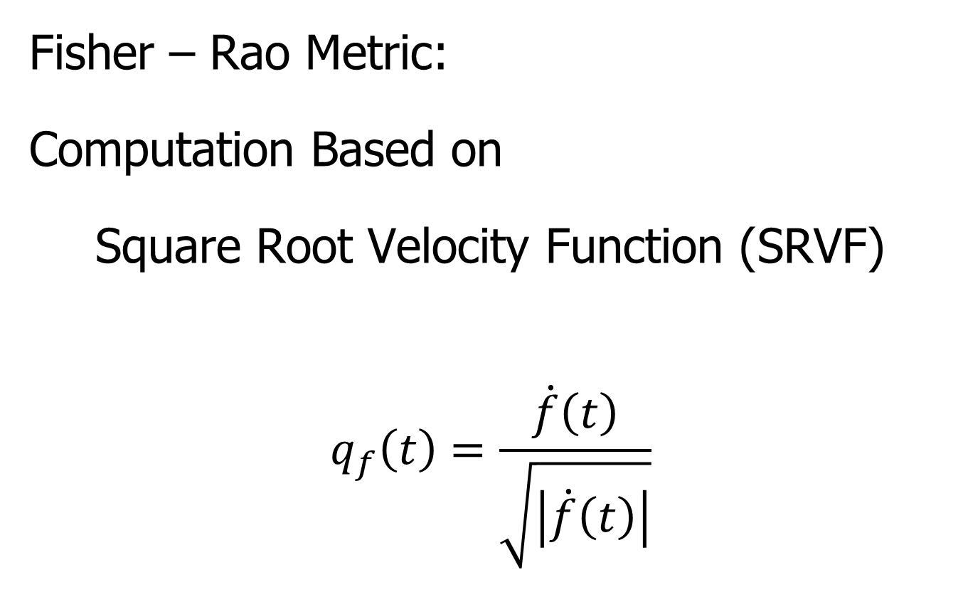
Metrics in Curve Space
Fisher – Rao Metric:
Computation Based on
Square Root Velocity Function (SRVF)
$$q_{f}\left(t\right)=\frac{\dot{f}\left(t\right)}{\sqrt{\left|\dot{f}\left(t\right)\right|}}$$
Where
$\dot{f}\left(t\right)=\frac{∂}{∂t}f(t)$
Signed Version
Of Square Root
Derivative

Slide 65
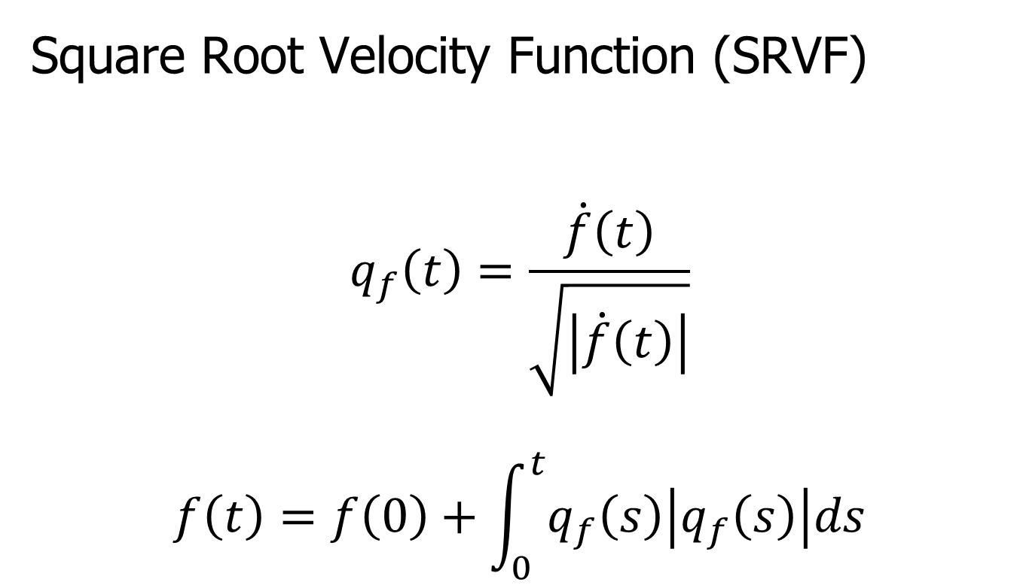
Metrics in Curve Space
Square Root Velocity Function (SRVF)
$$q_{f}\left(t\right)=\frac{\dot{f}\left(t\right)}{\sqrt{\left|\dot{f}\left(t\right)\right|}}$$
$$f\left(t\right)=f\left(0\right)+\int_{0}^{t}{q_{f}\left(s\right)\left|q_{f}\left(s\right)\right|ds}$$

Slide 66
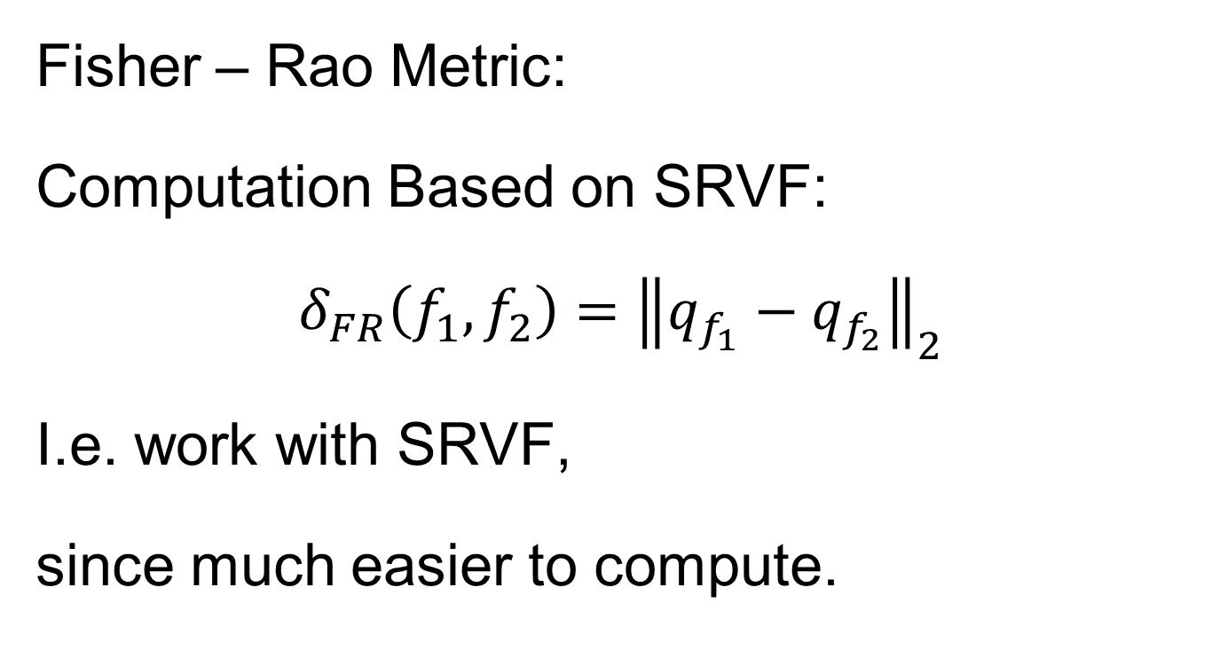
Metrics in Curve Space
Fisher – Rao Metric:
Computation Based on SRVF:
$$δ_{FR}\left(f_{1},f_{2}\right)={\left\|q_{f_{1}}−q_{f_{2}}\right\|}_{2}$$
I.e. work with SRVF,
since much easier to compute.

Slide 67

Metrics in Curve Space
Mathematical Note:
$δ_{FR}$ is not quite a metric (distance) , since
$$δ_{FR}\left(f_{1},f_{1}+C\right)=0$$
Only a pseudo-metric
Could add assumptions:
  Fix $f\left(0\right)$
  Assume probability density
  Replace $q_{f}$ with pair $(q_{f},f\left(0\right))$

Slide 68

Metrics in Curve Space
Note on SRVF representation:
$$δ_{FR}\left(f_{1},f_{2}\right)={\left\|q_{f_{1}}−q_{f_{2}}\right\|}_{2}$$
Warp Invariance
$$δ_{FR}\left(f_{1},f_{2}\right)=δ_{FR}\left(f_{1}∘γ,f_{2}∘γ\right)$$
Follows from Jacobean calculation

Slide 69

Could Do Homework
(a) Show the Warp Invariance of the
Fisher-Rao Metric, i.e.
$$δ_{FR}\left(f_{1},f_{2}\right)=δ_{FR}\left(f_{1}∘γ,f_{2}∘γ\right)$$

Slide 70

Metrics in Curve Space
Why
square
roots?
Thanks to
Xiaosun Lu

Slide 71

Metrics in Curve Space
Why
square
roots?

Slide 72

Metrics in Curve Space
Why
square
roots?

Slide 73

Metrics in Curve Space
Why
square
roots?

Slide 74

Metrics in Curve Space
Why
square
roots?

Slide 75

Metrics in Curve Space
Why
square
roots?

Slide 76

Metrics in Curve Space
Why
square
roots?

Slide 77

Metrics in Curve Space
Why
square
roots?

Slide 78

Metrics in Curve Space
Why
square
roots?

Slide 79
Metrics in Curve Space
Why
square
roots? Dislikes Pinching
Focusses Well On
Peaks of Unequal Height

Slide 80
Metrics in Curve Quotient Space
Above was Invariance for Individual Curves
Now extend to:
Equivalence Classes of Curves
I.e. Orbits as Data Objects
I.e. Define Metric on Quotient Space

Slide 81


Metrics in Curve Quotient Space
Again Have $δ_{A}\left(\left[f\right],\left[f+C\right]\right)=0$
Define Amplitude (Pseudo-)Metric on Orbits:
For $\left[f_{1}\right]$ & $\left[f_{2}\right]$, i.e. $\left[q_{1}\right]$ & $\left[q_{2}\right]$
$$δ_{A}\left(\left[f_{1}\right],\left[f_{2}\right]\right)=\inf_{γ∈Γ}\left\|q_{f_{1}}−q_{f_{2}∘γ}\right\|$$
Independent of Choice of $f_{1}$ & $f_{2}$
By Warp Invariance

Slide 82

Could Do Homework
Show the Amplitude Metric
$$δ_{A}\left(\left[f_{1}\right],\left[f_{2}\right]\right)=\inf_{γ∈Γ}\left\|q_{f_{1}}−q_{f_{2}∘γ}\right\|$$
Is Independent of $f_{1}$ and $f_{2}$

Slide 83

Could Do Homework
(c) Show the Amplitude Metric
$$δ_{A}\left(\left[f_{1}\right],\left[f_{2}\right]\right)=\inf_{γ∈Γ}\left\|q_{f_{1}}−q_{f_{2}∘γ}\right\|$$
Satisfies the Pseudo-Metric Properties
(i.e. Really is a Distance Measure)

Slide 84
Mean in Curve Quotient Space
Benefit of a Metric:
Allows Definition of a “Mean”
Fréchet Mean
Geodesic Mean
Barycenter
Karcher Mean
Nomenclature
Objected to by
Karcher (2014)

Slide 85

Mean in Curve Quotient Space
Given Equivalence Class Data Objects:
$$\left[f_{1}\right], \left[f_{2}\right], ⋯,\left[f_{n}\right]$$
The Karcher Mean is:
$$\left[μ\right]={argmin}_{\left[f\right]}\sum_{i=1}^{n}{{δ_{A}\left(\left[f\right],\left[f_{i}\right]\right)}^{2}}$$

Slide 86

Mean in Curve Quotient Space
The Karcher Mean is:
$$\left[μ\right]={argmin}_{\left[f\right]}\sum_{i=1}^{n}{{δ\left(\left[f\right],\left[f_{i}\right]\right)}^{2}}$$
Intuition: Recall, for Euclidean Data
Minimizer = Conventional $\overline{X}$

Slide 87

Mean in Curve Quotient Space
Next Define “Most Representative”
Choice of $μ_{n}$
As Representer of$\left[μ\right]$
(e.g. Need a Curve for Graphical Displays)

Slide 88

Mean in Curve Quotient Space
“Most Representative” $μ_{n}$ in$\left[μ\right]$
Given a candidate $μ$
Consider warps to each $f_{i}$
Choose $μ_{n}$ to make
Karcher mean of warps = Identity
(under Fisher Rao metric)

Slide 89


Mean in Curve Quotient Space
“Most Representative” $μ_{n}$ in$\left[μ\right]$
Thanks to Anuj Srivastava

Slide 90

Metrics in Curve Space
$$\inf_{γ}\left\|f_{1}−\left(f_{2}∘γ\right)\right\|≠\inf_{γ}\left\|f_{2}−\left(f_{1}∘γ\right)\right\|$$
Recall
Example
Illustrating
This Is Best
Representer
Of Karcher Mean

Slide 91

Shifted Betas Example
Recall
From
Above

Slide 92

Shifted Betas Example
Estimated
Warps
(Note:
Represented
With Karcher
Mean At
Identity)

Slide 93

Mean in Curve Quotient Space
“Most Representative” $μ_{n}$ in$\left[μ\right]$
Terminology: The “Template Mean”

Slide 94

More Data Objects
Final Curve Warps:
Warp Each Data Curve, $f_{1}, ⋯,f_{n}$
To Template Mean, $μ_{n}$
Denote Warp Functions $γ_{1}, ⋯,γ_{n}$
Gives (Roughly Speaking):
Vertical Components $f_{1}∘γ_{1}, ⋯,f_{n}∘γ_{n}$
(Aligned Curves)
Horizontal Components $γ_{1}, ⋯,γ_{n}$
Data Objects I

Slide 95
More Data Objects
Data Objects II
Final Curve Warps:
Warp Each Data Curve, $f_{1}, ⋯,f_{n}$
To Template Mean, $μ_{n}$
Denote Warp Functions $γ_{1}, ⋯,γ_{n}$
Gives (Roughly Speaking):
Vertical Components $f_{1}∘γ_{1}, ⋯,f_{n}∘γ_{n}$
(Aligned Curves)
Horizontal Components $γ_{1}, ⋯,γ_{n}$
~ Kendall’s Shapes

Slide 96
More Data Objects
Final Curve Warps:
Warp Each Data Curve, $f_{1}, ⋯,f_{n}$
To Template Mean, $μ_{n}$
Denote Warp Functions $γ_{1}, ⋯,γ_{n}$
Gives (Roughly Speaking):
Vertical Components $f_{1}∘γ_{1}, ⋯,f_{n}∘γ_{n}$
(Aligned Curves)
Horizontal Components $γ_{1}, ⋯,γ_{n}$
Data Objects III
~ Chang’s Transfo’s

Slide 97
Participant Presentation
Ray Shao
Next Class:
Dev Ghandi

