Slide 1
Statistics – O. R. 881 Object Oriented Data Analysis
Steve Marron
Dept. of Statistics and Operations Research
University of North Carolina

Slide 2
Current Sections in Textbook
Today:
Sections 9.2, 14.2
Next Class:
Sections 14.2, 14.1

Slide 3
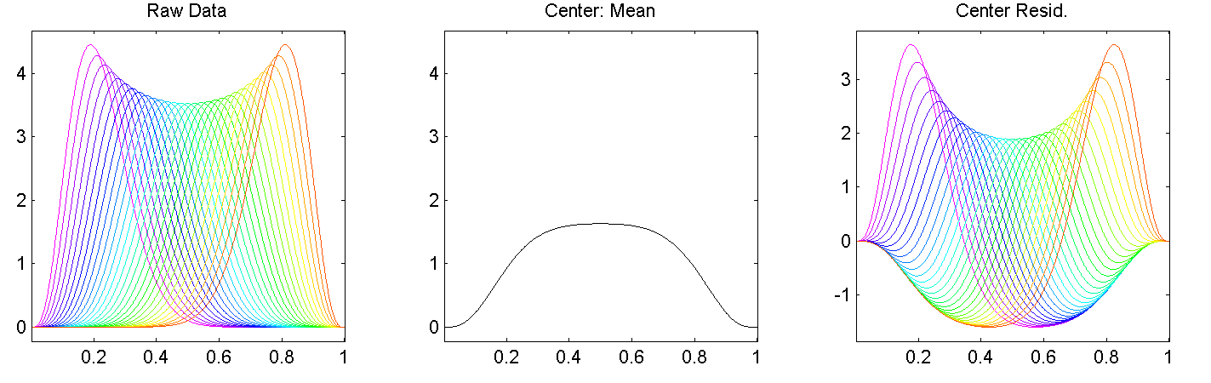
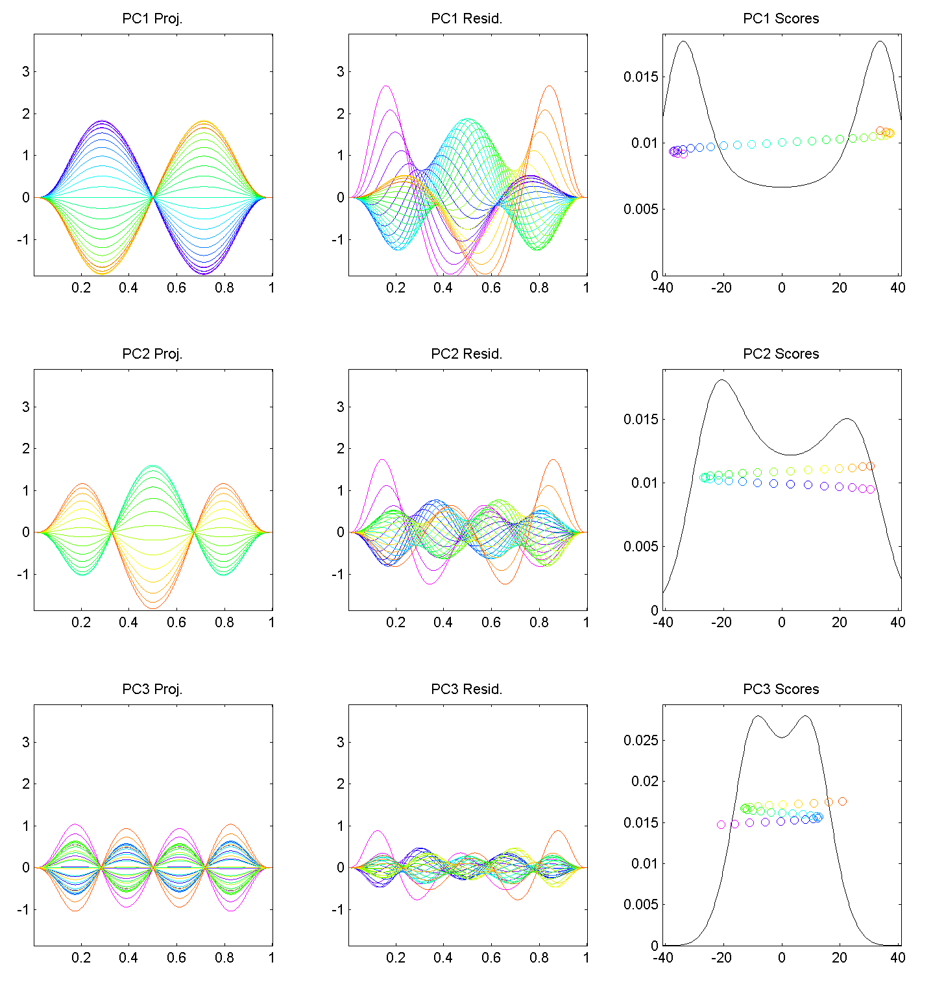
Last Class: Motivating Example
Shifted Betas
Example PCA
Hard to Interpret 1st Mode
Yet Scores Seem Sensible
Conclusion: PCA
Modes of Variation
Yield Poor Insights
About Phase
Similar for Other Modes
Looks Like Harmonics
From Fourier Theory
Is There a Sturm-
Liouville Theory?

Slide 4
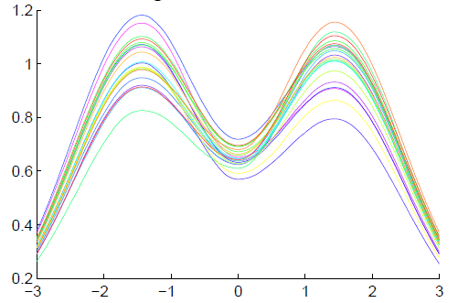
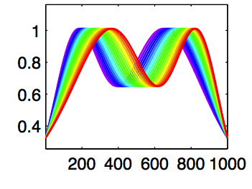
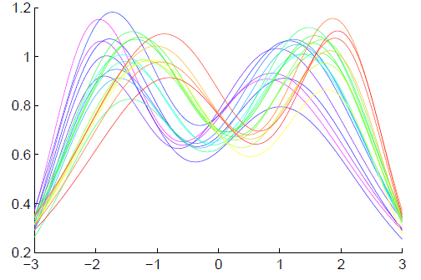
Last Class: General Amp - Phase Context
Appropriate
Mathematical
Framework?
Vertical Variation
Horiz’l
Var’n
Amplitude Mode of Variation
Phase Mode of Variation

Slide 5
Last Class: Time Warping
Foundational Concept for Curve Registration
Think Stretch & Compress Horizontal Axis
Mathematical Basis:
Diffeomorphisms

Slide 6

Last Class: Time Warping
Elastically Stretch & Compress Axis
$γ\left(x\right)$

Slide 7
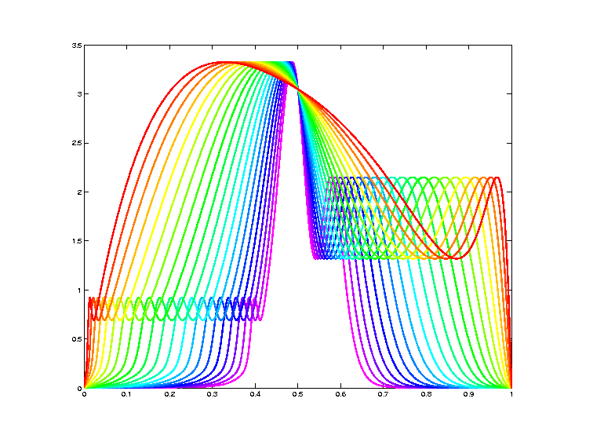
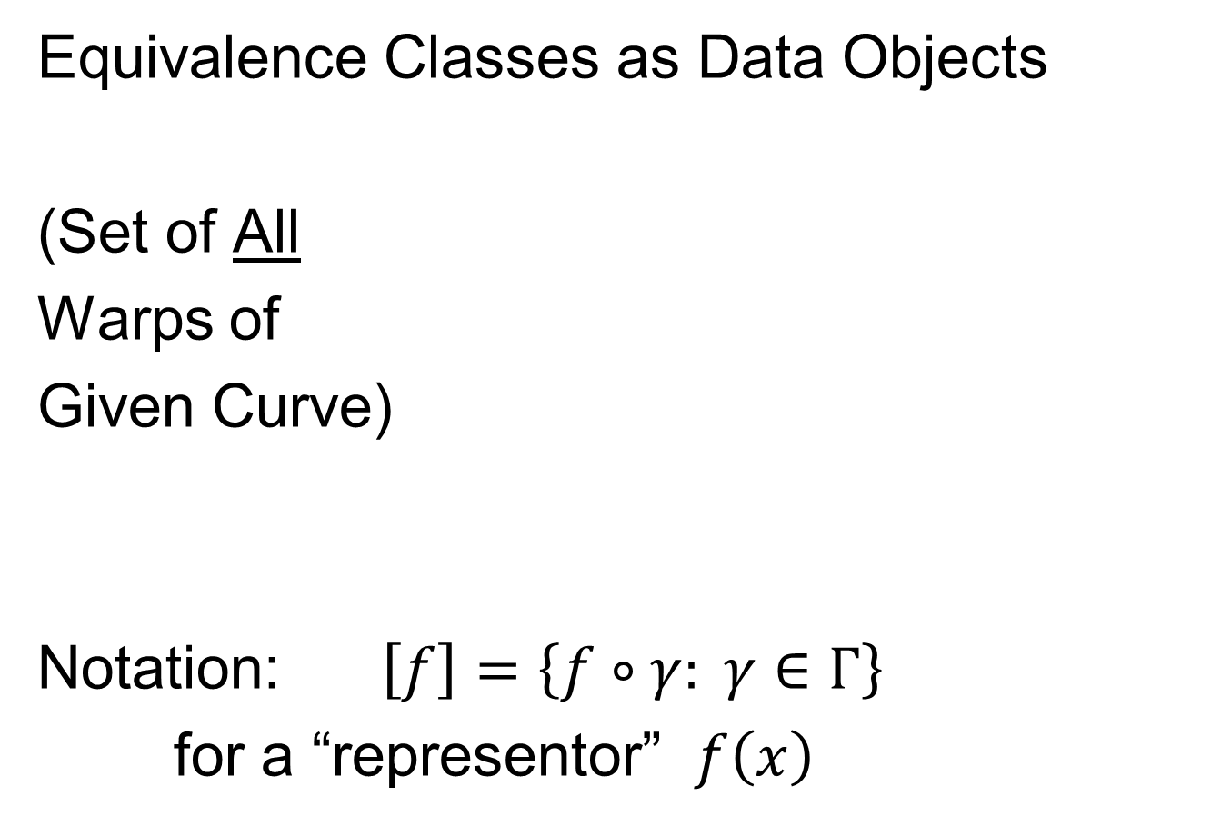
Last Class: Data Objects I
Equivalence Classes as Data Objects
(Set of All
Warps of
Given Curve)
Notation: $\left[f\right]=\left\{f∘γ: γ∈Γ\right\}$
for a “representor” $f\left(x\right)$

Slide 8
Last Class: Metrics in Curve Sp.
General Strategy:
Find Metric on Equivalence Classes
Start with Warp Invariant Metric on Curves
& Extend

Slide 9
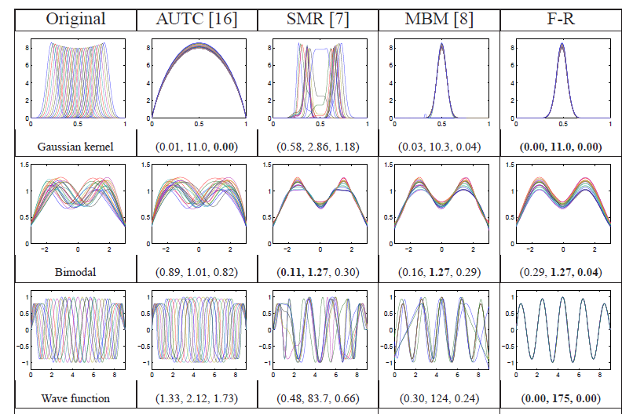
Previous Class: Challenge
Thanks to Wei Wu

Slide 10
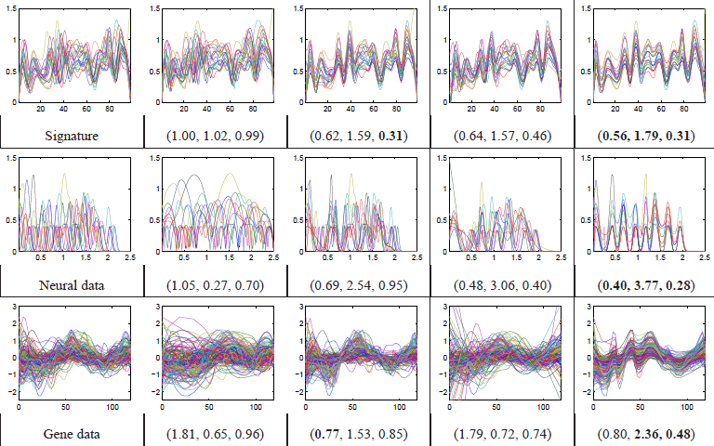
Previous Class: Challenge
Thanks to Wei Wu

Slide 11
Last Class: Metrics in Curve Sp.
General Strategy:
Find Metric on Equivalence Classes
Start with Warp Invariant Metric on Curves
& Extend

Slide 12
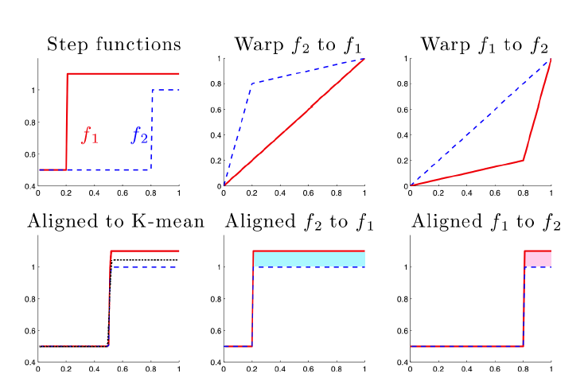

Last Class: Metrics in Curve Sp.
$$\inf_{γ}\left\|f_{1}−\left(f_{2}∘γ\right)\right\|≠\inf_{γ}\left\|f_{2}−\left(f_{1}∘γ\right)\right\|$$
Note:
Very
Different
L² norms
Thanks to
Xiaosun Lu
But There is a
Good Answer,
Explained Later

Slide 13
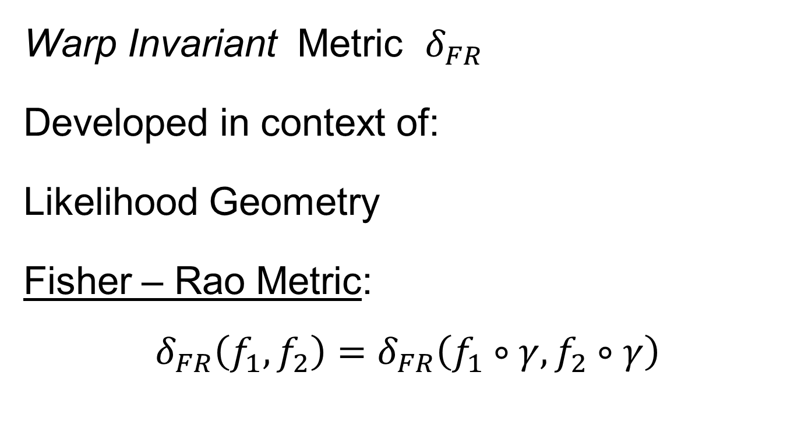
Last Class: Metrics in Curve Sp
Warp Invariant Metric $δ_{FR}$
Developed in context of:
Likelihood Geometry
Fisher – Rao Metric:
$$δ_{FR}\left(f_{1},f_{2}\right)=δ_{FR}\left(f_{1}∘γ,f_{2}∘γ\right)$$
Rao (1945)
Deeper Theory:
Amari (1985)

Slide 14
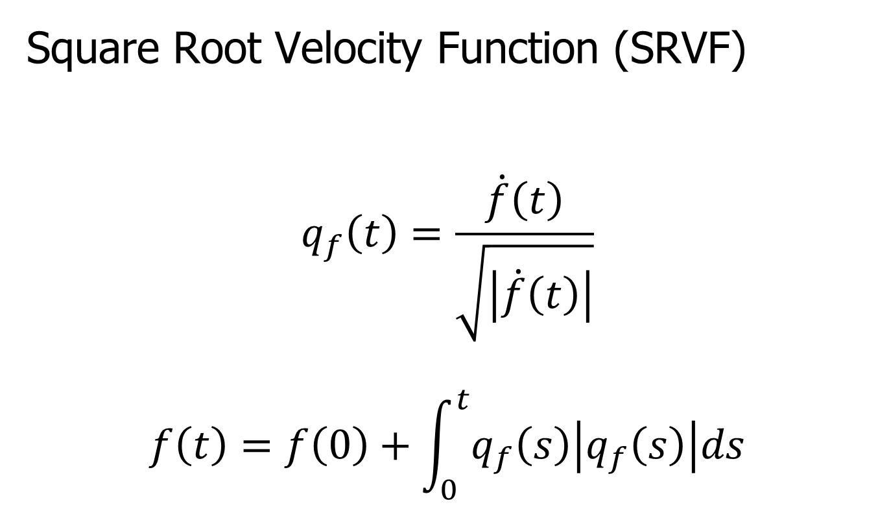
Last Class: Metrics in Curve Sp
Square Root Velocity Function (SRVF)
$$q_{f}\left(t\right)=\frac{\dot{f}\left(t\right)}{\sqrt{\left|\dot{f}\left(t\right)\right|}}$$
$$f\left(t\right)=f\left(0\right)+\int_{0}^{t}{q_{f}\left(s\right)\left|q_{f}\left(s\right)\right|ds}$$

Slide 15
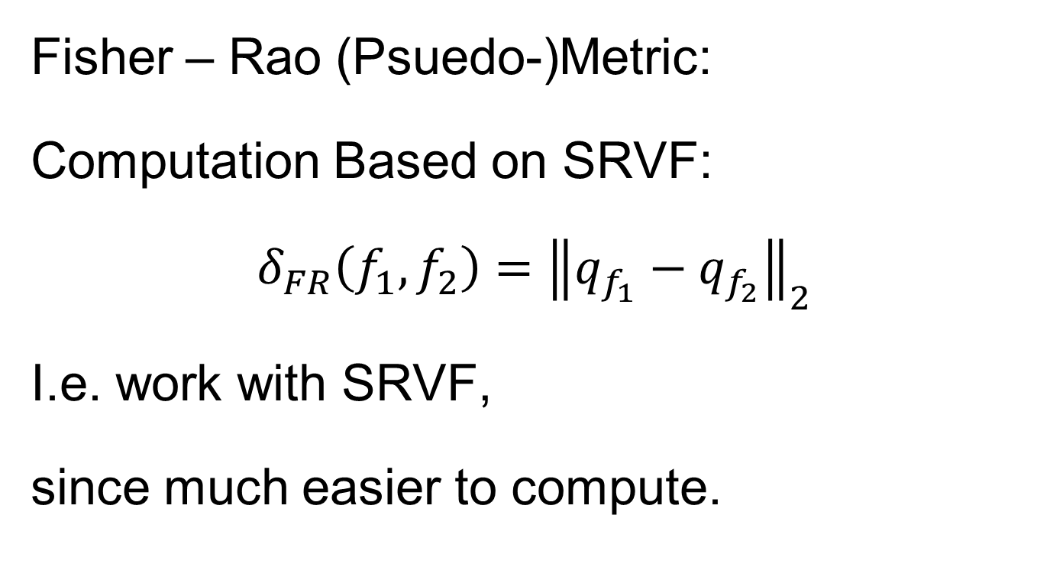
Last Class: Metrics in Curve Sp
Fisher – Rao (Psuedo-)Metric:
Computation Based on SRVF:
$$δ_{FR}\left(f_{1},f_{2}\right)={\left\|q_{f_{1}}−q_{f_{2}}\right\|}_{2}$$
I.e. work with SRVF,
since much easier to compute.

Slide 16
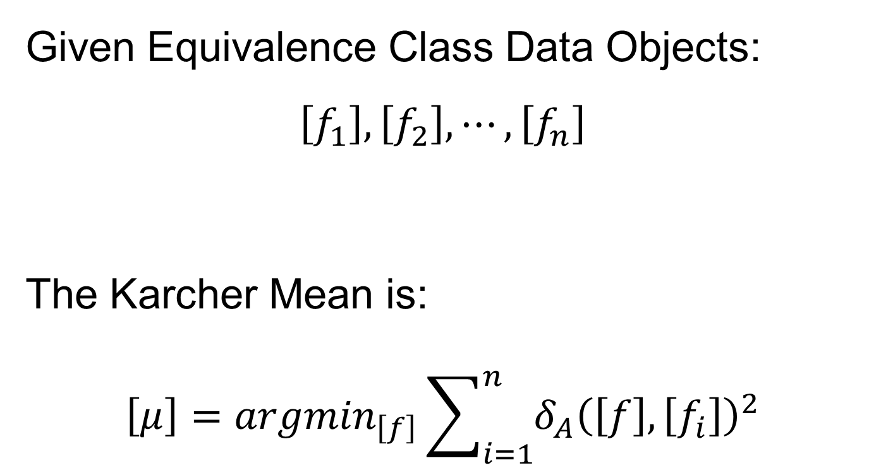
Last Class: Mean in Quot’t Space
Given Equivalence Class Data Objects:
$$\left[f_{1}\right], \left[f_{2}\right], ⋯,\left[f_{n}\right]$$
The Karcher Mean is:
$$\left[μ\right]={argmin}_{\left[f\right]}\sum_{i=1}^{n}{{δ_{A}\left(\left[f\right],\left[f_{i}\right]\right)}^{2}}$$

Slide 17
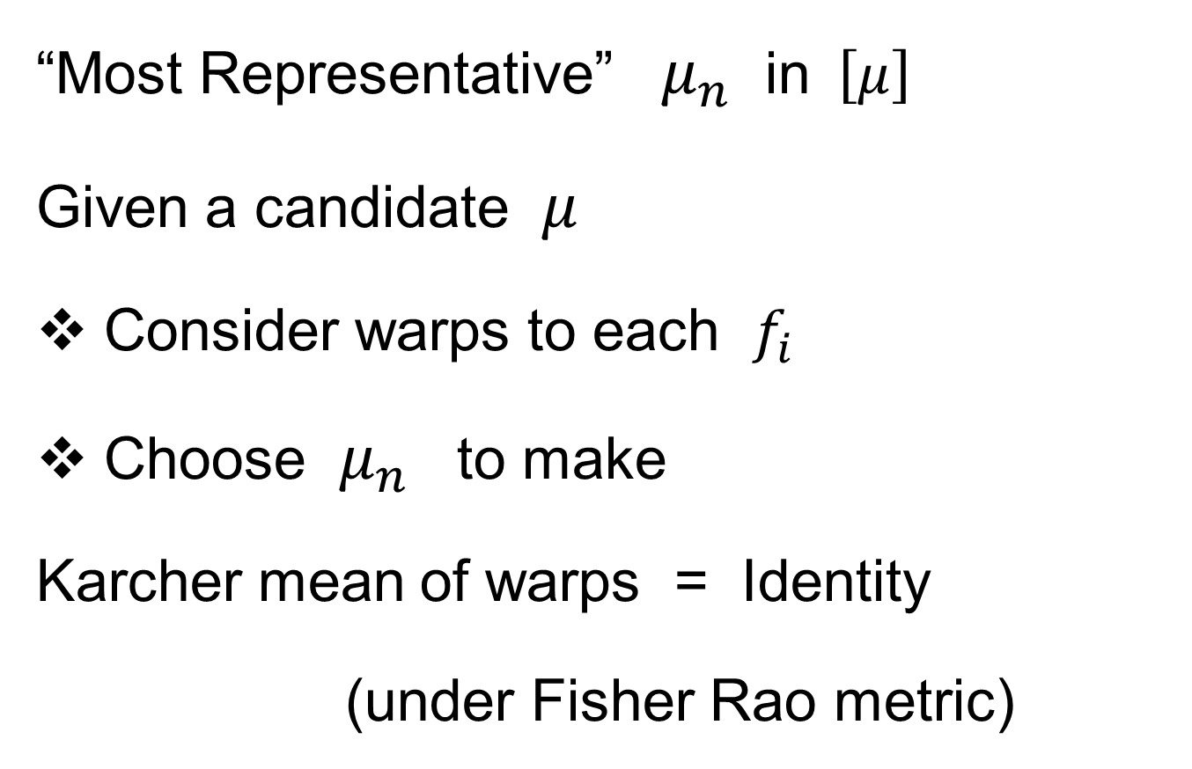
Last Class: Mean in Quot’t Space
“Most Representative” $μ_{n}$ in$\left[μ\right]$
Given a candidate $μ$
Consider warps to each $f_{i}$
Choose $μ_{n}$ to make
Karcher mean of warps = Identity
(under Fisher Rao metric)

Slide 18
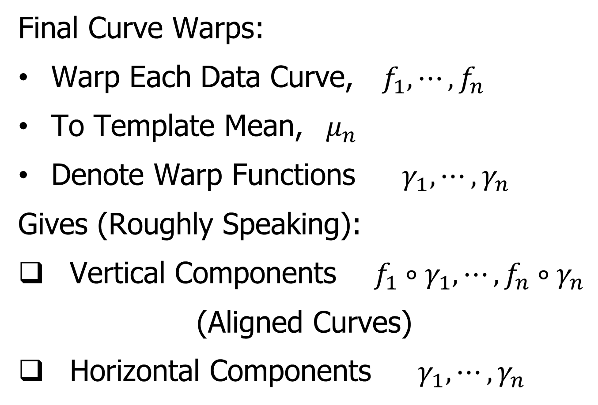
Last Class: More Data Objects
Final Curve Warps:
Warp Each Data Curve, $f_{1}, ⋯,f_{n}$
To Template Mean, $μ_{n}$
Denote Warp Functions $γ_{1}, ⋯,γ_{n}$
Gives (Roughly Speaking):
Vertical Components $f_{1}∘γ_{1}, ⋯,f_{n}∘γ_{n}$
(Aligned Curves)
Horizontal Components $γ_{1}, ⋯,γ_{n}$
Data Objects I

Slide 19
Last Class: More Data Objects
Data Objects II
Final Curve Warps:
Warp Each Data Curve, $f_{1}, ⋯,f_{n}$
To Template Mean, $μ_{n}$
Denote Warp Functions $γ_{1}, ⋯,γ_{n}$
Gives (Roughly Speaking):
Vertical Components $f_{1}∘γ_{1}, ⋯,f_{n}∘γ_{n}$
(Aligned Curves)
Horizontal Components $γ_{1}, ⋯,γ_{n}$
~ Kendall’s Shapes

Slide 20
Last Class: More Data Objects
Final Curve Warps:
Warp Each Data Curve, $f_{1}, ⋯,f_{n}$
To Template Mean, $μ_{n}$
Denote Warp Functions $γ_{1}, ⋯,γ_{n}$
Gives (Roughly Speaking):
Vertical Components $f_{1}∘γ_{1}, ⋯,f_{n}∘γ_{n}$
(Aligned Curves)
Horizontal Components $γ_{1}, ⋯,γ_{n}$
Data Objects III
~ Chang’s Transfo’s

Slide 21
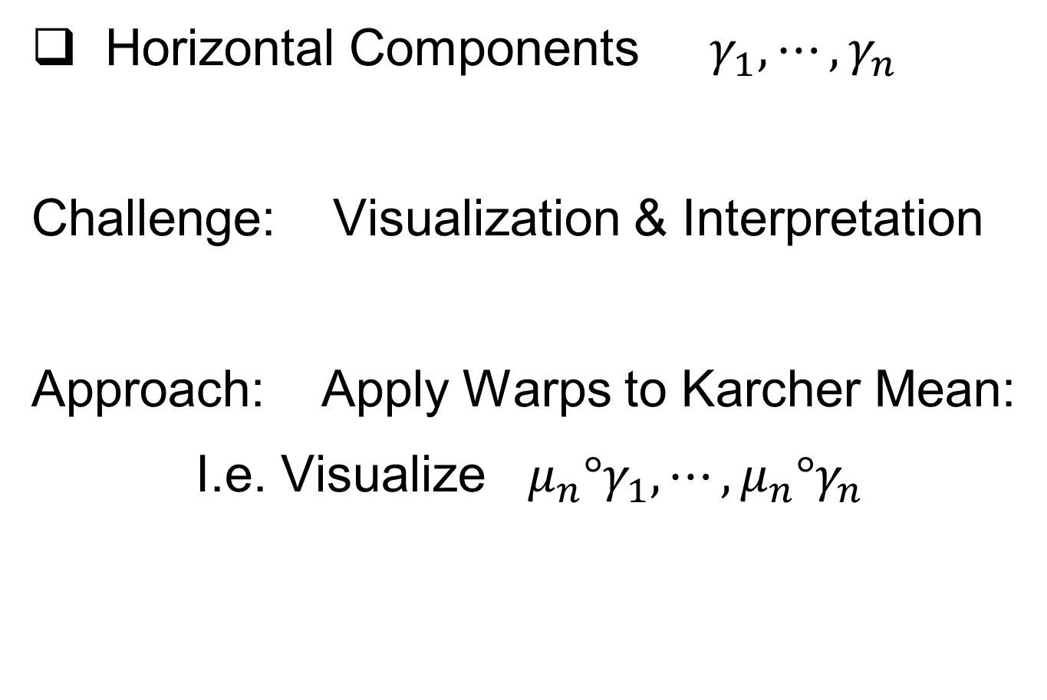
More Data Objects
Horizontal Components $γ_{1}, ⋯,γ_{n}$
Challenge: Visualization & Interpretation
Approach: Apply Warps to Karcher Mean:
I.e. Visualize ${μ_{n}°γ}_{1}, ⋯,μ_{n}°γ_{n}$

Slide 22
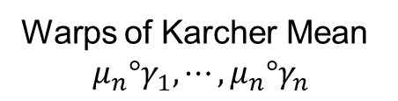
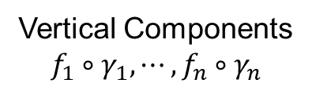
Functional Data Analysis
Insightful
Decomposition
Vertical Variation
Horiz’l
Var’n
Vertical Components
$$f_{1}∘γ_{1}, ⋯,f_{n}∘γ_{n}$$
Warps of Karcher Mean
$${μ_{n}°γ}_{1}, ⋯,μ_{n}°γ_{n}$$

Slide 23
Computation
Actual Mathematics is More Complicated
See Section 9.1.3 of Text For Full Details
Including Corresponding Phase Distance
Particularly
Accessible Source

Slide 24
Numeric Computation
Several Variations of
Dynamic Programming
Done by Eric Klassen, Wei Wu
R, Python, Matlab Software: Tucker (2025)

Slide 25
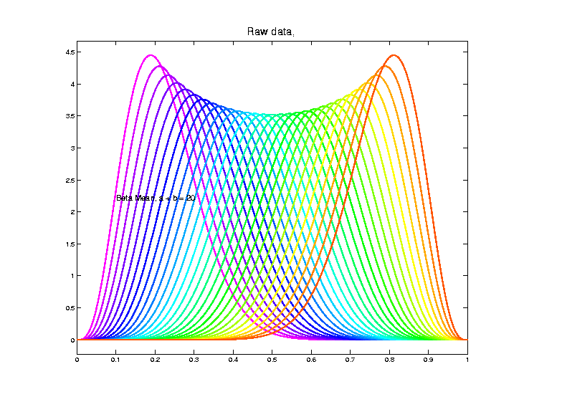
Shifted Betas Example
Raw
Data
Both
Horizontal
And
Vertical
Variation

Slide 26
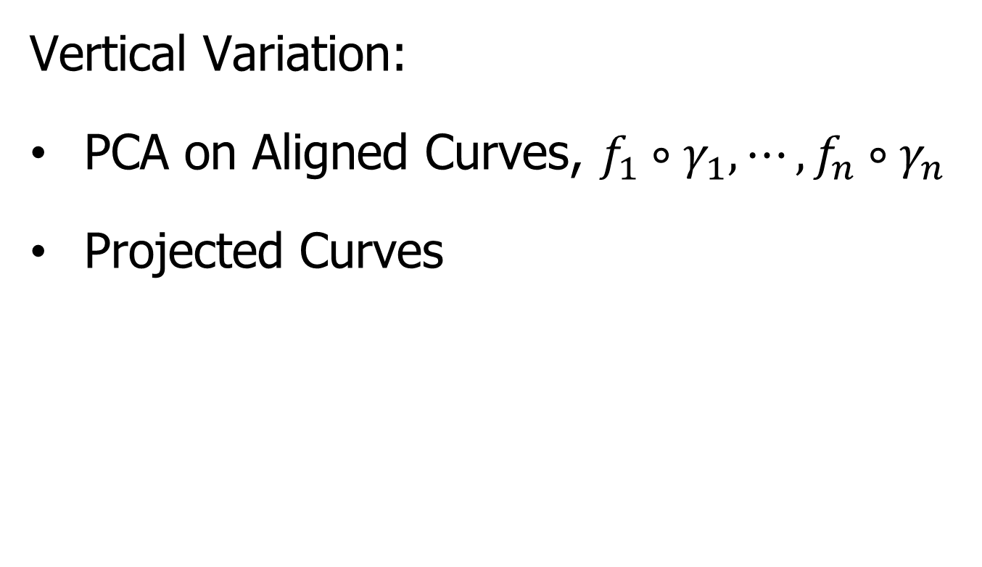
Visualization
Vertical Variation:
PCA on Aligned Curves, $f_{1}∘γ_{1}, ⋯,f_{n}∘γ_{n}$
Projected Curves

Slide 27
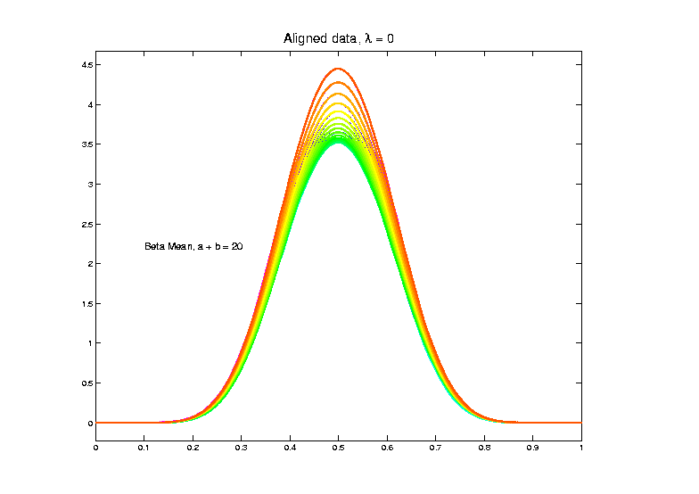
Shifted Betas Example
Aligned
Curves
(Clear
1-d
Vertical
Var’n)
Only Half of
Colors Due to
Exact Overlay

Slide 28
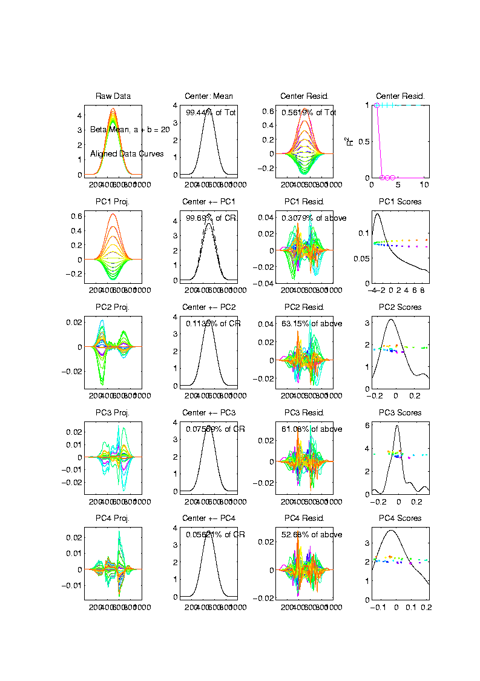
Shifted Betas Example
Back and Forth Scores
Aligned
Curve
PCA
Projections
All Var’n
In 1st
Component

Slide 29
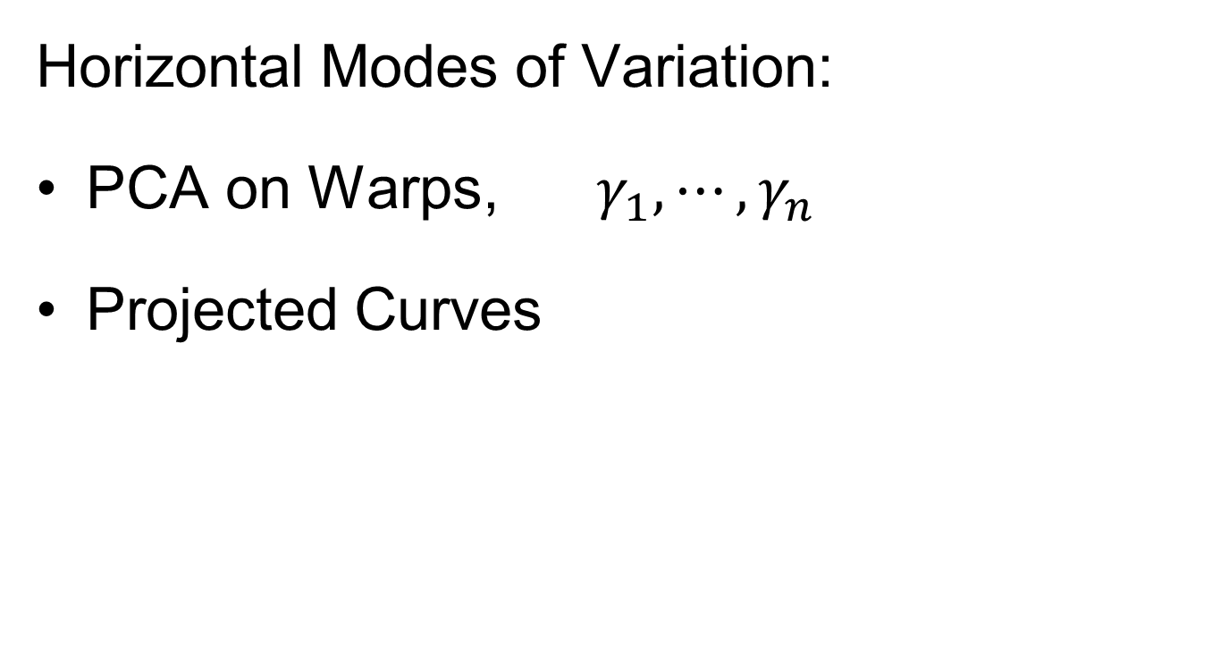
Visualization
Horizontal Modes of Variation:
PCA on Warps, $γ_{1}, ⋯,γ_{n}$
Projected Curves

Slide 30
Shifted Betas Example
Raw
Data
Both
Horizontal
And
Vertical
Modes of
Variation

Slide 31
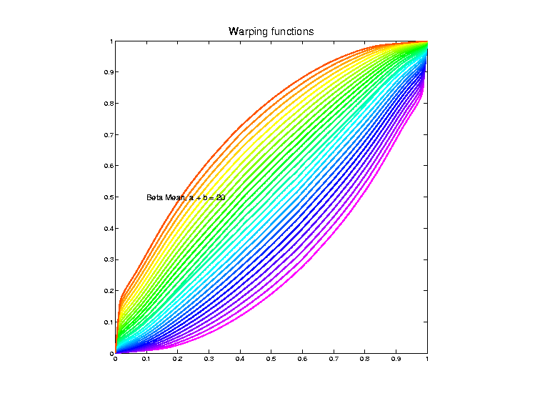
Shifted Betas Example
Estimated
Warps

Slide 32
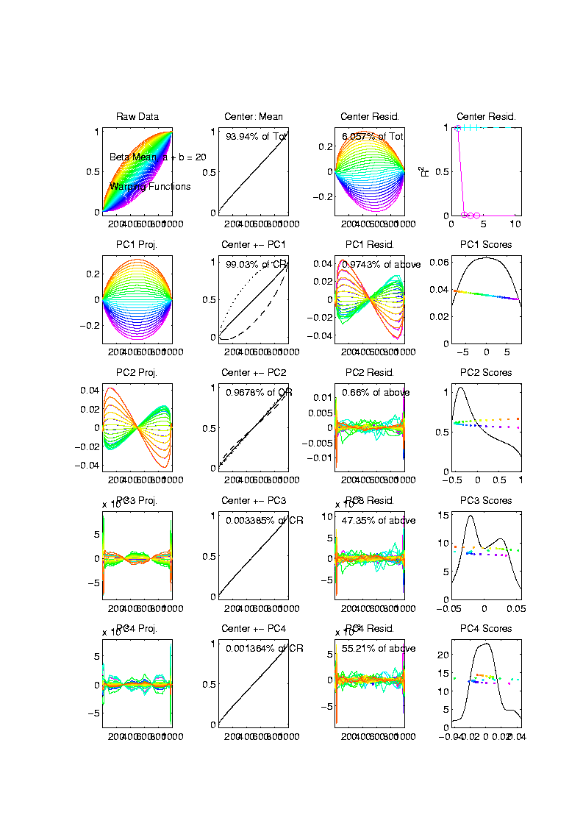
Shifted Betas Example
Warps,
PC
Projections

Slide 33
Shifted Betas Example
Warps,
PC
Projections
Mostly
1st PC

Slide 34
Shifted Betas Example
Back and Forth Scores
Warps,
PC
Projections
Mostly
1st PC,
But 2nd
Helps Some
Captures Varying Widths

Slide 35
Shifted Betas Example
Warps,
PC
Projections
Rest is
Not
Important

Slide 36
Shifted Betas Example
Horizontal Var’n Visualization Challenge:
(Complicated) Warps Hard to Interpret
Approach:
Apply Inverse Warps to Template Mean
(PCA components)

Slide 37
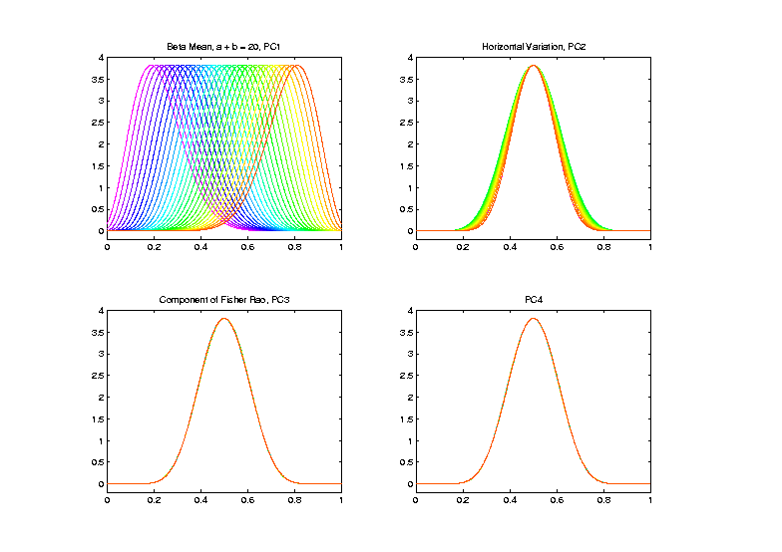
Shifted Betas Example
Inverse
Warp
Compon’ts
(+ Mean)
Applied to
Template
Mean

Slide 38
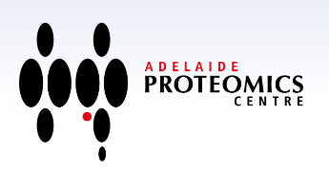
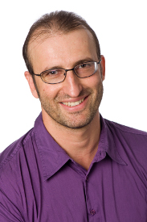
TIC testbed
Text: Sec 2.1
Serious Data Challenge:
TIC (Total Ion Count) Chromatograms
Modern type of “chemical spectra”
Thanks to Peter
Hoffmann

Slide 39
TIC testbed
Serious Data Challenge:
TIC (Total Ion Count) Chromatograms
Reference: Koch et al (2014)

Slide 40
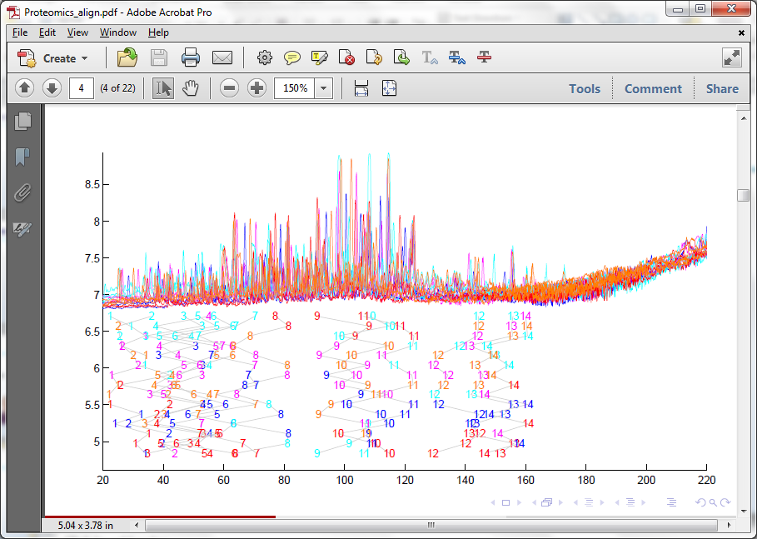
TIC testbed
Raw Data: 15 TIC Curves (5 Colors)

Slide 41
TIC testbed
Special Feature: Answer Key of Known Peaks
Found by
Major
Time &
Labor
Investment

Slide 42
TIC testbed
Special Feature: Answer Key of Known Peaks
Goal:
Find
Warps
To Align
These

Slide 43
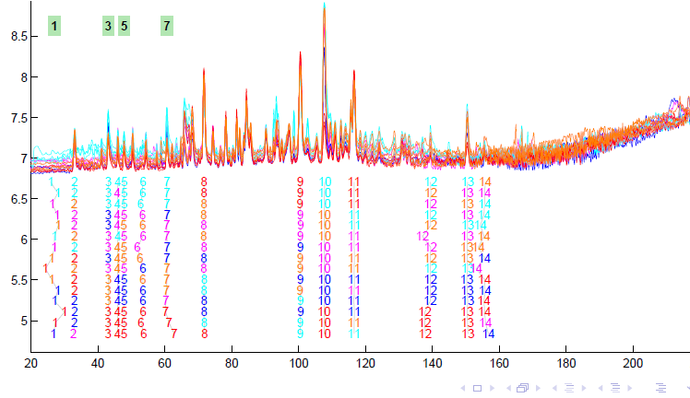
TIC testbed
Fisher – Rao Alignment

Slide 44
TIC testbed
Fisher – Rao Alignment
Spike-In
Peaks

Slide 45
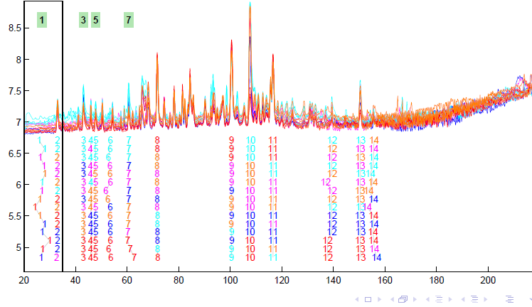
TIC testbed
Next Zoom in on This Region

Slide 46
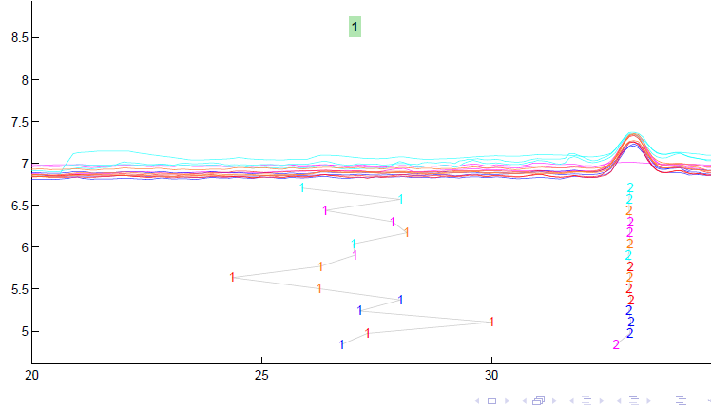
TIC testbed
Zoomed Fisher – Rao Alignment
Peak Missing
In 1 Case
This Compound
Not Present

Slide 47
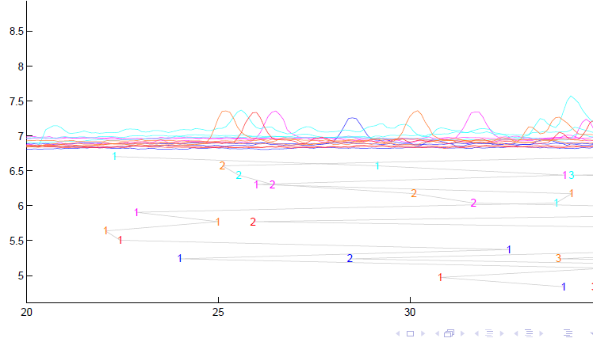
TIC testbed
Before Alignment

Slide 48

TIC testbed
Next Zoom in on This Region

Slide 49
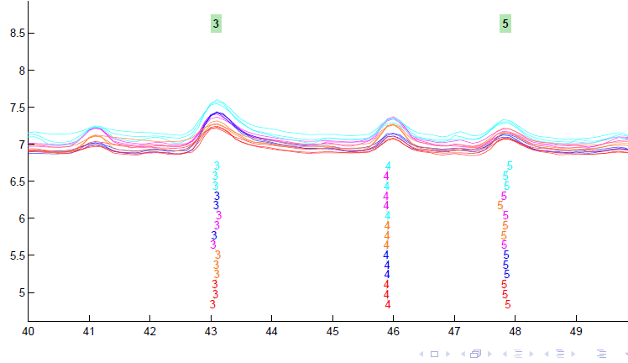
TIC testbed
Zoomed Fisher – Rao Alignment

Slide 50
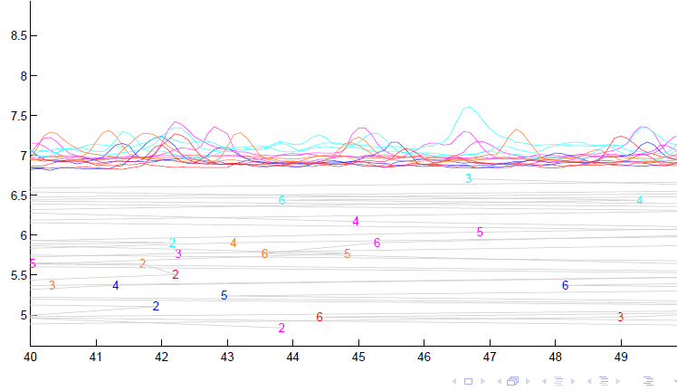
TIC testbed
Before Alignment

Slide 51
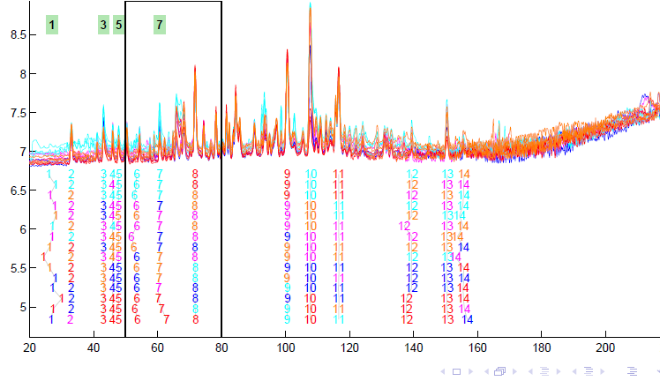
TIC testbed
Next Zoom in on This Region

Slide 52
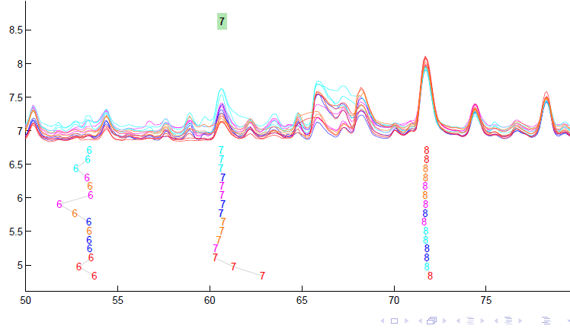
TIC testbed
Zoomed Fisher – Rao Alignment

Slide 53
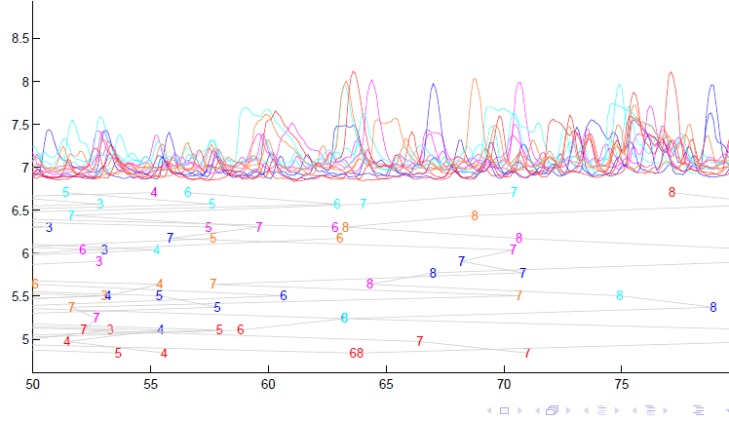
TIC testbed
Before Fisher-Rao Alignment

Slide 54
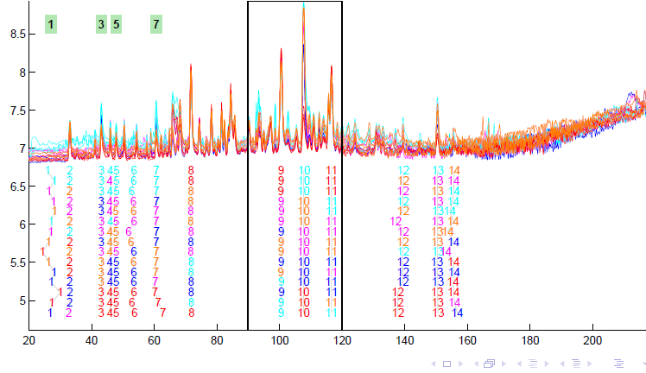
TIC testbed
Next Zoom in on This Region

Slide 55
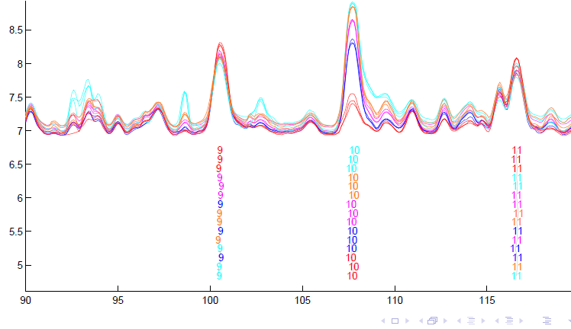
TIC testbed
Zoomed Fisher – Rao Alignment

Slide 56
TIC testbed
Zoomed Fisher – Rao Alignment
Note:
Very
Challenging

Slide 57
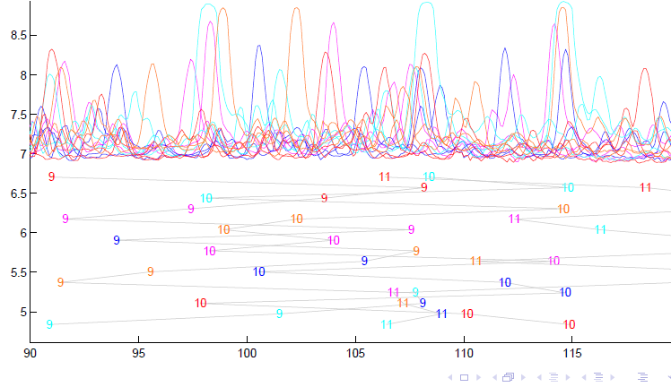
TIC testbed
Before Alignment

Slide 58

TIC testbed
Next Zoom in on This Region

Slide 59
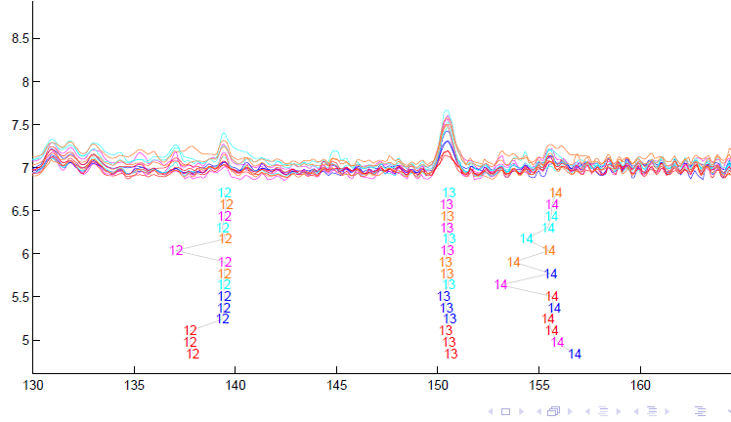
TIC testbed
Zoomed Fisher – Rao Alignment

Slide 60
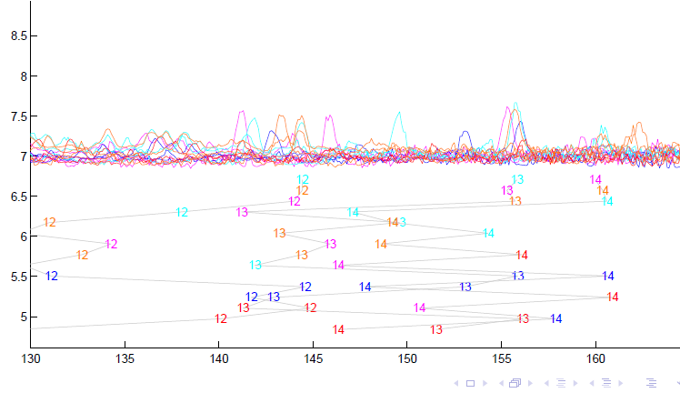
TIC testbed
Before Alignment

Slide 61
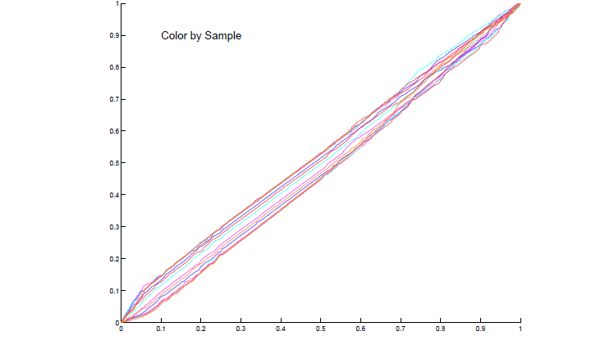
TIC testbed
Warping Functions
Looks Fairly Linear
Decent Linear Analysis:
Bernardi, et al. (2014)

Slide 62
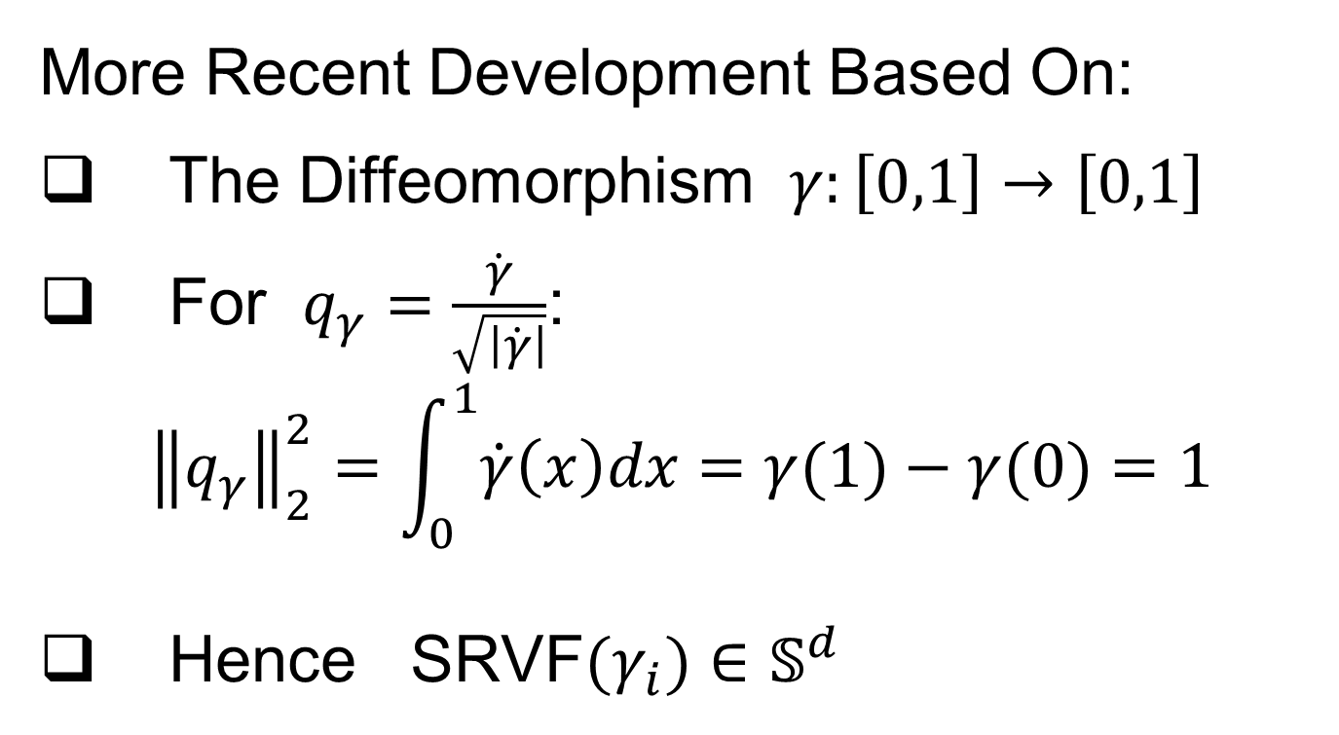
Refined Calculations
Text, Sec. 9.2
More Recent Development Based On:
The Diffeomorphism $γ:\left[0,1\right]→\left[0,1\right]$
For $q_{γ}=\frac{\dot{γ}}{\sqrt{\left|\dot{γ}\right|}}$:
$${\left\|q_{γ}\right\|}_{2}^{2}=\int_{0}^{1}{\dot{γ}\left(x\right)dx}=γ(1)−γ(0)=1$$
Hence SRVF${(γ}_{i})∈𝕊^{d}$

Slide 63
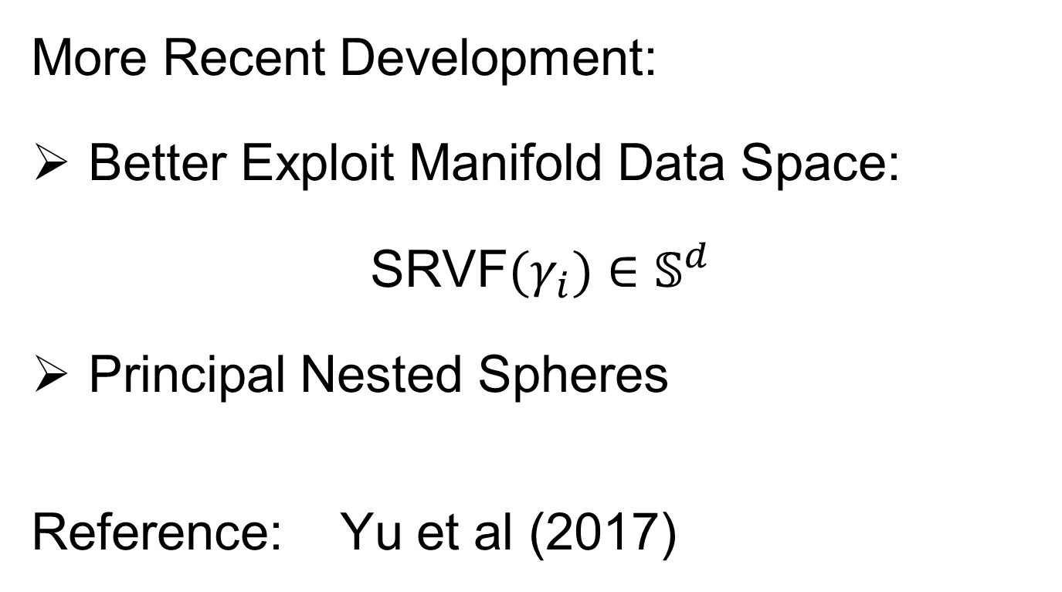
Refined Calculations
More Recent Development:
Better Exploit Manifold Data Space:
SRVF${(γ}_{i})∈𝕊^{d}$
Principal Nested Spheres
Reference: Yu et al (2017)

Slide 64
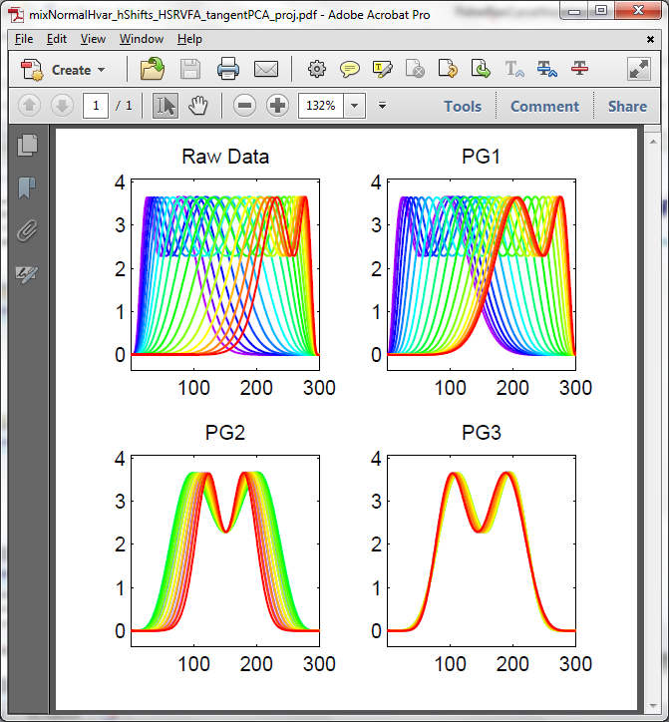
PNS on SRVF Sphere
Toy Example
Tangent Space PCA
(on Horiz. Var’n)
Thanks to Xiaosun Lu
Main Shift of Peaks
Peaks Left-Right,
Only Last Colors
Peaks In vs. Out

Slide 65

PNS on SRVF Sphere
Flip Back for Contrast
Toy Example
PNS Projections
(Fewer Modes)
Main Shift of Peaks
Peaks Left-Right,
Only Last Colors
Essentially
No Variation

Slide 66

PNS on SRVF Sphere
Now See Why
Only Saw Last
Part of Colors
These Two Modes
Are One in PNS
Toy Example
Tangent Space PCA
Note: 3 Comp’s
Needed for This

Slide 67

PNS on SRVF Sphere
Toy Example
PNS Projections
Only 2 for This

Slide 68

PNS on SRVF Sphere
Toy Example
Parametrized
By Values
At 1/3 And 2/3
Recall Early Example
Of 2-d Modes of Variation

Slide 69
PNS on SRVF Sphere
On Sphere
Toy Example
View As Points
Tangent Plane PC 1
PNS 1
Boundary of
Nonnegative
Orthant
In Euclidean Space
Projections No Longer
Strictly Increasing
(Not Diffeomorphisms!)

Slide 70

PNS on SRVF Sphere
Toy Example
Curves from
Tangent Plane PC 1
Note: Some Are
No Longer Warps!

Slide 71
PNS on SRVF Sphere
Toy Example
View As Points
PNS 1
Good 1-d
Approx.

Slide 72
PNS on SRVF Sphere
Toy Example
Recall Original
Warps
Flip Back to
See Quality Of
Approximation

Slide 73


PNS on SRVF Sphere
Toy Example
Another View
$∗$ Raw Warps
$⊡$Tangent PC1
$∘$ PNS 1
Weak 1-mode
Approximation
Much Better
Single Mode
Approximation

Slide 74

PNS on SRVF Sphere
Real Data Analysis: Blood Glucose Curves
Interpolation to Handle Missing Data,
And Non-Equally Spaced Times
Times Not Equally Spaced
Pretty Good
Approximations
Approximation
Satisfactory
for Application
Most Distant Pair

Slide 75

PNS on SRVF Sphere
Real Data Analysis: Blood Glucose Curves
Results of Fisher Rao Decomposition

Slide 76

PNS on SRVF Sphere
Real Data Analysis: Blood Glucose Curves
1st Mode Finds
More Variation
But Hard to
Interpret?

Slide 77

PNS on SRVF Sphere
Real Data Analysis: Blood Glucose Curves
Understand PNS 1 Mode
Of Variation, Using
Equally Spaced Scores
Moderate Slope in Middle
Flanked by Steep on
Both Sides
Recall 3 Types
of PCA Modes:
Projections
Whole Lines
Equally Spaced

Slide 78

PNS on SRVF Sphere
Real Data Analysis: Blood Glucose Curves
Similar Story As
In Toy Example

Slide 79



Juggling Data
Michael Newton – U. Wisconsin
Data from Ramsay et al (2014)
(Vertical Location vs. Time)
While Juggling
Thanks of Theravive.com

Slide 80

Juggling Data
Time
Traces
Cut Into
Time
Blocks:
(Data
Objects)

Slide 81

Juggling Data
Ampitude – Phase Variation Decomposition
(Analysis from Lu & Marron (2014))

Slide 82

Juggling Data
Every Dog
Has His Day
Clustering In Phase Variation Space:
Nor in Amplitude Variation
Nor in Warps
But Not in Raw Data
Sort of in SRVFs
Clear Clusters Here
Also Here

Slide 83

Juggling Data
Interpretation
of Clusters
Found
Known
Juggling
“Errors”

Slide 84
References for Much More
Big Picture Survey:
Marron et al (2015)
Results of a Competition:
Marron et al (2014)

Slide 85
Overview
Curve Registration is Slippery
Thus, Careful Mathematics is Useful
Fisher-Rao Approach:
Gets the Math Right
Intuitively Sensible
Computable
Generalizable
Worth the Complication

Slide 86

HDLSS Asymptotics
Text: Sec. 14.2
Recall Various “Mysteries” about
High Dimension Low Sample Size Data
Natural Separation of $N_{1000}\left(0,I\right)$ Data
Strange behavior in HDLSS Classificat’n
GWAS Failure of Spherical PCA
Next Investigate Mathematics Of These
Notes:
86

Slide 87

HDLSS Asymptotics
Modern Mathematical Statistics:
Based on asymptotic analysis
Notes:
87

Slide 88

HDLSS Asymptotics
Modern Mathematical Statistics:
Based on asymptotic analysis
I.e. Uses limiting operations
Very often $\lim_{n→∞}{}$
Workhorse Method for Much Insight:
Laws of Large Numbers (Consistency)
Central Limit Theorems
(Quantify Errors, Basis of Inference)
Notes:
88

Slide 89

HDLSS Asymptotics
Modern Mathematical Statistics:
Based on asymptotic analysis
I.e. Uses limiting operations
Very often $\lim_{n→∞}{}$
Occasional misconceptions:
Indicates behavior for large samples
Thus only makes sense for “large” samples
Models phenomenon of “increasing data”
So other flavors are useless???
Sometimes Ask
Junior Researchers
Why They Do
Asymptotics
Notes:
89

Slide 90
HDLSS Asymptotics
Modern Mathematical Statistics:
Based on asymptotic analysis
Real Reasons:
Approximation provides insights
Can find simple underlying structure
In complex situations
Thus various flavors are fine:
$$\lim_{n→∞}{} \lim_{d→∞}{} \lim_{n,d→∞}{} \lim_{σ→0}{}$$
Even desirable! (find additional insights)
Notes:
90

Slide 91
Participant Presentation
Dev Ghandi
Predicting Patterns of Occurrence
of PFAS in Water in the United States
Using Machine Learning
Next Class: David Allemang

