Slide 1
Statistics – O. R. 881 Object Oriented Data Analysis
Steve Marron
Dept. of Statistics and Operations Research
University of North Carolina

Slide 2
Current Sections in Textbook
Today:
Sections 14.2
Next Class:
Sections 14.1, 12.1

Slide 3
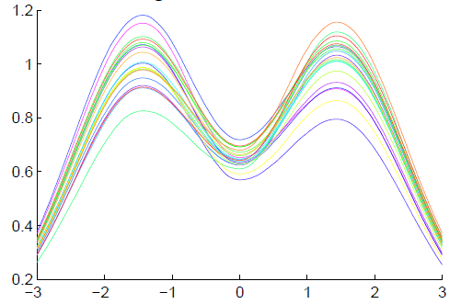
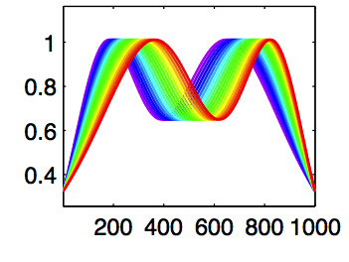
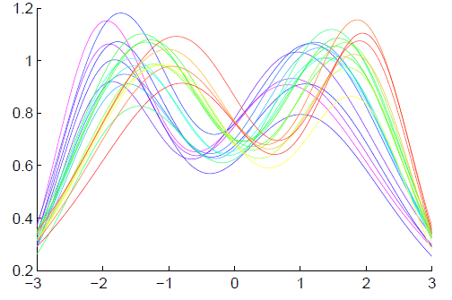
Last Class: Funct’l Data Anal.
Insightful
Decomposition
Vertical Variation
Horiz’l
Var’n

Slide 4
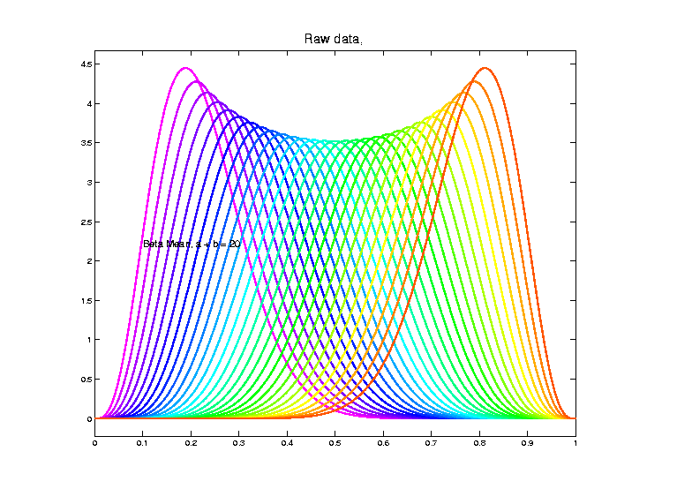
Last Class: Shifted Betas E.g.
Raw
Data
Both
Horizontal
And
Vertical
Variation

Slide 5
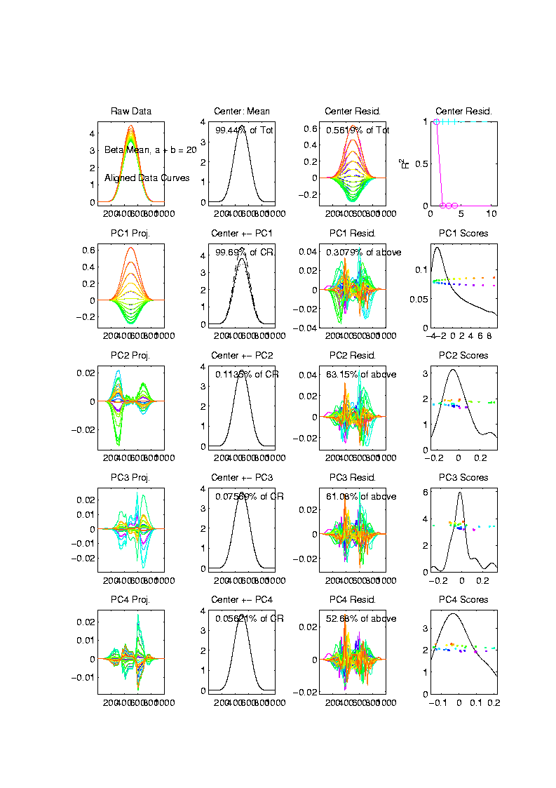
Last Class: Shifted Betas E.g.
Aligned
Curve
PCA
Projections
All Var’n
In 1st
Component

Slide 6
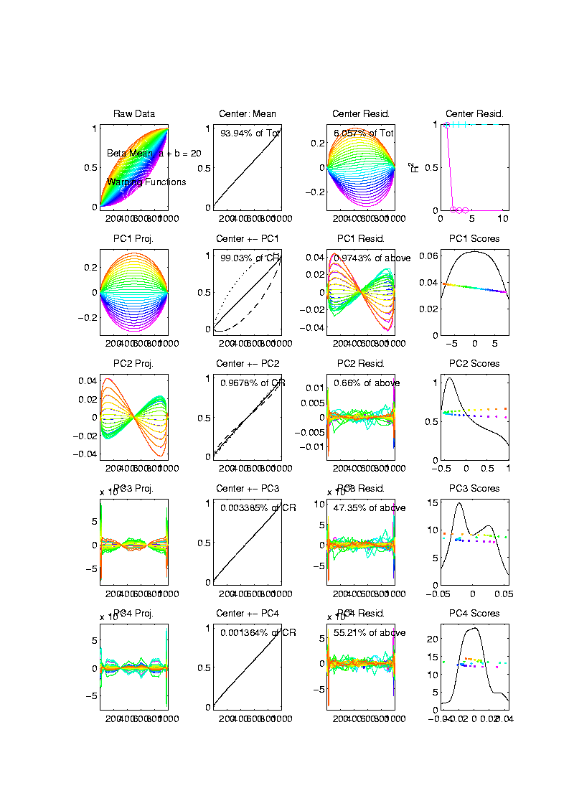
Last Class: Shifted Betas E.g.
Warps,
PC
Projections

Slide 7
Last Class: Shifted Betas E.g.
Warps,
PC
Projections
Rest is
Not
Important

Slide 8
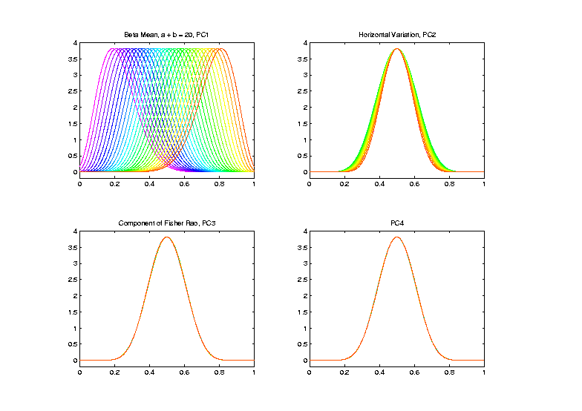
Last Class: Shifted Betas E.g.
Warp
Compon’ts
(+ Mean)
Applied to
Template
Mean

Slide 9
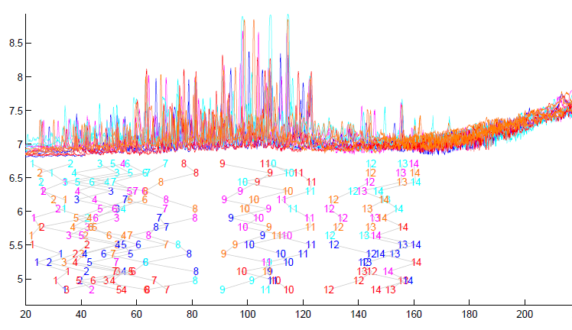
Last Class: TIC testbed
Special Feature: Answer Key of Known Peaks
Goal:
Find
Warps
To Align
These

Slide 10
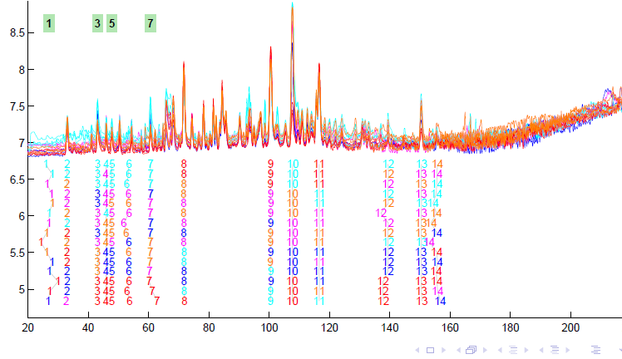
Last Class: TIC testbed
Fisher – Rao Alignment

Slide 11
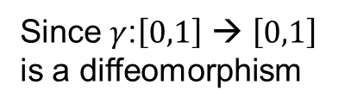
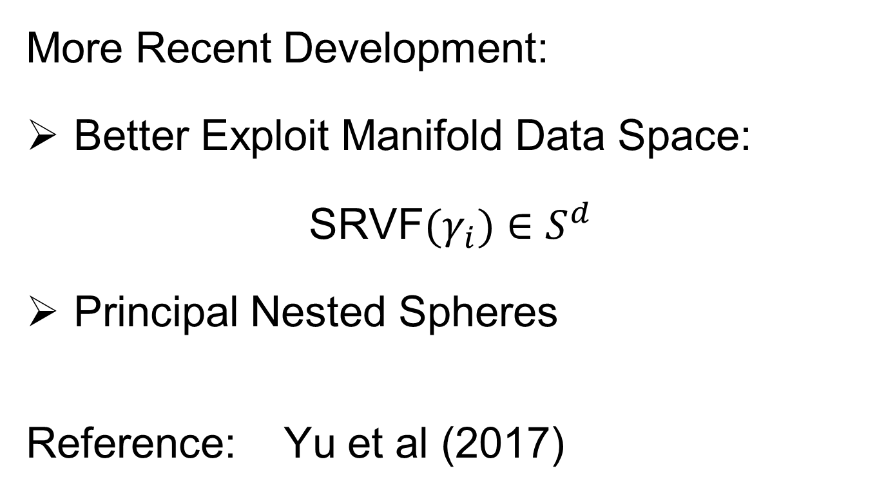
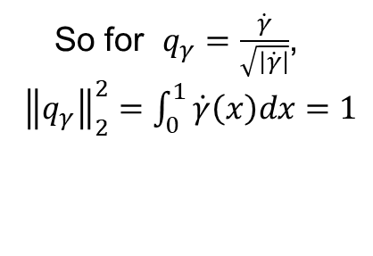
Last Class: Refined Calculat’ns
Text, Sec. 9.2
More Recent Development:
Better Exploit Manifold Data Space:
SRVF${(γ}_{i})∈S^{d}$
Principal Nested Spheres
Reference: Yu et al (2017)
Since $γ$:$\left[0,1\right]$ → $\left[0,1\right]$
is a diffeomorphism
So for $q_{γ}=\frac{\dot{γ}}{\sqrt{\left|\dot{γ}\right|}}$,
${\left\|q_{γ}\right\|}_{2}^{2}=\int_{0}^{1}{\dot{γ}\left(x\right)dx}=1$

Slide 12
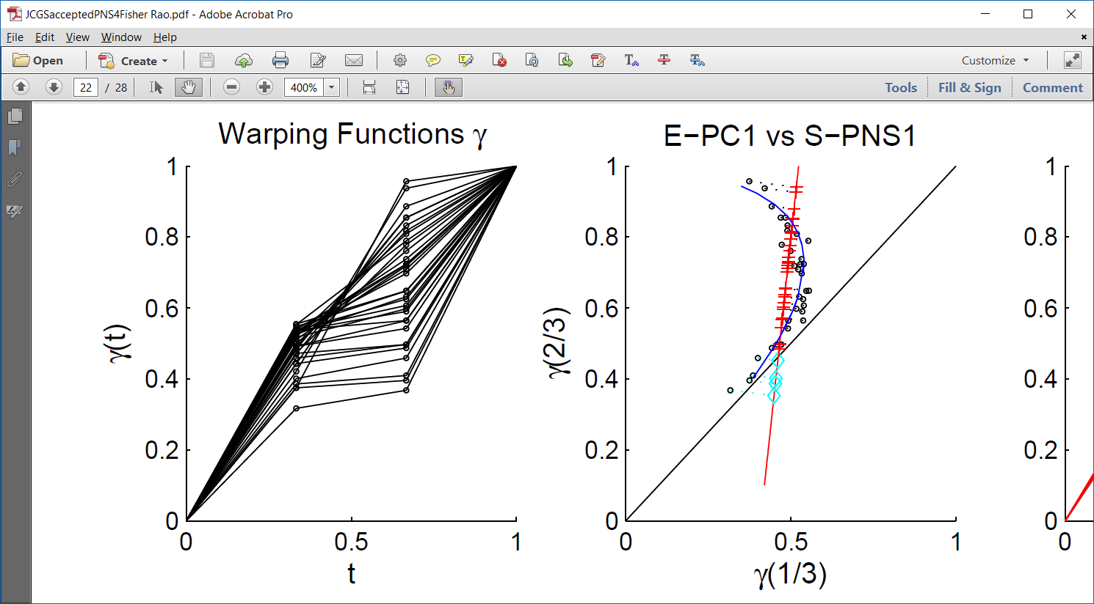
Last Class: PNS on SRVF Sph
Toy Example
Parametrized
By Values
At 1/3 And 2/3

Slide 13
Last Class: PNS on SRVF Sph
Toy Example
View As Points
Tangent Plane PC 1
PNS 1
Boundary of
Nonnegative
Orthant

Slide 14
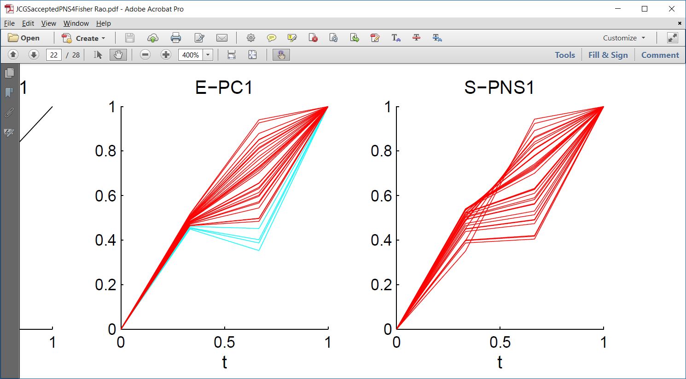
Last Class: PNS on SRVF Sph
Toy Example
Curves from
Tangent Plane PC 1
Note: Some Are
No Longer Warps!

Slide 15
Last Class: PNS on SRVF Sph
Toy Example
View As Points
PNS 1
Good 1-d
Approx.

Slide 16
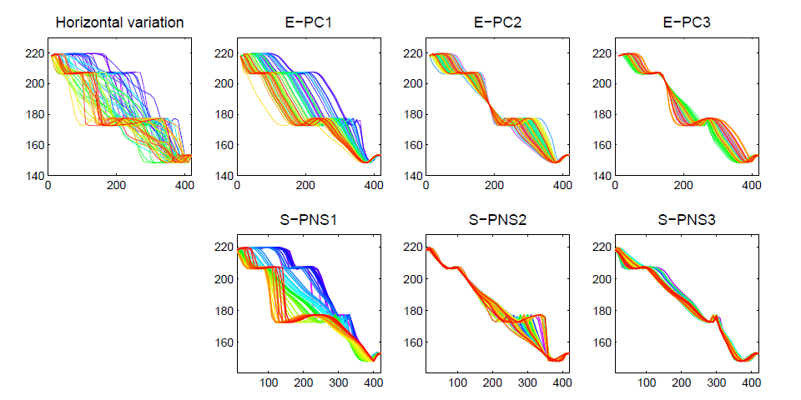
Last Class: PNS on SRVFs
Real Data Analysis: Blood Glucose Curves

Slide 17
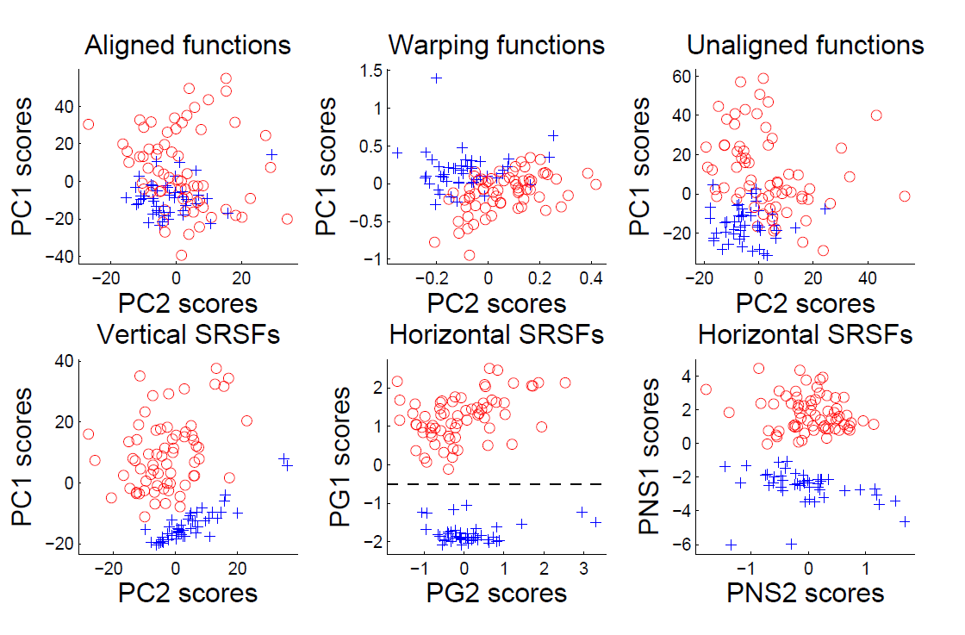
Last Class: Juggling Data
Clustering In Phase Variation Space:

Slide 18
Last Class: HDLSS Asymptotics
Modern Mathematical Statistics:
Based on asymptotic analysis
Real Reasons:
Approximation provides insights
Can find simple underlying structure
In complex situations
Thus various flavors are fine:
$$\lim_{n→∞}{} \lim_{d→∞}{} \lim_{n,d→∞}{} \lim_{σ→0}{}$$
Even desirable! (find additional insights)
Notes:
18

Slide 19
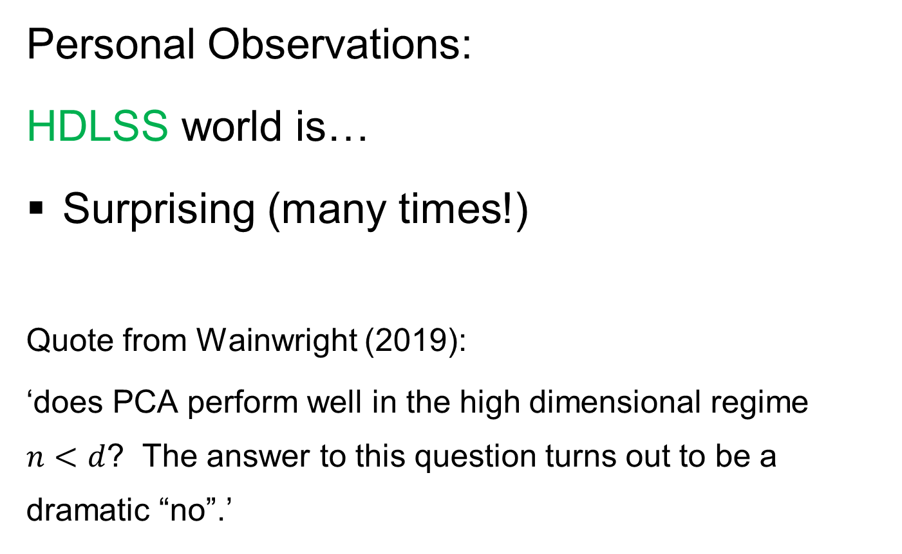
HDLSS Asymptotics
Personal Observations:
HDLSS world is…
Surprising (many times!)
Quote from Wainwright (2019):
‘does PCA perform well in the high dimensional regime $n<d$? The answer to this question turns out to be a dramatic “no”.’
Thought Leader in
Machine Learning
Consistent With Actual Data Analysis???

Slide 20
HDLSS Asymptotics
Personal Observations:
HDLSS world is…
Surprising (many times!)
[Think I’ve got it, and then …]
Mathematically Beautiful (?)
Doing Mathematics Is Essential
Practically Relevant
Only Way To Understand
When Intuition Fails!

Slide 21
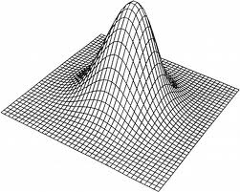
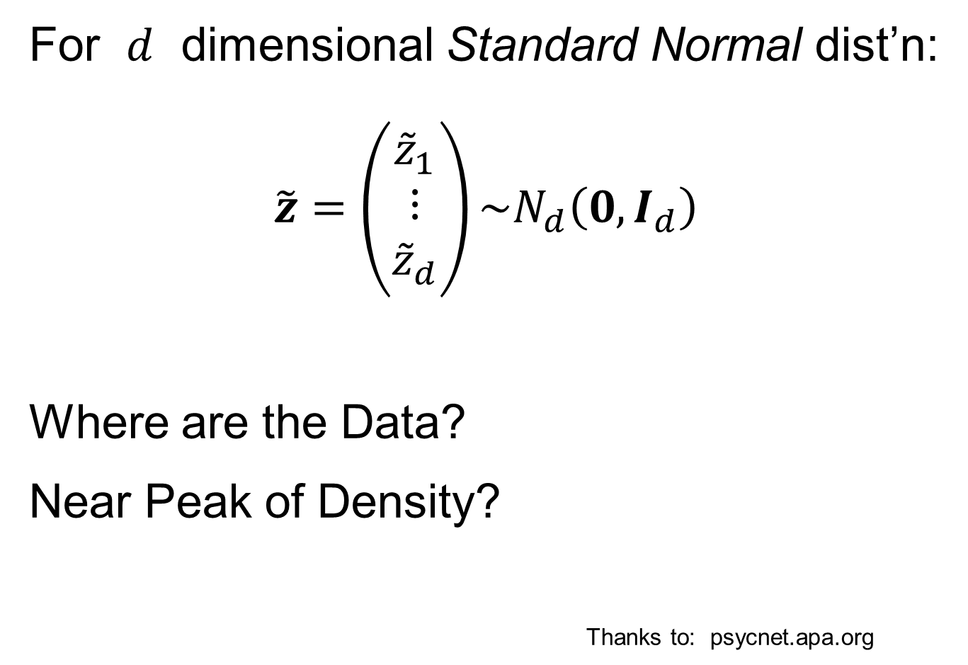
HDLSS Asymptotics: Simple Paradoxes
For $d$ dimensional Standard Normal dist’n:
$$\tilde{z}=\left(\begin{matrix}{\tilde{z}}_{1} \\ ⋮ \\ {\tilde{z}}_{d}\end{matrix}\right)\sim N_{d}\left(0,I_{d}\right)$$
Where are the Data?
Near Peak of Density?
Thanks to: psycnet.apa.org
Recall tilde for random,
Bold for vectors & matrices

Slide 22
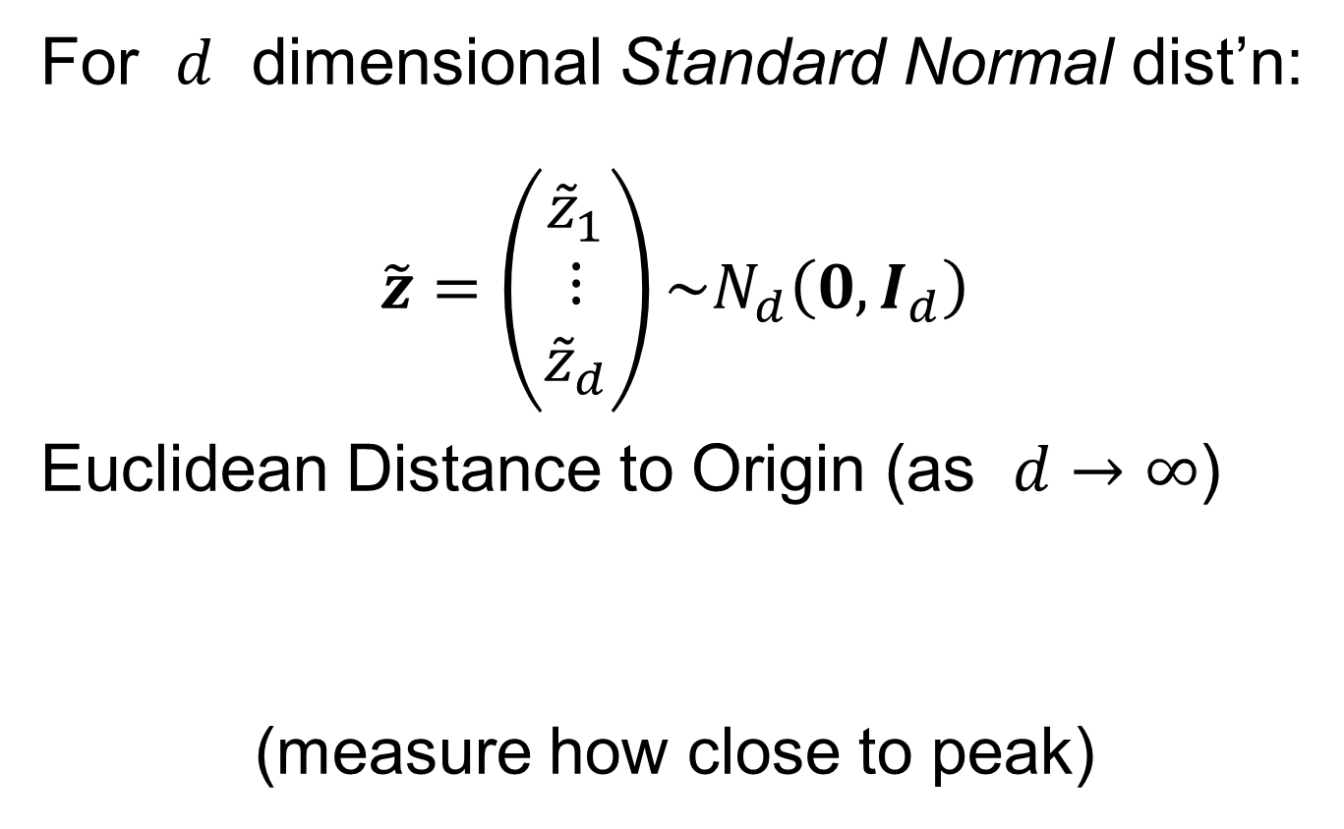
HDLSS Asymptotics: Simple Paradoxes
For $d$ dimensional Standard Normal dist’n:
$$\tilde{z}=\left(\begin{matrix}{\tilde{z}}_{1} \\ ⋮ \\ {\tilde{z}}_{d}\end{matrix}\right)\sim N_{d}\left(0,I_{d}\right)$$
Euclidean Distance to Origin (as $d→∞$)
(measure how close to peak)

Slide 23
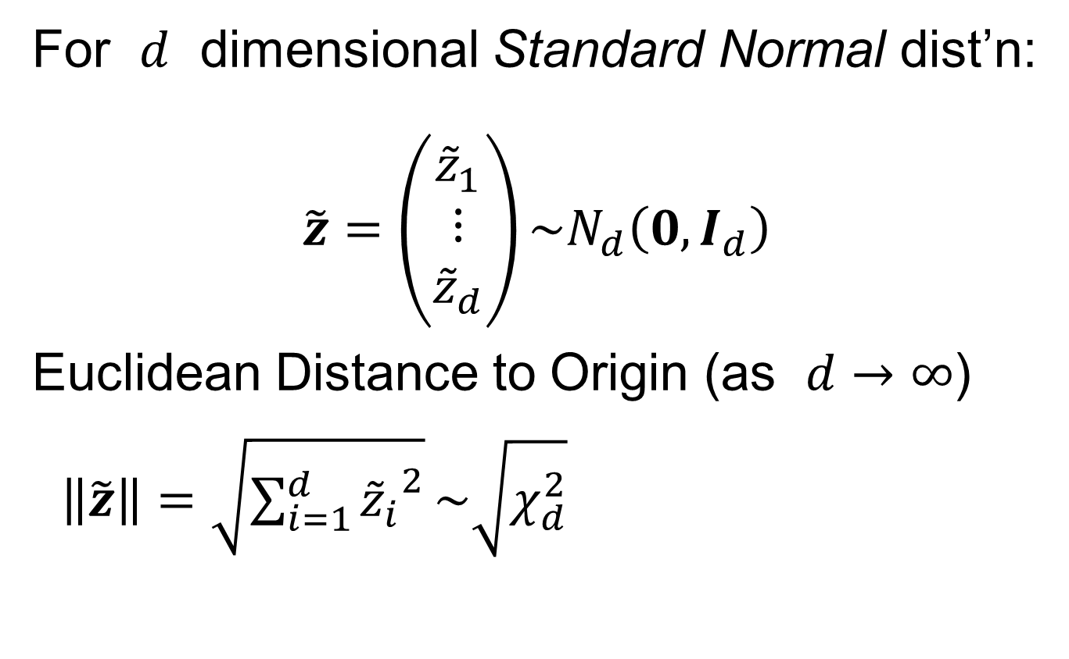

HDLSS Asymptotics: Simple Paradoxes
For $d$ dimensional Standard Normal dist’n:
$$\tilde{z}=\left(\begin{matrix}{\tilde{z}}_{1} \\ ⋮ \\ {\tilde{z}}_{d}\end{matrix}\right)\sim N_{d}\left(0,I_{d}\right)$$
Euclidean Distance to Origin (as $d→∞$)
$\left\|\tilde{z}\right\|=\sqrt{\sum_{i=1}^{d}{{{\tilde{z}}_{i}}^{2}}}\sim \sqrt{χ_{d}^{2}}$
Recall $Eχ_{d}^{2}=d$,
$var\left(χ_{d}^{2}\right)=2d$

Slide 24
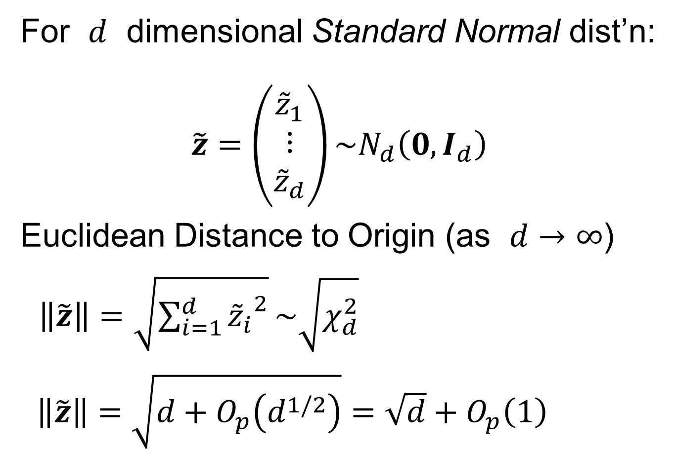
HDLSS Asymptotics: Simple Paradoxes
For $d$ dimensional Standard Normal dist’n:
$$\tilde{z}=\left(\begin{matrix}{\tilde{z}}_{1} \\ ⋮ \\ {\tilde{z}}_{d}\end{matrix}\right)\sim N_{d}\left(0,I_{d}\right)$$
Euclidean Distance to Origin (as $d→∞$)
$\left\|\tilde{z}\right\|=\sqrt{\sum_{i=1}^{d}{{{\tilde{z}}_{i}}^{2}}}\sim \sqrt{χ_{d}^{2}}$
$\left\|\tilde{z}\right\|=\sqrt{d+O_{p}\left(d^{1/2}\right)}=\sqrt{d}+O_{p}\left(1\right)$
Taylor Expansion,
i.e. “Delta Method”

Slide 25
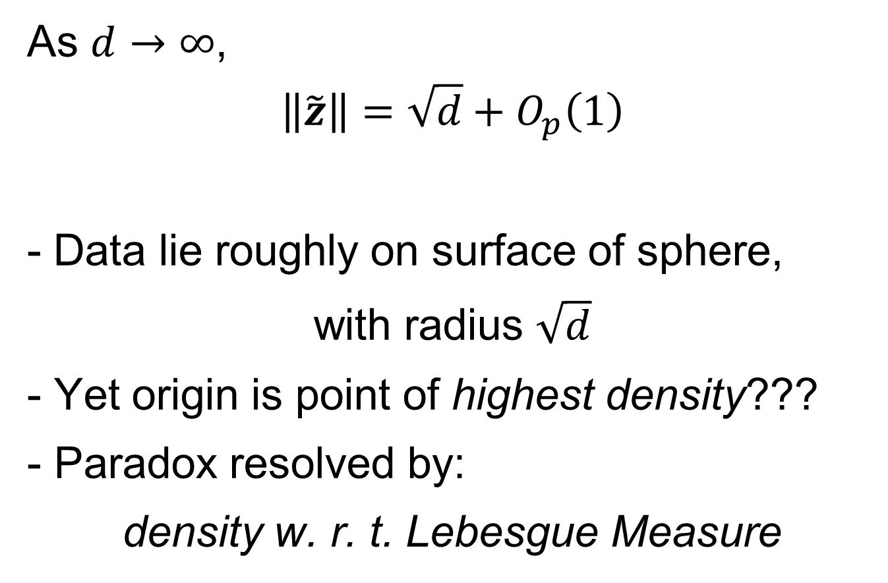
HDLSS Asymptotics: Simple Paradoxes
As $d→∞$,
$$\left\|\tilde{z}\right\|=\sqrt{d}+O_{p}\left(1\right)$$
Data lie roughly on surface of sphere,
with radius $\sqrt{d}$
- Yet origin is point of highest density???
- Paradox resolved by:
density w. r. t. Lebesgue Measure
Notes:
25

Slide 26
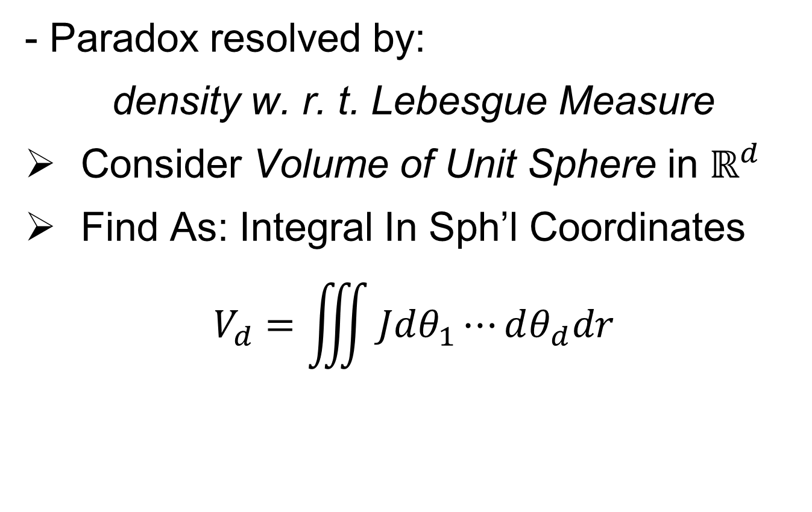
HDLSS Asymptotics: Simple Paradoxes
- Paradox resolved by:
density w. r. t. Lebesgue Measure
Consider Volume of Unit Sphere in $ℝ^{d}$
Find As: Integral In Sph’l Coordinates
$$V_{d}=\iiint{Jdθ_{1}⋯dθ_{d}dr}$$
Notes:
26

Slide 27
HDLSS Asymptotics: Simple Paradoxes
- Paradox resolved by:
density w. r. t. Lebesgue Measure
Consider Volume of Unit Sphere in $ℝ^{d}$
Find As: Integral In Sph’l Coordinates
$$V_{d}=\iiint{Jdθ_{1}⋯dθ_{d}dr}$$
Look At Integrand w.r.t. $r$
Can Show: Puts ~ All Weight Near $r=1$
Notes:
27

Slide 28
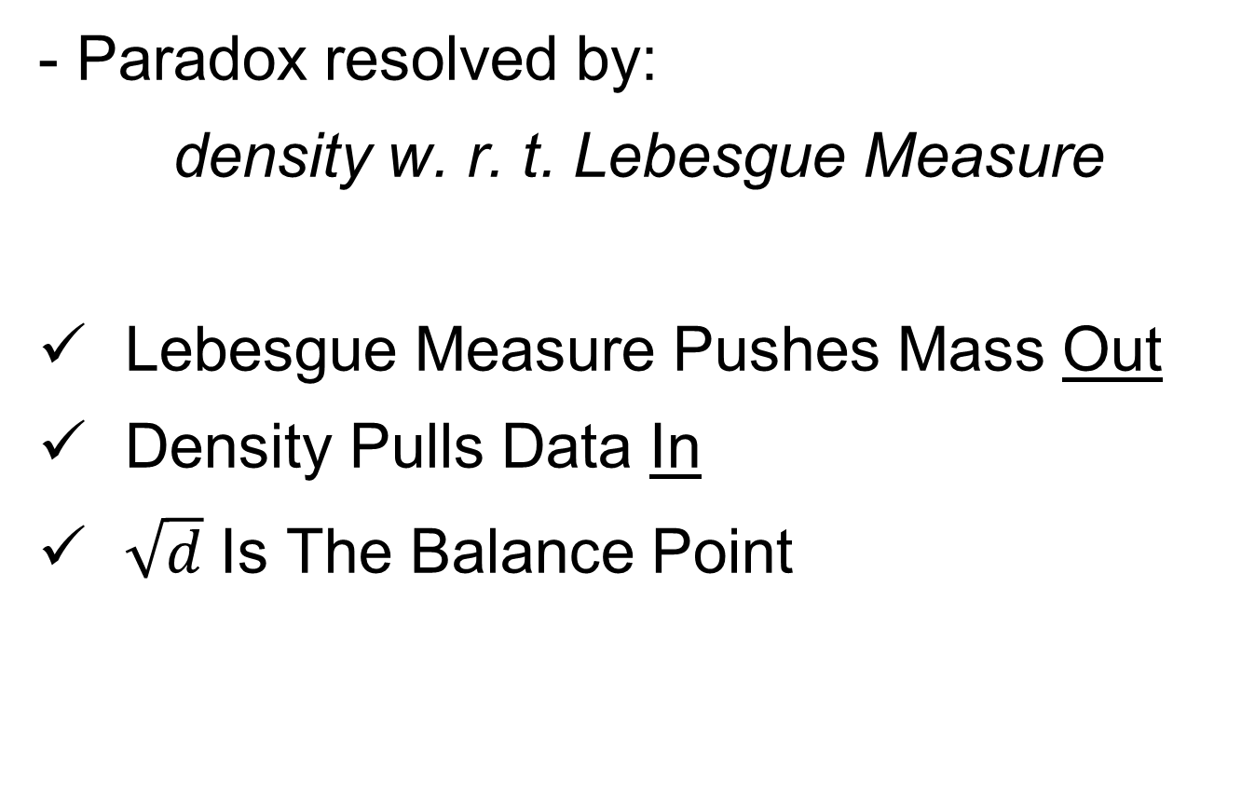
HDLSS Asymptotics: Simple Paradoxes
- Paradox resolved by:
density w. r. t. Lebesgue Measure
Lebesgue Measure Pushes Mass Out
Density Pulls Data In
$\sqrt{d}$ Is The Balance Point
Notes:
28

Slide 29
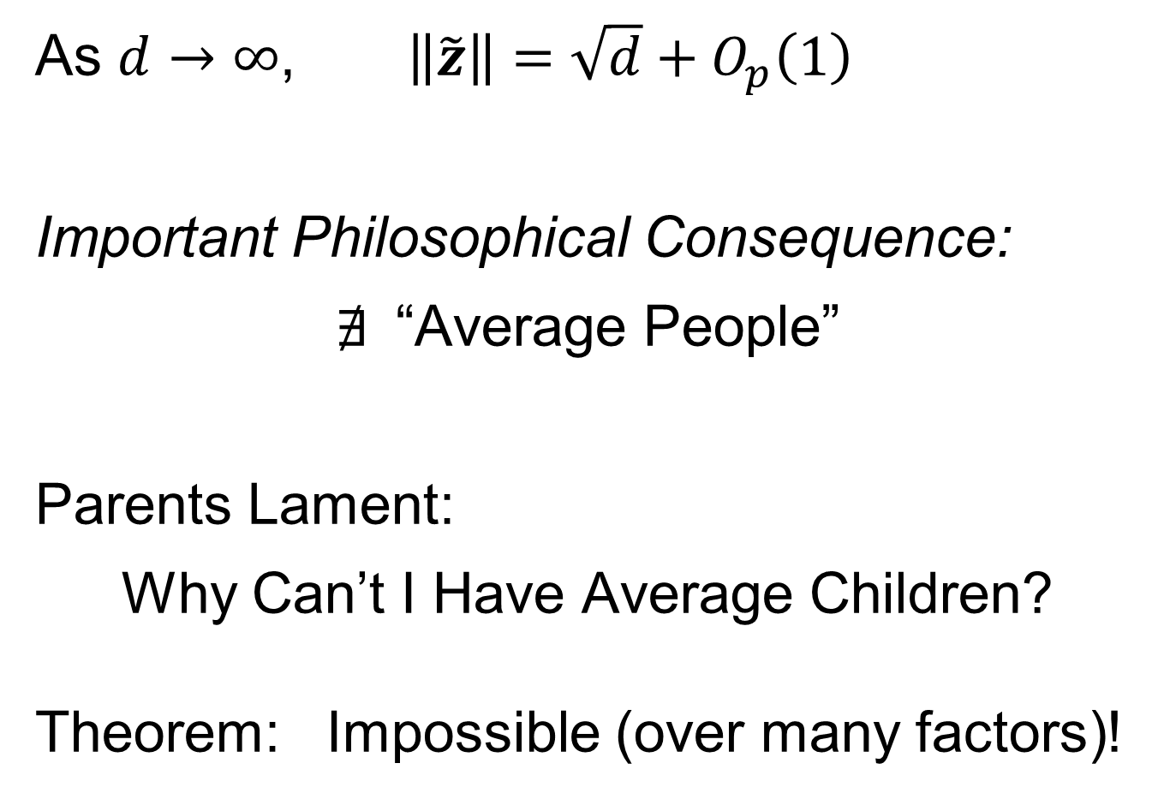
HDLSS Asymptotics: Simple Paradoxes
As $d→∞$, $\left\|\tilde{z}\right\|=\sqrt{d}+O_{p}\left(1\right)$
Important Philosophical Consequence:
$∄$“Average People”
Parents Lament:
Why Can’t I Have Average Children?
Theorem: Impossible (over many factors)!
Notes:
29

Slide 30
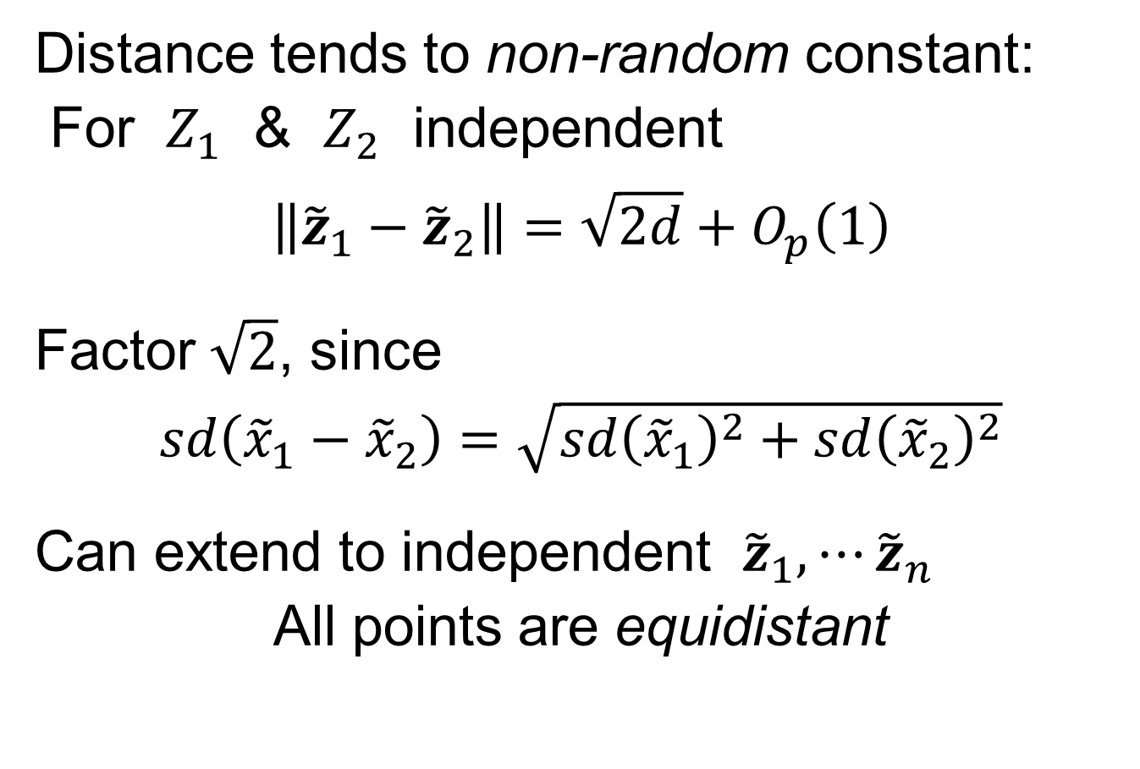
HDLSS Asymptotics: Simple Paradoxes
Distance tends to non-random constant:
For $Z_{1}$ & $Z_{2}$ independent
$$\left\|{\tilde{z}}_{1}−{\tilde{z}}_{2}\right\|=\sqrt{2d}+O_{p}\left(1\right)$$
Factor $\sqrt{2}$, since
$sd\left({\tilde{x}}_{1}−{\tilde{x}}_{2}\right)=\sqrt{{sd\left({\tilde{x}}_{1}\right)}^{2}+{sd\left({\tilde{x}}_{2}\right)}^{2}}$
Can extend to independent ${\tilde{z}}_{1},⋯{\tilde{z}}_{n}$
All points are equidistant
(We can only perceive 3 dimensions)
Notes:
30

Slide 31
HDLSS Asymptotics: Simple Paradoxes
Recall Reason Why
Perceptual System from Ancestors
They Needed to Find Food
Food Exists in 3-d World
(We can only perceive 3 dimensions)
Notes:
31

Slide 32
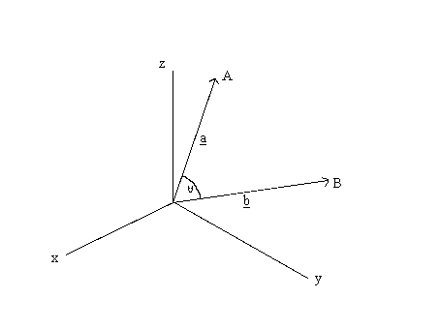
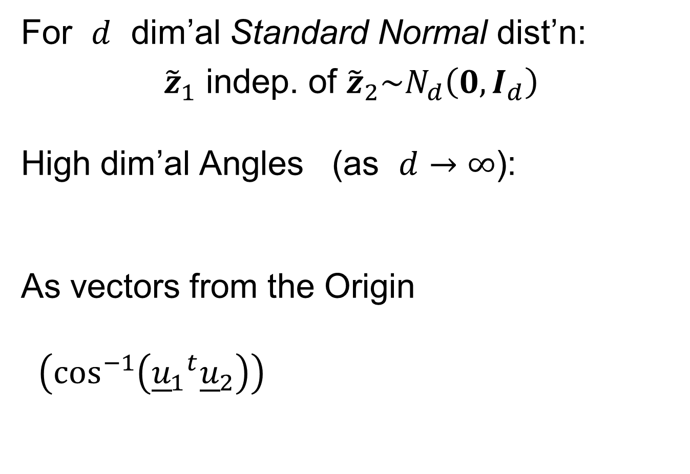
HDLSS Asymptotics: Simple Paradoxes
For $d$ dim’al Standard Normal dist’n:
${\tilde{z}}_{1}$ indep. of ${\tilde{z}}_{2}\sim N_{d}\left(0,I_{d}\right)$
High dim’al Angles (as $d→∞$):
As vectors from the Origin
$\left(\cos^{−1}\left({{\underline{u}}_{1}}^{t}{\underline{u}}_{2}\right)\right)$
Thanks to: members.tripod.com

Slide 33
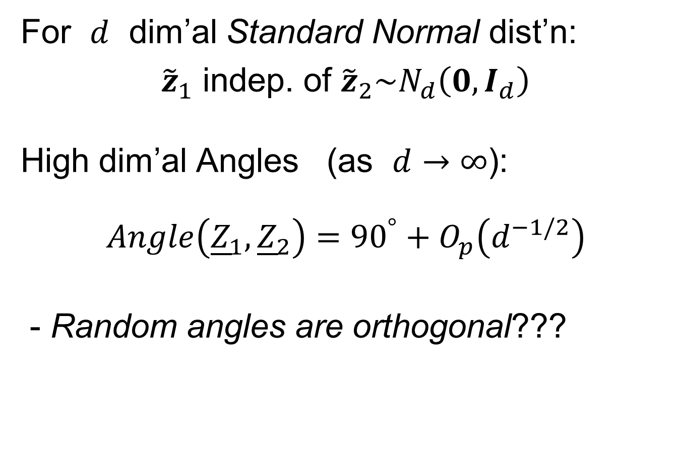




HDLSS Asymptotics: Simple Paradoxes
For $d$ dim’al Standard Normal dist’n:
${\tilde{z}}_{1}$ indep. of ${\tilde{z}}_{2}\sim N_{d}\left(0,I_{d}\right)$
High dim’al Angles (as $d→∞$):
$$Angle\left({\underline{Z}}_{1},{\underline{Z}}_{2}\right)={90}^{°}+O_{p}\left(d^{−1/2}\right)$$
- Random angles are orthogonal???
$\sqrt{2d}$
Note Pythagorean Theorem:
$\sqrt{d}$
${90}^{°}$
$\sqrt{d}$

Slide 34

HDLSS Asy’s: Geometrical Represent’n
Assume ${\tilde{z}}_{1},⋯{\tilde{z}}_{n}\sim N_{d}\left(0,I_{d}\right)$, let $d→∞$
Study Subspace Generated by Data
Hall, Marron & Neeman (2005)

Slide 35

HDLSS Asy’s: Geometrical Represent’n
Assume ${\tilde{z}}_{1},⋯{\tilde{z}}_{n}\sim N_{d}\left(0,I_{d}\right)$, let $d→∞$
Study Subspace Generated by Data
Hyperplane through $0$,
of dimension $n$
Hall, Marron & Neeman (2005)

Slide 36

HDLSS Asy’s: Geometrical Represent’n
Assume ${\tilde{z}}_{1},⋯{\tilde{z}}_{n}\sim N_{d}\left(0,I_{d}\right)$, let $d→∞$
Study Subspace Generated by Data
Hyperplane through $0$,
of dimension $n$
Points are “nearly equidistant to $0$”,
& dist $\sqrt{d}$
Hall, Marron & Neeman (2005)

Slide 37
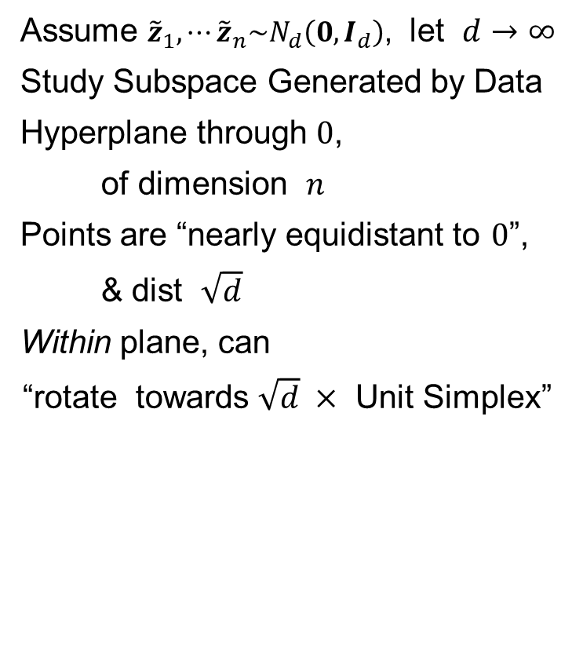
HDLSS Asy’s: Geometrical Represent’n
Assume ${\tilde{z}}_{1},⋯{\tilde{z}}_{n}\sim N_{d}\left(0,I_{d}\right)$, let $d→∞$
Study Subspace Generated by Data
Hyperplane through $0$,
of dimension $n$
Points are “nearly equidistant to $0$”,
& dist $\sqrt{d}$
Within plane, can
“rotate towards $\sqrt{d} ×$ Unit Simplex”
Hall, Marron & Neeman (2005)

Slide 38


Unit Simplex in $ℝ^{d}$
Convex Combinations of Unit Vectors
$\left(\begin{matrix}\begin{matrix}0 \\ 1 \\ 0\end{matrix} \\ ⋮ \\ 0\end{matrix}\right)$
$\left(\begin{matrix}\begin{matrix}1 \\ 0\end{matrix} \\ \begin{matrix}⋮ \\ 0\end{matrix}\end{matrix}\right)$
Simplex = $\left\{\left(\begin{matrix}x_{1} \\ ⋮ \\ x_{d}\end{matrix}\right):\sum_{i=1}^{d}{x_{i}=1,x_{i}≥0}\right\}$

Slide 39
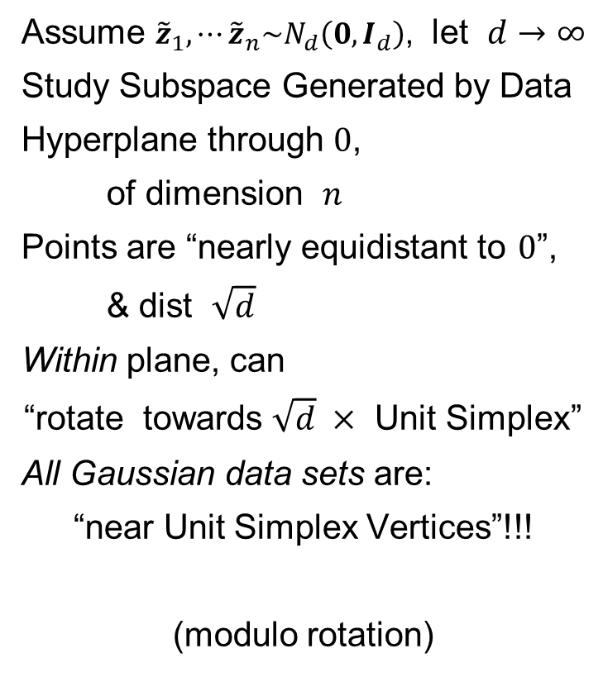
HDLSS Asy’s: Geometrical Represent’n
Assume ${\tilde{z}}_{1},⋯{\tilde{z}}_{n}\sim N_{d}\left(0,I_{d}\right)$, let $d→∞$
Study Subspace Generated by Data
Hyperplane through $0$,
of dimension $n$
Points are “nearly equidistant to $0$”,
& dist $\sqrt{d}$
Within plane, can
“rotate towards $\sqrt{d} ×$ Unit Simplex”
All Gaussian data sets are:
“near Unit Simplex Vertices”!!!
(modulo rotation)
Hall, Marron & Neeman (2005)

Slide 40
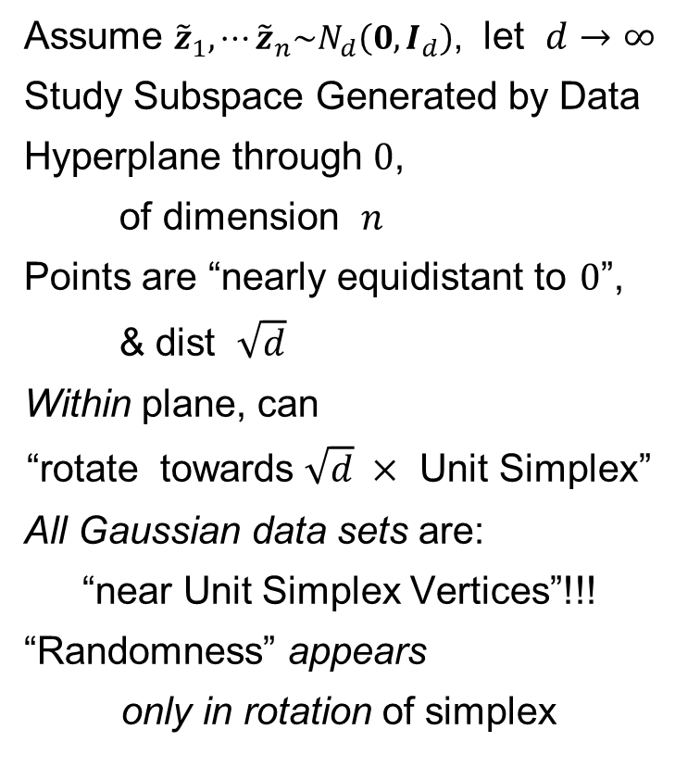
HDLSS Asy’s: Geometrical Represent’n
Assume ${\tilde{z}}_{1},⋯{\tilde{z}}_{n}\sim N_{d}\left(0,I_{d}\right)$, let $d→∞$
Study Subspace Generated by Data
Hyperplane through $0$,
of dimension $n$
Points are “nearly equidistant to $0$”,
& dist $\sqrt{d}$
Within plane, can
“rotate towards $\sqrt{d} ×$ Unit Simplex”
All Gaussian data sets are:
“near Unit Simplex Vertices”!!!
“Randomness” appears
only in rotation of simplex
Hall, Marron & Neeman (2005)

Slide 41
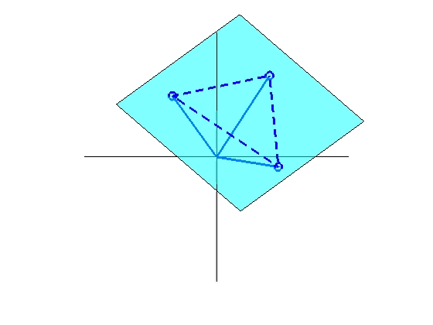
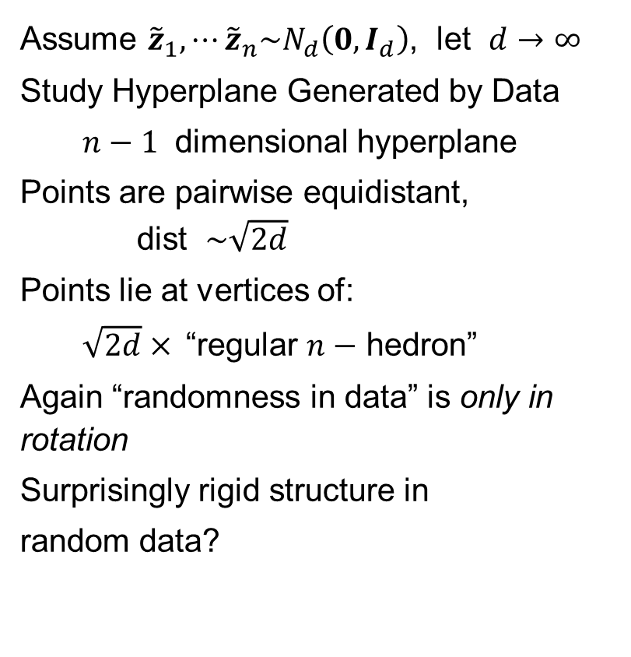
HDLSS Asy’s: Geometrical Represent’n
Assume ${\tilde{z}}_{1},⋯{\tilde{z}}_{n}\sim N_{d}\left(0,I_{d}\right)$, let $d→∞$
Study Hyperplane Generated by Data
$n−1$ dimensional hyperplane
Points are pairwise equidistant, dist $\sim \sqrt{2d}$
Points lie at vertices of:
$\sqrt{2d}×$“regular $n−$ hedron”
Again “randomness in data” is only in rotation
Surprisingly rigid structure in
random data?

Slide 42
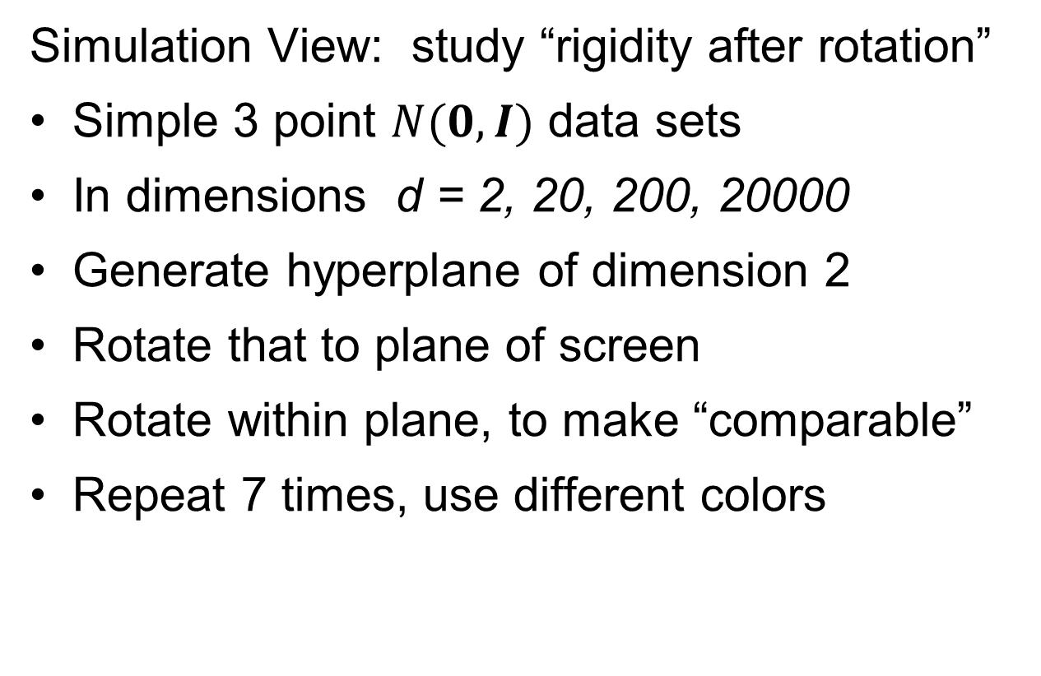
HDLSS Asy’s: Geometrical Represen’tion
Simulation View: study “rigidity after rotation”
Simple 3 point $N(0,I)$ data sets
In dimensions d = 2, 20, 200, 20000
Generate hyperplane of dimension 2
Rotate that to plane of screen
Rotate within plane, to make “comparable”
Repeat 7 times, use different colors

Slide 43
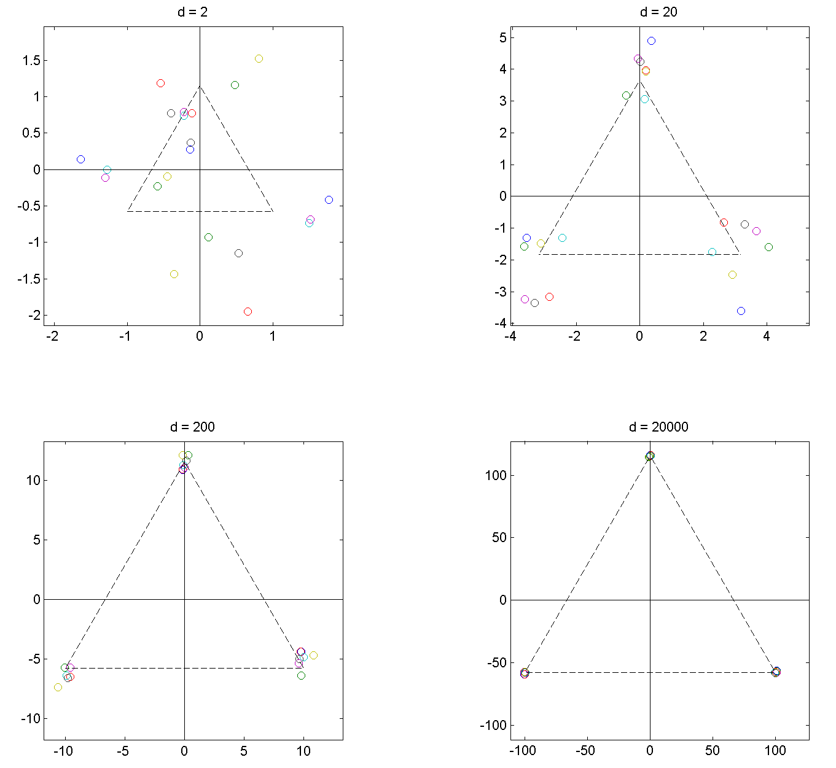
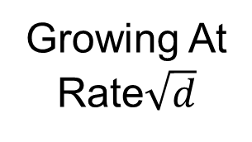
HDLSS Asy’s: Geometrical Represen’tion
Simulation View: Shows “Rigidity after Rotation”
Note
Expanding
Scales
Growing At
Rate$\sqrt{d}$

Slide 44
HDLSS Asy’s: Geometrical Represen’tion
View from Probability Theory:
These phenomena named
Concentration of Measure
Key References:
Talagrand (1991, 1995)
Ledoux (2005)

Slide 45
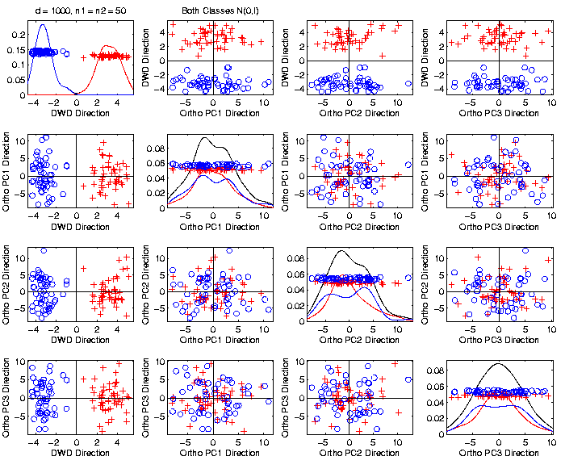
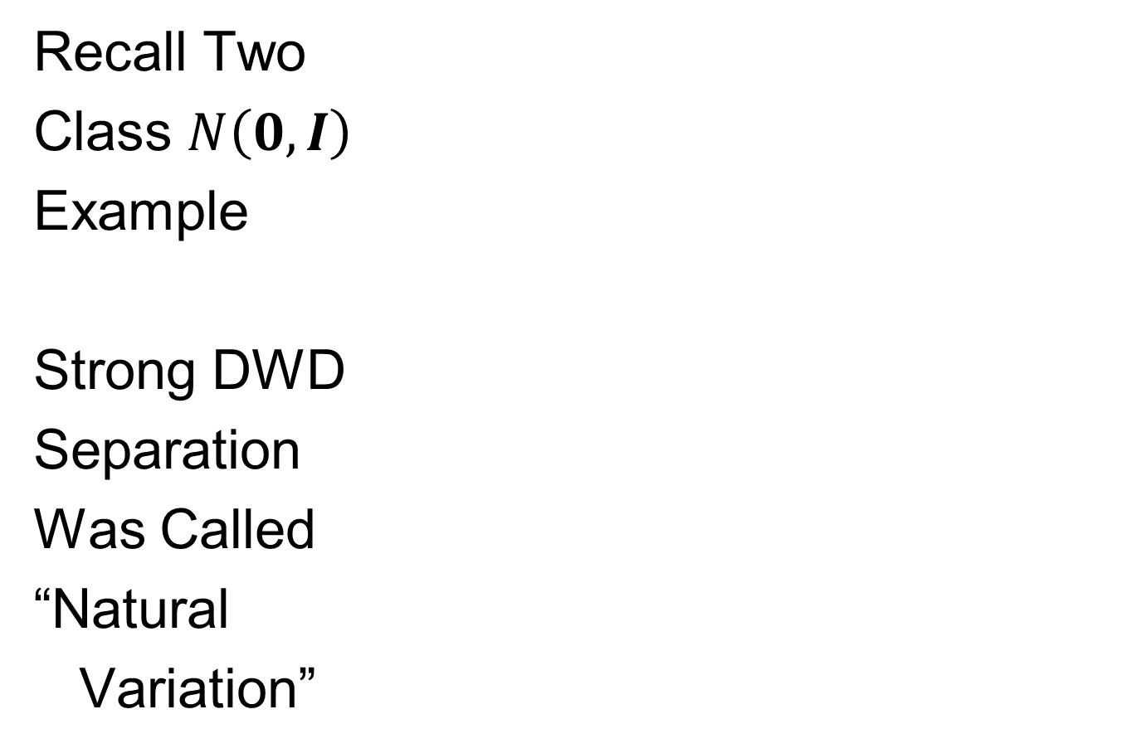
An Interesting HDLSS Explanation
Recall Two
Class $N\left(0,I\right)$
Example
Strong DWD
Separation
Was Called
“Natural
Variation”

Slide 46
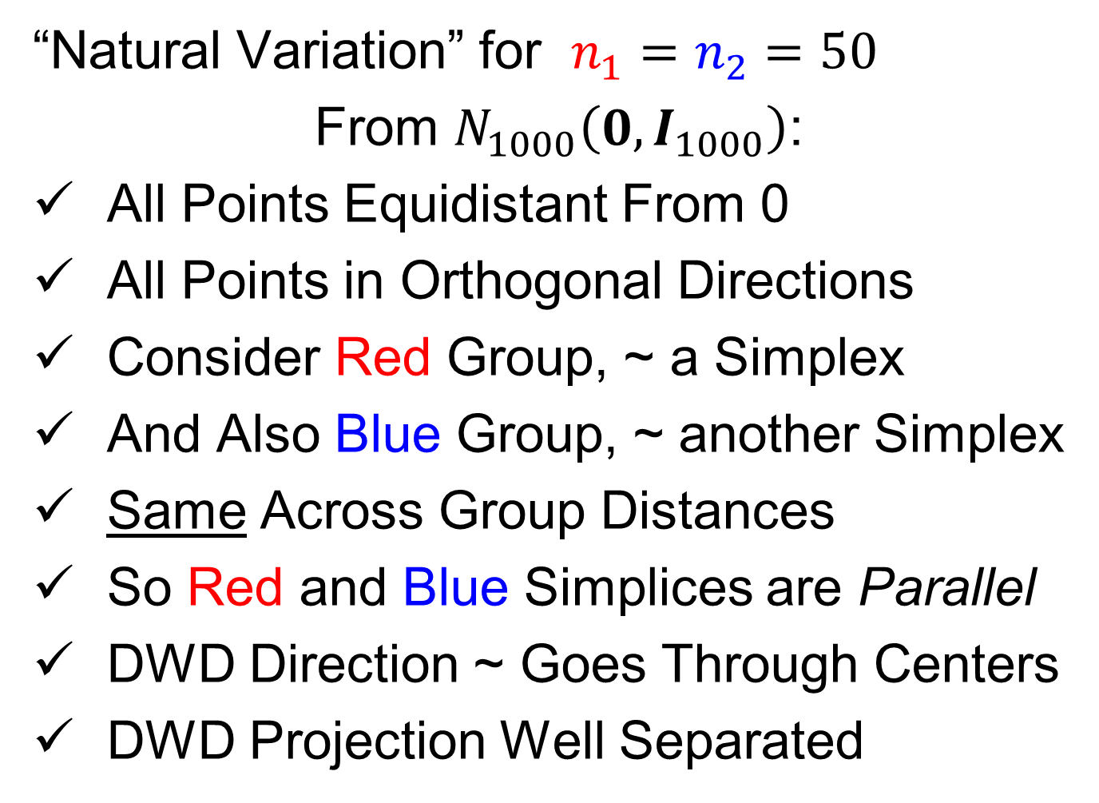
An Interesting HDLSS Explanation
“Natural Variation” for $n_{1}=n_{2}=50$
From $N_{1000}\left(0,I_{1000}\right)$:
All Points Equidistant From 0
All Points in Orthogonal Directions
Consider Red Group, ~ a Simplex
And Also Blue Group, ~ another Simplex
Same Across Group Distances
So Red and Blue Simplices are Parallel
DWD Direction ~ Goes Through Centers
DWD Projection Well Separated

Slide 47
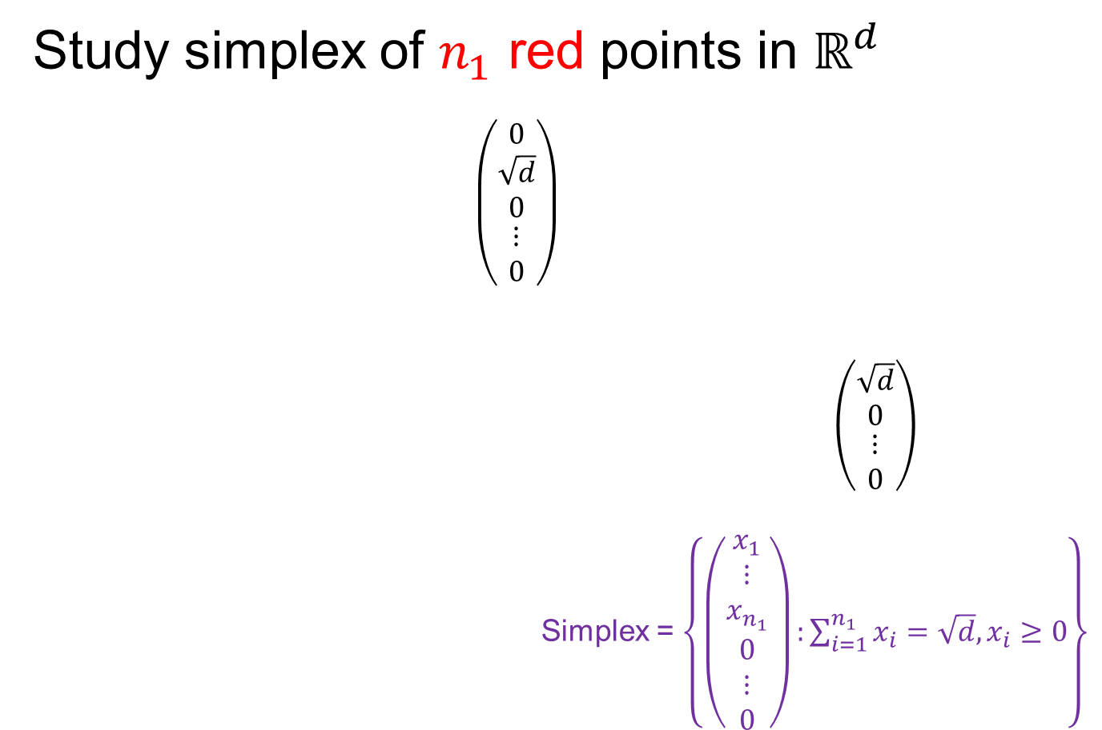
An Interesting HDLSS Explanation
Study simplex of $n_{1}$ red points in $ℝ^{d}$
$\left(\begin{matrix}\begin{matrix}0 \\ \sqrt{d} \\ 0\end{matrix} \\ ⋮ \\ 0\end{matrix}\right)$
$\left(\begin{matrix}\begin{matrix}\sqrt{d} \\ 0\end{matrix} \\ \begin{matrix}⋮ \\ 0\end{matrix}\end{matrix}\right)$
Simplex = $\left\{\left(\begin{matrix}\begin{matrix}x_{1} \\ ⋮ \\ x_{n_{1}}\end{matrix} \\ \begin{matrix}0 \\ ⋮ \\ 0\end{matrix}\end{matrix}\right):\sum_{i=1}^{n_{1}}{x_{i}=\sqrt{d},x_{i}≥0}\right\}$

Slide 48
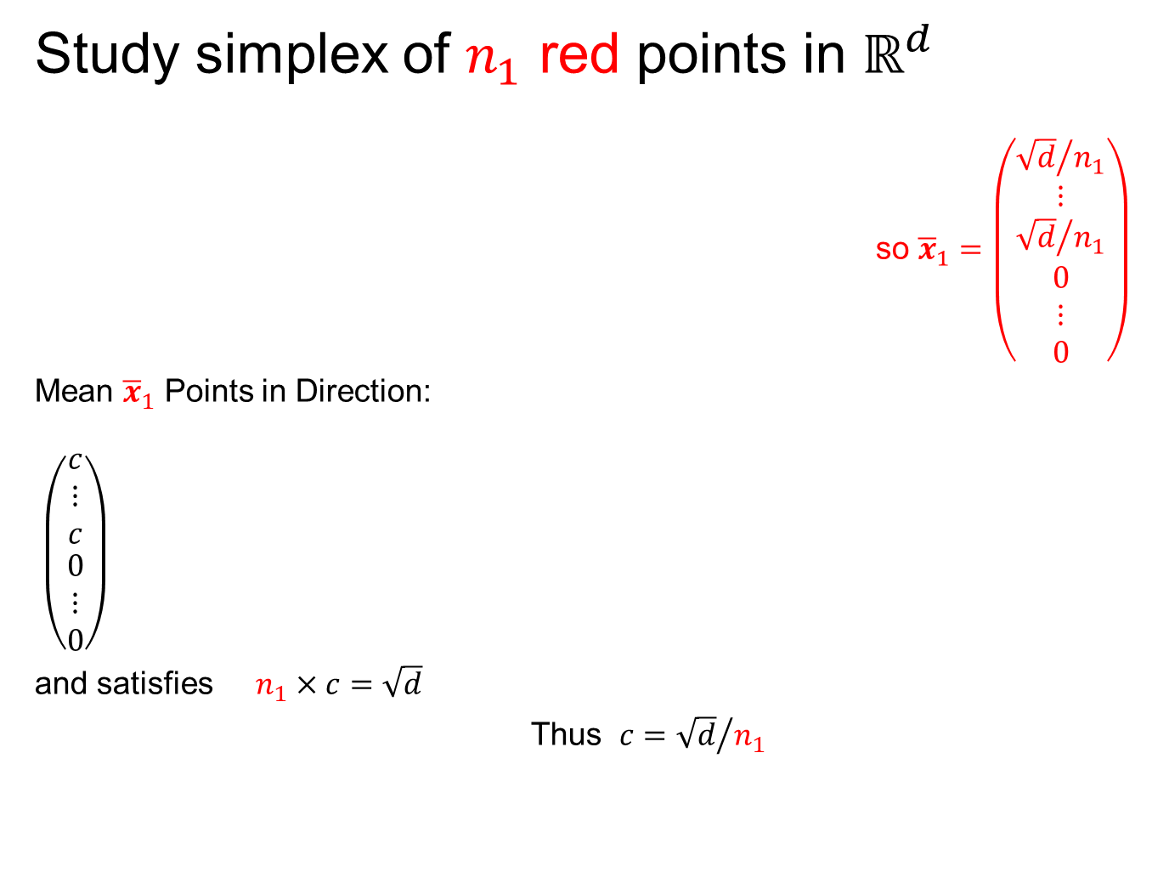
An Interesting HDLSS Explanation
Study simplex of $n_{1}$ red points in $ℝ^{d}$
so ${\overline{x}}_{1}=\left(\begin{matrix}\begin{matrix}{\sqrt{d}}/{n_{1}} \\ ⋮ \\ {\sqrt{d}}/{n_{1}}\end{matrix} \\ \begin{matrix}0 \\ ⋮ \\ 0\end{matrix}\end{matrix}\right)$
Mean ${\overline{x}}_{1}$ Points in Direction:
$\left(\begin{matrix}\begin{matrix}c \\ ⋮ \\ c\end{matrix} \\ \begin{matrix}0 \\ ⋮ \\ 0\end{matrix}\end{matrix}\right)$
and satisfies $n_{1}×c=\sqrt{d}$
Thus $c={\sqrt{d}}/{n_{1}}$
Think Projection on Flat Direction

Slide 49
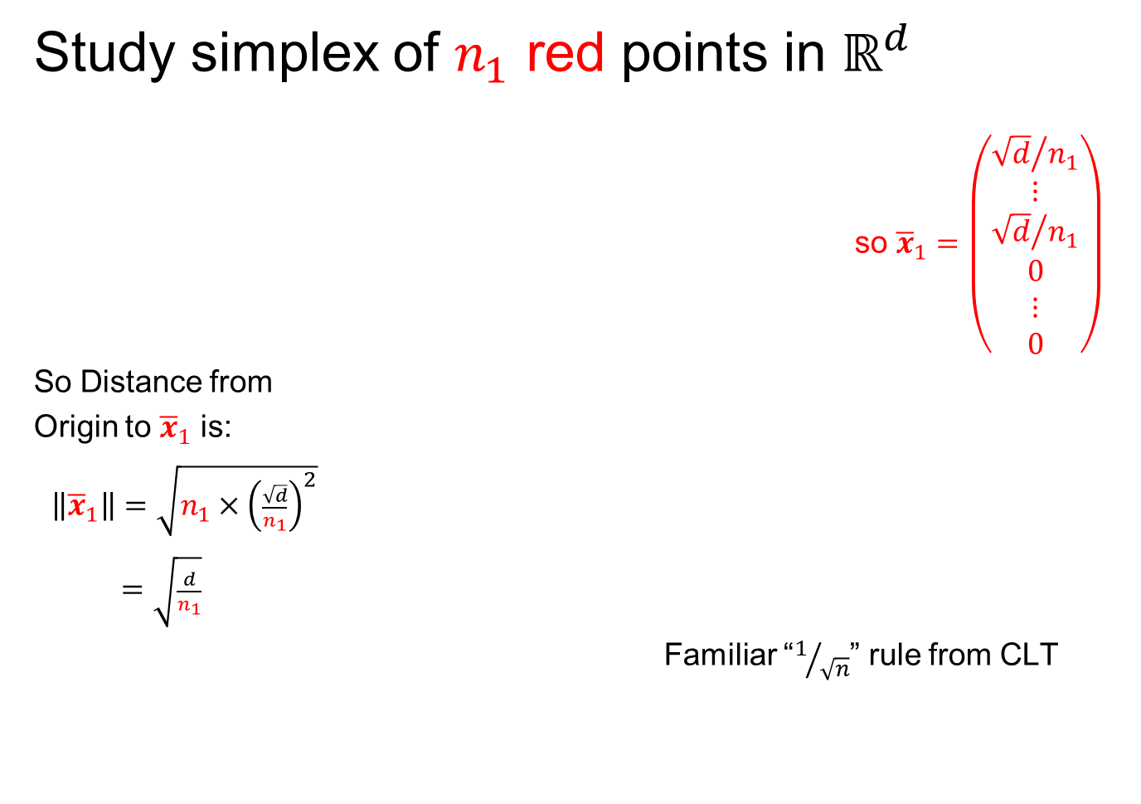
An Interesting HDLSS Explanation
Study simplex of $n_{1}$ red points in $ℝ^{d}$
so ${\overline{x}}_{1}=\left(\begin{matrix}\begin{matrix}{\sqrt{d}}/{n_{1}} \\ ⋮ \\ {\sqrt{d}}/{n_{1}}\end{matrix} \\ \begin{matrix}0 \\ ⋮ \\ 0\end{matrix}\end{matrix}\right)$
So Distance from
Origin to ${\overline{x}}_{1}$ is:
$\left\|{\overline{x}}_{1}\right\|=\sqrt{n_{1}×{\left(\frac{\sqrt{d}}{n_{1}}\right)}^{2}}$
$=\sqrt{\frac{d}{n_{1}}}$
Familiar “$1/{\sqrt{n}}$” rule from CLT

Slide 50
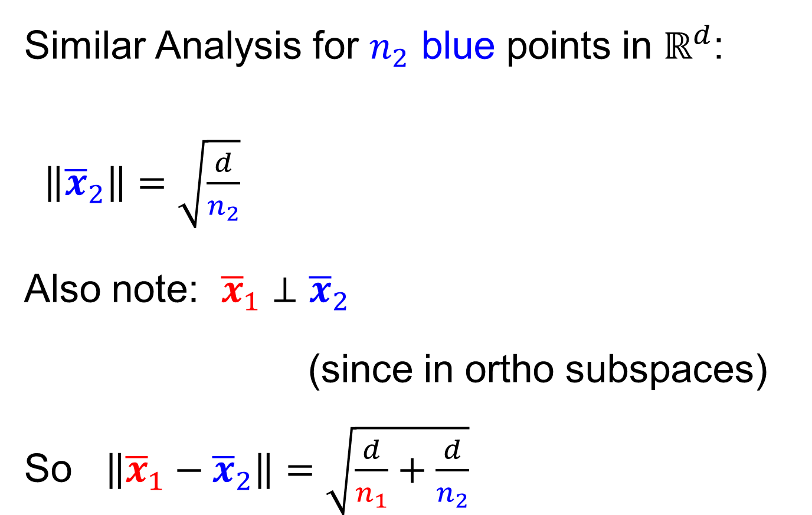
An Interesting HDLSS Explanation
Similar Analysis for $n_{2}$ blue points in $ℝ^{d}$:
$\left\|{\overline{x}}_{2}\right\|=\sqrt{\frac{d}{n_{2}}}$
Also note: ${\overline{x}}_{1}⊥{\overline{x}}_{2}$
(since in ortho subspaces)
So $\left\|{\overline{x}}_{1}−{\overline{x}}_{2}\right\|=\sqrt{\frac{d}{n_{1}}+\frac{d}{n_{2}}}$

Slide 51

An Interesting HDLSS Explanation
Recall Two
Class $N\left(0,I\right)$
Example
Plug In
These
Numbers

Slide 52

An Interesting HDLSS Explanation
Evaluate $\left\|{\overline{x}}_{1}−{\overline{x}}_{2}\right\|=\sqrt{\frac{d}{n_{1}}+\frac{d}{n_{2}}}$
$=\sqrt{\frac{1000}{50}+\frac{1000}{50}}$
$≈6.3$

Slide 53

An Interesting HDLSS Explanation
Recall Two
Class $N\left(0,I\right)$
Example
$\left\|\overline{x_{1}}−\overline{x_{2}}\right\|$
$≈6.3$
What about this big SD?

Slide 54
HDLSS Asy’s: History & Assumptions
On Geometrical Representation
Major Papers:
Hall, Marron and Neeman (2005)
Ahn, Marron, Muller & Chi (2007)
Yata & Aoshima (2009, 2010a, 2010b, 2012, 2013)
Survey: Aoshima, et al. (2018)

Slide 55


HDLSS Asy’s: History & Assumptions
Hall, Marron and Neeman (2005)

Slide 56


HDLSS Asy’s: History & Assumptions
Hall, Marron and Neeman (2005)
Above $\tilde{x}\sim N_{d}\left(0,I_{d}\right)$ is too strong
Recall for $\tilde{x}\sim N_{d}\left(μ,Σ\right)$:
$$cov\left({\tilde{x}}_{i},{\tilde{x}}_{j}\right)=0 ⟹Independent$$
But NOT Generally
$$\left(\begin{matrix}\begin{matrix}{\tilde{x}}_{1} \\ {\tilde{x}}_{2} \\ ⋮\end{matrix} \\ \begin{matrix}{\tilde{x}}_{i} \\ ⋮ \\ {\tilde{x}}_{d}\end{matrix}\end{matrix}\right)$$
Assumes Independent Entries
A Strong Assumption, Not
Just Gaussian Marginals

Slide 57

0 Covariance is not independence
Simple Example:
Random Variables $\tilde{x}$ and $\tilde{y}$
Make both Gaussian $\tilde{x},\tilde{y} \sim N\left(0,1\right)$
(Note: Not Using Multivariate Gaussian)

Slide 58


0 Covariance is not independence
Simple Example:
Random Variables $\tilde{x}$ and $\tilde{y}$
Make both Gaussian $\tilde{x},\tilde{y} \sim N\left(0,1\right)$
With strong dependence
Yet $0$ covariance
Given $c>0$, define $\tilde{y} =\left\{\begin{matrix}\tilde{x} & \left|\tilde{x}\right|>c \\ −\tilde{x} & \left|\tilde{x}\right|≤c\end{matrix}\right.$
Find $c$ to make
this happen
Very Strong Dependence

Slide 59


0 Covariance is not independence
Simple Example:
Can Lower This
By Increasing $c$

Slide 60

0 Covariance is not independence
Simple Example:
Have Overshot So
Search Between

Slide 61


0 Covariance is not independence
Simple Example, $c$ to make $cov\left(\tilde{x},\tilde{y}\right)=0$
Yet Strongly Dependent!

Slide 62

0 Covariance is not independence
Simple Example:
Distribution is degenerate
Supported on diagonal lines
Not abs. cont. w.r.t. 2-d Lebesgue meas.
For small $c$, have $cov\left(\tilde{x},\tilde{y}\right)>0$
For large $c$, have $cov\left(\tilde{x},\tilde{y}\right)<0$
By continuity, $∃ c$ with $cov\left(\tilde{x},\tilde{y}\right)=0$

Slide 63

0 Covariance is not independence
Result:
Joint distribution of $\tilde{x}$ and $\tilde{y}$:
Has Gaussian marginals
Has $cov\left(\tilde{x},\tilde{y}\right)=0$
Yet strong dependence of $\tilde{x}$ and $\tilde{y}$
Thus not multivariate Gaussian
Shows Multivariate Gaussian means more
than Gaussian Marginals
Critique: Not a
Distribution That
Naturally Arises

Slide 64

0 Covariance is not independence
More Natural Example:
Scale Mixture of Normals
E.g. ${\tilde{x}}_{i}\sim 0.5N_{d}\left(0,I_{d}\right)+0.5N_{d}\left(0,{100∗I}_{d}\right)$
Note Strong Dependence:
Single Large Coord. $⟹$ Others Large
Yet All Covariances are 0

Slide 65

Could Do Homework
For a random vector, with the scale mixture of Normals distribution,
$$\left(\begin{matrix}X_{1} \\ X_{2}\end{matrix}\right)\sim \frac{1}{2}N_{2}\left(\left(\begin{matrix}0 \\ 0\end{matrix}\right),3I_{2}\right)+\frac{1}{2}N_{2}\left(\left(\begin{matrix}0 \\ 0\end{matrix}\right),4I_{2}\right)$$
show that the (theoretical) covariance matrix is
$$Σ=\frac{25}{2}I_{2}=\left[\begin{matrix}\frac{25}{2} & 0 \\ 0 & \frac{25}{2}\end{matrix}\right]$$

Slide 66

HDLSS Asy’s: History & Assumptions
Hall, Marron and Neeman (2005)
Above $\tilde{x}\sim N_{d}\left(0,I_{d}\right)$ is too strong
Really Only Need:
Law of Large Numbers
Averages $→$ Population Mean
$$\left(\begin{matrix}\begin{matrix}{\tilde{x}}_{1} \\ {\tilde{x}}_{2} \\ ⋮\end{matrix} \\ \begin{matrix}{\tilde{x}}_{i} \\ ⋮ \\ {\tilde{x}}_{d}\end{matrix}\end{matrix}\right)$$
Assumes Independent Entries

Slide 67


HDLSS Asy’s: History & Assumptions
Hall, Marron and Neeman (2005)
Above $\tilde{x}\sim N_{d}\left(0,I_{d}\right)$ is too strong
Instead Assume $ρ$ Mixing Condition
$$\left(\begin{matrix}\begin{matrix}{\tilde{x}}_{1} \\ {\tilde{x}}_{2} \\ ⋮\end{matrix} \\ \begin{matrix}{\tilde{x}}_{i} \\ ⋮ \\ {\tilde{x}}_{d}\end{matrix}\end{matrix}\right)$$
Less Dependence for
Farther Away Entries

Slide 68

Mixing Conditions
Idea From Probability Theory:
Recall Standard Asymptotic Results, as $n→∞:$
Law of Large Numbers,
$$\overline{x}→μ$$
(“Weak” = in prob., “Strong” = a.s.)

Slide 69

Mixing Conditions
Idea From Probability Theory:
Recall Standard Asymptotic Results, as $n→∞:$
Law of Large Numbers,
$$\overline{x}→μ$$
Central Limit Theorem,
$$\overline{x}≈μ+\frac{σ}{\sqrt{n}}N\left(0,I\right)$$

Slide 70
Mixing Conditions
Idea From Probability Theory:
Law of Large Numbers,
Central Limit Theorem,
Both have Technical Assumptions
(Usually Ignore ???)

Slide 71

Mixing Conditions
Idea From Probability Theory:
Law of Large Numbers,
Central Limit Theorem,
Both have Technical Assumptions
E.g. ${\tilde{x}}_{1},⋯,{\tilde{x}}_{n}$ Independent and Ident. Dist’d

Slide 72
Mixing Conditions
Idea From Probability Theory:
Mixing Conditions:
Explore Weaker Assumptions, to Still Get
Law of Large Numbers,
Central Limit Theorem

Slide 73


Mixing Conditions
Mixing Conditions:
A Whole Area in Probability Theory
$∃$ a Large Literature
A Comprehensive Reference
Bradley (2005, update of 1986 version)
Newer Reference: White (2014)

Slide 74

Mixing Conditions
Mixing Condition Used Here:
Rho – Mixing
For Random Variables ${\left\{{\tilde{z}}_{j}\right\}}_{−∞}^{+∞}$, Define
$$ρ\left(m\right)=\sup_{j,f,g}\left|corr(f,g)\right|,$$
Where $f∈ℑ_{−∞}^{j}$, $g∈ℑ_{m+j}^{+∞}$

Slide 75

Mixing Conditions
Mixing Condition Used Here:
Rho – Mixing
For Random Variables ${\left\{{\tilde{z}}_{j}\right\}}_{−∞}^{+∞}$, Define
$$ρ\left(m\right)=\sup_{j,f,g}\left|corr(f,g)\right|,$$
Where $f∈ℑ_{−∞}^{j}$, $g∈ℑ_{m+j}^{+∞}$
For Sigma-Fields Generated by:
${\tilde{z}}_{−∞},⋯,{\tilde{z}}_{j}$

Slide 76

Mixing Conditions
Mixing Condition Used Here:
Rho – Mixing
For Random Variables ${\left\{{\tilde{z}}_{j}\right\}}_{−∞}^{+∞}$, Define
$$ρ\left(m\right)=\sup_{j,f,g}\left|corr(f,g)\right|,$$
Where $f∈ℑ_{−∞}^{j}$, $g∈ℑ_{m+j}^{+∞}$
For Sigma-Fields Generated by:
${\tilde{z}}_{−∞},⋯,{\tilde{z}}_{j}$
${\tilde{z}}_{m+j},⋯,{\tilde{z}}_{∞}$

Slide 77

Mixing Conditions
Mixing Condition Used Here:
Rho – Mixing
For Random Variables ${\left\{{\tilde{z}}_{j}\right\}}_{−∞}^{+∞}$, Define
$$ρ\left(m\right)=\sup_{j,f,g}\left|corr(f,g)\right|,$$
Where $f∈ℑ_{−∞}^{j}$, $g∈ℑ_{m+j}^{+∞}$
For Sigma-Fields Generated by:
${\tilde{z}}_{−∞},⋯,{\tilde{z}}_{j}$
${\tilde{z}}_{m+j},⋯,{\tilde{z}}_{∞}$
Note: Gap of Lag $m$

Slide 78

Mixing Conditions
Mixing Condition Used Here:
Rho – Mixing
For Random Variables ${\left\{{\tilde{z}}_{j}\right\}}_{−∞}^{+∞}$, Define
$$ρ\left(m\right)=\sup_{j,f,g}\left|corr(f,g)\right|,$$
Where $f∈ℑ_{−∞}^{j}$, $g∈ℑ_{m+j}^{+∞}$
Assume: $\lim_{m→∞}{ρ\left(m\right)=0}$
Idea: Uncorrelated at Far Lags

Slide 79
HDLSS Asy’s: History & Assumptions
Hall, Marron and Neeman (2005)
Above $\tilde{x}\sim N_{d}\left(0,I_{d}\right)$ is too strong
Instead Assume $ρ$ Mixing Condition
$$\left(\begin{matrix}\begin{matrix}{\tilde{x}}_{1} \\ {\tilde{x}}_{2} \\ ⋮\end{matrix} \\ \begin{matrix}{\tilde{x}}_{i} \\ ⋮ \\ {\tilde{x}}_{d}\end{matrix}\end{matrix}\right)$$
Far Apart Entries Uncorrelated

Slide 80

HDLSS Asy’s: History & Assumptions
Hall, Marron and Neeman (2005)
Publication History:
Rejected by Biometrika
“$ρ$-Mixing Along Vector Not Practical”
Hence Published in JRSS-B

Slide 81
HDLSS Asy’s: History & Assumptions
Hall, Marron and Neeman (2005)
Later Realization:
This Mixing is Very Natural in
Genome Wide Association Studies
1st such: Klein et al (2005)

Slide 82

GWAS Data Analysis
Genome Wide Association Study
Data Objects: Vectors of Genetic Variants, at known chromosome locations
(Called SNPs)
Discrete (takes on 2 or 3 values)
Dimension $d$ as large as ~5 million
(can be reduced, e.g. $d\sim 20000)$

Slide 83

GWAS Data Analysis
Genome Wide Association Study
Data Objects: Vectors of Genetic Variants, at known chromosome locations
(Called SNPs)
Sexual Reproduction $⇒$ $ρ$ - Mixing
Actually Very Natural “In Practice”

Slide 84
HDLSS Asy’s: History & Assumptions
On Geometrical Representation
Major Papers:
Hall, Marron and Neeman (2005)
Ahn, Marron, Muller & Chi (2007)
Yata & Aoshima (2009, 2010a, 2010b, 2012, 2013)

Slide 85
HDLSS Asy’s: History & Assumptions
Ahn, Marron, Muller & Chi (2007)
Assume 2nd Moments
Assume no eigenvalues too large
Via “Epsilon Statistic”,
Basis of Hypothesis Test for “Sphericity”
Of Normal Distribution
John (1976)

Slide 86

HDLSS Asy’s: History & Assumptions
Ahn, Marron, Muller & Chi (2007)
Assume 2nd Moments
Assume no eigenvalues too large
Then $\left\|{\tilde{x}}_{i}−{\tilde{x}}_{j}\right\|=O_{p}\left(1\right)×\sqrt{d}$
Not so strong as before:
$$\left\|{\tilde{z}}_{i}−{\tilde{z}}_{j}\right\|=\sqrt{2d}+O_{p}\left(1\right)$$
But Published in Biometrika

Slide 87
Participant Presentation
David Allemang
Protrusions on Skeletal
Shape Representations
Next Class: Will Nenad

