Slide 1
Statistics – O. R. 881
Object Oriented Data Analysis
Steve Marron
Dept. of Statistics and Operations Research
University of North Carolina

Slide 2
Last Class: Administrative Info
Details on Course Web Page
https://marron.web.unc.edu/course-home-page-stor-881-object-oriented-data-analysis-spring-2024/
Or access from Canvas page
Or:
  Google: “Marrons teaching material”
  Choose This Course

Slide 3
Current Sections in Textbook
Today:
Sections 3.3, 4.1, 6.4, 13.1, 18.1
Next Class:
Sections 5.1, 5.2, 5.3

Slide 4
Participant Presentations
Please Prepare to Sign Up (next class):
Name
Onyen (or Email Address)
Tentative Title (“????” Is OK)
Dept. & Advisor (Lab?)
ENRolled or AUDitor?
Level (MS or PHD stud, Postdoc, Faculty?)
When:
  Next Week, Early, March, April, Late

Slide 5
Last Class: Course Context
Currently Fashionable Topic:
Big Data Science
Many Important Issues.
But More Challenging (& Important?):
Complex Data
( )

Slide 6
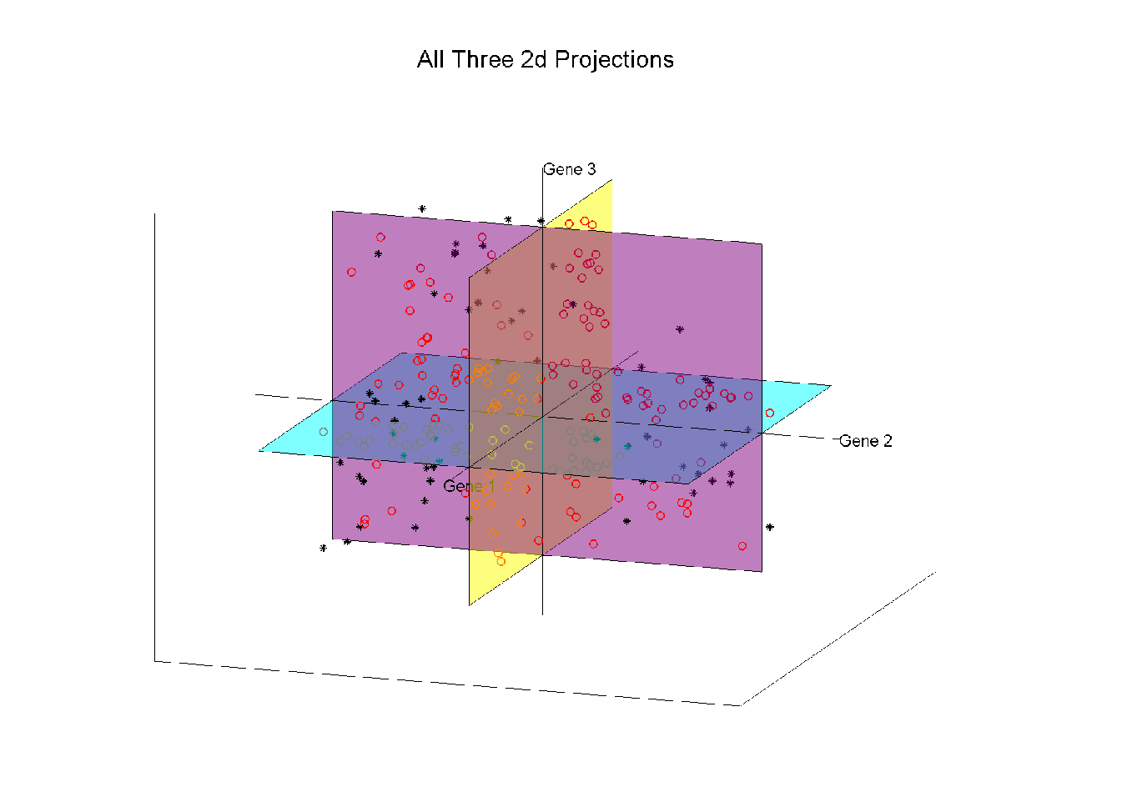
Last Class: Illust’n of Trait by Trait View:
Think:
Front
Top
Side
Views
Notes:
EgView1p27proj3Dall.ps

Slide 7
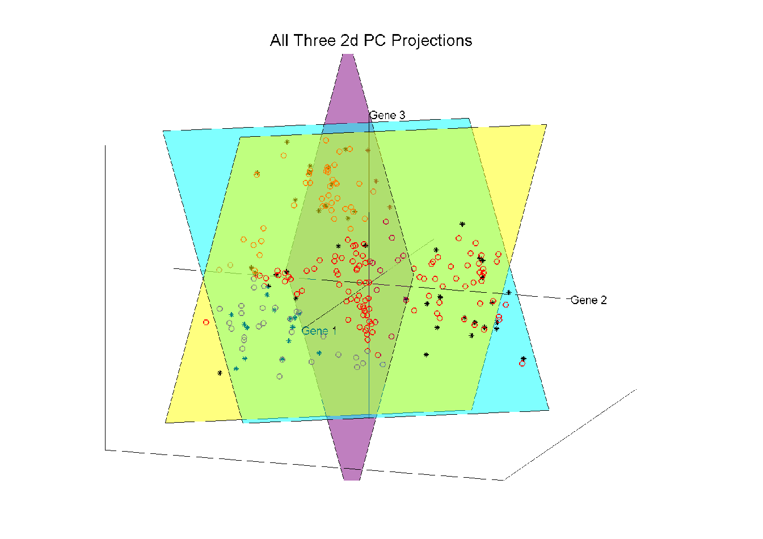
Last Class: Illust’n of PCA View
Notes:
EgView1p57proj3dPCall.ps

Slide 8
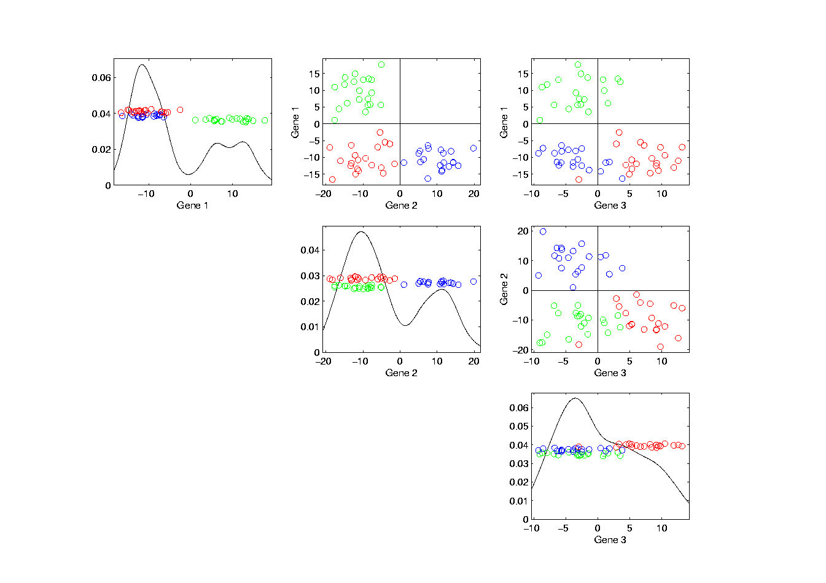
Last Class: Trait by Trait View
Note Colors Enhance
Impressions of Clusters
Notes:
EgView1p71GeneViewClustColor.ps

Slide 9
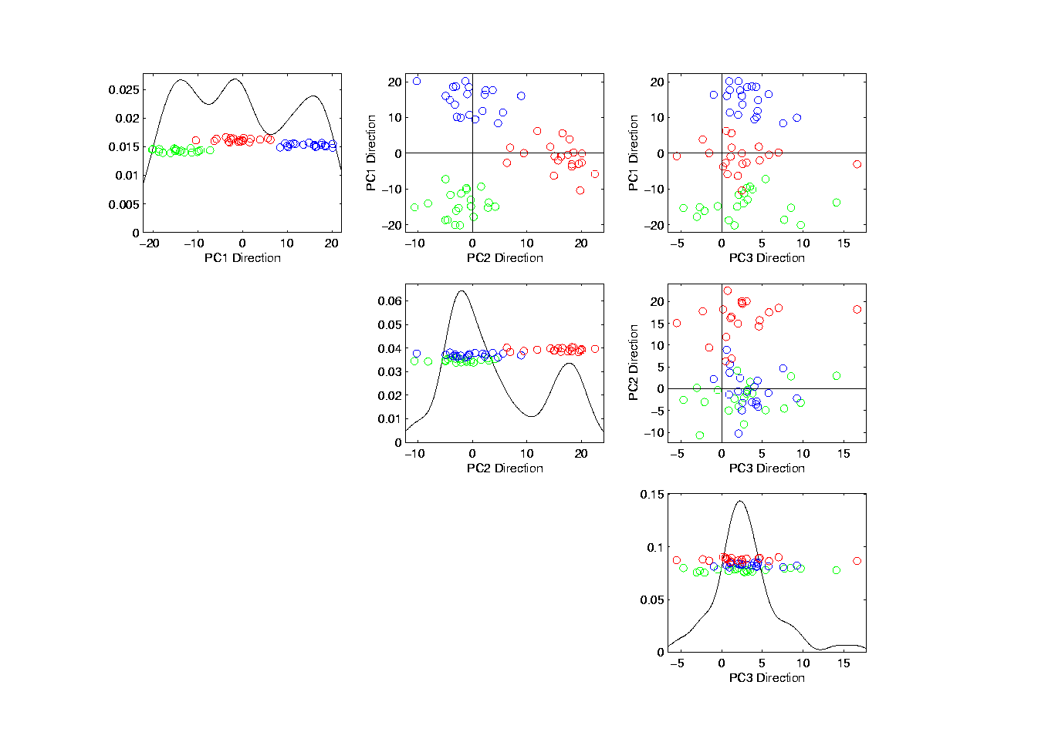
Last Class: PCA View
No Clusters in 3rd
Direction is Good,
Since Important
Aspects Appear
In Earlier Comp’ts
Clusters are “more distinct”
Since more “air space”
In between
Notes:
EgView1p72PCAViewClustColor.ps

Slide 10
Last Class: OODA
Three Major Phases of OODA:
I. Object Definition
“What are the Data Objects?”
Exploratory Analysis
“What Is Data Structure / Drivers?”
III. Confirmatory Analysis / Validation
Is it Really There (vs. Noise Artifact)?

Slide 11
Last Class: Basics of OODA
Useful Conceptual Framework:
Object Space ←→ Trait Space
(Where data
objects live)
(How they are
represented)

Slide 12
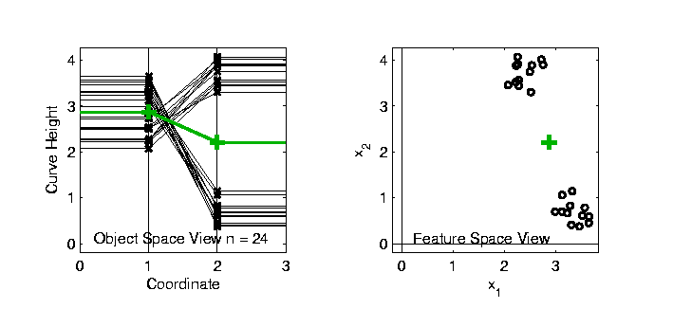

Last Class: Basics of OODA
Simple $d=2$ Toy Example:
Each Curve is a Point

Slide 13
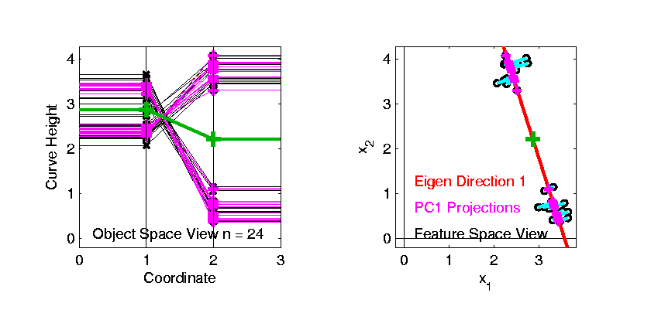
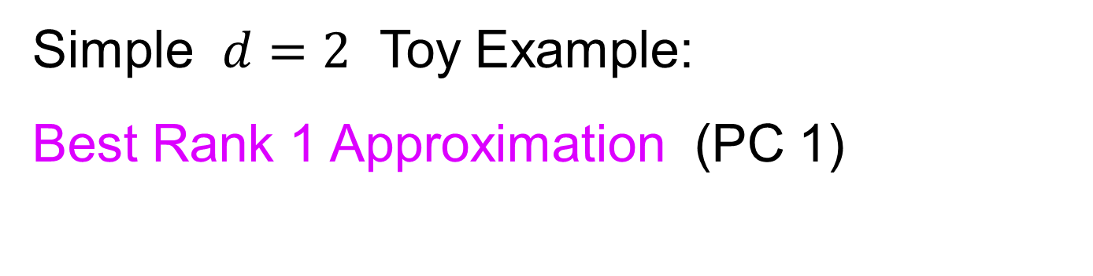
Last Class: Basics of OODA
Simple $d=2$ Toy Example:
Best Rank 1 Approximation (PC 1)
As Curves
and as Points

Slide 14
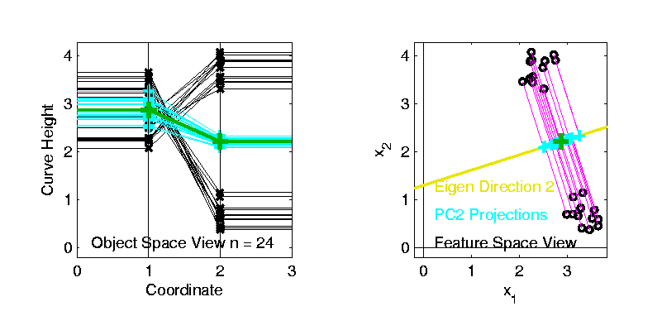
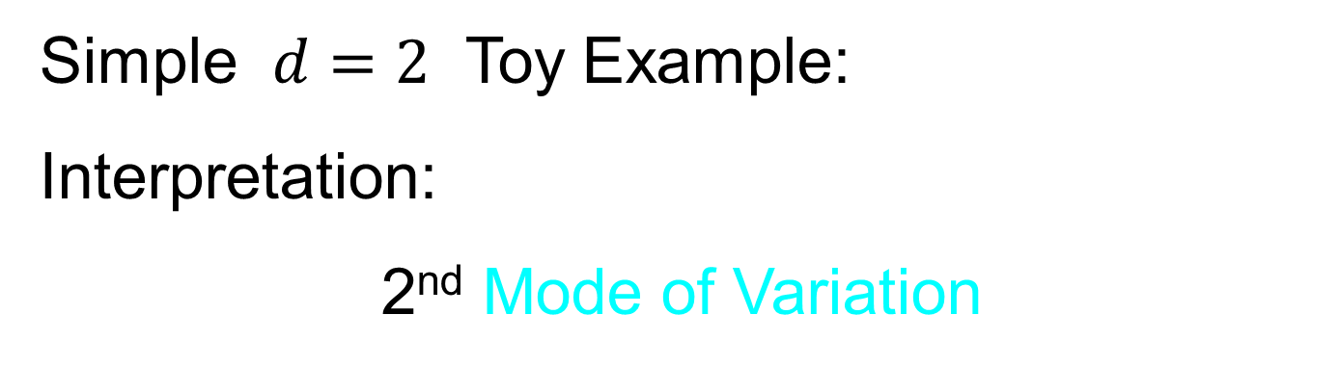
Last Class: Basics of OODA
Simple $d=2$ Toy Example:
Interpretation:
2nd Mode of Variation

Slide 15
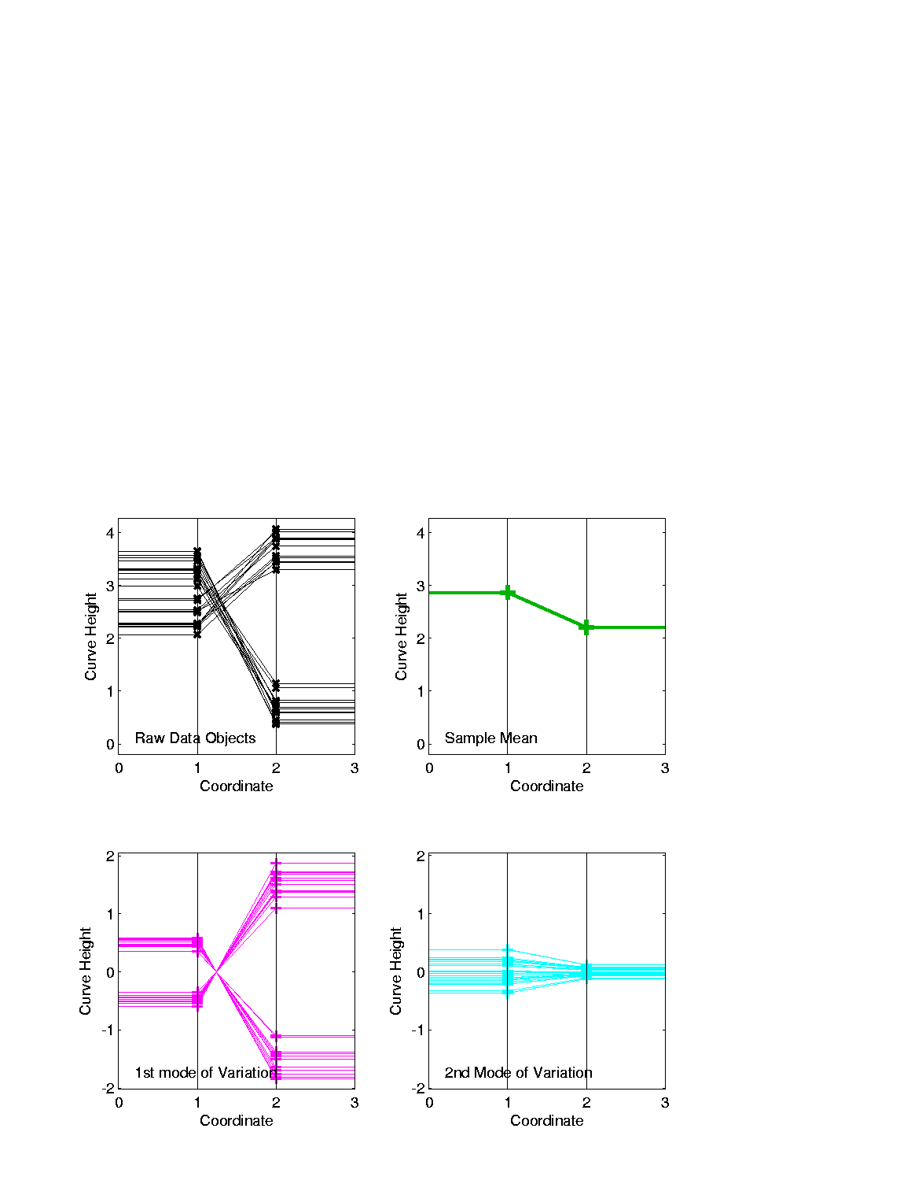
Last Class: Basics of OODA
Decomposition into Modes of Variation
Sum of Squares
After Mean
Centering
Variance (not s.d.)
To Reflect Energy
Just as in ANOVA
Usual Quantification: Variance of Each, Expressed as %
98.3% of
Variation
1.7% of
Variation

Slide 16
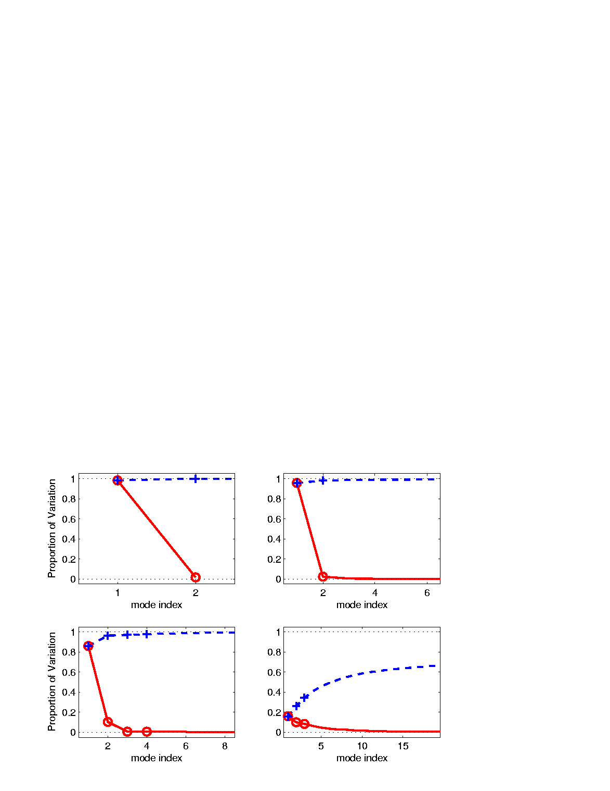
Last Class: Scree Plot
Idea: Visually Summarize Dist’n of Variance
Sometimes Also Useful
To Display Cumulative
98.3% of
Variation
1.7% of
Variation

Slide 17
Last Class: Scree Plot
More Examples
Spanish Male
Mortality Data
2-d Toy Data
10-d Toy Data
Genetic Data

Slide 18
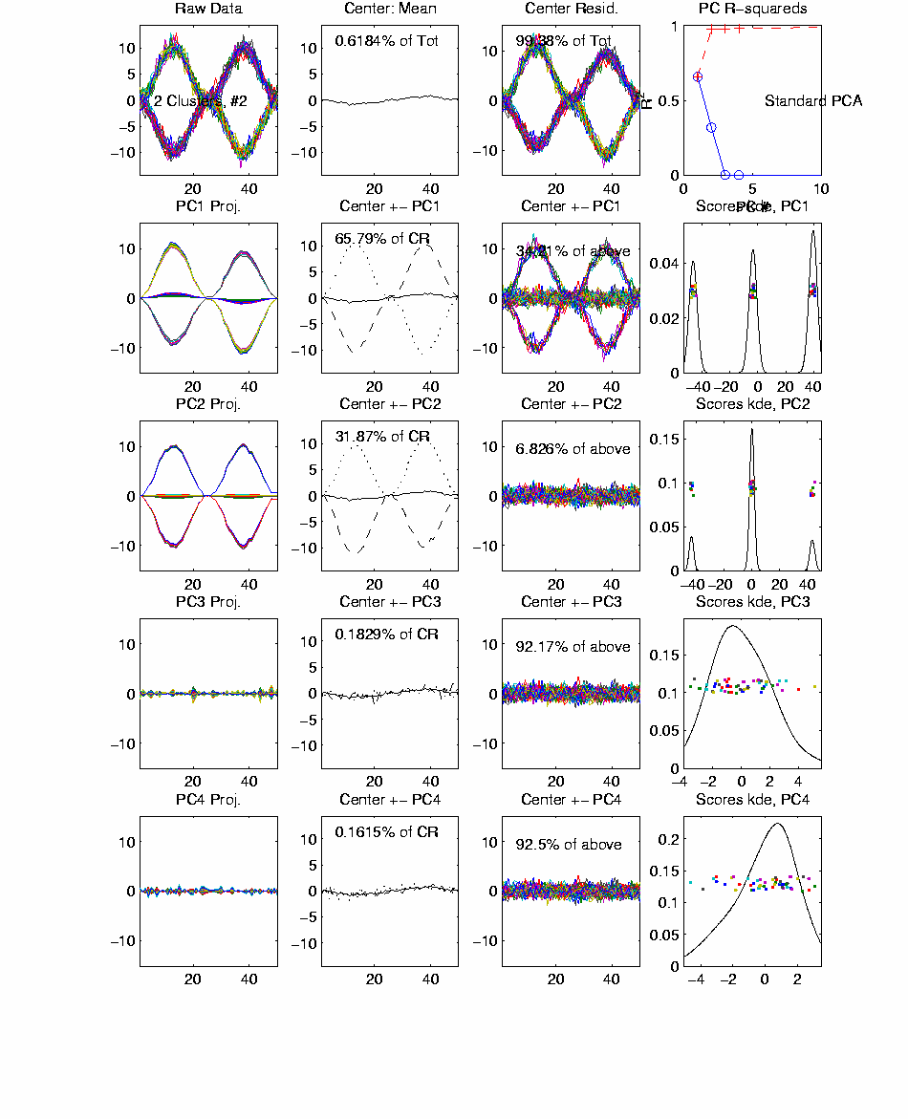
Last Class: FDA, Twin Arches
Notes:
EGCD1Clust4a.ps

Slide 19
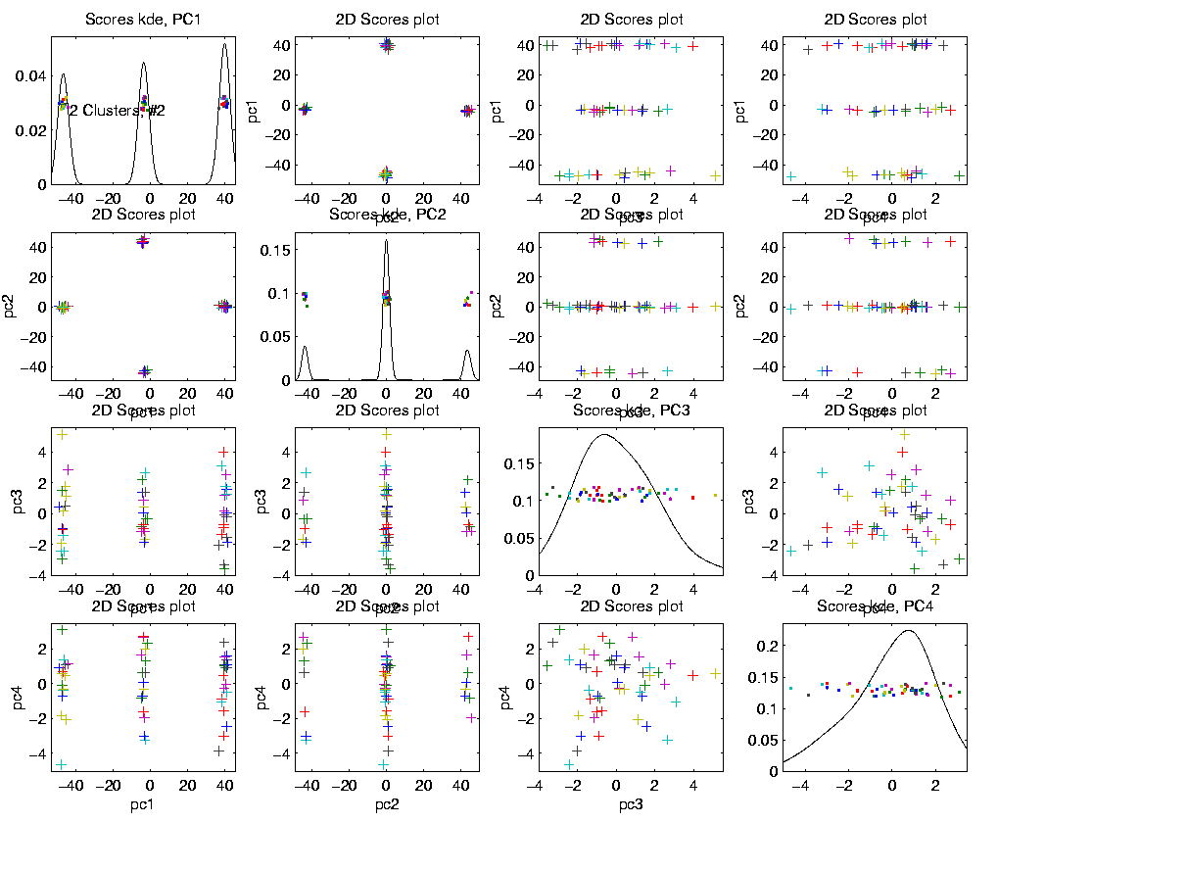
Last Class: FDA, Twin Arches
Notes:
EGCD1Clust4aDP2d.ps

Slide 20
Last Class: E.g. Curves As Data
Twin Arches Example
50-d curves
Pop’n structure hard to see in 1-d
2-d projections make structure clear
Joint Dist’ns More than Marginals
PCA: reveals “population structure”

Slide 21
Real Data Curve Objects
Text, Sec. 4.1.3
Lung Cancer Data Example
Genetics (Cancer Research)
RNAseq (Next Gener’n Sequen’g)
Deep look at “gene components”
Microarrays: Single number (per gene)
RNAseq: Thousands of measurements
I. Object Definition

Slide 22

Real Data Curve Objects
Lung Cancer Data Example
Genetics (Cancer Research)
RNAseq (Next Gener’n Sequen’g)
Deep look at “gene components”
Gene studied here: CDKN2A
Goal: Study Alternate Splicing
Sample Size, $n = 180$
Dimension, $d = 1709$

Slide 23
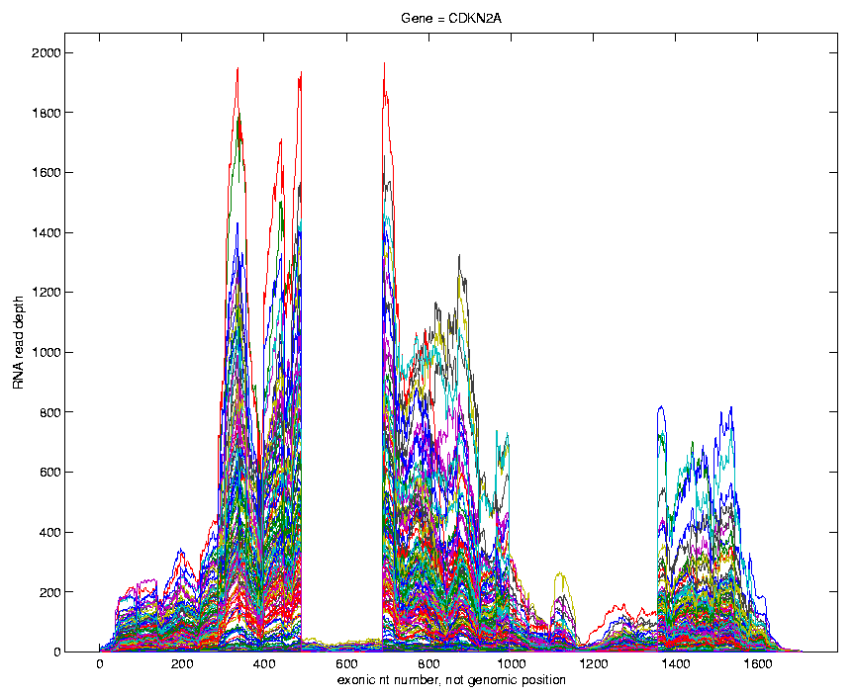
Lung Cancer Curve Objects
Simple
1st
View:
Curve
Overlay
(counts
scale)
Note: Data Set
Structure May
Be Hidden In
Low Areas
I. Object Representation

Slide 24
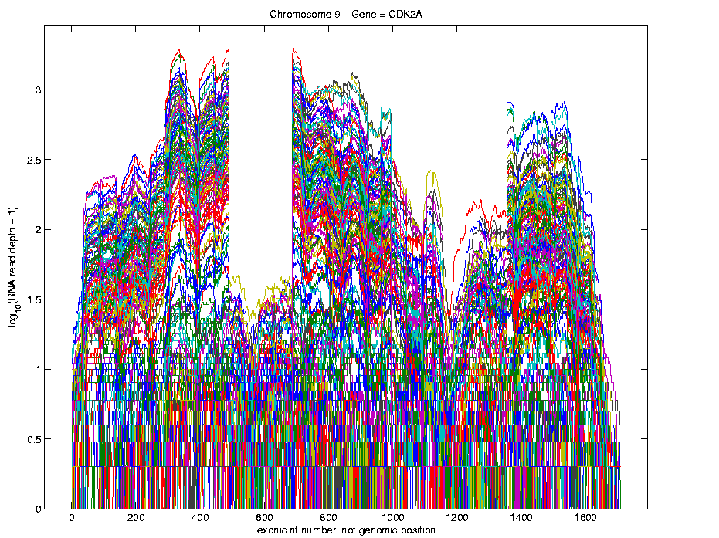
Lung Cancer Curve Objects
Simple
1st
View:
Curve
Overlay
(log
scale)
I. Object Representation

Slide 25
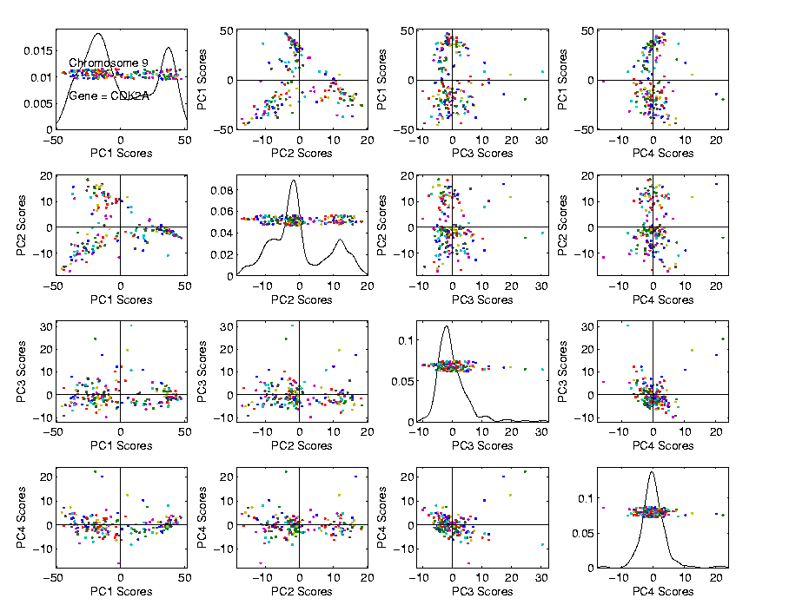
Lung Cancer Curve Objects
Visualization in Scores Space
Often
Useful
Population
View:
PCA
Scores

Slide 26
Lung Cancer Curve Objects
Suggestion
Of
Clusters
???
Suggested
By Smooth
Histograms

Slide 27
Lung Cancer Curve Objects
Suggestion
Of
Clusters
Which
Are
These?

Slide 28
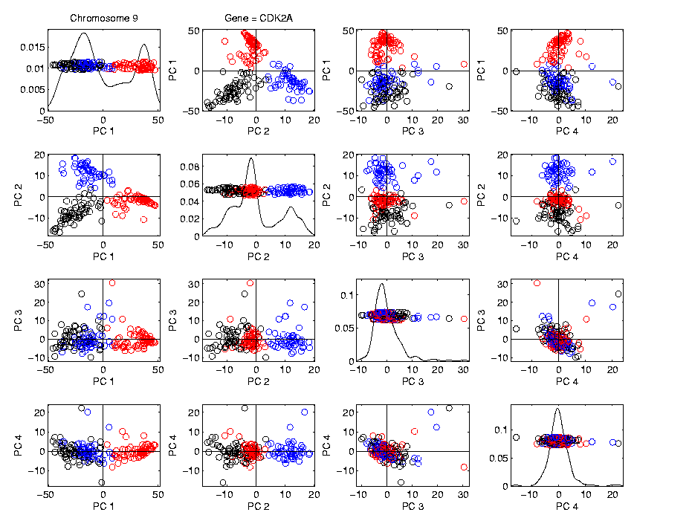
Lung Cancer Curve Objects
Visualization in Scores Space, Next Look in Object Space
Manually
“Brush”
Clusters
II. Exploratory
Analysis

Slide 29
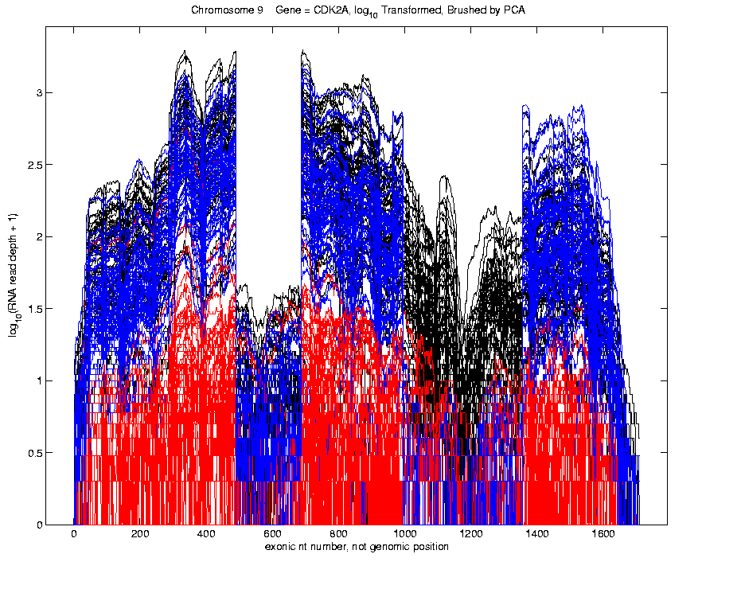
Lung Cancer Curve Objects
Manually
Brush
Clusters
Clear
Alternate
Splicing

Slide 30

Lung Cancer Curve Objects
Important Points
PCA found Important Structure
In High Dimensional Data Analysis
$$d = 1709$$
(Will Come Back To This Point)

Slide 31
Lung Cancer Curve Objects
Consequences:
Led to Development of SigFuge
Whole Genome Scan Found Interesting Genes
Wet Lab Experiment Verified Discoveries
Published in Kimes, et al (2014)

Slide 32
Lung Cancer Curve Objects
Interesting Question:
When are clusters really there?
(will study later)
III. Confirmatory Analysis

Slide 33
Lung Cancer Curve Objects
Manually
Brush
Clusters
Clear
Alternate
Splicing

Slide 34
Scree Plot
This was data illustrating
fallacy of “knee-finding”
for finding # of PCs
More Examples
Spanish Male
Mortality Data
2-d Toy Data
10-d Toy Data
Genetic Data

Slide 35
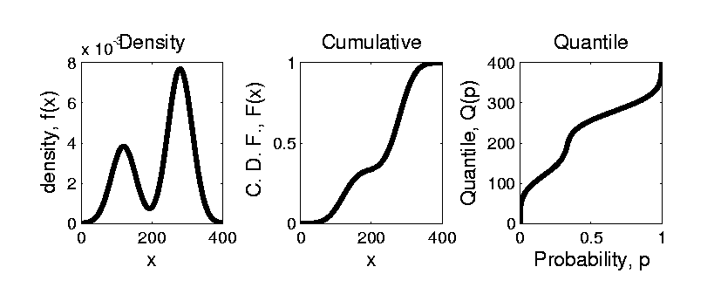


Prob. Dist’ns as Data Objects
Text, Sec. 3.3.1
How to Represent?
Several Common Choices:
$$F\left(x\right)=\int_{−∞}^{x}{f\left(t\right)dt}$$
$$Q\left(p\right)=F^{−1}(p)$$

Slide 36
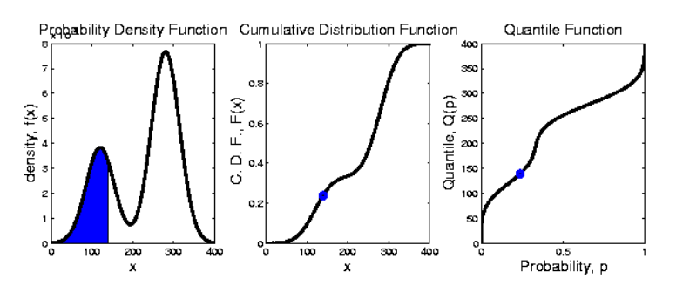
Prob. Dist’ns as Data Objects
Graphical Relationships:

Slide 37
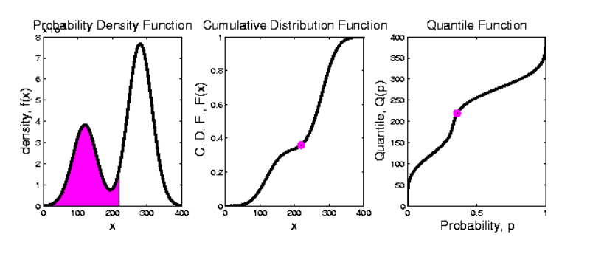
Prob. Dist’ns as Data Objects
Graphical Relationships:

Slide 38
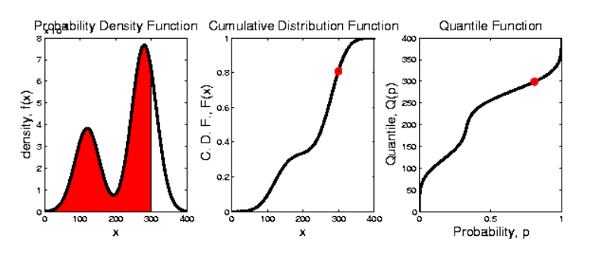
Prob. Dist’ns as Data Objects
Graphical Relationships:

Slide 39
Prob. Dist’ns as Data Objects
How to Represent?
Several Common Choices:
Density:
Good Intuition of Prob. Mass
Cumulative:
Can Read Off Probs.
Quantile:
Best Modes of Variation

Slide 40
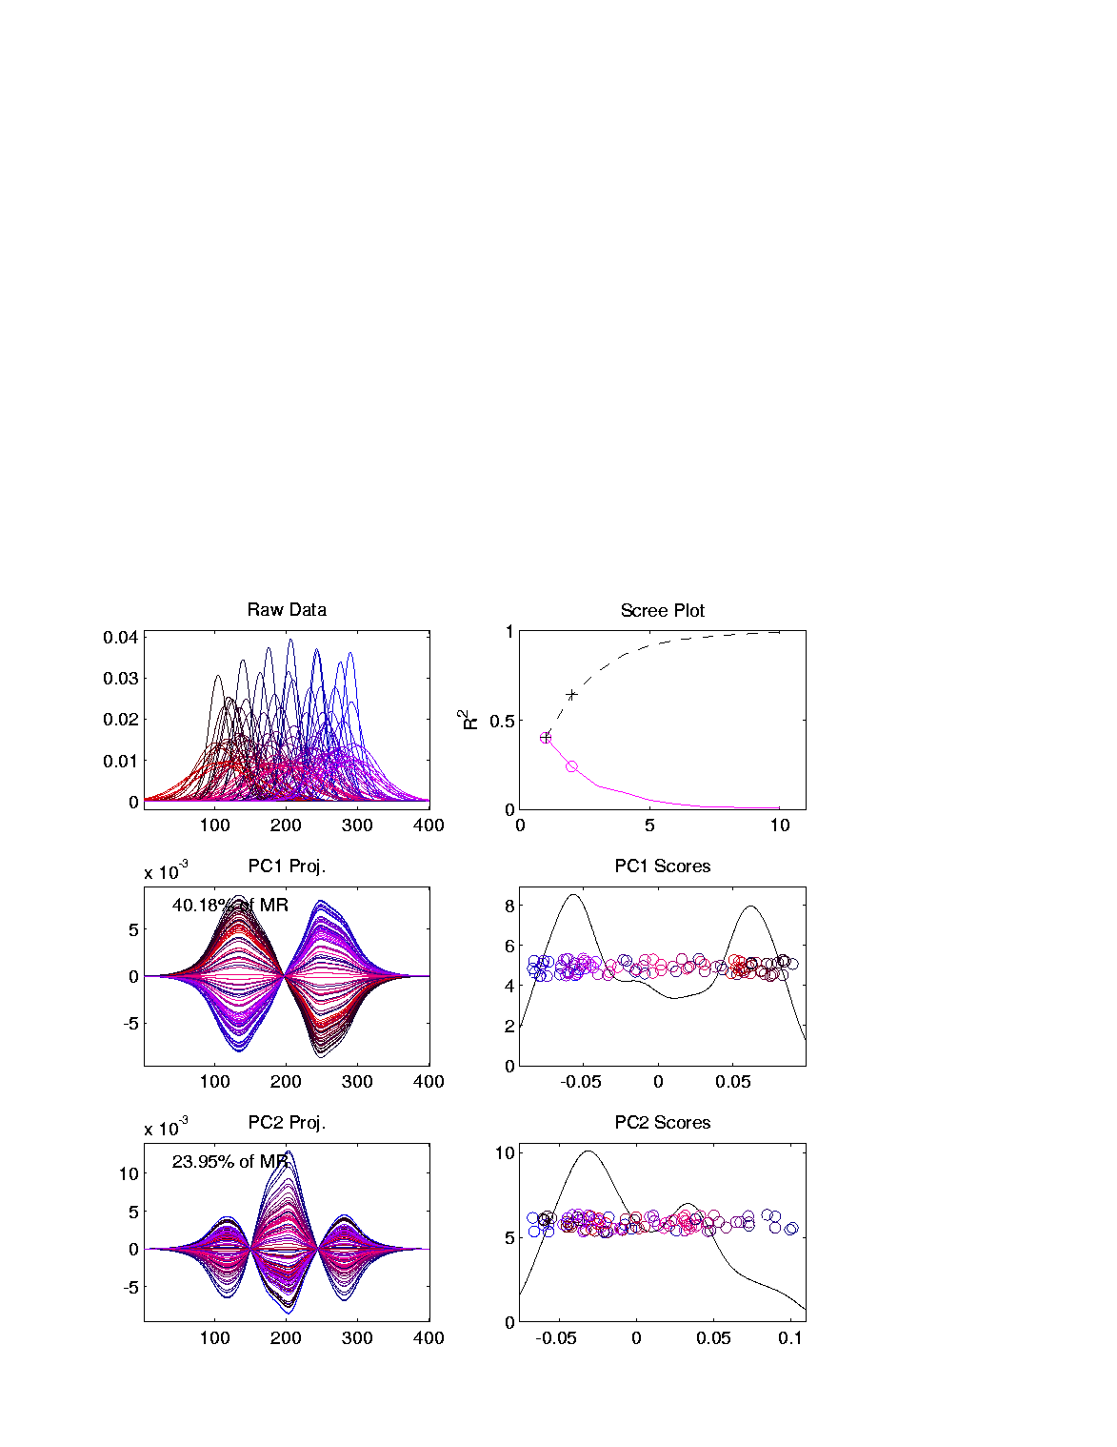
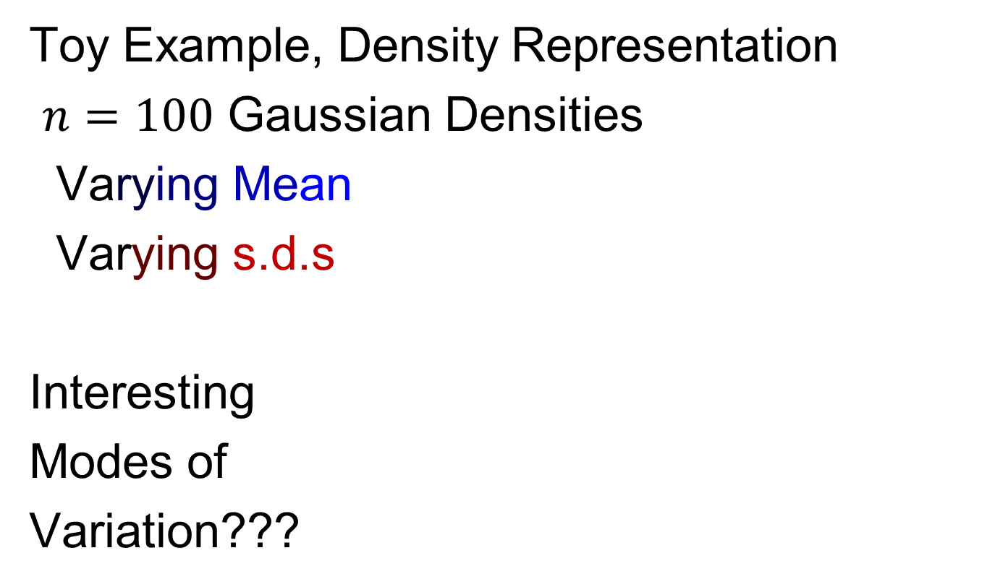
Prob. Dist’ns as Data Objects
Toy Example, Density Representation
$n=100$ Gaussian Densities
Varying Mean
Varying s.d.s
Interesting
Modes of
Variation???

Slide 41
Prob. Dist’ns as Data Objects
Energy Spread
Widely Across
The Spectrum
Toy Example, Density Representation
Try
Standard
PCA
Unintuitive
Modes of
Variation
Which Don’t
Explain Much
Variation

Slide 42
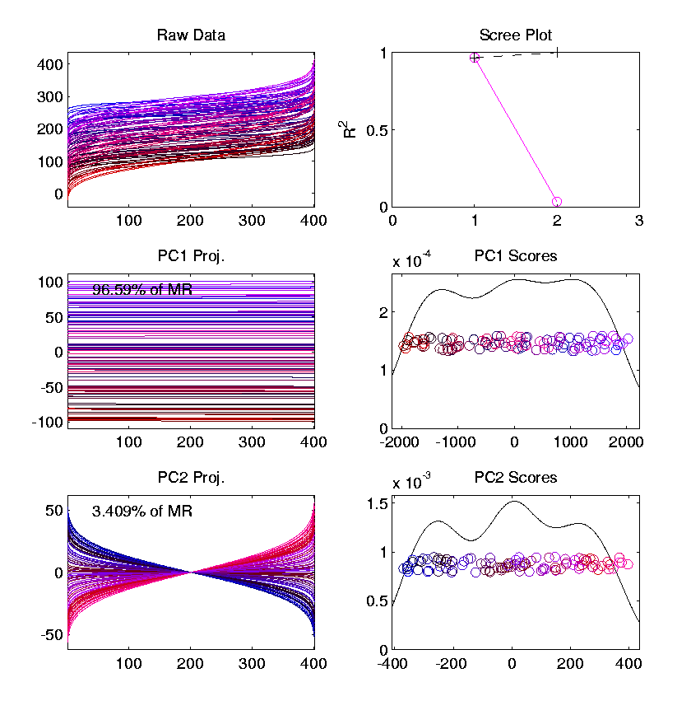
Prob. Dist’ns as Data Objects
Energy Entirely
Expressed In
Just 2 Modes
Toy Example, Quantile Representation
Try
Standard
PCA
0 1
1st Mode Is
Mean Var’n
0 1
Both Much More Interpretable!
2nd Mode Is
S.D. Var’n
0 1

Slide 43
Prob. Dist’ns as Data Objects
For More Discussion of the Usefulness of Quantile Representations of Dist’ns, see
Parzen (2004)

Slide 44
Prob. Dist’ns as Data Objects
How to Represent?
Alternative Choices:
Aitchison (1982)
Hron et al. (2016)
Menagfolio et al. (2018)

Slide 45

Matlab Software
OODA Software

Slide 46

Matlab Software
Download .zip file

Slide 47
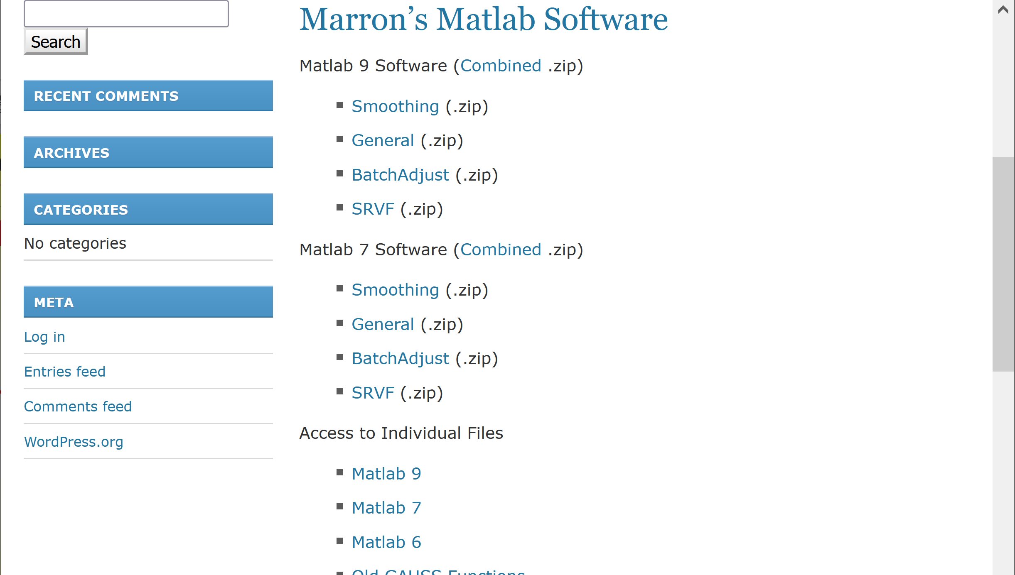
Matlab Software
Github Site with Individual Files

Slide 48
Introductory Slides
Slides 64 – 108 of 8-29-2019 Notes
of Previous OODA Course:
https://marronwebfiles.sites.oasis.unc.edu/Teaching/OODA-STOR881-Fall2019/STOR881-08-29-2019.pptx
Link also accessible in current HW 1
Includes Above Example of Lung Cancer Data

Slide 49
Scatterplot Matrix Graphics
Matlab Software:
scatplotSM.m
In General Directory

Slide 50
FDA Modes of Variation
Matlab Software:
curvdatSM.m
In General Directory

Slide 51
Limitation of PCA
PCA can provide useful projection directions
But can’t “see everything”…
Reason:
  PCA finds dir’ns of maximal variation
  Which may obscure interesting structure

Slide 52
Limitation of PCA
Toy Example:
Apple – Banana – Pear
Obscured by “noisy dimensions”
1st 3 PC directions only show noise
Study some rotations, to find structure
6 Dimenional,
Not HW1 or HW2

Slide 53
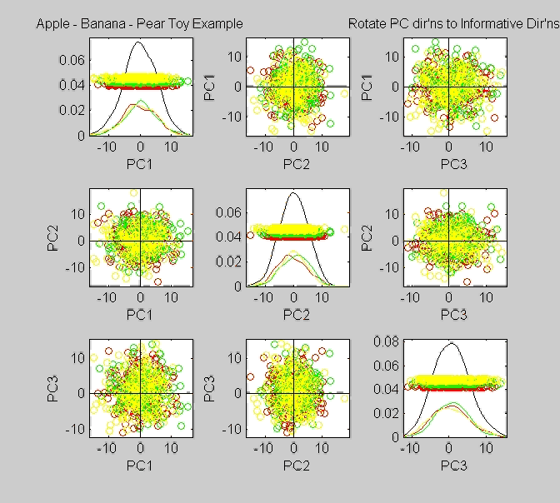
Limitation of PCA, Toy E.g.

Slide 54
Limitation of PCA
Toy Example:
Rotation shows Apple – Banana – Pear
Example constructed as:
  1st make these in 3-d
  Add 3 dimensions of high s.d. noise
Carefully watch axis labels

Slide 55
Limitation of PCA
Main Point:
May be Important Data Structure
Not Visible in 1st Few PCs

Slide 56
Limitation of PCA, E.g.
Interesting Data Set: NCI-60
NCI = National Cancer Institute
60 Cell Lines (cancer treatment targets)
For Different Cancer Types
Measured “Gene Expression”
= “Gene Activity”
Several Thousand Genes (Simultaneously)
Data Objects = Vectors of Gene Exp’n
Lots of Preprocessing (study later)
Example from:
Liu et al (2009)

Slide 57
NCI 60 Data
Important Aspect: 8 Cancer Types
Renal Cancer
Non Small Cell Lung Cancer
Central Nervous System Cancer
Ovarian Cancer
Leukemia Cancer
Colon Cancer
Breast Cancer
Melanoma (Skin)
Notes:
57

Slide 58
PCA Visualization of NCI 60 Data
Can we find classes:
(Renal, CNS, Ovar, Leuk, Colon, Melan)
Using PC directions??
First try “unsupervised view”
I.e. switch off class colors
Then turn on colors, to identify clusters
I.e. look at “supervised view”
II. Exploratory
Analysis
Notes:
58

Slide 59
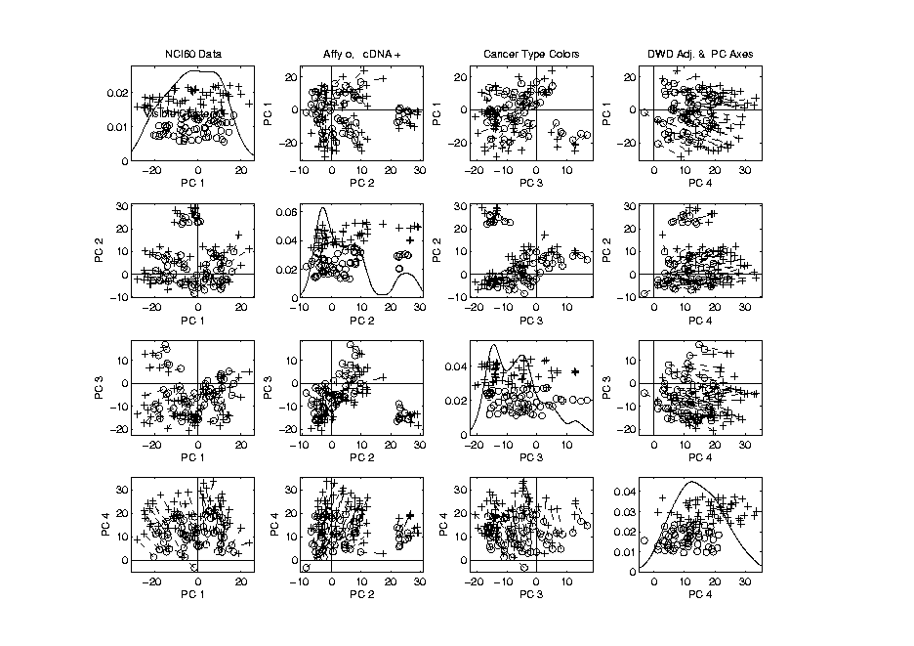
NCI 60: Can we find classes
Using PCA view?
Notes:
59

Slide 60
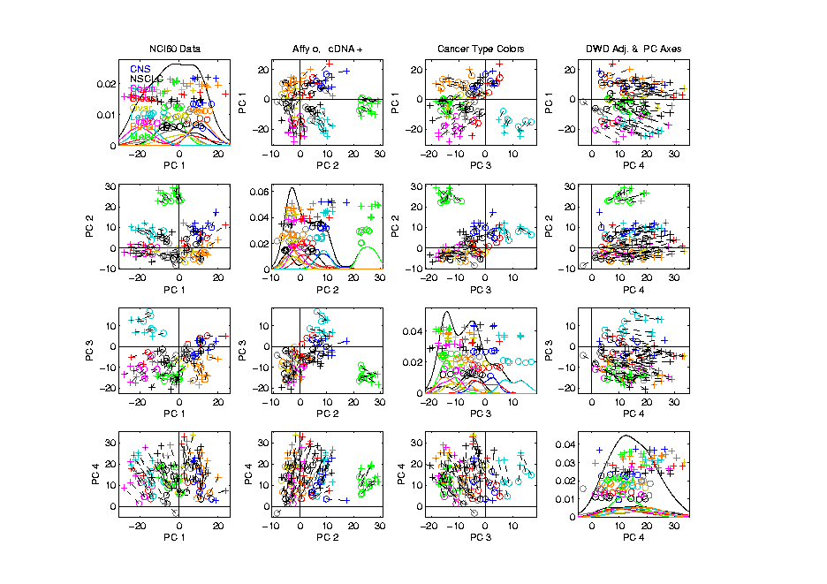
NCI 60: Can we find classes
Using PCA view?
Notes:
60

Slide 61
PCA Visualization of NCI 60 Data
Maybe need to look at more PCs?
Study array of such PCA projections:
Notes:
61

Slide 62
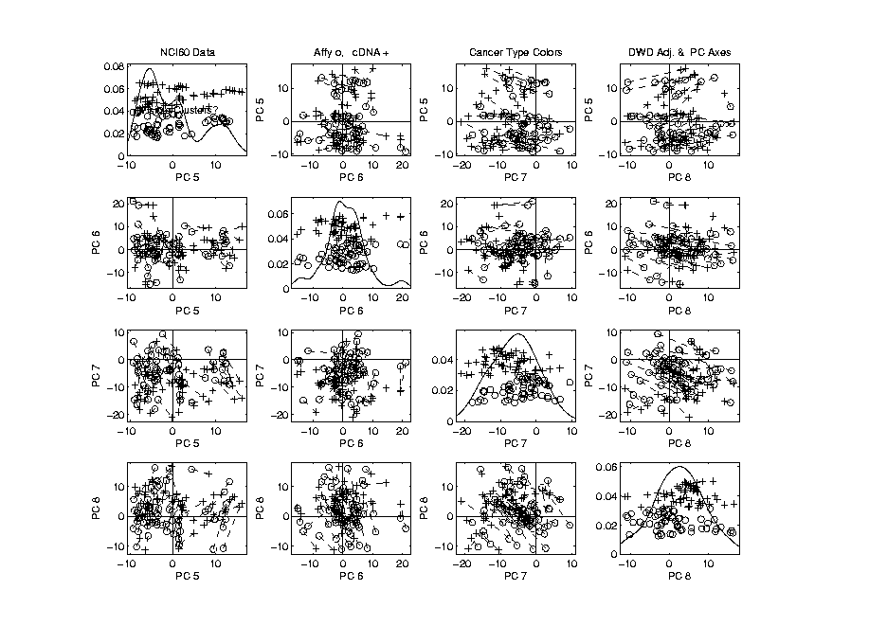
NCI 60: Can we find classes
Using PCA 5-8?
Notes:
62

Slide 63
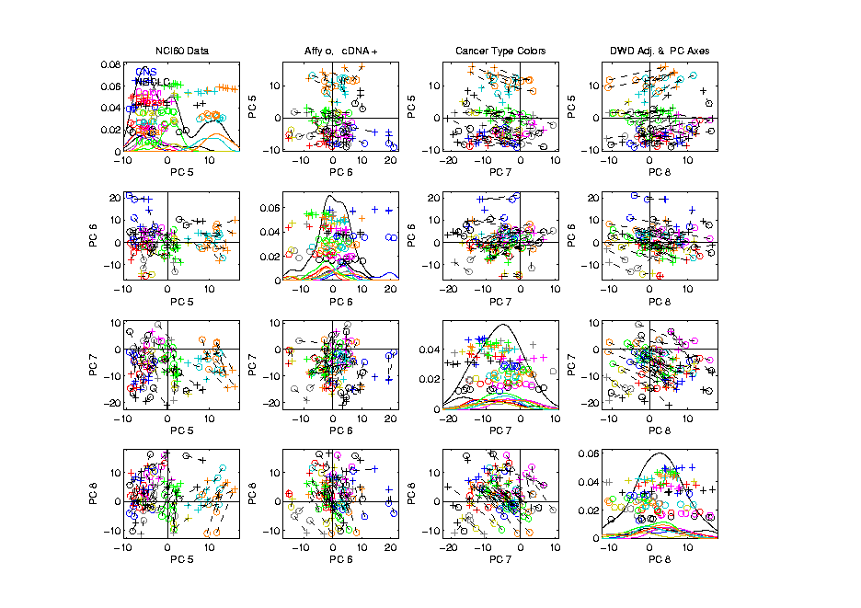
NCI 60: Can we find classes
Using PCA 5-8?
Notes:
63

Slide 64
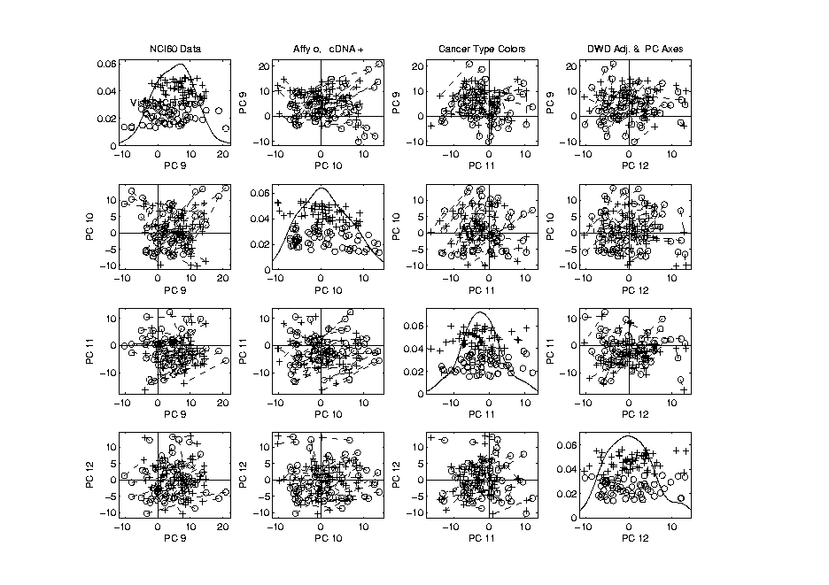
NCI 60: Can we find classes
Using PCA 9-12?
Notes:
64

Slide 65
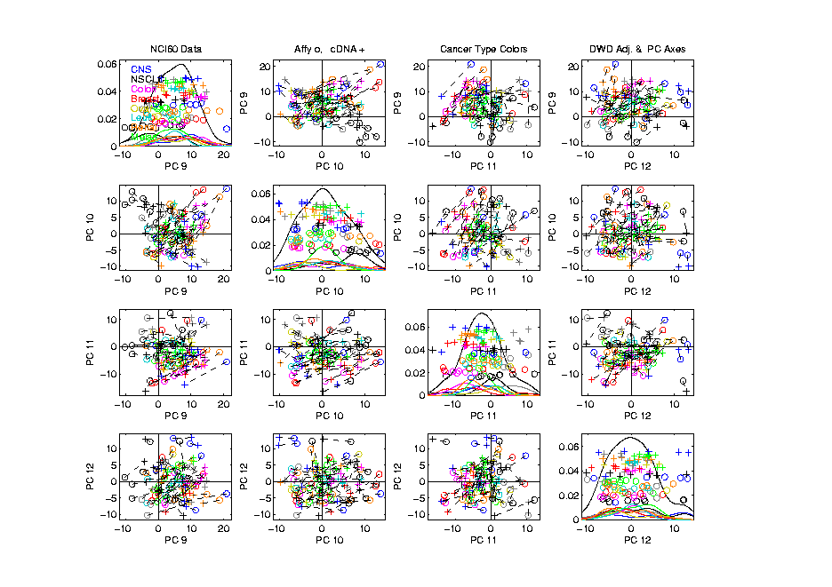
NCI 60: Can we find classes
Using PCA 9-12?
Notes:
65

Slide 66
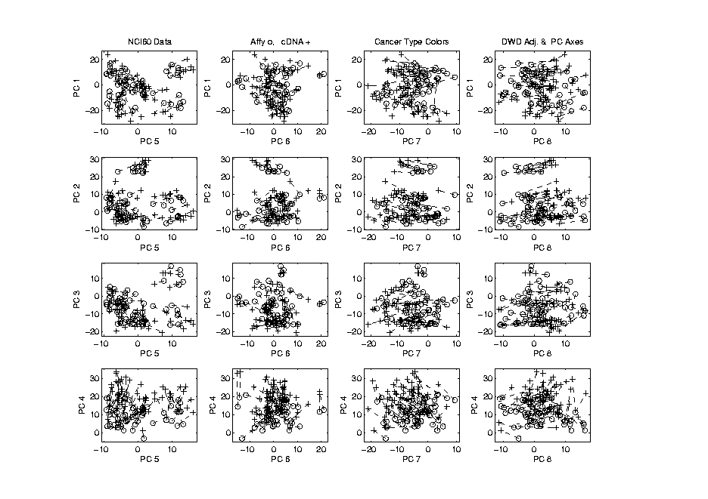
NCI 60: Can we find classes
Using PCA 1-4 vs. 5-8?
Notes:
66

Slide 67
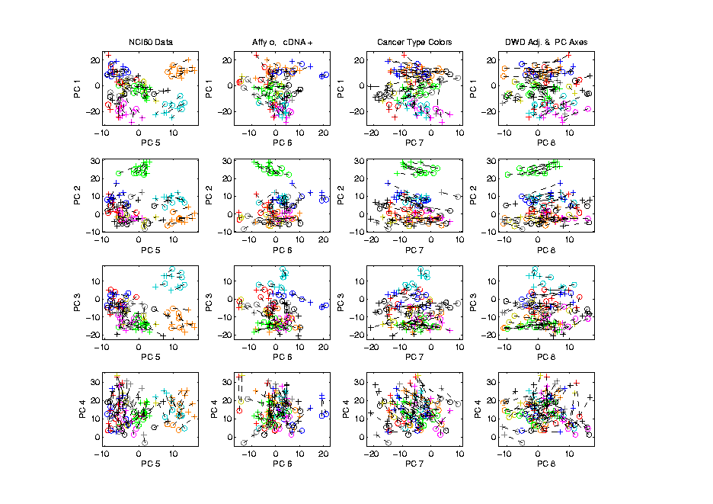
NCI 60: Can we find classes
Using PCA 1-4 vs. 5-8?
Notes:
67

Slide 68
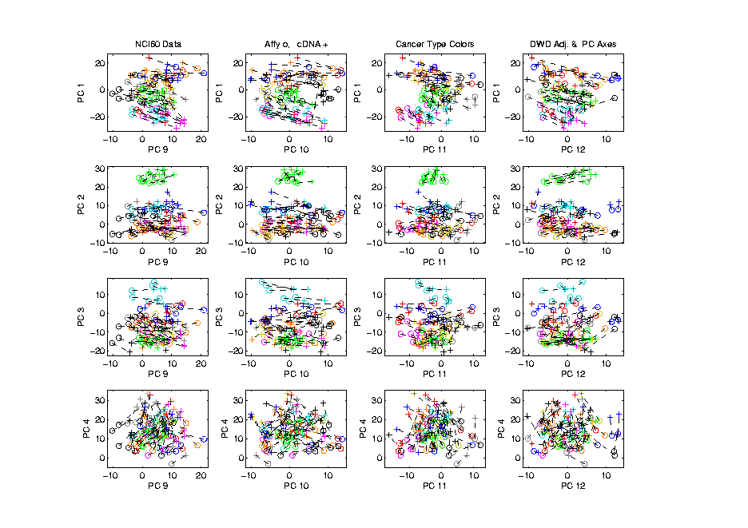
NCI 60: Can we find classes
Using PCA 1-4 vs. 9-12?
Notes:
68

Slide 69
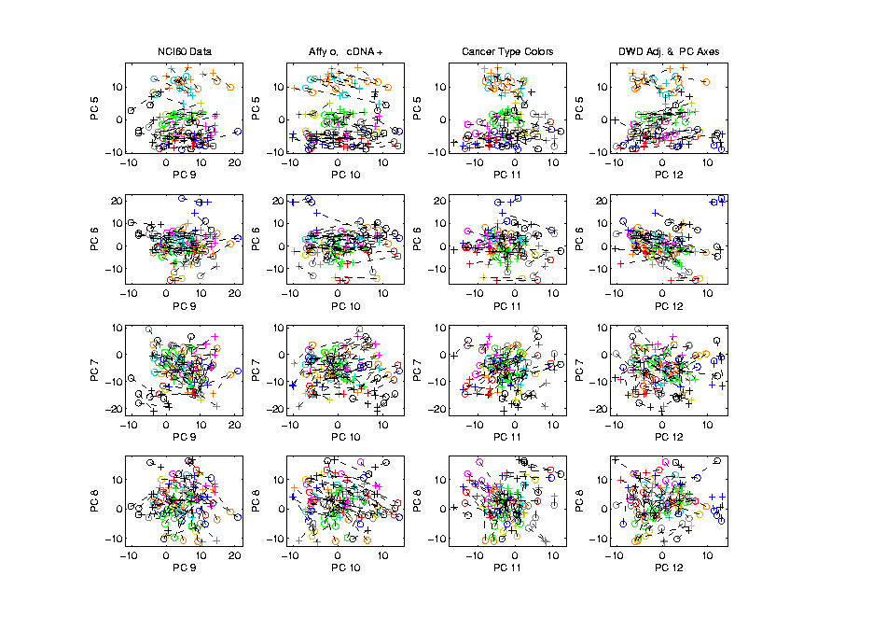
NCI 60: Can we find classes
Using PCA 5-8 vs. 9-12?
Notes:
69

Slide 70
PCA Visualization of NCI 60 Data
Can we find classes using PC directions??
Found some, but not others
Nothing after 1st five - six PCs
Rest seem to have other drivers
Are There Better Directions?
PCA only “feels” maximal variation
Ignores Class Labels
How Can We Use Class Labels?
Notes:
70

Slide 71
Visualization of NCI 60 Data
How Can We Use Class Labels?
Approach:
Find Directions to “Best Separate” Classes
In Disjoint Pairs (thus 4 Directions)
Use DWD:
Distance Weighted Discrimination
Defined (& Motivated) Later
Project All Data on These 4 Directions
Notes:
71

Slide 72
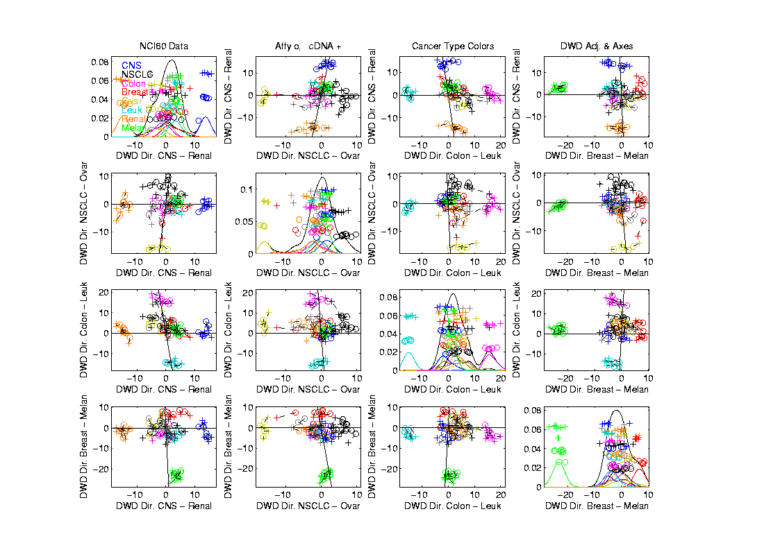
NCI 60: Views using DWD Dir’ns (focus on biology)
Notes:
72

Slide 73
DWD Visualization of NCI 60 Data
Most cancer types clearly distinct
(Renal, CNS, Ovar, Leuk, Colon, Melan)
Using these carefully chosen directions
Others less clear cut
  NSCLC (at least 3 subtypes)
  Breast (4 published subtypes)

Slide 74
DWD Visualization
Recall PCA limitations
DWD uses class info
Hence can “better separate known classes”
Do this for pairs of classes
(DWD just on those, ignore others)
Carefully choose pairs in NCI 60 data
Note DWD Directions Not Orthogonal
(PCA orthogonality may be
too strong a constraint)

Slide 75
NCI 60: Views using DWD Dir’ns (focus on biology)
Note: Off-Diagonal Plots Are No Longer
Transposes
Construction of Non-Orthogonal
Views Discussed
In Text, Fig. 6.14

Slide 76
PCA Visualization of NCI 60 Data
Can we find classes using PC directions??
Found some, but not others
Not so distinct as in DWD view
Nothing after 1st five PCs
Rest seem to be noise driven
Orthogonality too strong a constraint???
Interesting dir’ns are nearly orthogonal
(will see why later)
Notes:
76

Slide 77
Object Oriented Data Analysis
Three Major Phases of OODA:
I. Object Definition
“What are the Data Objects?”
Exploratory Analysis
“What Is Data Structure / Drivers?”
III. Confirmatory Analysis / Validation
Is it Really There (vs. Noise Artifact)?

Slide 78
Caution
Text, Sec. 4.1.2
DWD Separation Can Be Deceptive
Since DWD is Really Good at Separation
Important Concept:
Statistical Inference is Essential

Slide 79
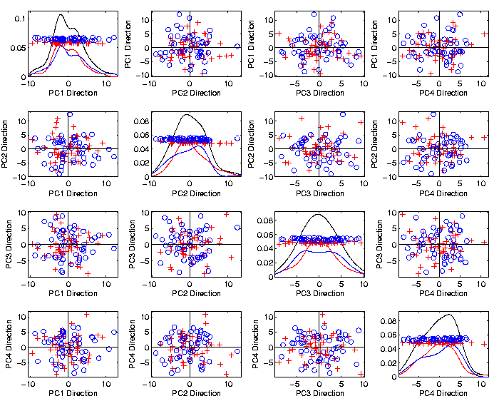
Caution
Toy 2-Class
Example
See
Structure?
Careful,
Only PC1-4

Slide 80
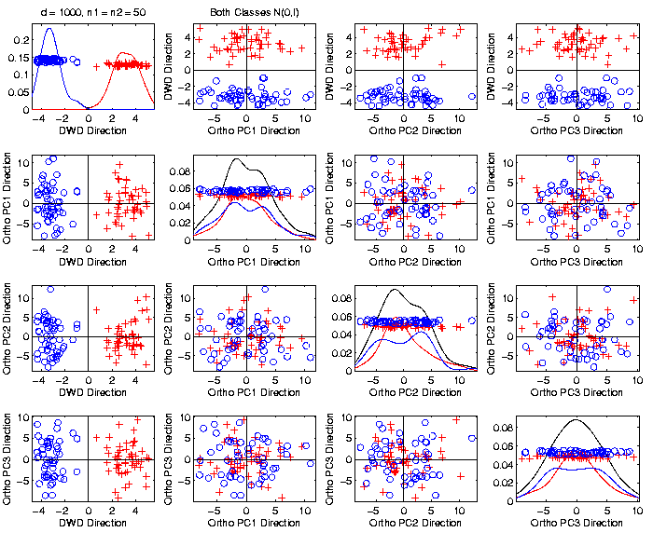
Caution
Toy 2-Class
Example
DWD &
Ortho PCA
Finds Big
Separation

Slide 81
Caution
Toy 2-Class
Example
Not in 1ST
3 PCs
Since
Smaller Scale

Slide 82

Caution
Toy 2-Class
Example
Actually
Both
Classes
Are $N\left(0,I\right)$
$$d=1000$$

Slide 83
Caution
Toy 2-Class
Example
Separation
Is Natural
Sampling
Variation
(Will Study in Detail Later)

Slide 84
Caution
Main Lesson Again:
DWD Separation Can Be Deceptive
Since DWD is Really Good at Separation
Important Concept:
Statistical Inference is Essential
III. Confirmatory Analysis

Slide 85
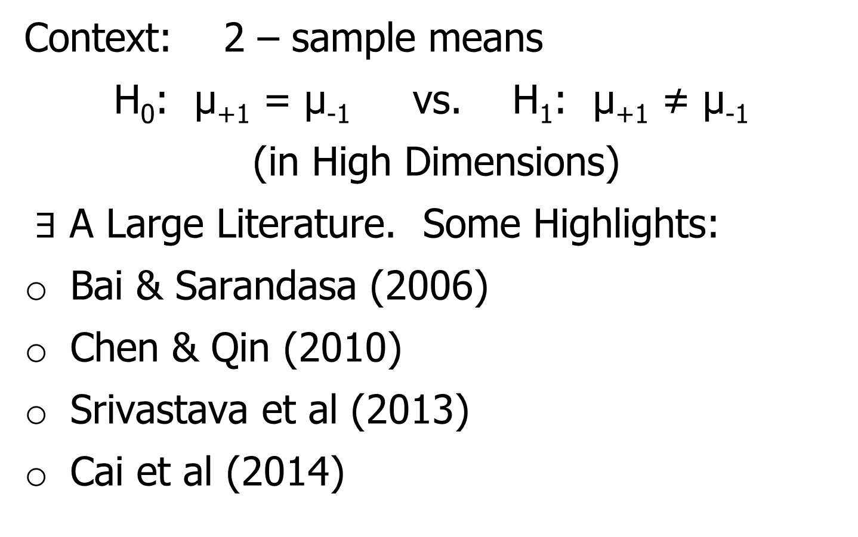
DiProPerm Hypothesis Test
Text, Sec. 13.1
Context: 2 – sample means
H₀: μ₊₁ = μ₋₁ vs. H₁: μ₊₁ ≠ μ₋₁
(in High Dimensions)
$∃$ A Large Literature. Some Highlights:
Bai & Sarandasa (2006)
Chen & Qin (2010)
Srivastava et al (2013)
Cai et al (2014)

Slide 86
DiProPerm Hypothesis Test
Context: 2 – sample means
H₀: μ₊₁ = μ₋₁ vs. H₁: μ₊₁ ≠ μ₋₁
(in High Dimensions)
Approach taken here:
Wei et al (2013)
Focus on Visualization via Projection
(Thus Test Related to Exploration)

Slide 87
DiProPerm Hypothesis Test
Context: 2 – sample means
H₀: μ₊₁ = μ₋₁ vs. H₁: μ₊₁ ≠ μ₋₁
Challenges:
Distributional Assumptions
Parameter Estimation
HDLSS space is slippery
High Dimension Low Sample Size

Slide 88
DiProPerm Hypothesis Test
Context: 2 – sample means
H₀: μ₊₁ = μ₋₁ vs. H₁: μ₊₁ ≠ μ₋₁
Challenges:
Distributional Assumptions
Parameter Estimation
Suggested Approach:
Permutation test
(A flavor of classical “non-parametrics”)

Slide 89
DiProPerm Hypothesis Test
Suggested Approach:
Find a DIrection
(separating classes)
PROject the data
(reduces to 1 dim)
PERMute
(class labels, to assess significance,
with recomputed direction)

Slide 90
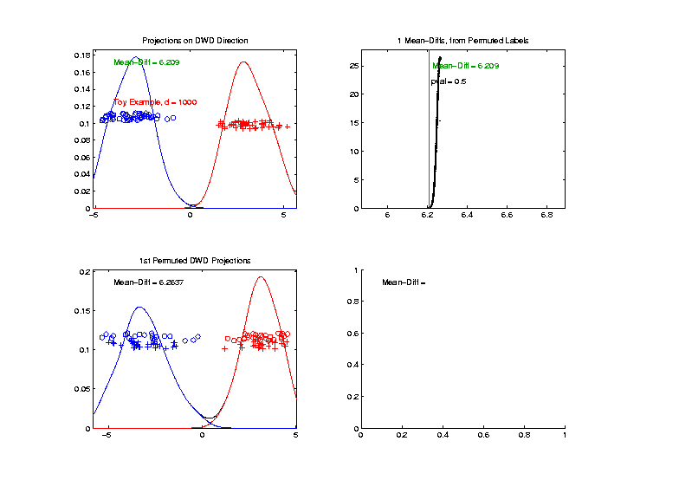

DiProPerm Hypothesis Test
Toy 2-Class Example
Separated DWD
Projections
(Again $N\left(0,I\right)$, $d=1000$)

Slide 91
DiProPerm Hypothesis Test
Toy 2-Class Example
Separated DWD
Projections
Measure Separation of Classes Using:
Mean Difference = 6.209

Slide 92
DiProPerm Hypothesis Test
Toy 2-Class Example
Separated DWD
Projections
Measure Separation of Classes Using:
Mean Difference = 6.209
Record as Vertical Line

Slide 93
DiProPerm Hypothesis Test
Toy 2-Class Example
Separated DWD
Projections
Measure Separation of Classes Using:
Mean Difference = 6.209
Statistically Significant???

Slide 94
DiProPerm Hypothesis Test
Toy 2-Class Example
Permuted
Class Labels

Slide 95
DiProPerm Hypothesis Test
Toy 2-Class Example
Permuted
Class Labels
Recompute DWD
& Projections

Slide 96
DiProPerm Hypothesis Test
Toy 2-Class Example
Measure Class
Separation
Using Mean
Difference
= 6.26

Slide 97
DiProPerm Hypothesis Test
Toy 2-Class Example
Measure Class
Separation
Using Mean
Difference
= 6.26
Record as Dot

Slide 98
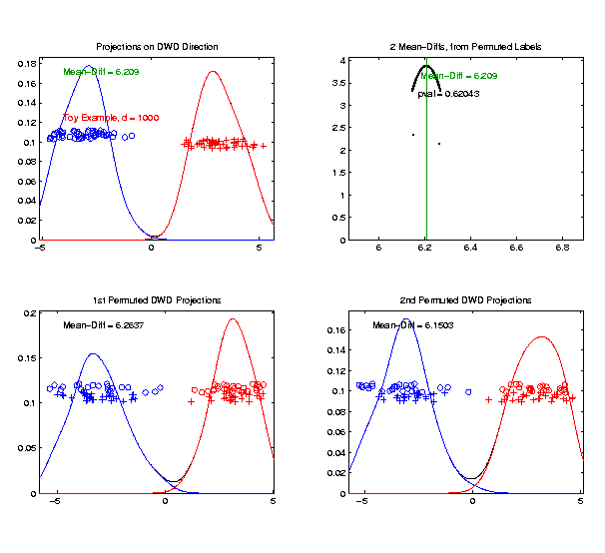
DiProPerm Hypothesis Test
Toy 2-Class Example
Generate 2nd
Permutation

Slide 99
DiProPerm Hypothesis Test
Toy 2-Class Example
Measure Class
Separation
Using Mean
Difference
= 6.15

Slide 100
DiProPerm Hypothesis Test
Toy 2-Class Example
Record as
Second Dot

Slide 101
DiProPerm Hypothesis Test
.
.
.
Repeat This 1,000 Times
To Generate Null Distribution

Slide 102
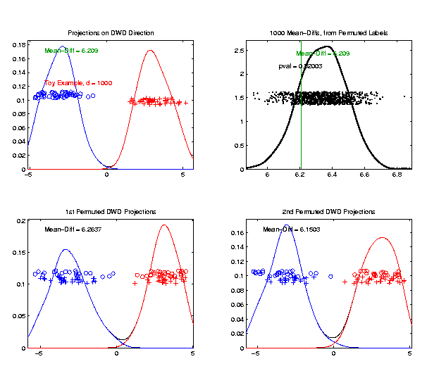
DiProPerm Hypothesis Test
Toy 2-Class Example
Generate Null
Distribution

Slide 103
DiProPerm Hypothesis Test
Toy 2-Class Example
Generate Null
Distribution
Compare With
Original Value

Slide 104
DiProPerm Hypothesis Test
Toy 2-Class Example
Generate Null
Distribution
Compare With
Original Value
Take Proportion
Larger as P-Value

Slide 105
DiProPerm Hypothesis Test
Toy 2-Class Example
Generate Null
Distribution
Compare With
Original Value
Not Significant

Slide 106
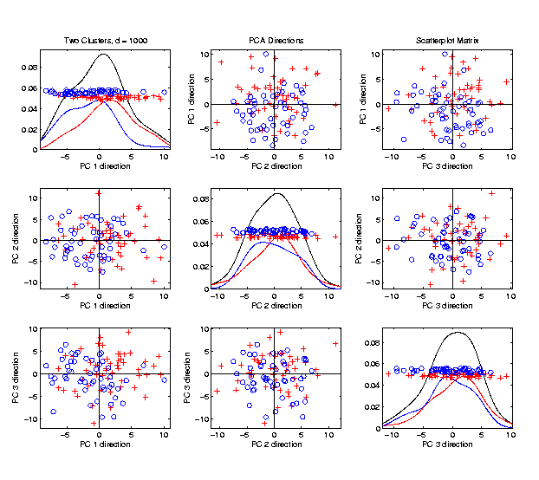
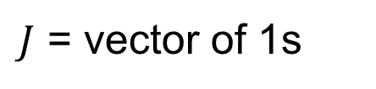

DiProPerm Hypothesis Test
$J$ = vector of 1s
Another Example
$N_{1000}\left(+0.05∗J,I\right)$
$N_{1000}\left(−0.05∗J,I\right)$
PCA View

Slide 107


DiProPerm Hypothesis Test
Another Example
$N_{1000}\left(+0.05∗J,I\right)$
$N_{1000}\left(−0.05∗J,I\right)$
DWD View
(Similar
to $N\left(0,I\right)$?)

Slide 108


DiProPerm Hypothesis Test
Prop’n > is 0, but more precise is “p-value < 0.001”
Another Example
$N_{1000}\left(+0.05∗J,I\right)$
$N_{1000}\left(−0.05∗J,I\right)$
DiProPerm Now
Quite Significant

Slide 109


DiProPerm Hypothesis Test
Stronger Example
$N_{1000}\left(+0.2∗J,I\right)$
$N_{1000}\left(−0.2∗J,I\right)$
Even PCA
Shows Class
Difference

Slide 110


DiProPerm Hypothesis Test
Stronger Example
$N_{1000}\left(+0.2∗J,I\right)$
$N_{1000}\left(−0.2∗J,I\right)$
DiProPerm Very
Significant

Slide 111

DiProPerm Hypothesis Test
=(MD – Xbar) / s
Stronger Example
$N_{1000}\left(+0.2∗J,I\right)$
$N_{1000}\left(−0.2∗J,I\right)$
DiProPerm Very
Significant
Z-Score Allows
Comparison
>> 5.4 above

Slide 112
DiProPerm Hypothesis Test
Text, Sec. 13.1
Deeper Look at Important Concept:
Statistical Inference is Essential
Slippery Visualization Comparisons:
Autism Data Example
Breast Cancer Data Example

Slide 113
DiProPerm Hypothesis Test
Real Data Example: Autism
Caudate Shape
(sub-cortical brain structure)
Shape summarized by 3-d locations of 1032 corresponding points
E.g. 1a: Autistic vs. Typically Developing
E.g. 1b: Development Delayed vs. Typ. Dev.
(Thanks to Josh Cates)
Cates et al. (2007)

Slide 114

DiProPerm Hypothesis Test
Example 1: Autism Data
Autism
Spectrum
Disorder
Typically
Developing
Develop’ly
Delayed
E.g. 1a
Some Difference,
But “Not Very Strong”?
E.g. 1b
Looks “Stronger”?

Slide 115
DiProPerm Hypothesis Test
Example 1: Autism Data
Actually Strongly
Stat’ly Significant
Not Quite
Stat’ly Significant
Visual Impression Can Be Slippery

Slide 116

DiProPerm Hypothesis Test
Example 2: Breast Cancer Data
Again 2
Comp’sons
Top Looks Like
“Strong Diff.”?
Bottom “More
Overlapped”?

Slide 117
DiProPerm Hypothesis Test
Example 2: Breast Cancer Data
Yet DiProPerm
Gives Opposite
Result!

Slide 118
DiProPerm Hypothesis Test
What is going on?
Is Visualization Useless?
Key Point:
Sample Sizes
Smaller Sample Size ←→ Weaker Inference
E.g. 1a | 88 vs. 34 | Strongly Stat’ly Significant
E.g. 1b | 13 vs. 34 | Not Stat’ly Significant
E.g. 2a | 16 vs. 34 | Not Stat’ly Significant
E.g. 2b | 36 vs. 44 | Strongly Stat’ly Significant

Slide 119
DiProPerm Hypothesis Test
Main Lessons:
Important to Do Inference
Intuition Can Be Slippery
Note: Cherry Picked These From
Larger Set of Examples
Opposite Results Not That Common

Slide 120

DiProPerm Hypothesis Test
Recent Discovery:
Yang et al. (2023)
Not in Text
For Very Strong Signal,
Test Power Can Decrease!

Slide 121

DiProPerm Hypothesis Test
Cause of Power Loss:
Use of “All Permutations”

Slide 122

DiProPerm Hypothesis Test
Use of “All Permutations”
Big Power Loss from Spread Null Distribution

Slide 123
DiProPerm Hypothesis Test
Solution:
Only Consider “Balanced Permutations”

Slide 124
DiProPerm Hypothesis Test
Only Consider “Balanced Permutations”
Much Tighter Null Distribution

Slide 125
DiProPerm Hypothesis Test
Recommendation:
Always Use “Balanced Permutations”

Slide 126
Matlab Software
Recall OODA Software

Slide 127
DiProPerm in Matlab
Matlab Software:
DiProPermXY.m
In General Directory

Slide 128
Object Oriented Data Analysis
Three Major Phases of OODA:
I. Object Definition
“What are the Data Objects?”
Exploratory Analysis
“What Is Data Structure / Drivers?”
III. Confirmatory Analysis / Validation
Is it Really There (vs. Noise Artifact)?

Slide 129
Object Oriented Data Analysis
Nomenclature Clash?
Computer Science View:
Object Oriented Programming:
Programming that supports encapsulation, inheritance, and polymorphism
(from Google: define object oriented programming,
my favorite: www.innovatia.com/software/papers/com.htm)
Text, Sec. 18.1
Text, Sec. 18.2 Discusses Deeper Conections

Slide 130
Object Oriented Data Analysis
Some statistical history:
John Chambers Idea (1960s - ):
Object Oriented approach to statistical computation
Developed as software package S
  Basis of S-plus (commerical product)
  And of R (free-ware, current favorite of Chambers)
Reference for more on this:
Venables & Ripley (2013)
Notes:
130

Slide 131

Object Oriented Data Analysis
Another take: J. O. Ramsay
http://www.psych.mcgill.ca/faculty/ramsay/ramsay.html
“Functional Data Objects”
(closer to C. S. meaning)
Personal Objection:
“Functional” in mathematics is:
“Function that operates on functions”

Slide 132


Object Oriented Data Analysis
More Terminology:
SAMSI Program (2010-2011):
OODA → Analysis of Object Oriented Data
→ Analysis of Object Data
Leland Wilkinson
Notes:
132

Slide 133
Object Oriented Data Analysis
More Terminology:
SAMSI Program (2010-2011):
OODA → Analysis of Object Oriented Data
→ Analysis of Object Data
“Object Data Analysis” Terminology Used in
Patrangenaru and Ellingson (2019)
Notes:
133

