Slide 1
Statistics – O. R. 881 Object Oriented Data Analysis
Steve Marron
Dept. of Statistics and Operations Research
University of North Carolina

Slide 2
Current Sections in Textbook
Today:
Sections 18.1, 18.2, 13.1, 5.1, 5.2
Next Class:
Sections 5.2, 5.3

Slide 3
Participant Presentations
Please Sign Up:
Name
Dept. & Advisor (Lab?)
Onyen (or Email Address)
ENRolled or AUDitor?
Tentative Title (“????” Is OK)
When:
Next Week, Early, March, April, Late

Slide 4
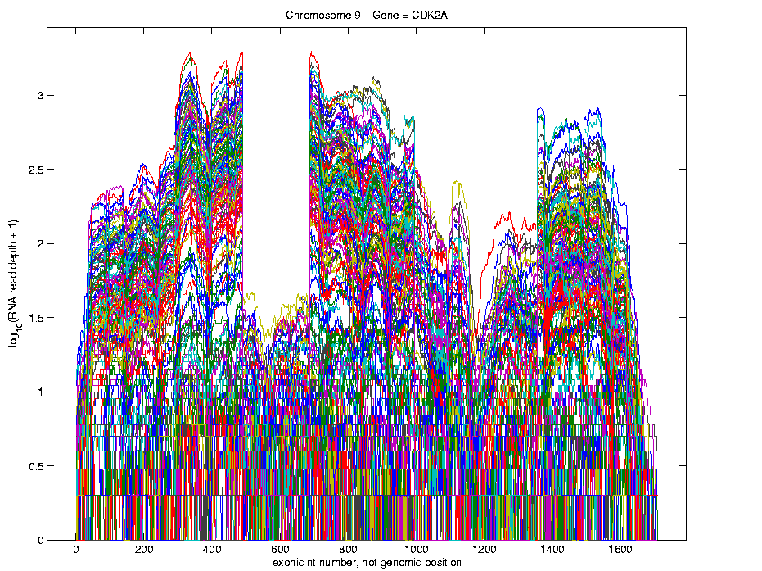
Last Class: Lung Cancer Curve Obj’s
Simple
1st
View:
Curve
Overlay
(log
scale)
I. Object Representation

Slide 5
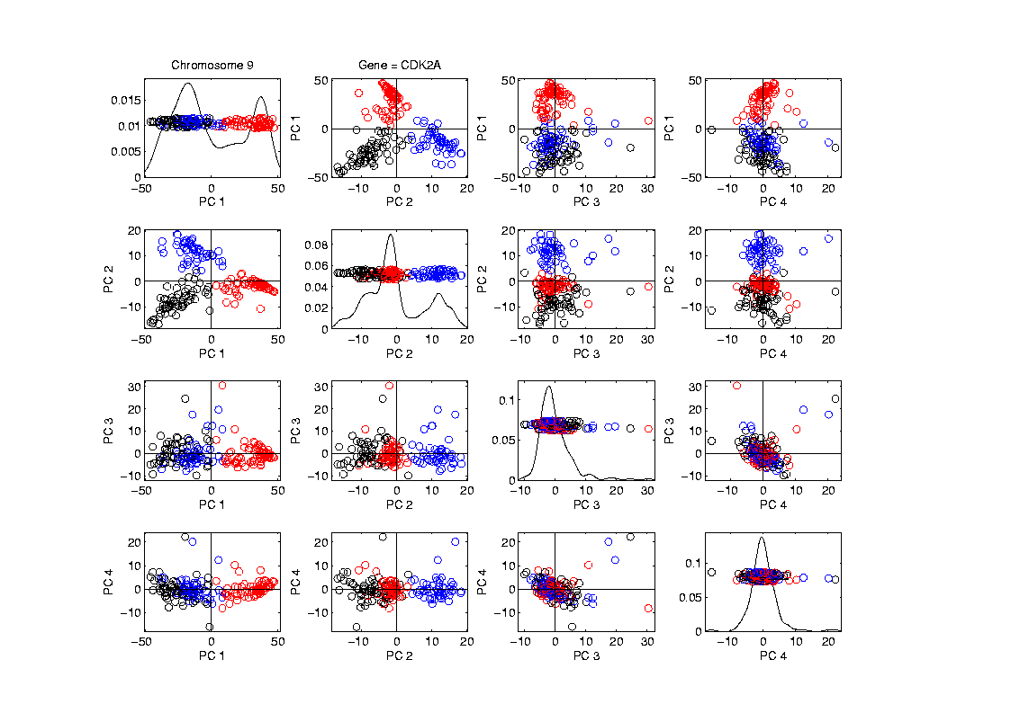
Last Class: Lung Cancer Curve Obj’s
Visualization in Feature Space, Next Look in Object Space
Manually
“Brush”
Clusters
II. Exploratory
Analysis

Slide 6
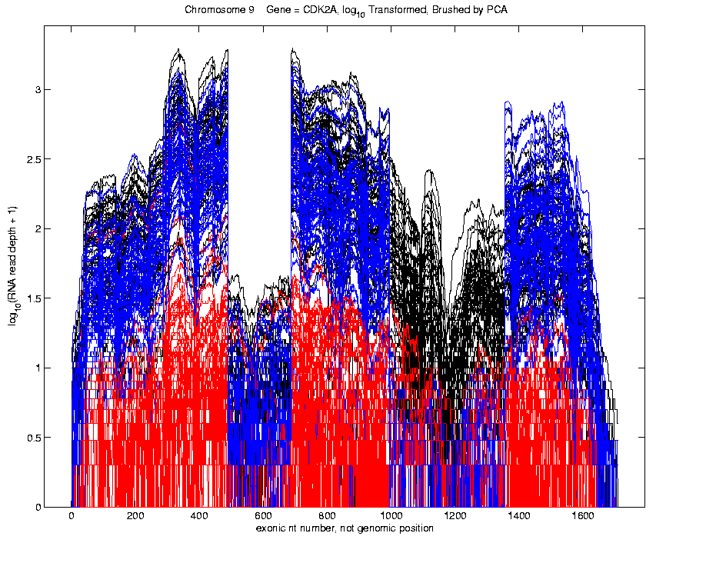
Last Class: Lung Cancer Curve Obj’s
Visualization in Object Space
Manually
Brush
Clusters
Clear
Alternate
Splicing
II. Exploratory
Analysis

Slide 7
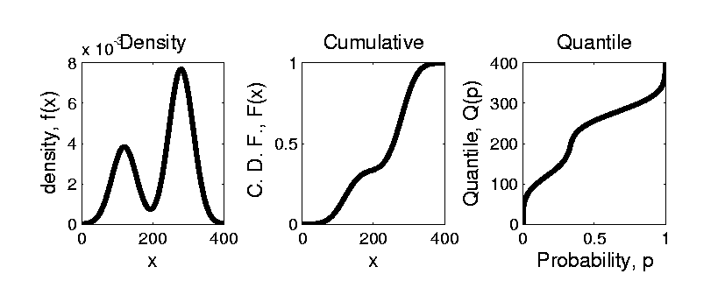


Last Class: Prob. Dist’ns
How to Represent?
Several Common Choices:
$$F\left(x\right)=\int_{−∞}^{x}{f\left(t\right)dt}$$
$$Q\left(p\right)=F^{−1}(p)$$

Slide 8
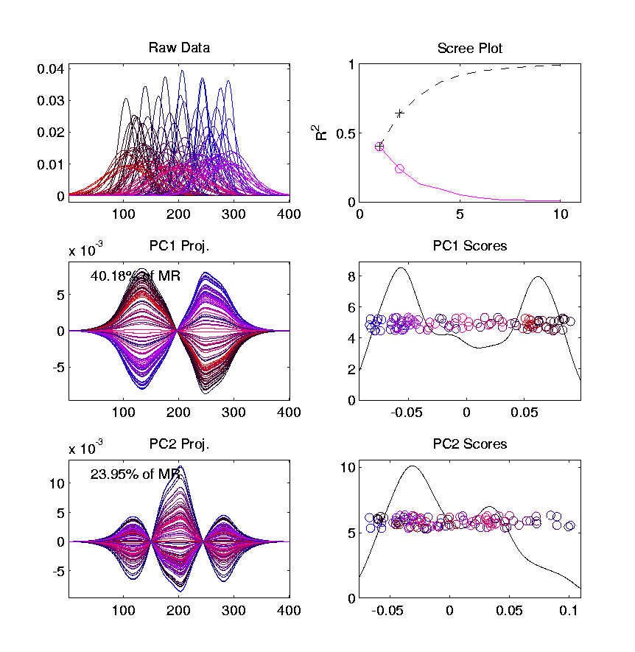
Last Class: Prob. Dist’ns
Energy Spread
Widely Across
The Spectrum
Toy Example, Density Representation
Try
Standard
PCA
Unintuitive
Modes of
Variation
Which Don’t
Explain Much
Variation

Slide 9
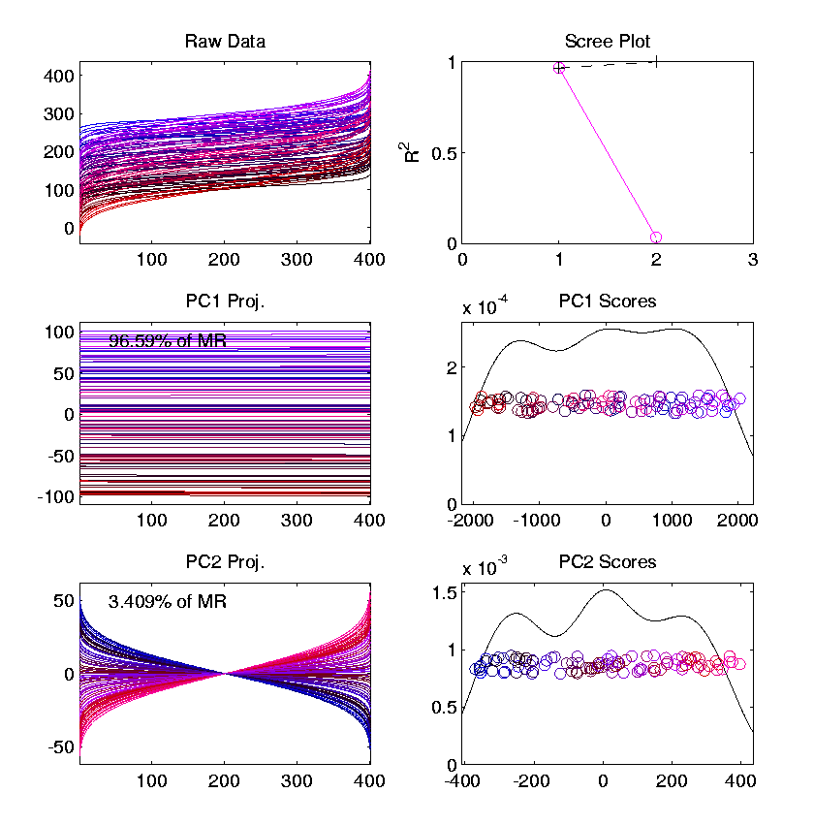
Last Class: Prob. Dist’ns
Energy Entirely
Expressed In
Just 2 Modes
Toy Example, Quantile Representation
Try
Standard
PCA
1st Mode Is
Mean Var’n
Both Much More Interpretable!
2nd Mode Is
S.D. Var’n

Slide 10
Last Class: Limitation of PCA
PCA can provide useful projection directions
But can’t “see everything”…
Reason:
PCA finds dir’ns of maximal variation
Which may obscure interesting structure

Slide 11
Last Class: Limitation of PCA
Toy Example:
Apple – Banana – Pear
Obscured by “noisy dimensions”
1st 3 PC directions only show noise
Study some rotations, to find structure

Slide 12
Last Class: Limitation of PCA
Interesting Data Set: NCI-60
NCI = National Cancer Institute
60 Cell Lines (cancer treatment targets)
For Different Cancer Types
Measured “Gene Expression”
= “Gene Activity”
Several Thousand Genes (Simultaneously)
Data Objects = Vectors of Gene Exp’n
Lots of Preprocessing (study later)
Example from:
Liu et al (2009)

Slide 13
Last Class: NCI 60 Data
Important Aspect: 8 Cancer Types
Renal Cancer
Non Small Cell Lung Cancer
Central Nervous System Cancer
Ovarian Cancer
Leukemia Cancer
Colon Cancer
Breast Cancer
Melanoma (Skin)
Notes:
13

Slide 14
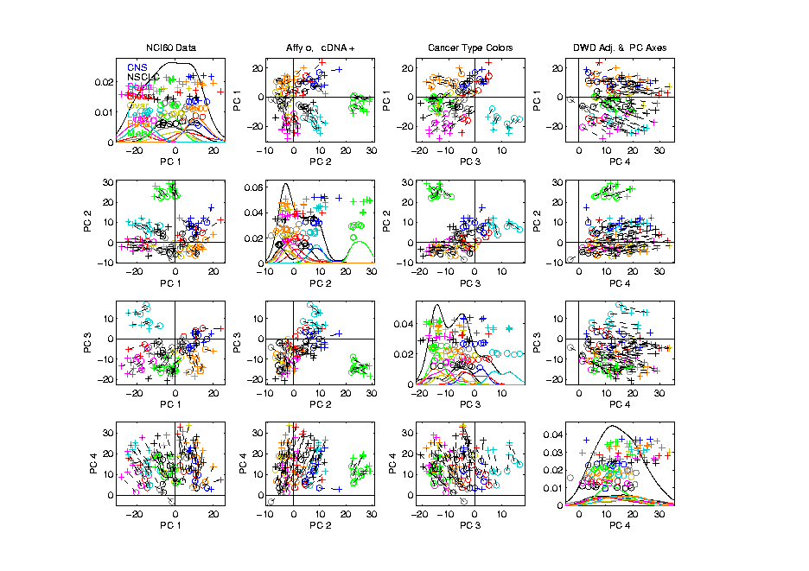
Last Class: NCI 60 Data Using PCA view?
Notes:
14

Slide 15
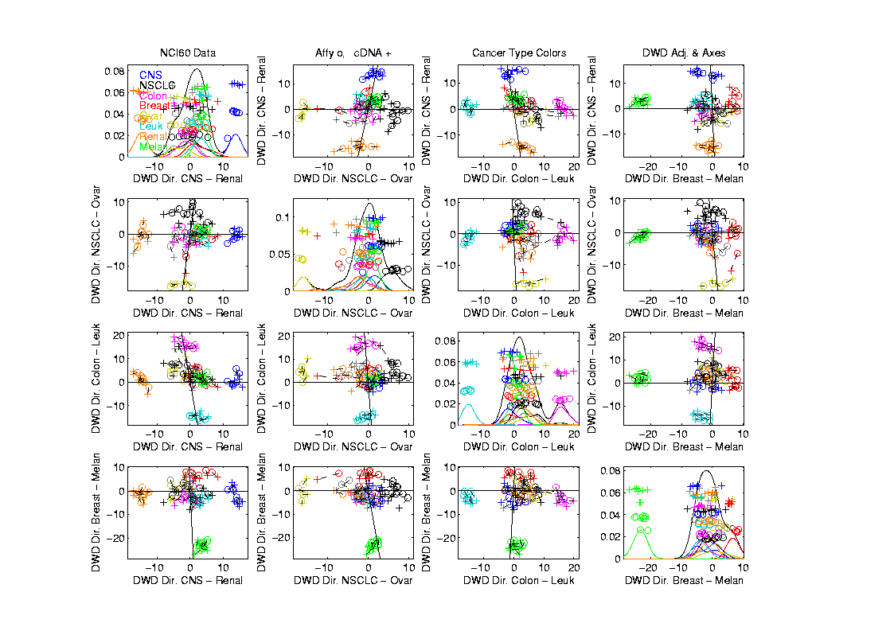
Last Class: NCI 60 Data Views using DWD Dir’ns
Notes:
15

Slide 16
Last Class: NCI 60 Data Views using DWD Dir’ns
Main Lessons:
PCA Finds Dir’ns of Maximal Variation
Often Shows Interesting Sturcture
But No Guarantees
Other Directions Also Important & Useful
Distance Weight Discrimination Targets
Subgroup Differences
Notes:
16

Slide 17
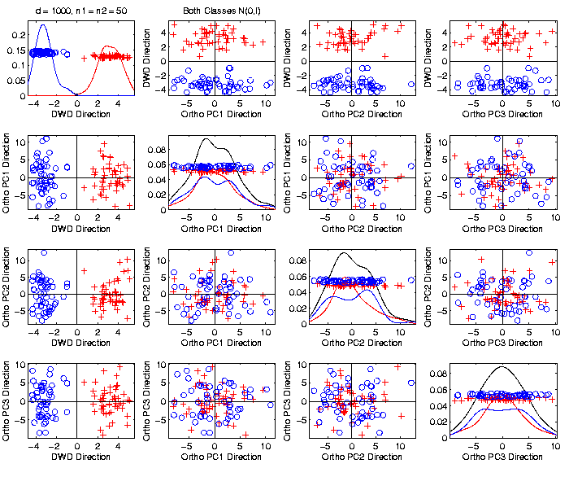

Last Class: Caution
Toy 2-Class
Example
Actually
Both
Classes
Are $N\left(0,I\right)$
$$d=1000$$

Slide 18
Last Class: Caution
Toy 2-Class
Example
Separation
Is Natural
Sampling
Variation
(Will Study in Detail Later)

Slide 19
Last Class: Caution
Main Lesson Again:
DWD Separation Can Be Deceptive
Since DWD is Really Good at Separation
Important Concept:
Statistical Inference is Essential
III. Confirmatory Analysis

Slide 20
Last Class: DiProPerm
Suggested Approach:
Find a DIrection
(separating classes)
PROject the data
(reduces to 1 dim)
PERMute
(class labels, to assess significance,
with recomputed direction)

Slide 21
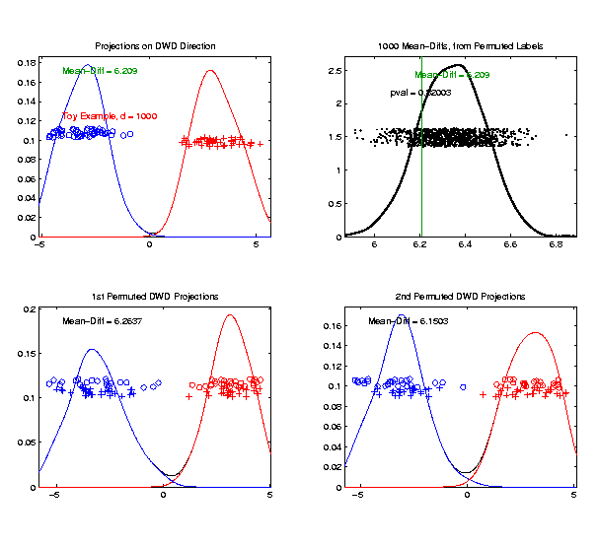
Last Class: DiProPerm
Toy 2-Class Example
Generate Null
Distribution
Compare With
Original Value

Slide 22
Last Class: DiProPerm
Toy 2-Class Example
Generate Null
Distribution
Compare With
Original Value
Take Proportion
Larger as P-Value

Slide 23
Last Class: DiProPerm
Toy 2-Class Example
Generate Null
Distribution
Compare With
Original Value
Not Significant

Slide 24
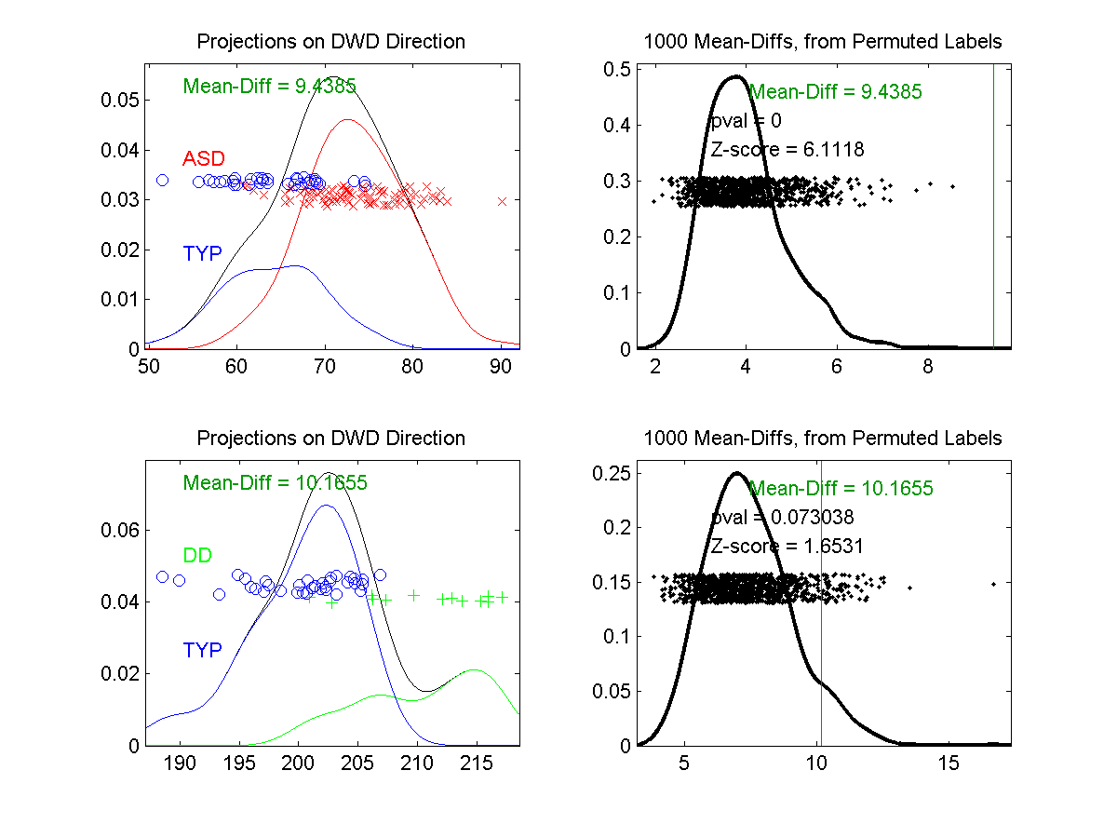
Last Class: DiProPerm
Example 1: Autism Data
Actually Strongly
Stat’ly Significant
Not Quite
Stat’ly Significant
Visual Impression Can Be Slippery

Slide 25
Object Oriented Data Analysis
Three Major Phases of OODA:
I. Object Definition
“What are the Data Objects?”
Exploratory Analysis
“What Is Data Structure / Drivers?”
III. Confirmatory Analysis / Validation
Is it Really There (vs. Noise Artifact)?

Slide 26
Object Oriented Data Analysis
Nomenclature Clash?
Computer Science View:
Object Oriented Programming:
Programming that supports encapsulation, inheritance, and polymorphism
(from Google: define object oriented programming,
my favorite: www.innovatia.com/software/papers/com.htm)
Text, Sec. 18.1
Text, Sec. 18.2 Discusses Deeper Connections

Slide 27
Object Oriented Data Analysis
Some statistical history:
John Chambers Idea (1960s - ):
Object Oriented approach to statistical computation
Developed as software package S
Basis of S-plus (commerical product)
And of R (free-ware, current favorite of Chambers)
Reference for more on this:
Venables & Ripley (2013)
Notes:
27

Slide 28

Object Oriented Data Analysis
Another take: J. O. Ramsay
http://www.psych.mcgill.ca/faculty/ramsay/ramsay.html
“Functional Data Objects”
(closer to C. S. meaning)
Personal Objection:
“Functional” in mathematics is:
“Function that operates on functions”

Slide 29

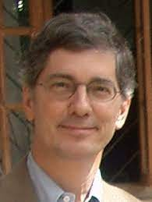
Object Oriented Data Analysis
More Terminology:
SAMSI Program (2010-2011):
OODA → Analysis of Object Oriented Data
→ Analysis of Object Data
Leland Wilkinson
Notes:
29

Slide 30
Object Oriented Data Analysis
More Terminology:
SAMSI Program (2010-2011):
OODA → Analysis of Object Oriented Data
→ Analysis of Object Data
“Object Data Analysis” Terminology Used in
Patrangenaru and Ellingson (2019)
Notes:
30

Slide 31
Object Oriented Data Analysis
Three Major Phases of OODA:
I. Object Definition
“What are the Data Objects?”
Exploratory Analysis
“What Is Data Structure / Drivers?”
III. Confirmatory Analysis / Validation
Is it Really There (vs. Noise Artifact)?

Slide 32

Big Picture Data Visualization
For a Matrix of Data:
$${\left(\begin{matrix}x_{11} & ⋯ & x_{1n} \\ ⋮ & ⋱ & ⋮ \\ x_{d1} & ⋯ & x_{dn}\end{matrix}\right)}_{d×n}$$

Slide 33
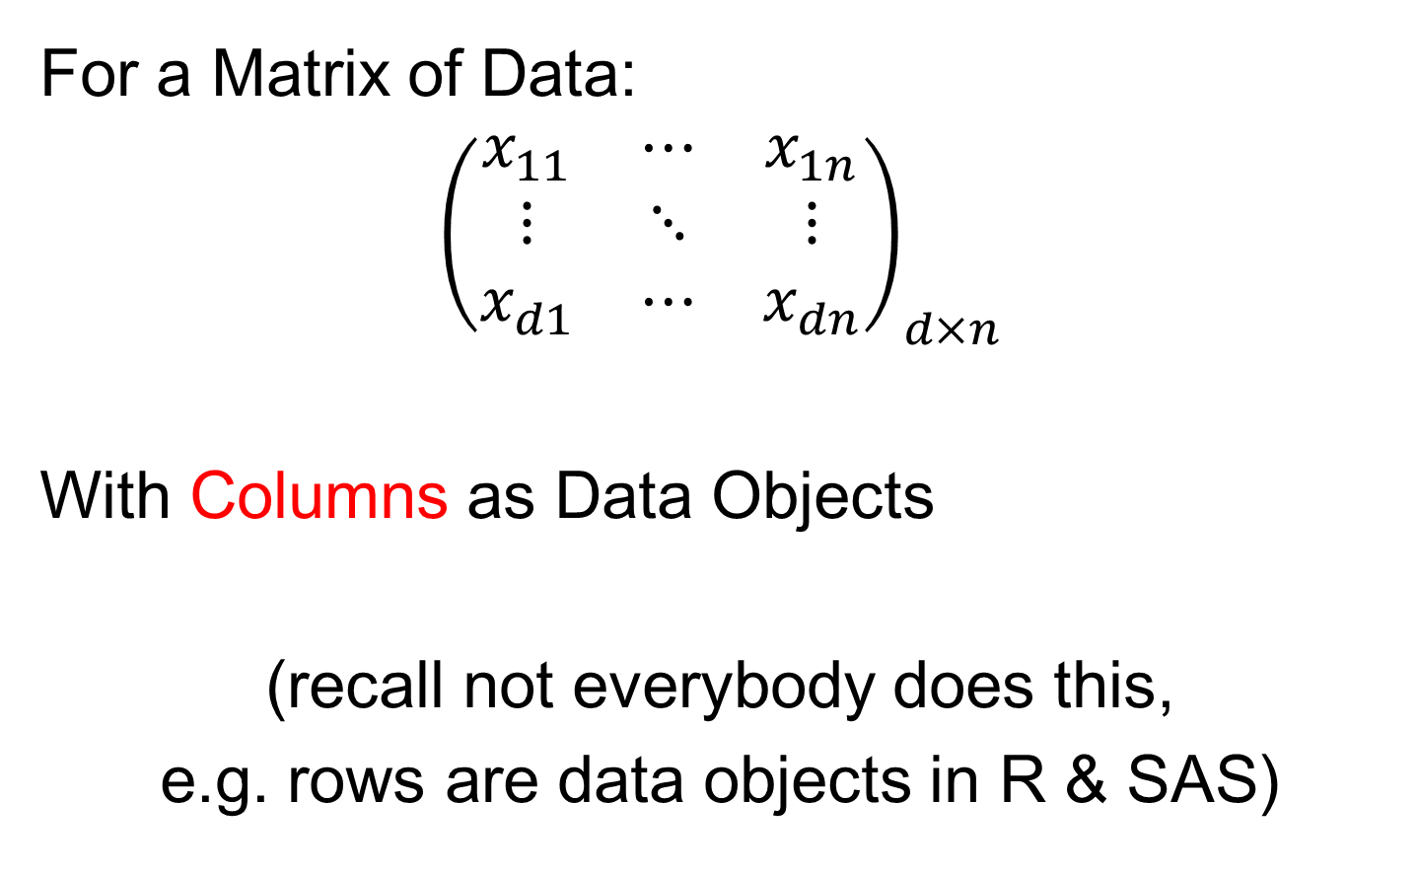
Big Picture Data Visualization
For a Matrix of Data:
$${\left(\begin{matrix}x_{11} & ⋯ & x_{1n} \\ ⋮ & ⋱ & ⋮ \\ x_{d1} & ⋯ & x_{dn}\end{matrix}\right)}_{d×n}$$
With Columns as Data Objects
(recall not everybody does this,
e.g. rows are data objects in R & SAS)

Slide 34
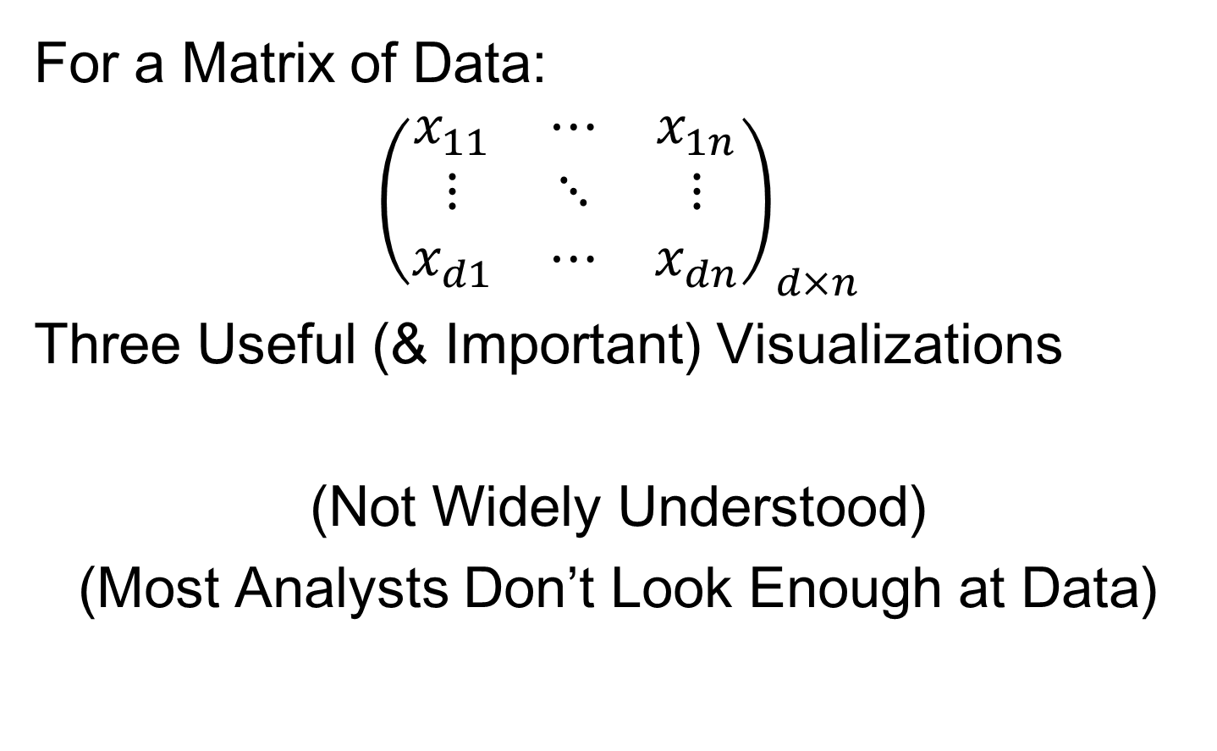
Big Picture Data Visualization
For a Matrix of Data:
$${\left(\begin{matrix}x_{11} & ⋯ & x_{1n} \\ ⋮ & ⋱ & ⋮ \\ x_{d1} & ⋯ & x_{dn}\end{matrix}\right)}_{d×n}$$
Three Useful (& Important) Visualizations
(Not Widely Understood)
(Most Analysts Don’t Look Enough at Data)

Slide 35
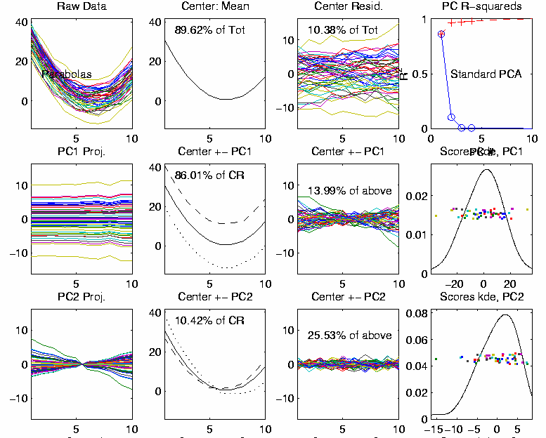

Big Picture Data Visualization
For a Matrix of Data:
$${\left(\begin{matrix}x_{11} & ⋯ & x_{1n} \\ ⋮ & ⋱ & ⋮ \\ x_{d1} & ⋯ & x_{dn}\end{matrix}\right)}_{d×n}$$
Three Useful (& Important) Visualizations
Curve Objects

Slide 36

Big Picture Data Visualization
For a Matrix of Data:
$${\left(\begin{matrix}x_{11} & ⋯ & x_{1n} \\ ⋮ & ⋱ & ⋮ \\ x_{d1} & ⋯ & x_{dn}\end{matrix}\right)}_{d×n}$$
Three Useful (& Important) Visualizations
Curve Objects
Relationships Between Objects
(e.g. scatterplot matrices)

Slide 37
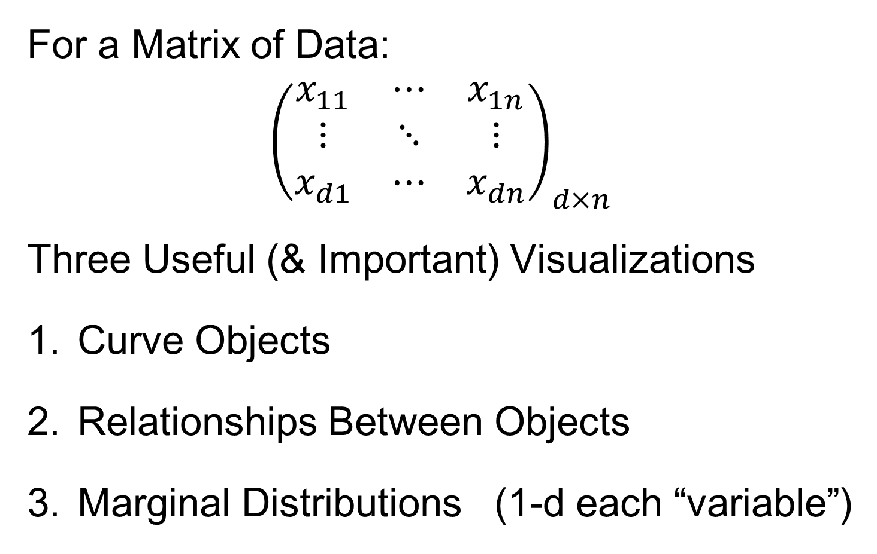
Big Picture Data Visualization
For a Matrix of Data:
$${\left(\begin{matrix}x_{11} & ⋯ & x_{1n} \\ ⋮ & ⋱ & ⋮ \\ x_{d1} & ⋯ & x_{dn}\end{matrix}\right)}_{d×n}$$
Three Useful (& Important) Visualizations
Curve Objects
Relationships Between Objects
Marginal Distributions (1-d each “variable”)

Slide 38
Marginal Distribution Plots
Ideas:
For Each Variable (i.e. Trait)
Study 1-d Distributions
Simultaneous Views:
Jitter Plots
Smooth Histograms (Kernel Density Est’s)

Slide 39
Next Time
Traits → Features

Slide 40
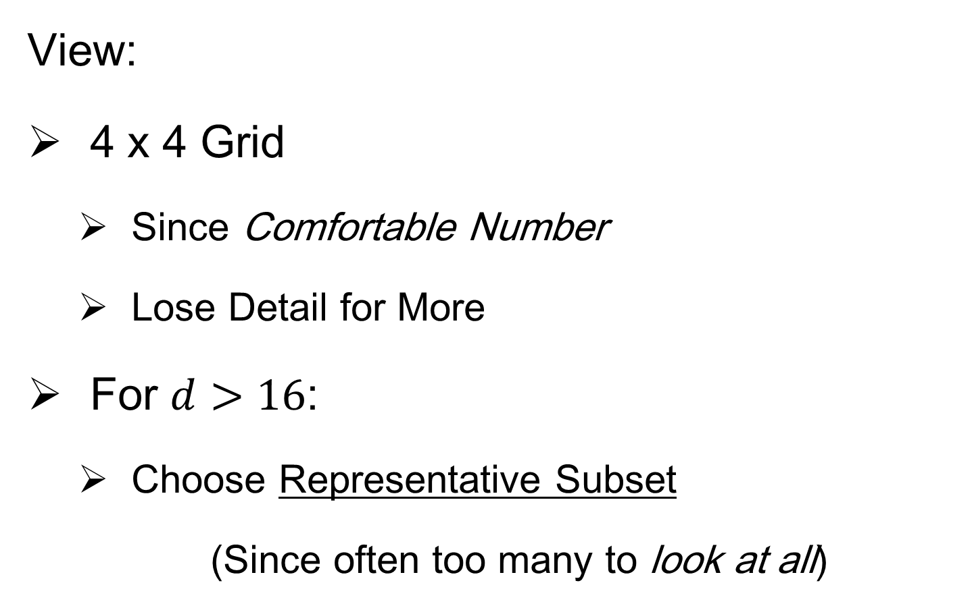
Marginal Distribution Plots
View:
4 x 4 Grid
Since Comfortable Number
Lose Detail for More
For $d>16$:
Choose Representative Subset
(Since often too many to look at all)
Text, Sec. 5.1

Slide 41
Marginal Distribution Plots
Representative Subset of Variables:
Sort Variables on a Data Summary
E.g Mean, S.D., Skewness, Median, …
Usually Take Nearly Equally Spaced Grid
Sometimes Specify Variables
E.g. All Largest (or Smallest) Summaries

Slide 42
Marginal Distribution Plots
Note Often Useful for:
Object Determination / Representation
Which Variables to Include?
How to Scale Variables?
Need to Transform (e.g. log) Variables?

Slide 43

Marginal Distribution Plots
Toy Example: $n=200$, $d=50$,
i.i.d. Poisson, with parameters $λ=0.2,⋯,20$
Each Row,
i.e. Variable
Logarithmically Equally Spaced

Slide 44
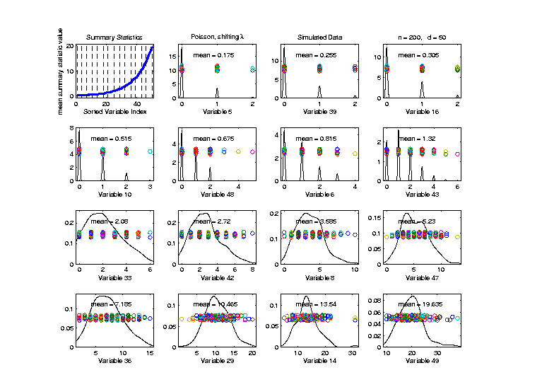

Marginal Distribution Plots
Toy Example: $n=200$, $d=50$,
i.i.d. Poisson, with parameters $λ=0.2,⋯,20$
Sort Variables
On Sample
Mean
Summary
Plot with
Equal
Spacing

Slide 45
Marginal Distribution Plots
Toy Example: $n=200$, $d=50$,
i.i.d. Poisson, with parameters $λ=0.2,⋯,20$
Sort Variables
On Sample
Mean
Dashed Lines
Correspond
To 1-d Distn’s

Slide 46
Marginal Distribution Plots
Toy Example: $n=200$, $d=50$,
i.i.d. Poisson, with parameters $λ=0.2,⋯,20$
Sort Variables
On Sample
Mean
Wide Range
Of Poissons

Slide 47
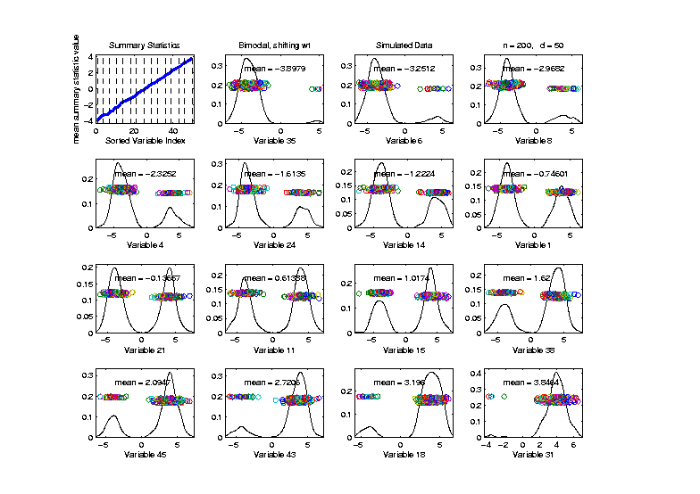

Marginal Distribution Plots
Toy Example: Normal Mean Mixture
$$ωN\left(4,1\right)+\left(1−ω\right)N\left(−4,1\right)$$
Sort on
Mean
Useful
Ordering

Slide 48
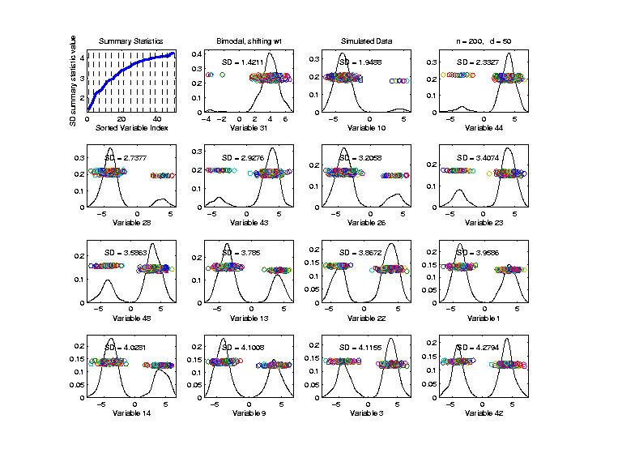

Marginal Distribution Plots
Toy Example: Normal Mean Mixture
$$ωN\left(4,1\right)+\left(1−ω\right)N\left(−4,1\right)$$
Sort on
Standard
Deviation
Less Useful
Ordering

Slide 49
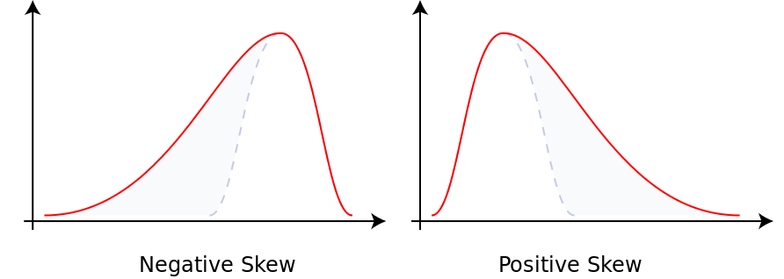
Marginal Distribution Plots
Additional Summaries: Skewness
Measure Asymmetry
Left Skewed Right Skewed
(Thanks to Wikipedia)

Slide 50
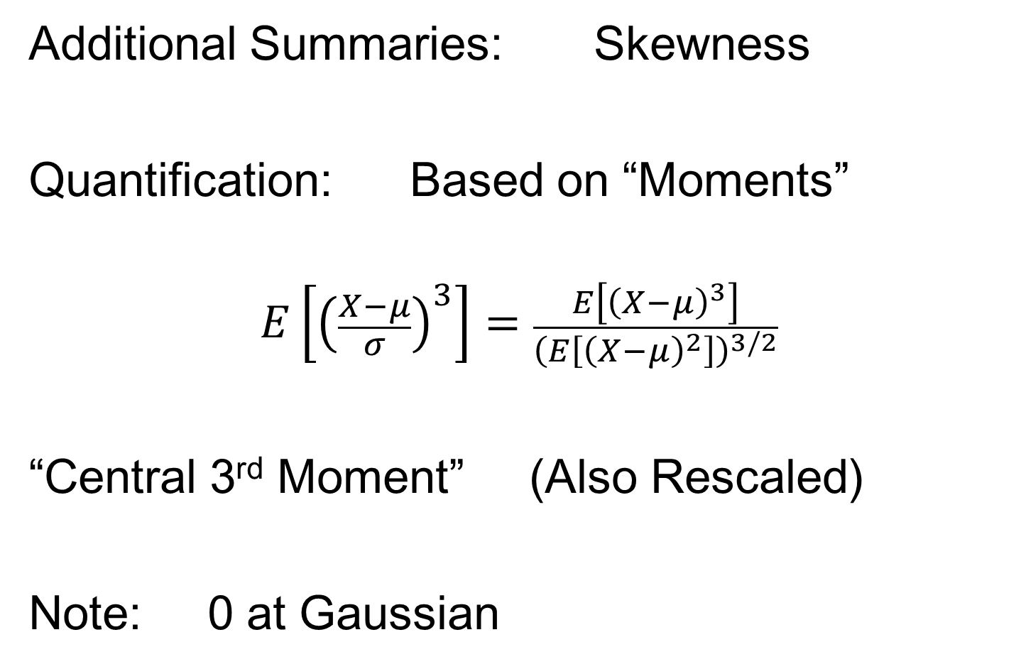
Marginal Distribution Plots
Additional Summaries: Skewness
Quantification: Based on “Moments”
$$E\left[{\left(\frac{X−μ}{σ}\right)}^{3}\right]=\frac{E\left[{\left(X−μ\right)}^{3}\right]}{{\left(E\left[{\left(X−μ\right)}^{2}\right]\right)}^{3/2}}$$
“Central 3rd Moment” (Also Rescaled)
Note: 0 at Gaussian

Slide 51
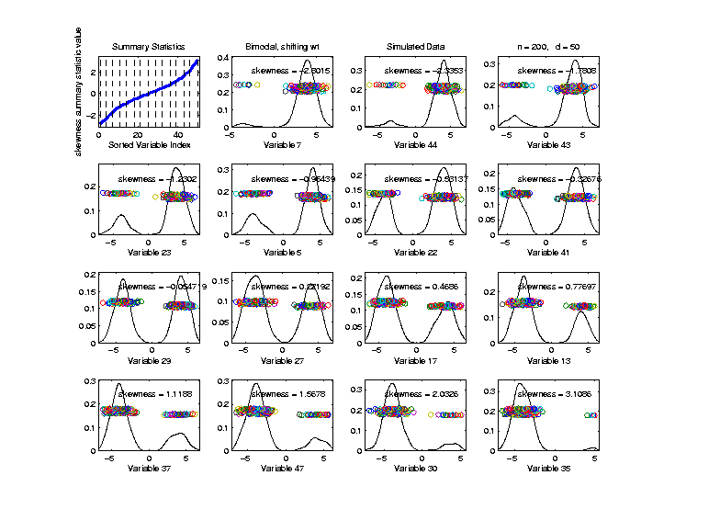
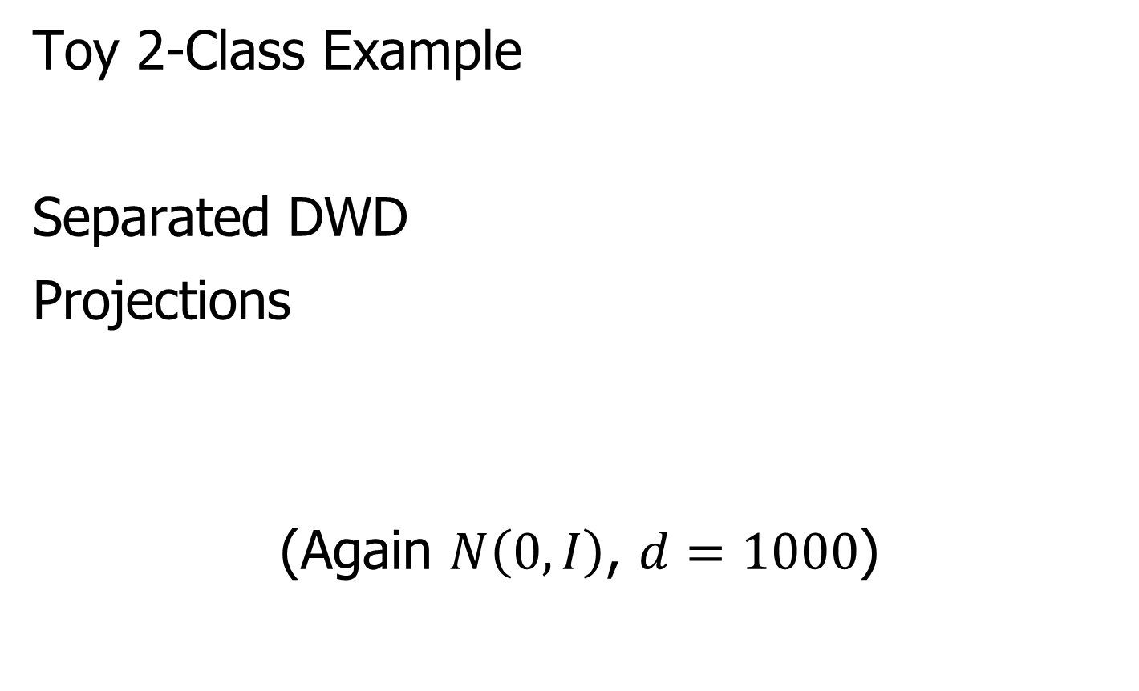
Marginal Distribution Plots
Toy Example: Normal Mean Mixture
$$ωN\left(4,1\right)+\left(1−ω\right)N\left(−4,1\right)$$
Sort on
Skewness
Useful
Ordering

Slide 52
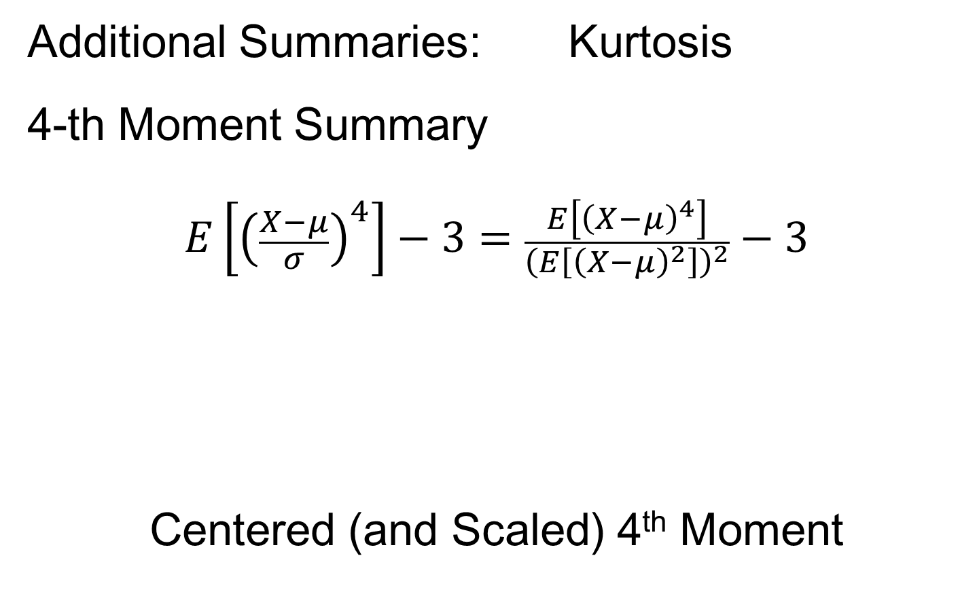
Marginal Distribution Plots
Additional Summaries: Kurtosis
4-th Moment Summary
$$E\left[{\left(\frac{X−μ}{σ}\right)}^{4}\right]−3=\frac{E\left[{\left(X−μ\right)}^{4}\right]}{{\left(E\left[{\left(X−μ\right)}^{2}\right]\right)}^{2}}−3$$
Centered (and Scaled) 4th Moment

Slide 53
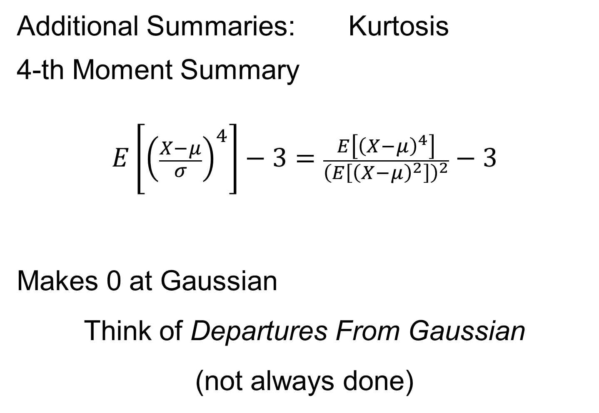
Marginal Distribution Plots
Additional Summaries: Kurtosis
4-th Moment Summary
$$E\left[{\left(\frac{X−μ}{σ}\right)}^{4}\right]−3=\frac{E\left[{\left(X−μ\right)}^{4}\right]}{{\left(E\left[{\left(X−μ\right)}^{2}\right]\right)}^{2}}−3$$
Makes 0 at Gaussian
Think of Departures From Gaussian
(not always done)

Slide 54
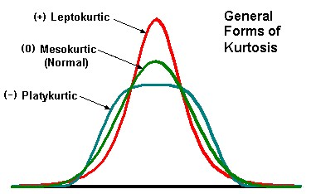
Marginal Distribution Plots
Additional Summaries: Kurtosis
4-th Moment Summary
Nice Graphic
(from mvpprograms.com)

Slide 55
Marginal Distribution Plots
Additional Summaries: Kurtosis
4-th Moment Summary
Positive Big at Peak
And Tails
(with controlled
variance)

Slide 56
Marginal Distribution Plots
Additional Summaries: Kurtosis
4-th Moment Summary
Negative Big in Flanks

Slide 57
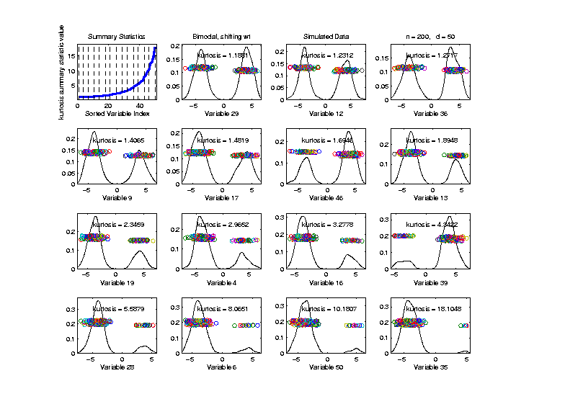
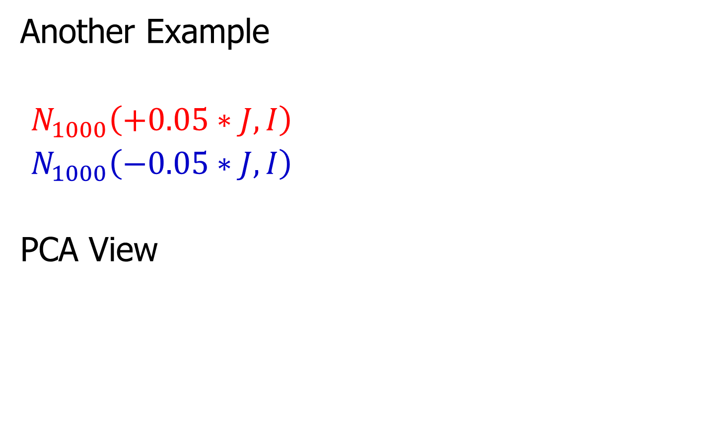
Marginal Distribution Plots
Toy Example: Normal Mean Mixture
$$ωN\left(4,1\right)+\left(1−ω\right)N\left(−4,1\right)$$
Sort on
Kurtosis
Less Useful
Ordering

Slide 58
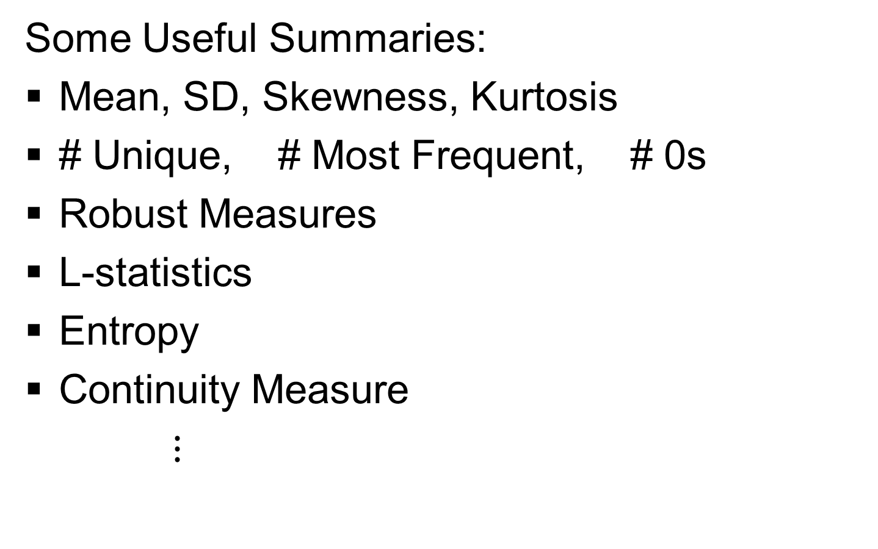
Marginal Distribution Plots
Some Useful Summaries:
Mean, SD, Skewness, Kurtosis
# Unique, # Most Frequent, # 0s
Robust Measures
L-statistics
Entropy
Continuity Measure
$⋮$

Slide 59
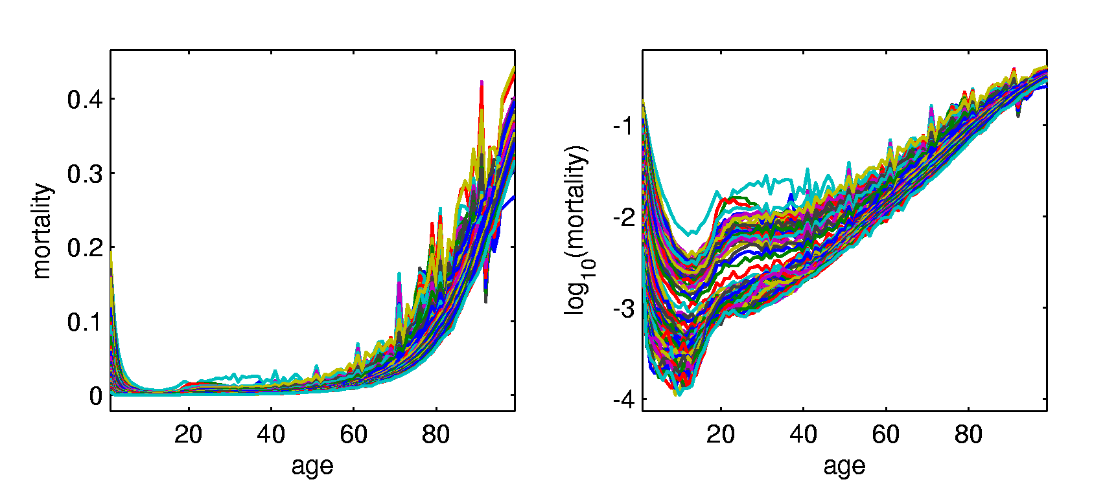
Marginal Distribution Plots
Spanish Male Mortality Data
Recall Value of Log Transform
Now Focus on Marginals
Text, Sec. 5.1.1
E. g. Just These Values
Or Just These

Slide 60
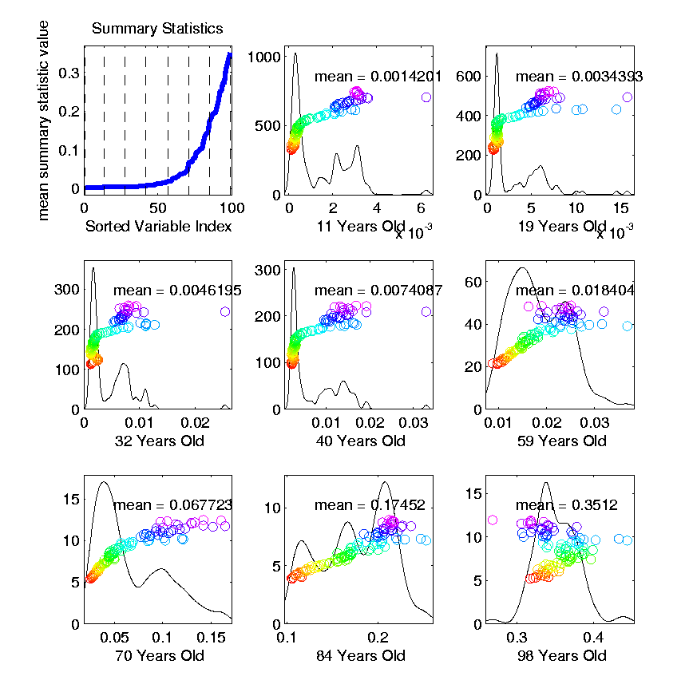
Marginal Distribution Plots
Spanish Male Mortality Data (Raw)
Note Many
Skewed
Marginals
Poor “Use
of Range”

Slide 61
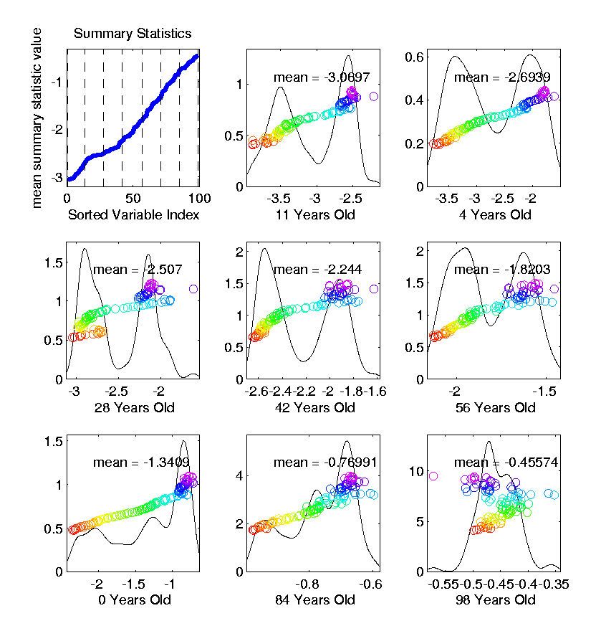
Marginal Distribution Plots
Spanish Male Mortality Data (log₁₀ scale)
Much Less
Skewness
Now Focus
On (Important)
Bimodality
Much Better
“Use of Range”

Slide 62
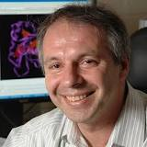
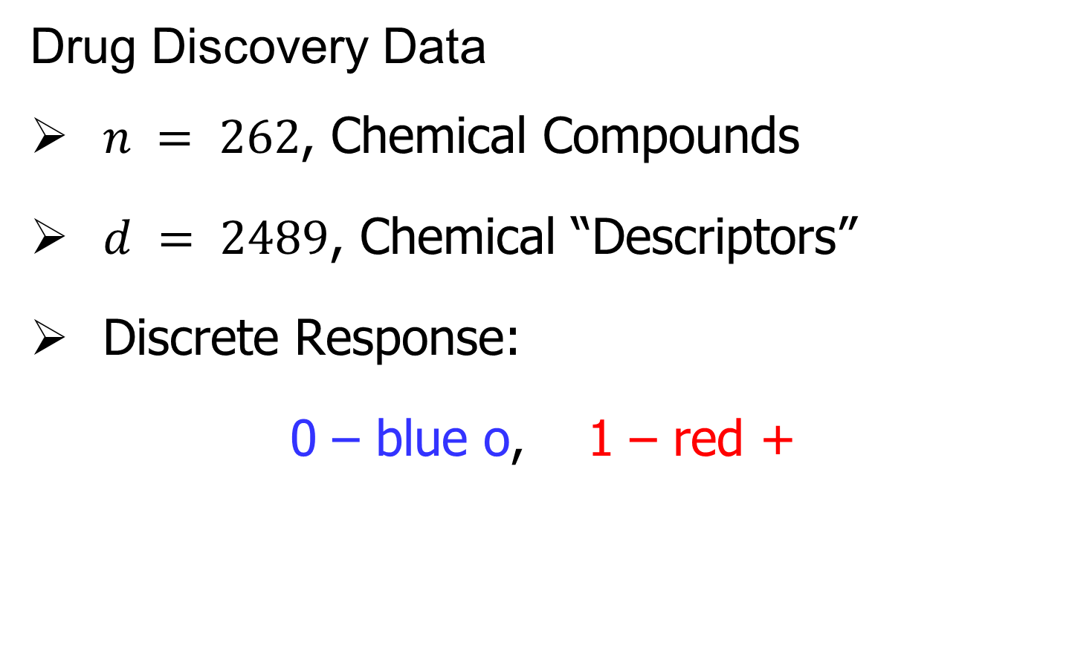
Marg. Dist. Plot Data Example
Drug Discovery Data
$n = 262$, Chemical Compounds
$d = 2489$, Chemical “Descriptors”
Discrete Response:
0 – blue o, 1 – red +
Text, Sec. 5.1.2
(Thanks to Alex Tropsha Lab)

Slide 63
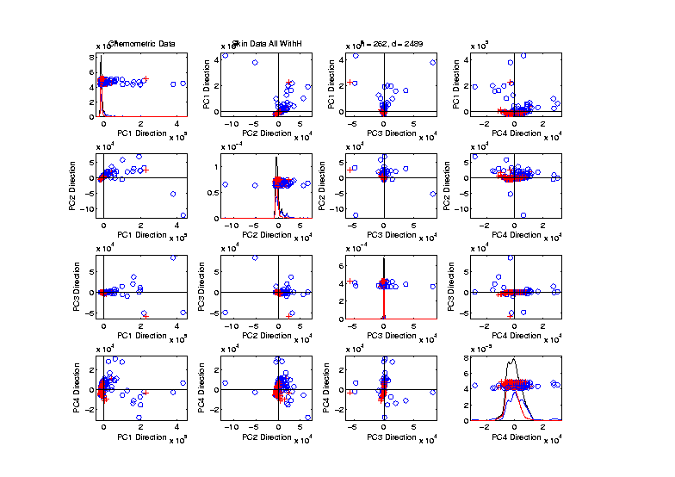
Marg. Dist. Plot Data Example
Drug Discovery – PCA Scatterplot
Dominated
By Few
Large
Compounds
Not Good
Blue - Red
Separation

Slide 64
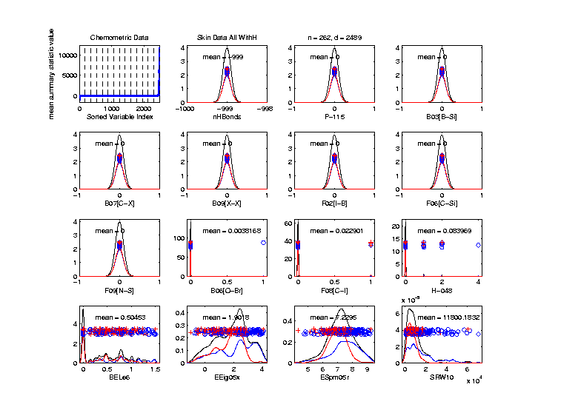
Marg. Dist. Plot Data Example
Drug Discovery – Sort on Means
Very Few
Are Crazy
Big
Will They
Dominate
PCA???

Slide 65
Marg. Dist. Plot Data Example
Drug Discovery – Sort on Means
Note: Many
With No
Variation???

Slide 66
Marg. Dist. Plot Data Example
Drug Discovery – Sort on Means
Suspicious
Value ???

Slide 67
Marg. Dist. Plot Data Example
Drug Discovery – Sort on Means
Note:
Sub-Densities
Highlight
Blue – Red
Differences

Slide 68
Marg. Dist. Plot Data Example
Drug Discovery – Sort on Means
Note:
Variable
(i.e. Trait)
Names

Slide 69
Next Time
Traits → Features

Slide 70
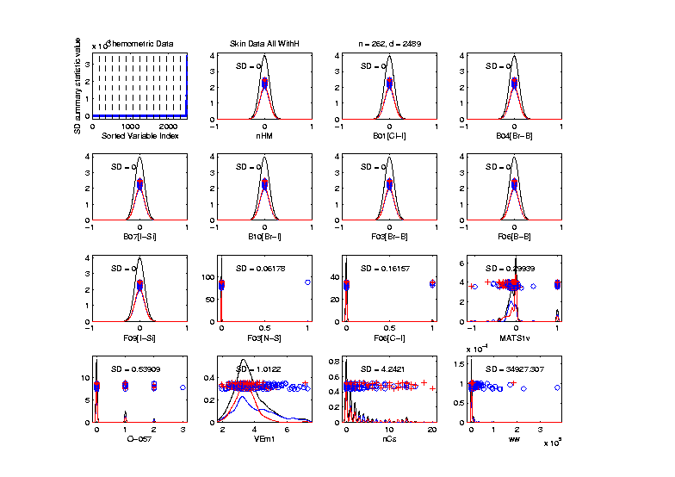
Marg. Dist. Plot Data Example
Drug Discovery – Sort on Standard Deviation
Very Large
Number of
0-Variation
Variables
(No Useful
Info…)

Slide 71
Marg. Dist. Plot Data Example
Drug Discovery – Sort on Means
Investigate Weird -999 Values
Note: Sometimes Such Values Are Used To Code Missing Values
(And Nobody Remembers to Say So)
(Not Too Bad Until Big Values Added In)

Slide 72
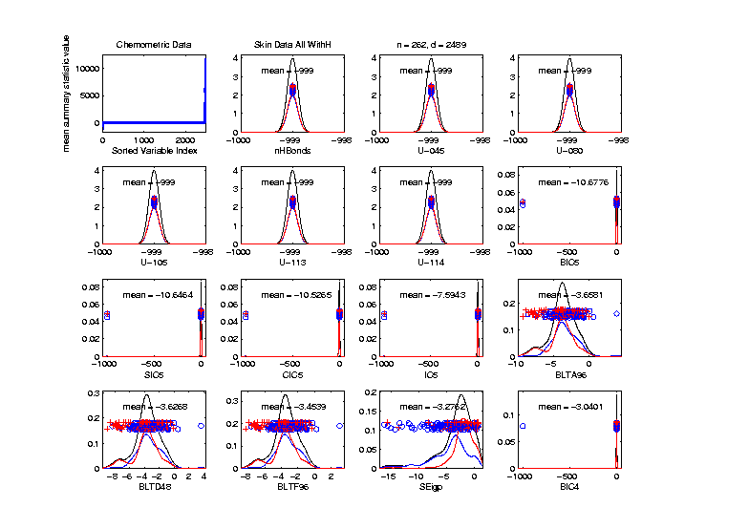
Marg. Dist. Plot Data Example
Drug Discovery – Sort on Means
Investigate Weird -999 Values, Via Mean
Look at
Smallest
Mean Values
(All Dashed
Bars On Left)

Slide 73
Marg. Dist. Plot Data Example
Drug Discovery – Sort on Means
Investigate Weird -999 Values, Via Mean,
Smallest
6 Variables
Are All -999

Slide 74
Marg. Dist. Plot Data Example
Drug Discovery – Sort on Means
Investigate Weird -999 Values, Via Mean,
Smallest
6 Variables
Are All -999
Other Have
Some -999

Slide 75
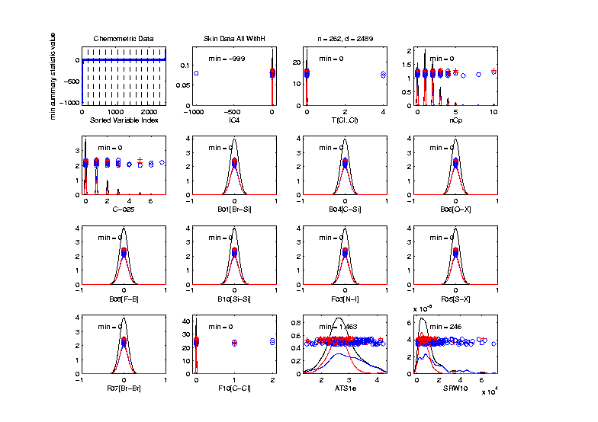
Marg. Dist. Plot Data Example
Drug Discovery
Focus on -999 Values, Using Minimum,
Equally
Spaced
Not Too
Many Such
Variables

Slide 76
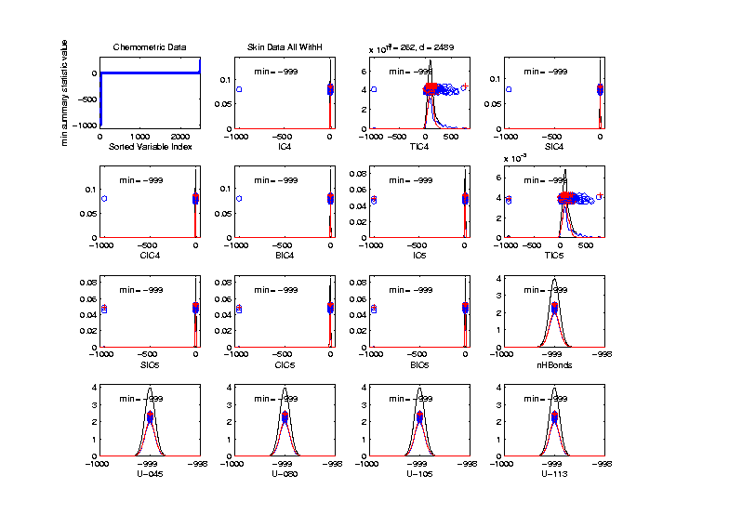
Marg. Dist. Plot Data Example
Drug Discovery
Focus More on -999 Values, Using Minimum,
Smallest 15
(Again All
Dashed
Bars On
Left)

Slide 77

Marg. Dist. Plot Data Example
Drug Discovery
Explicit Screening Found:
Out of $d = 2489$ Variables
$1315$ Had 0 Variance
$16$ Had some –999
So Deleted All Of The Above
Remaining Data Set Had $d = 1164$

Slide 78
Marg. Dist. Plot Data Example
Drug Discovery - Full Data PCA from Above
(Include
To Show
Contrast)

Slide 79

Marg. Dist. Plot Data Example
Drug Discovery - PCA After Variable Deletion
Looks Very
Similar!

Slide 80
Marg. Dist. Plot Data Example
Drug Discovery - PCA After Variable Deletion
Makes Sense
For 0-Var
Variables

Slide 81
Marg. Dist. Plot Data Example
Drug Discovery - PCA After Variable Deletion
-999s Have
No Impact
Since Others
Much Bigger!

Slide 82

Marg. Dist. Plot Data Example
Drug Discovery - After Variable Deletion
Sort Marginals On Means, Equally Spaced
Still Have
Massive
Variation
In Types

Slide 83
Marg. Dist. Plot Data Example
Drug Discovery - After Variable Deletion
Sort Marginals On Means, Equally Spaced
Still Have
Very Few
That Are
Very Big

Slide 84

Marg. Dist. Plot Data Example
Drug Discovery - Sort Marginals On SDs,
Equally Spaced To Study Variation
Very Wide
Range
Standardization
May Be Useful

Slide 85
Marg. Dist. Plot Data Example
Drug Discovery - Sort Marginals On SDs,
Equally Spaced To Study Variation
Now See
Some
Very Small
How Many?

Slide 86

Marg. Dist. Plot Data Example
Drug Discovery - Sort Marginals On SDs,
Smallest
Several
Very Small
Variables
Some Very
Skewed???

Slide 87

Marg. Dist. Plot Data Example
Drug Discovery - Sort On Skewness
Wide Range
(Consider
Transform-
ation)
0-1s Very
Prominent

Slide 88


Marg. Dist. Plot Data Example
Drug Discovery - Sort On Kurtosis
Again Very
Wide Range
Again 0-1s
Are Major
Players
So Focus on 0-1 Variables

Slide 89

Marg. Dist. Plot Data Example
Drug Discovery - Sort On Number Unique
Shows
Many
Binary

Slide 90
Marg. Dist. Plot Data Example
Drug Discovery - Sort On Number Unique
Shows
Many
Binary
Few Truly
Continuous

Slide 91

Marg. Dist. Plot Data Example
Drug Discovery - Sort On Number of Most Frequent
Shows Many
Have a Very
Common
Value
(Often 0)

Slide 92

Marg. Dist. Plot Data Example
Explicit Screening Found:
$d = 364$ Binary Variables
Consider Those Only
Do PCA
Try Variable Screening

Slide 93

Marg. Dist. Plot Data Example
Drug Discovery - PCA on Binary Variables
Interesting
Structure?

Slide 94
Marg. Dist. Plot Data Example
Drug Discovery - PCA on Binary Variables
Interesting
Structure?
Clusters?

Slide 95
Marg. Dist. Plot Data Example
Drug Discovery - PCA on Binary Variables
Interesting
Structure?
Clusters?
Stronger
Red vs. Blue

Slide 96
Marg. Dist. Plot Data Example
Drug Discovery - PCA on Binary Variables
Interesting
Structure?
Can See
“Activity
Cliffs”
Maggiora (2006)

Slide 97

Marg. Dist. Plot Data Example
Drug Discovery - Binary Variables, Mean Sort
Shows
Many Are
Mostly 0s

Slide 98

Marg. Dist. Plot Data Example
Common Practice:
Delete “Mostly 0” Variables (little information)
More Careful Look, Borysov et al (2016)
These Can Contain Useful Info
(Especially When So Many)
Not Clear What This Means!
Defined as “$≥95\% 0$s”

Slide 99

Marg. Dist. Plot Data Example
Explicit Screening Found:
$d = 800$Non-Binary Variables
Now Focus on Those Only
Standardize Variables
(Subtract Mean, Divide By SD)
An Approach to Wildly
Different Variable Scaling

Slide 100

Marg. Dist. Plot Data Example
Drug Discovery - PCA on non-Binary Variables
Interesting
Structure?

Slide 101
Marg. Dist. Plot Data Example
Drug Discovery - PCA on non-Binary Variables
Interesting
Structure?
Suggests
Subtypes

Slide 102
Marg. Dist. Plot Data Example
Drug Discovery - PCA on non-Binary Variables
Interesting
Structure?
Suggests
Subtypes
Reds Only?

Slide 103
Marg. Dist. Plot Data Example
Drug Discovery - PCA on non-Binary Variables
Again
Suggestion
Of “Activity
Cliffs”
Maggiora (2006)

Slide 104

Inference for Drug Discovery Data
Raw Data – DWD & Ortho PCs Scatterplot
Some
Blue - Red
Separation
But Dominated
By Few Large
Compounds
Now Do Confimatory Analysis

Slide 105

Inference for Drug Discovery Data
Binary Data – DWD & Ortho PCs Scatterplot
Better
Blue - Red
Separation
And
Visualization

Slide 106

Inference for Drug Discovery Data
Standard’d Non-Binary Data – DWD & OPCA
Better
Blue - Red
Separation
???
Very Useful
Visualization

Slide 107

Inference for Drug Discovery Data
DiProPerm test of Blue vs. Red
Full Raw Data
Z = 10.4
Reasonable
Difference
Note Strange
Permutations

Slide 108

Inference for Drug Discovery Data
DiProPerm test of Blue vs. Red
Delete var = 0 & -999 Variables
Z = 11.6
Slightly
Stronger
No Visual Diff.
Yet DiProPerm
Finds Some
Or Is Difference Within
Simulation Variation???

Slide 109

Inference for Drug Discovery Data
DiProPerm test of Blue vs. Red
Binary Variables Only
Z = 14.6
More Than
Raw Data
Much Nicer
Permutations

Slide 110

Inference for Drug Discovery Data
DiProPerm test of Blue vs. Red
Non-Binary – Standardized
Z = 17.3
Stronger
Reflects
More Info
In Data

Slide 111

Inference for Drug Discovery Data
Introduced
Very Soon
DiProPerm test of Blue vs. Red
Non-Binary – Shifted Log Transforms
Z = 17.9
Slightly
Stronger

Slide 112
Inference for Drug Discovery Data
Summary of DiProPerm Z-scores after each Processing Step:
Data | Z-score
Raw | 10.4
No Missings | 11.6
Binary Only | 14.6
Standardized | 17.3
Auto-log Trans’d | 17.8

Slide 113

Matlab Software
Recall OODA Software

Slide 114
Marginal Distribution Plots
Matlab Software:
MargDistPlotSM.m
In General Directory

Slide 115
Object Oriented Data Analysis
Three Major Phases of OODA:
I. Object Definition
“What are the Data Objects?”
Exploratory Analysis
“What Is Data Structure / Drivers?”
III. Confirmatory Analysis / Validation
Is it Really There (vs. Noise Artifact)?

Slide 116

Limitation of PCA
Strongly Feels Scaling of Each Variable
Consequence:
May want to standardize each variable
(i.e. subtract $\overline{X}$, divide by $s$)
Also called Whitening
Equivalent Approach:
Base PCA on Correlation Matrix
Called Correlation PCA
Instead of Usual
Covariance Matrix

Slide 117
Correlation PCA
Why use correlation matrix?
Makes variables (traits) “unit free”
e.g. Height, Weight, Age, $, …
Are “directions in point cloud” meaningful or useful?
Will unimportant directions dominate?
Text Section 5.2

Slide 118
Next Time
Traits → Features

Slide 119
Correlation PCA
A related (& better known?) variation of PCA:
Replace cov. matrix with correlation matrix
I.e. do eigen analysis of
Where

Slide 120
Correlation PCA
Personal Thoughts on Correlation PCA:
Can be very useful
(especially with noncommensurate units)
Not always, can hide important structure
To make choice:
Decide whether whitening is useful
My personal use of correlat’n PCA is rare
Other people use it most of the time

Slide 121
Correlation PCA
Personal Thoughts on Correlation PCA:
Can be very useful
(especially with noncommensurate units)
Not always, can hide important structure
Illustrate with example

Slide 122

Correlation PCA
Toy Example Contrasting Cov. vs. Corr.

Slide 123
Correlation PCA
Toy Example Contrasting Cov. vs. Corr.
Big Var’n
Part

Slide 124
Correlation PCA
Toy Example Contrasting Cov. vs. Corr.
Big Var’n
Part
Small
Var’n
Part

Slide 125

Correlation PCA
Toy Example Contrasting Cov. vs. Corr.
1st Comp:
Nearly Flat
Look at PCA Modes of Variation

Slide 126
Correlation PCA
Toy Example Contrasting Cov. vs. Corr.
1st Comp:
Nearly Flat
2nd Comp:
Contrast
Note: Another
Case Where
This View Is
Very Informative

Slide 127
Correlation PCA
Toy Example Contrasting Cov. vs. Corr.
1st Comp:
Nearly Flat
2nd Comp:
Contrast
3rd & 4th:
Very Small

Slide 128
Correlation PCA
Toy Example Contrasting Cov. vs. Corr.
1st Comp:
Nearly Flat
2nd Comp:
Contrast
3rd & 4th:
Look Very
Small Since
Common Axes

Slide 129

Correlation PCA
Toy Example Contrasting Cov. vs. Corr.
Use Rescaled
Axes (Typical
Default)
Now Can
See Mean

Slide 130
Correlation PCA
Toy Example Contrasting Cov. vs. Corr.
Use Rescaled
Axes (Typical
Default)
All Comp’s
Visible
(sin & cos)

Slide 131
Correlation PCA
Toy Example Contrasting Cov. vs. Corr.
Use Rescaled
Axes (Typical
Default)
All Comp’s
Visible
Good or
Bad ???

Slide 132

Correlation PCA
Toy Example Contrasting Cov. vs. Corr.
Correlation
“Whitened”
Version
Each Coord.
Rescaled
By Its S.D.

Slide 133

Correlation PCA
Toy Example Contrasting Cov vs. Corr.
Correlation
“Whitened”
Version
All Much
Different

Slide 134
Correlation PCA
Toy Example Contrasting Cov. vs. Corr.
Correlation
“Whitened”
Version
All Much
Different
Which Is
“Right” ???

Slide 135
Transformations
Text: Sec. 5.3
Useful Method for Data Analysis
Apply to Marginal Distributions
(i.e. to Individual Variables)
Idea: Put Data on Right Scale
Common Example:
Data Orders of Magnitude Different
Log₁₀ Puts Data on More Analyzable Scale
Recall Log for
Mortality and
RNAseq Data

Slide 136

Transformations
Famous Family:
Box – Cox Transformations
Box & Cox (1964)
Given a parameter $λ∈ℝ$,
$$x ↦ \frac{x^{λ}−1}{λ}$$

Slide 137

Transformations
Box – Cox Transformations
Why this strange form? Instead of just
$$x ↦x^{λ}$$
Reason: Nicer Behavior as $λ→0$,
$$\lim_{λ→0}{\frac{x^{λ}−1}{λ}}=\ln{x}$$

Slide 138

Homework 3
Verify that, for $x>0$, and $λ∈ℝ$,
$$\lim_{λ→0}{\frac{x^{λ}−1}{λ}}=\ln{x}$$
Turn in .pdf Answer on Canvas, Either
Word Processed or Write & Photo
Due: Feb. 8,
11:00AM

Slide 139


Transformations
Box – Cox Transformations
(vs. $x$)
(graphics from http://onlinestatbook.com/2/transformations/box-cox.html)

Slide 140

Transformations
Box – Cox Transformations
(vs. $x$)
(vs. $\ln{x}$)
(graphics from http://onlinestatbook.com/2/transformations/box-cox.html)

Slide 141


Transformations
Box – Cox Transformations (vs. $\ln{x}$)
(graphics from http://onlinestatbook.com/2/transformations/box-cox.html)
Lots of Flexibility
to Address Either
Positive or Negative
Skewness

Slide 142

Transformations
Another useful family:
Shifted Log Transformations
Given a parameter $δ∈ℝ$,
$$x ↦ \log\left(x+δ\right)$$
(Will use more below)

