Slide 1
Statistics – O. R. 881
Object Oriented Data Analysis
Steve Marron
Dept. of Statistics and Operations Research
University of North Carolina

Slide 2
Current Sections in Textbook
Today:
Sections 7.1, 7.2, 1.2, 5.2, 8.4
Next Class:
Sections 8.1, 8.2, 8.3

Slide 3
Participant Presentations
Starting Next Tuesday:
1:35 Sara Peterson
Notes:
Can Use USB Device
Or Your Computer (with HDMI)
Or Remote Log-In, Set Up Before Class
Have Title Page With:
  Your Name
  Your Affiliation
Check Website
For Schedule

Slide 4

Last Class: Centering
Data Matrix:
$\tilde{X}=\left[\begin{matrix}{\tilde{x}}_{1,1} & ⋯ & {\tilde{x}}_{1,n} \\ ⋮ & ⋱ & ⋮ \\ {\tilde{x}}_{d,1} & ⋯ & {\tilde{x}}_{d,n}\end{matrix}\right]$
Column Object Mean:
$${\overline{x}}_{co}=\left(\begin{matrix}{\overline{x}}_{1,A} \\ ⋮ \\ {\overline{x}}_{d,A}\end{matrix}\right)$$
where ${\overline{x}}_{i,A}=\frac{1}{n}\sum_{j=1}^{n}{{\tilde{x}}_{i,j}}$
Avoid Row-Column
Ambiguity Using
Object Oriented
Nomenclature
Could Call This
the “Row Mean”

Slide 5

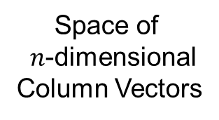
Last Class: Centering
Data Matrix:
$\tilde{X}=\left[\begin{matrix}{\tilde{x}}_{1,1} & ⋯ & {\tilde{x}}_{1,n} \\ ⋮ & ⋱ & ⋮ \\ {\tilde{x}}_{d,1} & ⋯ & {\tilde{x}}_{d,n}\end{matrix}\right]$
Additional Notion: Row Trait Mean
${\overline{x}}_{RT}^{t}=\left(\begin{matrix}{\overline{x}}_{A,1} & ⋯ & {\overline{x}}_{A,n}\end{matrix}\right)$ for ${\overline{x}}_{RT}∈ℝ^{n}$
where ${\overline{x}}_{A,j}=\frac{1}{d}\sum_{i=1}^{d}{{\tilde{X}}_{i,j}}$
transpose
Disambiguates
“Row Mean” vs.
“Column Mean”
Space of
$n$-dimensional
Column Vectors

Slide 6
Last Class: Detailed Look at PCA
Three Important (& Interesting) Viewpoints:
Mathematics
Numerics
Statistics
Goal: Study Interrelationships

Slide 7
Last Class: PCA: Rediscovery
Statistics:
Principal Component Analysis (PCA)
Social Sciences:
Factor Analysis (PCA is a subset)
Probability / Electrical Eng:
Karhunen – Loeve expansion
Applied Mathematics:
Proper Orthogonal Decomposition (POD)
Geo-Sciences:
Empirical Orthogonal Functions (EOF)

Slide 8
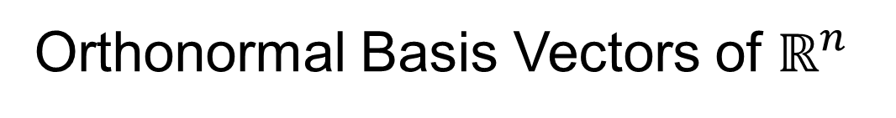
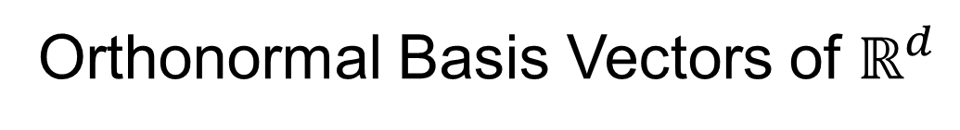




Last Class: Linear Algebra
SVD Full Representation:
=
$$V_{n×n}^{t}$$
$$X_{d×n}$$
$$U_{d×d}$$
$$S_{d×n}$$
Orthonormal Basis Vectors of $ℝ^{d}$
Diagonal Matrix of Singular Values
Orthonormal Basis Vectors of $ℝ^{n}$

Slide 9

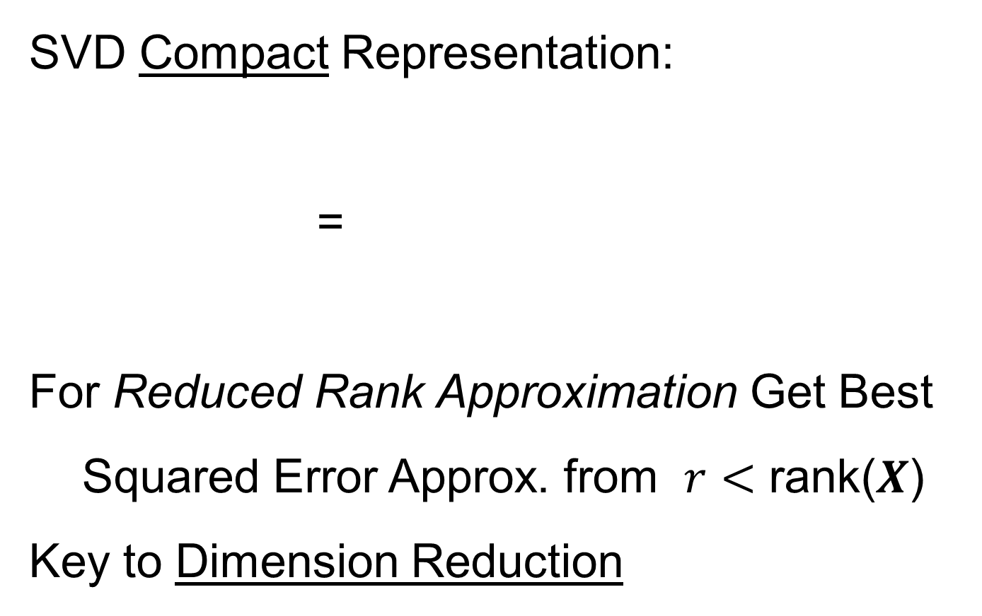


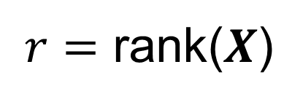
Last Class: Linear Algebra
SVD Compact Representation:
=
For Reduced Rank Approximation Get Best Squared Error Approx. from $r<$ rank($X$)
Key to Dimension Reduction
$$S_{r×r}$$
$$V_{r×n}^{t}$$
$$X_{d×n}$$
$$U_{d×r}$$
$r=$ rank($X$)

Slide 10
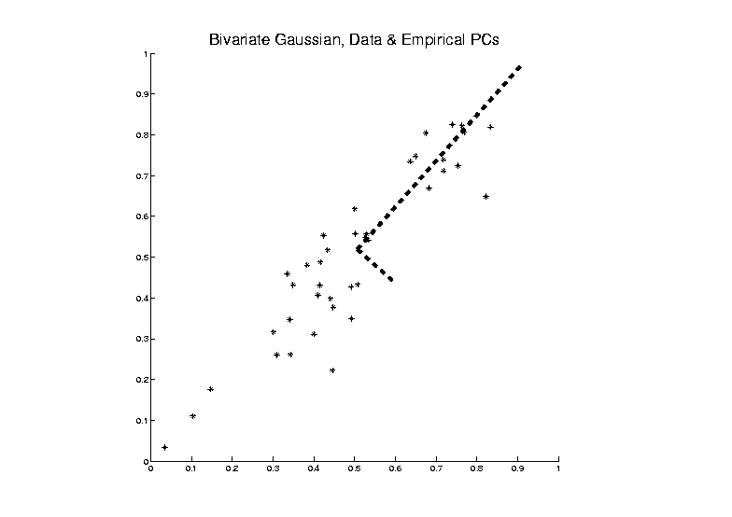


Last Class: PCA Optimization
Find Direction of Greatest Variability:
Approach to
Calculation:
And Optimize Over $u$, such that $\left\|u\right\|=1$
Start with
Candidate
Direction $u$

Slide 11
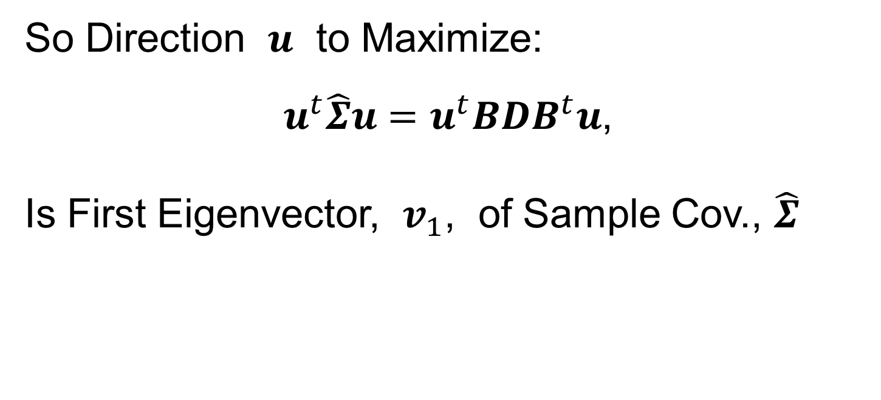
Last Class: PCA Optimization
So Direction $u$ to Maximize:
$u^{t}\hat{Σ}u=u^{t}BDB^{t}u$,
Is First Eigenvector, $v_{1}$, of Sample Cov., $\hat{Σ}$

Slide 12
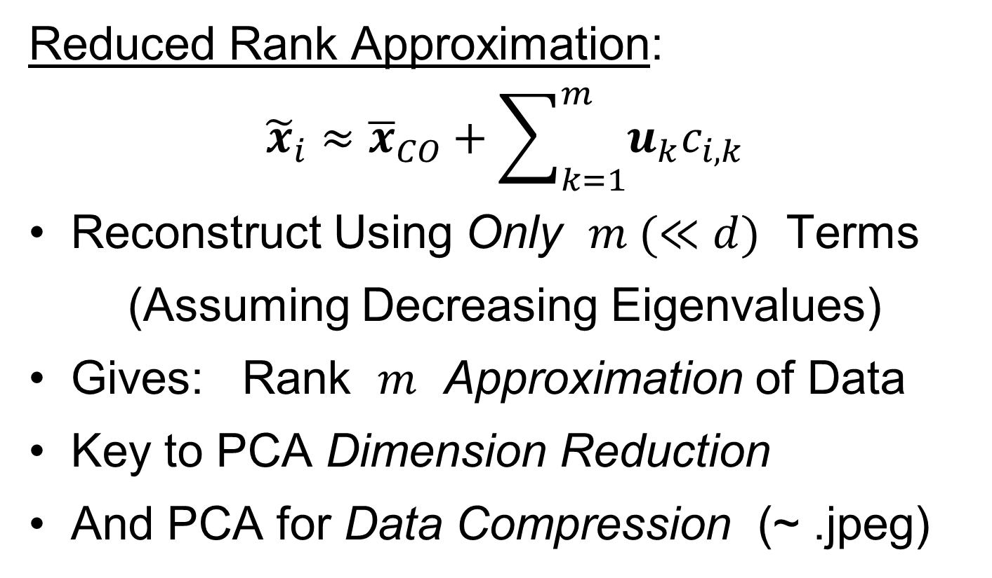
Last Class: PCA Data Rep’n
Reduced Rank Approximation:
$${\tilde{x}}_{i}≈{\overline{x}}_{CO}+\sum_{k=1}^{m}{u_{k}c_{i,k}}$$
Reconstruct Using Only $m (≪d)$ Terms
(Assuming Decreasing Eigenvalues)
Gives: Rank $m$ Approximation of Data
Key to PCA Dimension Reduction
And PCA for Data Compression (~ .jpeg)

Slide 13
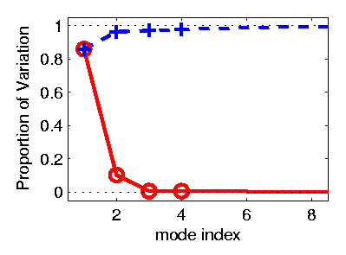
PCA Redistribution of Energy
Now for Scree Plots (Upper Right of FDA Anal.)
Carefully Look At:
Intuition
Relation to Eigenanalysis
Numerical Calculation

Slide 14

PCA Redist’n of Energy (Cont.)
ANOVA Mean Decomposition (of $x_{1},⋯,x_{n}∈ℝ$)
Total Variation =
= Mean Variation + Mean Residual Variation
$\sum_{i=1}^{n}{{\left\|x_{i}\right\|}^{2}}$= $\sum_{i=1}^{n}{{\left\|\overline{x}\right\|}^{2}}+\sum_{i=1}^{n}{{\left\|x_{i}−\overline{x}\right\|}^{2}}$
Mathematics: Pythagorean Theorem
Intuition Quantified via Sums of Squares
(Squares More Intuitive Than Absolutes)

Slide 15

PCA Redist’n of Energy (Cont.)
$$\frac{1}{n}\sum_{i=1}^{n}{{\left\|{\tilde{x}}_{i}−{\overline{x}}_{CO}\right\|}^{2}}=tr\left(BDB^{t}\right)=tr\left(BB^{t}D\right)=tr\left(D\right)=\sum_{j=1}^{d}{λ_{j}}$$
Eigenvalues Provide Atoms of SS Decompos’n
Useful Plots are:
Power Spectrum: $λ_{j}$ vs. $j$
log Power Spectrum: $log\left(λ_{j}\right)$ vs. $j$
Cumulative Power Spectrum: $\sum_{j^{′}=1}^{j}{λ_{j′}}$ vs. $j$
Note PCA Gives SS’s for Free (As Eigenval’s),
But Watch Factors of $\sqrt{n}$
“Scree Plot”
Notes:
15

Slide 16
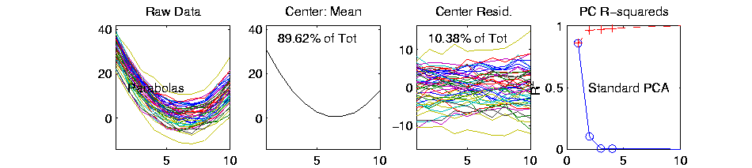
PCA Redist’n of Energy (Cont.)
Note, have already considered some of these Useful Plots:
Power Spectrum (as %s)
Cumulative Power Spectrum (%)
Recall Common Terminology:
Power Spectrum is Called
“Scree Plot”
Kruskal (1964) Cattell (1966)
(all but name “scree”) (1st Appearance of name???)
Notes:
16

Slide 17
PCA vs. SVD
Sometimes “SVD Analysis of Data”
= Uncentered PCA ≠ PCA Centered at 0

Slide 18
PCA vs. SVD
Sometimes “SVD Analysis of Data”
= Uncentered PCA ≠ PCA Centered at 0
Consequence: Skip this step

Slide 19
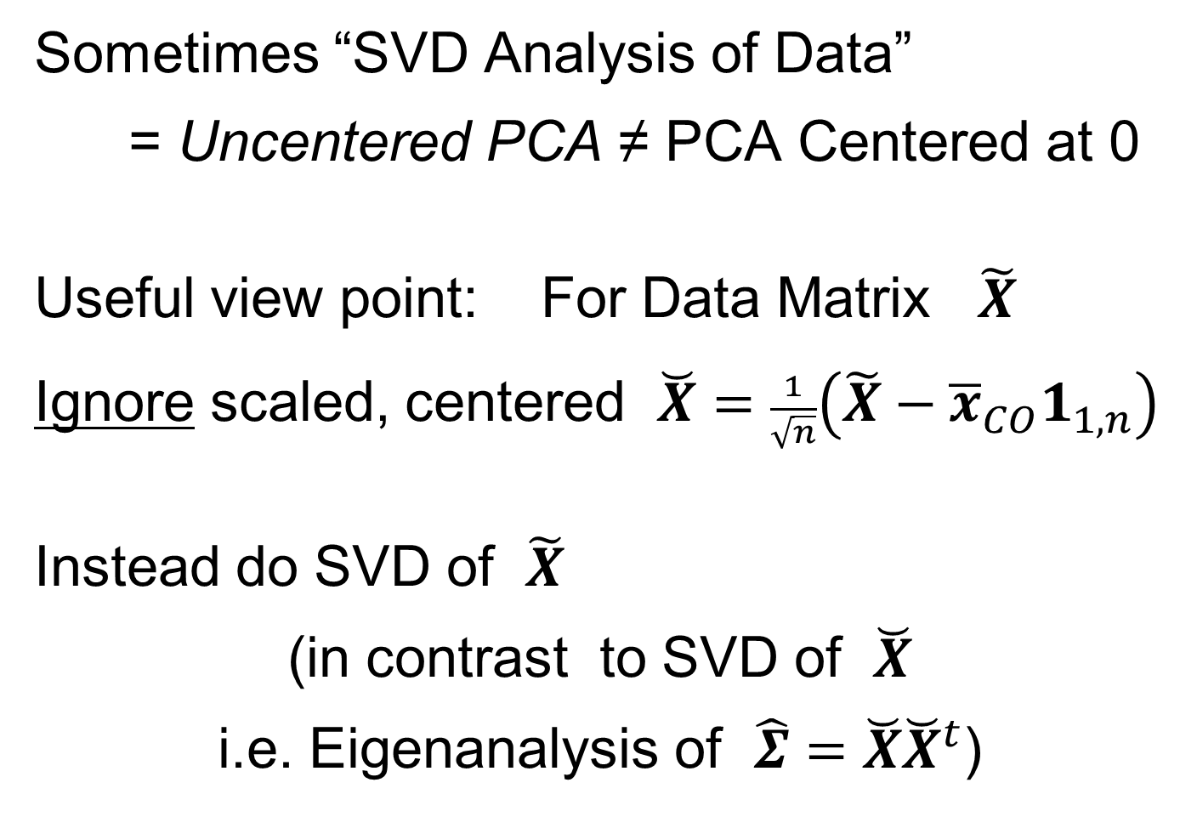
PCA vs. SVD
Sometimes “SVD Analysis of Data”
= Uncentered PCA ≠ PCA Centered at 0
Useful view point: For Data Matrix $\tilde{X}$
Ignore scaled, centered $\breve{X}=\frac{1}{\sqrt{n}}\left(\tilde{X}−{\overline{x}}_{CO}1_{1,n}\right)$
Instead do SVD of $\tilde{X}$
(in contrast to SVD of $\breve{X}$
i.e. Eigenanalysis of $\hat{Σ}=\breve{X}{\breve{X}}^{t}$)

Slide 20
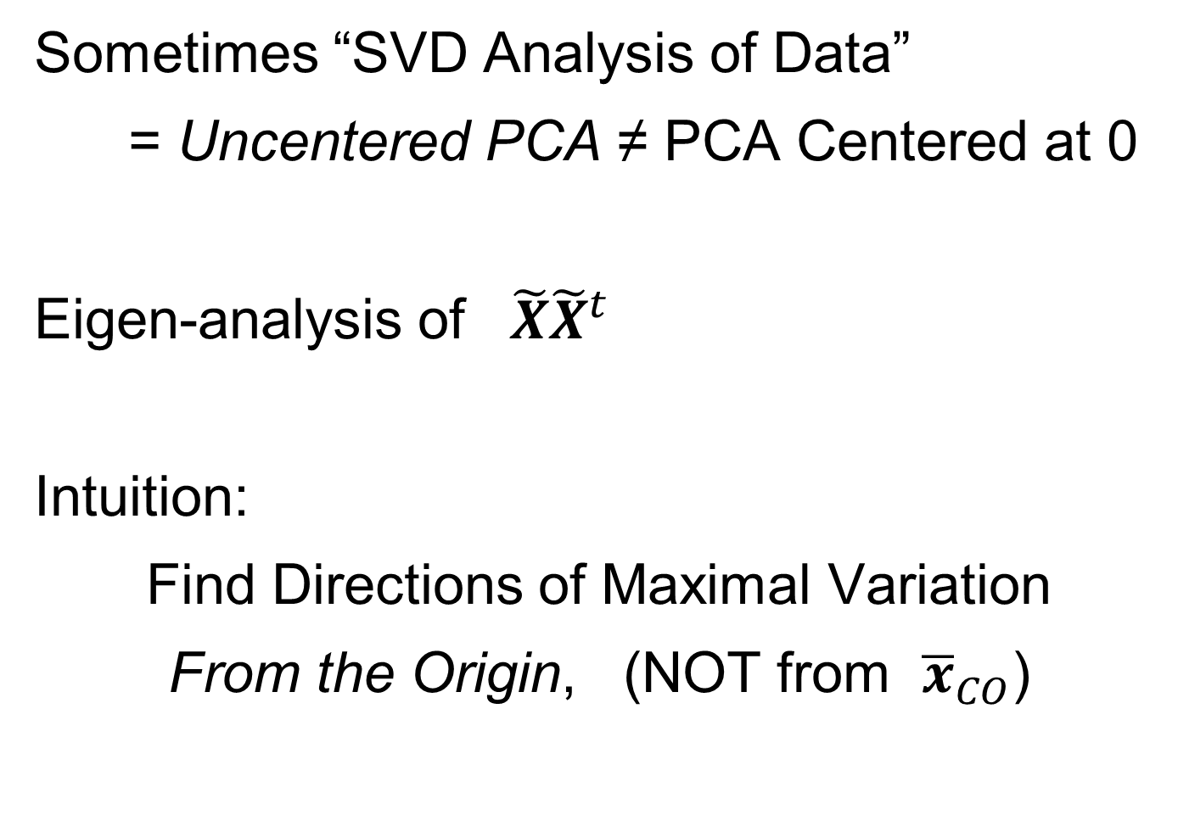
PCA vs. SVD
Sometimes “SVD Analysis of Data”
= Uncentered PCA ≠ PCA Centered at 0
Eigen-analysis of $\tilde{X}{\tilde{X}}^{t}$
Intuition:
Find Directions of Maximal Variation
From the Origin, (NOT from ${\overline{x}}_{CO}$)

Slide 21
PCA vs. SVD
Sometimes “SVD Analysis of Data”
= Uncentered PCA ≠ PCA Centered at 0
Investigate with Similar Toy Example

Slide 22
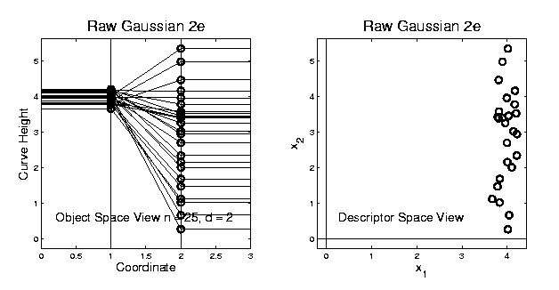
PCA vs. SVD
2-d Toy Example
Direction of “Maximal Variation”???

Slide 23
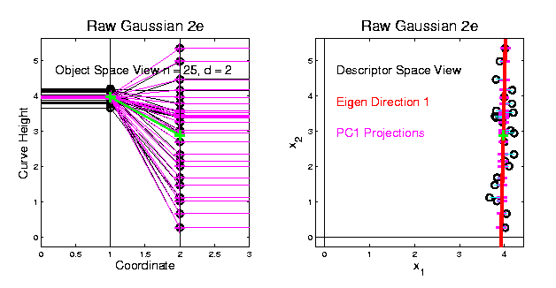
PCA vs. SVD
2-d Toy Example
Direction of “Maximal Variation”???
PC1 Solution (Mean Centered)
Very Good!

Slide 24
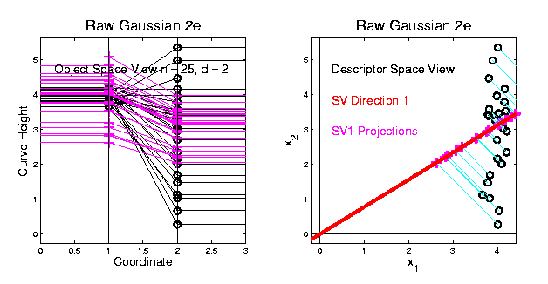
PCA vs. SVD
2-d Toy Example
Direction of “Maximal Variation”???
SV1 Solution (Origin Centered)
Poor Rep’n

Slide 25
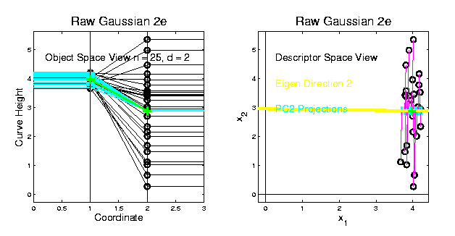
PCA vs. SVD
2-d Toy Example
Look in Orthogonal Direction:
PC2 Solution (Mean Centered) Very Good!

Slide 26
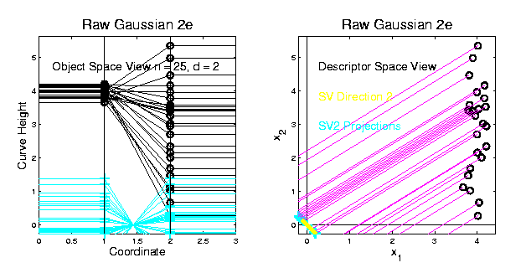
PCA vs. SVD
2-d Toy Example
Look in Orthogonal Direction:
SV2 Solution (Origin Centered) Off Map!

Slide 27
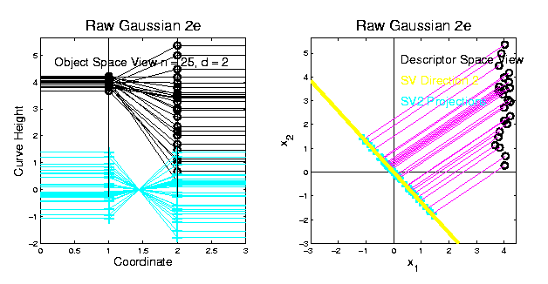
PCA vs. SVD
2-d Toy Example
SV2 Solution Larger Scale View:
Not Representative of Data

Slide 28
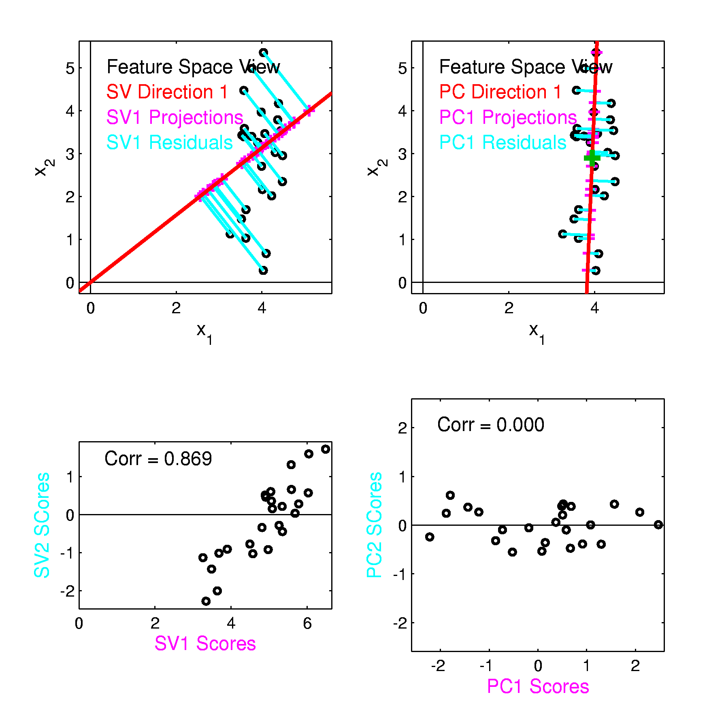
PCA vs. SVD
Similar 2-d
Toy Example
Now
Compare
Scores

Slide 29
PCA vs. SVD
Consequences
Of Centering:
PCA Scores Are
Mean Centered
Not SVD Scores

Slide 30
PCA vs. SVD
Consequences
Of Centering:
PCA Scores Are
Uncorrelated
Not SVD Scores

Slide 31
PCA vs. SVD
Sometimes “SVD Analysis of Data”
= Uncentered PCA
Investigated with Toy Examples:
Conclusions:
PCA Generally Better
Unless “Origin Is Important”
Deeper Look: Zhang et al (2007)

Slide 32
Different Views of PCA
Solves several optimization problems:
Direction to maximize SS of 1-d proj’d data
Notes:
32

Slide 33
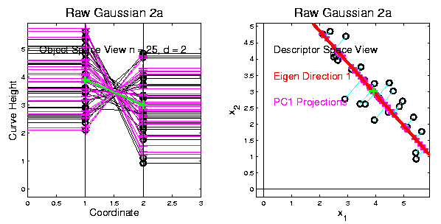
Different Views of PCA
2-d Toy Example
Max SS of Projected Data
Notes:
33

Slide 34
Different Views of PCA
Solves several optimization problems:
Direction to maximize SS of 1-d proj’d data
Direction to minimize SS of residuals
Notes:
34

Slide 35
Different Views of PCA
2-d Toy Example
Max SS of Projected Data
Min SS of Residuals
Notes:
35

Slide 36
Different Views of PCA
Solves several optimization problems:
Direction to maximize SS of 1-d proj’d data
Direction to minimize SS of residuals
(same, by Pythagorean Theorem)
“Best fit line” to data in “orthogonal sense”
(vs. regression of Y on X = vertical sense
& regression of X on Y = horizontal sense)
Notes:
36

Slide 37
Different Views of PCA
2-d Toy Example
Max SS of Projected Data
Min SS of Residuals
Best Fit Line
Notes:
37

Slide 38
Different Views of PCA
Toy Example Comparison of Fit Lines:
PC1
Regression of Y on X
Regression of X on Y
Notes:
38

Slide 39
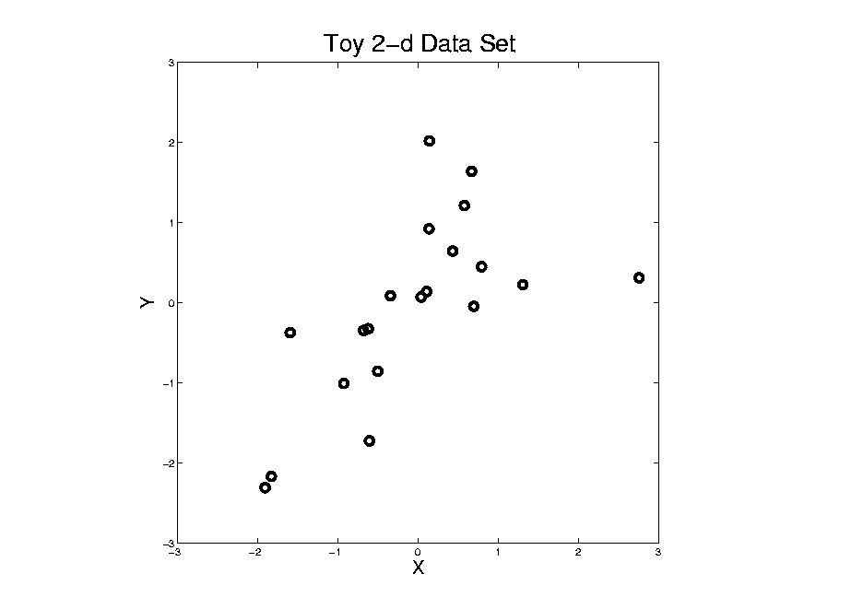
Different Views of PCA
Normal
Data
ρ = 0.3
Notes:
39

Slide 40
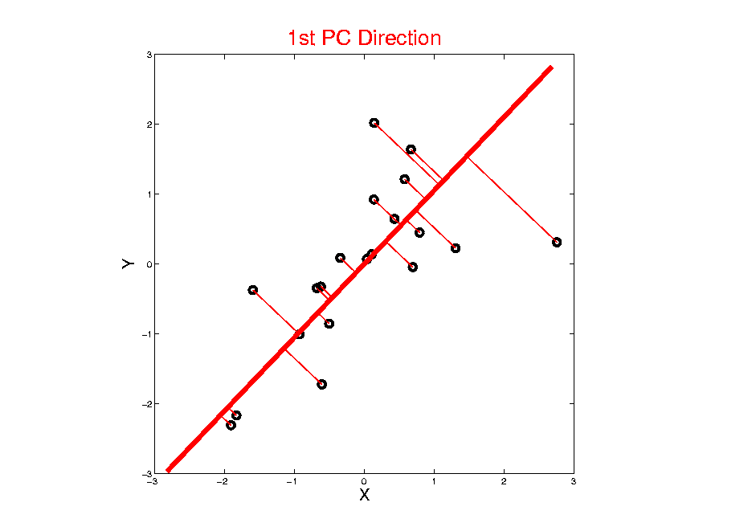
Different Views of PCA
Projected
Residuals
Notes:
40

Slide 41
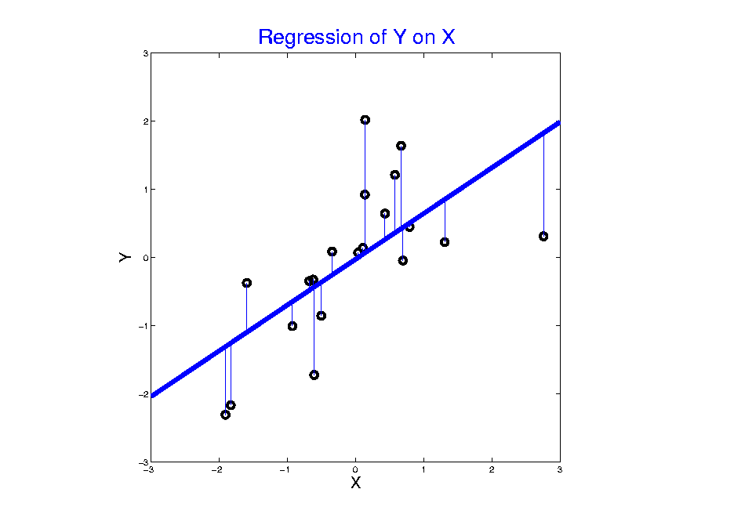
Different Views of PCA
Vertical
Residuals
(X predicts Y)
Note: Smaller Slope, Called
“Regression from Mean”
Notes:
41

Slide 42
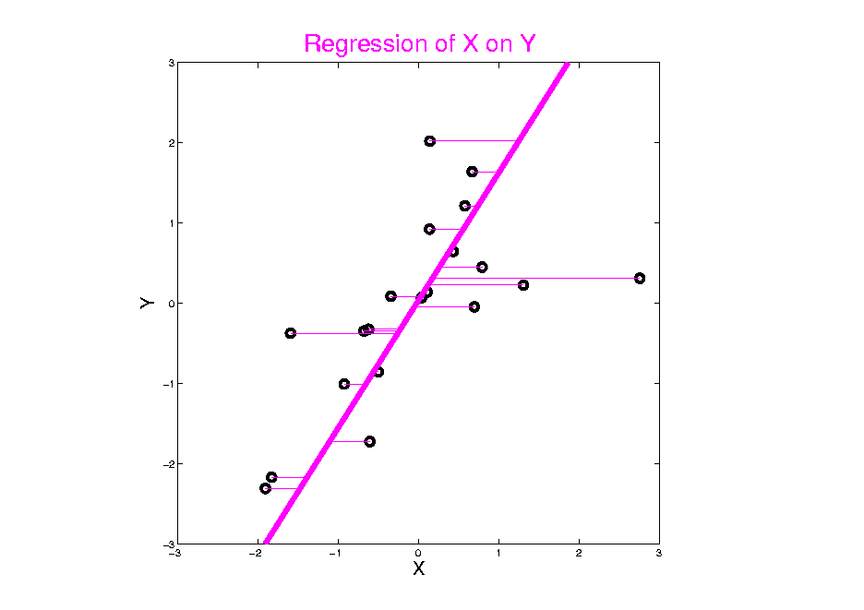
Different Views of PCA
Horizontal
Residuals
(Y predicts X)
Notes:
42

Slide 43
Different Views of PCA
Projected
Residuals
(Balanced
Treatment)
Notes:
43

Slide 44
Different Views of PCA
Toy Example Comparison of Fit Lines:
PC1
Regression of Y on X
Regression of X on Y
Note: Big Difference Prediction Matters
Notes:
44

Slide 45
Different Views of PCA
Related Ideas:
“Concordance Correlation”
Lin (1989)
“Maximizing Agreement”
Bottai, et al. (2022)
Notes:
45

Slide 46
Different Views of PCA
Solves several optimization problems:
Direction to maximize SS of 1-d proj’d data
Direction to minimize SS of residuals
(same, by Pythagorean Theorem)
“Best fit line” to data in “orthogonal sense”
(vs. regression of Y on X = vertical sense
& regression of X on Y = horizontal sense)
Use one that makes sense…
Notes:
46

Slide 47
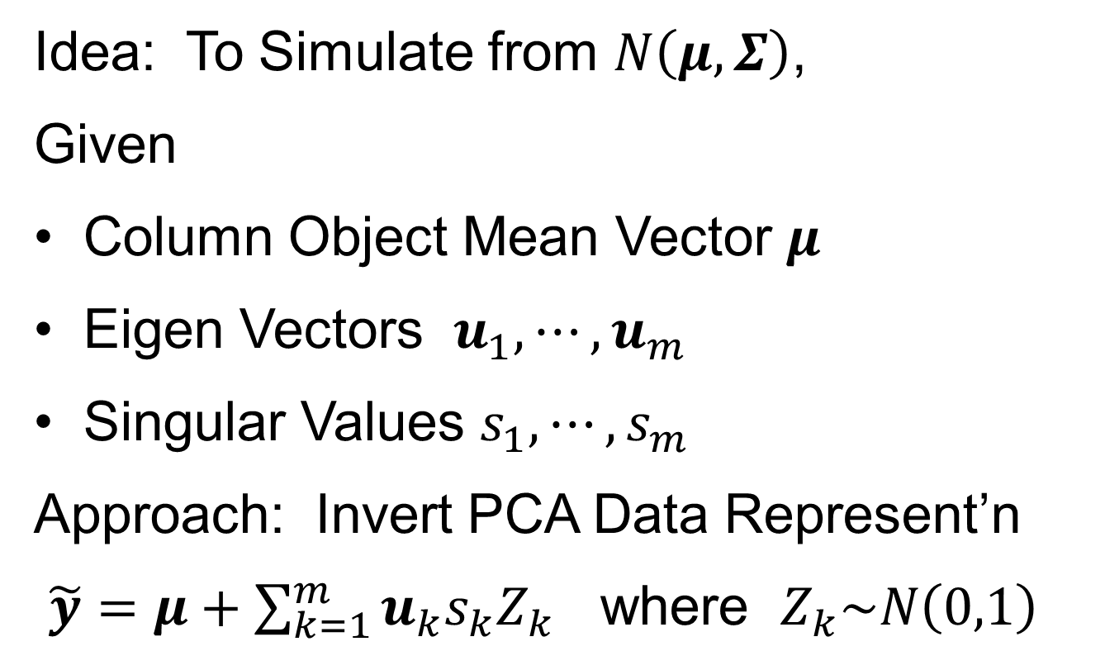
PCA Simulation
Idea: To Simulate from $N\left(μ,Σ\right)$,
Given
Column Object Mean Vector $μ$
Eigen Vectors $u_{1},⋯,u_{m}$
Singular Values $s_{1},⋯,s_{m}$
Approach: Invert PCA Data Represent’n
$\tilde{y}=μ+\sum_{k=1}^{m}{u_{k}s_{k}Z_{k}}$ where $Z_{k}\sim N\left(0,1\right)$

Slide 48
PCA & Graphical Displays
Small caution on PC directions & plotting:
PCA directions (may) have sign flip
Mathematically no difference
Numerically caused artifact of round off
Can have large graphical impact

Slide 49
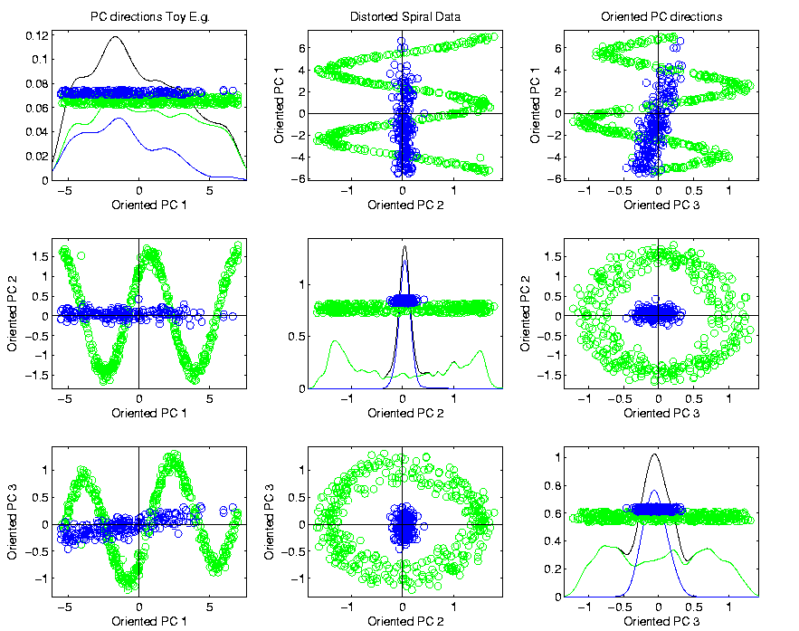
PCA & Graphical Displays
Toy Example (2 colored “clusters” in data)
Blues Form
Central Shaft
Sin and Cos
Waves
Indicate
Spiral

Slide 50
PCA & Graphical Displays
Toy Example (2 colored “clusters” in data)

Slide 51

PCA & Graphical Displays
Toy Example (1 point moved)
Important
Point:
Constant
Axes

Slide 52
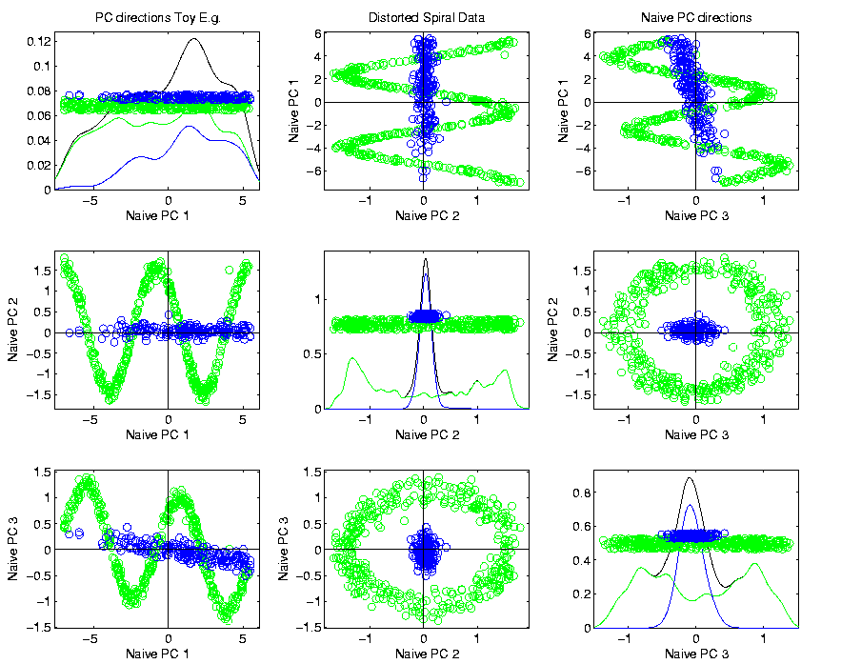
PCA & Graphical Displays
Original Data (arbitrary PC flip)

Slide 53
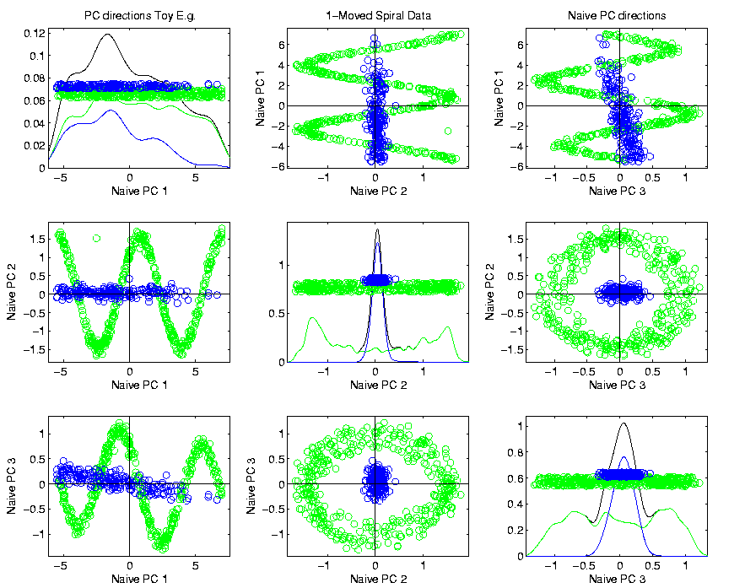
PCA & Graphical Displays
Point Moved Data (arbitrary PC flip)
Much
Harder
To See
Moving
Point

Slide 54
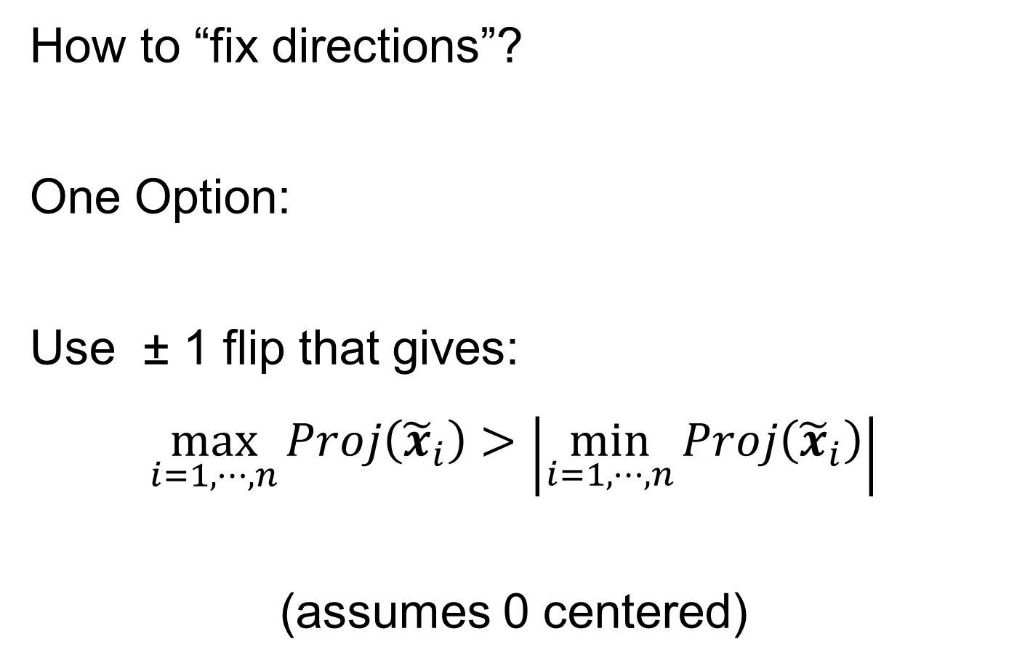
PCA & Graphical Displays
How to “fix directions”?
One Option:
Use ± 1 flip that gives:
$$\max_{i=1,⋯,n}{Proj\left({\tilde{x}}_{i}\right)}>\left|\min_{i=1,⋯,n}{Proj\left({\tilde{x}}_{i}\right)}\right|$$
(assumes 0 centered)

Slide 55
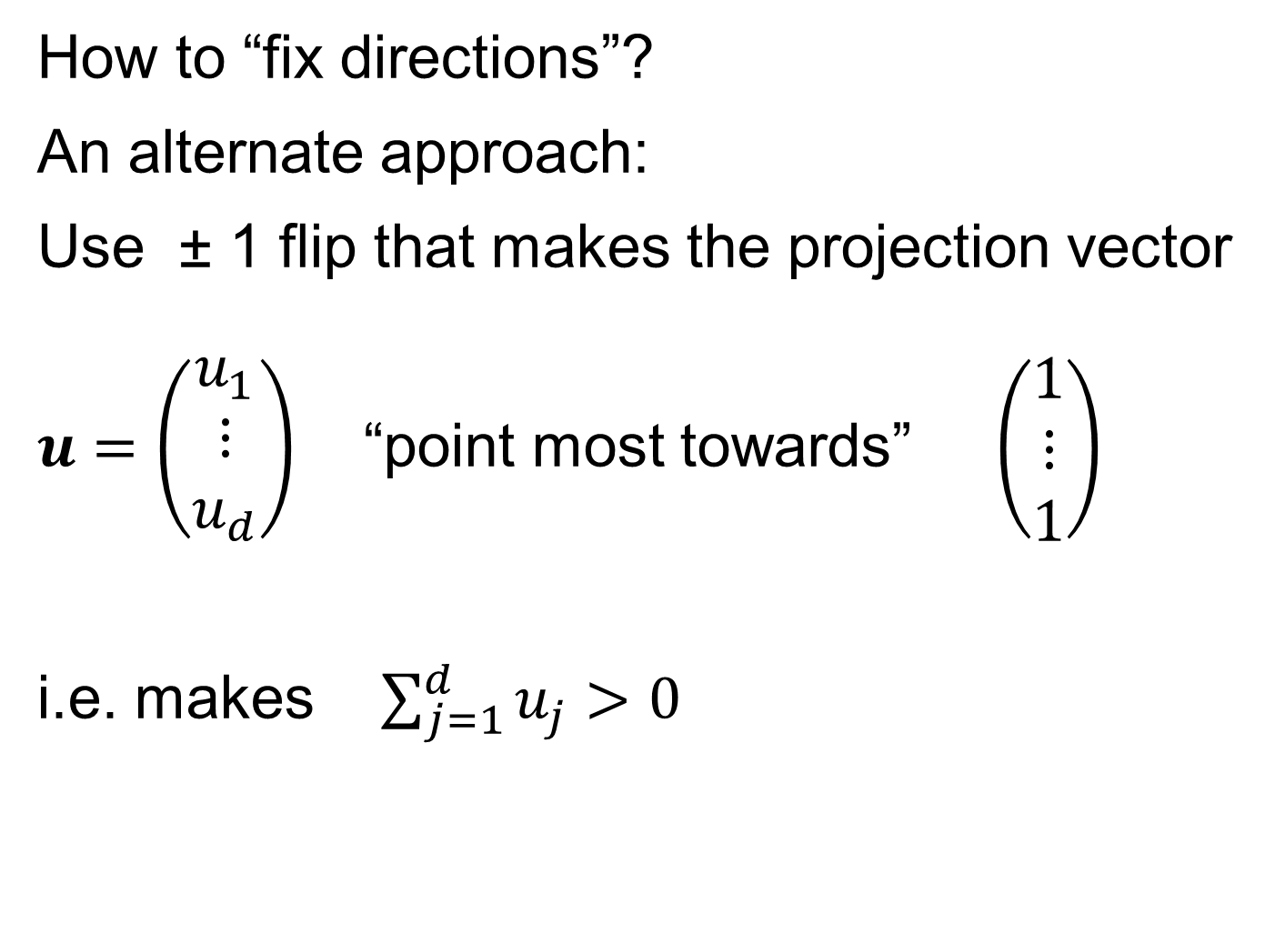
PCA & Graphical Displays
How to “fix directions”?
An alternate approach:
Use ± 1 flip that makes the projection vector
$u=\left(\begin{matrix}u_{1} \\ ⋮ \\ u_{d}\end{matrix}\right)$ “point most towards” $\left(\begin{matrix}1 \\ ⋮ \\ 1\end{matrix}\right)$
i.e. makes $\sum_{j=1}^{d}{u_{j}}>0$
Fails when Row Trait Mean
Has Been Subtracted Out
Recall: “Flat Direction”
Inner Product with Flat Dir’n

Slide 56
Distance Methods
Main Idea:
Approach to Data Lying in Complicated Space
(PCA Makes No Sense In Nonlinear Spaces)
However, Often Have Notion of “Distance”
I.e. Metric on Metric Space
So Base Analysis on Distances
Text: Chp. 7

Slide 57

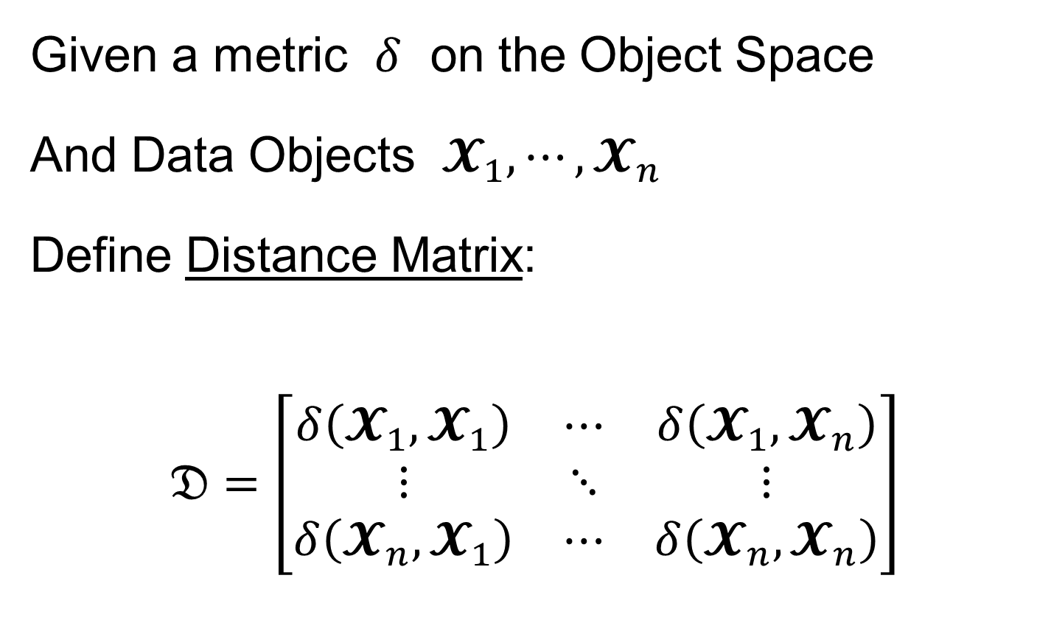
Distance Methods
Given a metric $δ$ on the Object Space
And Data Objects $𝓧_{1},⋯,𝓧_{n}$
Define Distance Matrix:
$$𝔇=\left[\begin{matrix}δ\left(𝓧_{1},𝓧_{1}\right) & ⋯ & δ\left(𝓧_{1},𝓧_{n}\right) \\ ⋮ & ⋱ & ⋮ \\ δ\left(𝓧_{n},𝓧_{1}\right) & ⋯ & δ\left(𝓧_{n},𝓧_{n}\right)\end{matrix}\right]$$
Script $𝓧$ Denotes
Arbitrary Data Objects

Slide 58
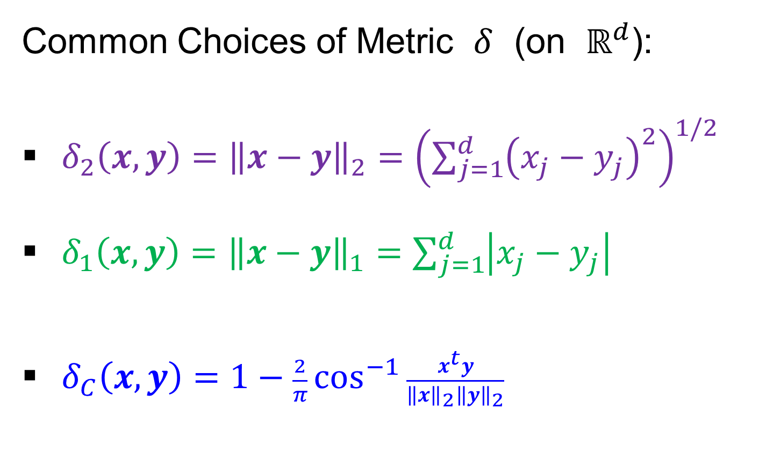
Distance Methods
Common Choices of Metric $δ$ (on $ℝ^{d}$):
$δ_{2}\left(x,y\right)={\left\|x−y\right\|}_{2}={\left(\sum_{j=1}^{d}{{\left(x_{j}−y_{j}\right)}^{2}}\right)}^{1/2}$
$δ_{1}\left(x,y\right)={\left\|x−y\right\|}_{1}=\sum_{j=1}^{d}{\left|x_{j}−y_{j}\right|}$
$δ_{C}\left(x,y\right)=1−\frac{2}{π}\cos^{−1}{\frac{x^{t}y}{{\left\|x\right\|}_{2}{\left\|y\right\|}_{2}}}$
Classical & Corresponds to Intuition
Very Good at Downweighting Outliers
Think Polar Coordinates, Focus on Angular Component and Ignore Radii

Slide 59
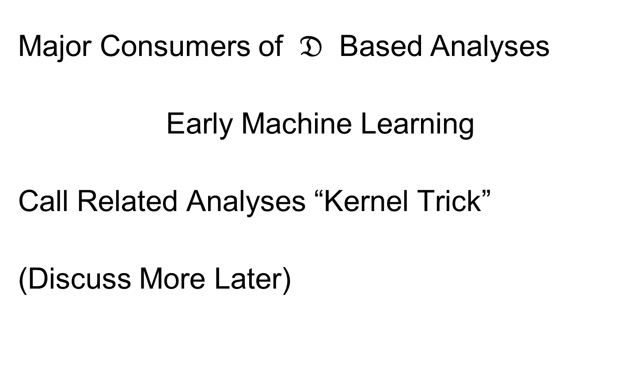
Distance Methods
Major Consumers of $𝔇$ Based Analyses
Early Machine Learning
Call Related Analyses “Kernel Trick”
(Discuss More Later)

Slide 60
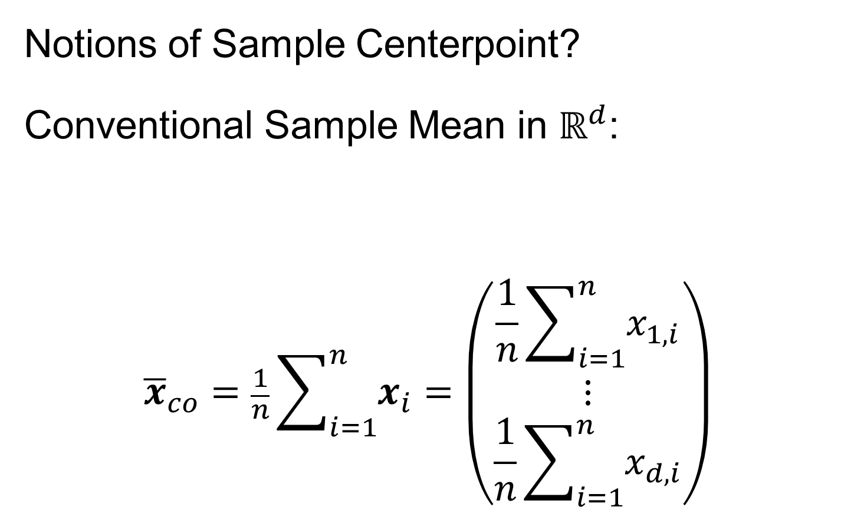
Distance Methods
Notions of Sample Centerpoint?
Conventional Sample Mean in $ℝ^{d}$:
$${\overline{x}}_{co}=\frac{1}{n}\sum_{i=1}^{n}{x_{i}}=\left(\begin{matrix}\frac{1}{n}\sum_{i=1}^{n}{x_{1,i}} \\ ⋮ \\ \frac{1}{n}\sum_{i=1}^{n}{x_{d,i}}\end{matrix}\right)$$
Text Sec. 7.1
Note: Uses Linear Operations,
Not Available in General

Slide 61
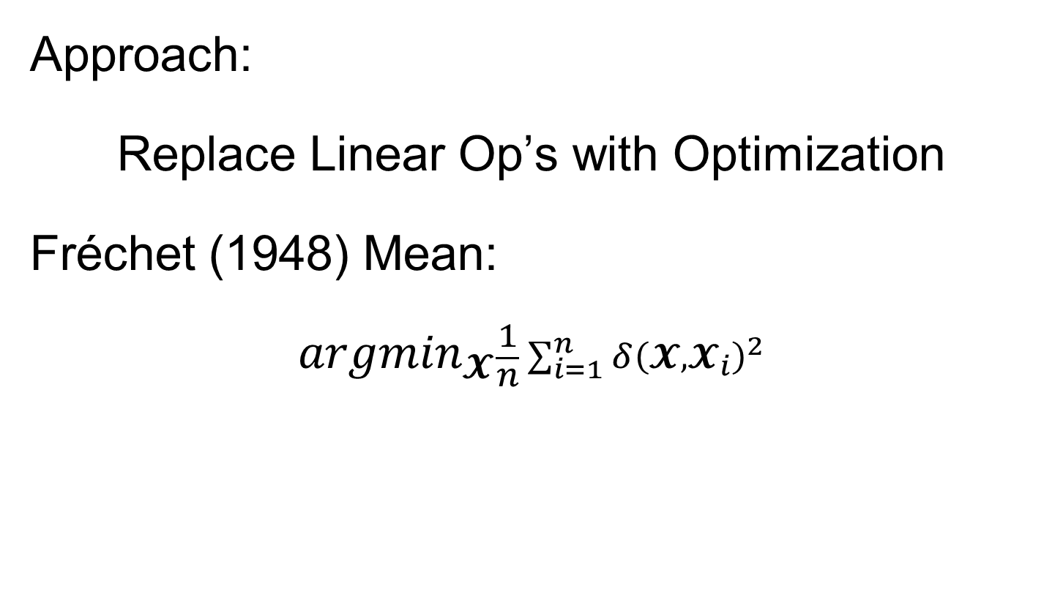
Distance Methods
Approach:
Replace Linear Op’s with Optimization
Fréchet (1948) Mean:
$${argmin}_{𝓧}\frac{1}{n}\sum_{i=1}^{n}{{δ\left(𝓧,𝓧_{i}\right)}^{2}}$$
Start With Candidate Point
Move Around to Min
Sum of Squared Dist’s

Slide 62
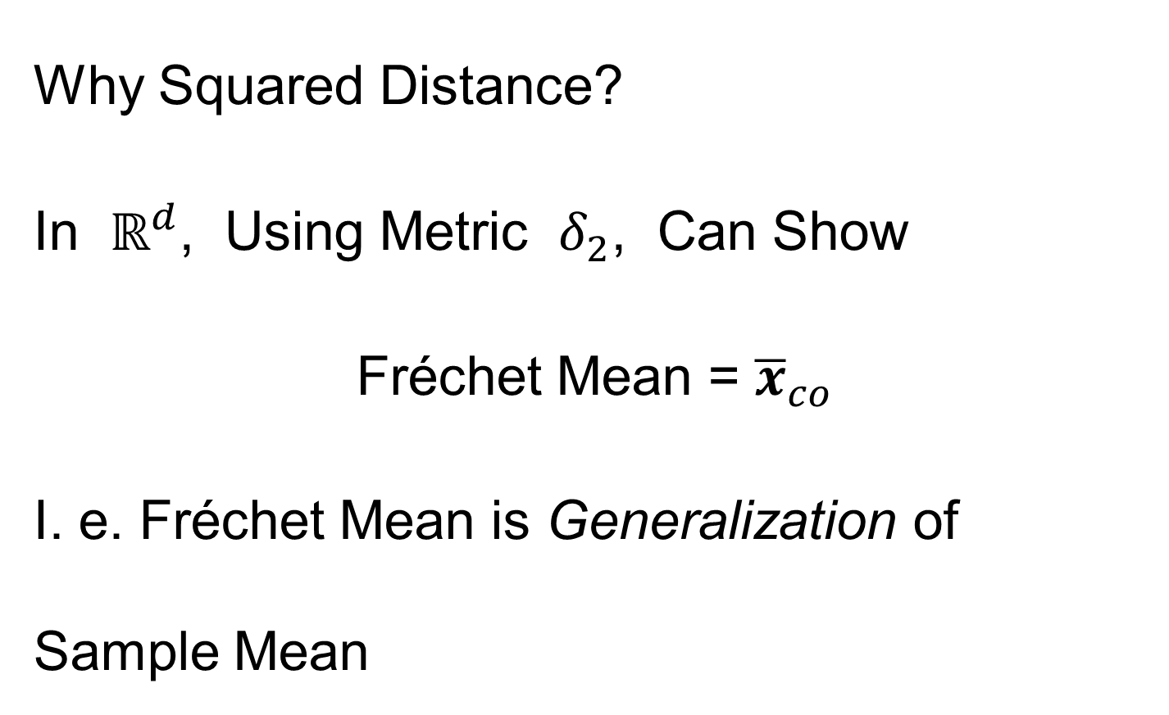
Distance Methods
Why Squared Distance?
In $ℝ^{d}$, Using Metric $δ_{2}$, Can Show
Fréchet Mean = ${\overline{x}}_{co}$
I. e. Fréchet Mean is Generalization of Sample Mean

Slide 63
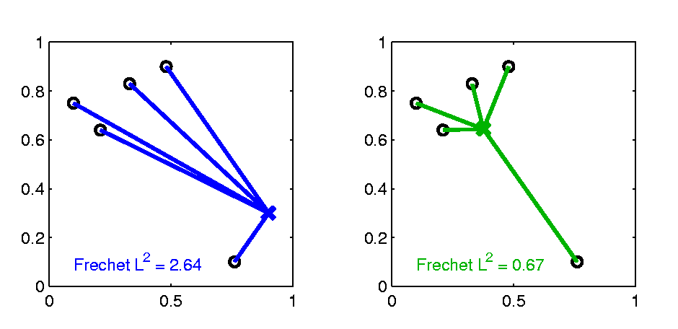

Distance Methods
Fréchet Sample Mean, $ℝ^{2}$ Toy Example
(Use Metric $δ=δ_{2}$)
Move Around to Min
Sum of Squared Dist’s
Start With Candidate Point

Slide 64
Distance Methods
Fréchet Sample Mean, $ℝ^{2}$ Toy Example
(Use Metric $δ=δ_{2}$)
Min Looks Like
Sample Mean???
Note: Outlier Pulls Mean Out of
Convex Hull Of Other 4 Points
Recall “Center
Of Mass”
Interpretretation
Known Problem with Mean: Not Robust Against Outliers

Slide 65

Distance Methods
Robust Variation: Fréchet (1948) Median:
$${argmin}_{𝓧}\frac{1}{n}\sum_{i=1}^{n}{δ\left(𝓧,𝓧_{i}\right)}$$
Again Start With Candidate Point
Move Around to Min
Sum of Distances

Slide 66


Distance Methods
Fréchet Sample Median, $ℝ^{2}$ Toy Example
(Use Metric $δ=δ_{2}$)
Move Around to Min
Sum of Distances
Start With Candidate Point

Slide 67
Distance Methods
Fréchet Sample Median, $ℝ^{2}$ Toy Example
(Use Metric $δ=δ_{2}$)
Better Robustness?
Note: Median Now Inside
Convex Hull Of Other 4 Points

Slide 68
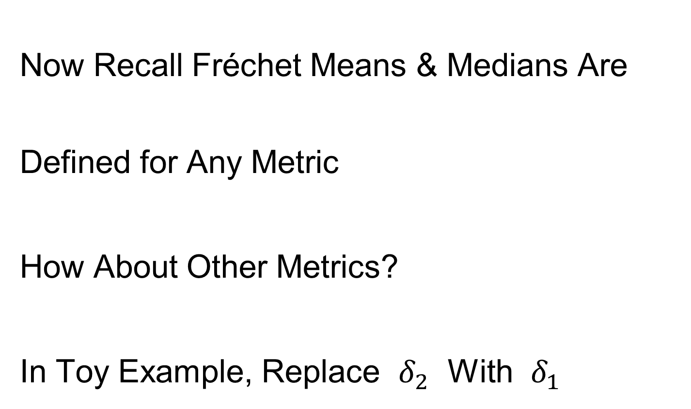
Distance Methods
Now Recall Fréchet Means & Medians Are Defined for Any Metric
How About Other Metrics?
In Toy Example, Replace $δ_{2}$ With $δ_{1}$

Slide 69
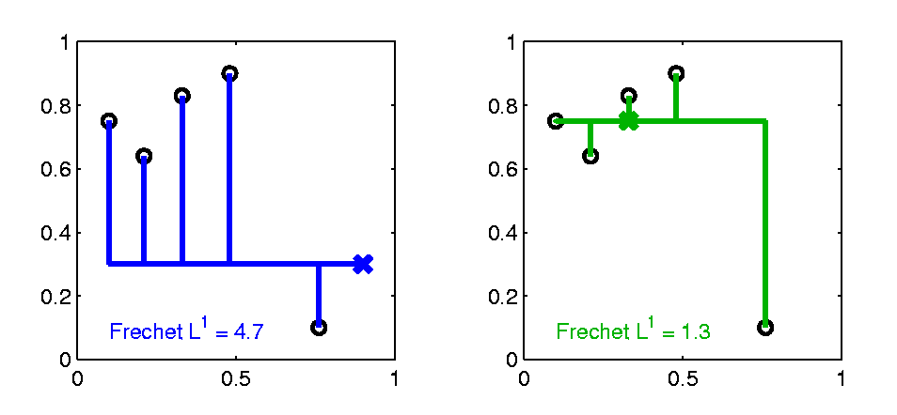

Distance Methods
$δ_{1}$ Fréchet Sample Median, $ℝ^{2}$ Toy Example
(Now Use Metric $δ=δ_{1}$)
Distance Depends on
Coordinates, Called
“Manhattan Distance”
Result Is Also
Rather Robust
Note: This is the
Coordinate-wise
Median

Slide 70
Distance Methods
Fréchet Means & Medians Allow Many Variations
Usually Studied in “Robust Statistics”
Might Look Deeper Later On (Text Chapter 16)
“Every Dog Has His Day”

Slide 71
Distance Methods
Recall General Approach:
Replace Linear Op’s with Optimization
Distance Based Version of PCA?
Text Sec. 7.2

Slide 72
Distance Methods
Multi Dimensional Scaling (MDS)
Name & Psychometric References:
Torgersen (1952, 1958), Gower (1966)
Earlier Versions of Ideas:
Eckart & Young (1936), Young and Householder (1938)

Slide 73
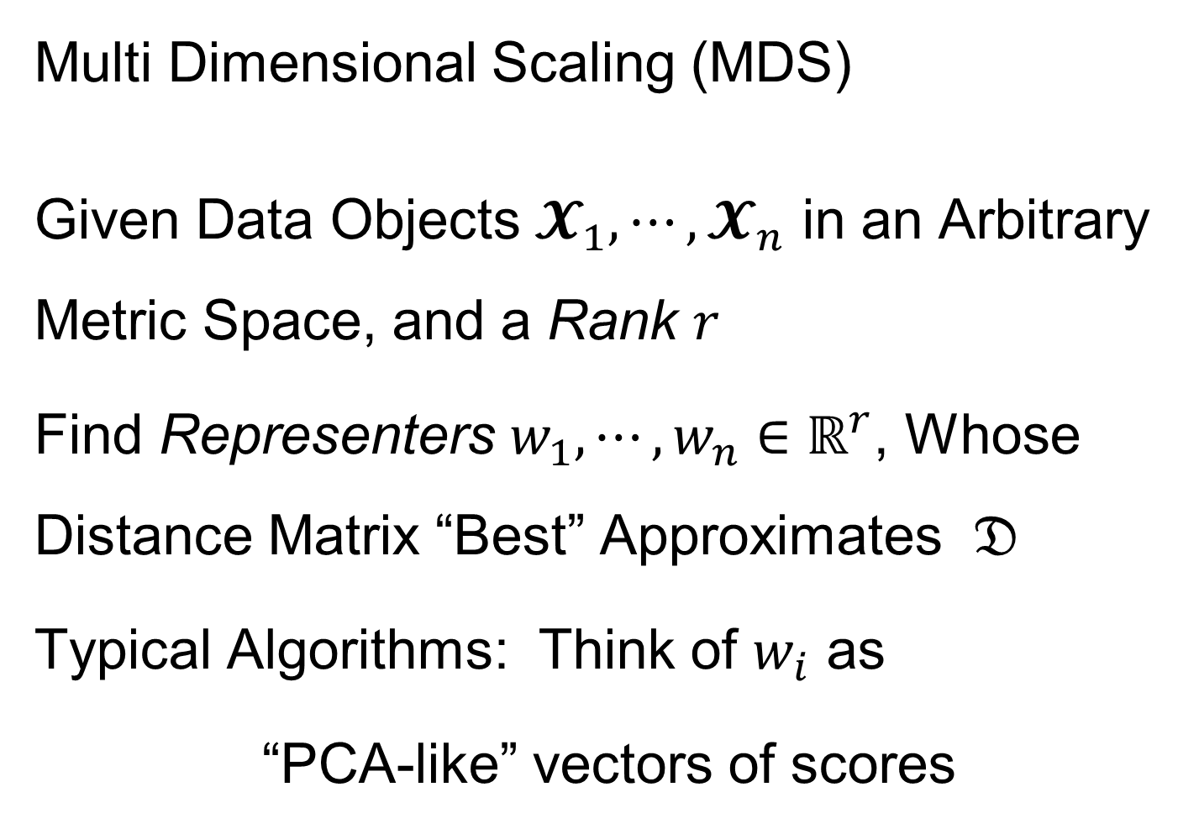
Distance Methods
Note: This
Representation
Is Called
“Auto-Encoder”
In AI literature
Multi Dimensional Scaling (MDS)
Given Data Objects $𝓧_{1},⋯,𝓧_{n}$ in an Arbitrary Metric Space, and a Rank $r$
Find Representers $w_{1},⋯,w_{n}∈ℝ^{r}$, Whose Distance Matrix “Best” Approximates $𝔇$
Typical Algorithms: Think of $w_{i}$ as
“PCA-like” vectors of scores

Slide 74
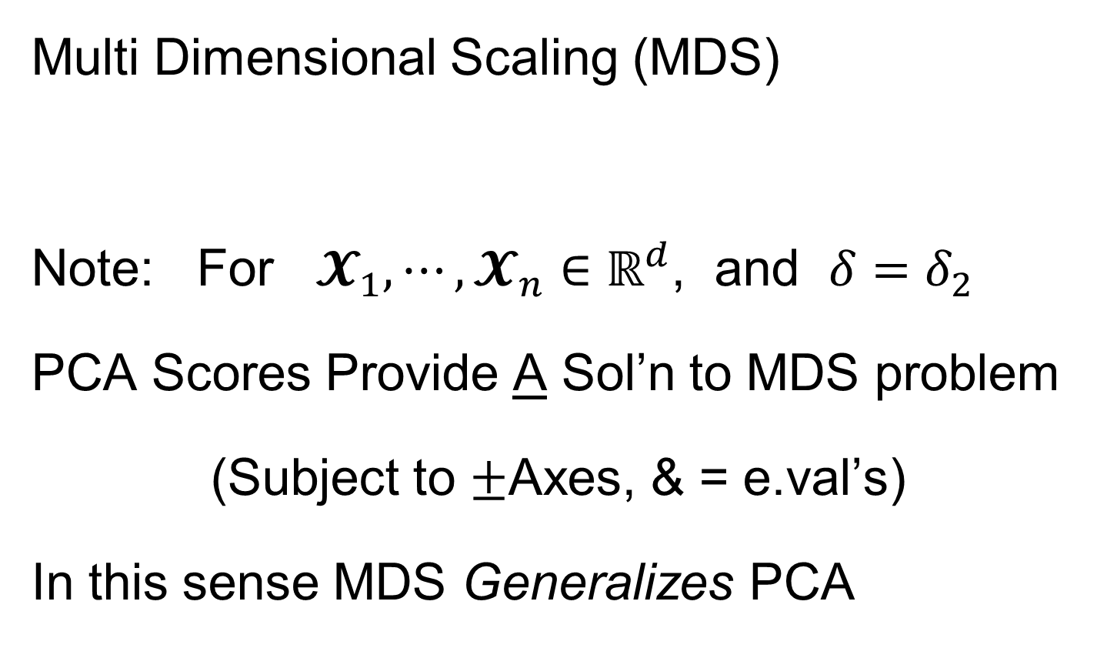
Distance Methods
Multi Dimensional Scaling (MDS)
Note: For $𝓧_{1},⋯,𝓧_{n}∈ℝ^{d}$, and $δ=δ_{2}$
PCA Scores Provide A Sol’n to MDS problem
(Subject to $±$Axes, & = e.val’s)
In this sense MDS Generalizes PCA

Slide 75




Distance Methods
Multi Dimensional Scaling (MDS)
Toy Data in $ℝ^{2}$
$r=2$ MDS Representation
Really Just “Rotation”,
Since $d=2$ and $r=2$
Track Corresponding
Points with Colors
Follows PC1 Axis (Flipped)

Slide 76
Distance Methods
Drawbacks of MDS relative to PCA
Only Gives Scores (Interpret Relationships)
But No Loadings (Explore Drivers)
Nor Modes of Variation
Can Have Serious Distortions (Nonlin. Case)
Which Can be “Good” or “Bad”

Slide 77


Distance Methods
Distortions “Good” or “Bad”???
Choice of Metric is Crucial in MDS:
E.g. Gaussian Data Wrapped Around Sphere
Data Lie on $S^{2}⊆ℝ^{3}$
“Appropriate” Metric?
Called
“Embedding
Space”
Fundamental Point:
One Major Mode of Variation

Slide 78

Distance Methods
E.g. Gaussian Data Wrapped Around Sphere
MDS, based on Euclidean ($ℝ^{3}$) Metric
Equivalent to PCA in $ℝ^{3}$
Bad News:
Needs 2 PCs (Modes of Variation) to
Model Data

Slide 79
Distance Methods
E.g. Gaussian Data Wrapped Around Sphere
Better Distance Choice: “Geodesic Distance”
Measured Along Surface of Sphere
MDS Based on
Geodesic Distance
Major Variation
Described with 1 Mode

Slide 80


Distance Methods
Less Attractive Approach to $𝔇$ Based PCA:
Treat Columns of $𝔇$ as Data Objects
And Do Euclidean PCA on Those
Survey in Duin and Pekalska (2005)
Try Out on Above
$ℝ^{2}$ Toy Data Set

Slide 81


Distance Methods
Columns of $𝔇$ as Data Objects
1st PC Looks
Sensible
As Do 1st & 3rd
But 2nd Suffers From
Strong Distortion???
Again Single Mode
Requires 2 Comp’s

Slide 82
Distance Methods
Columns of $𝔇$ as Data Objects
Called
“Horseshoe Effect”
Serious Problem
in Microbiome
Literature:
“MDS” called “PCoA”
See Morton, et al. (2017)

Slide 83
Distance Methods
Columns of $𝔇$ as Data Objects
Called
“Horseshoe Effect”
Elegant Analysis:
Diaconis et al. (2008)
Main Idea llustrated
In Text: Fig. 7.8

Slide 84

Big Picture
Object Oriented Data Analysis
Have done detailed study of Data Objects
In Euclidean Space, $ℝ^{d}$
Next: OODA in Non-Euclidean Spaces

Slide 85
Shapes As Data Objects
Several Different Notions of Shape
Oldest and Best Known (in Statistics):
Landmark Based
Text, Sec. 1.2, 5.2

Slide 86

Shapes As Data Objects
Landmark Based Shape Analysis:
Bookstein (1991)
Kendall et al. (1999)
Dryden & Mardia (2016)
(Note: these are summarizing
Monographs, $∃$ many papers)
Recommended
For Accessibility

Slide 87
Landmark Based Shape Analysis
Start by Representing Shapes
Data Object

Slide 88





Landmark Based Shape Analysis
Start by Representing Shapes by
Landmarks (points in $ℝ^{2}$ or $ℝ^{3}$)
$$\left(x_{1},y_{1}\right)$$
$$\left[\begin{matrix}\begin{matrix}x_{1} \\ y_{1}\end{matrix} \\ \begin{matrix}x_{2} \\ y_{2}\end{matrix} \\ \begin{matrix}x_{3} \\ y_{3}\end{matrix}\end{matrix}\right]∈ℝ^{6}$$
$$\left(x_{2},y_{2}\right)$$
$$\left(x_{3},y_{3}\right)$$
Data Object Vector

Slide 89
Landmark Based Shape Analysis
Clearly different shapes:

Slide 90
Landmark Based Shape Analysis
Clearly different shapes:
But what about: ?

Slide 91
Landmark Based Shape Analysis
Clearly different shapes:
But what about: ?
(just translation and rotation of ,
but different points in R⁶)

Slide 92
Landmark Based Shape Analysis
Note: Shape should be same over different:
Translations

Slide 93
Landmark Based Shape Analysis
Note: Shape should be same over different:
Translations
Rotations

Slide 94
Landmark Based Shape Analysis
Note: Shape should be same over different:
Translations
Rotations
Scalings (maybe)

Slide 95
Landmark Based Shape Analysis
Approach: Identify objects that are:
Translations
Rotations
Scalings (maybe)
of each other

Slide 96
Landmark Based Shape Analysis
Approach: Identify objects that are:
Translations
Rotations
Scalings (maybe)
of each other
Mathematics: Equivalence Relation

Slide 97
Equivalence Relations
Useful Mathematical Device
Weaker generalization of “=” for a set
Main consequence:
  Partitions Set Into Equivalence Classes
  For “=”, Equivalence Classes Are Singletons

Slide 98


Equivalence Relations
Common Example: Modulo Arithmetic
(E.g. Clock Arithmetic, mod 12)
3 hours after 11:00 is 2:00 …
Hours are equivalence classes:
{1} = {1:00, 13:00, …}
{2} = {2:00, 14:00, …}
$$⋮$$

Slide 99

Equivalence Relations
Common Example: Modulo Arithmetic
(E.g. Clock Arithmetic, mod 12)
For $a, b, c ∈ ℤ$, Say $a≡b (mod c)$
When $\left(b −a\right)$ is divisible by $c$
Clock e.g. $14−2=12$, so $14≡2 (mod 12)$
i.e. 14:00 is “identified with” 2:00

Slide 100

Equivalence Relations
For $a, b, c ∈ ℤ$, Say $a≡b (mod c)$
When $\left(b −a\right)$ is divisible by $c$
E.g. Binary Arithmetic, mod $2$
Equivalence classes:
$\left\{0\right\}=\left\{⋯,−2,0,2,4,⋯\right\}$
$$\left\{1\right\}=\left\{⋯,−1,1,3,5,⋯\right\}$$
(just evens and odds)

Slide 101

Equivalence Relations
Another Example: Vector Subspaces of $ℝ^{2}$
E.g. Say $\left(\begin{matrix}x_{1} \\ y_{1}\end{matrix}\right)≈\left(\begin{matrix}x_{2} \\ y_{2}\end{matrix}\right)$ when $y_{1}=y_{2}$
Equiv. Classes are indexed by $y∈ℝ^{1},$
And are: $\left\{y\right\}=\left\{\left(\begin{matrix}x \\ y\end{matrix}\right)∈ℝ^{2}:x∈ℝ^{1}\right\}$
i.e. Horizontal lines (same $y$ coordinate)

Slide 102
Equivalence Relations
Deeper Example: Transformation Groups
Set of Transformations
(e.g. Translations, Rotations, …)
Group Operation = Composition

Slide 103

Equivalence Relations
Deeper Example: Transformation Groups
For $g∈G$, operating on a set $S$
Say $s_{1}≈s_{2}$ when $∃$ $g$ where $g\left(s_{1}\right)=s_{2}$
Equivalence Classes:
$$\left\{s_{i}\right\}=\left\{s_{j}∈S:s_{j}=g\left(s_{i}\right), for some g∈G\right\}$$
Terminology: Also called orbits

Slide 104

Equivalence Relations
Deeper Example: Transformation Groups
Above Examples Are Special Cases
Modulo Arithmetic
$$G= \left\{g:ℤ→ℤ :g\left(z\right)=z+kc, for k∈ℤ\right\}$$
(Orbits are $\left\{0\right\},\left\{1\right\},⋯,\left\{c−1\right\}$)

Slide 105

Equivalence Relations
Deeper Example: Transformation Groups
Above Examples Are Special Cases
Modulo Arithmetic
Vector Subspace of $ℝ^{2}$
$$G=\left\{g:ℝ^{2}{→ℝ}^{2} :g\left(\begin{matrix}x \\ y\end{matrix}\right)=\left(\begin{matrix}x′ \\ y\end{matrix}\right), x′∈ℝ\right\}$$
(Orbits are horizontal lines, shifts of $ℝ$)

Slide 106

Equivalence Relations
Deeper Example: Transformation Groups
Above Examples Are Special Cases
Modulo Arithmetic
Vector Subspace of $ℝ^{2}$
General Vector Subspace $V$
$G$ maps $V$ into $V$
(Orbits are Shifts of $V$, indexed by $V^{⊥}$)

Slide 107

Equivalence Relations
Deeper Example: Transformation Groups
Above Examples Are Special Cases
Modulo Arithmetic
Vector Subspace of $ℝ^{2}$
General Vector Subspace $V$
Shape: $G=$ Group of “Similarities”
(translations, rotations, scalings)

Slide 108


Equivalence Relations
Deeper Example: Transformation Groups
Mathematical Terminology:
Quotient Operation
Set of Equiv. Classes = Quotient Space
Denoted $S/G$
(“Shape Space” will be of this form)
For Operation of Representing
Equivalence Classes Induced by $G$

Slide 109
Landmark Based Shape Analysis
Approach: Identify objects that are:
Translations
Rotations
Scalings
of each other
Group of Transformations

Slide 110
Landmark Based Shape Analysis
Approach: Identify objects that are:
Translations
Rotations
Scalings
of each other
Mathematics: Equivalence Relation
Results in: Equivalence Classes (i.e. Orbits)
Which become the Data Objects

Slide 111
Landmark Based Shape Analysis
Equivalence Classes become Data Objects
Mathematics: Called “Quotient Space”
Intuitive Representation: Manifold
(curved surface)

Slide 112
Landmark Based Shape Analysis
Triangle Shape Space: Represent as Sphere

Slide 113

Landmark Based Shape Analysis
Triangle Shape Space: Represent as Sphere
$ℝ^{6}$ → $ℝ^{4}$
Translation

Slide 114

Landmark Based Shape Analysis
Triangle Shape Space: Represent as Sphere
$ℝ^{6}$ → $ℝ^{4}$ → $ℝ^{3}$
rotation

Slide 115


Landmark Based Shape Analysis
Triangle Shape Space: Represent as Sphere
$ℝ^{6}$ → $ℝ^{4}$ → $ℝ^{3}$ →
scaling
(thanks to Wikipedia)

Slide 116
Landmark Based Shape Analysis
Triangle Shape Space: Represent as Sphere
Equilateral
Triangles
Hemispheres
Are
Reflections
Co-Linear
Point Triples
Deeper Discussion in
Sec. 4.3.4, of Dryden
and Mardia (2016)

Slide 117
Quotient Space Folklore
Many Quotient Operations Result in Space that is a Curved Manifold
Rigorous Theory Available Through
Induced Metric

Slide 118
Variation on Landmark Based Shape
Typical Viewpoint:
Variation in Shape is Goal
Other Variation+ is Nuisance
Recall Main Idea:
Represent Shapes as Coordinates
“Mod Out” Transl’n, Rotat’n, Scale
Shapes (Equiv. Classes) as Data Objects

Slide 119
Variation on Landmark Based Shape
Typical Viewpoint:
Variation in Shape is Goal
Other Variation+ is Nuisance
Interesting Alternative:
Study Variation in Transformation
Treat Shape as Nuisance
To be
Modded
Out!

Slide 120
Variation on Landmark Based Shape
Context: Study of Tectonic Plates
Movement of Earth’s Crust (over time)
Take Motions as Data Objects
Interesting Alternative:
Study Variation in Transformation
Treat Shape as Nuisance

Slide 121

Variation on Landmark Based Shape
Context: Study of Tectonic Plates
Movement of Earth’s Crust (over time)
Take Motions as Data Objects
Chang (1988)
Royer & Chang (1991)
Thanks to Wikipedia

Slide 122
OODA in Image Analysis
First Generation Problems:
Denoising
Segmentation
Registration
(all about single images,
still interesting challenges)

Slide 123
OODA in Image Analysis
Second Generation Problems:
Populations of Images
  Understanding Population Variation
  Discrimination (a.k.a. Classification)
Complex Data Structures (& Spaces)
HDLSS Statistics
Text,
Chp. 11
Will Study,
Text Sec. 14.2
High Dimension, Low Sample Size

Slide 124
OODA in Image Analysis
Common Goal in Image Analysis:
Focus on Shapes Within Images
I.e. Shapes Become the Data Objects
E.g. Organs Within a Medical Image

Slide 125
Shape Representations
Major Approaches for Shape Data Objects:
Landmark Representations
Boundary Representations
Skeletal Representations

Slide 126

Landmark Representations
Landmarks for Fly Wing Data:
Thanks to George Gilchrist

Slide 127
Landmark Representations
Major Drawback of Landmarks:
Need to always find each landmark
Need same relationship
I.e. Landmarks need to correspond
Often fails for medical images
E.g. How many corresponding landmarks on a set of kidneys, livers or brains???
Much More on Math’s of Landmark
Shape Analysis in Text, Sec. 8.4

Slide 128
Shape Representations
Major Approaches for Shape Data Objects:
Landmark Representations
Boundary Representations
Skeletal Representations

Slide 129
Boundary Representations
Traditional Major Sets of Ideas:
Triangular Meshes
  Survey: Owen (1998)
Active Shape Models
  Cootes, et al (1993)
Fourier Boundary Representations
  Keleman, et al (1997 & 1999)

Slide 130

Boundary Representations
Example of triangular mesh rep’n:
From:www.geometry.caltech.edu/pubs.html

Slide 131
Boundary Representations
Main Drawback:
Correspondence
For OODA (on vectors of parameters):
Need to “match up points”
Easy to find triangular mesh
  Lots of research on this driven by gamers
Challenge to match mesh across objects
  There are some interesting ideas…
Notes:
131

Slide 132
Boundary Representations
Correspondence for Mesh Objects:
Active Shape Models (PCA – like)
Cootes, et al (1993)
Automatic Landmark Choice
Cates, et al (2007)
Based on Optimization Problem:
Good Correspondence & Separation
(Formulate via Entropy)
Used in Analysis of
Childhood Development
Data In Earlier Class
Notes:
132

Slide 133
Shape Representations
Major Approaches for Shape Data Objects:
Landmark Representations
Boundary Representations
Skeletal Representations

