Slide 1
Statistics – O. R. 881
Object Oriented Data Analysis
Steve Marron
Dept. of Statistics and Operations Research
University of North Carolina

Slide 2
Current Sections in Textbook
Today:
Section 8.6, 8.7, 7.3, 10.1.2, 9.1
Next Class:
Section 9.1, 9.2

Slide 3
Last Class: Skeletal Repr’ns
Main Idea:
Represent Objects as:
Discretized skeletons (medial atoms)
Plus spokes from center to edge
Which imply a boundary
Very accessible early reference:
Yushkevich, et al (2001)
Volume Gives Better Representation
In 3d than Boundary Surface

Slide 4
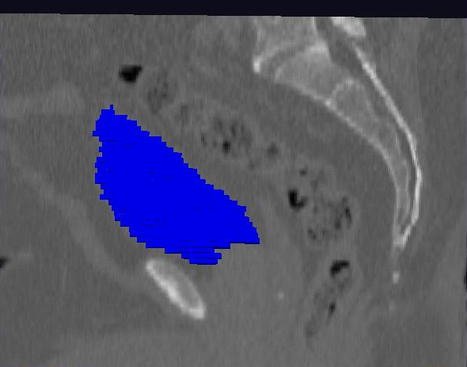
Last Class: Male Pelvis
Bladder:
manual segmentation
Slice by slice
Reassembled

Slide 5
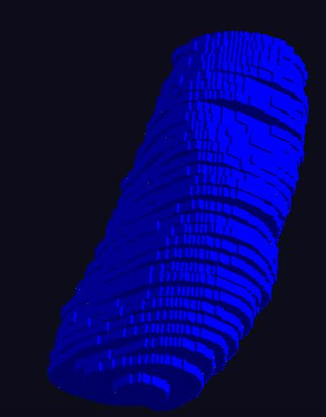
Last Class: Male Pelvis
Bladder:
Slices:
Reassembled in 3d
How to represent?
Thanks: Ja-Yeon Jeong
Called Binary
Representation

Slide 6
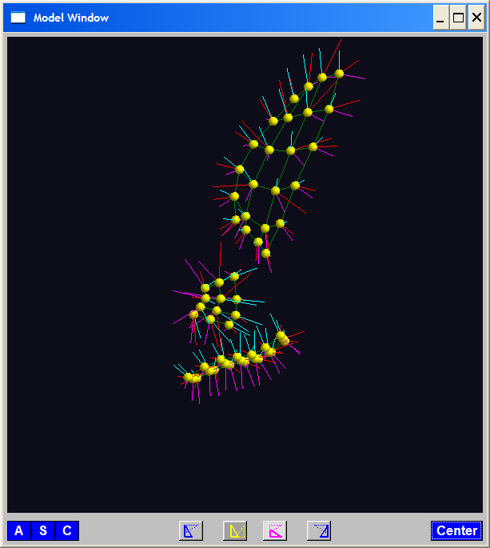
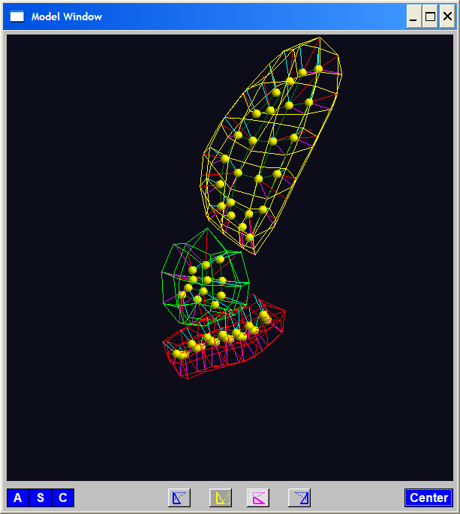
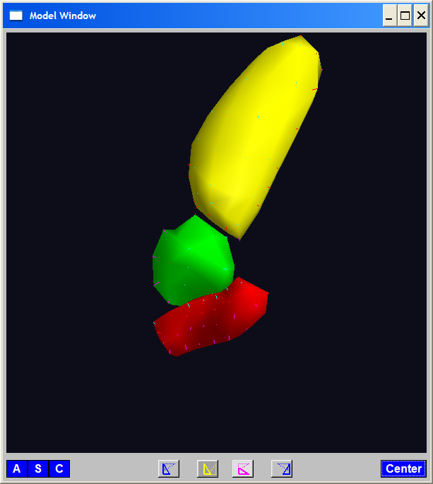
Last Class: Skeletal Repr’ns
3-d S-Rep Example: From Ja-Yeon Jeong
Bladder – Prostate - Rectum
Atoms - Spokes - Implied Boundary
Notes:
OODA.ppt

Slide 7
Last Class: 3-d s-reps
S-rep model fitting
Easy, when starting from binary (blue)
But very expensive (30 – 40 minutes technician’s time)
Want automatic approach
Challenging, because of poor contrast, noise, …
Need to borrow information across training sample
Use Bayes approach: prior & likelihood → posterior
~Conjugate Gaussians, but there are issues:
  Major HLDSS challenges
  Manifold aspect of data
Handle With Variation on PCA
Careful Handling Very Useful

Slide 8
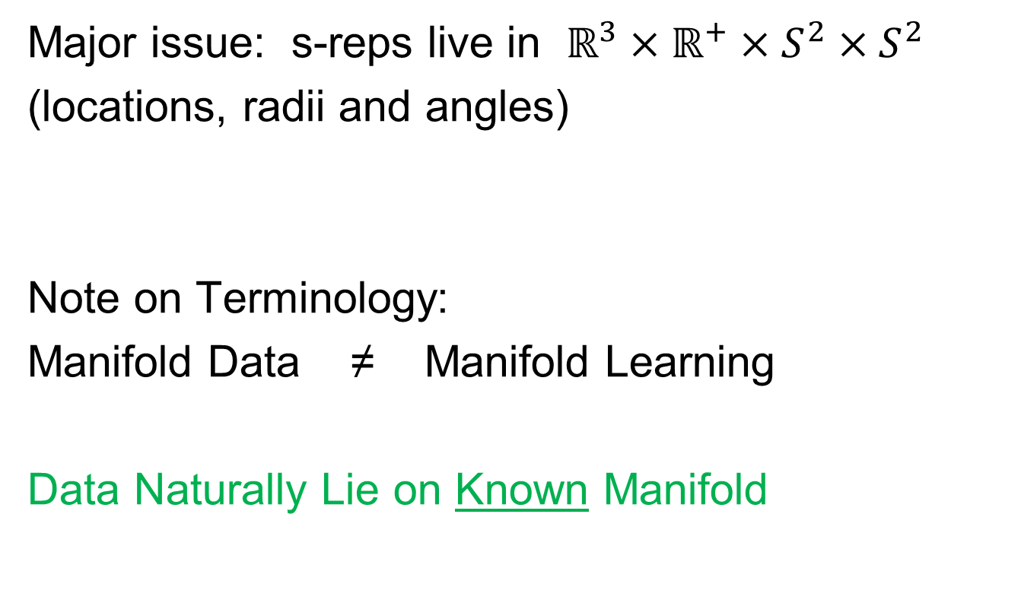
Last Class: Manifold Data
Major issue: s-reps live in $ℝ^{3}×ℝ^{+}×S^{2}×S^{2}$
(locations, radii and angles)
Note on Terminology:
Manifold Data ≠ Manifold Learning
Data Naturally Lie on Known Manifold

Slide 9
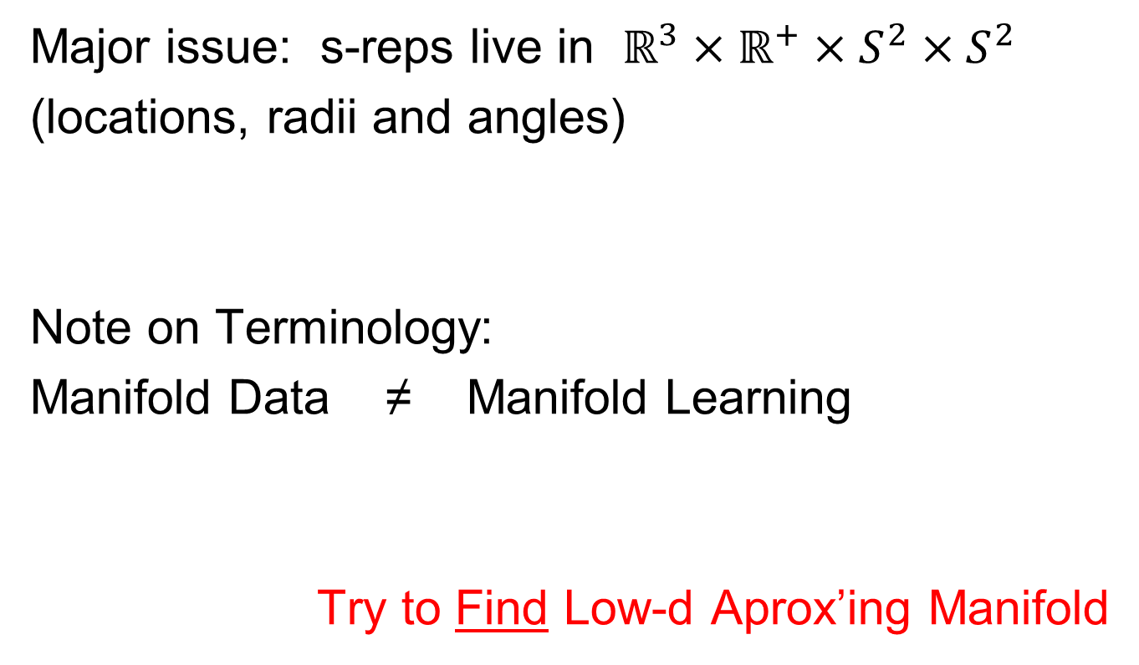
Last Class: Manifold Data
Major issue: s-reps live in $ℝ^{3}×ℝ^{+}×S^{2}×S^{2}$
(locations, radii and angles)
Note on Terminology:
Manifold Data ≠ Manifold Learning
Try to Find Low-d Aprox’ing Manifold

Slide 10
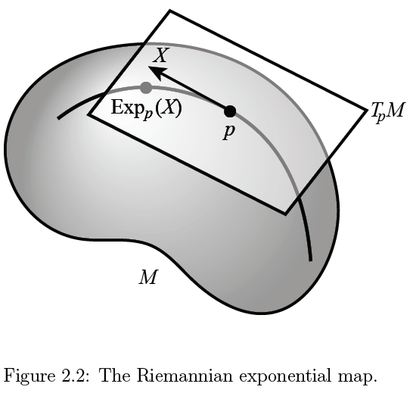
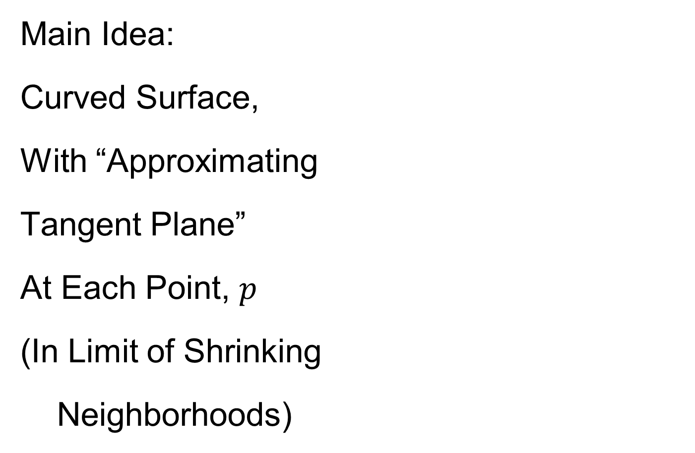
Last Class: Manifold Feature Spaces
Main Idea:
Curved Surface,
With “Approximating
Tangent Plane”
At Each Point, $p$
(In Limit of Shrinking
Neighborhoods)

Slide 11

Last Class: Manifold Feature Spaces
Important Mappings:
Plane → Surface:
$\exp_{p}$
Surface → Plane
$\log_{p}$

Slide 12
Last Class: Manifold Feature Spaces
Log & Exp Memory Device:
Complex Numbers
Exponential:
Tangent Plane → Manifold
Logarithm:
Manifold → Tangent Plane

Slide 13
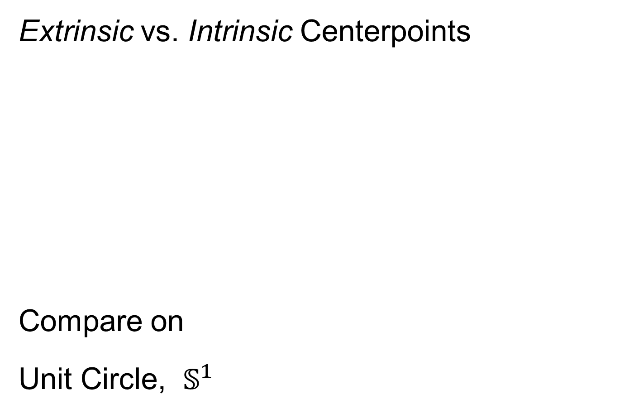
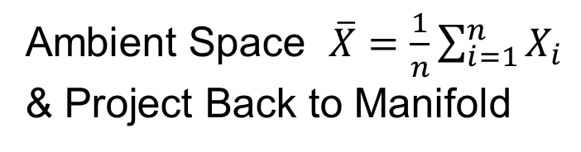
Last Class: Manifold Feature Spaces
Extrinsic vs. Intrinsic Centerpoints
Compare on
Unit Circle, $𝕊^{1}$
Ambient Space $\overline{X}=\frac{1}{n}\sum_{i=1}^{n}{X_{i}}$
& Project Back to Manifold
E.g. Fréchet Mean

Slide 14
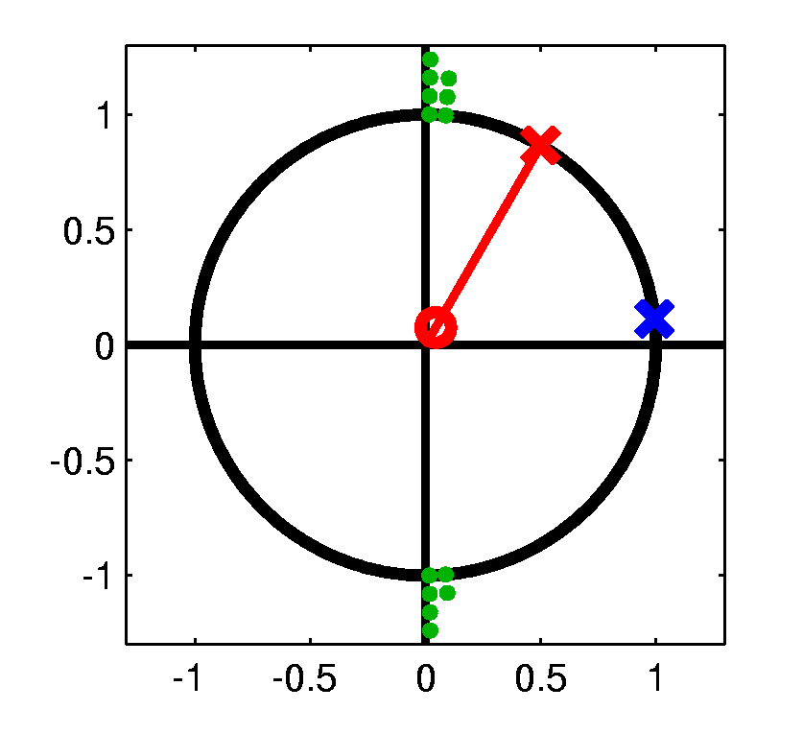
Last Class: Manifold Feature Spaces
Extrinsic vs. Intrinsic Centerpoints
Often Similar
Note Big Difference!
Which is Better?

Slide 15
Last Class: PCA for s-reps
PCA on manifold spaces?
(e.g. on Lie Groups / Symmetric Spaces)
T. Fletcher: Principal Geodesic Analysis
Idea: replace “linear summary of data”
With “geodesic summary of data”…

Slide 16
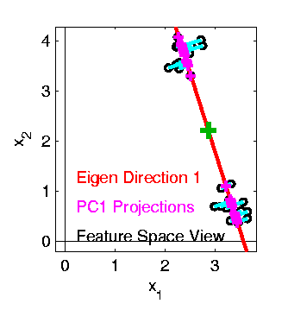

Last Class: PCA on Manifolds
Fletcher (Principal Geodesic Anal.)
  Best fit of geodesic to data
  Constrained to go through geodesic mean
Happens
Naturally
in $ℝ^{d}$
Mean
Contained
in Best
Fit Line

Slide 17
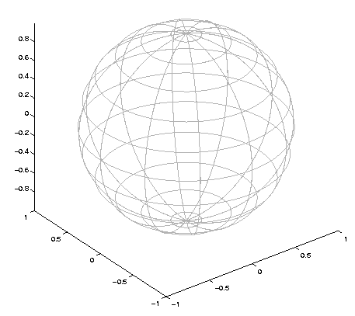

Last Class: Challenge for PGA
Data
On $S^{2}$
Geodesic
Mean(s)
Tangent Plane
Projections ($log$)
Requires 2
Modes of
Variation

Slide 18
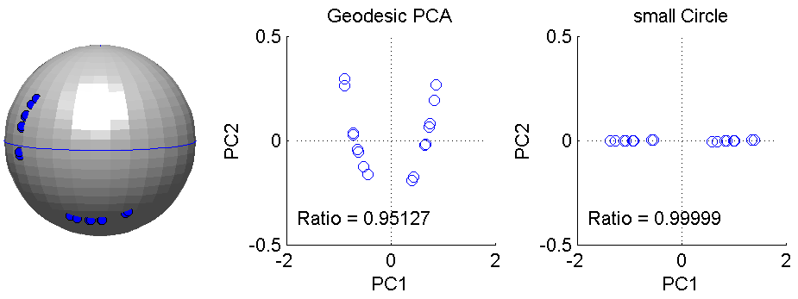
Last Class: PCA on Manifolds
Fletcher (Principal Geodesic Anal.)
  Best fit of geodesic to data
  Constrained to go through geodesic mean
Huckemann, Hotz & Munk (Geod. PCA)
  Best fit of any geodesic to data
Counterexample:
Data follows Tropic of Capricorn
Realizations of Spoke in
Blad.-Prost.-Rect. Simulator

Slide 19
Principal Arc Analysis
Jung, Foskey & Marron (2011)
  Best fit of any circle to data
  Can give better fit than geodesics

Slide 20
Principal Arc Analysis
Jung, Foskey & Marron (2011)
  Best fit of any circle to data
  Can give better fit than geodesics
  Observed for simulated s-rep example

Slide 21
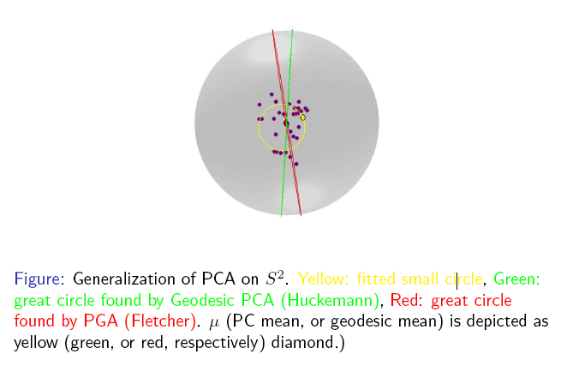
Important Challenge
Interesting
Results:
Kim (2018)

Slide 22

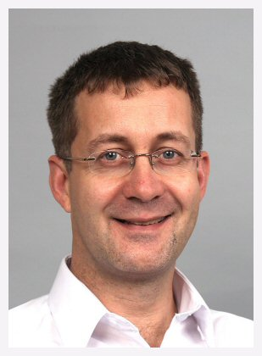

Principal Nested Spheres
Main Goal:
Extend Principal Arc Analysis ($𝕊^{2}$ to $𝕊^{k}$)
Jung, Dryden & Marron (2012)

Slide 23


Principal Nested Spheres
Main Goal:
Extend Principal Arc Analysis ($𝕊^{2}$ to $𝕊^{k}$)

Slide 24


Principal Nested Spheres
Jung et al (2012)
Context:
$d$ – dim
Sphere
(in $ℝ^{d+1}$)
$$𝕊^{d}$$

Slide 25

Principal Nested Spheres
For data $∈S^{d}$
Consider an
$S^{d−1}$ for a
“Rank $d−1$
Approxi’n”
$$𝕊^{d}$$
Determined by a Slicing Plane

Slide 26
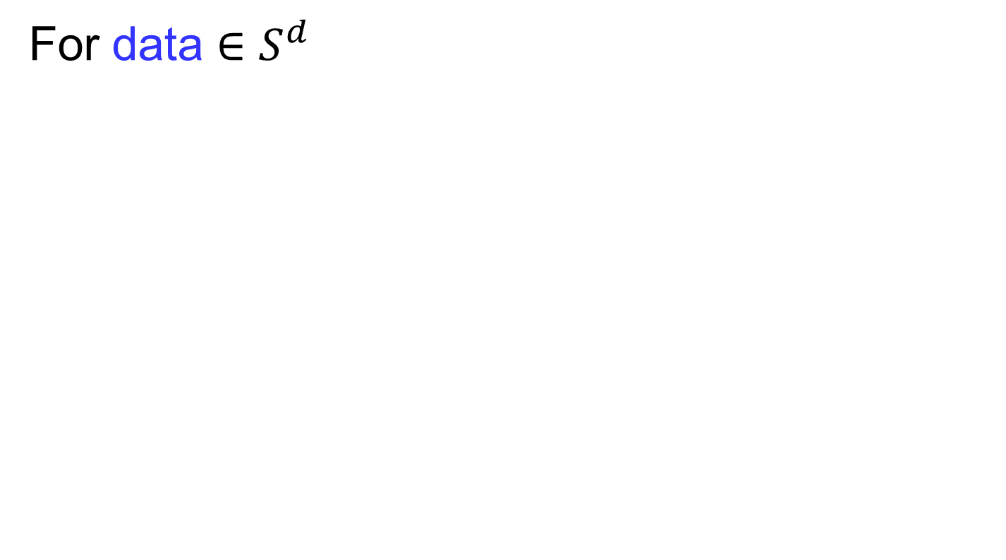

Principal Nested Spheres
For data $∈S^{d}$
Find Projec’ns
Onto $S^{d−1}$
$$𝕊^{d}$$
Along Surface (Geodesic Distance)

Slide 27

Principal Nested Spheres
Move plane
To Minimize
$\sum_{i}{{resid}_{i}^{2}}$
Keep signed
${resid}_{i}$ as
PNS-$d$ scores
$$𝕊^{d}$$
And Projections as Rank $d−1$ Approximations

Slide 28


Principal Nested Spheres
Now consider
Projections
As Data in
Subsphere
$𝕊^{d−1}$
Repeat for
PNS $d−1$
Scores
$$𝕊^{d−1}$$

Slide 29
Landmark Based Shape Analysis
Kendall
Bookstein
Dryden &
Mardia
(recall major monographs)

Slide 30
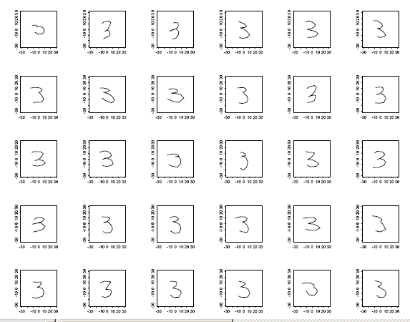
Landmark Based Shape Analysis
Kendall
Bookstein
Dryden &
Mardia
Digit 3 Data
Handwritten (by different people)
Goal: Automatic Recognition
Current Approach: Deep Learning, Early Attempt Was…

Slide 31
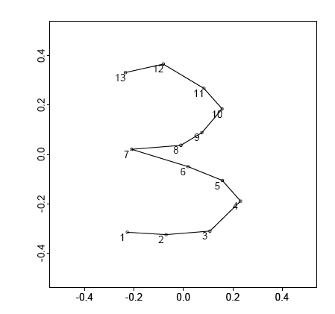
Landmark Based Shape Analysis
Kendall
Bookstein
Dryden &
Mardia
Digit 3 Data
(digitized to 13 landmarks)

Slide 32
Landmark Based Shape Analysis
Kendall
Bookstein
Dryden &
Mardia
Digit 3 Data

Slide 33
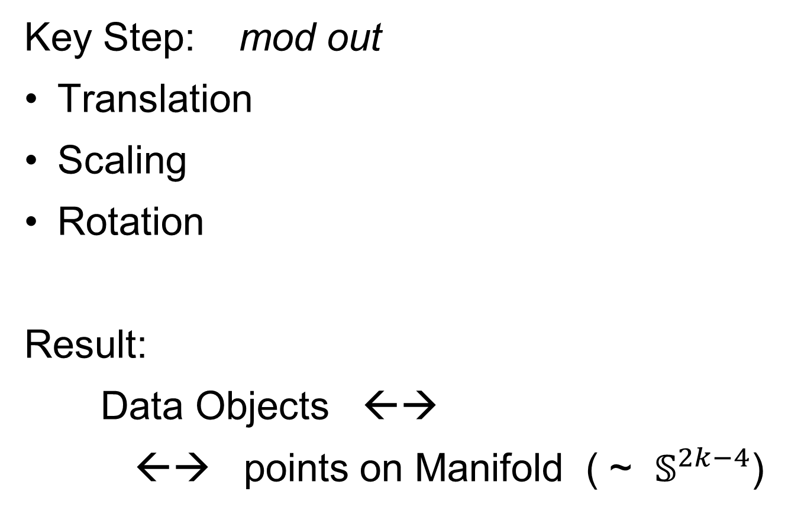

Landmark Based Shape Analysis
Key Step: mod out
Translation
Scaling
Rotation
Result:
Data Objects ←→
←→ points on Manifold ( ~ $𝕊^{2k−4}$)
Interesting Question:
Modes of Variation on $𝕊^{d}$

Slide 34
Digit 3 data: Principal variations of the shape
Recall Data
From Above

Slide 35
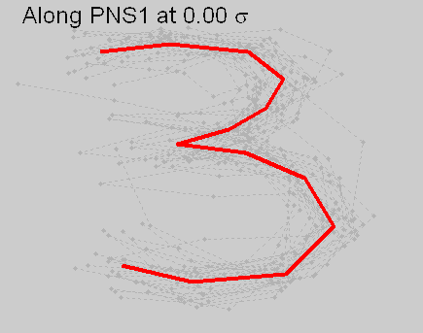
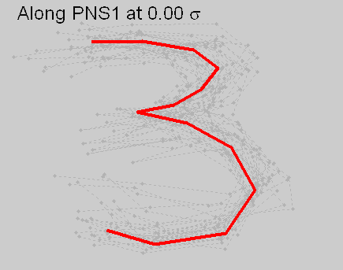


Digit 3 data: Principal variations of the shape
Princ. geodesics by PNS
Principal arcs by PNS

Slide 36
Digit 3 data: Principal variations of the shape
Principal Geodesics:
1st Mode: Center&Ends go Left&Right
2nd Mode: Fat vs. Skinny, Large Variation
Points Move Linearly
Principal Nested Spheres:
1st Mode: Traverses Long Curved Path
2nd Mode: Less Variation Left to Explain
Points Follow Curved Paths
Better “Signal Compression”

Slide 37
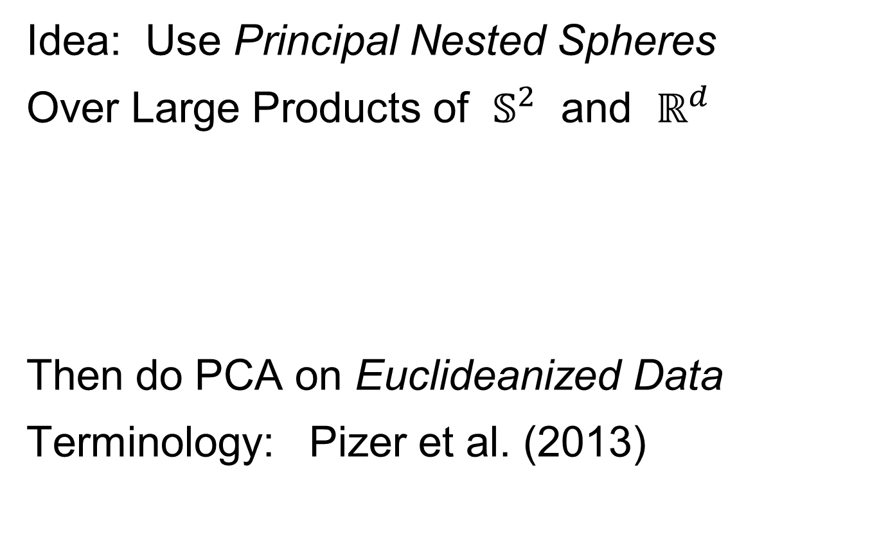
Composite Principal Nested Spheres
Idea: Use Principal Nested Spheres
Over Large Products of $𝕊^{2}$ and $ℝ^{d}$
Then do PCA on Euclideanized Data
Terminology: Pizer et al. (2013)
Vectors whose Entries are
Angles on Sphere and Reals

Slide 38
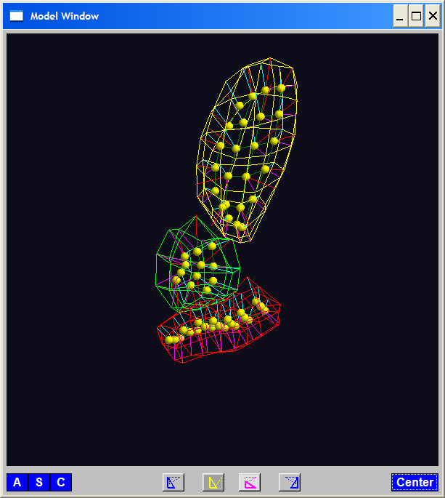
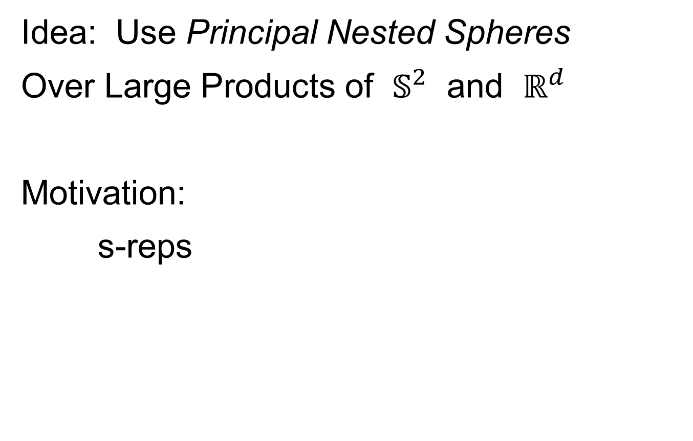
Composite Principal Nested Spheres
Idea: Use Principal Nested Spheres
Over Large Products of $𝕊^{2}$ and $ℝ^{d}$
Motivation:
s-reps

Slide 39

Composite Principal Nested Spheres
Idea: Use Principal Nested Spheres
Over Large Products of $𝕊^{2}$ and $ℝ^{d}$
Approach: Use Principal Nested Spheres
to Linearize $𝕊^{2}$ Components
Needs 2 Modes to
Capture Variation

Slide 40

Composite Principal Nested Spheres
Idea: Use Principal Nested Spheres
Over Large Products of $𝕊^{2}$ and $ℝ^{d}$
Approach: Use Principal Nested Spheres
to Linearize $S^{2}$ Components
PNS Explains All
With One Mode

Slide 41
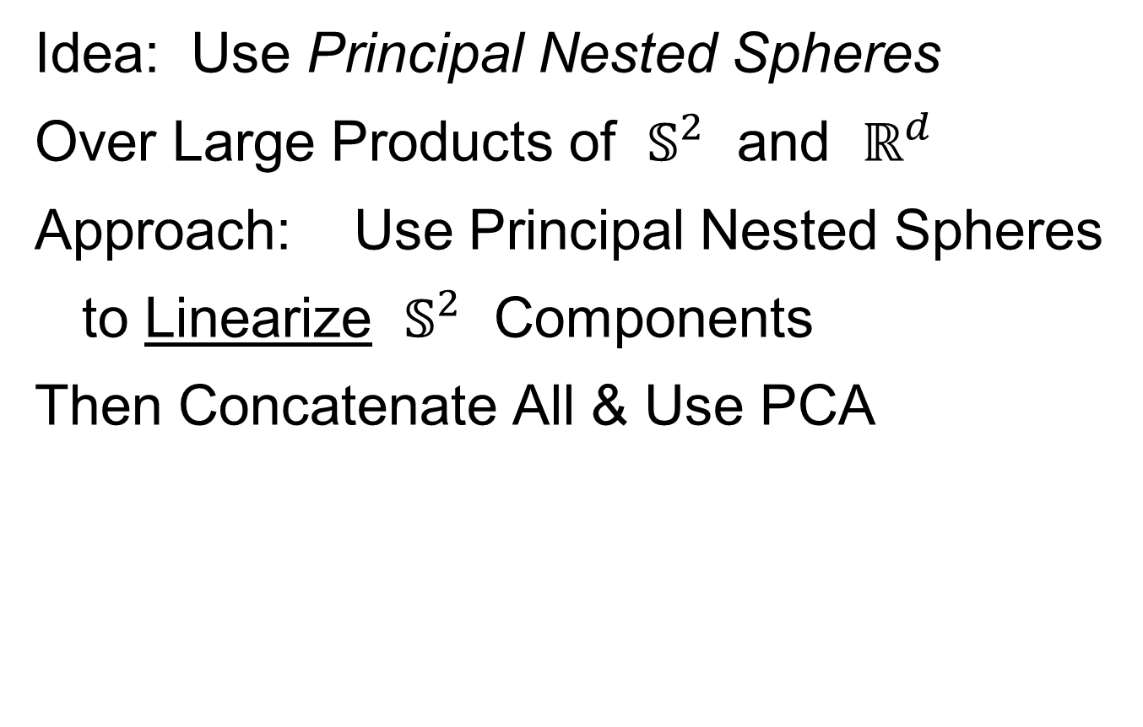
Composite Principal Nested Spheres
Idea: Use Principal Nested Spheres
Over Large Products of $𝕊^{2}$ and $ℝ^{d}$
Approach: Use Principal Nested Spheres
to Linearize $𝕊^{2}$ Components
Then Concatenate All & Use PCA

Slide 42
Composite Principal Nested Spheres
From Pizer et al. (2017, 2020) Impact on Segmentation:
PGA Segmentation: used ~20 comp’s
CPNS Segmentation: only need ~13
Resulted in visually better fits to data
Recall Bladder-Prostate-Rectum Data

Slide 43
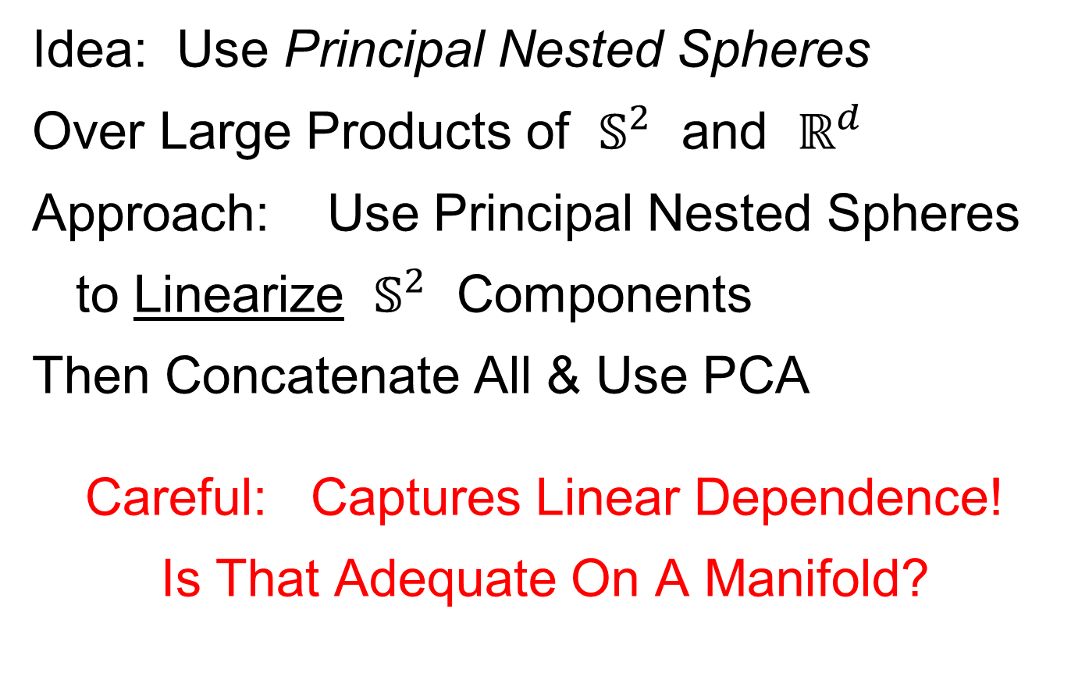
Composite Principal Nested Spheres
Idea: Use Principal Nested Spheres
Over Large Products of $𝕊^{2}$ and $ℝ^{d}$
Approach: Use Principal Nested Spheres
to Linearize $𝕊^{2}$ Components
Then Concatenate All & Use PCA
Careful: Captures Linear Dependence!
Is That Adequate On A Manifold?

Slide 44
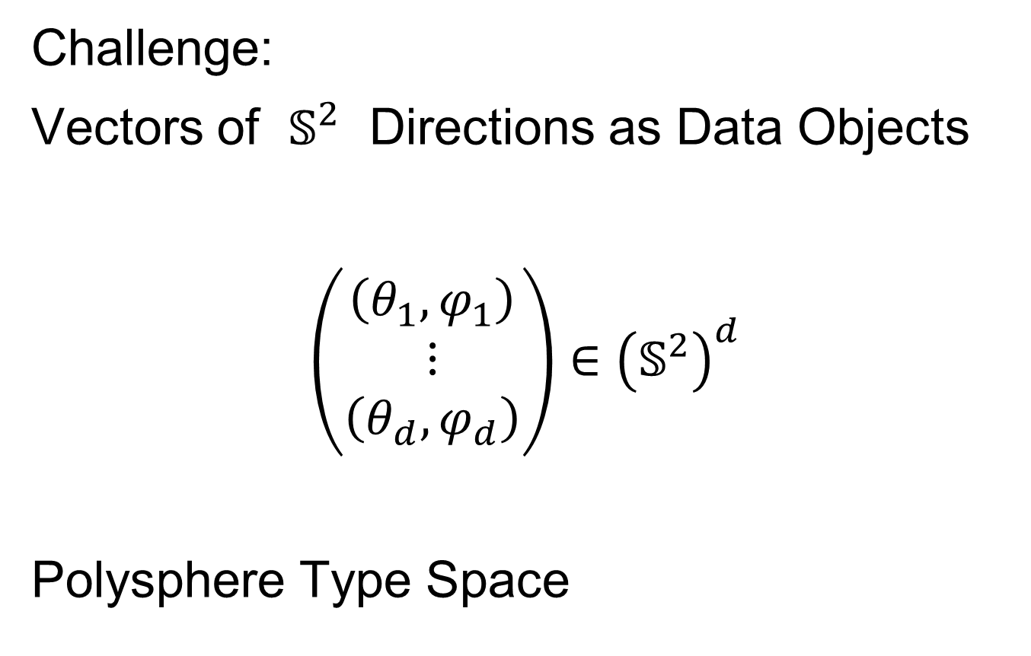
Extension to s-rep Space
Challenge:
Vectors of $𝕊^{2}$ Directions as Data Objects
$$\left(\begin{matrix}\left(θ_{1},φ_{1}\right) \\ ⋮ \\ \left(θ_{d},φ_{d}\right)\end{matrix}\right)∈{\left(𝕊^{2}\right)}^{d}$$
Polysphere Type Space

Slide 45
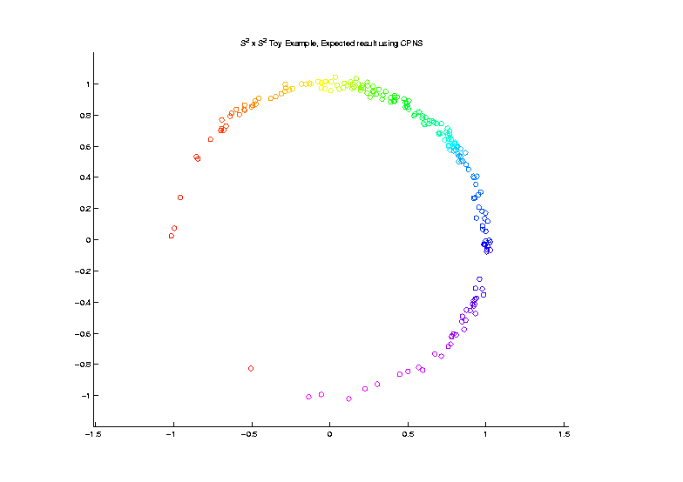

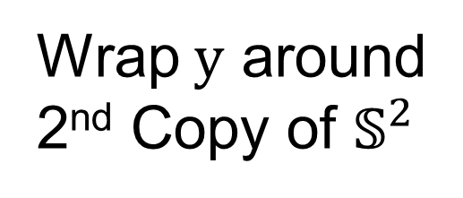
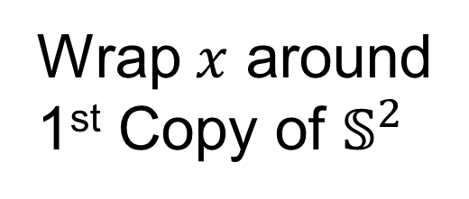
Extension to s-rep Space
Challenge: $𝕊^{2}×𝕊^{2}$ Polysphere Space
Generator Of
Toy Example
Wrap $x$ around
1st Copy of $𝕊^{2}$
Wrap $y$ around
2nd Copy of $𝕊^{2}$

Slide 46
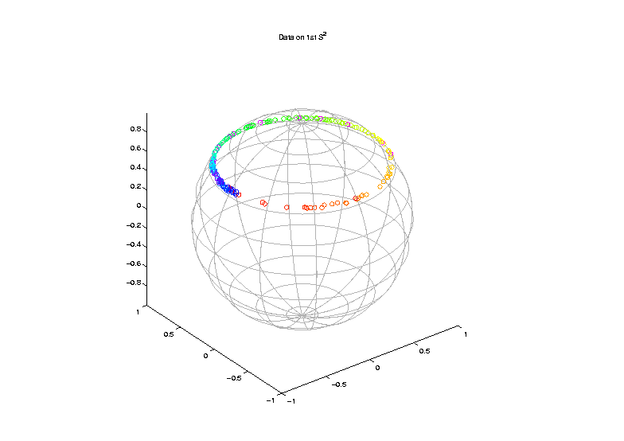

Extension to s-rep Space
Challenge: $𝕊^{2}×𝕊^{2}$ Polysphere Space
Note Colors
From $x$ In
Generator

Slide 47
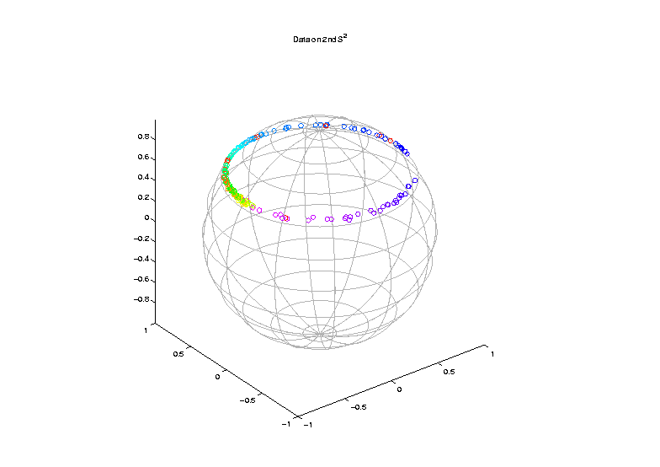

Extension to s-rep Space
Challenge: $𝕊^{2}×𝕊^{2}$ Polysphere Space
Note Colors
From $y$ In
Generator

Slide 48
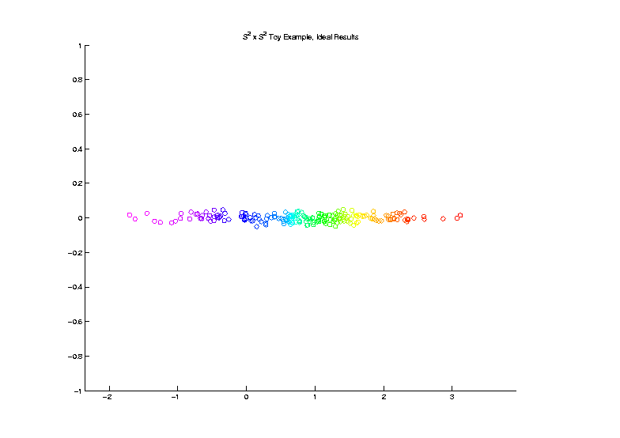
Extension to s-rep Space
Challenge: $𝕊^{2}×𝕊^{2}$ Polysphere Space
Desired Answer
From a PCA

Slide 49
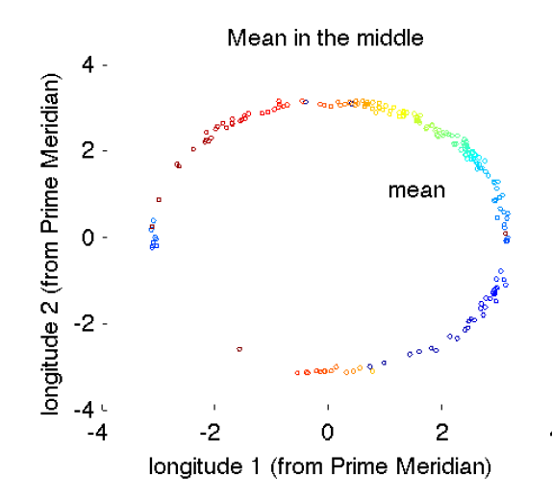
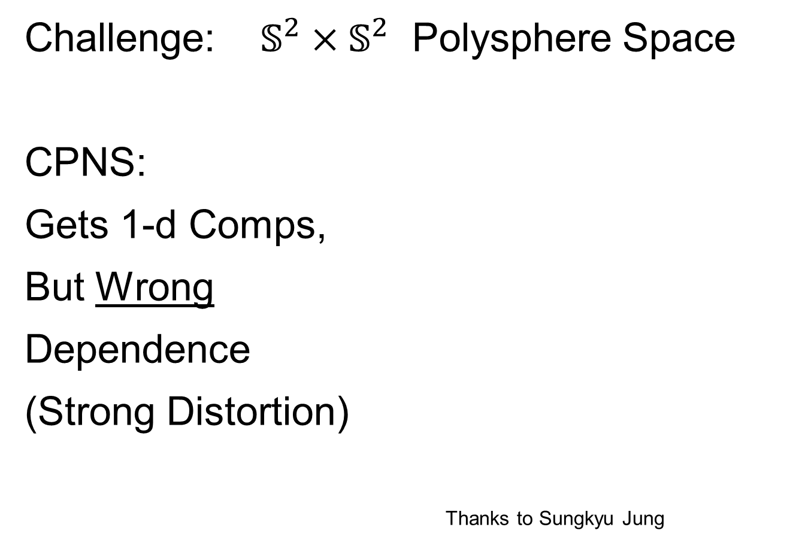
Extension to s-rep Space
Challenge: $𝕊^{2}×𝕊^{2}$ Polysphere Space
CPNS:
Gets 1-d Comps,
But Wrong
Dependence
(Strong Distortion)
Thanks to Sungkyu Jung

Slide 50

Polysphere PCA
Deeper New Methodology: PPCA
For Polysphere Spaces (e.g. s-reps)
Find Approximating (Higher $d$) Sphere
Then do PNS (Better Signal Compression)

Slide 51


Polysphere PCA
Deeper New Methodology: PPCA
For Polysphere Spaces (e.g. s-reps)
Reference: Elzner et al (2015)
Benjamin Eltzner Stephan Huckemann Sungkyu Jung

Slide 52

Polysphere PCA-type Analysis
Deeper New Methodology: PPCA
For Polysphere
~Toy Example
Pretty Good But
Still Some
Distortion
Thanks to B. Eltzner

Slide 53

Topologically Different Space
Vectors of Angles as Data Objects
$$\left(\begin{matrix}θ_{1} \\ ⋮ \\ θ_{d}\end{matrix}\right)∈{\left(𝕊^{1}\right)}^{d}=𝕋^{d}$$
Torus Type Spaces

Slide 54
Torus Spaces
Vectors of Angles as Data Objects
Natural Examples Include:
Structural Chemistry
(Sequences of Bond Angles)
Meteorology
(Wind Directions at Multiple Sites)
Astronomy
(Sunspots Moving Over Time)

Slide 55




Torus Space Views
Toy Example in $𝕋^{2}$
${\left[−π,π\right]}^{2}$ Square Representation
Donut Representation
Edges are Identified
Use Different Radii
To View Topology
Thanks to Eduardo García-Portugués

Slide 56
Torus PCA
Motivation:
“Sphere is most perfect geometric shape”
Eltzner, Huckemann & Mardia (2018)
Approach:
Deform Data to Sphere & Use PNS

Slide 57

Torus PCA
Eltzner, Huckemann & Mardia (2018)
Approach:
Deform Data to Sphere & Use PNS

Slide 58
Torus PCA
Eltzner, Huckemann & Mardia (2018)
Approach:
Deform Data to Sphere & Use PNS
Major Challenges:
Find A Good Cutpoint
Heavy Distortion
Approach: Specifically
Minimize Distortion

Slide 59

Multi-Dimensional Scaling
For Data Objects $𝓧_{1},⋯,𝓧_{n}$ in Metric Space,
Given a rank $r$:
Find Representers $w_{1},⋯,w_{n}∈ℝ^{r}$, Whose Distance Matrix “Best” Approximates $𝔇$
Typical Algorithms: Think of $w_{i}$ as
“PCA-like” Vectors of Scores
Note: This Representation Is
Called “Auto-Encoder” In AI literature

Slide 60


Multi-Dimensional Scaling
Ezra Miller Idea
(SAMSI Program on OODA):
For Strongly Non-Euclidean Data Space,
Embed Representers $w_{1},⋯,w_{n}$
In a Space with Less Distortion

Slide 61

Multi-Dimensional Scaling
For Data Objects $𝓧_{1},⋯,𝓧_{n}$ in Torus $𝕋^{d}$
Find Representers $w_{1},⋯,w_{n}∈{C∙𝕊}^{d}$, Whose Distance Matrix “Best” Approx’s $𝔇$,
Then Apply PNS
Also Optimize Over Tuning Parameter: $C$
(For $C$ Large, ${C∙S}^{d}≈ℝ^{d}$)

Slide 62


Scaled Torus PCA
Collaborators (Zoubouloglou et al. (2023)):
Pavlos Zoubouloglou
UNC, Statistics & OR
Eduardo García-Portugués
U. Carlos III, Madrid

Slide 63


Toy Example
Three Clusters in $𝕋^{3}$:
MDS
PNS
1st Mode Captures 3 Clusters,
Much Better Than PCA
Inverse Image of 1st Mode

Slide 64

Sunspots Data
Time Lagged Locations of Sunspots
Q: Linear
Relationship?
Recall Faces
Identified

Slide 65

Sunspots Data
TPCA Fit “Line”
TPCA Scores
Appears Clustered (Non-Linear)

Slide 66

Sunspots Data
STPCA Fit “Line”
STPCA Scores
Clearly Follows Line

Slide 67


RNA Torsion Angle Data
Goal: Find Clusters Here,
Using Only 7 Other Angles, i.e. in $𝕋^{7}$
Will Show
These Labels
As Colors
In PCAs

Slide 68


RNA Torsion Angle Data
Goal: Find Labelled Clusters in $𝕋^{7}$
STPCA Tends to Put
Clusters into 1st PC
TPCA-1 Scores
TPCA-2 Scores
STPCA Scores
PC1 - KDE Based Clustering
Much Better
Correspondence
of Target Labels

Slide 69

Principal Nested Spheres
Main Goal:
Extend Principal Arc Analysis ($𝕊^{2}$ to $𝕊^{k}$)
Jung et al (2012)
Important Landmark:
This Motivated Backwards PCA

Slide 70
Backwards PCA
Text: Sec. 8.6
Key Idea:
Replace usual forwards view of PCA
With a backwards approach to PCA

Slide 71
Terminology
Multiple linear regression:
Stepwise approaches:
Forwards: Start small, iteratively add variables to model
Backwards: Start with all, iteratively remove variables from model

Slide 72

Illust’n of PCA View: Recall Raw Data
Notes:
EgView1p1RawData.ps

Slide 73

Illust’n of PCA View: PC1 Projections
Notes:
EgView1p51proj3dPC1.ps

Slide 74

Illust’n of PCA View: PC2 Projections
Notes:
EgView1p52proj3dPC2.ps

Slide 75

Illust’n of PCA View: Projections on PC1,2 plane
Notes:
EgView1p54proj3dPC12.ps

Slide 76

Backwards PCA
Replace usual forwards view of PCA
Data → PC1 (1 dim approx)
→ PC2 (1 dim approx of Data-PC1)
→ PC1 U PC2 (2 dim approx)
$⋱$
→ PC1 U … U PCr
(r dim approx)

Slide 77

Backwards PCA
With a backwards approach to PCA
Data → PC1 U … U PCr (r dim approx)
→ PC1 U … U PC(r-1)
$⋱$
→ PC1 U PC2 (2 dim approx)
→ PC1 (1 dim approx)

Slide 78
Backwards PCA
Euclidean Settings:
Forwards PCA = Backwards PCA
(Pythagorean Theorem,
ANOVA Decomposition)
So Not Interesting
But Very Different in Non-Euclidean Settings
(Backwards is Better !?!)

Slide 79

Backwards PCA
Important Property of PCA:
Nested Series of Approximations
$$\left\{{PC}_{1}\right\}⊆\left\{{PC}_{1}{,PC}_{2}\right\}⊆\left\{{PC}_{1}{,PC}_{2},{PC}_{3}\right\}⊆⋯$$
(Often taken for granted)
(Desirable in Non-Euclidean Settings)

Slide 80
Backwards PCA
Desirability of Nesting:
Multi-Scale Analysis Makes Sense
Scores Visualization Makes Sense
Since Scores = Residuals
at Each Stage

Slide 81
An Interesting Question
How generally applicable is
Backwards approach to PCA?
Discussion:
Pizer et al (2013)
Damon and Marron (2014)

Slide 82
An Interesting Question
How generally applicable is
Backwards approach to PCA?
Anywhere this is already being done???

Slide 83

An Interesting Question
How generally applicable is
Backwards approach to PCA?
An Application:
Nonnegative Matrix Factorization
= PCA in Positive Orthant
Think $X ≈LS$
With ≥ 0 Constraints (on both $L$ & $S$)

Slide 84

Nonnegative Matrix Factorization
Isn’t This
Just PCA?
In the
Nonnegative
Orthant?
No, Most PC Directions Leave Orthant

Slide 85

Nonnegative Matrix Factorization
Isn’t This
Just PCA?
Data
(Near
Orthant
Faces)
Thanks to Lingsong Zhang

Slide 86
Nonnegative Matrix Factorization
Isn’t This
Just PCA?
Data
Mean
(Centered
Analysis)

Slide 87
Nonnegative Matrix Factorization
Isn’t This
Just PCA?
Data
Mean
PC1 Projections
Leave Orthant!

Slide 88

Nonnegative Matrix Factorization
Isn’t This
Just PCA?
Data
Mean
PC1 Projections
PC1 $⋃$ 2 Proj’ns
Leave Orthant!

Slide 89

Nonnegative Matrix Factorization
Note:
Problem not
Fixed by
SVD
(“Uncentered
PCA”)
Orthant Leaving Gets Worse

Slide 90

Nonnegative Matrix Factorization
Standard Approach:
Lee & Seung (1999):
Formulate & Solve Optimization
Major Challenge:
Not Nested, ($k=3 ≉ k=4$)

Slide 91

Nonnegative Matrix Factorization
Standard NMF
(Projections
All Inside
Orthant)

Slide 92

Nonnegative Matrix Factorization
Standard NMF
But Note
Not Nested
No “Multi-scale”
Analysis Possible
(Scores Plot?!?)

Slide 93

Nonnegative Matrix Factorization
Improved Version:
Use Backwards PCA Idea
“Nonnegative Nested Cone Analysis”
Collaborator:
Lingsong Zhang (Purdue)
Zhang, Lu, Marron (2015)

Slide 94

Nonnegative Nested Cone Analysis
Same Toy
Data Set
All
Projections
In Orthant

Slide 95

Nonnegative Nested Cone Analysis
Same Toy
Data Set
Rank 1
Approx.
Properly
Nested

Slide 96

Nonnegative Nested Cone Analysis
5-d Toy
Example
(Rainbow
Colored
by Peak
Order)

Slide 97

Nonnegative Nested Cone Analysis
5-d Toy Example Rank 1 NNCA Approx.

Slide 98

Nonnegative Nested Cone Analysis
5-d Toy Example Rank 2 NNCA Approx.

Slide 99
Nonnegative Nested Cone Analysis
5-d Toy Example Rank 2 NNCA Approx.
Nonneg.
Basis
Elements
(Not Trivial)

Slide 100

Nonnegative Nested Cone Analysis
5-d Toy Example Rank 3 NNCA Approx.
Current
Research:
How Many
Nonneg.
Basis El’ts
Needed?

Slide 101
An Interesting Question
How generally applicable is
Backwards approach to PCA?
Potential Application: Principal Curves
Hastie & Stuetzle, (1989)
(Foundation of Manifold Learning)

Slide 102
Manifold Learning
Goal: Find lower dimensional manifold that well approximates (high-dimensional) data
ISOmap
Tenenbaum, et al (2000)
Local Linear Embedding
Roweis & Saul (2000)

Slide 103
Manifold Learning
Tenenbaum, et al (2000)
Canonical Example:
Photographs (2-d) of Statue (3-d)
Different Viewpoints
Different Light Source Locations
Digitization of Photos is “Low-Dimensional”
But Not in a Subspace (Findable by PCA)
In a manifold (curved
surface) sense

Slide 104

Manifold Learning
Tenenbaum, et al (2000)
Reveals
Two
Interesting
Modes Of
Variation

Slide 105

1st Principal Curve
Linear Reg’n
Usual Smooth

Slide 106
1st Principal Curve
Linear Reg’n
Proj’s Reg’n
Usual Smooth

Slide 107
1st Principal Curve
Linear Reg’n
Proj’s Reg’n
Usual Smooth
Princ’l Curve

Slide 108
Manifold Learning
How generally applicable is
Backwards approach to PCA?
Potential Application: Principal Curves
Perceived Major Challenge:
How to find 2nd Principal Curve?

Slide 109
Manifold Learning
Key Component:
Principal Surfaces
LeBlanc & Tibshirani (1996)
Challenge:
Can have any dimensional surface,
But how to nest???
Proposal: Backwards Approach

Slide 110



An Interesting Question
How generally applicable is
Backwards approach to PCA?
Another Application:
HDLSS Robust PCA
L¹ Backwards PCA:
Brooks, Dulá, Boone (2013)

Slide 111
An Interesting Observation
In non-Euclidean cases,
Backwards PCA seems easier?
Why is that?
E.g. PNS, NNCA

Slide 112

An Interesting Question
Why does backwards PC seem easier?
An Attractive Answer:
James Damon, UNC Mathematics
Geometry
Singularity
Theory

Slide 113
An Interesting Question
Why does backwards PC seem easier?
An Attractive Answer:
James Damon, UNC Mathematics
Damon and Marron (2014)

Slide 114
An Interesting Question
Why does backwards PC seem easier?
An Attractive Answer:
James Damon, UNC Mathematics
Key Idea: Express Backwards PCA as
Nested Series of Constraints

Slide 115

General View of Backwards PCA
Define Nested Spaces via Constraints
Satisfying More Constraints $⇒$
$⇒$ Smaller Subspaces

Slide 116
General View of Backwards PCA
Define Nested Spaces via Constraints
E.g. SVD
(Singular Value Decomposition =
= Not Mean Centered PCA)
(notationally very clean)

Slide 117

General View of Backwards PCA
Define Nested Spaces via Constraints
E.g. SVD
Have Nested Subspaces:
$$S_{1}⊆S_{2}⊆⋯⊆S_{d}$$

Slide 118


General View of Backwards PCA
Define Nested Spaces via Constraints
E.g. SVD $S_{k}=\left\{x :x=\sum_{j=1}^{k}{c_{j}u_{j}}\right\}$
$k$-th SVD Subspace
Scores
Loading Vectors (Basis Elements)

Slide 119

General View of Backwards PCA
Define Nested Spaces via Constraints
E.g. SVD $S_{k}=\left\{x :x=\sum_{j=1}^{k}{c_{j}u_{j}}\right\}$
Now Define:
$$S_{k−1}=\left\{x∈S_{k} :\left\langle x,u_{k}\right\rangle =0\right\}$$
Constraint Gives Nested Reduction of Dim’n

Slide 120
General View of Backwards PCA
Define Nested Spaces via Constraints
Backwards PCA
Reduce Using Affine Constraints

Slide 121
General View of Backwards PCA
Define Nested Spaces via Constraints
Backwards PCA
Principal Nested Spheres
Use Affine Constraints (Planar Slices)
In Ambient Space

Slide 122
General View of Backwards PCA
Define Nested Spaces via Constraints
Backwards PCA
Principal Nested Spheres
Principal Surfaces
Spline Constraint Within Previous?
{Been Done Already???}

Slide 123
General View of Backwards PCA
Define Nested Spaces via Constraints
Backwards PCA
Principal Nested Spheres
Principal Surfaces
Other Manifold Data Spaces
Sub-Manifold Constraints??
(Algebraic Geometry)

Slide 124
Participant Presentation
1:35 Teresa McGhee:
QTl Mapping With Mediation
Next Class:
Victoria Sagasta Pereira

