Slide 1
Statistics – O. R. 881 Object Oriented Data Analysis
Steve Marron
Dept. of Statistics and Operations Research
University of North Carolina

Slide 2
Current Sections in Textbook
Today:
Section 9.1, 2.1, 9.2
Next Class:
Section 9.2, 17.2

Slide 3
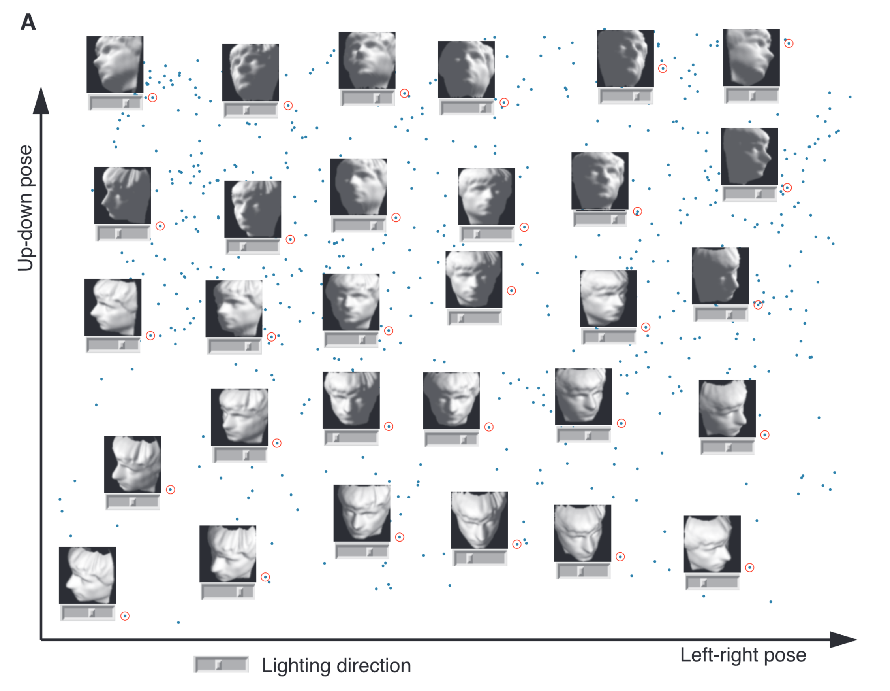
Last Class: Manifold Learning
Tenenbaum, et al (2000)
Reveals
Two
Interesting
Modes Of
Variation

Slide 4
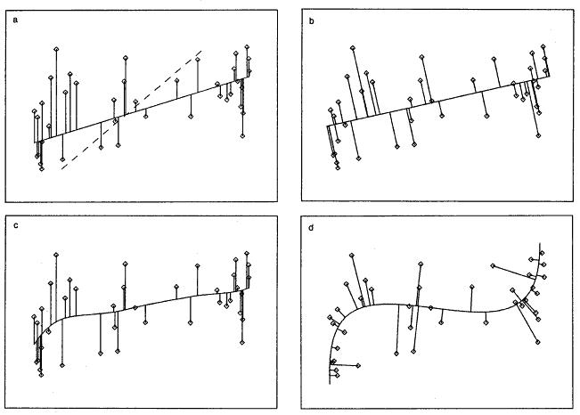
Last Class: 1st Principal Curve
Linear Reg’n
Proj’s Reg’n
Usual Smooth
Princ’l Curve

Slide 5
Last Class: Manifold Learning
Key Component:
Principal Surfaces
LeBlanc & Tibshirani (1996)
Challenge:
Can have any dimensional surface,
But how to nest???
Proposal: Backwards Approach

Slide 6
Last Class: Interesting Question
Why does backwards PC seem easier?
An Attractive Answer:
James Damon, UNC Mathematics
Key Idea: Express Backwards PCA as
Nested Series of Constraints

Slide 7
Last Class: Backwards PCA
Define Nested Spaces via Constraints
Backwards PCA
Principal Nested Spheres
Principal Surfaces
Other Manifold Data Spaces
Sub-Manifold Constraints??
(Algebraic Geometry)

Slide 8
Last Class: Cov. Mat. Data Objects
Motivation: Diffusion Tensor Imaging (DTI)
Variation on Magnetic Resonance Imaging
Major Goal: Map Brain Connectivity
By Finding “Fibers”
Text: Sec 8.7
Basser et al. (1994)

Slide 9
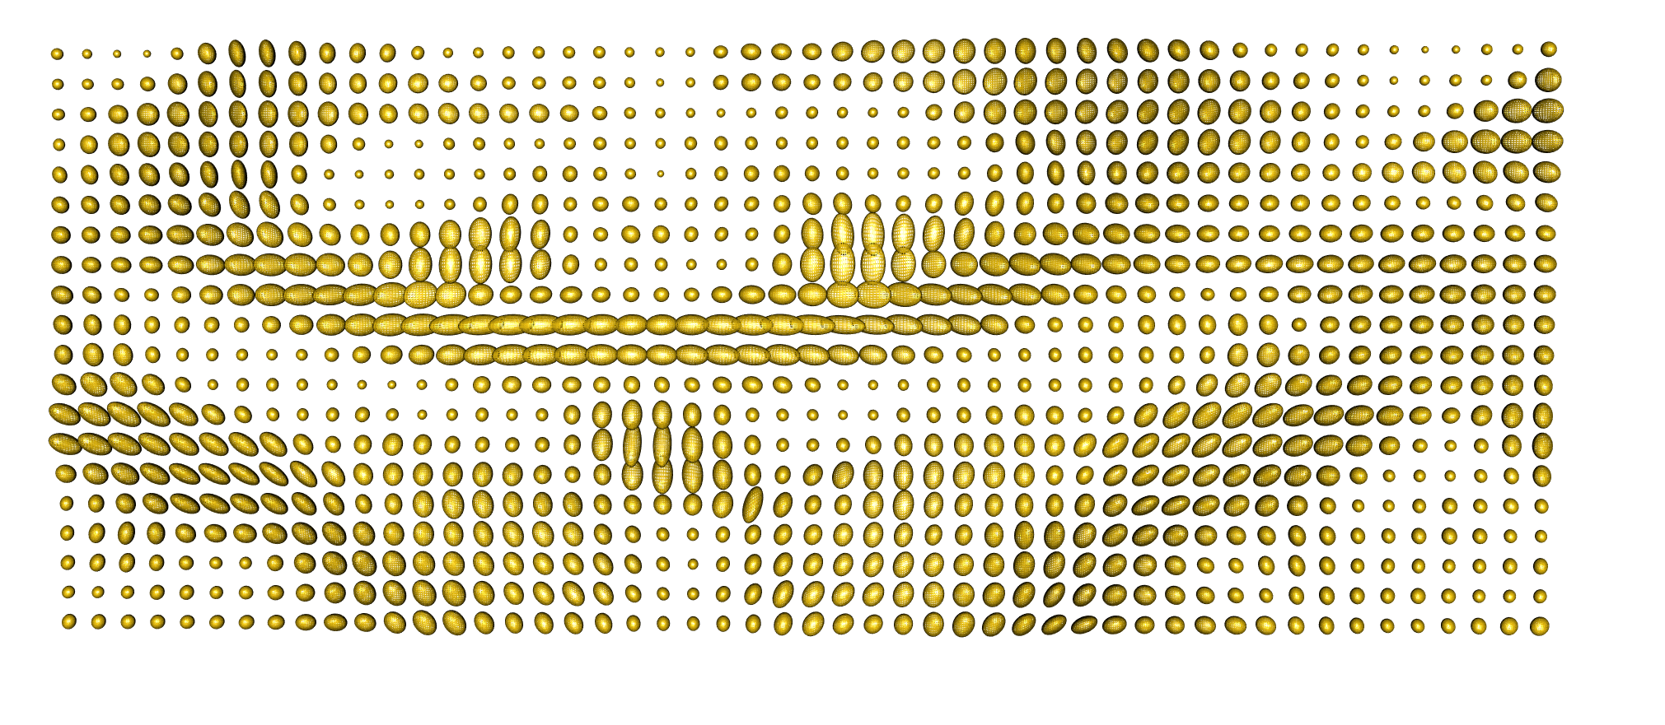



Last Class: Cov. Mat. Data Objects
Variation Expressed as Covariance Matrices
Low Variation $≈$ Solid Region
Spherical $≈$ Pure Fluid
Stretched $≈$ Fiber
One Slice, from One Person’s Brain

Slide 10
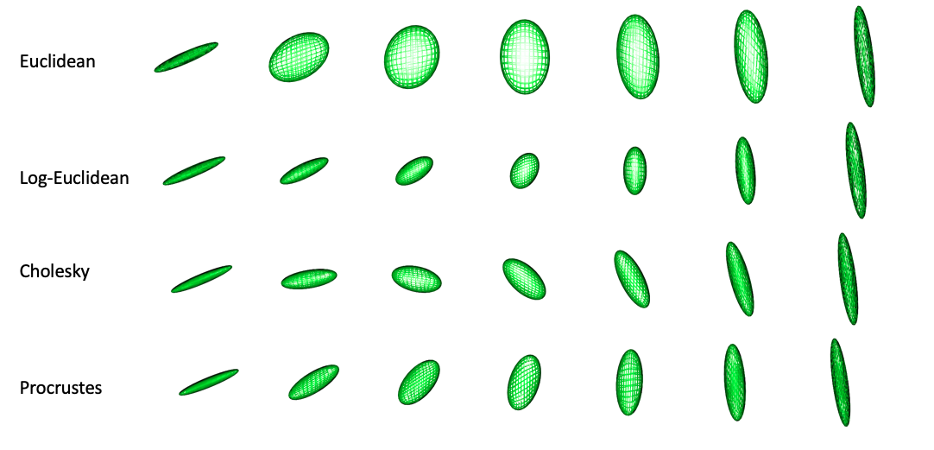
Last Class: Cov. Mat. Data Objects
Important Point: Choice of Metric Matters
Even Wildly Different Paths!

Slide 11
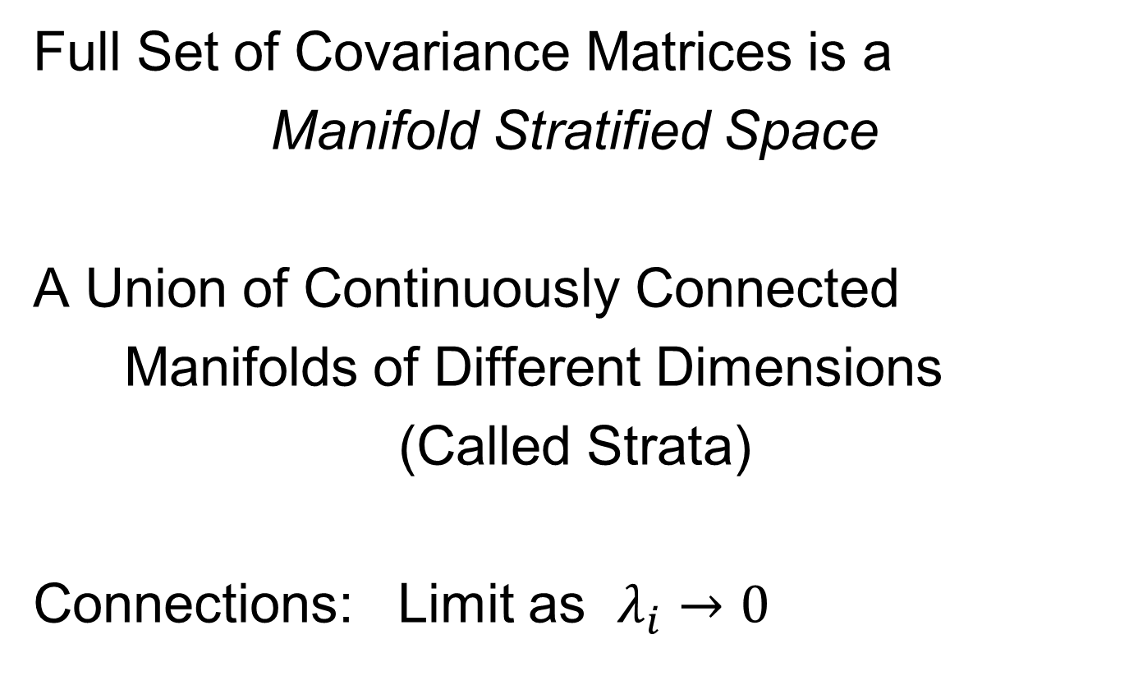
Last Class: Cov. Mat. Data Objects
Full Set of Covariance Matrices is a
Manifold Stratified Space
A Union of Continuously Connected
Manifolds of Different Dimensions
(Called Strata)
Connections: Limit as $λ_{i}→0$

Slide 12
Last Class: OODA Big Picture
Text: Chp. 9
New Topic:
Curve Registration
(Amplitude – Phase Variation)
Main Reference:
Srivastava et al (2011)
Interesting Aside: Never Published
Beyond ArXiv, yet 197 Google Citations

Slide 13
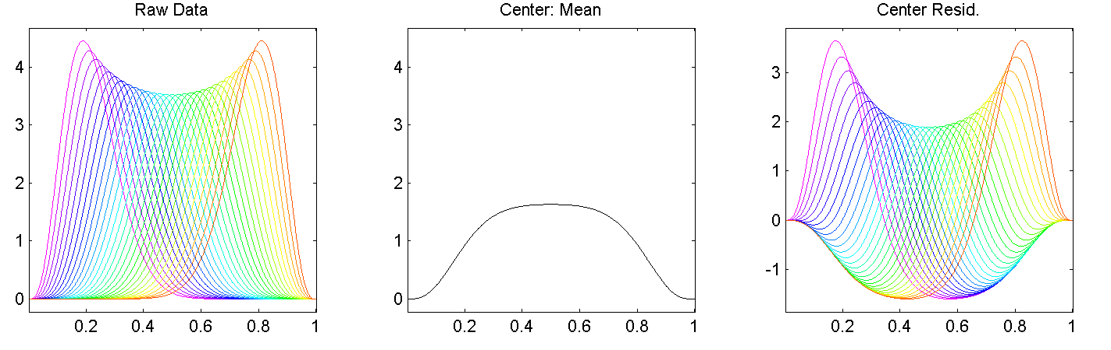
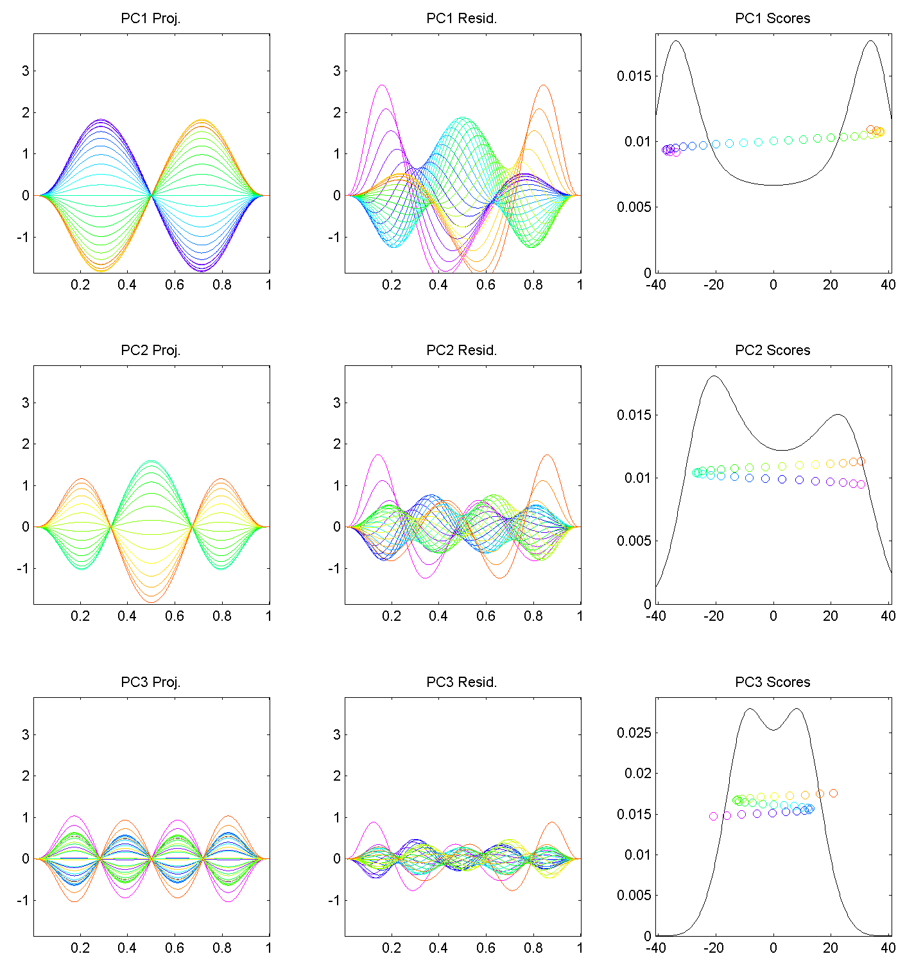
Last Class: Motivating Example
Shifted Betas
Example PCA
Hard to Interpret 1st Mode
Yet Scores Seem Sensible
Conclusion: PCA
Modes of Variation
Yield Poor Insights
About Phase
Similar for Other Modes
Looks Like Harmonics
From Fourier Theory
Is There a Sturm-
Liouville Theory?

Slide 14
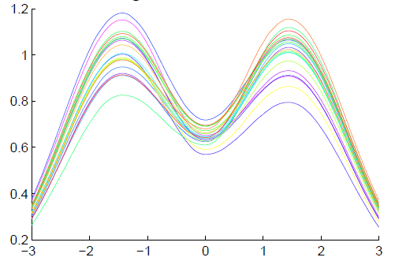
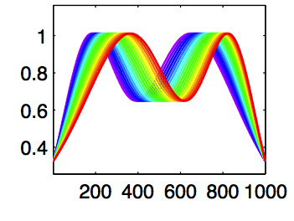
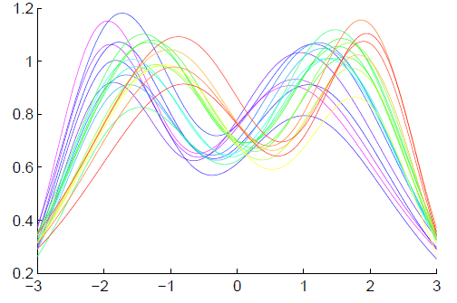
Last Class: General Amp - Phase Context
Appropriate
Mathematical
Framework?
Vertical Variation
Horiz’l
Var’n

Slide 15
Last Class: Time Warping
Foundational Concept for Curve Registration
Think Stretch & Compress Horizontal Axis
Mathematical Basis:
Diffeomorphisms

Slide 16

Last Class: Time Warping
Elastically Stretch & Compress Axis
$γ\left(x\right)$

Slide 17
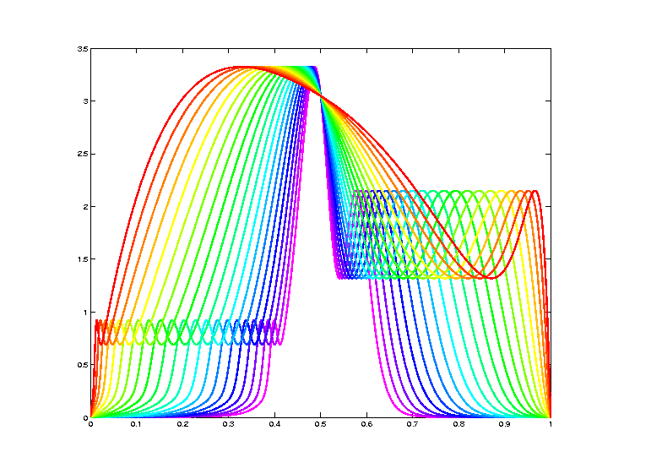
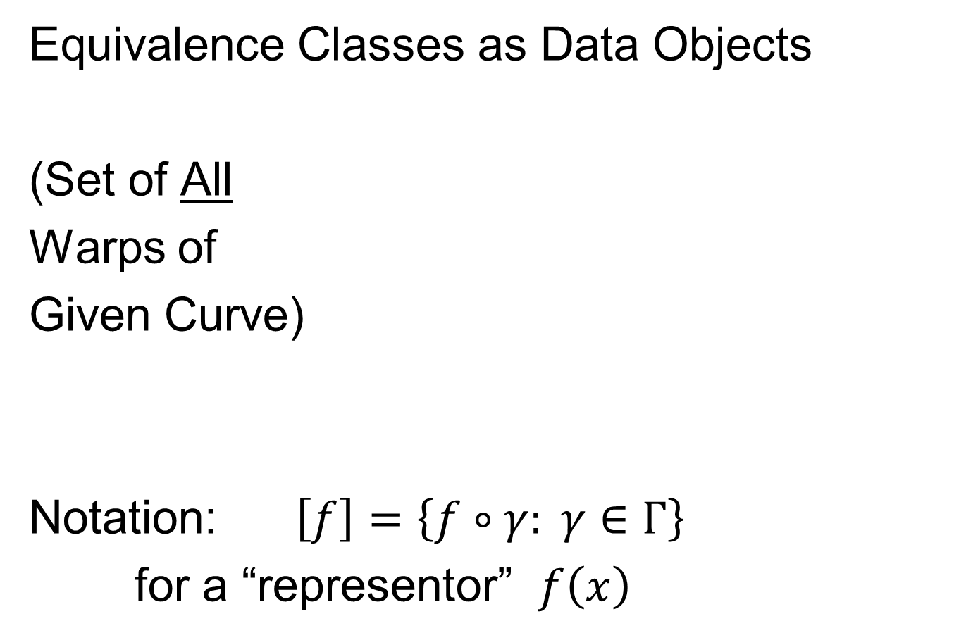
Last Class: Data Objects I
Equivalence Classes as Data Objects
(Set of All
Warps of
Given Curve)
Notation: $\left[f\right]=\left\{f∘γ: γ∈Γ\right\}$
for a “representor” $f\left(x\right)$

Slide 18
Last Class: Metrics in Curve Sp.
General Strategy:
Find Metric on Equivalence Classes
Start with Warp Invariant Metric on Curves
& Extend

Slide 19
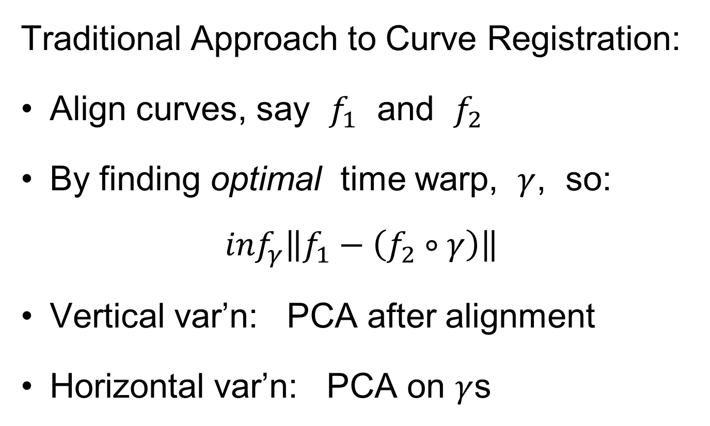
Metrics in Curve Space
Traditional Approach to Curve Registration:
Align curves, say $f_{1}$ and $f_{2}$
By finding optimal time warp, $γ$, so:
$$\inf_{γ}\left\|f_{1}−\left(f_{2}∘γ\right)\right\|$$
Vertical var’n: PCA after alignment
Horizontal var’n: PCA on $γ$s

Slide 20
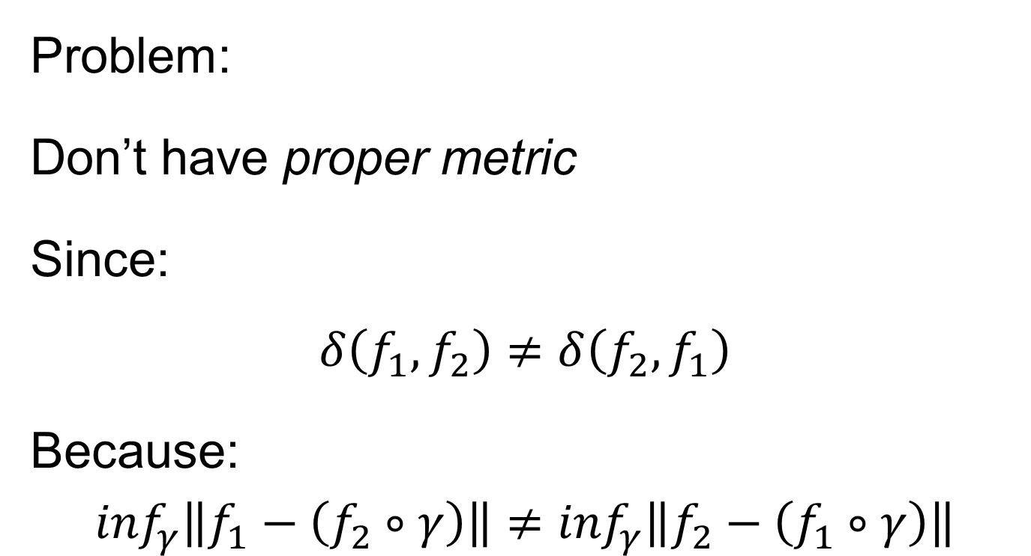
Metrics in Curve Space
Problem:
Don’t have proper metric
Since:
$$δ\left(f_{1},f_{2}\right)≠δ\left(f_{2},f_{1}\right)$$
Because:
$$\inf_{γ}\left\|f_{1}−\left(f_{2}∘γ\right)\right\|≠\inf_{γ}\left\|f_{2}−\left(f_{1}∘γ\right)\right\|$$

Slide 21
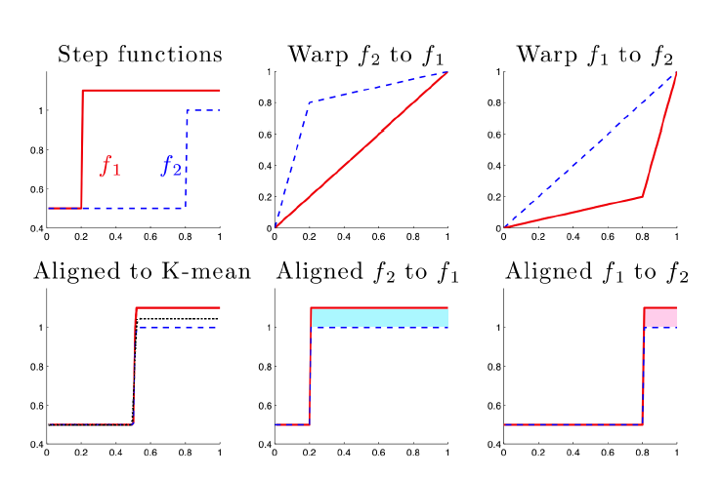





Metrics in Curve Space
$$\inf_{γ}\left\|f_{1}−\left(f_{2}∘γ\right)\right\|≠\inf_{γ}\left\|f_{2}−\left(f_{1}∘γ\right)\right\|$$
Thanks to
Xiaosun Lu
$$γ_{1}(x)$$
$$γ_{2}(x)$$
$$f_{2}(γ_{2}\left(x\right))$$
$$f_{1}(γ_{1}\left(x\right))$$

Slide 22

Metrics in Curve Space
$$\inf_{γ}\left\|f_{1}−\left(f_{2}∘γ\right)\right\|≠\inf_{γ}\left\|f_{2}−\left(f_{1}∘γ\right)\right\|$$
Note:
Very
Different
L² norms
Thanks to
Xiaosun Lu
But There is a
Good Answer,
Explained Later

Slide 23
Metrics in Curve Space
General Strategy Again:
Find Metric on Equivalence Classes
Start with Warp Invariant Metric on Curves
& Extend

Slide 24
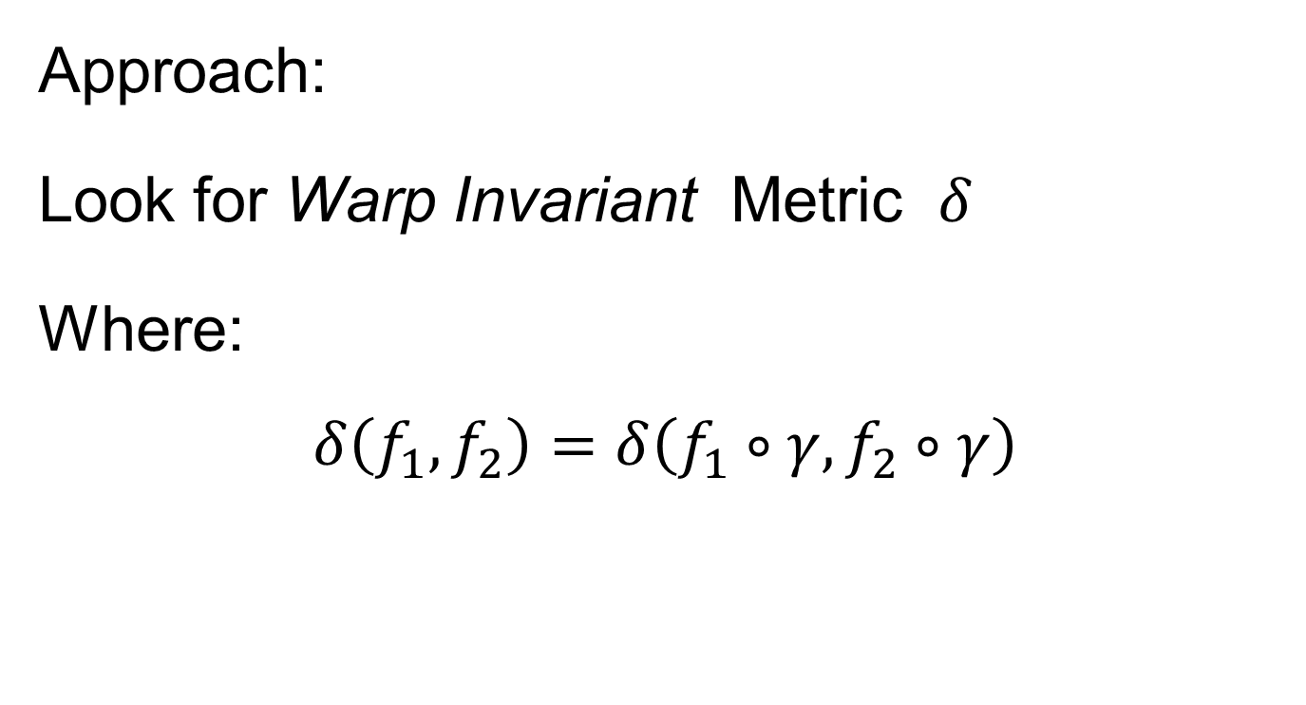
Metrics in Curve Space
Approach:
Look for Warp Invariant Metric $δ$
Where:
$$δ\left(f_{1},f_{2}\right)=δ\left(f_{1}∘γ,f_{2}∘γ\right)$$

Slide 25

Metrics in Curve Space
$$δ\left(f_{1},f_{2}\right)=δ\left(f_{1}∘γ,f_{2}∘γ\right)$$
I.e. Have “Parallel”
Representatives
Of Equivalence
Classes

Slide 26
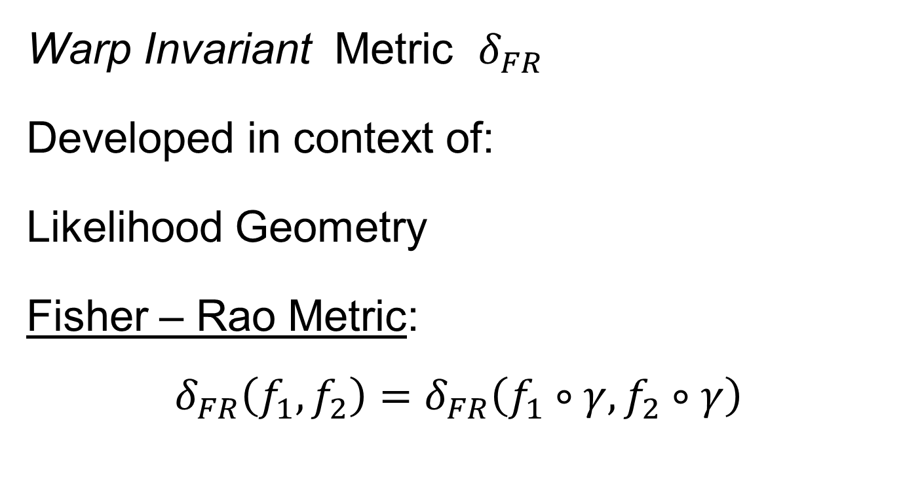
Metrics in Curve Space
Warp Invariant Metric $δ_{FR}$
Developed in context of:
Likelihood Geometry
Fisher – Rao Metric:
$$δ_{FR}\left(f_{1},f_{2}\right)=δ_{FR}\left(f_{1}∘γ,f_{2}∘γ\right)$$
Rao (1945)
Deeper Theory:
Amari (1985)

Slide 27

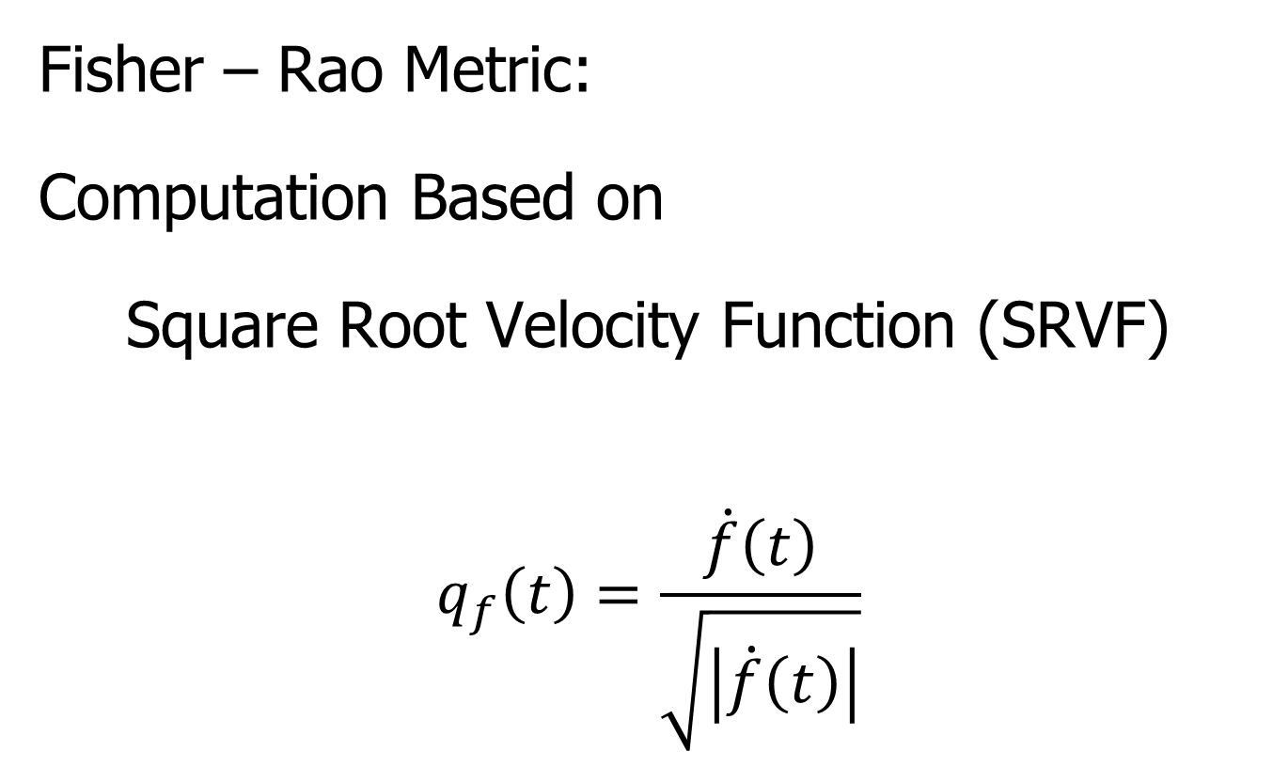
Metrics in Curve Space
Fisher – Rao Metric:
Computation Based on
Square Root Velocity Function (SRVF)
$$q_{f}\left(t\right)=\frac{\dot{f}\left(t\right)}{\sqrt{\left|\dot{f}\left(t\right)\right|}}$$
Where
$\dot{f}\left(t\right)=\frac{∂}{∂t}f(t)$
Signed Version
Of Square Root
Derivative

Slide 28
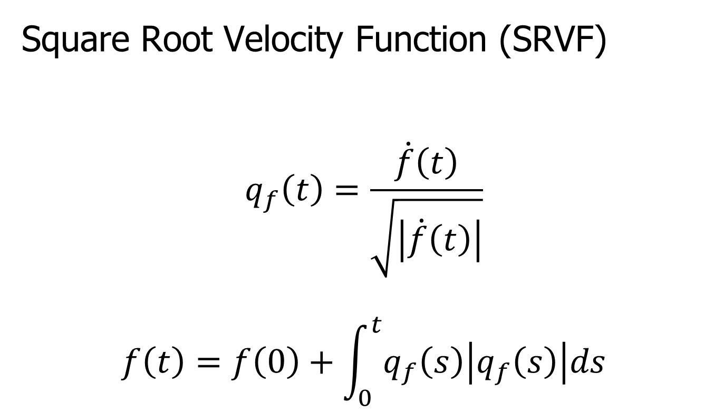
Metrics in Curve Space
Square Root Velocity Function (SRVF)
$$q_{f}\left(t\right)=\frac{\dot{f}\left(t\right)}{\sqrt{\left|\dot{f}\left(t\right)\right|}}$$
$$f\left(t\right)=f\left(0\right)+\int_{0}^{t}{q_{f}\left(s\right)\left|q_{f}\left(s\right)\right|ds}$$

Slide 29
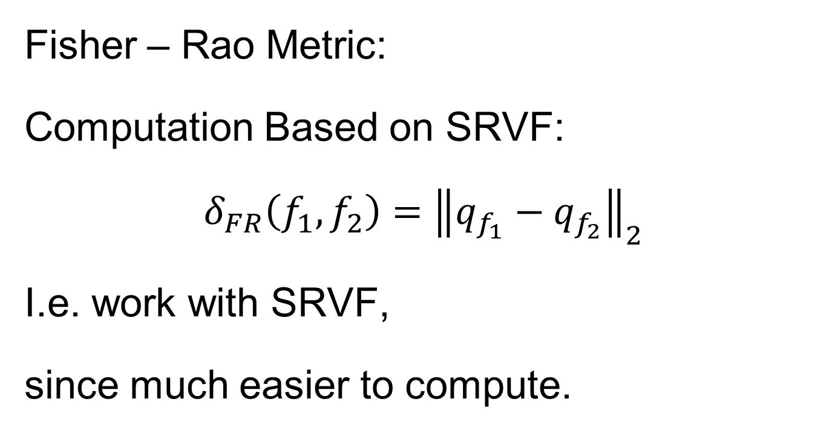
Metrics in Curve Space
Fisher – Rao Metric:
Computation Based on SRVF:
$$δ_{FR}\left(f_{1},f_{2}\right)={\left\|q_{f_{1}}−q_{f_{2}}\right\|}_{2}$$
I.e. work with SRVF,
since much easier to compute.

Slide 30
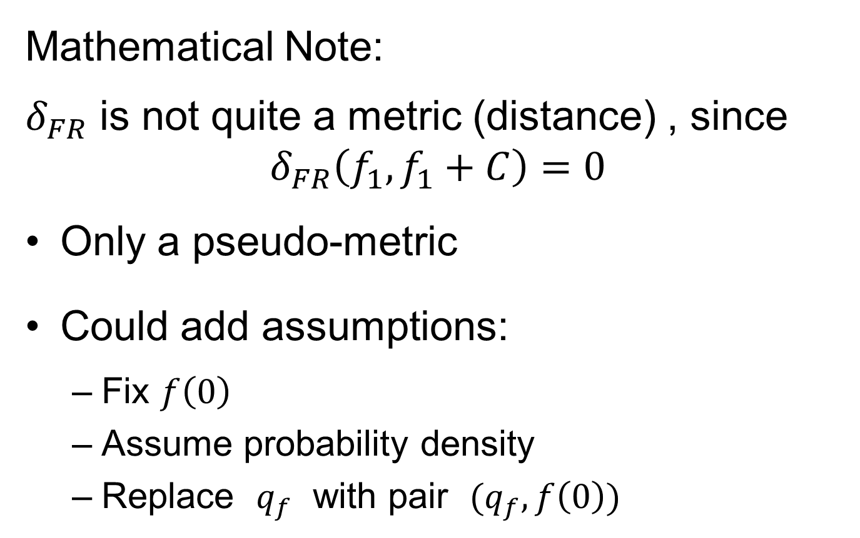
Metrics in Curve Space
Mathematical Note:
$δ_{FR}$ is not quite a metric (distance) , since
$$δ_{FR}\left(f_{1},f_{1}+C\right)=0$$
Only a pseudo-metric
Could add assumptions:
Fix $f\left(0\right)$
Assume probability density
Replace $q_{f}$ with pair $(q_{f},f\left(0\right))$

Slide 31
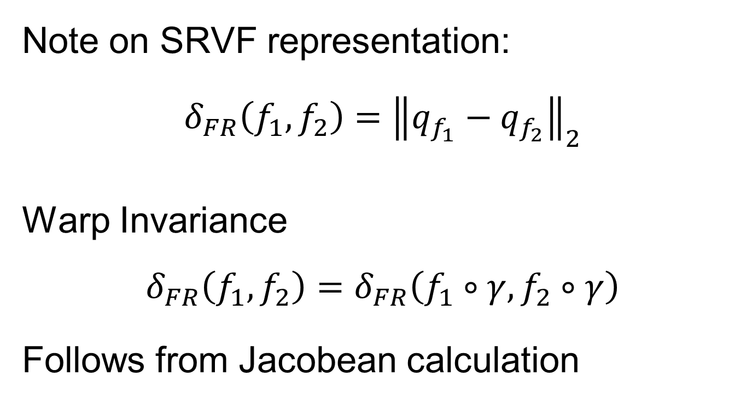
Metrics in Curve Space
Note on SRVF representation:
$$δ_{FR}\left(f_{1},f_{2}\right)={\left\|q_{f_{1}}−q_{f_{2}}\right\|}_{2}$$
Warp Invariance
$$δ_{FR}\left(f_{1},f_{2}\right)=δ_{FR}\left(f_{1}∘γ,f_{2}∘γ\right)$$
Follows from Jacobean calculation

Slide 32
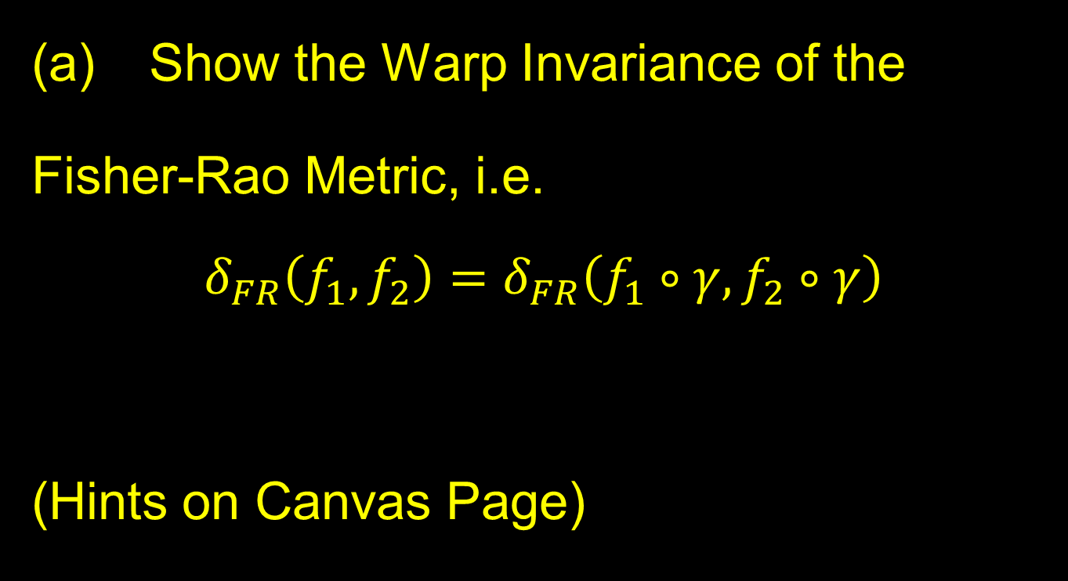
Homework 5
(a) Show the Warp Invariance of the
Fisher-Rao Metric, i.e.
$$δ_{FR}\left(f_{1},f_{2}\right)=δ_{FR}\left(f_{1}∘γ,f_{2}∘γ\right)$$
(Hints on Canvas Page)
Due: Mar. 7,
12:30AM

Slide 33
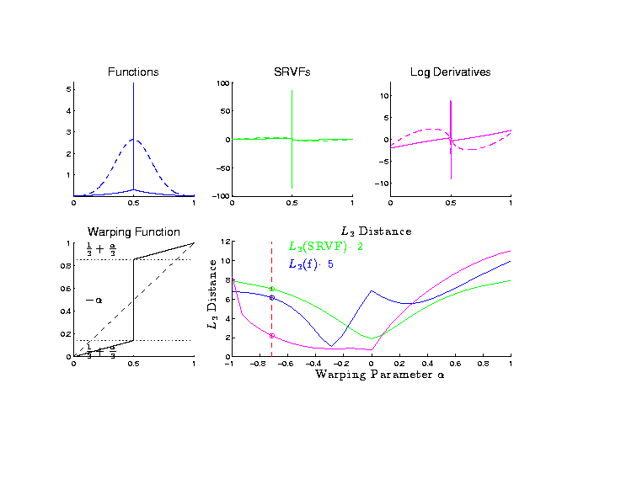
Metrics in Curve Space
Why
square
roots?
Thanks to
Xiaosun Lu

Slide 34
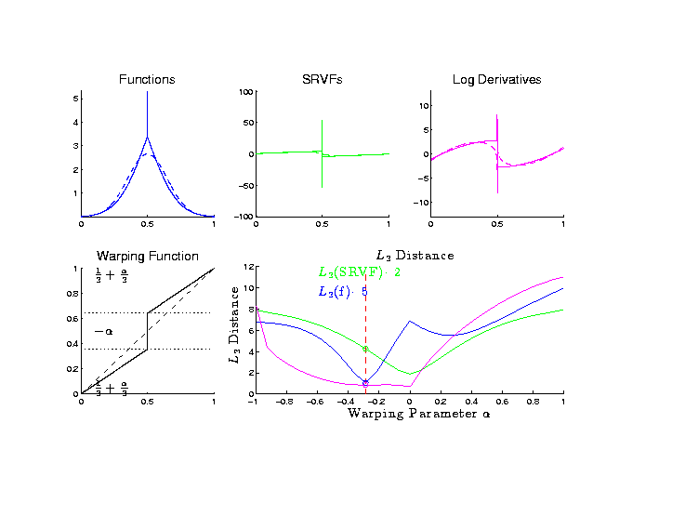
Metrics in Curve Space
Why
square
roots?

Slide 35
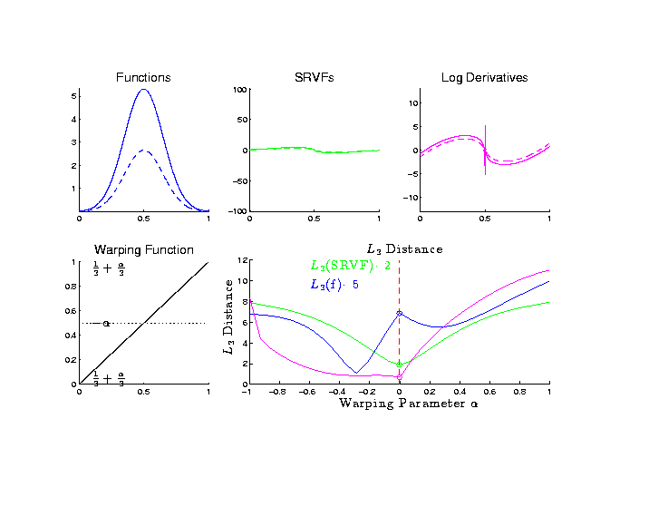
Metrics in Curve Space
Why
square
roots?

Slide 36
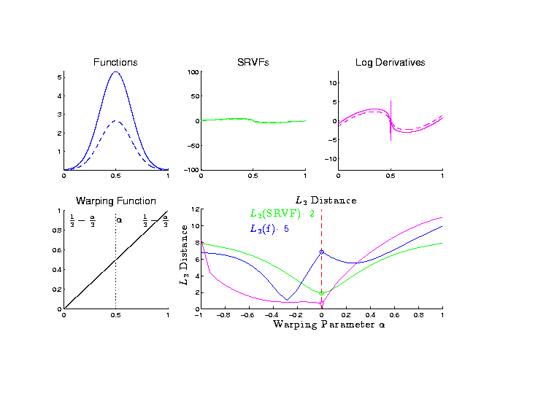
Metrics in Curve Space
Why
square
roots?

Slide 37
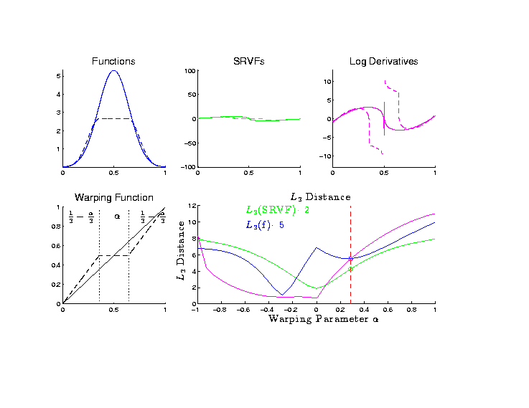
Metrics in Curve Space
Why
square
roots?

Slide 38
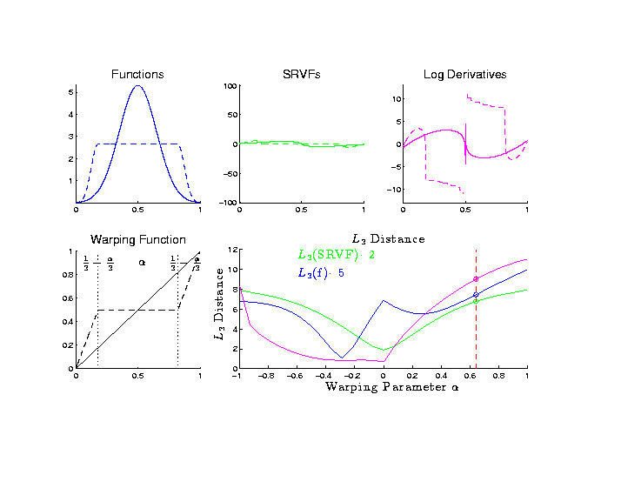
Metrics in Curve Space
Why
square
roots?

Slide 39
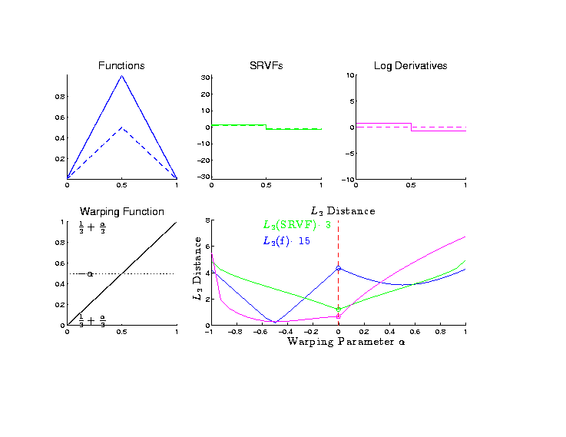
Metrics in Curve Space
Why
square
roots?

Slide 40
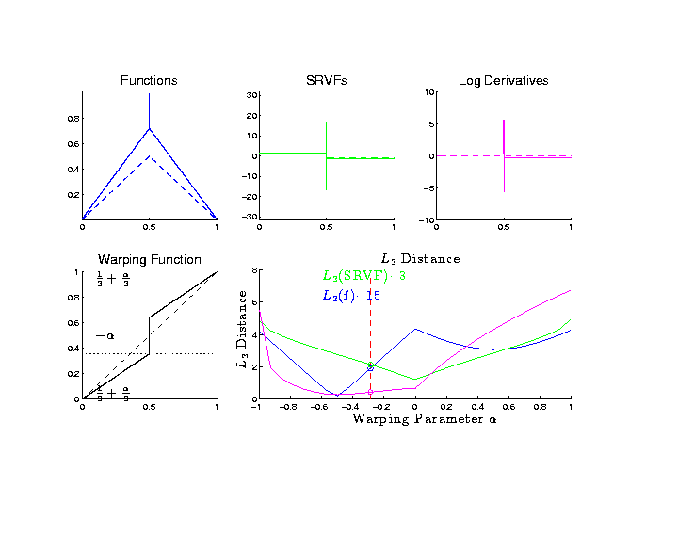
Metrics in Curve Space
Why
square
roots?

Slide 41
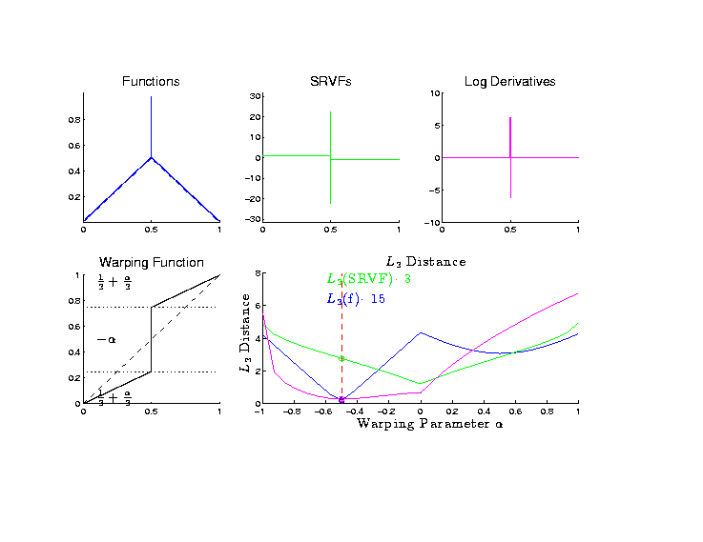
Metrics in Curve Space
Why
square
roots?

Slide 42
Metrics in Curve Space
Why
square
roots? Dislikes Pinching
Focusses Well On
Peaks of Unequal Height

Slide 43
Metrics in Curve Quotient Space
Above was Invariance for Individual Curves
Now extend to:
Equivalence Classes of Curves
I.e. Orbits as Data Objects
I.e. Define Metric on Quotient Space

Slide 44

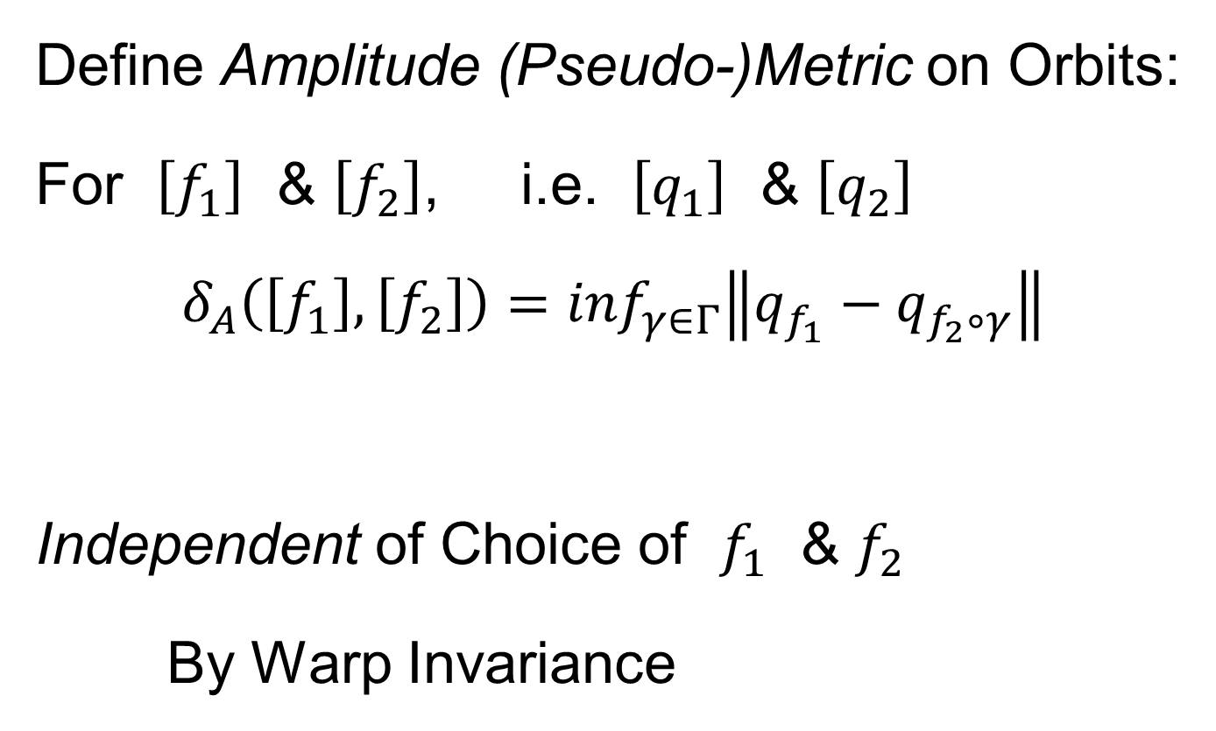
Metrics in Curve Quotient Space
Again Have $δ_{A}\left(\left[f\right],\left[f+C\right]\right)=0$
Define Amplitude (Pseudo-)Metric on Orbits:
For $\left[f_{1}\right]$ & $\left[f_{2}\right]$, i.e. $\left[q_{1}\right]$ & $\left[q_{2}\right]$
$$δ_{A}\left(\left[f_{1}\right],\left[f_{2}\right]\right)=\inf_{γ∈Γ}\left\|q_{f_{1}}−q_{f_{2}∘γ}\right\|$$
Independent of Choice of $f_{1}$ & $f_{2}$
By Warp Invariance

Slide 45
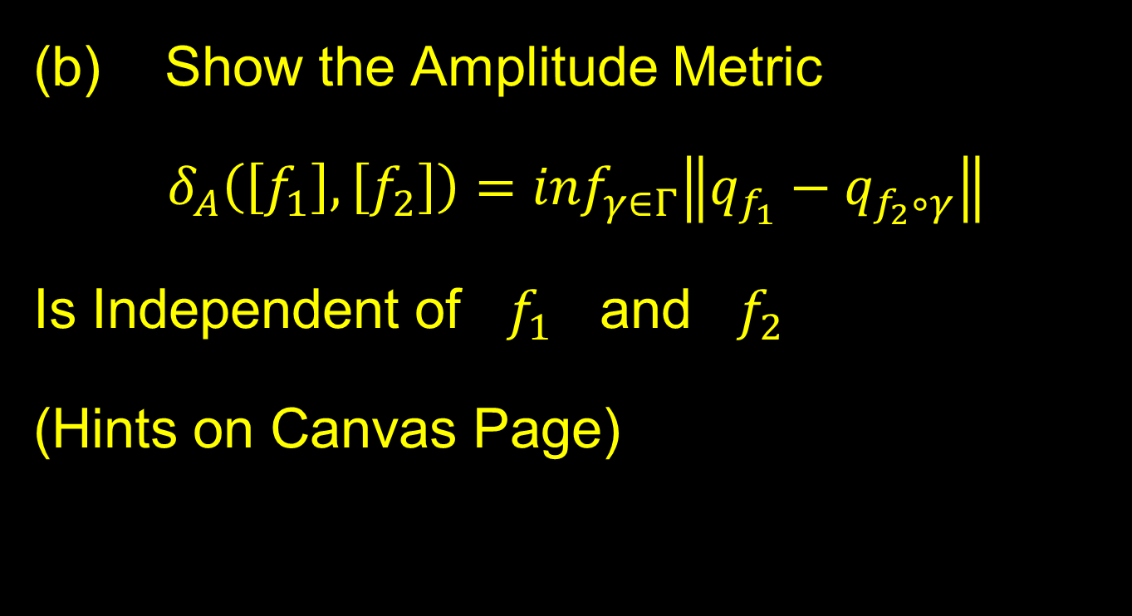
Homework 5
Show the Amplitude Metric
$$δ_{A}\left(\left[f_{1}\right],\left[f_{2}\right]\right)=\inf_{γ∈Γ}\left\|q_{f_{1}}−q_{f_{2}∘γ}\right\|$$
Is Independent of $f_{1}$ and $f_{2}$
(Hints on Canvas Page)
Due: Mar. 7,
12:30AM

Slide 46
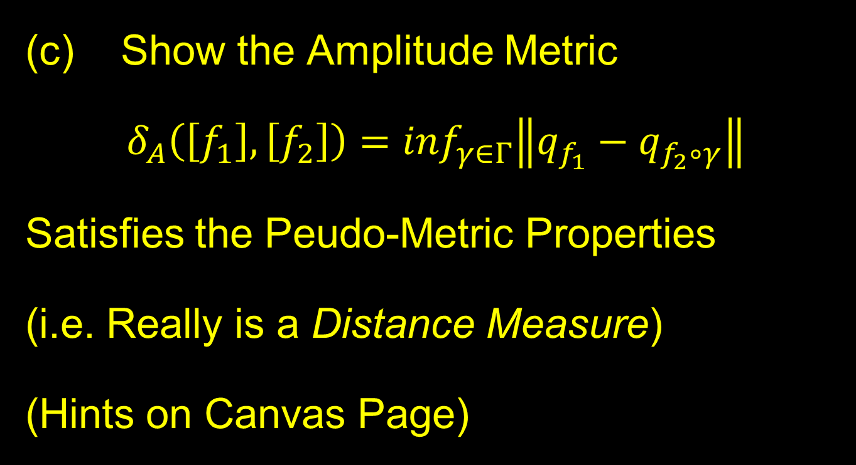
Homework 5
(c) Show the Amplitude Metric
$$δ_{A}\left(\left[f_{1}\right],\left[f_{2}\right]\right)=\inf_{γ∈Γ}\left\|q_{f_{1}}−q_{f_{2}∘γ}\right\|$$
Satisfies the Peudo-Metric Properties
(i.e. Really is a Distance Measure)
(Hints on Canvas Page)
Due: Mar. 7,
12:30AM

Slide 47
Mean in Curve Quotient Space
Benefit of a Metric:
Allows Definition of a “Mean”
Fréchet Mean
Geodesic Mean
Barycenter
Karcher Mean
Nomenclature
Objected to by
Karcher (2014)

Slide 48
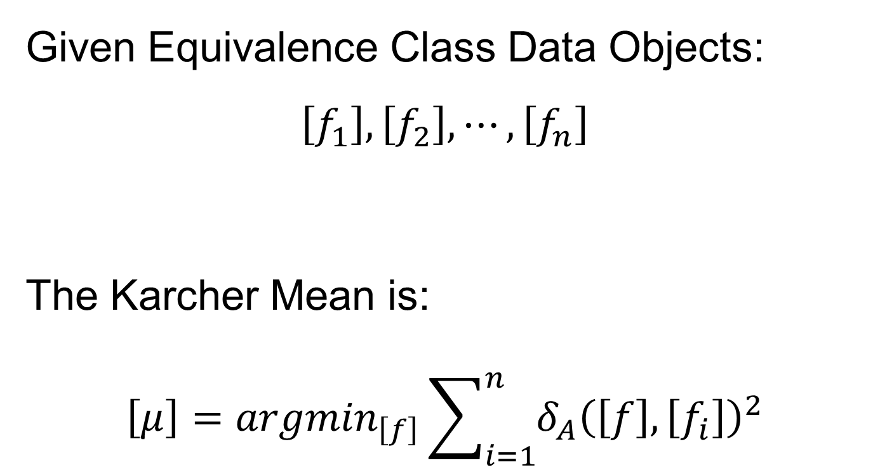
Mean in Curve Quotient Space
Given Equivalence Class Data Objects:
$$\left[f_{1}\right], \left[f_{2}\right], ⋯,\left[f_{n}\right]$$
The Karcher Mean is:
$$\left[μ\right]={argmin}_{\left[f\right]}\sum_{i=1}^{n}{{δ_{A}\left(\left[f\right],\left[f_{i}\right]\right)}^{2}}$$

Slide 49
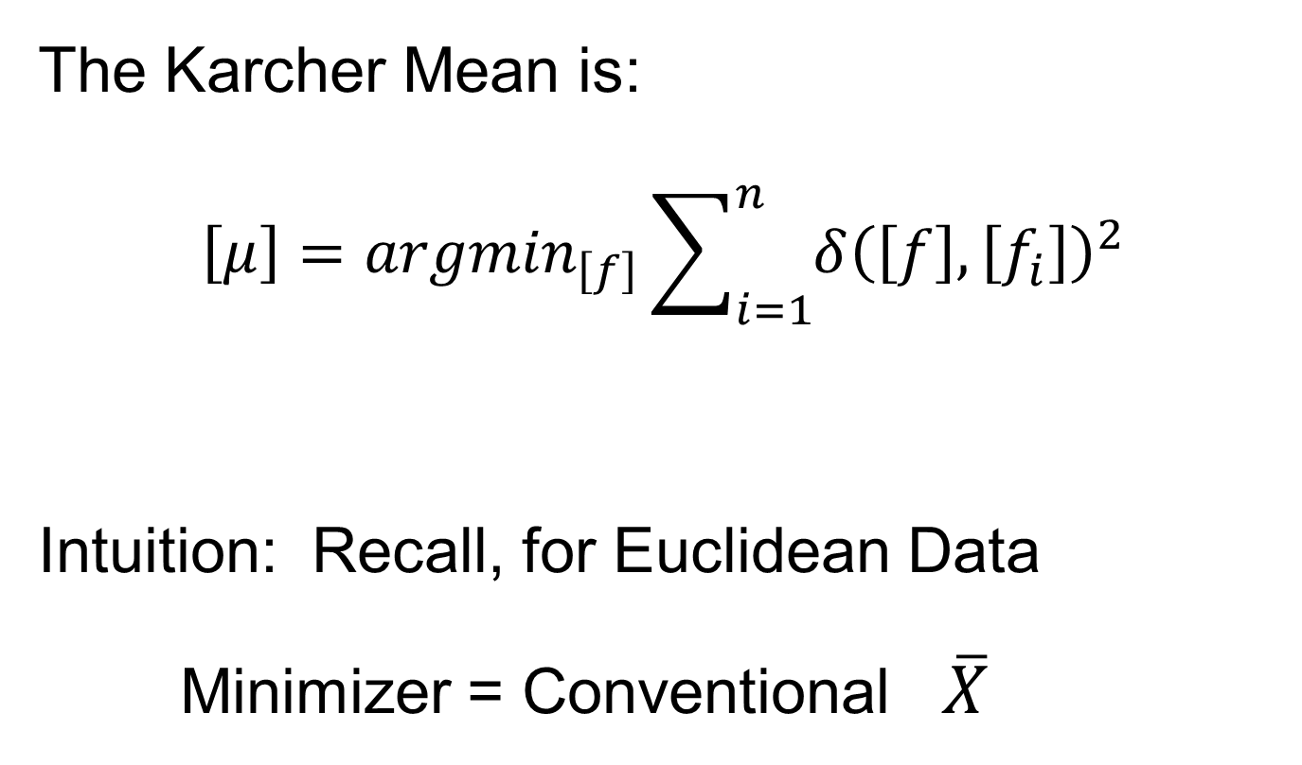
Mean in Curve Quotient Space
The Karcher Mean is:
$$\left[μ\right]={argmin}_{\left[f\right]}\sum_{i=1}^{n}{{δ\left(\left[f\right],\left[f_{i}\right]\right)}^{2}}$$
Intuition: Recall, for Euclidean Data
Minimizer = Conventional $\overline{X}$

Slide 50
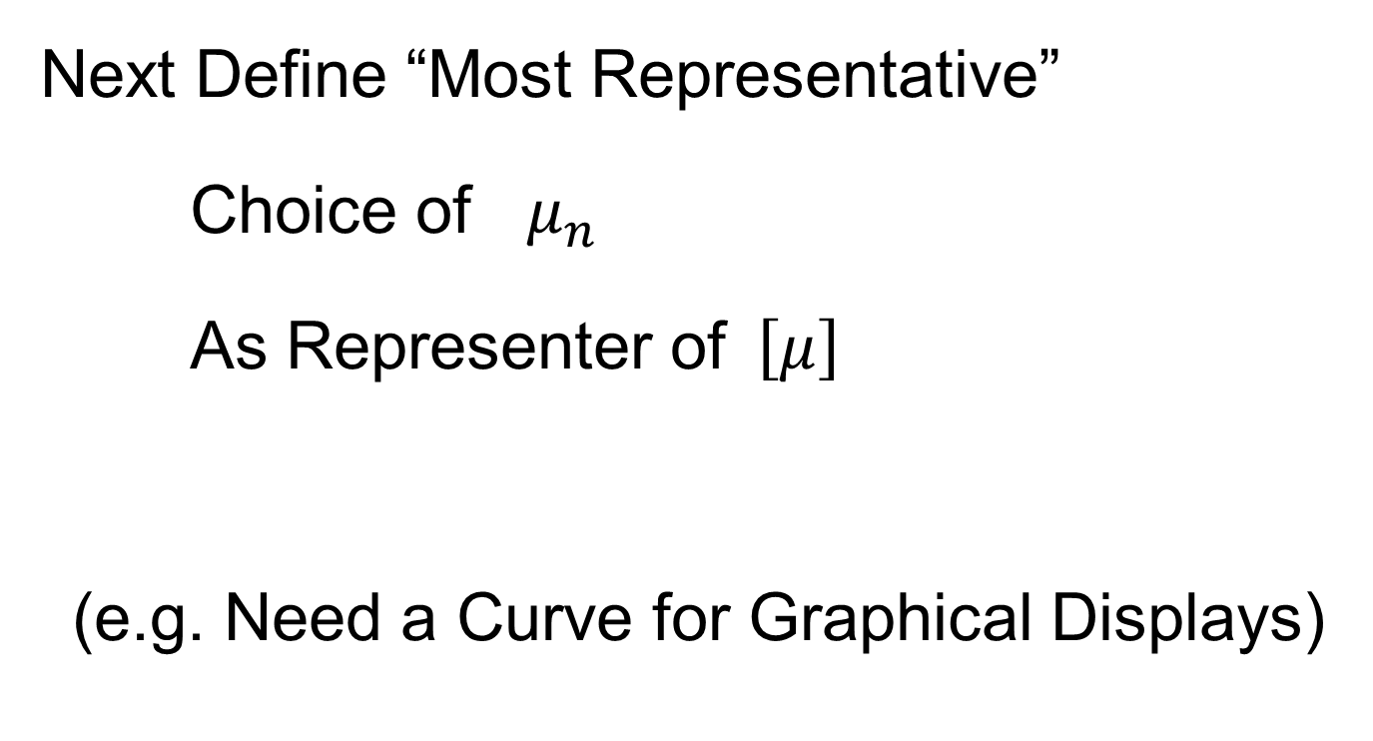
Mean in Curve Quotient Space
Next Define “Most Representative”
Choice of $μ_{n}$
As Representer of$\left[μ\right]$
(e.g. Need a Curve for Graphical Displays)

Slide 51
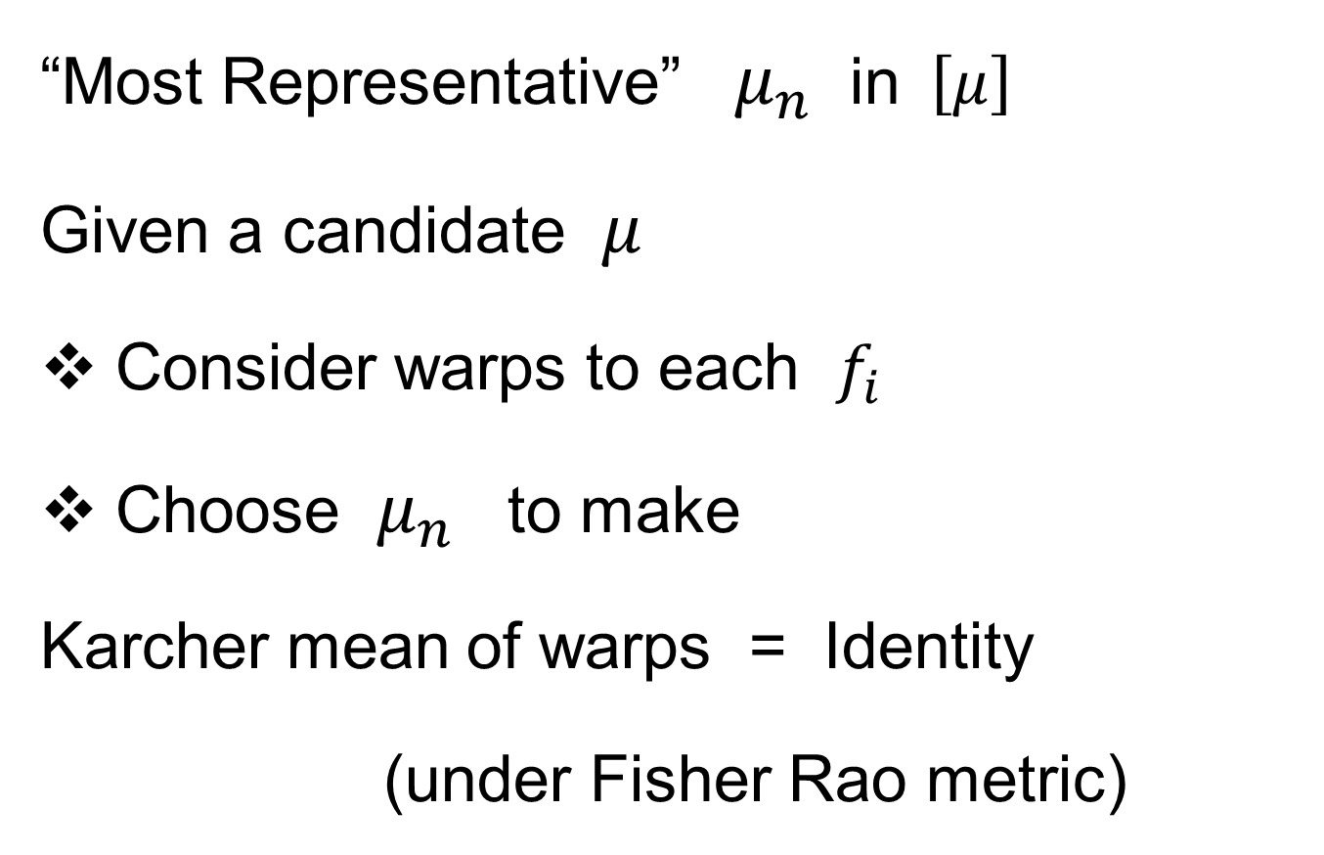
Mean in Curve Quotient Space
“Most Representative” $μ_{n}$ in$\left[μ\right]$
Given a candidate $μ$
Consider warps to each $f_{i}$
Choose $μ_{n}$ to make
Karcher mean of warps = Identity
(under Fisher Rao metric)

Slide 52
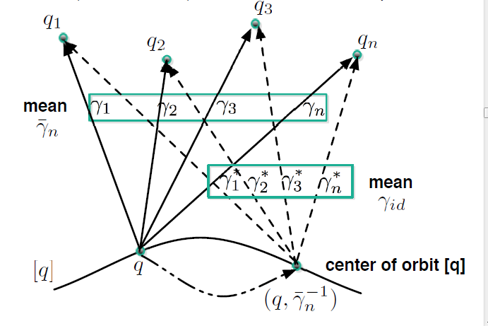
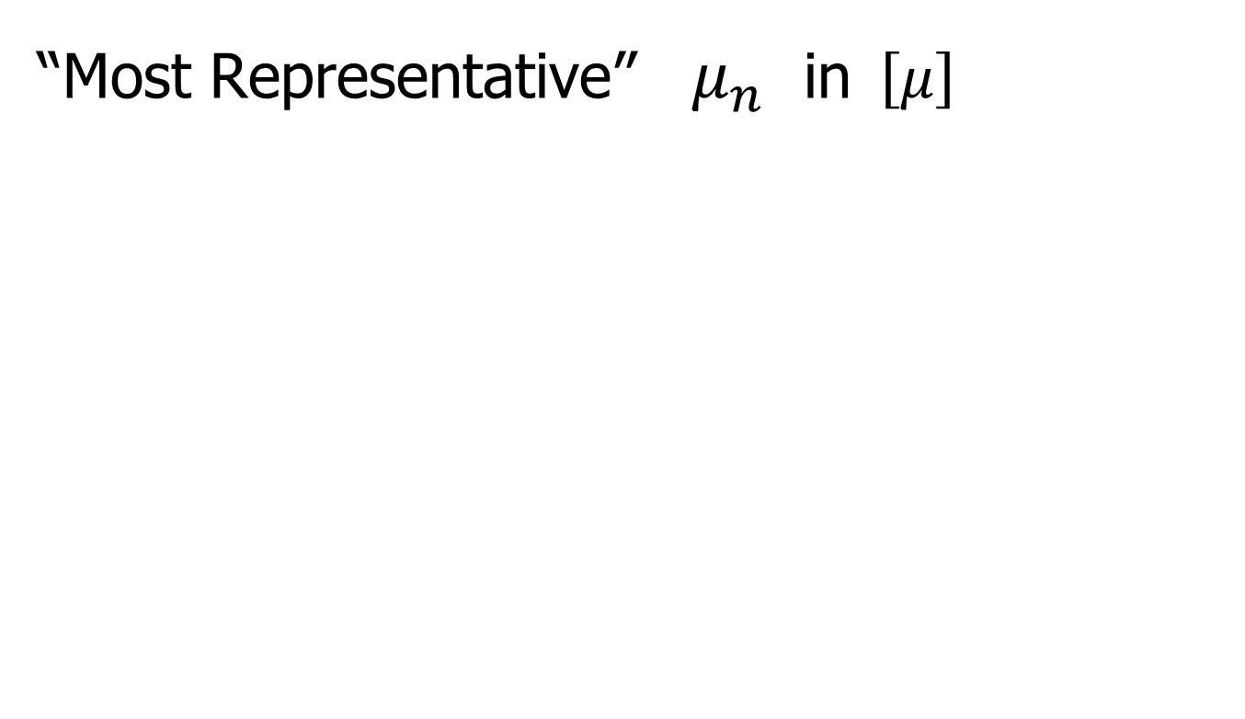
Mean in Curve Quotient Space
“Most Representative” $μ_{n}$ in$\left[μ\right]$
Thanks to Anuj Srivastava

Slide 53

Metrics in Curve Space
$$\inf_{γ}\left\|f_{1}−\left(f_{2}∘γ\right)\right\|≠\inf_{γ}\left\|f_{2}−\left(f_{1}∘γ\right)\right\|$$
Recall
Example
Illustrating
This Is Best
Representer
Of Karcher Mean

Slide 54
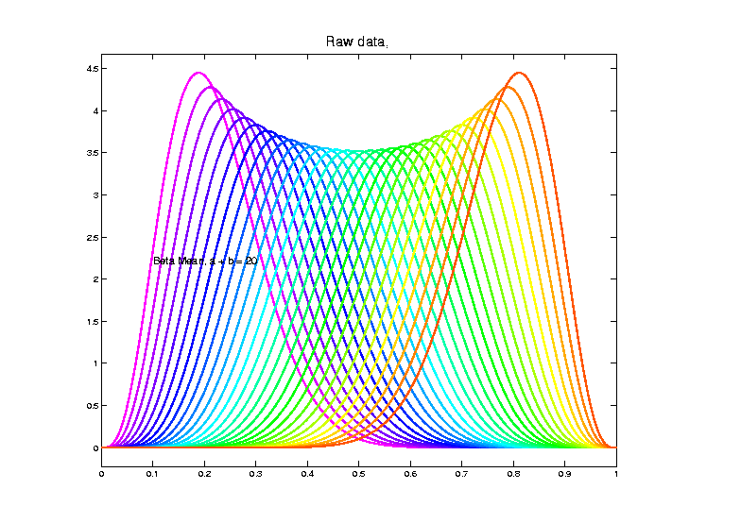
Shifted Betas Example
Recall
From
Above

Slide 55
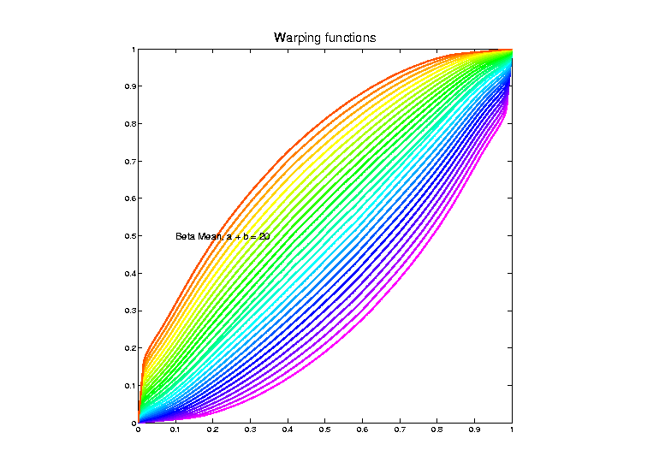
Shifted Betas Example
Estimated
Warps
(Note:
Represented
With Karcher
Mean At
Identity)

Slide 56
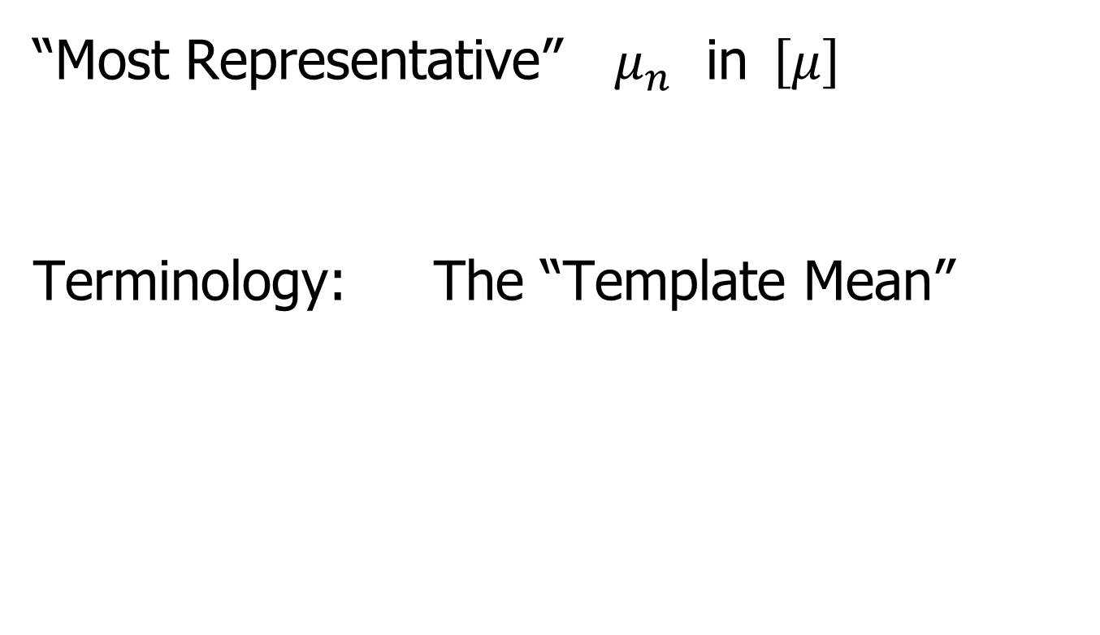
Mean in Curve Quotient Space
“Most Representative” $μ_{n}$ in$\left[μ\right]$
Terminology: The “Template Mean”

Slide 57

More Data Objects
Final Curve Warps:
Warp Each Data Curve, $f_{1}, ⋯,f_{n}$
To Template Mean, $μ_{n}$
Denote Warp Functions $γ_{1}, ⋯,γ_{n}$
Gives (Roughly Speaking):
Vertical Components $f_{1}∘γ_{1}, ⋯,f_{n}∘γ_{n}$
(Aligned Curves)
Horizontal Components $γ_{1}, ⋯,γ_{n}$
Data Objects I

Slide 58
More Data Objects
Data Objects II
Final Curve Warps:
Warp Each Data Curve, $f_{1}, ⋯,f_{n}$
To Template Mean, $μ_{n}$
Denote Warp Functions $γ_{1}, ⋯,γ_{n}$
Gives (Roughly Speaking):
Vertical Components $f_{1}∘γ_{1}, ⋯,f_{n}∘γ_{n}$
(Aligned Curves)
Horizontal Components $γ_{1}, ⋯,γ_{n}$
~ Kendall’s Shapes

Slide 59
More Data Objects
Final Curve Warps:
Warp Each Data Curve, $f_{1}, ⋯,f_{n}$
To Template Mean, $μ_{n}$
Denote Warp Functions $γ_{1}, ⋯,γ_{n}$
Gives (Roughly Speaking):
Vertical Components $f_{1}∘γ_{1}, ⋯,f_{n}∘γ_{n}$
(Aligned Curves)
Horizontal Components $γ_{1}, ⋯,γ_{n}$
Data Objects III
~ Chang’s Transfo’s

Slide 60

More Data Objects
Horizontal Components $γ_{1}, ⋯,γ_{n}$
Challenge: Visualization & Interpretation
Approach: Apply Warps to Karcher Mean:
I.e. Visualize ${μ_{n}°γ}_{1}, ⋯,μ_{n}°γ_{n}$

Slide 61
Functional Data Analysis
Insightful
Decomposition
Vertical Variation
Horiz’l
Var’n

Slide 62
Computation
Actual Mathematics is More Complicated
See Section 9.1.3 of Text For Full Details
Including Corresponding Phase Distance
Particularly
Accessible Source

Slide 63
Numeric Computation
Several Variations of
Dynamic Programming
Done by Eric Klassen, Wei Wu
R, Python, Matlab Software: Tucker (2024)

Slide 64
Shifted Betas Example
Raw
Data
Both
Horizontal
And
Vertical
Variation

Slide 65

Visualization
Vertical Variation:
PCA on Aligned Curves, $f_{1}∘γ_{1}, ⋯,f_{n}∘γ_{n}$
Projected Curves

Slide 66

Shifted Betas Example
Aligned
Curves
(Clear
1-d
Vertical
Var’n)
Only Half of
Colors Due to
Exact Overlay

Slide 67

Shifted Betas Example
Back and Forth Scores
Aligned
Curve
PCA
Projections
All Var’n
In 1st
Component

Slide 68

Visualization
Horizontal Variation:
PCA on Warps, $γ_{1}, ⋯,γ_{n}$
Projected Curves

Slide 69
Shifted Betas Example
Raw
Data
Both
Horizontal
And
Vertical
Variation

Slide 70
Shifted Betas Example
Estimated
Warps

Slide 71

Shifted Betas Example
Warps,
PC
Projections

Slide 72
Shifted Betas Example
Warps,
PC
Projections
Mostly
1st PC

Slide 73
Shifted Betas Example
Back and Forth Scores
Warps,
PC
Projections
Mostly
1st PC,
But 2nd
Helps Some
Captures Varying Widths

Slide 74
Shifted Betas Example
Warps,
PC
Projections
Rest is
Not
Important

Slide 75
Shifted Betas Example
Horizontal Var’n Visualization Challenge:
(Complicated) Warps Hard to Interpret
Approach:
Apply Inverse Warps to Template Mean
(PCA components)

Slide 76

Shifted Betas Example
Inverse
Warp
Compon’ts
(+ Mean)
Applied to
Template
Mean

Slide 77


TIC testbed
Text: Sec 2.1
Serious Data Challenge:
TIC (Total Ion Count) Chromatograms
Modern type of “chemical spectra”
Thanks to Peter
Hoffmann

Slide 78
TIC testbed
Serious Data Challenge:
TIC (Total Ion Count) Chromatograms
Reference: Koch et al (2014)

Slide 79

TIC testbed
Raw Data: 15 TIC Curves (5 Colors)

Slide 80
TIC testbed
Special Feature: Answer Key of Known Peaks
Found by
Major
Time &
Labor
Investment

Slide 81
TIC testbed
Special Feature: Answer Key of Known Peaks
Goal:
Find
Warps
To Align
These

Slide 82

TIC testbed
Fisher – Rao Alignment

Slide 83
TIC testbed
Fisher – Rao Alignment
Spike-In
Peaks

Slide 84

TIC testbed
Next Zoom in on This Region

Slide 85

TIC testbed
Zoomed Fisher – Rao Alignment
Peak Missing
In 1 Case
This Compound
Not Present

Slide 86

TIC testbed
Before Alignment

Slide 87

TIC testbed
Next Zoom in on This Region

Slide 88

TIC testbed
Zoomed Fisher – Rao Alignment

Slide 89

TIC testbed
Before Alignment

Slide 90

TIC testbed
Next Zoom in on This Region

Slide 91

TIC testbed
Zoomed Fisher – Rao Alignment

Slide 92

TIC testbed
Before Fisher-Rao Alignment

Slide 93

TIC testbed
Next Zoom in on This Region

Slide 94

TIC testbed
Zoomed Fisher – Rao Alignment

Slide 95
TIC testbed
Zoomed Fisher – Rao Alignment
Note:
Very
Challenging

Slide 96

TIC testbed
Before Alignment

Slide 97

TIC testbed
Next Zoom in on This Region

Slide 98

TIC testbed
Zoomed Fisher – Rao Alignment

Slide 99

TIC testbed
Before Alignment

Slide 100

TIC testbed
Warping Functions
Looks Fairly Linear
Decent Linear Analysis:
Bernardi, et al. (2014)

Slide 101

Refined Calculations
Text, Sec. 9.2
More Recent Development Based On:
The Diffeomorphism $γ:\left[0,1\right]→\left[0,1\right]$
For $q_{γ}=\frac{\dot{γ}}{\sqrt{\left|\dot{γ}\right|}}$:
$${\left\|q_{γ}\right\|}_{2}^{2}=\int_{0}^{1}{\dot{γ}\left(x\right)dx}=γ(1)−γ(0)=1$$
Hence SRVF${(γ}_{i})∈𝕊^{d}$

Slide 102

Refined Calculations
More Recent Development:
Better Exploit Manifold Data Space:
SRVF${(γ}_{i})∈𝕊^{d}$
Principal Nested Spheres
Reference: Yu et al (2017)

Slide 103

PNS on SRVF Sphere
Toy Example
Tangent Space PCA
(on Horiz. Var’n)
Thanks to Xiaosun Lu

Slide 104

PNS on SRVF Sphere
Toy Example
PNS Projections
(Fewer Modes)

Slide 105

PNS on SRVF Sphere
Toy Example
Tangent Space PCA
Note: 3 Comp’s
Needed for This

Slide 106

PNS on SRVF Sphere
Toy Example
PNS Projections
Only 2 for This

Slide 107

PNS on SRVF Sphere
Toy Example
Parametrized
By Values
At 1/3 And 2/3

Slide 108
PNS on SRVF Sphere
Toy Example
View As Points
Tangent Plane PC 1
PNS 1
Boundary of
Nonnegative
Orthant

Slide 109

PNS on SRVF Sphere
Toy Example
Curves from
Tangent Plane PC 1
Note: Some Are
No Longer Warps!

Slide 110
PNS on SRVF Sphere
Toy Example
View As Points
PNS 1
Good 1-d
Approx.

Slide 111
PNS on SRVF Sphere
Toy Example
Recall Original
Warps

Slide 112


PNS on SRVF Sphere
Toy Example
Another View
$∗$ Raw Warps
$⊡$Tangent PC1
$∘$ PNS 1

Slide 113
Participant Presentation
1:35: Michael Nisenzon
???
Next Class: Hyeon Lee

