Slide 1
Statistics – O. R. 881
Object Oriented Data Analysis
Steve Marron
Dept. of Statistics and Operations Research
University of North Carolina

Slide 2
Current Sections in Textbook
Today:
Section 17.2
Next Class:
Sections 14.2

Slide 3
Last Class: Canonical Corr’ns
Text: Sec, 17.2.2
Hotelling (1936):
Canonical Correlation Analysis (CCA)
Main Idea: Dir’ns to Maximize Correlation
(versus Covariance for PLS)
Founder of UNC STOR

Slide 4
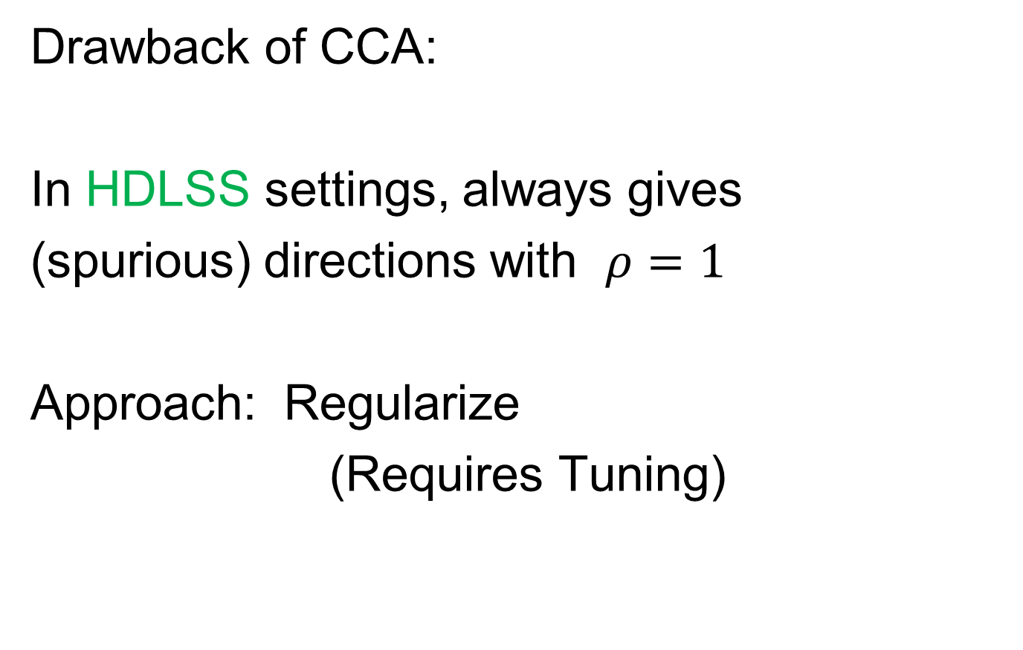
Last Class: Canonical Corr’ns
Drawback of CCA:
In HDLSS settings, always gives
(spurious) directions with $ρ=1$
Approach: Regularize
(Requires Tuning)

Slide 5
Last Class: JIVE
But Only Briefly Mentioned
Text: Sec, 17.2.3
Joint and Individual Variation Explained
Lock, Hoadley, Marron & Nobel (2013)
Joint Variation ~ CCA
Key Contribution: Individual Modes
Angle Based JIVE (AJIVE)
Feng, Jiang, Hannig & Marron (2018)
Non-Iterative Linear Algebra Calculation
Uses Intuitive Principal Angle Analysis

Slide 6
Last Class: AJIVE Goals
Explore & Quantify Variation
Through Joint Variation
via Common Scores
(Signatures Among Cases)
Focus Away from Directions in PCA
Now On Scores, Not Loadings
(As in PLS & CCA)
Since Commonality is Among Cases

Slide 7
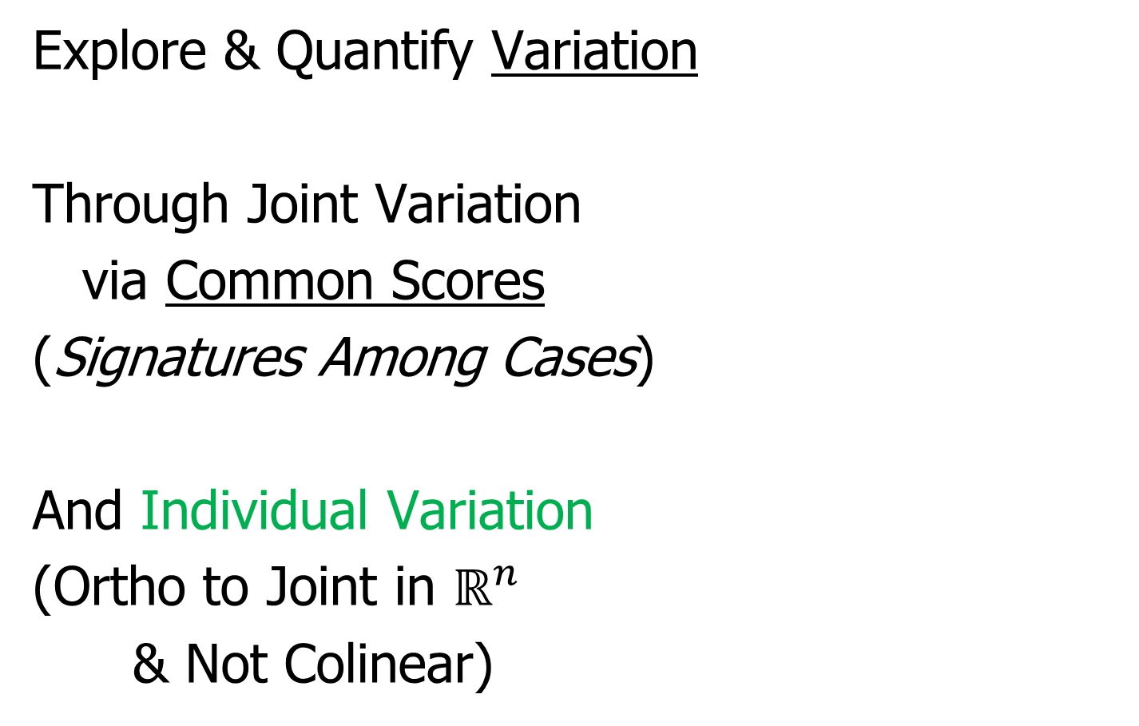
Last Class: AJIVE Goals
Explore & Quantify Variation
Through Joint Variation
via Common Scores
(Signatures Among Cases)
And Individual Variation
(Ortho to Joint in $ℝ^{n}$
& Not Colinear)

Slide 8
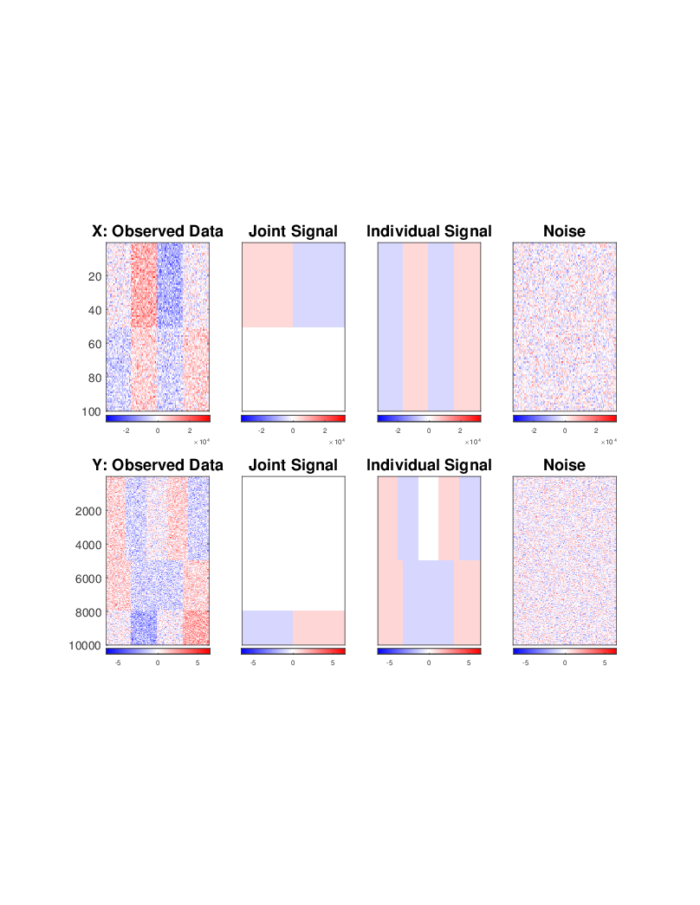
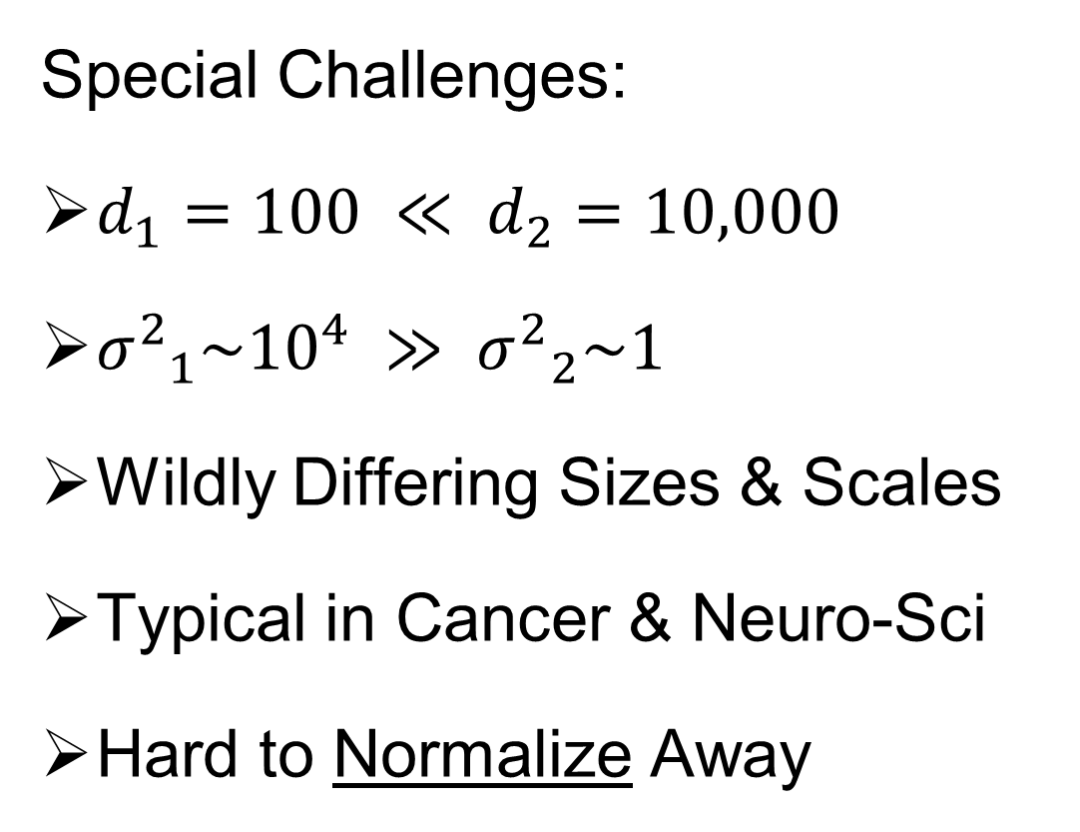
Last Class: AJIVE Toy Example
Special Challenges:
$d_{1}=100 ≪ d_{2}=10,000$
${σ^{2}}_{1}\sim {10}^{4} ≫ {σ^{2}}_{2}\sim 1$
Wildly Differing Sizes & Scales
Typical in Cancer & Neuro-Sci
Hard to Normalize Away

Slide 9
Last Class: AJIVE Toy Example
Underlying Components
(Additive
Signals +
+ Noise)
=
+
+
=
+
+

Slide 10
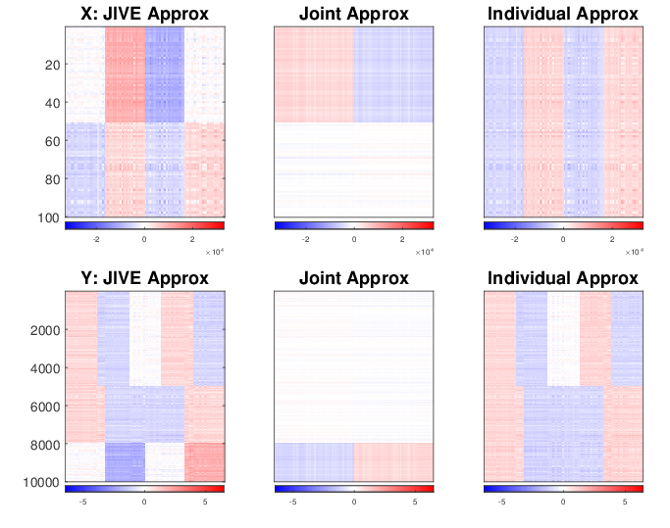
Last Class: AJIVE Toy Example
Current AJIVE: Excellent Decomposition (Both Joint and Individual)

Slide 11
Last Class: AJIVE FMRI Data
Functional Magnetic Resonance Imaging
Approach:
Measure “Brain Activity”
Over Both Location & Time
Via Blood Flow
Data Objects???

Slide 12
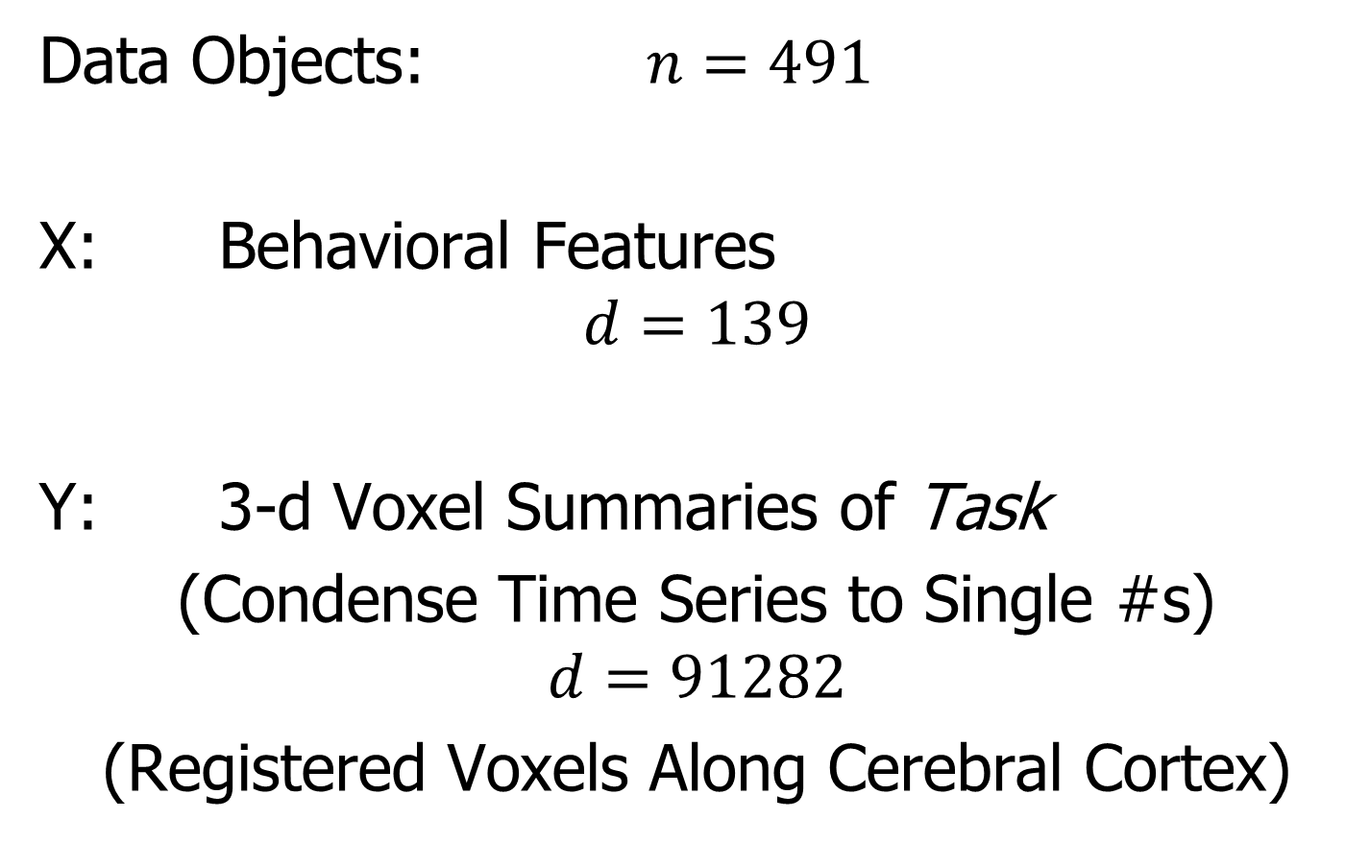
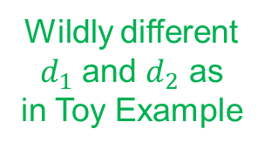
Last Class: AJIVE FMRI Data
Data Objects: $n=491$
X: Behavioral Features
$$d=139$$
Y: 3-d Voxel Summaries of Task
(Condense Time Series to Single #s)
$$d=91282$$
(Registered Voxels Along Cerebral Cortex)
Wildly different
$d_{1}$ and $d_{2}$ as
in Toy Example

Slide 13
Last Class: AJIVE FMRI Data
Focus of Analysis:
Loadings (Drivers)
  Behavioral Features
  Lit Up Brain Regions
Since Scores All Gaussian
(Normal Population)
Which Work
Together?
Which Work
Separately?

Slide 14
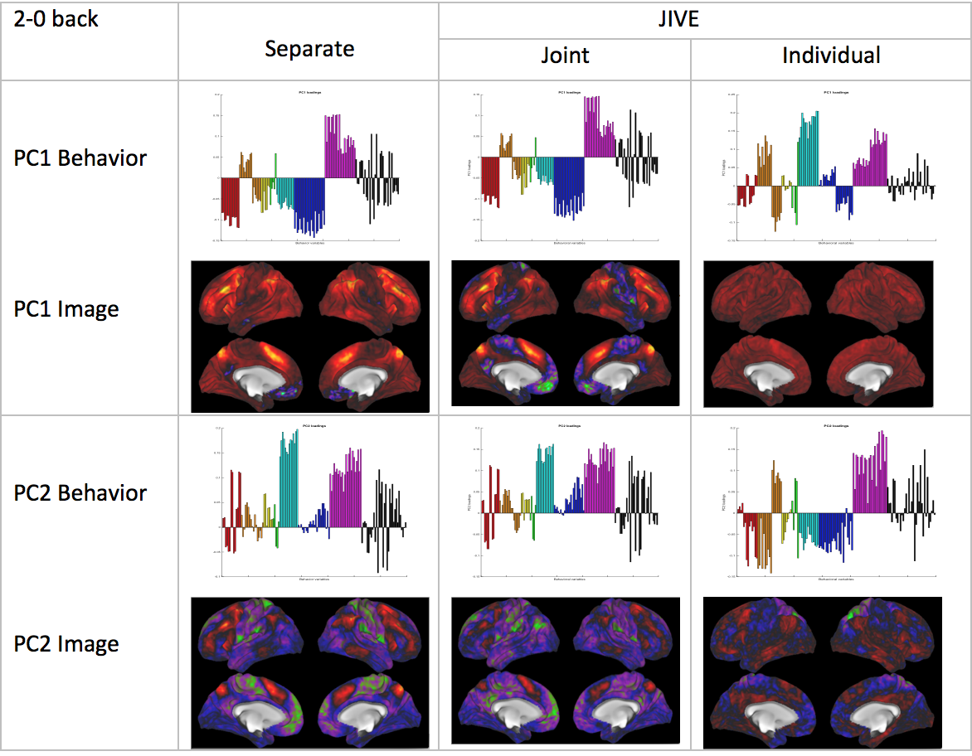
Last Class: AJIVE FMRI Data
Overall
Comparison
Sep. Beh. PC1
Assoc. w. Image
Joint Im. PC1
Concentrates
Relevant Parts
Of Sep.
PC1 & PC2

Slide 15
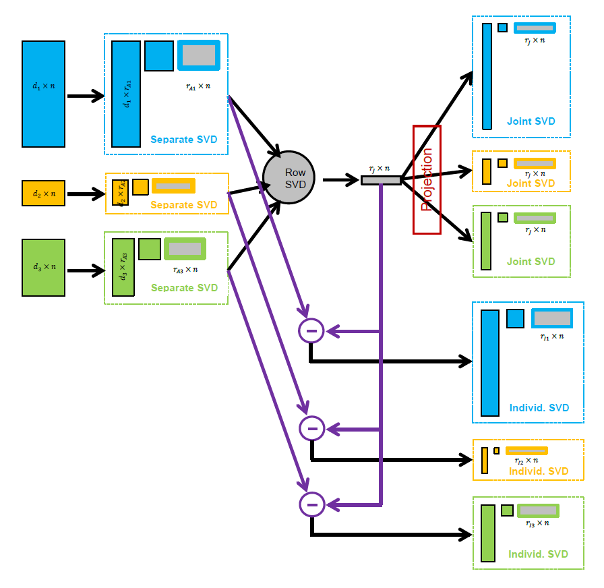
Last Class: AJIVE Algorithm
Overview

Slide 16




Last Class: Princ’l. Angle Anal.
Idea: Relate Subspaces $S_{1}$, $S_{2}$ of $ℝ^{n}$
Using Minimal Angles
$$θ_{1}=0$$
$$θ_{2}$$
Key JIVE concept:
Linear Algebra In
$n$ - Space
And Iterate Orthogonally
PAA Computation: ~Concatenate & SVD

Slide 17
AJIVE Algorithm
Output Options (for Differing Purposes):
Common Normalized Scores
Block Specific Scores (Joint & Indiv.)
Full Matrices

Slide 18
AJIVE Algorithm
Output Options (for Differing Purposes):
Common Normalized Scores
Block Specific Scores (Joint & Indiv.)
Full Matrices

Slide 19
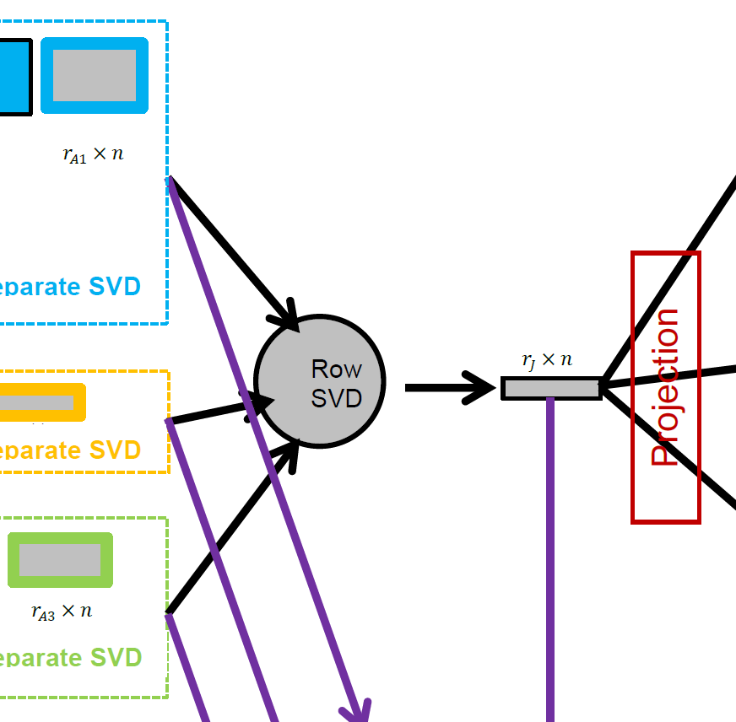
AJIVE Algorithm
Caution: Common
Normalized Loadings
Need Not Be Orthogonal
Common Normalized Scores
  Same for Each Block
  Scale Free (Length 1)
  Finds Joint Behavior
  Useful: Scatterplots
  Can Have Common
  Loadings By Projecting
  Gives Interpretation
  of Driving Features
E.g. FMRI Neuro Science Data

Slide 20
AJIVE Algorithm
Output Options (for Differing Purposes):
Common Normalized Scores
Block Specific Scores (Joint & Indiv.)
Full Matrices

Slide 21
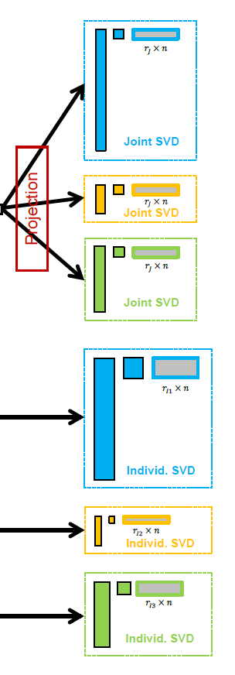

AJIVE Algorithm
Block Specific Scores
(Joint & Indiv.)
  SVD Re-Ordered Basis
  Loadings Now Orthogonal
  Includes Magnitudes (SVs)
  Compact $r_{∗}×n$ Representation
  E.g. Input for Classification
  Interpretation via Loadings
  Lose Cross Block Interpretation

Slide 22
AJIVE Algorithm
Output Options (for Differing Purposes):
Common Normalized Scores
Block Specific Scores (Joint & Indiv.)
Full Matrices

Slide 23

AJIVE Algorithm
Full Matrices
  Size of Original Data
  Best Rank $r_{j}$ Approx’s
  Allows Heat Map View
  And Network Analysis

Slide 24
Revisit Toy Example
Consider Initial
Rank Selection
Joint Signal has Rank 1
Underlying Components
(Additive
Signals +
+ Noise)
=
+
+
1st Individual Signal
has Rank 1
=
+
+
2nd Individual Signal
has Rank 2

Slide 25
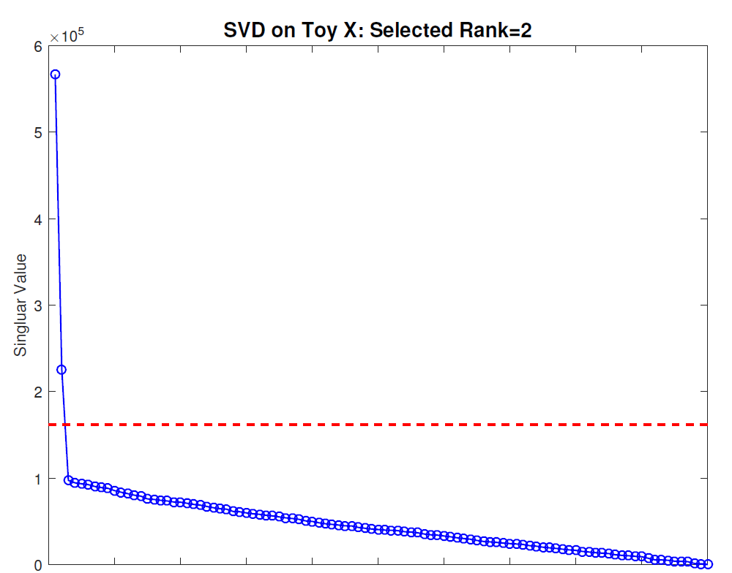
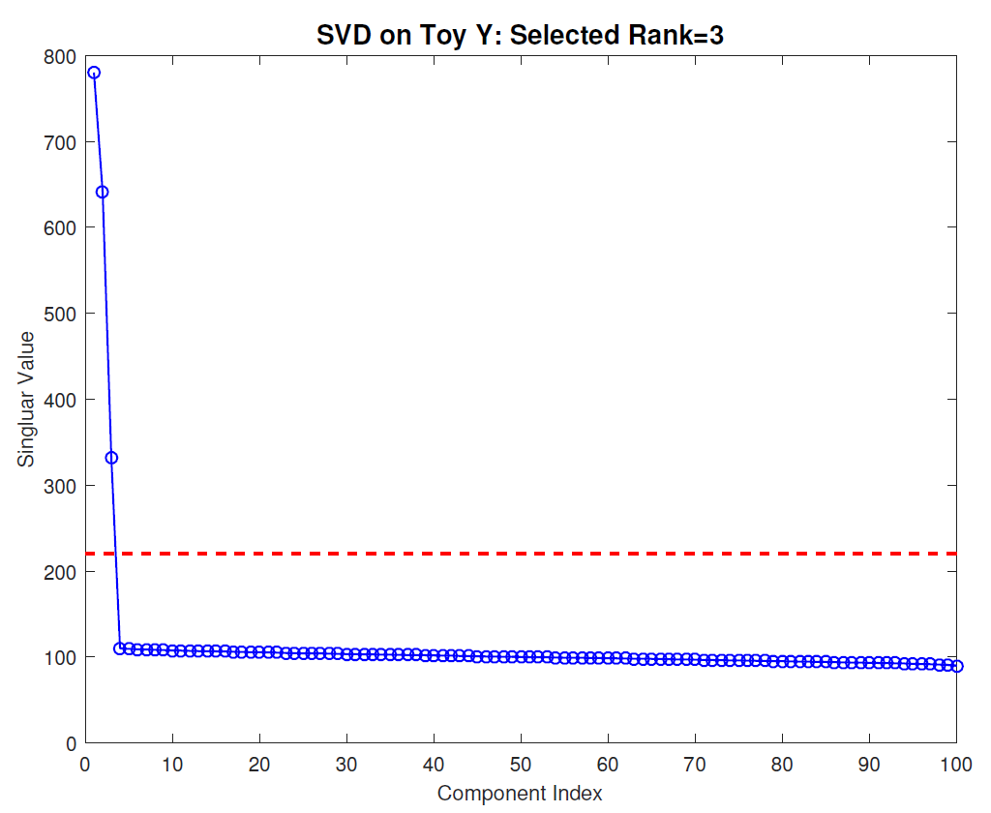


Revisit Toy Example
Recall Scree Plots
Easy in this Simple Case
Scree Block X
Chose $r_{A1}=2$
Scree Block Y
Chose $r_{A2}=3$

Slide 26
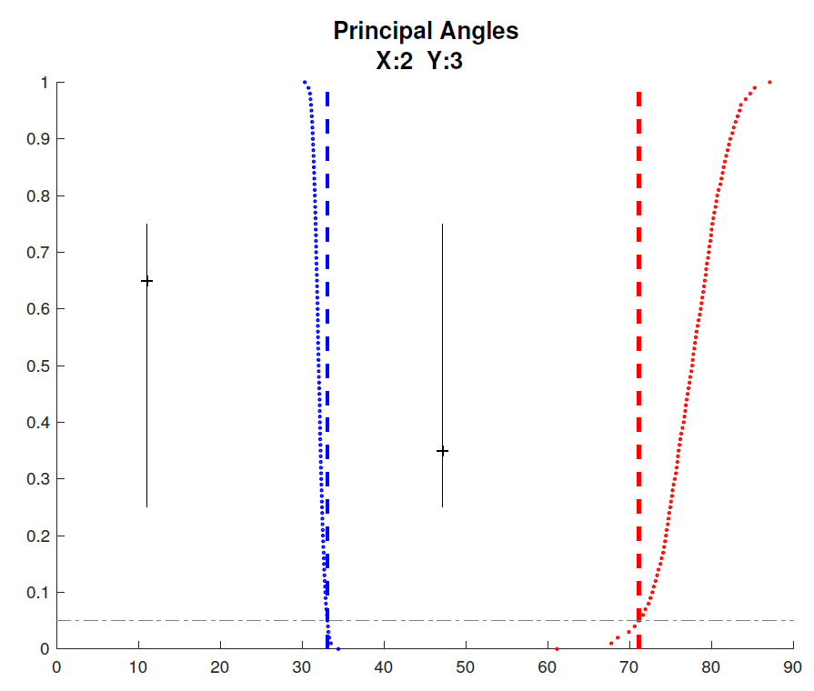

Revisit Toy Example
Well Chosen Initial Ranks, $r_{A1}=2$, $r_{A2}=3$
Diagnostic Plot:
1st Principal Angle
(Joint + noise)
Conclude
Neither Is
Random
Conclude
Larger
Not Joint
2nd Principal Angle
(Small Indiv. + )
Random Subspaces
Distribution & Quantile
Wedin Bound Estimates
Distribution & Quantile

Slide 27
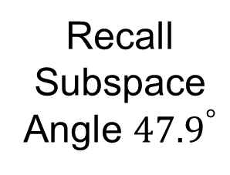
Revisit Toy Example
=
+
+
Relatively Small
Angle Between
Row Spaces
Recall
Subspace
Angle ${47.9}^{°}$
=
+
+

Slide 28
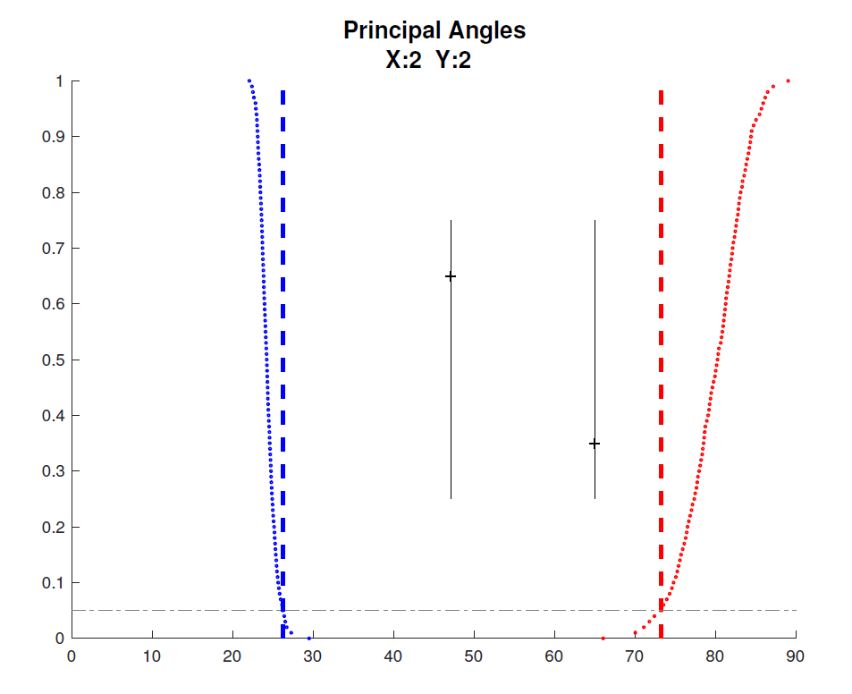

Revisit Toy Example
Choose $r_{A2}=2$, Too Small (Lose Info)
Diagnostic Plot:
Both Principal Angles
Larger (Lost Info)
Neither is Random
Neither is Joint
Since Joint Signal in Y
Relatively Small

Slide 29
Revisit Toy Example
=
+
+
Relatively
Less Signal
In Y Joint
Component
=
+
+

Slide 30
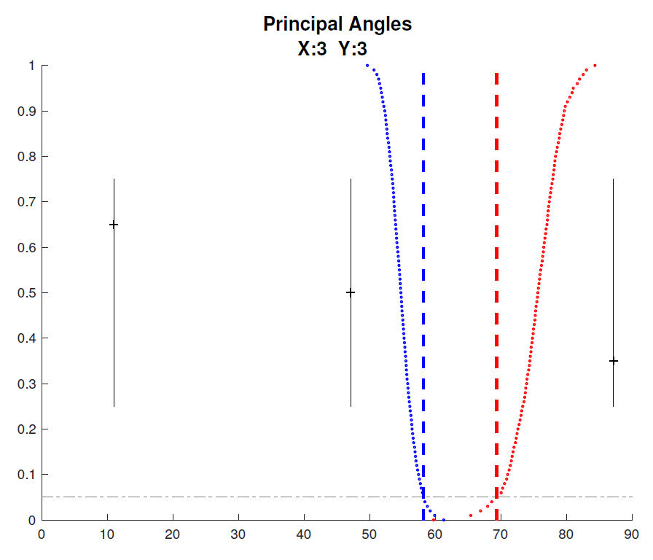


Revisit Toy Example
Choose $r_{A1}=3$, Too Big (Feels Noise)
Diagnostic Plot:
Now 3 Principal Angles
3rd Could be Random
(OK, Since True $r_{A1}=2$)
2nd Could be Joint
(Consequence of Poor
Wedin Approximation)

Slide 31
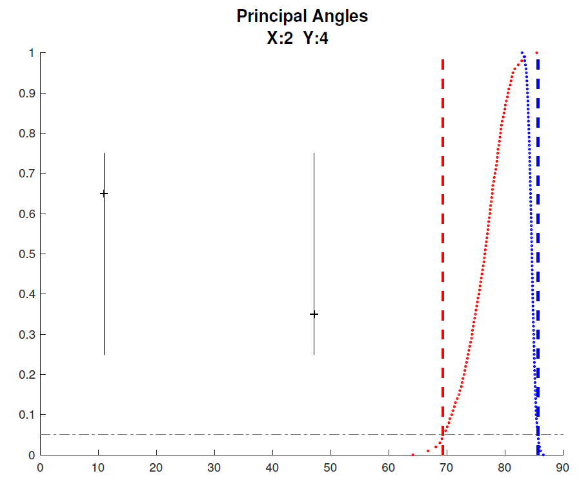


Revisit Toy Example
Choose $r_{A2}=4$, Too Big (Feels Noise)
Diagnostic Plot:
Wedin Bound Useless
$>$Random Subspace Bound
Due to High Noise
Neither Angle Random
Both Could Be Joint
Not Much Info Here

Slide 32


AJIVE Analysis of Cancer Data
Carolina Breast Cancer Study (CBCS)
Thanks to: Iain Carmichael (Deep Learning, AJIVE)
Melissa Troester (Head, CBCS)
Joseph Geradts, Benjamin Calhoun (Pathology)
Katie Hoadley, Chuck Perou (Genomics)
Carmichael, et al. (2021)

Slide 33
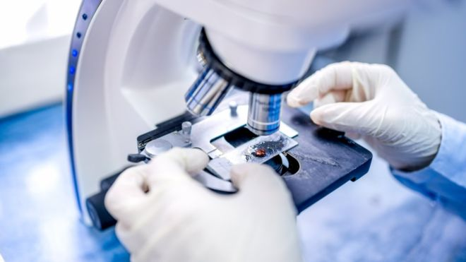
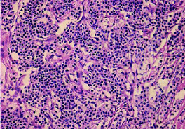
AJIVE Analysis of Cancer Data
Clinical Diagnosis of Cancer:
Pathologist Views Tissue Under Microscope,
Tissue Stained with Hematoxylin & Eosin (H&E)
Thanks to BBC.CO.UK
and Reseachgate.net

Slide 34
AJIVE Analysis of Cancer Data
Analysis Goal:
Understand How Images & Genomics
Work Together
Work Separately
Approach: AJIVE
Clinical Diagnostic Standard
Deep Insight &
New Treatments
As of Jan. 2020: ~70
Drugs Approved for
Breast Cancer Therapy

Slide 35
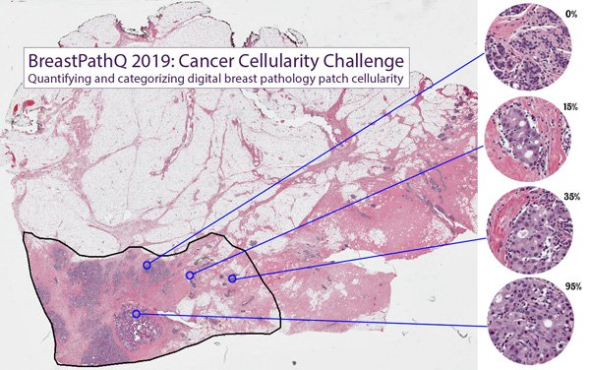
AJIVE Analysis of Cancer Data
Tissue Micro Array Data:
Extract Small
(1mm diam.)
“Cores”
Thanks to SPIE.ORG

Slide 36
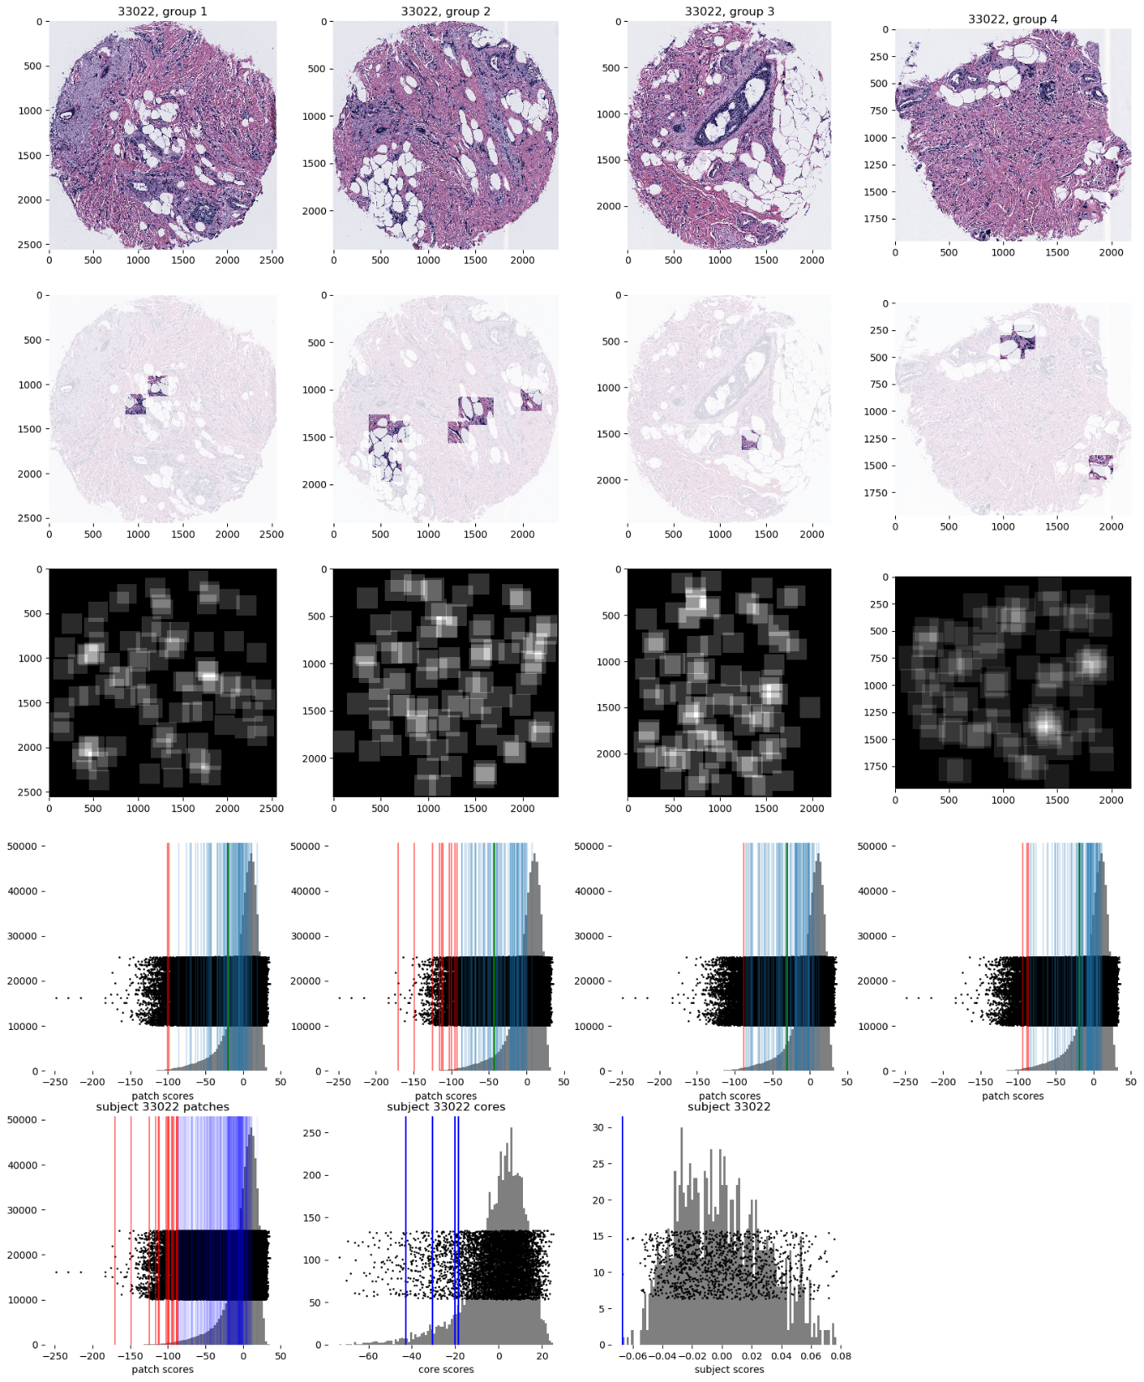
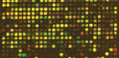

AJIVE Analysis of Cancer Data
Experimental Design: $n=1191$ people
For Each:
1 – 4 TMA Cores
PAM 50 Gene Expression:

Slide 37

AJIVE Analysis of Cancer Data
PAM 50 Gene Expression:
Set of 50 Genes
Measured mRNA Expression Level
Good at Separating SubTypes
  Basal
  Her2
  Luminal A
  Luminal B
Early Technology, More Recent
RNAseq → 10,000s Genes
Perou Discovery:
No Benefit From
Chemo-Therapy

Slide 38

AJIVE Analysis of Cancer Data
Deep Learning Image Representation
Each Core:
Randomly
Select 100
$224×224$
Patches

Slide 39
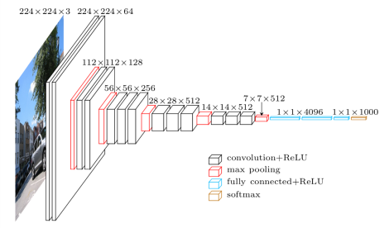
AJIVE Analysis of Cancer Data
Deep Learning Image Representation
Reduce Each Patch to 512 Features
Using Transfer Learning From VGG16:
(Trained on Many
Natural Images)
Thanks to pyimagesearch.com

Slide 40
AJIVE Analysis of Cancer Data
Deep Learning Image Representation
For Each Core:
Aggregate Patches by Averaging
(Damps Out “Location” Information)
Then Average Cores For Each Person

Slide 41
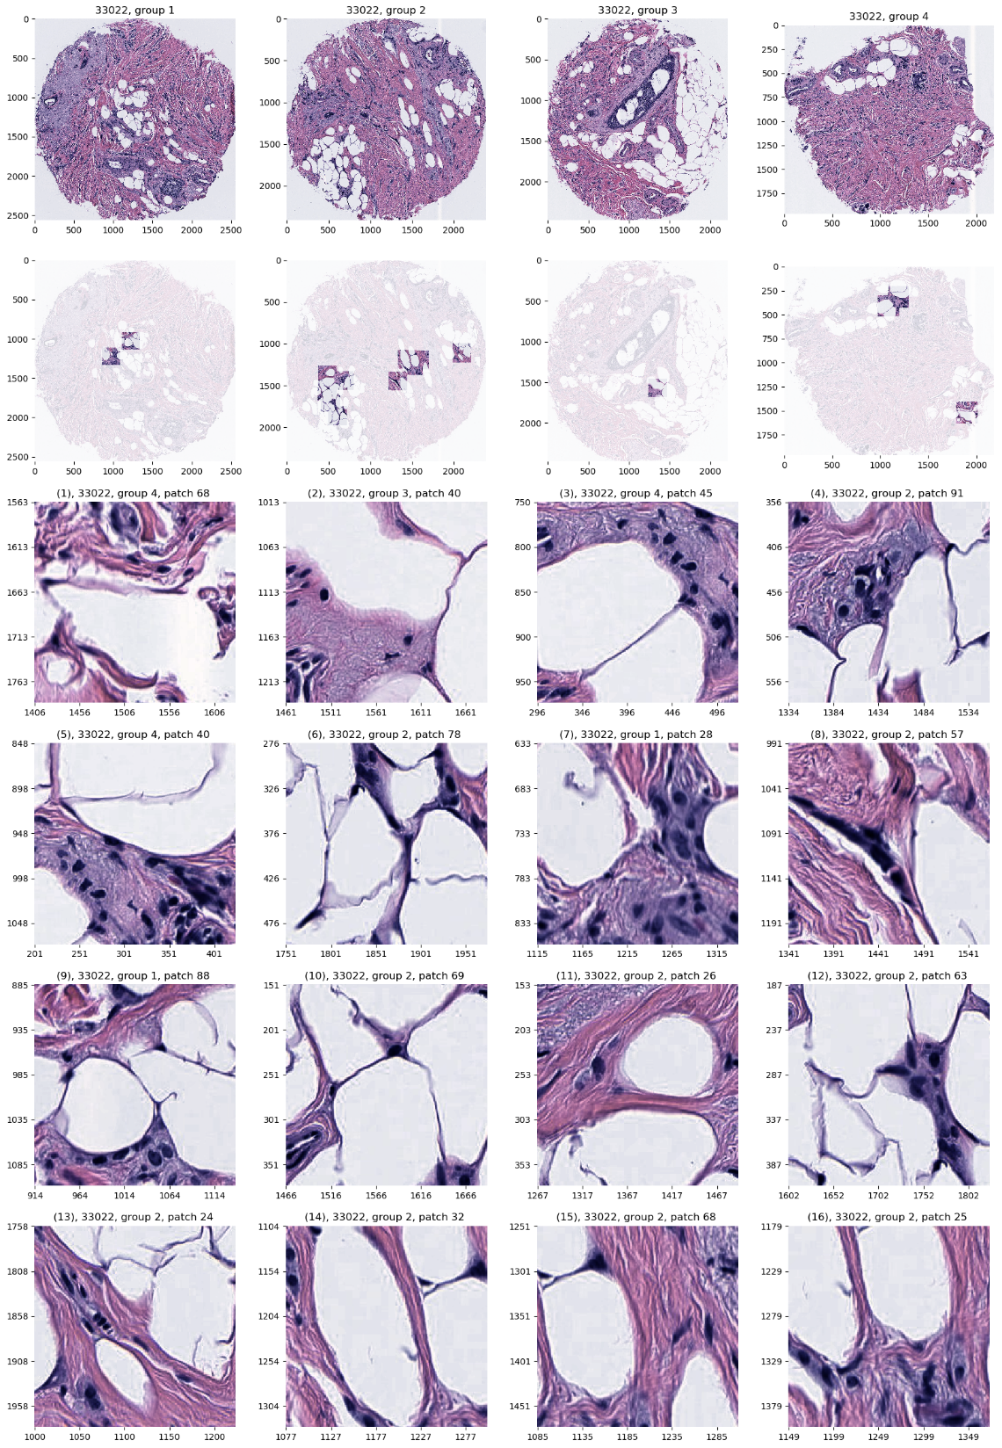
AJIVE Analysis of Cancer Data
JIVE: Common Normalized Scores 1
Look at Extremes
Negative End
Top Person
Top 16 Patches
Fat Cells & Stroma

Slide 42
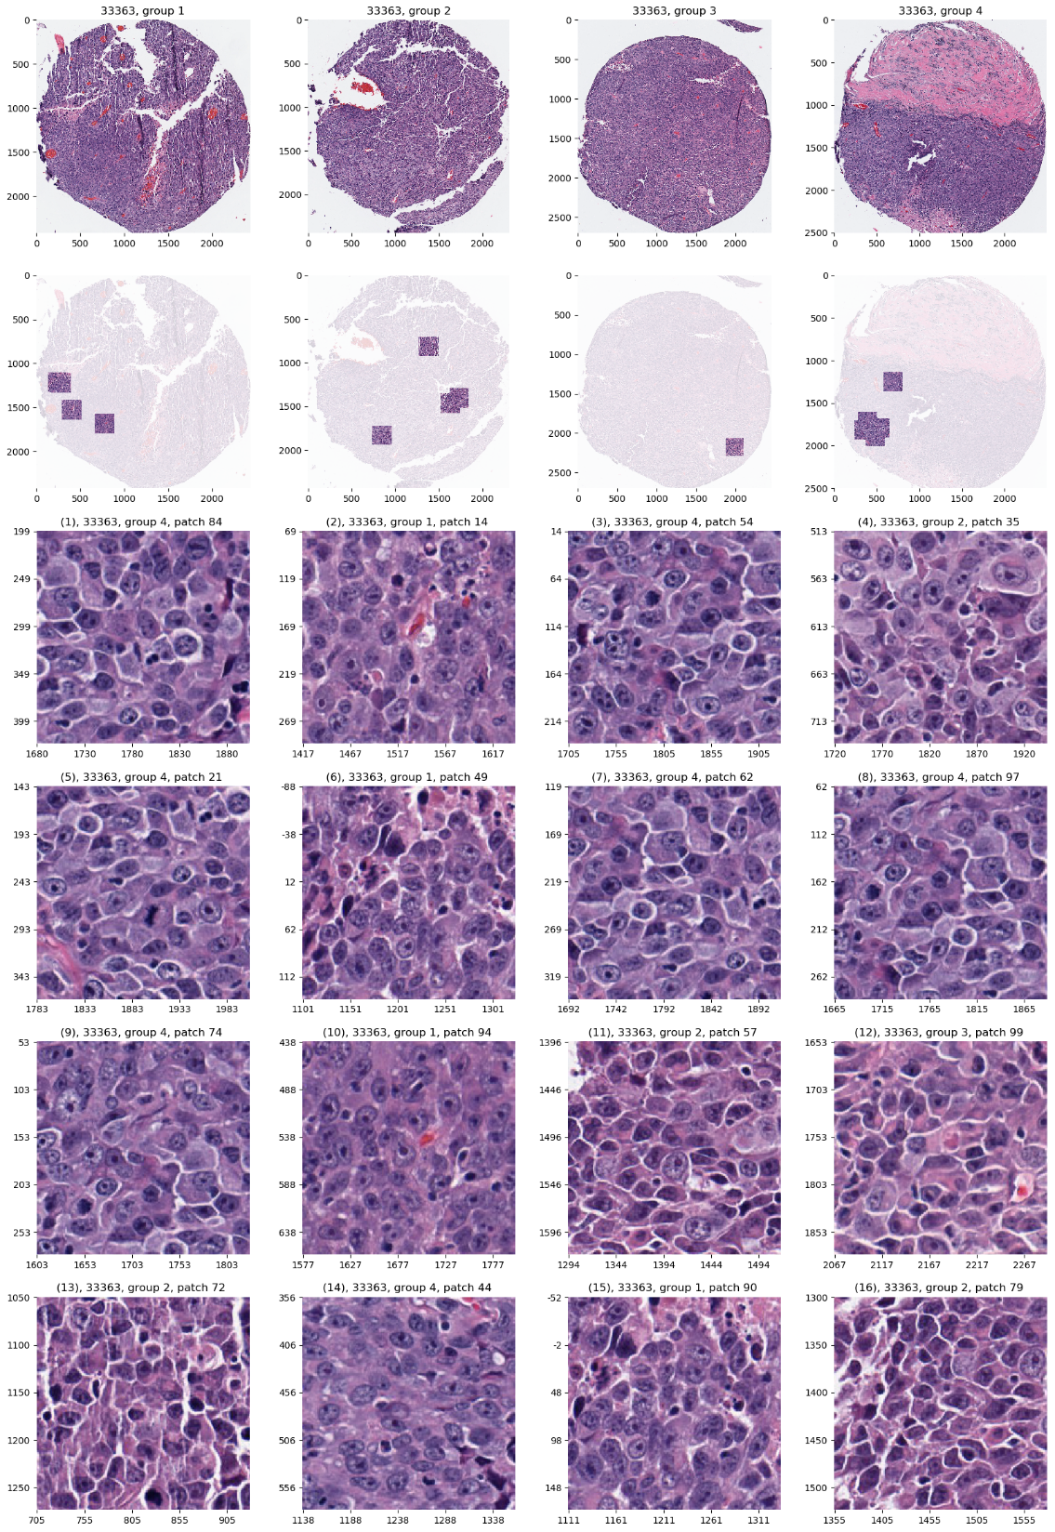
AJIVE Analysis of Cancer Data
JIVE: Common Normalized Scores 1
Look at Extremes
Positive End
Top Person
Top 16 Patches
Highly “Cellular”
Markedly Atypical Cells

Slide 43
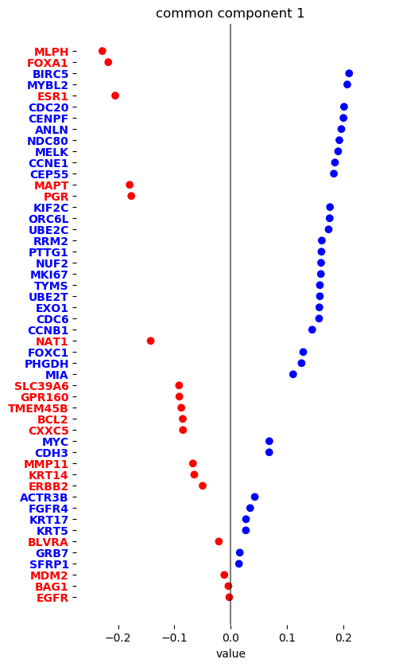
AJIVE Analysis of Cancer Data
JIVE: Gene Expression
Common Normalized
Loadings 1
Very Consistent w/ Image
“High Proliferation” Genes
“Low Prolif.” – Lum A Genes

Slide 44
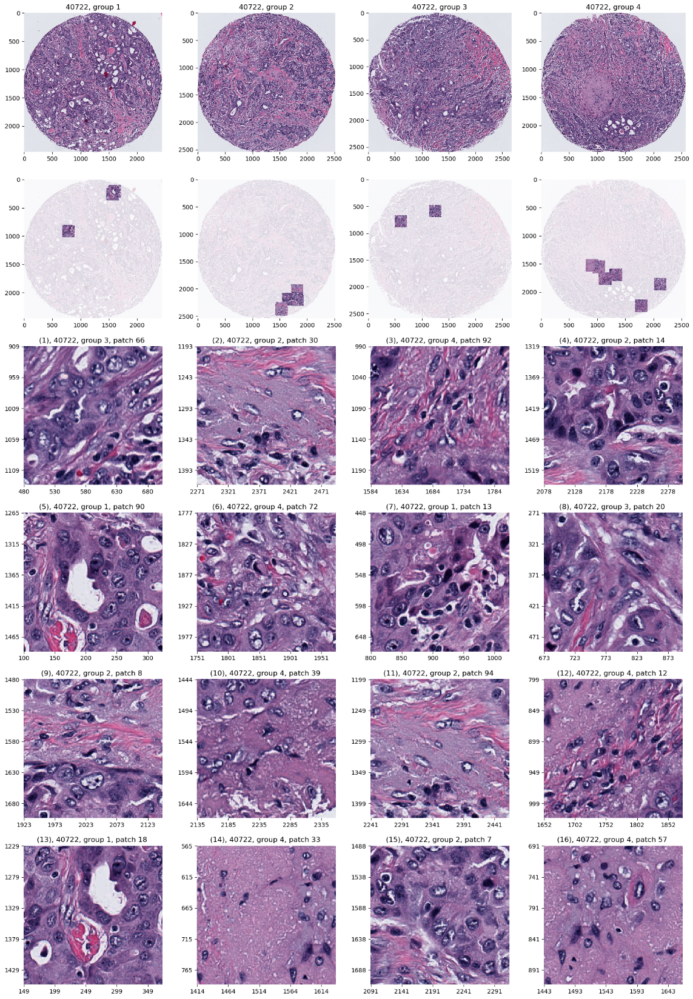
AJIVE Analysis of Cancer Data
JIVE: Common Normalized Scores 2
Look at Extremes
Negative, Top
Top 16 Patches
High Nuclear Grade
Atypical Cells

Slide 45
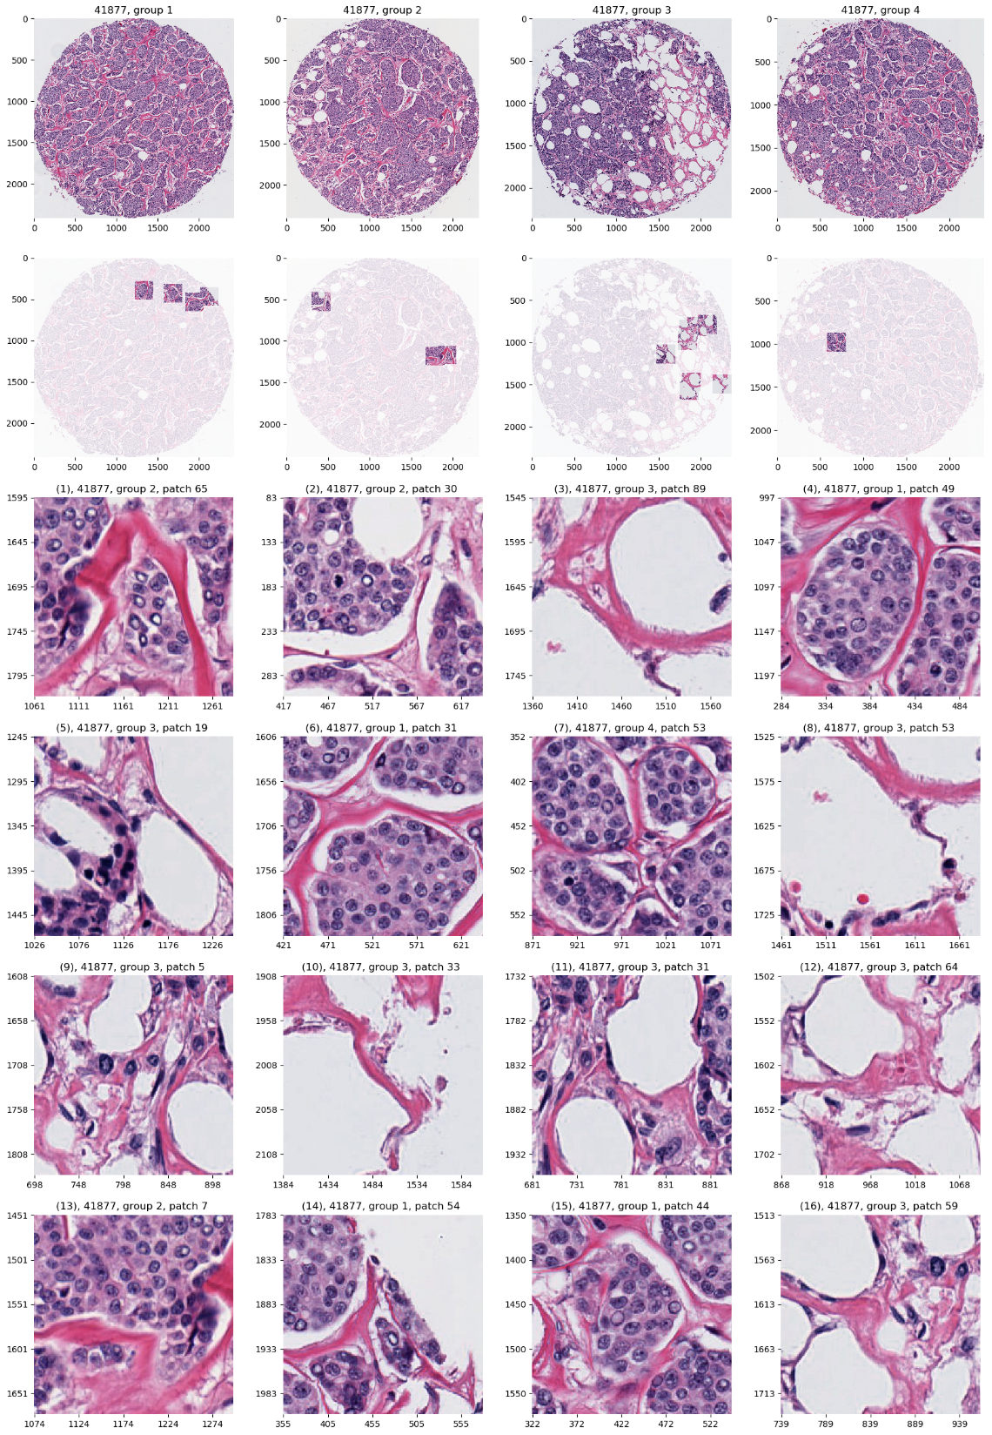
AJIVE Analysis of Cancer Data
JIVE: Common Normalized Scores 1
Look at Extremes
Positive, Top
Top 16 Patches
Lower Nuclear Grade
Stroma, Sclerosis

Slide 46
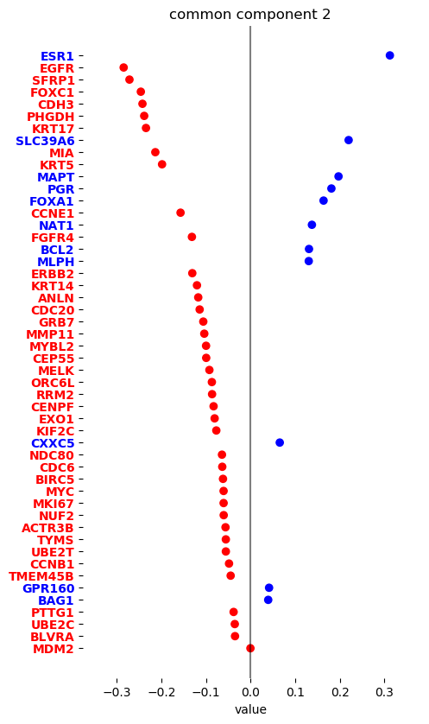
AJIVE Analysis of Cancer Data
JIVE: Gene Expression
Common Normalized
Loadings 2
Very Consistent w/ Image
Luminal Subtype Genes
Basal Subtype Genes

Slide 47
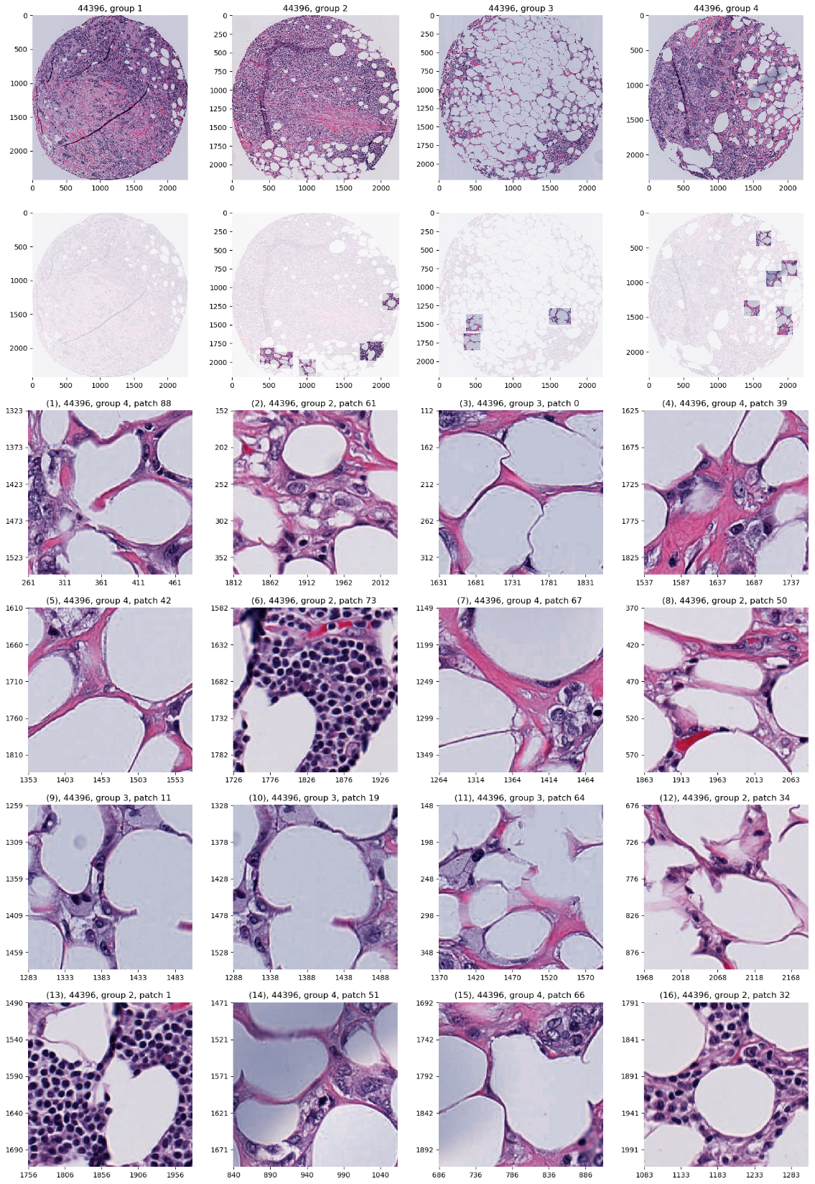
AJIVE Analysis of Cancer Data
JIVE, Images, Individual 1
Negative
Mostly Fat Cells
Few Nuclei

Slide 48
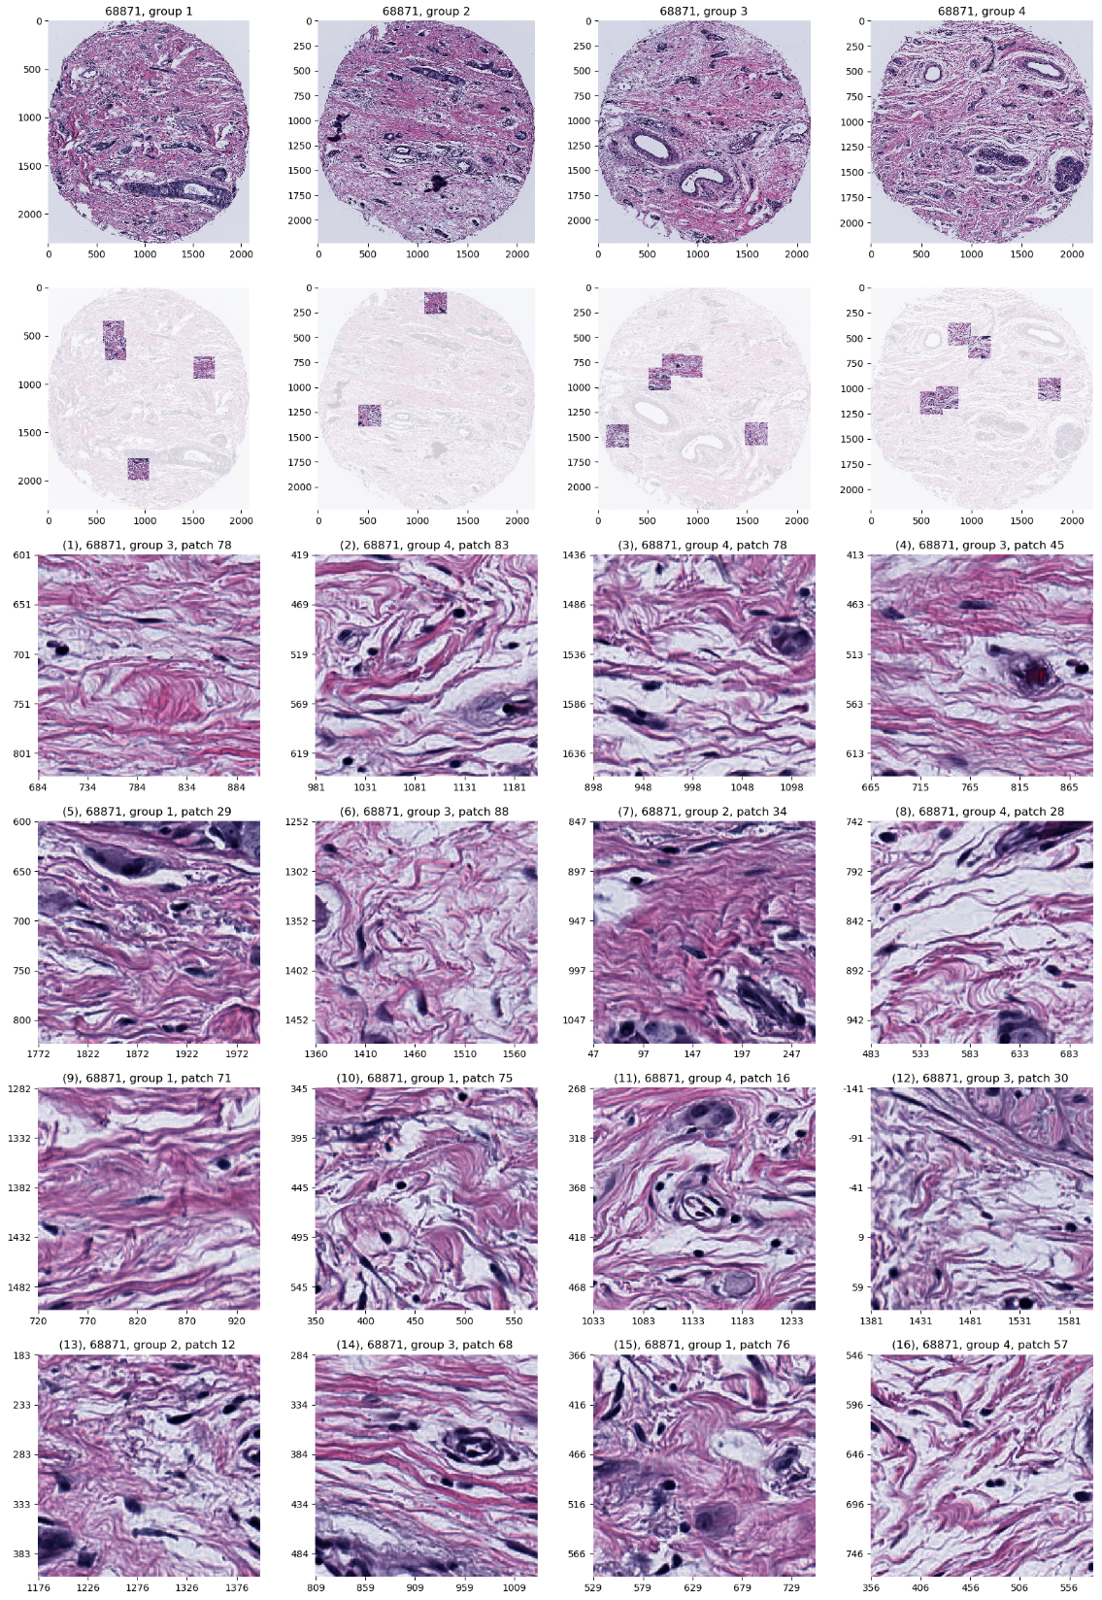
AJIVE Analysis of Cancer Data
JIVE, Genes, Individual 1
Positive
Reactive Stroma,
Few Nuclei
Little Gene Connected

Slide 49
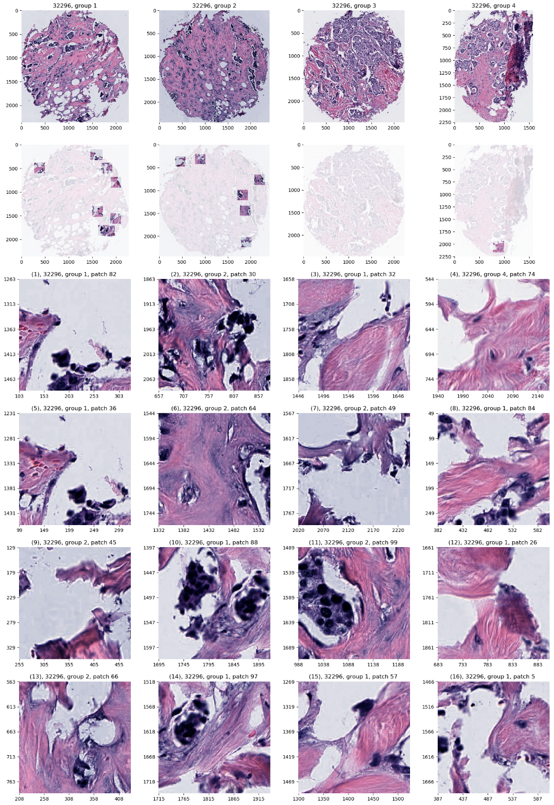
AJIVE Analysis of Cancer Data
JIVE, Genes, Individual 2
Negative
Mucinous & Micro-
Papillary Carcinoma
Not PAM50 Related

Slide 50
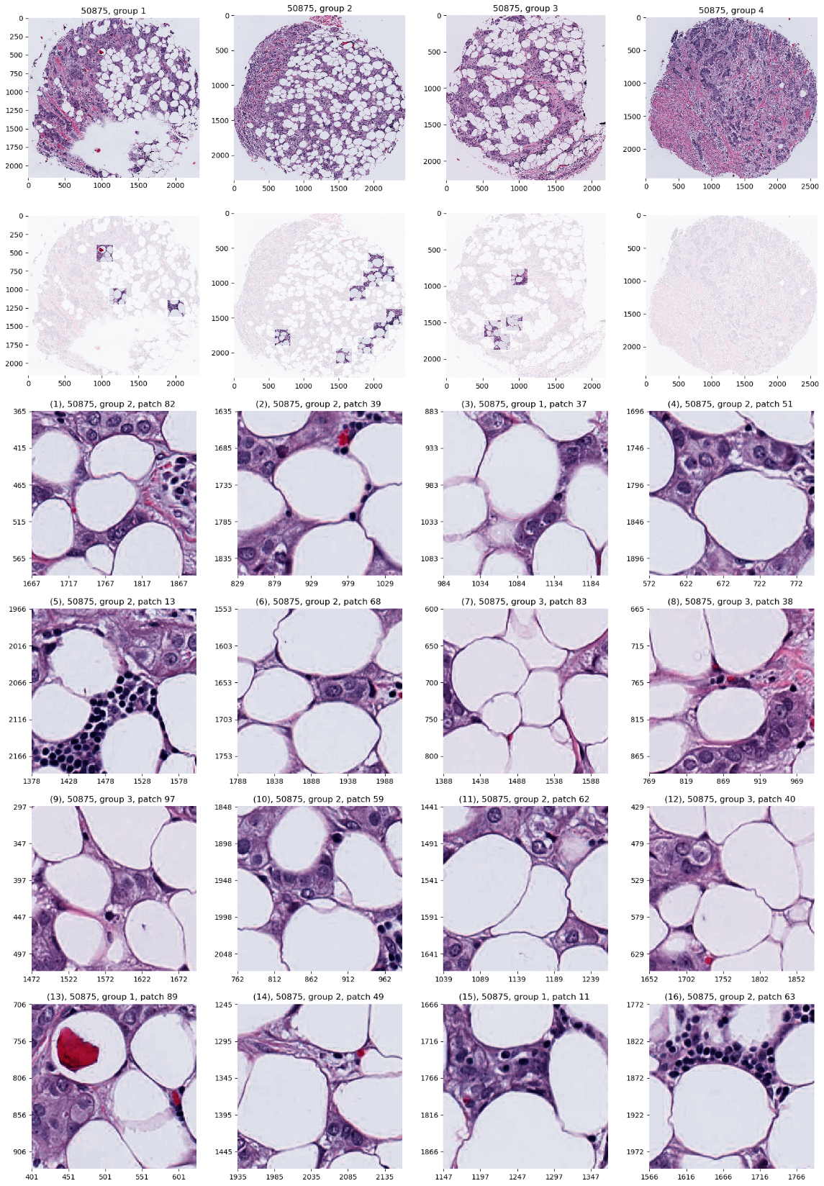
AJIVE Analysis of Cancer Data
JIVE, Genes, Individual 2
Positive
Fat Cells
Common Endpoint?
“Center”?

Slide 51
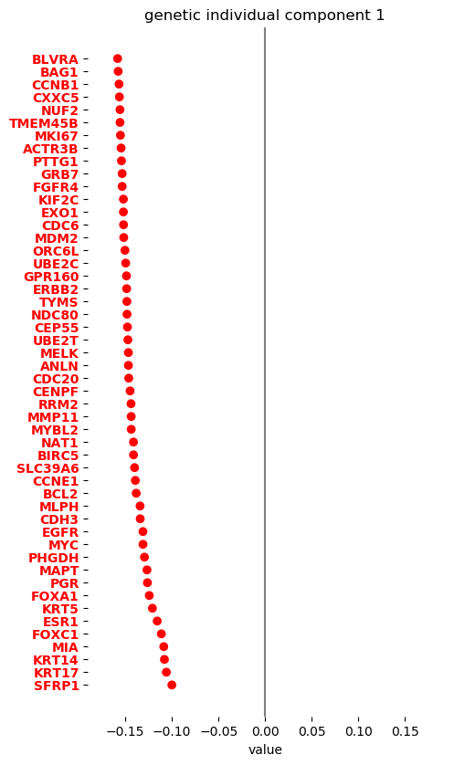
AJIVE Analysis of Cancer Data
JIVE, Genes, Individual 1
Overall Up & Down
Together
Flat Mode of Variation
Not Subtype Related!

Slide 52
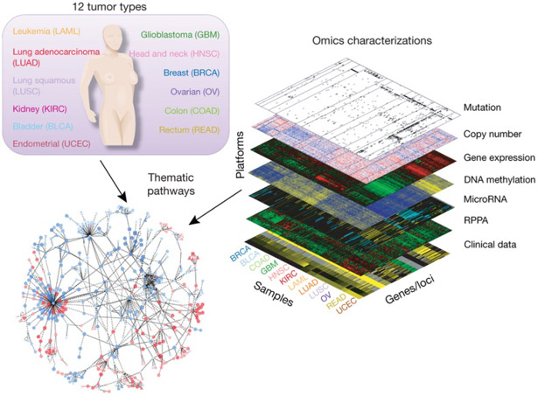
Cancer Genomics by AJIVE
Recall:
The Cancer
Genome Atlas
Subset Here:
Breast Cancer
Figure : The Cancer Genome Atlas Research Network, Weinstein, J.N., Collisson, E.A., Mills, G.B., Shaw, K.M., Ozenberger, B.A., Ellrott, K., Shmulevich, I., Sander, C., and Stuart, J.M. (2013)
The Cancer Genome Atlas Pan-Cancer analysis project.

Slide 53
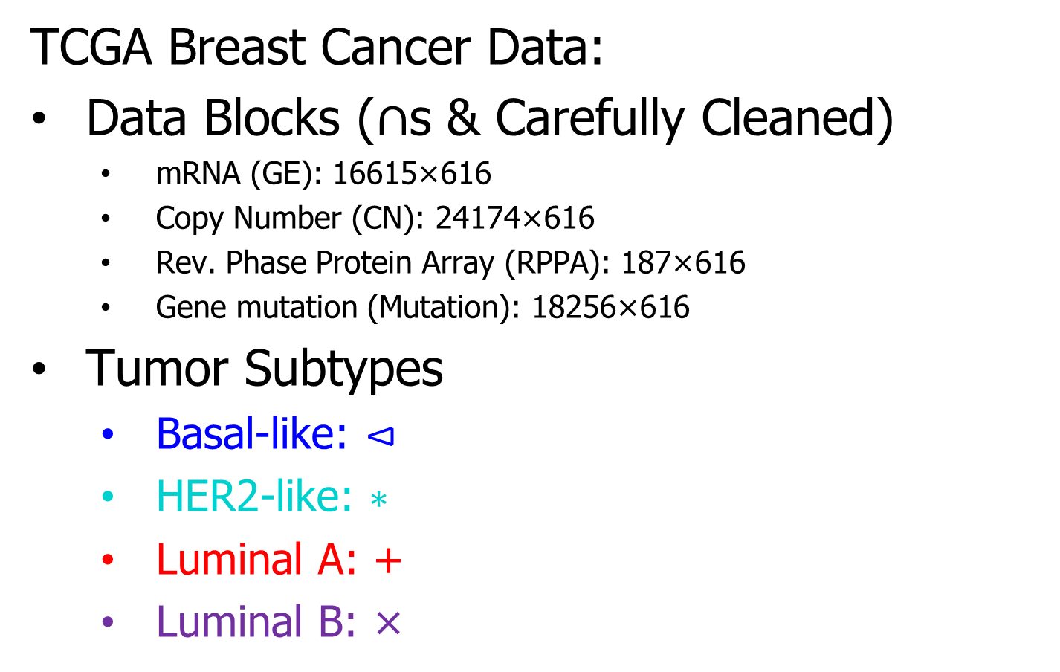
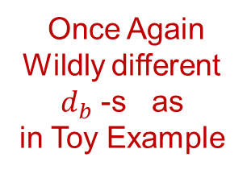
Cancer Genomics by AJIVE
TCGA Breast Cancer Data:
Data Blocks ($∩$s & Carefully Cleaned)
  mRNA (GE): 16615×616
  Copy Number (CN): 24174×616
  Rev. Phase Protein Array (RPPA): 187×616
  Gene mutation (Mutation): 18256×616
Tumor Subtypes
  Basal-like: ⊲
  HER2-like: ∗
  Luminal A: +
  Luminal B: ×
Once Again
Wildly different
$d_{b}$ -s as
in Toy Example
Apologies for Non-Standard Colors

Slide 54
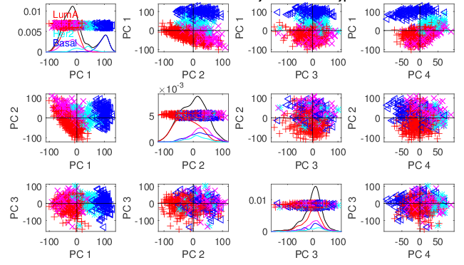
Cancer Genomics by AJIVE
Separate PCA on Gene Expression (GE)
Clear
Subtype
Effects
(Not
Surprising)

Slide 55
Cancer Genomics by AJIVE
Separate PCA on Gene Expression (GE)
PC1 Flags
Basals
PC2 Flags
LumAs

Slide 56
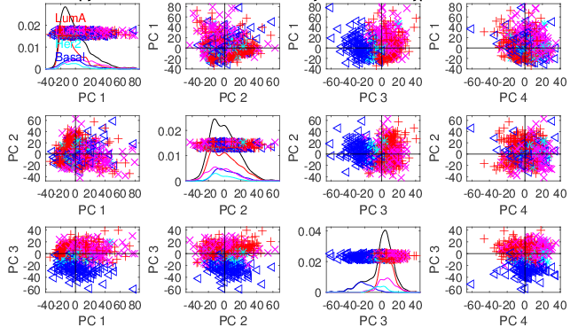
Cancer Genomics by AJIVE
Separate PCA on Copy Number (CN)
Other
Effects
+Subtypes

Slide 57
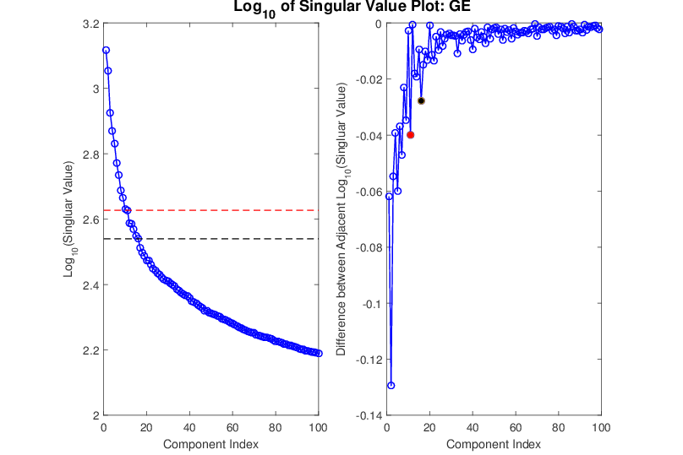
Cancer Genomics by AJIVE
Gene Expression (GE) 1st SVD Threshold
Suggested Ranks： 11 / 16
Log(Consecutive Differences)

Slide 58

Cancer Genomics by AJIVE
Copy Number (CN) 1st SVD Threshold
Suggested Ranks： 6 / 12

Slide 59

Cancer Genomics by AJIVE
Proteins (RPPA) 1st SVD Threshold
Suggested Ranks： 8 / 15

Slide 60

Cancer Genomics by AJIVE
Mutations (Mut) 1st SVD Threshold
Suggested Ranks： 12 / 16

Slide 61
Cancer Genomics by AJIVE
4-way Joint Threshold
After Step 3:
Only 1 Remaining Joint Component
(2nd Strong in all but Mut.)
(Fits w/ Biologist’s Impression of Mut. Data)

Slide 62

Cancer Genomics by AJIVE
In Contrast to PC1
Which Separated Basals
4-way Joint Scores (CNS)
Flags LumAs
Effect Driven
By All 4
Factors
Together
Interesting Point: Mutation Plays Role Here

Slide 63
Cancer Genomics by AJIVE
Next Issue: 3-way JIVE for GE-CN-RPPA
Approach: Use 3 Indiv. Blocks from above,
GE, CN, RPPA as inputs
Perform JIVE, Study Joint PC1

Slide 64

Cancer Genomics by AJIVE
Joint JIVE PC1 for GE-CN-RPPA (CNS)
Great Separation
of Basals
Some Separation
of Her2s
LumAs & LumBs
Combined
All More Distinct
Than Raw Data

Slide 65
Cancer Genomics by AJIVE
Now Focus on Pair-Wise Comparisons:
JIVE on GE – CN only
Hypothesis Test of Basals vs. Others
(DiProPerm Z-scores Allow Quantitation)

Slide 66

Cancer Genomics by AJIVE
JIVE on GE – CN, Test of Basals vs. Others
(SEPARATE!)
CN - PCA
View
Group
Coloring

Slide 67

Cancer Genomics by AJIVE
JIVE on GE – CN, Test of Basals vs. Others
Better
Separation
From DWD
& Ortho PC
Directions
How Separated???

Slide 68

Cancer Genomics by AJIVE
JIVE on GE – CN, Test of Basals vs. Others
DiProPerm Hypothesis Test
Stat. Sig. ~ Z-score

Slide 69
Cancer Genomics by AJIVE
JIVE on GE – CN, Test of Basals vs. Others
Summarize Z-scores
Separate PCA:
GE >> CN
(Not
Surprising)

Slide 70
Cancer Genomics by AJIVE
JIVE on GE – CN, Test of Basals vs. Others
Summarize Z-scores
Joint JIVE
>> Separate
JIVE Data
Combo Helps!

Slide 71
Cancer Genomics by AJIVE
JIVE on GE – CN, Test of Basals vs. Others
Summarize Z-scores
GE has info
Not in CN
But not CN

Slide 72
Early Single Cell RNAseq
Powerful Expression Technology
RNAseq for Separate Cells
Original Data: Grün et al (2014)
Challenge: Random RNA Amplification
Control: Spike In Measurements
scPLS Approach: Chen and Zhou (2016)

Slide 73

Early Single Cell RNAseq
Input Data
Clear Artifacts
Desired Groups

Slide 74

Early Single Cell RNAseq
scPLS
Some
Improvement
Desired Groups

Slide 75

Early Single Cell RNAseq
JIVE Individual
Much Better
Desired Groups

Slide 76

Early Single Cell RNAseq
Detail
View
of
JIVE
Analysis
Final Result
Ignore as Nuisance Variation

Slide 77
DIVAS
Data Integration Via Analysis of Subspaces (DIVAS)
Prothero, et al. (2022)

Slide 78
DIVAS
Improvements Over AJIVE:
3 Block JIVE Analysis
≈ +

Slide 79
DIVAS
Improvements Over AJIVE:
Partially Shared Blocks in DIVAS Analysis
≈ + + + +

Slide 80
DIVAS
Improvements Over AJIVE:
Partially Shared Blocks
Improved Initial Rank Choice
Inference Via Random Direction Bounds
Iterative Search Algorithm
Give Better and More Precise Inference

Slide 81
Participant Presentation
1:35 Andrew Walker:
Multiplex IF Image Analysis
Next Class: Enes Kelestemur

