Slide 1
Statistics – O. R. 881
Object Oriented Data Analysis
Steve Marron
Dept. of Statistics and Operations Research
University of North Carolina

Slide 2
Current Sections in Textbook
Today:
Section 14.2, 14.1, 12.1
Next Class:
Sections 12.2, 13.2

Slide 3
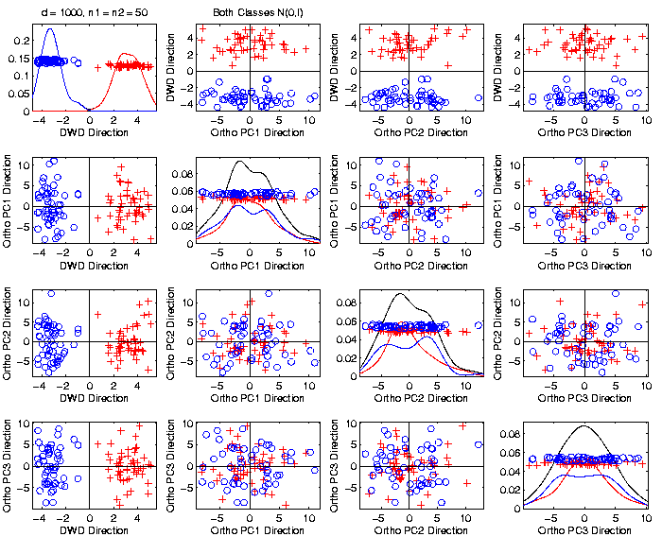
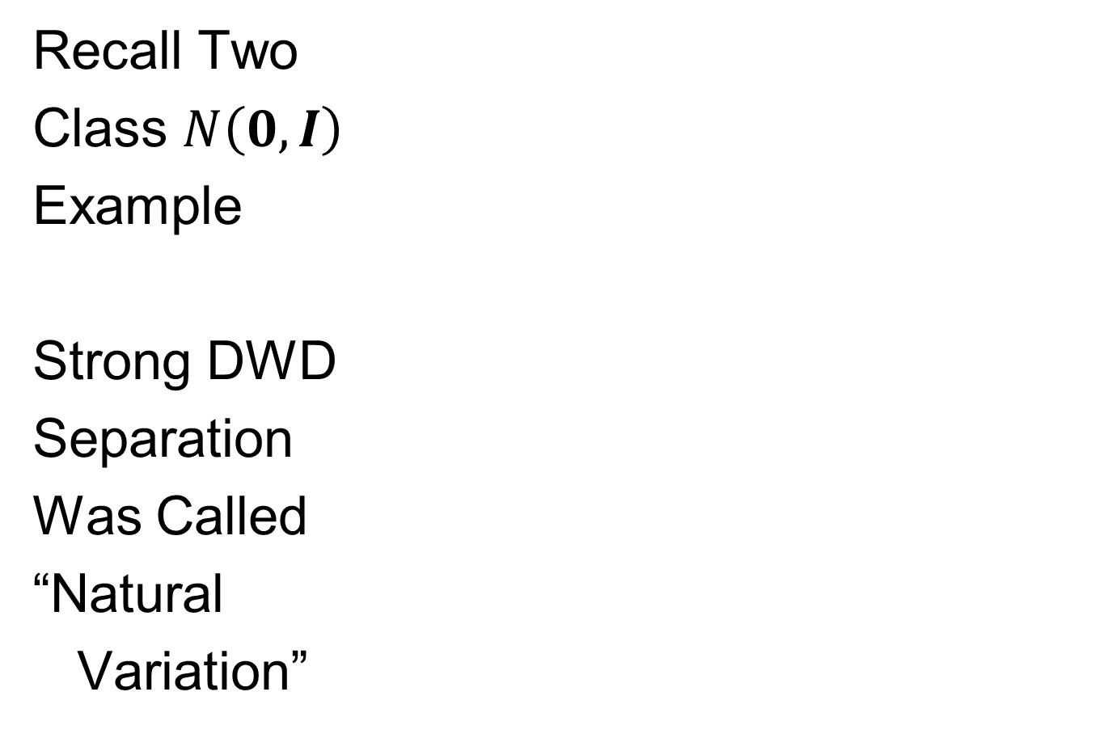
Last Class: HDLSS Explanation
Recall Two
Class $N\left(0,I\right)$
Example
Strong DWD
Separation
Was Called
“Natural
Variation”

Slide 4
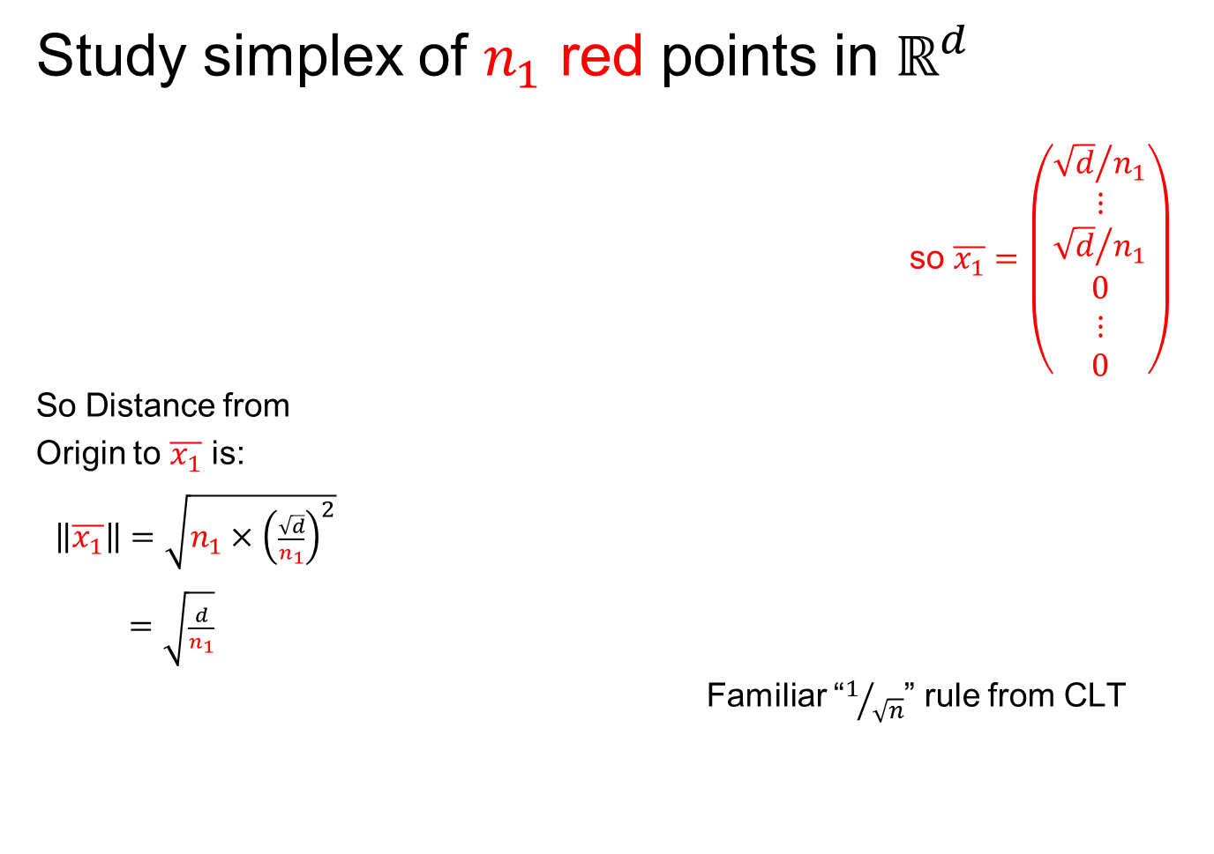
Last Class: HDLSS Explanation
Study simplex of $n_{1}$ red points in $ℝ^{d}$
so $\overline{x_{1}}=\left(\begin{matrix}\begin{matrix}{\sqrt{d}}/{n_{1}} \\ ⋮ \\ {\sqrt{d}}/{n_{1}}\end{matrix} \\ \begin{matrix}0 \\ ⋮ \\ 0\end{matrix}\end{matrix}\right)$
So Distance from
Origin to $\overline{x_{1}}$ is:
$\left\|\overline{x_{1}}\right\|=\sqrt{n_{1}×{\left(\frac{\sqrt{d}}{n_{1}}\right)}^{2}}$
$=\sqrt{\frac{d}{n_{1}}}$
Familiar “$1/{\sqrt{n}}$” rule from CLT

Slide 5

Last Class: HDLSS Explanation
Recall Two
Class $N\left(0,I\right)$
Example
$\left\|\overline{x_{1}}−\overline{x_{2}}\right\|$
$≈6.3$

Slide 6
Last Class: HDLSS History & Assum’ns
On Geometrical Representation
Major Papers:
Hall, Marron and Neeman (2005)
Ahn, Marron, Muller & Chi (2007)
Yata & Aoshima (2009, 2010a, 2010b, 2012, 2013)

Slide 7
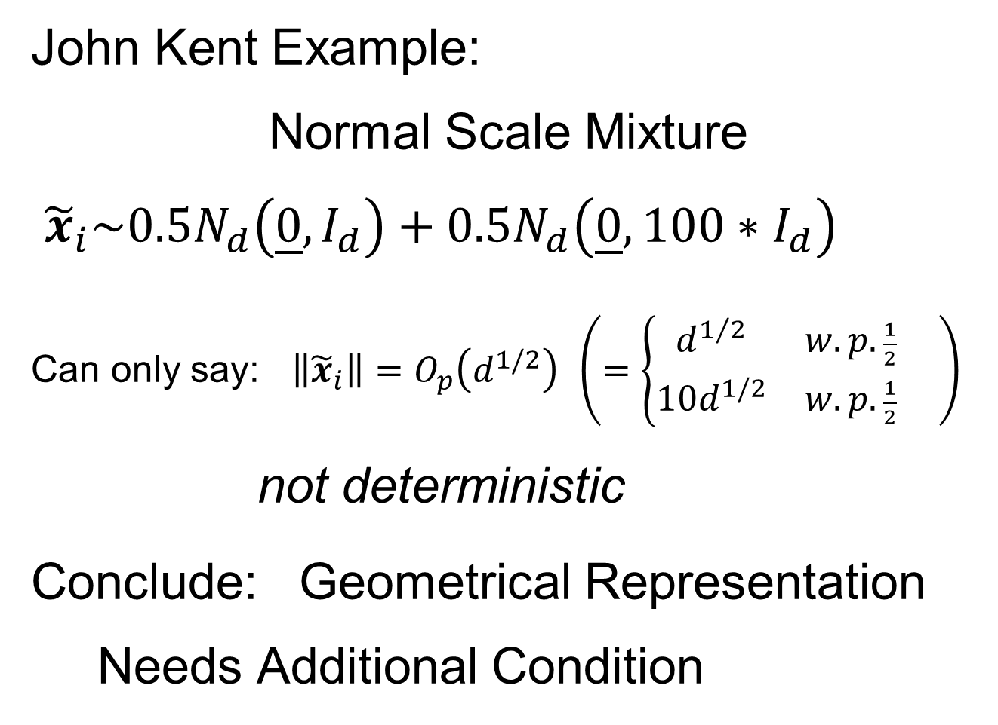
Last Class: HDLSS History & Assum’ns
John Kent Example:
Normal Scale Mixture
${\tilde{x}}_{i}\sim 0.5N_{d}\left(\underline{0},I_{d}\right)+0.5N_{d}\left(\underline{0},{100∗I}_{d}\right)$
Can only say: $\left\|{\tilde{x}}_{i}\right\|=O_{p}\left(d^{1/2}\right)$ $\left(=\left\{\begin{matrix}d^{1/2} & w.p.\frac{1}{2} \\ 10d^{1/2} & w.p.\frac{1}{2}\end{matrix}\right. \right)$
not deterministic
Conclude: Geometrical Representation Needs Additional Condition

Slide 8
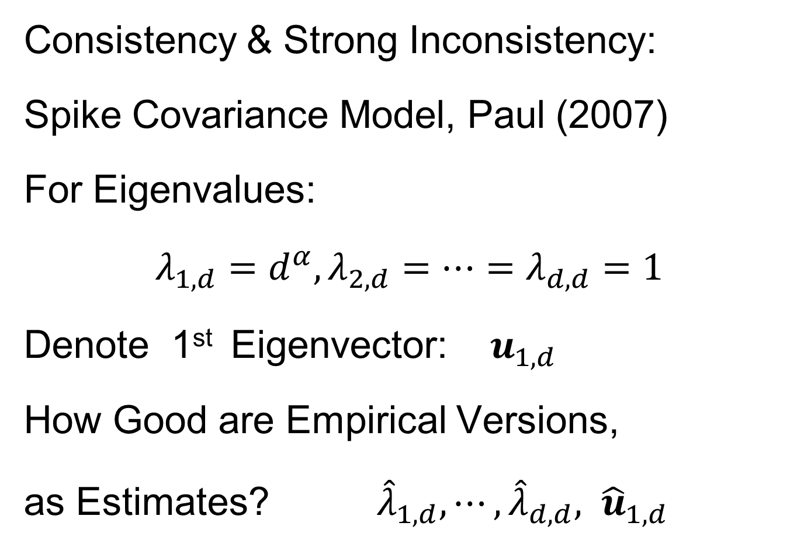
Last Class: HDLSS Math. Stat.
Consistency & Strong Inconsistency:
Spike Covariance Model, Paul (2007)
For Eigenvalues:
$λ_{1,d}=d^{α},λ_{2,d}=⋯=λ_{d,d}=1$
Denote 1st Eigenvector: $u_{1,d}$
How Good are Empirical Versions,
as Estimates? ${\hat{λ}}_{1,d},⋯,{\hat{λ}}_{d,d}, {\hat{u}}_{1,d}$

Slide 9
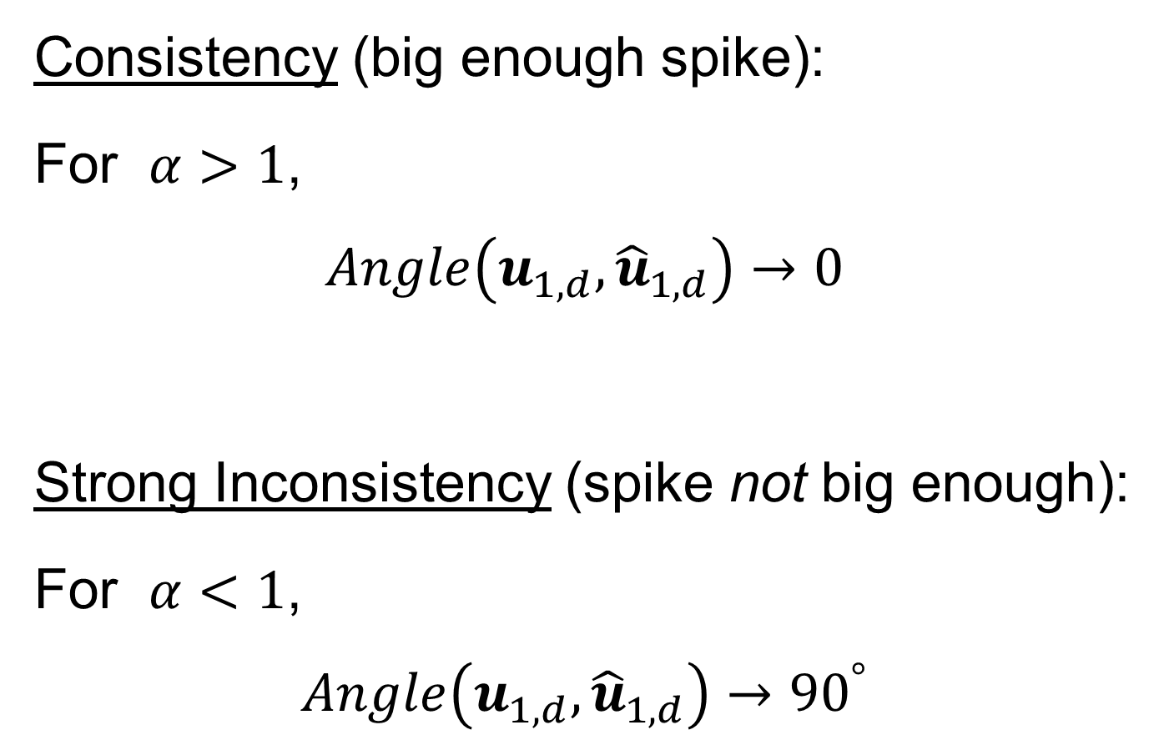
Last Class: HDLSS Math. Stat.
Consistency (big enough spike):
For $α>1$,
$$Angle\left(u_{1,d},{\hat{u}}_{1,d}\right)→0$$
Strong Inconsistency (spike not big enough):
For $α<1$,
$$Angle\left(u_{1,d},{\hat{u}}_{1,d}\right)→{90}^{°}$$

Slide 10
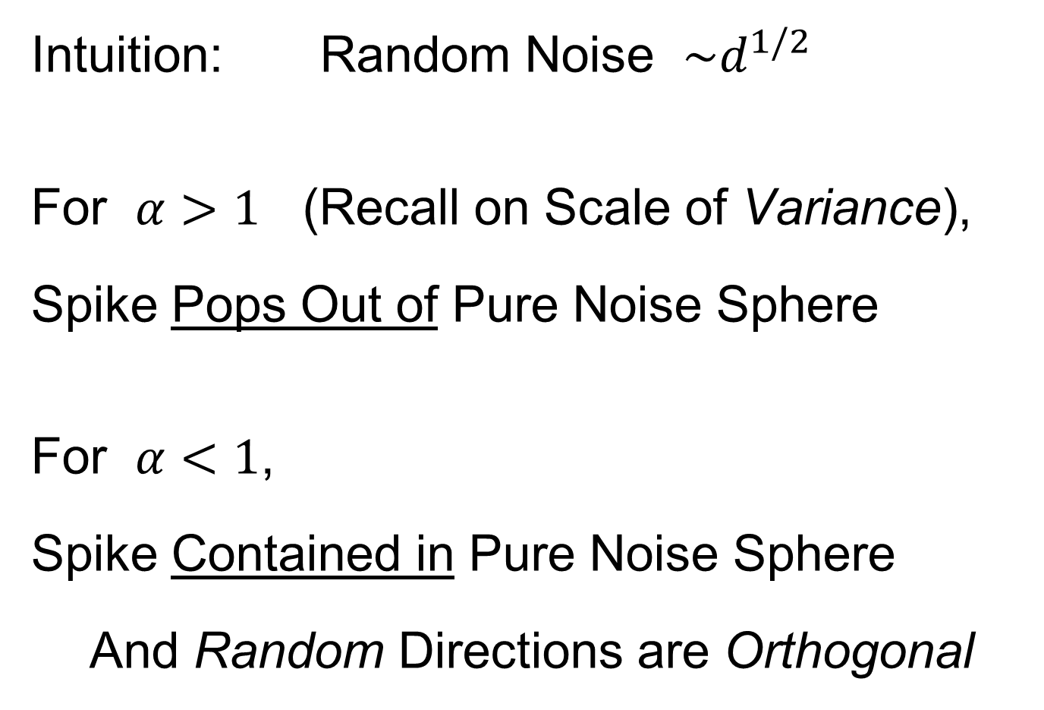
Last Class: HDLSS Math. Stat.
Intuition: Random Noise $\sim d^{1/2}$
For $α>1$ (Recall on Scale of Variance),
Spike Pops Out of Pure Noise Sphere
For $α<1$,
Spike Contained in Pure Noise Sphere
And Random Directions are Orthogonal

Slide 11
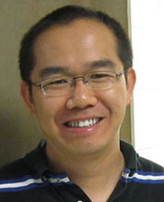
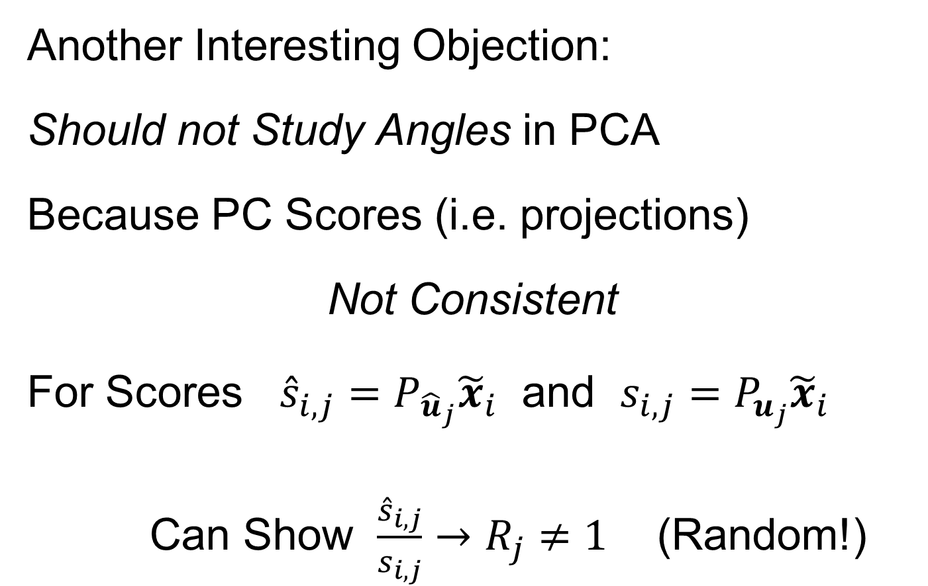
Last Class: HDLSS Math. Stat.
Another Interesting Objection:
Should not Study Angles in PCA
Because PC Scores (i.e. projections)
Not Consistent
For Scores ${\hat{s}}_{i,j}=P_{{\hat{u}}_{j}}{\tilde{x}}_{i}$ and $s_{i,j}=P_{u_{j}}{\tilde{x}}_{i}$
Can Show $\frac{{\hat{s}}_{i,j}}{s_{i,j}}→R_{j}≠1$ (Random!)
Due to Dan Shen

Slide 12
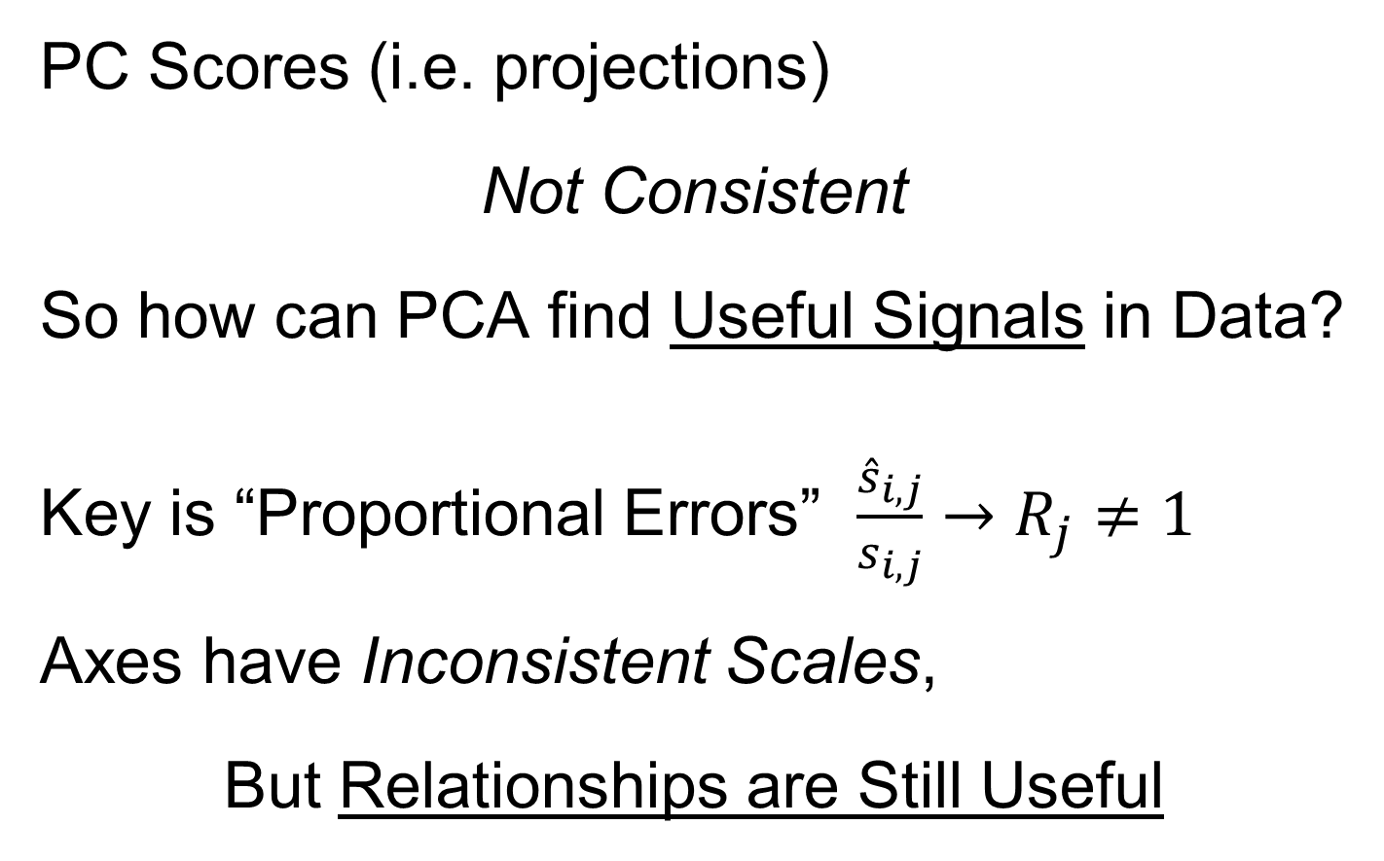
Last Class: HDLSS Math. Stat.
PC Scores (i.e. projections)
Not Consistent
So how can PCA find Useful Signals in Data?
Key is “Proportional Errors” $\frac{{\hat{s}}_{i,j}}{s_{i,j}}→R_{j}≠1$
Axes have Inconsistent Scales,
But Relationships are Still Useful

Slide 13
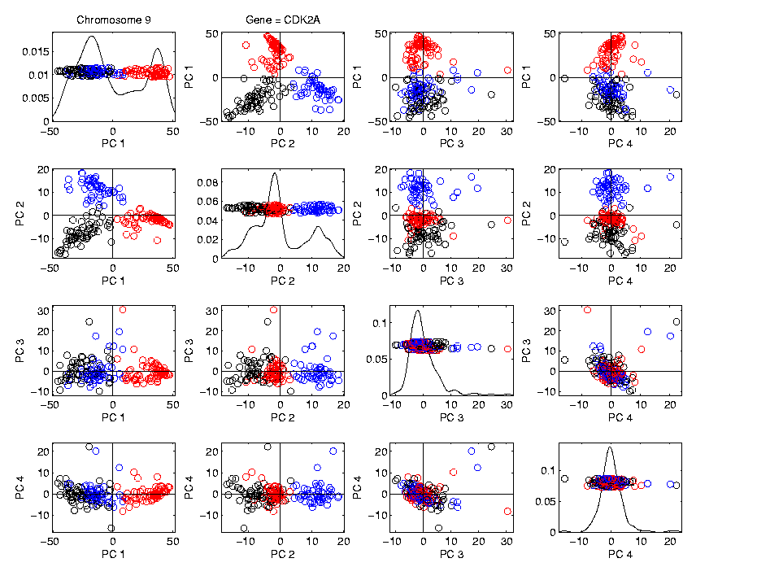
Last Class: HDLSS Math. Stat.
Numbers
On Axes
Are Wrong
But
Relationships
Are Right

Slide 14
More HDLSS Asymptotics
Yata & Aoshima (2009,…,2012)
Natural Covariance Matrix Assumptions
(non-Gaussian)
Improvements on PCA
(Milder Consistency Cond.)
Using Clever Dual Space Calculations

Slide 15

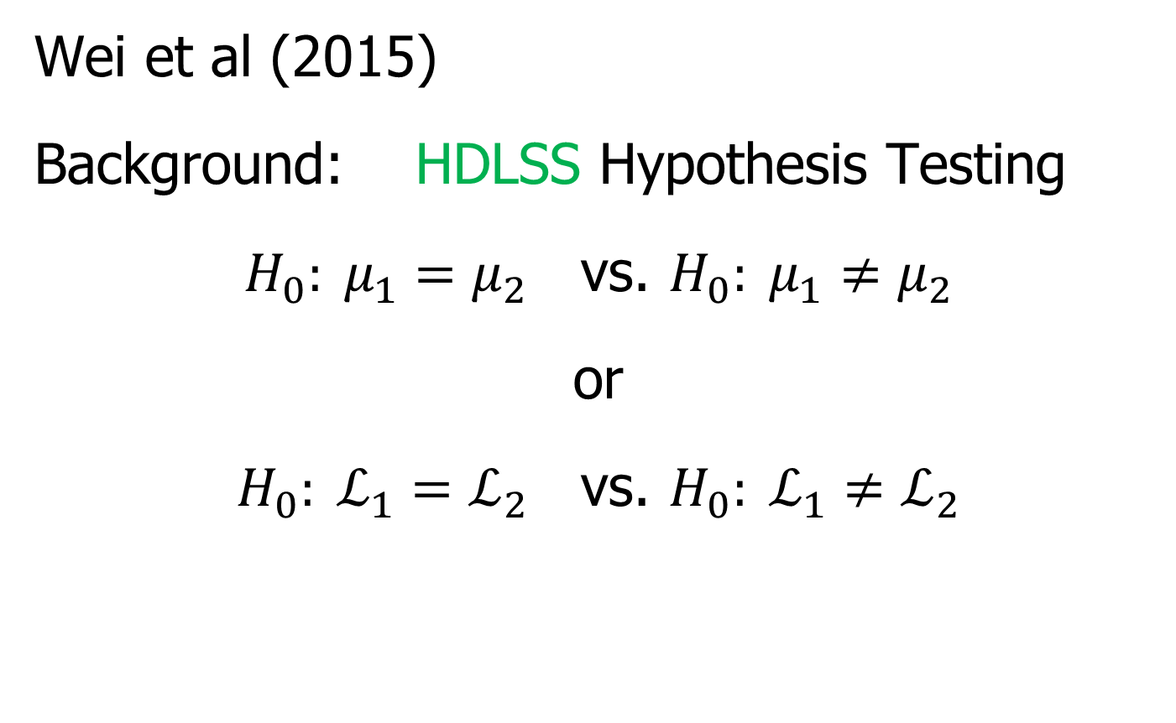
HDLSS Analysis of DiProPerm
Wei et al (2015)
Background: HDLSS Hypothesis Testing
$H_{0}: μ_{1}=μ_{2}$ vs. $H_{0}: μ_{1}≠μ_{2}$
or
$H_{0}: ℒ_{1}=ℒ_{2}$ vs. $H_{0}: ℒ_{1}≠ℒ_{2}$
Most Generally, But Test is Designed
for Maximal Power in Direction of Mean

Slide 16
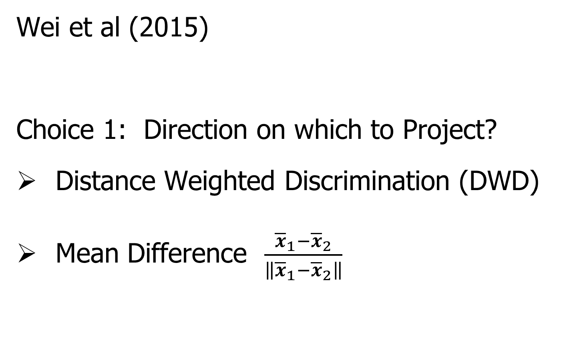
HDLSS Analysis of DiProPerm
Wei et al (2015)
Choice 1: Direction on which to Project?
Distance Weighted Discrimination (DWD)
Mean Difference $\frac{{\overline{x}}_{1}−{\overline{x}}_{2}}{\left\|{\overline{x}}_{1}−{\overline{x}}_{2}\right\|}$

Slide 17
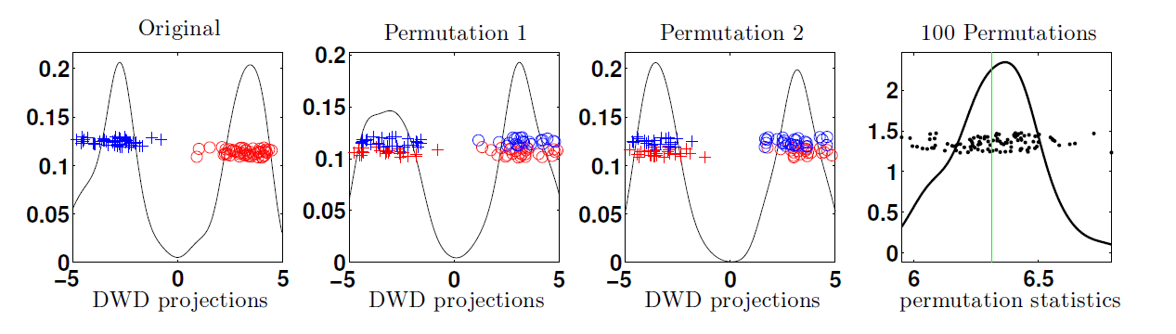
HDLSS Analysis of DiProPerm
Wei et al (2015)
Recall: N(0,1) data (both classes)

Slide 18
HDLSS Analysis of DiProPerm
Choice 2:
Which Statistic to Summarize Projections?
2 – Sample t statistic
Mean Difference

Slide 19
HDLSS Analysis of DiProPerm
Choice 2:
Which Statistic to Summarize Projections?
2 – Sample t statistic
Mean Difference
HDLSS Asymptotics, Wei et al. (2015):
Mean Difference is More Powerful

Slide 20


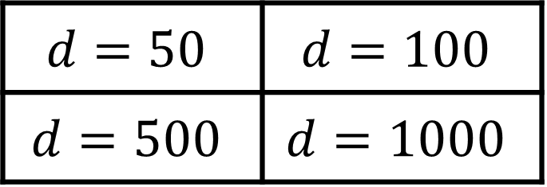

HDLSS Analysis of DiProPerm
Jack Prothero Simulations
$g=0$, $g=$1, $g=5$, $g=10$
$$N_{d}\left(\left(\begin{matrix}±g \\ ±g \\ \begin{matrix}0 \\ ⋮ \\ 0\end{matrix}\end{matrix}\right), I_{d}\right)$$
$$d=50$$ | $$d=100$$
$$d=500$$ | $$d=1000$$

Slide 21
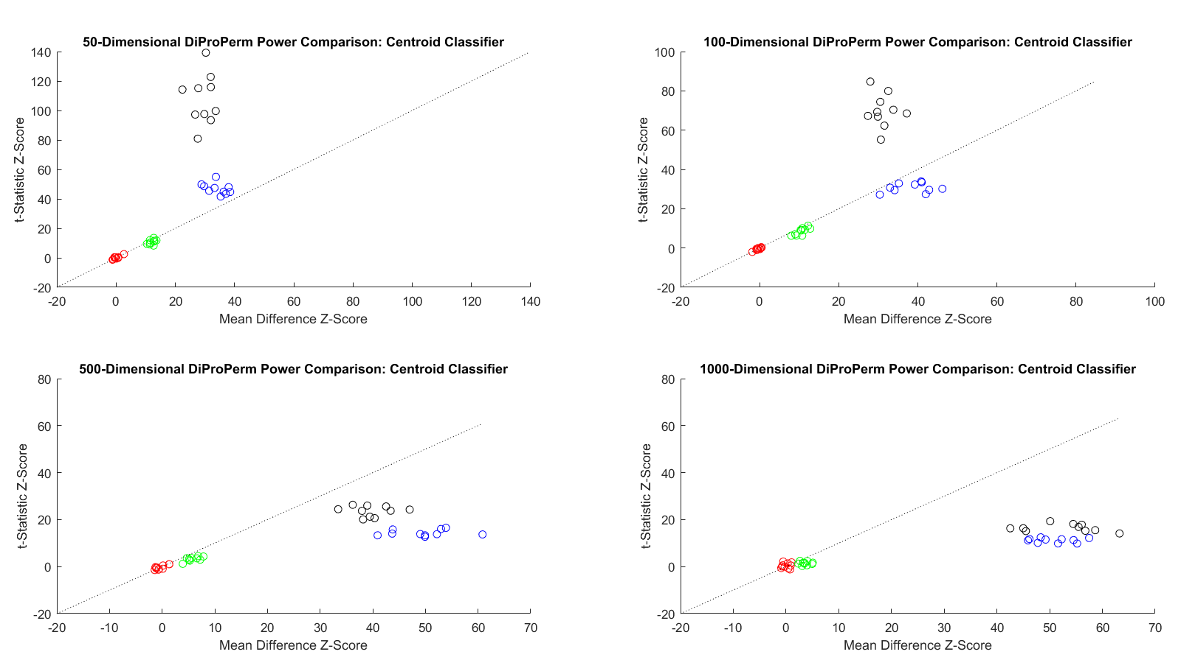
HDLSS Analysis of DiProPerm
Jack Prothero Simulations
Each Panel Compares
t-Statistic
With Mean Difference

Slide 22
HDLSS Analysis of DiProPerm
Jack Prothero Simulations
Over
Over Different Dimensions
All For The Centroid Direction

Slide 23


HDLSS Analysis of DiProPerm
Jack Prothero Simulations
T-Statistic Better for Lower $d$
Mean Difference Better for Higher $d$

Slide 24
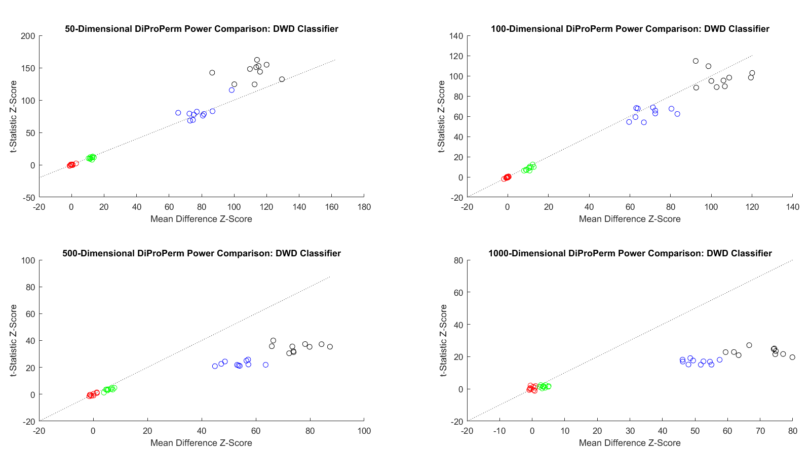


HDLSS Analysis of DiProPerm
Jack Prothero Simulations
Change to DWD Direction
Both Similar for Lower $d$
Mean Difference Better for Higher $d$

Slide 25
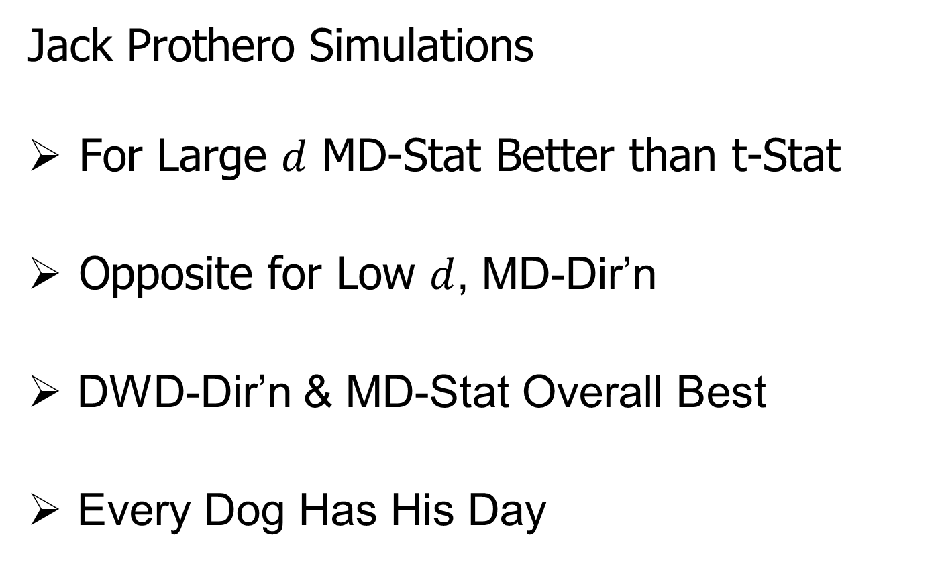
HDLSS Analysis of DiProPerm
Jack Prothero Simulations
For Large $d$ MD-Stat Better than t-Stat
Opposite for Low $d$, MD-Dir’n
DWD-Dir’n & MD-Stat Overall Best
Every Dog Has His Day

Slide 26
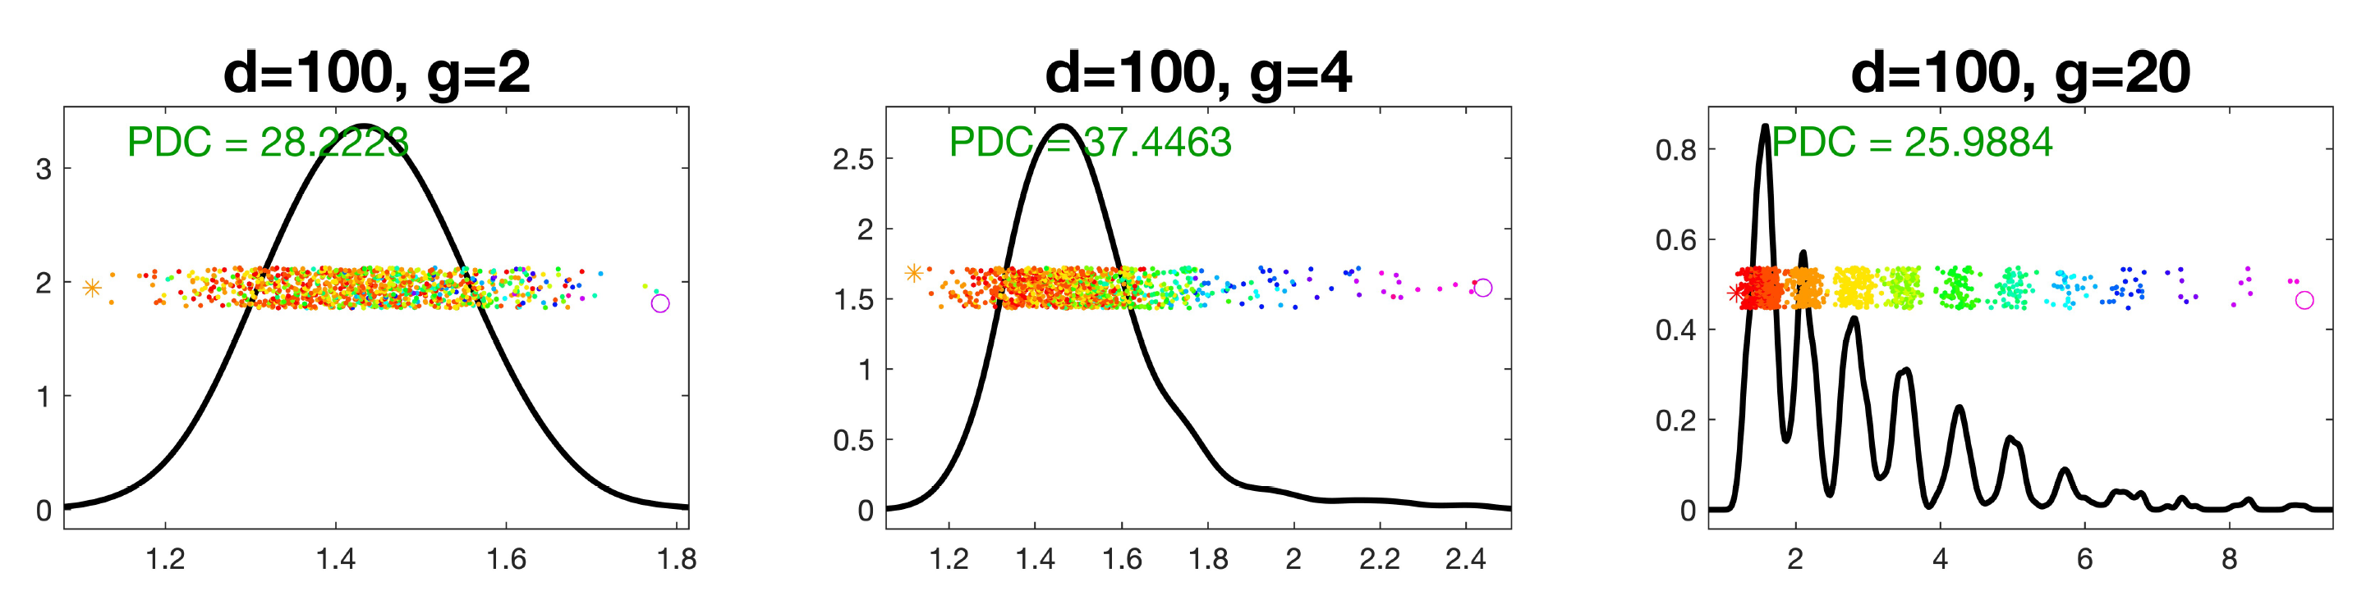
Deeper Look at DiProPerm
Recall Yang et al. (2023) Results:
Avoid Power Loss in High Dimensions Using
Balanced Permutations

Slide 27
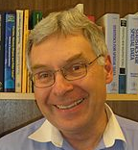
HDLSS Asymptotics
Survey & Introductory Paper:
Aoshima, Shen, Shen, Yata, Zhou & Marron (2018) Australian & New Zealand Journal of Statistics, 60, 4-19.
Memorial to Peter G. Hall

Slide 28
HDLSS Asymptotics
Personal Observations:
HDLSS world is…
Surprising (many times!)
[Think I’ve got it, and then …]
Mathematically Beautiful (?)
Practically Relevant

Slide 29
The Future of HDLSS Asymptotics
“Contiguity” in Hypo Testing?
Rates of Convergence?
Improvements of DWD?
(e.g. other functions of distance than inverse)
Many Others?
It is still early days …

Slide 30
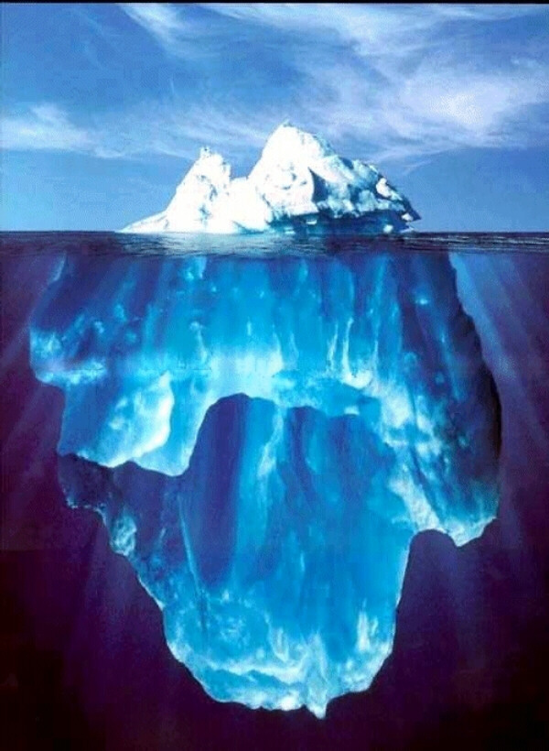
State of HDLSS Research?
Development
Of Methods
Mathematical
Assessment
…
(thanks to:
defiant.corban.edu/gtipton/net-fun/iceberg.html)

Slide 31
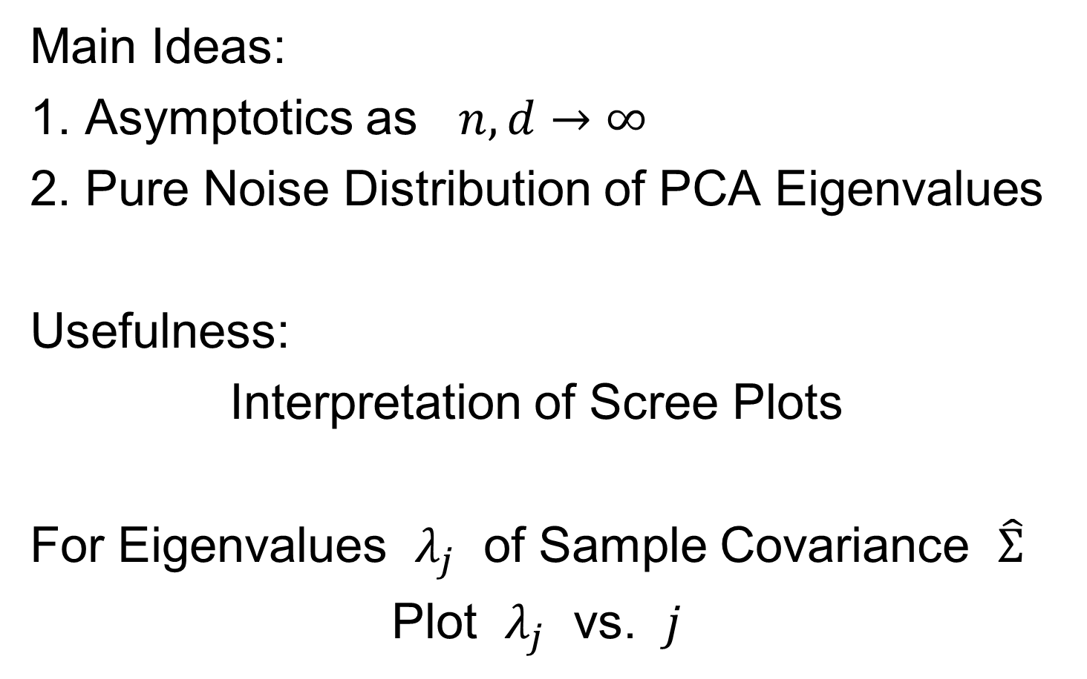
Random Matrix Theory
Text: Sec. 14.1
Main Ideas:
1. Asymptotics as $n,d→∞$
2. Pure Noise Distribution of PCA Eigenvalues
Usefulness:
Interpretation of Scree Plots
For Eigenvalues $λ_{j}$ of Sample Covariance $\hat{Σ}$
Plot $λ_{j}$ vs. $j$

Slide 32
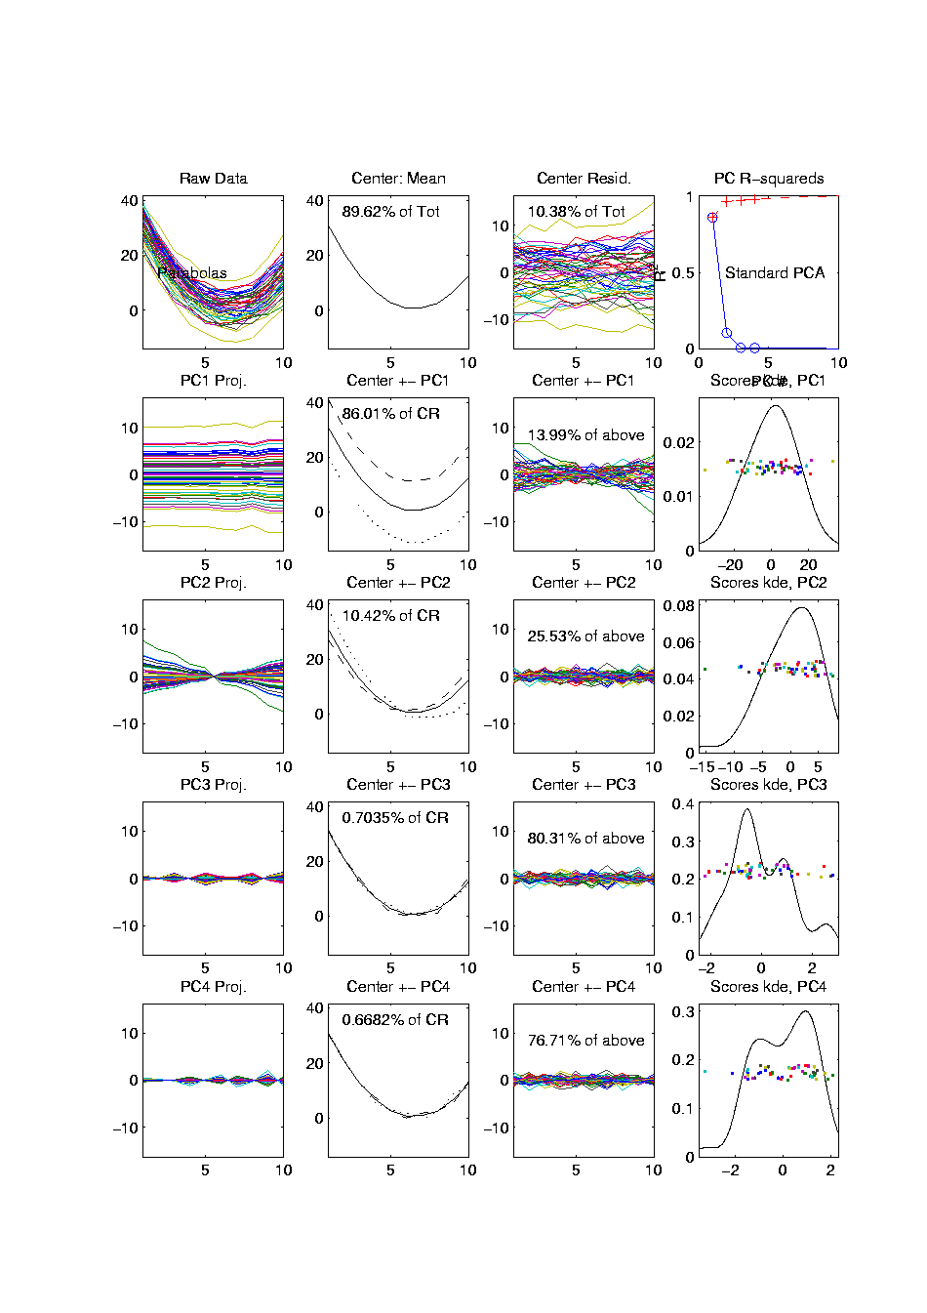
PCA Redist’n of Energy (Cont.)
Note, have already considered some of these Useful Plots:
Power Spectrum (as %s)
Cumulative Power Spectrum (%)
Common Terminology:
Power Spectrum is Called
“Scree Plot”
Kruskal (1964) Cattell (1966)
(all but name “scree”) (1st Appearance of name???)
Notes:
32

Slide 33
PCA Redist’n of Energy (Cont.)
Note, have already considered some of these Useful Plots:
Power Spectrum (as %s)
Cumulative Power Spectrum (%)
Large Values Reflect
Important Structure
Notes:
33

Slide 34
PCA Redist’n of Energy (Cont.)
Note, have already considered some of these Useful Plots:
Power Spectrum (as %s)
Cumulative Power Spectrum (%)
Zoom In & Characterize Noise
Notes:
34

Slide 35



Random Matrix Theory
Text, Sec. 14.1
Pure Noise Data Matrix:
$\tilde{X}=$
Defined as: Entries i.i.d. $N(0,1)$
$$d$$
Thinking of
Columns As
Data Objects
$$n$$

Slide 36
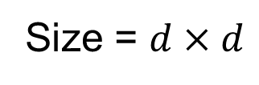
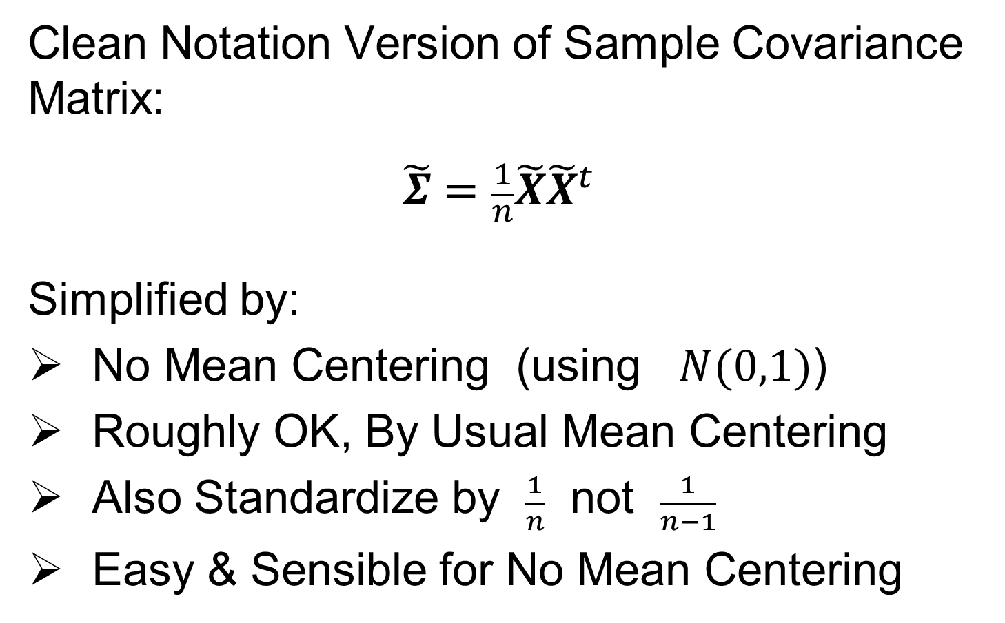
Random Matrix Theory
Clean Notation Version of Sample Covariance Matrix:
$$\tilde{Σ}=\frac{1}{n}\tilde{X}{\tilde{X}}^{t}$$
Simplified by:
No Mean Centering (using $N(0,1)$)
Roughly OK, By Usual Mean Centering
Also Standardize by $\frac{1}{n}$ not $\frac{1}{n−1}$
Easy & Sensible for No Mean Centering
Size = $d×d$

Slide 37
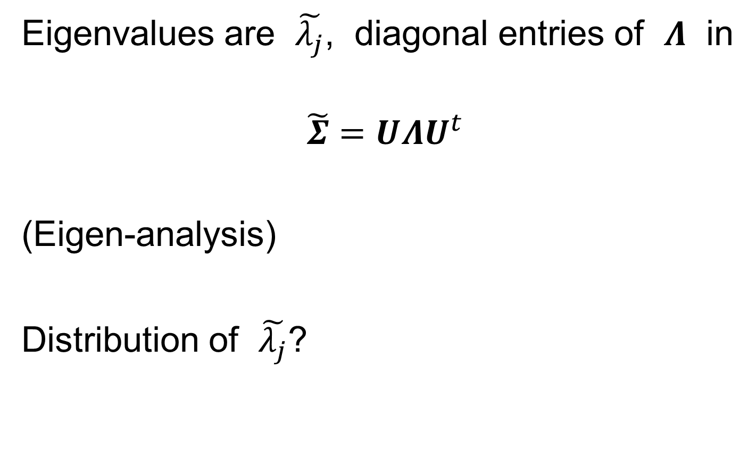
Random Matrix Theory
Eigenvalues are $\tilde{λ_{j}}$, diagonal entries of $Λ$ in
$$\tilde{Σ}=UΛU^{t}$$
(Eigen-analysis)
Distribution of $\tilde{λ_{j}}$?

Slide 38
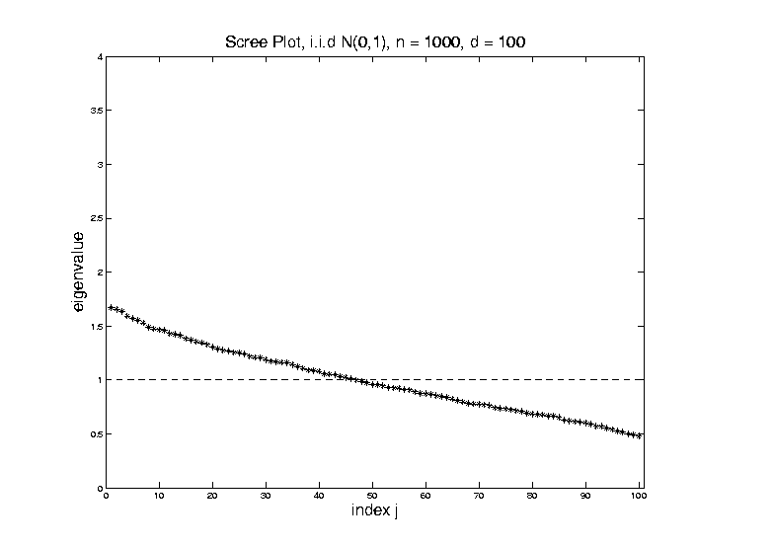

Random Matrix Theory
For $d=100$, $n=1000$, Eigenvalues $≈1$
But There Is (Chance) Variation

Slide 39
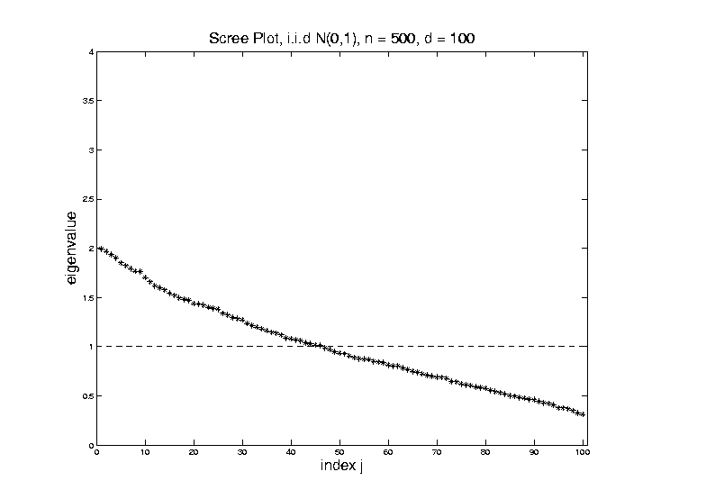

Random Matrix Theory
Smaller $n=500$ Boosts Variation
(More Uncertainty)

Slide 40
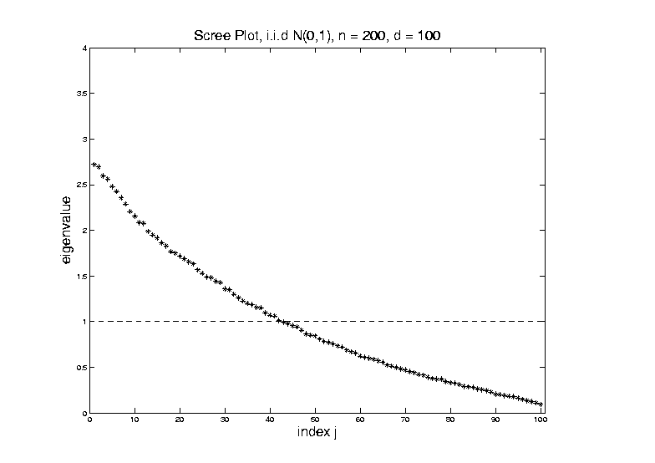

Random Matrix Theory
Smaller $n=200$ Boosts Variation
(Even More Uncertainty)

Slide 41
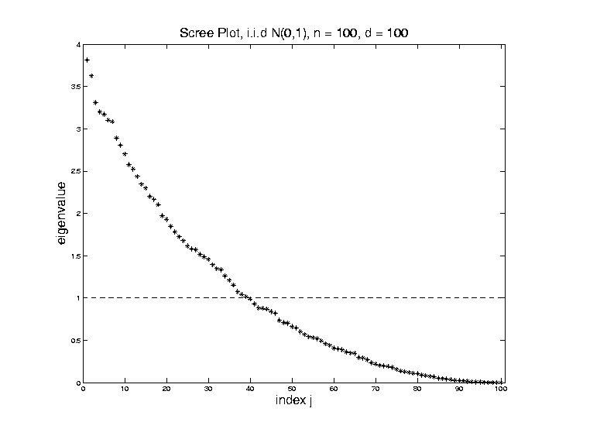

Random Matrix Theory
Smaller $n=100$ Boosts Variation
But Can’t Go Negative
Although
Can Get
Large
Which Induces
Assymetry

Slide 42
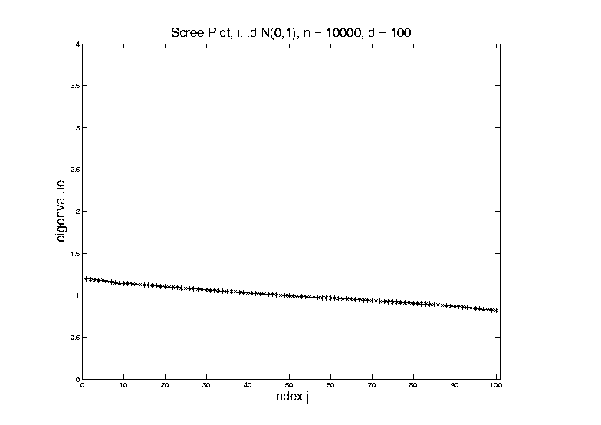

Random Matrix Theory
Larger $n=10,000$ Reduces Variation

Slide 43
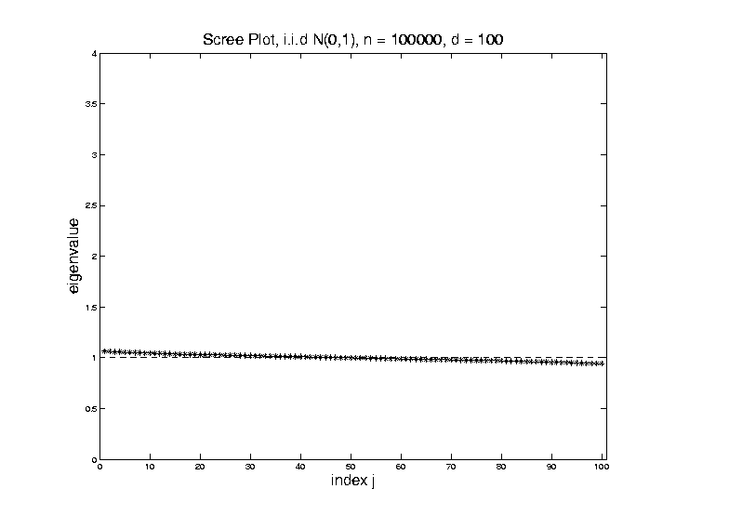

Random Matrix Theory
Larger $n=100,000$ Reduces Variation

Slide 44
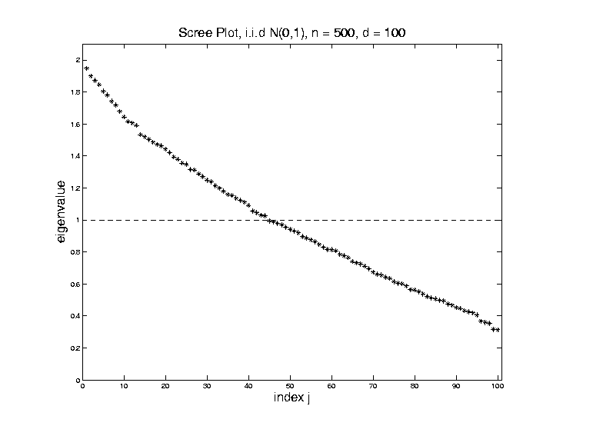

Random Matrix Theory
Fix $y=\frac{d}{n}=\frac{1}{5}$, and let $d$, $n$ grow ($→∞$).

Slide 45
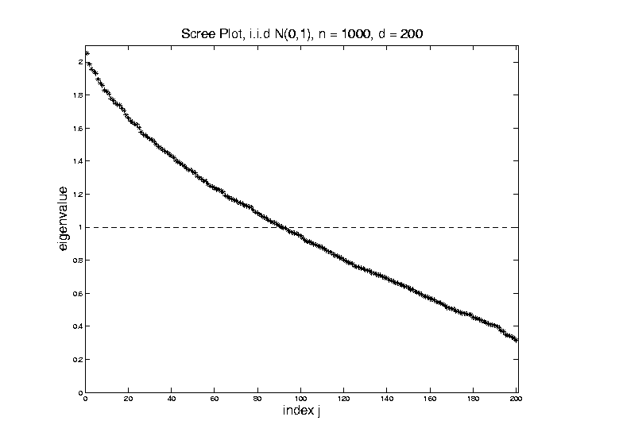

Random Matrix Theory
Fix $y=\frac{d}{n}=\frac{1}{5}$, and let $d$, $n$ grow ($→∞$).
Essentially
Same
Shape

Slide 46
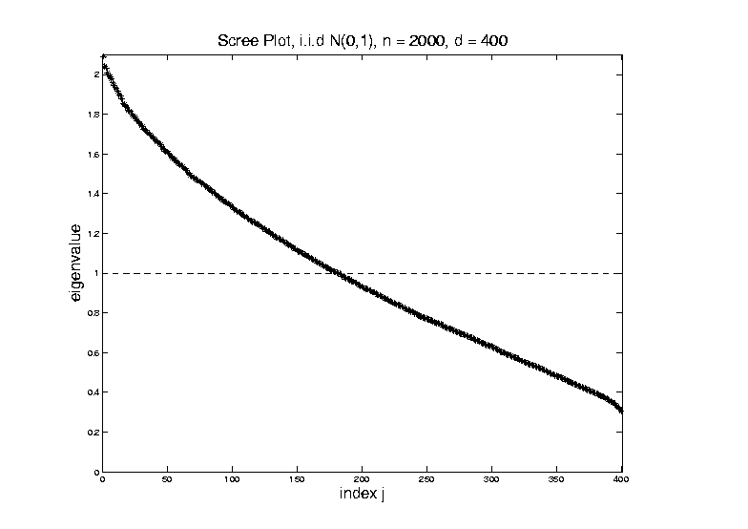

Random Matrix Theory
Fix $y=\frac{d}{n}=\frac{1}{5}$, and let $d$, $n$ grow ($→∞$).
But Less
Sampling
Noise

Slide 47

Random Matrix Theory
Fix $y=\frac{d}{n}=\frac{1}{5}$, and let $d$, $n$ grow ($→∞$).
But Less
Sampling
Noise

Slide 48


Random Matrix Theory
Fix $y=\frac{d}{n}=\frac{1}{5}$, and let $d$, $n$ grow ($→∞$).
What
Is That
Distribution?

Slide 49
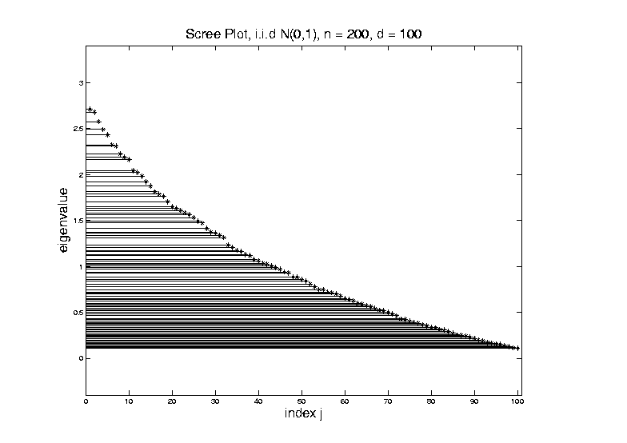
Random Matrix Theory
Shape is Captured by
Empirical Spectral Density
“Density”
Of These
Eigenvalues

Slide 50

Random Matrix Theory
Limiting Spectral Density
(in limit as $n, d→∞$, with $y=\frac{d}{n}$)
References:
Marčenko Pastur (1967)
Yao et al (2015)
Dobriban (2015)

Slide 51

Random Matrix Theory
Limiting Spectral Density
(in limit as $n, d→∞$, with $y=\frac{d}{n}$)
Limit Exists
No Closed Form
But Can Implicitly Define
(Using Integral Equations)
And Numerically Approximate

Slide 52


Random Matrix Theory
Limiting Spectral Density, for given $y=\frac{d}{n}$
Convenient Visualization Interface
By Hyo Young Choi

Slide 53

Random Matrix Theory
LSD:
Above
Case
$n=200,$
$d=100$

Slide 54


Random Matrix Theory
LSD:
Above
Case
$n=200,$
$d=100,$
$y=0.5$
$\log_{10}{y}=−0.301$

Slide 55

Random Matrix Theory
LSD
Note: These
Have Finite
Support
$⊂(0,∞)$

Slide 56


Random Matrix Theory
LSD
In Particular:
$$σ^{2}{\left(1−\sqrt{y}\right)}^{2}$$
$$σ^{2}{\left(1+\sqrt{y}\right)}^{2}$$

Slide 57


Random Matrix Theory
LSD:
Now Try Smaller
(More Negative log)
Values of $y=\frac{d}{n}$
Think Larger $n$

Slide 58


Random Matrix Theory
LSD:
Now Try Smaller
(More Negative log)
Values of $y=\frac{d}{n}$

Slide 59


Random Matrix Theory
LSD:
Now Try Smaller
(More Negative log)
Values of $y=\frac{d}{n}$
Note: Support
Points $→1$

Slide 60

Random Matrix Theory
LSD:
Now Try Smaller
(More Negative log)
Values of $y=\frac{d}{n}$

Slide 61



Random Matrix Theory
LSD:
Now Try Smaller
(More Negative log)
Values of $y=\frac{d}{n}$
Note: Increasing
Symmetry
Endpoints $σ^{2}{\left(1±\sqrt{y}\right)}^{2}$
Are Converging To 1

Slide 62

Random Matrix Theory
Larger $n=100,000$ Reduces Variation
Recall
Previous
Large $n$
Case,
LSD is
Zooming
In On This

Slide 63

Random Matrix Theory
Limiting Case:
$$\lim_{d→∞}{\lim_{n→∞}{}}$$
Called Medium Dimension High Sample Size
Resulting Density is “Semi-Circle”
$$f\left(x\right)=\frac{2}{πR^{2}}\sqrt{R^{2}−x^{2}}1_{\left[−R,R\right]}(x)$$
Called “Wigner Semi-Circle Distribution”

Slide 64

Random Matrix Theory
Summary:
Have Studied Data Matrix Shapes
Observed:
Convergence to 1
Increasing Symmetry
What About Other Direction (Larger $d$)?

Slide 65

Random Matrix Theory
Consider Growing $d$
Challenge:
Only $n$ Columns in $X$ (so rank $=n$)
Yet $\tilde{Σ}=\frac{1}{n}XX^{t}$ is $d×d$
So Have $d−n$ Eigenvalues $=0$

Slide 66


Random Matrix Theory
LSD:
Start With
$y=\frac{d}{n}≈1$
Case

Slide 67


Random Matrix Theory
LSD:
Now Try Larger
Values of $y=\frac{d}{n}$
Proportion of
0 Eigenvalues

Slide 68

Random Matrix Theory
LSD:
Now Try Larger
Values of $y=\frac{d}{n}$
Spectral Density of
Non-0 Eigenvalues

Slide 69

Random Matrix Theory
LSD:
Now Try Larger
Values of $y=\frac{d}{n}$

Slide 70

Random Matrix Theory
LSD:
Now Try Larger
Values of $y=\frac{d}{n}$

Slide 71

Random Matrix Theory
LSD:
Now Try Larger
Values of $y=\frac{d}{n}$
Again Heads
Towards Semi-Circle
But Small
Proportion

Slide 72

Random Matrix Theory
LSD:
Now Try Larger
Values of $y=\frac{d}{n}$
Note:
Shapes Seem Similar to Above

Slide 73

Random Matrix Theory
LSD: Dual Covariance Variation
Idea: Replace $\tilde{Σ}=\frac{1}{n}\tilde{X}{\tilde{X}}^{t}$ by $\frac{1}{d}{\tilde{X}}^{t}\tilde{X}$
Recall:
Rows as Data Objects
Inner Product of $\tilde{X}$
Different Normalization ($d$ not $n$)
N(0,1) Avoids Messy Centering Issues
Sometimes Called
Gram Matrix

Slide 74


Random Matrix Theory
LSD: Dual Covariance Variation
$y=\frac{d}{n}=100$ Is
Close to Semi-Circle

Slide 75

Random Matrix Theory
LSD: Dual Covariance Variation

Slide 76

Random Matrix Theory
LSD: Dual Covariance Variation
Seem to Follow
Similar Pattern

Slide 77

Random Matrix Theory
LSD: Dual Covariance Variation

Slide 78


Random Matrix Theory
LSD: Dual Covariance Variation
For $d<n$ Now
Get 0 Eignevalues

Slide 79

Random Matrix Theory
LSD: Dual Covariance Variation

Slide 80

Random Matrix Theory
LSD: Dual Covariance Variation

Slide 81

Random Matrix Theory
LSD: Dual Covariance Variation
Again Heads To
Semi-Circle

Slide 82

Random Matrix Theory
LSD: Primal & Dual
Overlaid For
Direct
Comparison
Notes:
Area = 1
Area = 1 - Bar

Slide 83

Random Matrix Theory
LSD: Primal & Dual

Slide 84


Random Matrix Theory
LSD: Primal & Dual
Very Close
For $d≈n$

Slide 85

Random Matrix Theory
LSD: Primal & Dual
Very Close
For $d≈n$

Slide 86

Random Matrix Theory
LSD: Primal & Dual

Slide 87

Random Matrix Theory
LSD: Primal & Dual

Slide 88

Random Matrix Theory
LSD: Primal & Dual

Slide 89


Random Matrix Theory
LSD: Rescaled
Primal & Dual
$\sqrt{y}×LSD$
(underneath)
$\frac{1}{\sqrt{y}}×Dual LSD$

Slide 90

Random Matrix Theory
LSD: Rescaled
Primal & Dual

Slide 91

Random Matrix Theory
LSD: Rescaled
Primal & Dual

Slide 92

Random Matrix Theory
LSD: Rescaled
Primal & Dual

Slide 93

Random Matrix Theory
LSD: Rescaled
Primal & Dual

Slide 94

Random Matrix Theory
LSD: Rescaled
Primal & Dual

Slide 95
Random Matrix Theory
Conclusion:
Family of Marcenko – Pastur Distributions
Has Several Interesting Symmetries

Slide 96
Random Matrix Theory
Important Parallel Theory:
Distribution of Largest Eigenvalue
(Assuming Matrix of i.i.d. N(0,1)s)
Tracey & Widom (1994)
Good Discussion of Statistical Implications
Johnstone (2008) & Yao et al. (2015)

Slide 97

Clustering
Text:
Chp 12
Idea: Given data ${\tilde{x}}_{1},⋯,{\tilde{x}}_{n}$
Assign each object to a class
Of similar objects
Completely data driven
I.e. assign labels to data
“Unsupervised Learning”
Contrast to Classification (Discrimination)
With predetermined given class labels
“Supervised Learning”

Slide 98
Clustering
Important References:
MacQueen (1967)
Hartigan (1975)
Gersho and Gray (1992)
Kaufman and Rousseeuw (2005)
See Also: Wikipedia

Slide 99

K-means Clustering
Main Idea: for data ${\tilde{x}}_{1},⋯,{\tilde{x}}_{n}∈ℝ^{d}$
Partition indices $i=1,⋯,n$
among classes $C_{1},⋯$, $C_{K}$
Where Index sets $C_{1},⋯$, $C_{K}$
Partition $\left\{1,⋯,n\right\}$
Represent clusters by “class means”
i.e, ${\overline{x}}_{j}=\frac{1}{\#\left(C_{j}\right)}\sum_{i∈C_{j}}{{\tilde{x}}_{i}}$ (within class means)
Each goes into
exactly 1 class

Slide 100


K-means Clustering
Given index sets $C_{1},⋯$, $C_{K}$
Measure how well clustered, using
Within Class Sum of Squares
$$\sum_{j=1}^{K}{\sum_{i∈C_{j}}{{\left\|{\tilde{x}}_{i}−{\overline{x}}_{j}\right\|}^{2}}}$$

Slide 101

K-means Clustering
Common Variation:
Put on scale of proportions (i.e. in [0,1])
By dividing “within class SS”
by “overall SS”
Gives Cluster Index:
$$CI\left(C_{1},⋯,C_{K}\right)=\frac{\sum_{j=1}^{K}{\sum_{i∈C_{j}}{{\left\|{\tilde{x}}_{i}−{\overline{x}}_{j}\right\|}^{2}}}}{\sum_{i=1}^{n}{{\left\|{\tilde{x}}_{i}−{\overline{x}}_{j}\right\|}^{2}}}$$

Slide 102

K-means Clustering
Notes on Cluster Index:
$$CI\left(C_{1},⋯,C_{K}\right)=\frac{\sum_{j=1}^{K}{\sum_{i∈C_{j}}{{\left\|{\tilde{x}}_{i}−{\overline{x}}_{j}\right\|}^{2}}}}{\sum_{i=1}^{n}{{\left\|{\tilde{x}}_{i}−{\overline{x}}_{j}\right\|}^{2}}}$$
$CI=0$ when all data at cluster means
$CI$ small when $C_{1},⋯,C_{K}$ are tight clusters
(within SS contains little variation)
$CI$ big when $C_{1},⋯,C_{K}$ gives poor clustering
(within SS contains most of variation)
$CI=1$ when all cluster means are same

Slide 103

K-means Clustering
Clustering Goal:
Given data ${\tilde{X}}_{1},⋯,{\tilde{X}}_{n}$
Choose classes $C_{1},⋯,C_{K}$
To minimize
$$CI\left(C_{1},⋯,C_{K}\right)=\frac{\sum_{j=1}^{K}{\sum_{i∈C_{j}}{{\left\|{\tilde{x}}_{i}−{\overline{x}}_{j}\right\|}^{2}}}}{\sum_{i=1}^{n}{{\left\|{\tilde{x}}_{i}−{\overline{x}}_{j}\right\|}^{2}}}$$

Slide 104
2-means Clustering
Study CI, using simple 1-d examples
Varying Standard Deviation

Slide 105

2-means Clustering

Slide 106

2-means Clustering

Slide 107

2-means Clustering

Slide 108

2-means Clustering

Slide 109

2-means Clustering

Slide 110

2-means Clustering

Slide 111

2-means Clustering

Slide 112

2-means Clustering

Slide 113

2-means Clustering

Slide 114

2-means Clustering

Slide 115
2-means Clustering
Study CI, using simple 1-d examples
Varying Standard Deviation
Varying Mean

Slide 116

2-means Clustering

Slide 117

2-means Clustering

Slide 118

2-means Clustering

Slide 119

2-means Clustering

Slide 120

2-means Clustering

Slide 121

2-means Clustering

Slide 122

2-means Clustering

Slide 123

2-means Clustering

Slide 124

2-means Clustering

Slide 125

2-means Clustering

Slide 126

2-means Clustering

Slide 127

2-means Clustering

Slide 128
2-means Clustering
Study CI, using simple 1-d examples
Varying Standard Deviation
Varying Mean
Varying Proportion

Slide 129

2-means Clustering

Slide 130

2-means Clustering

Slide 131

2-means Clustering

Slide 132

2-means Clustering

Slide 133

2-means Clustering

Slide 134

2-means Clustering

Slide 135

2-means Clustering

Slide 136

2-means Clustering

Slide 137

2-means Clustering

Slide 138

2-means Clustering

Slide 139

2-means Clustering

Slide 140

2-means Clustering

Slide 141

2-means Clustering

Slide 142

2-means Clustering
Important Point:
K-Means Dislikes
Small Clusters

Slide 143
2-means Clustering
Study CI, using simple 1-d examples
Over changing Classes (moving b’dry)

Slide 144

2-means Clustering

Slide 145

2-means Clustering

Slide 146

2-means Clustering

Slide 147

2-means Clustering
C. Index for
Clustering
Greens
& Blues

Slide 148

2-means Clustering

Slide 149

2-means Clustering

Slide 150

2-means Clustering

Slide 151

2-means Clustering

Slide 152

2-means Clustering

Slide 153

2-means Clustering
Curve Shows CI for Many
Reasonable Clusterings
Separated Local Minima!

Slide 154

2-means Clustering
Study CI, using simple 1-d examples
Over changing Classes (moving b’dry)
Multi-modal data → interesting effects
  Multiple local minima in CI (large number)
  Maybe disconnected
  Optimization (over $C_{1},⋯$, $C_{K}$) can be tricky…
(even in 1 dimension, with $K=2$)

Slide 155

2-means Clustering
Shows Even More
Local Minima

Slide 156
2-means Clustering
Study CI, using simple 1-d examples
Over changing Classes (moving b’dry)
Multi-modal data → interesting effects
  Can have 4 (or more) local mins
(even in 1 dimension, with K = 2)

Slide 157

2-means Clustering
Shows True
Minimum May
Be Hard To Find

Slide 158

2-means Clustering
Study CI, using simple 1-d examples
Over changing Classes (moving b’dry)
Multi-modal data → interesting effects
  Local mins can be hard to find
  i.e. iterative procedures can “get stuck”
(even in 1 dimension, with $K=2$)
Common, But Slippery,
Approach: Many
Random Restarts

Slide 159
2-means Clustering
Study CI, using simple 1-d examples
Effect of a single outlier?

Slide 160

2-means Clustering
Minimum CI
Splits in Half

Slide 161

2-means Clustering
Move
Outlier
Farther
Out
Already Have
Local Minima

Slide 162

2-means Clustering

Slide 163

2-means Clustering
Global CI
Minimum
Now Here

Slide 164

2-means Clustering

Slide 165

2-means Clustering

Slide 166

2-means Clustering

Slide 167

2-means Clustering

Slide 168

2-means Clustering

Slide 169

2-means Clustering

Slide 170

2-means Clustering
Single Outlier Can Make CI Arbitrarily Small

Slide 171
2-means Clustering
Study CI, using simple 1-d examples
Effect of a single outlier?
  Can create local minimum
  Can also yield a global minimum
  This gives a one point class
  Can make CI arbitrarily small
  (really a “good clustering”???)

Slide 172

K-Means Clustering
2-d Toy Example
Long Thin Cluster
Close Round Clusters
Outliers or Clusters???

Slide 173





K-Means Clustering
2-d Toy Example
$k=2$, Groups
All Small Ones
$k=3$, Splits
Round Ones
K-Means Can Be Slippery
$k=4$, Splits
Long Cluster
Local Minimum?
$k=5$, Splits
Outliers, Not
Round Ones?

Slide 174




K-Means Clustering
2-d Toy Example, More Careful Look
Recommendation: Visual Validation!
So Global Min’r
So Local Min’r
K-Means Can Be Slippery
$k=4$: $CI=0.091$
$k=5$, $CI=0.063$
$k=4$: Separated
Out Pair: $CI=0.161$
$k=5$: Split
Spheres $CI=0.059$

Slide 175
Participant Presentation
1:35 Gilbert Giri:
Evolution of Gene Regulation
Next Class: Tianzhu Liu

