Slide 1
Statistics – O. R. 881 Object Oriented Data Analysis
Steve Marron
Dept. of Statistics and Operations Research
University of North Carolina

Slide 2
Current Sections in Textbook
Today:
Sections 13.2, 12.3, 15.1, 15.2, 15.3
Next Class:
Sections 16.1, 16.2

Slide 3
Last Class: SWISS Score
Avg. Pairwise SWISS – Toy Examples

Slide 4
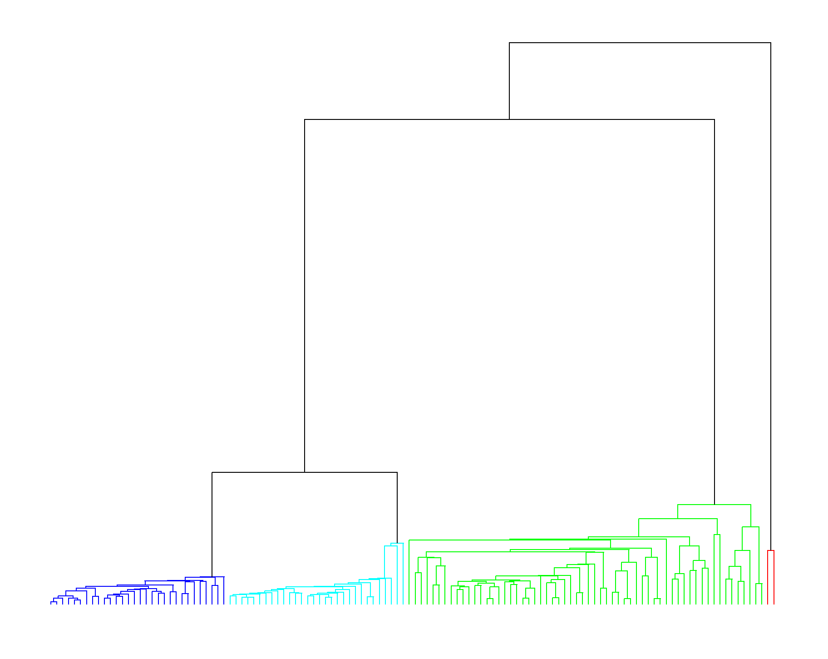
Last Class: Clustering
2-d Toy Example, Euclidean Distance
Single Linkage Dendrogram
Reveals
Ordering
Of Clusters
Heights
Correspond
to Gaps
Because of

Slide 5
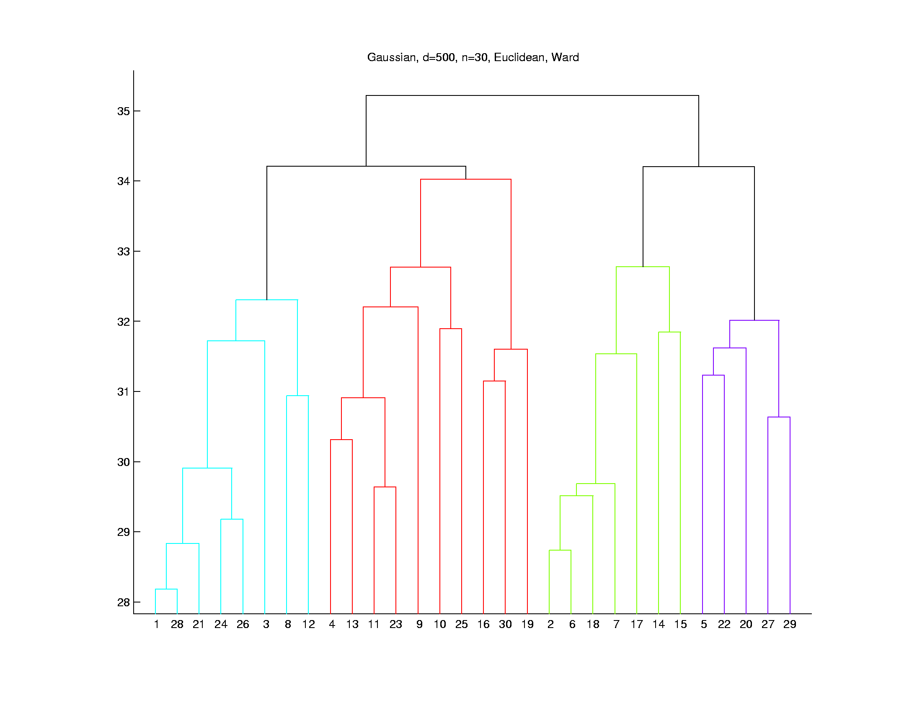

Last Class: Clustering
Higher Dimensions, $d=500$, $n=30$, $N(0,I)$
Euclidean Dist.
Ward’s Linkage
Likes
Balanced
Cluster
Sizes
Note Sizes:
8
10
7
5

Slide 6
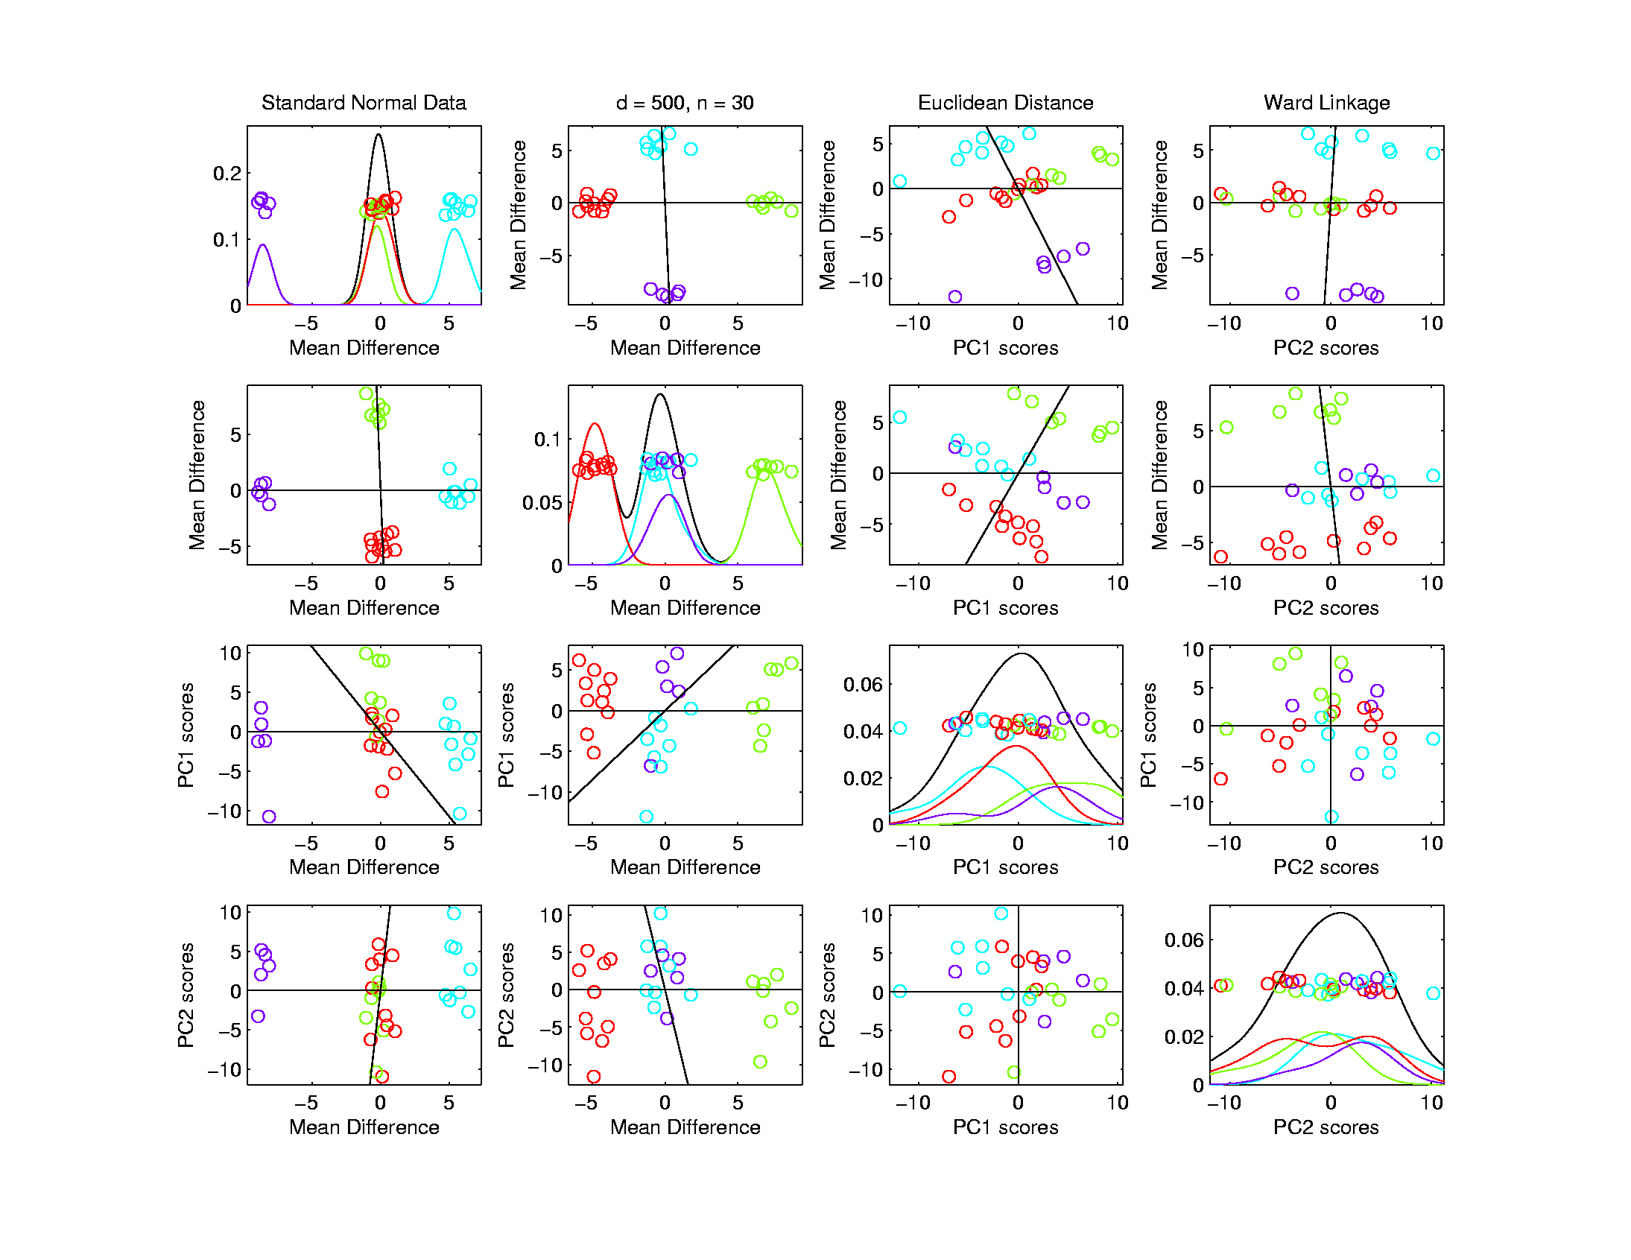



Last Class: Clustering
Higher Dimensions, $d=500$, $n=30$, $N(0,I)$
Euclidean Dist.
Ward’s Linkage
Visualize
With Mean
Differences
$$≈12.7$$
$$≈11.0$$

Slide 7
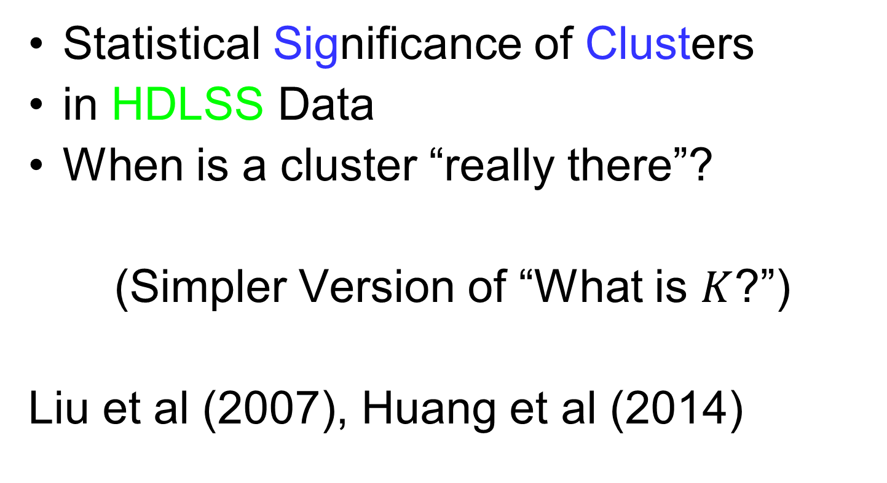
Last Class: SigClust
Statistical Significance of Clusters
in HDLSS Data
When is a cluster “really there”?
(Simpler Version of “What is $K$?”)
Liu et al (2007), Huang et al (2014)

Slide 8
Last Class: SigClust
Basis of SigClust Approach:
What defines: A Single Cluster?
A Gaussian distribution (Sarle & Kou 1993)
So define SigClust test based on:
2-means cluster index (measure) as statistic
Gaussian null distribution
Currently compute by simulation
Possible to do this analytically???

Slide 9
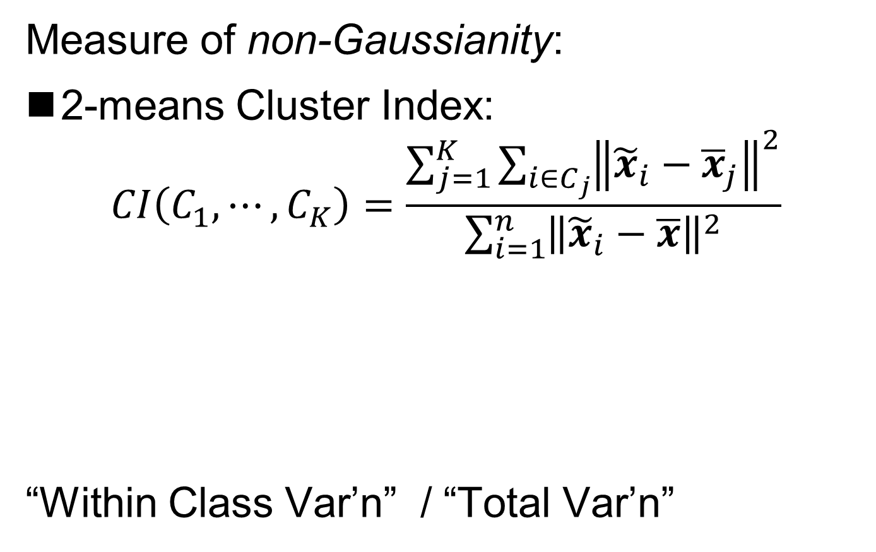
Last Class: SigClust Statistic
Measure of non-Gaussianity:
2-means Cluster Index:
$$CI\left(C_{1},⋯,C_{K}\right)=\frac{\sum_{j=1}^{K}{\sum_{i∈C_{j}}{{\left\|{\tilde{x}}_{i}−{\overline{x}}_{j}\right\|}^{2}}}}{\sum_{i=1}^{n}{{\left\|{\tilde{x}}_{i}−\overline{x}\right\|}^{2}}}$$
“Within Class Var’n” / “Total Var’n”
Class Index Sets
Class Means

Slide 10
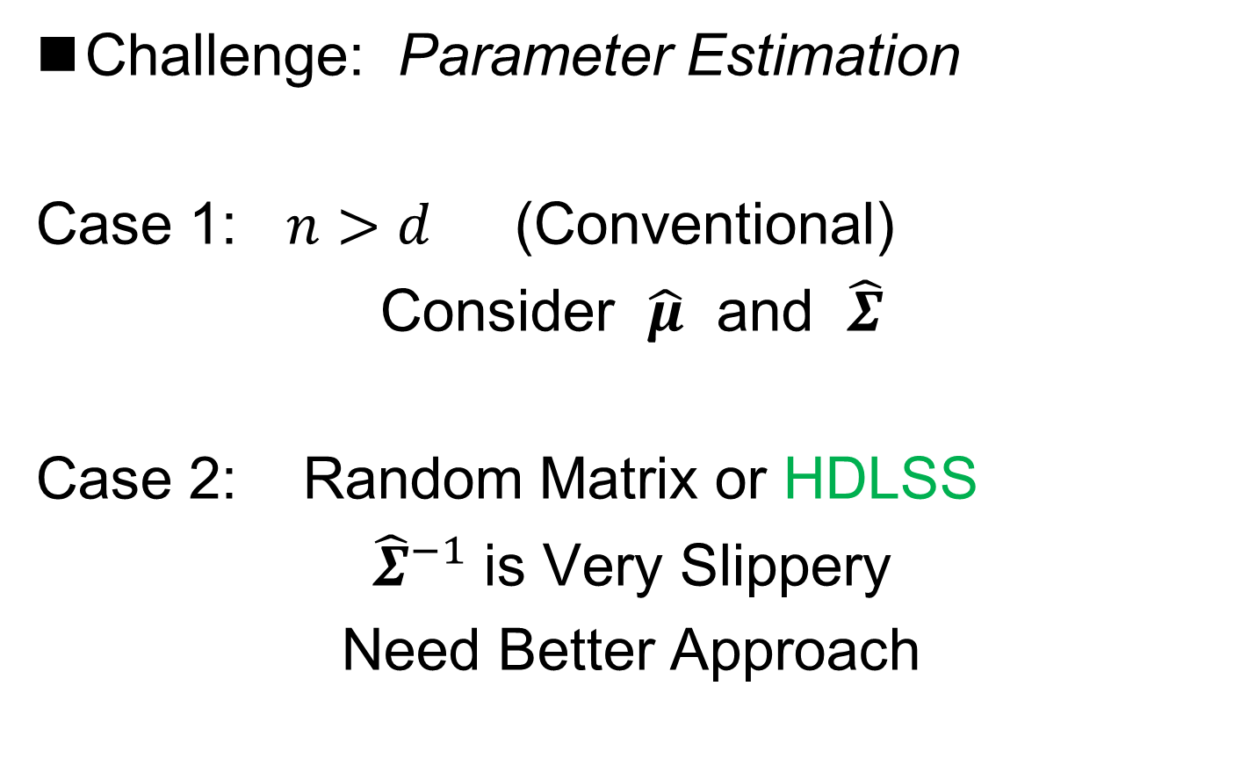
Last Class: SigClust Null
Challenge: Parameter Estimation
Case 1: $n>d$ (Conventional)
Consider $\hat{μ}$ and $\hat{Σ}$
Case 2: Random Matrix or HDLSS
${\hat{Σ}}^{−1}$ is Very Slippery
Need Better Approach
Can Always Do This
But Can Be Very
Conservative

Slide 11
Last Class: SigClust Null
Estimated Mean, $μ$ (of Gaussian dist’n)?
1st Key Idea: Can ignore this
By appealing to shift invariance of CI
When Data are (rigidly) shifted
CI remains the same
So enough to simulate with mean 0
Other uses of invariance ideas?

Slide 12
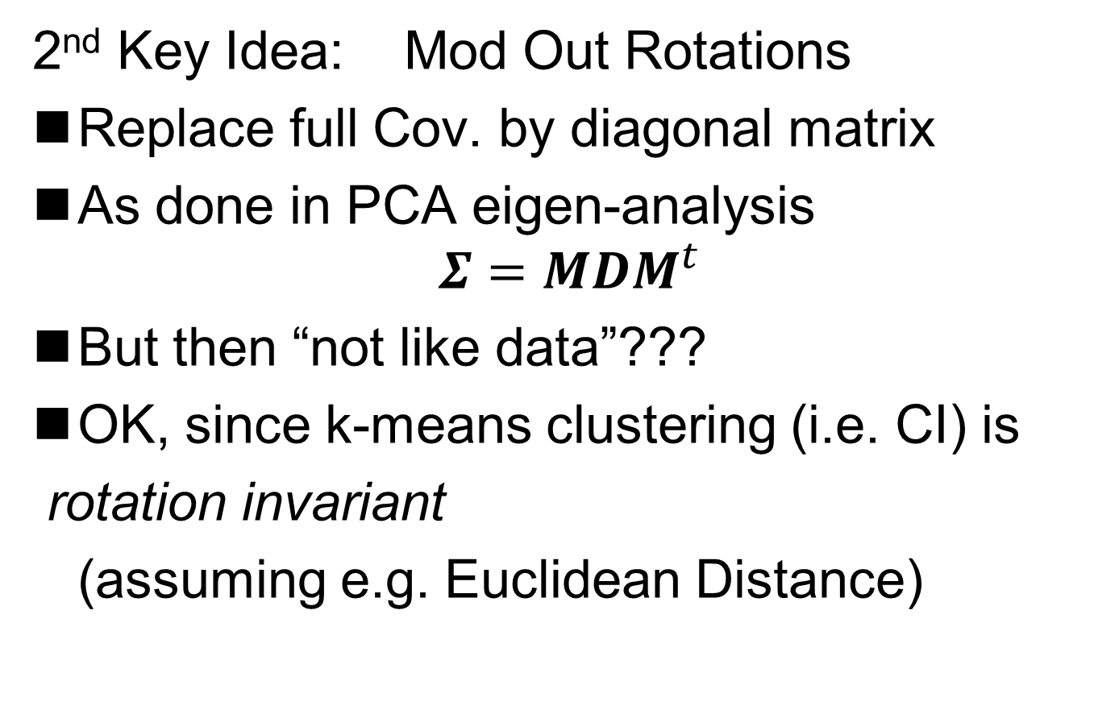
Last Class: SigClust Null
2nd Key Idea: Mod Out Rotations
Replace full Cov. by diagonal matrix
As done in PCA eigen-analysis
$$Σ=MDM^{t}$$
But then “not like data”???
OK, since k-means clustering (i.e. CI) is
rotation invariant
(assuming e.g. Euclidean Distance)

Slide 13
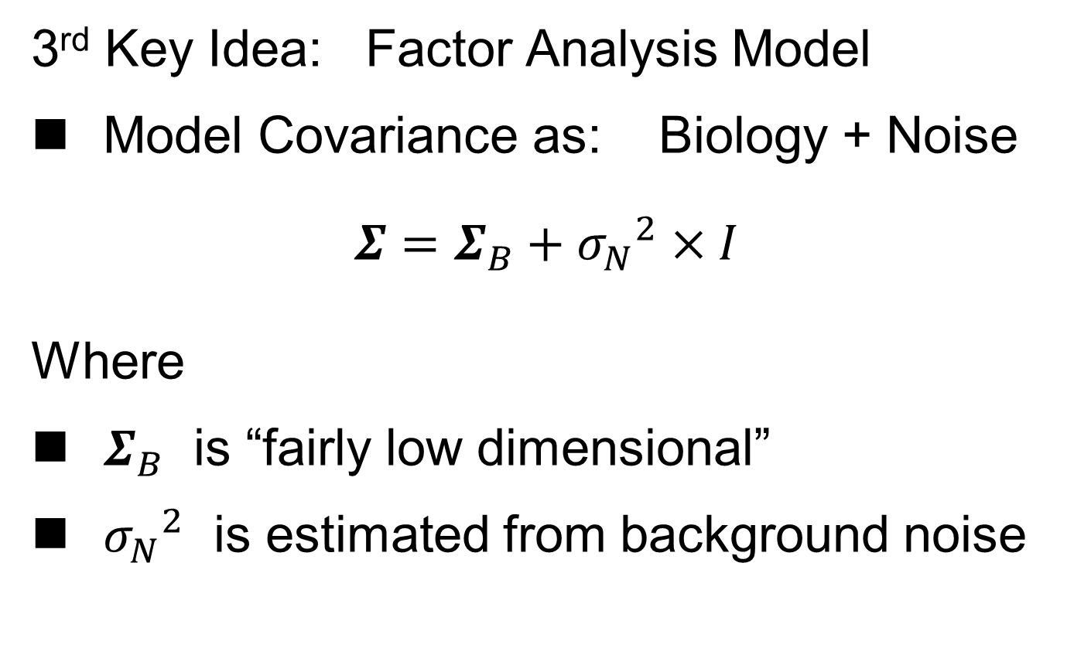
Last Class: SigClust Null
3rd Key Idea: Factor Analysis Model
Model Covariance as: Biology + Noise
$$Σ=Σ_{B}+{σ_{N}}^{2}×I$$
Where
$Σ_{B}$ is “fairly low dimensional”
${σ_{N}}^{2}$ is estimated from background noise

Slide 14
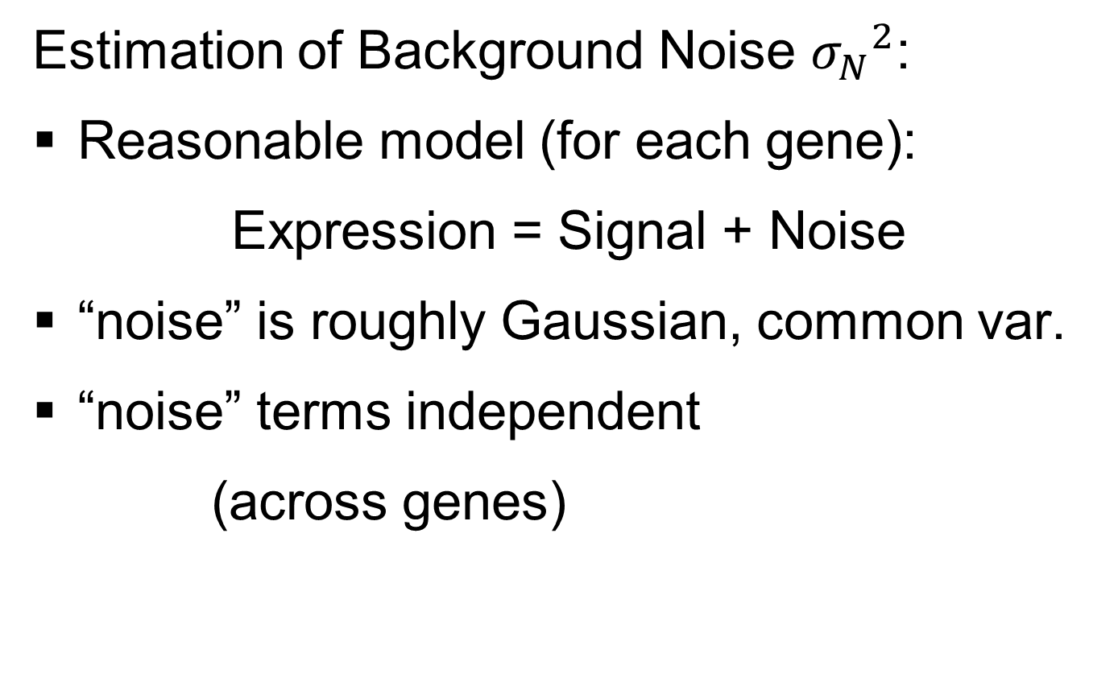
Last Class: SigClust Null
Estimation of Background Noise ${σ_{N}}^{2}$:
Reasonable model (for each gene):
Expression = Signal + Noise
“noise” is roughly Gaussian, common var.
“noise” terms independent
(across genes)

Slide 15
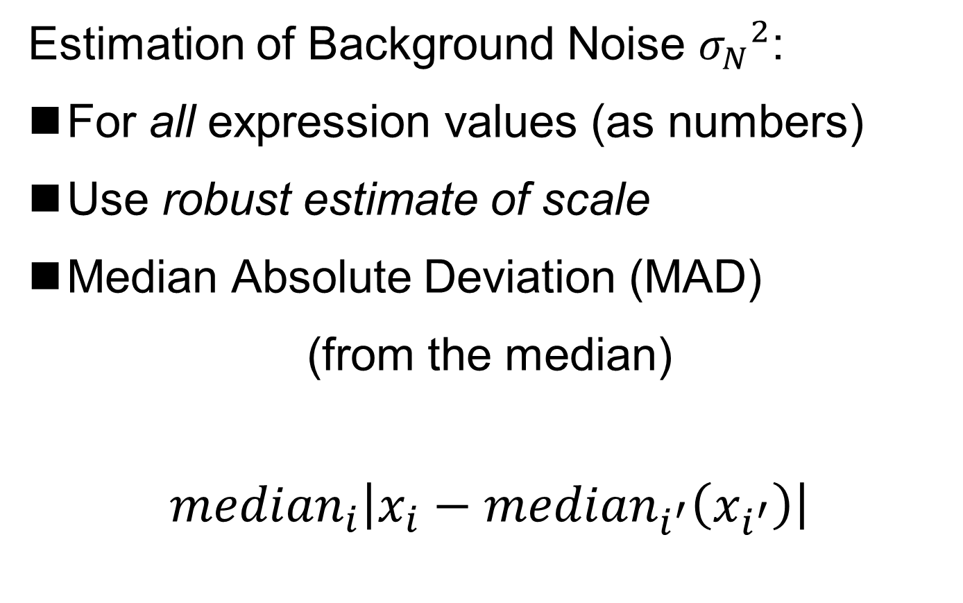
Last Class: SigClust Null
Estimation of Background Noise ${σ_{N}}^{2}$:
For all expression values (as numbers)
Use robust estimate of scale
Median Absolute Deviation (MAD)
(from the median)
$${median}_{i}\left|x_{i}−{median}_{i^{′}}\left(x_{i^{′}}\right)\right|$$

Slide 16
Last Class: SigClust Null
Estimation of Background Noise ${σ_{N}}^{2}$:
For all expression values (as numbers)
Use robust estimate of scale
Median Absolute Deviation (MAD)
(from the median)
Rescale to put on same scale as s. d.:
$$\hat{σ}=\frac{{MAD}_{data}}{{MAD}_{N\left(0,1\right)}}$$

Slide 17
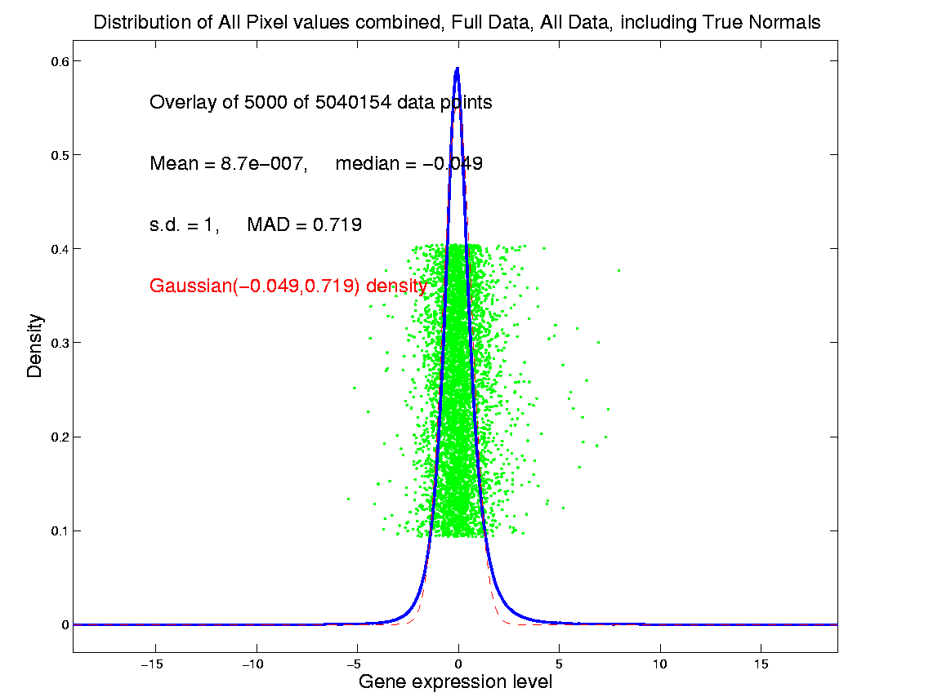
SigClust Estimation of Background Noise
n = 533, d = 9456

Slide 18
SigClust Estimation of Background Noise
Hope: Most
Entries are
“Pure Noise,
(Gaussian)”

Slide 19
SigClust Estimation of Background Noise
Hope: Most
Entries are
“Pure Noise,
(Gaussian)”
A Few (<< ¼)
Are Biological
Signal –
Outliers

Slide 20
SigClust Estimation of Background Noise
Hope: Most
Entries are
“Pure Noise,
(Gaussian)”
A Few (<< ¼)
Are Biological
Signal –
Outliers
How to Check?

Slide 21
SigClust Estimation of Background Noise
Overall distribution has strong kurtosis
Shown by height of kde relative to
MAD based Gaussian fit
Mean and Median both ~ 0
SD ~ 1, driven by few large values
MAD ~ 0.7, driven by bulk of data

Slide 22
SigClust Estimation of Background Noise
Central part of distribution
“seems to look Gaussian”
But density does not provide
great diagnosis of Gaussianity
Better to look at Q-Q plot
Not Done in Detail This Semester

Slide 23
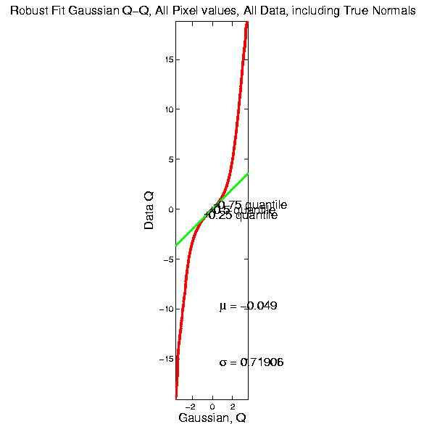
SigClust Estimation of Background Noise

Slide 24
SigClust Estimation of Background Noise
Distribution clearly not Gaussian
Except near the middle
Q-Q curve is very linear there
(closely follows 45º line)
Suggests Gaussian approx. is good there
And that MAD scale estimate is good
(Always a good idea to do such diagnostics)

Slide 25
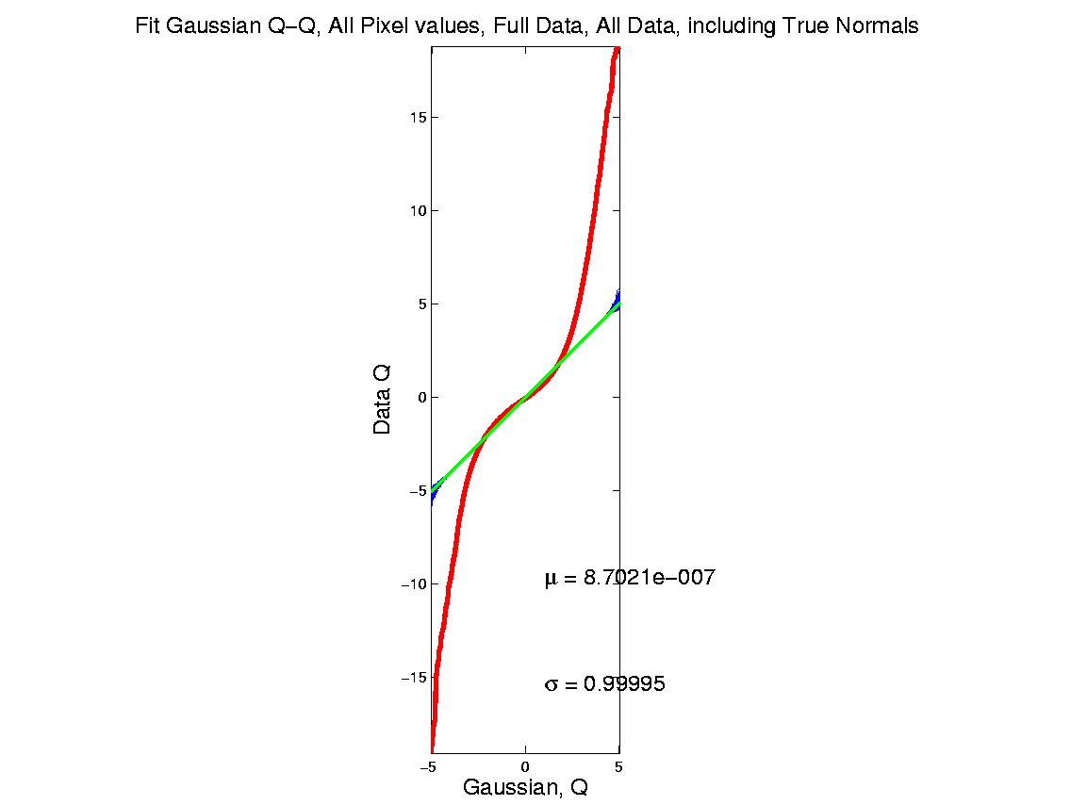
SigClust Estimation of Background Noise
Now Check Effect of
Using SD, not MAD

Slide 26
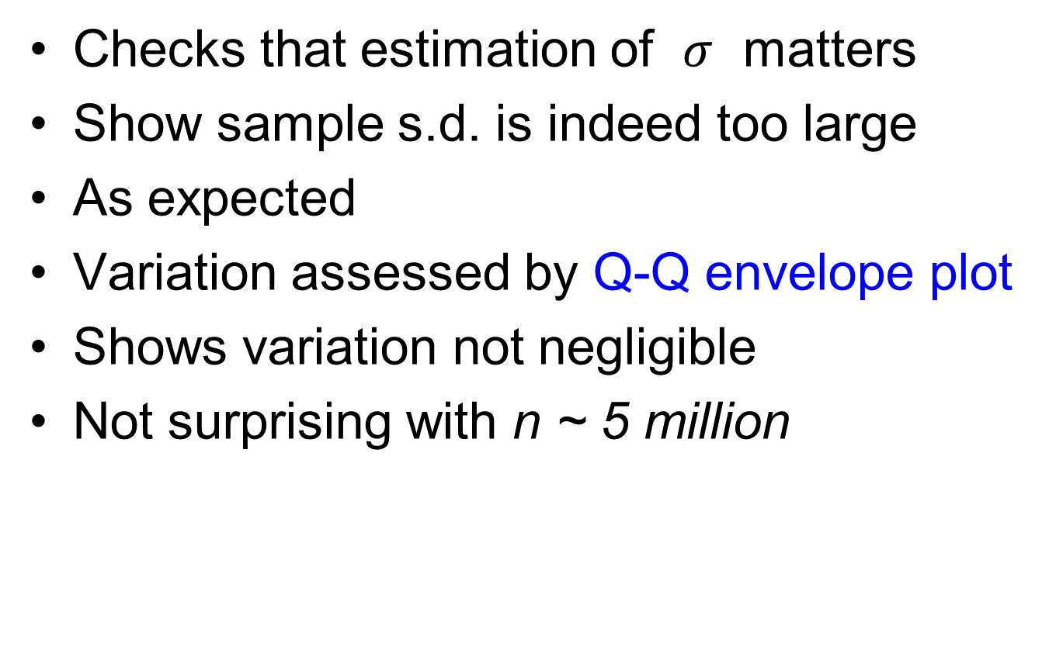
SigClust Estimation of Background Noise
Checks that estimation of $σ$ matters
Show sample s.d. is indeed too large
As expected
Variation assessed by Q-Q envelope plot
Shows variation not negligible
Not surprising with n ~ 5 million

Slide 27
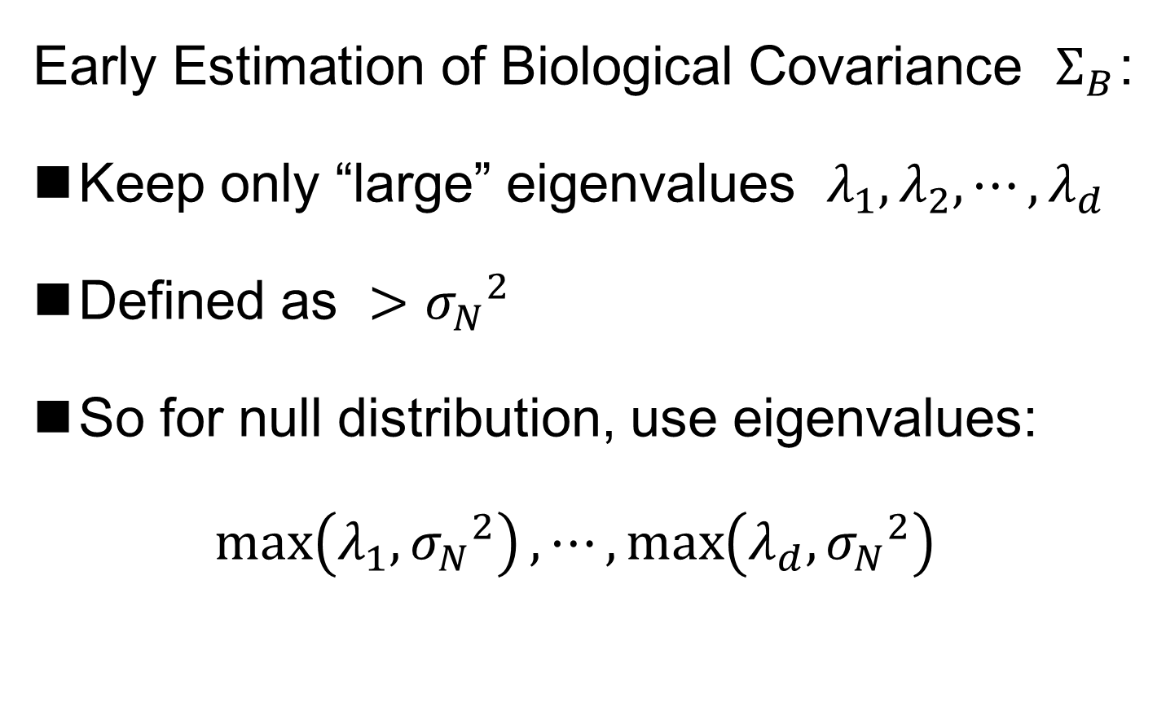
SigClust Gaussian null distribut’n
Early Estimation of Biological Covariance $Σ_{B}$:
Keep only “large” eigenvalues $λ_{1},λ_{2},⋯,λ_{d}$
Defined as $>{σ_{N}}^{2}$
So for null distribution, use eigenvalues:
$$\max_{}\left(λ_{1},{σ_{N}}^{2}\right),⋯,\max_{}\left(λ_{d},{σ_{N}}^{2}\right)$$

Slide 28
SigClust Gaussian null distribut’n
Improved Eigenvalue Estimation:
Soft Thresholding
Huang et al (2014)

Slide 29
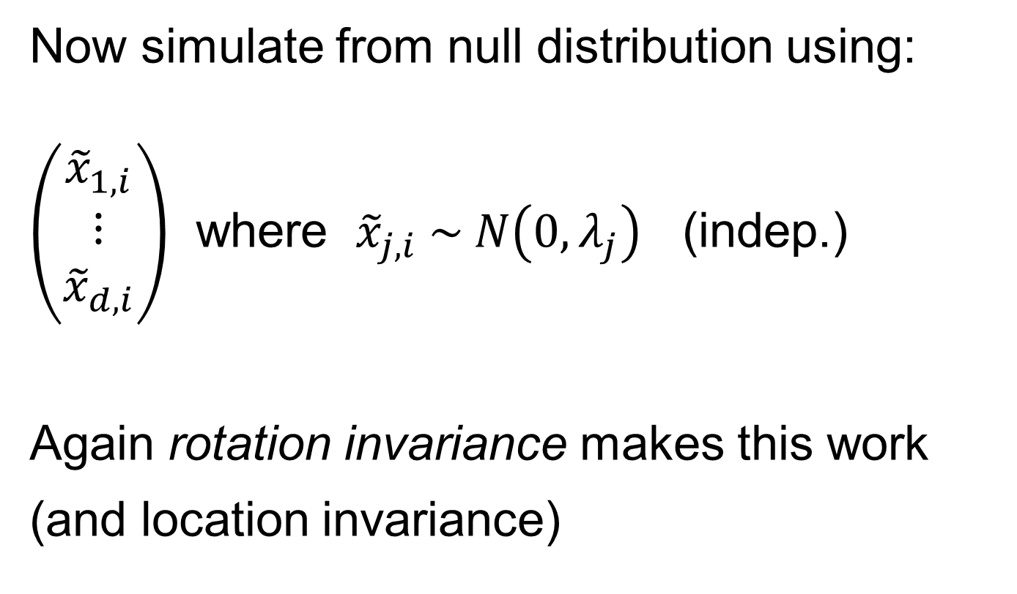
SigClust Gaussian null distribution - Simulation
Now simulate from null distribution using:
$\left(\begin{matrix}{\tilde{x}}_{1,i} \\ ⋮ \\ {\tilde{x}}_{d,i}\end{matrix}\right)$ where ${\tilde{x}}_{j,i} \sim N\left(0,λ_{j}\right)$ (indep.)
Again rotation invariance makes this work
(and location invariance)

Slide 30
SigClust Gaussian null distribution - Simulation
Then compare data CI,
With simulated null population CIs
Spirit similar to DiProPerm
But now significance happens for
smaller values of CI

Slide 31
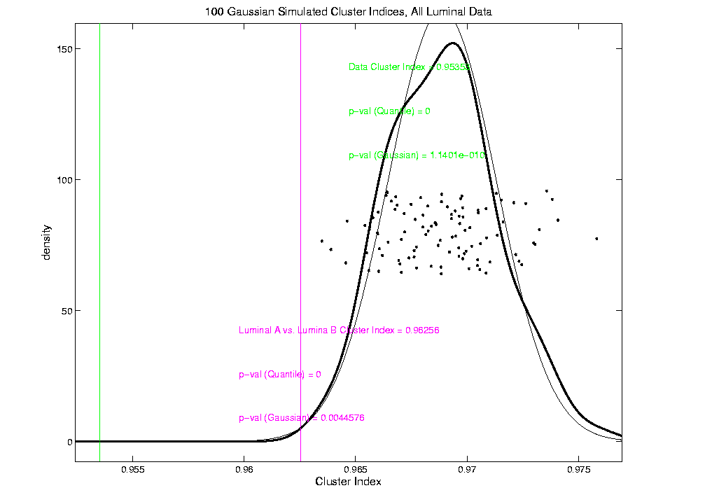
An example (details to follow)
P-val = 0.0045

Slide 32
SigClust Modalities
Two major modes:
Test significance of given clusterings
(e.g. for those found in heat map)
(Use given class labels)
Test if known cluster can be further split
(Use 2-means class labels)

Slide 33
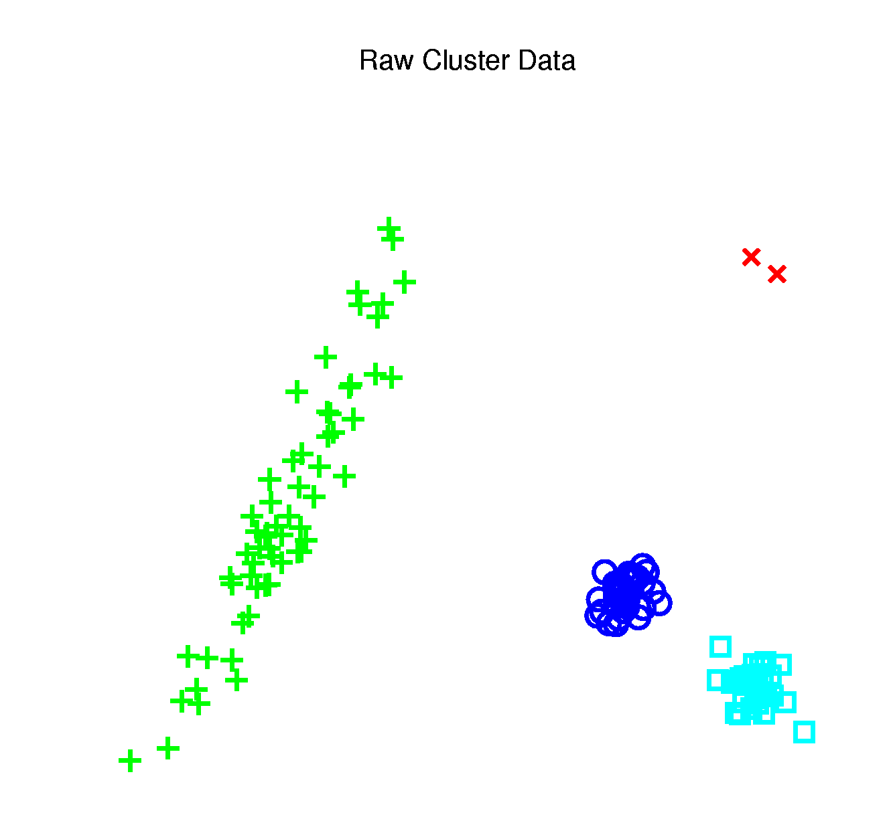
SigClust Examples
Illustrate Using Earlier 4 Cluster Toy Data
Test if known cluster can be further split
First Investigate
Two Round Clusters

Slide 34
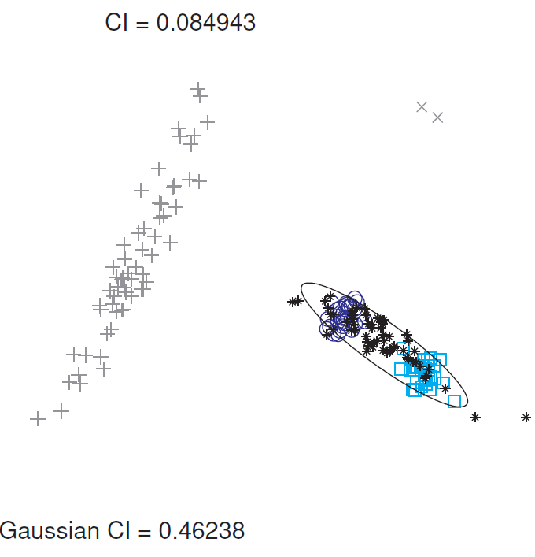
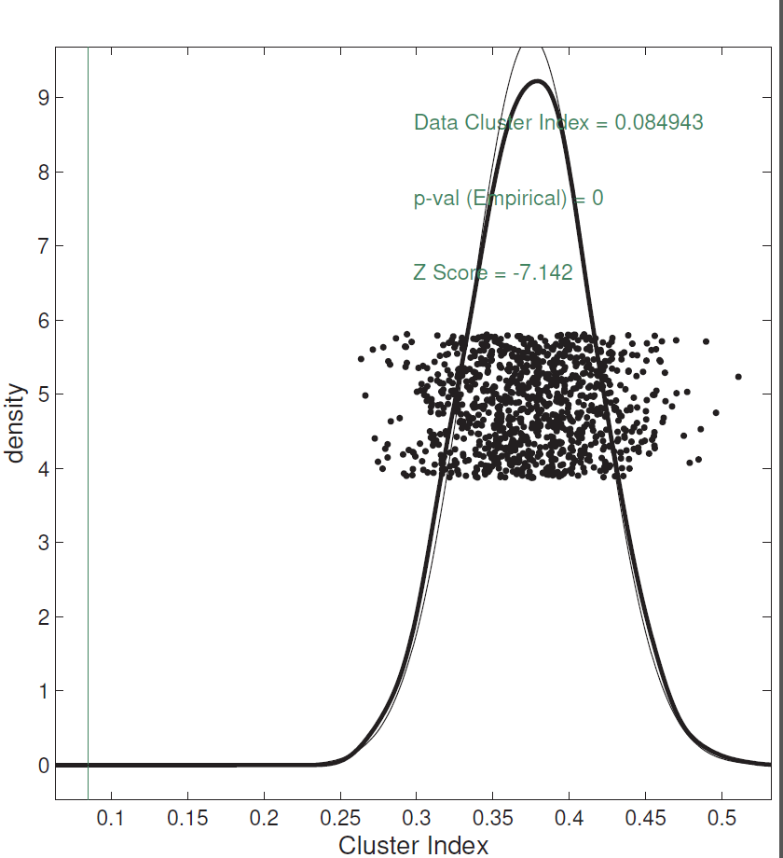
SigClust Examples
Investigate Two Round Clusters
= Actual Data CI
Gray Out
(Ignore)
Others
Compare for Significance
Fit Gaussian to Data
Conclude Clusters
Strongly Significant
Simulate from Gaussian
Record in Diagnostic Plot

Slide 35
SigClust Examples
Illustrate Using Earlier 4 Cluster Toy Data
Second Try To Split
Long Green Cluster

Slide 36
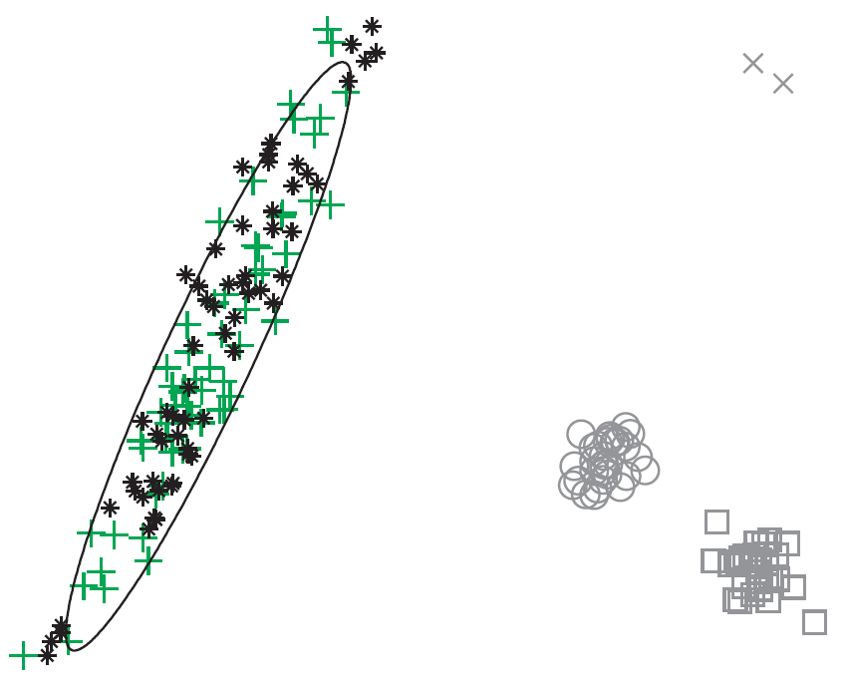
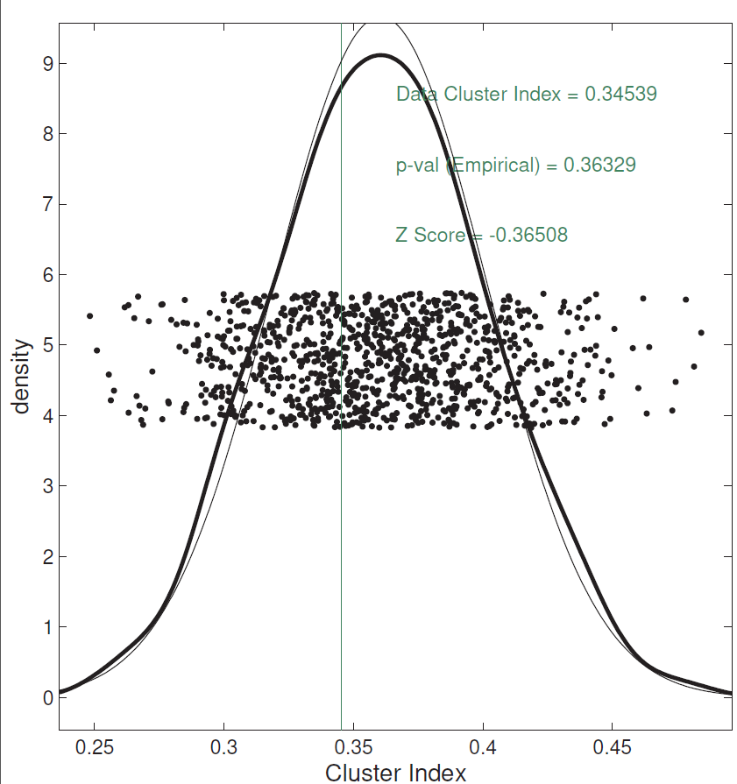
SigClust Examples
Try to Split Long Green Cluster
Can NOT Conclude
Two Clusters,
Accept Gaussian Null

Slide 37
SigClust Examples
Illustrate Using Earlier 4 Cluster Toy Data
Are Outliers A
Separate Cluster?

Slide 38
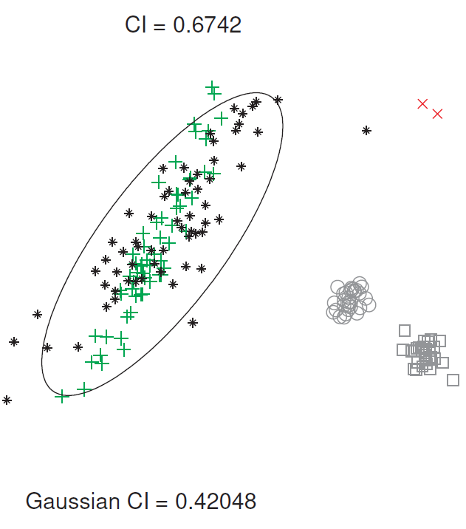
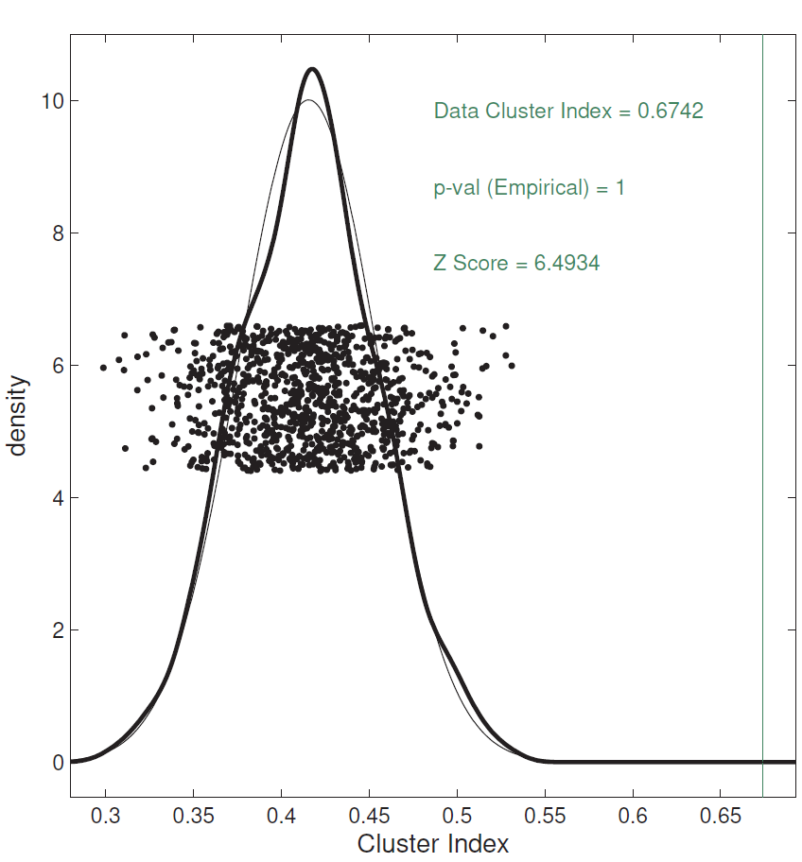
SigClust Examples
Are Outliers A Separate Cluster?
Note: No Conclusion Available
Since Random Labels → CI ≈ 1
Real CI on right side!?!
Artifact of Severe
Imbalance
Approach to Unbalanced
SigClust: Tom Keefe

Slide 39
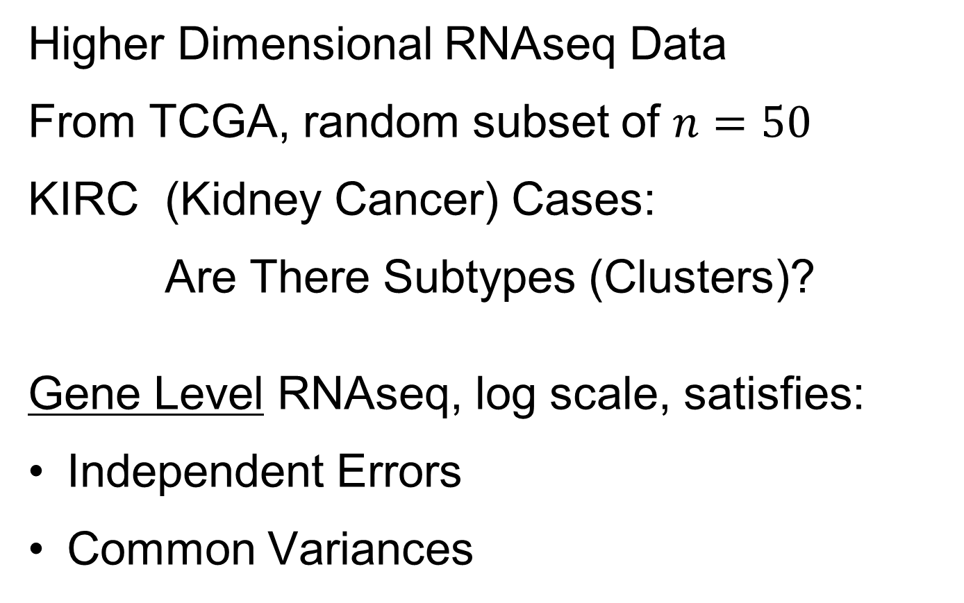
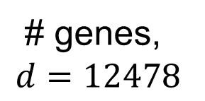
SigClust Examples
Higher Dimensional RNAseq Data
From TCGA, random subset of $n=50$
KIRC (Kidney Cancer) Cases:
Are There Subtypes (Clusters)?
Gene Level RNAseq, log scale, satisfies:
Independent Errors
Common Variances
# genes,
$$d=12478$$

Slide 40
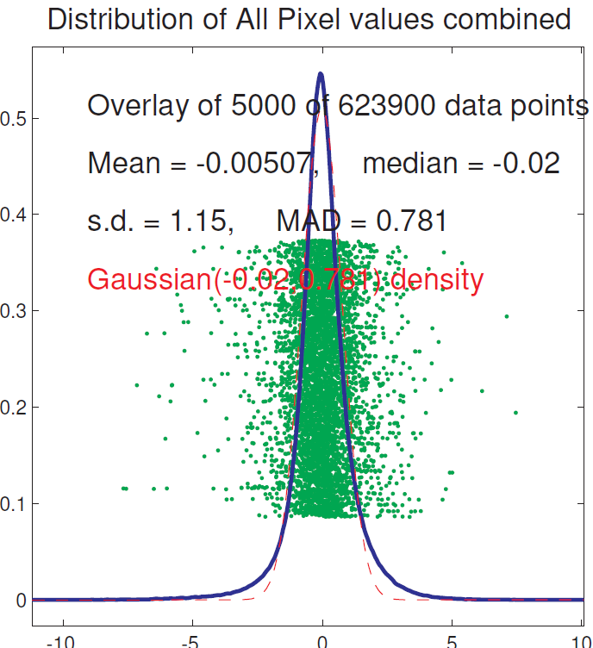
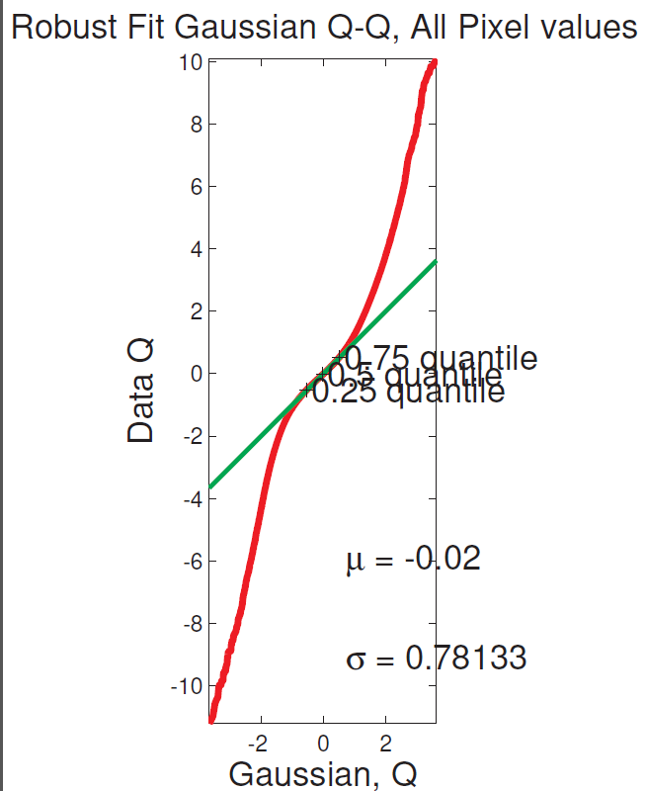
SigClust Examples
Split KIRC Cases? Diagnostic Plots

Slide 41
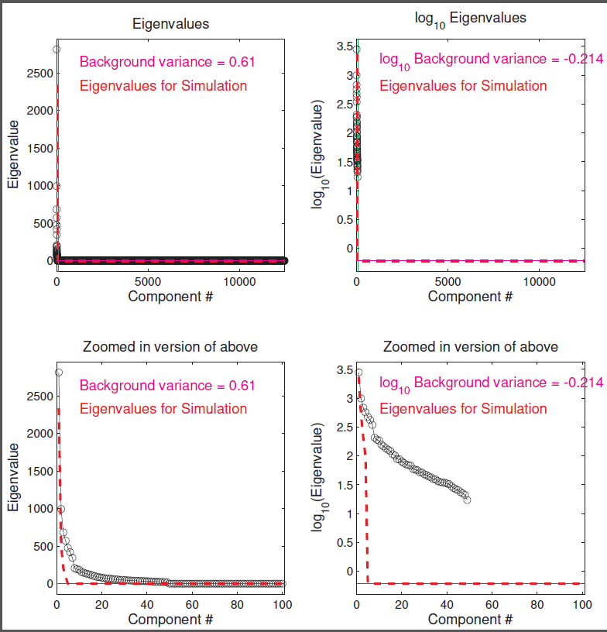
SigClust Examples
Split KIRC Cases? Check Soft Threshold

Slide 42
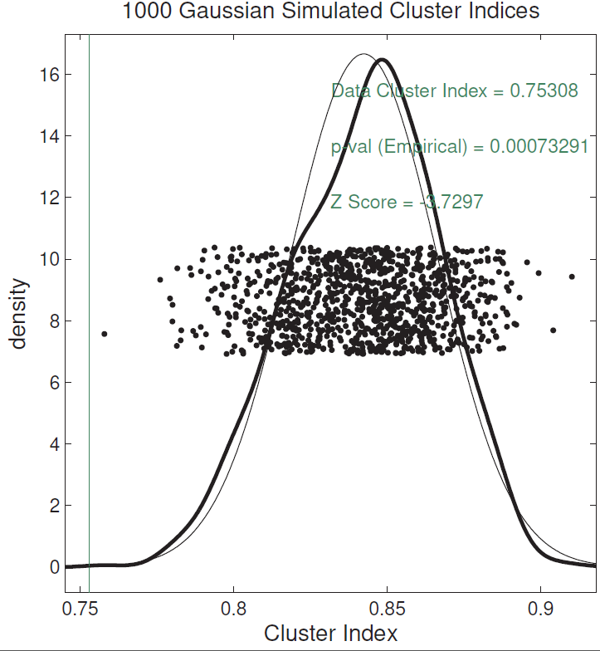
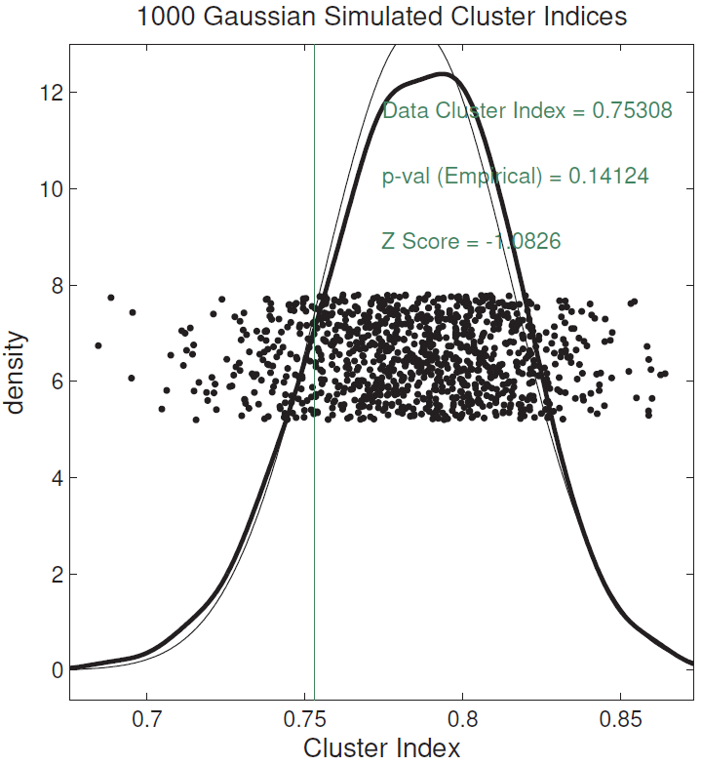
SigClust Examples
Split KIRC Cases?
Yes, using Soft
Thresholded Cov. Est.
No, Using Sample Cov. Est.
Too Conservative

Slide 43
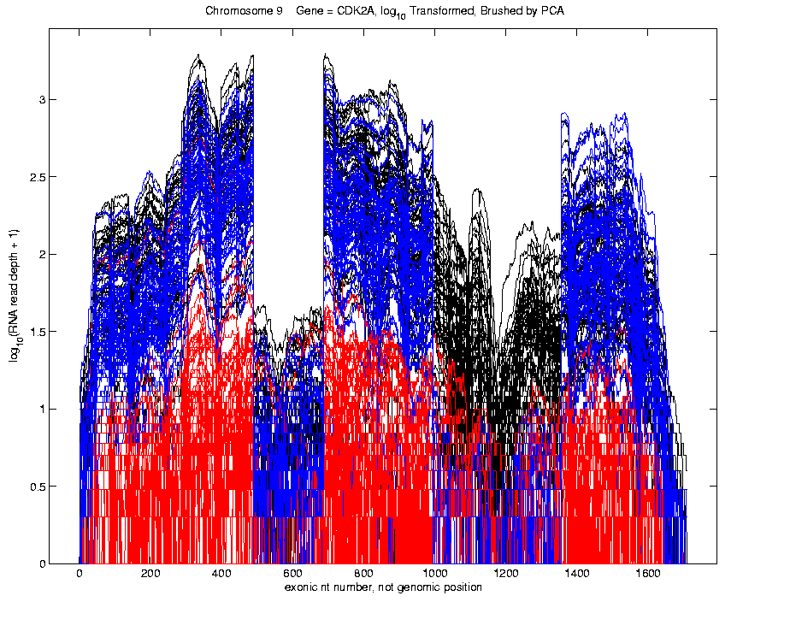
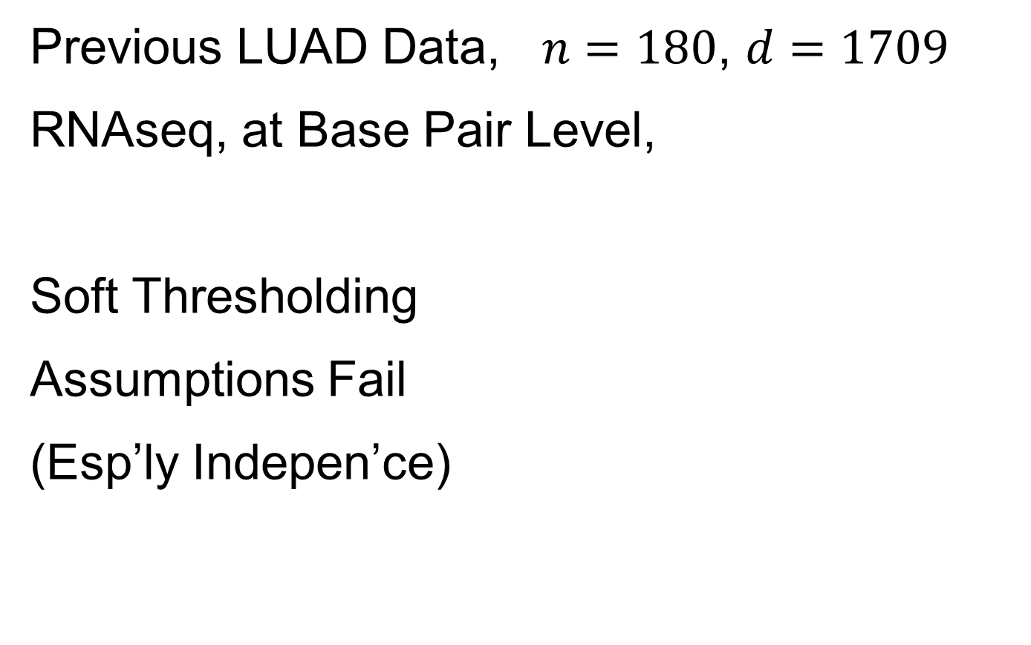
SigClust Examples
Previous LUAD Data, $n=180$, $d=1709$
RNAseq, at Base Pair Level,
Soft Thresholding
Assumptions Fail
(Esp’ly Indepen’ce)

Slide 44
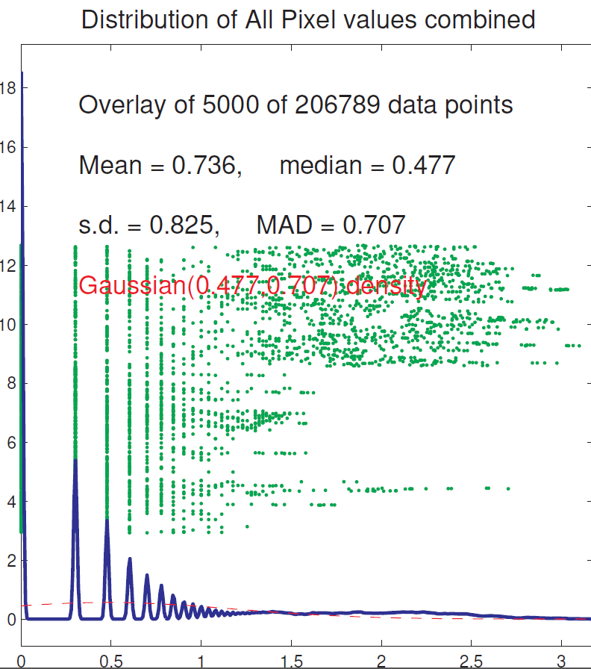
SigClust Examples
Previous LUAD Data, Diagnostic
Far From
Few Large Pixels
& Gaussian
Background Noise
Use Sample Cov. Est.
Not Soft Threshold

Slide 45
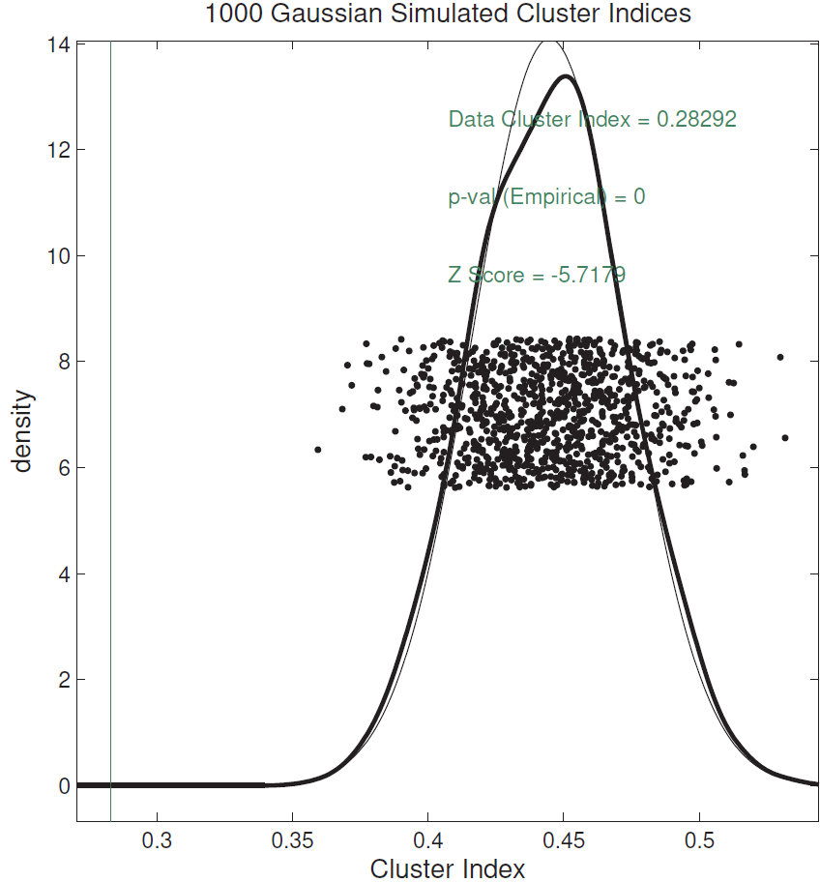
SigClust Examples
Previous LUAD Data, Conclusion
Can Split LUAD
Strong Evidence
For Clusters
(Recall Seen in PCA)

Slide 46
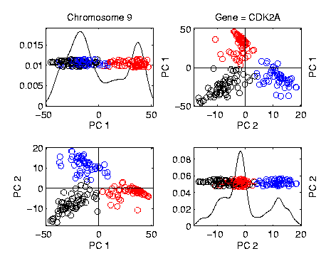
SigClust Examples
Previous LUAD Data, Conclusion
Can Split LUAD
Strong Evidence
For Clusters
(Recall Seen in PCA)

Slide 47
SigClust Extension
Adaptation to Hierarchical Clustering
Kimes et al. (2017)

Slide 48
Mass Flux Data
Illustrates Clustering by Visualization
Data from Enrica Bellone,
National Center for Atmospheric Research
Mass Flux for quantifying cloud types
How does mass change when moving into a cloud
Text, Sec. 12.3

Slide 49
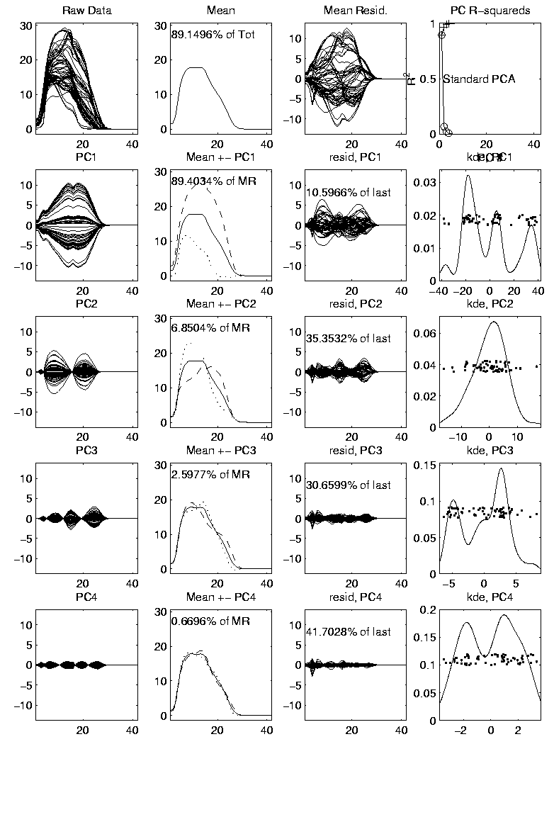

Mass Flux Data
Mean Captures
Mountain Shape
PCA of Mass Flux Data:
PC1 is
Height
Variation
Impression
Enhanced
By Smooth
Histogram
Are Clusters “Really There”?
Shows Up Well
In Mean $±$ Panel
Discovery?
Noise Artifact?
Scores
Suggest
3 Clusters

Slide 50


Mass Flux Data
PCA of Mass Flux Data:
PC3
Shows
Width
Adjustment
Nonlinear Modes of Variation?
PC2 is
Location
Of Peak
Again
Best In
Mean $±$
Panel
Fisher Rao Analysis?
Shows Up Best
In Mean $±$ Panel

Slide 51
Mass Flux Data
Return to Investigation of PC1 Clusters:
Can see 3 bumps in smooth histogram
Main Question:
Important structure
or
sampling variability?
Approach: SiZer
(SIgnificance of ZERo crossings of deriv.)

Slide 52
Statistical Smoothing
In 1 Dimension
(Numbers as Data Objects)

Slide 53
Statistical Smoothing
In 1 Dimension, 2 Major Settings:
Density Estimation
“Histograms”
Nonparametric Regression
“Scatterplot Smoothing”

Slide 54
Density Estimation
E.g. Hidalgo Stamp Data
Thicknesses of Postage Stamps
Produced in Mexico
Over ~ 70 years
During 1800s
Paper produced in several factories?
How many factories? (Records lost)
Brought to statistical literature by:
Izenman and Sommer (1988)

Slide 55
Density Estimation
E.g. Hidalgo Stamp Data
Thicknesses of Postage Stamps
Produced in Mexico
Over ~ 70 years
During 1800s
Paper produced in several factories?
(Thicknesses vary by up to factor of 2)

Slide 56
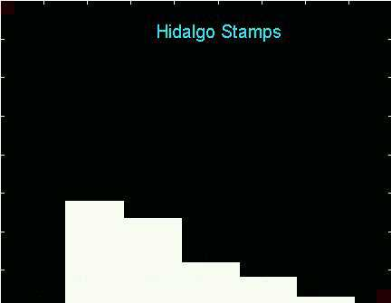
Density Estimation
E.g. Hidalgo Stamp Data
A histogram
“Oversmoothed”
Bin Width too
large?
Miss important
structure?
Hard to Say Much
About # of Factories

Slide 57
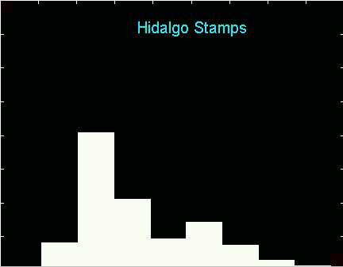
Density Estimation
E.g. Hidalgo Stamp Data
Another histogram
Smaller binwidth
Suggests 2 modes?
2 factories making
the paper?

Slide 58
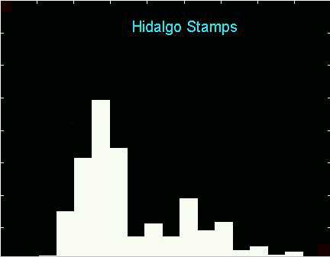
Density Estimation
E.g. Hidalgo Stamp Data
Another histogram
Smaller binwidth
Suggests 6 modes?
6 factories making
the paper?

Slide 59
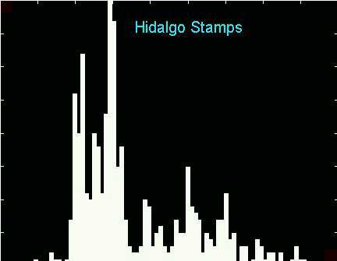
Density Estimation
E.g. Hidalgo Stamp Data
Another histogram
Even smaller binwidth
Suggests many modes?
Really believe
modes are “there”?
Or just sampling
variation?

Slide 60
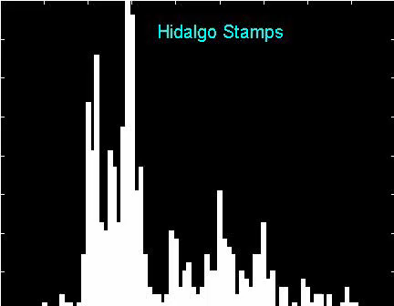
Density Estimation
E.g. Hidalgo Stamp Data
Critical Issue for histograms:
Choice of binwidth (well understood?)

Slide 61
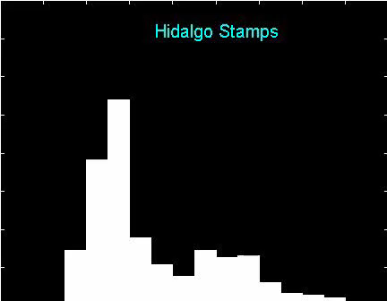
Histograms
Less Well Understood Issue:
Choice of bin location
Major impact on number of modes (2-7)
All for same binwidth

Slide 62
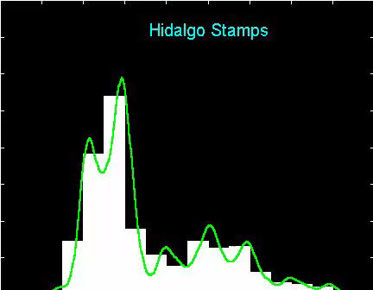
Histograms
Choice of bin location:
What is going on?
Compare with Average Histogram

Slide 63
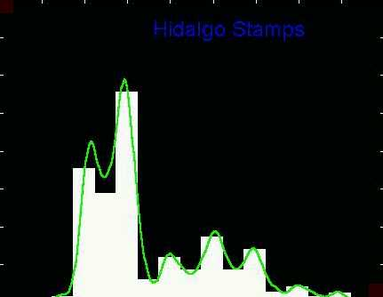
Density Estimation
Compare shifts with Average Histogram
For 7 mode shift
Peaks line up with bin centers
So shifted histo’s
find peaks

Slide 64
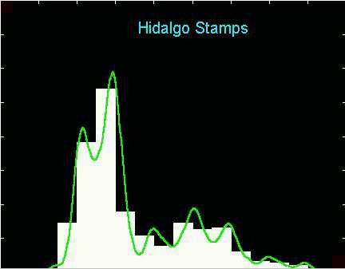
Density Estimation
Compare shifts with Average Histogram
For 2 (3?) mode shift
Peaks split between bins
So shifted histo’s
miss peaks
This Is Why Histograms
Were Not Used in Many
Displays of 1-d Dist’ns,
Earlier in Course

Slide 65
Density Estimation
Histogram Drawbacks:
Need to choose bin width
Need to choose bin location
But Average Histogram reveals structure
So should use that, instead of histo
Name: Kernel Density Estimate

Slide 66
Kernel Density Estimation
Chondrite Data:
Stony (metal) Meteorites (hit the earth)
So have a chunk of rock
Study “% of silica”
From how many sources?
Only 22 rocks…
Histogram hopeless?
Brought to statistical literature by:
Good and Gaskins (1980)

Slide 67
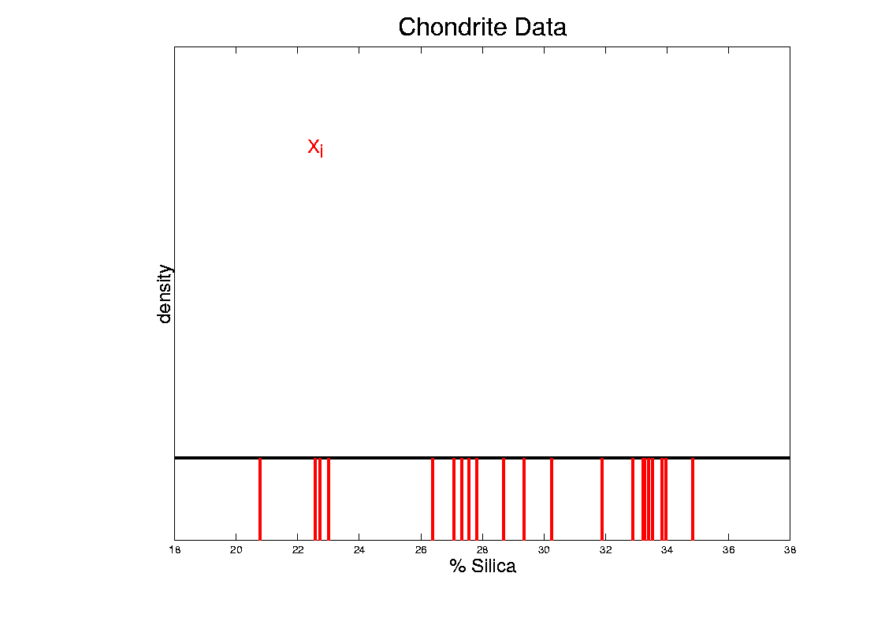
Kernel Density Estimation
Chondrite Data:
Represent points by red bars
Where are data “more dense”?

Slide 68
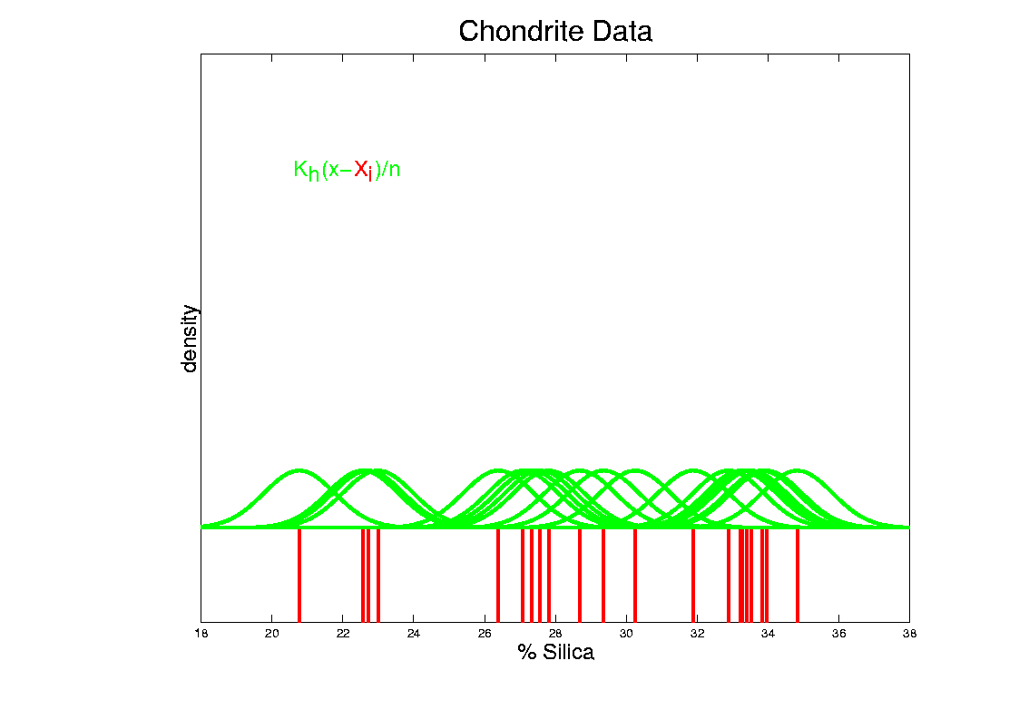
Kernel Density Estimation
Chondrite Data:
Put probability mass 1/n at each point
Smooth piece of “density”

Slide 69

Kernel Density Estimation
Chondrite Data:
Sum pieces to estimate density
Suggests 3 modes (rock sources)

Slide 70

Kernel Density Estimation
Mathematical Notation:
$${\hat{f}}_{h}\left(x\right)=\frac{1}{n}\sum_{i=1}^{n}{K_{h}\left(x−{\tilde{x}}_{i}\right)}$$
Where
Window shape given by “kernel”,
$$K_{h}\left(∙\right)=\frac{1}{h}K\left(\frac{∙}{h}\right)$$
Window width given by “bandwidth”, $h$

Slide 71

Kernel Density Estimation
Mathematical Notation:
$${\hat{f}}_{h}\left(x\right)=\frac{1}{n}\sum_{i=1}^{n}{K_{h}\left(x−{\tilde{x}}_{i}\right)}$$
This
Was
Used
In PCA
Graphics

Slide 72


Kernel Density Estimation
Recall Subdensities For Different Groups
Black Curves
have Area = 1
Colored Curves
have Area = $\frac{n_{k}}{n}$
Use Same Window
Width, So They Sum

Slide 73
Kernel Density Estimation
Choice of kernel (window shape)?
Controversial issue
Want Computational Speed?
Want Statistical Efficiency?
Want Smooth Estimates?
There is more, but personal choice:
Gaussian
Good Overall Reference:
Wand and Jones (1994)
Looks the Best,
Minimal Distracting
Small Scale Noise

Slide 74

Kernel Density Estimation
Choice of bandwidth (window width)?
Very important to performance
Fundamental Issue:
Which modes are “really there”?

Slide 75
Density Estimation
How to use histograms if you must:
Undersmooth (minimizes bin edge effect)
Human eye is OK at “post-smoothing”

Slide 76
Statistical Smoothing
2 Major Settings:
Density Estimation
“Histograms”
Nonparametric Regression
“Scatterplot Smoothing”

Slide 77

Scatterplot Smoothing
E.g. Bralower Fossil Data
Prof. of Geosciences
Penn. State Univ.

Slide 78
Scatterplot Smoothing
E.g. Bralower Fossil Data
Study Global Climate
Time scale of millions of years
Data points are fossil shells
Dated by surrounding material
Ratio of Isotopes of Strontium
Surrogate for Sea Level (Ice Ages)

Slide 79

Scatterplot Smoothing
E.g. Bralower Fossil Data
Differences in 4th
Decimal Place!
No Parametric (e.g. Linear) Model
~50 m
Sea
Level
Diff.
Yet Clear
Systematic
Structure
Humans on Earth ~1mil. Years

Slide 80
Scatterplot Smoothing
E.g. Bralower Fossil Data
Way to bring out structure:
Smooth the data
Methods of smoothing?
Local Averages
Splines (several types)
Fourier – trim high frequencies
Other bases
…
Also controversial

Slide 81
Scatterplot Smoothing
E.g. Bralower Fossil Data – some smooths

Slide 82

Scatterplot Smoothing
A simple approach: local averages
Given data: $\left({\tilde{x}}_{1},{\tilde{y}}_{1}\right),⋯,\left({\tilde{x}}_{n},{\tilde{y}}_{n}\right)$
Model in regression form:
$$E\left({\tilde{y}}_{i}|{\tilde{x}}_{i}\right)=m\left({\tilde{x}}_{i}\right), i=1,⋯,n$$
How to estimate $m\left(x\right)$?

Slide 83


Scatterplot Smoothing
A simple approach: local averages
Given a kernel window function:
$$K_{h}\left(x\right)=\frac{1}{h}K\left(\frac{x}{h}\right)$$
Estimate the curve $m\left(x\right)$
by a $K_{h}$ weighted local average:
$${\hat{m}}_{h}\left(x\right)=\frac{\sum_{i=1}^{n}{K_{h}\left(x−{\tilde{x}}_{i}\right){\tilde{y}}_{i}}}{\sum_{i=1}^{n}{K_{h}\left(x−{\tilde{x}}_{i}\right)}}$$
Same Form As
Kernel Density
Width Controlled
By Bandwidth $h$
Makes
Weights
Sum to 1

Slide 84

Scatterplot Smoothing
Interesting representation of local average:
Given kernel window weights,
$$K_{h}\left(x\right)=\frac{1}{h}K\left(\frac{x}{h}\right)$$
Local Constant Least Squares Fit to Data:
$${\hat{m}}_{h}\left(x\right)={argmin}_{a}\sum_{i=1}^{n}{K_{h}\left(x−{\tilde{x}}_{i}\right){\left({\tilde{y}}_{i}−a\right)}^{2}}$$
Kernel Weighted Fréchet Mean

Slide 85


Scatterplot Smoothing
Local Constant Fits (visually):
“Moving Average”
Window width $h$ is critical (~ k.d.e.)
Goldilocks
Smoothing
Levels
Too Small
About Right
Too Big
Recommended
For Manual
Window Choice
Graphics Relevant to Smoothing Theory
Thanks to
Brad Davis

Slide 86

Scatterplot Smoothing
Interesting variation:
Local linear fit to data:
Given kernel window weights, $K_{h}\left(x\right)=\frac{1}{h}K\left(\frac{x}{h}\right)$
$${\hat{m}}_{h}\left(x\right)={argmin}_{a}\sum_{i=1}^{n}{K_{h}\left(x−{\tilde{x}}_{i}\right){\left({\tilde{y}}_{i}−\left(b{\tilde{x}}_{i}+a\right)\right)}^{2}}$$
Only Keep
Intercept
Kernel Weighted Least Squares Fit
Local Linear Value Added?

Slide 87



Scatterplot Smoothing
Local Linear Fits (visually):
“Intercept of Moving Fit Line”
Window width $h$ is critical (~ k.d.e.)
Main Difference at Boundary
And for Not Equally Spaced $x_{i}$

Slide 88


Scatterplot Smoothing
Another variation:
“Intercept of Moving Polynomial Fit”
Window width $h$ is critical (~ k.d.e.)
Higher Degree Gives More Flexible Fit

Slide 89
Scatterplot Smoothing
Local Polynomial Smoothing
What is best polynomial degree?
Once again controversial…
Advocates for all of 0, 1, 2, 3.
Depends on personal weighting of factors involved
Good reference:
Fan & Gijbels (1995)
Personal choice: degree 1, local linear

Slide 90
Scatterplot Smoothing
E.g. Bralower Fossils – local linear smooths
Goldilocks Smoothing
Parameter Selection
Undersmoothed, Feels Sampling Variation
Oversmoothed,
Misses Important
Structure
Is This Valley Real?
About Right? Seems Good Balance?
Nicely Follows
Deep Valley

Slide 91
Scatterplot Smoothing
Smooths of Bralower Fossil Data:
Oversmoothed misses structure
Undersmoothed feels sampling noise?
About right shows 2 valleys:
One seems clear
Is other one really there?
Same question as above…
Needs “Statistical Inference”,
i.e. Confirmatory Analysis

Slide 92
Kernel Density Estimation
Choice of bandwidth (window width)?
Very important to performance
Fundamental Issue:
Which modes are “really there”?

Slide 93
Kernel Density Estimation
Choice of bandwidth (window width)?
Very important to performance
Data Based Choice?
Controversial Issue
Many recommendations
Suggested Reference:
Jones, Marron & Sheather (1996)
Never a consensus…

Slide 94
Kernel Density Estimation
Choice of bandwidth (window width)?
Alternate Choice:
Consider all of them!
I.e. look at whole spectrum of smooths
Can see different structure
At different smoothing levels
Connection to Scale Space
E.g. Stamps data
How many modes?
All answers are there….

Slide 95


Kernel Density Estimation
Rainbow Color
Scheme on $\log_{10}h$
1 Mode
2 Modes
5 Modes
7 Modes
More …

Slide 96
Statistical Smoothing
Fundamental Question
For both of
Density Estimation: “Histograms”
Regression: “Scatterplot Smoothing”
Which bumps are “really there”?
vs. “artifacts of sampling noise”?

Slide 97
SiZer Background
Scale Space – Idea from Computer Vision
Goal: Teach Computers to “See”
Modern Research:
Extract “Information” from Images
Early Theoretical work

Slide 98
SiZer Background
Scale Space – Idea from Computer Vision
Conceptual basis:
Oversmoothing = “view from afar”
(macroscopic)
Undersmoothing = “zoomed in view”
(microscopic)
Main idea: all smooths contain useful information, so study “full spectrum”
(i. e. all smoothing levels)
Recommended reference: Lindeberg (1994)

Slide 99

SiZer Background
Fun Scale Space Views
(of Family Incomes Data)

Slide 100

SiZer Background
Fun Scale Space Views (Incomes Data)
Spectrum Overlay

Slide 101

SiZer Background
Fun Scale Space Views (Incomes Data)
Surface View

Slide 102
SiZer Background
Fun Scale Space Views
(of Family Incomes Data)
Note:
The scale space viewpoint makes
Data Dased Bandwidth Selection
Much less important
(than I once thought….)

Slide 103
SiZer Background
SiZer:
Significance of Zero crossings, of the derivative, in scale space
Combines:
needed statistical inference
novel visualization
To get: a powerful exploratory + confirmatory data analysis method
Main references:
Chaudhuri & Marron (1999)
Hannig & Marron (2006)

Slide 104
SiZer Background
Basic idea: a bump is characterized by:
an increase
followed by a decrease
Generalization:
Many features of interest captured
by sign of the slope of the smooth
Foundation of SiZer:
Statistical inference on slopes,
over scale space

Slide 105
SiZer Background
SiZer Visual presentation:
Color map over scale space:
Blue: slope significantly upwards
(derivative CI above 0)
Red: slope significantly downwards
(derivative CI below 0)
Purple: slope insignificant
(derivative CI contains 0)

Slide 106

SiZer Background
SiZer analysis of Fossils data:

Slide 107
SiZer Background
SiZer analysis of Fossils data:
Upper Left: Scatterplot, family of smooths, 1 highlighted
Upper Right: Scale space rep’n of family, with SiZer colors
Lower Left: SiZer map, more easy to view
Lower Right: SiCon map – replace slope by curvature
Slider (in movie viewer) highlights different smoothing levels

Slide 108
SiZer Background
SiZer analysis of Fossils data (cont.):
Oversmoothed (top of SiZer map):
Decreases at left, not on right
Medium smoothed (middle of SiZer map):
Main valley significant, and left most increase
Smaller valley not statistically significant
Undersmoothed (bottom of SiZer map):
“noise wiggles” not significant
Additional SiZer color: gray - not enough data for inference

Slide 109
SiZer Background
SiZer analysis of Fossils data (cont.):
Common Question: Which is right?
Decreases on left, then flat
(top of SiZer map)
Up, then down, then up again
(middle of SiZer map)
No significant features
(bottom of SiZer map)
Answer: All are right
Just different scales of view,
i.e. levels of resolution of data

Slide 110

SiZer Background
SiZer analysis of British Incomes data:

Slide 111
SiZer Background
SiZer analysis of British Incomes data:
Oversmoothed: Only one mode
Medium smoothed: Two modes, statistically significant
Confirmed by Schmitz & Marron, (1992)
Undersmoothed: many noise wiggles, not significant
Again: all are correct,
just different scales

Slide 112


SiZer Background
E.g. - Marron & Wand (1992) Trimodal #9
Increasing $n$
Only 1 Signif’t Mode
Now 2 Signif’t Modes
Finally all 3 Modes

Slide 113


SiZer Background
E.g. - Marron & Wand Discrete Comb #15
Increasing $n$
Coarse Bumps Only
Now Fine bumps too
Someday: “draw” local
Bandwidth on SiZer map

Slide 114

SiZer Background
Finance "tick data":
(time, price) of single stock transactions
Idea: "on line" version of SiZer
for viewing and understanding trends

Slide 115
SiZer Background
Finance "tick data":
(time, price) of single stock transactions
Idea: "on line" version of SiZer
for viewing and understanding trends
Notes:
trends depend heavily on scale
double points and more
background color transition
(flop over at top)

Slide 116

SiZer Background
Internet traffic data analysis:
SiZer analysis of
time series of
packet times
at internet hub (UNC)
Hannig, Marron,
and Riedi (2001)
Notes:
116

Slide 117
SiZer Background
Internet traffic data analysis:
SiZer analysis of
time series of packet times
at internet hub (UNC)
across very wide range of scales
needs more pixels than screen allows
thus do zooming view
(zoom in over time)
zoom in to yellow bd’ry in next frame
readjust vertical axis
Notes:
117

Slide 118
SiZer Background
Internet traffic data analysis (cont.)
Insights from SiZer analysis:
Coarse scales:
amazing amount of significant structure
Evidence of self-similar fractal type process?
Fewer significant features at small scales
But they exist, so not Poisson process
Poisson approximation OK at small scale???
Smooths (top part) stable at large scales?
Notes:
118

Slide 119
Dependent SiZer
Rondonotti, Marron, and Park (2007)
SiZer compares data with white noise
Inappropriate in time series
Dependent SiZer compares data with an assumed model
Visual Goodness of Fit test
Notes:
119

Slide 120

Dep’ent SiZer : 2002 Apr 13 Sat 1 pm – 3 pm
Internet Traffic At
UNC Main Link
2 hour span
Notes:
120

Slide 121
Dep’ent SiZer : 2002 Apr 13 Sat 1 pm – 3 pm
Big Spike in Traffic
Is “Really There”
Notes:
121

Slide 122
Dep’ent SiZer : 2002 Apr 13 Sat 1 pm – 3 pm
Zoom in for
Closer Look
Notes:
122

Slide 123

Zoomed view (to red region, i.e. “flat top”)
Strange “Hole in Middle”
Is “Really There”
Notes:
123

Slide 124
Zoomed view (to red region, i.e. “flat top”)
Zoom in for
Closer Look
Notes:
124

Slide 125

Further Zoom: finds very periodic behavior!
SiZer found interesting structure, but depends on scale
Notes:
125

Slide 126
Possible Physical Explanation
IP “Port Scan”
Common device of hackers
Searching for “break in points”
Send query to every possible (within UNC domain):
IP address
Port Number
Replies can indicate system weaknesses
Internet Traffic is hard to model
Notes:
126

Slide 127
SiZer Background
Historical Note & Acknowledgements:
Scale Space: S. M. Pizer
SiZer: Probal Chaudhuri
Main References:
Chaudhuri & Marron (1999)
Chaudhuri & Marron (2000)
Hannig & Marron (2006)

Slide 128


SiZer Background
Extension to 2-d:
Significance in Scale Space
Main Challenge: Visualization
References:
Godtliebsen et al (2002, 2004, 2006)
What Is Up and Down?
Significant
Gradients
& Contours
Significant
Curvature

Slide 129
SiZer Overview
Would you like to try smoothing & SiZer?
Marron Software Website as Before
In “Smoothing” Directory:
kdeSM.m
nprSM.m
sizerSM.m
Recall: “>> help sizerSM” for usage

Slide 130
PCA to find clusters
Return to PCA of Mass Flux Data:
Big Question:
Are The
3 Clusters
Really There?
Notes:
MassFlux1d1p1.ps

Slide 131

PCA to find clusters
SiZer analysis of Mass Flux, PC1
Notes:
MassFlux1d1p1s.ps

Slide 132
PCA to find clusters
SiZer analysis of Mass Flux, PC1
All 3
Signif’t
Notes:
MassFlux1d1p1s.ps

Slide 133
PCA to find clusters
SiZer analysis of Mass Flux, PC1
Also in
Curvature
Notes:
MassFlux1d1p1s.ps

Slide 134
PCA to find clusters
SiZer analysis of Mass Flux, PC1
And in
Other
Comp’s
Notes:
MassFlux1d1p1s.ps

Slide 135
PCA to find clusters
SiZer analysis of Mass Flux, PC1
Conclusion:
Found 3 significant clusters!
Worth deeper investigation
Correspond to 3 known “cloud types”

Slide 136
Statistical Smoothing
Usefulness of SiZer :
Detailed & Insightful Analysis of 1 Dataset
To Analyze Many Data Sets
Need Automatic Choice
Reference:
Jones, et al. (1996)
Also Recall Goldilocks Visual Approach
Too Small, Too Big, Just Right

Slide 137
Participant Presentation
1:35 Kendall Thomas:
Comprehensive Female Athlete Health & Performance Monitoring
Next Class: Kyung Rok Kim

