Slide 1
Statistics – O. R. 881
Object Oriented Data Analysis
Steve Marron
Dept. of Statistics and Operations Research
University of North Carolina

Slide 2
Current Sections in Textbook
Today:
Sections 11.1, 11.2
Next Class:
Sections 11.2, 11.3

Slide 3
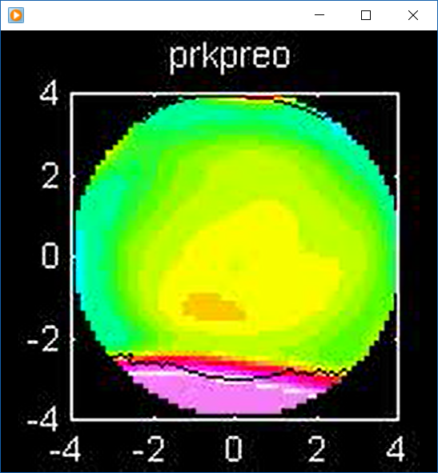
Last Class: Outliers in PCA
Example
Cornea Data
Which One Is
The Outlier?
But In Fact Is This

Slide 4
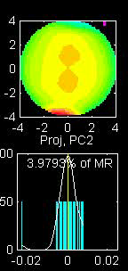
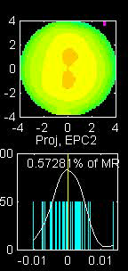
Last Class: Robust PCA
Elliptical PCA for cornea data:
Original PC2, Elliptical PC2

Slide 5
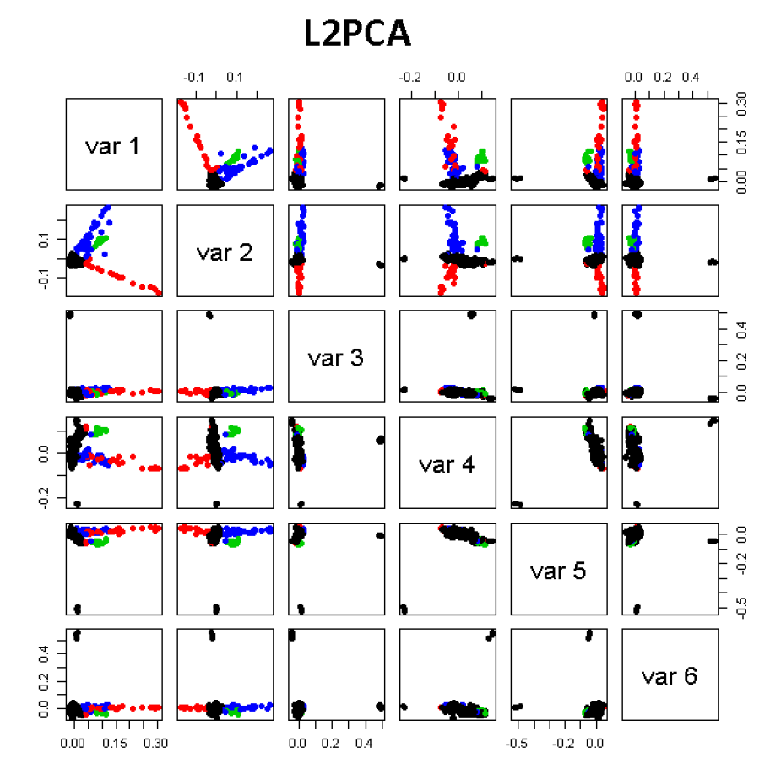
Last Class: GWAS Data Anal.
PCA View
Clear Ethnic
Groups
And Several
Outliers!
Eliminate With
Spherical PCA?

Slide 6
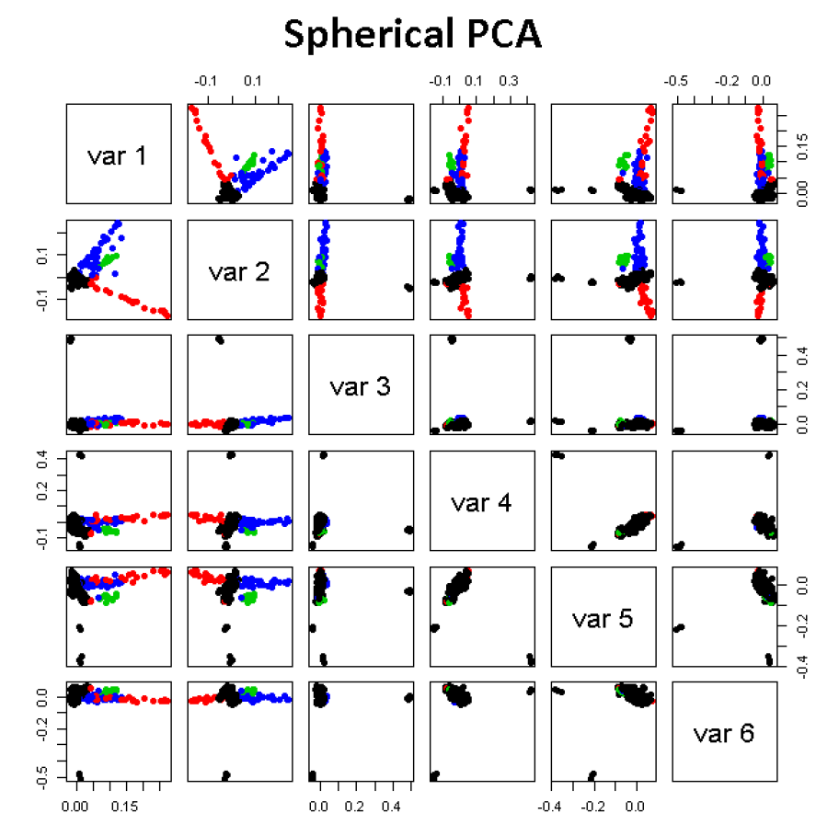
Last Class: GWAS Data Anal.
Spherical
PCA
Looks Same?!?
What is
going on?
Will Explain
Later

Slide 7
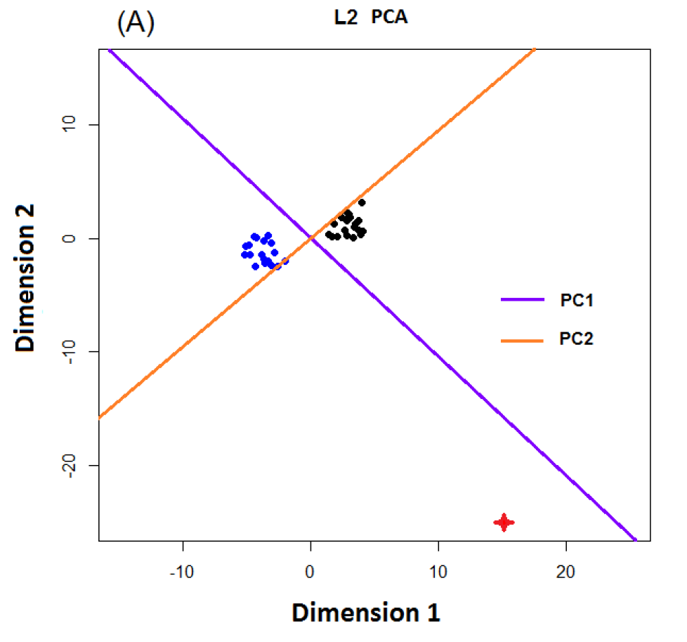
Last Class: L1 PCA
Conventional
L2 PCA
Outlier Pulls
Off PC1
Direction

Slide 8
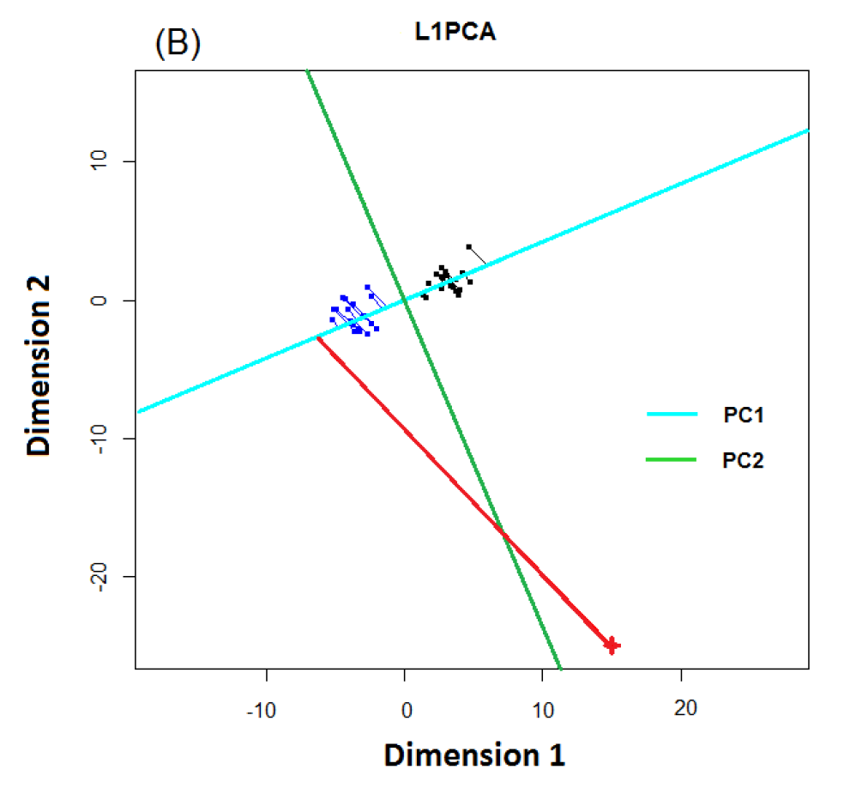
Last Class: L1 PCA
L1 PCA
Much Better
PC1 Direction
But Very Strange
Projections
(i.e. Little
Data Insight)

Slide 9
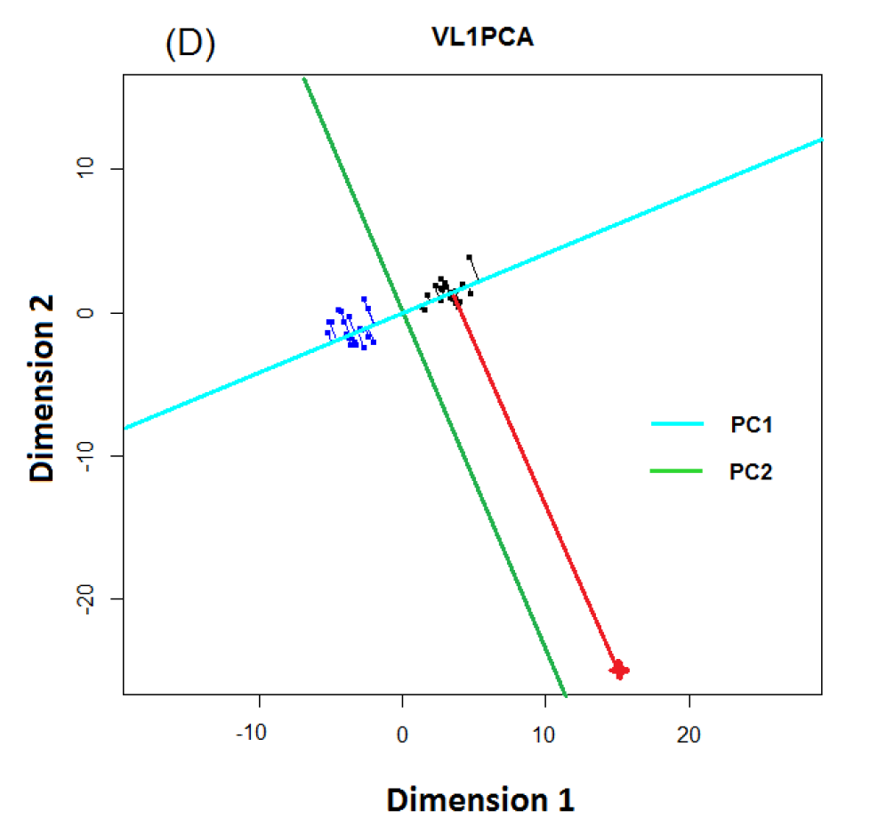
Last Class: L1 PCA
VL1 PCA
Excellent PC
Directions
Interpretable
Scores

Slide 10
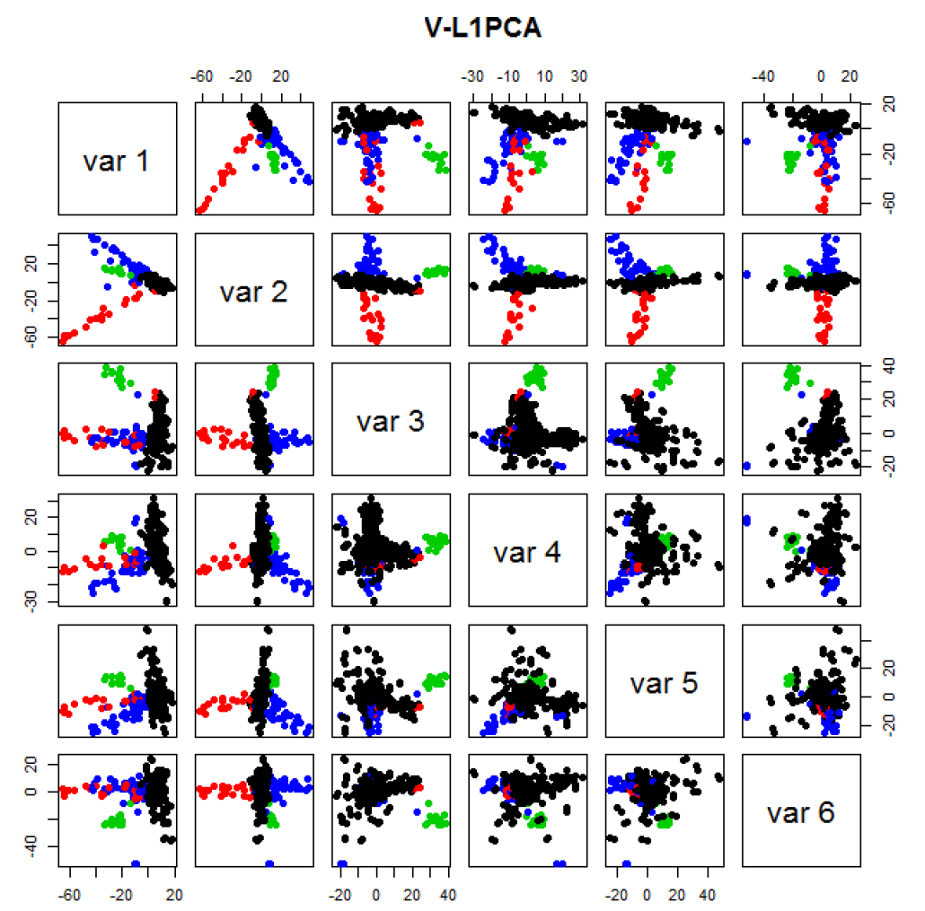
Last Class: GWAS Data
VL1 PCA
Best Focus
On Ethnic
Groups
Seems To
Find Unlabelled
Clusters

Slide 11
Last Class: Classification – Disc’n
Background: Two Class (Binary) version:
Using “training data” from
Class +1 and Class -1
Develop a “rule” for
assigning new data to a Class
Canonical Example: Disease Diagnosis
New Patients are “Healthy” or “Ill”
Determine based on measurements
Text, Chp 11

Slide 12
Last Class: Classification Basics
Binary Classification
Goal: Use Training Data
$$\left(x_{1},y_{1}\right),⋯,\left(x_{n},y_{n}\right)$$
To Classify New Case: $\left(x_{0},y_{0}\right)$
I.e. Use $x_{0}∈ℝ^{d}$ to Predict $y_{0}∈\left\{+1,−1\right\}$
Notes:
HDLSStmbRaw.ps

Slide 13
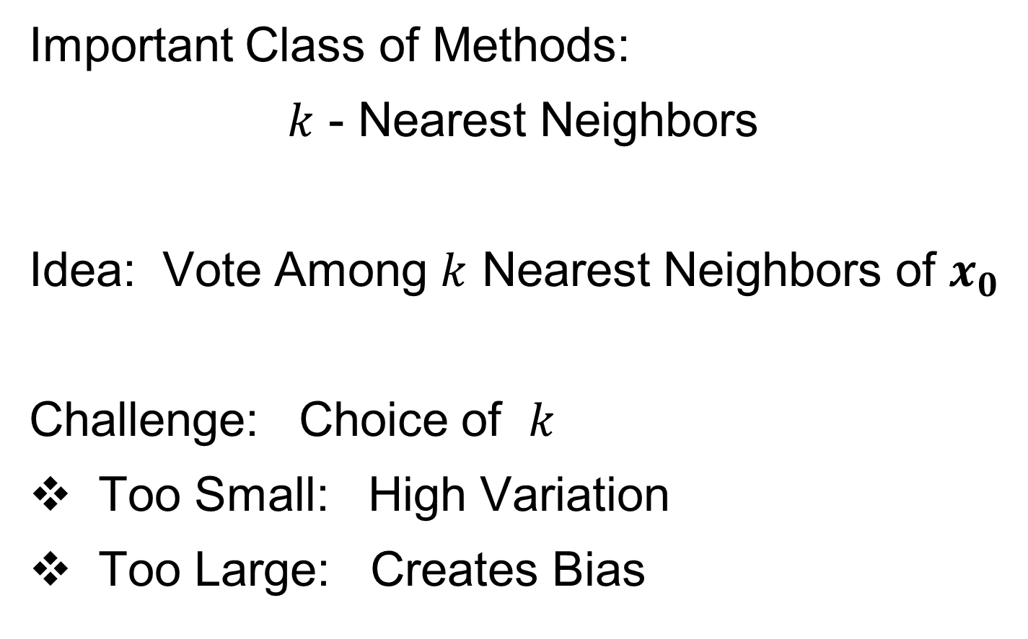
Last Class: Classification Basics
Important Class of Methods:
$k$ - Nearest Neighbors
Idea: Vote Among $k$ Nearest Neighbors of $x_{0}$
Challenge: Choice of $k$
Too Small: High Variation
Too Large: Creates Bias
Notes:
HDLSStmbRaw.ps

Slide 14
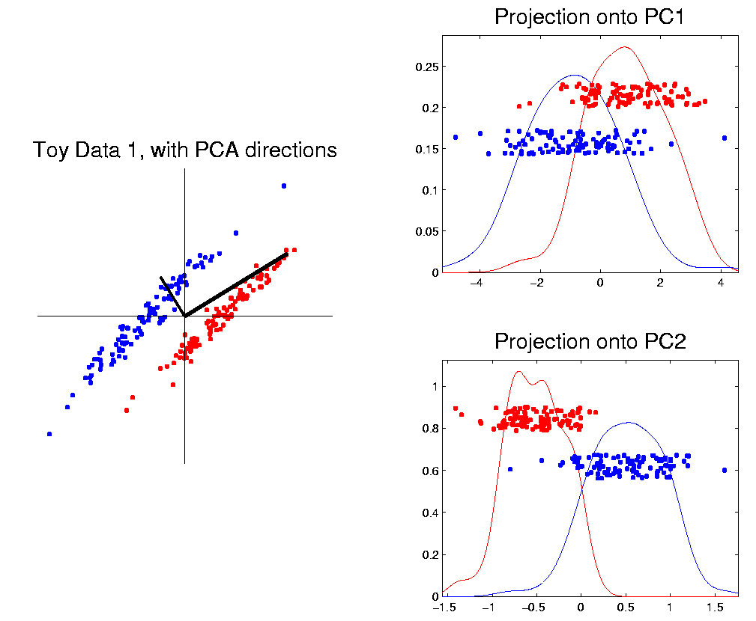
Last Class: Classification Basics
PCA for slanted clouds:
PC1 terrible
PC2 better?
Still misses
right dir’n
Doesn’t use
Class Labels
Notes:
HDLSSod1PCA.ps

Slide 15
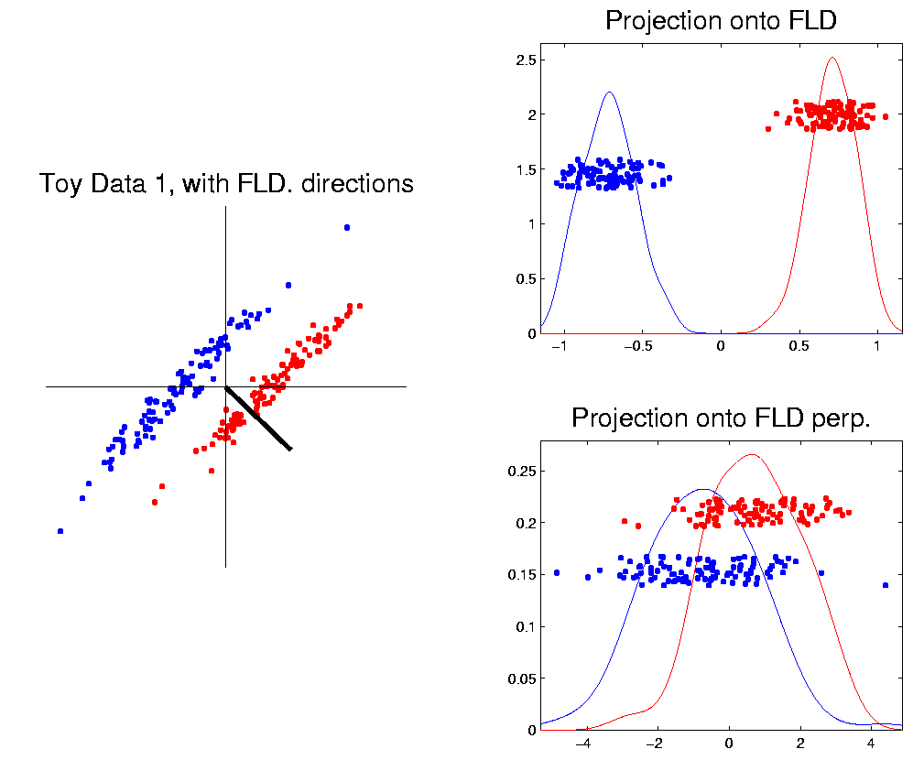
Last Class: Classification Basics
Better Solution: Linear Discriminant Analysis
Gets the
right dir’n
How does
it work?
Notes:
HDLSSod1FLD.ps

Slide 16
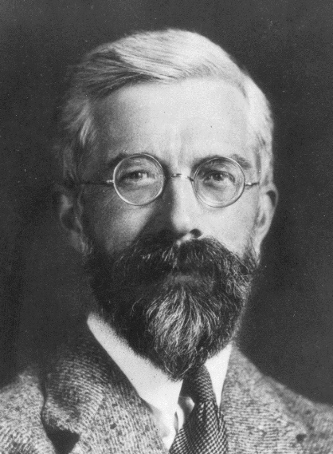
Linear Discriminant Analysis
Other common terminology (for LDA):
Fisher Linear Discrimination
Original Paper: Fisher (1936)
Same in Fisher-Rao, and popularized “p-value”
Published in Annals of Eugenics…
Founding Father of Both Statistics and Genetics, Now
Discredited Over Eugenics = Racist Pseudo-Science
(Also Tried to Disprove Evidence of Harm from Smoking)

Slide 17
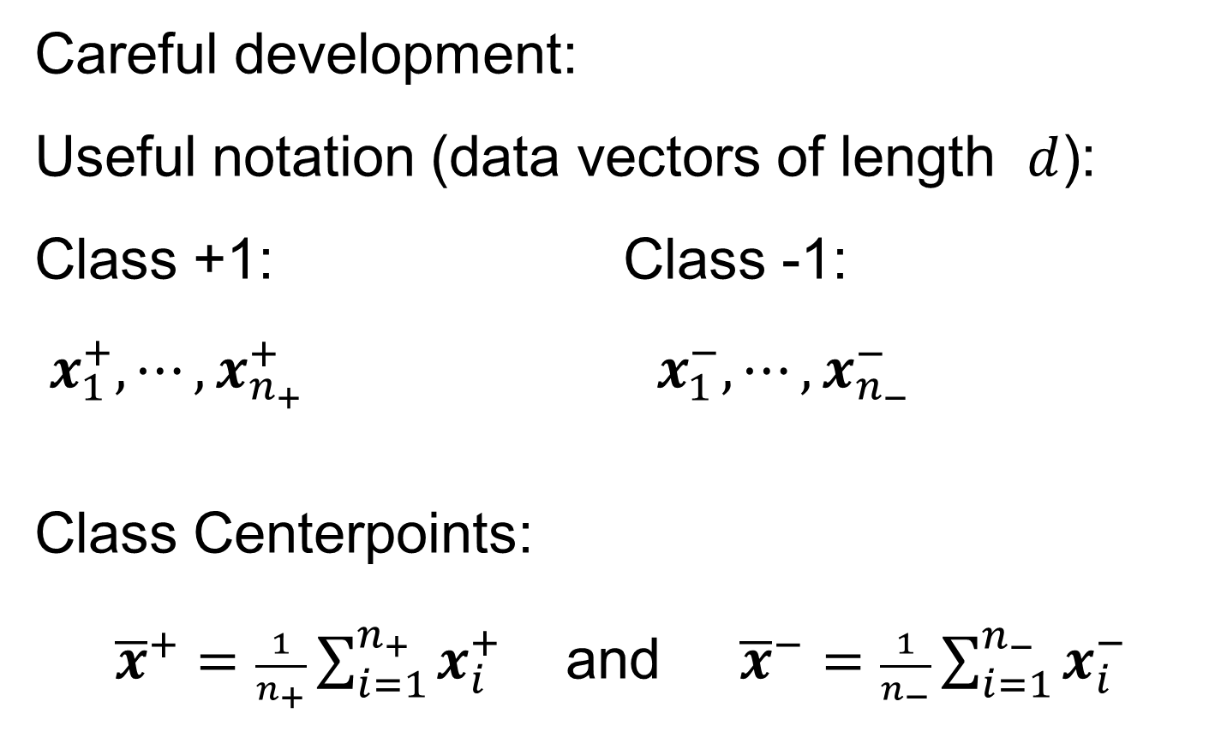
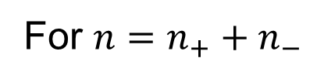
Linear Discriminant Analysis
Careful development:
Useful notation (data vectors of length $d$):
Class +1: Class -1:
$x_{1}^{+},⋯,x_{n_{+}}^{+} x_{1}^{−},⋯,x_{n_{−}}^{−}$
Class Centerpoints:
${\overline{x}}^{+}=\frac{1}{n_{+}}\sum_{i=1}^{n_{+}}{x_{i}^{+}}$ and ${\overline{x}}^{−}=\frac{1}{n_{−}}\sum_{i=1}^{n_{−}}{x_{i}^{−}}$
Text, Sec. 11.1
For $n=n_{+}+n_{−}$

Slide 18
Linear Discriminant Analysis
Covariances, ${\hat{Σ}}^{⨀}={\breve{X}}^{⨀}{{\breve{X}}^{⨀}}^{t}$ for $⨀$ = +,-
(outer products)
Based on centered, normalized data matrices:
$${\breve{X}}^{⨀}=\frac{1}{\sqrt{n_{⨀}}}\left(x_{1}^{⨀}−{\overline{x}}^{⨀},⋯,x_{n_{⨀}}^{⨀}−{\overline{x}}^{⨀}\right)$$
Column Object
Mean Centered
Note: use “MLE” version of estimated
covariance matrices, for simpler notation

Slide 19
Linear Discriminant Analysis
Good estimate of (common) within class cov?
Pooled (weighted average) within class cov:
$${\hat{Σ}}^{w}=\frac{n_{+}{\hat{Σ}}^{+}+n_{−}{\hat{Σ}}^{−}}{n_{+}+n_{−}}=\breve{\breve{X}}{\breve{\breve{X}}}^{t}$$
Outer Product of combined full data matrix:
$\breve{\breve{X}}$=$\frac{1}{\sqrt{n_{+}+n_{−}}}\left(\sqrt{n_{+}}{\breve{X}}^{+} \sqrt{n_{−}}{\breve{X}}^{−}\right)$
For “Within Class”
Thinking About Similar, But Shifted Distributions
Note: Different Means

Slide 20
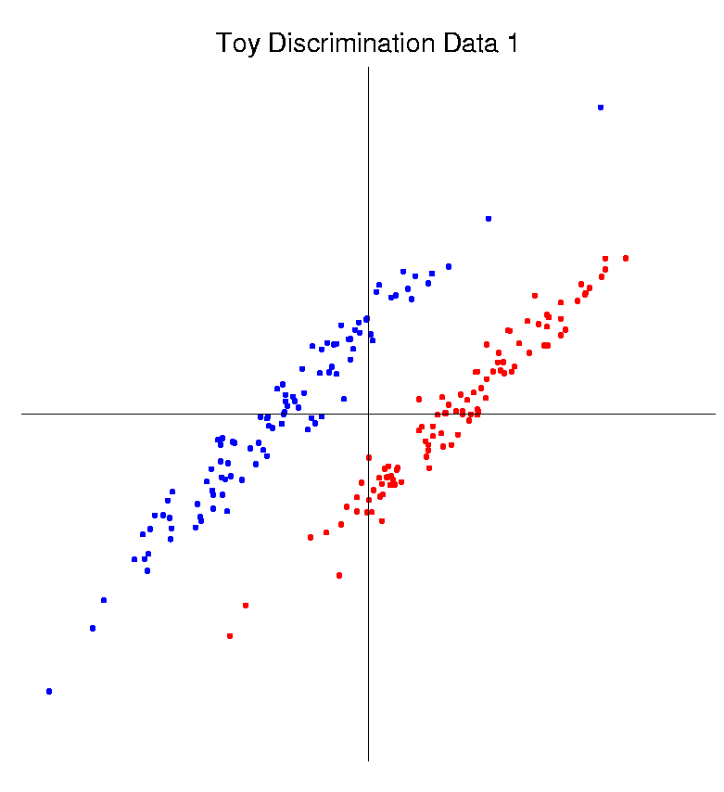
Linear Discriminant Analysis
Note: ${\hat{Σ}}^{w}$ is similar to $\hat{Σ}$ from before
I.e. covariance matrix ignoring class labels
Important Difference:
Class by Class Centering
Will be important later
Notes:
HDLSSod1Raw.ps

Slide 21
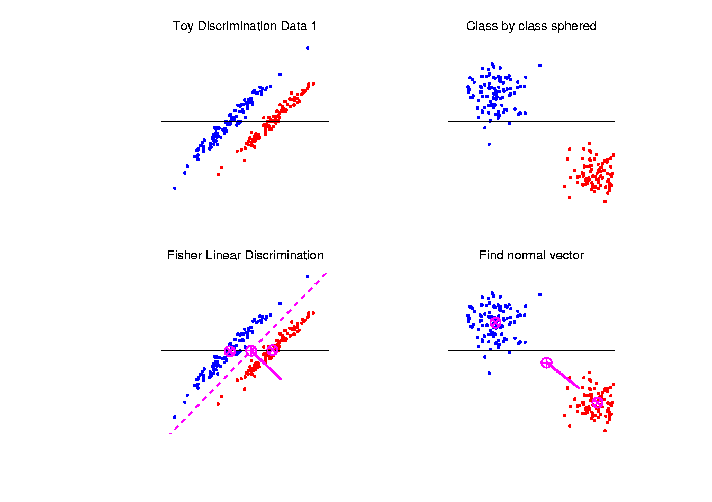
Linear Discriminant Analysis
Simple way to find “correct cov. adjustment”:
Individually transform subpopulations so
“spherical” about their means
For $⨀$ = +,- define $z_{i}^{⨀}={\left({\hat{Σ}}^{w}\right)}^{−1/2}x_{i}^{⨀}$
Notes:
HDLSSod1egFLD.ps

Slide 22
Linear Discriminant Analysis
For $⨀$ = +,- define $z_{i}^{⨀}={\left({\hat{Σ}}^{w}\right)}^{−1/2}x_{i}^{⨀}$
Note: This spheres the data, in the sense that
$$ZZ^{t}={\hat{Σ}}^{{−1}/2}\breve{X}{\left({\hat{Σ}}^{{−1}/2}\breve{X}\right)}^{t}=$$
$$={\hat{Σ}}^{{−1}/2}\breve{X}{\breve{X}}^{t}{\hat{Σ}}^{{−1}/2}=I$$
Notes:
HDLSSod1egFLD.ps

Slide 23
Linear Discriminant Analysis
Then:
In Transformed Space,
Best separating hyperplane
is
Perpendicular bisector of
line between means
Again Assuming Equal
Sample Sizes for Simplicity
Notes:
HDLSSod1egFLD.ps

Slide 24
Linear Discriminant Analysis
In Transformed Space,
Separating Hyperplane has:
Transformed Normal Vector:
$n_{TLDA}={\left({\hat{Σ}}^{w}\right)}^{−1/2}{\overline{x}}^{+}−{\left({\hat{Σ}}^{w}\right)}^{−1/2}{\overline{x}}^{−}$
$={\left({\hat{Σ}}^{w}\right)}^{−1/2}\left({\overline{x}}^{+}−{\overline{x}}^{−}\right)$
Notes:
HDLSSod1egFLD.ps

Slide 25
Linear Discriminant Analysis
In Transformed Space,
Separating Hyperplane has:
Transformed Normal Vector:
$n_{TLDA}={\left({\hat{Σ}}^{w}\right)}^{−1/2}{\overline{x}}^{+}−{\left({\hat{Σ}}^{w}\right)}^{−1/2}{\overline{x}}^{−}$
$={\left({\hat{Σ}}^{w}\right)}^{−1/2}\left({\overline{x}}^{+}−{\overline{x}}^{−}\right)$
Transformed Intercept:
$μ_{TLDA}={\frac{1}{2}\left({\hat{Σ}}^{w}\right)}^{−1/2}{\overline{x}}^{+}+\frac{1}{2}{\left({\hat{Σ}}^{w}\right)}^{−1/2}{\overline{x}}^{−}$
$={\left({\hat{Σ}}^{w}\right)}^{−1/2}\left(\frac{1}{2}{\overline{x}}^{+}+\frac{1}{2}{\overline{x}}^{−}\right)$
Notes:
HDLSSod1egFLD.ps

Slide 26
Linear Discriminant Analysis
In Transformed Space,
Separating Hyperplane has:
Transformed Normal Vector:
$n_{TLDA}={\left({\hat{Σ}}^{w}\right)}^{−1/2}{\overline{x}}^{+}−{\left({\hat{Σ}}^{w}\right)}^{−1/2}{\overline{x}}^{−}$
$={\left({\hat{Σ}}^{w}\right)}^{−1/2}\left({\overline{x}}^{+}−{\overline{x}}^{−}\right)$
Transformed Intercept:
$μ_{TLDA}={\frac{1}{2}\left({\hat{Σ}}^{w}\right)}^{−1/2}{\overline{x}}^{+}+\frac{1}{2}{\left({\hat{Σ}}^{w}\right)}^{−1/2}{\overline{x}}^{−}$
$={\left({\hat{Σ}}^{w}\right)}^{−1/2}\left(\frac{1}{2}{\overline{x}}^{+}+\frac{1}{2}{\overline{x}}^{−}\right)$
Separating Hyperplane Has Eqn.
$\left\{z:\left\langle z,n_{TLDA}\right\rangle =\left\langle μ_{TLDA},n_{TLDA}\right\rangle \right\}$
Notes:
HDLSSod1egFLD.ps

Slide 27
Linear Discriminant Analysis
Thus discrimination rule is:
Given a new data vector $x_{0}$,
Choose Class +1 when:
$$\left\langle {\left({\hat{Σ}}^{w}\right)}^{−1/2}x_{0},n_{TLDA}\right\rangle ≥\left\langle μ_{TLDA},n_{TLDA}\right\rangle$$
Using Boundary: $\left\{z:\left\langle z,n_{TLDA}\right\rangle =\left\langle μ_{TLDA},n_{TLDA}\right\rangle \right\}$

Slide 28
Linear Discriminant Analysis
Thus discrimination rule is:
Given a new data vector $x_{0}$,
Choose Class +1 when:
$$\left\langle {\left({\hat{Σ}}^{w}\right)}^{−1/2}x_{0},n_{TLDA}\right\rangle ≥\left\langle μ_{TLDA},n_{TLDA}\right\rangle$$
i.e. (transforming back to original space)
$$\left\langle x_{0},{\left({\hat{Σ}}^{w}\right)}^{−1/2}n_{TLDA}\right\rangle ≥\left\langle {\left({\hat{Σ}}^{w}\right)}^{1/2}μ_{TLDA},{\left({\hat{Σ}}^{w}\right)}^{−1/2}n_{TLDA}\right\rangle$$
$$\left\langle x_{0},n_{LDA}\right\rangle ≥\left\langle μ_{LDA},n_{LDA}\right\rangle$$
where:
$$n_{LDA}={\left({\hat{Σ}}^{w}\right)}^{−1/2}n_{TLDA}={\left({\hat{Σ}}^{w}\right)}^{−1}\left({\overline{x}}^{+}−{\overline{x}}^{−}\right)$$
$$μ_{LDA}={\left({\hat{Σ}}^{w}\right)}^{1/2}μ_{TLDA}=\left(\frac{1}{2}{\overline{x}}^{+}+\frac{1}{2}{\overline{x}}^{−}\right)$$
Modified
Direction
But Same Center

Slide 29
Linear Discriminant Analysis
Thus discrimination rule is:
Classify $x_{0}$ to Class +1 when:
$$\left\langle x_{0}, {\underline{n}}_{LDA}\right\rangle ≥\left\langle {\underline{μ}}_{LDA}, {\underline{n}}_{LDA}\right\rangle$$
where:
$n_{LDA}={\left({\hat{Σ}}^{w}\right)}^{−1/2}n_{TLDA}={\left({\hat{Σ}}^{w}\right)}^{−1}\left({\overline{x}}^{+}−{\overline{x}}^{−}\right)$
$μ_{LDA}={\left({\hat{Σ}}^{w}\right)}^{1/2}μ_{TLDA}=\left(\frac{1}{2}{\overline{x}}^{+}+\frac{1}{2}{\overline{x}}^{−}\right)$
i.e.
${x_{0}}^{t}{\left({\hat{Σ}}^{w}\right)}^{−1}\left({\overline{x}}^{+}−{\overline{x}}^{−}\right)≥$
$≥{\frac{1}{2}\left({\overline{x}}^{+}+{\overline{x}}^{−}\right)}^{t}{\left({\hat{Σ}}^{w}\right)}^{−1}$ $\left({\overline{x}}^{+}−{\overline{x}}^{−}\right)$
Same Inner Product
Of Center Point
Inner Product of New Data
Point & Transf’d Direction

Slide 30
Linear Discriminant Analysis
So (in orig’l space) have separ’ting hyperplane with:
Normal vector: $n_{LDA}$
Intercept:$μ_{LDA}$
Notes:
HDLSSod1egFLD.ps

Slide 31
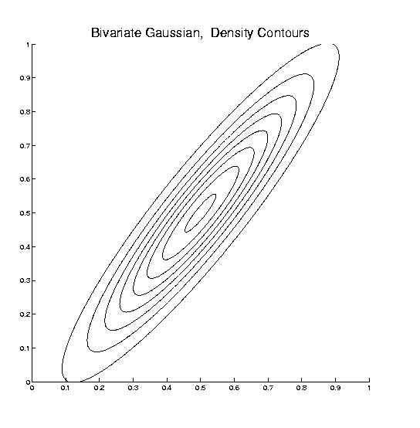
Linear Discriminant Analysis
Relationship to Mahalanobis distance
Idea: For $x_{1},x_{2}\sim N\left(μ,Σ\right)$, a natural distance
measure is: $d_{M}={\left[{\left(x_{1}−x_{2}\right)}^{t}Σ^{−1}\left(x_{1}−x_{2}\right)\right]}^{1/2}$
$$d_{1}=d_{2}$$

Slide 32
Linear Discriminant Analysis
Relationship to Mahalanobis distance
Idea: For $x_{1},x_{2}\sim N\left(μ,Σ\right)$, a natural distance
measure is: $d_{M}={\left[{\left(x_{1}−x_{2}\right)}^{t}Σ^{−1}\left(x_{1}−x_{2}\right)\right]}^{1/2}$
“unit free”, i.e. “standardized”
essentially mod out covariance structure
Euclidean dist. applied to $Σ^{−1/2}x_{1}$ & $Σ^{−1/2}x_{2}$
Same as key transformation for LDA
I.e. LDA is
mean difference in Mahalanobis space

Slide 33
Classical Discrimination
Above derivation of LDA was:
Nonstandard
Not in any other textbooks(?)
Nonparametric (don’t need Gaussian data)
I.e. Used no probability distributions
More Machine Learning than Statistics
(but careful about HDLSS case)

Slide 34
Classical Discrimination
LDA Likelihood View
Assume:
Class distributions are multivariate
$N\left(μ^{⨀},Σ^{w}\right)$ for $⨀$ = +,-
strong distributional assumption
+ common covariance (Within Class)

Slide 35
Classical Discrimination
LDA Likelihood View (cont.)
At a location $x_{0}$, the likelihood ratio, for
choosing between Class +1 and Class -1, is:
$$LR\left(x_{0},μ^{+},μ^{−},Σ^{w}\right)={φ_{Σ^{w}}\left(x_{0}−μ^{+}\right)}/{φ_{Σ^{w}}\left(x_{0}−μ^{−}\right)}$$
where $φ_{Σ^{w}}$ is the Gaussian density,
with covariance $Σ^{w}$

Slide 36
Classical Discrimination
LDA Likelihood View (cont.)
Simplifying, using the Gaussian density:
$$φ_{Σ^{w}}\left(x\right)=\frac{1}{{\left(2π\right)}^{d/2}\left|Σ^{w}\right|}e^{{−\left(x^{t}{Σ^{w}}^{−1}x\right)}/2}$$
Gives (critically using common covariances):
$LR\left(x_{0},μ^{+},μ^{−},Σ^{w}\right)$=
$$=e^{{−\left[{\left(x_{0}−μ^{+}\right)}^{t}{Σ^{w}}^{−1}\left(x_{0}−μ^{+}\right)−{\left(x_{0}−μ^{−}\right)}^{t}{Σ^{w}}^{−1}\left(x_{0}−μ^{−}\right)\right]}/2}$$
$−2\log{LR\left(x_{0},μ^{+},μ^{−},Σ^{w}\right)}=$
$$=\left[{\left(x_{0}−μ^{+}\right)}^{t}{Σ^{w}}^{−1}\left(x_{0}−μ^{+}\right)−{\left(x_{0}−μ^{−}\right)}^{t}{Σ^{w}}^{−1}\left(x_{0}−μ^{−}\right)\right]$$

Slide 37
Classical Discrimination
LDA Likelihood View (cont.)
But: ${\left(x_{0}−μ^{⨀}\right)}^{t}{Σ^{w}}^{−1}\left(x_{0}−μ^{⨀}\right)=$
$$={x_{0}}^{t}{Σ^{w}}^{−1}x_{0}−2{x_{0}}^{t}{Σ^{w}}^{−1}μ^{⨀}+{μ^{⨀}}^{t}{Σ^{w}}^{−1}μ^{⨀}$$
for $⨀=−1, +1$

Slide 38
Classical Discrimination
LDA Likelihood View (cont.)
But: ${\left(x_{0}−μ^{⨀}\right)}^{t}{Σ^{w}}^{−1}\left(x_{0}−μ^{⨀}\right)=$
$$={x_{0}}^{t}{Σ^{w}}^{−1}x_{0}−2{x_{0}}^{t}{Σ^{w}}^{−1}μ^{⨀}+{μ^{⨀}}^{t}{Σ^{w}}^{−1}μ^{⨀}$$
so: $−2\log{LR\left(x_{0},μ^{+},μ^{−},Σ^{w}\right)}=$
$$=−2{x_{0}}^{t}{Σ^{w}}^{−1}\left(μ^{+}−μ^{−}\right)+{\left(μ^{+}+μ^{−}\right)}^{t}{Σ^{w}}^{−1}\left(μ^{+}−μ^{−}\right)$$
Note: same terms subtract off

Slide 39
Classical Discrimination
LDA Likelihood View (cont.)
But: ${\left(x_{0}−μ^{⨀}\right)}^{t}{Σ^{w}}^{−1}\left(x_{0}−μ^{⨀}\right)=$
$$={x_{0}}^{t}{Σ^{w}}^{−1}x_{0}−2{x_{0}}^{t}{Σ^{w}}^{−1}μ^{⨀}+{μ^{⨀}}^{t}{Σ^{w}}^{−1}μ^{⨀}$$
so: $−2\log{LR\left(x_{0},{\underline{μ}}^{+},{\underline{μ}}^{−},Σ^{w}\right)}=$
$$=−2{x_{0}}^{t}{Σ^{w}}^{−1}\left(μ^{+}−μ^{−}\right)+{\left(μ^{+}+μ^{−}\right)}^{t}{Σ^{w}}^{−1}\left(μ^{+}−μ^{−}\right)$$
Note: cross terms have ± cancellation
Seen in Above
Nonparametric
Derivation
Similar To
Above Center

Slide 40
Classical Discrimination
LDA Likelihood View (cont.)
But: ${\left(x_{0}−μ^{⨀}\right)}^{t}{Σ^{w}}^{−1}\left(x_{0}−μ^{⨀}\right)=$
$$={x_{0}}^{t}{Σ^{w}}^{−1}x_{0}−2{x_{0}}^{t}{Σ^{w}}^{−1}μ^{⨀}+{μ^{⨀}}^{t}{Σ^{w}}^{−1}μ^{⨀}$$
so: $−2\log{LR\left(x_{0},μ^{+},{\underline{μ}}^{−},Σ^{w}\right)}=$
$$=−2{x_{0}}^{t}{Σ^{w}}^{−1}\left(μ^{+}−μ^{−}\right)+{\left(μ^{+}+μ^{−}\right)}^{t}{Σ^{w}}^{−1}\left(μ^{+}−μ^{−}\right)$$
Thus $LR\left(x_{0},μ^{+},μ^{−},Σ^{w}\right)≥1$ when
$$−2\log{LR\left(x_{0},μ^{+},μ^{−},Σ^{w}\right)}≤0$$
i.e. ${x_{0}}^{t}{Σ^{w}}^{−1}\left(μ^{+}−μ^{−}\right)≥\frac{1}{2}{\left(μ^{+}+μ^{−}\right)}^{t}{Σ^{w}}^{−1}\left(μ^{+}−μ^{−}\right)$

Slide 41
Classical Discrimination
LDA Likelihood View (cont.)
Replacing $μ^{+}$, $μ^{−}$ and $Σ^{w}$
by maximum likelihood estimates:
${\overline{x}}^{+}$, ${\overline{x}}^{−}$and ${\hat{Σ}}^{w}$
Gives the likelihood ratio discrimination rule:
Choose Class +1, when
$${x_{0}}^{t}{{\hat{Σ}}^{w}}^{−1}\left({\overline{x}}^{+}−{\overline{x}}^{−}\right)≥\frac{1}{2}{\left({\overline{x}}^{+}+{\overline{x}}^{−}\right)}^{t}{{\hat{Σ}}^{w}}^{−1}\left({\overline{x}}^{+}−{\overline{x}}^{−}\right)$$
Same as above, so: LDA can be viewed as
Likelihood Ratio Rule

Slide 42
Classical Discrimination
LDA Generalization I
Gaussian Likelihood Ratio Discrimination
(a. k. a. “Nonlinear Discriminant Analysis”)
Idea: Assume
class distributions are $N\left(μ^{⨀},Σ^{⨀}\right)$
Different covariances!
Likelihood Ratio rule is straightf’d num’l calc.
(thus can easily implement, and do discrim’n)

Slide 43
Classical Discrimination
Gaussian Likelihood Ratio Discrim’n (cont.)
No longer have separ’g hyperplane repr’n
(instead regions determined by quadratics)
(fairly complicated case-wise calculations)
Graphical display: for grid of test points,
color as:
Yellow if assigned to Class +1
Cyan if assigned to Class -1
(intensity is strength of assignment)

Slide 44
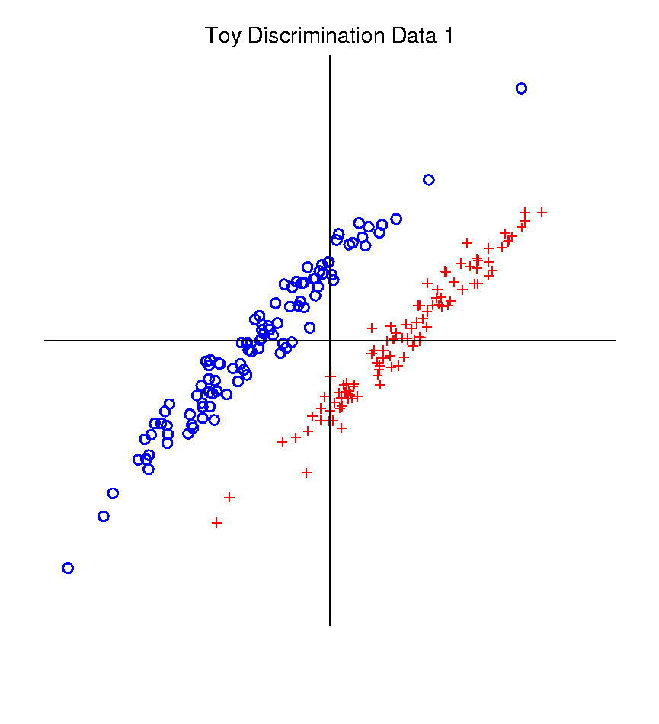
Classical Discrimination
Graphical Display of Classifiers
Use Yellow for Grid
Points Assigned
to Plus Class
Use Cyan for Grid
Points Assigned
to Minus Class
Notes:
PEod1FLDe1.ps

Slide 45
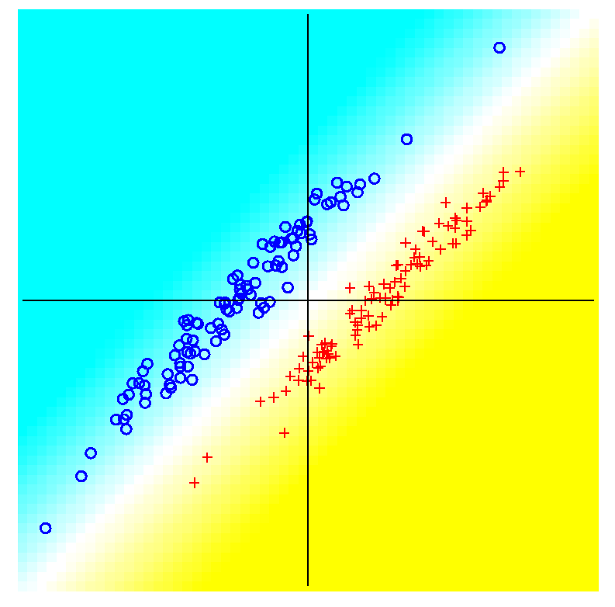
Classical Discrimination
LDA for Tilted Point Clouds – Works well
Notes:
PEod1FLDe1.ps

Slide 46
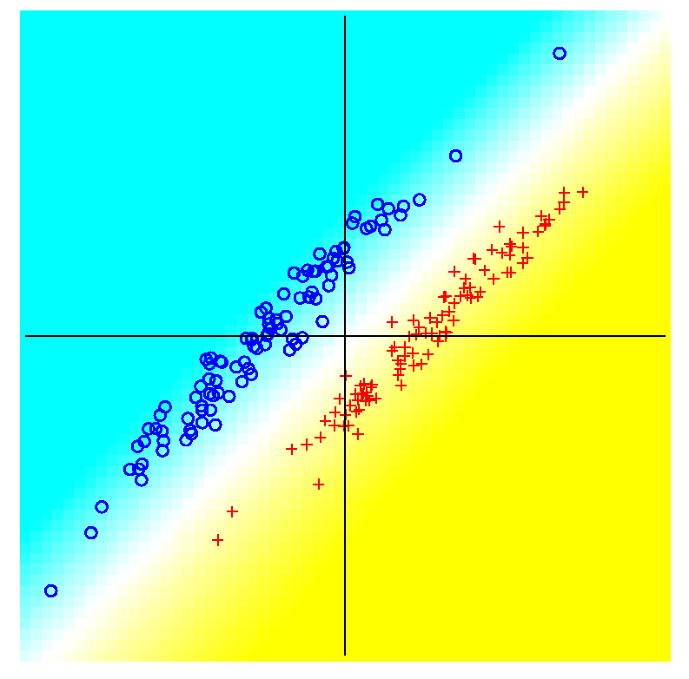
Classical Discrimination
GLR for Tilted Point Clouds – Works well
Notes:
PEod1GLRe1.ps

Slide 47
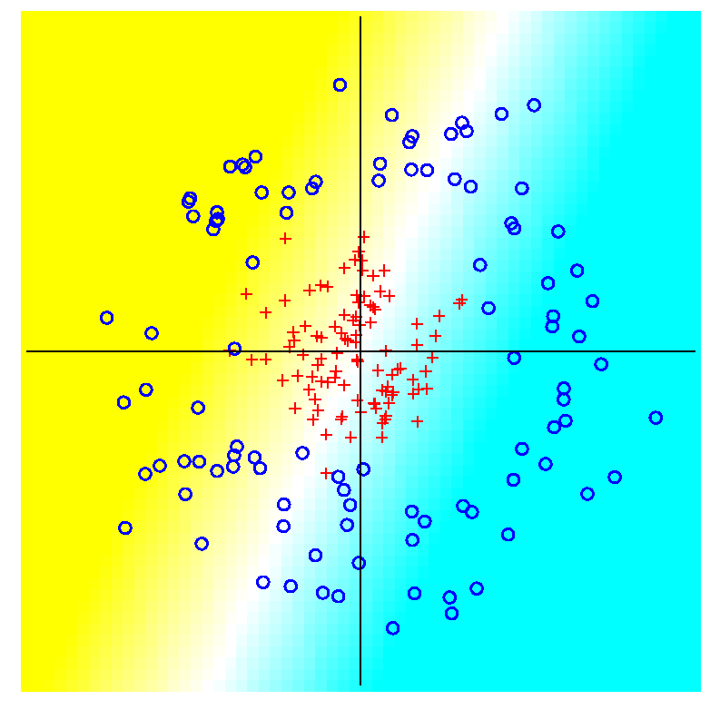
Classical Discrimination
LDA for Donut – Poor, no plane can work
Notes:
PEdonFLDe1.ps

Slide 48
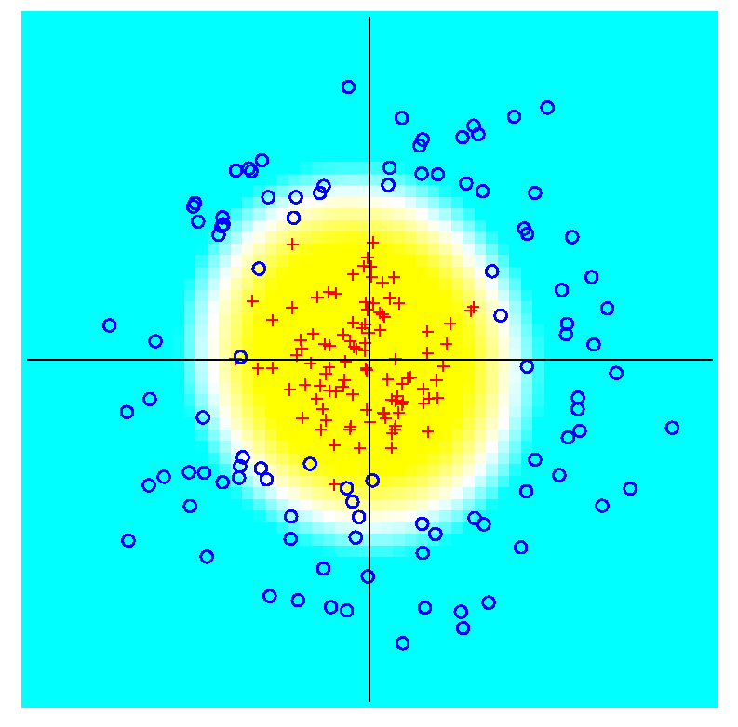
Classical Discrimination
GLR for Donut – Works well (good quadratic)
(Even
though
data not
Gaussian)
Notes:
PEdonGLRe1.ps

Slide 49
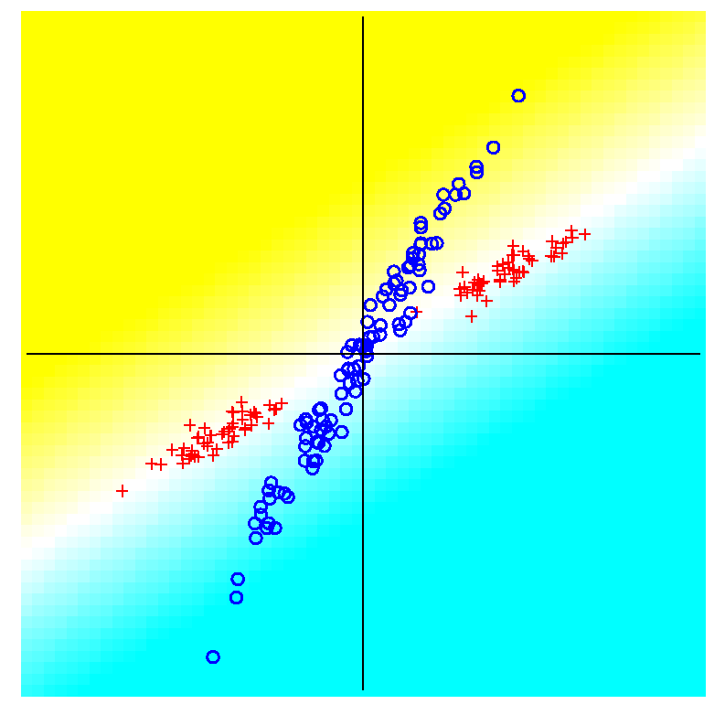
Classical Discrimination
LDA for X – Poor, no plane can work
Notes:
PExd3FLDe1.ps

Slide 50
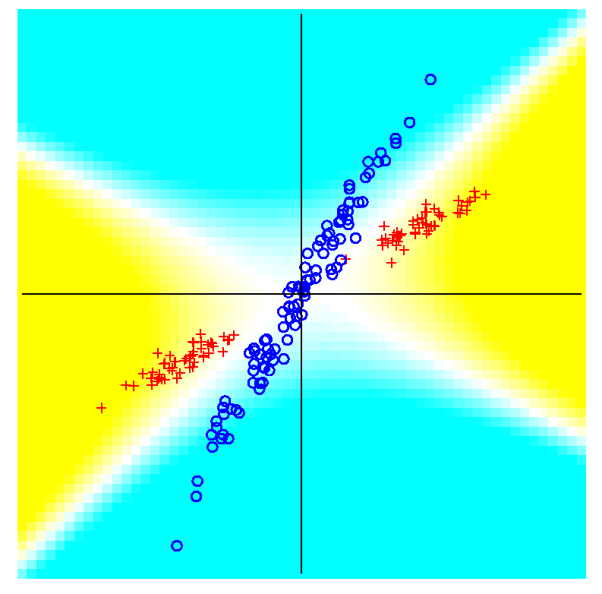
Classical Discrimination
GLR for X – Better, but not great
Notes:
PExd3GLRe1.ps

Slide 51
Classical Discrimination
Summary of LDA vs. GLR:
Tilted Point Clouds Data
  LDA good
  GLR good
Donut Data
  LDA bad
  GLR good
X Data
  LDA bad
  GLR OK, not great
Classical Conclusion: GLR generally better
(will see a different answer for HDLSS data)
High Dimension
Low Sample Size

Slide 52
Classical Discrimination
LDA Generalization II (Gen. I was GLR)
Different prior probabilities
Main idea:
Give different weights to 2 classes
I.e. assume not a priori equally likely
Canonical Example: Rare Disease Testing
(Often Train on Mostly Rare Cases)

Slide 53
Classical Discrimination
LDA Generalization II (Gen. I was GLR)
Different prior probabilities
Main idea:
Give different weights to 2 classes
I.e. assume not a priori equally likely
Development is “straightforward”
Modified likelihood
Change intercept in LDA
Won’t explore further here

Slide 54
Classical Discrimination
LDA Generalization III
Principal Discriminant Analysis
Also Called:
Multiple Discriminant Analysis
Duda, et al. (2001)
Canonical Variate Analysis
Mardia, et al. (1979)

Slide 55
Classical Discrimination
LDA Generalization III
Principal Discriminant Analysis
Idea: LDA-like approach to $K>2$ classes
Assumption: Class covariance matrices are the same (similar)
(but not Gaussian, same situation as for LDA)
Main idea:
Quantify “location of classes” by their means
$${\underline{μ}}^{(1)},{\underline{μ}}^{(2)},⋯,{\underline{μ}}^{(K)}$$
Analog of MD
For $K$ Classes

Slide 56
Classical Discrimination
Principal Discriminant Analysis (cont.)
Simple way to find “interesting directions” among the means:
PCA on set of means
(Think Analog of Mean Difference)

Slide 57
Classical Discrimination
Principal Discriminant Analysis (cont.)
Simple way to find “interesting directions” among the means:
PCA on set of means
i.e. Eigen-analysis of “between class covariance matrix” ${\hat{Σ}}^{B}=MM^{t}$
Where
$$M=\frac{1}{\sqrt{K}}\left(μ^{(1)}−\overline{μ} ⋯μ^{(K)}−\overline{μ}\right)$$
Aside: can show: overall $n\hat{Σ}=K{\hat{Σ}}^{B}+n{\hat{Σ}}^{w}$
Mean of Means

Slide 58
Classical Discrimination
Principal Discriminant Analysis (cont.)
But PCA only works like Mean Difference,
Expect can improve by
taking covariance into account.
(Recall Improvement of LDA over MD)

Slide 59
Classical Discrimination
Principal Discriminant Analysis (cont.)
But PCA only works like Mean Difference,
Expect can improve by
taking covariance into account.
Blind application of above ideas suggests eigen-analysis of: ${Σ^{w}}^{−1}Σ^{B}$

Slide 60
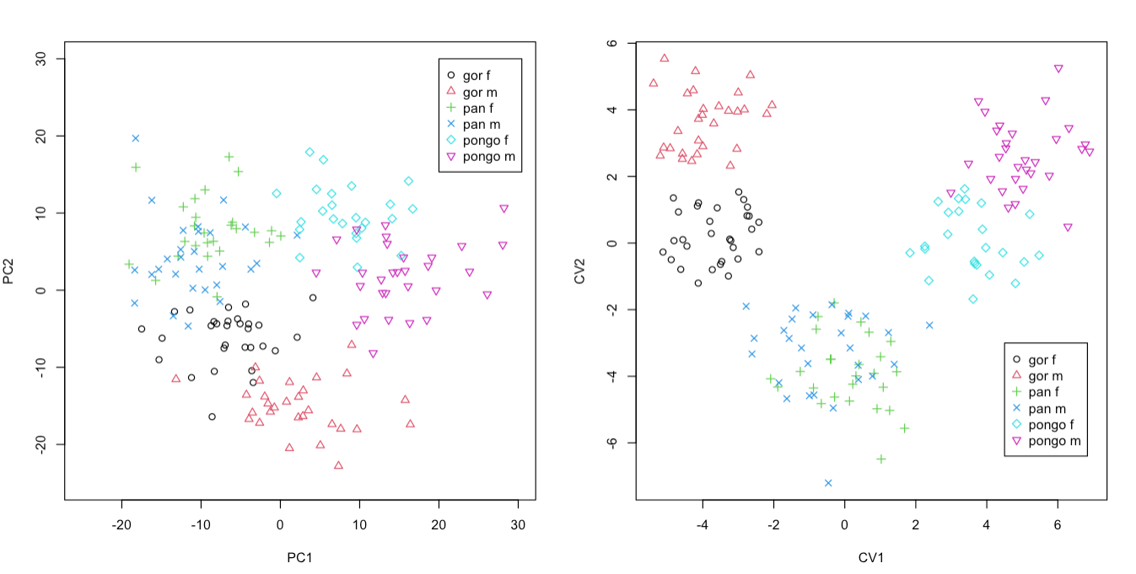
Classical Discrimination
Principal Discriminant Analysis Illustrated
Landmark Shapes of Great Ape Skulls
Text Figure 11.5

Slide 61
Classical Discrimination
Principal Discriminant Analysis Illustrated
Recall Synonyms
Principal Component Analysis
Canonical Variate Analysis
Classes Overlap
Much Better
Separation

Slide 62
Classical Discrimination
Principal Discriminant Analysis (cont.)
There are:
smarter ways to compute
(“generalized eigenvalue”)
other representations
(this solves optimization prob’s)
Special case: 2 classes,
reduces to standard LDA
Good reference for more: Section 3.8 of:
Duda et al. (2001)

Slide 63
Classical Discrimination
Recall Above Summary of Classical Ideas:
Among “Simple Methods”
  MD and LDA sometimes similar
  Sometimes LDA better
  So LDA is preferred
Among Complicated Methods
  GLR is best
  So always use that?
Caution:
  Story changes for HDLSS settings
Now Study This

Slide 64
HDLSS Discrimination
Main HDLSS issues:
Sample Size, $n$ < Dimension, $d$
Singular sample covariance matrix, $\hat{Σ}$
So can’t use matrix inverse
I.e. can’t standardize (sphere) the data
(requires root inverse covariance)
Can’t do classical multivariate analysis

Slide 65
HDLSS Discrimination
Main HDLSS issues:
Can’t do classical multivariate analysis
  Key Idea: Standardize
    Subtract Sample Mean
    Sphere the Data (i.e. Multiply by ${\hat{Σ}}^{−1/2}$)
  And use $N(0,I)$ dist’n for statistical inference

Slide 66
HDLSS Discrimination
An approach to non-invertible covariances:
Replace by generalized inverses
Sometimes called pseudo inverses
Note: there are several
Here use Moore Penrose inverse
As used by Matlab (pinv.m)
Often provides useful results
(but not always)

Slide 67
Moore Penrose Generalized Inverse
Based on Eigen-Analysis of $d×d$ Symmetric
Matrix $Σ$
$$Σ=UΛU^{t}$$
Where:
$U$ is an orthonormal basis matrix of $ℝ^{d}$
$Λ$ is a diagonal matrix of eigen-values:
$$λ_{1}≥⋯≥λ_{r}>0=⋯=0$$
$d−r$ is number
of $0$ eigen-values
Rank of $Σ$ is $r$

Slide 68
Moore Penrose Generalized Inverse
Let $Σ^{−}=UΛ^{−}U^{t}$
Where $Λ^{−}$ is the diagonal matrix with entries:
$$\frac{1}{λ_{1}},⋯,\frac{1}{λ_{r}},0,⋯,0$$
$Σ^{−}$ is a generalized inverse in the sense
$Σ^{−}=Σ^{−}ΣΣ^{−}$ and $Σ=ΣΣ^{−}Σ$

Slide 69
HDLSS Discrimination
Application of Generalized Inverse to LDA:
Direction (Normal) Vector:
$$n_{LDA}={\left({\hat{Σ}}^{w}\right)}^{−}\left({\overline{x}}^{+}−{\overline{x}}^{−}\right)$$
Intercept:
$$μ_{LDA}=\left(\frac{1}{2}{\overline{x}}^{+}+\frac{1}{2}{\overline{x}}^{−}\right)$$

Slide 70
HDLSS Discrimination
Application of Generalized Inverse to LDA:
Direction (Normal) Vector:
$$n_{LDA}={\left({\hat{Σ}}^{w}\right)}^{−}\left({\overline{x}}^{+}−{\overline{x}}^{−}\right)$$
Intercept:
$$μ_{LDA}=\left(\frac{1}{2}{\overline{x}}^{+}+\frac{1}{2}{\overline{x}}^{−}\right)$$
Have replaced ${\left({\hat{Σ}}^{w}\right)}^{−1}$ by ${\left({\hat{Σ}}^{w}\right)}^{−}$

Slide 71
HDLSS Discrimination
Toy Example: Increasing Dimension
$n_{+}=n_{−}=20$ data vectors:
Entry 1:
Class +1: $N\left(+2.2,1\right)$ Class –1: $N\left(−2.2,1\right)$
Other Entries: $N\left(0,1\right)$
All Entries Independent
Look through dimensions, $d=1, 2, ⋯, 1000$

Slide 72
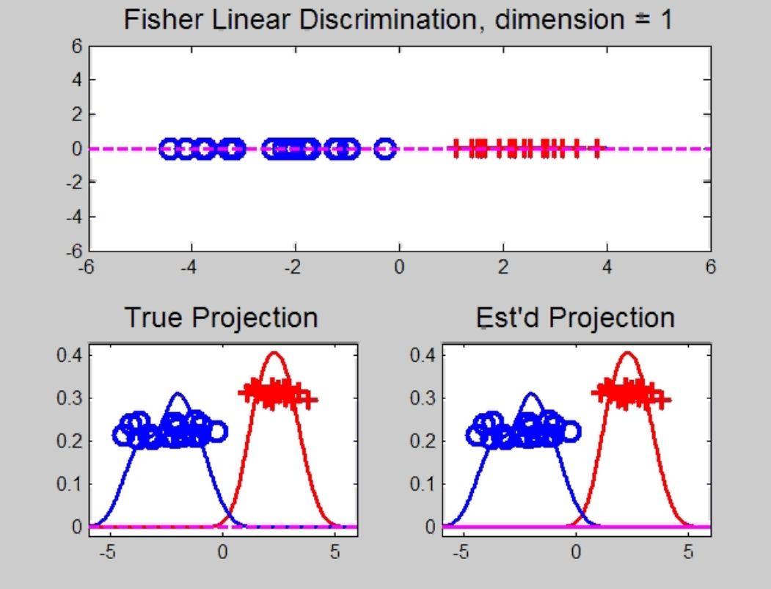
HDLSS Discrimination
Increasing Dimension Example
Project on
Optimal
Direction
Project on
LDA Direction
Project on
Both

Slide 73
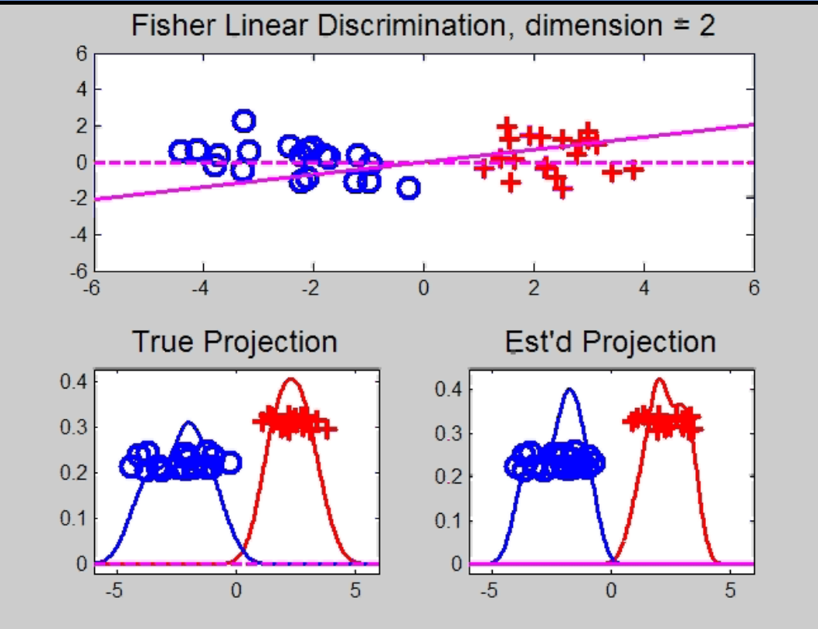
HDLSS Discrimination
Add a 2nd Dimension ($N\left(0,1\right)$ noise)
Same Projections on
Optimal Direction
Axes Here
Are Same As
Directions Here
Now See 2
Dimensions

Slide 74
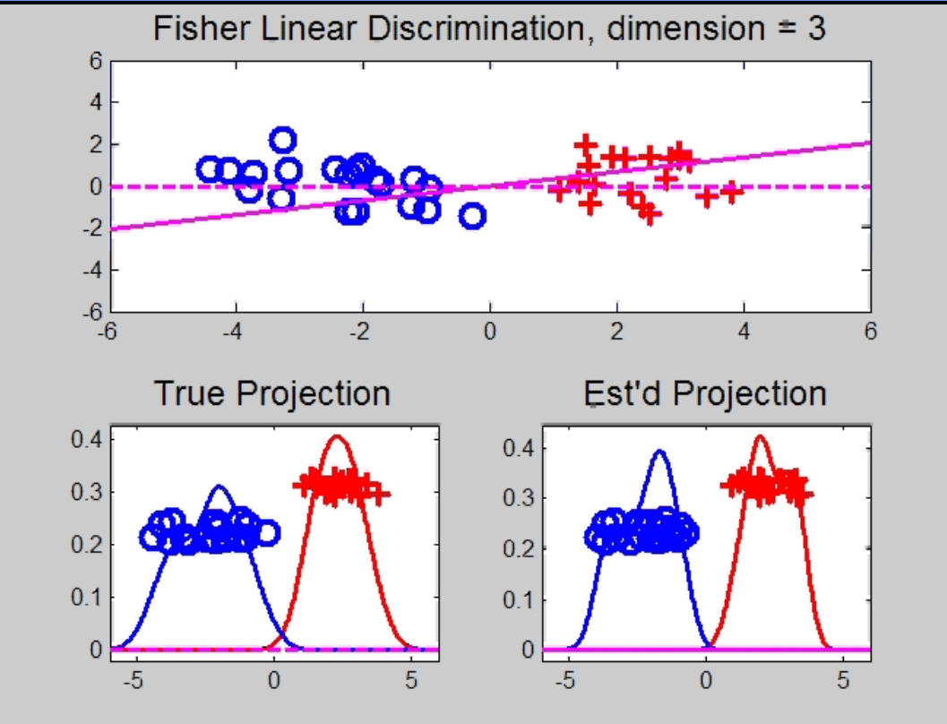
HDLSS Discrimination
Add a 3rd Dimension ($N\left(0,1\right)$ noise)
Project on
2-d subspace
generated
by optimal
dir’n & by
LDA dir’n

Slide 75
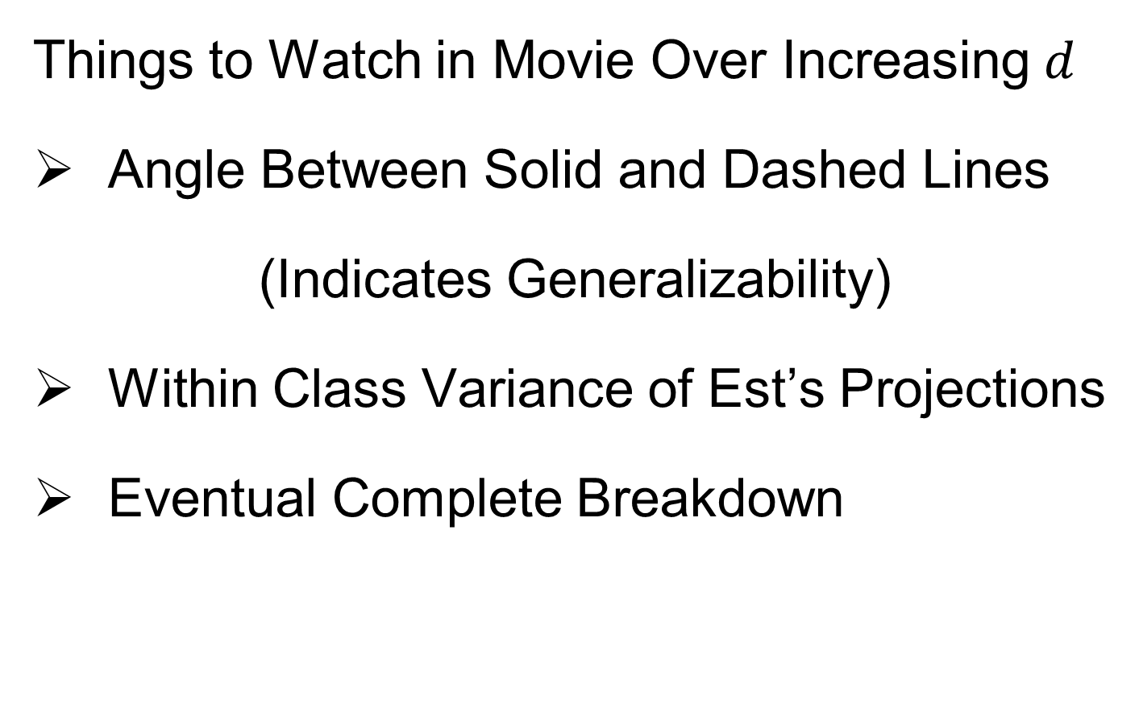
HDLSS Discrimination
Things to Watch in Movie Over Increasing $d$
Angle Between Solid and Dashed Lines
(Indicates Generalizability)
Within Class Variance of Est’s Projections
Eventual Complete Breakdown

Slide 76
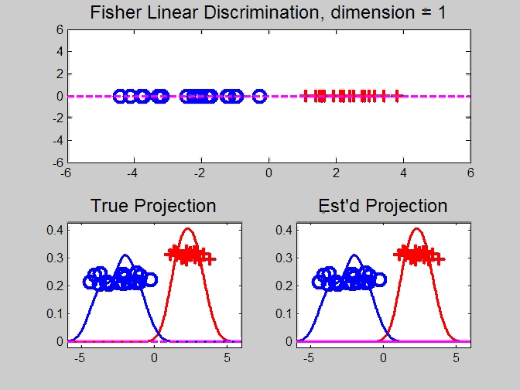
HDLSS Discrimination
Movie Through Increasing Dimensions

Slide 77
HDLSS Discrimination
LDA in Increasing Dimensions:
Low dimensions (d = 2-9):
  Visually good separation
  Small angle between LDA and Optimal
  Good generalizability
Medium Dimensions (d = 10-26):
  Visual separation too good?!?
  Larger angle between LDA and Optimal
  Worse generalizability
  Feel effect of sampling noise

Slide 78
HDLSS Discrimination
LDA in Increasing Dimensions:
High Dimensions (d=27-37):
  Much worse angle
  Very poor generalizability
  But very small within class variation
  Poor separation between classes
  Large separation / variation ratio

Slide 79
HDLSS Discrimination
LDA in Increasing Dimensions:
At HDLSS Boundary (d=38):
  38 = degrees of freedom
  (need to estimate 2 class means)
  Within class variation = 0 ?!?
  Data pile up, on just two points
  Perfect separation / variation ratio?
  But only feels microscopic noise aspects
  So likely not generalizable
  Angle to optimal very large

Slide 80
HDLSS Discrimination
LDA in Increasing Dimensions:
Just beyond HDLSS boundary (d=39-70):
  Improves with higher dimension?!?
  Angle gets better
  Improving generalizability?
  More noise helps classification?!?

Slide 81
HDLSS Discrimination
LDA in Increasing Dimensions:
Far beyond HDLSS boun’ry (d=70-1000):
  Quality degrades
  Projections look terrible
  (populations overlap)
  And Generalizability falls apart, as well
  Asymptotics worked out by Bickel & Levina (2004)
  Problem is estimation of $d×d$ covariance matrix

Slide 82
HDLSS Discrimination
Simple Solution:
Mean Difference (Centroid) Method
Recall not classically recommended
  Usually no better than LDA
  Sometimes worse
But avoids estimation of covariance
Means are very stable
Expect less HDLSS problem

Slide 83
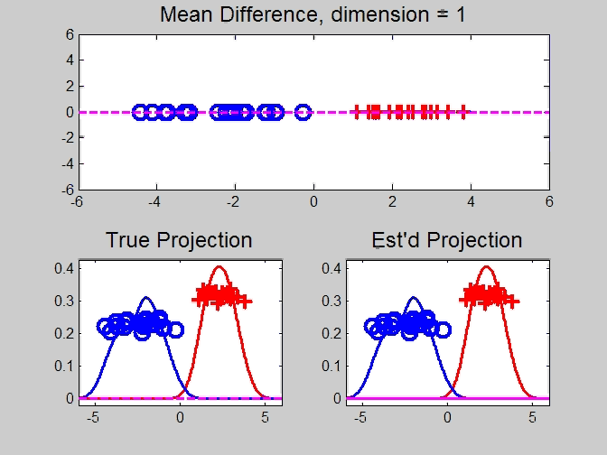
HDLSS Discrimination
Mean Difference (Centroid) Method
Same
Data,
Movie
over
dim’s

Slide 84
HDLSS Discrimination
Mean Difference (Centroid) Method
Far more stable over dimensions
Because is likelihood ratio solution
(for known variance - Gaussians)
Doesn’t feel HDLSS boundary
Eventually becomes too good?!?
Widening gap between clusters?!?
Careful: angle to optimal grows
So lose generalizability (since noise inc’s)
HDLSS data present some odd effects…

Slide 85
Participant Presentation
1:35 Qichen Wang
Breast Cancer Epidemiology Study
Next Class: Yuhao Zhao

