Slide 1
Statistics – O. R. 881 Object Oriented Data Analysis
Steve Marron
Dept. of Statistics and Operations Research
University of North Carolina

Slide 2
Current Sections in Textbook
Today:
Sections 11.1, 11.2
Next Class:
Sections 11.2, 11.3

Slide 3
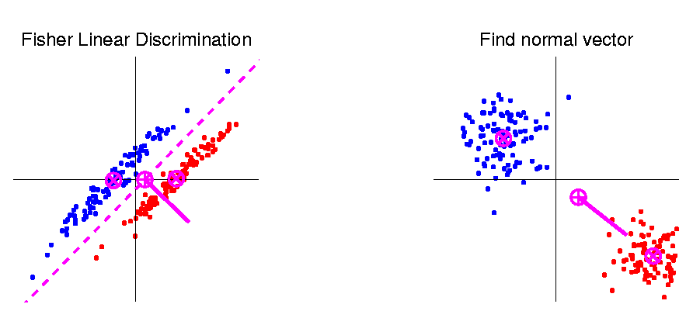
Last Class: Linear Disc. Anal.
So (in orig’l space) have separ’ting hyperplane with:
Normal vector: $n_{LDA}$
Intercept:$μ_{LDA}$
Notes:
HDLSSod1egFLD.ps

Slide 4
Last Class: Classical Discr’n
LDA Likelihood View (cont.)
Replacing $μ^{+}$, $μ^{−}$ and $Σ^{w}$
by maximum likelihood estimates:
${\overline{x}}^{+}$, ${\overline{x}}^{−}$and ${\hat{Σ}}^{w}$
Gives the likelihood ratio discrimination rule:
Choose Class +1, when
$${x_{0}}^{t}{{\hat{Σ}}^{w}}^{−1}\left({\overline{x}}^{+}−{\overline{x}}^{−}\right)≥\frac{1}{2}{\left({\overline{x}}^{+}+{\overline{x}}^{−}\right)}^{t}{{\hat{Σ}}^{w}}^{−1}\left({\overline{x}}^{+}−{\overline{x}}^{−}\right)$$
Same as above, so: LDA can be viewed as
Likelihood Ratio Rule

Slide 5
Last Class: Classical Discr’n
LDA Generalization I
Gaussian Likelihood Ratio Discrimination
(a. k. a. “Nonlinear Discriminant Analysis”)
Idea: Assume
class distributions are $N\left(μ^{⨀},Σ^{⨀}\right)$
Different covariances!
Likelihood Ratio rule is straightf’d num’l calc.
(thus can easily implement, and do discrim’n)

Slide 6
Last Class: Classical Discr’n
LDA Generalization II (Gen. I was GLR)
Different prior probabilities
Main idea:
Give different weights to 2 classes
I.e. assume not a priori equally likely
Canonical Example: Rare Disease Testing
(Often Train on Mostly Rare Cases)

Slide 7
Last Class: Classical Discr’n
LDA Generalization III
Principal Discriminant Analysis
Idea: LDA-like approach to $K>2$ classes
Assumption: Class covariance matrices are the same (similar)
(but not Gaussian, same situation as for LDA)
Main idea:
Quantify “location of classes” by their means
$${\underline{μ}}^{(1)},{\underline{μ}}^{(2)},⋯,{\underline{μ}}^{(K)}$$
Analog of MD
For $K$ Classes

Slide 8
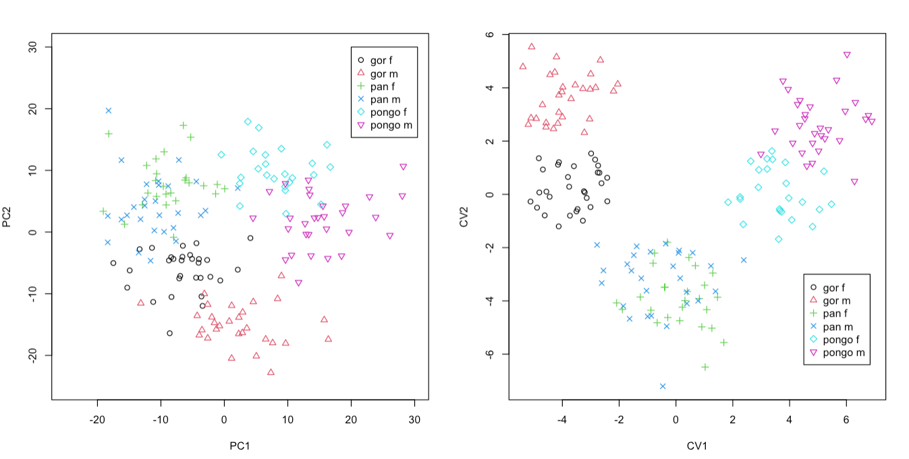
Last Class: Classical Discr’n
Principal Discriminant Analysis Illustrated
Recall Synonyms
Principal Component Analysis
Canonical Variate Analysis
Classes Overlap
Much Better
Separation

Slide 9
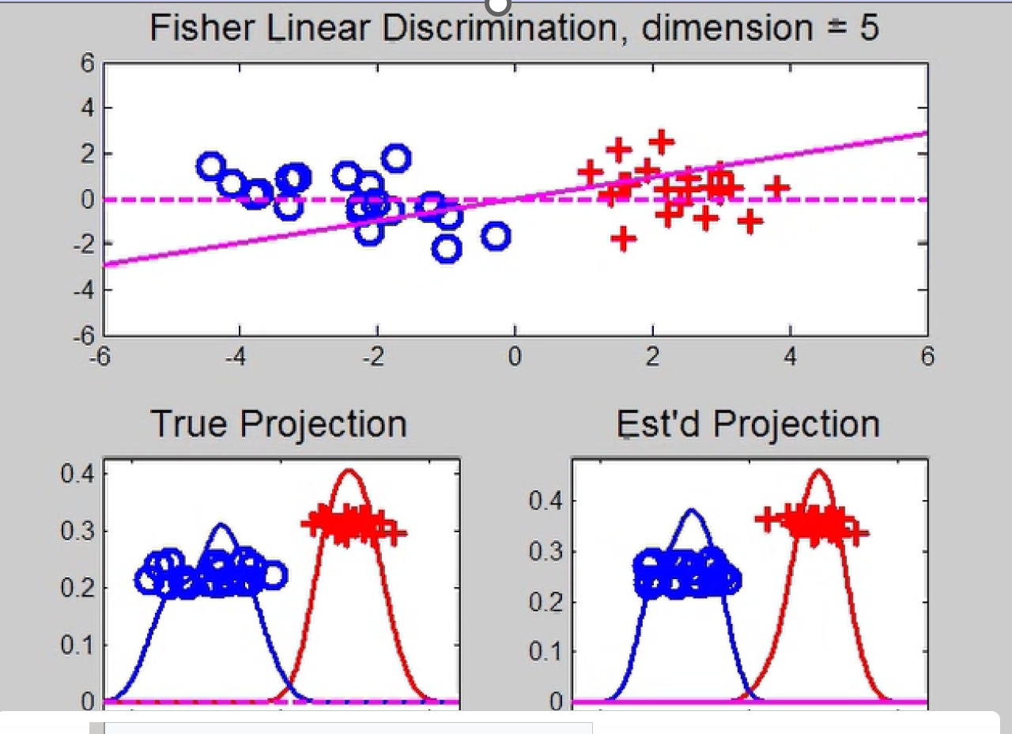
Last Class: HDLSS Discrimi’n
Movie Through Increasing Dimensions
LDA Performs
Well In Low
Dimensions

Slide 10
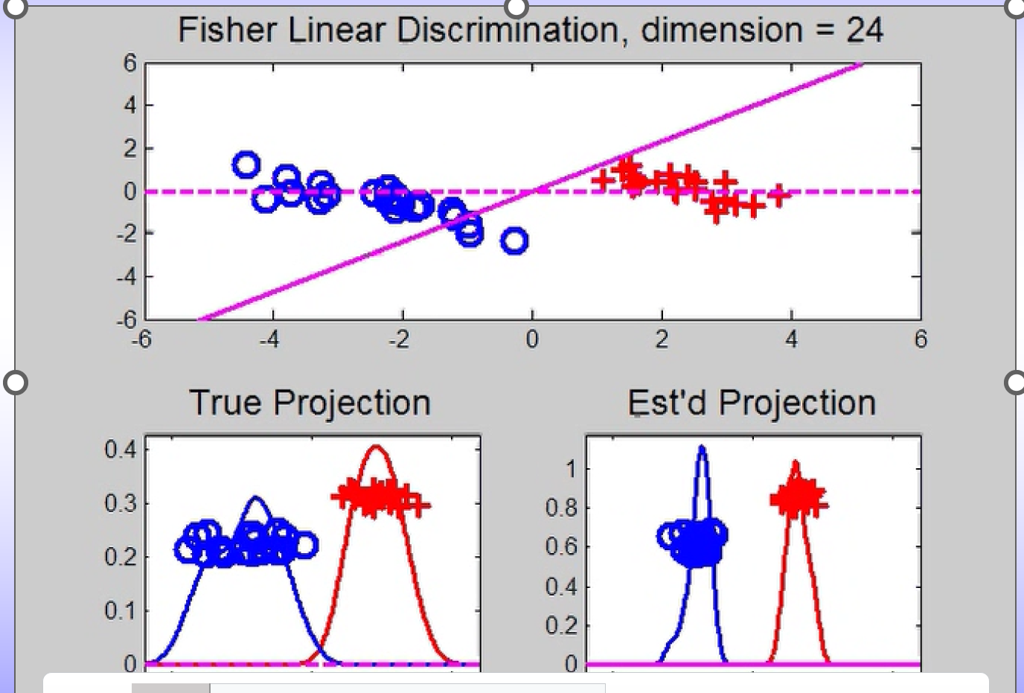
Last Class: HDLSS Discrimi’n
Movie Through Increasing Dimensions
Less Well
In Higher
Dimensions
LDA Direction
Farther From
Optimal

Slide 11
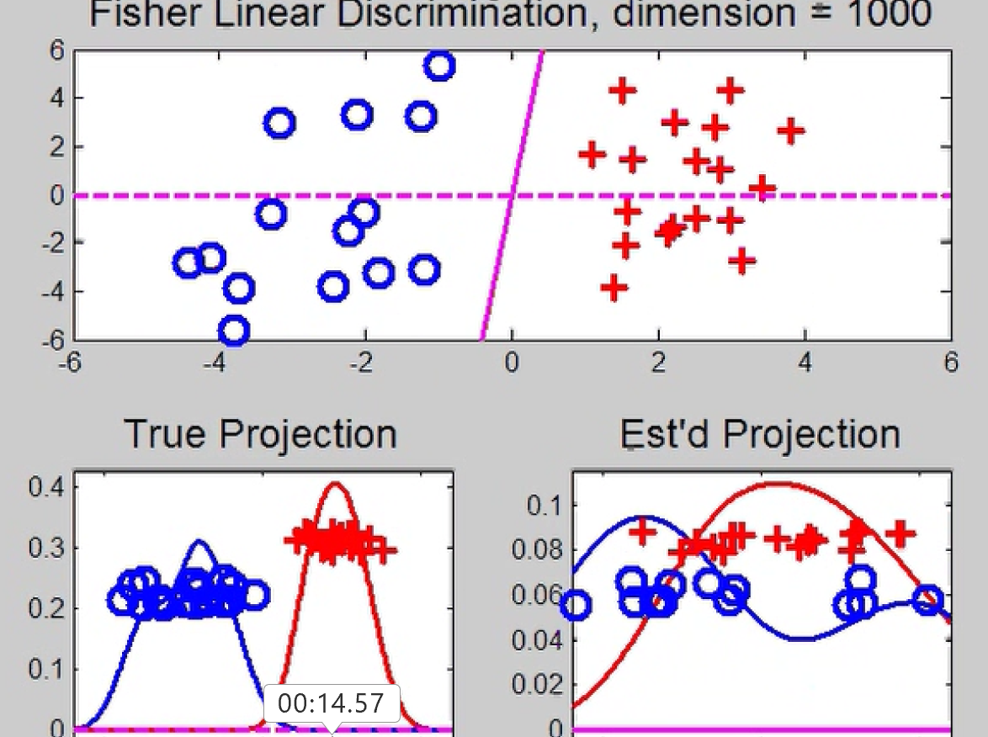
Last Class: HDLSS Discrimi’n
Movie Through Increasing Dimensions
Falls Apart
Completely
In Very High
Dimensions

Slide 12
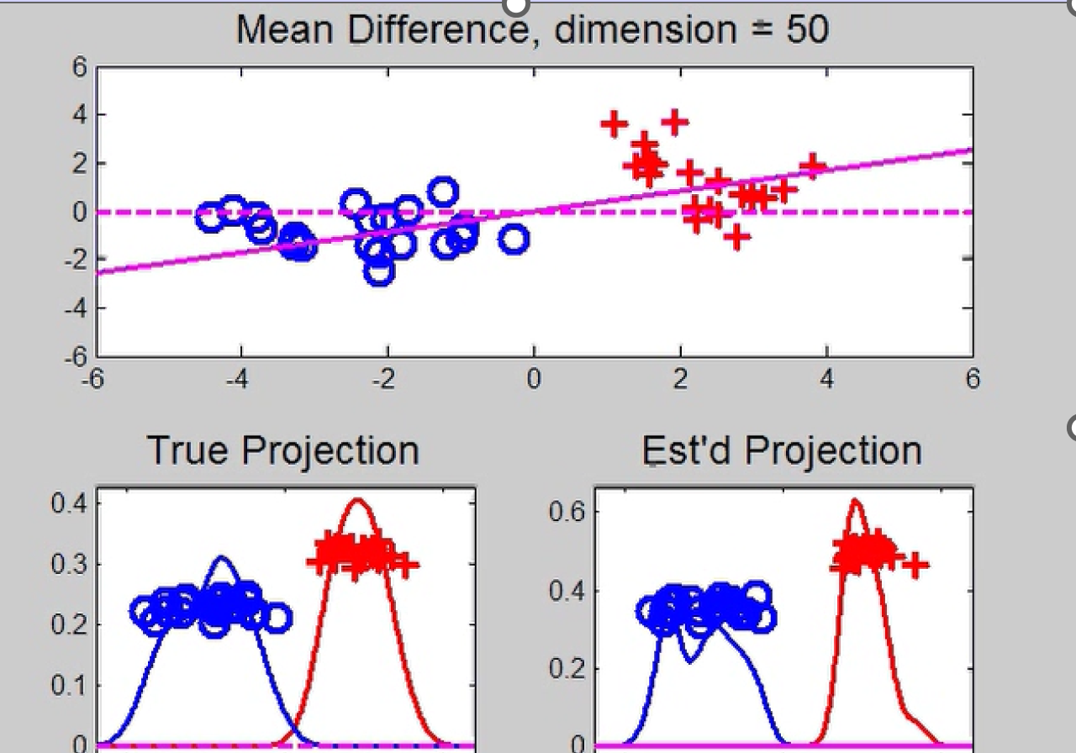
Last Class: HDLSS Discrimi’n
Mean Difference (Centroid) Method
Same
Data,
Movie
over
dim’s
Much Better
Performance
Covariance
Estimation
Has A Cost
In High Dim’n

Slide 13
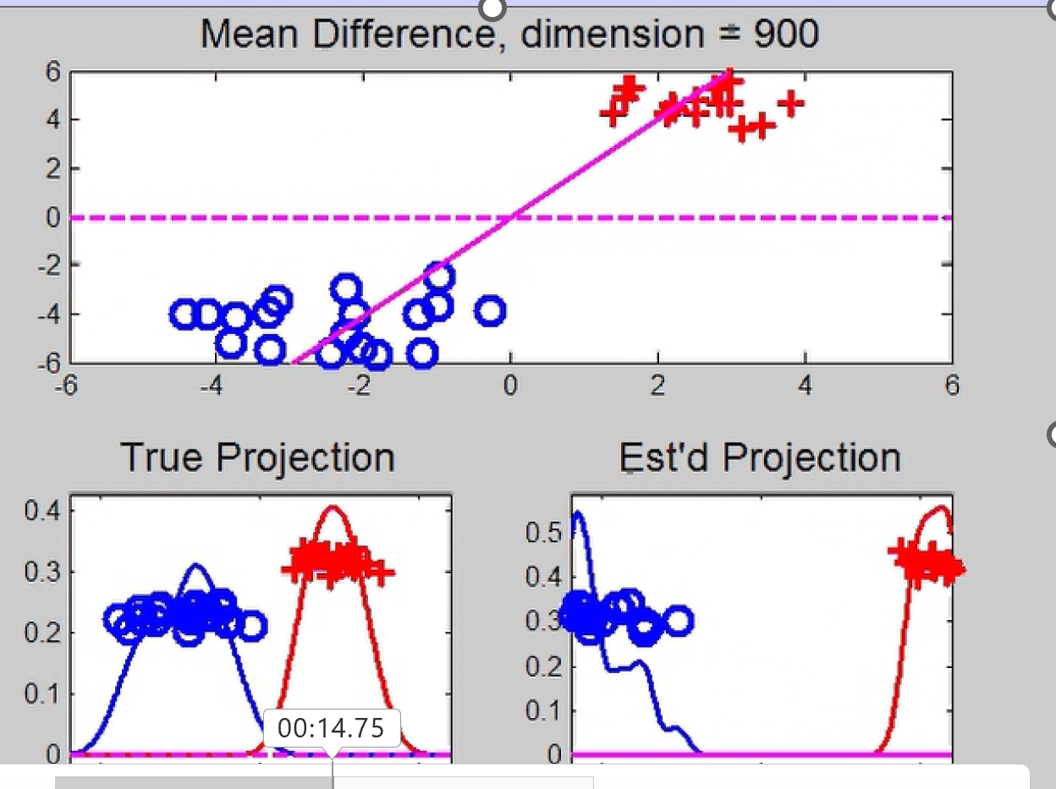
Last Class: HDLSS Discrimi’n
Mean Difference (Centroid) Method
Same
Data,
Movie
over
dim’s
Good Even
in Very
High Dim’n
Among
HDLSS
Effects

Slide 14
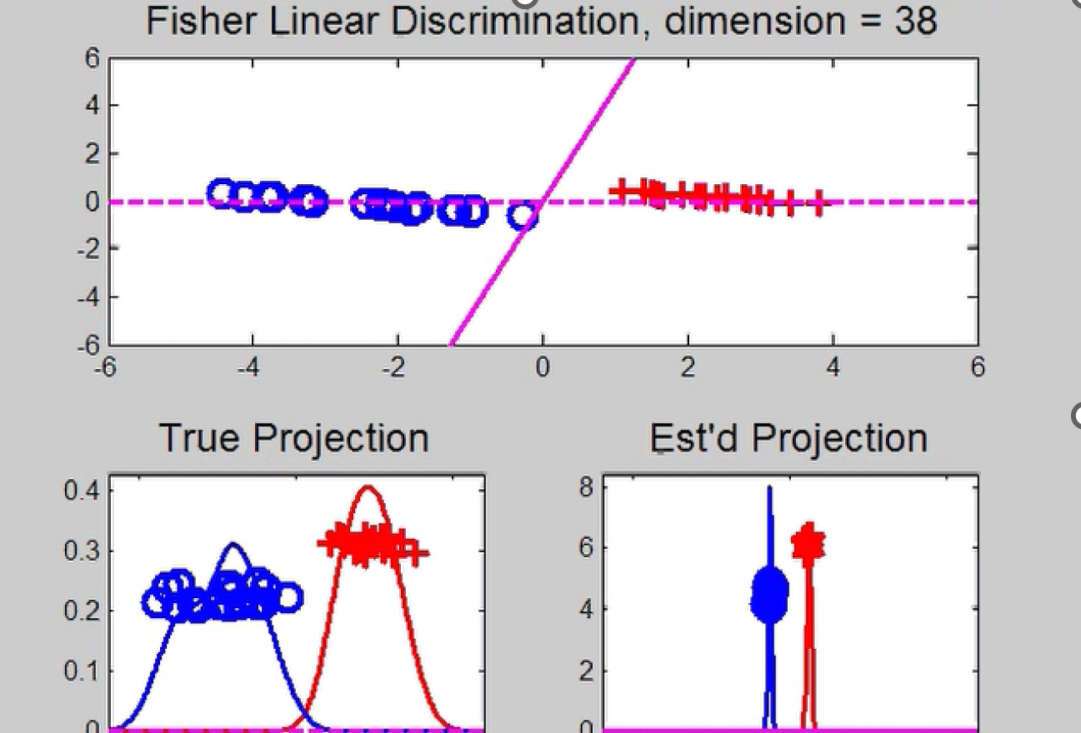
Last Class: HDLSS Discrimi’n
Movie Through Increasing Dimensions
Strange Behavior in Between

Slide 15
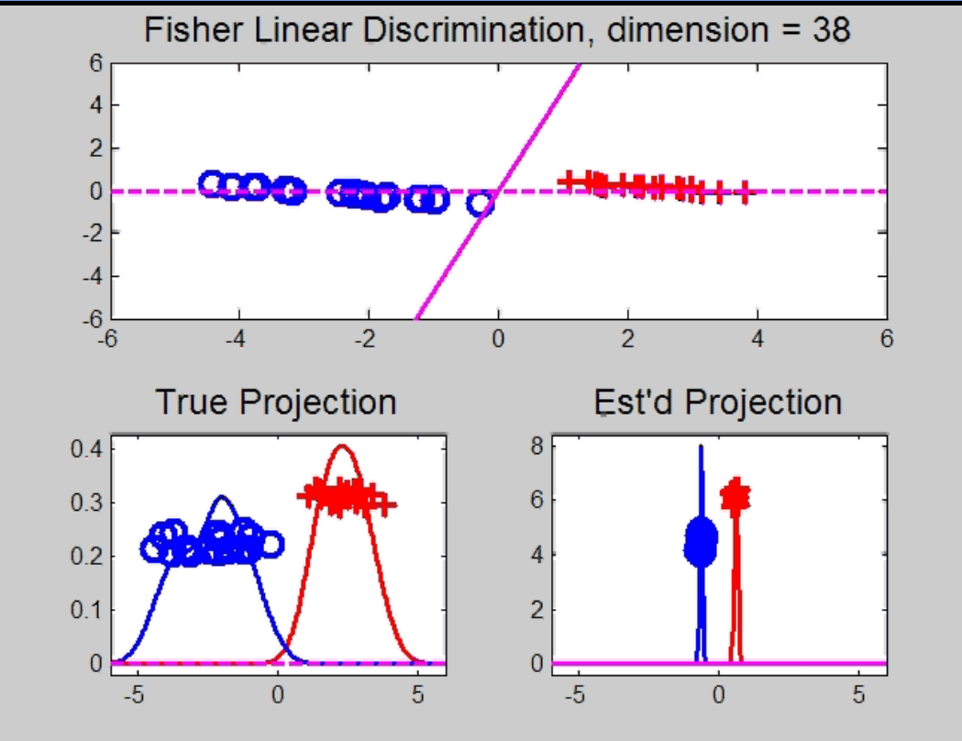
Maximal Data Piling
Text, Sec. 11.1
Strange LDA effect at HDLSS boundary:
Data Piling:
For each class,
all data
project to
single
value

Slide 16
Maximal Data Piling
What is happening?
Hard to imagine
Since our intuition is 3-dim’al
Came from our ancestors…
Try to understand data piling with
some simple examples

Slide 17

Maximal Data Piling
Simple example (Ahn & Marron 2010):
$n_{+}=n_{−}=2$ in $ℝ^{3}$
Let ${ \tilde{H}}_{+}$ be the hyperplane:
Generated by Class +1
Which has dimension = 1
I.e. line containing the 2 points
Similarly, let ${\tilde{H}}_{−}$ be the hyperplane
Generated by Class -1

Slide 18
Maximal Data Piling
Simple example: $n_{+}=n_{−}=2$ in $ℝ^{3}$
Let $H_{+}$, $H_{−}$ be
Parallel shifts of ${\tilde{H}}_{+}$, ${\tilde{H}}_{−}$
So that they pass through the origin
Still have dimension 1
But now are subspaces

Slide 19
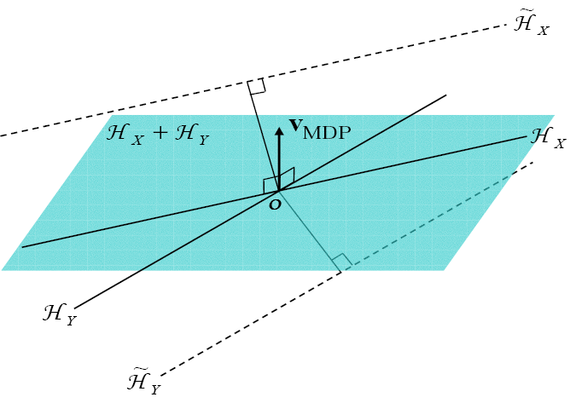
Maximal Data Piling
Simple example: $n_{+}=n_{−}=2$ in $ℝ^{3}$
Notes:
C:\Documents and Settings\J S Marron\My Documents\Research\ComplexPopn\MaxDataPiling\dppic2_2.pdf

Slide 20
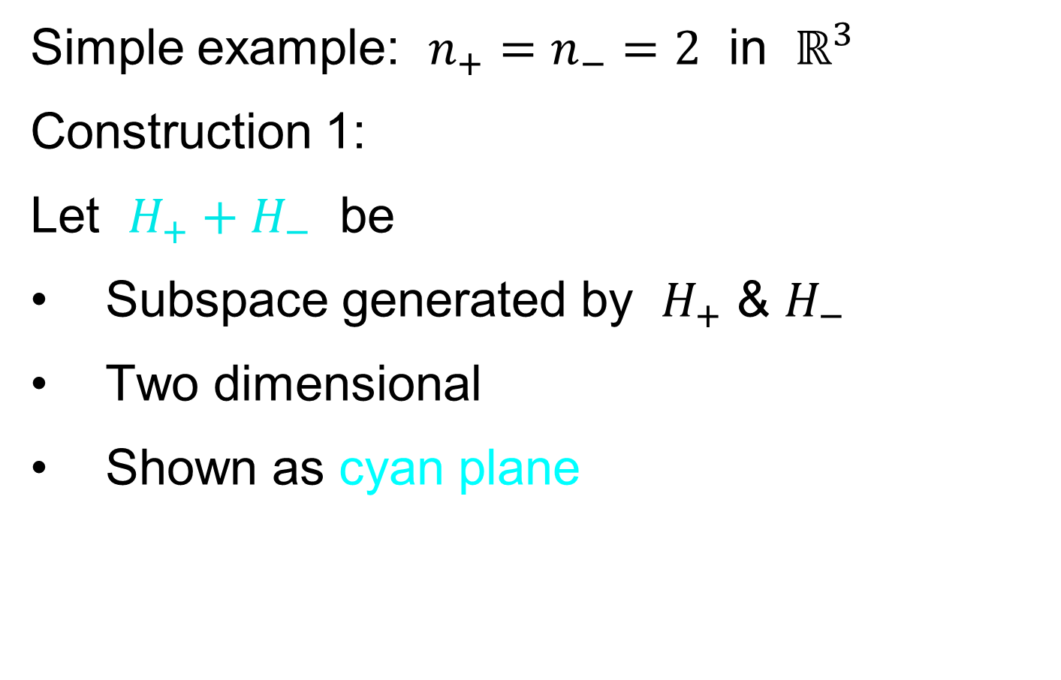
Maximal Data Piling
Simple example: $n_{+}=n_{−}=2$ in $ℝ^{3}$
Construction 1:
Let $H_{+}+H_{−}$ be
Subspace generated by $H_{+}$ & $H_{−}$
Two dimensional
Shown as cyan plane

Slide 21
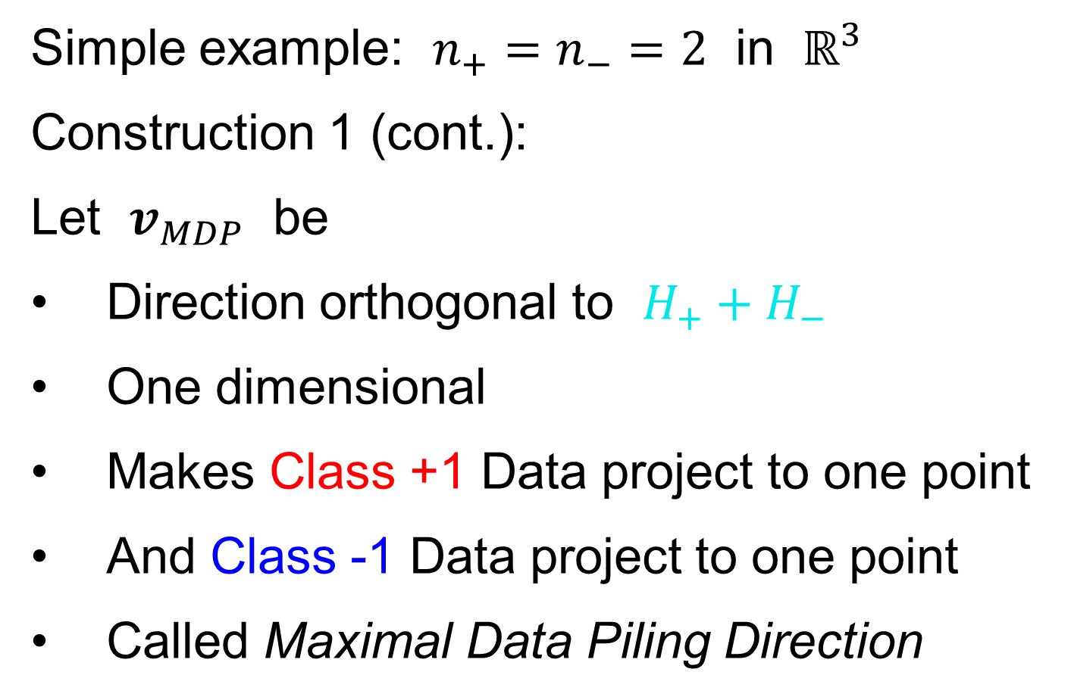
Maximal Data Piling
Simple example: $n_{+}=n_{−}=2$ in $ℝ^{3}$
Construction 1 (cont.):
Let $v_{MDP}$ be
Direction orthogonal to $H_{+}+H_{−}$
One dimensional
Makes Class +1 Data project to one point
And Class -1 Data project to one point
Called Maximal Data Piling Direction

Slide 22
Maximal Data Piling
Simple example: $n_{+}=n_{−}=2$ in $ℝ^{3}$
Notes:
C:\Documents and Settings\J S Marron\My Documents\Research\ComplexPopn\MaxDataPiling\dppic2_2.pdf

Slide 23
Maximal Data Piling
Simple example: $n_{+}=n_{−}=2$ in $ℝ^{3}$
Construction 2:
Let ${H_{+}}^{⊥}$ & ${H_{−}}^{⊥}$ be
Subspaces orthogonal to $H_{+}$ & $H_{−}$
(respectively)
${H_{+}}^{⊥}$ Projection collapses Class +1
${H_{−}}^{⊥}$ Projection collapses Class -1
Both are 2-d (planes)

Slide 24
Maximal Data Piling
Simple example: $n_{+}=n_{−}=2$ in $ℝ^{3}$
Construction 2 (cont.):
Let intersection of ${H_{+}}^{⊥}$ & ${H_{−}}^{⊥}$ be $v_{MDP}$
Same Maximal Data Piling Direction
Projection collapses both
Class +1 and Class -1
Intersection of 2-d (planes) is 1-d dir’n

Slide 25
Maximal Data Piling
General Case: $n_{+}$,$n_{−}$ in $ℝ^{d}$ with $d≥n_{+}+n_{−}$
Let ${\tilde{H}}_{+}$ & ${\tilde{H}}_{−}$ be
Hyperplanes generated by Classes
Of Dimensions $n_{+}−1$, $n_{−}−1$ (resp.)
Let $H_{+}$ & $H_{−}$ be
Parallel subspaces
I.e. shifts to origin
Of Dimensions $n_{+}−1$, $n_{−}−1$ (resp.)

Slide 26
Maximal Data Piling
General Case: $n_{+}$,$n_{−}$ in $ℝ^{d}$ with $d≥n_{+}+n_{−}$
Let ${H_{+}}^{⊥}$ & ${H_{−}}^{⊥}$ be
Orthogonal Subspaces
Of Dim’ns $d−n_{+}+1$, $d−n_{−}+$1 (resp.)
Where
Proj’n in ${H_{+}}^{⊥}$ Dir’ns Collapse Class +1
Proj’n in ${H_{−}}^{⊥}$ Dir’ns Collapse Class -1
Expect $d−n_{+}−n_{−}+2$ intersection

Slide 27
Maximal Data Piling
General Case: $n_{+}$,$n_{−}$ in $ℝ^{d}$ with $d≥n_{+}+n_{−}$
Can show (Ahn & Marron 2010):
Most dir’ns in intersection collapse all to 0
But there is a great circle of directions
(within subspace generated by data)

Slide 28
Maximal Data Piling
General Case: $n_{+}$,$n_{−}$ in $ℝ^{d}$ with $d≥n_{+}+n_{−}$
Can show (Ahn & Marron 2010):
Most dir’ns in intersection collapse all to 0
But there is a great circle of directions,
Where Classes collapse to different points
(Gap changes along great circle,
including sign flips)

Slide 29
Maximal Data Piling
General Case: $n_{+}$,$n_{−}$ in $ℝ^{d}$ with $d≥n_{+}+n_{−}$
Can show (Ahn & Marron 2010):
Most dir’ns in intersection collapse all to 0
But there is a great circle of directions,
Where Classes collapse to different points
Distance is max’ed in 2 direct’ns: $±v_{MDP}$
Called Maximal Data Piling direction(s)
Unique (up to $±$) in subspace of data

Slide 30
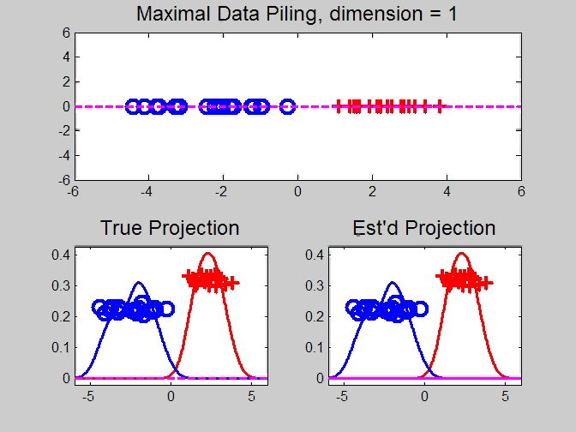
Maximal Data Piling
Movie Through Increasing Dimensions

Slide 31
Maximal Data Piling
MDP in Increasing Dimensions:
Sub HDLSS dimensions (d = 1-37):
Looks similar to FLD?!?
Reason for this?
At HDLSS Boundary (d = 38):
Again similar to FLD…

Slide 32
Maximal Data Piling
FLD in Increasing Dimensions:
For HDLSS dimensions (d = 39-1000):
Always have data piling
Gap between grows for larger n
Even though noise increases?
Angle (gen’bility) first improves, d = 39–180
Then worsens, d = 200-1000
Eventually noise dominates
Trade-off is where gap near optimal diff’nce

Slide 33
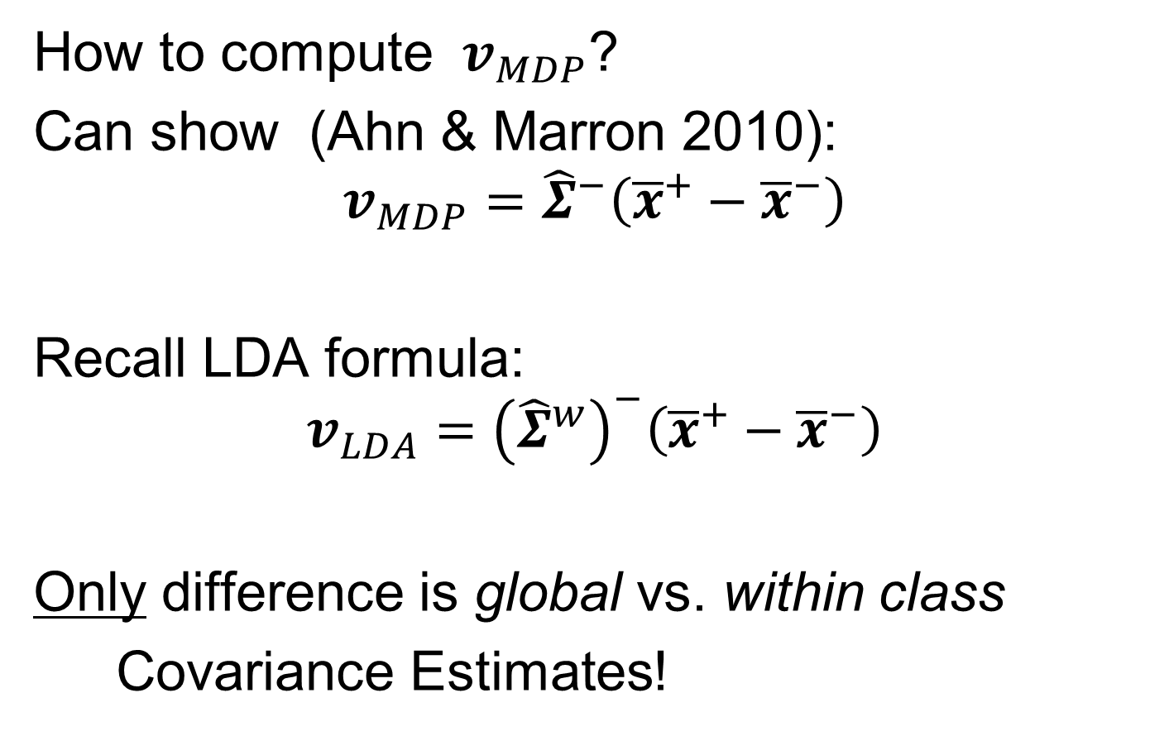
Maximal Data Piling
How to compute $v_{MDP}$?
Can show (Ahn & Marron 2010):
$$v_{MDP}={\hat{Σ}}^{−}\left({\overline{x}}^{+}−{\overline{x}}^{−}\right)$$
Recall LDA formula:
$$v_{LDA}={\left({\hat{Σ}}^{w}\right)}^{−}\left({\overline{x}}^{+}−{\overline{x}}^{−}\right)$$
Only difference is global vs. within class
Covariance Estimates!

Slide 34
Maximal Data Piling
Historical Note:
Discovery of MDP
Came from a programming error
Forgetting to use within class covariance
In LDA…

Slide 35
Maximal Data Piling
Visual similarity of ${\underline{v}}_{MDP}$ & ${\underline{v}}_{LDA}$?
Can show (Ahn & Marron 2010),
for $d≤n−2$:
$${{\underline{v}}_{MDP}}/{\left\|{\underline{v}}_{MDP}\right\|}={{\underline{v}}_{LDA}}/{\left\|{\underline{v}}_{LDA}\right\|}$$
I.e. directions are the same!
How can this be?
Note lengths are different…
Study from transformation viewpoint

Slide 36
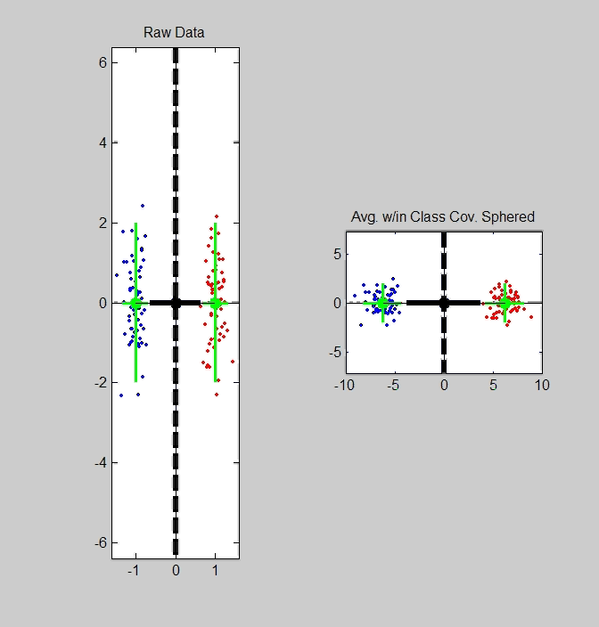
Maximal Data Piling
Recall
Transfo’
view of
LDA:

Slide 37
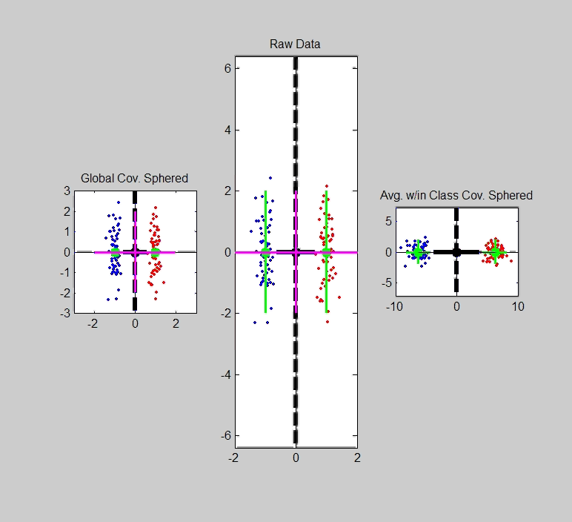
Maximal Data Piling
Include
Corres-
ponding
MDP
Transfo’:
Both give
Same
Result!

Slide 38
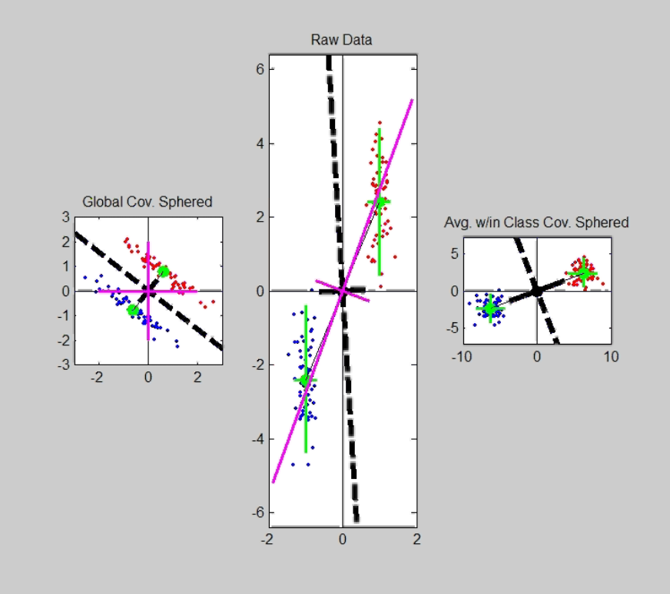
Maximal Data Piling
Details:
LDA & MDP:
Separating Plane
Normal Vector
Computed in Each
Transformed Space,
Shown in Original
Space

Slide 39
Maximal Data Piling
Details:
LDA & MDP:
Separating Plane
Normal Vector
Within Class:
PC1
PC2
Computed for Each
Class Separately

Slide 40
Maximal Data Piling
Details:
LDA & MDP:
Separating Plane
Normal Vector
Within Class:
PC1
PC2
Global:
PC1
PC2
Computed
Globally

Slide 41

Maximal Data Piling
Acknowledgement:
This viewpoint
I.e. insight into why LDA = MDP
(for low dim’al data)
Suggested by Daniel Peña

Slide 42
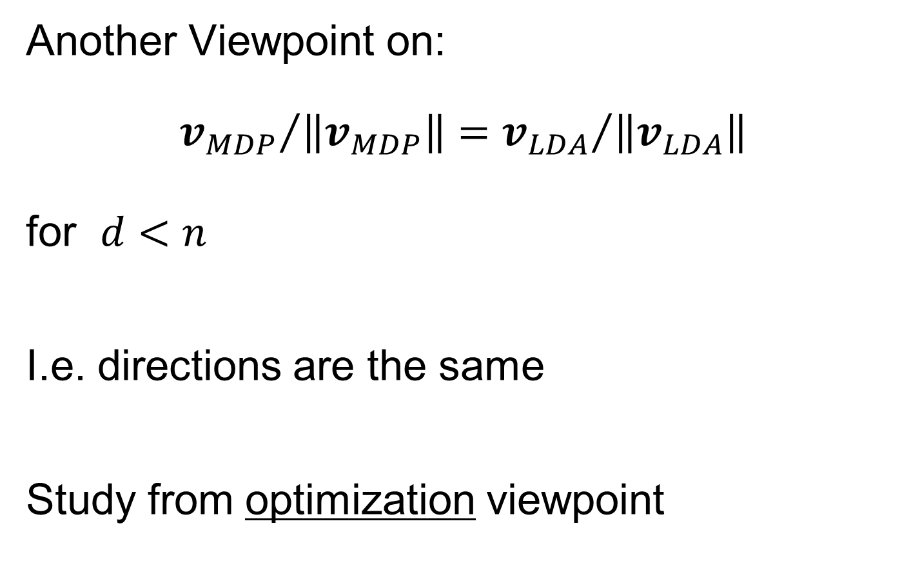
Maximal Data Piling
Another Viewpoint on:
$${v_{MDP}}/{\left\|v_{MDP}\right\|}={v_{LDA}}/{\left\|v_{LDA}\right\|}$$
for $d<n$
I.e. directions are the same
Study from optimization viewpoint

Slide 43
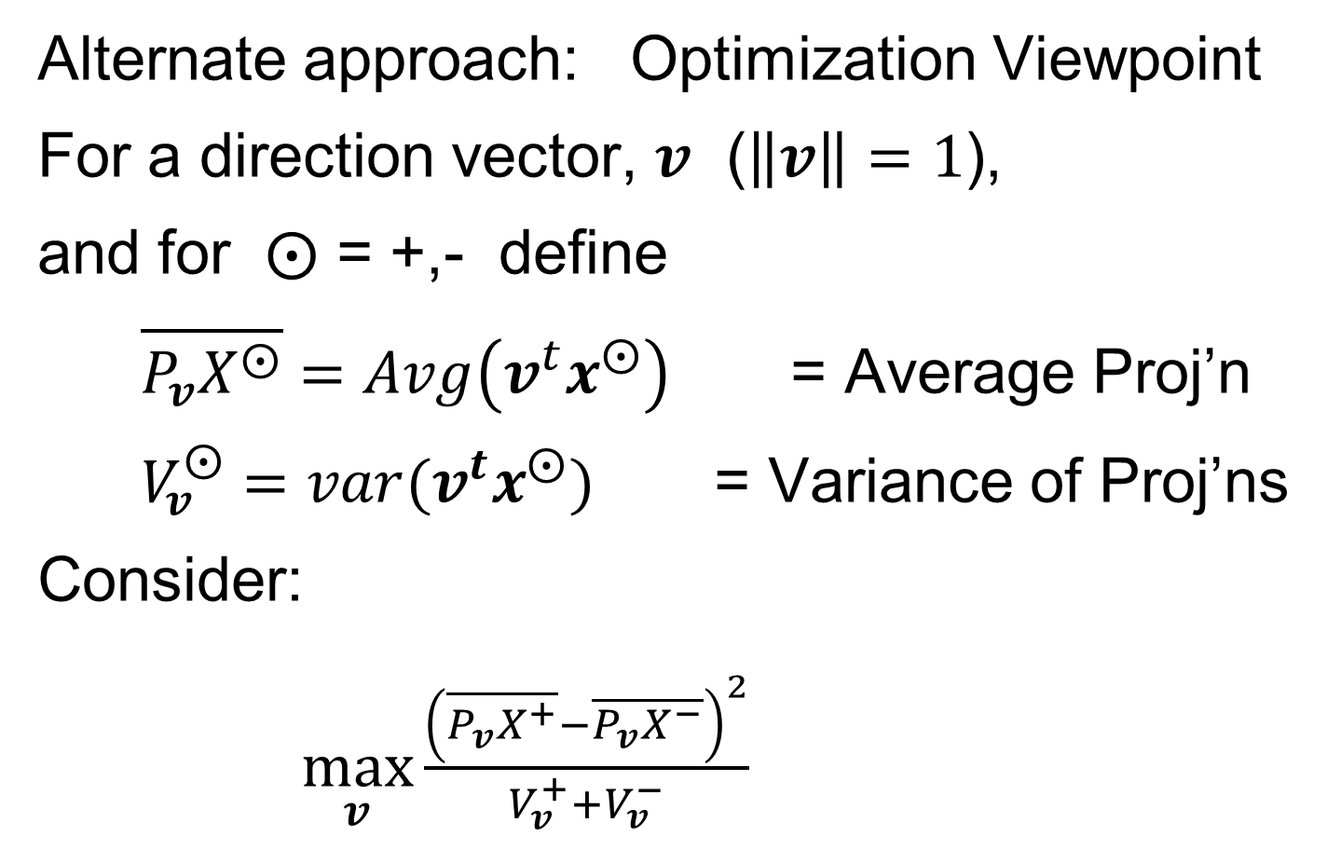
Maximal Data Piling
Alternate approach: Optimization Viewpoint
For a direction vector, $v$ ($\left\|v\right\|=1$),
and for $⨀$ = +,- define
$\overline{P_{v}X^{⨀}}=Avg\left(v^{t}x^{⨀}\right)$ = Average Proj’n
$V_{v}^{⨀}=var(v^{t}x^{⨀})$ = Variance of Proj’ns
Consider:
$\max_{v}{\frac{{\left(\overline{P_{v}X^{+}}−\overline{P_{v}X^{−}}\right)}^{2}}{V_{v}^{+}+V_{v}^{−}}}$
Between Class
Variation
Within Class
Variation

Slide 44
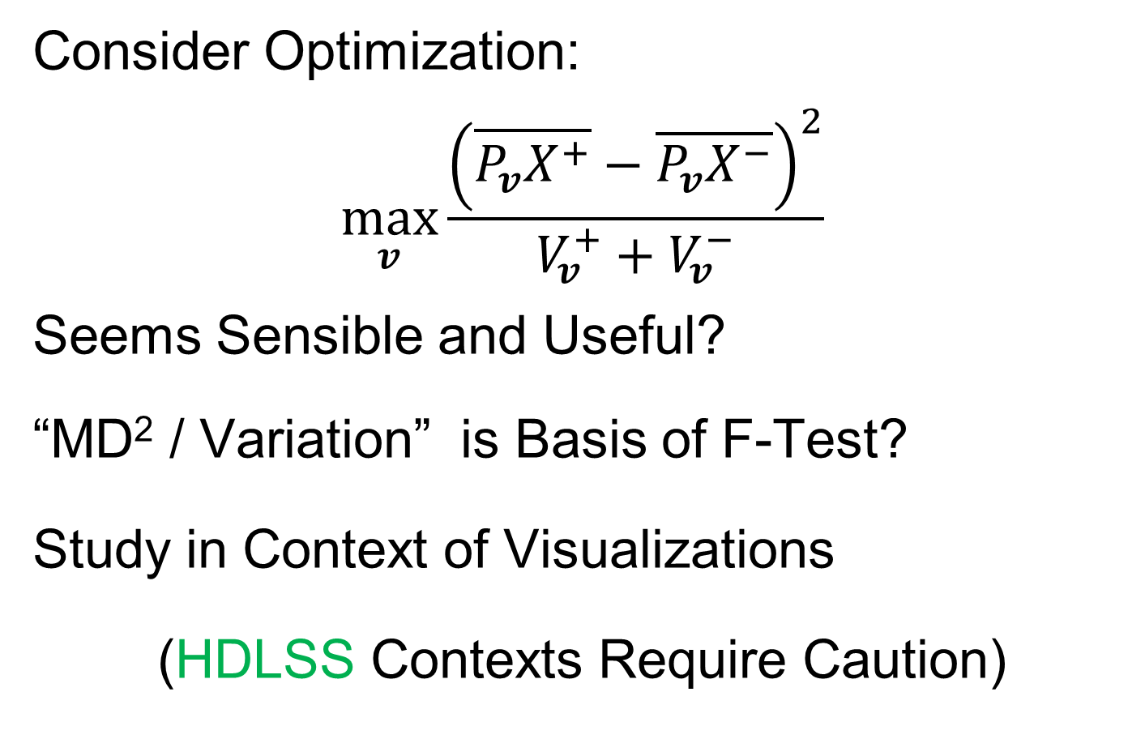
Maximal Data Piling
Consider Optimization:
$$\max_{v}{\frac{{\left(\overline{P_{v}X^{+}}−\overline{P_{v}X^{−}}\right)}^{2}}{V_{v}^{+}+V_{v}^{−}}}$$
Seems Sensible and Useful?
“MD² / Variation” is Basis of F-Test?
Study in Context of Visualizations
(HDLSS Contexts Require Caution)

Slide 45
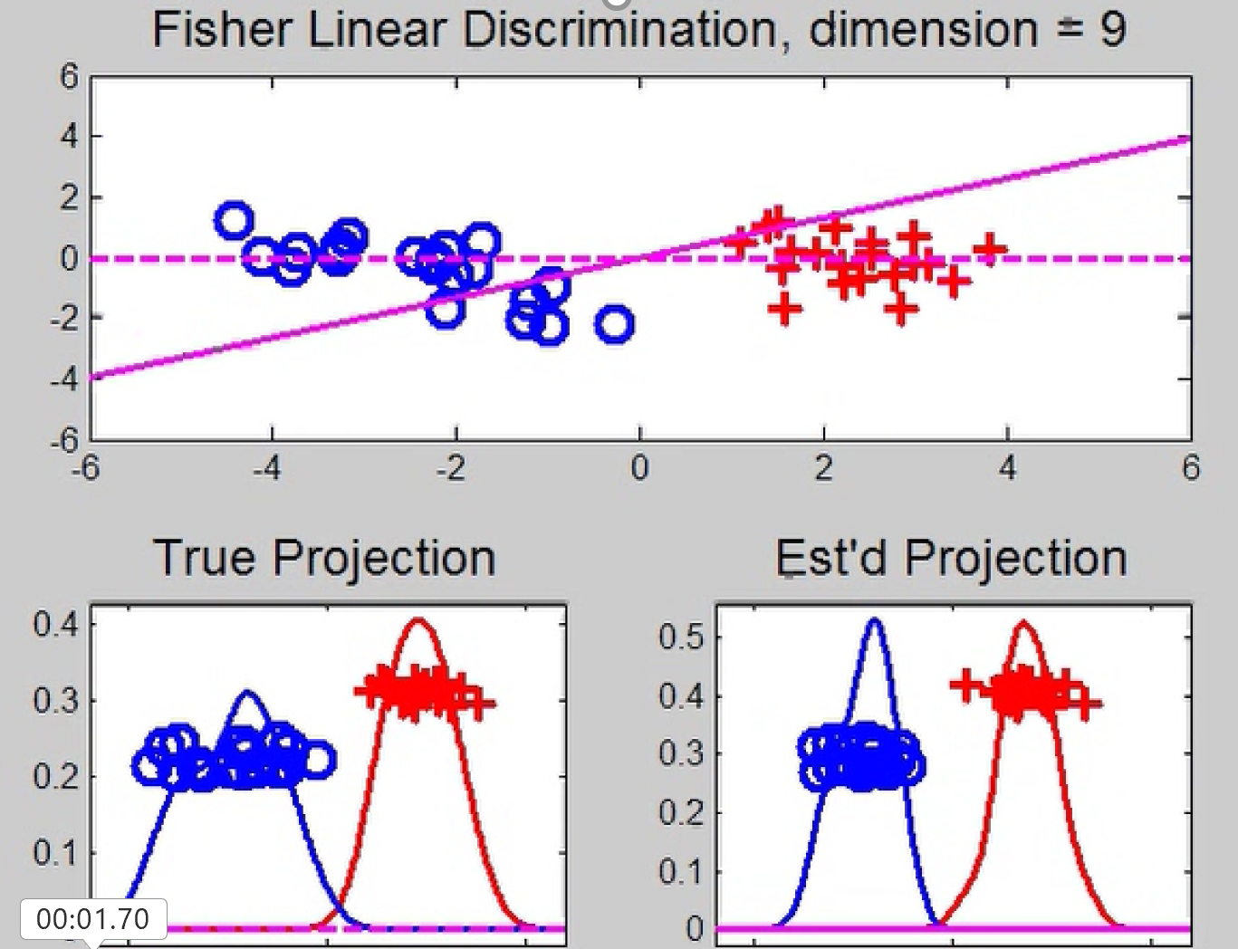
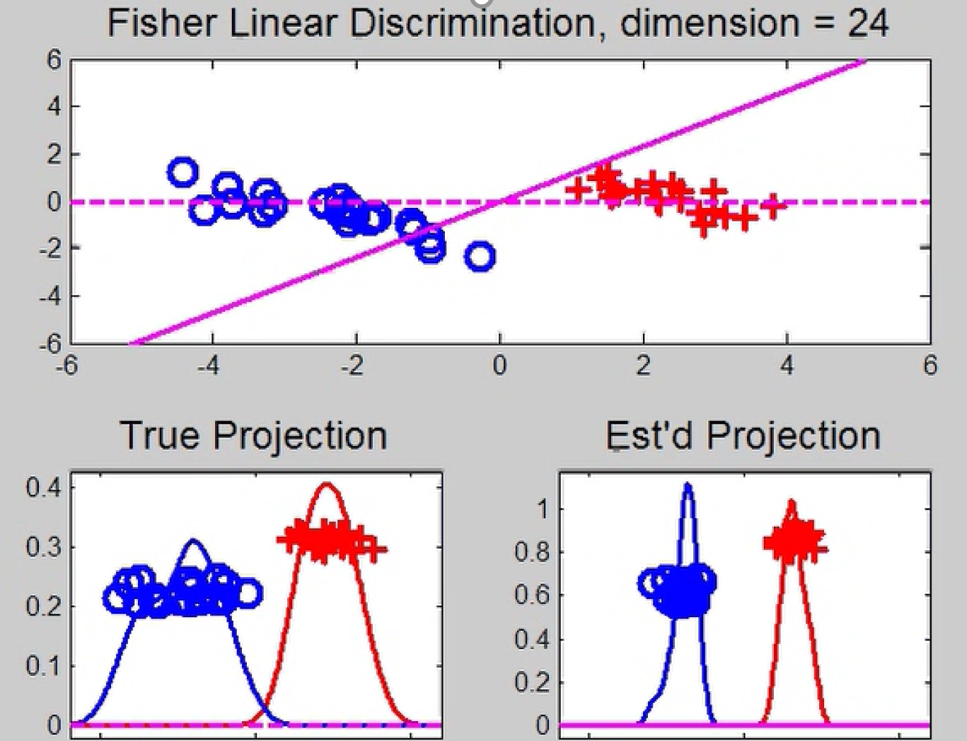

Maximal Data Piling
Now Relate Visualizations to Optimization:
$\max_{v}{\frac{{\left(\overline{P_{v}X^{+}}−\overline{P_{v}X^{−}}\right)}^{2}}{V_{v}^{+}+V_{v}^{−}}}$
Yet Lower $d$
Is More
Generalizable
This is Better
For Higher $d$

Slide 46
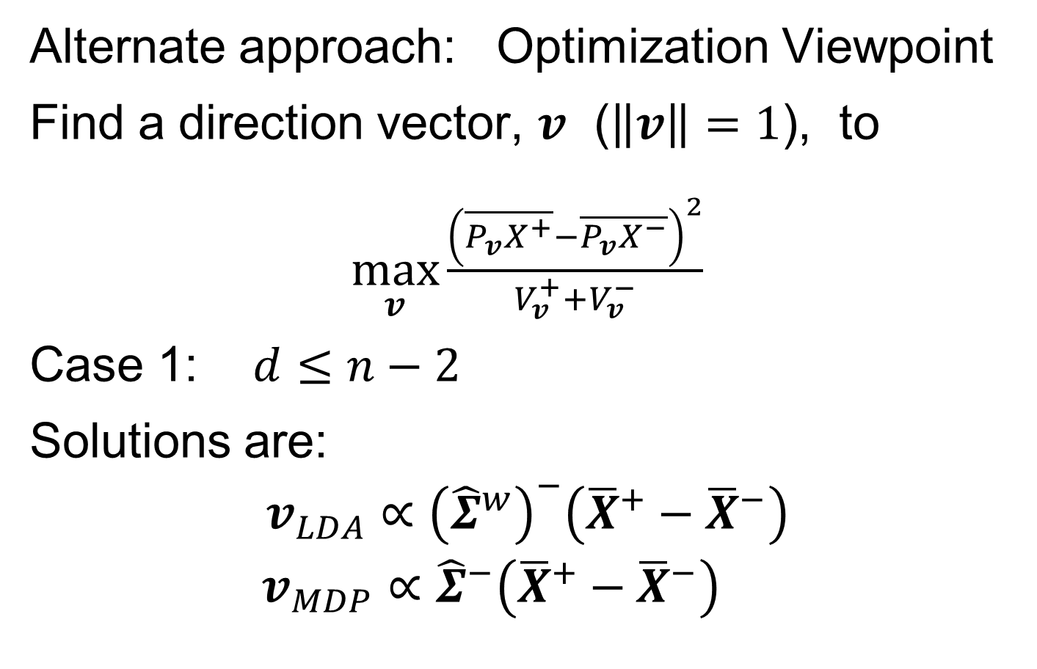
Maximal Data Piling
Alternate approach: Optimization Viewpoint
Find a direction vector, $v$ ($\left\|v\right\|=1$), to
$\max_{v}{\frac{{\left(\overline{P_{v}X^{+}}−\overline{P_{v}X^{−}}\right)}^{2}}{V_{v}^{+}+V_{v}^{−}}}$
Case 1: $d≤n−2$
Solutions are:
$$v_{LDA}∝{\left({\hat{Σ}}^{w}\right)}^{−}\left({\overline{X}}^{+}−{\overline{X}}^{−}\right)$$
$$v_{MDP}∝{\hat{Σ}}^{−}\left({\overline{X}}^{+}−{\overline{X}}^{−}\right)$$
E.g. Sec. 3.8.2 of
Duda et al (2001)
Common
Practice In
Literature:
Assume
This, But
Not Make It
Very Clear

Slide 47
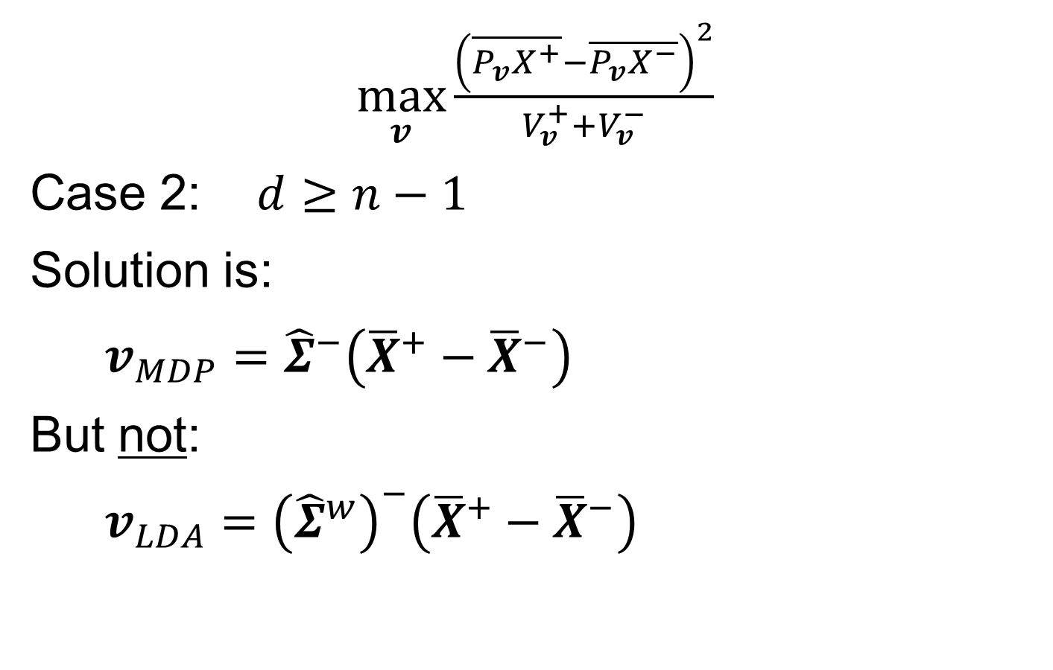
Maximal Data Piling
$\max_{v}{\frac{{\left(\overline{P_{v}X^{+}}−\overline{P_{v}X^{−}}\right)}^{2}}{V_{v}^{+}+V_{v}^{−}}}$
Case 2: $d≥n−1$
Solution is:
$v_{MDP}={\hat{Σ}}^{−}\left({\overline{X}}^{+}−{\overline{X}}^{−}\right)$
But not:
$v_{LDA}={\left({\hat{Σ}}^{w}\right)}^{−}\left({\overline{X}}^{+}−{\overline{X}}^{−}\right)$
Point
Not Made
Anywhere
Else???

Slide 48
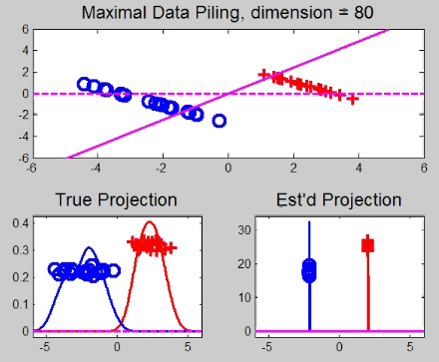
Maximal Data Piling
A point of terminology (Ahn & Marron 2010):
MDP is “maximal” in 2 senses:
# of data piled
Size of gap
(within subspace
gen’d by data)

Slide 49
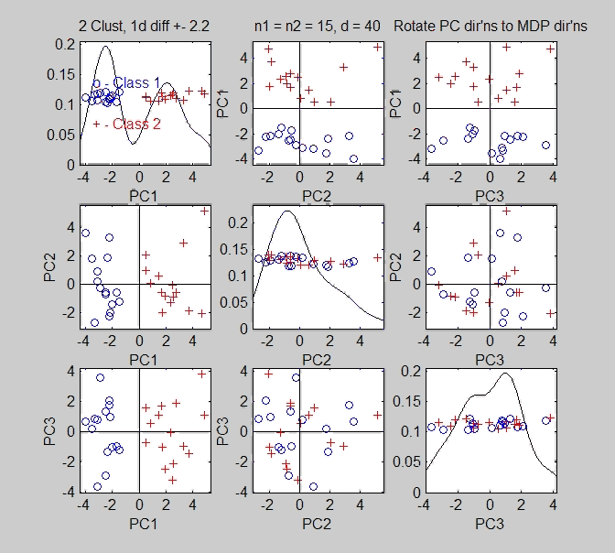
Maximal Data Piling
Fun e.g:
rotate
from PCA
to MDP
dir’ns

Slide 50
Maximal Data Piling
MDP for other class labellings:
Always exists
Separation bigger for natural clusters
Could be used for clustering
Consider all pairwise MDP directions
Find one that makes largest gap
Very hard optimization problem
Over 2^{n-2} possible directions
Ahn, et al. (2012)
Major Challenge:
Fast Computation?

Slide 51
Maximal Data Piling
Usefulness for Classification?
First Glance: Terrible, not generalizable
HDLSS View: Maybe OK?
Simulation Result:
Good Performance for
Autocorrelated Errors
Every Dog
Has His Day
Reason: Induces Stretch in Data - Miao (2015)

Slide 52
Maximal Data Piling
Recurring, over-arching, issue:
HDLSS space is a weird place

Slide 53
Kernel Embedding
Aizerman, Braverman and Rozoner (1964)
Motivating idea:
Extend scope of linear discrimination,
By adding nonlinear components to data
(embedding in a higher dim’al space)
Better use of name:
nonlinear discrimination?
Text: Sec. 11.2

Slide 54
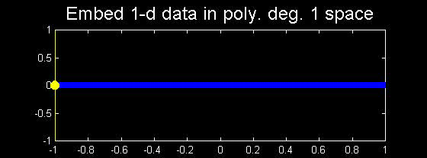
Kernel Embedding
Toy Examples:
In 1d, linear separation splits the domain
$\left\{x:x∈ℝ\right\}$ into only 2 parts

Slide 55
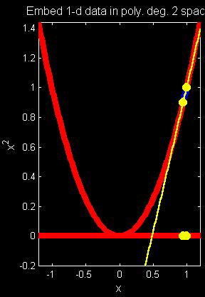
Kernel Embedding
But in the “quadratic
embedded domain”,
$\left\{{\left(x,x^{2}\right)}^{t}:x∈ℝ\right\}⊂ℝ^{2}$
linear separation
can give 3 parts

Slide 56
Kernel Embedding
But in the quadratic embedded domain
$\left\{{\left(x,x^{2}\right)}^{t}:x∈ℝ\right\}⊂ℝ^{2}$
Linear separation can give 3 parts
original data space lies in 1d manifold
very sparse region of $ℝ^{2}$
curvature of manifold gives:
better linear separation
can have any 2 break points
(2 points $⟹$ line)

Slide 57
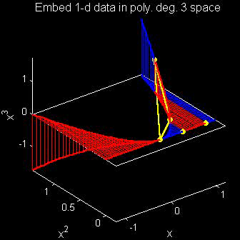
Kernel Embedding
Stronger effects for
higher order
polynomial embedding:
E.g. for cubic,
$\left\{{\left(x,x^{2},x^{3}\right)}^{t}:x∈ℝ\right\}⊂ℝ^{3}$
linear separation
can give 4 parts
(or fewer)

Slide 58
Kernel Embedding
Stronger effects - high. ord. poly. embedding:
original space lies in 1-d manifold,
even sparser in $ℝ^{3}$
higher $d$ curvature gives:
improved linear separation
can have any 3 break points
(3 points $⟹$ plane)?
Note: relatively few
“interesting separating planes”

Slide 59
Kernel Embedding
General View: for original data matrix:
$$\left(\begin{matrix}x_{11} & ⋯ & x_{1n} \\ ⋮ & ⋱ & ⋮ \\ x_{d1} & ⋯ & x_{dn}\end{matrix}\right)$$
add rows:
i.e. embed in
Higher
Dimensional
space
$$\left(\begin{matrix}\begin{matrix}x_{11} \\ ⋮ \\ x_{d1}\end{matrix} & & \begin{matrix}x_{1n} \\ ⋮ \\ x_{dn}\end{matrix} \\ \begin{matrix}x_{11}^{2} \\ ⋮ \\ x_{d1}^{2}\end{matrix} & ⋯ & \begin{matrix}x_{1n}^{2} \\ ⋮ \\ x_{dn}^{2}\end{matrix} \\ \begin{matrix}x_{11}x_{21} \\ ⋮\end{matrix} & & \begin{matrix}x_{1d}x_{2d} \\ ⋮\end{matrix}\end{matrix}\right)$$

Slide 60
Kernel Embedding
Embedded Linear Discriminant Analysis:
Choose Class +1, for any ${\underline{x}}^{0}∈ℝ^{d}$ when:
$${x^{0}}^{t}{{\hat{Σ}}^{w}}^{−1}\left({\overline{x}}^{+}−{\overline{x}}^{−}\right)≥\frac{1}{2}{{{\left({\overline{x}}^{+}+{\overline{x}}^{−}\right)}^{t}\hat{Σ}}^{w}}^{−1}\left({\overline{x}}^{+}−{\overline{x}}^{−}\right)$$
in embedded space.
Image of class boundaries in original space is nonlinear
Allows more complicated class regions
Can also do Gaussian Lik. Rat. (or others)
Compute image by classifying points from original space

Slide 61
Kernel Embedding
Visualization for Toy Examples:
Have Linear Disc. In Embedded Space
Study Effect in Original Data Space
Via Implied Nonlinear Regions
Challenge: Hard to Explicitly Compute

Slide 62
Kernel Embedding
Visualization for Toy Examples:
Have Linear Disc. In Embedded Space
Study Effect in Original Data Space
Via Implied Nonlinear Regions
Approach:
Use Test Set in Original Space
(dense equally spaced grid)
Apply embedded discrimination Rule
Color Using the Result

Slide 63
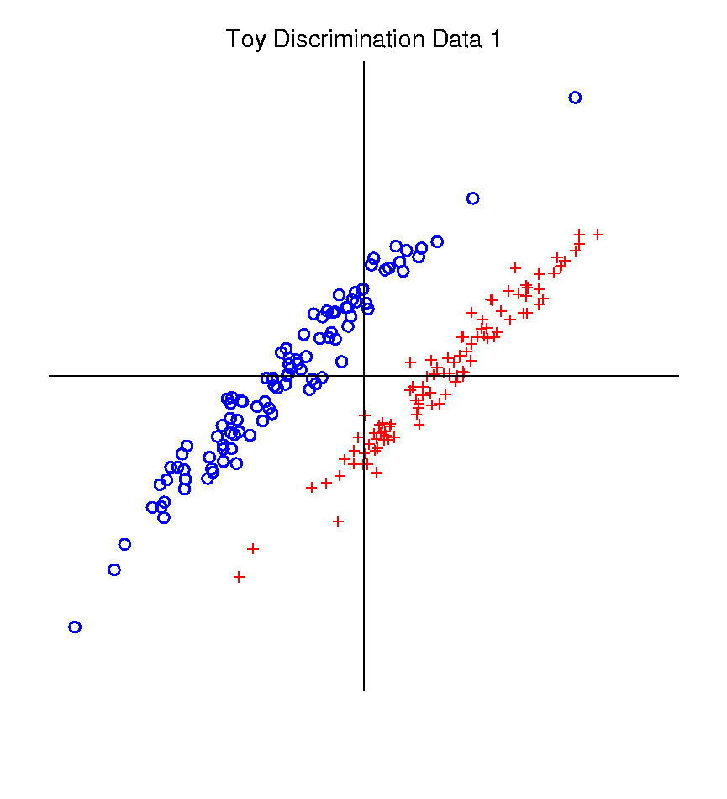
Kernel Embedding
Recall Classifier Display Device:
Parallel Clouds
Use Yellow for Grid
Points Assigned
to Plus Class
Use Cyan for Grid
Points Assigned
to Minus Class
Notes:
PEod1Raw.ps

Slide 64
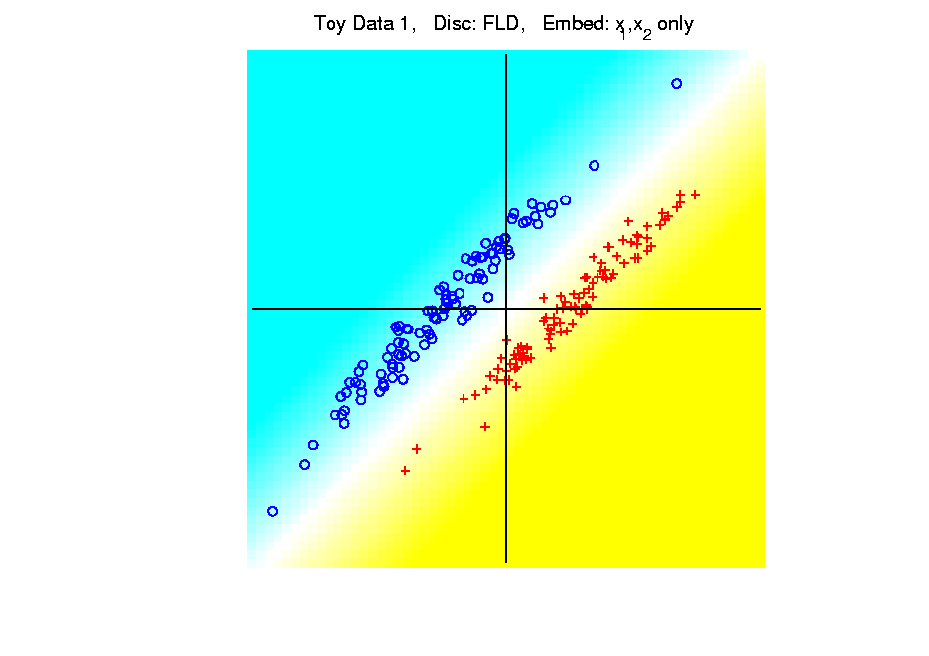
Kernel Embedding
Polynomial Embedding, Toy Example 1:
Parallel Clouds
LDA
Original
Data
Notes:
PEod1Raw.ps

Slide 65
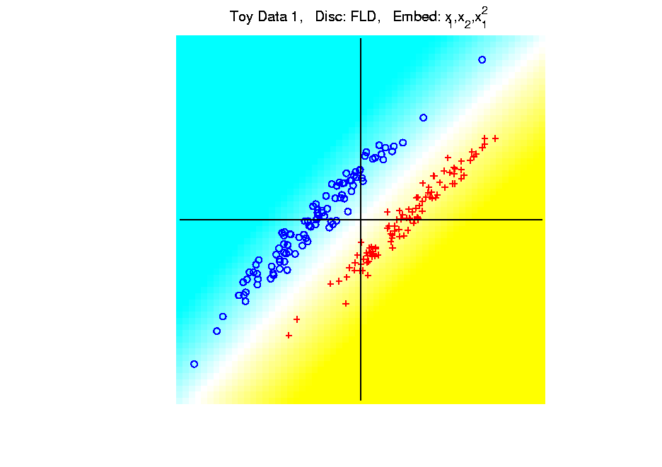
Kernel Embedding
Polynomial Embedding, Toy Example 1:
Parallel Clouds
LDA
Notes:
PEod1Raw.ps

Slide 66
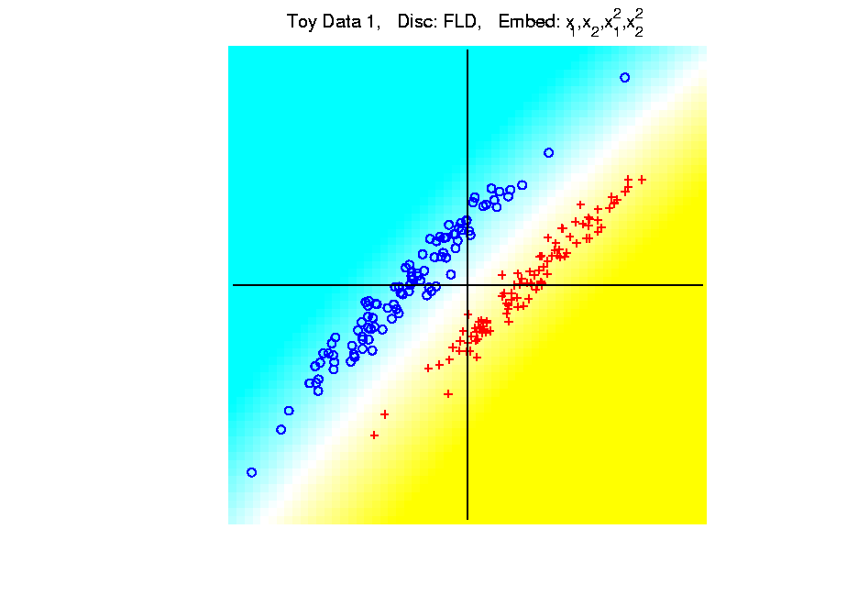
Kernel Embedding
Polynomial Embedding, Toy Example 1:
Parallel Clouds
LDA
Notes:
PEod1Raw.ps

Slide 67
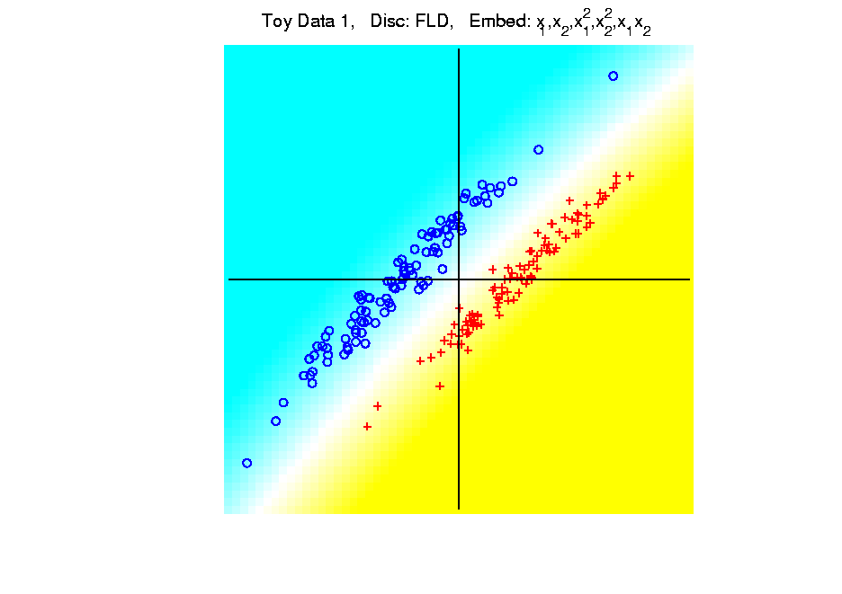
Kernel Embedding
Polynomial Embedding, Toy Example 1:
Parallel Clouds
LDA
Notes:
PEod1Raw.ps

Slide 68
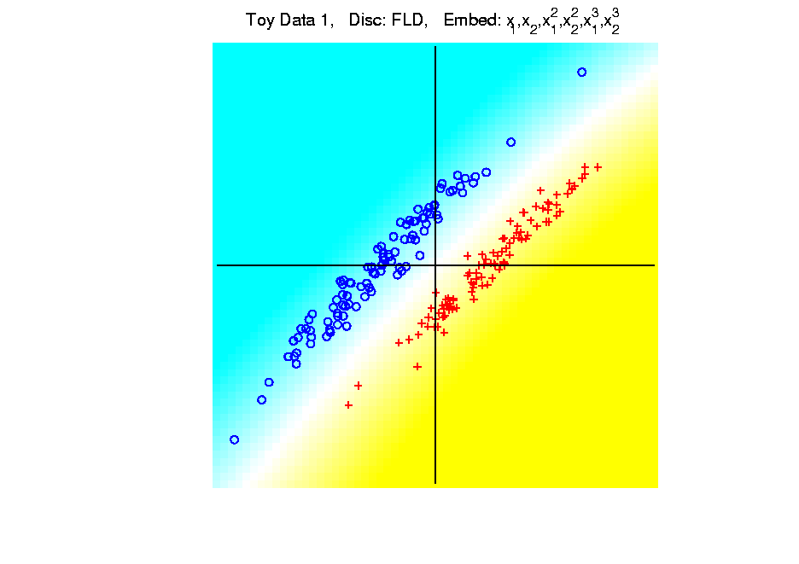
Kernel Embedding
Polynomial Embedding, Toy Example 1:
Parallel Clouds
LDA
All Stable
& Very Good
Since No Better
Separation in
Embedded Space
Notes:
PEod1Raw.ps

Slide 69
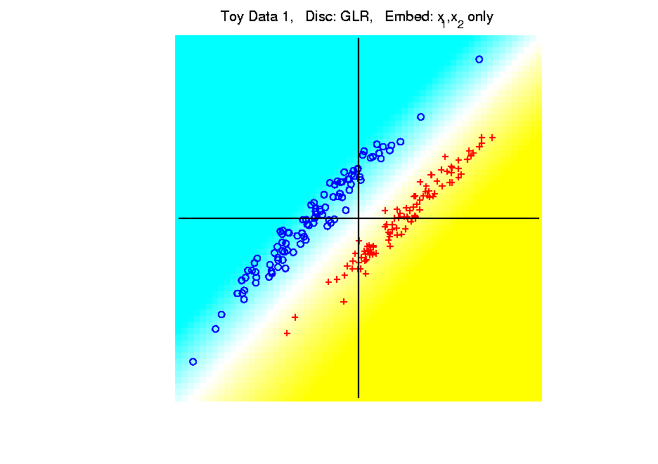
Kernel Embedding
Polynomial Embedding, Toy Example 1:
Parallel Clouds
GLR
Original
Data
Notes:
PEod1Raw.ps

Slide 70
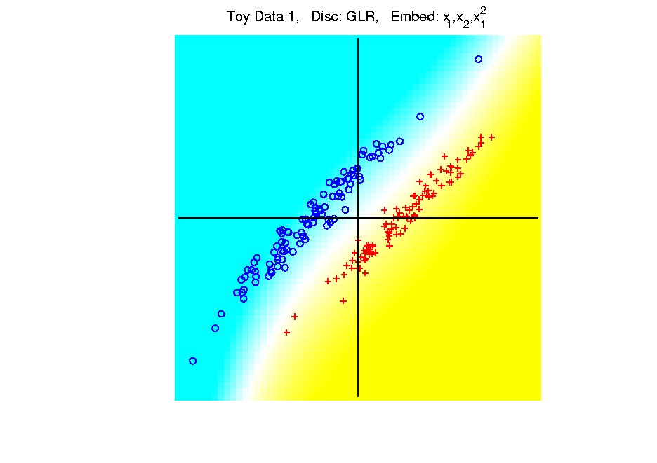
Kernel Embedding
Polynomial Embedding, Toy Example 1:
Parallel Clouds
GLR
Notes:
PEod1Raw.ps

Slide 71
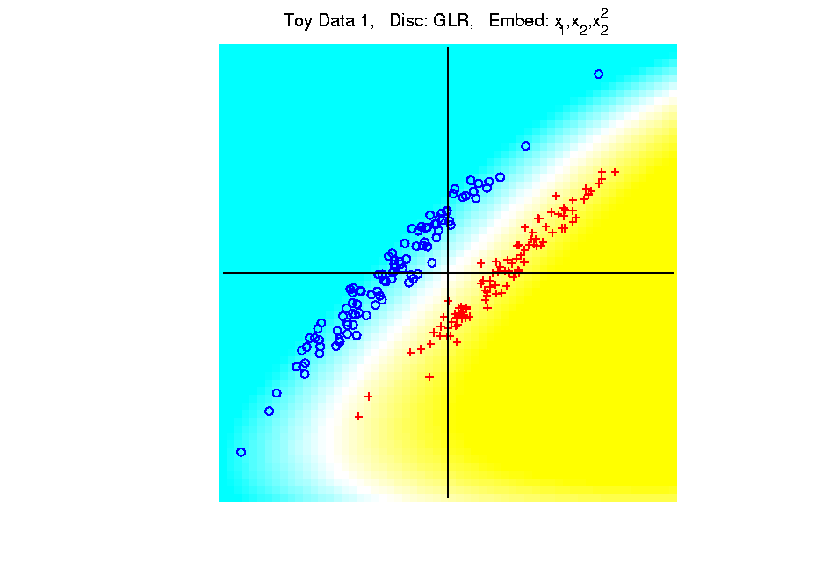
Kernel Embedding
Polynomial Embedding, Toy Example 1:
Parallel Clouds
GLR
Notes:
PEod1Raw.ps

Slide 72
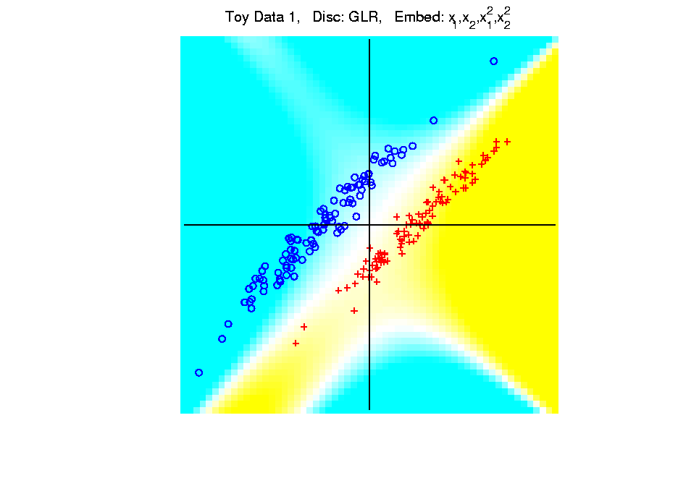
Kernel Embedding
Polynomial Embedding, Toy Example 1:
Parallel Clouds
GLR
Notes:
PEod1Raw.ps

Slide 73
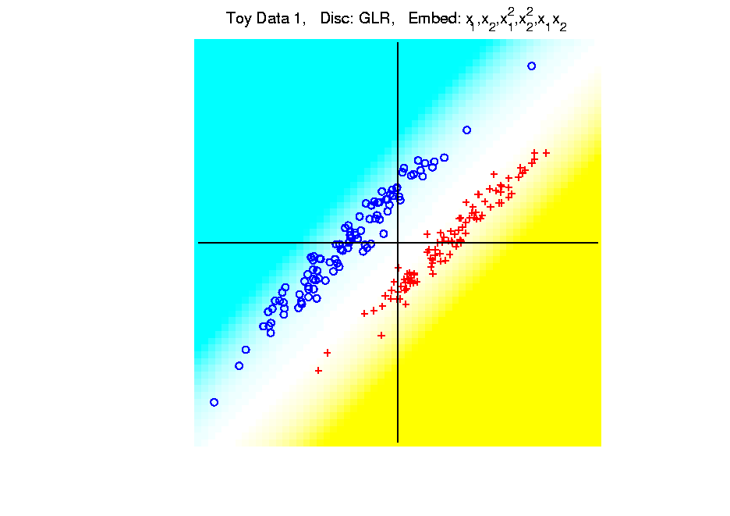
Kernel Embedding
Polynomial Embedding, Toy Example 1:
Parallel Clouds
GLR
Notes:
PEod1Raw.ps

Slide 74
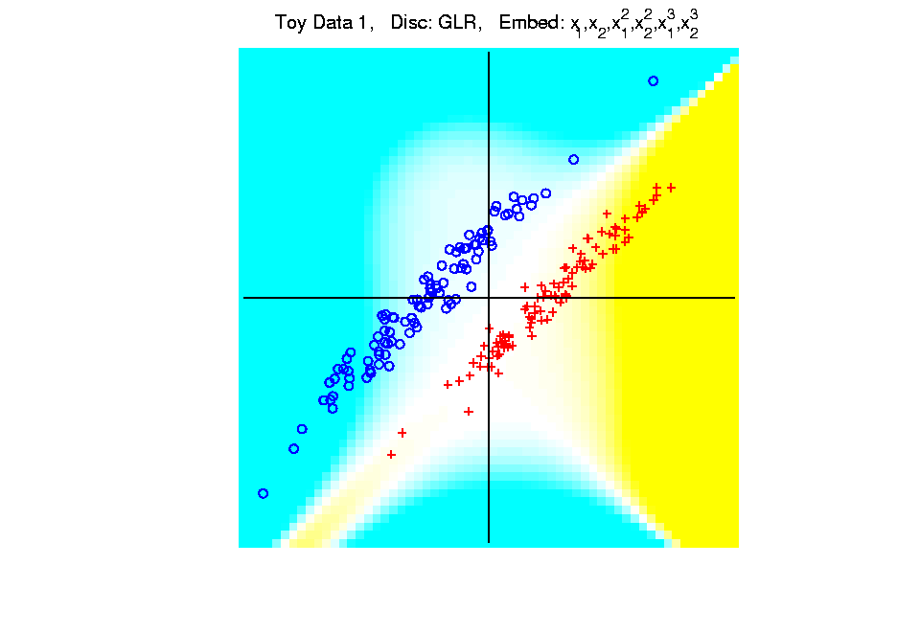
Kernel Embedding
Polynomial Embedding, Toy Example 1:
Parallel Clouds
GLR
Unstable
Subject to
Overfitting
Too Much Flexibility
In Embedded Space
Notes:
PEod1Raw.ps

Slide 75
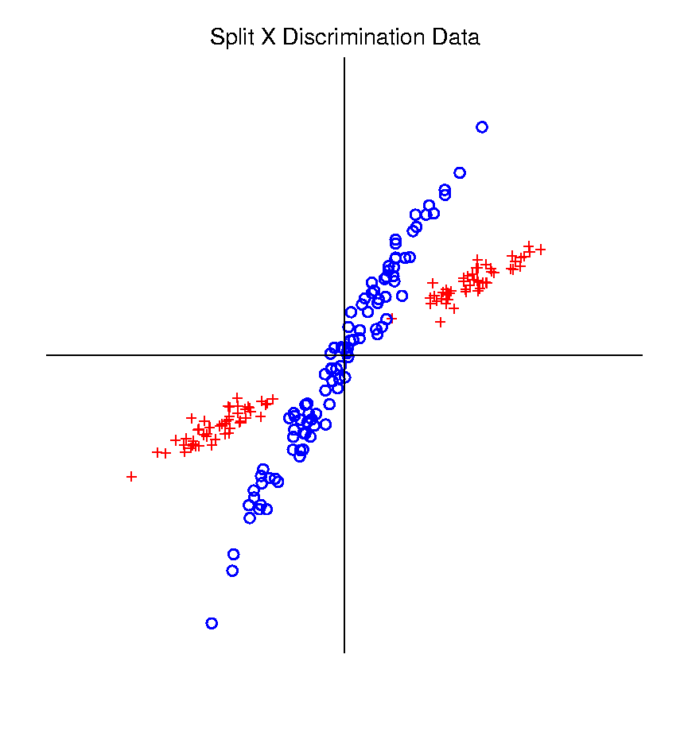
Kernel Embedding
Polynomial Embedding, Toy Example 2:
Split X
Very Challenging
For Linear
Approaches
Notes:
PEod1Raw.ps

Slide 76
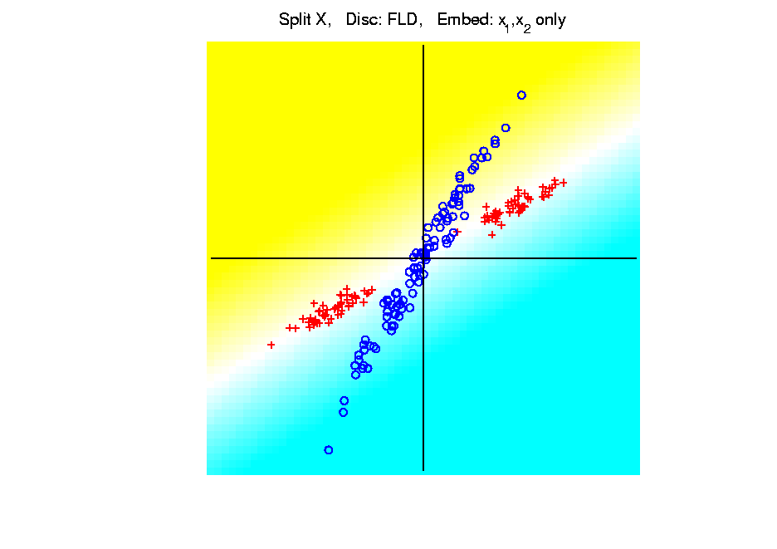
Kernel Embedding
Polynomial Embedding, Toy Example 2:
Split X
LDA
Original
Data
Notes:
PEod1Raw.ps

Slide 77
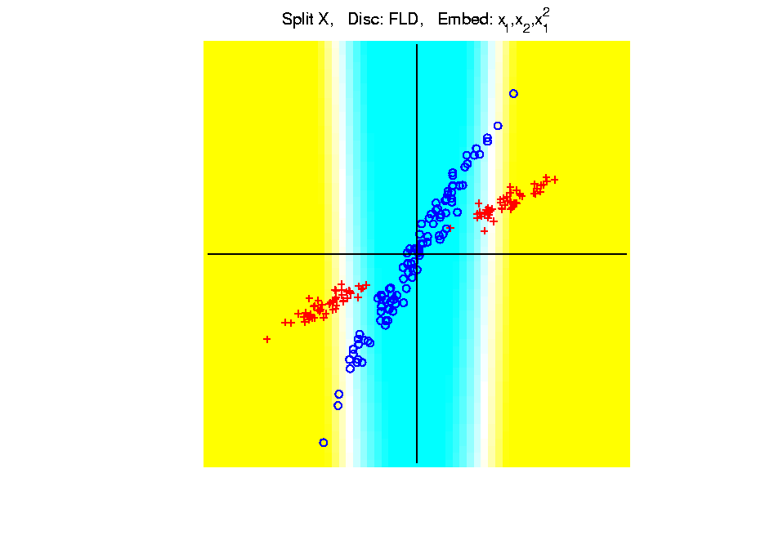
Kernel Embedding
Polynomial Embedding, Toy Example 2:
Split X
LDA
Slightly
Better
Notes:
PEod1Raw.ps

Slide 78
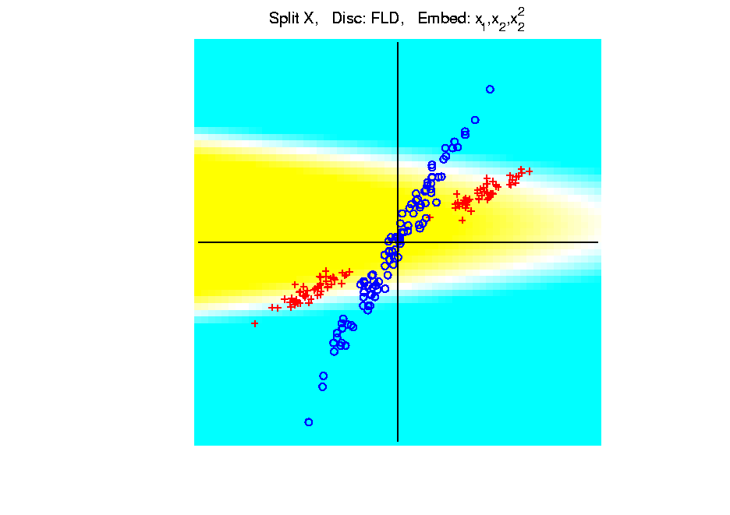
Kernel Embedding
Polynomial Embedding, Toy Example 2:
Split X
LDA
Notes:
PEod1Raw.ps

Slide 79
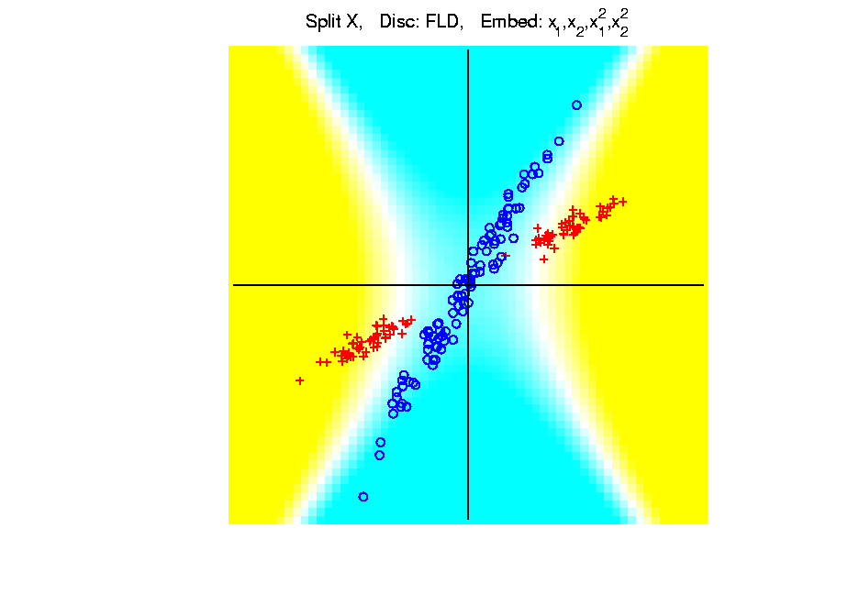
Kernel Embedding
Polynomial Embedding, Toy Example 2:
Split X
LDA
Very Good
Effective
Hyperbola
Notes:
PEod1Raw.ps

Slide 80
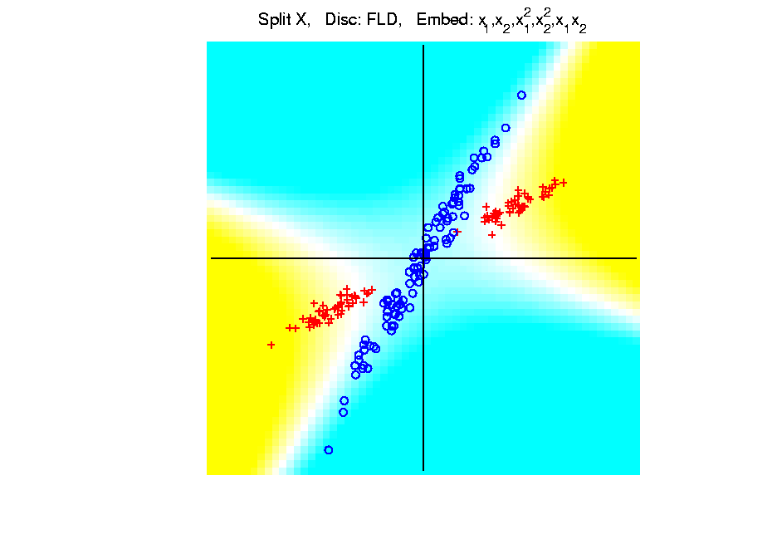
Kernel Embedding
Polynomial Embedding, Toy Example 2:
Split X
LDA
Notes:
PEod1Raw.ps

Slide 81

Kernel Embedding
Polynomial Embedding, Toy Example 2:
Split X
LDA
Robust
Against
Overfitting
Notes:
PEod1Raw.ps

Slide 82
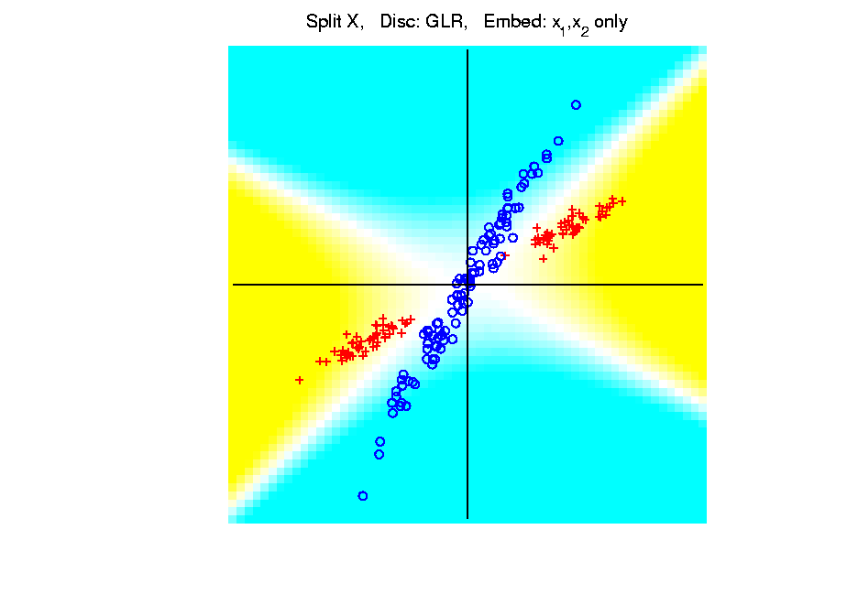
Kernel Embedding
Polynomial Embedding, Toy Example 2:
Split X
GLR
Original
Data
Looks
Very
Good
Notes:
PEod1Raw.ps

Slide 83
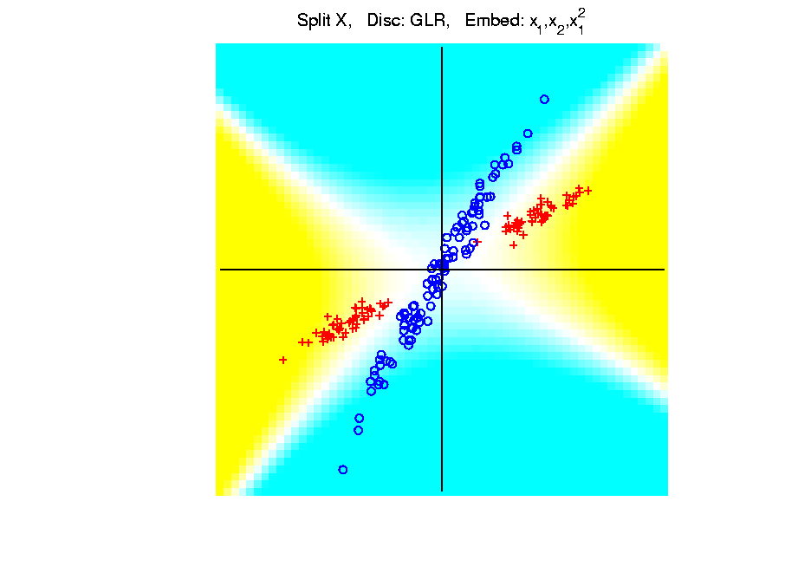
Kernel Embedding
Polynomial Embedding, Toy Example 2:
Split X
GLR
Notes:
PEod1Raw.ps

Slide 84

Kernel Embedding
Polynomial Embedding, Toy Example 2:
Split X
GLR
Reasonably
Stable
Never Ellipse
Around Blues
Notes:
PEod1Raw.ps

Slide 85

Kernel Embedding
Polynomial Embedding, Toy Example 3:
Donut
Very Challenging
For Any Linear
Approach
Notes:
PEod1Raw.ps

Slide 86

Kernel Embedding
Polynomial Embedding, Toy Example 3:
Donut
LDA
Original
Data
Very
Bad
Notes:
PEod1Raw.ps

Slide 87

Kernel Embedding
Polynomial Embedding, Toy Example 3:
Donut
LDA
Somewhat
Better
(Parabolic Fold)
Notes:
PEod1Raw.ps

Slide 88

Kernel Embedding
Polynomial Embedding, Toy Example 3:
Donut
LDA
Somewhat
Better
(Other Fold)
Notes:
PEod1Raw.ps

Slide 89

Kernel Embedding
Polynomial Embedding, Toy Example 3:
Donut
LDA
Good
Performance
(Slice of
Paraboloid)
Notes:
PEod1Raw.ps

Slide 90

Kernel Embedding
Polynomial Embedding, Toy Example 3:
Donut
LDA
Robust
Against
Overfitting
Notes:
PEod1Raw.ps

Slide 91

Kernel Embedding
Polynomial Embedding, Toy Example 3:
Donut
GLR
Original
Data
Best With
No Embedding?
Notes:
PEod1Raw.ps

Slide 92

Kernel Embedding
Polynomial Embedding, Toy Example 3:
Donut
GLR
Notes:
PEod1Raw.ps

Slide 93

Kernel Embedding
Polynomial Embedding, Toy Example 3:
Donut
GLR
Notes:
PEod1Raw.ps

Slide 94

Kernel Embedding
Polynomial Embedding, Toy Example 3:
Donut
GLR
Overfitting
Gives Square
Shape?
Notes:
PEod1Raw.ps

Slide 95
Kernel Embedding
Drawbacks to polynomial embedding:
Too many extra terms create spurious structure
i.e. have “overfitting”
Too much flexibility
HDLSS problems typically get worse
Iain D Carmichael <idc9@uw.edu>
Iain D Carmichael <idc9@uw.edu>

Slide 96
Kernel Embedding
Important Variation: “Kernel Machines”
Idea: replace polynomials by
other nonlinear functions
e.g. 1: sigmoid functions from neural nets
e.g. 2: radial basis functions
Gaussian kernels
Related to “kernel density estimation”
(studied previously)

Slide 97
Kernel Embedding
Radial Basis Functions:
Note: there are several ways to embed:
Naïve Embedding (equally spaced grid)
Explicit Embedding (evaluate at data)
Implicit Embedding (inner prod. based)
(everybody currently does the latter)

Slide 98
Kernel Embedding
Naïve Embedding, Radial basis functions:
At some “grid points” $g_{1}⋯,g_{k}$,
For a “bandwidth” (i.e. standard dev’n) $σ$,
Consider ($d$ dim’al) functions:
$$φ_{σ}\left(x−g_{1}\right),⋯,φ_{σ}\left(x−g_{k}\right)$$
$N_{d}\left(0,σ^{2}I\right)$ Probability Density

Slide 99
Kernel Embedding
Naïve Embedding, Radial basis functions:
At some “grid points” $g_{1}⋯,g_{k}$,
For a “bandwidth” (i.e. standard dev’n) $σ$,
Consider ($d$ dim’al) functions:
$$φ_{σ}\left(x−g_{1}\right),⋯,φ_{σ}\left(x−g_{k}\right)$$
Replace data matrix with:
$$\left(\begin{matrix}φ_{σ}\left(x_{1}−g_{1}\right) & ⋯ & φ_{σ}\left(x_{n}−g_{1}\right) \\ ⋮ & ⋱ & ⋮ \\ φ_{σ}\left(x_{1}−g_{k}\right) & ⋯ & φ_{σ}\left(x_{n}−g_{k}\right)\end{matrix}\right)$$

Slide 100
Kernel Embedding
Naïve Embedding, Radial basis functions:
For discrimination: work in radial basis space, With new data vector $x_{0}$,
represented by: $\left(\begin{matrix}φ_{σ}\left(x_{0}−g_{1}\right) \\ ⋮ \\ φ_{σ}\left(x_{0}−g_{k}\right)\end{matrix}\right)$

Slide 101

Kernel Embedding
Naïve Embedd’g, Toy E.g. 1: Parallel Clouds
Good
at data
Poor
outside

Slide 102

Kernel Embedding
Naïve Embedd’g, Toy E.g. 2: Split X
OK at
data
Strange
outside

Slide 103

Kernel Embedding
Naïve Embedd’g, Toy E.g. 3: Donut
Mostly
good
Slight
mistake
for one
kernel

Slide 104
Kernel Embedding
Naïve Embedding, Radial basis functions:
Toy Example, Main lessons:
Generally good in regions with data,
Unpredictable where data are sparse

Slide 105

Kernel Embedding
Toy Example 4: Checkerboard
Very
Challenging!
Linear
Method?
Polynomial
Embedding?
Notes:
PEod1Raw.ps

Slide 106

Kernel Embedding
Toy Example 4: Checkerboard
Very
Challenging!
LDA
Linear Is
Hopeless
Notes:
PEod1Raw.ps

Slide 107

Kernel Embedding
Toy Example 4: Checkerboard
Very
Challenging!
LDA
Notes:
PEod1Raw.ps

Slide 108

Kernel Embedding
Toy Example 4: Checkerboard
Very
Challenging!
LDA
Notes:
PEod1Raw.ps

Slide 109

Kernel Embedding
Toy Example 4: Checkerboard
Very
Challenging!
LDA
Notes:
PEod1Raw.ps

Slide 110

Kernel Embedding
Toy Example 4: Checkerboard
Very
Challenging!
LDA
Notes:
PEod1Raw.ps

Slide 111

Kernel Embedding
Toy Example 4: Checkerboard
Very
Challenging!
LDA
Embedding
Gets Better
But Still
Not Great
Notes:
PEod1Raw.ps

Slide 112
Kernel Embedding
Toy Example 4: Checkerboard
Very
Challenging!
Polynomials
Don’t Have
Needed
Flexiblity
Notes:
PEod1Raw.ps

Slide 113

Kernel Embedding
Toy Example 4: Checkerboard
Radial
Basis
Embedding
+ LDA
Is
Excellent!
Notes:
PEod1Raw.ps

Slide 114
Kernel Embedding
Drawbacks to naïve embedding:
Equally spaced grid too big in high $d$
Not computationally tractable $\left(g^{d}\right)$
Approach:
Evaluate only at data points
Not on full grid
But where data live

Slide 115
Kernel Embedding
Other types of embedding:
Explicit
Implicit
Will be studied soon, after
introduction to Support Vector Machines…

Slide 116
Kernel Embedding
Other types of embedding:
Explicit
Implicit
Important Issue: Bandwidth Selection:
Ahn (2010)

Slide 117
Kernel Embedding
$∃$ generalizations of this idea to other types of analysis
& some clever computational ideas.
E.g. “Kernel based, nonlinear Principal Components Analysis”
Ref: Schölkopf et al (1997)

Slide 118

High $d$ Asymptotics & Kernel Methods
Recall
Flexibility
From
Kernel
Embedding
Idea

Slide 119

High $d$ Asymptotics & Kernel Methods
Recall
Flexibility
From
Kernel
Embedding
Idea

Slide 120

High $d$ Asymptotics & Kernel Methods
Recall
Flexibility
From
Kernel
Embedding
Idea

Slide 121

High $d$ Asymptotics & Kernel Methods
Interesting Question:
Behavior in Very High Dimensions?
Answer: El Karoui (2010)
In Random Matrix Limit, $n\sim d→∞$
Kernel Embedded Classifiers ~
~ Linear Classifiers

Slide 122
High $d$ Asymptotics & Kernel Methods
In Random Matrix Limit, $n\sim d→∞$
Kernel Embedded Classifiers ~
~ Linear Classifiers
Intuitively Sensible?
High Dimensional Space is Very Big
Recall HDLSS Geometric Represent’n
Linear Methods: “Enough Room to Work”

Slide 123
High $d$ Asymptotics & Kernel Methods
Interesting Question:
Behavior in Very High Dimensions?
Implications for DWD:
Recall Main Advantage is for High d
So Not Clear Embedding Helps
Thus Not Yet Implemented in DWD

Slide 124
Kernel PCA
Main Idea: PCA in Kernel Space
At some “grid points” $g_{1}⋯,g_{k}$,
Eg. Radial Function (Gaussian) Kernel
With Window Width (s. d.) $σ$
$$\left(\begin{matrix}φ_{σ}\left(x_{1}−g_{1}\right) & ⋯ & φ_{σ}\left(x_{n}−g_{1}\right) \\ ⋮ & ⋱ & ⋮ \\ φ_{σ}\left(x_{1}−g_{k}\right) & ⋯ & φ_{σ}\left(x_{n}−g_{k}\right)\end{matrix}\right)$$

Slide 125
Kernel PCA
Main Idea: PCA in Kernel Space
Hurdle: Visualization
At “grid of points” $g_{1}⋯,g_{k}$, Compute Scores
Visualize with Heat Map

Slide 126

Kernel PCA
Toy $ℝ^{2}$ Example: Raw Data
Long Stretched
Cluster
Round Clusters
Outliers?
Small Cluster?

Slide 127


Kernel PCA
1st Component
Finds Coarse
Scale Green
vs. Blues
At Rectangular Grid of Pixels, i.e. $g_{j}$
Gray Level Map of Kernel Space PC Scores
Contours of Scores Surface

Slide 128

Kernel PCA
2nd Component
Separates
Blue & Cyan
Strong
Locality!

Slide 129

Kernel PCA
3rd Component
Splits
Greens

Slide 130

Kernel PCA
4th Component
Higher
Harmonic
Of Greens

Slide 131

Kernel PCA
5th Component
Finally Find
Outliers

Slide 132

Kernel PCA
6th Component
Even Higher
Harmonic
Of Greens

Slide 133
Kernel PCA
Summary:
Insightful Decomposition of Variation
Elegantly Integrated With Locality
Why Not More Widely Used?
Needs Visualization in $ℝ^{d}$

Slide 134
Kernel PCA
Caution:
Results Depend on Window Width
(will study later)

Slide 135
Participant Presentation
1:35 Yuhao Zhou
Causal Graphical Models
Next Class: Jason Hu

