Slide 1
Statistics – O. R. 881
Object Oriented Data Analysis
Steve Marron
Dept. of Statistics and Operations Research
University of North Carolina

Slide 2
Current Sections in Textbook
Today:
Section 10.1

Slide 3
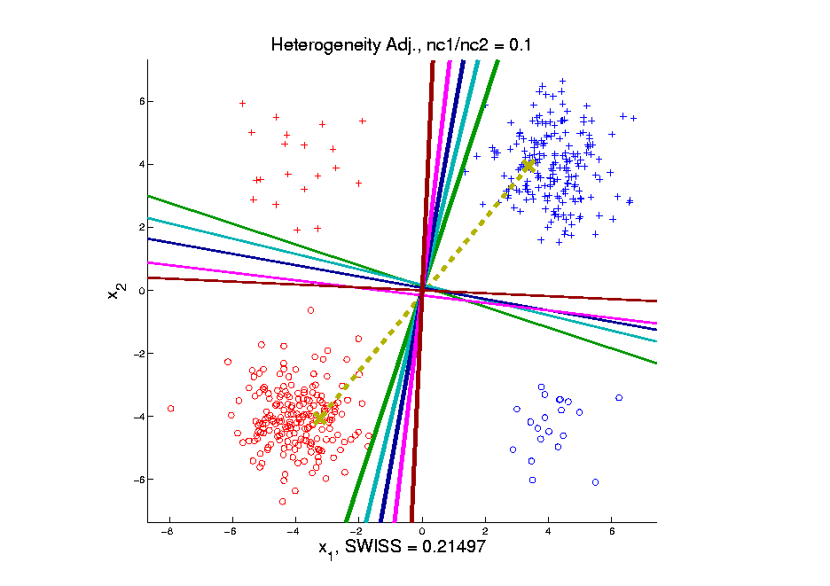
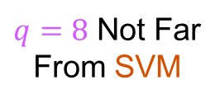
Last Class: Generalized DWD
Very Unbalanced Subtypes
MD Clearly
Very Poor
Others More Robust
& Now Different
$q=8$ Not Far
From SVM
Notes:
3

Slide 4
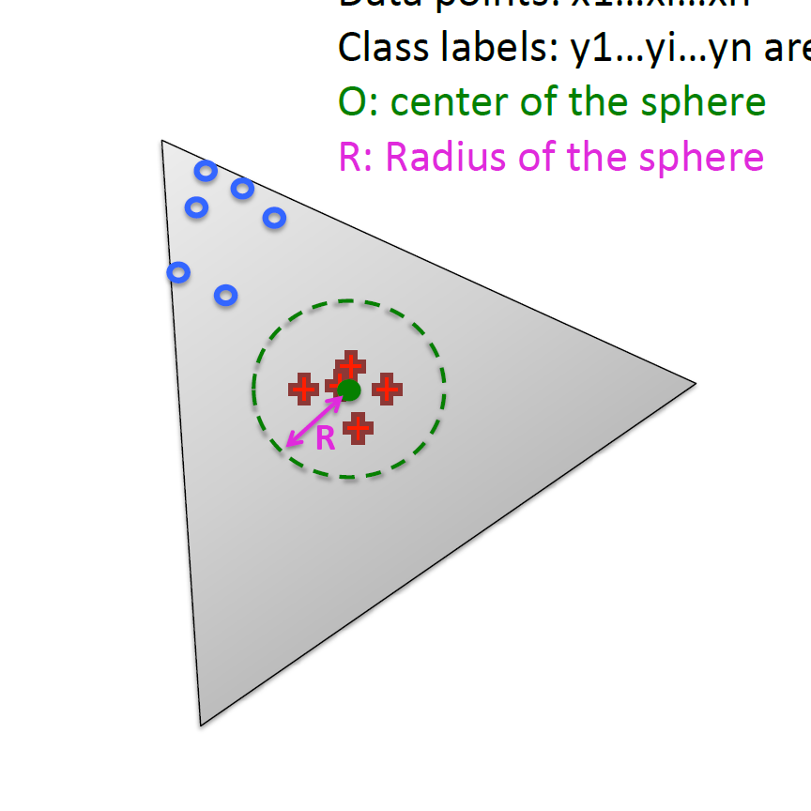
Last Class: Radial DWD
Approach:
Replace Separating Plane
With Separating Sphere
Find Parameters
Via DWD-like
Optimization
Enables Finding Corners
With No Training Data
Notes:
4

Slide 5
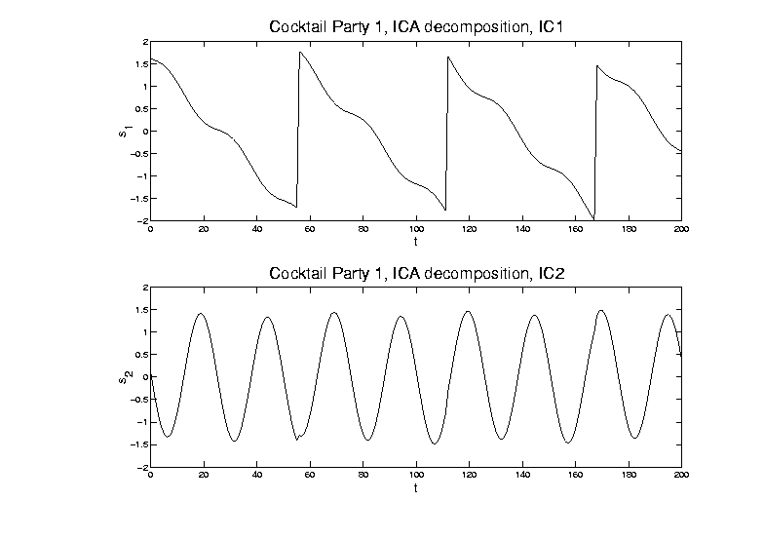
Last Class: ICA, Motivating Example
ICA (will describe method later)

Slide 6
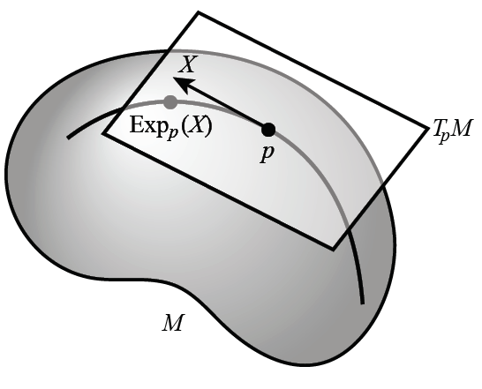
Non - Euclidean Data Spaces
Recall Data Objects Lying on a Manifold
Called “Mildly
Non-Euclidean”

Slide 7
Non - Euclidean Data Spaces
What is “Strongly Non-Euclidean” Case?
Tree Structured Data Objects
Special Challenge:
No Tangent Plane
Must Re-Invent
Data Analysis

Slide 8
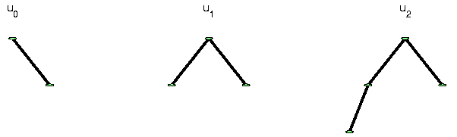
Strongly Non-Euclidean Spaces
Text: Sec. 10.1
Trees as Data Objects
From Graph Theory:
Data Objects: Trees
Graph is a Set of Nodes and Edges
Tree has a Root and Direction
Thanks to Burcu Aydin
Notes:
FIGp8correct.eps

Slide 9
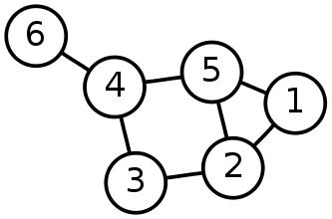
Strongly Non-Euclidean Spaces
General Graph:
Thanks to Sean Skwerer

Slide 10
Strongly Non-Euclidean Spaces
Special Case Called “Tree”
Directed
Acyclic
Graphical note:
Sometimes “grow up” $↑$
Others “grow down” $↓$
5
3
4
1
2
Terminology:
Root
0

Slide 11
Strongly Non-Euclidean Spaces
Special Case Called “Tree”
Directed
Acyclic
5
3
4
Terminology:
Children
Of
Parent
1
2
0

Slide 12

Strongly Non-Euclidean Spaces
Motivating Example:
From Dr. Elizabeth Bullitt
  Dept. of Neurosurgery, UNC
Blood Vessel Trees in Brains
Segmented from MRAs
Study population of trees
Forest of Trees

Slide 13
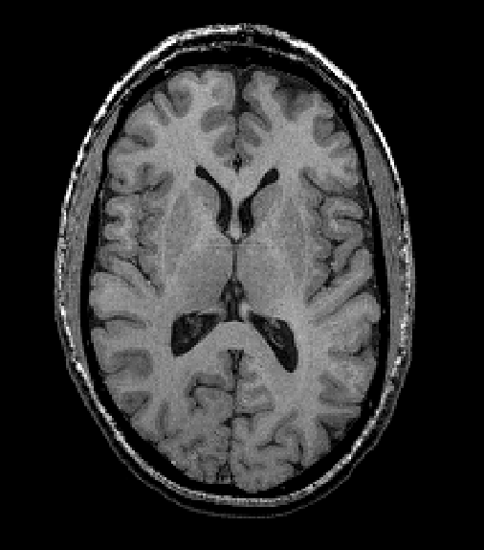
Blood vessel tree data
Marron’s brain:
MRI (T1) view
(Magnetic Resonance Image)
Single Slice
From 3-d Image

Slide 14
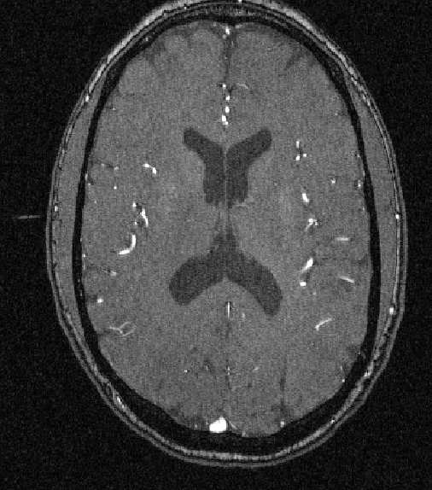
Blood vessel tree data
Marron’s brain:
MRA view
“A” for “Angiography”
Finds Arteries
(show up as white)
Track through 3d

Slide 15

Blood vessel tree data
Marron’s brain:
MRA view
“A” for “Angiography”
Finds Arteries
(show up as white)
Track through 3d

Slide 16

Blood vessel tree data
Marron’s brain:
MRA view
“A” for “Angiography”
Finds Arteries
(show up as white)
Track through 3d

Slide 17
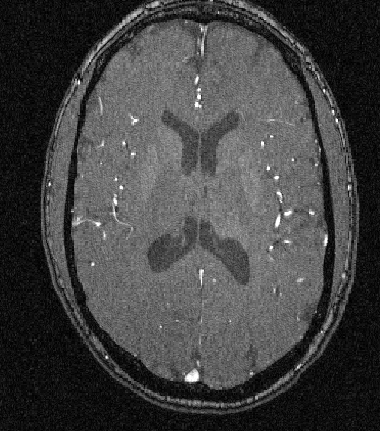
Blood vessel tree data
Marron’s brain:
MRA view
“A” for “Angiography”
Finds Arteries
(show up as white)
Track through 3d

Slide 18
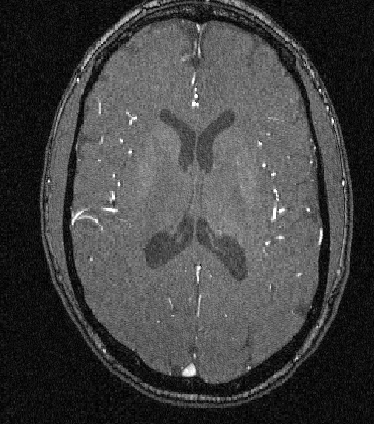
Blood vessel tree data
Marron’s brain:
MRA view
“A” for “Angiography”
Finds Arteries
(show up as white)
Track through 3d

Slide 19

Blood vessel tree data
Marron’s brain:
MRA view
“A” for “Angiography”
Finds Arteries
(show up as white)
Track through 3d

Slide 20
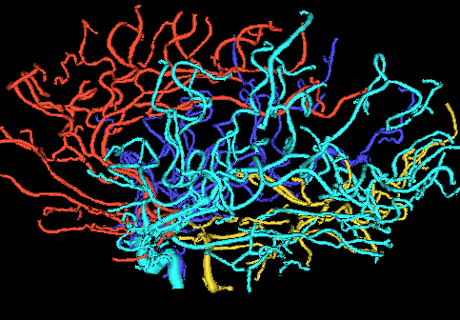
Blood vessel tree data
Marron’s brain:
From MRA
Segment tree
of vessel segments
Using tube tracking
Bullitt and Aylward (2002)

Slide 21
Blood vessel tree data
Marron’s brain:
From MRA
Reconstruct trees
in 3d
Rotate to view

Slide 22
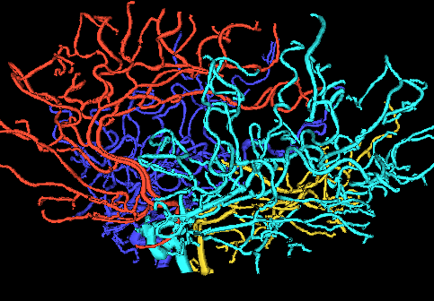
Blood vessel tree data
Marron’s brain:
From MRA
Reconstruct trees
in 3d
Rotate to view

Slide 23
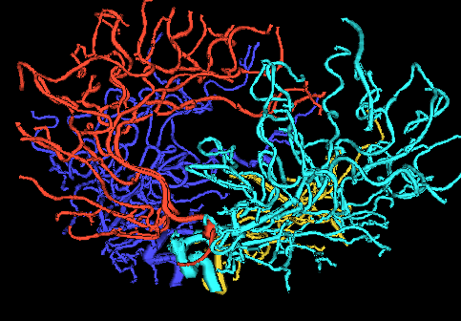
Blood vessel tree data
Marron’s brain:
From MRA
Reconstruct trees
in 3d
Rotate to view

Slide 24
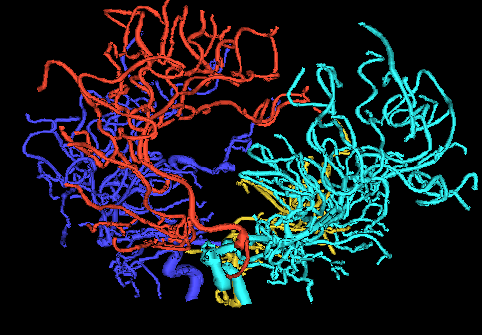
Blood vessel tree data
Marron’s brain:
From MRA
Reconstruct trees
in 3d
Rotate to view

Slide 25
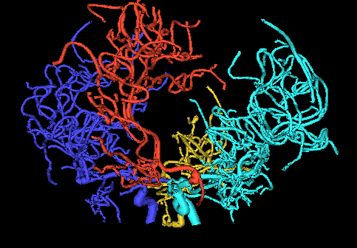
Blood vessel tree data
Marron’s brain:
From MRA
Reconstruct trees
in 3d
Rotate to view

Slide 26
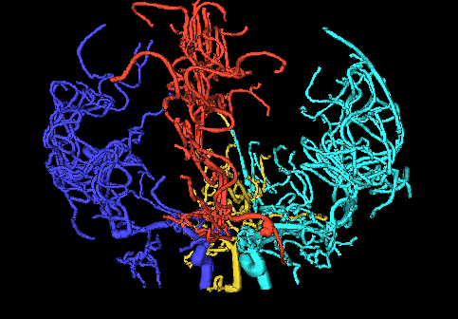
Blood vessel tree data
Marron’s brain:
From MRA
Reconstruct trees
in 3d
Rotate to view

Slide 27
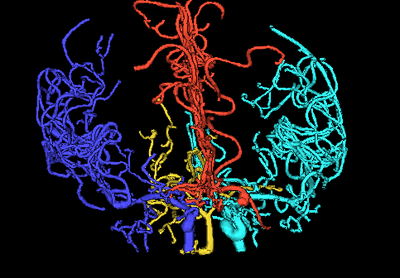
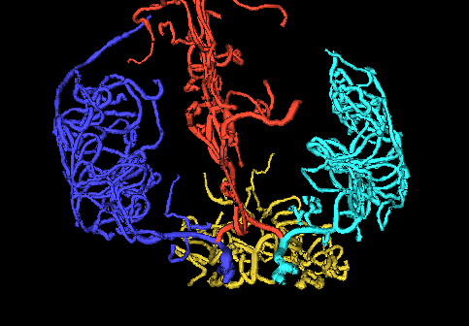
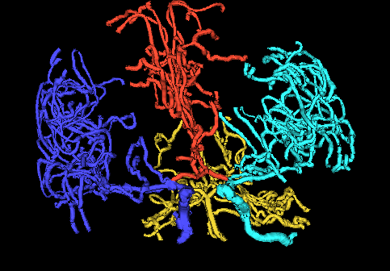
Blood vessel tree data
,
, ... ,
Now look over many people (data objects)
Structure of population (understand variation?)
Modes of Variation in
strongly non-Euclidean Space???

Slide 28
Blood vessel tree data
,
, ... ,
Examples of Potential Specific Goals
(not accessible by traditional methods)
Predict Stroke Tendency (Collateral Circulation)
Screen for Loci of Pathology
Explore how age affects connectivity

Slide 29
Blood vessel tree data
Big Picture: 4 Approaches
Purely Combinatorial
Euclidean Orthant (Phylogenetics)
Dyck Path
Persistent Homologies - Topological DA
Aydin, et al. (2009)
Shen, et al. (2014)
Zhai, et al. (2016)

Slide 30
Blood vessel tree data
Big Picture: 4 Approaches
Purely Combinatorial
Euclidean Orthant (Phylogenetics)
Dyck Path
Persistent Homologies

Slide 31



Persistent Homology Approach
People:
Paul Bendich
Ezra Miller
Sean Skwerer
Paper: Bendich
et al (2016)

Slide 32
Persistent Homology Approach
Persistent Homology Idea:
Alternate Data Representation
Focusing on Structure not Location
Summarized via Filtration
(Think: Multi-Scale Summary)

Slide 33
Persistent Homology Approach
Persistent Homology “Flavors”:
H0 - Count Connected Components
H1 - Count Loops
H2 - Count Cavities (3-d “holes”)
(Counting Done Across Scales of Filtration)

Slide 34
Persistent Homology Approach
Brain Tree Persistent Homology “Flavors”:
All H0 (just conn’s, no loops, cavities, etc.)
Tried Various Filtrations
  Expanding Balls
  Rising Sub-Level Sets

Slide 35
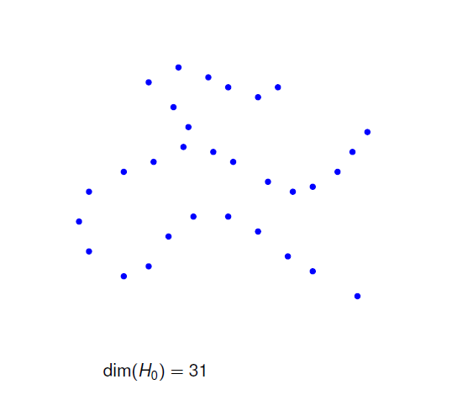
Persistent Homology Filtration
Example:
Expanding
Balls

Slide 36
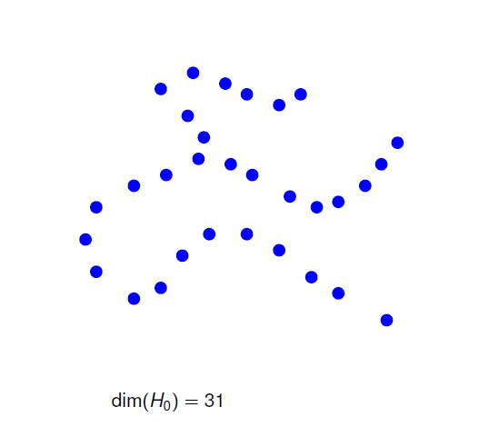
Persistent Homology Filtration
Example:
Expanding
Balls

Slide 37
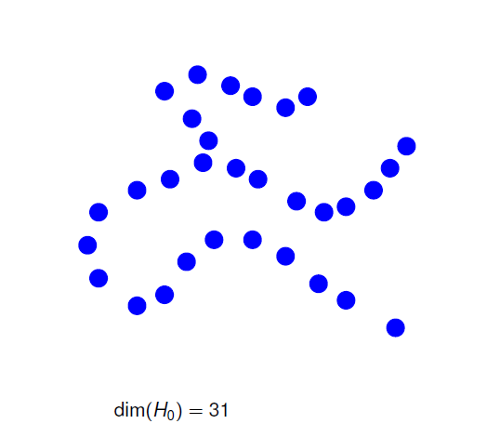
Persistent Homology Filtration
Example:
Expanding
Balls

Slide 38
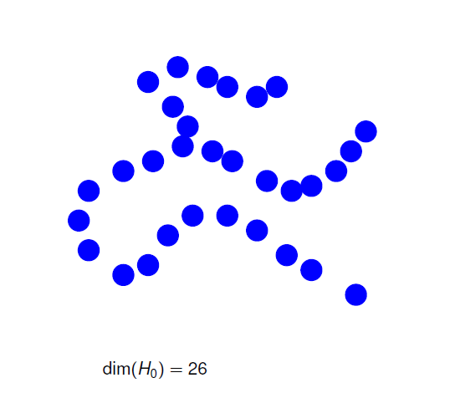
Persistent Homology Filtration
Example:
Expanding
Balls

Slide 39
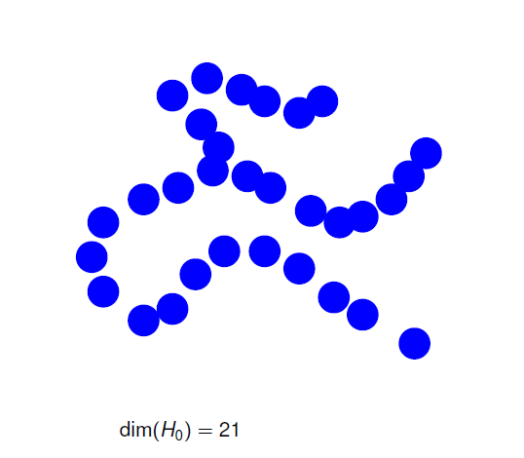
Persistent Homology Filtration
Example:
Expanding
Balls

Slide 40
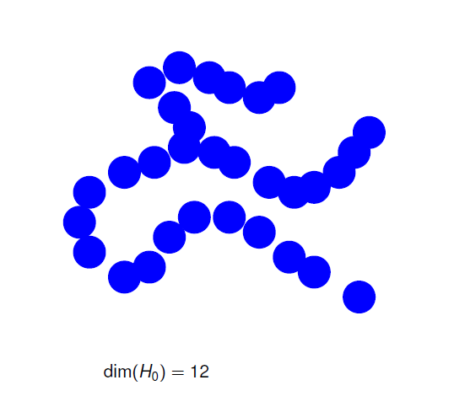
Persistent Homology Filtration
Example:
Expanding
Balls

Slide 41
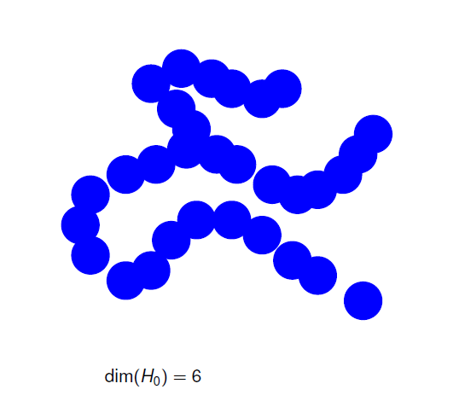
Persistent Homology Filtration
Example:
Expanding
Balls

Slide 42
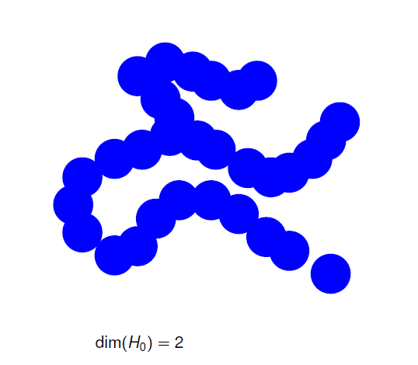
Persistent Homology Filtration
Example:
Expanding
Balls

Slide 43
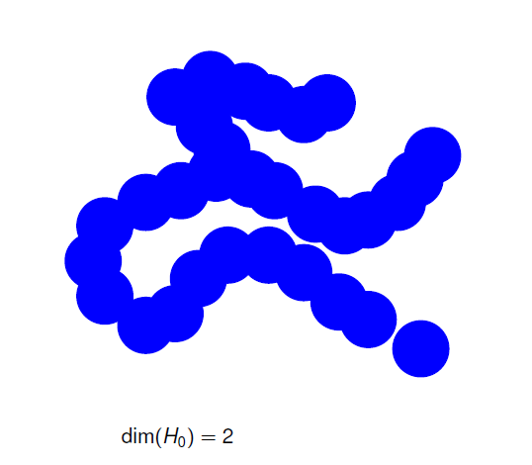
Persistent Homology Filtration
Example:
Expanding
Balls

Slide 44
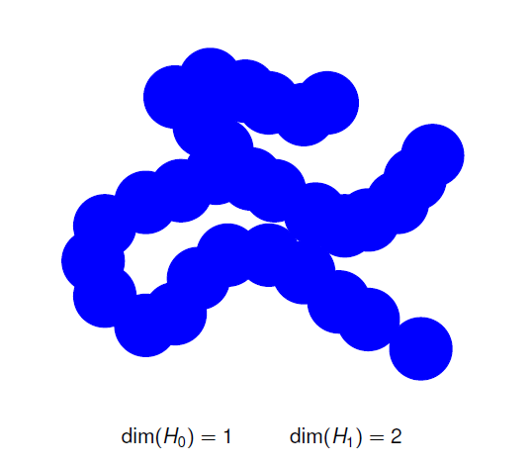
Persistent Homology Filtration
Example:
Expanding
Balls

Slide 45
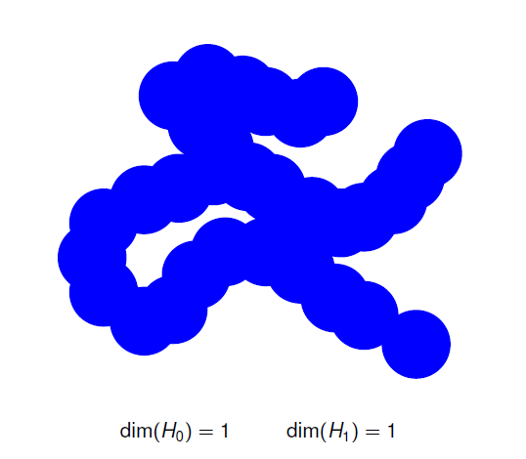
Persistent Homology Filtration
Example:
Expanding
Balls

Slide 46
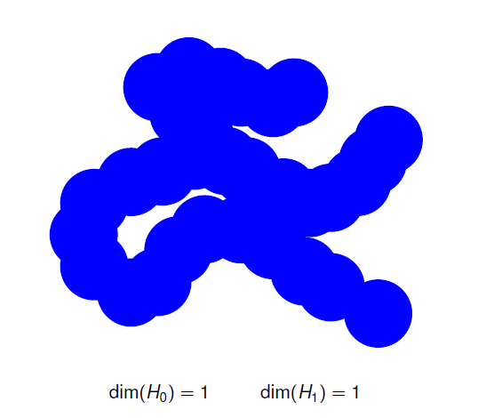
Persistent Homology Filtration
Example:
Expanding
Balls

Slide 47
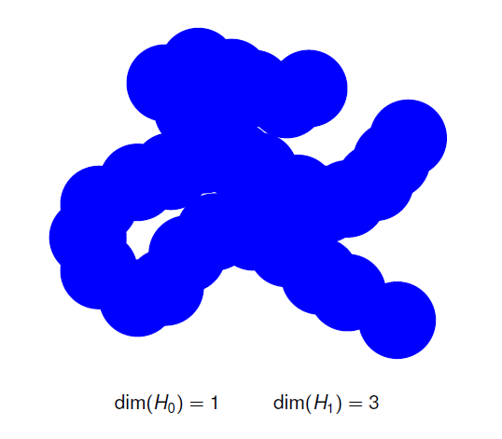
Persistent Homology Filtration
Example:
Expanding
Balls

Slide 48
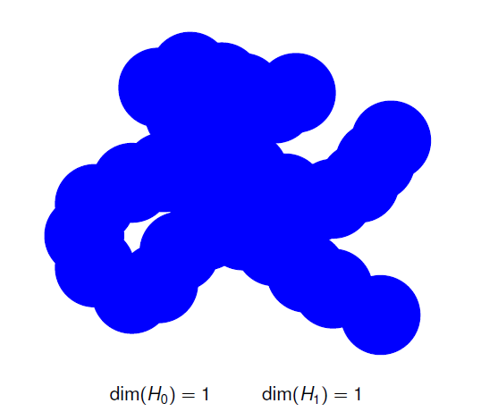
Persistent Homology Filtration
Example:
Expanding
Balls

Slide 49

Persistent Homology Filtration
Example:
Expanding
Balls

Slide 50
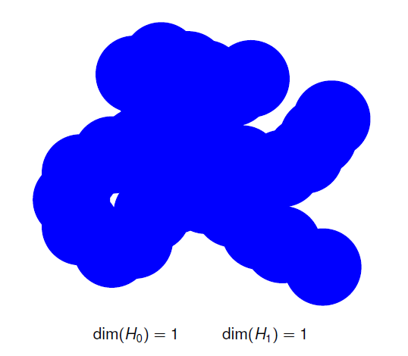
Persistent Homology Filtration
Example:
Expanding
Balls

Slide 51
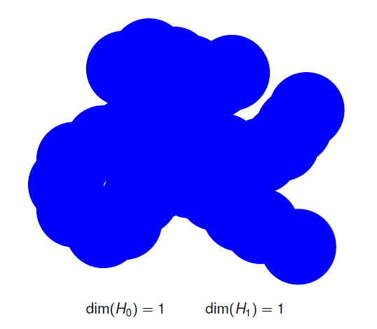
Persistent Homology Filtration
Example:
Expanding
Balls

Slide 52
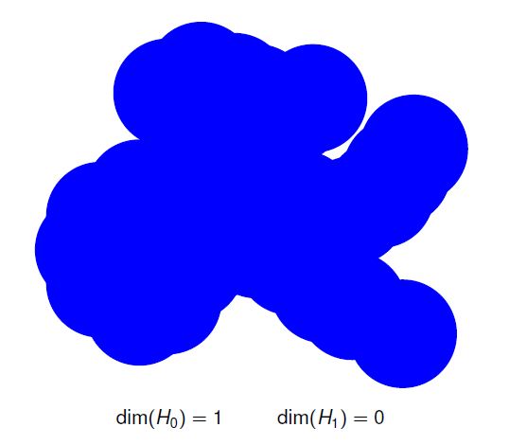
Persistent Homology Filtration
Example:
Expanding
Balls

Slide 53
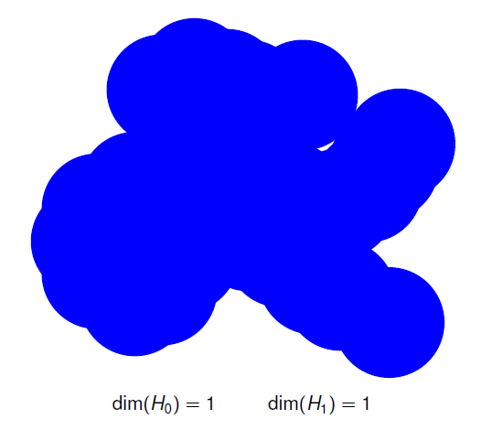
Persistent Homology Filtration
Example:
Expanding
Balls

Slide 54
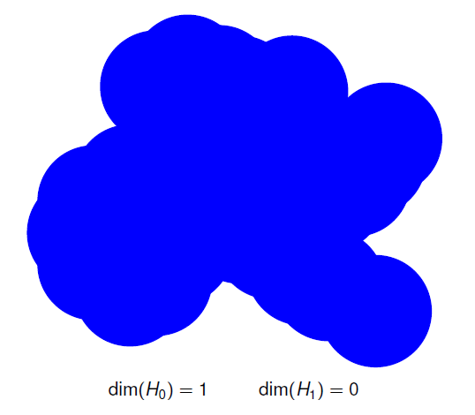
Persistent Homology Filtration
Example:
Expanding
Balls

Slide 55
Persistent Homology Filtration
Rising
Sub-Level Brain
Sets Artery
For 1 Trees
Tree
Thanks to:
Paul Bendich
Sean Skwerer

Slide 56
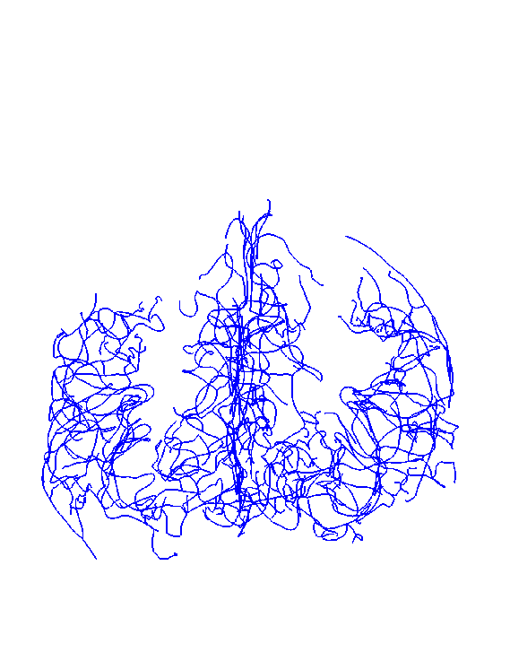
Persistent Homology Generation
Rising
Sub-Level
Sets
For 1
Tree

Slide 57
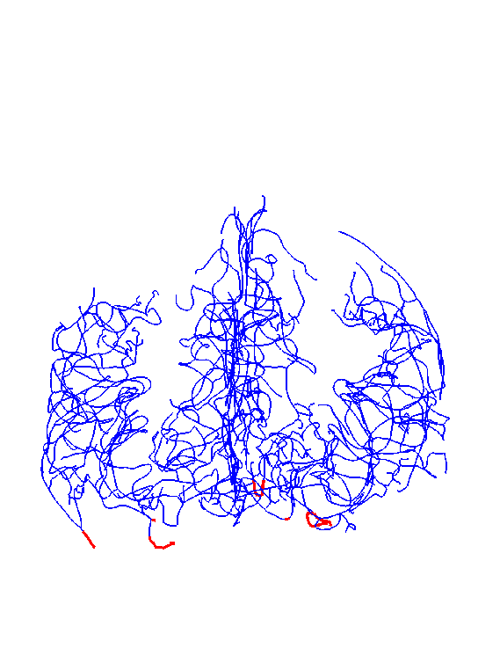
Persistent Homology Generation
Rising
Sub-Level
Sets
For 1
Tree

Slide 58
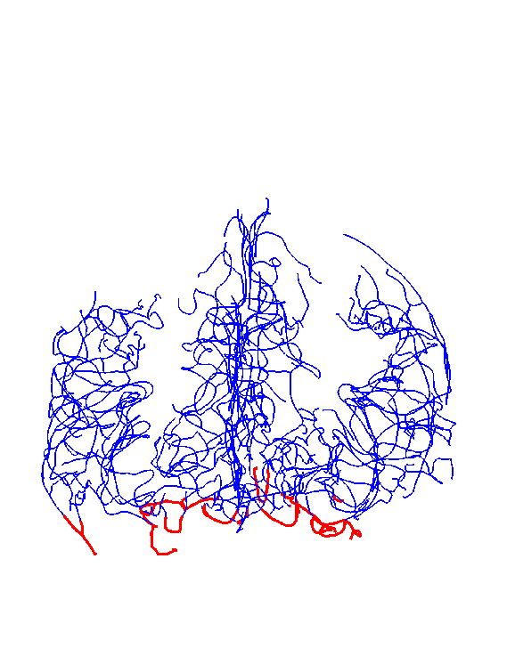
Persistent Homology Generation
Rising
Sub-Level
Sets
For 1
Tree

Slide 59
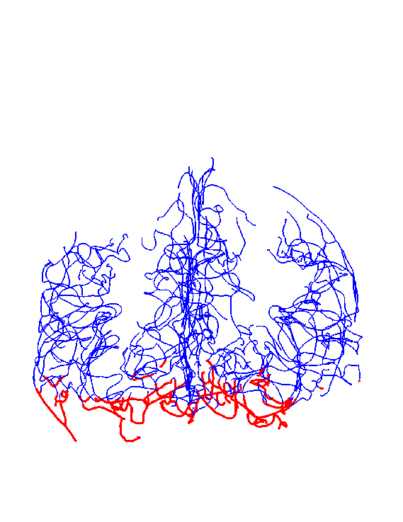
Persistent Homology Generation
Rising
Sub-Level
Sets
For 1
Tree

Slide 60
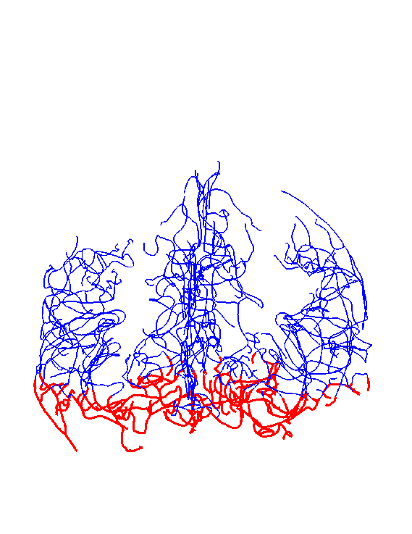
Persistent Homology Generation
Rising
Sub-Level
Sets
For 1
Tree

Slide 61
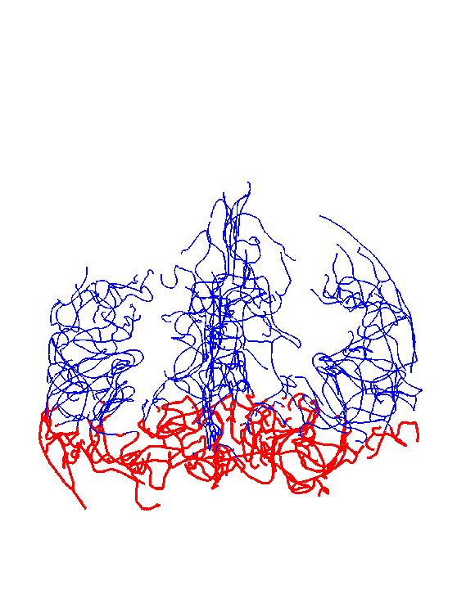
Persistent Homology Generation
Rising
Sub-Level
Sets
For 1
Tree

Slide 62
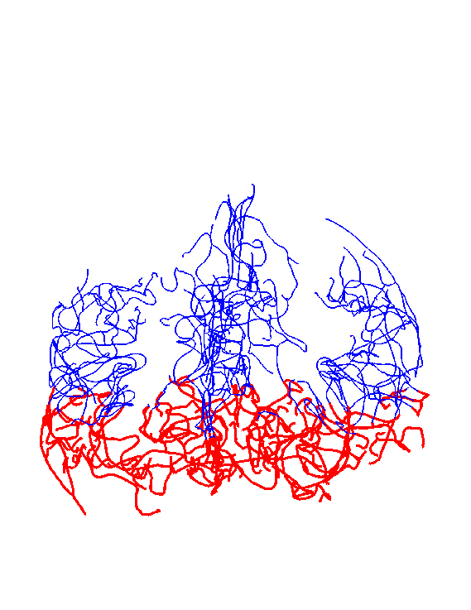
Persistent Homology Generation
Rising
Sub-Level
Sets
For 1
Tree

Slide 63
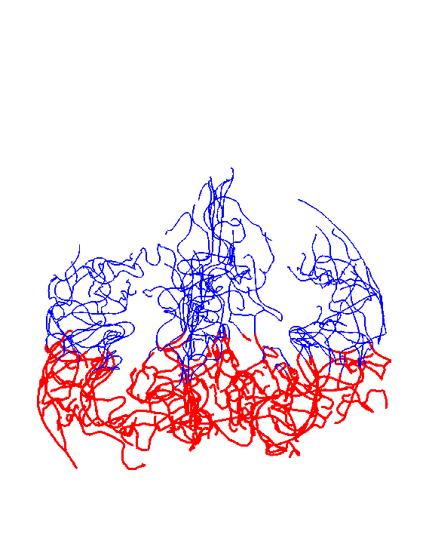
Persistent Homology Generation
Rising
Sub-Level
Sets
For 1
Tree

Slide 64
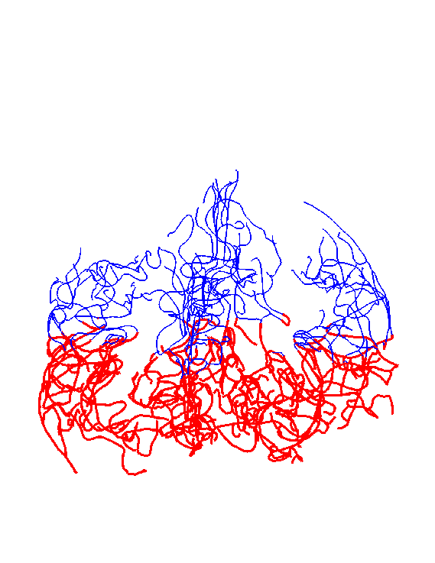
Persistent Homology Generation
Rising
Sub-Level
Sets
For 1
Tree

Slide 65
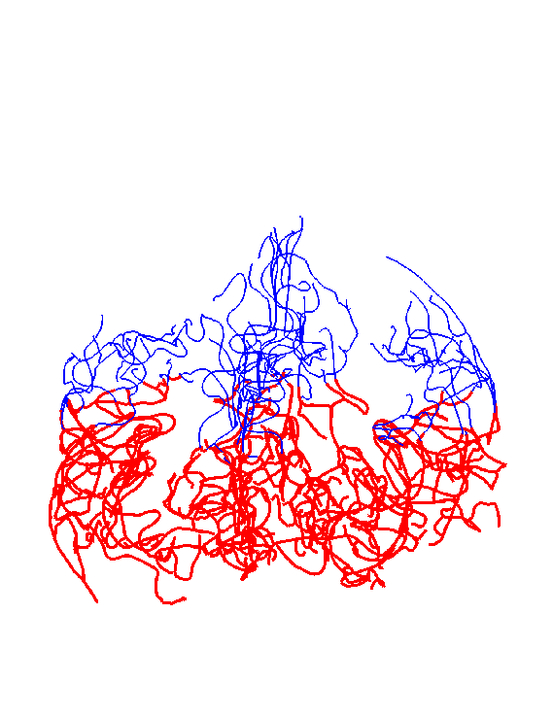
Persistent Homology Generation
Rising
Sub-Level
Sets
For 1
Tree

Slide 66

Persistent Homology Generation
Rising
Sub-Level
Sets
For 1
Tree

Slide 67
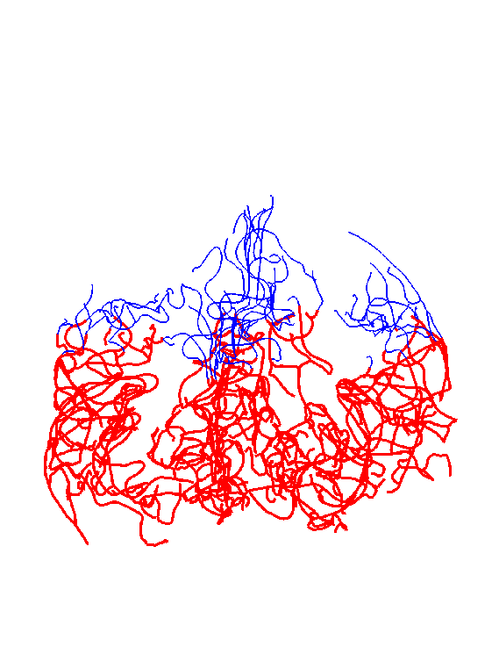
Persistent Homology Generation
Rising
Sub-Level
Sets
For 1
Tree

Slide 68

Persistent Homology Generation
Rising
Sub-Level
Sets
For 1
Tree

Slide 69

Persistent Homology Generation
Rising
Sub-Level
Sets
For 1
Tree

Slide 70

Persistent Homology Generation
Rising
Sub-Level
Sets
For 1
Tree

Slide 71

Persistent Homology Generation
Rising
Sub-Level
Sets
For 1
Tree

Slide 72

Persistent Homology Generation
Rising
Sub-Level
Sets
For 1
Tree

Slide 73

Persistent Homology Generation
Rising
Sub-Level
Sets
For 1
Tree

Slide 74

Persistent Homology Generation
Rising
Sub-Level
Sets
For 1
Tree

Slide 75

Persistent Homology Generation
Rising
Sub-Level
Sets
For 1
Tree

Slide 76
Persistent Homology Filtration
Result:
Each Tree Represented as Persist. Diag.
“Coordinate Free Rep’n” (Edelsbrunner)
I.e. Persistence Diag.s are Data Objects

Slide 77

Raw Data Persistence Diagrams

Slide 78

Raw Data Persistence Diagrams

Slide 79

Raw Data Persistence Diagrams

Slide 80

Raw Data Persistence Diagrams

Slide 81
Levels of Homology Application
Data Objects:

Slide 82

Levels of Homology Application
Carlsson, Edelsbrunner, et al
Population Level
Data Objects:

Slide 83




Levels of Homology Application
Data Objects:
Bendich et al
Data Object Level

Slide 84
Persistence Diag. Data Objects?
Data Object Choices:
Full Diagrams (Wasserstein Metric)
Complete & Compelling
But Unwieldy
Harder to Go Deep

Slide 85
Persistence Diag. Data Objects?
Data Object Choices:
Full Diagrams (Wasserstein Metric)
Euclidean Summaries
Many Methods Available
Deep Results Come Quick
Still Exploit “Coordinate Free” Aspects!

Slide 86
Persistence Diag. Data Objects?
Data Object Choices:
Full Diagrams (Wasserstein Metric)
Euclidean Summaries
Other Options?
Smooth Functions: Fasy et al (2014)
Landscapes: Bubenik (2015)

Slide 87
Euclidean Summaries
Many Aspects to Consider:
Start Times
Bar Lengths
Bar Numbers
Ordering of Summaries
Others???

Slide 88

Euclidean Summaries
Repr’n:
Top 2
Points
(Length)

Slide 89

Euclidean Summaries
Repr’n:
Top 5
Points
(Length
& Length
Order)

Slide 90

Euclidean Summaries
Repr’n:
Top 5
Points
(Length
& Birth
Order)

Slide 91

Euclidean Summaries
Repr’n:
Lengths
Only,
Length
Order

Slide 92

Euclidean Summaries
Repr’n:
Lengths
Only,
Length
Order,
Log₁₀
Scale

Slide 93

Euclidean Summaries
Repr’n:
Lengths
Only,
Log₁₀ Scale,
Smaller
Set

Slide 94
Euclidean Summaries
Measures of Success:
Would love to do:
Find Brain Cancer (Tortuosity)
Predict Stroke Tendency

Slide 95
Euclidean Summaries
Measures of Success:
Would love to do:
Find Brain Cancer (Tortuosity)
Predict Stroke Tendency
No Data On These

Slide 96
Euclidean Summaries
Measures of Success:
Correlation with Age
Distinguish Gender
(Have Transexuals)

Slide 97
Euclidean Summaries
Measures of Success:
Correlation with Age
Distinguish Gender
Also have Handedness (but too many Rights)

Slide 98
Age & Gender
Previous Approaches:
Combinatorics: Found Nothing
Aydin et al (2009)

Slide 99
Age & Gender
Previous Approaches:
Combinatorics: Found Nothing
Dyck Path:
Shen et al (2014)

Slide 100
Age & Gender
Previous Approaches:
Combinatorics: Found Nothing
Dyck Path:
  Rather Faint Effects
  Required Complicated Tree Pruning

Slide 101
Euclidean Summaries
Measures of Success:
Correlation with Age
Distinguish Gender

Slide 102
Correlation with Age
Best P. H. Representation:
Top 100 lengths
In Length Order
Log Scale

Slide 103
Correlation with Age
Raw
Data
Curves

Slide 104

Correlation with Age
PCA
Loadings
Analysis
(Study Parts
Separately)

Slide 105
Correlation with Age
Raw
Data
Mean
Resid’s

Slide 106
Correlation with Age
PC1
(age!)
PC2

Slide 107
Correlation with Age
PC3
PC4

Slide 108

Correlation with Age
Focus
On
PC1
Vs. Age

Slide 109
Correlation with Age
PC1
Vs. Age
Strongly
Signif’t
Correl’n
With Age

Slide 110
Correlation with Age
Zoom
In On
Bar
Intervals
Start at l = 20
End at l = 60
Restrict to Windows

Slide 111

Correlation with Age
Zoom
In On
Bar
Intervals
E.g. Window
Color by Age Correlation

Slide 112
Correlation with Age
Less Correlation
From Longest
Bars
(Since Common
To All, So
Least Variation)

Slide 113
Correlation with Age
Most Correlation
From Medium
Bars
(Important
Variation)

Slide 114
Correlation with Age
Higher Order
Bars Mostly
Add Noise
(w.r.t. Age)

Slide 115
Euclidean Summaries
Measures of Success:
Correlation with Age
Distinguish Gender

Slide 116
Distinguish Gender
Best P. H. Representation:
Top 10 (length) points
(Birth, Length)
In Birth Order
(length order much worse)

Slide 117

Distinguish Gender
Raw
Data
Overlaid
Age
Colors

Slide 118

Distinguish Gender
PCA
Scatterplot
Gender
Symbols

Slide 119

Distinguish Gender
Gender
DWD
Projection
& Ortho
PCA
Reasonable
Separation?

Slide 120
Distinguish Gender
Gender Effect Looks Strong
But is it Real?
DWD Can Find Spurious Separation

Slide 121
Distinguish Gender
Gender Effect Looks Strong
But is it Real?
DWD Can Find Spurious Separation
Approach Di-Pro-Perm Test:
  Find Separating Direction (DWD)
  Project & Summarize
  Permute (to Assess Significance)

Slide 122

Distinguish Gender
Projected
Statistic

Slide 123
Distinguish Gender
Projected
Statistic
Null Dist’n
(permuted)

Slide 124
Distinguish Gender
Projected
Statistic
Null Dist’n
Strongly
Significant

Slide 125
Persistent Homology Summary
“Coordinate Free” Representation
Any Benefit?
More Conclusive than Other Rep’ns
  Best Yet Correlation With Age
  Significant Gender Correlation
Main Lesson:
  Connectivity & Branch Length Not Enough
  “Location” & “Twists” Also Important

Slide 126
State of Topological Data Analysis
“Smoke and Mirrors”?
Has Been Over-Advertised
Won’t Solve All Problems
Remember that tune?
  Artificial Intelligence
  Neural Networks
  Machine Learning

Slide 127
State of Topological Data Analysis
“Smoke and Mirrors”?
No:
There are Situations it Works Very Well
Need to Understand When
Suggested Motivation:
Serious Data Analysis

Slide 128





Bump Hunting via TDA
Sommerfeld et al (2017)
Collaborators:
Max Sommerfeld Peter Kim
Giseon Heo Stephen Rush

Slide 129

Bump Hunting via TDA
Bump Hunting Background:
Approach: Kernel Density Estimation

Slide 130

Bump Hunting via TDA
Bump Hunting Background:
Approach: Kernel Density Estimation

Slide 131

Bump Hunting via TDA
Bump Hunting Background:
Approach: Kernel Density Estimation

Slide 132
Bump Hunting via TDA
Bump Hunting Background:
Approach: Kernel Density Estimation
$${\hat{f}}_{h}\left(x\right)=n^{−1}\sum_{i=1}^{n}{K_{h}\left(x−X_{i}\right)}$$
Scale Factor: $h$ (bandwidth)
Choice of $K$: Gaussian (Variation Diminishing)

Slide 133

Bump Hunting via TDA
Bump Hunting Background:
Fun Data Set: Hidalgo Stamp Data ($n=485$)
How Many Bumps
Are “Really There”?

Slide 134

Bump Hunting via TDA
Bump Hunting Background:
Fun Data Set: Hidalgo Stamp Data ($n=485$)
How Many Bumps
Are “Really There”?
2?

Slide 135

Bump Hunting via TDA
Bump Hunting Background:
Fun Data Set: Hidalgo Stamp Data ($n=485$)
How Many Bumps
Are “Really There”?
2?
5?

Slide 136
Bump Hunting via TDA
Bump Hunting Background:
Fun Data Set: Hidalgo Stamp Data ($n=485$)
How Many Bumps
Are “Really There”?
2?
5?
7?

Slide 137

Bump Hunting via TDA
Bump Hunting Background:
Fun Data Set: Hidalgo Stamp Data ($n=485$)
How Many Bumps
Are “Really There”?
2?
5?
7?
10?

Slide 138

Bump Hunting via TDA
Exploratory Approach: SiZer
Chaudhuri & Marron (1999)
Suggests 3-5
Are “Real”

Slide 139
Bump Hunting via TDA
Exploratory Approach: SiZer
Chaudhuri & Marron (1999)
Important Concept:
Investigate Bumps in $K_{h}∗f\left(x\right)$
Not More Traditional: $f\left(x\right)$

Slide 140
Bump Hunting via TDA
Connection to TDA:
Bandwidth (Scale) ~ Persistence Filtration

Slide 141
Bump Hunting via TDA
Actual Approach: Double Filtration
Bandwidth (Scale) $h$
Sub-Level Sets, Indexed by $ε>0$, of ${\hat{f}}_{h}$
$$L_{ε}=\left\{x∈R^{n}: {\hat{f}}_{h}\left(x\right)≤ε\right\}$$
Note: Clear Natural Ordering

Slide 142
Bump Hunting via TDA
Key to Statistical Inference:
Fasy, et al. (2014),
‘Confidence sets for persistence diagrams’

Slide 143

Bump Hunting via TDA
Stamps Data:
Each dot is a peak at scale (bandwidth $h$)

Slide 144
Bump Hunting via TDA
Stamps Data:
Each dot is a peak at scale (bandwidth $h$)
Colored Red for “Really There”

Slide 145
Bump Hunting via TDA
Significant Sub-Level Death Time

Slide 146
Bump Hunting via TDA
Significance Threshold

Slide 147

Bump Hunting via TDA
Large Scale: Only 2 Significant

Slide 148

Bump Hunting via TDA
Fine Scale: Have 4 Significant!

Slide 149

Bump Hunting via TDA
Note on Fine Scale: Many Bumps Are There!

Slide 150
Participant Presentation
1:30 Ashley Buck
Phenotyping gait biomechanics in knee osteoarthritis

Slide 151
Carry Away Concept
OODA is more than a “framework”
It Provides a Focal Point
Highlights Pivotal Choices:
What should be the Data Objects?
How should they be Represented?

