Slide 1
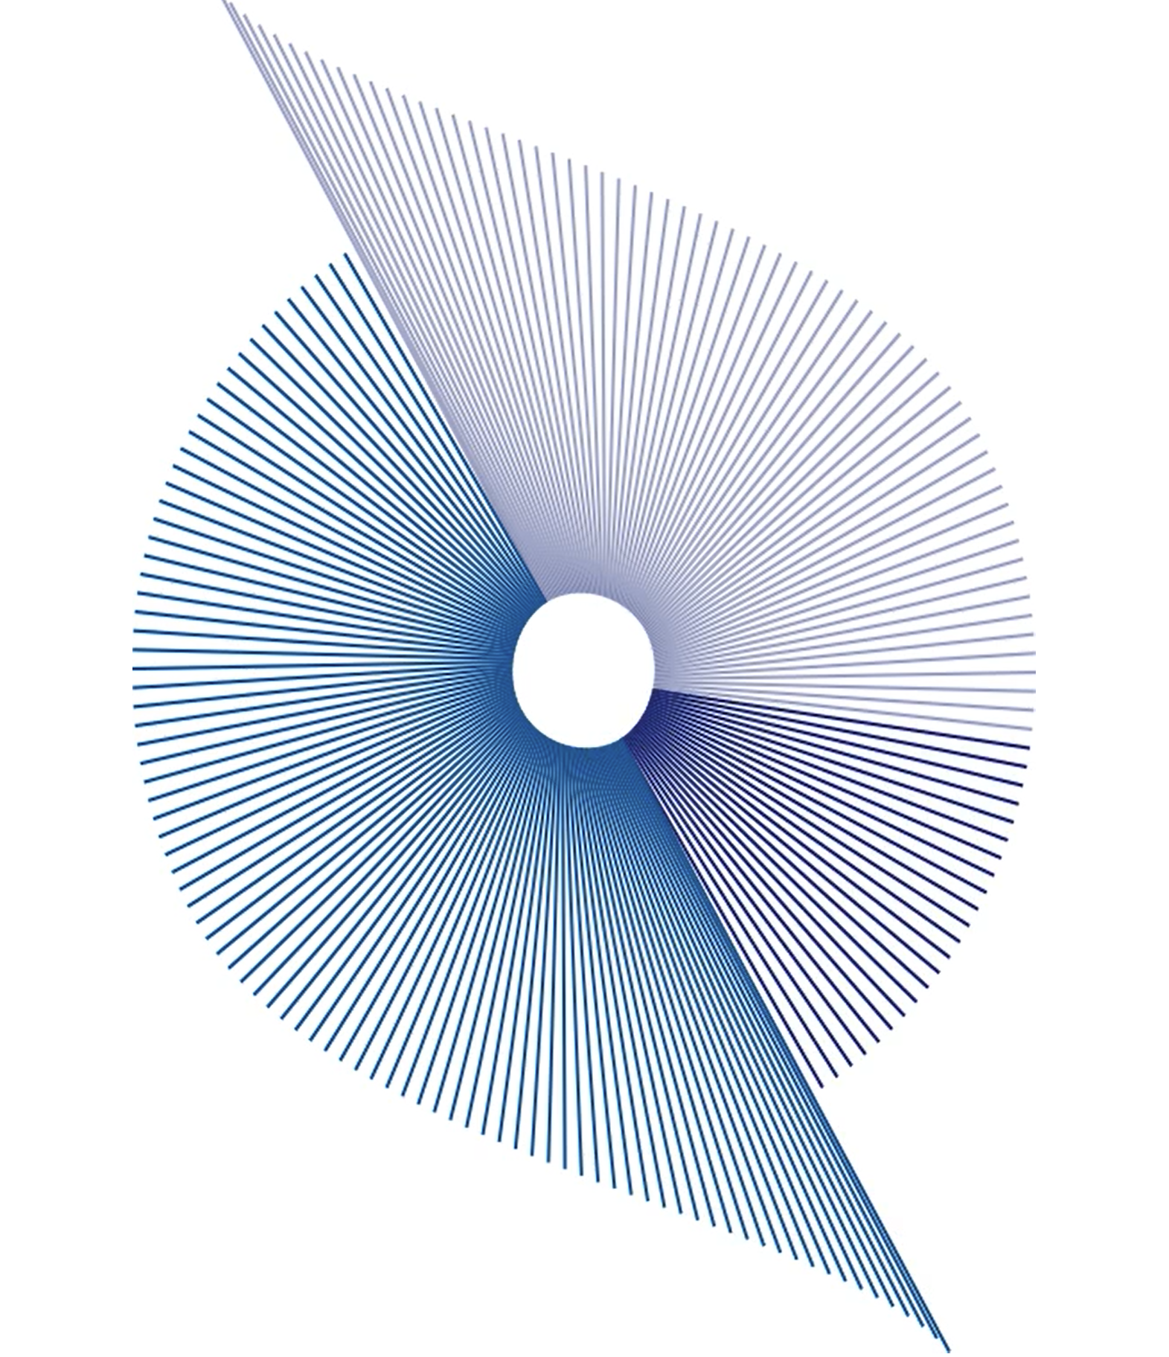
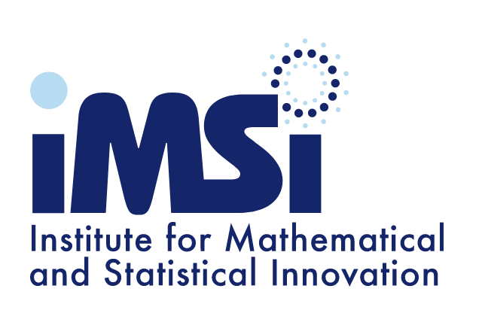
IMSI Workshop:
Object Oriented Data Analysis in Health Sciences
J. S. (Steve) Marron
Department of Statistics & OR
University of North Carolina

Slide 2
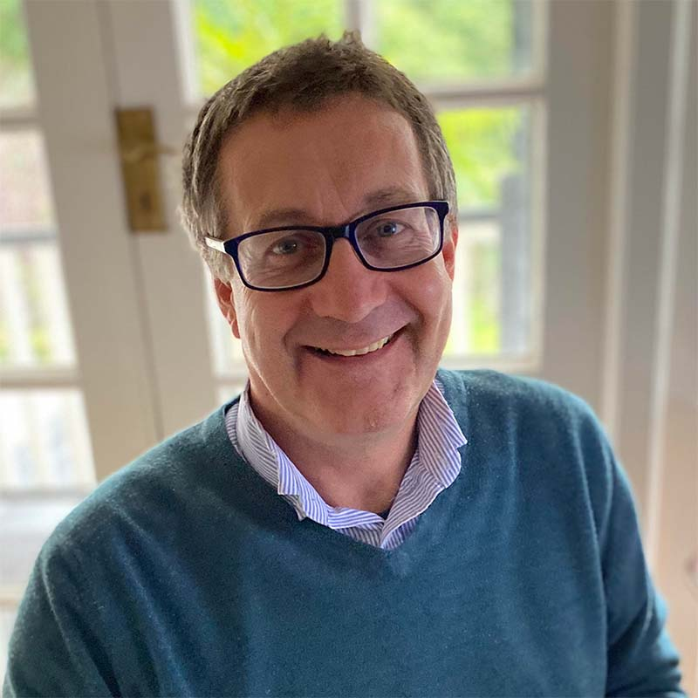
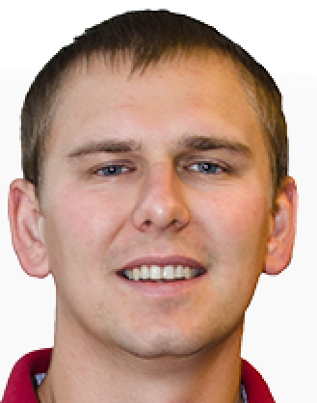
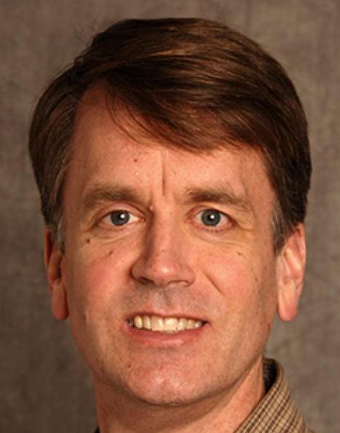
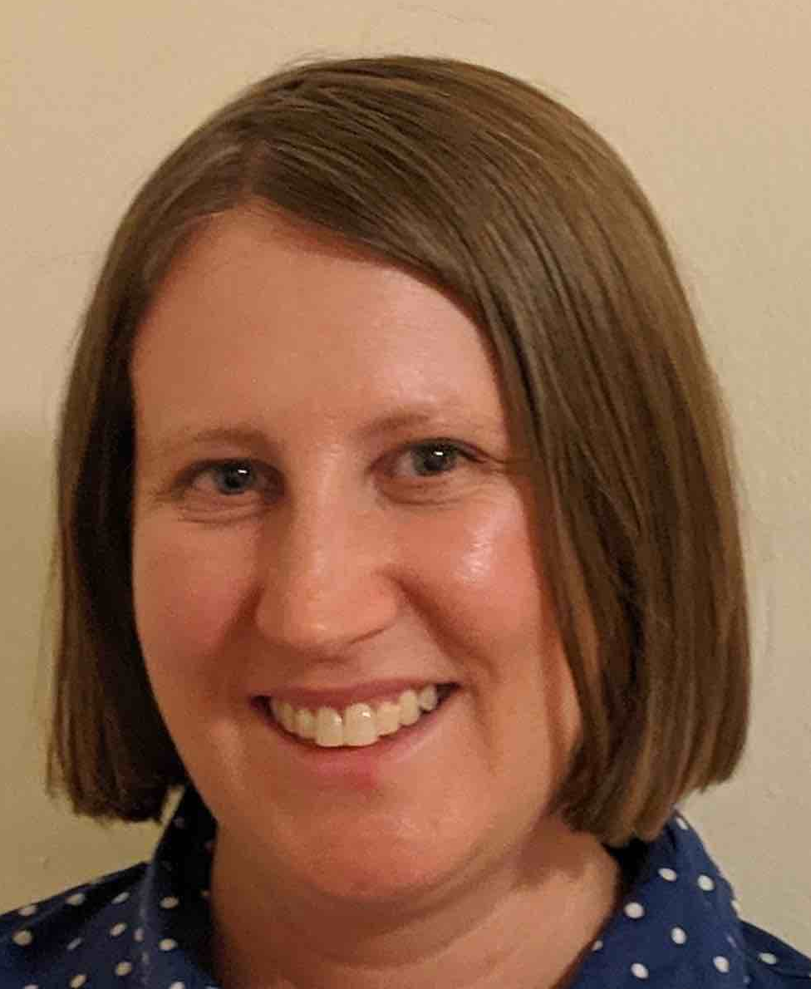
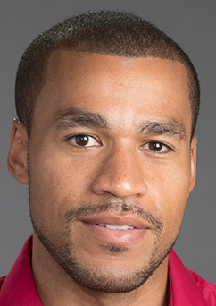
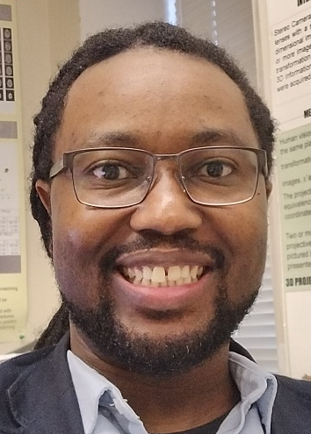
Organizing Committee
Ian Dryden
Florida Inter’al U.
Sebastian Kurtek
Ohio State U.
R. Todd Ogden
Columbia U.
Daniel Osborne
Florida A&M U.
Megan Owen
City U. New York
Sean Simpson
Wake Forest U.

Slide 3
Object Oriented Data Analysis
BIG DATA
Is a Serious Challenge
But Much Harder (& More Important?) Is
Complex Data

Slide 4
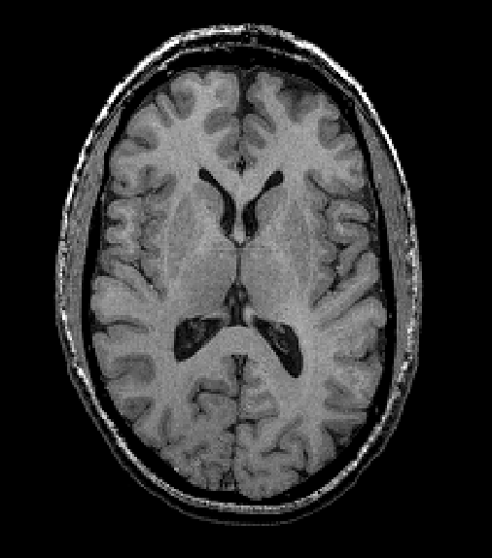
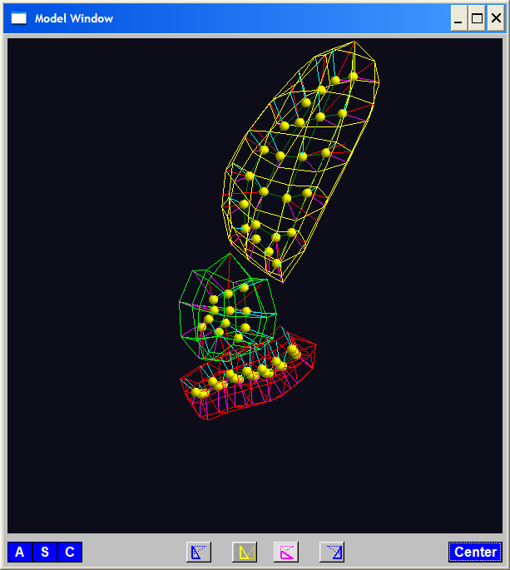
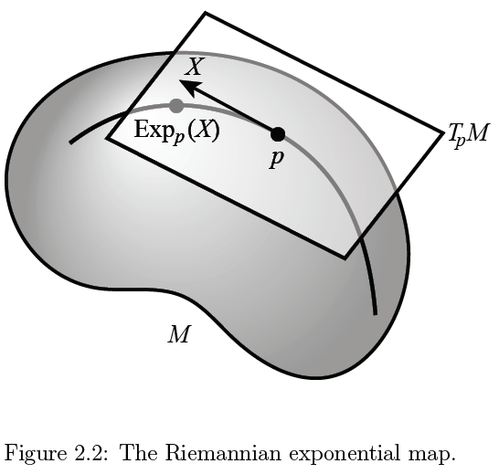
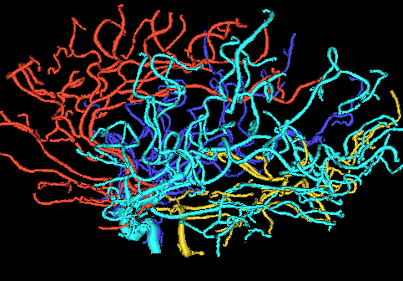
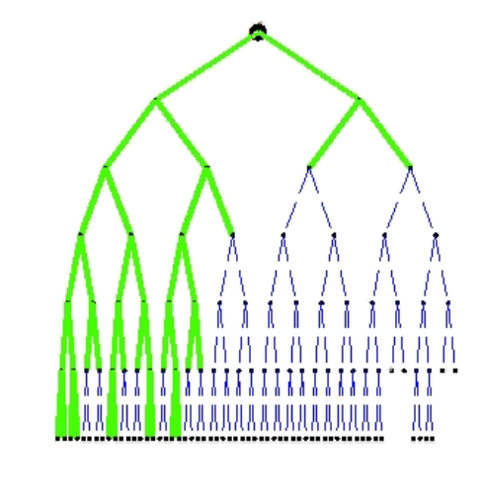
Object Oriented Data Analysis
Extension of FDA
To More General Statistical “Atoms”

Slide 5
Object Oriented Data Analysis
Why Another Name?

Slide 6
Object Oriented Data Analysis
Why Another Name:
Concept Focusses Discussion
“What shall we take as Data Objects?”

Slide 7
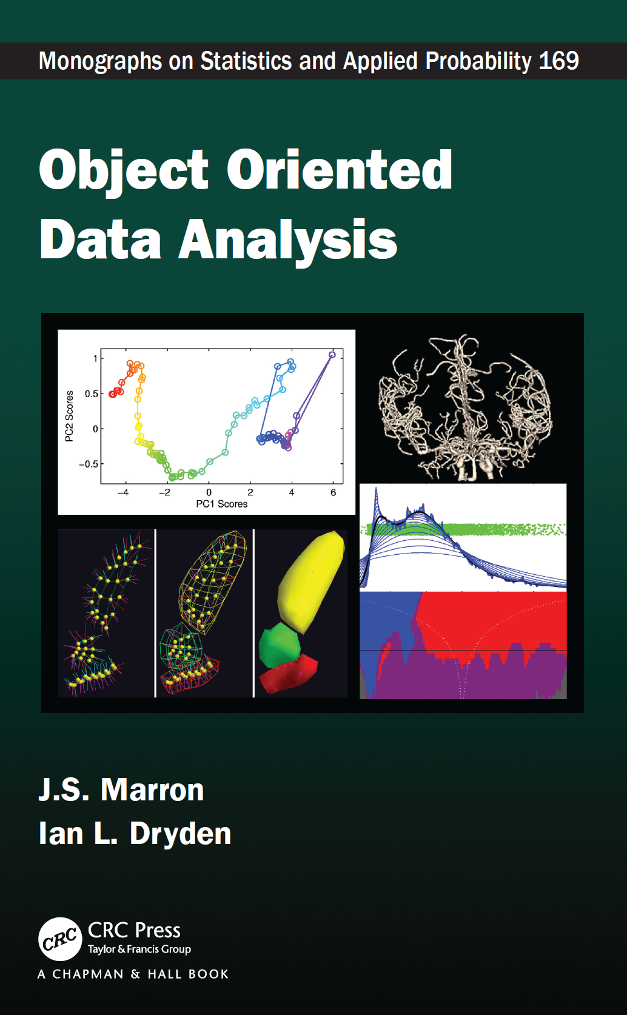
Object Oriented Data Analysis
Book with Ian Dryden:

Slide 8
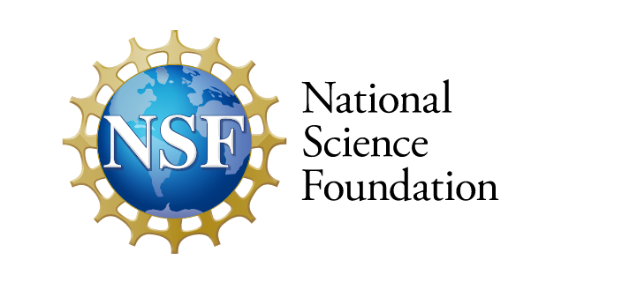
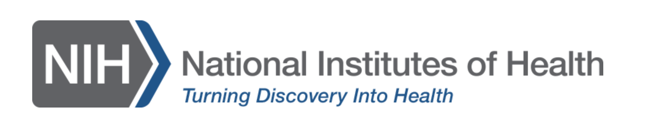
Object Oriented Data Analysis
Cool Terminology for
Your Next Grant Proposal?

Slide 9
Workshop Format
Deliberately Interactive
Discussion Groups (vs. Series of Talks)
Need Your Help / Engagement
Please Speak Up With Questions, etc.

Slide 10
Discussion Groups
Suggested By Any Participant
  Some Decided A Priori
  Hope For Many Suggestions in 1:30 Session
  Please Suggest Later as Well
Each Needs a Group Leader
Results Presented Friday Morning
Expect Large Variation
  Big Picture vs. Quite Specific
  Long Lasting vs. 1 Session

Slide 11
Research Talks
Note Slots on Schedule
20 Min. Discussion Group Intro’s
  Try to Pique “Non-Expert” Interest
  Give Sufficient Background to Topic
Want to Give One?
Suggest Discussion Group Topic

Slide 12
Scheduling
Done Interactively by Organizers
(Each day at 4:00)
Goals:
Maximize Group Participation
Minimize Overlap
Please Offer Comments to Several of Us

Slide 13
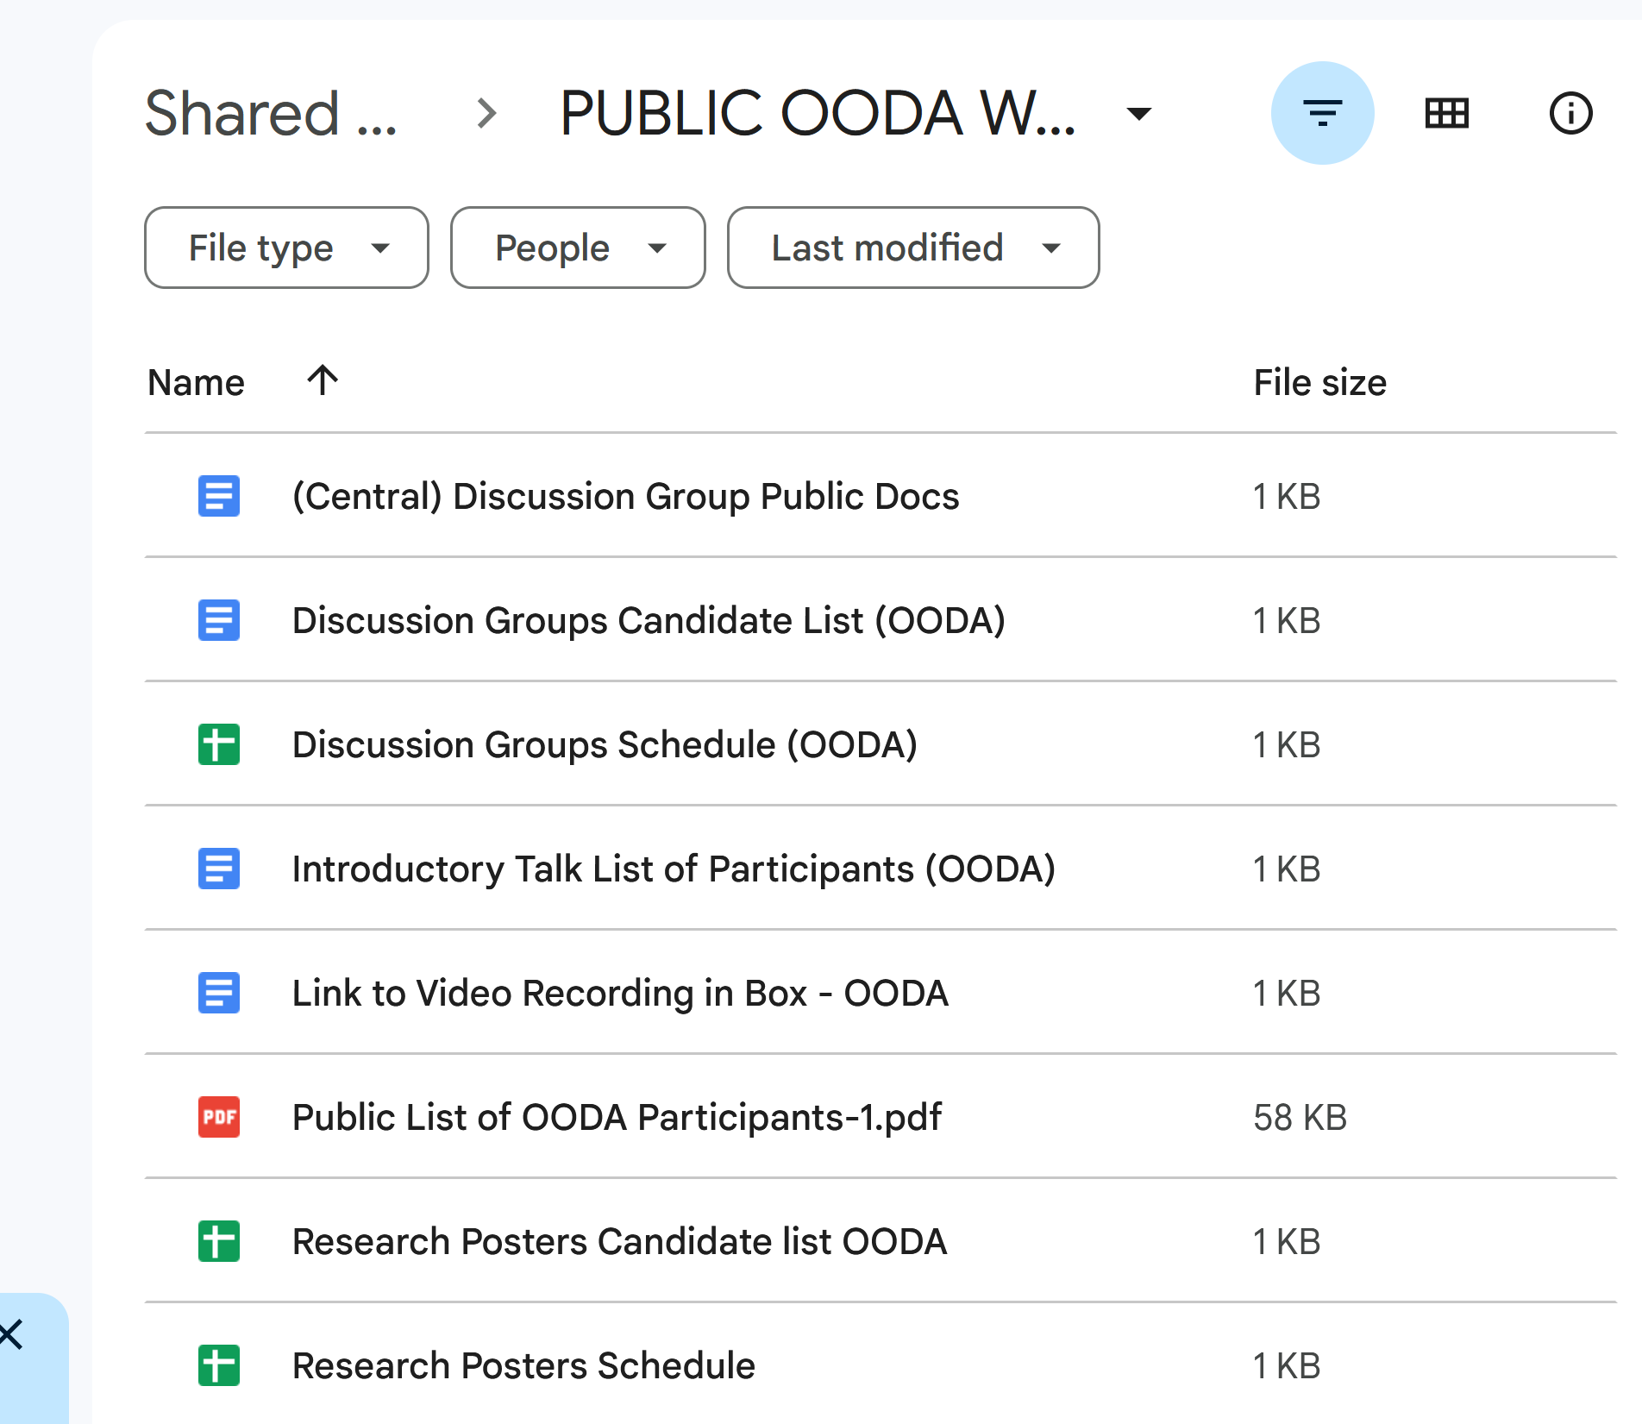
Organization
IMSI Google Docs
You Should Have Received Link by Email

Slide 14
IMSI Google Docs
For Discussion Groups:
Candidates List
  Send Suggestions to: Ian Dryden
Schedule (Edited by Sebastian Kurtek)
Public Docs
  Started by Megan Owen
  With Link to Main Page
  Edited by All

Slide 15
IMSI Google Docs
For Posters:
Candidates List
  Send Suggestions to: Todd Ogden
Schedule (Edited by Todd Ogden)
For Wish List Posters:
Candidates List
  Send Suggestions to: Todd Ogden
Schedule (Edited by Todd Ogden)

Slide 16
Introductory Talks
2 Minutes Please
Show Graphics (1-2 slides) by Zoom
  Should have link in IMSI email
  Can also find by logging in to IMSI
  Please Come to Front of Room
  See Who is Next on List (Between Talks)
Virtual Participants:
Please Direct Zoom Chat
to Daniel Osborne with your Name

Slide 17
Further Thoughts
Interactive Nature of Meeting
Aimed at Maximizing Participation
Please Ask Lots of Questions
Expect Flubs and Failures
Please Be Patient & Offer Suggestions

Slide 18
Introductory
Session

