Slide 1
Statistics – O. R. 891
Object Oriented Data Analysis
J. S. Marron
Dept. of Statistics and Operations Research
University of North Carolina

Slide 2
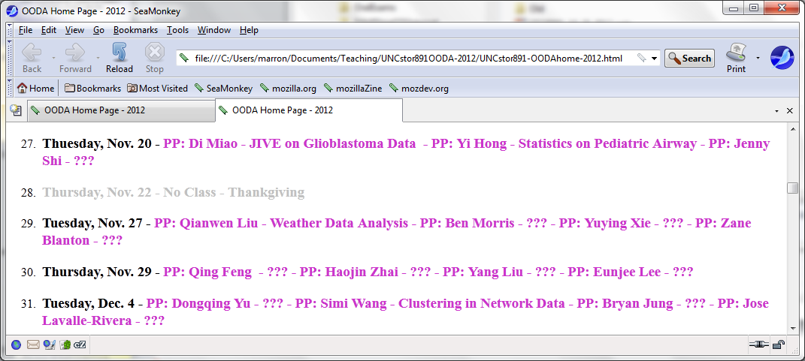
Participant Presentations

Slide 3
Participant Presentations
Please Send (Tentative) Title

Slide 4
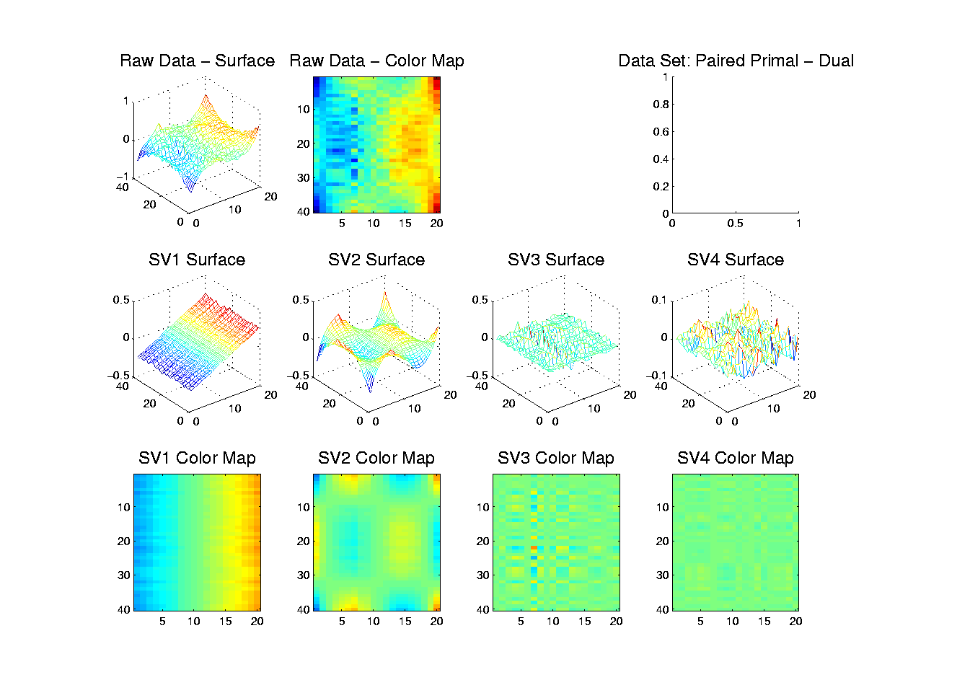
Primal - Dual PCA
Toy Example 5: SVD – Matrix-Image
Const. x Linear
Parab. x Cubic
Gaussian
Noise
Notes:
4

Slide 5
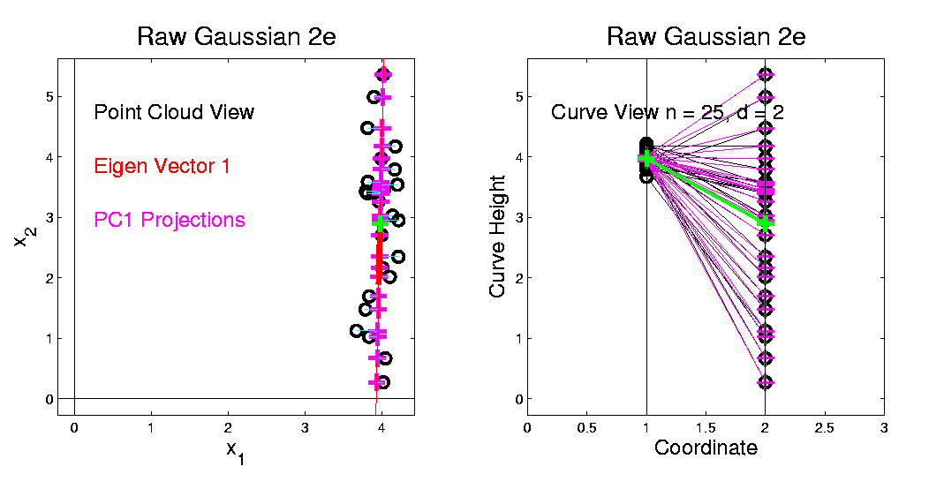
Primal - Dual PCA
PC1 Mode of Variation (Centered at Mean):
Yields Useful (1-d) Mode of Variation
Notes:
5

Slide 6
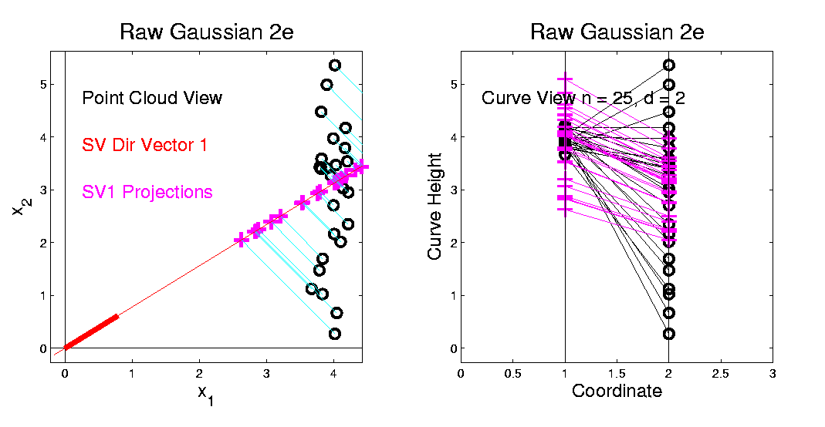
Primal - Dual PCA
SV1 mode of Variation (Centered at 0):
Unintuitive Major Mode of Variation
Notes:
6

Slide 7
HDLSS Asymptotics
Modern Mathematical Statistics:
Based on asymptotic analysis
Real Reasons:
  Approximation provides insights
  Can find simple underlying structure
  In complex situations
Thus various flavors are fine:
Even desirable! (find additional insights)
Notes:
7

Slide 8
HDLSS Asymptotics
Personal Observations:
HDLSS world is…
Surprising (many times!)
[Think I’ve got it, and then …]
Mathematically Beautiful (?)
Practically Relevant

Slide 9
HDLSS Asymptotics: Simple Paradoxes
As ,
Data lie roughly on surface of sphere,
with radius
- Yet origin is point of highest density???
- Paradox resolved by:
density w. r. t. Lebesgue Measure
Notes:
9

Slide 10
HDLSS Asy’s: Geometrical Represent’n
Assume , let
Study Subspace Generated by Data
Hyperplane through 0,
of dimension
Points are “nearly equidistant to 0”,
& dist
Within plane, can
“rotate towards Unit Simplex”
All Gaussian data sets are:
“near Unit Simplex Vertices”!!!
“Randomness” appears
only in rotation of simplex
Hall, Marron & Neeman (2005)

Slide 11
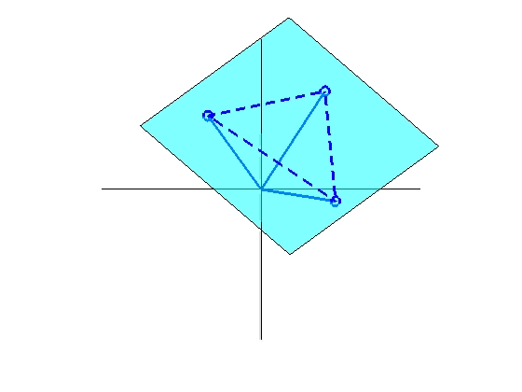
HDLSS Asy’s: Geometrical Represent’n
Assume , let
Study Hyperplane Generated by Data
dimensional hyperplane
Points are pairwise equidistant, dist
Points lie at vertices of:
“regular hedron”
Again “randomness in data” is only in rotation
Surprisingly rigid structure in random data?

Slide 12
HDLSS Discrim’n Simulations
Can we say more about:
All methods come together
in very high dimensions???
Mathematical Statistical Question:
Mathematics behind this???
(Use Geometric Representation)
Notes:
12

Slide 13
2nd Paper on HDLSS Asymptotics
Notes on Kent’s Normal Scale Mixture
Data Vectors are indep’dent of each other
But entries of each have strong depend’ce
However, can show entries have cov = 0!
Recall statistical folklore:
Covariance = 0 Independence

Slide 14
0 Covariance is not independence
Simple Example

Slide 15
0 Covariance is not independence
Simple Example:
Random Variables and
Make both Gaussian
(Note: Not Using Multivariate Gaussian)

Slide 16
0 Covariance is not independence
Simple Example:
Random Variables and
Make both Gaussian
With strong dependence
Yet 0 covariance
Given , define

Slide 17
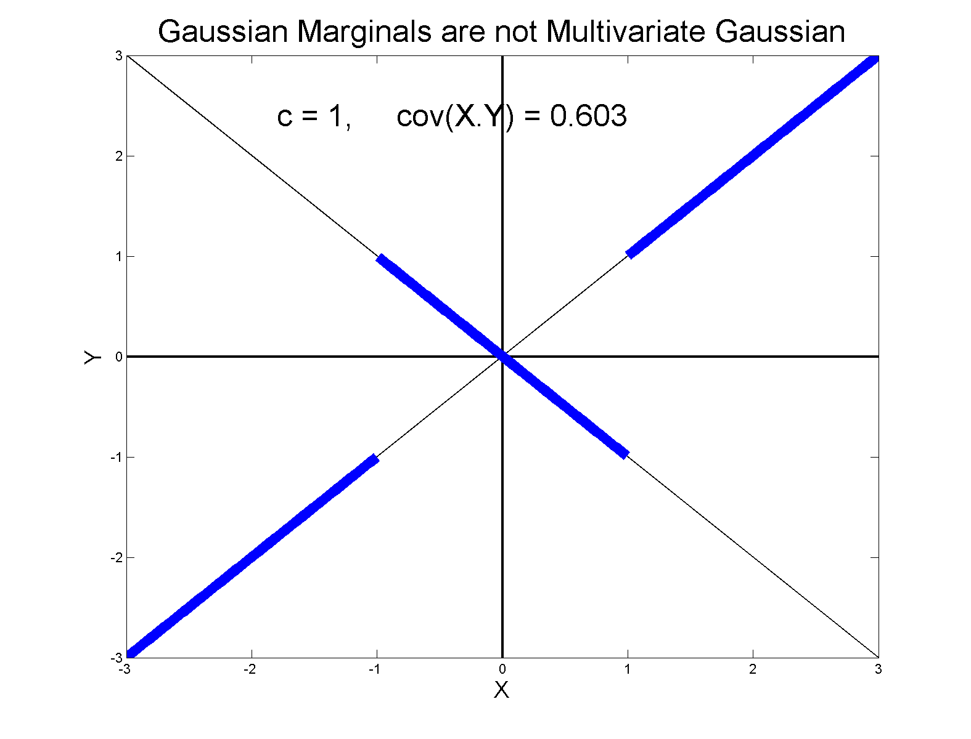
0 Covariance is not independence
Simple Example:

Slide 18
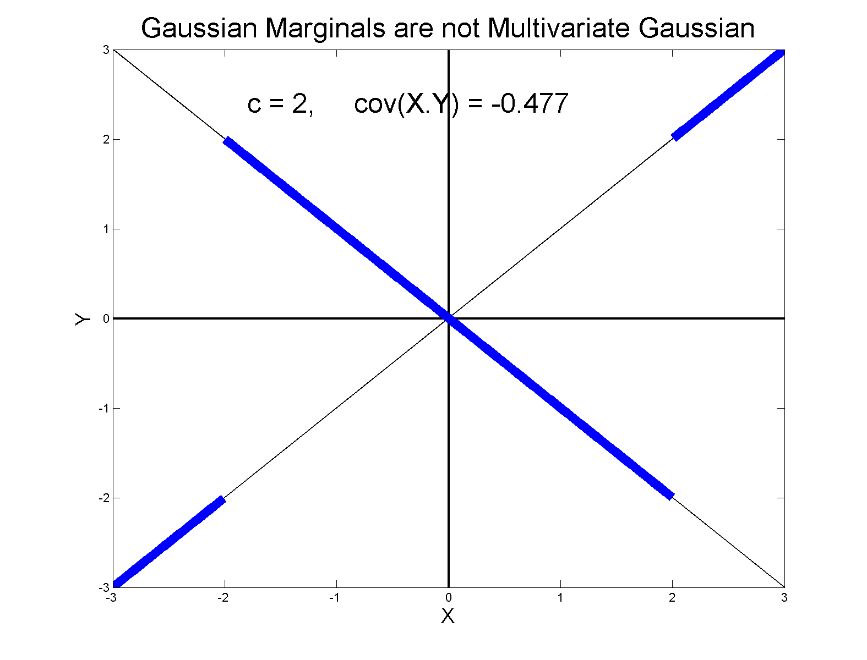
0 Covariance is not independence
Simple Example:

Slide 19
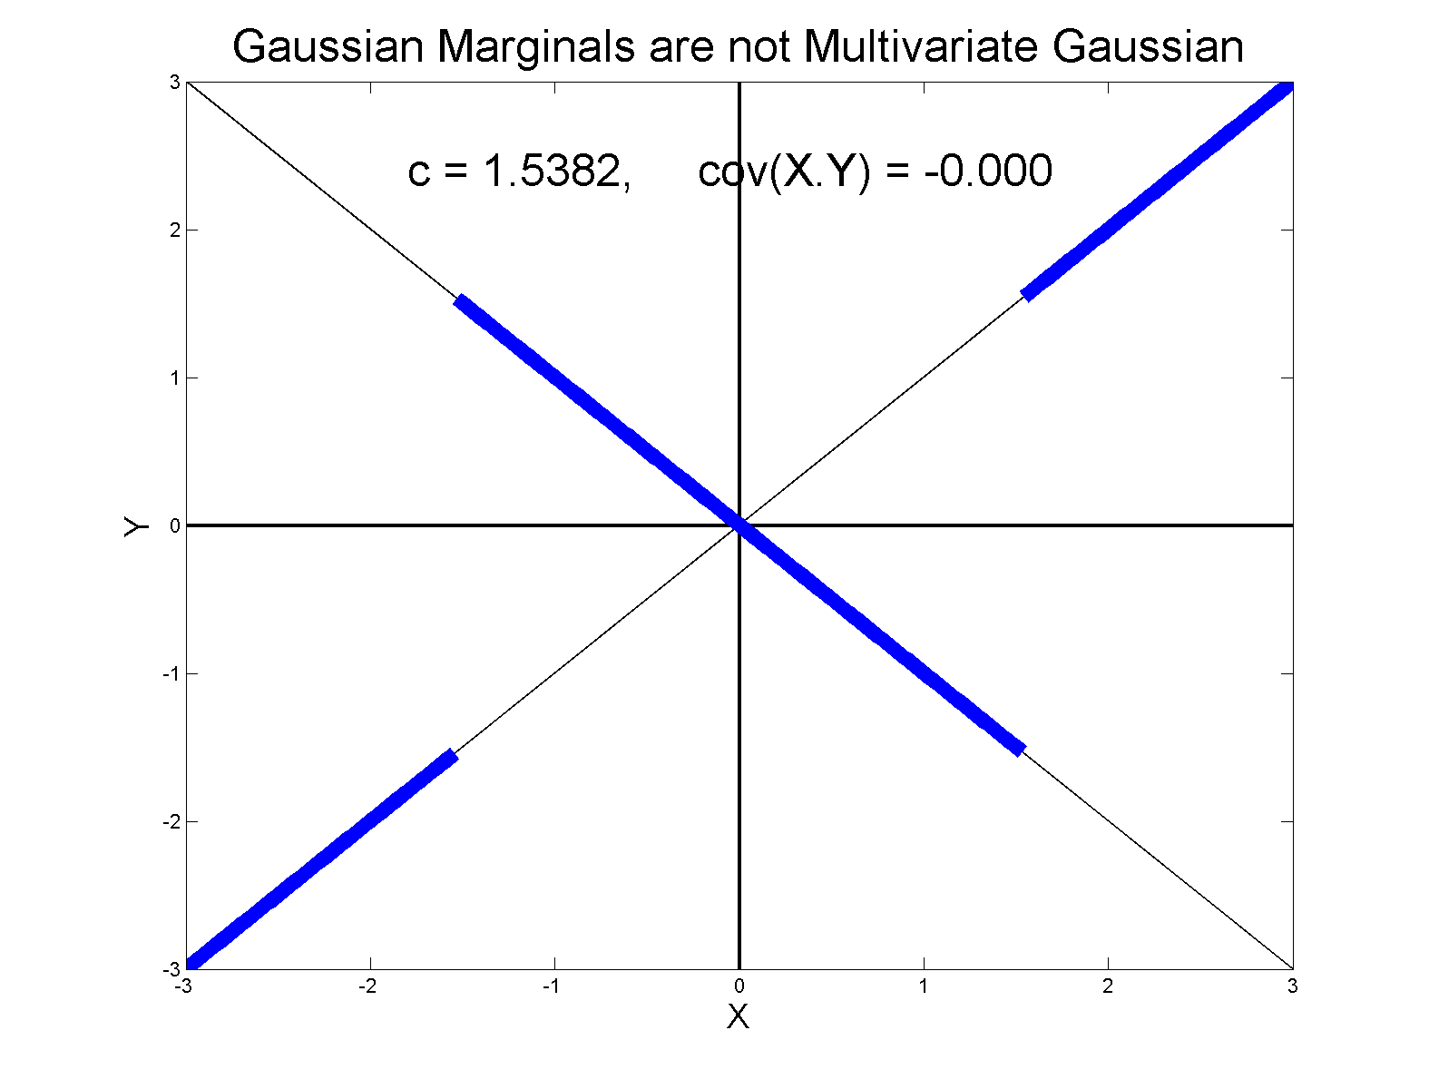
0 Covariance is not independence
Simple Example, c to make cov(X,Y) = 0

Slide 20
0 Covariance is not independence
Result:
Joint distribution of and :
  Has Gaussian marginals
  Has
  Yet strong dependence of and
  Thus not multivariate Gaussian
Shows Multivariate Gaussian means more
than Gaussian Marginals

Slide 21
HDLSS Asy’s: Geometrical Represen’tion
Further Consequences of Geometric Represen’tion
1. DWD more stable than SVM
(based on deeper limiting distributions)
(reflects intuitive idea feeling sampling variation)
(something like mean vs. median)
Hall, Marron, Neeman (2005)

Slide 22
HDLSS Asy’s: Geometrical Represen’tion
Further Consequences of Geometric Represen’tion
1. DWD more stable than SVM
(based on deeper limiting distributions)
(reflects intuitive idea feeling sampling variation)
(something like mean vs. median)
Hall, Marron, Neeman (2005)
2. 1-NN rule inefficiency is quantified.
Hall, Marron, Neeman (2005)

Slide 23
HDLSS Asy’s: Geometrical Represen’tion
Further Consequences of Geometric Represen’tion
1. DWD more stable than SVM
(based on deeper limiting distributions)
(reflects intuitive idea feeling sampling variation)
(something like mean vs. median)
Hall, Marron, Neeman (2005)
2. 1-NN rule inefficiency is quantified.
Hall, Marron, Neeman (2005)
3. Inefficiency of DWD for uneven sample size
(motivates weighted version)
Qiao, et al (2010)

Slide 24
HDLSS Math. Stat. of PCA
Consistency & Strong Inconsistency
(Study Properties of PCA,
In Estimating Eigen-Directions & -Values)

Slide 25
HDLSS Math. Stat. of PCA
Consistency & Strong Inconsistency:
Spike Covariance Model, Paul (2007)
For Eigenvalues:

Slide 26
HDLSS Math. Stat. of PCA
Consistency & Strong Inconsistency:
Spike Covariance Model, Paul (2007)
For Eigenvalues:
Note: Critical Parameter

Slide 27
HDLSS Math. Stat. of PCA
Consistency & Strong Inconsistency:
Spike Covariance Model, Paul (2007)
For Eigenvalues:
1st Eigenvector:
Turns out: Direction Doesn’t Matter

Slide 28
HDLSS Math. Stat. of PCA
Consistency & Strong Inconsistency:
Spike Covariance Model, Paul (2007)
For Eigenvalues:
1st Eigenvector:
How Good are Empirical Versions,
as Estimates?

Slide 29
HDLSS Math. Stat. of PCA
Consistency (big enough spike):
For ,

Slide 30
HDLSS Math. Stat. of PCA
Consistency (big enough spike):
For ,
Strong Inconsistency (spike not big enough):
For ,

Slide 31
HDLSS Math. Stat. of PCA
Intuition: Random Noise ~ d^{1/2}
For (Recall on Scale of Variance),
Spike Pops Out of Pure Noise Sphere

Slide 32
HDLSS Math. Stat. of PCA
Intuition: Random Noise ~ d^{1/2}
For (Recall on Scale of Variance),
Spike Pops Out of Pure Noise Sphere
For ,
Spike Contained in Pure Noise Sphere

Slide 33
HDLSS Math. Stat. of PCA
Consistency of eigenvalues?

Slide 34
HDLSS Math. Stat. of PCA
Consistency of eigenvalues?
Eigenvalues Inconsistent

Slide 35
HDLSS Math. Stat. of PCA
Consistency of eigenvalues?
Eigenvalues Inconsistent
But Known Distribution

Slide 36
HDLSS Math. Stat. of PCA
Consistency of eigenvalues?
Eigenvalues Inconsistent
But Known Distribution
Consistent when as Well

Slide 37
HDLSS Math. Stat. of PCA
Conditions for Geo. Rep’n & PCA Consist.:
John Kent example:

Slide 38
HDLSS Math. Stat. of PCA
Conditions for Geo. Rep’n & PCA Consist.:
John Kent example:
Can only say:
not deterministic

Slide 39
HDLSS Math. Stat. of PCA
Conditions for Geo. Rep’n & PCA Consist.:
John Kent example:
Can only say:
not deterministic
PCA Conditions Same, since Noise Still

Slide 40
HDLSS Math. Stat. of PCA
Conditions for Geo. Rep’n & PCA Consist.:
John Kent example:
Can only say:
not deterministic
But for Geo. Rep’n: need some Mixing Cond.

Slide 41
HDLSS Math. Stat. of PCA
Conditions for Geo. Rep’n:
Conclude: Need some Mixing Condition

Slide 42
Mixing Conditions
Idea From Probability Theory:

Slide 43

Mixing Conditions
Idea From Probability Theory:
Recall Standard Asymptotic Results, as $n→∞:$

Slide 44
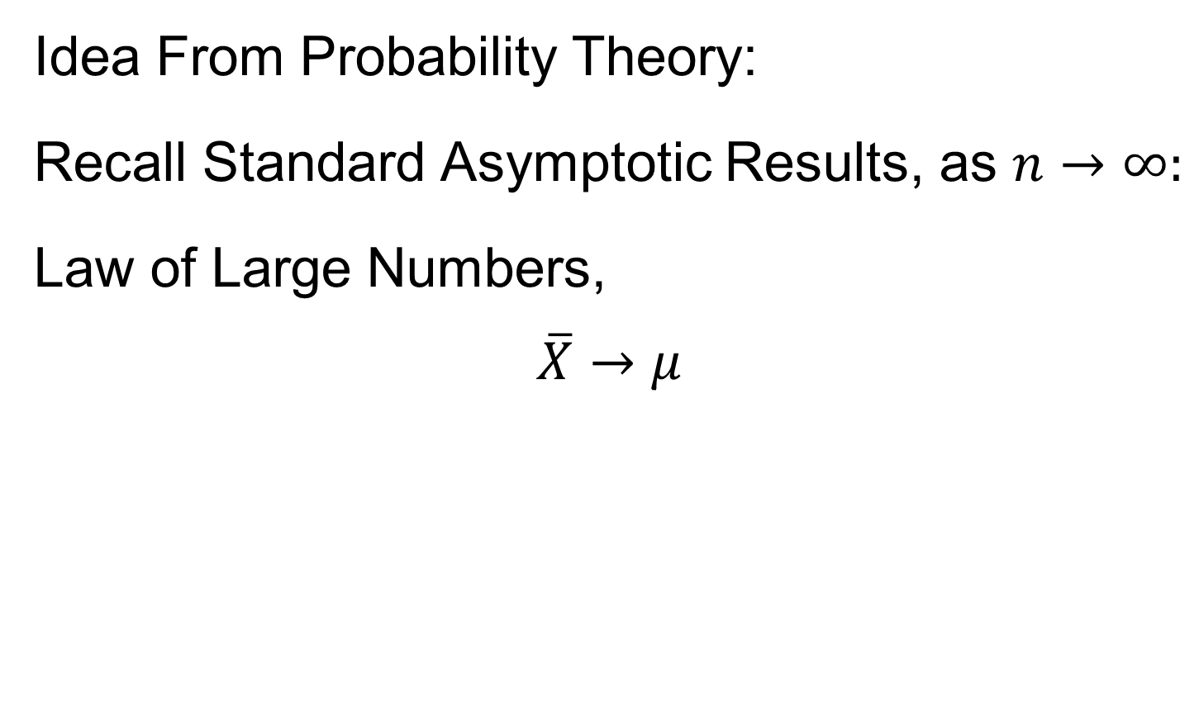
Mixing Conditions
Idea From Probability Theory:
Recall Standard Asymptotic Results, as $n→∞:$
Law of Large Numbers,
$$\overline{X}→μ$$

Slide 45
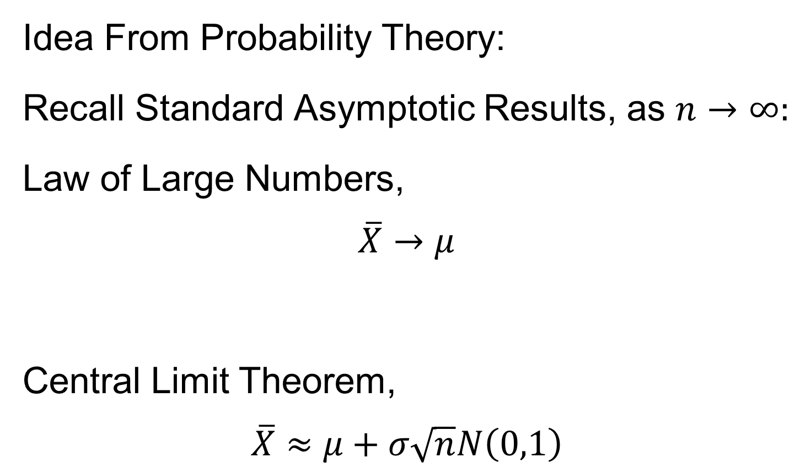
Mixing Conditions
Idea From Probability Theory:
Recall Standard Asymptotic Results, as $n→∞:$
Law of Large Numbers,
$$\overline{X}→μ$$
Central Limit Theorem,
$$\overline{X}≈μ+σ\sqrt{n}N\left(0,1\right)$$

Slide 46
Mixing Conditions
Idea From Probability Theory:
Law of Large Numbers,
Central Limit Theorem,
Both have Technical Assumptions
(Usually Ignore ???)

Slide 47
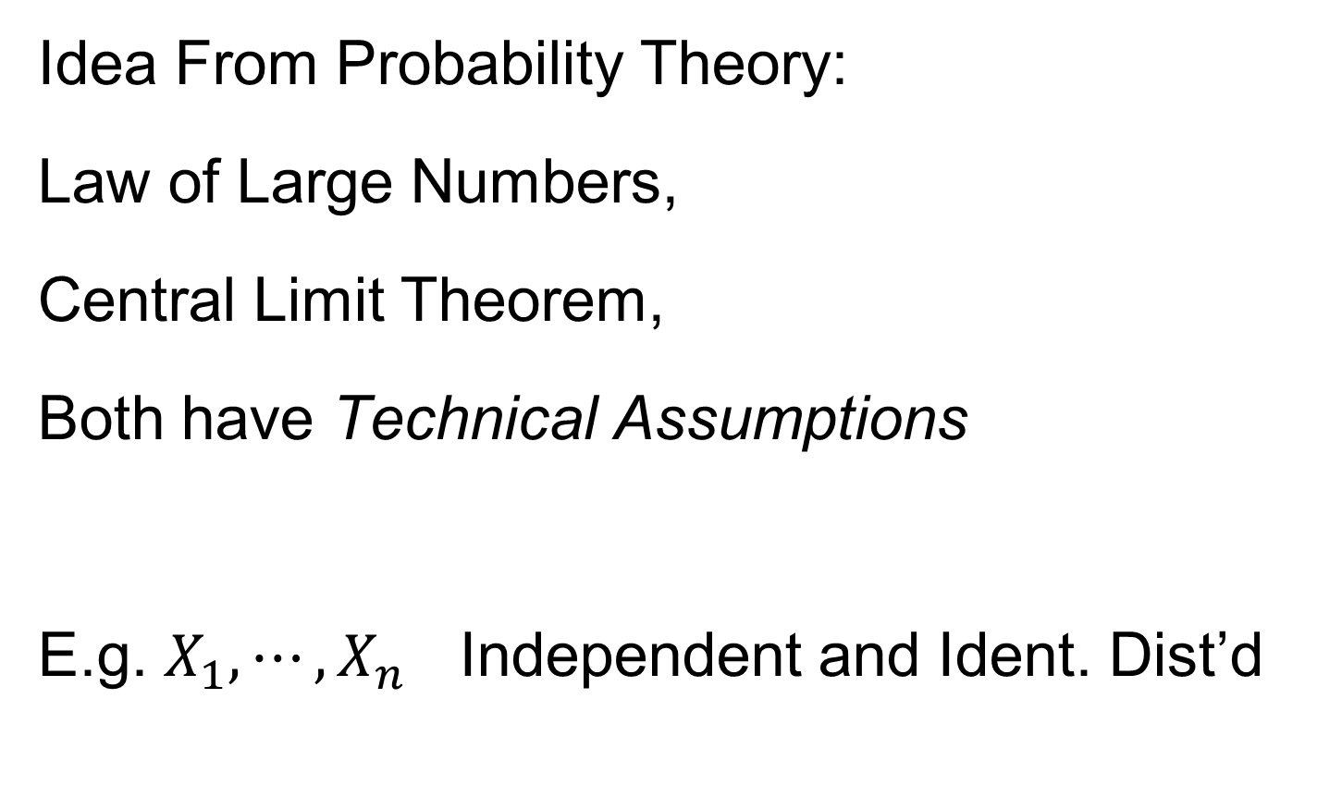
Mixing Conditions
Idea From Probability Theory:
Law of Large Numbers,
Central Limit Theorem,
Both have Technical Assumptions
E.g. $X_{1},⋯,X_{n}$ Independent and Ident. Dist’d

Slide 48
Mixing Conditions
Idea From Probability Theory:
Mixing Conditions:
Explore Weaker Assumptions, to Still Get
Law of Large Numbers,
Central Limit Theorem

Slide 49

Mixing Conditions
Mixing Conditions:
A Whole Area in Probability Theory
$∃$ a Large Literature

Slide 50
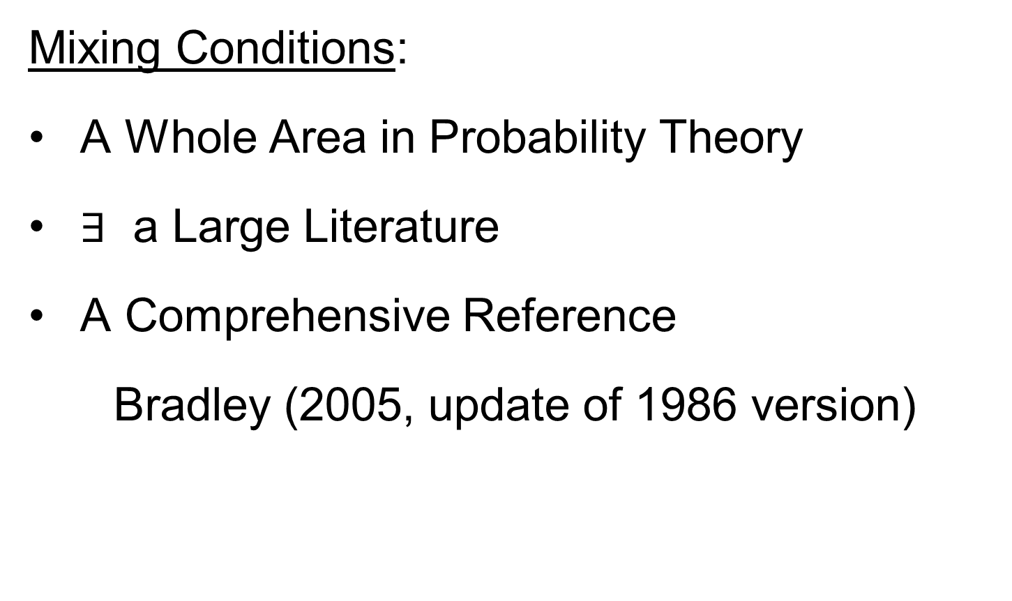
Mixing Conditions
Mixing Conditions:
A Whole Area in Probability Theory
$∃$ a Large Literature
A Comprehensive Reference
Bradley (2005, update of 1986 version)

Slide 51
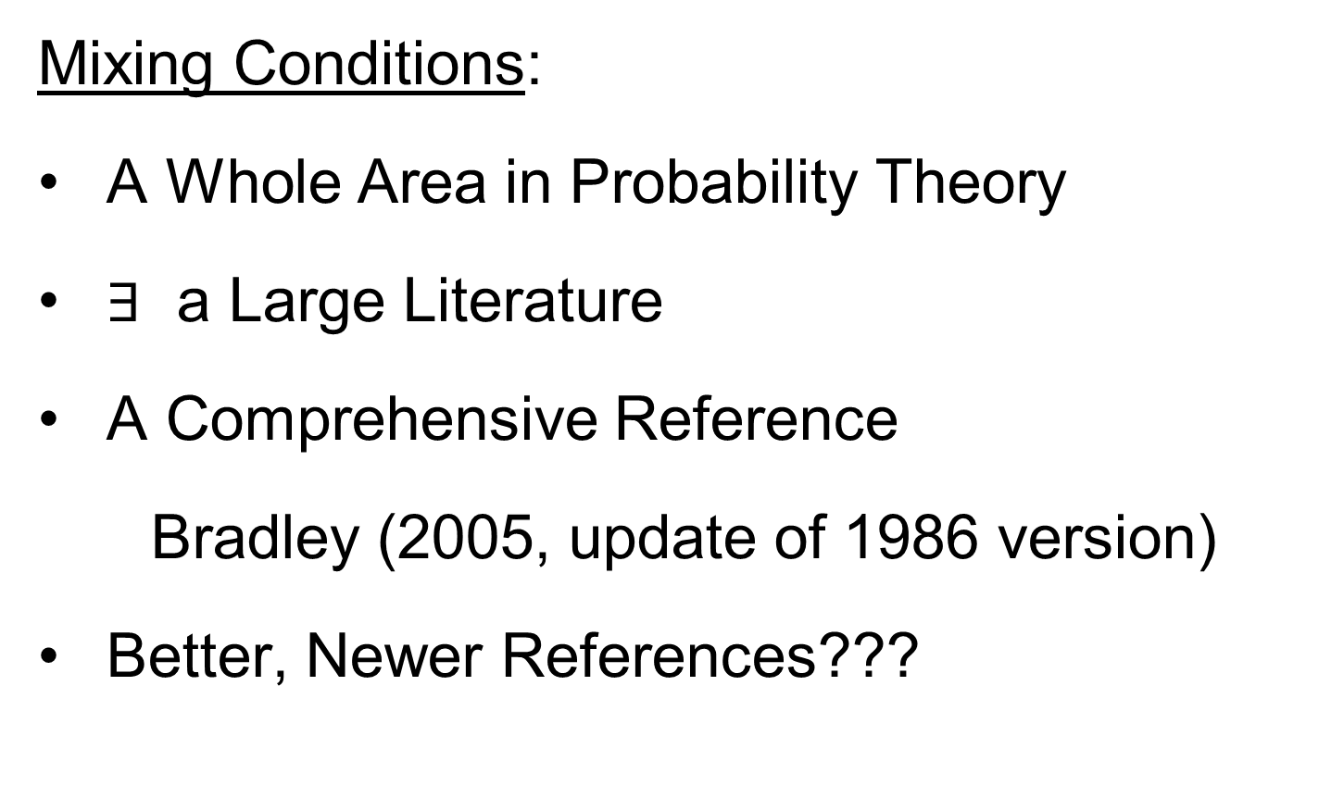
Mixing Conditions
Mixing Conditions:
A Whole Area in Probability Theory
$∃$ a Large Literature
A Comprehensive Reference
Bradley (2005, update of 1986 version)
Better, Newer References???

Slide 52
Mixing Conditions
Mixing Condition Used Here:
Rho – Mixing

Slide 53
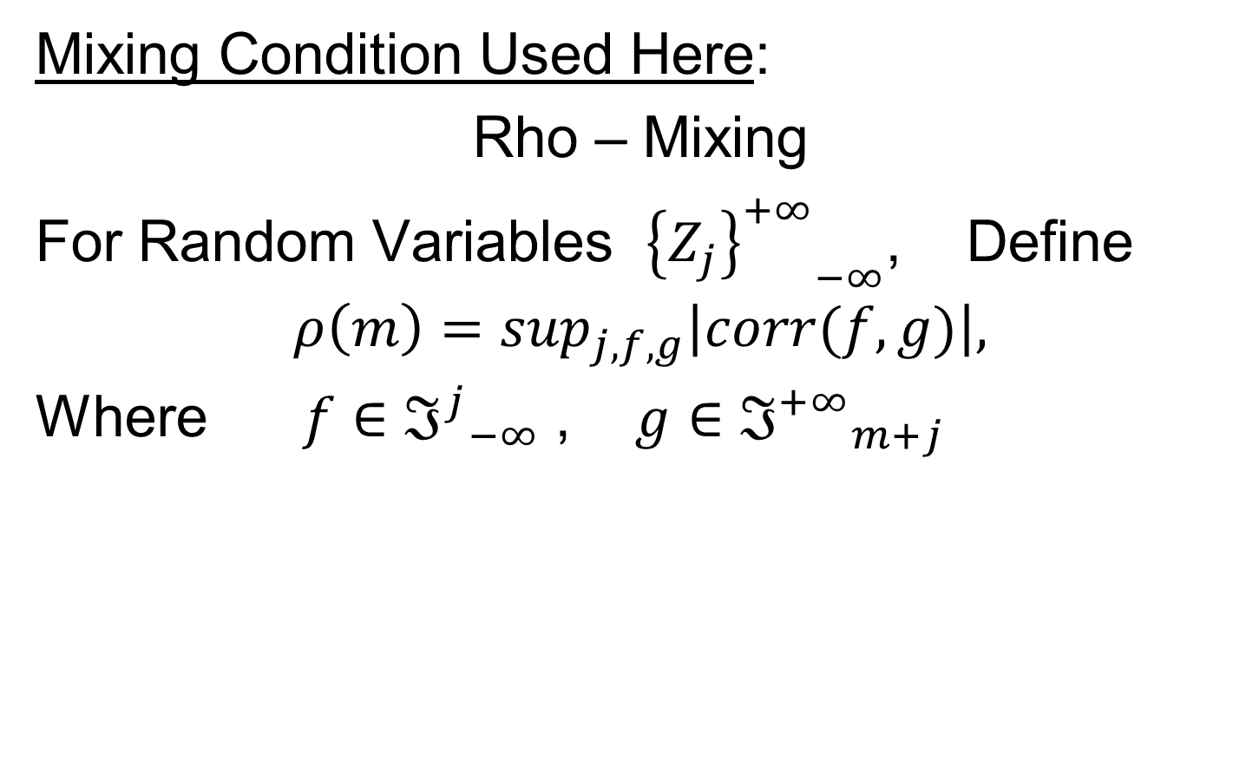
Mixing Conditions
Mixing Condition Used Here:
Rho – Mixing
For Random Variables ${{\left\{Z_{j}\right\}}^{+∞}}_{−∞}^{}$, Define
$$ρ\left(m\right)=\sup_{j,f,g}\left|corr(f,g)\right|,$$
Where $f∈{ℑ^{j}}_{−∞}^{}$ , $g∈{ℑ^{+∞}}_{m+j}^{}$

Slide 54
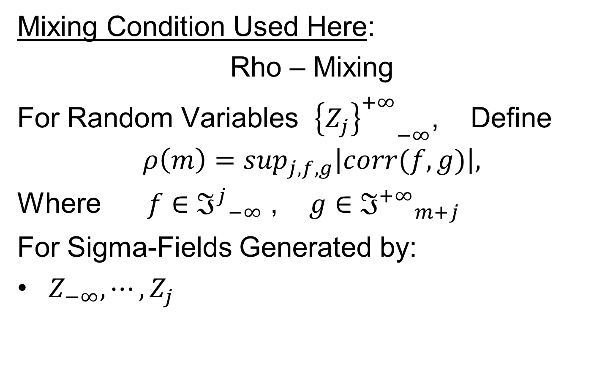
Mixing Conditions
Mixing Condition Used Here:
Rho – Mixing
For Random Variables ${{\left\{Z_{j}\right\}}^{+∞}}_{−∞}^{}$, Define
$$ρ\left(m\right)=\sup_{j,f,g}\left|corr(f,g)\right|,$$
Where $f∈{ℑ^{j}}_{−∞}^{}$ , $g∈{ℑ^{+∞}}_{m+j}^{}$
For Sigma-Fields Generated by:
$Z_{−∞},⋯,Z_{j}$

Slide 55
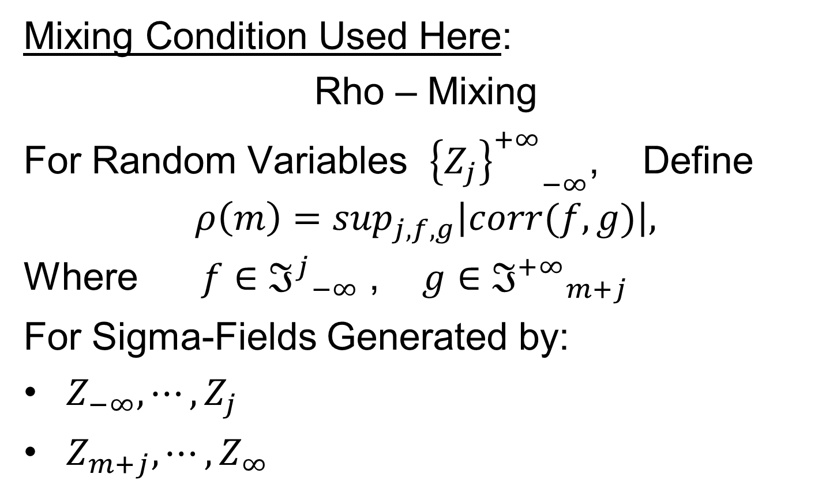
Mixing Conditions
Mixing Condition Used Here:
Rho – Mixing
For Random Variables ${{\left\{Z_{j}\right\}}^{+∞}}_{−∞}^{}$, Define
$$ρ\left(m\right)=\sup_{j,f,g}\left|corr(f,g)\right|,$$
Where $f∈{ℑ^{j}}_{−∞}^{}$ , $g∈{ℑ^{+∞}}_{m+j}^{}$
For Sigma-Fields Generated by:
$Z_{−∞},⋯,Z_{j}$
$Z_{m+j},⋯,Z_{∞}$

Slide 56
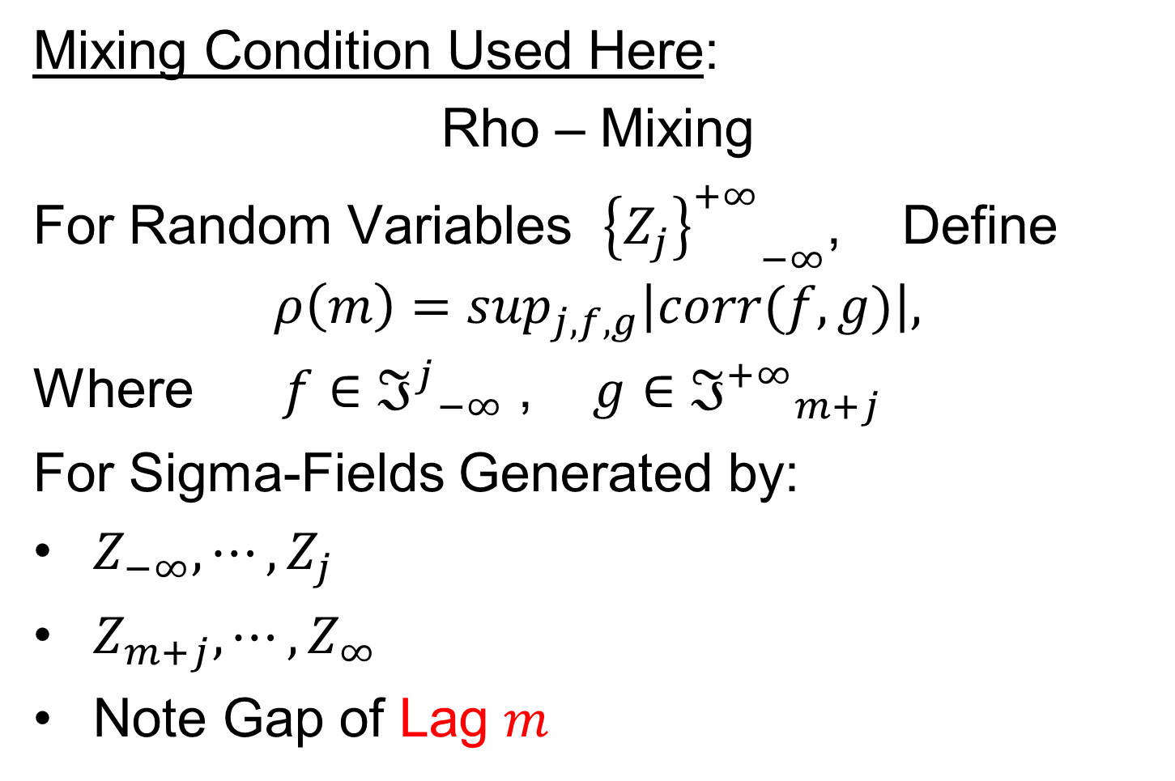
Mixing Conditions
Mixing Condition Used Here:
Rho – Mixing
For Random Variables ${{\left\{Z_{j}\right\}}^{+∞}}_{−∞}^{}$, Define
$$ρ\left(m\right)=\sup_{j,f,g}\left|corr(f,g)\right|,$$
Where $f∈{ℑ^{j}}_{−∞}^{}$ , $g∈{ℑ^{+∞}}_{m+j}^{}$
For Sigma-Fields Generated by:
$Z_{−∞},⋯,Z_{j}$
$Z_{m+j},⋯,Z_{∞}$
Note Gap of Lag $m$

Slide 57
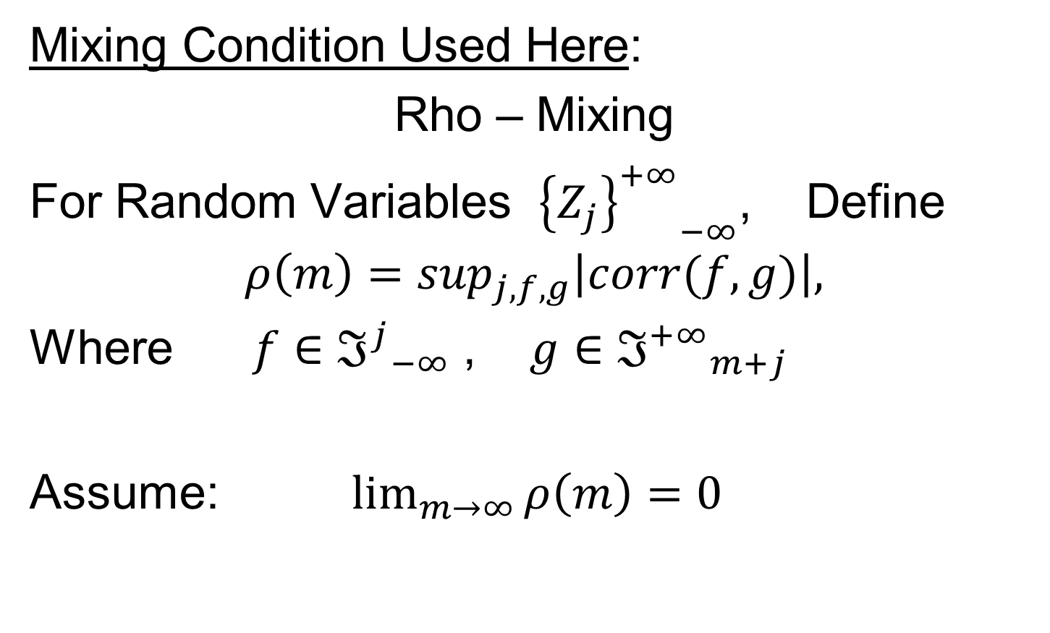
Mixing Conditions
Mixing Condition Used Here:
Rho – Mixing
For Random Variables ${{\left\{Z_{j}\right\}}^{+∞}}_{−∞}^{}$, Define
$$ρ\left(m\right)=\sup_{j,f,g}\left|corr(f,g)\right|,$$
Where $f∈{ℑ^{j}}_{−∞}^{}$ , $g∈{ℑ^{+∞}}_{m+j}^{}$
Assume: $\lim_{m→∞}{ρ\left(m\right)=0}$

Slide 58
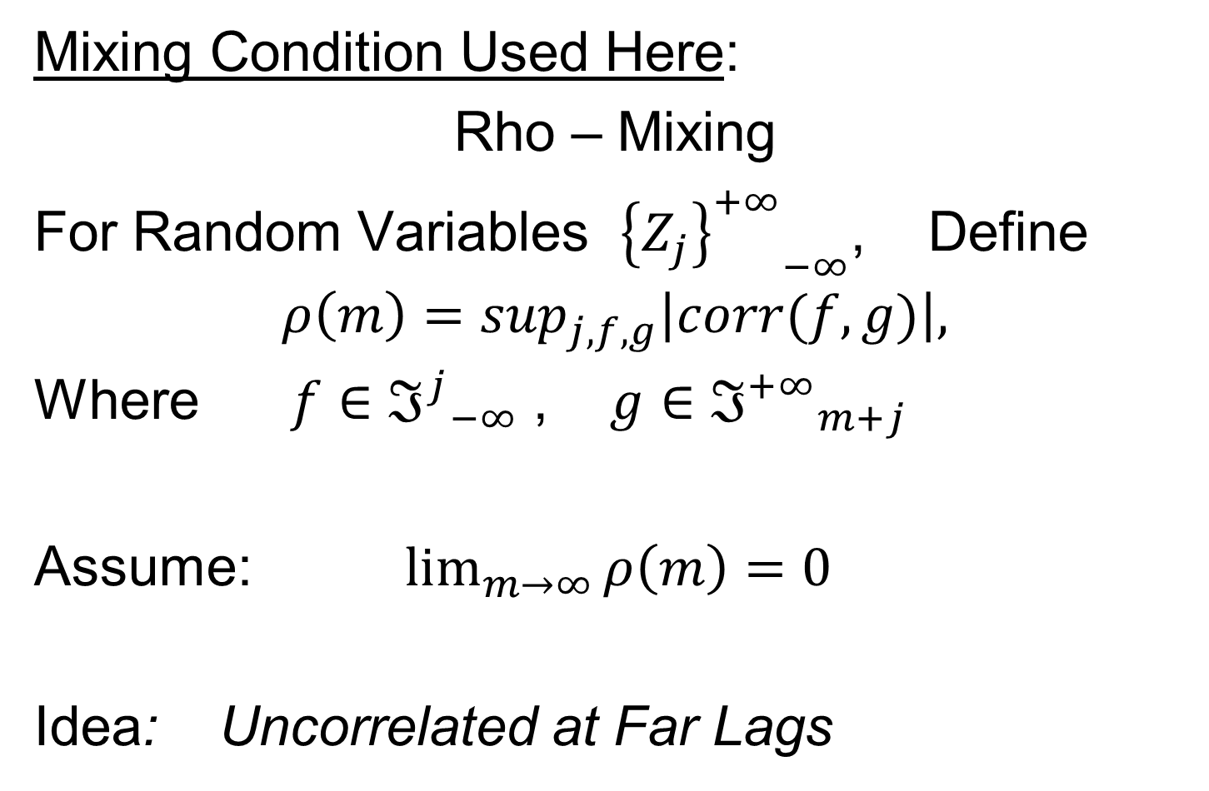
Mixing Conditions
Mixing Condition Used Here:
Rho – Mixing
For Random Variables ${{\left\{Z_{j}\right\}}^{+∞}}_{−∞}^{}$, Define
$$ρ\left(m\right)=\sup_{j,f,g}\left|corr(f,g)\right|,$$
Where $f∈{ℑ^{j}}_{−∞}^{}$ , $g∈{ℑ^{+∞}}_{m+j}^{}$
Assume: $\lim_{m→∞}{ρ\left(m\right)=0}$
Idea: Uncorrelated at Far Lags

Slide 59
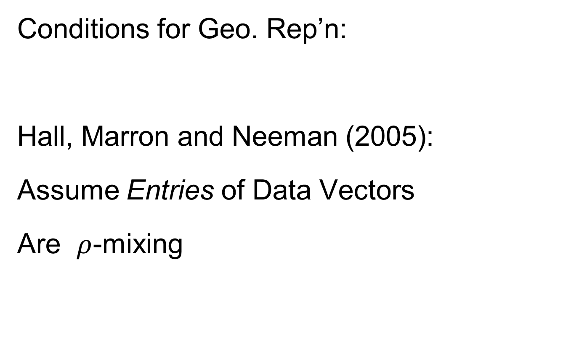
HDLSS Math. Stat. of PCA
Conditions for Geo. Rep’n:
Hall, Marron and Neeman (2005):
Assume Entries of Data Vectors
Are $ρ$-mixing

Slide 60
HDLSS Math. Stat. of PCA
Conditions for Geo. Rep’n:
Hall, Marron and Neeman (2005):
Drawback: Strong Assumption
(In JRSS-B, since
Biometrika Refused)

Slide 61
HDLSS Math. Stat. of PCA
Conditions for Geo. Rep’n:
Series of Technical Improvements:
Ahn, Marron, Muller & Chi (2007)
Aoshima (2010), Yata & Aoshima (2012)
(Fully Covariance Based,
No Mixing)

Slide 62
HDLSS Math. Stat. of PCA
Conditions for Geo. Rep’n:
Tricky Point: Classical Mixing Conditions
Require Notion of Time Ordering
Not Always Clear, e.g. Microarrays

Slide 63
HDLSS Math. Stat. of PCA
Conditions for Geo. Rep’n:
Condition from Jung & Marron (2009):
where
Note: Not Gaussian

Slide 64
HDLSS Math. Stat. of PCA
Conditions for Geo. Rep’n:
Condition from Jung & Marron (2009):
where
Define:
Standardized Version

Slide 65
HDLSS Math. Stat. of PCA
Conditions for Geo. Rep’n:
Condition from Jung & Marron (2009):
where
Define:
Assume: Ǝ a permutation,
So that is ρ-mixing

Slide 66
HDLSS Math. Stat. of PCA
Careful look at:
PCA Consistency - spike
(Reality Check, Suggested by Reviewer)

Slide 67
HDLSS Math. Stat. of PCA
Careful look at:
PCA Consistency - spike
Independent of Sample Size,
So true for n = 1 (!?!)

Slide 68
HDLSS Math. Stat. of PCA
Careful look at:
PCA Consistency - spike
Independent of Sample Size,
So true for n = 1 (!?!)
Reviewers Conclusion: Absurd, shows assumption too strong for practice ???

Slide 69
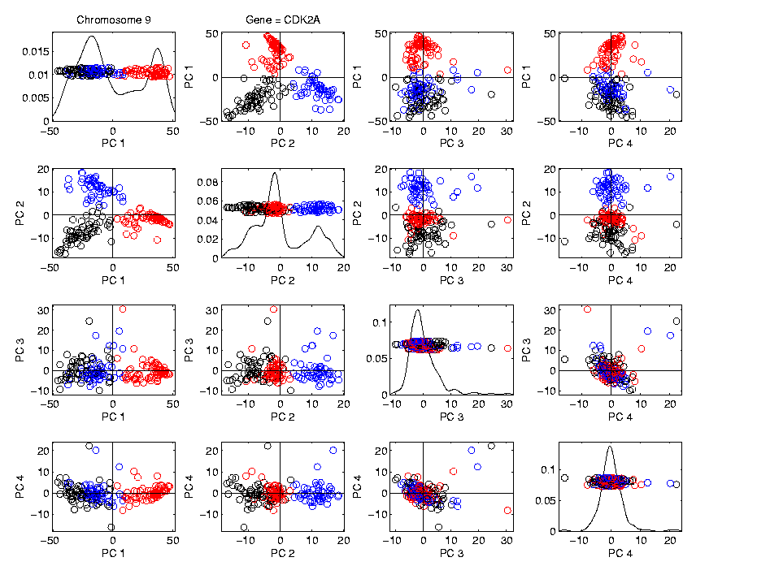
HDLSS Math. Stat. of PCA
HDLSS
PCA
Often
Finds
Signal,
Not Pure
Noise

Slide 70
HDLSS Math. Stat. of PCA
Recall
RNAseq
Data From
8/23/12
d ~ 1700
n = 180

Slide 71
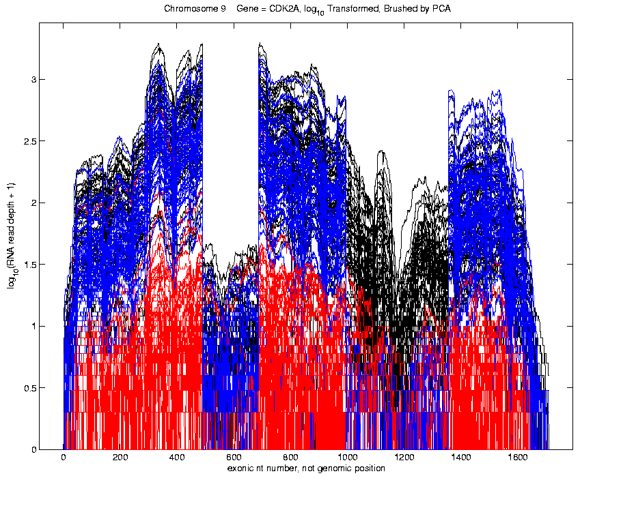
Functional Data Analysis
Manually
Brushed
Clusters
Clear
Alternate
Splicing
Not
Noise!

Slide 72
HDLSS Math. Stat. of PCA
Recall Theoretical Separation:
Strong Inconsistency - spike
Consistency - spike

Slide 73
HDLSS Math. Stat. of PCA
Recall Theoretical Separation:
Strong Inconsistency - spike
Consistency - spike
Mathematically Driven Conclusion:
Real Data Signals Are This Strong

Slide 74
HDLSS Math. Stat. of PCA
An Interesting Objection:
Should not Study Angles in PCA

Slide 75
HDLSS Math. Stat. of PCA
An Interesting Objection:
Should not Study Angles in PCA
Recall, for Consistency:

Slide 76
HDLSS Math. Stat. of PCA
An Interesting Objection:
Should not Study Angles in PCA
Recall, for Consistency:
For Strong Inconsistency:

Slide 77
HDLSS Math. Stat. of PCA
An Interesting Objection:
Should not Study Angles in PCA
Because PC Scores (i.e. projections)
Not Consistent

Slide 78
HDLSS Math. Stat. of PCA
An Interesting Objection:
Should not Study Angles in PCA
Because PC Scores (i.e. projections)
Not Consistent
For Scores
What we study in PCA scatterplots

Slide 79
HDLSS Math. Stat. of PCA
An Interesting Objection:
Should not Study Angles in PCA
Because PC Scores (i.e. projections)
Not Consistent
For Scores and

Slide 80
HDLSS Math. Stat. of PCA
An Interesting Objection:
Should not Study Angles in PCA
Because PC Scores (i.e. projections)
Not Consistent
For Scores and
Can Show (Random!)
Thanks to Dan Shen

Slide 81
HDLSS Math. Stat. of PCA
PC Scores (i.e. projections)
Not Consistent
So how can PCA find Useful Signals in Data?

Slide 82
HDLSS Math. Stat. of PCA
HDLSS
PCA
Often
Finds
Signal,
Not Pure
Noise

Slide 83
HDLSS Math. Stat. of PCA
PC Scores (i.e. projections)
Not Consistent
So how can PCA find Useful Signals in Data?
Key is “Proportional Errors”

Slide 84
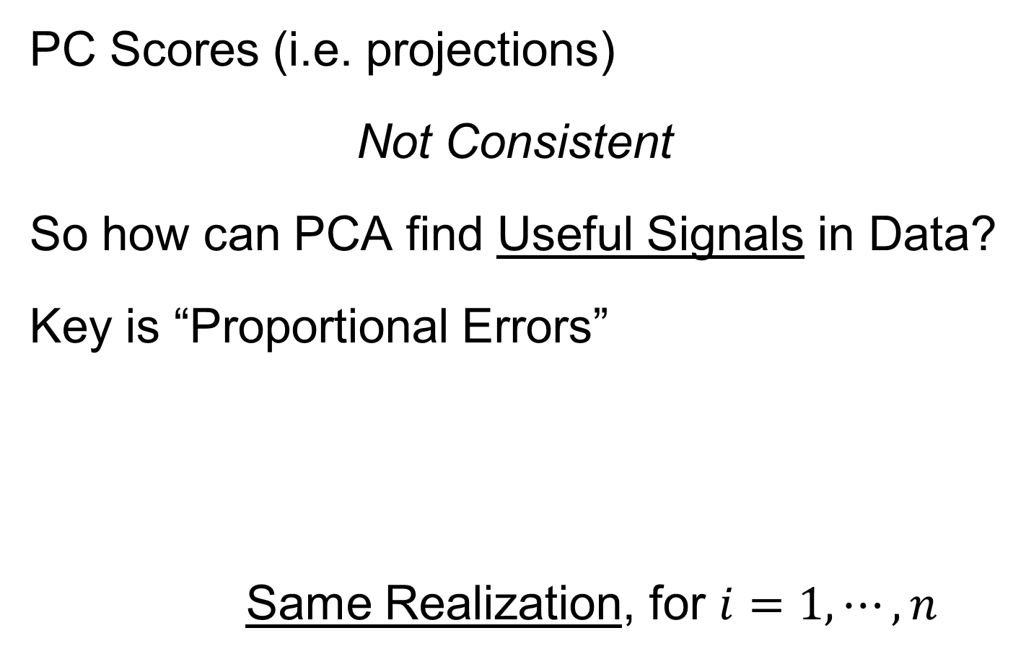
HDLSS Math. Stat. of PCA
PC Scores (i.e. projections)
Not Consistent
So how can PCA find Useful Signals in Data?
Key is “Proportional Errors”
Same Realization, for $i=1,⋯,n$

Slide 85
HDLSS Math. Stat. of PCA
PC Scores (i.e. projections)
Not Consistent
So how can PCA find Useful Signals in Data?
Key is “Proportional Errors”
Axes have Inconsistent Scales,
But Relationships are Still Useful

Slide 86
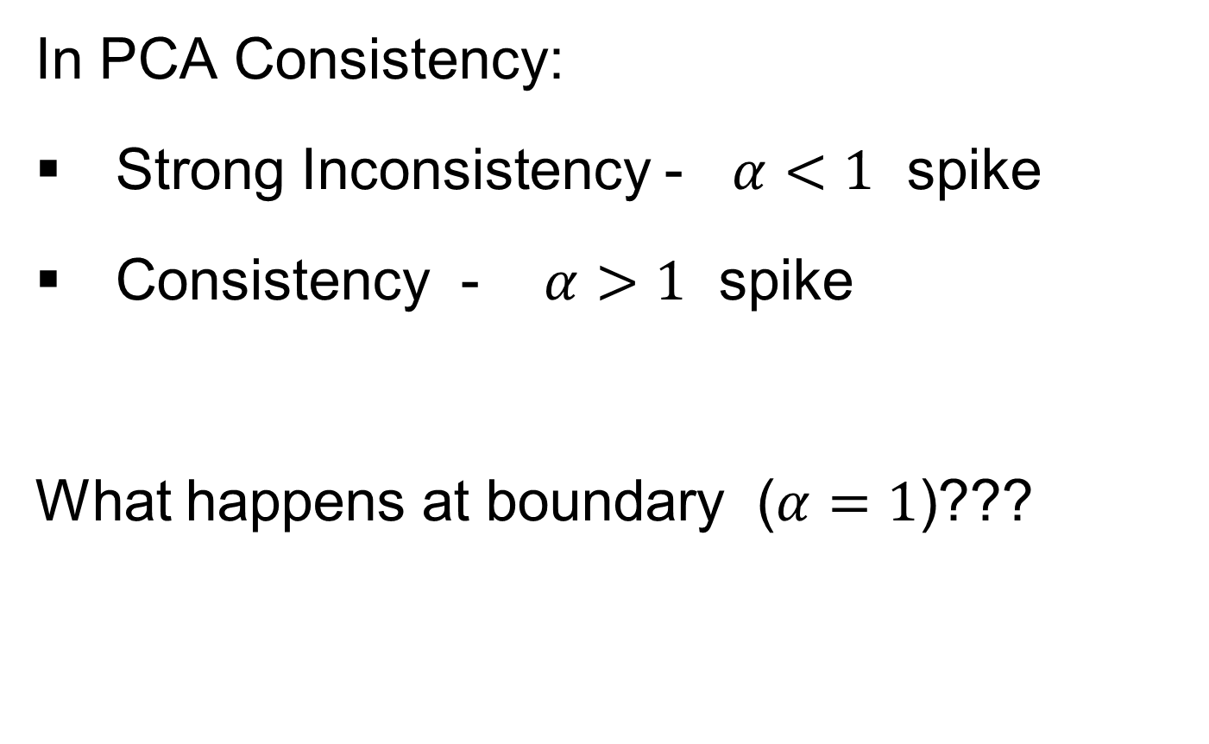
HDLSS Deep Open Problem
In PCA Consistency:
Strong Inconsistency - $α<1$ spike
Consistency - $α>1$ spike
What happens at boundary ($α=1$)???

Slide 87
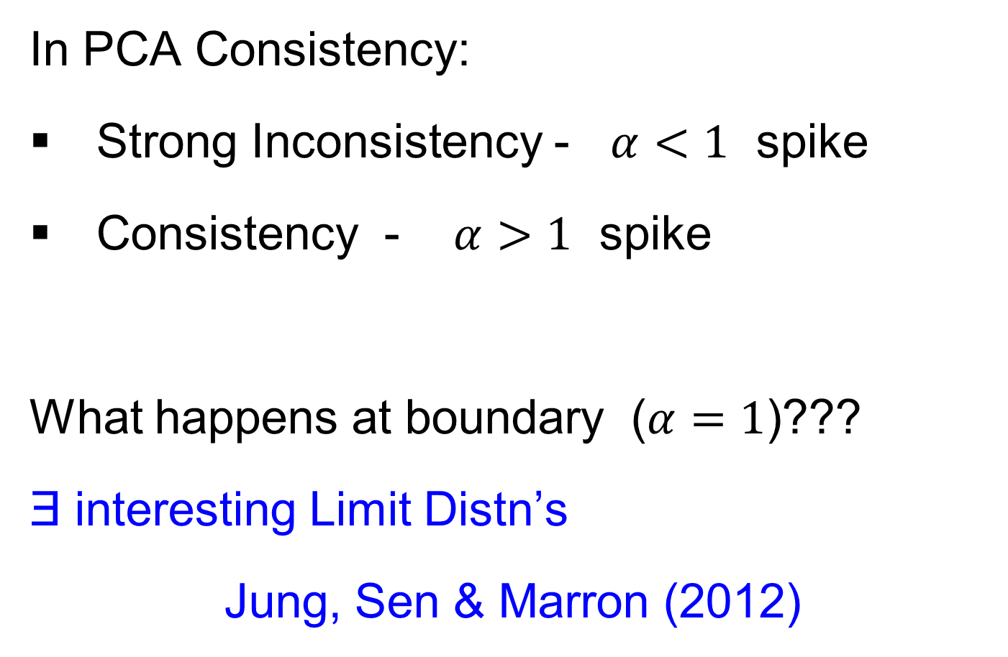
HDLSS Deep Open Problem
Result
In PCA Consistency:
Strong Inconsistency - $α<1$ spike
Consistency - $α>1$ spike
What happens at boundary ($α=1$)???
Ǝ interesting Limit Distn’s
Jung, Sen & Marron (2012)

Slide 88
HDLSS Asymptotics
Personal Observations:
HDLSS world is…

Slide 89
HDLSS Asymptotics
Personal Observations:
HDLSS world is…
Surprising (many times!)
[Think I’ve got it, and then …]

Slide 90
HDLSS Asymptotics
Personal Observations:
HDLSS world is…
Surprising (many times!)
[Think I’ve got it, and then …]
Mathematically Beautiful (?)

Slide 91
HDLSS Asymptotics
Personal Observations:
HDLSS world is…
Surprising (many times!)
[Think I’ve got it, and then …]
Mathematically Beautiful (?)
Practically Relevant

Slide 92
The Future of HDLSS Asymptotics
“Contiguity” in Hypo Testing?
Rates of Convergence?
Improvements of DWD?
(e.g. other functions of distance than inverse)
Many Others?
It is still early days …

Slide 93
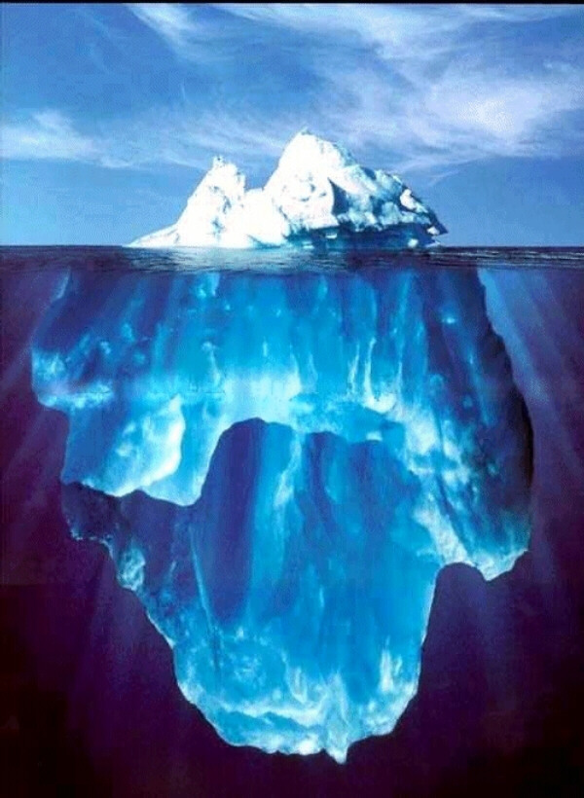
State of HDLSS Research?
Development
Of Methods
Mathematical
Assessment
…
(thanks to:
defiant.corban.edu/gtipton/net-fun/iceberg.html)

Slide 94
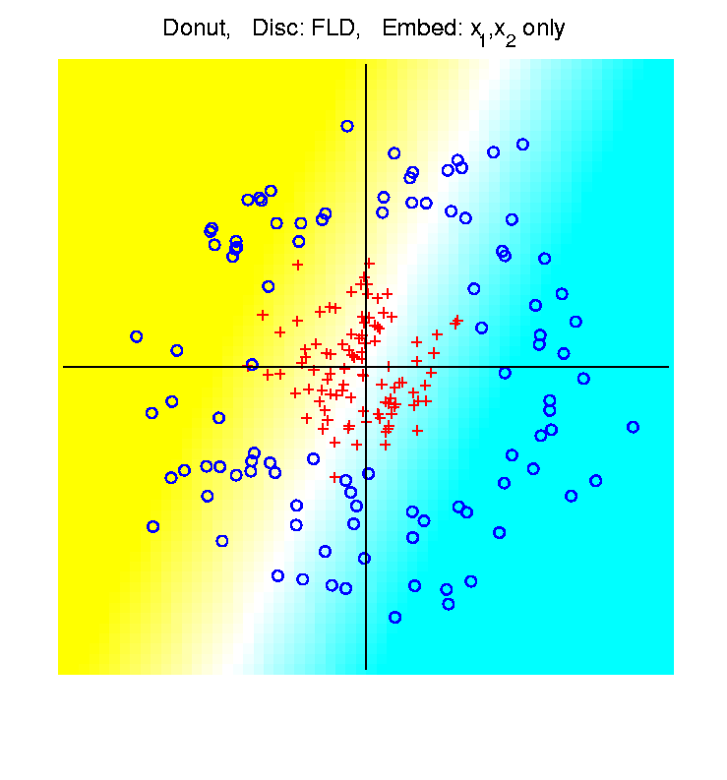
HDLSS Asymptotics & Kernel Methods
Recall
Flexibility
From
Kernel
Embedding
Idea

Slide 95
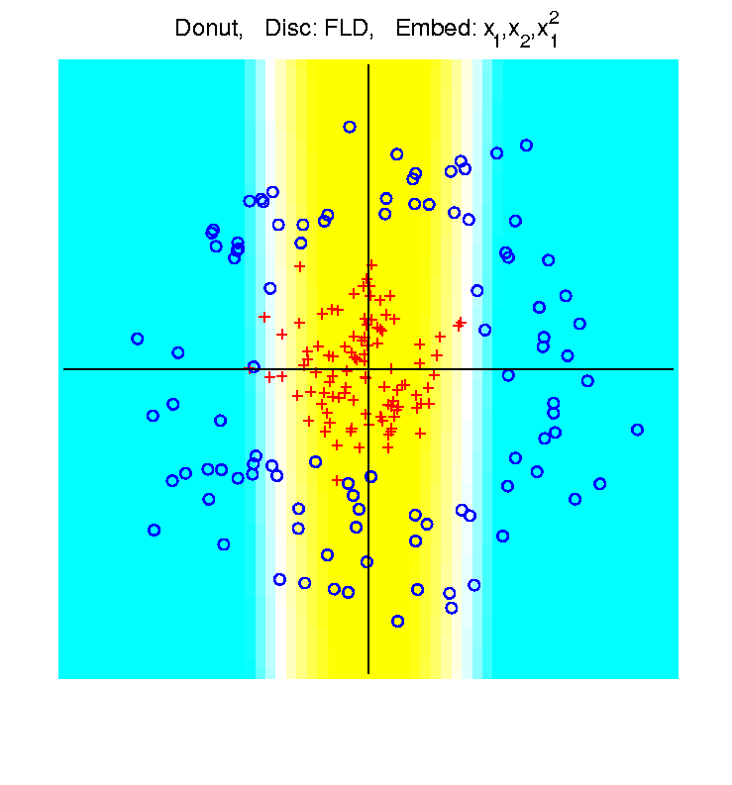
HDLSS Asymptotics & Kernel Methods
Recall
Flexibility
From
Kernel
Embedding
Idea

Slide 96
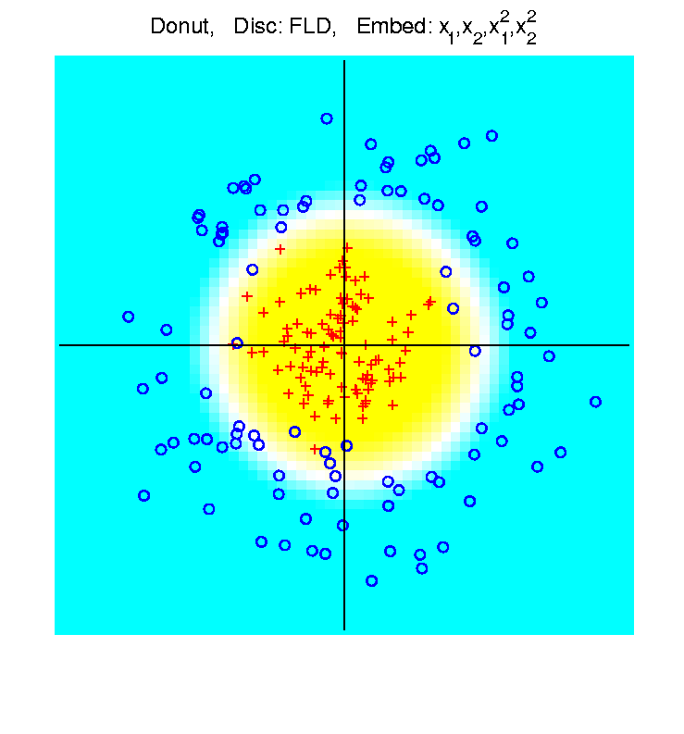
HDLSS Asymptotics & Kernel Methods
Recall
Flexibility
From
Kernel
Embedding
Idea

Slide 97
HDLSS Asymptotics & Kernel Methods
Interesting Question:
Behavior in Very High Dimension?

Slide 98
HDLSS Asymptotics & Kernel Methods
Interesting Question:
Behavior in Very High Dimension?
Answer: El Karoui (2010)

Slide 99
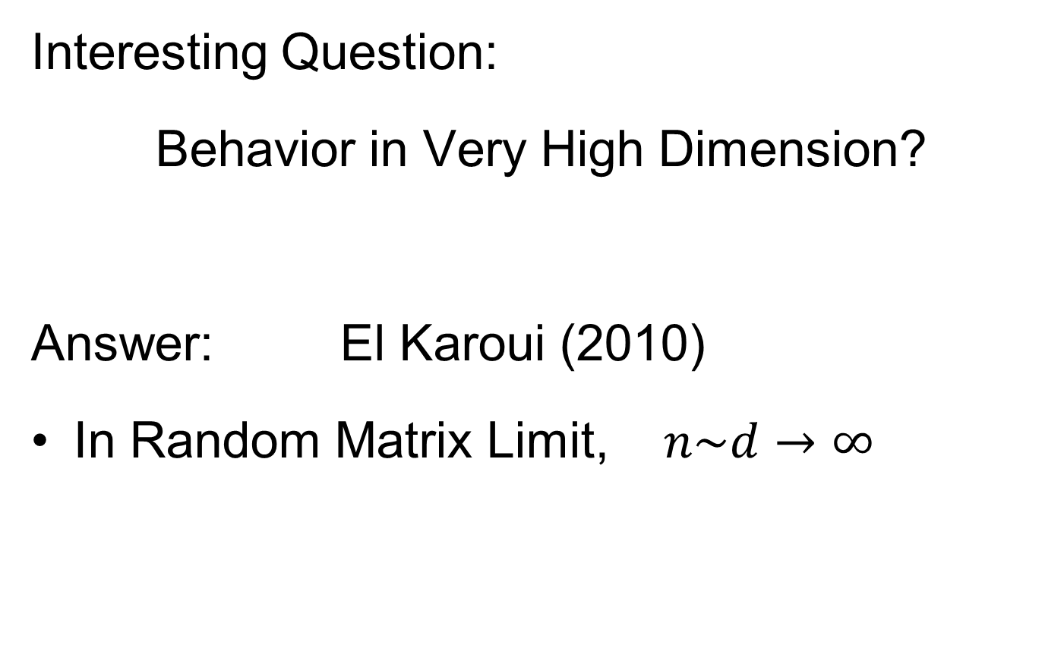

HDLSS Asymptotics & Kernel Methods
Interesting Question:
Behavior in Very High Dimension?
Answer: El Karoui (2010)
In Random Matrix Limit, $n\sim d→∞$

Slide 100
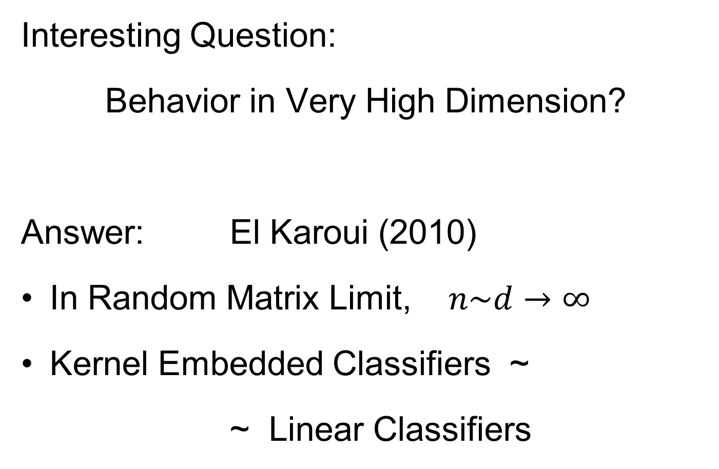
HDLSS Asymptotics & Kernel Methods
Interesting Question:
Behavior in Very High Dimension?
Answer: El Karoui (2010)
In Random Matrix Limit, $n\sim d→∞$
Kernel Embedded Classifiers ~
~ Linear Classifiers

Slide 101
HDLSS Asymptotics & Kernel Methods
Interesting Question:
Behavior in Very High Dimension?
Implications for DWD:
Recall Main Advantage is for High d

Slide 102
HDLSS Asymptotics & Kernel Methods
Interesting Question:
Behavior in Very High Dimension?
Implications for DWD:
Recall Main Advantage is for High d
So not Clear Embedding Helps
Thus not yet Implemented in DWD

Slide 103
Shapes As Data Objects
Several Different Notions of Shape

Slide 104
Shapes As Data Objects
Several Different Notions of Shape
Oldest and Best Known (in Statistics):
Landmark Based

Slide 105
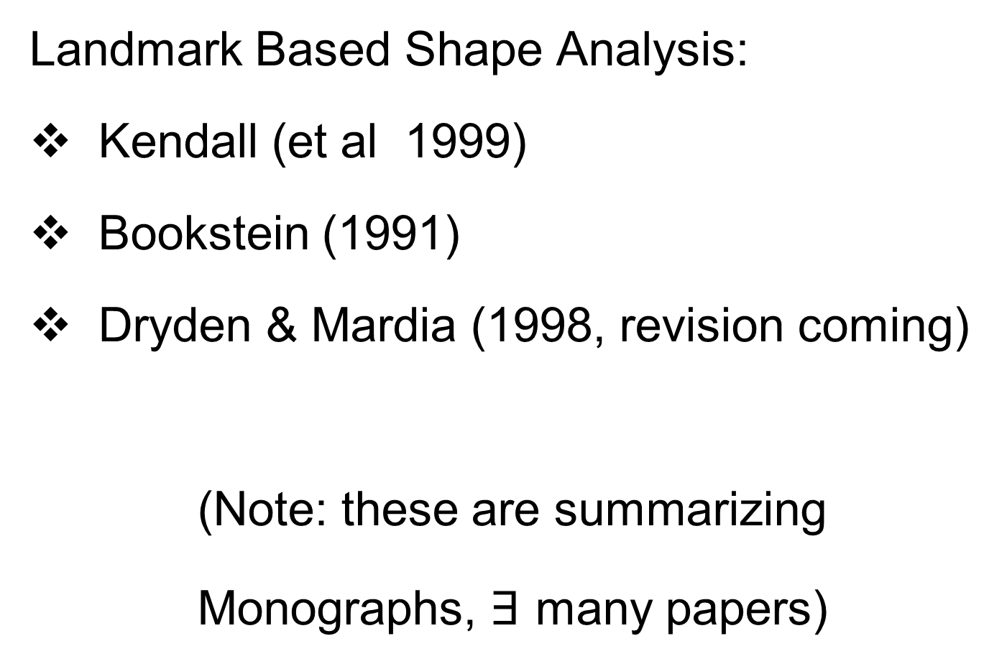
Shapes As Data Objects
Landmark Based Shape Analysis:
Kendall (et al 1999)
Bookstein (1991)
Dryden & Mardia (1998, revision coming)
(Note: these are summarizing
Monographs, $∃$ many papers)

Slide 106
Shapes As Data Objects
Landmark Based Shape Analysis:
Kendall (et al 1999)
Bookstein (1991)
Dryden & Mardia (1998, revision coming)
Recommended as Most Accessible

Slide 107
Landmark Based Shape Analysis
Start by Representing Shapes

Slide 108



Landmark Based Shape Analysis
Start by Representing Shapes by
Landmarks (points in R² or R³)
$$\left(x_{1},y_{1}\right)$$
$$\left(x_{2},y_{2}\right)$$
$$\left(x_{3},y_{3}\right)$$

Slide 109
Landmark Based Shape Analysis
Start by Representing Shapes by
Landmarks (points in R² or R³)
$$\left(x_{1},y_{1}\right)$$
$$\left(x_{2},y_{2}\right)$$
$$\left(x_{3},y_{3}\right)$$

Slide 110
Landmark Based Shape Analysis
Clearly different shapes:

Slide 111
Landmark Based Shape Analysis
Clearly different shapes:
But what about: ?

Slide 112
Landmark Based Shape Analysis
Clearly different shapes:
But what about: ?
(just translation and rotation of,
but different points in R⁶)

Slide 113
Landmark Based Shape Analysis
Note: Shape should be same over different:
Translations

Slide 114
Landmark Based Shape Analysis
Note: Shape should be same over different:
Translations
Rotations

Slide 115
Landmark Based Shape Analysis
Note: Shape should be same over different:
Translations
Rotations
Scalings

Slide 116
Landmark Based Shape Analysis
Approach: Identify objects that are:
Translations
Rotations
Scalings
of each other

Slide 117
Landmark Based Shape Analysis
Approach: Identify objects that are:
Translations
Rotations
Scalings
of each other
Mathematics: Equivalence Relation

Slide 118
Landmark Based Shape Analysis
Approach: Identify objects that are:
Translations
Rotations
Scalings
of each other
Mathematics: Equivalence Relation
Results in: Equivalence Classes

Slide 119
Landmark Based Shape Analysis
Approach: Identify objects that are:
Translations
Rotations
Scalings
of each other
Mathematics: Equivalence Relation
Results in: Equivalence Classes
Which become the Data Objects

Slide 120
Landmark Based Shape Analysis
Equivalence Classes become Data Objects
, , , , , ,

Slide 121
Landmark Based Shape Analysis
Equivalence Classes become Data Objects
Mathematics: Called “Quotient Space”
, , , , , ,

Slide 122
Landmark Based Shape Analysis
Equivalence Classes become Data Objects
Mathematics: Called “Quotient Space”
Intuitive Representation: Manifold
(curved surface)
, , , , , ,

Slide 123
Landmark Based Shape Analysis
Triangle Shape Space: Represent as Sphere
, , , , , ,

Slide 124
Landmark Based Shape Analysis
Triangle Shape Space: Represent as Sphere:
R⁶ → R⁴
translation
, , , , , ,

Slide 125
Landmark Based Shape Analysis
Triangle Shape Space: Represent as Sphere:
R⁶ → R⁴ → R³
rotation
, , , , , ,

Slide 126
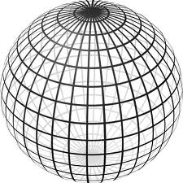
Landmark Based Shape Analysis
Triangle Shape Space: Represent as Sphere:
R⁶ → R⁴ → R³ →
scaling
(thanks to Wikipedia)
, , , , , ,

Slide 127
Shapes As Data Objects
Common Property of Shape Data Objects:
Natural Feature Space is Curved
I.e. a Manifold (from Differential Geometry)

Slide 128
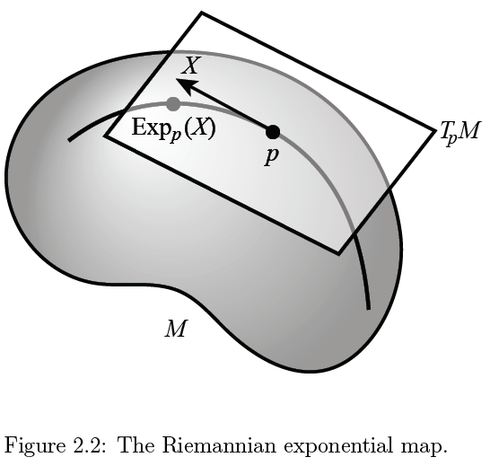
Manifold Feature Spaces
(Elegant
Illustrative
Graphic)
Thanks to P. T. Fletcher

Slide 129
Manifold Feature Spaces
Data Lie in Curved
Surface

Slide 130
Manifold Feature Spaces
At Each Point

Slide 131

Manifold Feature Spaces
At Each Point,
$∃$ Approx’ing
Tangent Plane
(in limit of shrinking
neighborhoods of p)

Slide 132

Manifold Feature Spaces
Important Mappings:
Plane → Surface:
$\exp_{p}$

Slide 133

Manifold Feature Spaces
Important Mappings:
Plane → Surface:
$\exp_{p}$
Surface → Plane
$\log_{p}$

Slide 134

Manifold Feature Spaces
Important Mappings:
Plane → Surface:
$\exp_{p}$
Surface → Plane
$\log_{p}$
(matrix versions)

Slide 135
Manifold Feature Spaces
Log & Exp Memory Device:
Complex Numbers

Slide 136
Manifold Feature Spaces
Log & Exp Memory Device:
Complex Numbers
Exponential:
Tangent Plane → Manifold

Slide 137
Manifold Feature Spaces
Log & Exp Memory Device:
Complex Numbers
Exponential:
Tangent Plane → Manifold
Logarithm:
Manifold → Tangent Plane

Slide 138
Manifold Feature Spaces
Standard Statistical Example:
Directional Data (aka Circular Data)

Slide 139
Manifold Feature Spaces
Standard Statistical Example:
Directional Data (aka Circular Data)
Idea: Angles as Data Objects
Wind Directions
Magnetic Compass Headings
Cracks in Mines

Slide 140
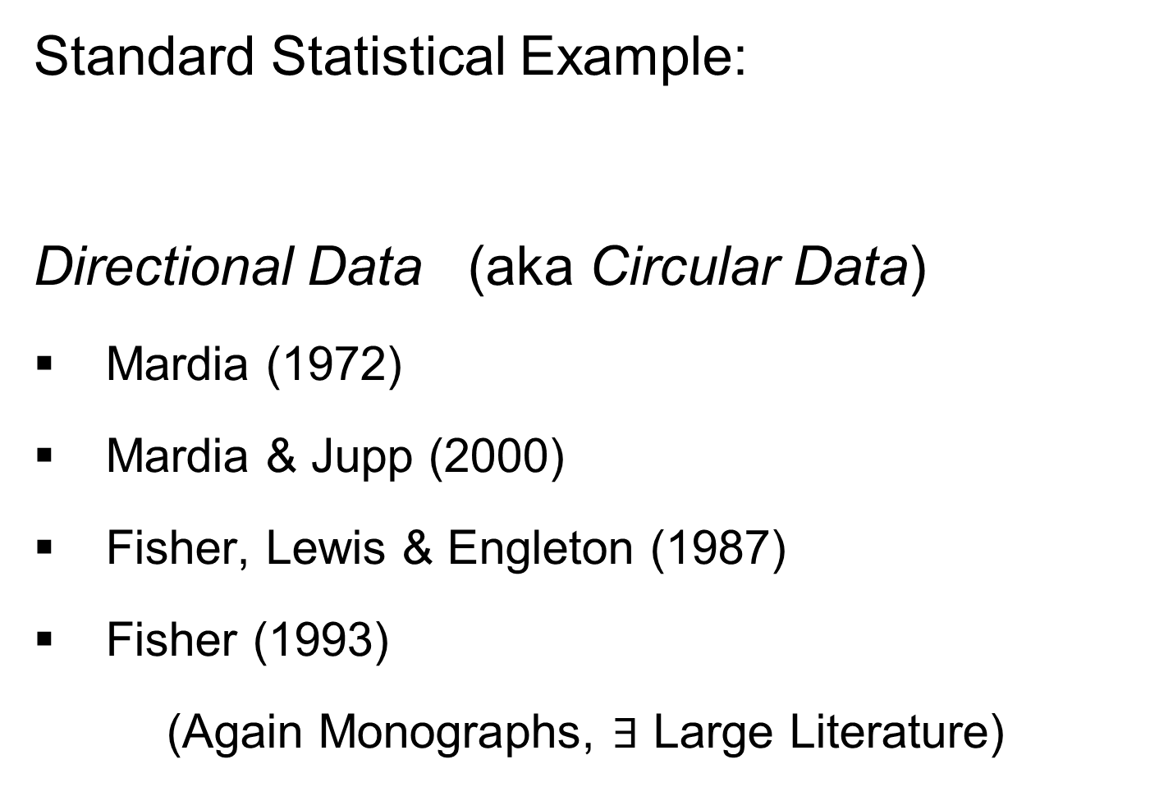
Manifold Feature Spaces
Standard Statistical Example:
Directional Data (aka Circular Data)
Mardia (1972)
Mardia & Jupp (2000)
Fisher, Lewis & Engleton (1987)
Fisher (1993)
(Again Monographs, $∃$ Large Literature)

Slide 141
Manifold Feature Spaces
Standard Statistical Example:
Directional Data (aka Circular Data)
Reasonable View:
Points on Unit Circle

