Slide 1
Statistics – O. R. 891
Object Oriented Data Analysis
J. S. Marron
Dept. of Statistics and Operations Research
University of North Carolina

Slide 2
HDLSS Asymptotics
Modern Mathematical Statistics:
Based on asymptotic analysis
Real Reasons:
  Approximation provides insights
  Can find simple underlying structure
  In complex situations
Thus various flavors are fine:
Even desirable! (find additional insights)
Notes:
2

Slide 3
HDLSS Math. Stat. of PCA
PC Scores (i.e. projections)
Not Consistent
So how can PCA find Useful Signals in Data?
Key is “Proportional Errors”
Axes have Inconsistent Scales,
But Relationships are Still Useful

Slide 4
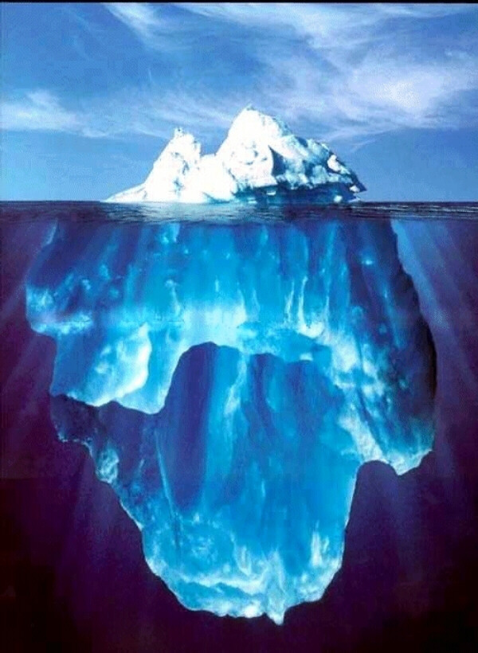
State of HDLSS Research?
Development
Of Methods
Mathematical
Assessment
…
(thanks to:
defiant.corban.edu/gtipton/net-fun/iceberg.html)

Slide 5
HDLSS Asymptotics & Kernel Methods
Interesting Question:
Behavior in Very High Dimension?
Implications for DWD:
Recall Main Advantage is for High d
So not Clear Embedding Helps
Thus not yet Implemented in DWD

Slide 6
Shapes As Data Objects
Several Different Notions of Shape
Oldest and Best Known (in Statistics):
Landmark Based

Slide 7
Landmark Based Shape Analysis
Equivalence Classes become Data Objects
Mathematics: Called “Quotient Space”
Intuitive Representation: Manifold
(curved surface)
, , , , , ,

Slide 8
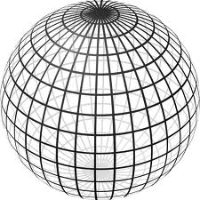
Landmark Based Shape Analysis
Triangle Shape Space: Represent as Sphere:
R⁶ → R⁴ → R³ →
scaling
(thanks to Wikipedia)
, , , , , ,

Slide 9
Shapes As Data Objects
Common Property of Shape Data Objects:
Natural Feature Space is Curved
I.e. a Manifold (from Differential Geometry)

Slide 10
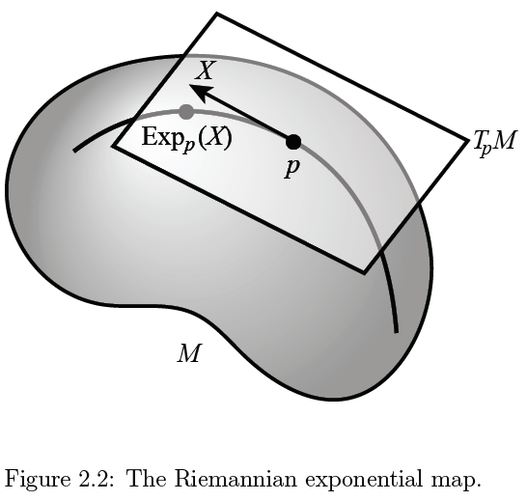

Manifold Feature Spaces
At Each Point,
$∃$ Approx’ing
Tangent Plane
(in limit of shrinking
neighborhoods of p)

Slide 11
Manifold Feature Spaces
Log & Exp Memory Device:
Complex Numbers
Exponential:
Tangent Plane → Manifold

Slide 12
Manifold Feature Spaces
Log & Exp Memory Device:
Complex Numbers
Exponential:
Tangent Plane → Manifold
Logarithm:
Manifold → Tangent Plane

Slide 13
Manifold Feature Spaces
Standard Statistical Example:
Directional Data (aka Circular Data)
Idea: Angles as Data Objects
Wind Directions
Magnetic Compass Headings
Cracks in Mines

Slide 14
Manifold Feature Spaces
Standard Statistical Example:
Directional Data (aka Circular Data)
Reasonable View:
Points on Unit Circle
(a Very Simple Manifold)

Slide 15
Manifold Feature Spaces
Directional Data
(Already Challenging)

Slide 16

Manifold Feature Spaces
Directional Data
E.g. “average” of: $2^{°}$, $3^{°}$, ${358}^{°}$, ${359}^{°}$, = ???

Slide 17

Manifold Feature Spaces
Directional Data
E.g. “average” of: $2^{°}$, $3^{°}$, ${358}^{°}$, ${359}^{°}$, = ???
$\sum_{i}{{θ_{i}}/4}$ ?

Slide 18

Manifold Feature Spaces
Directional Data
E.g. “average” of: $2^{°}$, $3^{°}$, ${358}^{°}$, ${359}^{°}$, = ???
$\sum_{i}{{θ_{i}}/4}$
x
x
x
x

Slide 19
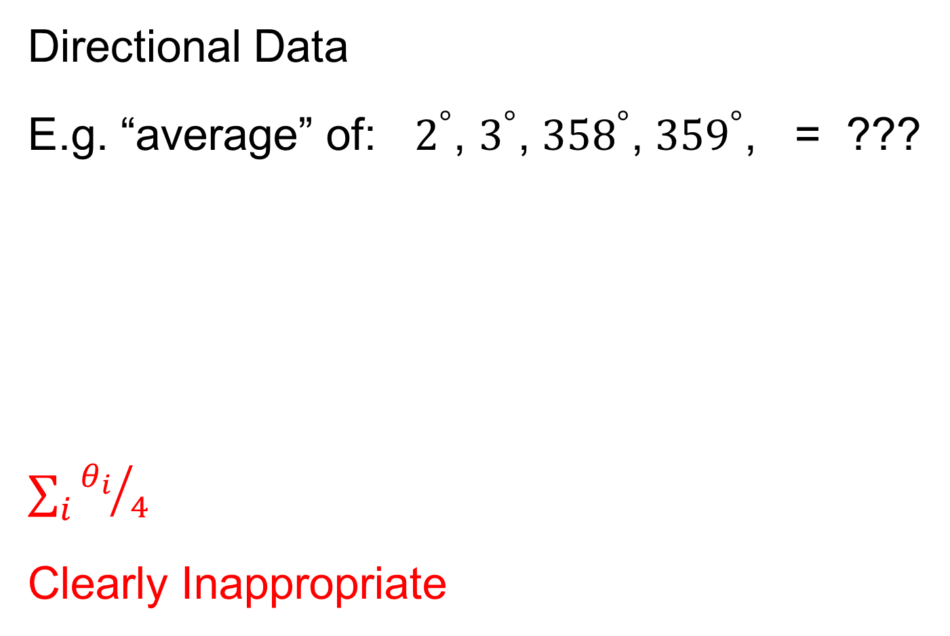
Manifold Feature Spaces
Directional Data
E.g. “average” of: $2^{°}$, $3^{°}$, ${358}^{°}$, ${359}^{°}$, = ???
$\sum_{i}{{θ_{i}}/4}$
Clearly Inappropriate
x
x
x
x

Slide 20
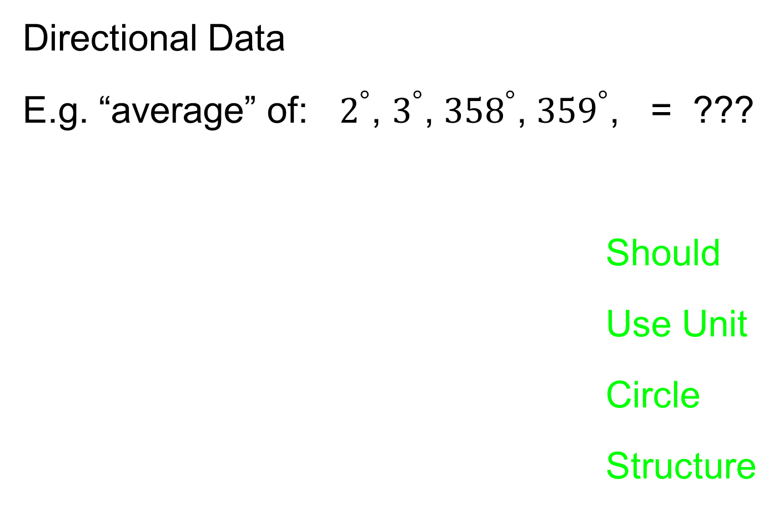
Manifold Feature Spaces
Directional Data
E.g. “average” of: $2^{°}$, $3^{°}$, ${358}^{°}$, ${359}^{°}$, = ???
Should
Use Unit
Circle
Structure
x
x
x
x

Slide 21
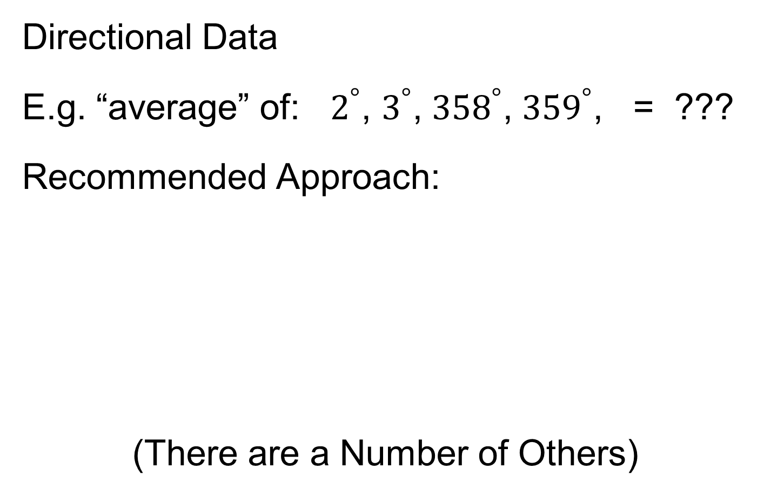
Manifold Feature Spaces
Directional Data
E.g. “average” of: $2^{°}$, $3^{°}$, ${358}^{°}$, ${359}^{°}$, = ???
Recommended Approach:
(There are a Number of Others)

Slide 22
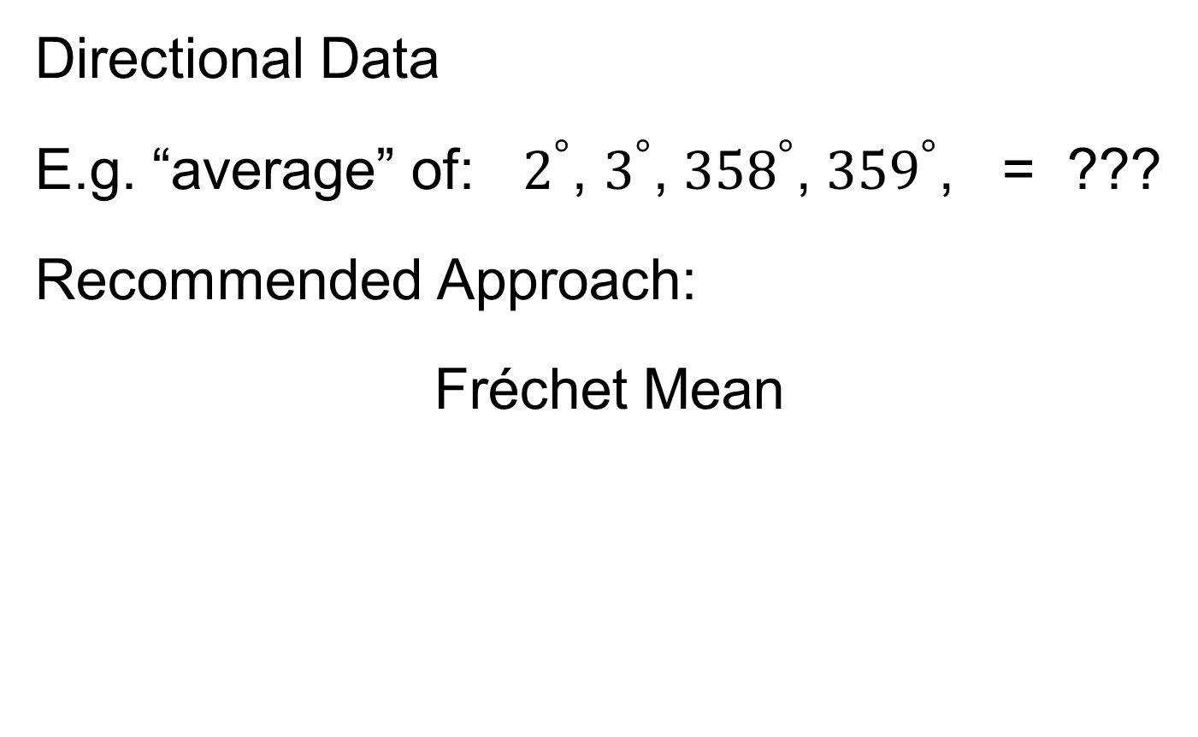
Manifold Feature Spaces
Directional Data
E.g. “average” of: $2^{°}$, $3^{°}$, ${358}^{°}$, ${359}^{°}$, = ???
Recommended Approach:
Fréchet Mean

Slide 23
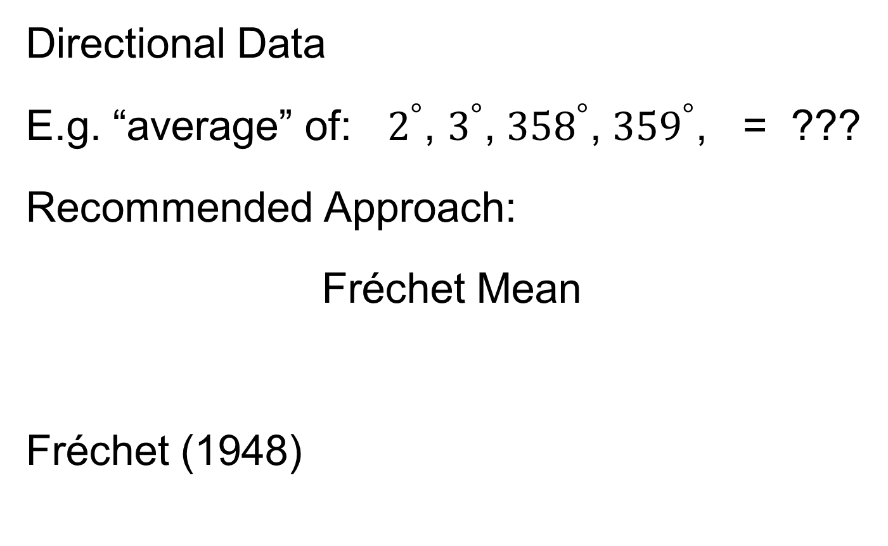
Manifold Feature Spaces
Directional Data
E.g. “average” of: $2^{°}$, $3^{°}$, ${358}^{°}$, ${359}^{°}$, = ???
Recommended Approach:
Fréchet Mean
Fréchet (1948)

Slide 24

Manifold Feature Spaces
Fréchet Mean
Synonyms:
Geodesic Mean
Barycenter
Karcher Mean
$⋮$

Slide 25
Manifold Feature Spaces
Fréchet Mean of Numbers:
Point Nearest to Data Points in L. S. Sense

Slide 26
Manifold Feature Spaces
Fréchet Mean of Numbers:
(Easy to Check by Calculus)

Slide 27

Manifold Feature Spaces
Fréchet Mean of Numbers:
Fréchet Mean in Euclidean Space ($ℝ^{d}$):

Slide 28
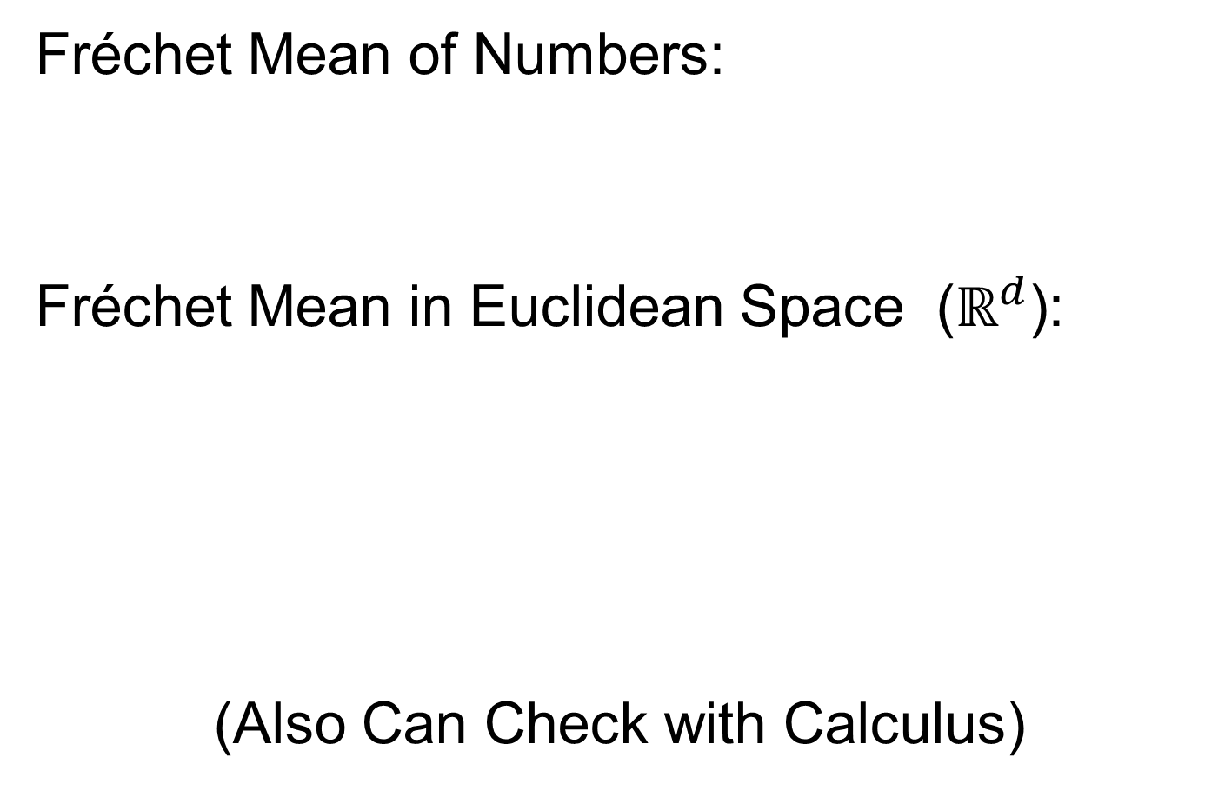
Manifold Feature Spaces
Fréchet Mean of Numbers:
Fréchet Mean in Euclidean Space ($ℝ^{d}$):
(Also Can Check with Calculus)

Slide 29
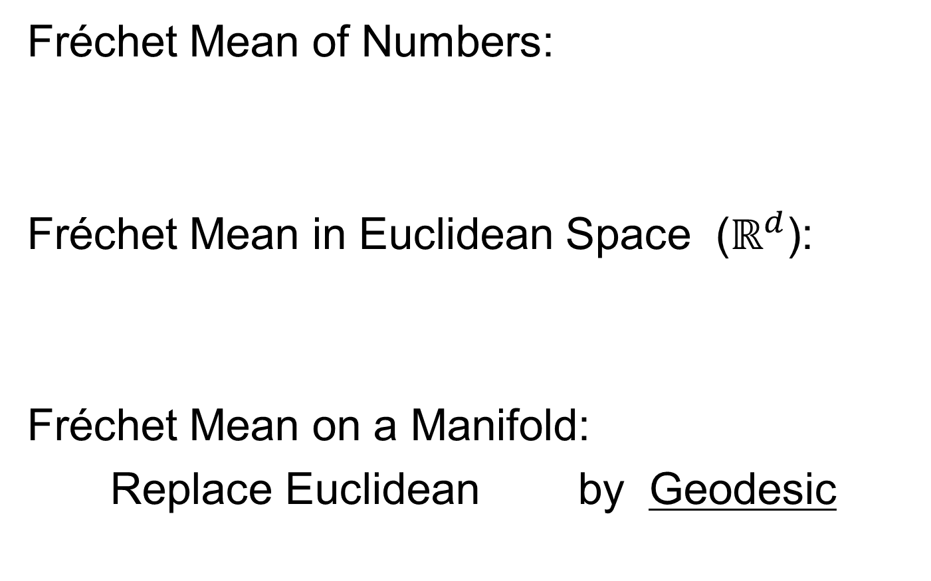
Manifold Feature Spaces
Fréchet Mean of Numbers:
Fréchet Mean in Euclidean Space ($ℝ^{d}$):
Fréchet Mean on a Manifold:
Replace Euclidean by Geodesic

Slide 30
Manifold Feature Spaces
Geodesics:
Idea:
March Along Manifold Without Turning

Slide 31
Manifold Feature Spaces
Geodesics:
Idea:
March Along Manifold Without Turning
(Defined in Tangent Plane)

Slide 32
Manifold Feature Spaces
Geodesics:
Idea:
March Along Manifold Without Turning
(Defined in Tangent Plane)
E.g. Surface of the Earth: Great Circle
(but not small circles)

Slide 33
Manifold Feature Spaces
Geodesics:
Idea:
March Along Manifold Without Turning
(Defined in Tangent Plane)
E.g. Surface of the Earth: Great Circle
E.g. Lines of Longitude (Not Latitude…)

Slide 34

Manifold Feature Spaces
Geodesic Distance:
Given Points $x$ & $y$, define
$$d\left(x,y\right)=\min_{g:geodesic from x to y}{length(g)}$$

Slide 35
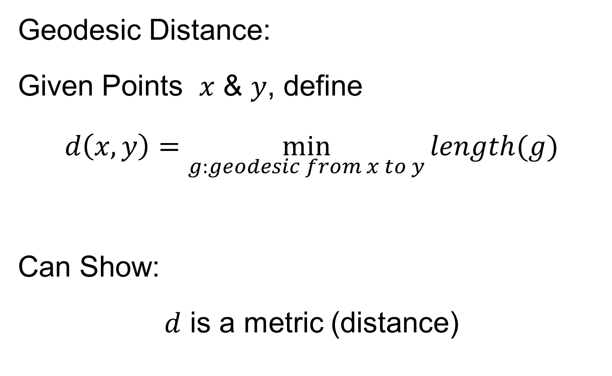
Manifold Feature Spaces
Geodesic Distance:
Given Points $x$ & $y$, define
$$d\left(x,y\right)=\min_{g:geodesic from x to y}{length(g)}$$
Can Show:
$d$ is a metric (distance)

Slide 36
Manifold Feature Spaces
Fréchet Mean of Numbers:
Fréchet Mean in Euclidean Space ($ℝ^{d}$):
Fréchet Mean on a Manifold:
Replace Euclidean by Geodesic

Slide 37
Manifold Feature Spaces
Fréchet Mean of Numbers:
Well Known in Robust Statistics

Slide 38
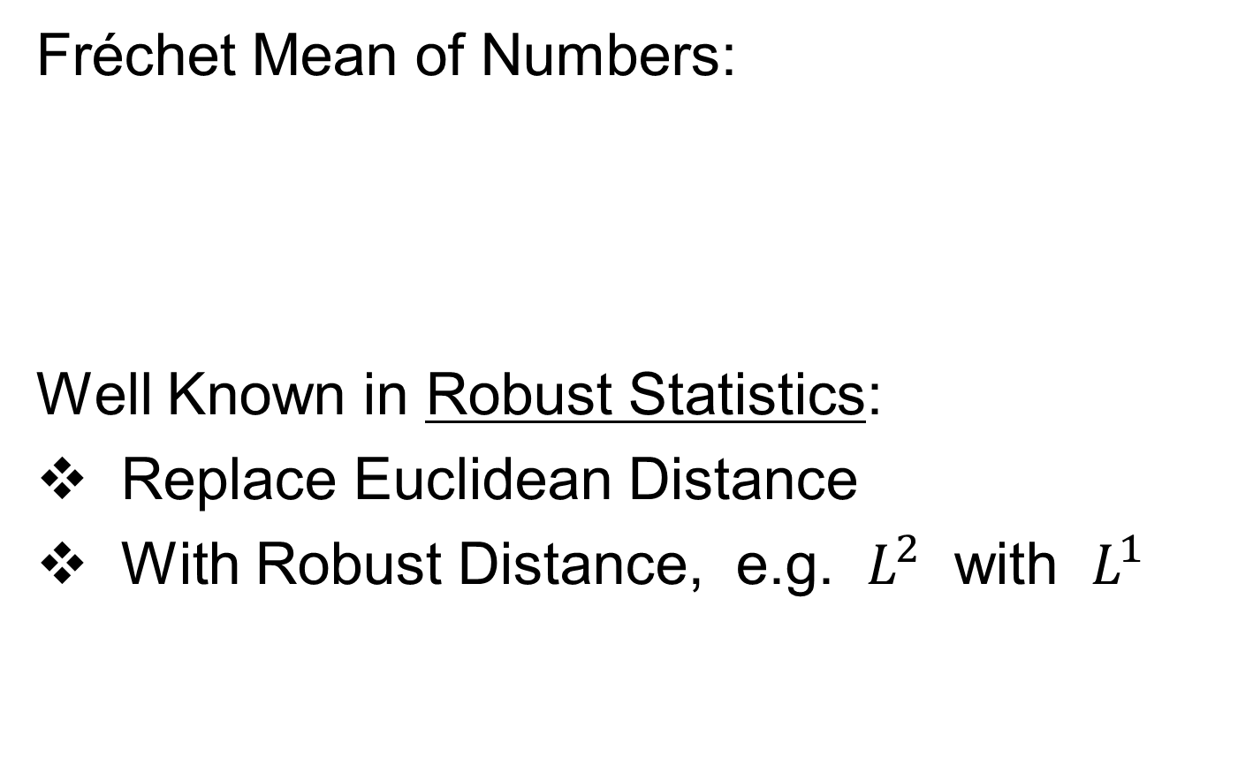
Manifold Feature Spaces
Fréchet Mean of Numbers:
Well Known in Robust Statistics:
Replace Euclidean Distance
With Robust Distance, e.g. $L^{2}$ with $L^{1}$

Slide 39
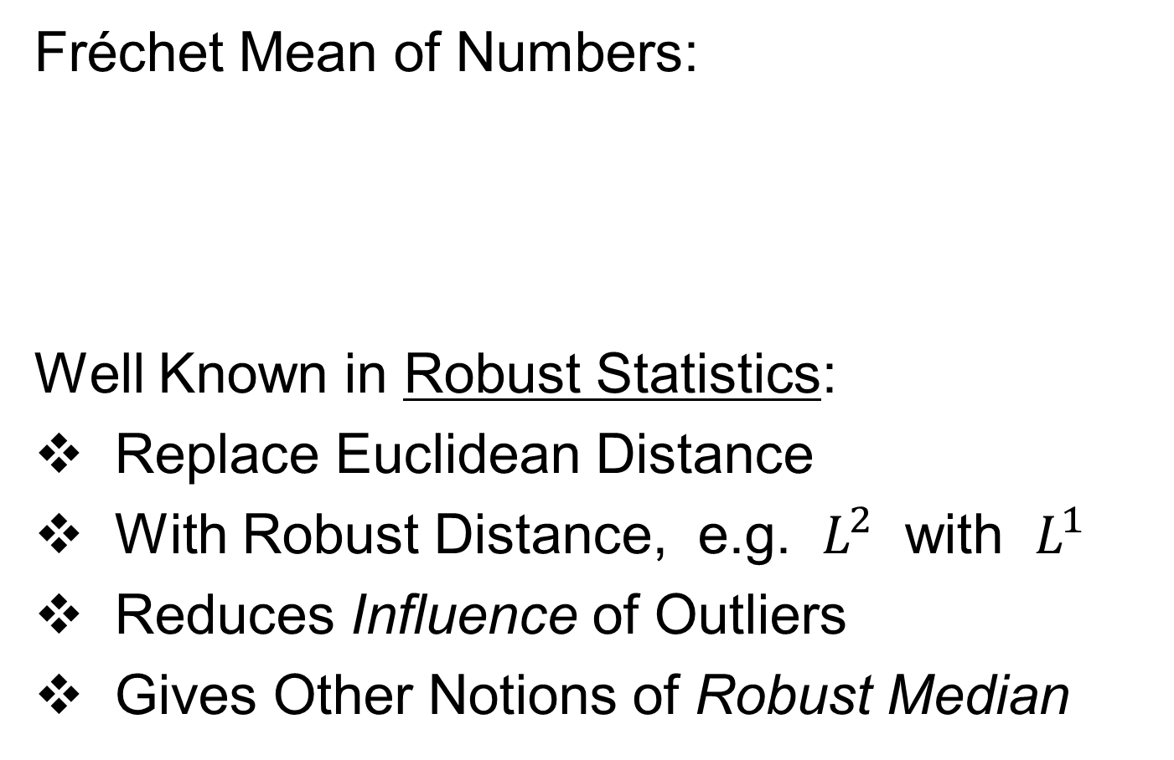
Manifold Feature Spaces
Fréchet Mean of Numbers:
Well Known in Robust Statistics:
Replace Euclidean Distance
With Robust Distance, e.g. $L^{2}$ with $L^{1}$
Reduces Influence of Outliers
Gives Other Notions of Robust Median

Slide 40
Manifold Feature Spaces
Fréchet Mean in General:
Big Advantage:
Works in Any Metric Space

Slide 41
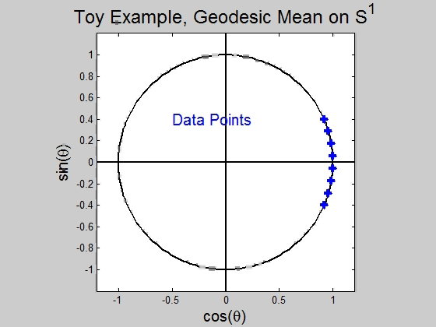
Manifold Feature Spaces
Directional Data Examples of Fréchet Mean

Slide 42
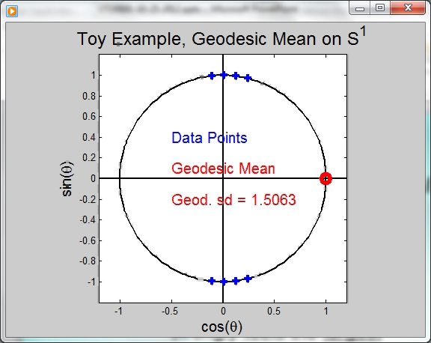
Manifold Feature Spaces
Directional Data Examples of Fréchet Mean:
Not always easily interpretable

Slide 43
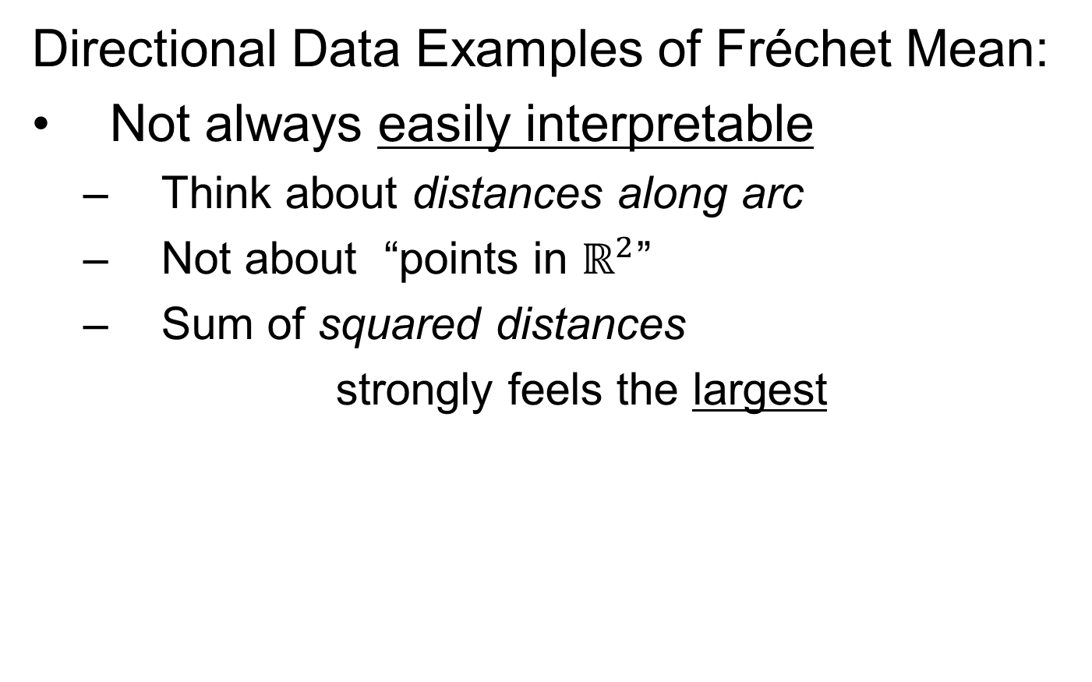
Manifold Feature Spaces
Directional Data Examples of Fréchet Mean:
Not always easily interpretable
  Think about distances along arc
  Not about “points in $ℝ^{2}$”
  Sum of squared distances
  strongly feels the largest

Slide 44
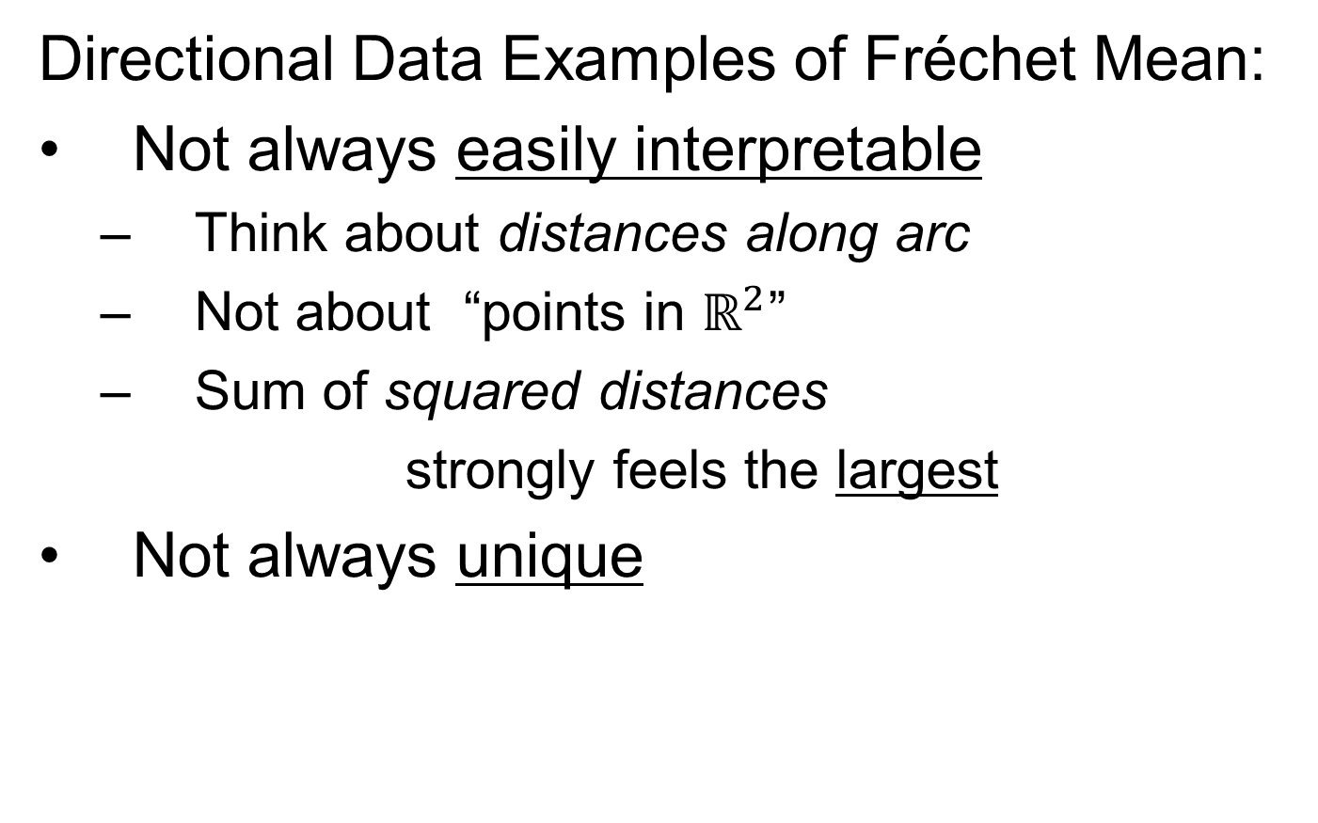
Manifold Feature Spaces
Directional Data Examples of Fréchet Mean:
Not always easily interpretable
  Think about distances along arc
  Not about “points in $ℝ^{2}$”
  Sum of squared distances
  strongly feels the largest
Not always unique

Slide 45
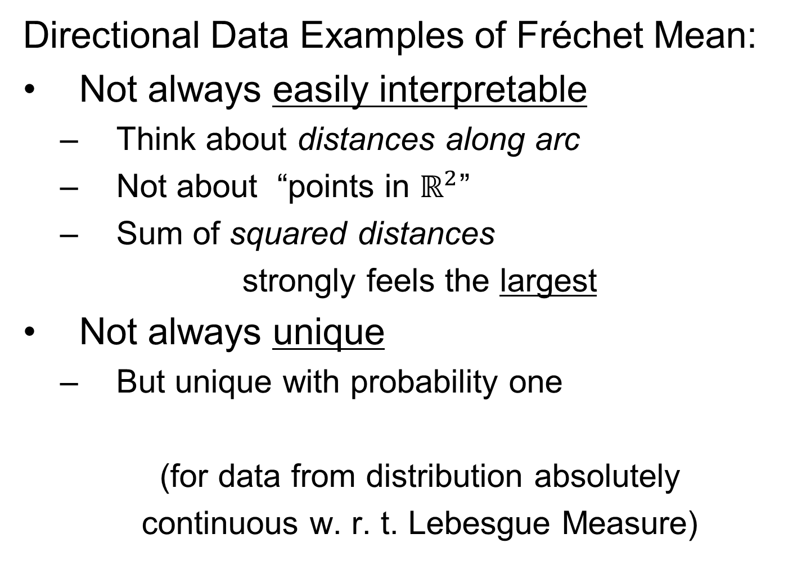
Manifold Feature Spaces
Directional Data Examples of Fréchet Mean:
Not always easily interpretable
  Think about distances along arc
  Not about “points in $ℝ^{2}$”
  Sum of squared distances
  strongly feels the largest
Not always unique
  But unique with probability one
  (for data from distribution absolutely
  continuous w. r. t. Lebesgue Measure)

Slide 46
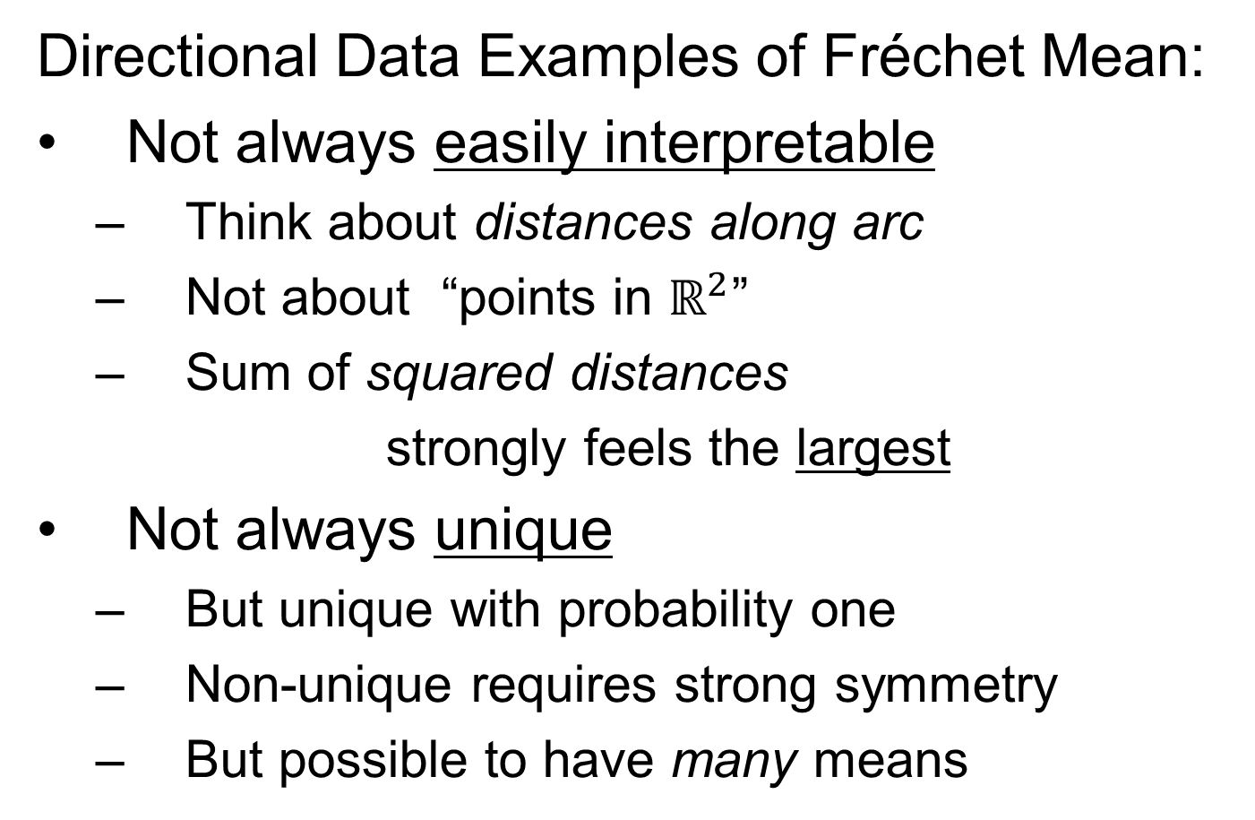
Manifold Feature Spaces
Directional Data Examples of Fréchet Mean:
Not always easily interpretable
  Think about distances along arc
  Not about “points in $ℝ^{2}$”
  Sum of squared distances
  strongly feels the largest
Not always unique
  But unique with probability one
  Non-unique requires strong symmetry
  But possible to have many means

Slide 47
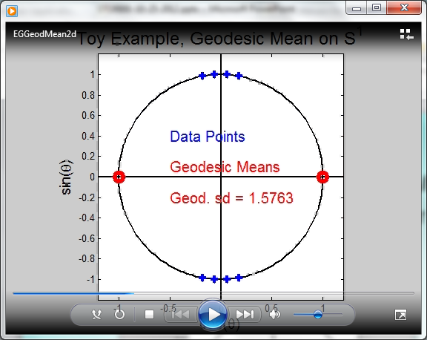
Manifold Feature Spaces
Directional Data Examples of Fréchet Mean:
Not always sensible notion of center

Slide 48
Manifold Feature Spaces
Directional Data Examples of Fréchet Mean:
Not always sensible notion of center
  Sometimes prefer top & bottom?
  At end: farthest points from data

Slide 49
Manifold Feature Spaces
Directional Data Examples of Fréchet Mean:
Not always sensible notion of center
  Sometimes prefer top & bottom?
  At end: farthest points from data
Not continuous Function of Data
  Jump from 1 – 2
  Jump from 2 – 8

Slide 50
Manifold Feature Spaces
Directional Data Examples of Fréchet Mean:
Not always sensible notion of center
  Sometimes prefer top & bottom?
  At end: farthest points from data
Not continuous Function of Data
  Jump from 1 – 2
  Jump from 2 – 8
All False for Euclidean Mean
But all happen generally for Manifold Data

Slide 51
Manifold Feature Spaces
Directional Data Examples of Fréchet Mean:
Also of interest is Fréchet Variance:
Works like Euclidean sample variance

Slide 52
Manifold Feature Spaces
Directional Data Examples of Fréchet Mean:
Also of interest is Fréchet Variance:
Works like Euclidean sample variance
Note values in movie, reflecting spread in data

Slide 53
Manifold Feature Spaces
Directional Data Examples of Fréchet Mean:
Also of interest is Fréchet Variance:
Works like Euclidean sample variance
Note values in movie, reflecting spread in data
Note theoretical version:
Useful for Laws of Large Numbers, etc.

Slide 54
OODA in Image Analysis
First Generation Problems

Slide 55
OODA in Image Analysis
First Generation Problems:
Denoising
(extract signal from noise)

Slide 56
OODA in Image Analysis
First Generation Problems:
Denoising
Segmentation
(find object boundary)

Slide 57
OODA in Image Analysis
First Generation Problems:
Denoising
Segmentation
Registration
(align same object in 2 images)

Slide 58
OODA in Image Analysis
First Generation Problems:
Denoising
Segmentation
Registration
(all about single images,
still interesting challenges)

Slide 59
OODA in Image Analysis
Second Generation Problems:
Populations of Images

Slide 60
OODA in Image Analysis
Second Generation Problems:
Populations of Images
  Understanding Population Variation
  Discrimination (a.k.a. Classification)

Slide 61
OODA in Image Analysis
Second Generation Problems:
Populations of Images
  Understanding Population Variation
  Discrimination (a.k.a. Classification)
Complex Data Structures (& Spaces)

Slide 62
OODA in Image Analysis
Second Generation Problems:
Populations of Images
  Understanding Population Variation
  Discrimination (a.k.a. Classification)
Complex Data Structures (& Spaces)
HDLSS Statistics

Slide 63
Image Object Representation
Major Approaches for Image Data Objects:
Landmark Representations
Boundary Representations
Medial Representations

Slide 64
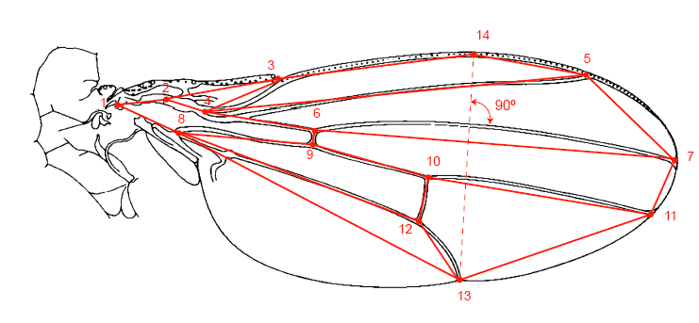
Landmark Representations
Landmarks for Fly Wing Data:
Thanks to George Gilchrist

Slide 65
Landmark Representations
Major Drawback of Landmarks:
Need to always find each landmark
Need same relationship

Slide 66
Landmark Representations
Major Drawback of Landmarks:
Need to always find each landmark
Need same relationship
I.e. Landmarks need to correspond

Slide 67
Landmark Representations
Major Drawback of Landmarks:
Need to always find each landmark
Need same relationship
I.e. Landmarks need to correspond
Often fails for medical images
E.g. How many corresponding landmarks on a set of kidneys, livers or brains???

Slide 68
Boundary Representations
Traditional Major Sets of Ideas:
Triangular Meshes
  Survey: Owen (1998)

Slide 69
Boundary Representations
Traditional Major Sets of Ideas:
Triangular Meshes
  Survey: Owen (1998)
Active Shape Models
  Cootes, et al (1993)

Slide 70
Boundary Representations
Traditional Major Sets of Ideas:
Triangular Meshes
  Survey: Owen (1998)
Active Shape Models
  Cootes, et al (1993)
Fourier Boundary Representations
  Keleman, et al (1997 & 1999)

Slide 71
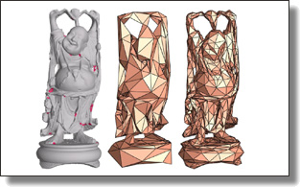
Boundary Representations
Example of triangular mesh rep’n:
From:www.geometry.caltech.edu/pubs.html

Slide 72
Boundary Representations
Main Drawback:
Correspondence
For OODA (on vectors of parameters):
Need to “match up points”
Notes:
72

Slide 73
Boundary Representations
Main Drawback:
Correspondence
For OODA (on vectors of parameters):
Need to “match up points”
Easy to find triangular mesh
  Lots of research on this driven by gamers
Notes:
73

Slide 74
Boundary Representations
Main Drawback:
Correspondence
For OODA (on vectors of parameters):
Need to “match up points”
Easy to find triangular mesh
  Lots of research on this driven by gamers
Challenge to match mesh across objects
  There are some interesting ideas…
Notes:
74

Slide 75
Boundary Representations
Correspondence for Mesh Objects:
Active Shape Models (PCA – like)
Notes:
75

Slide 76
Boundary Representations
Correspondence for Mesh Objects:
Active Shape Models (PCA – like)
Automatic Landmark Choice
Cates, et al (2007)
Based on Optimization Problem:
Good Correspondence & Separation
(Formulate via Entropy)
Notes:
76

Slide 77
Medial Representations
Main Idea

Slide 78
Medial Representations
Main Idea:
Represent Objects as:
Discretized skeletons (medial atoms)

Slide 79
Medial Representations
Main Idea:
Represent Objects as:
Discretized skeletons (medial atoms)
Plus spokes from center to edge
Which imply a boundary

Slide 80
Medial Representations
Main Idea:
Represent Objects as:
Discretized skeletons (medial atoms)
Plus spokes from center to edge
Which imply a boundary
Very accessible early reference:
Yushkevich, et al (2001)

Slide 81
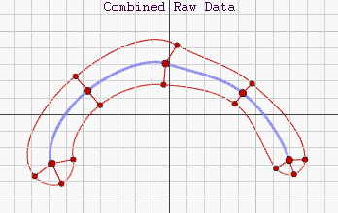
Medial Representations
2-d M-Rep Example:
Corpus Callosum
(Yushkevich)
Notes:
CCMsciznormRaw.avi

Slide 82
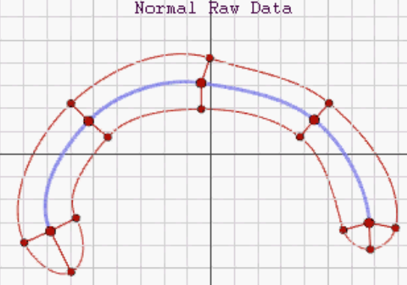
Medial Representations
2-d M-Rep Example:
Corpus Callosum
(Yushkevich)
Atoms
Notes:
CCMsciznormRaw.avi

Slide 83
Medial Representations
2-d M-Rep Example:
Corpus Callosum
(Yushkevich)
Atoms
Spokes
Notes:
CCMsciznormRaw.avi

Slide 84
Medial Representations
2-d M-Rep Example:
Corpus Callosum
(Yushkevich)
Atoms
Spokes
Implied
Boundary
Notes:
CCMsciznormRaw.avi

Slide 85
Medial Representations
3-d M-Rep Example: From Ja-Yeon Jeong
Bladder – Prostate - Rectum
Notes:
OODA.ppt

Slide 86
Medial Representations
3-d M-Rep Example: From Ja-Yeon Jeong
Bladder – Prostate - Rectum
In Male Pelvis
Valve on Bladder
Notes:
OODA.ppt

Slide 87
Medial Representations
3-d M-Rep Example: From Ja-Yeon Jeong
Bladder – Prostate - Rectum
In Male Pelvis
Valve on Bladder
Common Area for Cancer in Males
Notes:
OODA.ppt

Slide 88
Medial Representations
3-d M-Rep Example: From Ja-Yeon Jeong
Bladder – Prostate - Rectum
In Male Pelvis
Valve on Bladder
Common Area for Cancer in Males
Goal: Design Radiation Treatment
  Hit Prostate
  Miss Prostate & Rectum
Notes:
OODA.ppt

Slide 89
Medial Representations
3-d M-Rep Example: From Ja-Yeon Jeong
Bladder – Prostate - Rectum
In Male Pelvis
Valve on Bladder
Common Area for Cancer in Males
Goal: Design Radiation Treatment
  Hit Prostate
  Miss Prostate & Rectum
  Over Course of Many Days
Notes:
OODA.ppt

Slide 90
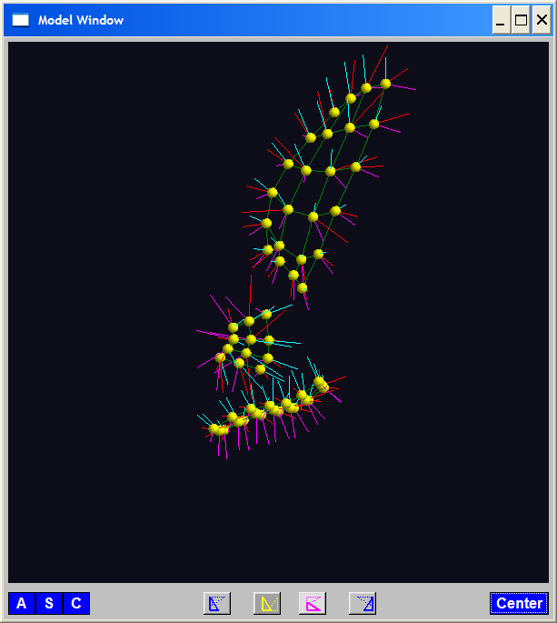
Medial Representations
3-d M-Rep Example: From Ja-Yeon Jeong
Bladder – Prostate - Rectum
Atoms (yellow dots)
Notes:
OODA.ppt

Slide 91
Medial Representations
3-d M-Rep Example: From Ja-Yeon Jeong
Bladder – Prostate - Rectum
Atoms - Spokes (line segments)
Notes:
OODA.ppt

Slide 92
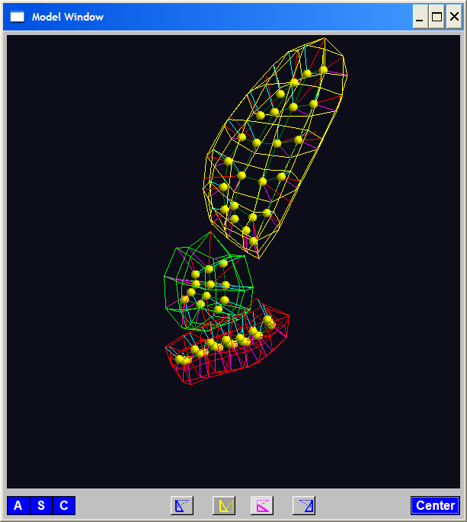
Medial Representations
3-d M-Rep Example: From Ja-Yeon Jeong
Bladder – Prostate - Rectum
Atoms - Spokes - Implied Boundary
Notes:
OODA.ppt

Slide 93
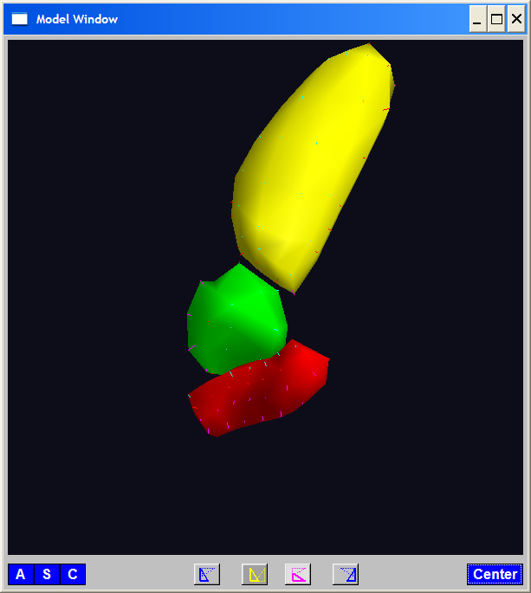
Medial Representations
3-d M-Rep Example: From Ja-Yeon Jeong
Bladder – Prostate - Rectum
Atoms - Spokes - Implied Boundary
Notes:
OODA.ppt

Slide 94
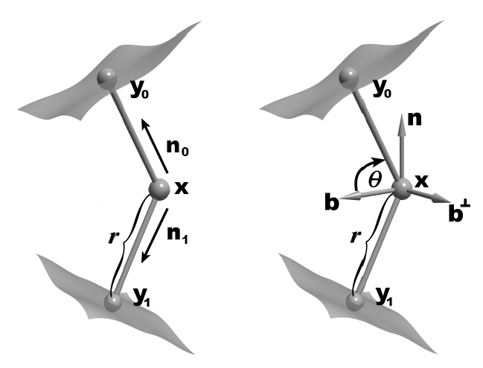
Medial Representations
3-d M-reps: there are several variations
Two choices:
From
Fletcher
(2004)
Notes:
fletcher_thesis.pdf

Slide 95
Medial Representations
Detailed discussion of M-reps:
Siddiqi, K. and Pizer, S. M. (2008)
Notes:
fletcher_thesis.pdf

Slide 96
Medial Representations
Statistical Challenge
M-rep parameters are:
  Locations
  Radii
  Angles (not comparable)

Slide 97
Medial Representations
Statistical Challenge
M-rep parameters are:
  Locations
  Radii
  Angles (not comparable)
Stuffed into a long vector
I.e. many direct products of these

Slide 98
Medial Representations
Statistical Challenge
Many direct products of:
  Locations
  Radii
  Angles (not comparable)
Appropriate View:
Data Lie on Curved Manifold
Embedded in higher dim’al Eucl’n Space

Slide 99
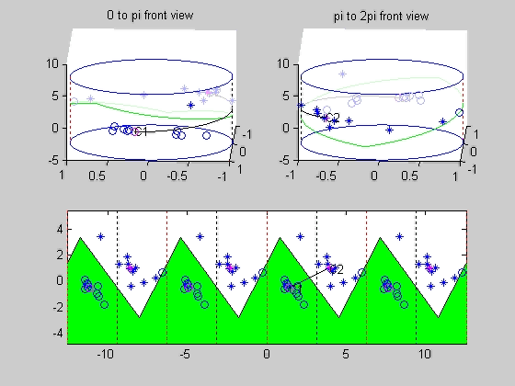
Medial Representations
Data on Curved Manifold Toy Example:

Slide 100
Medial Representations
Data on Curved Manifold Viewpoint:
Very Simple Toy Example (last movie)
Data on a Cylinder =

Slide 101
Medial Representations
Data on Curved Manifold Viewpoint:
Very Simple Toy Example (last movie)
Data on a Cylinder =
Notes:
  Simplest non-Euclidean Example
  2-d data, embedded on manifold in
  Can flatten the cylinder, to a plane
  Have periodic representation

Slide 102
Medial Representations
Data on Curved Manifold Viewpoint:
Very Simple Toy Example (last movie)
Data on a Cylinder =
Notes:
  Simplest non-Euclidean Example
  2-d data, embedded on manifold in
  Can flatten the cylinder, to a plane
  Have periodic representation
  Movie by: Suman Sen
Same idea for more complex direct prod’s

Slide 103
A Challenging Example
Male Pelvis
  Bladder – Prostate – Rectum

Slide 104
A Challenging Example
Male Pelvis
  Bladder – Prostate – Rectum
  How do they move over time (days)?
  (all within same person)

Slide 105
A Challenging Example
Male Pelvis
  Bladder – Prostate – Rectum
  How do they move over time (days)?
  Critical to Radiation Treatment (cancer)

Slide 106
A Challenging Example
Male Pelvis
  Bladder – Prostate – Rectum
  How do they move over time (days)?
  Critical to Radiation Treatment (cancer)
Work with 3-d CT
(“Computed Tomography”,
= 3d version of X-ray)

Slide 107
A Challenging Example
Male Pelvis
  Bladder – Prostate – Rectum
  How do they move over time (days)?
  Critical to Radiation Treatment (cancer)
Work with 3-d CT
  Very Challenging to Segment
  Find boundary of each object?
  Represent each Object?

Slide 108
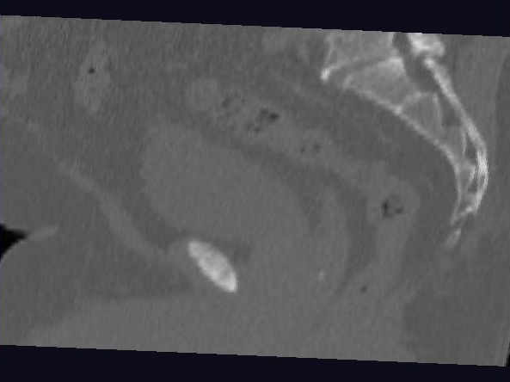
Male Pelvis – Raw Data
One CT Slice
(in 3d image)
Like X-ray:
White = Dense
(Bone)
Black = Gas

Slide 109
Male Pelvis – Raw Data
One CT Slice
(in 3d image)
Tail Bone

Slide 110
Male Pelvis – Raw Data
One CT Slice
(in 3d image)
Tail Bone
Rectum

Slide 111
Male Pelvis – Raw Data
One CT Slice
(in 3d image)
Tail Bone
Rectum
Bladder

Slide 112
Male Pelvis – Raw Data
One CT Slice
(in 3d image)
Tail Bone
Rectum
Bladder
Prostate

Slide 113
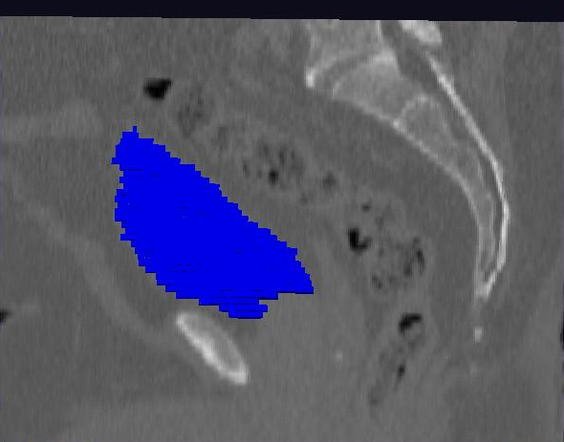
Male Pelvis – Raw Data
Prostate:
manual segmentation
Slice by slice
Reassembled

Slide 114
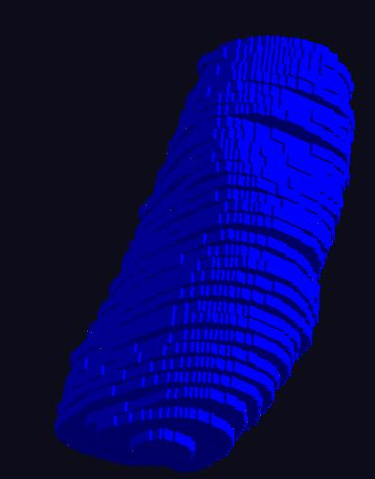
Male Pelvis – Raw Data
Prostate:
Slices:
Reassembled in 3d
How to represent?
Thanks: Ja-Yeon Jeong

Slide 115
Object Representation
Landmarks (hard to find)

Slide 116
Object Representation
Landmarks (hard to find)
Boundary Rep’ns (no correspondence)

Slide 117
Object Representation
Landmarks (hard to find)
Boundary Rep’ns (no correspondence)
Medial representations
  Find “skeleton”
  Discretize as “atoms” called M-reps

Slide 118
3-d m-reps
Bladder – Prostate – Rectum (multiple objects, J. Y. Jeong)
Medial Atoms provide “skeleton”
Implied Boundary from “spokes” → “surface”

Slide 119
3-d m-reps
M-rep model fitting
Easy, when starting from binary (blue)

Slide 120
3-d m-reps
M-rep model fitting
Easy, when starting from binary (blue)
But very expensive (30 – 40 minutes technician’s time)
Want automatic approach

Slide 121
3-d m-reps
M-rep model fitting
Easy, when starting from binary (blue)
But very expensive (30 – 40 minutes technician’s time)
Want automatic approach
Challenging, because of poor contrast, noise, …
Need to borrow information across training sample

Slide 122
3-d m-reps
M-rep model fitting
Easy, when starting from binary (blue)
But very expensive (30 – 40 minutes technician’s time)
Want automatic approach
Challenging, because of poor contrast, noise, …
Need to borrow information across training sample
Use Bayes approach: prior & likelihood → posterior
(A surrogate for “atomical knowledge”)

Slide 123
3-d m-reps
M-rep model fitting
Easy, when starting from binary (blue)
But very expensive (30 – 40 minutes technician’s time)
Want automatic approach
Challenging, because of poor contrast, noise, …
Need to borrow information across training sample
Use Bayes approach: prior & likelihood → posterior
~Conjugate Gaussians
(Embarassingly Straightforward?)

Slide 124
3-d m-reps
M-rep model fitting
Easy, when starting from binary (blue)
But very expensive (30 – 40 minutes technician’s time)
Want automatic approach
Challenging, because of poor contrast, noise, …
Need to borrow information across training sample
Use Bayes approach: prior & likelihood → posterior
~Conjugate Gaussians, but there are issues:
  Major HLDSS challenges
  Manifold aspect of data

Slide 125
3-d m-reps
M-rep model fitting
Very Successful
Jeong (2009)

Slide 126
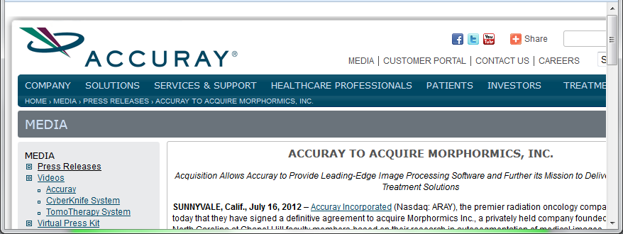
3-d m-reps
M-rep model fitting
Very Successful
Jeong (2009)
Basis of Startup Company: Morphormics

Slide 127
Mildly Non-Euclidean Spaces
Statistical Analysis of M-rep Data
Recall: Many direct products of:
Locations
Radii
Angles

Slide 128
Mildly Non-Euclidean Spaces
Statistical Analysis of M-rep Data
Recall: Many direct products of:
Locations
Radii
Angles
I.e. points on smooth manifold

Slide 129
Mildly Non-Euclidean Spaces
Statistical Analysis of M-rep Data
Recall: Many direct products of:
Locations
Radii
Angles
I.e. points on smooth manifold
Data in non-Euclidean Space
But only mildly non-Euclidean

Slide 130
PCA for m-reps, II
PCA on non-Euclidean spaces?
(i.e. on Lie Groups / Symmetric Spaces)

Slide 131
PCA for m-reps, II
PCA on non-Euclidean spaces?
(i.e. on Lie Groups / Symmetric Spaces)
T. Fletcher: Principal Geodesic Analysis
(2004 UNC CS PhD Dissertation)

Slide 132
PCA for m-reps, II
PCA on non-Euclidean spaces?
(i.e. on Lie Groups / Symmetric Spaces)
T. Fletcher: Principal Geodesic Analysis
Idea: replace “linear summary of data”
With “geodesic summary of data”…

Slide 133

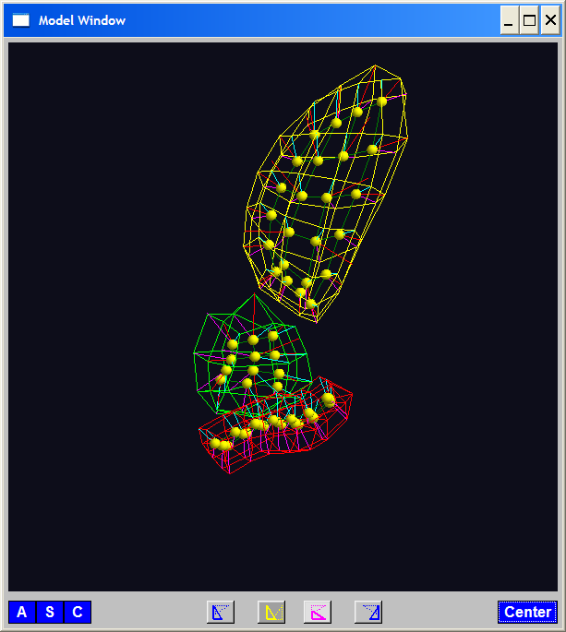
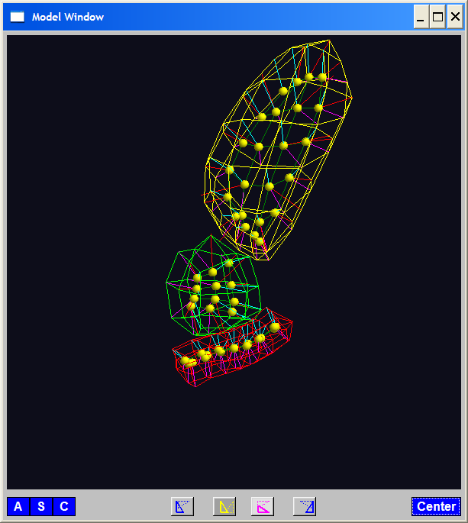
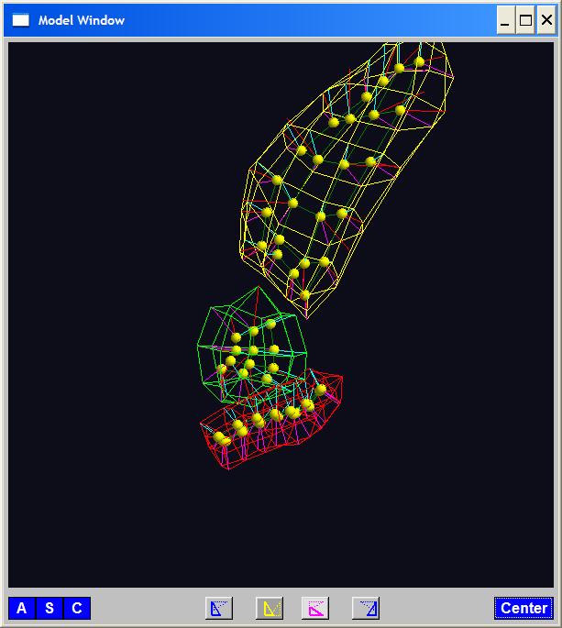
PGA for m-reps, Bladder-Prostate-Rectum
Bladder – Prostate – Rectum, 1 person, 17 days
PG 1 PG 2 PG 3
(analysis by Ja Yeon Jeong)

Slide 134
PGA for m-reps, Bladder-Prostate-Rectum
Bladder – Prostate – Rectum, 1 person, 17 days
PG 1 PG 2 PG 3
(analysis by Ja Yeon Jeong)

Slide 135
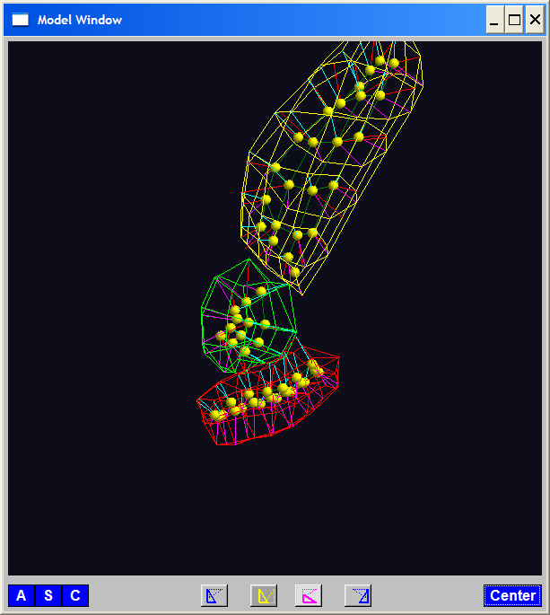
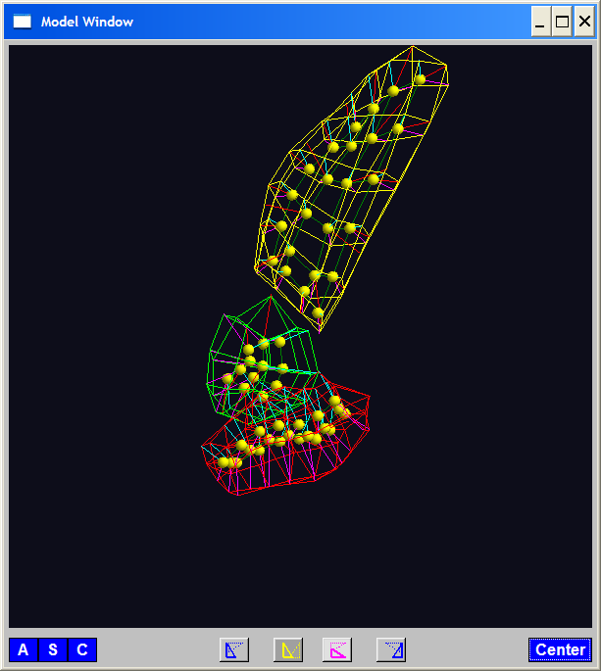
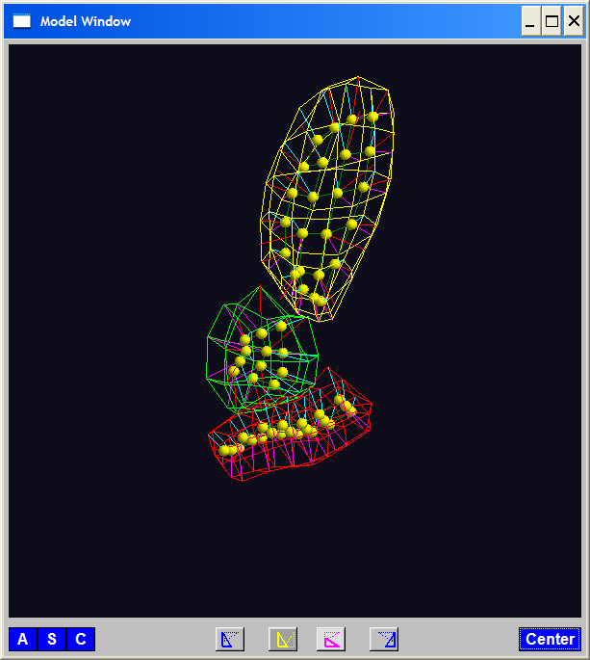
PGA for m-reps, Bladder-Prostate-Rectum
Bladder – Prostate – Rectum, 1 person, 17 days
PG 1 PG 2 PG 3
(analysis by Ja Yeon Jeong)

Slide 136
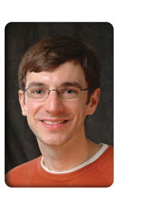
PCA Extensions for Data on Manifolds
Fletcher (Principal Geodesic Anal.)
  Best fit of geodesic to data

Slide 137
PCA Extensions for Data on Manifolds
Fletcher (Principal Geodesic Anal.)
  Best fit of geodesic to data
  Constrained to go through geodesic mean

Slide 138
PCA Extensions for Data on Manifolds
Fletcher (Principal Geodesic Anal.)
  Best fit of geodesic to data
  Constrained to go through geodesic mean
Counterexample:
Data on sphere, along equator

Slide 139
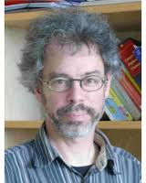
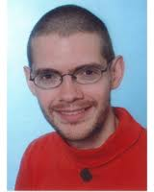

PCA Extensions for Data on Manifolds
Fletcher (Principal Geodesic Anal.)
  Best fit of geodesic to data
  Constrained to go through geodesic mean
Huckemann, Hotz & Munk (Geod. PCA)

Slide 140
PCA Extensions for Data on Manifolds
Fletcher (Principal Geodesic Anal.)
  Best fit of geodesic to data
  Constrained to go through geodesic mean
Huckemann, Hotz & Munk (Geod. PCA)
  Best fit of any geodesic to data

