Slide 1
Statistics – O. R. 891 Object Oriented Data Analysis
J. S. Marron
Dept. of Statistics and Operations Research
University of North Carolina

Slide 2
Blood vessel tree data
Big Picture: 3 Approaches
Purely Combinatorial
Euclidean Orthant
Dyck Path

Slide 3
Graphical Concept: Support Tree
Comparison of Correspondences:
Thickness Corr. gives bushier trees
(shows more population structure)
Descendant Corr. suggests compact rep’n
(easier to decompose, e.g. “PCA”?)

Slide 4
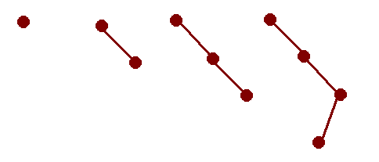
Strongly Non-Euclidean Spaces
PCA on Tree Space: Treeline
Best 1-d representation of data
Basic idea:
From some starting tree
Grow only in 1 “direction”

Slide 5
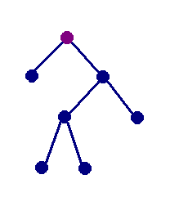
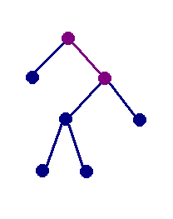
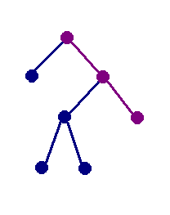
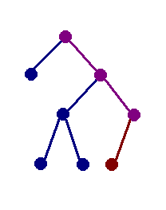
Example of projection
u₀: d(u₀,t) = 6
u₁: d(u₁,t)=5
u₂: d(u₂,t)=4
u₃: d(u₃,t)=5
Closest!

Slide 6
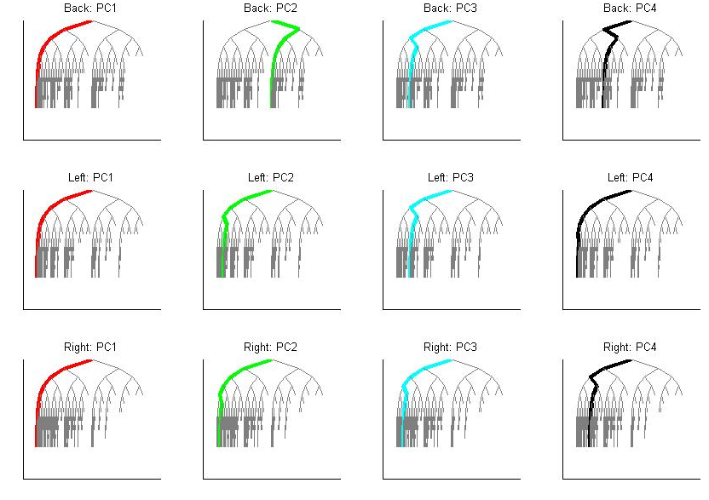
PCA for blood vessel tree data
Descendant
Corr.
Similar
Lessons
But Effects
Stronger
Better
Repres’n?

Slide 7
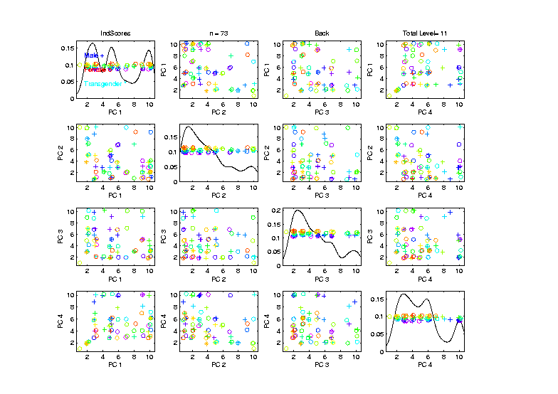
PCA for blood vessel tree data
Data Analytic Goals: Age, Gender
See
these?
No…

Slide 8
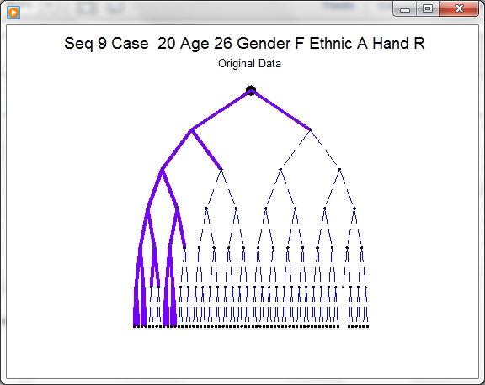
D-L Visualization of Trees
Challenge:
Visual
Display of
Full Tree
Structure

Slide 9
D-L Visualization of Trees
Challenge:
Visual
Display of
Full Tree
Structure
Actually
Goes to
Level 17
(Truncated
in View)

Slide 10
D-L Visualization of Trees
Approach: Different Coordinate System
Aydin, et al (2011)

Slide 11
D-L Visualization of Trees
Approach: Different Coordinate System
Idea: Focus on Important Aspects (of Nodes)
Level of Node
Number of Children

Slide 12
D-L Visualization of Trees
Approach: Different Coordinate System
Idea: Focus on Important Aspects (of Nodes)
Level of Node
Number of Children
Using These as Coordinates

Slide 13
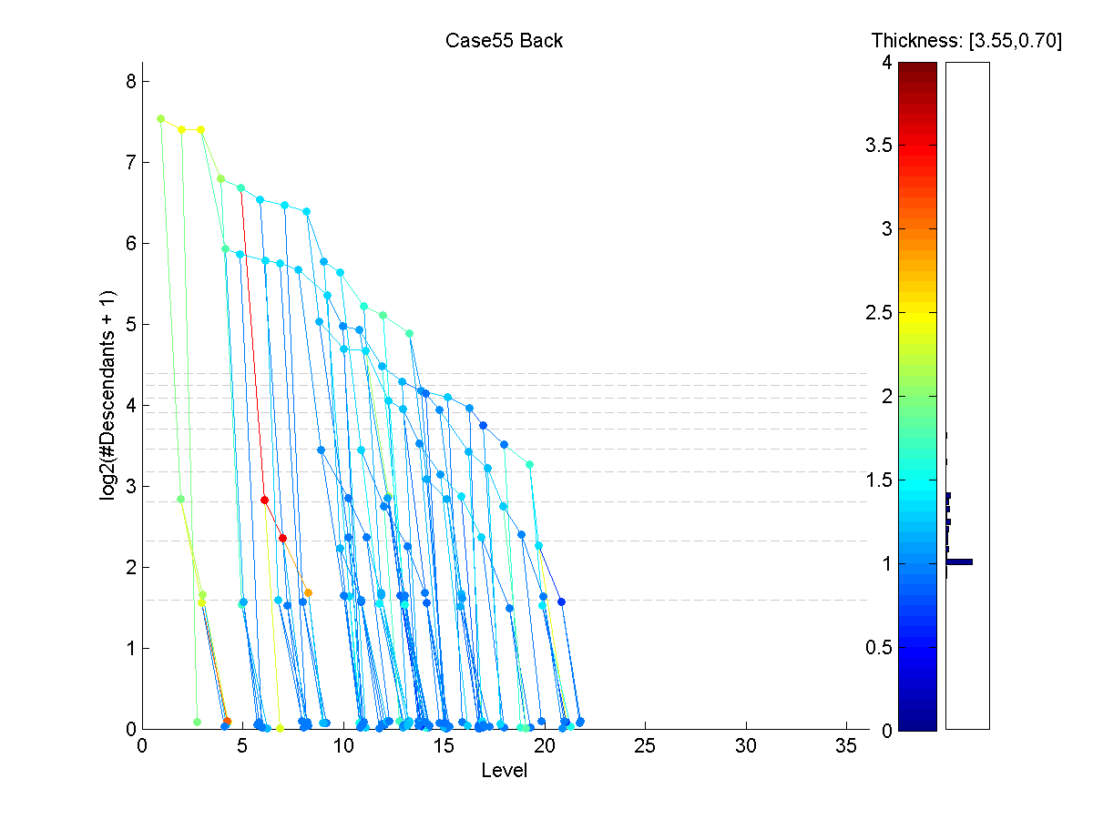
D-L Visualization of Trees
D-L
View

Slide 14
D-L Visualization of Trees
D-L
View
Nodes

Slide 15
D-L Visualization of Trees
D-L
View
Level

Slide 16
D-L Visualization of Trees
D-L
View
Level
Much
Deeper
Than
Early
View

Slide 17
D-L Visualization of Trees
D-L
View
# Des-
cend-
ants
(log
scale)

Slide 18
D-L Visualization of Trees
D-L
View
Color
Codes
Branch
Thick-
ness

Slide 19
D-L Visualization of Trees
D-L
View
Reveals
Strange
Struc-
ture

Slide 20
D-L Visualization of Trees
D-L
View
Reveals
Strange
Struc-
ture
Linking
Errors

Slide 21

D-L Visualization of Trees
D-L
View
Fixed
Version

Slide 22
Blood vessel tree data
Big Picture: 3 Approaches
Purely Combinatorial
Euclidean Orthant
Dyck Path

Slide 23
Euclidean Orthant Approach
People:
Scott Provan
Sean Skwerer
Megan Owen
Ezra Miller
Martin Styner
Ipek Oguz

Slide 24
Euclidean Orthant Approach
Setting: Connectivity & Length

Slide 25
Euclidean Orthant Approach
Setting: Connectivity & Length
Background: Phylogenetic Trees

Slide 26
Euclidean Orthant Approach
Setting: Connectivity & Length
Background: Phylogenetic Trees
Important Concept from Evolutionary Biology

Slide 27
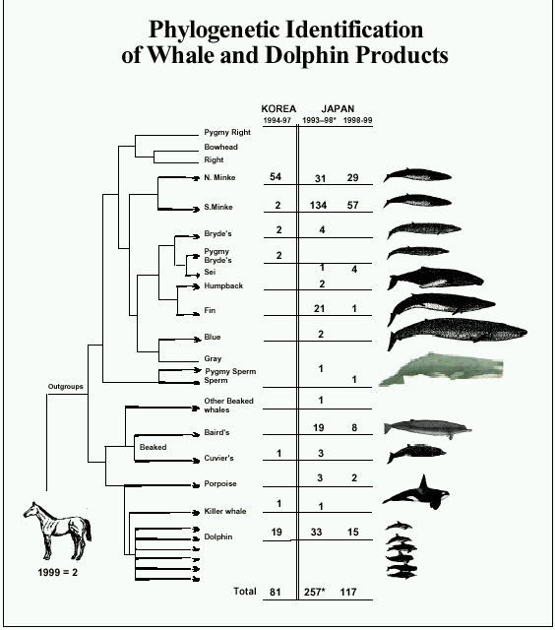
Phylogenetic Trees
Idea: Study
“Common
Ancestry”
Via a tree
Species are leaves
thanks to Susan Holmes

Slide 28
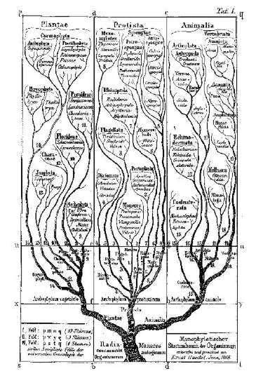
Phylogenetic Trees
Very Early Reference:
E. Schröder (1870),
Zeit. für. Math. Phys.,
15, 361-376.
thanks to Susan Holmes

Slide 29
Phylogenetic Trees
Important Reference:
Billera L, Holmes S, & Vogtmann K (2001)

Slide 30
Phylogenetic Trees
Important Reference:
Billera L, Holmes S, & Vogtmann K (2001)
Put Large Field on Firm Mathematical Basis

Slide 31
Euclidean Orthant Approach
Setting: Connectivity & Length
Background: Phylogenetic Trees
Major Restriction: Need common leaves

