Slide 1
Statistics – O. R. 891 Object Oriented Data Analysis
J. S. Marron
Dept. of Statistics and Operations Research
University of North Carolina

Slide 2
Blood vessel tree data
Big Picture: 3 Approaches
Purely Combinatorial
Euclidean Orthant
Dyck Path

Slide 3
Phylogenetic Trees
Important Reference:
Billera L, Holmes S, & Vogtmann K (2001)
Put Large Field on Firm Mathematical Basis

Slide 4
Euclidean Orthant Approach
Setting: Connectivity & Length
Background: Phylogenetic Trees
Major Restriction: Need common leaves
Big Payoff: Data space nearly Euclidean
sort of Euclidean

Slide 5
Euclidean Orthant Approach
Major Restriction: Need common leaves

Slide 6
Euclidean Orthant Approach
Major Restriction: Need common leaves
Approach:
Find common cortical landmarks (Oguz)
corresponding across cases

Slide 7
Euclidean Orthant Approach
Major Restriction: Need common leaves
Approach:
Find common cortical landmarks (Oguz)
corresponding across cases
Oguz (2009)

Slide 8
Euclidean Orthant Approach
Major Restriction: Need common leaves
Approach:
Find common cortical landmarks (Oguz)
corresponding across cases
Treat as pseudo – leaves
by projecting to points on tree
(draw pic)

Slide 9
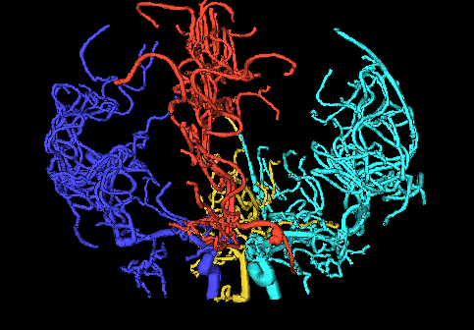
Blood vessel tree data
Marron’s brain:
From MRA
Reconstruct trees
in 3d
Rotate to view

Slide 10
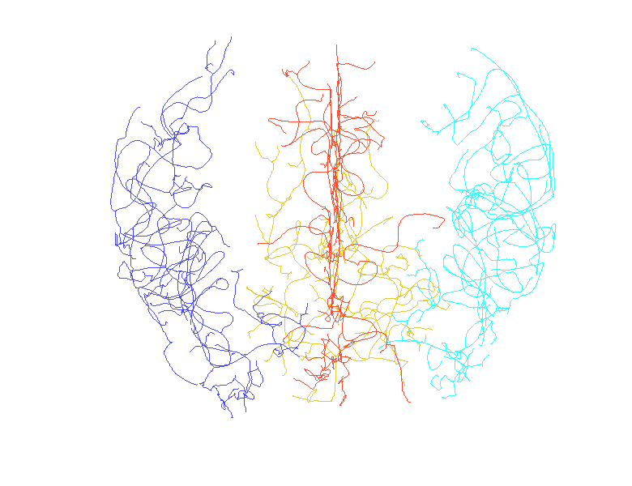
Vessel Locations
(thanks to Sean Skwerer)

Slide 11
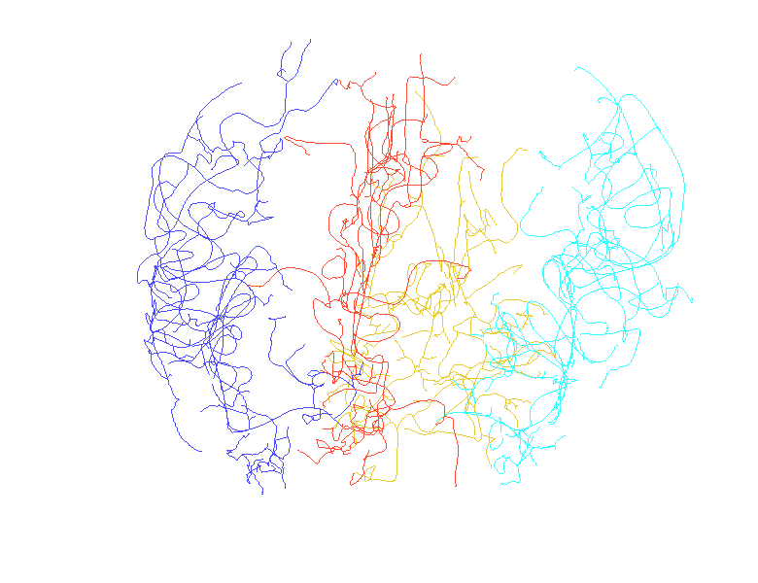
Vessel Locations

Slide 12
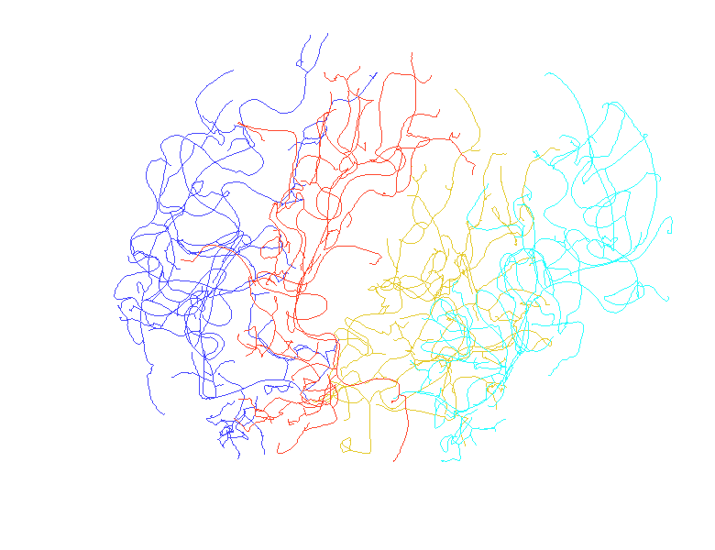
Vessel Locations

Slide 13
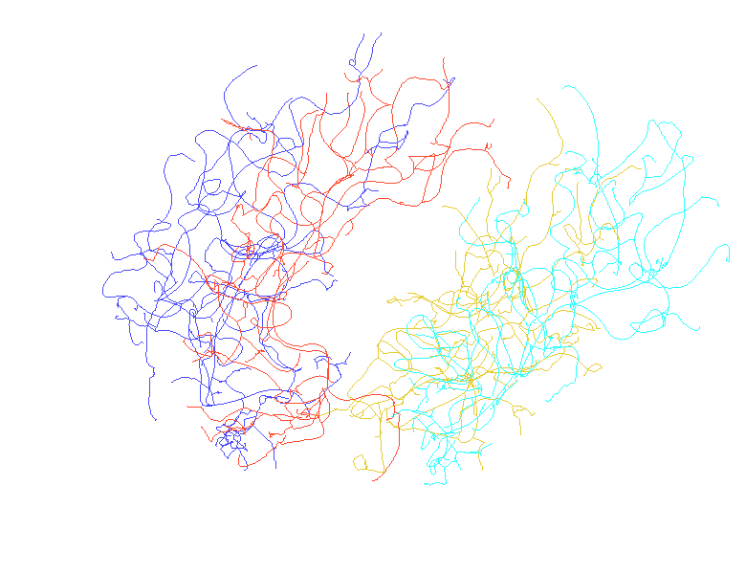
Vessel Locations

Slide 14
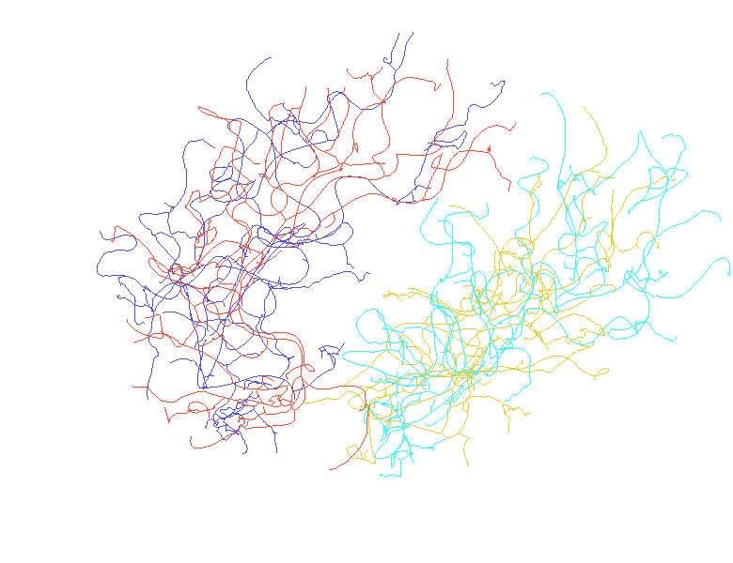
Vessel Locations

Slide 15
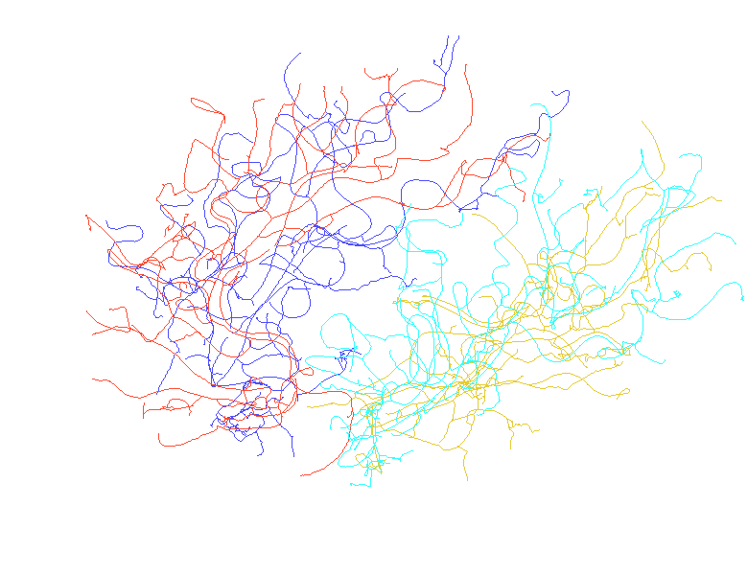
Vessel Locations

Slide 16
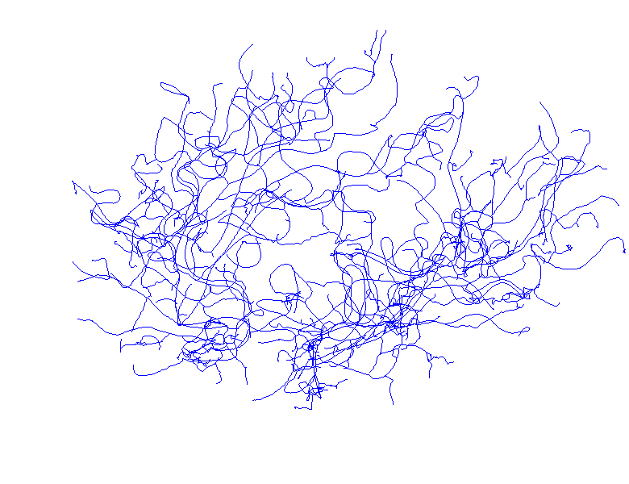
Common Color

Slide 17
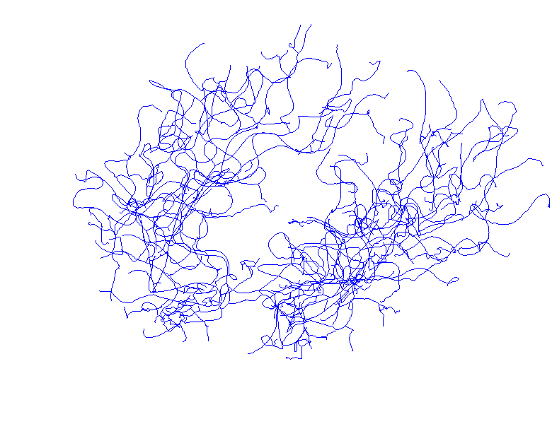
Common Color

Slide 18
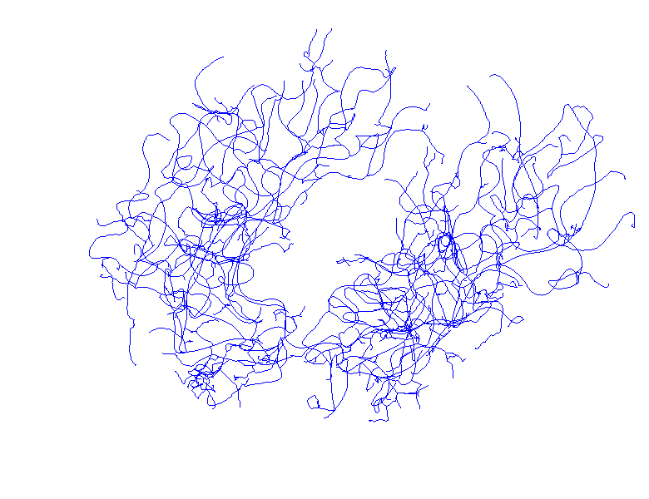
Common Color

Slide 19
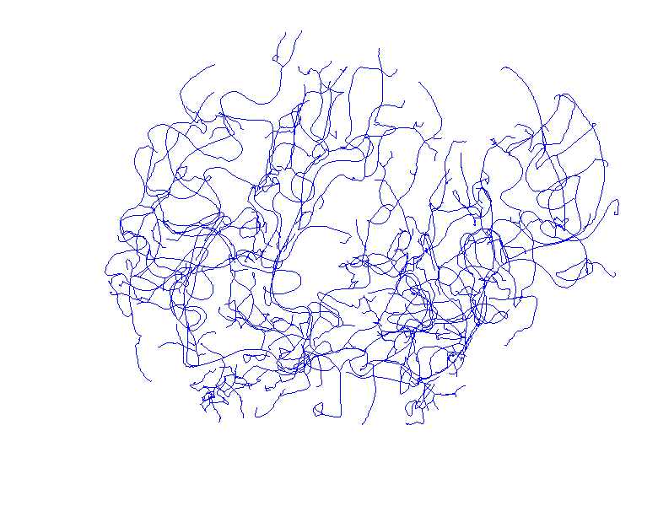
Common Color

Slide 20
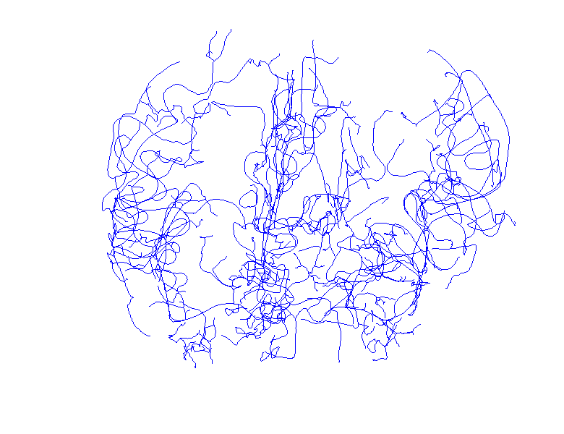
Common Color

Slide 21
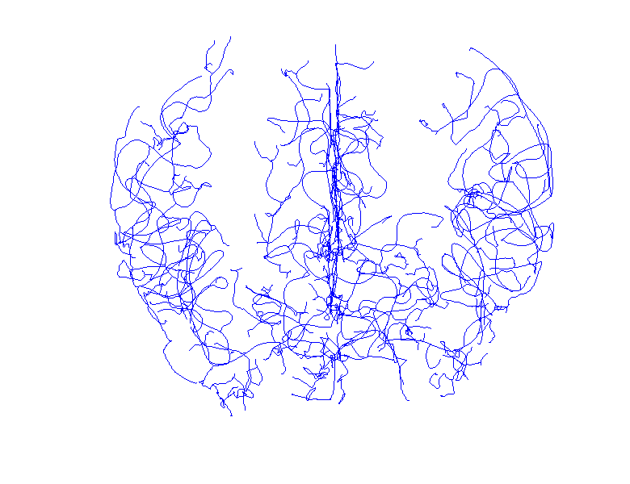
Common Color

Slide 22
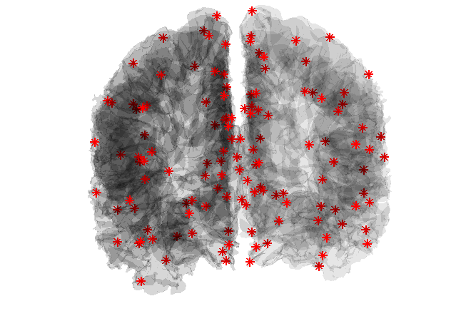
Cortical Surface & Landmarks
Corresponding Landmarks Courtesy of Ipek Oguz

Slide 23

Cortical Surface & Landmarks

Slide 24
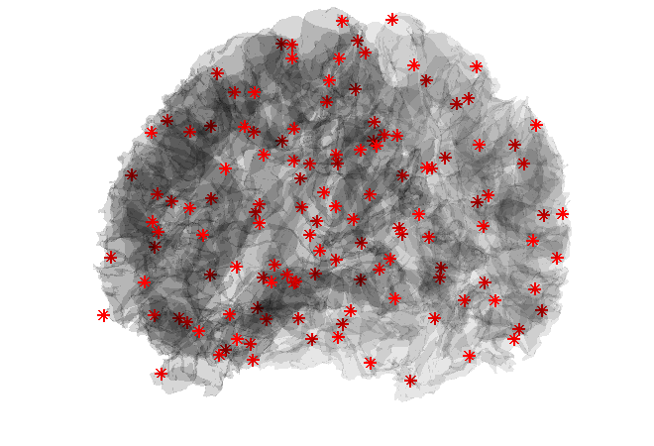
Cortical Surface & Landmarks

Slide 25
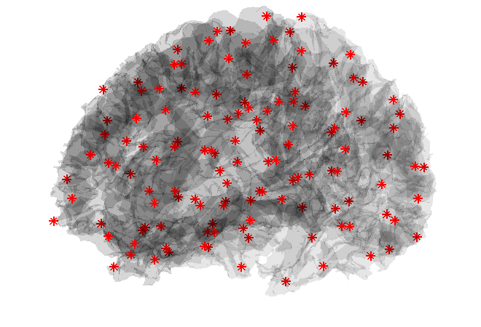
Cortical Surface & Landmarks

Slide 26
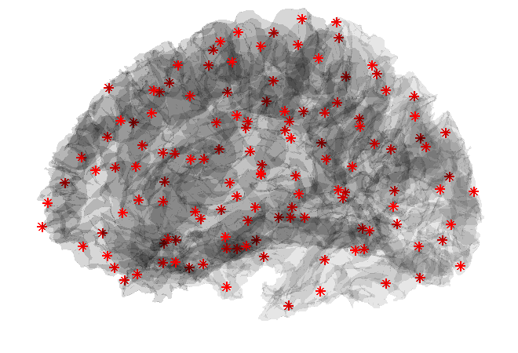
Cortical Surface & Landmarks

Slide 27
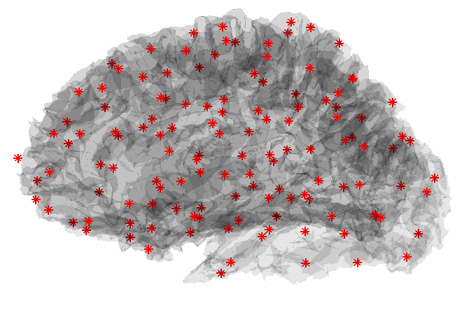
Cortical Surface & Landmarks

Slide 28
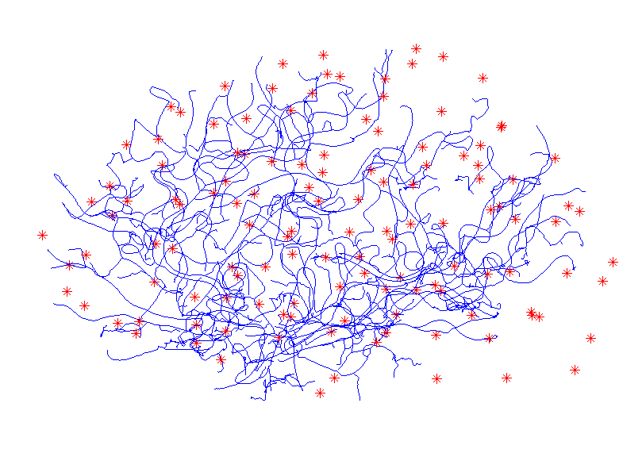
Landmarks and Vessels

Slide 29
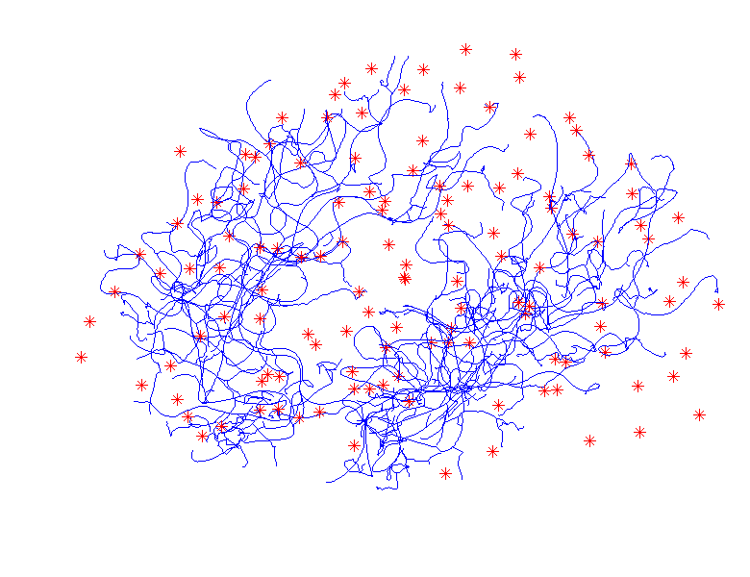
Landmarks and Vessels

Slide 30
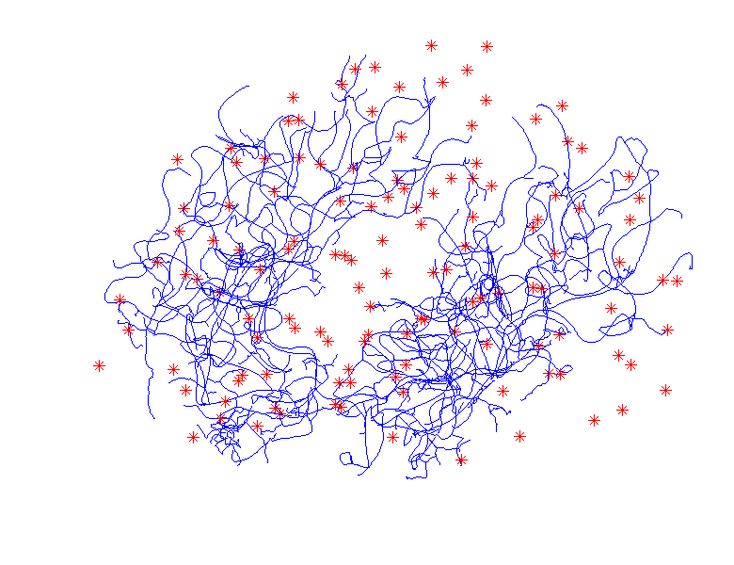
Landmarks and Vessels

Slide 31
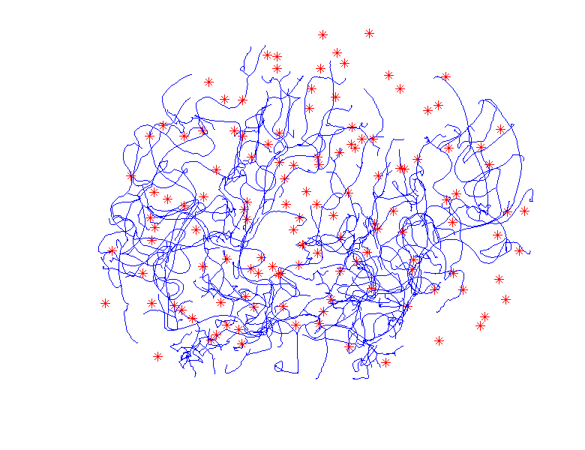
Landmarks and Vessels

Slide 32
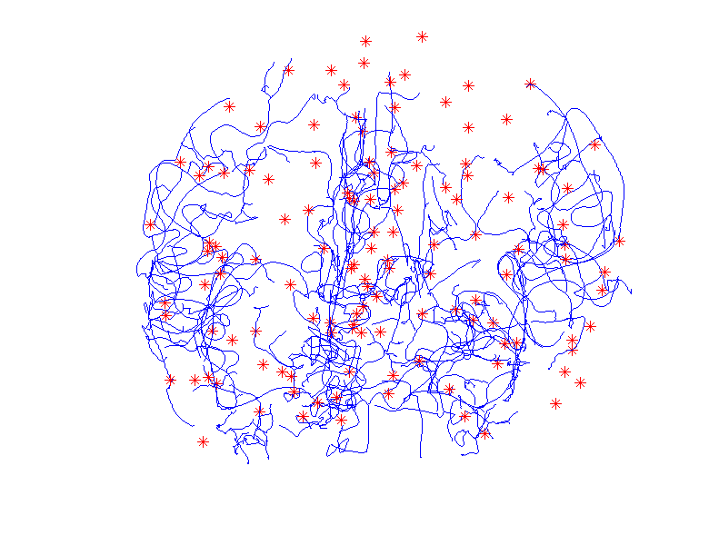
Landmarks and Vessels

Slide 33
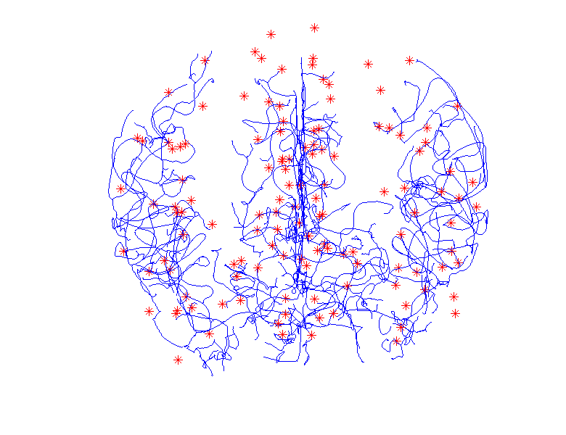
Landmarks and Vessels

Slide 34
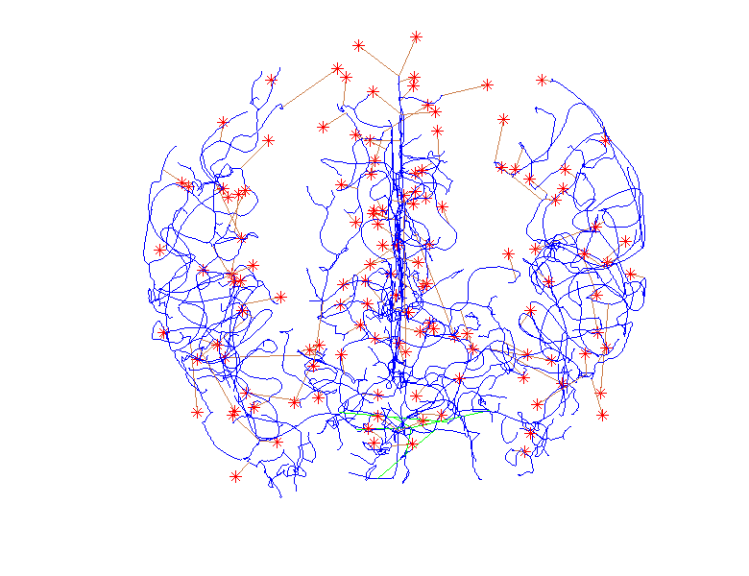
Attach Landmarks & Subtrees

Slide 35
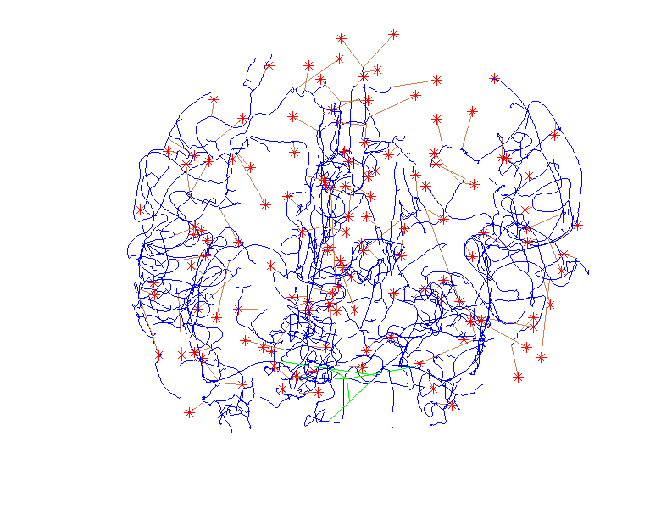
Attach Landmarks & Subtrees

Slide 36

Attach Landmarks & Subtrees

Slide 37
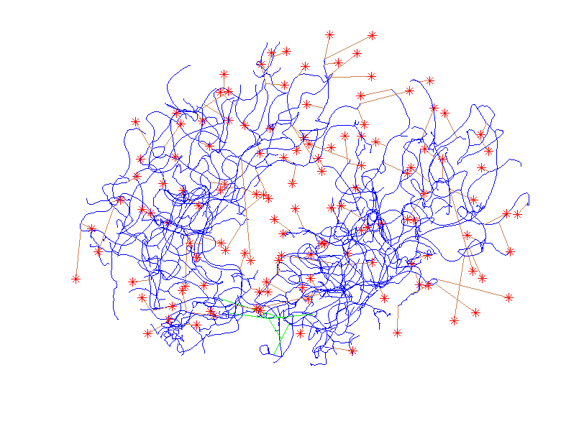
Attach Landmarks & Subtrees

Slide 38
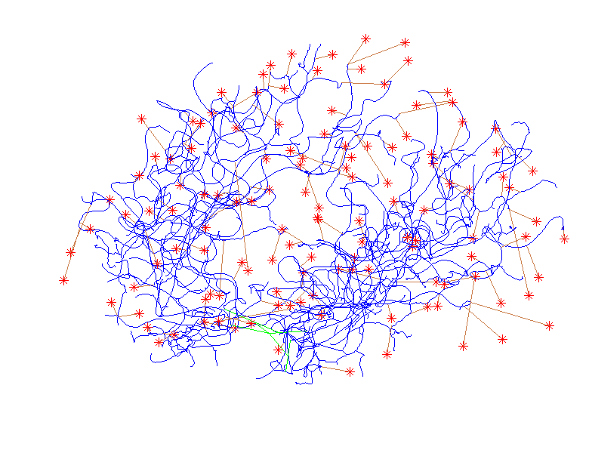
Attach Landmarks & Subtrees

Slide 39
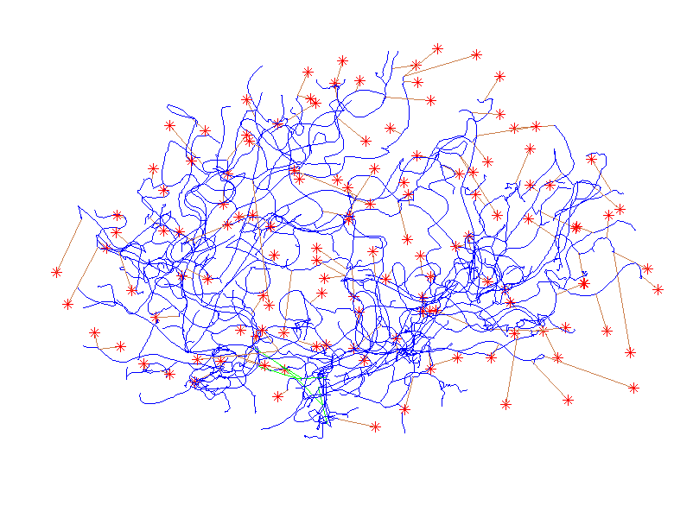
Attach Landmarks & Subtrees

Slide 40
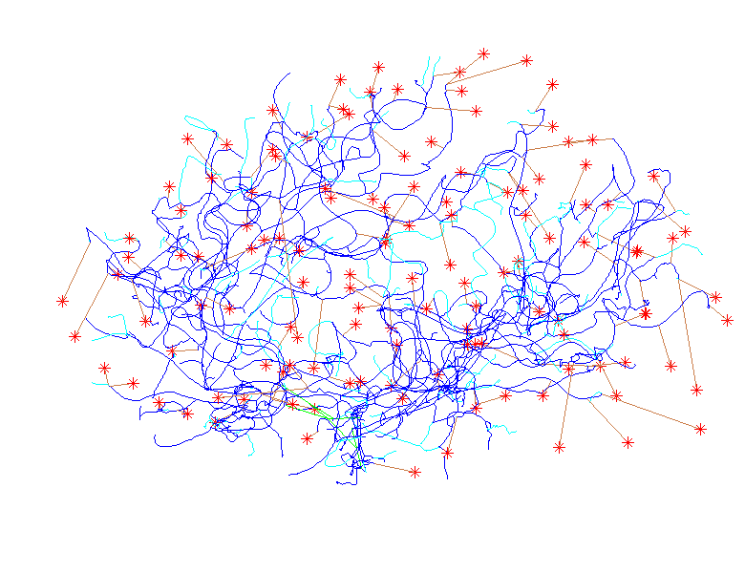
Highlight Orphans

Slide 41
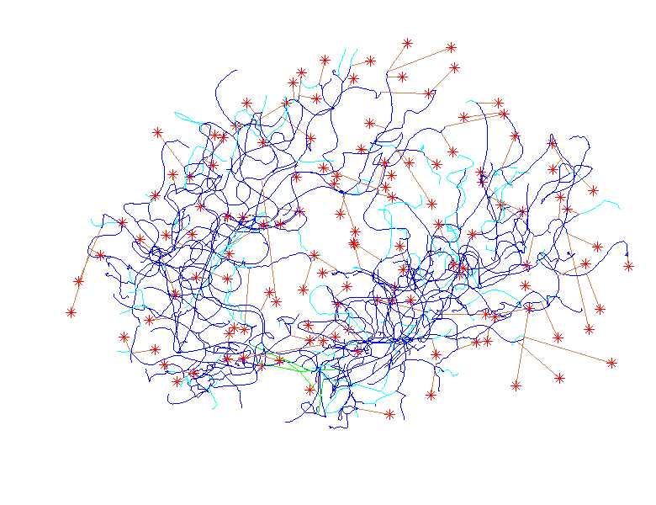
Highlight Orphans

Slide 42
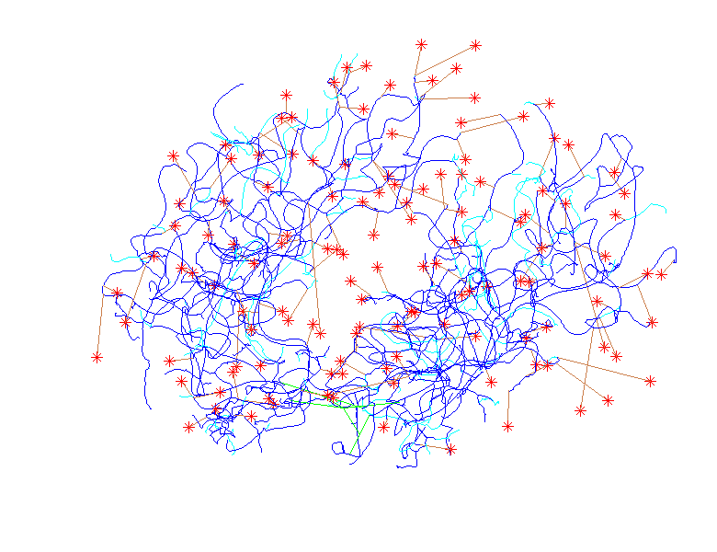
Highlight Orphans

Slide 43
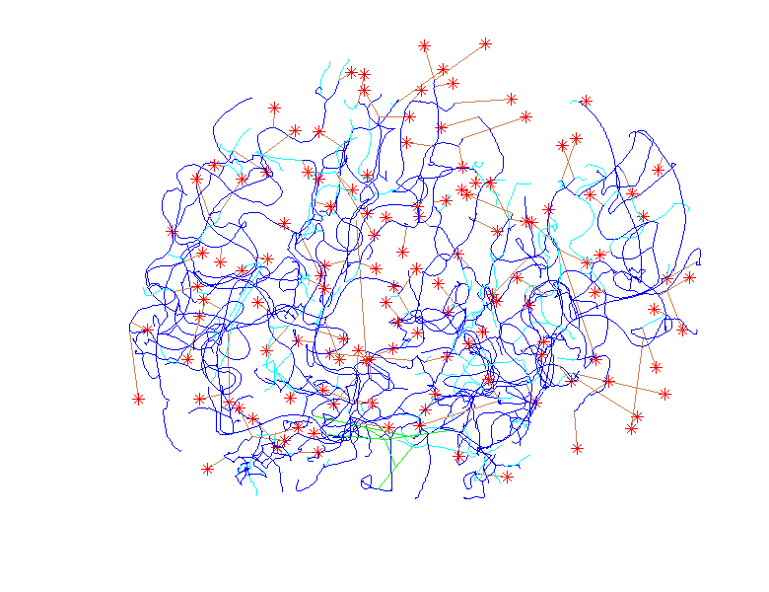
Highlight Orphans

Slide 44
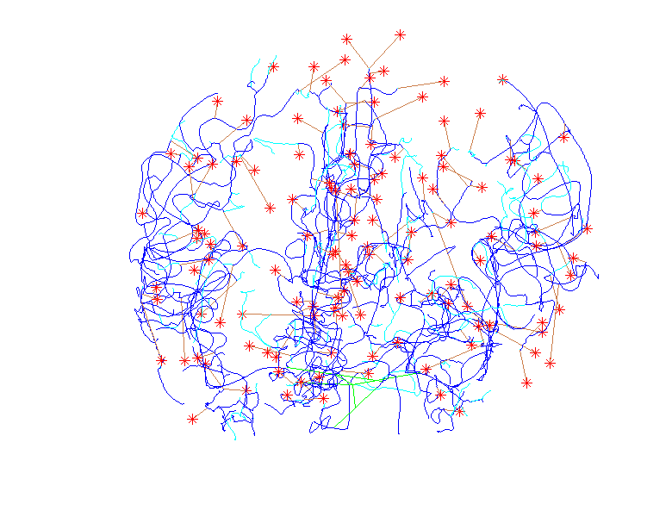
Highlight Orphans

Slide 45
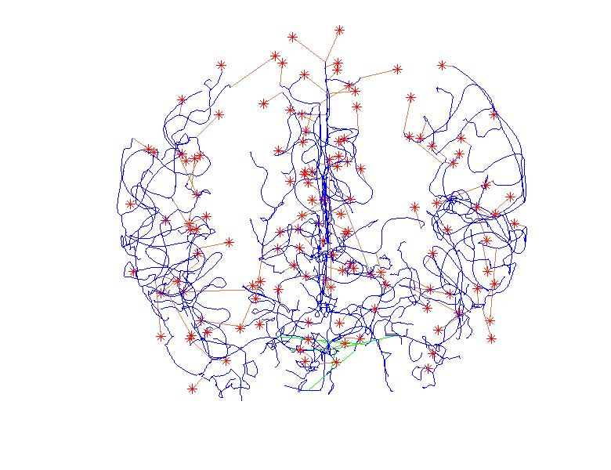
Trim Orphans

Slide 46
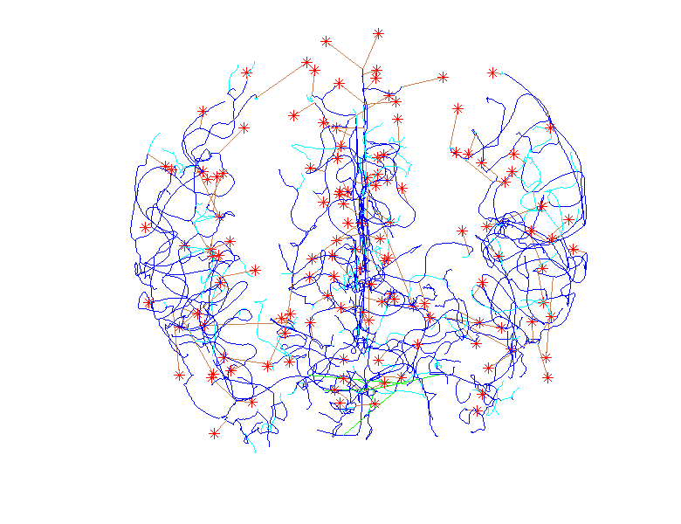
Highlight Orphans

Slide 47
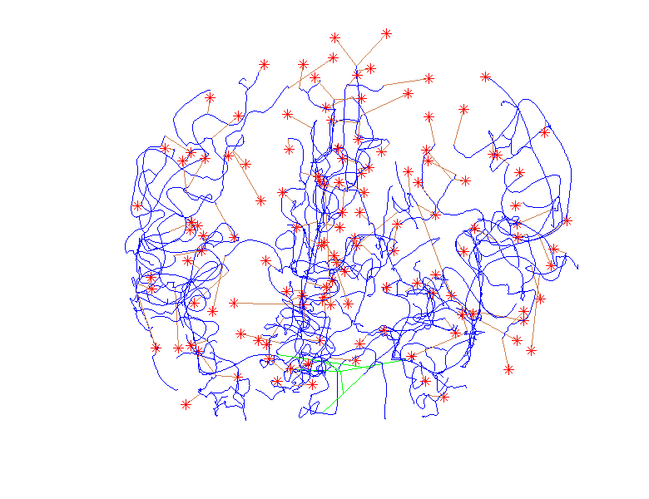
Trim Orphans

Slide 48
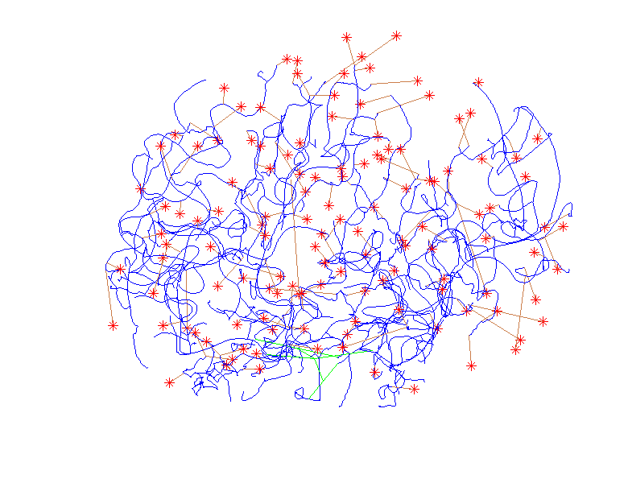
Trim Orphans

Slide 49
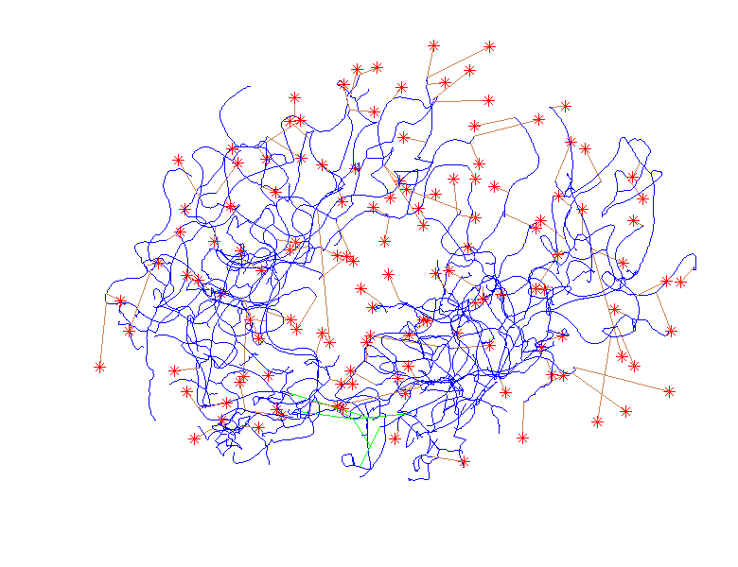
Trim Orphans

Slide 50
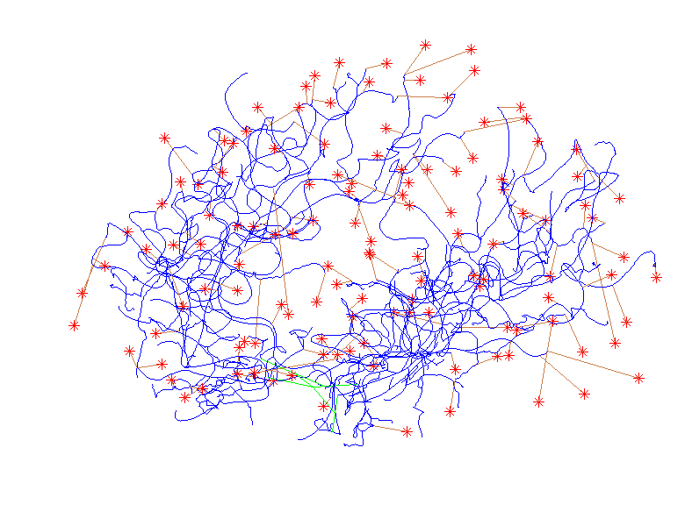
Trim Orphans

Slide 51
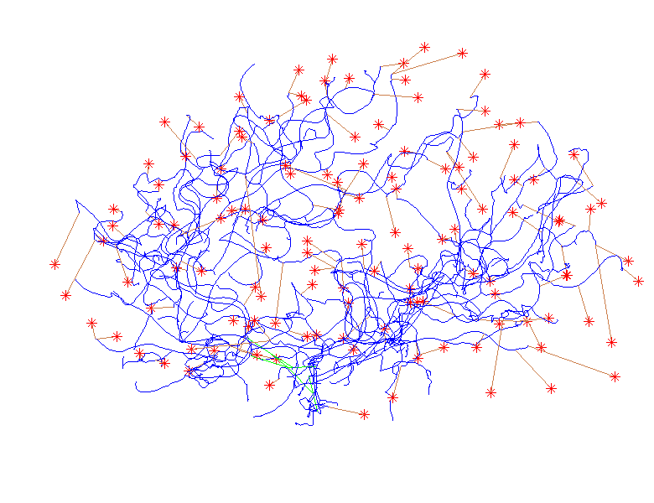
Trim Orphans

Slide 52
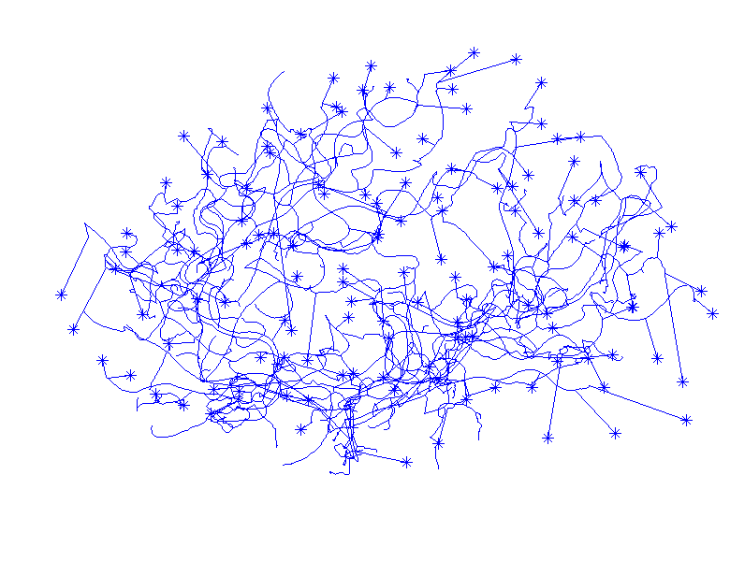
Final Tree (common leaves)

Slide 53
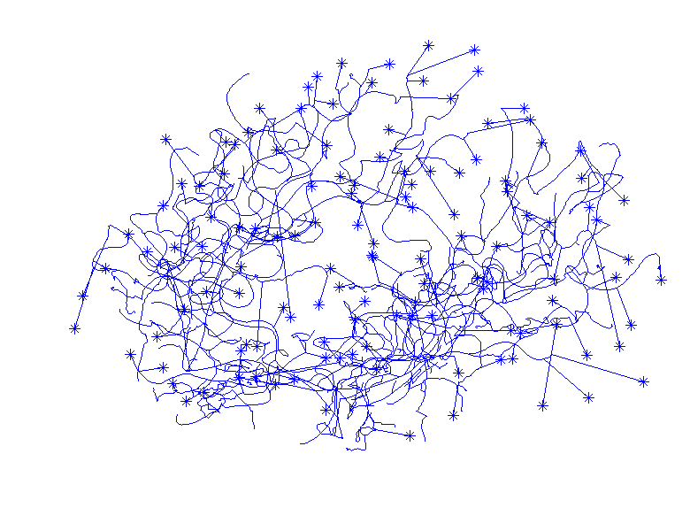
Final Tree (common leaves)

Slide 54
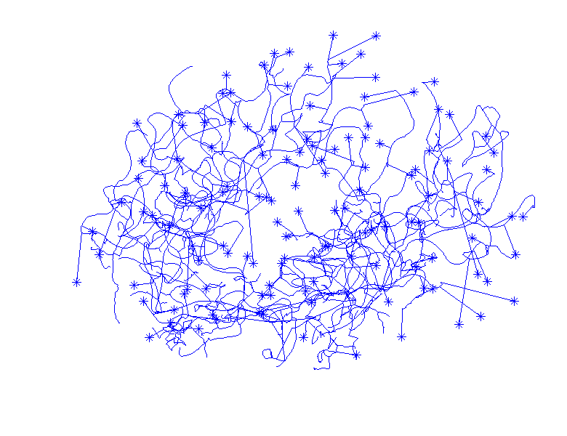
Final Tree (common leaves)

Slide 55
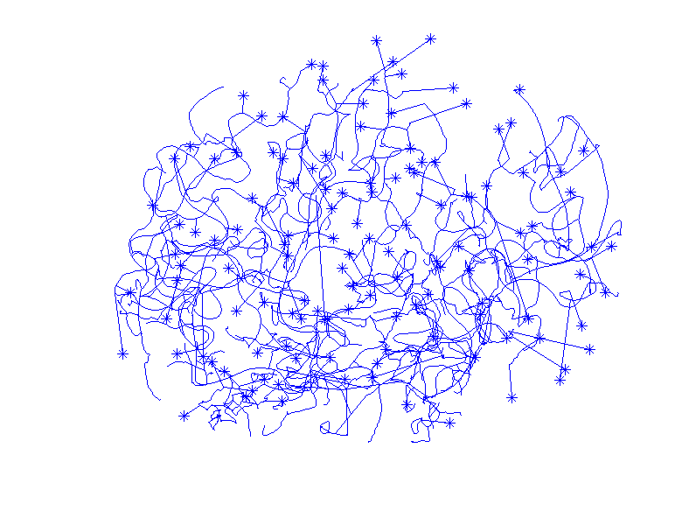
Final Tree (common leaves)

Slide 56
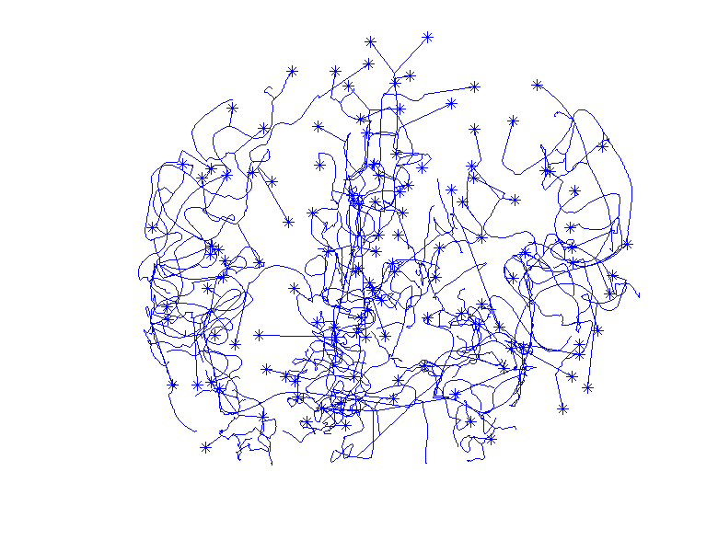
Final Tree (common leaves)

Slide 57
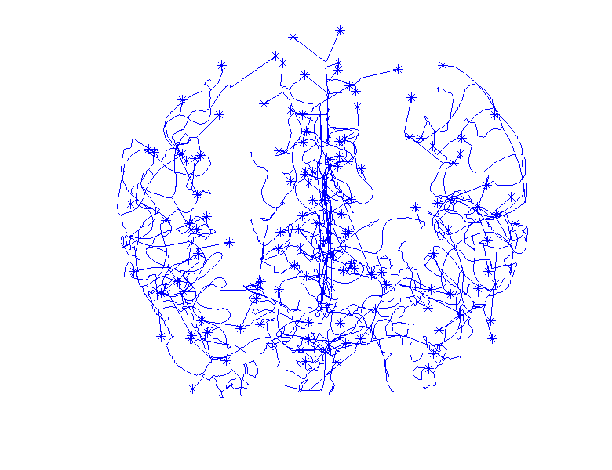
Final Tree (common leaves)

Slide 58
Euclidean Orthant Approach
Setting: Connectivity & Length
Background: Phylogenetic Trees
Major Restriction: Need common leaves
Big Payoff: Data space nearly Euclidean
sort of Euclidean

Slide 59
Labeled n-Trees
5-tree
e.g. n = 5
Thanks to Sean Skwerer

Slide 60
Labeled n-Trees
leaves - fixed a priori
5-tree

Slide 61
Labeled n-Trees
leaves - fixed a priori
5-tree
root

Slide 62
Labeled n-Trees
leaves - fixed a priori
labeled {0,1, . . . ,n}
5-tree
root

Slide 63
Labeled n-Trees
leaves - fixed a priori
labeled {0,1, . . . ,n}
Internal (nonleaf)
vertices degree ≥ 3
5-tree
root

Slide 64
Labeled n-Trees
leaves - fixed a priori
labeled {0,1, . . . ,n}
Internal (nonleaf)
vertices degree ≥ 3
# edges
from node
5-tree
root

Slide 65
Labeled n-Trees
leaves - fixed a priori
labeled {0,1, . . . ,n}
Internal (nonleaf)
vertices degree ≥ 3
(note: not labelled)
5-tree
root

Slide 66
Labeled n-Trees
leaves - fixed a priori
labeled {0,1, . . . ,n}
Internal (nonleaf)
vertices degree ≥ 3
edge e has
nonneg. length
5-tree
root
|e₁|=3
|e₂|=4
|e₃|=6

Slide 67
Labeled n-Trees
Note: To study
‘topology’,
(i.e. tree structure)
5-tree
root
|e₁|=3
|e₂|=4
|e₃|=6

Slide 68
Labeled n-Trees
Note: To study
‘topology’,
(i.e. tree structure)
Enough to consider
only lengths of
internal edges
5-tree
root
|e₁|=3
|e₂|=4
|e₃|=6

Slide 69
Labeled n-Trees
Terminology:
Leaf edges called
‘pendants’
(Care about lengths
of pendants in
brain arteries)
5-tree
root
|e₁|=3
|e₂|=4
|e₃|=6

Slide 70
Toy Examples
=
Same tree, since same internal edges

Slide 71
Toy Examples
=
Different tree, since different connections

Slide 72
Toy Examples
A valid tree, called “Star tree” or “0 tree” (since all internal edge lengths are 0)

Slide 73
Toy Examples
A 5-tree
leaves - fixed a priori
- labels {0,1, . . . ,5}
Internal (nonleaf) vertices degree ≥ 3.

Slide 74
Characterizing Edges
edge characterized
by split of vertices
e₁: 05 | 1234
e₂: 0345 | 12
e₃: 0125 | 34

Slide 75
Characterizing Edges
edge characterized
by split of vertices
e₁: 05 | 1234
e₂: 0345 | 12
e₃: 0125 | 34

Slide 76
Characterizing Edges
edge characterized
by split of vertices
e₁: 05 | 1234
e₂: 0345 | 12
e₃: 0125 | 34

Slide 77
Characterizing Trees
Which set of splits can form a tree?
Key Concept: Compatibility
Edges in the same tree must be compatible
Characterization?

Slide 78
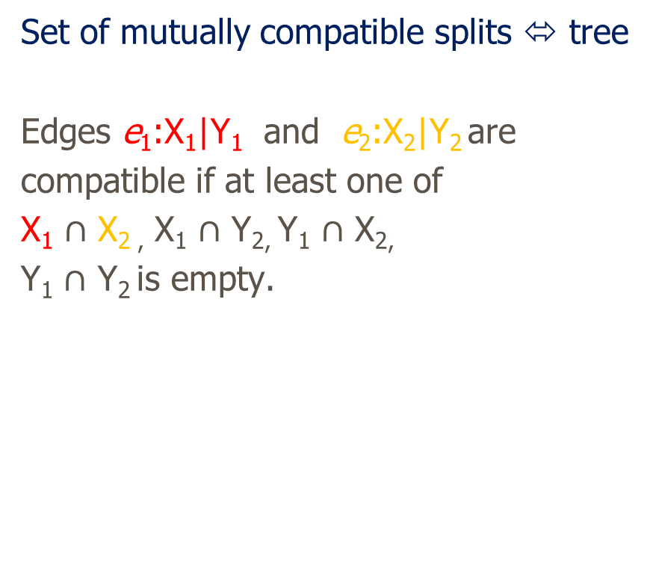
Characterizing Trees
e₁: 05 | 1234
e₂: 0345 | 12
e₃: 0125 | 34

Slide 79
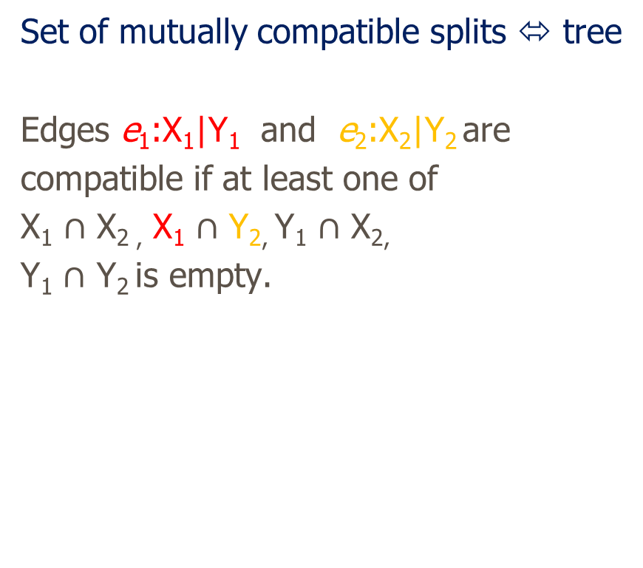
Characterizing Trees
Empty
Intersection
e₁: 05 | 1234
e₂: 0345 | 12
e₃: 0125 | 34

Slide 80
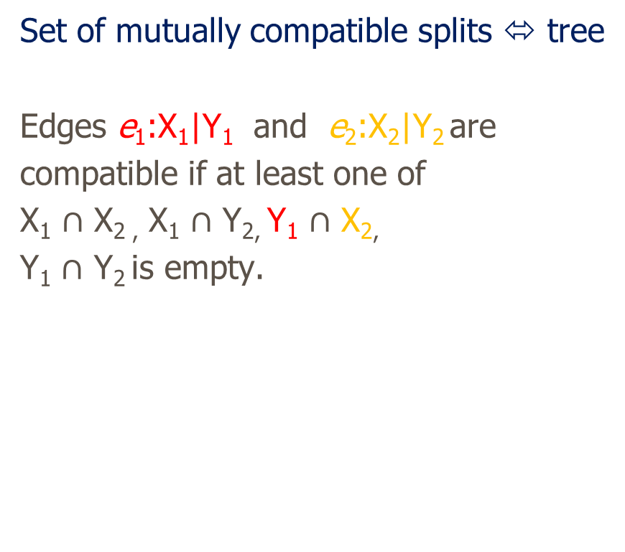
Characterizing Trees
e₁: 05 | 1234
e₂: 0345 | 12
e₃: 0125 | 34

Slide 81

Characterizing Trees
e₁: 05 | 1234
e₂: 0345 | 12
e₃: 0125 | 34

Slide 82
Incompatible Splits Example
e₁: 05 | 1234
e₂: 0345 | 12
e₃: 0125 | 34
e₂: 05 | 1234
e₄: 04 | 1235
e₅: 0124 | 35
e₁ and e₄ can not be in the same tree!

Slide 83
Characterizing Tree Edges
Set of mutually compatible splits ⬄ tree
e₁: 05 | 1234
e₂: 0345 | 12
e₃: 0125 | 34

Slide 84
Characterizing Tree Edges
Set of mutually compatible splits ⬄ tree
e₁: 05 | 1234
e₂: 0345 | 12
e₃: 0125 | 34

Slide 85
Characterizing Tree Edges
Set of mutually compatible splits ⬄ tree
e₁: 05 | 1234
e₂: 0345 | 12
e₃: 0125 | 34

Slide 86
The Concept of Tree Space
Tree space (Billera, Holmes, Vogtmann, 2001) places trees in a “Euclidean Orthant” setting.

Slide 87
The Concept of Tree Space
Tree space (Billera, Holmes, Vogtmann, 2001) places trees in a “Euclidean Orthant” setting.
Each n-tree is placed in an orthant of R^{n-2} whose (nonnegative) coordinates represent the lengths of the edges in tree.

Slide 88
The Concept of Tree Space
Tree space (Billera, Holmes, Vogtmann, 2001) places trees in a “Euclidean Orthant” setting.
Each n-tree is placed in an orthant of R^{n-2} whose (nonnegative) coordinates represent the lengths of the edges in tree.
Orthants are pasted together along boundaries of common edges.

Slide 89
The Concept of Tree Space
Tree space (Billera, Holmes, Vogtmann, 2001) places trees in a “Euclidean Orthant” setting.
Each n-tree is placed in an orthant of R^{n-2} whose (nonnegative) coordinates represent the lengths of the edges in tree.
Orthants are pasted together along boundaries of common edges.
2^{n} – n – 2 possible internal edges

Slide 90

Positive Orthants in R³
(pic here)

Slide 91



Tree Space Examples, T-4
$$Edge \left\{\begin{matrix}In if & \left|e\right|>0 \\ Out if & \left|e\right|=0\end{matrix}\right.$$
Set of mutually compatible splits ⬄ tree
Thanks to Megan Owen

Slide 92

Three quadrants meeting at common axis

Slide 93
Three quadrants meeting at common axis
Star Tree = 0 Tree

Slide 94
Three quadrants meeting at common axis
Star Tree
(point)

Slide 95
Three quadrants meeting at common axis
Star Tree
(point)
1-edge Trees
(line)

Slide 96
Three quadrants meeting at common axis
Star Tree
(point)
1-edge Trees
(line)
2-edge Trees
(planes)

Slide 97
Three quadrants meeting at common axis
Mathematical
Construct:
Manifold Stratified
Space

Slide 98
Three quadrants meeting at common axis
Mathematical
Construct:
Manifold Stratified
Space
Manifolds (planes)
of Different Dimensions
Glued Together

Slide 99
Three quadrants meeting at common axis
Mathematical
Construct:
Manifold Stratified
Space
Manifolds (planes)
of Different Dimensions
Glued Together

Slide 100
Three quadrants meeting at common axis
Mathematical
Construct:
Manifold Stratified
Space
Manifolds (planes)
of Different Dimensions
Glued Together

Slide 101

‘Connectivity’ of T-4

Slide 102
‘Connectivity’ of T-4
Cone Structure
(Reflects edge
lengths > 0)

Slide 103
‘Connectivity’ of T-4
Cone Structure
Star (0) Tree
(At Origin)

Slide 104
‘Connectivity’ of T-4
Cone Structure
Star (0) Tree
Single Edge
Trees
(On Boundary
Lines)

Slide 105
‘Connectivity’ of T-4
Cone Structure
Star (0) Tree
Single Edge
Trees
Full (2 Edge)
Trees
(On Planes)

Slide 106
‘Connectivity’ of T-4
Each Line
Connects to
3 planes
(# compatible
edges)

Slide 107
‘Connectivity’ of T-4
Each Line
Connects to
3 planes
(# compatible
edges)

Slide 108
Paths Between Trees
5
10
4
4
3
2.5
2.5
5
3
10
Compare trees by “how far apart” they are:
Use “continuous” path between them
Based upon changing edge lengths

Slide 109
Geodesic Paths
Given 2 trees,
Shortest path between is a
geodesic

Slide 110
Geodesic Paths
Given 2 trees,
Shortest path between is a
geodesic
Recall: March along manifold
“without turning”

Slide 111
Geodesic Paths
Given 2 trees,
Shortest path
Some math:
Can show unique in this space
(non-positive curvature)

Slide 112
Geodesic Paths
Given 2 trees,
Shortest path
Some math:
Can show unique in this space
Both geodesics & shortest paths

Slide 113
Geodesic Examples, T-4
Thanks to Megan Owen

Slide 114
Geodesic Examples, T-4
Thanks to Megan Owen

