Slide 1
Statistics – O. R. 891 Object Oriented Data Analysis
J. S. Marron
Dept. of Statistics and Operations Research
University of North Carolina

Slide 2
Administrative Info
Details on Course Web Page
Google: “Marron Courses”
Choose This Course
Go Through These

Slide 3
Who are we?
Varying Levels of Expertise
2nd Year Graduate Students
…
Senior Researchers
Various Backgrounds
Statistics
Computer Science – Imaging
Bioinformatics
Pharmacy
Others?

Slide 4
Course Expectations
Grading Based on:
“Participant Presentations”
5 – 10 minute talks
By Enrolled Student
Hopefully Others

Slide 5
Class Meeting Style
When you don’t understand something
Many others probably join you
So please fire away with questions
Discussion usually enlightening for others
If needed, I’ll tell you to shut up
(essentially never happens)

Slide 6
Object Oriented Data Analysis
What is it?
A Sound-Bite Explanation:
What is the “atom of the statistical analysis”?
1st Course: Numbers
Multivariate Analysis Course : Vectors
Functional Data Analysis: Curves

Slide 7
Functional Data Analysis
Active new field in statistics, see:
Ramsay, J. O. & Silverman, B. W. (2005) Functional Data Analysis, 2nd Edition, Springer, N.Y.
Ramsay, J. O. & Silverman, B. W. (2002) Applied Functional Data Analysis, Springer, N.Y.
Ramsay, J. O. (2005) Functional Data Analysis Web Site, http://ego.psych.mcgill.ca/misc/fda/

Slide 8
Object Oriented Data Analysis
What is it?
A Sound-Bite Explanation:
What is the “atom of the statistical analysis”?
1st Course: Numbers
Multivariate Analysis Course : Vectors
Functional Data Analysis: Curves
More generally: Data Objects

Slide 9
Object Oriented Data Analysis
Nomenclature Clash?
Computer Science View:
Object Oriented Programming:
Programming that supports encapsulation, inheritance, and polymorphism
(from Google: define object oriented programming,
my favorite: www.innovatia.com/software/papers/com.htm)

Slide 10
Object Oriented Data Analysis
Some statistical history:
John Chambers Idea (1960s - ):
Object Oriented approach to statistical analysis
Developed as software package S
Basis of S-plus (commerical product)
And of R (free-ware, current favorite of Chambers)
Reference for more on this:
Venables, W. N. and Ripley, B. D. (2002) Modern Applied Statistics with S, Fourth Edition, Springer, N. Y., ISBN 0-387-95457-0.
Notes:
10

Slide 11
Object Oriented Data Analysis
Another take: J. O. Ramsay
http://www.psych.mcgill.ca/faculty/ramsay/ramsay.html
“Functional Data Objects”
(closer to C. S. meaning)
Personal Objection:
“Functional” in mathematics is:
“Function that operates on functions”

Slide 12
Object Oriented Data Analysis
Current Motivation:
In Complicated Data Analyses
Fundamental (Non-Obvious) Question Is:
“What Should We Take as Data Objects?”
Key to Focussing Needed Analyses

Slide 13
Object Oriented Data Analysis
Reviewer for Annals of Applied Statistics:
Why not just say:
“Experimental Units”?
OK, for Conventional Data Types
Clumsier for Very Exotic Objects
(images, movies, trees, equivalence classes, …)
Too Much of a Mouthful

Slide 14
Object Oriented Data Analysis
Comment from Randy Eubank:
This terminology:
"Object Oriented Data Analysis"
First appeared in Florida FDA Meeting:
http://www.stat.ufl.edu/symposium/2003/fundat/

Slide 15
Object Oriented Data Analysis
What is Actually Done?
Major Statistical Tasks:
Understanding Population Structure
Classification (i. e. Discrimination)
Time Series of Data Objects
“Vertical Integration” of Datatypes

Slide 16
Visualization
How do we look at data?
Start in Euclidean Space,
Will later study other spaces

Slide 17
Notation
Note: many statisticians prefer “p”, not “d”
(perhaps for “parameters”
or “predictors”)
I will use “d” for “dimension”
(with idea that it is more
broadly understandable)

Slide 18
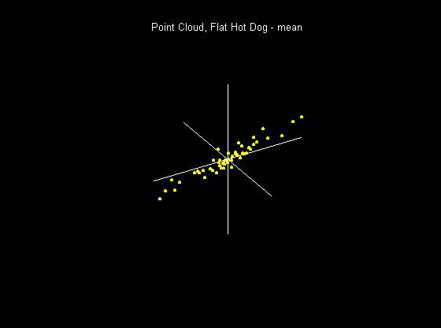
Visualization
How do we look at Euclidean data?
1-d: histograms, etc.
2-d: scatterplots
3-d: spinning point clouds

Slide 19
Visualization
How do we look at Euclidean data?
Higher Dimensions?
Workhorse Idea: Projections

Slide 20
Projection
Important Point
There are many “directions of interest” on which projection is useful
An important set of directions:
Principal Components

Slide 21
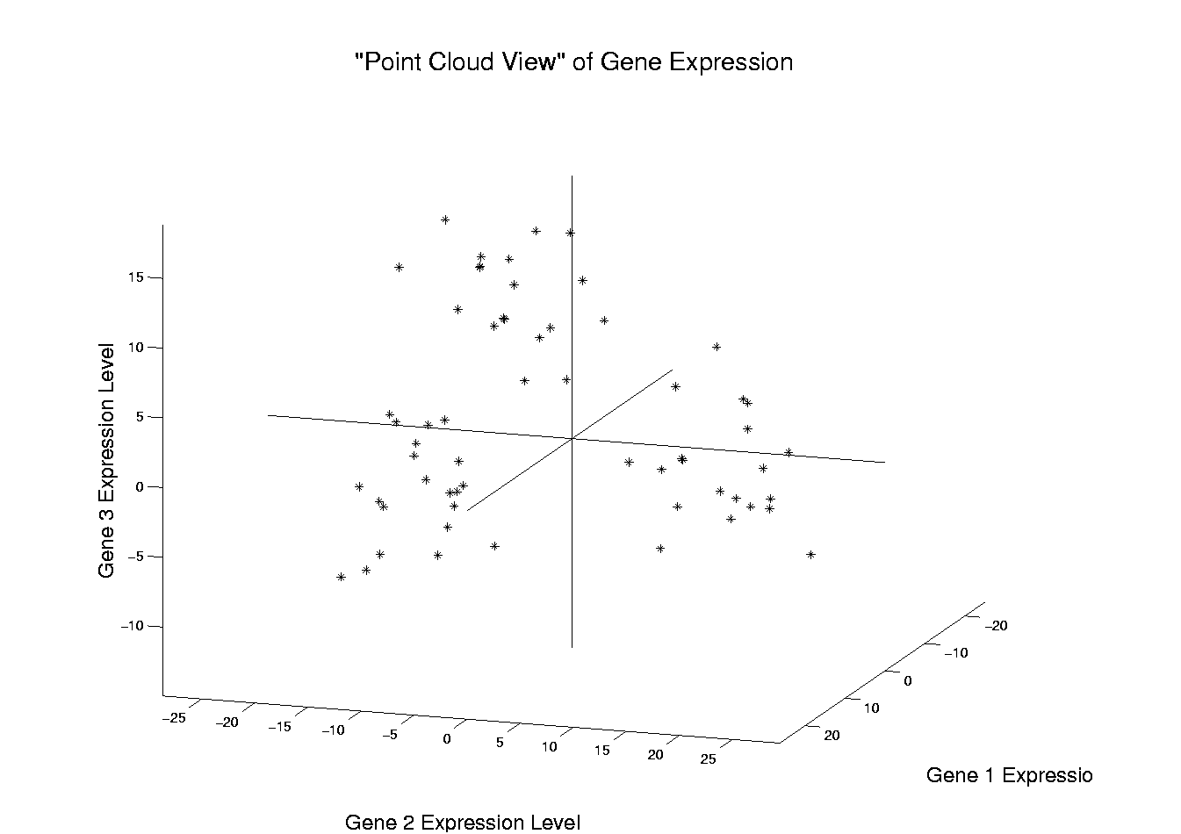
Illustration of Multivariate View: Raw Data
Notes:
EgView1p1RawData.ps

Slide 22
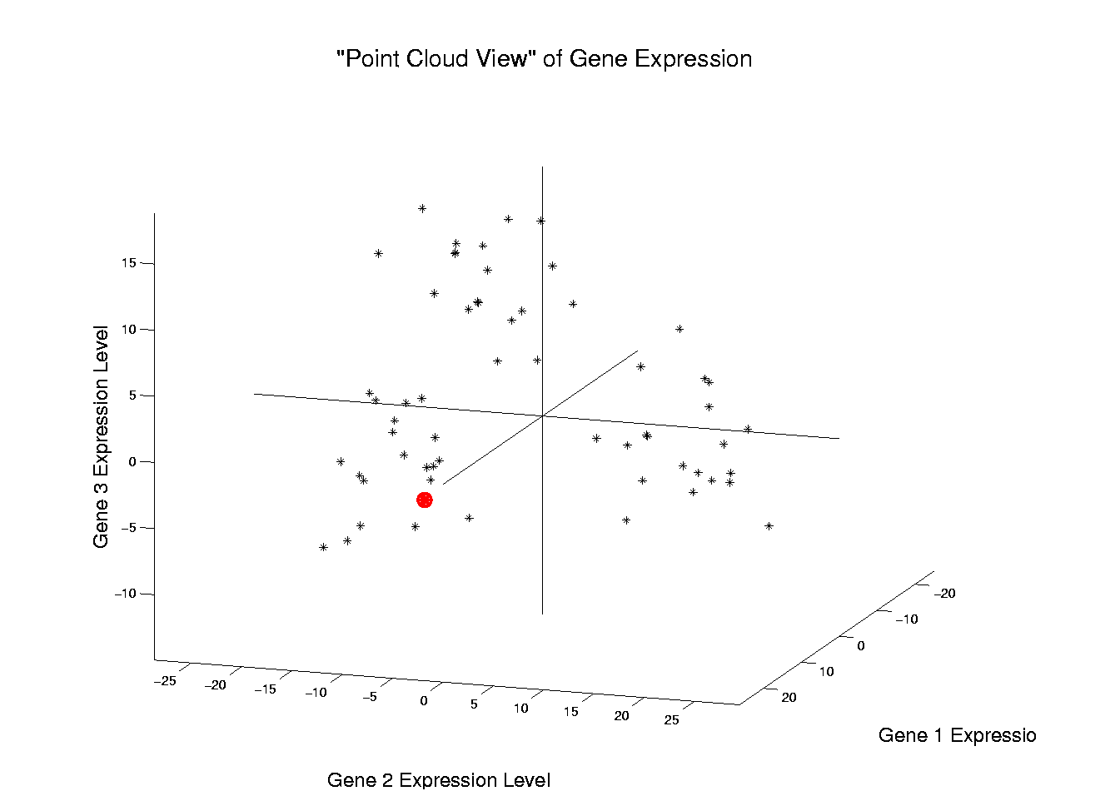
Illustration of Multivariate View: Highlight One
Notes:
EgView1p2RawDataHiLite1.ps

Slide 23
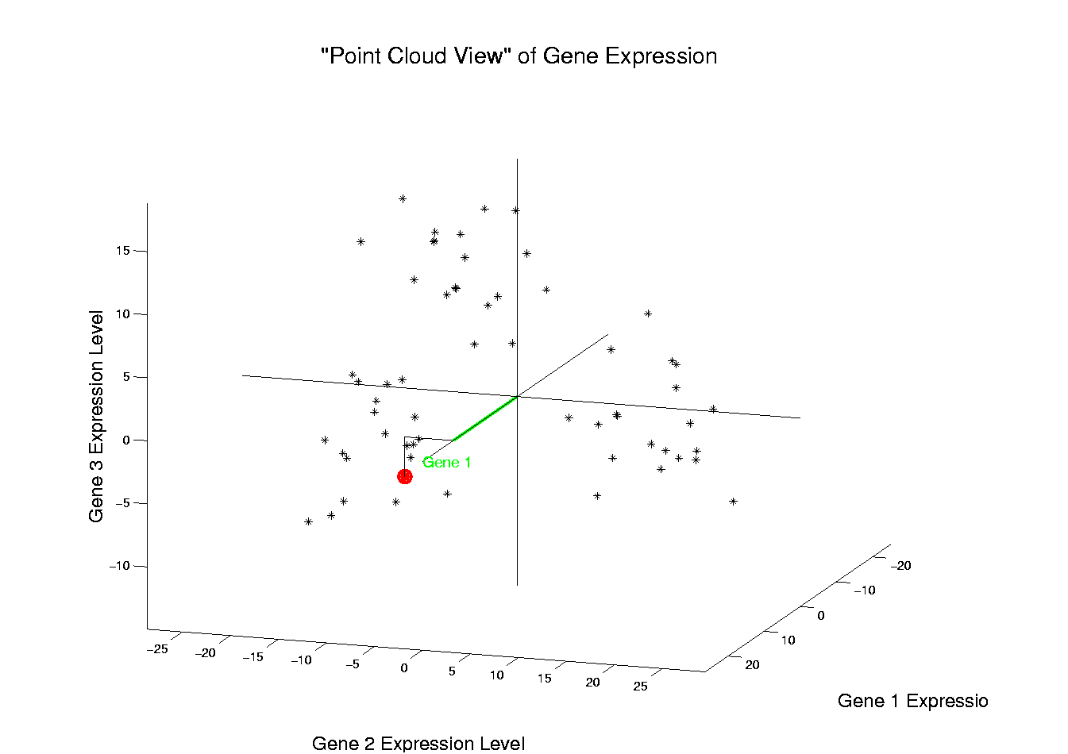
Illustration of Multivariate View: Gene 1 Express’n
Notes:
EgView1p3RawDataHL1CoordX.ps

Slide 24
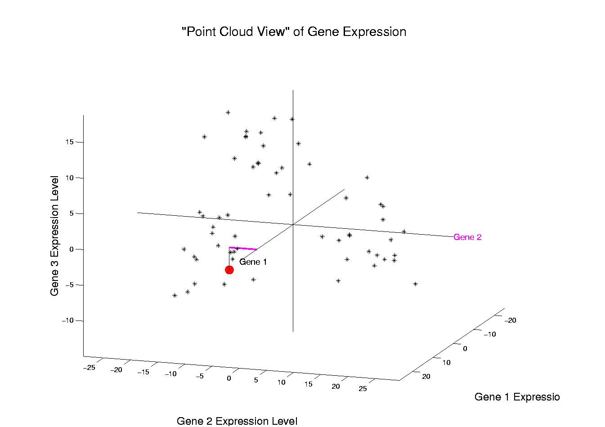
Illustration of Multivariate View: Gene 2 Express’n
Notes:
EgView1p3RawDataHL1CoordY.ps

Slide 25
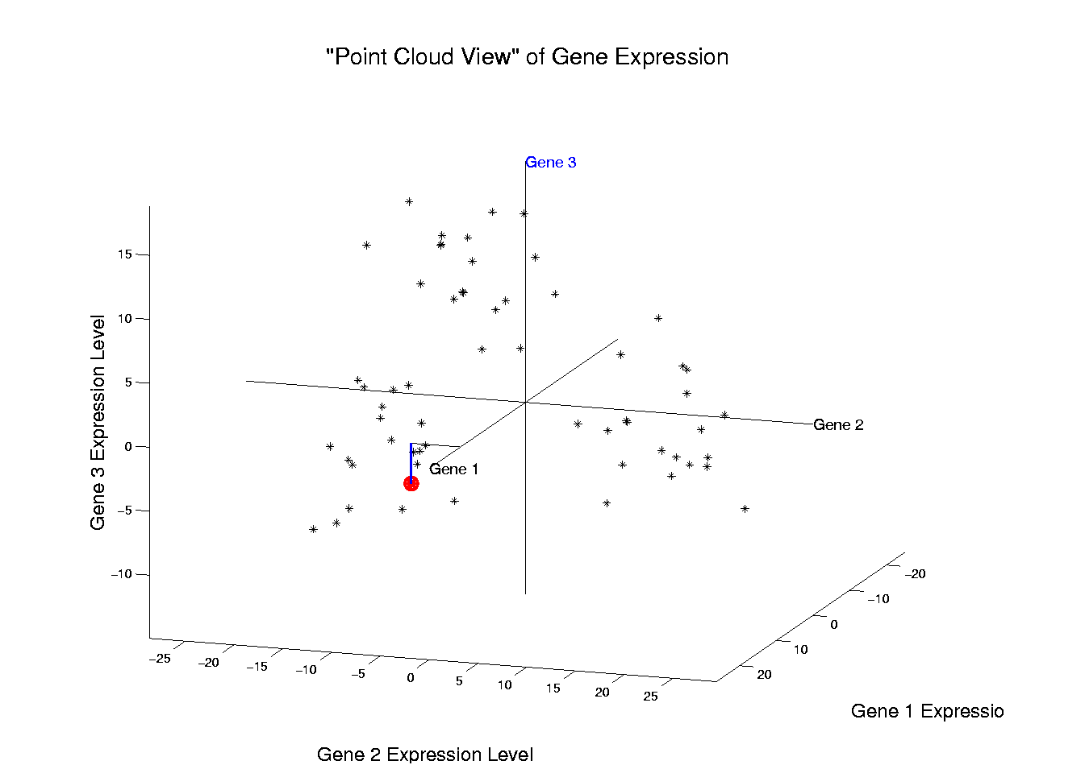
Illustration of Multivariate View: Gene 3 Express’n
Notes:
EgView1p3RawDataHL1CoordZ.ps

Slide 26
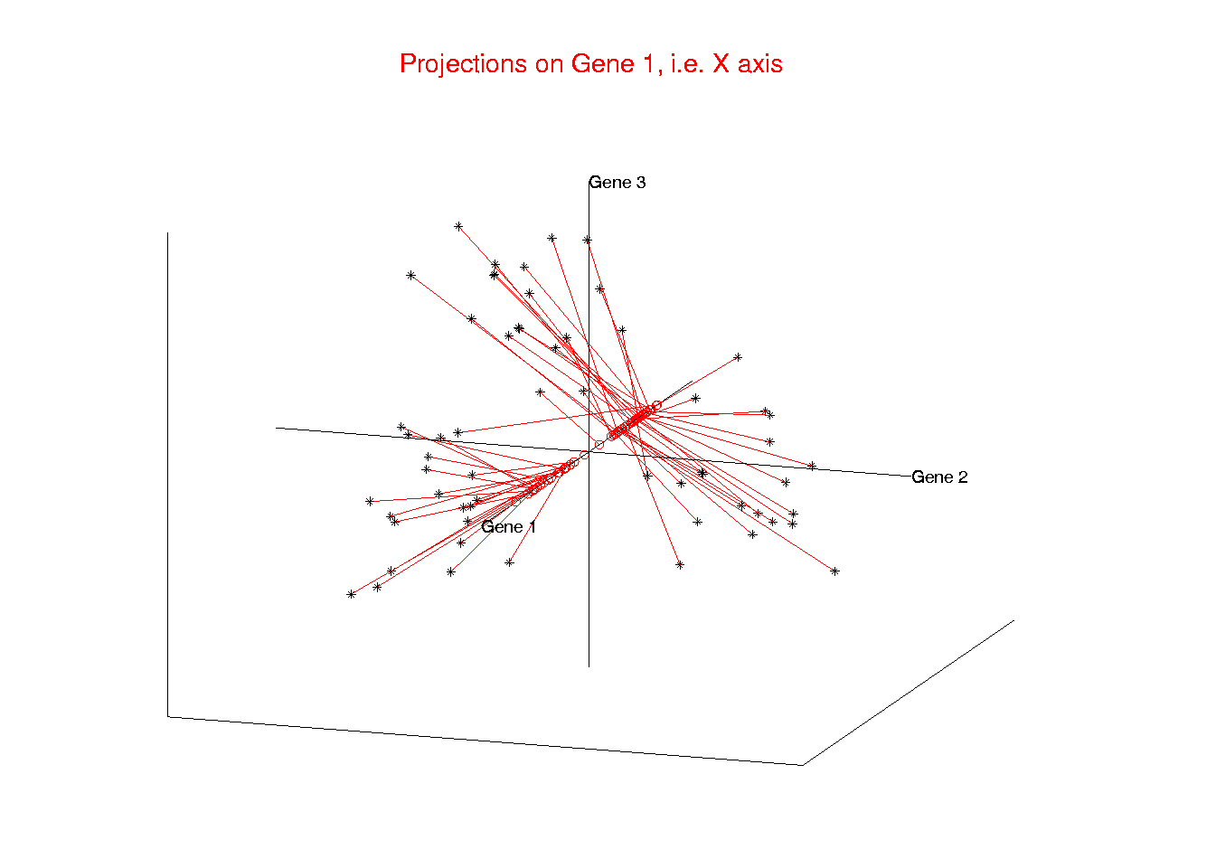
Illust’n of Multivar. View: 1-d Projection, X-axis
Notes:
EgView1p21proj3DX.ps

Slide 27
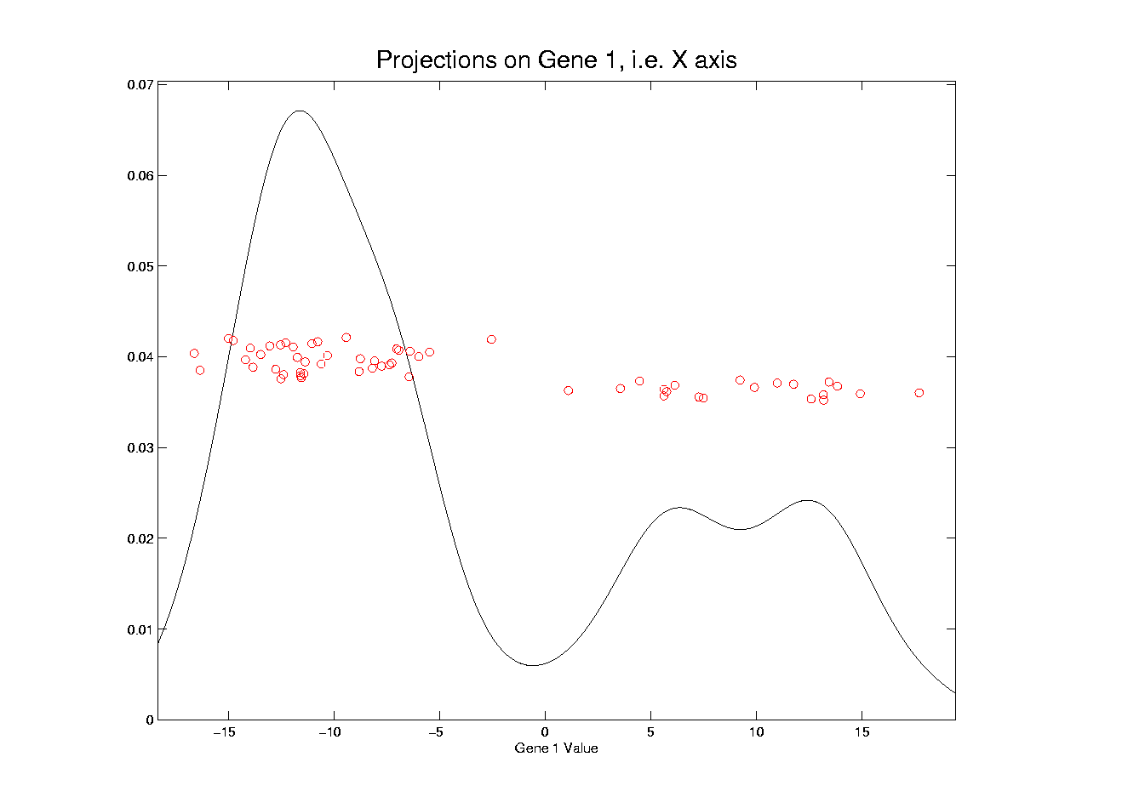
Illust’n of Multivar. View: X-Projection, 1-d view
Notes:
EgView1p31Proj1dX.ps

Slide 28
Illust’n of Multivar. View: X-Projection, 1-d view
X Coordinates
Are Projections
Notes:
EgView1p31Proj1dX.ps

Slide 29
Illust’n of Multivar. View: X-Projection, 1-d view
Y Coordinates Show
Order in Data Set
(or Random)
Notes:
EgView1p31Proj1dX.ps

Slide 30
Illust’n of Multivar. View: X-Projection, 1-d view
Smooth histogram =
Kernel Density Estimate
Notes:
EgView1p31Proj1dX.ps

Slide 31
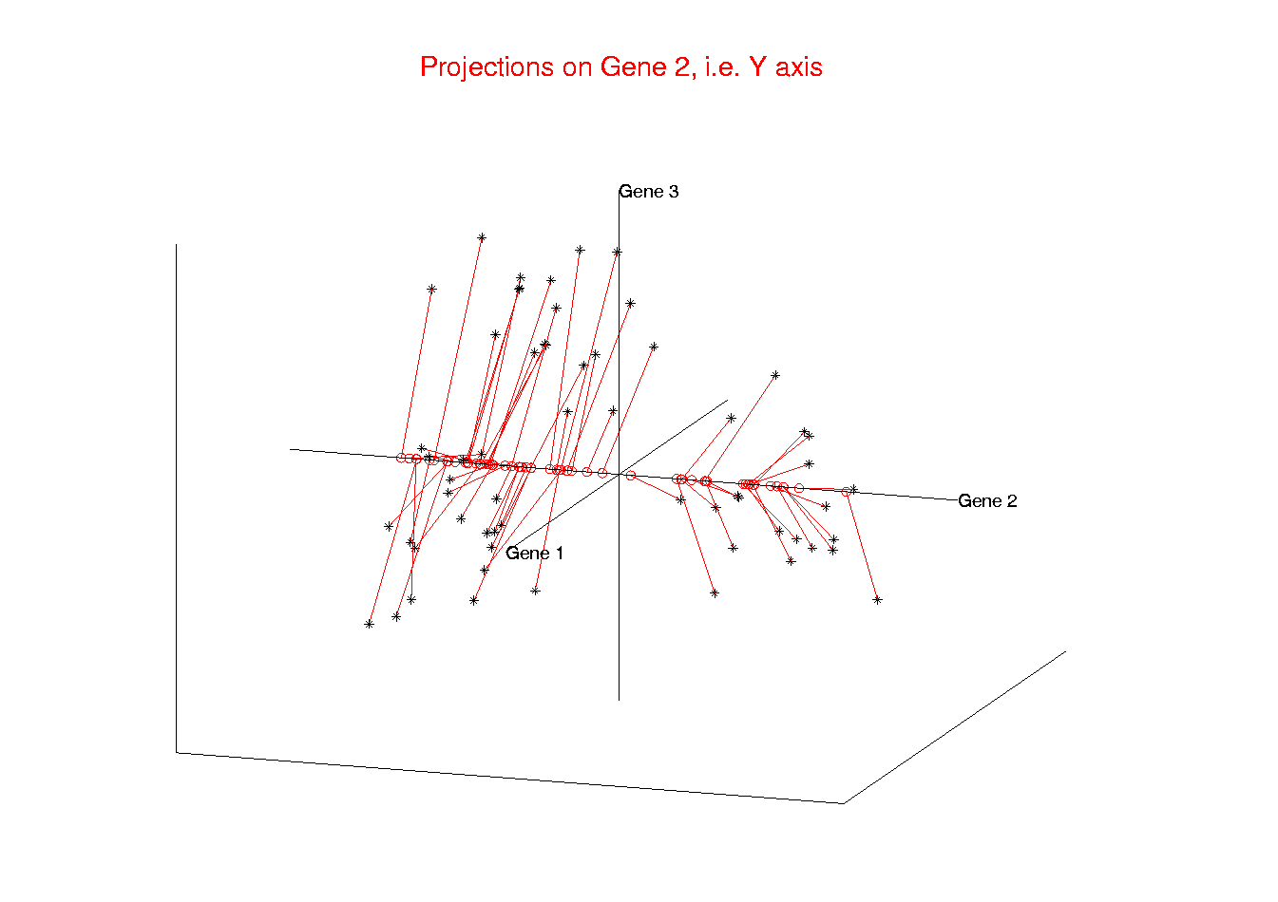
Illust’n of Multivar. View: 1-d Projection, Y-axis
Notes:
EgView1p22proj3DY.ps

Slide 32
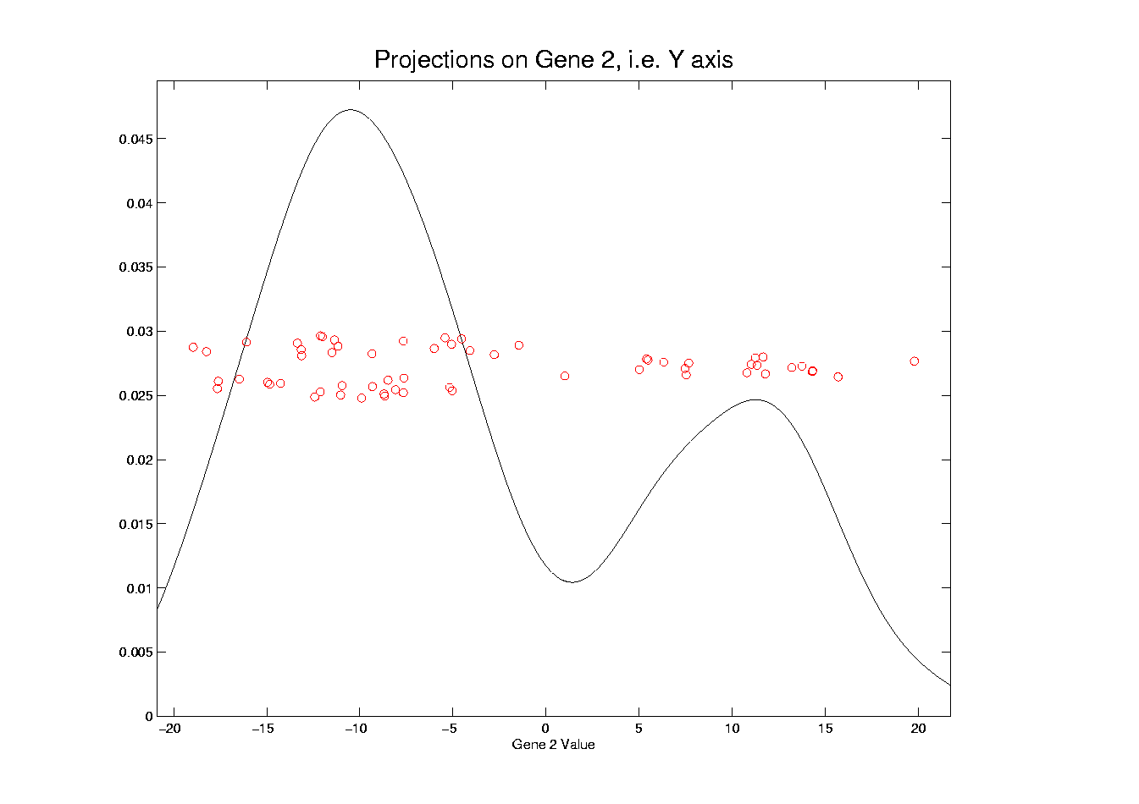
Illust’n of Multivar. View: Y-Projection, 1-d view
Notes:
EgView1p32Proj1dY.ps

Slide 33
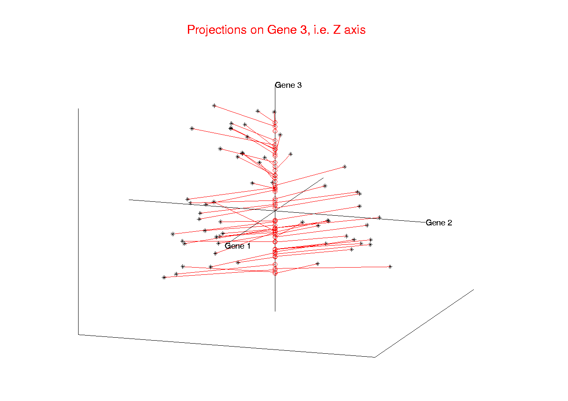
Illust’n of Multivar. View: 1-d Projection, Z-axis
Notes:
EgView1p23proj3DZ.ps

Slide 34
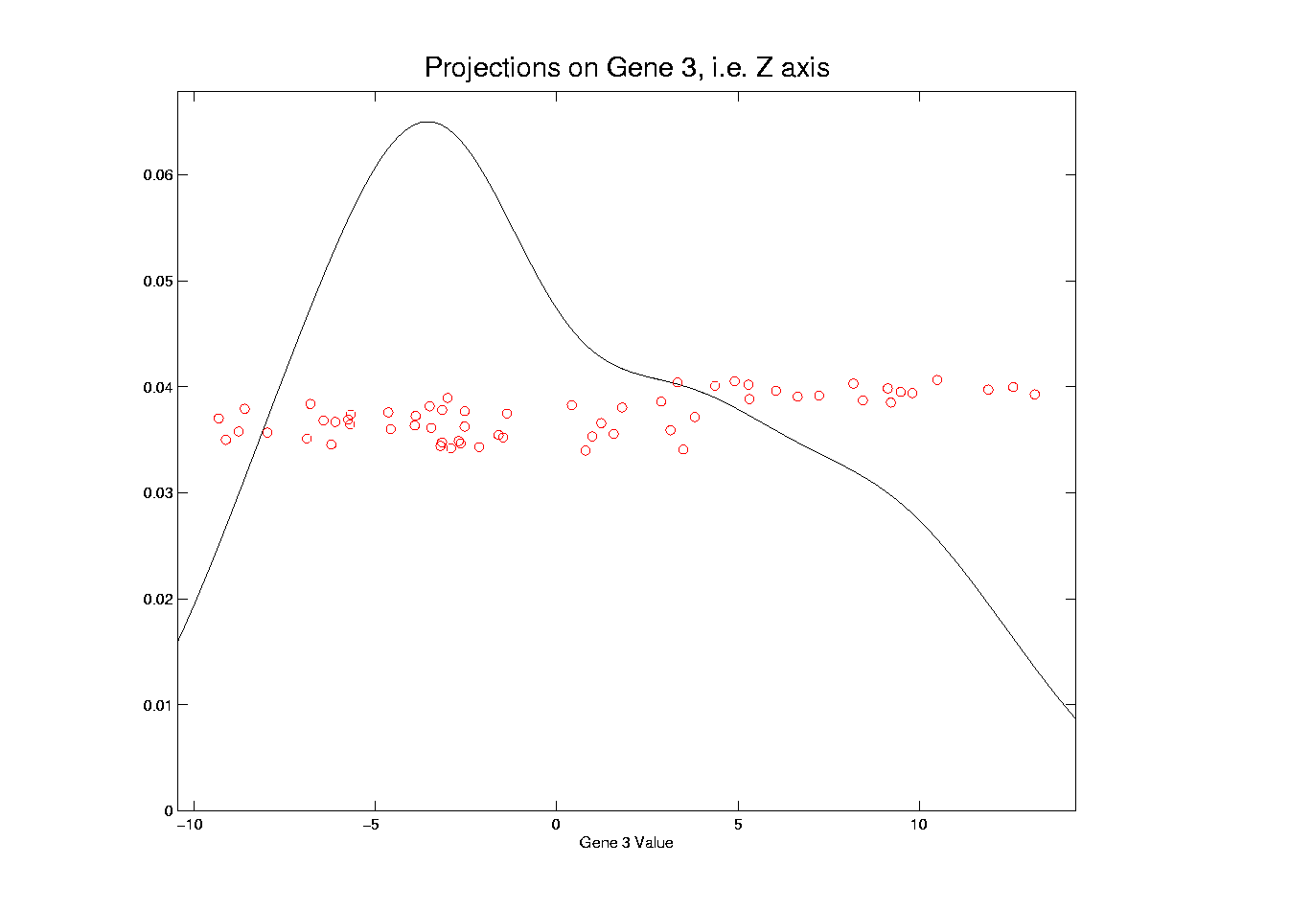
Illust’n of Multivar. View: Z-Projection, 1-d view
Notes:
EgView1p33Proj1dZ.ps

Slide 35
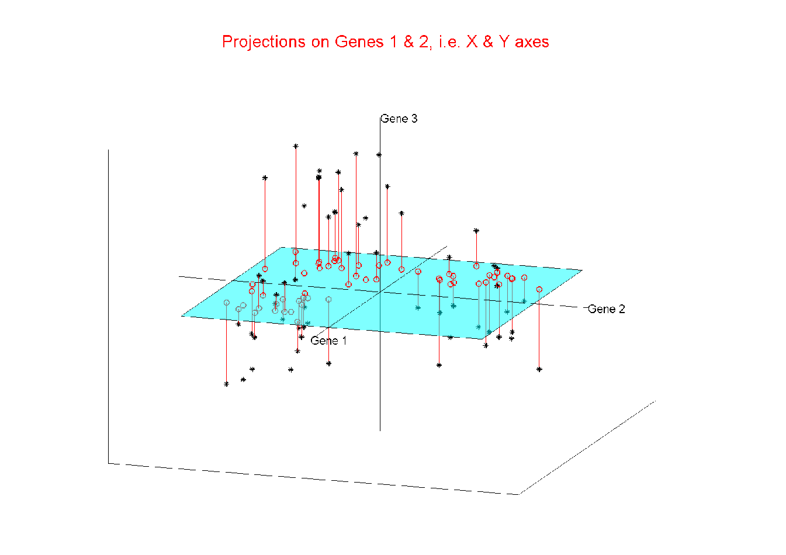
Illust’n of Multivar. View: 2-d Proj’n, XY-plane
Notes:
EgView1p24proj3DXY.ps

Slide 36
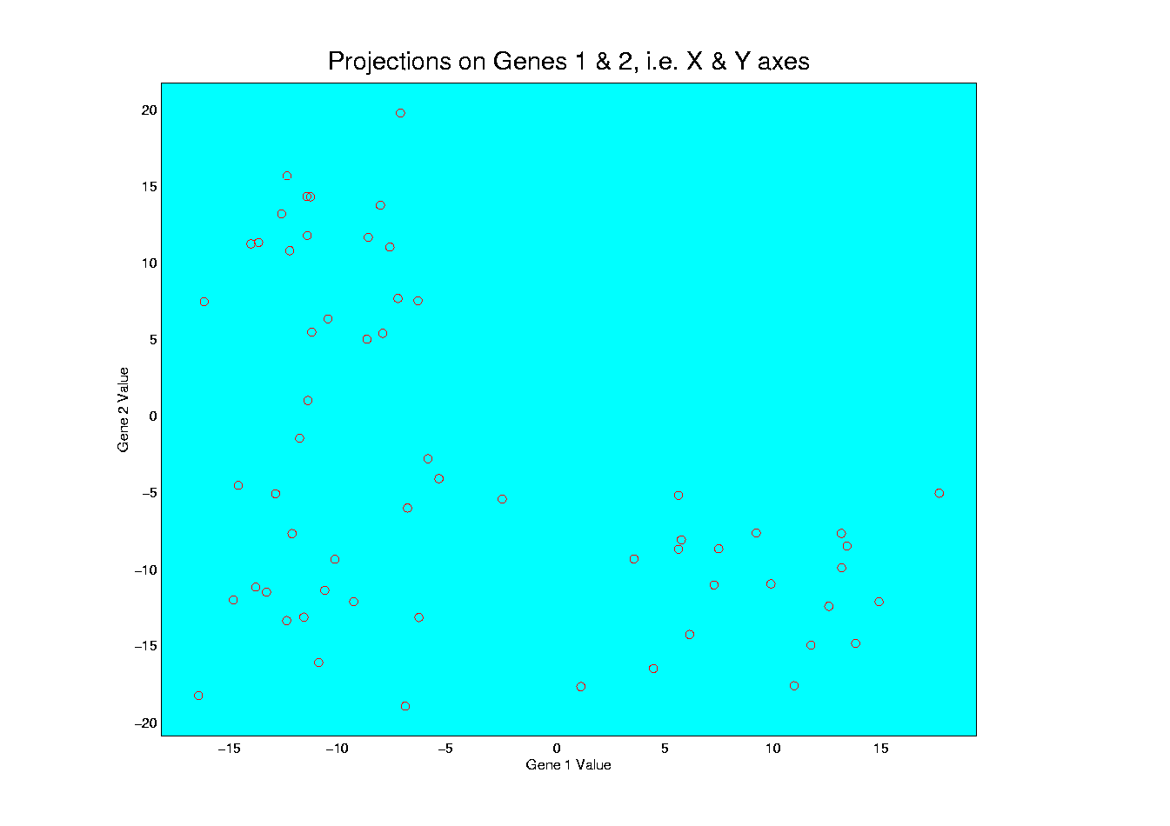
Illust’n of Multivar. View: XY-Proj’n, 2-d view
Notes:
EgView1p34proj2DXY.ps

Slide 37
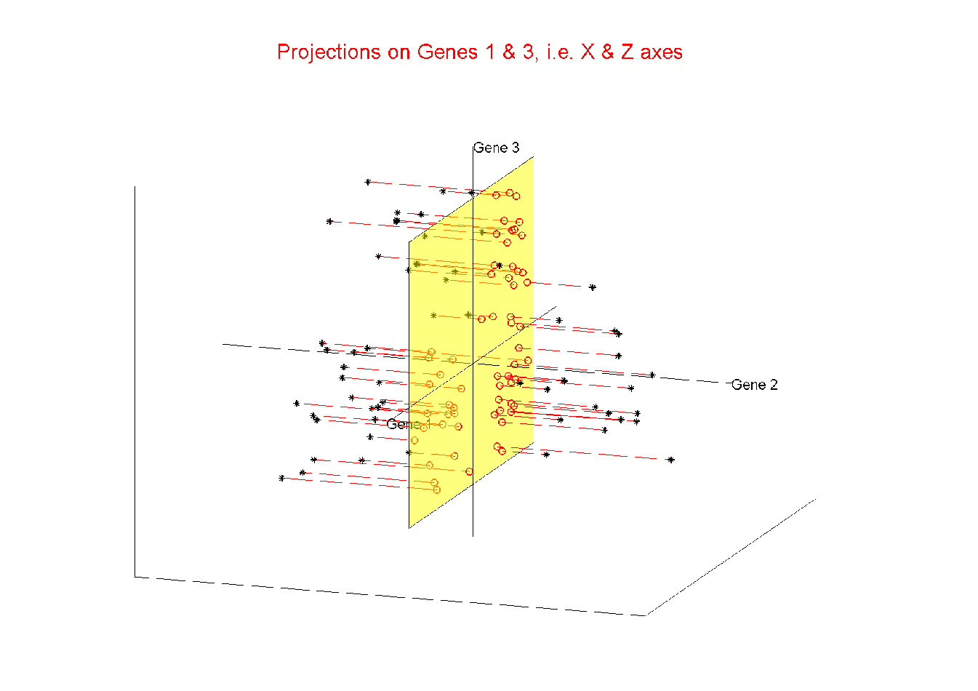
Illust’n of Multivar. View: 2-d Proj’n, XZ-plane
Notes:
EgView1p25proj3DXZ.ps

Slide 38
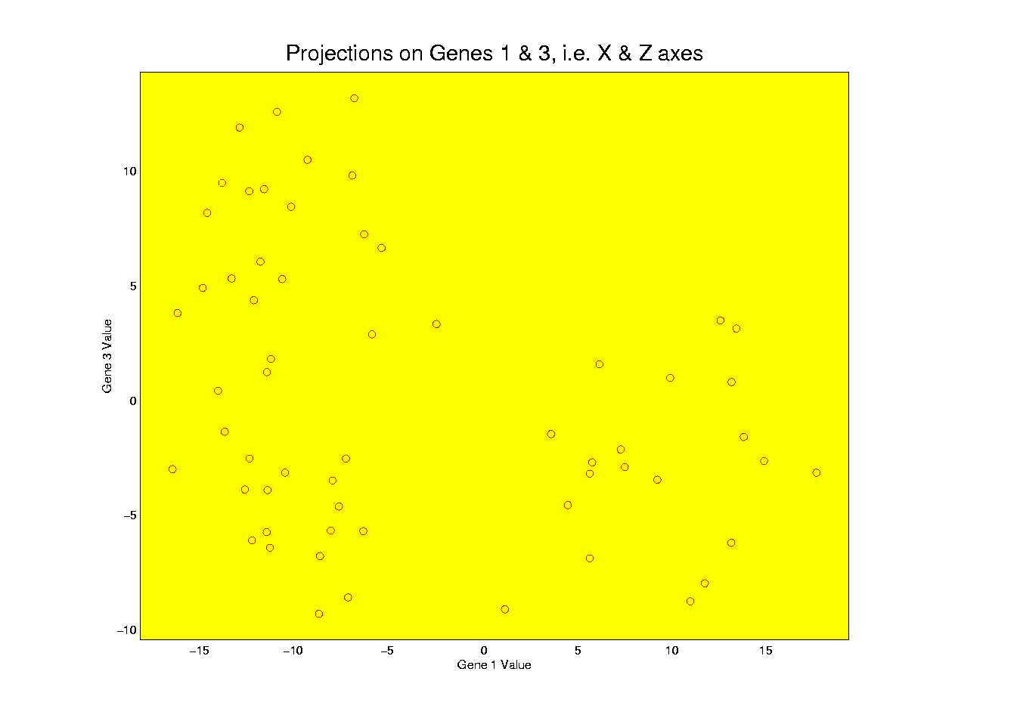
Illust’n of Multivar. View: XZ-Proj’n, 2-d view
Notes:
EgView1p35proj2DXZ.ps

Slide 39
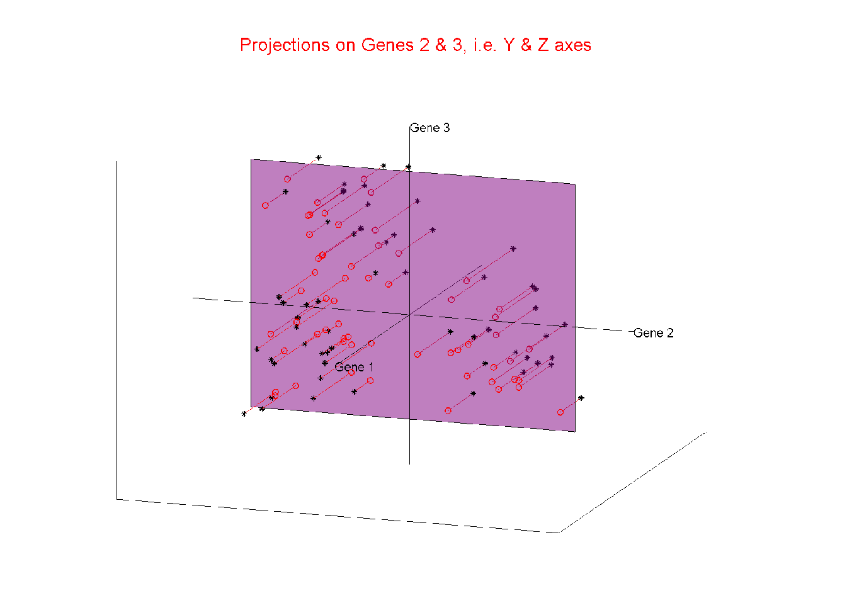
Illust’n of Multivar. View: 2-d Proj’n, YZ-plane
Notes:
EgView1p26proj3DYZ.ps

Slide 40
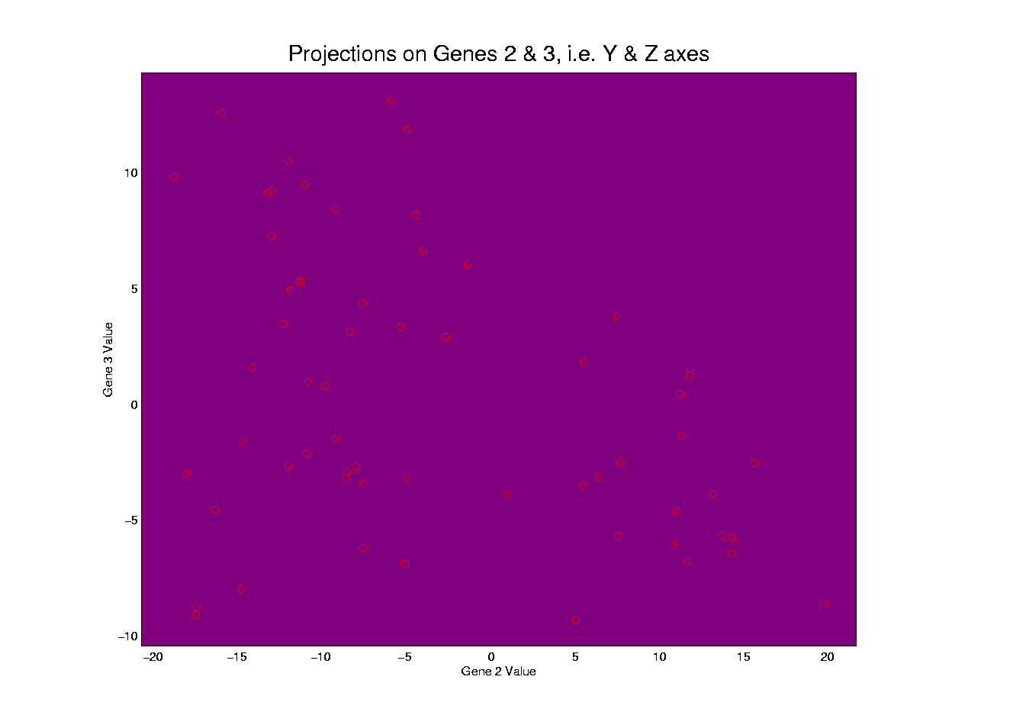
Illust’n of Multivar. View: YZ-Proj’n, 2-d view
Notes:
EgView1p36proj2DYZ.ps

Slide 41
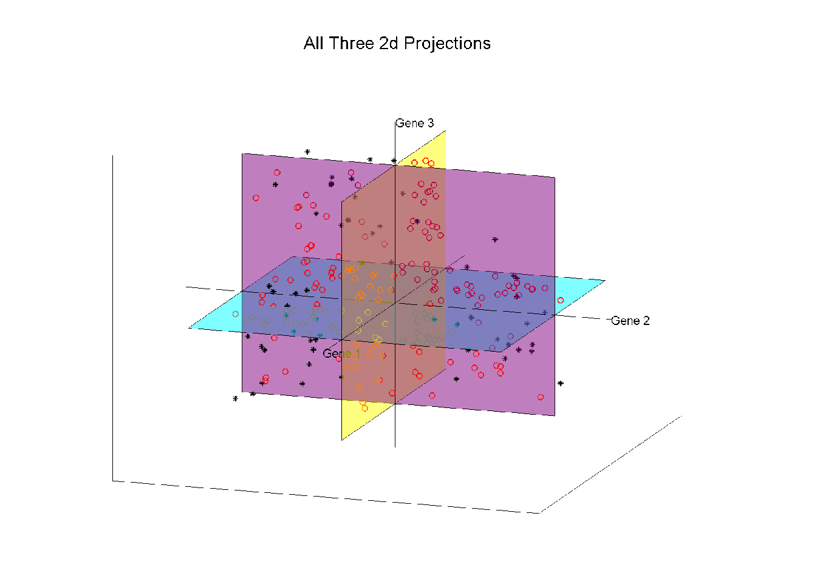
Illust’n of Multivar. View: all 3 planes
Notes:
EgView1p27proj3Dall.ps

Slide 42
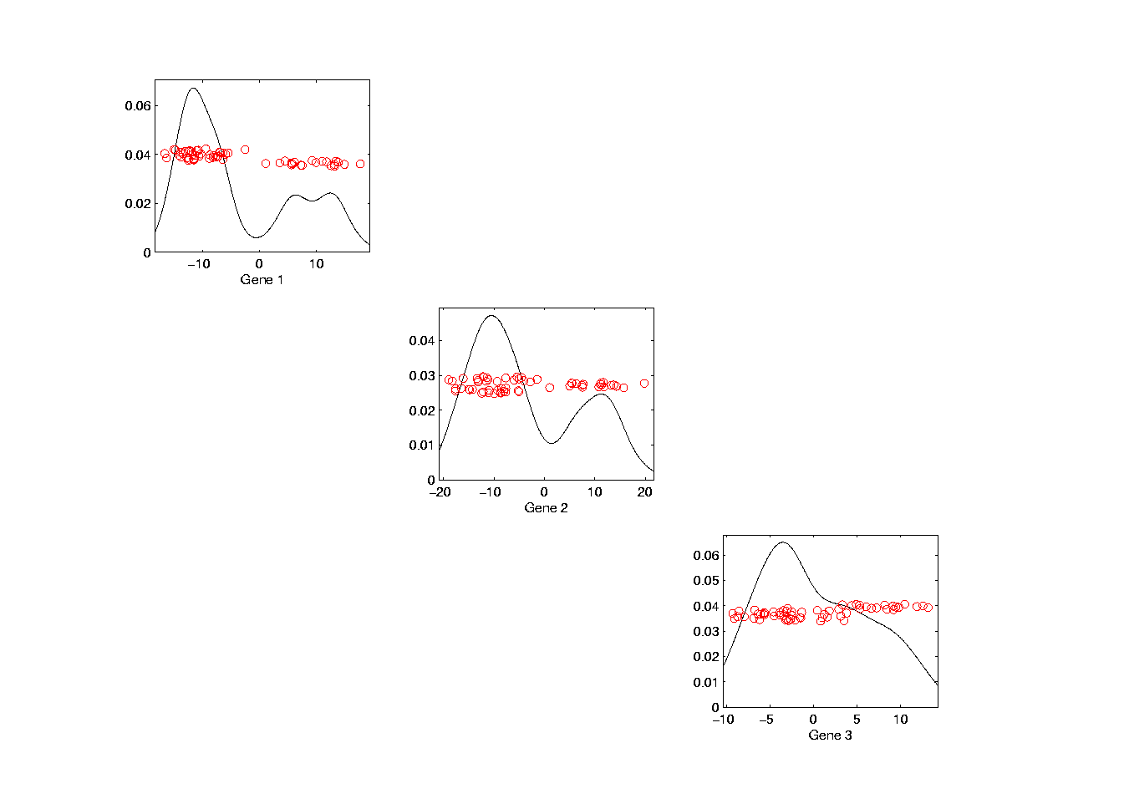
Illust’n of Multivar. View: Diagonal 1-d proj’ns
Notes:
EgView1p37proj1Ddiag.ps

Slide 43
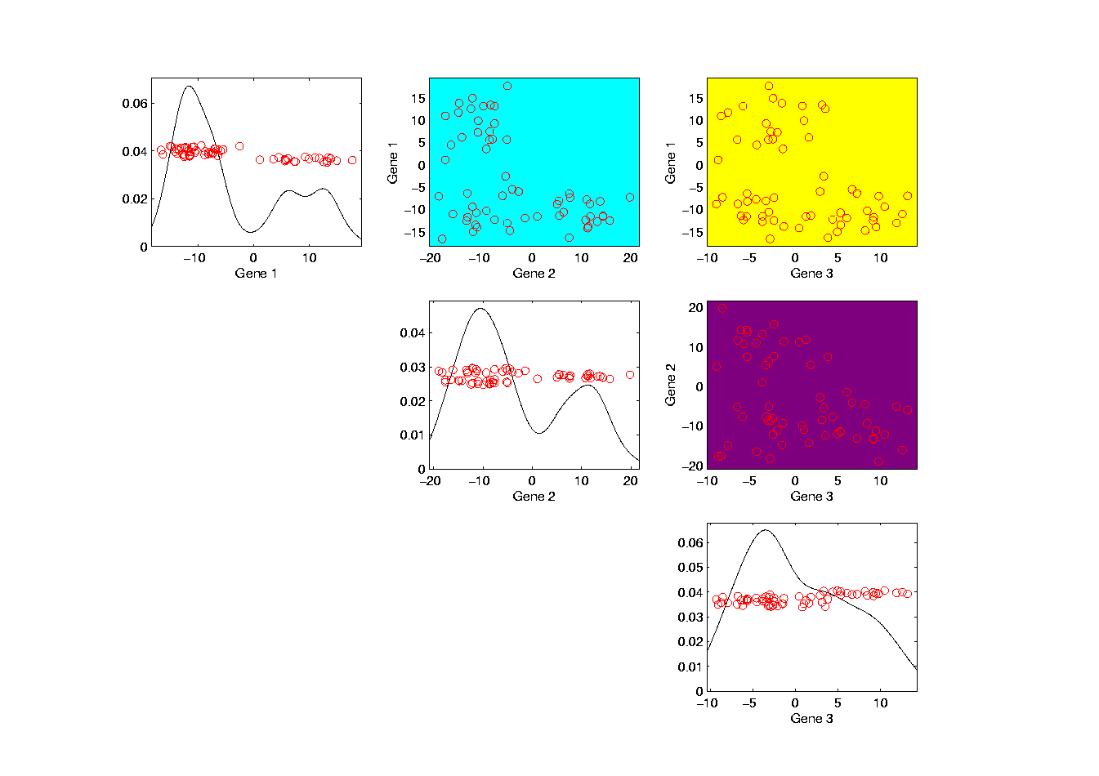
Illust’n of Multivar. View: Add off-diagonals
Notes:
EgView1p38proj1n2Dcolor.ps

Slide 44
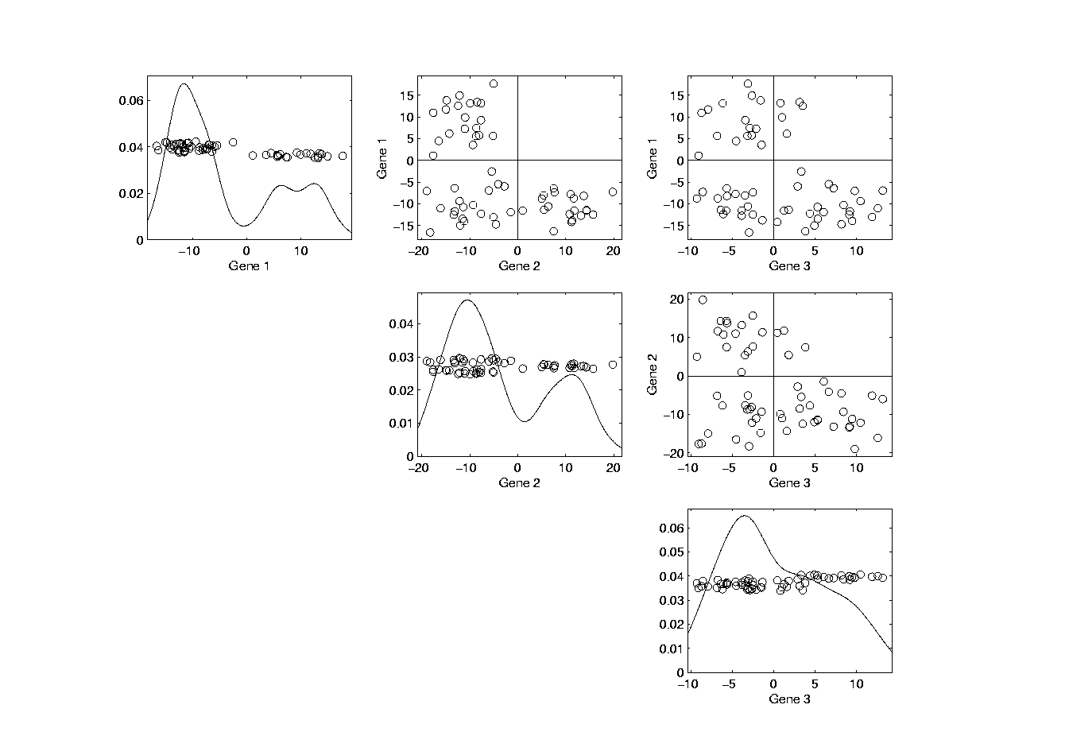
Illust’n of Multivar. View: Typical View
Notes:
EgView1p39ScatPlot.ps

Slide 45
Projection
Important Point
There are many “directions of interest” on which projection is useful
An important set of directions:
Principal Components

Slide 46
Principal Components
Find Directions of:
“Maximal (projected) Variation”
Compute Sequentially
On Orthogonal Subspaces
Will take careful look at mathematics later

Slide 47
Principal Components
For simple,
3-d toy data,
recall raw
data view:
Notes:
47

Slide 48
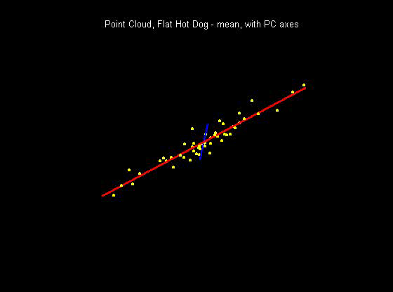
Principal Components
PCA just
gives rotated
coordinate
system:
Notes:
48

Slide 49
Illust’n of PCA View: Recall Raw Data
Notes:
EgView1p1RawData.ps

Slide 50
Illust’n of PCA View: Recall Gene by Gene Views
Notes:
EgView1p27proj3Dall.ps

Slide 51
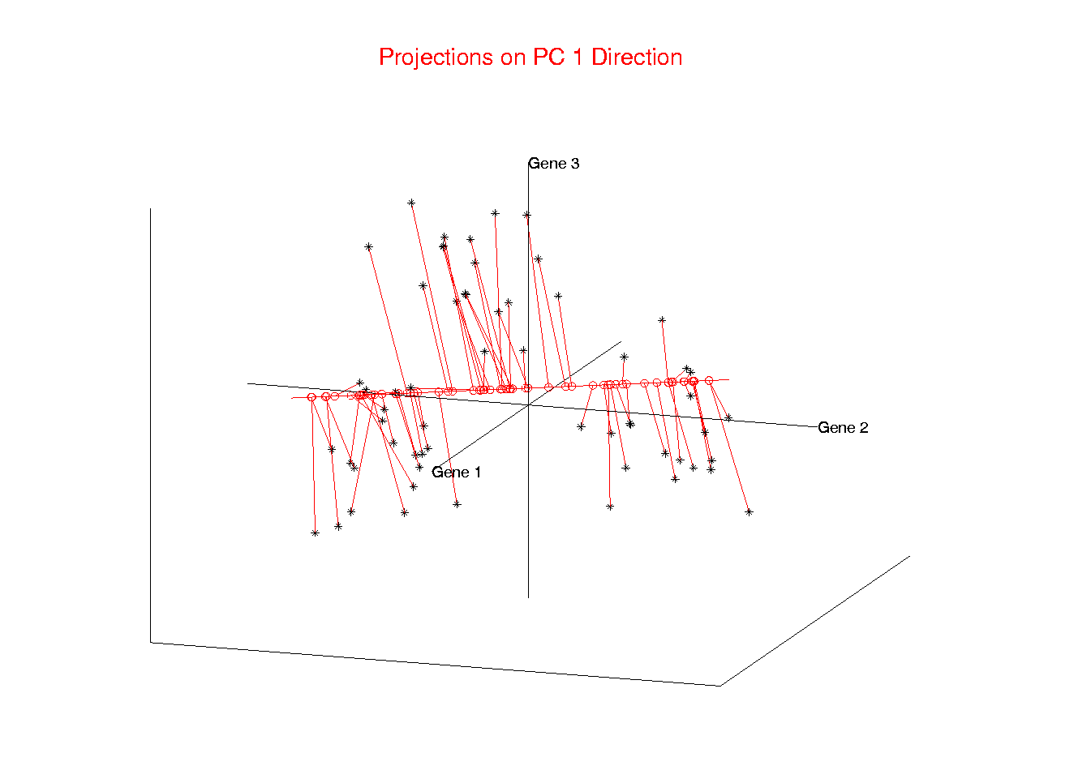
Illust’n of PCA View: PC1 Projections
Notes:
EgView1p51proj3dPC1.ps

Slide 52
Illust’n of PCA View: PC1 Projections
Note Different Axis
Chosen to
Maximize Spread
Notes:
EgView1p51proj3dPC1.ps

Slide 53
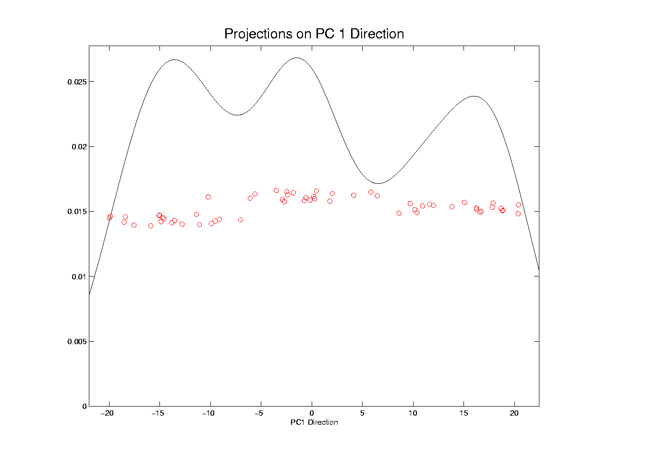
Illust’n of PCA View: PC1 Projections, 1-d View
Notes:
EgView1p61Proj1dPC1.ps

Slide 54
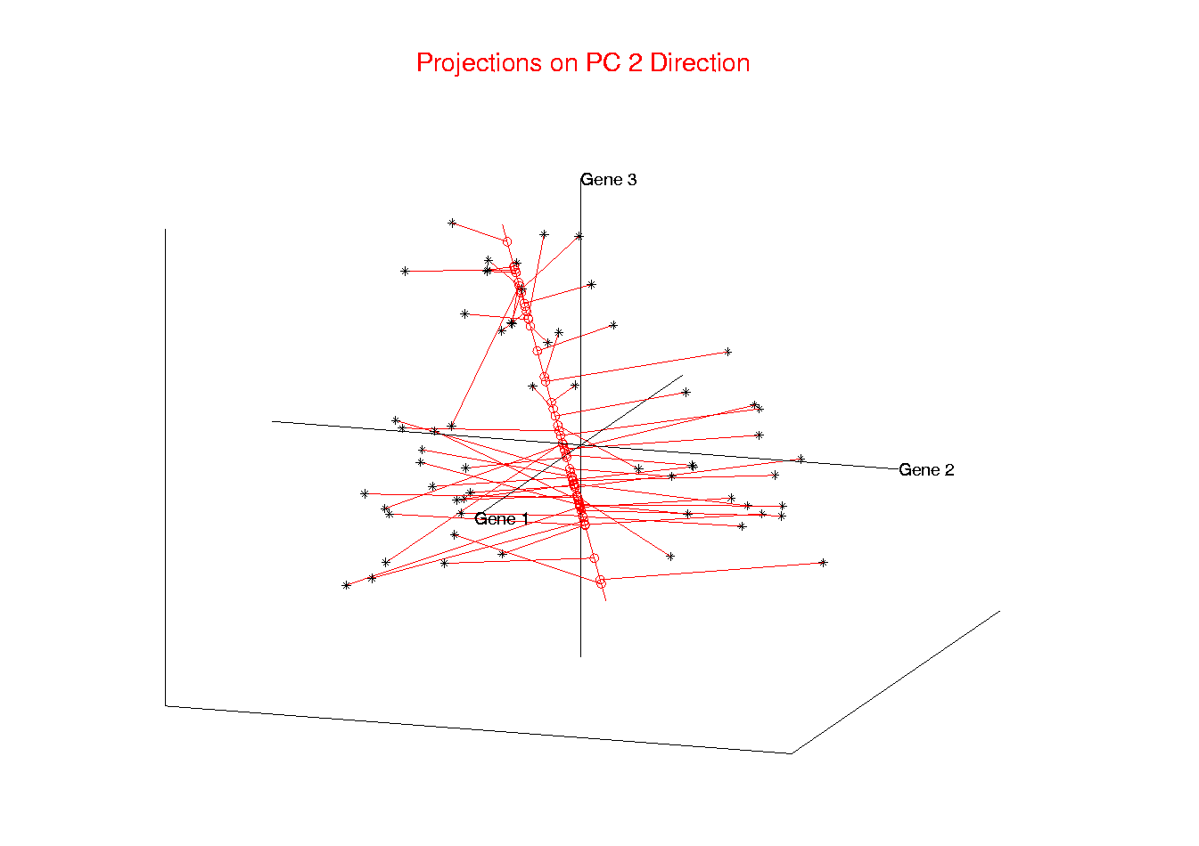
Illust’n of PCA View: PC2 Projections
Notes:
EgView1p52proj3dPC2.ps

Slide 55
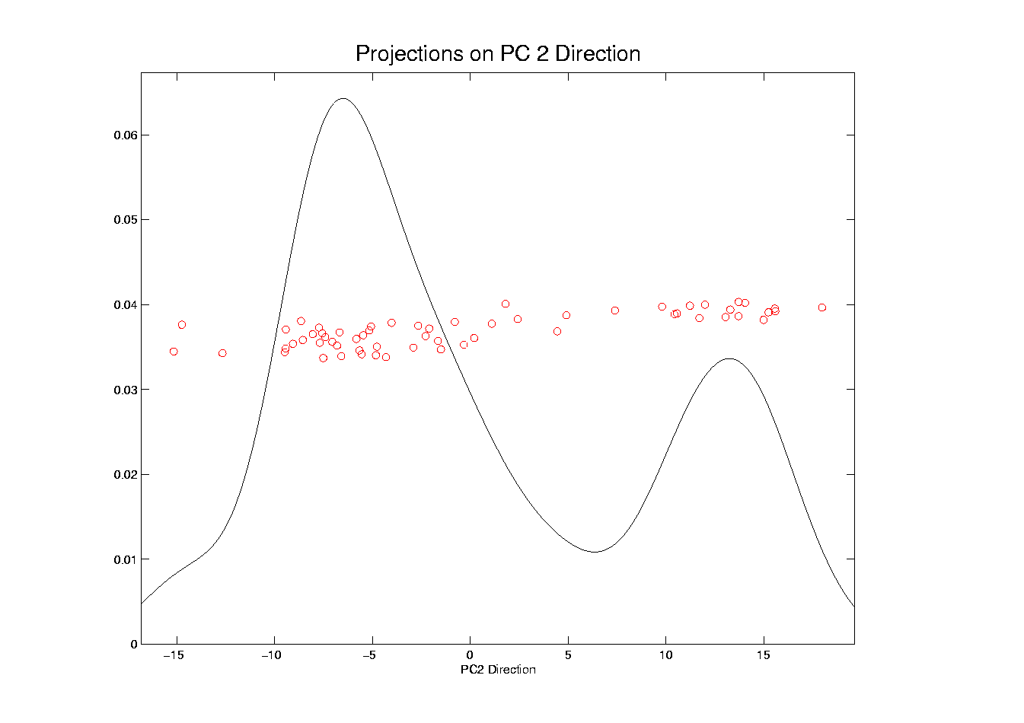
Illust’n of PCA View: PC2 Projections, 1-d View
Notes:
EgView1p62Proj1dPC2.ps

Slide 56
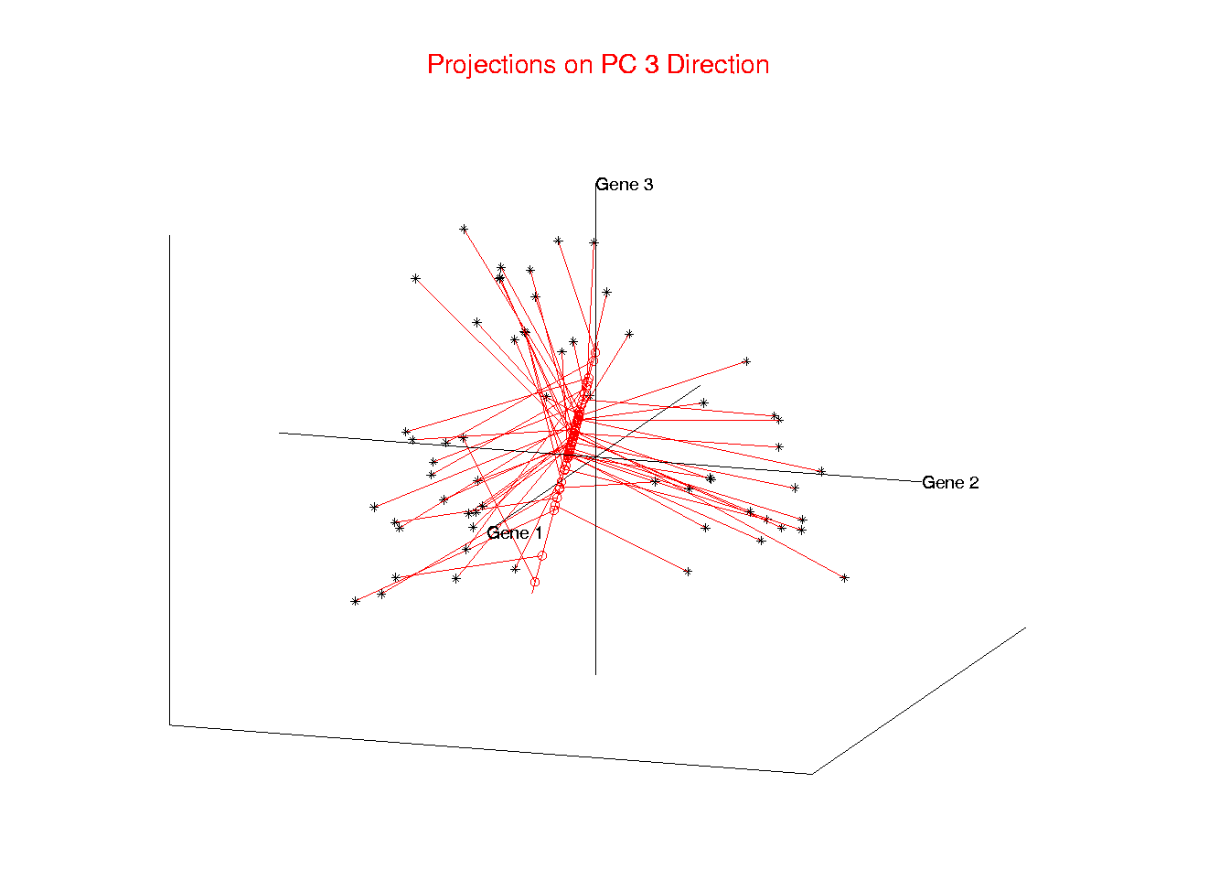
Illust’n of PCA View: PC3 Projections
Notes:
EgView1p53proj3dPC3.ps

Slide 57
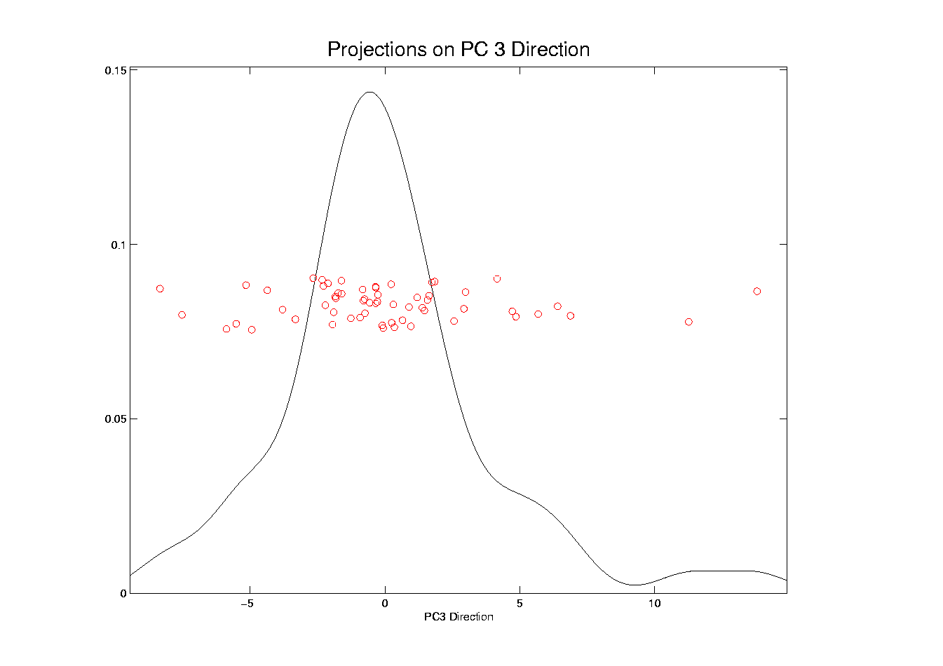
Illust’n of PCA View: PC3 Projections, 1-d View
Notes:
EgView1p63Proj1dPC3.ps

Slide 58
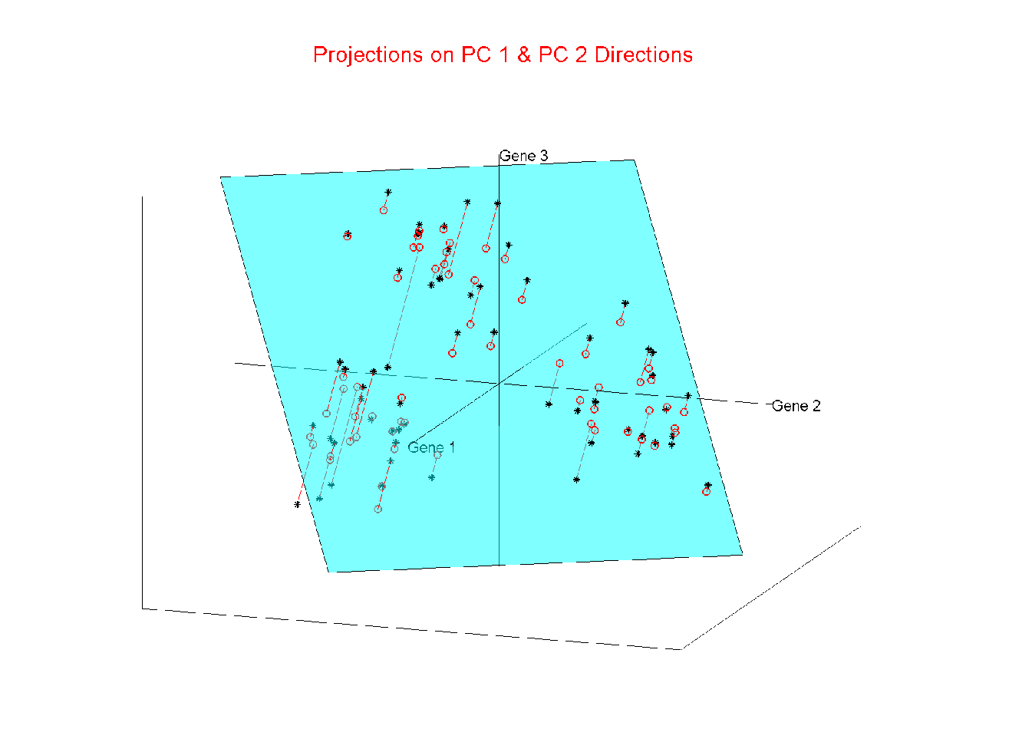
Illust’n of PCA View: Projections on PC1,2 plane
Notes:
EgView1p54proj3dPC12.ps

Slide 59
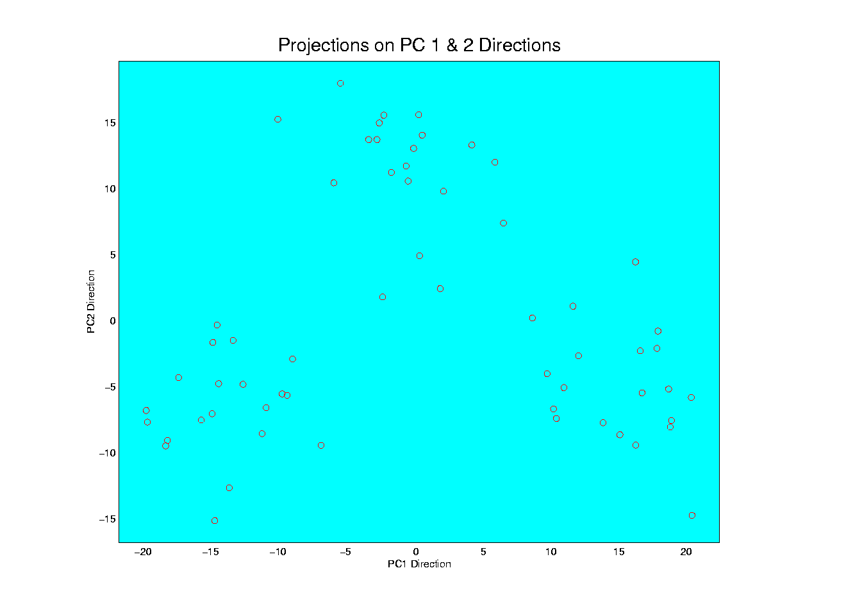
Illust’n of PCA View: PC1 & 2 Proj’n Scatterplot
Notes:
EgView1p64proj2dPC12.ps

Slide 60
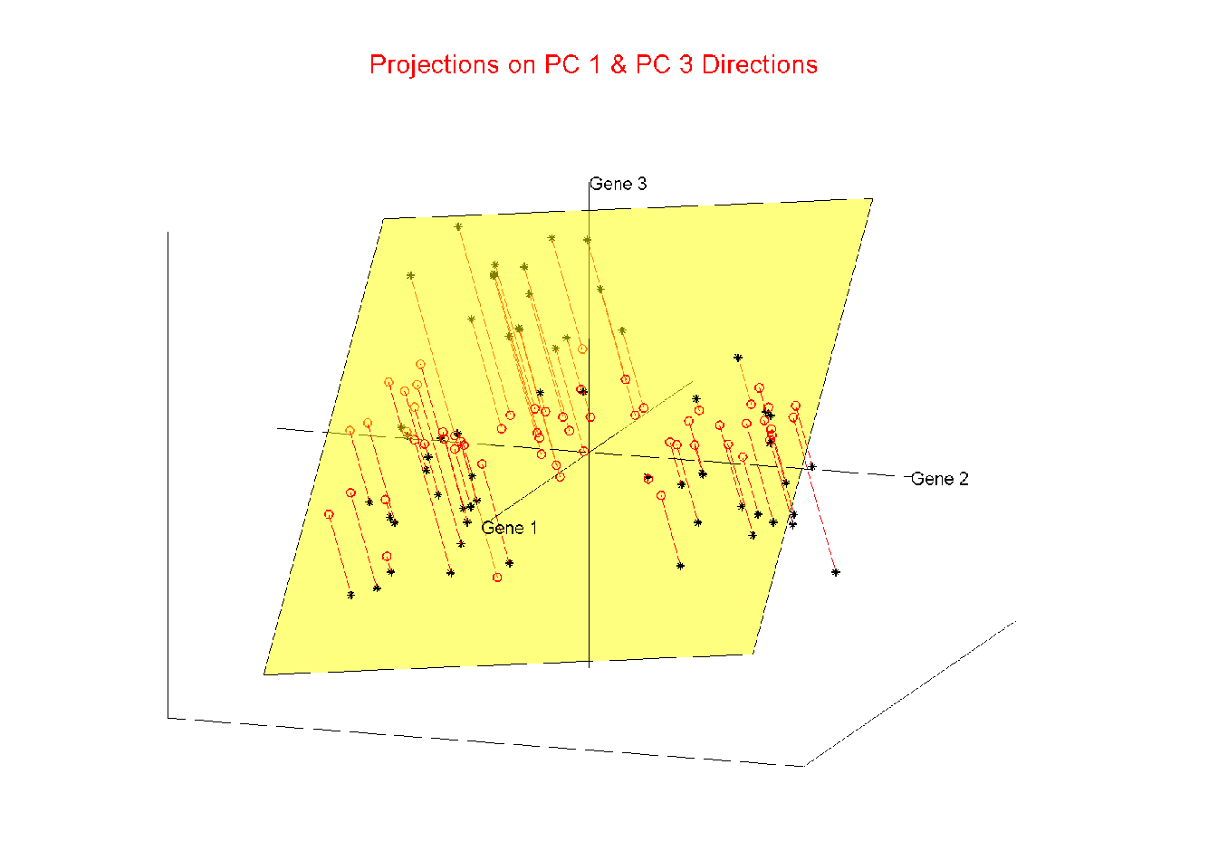
Illust’n of PCA View: Projections on PC1,3 plane
Notes:
EgView1p55proj3dPC13.ps

Slide 61
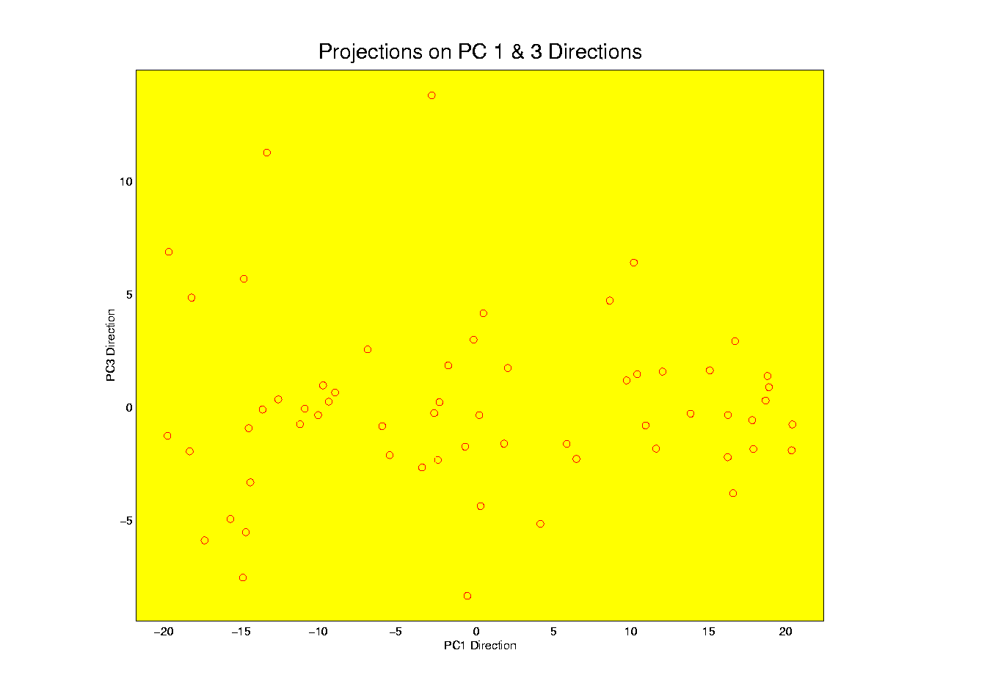
Illust’n of PCA View: PC1 & 3 Proj’n Scatterplot
Notes:
EgView1p65proj2dPC13.ps

Slide 62
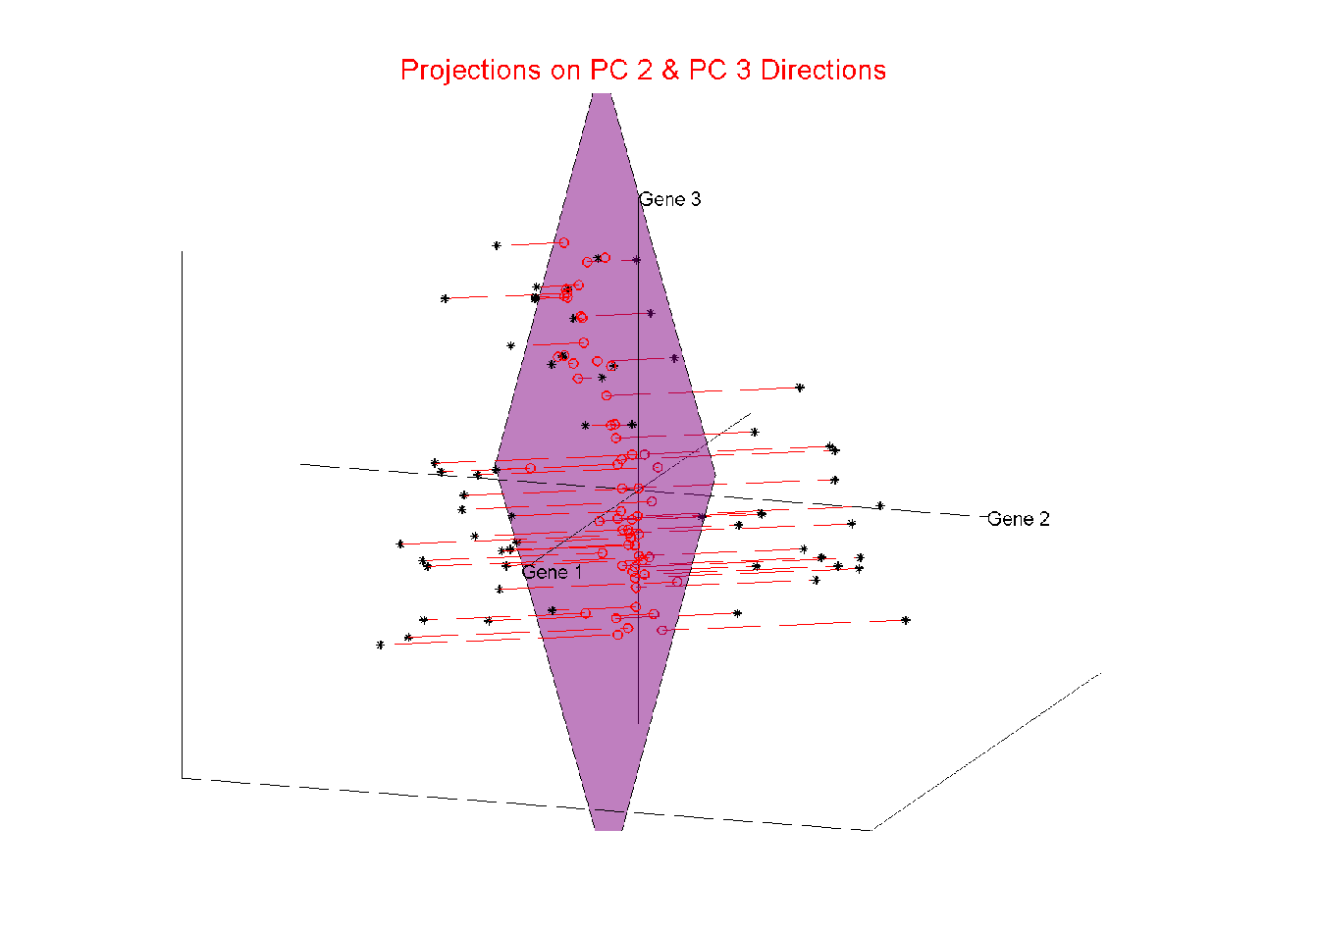
Illust’n of PCA View: Projections on PC2,3 plane
Notes:
EgView1p56proj3dPC23.ps

Slide 63
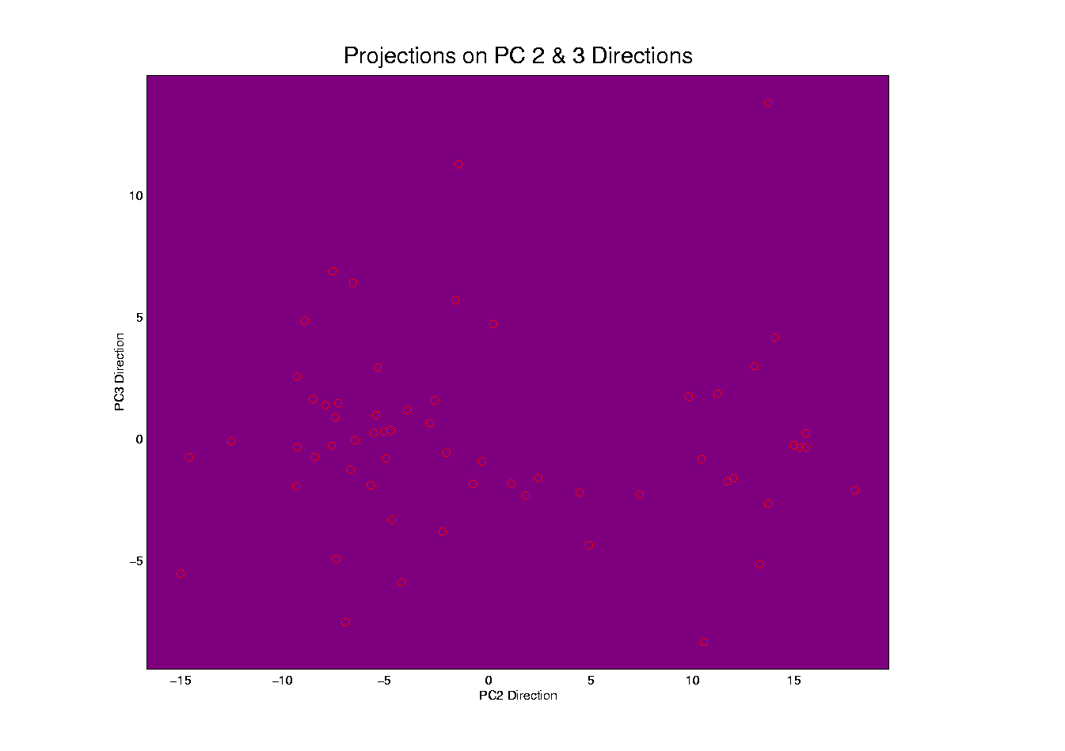
Illust’n of PCA View: PC2 & 3 Proj’n Scatterplot
Notes:
EgView1p66proj2dPC23.ps

Slide 64
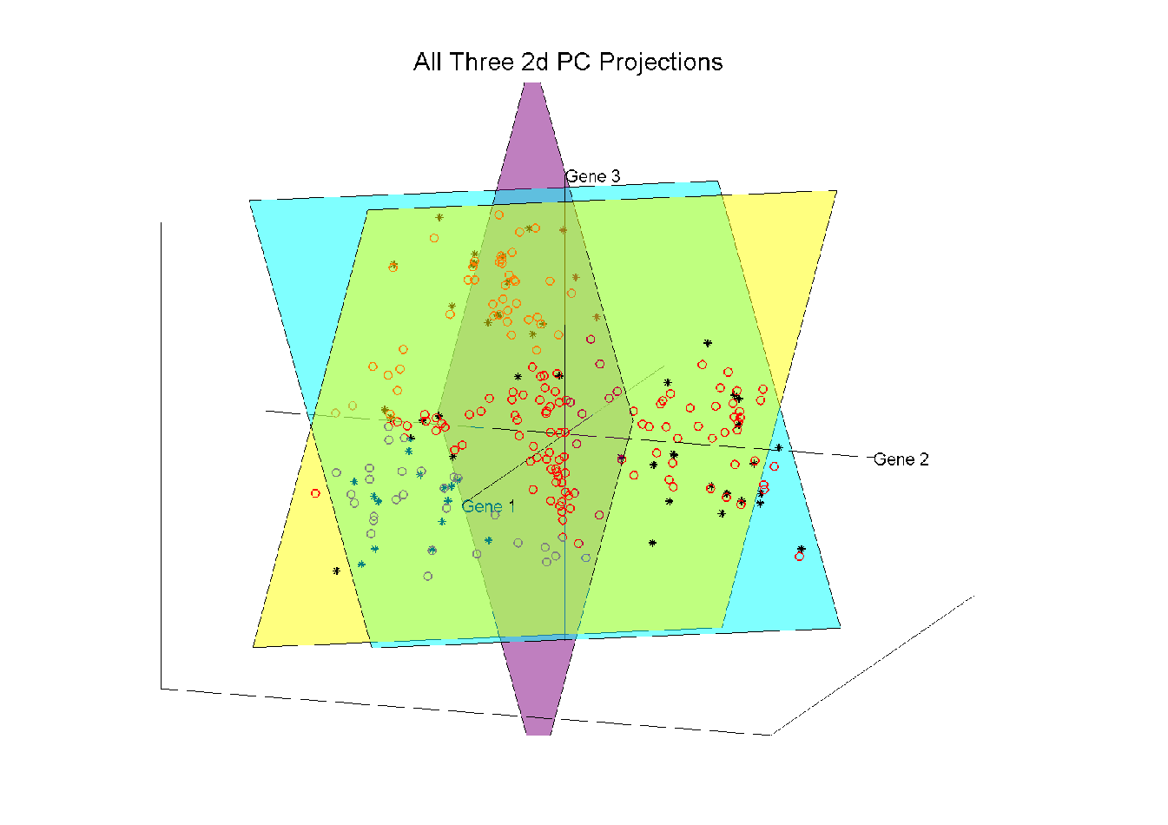
Illust’n of PCA View: All 3 PC Projections
Notes:
EgView1p57proj3dPCall.ps

Slide 65
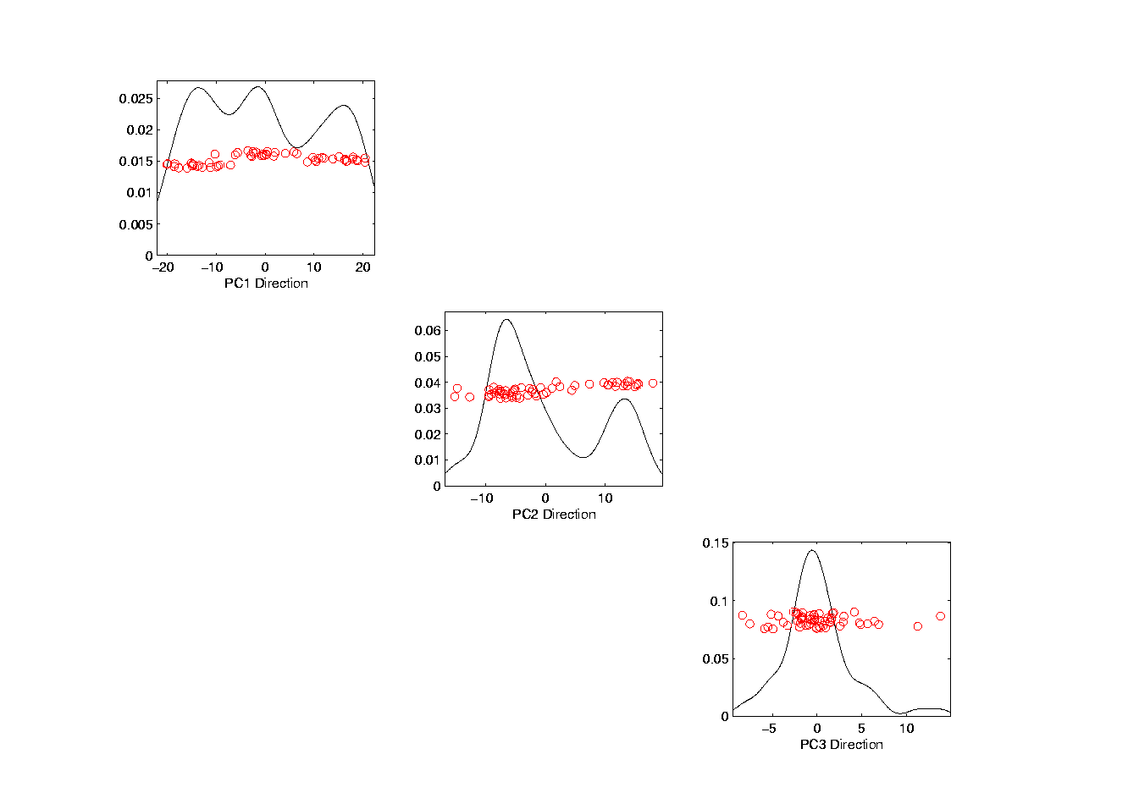
Illust’n of PCA View: Matrix with 1-d proj’ns on diag.
Notes:
EgView1p67proj1dPCAdiag.ps

Slide 66
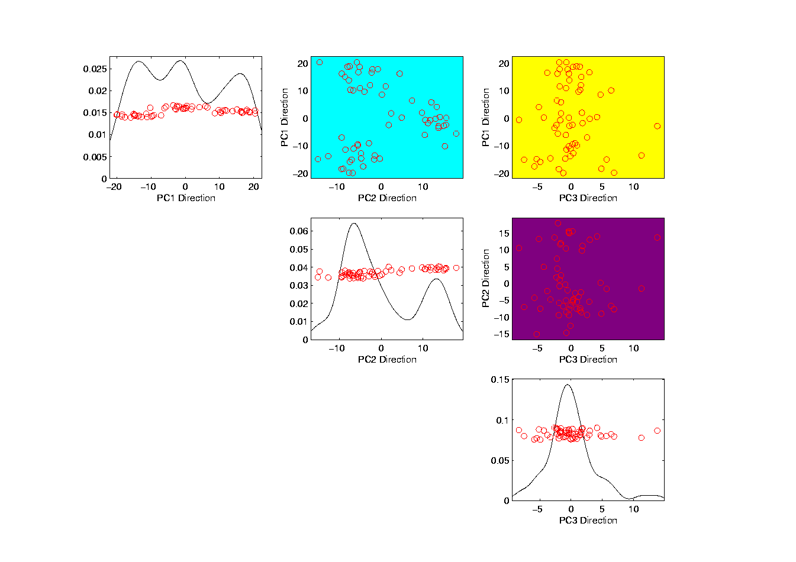
Illust’n of PCA: Add off-diagonals to matrix
Notes:
EgView1p68proj1n2dPCAcolor.ps

Slide 67
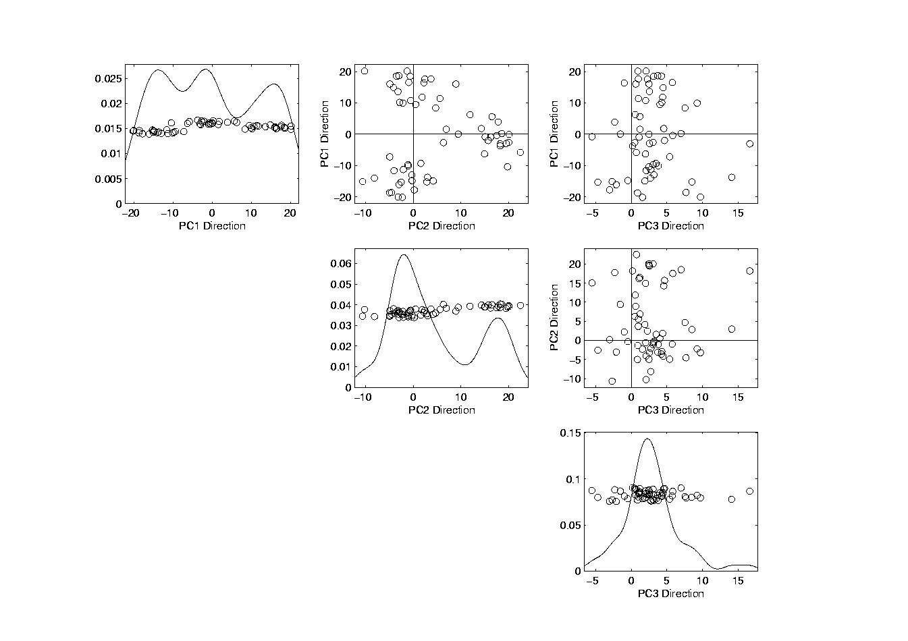
Illust’n of PCA View: Typical View
Notes:
EgView1p69PCAScatPlot.ps

Slide 68
Comparison of Views
Highlight 3 clusters
Gene by Gene View
Clusters appear in all 3 scatterplots
But never very separated
PCA View
1st shows three distinct clusters
Better separated than in gene view
Clustering concentrated in 1st scatterplot
Effect is small, since only 3-d

Slide 69
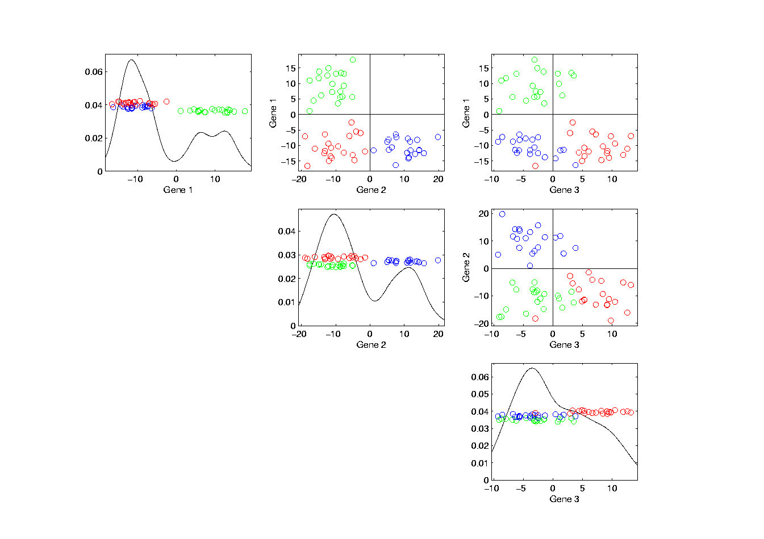
Illust’n of PCA View: Gene by Gene View
Notes:
EgView1p71GeneViewClustColor.ps

Slide 70
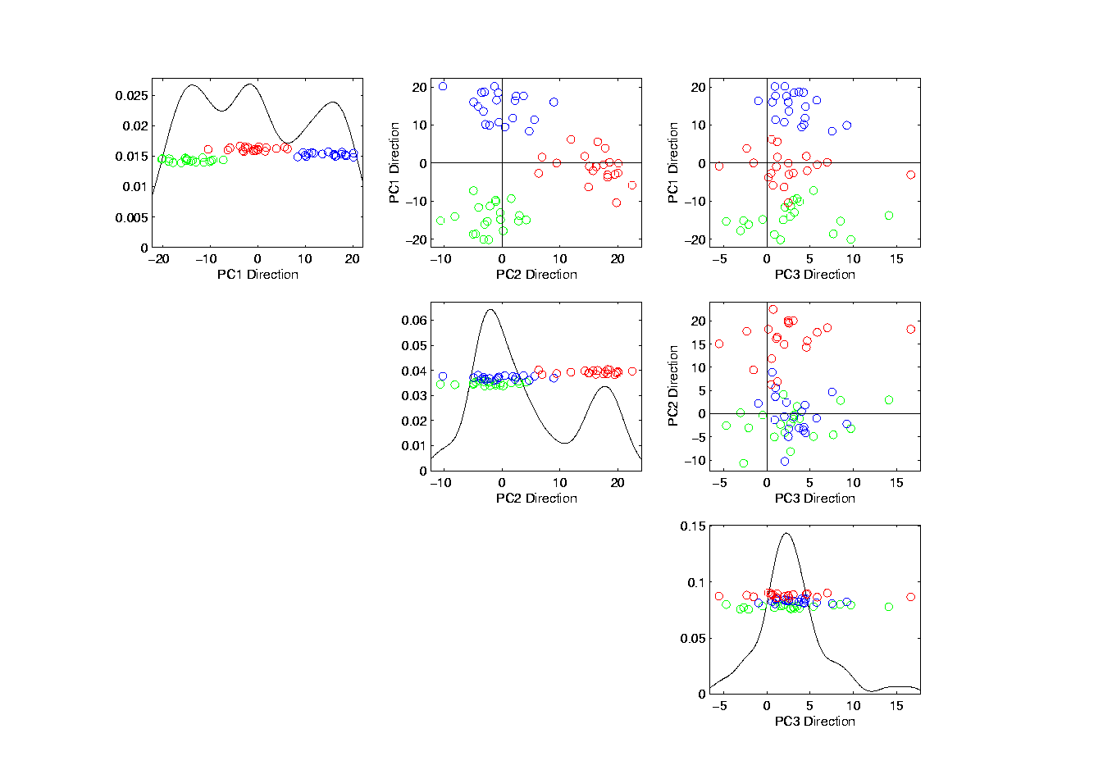
Illust’n of PCA View: PCA View
Notes:
EgView1p72PCAViewClustColor.ps

Slide 71
Illust’n of PCA View: PCA View
Clusters are “more distinct”
Since more “air space”
In between
Notes:
EgView1p72PCAViewClustColor.ps

Slide 72
Another Comparison of Views
Much higher dimension, # genes = 4000
Gene by Gene View
Clusters very nearly the same
Very slight difference in means
PCA View
Huge difference in 1st PC Direction
Magnification of clustering
Lesson: Alternate views can show much more
(especially in high dimensions, i.e. for many genes)
Shows PC view is very useful

Slide 73
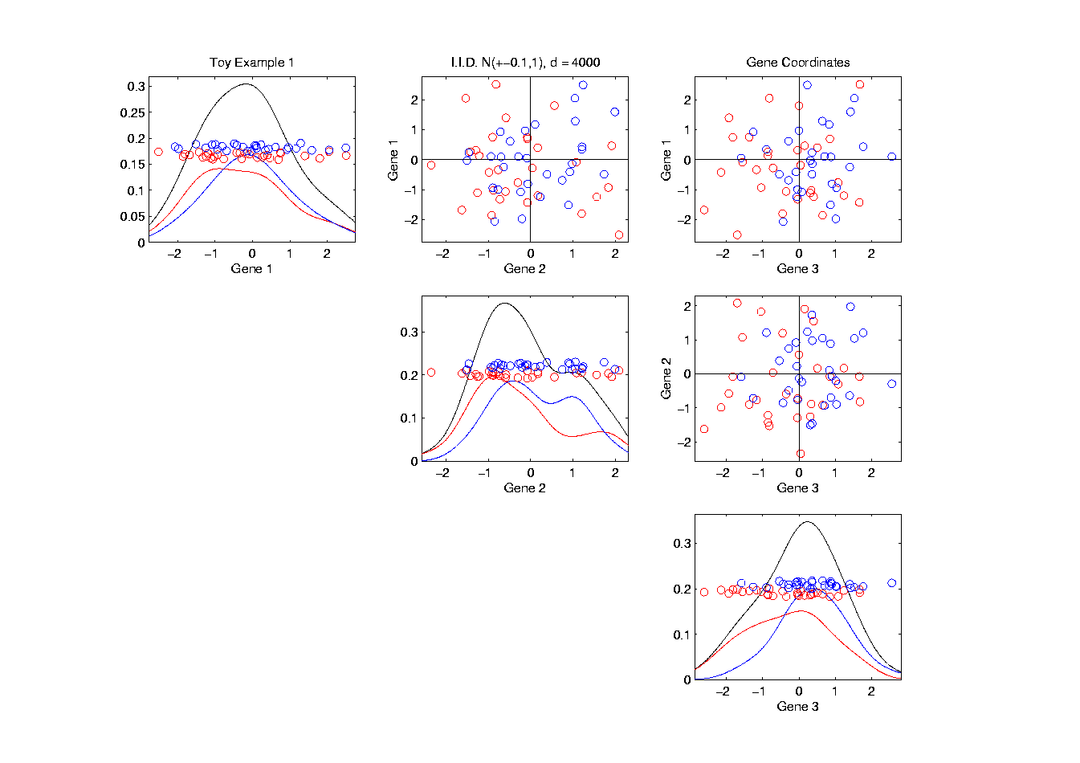
Another Comparison: Gene by Gene View
Notes:
EgView2p1dat1GeneView.ps

Slide 74
Another Comparison: Gene by Gene View
Very Small Differences
Between Means
Notes:
EgView2p1dat1GeneView.ps

Slide 75
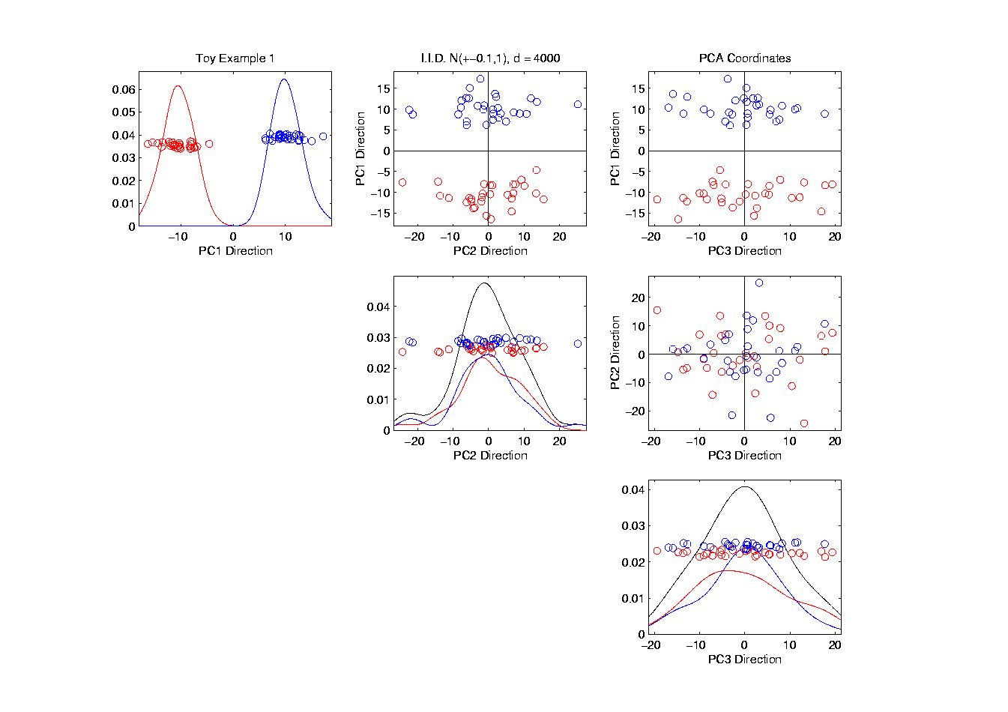
Another Comparison: PCA View
Notes:
EgView2p2dat1PCAView.ps

Slide 76
Data Object Conceptualization
Object Space ←→ Feature Space
Curves
Images Manifolds
Shapes Tree Space
Trees

Slide 77
More on Terminology
“Feature Vector” dates back at least to field of:
Statistical Pattern Recognition
Famous reference (there are many):
Devijver, P. A. and Kittler, J. (1982) Pattern Recognition: A Statistical Approach, Prentice Hall, London.
Caution:
Features there are entries of vectors
For me, features are “aspects of populations”

Slide 78
E.g. Curves As Data
Object Space: Set of curves
Feature Space(s):
Curves digitized to vectors (look at 1st)
Basis Representations:
Fourier (sin & cos)
B-splines
Wavelets

Slide 79
E.g. Curves As Data, I
Very simple example (Travis Gaydos)
“2 dimensional” family of (digitized) curves
Object space: piece-wise linear f’ns
Feature space =
PCA: reveals “population structure”

Slide 80
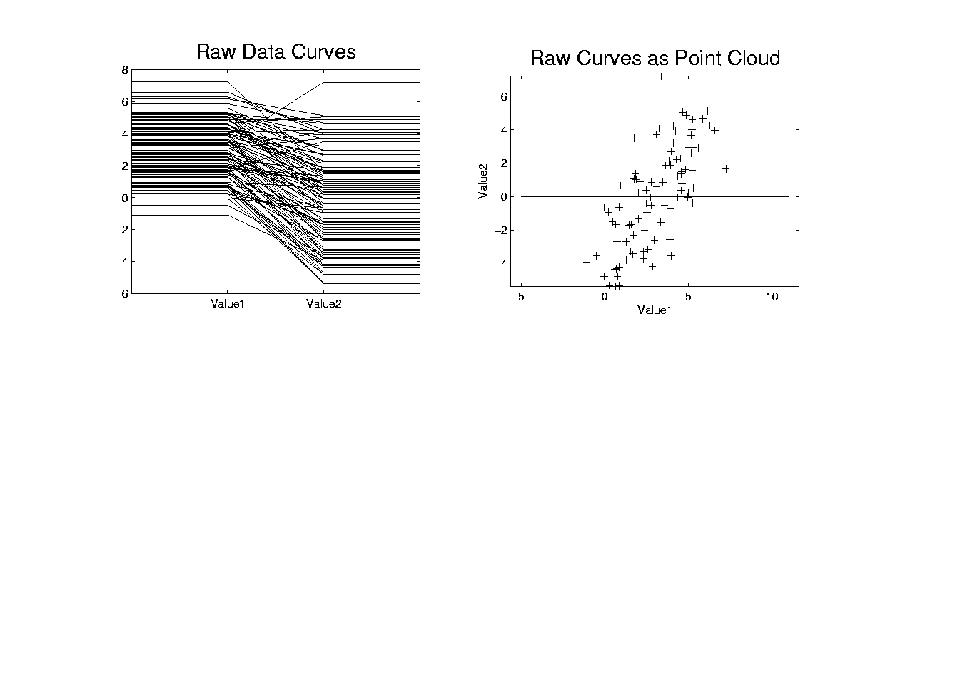
Functional Data Analysis, Toy EG I
Notes:
toyraw.ps

Slide 81
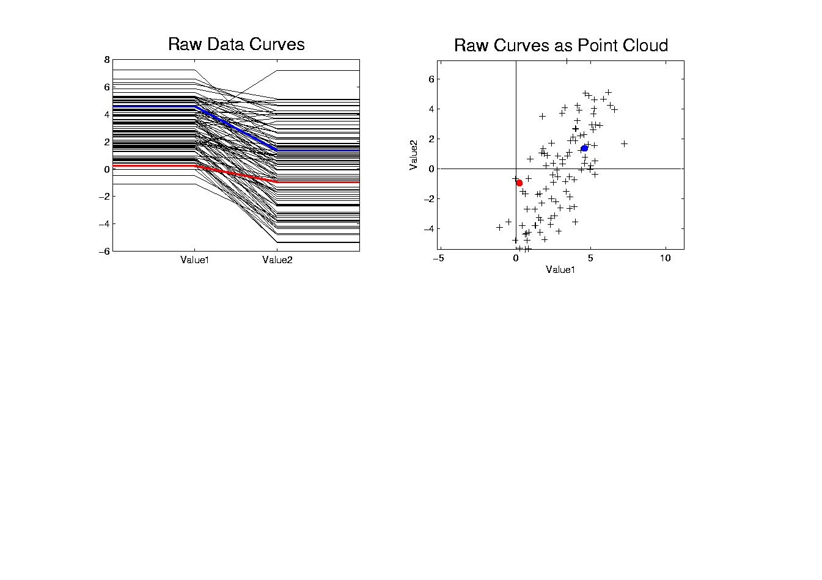
Functional Data Analysis, Toy EG II
Notes:
toyrawcol.ps

Slide 82
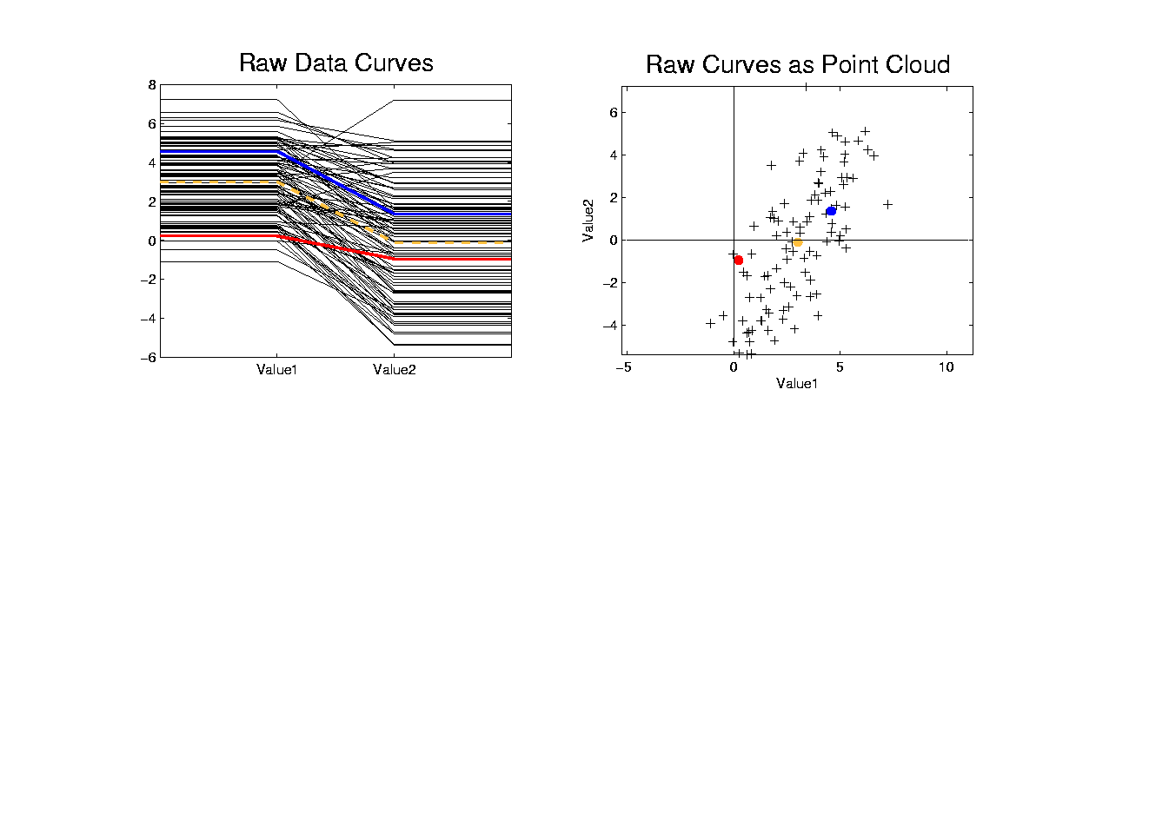
Functional Data Analysis, Toy EG III
Notes:
toyrawcolmean.ps

Slide 83
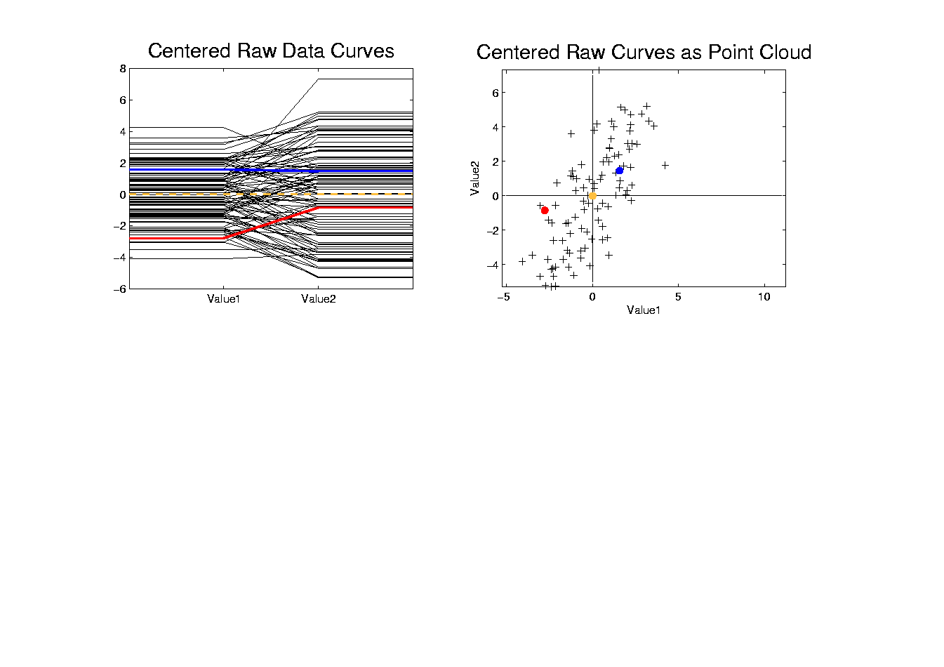
Functional Data Analysis, Toy EG IV
Notes:
centoyrawcolmean.ps

Slide 84
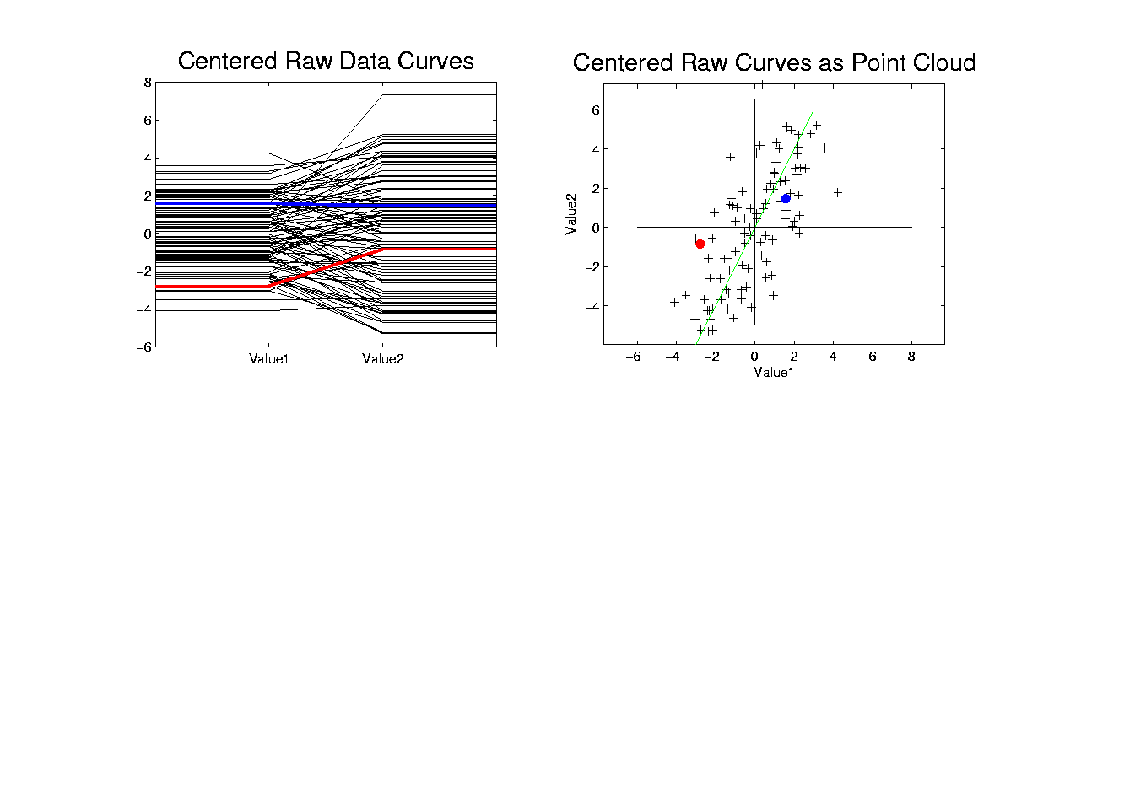
Functional Data Analysis, Toy EG V
Notes:
centoypc1.ps

Slide 85
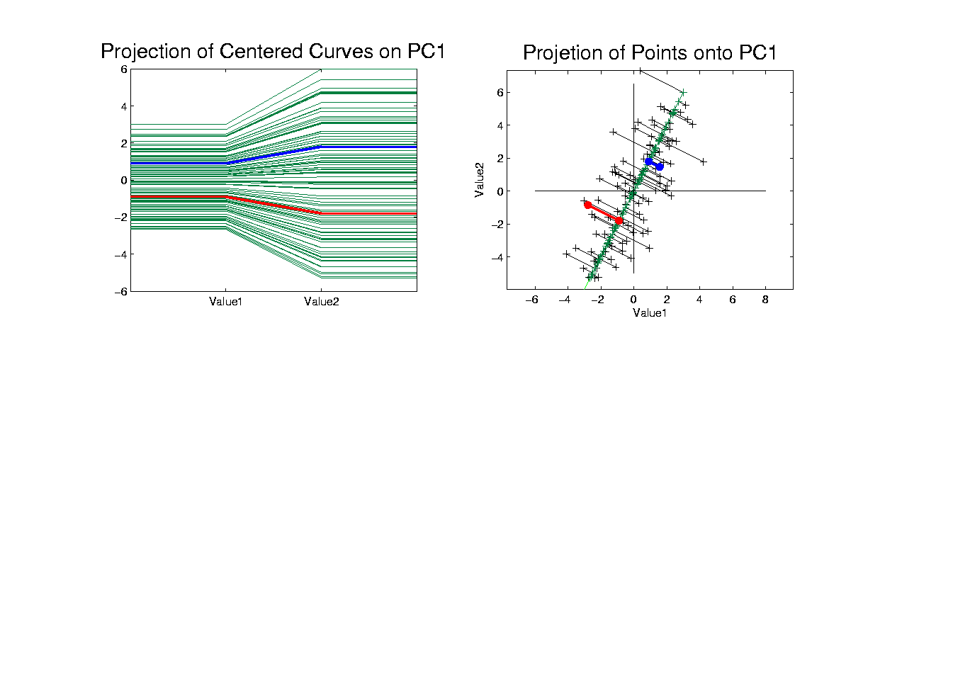
Functional Data Analysis, Toy EG VI
Notes:
centoypc1proj.ps

Slide 86
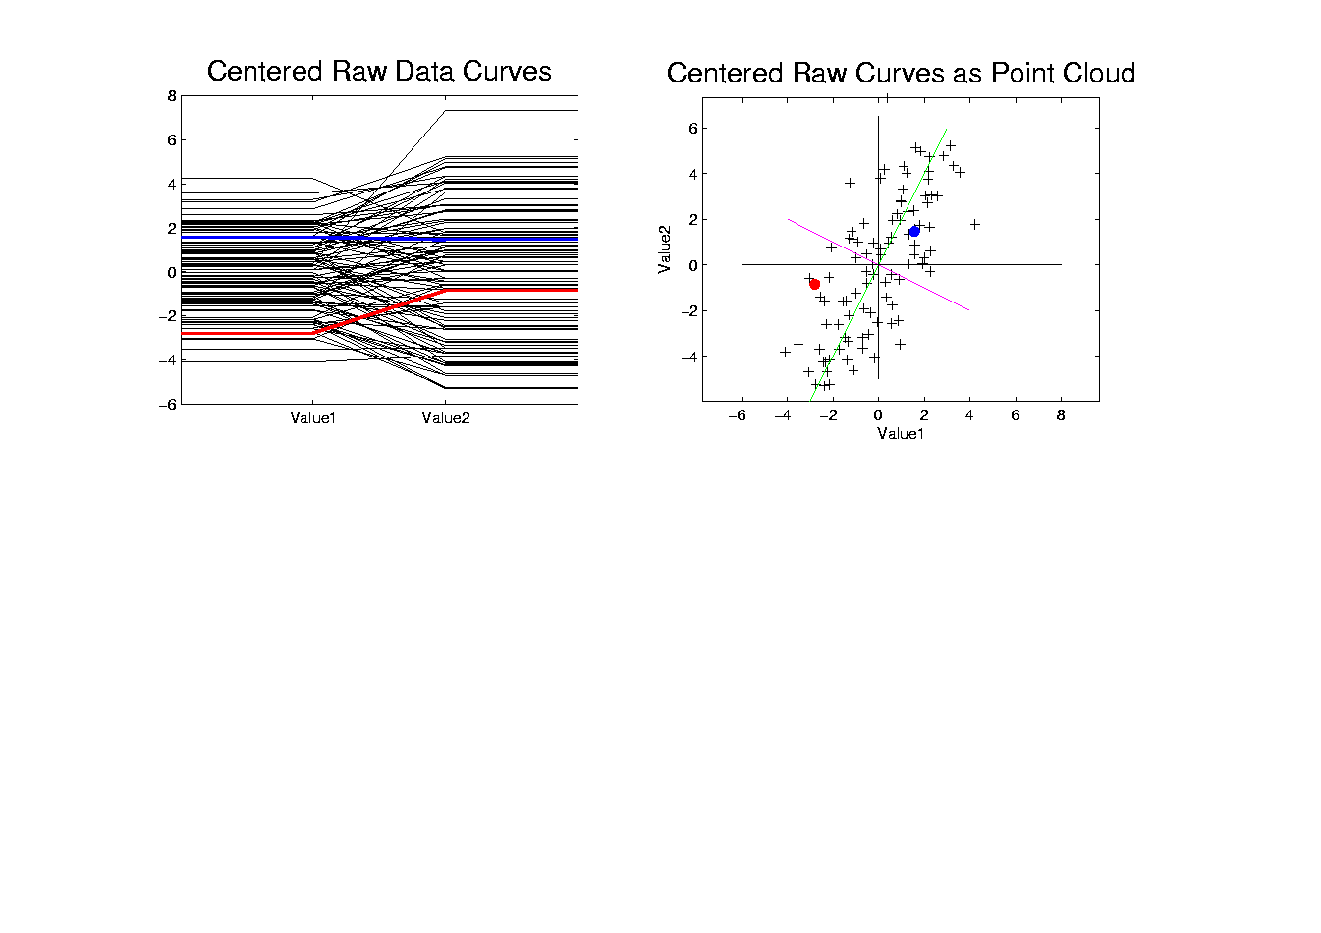
Functional Data Analysis, Toy EG VII
Notes:
centoypc2.ps

Slide 87

Functional Data Analysis, Toy EG VIII
Notes:
centoypc2proj.ps

Slide 88

Functional Data Analysis, Toy EG IX
Notes:
addup.ps

Slide 89

Functional Data Analysis, Toy EG X
Notes:
addupcol.ps

Slide 90
E.g. Curves As Data, I
Very simple example (Travis Gaydos)
“2 dimensional” family of (digitized) curves
Object space: piece-wise linear f’ns
Feature space =
PCA: reveals “population structure”
Decomposition into modes of variation

Slide 91
E.g. Curves As Data, II
Deeper example
10-d family of (digitized) curves
Object space: bundles of curves
Feature space =
(harder to visualize as point cloud,
But keep point cloud in mind)
PCA: reveals “population structure”

Slide 92

Functional Data Analysis, 10-d Toy EG 1
Notes:
EGCD1Parabs.ps

Slide 93
Functional Data Analysis, 10-d Toy EG 1
Notes:
EGCD1Parabs.ps

Slide 94
E.g. Curves As Data, II
PCA: reveals “population structure”
Mean → Parabolic Structure
PC1 → Vertical Shift
PC2 → Tilt
higher PCs → Gaussian (spherical)
Decomposition into modes of variation

Slide 95
E.g. Curves As Data, III
Two Cluster Example
10-d curves again
Two big clusters
Revealed by 1-d projection plot (right side)
Note: Cluster Difference is not orthogonal
to Vertical Shift
PCA: reveals “population structure”

Slide 96

Functional Data Analysis, 10-d Toy EG 2
Notes:
EGCD1Clust2.ps

Slide 97
E.g. Curves As Data, IV
More Complicated Example
10-d curves again
Pop’n structure hard to see in 1-d
2-d projections make structure clear
PCA: reveals “population structure”

Slide 98

Functional Data Analysis, 10-d Toy EG 3
Notes:
EGCD1Clust4a.ps

Slide 99

Functional Data Analysis, 10-d Toy EG 3
Notes:
EGCD1Clust4aDP2d.ps

Slide 100
Functional Data Analysis
Interesting Data Set:
Mortality Data
For Spanish Males (thus can relate to history)
Each curve is a single year
x coordinate is age
Mortality = # died / total # (for each age)
Study on log scale
Investigate change over years 1908 – 2002
From Andres Alonso, U. Carlos III, Madrid

Slide 101
Functional Data Analysis
Interesting Data Set:
Mortality Data
For Spanish Males (thus can relate to history)
Each curve is a single year
x coordinate is age
Note: Choice made of Data Object
(could also study age as curves,
x coordinate = time)

Slide 102
Functional Data Analysis
Important Issue:
What are the Data Objects?
Curves (years) : Mortality vs. Age
Curves (Ages) : Mortality vs. Year
Note: Rows vs. Columns of Data Matrix

Slide 103
Functional Data Analysis
Important Issue:
What are the Data Objects?
Curves (years) : Mortality vs. Age
Curves (Ages) : Mortality vs. Year
Note: Rows vs. Columns of Data Matrix

Slide 104
Functional Data Analysis
Interesting Data Set:
Mortality Data
For Spanish Males (thus can relate to history)
Each curve is a single year
x coordinate is age
Mortality = # died / total # (for each age)
Study on log scale
Another Data Object Choice

Slide 105

Mortality Time Series
Conventional
Coloring:
Rotate
Through
(7) Colors
Hard to
See Time
Structure

Slide 106

Mortality Time Series
Improved
Coloring:
Rainbow
Representing
Year:
Magenta
= 1908
Red = 2002

Slide 107

Mortality Time Series
Find
Population Center
(Mean Vector)
Compute in
Feature Space
Show in
Object Space

Slide 108
Mortality Time Series
Blips Appear
At Decades
Since Ages
Not Precise
(in Spain)
Reported as
“about 50”,
Etc.

Slide 109

Mortality Time Series
Mean
Residual
Object Space
View of
Shifting Data
To Origin
In Feature Space

Slide 110
Mortality Time Series
Shows:
Main Age
Effects in
Mean, Not
Variation
About Mean

Slide 111

Mortality Time Series
Object Space View of Projections
Onto PC1
Direction
Main Mode
Of Variation:
Constant
Across Ages

Slide 112
Mortality Time Series
Shows Major
Improvement
Over Time
(medical technology,
etc.)
And Change
In Age
Rounding Blips

Slide 113

Mortality Time Series
Corresponding
PC 1 Scores
Again Shows
Overall
Improvement
High Mortality
Early

Slide 114
Mortality Time Series
Corresponding
PC 1 Scores
Again Shows
Overall
Improvement
High Mortality
Early
Lower Later

Slide 115
Mortality Time Series
Outliers

Slide 116
Mortality Time Series
Outliers
1918 Global
Flu Pandemic

Slide 117
Mortality Time Series
Outliers
1918 Global
Flu Pandemic

Slide 118
Mortality Time Series
Outliers
1918 Global
Flu Pandemic
1936-1939
Spanish
Civil War

Slide 119

Mortality Time Series
Object Space View of Projections
Onto PC2
Direction

Slide 120
Mortality Time Series
Object Space View of Projections
Onto PC2
Direction
2nd Mode
Of Variation:
Difference
Between
20-45 & Rest

Slide 121

Mortality Time Series
Explain Using
PC 2 Scores
Early
Improvement

Slide 122
Mortality Time Series
Explain Using
PC 2 Scores
Early
Improvement
Pandemic
Hit Hardest

Slide 123
Mortality Time Series
Explain Using
PC 2 Scores
Then better

Slide 124
Mortality Time Series
Explain Using
PC 2 Scores
Then better
Spanish Civil War Hit
Hardest

Slide 125
Mortality Time Series
Explain Using
PC 2 Scores
Steady
Improvement
To mid-50s

Slide 126
Mortality Time Series
Explain Using
PC 2 Scores
Steady
Improvement
To mid-50s
Increasing
Automotive
Death Rate

Slide 127
Mortality Time Series
Explain Using
PC 2 Scores
Corner Finally
Turned by
Safer Cars
& Roads

Slide 128

Mortality Time Series
Scores Plot
Feature
(Point Cloud)
Space View
Connecting
Lines
Highlight
Time Order
Good View of
Historical
Effects

Slide 129
Time Series of Data Objects
Mortality Data Illustrates an Important Point:
OODA is more than a “framework”
It Provides a Focal Point
Highlights Pivotal Choice:
What should be the Data Objects?

