Slide 1
Statistics – O. R. 891
Object Oriented Data Analysis
J. S. Marron
Dept. of Statistics and Operations Research
University of North Carolina

Slide 2
Administrative Info
Details on Course Web Page
  Google: “Marron Courses”
  Choose This Course
Go Through These

Slide 3
Warning
Class Credits
Connect Carolina Offers 1 – 20
You need to tell it 3 credits, when enrolling
Some showed only 1 (apparent default)
Charlotte reset everybody to 3
Careful about other courses

Slide 4
Object Oriented Data Analysis
What is it?
A Sound-Bite Explanation:
What is the “atom of the statistical analysis”?
1st Course: Numbers
Multivariate Analysis Course : Vectors
Functional Data Analysis: Curves
More generally: Data Objects

Slide 5
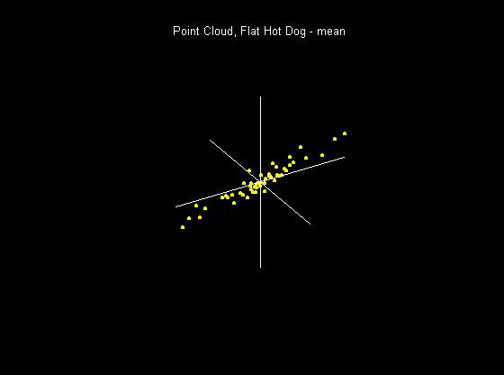
Visualization
How do we look at Euclidean data?
1-d: histograms, etc.
2-d: scatterplots
3-d: spinning point clouds

Slide 6
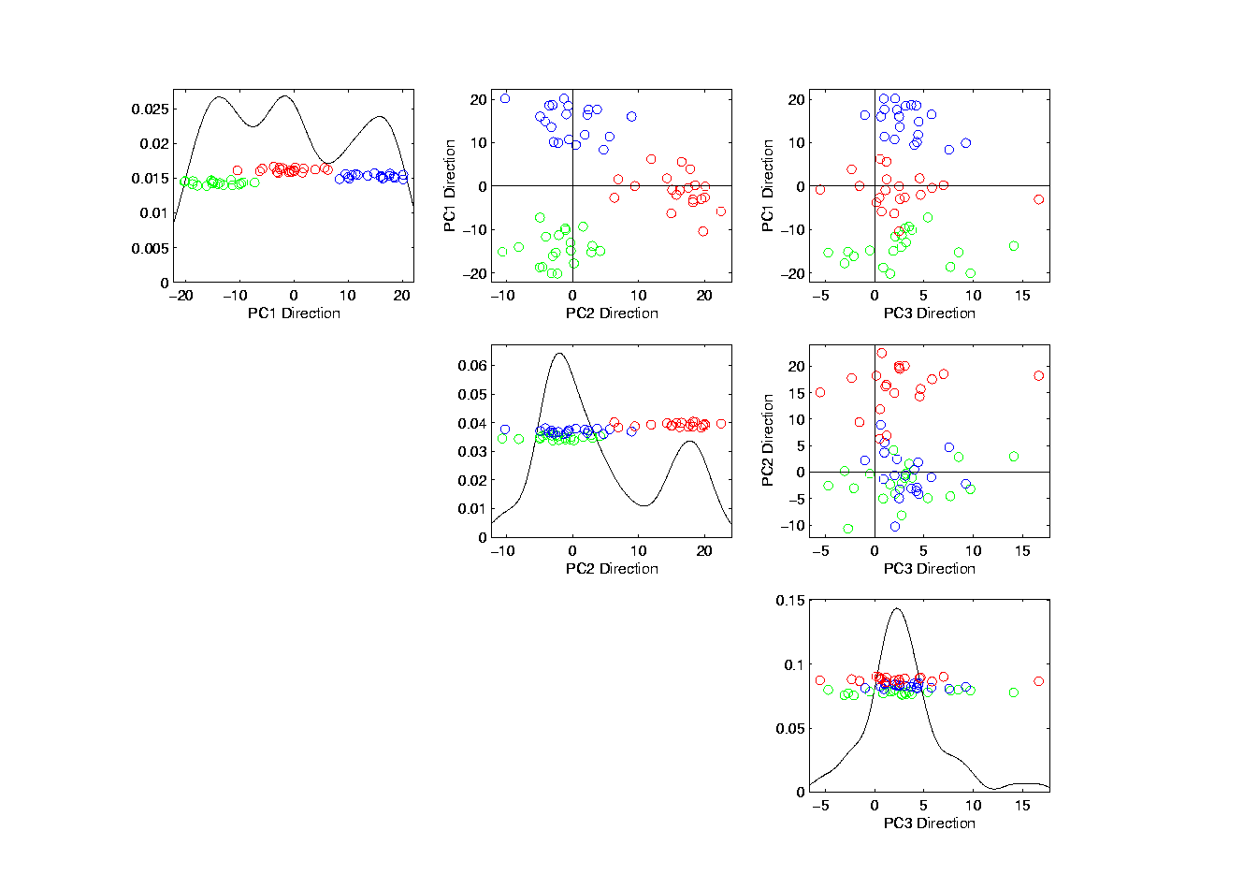
Illust’n of PCA View: PCA View
Notes:
EgView1p72PCAViewClustColor.ps

Slide 7
PCA Terminology
Projections Coefficients
are called “Scores”
Entries of Direction Vectors
are called “Loadings”
Notes:
EgView1p72PCAViewClustColor.ps

Slide 8
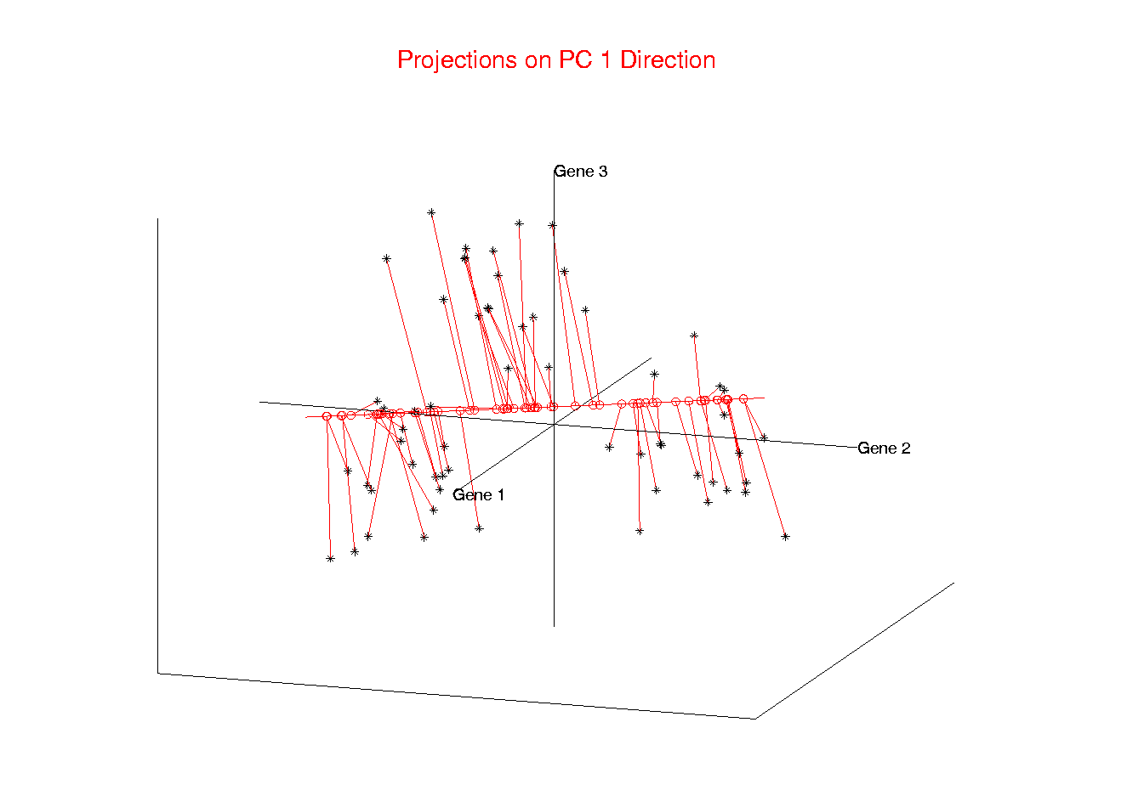
Illust’n of PCA View: PC1 Projections
Coefficients = “Scores”
Notes:
EgView1p51proj3dPC1.ps

Slide 9
Illust’n of PCA View: PCA View
Scores:
PC1
PC2
PC3
So call this “scores plot”
Notes:
EgView1p72PCAViewClustColor.ps

Slide 10
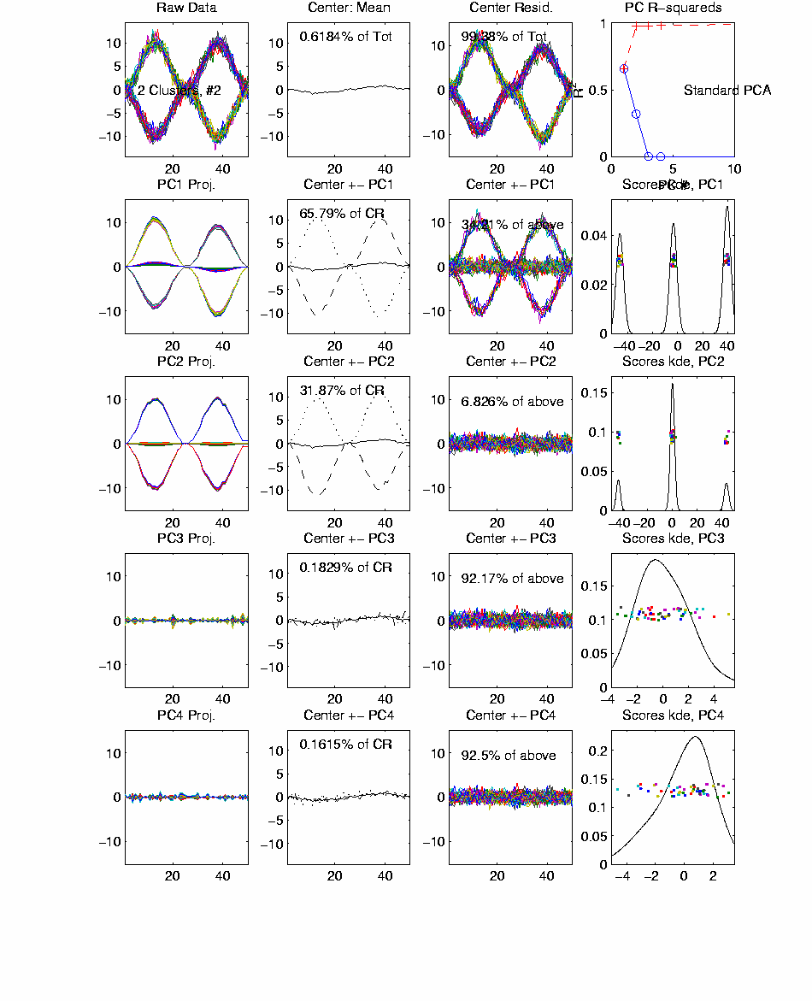
Functional Data Analysis, 40-d Toy EG 3
Notes:
EGCD1Clust4a.ps

Slide 11
Functional Data Analysis, 40-d Toy EG 3
Loadings = Entries of Direction Vector
These are multiples, so call this
Loadings Plot
Notes:
EGCD1Clust4a.ps

Slide 12
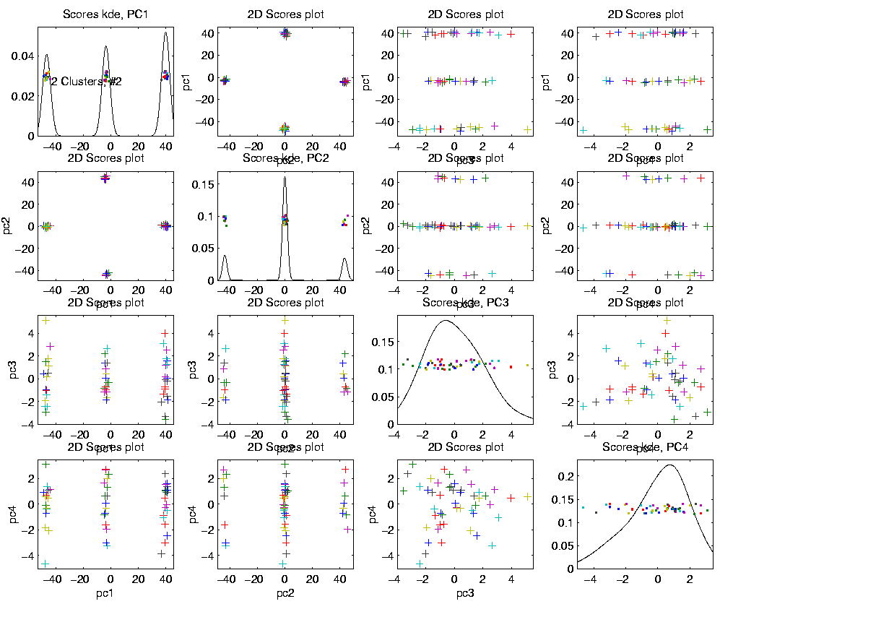
Functional Data Analysis, 40-d Toy EG 3
Notes:
EGCD1Clust4aDP2d.ps

Slide 13
Functional Data Analysis, 40-d Toy EG 3
Recall “Scores Plot"
Notes:
EGCD1Clust4aDP2d.ps

Slide 14
Functional Data Analysis
Interesting Data Set:
Mortality Data
For Spanish Males (thus can relate to history)
Each curve is a single year
x coordinate is age
Mortality = # died / total # (for each age)
Study on log scale
Investigate change over years 1908 – 2002
From Andres Alonso, U. Carlos III, Madrid

Slide 15
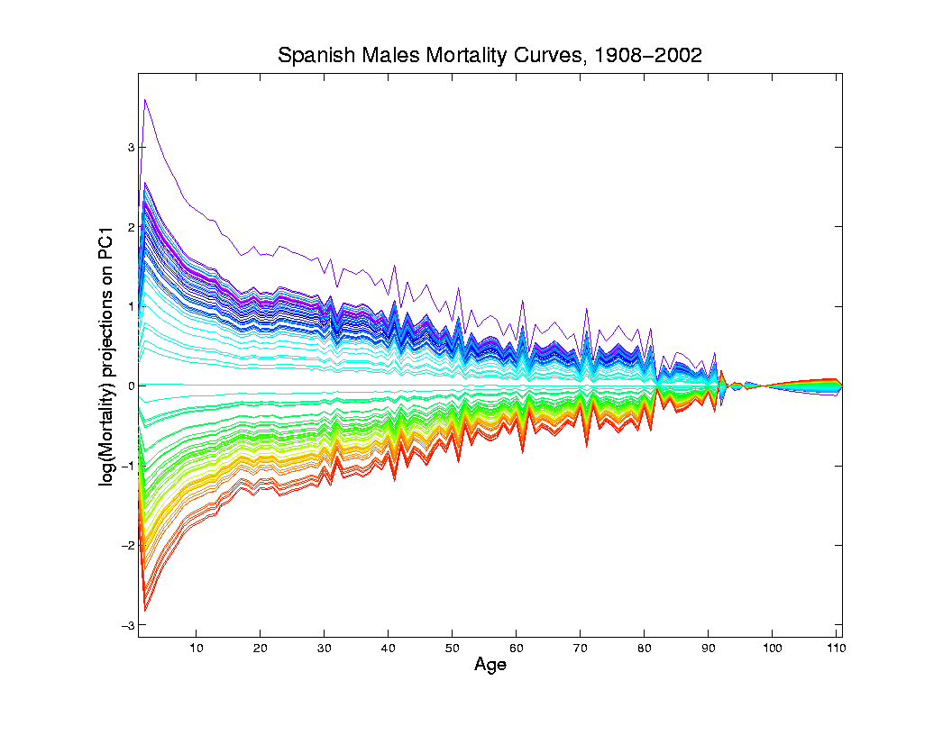
Mortality Time Series
Object Space View of Projections
Onto PC1
Direction
Main Mode
Of Variation:
Constant
Across Ages
Loadings Plot

Slide 16
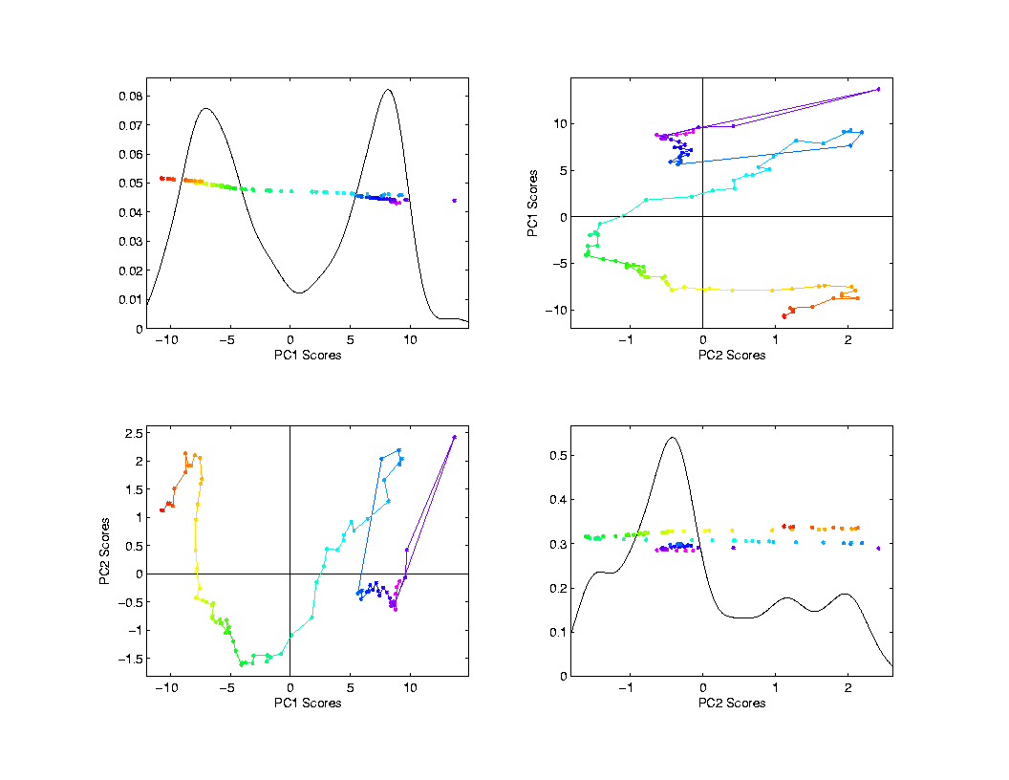
Mortality Time Series
Scores Plot
Scores Plot
Feature
(Point Cloud)
Space View
Connecting
Lines
Highlight
Time Order
Good View of
Historical
Effects

Slide 17
Time Series of Data Objects
Mortality Data Illustrates an Important Point:
OODA is more than a “framework”
It Provides a Focal Point
Highlights Pivotal Choice:
What should be the Data Objects?

Slide 18
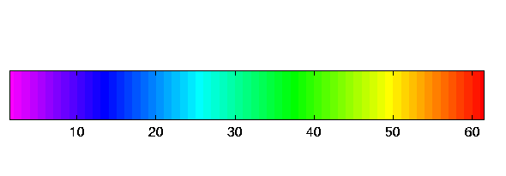
Time Series of Curves
Just a “Set of Curves”
But Time Order is Important!
Useful Approach:
Use color to code for time
Start End

Slide 19
Time Series Toy E.g.
Explore Question:
“Is Horizontal Motion Linear Variation?”
Example: Set of time shifted
Gaussian densities
View: Code time with colors as above

Slide 20
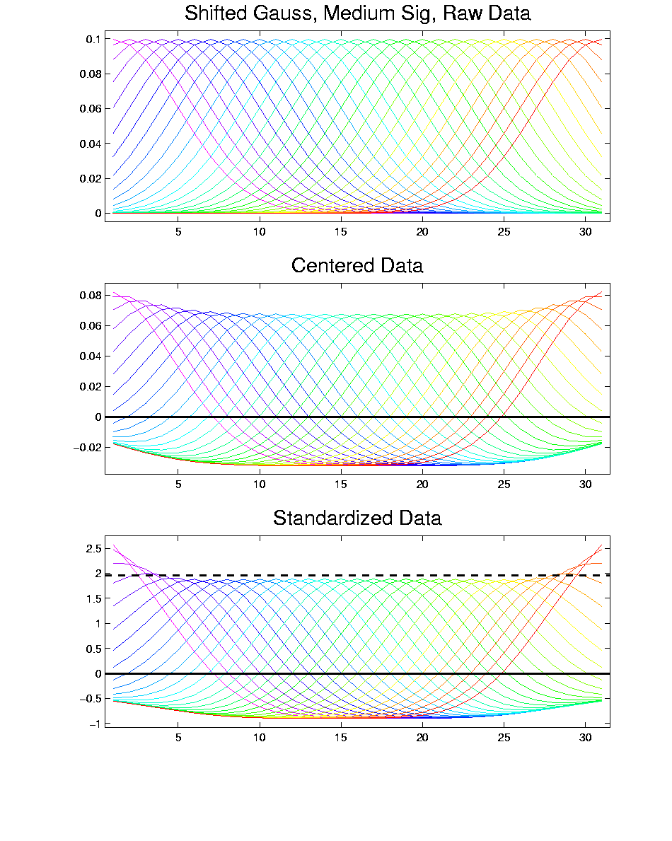
T. S. Toy E.g., Raw Data

Slide 21
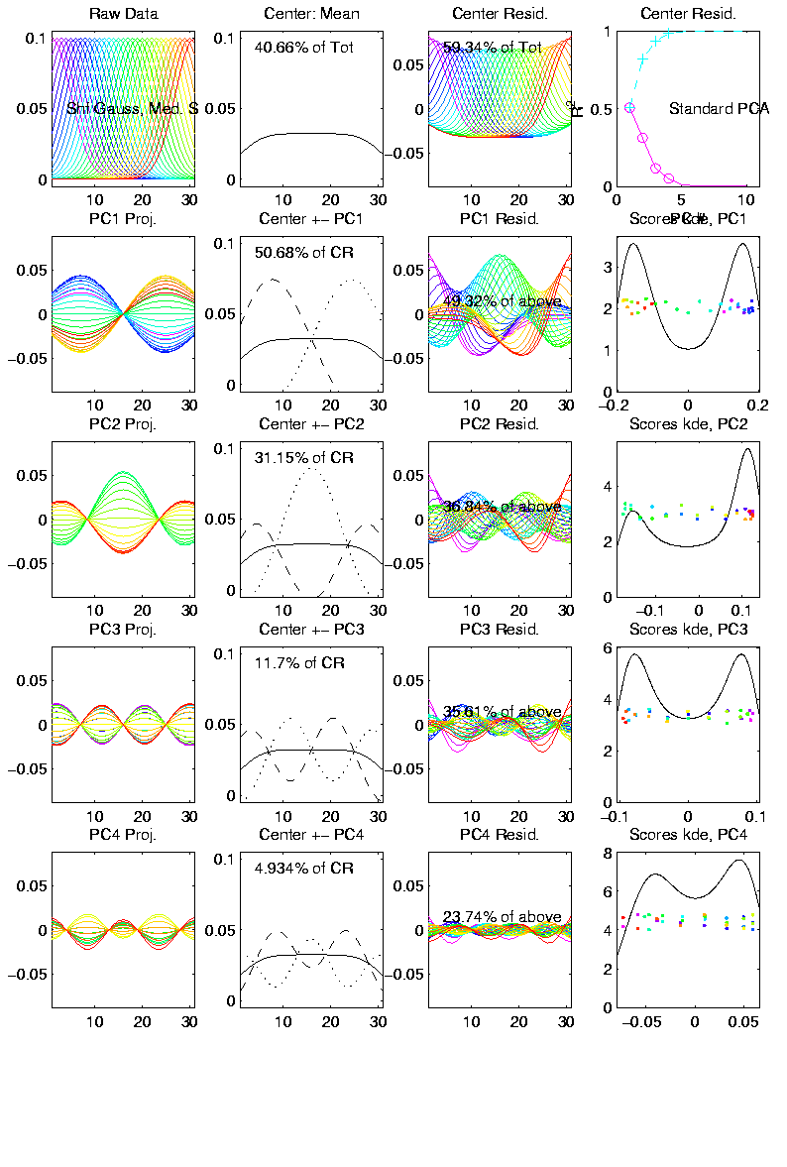
T. S. Toy E.g., PCA View
PCA gives “Modes of Variation”
But there are Many…

Slide 22
T. S. Toy E.g., PCA View
PCA gives “Modes of Variation”
But there are Many…
Intuitively Useful???
Like “harmonics”?

Slide 23
T. S. Toy E.g., PCA View
PCA gives “Modes of Variation”
But there are Many…
Intuitively Useful???
Like “harmonics”?
Isn’t there only 1 mode of variation?

Slide 24
T. S. Toy E.g., PCA View
PCA gives “Modes of Variation”
But there are Many…
Intuitively Useful???
Like “harmonics”?
Isn’t there only 1 mode of variation?
Answer comes in scores scatterplots

Slide 25
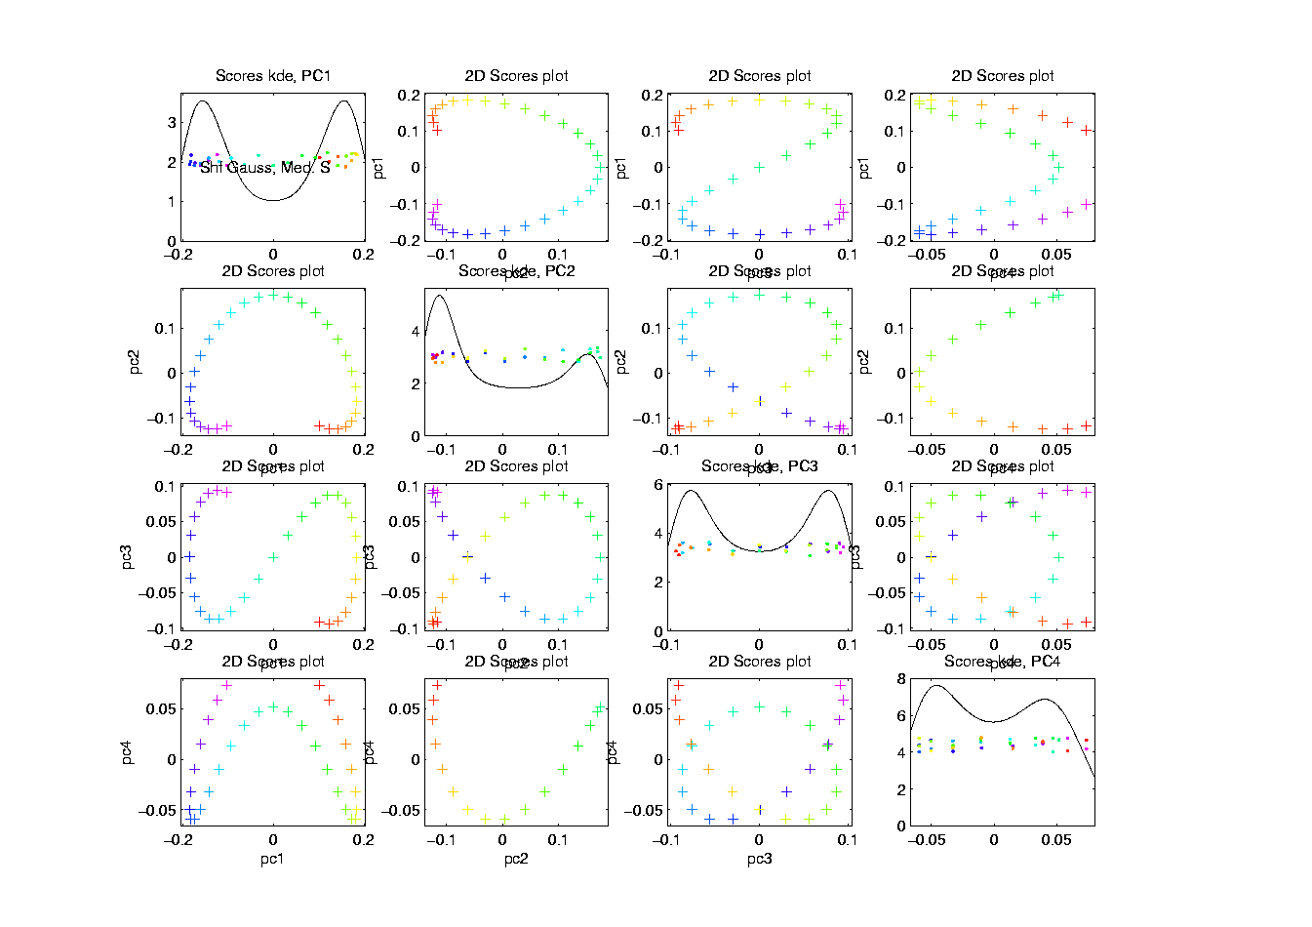
T. S. Toy E.g., PCA Scatterplot

Slide 26
T. S. Toy E.g., PCA Scatterplot
Where is the Point Cloud?
Lies along a 1-d curve in

Slide 27
T. S. Toy E.g., PCA Scatterplot
Where is the Point Cloud?
Lies along a 1-d curve in
So actually have 1-d mode of variation
But a non-linear mode of variation

Slide 28
T. S. Toy E.g., PCA Scatterplot
Where is the Point Cloud?
Lies along a 1-d curve in
So actually have 1-d mode of variation
But a non-linear mode of variation
Poorly captured by PCA (linear method)
Will study more later

Slide 29
Interesting Question
Can we find a 1-d Representation?
Perhaps by:
Different Analysis?
Other Choice of Data Objects?

Slide 30
Chemo-metric Time Series
Mass Spectrometry Measurements
On an Aging Substance, called “Estane”
Made over Logarithmic Time Grid, n = 60
Each Data Object is a Spectrum
What about Time Evolution?
Approach: PCA & Time Coloring

Slide 31
Chemo-metric Time Series
Joint Work w/ E. Kober & J. Wendelberger
Los Alamos National Lab
Four Experimental Conditions:
Control
Aged 59 days in Dry Air
Aged 27 days in Humid Air
Aged 59 days in Humid Air

Slide 32
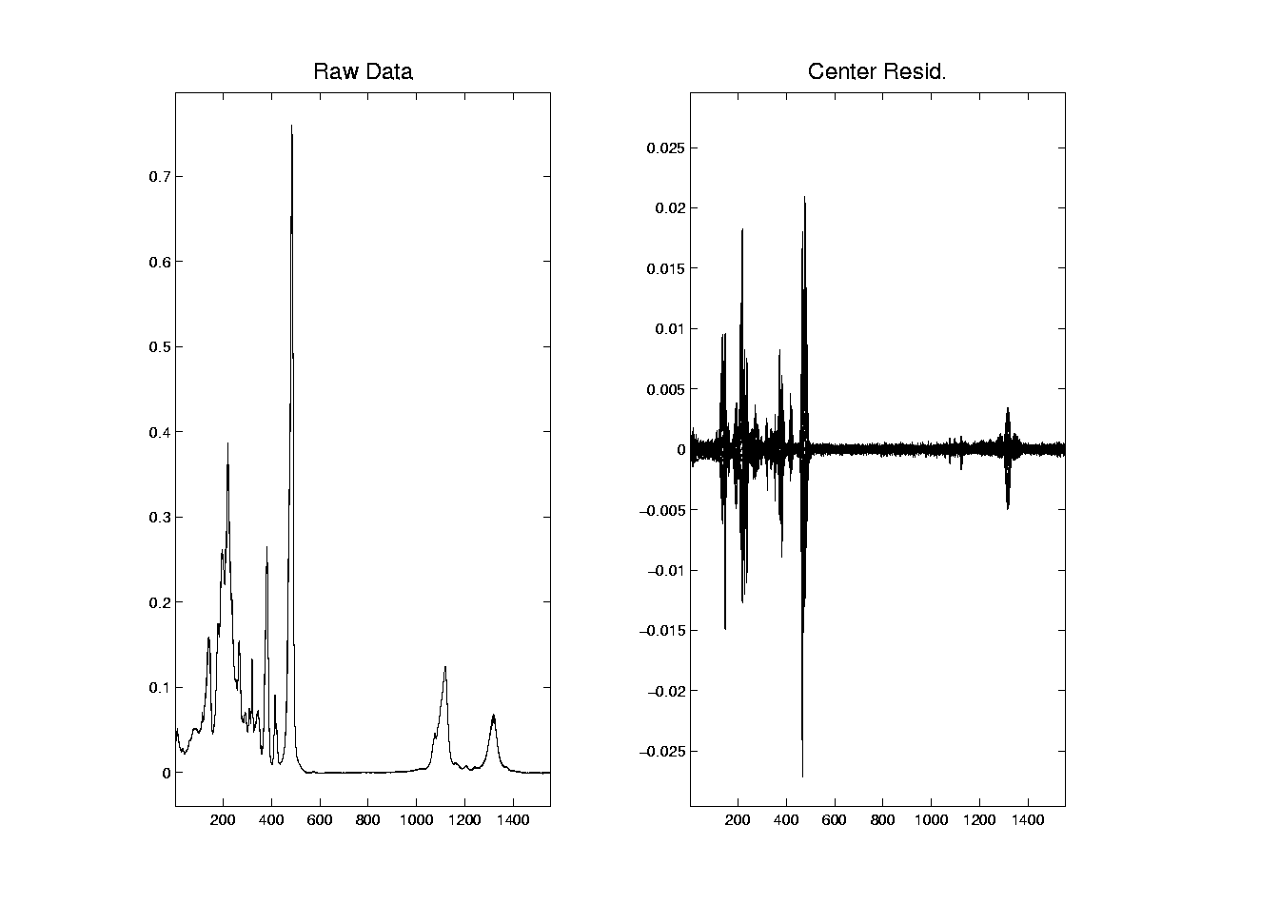
Chemo-metric Time Series, HA 27

Slide 33
Chemo-metric Time Series, HA 27
Raw Data:
All 60 spectra essentially the same
“Scale” of mean is much bigger than variation about mean
Hard to see structure of all 1600 freq’s
Centered Data:
Now can see different spectra
Since mean subtracted off
Note much smaller vertical axis

Slide 34
Chemo-metric Time Series, HA 27
Next Zoom in on “Region of Interest”

Slide 35
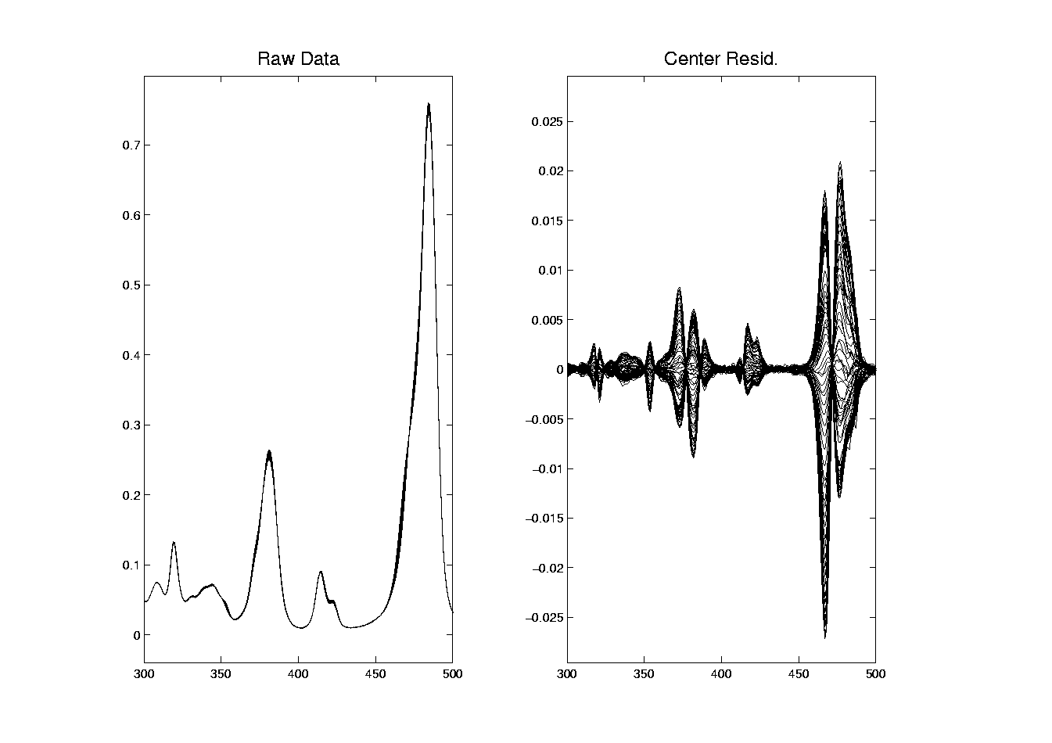
Chemo-metric Time Series, HA 27

Slide 36
Chemo-metric Time Series, HA 27
Data zoomed to “important” freq’s:
Raw Data:
Now see slight differences
Smoother “natural looking” spectra
Centered Data:
Differences in spectra more clear
Maybe now have “real structure”
Scale is important

Slide 37
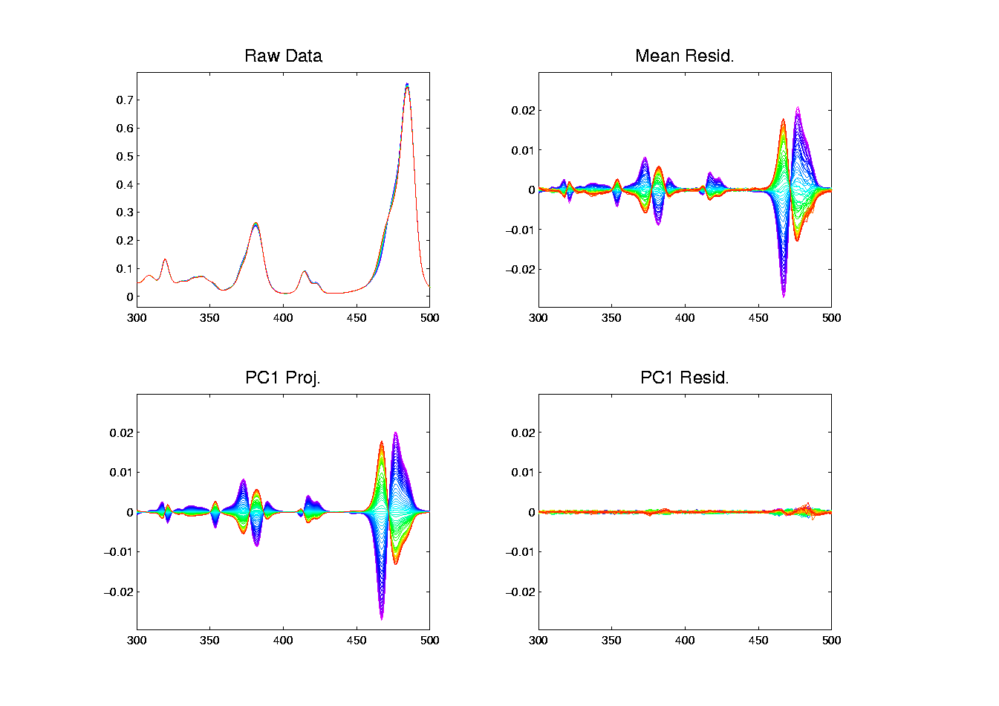
Chemo-metric Time Series, HA 27

Slide 38
Chemo-metric Time Series, HA 27
Use of Time Order Coloring:
Raw Data:
Can see a little ordering, not much
Centered Data:
Clear time ordering
Shifting peaks? (compare to Raw)
PC1:
Almost everything?
PC1 Residuals:
Data nearly linear (same scale import’nt)

Slide 39
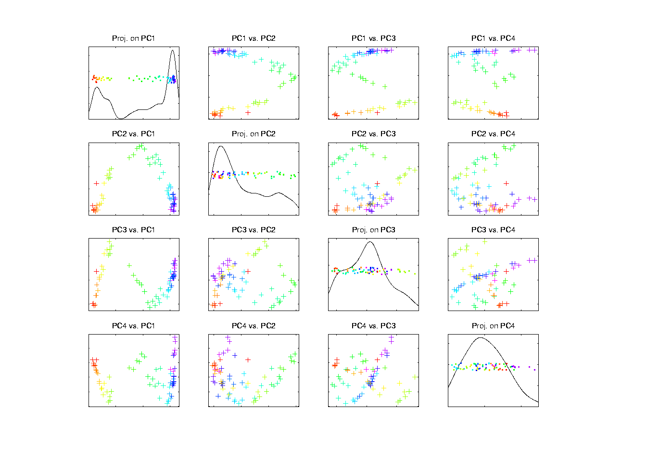
Chemo-metric Time Series, Control

Slide 40
Chemo-metric Time Series, Control
PCA View
Clear systematic structure
Time ordering very important
Reminiscent of Toy Example
Roughly 1-d curve in Feature Space
Physical Explanation?

Slide 41
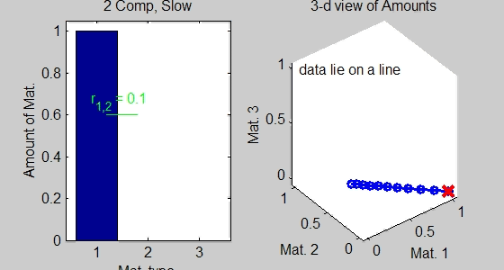
Toy Data Explanations
Simple Chemical Reaction Model:
Subst. 1 transforms into Subst. 2
Note: linear path in Feature Space

Slide 42
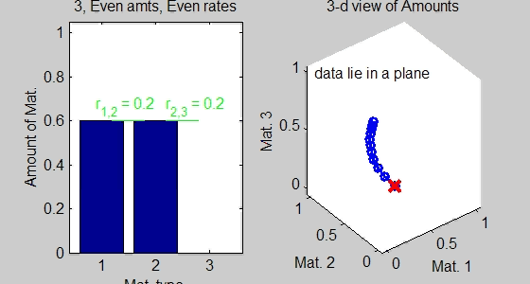
Toy Data Explanations
Richer Chemical Reaction Model:
Subst. 1 → Subst. 2 → Subst. 3
Curved path in Feat. Sp.
2 Reactions → Curve lies in 2-dim’al subsp.

Slide 43
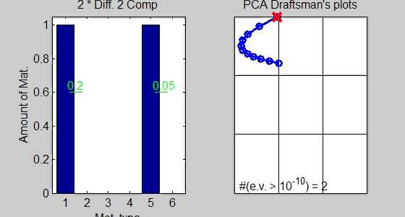
Toy Data Explanations
Another Chemical Reaction Model:
Subst. 1 → Subst. 2 & Subst. 5 → Subst. 6
Curved path in Feat. Sp.
2 Reactions → Curve lies in 2-dim’al subsp.

Slide 44
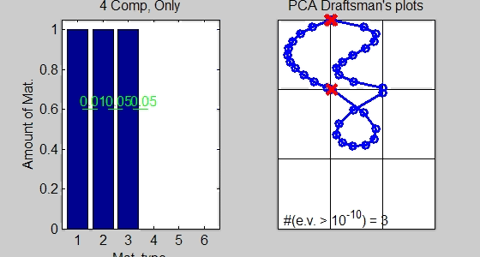
Toy Data Explanations
More Complex Chemical Reaction Model:
1 → 2 → 3 → 4
Curved path in Feat. Sp. (lives in 3-d)
3 Reactions → Curve lies in 3-dim’al subsp.

Slide 45
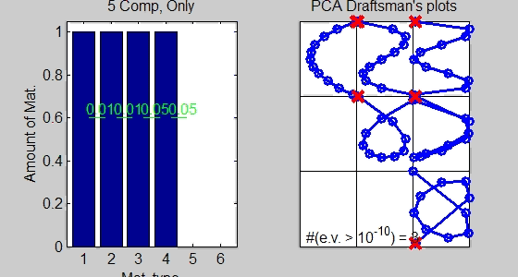
Toy Data Explanations
Even More Complex Chemical Reaction Model:
1 → 2 → 3 → 4 → 5
Curved path in Feat. Sp. (lives in 4-d)
4 Reactions → Curve lies in 4-dim’al subsp.

Slide 46
Chemo-metric Time Series, Control

Slide 47
Chemo-metric Time Series, Control
Suggestions from Toy Examples:
Clearly 3 reactions under way
Maybe a 4th???
Hard to distinguish from noise?
Interesting statistical open problem!

Slide 48
Chemo-metric Time Series
What about the other experiments? Recall:
  Control
  Aged 59 days in Dry Air
  Aged 27 days in Humid Air
  Aged 59 days in Humid Air
Above results were “cherry picked”,
to best makes points
What about other cases???

Slide 49
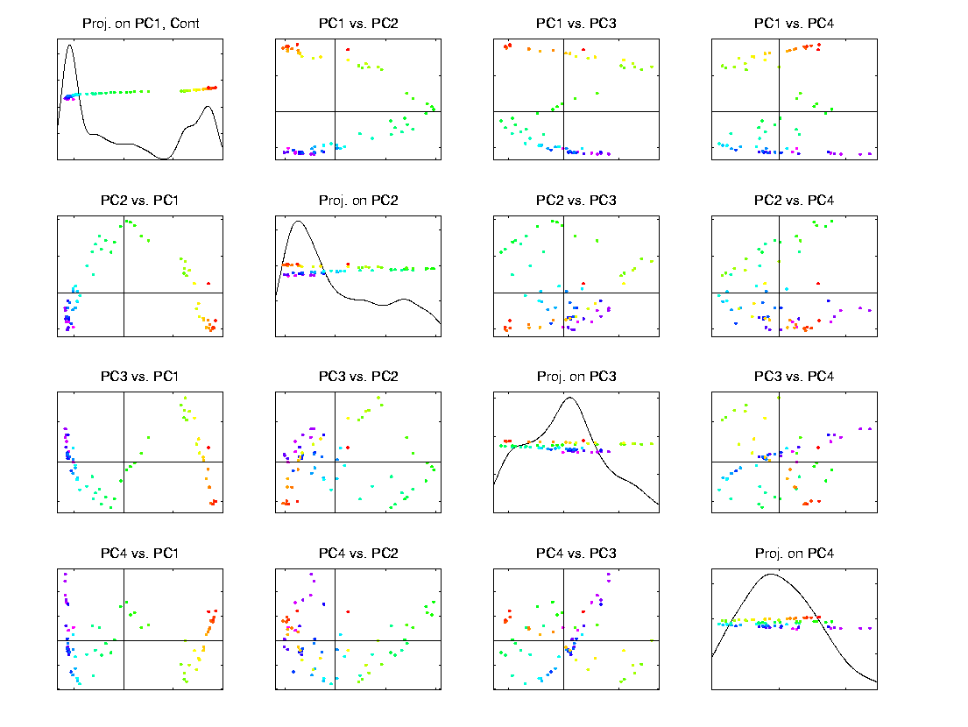
Scatterplot Matrix, Control
Above E.g., maybe ~4d curve → ~4 reactions

Slide 50
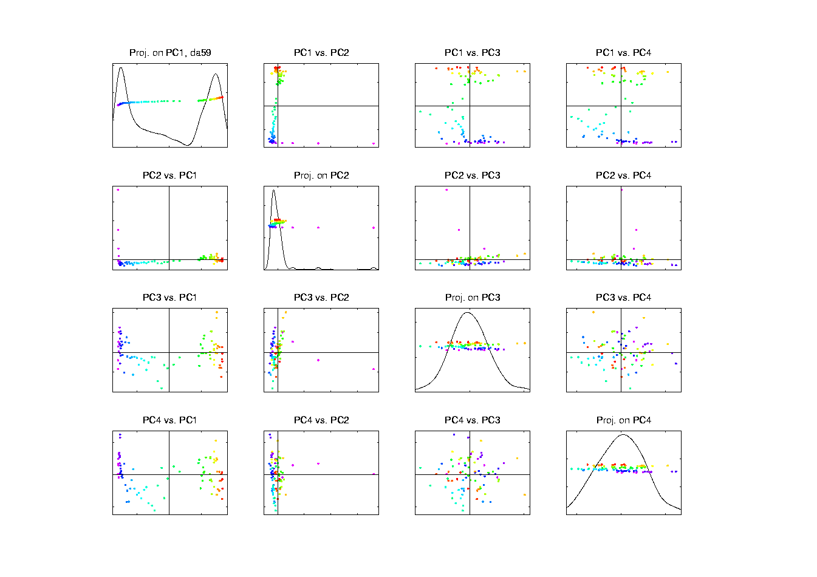
Scatterplot Matrix, Da59
PC2 is “bleeding of CO2”, discussed below

Slide 51
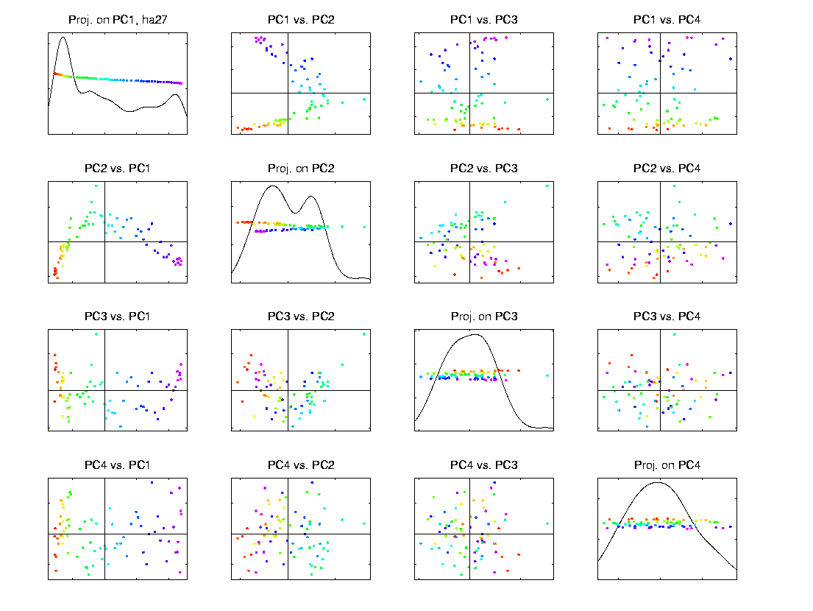
Scatterplot Matrix, Ha27
Only “3-d + noise”? → Only 3 reactions

Slide 52
Scatterplot Matrix, Ha59
Harder to judge???

Slide 53
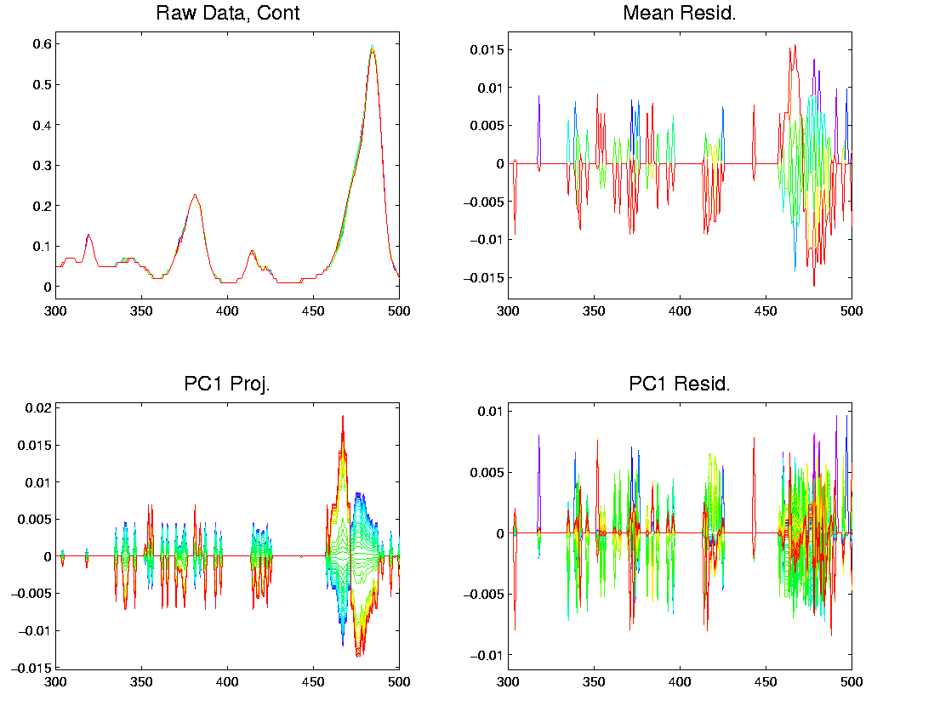
Object Space View, Control
Terrible discretization effect, despite ~4d …

Slide 54
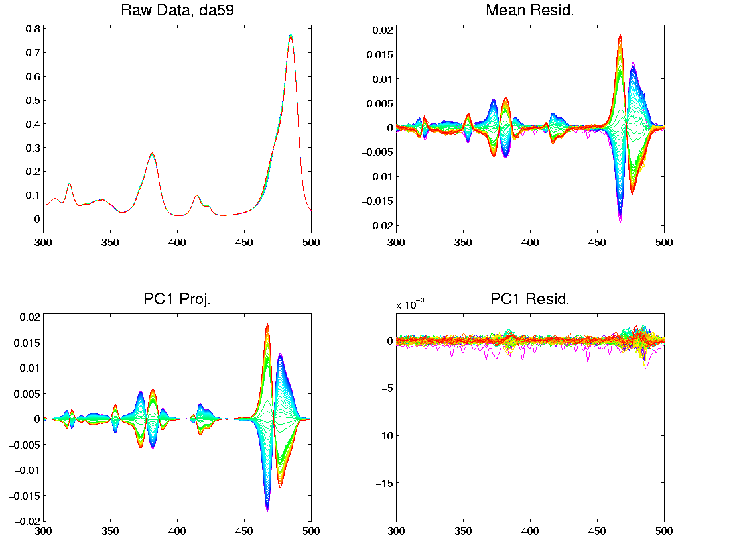
Object Space View, Da59
OK, except strange at beginning (CO2 …)

Slide 55
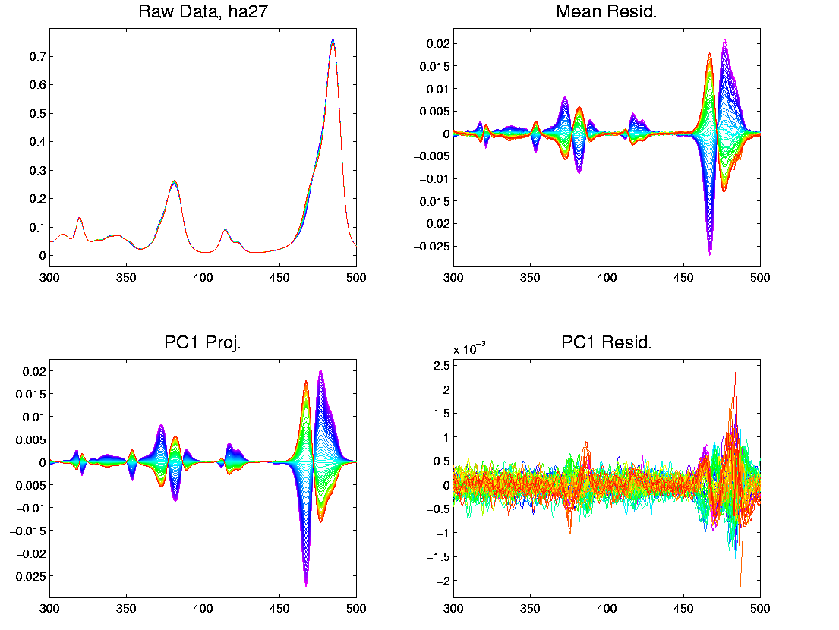
Object Space View, Ha27
Strong structure in PC1 Resid (d < 2)

Slide 56
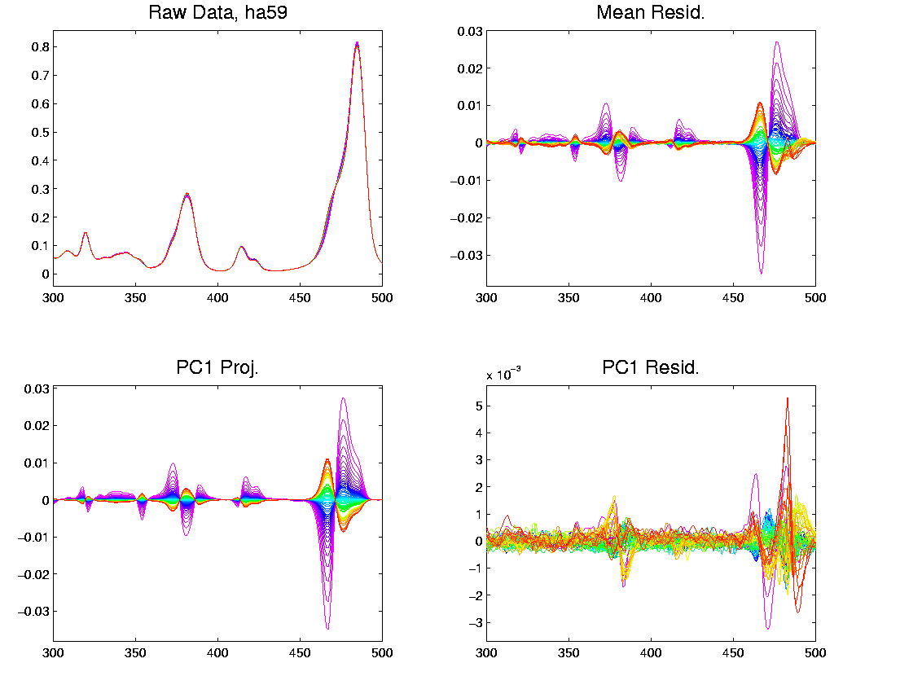
Object Space View, Ha59
Lots at beginning, OK since “oldest”

Slide 57
Problem with Da59
What about strange behavior for DA59?
Recall:
PC2 showed “really different behavior at start”
Chemists comments:
Ignore this, should have started measuring later…

Slide 58
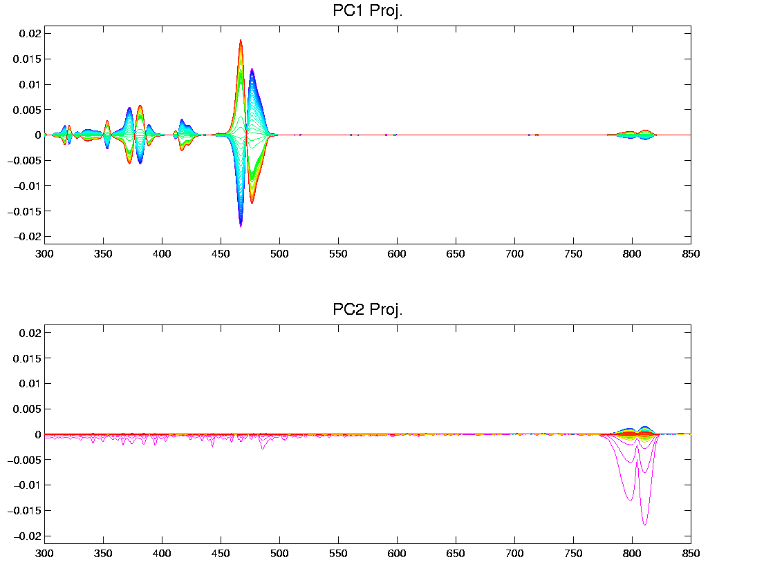
Problem with Da59
But still fun to look at broader spectra

Slide 59
Chemo-metric T. S. Joint View
Throw them all together as big population
Take Point Cloud View

Slide 60
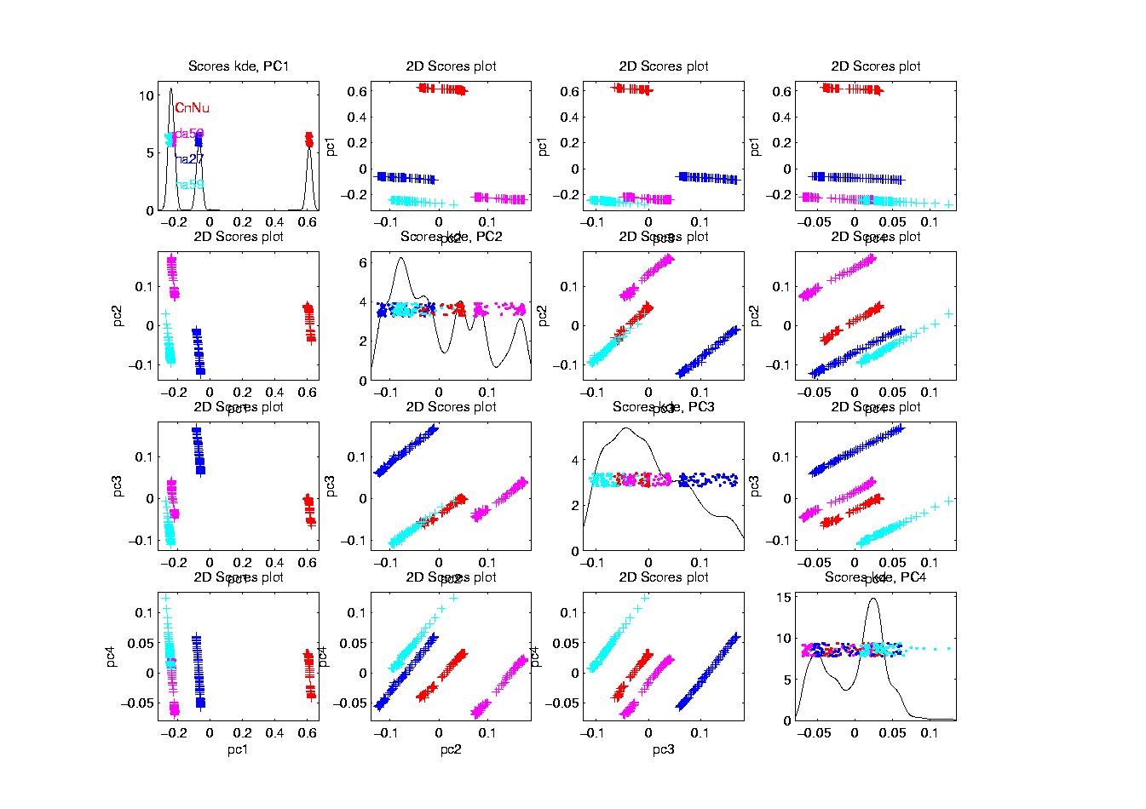
Chemo-metric T. S. Joint View

Slide 61
Chemo-metric T. S. Joint View
Throw them all together as big population
Take Point Cloud View
Note 4d space of interest, driven by:
  4 clusters (3d)
  PC1 of chemical reaction (1-d)
But these don’t appear as the 4 PCs
  Chem. PC1 “spread over PC2,3,4”
Essentially a “rotation of interesting dir’ns”
How to “unrotate”???

Slide 62
Chemo-metric T. S. Joint View
Interesting Variation:
Remove cluster means
Allows clear comparison of within curve variation

Slide 63
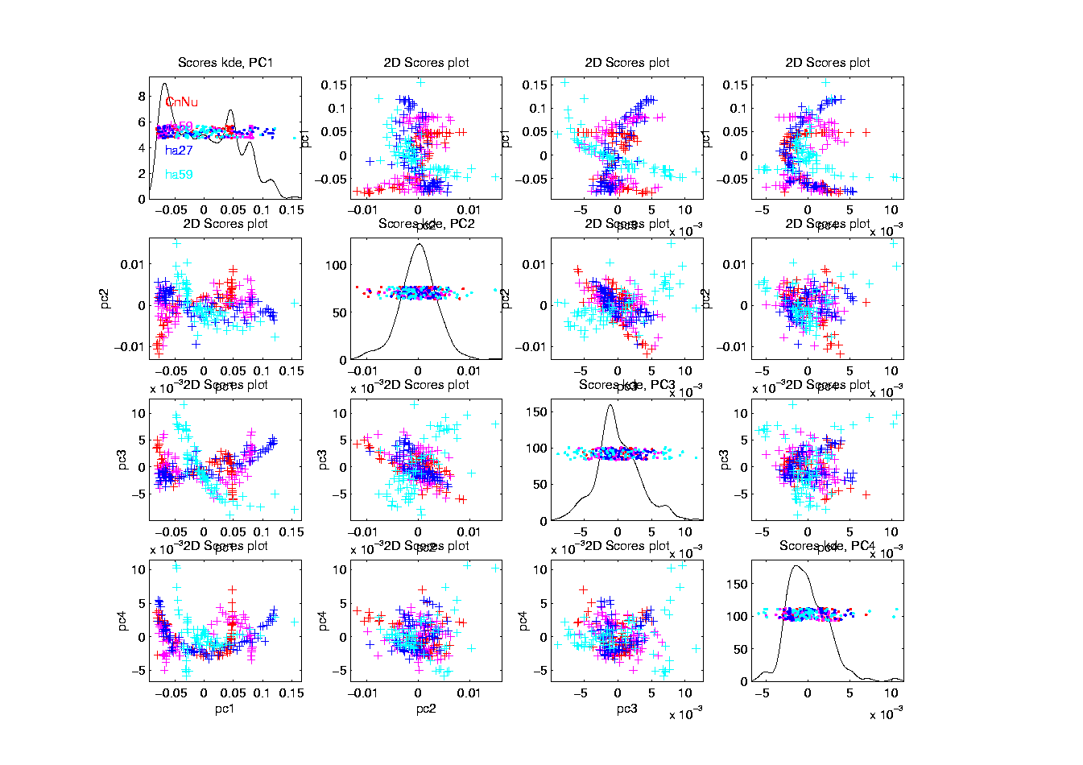
Chemo-metric T. S. Joint View (- mean)

Slide 64
Chemo-metric T. S. Joint View
Interesting Variation:
Remove cluster means
Allows clear comparison of within curve variation:
PC1 versus others are quite revealing
(note different “rotations”)
Others don’t show so much

Slide 65
Functional Data Analysis
Interesting Real Data Example
Genetics (Cancer Research)
RNAseq (Next Gener’n Sequen’g)
Deep look at “gene components”
Microarrays: Single number (per gene)
RNAseq: Thousands of measurements

Slide 66
Functional Data Analysis
Interesting Real Data Example
Genetics (Cancer Research)
RNAseq (Next Gener’n Sequen’g)
Deep look at “gene components”
Gene studied here: CDK2A
Goal: Study Alternate Splicing
Sample Size, n = 180
Dimension, d = ~1700

Slide 67
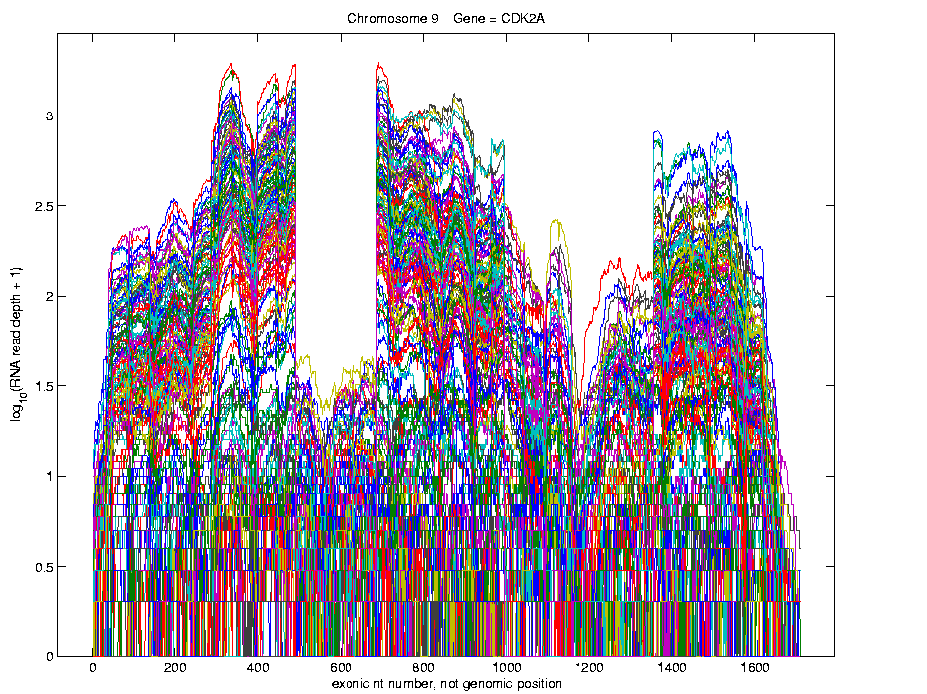
Functional Data Analysis
Simple
1st
View:
Curve
Overlay
(log
scale)

Slide 68
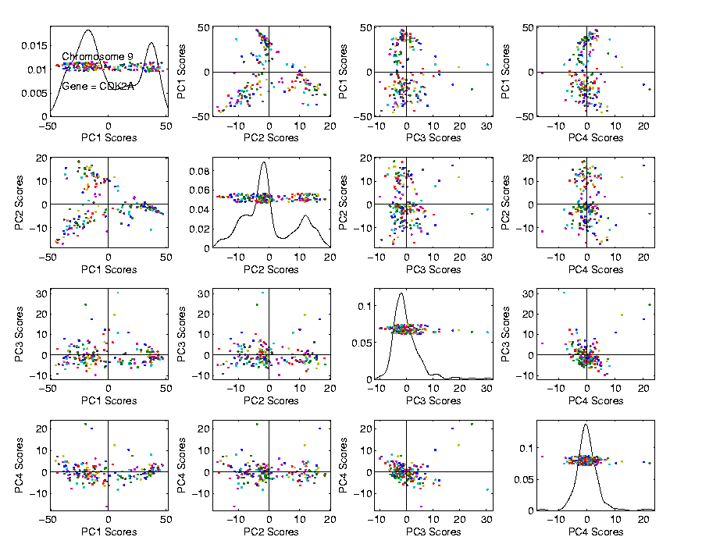
Functional Data Analysis
Often
Useful
Population
View:
PCA
Scores

Slide 69
Functional Data Analysis
Suggestion
Of
Clusters
???

Slide 70
Functional Data Analysis
Suggestion
Of
Clusters
Which
Are
These?

Slide 71
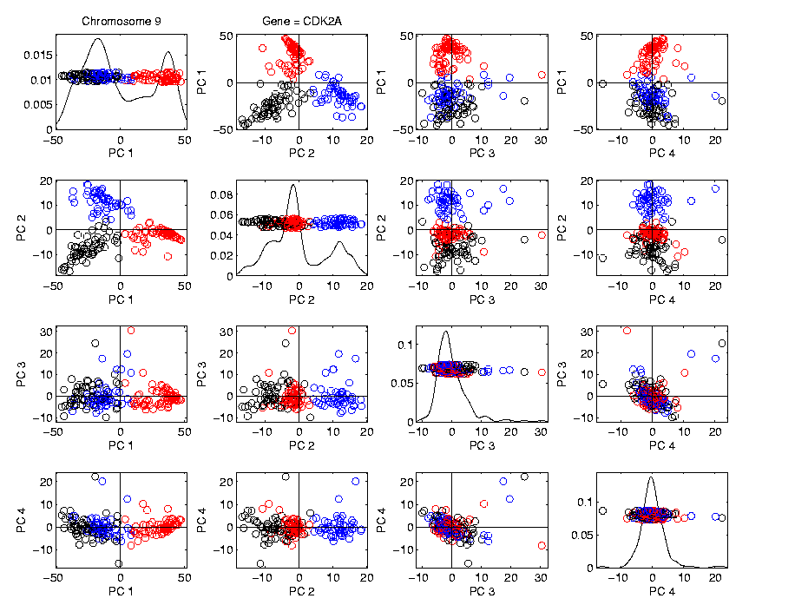
Functional Data Analysis
Manually
“Brush”
Clusters

Slide 72
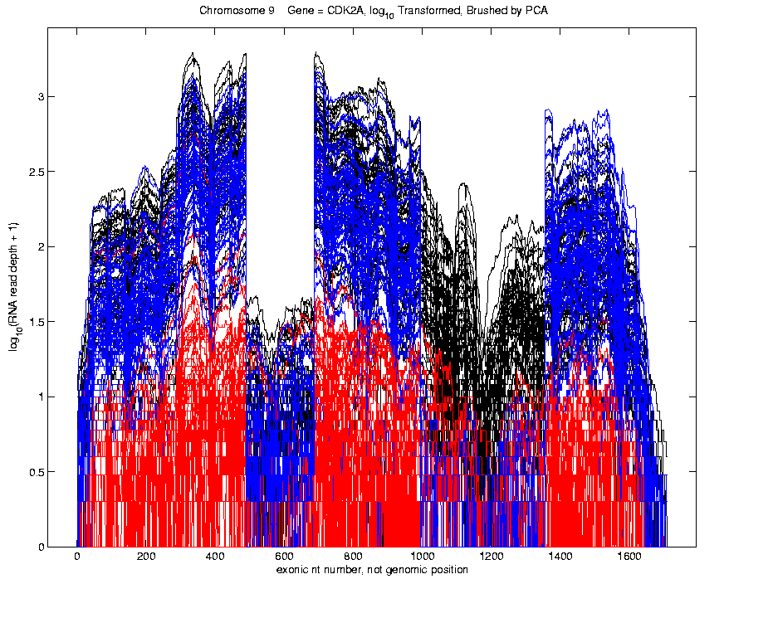
Functional Data Analysis
Manually
Brush
Clusters
Clear
Alternate
Splicing

Slide 73
Functional Data Analysis
Important Points
PCA found Important Structure
In High Dimensional Data Analysis
d ~ 1700

Slide 74
Functional Data Analysis
Interesting Question:
When are clusters really there?
(will study later)

Slide 75
Limitation of PCA
PCA can provide useful projection directions

Slide 76
Limitation of PCA
PCA can provide useful projection directions
But can’t “see everything”…

Slide 77
Limitation of PCA
PCA can provide useful projection directions
But can’t “see everything”…
Reason:
  PCA finds dir’ns of maximal variation
  Which may obscure interesting structure

Slide 78
Limitation of PCA
Toy Example:
Apple – Banana – Pear

Slide 79
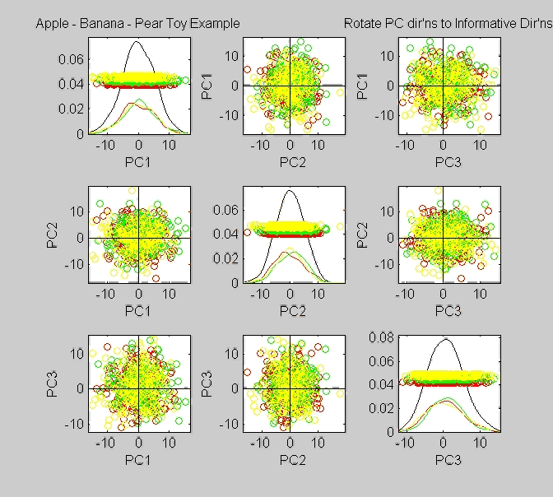
Limitation of PCA, Toy E.g.

Slide 80
Limitation of PCA
Toy Example:
Apple – Banana – Pear
Obscured by “noisy dimensions”
1st 3 PC directions only show noise

Slide 81
Limitation of PCA
Toy Example:
Apple – Banana – Pear
Obscured by “noisy dimensions”
1st 3 PC directions only show noise
Study some rotations, to find structure

Slide 82

Limitation of PCA, Toy E.g.

Slide 83
Limitation of PCA
Toy Example:
Rotation shows Apple – Banana – Pear
Example constructed as:
  1st make these in 3-d
  Add 3 dimensions of high s.d. noise
Carefully watch axis labels

Slide 84
Limitation of PCA
Main Point:
May be Important Data Structure
Not Visible in 1st Few PCs

Slide 85
Limitation of PCA, E.g.
Interesting Data Set: NCI-60

Slide 86
Limitation of PCA, E.g.
Interesting Data Set: NCI-60
NCI = National Cancer Institute
60 Cell Lines (cancer treatment targets)
For Different Cancer Types

Slide 87
Limitation of PCA, E.g.
Interesting Data Set: NCI-60
NCI = National Cancer Institute
60 Cell Lines (cancer treatment targets)
For Different Cancer Types
Measured “Gene Expression”
= “Gene Activity”
Several Thousand Genes (Simultaneously)

Slide 88
Limitation of PCA, E.g.
Interesting Data Set: NCI-60
NCI = National Cancer Institute
60 Cell Lines (cancer treatment targets)
For Different Cancer Types
Measured “Gene Expression”
= “Gene Activity”
Several Thousand Genes (Simultaneously)
Data Objects = Vectors of Gene Exp’n
Lots of Preprocessing (study later)

Slide 89
NCI 60 Data
Important Aspect: 8 Cancer Types
Renal Cancer
Non Small Cell Lung Cancer
Central Nervous System Cancer
Ovarian Cancer
Leukemia Cancer
Colon Cancer
Breast Cancer
Melanoma (Skin)
Notes:
89

Slide 90
PCA Visualization of NCI 60 Data
Can we find classes:
(Renal, CNS, Ovar, Leuk, Colon, Melan)
Using PC directions??
First try “unsupervised view”
I.e. switch off class colors
Then turn on colors, to identify clusters
I.e. look at “supervised view”
Notes:
90

Slide 91
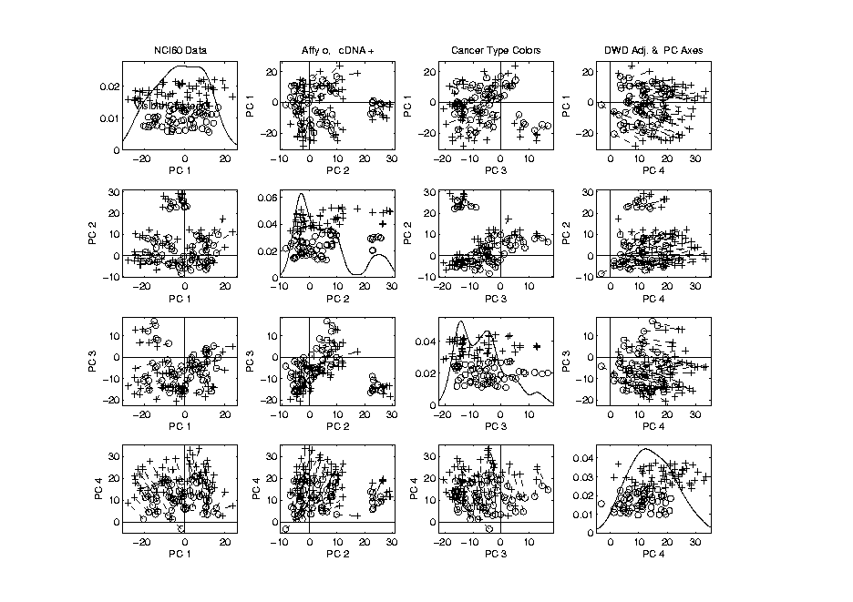
NCI 60: Can we find classes
Using PCA view?
Notes:
91

Slide 92
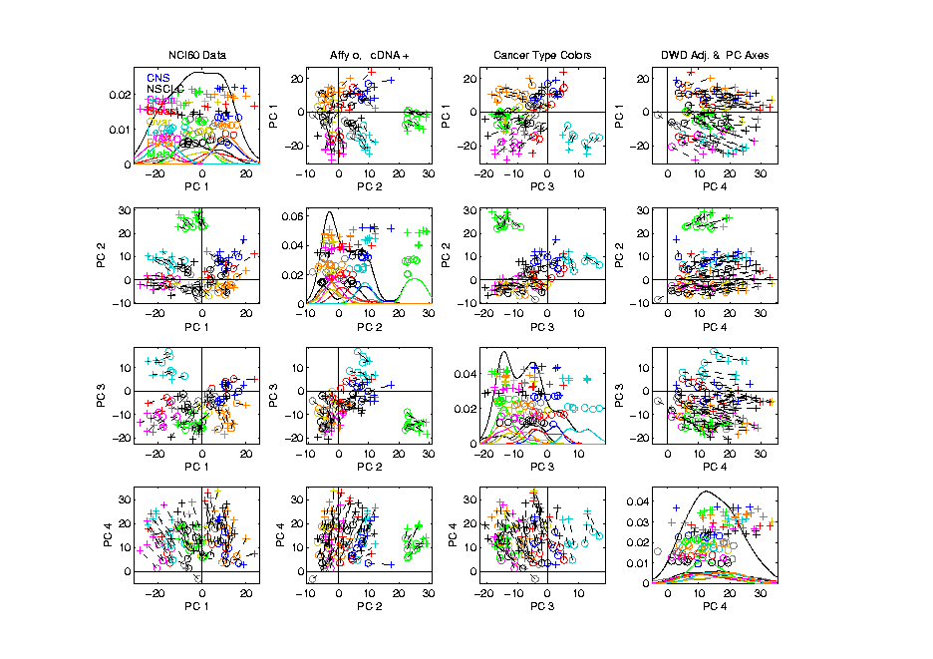
NCI 60: Can we find classes
Using PCA view?
Notes:
92

Slide 93
PCA Visualization of NCI 60 Data
Maybe need to look at more PCs?
Study array of such PCA projections:
Notes:
93

Slide 94
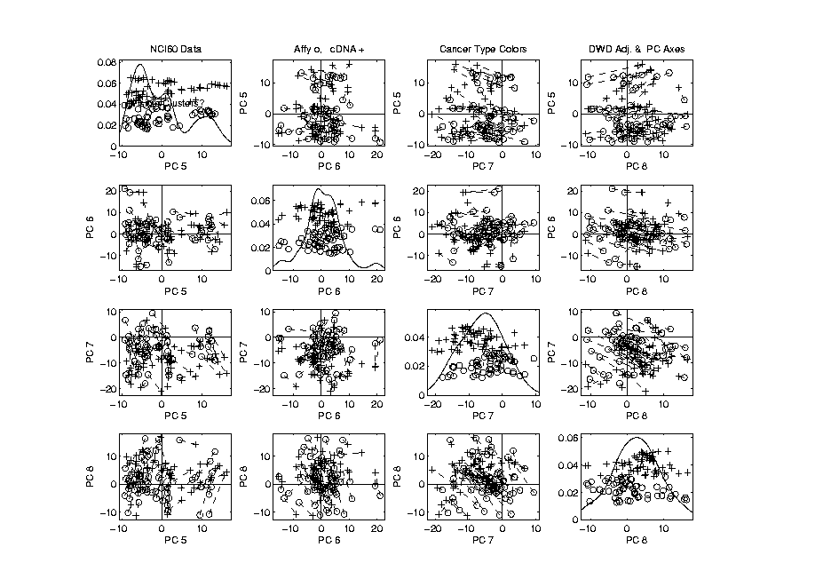
NCI 60: Can we find classes
Using PCA 5-8?
Notes:
94

Slide 95
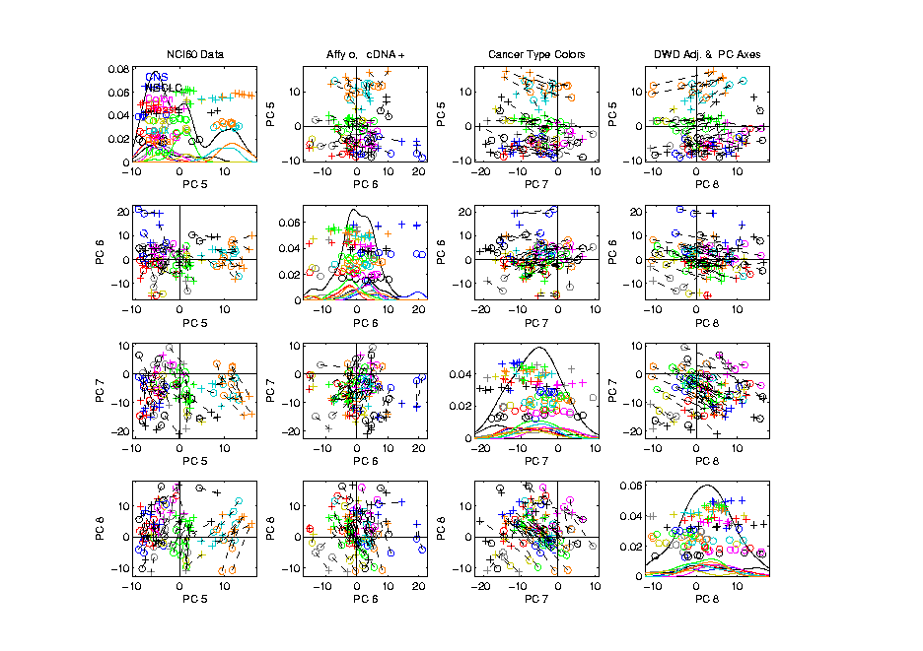
NCI 60: Can we find classes
Using PCA 5-8?
Notes:
95

Slide 96
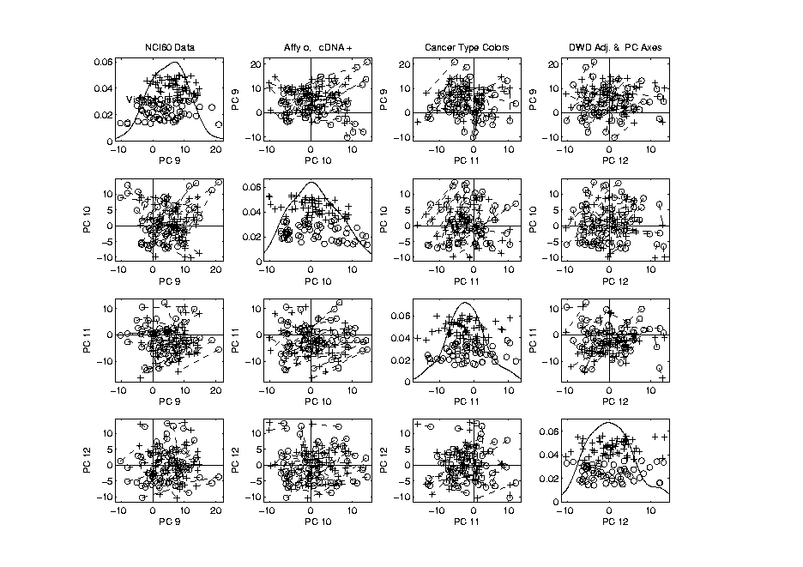
NCI 60: Can we find classes
Using PCA 9-12?
Notes:
96

Slide 97
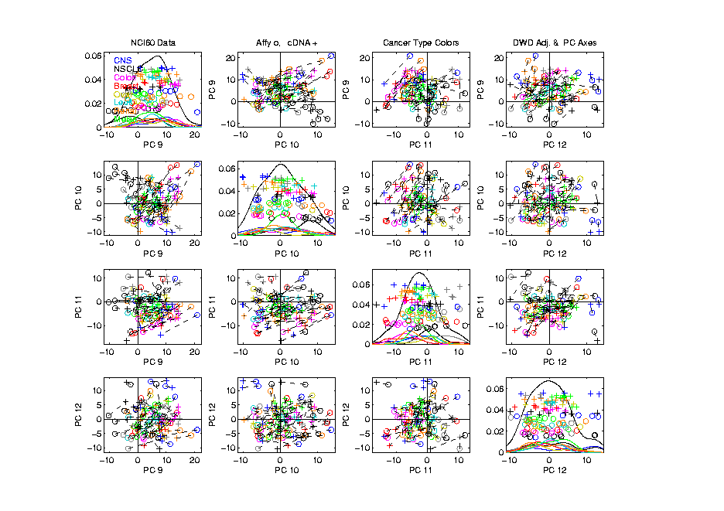
NCI 60: Can we find classes
Using PCA 9-12?
Notes:
97

Slide 98
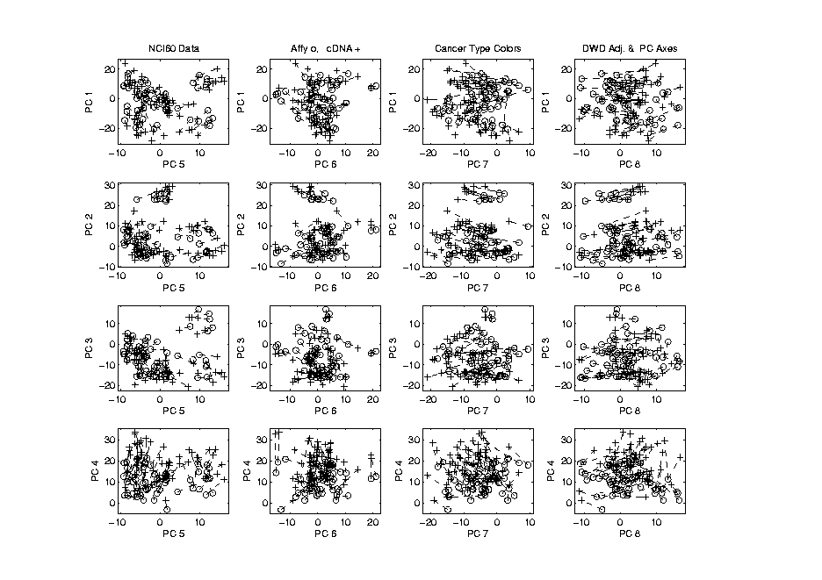
NCI 60: Can we find classes
Using PCA 1-4 vs. 5-8?
Notes:
98

Slide 99
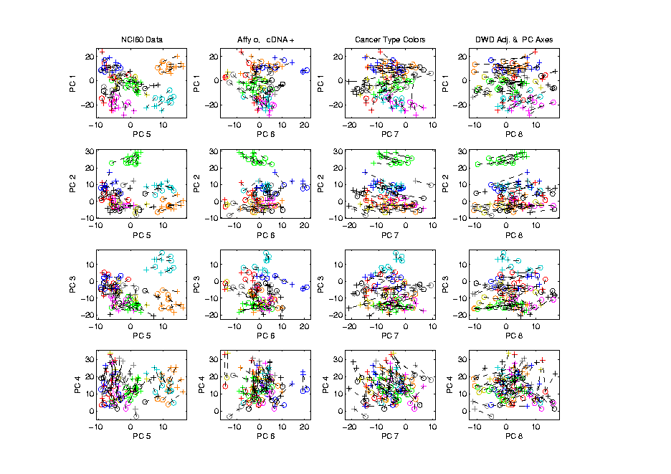
NCI 60: Can we find classes
Using PCA 1-4 vs. 5-8?
Notes:
99

Slide 100
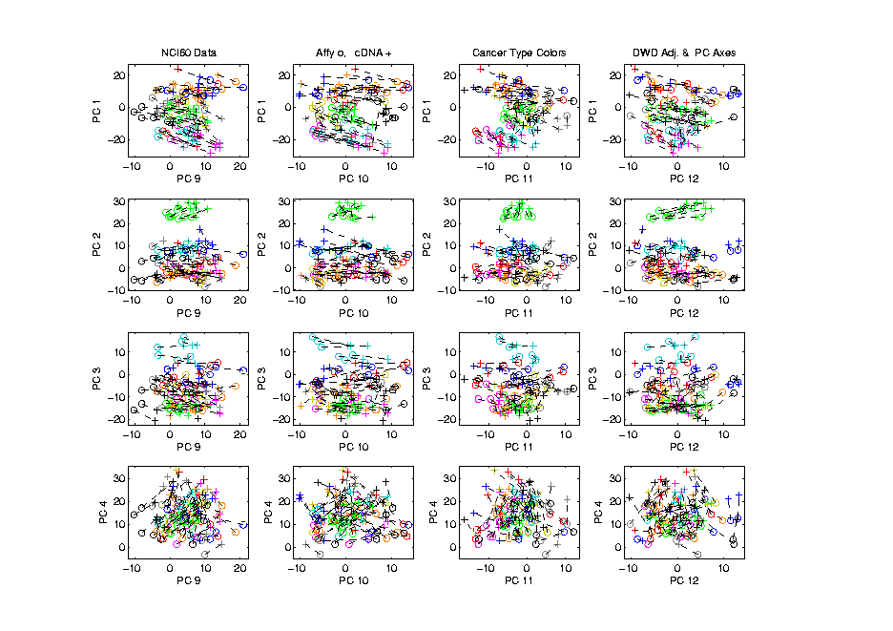
NCI 60: Can we find classes
Using PCA 1-4 vs. 9-12?
Notes:
100

Slide 101
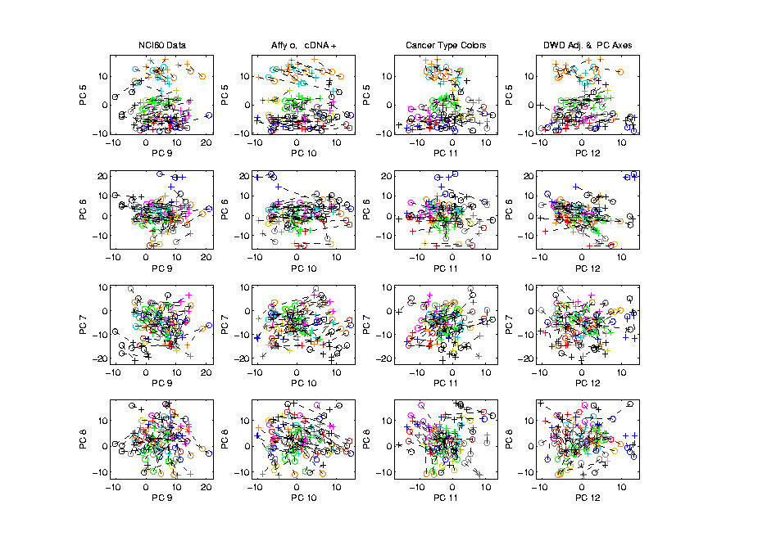
NCI 60: Can we find classes
Using PCA 5-8 vs. 9-12?
Notes:
101

Slide 102
PCA Visualization of NCI 60 Data
Can we find classes using PC directions??
Found some, but not others
Nothing after 1st five PCs
Rest seem to be noise driven
Notes:
102

Slide 103
PCA Visualization of NCI 60 Data
Can we find classes using PC directions??
Found some, but not others
Nothing after 1st five PCs
Rest seem to be noise driven
Are There Better Directions?
PCA only “feels” maximal variation
Ignores Class Labels
How Can We Use Class Labels?
Notes:
103

Slide 104
Visualization of NCI 60 Data
How Can We Use Class Labels?
Approach:
Find Directions to “Best Separate” Classes
In Disjoint Pairs (thus 4 Directions)
Use DWD:
Distance Weighted Discrimination
Defined (& Motivated) Later
Project All Data on These 4 Directions
Notes:
104

Slide 105
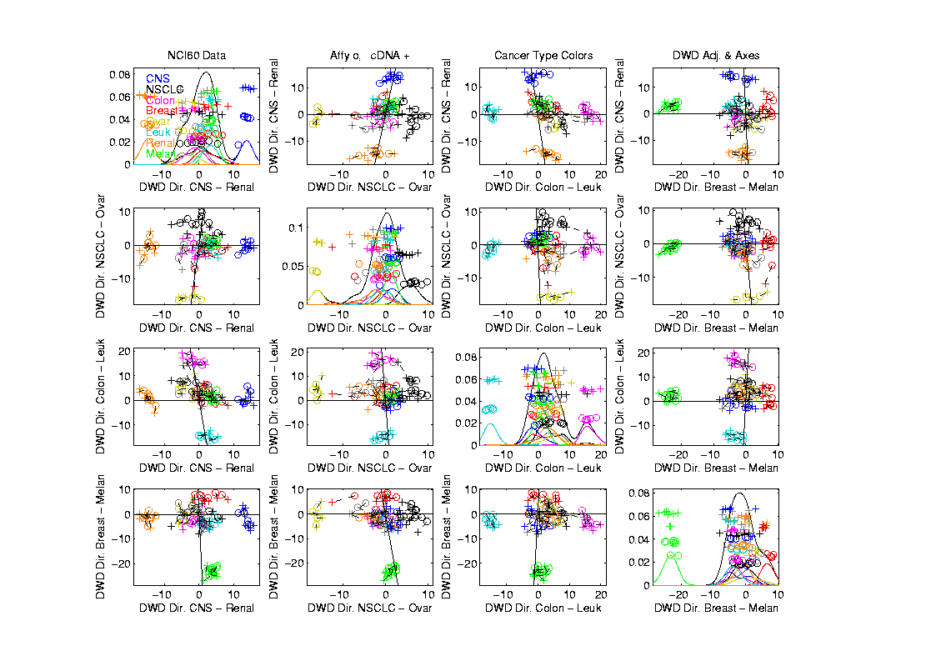
NCI 60: Views using DWD Dir’ns (focus on biology)
Notes:
105

Slide 106
DWD Visualization of NCI 60 Data
Most cancer types clearly distinct
(Renal, CNS, Ovar, Leuk, Colon, Melan)
Using these carefully chosen directions
Others less clear cut
  NSCLC (at least 3 subtypes)
  Breast (4 published subtypes)

Slide 107
DWD Visualization
Recall PCA limitations
DWD uses class info
Hence can “better separate known classes”
Do this for pairs of classes
(DWD just on those, ignore others)
Carefully choose pairs in NCI 60 data
Note DWD Directions Not Orthogonal
(PCA orthogonality may be
too strong a constraint)

Slide 108
NCI 60: Views using DWD Dir’ns (focus on biology)

Slide 109
PCA Visualization of NCI 60 Data
Can we find classes using PC directions??
Found some, but not others
Not so distinct as in DWD view
Nothing after 1st five PCs
Rest seem to be noise driven
Orthogonality too strong a constraint???
Interesting dir’ns are nearly orthogonal
Notes:
109

Slide 110
Limitation of PCA
Main Point:
May be Important Data Structure
Not Visible in 1st Few PCs

Slide 111
Yeast Cell Cycle Data
“Gene Expression” – Microarray data
Data (after major preprocessing): Expression “level” of:
thousands of genes (d ~ 1,000s)
but only dozens of “cases” (n ~ 10s)
Interesting statistical issue:
High Dimension Low Sample Size data
(HDLSS)

Slide 112
Yeast Cell Cycle Data
Data from:
Spellman, P. T., Sherlock, G., Zhang, M.Q., Iyer, V.R., Anders, K., Eisen, M.B., Brown, P.O., Botstein, D. and Futcher, B. (1998), “Comprehensive Identification of Cell Cycle-regulated Genes of the Yeast Saccharomyces cerevisiae by Microarray Hybridization”, Molecular Biology of the Cell, 9, 3273-3297.

Slide 113
Yeast Cell Cycle Data
Analysis here is from:
Zhao, X., Marron, J.S. and Wells, M.T. (2004) The Functional Data View of Longitudinal Data, Statistica Sinica, 14, 789-808

Slide 114
Yeast Cell Cycle Data
Lab experiment:
Chemically “synchronize cell cycles”, of yeast cells
Do cDNA micro-arrays over time
Used 18 time points, over “about 2 cell cycles”
Studied 4,489 genes (whole genome)
Time series view of data:
have 4,489 time series of length 18
Functional Data View:
have 18 “curves”, of dimension 4,489

Slide 115
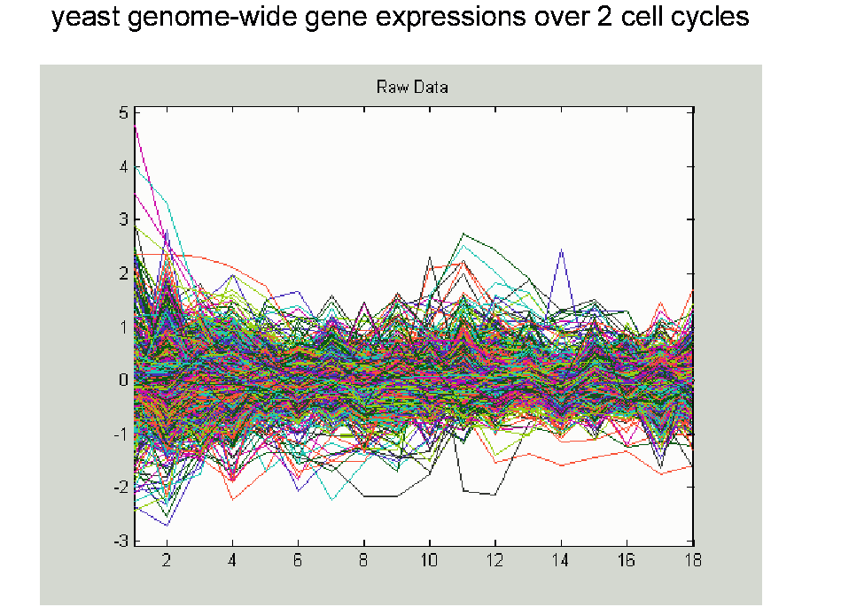
Yeast Cell Cycle Data, FDA View
Central question:
Which genes are “periodic” over 2 cell cycles?

