Slide 1
Statistics – O. R. 891
Object Oriented Data Analysis
J. S. Marron
Dept. of Statistics and Operations Research
University of North Carolina

Slide 2
PCA Terminology
Projections Coefficients
are called “Scores”
Entries of Direction Vectors
are called “Loadings”
Notes:
EgView1p72PCAViewClustColor.ps

Slide 3
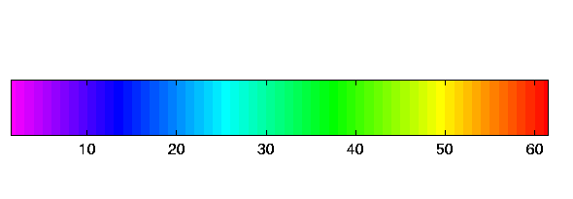
Time Series of Curves
Just a “Set of Curves”
But Time Order is Important!
Useful Approach:
Use color to code for time
Start End

Slide 4
T. S. Toy E.g., PCA Scatterplot
Where is the Point Cloud?
Lies along a 1-d curve in
So actually have 1-d mode of variation
But a non-linear mode of variation
Poorly captured by PCA (linear method)
Will study more later

Slide 5
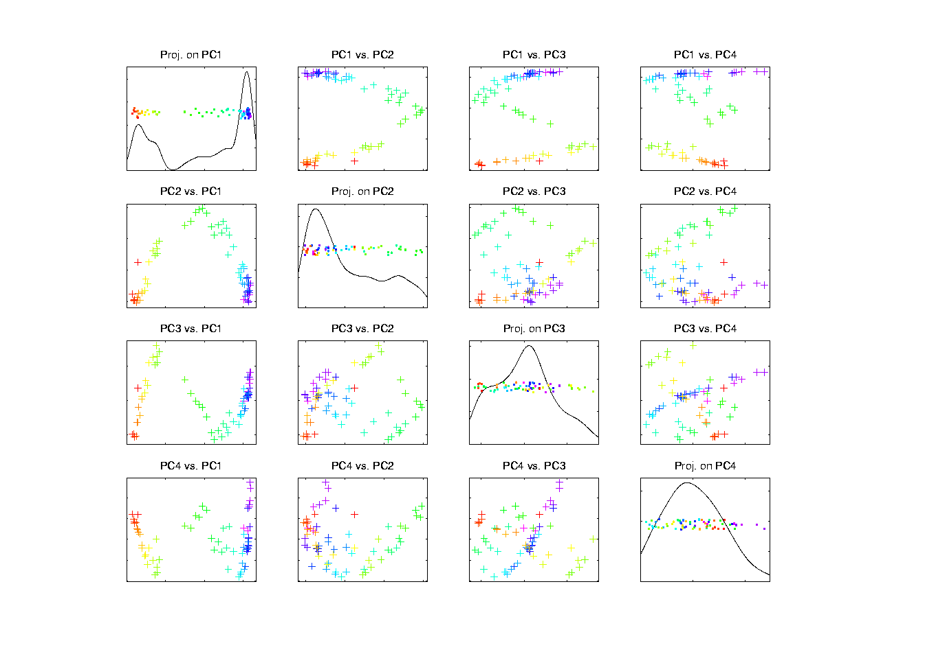
Chemo-metric Time Series, Control

Slide 6
Limitation of PCA
PCA can provide useful projection directions
But can’t “see everything”…
Reason:
  PCA finds dir’ns of maximal variation
  Which may obscure interesting structure

Slide 7
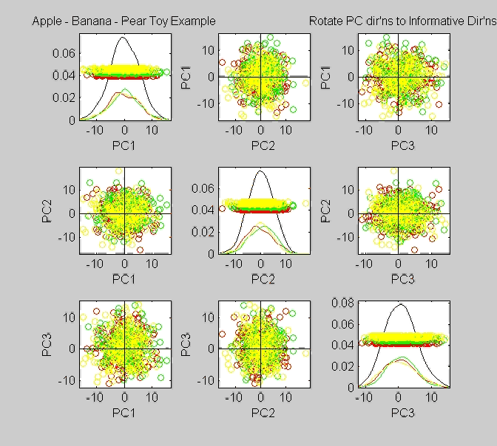
Limitation of PCA, Toy E.g.

Slide 8
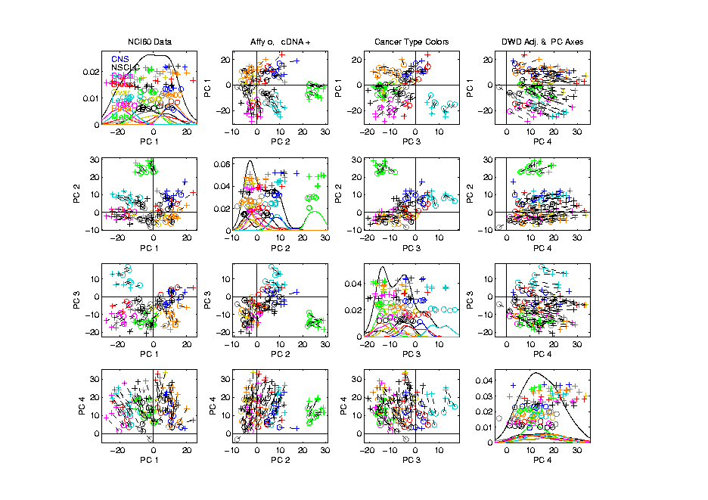
NCI 60: Can we find classes
Using PCA view?
Notes:
8

Slide 9
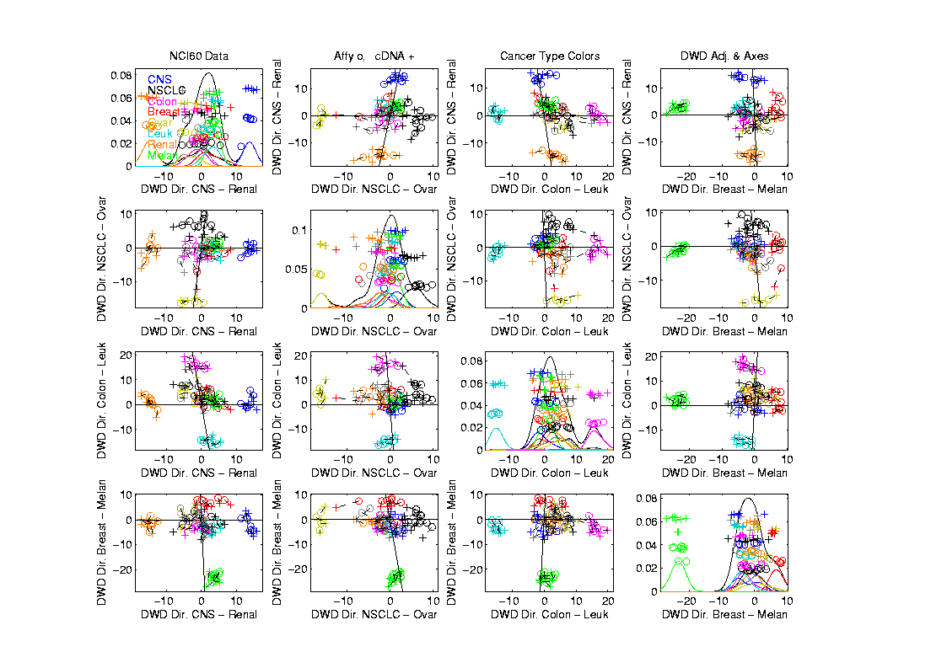
NCI 60: Views using DWD Dir’ns (focus on biology)

Slide 10
Yeast Cell Cycle Data
“Gene Expression” – Microarray data
Data (after major preprocessing): Expression “level” of:
thousands of genes (d ~ 1,000s)
but only dozens of “cases” (n ~ 10s)
Interesting statistical issue:
High Dimension Low Sample Size data
(HDLSS)

Slide 11
Yeast Cell Cycle Data
Lab experiment:
Chemically “synchronize cell cycles”, of yeast cells
Do cDNA micro-arrays over time
Used 18 time points, over “about 2 cell cycles”
Studied 4,489 genes (whole genome)
Time series view of data:
have 4,489 time series of length 18
Functional Data View:
have 18 “curves”, of dimension 4,489

Slide 12
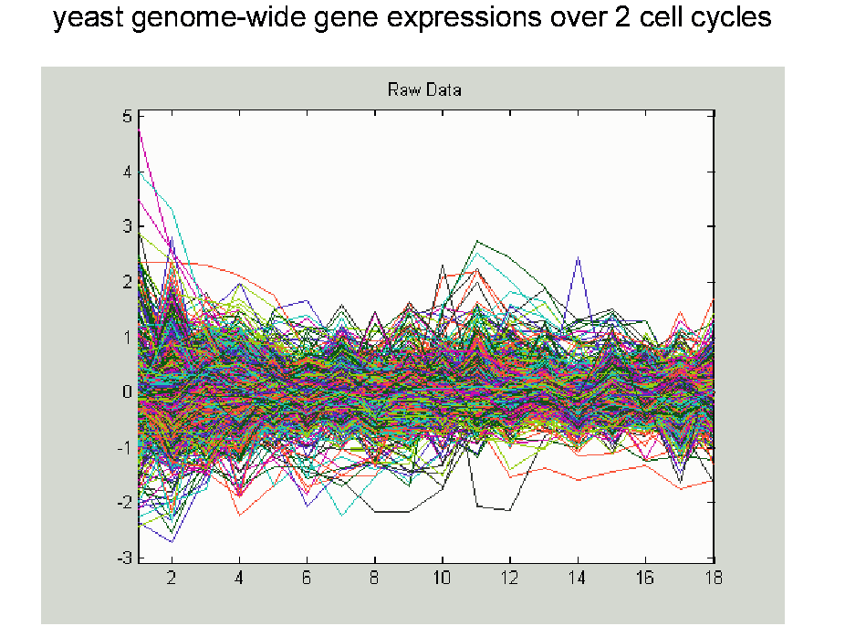
Yeast Cell Cycle Data, FDA View
Central question:
Which genes are “periodic” over 2 cell cycles?

Slide 13
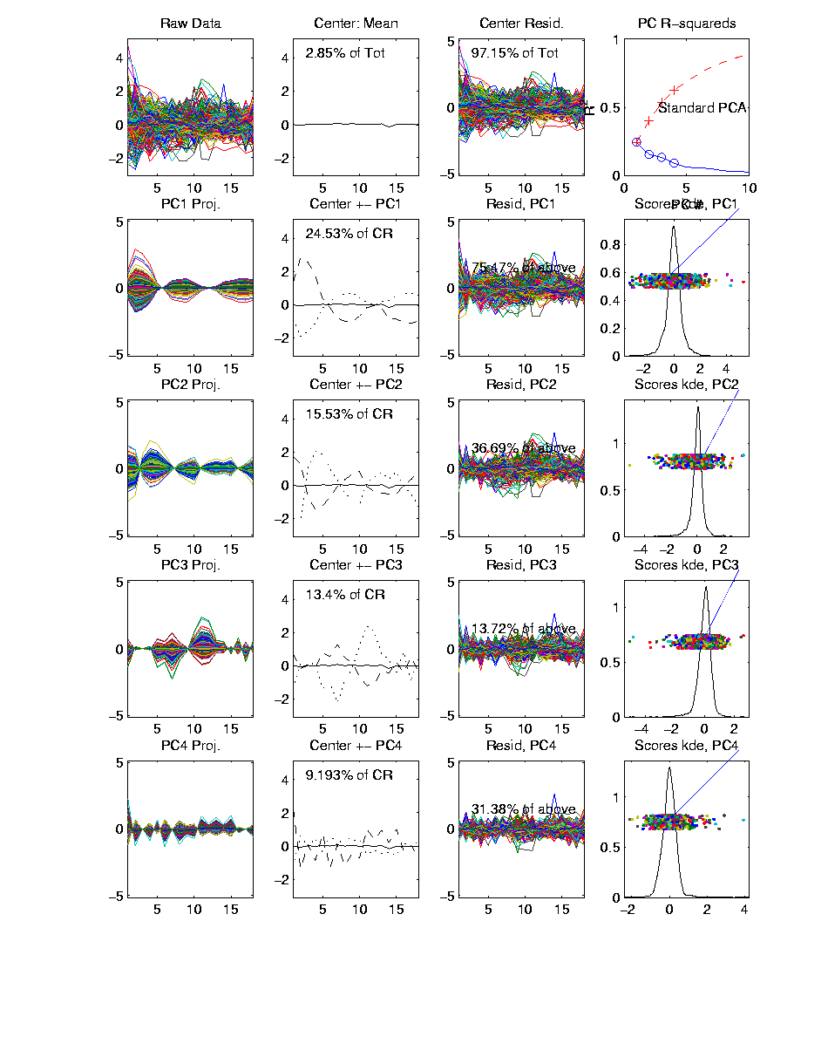
Yeast Cell Cycle Data, FDA View
Periodic
genes?
Naïve
approach:
Simple PCA

Slide 14
Yeast Cell Cycle Data, FDA View
Central question: which genes are “periodic” over 2 cell cycles?
Naïve approach: Simple PCA
No apparent (2 cycle) periodic structure?
Eigenvalues suggest large amount of “variation”
PCA finds “directions of maximal variation”
Often, but not always, same as “interesting directions”
Here need better approach to study periodicities

Slide 15
Yeast Cell Cycle Data, FDA View
Approach
Project on Period 2 Components Only
Calculate via Fourier Representation
To understand, study Fourier Basis
Powerful Fact: linear combos of sin and cos capture “phase”, since:

Slide 16
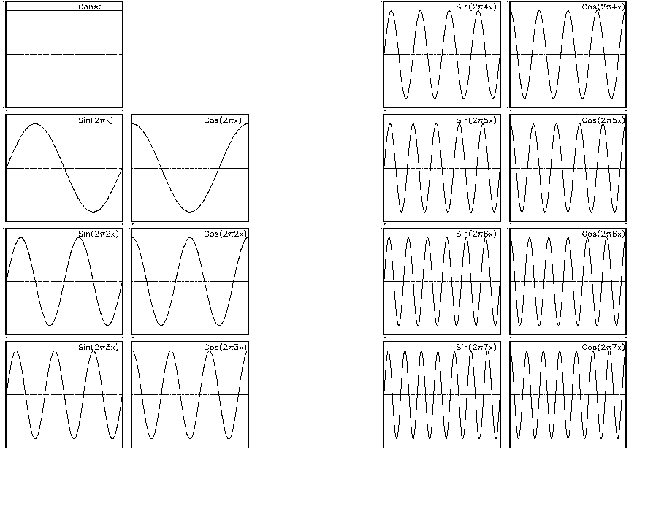
Fourier Basis

Slide 17
Yeast Cell Cycle Data, FDA View
Approach
Project on Period 2 Components Only
Calculate via Fourier Representation
Project onto Subspace of Even Frequencies
Keeps only 2-period part of data
(i.e. same over both cycles)
Then do PCA on projected data

Slide 18
Fourier Basis

Slide 19
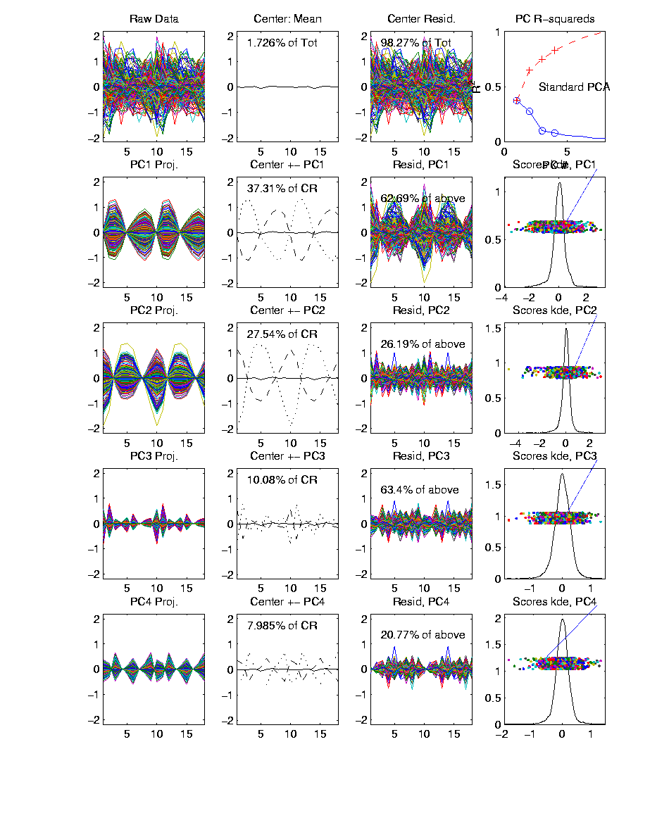
Yeast Cell Cycles, Freq. 2 Proj.
PCA on
Freq. 2
Periodic
Component
Of Data

Slide 20
Yeast Cell Cycles, Freq. 2 Proj.
PCA on periodic component of data
Hard to see periodicities in raw data
But very clear in PC1 (~sin) and PC2 (~cos)
PC1 and PC2 explain 65% of variation (see residuals)
Recall linear combos of sin and cos capture “phase”, since:

Slide 21
Frequency 2 Analysis
Important features of data appear only at frequency 2,
Hence project data onto 2-dim space of sin and cos (freq. 2)
Useful view: scatterplot
Similar to PCA proj’ns, except “directions” are now chosen, not “var max’ing”

Slide 22
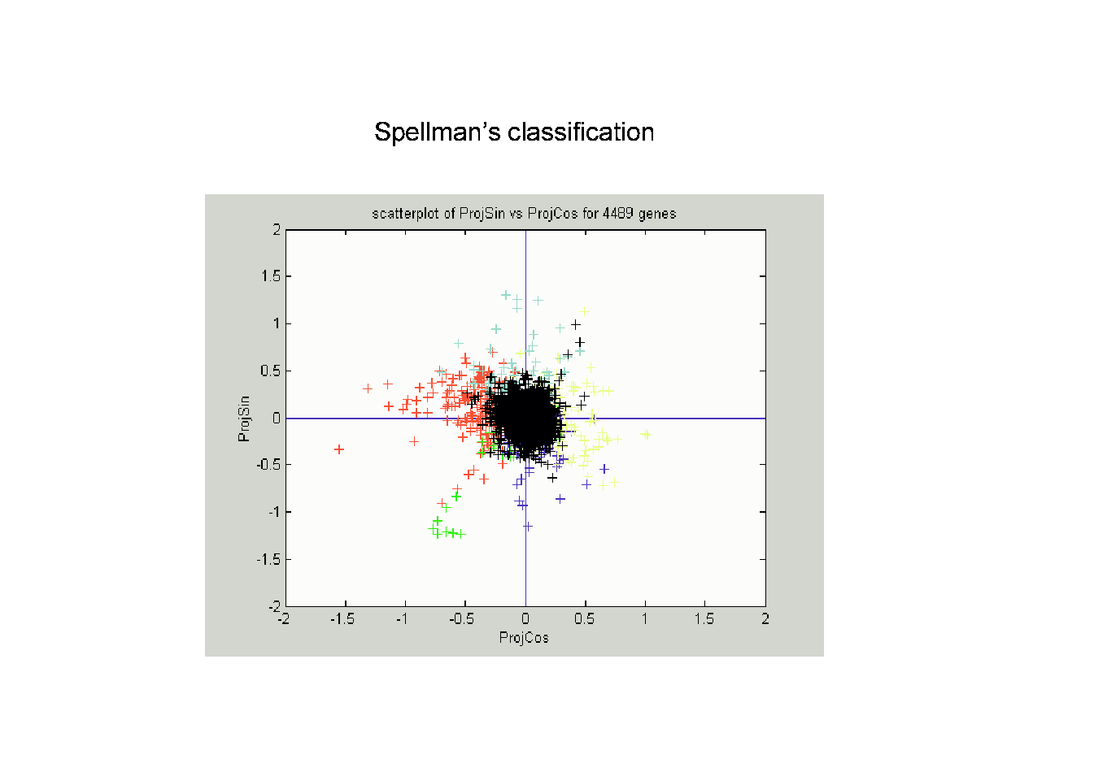
Frequency 2 Analysis

Slide 23
Frequency 2 Analysis
Project data onto 2-dim space of sin and cos (freq. 2)
Useful view: scatterplot
Angle (in polar coordinates) shows phase
Colors: Spellman’s cell cycle phase classification
Black was labeled “not periodic”
Within class phases approx’ly same, but notable differences
Later will try to improve “phase classification”

Slide 24
Batch and Source Adjustment
For Stanford Breast Cancer Data (C. Perou)
Analysis in Benito, et al (2004) Bioinformatics, 20, 105-114.
https://genome.unc.edu/pubsup/dwd/
Adjust for Source Effects
  Different sources of mRNA
Adjust for Batch Effects
  Arrays fabricated at different times

Slide 25
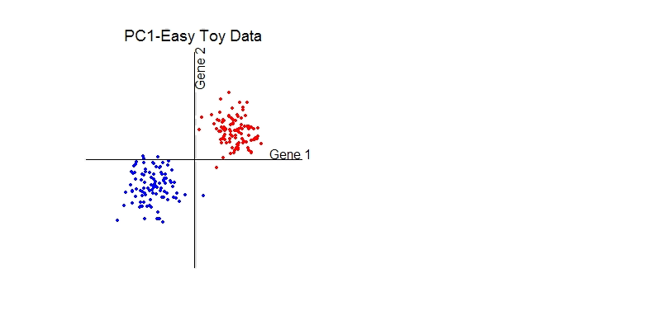
Idea Behind Adjustment
Find “direction” from one to other
Shift data along that direction
Details of DWD Direction developed later

Slide 26
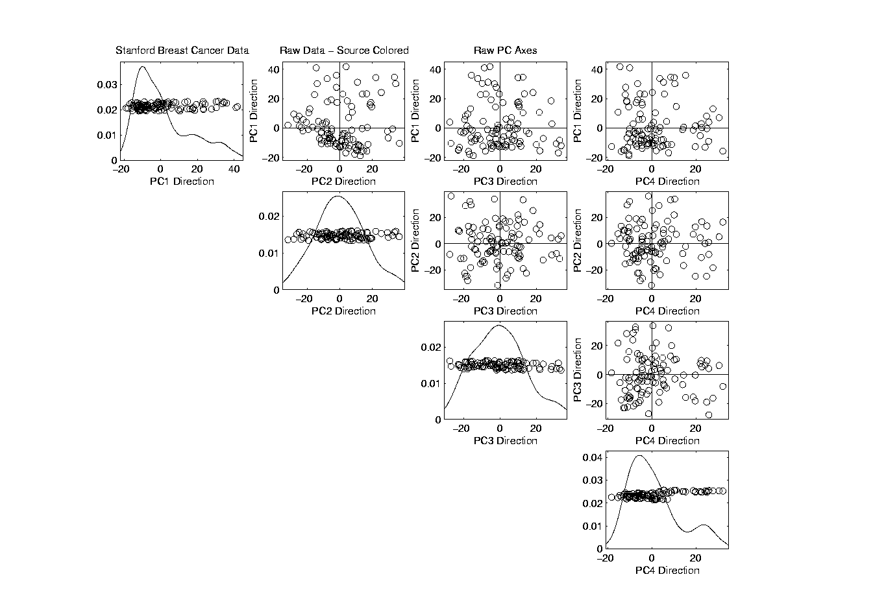
Source Batch Adj: Raw Breast Cancer data

Slide 27
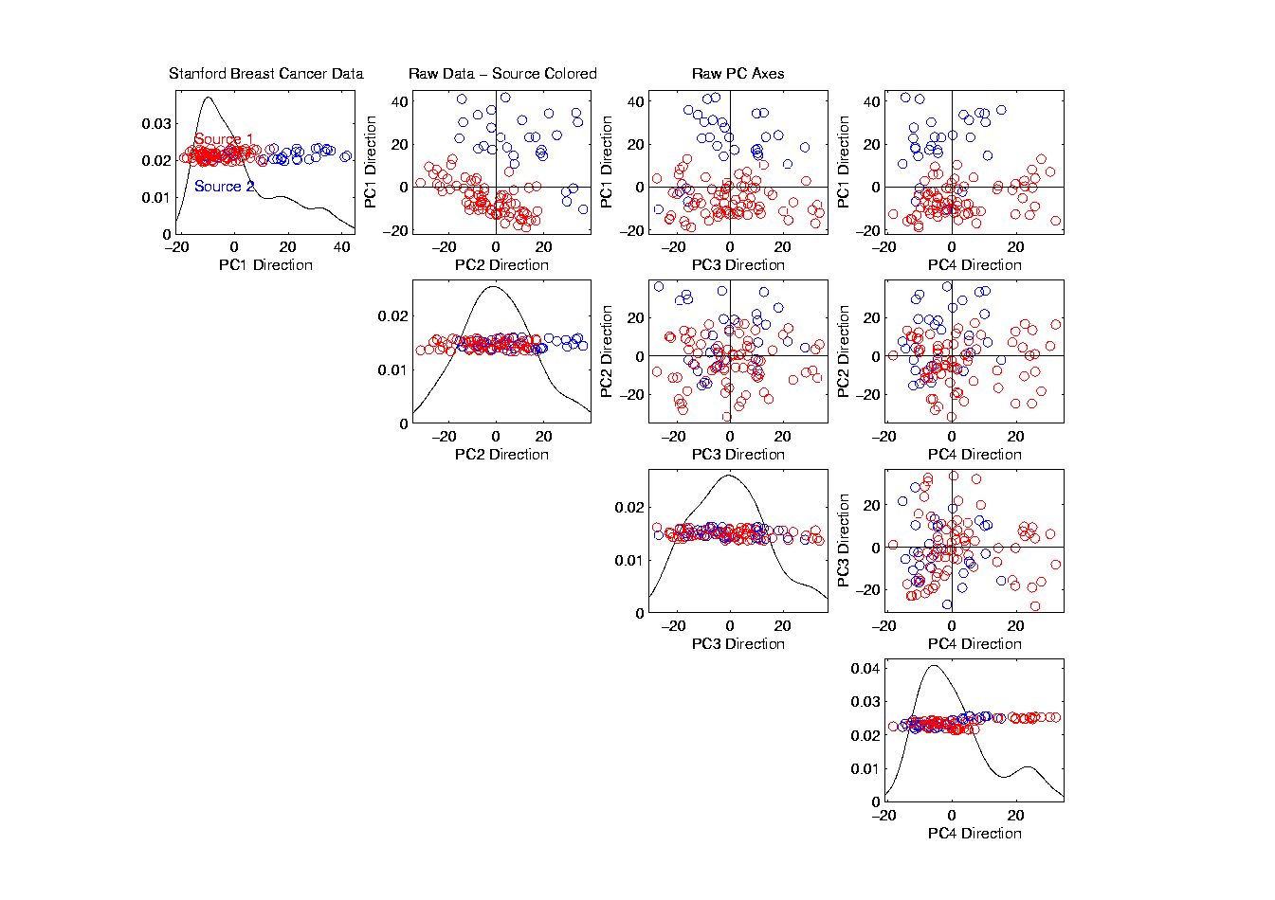
Source Batch Adj: Source Colors

Slide 28
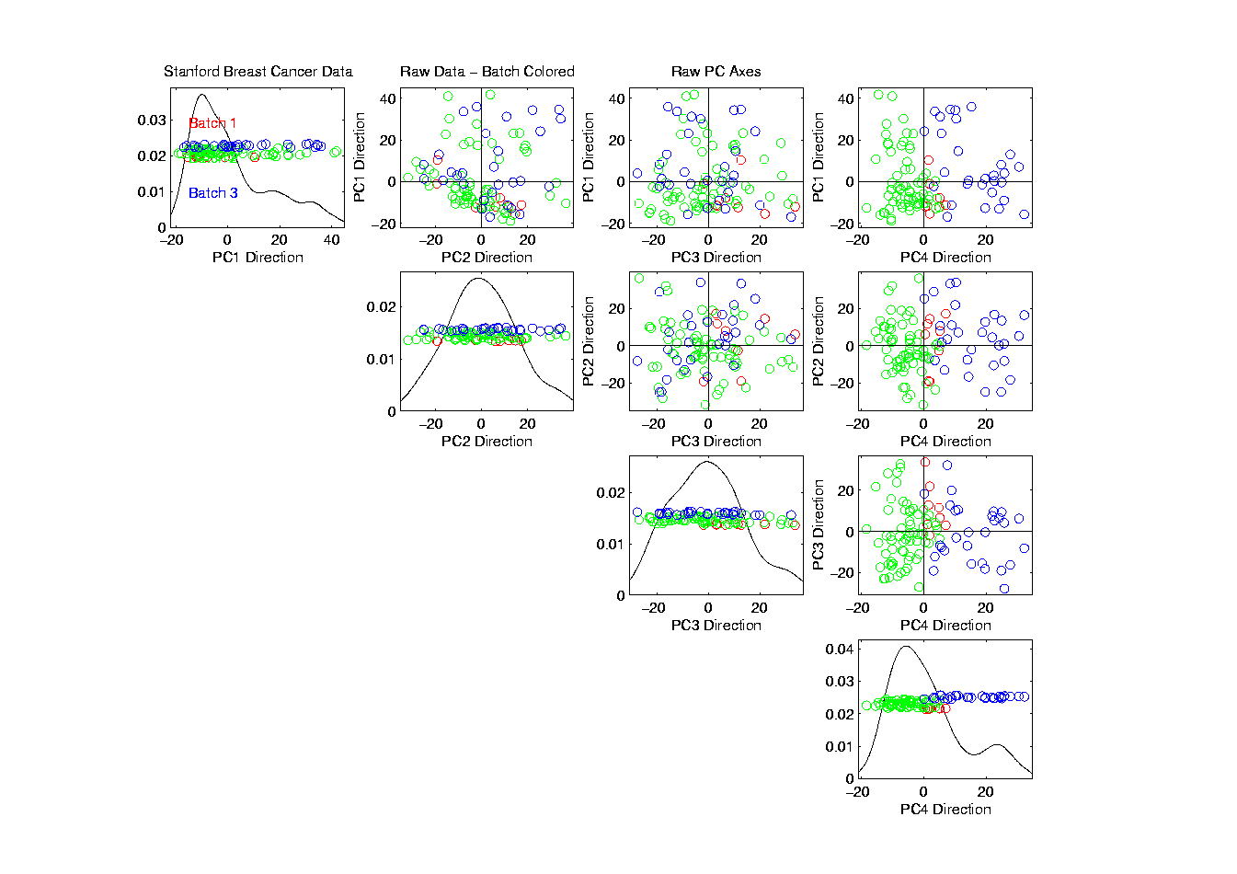
Source Batch Adj: Batch Colors

Slide 29
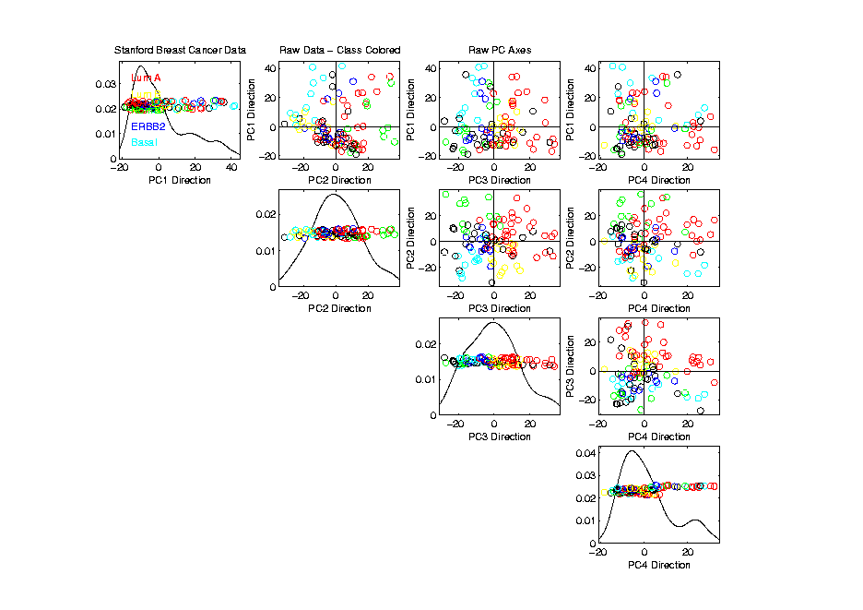
Source Batch Adj: Biological Class Colors

Slide 30
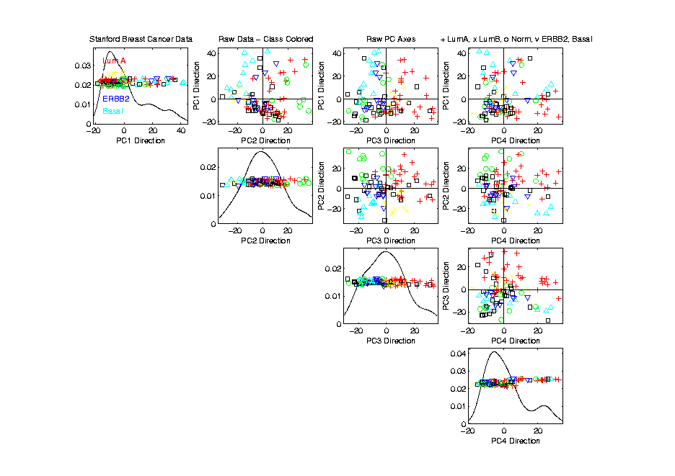
Source Batch Adj: Biological Class Col. & Symbols

Slide 31
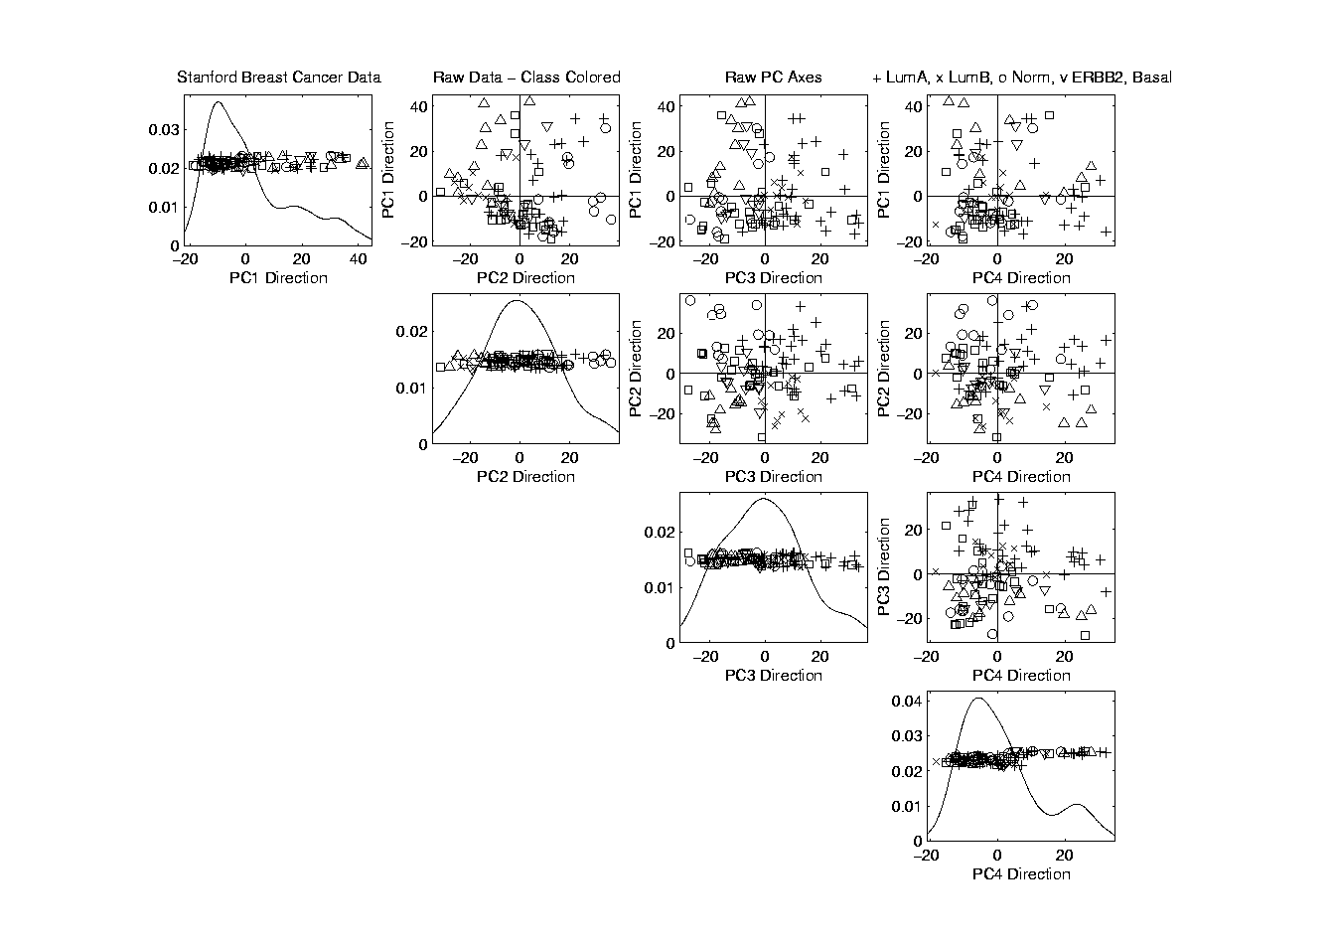
Source Batch Adj: Biological Class Symbols

Slide 32
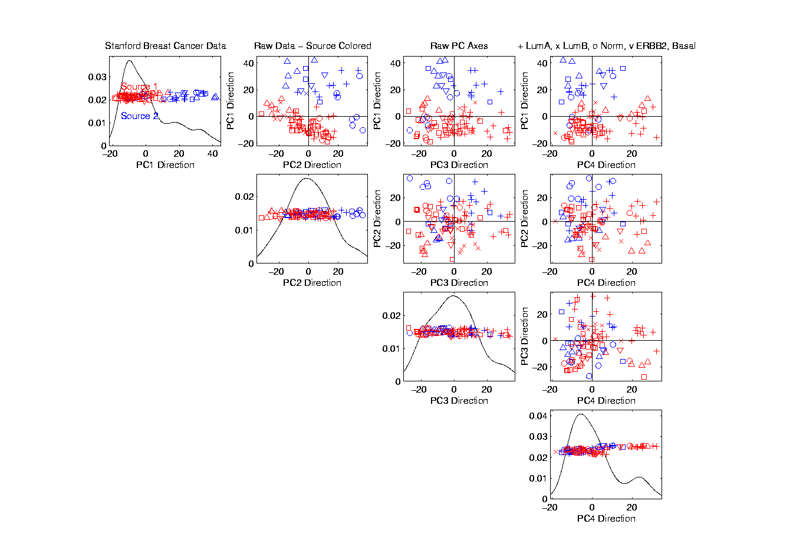
Source Batch Adj: Source Colors

Slide 33
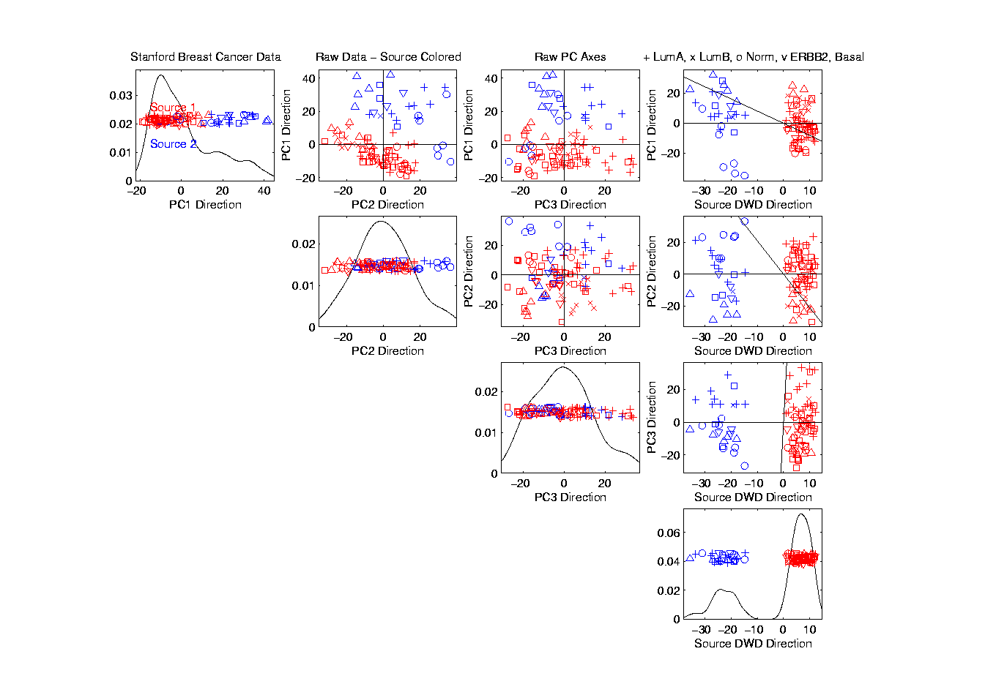
Source Batch Adj: PC 1-3 & DWD direction

Slide 34
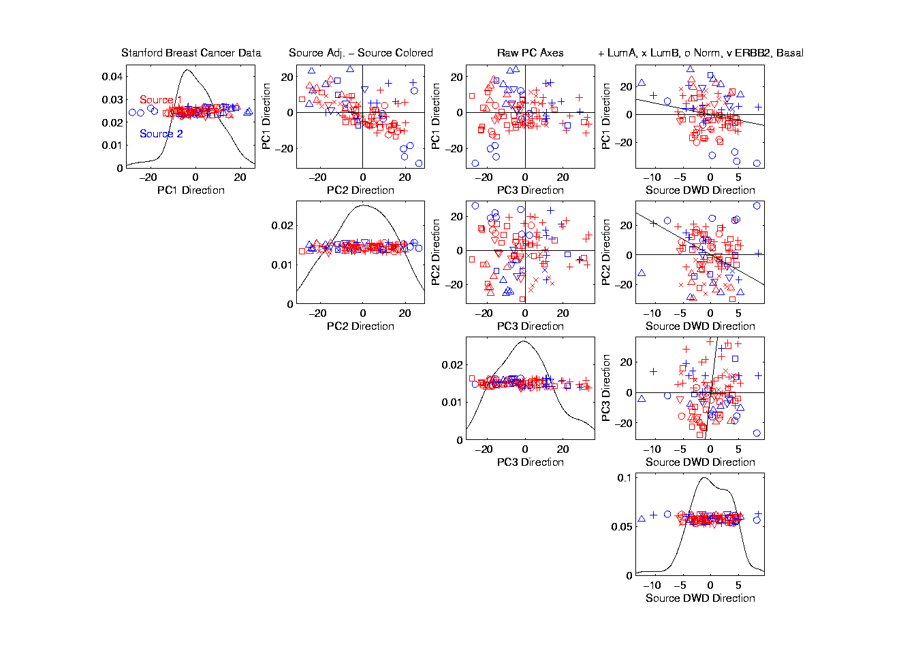
Source Batch Adj: DWD Source Adjustment

Slide 35
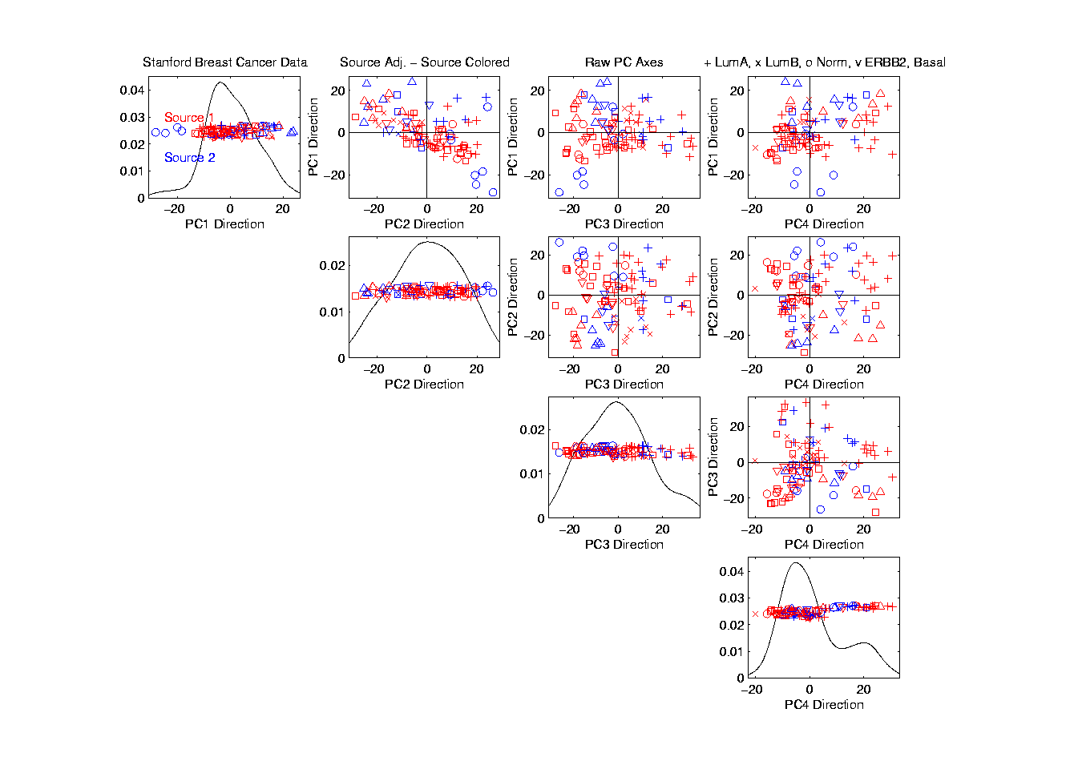
Source Batch Adj: Source Adj’d, PCA view

Slide 36
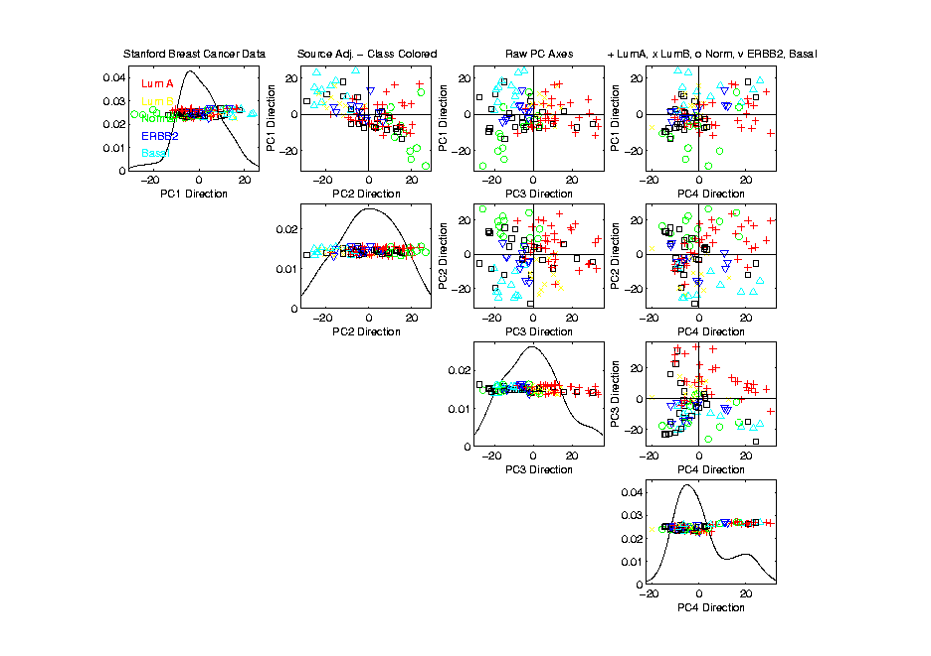
Source Batch Adj: Source Adj’d, Class Colored

Slide 37
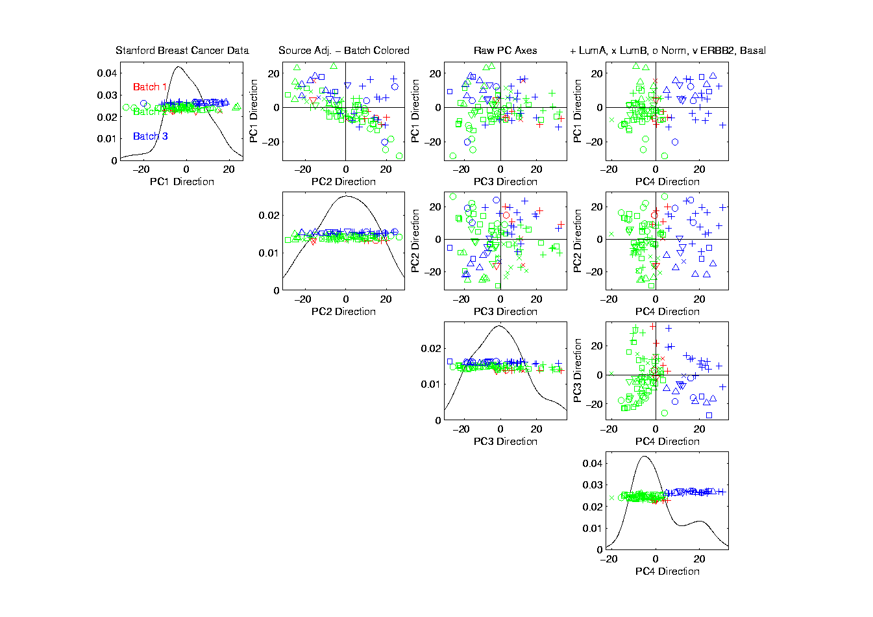
Source Batch Adj: Source Adj’d, Batch Colored

Slide 38
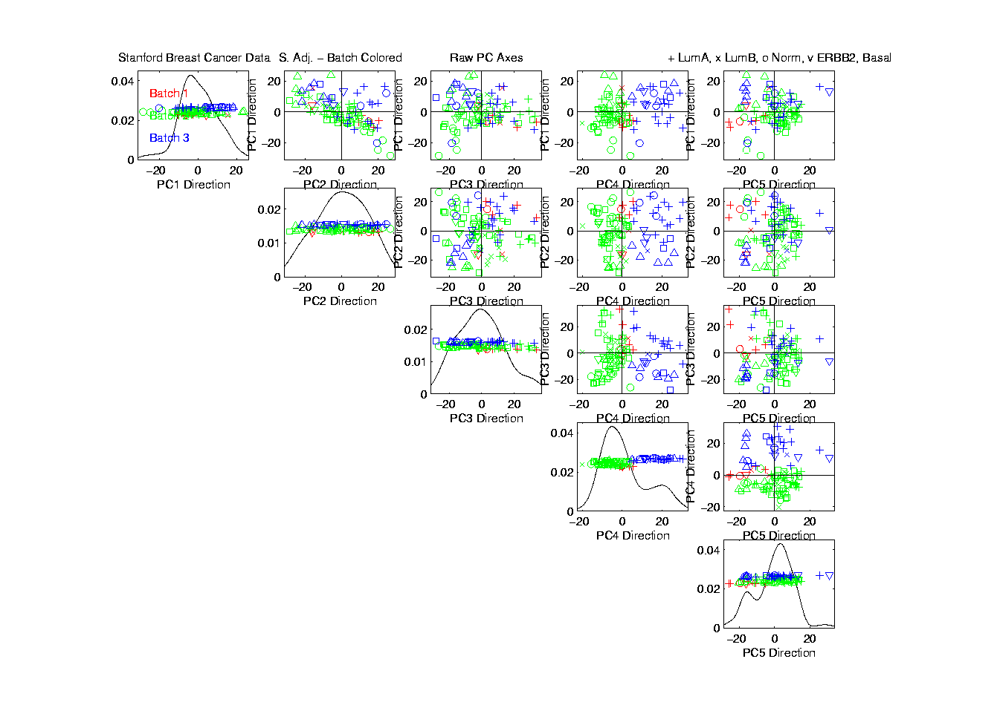
Source Batch Adj: Source Adj’d, 5 PCs

Slide 39
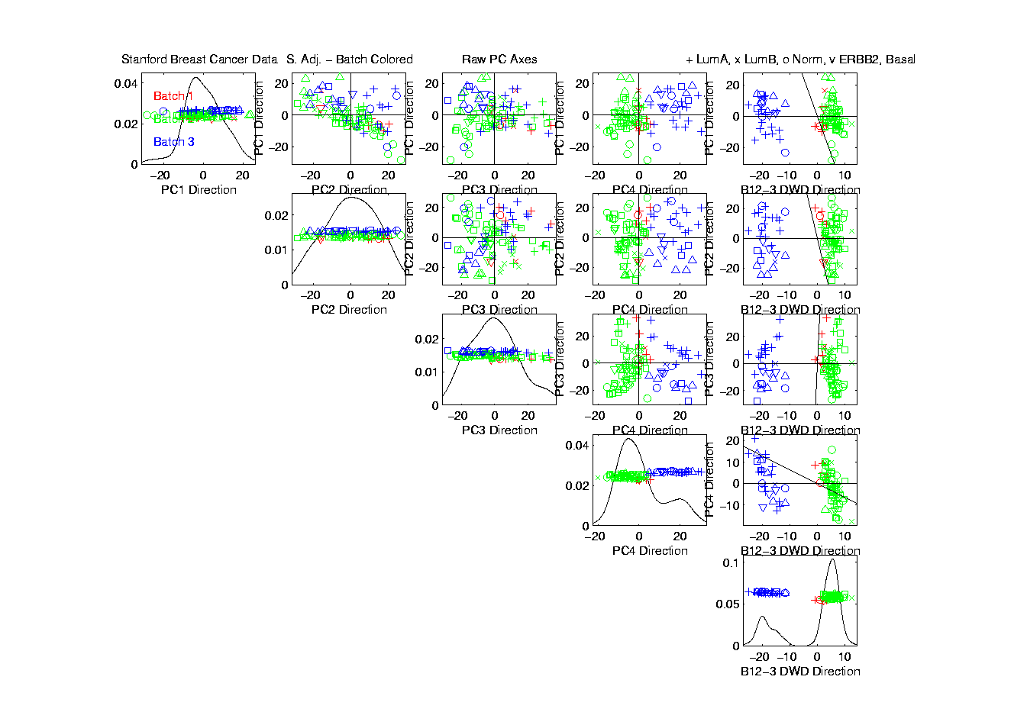
Source Batch Adj: S. Adj’d, Batch 1,2 vs. 3 DWD

Slide 40
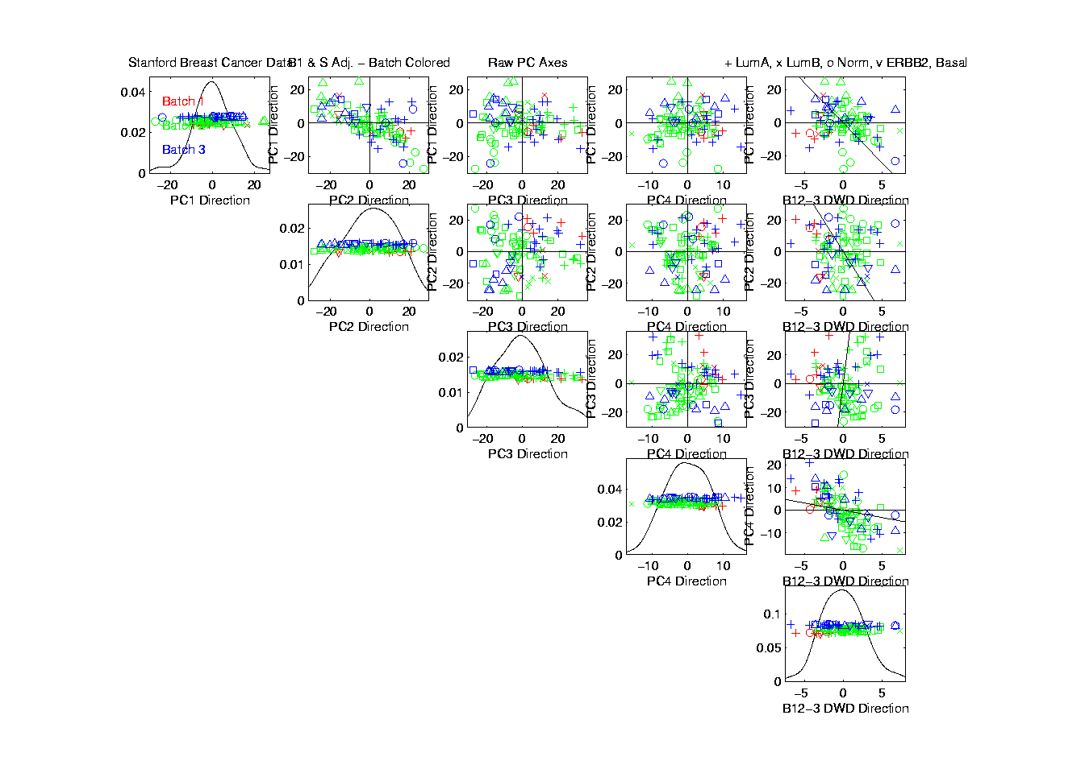
Source Batch Adj: S. & B1,2 vs. 3 Adjusted

Slide 41

Source Batch Adj: S. & B1,2 vs. 3 Adj’d, 5 PCs

Slide 42
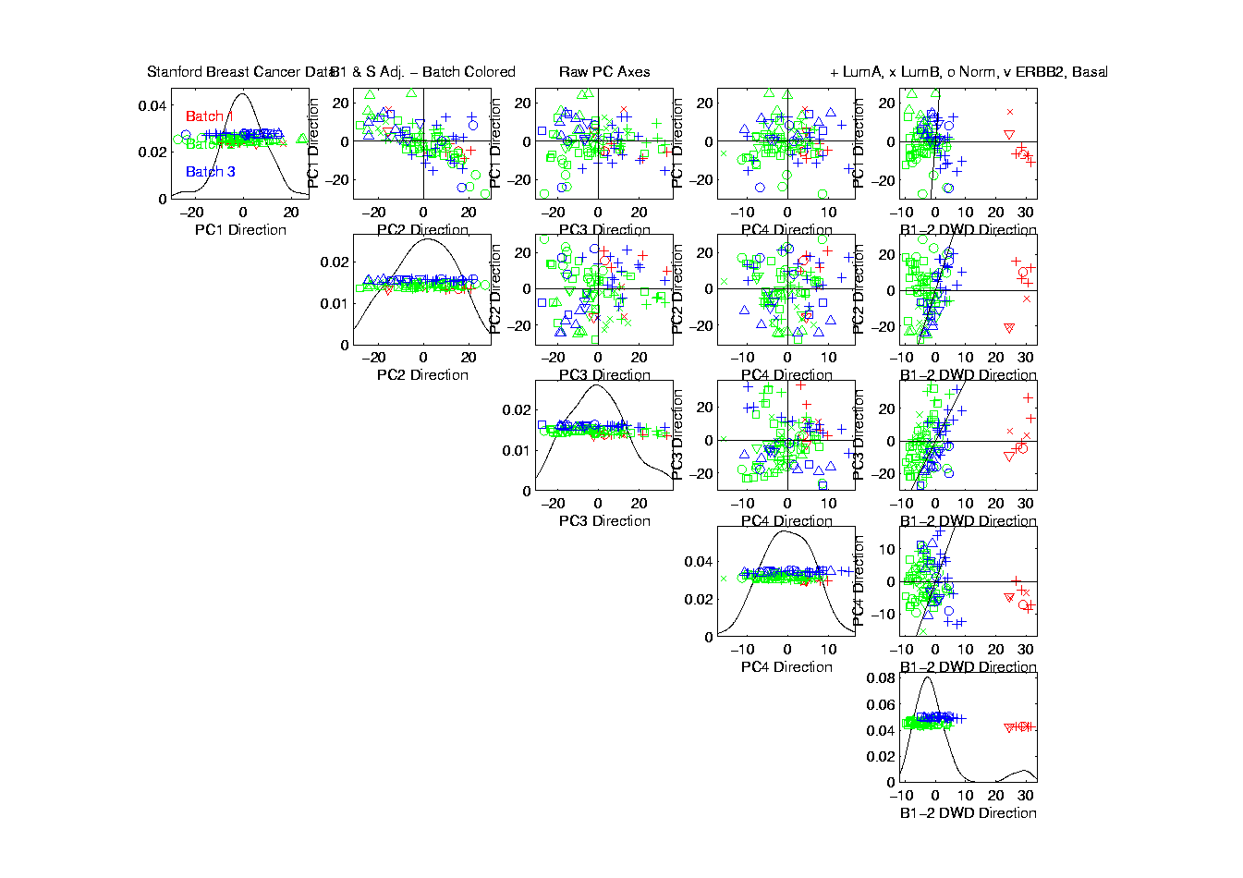
Source Batch Adj: S. & B Adj’d, B1 vs. 2 DWD

Slide 43
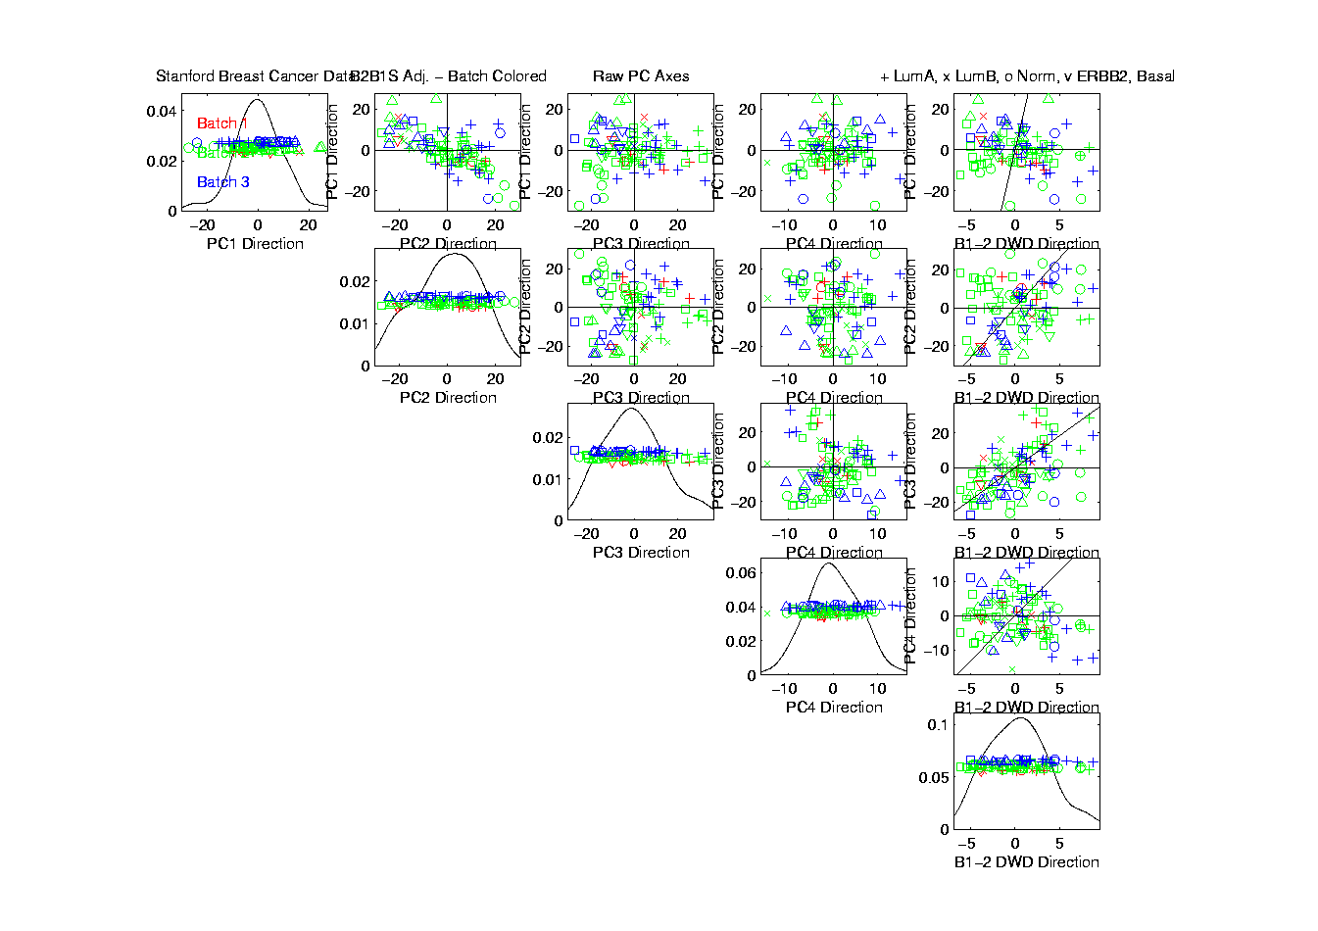
Source Batch Adj: S. & B Adj’d, B1 vs. 2 Adj’d

Slide 44
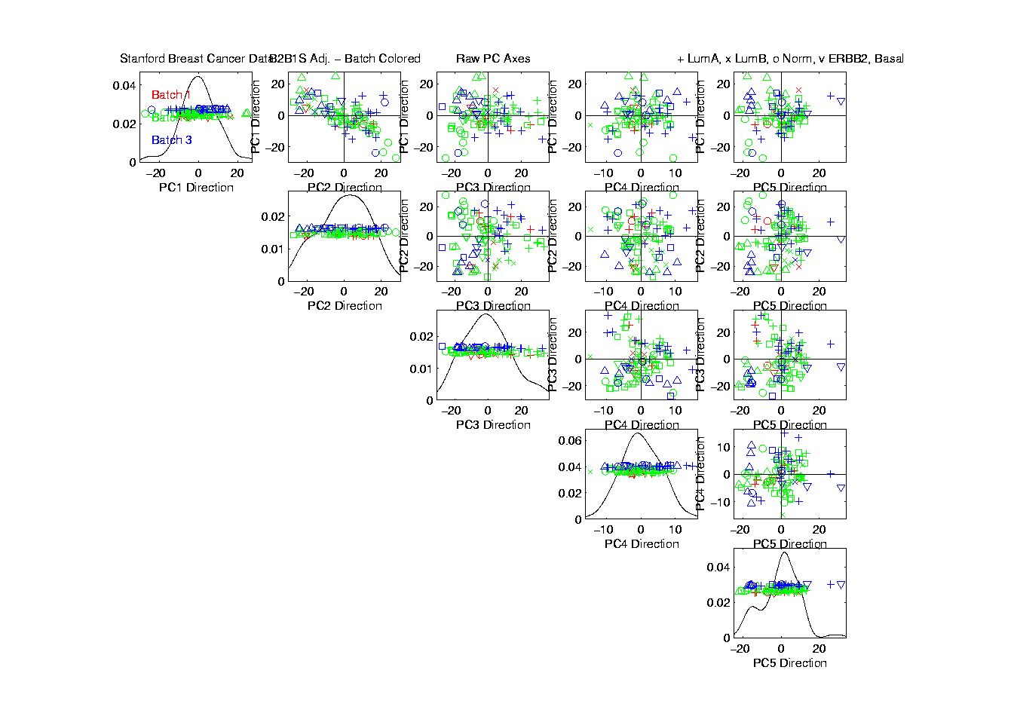
Source Batch Adj: S. & B Adj’d, 5 PC view

Slide 45

Source Batch Adj: S. & B Adj’d, 4 PC view

Slide 46

Source Batch Adj: S. & B Adj’d, Class Colors

Slide 47
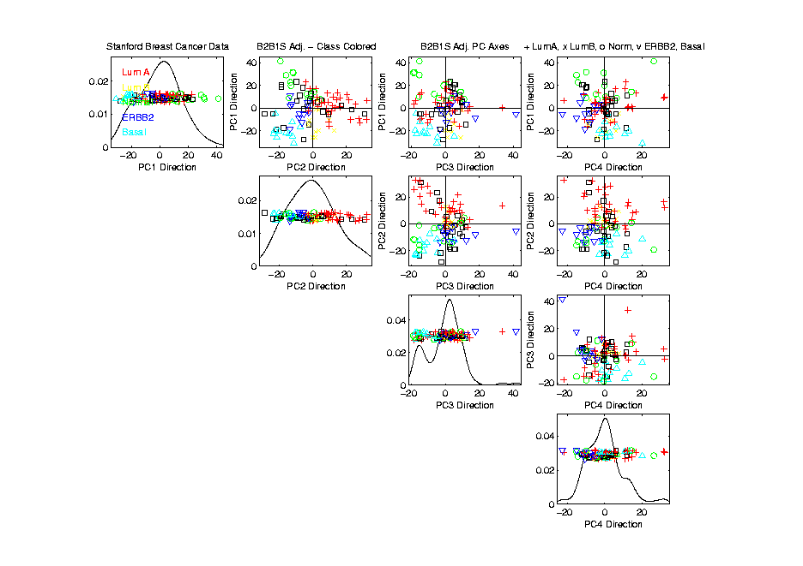
Source Batch Adj: S. & B Adj’d, Adj’d PCA

Slide 48
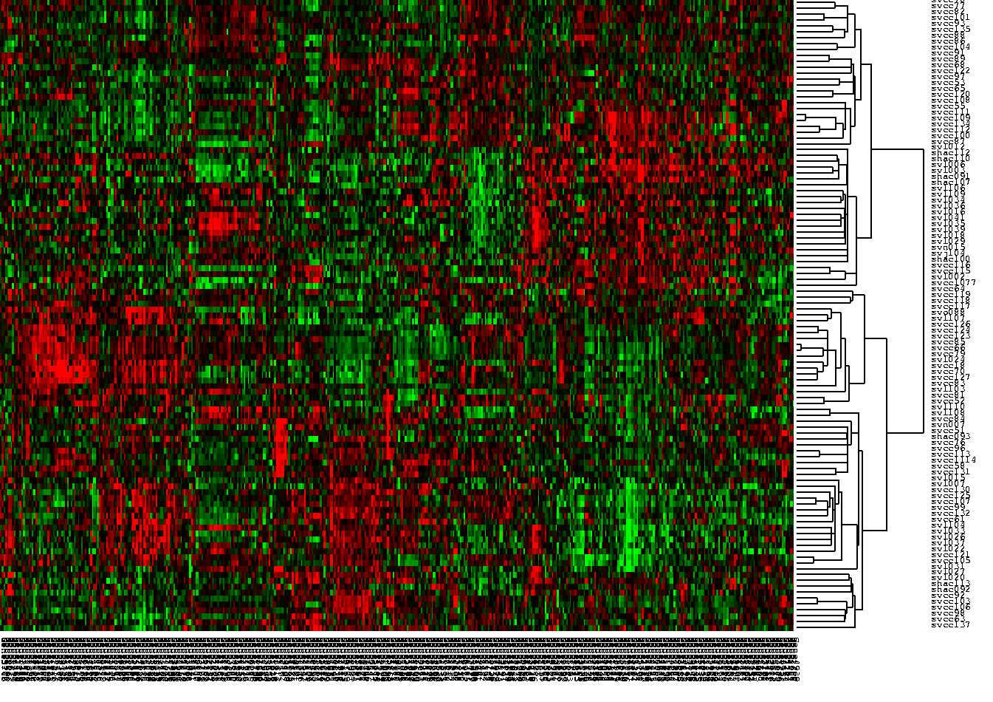
Source Batch Adj: Raw Data, Tree View

Slide 49
Caution on Colors
~10 % of Males are:
Red – Green Color Blind
Can’t distinguish Red vs. Green
Should use better scheme…

Slide 50
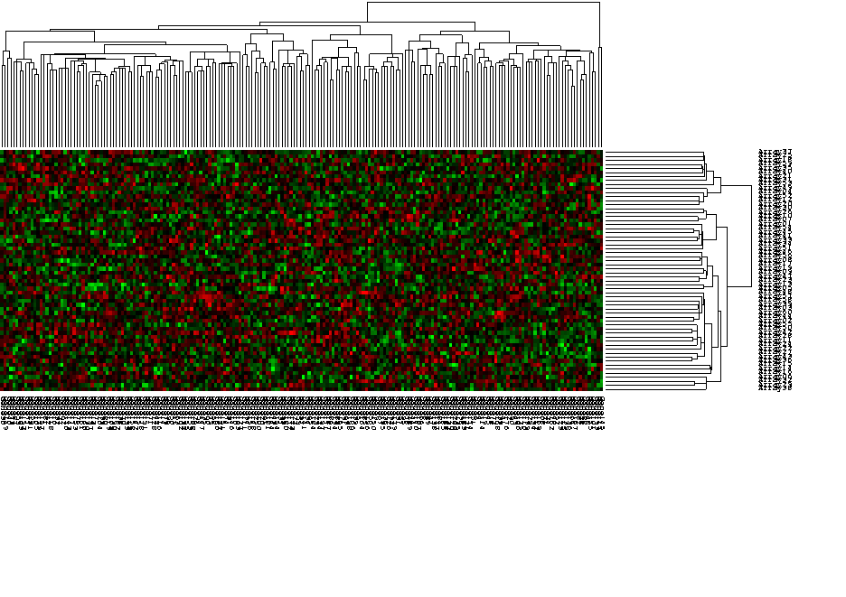
Caution About Tree View
Can Miss Important Features

Slide 51
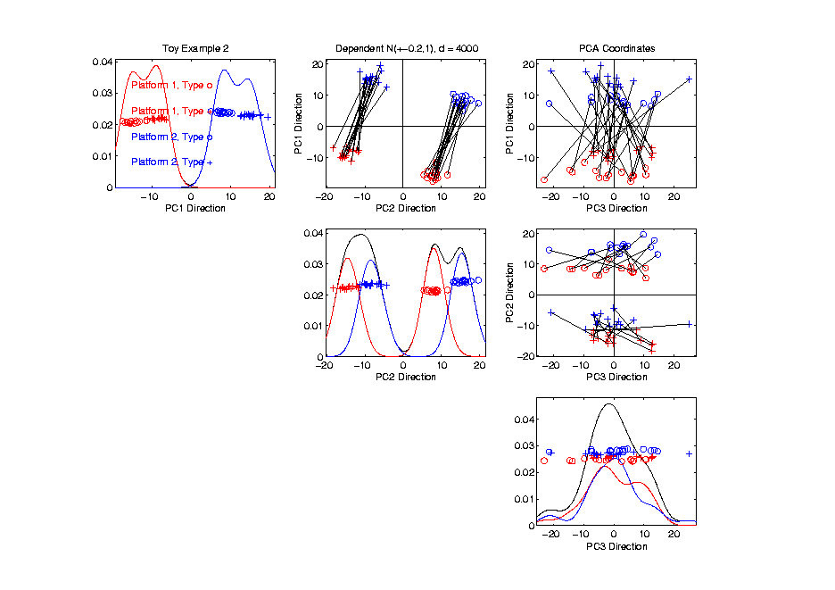
Caution About Tree View
Important Clusters, not in Coord Axis Dir’n

Slide 52
Source Batch Adj: Raw Data, Tree View

Slide 53
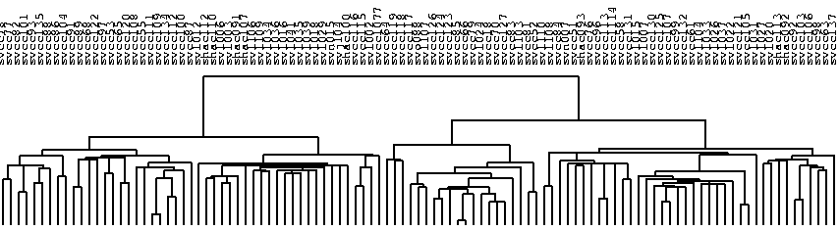
Source Batch Adj: Raw Data, Array Tree

Slide 54
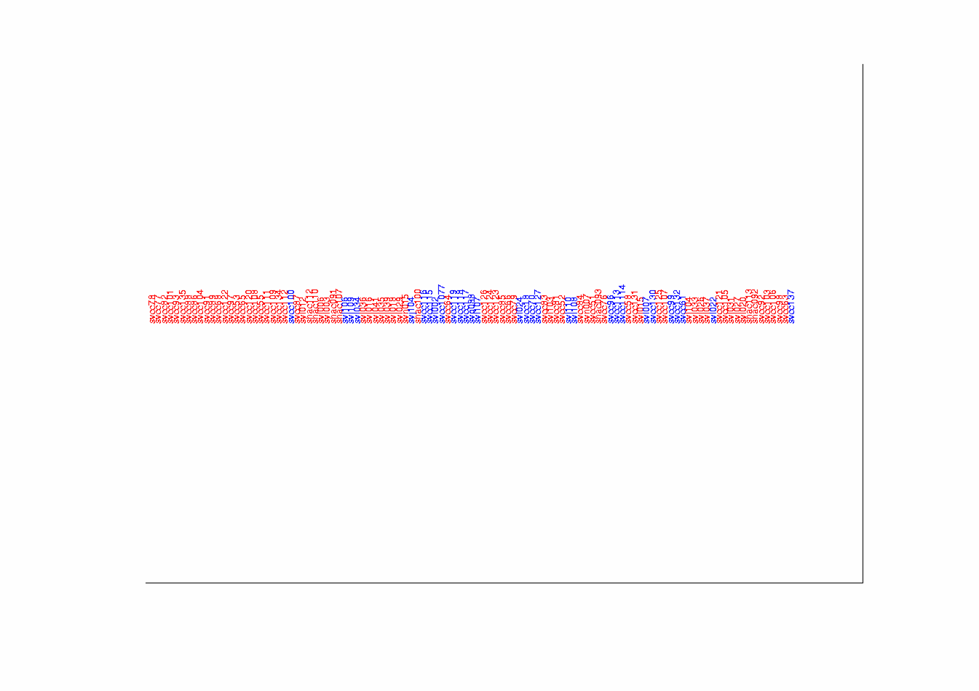
Source Batch Adj: Raw Array Tree, Source Colored

Slide 55
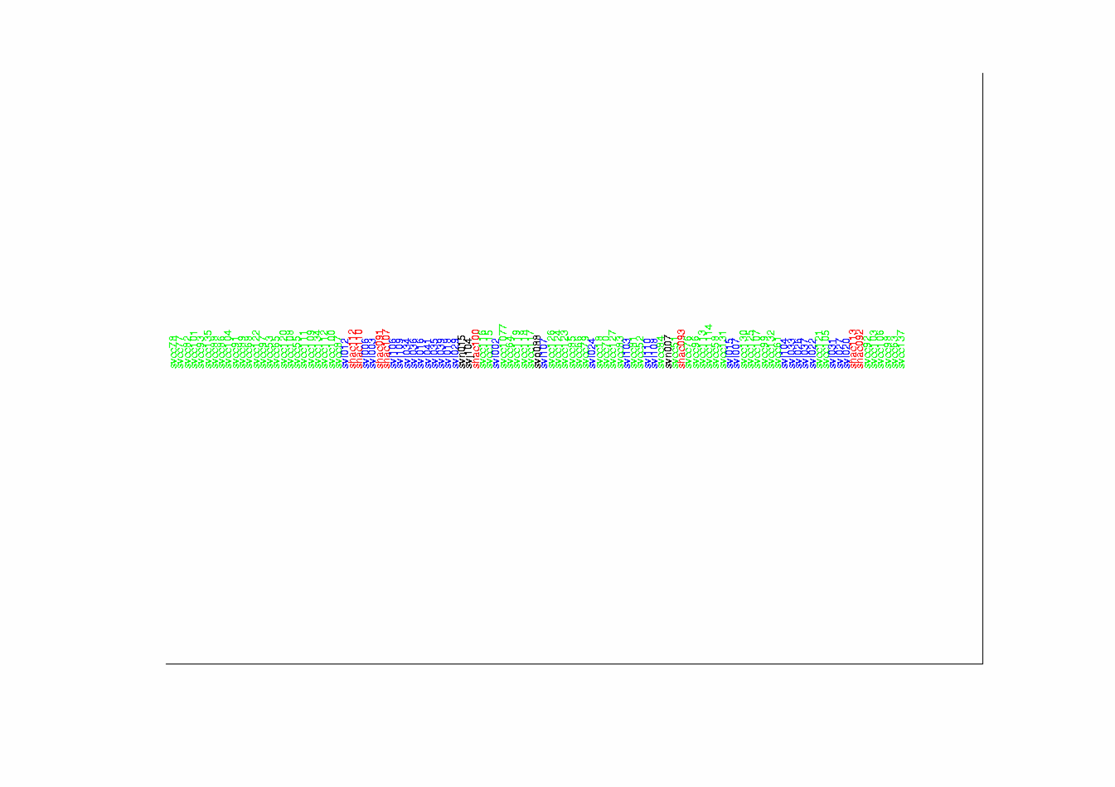
Source Batch Adj: Raw Array Tree, Batch Colored

Slide 56
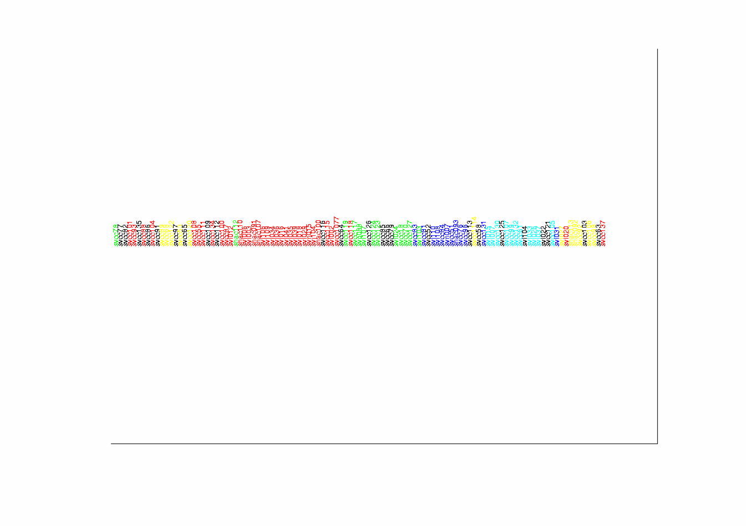
Source Batch Adj: Raw Array Tree, Class Colored

Slide 57
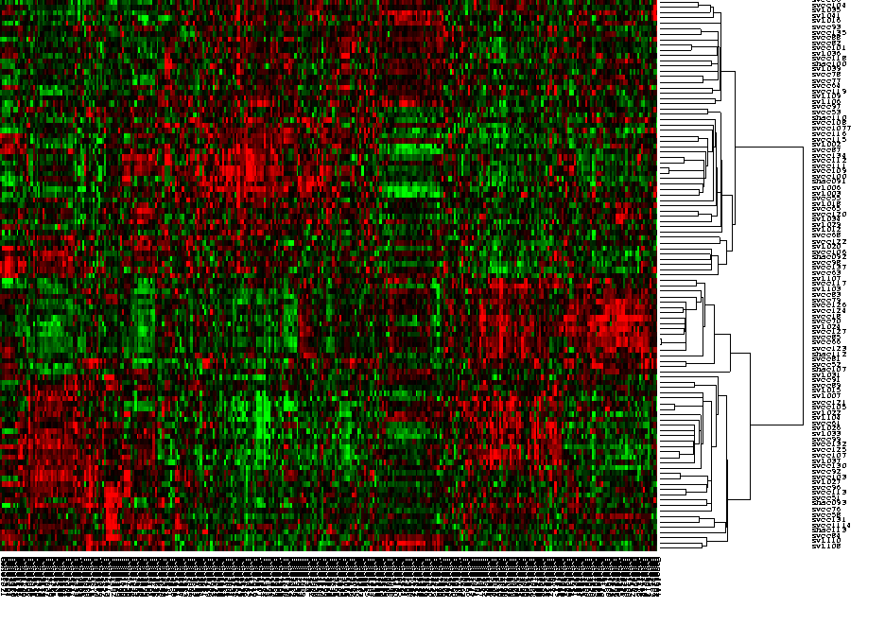
Source Batch Adj: DWD Adjusted Data, Tree View

Slide 58
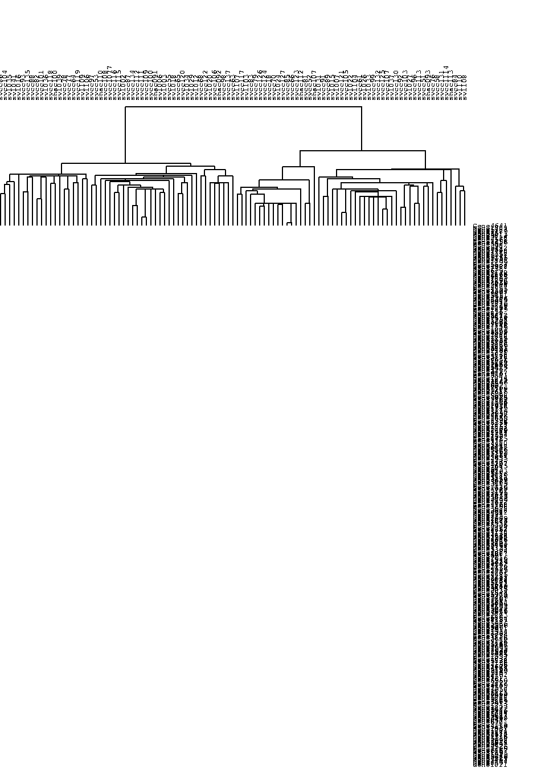
Source Batch Adj: DWD Adjusted Data, Array Tree

Slide 59
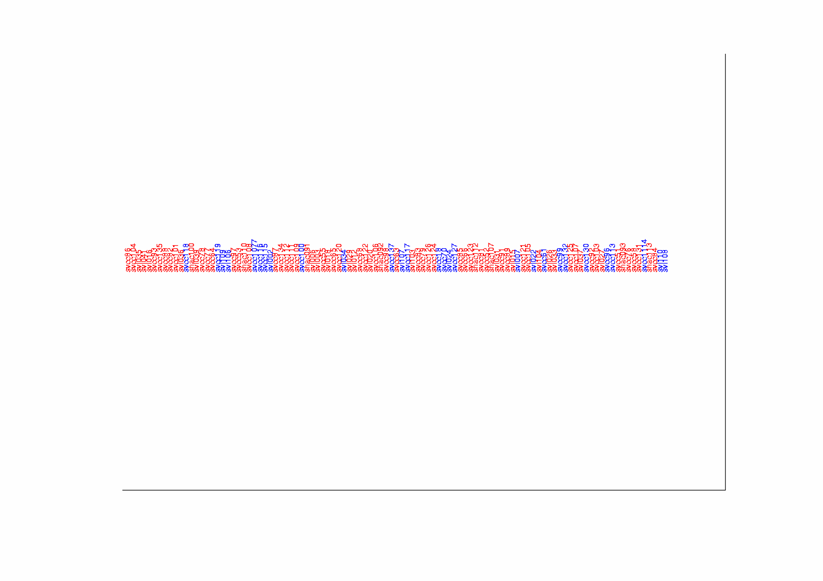
Source Batch Adj: DWD Adjusted Data, Source Colored

Slide 60
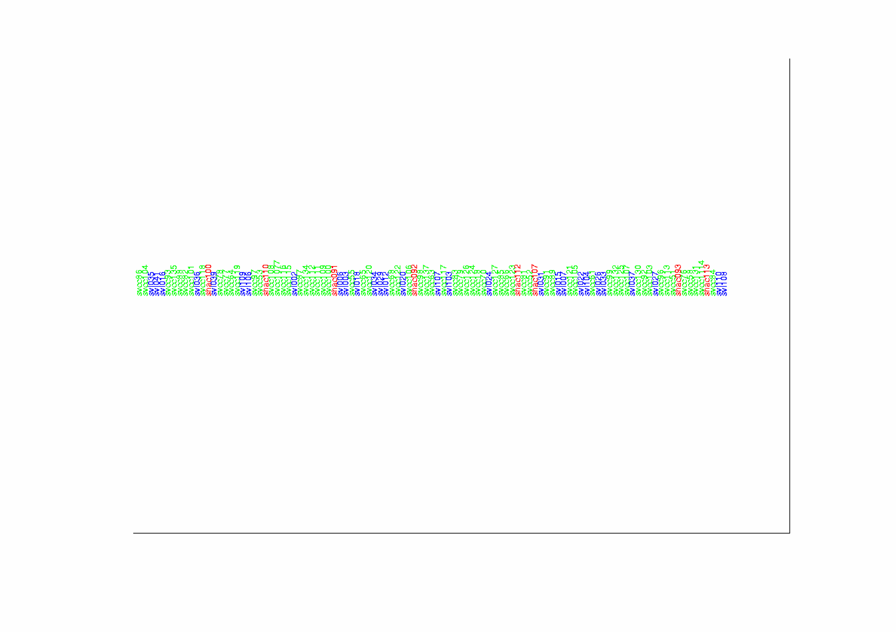
Source Batch Adj: DWD Adjusted Data, Batch Colored

Slide 61
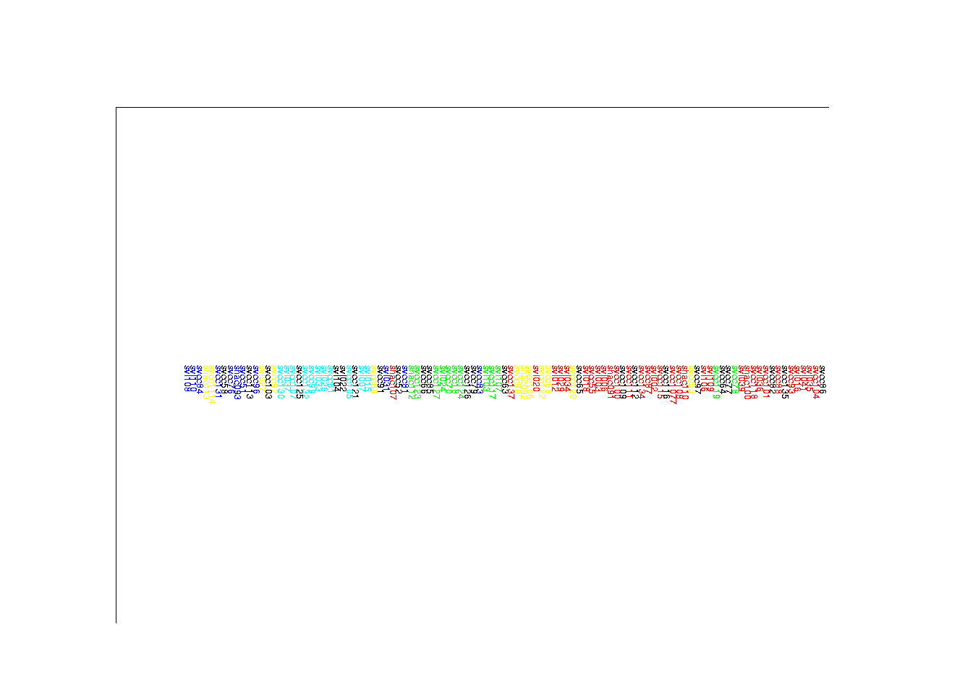
Source Batch Adj: DWD Adjusted Data, Class Colored

Slide 62
DWD: A look under the hood
Distance Weighted Discrimination (DWD)
  Modification of Support Vector Machine
  For HDLSS data
  Uses 2nd Order Cone programming
  Will study later
Main Goal:
  Find direction, that separates data classes
  In “best” possible way

Slide 63
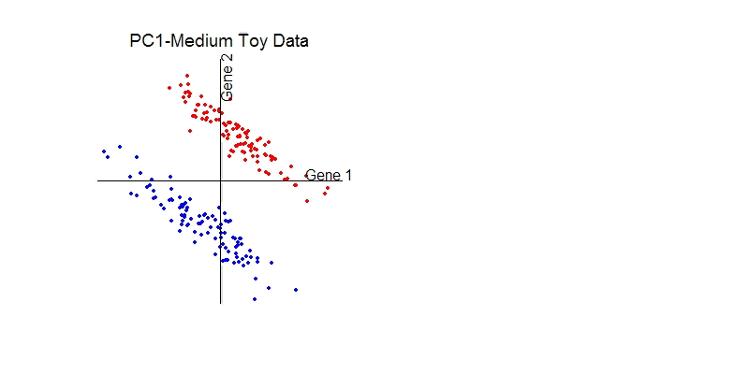
DWD: Why not PC1?
PC 1 Direction feels variation, not classes
Also eliminates (important?) within class variation

Slide 64
DWD: Why not PC1?
Direction driven by classes
“Sliding” maintains (important?) within class variation

Slide 65
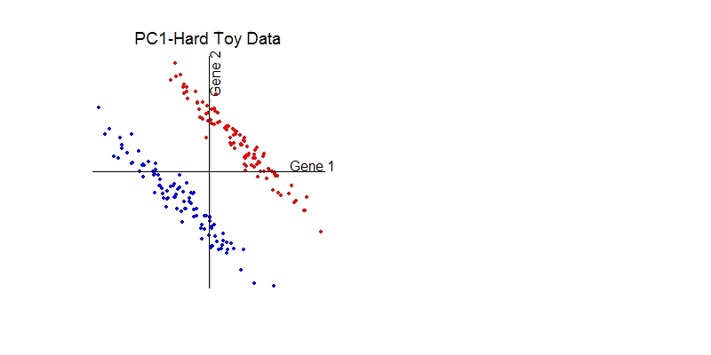
E. g. even worse for PCA
PC1 direction is worst possible

Slide 66
But easy for DWD
Since DWD uses class label information

Slide 67
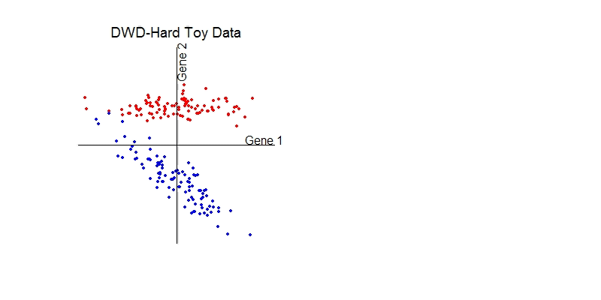
DWD does not solve all problems
Only handles means, not differing variation

Slide 68
Interesting Benchmark Data Set
NCI 60 Cell Lines
  Interesting benchmark, since same cells
  Data Web available:
  http://discover.nci.nih.gov/datasetsNature2000.jsp
  Both cDNA and Affymetrix Platforms
Different from Breast Cancer Data
  Which had no common samples

Slide 69
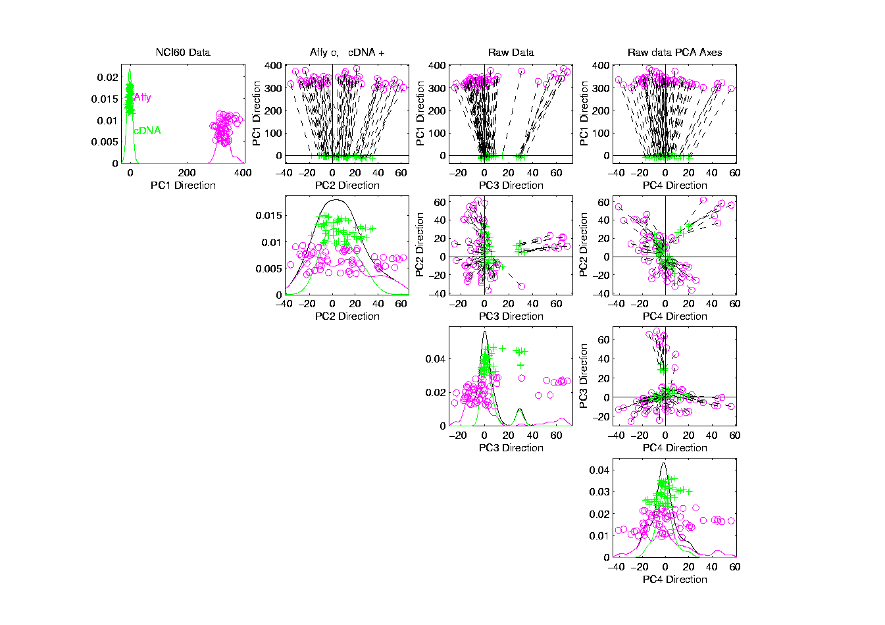
NCI 60: Raw Data, Platform Colored

Slide 70
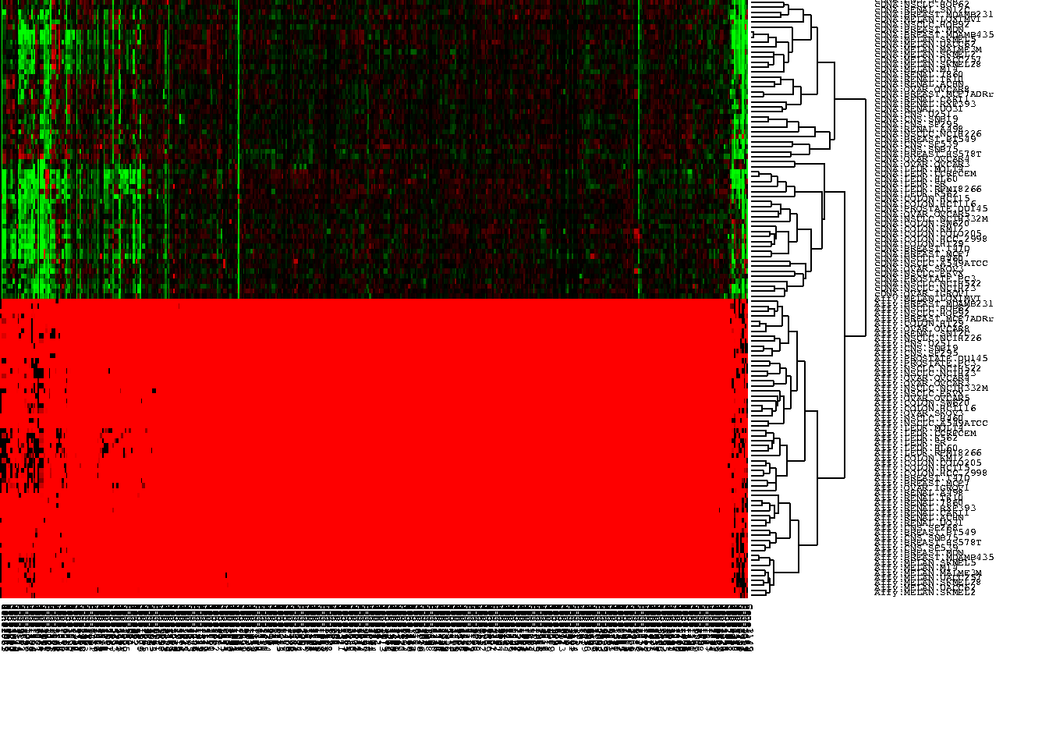
NCI 60: Raw Data, Tree View

Slide 71
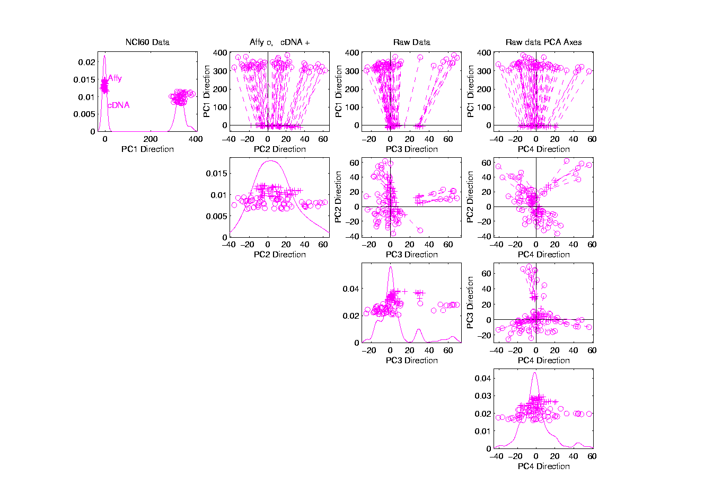
NCI 60: Raw Data

Slide 72
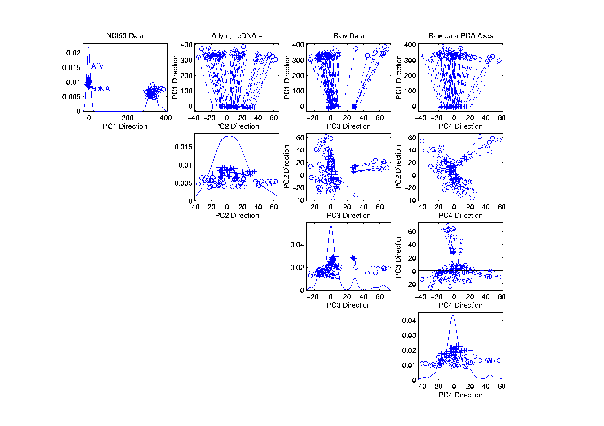
NCI 60: Raw Data, Before DWD Adjustment

Slide 73
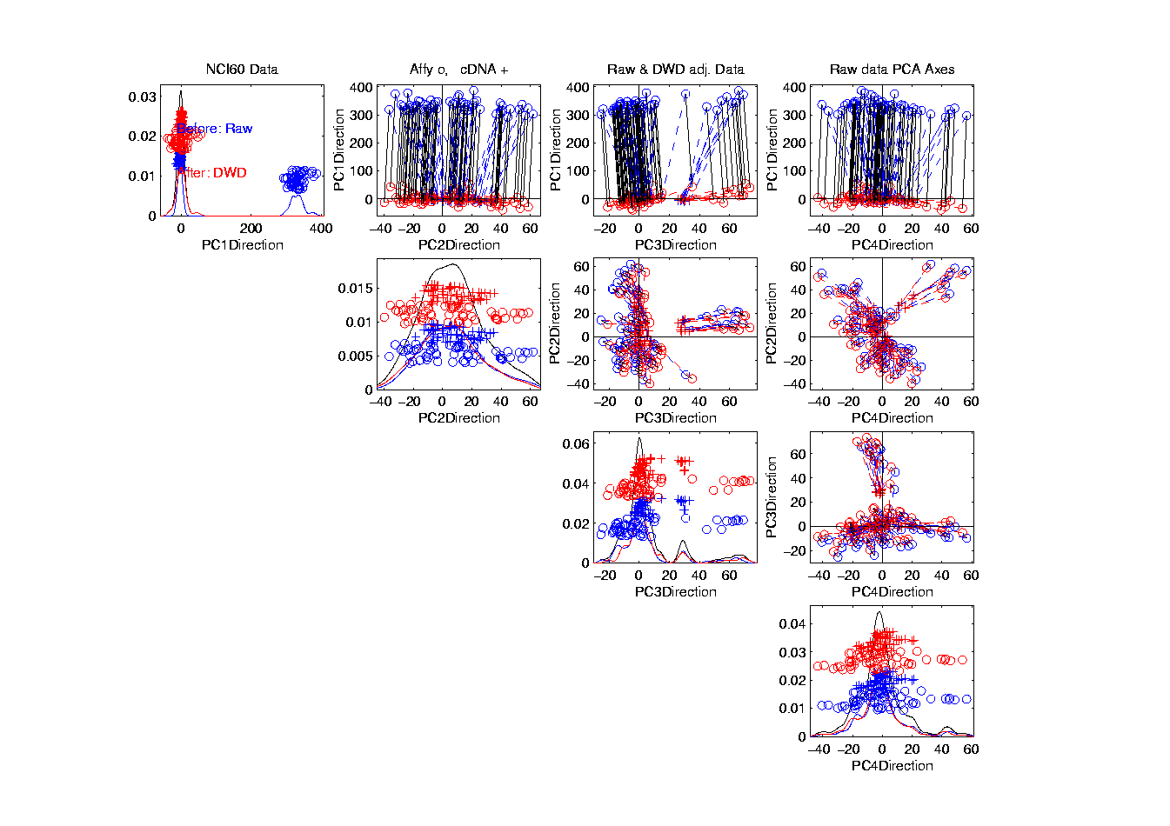
NCI 60: Before & After DWD adjustment

Slide 74

NCI 60: Before & After, new scales

Slide 75

NCI 60: After DWD

Slide 76

NCI 60: DWD adjusted data

Slide 77

NCI 60: Before Column Mean Adjustment

Slide 78

NCI 60: Before & After Column Mean Adjustment

Slide 79

NCI 60: Before & After Col. Mean Adj., Rescaled

Slide 80

NCI 60: After DWD & Column Mean Adj.

Slide 81

NCI 60: DWD & Column Mean Adjusted

Slide 82

NCI 60: Before Column Stand. Dev. Adjustment

Slide 83

NCI 60: Before and After Column S.D. Adjustment

Slide 84

NCI 60: Before and After Col. S.D. Adj., Rescaled

Slide 85

NCI 60: After Column Stand. Dev. adjustment

Slide 86

NCI 60: Fully Adjusted Data

Slide 87

NCI 60: Fully Adjusted Data, Platform Colored

Slide 88

NCI 60: Fully Adjusted Data, Tree View

Slide 89

NCI 60: Fully Adjusted Data, Melanoma Cluster
BREAST.MDAMB435
BREAST.MDN
MELAN.MALME3M
MELAN.SKMEL2
MELAN.SKMEL5
MELAN.SKMEL28
MELAN.M14
MELAN.UACC62
MELAN.UACC257

Slide 90

NCI 60: Fully Adjusted Data, Leukemia Cluster
LEUK.CCRFCEM
LEUK.K562
LEUK.MOLT4
LEUK.HL60
LEUK.RPMI8266
LEUK.SR

Slide 91
Another DWD Appl’n: Visualization
Recall PCA limitations
DWD uses class info
Hence can “better separate known classes”
Do this for pairs of classes
(DWD just on those, ignore others)
Carefully choose pairs in NCI 60 data
Shows Effectiveness of Adjustment

Slide 92
NCI 60: Views using DWD Dir’ns (focus on biology)

Slide 93
DWD Visualization of NCI 60 Data
Most cancer types clearly distinct
(Renal, CNS, Ovar, Leuk, Colon, Melan)
Using these carefully chosen directions
Others less clear cut
  NSCLC (at least 3 subtypes)
  Breast (4 published subtypes)
DWD adjustment was very effective
(very few black connectors visible)

Slide 94
Matlab Software
Want to try similar analyses?
Matlab Available from UNC Site License
Download Software:
Google “Marron Software”

Slide 95

Matlab Software
Choose

Slide 96

Matlab Software
Download .zip File, & Expand to 3 Directories

Slide 97

Matlab Software
Put these is Matlab Path

Slide 98

Matlab Software
Put these is Matlab Path

Slide 99
Matlab Basics
Matlab has Modalities:
Interpreted (Type Commands)
Batch (Run “Script Files”)

Slide 100

Matlab Basics
Matlab in Interpreted Mode:

Slide 101

Matlab Basics
Matlab in Interpreted Mode:

Slide 102

Matlab Basics
Matlab in Interpreted Mode:

Slide 103

Matlab Basics
Matlab in Interpreted Mode:

Slide 104

Matlab Basics
Matlab in Interpreted Mode:

Slide 105

Matlab Basics
Matlab in Interpreted Mode:

Slide 106
Matlab Basics
Matlab in Interpreted Mode:
For description of a function:
>> help [function name]

Slide 107

Matlab Basics
Matlab in Interpreted Mode:

Slide 108
Matlab Basics
Matlab in Interpreted Mode:
To Find Functions:
>> help [category name]
e.g.
>> help stats

Slide 109

Matlab Basics
Matlab in Interpreted Mode:

Slide 110
Matlab Basics
Matlab has Modalities:
Interpreted (Type Commands)
Batch (Run “Script Files”)
For Serious Scientific Computing:
Always Run Scripts

Slide 111
Matlab Basics
Matlab Script File:
Just a List of Matlab Commands
Matlab Executes Them in Order
Why Bother (Why Not Just Type Commands)?
Reproducibility
(Can Find Mistakes & Use Again Much Later)

Slide 112
Matlab Script Files
An Example:
Recall “Brushing Analysis” of
Next Generation Sequencing Data

Slide 113

Functional Data Analysis
Simple
1st
View:
Curve
Overlay
(log
scale)

Slide 114

Functional Data Analysis
Often
Useful
Population
View:
PCA
Scores

Slide 115
Functional Data Analysis
Suggestion
Of
Clusters
???

Slide 116
Functional Data Analysis
Suggestion
Of
Clusters
Which
Are
These?

Slide 117

Functional Data Analysis
Manually
“Brush”
Clusters

Slide 118

Functional Data Analysis
Manually
Brush
Clusters
Clear
Alternate
Splicing

Slide 119
Matlab Script Files
An Example:
Recall “Brushing Analysis” of
Next Generation Sequencing Data
Analysis In Script File:
VisualizeNextGen2011.m
Matlab Script File Suffix

Slide 120

Matlab Script Files
String of Text

Slide 121
Matlab Script Files
Command to Display String to Screen

Slide 122
Matlab Script Files
Notes About Data (Maximizes Reproducibility)

Slide 123

Matlab Script Files
Have Index for Each Part of Analysis

Slide 124
Matlab Script Files
So Keep Everything Done (Max’s Reprod’ity)

Slide 125
Matlab Script Files
Note Some Are Graphics Shown (Can Repeat)

Slide 126

Matlab Script Files
Set Graphics to Default

Slide 127
Matlab Script Files
Put Different Program Parts in IF-Block

Slide 128
Matlab Script Files
Comment Out Currently Unused Commands

Slide 129
Matlab Script Files
Read Data from Excel File

Slide 130

Matlab Script Files
For Generic Functional Data Analysis:

Slide 131
Matlab Script Files
Input Data Matrix

Slide 132
Matlab Script Files
Structure, with Other Settings

Slide 133

Matlab Script Files
Make Scores Scatterplot

Slide 134
Matlab Script Files
Uses Careful Choice of Color Matrix

Slide 135

Matlab Script Files
Start with PCA

Slide 136

Matlab Script Files
Then Create Color Matrix

Slide 137
Matlab Script Files
Black Red Blue

Slide 138

Matlab Script Files
Run Script Using Filename as a Command

Slide 139
Cornea Data
Cornea: Outer surface of the eye
Driver of Vision: Curvature of Cornea
Datat Objects: Images on the unit disk
Radial Curvature as “Heat Map”
Special Thanks to K. L. Cohen, N. Tripoli,
UNC Ophthalmology

Slide 140

Cornea Data
Cornea Data:
Raw Data
Modes of
Variation?

Slide 141
Cornea Data
Reference: Locantore, et al (1999)
Visualization (generally true for images):
More challenging than for curves
(since can’t overlay)
Instead view sequence of images
Harder to see “population structure”
(than for curves)
So PCA type decomposition of variation is more important

Slide 142
Cornea Data
Nature of images
(on the unit disk, not usual rectangle)
Color is “curvature”
Along radii of circle
(direction with most effect on vision)
Hotter (red, yellow) for “more curvature”
Cooler (blue, green) for “less curvature”
Feature vec. is coeff’s of Zernike expansion
Zernike basis: ~ Fourier basis, on disk
Conveniently represented in polar coord’s

Slide 143
Cornea Data
Data Representation - Zernike Basis
Pixels as features is large and wasteful
Natural to find more efficient represent’n
Polar Coordinate Tensor Product of:
  Fourier basis (angular)
  Special Jacobi (radial, to avoid singularities)
See:
  Schwiegerling, Greivenkamp & Miller (1995)
  Born & Wolf (1980)

