Slide 1
Statistics – O. R. 891
Object Oriented Data Analysis
J. S. Marron
Dept. of Statistics and Operations Research
University of North Carolina

Slide 2
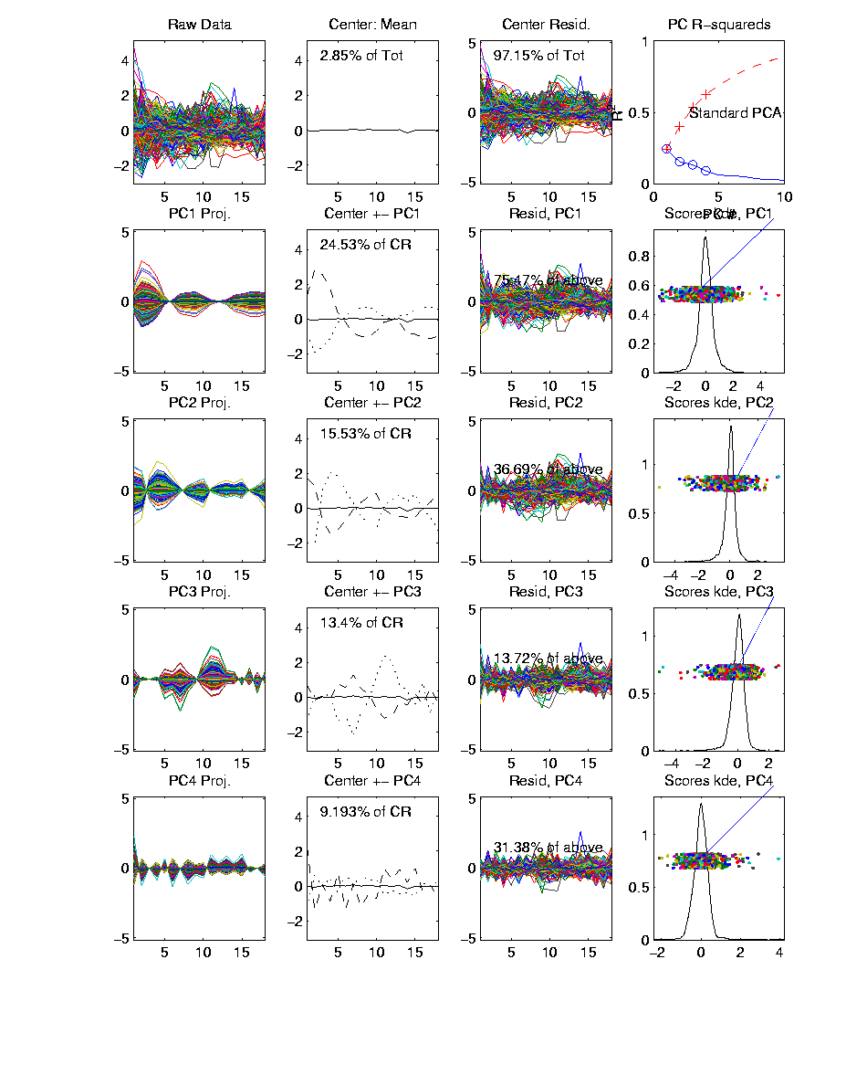
Yeast Cell Cycle Data, FDA View
Periodic
genes?
Naïve
approach:
Simple PCA

Slide 3
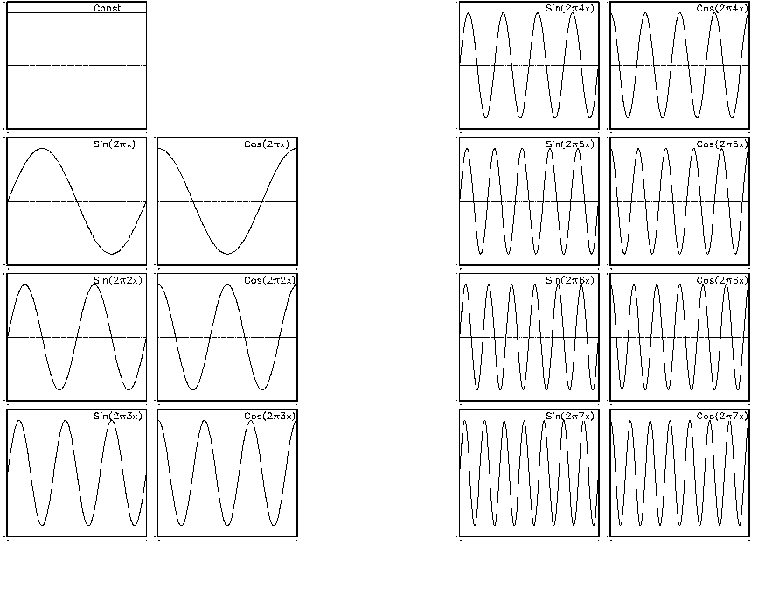
Fourier Basis

Slide 4
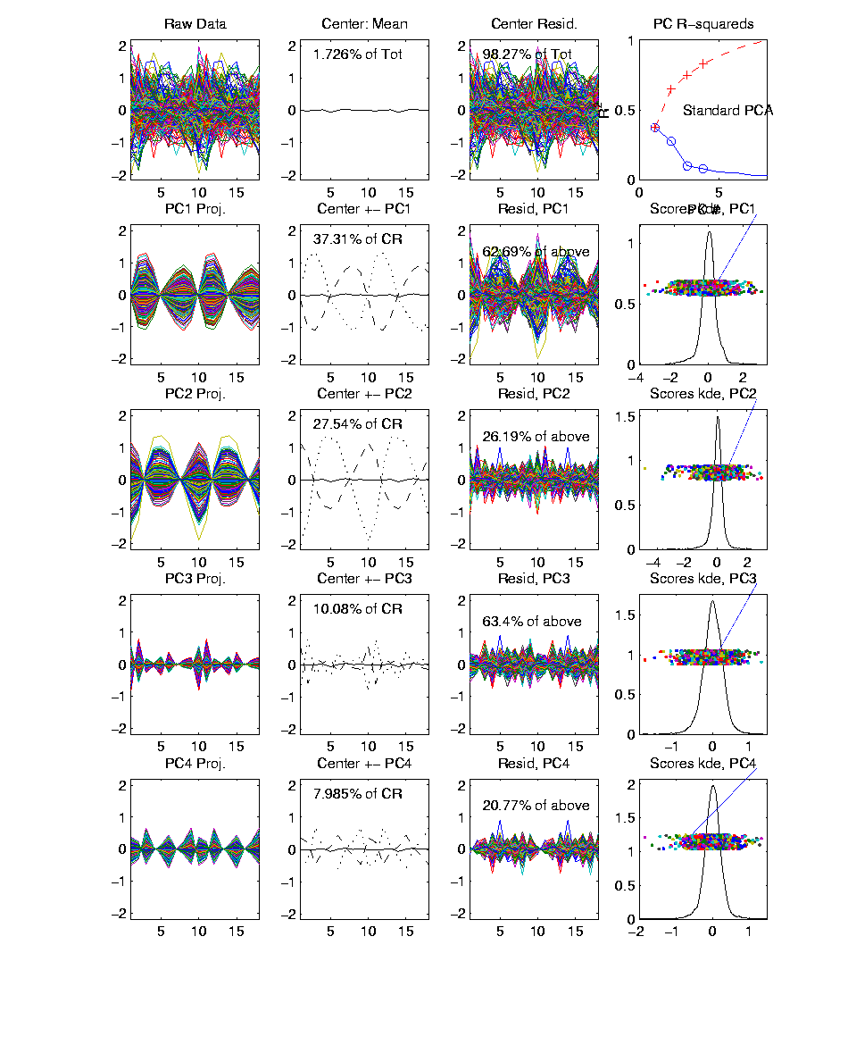
Yeast Cell Cycles, Freq. 2 Proj.
PCA on
Freq. 2
Periodic
Component
Of Data

Slide 5
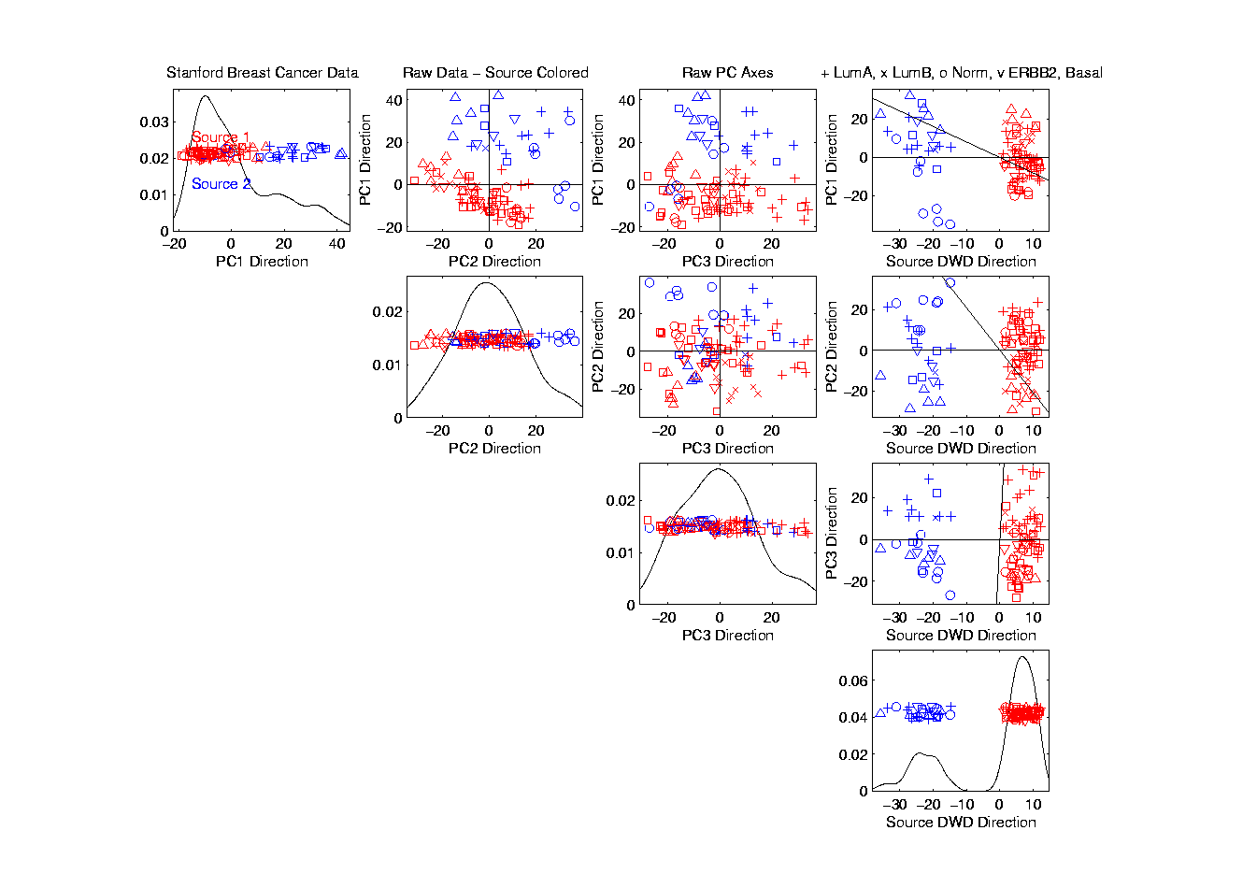
Source Batch Adj: PC 1-3 & DWD direction

Slide 6
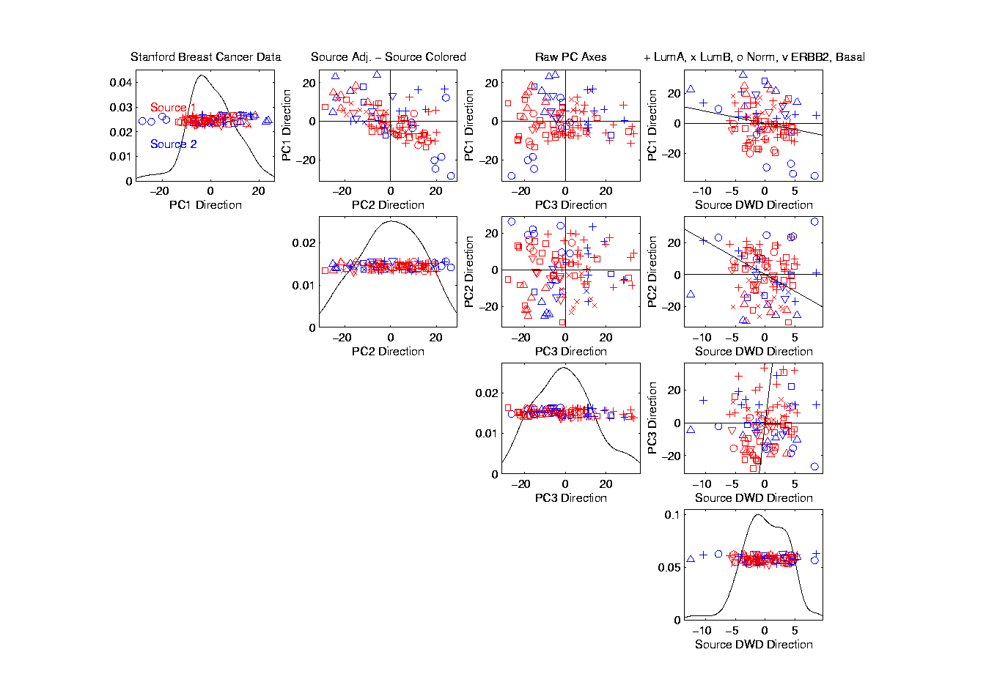
Source Batch Adj: DWD Source Adjustment

Slide 7
Matlab Software
Want to try similar analyses?
Matlab Available from UNC Site License
Download Software:
Google “Marron Software”

Slide 8
Matlab Software
Missing Part of Last Classes Discussion:
Matlab Script File Used as Example
Check Class Website:

Slide 9
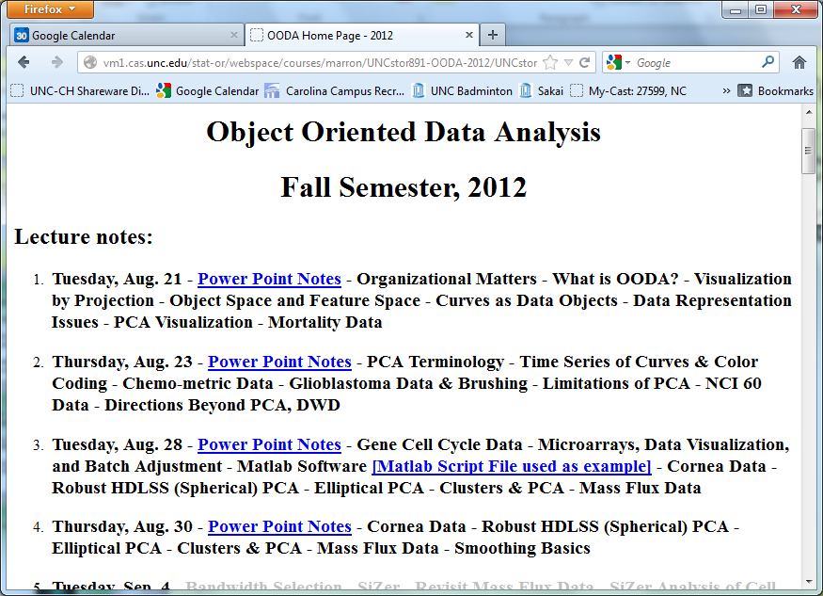
Example File Added
Missing Part of Last Classes Discussion:
Matlab Script File Used as Example
Check Class Website:

Slide 10
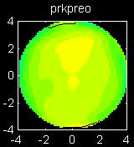
Cornea Data
Cornea Data:
Raw Data
Modes of
Variation?
Population
Structure?

Slide 11
PCA of Cornea Data
Recall: PCA can find (often insightful)
direction of greatest variability
Main problem: display of result (no overlays for images)
Solution: show movie of “marching along the direction vector”

Slide 12
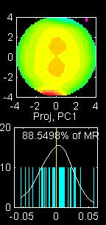
PCA of Cornea Data
PC1 Movie:

Slide 13
PCA of Cornea Data
PC1 Summary:
Mean (1st image): mild vert’l astigmatism
known pop’n structure called “with the rule”
Main dir’n: “more curved” & “less curved”
Corresponds to first optometric measure
(89% of variat’n, in Mean Resid. SS sense)
Also: “stronger astig’m” & “no astig’m”
Found corr’n between astig’m and curv’re
Scores (blue): Apparent Gaussian dist’n

Slide 14
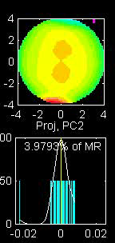
PCA of Cornea Data
PC2 Movie:

Slide 15
PCA of Cornea Data
PC2 Movie:
Mean: same as above
Common centerpoint of point cloud
Are studying “directions from mean”
Images along direction vector:
Looks terrible???
Why?

Slide 16
PCA of Cornea Data
PC2 Movie:
Reason made clear in Scores Plot (blue):
Single outlying data object drives PC dir’n
A known problem with PCA
Recall finds direction with “max variation”
In sense of variance
Easily dominated by single large observat’n

Slide 17
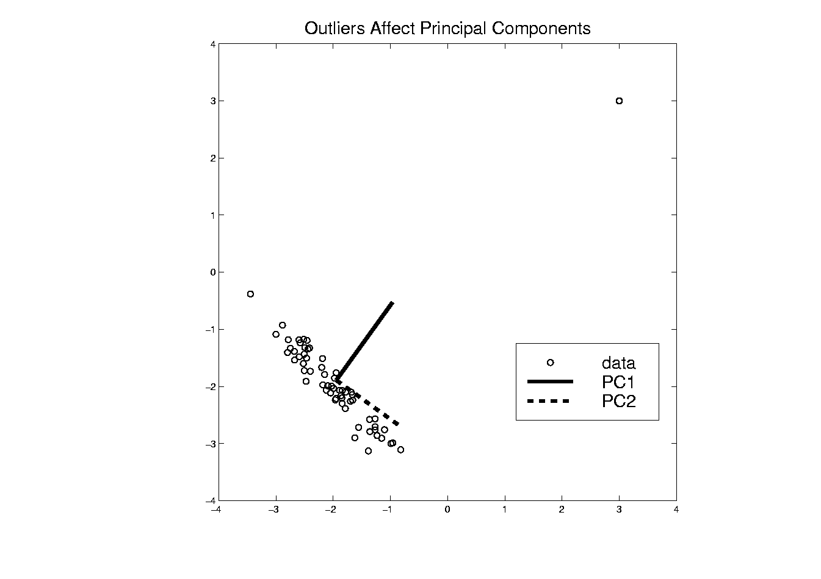
PCA of Cornea Data
Toy Example: Single Outlier Driving PCA

Slide 18
PCA of Cornea Data
PC2 Affected by Outlier:
How bad is this problem?
View 1: Statistician: Arrggghh!!!!
Outliers are very dangerous
Can give arbitrary and meaningless dir’ns

Slide 19
PCA of Cornea Data
PC2 Affected by Outlier:
How bad is this problem?
View 2: Ophthalmologist: No Problem
Driven by “edge effects” (see raw data)
Artifact of “light reflection” data gathering
(“eyelid blocking”, and drying effects)
Routinely “visually ignore” those anyway
Found interesting (& well known) dir’n:
steeper superior vs steeper inferior

Slide 20
Cornea Data
Cornea Data:
Raw Data
Which one
is the outlier?
Will say more
later …

Slide 21
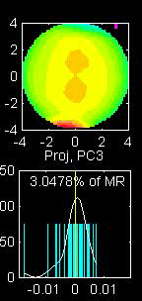
PCA of Cornea Data
PC3 Movie

Slide 22
PCA of Cornea Data
PC3 Movie (ophthalmologist’s view):
Edge Effect Outlier is present
But focusing on “central region” shows changing dir’n of astig’m (3% of MR SS)
“with the rule” (vertical) vs. “against the rule” (horizontal)
most astigmatism is “with the rule”
most of rest is “against the rule”
(known folklore)

Slide 23
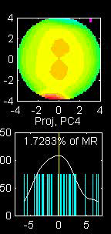
PCA of Cornea Data
PC4 movie

Slide 24
PCA of Cornea Data
Continue with ophthalmologists view…
PC4 movie version:
Other direction of astigmatism???
Location (i.e. “registration”) effect???
Harder to interpret …
OK, since only 1.7% of MR SS
Substantially less than for PC2 & PC3

Slide 25
PCA of Cornea Data
Ophthalmologists View (cont.)
Overall Impressions / Conclusions:
Useful decomposition of population variation
Useful insight into population structure

Slide 26
PCA of Cornea Data
Now return to Statistician’s View:
How can we handle these outliers?
Even though not fatal here, can be for other examples…
Recall Simple
Toy Example
(in 2d):

Slide 27
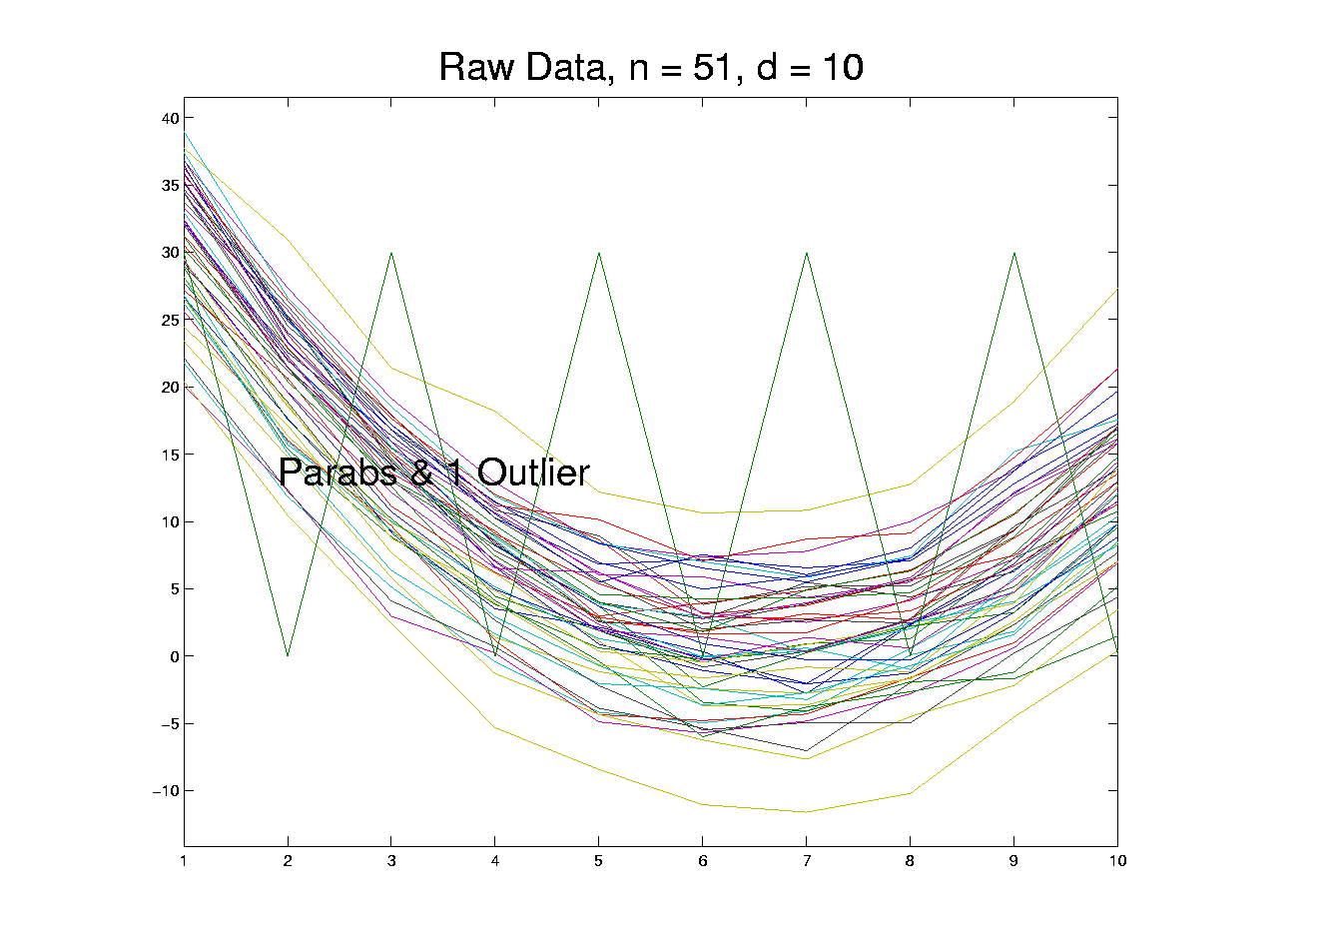
Outliers in PCA
Deeper Toy Example:

Slide 28
Outliers in PCA
Deeper Toy Example:
Why is that an outlier?
Never leaves range of other data
But Euclidean distance to others very large
relative to other distances
Also major difference in terms of shape
And even smoothness
Important lesson:
many directions in

Slide 29
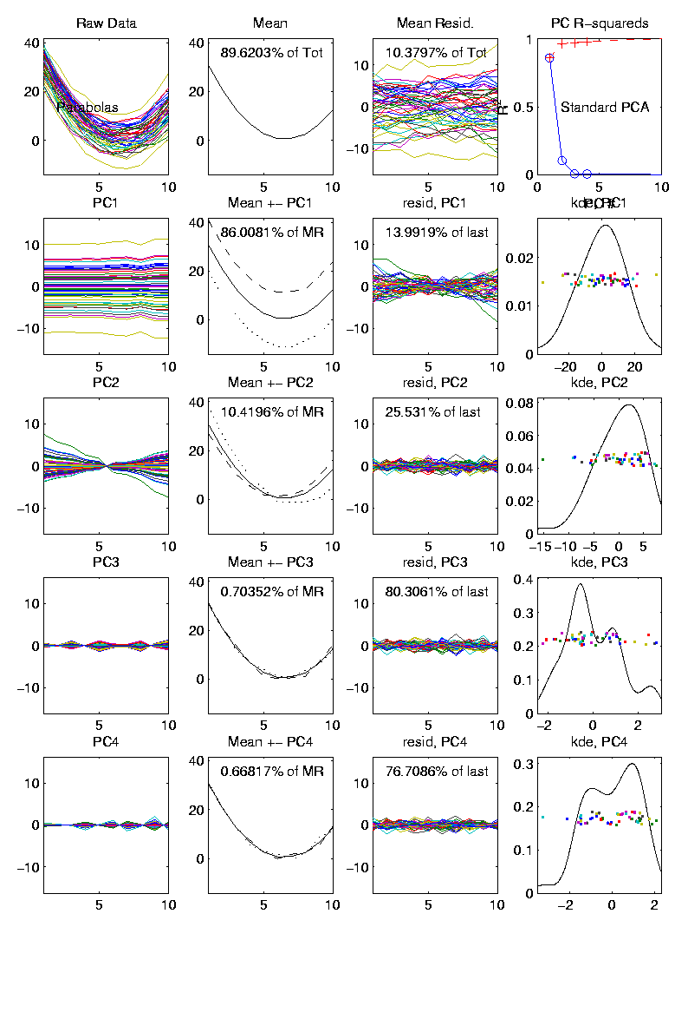
Outliers in PCA
Much like
earlier
Parabolas
Example
But with
1 “outlier”
thrown in

Slide 30
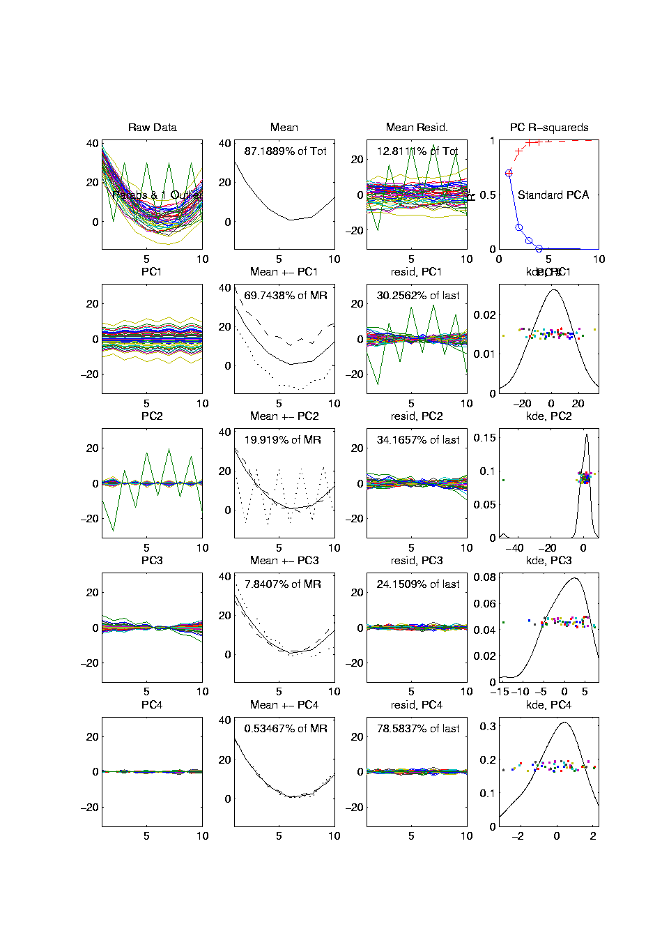
Outliers in PCA
PCA for
Deeper
Toy E.g.
Data:

Slide 31
Outliers in PCA
Deeper Toy Example:
At first glance, mean and PC1 look similar to no outlier version
PC2 clearly driven completely by outlier
PC2 scores plot (on right) gives clear outlier diagnostic
Outlier does not appear in other directions
Previous PC2, now appears as PC3
Total Power (upper right plot) now “spread farther”

Slide 32
Outliers in PCA
Closer Look at Deeper Toy Example:
Mean “influenced” a little, by the outlier
Appearance of “corners” at every other coordinate
PC1 substantially “influenced” by the outlier
Clear “wiggles”

Slide 33
Outliers in PCA
What can (should?) be done about outliers?
Context 1: Outliers are important aspects of the population
  They need to be highlighted in the analysis
  Although could separate into subpopulations
Context 2: Outliers are “bad data”, of no interest
  recording errors? Other mistakes?
  Then should avoid distorted view of PCA

Slide 34
Outliers in PCA
Standard Statistical Approaches to Dealing with Outliers:
Outlier Deletion:
Kick out “bad data”
Robust Statistical methods:
Work with full data set,
but downweight “bad data”
Reduce influence, instead of “deleting”

Slide 35
Outliers in PCA
Example Cornea Data:
Can find PC2 outlier (by looking through data (careful!))
Problem: after removal, another point dominates PC2
Could delete that, but then another appears
After 4th step have eliminated 10% of data (n = 43)

Slide 36
Outliers in PCA
Example
Cornea
Data

Slide 37
Outliers in PCA
Motivates alternate approach:
Robust Statistical Methods
Recall main idea:
Downweight (instead of delete) outliers
a large literature. Good intro’s
(from different viewpoints) are:
Huber (1981)
Hampel, et al (1986)
Staudte & Sheather (1990)

Slide 38
Outliers in PCA
Simple robustness concept: breakdown point
how much of data “moved to ”
will “destroy estimate”?
Usual mean has breakdown 0
Median has breakdown ½ (best possible)
Conclude:
Median much more robust than mean
Median uses all data
Median gets good breakdown from
“equal vote”

Slide 39
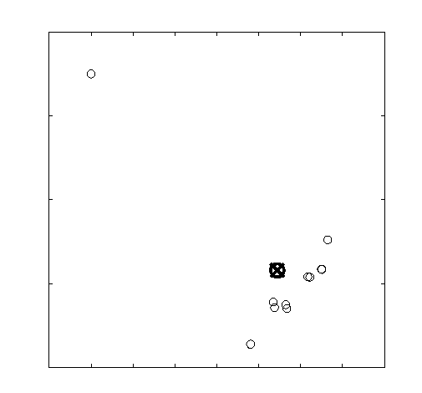
Outliers in PCA
Mean has
breakdown 0
Single
Outlier
Pulls Mean
Outside
range
of data

Slide 40
Outliers in PCA
Controversy:
Is median’s “equal vote” scheme good or bad?
Huber:
Outliers contain some information,
So should only control “influence”
(e.g. median)
Hampel, et. al.:
Outliers contain no useful information
Should be assigned weight 0
(not done by median)
Using “proper robust method”
(not simply deleted)

Slide 41
Outliers in PCA
Robustness Controversy (cont.):
Both are “right” (depending on context)
Source of major (unfortunately bitter) debate!
Application to Cornea data:
Huber’s model more sensible
Already know some useful info in each data point
Thus “median type” methods are sensible

Slide 42
Robust PCA
What is multivariate median?
There are several!
(“median” generalizes in different ways)
Coordinate-wise median
Often worst
Not rotation invariant
(2-d data uniform on “L”)
Can lie on convex hull of data
(same example)
Thus poor notion of “center”

Slide 43
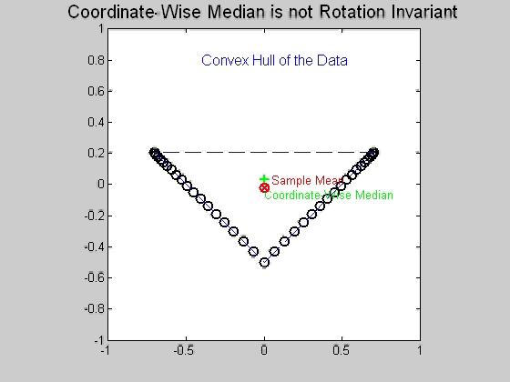
Robust PCA
Coordinate-wise median
Not rotation invariant
Thus poor notion of “center”

Slide 44
Robust PCA
Coordinate-wise median
Can lie on convex hull of data
Thus poor notion of “center”

Slide 45
Robust PCA
What is multivariate median (cont.)?
ii. Simplicial depth (a. k. a. “data depth”):
Liu (1990)
“Paint Thickness” of dim “simplices” with corners at data
Nice idea
Good invariance properties
Slow to compute

Slide 46
Robust PCA
What is multivariate median (cont.)?
iii. Huber’s M-estimate:
Given data ,
Estimate “center of population” by
Where is the usual Euclidean norm
Here: use only
(minimal impact by outliers)

Slide 47
Robust PCA
Huber’s M-estimate (cont):
Estimate “center of population” by
Case :
Can show (sample mean)
(also called “Fréchet Mean”)
Here: use only
(minimal impact by outliers)

Slide 48
Robust PCA
M-estimate (cont.):
A view of minimizer: solution of
A useful viewpoint is based on:
= “Proj’n of data onto sphere
cent’d at with radius ”
And representation:

Slide 49
Robust PCA
M-estimate (cont.):
Thus the solution of
is the solution of:
So is location where projected data are centered
“Slide sphere around until mean (of projected data) is at center”

Slide 50
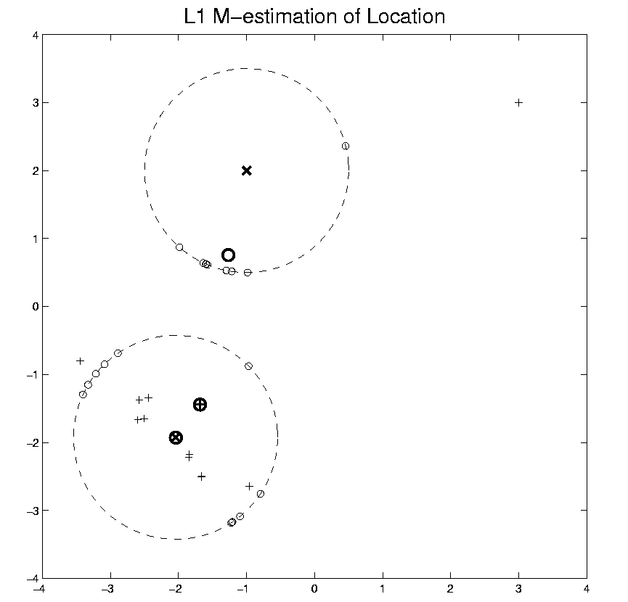
Robust PCA
M-estimate (cont.):
“Slide sphere
around until
mean (of
projected data)
is at center”

Slide 51
Robust PCA
M-estimate (cont.):
Additional literature:
Called “geometric median” (long before Huber) by: Haldane (1948)
Shown unique for by: Milasevic and Ducharme (1987)
Useful iterative algorithm: Gower (1974)
(see also Sec. 3.2 of Huber).
Cornea Data experience:
works well for

Slide 52
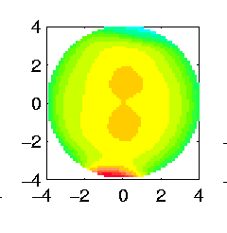
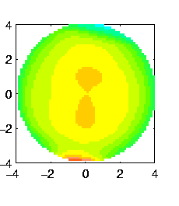
Robust PCA
M-estimate for Cornea Data:
Sample Mean M-estimate
Definite improvement
But outliers still have some influence
Improvement? (will suggest one soon)

Slide 53
Robust PCA
Now have robust measure of “center”,
how about
“spread”?
I.e. how
can we
do robust
PCA?

Slide 54
Robust PCA
Now have robust measure of “center”,
how about
“spread”?
I.e. how
can we
do robust
PCA?

Slide 55
Robust PCA
Approaches to Robust PCA:
Robust Estimation of Covariance Matrix
Projection Pursuit
Spherical PCA

Slide 56
Robust PCA
Robust PCA 1: Robust Estimation of Covariance Matrix
A. Component-wise Robust Covariances:
Major problem:
Hard to get non-negative definiteness
Minimum Volume Ellipsoid:
Rousseeuw & Leroy (1987)
Requires (in available software)
Needed for simple definition of affine invariant

Slide 57
Important Aside
Major difference between Fun’al Data Anal’s
& Classical Multivariate Analysis
High Dimension, Low Sample Size Data
(sample size < dimension )
Classical Multivariate Analysis:
start with “sphering data” (multiply by )
but doesn’t exist for HDLSS data

Slide 58
Important Aside
Classical Approach to HDLSS data: “Don’t have enough data for analysis, get more”
Unworkable (and getting worse) for many modern settings:
Medical Imaging (e.g. Cornea Data)
Micro-arrays & gene expression
Chemometric spectra data

Slide 59
Robust PCA
Robust PCA 2: Projection Pursuit
Idea: focus on
“finding direction of greatest variability”
Reference: Li and Chen (1985)
Problems:
Robust estimates of “spread” are nonlinear
Results in many local optima

Slide 60
Robust PCA
Robust PCA 2: Projection Pursuit (cont.)
Problems:
Results in many local optima
Makes search problem very challenging
Especially in very high dimensions
Most examples have
Guoying Li:
“I’ve heard of ,
but seems too big”

Slide 61
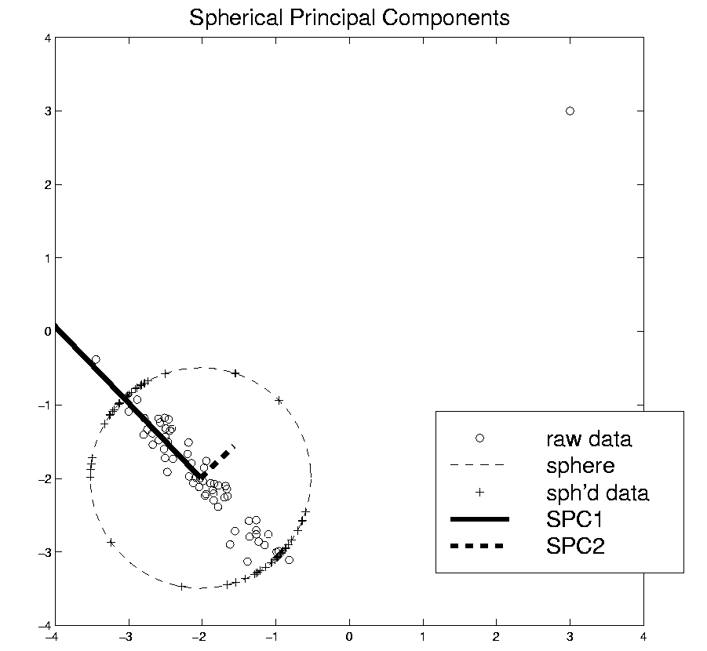
Robust PCA
Robust PCA 3:
Spherical
PCA

Slide 62
Robust PCA
Robust PCA 3: Spherical PCA
Idea: use “projection to sphere” idea from M-estimation
In particular project data to centered sphere
“Hot Dog” of data becomes “Ice Caps”
Easily found by PCA (on proj’d data)
Outliers pulled in to reduce influence
Radius of sphere unimportant
Notes:
62

Slide 63
Robust PCA
Robust PCA 3: Spherical PCA
Independent Derivation & Alternate Name:
Spatial Signs
(think: multivariate extension of “sign test”)
Complete Description:
Oja, H. (2010) Multivar. Nonpar. Methods …
Notes:
63

Slide 64
Robust PCA
Spatial Signs
Interesting Variation:
Spatial Ranks
Idea: Keep
Track of “Depth”
Notes:
64

Slide 65
Robust PCA
Spherical PCA for Toy Example:
Curve Data
With an
Outlier
First recall
Conventional
PCA
Notes:
65

Slide 66
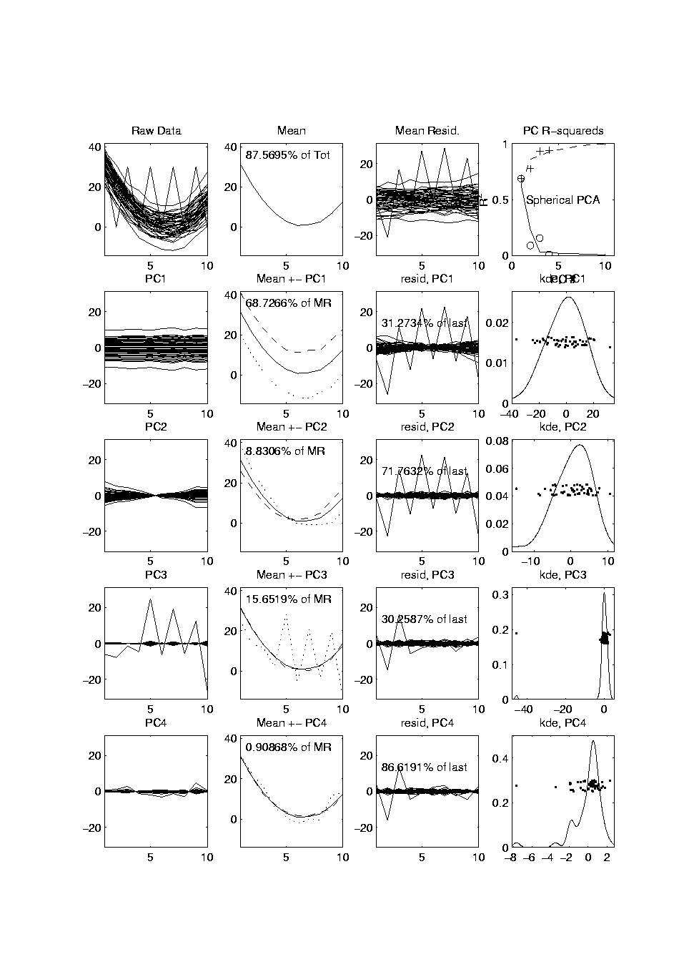
Robust PCA
Spherical PCA for Toy Example:
Now do
Spherical
PCA
Better result?
Notes:
66

Slide 67
Robust PCA
Spherical PCA for Toy Data:
Mean looks “smoother”
PC1 nearly “flat” (unaffected by outlier)
PC2 is nearly “tilt” (again unaffected by outlier)
PC3 finally strongly driven by outlier
OK, since all other directions “about equal in variation”
Energy Plot, no longer ordered
(outlier drives SS, but not directions)
Notes:
67

Slide 68
Robust PCA
Spherical PCA for Toy Example:
Check out
Later
Components
Notes:
68

Slide 69
Robust PCA
Higher Order Components:
Neither PC3 nor PC4 catch all of outlier
An effect of this down-weighting method
PC lines show power of sphered data
PC symbols show “SS for curves”
(reflects visual impression)
Latter are not monotonic!
Reflects reduced influence property of spherical PCA
Notes:
69

Slide 70
Robust PCA
Recall M-estimate for Cornea Data:
Sample Mean M-estimate
Definite improvement
But outliers still have some influence
Projection onto sphere distorts the data
Notes:
70

Slide 71
Aside On Visualization
Another Multivariate Data Visualization Tool:
Parallel Coordinates
Inselberg (1985) [1st paper]
Inselberg (2009) [Detailed Monograph]
Also see Wikipedia
Notes:
71

Slide 72
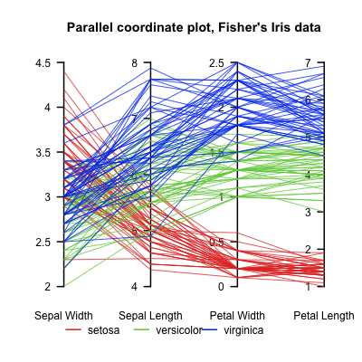
Aside On Visualization
Another Multivariate Data Visualization Tool:
Parallel Coordinates
E.g. Fisher Iris Data
d = 4
Named Variables
Notes:
72

Slide 73
Aside On Visualization
Another Multivariate Data Visualization Tool:
Parallel Coordinates
E.g. Fisher Iris Data
d = 4
Named Variables
Curves are Data Objects
(4-vectors)
Notes:
73

Slide 74
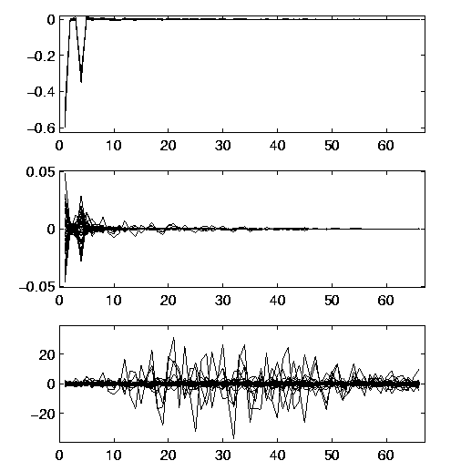
Robust PCA
Useful View: Parallel Coordinates Plot
X-axis:
Zernike
Coefficient
Number
Y-axis:
Coefficient
Notes:
74

Slide 75
Robust PCA
Cornea Data, Parallel Coordinates Plot:
Top Plot: Zernike
Coefficients
All n = 43 very
Similar
Most Action in few
Low Freq. Coeffs.
Notes:
75

Slide 76
Robust PCA
Cornea Data, Parallel Coordinates Plot
Middle Plot: Zernike Coefficients – median
Most Variation in lowest frequencies
E.g. as in Fourier compression of smooth signals
Projecting on sphere will destroy this
By magnifying high frequency behavior
Bottom Plot: discussed later
Notes:
76

Slide 77
Robust PCA
Spherical PCA Problem :
Magnification of High Freq. Coeff’s
Solution : Elliptical Analysis
Main idea: project data onto suitable ellipse, not sphere
Which ellipse? (in general, this is problem that PCA solves!)
Simplification: Consider ellipses parallel to coordinate axes
Notes:
77

Slide 78
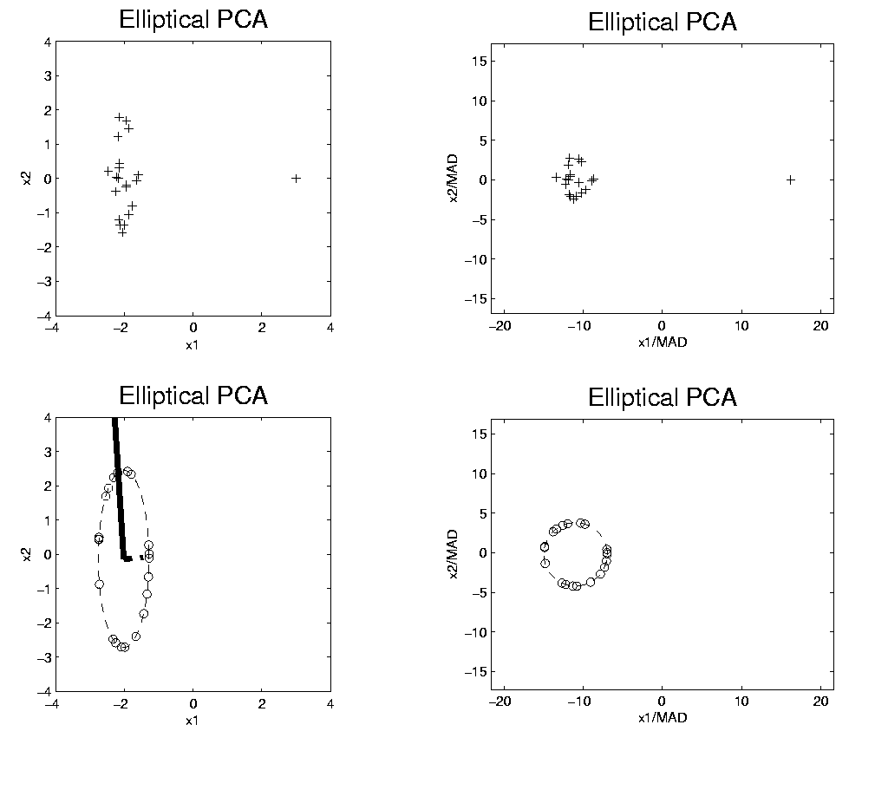
Robust PCA
Rescale
Coords
Spherical PCA
Unscale
Coords

Slide 79
Robust PCA
Elliptical Analysis (cont.):
Simple Implementation,
via coordinate axis rescaling
Divide each axis by MAD
Project Data to sphere (in transformed space)
Return to original space (mul’ply by orig’l MAD) for analysis
Where MAD = Median Absolute Deviation (from median)
(simple, high breakdown,
outlier resistant, measure of “scale”)

Slide 80

Robust PCA
Elliptical Estimate of “center”:
Do M-estimation in transformed space
(then transform back)
Results for cornea data:
Sample Mean Spherical Center Elliptical Center
Elliptical clearly best
Nearly no edge effect

Slide 81
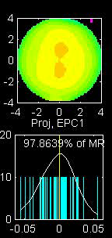
Robust PCA
Elliptical PCA for cornea data:
Original PC1, Elliptical PC1

Slide 82
Robust PCA
Elliptical PCA for cornea data:
Original PC1, Elliptical PC1
Still finds overall curvature & correlated astigmatism
Minor edge effects almost completely gone

Slide 83
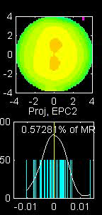
Robust PCA
Elliptical PCA for cornea data:
Original PC2, Elliptical PC2

Slide 84
Robust PCA
Elliptical PCA for cornea data:
Original PC1, Elliptical PC1
Still finds overall curvature & correlated astigmatism
Minor edge effects almost completely gone
Original PC2, Elliptical PC2
Huge edge effects dramatically reduced
Still finds steeper superior vs. inferior

Slide 85
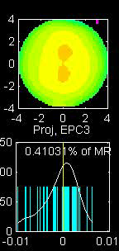
Robust PCA
Elliptical PCA for cornea data:
Original PC3, Elliptical PC3

Slide 86
Robust PCA
Elliptical PCA for Cornea Data (cont.):
Original PC3, Elliptical PC3
-Edge effects greatly diminished
But some of against the rule astigmatism also lost
Price paid for robustness

Slide 87
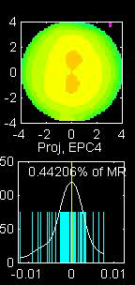
Robust PCA
Elliptical PCA for cornea data:
Original PC4, Elliptical PC4

Slide 88
Robust PCA
Elliptical PCA for Cornea Data (cont.):
Original PC3, Elliptical PC3
-Edge effects greatly diminished
But some of against the rule astigmatism also lost
Price paid for robustness
Original PC4, Elliptical PC4
Now looks more like variation on astigmatism???

Slide 89
Robust PCA
Current state of the art:
Spherical & Elliptical PCA are a kludge
Put together by Robustness Amateurs
To solve this HDLSS problem
Good News: Robustness Pros are now in the game:
Maronna, et al (2006) Robust Statistics:
Theory and Methods, Sec. 6.10.2

Slide 90
Robust PCA
Disclaimer on robust analy’s of Cornea Data:
Critical parameter is “radius of analysis”,
: Shown above, Elliptical PCA very effective
: Stronger edge effects, Elliptical PCA less useful
: Edge effects weaker, don’t need robust PCA

