Slide 1
Statistics – O. R. 891
Object Oriented Data Analysis
J. S. Marron
Dept. of Statistics and Operations Research
University of North Carolina

Slide 2
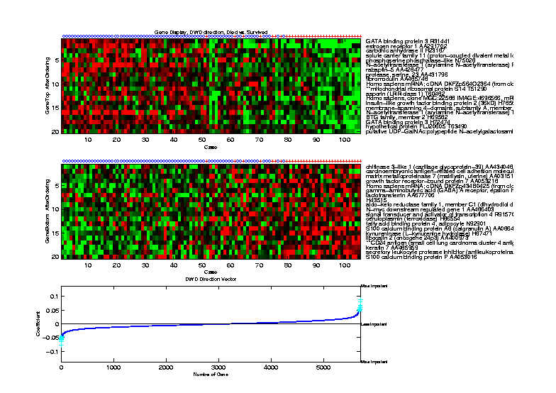
Outcomes Data
Which is “better”? DWD direction
Notes:
2

Slide 3
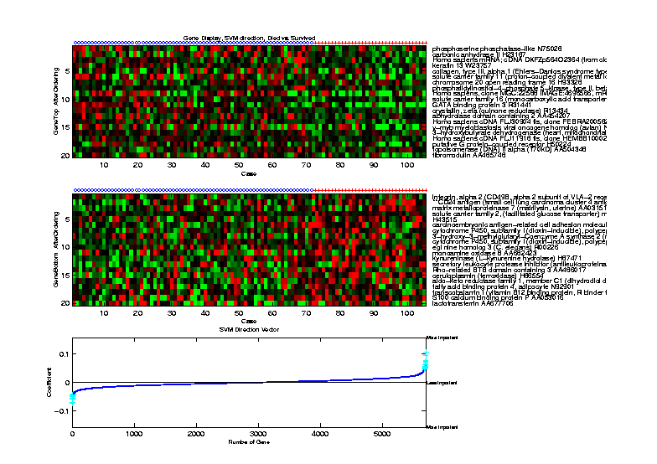
Outcomes Data
Which is “better”? SVM direction
Notes:
3

Slide 4
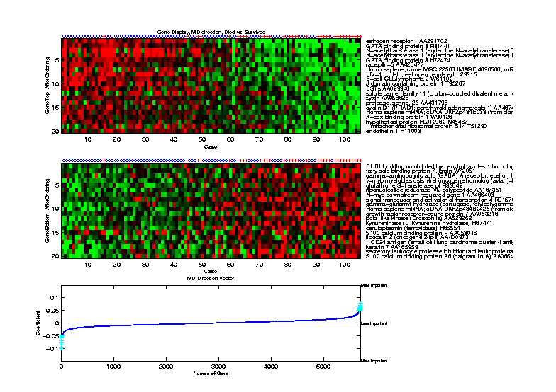
Outcomes Data
How about Centroid (Mean Diff’nce) Method?
Notes:
4

Slide 5
HDLSS Discrim’n Simulations
Conclusions:
Everything (sensible) is best sometimes
DWD often very near best
MD weak beyond Gaussian
Caution about simulations (and examples):
Very easy to cherry pick best ones
Good practice in Machine Learning
  “Ignore method proposed, but read
  paper for useful comparison of others”

Slide 6
SVM & DWD Tuning Parameter
Possible Approaches:
Visually Tuned
Simple Defaults
Cross Validation
Scale Space
(Work with Full Range of Choices)
Notes:
6

Slide 7
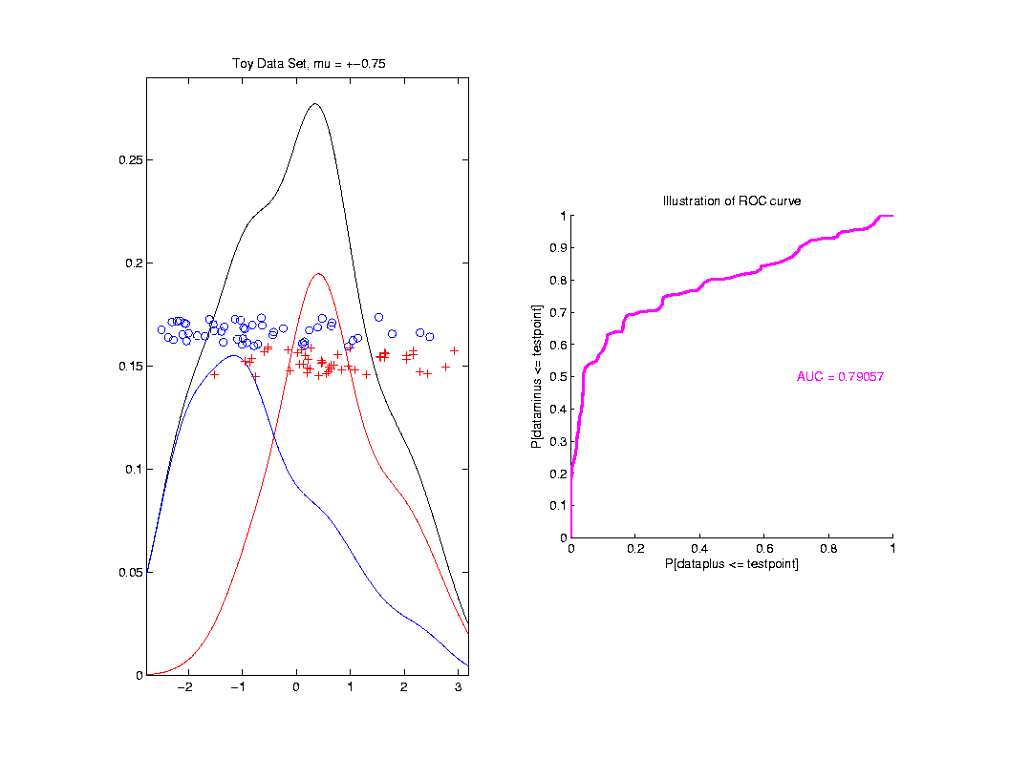
ROC Curve
Summarize
& Compare
Using
Area
Under
Curve
(AUC)

Slide 8
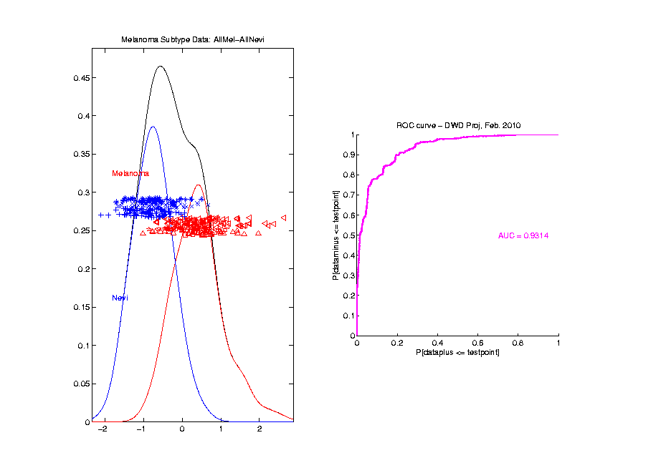
Melanoma Data
Full Data
ROC
Analysis
AUC = 0.93

Slide 9
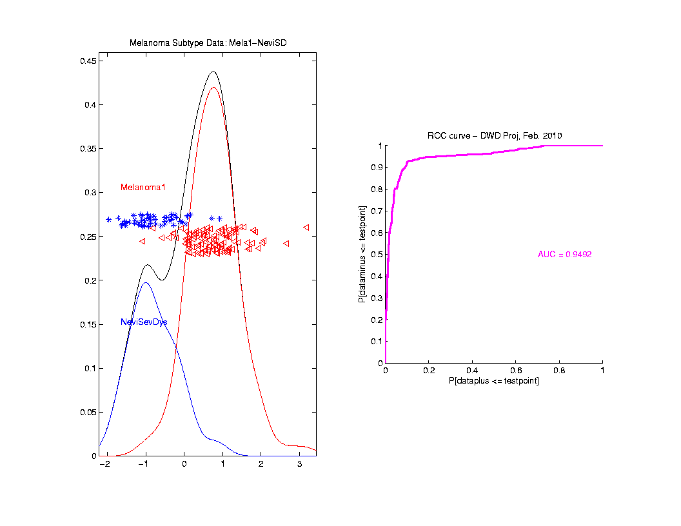
Melanoma Data
SubClass
ROC
Analysis
AUC = 0.95
Better,
Makes
Intuitive
Sense

Slide 10
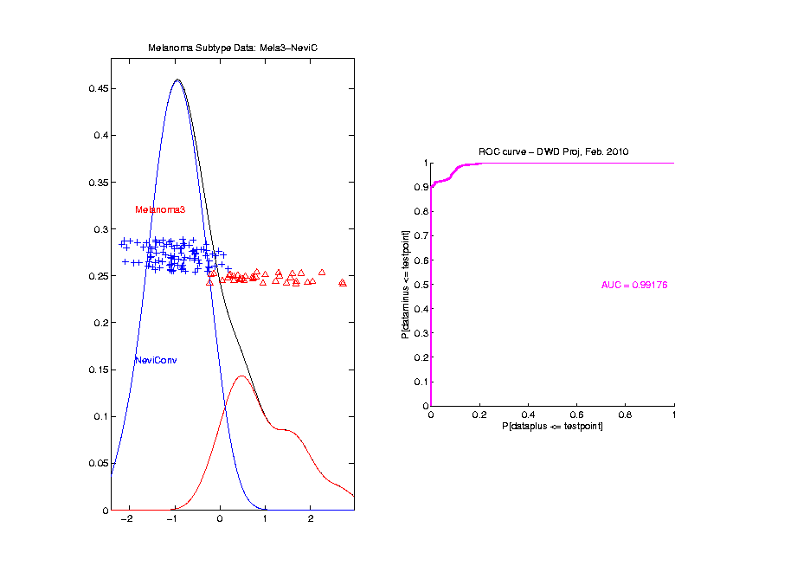
Melanoma Data
ROC
Analysis
AUC = 0.99

Slide 11
Clustering
Idea: Given data
Assign each object to a class
Of similar objects
Completely data driven
I.e. assign labels to data
“Unsupervised Learning”
Contrast to Classification (Discrimination)
With predetermined classes
“Supervised Learning”

Slide 12
K-means Clustering
Clustering Goal:
Given data
Choose classes
To miminize

Slide 13
K-means Clustering
Notes on Cluster Index:
CI = 0 when all data at cluster means
CI small when gives tight clustering
(within SS contains little variation)
CI big when gives poor clustering
(within SS contains most of variation)

Slide 14
K-means Clustering
Notes on Cluster Index:
Unit Free
Shift Invariant
Scale Invariant
Rotation Invariant
(Will Use These Soon)

Slide 15
SWISS Score
Another Application of CI (Cluster Index)
Cabanski et al (2010)

Slide 16
SWISS Score
Another Application of CI (Cluster Index)
Cabanski et al (2010)
Idea: Use CI in bioinformatics to
“measure quality of data preprocessing”

Slide 17
SWISS Score
Another Application of CI (Cluster Index)
Cabanski et al (2010)
Idea: Use CI in bioinformatics to
“measure quality of data preprocessing”
Philosophy: Clusters Are Scientific Goal
So Want to Accentuate Them

Slide 18
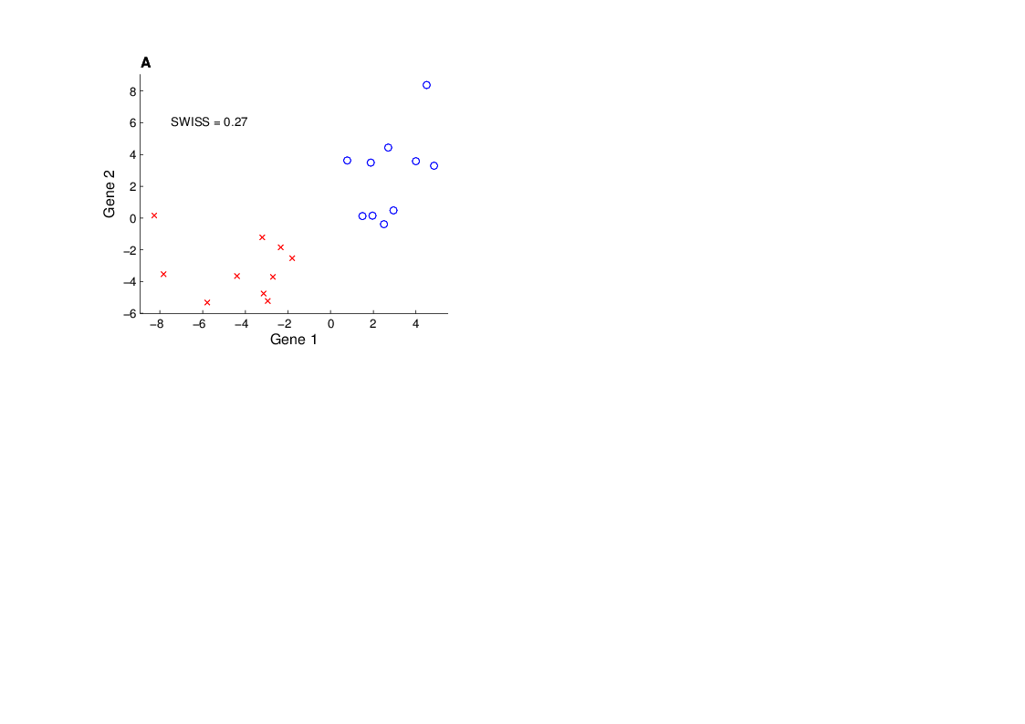
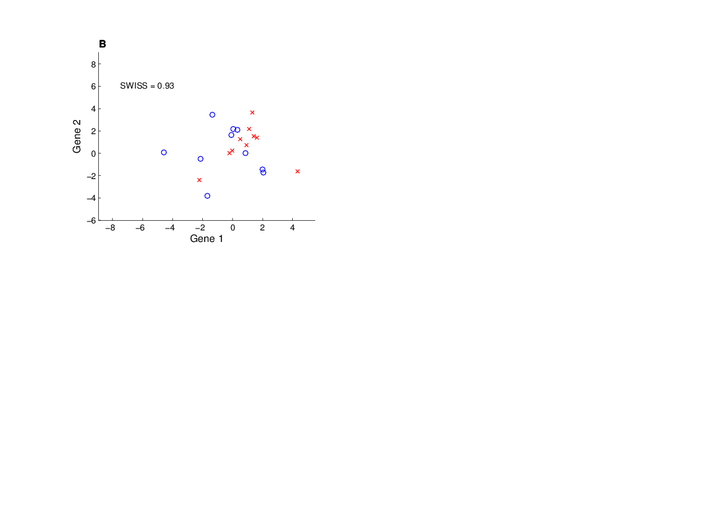
SWISS Score
Toy Examples (2-d):
Which are “More Clustered?”

Slide 19
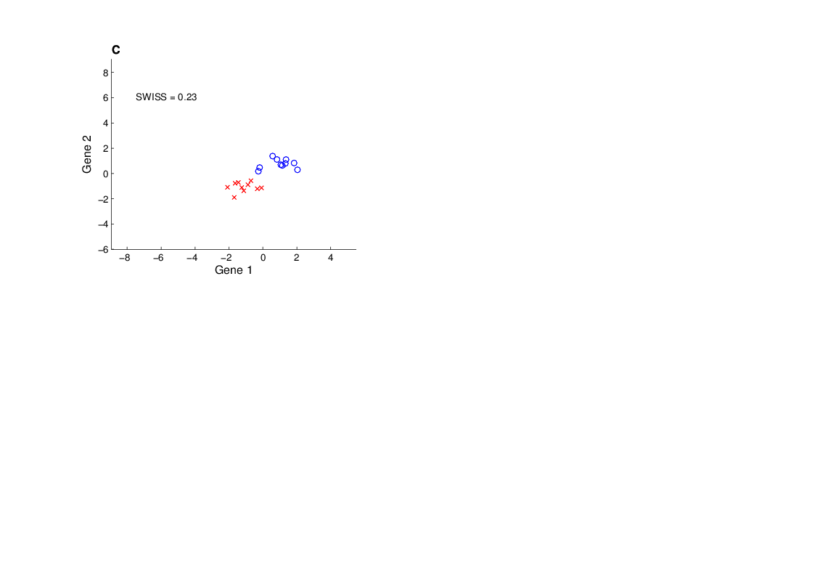
SWISS Score
Toy Examples (2-d):
Which are “More Clustered?”

Slide 20
SWISS Score
SWISS =
Standardized Within class Sum of Squares

Slide 21
SWISS Score
SWISS =
Standardized Within class Sum of Squares

Slide 22
SWISS Score
SWISS =
Standardized Within class Sum of Squares

Slide 23
SWISS Score
SWISS =
Standardized Within class Sum of Squares

Slide 24
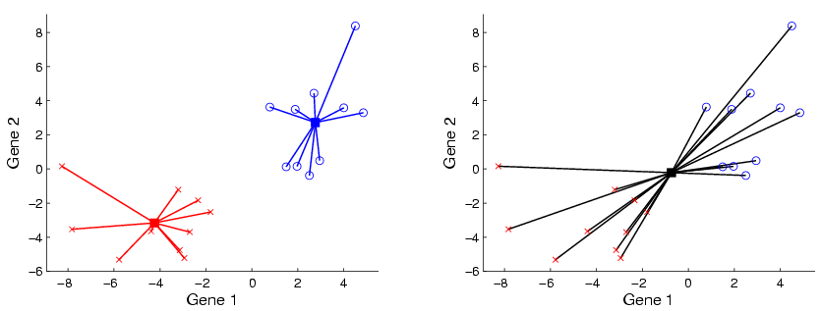
SWISS Score
Nice Graphical Introduction:

Slide 25
SWISS Score
Nice Graphical Introduction:

Slide 26
SWISS Score
Nice Graphical Introduction:

Slide 27
SWISS Score
Revisit Toy Examples (2-d):
Which are “More Clustered?”

Slide 28
SWISS Score
Toy Examples (2-d):
Which are “More Clustered?”

Slide 29

SWISS Score
Toy Examples (2-d):
Which are “More Clustered?”

Slide 30
SWISS Score
Now Consider K > 2:
How well does it work?

Slide 31
SWISS Score
K = 3, Toy Example:

Slide 32
SWISS Score
K = 3, Toy Example:

Slide 33
SWISS Score
K = 3, Toy Example:

Slide 34
SWISS Score
K = 3, Toy Example:
But C
Seems
“Better
Clustered”

Slide 35
SWISS Score
K-Class SWISS:
Instead of using K-Class CI
Use Average of Pairwise SWISS Scores

Slide 36
SWISS Score
K-Class SWISS:
Instead of using K-Class CI
Use Average of Pairwise SWISS Scores
(Preserves [0,1] Range)

Slide 37
SWISS Score
Avg. Pairwise SWISS – Toy Examples

Slide 38
SWISS Score
Additional Feature:
Ǝ Hypothesis Tests:
H₁: SWISS₁ < 1
H₁: SWISS₁ < SWISS₂
Permutation Based
See Cabanski et al (2010)

Slide 39
Clustering
A Very Large Area
K-Means is Only One Approach

Slide 40
Clustering
A Very Large Area
K-Means is Only One Approach
Has its Drawbacks
(Many Toy Examples of This)

Slide 41
Clustering
A Very Large Area
K-Means is Only One Approach
Has its Drawbacks
(Many Toy Examples of This)
Ǝ Many Other Approaches

Slide 42
Clustering
Recall Important References (monographs):
Hartigan (1975)
Gersho and Gray (1992)
Kaufman and Rousseeuw (2005)
See Also Wikipedia

Slide 43
Clustering
A Very Large Area
K-Means is Only One Approach
Has its Drawbacks
(Many Toy Examples of This)
Ǝ Many Other Approaches
Important (And Broad) Class
Hierarchical Clustering

Slide 44
Hiearchical Clustering
Idea: Consider Either:
Bottom Up Aggregation:
One by One Combine Data
Top Down Splitting:
All Data in One Cluster & Split
Through Entire Data Set, to get Dendogram

Slide 45
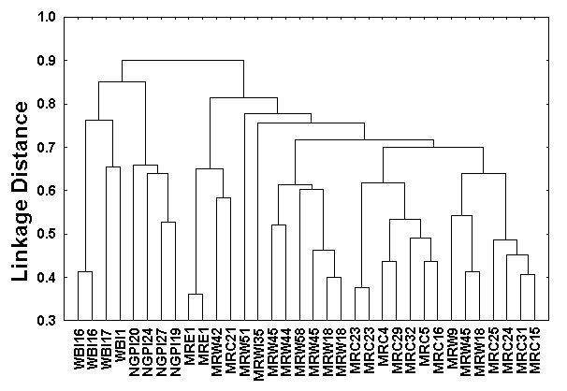
Hiearchical Clustering
Aggregate or Split, to get Dendogram
Thanks to US EPA: water.epa.gov

Slide 46
Hiearchical Clustering
Aggregate or Split, to get Dendogram
Aggregate:
Start With
Individuals,
Move Up

Slide 47
Hiearchical Clustering
Aggregate or Split, to get Dendogram
Aggregate:
Start With
Individuals

Slide 48
Hiearchical Clustering
Aggregate or Split, to get Dendogram
Aggregate:
Start With
Individuals,
Move Up

Slide 49
Hiearchical Clustering
Aggregate or Split, to get Dendogram
Aggregate:
Start With
Individuals,
Move Up

Slide 50
Hiearchical Clustering
Aggregate or Split, to get Dendogram
Aggregate:
Start With
Individuals,
Move Up

Slide 51
Hiearchical Clustering
Aggregate or Split, to get Dendogram
Aggregate:
Start With
Individuals,
Move Up,
End Up With
All in 1 Cluster

Slide 52
Hiearchical Clustering
Aggregate or Split, to get Dendogram
Split:
Start With
All in 1 Cluster

Slide 53
Hiearchical Clustering
Aggregate or Split, to get Dendogram
Split:
Start With
All in 1 Cluster,
Move Down

Slide 54
Hiearchical Clustering
Aggregate or Split, to get Dendogram
Split:
Start With
All in 1 Cluster,
Move Down,
End With
Individuals

Slide 55
Hiearchical Clustering
Vertical Axis in Dendogram:
Based on:
Distance Metric
(Ǝ many, e.g. L², L¹, L∞, …)
Linkage Function
(Reflects Clustering Type)

Slide 56
Hiearchical Clustering
Dendogram Interpretation
Branch
Length
Reflects
Cluster
Strength

Slide 57
SigClust
Statistical Significance of Clusters
in HDLSS Data
When is a cluster “really there”?

Slide 58
SigClust
Statistical Significance of Clusters
in HDLSS Data
When is a cluster “really there”?
Liu et al (2007)

Slide 59
SigClust
Co-authors:
Andrew Nobel – UNC Statistics & OR
C. M. Perou – UNC Genetics
D. N. Hayes – UNC Oncology & Genetics
Yufeng Liu – UNC Statistics & OR

Slide 60
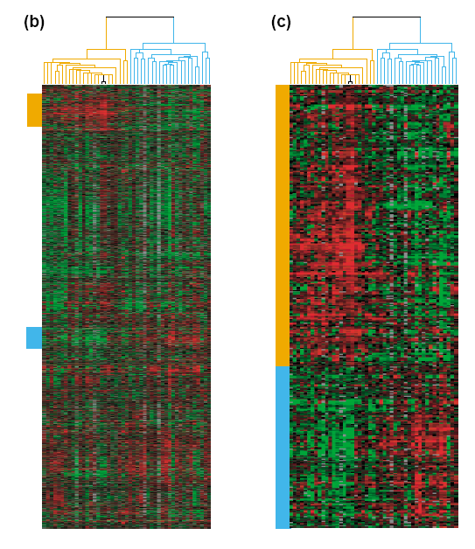
Common Microarray Analytic Approach: Clustering
From: Perou, Brown,
Botstein (2000)
Molecular Medicine
Today
d = 1161 genes
Zoomed to “relevant”
Gene subsets

Slide 61
Interesting Statistical Problem
For HDLSS data:
When clusters seem to appear
  E.g. found by clustering method
How do we know they are really there?
  Question asked by Neil Hayes
  Define appropriate statistical significance?
  Can we calculate it?

Slide 62
First Approaches: Hypo Testing
e.g. Direction, Projection, Permutation
Hypothesis test
Discussed in Guest Lecture by Susan Wei
Oct. 9, 2012

Slide 63
First Approaches: Hypo Testing
e.g. Direction, Projection, Permutation
Hypothesis test of:
Significant difference between sub-populations

Slide 64
First Approaches: Hypo Testing
e.g. Direction, Projection, Permutation
Hypothesis test of:
Significant difference between sub-populations
Effective and Accurate
I.e. Sensitive and Specific
There exist several such tests

Slide 65
First Approaches: Hypo Testing
e.g. Direction, Projection, Permutation
Hypothesis test of:
Significant difference between sub-populations
Effective and Accurate
I.e. Sensitive and Specific
There exist several such tests
But critical point is:
What result implies about clusters

Slide 66
Clarifying Simple Example
Why Population Difference Tests cannot indicate clustering
Andrew Nobel Observation
For Gaussian Data (Clearly 1 Cluster!)
Assign Extreme Labels
(e.g. by clustering)
Subpopulations are signif’ly different

Slide 67
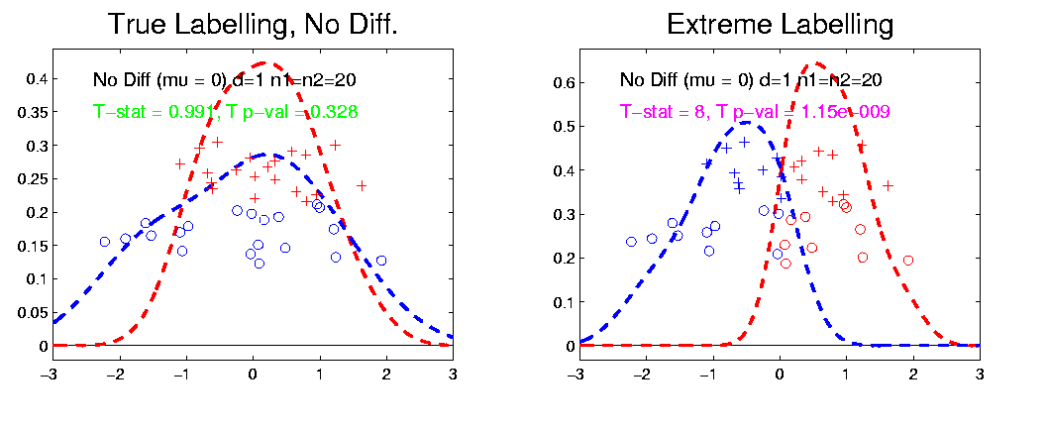
Simple Gaussian Example
Clearly only 1 Cluster in this Example
But Extreme Relabelling looks different
Extreme T-stat strongly significant
Indicates 2 clusters in data

Slide 68
Simple Gaussian Example
Results:
Random relabelling T-stat is not significant
But extreme T-stat is strongly significant
This comes from clustering operation
Conclude sub-populations are different

Slide 69
Simple Gaussian Example
Results:
Random relabelling T-stat is not significant
But extreme T-stat is strongly significant
This comes from clustering operation
Conclude sub-populations are different
Now see that:
Not the same as clusters really there

Slide 70
Simple Gaussian Example
Results:
Random relabelling T-stat is not significant
But extreme T-stat is strongly significant
This comes from clustering operation
Conclude sub-populations are different
Now see that:
Not the same as clusters really there
Need a new approach to study clusters

Slide 71
Statistical Significance of Clusters
Basis of SigClust Approach:
What defines: A Single Cluster?
  A Gaussian distribution (Sarle & Kou 1993)

Slide 72
Statistical Significance of Clusters
Basis of SigClust Approach:
What defines: A Single Cluster?
  A Gaussian distribution (Sarle & Kou 1993)
So define SigClust test based on:
  2-means cluster index (measure) as statistic
  Gaussian null distribution
  Currently compute by simulation
  Possible to do this analytically???

Slide 73
SigClust Statistic – 2-Means Cluster Index
Measure of non-Gaussianity:
2-means Cluster Index
Familiar Criterion from k-means Clustering

Slide 74
SigClust Statistic – 2-Means Cluster Index
Measure of non-Gaussianity:
2-means Cluster Index
Familiar Criterion from k-means Clustering
Within Class Sum of Squared Distances to Class Means
Prefer to divide (normalize) by Overall Sum of Squared Distances to Mean
Puts on scale of proportions

Slide 75
SigClust Statistic – 2-Means Cluster Index
Measure of non-Gaussianity:
2-means Cluster Index:
Class Index Sets Class Means
“Within Class Var’n” / “Total Var’n”

Slide 76
SigClust Gaussian null distribut’n
Which Gaussian (for null)?

Slide 77
SigClust Gaussian null distribut’n
Which Gaussian (for null)?
Standard (sphered) normal?
  No, not realistic
  Rejection not strong evidence for clustering
  Could also get that from a-spherical Gaussian

Slide 78
SigClust Gaussian null distribut’n
Which Gaussian (for null)?
Standard (sphered) normal?
  No, not realistic
  Rejection not strong evidence for clustering
  Could also get that from a-spherical Gaussian
Need Gaussian more like data:
  Challenge: Parameter Estimation
  Recall HDLSS Context

Slide 79
SigClust Gaussian null distribut’n
Estimated Mean (of Gaussian dist’n)?
1st Key Idea: Can ignore this

Slide 80
SigClust Gaussian null distribut’n
Estimated Mean (of Gaussian dist’n)?
1st Key Idea: Can ignore this
By appealing to shift invariance of CI
  When Data are (rigidly) shifted
  CI remains the same
So enough to simulate with mean 0

Slide 81
SigClust Gaussian null distribut’n
Estimated Mean (of Gaussian dist’n)?
1st Key Idea: Can ignore this
By appealing to shift invariance of CI
  When Data are (rigidly) shifted
  CI remains the same
So enough to simulate with mean 0
Other uses of invariance ideas?

Slide 82
SigClust Gaussian null distribut’n
Challenge: how to estimate cov. Matrix?

Slide 83
SigClust Gaussian null distribut’n
Challenge: how to estimate cov. Matrix?
Number of parameters:
E.g. Perou 500 data:
Dimension
so
But Sample Size

Slide 84
SigClust Gaussian null distribut’n
Challenge: how to estimate cov. Matrix?
Number of parameters:
E.g. Perou 500 data:
Dimension
so
But Sample Size
Impossible in HDLSS settings????
Way around this problem?

Slide 85
SigClust Gaussian null distribut’n
2nd Key Idea: Mod Out Rotations

Slide 86
SigClust Gaussian null distribut’n
2nd Key Idea: Mod Out Rotations
Replace full Cov. by diagonal matrix
As done in PCA eigen-analysis
But then “not like data”???

Slide 87
SigClust Gaussian null distribut’n
2nd Key Idea: Mod Out Rotations
Replace full Cov. by diagonal matrix
As done in PCA eigen-analysis
But then “not like data”???
OK, since k-means clustering (i.e. CI) is
rotation invariant
(assuming e.g. Euclidean Distance)

Slide 88
SigClust Gaussian null distribut’n
2nd Key Idea: Mod Out Rotations
Only need to estimate diagonal matrix
But still have HDLSS problems?

Slide 89
SigClust Gaussian null distribut’n
2nd Key Idea: Mod Out Rotations
Only need to estimate diagonal matrix
But still have HDLSS problems?
E.g. Perou 500 data:
Dimension
Sample Size
Still need to estimate param’s

Slide 90
SigClust Gaussian null distribut’n
3rd Key Idea: Factor Analysis Model

Slide 91
SigClust Gaussian null distribut’n
3rd Key Idea: Factor Analysis Model
Model Covariance as: Biology + Noise
Where
is “fairly low dimensional”
is estimated from background noise

Slide 92
SigClust Gaussian null distribut’n
Estimation of Background Noise :

Slide 93
SigClust Gaussian null distribut’n
Estimation of Background Noise :
Reasonable model (for each gene):
Expression = Signal + Noise

Slide 94
SigClust Gaussian null distribut’n
Estimation of Background Noise :
Reasonable model (for each gene):
Expression = Signal + Noise
“noise” is roughly Gaussian
“noise” terms essentially independent
(across genes)

Slide 95
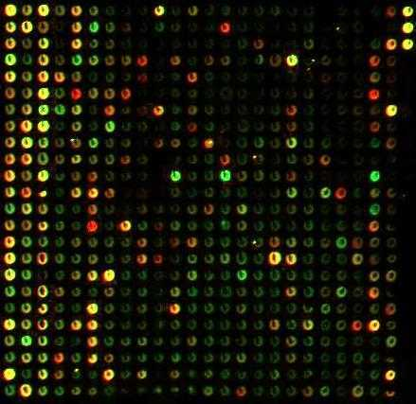
SigClust Gaussian null distribut’n
Estimation of Background Noise :
Model OK, since
data come from
light intensities
at colored spots

Slide 96
SigClust Gaussian null distribut’n
Estimation of Background Noise :
For all expression values (as numbers)
(Each Entry of dxn Data matrix)

Slide 97
SigClust Gaussian null distribut’n
Estimation of Background Noise :
For all expression values (as numbers)
Use robust estimate of scale
Median Absolute Deviation (MAD)
(from the median)

Slide 98
SigClust Gaussian null distribut’n
Estimation of Background Noise :
For all expression values (as numbers)
Use robust estimate of scale
Median Absolute Deviation (MAD)
(from the median)
Rescale to put on same scale as s. d.:

Slide 99
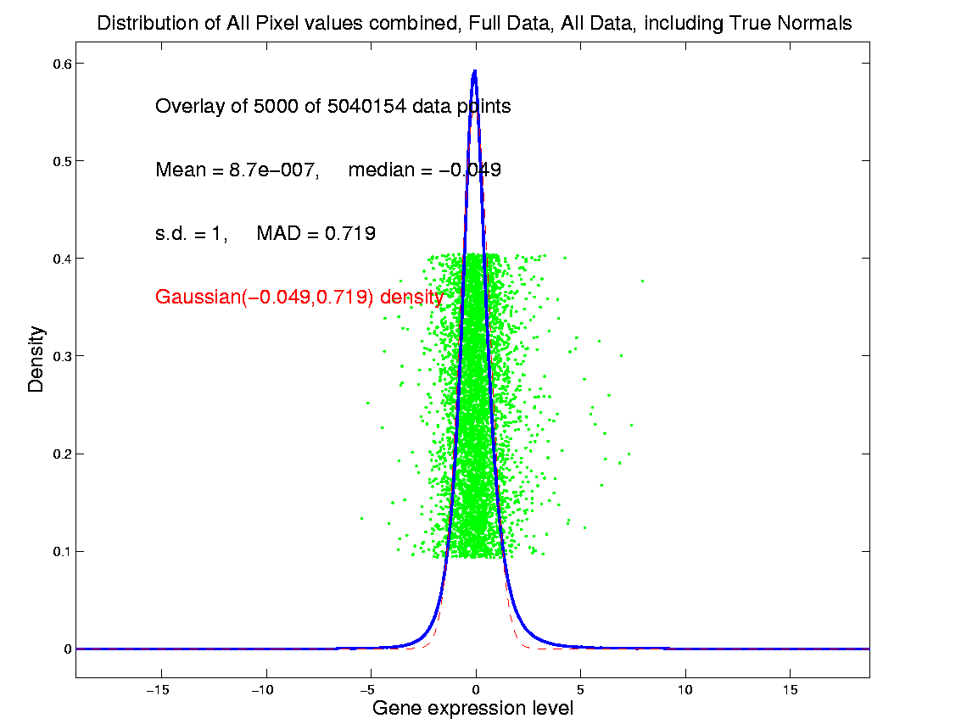
SigClust Estimation of Background Noise

Slide 100
SigClust Estimation of Background Noise
Hope: Most
Entries are
“Pure Noise,
(Gaussian)”

Slide 101
SigClust Estimation of Background Noise
Hope: Most
Entries are
“Pure Noise,
(Gaussian)”
A Few (< ¼)
Are Biological
Signal –
Outliers

Slide 102
SigClust Estimation of Background Noise
Hope: Most
Entries are
“Pure Noise,
(Gaussian)”
A Few (< ¼)
Are Biological
Signal –
Outliers
How to Check?

Slide 103
Q-Q plots
An aside:
Fitting probability distributions to data

Slide 104
Q-Q plots
An aside:
Fitting probability distributions to data
Does Gaussian distribution “fit”???
If not, why not?

Slide 105
Q-Q plots
An aside:
Fitting probability distributions to data
Does Gaussian distribution “fit”???
If not, why not?
Fit in some part of the distribution?
(e.g. in the middle only?)

Slide 106
Q-Q plots
Approaches to:
Fitting probability distributions to data
Histograms
Kernel Density Estimates

Slide 107
Q-Q plots
Approaches to:
Fitting probability distributions to data
Histograms
Kernel Density Estimates
Drawbacks: often not best view
(for determining goodness of fit)

Slide 108
Q-Q plots
Consider Testbed of 4 Toy Examples:
non-Gaussian!
non-Gaussian(?)
Gaussian
Gaussian?
(Will use these names several times)

Slide 109
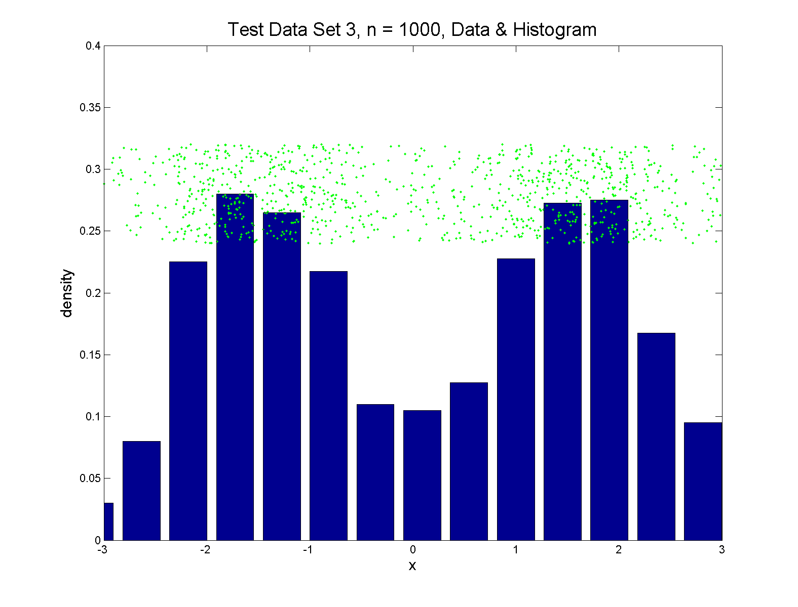
Q-Q plots
Simple Toy Example, non-Gaussian!

Slide 110
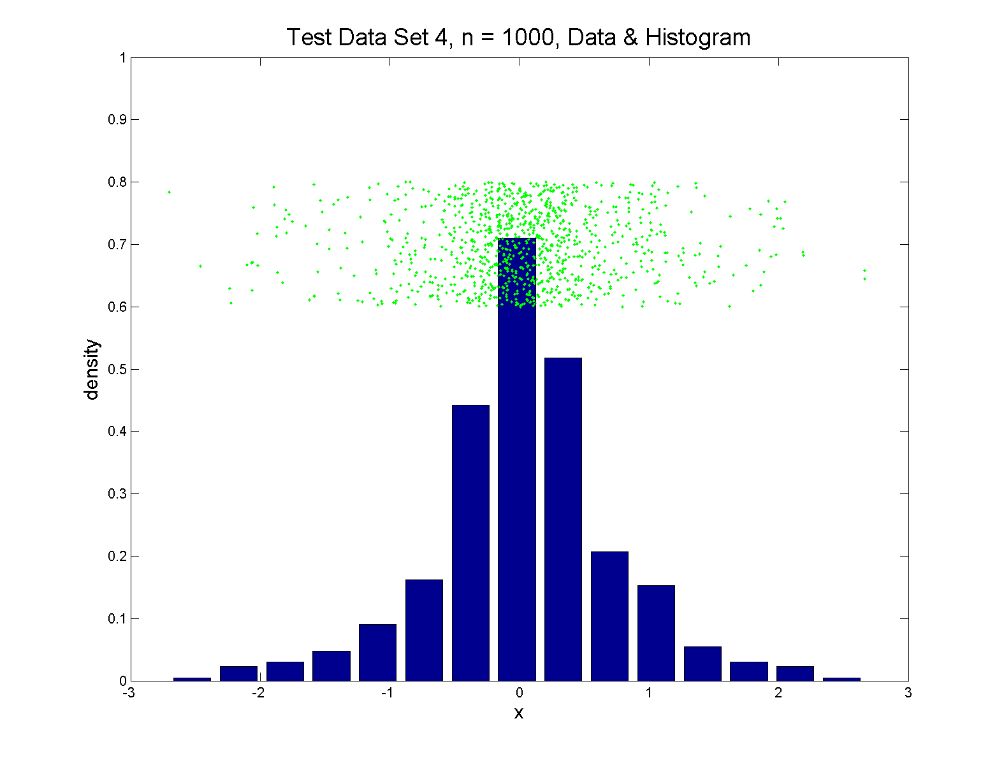
Q-Q plots
Simple Toy Example, non-Gaussian(?)

Slide 111
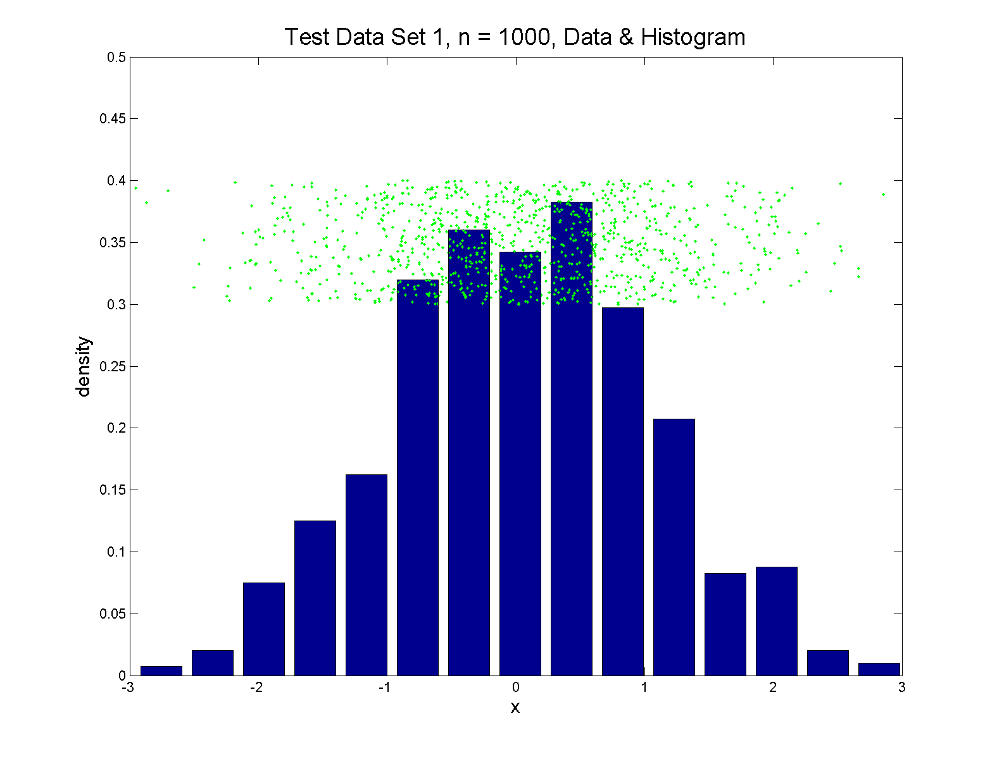
Q-Q plots
Simple Toy Example, Gaussian

Slide 112
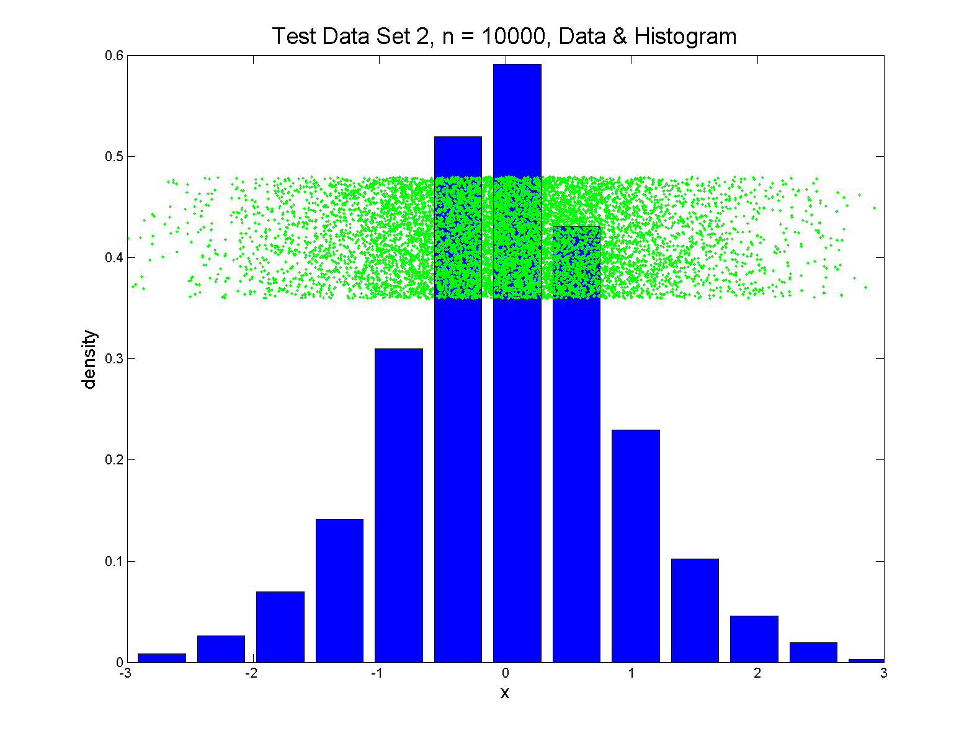
Q-Q plots
Simple Toy Example, Gaussian?

Slide 113
Q-Q plots
Notes:
Bimodal → see non-Gaussian with histo
Other cases: hard to see
Conclude:
Histogram poor at assessing Gauss’ity

Slide 114
Q-Q plots
Standard approach to checking Gaussianity
QQ – plots
Background:
Graphical Goodness of Fit
Fisher (1983)

Slide 115
Q-Q plots
Background: Graphical Goodness of Fit
Basis:
Cumulative Distribution Function (CDF)

Slide 116
Q-Q plots
Background: Graphical Goodness of Fit
Basis:
Cumulative Distribution Function (CDF)
Probability quantile notation:
for "probability” and "quantile"

Slide 117
Q-Q plots
Probability quantile notation:
for "probability” and "quantile“
Thus is called the quantile function

Slide 118
Q-Q plots
Two types of CDF:
Theoretical

Slide 119
Q-Q plots
Two types of CDF:
Theoretical
Empirical, based on data

Slide 120
Q-Q plots
Direct Visualizations:
Empirical CDF plot:
plot
vs. grid of (sorted data) values

Slide 121
Q-Q plots
Direct Visualizations:
Empirical CDF plot:
plot
vs. grid of (sorted data) values
Quantile plot (inverse):
plot
vs.

Slide 122
Q-Q plots
Comparison Visualizations:
(compare a theoretical with an empirical)
P-P plot:
plot vs.
for a grid of values

Slide 123
Q-Q plots
Comparison Visualizations:
(compare a theoretical with an empirical)
P-P plot:
plot vs.
for a grid of values
Q-Q plot:
plot vs.
for a grid of values

Slide 124
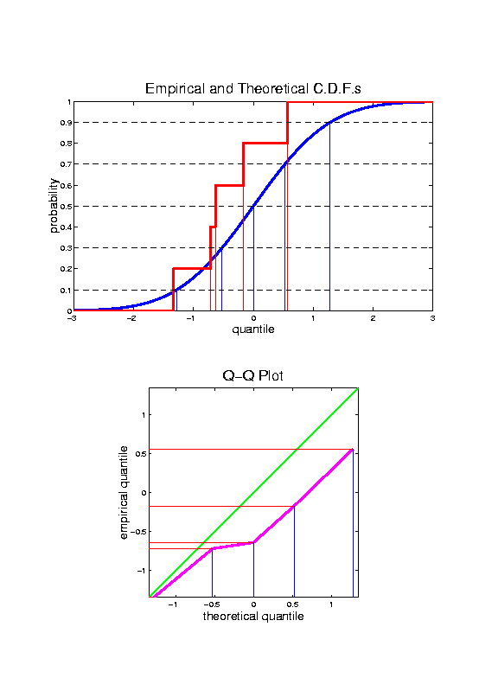
Q-Q plots
Illustrative graphic (toy data set):

Slide 125
Q-Q plots
Empirical Quantiles (sorted data points)

Slide 126
Q-Q plots
Corresponding ( matched) Theoretical Quantiles

Slide 127
Q-Q plots
Illustrative graphic (toy data set):
Main goal of Q-Q Plot:
Display how well quantiles compare
vs.

Slide 128
Q-Q plots
Illustrative graphic (toy data set):

Slide 129
Q-Q plots
Illustrative graphic (toy data set):

Slide 130
Q-Q plots
Illustrative graphic (toy data set):

Slide 131
Q-Q plots
Illustrative graphic (toy data set):

Slide 132
Q-Q plots
Illustrative graphic (toy data set):

Slide 133
Q-Q plots
Illustrative graphic (toy data set):

Slide 134
Q-Q plots
Illustrative graphic (toy data set):
Empirical Qs near Theoretical Qs
when
Q-Q curve is near 45⁰ line
(general use of Q-Q plots)

Slide 135
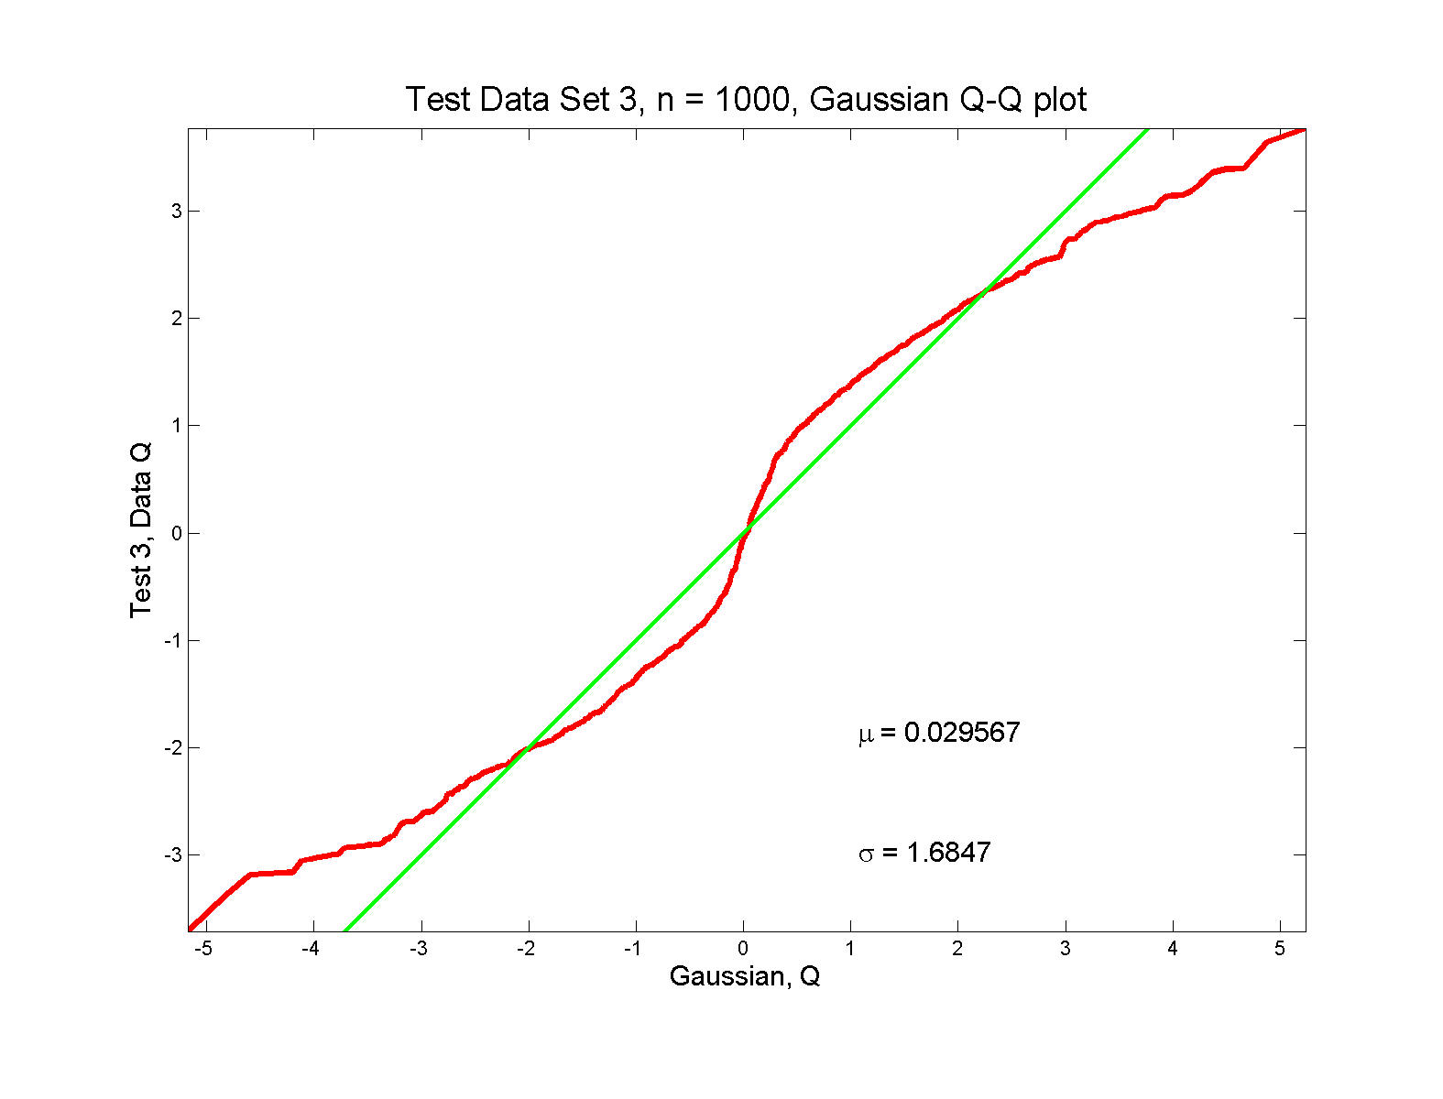
Q-Q plots
non-Gaussian! departures from line?

Slide 136
Q-Q plots
non-Gaussian! departures from line?
Seems different from line?
2 modes turn into wiggles?
Less strong feature
Been proposed to study modality

Slide 137
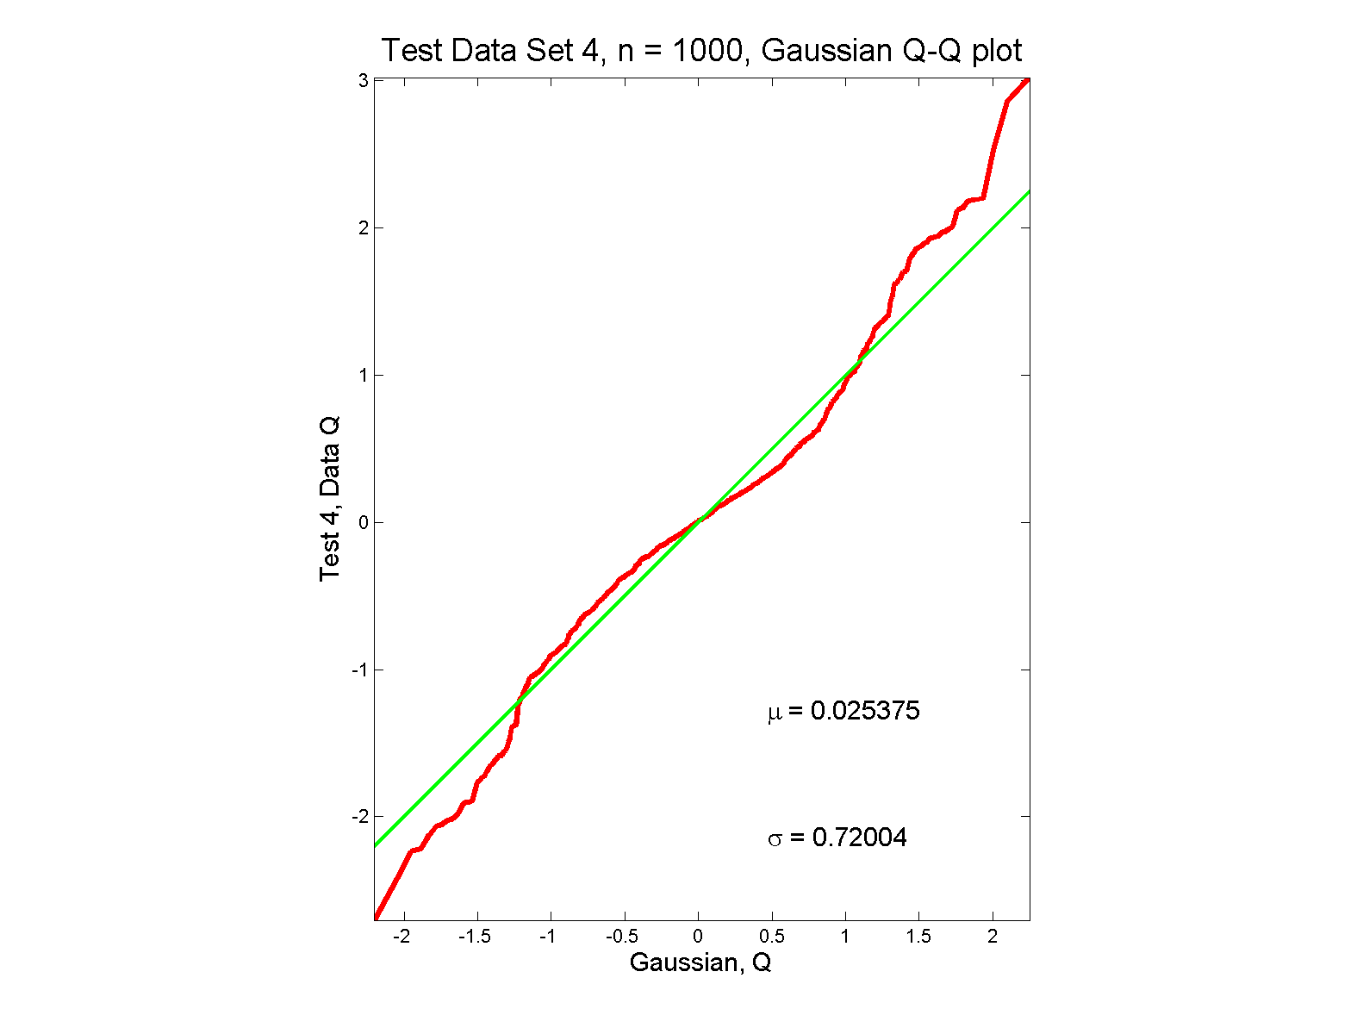
Q-Q plots
non-Gaussian (?) departures from line?

Slide 138
Q-Q plots
non-Gaussian (?) departures from line?
Seems different from line?
Harder to say this time?
What is signal & what is noise?
Need to understand sampling variation

Slide 139
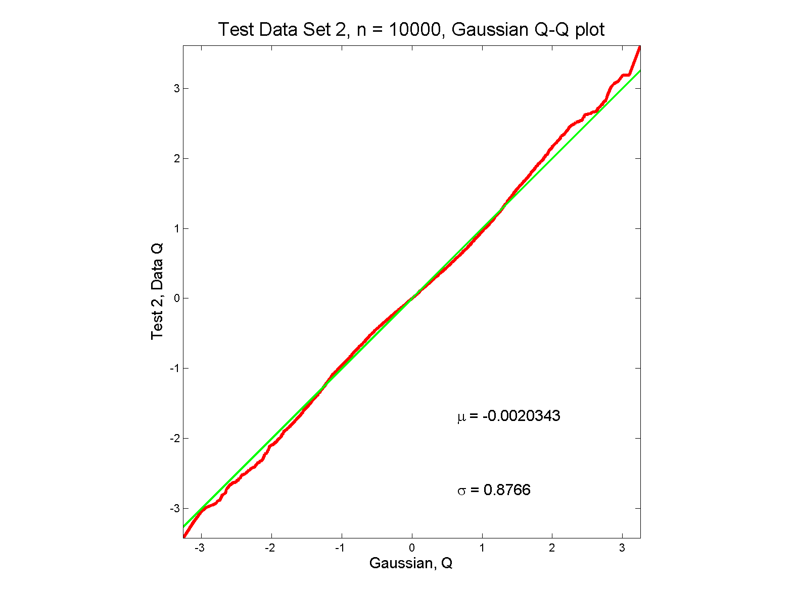
Q-Q plots
Gaussian? departures from line?

Slide 140
Q-Q plots
Gaussian? departures from line?
Looks much like?
Wiggles all random variation?
But there are n = 10,000 data points…
How to assess signal & noise?
Need to understand sampling variation

Slide 141
Q-Q plots
Need to understand sampling variation
Approach: Q-Q envelope plot

Slide 142
Q-Q plots
Need to understand sampling variation
Approach: Q-Q envelope plot
  Simulate from Theoretical Dist’n
  Samples of same size

Slide 143
Q-Q plots
Need to understand sampling variation
Approach: Q-Q envelope plot
  Simulate from Theoretical Dist’n
  Samples of same size
  About 100 samples gives
  “good visual impression”

Slide 144
Q-Q plots
Need to understand sampling variation
Approach: Q-Q envelope plot
  Simulate from Theoretical Dist’n
  Samples of same size
  About 100 samples gives
  “good visual impression”
  Overlay resulting 100 QQ-curves
  To visually convey natural sampling variation

Slide 145
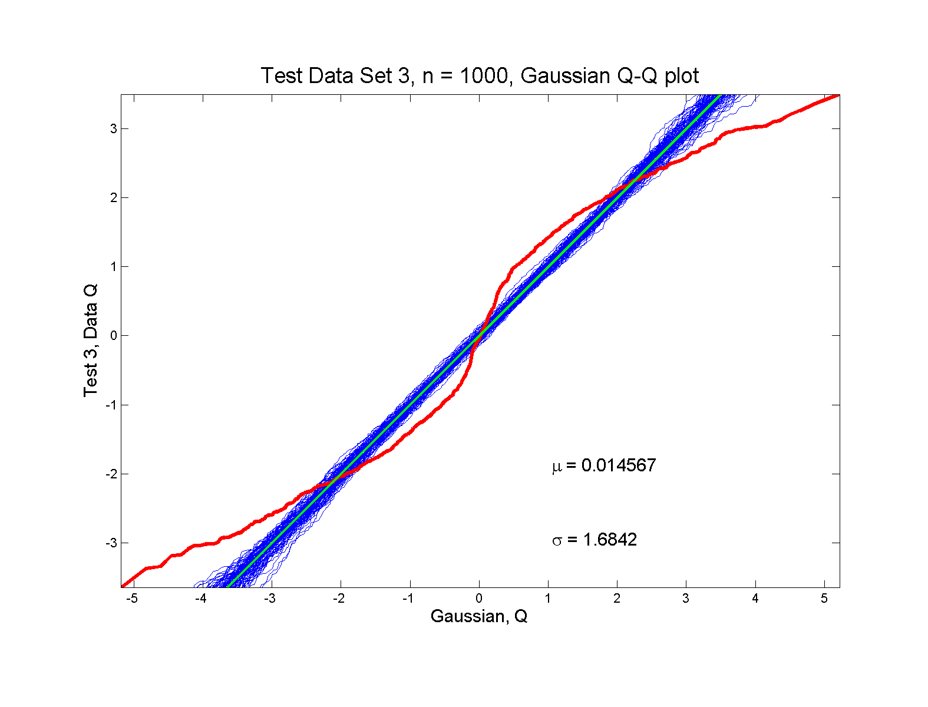
Q-Q plots
non-Gaussian! departures from line?

Slide 146
Q-Q plots
non-Gaussian! departures from line?
Envelope Plot shows:
Departures are significant
Clear these data are not Gaussian
Q-Q plot gives clear indication

Slide 147
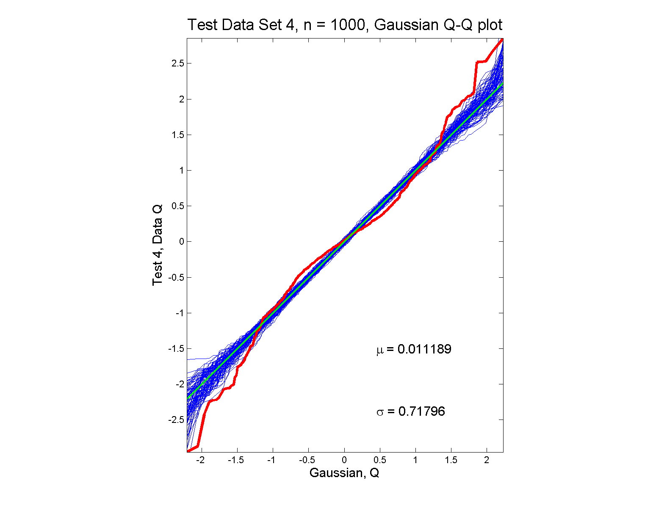
Q-Q plots
non-Gaussian (?) departures from line?

Slide 148
Q-Q plots
non-Gaussian (?) departures from line?
Envelope Plot shows:
Departures are significant
Clear these data are not Gaussian
Recall not so clear from e.g. histogram
Q-Q plot gives clear indication
Envelope plot reflects sampling variation

Slide 149
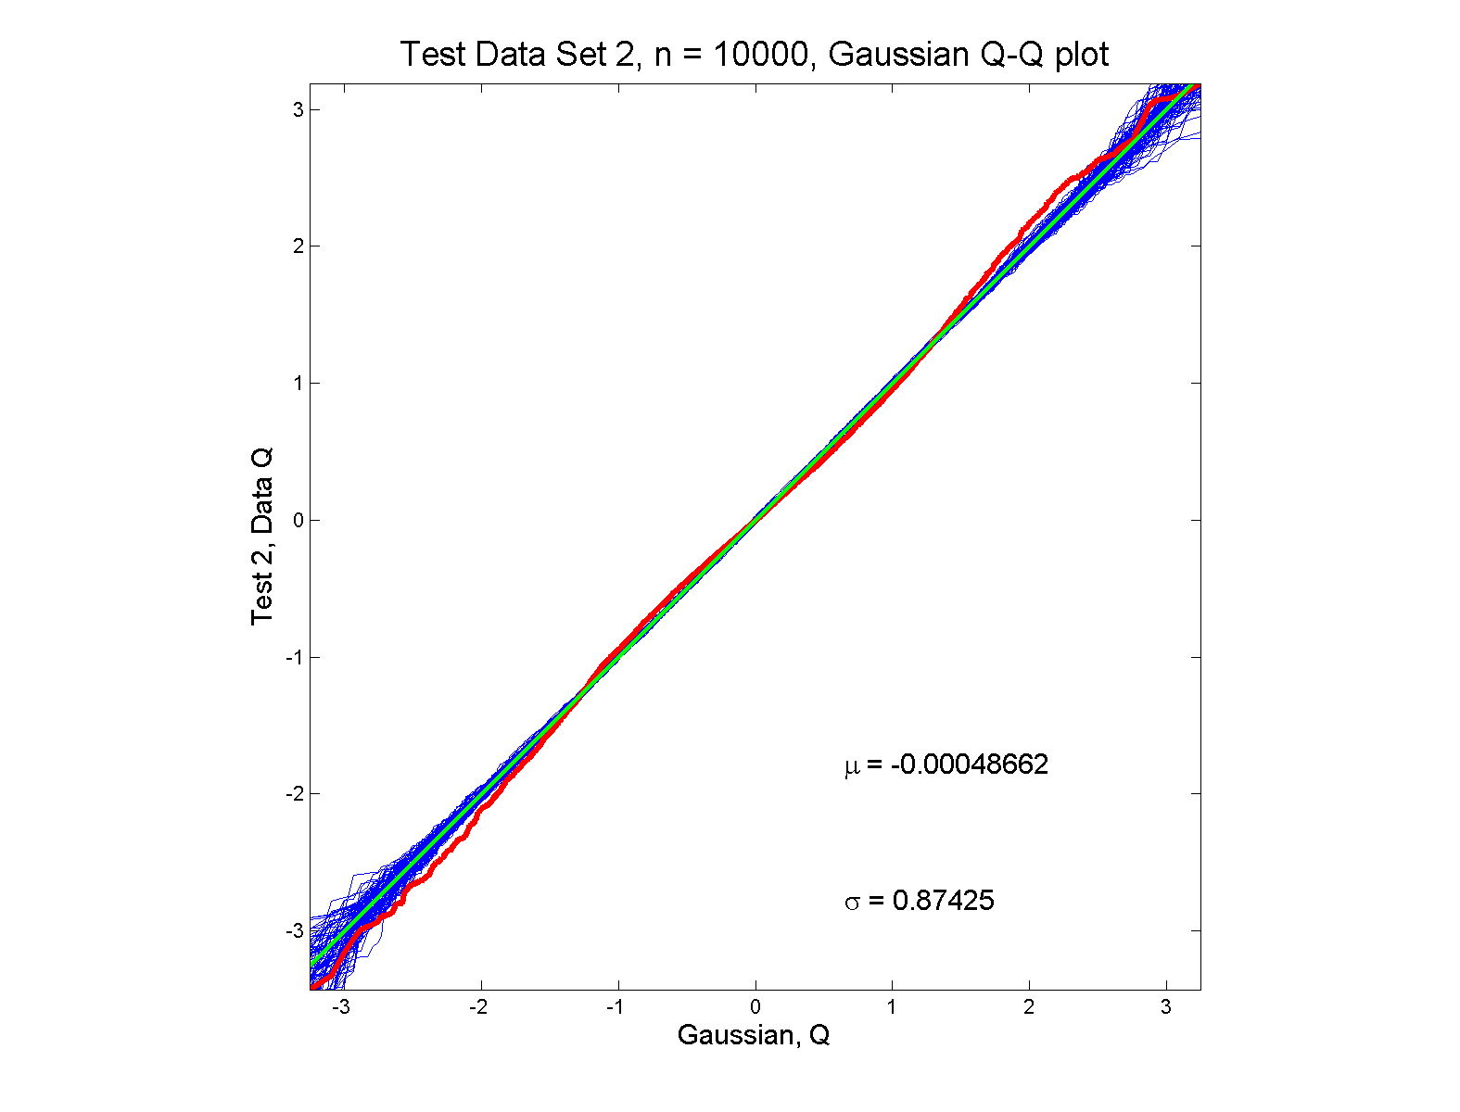
Q-Q plots
Gaussian? departures from line?

Slide 150
Q-Q plots
Gaussian? departures from line?
Harder to see
But clearly there
Conclude non-Gaussian
Really needed n = 10,000 data points…
(why bigger sample size was used)
Envelope plot reflects sampling variation

Slide 151
Q-Q plots
What were these distributions?
Non-Gaussian!
  0.5 N(-1.5,0.75²) + 0.5 N(1.5,0.75²)
Non-Gaussian (?)
  0.4 N(0,1) + 0.3 N(0,0.5²) + 0.3 N(0,0.25²)
Gaussian
Gaussian?
  0.7 N(0,1) + 0.3 N(0,0.5²)

Slide 152
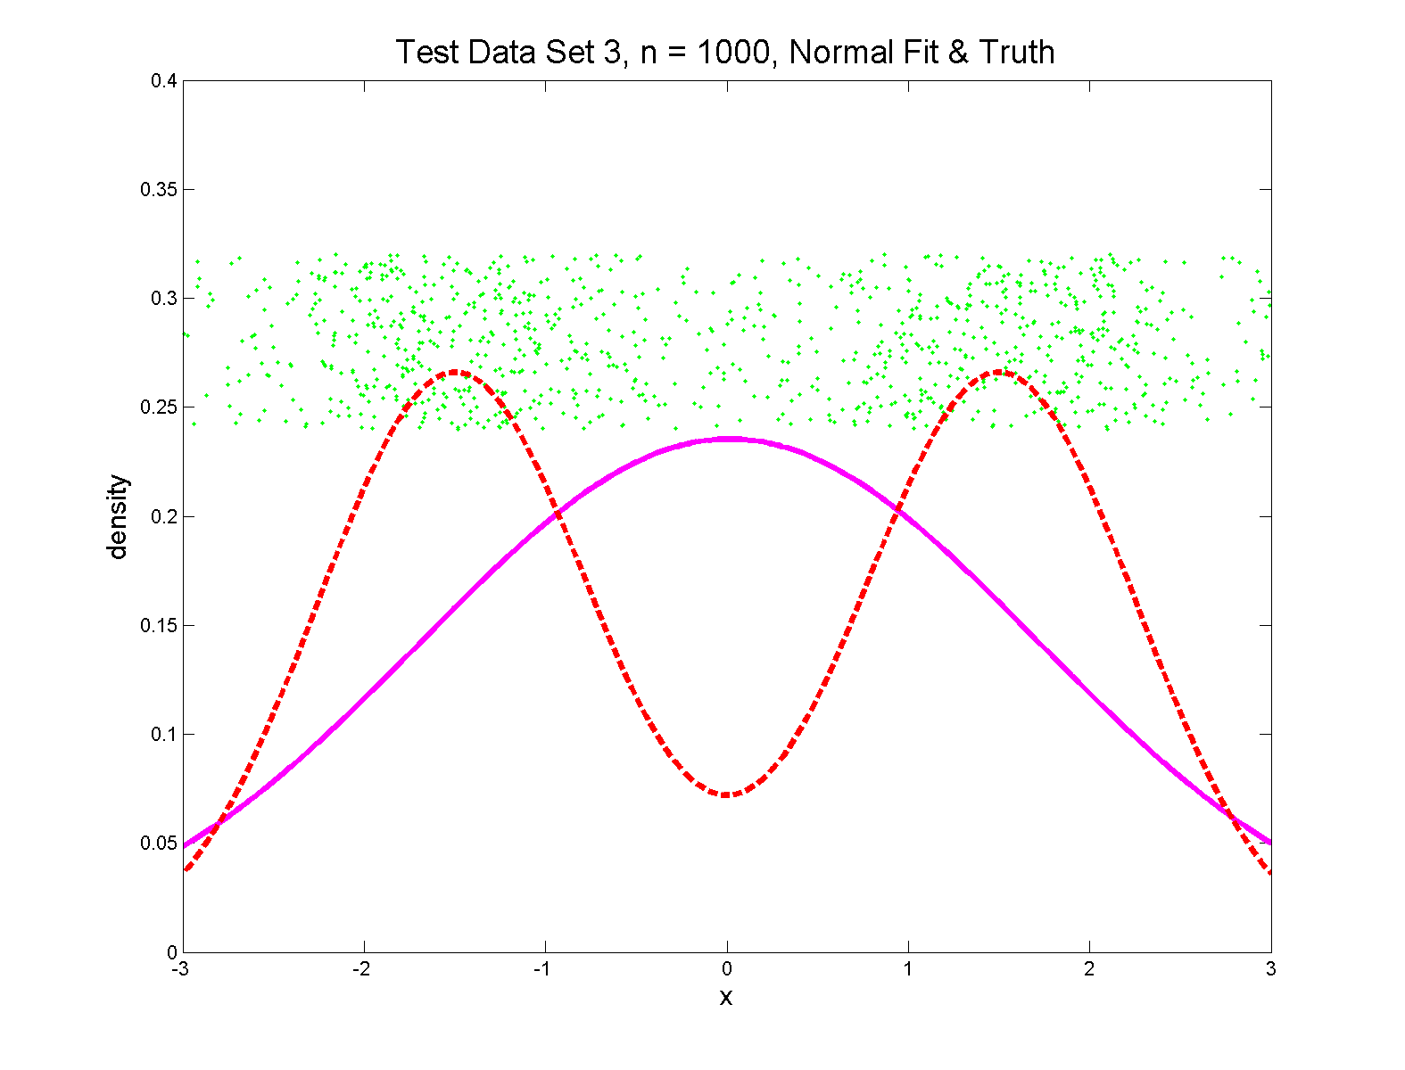
Q-Q plots
Non-Gaussian! .5 N(-1.5,0.75²) + 0.5 N(1.5,0.75²)

Slide 153
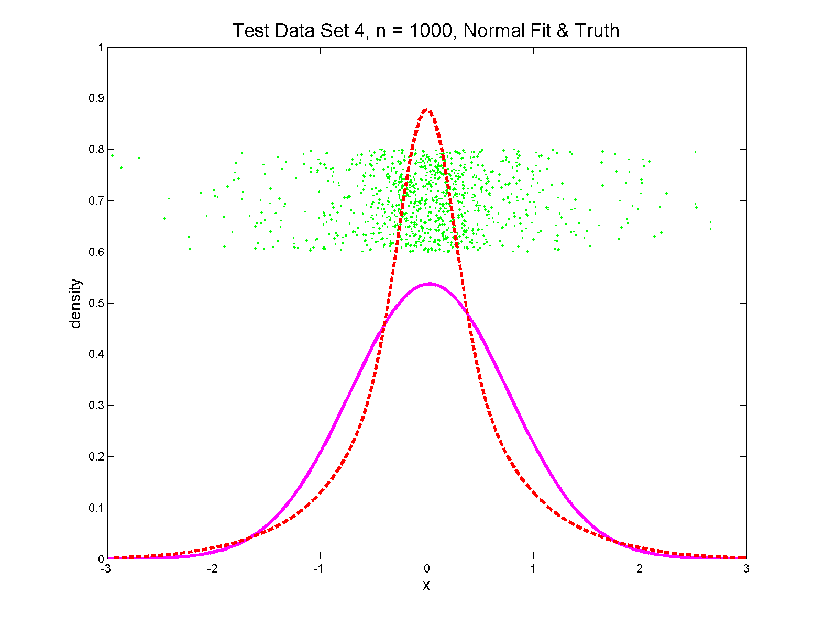
Q-Q plots
Non-Gaussian (?) 0.4 N(0,1) + 0.3 N(0,0.5²) + 0.3 N(0,0.25²)

Slide 154
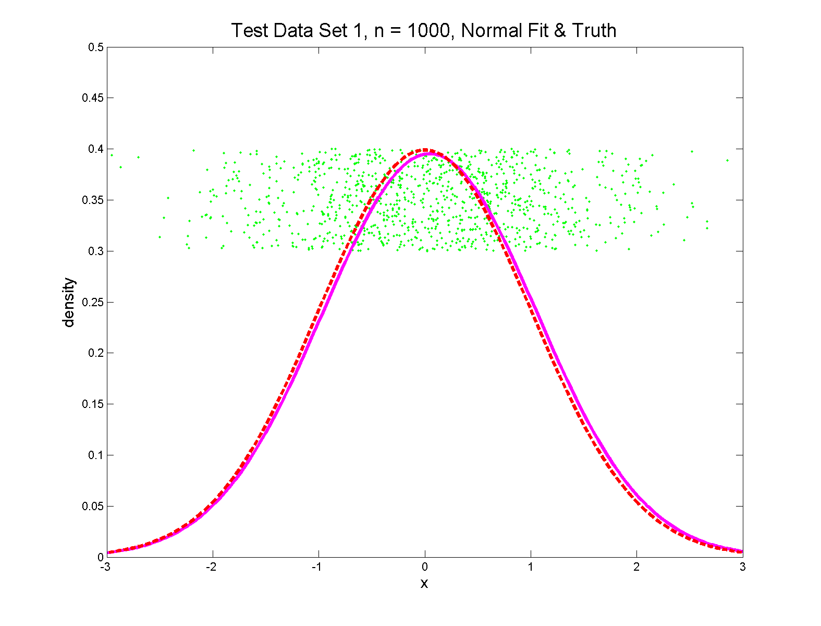
Q-Q plots
Gaussian

Slide 155
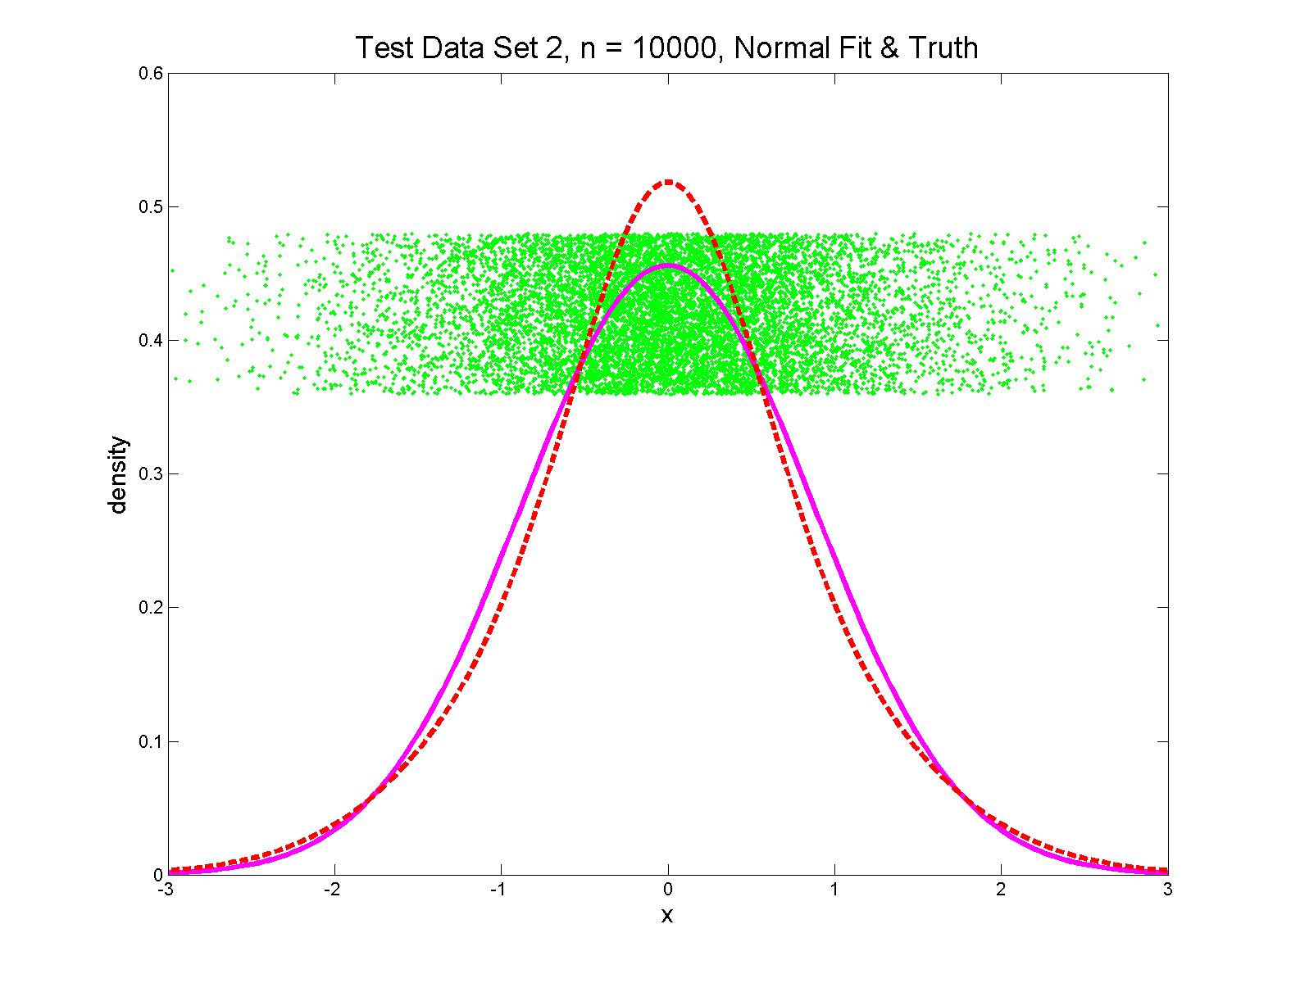
Q-Q plots
Gaussian? 0.7 N(0,1) + 0.3 N(0,0.5²)

Slide 156
Q-Q plots
Variations on Q-Q Plots:
For theoretical distribution:

Slide 157
Q-Q plots
Variations on Q-Q Plots:
For theoretical distribution:
Solving for gives
Where is the Standard Normal Quantile

Slide 158
Q-Q plots
Variations on Q-Q Plots:
Solving for gives
So Q-Q plot against Standard Normal
is linear
With slope and intercept

Slide 159
Q-Q plots
Variations on Q-Q Plots:
Can replace Gaussian with other dist’ns
Can compare 2 theoretical distn’s
Can compare 2 empirical distn’s
(i.e. 2 sample version of Q-Q Plot)

Slide 160
SigClust
Statistical Significance of Clusters
in HDLSS Data
When is a cluster “really there”?
From Liu, et al. (2007)

Slide 161
Statistical Significance of Clusters
Basis of SigClust Approach:
What defines: A Cluster?
  A Gaussian distribution (Sarle & Kou 1993)
So define SigClust test based on:
  2-means cluster index (measure) as statistic
  Gaussian null distribution
  Currently compute by simulation
  Possible to do this analytically???

Slide 162
SigClust Gaussian null distribut’n
3rd Key Idea: Factor Analysis Model
Model Covariance as: Biology + Noise
Where
is “fairly low dimensional”
is estimated from background noise

Slide 163
SigClust Gaussian null distribut’n
Estimation of Background Noise :
Reasonable model (for each gene):
Expression = Signal + Noise
“noise” is roughly Gaussian
“noise” terms essentially independent
(across genes)

Slide 164
SigClust Gaussian null distribut’n
Estimation of Background Noise :
For all expression values (as numbers)
Use robust estimate of scale
Median Absolute Deviation (MAD)
(from the median)
Rescale to put on same scale as s. d.:

Slide 165
SigClust Estimation of Background Noise

Slide 166
SigClust Estimation of Background Noise
Overall distribution has strong kurtosis
Shown by height of kde relative to
MAD based Gaussian fit
Mean and Median both ~ 0
SD ~ 1, driven by few large values
MAD ~ 0.7, driven by bulk of data

Slide 167
SigClust Estimation of Background Noise
Central part of distribution
“seems to look Gaussian”
But recall density does not provide
useful diagnosis of Gaussianity
Better to look at Q-Q plot

Slide 168
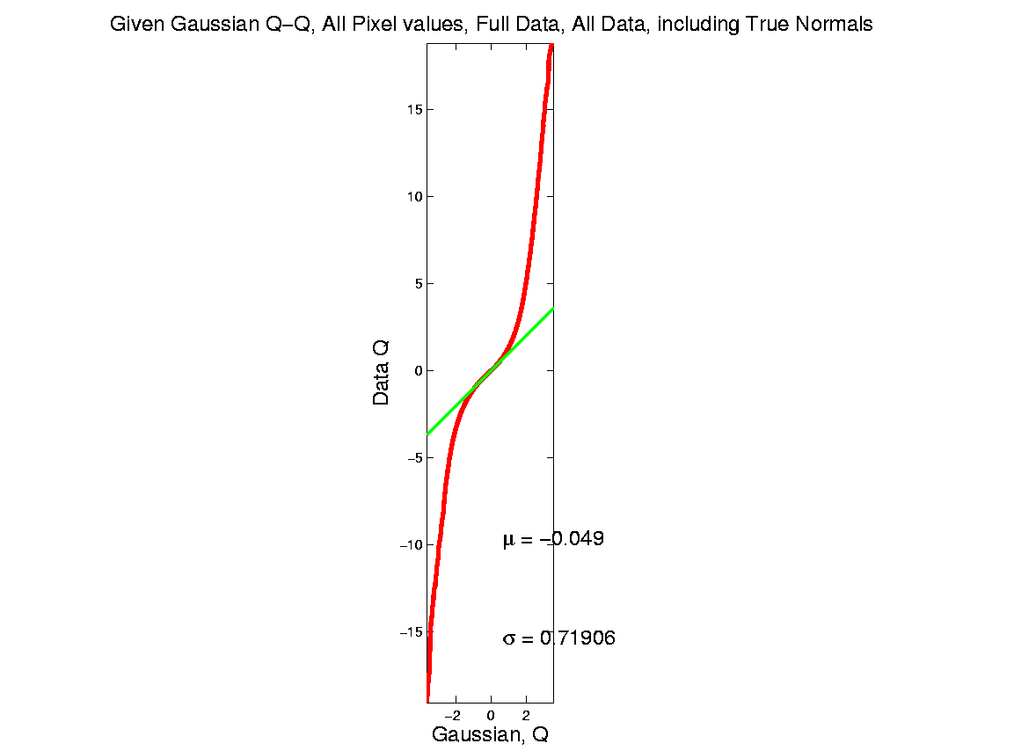
SigClust Estimation of Background Noise

Slide 169
SigClust Estimation of Background Noise
Distribution clearly not Gaussian
Except near the middle
Q-Q curve is very linear there
(closely follows 45º line)
Suggests Gaussian approx. is good there
And that MAD scale estimate is good
(Always a good idea to do such diagnostics)

Slide 170
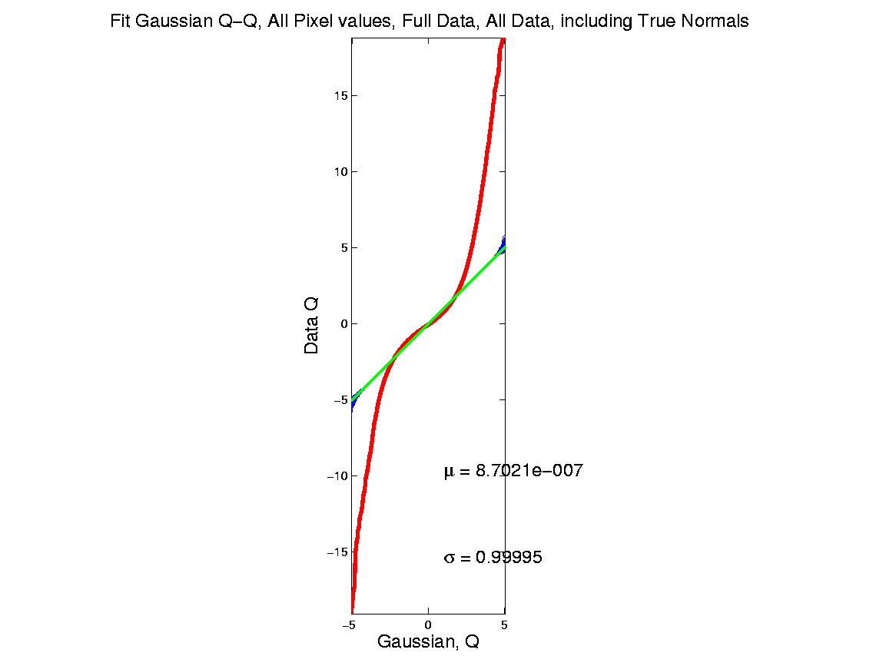
SigClust Estimation of Background Noise

Slide 171
SigClust Estimation of Background Noise
Checks that estimation of matters
Show sample s.d. is indeed too large
As expected
Variation assessed by Q-Q envelope plot
Shows variation negligible
Not surprising with n ~ 5 million

Slide 172
SigClust Gaussian null distribut’n
Estimation of Biological Covariance :
Keep only “large” eigenvalues
Defined as
So for null distribution, use eigenvalues:

Slide 173
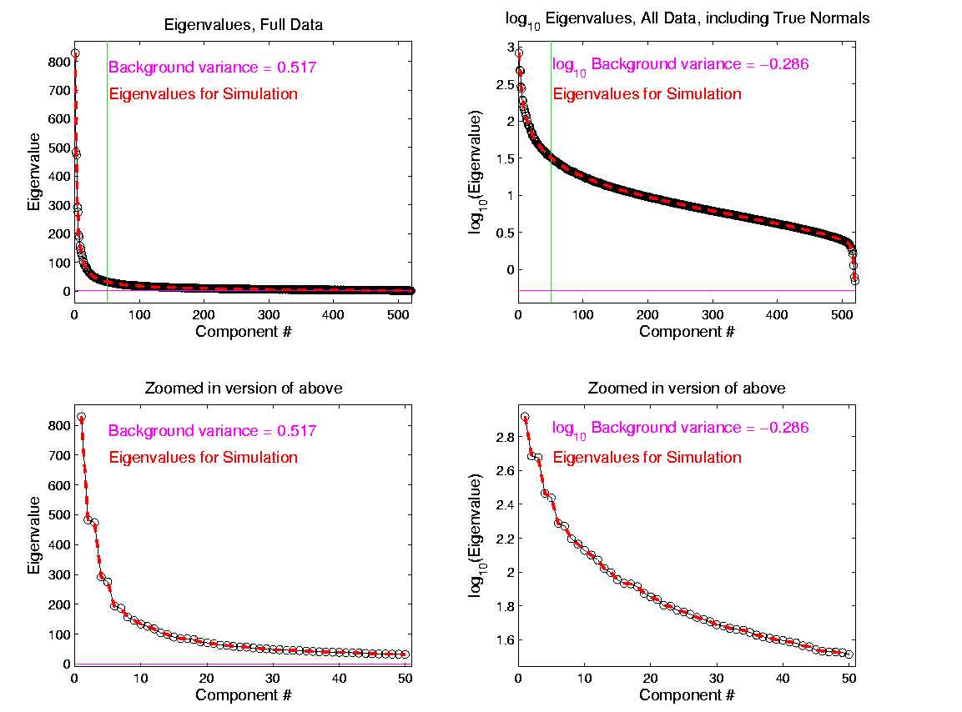
SigClust Estimation of Eigenval’s

Slide 174
SigClust Estimation of Eigenval’s
All eigenvalues > !
Suggests biology is very strong here!
I.e. very strong signal to noise ratio
Have more structure than can analyze
(with only 533 data points)
Data are very far from pure noise
So don’t actually use Factor Anal. Model
Instead end up with estim’d eigenvalues

Slide 175
SigClust Estimation of Eigenval’s
Do we need the factor model?
Explore this with another data set
(with fewer genes)
This time:
  n = 315 cases
  d = 306 genes

Slide 176
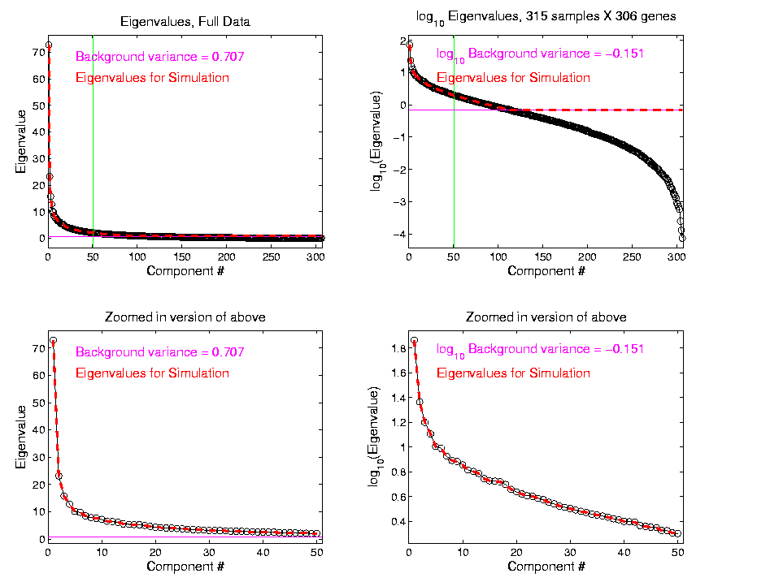
SigClust Estimation of Eigenval’s

Slide 177
SigClust Estimation of Eigenval’s
Try another data set, with fewer genes
This time:
  First ~110 eigenvalues >
  Rest are negligible
  So threshold smaller ones at

Slide 178
SigClust Gaussian null distribution - Simulation
Now simulate from null distribution using:
where (indep.)
Again rotation invariance makes this work
(and location invariance)

Slide 179
SigClust Gaussian null distribution - Simulation
Then compare data CI,
With simulated null population CIs
Spirit similar to DiProPerm
But now significance happens for
smaller values of CI

Slide 180
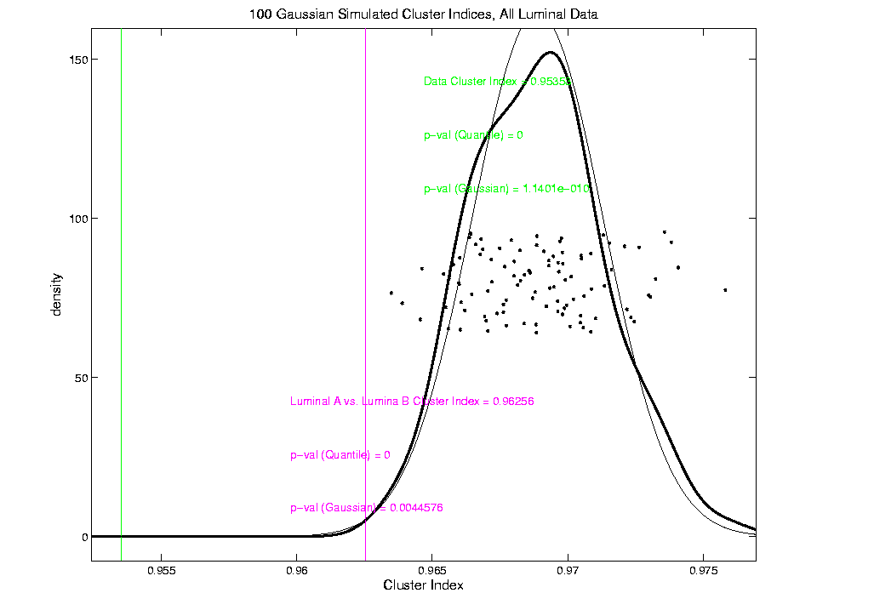
An example (details to follow)
P-val = 0.0045

Slide 181
SigClust Modalities
Two major applications:
Test significance of given clusterings
(e.g. for those found in heat map)
(Use given class labels)

Slide 182
SigClust Modalities
Two major applications:
Test significance of given clusterings
(e.g. for those found in heat map)
(Use given class labels)
Test if known cluster can be further split
(Use 2-means class labels)

Slide 183
SigClust Real Data Results
Analyze Perou 500 breast cancer data
(large cross study combined data set)
Current folklore: 5 classes
Luminal A
Luminal B
Normal
Her 2
Basal

Slide 184
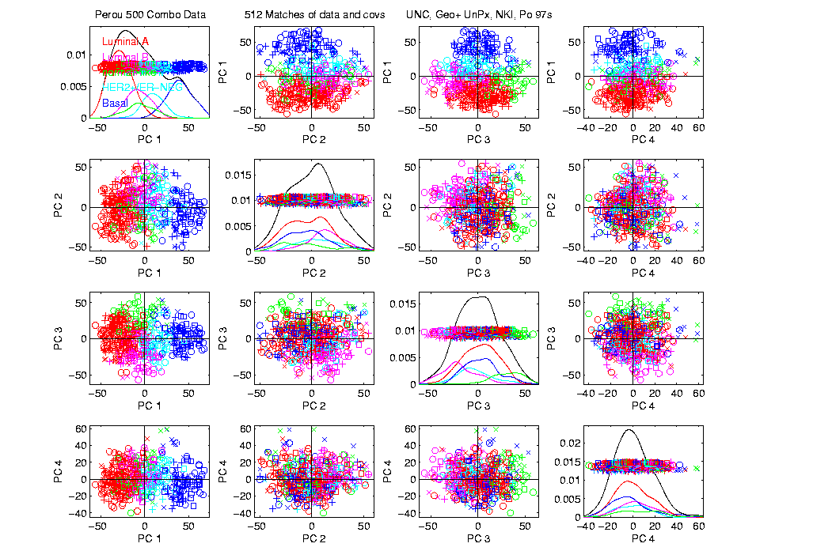
Perou 500 PCA View – real clusters???

Slide 185
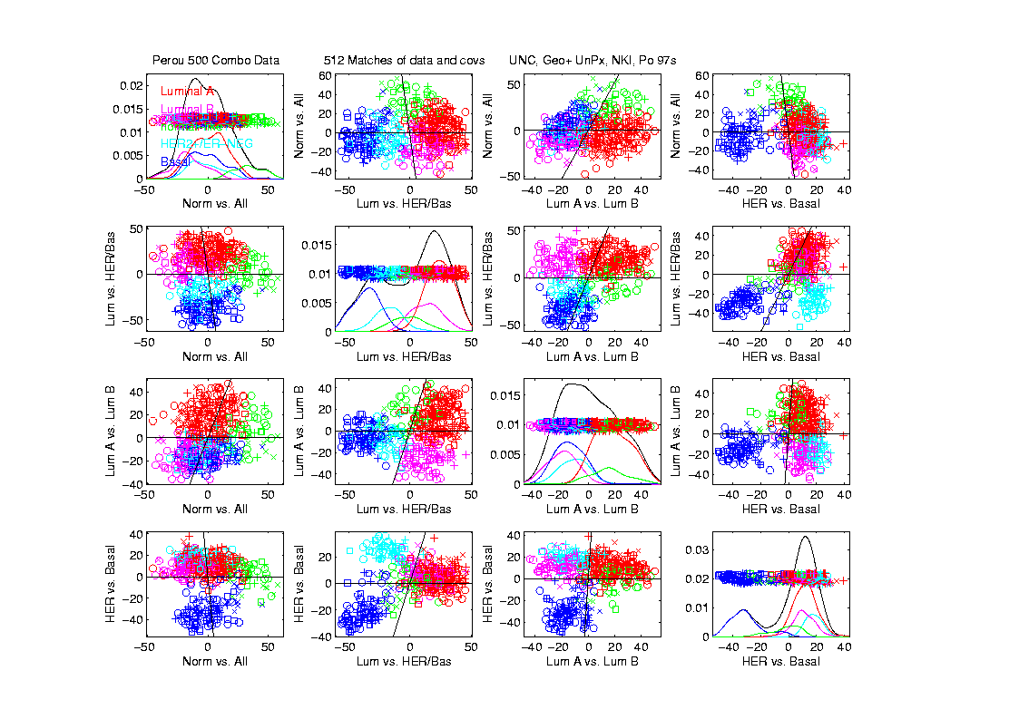
Perou 500 DWD Dir’ns View – real clusters???

Slide 186
Perou 500 – Fundamental Question
Are Luminal A &
Luminal B really
distinct clusters?
Famous for
Far Different
Survivability

Slide 187
SigClust Results for Luminal A vs. Luminal B
P-val = 0.0045

Slide 188
SigClust Results for Luminal A vs. Luminal B
Get p-values from:
Empirical Quantile
  From simulated sample CIs

Slide 189
SigClust Results for Luminal A vs. Luminal B
Get p-values from:
Empirical Quantile
  From simulated sample CIs
Fit Gaussian Quantile
  Don’t “believe these”
  But useful for comparison
  Especially when Empirical Quantile = 0

Slide 190
SigClust Results for Luminal A vs. Luminal B
Test significance of given clusterings
Empirical p-val = 0
  Definitely 2 clusters
Gaussian fit p-val = 0.0045
  same strong evidence
Conclude these really are two clusters

Slide 191
SigClust Results for Luminal A vs. Luminal B
Test if known cluster can be further split
Empirical p-val = 0
  definitely 2 clusters
Gaussian fit p-val = 10⁻¹⁰
  Stronger evidence than above
  Such comparison is value of Gaussian fit
  Makes sense (since CI is min possible)
Conclude these really are two clusters

Slide 192
SigClust Real Data Results
Summary of Perou 500 SigClust Results:
Lum & Norm vs. Her2 & Basal, p-val = 10⁻¹⁹
Luminal A vs. B, p-val = 0.0045
Her 2 vs. Basal, p-val = 10⁻¹⁰
Split Luminal A, p-val = 10⁻⁷
Split Luminal B, p-val = 0.058
Split Her 2, p-val = 0.10
Split Basal, p-val = 0.005

Slide 193
SigClust Real Data Results
Summary of Perou 500 SigClust Results:
All previous splits were real
Most not able to split further
Exception is Basal, already known
Chuck Perou has good intuition!
(insight about signal vs. noise)
How good are others???

Slide 194
SigClust Real Data Results
Experience with Other Data Sets: Similar
Smaller data sets: less power
Gene filtering: more power
Lung Cancer: more distinct clusters

Slide 195
SigClust Real Data Results
Some Personal Observations
Experienced Analysts Impressively Good
SigClust can save them time
SigClust can help them with skeptics
SigClust essential for non-experts

Slide 196
SigClust Mathematical Statistics
Have HDLSS first asymptotic results
Too complicated to state here
Main idea: “consistency”
But not as n → ∞
Instead as d → ∞, with n fixed
(emerging new area, both here,
and in other contexts)

Slide 197
SigClust Simulations
Results show reasonable 1st approx’n
But improvements are possible
E.g. in variance estimation
(interesting open problem)
Usual problem is loss of power
So current results OK, just conservative

Slide 198
SigClust Open Problems
Improved Variance Estimation
More attention to Local Minima in 2-means Clustering
Theoretical Null Distributions
Inference for k > 2 means Clustering
Multiple Comparison Issues

