Slide 1
Statistics – O. R. 891
Object Oriented Data Analysis
J. S. Marron
Dept. of Statistics and Operations Research
University of North Carolina

Slide 2
SigClust
Statistical Significance of Clusters
in HDLSS Data
When is a cluster “really there”?
Liu et al (2007)

Slide 3
Statistical Significance of Clusters
Basis of SigClust Approach:
What defines: A Cluster?
  A Gaussian distribution (Sarle & Kou 1993)
So define SigClust test based on:
  2-means cluster index (measure) as statistic
  Gaussian null distribution
  Currently compute by simulation
  Possible to do this analytically???

Slide 4
SigClust Real Data Results
Some Personal Observations
Experienced Analysts Impressively Good
SigClust can save them time
SigClust can help them with skeptics
SigClust essential for non-experts

Slide 5
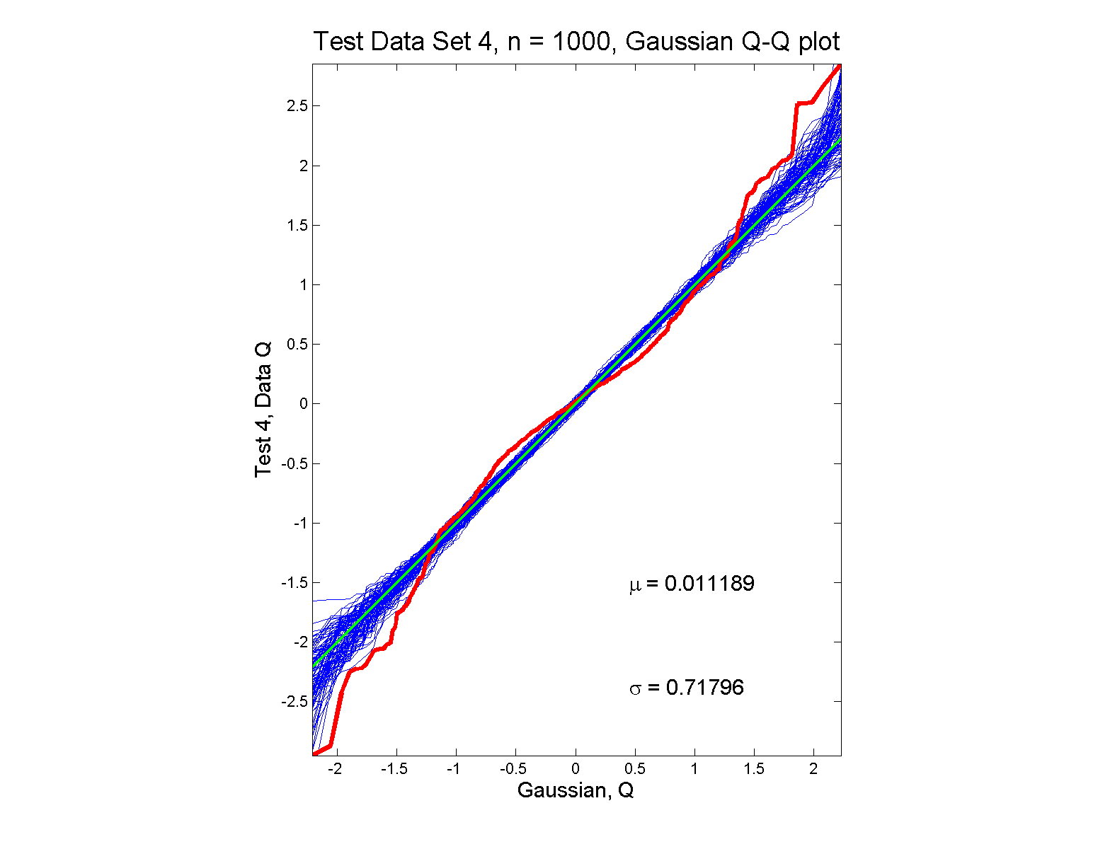
Q-Q plots
non-Gaussian (?) departures from line?

Slide 6
Detailed Look at PCA
Three Important (& Interesting) Viewpoints:
Mathematics
Numerics
Statistics
1st: Review Linear Alg. and Multivar. Prob.

Slide 7
Review of Linear Algebra
Vector Space:
set of “vectors”, ,
and “scalars” (coefficients),
“closed” under “linear combination”
( in space)
e.g.
,
“ dim Euclid’n space”

Slide 8
Review of Linear Algebra (Cont.)
SVD Full Representation:
=
Graphics Display Assumes

Slide 9
Review of Linear Algebra (Cont.)
SVD Compact Representation:
=

Slide 10
Review of Linear Algebra (Cont.)
Eigenvalue Decomposition:
For a (Symmetric) Square Matrix
Find

Slide 11
Review of Linear Algebra (Cont.)
Eigenvalue Decomposition:
For a (Symmetric) Square Matrix
Find a Diagonal Matrix
Called Eigenvalues
Convenient Ordering:

Slide 12
Review of Linear Algebra (Cont.)
Eigenvalue Decomposition:
For a (Symmetric) Square Matrix
Find a Diagonal Matrix
And an Orthonormal Matrix
(i.e. )

Slide 13
Review of Linear Algebra (Cont.)
Eigenvalue Decomposition:
For a (Symmetric) Square Matrix
Find a Diagonal Matrix
And an Orthonormal Matrix
(i.e. )
So that: , i.e.

Slide 14
Review of Linear Algebra (Cont.)
Eigenvalue Decomposition (cont.):
Relation to Singular Value Decomposition
(looks similar?)

Slide 15
Review of Linear Algebra (Cont.)
Eigenvalue Decomposition (cont.):
Relation to Singular Value Decomposition
(looks similar?):
Eigenvalue Decomposition “Looks Harder”
Since Needs

Slide 16
Review of Linear Algebra (Cont.)
Eigenvalue Decomposition (cont.):
Relation to Singular Value Decomposition
(looks similar?):
Eigenvalue Decomposition “Looks Harder”
Since Needs
Price is Eigenvalue Decomp’n is Generally Complex (uses )

Slide 17
Review of Linear Algebra (Cont.)
Eigenvalue Decomposition (cont.):
Relation to Singular Value Decomposition
(looks similar?):
Eigenvalue Decomposition “Looks Harder”
Since Needs
Price is Eigenvalue Decomp’n is Generally Complex (uses )
Except for Square and Symmetric
  Then Eigenvalue Decomp. is Real Valued
  Thus is the Sing’r Value Decomp. with:

Slide 18
Review of Linear Algebra (Cont.)
Better View of Relationship:
Singular Value Dec. ←→ Eigenvalue Dec.

Slide 19
Review of Linear Algebra (Cont.)
Better View of Relationship:
Singular Value Dec. ←→ Eigenvalue Dec.
Start with data matrix:
With SVD:

Slide 20
Review of Linear Algebra (Cont.)
Better View of Relationship:
Singular Value Dec. ←→ Eigenvalue Dec.
Start with data matrix:
With SVD:
Create square, symmetric matrix:

Slide 21
Review of Linear Algebra (Cont.)
Better View of Relationship:
Singular Value Dec. ←→ Eigenvalue Dec.
Start with data matrix:
With SVD:
Create square, symmetric matrix:
Note that:

Slide 22
Review of Linear Algebra (Cont.)
Better View of Relationship:
Singular Value Dec. ←→ Eigenvalue Dec.
Start with data matrix:
With SVD:
Create square, symmetric matrix:
Note that:
Gives Eigenanalysis,

Slide 23
Review of Linear Algebra (Cont.)
Computation of Singular Value and Eigenvalue Decompositions

Slide 24
Review of Linear Algebra (Cont.)
Computation of Singular Value and Eigenvalue Decompositions:
Details too complex to spend time here
A “primitive” of good software packages

Slide 25
Review of Linear Algebra (Cont.)
Computation of Singular Value and Eigenvalue Decompositions:
Details too complex to spend time here
A “primitive” of good software packages
Eigenvalues are Unique

Slide 26
Review of Linear Algebra (Cont.)
Computation of Singular Value and Eigenvalue Decompositions:
Details too complex to spend time here
A “primitive” of good software packages
Eigenvalues are Unique
Columns of are Called
“Eigenvectors”

Slide 27
Review of Linear Algebra (Cont.)
Computation of Singular Value and Eigenvalue Decompositions:
Details too complex to spend time here
A “primitive” of good software packages
Eigenvalues are Unique
Columns of are Called
“Eigenvectors”
Eigenvectors are “ -Stretched” by :

Slide 28
Review of Linear Algebra (Cont.)
Eigenvalue Decomp. Solves Matrix Problems

Slide 29
Review of Linear Algebra (Cont.)
Eigenvalue Decomp. Solves Matrix Problems:
Inversion:

Slide 30
Review of Linear Algebra (Cont.)
Eigenvalue Decomp. Solves Matrix Problems:
Inversion:
Square Root:

Slide 31
Review of Linear Algebra (Cont.)
Eigenvalue Decomp. Solves Matrix Problems:
Inversion:
Square Root:
is Positive (Nonn’ve, i.e. Semi) Definite all

Slide 32
Recall Linear Algebra (Cont.)
Moore-Penrose Generalized Inverse:
For

Slide 33
Recall Linear Algebra (Cont.)
Easy to see this satisfies the definition of
Generalized (Pseudo) Inverse
symmetric
symmetric

Slide 34
Recall Linear Algebra (Cont.)
Moore-Penrose Generalized Inverse:
Idea: Matrix Inverse on Non-Null Space
of the Corresponding Linear Transformation

Slide 35
Recall Linear Algebra (Cont.)
Moore-Penrose Generalized Inverse:
Idea: Matrix Inverse on Non-Null Space
of the Corresponding Linear Transformation
Reduces to Ordinary Inverse, in Full Rank case,
i.e. for r = d, so could just Always Use This

Slide 36
Recall Linear Algebra (Cont.)
Moore-Penrose Generalized Inverse:
Idea: Matrix Inverse on Non-Null Space
of the Corresponding Linear Transformation
Reduces to Ordinary Inverse, in Full Rank case,
i.e. for r = d, so could just Always Use This
Tricky aspect:
“>0 vs. = 0” & Floating Point Arithmetic

Slide 37
Recall Linear Algebra (Cont.)
Moore-Penrose Generalized Inverse:
Folklore: most multivariate formulas involving matrix inversion “still work” when Generalized Inverse is used instead

Slide 38
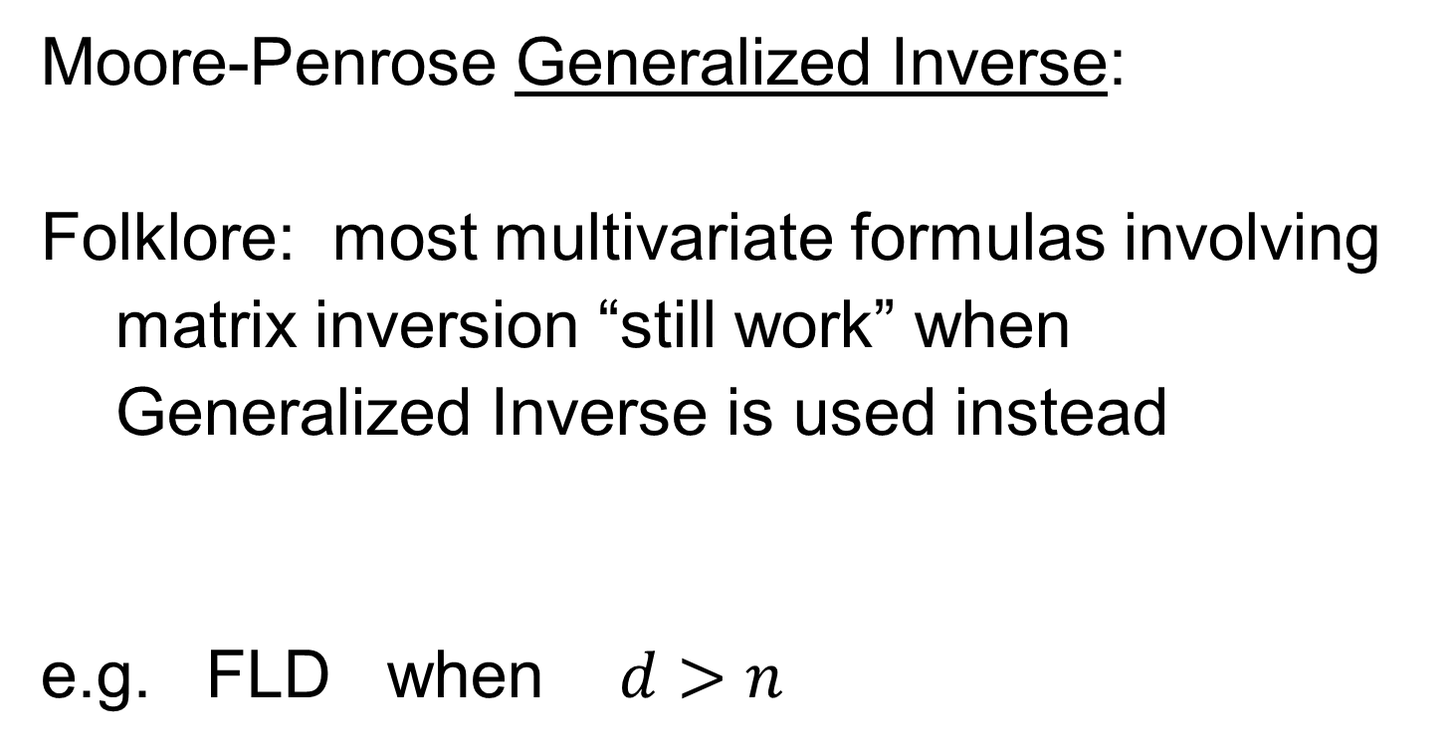
Recall Linear Algebra (Cont.)
Moore-Penrose Generalized Inverse:
Folklore: most multivariate formulas involving matrix inversion “still work” when Generalized Inverse is used instead
e.g. FLD when $d>n$

Slide 39
Review of Multivariate Probability
Given a Random Vector,

Slide 40
Review of Multivariate Probability
Given a Random Vector,
A Center of the Distribution is the Mean Vector,

Slide 41
Review of Multivariate Probability
Given a Random Vector,
A Center of the Distribution is the Mean Vector,
Note: Component-Wise Calc’n (Euclidean)

Slide 42
Review of Multivariate Probability
Given a Random Vector,
A Measure of Spread is the Covariance Matrix:

Slide 43
Review of Multivar. Prob. (Cont.)
Covariance Matrix:
Noneg’ve Definite (Since all varia’s are 0)
(i.e. var of any linear combo)

Slide 44
Review of Multivar. Prob. (Cont.)
Covariance Matrix:
Noneg’ve Definite (Since all varia’s are 0)
Provides “Elliptical Summary of Distribution”
(e.g. Contours of Gaussian Density)

Slide 45
Review of Multivar. Prob. (Cont.)
Covariance Matrix:
Noneg’ve Definite (Since all varia’s are 0)
Provides “Elliptical Summary of Distribution”
Calculated via “Outer Product”:

Slide 46
Review of Multivar. Prob. (Cont.)
Empirical Versions:
Given a Random Sample

Slide 47
Review of Multivar. Prob. (Cont.)
Empirical Versions:
Given a Random Sample ,
Estimate the Theoretical Mean

Slide 48
Review of Multivar. Prob. (Cont.)
Empirical Versions:
Given a Random Sample ,
Estimate the Theoretical Mean ,
with the Sample Mean:

Slide 49
Review of Multivar. Prob. (Cont.)
Empirical Versions:
Given a Random Sample ,
Estimate the Theoretical Mean ,
with the Sample Mean:
Notation: “hat” for estimate

Slide 50
Review of Multivar. Prob. (Cont.)
Empirical Versions (cont.)
And Estimate the “Theoretical Cov.”

Slide 51
Review of Multivar. Prob. (Cont.)
Empirical Versions (cont.)
And Estimate the “Theoretical Cov.” ,
with the “Sample Cov.”:

Slide 52
Review of Multivar. Prob. (Cont.)
Empirical Versions (cont.)
And Estimate the “Theoretical Cov.” ,
with the “Sample Cov.”:
Normalizations:
Gives Unbiasedness
Gives MLE in Gaussian Case

Slide 53
Review of Multivar. Prob. (Cont.)
Outer Product Representation:

Slide 54
Review of Multivar. Prob. (Cont.)
Outer Product Representation:

Slide 55
Review of Multivar. Prob. (Cont.)
Outer Product Representation:
,
Where:

Slide 56

Review of Multivar. Prob. (Cont.)
Aside on Terminology,
Inner Product:
${\underline{x}}^{t}\underline{y}$

Slide 57

Review of Multivar. Prob. (Cont.)
Aside on Terminology,
Inner Product:
${\underline{x}}^{t}\underline{y}$
=
(scalar)

Slide 58

Review of Multivar. Prob. (Cont.)
Aside on Terminology,
Inner Product: Outer Product:
${\underline{x}}^{t}\underline{y}$ $\underline{x}{\underline{y}}^{t}$
=
(scalar)

Slide 59

Review of Multivar. Prob. (Cont.)
Aside on Terminology,
Inner Product: Outer Product:
${\underline{x}}^{t}\underline{y}$ $\underline{x}{\underline{y}}^{t}$
= =
(scalar) (matrix)

Slide 60
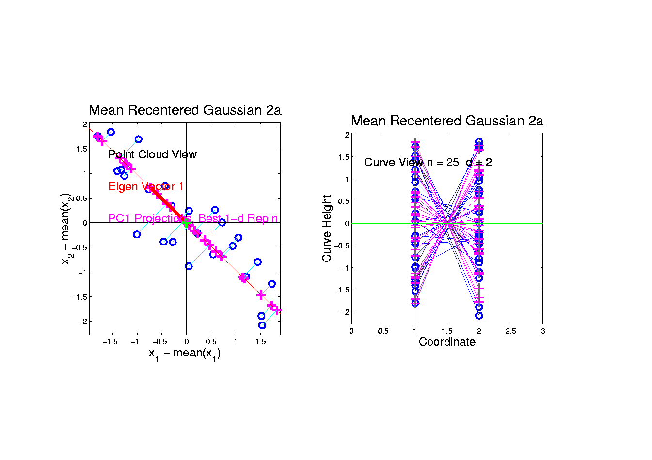
PCA as an Optimization Problem
Find “Direction of Greatest Variability”:
Raw Data

Slide 61
PCA as an Optimization Problem
Find “Direction of Greatest Variability”:
Raw Data
Projections

Slide 62
PCA as an Optimization Problem
Find Direction of Greatest Variability:
Raw Data
Projections
Direction
Vector

Slide 63
PCA as Optimization (Cont.)
Find Direction of Greatest Variability:
Given a Direction Vector, (i.e. )
(Variable, Over Which Will Optimize)

Slide 64
PCA as Optimization (Cont.)
Find Direction of Greatest Variability:
Given a Direction Vector, (i.e. )
Projection of in the Direction :

Slide 65
PCA as Optimization (Cont.)
Find Direction of Greatest Variability:
Given a Direction Vector, (i.e. )
Projection of in the Direction :
Variability in the Direction :

Slide 66
PCA as Optimization (Cont.)
Find Direction of Greatest Variability:
Given a Direction Vector, (i.e. )
Projection of in the Direction :
Variability in the Direction :

Slide 67
PCA as Optimization (Cont.)
Find Direction of Greatest Variability:
Given a Direction Vector, (i.e. )
Projection of in the Direction :
Variability in the Direction :

Slide 68
PCA as Optimization (Cont.)
Variability in the Direction :

Slide 69
PCA as Optimization (Cont.)
Variability in the Direction :
i.e. (Proportional to) a
Quadratic Form in the Covariance Matrix

Slide 70
PCA as Optimization (Cont.)
Variability in the Direction :
i.e. (Proportional to) a
Quadratic Form in the Covariance Matrix
Simple Solution Comes from the Eigenvalue Representation of :

Slide 71
PCA as Optimization (Cont.)
Variability in the Direction :
i.e. (Proportional to) a
Quadratic Form in the Covariance Matrix
Simple Solution Comes from the Eigenvalue Representation of :
Where is Orthonormal, &

Slide 72
PCA as Optimization (Cont.)
Variability in the Direction :

Slide 73
PCA as Optimization (Cont.)
Variability in the Direction :
But

Slide 74
PCA as Optimization (Cont.)
Variability in the Direction :
But = “ Transform of ”

Slide 75
PCA as Optimization (Cont.)
Variability in the Direction :
But = “ Transform of ”
= “ Rotated into Coordinates”,

Slide 76
PCA as Optimization (Cont.)
Variability in the Direction :
But = “ Transform of ”
= “ Rotated into Coordinates”,
and the Diagonalized Quadratic Form Becomes

Slide 77
PCA as Optimization (Cont.)
Now since is an Orthonormal Basis Matrix,
and

Slide 78
PCA as Optimization (Cont.)
Now since is an Orthonormal Basis Matrix,
and
So the Rotation Gives a Distribution of the (Unit) Energy of Over the Eigen-Directions

Slide 79
PCA as Optimization (Cont.)
Now since is an Orthonormal Basis Matrix,
and
So the Rotation Gives a Distribution of the (Unit) Energy of Over the Eigen-Directions
And is Max’d (Over ), by Putting all Energy in the “Largest Direction”, i.e. ,
Where “Eigenvalues are Ordered”,

Slide 80
PCA as Optimization (Cont.)
Notes:
Solution is Unique when

Slide 81
PCA as Optimization (Cont.)
Notes:
Solution is Unique when
Else have Sol’ns in Subsp. Gen’d by 1st s

Slide 82
PCA as Optimization (Cont.)
Notes:
Solution is Unique when
Else have Sol’ns in Subsp. Gen’d by 1st s
Projecting onto Subspace to ,
Gives as Next Direction

Slide 83
PCA as Optimization (Cont.)
Notes:
Solution is Unique when
Else have Sol’ns in Subsp. Gen’d by 1st s
Projecting onto Subspace to ,
Gives as Next Direction
Continue Through ,…,

Slide 84
PCA as Optimization (Cont.)
Notes:
Solution is Unique when
Else have Sol’ns in Subsp. Gen’d by 1st s
Projecting onto Subspace to ,
Gives as Next Direction
Continue Through ,…,
Replace by to get Theoretical PCA
Estimated by the Empirical Version

Slide 85
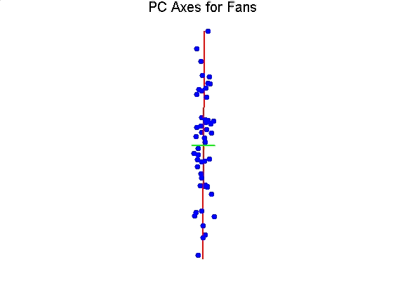
Iterated PCA Visualization

Slide 86
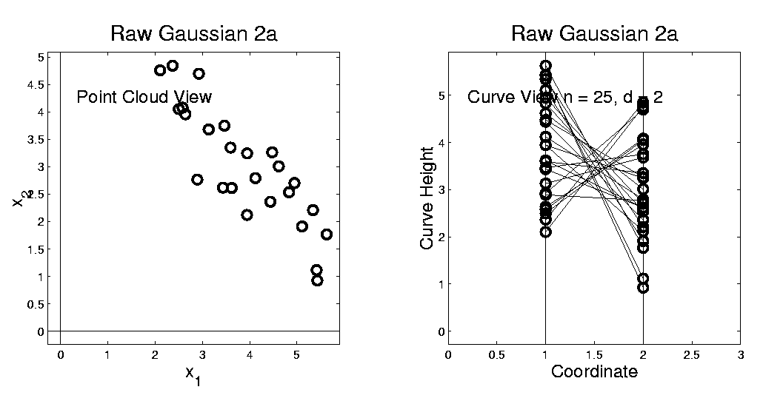
Connect Math to Graphics
2-d Toy Example
Feature Space Object Space
Data Points (Curves) are columns of data matrix, X

Slide 87
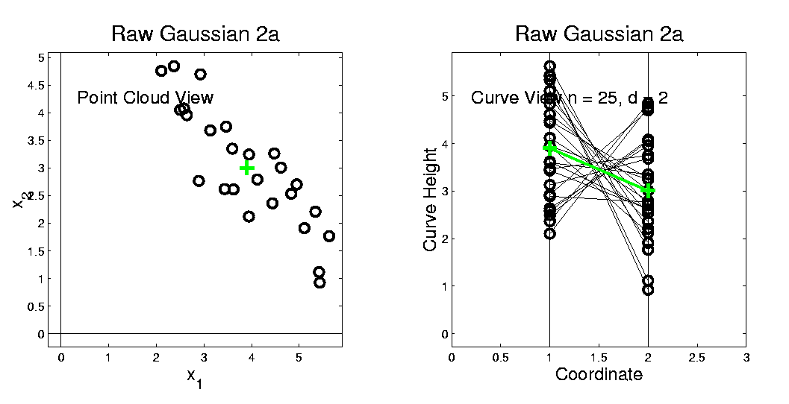
Connect Math to Graphics (Cont.)
2-d Toy Example
Feature Space Object Space
Sample Mean, X

Slide 88
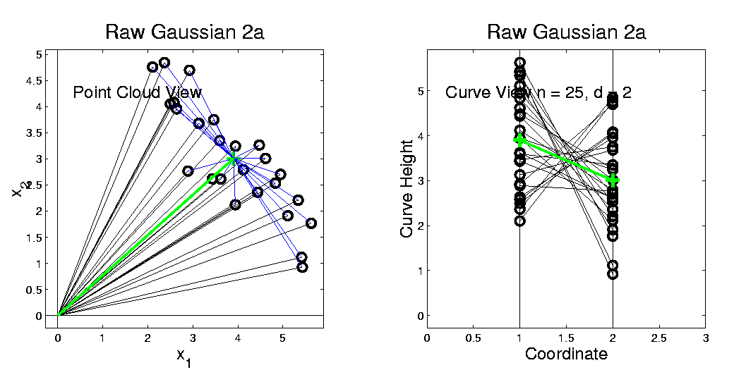
Connect Math to Graphics (Cont.)
2-d Toy Example
Feature Space Object Space
Residuals from Mean = Data - Mean

Slide 89
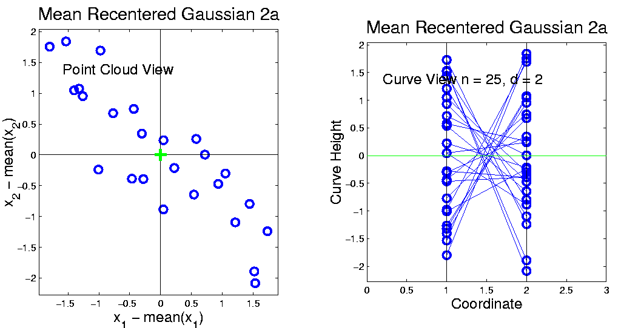
Connect Math to Graphics (Cont.)
2-d Toy Example
Feature Space Object Space
Recentered Data = Mean Residuals, shifted to 0
= (rescaling of) X

Slide 90
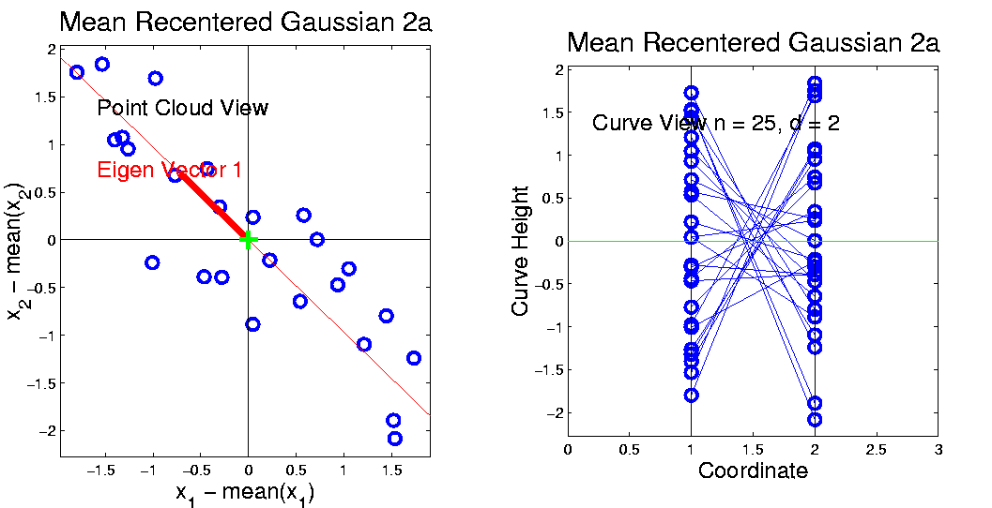
Connect Math to Graphics (Cont.)
2-d Toy Example
Feature Space Object Space
PC1 Direction = η = Eigenvector (w/ biggest λ)

Slide 91
Connect Math to Graphics (Cont.)
2-d Toy Example
Feature Space Object Space
Centered Data PC1 Projection Residual

Slide 92
Connect Math to Graphics (Cont.)
2-d Toy Example
Feature Space Object Space
Centered Data PC1 Projection Residual
Best 1-d Approx’s of Data

Slide 93
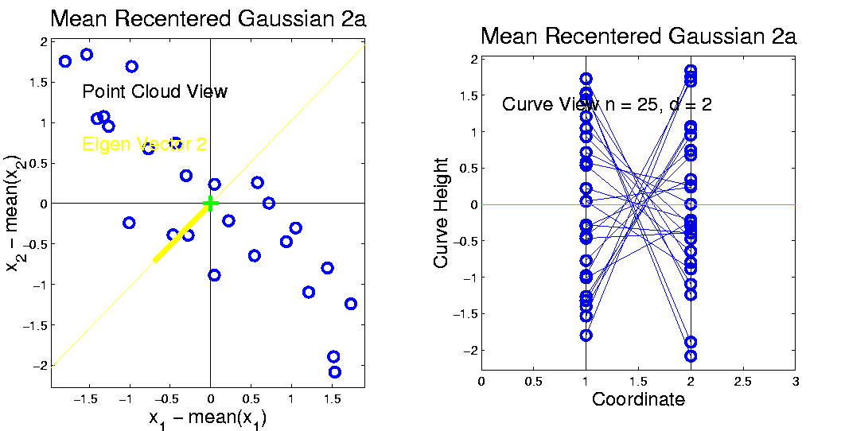
Connect Math to Graphics (Cont.)
2-d Toy Example
Feature Space Object Space
PC2 Direction = η = Eigenvector (w/ 2nd biggest λ)

Slide 94
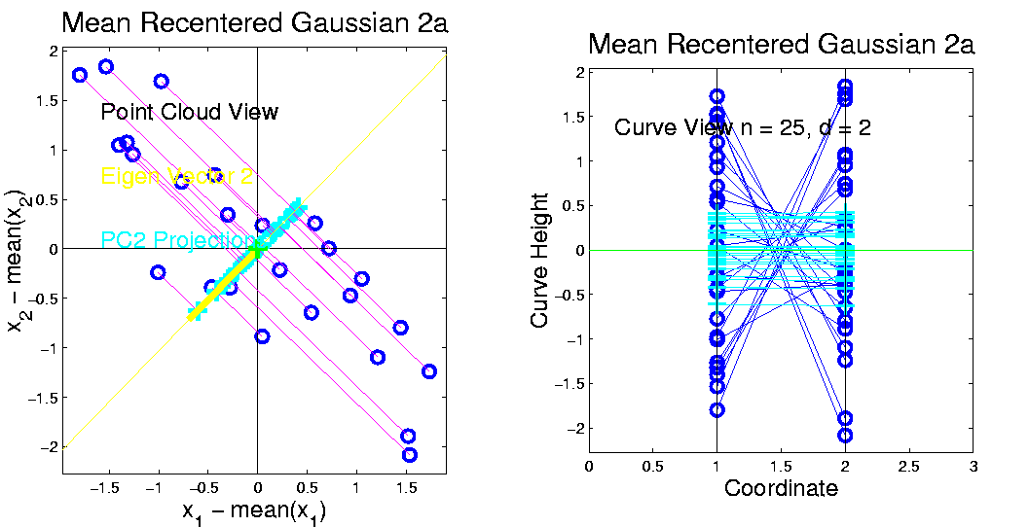
Connect Math to Graphics (Cont.)
2-d Toy Example
Feature Space Object Space
Centered Data PC2 Projection Residual

Slide 95
Connect Math to Graphics (Cont.)
2-d Toy Example
Feature Space Object Space
Centered Data PC2 Projection Residual
Worst 1-d Approx’s of Data

Slide 96
Connect Math to Graphics (Cont.)
Note for this 2-d Example:
PC1 Residuals = PC2 Projections
PC2 Residuals = PC1 Projections
(i.e. colors common across these pics)

Slide 97
PCA Redistribution of Energy
Convenient Summary of Amount of Structure:
Total Sum of Squares

Slide 98
PCA Redistribution of Energy
Convenient Summary of Amount of Structure:
Total Sum of Squares
Physical Interpetation:
Total Energy in Data

Slide 99
PCA Redistribution of Energy
Convenient Summary of Amount of Structure:
Total Sum of Squares
Physical Interpetation:
Total Energy in Data
(Signal Processing Literature)

Slide 100
PCA Redistribution of Energy
Convenient Summary of Amount of Structure:
Total Sum of Squares
Physical Interpetation:
Total Energy in Data
Insight comes from decomposition

Slide 101
PCA Redistribution of Energy
Convenient Summary of Amount of Structure:
Total Sum of Squares
Physical Interpetation:
Total Energy in Data
Insight comes from decomposition
Statistical Terminology:
ANalysis Of VAriance (ANOVA)

Slide 102
PCA Redist’n of Energy (Cont.)
ANOVA Mean Decomposition:
Total Variation

Slide 103
PCA Redist’n of Energy (Cont.)
ANOVA Mean Decomposition:
Total Variation =
= Mean Variation + Mean Residual Variation

Slide 104
PCA Redist’n of Energy (Cont.)
ANOVA Mean Decomposition:
Total Variation =
= Mean Variation + Mean Residual Variation
Mathematics: Pythagorean Theorem

Slide 105
PCA Redist’n of Energy (Cont.)
ANOVA Mean Decomposition:
Total Variation =
= Mean Variation + Mean Residual Variation
Mathematics: Pythagorean Theorem
Intuition Quantified via Sums of Squares

Slide 106
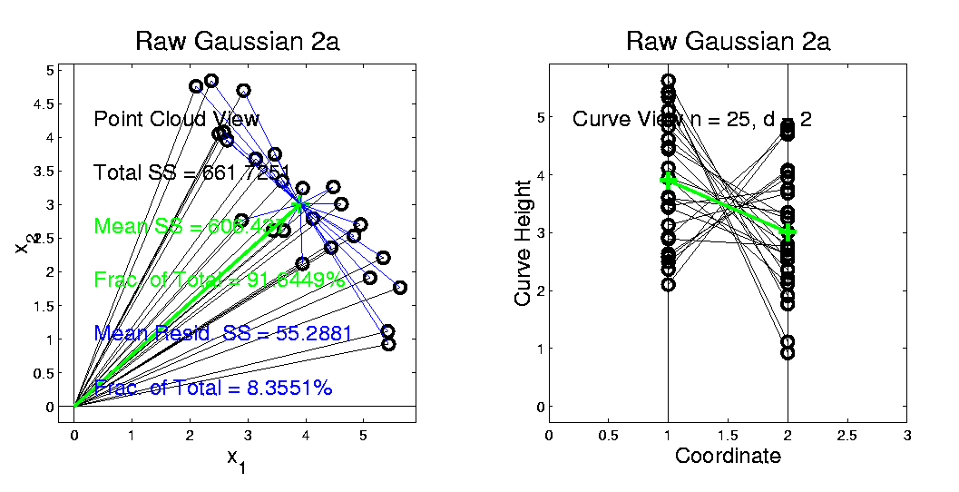
Connect Math to Graphics (Cont.)
2-d Toy Example
Feature Space Object Space
Residuals from Mean

Slide 107
Connect Math to Graphics (Cont.)
2-d Toy Example
Feature Space Object Space
Residuals from Mean = Data – Mean

Slide 108
Connect Math to Graphics (Cont.)
2-d Toy Example
Feature Space Object Space
Residuals from Mean = Data – Mean

Slide 109
Connect Math to Graphics (Cont.)
2-d Toy Example
Feature Space Object Space
Residuals from Mean = Data – Mean
Most of Variation

Slide 110
Connect Math to Graphics (Cont.)
2-d Toy Example
Feature Space Object Space
Residuals from Mean = Data – Mean
Most of Variation = 92% is Mean Variation SS

Slide 111
Connect Math to Graphics (Cont.)
2-d Toy Example
Feature Space Object Space
Residuals from Mean = Data – Mean
Most of Variation = 92% is Mean Variation SS
Remaining Variation = 8% is Resid. Var. SS

Slide 112
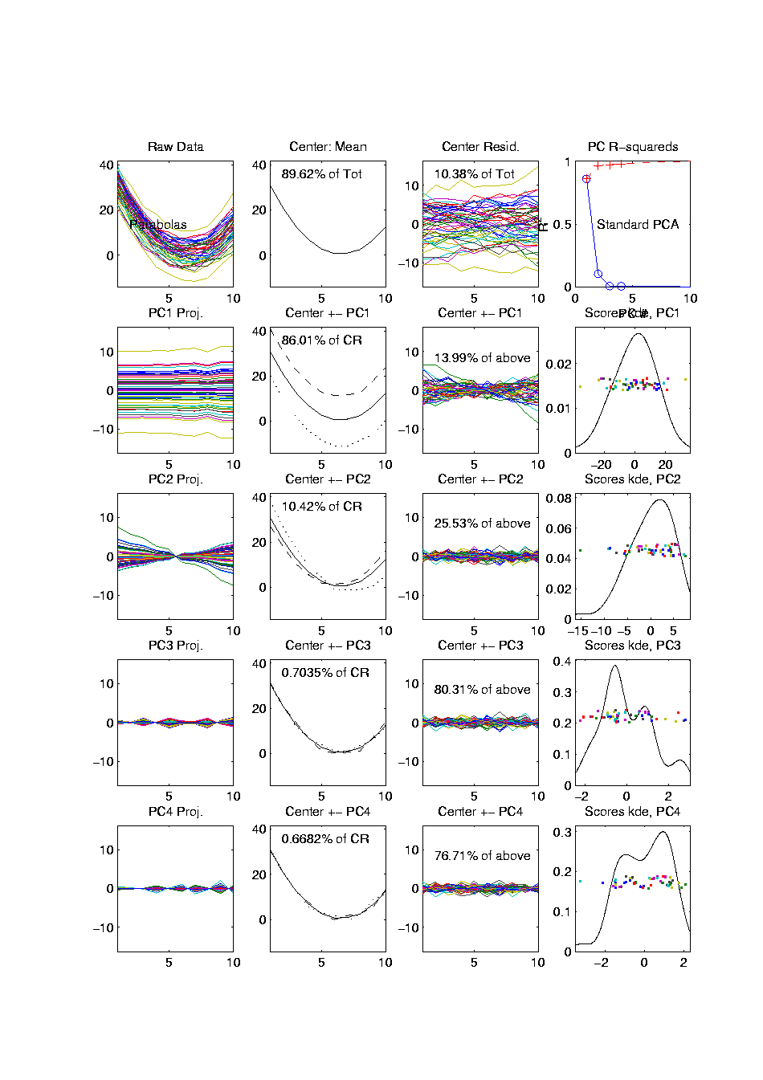
PCA Redist’n of Energy (Cont.)
Have already studied this decomposition (recall curve e.g.)
Notes:
112

Slide 113
PCA Redist’n of Energy (Cont.)
Have already studied this decomposition (recall curve e.g.)
Variation (SS) due to Mean (% of total)
Notes:
113

Slide 114
PCA Redist’n of Energy (Cont.)
Have already studied this decomposition (recall curve e.g.)
Variation (SS) due to Mean (% of total)
Variation (SS) of Mean Residuals (% of total)
Notes:
114

Slide 115
PCA Redist’n of Energy (Cont.)
Now Decompose SS About the Mean
where:
Notes:
115

Slide 116
PCA Redist’n of Energy (Cont.)
Now Decompose SS About the Mean
where:
Recall: Can Commute Matrices Inside Trace
Notes:
116

Slide 117
PCA Redist’n of Energy (Cont.)
Now Decompose SS About the Mean
where:
Recall: Cov Matrix is Outer Product
Notes:
117

Slide 118
PCA Redist’n of Energy (Cont.)
Now Decompose SS About the Mean
where:
i.e. Energy is Expressed in Trace of Cov Matrix
Notes:
118

Slide 119
PCA Redist’n of Energy (Cont.)
(Using Eigenvalue Decomp. Of Cov Matrix)
Notes:
119

Slide 120
PCA Redist’n of Energy (Cont.)
(Commute Matrices Within Trace)
Notes:
120

Slide 121
PCA Redist’n of Energy (Cont.)
(Since Basis Matrix is Orthonormal)
Notes:
121

Slide 122
PCA Redist’n of Energy (Cont.)
Eigenvalues Provide Atoms of SS Decompos’n
Notes:
122

Slide 123
PCA Redist’n of Energy (Cont.)
Eigenvalues Provide Atoms of SS Decompos’n
Useful Plots are:
Power Spectrum: vs.
Notes:
123

Slide 124
PCA Redist’n of Energy (Cont.)
Eigenvalues Provide Atoms of SS Decompos’n
Useful Plots are:
Power Spectrum: vs.
log Power Spectrum: vs.
(Very Useful When Are Orders of Mag. Apart)
Notes:
124

Slide 125
PCA Redist’n of Energy (Cont.)
Eigenvalues Provide Atoms of SS Decompos’n
Useful Plots are:
Power Spectrum: vs.
log Power Spectrum: vs.
Cumulative Power Spectrum: vs.
Notes:
125

Slide 126
PCA Redist’n of Energy (Cont.)
Eigenvalues Provide Atoms of SS Decompos’n
Useful Plots are:
Power Spectrum: vs.
log Power Spectrum: vs.
Cumulative Power Spectrum: vs.
Note PCA Gives SS’s for Free (As Eigenval’s),
But Watch Factors of
Notes:
126

Slide 127
PCA Redist’n of Energy (Cont.)
Note, have already considered some of these Useful Plots:
Notes:
127

Slide 128
PCA Redist’n of Energy (Cont.)
Note, have already considered some of these Useful Plots:
Power Spectrum
Notes:
128

Slide 129
PCA Redist’n of Energy (Cont.)
Note, have already considered some of these Useful Plots:
Power Spectrum
Cumulative Power Spectrum
Notes:
129

Slide 130
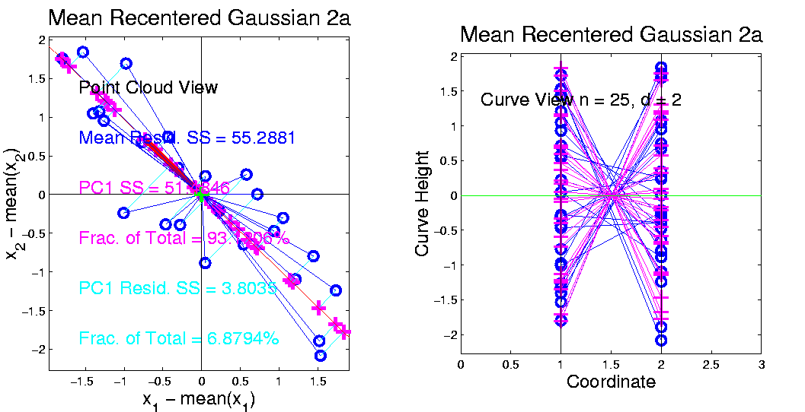
Connect Math to Graphics (Cont.)
2-d Toy Example
Feature Space Object Space
Revisit SS Decomposition for PC1
Notes:
130

Slide 131
Connect Math to Graphics (Cont.)
2-d Toy Example
Feature Space Object Space
Revisit SS Decomposition for PC1:
PC1 has “most of var’n” = 93%
Reflected by good approximation in Object Space
Notes:
131

Slide 132
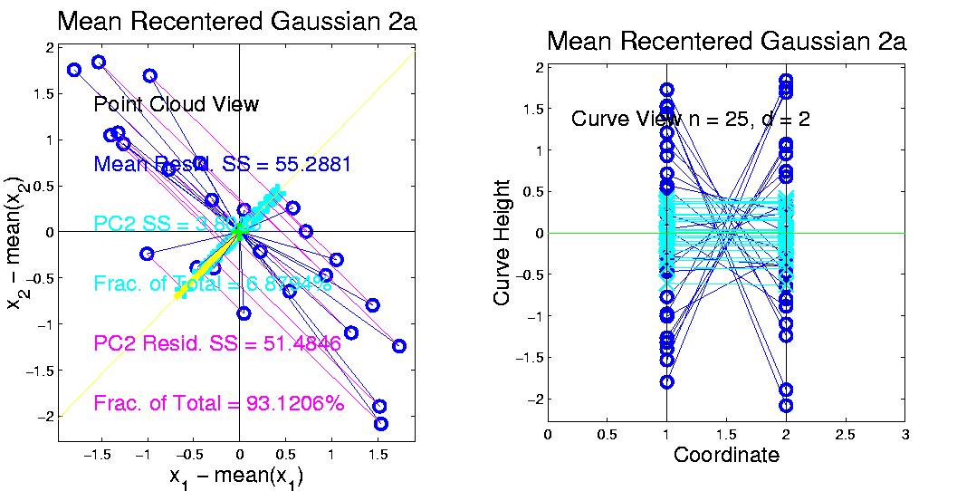
Connect Math to Graphics (Cont.)
2-d Toy Example
Feature Space Object Space
Revisit SS Decomposition for PC1:
PC2 has “only a little var’n” = 7%
Reflected by poor approximation in Object Space
Notes:
132

Slide 133
Different Views of PCA
Solves several optimization problems:
Direction to maximize SS of 1-d proj’d data
Notes:
133

Slide 134
Different Views of PCA
2-d Toy Example
Feature Space Object Space
Max SS of Projected Data
Min SS of Residuals
Best Fit Line
Notes:
134

Slide 135
Different Views of PCA
Solves several optimization problems:
Direction to maximize SS of 1-d proj’d data
Direction to minimize SS of residuals
Notes:
135

Slide 136
Different Views of PCA
2-d Toy Example
Feature Space Object Space
Max SS of Projected Data
Min SS of Residuals
Best Fit Line
Notes:
136

Slide 137
Different Views of PCA
Solves several optimization problems:
Direction to maximize SS of 1-d proj’d data
Direction to minimize SS of residuals
(same, by Pythagorean Theorem)
Notes:
137

Slide 138
Different Views of PCA
Solves several optimization problems:
Direction to maximize SS of 1-d proj’d data
Direction to minimize SS of residuals
(same, by Pythagorean Theorem)
“Best fit line” to data in “orthogonal sense”
(vs. regression of Y on X = vertical sense
& regression of X on Y = horizontal sense)
Notes:
138

Slide 139
Different Views of PCA
Toy Example Comparison of Fit Lines:
PC1
Regression of Y on X
Regression of X on Y
Notes:
139

Slide 140
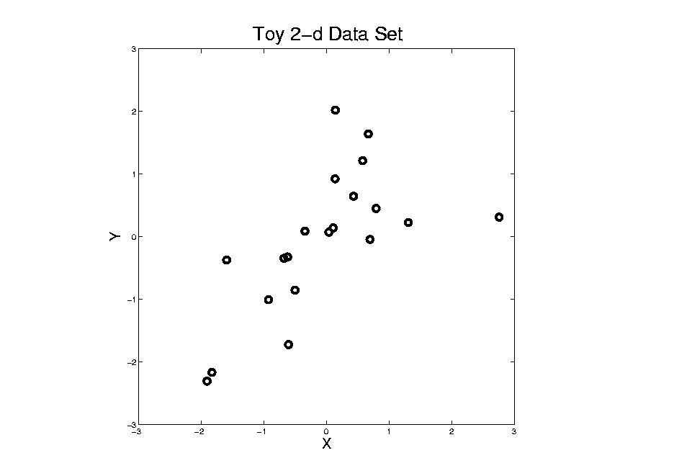
Different Views of PCA
Normal
Data
ρ = 0.3
Notes:
140

Slide 141
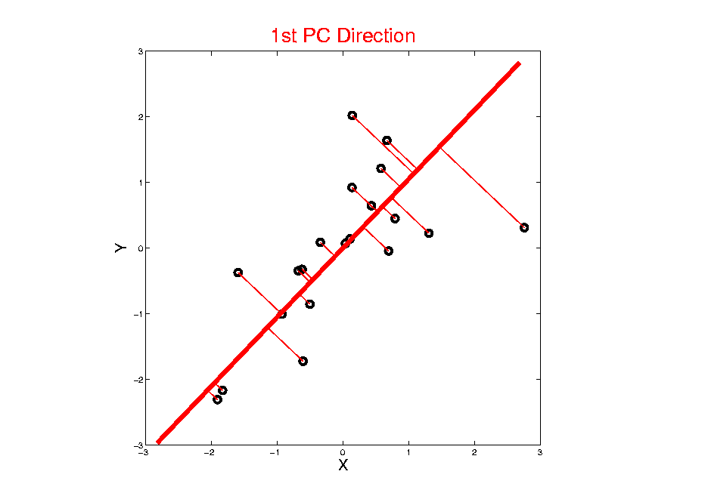
Different Views of PCA
Projected
Residuals
Notes:
141

Slide 142
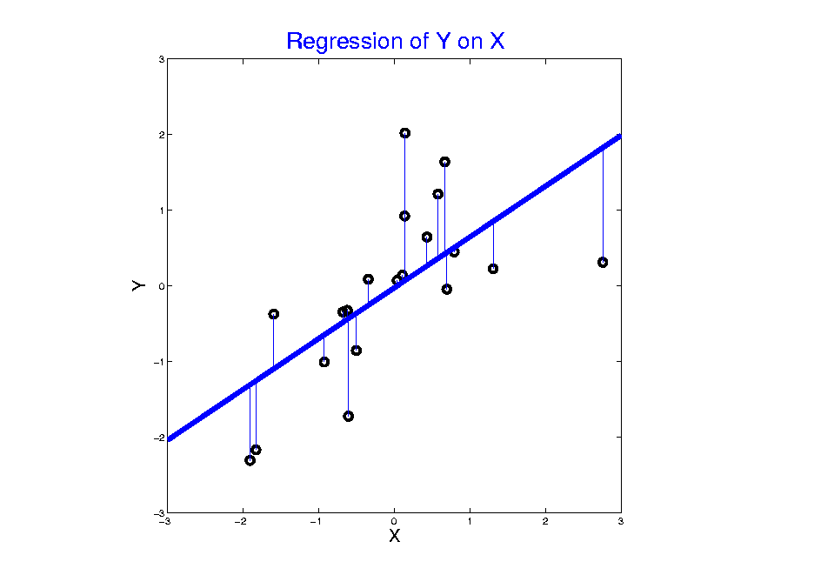
Different Views of PCA
Vertical
Residuals
Notes:
142

Slide 143
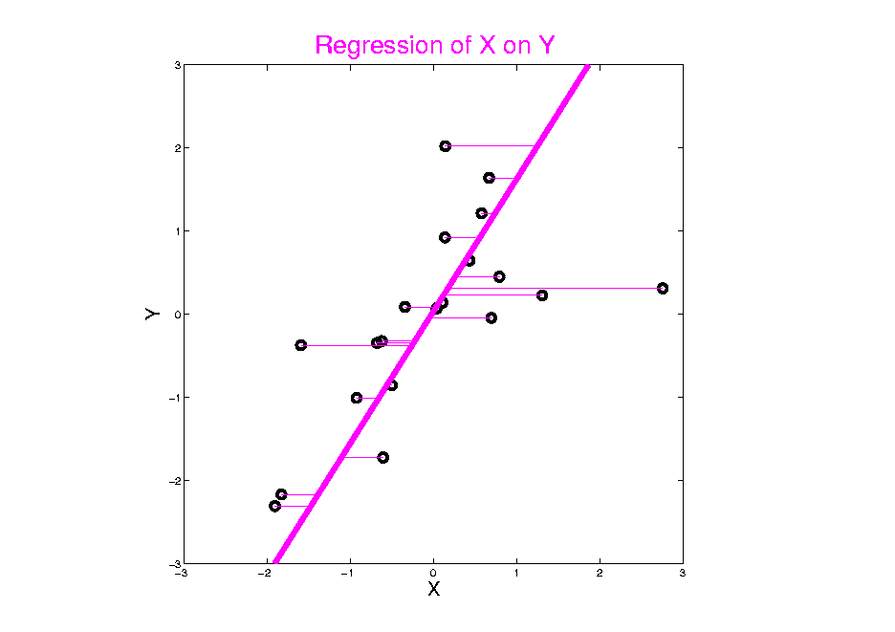
Different Views of PCA
Horizontal
Residuals
Notes:
143

Slide 144
Different Views of PCA
Toy Example Comparison of Fit Lines:
PC1
Regression of Y on X
Regression of X on Y
Note: Big Difference Prediction Matters
Notes:
144

Slide 145
Different Views of PCA
Solves several optimization problems:
Direction to maximize SS of 1-d proj’d data
Direction to minimize SS of residuals
(same, by Pythagorean Theorem)
“Best fit line” to data in “orthogonal sense”
(vs. regression of Y on X = vertical sense
& regression of X on Y = horizontal sense)
Use one that makes sense…
Notes:
145

Slide 146
PCA Data Representation
Idea: Expand Data Matrix
in Terms of Inner Prod’ts & Eigenvectors

Slide 147
PCA Data Representation
Idea: Expand Data Matrix
in Terms of Inner Prod’ts & Eigenvectors
Recall Notation:
(Mean Centered Data)

Slide 148
PCA Data Representation
Idea: Expand Data Matrix
in Terms of Inner Prod’ts & Eigenvectors
Recall Notation:
Spectral Representation (centered data):

Slide 149
PCA Data Represent’n (Cont.)
Now Using:

Slide 150
PCA Data Represent’n (Cont.)
Now Using:
Spectral Representation (Raw Data):

Slide 151
PCA Data Represent’n (Cont.)
Now Using:
Spectral Representation (Raw Data):
Where:
Entries of are Loadings
Entries of are Scores

Slide 152
PCA Data Represent’n (Cont.)
Can Focus on Individual Data Vectors:
(Part of Above Full Matrix Rep’n)

Slide 153
PCA Data Represent’n (Cont.)
Can Focus on Individual Data Vectors:
(Part of Above Full Matrix Rep’n)
Terminology: are Called “PCs”
and are also Called Scores

Slide 154
PCA Data Represent’n (Cont.)
More Terminology:
Scores, are Coefficients in Spectral Representation:

Slide 155
PCA Data Represent’n (Cont.)
More Terminology:
Scores, are Coefficients in Spectral Representation:
Loadings are Entries of Eigenvectors:

Slide 156
PCA Data Represent’n (Cont.)
Reduced Rank Representation:

Slide 157
PCA Data Represent’n (Cont.)
Reduced Rank Representation:
Reconstruct Using Only Terms
(Assuming Decreasing Eigenvalues)

Slide 158
PCA Data Represent’n (Cont.)
Reduced Rank Representation:
Reconstruct Using Only Terms
(Assuming Decreasing Eigenvalues)
Gives: Rank Approximation of Data

Slide 159
PCA Data Represent’n (Cont.)
Reduced Rank Representation:
Reconstruct Using Only Terms
(Assuming Decreasing Eigenvalues)
Gives: Rank Approximation of Data
Key to PCA Dimension Reduction

Slide 160
PCA Data Represent’n (Cont.)
Reduced Rank Representation:
Reconstruct Using Only Terms
(Assuming Decreasing Eigenvalues)
Gives: Rank Approximation of Data
Key to PCA Dimension Reduction
And PCA for Data Compression (~ .jpeg)

Slide 161
PCA Data Represent’n (Cont.)
Choice of in Reduced Rank Represent’n:

Slide 162
PCA Data Represent’n (Cont.)
Choice of in Reduced Rank Represent’n:
Generally Very Slippery Problem

Slide 163
PCA Data Represent’n (Cont.)
Choice of in Reduced Rank Represent’n:
Generally Very Slippery Problem
Not Recommended:
Arbitrary Choice
E.g. % Variation Explained 90%? 95%?

Slide 164
PCA Data Represent’n (Cont.)
Choice of in Reduced Rank Represent’n:
Generally Very Slippery Problem
SCREE Plot (Kruskal 1964):
Find Knee in Power Spectrum

Slide 165
PCA Data Represent’n (Cont.)
SCREE Plot Drawbacks:
What is a Knee?

Slide 166
PCA Data Represent’n (Cont.)
SCREE Plot Drawbacks:
What is a Knee?
What if There are Several?

Slide 167
PCA Data Represent’n (Cont.)
SCREE Plot Drawbacks:
What is a Knee?
What if There are Several?
Knees Depend on Scaling (Power? log?)

Slide 168
PCA Data Represent’n (Cont.)
SCREE Plot Drawbacks:
What is a Knee?
What if There are Several?
Knees Depend on Scaling (Power? log?)
Personal Suggestions:
Find Auxiliary Cutoffs (Inter-Rater Variation)
Use the Full Range (ala Scale Space)

