Slide 1
Statistics – O. R. 891 Object Oriented Data Analysis
J. S. Marron
Dept. of Statistics and Operations Research
University of North Carolina

Slide 2
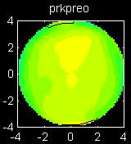
Cornea Data
Cornea Data:
Raw Data
Which one
is the outlier?
Will say more
later …

Slide 3
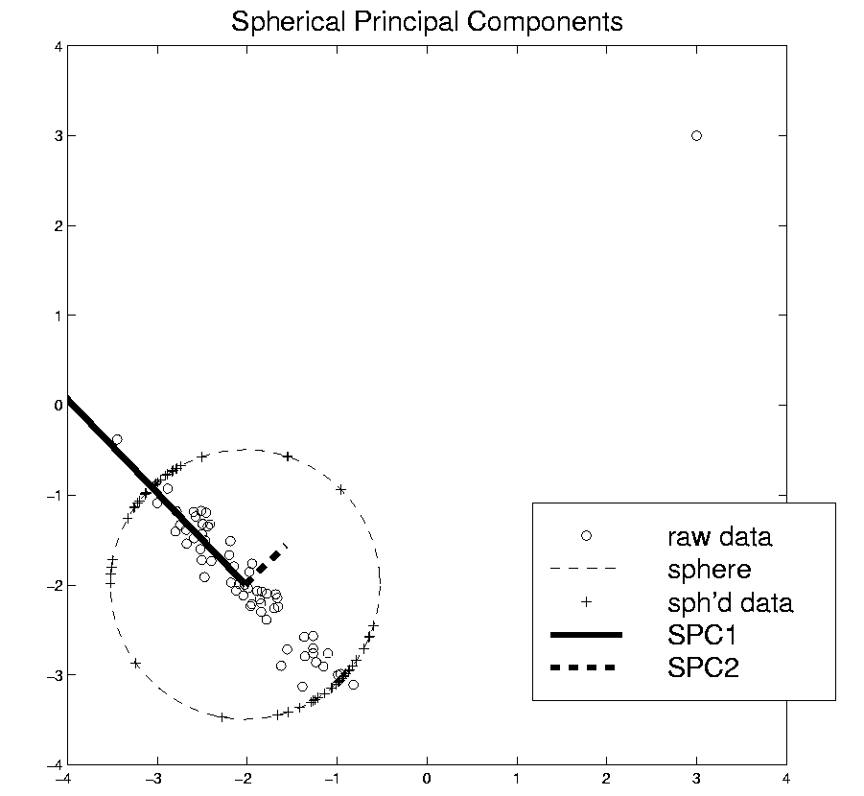
Robust PCA
Robust PCA 3:
Spherical
PCA

Slide 4
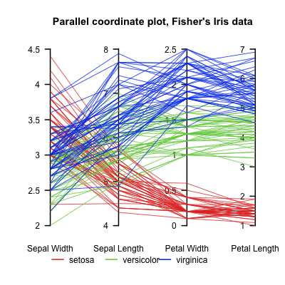
Aside On Visualization
Another Multivariate Data Visualization Tool:
Parallel Coordinates
E.g. Fisher Iris Data
d = 4
Named Variables
Notes:
4

Slide 5
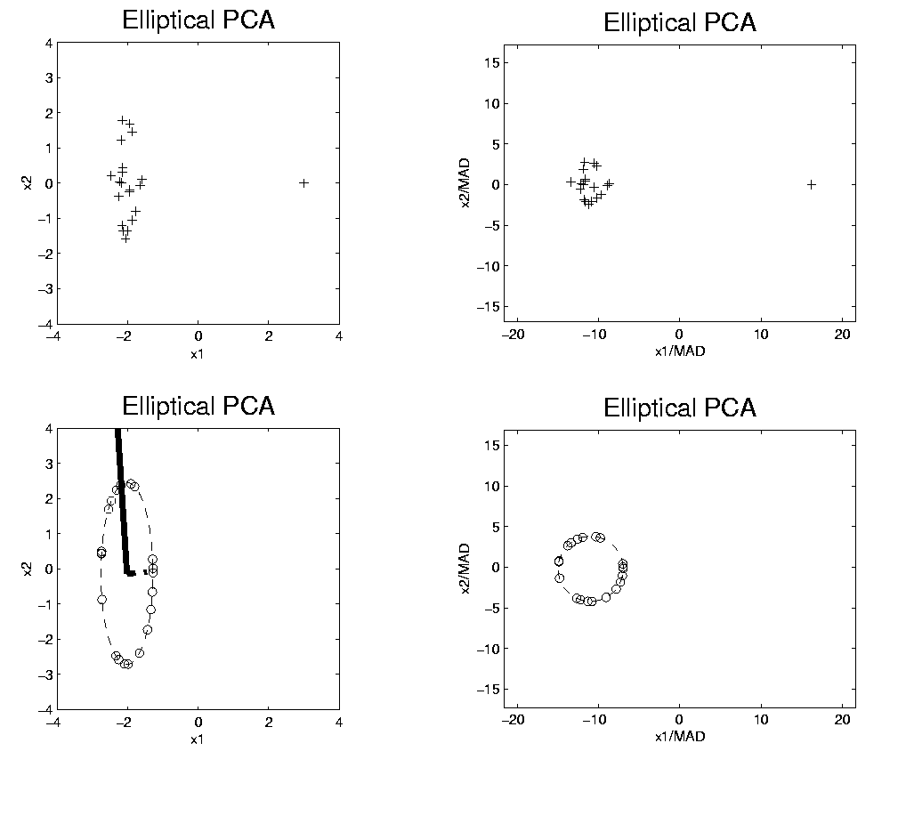
Robust PCA
Rescale
Coords
Spherical PCA
Unscale
Coords

Slide 6
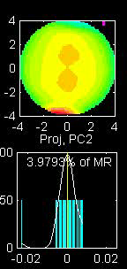
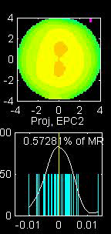
Robust PCA
Elliptical PCA for cornea data:
Original PC2, Elliptical PC2

Slide 7
Big Picture View of PCA
Above View:
PCA finds optimal directions in point cloud
Maximize projected variation
Minimize residual variation
(same by Pythagorean Theorem)
Notes:
Get useful insights about data
Shows can compute for any point cloud
But there are other views.

Slide 8
Big Picture View of PCA
Alternate Viewpoint: Gaussian Likelihood
When data are multivariate Gaussian
PCA finds major axes of ellipt’al contours
of Probability Density
Maximum Likelihood Estimate
Mistaken idea:
PCA only useful for Gaussian data

Slide 9
Big Picture View of PCA
Simple check for Gaussian distribution:
Standardized parallel coordinate plot
Subtract coordinate wise median
(robust version of mean)
(not good as “point cloud center”,
but now only looking at coordinates)
Divide by MAD / MAD(N(0,1))
(put on same scale as “standard deviation”)
See if data stays in range –3 to +3

Slide 10
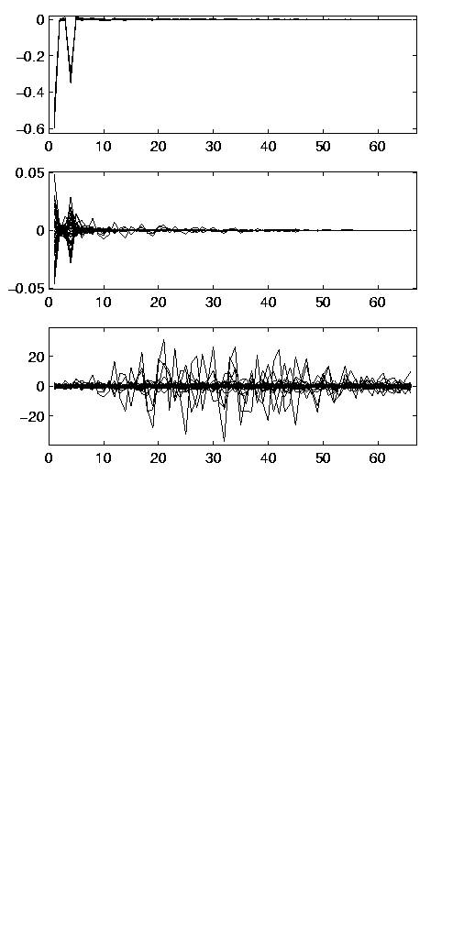
Big Picture View of PCA
E.g.
Cornea Data:
Standardized
Parallel
Coordinate
Plot
Shown before

Slide 11
Big Picture View of PCA
Raw Cornea Data:
Data – Median
(Data – Median)
-------------------
MAD

Slide 12
Big Picture View of PCA
Check for Gaussian dist’n:
Stand’zed Parallel Coord. Plot
E.g. Cornea data
(recall image view of data)
Several data points > 20 “s.d.s” from the center
Distribution clearly not Gaussian
Strong kurtosis (“heavy tailed”)
But PCA still gave strong insights

Slide 13
Big Picture View of PCA
Image View of Cornea Data:

Slide 14
Correlation PCA
A related (& better known) variation of PCA:
Replace cov. matrix with correlation matrix
I.e. do eigen analysis of
Where

Slide 15
Correlation PCA
Why use correlation matrix?
Makes features “unit free”
e.g. M-reps: mix “lengths” with “angles”
(degrees? radians?)
Are “directions in point cloud” meaningful or useful?
Will unimportant directions dominate?

Slide 16
Correlation PCA
Personal Thoughts on Correlation PCA:
Can be very useful
(especially with noncommensurate units)
Not always, can hide important structure
To make choice:
Decide whether whitening is useful
My personal use of correlat’n PCA is rare
Other people use it most of the time

Slide 17
Transformations
Useful Method for Data Analysts
Apply to Marginal Distributions
(i.e. to Individual Variables)
Idea: Put Data on Right Scale
Common Example:
Data Orders of Magnitude Different
Log₁₀ Puts Data on More Analyzable Scale

Slide 18
Transformations
Example: Melanoma Data Analysis
Current Collaborators:
Nancy Thomas
Marc Niethammer
David Eberhard
Susan Wei
Heather Couture

Slide 19
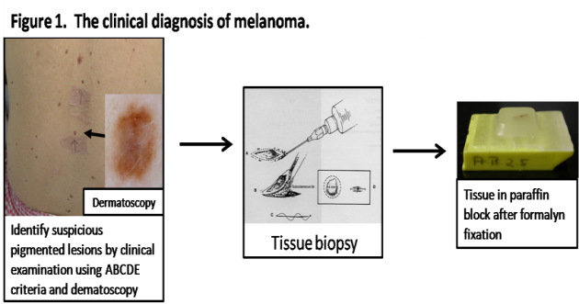
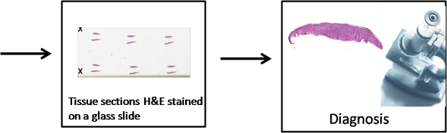
Introduction
Background
Clinical diagnosis

Slide 20
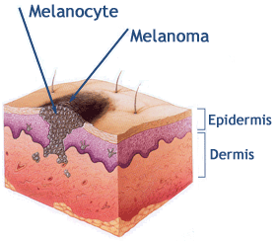
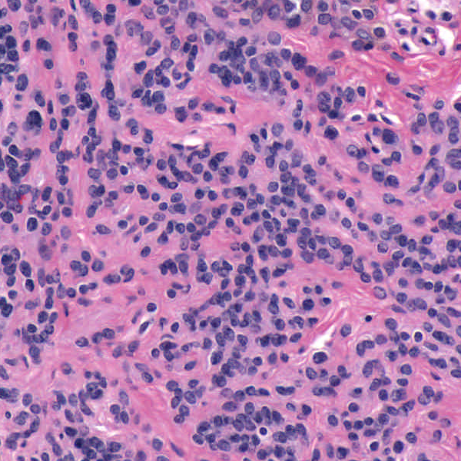
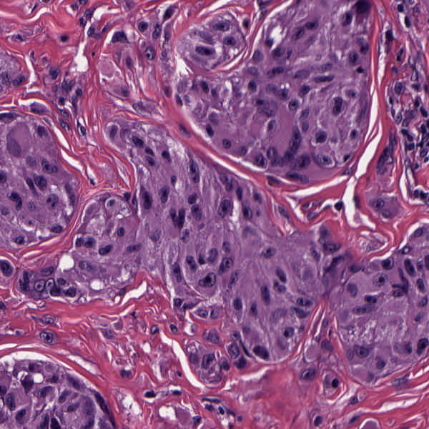
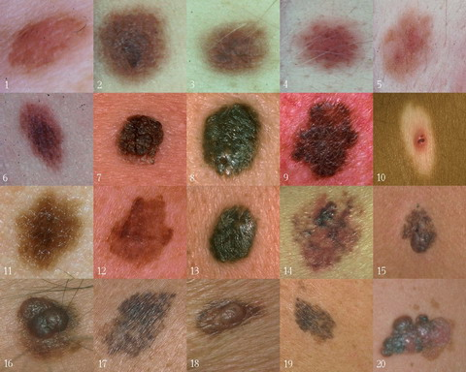
Background
Goal
Image Analysis of Histology Slides
Image: www.melanoma.ca
Benign
Melanoma
1 in 75 North Americans will develop a
malignant melanoma in their lifetime.
Initial goal: Automatically segment nuclei.
Challenge: Dense packing of nuclei.
Ultimately: Cancer grading and patient survival.
Image: melanoma.blogsome.com

Slide 21
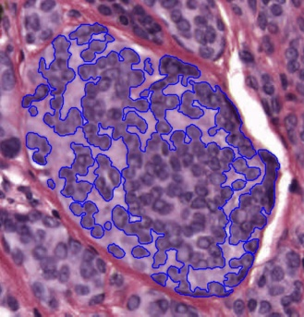
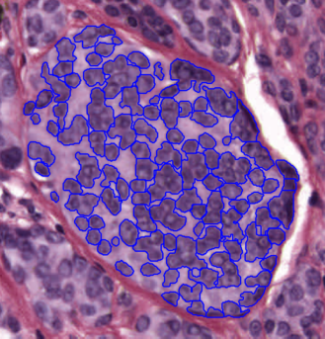
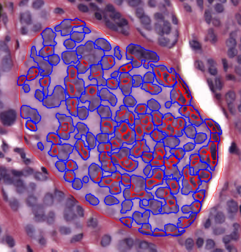
Segmentation
Cell Nuclei from Histology
Cutting Cell Clusters
Without subdivision
With subdivision
Our segmentation
Commercial seg.
Not perfect, but improved over standard algorithm (rq. validation).

Slide 22
Feature Extraction
Features from Cell Nuclei
Feature Extraction
Extract various features based on color and morphology
Example “high-level” concepts:
Stain intensity
Nuclear area
Density of nuclei
Regularity of nuclear shape

Slide 23
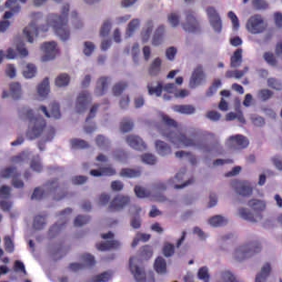
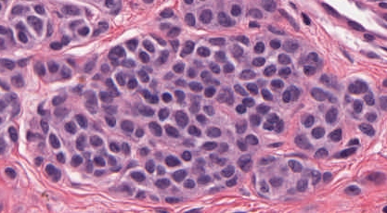
Feature Extraction
Features from Cell Nuclei
Original Image
Conventional Nevus
Superficial Spreading Melanoma

Slide 24
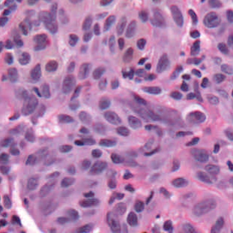
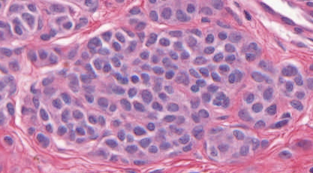
Feature Extraction
Features from Cell Nuclei
Restained Image
Conventional Nevus
Superficial Spreading Melanoma

Slide 25

Feature Extraction
Features from Cell Nuclei
Masked Region
Conventional Nevus
Conventional Nevus
Superficial Spreading Melanoma
Superficial Spreading Melanoma
Masks generated by pathologist

Slide 26
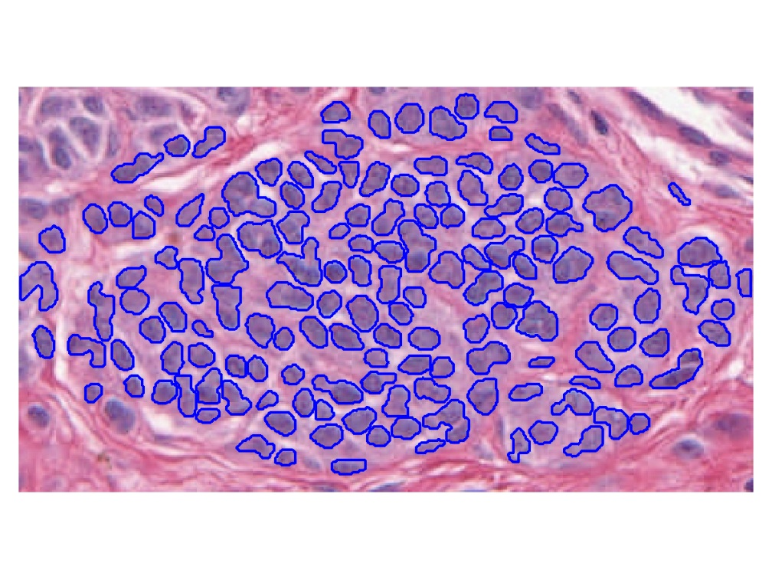
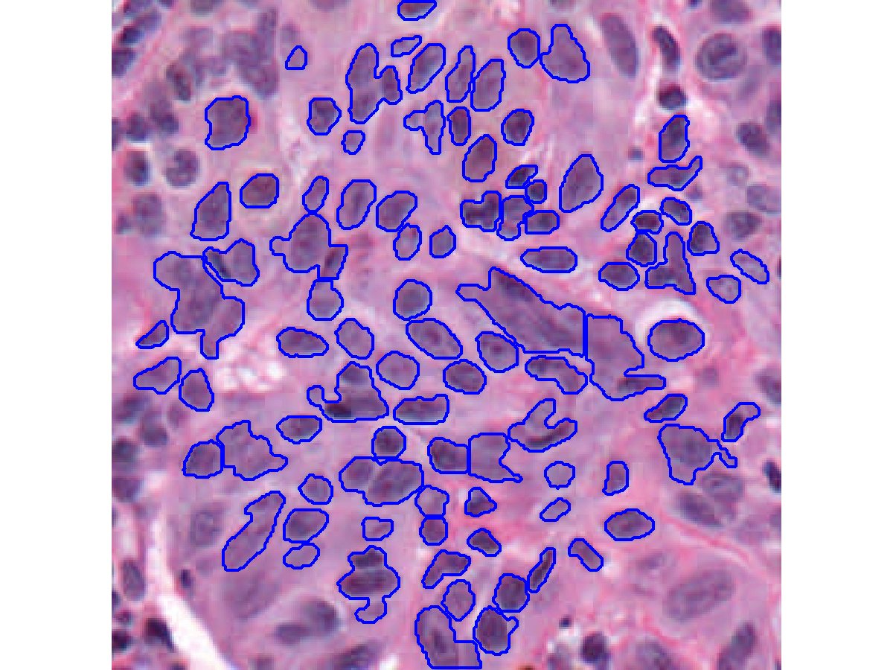
Feature Extraction
Features from Cell Nuclei
Segmented Nuclei
Conventional Nevus
Superficial Spreading Melanoma

Slide 27
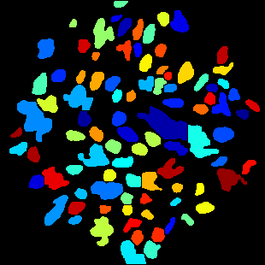
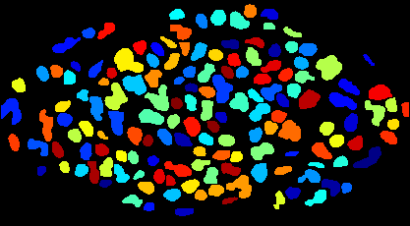
Feature Extraction
Features from Cell Nuclei
Labeled Nuclei
Conventional Nevus
Superficial Spreading Melanoma

Slide 28
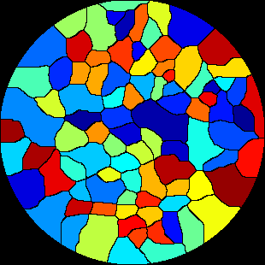
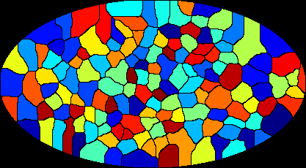
Feature Extraction
Features from Cell Nuclei
Nuclear Regions
Conventional Nevus
Superficial Spreading Melanoma
Generated by growing nuclei out from boundary
Used for various color and density features:
Region Stain 2, Region Area Ratio, etc.

Slide 29
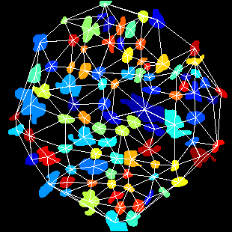
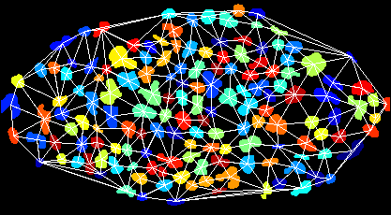
Feature Extraction
Features from Cell Nuclei
Delaunay Triangulation
Conventional Nevus
Superficial Spreading Melanoma
Triangulation of nuclear centers
Used for various density features:
Mean Delaunay, Max. Delaunay, etc.

Slide 30
Transformations
Statistical Challenge:
Some Features Spread Over Several Orders of Magnitude
Few Big Values Can Dominate Analysis

Slide 31
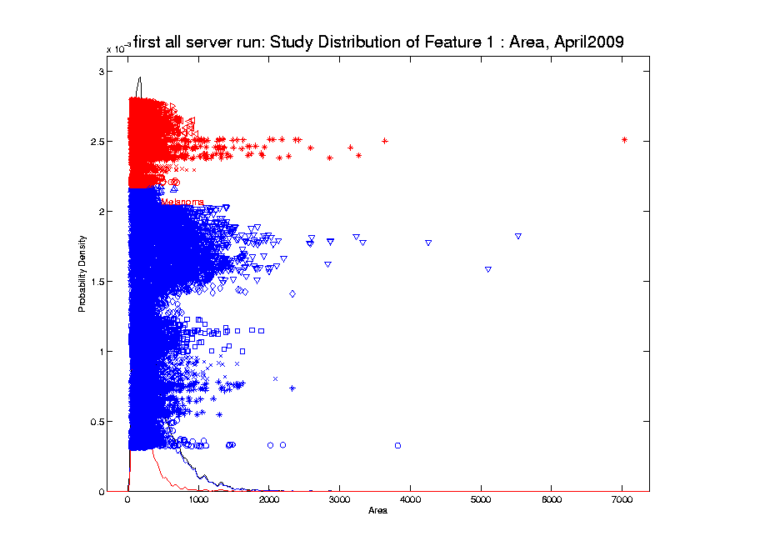
Transformations
Few Large Values Can Dominate Analysis

Slide 32
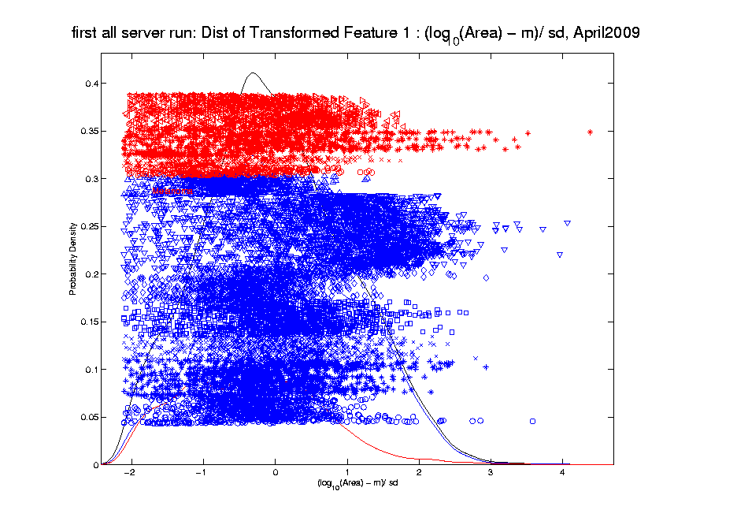
Transformations
Log Scale Gives All More Appropriate Weight
Note:
Orders
Of
Magnitude
Log₁₀ most
Interpretable

Slide 33
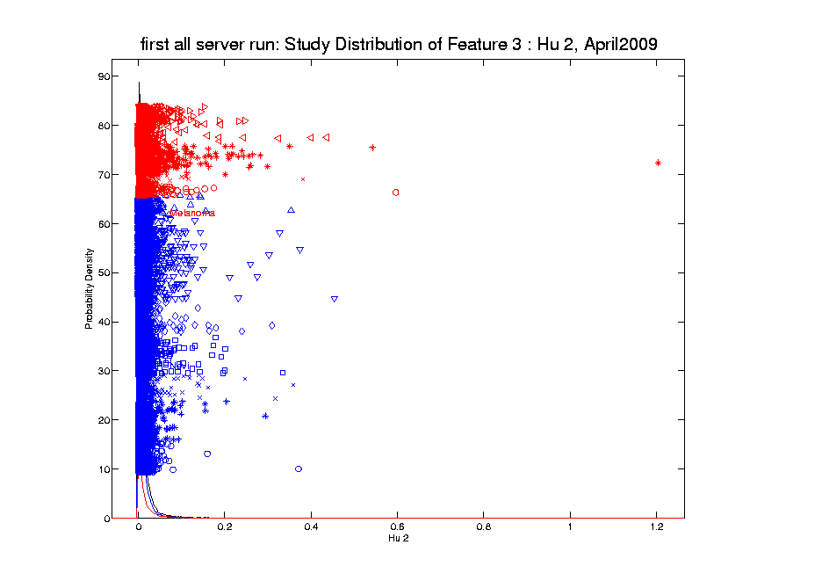
Transformations
Another Feature with Large Values
Problem
For This
Feature:
0 Values
(no log)

Slide 34

Transformations
Another Feature with Large Values
Approach:
Shifted
Log:
$$log\left(∙+δ\right)$$
Need to
Tune

Slide 35
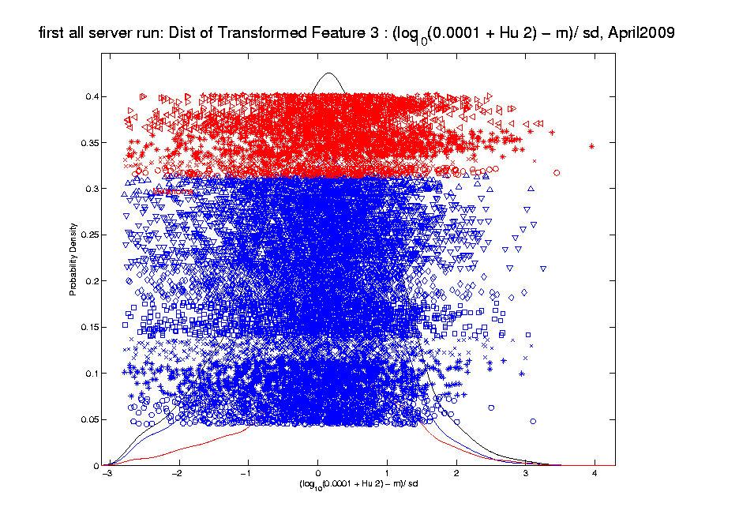
Transformations
Much Nicer Distribution

Slide 36
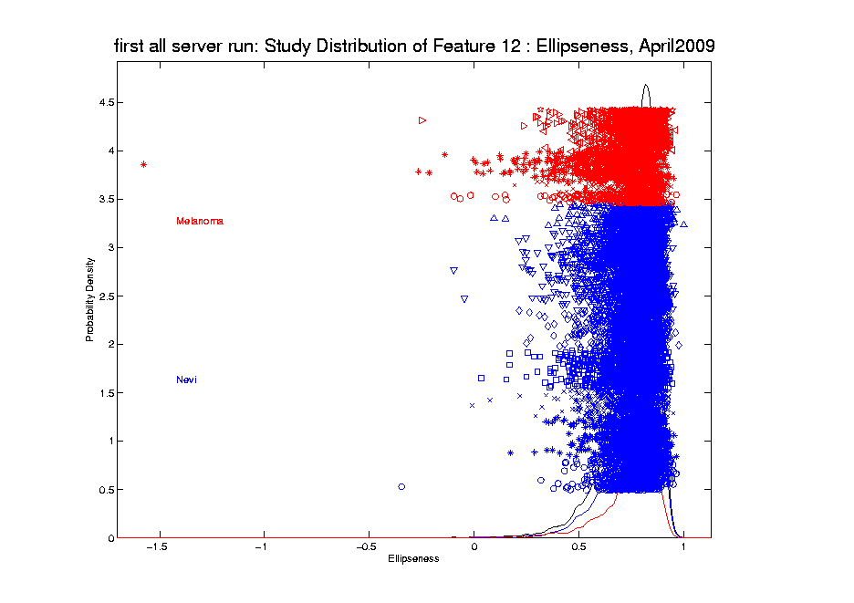
Transformations
Different Type of Skewness

Slide 37
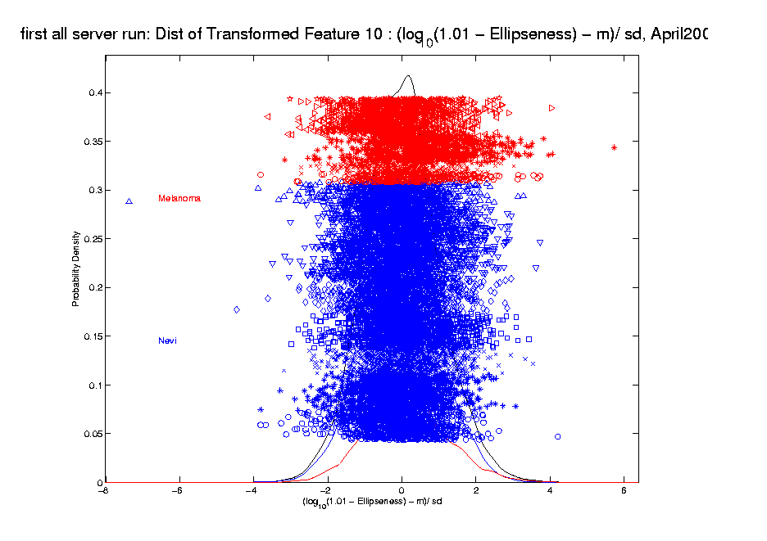
Transformations
Use Log Difference Transformation

Slide 38
Transformations
Useful Visualization: MargDistPlot
Idea: Visually Screen Many Marginal
Distributions, Simultaneously
Approach: Order, Using Some Summary
E.g. Set of Poisson(λ) Distributions
With Wide Range of λ Parameters

Slide 39
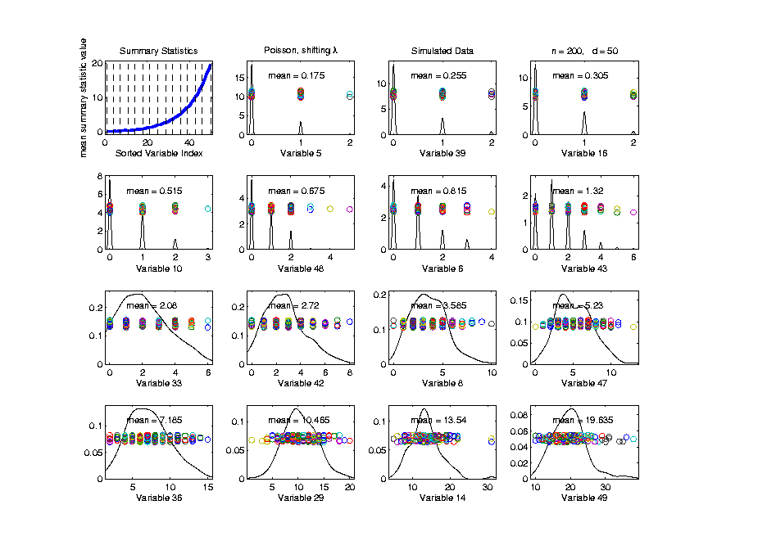
Transformations
Useful Visualization: MargDistPlot
Summary
Plot
Here
Using
Means

Slide 40
Transformations
Useful Visualization: MargDistPlot
Summary
Plot
Show
Repre’tive
Marginal
Dist’ns

Slide 41
Transformations
Useful Visualization: MargDistPlot
Summary
Plot
Note:
Sensible
Ordering

Slide 42
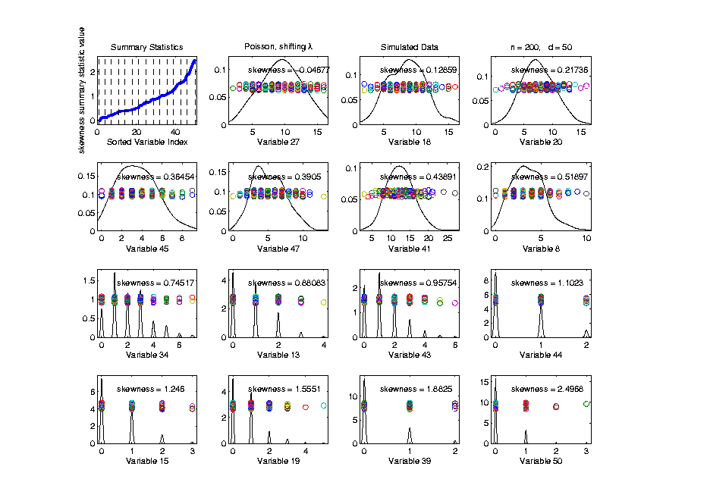
Transformations
Useful Visualization: MargDistPlot
Change
Summary
To
Skewness
Most/Least
Symmetric

Slide 43
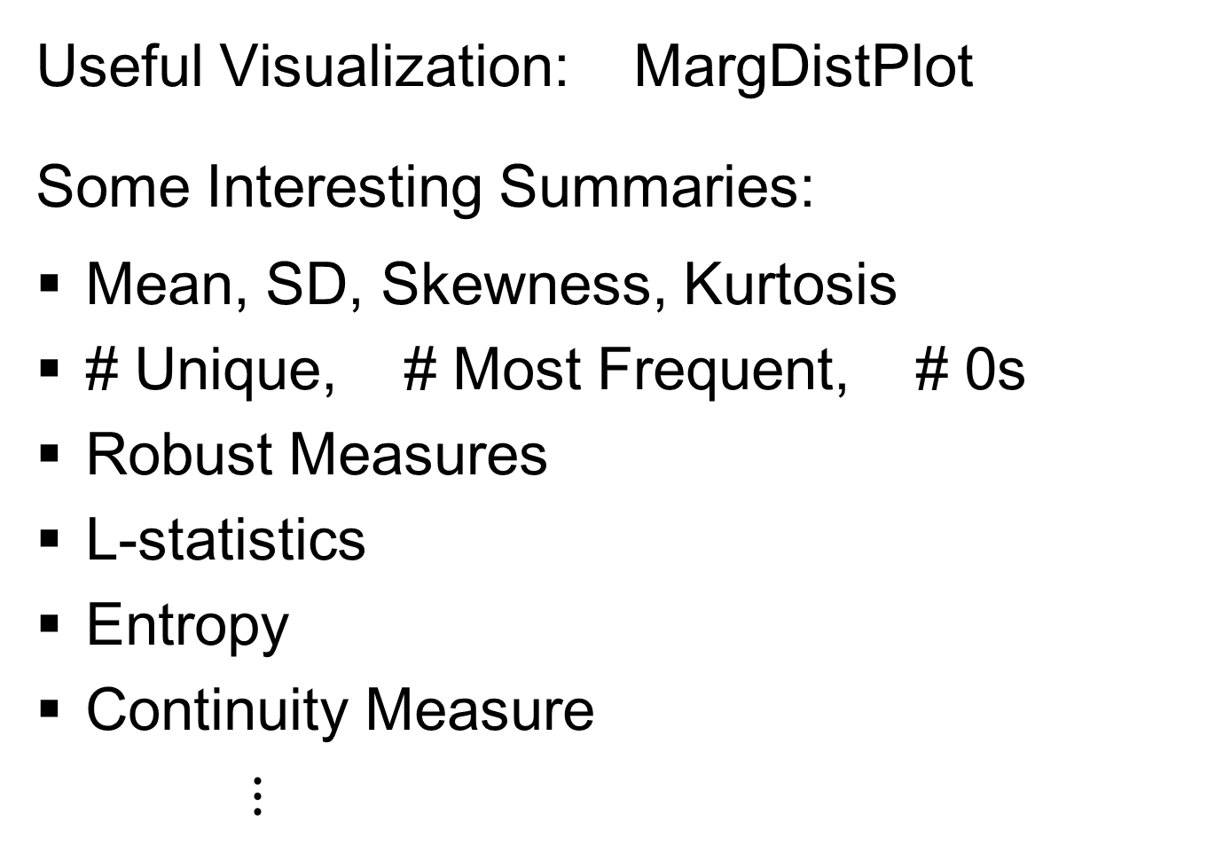
Transformations
Useful Visualization: MargDistPlot
Some Interesting Summaries:
Mean, SD, Skewness, Kurtosis
# Unique, # Most Frequent, # 0s
Robust Measures
L-statistics
Entropy
Continuity Measure
$⋮$

Slide 44
Clusters in data
Common Statistical Task:
Find Clusters in Data
Interesting sub-populations?
Important structure in data?
How to do this?
PCA provides very simple approach
There is a large literature of other methods
(will study more later)

Slide 45
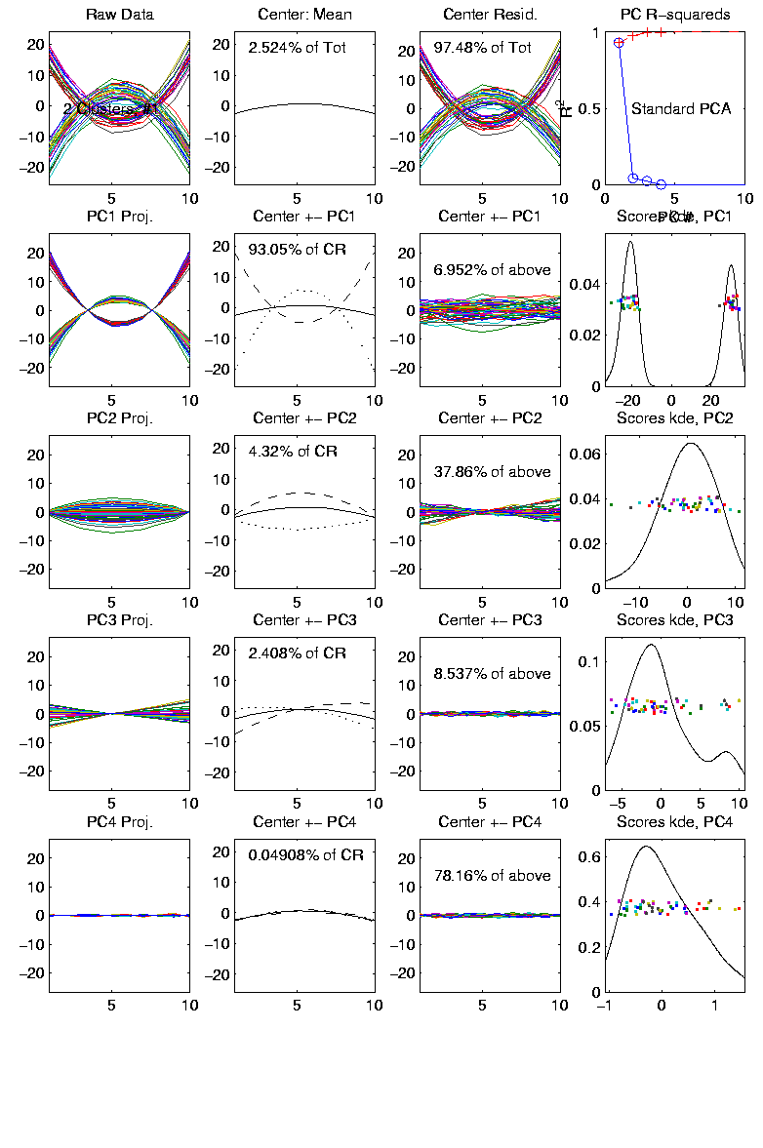
PCA to find clusters
Toy Example (2 clusters)

Slide 46
PCA to find clusters
Toy Example (2 clusters)
Dominant direction finds very distinct clusters
Skewer through meatballs (in point cloud space)
Shows up clearly in scores plot
An important use of scores plot is finding such structure

Slide 47
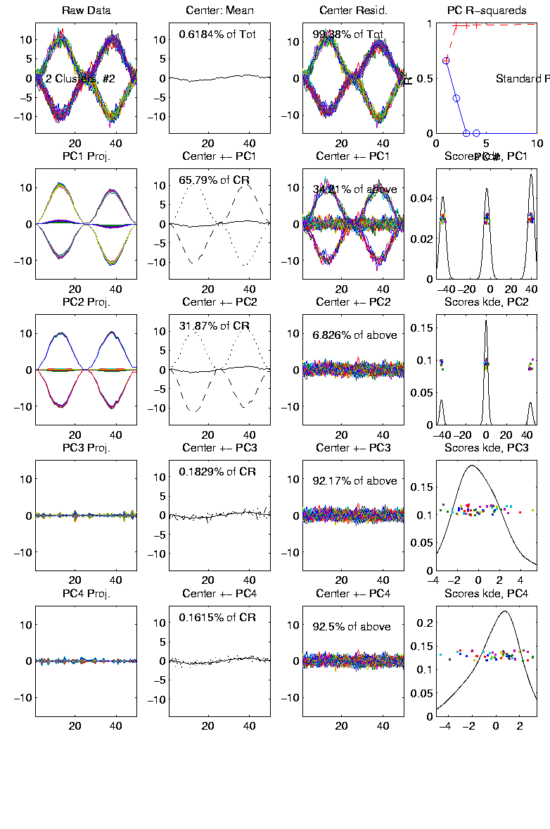
PCA to find clusters
Recall Toy Example with more clusters:

Slide 48
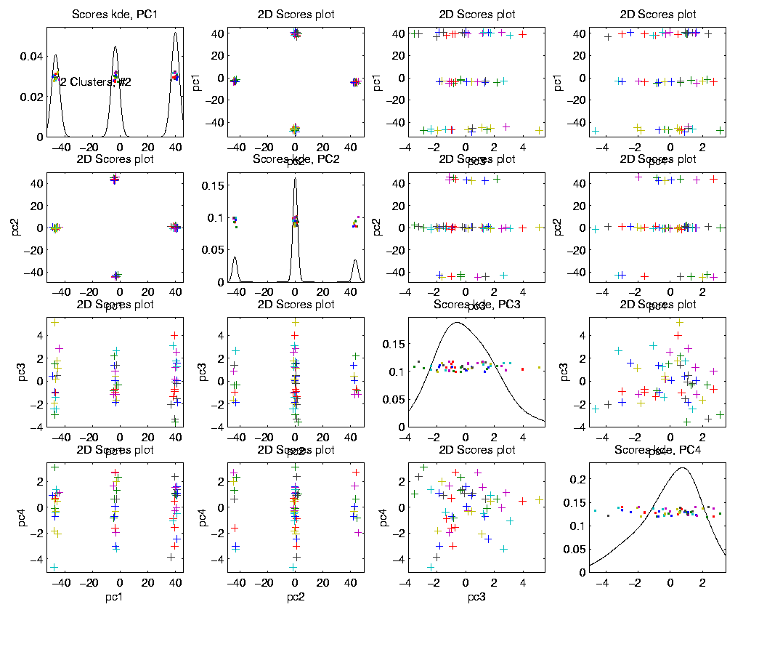
PCA to find clusters
Best revealed by 2d scatterplots (4 clusters):

Slide 49
PCA to find clusters
Caution: there are limitations…
Revealed by NCI60 data
Recall Microarray data
With 8 known different cancer types
Could separate out clusters
Using specialized DWD directions
But mostly not found using PCA
Recall only finds dirn’s of max variation
Does not use class label information

Slide 50
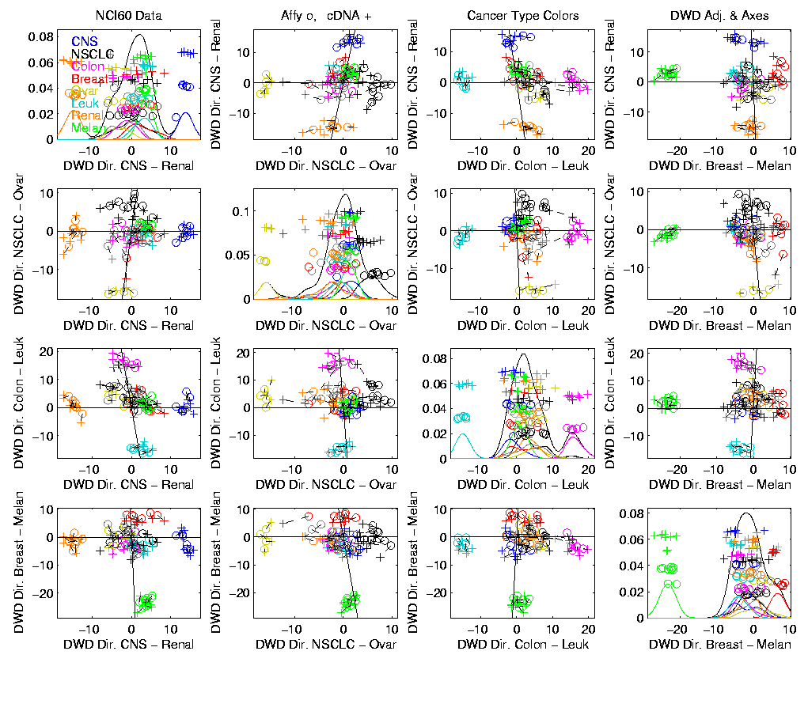
PCA to find clusters
Specific DWD directions, for NCI60 Data:
Good
Separation
Of Cancer
Types

Slide 51
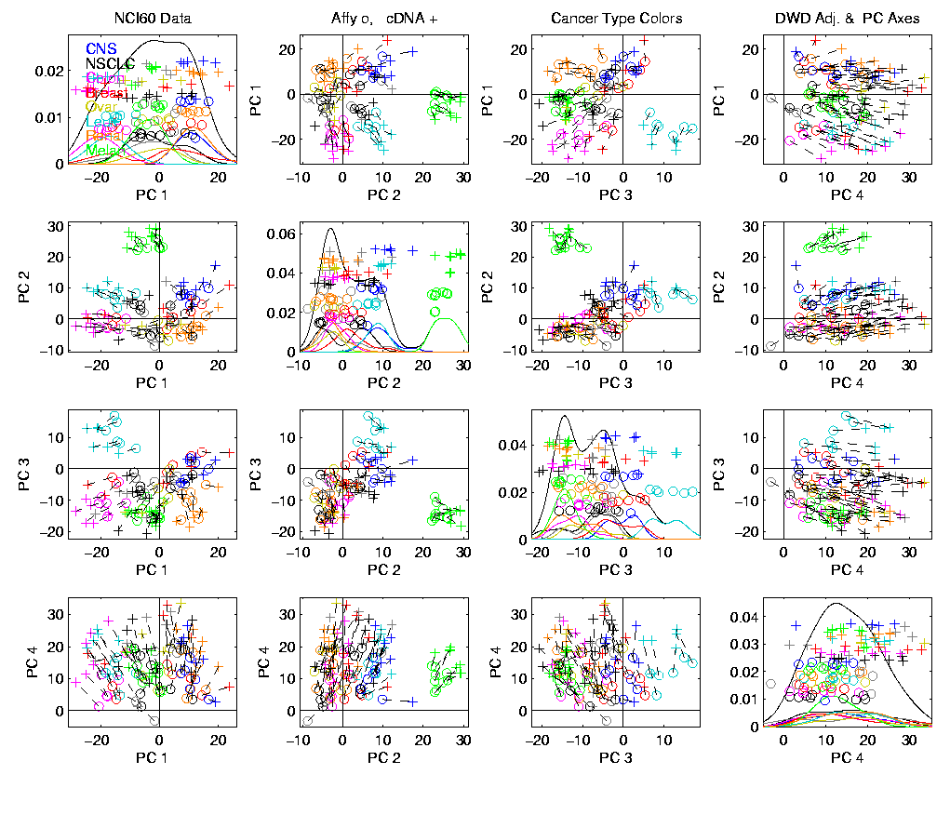
PCA to find clusters
PCA directions, for NCI60 Data:
PC2:
Melanoma
PC1-3
Leukemia

Slide 52
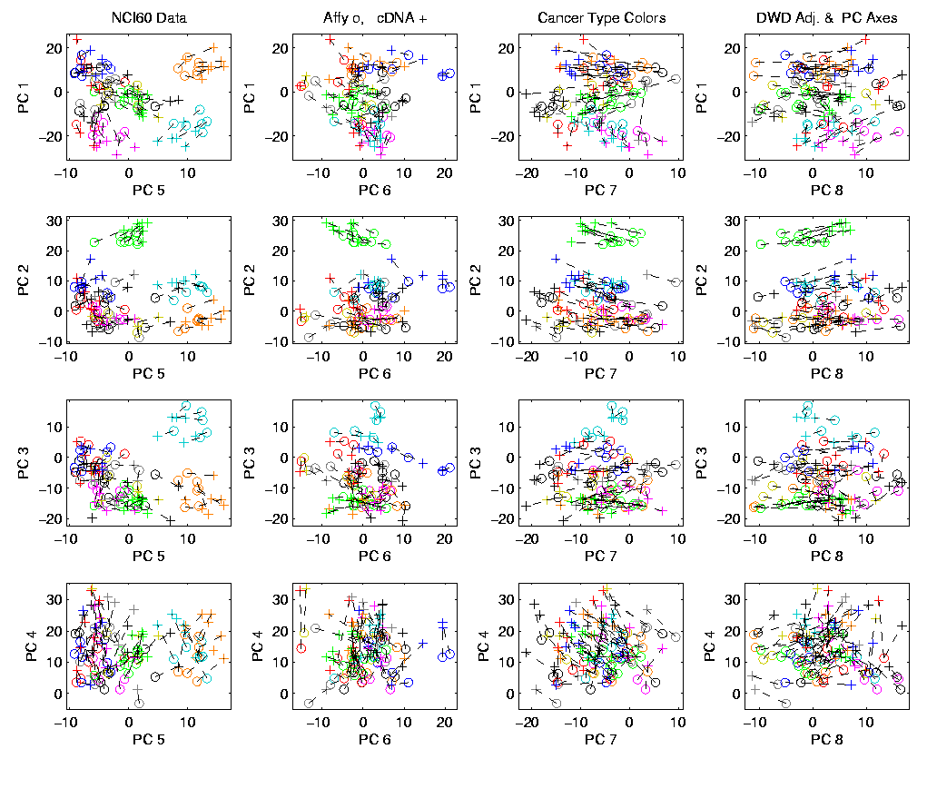
PCA to find clusters
Off Diagonal PC1-4 & 5-8, NCI60 Data:
PC1 & 5
Renal
Leukemia
(separated)
PC2:
Melanoma

Slide 53
PCA to find clusters
Main Lesson:
PCA is limited at finding clusters
Revealed by NCI60 data
Recall Microarray data
With 8 known different cancer types
PCA does not find all 8 clusters
Recall only finds dirn’s of max variation
Does not use class label information

Slide 54
PCA to find clusters
A deeper example:
Mass Flux Data
Data from Enrica Bellone,
National Center for Atmospheric Research
Mass Flux for quantifying cloud types
How does mass change when moving into a cloud

Slide 55
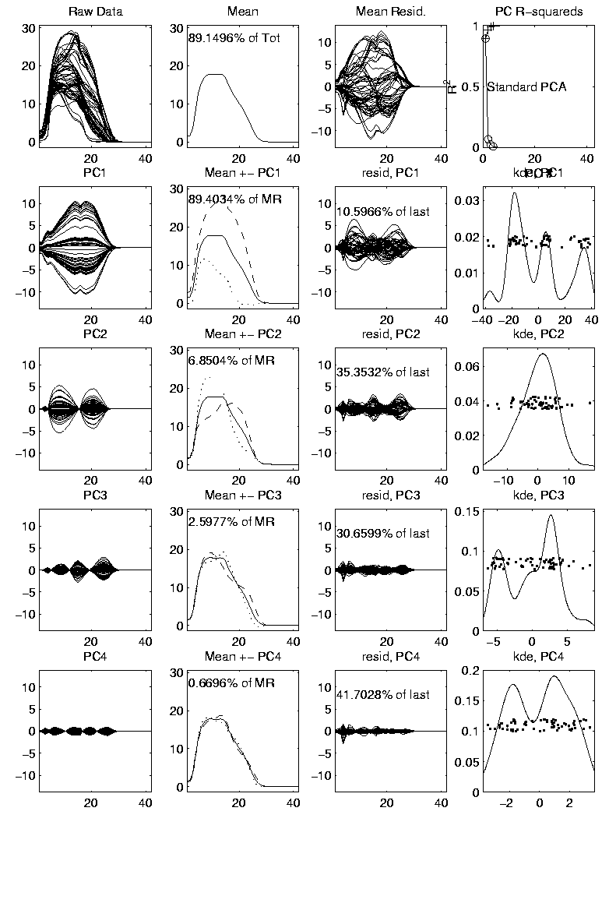
PCA to find clusters
PCA of Mass Flux Data:

Slide 56
PCA to find clusters
Summary of PCA of Mass Flux Data:
Mean:
Captures General Mountain Shape
PC1:
Generally overall height of peak
shows up nicely in mean +- plot (2nd col)
3 apparent clusters in scores plot
Are those “really there”?
If so, could lead to interesting discovery
If not, could waste effort in investigation

Slide 57
PCA to find clusters
Summary of PCA of Mass Flux Data:
PC2:
Location of peak
again mean +- plot very useful here
PC3:
Width adjustment
again see most clearly in mean +- plot
Maybe non-linear modes of variation???

Slide 58
PCA to find clusters
Return to Investigation of PC1 Clusters:
Can see 3 bumps in smooth histogram
Main Question:
Important structure
or
sampling variability?
Approach: SiZer
(SIgnificance of ZERo crossings of deriv.)

Slide 59
Statistical Smoothing
2 Major Settings:
Density Estimation
“Histograms”
Nonparametric Regression
“Scatterplot Smoothing”

Slide 60
Density Estimation
E.g. Hidalgo Stamp Data
Thicknesses of Postage Stamps
Produced in Mexico
Over ~ 70 years
During 1800s
Paper produced in several factories?
How many factories? (Records lost)
Brought to statistical literature by:
Izenman and Sommer (1988)

Slide 61
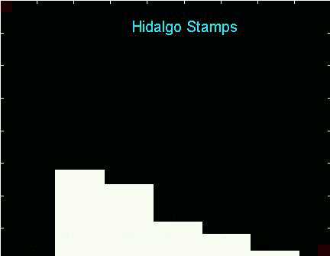
Density Estimation
E.g. Hidalgo Stamp Data
A histogram
“Oversmoothed”
Bin Width too
large?
Miss important
structure?

Slide 62
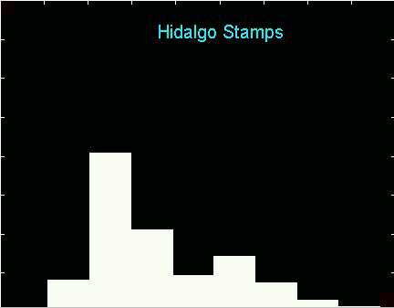
Density Estimation
E.g. Hidalgo Stamp Data
Another histogram
Smaller binwidth
Suggests 2 modes?
2 factories making
the paper?

Slide 63
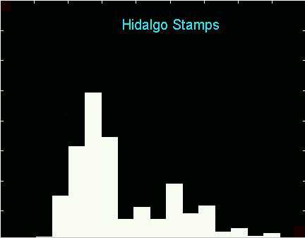
Density Estimation
E.g. Hidalgo Stamp Data
Another histogram
Smaller binwidth
Suggests 6 modes?
6 factories making
the paper?

Slide 64
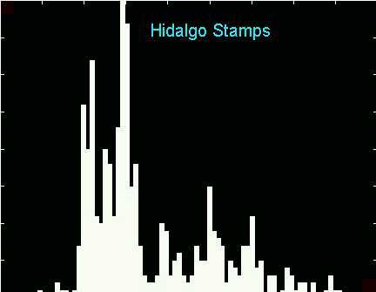
Density Estimation
E.g. Hidalgo Stamp Data
Another histogram
Even smaller binwidth
Suggests many modes?
Really believe
modes are “there”?
Or just sampling
variation?

Slide 65
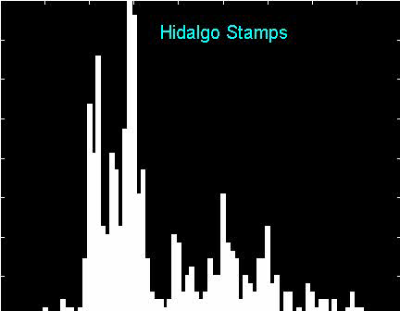
Density Estimation
E.g. Hidalgo Stamp Data
Critical Issue for histograms:
Choice of binwidth (well understood?)

Slide 66

Histograms
Less Well Understood issue:
Choice of bin location
Major impact on number of modes (2-7)
All for same binwidth

Slide 67

Histograms
Choice of bin location:
What is going on?
Compare with Average Histogram

Slide 68

Density Estimation
Compare shifts with Average Histogram
For 7 mode shift
Peaks line up with bin centers
So shifted histo’s
find peaks

Slide 69

Density Estimation
Compare shifts with Average Histogram
For 2 (3?) mode shift
Peaks split between bins
So shifted histo’s
miss peaks

Slide 70
Density Estimation
Histogram Drawbacks:
Need to choose bin width
Need to choose bin location
But Average Histogram reveals structure
So should use that, instead of histo
Name: Kernel Density Estimate

Slide 71
Kernel Density Estimation
Chondrite Data:
Stony (metal) Meteorites (hit the earth)
So have a chunk of rock
Study “% of silica”
From how many sources?
Only 22 rocks…
Histogram hopeless?
Brought to statistical literature by:
Good and Gaskins (1980)

Slide 72

Kernel Density Estimation
Chondrite Data:
Represent points by red bars
Where are data “more dense”?

Slide 73

Kernel Density Estimation
Chondrite Data:
Put probability mass 1/n at each point
Smooth piece of “density”

Slide 74

Kernel Density Estimation
Chondrite Data:
Sum pieces to estimate density
Suggests 3 modes (rock sources)

Slide 75
Kernel Density Estimation
Mathematical Notation:
Where
Window shape given by “kernel”,
Window width given by “bandwidth”,

Slide 76
Kernel Density Estimation
Choice of kernel (window shape)?
Controversial issue
Want Computational Speed?
Want Statistical Efficiency?
Want smooth estimates?
There is more, but personal choice:
Gaussian
Good Overall Reference:
Wand and Jones (1994)

Slide 77

Kernel Density Estimation
Choice of bandwidth (window width)?
Very important to performance
Fundamental Issue:
Which modes are “really there”?

Slide 78

Density Estimation
How to use histograms if you must:
Undersmooth (minimizes bin edge effect)
Human eye is OK at “post-smoothing”

Slide 79
Statistical Smoothing
2 Major Settings:
Density Estimation
“Histograms”
Nonparametric Regression
“Scatterplot Smoothing”

Slide 80

Scatterplot Smoothing
E.g. Bralower Fossil Data
Prof. of Geosciences
Penn. State Univ.

Slide 81
Scatterplot Smoothing
E.g. Bralower Fossil Data
Study Global Climate
Time scale of millions of years
Data points are fossil shells
Dated by surrounding material
Ratio of Isotopes of Strontium
(differences in 4th decimal point!)
Surrogate for Sea Level (Ice Ages)
Data seem to have structure…

Slide 82

Scatterplot Smoothing
E.g. Bralower Fossil Data

Slide 83
Scatterplot Smoothing
E.g. Bralower Fossil Data
Way to bring out structure:
Smooth the data
Methods of smoothing?
Local Averages
Splines (several types)
Fourier – trim high frequencies
Other bases
…
Also controversial

Slide 84
Scatterplot Smoothing
E.g. Bralower Fossil Data – some smooths

Slide 85
Scatterplot Smoothing
A simple approach: local averages
Given data:
Model in regression form:
How to estimate ?

Slide 86
Scatterplot Smoothing
A simple approach: local averages
Given a kernel window function:
Estimate the curve
by a weighted local average:

Slide 87
Scatterplot Smoothing
Interesting representation of local average:
Given kernel window weights,
Local constant fit to data:

Slide 88

Scatterplot Smoothing
Local Constant Fits (visually):
“Moving Average”
Window width is critical (~ k.d.e.)

Slide 89
Scatterplot Smoothing
Interesting variation:
Local linear fit to data:
Given kernel window weights,

Slide 90

Scatterplot Smoothing
Local Linear Fits (visually):
“Intercept of Moving Fit Line”
Window width is critical (~ k.d.e.)

Slide 91

Scatterplot Smoothing
Another variation:
“Intercept of Moving Polynomial Fit”
Window width is critical (~ k.d.e.)

Slide 92
Scatterplot Smoothing
Local Polynomial Smoothing
What is best polynomial degree?
Once again controversial…
Advocates for all of 0, 1, 2, 3.
Depends on personal weighting of factors involved
Good reference:
Fan & Gijbels (1995)
Personal choice: degree 1, local linear

Slide 93
Scatterplot Smoothing
E.g. Bralower Fossils – local linear smooths

Slide 94
Scatterplot Smoothing
Smooths of Bralower Fossil Data:
Oversmoothed misses structure
Undersmoothed feels sampling noise?
About right shows 2 valleys:
One seems clear
Is other one really there?
Same question as above…

Slide 95
Kernel Density Estimation
Choice of bandwidth (window width)?
Very important to performance
Fundamental Issue:
Which modes are “really there”?

Slide 96
Kernel Density Estimation
Choice of bandwidth (window width)?
Very important to performance
Data Based Choice?
Controversial Issue
Many recommendations
Suggested Reference:
Jones, Marron & Sheather (1996)
Never a consensus…

Slide 97
Kernel Density Estimation
Choice of bandwidth (window width)?
Alternate Choice:
Consider all of them!
I.e. look at whole spectrum of smooths
Can see different structure
At different smoothing levels
Connection to Scale Space
E.g. Stamps data
How many modes?
All answers are there….

Slide 98

Kernel Density Estimation

Slide 99
Statistical Smoothing
Fundamental Question
For both of
Density Estimation: “Histograms”
Regression: “Scatterplot Smoothing”
Which bumps are “really there”?
vs. “artifacts of sampling noise”?

Slide 100
SiZer Background
Two Major Settings:
2-d scatterplot smoothing
1-d histograms
(continuous data, not discrete bar plots)
Central Question:
Which features are really there?
Solution, Part 1: Scale space
Solution, Part 2: SiZer

Slide 101

SiZer Background
Bralower’s Fossil Data - Global Climate

Slide 102
SiZer Background
Smooths - Suggest Structure - Real?

Slide 103
SiZer Background
Smooths of Fossil Data (details given later)
Dotted line: undersmoothed
(feels sampling variability)
Dashed line: oversmoothed
(important features missed?)
Solid line: smoothed about right?
Central question:
Which features are “really there”?

Slide 104
SiZer Background
Smoothing Setting 2: Histograms
Family Income Data:
British Family Expenditure Survey
For the year 1975
Distribution of Family Incomes
~ 7000 families

Slide 105

SiZer Background
Family Income Data, Histogram Analysis:

Slide 106
SiZer Background
Family Income Data, Histogram Analysis:
Again under- and over- smoothing issues
Perhaps 2 modes in data?
Histogram Problem 1:
Binwidth (well known)
Central question:
Which features are “really there”?
e.g. 2 modes?
Same problem as existence of “clusters” in PCA

Slide 107

SiZer Background
Why not use (conventional) histograms?
Histogram Problem 2:
Bin shift (less well known)

Slide 108
SiZer Background
Why not use (conventional) histograms?
Histogram Problem 2:
Bin shift (less well known)
For same binwidth
Get much different impression
By only “shifting grid location“
Get it right by chance?

Slide 109
SiZer Background
Why not use (conventional) histograms?
Solution to binshift problem:
Average over all shifts

Slide 110
SiZer Background
Why not use (conventional) histograms?
Solution to binshift problem:
Average over all shifts
1st peak all in one bin: bimodal
1st peak split between bins: unimodal
Smooth histo’m provides understanding,
So should use for data analysis
Another name: Kernel Density Estimate

Slide 111
SiZer Background
Scale Space – Idea from Computer Vision
Conceptual basis:
Oversmoothing = “view from afar”
(macroscopic)
Undersmoothing = “zoomed in view”
(microscopic)
Main idea: all smooths contain useful information, so study “full spectrum”
(i. e. all smoothing levels)
Recommended reference: Lindeberg (1994)

Slide 112

SiZer Background
Fun Scale Space Views
(of Family Incomes Data)

Slide 113

SiZer Background
Fun Scale Space Views (Incomes Data)
Spectrum Overlay

Slide 114

SiZer Background
Fun Scale Space Views (Incomes Data)
Surface View

Slide 115
SiZer Background
Fun Scale Space Views
(of Family Incomes Data)
Note:
The scale space viewpoint makes
Data Dased Bandwidth Selection
Much less important
(than I once thought….)

Slide 116
SiZer Background
SiZer:
Significance of Zero crossings, of the derivative, in scale space
Combines:
needed statistical inference
novel visualization
To get: a powerful exploratory data analysis method
Main reference:
Chaudhuri & Marron (1999)

Slide 117
SiZer Background
Basic idea: a bump is characterized by:
an increase
followed by a decrease
Generalization:
Many features of interest captured
by sign of the slope of the smooth
Foundation of SiZer:
Statistical inference on slopes,
over scale space

Slide 118
SiZer Background
SiZer Visual presentation:
Color map over scale space:
Blue: slope significantly upwards
(derivative CI above 0)
Red: slope significantly downwards
(derivative CI below 0)
Purple: slope insignificant
(derivative CI contains 0)

Slide 119

SiZer Background
SiZer analysis of Fossils data:

Slide 120
SiZer Background
SiZer analysis of Fossils data:
Upper Left: Scatterplot, family of smooths, 1 highlighted
Upper Right: Scale space rep’n of family, with SiZer colors
Lower Left: SiZer map, more easy to view
Lower Right: SiCon map – replace slope by curvature
Slider (in movie viewer) highlights different smoothing levels

Slide 121
SiZer Background
SiZer analysis of Fossils data (cont.):
Oversmoothed (top of SiZer map):
Decreases at left, not on right
Medium smoothed (middle of SiZer map):
Main valley significant, and left most increase
Smaller valley not statistically significant
Undersmoothed (bottom of SiZer map):
“noise wiggles” not significant
Additional SiZer color: gray - not enough data for inference

Slide 122
SiZer Background
SiZer analysis of Fossils data (cont.):
Common Question: Which is right?
Decreases on left, then flat
(top of SiZer map)
Up, then down, then up again
(middle of SiZer map)
No significant features
(bottom of SiZer map)
Answer: All are right
Just different scales of view,
i.e. levels of resolution of data

Slide 123

SiZer Background
SiZer analysis of British Incomes data:

Slide 124
SiZer Background
SiZer analysis of British Incomes data:
Oversmoothed: Only one mode
Medium smoothed: Two modes, statistically significant
Confirmed by Schmitz & Marron, (1992)
Undersmoothed: many noise wiggles, not significant
Again: all are correct,
just different scales

Slide 125
SiZer Background
Historical Note & Acknowledgements:
Scale Space: S. M. Pizer
SiZer: Probal Chaudhuri
Main Reference: Chaudhuri & Marron (1999)

Slide 126

SiZer Background
Toy E.g. - Marron & Wand Trimodal #9
Increasing n
Only 1 Signif’t Mode
Now 2 Signif’t Modes
Finally all 3 Modes

Slide 127

SiZer Background
E.g. - Marron & Wand Discrete Comb #15
Increasing n
Coarse Bumps Only
Now Fine bumps too
Someday: “draw” local
Bandwidth on SiZer map

Slide 128

SiZer Background
Finance "tick data":
(time, price) of single stock transactions
Idea: "on line" version of SiZer
for viewing and understanding trends

Slide 129
SiZer Background
Finance "tick data":
(time, price) of single stock transactions
Idea: "on line" version of SiZer
for viewing and understanding trends
Notes:
trends depend heavily on scale
double points and more
background color transition
(flop over at top)

