Slide 1
Statistics – O. R. 891
Object Oriented Data Analysis
J. S. Marron
Dept. of Statistics and Operations Research
University of North Carolina

Slide 2
Correlation PCA
Personal Thoughts on Correlation PCA:
Can be very useful
(especially with noncommensurate units)
Not always, can hide important structure
To make choice:
Decide whether whitening is useful
My personal use of correlat’n PCA is rare
Other people use it most of the time

Slide 3
Transformations
Useful Method for Data Analysts
Apply to Marginal Distributions
(i.e. to Individual Variables)
Idea: Put Data on Right Scale
Common Example:
  Data Orders of Magnitude Different
  Log₁₀ Puts Data on More Analyzable Scale

Slide 4
Transformations
Useful Visualization: MargDistPlot
Idea: Visually Screen Many Marginal
Distributions, Simultaneously
Approach: Order, Using Some Summary
E.g. Set of Poisson(λ) Distributions
With Wide Range of λ Parameters

Slide 5
Clusters in data
Common Statistical Task:
Find Clusters in Data
Interesting sub-populations?
Important structure in data?
How to do this?
PCA provides very simple approach
There is a large literature of other methods
(will study more later)

Slide 6
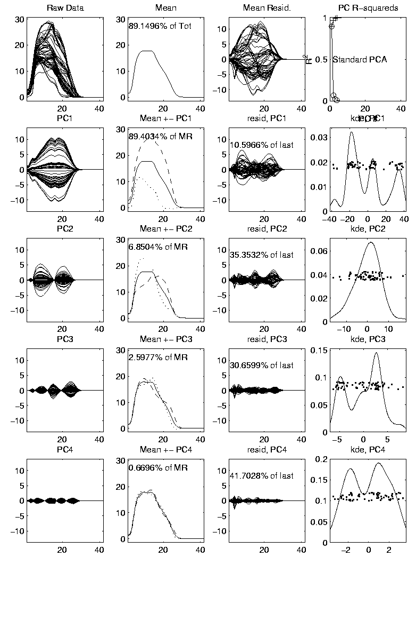
PCA to find clusters
PCA of Mass Flux Data:

Slide 7
PCA to find clusters
Summary of PCA of Mass Flux Data:
Mean:
Captures General Mountain Shape
PC1:
Generally overall height of peak
  shows up nicely in mean +- plot (2nd col)
  3 apparent clusters in scores plot
  Are those “really there”?
  If so, could lead to interesting discovery
  If not, could waste effort in investigation

Slide 8
PCA to find clusters
Summary of PCA of Mass Flux Data:
PC2:
Location of peak
again mean +- plot very useful here
PC3:
Width adjustment
again see most clearly in mean +- plot
Maybe non-linear modes of variation???

Slide 9
PCA to find clusters
Return to Investigation of PC1 Clusters:
Can see 3 bumps in smooth histogram
Main Question:
Important structure
or
sampling variability?
Approach: SiZer
(SIgnificance of ZERo crossings of deriv.)

Slide 10
Statistical Smoothing
2 Major Settings:
Density Estimation
“Histograms”
Nonparametric Regression
“Scatterplot Smoothing”

Slide 11
Density Estimation
Histogram Drawbacks:
Need to choose bin width
Need to choose bin location
But Average Histogram reveals structure
So should use that, instead of histo
Name: Kernel Density Estimate

Slide 12
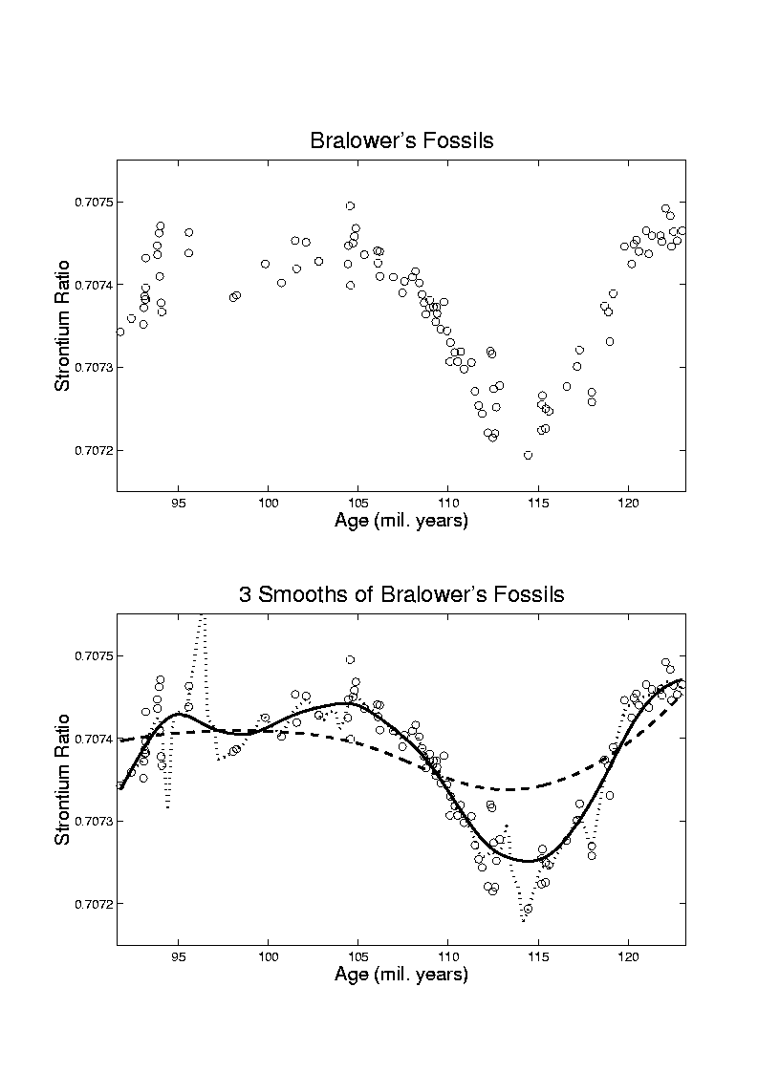
Scatterplot Smoothing
E.g. Bralower Fossil Data

Slide 13
Scatterplot Smoothing
E.g. Bralower Fossil Data – some smooths

Slide 14
Scatterplot Smoothing
Smooths of Bralower Fossil Data:
Oversmoothed misses structure
Undersmoothed feels sampling noise?
About right shows 2 valleys:
  One seems clear
  Is other one really there?
  Same question as above…

Slide 15
SiZer Background
Two Major Settings:
2-d scatterplot smoothing
1-d histograms
(continuous data, not discrete bar plots)
Central Question:
Which features are really there?
Solution, Part 1: Scale space
Solution, Part 2: SiZer

Slide 16
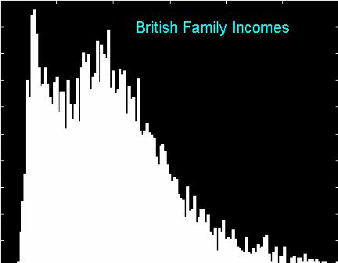
SiZer Background
Family Income Data, Histogram Analysis:

Slide 17
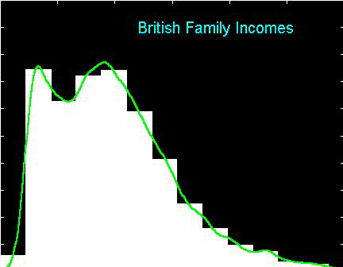
SiZer Background
Why not use (conventional) histograms?
Solution to binshift problem:
Average over all shifts

Slide 18
SiZer Background
Scale Space – Idea from Computer Vision
Conceptual basis:
Oversmoothing = “view from afar”
(macroscopic)
Undersmoothing = “zoomed in view”
(microscopic)
Main idea: all smooths contain useful information, so study “full spectrum”
(i. e. all smoothing levels)
Recommended reference: Lindeberg (1994)

Slide 19
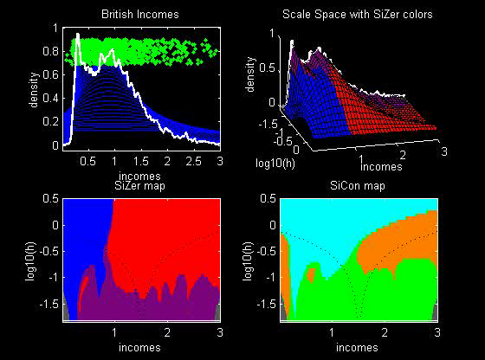
SiZer Background
SiZer analysis of British Incomes data:

Slide 20
SiZer Background
SiZer analysis of British Incomes data:
Oversmoothed: Only one mode
Medium smoothed: Two modes, statistically significant
Confirmed by Schmitz & Marron, (1992)
Undersmoothed: many noise wiggles, not significant
Again: all are correct,
just different scales

Slide 21
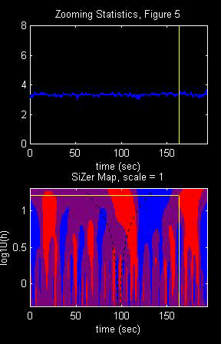
SiZer Background
Internet traffic data analysis:
SiZer analysis of
time series of
packet times
at internet hub (UNC)
Hannig, Marron,
and Riedi (2001)
Notes:
21

Slide 22
SiZer Background
Internet traffic data analysis:
SiZer analysis of
time series of packet times
at internet hub (UNC)
across very wide range of scales
needs more pixels than screen allows
thus do zooming view
(zoom in over time)
  zoom in to yellow bd’ry in next frame
  readjust vertical axis
Notes:
22

Slide 23
SiZer Background
Internet traffic data analysis (cont.)
Insights from SiZer analysis:
Coarse scales:
amazing amount of significant structure
Evidence of self-similar fractal type process?
Fewer significant features at small scales
But they exist, so not Poisson process
Poisson approximation OK at small scale???
Smooths (top part) stable at large scales?
Notes:
23

Slide 24
Dependent SiZer
Rondonotti, Marron, and Park (2007)
SiZer compares data with white noise
Inappropriate in time series
Dependent SiZer compares data with an assumed model
Visual Goodness of Fit test
Notes:
24

Slide 25
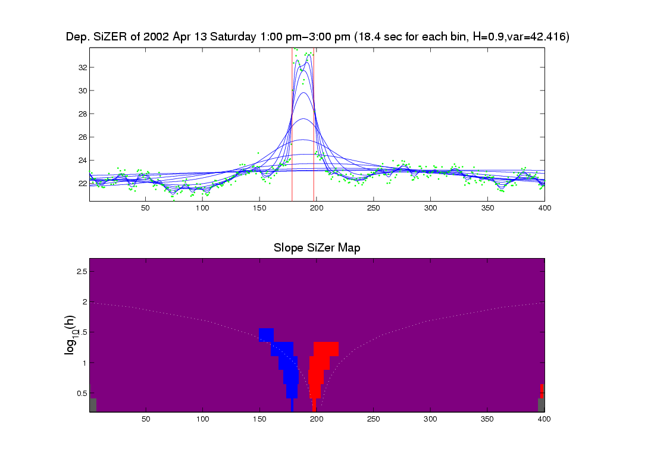
Dep’ent SiZer : 2002 Apr 13 Sat 1 pm – 3 pm
Internet Traffic At
UNC Main Link
2 hour span
Notes:
25

Slide 26
Dep’ent SiZer : 2002 Apr 13 Sat 1 pm – 3 pm
Big Spike in Traffic
Is “Really There”
Notes:
26

Slide 27
Dep’ent SiZer : 2002 Apr 13 Sat 1 pm – 3 pm
Zoom in for
Closer Look
Notes:
27

Slide 28
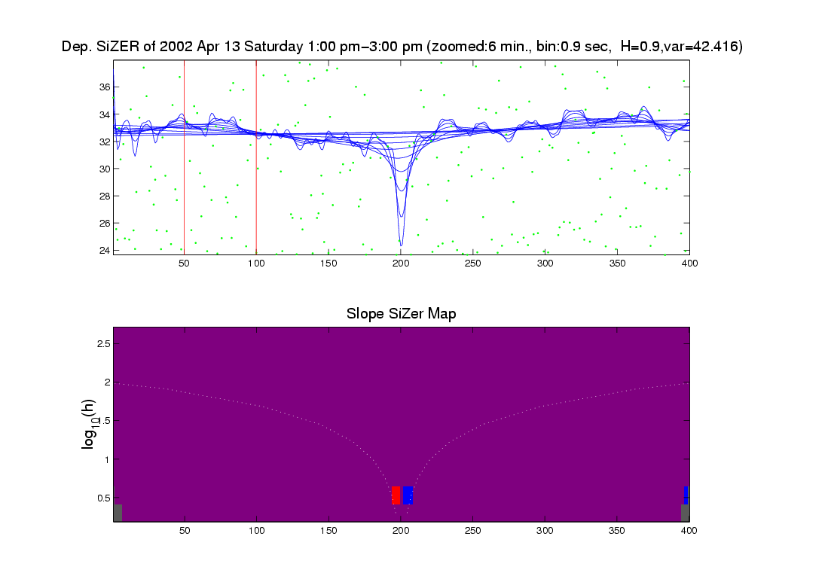
Zoomed view (to red region, i.e. “flat top”)
Strange “Hole in Middle”
Is “Really There”
Notes:
28

Slide 29
Zoomed view (to red region, i.e. “flat top”)
Zoom in for
Closer Look
Notes:
29

Slide 30
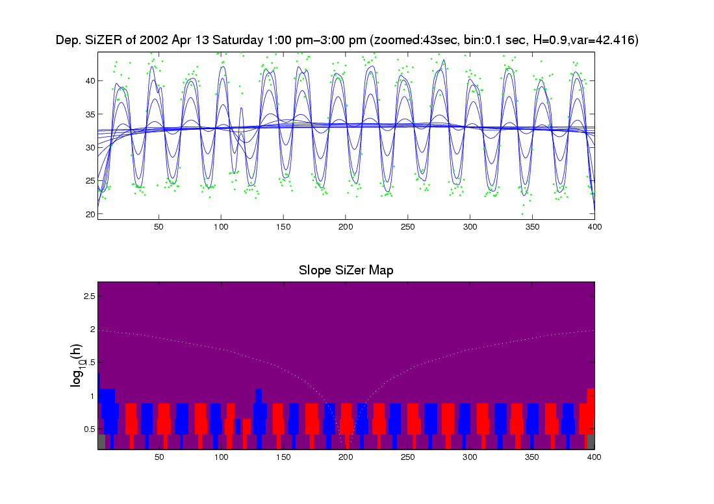
Further Zoom: finds very periodic behavior!
Notes:
30

Slide 31
Further Zoom: finds very periodic behavior!
SiZer found interesting structure, but depends on scale
Notes:
31

Slide 32
Possible Physical Explanation
IP “Port Scan”
Common device of hackers
Searching for “break in points”
Send query to every possible (within UNC domain):
  IP address
  Port Number
Replies can indicate system weaknesses
Internet Traffic is hard to model
Notes:
32

Slide 33
SiZer Overview
Would you like to try smoothing & SiZer?
Marron Software Website as Before
In “Smoothing” Directory:
  kdeSM.m
  nprSM.m
  sizerSM.m
Recall: “>> help sizerSM” for usage

Slide 34
PCA to find clusters
Return to PCA of Mass Flux Data:
Notes:
MassFlux1d1p1.ps

Slide 35
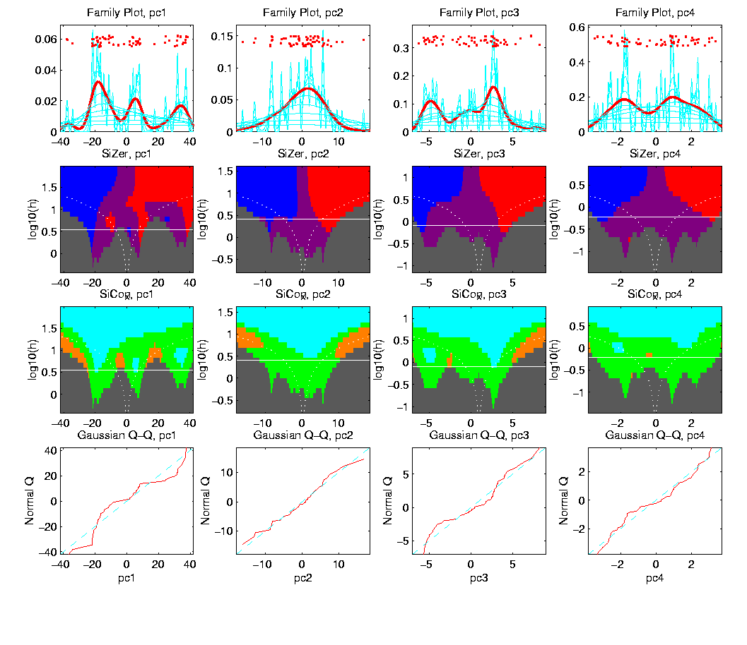
PCA to find clusters
SiZer analysis of Mass Flux, PC1
Notes:
MassFlux1d1p1s.ps

Slide 36
PCA to find clusters
SiZer analysis of Mass Flux, PC1
Conclusion:
Found 3 significant clusters!
Correspond to 3 known “cloud types”
Worth deeper investigation

Slide 37
Recall Yeast Cell Cycle Data
“Gene Expression” – Micro-array data
Data (after major preprocessing): Expression “level” of:
thousands of genes (d ~ 1,000s)
but only dozens of “cases” (n ~ 10s)
Interesting statistical issue:
High Dimension Low Sample Size data
(HDLSS)

Slide 38
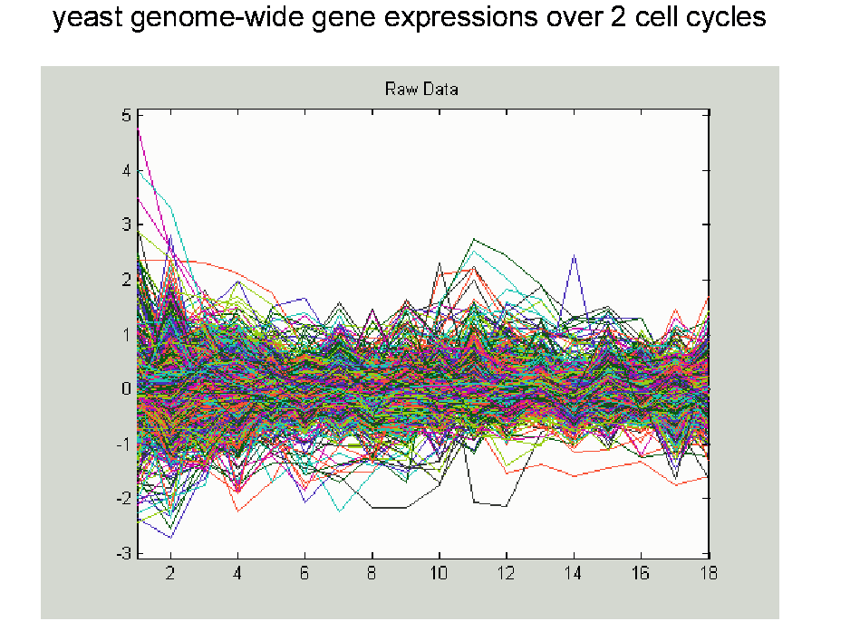
Yeast Cell Cycle Data, FDA View
Central question:
Which genes are “periodic” over 2 cell cycles?
Notes:
CellCycRaw.ps

Slide 39
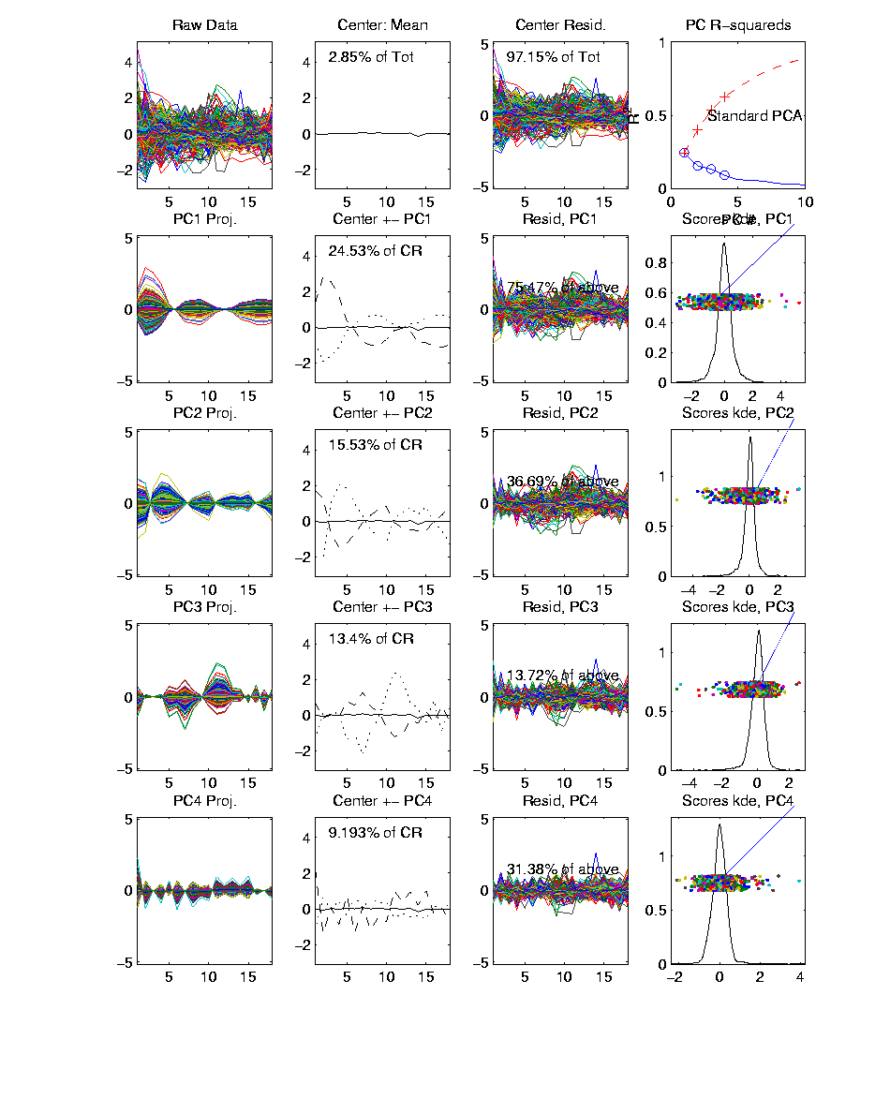
Yeast Cell Cycle Data, FDA View
Periodic
genes?
Naïve
approach:
Simple PCA
Notes:
spellman_alpah_complete_pca.ps

Slide 40
Yeast Cell Cycle Data, FDA View
Central question: which genes are “periodic” over 2 cell cycles?
Naïve approach: Simple PCA
No apparent (2 cycle) periodic structure?
Eigenvalues suggest large amount of “variation”
PCA finds “directions of maximal variation”
Often, but not always, same as “interesting directions”
Here need better approach to study periodicities

Slide 41
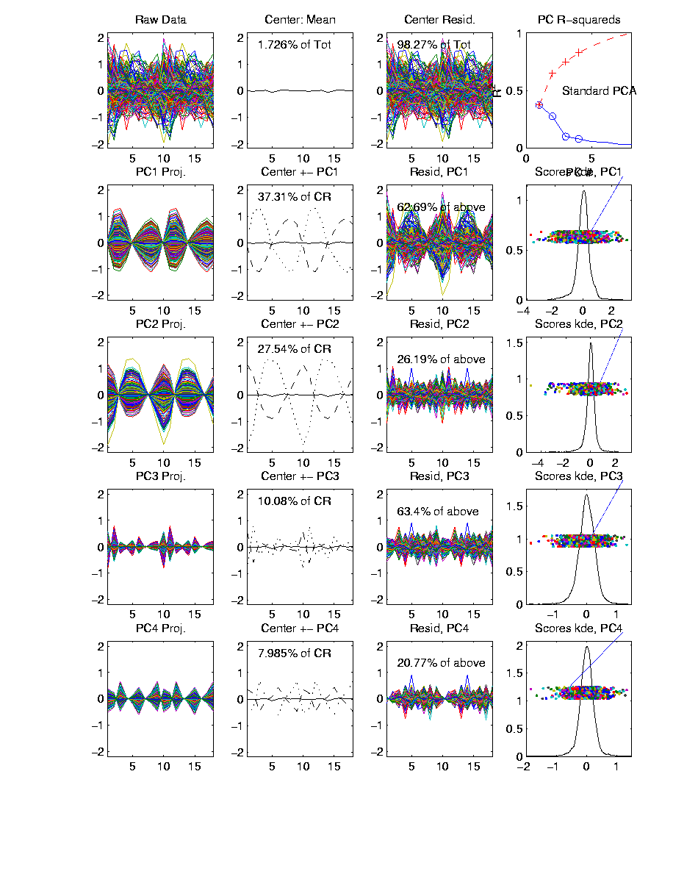
Yeast Cell Cycles, Freq. 2 Proj.
PCA on
Freq. 2
Periodic
Component
Of Data
Notes:
spellman_alpah_complete_proj_pca.ps

Slide 42
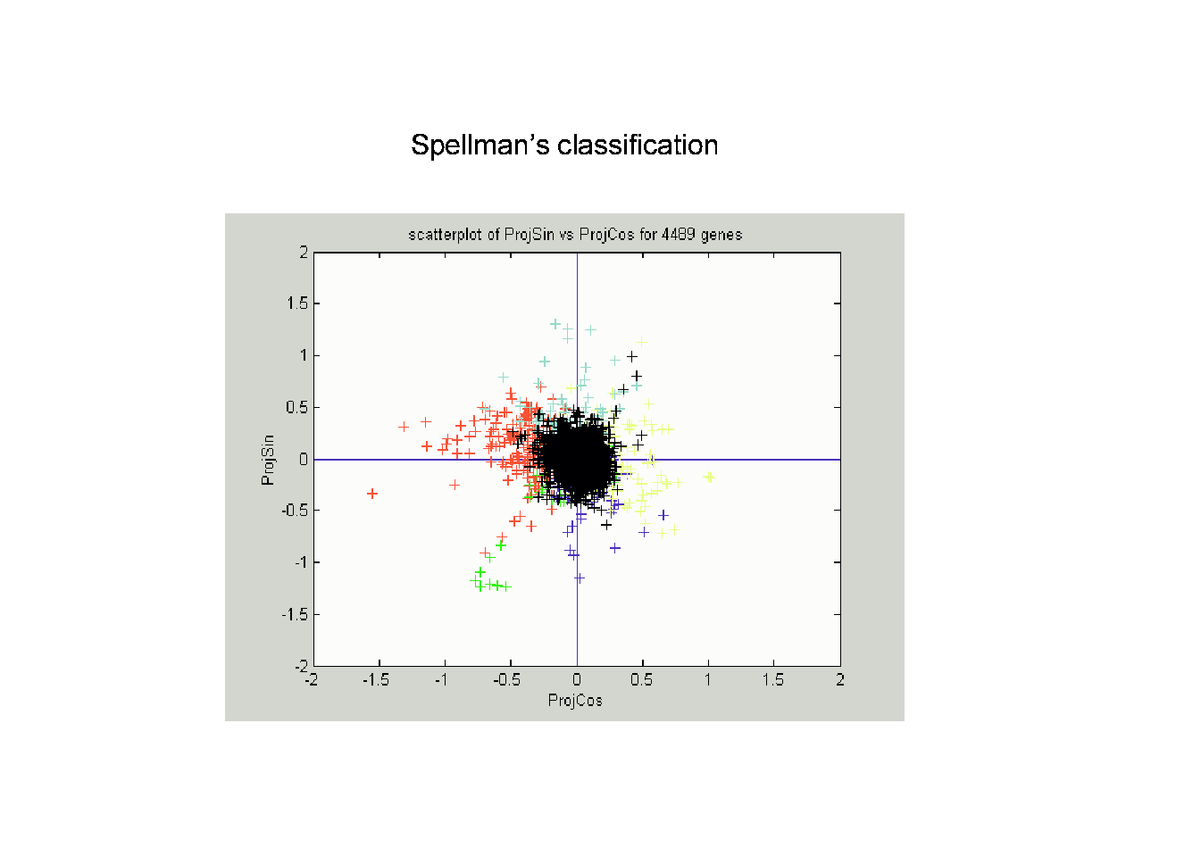
Frequency 2 Analysis
Notes:
CellCyc2dSpellClass.ps

Slide 43
Frequency 2 Analysis
Project data onto 2-dim space of sin and cos (freq. 2)
Useful view: scatterplot
Angle (in polar coordinates) shows phase
Colors: Spellman’s cell cycle phase classification
Black was labeled “not periodic”
Within class phases approx’ly same, but notable differences
Now try to improve “phase classification”

Slide 44
Yeast Cell Cycle
Revisit “phase classification”, approach:
Use outer 200 genes
(other numbers tried, less resolution)
Study distribution of angles
Use SiZer analysis
(finds significant bumps, etc., in histogram)
Carefully redrew boundaries
Check by studying k.d.e. angles

Slide 45
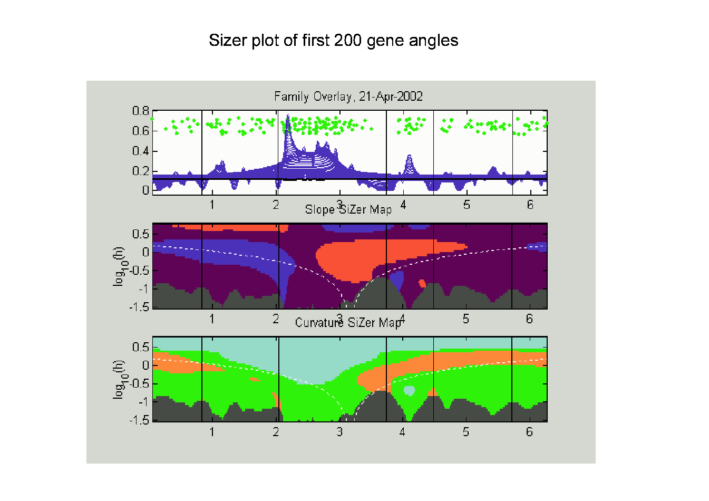
SiZer Study of Dist’n of Angles
Notes:
CellCycTh200SiZer.ps

Slide 46
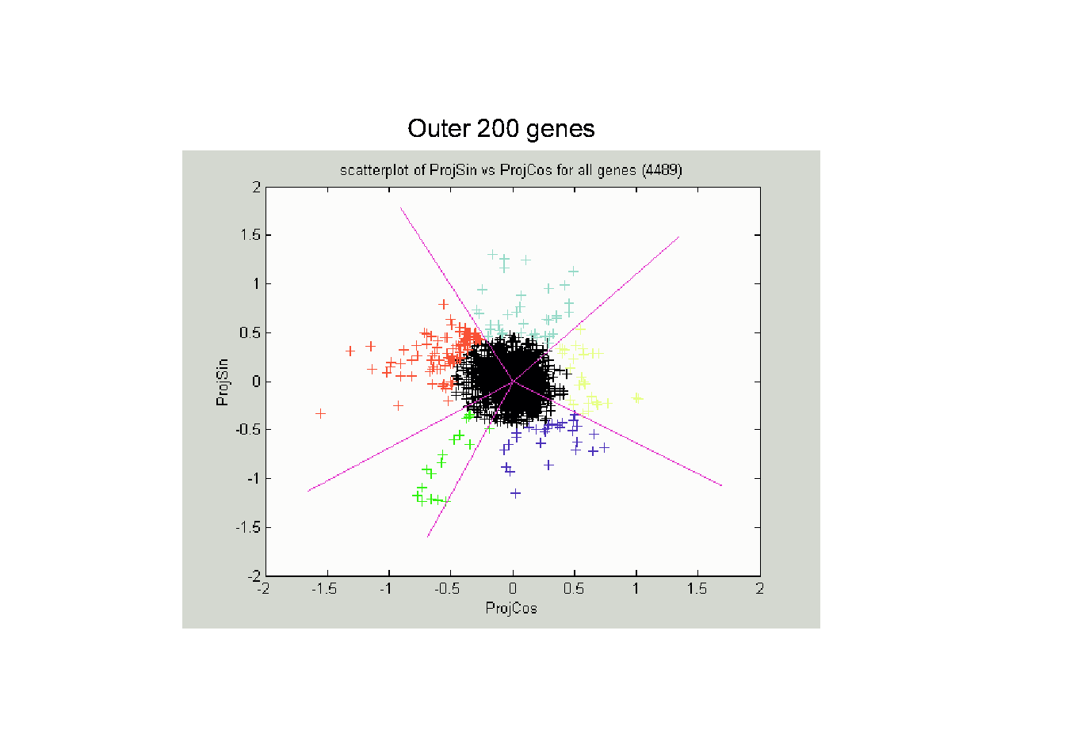
Reclassification of Major Genes
Notes:
CellCycTh200ScatPlot.ps

Slide 47
Compare to Previous Classif’n
Notes:
CellCyc2dSpellClass.ps

Slide 48
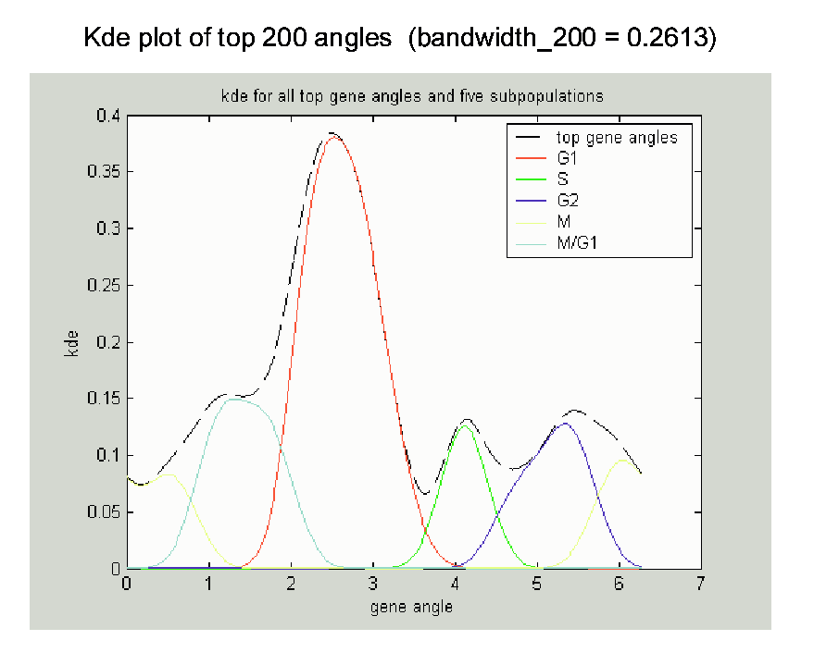
New Subpopulation View
Notes:
CellCycTh200KDE.ps

Slide 49
New Subpopulation View
Note:
Subdensities
Have Same
Bandwidth &
Proportional
Areas
(so Σ = 1)
Notes:
CellCycTh200KDE.ps

Slide 50
Return to Big Picture
Main statistical goals of OODA:
Understanding population structure
  Low dim’al Projections, PCA, PGA, …
Classification (i. e. Discrimination)
  Understanding 2+ populations
Time Series of Data Objects
  Chemical Spectra, Mortality Data
“Vertical Integration” of Data Types

Slide 51
Return to Big Picture
Main statistical goals of OODA:
Understanding population structure
  Low dim’al Projections, PCA, PGA, …
Classification (i. e. Discrimination)
  Understanding 2+ populations
Time Series of Data Objects
  Chemical Spectra, Mortality Data
“Vertical Integration” of Data Types

Slide 52
Classification - Discrimination
Background: Two Class (Binary) version:
Using “training data” from
Class +1 and Class -1
Develop a “rule” for
assigning new data to a Class
Canonical Example: Disease Diagnosis
New Patients are “Healthy” or “Ill”
Determined based on measurements

Slide 53
Classification - Discrimination
Important Distinction:
Classification vs. Clustering

Slide 54
Classification - Discrimination
Important Distinction:
Classification vs. Clustering
Classification:
Class labels are known,
Goal: understand differences

Slide 55
Classification - Discrimination
Important Distinction:
Classification vs. Clustering
Classification:
Class labels are known,
Goal: understand differences
Clustering:
Goal: Find class labels (to be similar)

Slide 56
Classification - Discrimination
Important Distinction:
Classification vs. Clustering
Classification:
Class labels are known,
Goal: understand differences
Clustering:
Goal: Find class labels (to be similar)
Both are about clumps of similar data,
but much different goals

Slide 57
Classification - Discrimination
Important Distinction:
Classification vs. Clustering
Useful terminology:
Classification: supervised learning
Clustering: unsupervised learning

Slide 58
Classification - Discrimination
Terminology:
For statisticians, these are synonyms

Slide 59
Classification - Discrimination
Terminology:
For statisticians, these are synonyms
For biologists, classification means:
Constructing taxonomies
And sorting organisms into them

Slide 60
Classification - Discrimination
Terminology:
For statisticians, these are synonyms
For biologists, classification means:
Constructing taxonomies
And sorting organisms into them
(maybe this is why discrimination
was used, until politically incorrect…)

Slide 61
Classification (i.e. discrimination)
There are a number of:
Approaches
Philosophies
Schools of Thought
Too often cast as:
Statistics vs. EE - CS

Slide 62
Classification (i.e. discrimination)
EE – CS variations:
Pattern Recognition
Artificial Intelligence
Neural Networks
Data Mining
Machine Learning

Slide 63
Classification (i.e. discrimination)
Differing Viewpoints:
Statistics
Model Classes with Probability Distribut’ns
Use to study class diff’s & find rules

Slide 64
Classification (i.e. discrimination)
Differing Viewpoints:
Statistics
Model Classes with Probability Distribut’ns
Use to study class diff’s & find rules
EE – CS
Data are just Sets of Numbers
Rules distinguish between these

Slide 65
Classification (i.e. discrimination)
Differing Viewpoints:
Statistics
Model Classes with Probability Distribut’ns
Use to study class diff’s & find rules
EE – CS
Data are just Sets of Numbers
Rules distinguish between these
Current thought: combine these

Slide 66
Classification (i.e. discrimination)
Important Overview Reference:
Duda, Hart and Stork (2001)
Too much about neural nets???
Pizer disagrees…
Update of Duda & Hart (1973)

Slide 67
Classification (i.e. discrimination)
For a more classical statistical view:
McLachlan (2004).
Gaussian Likelihood theory, etc.
Not well tuned to HDLSS data
Notes:
67

Slide 68
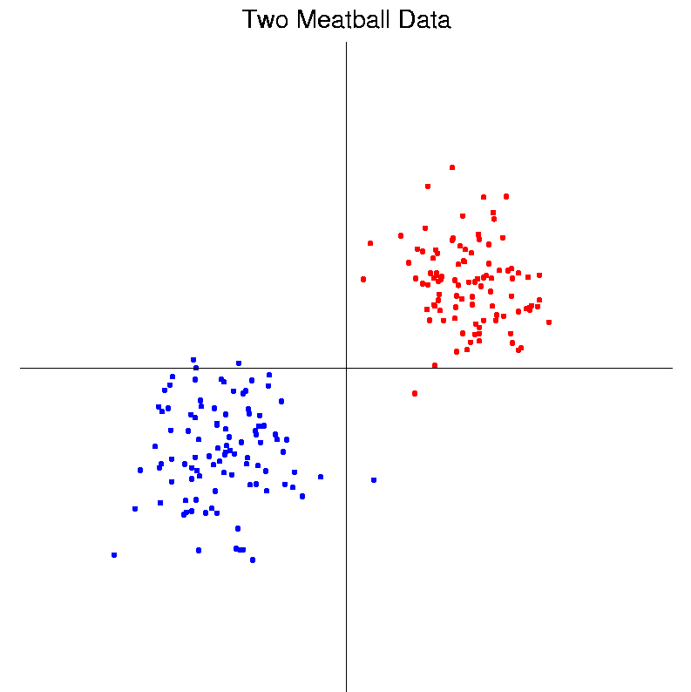
Classification Basics
Personal Viewpoint: Point Clouds
Notes:
HDLSStmbRaw.ps

Slide 69
Classification Basics
Simple and Natural Approach:
Mean Difference
a.k.a.
Centroid Method
Find “skewer through two meatballs”

Slide 70
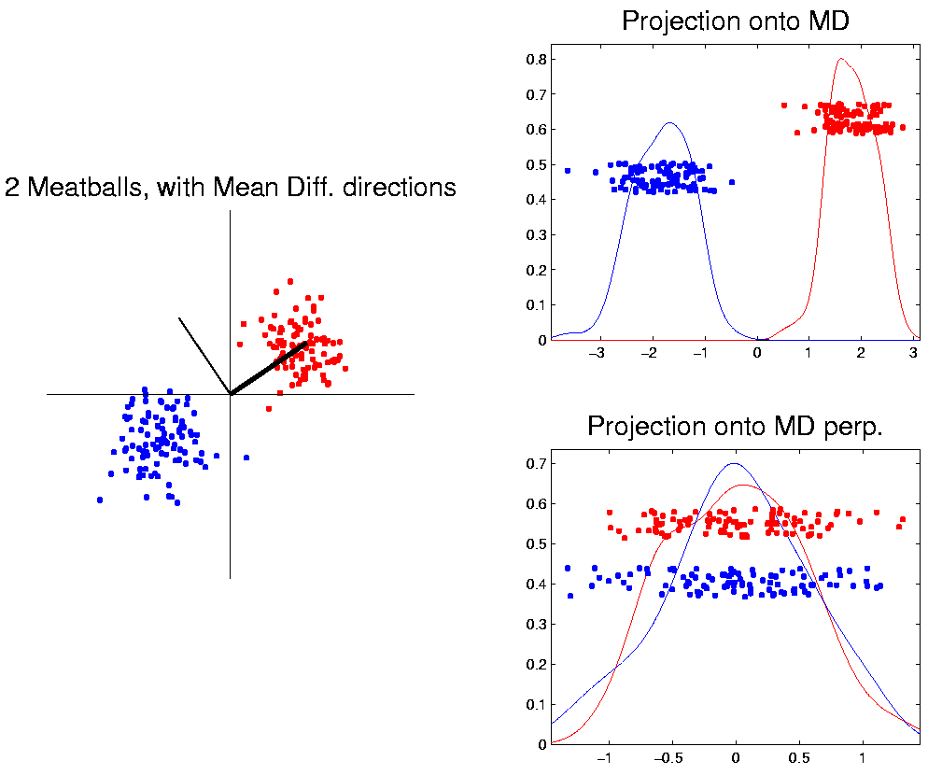
Classification Basics
For Simple Toy Example:
Project
On MD
& split
at center
Notes:
HDLSStmbMdif.ps

Slide 71
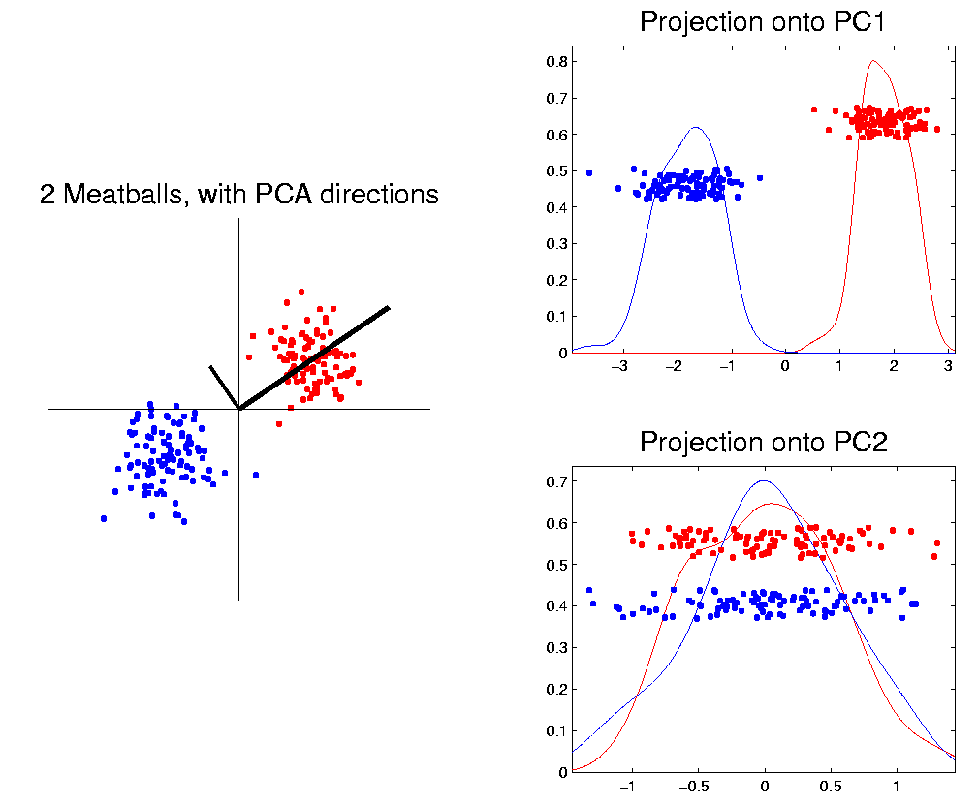
Classification Basics
Why not use PCA?
Reasonable
Result?
Doesn’t use
class labels…
Good?
Bad?
Notes:
HDLSStmbPCA.ps

Slide 72
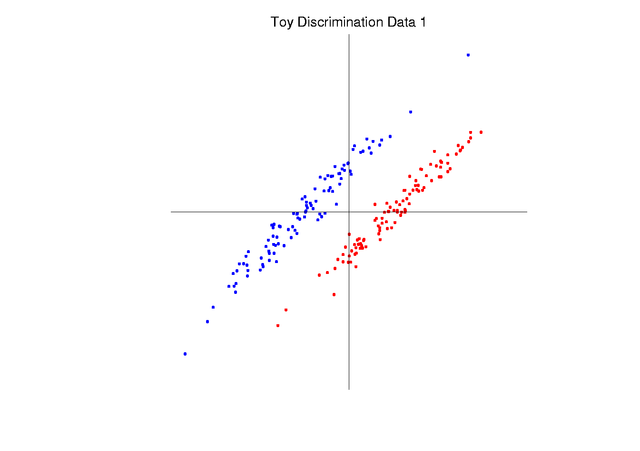
Classification Basics
Harder Example (slanted clouds):
Notes:
HDLSSod1Raw.ps

Slide 73
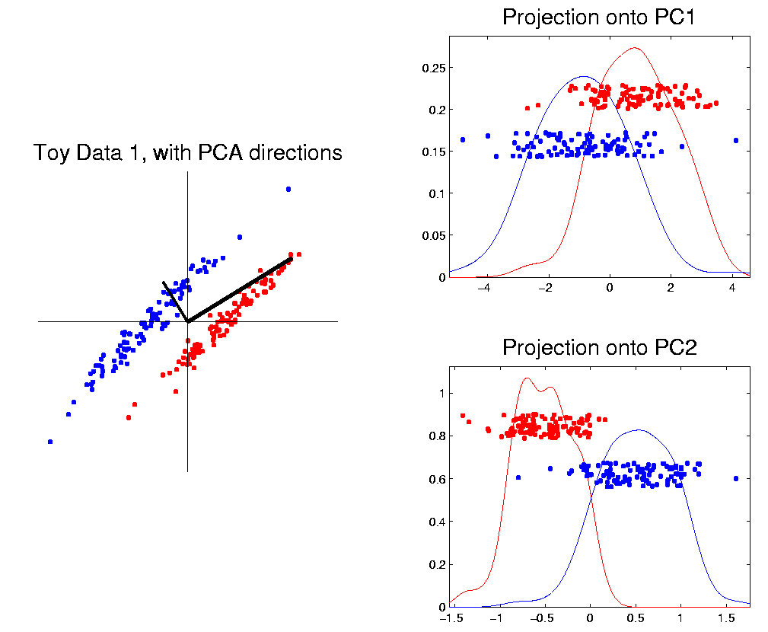
Classification Basics
PCA for slanted clouds:
PC1 terrible
PC2 better?
Still misses
right dir’n
Doesn’t use
Class Labels
Notes:
HDLSSod1PCA.ps

Slide 74
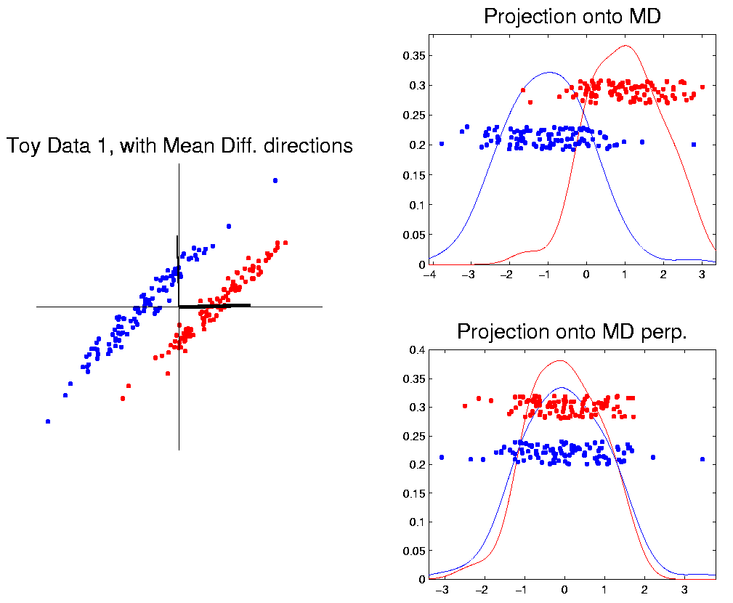
Classification Basics
Mean Difference for slanted clouds:
A little
better?
Still misses
right dir’n
Want to
account for
covariance
Notes:
HDLSSod1Mdif.ps

Slide 75
Classification Basics
Mean Difference & Covariance,
Simplest Approach:
Rescale (standardize) coordinate axes
i. e. replace (full) data matrix:
Then do Mean Difference
Called “Naïve Bayes Approach”

Slide 76
Classification Basics
Naïve Bayes Reference:
Domingos & Pazzani (1997)
Most sensible contexts:
Non-comparable data
E.g. different units

Slide 77
Classification Basics
Problem with Naïve Bayes:
Only adjusts
Variances
Not Covariances
Doesn’t solve
this problem
Notes:
HDLSSod1Raw.ps

Slide 78
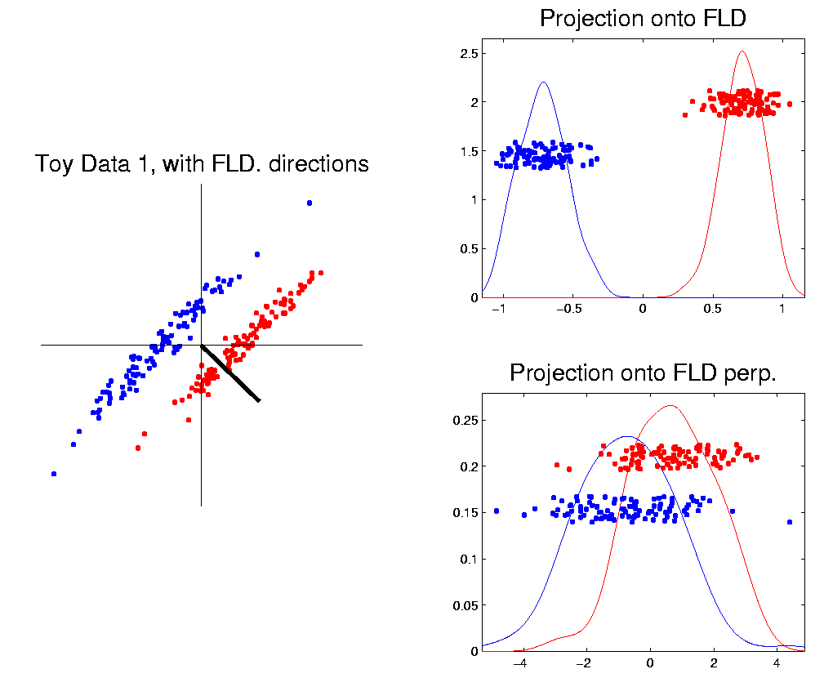
Classification Basics
Better Solution: Fisher Linear Discrimination
Gets the
right dir’n
How does
it work?
Notes:
HDLSSod1FLD.ps

Slide 79
Fisher Linear Discrimination
Other common terminology (for FLD):
Linear Discriminant Analysis (LDA)
Original Paper: Fisher (1936)

Slide 80
Fisher Linear Discrimination
Careful development:
Useful notation (data vectors of length ):
Class +1: Class -1:
Centerpoints:
and

Slide 81
Fisher Linear Discrimination
Covariances, for
(outer products)
Based on centered, normalized data matrices:

Slide 82
Fisher Linear Discrimination
Covariances, for
(outer products)
Based on centered, normalized data matrices:
Note: use “MLE” version of estimated covariance matrices, for simpler notation

Slide 83
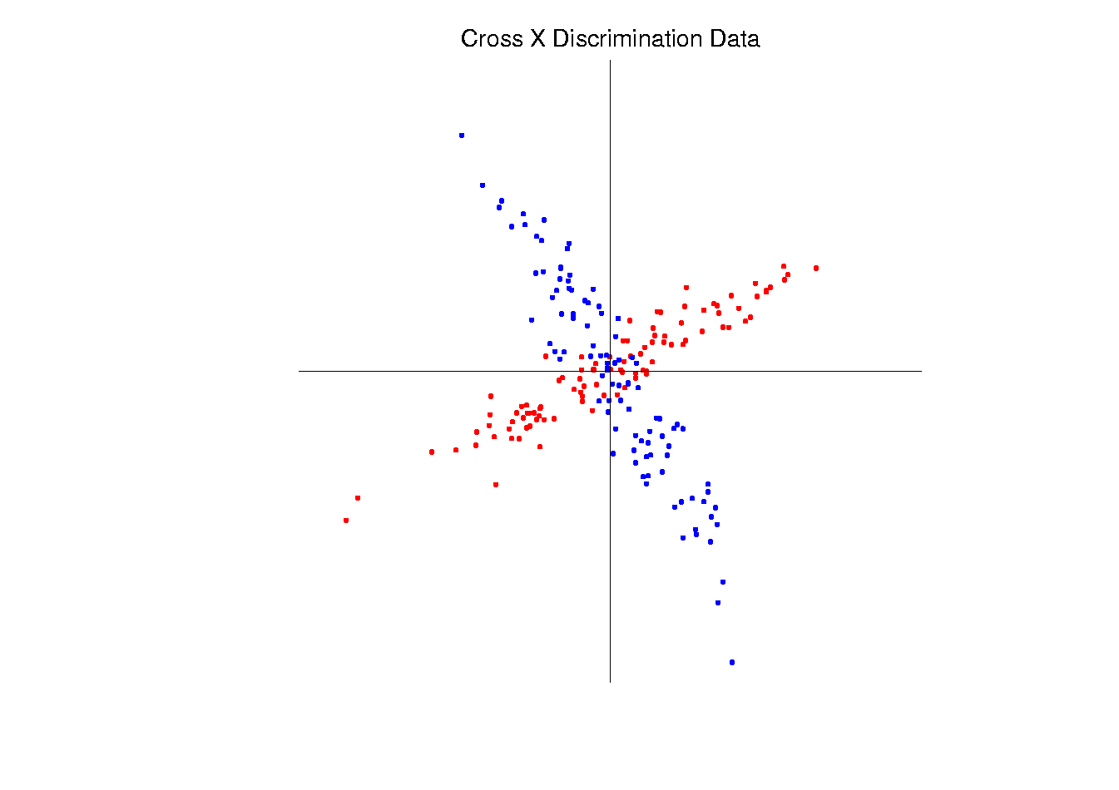
Fisher Linear Discrimination
Major Assumption:
Class covariances are the same (or “similar”)
Like this: Not this:
Notes:
HDLSSod1Raw.ps & HDLSSxd1Raw.ps

Slide 84
Fisher Linear Discrimination
Good estimate of (common) within class cov?
Pooled (weighted average) within class cov:
based on the combined full data matrix:

Slide 85
Fisher Linear Discrimination
Note: is similar to from before
I.e. covariance matrix ignoring class labels
Important Difference:
Class by Class Centering
Will be important later
Notes:
HDLSSod1Raw.ps

Slide 86
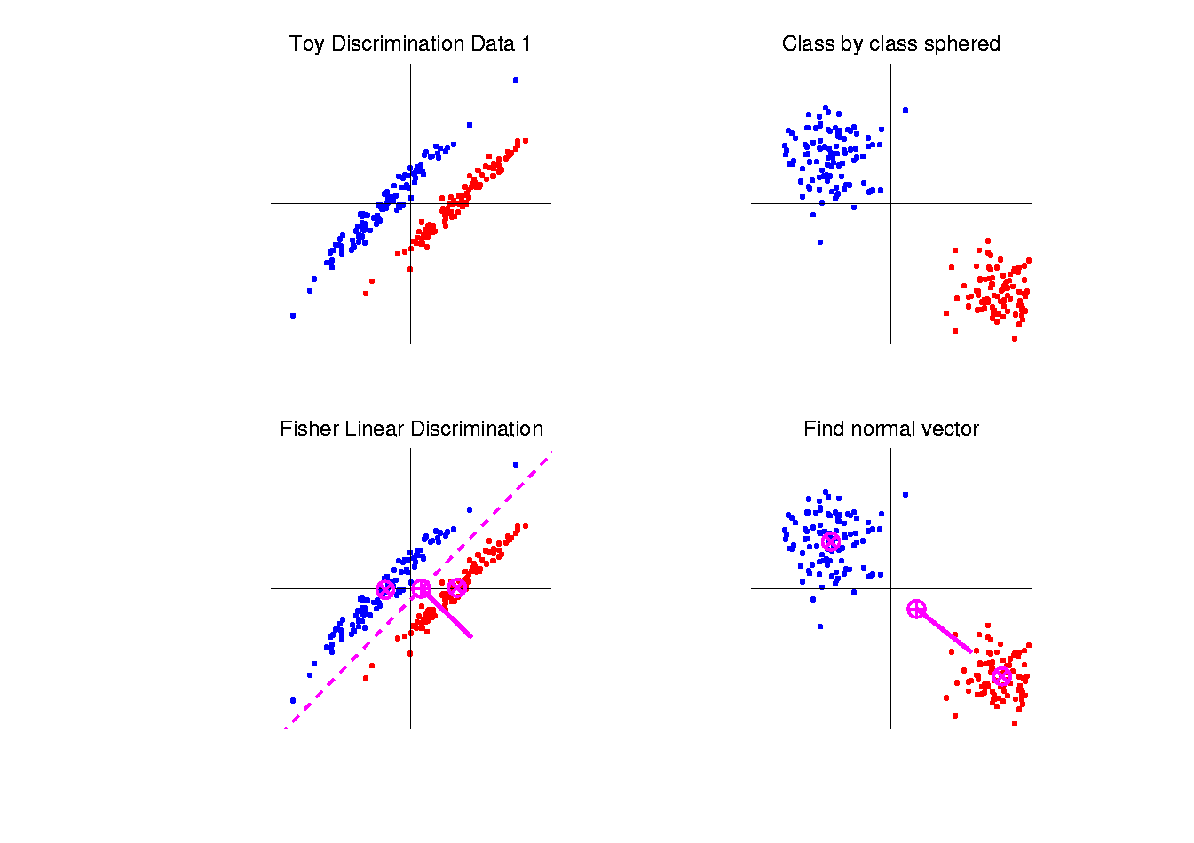
Fisher Linear Discrimination
Simple way to find “correct cov. adjustment”:
Individually transform subpopulations so
“spherical” about their means
For define
Notes:
HDLSSod1egFLD.ps

Slide 87
Fisher Linear Discrimination
Then:
In Transformed Space,
Best separating hyperplane
is
Perpendicular bisector of
line between means
Notes:
HDLSSod1egFLD.ps

Slide 88
Fisher Linear Discrimination
In Transformed Space,
Separating Hyperplane has:
Transformed Normal Vector:
Notes:
HDLSSod1egFLD.ps

Slide 89
Fisher Linear Discrimination
In Transformed Space,
Separating Hyperplane has:
Transformed Normal Vector:
Transformed Intercept:
Notes:
HDLSSod1egFLD.ps

Slide 90
Fisher Linear Discrimination
In Transformed Space,
Separating Hyperplane has:
Transformed Normal Vector:
Transformed Intercept:
Sep. Hyperp. has Equation:
Notes:
HDLSSod1egFLD.ps

Slide 91
Fisher Linear Discrimination
Thus discrimination rule is:
Given a new data vector ,
Choose Class +1 when:

Slide 92
Fisher Linear Discrimination
Thus discrimination rule is:
Given a new data vector ,
Choose Class +1 when:
i.e. (transforming back to original space)
Using, for symmetric and invertible:

Slide 93
Fisher Linear Discrimination
Thus discrimination rule is:
Given a new data vector ,
Choose Class +1 when:
i.e. (transforming back to original space)
where:

Slide 94
Fisher Linear Discrimination
So (in orig’l space) have separ’ting hyperplane with:
Normal vector: Intercept:
Notes:
HDLSSod1egFLD.ps

Slide 95
Fisher Linear Discrimination
Relationship to Mahalanobis distance
Idea: For , a natural distance measure is:

Slide 96
Fisher Linear Discrimination
Relationship to Mahalanobis distance
Idea: For , a natural distance measure is:
“unit free”, i.e. “standardized”
essentially mod out covariance structure

Slide 97
Fisher Linear Discrimination
Relationship to Mahalanobis distance
Idea: For , a natural distance measure is:
“unit free”, i.e. “standardized”
essentially mod out covariance structure
Euclidean dist. applied to &
Same as key transformation for FLD

Slide 98
Fisher Linear Discrimination
Relationship to Mahalanobis distance
Idea: For , a natural distance measure is:
“unit free”, i.e. “standardized”
essentially mod out covariance structure
Euclidean dist. applied to &
Same as key transformation for FLD
I.e. FLD is
mean difference in Mahalanobis space

Slide 99
Classical Discrimination
Above derivation of FLD was:
Nonstandard
Not in any textbooks(?)

Slide 100
Classical Discrimination
Above derivation of FLD was:
Nonstandard
Not in any textbooks(?)
Nonparametric (don’t need Gaussian data)
I.e. Used no probability distributions

Slide 101
Classical Discrimination
Above derivation of FLD was:
Nonstandard
Not in any textbooks(?)
Nonparametric (don’t need Gaussian data)
I.e. Used no probability distributions
More Machine Learning than Statistics

Slide 102
Classical Discrimination
FLD Likelihood View

Slide 103
Classical Discrimination
FLD Likelihood View
Assume:
Class distributions are multivariate
for

Slide 104
Classical Discrimination
FLD Likelihood View
Assume:
Class distributions are multivariate
for
strong distributional assumption
+ common covariance

Slide 105
Classical Discrimination
FLD Likelihood View (cont.)
At a location , the likelihood ratio, for
choosing between Class +1 and Class -1, is:
where is the Gaussian density
with covariance

Slide 106
Classical Discrimination
FLD Likelihood View (cont.)
Simplifying, using the Gaussian density:
Gives

Slide 107
Classical Discrimination
FLD Likelihood View (cont.)
Simplifying, using the Gaussian density:
Gives (critically using common covariances):

Slide 108
Classical Discrimination
FLD Likelihood View (cont.)
Simplifying, using the Gaussian density:
Gives (critically using common covariances):

Slide 109
Classical Discrimination
FLD Likelihood View (cont.)
But:
for

Slide 110
Classical Discrimination
FLD Likelihood View (cont.)
But:
so:
Note: same terms subtract off

Slide 111
Classical Discrimination
FLD Likelihood View (cont.)
But:
so:
Note: cross terms have ± cancellation

Slide 112
Classical Discrimination
FLD Likelihood View (cont.)
But:
so:
Thus when

Slide 113
Classical Discrimination
FLD Likelihood View (cont.)
But:
so:
Thus when
i.e.

Slide 114
Classical Discrimination
FLD Likelihood View (cont.)
Replacing , and
by maximum likelihood estimates:
, and
Gives the likelihood ratio discrimination rule

Slide 115
Classical Discrimination
FLD Likelihood View (cont.)
Replacing , and
by maximum likelihood estimates:
, and
Gives the likelihood ratio discrimination rule:
Choose Class +1, when

Slide 116
Classical Discrimination
FLD Likelihood View (cont.)
Replacing , and
by maximum likelihood estimates:
, and
Gives the likelihood ratio discrimination rule:
Choose Class +1, when
Same as above, so: FLD can be viewed as
Likelihood Ratio Rule

Slide 117
Classical Discrimination
FLD Generalization I
Gaussian Likelihood Ratio Discrimination
(a. k. a. “nonlinear discriminant analysis”)

Slide 118
Classical Discrimination
FLD Generalization I
Gaussian Likelihood Ratio Discrimination
(a. k. a. “nonlinear discriminant analysis”)
Idea: Assume
class distributions are
Different covariances!

Slide 119
Classical Discrimination
FLD Generalization I
Gaussian Likelihood Ratio Discrimination
(a. k. a. “nonlinear discriminant analysis”)
Idea: Assume
class distributions are
Different covariances!
Likelihood Ratio rule is straightf’d num’l calc.
(thus can easily implement, and do discrim’n)

Slide 120
Classical Discrimination
Gaussian Likelihood Ratio Discrim’n (cont.)
No longer have separ’g hyperplane repr’n
(instead regions determined by quadratics)
(fairly complicated case-wise calculations)

Slide 121
Classical Discrimination
Gaussian Likelihood Ratio Discrim’n (cont.)
No longer have separ’g hyperplane repr’n
(instead regions determined by quadratics)
(fairly complicated case-wise calculations)
Graphical display: for each point, color as:
Yellow if assigned to Class +1
Cyan if assigned to Class -1
(intensity is strength of assignment)

Slide 122
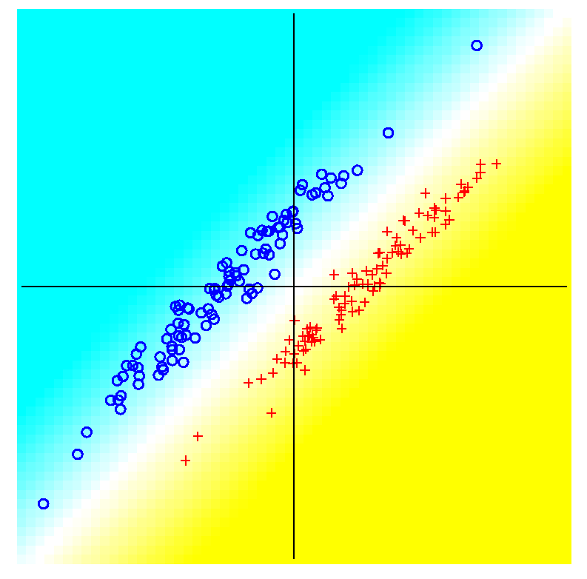
Classical Discrimination
FLD for Tilted Point Clouds – Works well
Notes:
PEod1FLDe1.ps

Slide 123
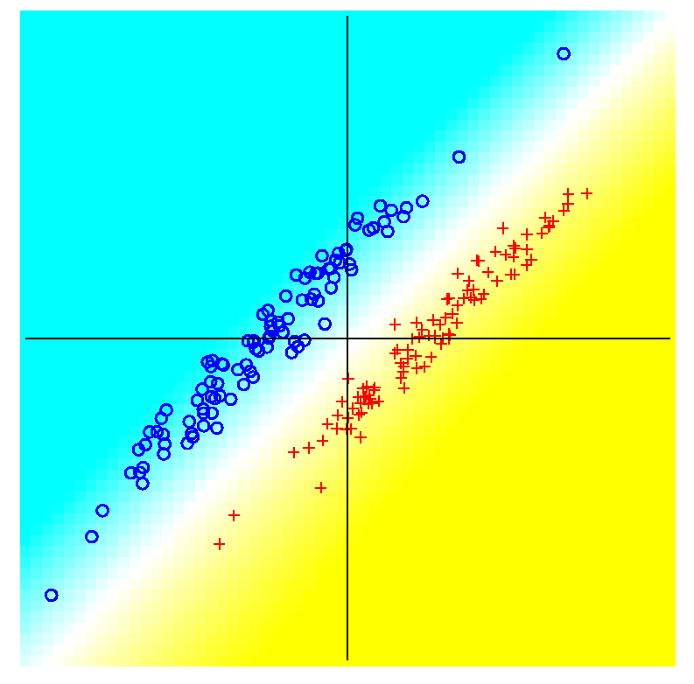
Classical Discrimination
GLR for Tilted Point Clouds – Works well
Notes:
PEod1GLRe1.ps

Slide 124
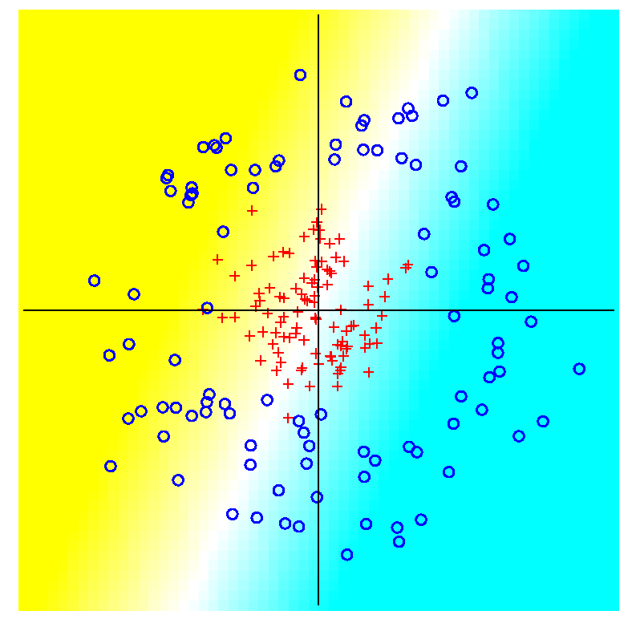
Classical Discrimination
FLD for Donut – Poor, no plane can work
Notes:
PEdonFLDe1.ps

Slide 125
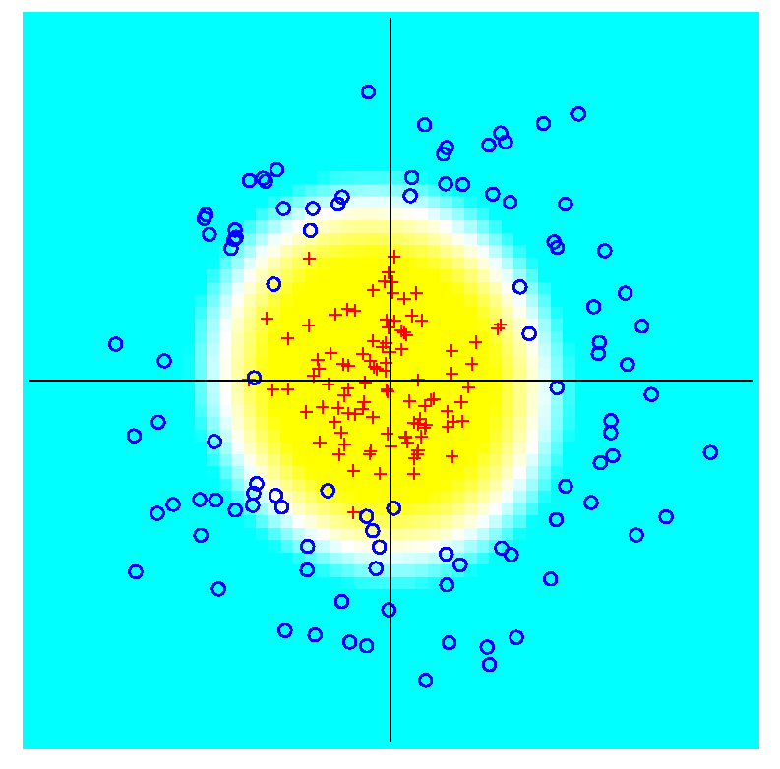
Classical Discrimination
GLR for Donut – Works well (good quadratic)
Notes:
PEdonGLRe1.ps

Slide 126
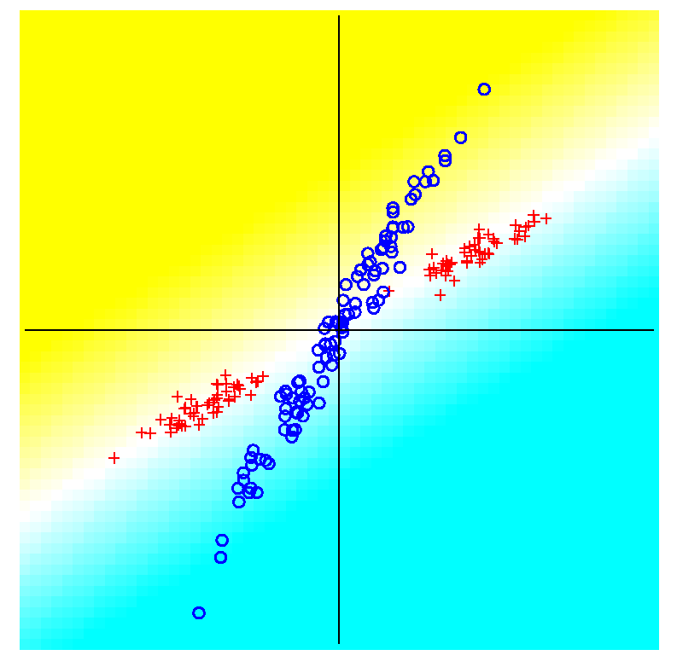
Classical Discrimination
FLD for X – Poor, no plane can work
Notes:
PExd3FLDe1.ps

Slide 127
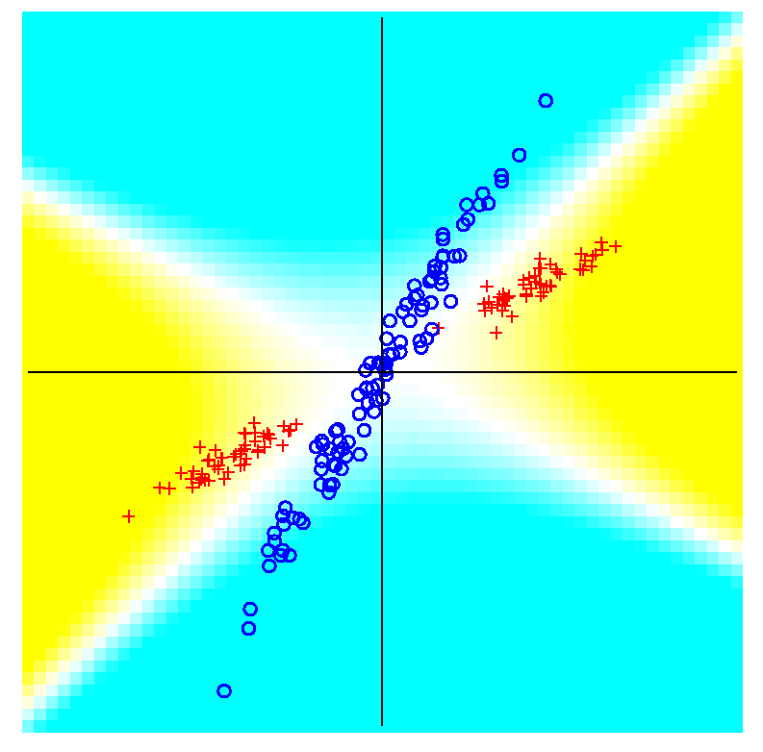
Classical Discrimination
GLR for X – Better, but not great
Notes:
PExd3GLRe1.ps

Slide 128
Classical Discrimination
Summary of FLD vs. GLR:
Tilted Point Clouds Data
  FLD good
  GLR good
Donut Data
  FLD bad
  GLR good
X Data
  FLD bad
  GLR OK, not great
Classical Conclusion: GLR generally better
(will see a different answer for HDLSS data)

