Slide 1
BD2K Module – Clustering February 16, 2020
Steve Marron
Primary: Dept. of Statistics & O. R.
Joint: Dept. of Biostatistics
Adjunct: Dept. of Computer Science
Member: Lineberger Cancer Center
& Computational Medicine
University of North Carolina

Slide 2
A Personal View
Most Modern Data Analysts
Don’t Look at Data Well Enough
Will Try to Provide You With Tools For This

Slide 3
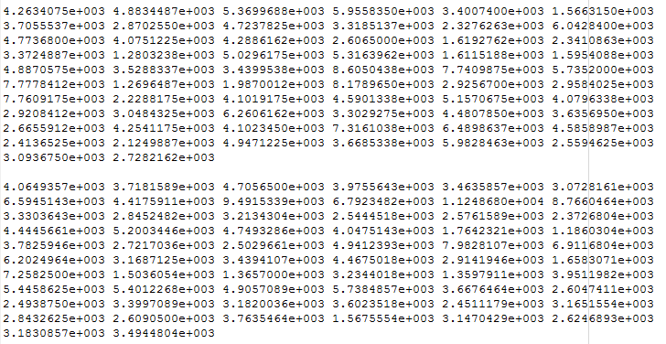
Data Visualizations
Terrible Approach: Look at .txt file

Slide 4
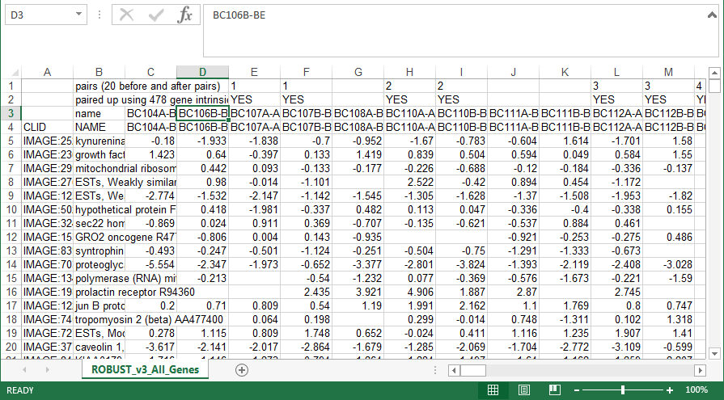
Data Visualizations
Almost as bad: Look at .xls file

Slide 5
Heat-Map Views
Main Idea:
Look at Full Data Matrix
As an Image (Rectangular Array of “Pixels”)
Coding Values with Colors (Gray Levels)

Slide 6
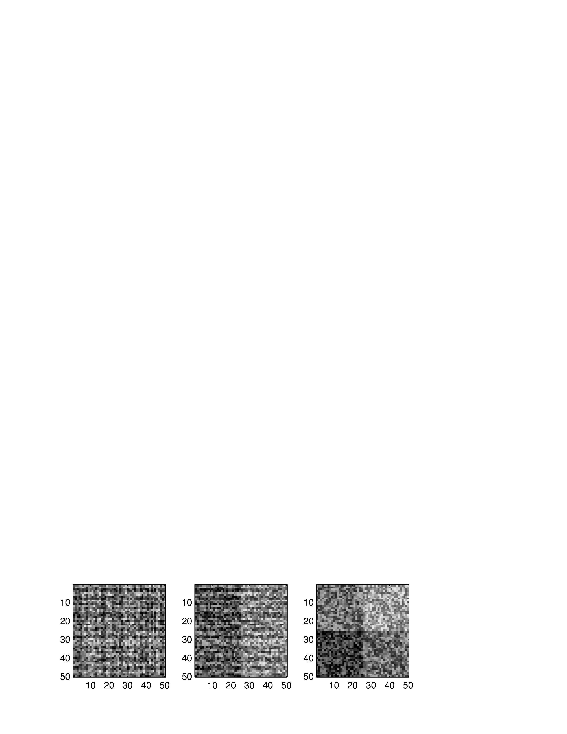
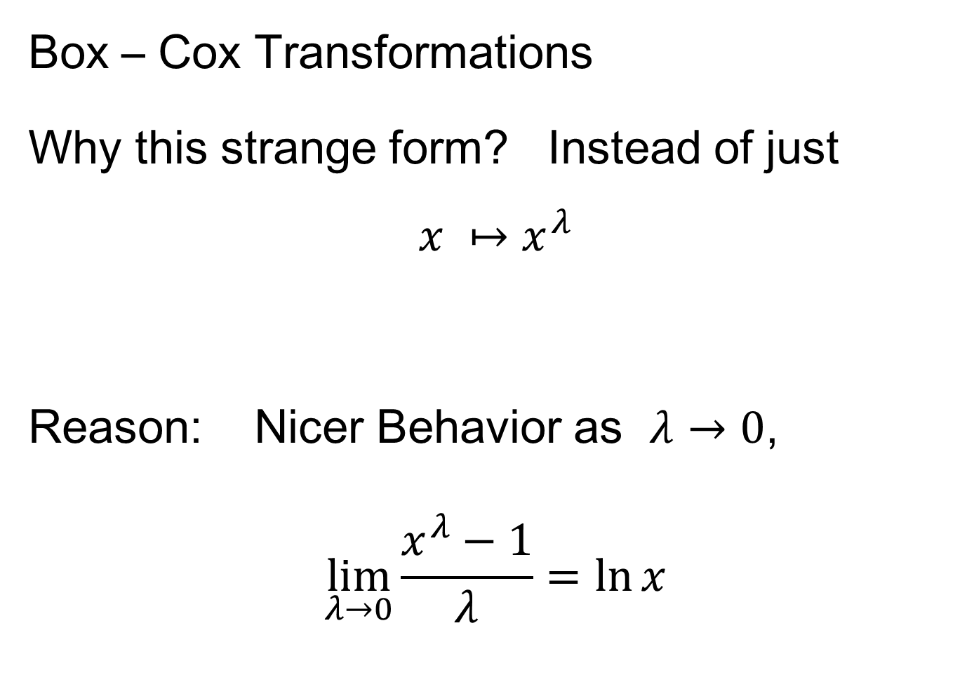
Heat-Map Views
Some Principles:
For Nonnegative Data (i. e. all $x_{i,j}≥0$)
Gray Level is Informative (& Not Distracting)
Actually Gray Level Is Also Good For:
“No Pivotal Value (e.g. 0) To HighLight”
Some Advocate a RAINBOW
Gives “Greater Range”???
Borland & Taylor (2007) Disagree
Over Perceptual Interpretation
(What Is Equally Spaced ???)

Slide 7
Heat-Map Views
Some Principles:
Ordering Rows and Columns Really Matters
Clustering Columns Highlights Relationships
Clustering “Knobs”:
Hierarchical with
Euclidean Distance
& Average Linkage

Slide 8
Heat-Map Views
Some Principles:
Ordering Rows and Columns Really Matters
Clustering Columns & Rows is Crucial
Population Structure
Invisible w/ Random Order

Slide 9
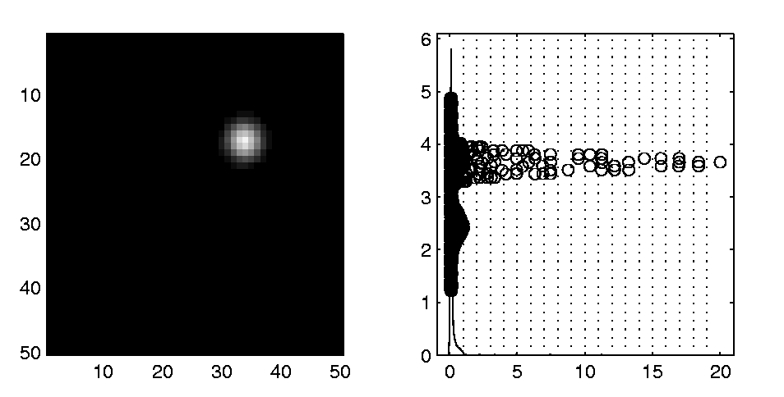
Heat-Map Views
Dist’n of Values, with
Jitter Plot + Smooth Histo
Some Principles:
Color Scale is Also Critical
Equal Bin Spacing
Toy Example
Many Small
Values & Few
Large Ones
Results in Very
Poor Contrast

Slide 10
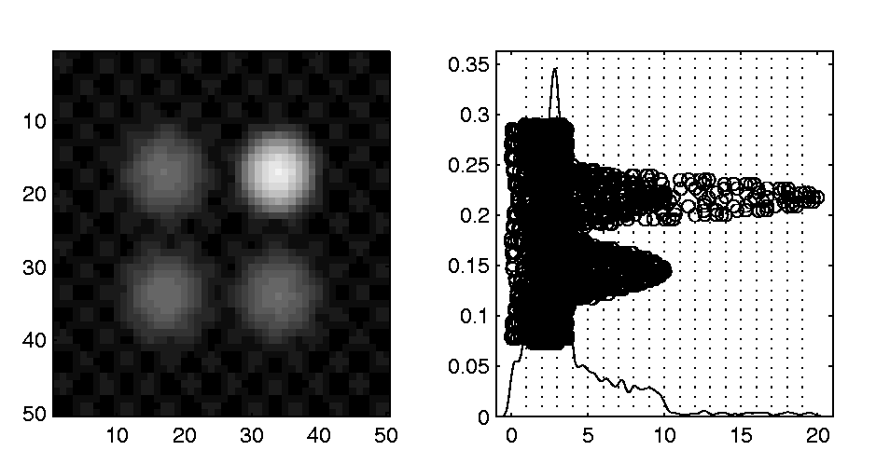
Heat-Map Views
Natural Approach (to Skewed Dist’n):
Log Transformation
Much Better
Scaling, Using
More of the
Color Range
Same Toy Example
Much Better
Contrast, Now
See 4 Peaks

Slide 11
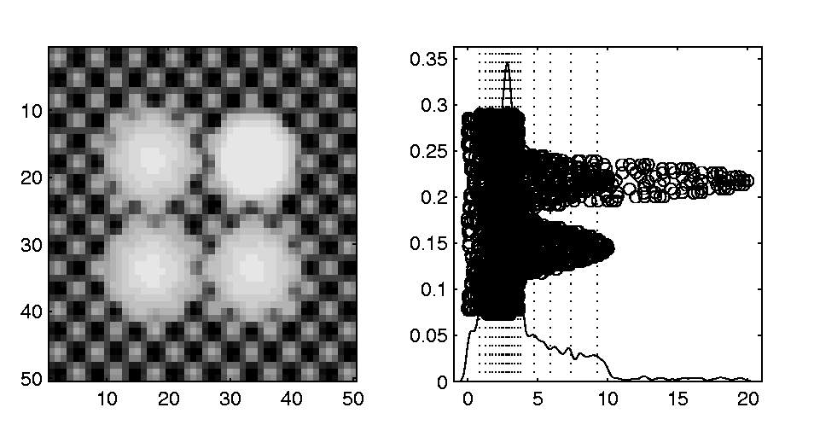
Heat-Map Views
Can Look at Either
Original Or Log View
Natural Approach (to Skewed Dist’n):
Quantile Scaling (= #s in Each Bin)
Same Toy Example
Non-Equally Spaced Bins
Far More
Contrast
Good or Bad?
Peaks Less
Prominent

Slide 12
Heat-Map Views
“Best” Choice of Color Scaling:
Context Dependent
Equally Spaced (Most Interpretable?)
Log Spacing (Can Be Very Useful)
Quantile Spacing (Also Useful)
Should Look At Several & Decide

Slide 13
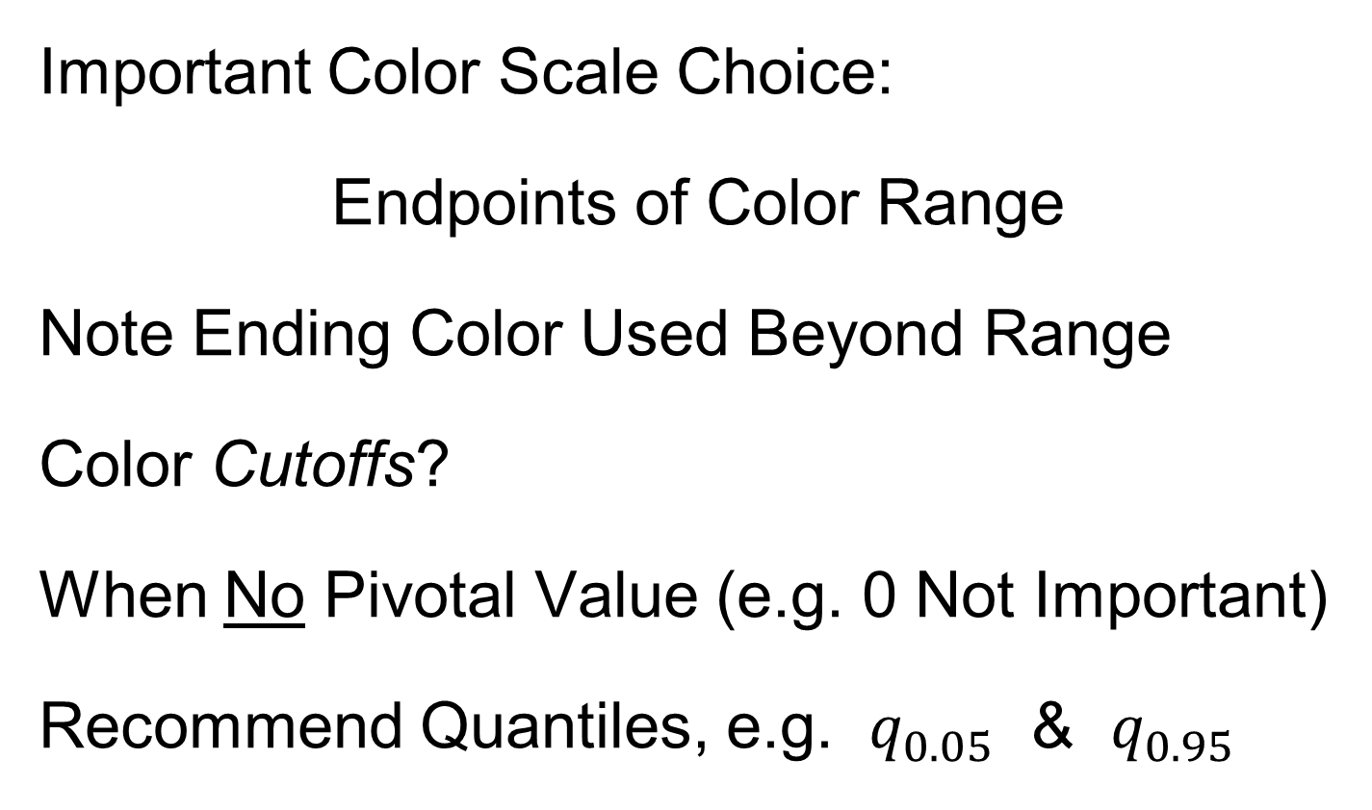
Heat-Map Views
Important Color Scale Choice:
Endpoints of Color Range
Note Ending Color Used Beyond Range
Color Cutoffs?
When No Pivotal Value (e.g. 0 Not Important)
Recommend Quantiles, e.g. $q_{0.05}$ & $q_{0.95}$
Often Worth
Twiddling These

Slide 14
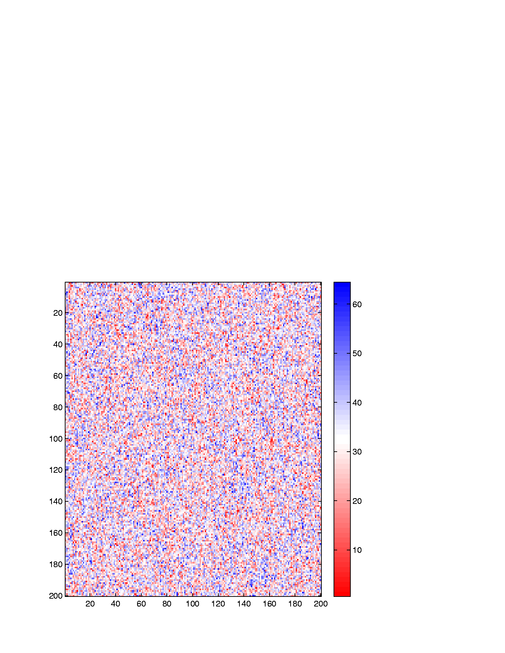
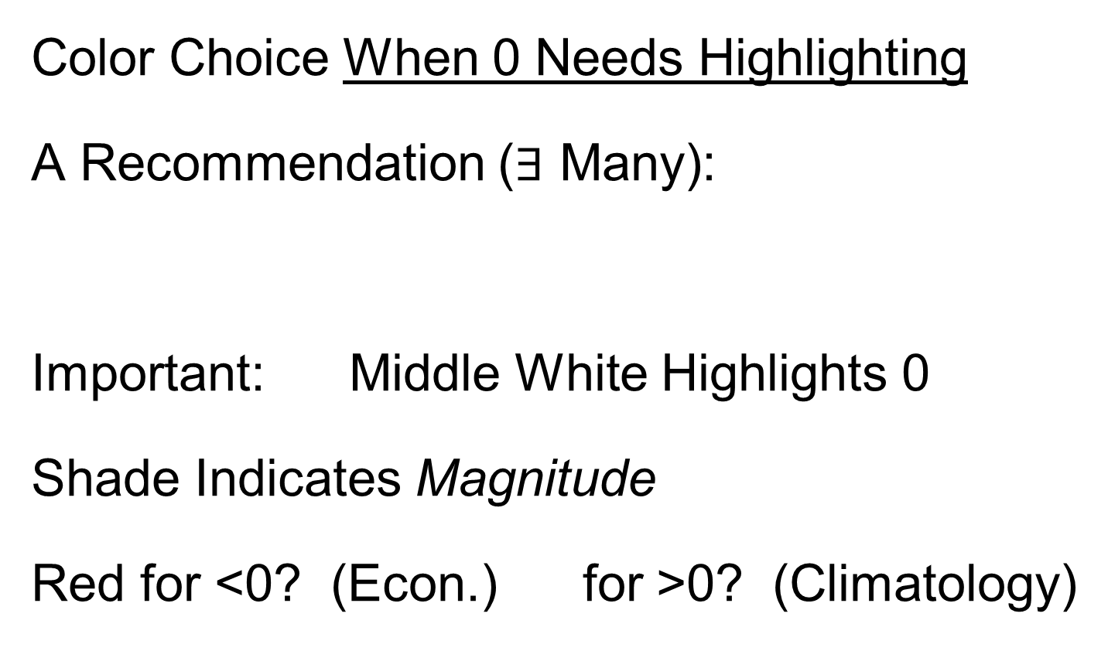
Heat-Map Views
Color Choice When 0 Needs Highlighting
A Recommendation ($∃$ Many):
Important: Middle White Highlights 0
Shade Indicates Magnitude
Red for <0? (Econ.) for >0? (Climatology)

Slide 15
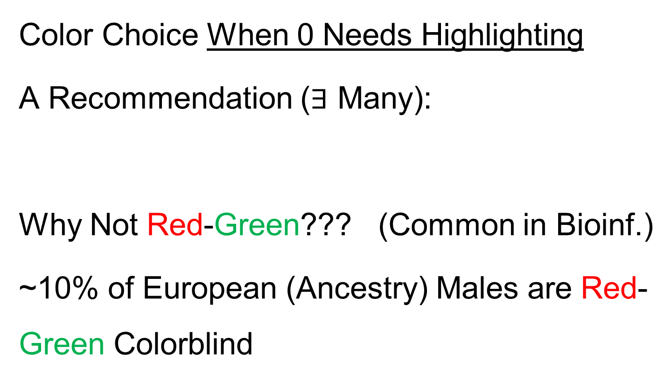
Heat-Map Views
Color Choice When 0 Needs Highlighting
A Recommendation ($∃$ Many):
Why Not Red-Green??? (Common in Bioinf.)
~10% of European (Ancestry) Males are Red-Green Colorblind
Most Other Choices as Good as This

Slide 16
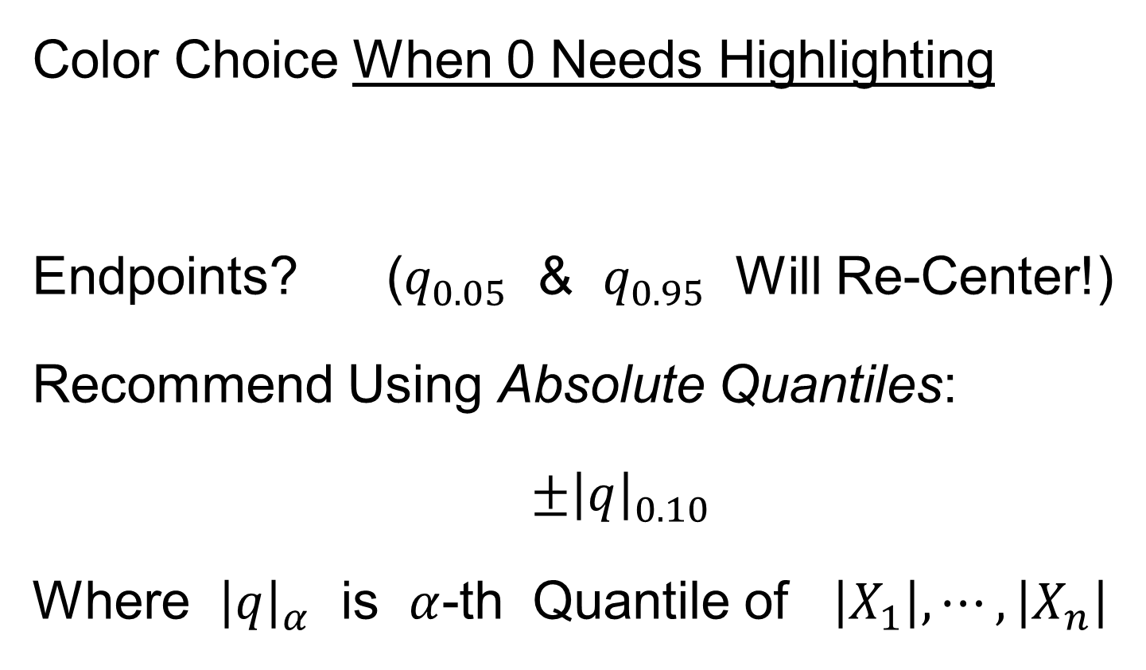
Heat-Map Views
Caution: Many
Packages Do This!
Color Choice When 0 Needs Highlighting
Endpoints? ($q_{0.05}$ & $q_{0.95}$ Will Re-Center!)
Recommend Using Absolute Quantiles:
$±{\left|q\right|}_{0.10}$
Where ${\left|q\right|}_{α}$ is $α$-th Quantile of $\left|X_{1}\right|,⋯,\left|X_{n}\right|$

Slide 17
RNAseq Data Example
Interesting Real Data Example
Genomics (Cancer Research)
RNAseq (Next Gener’n Sequen’g)
Deep look at “gene components”
Microarrays: Single number (per gene)
RNAseq: Thousands of measurements

Slide 18

RNAseq Data Example
Interesting Real Data Example
Genomics (Cancer Research)
RNAseq (Next Gener’n Sequen’g)
Deep look at “gene components”
Gene studied here: CDKN2A
Goal: Study Alternate Splicing
Sample Size, $n=180$
Dimension, $d=1709$
Early Version of TCGA LUAD:
Lung Adeno
Carcinoma

Slide 19
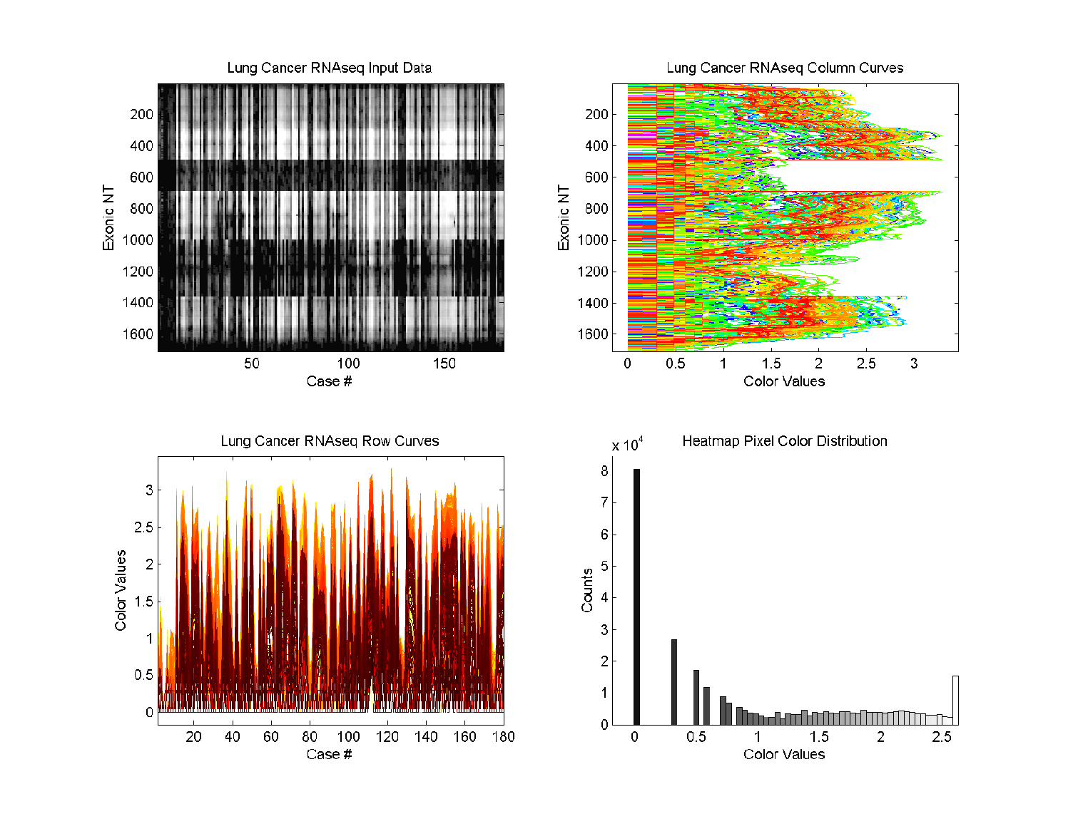

RNAseq Data Example
Heatmap View of $\log_{10}$ Counts
Interesting
Structure?
Distribution of Colors

Slide 20
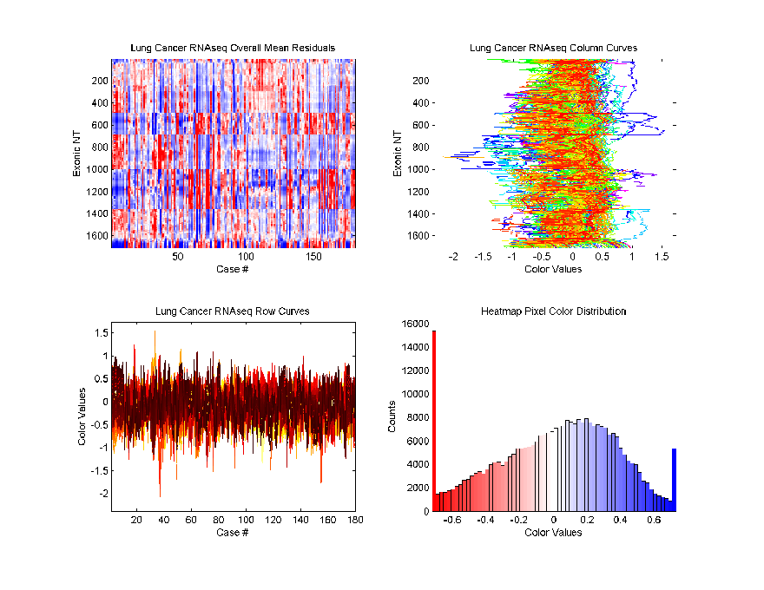
RNAseq Data Example
Better
Sort?
Centered (Rows & Columns) Version
Harder to
Intrepret?
Distribution of Colors

Slide 21
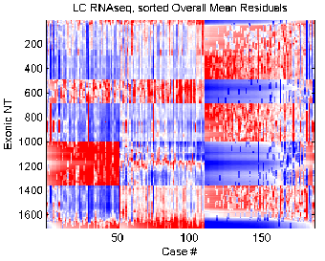
RNAseq Data Example
A Better Sorting
Interpretation?
Distribution of Colors

Slide 22
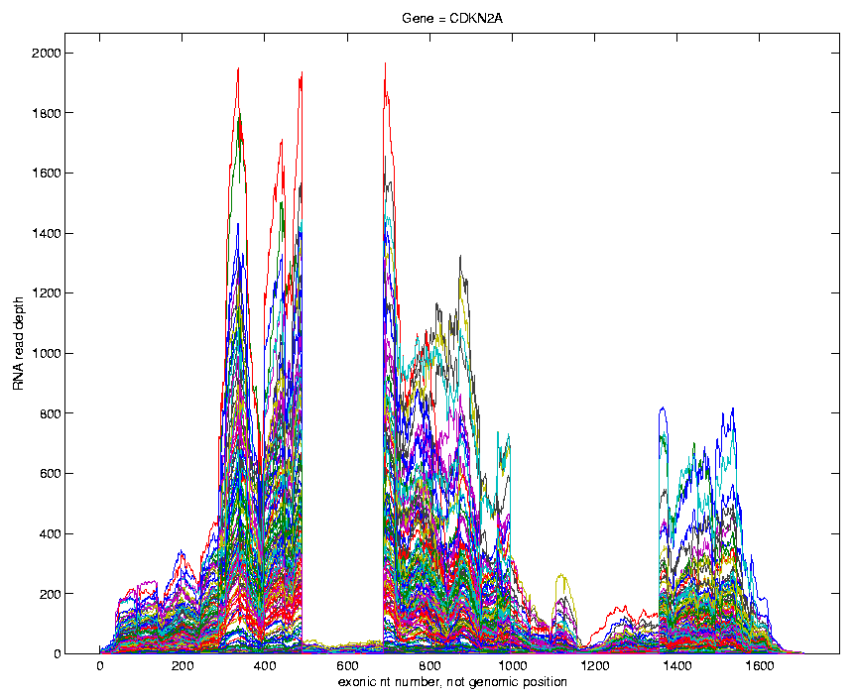
RNAseq Data Example
Alternate
View:
Curve
Overlay
(counts
scale)
Note: Data Set
Structure May
Be Hidden In
Low Areas

Slide 23
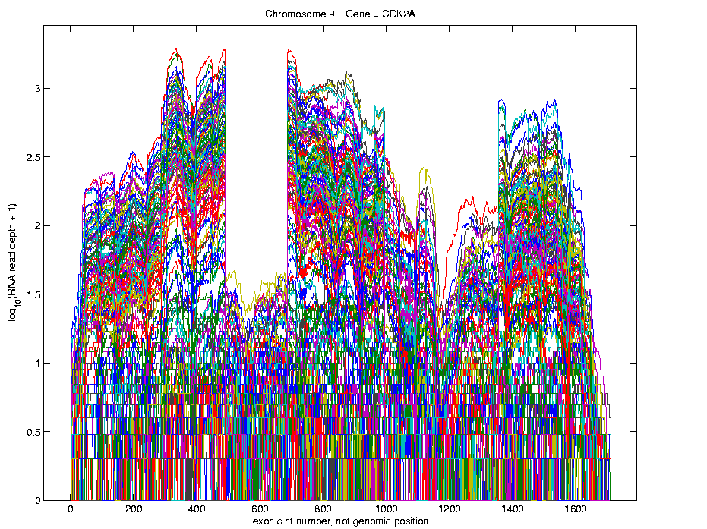

RNAseq Data Example
Alternate
View:
Curve
Overlay
($\log_{10}$
counts
scale)
Relationship Between Curves?
Build Tools
To Explore

Slide 24
Data Visualizations
Familiar Methods:
Histograms (1-d Data = Sets of #s)
(Better: Smooth Version – Kernel Density Est.)

Slide 25
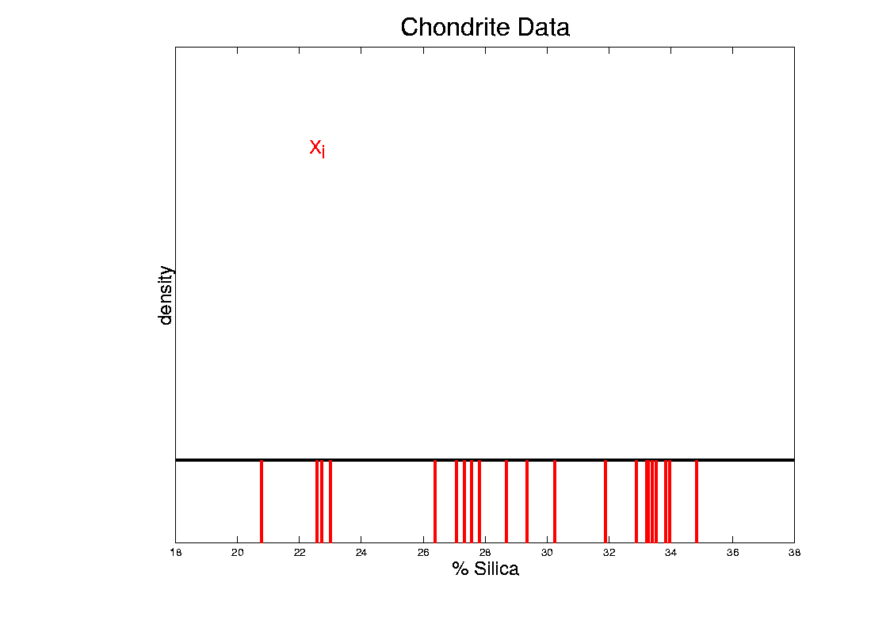
Kernel Density Estimation
Chondrite Data:
Represent points by red bars
Where are data “more dense”?

Slide 26
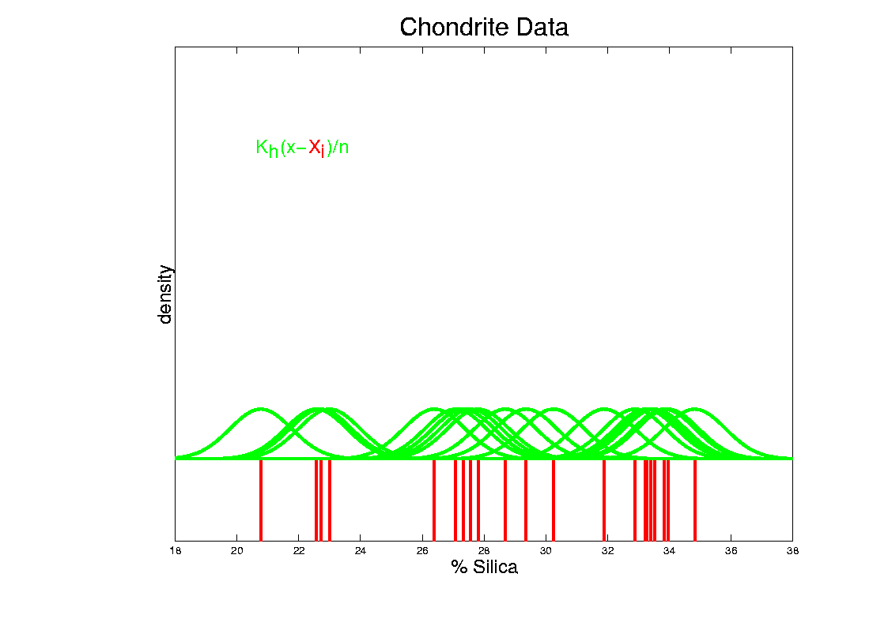
Kernel Density Estimation
Chondrite Data:
Put probability mass 1/n at each point
Smooth piece of “density”

Slide 27
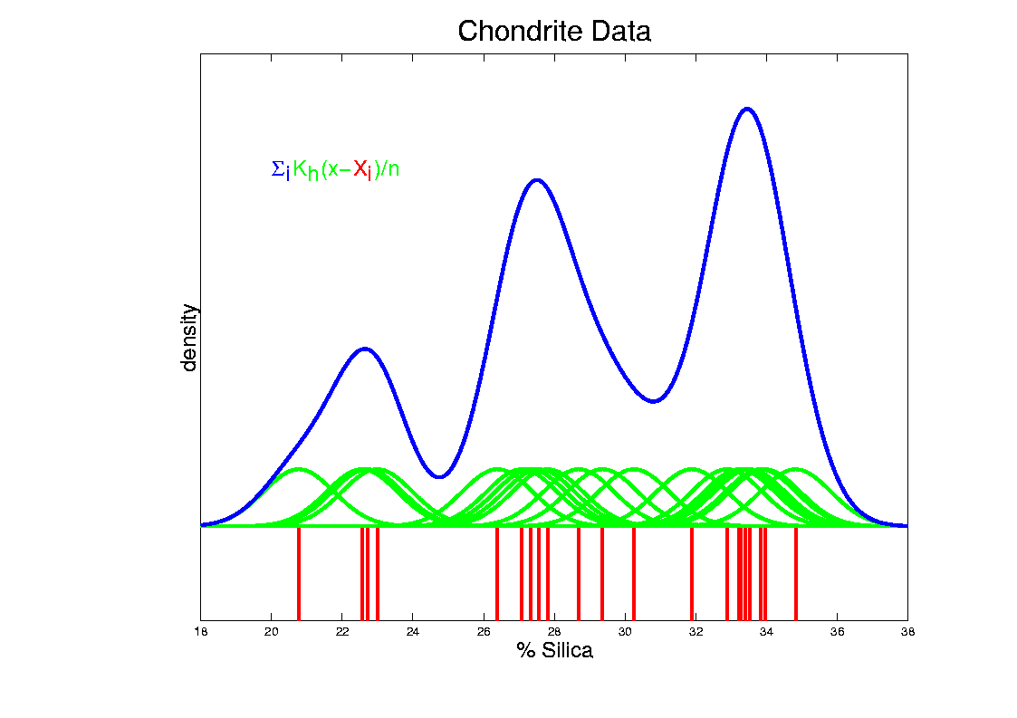
Kernel Density Estimation
Chondrite Data:
Sum pieces to estimate density
Suggests 3 modes (rock sources)

Slide 28
Data Visualizations
Familiar Methods:
Histograms (1-d Data = Sets of #s)
(Better: Smooth Version – Kernel Density Est.)
Scatterplots (2-d Data = pairs of #s)

Slide 29
Visualization Challenge
Higher Dimensions
Approaches:
Low dim’al Projections
On Directions of Interest
Scatter Plot Matrices
Many Choices Here,
Will Consider Several
Common & Useful
Directions From Principal
Component Analysis (PCA)
Useful Combination
of Multiple Directions

Slide 30
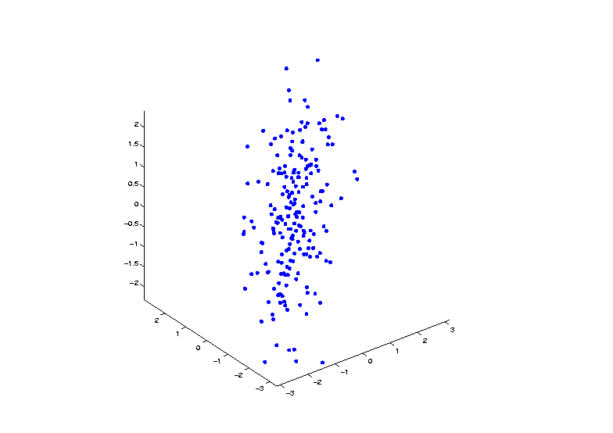


Demo PCA in $ℝ^{3}$
Raw Toy Data Set in $ℝ^{3}$

Slide 31
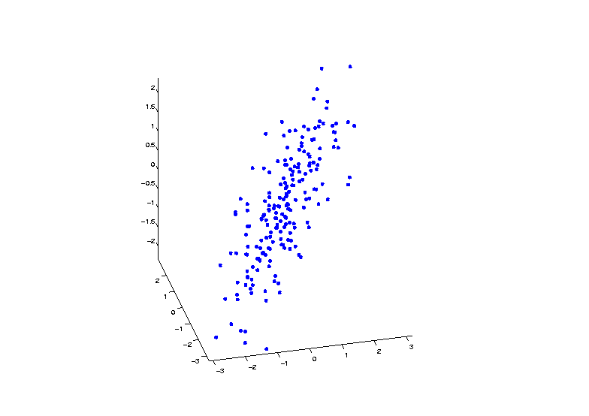
Demo PCA in $ℝ^{3}$
Raw Toy Data Set in $ℝ^{3}$

Slide 32
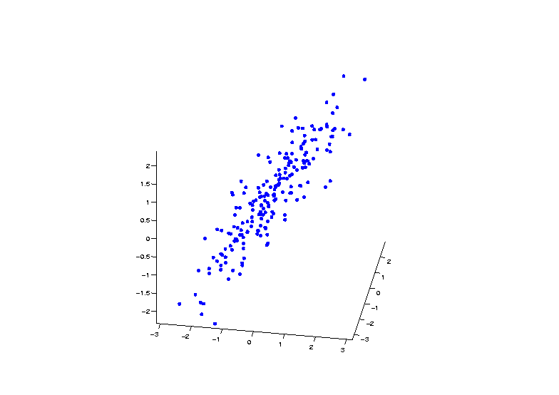
Demo PCA in $ℝ^{3}$
Raw Toy Data Set in $ℝ^{3}$

Slide 33
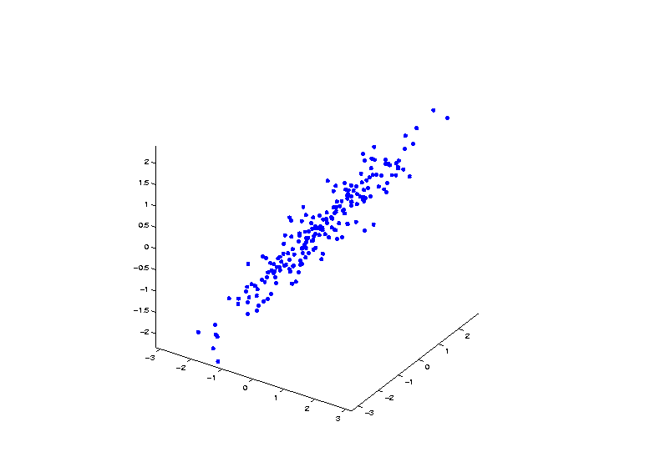
Demo PCA in $ℝ^{3}$
Raw Toy Data Set in $ℝ^{3}$

Slide 34
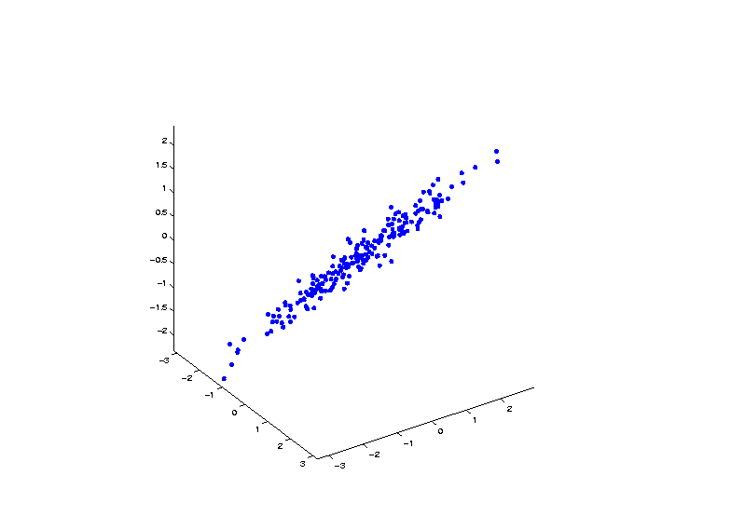
Demo PCA in $ℝ^{3}$
Raw Toy Data Set in $ℝ^{3}$

Slide 35
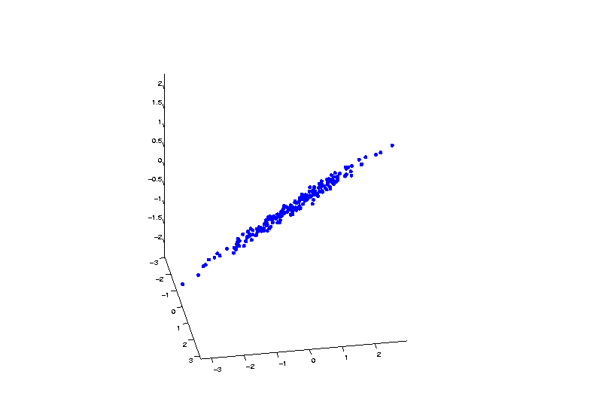
Demo PCA in $ℝ^{3}$
Raw Toy Data Set in $ℝ^{3}$

Slide 36
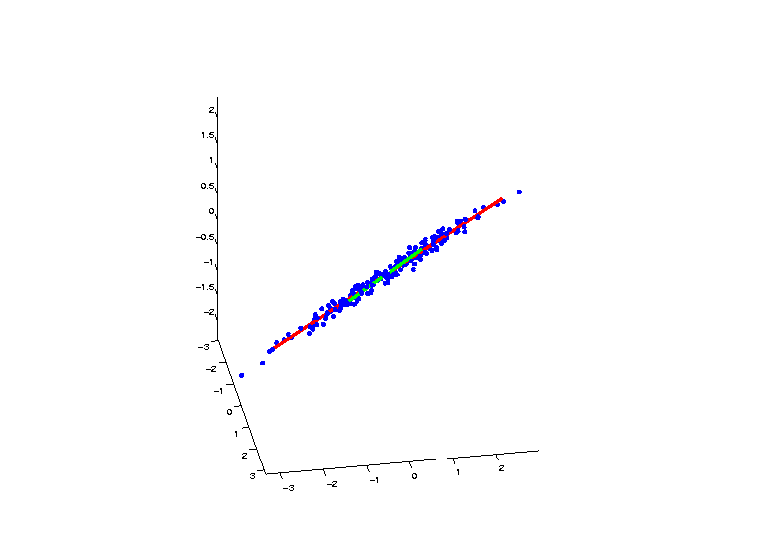
Demo PCA in $ℝ^{3}$
PCA Eigenvectors Give Useful Coordinates

Slide 37
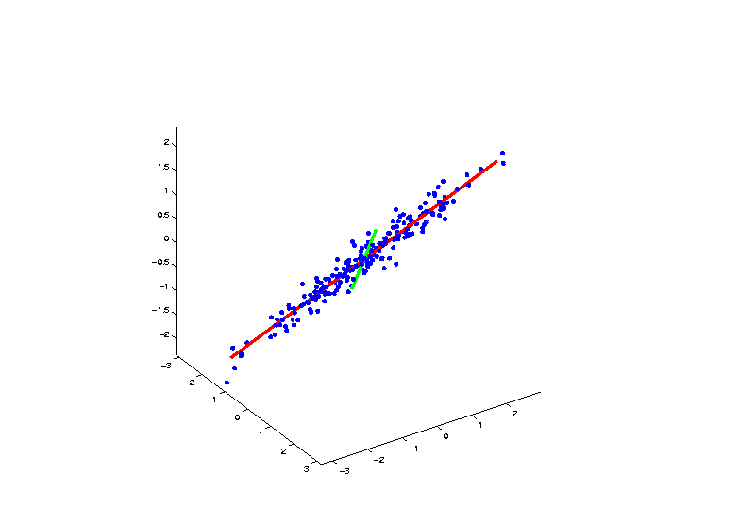
Demo PCA in $ℝ^{3}$
PCA Eigenvectors Give Useful Coordinates

Slide 38
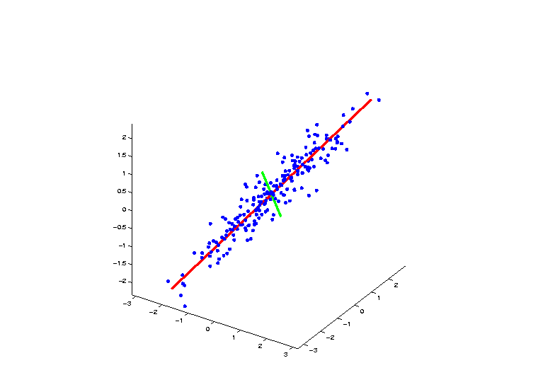
Demo PCA in $ℝ^{3}$
PCA Eigenvectors Give Useful Coordinates

Slide 39
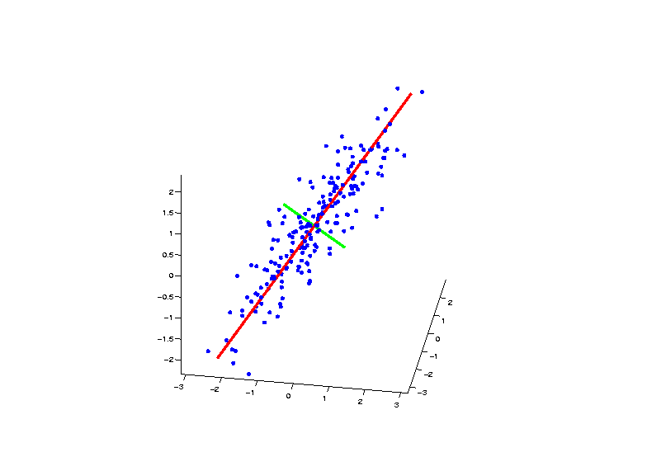
Demo PCA in $ℝ^{3}$
PCA Eigenvectors Give Useful Coordinates

Slide 40
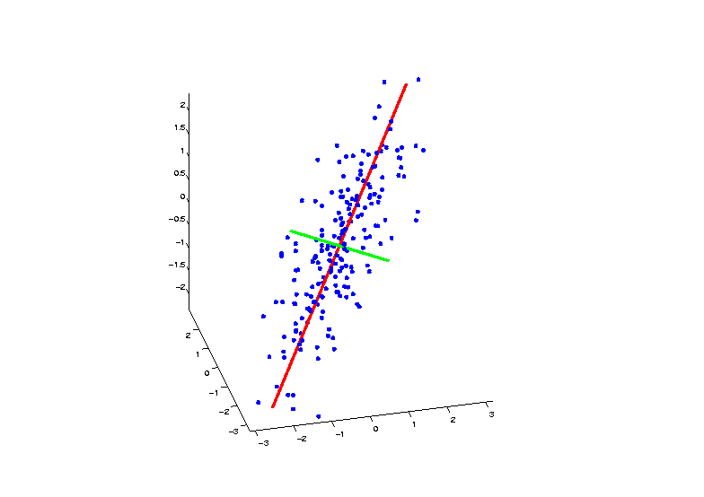
Demo PCA in $ℝ^{3}$
PCA Eigenvectors Give Useful Coordinates

Slide 41
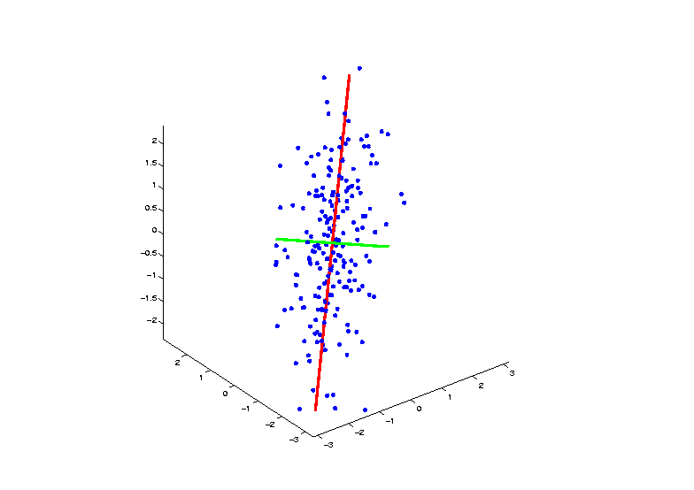
Demo PCA in $ℝ^{3}$
PCA Eigenvectors Give Useful Coordinates
1st and 2nd
Directions
Of Maximal
Variation
Use These as
Axes in PCA

Slide 42
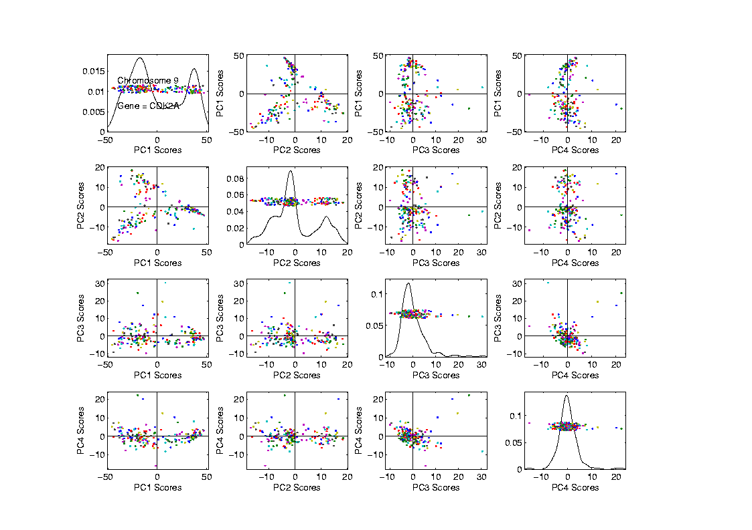
Scatterplot Matrix View
PCA
Scatterplot
View

Slide 43
Scatterplot Matrix View
PCA
Scatterplot
View
1-d Projections
On Diagonal
(jitter plot
& KDE)

Slide 44
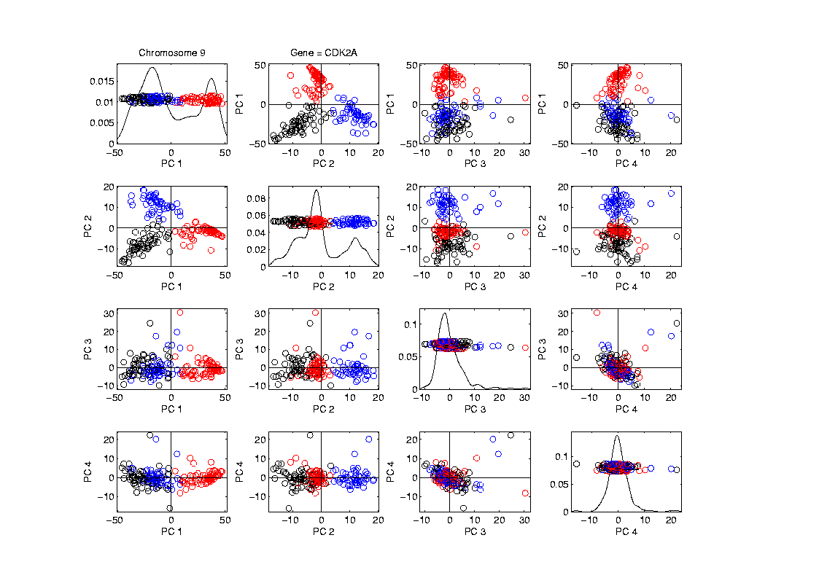
Marginal Distribution Plots
Ideas:
For Each Variable
Study 1-d Distributions
SimultaneousViews:
Jitter Plots
Smooth Histograms (Kernel Density Est’s)

Slide 45
Scatterplot Matrix View
PCA
Scatterplot
View
2-d Projections
Off Diagonal

Slide 46
Scatterplot Matrix View
PCA
Scatterplot
View
Note Common
Axes

Slide 47
Scatterplot Matrix View
PCA
Scatterplot
View
Note Common
Axes

Slide 48
Scatterplot Matrix View
PCA
Scatterplot
View
Think:
Front
Side
Top
Rotations

Slide 49

RNAseq Data Example
Alternate
View:
Curve
Overlay
($\log_{10}$
counts
scale)
Relationship Between Curves?
Build Tools
To Explore

Slide 50
RNAseq Data Example
Often
Useful
Population
View:
PCA
Scores

Slide 51
RNAseq Data Example
Suggestion
Of
Clusters
???

Slide 52
RNAseq Data Example
Suggestion
Of
Clusters
Which
Are
These?

Slide 53
RNAseq Data Example
Manually
“Brush”
Clusters

Slide 54
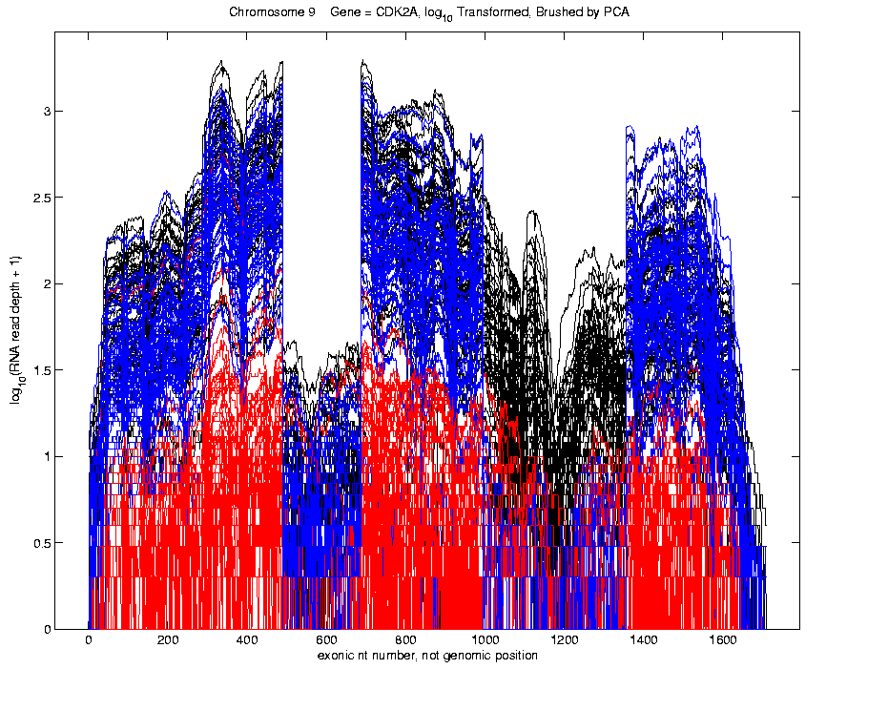
RNAseq Data Example
Manually
Brush
Clusters
Clear
Alternate
Splicing

Slide 55

RNAseq Data Example
Important Points
PCA found Important Structure
Non-Gaussian in Nature
In High Dimensional Data Analysis
$$d=1709$$

Slide 56
RNAseq Data Example
Consequences:
Led to Development of SigFuge
Whole Genome Scan Found Interesting Genes
Published in Kimes, et al (2014)

Slide 57
RNAseq Data Example
Often Crucial Question:
When are clusters really there?
Useful Method: SigClust
Will Investigate in Detail

Slide 58
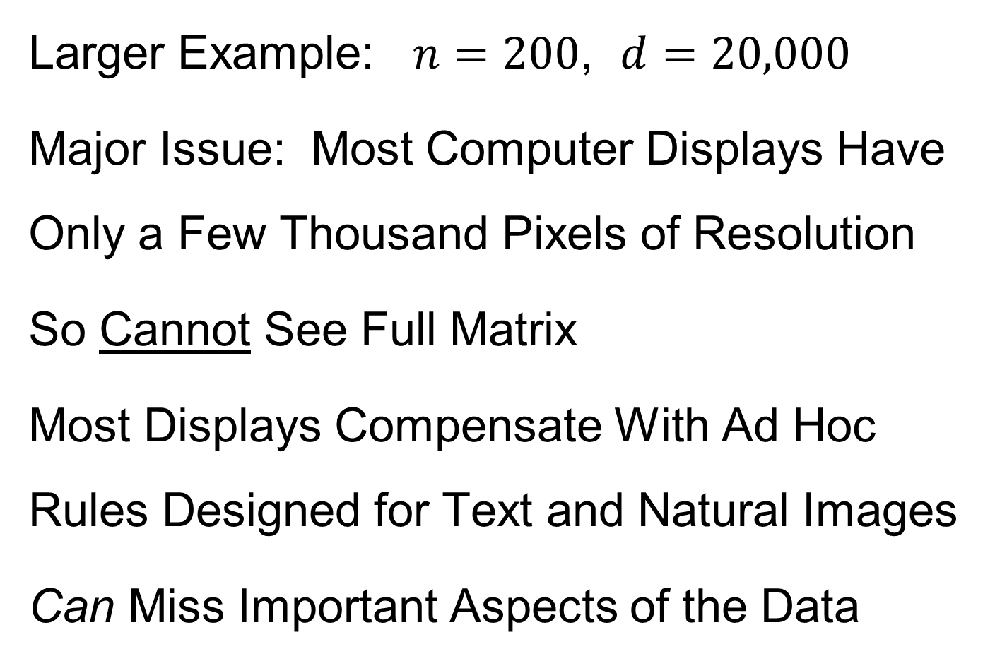
Heat-Map Views
Larger Example: $n=200$, $d=20,000$
Major Issue: Most Computer Displays Have Only a Few Thousand Pixels of Resolution
So Cannot See Full Matrix
Most Displays Compensate With Ad Hoc Rules Designed for Text and Natural Images
Can Miss Important Aspects of the Data

Slide 59
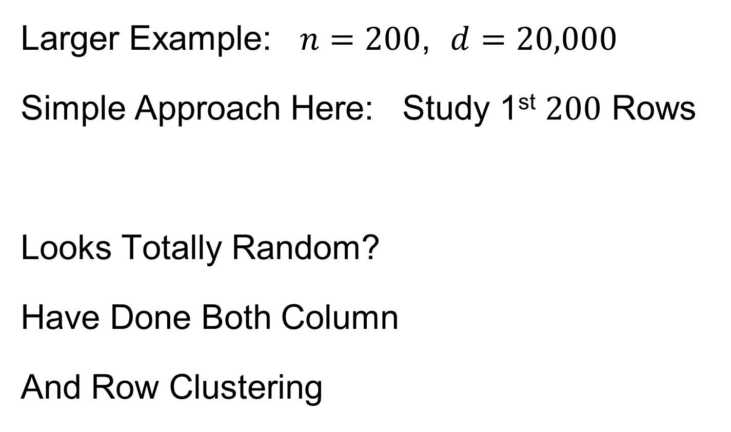
Heat-Map Views
Will See OK
For This Data
Larger Example: $n=200$, $d=20,000$
Simple Approach Here: Study 1st $200$ Rows
Looks Totally Random?
Have Done Both Column
And Row Clustering

Slide 60
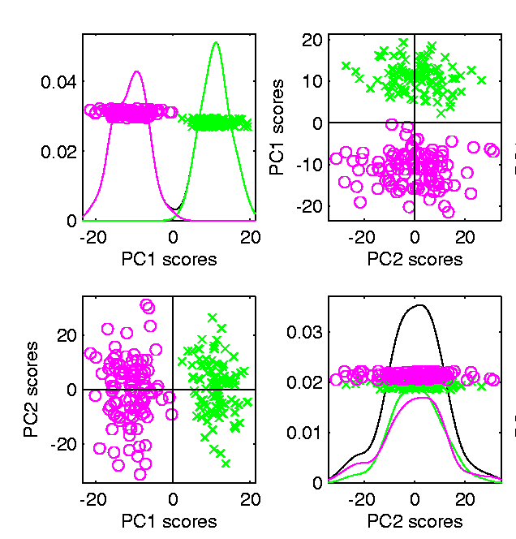

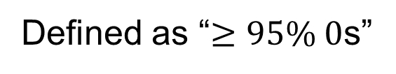
Heat-Map Views
Larger Example: $n=200$, $d=20,000$
Revisit With Scatterplot Matrix View
Conclude: Heat
Map Worse
Than Scatterplot
In This Case
Colored 1st 100 & 2nd 100
Clear Cluster Structure
Hidden by Noise in
Heatmap View!
Is This Real (or Artifact)?
$N(−0.04,1)$ & $N(0.04,1)$

Slide 61
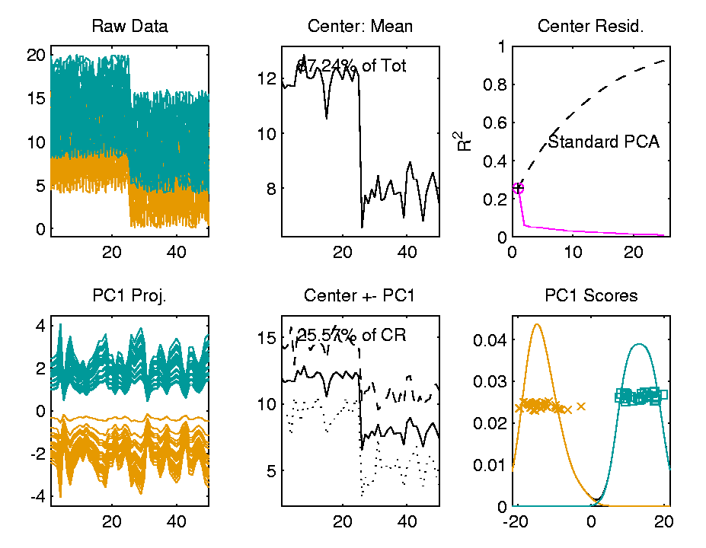

Heat-Map Views
For Opposite Answer Consider Another
Data Set ($n=d=50$) with Curve View:
Very Noisy
1st 25 Features
>> 2nd 25
Two Clear
Clusters
Understand Pop’n
Structure???

Slide 62
Heat-Map Views
Data Source is Above Example:
Gives Quicker Impression of Structure
More Natural View Than Curves
2 Clusters
1st Features Larger

Slide 63
Heat-Map Views
Which Data View Is “Best”???
Heat Maps?
Curves?
Scatterplots?

Slide 64

Heat-Map Views
Which Data View Is “Best”???
Simon Sheather Quote:
“Every Dog Has His Day”

Slide 65
Heat-Map Views
“Every Dog Has His Day”
Idea:
Any Data Analytic Method Somebody Likes Has Some Situations Where It Is “Best”
& Of Course Others Where It Is Poor
(Will See This Again)

Slide 66
Heat-Map Views
Some Overview Papers:
History:
Wilkinson & Friendly (2009)
Criticism of Common Color Choices:
Borland & Taylor (2007)

Slide 67
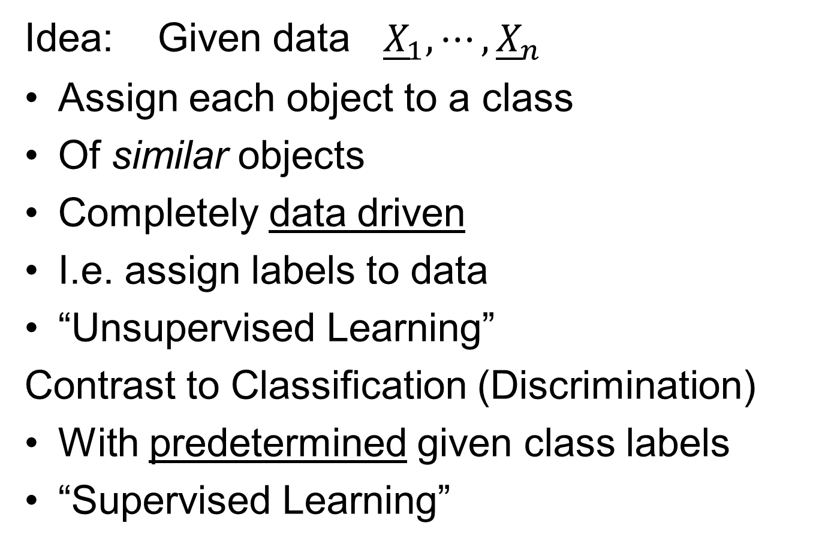
Clustering
Idea: Given data ${\underline{X}}_{1},⋯,{\underline{X}}_{n}$
Assign each object to a class
Of similar objects
Completely data driven
I.e. assign labels to data
“Unsupervised Learning”
Contrast to Classification (Discrimination)
With predetermined given class labels
“Supervised Learning”

Slide 68
Clustering
Important References:
MacQueen (1967)
Hartigan (1975)
Gersho and Gray (1992)
Kaufman and Rousseeuw (2005)
See Also: Wikipedia

Slide 69
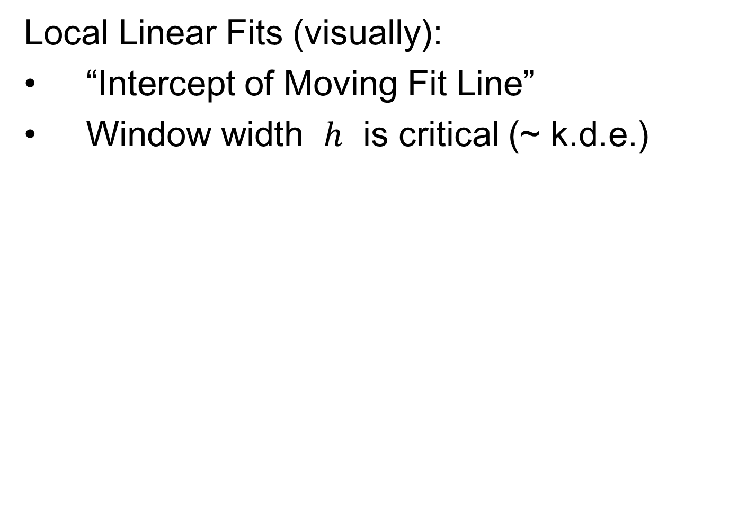
K-means Clustering
Main Idea: for data ${\underline{X}}_{1},⋯,{\underline{X}}_{n}$
Partition indices $i=1,⋯,n$
among classes $C_{1},⋯$, $C_{K}$
Given index sets $C_{1},⋯$, $C_{K}$
that partition $\left\{1,⋯,n\right\}$
represent clusters by “class means”
i.e, ${\overline{\underline{X}}}_{j}=\frac{1}{\#\left(C_{j}\right)}\sum_{i∈C_{j}}{{\underline{X}}_{i}}$ (within class means)
Each goes into
exactly 1 class

Slide 70
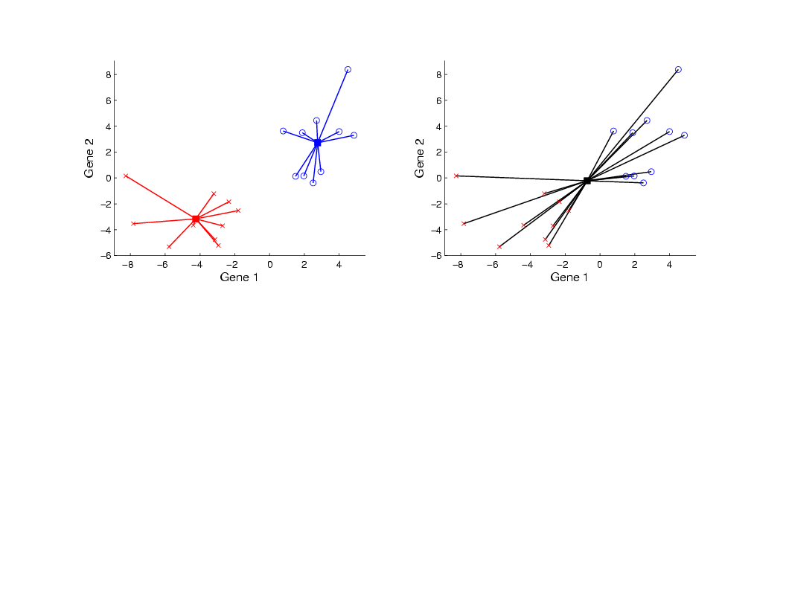
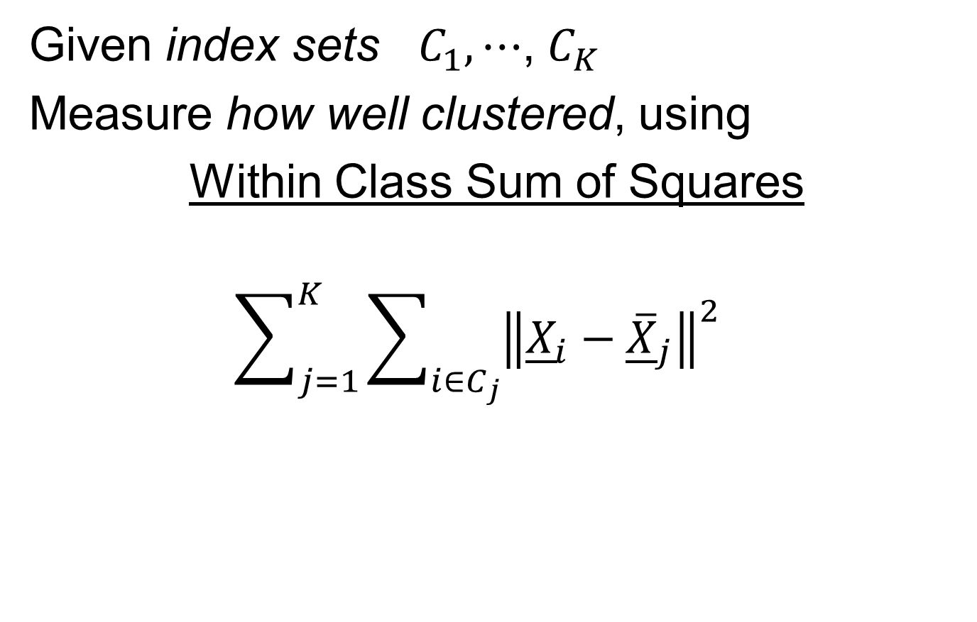
K-means Clustering
Given index sets $C_{1},⋯$, $C_{K}$
Measure how well clustered, using
Within Class Sum of Squares
$$\sum_{j=1}^{K}{\sum_{i∈C_{j}}{{\left\|{\underline{X}}_{i}−{\overline{\underline{X}}}_{j}\right\|}^{2}}}$$

Slide 71

K-means Clustering
Common Variation:
Put on scale of proportions (i.e. in [0,1])
By dividing “within class SS”
by “overall SS”
Gives Cluster Index:
$$CI\left(C_{1},⋯,C_{K}\right)=\frac{\sum_{j=1}^{K}{\sum_{i∈C_{j}}{{\left\|{\underline{X}}_{i}−{\overline{\underline{X}}}_{j}\right\|}^{2}}}}{\sum_{i=1}^{n}{{\left\|{\underline{X}}_{i}−\overline{\underline{X}}\right\|}^{2}}}$$

Slide 72
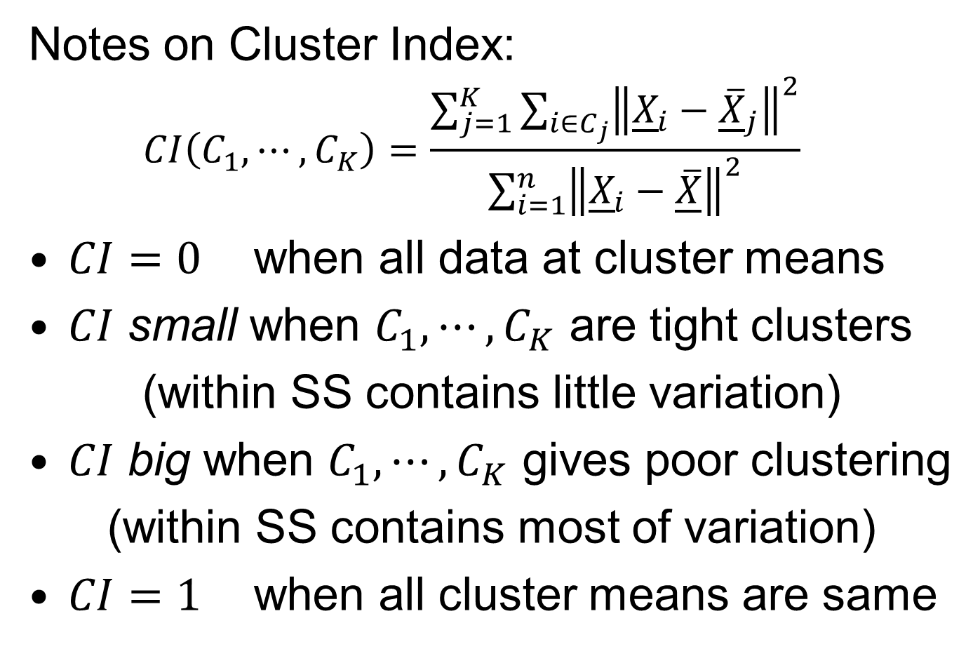
K-means Clustering
Notes on Cluster Index:
$$CI\left(C_{1},⋯,C_{K}\right)=\frac{\sum_{j=1}^{K}{\sum_{i∈C_{j}}{{\left\|{\underline{X}}_{i}−{\overline{\underline{X}}}_{j}\right\|}^{2}}}}{\sum_{i=1}^{n}{{\left\|{\underline{X}}_{i}−\overline{\underline{X}}\right\|}^{2}}}$$
$CI=0$ when all data at cluster means
$CI$ small when $C_{1},⋯,C_{K}$ are tight clusters
(within SS contains little variation)
$CI$ big when $C_{1},⋯,C_{K}$ gives poor clustering
(within SS contains most of variation)
$CI=1$ when all cluster means are same

Slide 73

K-means Clustering
Clustering Goal:
Given data ${\underline{X}}_{1},⋯,{\underline{X}}_{n}$
Choose classes $C_{1},⋯,C_{K}$
To miminize
$$CI\left(C_{1},⋯,C_{K}\right)=\frac{\sum_{j=1}^{K}{\sum_{i∈C_{j}}{{\left\|{\underline{X}}_{i}−{\overline{\underline{X}}}_{j}\right\|}^{2}}}}{\sum_{i=1}^{n}{{\left\|{\underline{X}}_{i}−\overline{\underline{X}}\right\|}^{2}}}$$

Slide 74

K-Means Clustering
2-d Toy Example
Long Thin Cluster
Close Round Clusters
Outliers or Clusters???

Slide 75





K-Means Clustering
2-d Toy Example
$k=2$, Groups
All Small Ones
$k=3$, Splits
Round Ones
K-Means Can Be Slippery
$k=4$, Splits
Long Cluster
Local Minimum?
$k=5$, Splits
Outliers, Not
Round Ones?

Slide 76



K-Means Clustering
2-d Toy Example, No Outliers
$k=2$, Groups
All Small Ones
$k=3$, Splits
Round Ones
K-Means Can Be Slippery,
Careful About Local Minima
$k=$4, Splits
Long Cluster
$k=5$, Not
Round Ones?

Slide 77
Clustering
A Very Large Area
K-Means is Only One Approach
Has its Drawbacks
(Many Toy Examples of This)
Ǝ Many Other Approaches
Important (And Broad) Class
Hierarchical Clustering

Slide 78
Hierarchical Clustering
Idea: Consider Either:
Bottom Up Aggregation:
One by One Combine Data
Top Down Splitting:
All Data in One Cluster & Split
Through Entire Data Set, to get Dendogram

Slide 79

Hierarchical Clustering
Aggregate or Split, to get Dendogram
Thanks to US EPA: water.epa.gov

Slide 80
Hierarchical Clustering
Aggregate or Split, to get Dendogram
Aggregate:
Start With
Individuals

Slide 81
Hierarchical Clustering
Aggregate or Split, to get Dendogram
Aggregate:
Start With
Individuals,
Move Up

Slide 82
Hierarchical Clustering
Aggregate or Split, to get Dendogram
Aggregate:
Start With
Individuals,
Move Up

Slide 83
Hierarchical Clustering
Aggregate or Split, to get Dendogram
Aggregate:
Start With
Individuals,
Move Up

Slide 84
Hierarchical Clustering
Aggregate or Split, to get Dendogram
Aggregate:
Start With
Individuals,
Move Up

Slide 85
Hierarchical Clustering
Aggregate or Split, to get Dendogram
Aggregate:
Start With
Individuals,
Move Up,
End Up With
All in 1 Cluster

Slide 86
Hierarchical Clustering
Aggregate or Split, to get Dendogram
Split:
Start With
All in 1 Cluster

Slide 87
Hierarchical Clustering
Aggregate or Split, to get Dendogram
Split:
Start With
All in 1 Cluster,
Move Down

Slide 88
Hierarchical Clustering
Aggregate or Split, to get Dendogram
Split:
Start With
All in 1 Cluster,
Move Down,
End With
Individuals

Slide 89
Hierarchical Clustering
Aggregate or Split, to get Dendogram
While Result
Is Same,
There Are
Computational
Considerations

Slide 90

Hierarchical Clustering
Vertical Axis in Dendogram:
Based on:
Distance Metric
(Ǝ many, e.g. $L^{2}$, $L^{1}$, $L^{∞}$, …)
Linkage Function
(Reflects Clustering Type)
A Lot of “Art” Involved

Slide 91
Hierarchical Clustering
Dendogram Interpretation
Branch
Length
Reflects
Cluster
Strength

Slide 92
Hierarchical Clustering
2-d Toy Example
Recall From Before
Long Thin Cluster
Close Round Clusters
Outliers or Clusters???

Slide 93

Hierarchical Clustering
2-d Toy Example, Euclidean Distance
Ward’s Linkage (Cut at 4 Clusters)
Likes
Balanced
Splits

Slide 94
Hierarchical Clustering
2-d Toy Example, Euclidean Distance
Linkages: Distances Between Clusters
Based on Pairwise Distances

Slide 95
Hierarchical Clustering
2-d Toy Example, Euclidean Distance
Complete Linkage
Idea: Cluster Distance = Max Pairwise Dist.

Slide 96

Hierarchical Clustering
2-d Toy Example, Euclidean Distance
Complete Linkage (Cut at 4 Clusters)
Clusters
Avoid Far Away
Members

Slide 97
Hierarchical Clustering
2-d Toy Example, Euclidean Distance
Average Linkage
Idea: Cluster Distance = Avg. Pairwise Dist.

Slide 98

Hierarchical Clustering
2-d Toy Example, Euclidean Distance
Average Linkage (Cut at 4 Clusters)
Allows Outliers
To Split Off
But Still Groups
Round Clusters

Slide 99
Hierarchical Clustering
2-d Toy Example, Euclidean Distance
Single Linkage
Idea: Cluster Distance = Min Pairwise Dist.

Slide 100

Hierarchical Clustering
2-d Toy Example, Euclidean Distance
Single Linkage (Cut at 4 Clusters)
Gives Intuitively
Natural Result
Good 2-d
Performance

Slide 101

Hierarchical Clustering
2-d Toy Example, Euclidean Distance
Single Linkage Dendrogram
Reveals
Ordering
Of Clusters

Slide 102

Hierarchical Clustering
2-d Toy Example, Euclidean Distance
Single Linkage (Cut at 3 Clusters)
Groups
Closest
Clusters

Slide 103

Hierarchical Clustering
2-d Toy Example, Euclidean Distance
Single Linkage (Cut at 5 Clusters)
Splits Long Cluster
But Finds Gap,
Not Cut In Half

Slide 104

Hierarchical Clustering
2-d Toy Example, $L^{1}$ Distance
Single Linkage (Cut at 4 Clusters)
Rather Similar
For This 2-d
Example

Slide 105

Hierarchical Clustering
2-d Toy Example, Spearman Distance
Single Linkage (Cut at 4 Clusters)
Yuck!
Distances Matter

Slide 106

Hierarchical Clustering
2-d Toy Example, Cosine Distance
Single Linkage (Cut at 4 Clusters)
Think “Angle In
Polar Coordinates”
Depends On Center
Poor Choice

Slide 107

Hierarchical Clustering
2-d Toy Example, Cosine Distance
Single Linkage (Cut at 4 Clusters)
Better When
Centering At
Mean
Still Not Great

Slide 108

Hierarchical Clustering
2-d Toy Example, Cosine Distance
Single Linkage (Cut at 4 Clusters)
Careful Choice
Gives Good
Result
Think Sectors in
Polar Coordinates

Slide 109
Hierarchical Clustering
2-d Toy Example, Cosine Distance
Single Linkage (Cut at 4 Clusters)
Revisit Mean
Centering
With Sectors

Slide 110
Hierarchical Clustering
2-d Toy Example, Cosine Distance
Single Linkage (Cut at 4 Clusters)
Revisit Bad
Centering
With Sectors

Slide 111

Hierarchical Clustering
Higher Dimensions, $d=500$, $n=30$, $N(0,I)$
Euclidean Dist.
Single Linkage
Peels Off
Points One
At A Time
Usually Less
Useful
Explore These
Farthest Three

Slide 112

Hierarchical Clustering
Higher Dimensions, $d=500$, $n=30$, $N(0,I)$
Euclidean Dist.
Single Linkage
Visualize
With PCA
Blacks Are
Outliers?
No Clear Patterns?
“Larger Variation”
Dir’ns Feel Groups

Slide 113

Hierarchical Clustering
Higher Dimensions, $d=500$, $n=30$, $N(0,I)$
Euclidean Dist.
Single Linkage
Use Outlier
Data Dir’ns
Better
Impression
Of Outliers
Recall HDLSS Space Is Very Big
$∃$ Many Interesting Directions Besides PCs

Slide 114

Hierarchical Clustering
Higher Dimensions, $d=500$, $n=30$, $N(0,I)$
Euclidean Dist.
Average Linkage
Get More
Grouping,
Lower
Singletons

Slide 115

Hierarchical Clustering
Higher Dimensions, $d=500$, $n=30$, $N(0,I)$
Euclidean Dist.
Complete Linkage
Much More
Grouping,
Singletons
Much Lower

Slide 116

Hierarchical Clustering
Higher Dimensions, $d=500$, $n=30$, $N(0,I)$
Euclidean Dist.
Complete Linkage
Explore
With PCA
Some Patterns Visible
But Mostly in Higher PCs

Slide 117

Hierarchical Clustering
Higher Dimensions, $d=500$, $n=30$, $N(0,I)$
Euclidean Dist.
Complete Linkage
Visualize
With MDs
Good Separation
MD spread
$≪$PC spread

Slide 118

Hierarchical Clustering
Higher Dimensions, $d=500$, $n=30$, $N(0,I)$
Euclidean Dist.
Ward’s Linkage
Likes
Balanced
Cluster
Sizes

Slide 119

Hierarchical Clustering
Higher Dimensions, $d=500$, $n=30$, $N(0,I)$
Euclidean Dist.
Ward’s Linkage
Once Again
Not Very
Apparent
In PCA???

Slide 120

Hierarchical Clustering
Higher Dimensions, $d=500$, $n=30$, $N(0,I)$
Euclidean Dist.
Ward’s Linkage
Visualize
With Mean
Differences
Great Separation,
Slightly BetterThan Complete

Slide 121
Hierarchical Clustering
Linkage Observations:
Single Linkage
Useful in Low d
Peels Off Singleton’s in High d
Average Linkage
Generally In Between
Ward’s Linkage
Likes Balanced Cluster Sizes
Often Useful in High d
Every Dog Has His Day
Complete Linkage
Is Close, But Not
Quite as Good

Slide 122
SigClust
Statistical Significance of Clusters
in HDLSS Data
When is a cluster “really there”?
(Simpler Version of “What is $K$?”)
Liu et al (2007), Huang et al (2014)

Slide 123

Common Genomic Analytic Approach: Clustering
From: Perou et al (2000)
d = 1161 genes
Zoomed to “relevant”
Gene subsets

Slide 124
Interesting Statistical Problem
For HDLSS data:
When clusters seem to appear
E.g. found by clustering method
How do we know they are really there?
Question asked by Neil Hayes
Define appropriate statistical significance?
Can we calculate it?

Slide 125
First Approaches: Hypo Testing
e.g. Direction, Projection, Permutation
Hypothesis test of:
Significant difference between sub-populations

Slide 126

DiProPerm Hypothesis Test
Two
Examples
Which Is
“More
Distinct”?
Visually Better Separation?
Thanks to Katie Hoadley

Slide 127

DiProPerm Hypothesis Test
Two
Examples
Which Is
“More
Distinct”?
Stronger Statistical Significance!
Thanks to Katie Hoadley
Due to Larger Sample Sizes

Slide 128
First Approaches: Hypo Testing
e.g. Direction, Projection, Permutation
Hypothesis test of:
Significant difference between sub-populations
Effective and Accurate
I.e. Sensitive and Specific
There exist several such tests
But critical point is:
What result implies about clusters

Slide 129
Clarifying Simple Example
Why Population Difference Tests cannot indicate clustering
Andrew Nobel Observation
For Gaussian Data (Clearly 1 Cluster!)
Assign Extreme Labels
(e.g. by clustering)
Subpopulations are signif’ly different

Slide 130

Clarifying Simple Example
2-d Standard Gaussian Data (i.e. N(0,1))

Slide 131

Clarifying Simple Example
2-d Standard Gaussian Data (i.e. N(0,1))
Apply
2-Means
Clustering

Slide 132

Clarifying Simple Example
2-d Standard Gaussian Data (i.e. N(0,1))
Apply
2-Means
Clustering
DiProPerm
Result
Note: Cluster Means Very Sig’tly Different

Slide 133

Clarifying Simple Example
2-d Standard Gaussian Data (i.e. N(0,1))
But Not
Significant
By
Sig Clust
Lies in Middle
Of Null Pop’n

Slide 134
Statistical Significance of Clusters
Basis of SigClust Approach:
What defines: A Single Cluster?
A Gaussian distribution (Sarle & Kou 1993)
So define SigClust test based on:
2-means cluster index (measure) as statistic
Gaussian null distribution
Currently compute by simulation
Possible to do this analytically???

Slide 135
SigClust Statistic – 2-Means Cluster Index
Measure of non-Gaussianity:
2-means Cluster Index
Familiar Criterion from k-means Clustering
Within Class Sum of Squared Distances to Class Means
Prefer to divide (normalize) by Overall Sum of Squared Distances to Mean
Puts on scale of proportions

Slide 136
SigClust Statistic – 2-Means Cluster Index
Measure of non-Gaussianity:
2-means Cluster Index:
$$CI\left(C_{1},⋯,C_{K}\right)=\frac{\sum_{j=1}^{K}{\sum_{i∈C_{j}}{{\left\|{\underline{X}}_{i}−{\overline{\underline{X}}}_{j}\right\|}^{2}}}}{\sum_{i=1}^{n}{{\left\|{\underline{X}}_{i}−\overline{\underline{X}}\right\|}^{2}}}$$
“Within Class Var’n” / “Total Var’n”
Class Index Sets
Class Means

Slide 137
SigClust Gaussian null distribut’n
Which Gaussian (for null)?
Standard (sphered) normal?
No, not realistic
Rejection not strong evidence for clustering
Could also get that from a-spherical Gaussian
Need Gaussian more like data:
Need Full $N_{d}\left(μ,Σ\right)$ model
Challenge: Parameter Estimation
Especially in HDLSS Context

Slide 138

SigClust Gaussian null distribut’n
Challenge: Parameter Estimation
Case 1: $n>d$ (Conventional)
Consider $\hat{μ}$ and $\hat{Σ}$
Case 2: Random Matrix or HDLSS
${\hat{Σ}}^{−1}$ is Very Slippery
Need Better Approach
Can Always Do This
But Can Be Very
Conservative

Slide 139
SigClust Gaussian null distribut’n
Estimated Mean, $μ$ (of Gaussian dist’n)?
1st Key Idea: Can ignore this
By appealing to shift invariance of CI
When Data are (rigidly) shifted
CI remains the same
So enough to simulate with mean 0
Other uses of invariance ideas?

Slide 140
SigClust Gaussian null distribut’n
Challenge: how to estimate cov. Matrix $Σ$?
Number of parameters: $\frac{d\left(d+1\right)}{2}$
E.g. Perou 500 data:
Dimension $d=9674$
so $\frac{d\left(d+1\right)}{2}=46,797,975$
But Sample Size $n=533$
Impossible in HDLSS settings????
Way around this problem?

Slide 141
SigClust Gaussian null distribut’n
2nd Key Idea: Mod Out Rotations
Replace full Cov. by diagonal matrix
As done in PCA eigen-analysis
$$Σ=MDM^{t}$$
But then “not like data”???
OK, since k-means clustering (i.e. CI) is
rotation invariant
(assuming e.g. Euclidean Distance)

Slide 142
SigClust Gaussian null distribut’n
2nd Key Idea: Mod Out Rotations
Only need to estimate diagonal matrix
But still have HDLSS problems?
E.g. Perou 500 data:
Dimension $d=9674$
Sample Size $n=533$
Still need to estimate $d=9674$ param’s

Slide 143
SigClust Gaussian null distribut’n
3rd Key Idea: Factor Analysis Model
Model Covariance as: Biology + Noise
$$Σ=Σ_{B}+{σ_{N}}^{2}×I$$
Where
$Σ_{B}$ is “fairly low dimensional”
${σ_{N}}^{2}$ is estimated from background noise

Slide 144

SigClust Gaussian null distribut’n
Estimation of Background Noise ${σ_{N}}^{2}$:
Reasonable model (for each gene):
Expression = Signal + Noise
“noise” is roughly Gaussian, common var.
“noise” terms independent
(across genes)

Slide 145


SigClust Gaussian null distribut’n
Estimation of Background Noise ${σ_{N}}^{2}$:
Microarrays:
Model OK, since
data come from
light intensities
at colored spots

Slide 146
SigClust Gaussian null distribut’n
Estimation of Background Noise ${σ_{N}}^{2}$:
For all expression values (as numbers)
(Each Entry of $d×n$ Data matrix)

Slide 147
SigClust Gaussian null distribut’n
Estimation of Background Noise ${σ_{N}}^{2}$:
For all expression values (as numbers)
Use robust estimate of scale
Median Absolute Deviation (MAD)
(from the median)
$${median}_{i}\left|X_{i}−{median}_{i^{′}}\left(X_{i^{′}}\right)\right|$$

Slide 148
SigClust Gaussian null distribut’n
Estimation of Background Noise ${σ_{N}}^{2}$:
For all expression values (as numbers)
Use robust estimate of scale
Median Absolute Deviation (MAD)
(from the median)
Rescale to put on same scale as s. d.:
$$\hat{σ}=\frac{{MAD}_{data}}{{MAD}_{N\left(0,1\right)}}$$

Slide 149

SigClust Estimation of Background Noise
n = 533, d = 9456

Slide 150
SigClust Estimation of Background Noise
Hope: Most
Entries are
“Pure Noise,
(Gaussian)”

Slide 151
SigClust Estimation of Background Noise
Hope: Most
Entries are
“Pure Noise,
(Gaussian)”
A Few (<< ¼)
Are Biological
Signal –
Outliers

Slide 152
SigClust Estimation of Background Noise
Hope: Most
Entries are
“Pure Noise,
(Gaussian)”
A Few (<< ¼)
Are Biological
Signal –
Outliers
How to Check?

Slide 153
SigClust Estimation of Background Noise
Overall distribution has strong kurtosis
Shown by height of kde relative to
MAD based Gaussian fit
Mean and Median both ~ 0
SD ~ 1, driven by few large values
MAD ~ 0.7, driven by bulk of data

Slide 154
SigClust Estimation of Background Noise
Central part of distribution
“seems to look Gaussian”
But recall density does not provide
great diagnosis of Gaussianity
Better to look at Q-Q plot

Slide 155

SigClust Estimation of Background Noise

Slide 156
SigClust Estimation of Background Noise
Distribution clearly not Gaussian
Except near the middle
Q-Q curve is very linear there
(closely follows 45º line)
Suggests Gaussian approx. is good there
And that MAD scale estimate is good
(Always a good idea to do such diagnostics)

Slide 157

SigClust Estimation of Background Noise
Now Check Effect of
Using SD, not MAD

Slide 158

SigClust Estimation of Background Noise
Checks that estimation of $σ$ matters
Show sample s.d. is indeed too large
As expected
Variation assessed by Q-Q envelope plot
Shows variation not negligible
Not surprising with n ~ 5 million

Slide 159

SigClust Gaussian null distribut’n
Early Estimation of Biological Covariance $Σ_{B}$:
Keep only “large” eigenvalues $λ_{1},λ_{2},⋯,λ_{d}$
Defined as $>{σ_{N}}^{2}$
So for null distribution, use eigenvalues:
$$\max_{}\left(λ_{1},{σ_{N}}^{2}\right),⋯,\max_{}\left(λ_{d},{σ_{N}}^{2}\right)$$

Slide 160
SigClust Gaussian null distribut’n
Improved Eigenvalue Estimation:
Soft Thresholding
Huang et al (2014)

Slide 161

SigClust Gaussian null distribution - Simulation
Now simulate from null distribution using:
$\left(\begin{matrix}X_{1,i} \\ ⋮ \\ X_{d,i}\end{matrix}\right)$ where $X_{j,i} \sim N\left(0,λ_{j}\right)$ (indep.)
Again rotation invariance makes this work
(and location invariance)

Slide 162
SigClust Gaussian null distribution - Simulation
Then compare data CI,
With simulated null population CIs
Spirit similar to DiProPerm
But now significance happens for
smaller values of CI

Slide 163

An example (details to follow)
P-val = 0.0045

Slide 164
SigClust Modalities
Two major modes:
Test significance of given clusterings
(e.g. for those found in heat map)
(Use given class labels)
Test if known cluster can be further split
(Use 2-means class labels)

Slide 165
SigClust Examples
Illustrate Using Earlier 4 Cluster Toy Data
First Investigate
Two Round Clusters

Slide 166


SigClust Examples
Investigate Two Round Clusters

Slide 167
SigClust Examples
Illustrate Using Earlier 4 Cluster Toy Data
Second Try To Split
Long Green Cluster

Slide 168


SigClust Examples
Try to Split Long Green Cluster

Slide 169
SigClust Examples
Illustrate Using Earlier 4 Cluster Toy Data
Are Outliers A
Separate Cluster?

Slide 170


SigClust Examples
Are Outliers A Separate Cluster?
Real CI on right side!?!
Artifact of Severe
Imbalance

Slide 171


SigClust Examples
Higher Dimensional RNAseq Data
From TCGA, random subset of $n=50$
KIRC (Kidney Cancer) Cases:
Are There Subtypes (Clusters)?
Gene Level RNAseq, log scale, satisfies:
Independent Errors
Common Variances
# genes,
$$d=12478$$

Slide 172


SigClust Examples
Split KIRC Cases? Diagnostic Plots

Slide 173

SigClust Examples
Split KIRC Cases? Check Soft Threshold

Slide 174


SigClust Examples
Split KIRC Cases?
Yes, using Soft
Thresholded Cov. Est.
No, Using Sample Cov. Est.
Too Conservative

Slide 175

SigClust Examples
Previous LUAD Data, $n=180$, $d=1709$
RNAseq, at Base Pair Level,
Soft Thresholding
Assumptions Fail
(Esp’ly Indepen’ce)

Slide 176

SigClust Examples
Previous LUAD Data, Diagnostic
Far From
Few Large Pixels
& Gaussian
Background Noise
Use Sample Cov. Est.
Not Soft Threshold

Slide 177

SigClust Examples
Previous LUAD Data, Conclusion
Can Split KIRC
Strong Evidence
For Clusters
(Subtypes?)

Slide 178
Limitation of PCA
PCA can provide useful projection directions
But can’t “see everything”…
Reason:
PCA finds dir’ns of maximal variation
Which may obscure interesting structure

Slide 179
Limitation of PCA
Toy Example:
Apple – Banana – Pear

Slide 180

Limitation of PCA, Toy E.g.

Slide 181
Limitation of PCA
Toy Example:
Apple – Banana – Pear
Obscured by “noisy dimensions”
1st 3 PC directions only show noise
Study some rotations, to find structure

Slide 182
Limitation of PCA, Toy E.g.

Slide 183
Limitation of PCA
Toy Example:
Rotation shows Apple – Banana – Pear
Example constructed as:
1st make these in 3-d
Add 3 dimensions of high s.d. noise
Carefully watch axis labels

Slide 184
Limitation of PCA
Main Point:
May be Important Data Structure
Not Visible in 1st Few PCs

Slide 185
Limitation of PCA, E.g.
Interesting Data Set: NCI-60
NCI = National Cancer Institute
60 Cell Lines (cancer treatment targets)
For Different Cancer Types
Microarray “Gene Expression”
Several Thousand Genes (Simultaneously)
Data Objects = Vectors of Gene Exp’n
Lots of Preprocessing

Slide 186
NCI 60 Data
Important Aspect: 8 Cancer Types
Renal Cancer
Non Small Cell Lung Cancer
Central Nervous System Cancer
Ovarian Cancer
Leukemia Cancer
Colon Cancer
Breast Cancer
Melanoma (Skin)
Notes:
186

Slide 187
PCA Visualization of NCI 60 Data
Can we find classes:
(Renal, CNS, Ovar, Leuk, Colon, Melan)
Using PC directions??
First try “unsupervised view”
I.e. switch off class colors
Then turn on colors, to identify clusters
I.e. look at “supervised view”
II. Exploratory
Analysis
Notes:
187

Slide 188

NCI 60: Can we find classes Using PCA view?
Notes:
188

Slide 189

NCI 60: Can we find classes Using PCA view?
Notes:
189

Slide 190
PCA Visualization of NCI 60 Data
Maybe need to look at more PCs?
Study array of such PCA projections:
Notes:
190

Slide 191

NCI 60: Can we find classes Using PCA 5-8?
Notes:
191

Slide 192

NCI 60: Can we find classes Using PCA 5-8?
Notes:
192

Slide 193

NCI 60: Can we find classes Using PCA 9-12?
Notes:
193

Slide 194

NCI 60: Can we find classes Using PCA 9-12?
Notes:
194

Slide 195

NCI 60: Can we find classes Using PCA 1-4 vs. 5-8?
Notes:
195

Slide 196

NCI 60: Can we find classes Using PCA 1-4 vs. 5-8?
Notes:
196

Slide 197

NCI 60: Can we find classes Using PCA 1-4 vs. 9-12?
Notes:
197

Slide 198

NCI 60: Can we find classes Using PCA 5-8 vs. 9-12?
Notes:
198

Slide 199
PCA Visualization of NCI 60 Data
Can we find classes using PC directions??
Found some, but not others
Nothing after 1st five PCs
Rest seem to be noise driven
Are There Better Directions?
PCA only “feels” maximal variation
Ignores Class Labels
How Can We Use Class Labels?
Notes:
199

Slide 200
Visualization of NCI 60 Data
How Can We Use Class Labels?
Approach:
Find Directions to “Best Separate” Classes
In Disjoint Pairs (thus 4 Directions)
Use DWD:
Distance Weighted Discrimination
Project All Data on These 4 Directions
Notes:
200

Slide 201

NCI 60: Views using DWD Dir’ns (focus on biology)
Notes:
201

Slide 202
DWD Visualization of NCI 60 Data
Most cancer types clearly distinct
(Renal, CNS, Ovar, Leuk, Colon, Melan)
Using these carefully chosen directions
Others less clear cut
NSCLC (at least 3 subtypes)
Breast (4 published subtypes)

Slide 203
DWD Visualization
Recall PCA limitations
DWD uses class info
Hence can “better separate known classes”
Do this for pairs of classes
(DWD just on those, ignore others)
Carefully choose pairs in NCI 60 data
Note DWD Directions Not Orthogonal
(PCA orthogonality may be
too strong a constraint)

Slide 204
NCI 60: Views using DWD Dir’ns (focus on biology)

Slide 205
PCA Visualization of NCI 60 Data
Can we find classes using PC directions??
Found some, but not others
Not so distinct as in DWD view
Nothing after 1st five PCs
Rest seem to be noise driven
Orthogonality too strong a constraint???
Interesting dir’ns are nearly orthogonal
Notes:
205

Slide 206
Caution
DWD Separation Can Be Deceptive
Since DWD is Really Good at Separation
Important Concept:
Statistical Inference is Essential
III. Confirmatory Analysis

Slide 207

Caution
Toy 2-Class
Example
See
Structure?
Careful,
Only PC1-4

Slide 208

Caution
Toy 2-Class
Example
DWD &
Ortho PCA
Finds Big
Separation

Slide 209

Caution
Toy 2-Class
Example
Actually
Both
Classes
Are $N\left(0,I\right)$
$$d=1000$$

Slide 210
Caution
Toy 2-Class
Example
Separation
Is Natural
Sampling
Variation

Slide 211
Caution
Main Lesson Again:
DWD Separation Can Be Deceptive
Since DWD is Really Good at Separation
Important Concept:
Statistical Inference is Essential
III. Confirmatory Analysis

Slide 212

DiProPerm Hypothesis Test
Context: 2 – sample means
H₀: μ₊₁ = μ₋₁ vs. H₁: μ₊₁ ≠ μ₋₁
(in High Dimensions)
$∃$ A Large Literature. Some Highlights:
Bai & Sarandasa (2006)
Chen & Qin (2010)
Srivastava et al (2013)
Cai et al (2014)

Slide 213
DiProPerm Hypothesis Test
Context: 2 – sample means
H₀: μ₊₁ = μ₋₁ vs. H₁: μ₊₁ ≠ μ₋₁
(in High Dimensions)
Approach taken here:
Wei et al (2013)
Focus on Visualization via Projection
(Thus Test Related to Exploration)

Slide 214
DiProPerm Hypothesis Test
Context: 2 – sample means
H₀: μ₊₁ = μ₋₁ vs. H₁: μ₊₁ ≠ μ₋₁
Challenges:
Distributional Assumptions
Parameter Estimation
HDLSS space is slippery

Slide 215
DiProPerm Hypothesis Test
Context: 2 – sample means
H₀: μ₊₁ = μ₋₁ vs. H₁: μ₊₁ ≠ μ₋₁
Challenges:
Distributional Assumptions
Parameter Estimation
Suggested Approach:
Permutation test
(A flavor of classical “non-parametrics”)

Slide 216
DiProPerm Hypothesis Test
Suggested Approach:
Find a DIrection
(separating classes)
PROject the data
(reduces to 1 dim)
PERMute
(class labels, to assess significance,
with recomputed direction)

Slide 217


DiProPerm Hypothesis Test
Toy 2-Class Example
Separated DWD
Projections
(Again $N\left(0,I\right)$, $d=1000$)

Slide 218
DiProPerm Hypothesis Test
Toy 2-Class Example
Separated DWD
Projections
Measure Separation of Classes Using:
Mean Difference = 6.209

Slide 219
DiProPerm Hypothesis Test
Toy 2-Class Example
Separated DWD
Projections
Measure Separation of Classes Using:
Mean Difference = 6.209
Record as Vertical Line

Slide 220
DiProPerm Hypothesis Test
Toy 2-Class Example
Separated DWD
Projections
Measure Separation of Classes Using:
Mean Difference = 6.209
Statistically Significant???

Slide 221
DiProPerm Hypothesis Test
Toy 2-Class Example
Permuted
Class Labels

Slide 222
DiProPerm Hypothesis Test
Toy 2-Class Example
Permuted
Class Labels
Recompute DWD
& Projections

Slide 223
DiProPerm Hypothesis Test
Toy 2-Class Example
Measure Class
Separation
Using Mean
Difference
= 6.26

Slide 224
DiProPerm Hypothesis Test
Toy 2-Class Example
Measure Class
Separation
Using Mean
Difference
= 6.26
Record as Dot

Slide 225

DiProPerm Hypothesis Test
Toy 2-Class Example
Generate 2nd
Permutation

Slide 226
DiProPerm Hypothesis Test
Toy 2-Class Example
Measure Class
Separation
Using Mean
Difference
= 6.15

Slide 227
DiProPerm Hypothesis Test
Toy 2-Class Example
Record as
Second Dot

Slide 228
DiProPerm Hypothesis Test
.
.
.
Repeat This 1,000 Times
To Generate Null Distribution

Slide 229

DiProPerm Hypothesis Test
Toy 2-Class Example
Generate Null
Distribution

Slide 230
DiProPerm Hypothesis Test
Toy 2-Class Example
Generate Null
Distribution
Compare With
Original Value

Slide 231
DiProPerm Hypothesis Test
Toy 2-Class Example
Generate Null
Distribution
Compare With
Original Value
Take Proportion
Larger as P-Value

Slide 232
DiProPerm Hypothesis Test
Toy 2-Class Example
Generate Null
Distribution
Compare With
Original Value
Not Significant

Slide 233



DiProPerm Hypothesis Test
$J$ = vector of 1s
Another Example
$N_{1000}\left(+0.05∗J,I\right)$
$N_{1000}\left(−0.05∗J,I\right)$
PCA View

Slide 234


DiProPerm Hypothesis Test
Another Example
$N_{1000}\left(+0.05∗J,I\right)$
$N_{1000}\left(−0.05∗J,I\right)$
DWD View
(Similar
to $N\left(0,I\right)$?)

Slide 235


DiProPerm Hypothesis Test
Another Example
$N_{1000}\left(+0.05∗J,I\right)$
$N_{1000}\left(−0.05∗J,I\right)$
DiProPerm Now
Quite Significant

Slide 236


DiProPerm Hypothesis Test
Stronger Example
$N_{1000}\left(+0.2∗J,I\right)$
$N_{1000}\left(−0.2∗J,I\right)$
Even PCA
Shows Class
Difference

Slide 237


DiProPerm Hypothesis Test
Stronger Example
$N_{1000}\left(+0.2∗J,I\right)$
$N_{1000}\left(−0.2∗J,I\right)$
DiProPerm Very
Significant

Slide 238

DiProPerm Hypothesis Test
Stronger Example
$N_{1000}\left(+0.2∗J,I\right)$
$N_{1000}\left(−0.2∗J,I\right)$
DiProPerm Very
Significant
Z-Score Allows
Comparison
>> 5.4 above

Slide 239
DiProPerm Hypothesis Test
Two
Examples
Which Is
“More
Distinct”?
Visually Better Separation?
Thanks to Katie Hoadley

Slide 240
DiProPerm Hypothesis Test
Two
Examples
Which Is
“More
Distinct”?
Stronger Statistical Significance!
(Reason: Differing Sample Sizes)

Slide 241

DiProPerm Hypothesis Test
Value of DiProPerm:
Visual Impression is Easily Misleading
(Onto HDLSS Projections,
Recall $N\left(0,I\right)$ Example)
Really Need to Assess Significance
DiProPerm used routinely
(even for variable selection)

Slide 242
DiProPerm Hypothesis Test
Choice of Direction:
Distance Weighted Discrimination (DWD)
Support Vector Machine (SVM)
Mean Difference
Maximal Data Piling

Slide 243
DiProPerm Hypothesis Test
Choice of 1-d Summary Statistic:
2-sample t-stat
Mean difference
Median difference
Area Under ROC Curve
Surprising
Comparison

Slide 244
Object Oriented Data Analysis
Advertisement:
Will Offer OODA Course
Perhaps Next Fall, 2021
STOR 881
Will Look More Deeply at These
And Many More Things

