Slide 1
Place Name???
Data Integration Via Subspace Analysis
(DIVAS)
J. S. Marron
Dept. of Statistics and Operations Research
University of North Carolina
June 18, 2019

Slide 2
Object Oriented Data Analysis
What is the “atom” of a statistical analysis?
1st Course: Numbers
Multivariate Analysis Course : Vectors
Functional Data Analysis: Curves
More generally: Data Objects

Slide 3
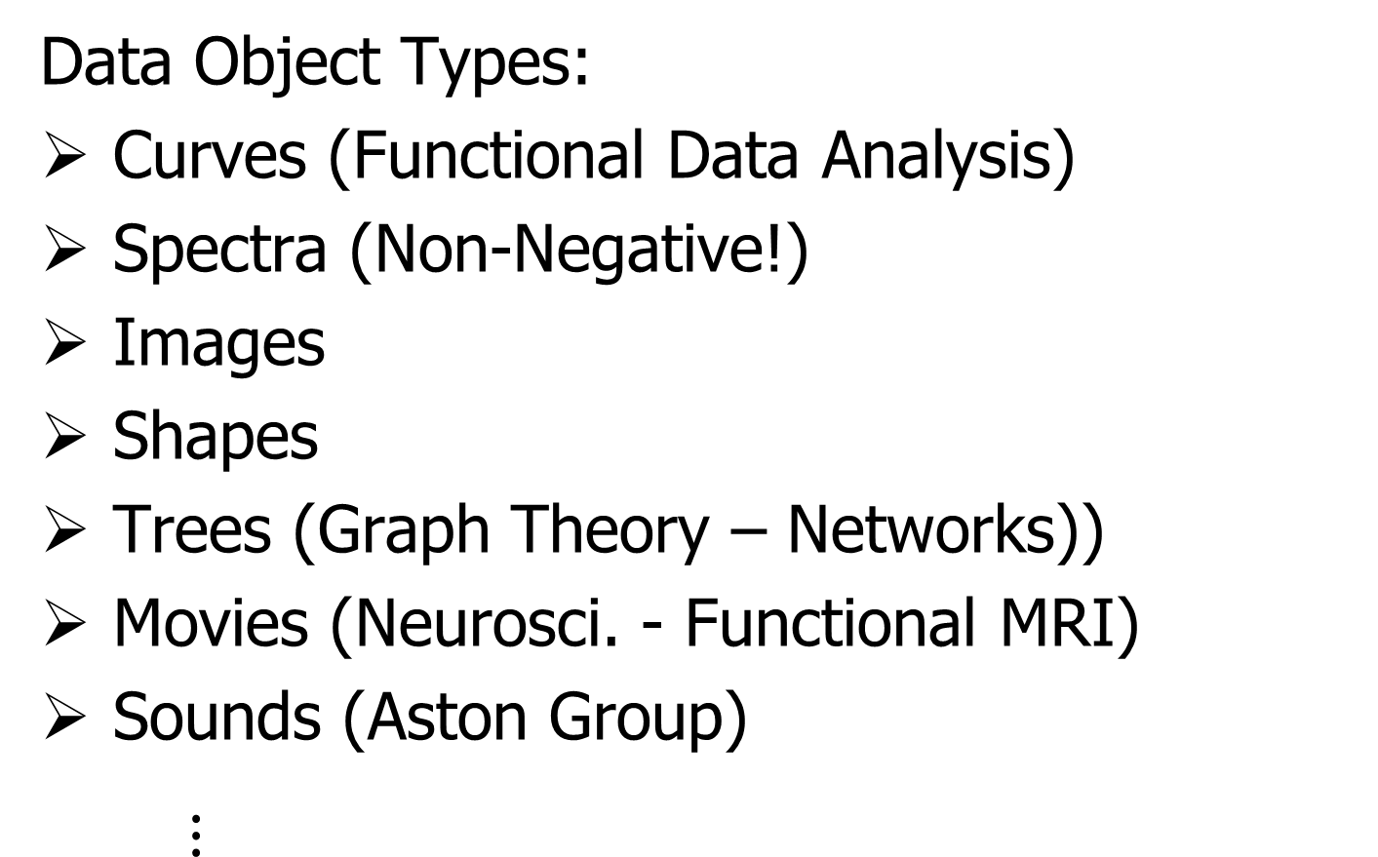
Some Special Cases of OODA
Data Object Types:
Curves (Functional Data Analysis)
Spectra (Non-Negative!)
Images
Shapes
Trees (Graph Theory – Networks))
Movies (Neurosci. - Functional MRI)
Sounds (Aston Group)
$⋮$

Slide 4
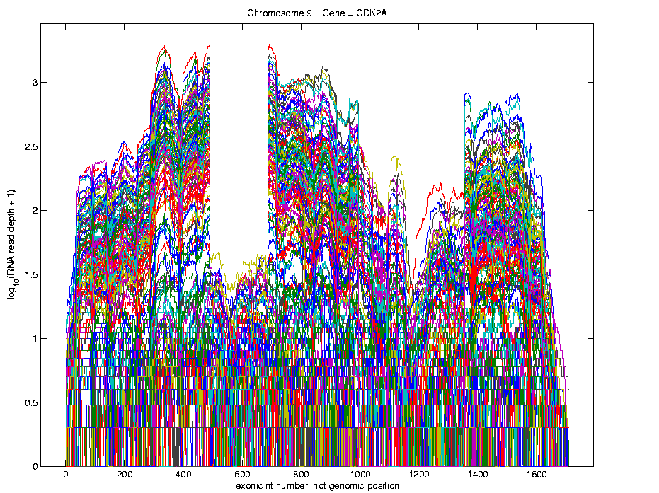
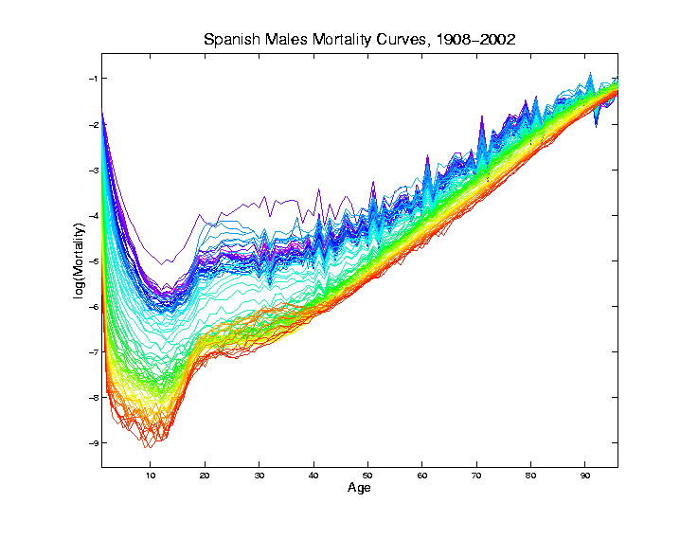
Curves as Data Objects (FDA)
Generally Euclidean: Use standard methods

Slide 5
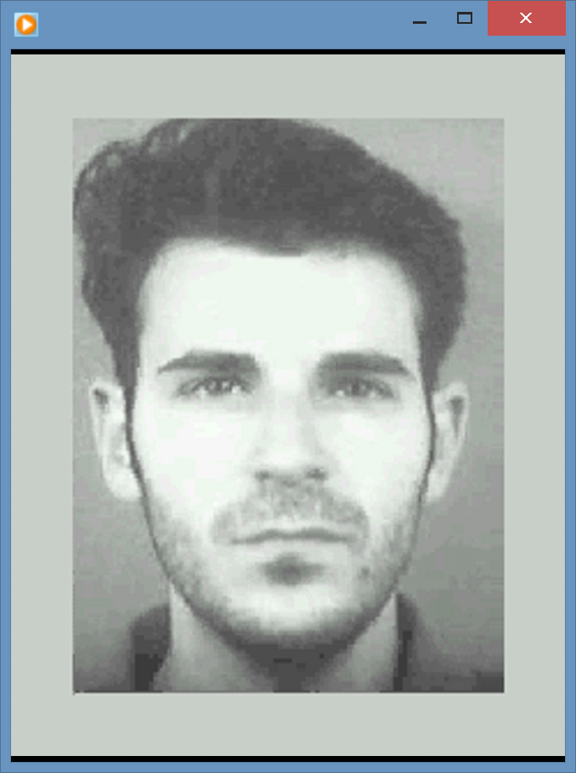
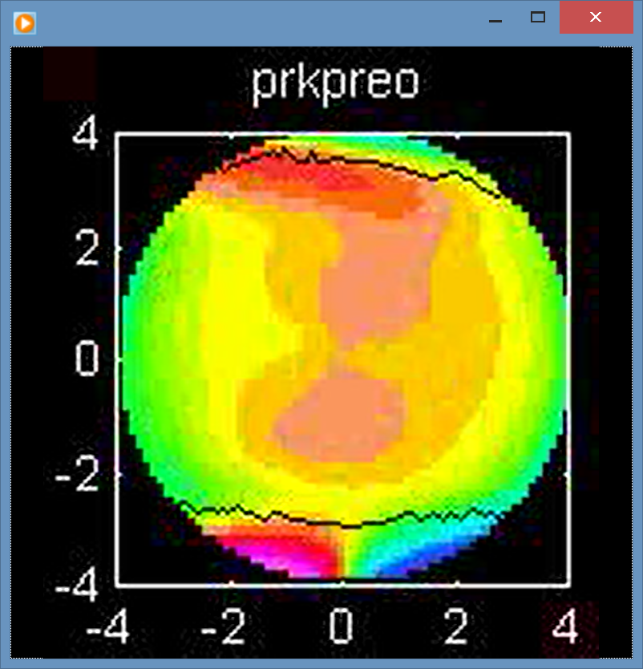
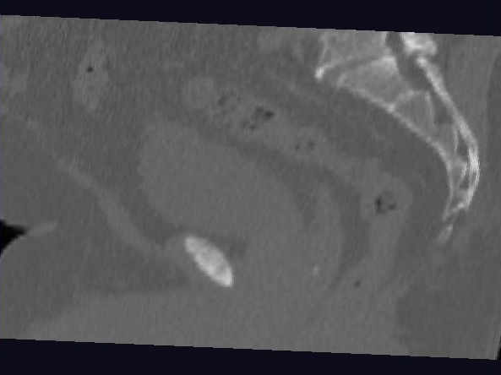
Images as Data Objects
Challenge: High Dimension, Low Sample Size

Slide 6
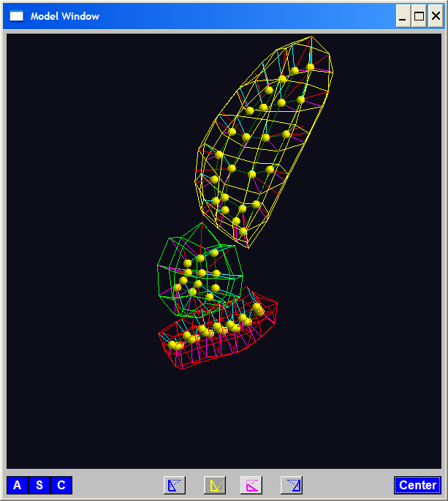
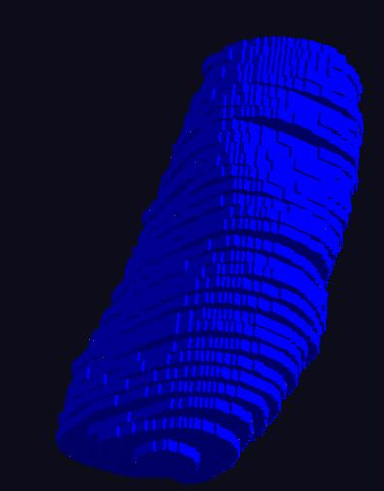
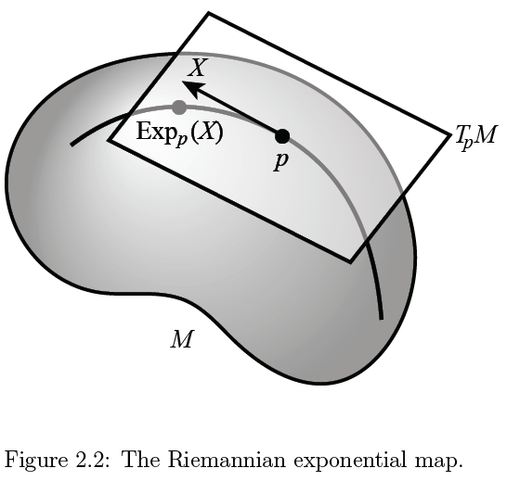
Shapes as Data Objects
Challenge: Data Lie in (Curved) Manifold

Slide 7
Shapes as Data Objects
Challenge: Data Lie in (Curved) Manifold
Important General Development:
Backwards PCA

Slide 8
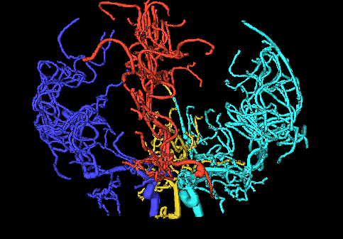
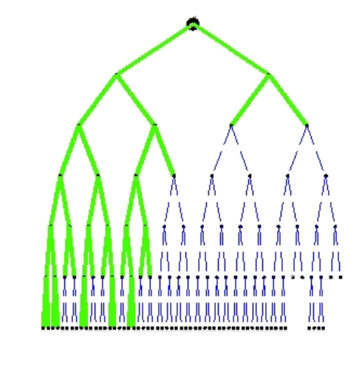
Trees as Data Objects
Challenge: More Complicated Data Space
Manifold Stratified Space

Slide 9
Trees as Data Objects
Challenge: More Complicated Data Space
Manifold Stratified Space
Surprisingly (?!?) Useful Approach:
Topological Data Analysis
Persistent Homology

Slide 10
Object Oriented Data Analysis
Original Thought:
OODA = Mathematical Framework
(containing wide variety
of interesting cases)

Slide 11
Object Oriented Data Analysis
Original Thought:
OODA = Mathematical Framework
Current View:
OODA = Focal Point
{For discussions (interdisciplinary)
about tackling serious analyses}

Slide 12
Object Oriented Data Analysis
Original Thought:
OODA = Mathematical Framework
Current View:
OODA = Focal Point
What should be the Data Objects?

Slide 13
DIVAS Motivation
Traditional Data:
Organized as Matrix
(Single Data Block)
Increasingly Common:
Multi-Block Data
(From Same Cases)

Slide 14
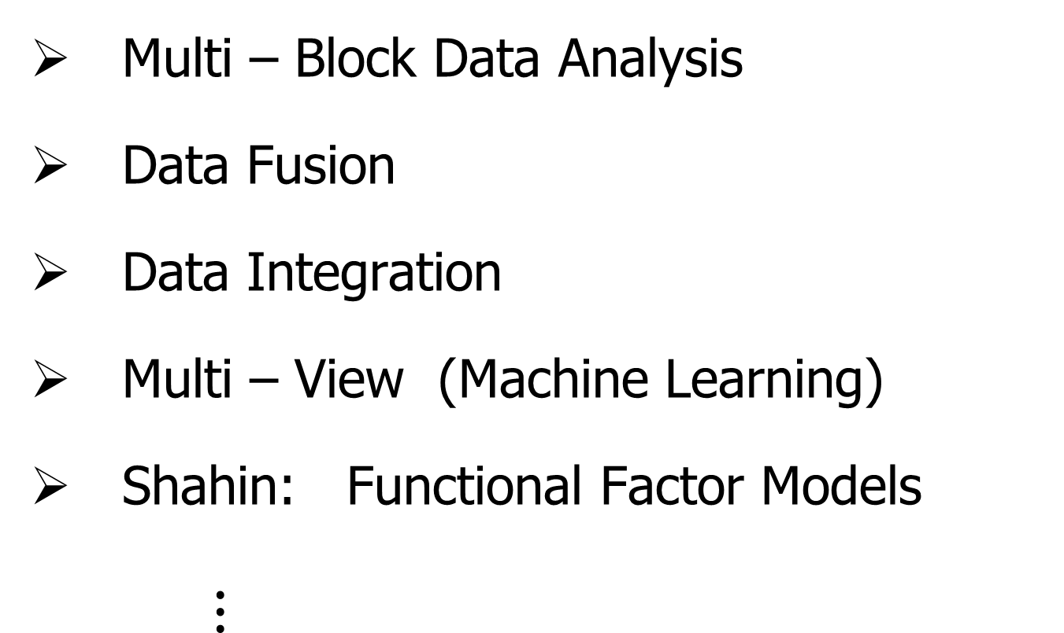
Multi – Block Synonyms
Multi – Block Data Analysis
Data Fusion
Data Integration
Multi – View (Machine Learning)
Shahin: Functional Factor Models
$⋮$

Slide 15
DIVAS Motivation
Cancer Research:
2000 – Microarrays for gene expression
Hype: “Will Cure Cancer”
Hmm, afraid not…
Response:
Have $$$, so measure much more…

Slide 16
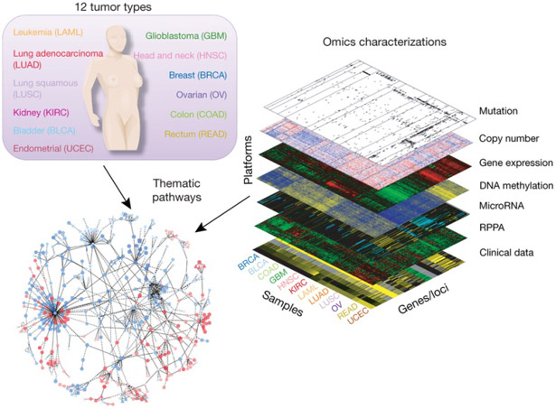
DIVAS Motivation
The Cancer
Genome
Atlas
Multiple Blocks
People Common
Across Blocks
Figure : The Cancer Genome Atlas Research Network, Weinstein, J.N., Collisson, E.A., Mills, G.B., Shaw, K.M., Ozenberger, B.A., Ellrott, K., Shmulevich, I., Sander, C., and Stuart, J.M. (2013)
The Cancer Genome Atlas Pan-Cancer analysis project.

Slide 17
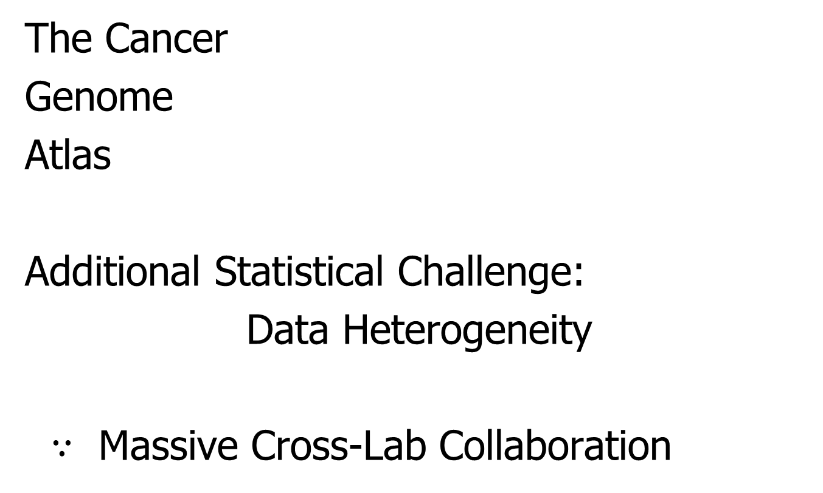
DIVAS Motivation
The Cancer
Genome
Atlas
Additional Statistical Challenge:
Data Heterogeneity
$∵$ Massive Cross-Lab Collaboration

Slide 18
DIVAS Motivation
Context:
Multiple Measurements – Same Cases
E.g. Cancer Research 1:
The Cancer Genome Atlas

Slide 19
DIVAS Motivation
Context:
Multiple Measurements – Same Cases
E.g. Cancer Research 1:
E.g. Cancer Research 2:
H&E Image Features
Genetics

Slide 20
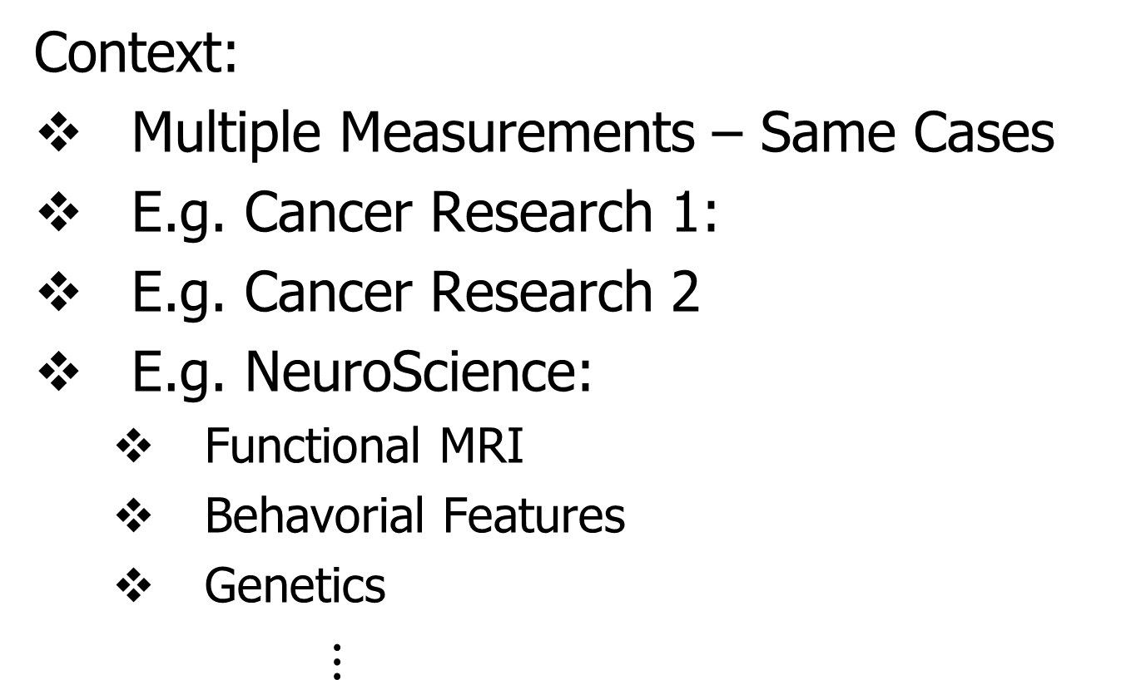
DIVAS Motivation
Context:
Multiple Measurements – Same Cases
E.g. Cancer Research 1:
E.g. Cancer Research 2
E.g. NeuroScience:
Functional MRI
Behavorial Features
Genetics
$⋮$

Slide 21
DIVAS: Important Pre-cursor
JIVE
“Joint and Individual Variation Explained”

Slide 22

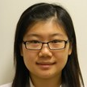


JIVE Collaborators
Eric Lock
Qing Feng
Andrew Nobel
Jan Hannig

Slide 23
JIVE Data Structure
Organizational Model
for Single Data Set:
Matrix
Convention in this talk:
“Columns as Data Objects”
(Atoms of the Statistical Analysis,
i.e. Experimental Units, or Data Vectors)

Slide 24
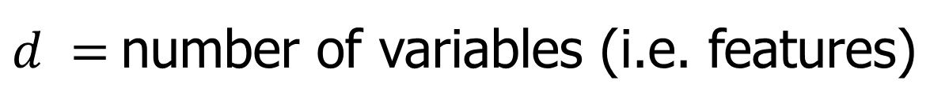


JIVE Data Structure
Organizational Model
for Single Data Set:
Matrix
Convention in this talk:
“Columns as Data Objects”
$$d$$
$$n$$
$d =$number of variables (i.e. features)
$n =$number of cases (i.e. subjects or samples)

Slide 25
JIVE Data Structure
Organizational Model
for Single Data Set: ←
Matrix
Convention in this talk:
Data Are “Column Object Centered”
i.e. Mean Vector is 0

Slide 26
JIVE Data Structure
Organizational Model
for Single Data Set:
Matrix
Convention in this talk:
Data Are “Column Object Centered”
i.e. Mean Vector is 0
i.e. Mean of Entries in Each Row is 0

Slide 27
JIVE Data Structure
JIVE Organizational Model:
Multiple Matrices
(Data Types, i.e. “Blocks”)
With common
Columns as Data Objects

Slide 28
JIVE Data Structure
JIVE Organizational Model:
Multiple Matrices
(Data Types, i.e. “Blocks”)
With common
Columns as Data Objects
1st consider only 2 blocks

Slide 29
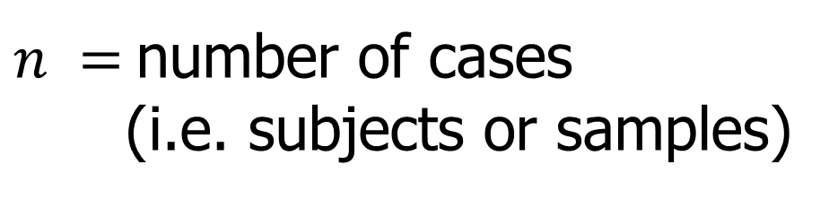
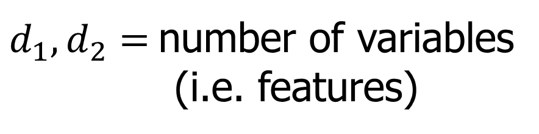



JIVE Data Structure
JIVE Organizational Model:
Multiple Matrices:
$d_{1},d_{2}=$number of variables
(i.e. features)
$$d_{1}$$
$$n$$
$n =$number of cases
(i.e. subjects or samples)
$$d_{2}$$
$$n$$

Slide 30
JIVE Analytic Goals
Explore & Quantify Variation
In spirit of PCA
(Principal Component Analysis)

Slide 31









PCA Underpinnings
For Col. Object Mean Centered Data Matrix:
Apply Singular Value Decomposition
$$r$$
$$r$$
$$=$$
$$r$$
$$n$$
$$d$$
$$d$$
$$n$$
$$r$$
Loadings
x Scores

Slide 32
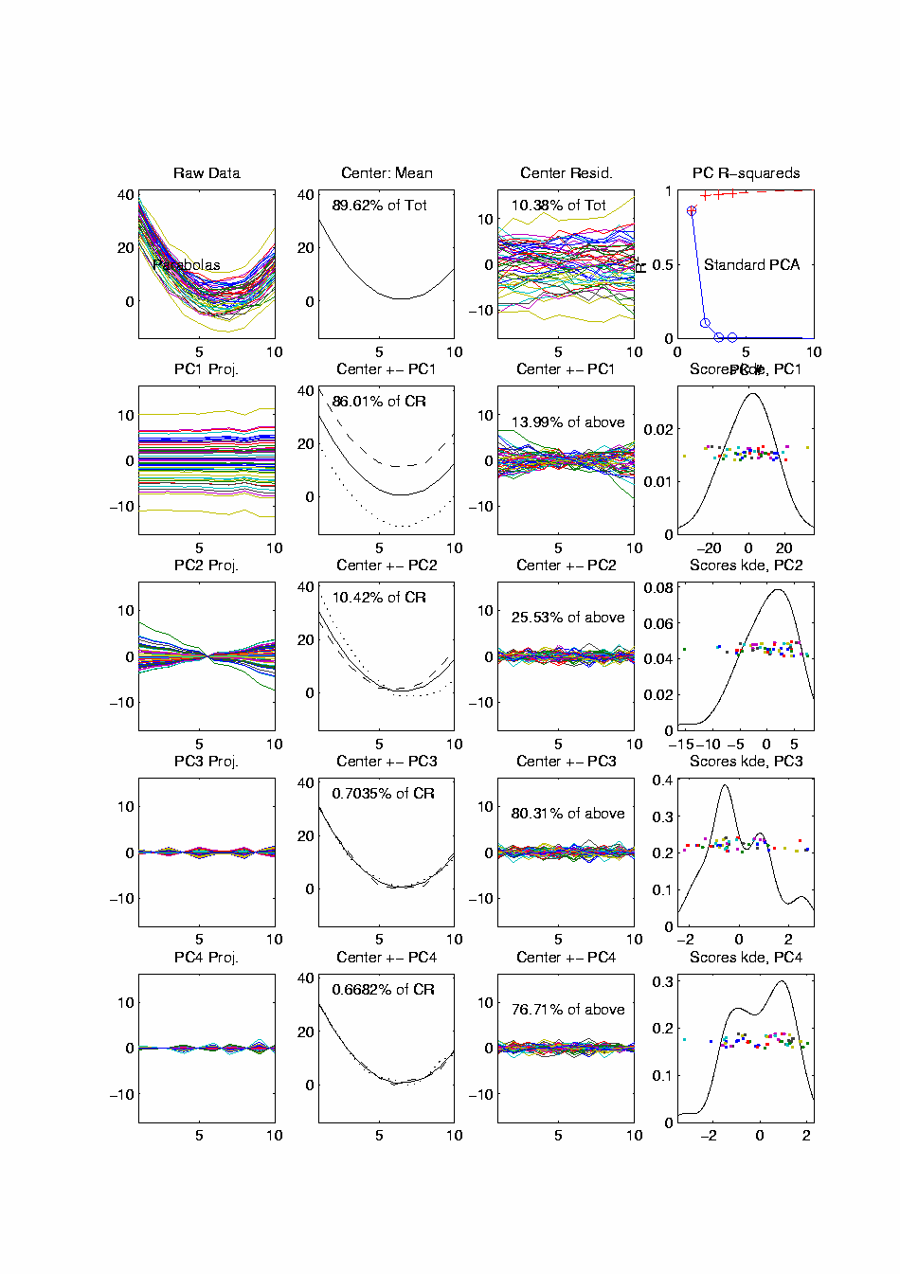

PCA Toy Eg. - Functional Data Analysis
$n=50,$
$d=10$
Data
Vectors
Note Mode
of Variation:
All Up vs.
All Down
Loading
Vectors
x
Scores
Scores

Slide 33
Functional Data Analysis, 10-d Toy EG 1

Slide 34
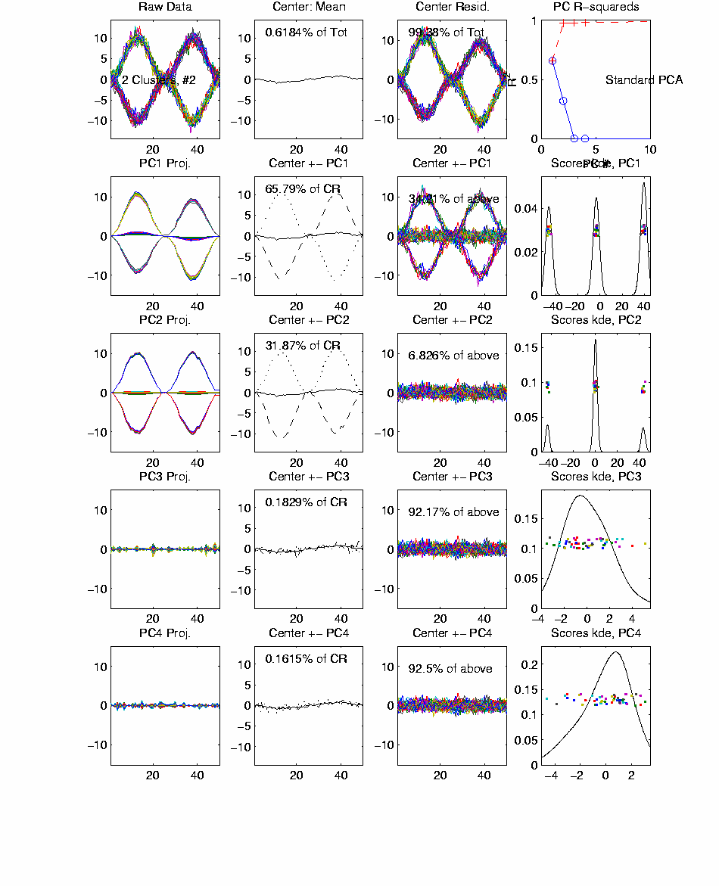
Functional Data Analysis, 50-d Toy EG 2

Slide 35
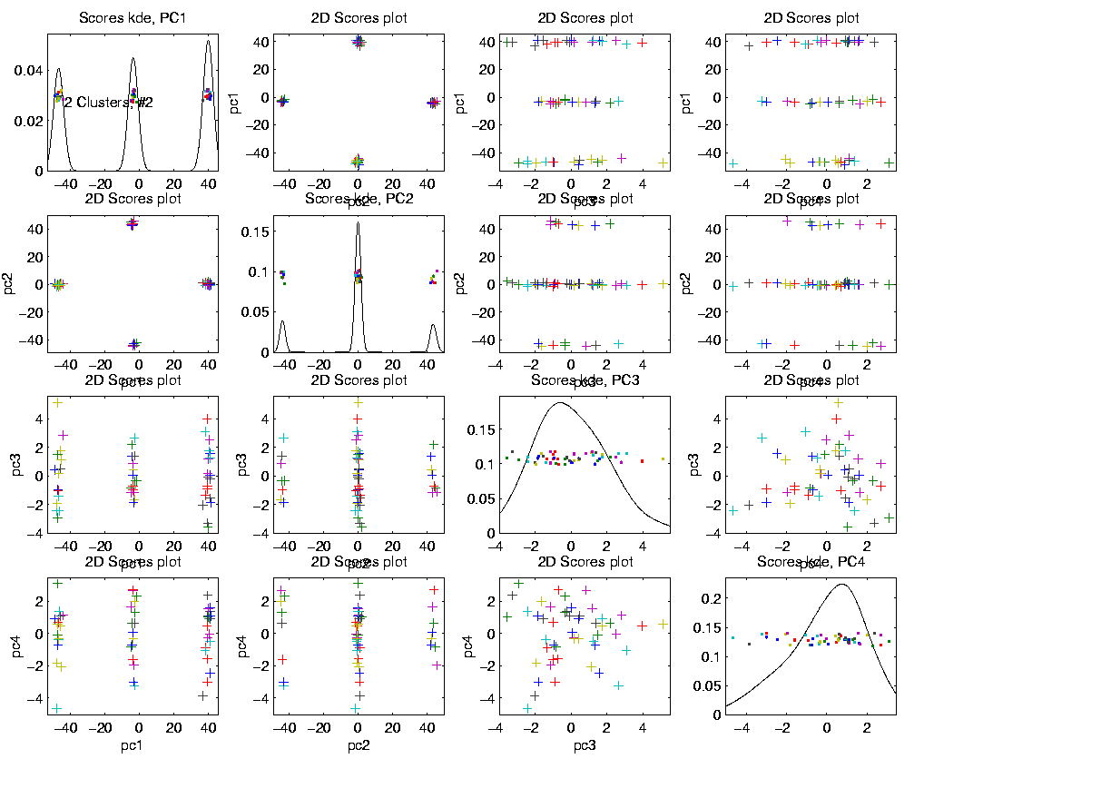
Functional Data Analysis, 50-d Toy EG 2
Scores Show
Relations
Between
Data Objects

Slide 36
Functional Data Analysis, 50-d Toy EG 2
Note: Clean Directions
Are a Consequence of
Separated Eigenvalues

Slide 37
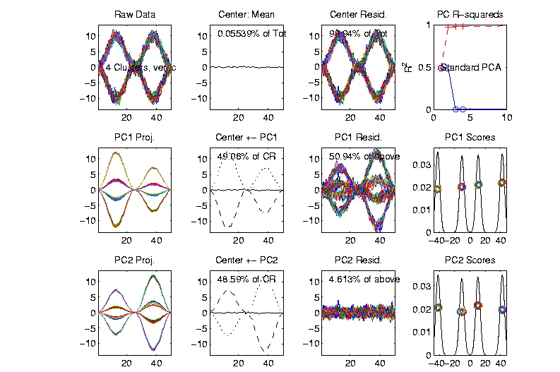
Functional Data Analysis, 50-d Toy EG 2
First 2
Eigenvalues
Now Similar
Related
Example
Rotated
(Linear
Combo)
Directions
Hard to
Interpret
Gives Random Rotation

Slide 38

Example of PCA Data Exploration
Context: Single Data Set
Fun Example:
RNAseq Lung Cancer Data
Thanks to: D. Neil Hayes
Oncology, UNC

Slide 39
Example of PCA Data Exploration
Interesting Real Data Example
Genetics (Cancer Research)
RNAseq (Next Gener’n Sequen’g)
Deep look at “gene expression”
Microarrays: Single number (per gene)
RNAseq: Thousands of measurements

Slide 40
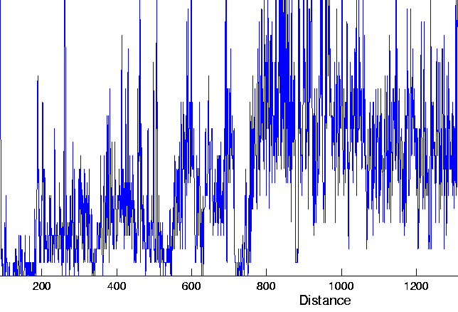
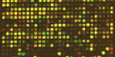
Example of PCA Data Exploration
Interesting Real Data Example
Genetics (Cancer Research)
RNAseq (Next Gener’n Sequen’g)
Deep look at “gene expression”

Slide 41
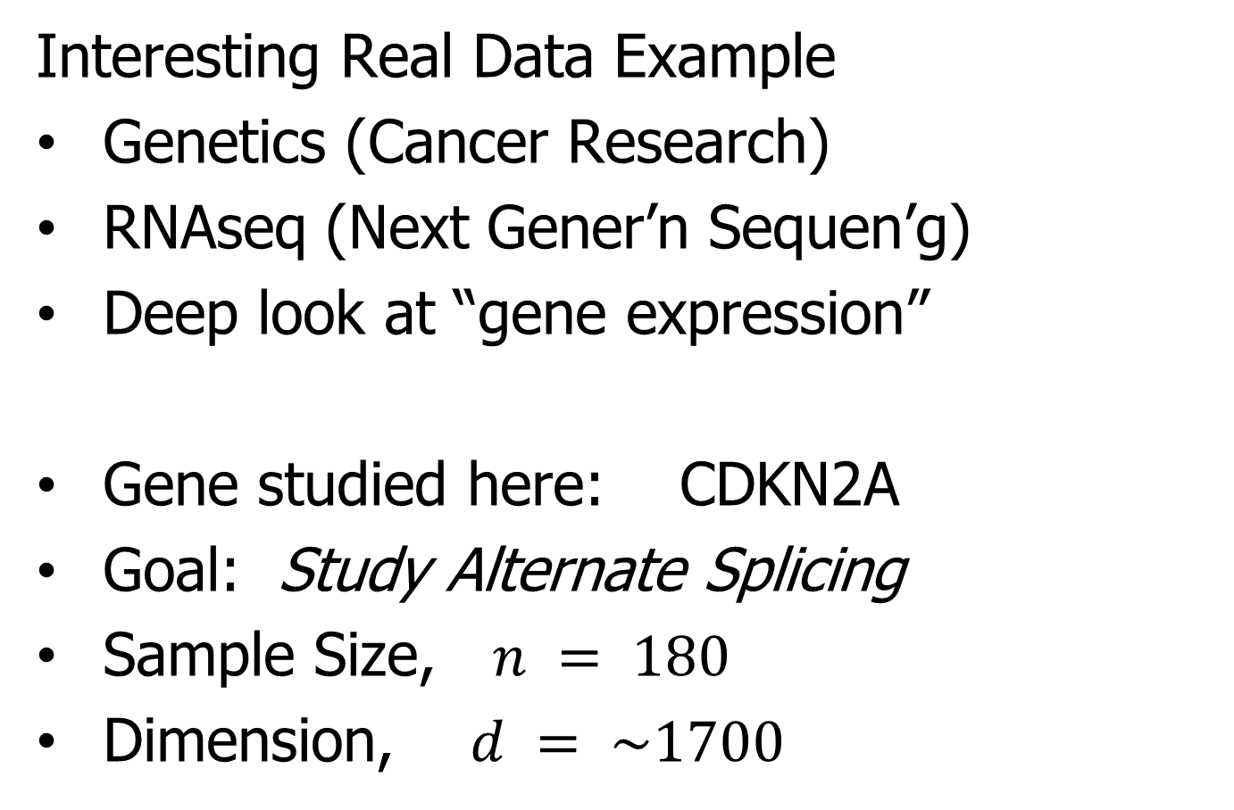
Example of PCA Data Exploration
Interesting Real Data Example
Genetics (Cancer Research)
RNAseq (Next Gener’n Sequen’g)
Deep look at “gene expression”
Gene studied here: CDKN2A
Goal: Study Alternate Splicing
Sample Size, $n = 180$
Dimension, $d = \sim 1700$

Slide 42
Example of PCA Data Exploration
Simple
1st
View:
Curve
Overlay
(log
scale)
Thanks to
Matt Wilkerson

Slide 43
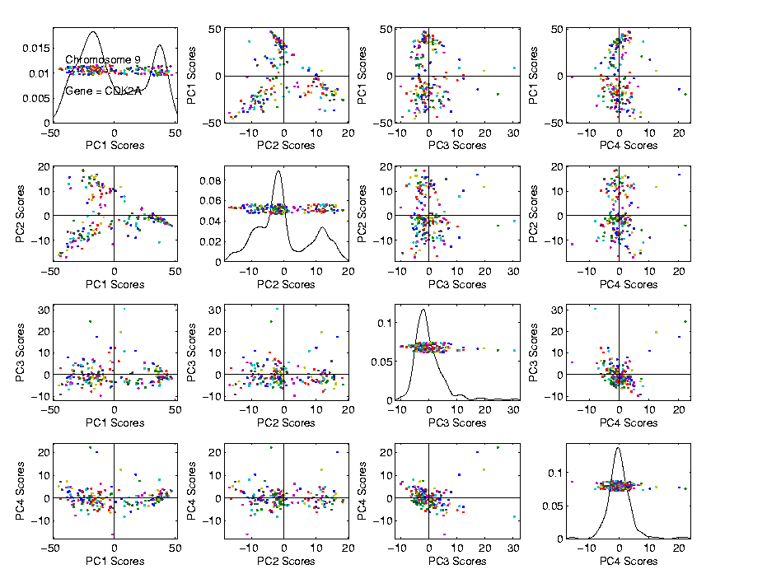
Example of PCA Data Exploration
Often
Useful
Population
View:
PCA
Scores

Slide 44
Example of PCA Data Exploration
Suggestion
Of
Clusters
???

Slide 45
Example of PCA Data Exploration
Suggestion
Of
Clusters
Which
Are
These?

Slide 46
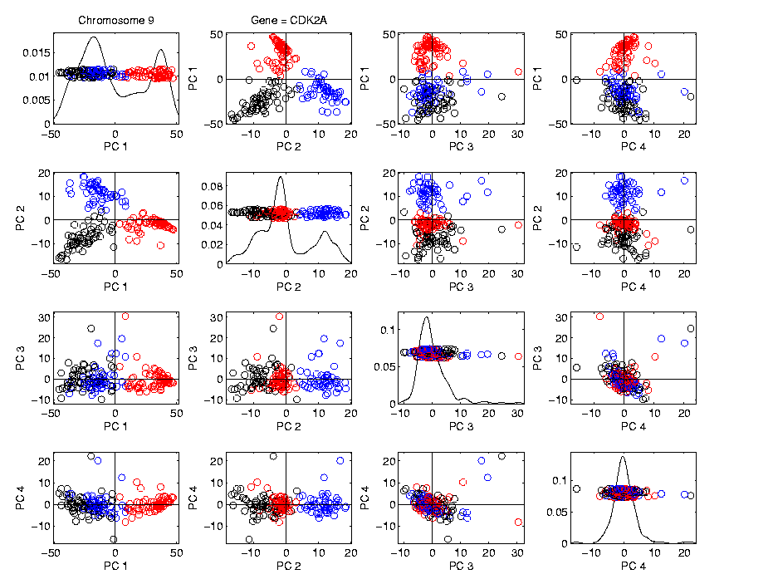
Example of PCA Data Exploration
Manually
Brush
Clusters

Slide 47
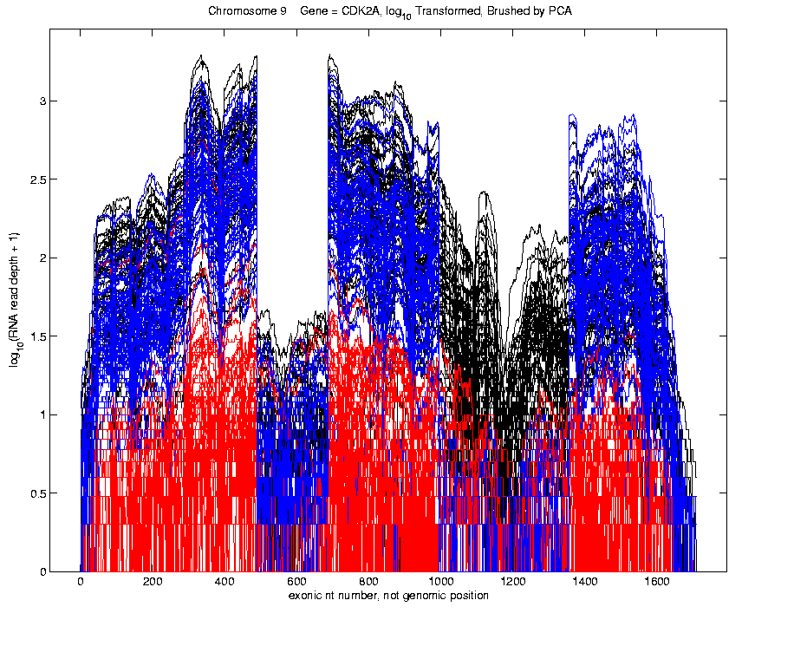
Example of PCA Data Exploration
Manually
Brush
Clusters
Clear
Alternate
Splicing

Slide 48
Example of PCA Data Exploration
Consequences of this Visualization:
Lead to Full Genome Screening Method
SigFuge
Important Component: SigClust
(Which Clusters are Really There?)
Found New Splices
(Now Been Biologically Verified)

Slide 49

Example of PCA Data Exploration
Context: Single Data Set
Fun Example:
Spanish Male Mortality
Thanks to: Andrés M. Alonso
U. Carlos III, Madrid

Slide 50
Example of PCA Data Exploration
Context: Single Data Set
Fun Example:
Spanish Male Mortality
Data Objects:
Mortality(age) = log(# of age died / # age)

Slide 51
Example of PCA Data Exploration
Context: Single Data Set
Fun Example:
Spanish Male Mortality
Data Objects:
Mortality(age) = log(# of age died / # age)
Over years (1908 - 2002)

Slide 52
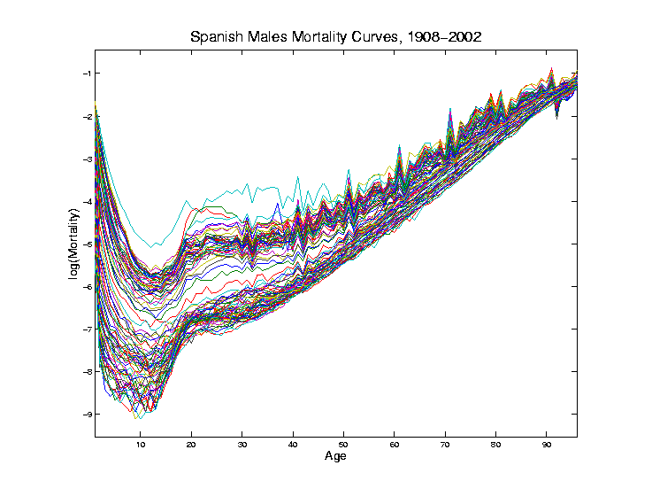
PCA Exploration of Spanish Mortality
Conventional
Coloring:
Rotate
Through
(7) Colors
Hard to
See Time
Structure

Slide 53
PCA Exploration of Spanish Mortality
Improved
Coloring:
Rainbow
Representing
Year:
Magenta
= 1908
Red = 2002

Slide 54
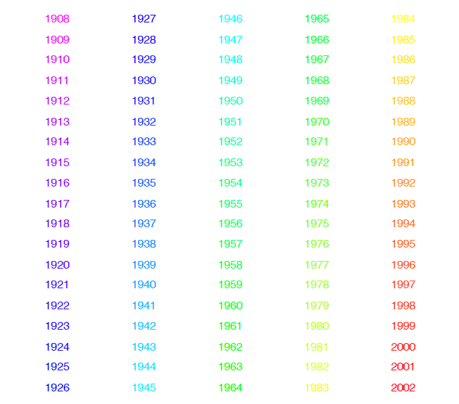
PCA Exploration of Spanish Mortality
Color Code
(Years)

Slide 55
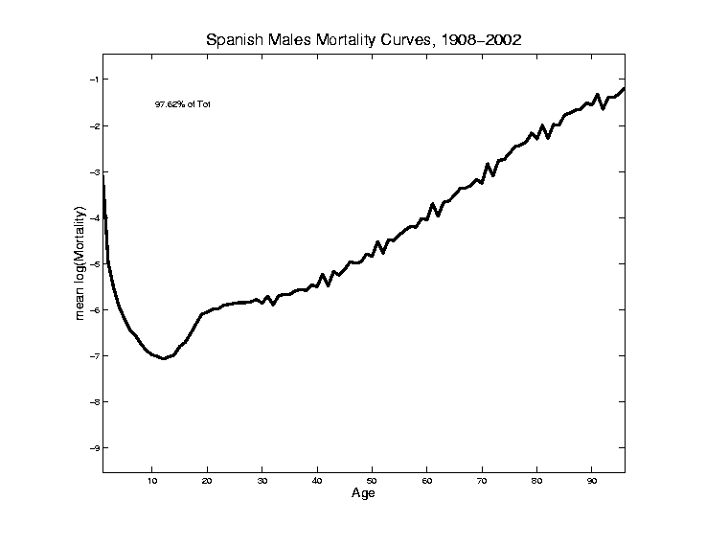
PCA Exploration of Spanish Mortality
Find
Population Center
(Mean Vector)

Slide 56
PCA Exploration of Spanish Mortality
Blips Appear
At Decades
Since Ages
Not Precise
(in Spain)
Reported as
“about 50”,
Etc.

Slide 57
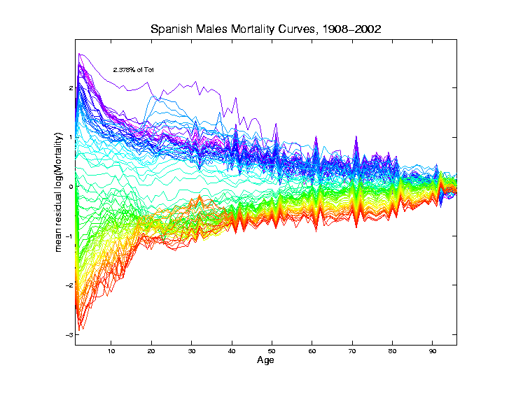
PCA Exploration of Spanish Mortality
Mean
Residual
View of
Shifting Data
To Origin

Slide 58
PCA Exploration of Spanish Mortality
Shows:
Main Age
Effects in
Mean, Not
Variation
About Mean

Slide 59
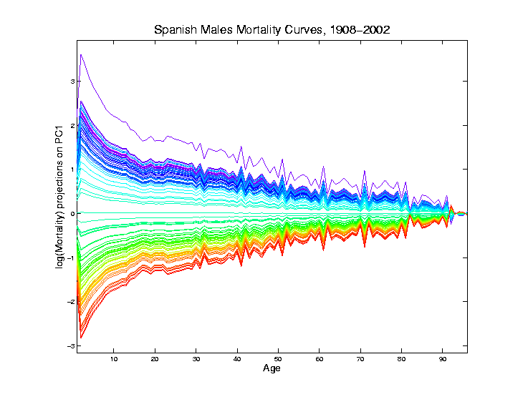
PCA Exploration of Spanish Mortality
Projections
Onto PC1
Direction
Main Mode
Of Variation:
Constant
Across Ages
1st Loading Vector x Scores

Slide 60
PCA Exploration of Spanish Mortality
Shows Major
Improvement
Over Time
(medical technology,
etc.)

Slide 61
PCA Exploration of Spanish Mortality
Shows Major
Improvement
Over Time
(medical technology,
etc.)
And Change
In Age
Rounding Blips
Mode of Variation:
All Up vs. All Down

Slide 62
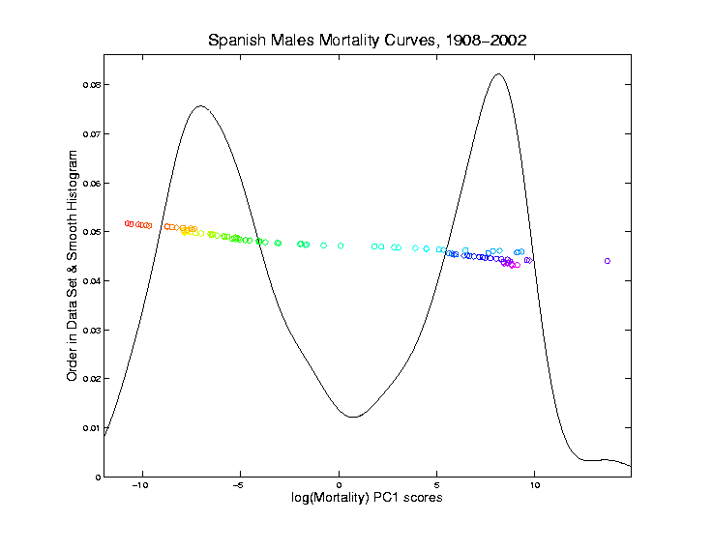
PCA Exploration of Spanish Mortality
Corresponding
PC 1 Scores
Again Shows
Overall
Improvement

Slide 63
PCA Exploration of Spanish Mortality
Corresponding
PC 1 Scores
Again Shows
Overall
Improvement
High Mortality
Early

Slide 64
PCA Exploration of Spanish Mortality
Corresponding
PC 1 Scores
Again Shows
Overall
Improvement
High Mortality
Early
Lower Later
Transformation Fairly Rapid

Slide 65
PCA Exploration of Spanish Mortality
Outliers
1918 Global
Flu Pandemic
1936-1939
Spanish
Civil War

Slide 66
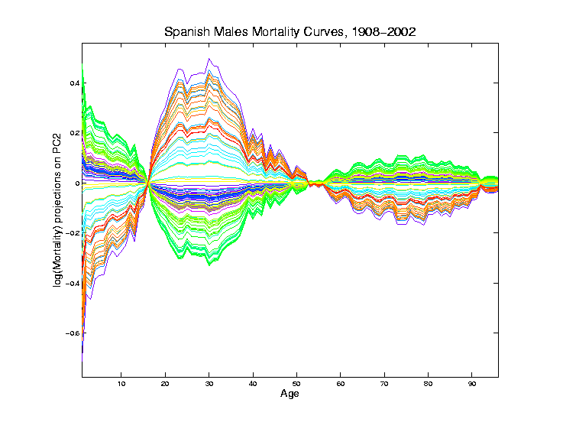
PCA Exploration of Spanish Mortality
Projections
Onto PC2
Direction
2nd Loading Vector x Scores

Slide 67
PCA Exploration of Spanish Mortality
Projections
Onto PC2
Direction
2nd Mode
Of Variation:
Difference
Between
20-45 & Rest

Slide 68
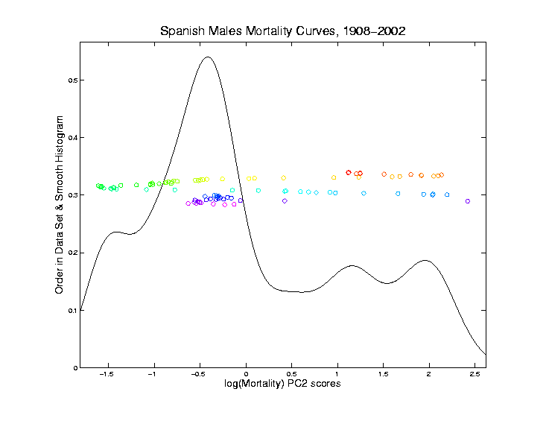
PCA Exploration of Spanish Mortality
Explain Using
PC 2 Scores

Slide 69
PCA Exploration of Spanish Mortality
Explain Using
PC 2 Scores
Pandemic Hit Relatively
Hardest

Slide 70
PCA Exploration of Spanish Mortality
Explain Using
PC 2 Scores
Spanish Civil War Hit
Hardest
Steady
Improvement
To mid-50s

Slide 71
PCA Exploration of Spanish Mortality
Explain Using
PC 2 Scores
Increasing
Automotive
Death Rate
Corner Finally
Turned by
Safer Cars
& Roads

Slide 72
PCA Exploration of Spanish Mortality
Future
Swings?
Texting
&
Driving
???

Slide 73
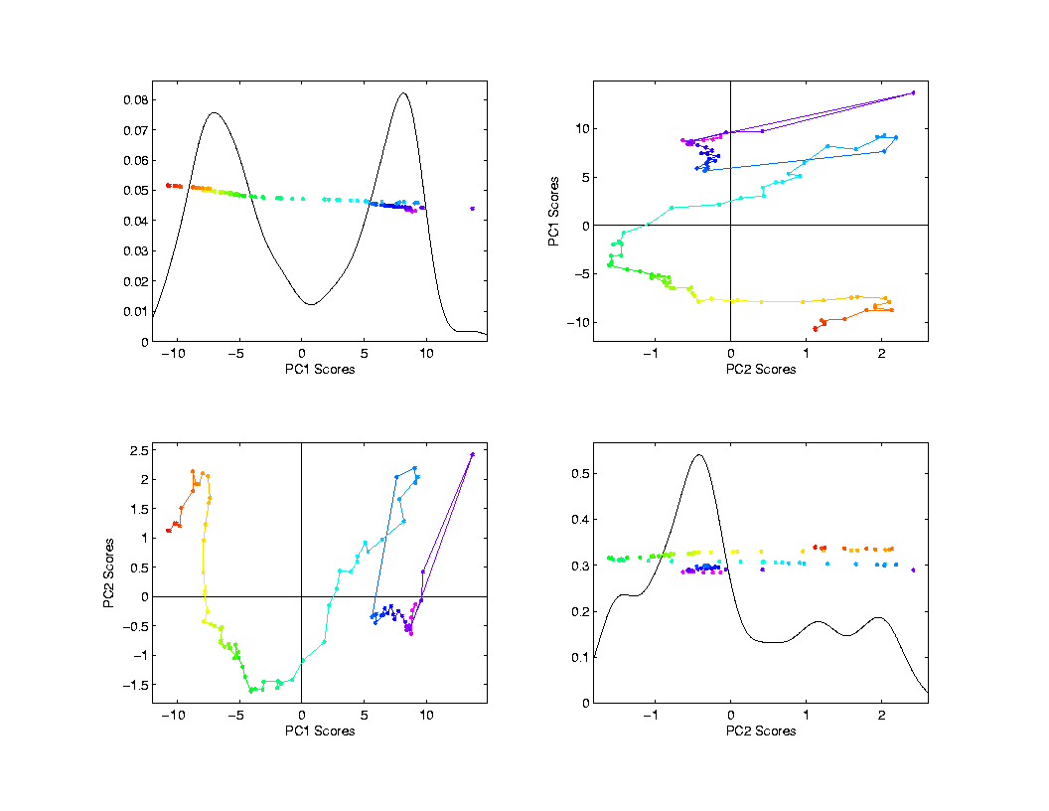
PCA Exploration of Spanish Mortality
Scatterplot
Matrix View
Scores Plot
Connecting
Lines
Highlight
Time Order

Slide 74
PCA Exploration of Spanish Mortality
Scatterplot
Matrix View
Scores Plot
Common 1st Graphic in Exploratory
Analysis
Reveals Relationships Between Data Objects

Slide 75
PCA Exploration of Spanish Mortality
Common 2nd Graphic in Exploratory
Analysis
Shows
Driver
Of PC
Direction
Via Vector
Entries
Loadings Plot

Slide 76
JIVE Analytic Goals
Explore & Quantify Variation
In spirit of PCA
(Principal Component Analysis)
For 2+ Data Blocks

Slide 77
JIVE Analytic Goals
Explore & Quantify Variation
Through Joint Variation
via Common Scores
(Signatures Among Cases)

Slide 78
JIVE Analytic Goals
Explore & Quantify Variation
Through Joint Variation
via Common Scores
(Signatures Among Cases)
And Individual Variation
(Ortho to Joint & Not Colinear)

Slide 79
JIVE Analytic Goals
Understand Drivers
Using Loadings
Joint Loadings

Slide 80
JIVE Analytic Goals
Understand Drivers
Using Loadings
Joint Loadings
Individual Loadings

Slide 81
JIVE Algorithm
Overview of Steps
Low Rank Reduction (SVD)
Principal Angle Analysis & Threshold
→ Common Normalized Scores
Projections to get Decompositions
Joint & Individual Scores and Loadings

Slide 82




Principal Angle Analysis
Idea: Relate Subspaces $S_{1}$, $S_{2}$ of $ℝ^{n}$
Using Minimal Angles
$$θ_{1}=0$$
$$θ_{2}$$
Key JIVE concept:
Linear Algebra In
$n$ - Space
And Iterate Orthogonally
PAA Computation: ~Concatenate & SVD

Slide 83
Functional Magnetic Resonance Imaging
Approach:
Measure “Brain Activity”
Over Both Location & Time
Via Blood Flow
Data Objects???

Slide 84

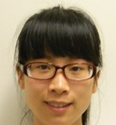

Functional Magnetic Resonance Imaging
2015 SAMSI Program
On Neuroscience
Qunqun Yu Benjamin Risk

Slide 85
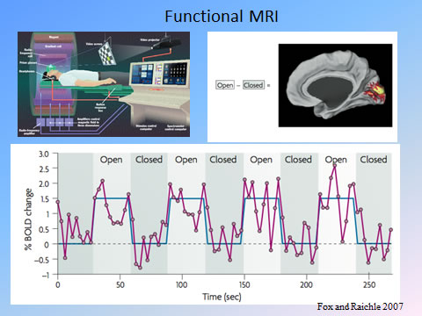
Functional Magnetic Resonance Imaging
Data
Objects?
3d- Movie?
Time Series
At Voxels?
Thanks to fmri.ucsd.edu

Slide 86

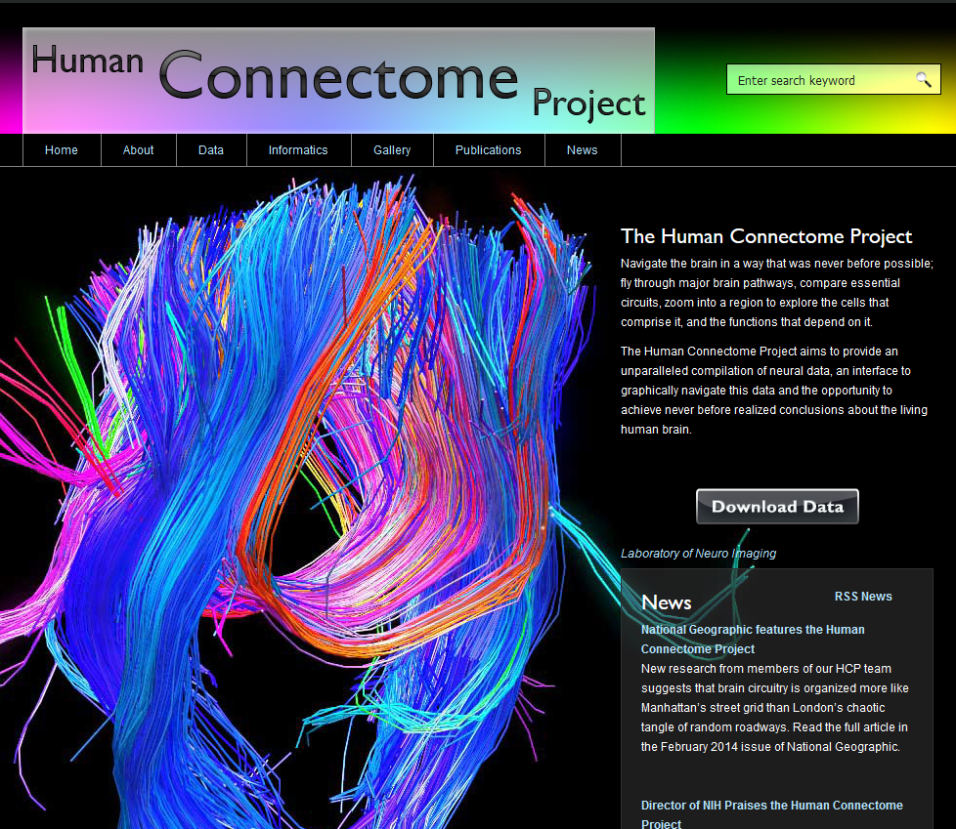
Functional Magnetic Resonance Imaging
Study Data From:

Slide 87
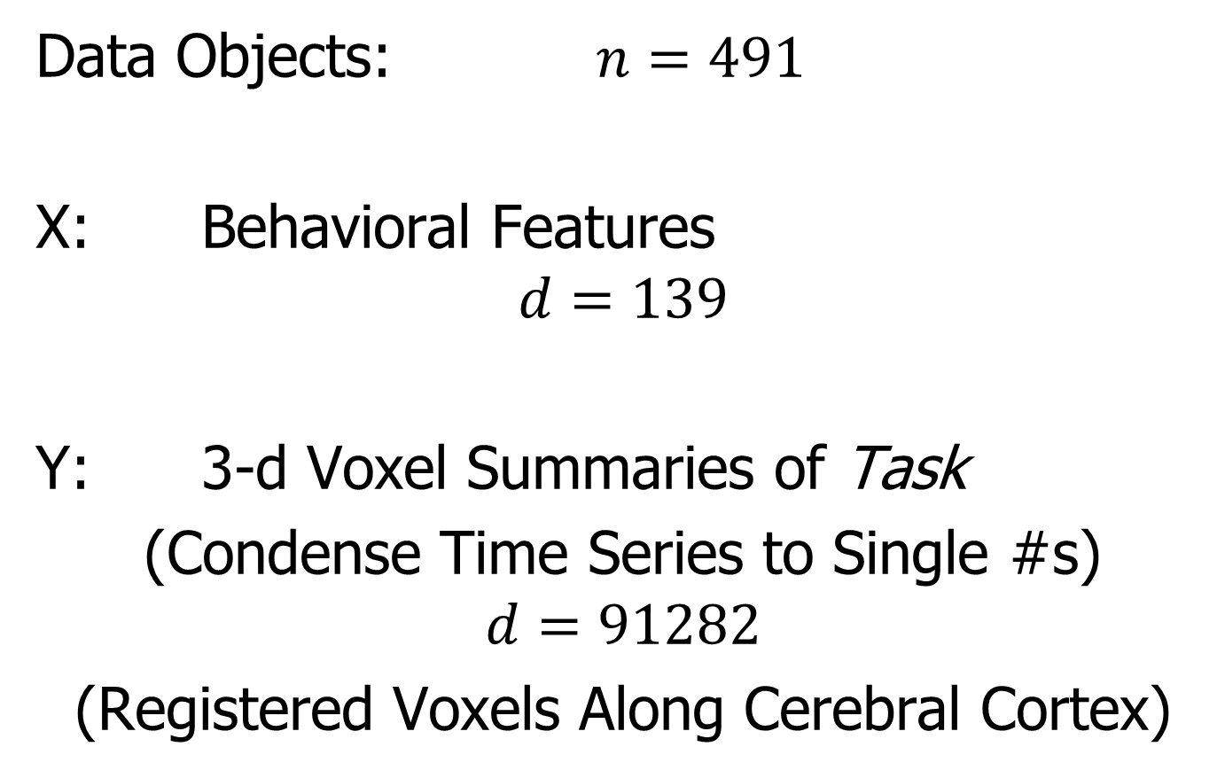
Functional Magnetic Resonance Imaging
Data Objects: $n=491$
X: Behavioral Features
$$d=139$$
Y: 3-d Voxel Summaries of Task
(Condense Time Series to Single #s)
$$d=91282$$
(Registered Voxels Along Cerebral Cortex)

Slide 88
Functional Magnetic Resonance Imaging
Focus of Analysis:
Loadings (Drivers)
Behavioral Features
Lit Up Brain Regions
Since Scores All Gaussian
(Normal Population)
Which Work
Together?
Which Work
Separately?

Slide 89
Functional Magnetic Resonance Imaging
View Entries of Eigenvectors
Separate
PC1 of
Behavior
Feature
Loadings
Important
Groups

Slide 90
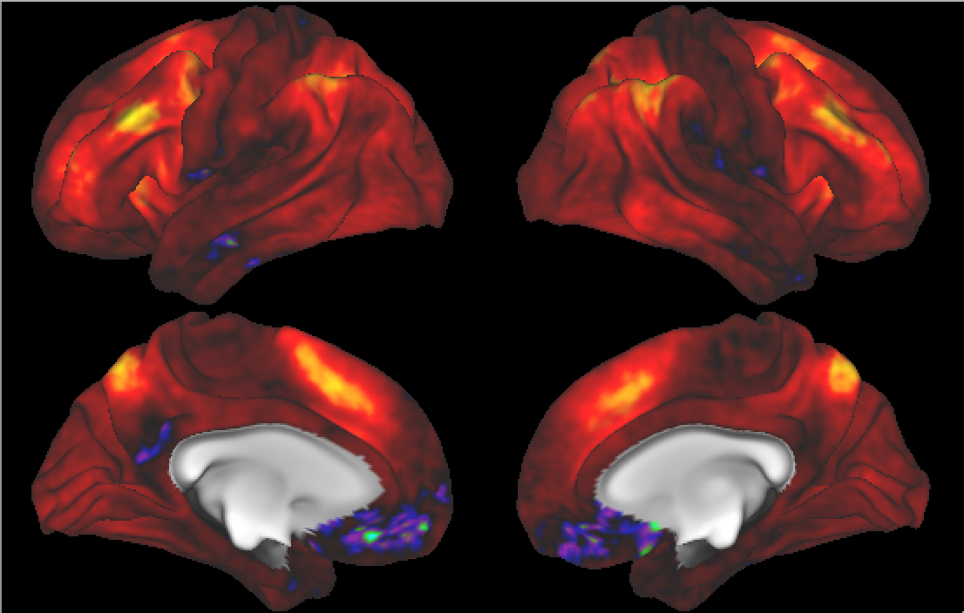

Functional Magnetic Resonance Imaging
View Entries of Eigenvectors
Separate PC1 of Image Loadings
All Up
& Down
Together
Also Some
Hot Spots?

Slide 91
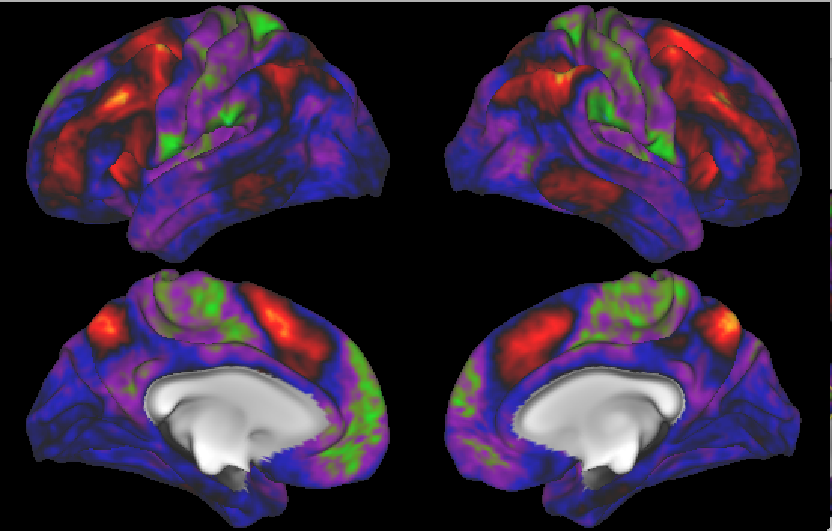
Functional Magnetic Resonance Imaging
Separate PC2 of Image Loadings
Interesting
Structure
???
And Same
Hot Spots?

Slide 92
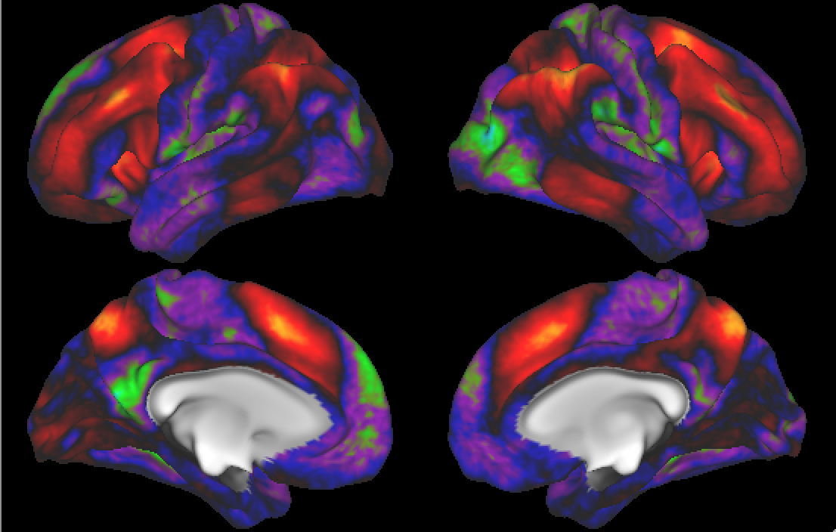
Functional Magnetic Resonance Imaging
Previous Mapping of Regions of Interest
Hot Spots
Are
Working
Memory
Related

Slide 93
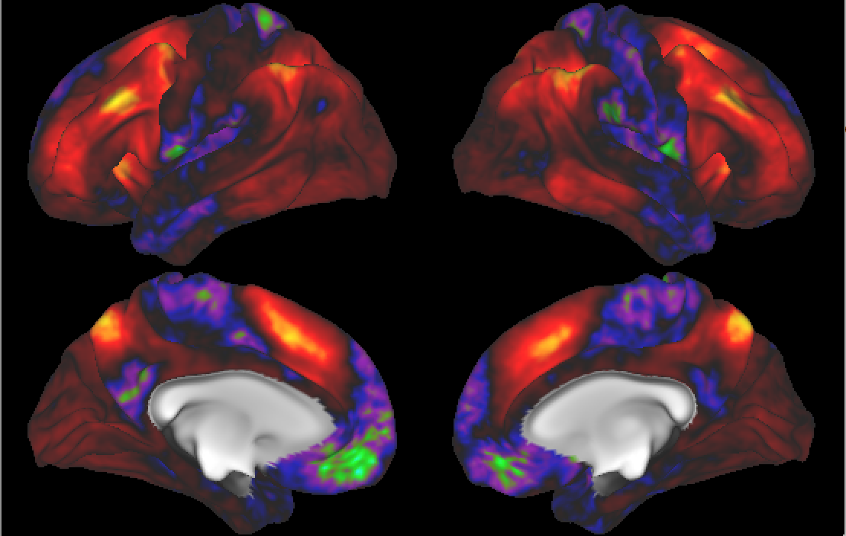
Functional Magnetic Resonance Imaging
Joint PC1 of Image Loadings
Using
Behavior
Combines
Hot Spots
From
Separate
PC1 & 2

Slide 94
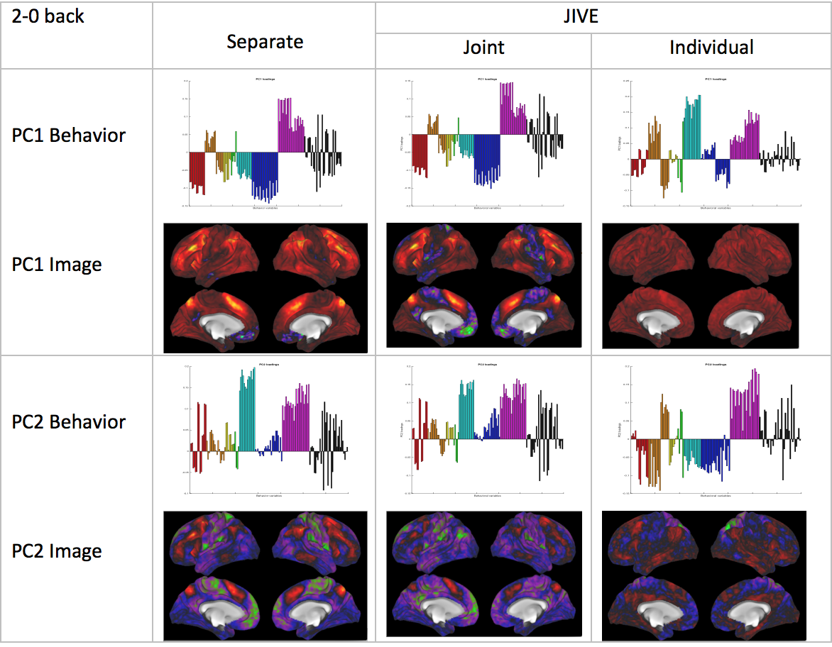
Functional Magnetic Resonance Imaging
Overall
Comparison
Sep. Beh. PC1
Assoc. w. Image
Joint Im. PC1
Concentrates
Relevant Parts
Of Sep.
PC1 & PC2

Slide 95
Functional Magnetic Resonance Imaging
Overall
Comparison
Overall Heat
Var’n not
Assoc. w/
Behavior
New 2nd Mode
Of Joint Var’n
Behavior
~ Sep. PC2

Slide 96

Carolina Breast Cancer Study
Thanks to: Iain Carmichael (Deep Learning, AJIVE)
Melissa Troester (Head, CBCS)
Joseph Geradts (Pathology)
Katie Hoadley, Chuck Perou (Genetics)

Slide 97
Carolina Breast Cancer Study
Analysis Goal:
Understand How Images & Genetics
Work Together
Work Separately
Approach: AJIVE
Clinical Diagnostic Standard
Deep Insight &
New Treatments

Slide 98
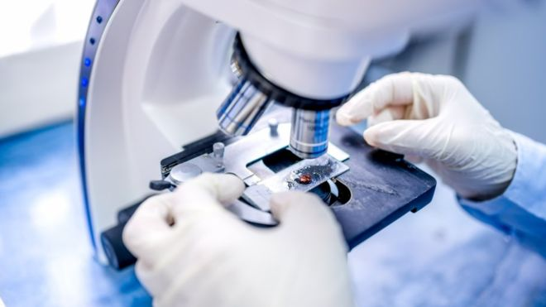

Carolina Breast Cancer Study
Clinical Diagnosis of Cancer:
Pathologist Views Tissue Under Microscope,
Tissue Stained with Hematoxylin & Eosin (H&E)
Thanks to BBC.CO.UK
and Reseachgate.net

Slide 99

Carolina Breast Cancer Study
Tissue Micro Array Data:
Extract Small
(1mm diam.)
“Cores”
Thanks to SPIE.ORG

Slide 100


Carolina Breast Cancer Study
Experimental Design: $n=1191$ people
For Each: 1 – 4 TMA Cores
PAM 50 Gene Expression:

Slide 101
Carolina Breast Cancer Study
PAM 50 Gene Expression:
Set of 50 Genes
Measured mRNA Expression Level
Good at Separating SubTypes
Basal
Her2
Luminal A
Luminal B
Perou Discovery:
No Benefit From
Chemo-Therapy

Slide 102

Carolina Breast Cancer Study
Deep Learning Image Representation
Each Core:
Randomly
Select 100
$224×224$
Patches

Slide 103

Carolina Breast Cancer Study
Deep Learning Image Representation
Reduce Each Patch to 512 Features
Using Transfer Learning From VGG16:
(Trained on Many
Natural Images)
Thanks to pyimagesearch.com

Slide 104
Carolina Breast Cancer Study
Deep Learning Image Representation
For Each Core:
Aggregate Patches by Averaging
(Damps Out “Location” Information)
Then Average Cores For Each Person

Slide 105

Carolina Breast Cancer Study
JIVE: Common Normalized Scores 1
Look at Extremes
Negative End
Top Person
Top 16 Patches
Fat Cells & Stroma

Slide 106

Carolina Breast Cancer Study
JIVE: Common Normalized Scores 1
Look at Extremes
Positive End
Top Person
Top 16 Patches
Highly “Cellular”
Markedly Atypical Cells

Slide 107

Carolina Breast Cancer Study
JIVE: Gene Expression
Common Normalized
Loadings 1
Very Consistent w/ Image
“High Proliferation” Genes
“Low Prolif.” – Lum A Genes

Slide 108

Carolina Breast Cancer Study
JIVE: Common Normalized Scores 2
Look at Extremes
Negative, Top
Top 16 Patches
High Nuclear Grade
Atypical Cells

Slide 109

Carolina Breast Cancer Study
JIVE: Common Normalized Scores 1
Look at Extremes
Positive, Top
Top 16 Patches
Lower Nuclear Grade
Stroma, Sclerosis

Slide 110

Carolina Breast Cancer Study
JIVE: Gene Expression
Common Normalized
Loadings 2
Very Consistent w/ Image
Luminal Subtype Genes
Basal Subtype Genes

Slide 111

Carolina Breast Cancer Study
JIVE, Genes, Individual 1
Overall Up & Down
Together
Not Subtype Related!

Slide 112

Carolina Breast Cancer Study
JIVE, Genes, Individual 2
Luminal vs. Basal
“Contrast”?
“Unbalanced Types”?

Slide 113

Carolina Breast Cancer Study
JIVE, Images, Individual 1
Negative
Mostly Fat Cells
Few Nuclei

Slide 114

Carolina Breast Cancer Study
JIVE, Images, Individual 1
Positive
Reactive Stroma,
Few Nuclei
Little Gene Connected

Slide 115

Carolina Breast Cancer Study
JIVE, Images, Individual 2
Negative
Mucinous & Micro-
Papillary Carcinoma
Not PAM50 Related

Slide 116

Carolina Breast Cancer Study
JIVE, Images, Individual 2
Positive
Fat Cells
Common Endpoint?
“Center”?

Slide 117




DIVAS / JIVE Collaborators
Jan Hannig
Meilei Jiang
Xi Yang
Iain Carmichael
Jack Prothero

Slide 118
DIVAS Improves JIVE
Partially Shared Blocks

Slide 119


DIVAS Improves JIVE
Partially Shared Blocks
JIVE
$$≈$$
$$+$$
Input
Data
Joint
Comp.
Indiv.
Comp.

Slide 120


DIVAS Improves JIVE
Partially Shared Blocks
DIVAS
$$≈$$
$$+$$
$$+$$
$$+$$
$$+$$
Input
Data
Joint
Comp.
Partial
Sharing
Indiv.
Comp.

Slide 121
DIVAS Improves JIVE
Partially Shared Blocks
Better Initial Low Rank Approx. (SVD)
Using Marcenko-Pastur & Shrinkage
Inference from Random Direction Bounds
Iterative Search Approach
From Better Statistical Inference

Slide 122



DIVAS Improves JIVE
Statistical Inference Assumptions:
= $+ ε$
Low
Rank
Approx.
Data
Block
$d_{k}×n$, Rotationally Invariant + Moments
e.g. iid $N_{d_{k}}\left(0,σ^{2}I\right)$

Slide 123

DIVAS Improves JIVE
2a. Marcenko-Pastur & Shrinkage
E.g. Gene Expression
Data Block
Shabalin-Nobel
&
Gavish-Donoho
Shrinkage

Slide 124

DIVAS Improves JIVE
2b. Random Direction Bounds
Idea: For each data block
$V⊆ℝ^{n}$ = Approx’ng Subspace of Rank $r$
$u$ a random direction (Unif. on $S^{n}$)
For distribution of $angle(u,V)$,
Rand. Dir’n Bound = 0.05 Quantile
Easy to Simulate

Slide 125

DIVAS Improves JIVE
2b. Random Direction Bounds
E.g. Gene Expression
Data Block

Slide 126

DIVAS Improves JIVE
2c. Iterative Search Approach
Idea:
Index Data Blocks $k=1,⋯,K$
And Approx. Subspaces $V_{k}⊆ℝ^{n}$
Seek ${u′∈S}^{n}$, so $angle\left(u^{′},V_{k}\right)<RDB$
Iterate over orthogonal subspaces
Infeasible? Reduce Index Set

Slide 127
DIVAS on TCGA Data
Breast Cancer
Gene Expression (GE) [16615 x 616]
Copy Number (CN) [24174 x 616]
Protein Exp. (RPPA) [187 x 616]
Mutation Status (MU) [18256 x 616]

Slide 128

DIVAS on TCGA Data
Statistical Significance Summary

Slide 129

DIVAS on TCGA Data
Angle Based Diagnostic

Slide 130
JIVE
Start Old Stuff

Slide 131

JIVE Algorithm
Overview
Step 1

Slide 132


JIVE Algorithm
Step 1:
Initial Low Rank
Approximations
Separate SVDs
Ranks: $r_{A1},r_{A2},$ $r_{A3}$

Slide 133





JIVE Algorithm
Scree Block 1
Chose $r_{A1}=2$
Step 1:
Initial Low Rank
Approximations
Separate SVDs
Ranks: $r_{A1},r_{A2},$ $r_{A3}$
Source of Candidates:
Scree Plots
Scree Block 2
Chose $r_{A2}=3$

Slide 134
JIVE Algorithm
Step 1:
Initial Low Rank
Approximations
Separate SVDs
Ranks: $r_{A1},r_{A2},$ $r_{A3}$
Source of Candidates:
Scree Plots
Assessment of Ranks:
Wedin Bounds
Random Subspaces
Diagnostic Plots
Directional Bounds
Active Research

Slide 135
JIVE Algorithm
Overview
Step 2

Slide 136


JIVE Algorithm
Step 2:
Find Joint Scores
Rank $r_{J}$ SVD of
Concatenated
Scores
For $k=2$:
Called Principal
Angle Analysis

Slide 137


Aside: Principal Angle Analysis
For 2 Subspaces, Find Pair of Basis Vectors,
$v_{J,1},v_{J,2}$ with Minimal Angle, $θ$
Implementation: SVD of Concatenated Bases
$$θ$$

Slide 138
JIVE Algorithm
Overview
Step 3

Slide 139


JIVE Algorithm
Step 3:
Find Individual
Scores
By Orthogonal
Basis Subtraction
Guarantees
Joint $⊥$ Individual

Slide 140
JIVE Algorithm
Overview
Step 4

Slide 141

JIVE Algorithm
Step 4:
Reproject Data
To Get Both
Joint and
Individual
Decompositions

Slide 142
JIVE Algorithm
Output Options (for Differing Purposes):
Common Normalized Scores
Block Specific Scores (Joint & Indiv.)
Full Matrices

Slide 143
JIVE Algorithm
Output Options (for Differing Purposes):
Common Normalized Scores
Block Specific Scores (Joint & Indiv.)
Full Matrices

Slide 144

JIVE Algorithm
Common Normalized Scores
Same for Each Block
Finds Joint Behavior
Useful: Scatterplots
Can Have Common
Loadings By Projecting
Gives Interpretation
of Driving Features
E.g. FMRI Neuro Science Data

Slide 145
Earlier Example of Scores Visualization
Manually
Brush
Clusters

Slide 146
Earlier Example of Scores Visualization
Scatterplot
Matrix View
Scores Plot
Connecting
Lines
Highlight
Time Order

Slide 147
JIVE Algorithm
Output Options (for Differing Purposes):
Common Normalized Scores
Block Specific Scores (Joint & Indiv.)
Full Matrices

Slide 148

JIVE Algorithm
Block Specific Scores
(Joint & Indiv.)
SVD Re-Ordered Basis
Includes Magnitudes (SVs)
Compact $r_{∗}×n$ Representation
E.g. Input for Classification
Interpretation via Loadings

Slide 149
Example of Loadings Analysis
Overall
Comparison
Sep. Beh. PC1
Assoc. w. Image
Joint Im. PC1
Concentrates
Relevant Parts
Of Sep.
PC1 & PC2

Slide 150
JIVE Algorithm
Output Options (for Differing Purposes):
Common Normalized Scores
Block Specific Scores (Joint & Indiv.)
Full Matrices

Slide 151
JIVE Algorithm
Full Matrices
Size of Original Data
Allows Heat Map View
And Network Analysis

Slide 152

JIVE Toy Example
“Heat Map” View
Based on Color Bar
Red for > 0
White for = 0
Blue for < 0
Intensity shows magnitude

Slide 153

JIVE Toy Example
Special Challenges:
$d_{1}=100 ≪ d_{2}=10,000$
${σ^{2}}_{1}\sim {10}^{4} ≫ {σ^{2}}_{2}\sim 1$
Wildly Differing Sizes & Scales
Typical in Cancer & Neuro-Sci
Hard to Normalize Away

Slide 154
JIVE Toy Example
Underlying Components
(Additive
Signals +
+ Noise)

Slide 155
JIVE Toy Example
Underlying Components:
Joint – Rank 1
Same
“Subject
Signal”
(linear combo)

Slide 156

JIVE Toy Example
Underlying Components:
Indiv X – Rank 1
$⊥$ to Joint
(in $ℝ^{n}$ =
Row Space)

Slide 157

JIVE Toy Example
Underlying Components:
Indiv Y – Rank 2
$⊥$ to Joint
$∩$ with
Indiv X = {0}
(don’t need $⊥$)

Slide 158


JIVE Toy Example (Prior Approach 1)
Concatenate & SVD:
Only (Joint $∪$ X – Indiv), Lose Sep. & Y – Indiv

Slide 159

JIVE Toy Example (Prior Approach 2)
Partial Least Squares:
Decent Rank 2 Approx., but no Indiv. Comp.

Slide 160

JIVE Toy Example (Prior Approach 3)
Early JIVE (Lock et al, 2013):
Good 2-d Approx. – Missed Joint-Ind Decomp.

Slide 161

JIVE Toy Example
Current JIVE: Excellent Decomposition (Both Joint and Individual)

Slide 162


JIVE Toy Example
A Look Under the Hood: Recall Scree Plots
Easy in this Simple Case
Scree Block X
Chose $r_{A1}=2$
Scree Block Y
Chose $r_{A2}=3$

Slide 163


JIVE Toy Example
Well Chosen Initial Ranks, $r_{A1}=2$, $r_{A2}=3$
Diagnostic Plot:
1st Principal Angle
(Joint + noise)
Conclude
Neither Is
Random
Conclude
Larger
Not Joint
2nd Principal Angle
(Small Indiv. + )
Random Subspaces
Distribution & Quantile
Wedin Bound Estimates
Distribution & Quantile

Slide 164
JIVE Toy Example
Relatively Small
Angle Between
Row Spaces

Slide 165


JIVE Toy Example
Choose $r_{A2}=2$, Too Small (Lose Info)
Diagnostic Plot:
Both Principal Angles
Larger (Lost Info)
Neither is Random
Neither is Joint
Since Joint Signal in Y
Relatively Small

Slide 166
JIVE Toy Example
Relatively
Less Signal
In Y Joint
Component

Slide 167



JIVE Toy Example
Choose $r_{A1}=3$, Too Big (Feels Noise)
Diagnostic Plot:
Now 3 Principal Angles
3rd Could be Random
(OK, Since True $r_{A1}=2$)
2nd Could be Joint
(Consequence of Poor
Wedin Approximation)

Slide 168



JIVE Toy Example
Choose $r_{A2}=4$, Too Big (Feels Noise)
Diagnostic Plot:
Wedin Bound Useless
$>$Random Subspace Bound
Due to High Noise
Neither Angle Random
Both Could Be Joint
Not Much Info Here

Slide 169
Major Application: Cancer Genetics
Data Source:
The Cancer
Genome Atlas
Subset Here:
Breast Cancer
Figure : The Cancer Genome Atlas Research Network, Weinstein, J.N., Collisson, E.A., Mills, G.B., Shaw, K.M., Ozenberger, B.A., Ellrott, K., Shmulevich, I., Sander, C., and Stuart, J.M. (2013)
The Cancer Genome Atlas Pan-Cancer analysis project.

Slide 170

Major Application: Cancer Genetics
TCGA Breast Cancer Data:
Data Blocks ($∩$s & Carefully Cleaned)
mRNA (GE): 16615×616
Copy Number (CN): 24174×616
Rev. Phase Protein Array (RPPA): 187×616
Gene mutation (Mutation): 18256×616
Tumor Subtypes
Basal-like: ⊲
HER2-like: ∗
Luminal A: +
Luminal B: ×

Slide 171

TCGA Breast Cancer Data
Separate PCA on Gene Expression (GE)
Clear
Subtype
Effects
(Not
Surprising)

Slide 172
TCGA Breast Cancer Data
Separate PCA on Gene Expression (GE)
PC1 Flags
Basals
PC2 Flags
LumAs

Slide 173

TCGA Breast Cancer Data
Separate PCA on Copy Number (CN)
Other
Effects
+Subtypes

Slide 174

JIVE Analysis – TCGA Breast Cancer Data
Gene Expression (GE) 1st SVD Threshold
Suggested Ranks： 11 / 16

Slide 175

JIVE Analysis – TCGA Breast Cancer Data
Copy Number (CN) 1st SVD Threshold
Suggested Ranks： 6 / 12

Slide 176

JIVE Analysis – TCGA Breast Cancer Data
Proteins (RPPA) 1st SVD Threshold
Suggested Ranks： 8 / 15

Slide 177

JIVE Analysis – TCGA Breast Cancer Data
Mutations (Mut) 1st SVD Threshold
Suggested Ranks： 12 / 16

Slide 178

JIVE Analysis – TCGA Breast Cancer Data
4-way Joint Threshold
2nd Comp.
~ Thresh.

Slide 179
JIVE Analysis – TCGA Breast Cancer Data
4-way Joint Threshold
After Step 3:
Only 1 Remaining Joint Component
(2nd Strong in all but Mut.)
(Fits w/ Biologist’s Impression of Mut. Data)

Slide 180

JIVE Analysis – TCGA Breast Cancer Data
4-way Joint Scores (CNS)
Flags LumAs
Effect Driven
By All 4
Factors
Together
Interesting Point: Mutation Plays Role Here

Slide 181
JIVE Analysis – TCGA Breast Cancer Data
Next Issue: 3-way JIVE for GE-CN-RPPA
Approach: Use 3 Indiv. Blocks from above,
GE, CN, RPPA as inputs
Perform JIVE, Study Joint PC1

Slide 182

JIVE Analysis – TCGA Breast Cancer Data
Joint JIVE PC1 for GE-CN-RPPA (CNS)
Great Separation
of Basals
Some Separation
of Her2s
LumAs & LumBs
Combined
All More Distinct
Than Raw Data
Differences Separate from Mutation

Slide 183
JIVE Analysis – TCGA Breast Cancer Data
Now Focus on Pair-Wise Comparisons:
JIVE on GE – CN only
Hypothesis Test of Basals vs. Others
(DiProPerm Z-scores Allow Quantitation)

Slide 184

JIVE Analysis – TCGA Breast Cancer Data
JIVE on GE – CN, Test of Basals vs. Others
(SEPARATE!)
CN - PCA
View
Group
Coloring

Slide 185

JIVE Analysis – TCGA Breast Cancer Data
JIVE on GE – CN, Test of Basals vs. Others
Better
Separation
From DWD
& Ortho PC
Directions
How Separated???

Slide 186

JIVE Analysis – TCGA Breast Cancer Data
JIVE on GE – CN, Test of Basals vs. Others
DiProPerm Hypothesis Test
Stat. Sig. ~ Z-score

Slide 187
JIVE Analysis – TCGA Breast Cancer Data
JIVE on GE – CN, Test of Basals vs. Others
Summarize Z-scores
Separate PCA:
GE >> CN
(Not
Surprising)

Slide 188
JIVE Analysis – TCGA Breast Cancer Data
JIVE on GE – CN, Test of Basals vs. Others
Summarize Z-scores
Joint JIVE
>> Separate
JIVE Data
Combo Helps!

Slide 189
JIVE Analysis – TCGA Breast Cancer Data
JIVE on GE – CN, Test of Basals vs. Others
Summarize Z-scores
GE has info
Not in CN
But not CN

Slide 190
JIVE Analysis – TCGA Breast Cancer Data
To be Continued …
(Both Inter of Above, & Other Case
& Scores Plots)

Slide 191
Single Cell RNAseq Example
Powerful Expression Technology
RNAseq for Separate Cells
Original Data: Grun et al (2014)
Challenge: Batch Bias
Control: Spike In Measurements
scPLS Approach: Chen and Zhou (2016)

Slide 192

Single Cell RNAseq Example
Input Data
Clear Artifacts
Desired Groups

Slide 193

Single Cell RNAseq Example
scPLS
Some Improvement
Desired Groups

Slide 194

Single Cell RNAseq Example
JIVE Individual
Much Better
Desired Groups

Slide 195

Single Cell RNAseq Example
Detail
View
of
JIVE
Analysis
Final Result
Ignore as Nuisance Variation

Slide 196
Revisit Spanish Mortality Data
Recall PCA Example & Analysis Above:

Slide 197
Revisit Spanish Mortality Data
Data Blocks for JIVE Analysis

Slide 198

Revisit Spanish Mortality Data
Diagnostic Plot

Slide 199

Revisit Spanish Mortality Data
Diagnostic Plot

Slide 200

Revisit Spanish Mortality Data
Diagnostic Plot

Slide 201

Revisit Spanish Mortality Data
Diagnostic Plot

Slide 202

Revisit Spanish Mortality Data
Joint Component 1

Slide 203


Revisit Spanish Mortality Data
Joint Component 2

Slide 204

Revisit Spanish Mortality Data
Individual Component 1 - Male

Slide 205
Revisit Spanish Mortality Data
To Be Continued…

Slide 206
JIVE Research in Progress
Improved 1st Thresholds (Scale Space?)
Sub-Joint Blocks (e.g. Pairs)

Slide 207
JIVE Research in Progress
Improved 1st Thresholds (Scale Space?)
Sub-Joint Blocks (e.g. Pairs)
≈ + + + +

Slide 208
New JIVE-Motivated Approach
Data Integration Via Subspace Analysis
(DIVAS)
With Hannig, Prothero, Carmichael

Slide 209
Data Integ’n Via Subsp. Anal. (DIVAS)
Improvements Over AJIVE:
Partially Shared Blocks
≈ + + + +

Slide 210
Data Integ’n Via Subsp. Anal. (DIVAS)
Improvements Over AJIVE:
Partially Shared Blocks
Sensible Initial Rank Choice
Inference Via Random Directions
Subspace Angles for Interpretation

Slide 211

Data Integ’n Via Subsp. Anal. (DIVAS)
Mathematical Set Up:
Blocks $X_{k}=A_{k}+E_{k}∈ℝ^{d_{k}×n}$, $k=1,⋯,K$
Where:
$A_{k}$ Is Low Rank
$E_{k}$ Entries i.i.d. mean $0$, var $σ^{2}$, 4th Mom.
$A_{k}$ & $E_{k}$ “relatively isotropous”
(Weaker than Gaussian)

Slide 212


Data Integ’n Via Subsp. Anal. (DIVAS)
Improved Initial Rank Choice
Conventional Scree Plot
Shabalin
Nobel
Shrinkage
${\hat{σ}}^{2}$ Based on Median
Of Marcenko-Pasteur

Slide 213


Data Integ’n Via Subsp. Anal. (DIVAS)
Shabalin Nobel Shrinkage (For Denoising)
Optimized
For
Marcenko
Pasteur
Optimal
Cutoff
Gives
Initial
Rank,
${\hat{r}}_{k}$

Slide 214

Data Integ’n Via Subsp. Anal. (DIVAS)
Inference I: Random Direction Bound
For Random Direction $u^{∗}∈ℝ^{n}$,
And ${\hat{r}}_{k}$-dim’al Random Subspace $S^{∗}⊆ℝ^{n}.$
5th %-tile of dist’n of:
$$Angle\left(u^{∗},S^{∗}\right)=\min_{v∈S^{∗}}Angle\left(u^{∗},v\right)$$
Idea: Smaller Angles “Have Signal”,
Larger Angles Could Be “Pure Noise”

Slide 215



Data Integ’n Via Subsp. Anal. (DIVAS)
Inference II: Bootstrap Principal Angles
Goal: Relationship Between Subspaces
Signal $row\left(A_{k}\right)$ & Estimated $row\left({\tilde{A}}_{k}\right)$
Useful Summary:
Principal Angle Analysis
Bootstrap Unknown $A_{k}$

Slide 216

Data Integ’n Via Subsp. Anal. (DIVAS)
Inference II: Bootstrap Principal Angles
Based on rank ${\hat{r}}_{k}$ SVD: $X_{k}=UDV^{t}$
And Shabalin-Nobel Shrunken s.v.s $D_{s}$
Estimate Residual Matrix, ${\hat{E}}_{k}=X_{k}−UD_{s}V^{t}$
Simulate Bootstrap Signal: $A_{k}^{∗}=U^{∗}D_{s}V^{∗t}$
Where $U^{∗}$, $V^{∗}$ are ${\hat{r}}_{k}$ bases of $ℝ^{d}$, $ℝ^{n}$ (resp.)
Think Random Rotations

Slide 217

Data Integ’n Via Subsp. Anal. (DIVAS)
Inference II: Bootstrap Principal Angles
PAA measures of Subspace Approximations
Real World: $row\left(A_{k}\right)$ Est’d by $row\left({\tilde{A}}_{k}\right)$
Bootstrap World: $row\left(A_{k}^{∗}\right)$ Est’d by$row\left({\tilde{A}}_{k}^{∗}\right)$
≈
“Relative Isotropy” Makes This Work

Slide 218

Data Integ’n Via Subsp. Anal. (DIVAS)
Inference II: Bootstrap Principal Angles
Generate Bootstrap Data: $X_{k}^{∗}=A_{k}^{∗}+{\hat{E}}_{k}$
Get Bootstrap Estimates: ${\tilde{V}}_{k}^{∗}$
For $l=1,⋯,{\hat{r}}_{k}$,
Study Largest Principal Angles
Between 1st $l$ Cols of $V_{k}^{∗}$ and ${\tilde{V}}_{k}^{∗}$

Slide 219





Data Integ’n Via Subsp. Anal. (DIVAS)
Initial Rank “Culling” (Bootstrap Inference):
Random Direction Bound
Scaled by $β=\frac{1}{2}$
$β$ gives comparable
control for $k=1,⋯,K$
Determines ${\tilde{r}}_{k}$
Gene Exp. Block, $d=16,615$

Slide 220


Data Integ’n Via Subsp. Anal. (DIVAS)
Initial Rank “Culling” (Bootstrap Inference):
Copy Num. Block, $d=24,174$

Slide 221


Data Integ’n Via Subsp. Anal. (DIVAS)
Initial Rank “Culling” (Bootstrap Inference):
Proteins Block, $d=187$

Slide 222


Data Integ’n Via Subsp. Anal. (DIVAS)
Initial Rank “Culling” (Bootstrap Inference):
Mutation Block, $d=18,256$

Slide 223

Data Integ’n Via Subsp. Anal. (DIVAS)
Iteratively Find Orthogonal Directions $v∈ℝ^{n}$
To Minimize Angles to $V_{k}$
Until One > Random Direction Bound
Then Work With Subsets of Blocks,
Indexed by $I⊆2^{k}$
Finally Remainders are Individual Directions

Slide 224





DIVAS – 3 Block Toy Example
1-2 Joint Comp, Rank 1
1-2 Scores
Orthogonal to
1-2-3 Scores
1-2-3 Joint Component, Rank 1

Slide 225






DIVAS – 3 Block Toy Example
1-3 Comps.
2-3 Comps.
Both $⊥$ to Joint
And All three ${60}^{°}$ Apart

Slide 226






DIVAS – 3 Block Toy Example
Input to DIVAS: Sum of ALL
IID Gaussian Noise

Slide 227









DIVAS – 3 Block Toy Example
$$X_{1}$$
$$A_{1}$$
$$E_{1}$$
$$X_{2}$$
$$A_{2}$$
$$E_{2}$$
$$X_{3}$$
$$A_{3}$$
$$E_{3}$$

Slide 228






DIVAS – 3 Block Toy Example
Deeper Look at Estimation of 1st Block, i.e. $A_{1}$
Target
DIVAS
AJIVE
2.7647°
5.01°
1.71°
4.2288°
7.8852°
7.1420°

Slide 229







DIVAS – 3 Block Toy Example
Deeper Look at Estimation of 2nd Block
Target
DIVAS
AJIVE
2.76°
5.00°
2.11°
4.23°
5.79°
3.76°

Slide 230
DIVAS – 3 Block Toy Example
Deeper 3rd Block - Target

Slide 231



DIVAS – 3 Block Toy Example
Deeper 3rd Block - DIVAS
2.76°
1.71°
2.11°

Slide 232


DIVAS – 3 Block Toy Example
Deeper 3rd Block - AJIVE
4.23°
1.43°
2.47°

Slide 233


DIVAS – Small Angle Examples
$0^{∘}$ Between Column Spaces - Truth

Slide 234


DIVAS – Small Angle Examples
$0^{∘}$ Between Column Spaces - DIVAS
Automatic rank selection (correctly) chooses [1, 3].

Slide 235


DIVAS – Small Angle Examples
$0^{∘}$ Between Column Spaces – AJIVE [1,3]

Slide 236


DIVAS – Small Angle Examples
$0^{∘}$ Between Column Spaces – AJIVE [2,3]

Slide 237


DIVAS – Small Angle Examples
${15}^{∘}$ Between Column Spaces – Truth

Slide 238


DIVAS – Small Angle Examples
${15}^{∘}$ Between Column Spaces – DIVAS

Slide 239


DIVAS – Small Angle Examples
${15}^{∘}$ Between Column Spaces – AJIVE [1,3]

Slide 240


DIVAS – Small Angle Examples
${15}^{∘}$ Between Column Spaces – AJIVE [2,3]

Slide 241


DIVAS – Small Angle Examples
${20}^{∘}$ Between Column Spaces – Truth

Slide 242


DIVAS – Small Angle Examples
${20}^{∘}$ Between Column Spaces – Divas

Slide 243


DIVAS – Small Angle Examples
${20}^{∘}$ Between Column Spaces – AJIVE [2,3]

Slide 244


DIVAS – Small Angle Examples
${20}^{∘}$ Between Column Spaces – AJIVE [1,3]

Slide 245
Data Integ’n Via Subsp. Anal. (DIVAS)
Toy Example:

Slide 246
Data Integ’n Via Subsp. Anal. (DIVAS)
Analysis of Breast Cancer “Lobular Freeze”:

Slide 247

Data Integ’n Via Subsp. Anal. (DIVAS)
Analysis of Breast Cancer “Lobular Freeze”:

Slide 248
JIVE Research in Progress
Improved 1st Thresholds (Scale Space?)
Sub-Joint Blocks (e.g. Pairs)
Statistical Inference
Joint Block as Nuisance → Batch Effects
Supervised JIVE (Vert’l and/or Horiz’l)

Slide 249
JIVE Open Problems
Integration with Network Analysis???
Post – JIVE Gene Networks???
Compare “Joint” and “Individual” Networks
Combine JIVE & Brain Connectivity???
Relationships with Behavior & Genetics

Slide 250
Take Away Concepts
Object Oriented Data Analysis
(To Handle Complex Data)
JIVE for Integration of Data Types
Joint And Individual Variation
Visualization to Find Hidden Structure

Slide 251
Place Holder
Start
Old Stuff

Slide 252

Data Integ’n Via Subsp. Anal. (DIVAS)
Direction Based Approach:
Focus on Directions in $ℝ^{n}$
Search For Maximal Jointness
Inference for Sharing Space Reduction
Repeat in Orthogonal (in $ℝ^{n}$) Subspace

Slide 253
JIVE Algorithm
Overview:
Step 1: Separate Low Rank SVDs
Step 2: Find Joint & Indiv. Components
Step 3: Rethreshold Joint-Indiv. Comps.
Step 4: Give Needed Output (3 Options)

Slide 254

JIVE Algorithm
Overview
Step 1

Slide 255

JIVE Algorithm
Step 1: Separate Low Rank SVDs
$X_{1}$ = $A_{1}$ + $E_{1}$
$X_{2}$ = $A_{2}$ + $E_{2}$
Residuals

Slide 256


JIVE Algorithm
Step 1: Separate Low Rank SVDs
Toy Example:
SCREE – Plot Rank Selection
X SVD rank = 2
Y SVD rank = 3

Slide 257
JIVE Algorithm
Overview
Step 2

Slide 258

JIVE Algorithm
Step 2: Find Joint & Indiv. Components
$A_{1}$ = $J_{1}$ + $I_{1}$
$A_{2}$ = $J_{2}$ + $I_{2}$
(Further Decomposition)

Slide 259


JIVE Algorithm
Step 2: Find Joint & Indiv. Components
Notion of Joint:
$J_{1}$ = $U_{J1}$ $S_{J1}$ $V_{J1}$
$J_{2}$ = $U_{J2}$ $S_{J2}$ $V_{J2}$
Where Rowspace of $V_{J1}$ = Rowspace of $V_{J2}$
Note: Linear
Algebra in $ℝ^{n}$

Slide 260


JIVE Algorithm
And Assume: $∩ = \left\{0\right\}$
Step 2: Find Joint & Indiv. Components
Notion of Individual:
$I_{1}$ = $U_{I1}$ $S_{I1}$ $V_{I1}$
$I_{2}$ = $U_{I2}$ $S_{I2}$ $V_{I2}$
Where Rowspace of $V_{Ik}$ $⊥$ Rowspace of $V_{Jk}$
Note: Linear
Algebra in $ℝ^{n}$

Slide 261
JIVE Algorithm
Overview
Step 2a
Find Joint Row
Basis

Slide 262
JIVE Algorithm
Step 2: Find Joint & Indiv. Components
Computation: Principal Angle Analysis
Implementation: Carefully Chosen SVD
$$θ$$

Slide 263

JIVE Algorithm
Step 2: Find Joint & Indiv. Components
Computation: Principal Angle Analysis
Idea: (Theoretical Version)
In $ℝ^{n}$, Row($V_{J1}$) = Row($V_{J2}$)
So: (Empirical Version)
In $ℝ^{n}$, Row(${\hat{V}}_{J1}$) $≈$ Row(${\hat{V}}_{J2}$)
Princ. Ang. Anal. finds pairs of basis vectors,
with minimal angles, $v_{J,1},v_{J,2}$

Slide 264

JIVE Algorithm
Step 2: Find Joint & Indiv. Components
Final Joint Basis Vector (in $ℝ^{n}$):
Average of $v_{J,1}≈v_{J,2}$
$\frac{v_{J,1}+v_{J,2}}{\left\|v_{J,1}+v_{J,2}\right\|}$

Slide 265

JIVE Algorithm
Step 2: Find Joint & Indiv. Components
Key New Methodology:
Wedin (1972) Generalized $sin$ Thm
→ Fully Automatic Joint Threshold
Assuming Each Theor. Resid. $E_{1}, E_{2}$ Isotropic
(i.e. homoscedastic in all directions,
don’t need Gaussianity)

Slide 266
JIVE Algorithm
Overview
Step 2b
Basis
Subtr.
For Ind Row
Basis

Slide 267

JIVE Algorithm
Step 2: Find Joint & Indiv. Components
For Individual Components:
“Basis Subtract”, in $ℝ^{n}$, $V_{Ik}=V_{Ak}⊖V_{Jk}$
“Reproject” to find $S_{Ik}$, $U_{Ik}$

Slide 268
JIVE Algorithm
Overview
Step 2c
Reproj.

Slide 269
JIVE Algorithm
Step 3: Post-Process Joint-Indiv. Comps.
Challenge: After Finding Joint Space,
Some Blocks Might Have Comp. < Thresh.
(e.g. “Semi-Joint” in Multi-Block)
Then Move Comp. to Indiv. or Error
Similarly for Indiv. Comp.

Slide 270
JIVE Algorithm
Overview:
Step 1: Individual Low Rank SVDs
Step 2: Find Joint Components
Step 3: Rethreshold Joint-Indiv. Comps.
Step 4: Give Needed Output (3 Options)

Slide 271

JIVE Algorithm
Step 4: Give Needed Output
User Choice Among 3 Natural Types
Understood in SVD terms (both $J$ & $I$)
$$M=USV^{t}$$

Slide 272

JIVE Algorithm
Step 4: Give Needed Output
User Choice Among 3 Natural Types
Understood in SVD terms (both $J$ & $I$)
$$M=USV^{t}$$
Common Normalized Scores (CNS)
Joint is Same (Subpace) for All Blocks
Allows Balanced (Over Blocks) Interpretation
Think Correlation (vs. Covariance) PCA

Slide 273
JIVE Algorithm
Overview
CNS

Slide 274

JIVE Algorithm
Step 4: Give Needed Output
User Choice Among 3 Natural Types
Understood in SVD terms (both $J$ & $I$)
$$M=USV^{t}$$
Common Normalized Scores (CNS)
Block Specific Scores (BSS)
[Re-Rotated in Each Block]

Slide 275

JIVE Algorithm
Step 4: Give Needed Output
User Choice Among 3 Natural Types
Understood in SVD terms (both $J$ & $I$)
$$M=USV^{t}$$
Common Normalized Scores (CNS)
Block Specific Scores (BSS)
Think Covariance PCA (Raw Data Scale)
E.g. Natural for Post-JIVE Classification
Note Compact, Low Rank Representation

Slide 276
JIVE Algorithm
Overview
BSS

Slide 277

JIVE Algorithm
Step 4: Give Needed Output
User Choice Among 3 Natural Types
Understood in SVD terms (both $J$ & $I$)
$$M=USV^{t}$$
Common Normalized Scores (CNS)
Block Specific Scores (BSS)
Full Matrix Representation
On Scale of Original Features (Not Compact)
Allows Post-Jive Feature Interpretation
E.g. Gene Network Analysis

Slide 278
JIVE Algorithm
Overview
Full
Matrix

Slide 279
JIVE Algorithm
Extension to > 2 Blocks:
Replace Principal Angle Analysis
With Same SVD
Other Aspects Directly Extend

Slide 280

Revisit Spanish Mortality Data
Data Blocks:
+
-
Spanish Males
Age as features
(0 – 95)
Years as Subjects (1908 - 2002)
Spanish Females
Age as features

