Slide 1
Oslo University
Joint and Individual Variation Explained
J. S. Marron
Dept. of Statistics and Operations Research
University of North Carolina
March 15, 2019

Slide 2
Object Oriented Data Analysis
What is the “atom” of a statistical analysis?
1st Course: Numbers
Multivariate Analysis Course : Vectors
Functional Data Analysis: Curves
More generally: Data Objects

Slide 3
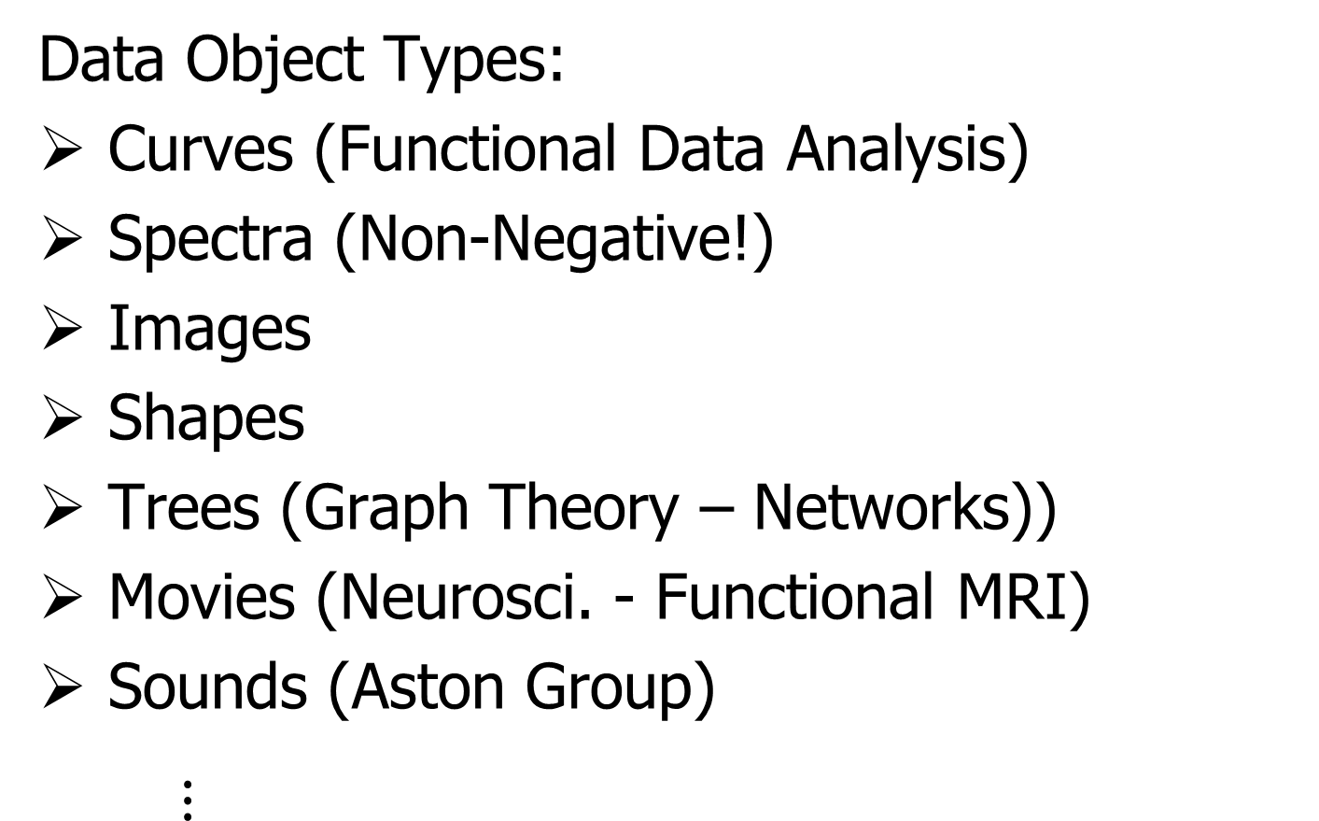
Some Special Cases of OODA
Data Object Types:
Curves (Functional Data Analysis)
Spectra (Non-Negative!)
Images
Shapes
Trees (Graph Theory – Networks))
Movies (Neurosci. - Functional MRI)
Sounds (Aston Group)
$⋮$

Slide 4
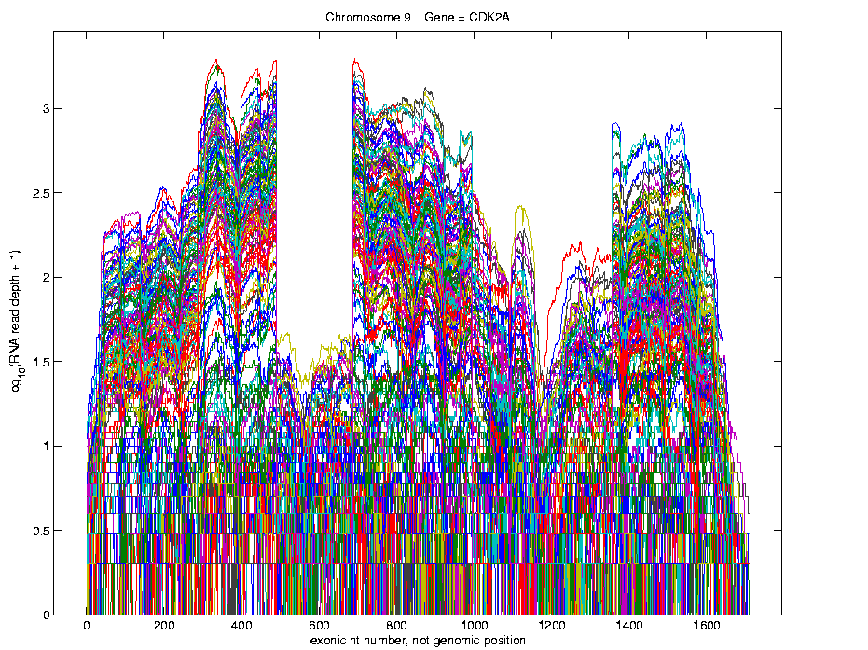
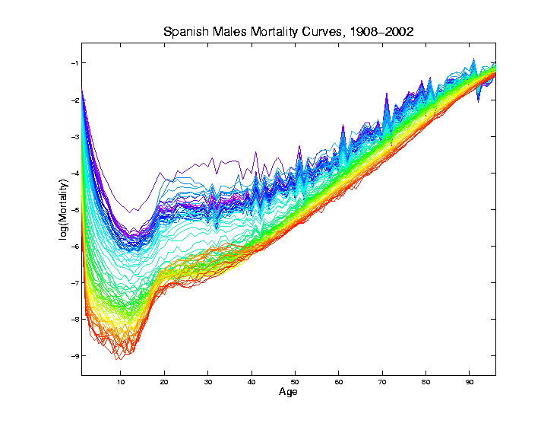
Curves as Data Objects (FDA)
Generally Euclidean: Use standard methods

Slide 5
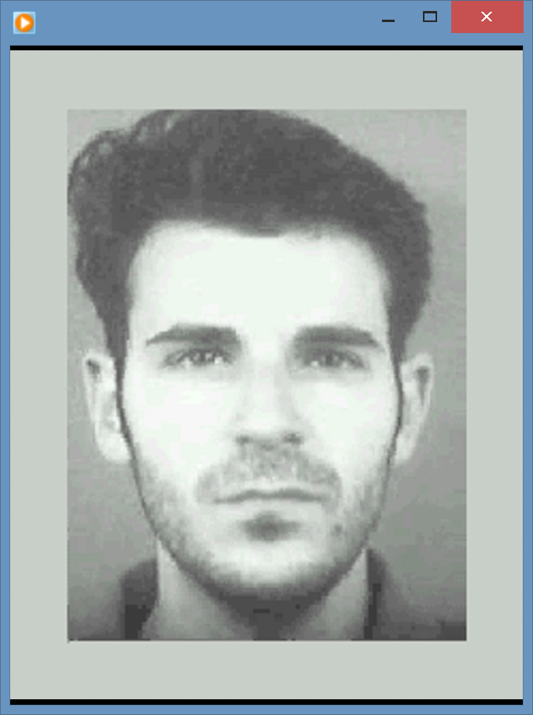
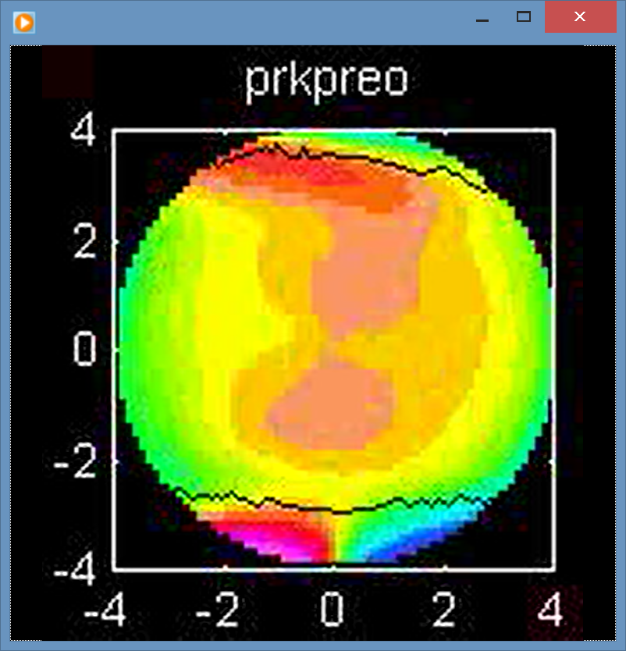
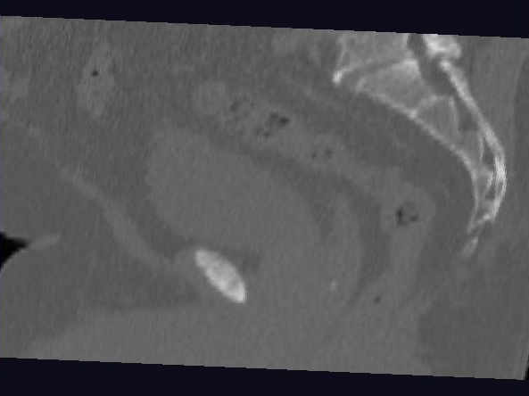
Images as Data Objects
Challenge: High Dimension, Low Sample Size

Slide 6
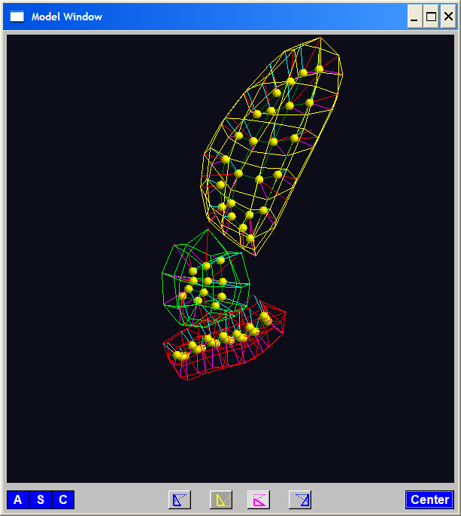
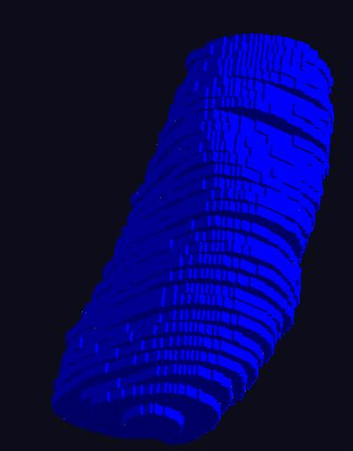
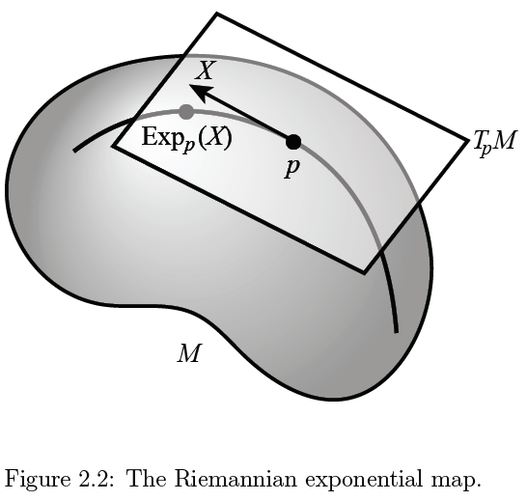
Shapes as Data Objects
Challenge: Data Lie in (Curved) Manifold

Slide 7
Shapes as Data Objects
Challenge: Data Lie in (Curved) Manifold
Important General Development:
Backwards PCA

Slide 8
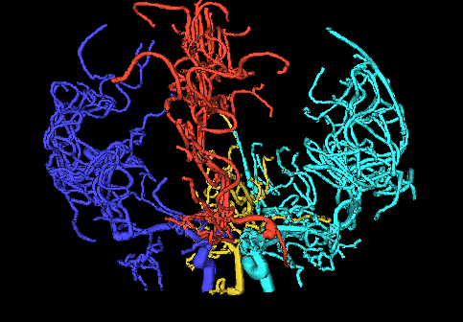
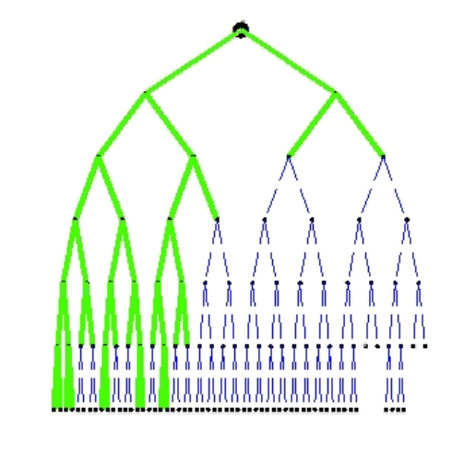
Trees as Data Objects
Challenge: More Complicated Data Space
Manifold Stratified Space

Slide 9
Trees as Data Objects
Challenge: More Complicated Data Space
Manifold Stratified Space
Surprisingly (?!?) Useful Approach:
Topological Data Analysis
Persistent Homology

Slide 10
Object Oriented Data Analysis
Original Thought:
OODA = Mathematical Framework
(containing wide variety
of interesting cases)

Slide 11
Object Oriented Data Analysis
Original Thought:
OODA = Mathematical Framework
Current View:
OODA = Focal Point
{For discussions (interdisciplinary)
about tackling serious analyses}

Slide 12
Object Oriented Data Analysis
Original Thought:
OODA = Mathematical Framework
Current View:
OODA = Focal Point
What should be the Data Objects?

Slide 13

Acronym
Joint and Individual Variation Explained
$$↓$$
JIVE

Slide 14
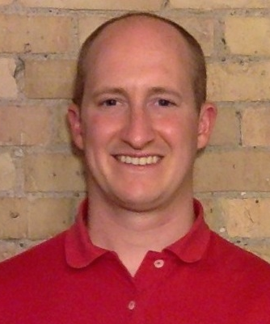
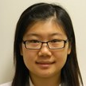


JIVE Collaborators
Eric Lock
Qing Feng
Andrew Nobel
Jan Hannig

Slide 15
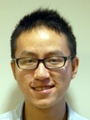



JIVE Collaborators
Meilei Jiang
Xi Yang
Iain Carmichael
Jack Prothero

Slide 16
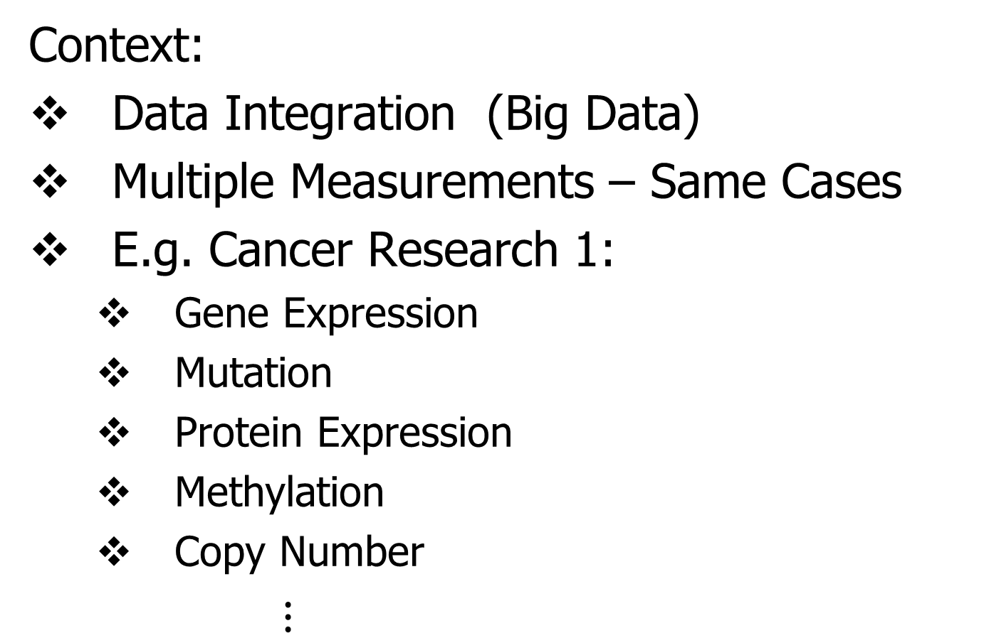
JIVE Overview
Context:
Data Integration (Big Data)
Multiple Measurements – Same Cases
E.g. Cancer Research 1:
Gene Expression
Mutation
Protein Expression
Methylation
Copy Number
$⋮$

Slide 17
JIVE Overview
Context:
Data Integration (Big Data)
Multiple Measurements – Same Cases
E.g. Cancer Research 1
E.g. Cancer Research 2:
H&E Image Features
Genetics

Slide 18
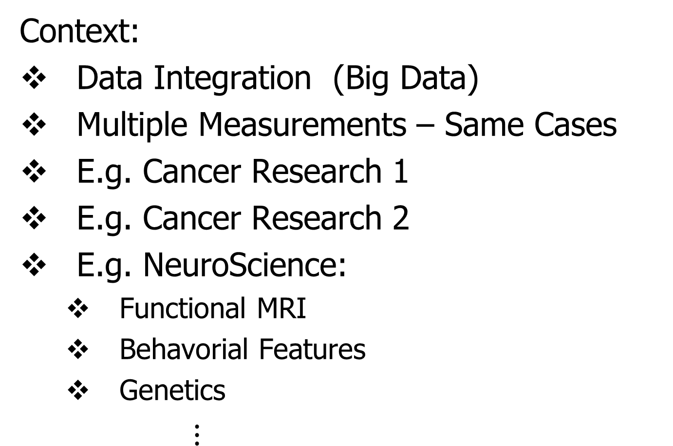
JIVE Overview
Context:
Data Integration (Big Data)
Multiple Measurements – Same Cases
E.g. Cancer Research 1
E.g. Cancer Research 2
E.g. NeuroScience:
Functional MRI
Behavorial Features
Genetics
$⋮$

Slide 19
JIVE Data Structure
Organizational Model
for Single Data Set:
Matrix
Convention in this talk:
“Columns as Data Objects”
(Atoms of the Statistical Analysis,
i.e. Experimental Units, or Data Vectors)

Slide 20
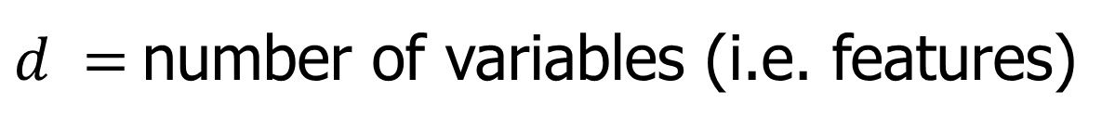


JIVE Data Structure
Organizational Model
for Single Data Set:
Matrix
Convention in this talk:
“Columns as Data Objects”
$$d$$
$$n$$
$d =$number of variables (i.e. features)
$n =$number of cases (i.e. subjects or samples)

Slide 21
JIVE Data Structure
Organizational Model
for Single Data Set: ←
Matrix
Convention in this talk:
Data Are “Column Object Centered”
i.e. Mean Vector is 0

Slide 22
JIVE Data Structure
Organizational Model
for Single Data Set:
Matrix
Convention in this talk:
Data Are “Column Object Centered”
i.e. Mean Vector is 0
i.e. Mean of Entries in Each Row is 0

Slide 23
JIVE Data Structure
JIVE Organizational Model:
Multiple Matrices
(Data Types, i.e. “Blocks”)
With common
Columns as Data Objects

Slide 24
JIVE Data Structure
JIVE Organizational Model:
Multiple Matrices
(Data Types, i.e. “Blocks”)
With common
Columns as Data Objects
1st consider only 2 blocks

Slide 25
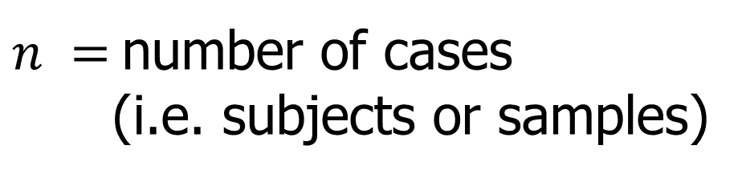
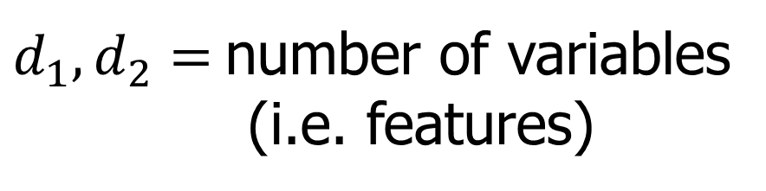



JIVE Data Structure
JIVE Organizational Model:
Multiple Matrices:
$d_{1},d_{2}=$number of variables
(i.e. features)
$$d_{1}$$
$$n$$
$n =$number of cases
(i.e. subjects or samples)
$$d_{2}$$
$$n$$

Slide 26
JIVE Analytic Goals
Explore & Quantify Variation
In spirit of PCA
(Principal Component Analysis)

Slide 27









PCA Underpinnings
For Mean Centered Data Matrix:
Apply Singular Value Decomposition
$$r$$
$$r$$
$$=$$
$$r$$
$$n$$
$$d$$
$$d$$
$$n$$
$$r$$
Loadings
x Scores

Slide 28

Example of PCA Data Exploration
Context: Single Data Set
Fun Example:
RNAseq Lung Cancer Data
Thanks to: D. Neil Hayes
Oncology, UNC

Slide 29
Example of PCA Data Exploration
Interesting Real Data Example
Genetics (Cancer Research)
RNAseq (Next Gener’n Sequen’g)
Deep look at “gene expression”
Microarrays: Single number (per gene)
RNAseq: Thousands of measurements

Slide 30
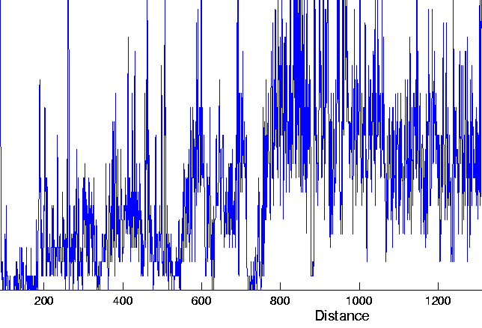
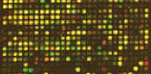
Example of PCA Data Exploration
Interesting Real Data Example
Genetics (Cancer Research)
RNAseq (Next Gener’n Sequen’g)
Deep look at “gene expression”

Slide 31
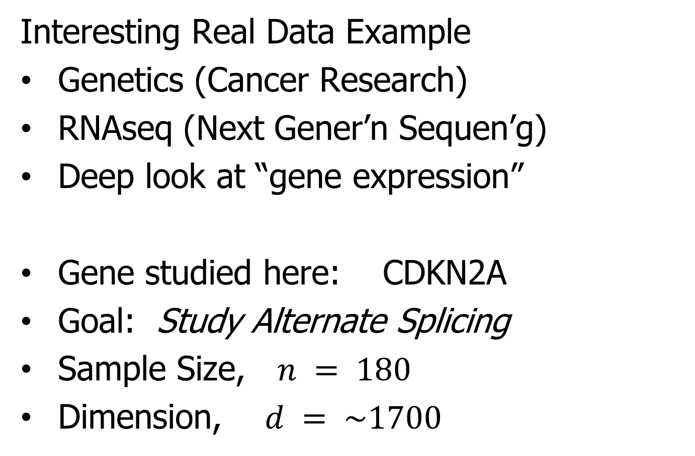
Example of PCA Data Exploration
Interesting Real Data Example
Genetics (Cancer Research)
RNAseq (Next Gener’n Sequen’g)
Deep look at “gene expression”
Gene studied here: CDKN2A
Goal: Study Alternate Splicing
Sample Size, $n = 180$
Dimension, $d = \sim 1700$

Slide 32
Example of PCA Data Exploration
Simple
1st
View:
Curve
Overlay
(log
scale)
Thanks to
Matt Wilkerson

Slide 33
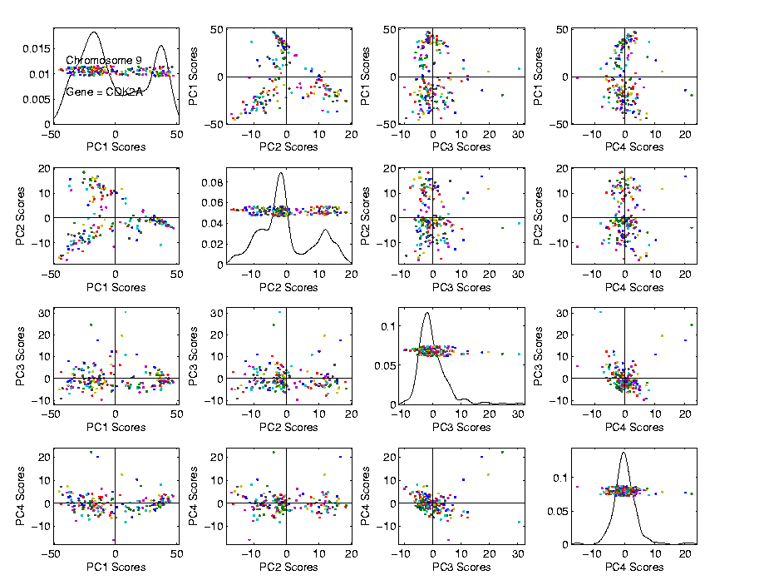
Example of PCA Data Exploration
Often
Useful
Population
View:
PCA
Scores

Slide 34
Example of PCA Data Exploration
Suggestion
Of
Clusters
???

Slide 35
Example of PCA Data Exploration
Suggestion
Of
Clusters
Which
Are
These?

Slide 36
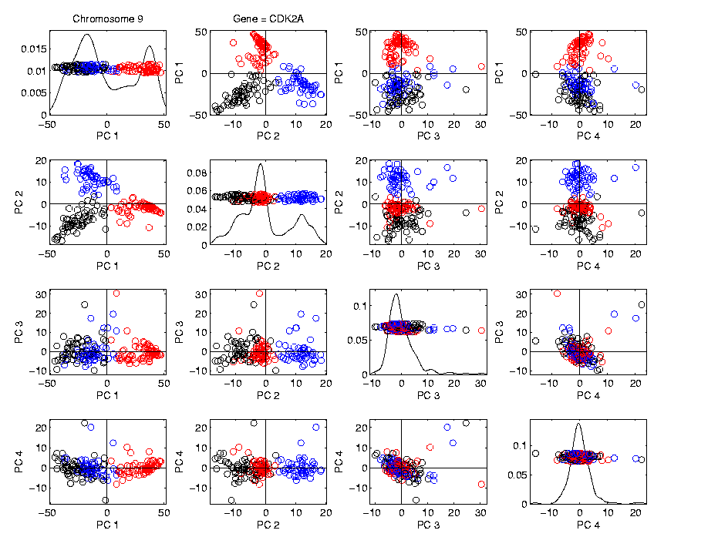
Example of PCA Data Exploration
Manually
Brush
Clusters

Slide 37
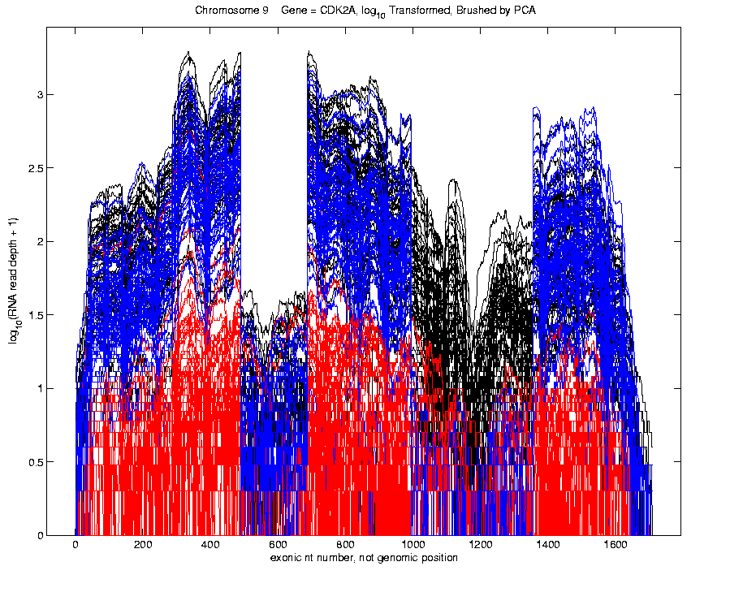
Example of PCA Data Exploration
Manually
Brush
Clusters
Clear
Alternate
Splicing

Slide 38
Example of PCA Data Exploration
Consequences of this Visualization:
Lead to Full Genome Screening Method
SigFuge
Important Component: SigClust
(Which Clusters are Really There?)
Found New Splices
(Now Been Biologically Verified)

Slide 39
JIVE Analytic Goals
Explore & Quantify Variation
Through Joint Variation
via Common Scores
(Signatures Among Cases)

Slide 40
JIVE Analytic Goals
Explore & Quantify Variation
Through Joint Variation
via Common Scores
(Signatures Among Cases)
And Individual Variation
(Ortho to Joint & Not Colinear)

Slide 41
JIVE Analytic Goals
Understand Drivers
Using Loadings
Joint Loadings

Slide 42
JIVE Analytic Goals
Understand Drivers
Using Loadings
Joint Loadings
Individual Loadings

Slide 43
Functional Magnetic Resonance Imaging
Approach:
Measure “Brain Activity”
Over Both Location & Time
Via Blood Flow
Data Objects???

Slide 44

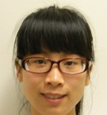

Functional Magnetic Resonance Imaging
2015 SAMSI Program
On Neuroscience
Qunqun Yu Benjamin Risk

Slide 45
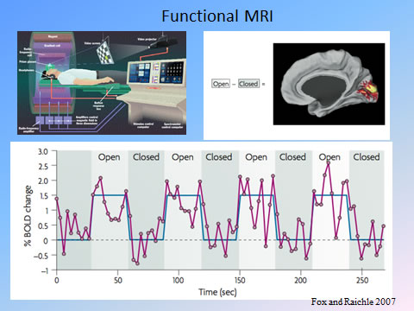
Functional Magnetic Resonance Imaging
Data
Objects?
3d- Movie?
Time Series
At Voxels?
Thanks to fmri.ucsd.edu

Slide 46
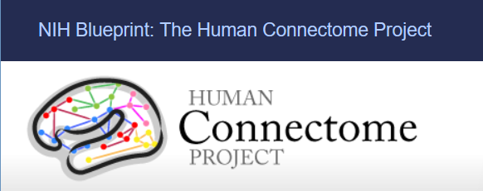
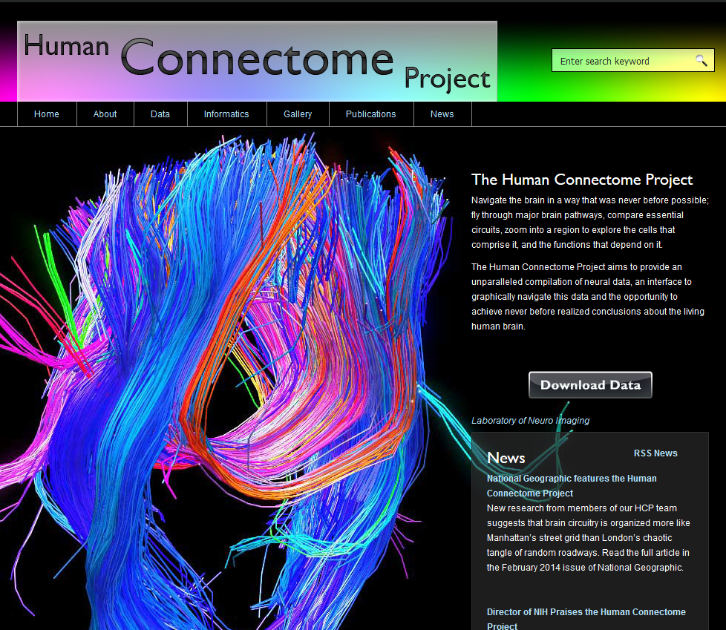
Functional Magnetic Resonance Imaging
Study Data From:

Slide 47
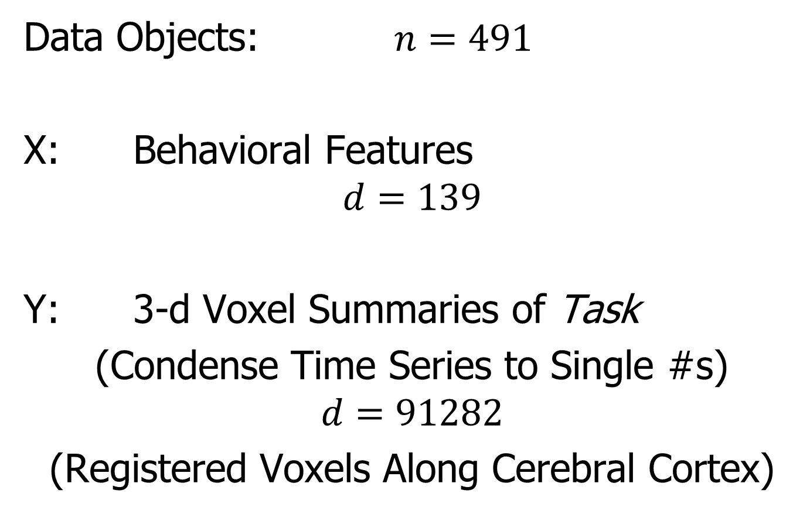
Functional Magnetic Resonance Imaging
Data Objects: $n=491$
X: Behavioral Features
$$d=139$$
Y: 3-d Voxel Summaries of Task
(Condense Time Series to Single #s)
$$d=91282$$
(Registered Voxels Along Cerebral Cortex)

Slide 48
Functional Magnetic Resonance Imaging
Focus of Analysis:
Loadings (Drivers)
Behavioral Features
Lit Up Brain Regions
Since Scores All Gaussian
(Normal Population)
Which Work
Together?
Which Work
Separately?

Slide 49
Functional Magnetic Resonance Imaging
View Entries of Eigenvectors
Separate
PC1 of
Behavior
Feature
Loadings
Important
Groups

Slide 50
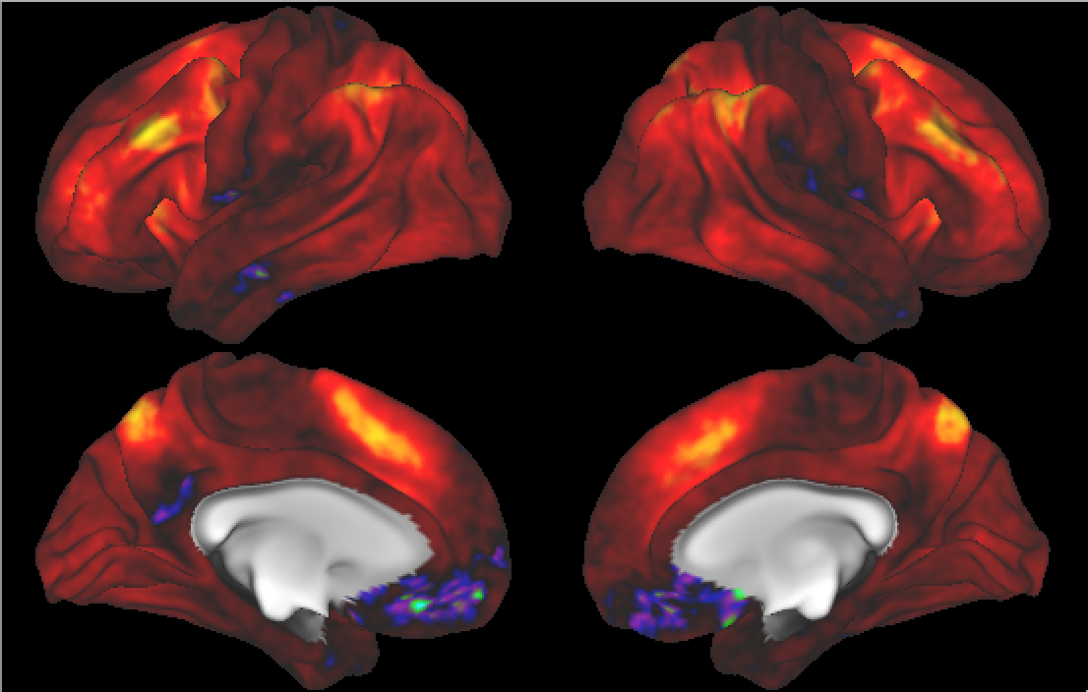

Functional Magnetic Resonance Imaging
View Entries of Eigenvectors
Separate PC1 of Image Loadings
All Up
& Down
Together
Also Some
Hot Spots?

Slide 51
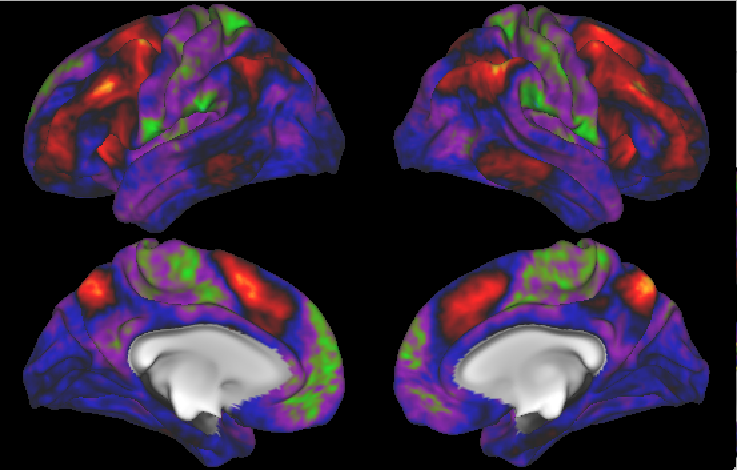
Functional Magnetic Resonance Imaging
Separate PC2 of Image Loadings
Interesting
Structure
???
And Same
Hot Spots?

Slide 52
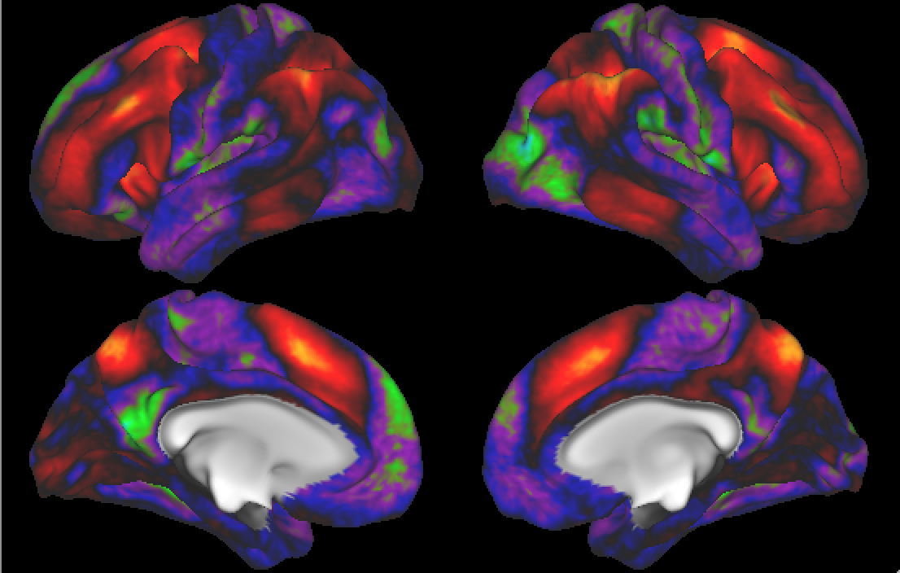
Functional Magnetic Resonance Imaging
Previous Mapping of Regions of Interest
Hot Spots
Are
Working
Memory
Related

Slide 53
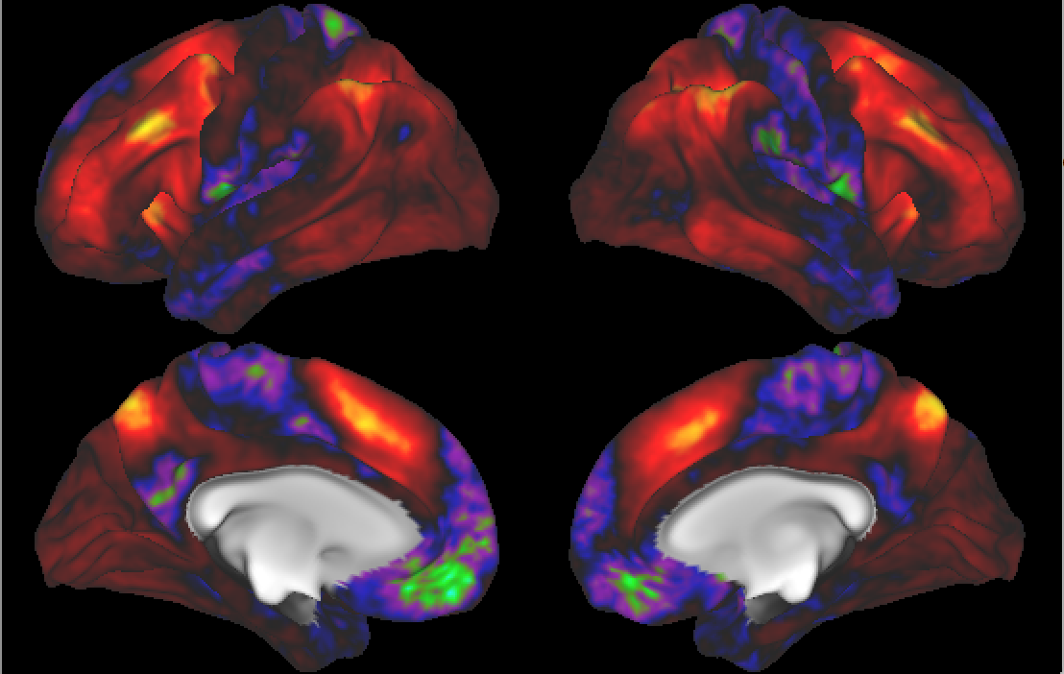
Functional Magnetic Resonance Imaging
Joint PC1 of Image Loadings
Using
Behavior
Combines
Hot Spots
From
Separate
PC1 & 2

Slide 54
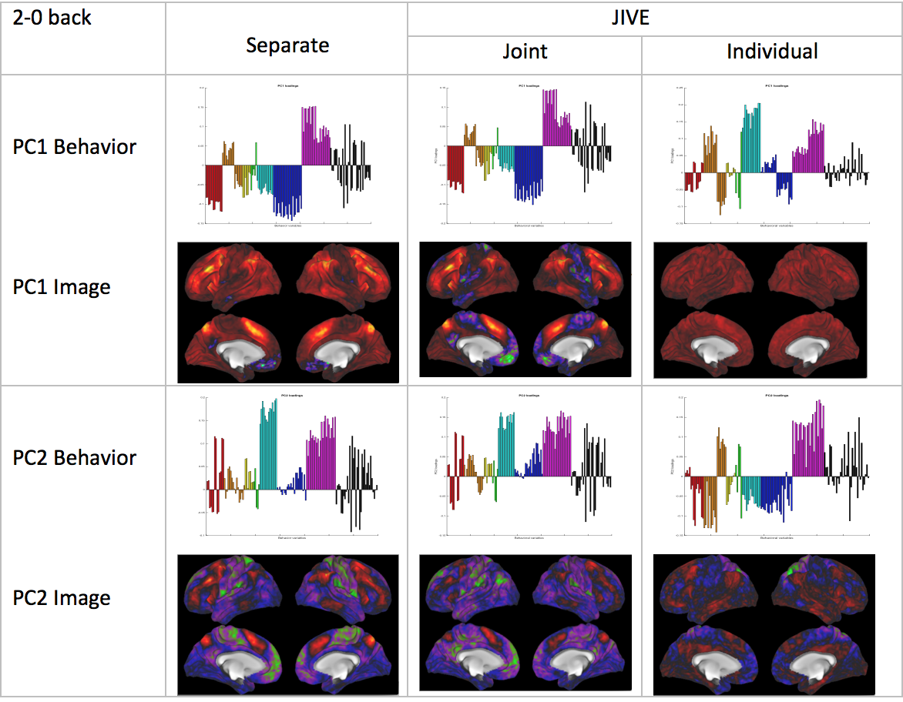
Functional Magnetic Resonance Imaging
Overall
Comparison
Sep. Beh. PC1
Assoc. w. Image
Joint Im. PC1
Concentrates
Relevant Parts
Of Sep.
PC1 & PC2

Slide 55
Functional Magnetic Resonance Imaging
Overall
Comparison
Overall Heat
Var’n not
Assoc. w/
Behavior
New 2nd Mode
Of Joint Var’n
Behavior
~ Sep. PC2

Slide 56
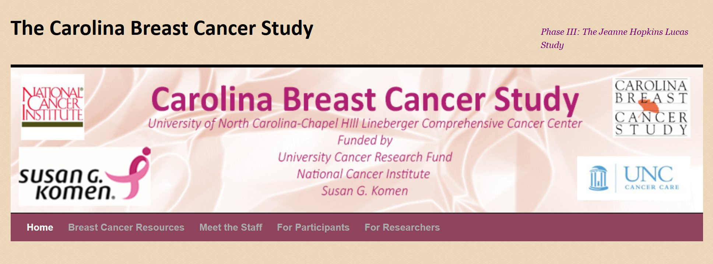
Carolina Breast Cancer Study

Slide 57
Carolina Breast Cancer Study
Analysis Goal:
Understand How Images & Genetics
Work Together
Work Separately
Approach: AJIVE
Clinical Diagnostic Standard
Deep Insight &
New Treatments

Slide 58
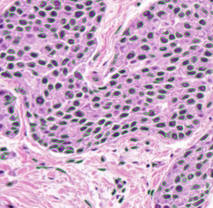
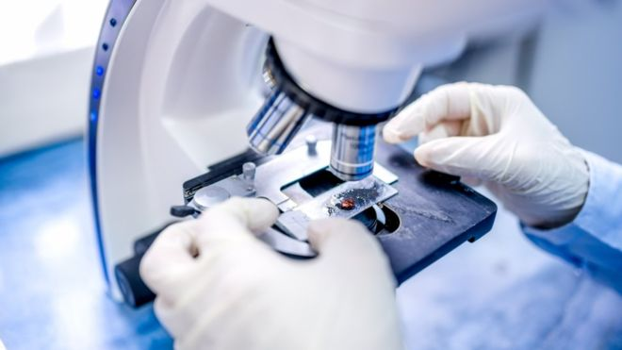
Carolina Breast Cancer Study
Clinical Diagnosis of Cancer:
Pathologist Views Tissue Under Microscope,
Tissue Stained with Hematoxylin & Eosin (H&E)
Thanks to BBC.CO.UK
and Reseachgate.net

Slide 59
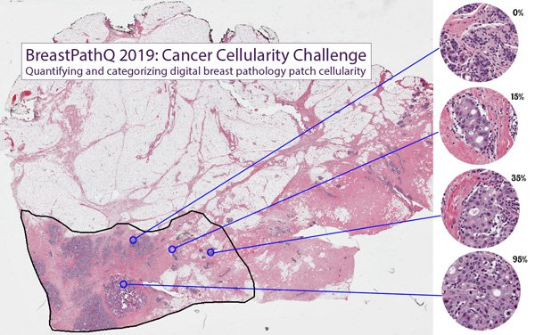
Carolina Breast Cancer Study
Tissue Micro Array Data:
Extract Small
(1mm diam.)
“Cores”
Thanks to SPIE.ORG

Slide 60
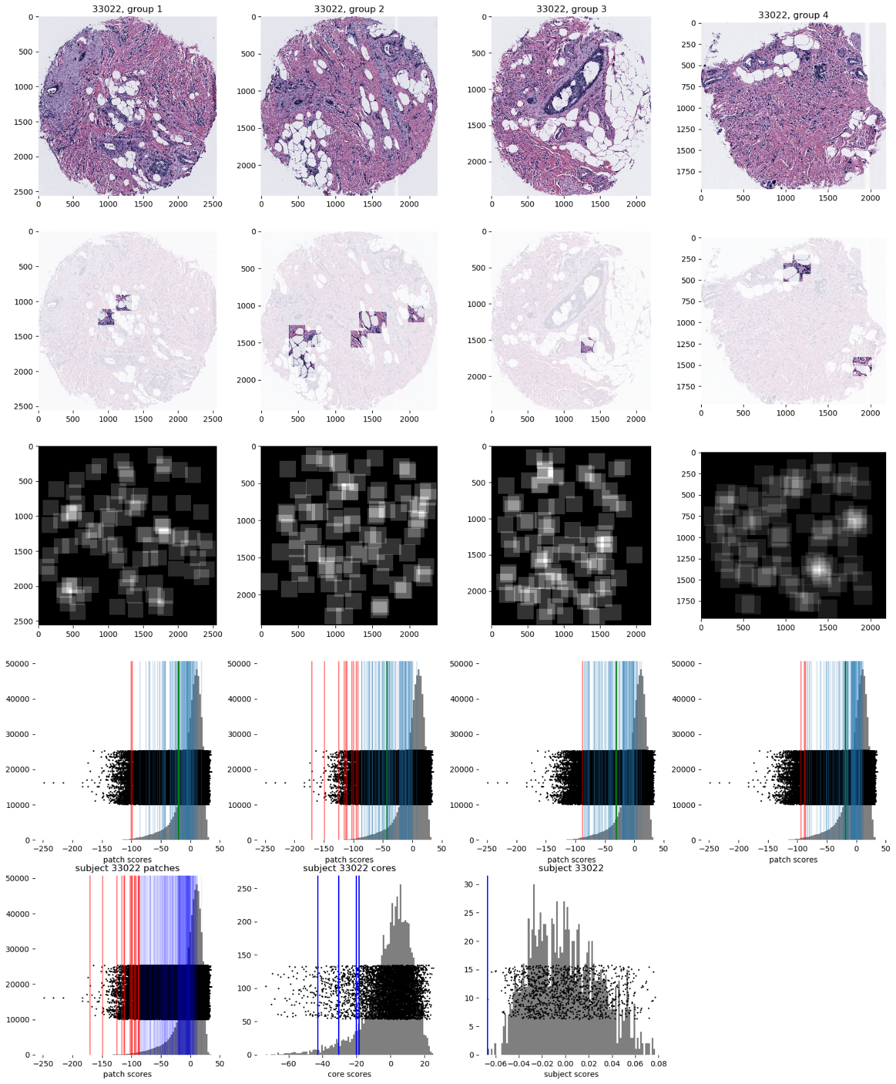

Carolina Breast Cancer Study
Experimental Design: $n=1191$ people
For Each: 1 – 4 TMA Cores
PAM 50 Gene Expression:

Slide 61
Carolina Breast Cancer Study
PAM 50 Gene Expression:
Set of 50 Genes
Measured mRNA Expression Level
Good at Separating SubTypes
Basal
Her2
Luminal A
Luminal B
Perou Discovery:
No Benefit From
Chemo-Therapy

Slide 62
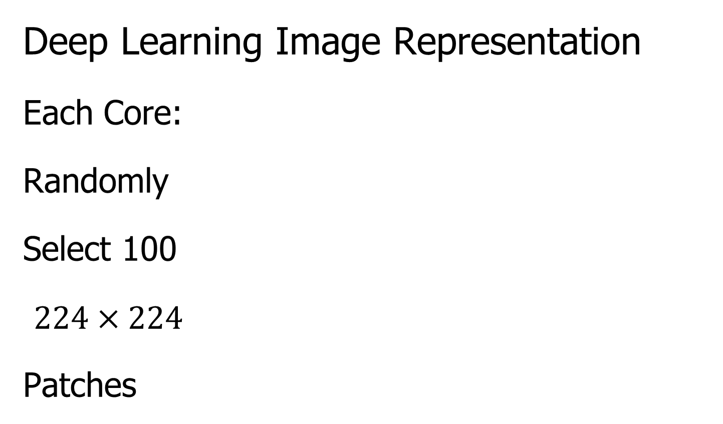
Carolina Breast Cancer Study
Deep Learning Image Representation
Each Core:
Randomly
Select 100
$224×224$
Patches

Slide 63
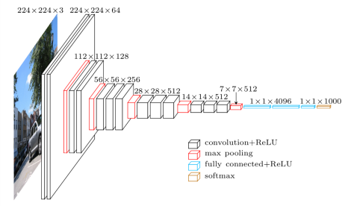
Carolina Breast Cancer Study
Deep Learning Image Representation
Reduce Each Patch to 512 Features
Using Transfer Learning From VGG16:
(Trained on Many
Natural Images)
Thanks to pyimagesearch.com

Slide 64
Carolina Breast Cancer Study
Deep Learning Image Representation
For Each Core:
Aggregate Patches by Averaging
(Damps Out “Location” Information)
Then Average Cores For Each Person

Slide 65
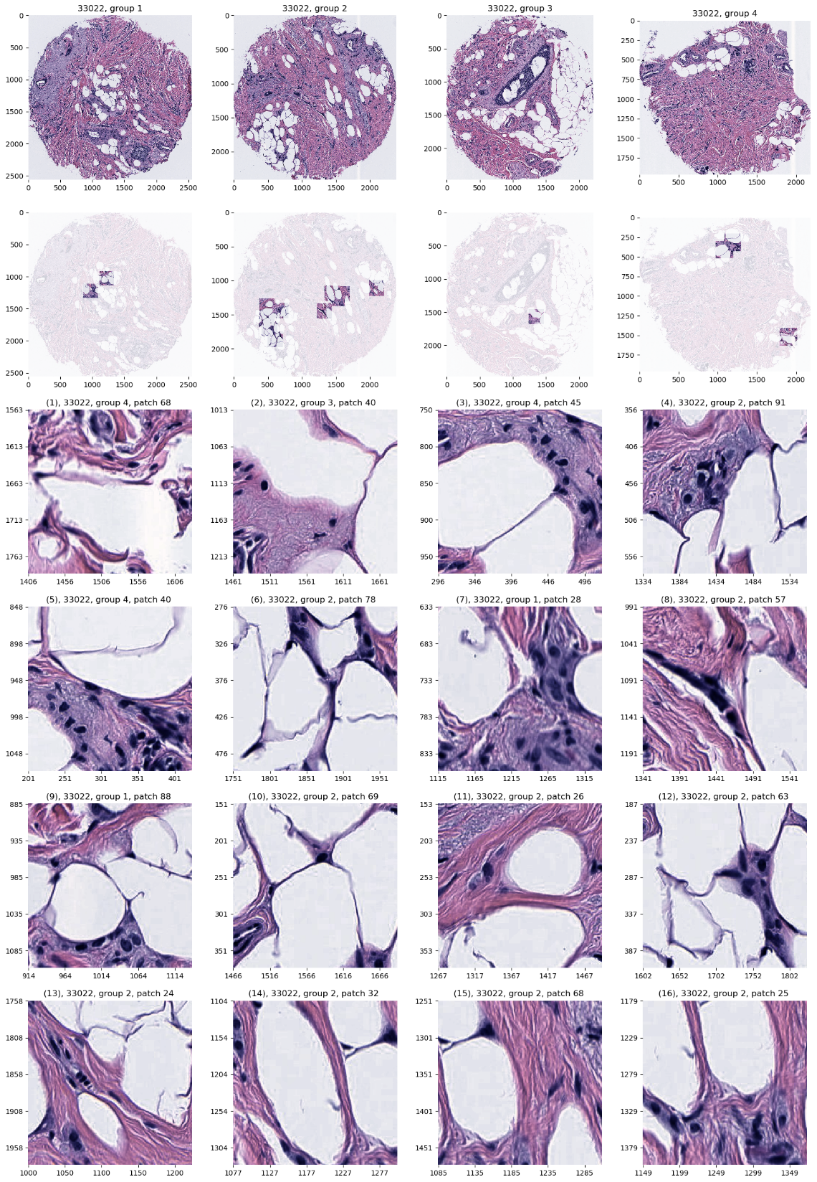
Carolina Breast Cancer Study
JIVE: Common Normalized Scores 1
Look at Extremes
Negative End
Top Person
Top 16 Patches
Fat Cells & Stroma

Slide 66
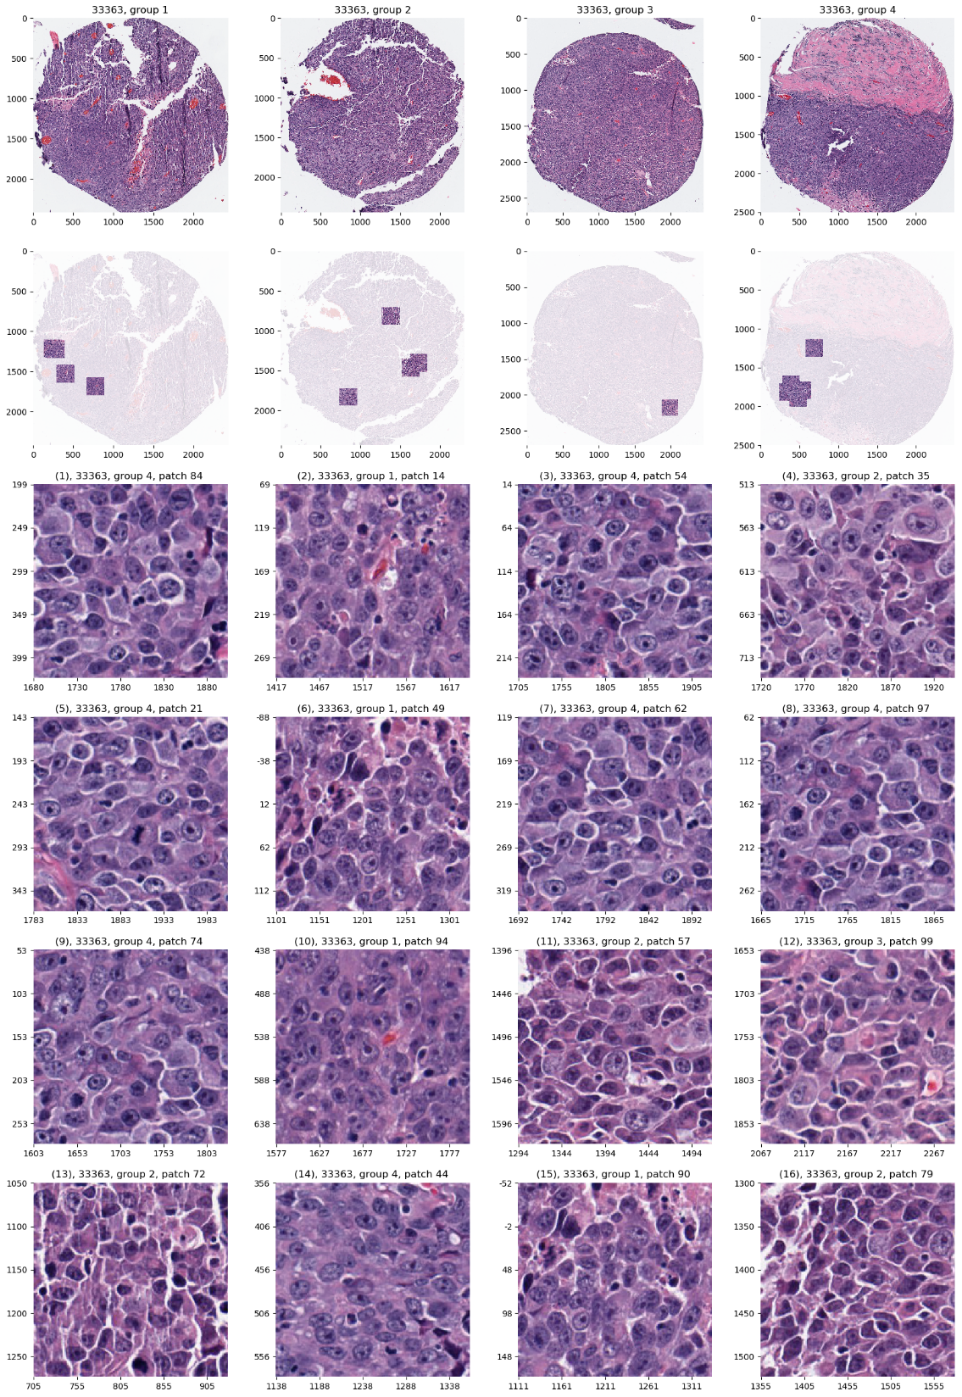
Carolina Breast Cancer Study
JIVE: Common Normalized Scores 1
Look at Extremes
Positive End
Top Person
Top 16 Patches
Highly “Cellular”
Markedly Atypical Cells

Slide 67
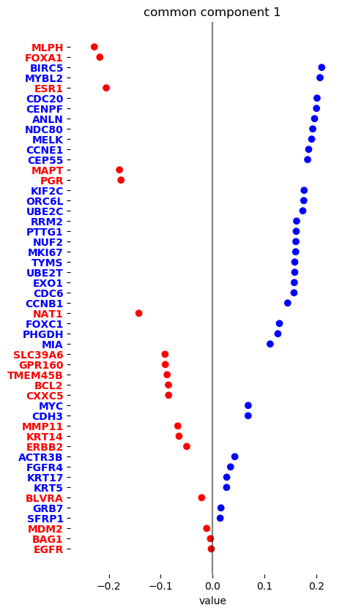
Carolina Breast Cancer Study
JIVE: Gene Expression
Common Normalized
Loadings 1
Very Consistent w/ Image
“High Proliferation” Genes
“Low Prolif.” – Lum A Genes

Slide 68
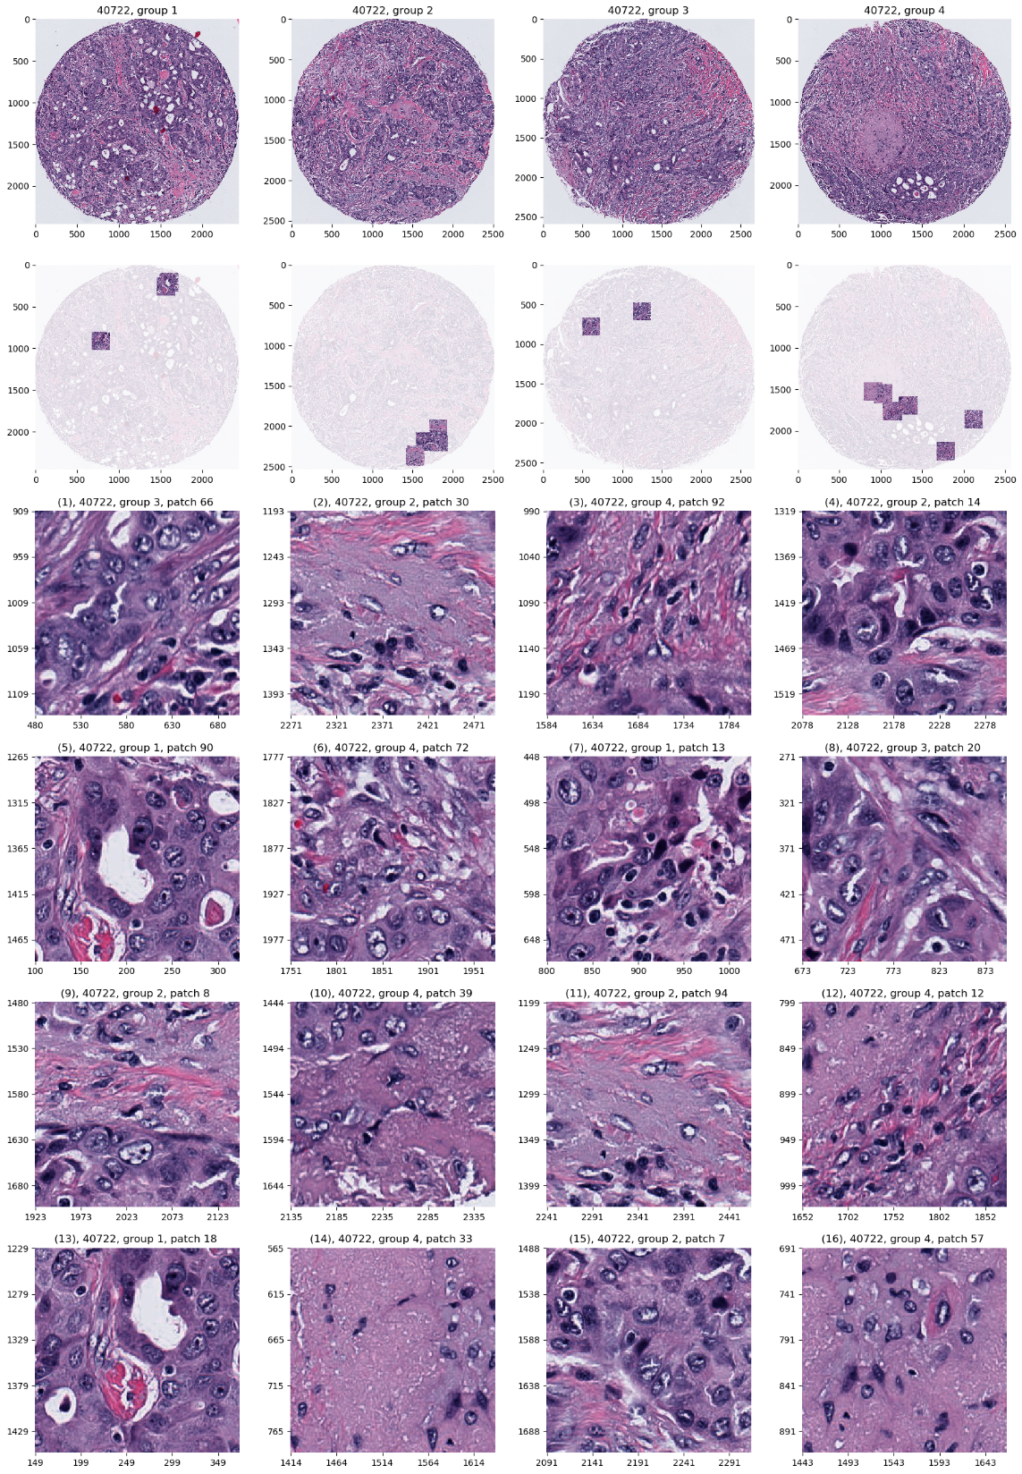
Carolina Breast Cancer Study
JIVE: Common Normalized Scores 2
Look at Extremes
Negative, Top
Top 16 Patches
High Nuclear Grade
Atypical Cells

Slide 69
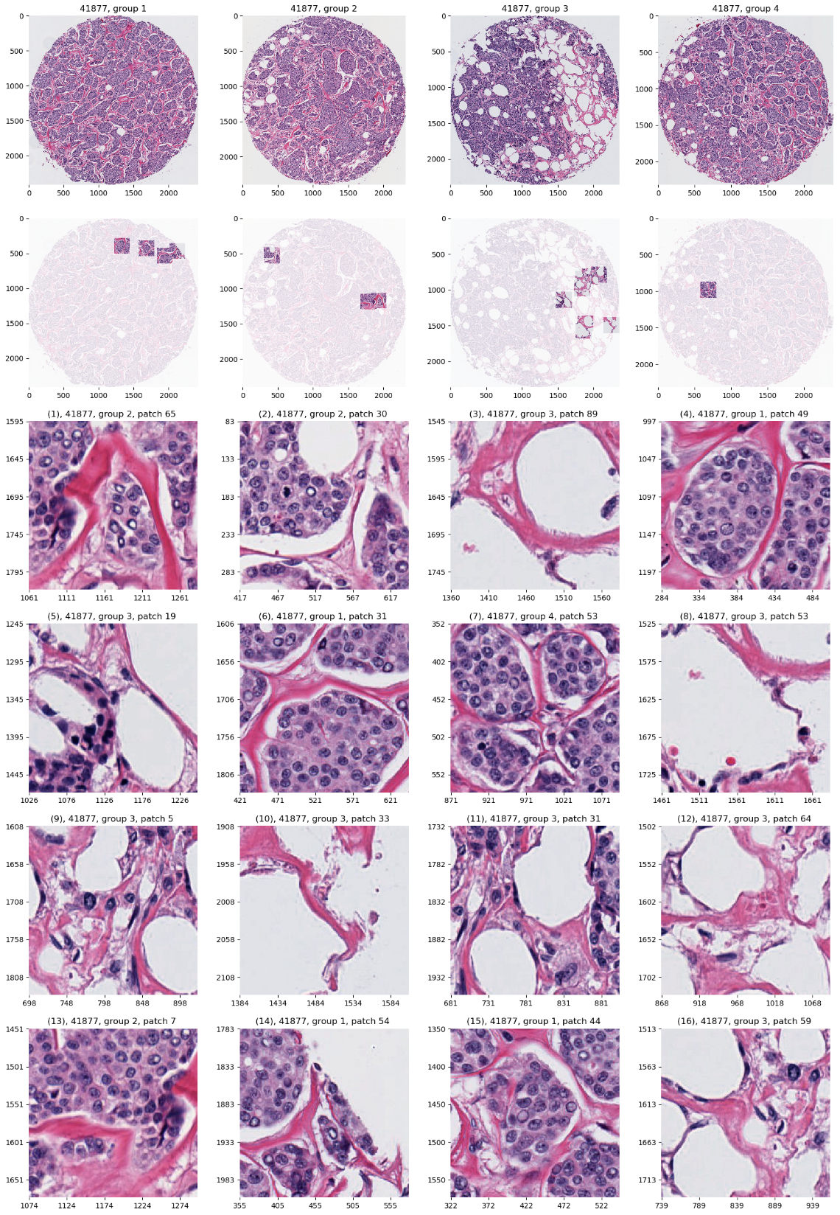
Carolina Breast Cancer Study
JIVE: Common Normalized Scores 1
Look at Extremes
Positive, Top
Top 16 Patches
Lower Nuclear Grade
Stroma, Sclerosis

Slide 70
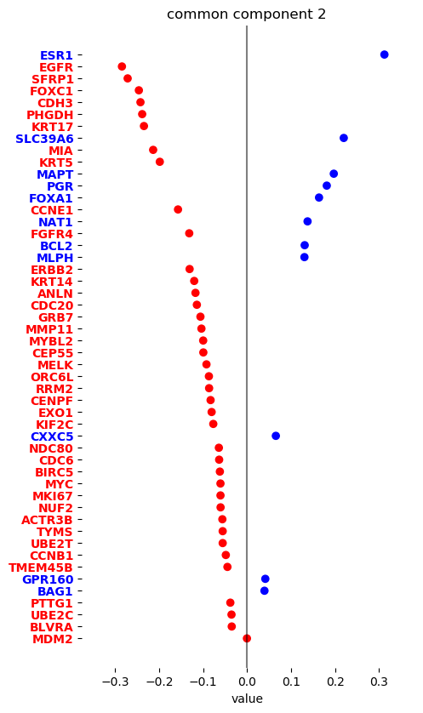
Carolina Breast Cancer Study
JIVE: Gene Expression
Common Normalized
Loadings 2
Very Consistent w/ Image
Luminal Subtype Genes
Basal Subtype Genes

Slide 71

Carolina Breast Cancer Study
JIVE, Genes, Individual 1
Overall Up & Down
Together
Not Subtype Related!

Slide 72

Carolina Breast Cancer Study
JIVE, Genes, Individual 2
Luminal vs. Basal
“Contrast”?
“Unbalanced Types”?

Slide 73

Carolina Breast Cancer Study
JIVE, Images, Individual 1
Negative
Mostly Fat Cells
Few Nuclei

Slide 74

Carolina Breast Cancer Study
JIVE, Images, Individual 1
Positive
Reactive Stroma,
Few Nuclei
Little Gene Connected

Slide 75

Carolina Breast Cancer Study
JIVE, Images, Individual 2
Negative
Mucinous & Micro-
Papillary Carcinoma
Not PAM50 Related

Slide 76

Carolina Breast Cancer Study
JIVE, Images, Individual 2
Positive
Fat Cells
Common Endpoint?
“Center”?

Slide 77
Single Cell RNAseq Example
Powerful Expression Technology
RNAseq for Separate Cells
Original Data: Grun et al (2014)
Challenge: Batch Bias
Control: Spike In Measurements
scPLS Approach: Chen and Zhou (2016)

Slide 78

Single Cell RNAseq Example
Input Data
Clear Artifacts
Desired Groups

Slide 79

Single Cell RNAseq Example
scPLS
Some Improvement
Desired Groups

Slide 80

Single Cell RNAseq Example
JIVE Individual
Much Better
Desired Groups

Slide 81

Single Cell RNAseq Example
Detail
View
of
JIVE
Analysis
Final Result
Ignore as Nuisance Variation

Slide 82
New JIVE-Motivated Approach
Data Integration Via Subspace Analysis
(DIVAS)
With Hannig, Prothero, Carmichael

Slide 83
Data Integ’n Via Subsp. Anal. (DIVAS)
Improvements Over AJIVE:
Partially Shared Blocks
≈ + + + +

Slide 84
Data Integ’n Via Subsp. Anal. (DIVAS)
Improvements Over AJIVE:
Partially Shared Blocks
Sensible Initial Rank Choice
Inference Via Random Directions
Subspace Angles for Interpretation

Slide 85

Data Integ’n Via Subsp. Anal. (DIVAS)
Mathematical Set Up:
Blocks $X_{k}=A_{k}+E_{k}∈ℝ^{d_{k}×n}$, $k=1,⋯,K$
Where:
$A_{k}$ Is Low Rank
$E_{k}$ Entries i.i.d. mean $0$, var $σ^{2}$, 4th Mom.
$A_{k}$ & $E_{k}$ “relatively isotropous”
(Weaker than Gaussian)

Slide 86


Data Integ’n Via Subsp. Anal. (DIVAS)
Improved Initial Rank Choice
Conventional Scree Plot
Shabalin
Nobel
Shrinkage
${\hat{σ}}^{2}$ Based on Median
Of Marcenko-Pasteur

Slide 87


Data Integ’n Via Subsp. Anal. (DIVAS)
Shabalin Nobel Shrinkage (For Denoising)
Optimized
For
Marcenko
Pasteur
Optimal
Cutoff
Gives
Initial
Rank,
${\hat{r}}_{k}$

Slide 88

Data Integ’n Via Subsp. Anal. (DIVAS)
Inference I: Random Direction Bound
For Random Direction $u^{∗}∈ℝ^{n}$,
And ${\hat{r}}_{k}$-dim’al Random Subspace $V^{∗}⊆ℝ^{n}.$
5th %-tile of dist’n of:
$$Angle\left(u^{∗},V^{∗}\right)=\min_{v∈V^{∗}}Angle\left(u^{∗},v\right)$$
Idea: Larger Angles Could Be “Pure Noise”

Slide 89

Data Integ’n Via Subsp. Anal. (DIVAS)
Inference II: Bootstrap Principal Angles
Based on rank ${\hat{r}}_{k}$ SVD: $X_{k}=UDV^{t}$
And Shabalin-Nobel Shrunken s.v.s $D_{S}$
Estimate Residual Matrix, ${\hat{E}}_{k}=X_{k}−UD_{S}V^{t}$
Simulate Random Signal: $A_{k}^{∗}=U^{∗}D_{s}V^{∗t}$
Where $U^{∗}$, $V^{∗}$ are ${\hat{r}}_{k}$ bases of $ℝ^{d}$, $ℝ^{n}$ (resp.)
Think Random Rotations

Slide 90


Data Integ’n Via Subsp. Anal. (DIVAS)
Inference II: Bootstrap Principal Angles
Generate Bootstrap Data: $X_{k}^{∗}=A_{k}^{∗}+{\hat{E}}_{k}$
Get Bootstrap Estimates: ${\hat{V}}_{k}^{∗}$
For $l=1,⋯,{\hat{r}}_{k}$,
Study Largest Principal Angles
Between 1st $l$ Cols of $V_{k}^{∗}$ and ${\hat{V}}_{k}^{∗}$

Slide 91





Data Integ’n Via Subsp. Anal. (DIVAS)
Initial Rank “Culling” (Bootstrap Inference):
Random Direction Bound
Scaled by $β=\frac{1}{2}$
$β$ gives comparable
control for $k=1,⋯,K$
Determines ${\tilde{r}}_{k}$
Gene Exp. Block, $d=16,615$

Slide 92


Data Integ’n Via Subsp. Anal. (DIVAS)
Initial Rank “Culling” (Bootstrap Inference):
Copy Num. Block, $d=24,174$

Slide 93


Data Integ’n Via Subsp. Anal. (DIVAS)
Initial Rank “Culling” (Bootstrap Inference):
Proteins Block, $d=187$

Slide 94


Data Integ’n Via Subsp. Anal. (DIVAS)
Initial Rank “Culling” (Bootstrap Inference):
Mutation Block, $d=18,256$

Slide 95

Data Integ’n Via Subsp. Anal. (DIVAS)
Iteratively Find Orthogonal Directions $v∈ℝ^{n}$
To Minimize Angles to $V_{k}$
Until One > Random Direction Bound
Then Work With Subsets of Blocks,
Indexed by $I⊆2^{k}$
Finally Remainders are Individual Directions

Slide 96





DIVAS – 3 Block Toy Example
1-2 Joint Comp, Rank 1
1-2 Scores
Orthogonal to
1-2-3 Scores
1-2-3 Joint Component, Rank 1

Slide 97






DIVAS – 3 Block Toy Example
1-3 Comps.
2-3 Comps.
Both $⊥$ to Joint
And All three ${60}^{°}$ Apart

Slide 98






DIVAS – 3 Block Toy Example
Input to DIVAS: Sum of ALL
IID Gaussian Noise

Slide 99









DIVAS – 3 Block Toy Example
$$X_{1}$$
$$A_{1}$$
$$E_{1}$$
$$X_{2}$$
$$A_{2}$$
$$E_{2}$$
$$X_{3}$$
$$A_{3}$$
$$E_{3}$$

Slide 100






DIVAS – 3 Block Toy Example
Deeper Look at Estimation of 1st Block, i.e. $A_{1}$
Target
DIVAS
AJIVE
2.7647°
5.01°
1.71°
4.2288°
7.8852°
7.1420°

Slide 101







DIVAS – 3 Block Toy Example
Deeper Look at Estimation of 2nd Block
Target
DIVAS
AJIVE
2.76°
5.00°
2.11°
4.23°
5.79°
3.76°

Slide 102
DIVAS – 3 Block Toy Example
Deeper 3rd Block - Target

Slide 103



DIVAS – 3 Block Toy Example
Deeper 3rd Block - DIVAS
2.76°
1.71°
2.11°

Slide 104


DIVAS – 3 Block Toy Example
Deeper 3rd Block - AJIVE
4.23°
1.43°
2.47°

Slide 105


DIVAS – Small Angle Examples
$0^{∘}$ Between Column Spaces - Truth

Slide 106


DIVAS – Small Angle Examples
$0^{∘}$ Between Column Spaces - DIVAS
Automatic rank selection (correctly) chooses [1, 3].

Slide 107


DIVAS – Small Angle Examples
$0^{∘}$ Between Column Spaces – AJIVE [1,3]

Slide 108


DIVAS – Small Angle Examples
$0^{∘}$ Between Column Spaces – AJIVE [2,3]

Slide 109


DIVAS – Small Angle Examples
${15}^{∘}$ Between Column Spaces – Truth

Slide 110


DIVAS – Small Angle Examples
${15}^{∘}$ Between Column Spaces – DIVAS

Slide 111


DIVAS – Small Angle Examples
${15}^{∘}$ Between Column Spaces – AJIVE [1,3]

Slide 112


DIVAS – Small Angle Examples
${15}^{∘}$ Between Column Spaces – AJIVE [2,3]

Slide 113


DIVAS – Small Angle Examples
${20}^{∘}$ Between Column Spaces – Truth

Slide 114


DIVAS – Small Angle Examples
${20}^{∘}$ Between Column Spaces – Divas

Slide 115


DIVAS – Small Angle Examples
${20}^{∘}$ Between Column Spaces – AJIVE [2,3]

Slide 116


DIVAS – Small Angle Examples
${20}^{∘}$ Between Column Spaces – AJIVE [1,3]

Slide 117

Major Application: Cancer Genetics
Data Source:
The Cancer
Genome Atlas
Subset Here:
Breast Cancer
Figure : The Cancer Genome Atlas Research Network, Weinstein, J.N., Collisson, E.A., Mills, G.B., Shaw, K.M., Ozenberger, B.A., Ellrott, K., Shmulevich, I., Sander, C., and Stuart, J.M. (2013)
The Cancer Genome Atlas Pan-Cancer analysis project.

Slide 118

Major Application: Cancer Genetics
TCGA Breast Cancer Data:
Data Blocks ($∩$s & Carefully Cleaned)
mRNA (GE): 16615×616
Copy Number (CN): 24174×616
Rev. Phase Protein Array (RPPA): 187×616
Gene mutation (Mutation): 18256×616
Tumor Subtypes
Basal-like: ⊲
HER2-like: ∗
Luminal A: +
Luminal B: ×

Slide 119

Data Integ’n Via Subsp. Anal. (DIVAS)
Analysis of Breast Cancer “Lobular Freeze”:

Slide 120
JIVE Open Problems
Integration with Network Analysis???
Post – JIVE Gene Networks???
Compare “Joint” and “Individual” Networks
Combine JIVE & Brain Connectivity???
Relationships with Behavior & Genetics

Slide 121
Take Away Concepts
Object Oriented Data Analysis
(To Handle Complex Data)
JIVE for Integration of Data Types
Joint And Individual Variation
Visualization to Find Hidden Structure

