Slide 1
Statistics – O. R. 881
Object Oriented Data Analysis
Steve Marron
Dept. of Statistics and Operations Research
University of North Carolina

Slide 2
Administrative Info
Details on Course Web Page
https://marron.web.unc.edu/stor-881-object-oriented-data-analysis-fall-2019/
Or:
  Google: “Marrons teaching material”
  Choose This Course

Slide 3
Course Context
Currently Fashionable Topic:
Big Data Science
Many Important Issues.
But More Challenging (& Important?):
Complex Data
( )

Slide 4
Object Oriented Data Analysis
What is it?
A Sound-Bite Explanation:
What is the “atom of the statistical analysis”?
1st Course: Numbers
Multivariate Analysis Course : Vectors
Functional Data Analysis: Curves
More generally: Data Objects

Slide 5
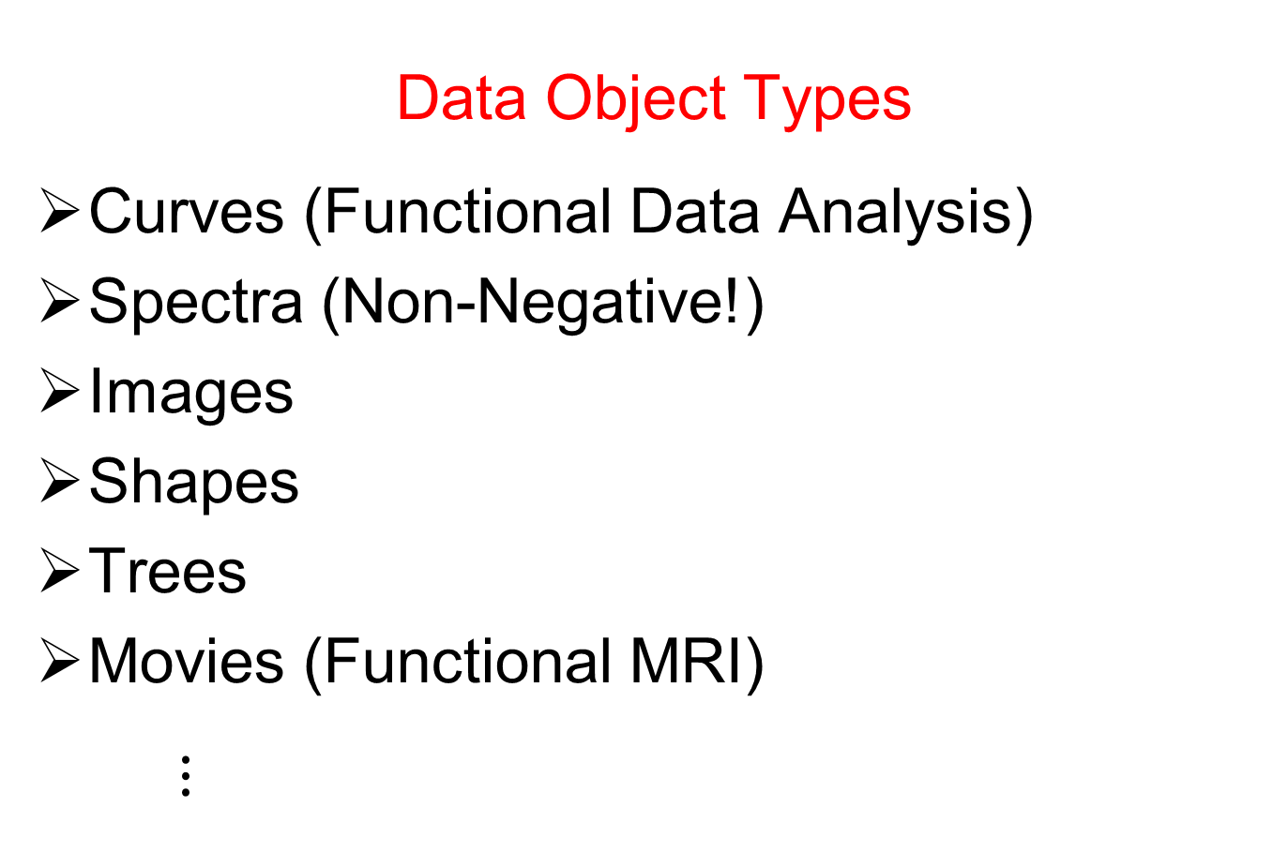
Object Oriented Data Analysis
Data Object Types
Curves (Functional Data Analysis)
Spectra (Non-Negative!)
Images
Shapes
Trees
Movies (Functional MRI)
$⋮$

Slide 6
Object Oriented Data Analysis
Current Motivation (of OODA terminology):
In Complicated Data Analyses
Fundamental (Non-Obvious) Question Is:
“What Should We Take as Data Objects?”
Key to Focusing Needed Analyses

Slide 7
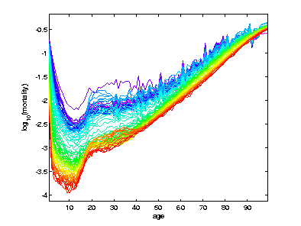
A Taste of OODA Examples
Spanish Male Mortality Curves
Enhancement: Color by Year
1908
1931
1964
1987
2002

Slide 8
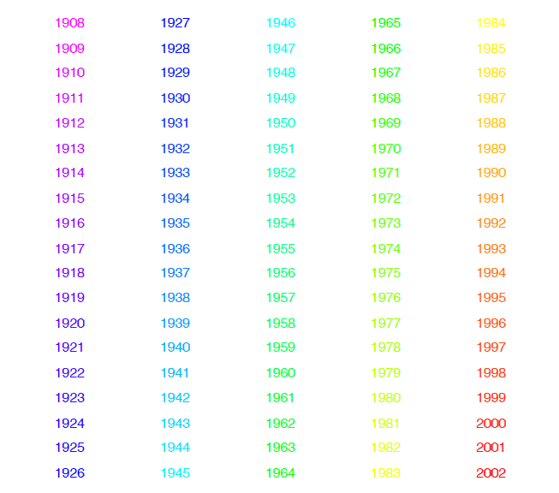
Mortality Time Series
Color Code
(Years)
Notes:
8

Slide 9
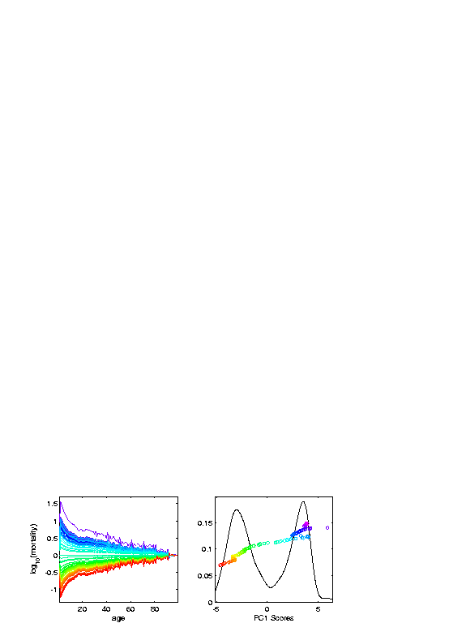
A Taste of OODA Examples
Spanish Male Mortality Curves
1918 Flu Pandemic
Spanish Civil War

Slide 10
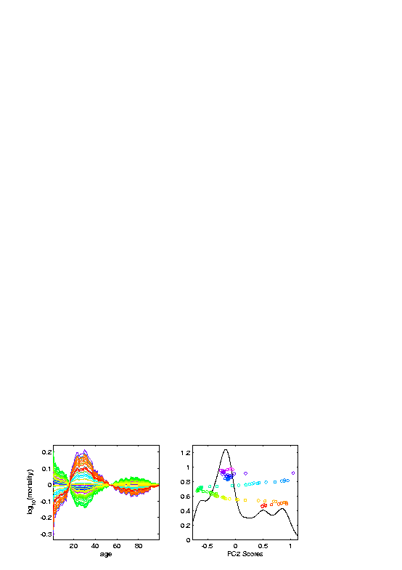
A Taste of OODA Examples
Spanish Male Mortality Curves
Flu Pandemic, Civil War
Intro of Automobile,
Improved Safety

Slide 11
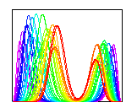
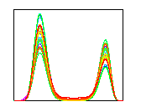

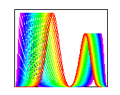
A Taste of OODA Examples
Phase and Amplitude Curves
Raw
Data
Ampl’de
Varia’n
Interesting
Modes of
Variation!
Phase
Varia’n
Warps

Slide 12
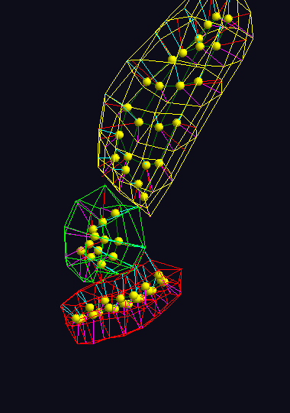
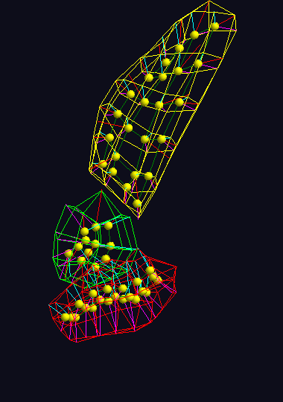
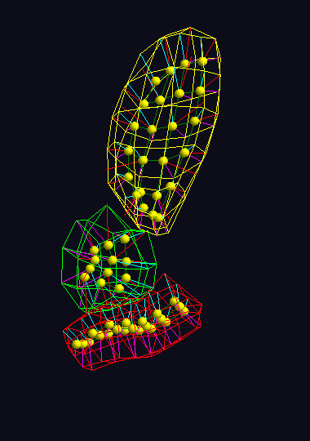



A Taste of OODA Examples
Note: Different Display of Modes of Variation
Shapes in Image Analysis (3-d)
Analysis of Variation (Princ. Geod. Anal.)
Mode 1: Rectum
Mode 2: Twisting
Mode 3: Bladder
$$μ−2×{PC}_{1}$$
$$μ−2×{PC}_{1}$$
$$μ−2×{PC}_{1}$$

Slide 13
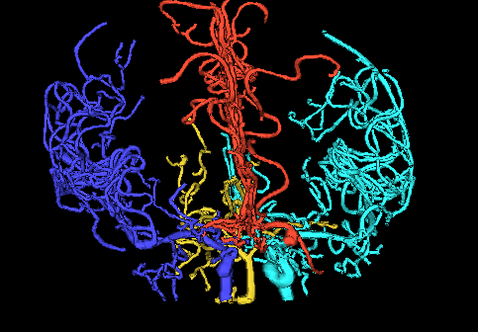
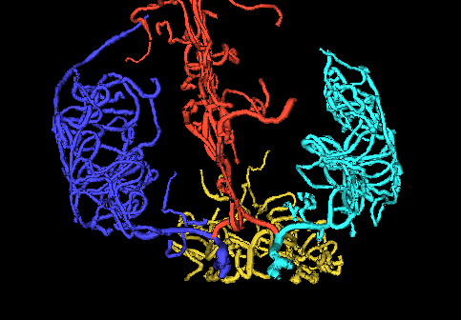
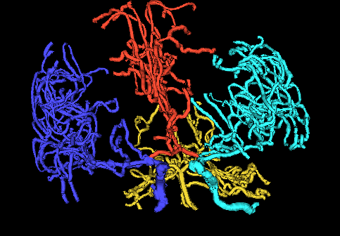
A Taste of OODA Examples
Tree Structured Data Objects
Brain Artery Data,
Analyze Sample of n=100
Average? Variation About Average???
Modes of Variation???
,
, ... ,

Slide 14
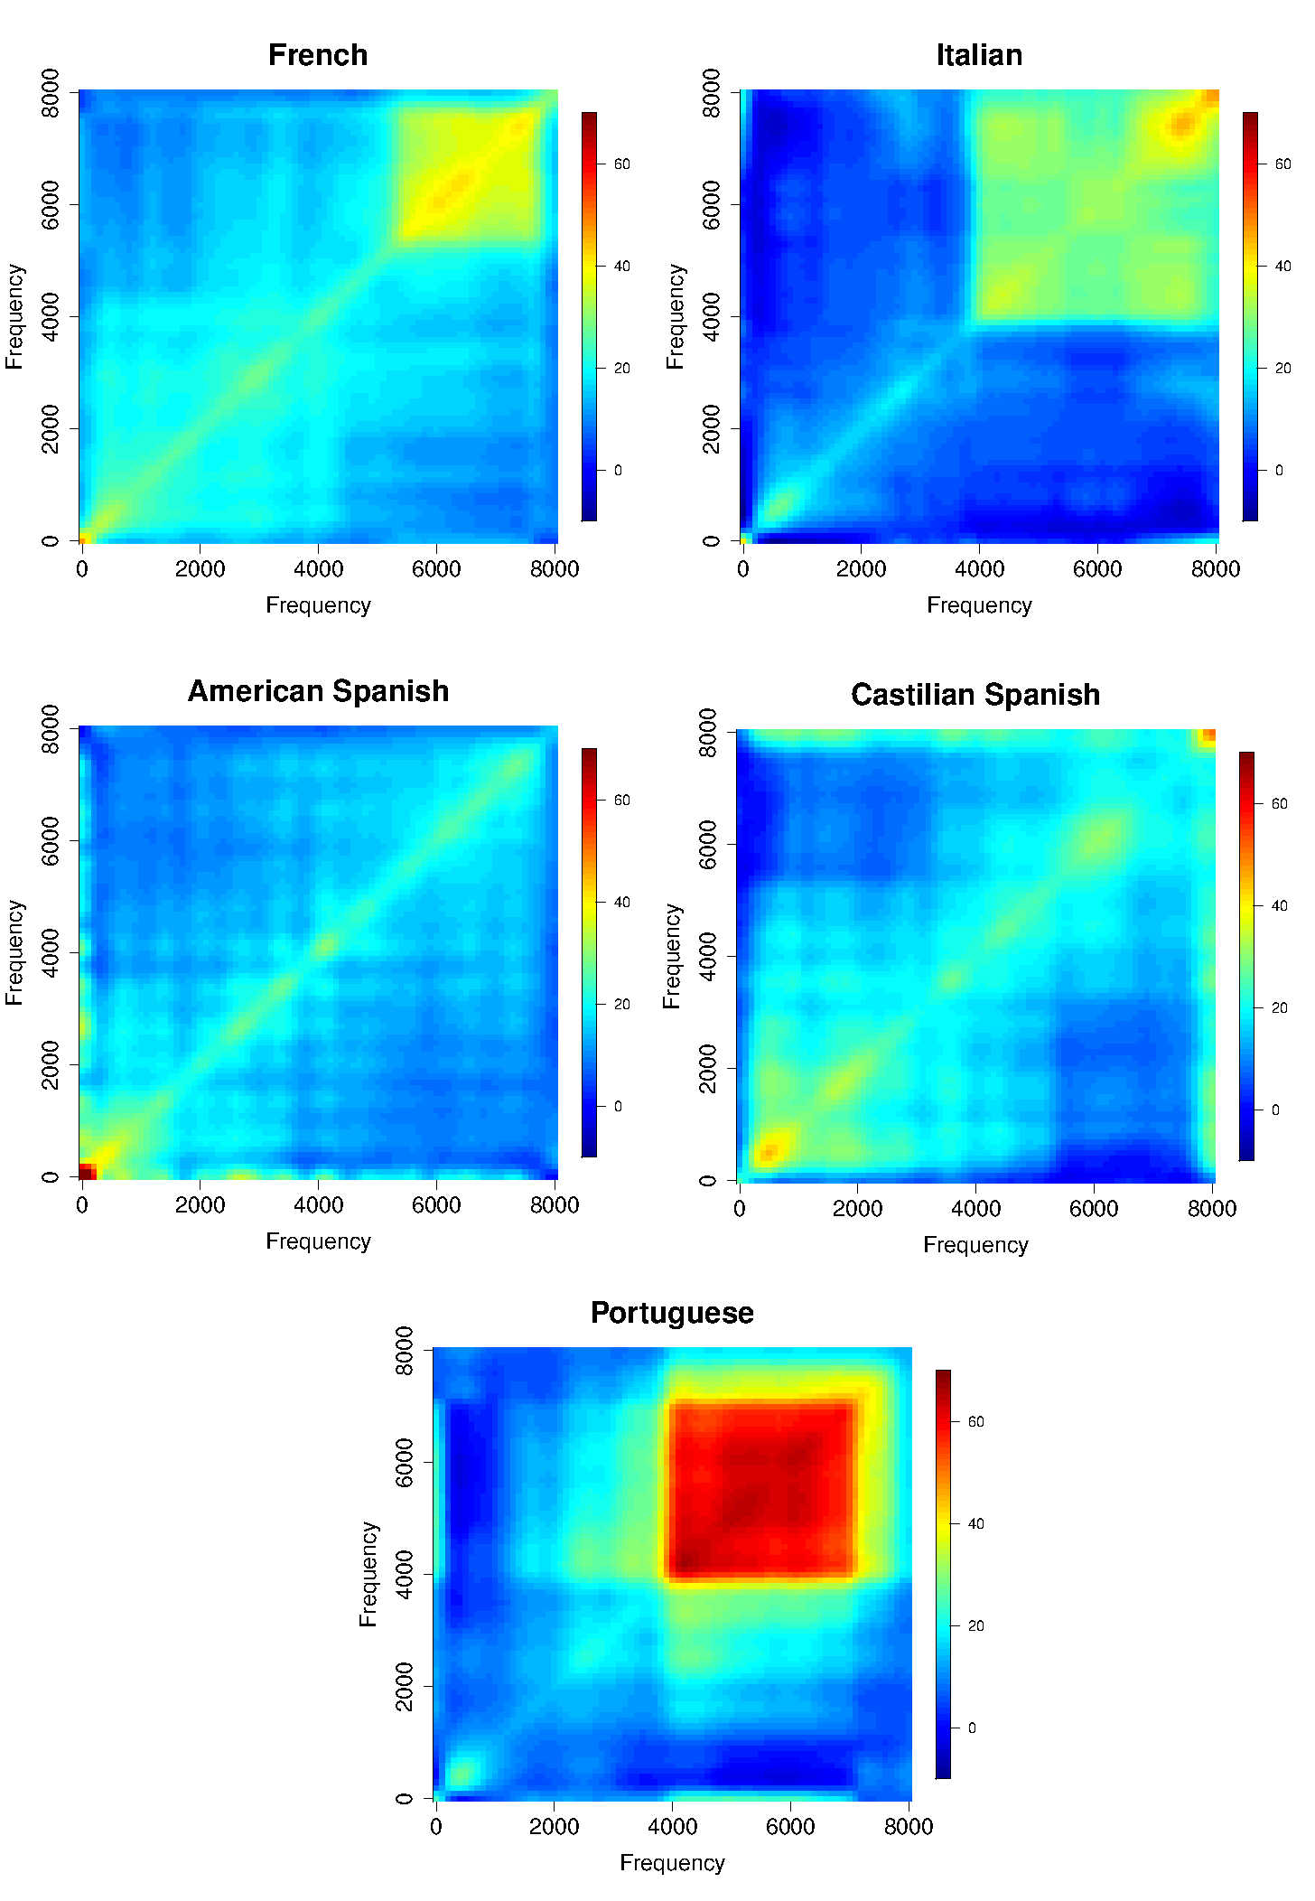
A Taste of OODA Examples
Sounds
as Data
Objects
Analysis
Of Dialects

Slide 15
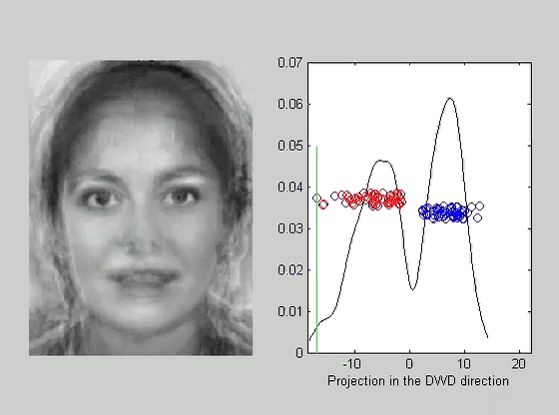
A Taste of OODA Examples
Faces as Data Objects
Classify
Males vs.
Females

Slide 16
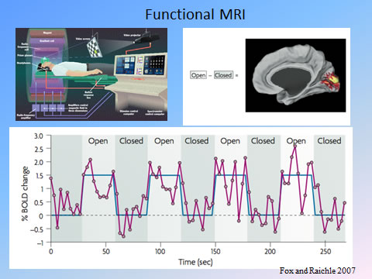
A Taste of OODA Examples
Functional Magnetic Resonance Imaging
3-d Maps of
Brain Activity
Collected
Over Time
Data Objects?
Heat Map at
One Time?
Time Series at
One Location?

Slide 17
Object Oriented Data Analysis
Three Major Phases of OODA:
I. Object Definition
“What are the Data Objects?”
Exploratory Analysis
“What Is Data Structure / Drivers?”
III. Confirmatory Analysis / Validation
Is it Really There (vs. Noise Artifact)?

Slide 18

Basics of OODA
Convenient Organizational Structure:
Data Matrix
$$\left[\begin{matrix}x_{11} & ⋯ & x_{1n} \\ ⋮ & ⋱ & ⋮ \\ x_{d1} & ⋯ & x_{dn}\end{matrix}\right]$$
Convention Here:
Columns are Data Objects
(Indexed by $j=1,⋯,n$)

Slide 19

Basics of OODA
Convenient Organizational Structure:
Data Matrix
$$\left[\begin{matrix}x_{11} & ⋯ & x_{1n} \\ ⋮ & ⋱ & ⋮ \\ x_{d1} & ⋯ & x_{dn}\end{matrix}\right]$$
Terminology:
Numbers in Rows are called “Features”
(Indexed by $i=1,⋯,d$)

Slide 20
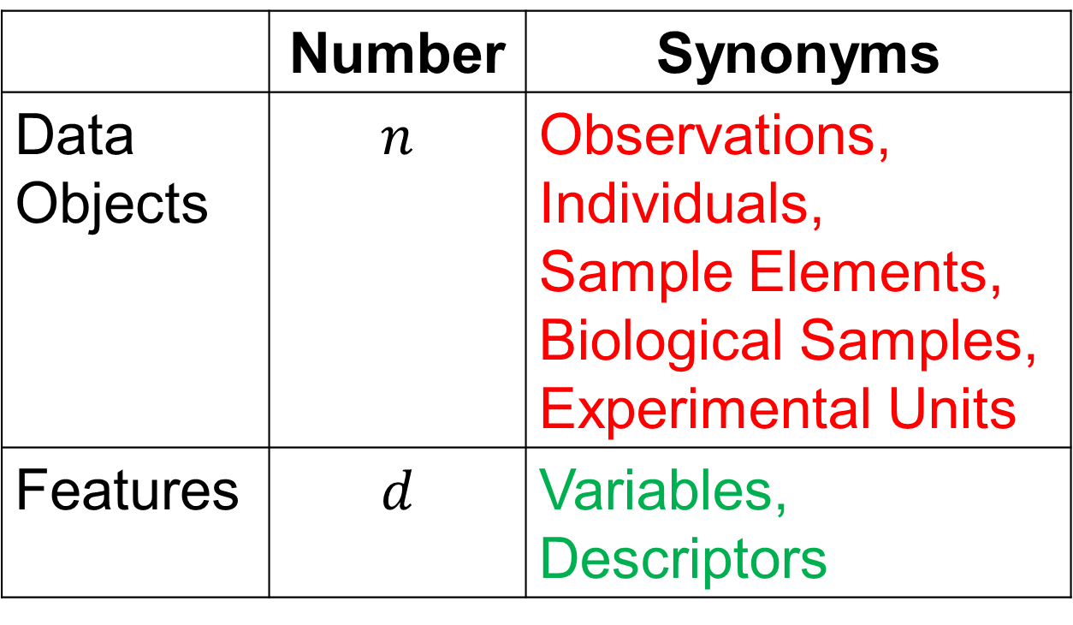
Basics of OODA
Common Synonyms:
 | Number | Synonyms
Data Objects | $$n$$ | Observations, Individuals, Sample Elements, Biological Samples, Experimental Units
Features | $$d$$ | Variables, Descriptors

Slide 21
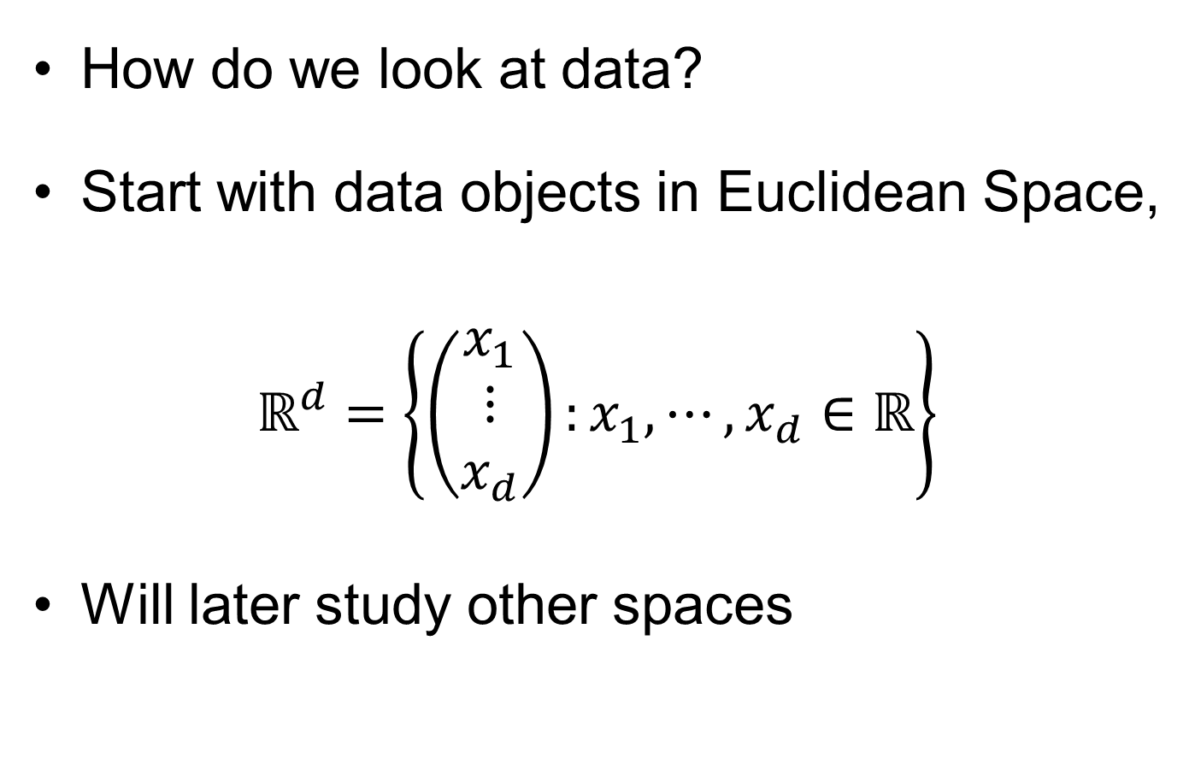
Visualization
How do we look at data?
Start with data objects in Euclidean Space,
$$ℝ^{d}=\left\{\left(\begin{matrix}x_{1} \\ ⋮ \\ x_{d}\end{matrix}\right):x_{1},⋯,x_{d}∈ℝ\right\}$$
Will later study other spaces

Slide 22
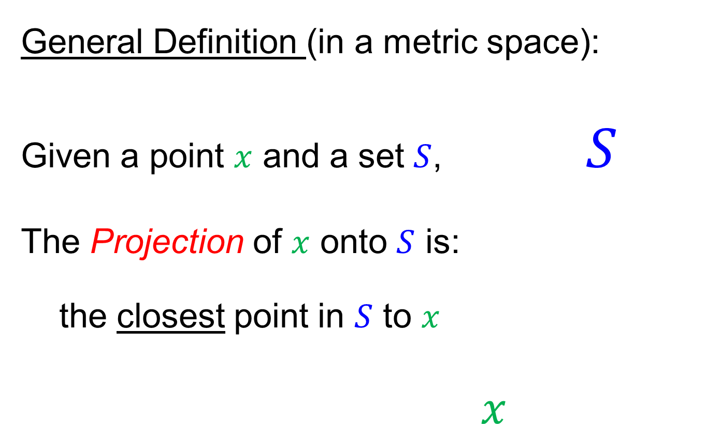
Projection
General Definition (in a metric space):
Given a point $x$ and a set $S$, $S$
The Projection of $x$ onto $S$ is:
the closest point in $S$ to $x$
$x$

Slide 23
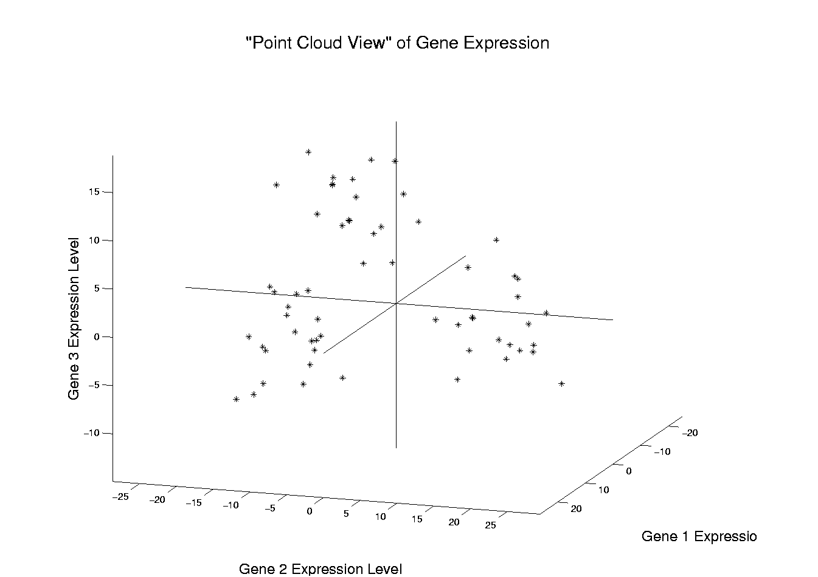
Illustration of Multivariate View: Raw Data
Notes:
EgView1p1RawData.ps

Slide 24
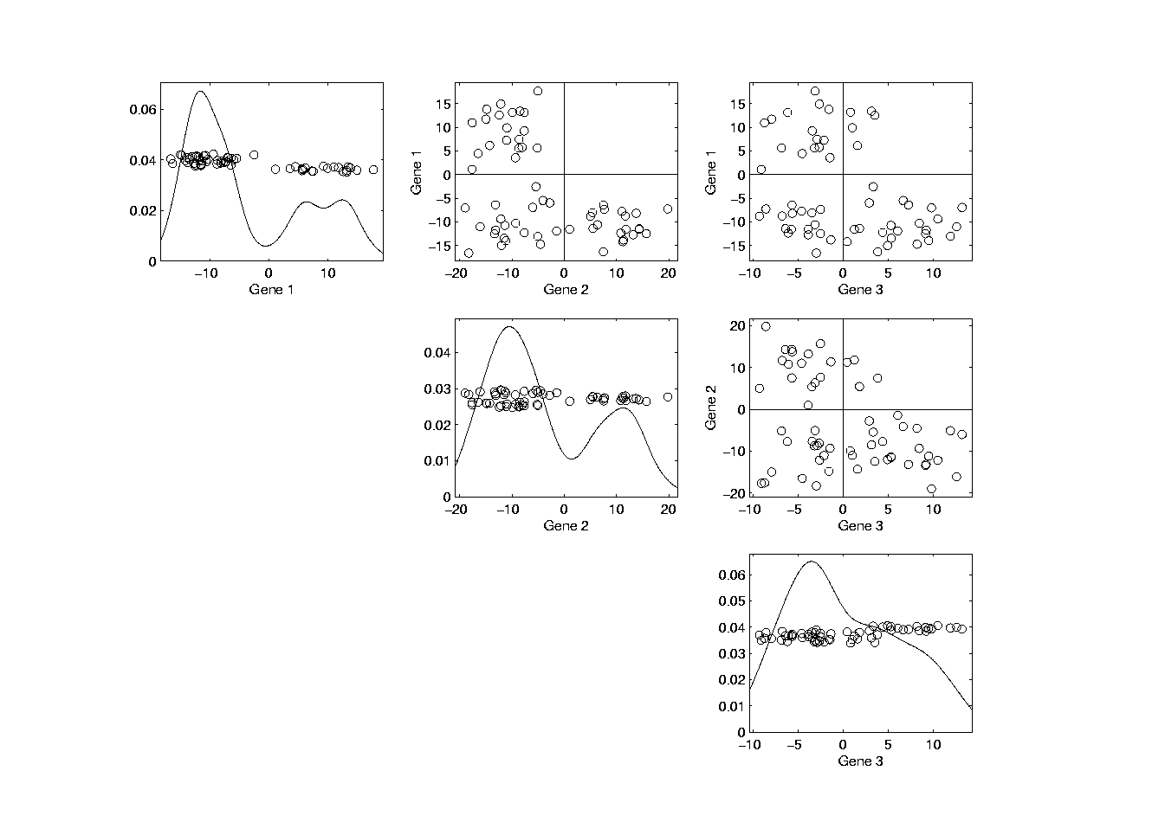
Illust’n of Multivar. View: Typical View
Notes:
EgView1p39ScatPlot.ps

Slide 25
Illust’n of Multivar. View: Typical View
Note Linkage of Axes
Notes:
EgView1p39ScatPlot.ps

Slide 26
Illust’n of Multivar. View: Typical View
Note Linkage of Axes
Notes:
EgView1p39ScatPlot.ps

Slide 27
Illust’n of Multivar. View: Typical View
Note Linkage of Axes
Notes:
EgView1p39ScatPlot.ps

Slide 28
Projection
Important Point
There are many “directions of interest” on which projection is useful
An important set of directions:
Principal Components

Slide 29
Principal Components
Find Directions of:
“Maximal (Projected) Variation”
Compute Sequentially
On Orthogonal Subspaces
Will take careful look at mathematics later

Slide 30
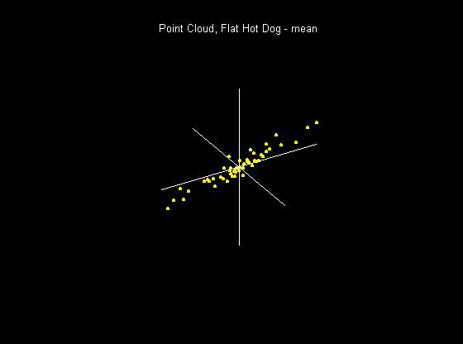
Principal Components
For simple,
3-d toy data,
recall raw
data view:
Notes:
30

Slide 31
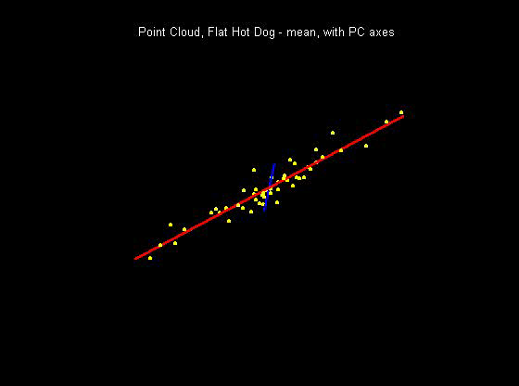
Principal Components
PCA just
gives rotated
coordinate
system:
Notes:
31

Slide 32
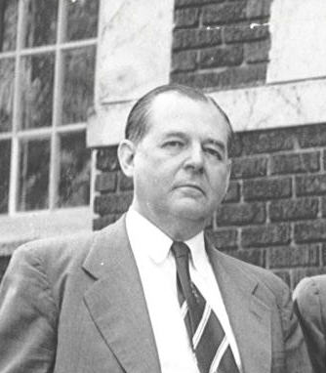
Principal Components
Early References:
Pearson (1901)
Hotelling (1933)
Founder of UNC Statistics Dept.
Notes:
32

Slide 33
Illust’n of PCA View: Recall Raw Data
Notes:
EgView1p1RawData.ps

Slide 34
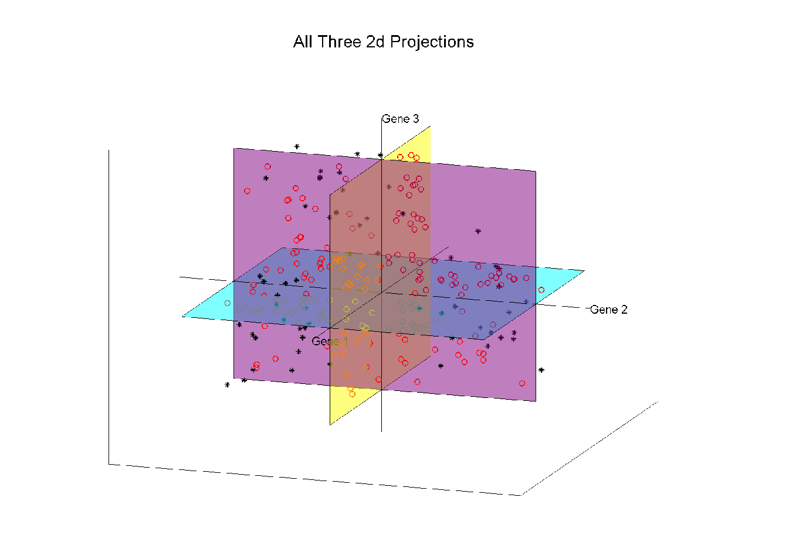
Illust’n of PCA View: Recall Gene by Gene Views
Notes:
EgView1p27proj3Dall.ps

Slide 35
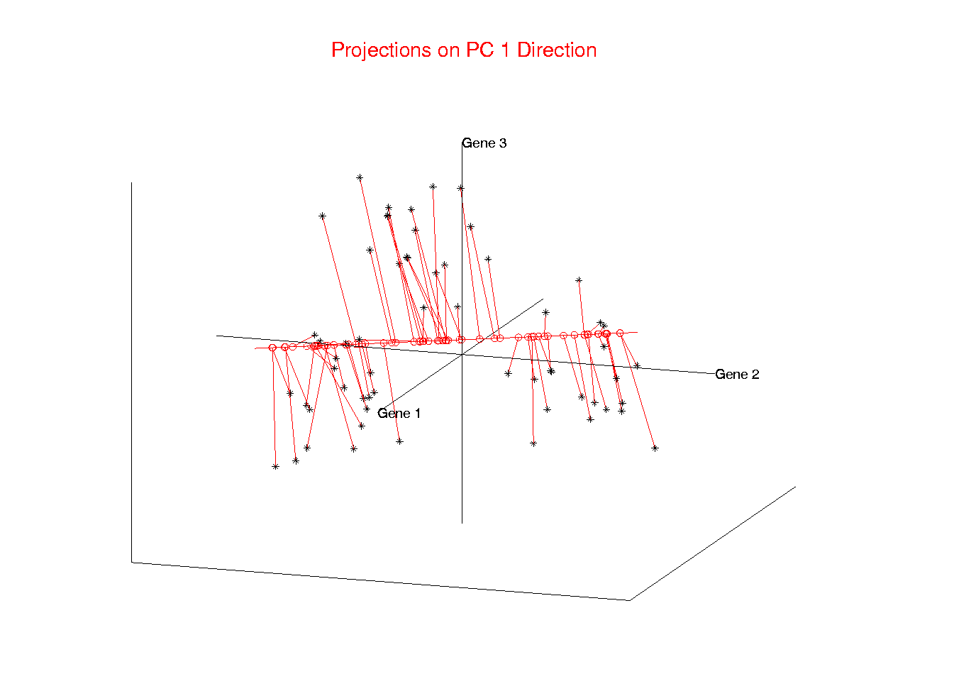
Illust’n of PCA View: PC1 Projections
Notes:
EgView1p51proj3dPC1.ps

Slide 36
Illust’n of PCA View: PC1 Projections
Note Different Axis
Chosen to
Maximize Spread
Notes:
EgView1p51proj3dPC1.ps

Slide 37
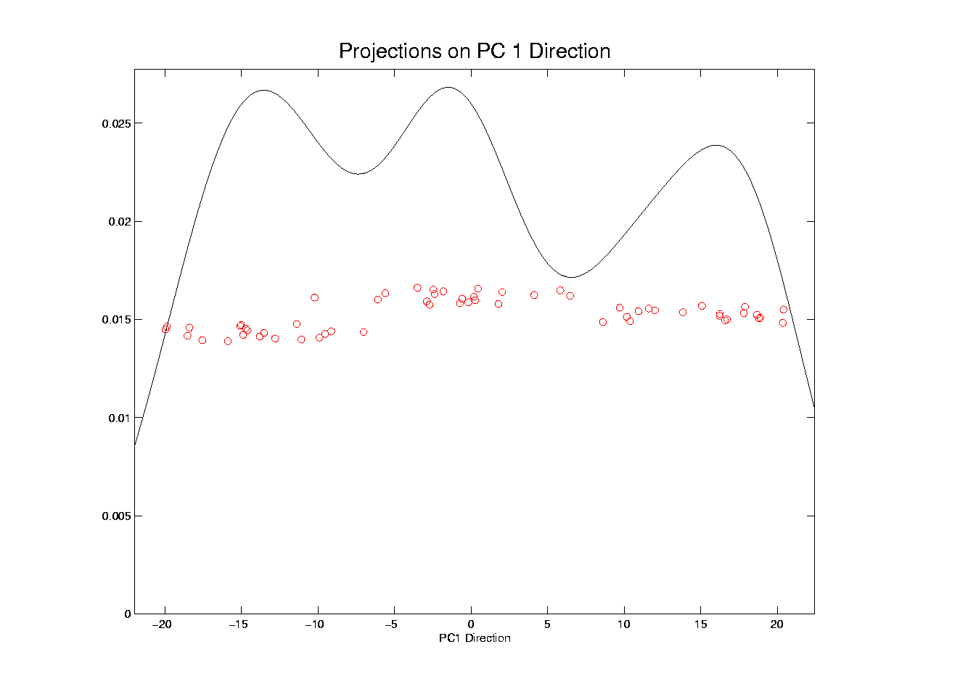
Illust’n of PCA View: PC1 Projections, 1-d View
Notes:
EgView1p61Proj1dPC1.ps

Slide 38
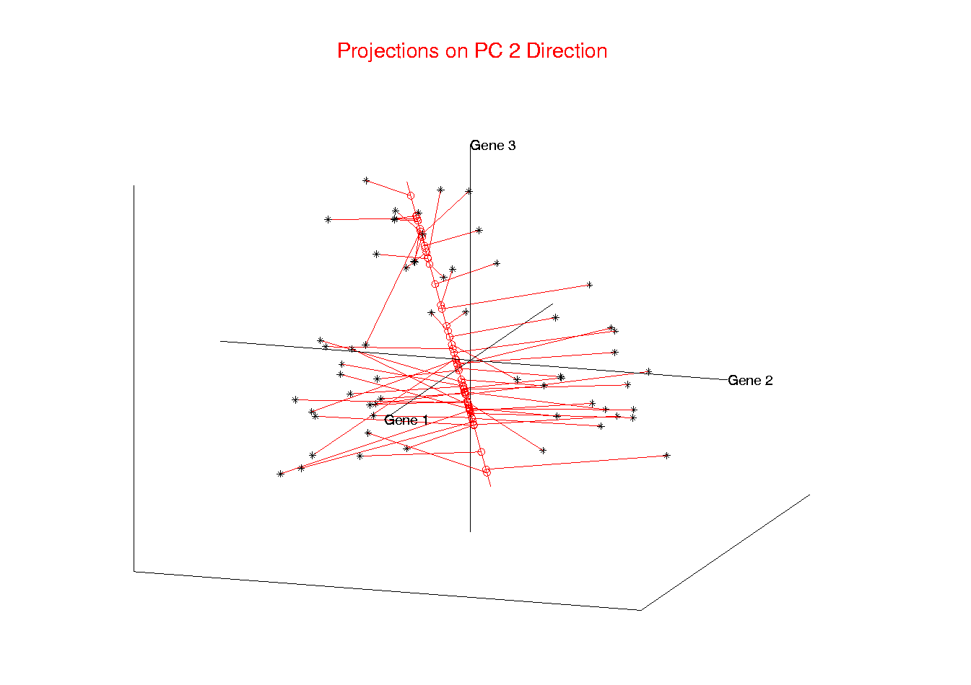
Illust’n of PCA View: PC2 Projections
Notes:
EgView1p52proj3dPC2.ps

Slide 39
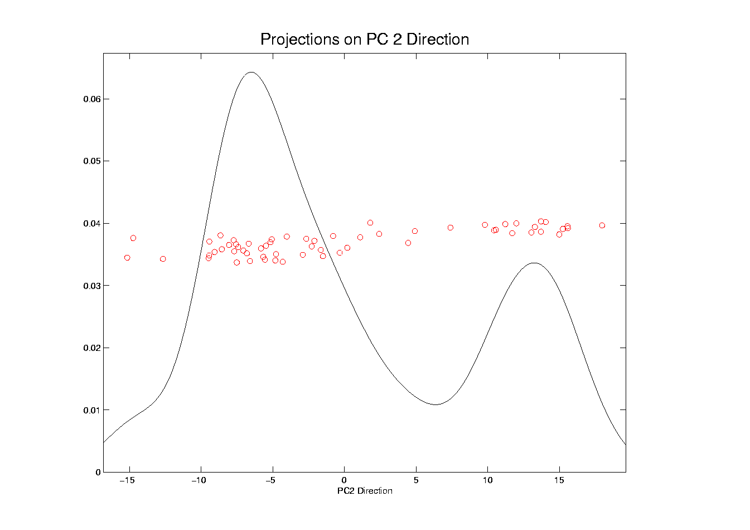
Illust’n of PCA View: PC2 Projections, 1-d View
Notes:
EgView1p62Proj1dPC2.ps

Slide 40
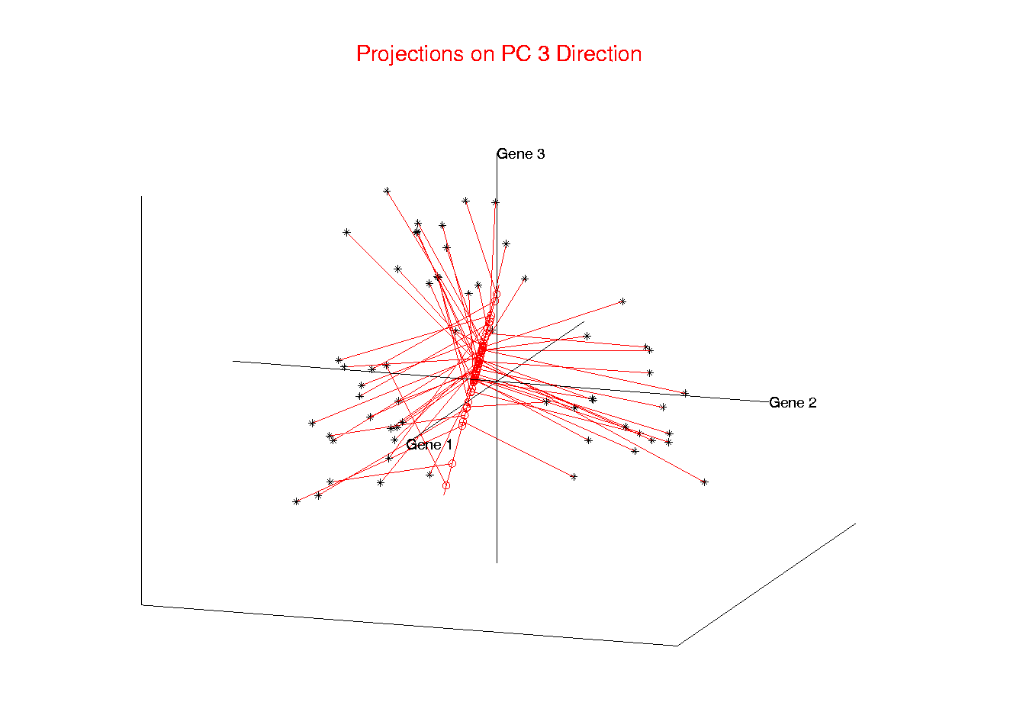
Illust’n of PCA View: PC3 Projections
Notes:
EgView1p53proj3dPC3.ps

Slide 41
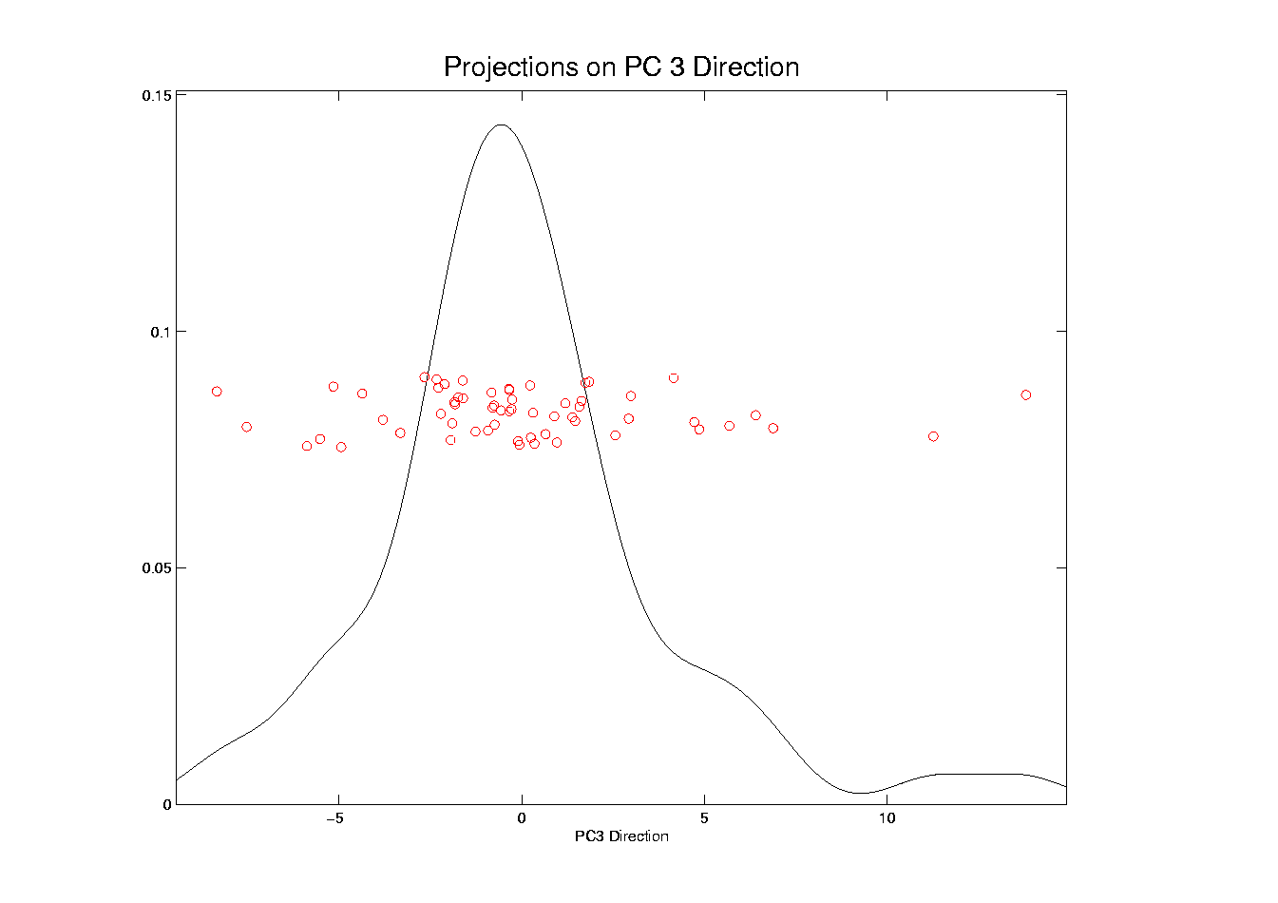
Illust’n of PCA View: PC3 Projections, 1-d View
Notes:
EgView1p63Proj1dPC3.ps

Slide 42
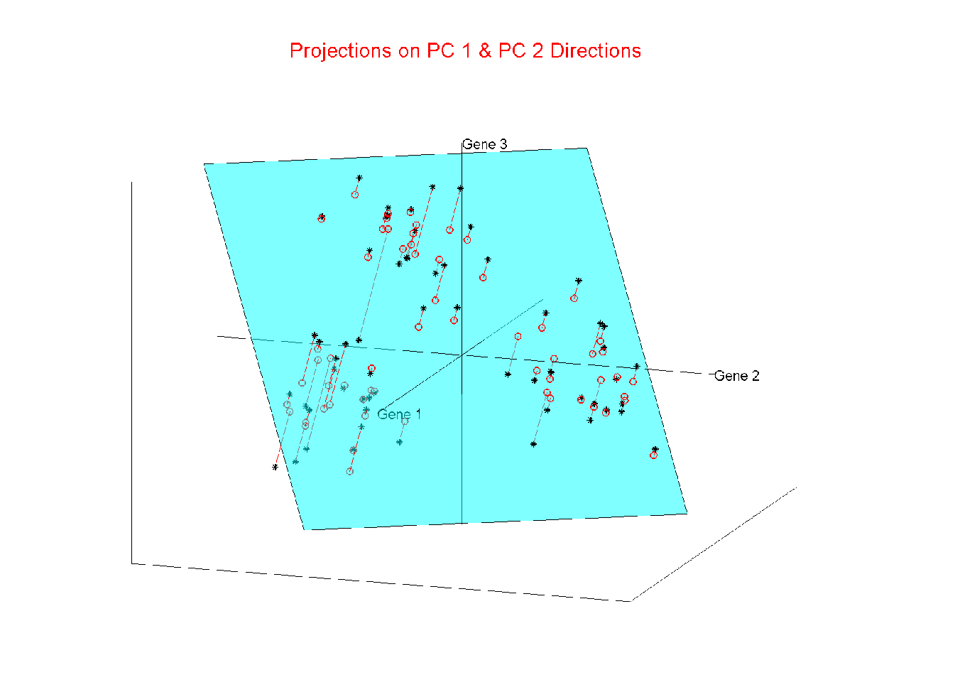
Illust’n of PCA View: Projections on PC1,2 plane
Notes:
EgView1p54proj3dPC12.ps

Slide 43
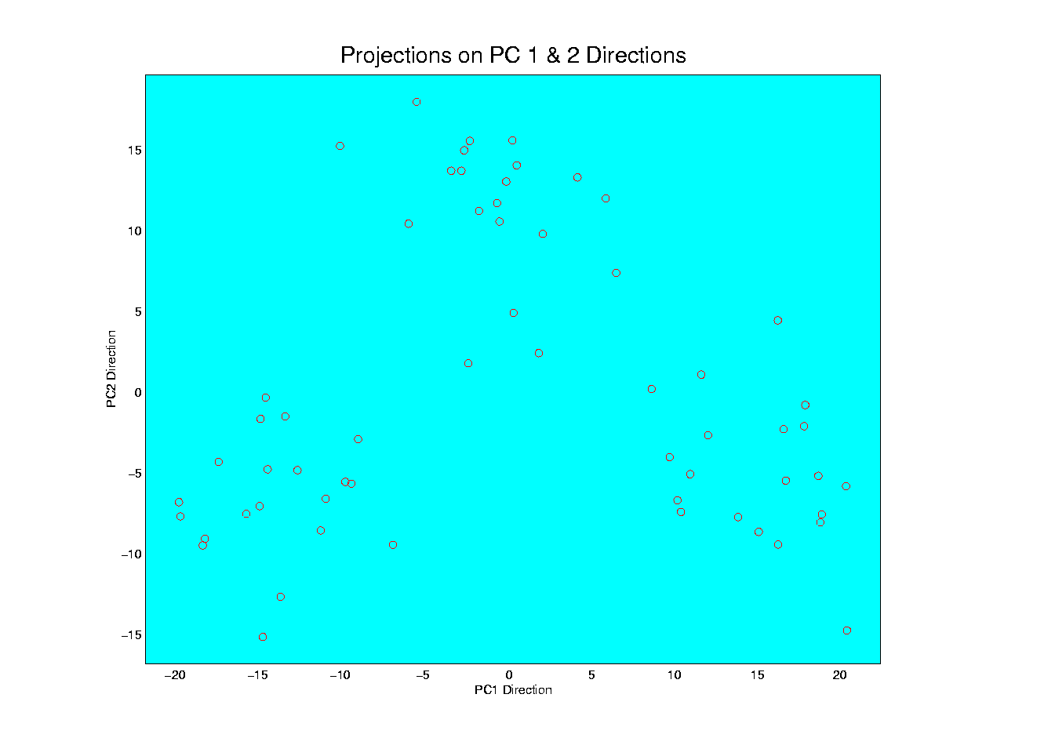
Illust’n of PCA View: PC1 & 2 Proj’n Scatterplot
Notes:
EgView1p64proj2dPC12.ps

Slide 44
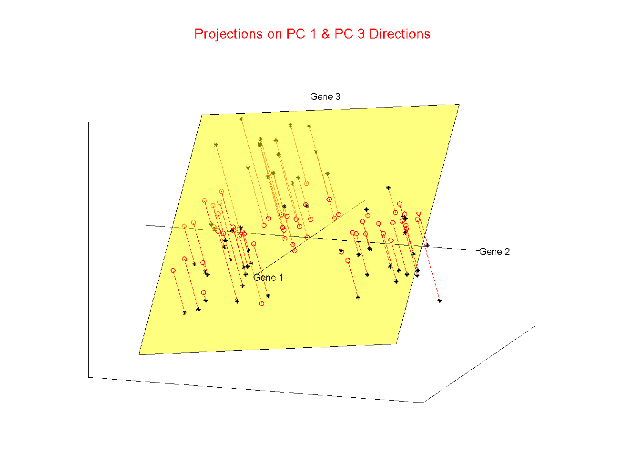
Illust’n of PCA View: Projections on PC1,3 plane
Notes:
EgView1p55proj3dPC13.ps

Slide 45
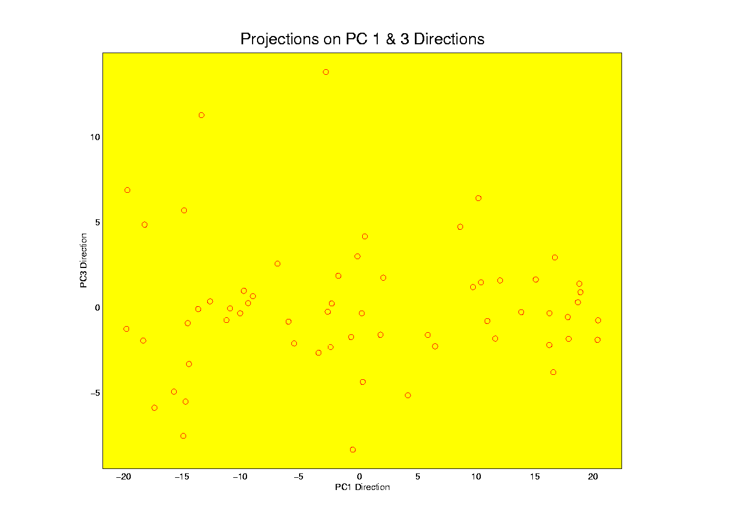
Illust’n of PCA View: PC1 & 3 Proj’n Scatterplot
Notes:
EgView1p65proj2dPC13.ps

Slide 46
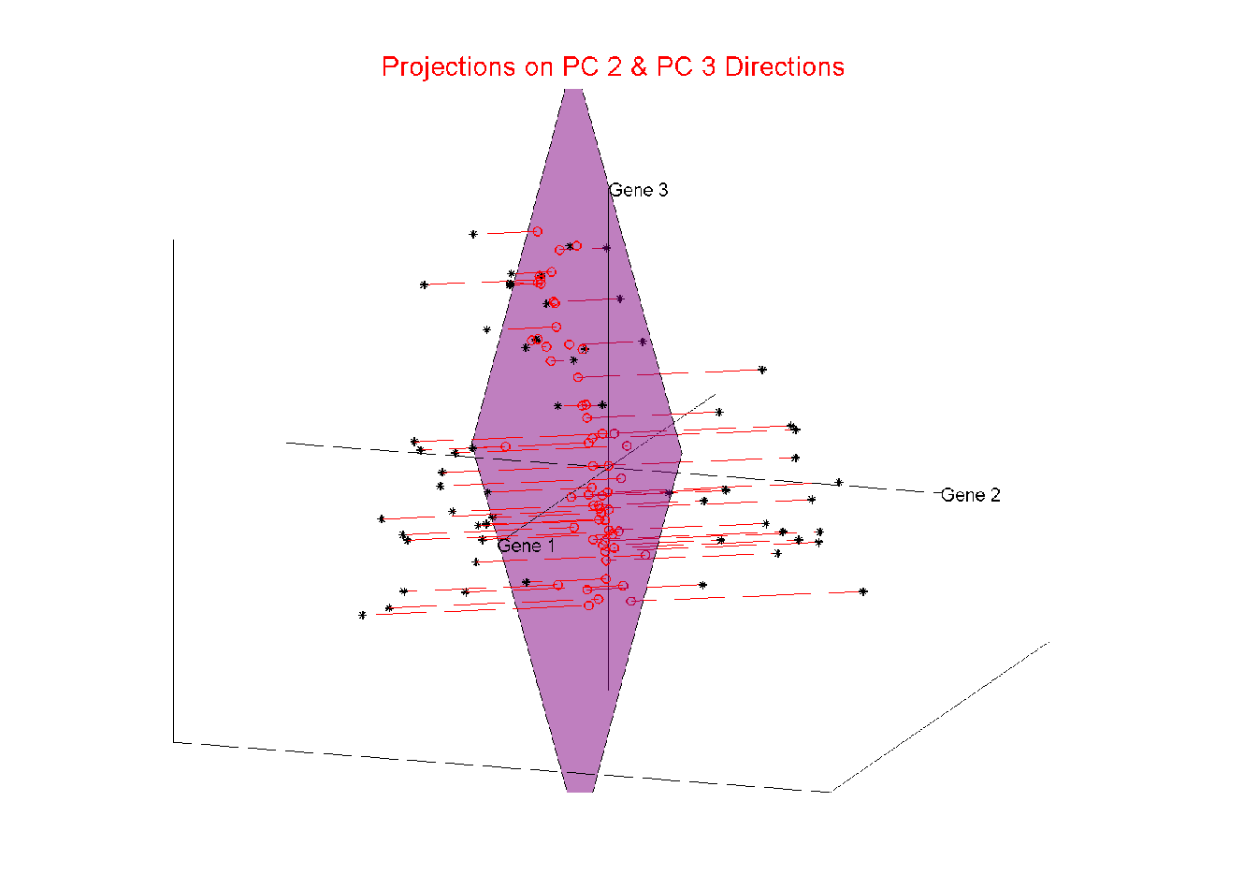
Illust’n of PCA View: Projections on PC2,3 plane
Notes:
EgView1p56proj3dPC23.ps

Slide 47
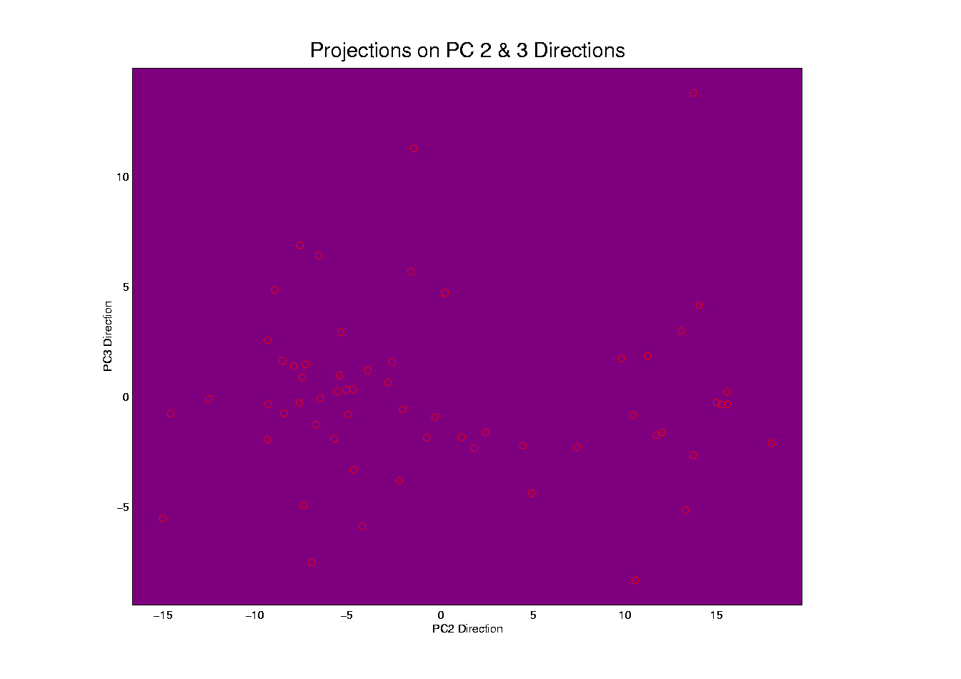
Illust’n of PCA View: PC2 & 3 Proj’n Scatterplot
Notes:
EgView1p66proj2dPC23.ps

Slide 48
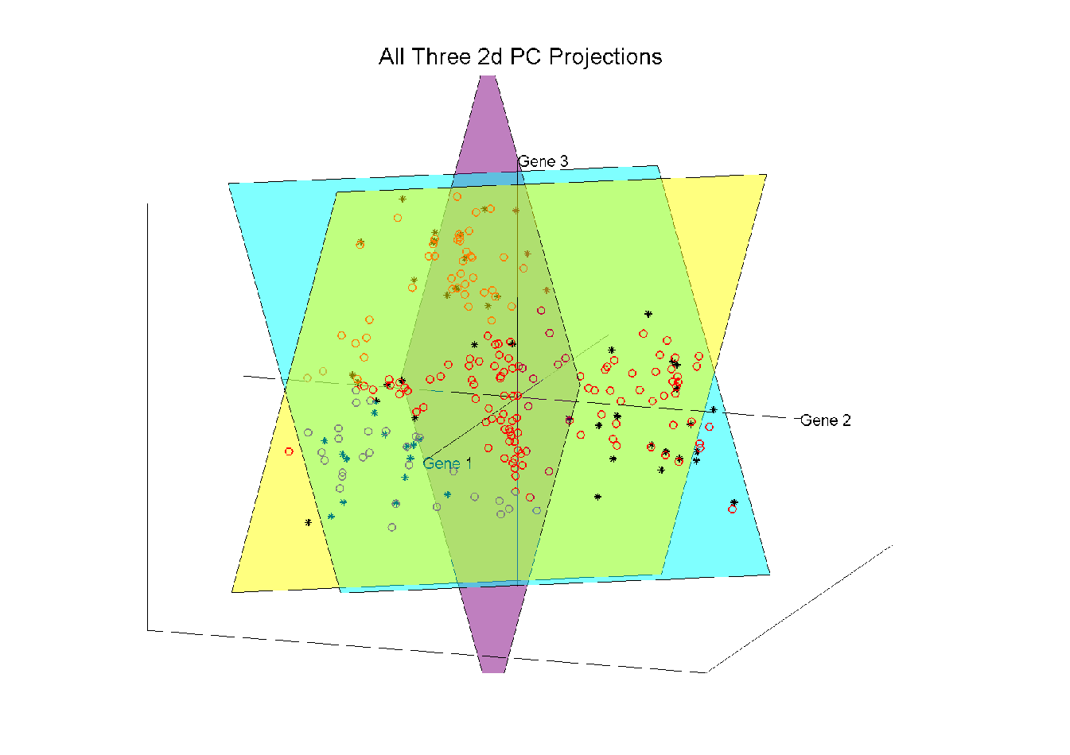
Illust’n of PCA View: All 3 PC Projections
Notes:
EgView1p57proj3dPCall.ps

Slide 49
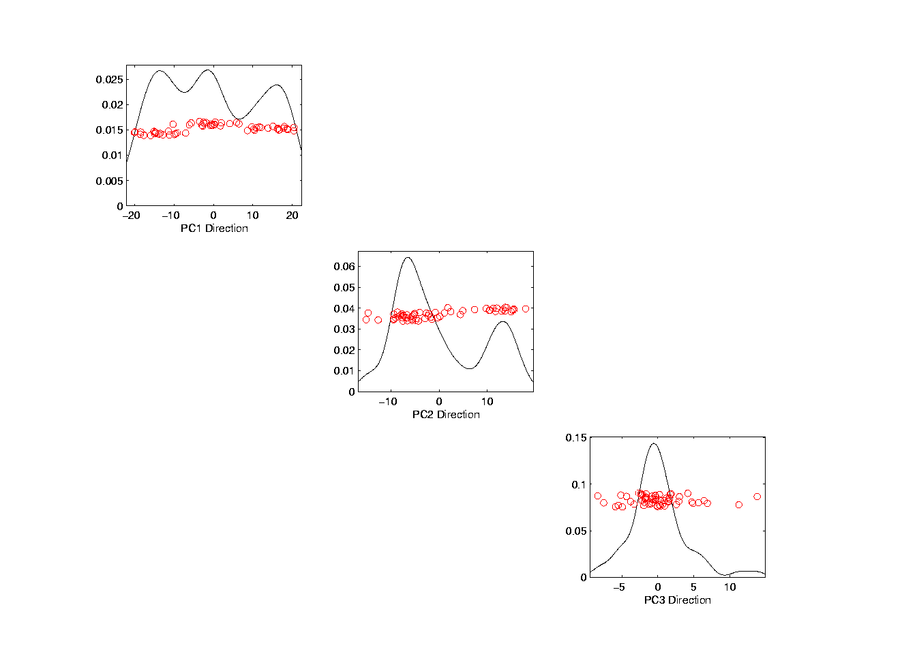
Illust’n of PCA View: Matrix with 1-d proj’ns on diag.
Notes:
EgView1p67proj1dPCAdiag.ps

Slide 50
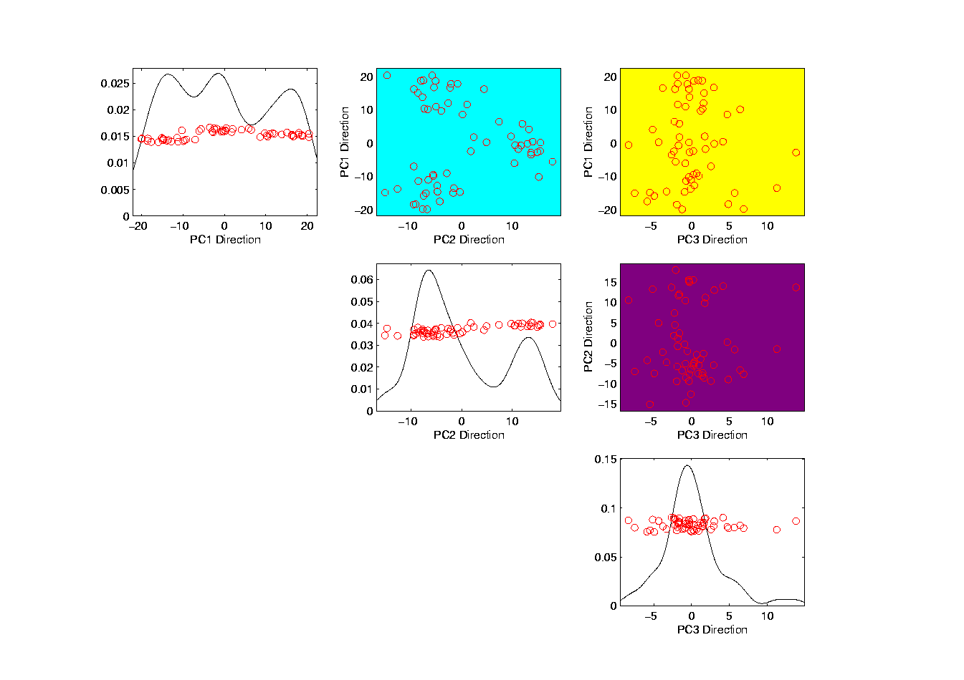
Illust’n of PCA: Add off-diagonals to matrix
Notes:
EgView1p68proj1n2dPCAcolor.ps

Slide 51
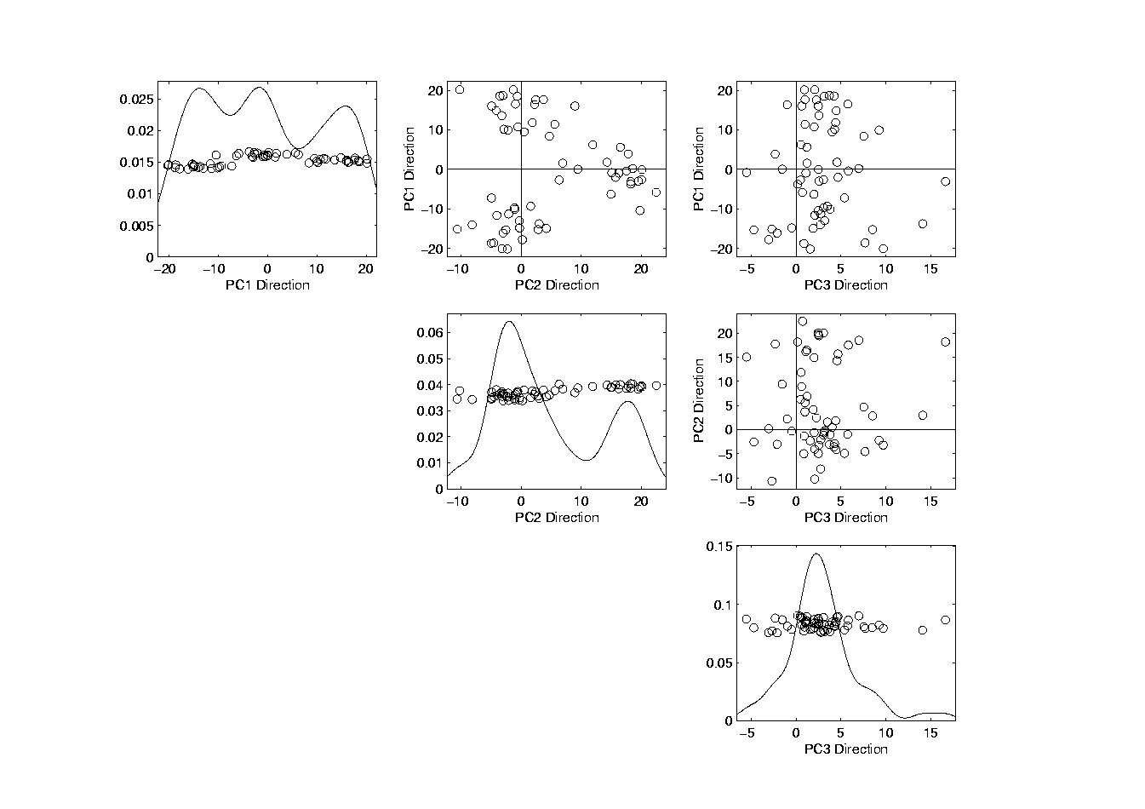
Illust’n of PCA View: Typical View
Useful “3-d” Interpretation
Front View
Side View
Top View
Notes:
EgView1p69PCAScatPlot.ps

Slide 52
Comparison of Views
Highlight 3 clusters
Gene by Gene View
  Clusters appear in all 3 scatterplots
  But never very separated
PCA View
  1st shows three distinct clusters
  Better separated than in gene view
  Clustering concentrated in 1st scatterplot
Effect is small, since only 3-d

Slide 53
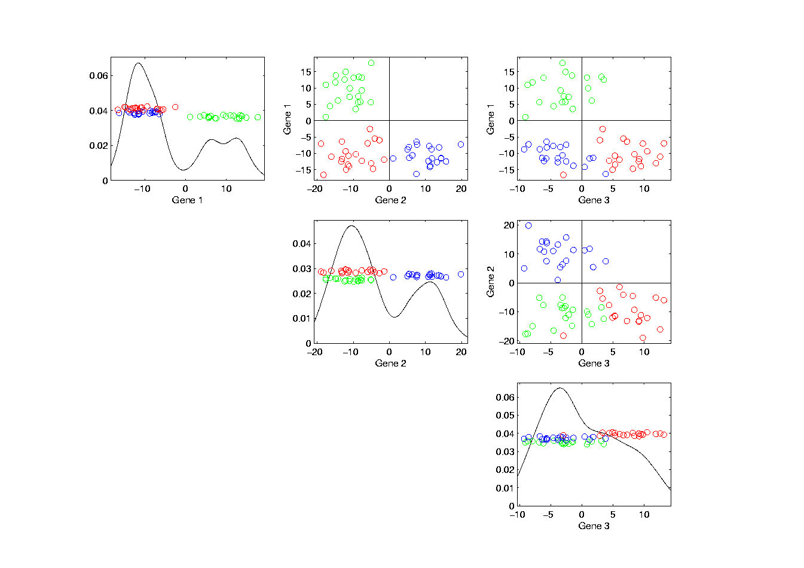
Illust’n of PCA View: Gene by Gene View
Note Colors Enhance
Impressions of Clusters
Notes:
EgView1p71GeneViewClustColor.ps

Slide 54
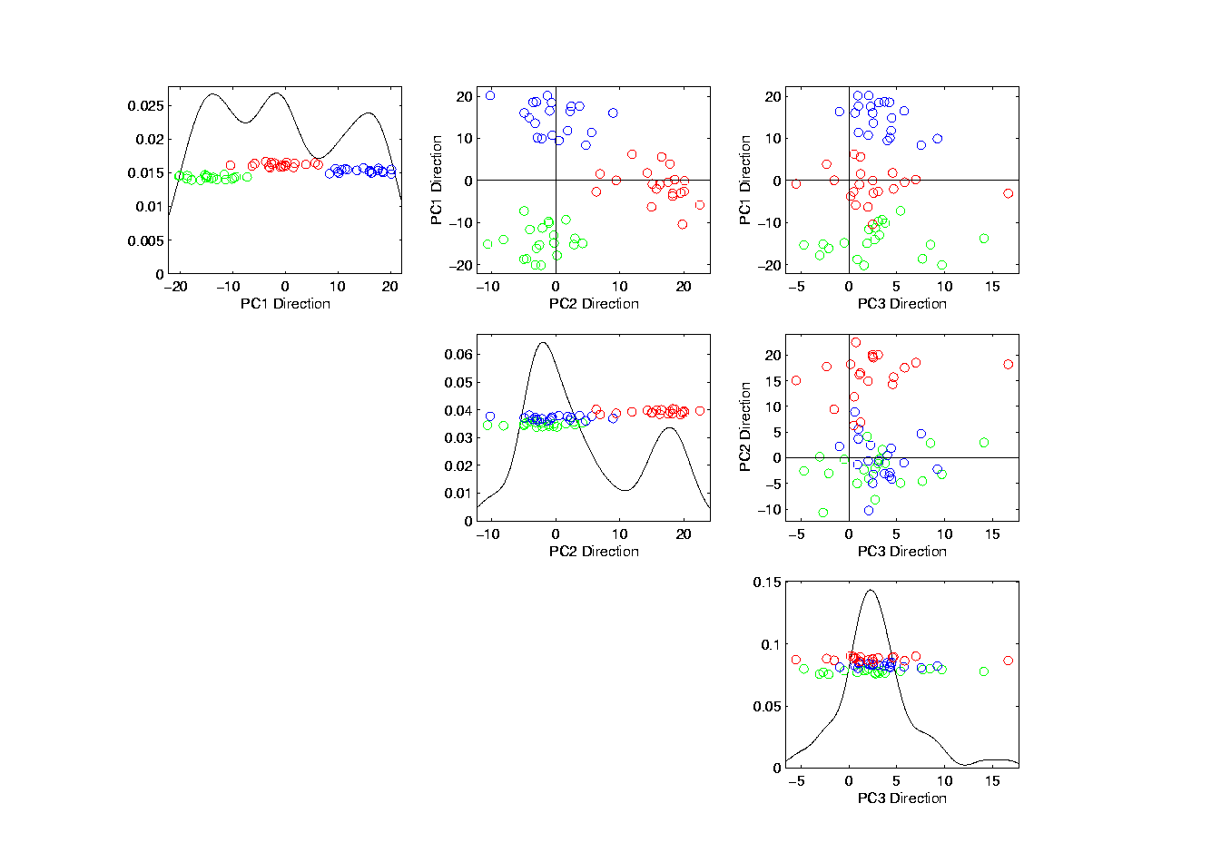
Illust’n of PCA View: PCA View
No Clusters in 3rd
Direction is Good,
Since Important
Aspects Appear
In Earlier Comp’ts
Clusters are “more distinct”
Since more “air space”
In between
Notes:
EgView1p72PCAViewClustColor.ps

Slide 55
Next Time
Point out less variation explained in 3rd direction
Different from gene by gene view

Slide 56
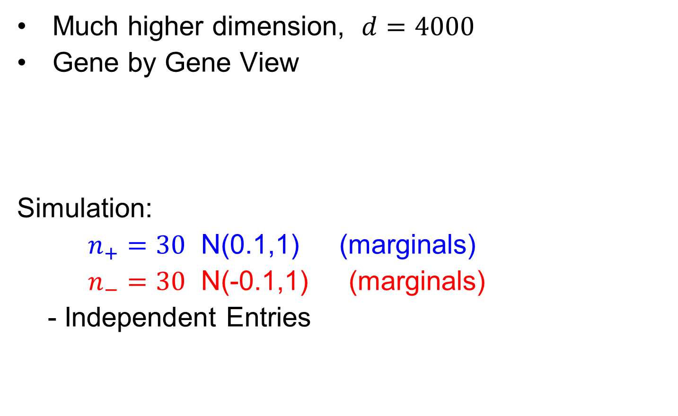
Another Comparison of Views
Much higher dimension, $d=4000$
Gene by Gene View
Simulation:
$n_{+}=30$ N(0.1,1) (marginals)
$n_{−}=30$ N(-0.1,1) (marginals)
- Independent Entries

Slide 57
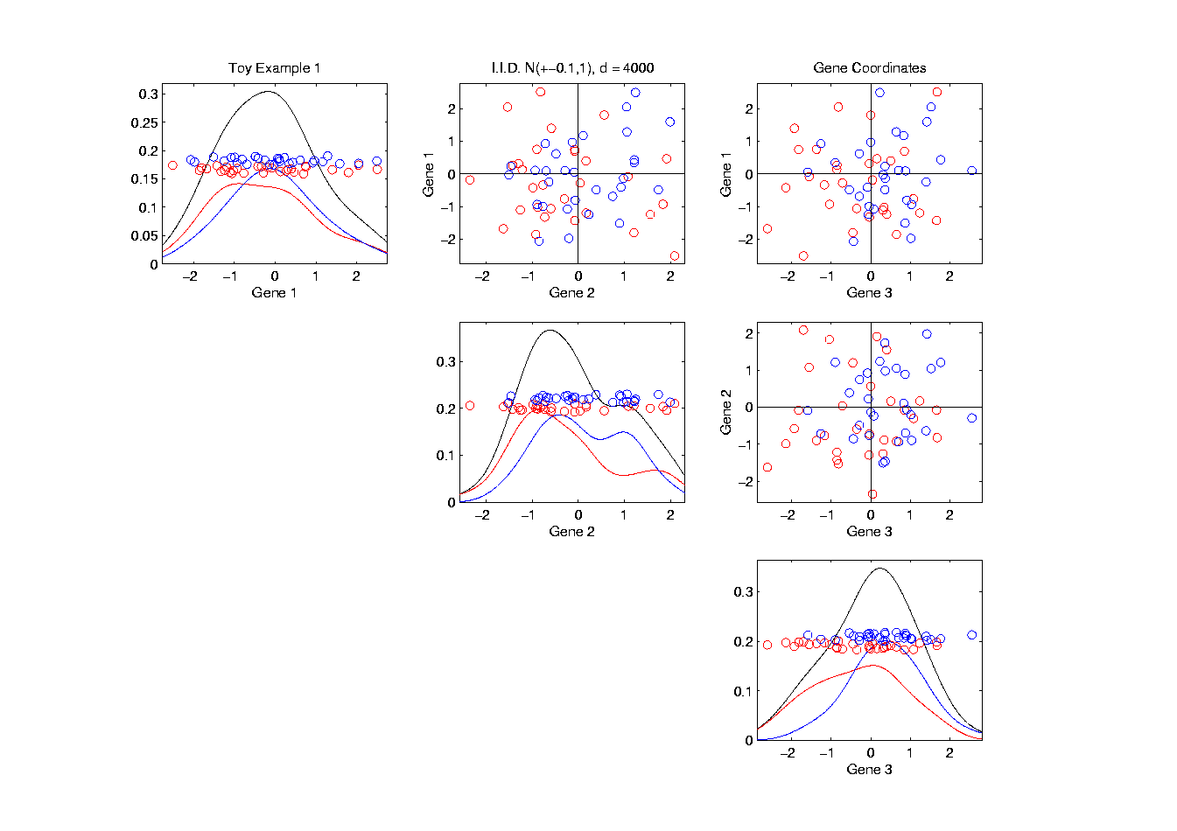
Another Comparison: Gene by Gene View
Notes:
EgView2p1dat1GeneView.ps

Slide 58
Another Comparison: Gene by Gene View
Very Small Differences
Between Means
Notes:
EgView2p1dat1GeneView.ps

Slide 59

Another Comparison of Views
Much higher dimension, $d=4000$
Gene by Gene View
  Clusters very nearly the same
  Very slight difference in means

Slide 60
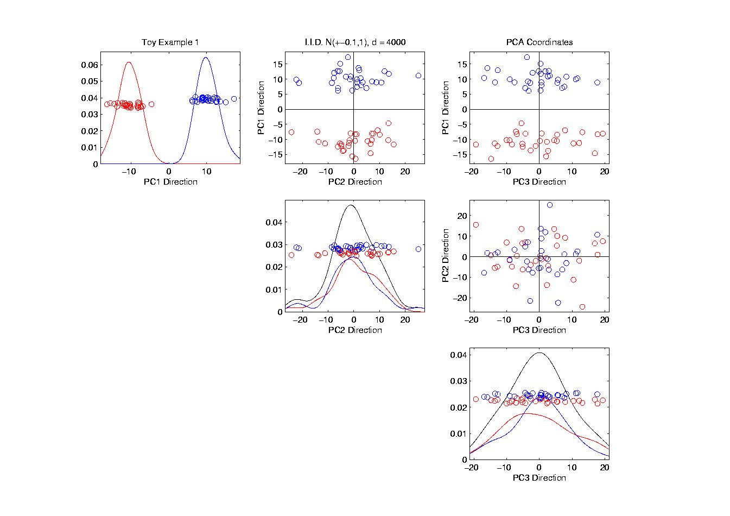
Another Comparison: PCA View
Notes:
EgView2p2dat1PCAView.ps

Slide 61

Another Comparison of Views
Much higher dimension, $d=4000$
Gene by Gene View
  Clusters very nearly the same
  Very slight difference in means
PCA View
  Huge difference in 1st PC Direction
  Magnification of clustering
  Lesson: Alternate views can show much more
  (especially in high dimensions, i.e. for many genes)
  Shows PC view is very useful`

Slide 62


Another Comparison: PCA View
Another Viewpoint:
Consider Vectors
$\vec{μ_{+}}=\left(\begin{matrix}+0.1 \\ ⋮ \\ +0.1\end{matrix}\right)$
$\vec{μ_{−}}=\left(\begin{matrix}−0.1 \\ ⋮ \\ −0.1\end{matrix}\right)$
Difference points in direction $\left(\begin{matrix}1 \\ ⋮ \\ 1\end{matrix}\right)$
Notes:
EgView2p2dat1PCAView.ps

Slide 63

Another Comparison: PCA View
High Dimensional
Space Is Slippery!
Interesting Issue:
How close is $\left(\begin{matrix}1 \\ ⋮ \\ 1\end{matrix}\right)$ to coordinate axes in $ℝ^{d}$?
Angle $= \cos^{−1}\left[\left(\begin{matrix}\frac{1}{\sqrt{d}} & ⋯ & \frac{1}{\sqrt{d}}\end{matrix}\right)\left(\begin{matrix}1 \\ 0 \\ \begin{matrix}⋮ \\ 0\end{matrix}\end{matrix}\right)\right]$
Which for $d=4000$ is ${89.1}^{°}$
Notes:
EgView2p2dat1PCAView.ps

Slide 64
Object Oriented Data Analysis
Three Major Phases of OODA:
I. Object Definition
“What are the Data Objects?”
Exploratory Analysis
“What Is Data Structure / Drivers?”
III. Confirmatory Analysis / Validation
Is it Really There (vs. Noise Artifact)?

Slide 65
Basics of OODA
Useful Conceptual Framework:
Object Space ←→ Feature Space
(Where data
objects live)
(How they are
represented)

Slide 66

Basics of OODA
Object Space ←→ Feature Space
Curves $ℝ^{d}$
Images Manifolds
Shapes Graph Space
Trees
Movies

Slide 67


Basics of OODA
Object Space ←→ Feature Space
Simple $d=2$ Toy Example:
Enables Visualization of BOTH Spaces

Slide 68

Basics of OODA
Simple $d=2$ Toy Example:
Each Curve is a Point

Slide 69


Basics of OODA
Simple $d=2$ Toy Example:
Each Curve is a Point
Mean is shown as well (part of analysis)
Can Compute
Mean in $ℝ^{2}$
Or Equivalently Pointwise in Object Space

Slide 70


Basics of OODA
Simple $d=2$ Toy Example:
Best Rank 1 Approximation (PC 1)
As Curves
and as Points

Slide 71

Basics of OODA
Simple $d=2$ Toy Example:
Computed as Projections onto
Eigen-direction centered at Mean

Slide 72

Basics of OODA
Simple $d=2$ Toy Example:
Interpretation:
1st Mode of Variation

Slide 73


Basics of OODA
Simple $d=2$ Toy Example:
Second Best Rank 1 Approximation (PC 2)
As Curves
and as Points

Slide 74

Basics of OODA
Simple $d=2$ Toy Example:
Computed as Projections onto
Eigen-direction centered at Mean

Slide 75

Basics of OODA
Simple $d=2$ Toy Example:
Interpretation:
2nd Mode of Variation

Slide 76

Basics of OODA
Decomposition into Modes of Variation
Note Much More
Variation Here
Than Here

Slide 77
Basics of OODA
Decomposition into Modes of Variation
Sum of Squares
After Mean
Centering
Variance (not s.d.)
To Reflect Energy
Just as in ANOVA
Usual Quantification: Variance of Each, Expressed as %
98.3% of
Variation
1.7% of
Variation

Slide 78

Scree Plot
Idea: Visually Summarize Dist’n of Variance
Sometimes Also Useful
To Display Cumulative
98.3% of
Variation
1.7% of
Variation

Slide 79
Scree Plot
More Examples
Spanish Male
Mortality Data
2-d Toy Data

Slide 80

Scree Plot
Recall Spanish Male Mortality Data

Slide 81

Scree Plot
Recall Spanish Male Mortality Decomposition
95.8% of Variation
2.7% of
Variation
Don’t Believe It?
Check Axes!

Slide 82
Scree Plot
More Examples
95.8% of Variation
Spanish Male
Mortality Data
2-d Toy Data
2.7% of
Variation

Slide 83
Scree Plot
More Examples
Spanish Male
Mortality Data
2-d Toy Data
10-d Toy Data
Genetic Data
(Will Discuss These Later)

Slide 84
Scree Plot
More Examples
Illustrates Common Use of Scree:
Separate “Signal” From “Noise”
Spanish Male
Mortality Data
2-d Toy Data
Look for “Elbow” (or “Knee”)
10-d Toy Data
Genetic Data

Slide 85

Scree Plot
Etymology of term Scree:
Geological Feature
Pile Up of Rock
Fragments
(from Wikipedia)

Slide 86
Basics of OODA
Recall Decomposition into Modes of Variation
& Elsewhere
As well

Slide 87
Basics of OODA
Definition of Mode of Variation
(of a sample of data objects)
A Set of Members of the Object Space That:
Summarize One Component of Variation
Is in Some Sense “One Dimensional”
(e.g. Indexed by a Single Real Parameter)

Slide 88
Basics of OODA
Recall Decomposition into Modes of Variation
Multiples Of A Single Curve

Slide 89
Basics of OODA
Recall Spanish Male Mortality Data
Multiples Of A Single Curve

Slide 90
Basics of OODA
Recall Amplitude Phase Example
1-d Families of Curves

Slide 91


Basics of OODA
Recall Bladder Prostate Rectum Data
1-d Set of Members of Object Space

Slide 92
Basics of OODA
Recall Faces a Data Objects
1-d Set of
Members of
Object Space,
So Also a “Mode Of
Variation”

Slide 93


Representing Vectors as Curves
Aside on Visualization:
$\left(\begin{matrix}x_{1} \\ ⋮ \\ x_{d}\end{matrix}\right)$
Called Parallel Coordinate View
by Inselberg (1985, 2005)

Slide 94

Parallel Coordinates
Proposed for Multivariate Data Visualization:
by Inselberg (1985, 2005)
E.g. Fisher Iris Data
d = 4
Named Variables
(thanks to Wikipedia)
Notes:
94

Slide 95
Parallel Coordinates
Proposed for Multivariate Data Visualization:
by Inselberg (1985, 2005)
E.g. Fisher Iris Data
d = 4
Named Variables
Curves are Data Objects
Vectors → Curves
Notes:
95

Slide 96
Representing Vectors as Curves
Summary of Approaches:
Parallel Coordinates
Fourier Basis
Orthogonal Polynomials
B-Splines
Wavelet Bases
Notes:
96

Slide 97
Object Oriented Data Analysis
Three Major Phases of OODA:
I. Object Definition
“What are the Data Objects?”
Exploratory Analysis
“What Is Data Structure / Drivers?”
III. Confirmatory Analysis / Validation
Is it Really There (vs. Noise Artifact)?

Slide 98

E.g. Curves As Data
Deeper example
10-d family of (digitized) curves
Object space: bundles of curves
Descriptor space = $ℝ^{10}$
(harder to visualize as point cloud,
but keep point cloud in mind)
PCA: reveals “population structure”

Slide 99

Functional Data Analysis, 10-d Toy EG 1
Terminology:
“Loadings Plots” “Scores Plots”
Notes:
EGCD1Parabs.ps

Slide 100
Functional Data Analysis, 10-d Toy EG 1
OODA Conceptual Framework
Object
Space
Views
Desc-
riptor
Space
Views
Notes:
EGCD1Parabs.ps

Slide 101
Functional Data Analysis, 10-d Toy EG 1
Notes:
EGCD1Parabs.ps

Slide 102
Functional Data Analysis, 10-d Toy EG 1
OODA Conceptual Framework
Note Scree Plot, Already Shown Above,
To Illustrate Distribution of Variation
Notes:
EGCD1Parabs.ps

Slide 103
Scree Plot
More Examples
Spanish Male
Mortality Data
2-d Toy Data
10-d Toy Data
Genetic Data

