Slide 1
Statistics – O. R. 881
Object Oriented Data Analysis
Steve Marron
Dept. of Statistics and Operations Research
University of North Carolina

Slide 2
Administrative Info
Details on Course Web Page
https://marron.web.unc.edu/stor-881-object-oriented-data-analysis-fall-2019/
Or:
  Google: “Marrons teaching material”
  Choose This Course

Slide 3
Participant Presentations
Please Prepare to Sign Up (on Thursday):
Name
Email (Onyen is fine, or …)
Are You ENRolled?
Dept. & Advisor (Lab?)
Tentative Title (“????” Is OK)
When:
  Next Week, Early, Oct., Nov., Late

Slide 4
Course Context
Currently Fashionable Topic:
Big Data Science
Many Important Issues.
But More Challenging (& Important?):
Complex Data
( )

Slide 5
Comparison of Views
Highlight 3 clusters
Gene by Gene View
  Clusters appear in all 3 scatterplots
  But never very separated
PCA View
  1st shows three distinct clusters
  Better separated than in gene view
  Clustering concentrated in 1st scatterplot
Effect is small, since only 3-d

Slide 6
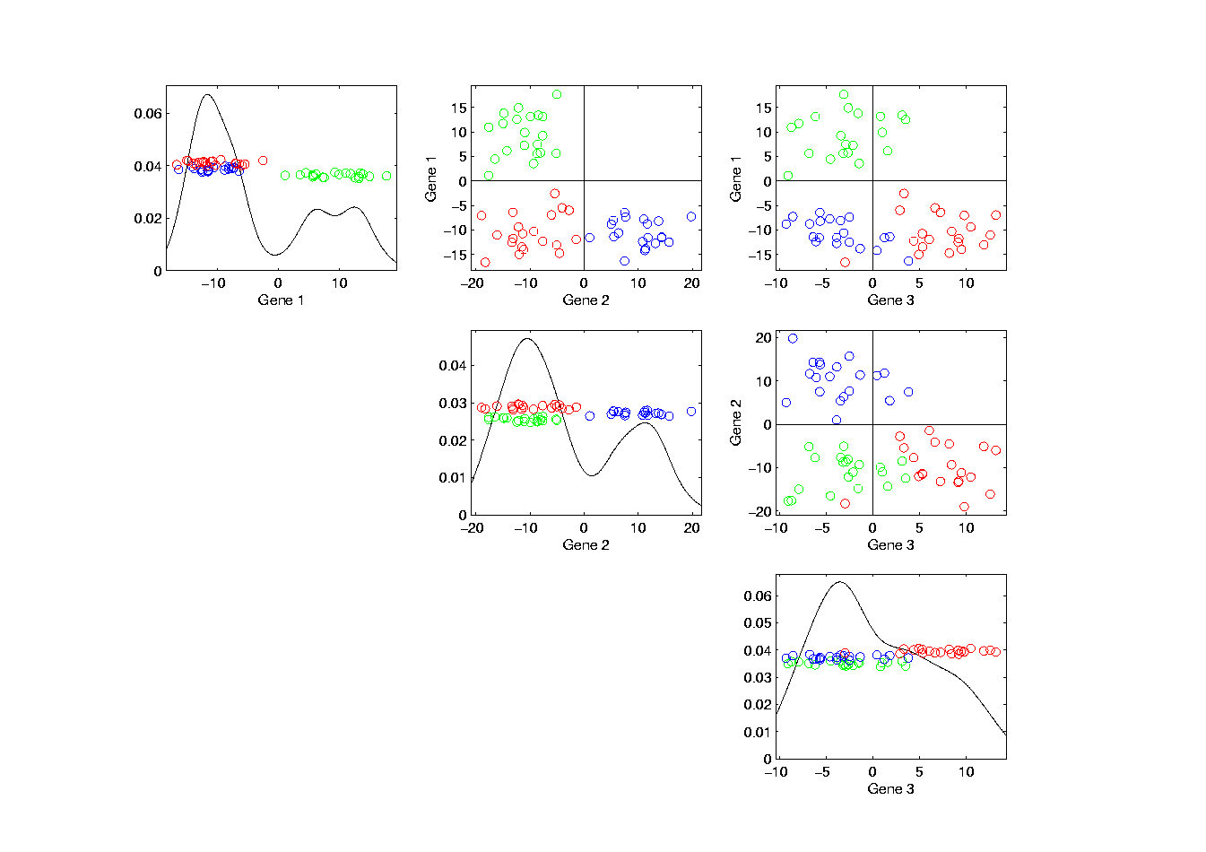
Illust’n of PCA View: Gene by Gene View
Note Colors Enhance
Impressions of Clusters
Notes:
EgView1p71GeneViewClustColor.ps

Slide 7
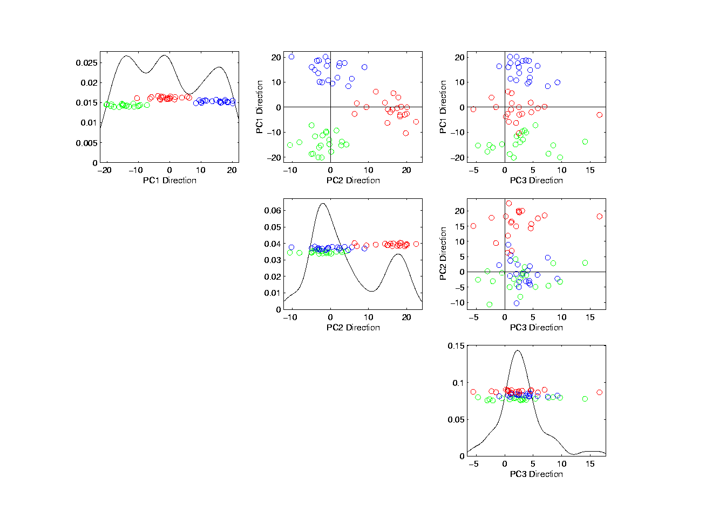
Illust’n of PCA View: PCA View
No Clusters in 3rd
Direction is Good,
Since Important
Aspects Appear
In Earlier Comp’ts
Clusters are “more distinct”
Since more “air space”
In between
Notes:
EgView1p72PCAViewClustColor.ps

Slide 8
Object Oriented Data Analysis
Three Major Phases of OODA:
I. Object Definition
“What are the Data Objects?”
Exploratory Analysis
“What Is Data Structure / Drivers?”
III. Confirmatory Analysis / Validation
Is it Really There (vs. Noise Artifact)?

Slide 9
Basics of OODA
Useful Conceptual Framework:
Object Space ←→ Feature Space
(Where data
objects live)
(How they are
represented)

Slide 10
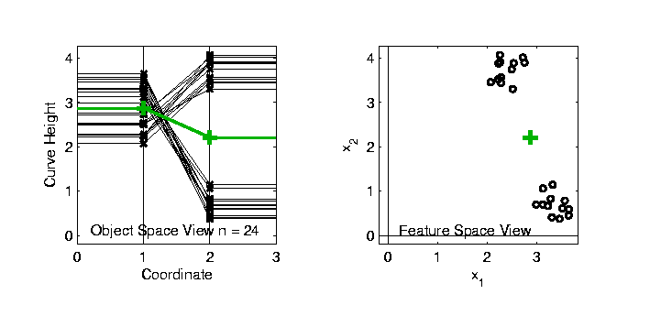

Basics of OODA
Simple $d=2$ Toy Example:
Each Curve is a Point

Slide 11
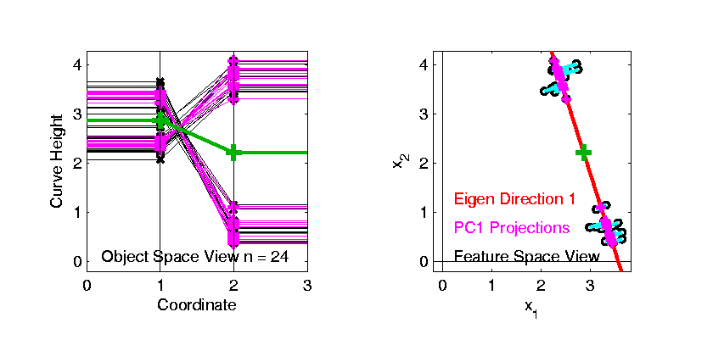
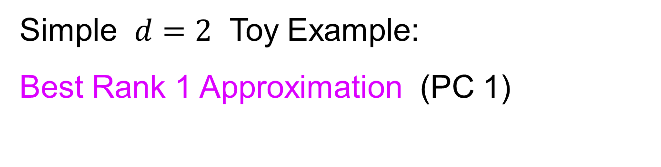
Basics of OODA
Simple $d=2$ Toy Example:
Best Rank 1 Approximation (PC 1)
As Curves
and as Points

Slide 12
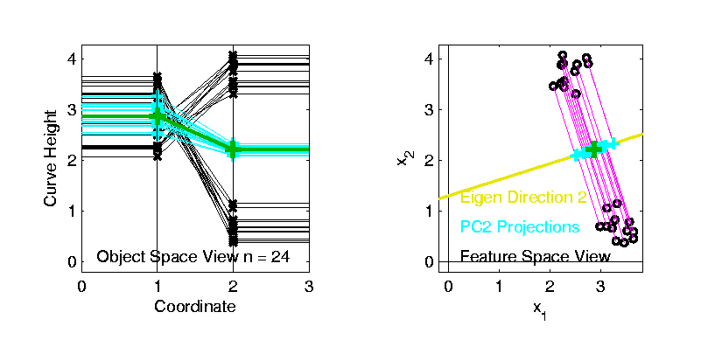
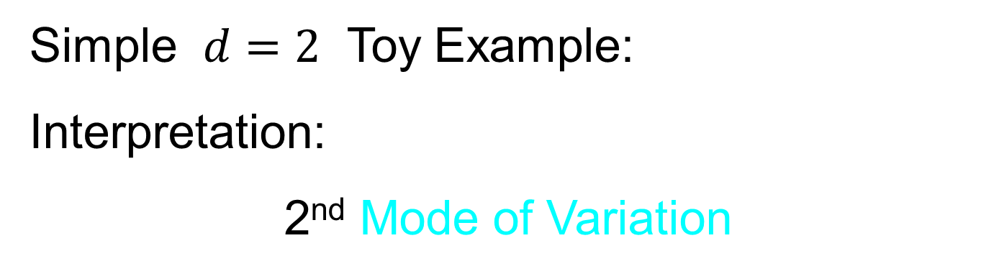
Basics of OODA
Simple $d=2$ Toy Example:
Interpretation:
2nd Mode of Variation

Slide 13
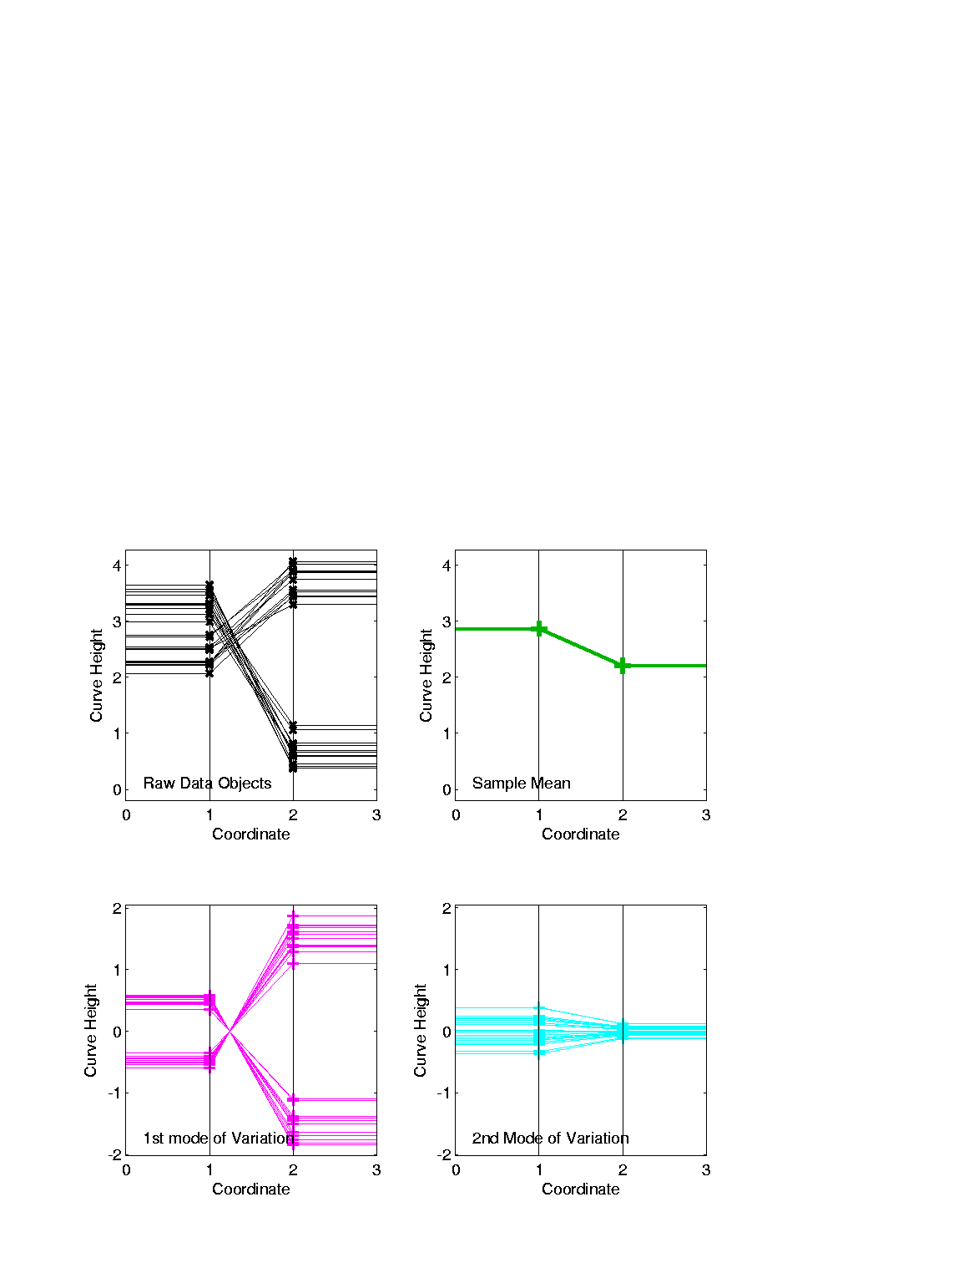
Basics of OODA
Decomposition into Modes of Variation
Sum of Squares
After Mean
Centering
Variance (not s.d.)
To Reflect Energy
Just as in ANOVA
Usual Quantification: Variance of Each, Expressed as %
98.3% of
Variation
1.7% of
Variation

Slide 14
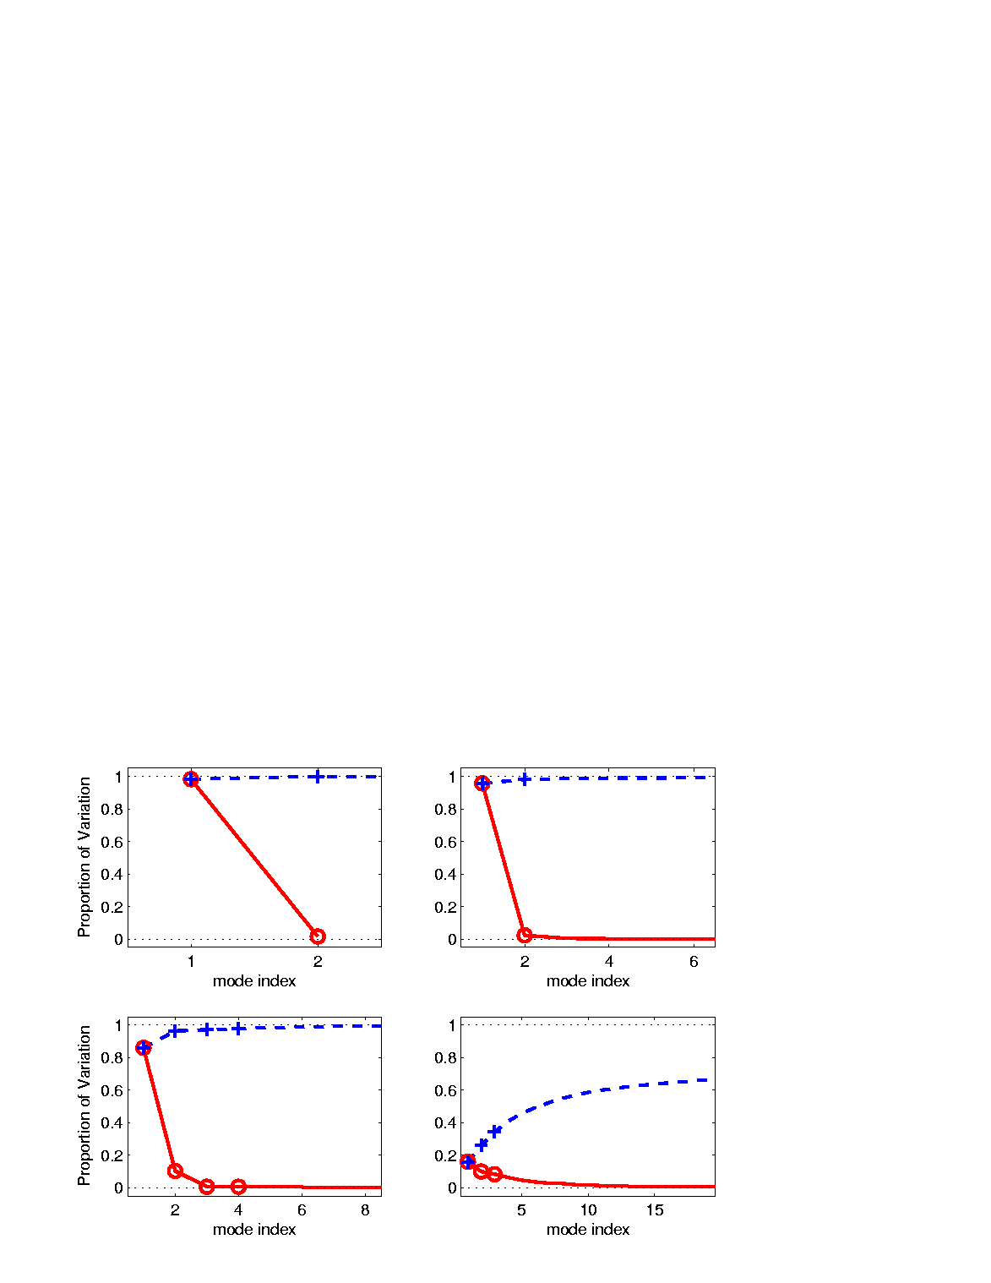
Scree Plot
Idea: Visually Summarize Dist’n of Variance
Sometimes Also Useful
To Display Cumulative
98.3% of
Variation
1.7% of
Variation

Slide 15
Scree Plot
More Examples
Illustrates Common Use of Scree:
Separate “Signal” From “Noise”
Spanish Male
Mortality Data
2-d Toy Data
Look for “Elbow” (or “Knee”)
10-d Toy Data
Genetic Data

Slide 16
Basics of OODA
Definition of Mode of Variation
(of a sample of data objects)
A Set of Members of the Object Space That:
Summarize One Component of Variation
Is in Some Sense “One Dimensional”
(e.g. Indexed by a Single Real Parameter)

Slide 17
Basics of OODA
Recall Decomposition into Modes of Variation
Multiples Of A Single Curve

Slide 18
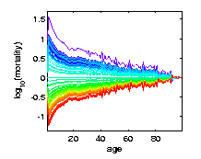
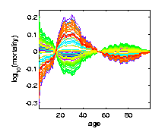
Basics of OODA
Recall Spanish Male Mortality Data
Multiples Of A Single Curve

Slide 19
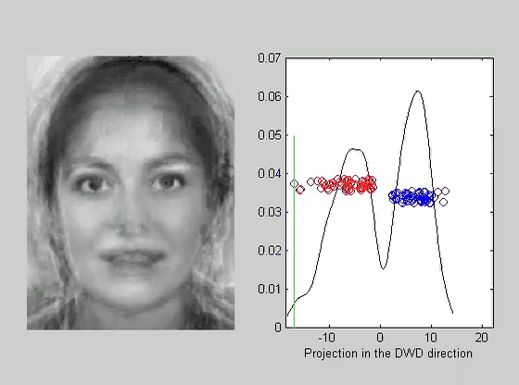
Basics of OODA
Recall Faces a Data Objects
1-d Set of
Members of
Object Space,
So Also a “Mode Of
Variation”

Slide 20


Representing Vectors as Curves
Aside on Visualization:
$\left(\begin{matrix}x_{1} \\ ⋮ \\ x_{d}\end{matrix}\right)$
Called Parallel Coordinate View
by Inselberg (1985, 2005)

Slide 21
Object Oriented Data Analysis
Three Major Phases of OODA:
I. Object Definition
“What are the Data Objects?”
Exploratory Analysis
“What Is Data Structure / Drivers?”
III. Confirmatory Analysis / Validation
Is it Really There (vs. Noise Artifact)?

Slide 22
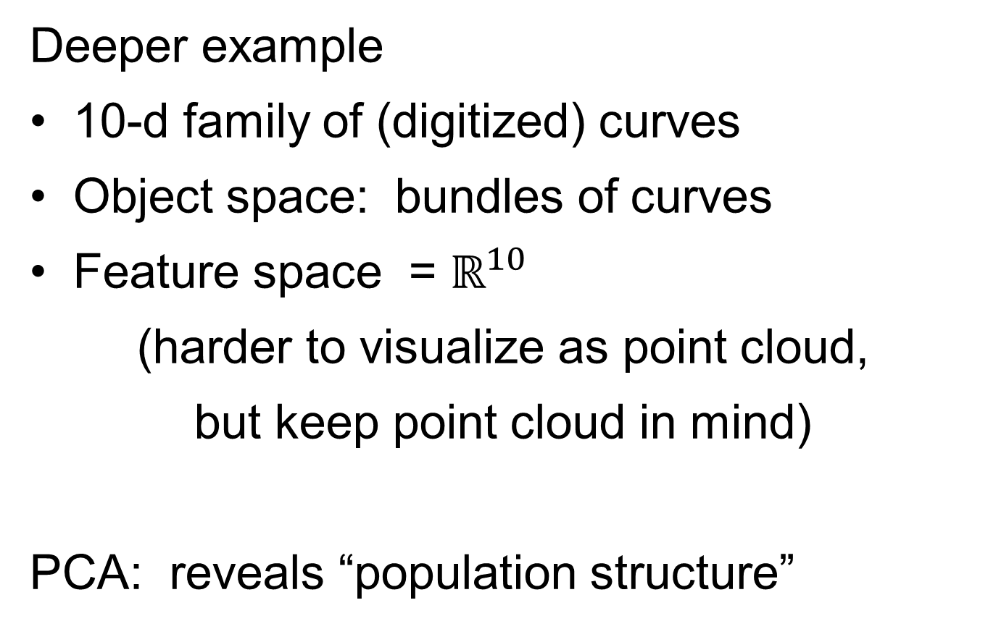
E.g. Curves As Data Objects
Deeper example
10-d family of (digitized) curves
Object space: bundles of curves
Feature space = $ℝ^{10}$
(harder to visualize as point cloud,
but keep point cloud in mind)
PCA: reveals “population structure”

Slide 23
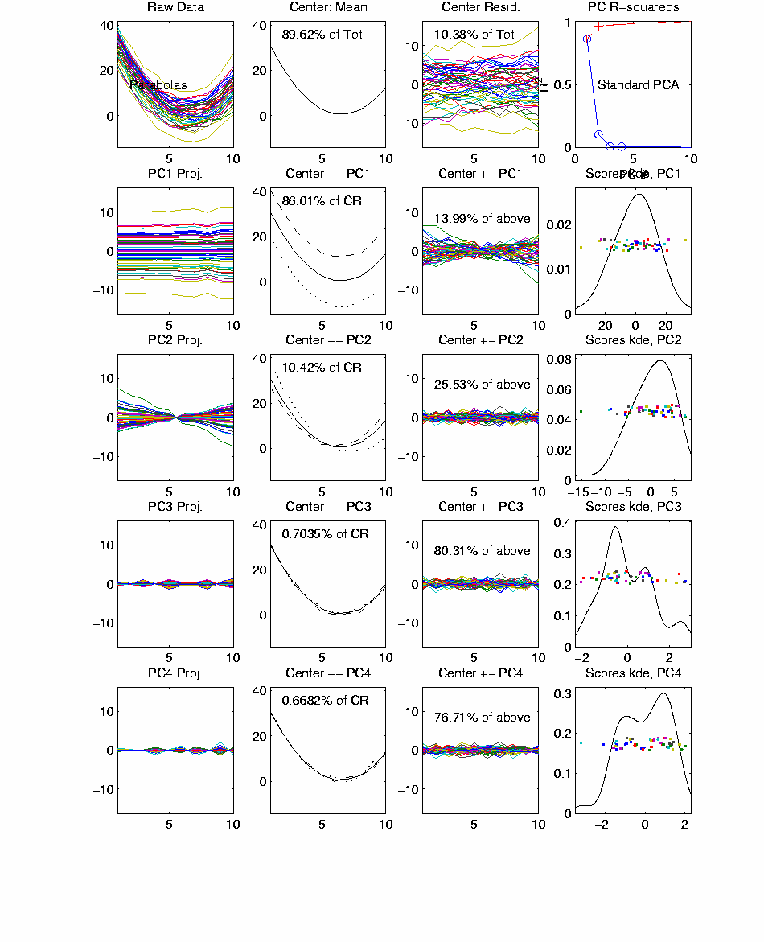
Functional Data Analysis, 10-d Toy EG 1
Terminology:
“Loadings Plots” “Scores Plots”
Notes:
EGCD1Parabs.ps

Slide 24
Functional Data Analysis, 10-d Toy EG 1
OODA Conceptual Framework
Object
Space
Views
Feature
Space
Views
Notes:
EGCD1Parabs.ps

Slide 25
Functional Data Analysis, 10-d Toy EG 1
OODA Conceptual Framework
Note Scree Plot, Already Shown Above,
To Illustrate Distribution of Variation
Notes:
EGCD1Parabs.ps

Slide 26
Scree Plot
More Examples
Spanish Male
Mortality Data
2-d Toy Data
10-d Toy Data
Genetic Data

Slide 27
E.g. Curves As Data
PCA: reveals “population structure”
Mean → Parabolic Structure
PC1 → Vertical Shift
PC2 → Tilt
higher PCs → Gaussian (spherical)
Decomposition into modes of variation

Slide 28
E.g. Curves As Data
Two Cluster Example
10-d curves again

Slide 29
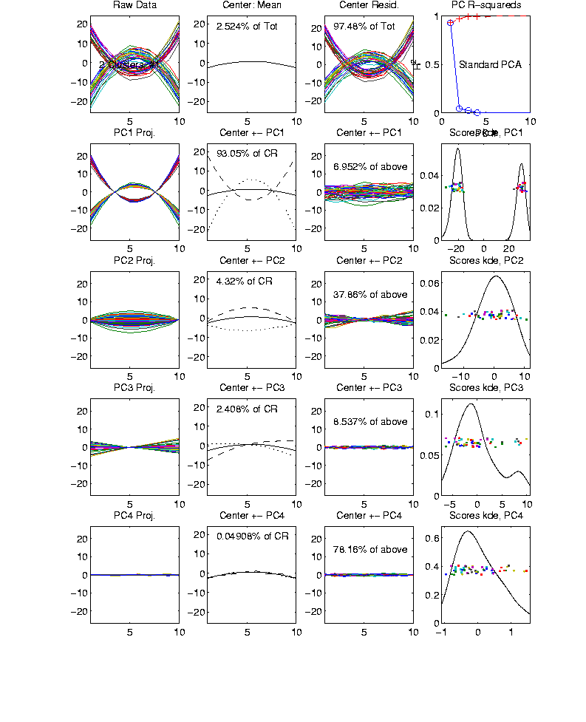
Functional Data Analysis, 10-d Toy EG 2
Notes:
EGCD1Clust2.ps

Slide 30
E.g. Curves As Data
Two Cluster Example
10-d curves again
Two big clusters
Revealed by 1-d scores plot (right side)
Note: Cluster Difference is not orthogonal
to Vertical Shift
PCA: reveals “population structure”

Slide 31
E.g. Curves As Data
More Complicated Example
50-d curves

Slide 32
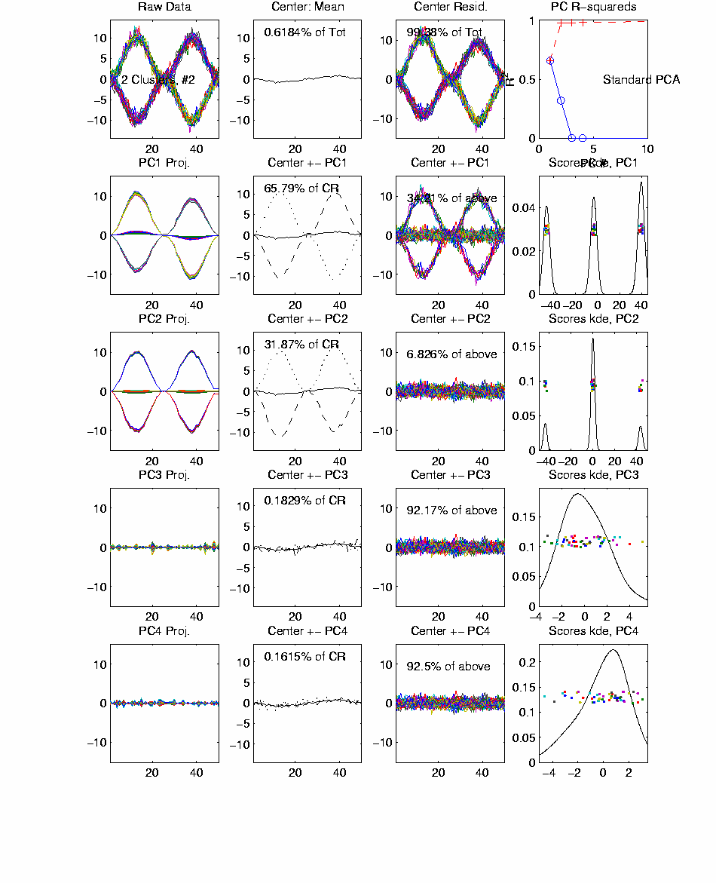
Functional Data Analysis, 50-d Toy EG 3
Notes:
EGCD1Clust4a.ps

Slide 33
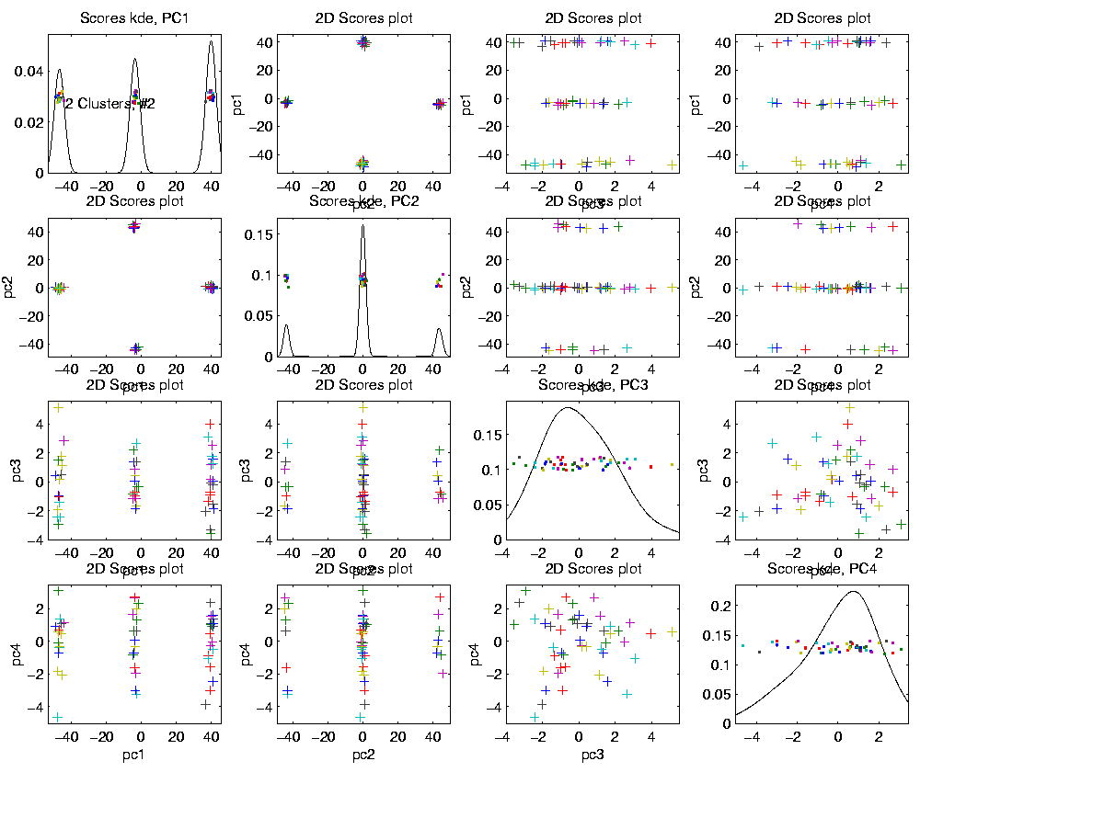
Functional Data Analysis, 50-d Toy EG 3
Notes:
EGCD1Clust4aDP2d.ps

Slide 34
E.g. Curves As Data
More Complicated Example
50-d curves
Pop’n structure hard to see in 1-d
2-d projections make structure clear
Joint Dist’ns More than Marginals
PCA: reveals “population structure”

Slide 35
Real Data Curve Objects
Interesting Real Data Example
Genetics (Cancer Research)
RNAseq (Next Gener’n Sequen’g)
Deep look at “gene components”
Microarrays: Single number (per gene)
RNAseq: Thousands of measurements
I. Object Definition

Slide 36

Real Data Curve Objects
Interesting Real Data Example
Genetics (Cancer Research)
RNAseq (Next Gener’n Sequen’g)
Deep look at “gene components”
Gene studied here: CDKN2A
Goal: Study Alternate Splicing
Sample Size, $n = 180$
Dimension, $d = \sim 1700$

Slide 37
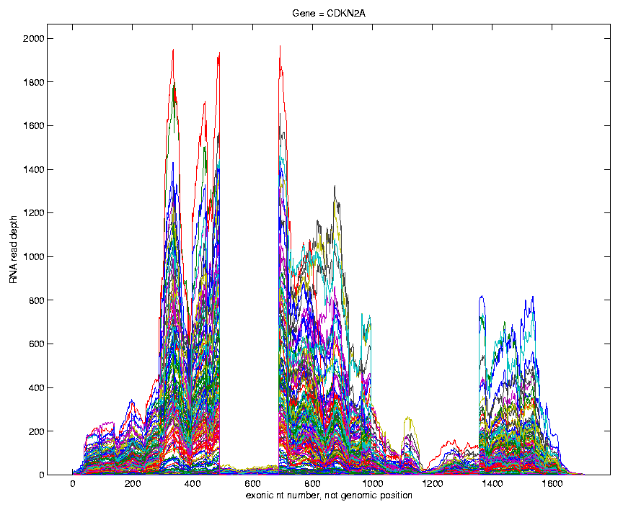
Real Data Curve Objects
Simple
1st
View:
Curve
Overlay
(counts
scale)
Note: Data Set
Structure May
Be Hidden In
Low Areas
I. Object Representation

Slide 38
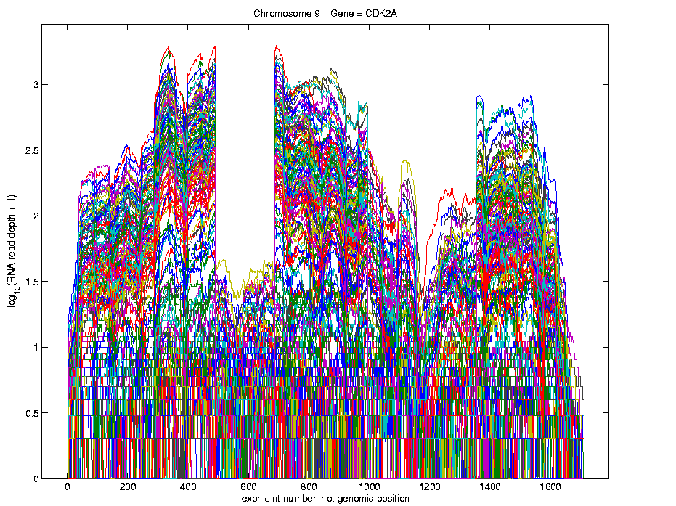
Real Data Curve Objects
Simple
1st
View:
Curve
Overlay
(log
scale)
I. Object Representation

Slide 39
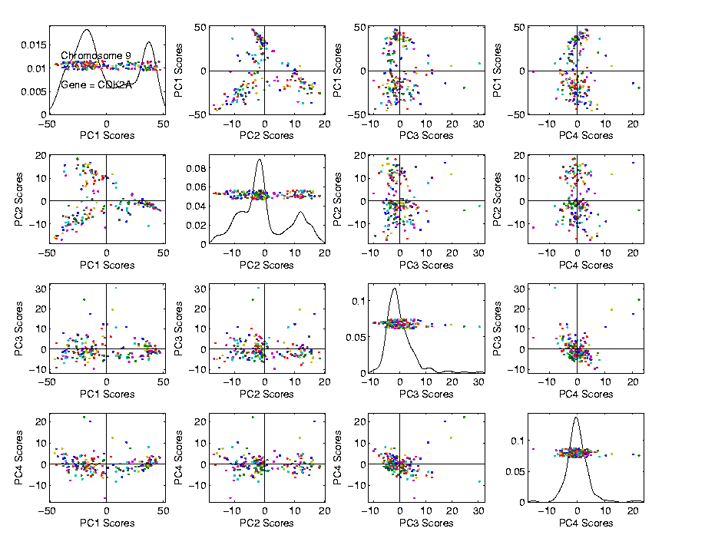
Real Data Curve Objects
Visualization in Feature Space
Often
Useful
Population
View:
PCA
Scores

Slide 40
Real Data Curve Objects
Suggestion
Of
Clusters
???

Slide 41
Real Data Curve Objects
Suggestion
Of
Clusters
Which
Are
These?

Slide 42
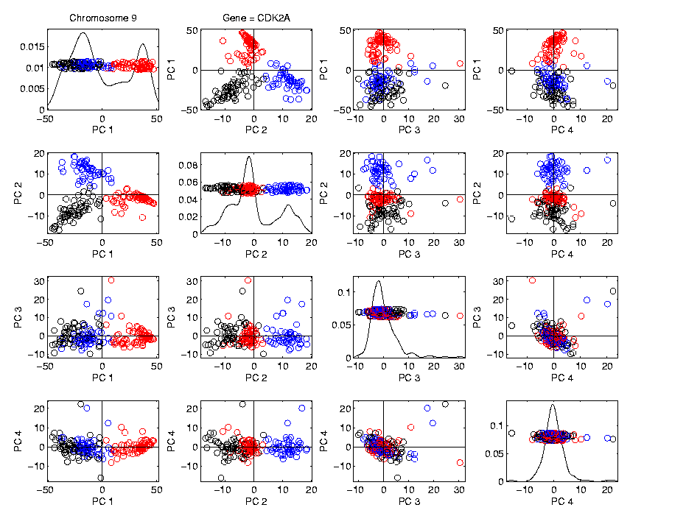
Real Data Curve Objects
Visualization in Feature Space, Next Look in Object Space
Manually
“Brush”
Clusters
II. Exploratory
Analysis

Slide 43
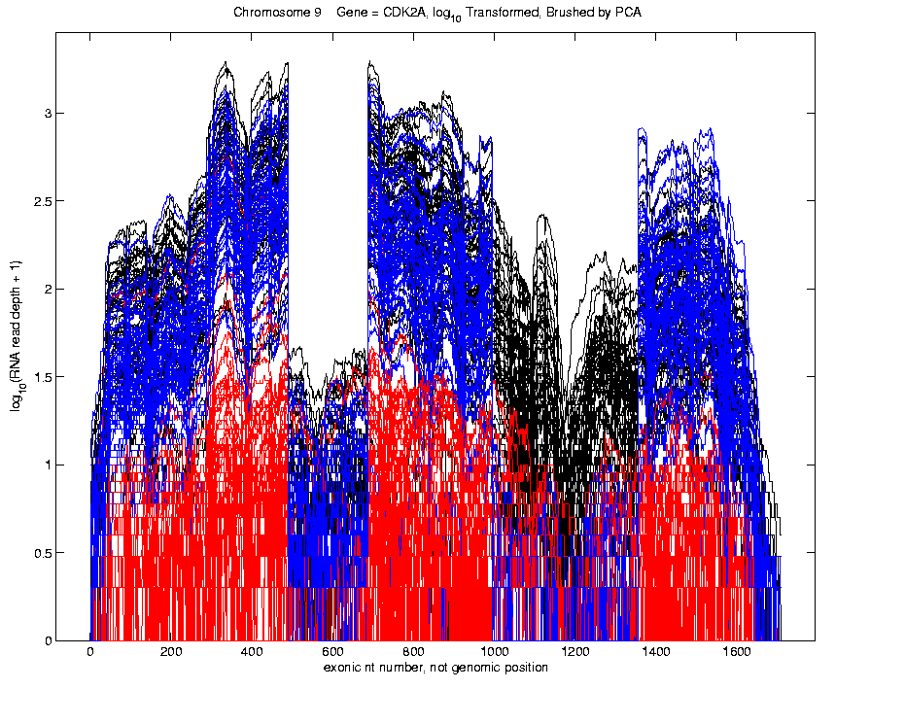
Real Data Curve Objects
Visualization in Object Space
Manually
Brush
Clusters
Clear
Alternate
Splicing
II. Exploratory
Analysis

Slide 44
Real Data Curve Objects
Important Points
PCA found Important Structure
In High Dimensional Data Analysis
d ~ 1700
(Will Come Back To This Point)

Slide 45
Real Data Curve Objects
Consequences:
Led to Development of SigFuge
Whole Genome Scan Found Interesting Genes
Wet Lab Experiment Verified Discoveries
Published in Kimes, et al (2014)

Slide 46
Real Data Curve Objects
Interesting Question:
When are clusters really there?
(will study later)
III. Confirmatory Analysis

Slide 47
Caution About PCA
Often Shows Useful Directions
But Not Always
Since It Only Maximizes Variation
Other Criteria Can Be More Important

Slide 48
Caution About PCA
Example: Gene Expression Data
Multiple Cancer Types:
Bladder Cancer
Kidney Renal Cancer
Ovarian Cancer
Head and Neck Squamous Cells
Colon Adenocarcinoma
Breast Cancer

Slide 49
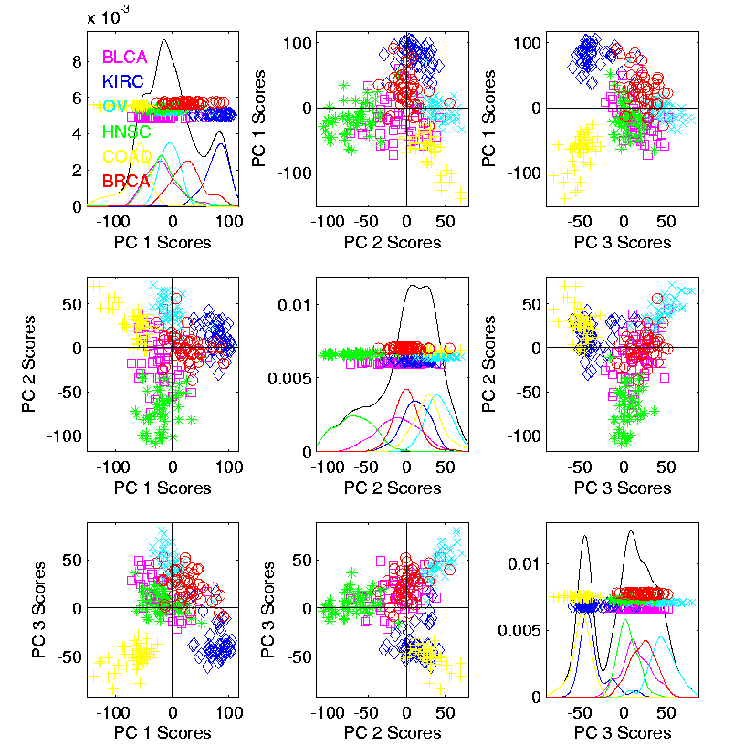

Caution About PCA
$d=12478$
genes
Substantial
Overlap
Of Cancer
Types

Slide 50
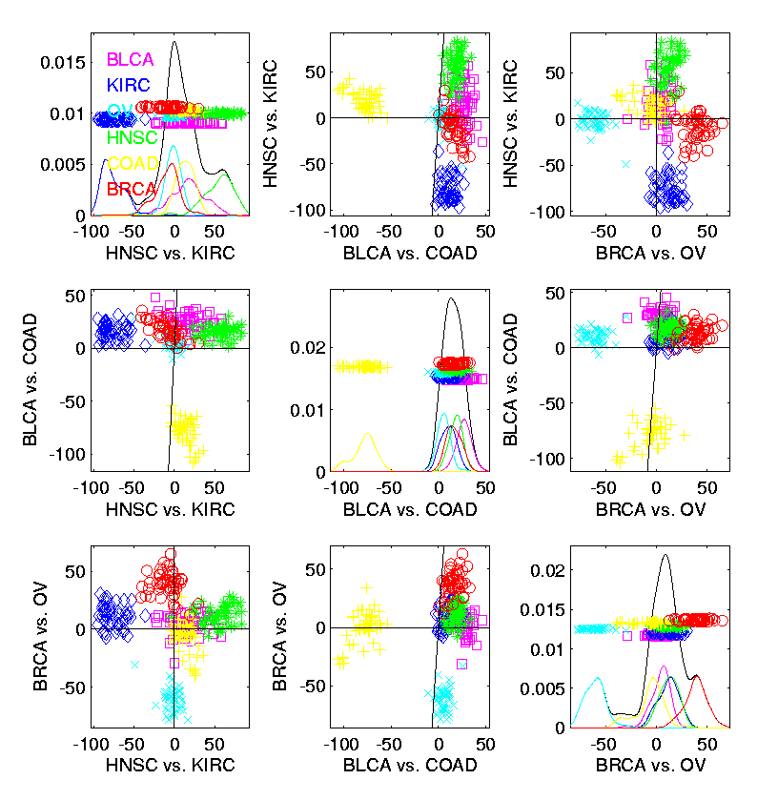
Improved Projection Directions
DWD Trained
On Pairs
Much Better
Separation
Of Cancer
Types

Slide 51
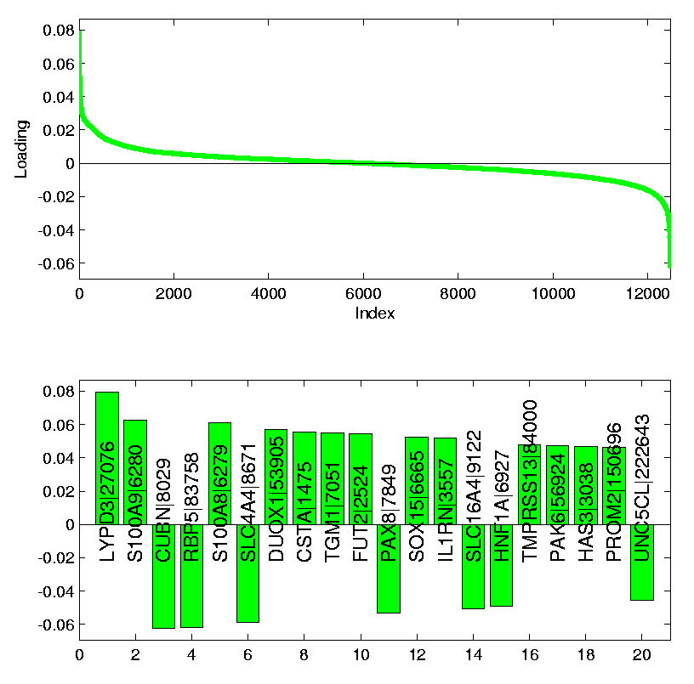
Improved Projection Directions
Drivers of DWD Differences?
Seen In
Loadings
Plots
(Entries
Of Direction
Vectors)
DWD Loadings, KIRC vs. HNSC

Slide 52
Scree Plot
More Examples
Spanish Male
Mortality Data
2-d Toy Data
Really Not Much
Elbow or Knee!
10-d Toy Data
Genetic Data

Slide 53
Limitation of PCA
PCA can provide useful projection directions
But can’t “see everything”…
Reason:
  PCA finds dir’ns of maximal variation
  Which may obscure interesting structure

Slide 54
Limitation of PCA
Toy Example:
Apple – Banana – Pear
Obscured by “noisy dimensions”
1st 3 PC directions only show noise
Study some rotations, to find structure

Slide 55
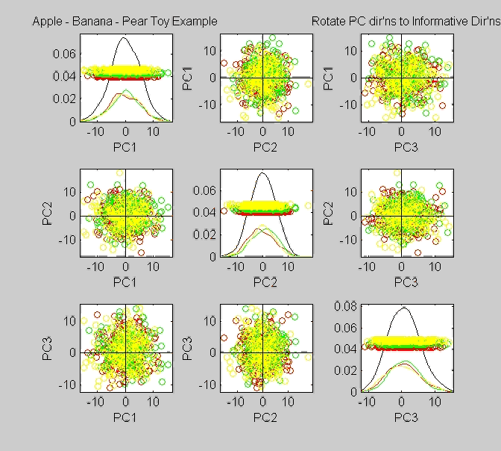
Limitation of PCA, Toy E.g.

Slide 56
Limitation of PCA
Toy Example:
Rotation shows Apple – Banana – Pear
Example constructed as:
  1st make these in 3-d
  Add 3 dimensions of high s.d. noise
Carefully watch axis labels

Slide 57
Limitation of PCA
Main Point:
May be Important Data Structure
Not Visible in 1st Few PCs

Slide 58
Limitation of PCA, E.g.
Interesting Data Set: NCI-60
NCI = National Cancer Institute
60 Cell Lines (cancer treatment targets)
For Different Cancer Types
Measured “Gene Expression”
= “Gene Activity”
Several Thousand Genes (Simultaneously)
Data Objects = Vectors of Gene Exp’n
Lots of Preprocessing (study later)
Example from:
Liu et al (2009)

Slide 59
NCI 60 Data
Important Aspect: 8 Cancer Types
Renal Cancer
Non Small Cell Lung Cancer
Central Nervous System Cancer
Ovarian Cancer
Leukemia Cancer
Colon Cancer
Breast Cancer
Melanoma (Skin)
Notes:
59

Slide 60
PCA Visualization of NCI 60 Data
Can we find classes:
(Renal, CNS, Ovar, Leuk, Colon, Melan)
Using PC directions??
First try “unsupervised view”
I.e. switch off class colors
Then turn on colors, to identify clusters
I.e. look at “supervised view”
II. Exploratory
Analysis
Notes:
60

Slide 61
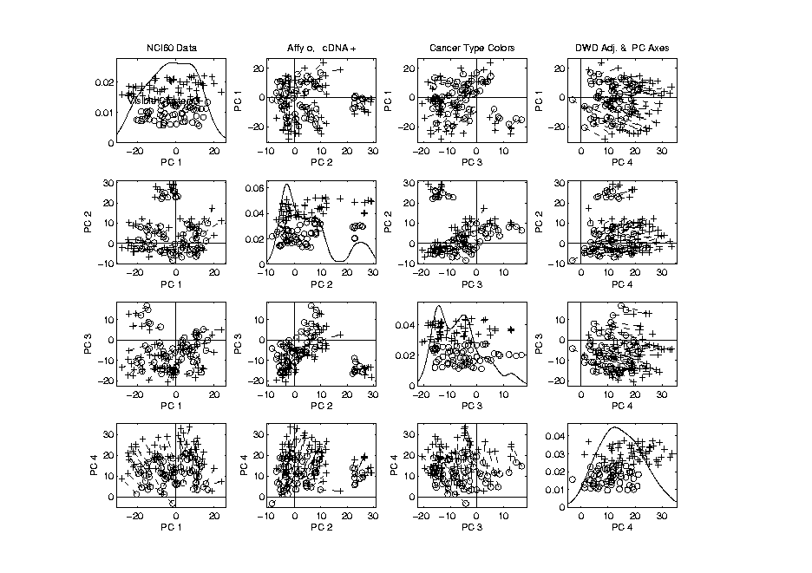
NCI 60: Can we find classes
Using PCA view?
Notes:
61

Slide 62
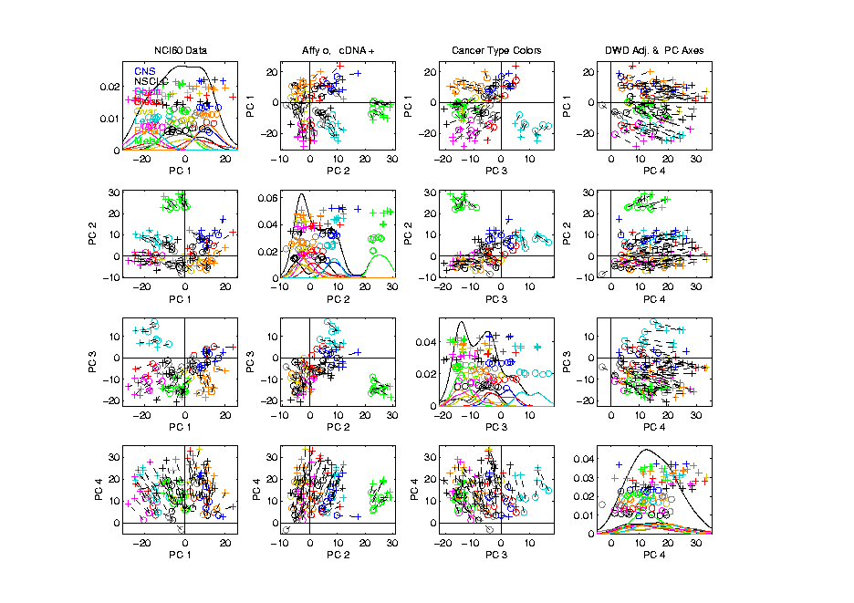
NCI 60: Can we find classes
Using PCA view?
Notes:
62

Slide 63
PCA Visualization of NCI 60 Data
Maybe need to look at more PCs?
Study array of such PCA projections:
Notes:
63

Slide 64
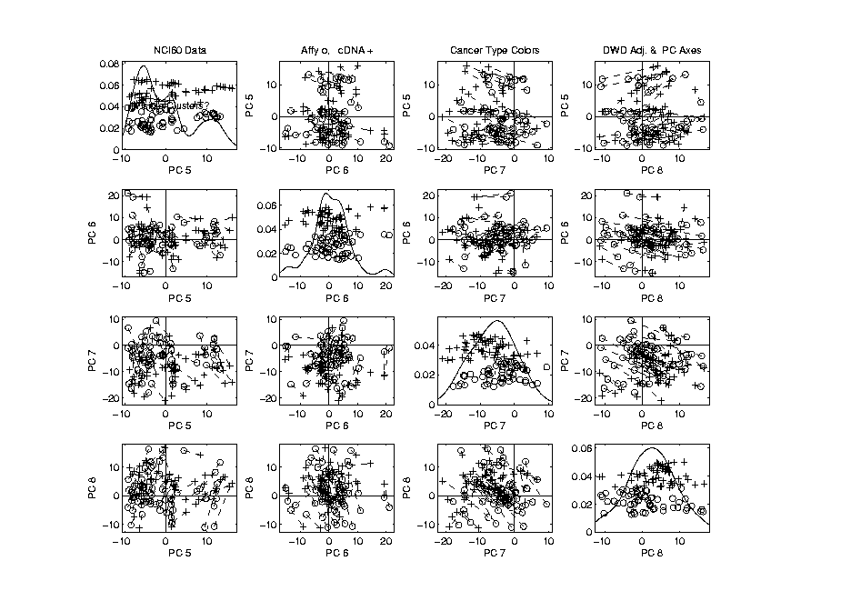
NCI 60: Can we find classes
Using PCA 5-8?
Notes:
64

Slide 65
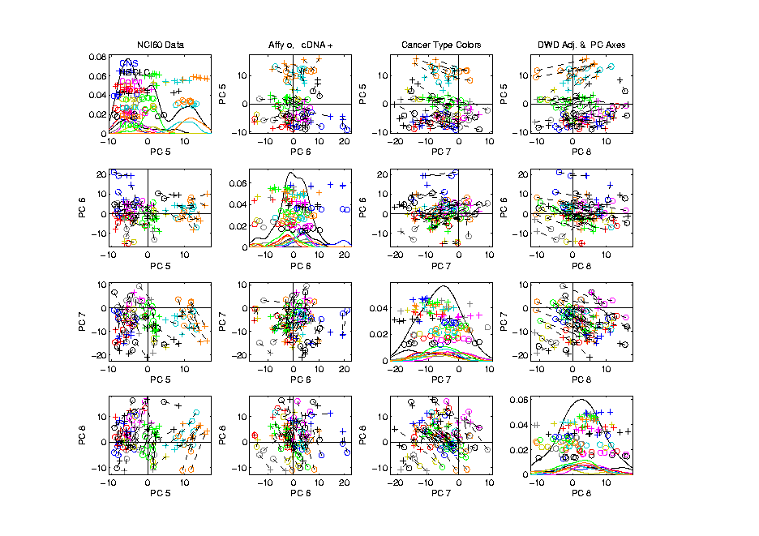
NCI 60: Can we find classes
Using PCA 5-8?
Notes:
65

Slide 66
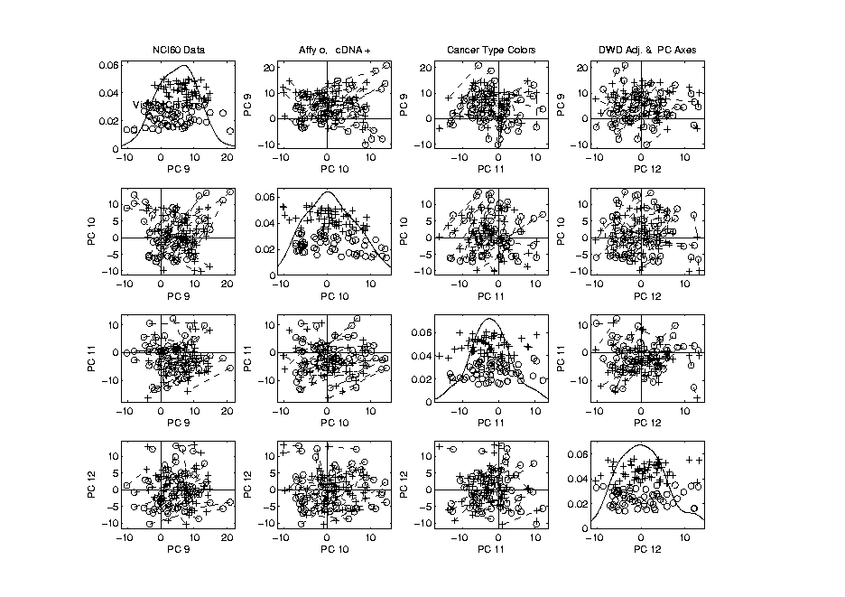
NCI 60: Can we find classes
Using PCA 9-12?
Notes:
66

Slide 67
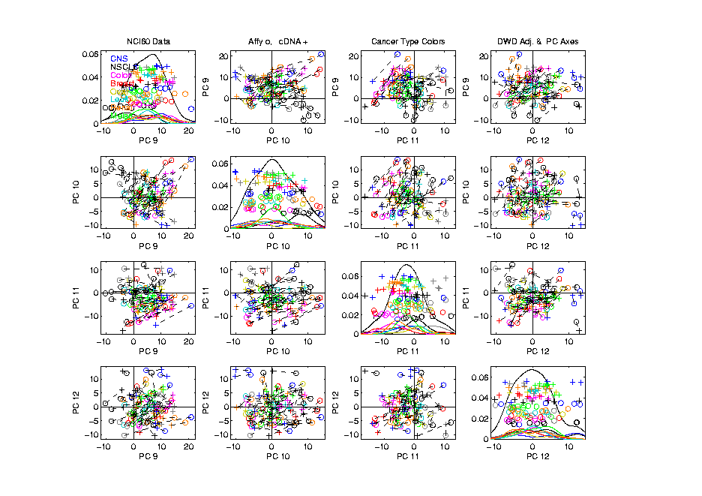
NCI 60: Can we find classes
Using PCA 9-12?
Notes:
67

Slide 68
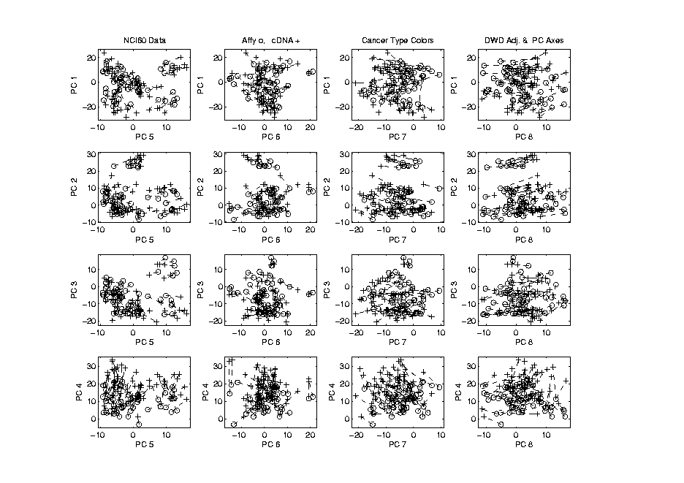
NCI 60: Can we find classes
Using PCA 1-4 vs. 5-8?
Notes:
68

Slide 69
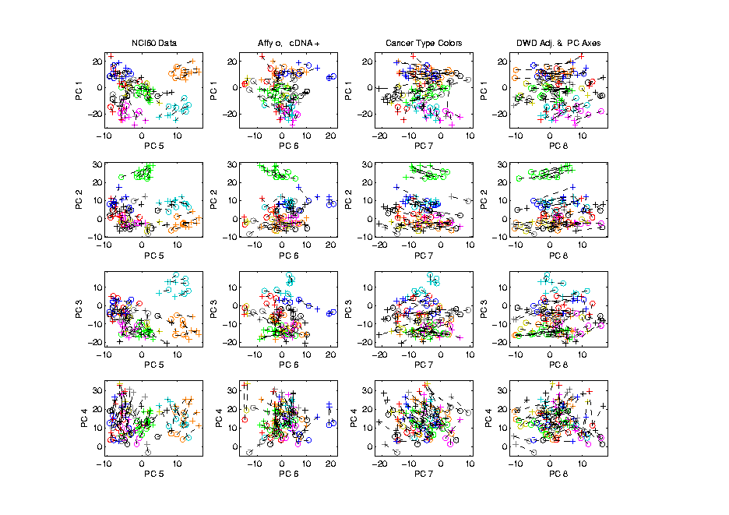
NCI 60: Can we find classes
Using PCA 1-4 vs. 5-8?
Notes:
69

Slide 70
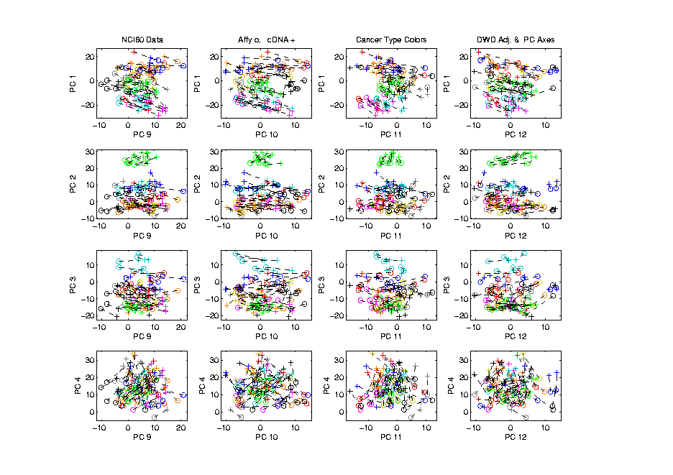
NCI 60: Can we find classes
Using PCA 1-4 vs. 9-12?
Notes:
70

Slide 71
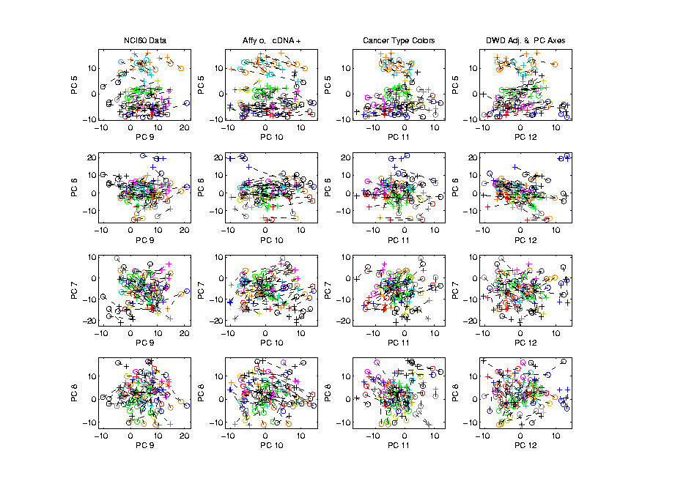
NCI 60: Can we find classes
Using PCA 5-8 vs. 9-12?
Notes:
71

Slide 72
PCA Visualization of NCI 60 Data
Can we find classes using PC directions??
Found some, but not others
Nothing after 1st five - six PCs
Rest seem to have other drivers
Are There Better Directions?
PCA only “feels” maximal variation
Ignores Class Labels
How Can We Use Class Labels?
Notes:
72

Slide 73
Visualization of NCI 60 Data
How Can We Use Class Labels?
Approach:
Find Directions to “Best Separate” Classes
In Disjoint Pairs (thus 4 Directions)
Use DWD:
Distance Weighted Discrimination
Defined (& Motivated) Later
Project All Data on These 4 Directions
Notes:
73

Slide 74
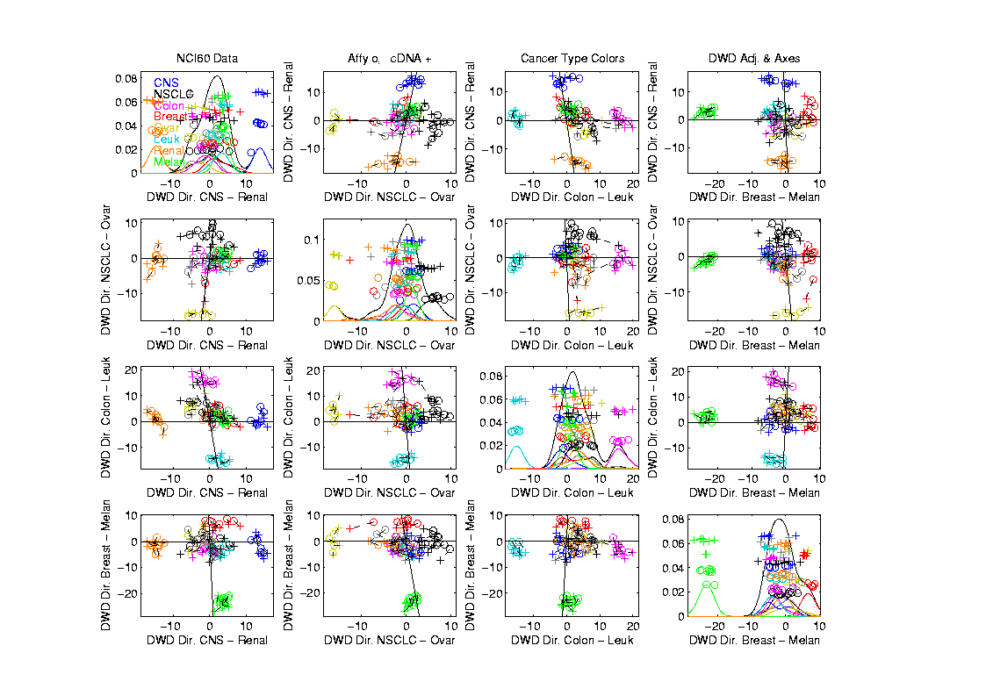
NCI 60: Views using DWD Dir’ns (focus on biology)
Notes:
74

Slide 75
DWD Visualization of NCI 60 Data
Most cancer types clearly distinct
(Renal, CNS, Ovar, Leuk, Colon, Melan)
Using these carefully chosen directions
Others less clear cut
  NSCLC (at least 3 subtypes)
  Breast (4 published subtypes)

Slide 76
DWD Visualization
Recall PCA limitations
DWD uses class info
Hence can “better separate known classes”
Do this for pairs of classes
(DWD just on those, ignore others)
Carefully choose pairs in NCI 60 data
Note DWD Directions Not Orthogonal
(PCA orthogonality may be
too strong a constraint)

Slide 77
NCI 60: Views using DWD Dir’ns (focus on biology)

Slide 78
PCA Visualization of NCI 60 Data
Can we find classes using PC directions??
Found some, but not others
Not so distinct as in DWD view
Nothing after 1st five PCs
Rest seem to be noise driven
Orthogonality too strong a constraint???
Interesting dir’ns are nearly orthogonal
(will see why later)
Notes:
78

Slide 79
Object Oriented Data Analysis
Three Major Phases of OODA:
I. Object Definition
“What are the Data Objects?”
Exploratory Analysis
“What Is Data Structure / Drivers?”
III. Confirmatory Analysis / Validation
Is it Really There (vs. Noise Artifact)?

Slide 80
Caution
DWD Separation Can Be Deceptive
Since DWD is Really Good at Separation
Important Concept:
Statistical Inference is Essential

Slide 81
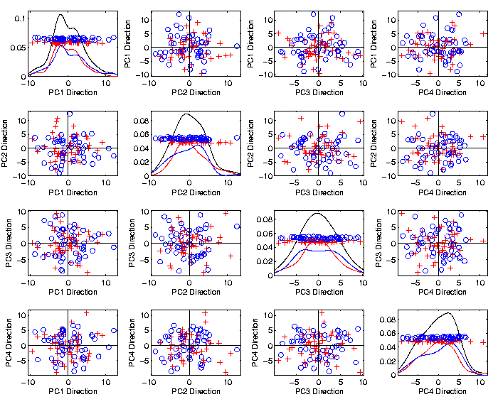
Caution
Toy 2-Class
Example
See
Structure?
Careful,
Only PC1-4

Slide 82
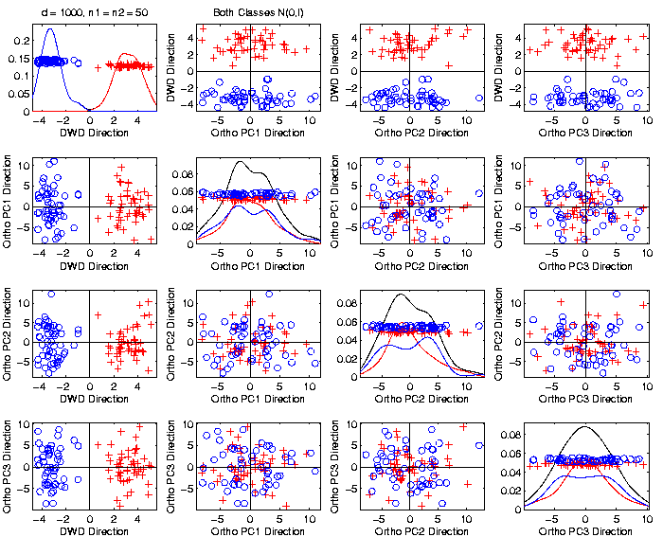
Caution
Toy 2-Class
Example
DWD &
Ortho PCA
Finds Big
Separation

Slide 83
Caution
Toy 2-Class
Example
Not in 1ST
4 PCs
Since
Smaller Scale

Slide 84

Caution
Toy 2-Class
Example
Actually
Both
Classes
Are $N\left(0,I\right)$
$$d=1000$$

Slide 85
Caution
Toy 2-Class
Example
Separation
Is Natural
Sampling
Variation
(Will Study in Detail Later)

Slide 86
Caution
Main Lesson Again:
DWD Separation Can Be Deceptive
Since DWD is Really Good at Separation
Important Concept:
Statistical Inference is Essential
III. Confirmatory Analysis

