Slide 1
Participant Presentations
Please Prepare to Sign Up (on Thursday):
Name
Email (Onyen is fine, or …)
Are You ENRolled?
Dept. & Advisor (Lab?)
Tentative Title (“????” Is OK)
When:
  Next Week, Early, Oct., Nov., Late

Slide 2
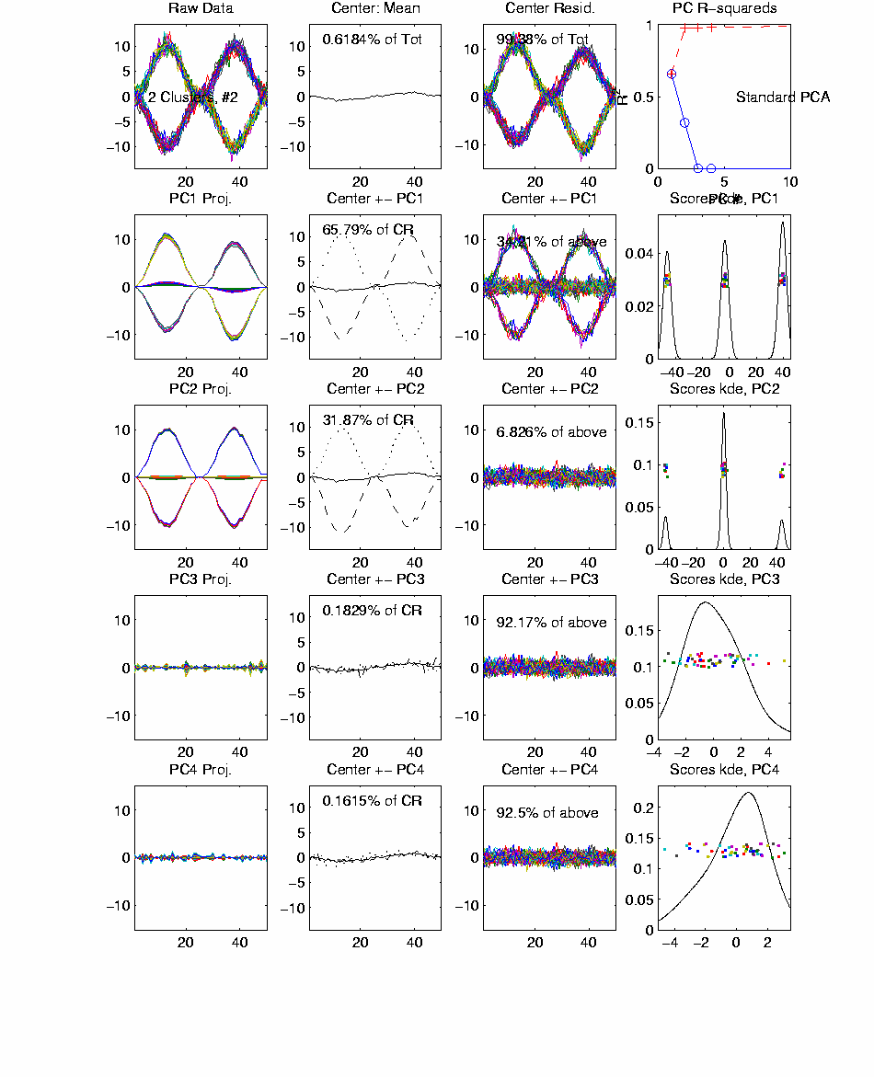
Functional Data Analysis, 50-d Toy EG 3
Notes:
EGCD1Clust4a.ps

Slide 3
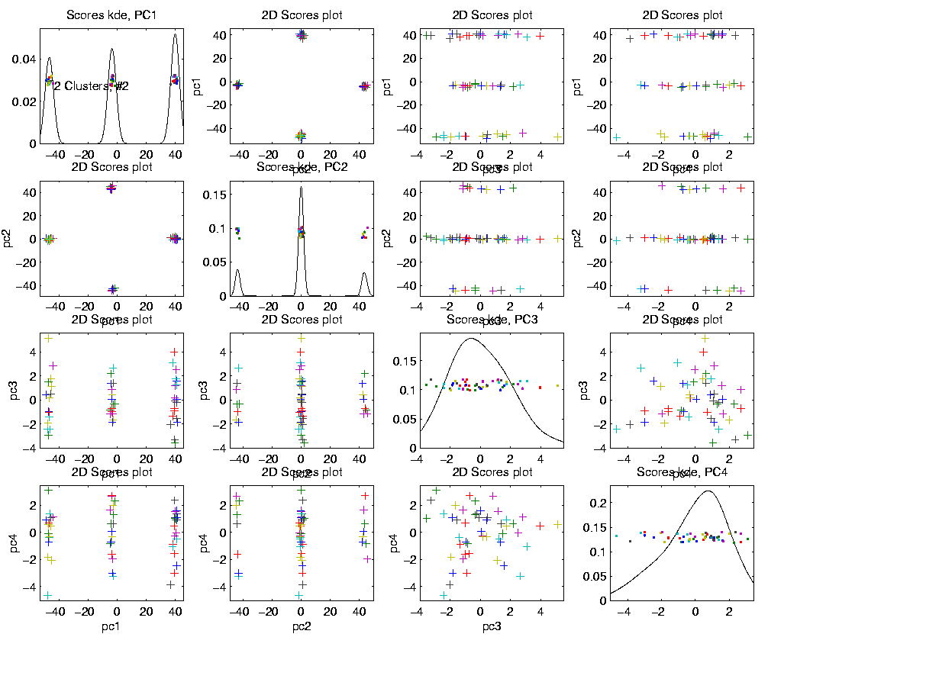
Functional Data Analysis, 50-d Toy EG 3
Notes:
EGCD1Clust4aDP2d.ps

Slide 4
E.g. Curves As Data
More Complicated Example
50-d curves
Pop’n structure hard to see in 1-d
2-d projections make structure clear
Joint Dist’ns More than Marginals
PCA: reveals “population structure”

Slide 5
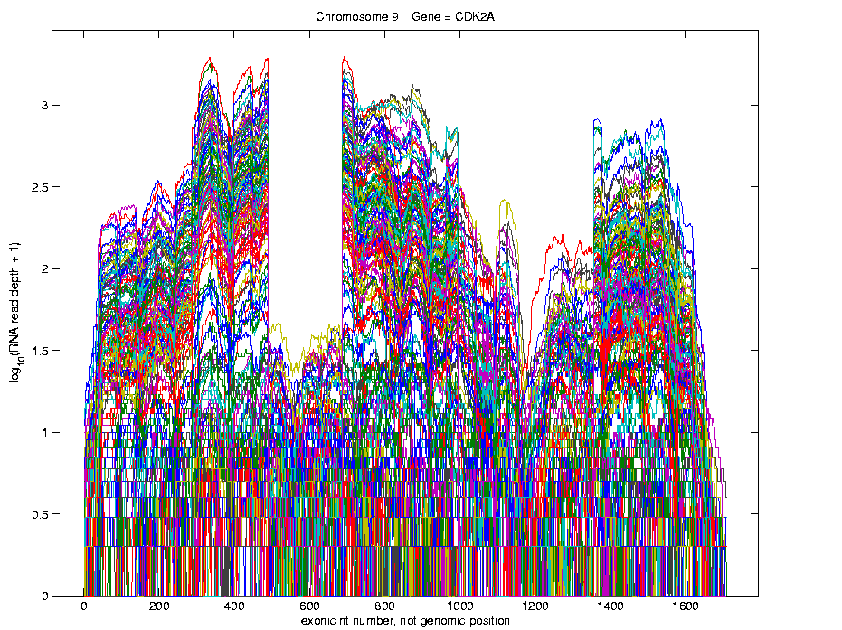
Real Data Curve Objects
Simple
1st
View:
Curve
Overlay
(log
scale)
I. Object Representation

Slide 6
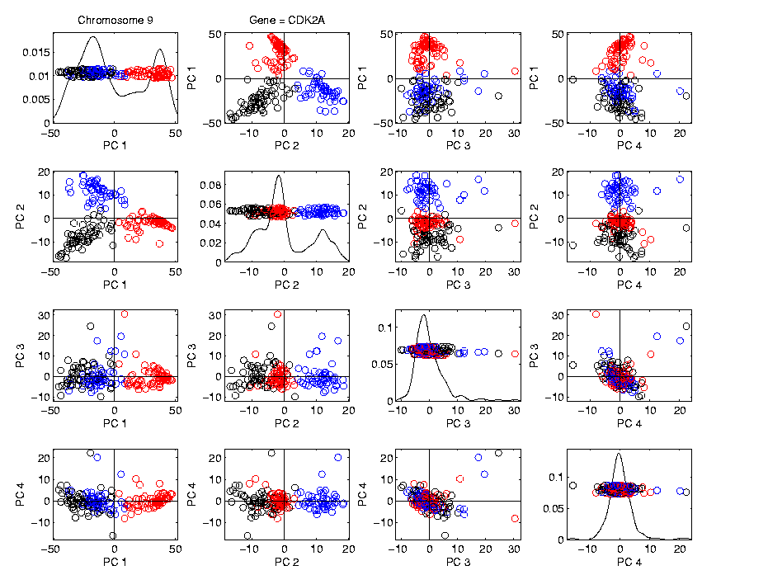
Real Data Curve Objects
Visualization in Feature Space, Next Look in Object Space
Manually
“Brush”
Clusters
II. Exploratory
Analysis

Slide 7
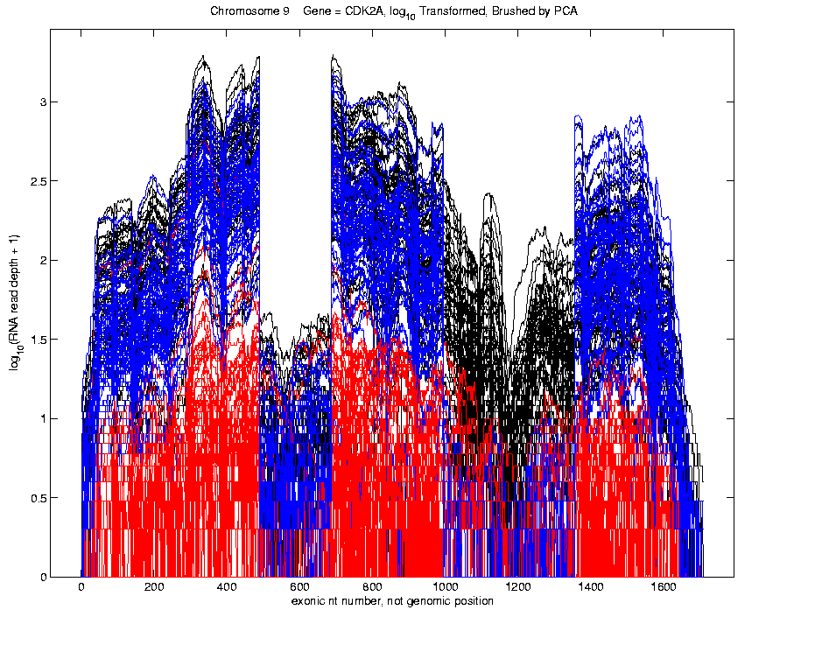
Real Data Curve Objects
Visualization in Object Space
Manually
Brush
Clusters
Clear
Alternate
Splicing
II. Exploratory
Analysis

Slide 8
Limitation of PCA
PCA can provide useful projection directions
But can’t “see everything”…
Reason:
  PCA finds dir’ns of maximal variation
  Which may obscure interesting structure

Slide 9
Limitation of PCA
Toy Example:
Apple – Banana – Pear
Obscured by “noisy dimensions”
1st 3 PC directions only show noise
Study some rotations, to find structure

Slide 10
Limitation of PCA, E.g.
Interesting Data Set: NCI-60
NCI = National Cancer Institute
60 Cell Lines (cancer treatment targets)
For Different Cancer Types
Measured “Gene Expression”
= “Gene Activity”
Several Thousand Genes (Simultaneously)
Data Objects = Vectors of Gene Exp’n
Lots of Preprocessing (study later)
Example from:
Liu et al (2009)

Slide 11
NCI 60 Data
Important Aspect: 8 Cancer Types
Renal Cancer
Non Small Cell Lung Cancer
Central Nervous System Cancer
Ovarian Cancer
Leukemia Cancer
Colon Cancer
Breast Cancer
Melanoma (Skin)
Notes:
11

Slide 12
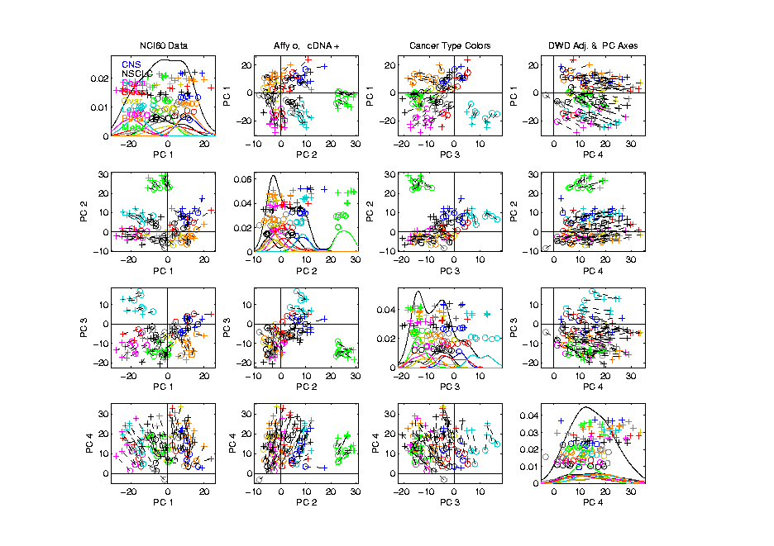
NCI 60: Can we find classes
Using PCA view?
Notes:
12

Slide 13
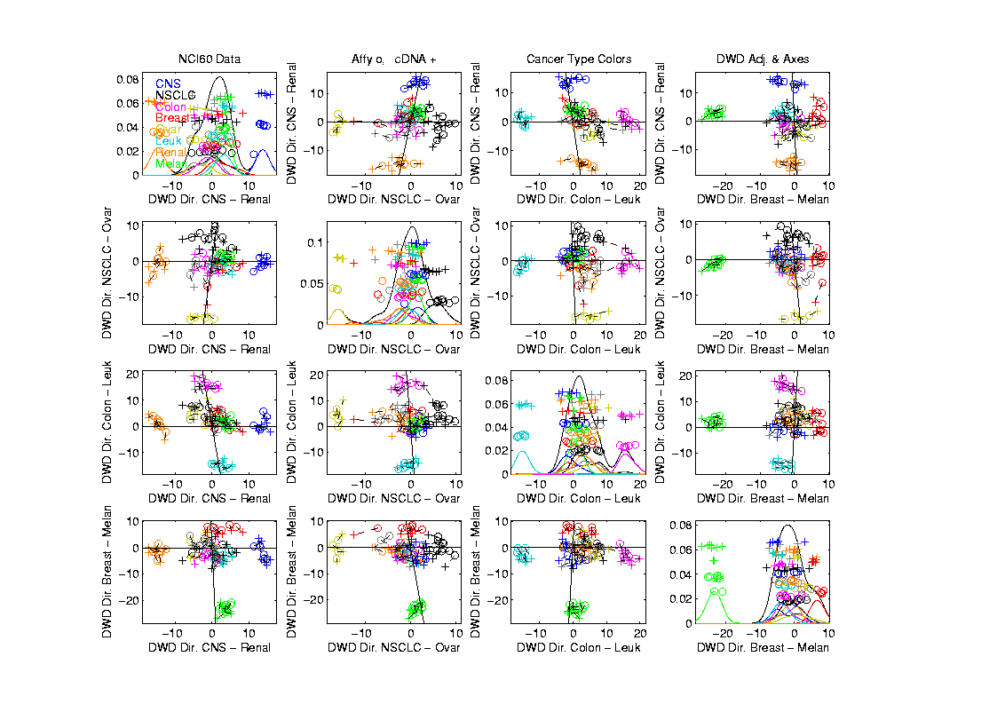
NCI 60: Views using DWD Dir’ns (focus on biology)
Notes:
13

Slide 14
Object Oriented Data Analysis
Three Major Phases of OODA:
I. Object Definition
“What are the Data Objects?”
Exploratory Analysis
“What Is Data Structure / Drivers?”
III. Confirmatory Analysis / Validation
Is it Really There (vs. Noise Artifact)?

Slide 15
Caution
DWD Separation Can Be Deceptive
Since DWD is Really Good at Separation
Important Concept:
Statistical Inference is Essential

Slide 16
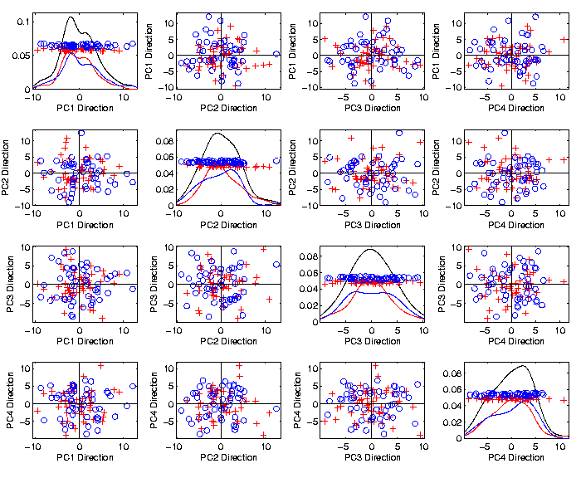
Caution
Toy 2-Class
Example
See
Structure?
Careful,
Only PC1-4

Slide 17
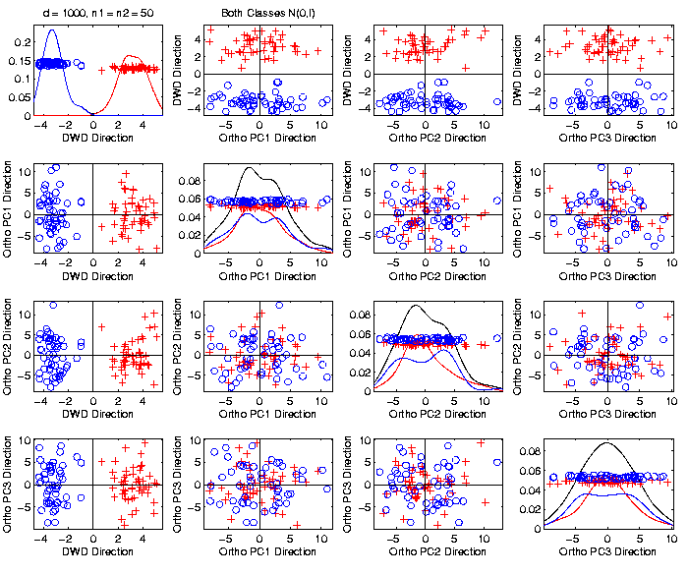
Caution
Toy 2-Class
Example
DWD &
Ortho PCA
Finds Big
Separation

Slide 18

Caution
Toy 2-Class
Example
Actually
Both
Classes
Are $N\left(0,I\right)$
$$d=1000$$

Slide 19
Caution
Toy 2-Class
Example
Separation
Is Natural
Sampling
Variation
(Will Study in Detail Later)

Slide 20
Caution
Main Lesson Again:
DWD Separation Can Be Deceptive
Since DWD is Really Good at Separation
Important Concept:
Statistical Inference is Essential
III. Confirmatory Analysis

Slide 21
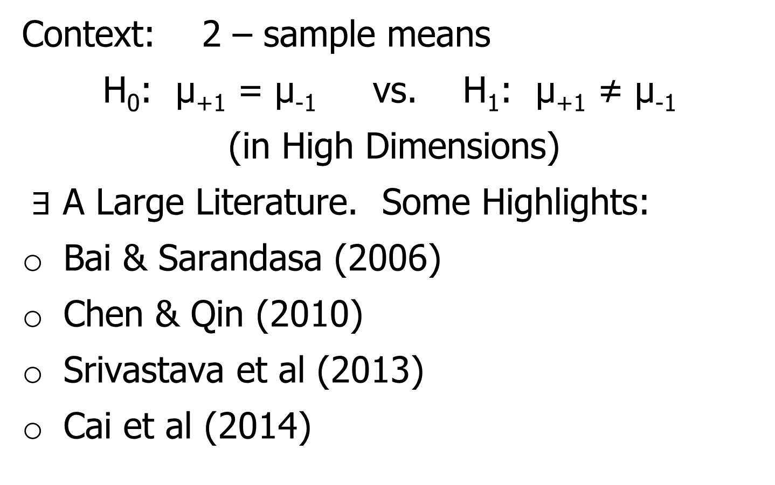
DiProPerm Hypothesis Test
Context: 2 – sample means
H₀: μ₊₁ = μ₋₁ vs. H₁: μ₊₁ ≠ μ₋₁
(in High Dimensions)
$∃$ A Large Literature. Some Highlights:
Bai & Sarandasa (2006)
Chen & Qin (2010)
Srivastava et al (2013)
Cai et al (2014)

Slide 22
DiProPerm Hypothesis Test
Context: 2 – sample means
H₀: μ₊₁ = μ₋₁ vs. H₁: μ₊₁ ≠ μ₋₁
(in High Dimensions)
Approach taken here:
Wei et al (2013)
Focus on Visualization via Projection
(Thus Test Related to Exploration)

Slide 23
DiProPerm Hypothesis Test
Context: 2 – sample means
H₀: μ₊₁ = μ₋₁ vs. H₁: μ₊₁ ≠ μ₋₁
Challenges:
Distributional Assumptions
Parameter Estimation
HDLSS space is slippery

Slide 24
DiProPerm Hypothesis Test
Context: 2 – sample means
H₀: μ₊₁ = μ₋₁ vs. H₁: μ₊₁ ≠ μ₋₁
Challenges:
Distributional Assumptions
Parameter Estimation
Suggested Approach:
Permutation test
(A flavor of classical “non-parametrics”)

Slide 25
DiProPerm Hypothesis Test
Suggested Approach:
Find a DIrection
(separating classes)
PROject the data
(reduces to 1 dim)
PERMute
(class labels, to assess significance,
with recomputed direction)

Slide 26
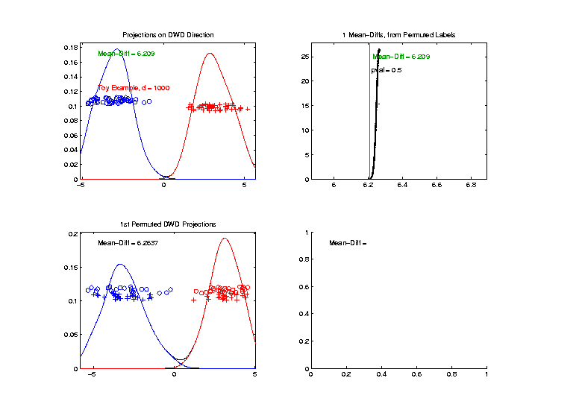

DiProPerm Hypothesis Test
Toy 2-Class Example
Separated DWD
Projections
(Again $N\left(0,I\right)$, $d=1000$)

Slide 27
DiProPerm Hypothesis Test
Toy 2-Class Example
Separated DWD
Projections
Measure Separation of Classes Using:
Mean Difference = 6.209

Slide 28
DiProPerm Hypothesis Test
Toy 2-Class Example
Separated DWD
Projections
Measure Separation of Classes Using:
Mean Difference = 6.209
Record as Vertical Line

Slide 29
DiProPerm Hypothesis Test
Toy 2-Class Example
Separated DWD
Projections
Measure Separation of Classes Using:
Mean Difference = 6.209
Statistically Significant???

Slide 30
DiProPerm Hypothesis Test
Toy 2-Class Example
Permuted
Class Labels

Slide 31
DiProPerm Hypothesis Test
Toy 2-Class Example
Permuted
Class Labels
Recompute DWD
& Projections

Slide 32
DiProPerm Hypothesis Test
Toy 2-Class Example
Measure Class
Separation
Using Mean
Difference
= 6.26

Slide 33
DiProPerm Hypothesis Test
Toy 2-Class Example
Measure Class
Separation
Using Mean
Difference
= 6.26
Record as Dot

Slide 34
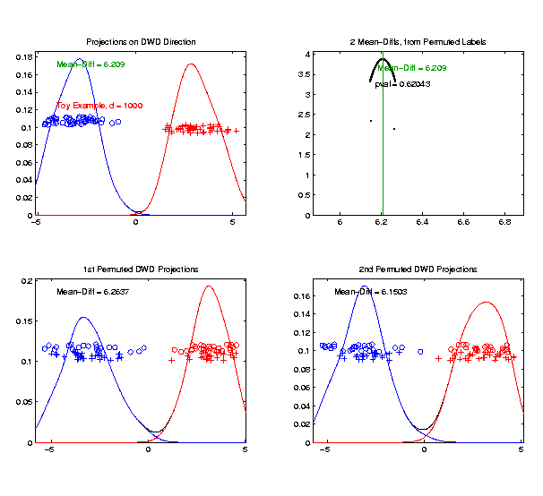
DiProPerm Hypothesis Test
Toy 2-Class Example
Generate 2nd
Permutation

Slide 35
DiProPerm Hypothesis Test
Toy 2-Class Example
Measure Class
Separation
Using Mean
Difference
= 6.15

Slide 36
DiProPerm Hypothesis Test
Toy 2-Class Example
Record as
Second Dot

Slide 37
DiProPerm Hypothesis Test
.
.
.
Repeat This 1,000 Times
To Generate Null Distribution

Slide 38
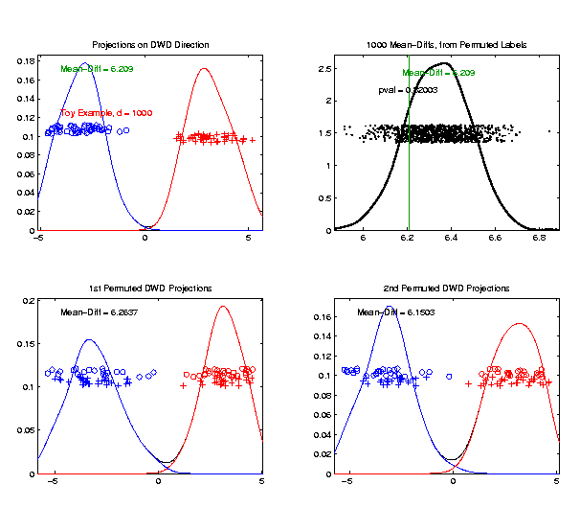
DiProPerm Hypothesis Test
Toy 2-Class Example
Generate Null
Distribution

Slide 39
DiProPerm Hypothesis Test
Toy 2-Class Example
Generate Null
Distribution
Compare With
Original Value

Slide 40
DiProPerm Hypothesis Test
Toy 2-Class Example
Generate Null
Distribution
Compare With
Original Value
Take Proportion
Larger as P-Value

Slide 41
DiProPerm Hypothesis Test
Toy 2-Class Example
Generate Null
Distribution
Compare With
Original Value
Not Significant

Slide 42
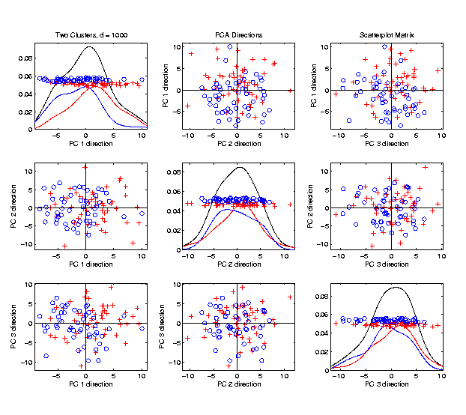
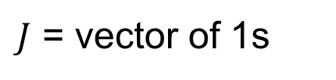

DiProPerm Hypothesis Test
$J$ = vector of 1s
Another Example
$N_{1000}\left(+0.05∗J,I\right)$
$N_{1000}\left(−0.05∗J,I\right)$
PCA View

Slide 43
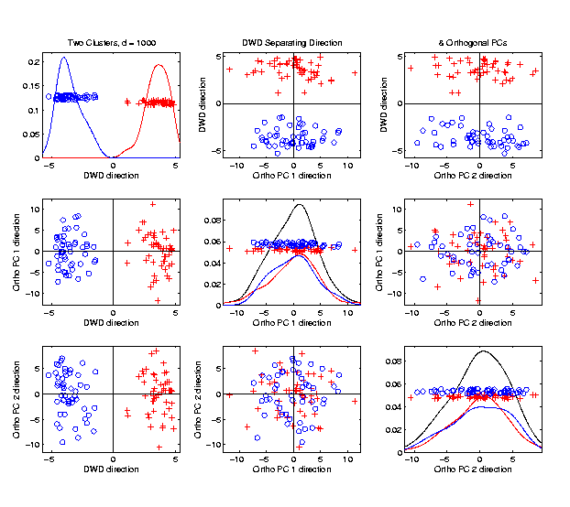

DiProPerm Hypothesis Test
Another Example
$N_{1000}\left(+0.05∗J,I\right)$
$N_{1000}\left(−0.05∗J,I\right)$
DWD View
(Similar
to $N\left(0,I\right)$?)

Slide 44
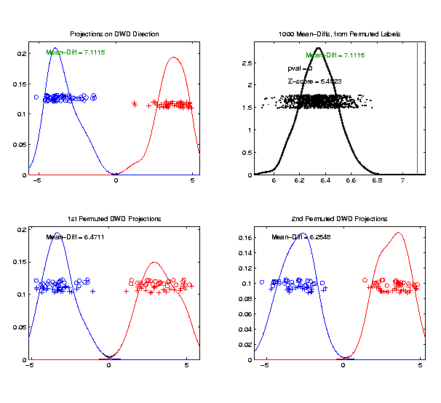

DiProPerm Hypothesis Test
Another Example
$N_{1000}\left(+0.05∗J,I\right)$
$N_{1000}\left(−0.05∗J,I\right)$
DiProPerm Now
Quite Significant

Slide 45
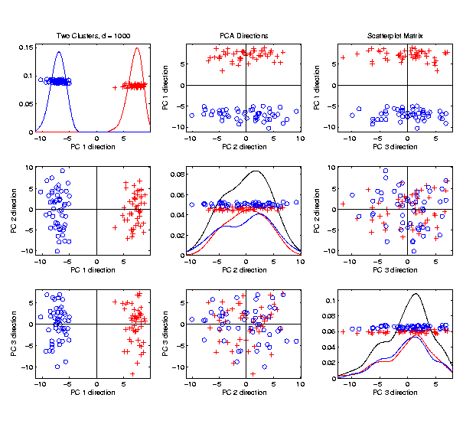

DiProPerm Hypothesis Test
Stronger Example
$N_{1000}\left(+0.2∗J,I\right)$
$N_{1000}\left(−0.2∗J,I\right)$
Even PCA
Shows Class
Difference

Slide 46
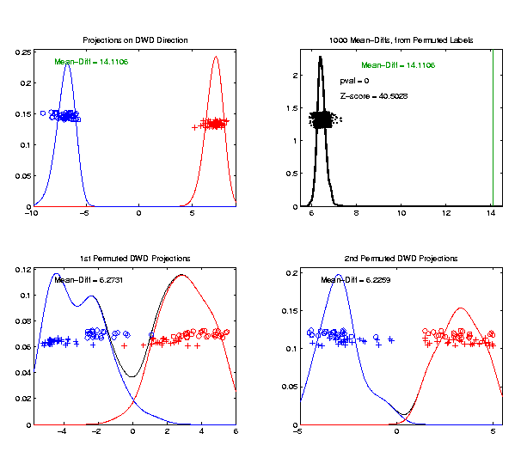

DiProPerm Hypothesis Test
Stronger Example
$N_{1000}\left(+0.2∗J,I\right)$
$N_{1000}\left(−0.2∗J,I\right)$
DiProPerm Very
Significant

Slide 47

DiProPerm Hypothesis Test
Stronger Example
$N_{1000}\left(+0.2∗J,I\right)$
$N_{1000}\left(−0.2∗J,I\right)$
DiProPerm Very
Significant
Z-Score Allows
Comparison
>> 5.4 above

Slide 48
DiProPerm Hypothesis Test
Real Data Example: Autism
Caudate Shape
(sub-cortical brain structure)
Shape summarized by 3-d locations of 1032 corresponding points
Autistic vs. Typically Developing
(Thanks to Josh Cates)

Slide 49
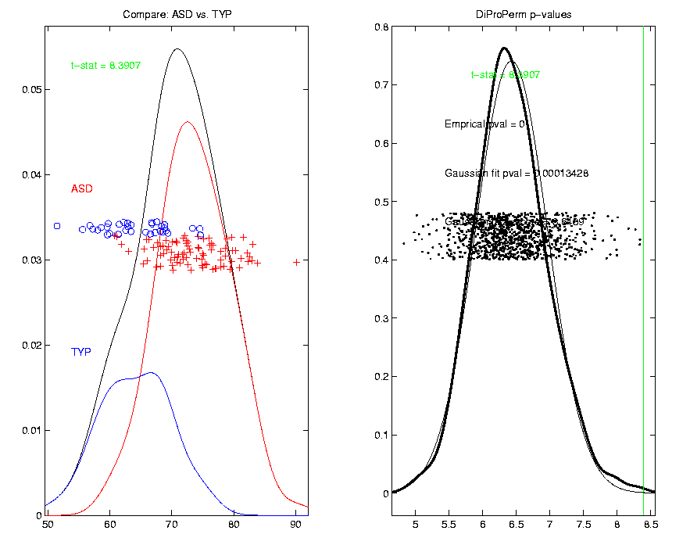
DiProPerm Hypothesis Test
Finds
Significant
Difference
Despite Weak
Visual
Impression

Slide 50
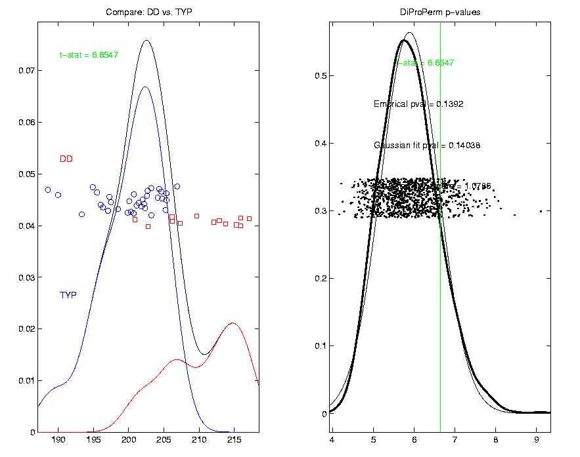
DiProPerm Hypothesis Test
Also Compare: Developmentally Delayed
No
Significant
Difference
But Stronger
Visual
Impression

Slide 51
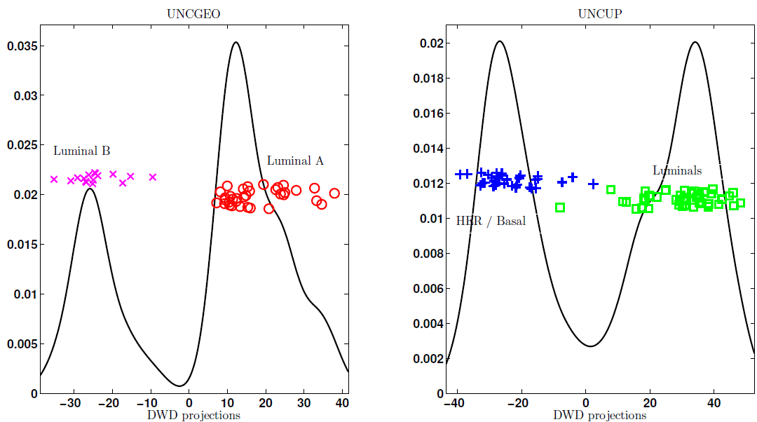
DiProPerm Hypothesis Test
Two
Examples
Which Is
“More
Distinct”?
Visually Better Separation?
Thanks to Katie Hoadley

Slide 52
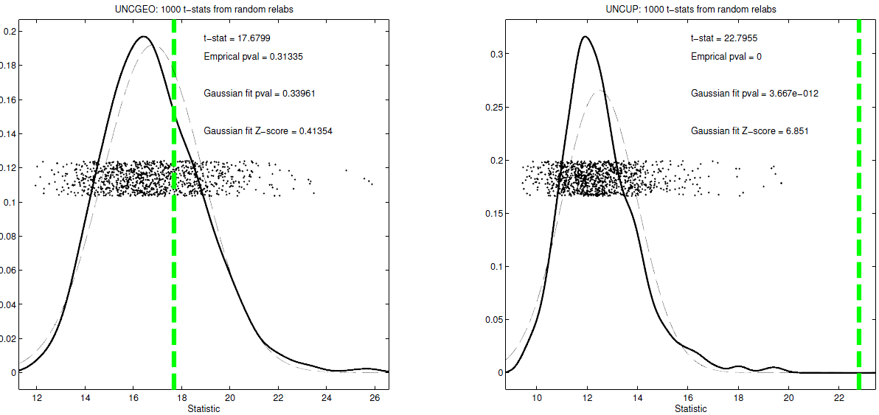
DiProPerm Hypothesis Test
Two
Examples
Which Is
“More
Distinct”?
Stronger Statistical Significance!
(Reason: Differing Sample Sizes)

Slide 53
Object Oriented Data Analysis
Three Major Phases of OODA:
I. Object Definition
“What are the Data Objects?”
Exploratory Analysis
“What Is Data Structure / Drivers?”
III. Confirmatory Analysis / Validation
Is it Really There (vs. Noise Artifact)?

Slide 54
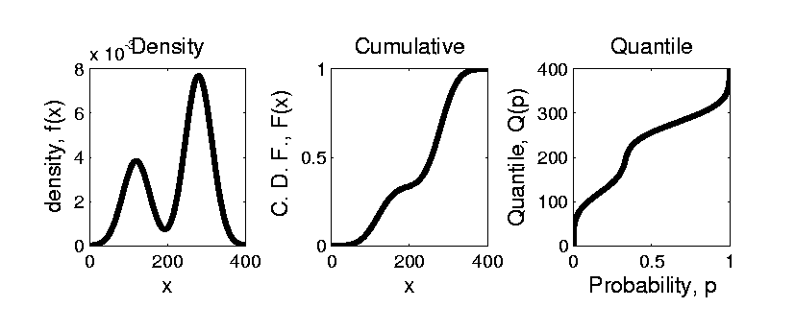


Prob. Dist’ns as Data Objects
How to Represent?
Several Common Choices:
$$F\left(x\right)=\int_{−∞}^{x}{f\left(t\right)dt}$$
$$Q\left(p\right)=F^{−1}(p)$$

Slide 55
Prob. Dist’ns as Data Objects
How to Represent?
Several Common Choices:
Density:
Good Intuition of Prob. Mass
Cumulative:
Can Read Off Probs.
Quantile:
Best Modes of Variation

Slide 56
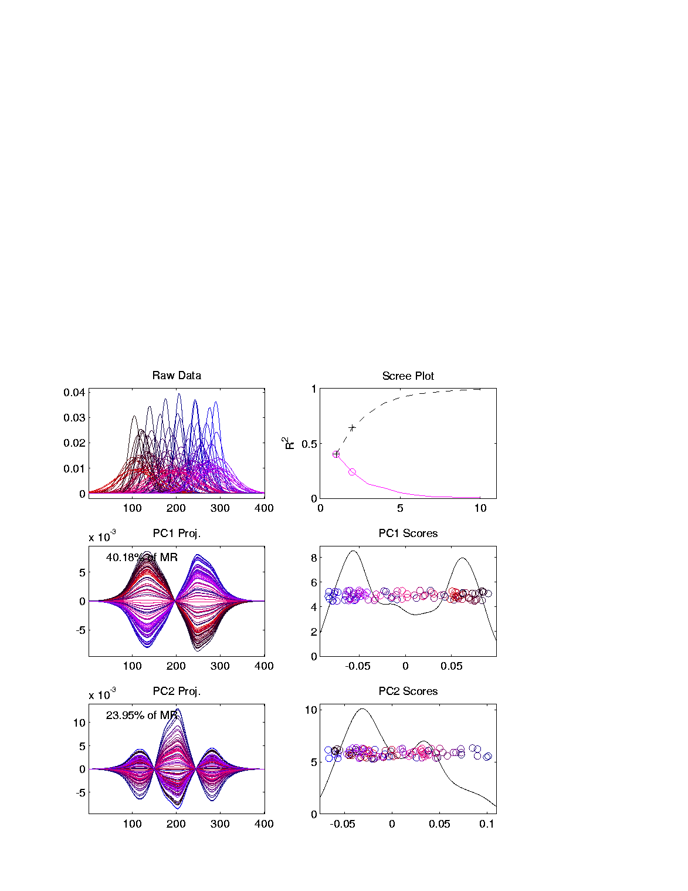
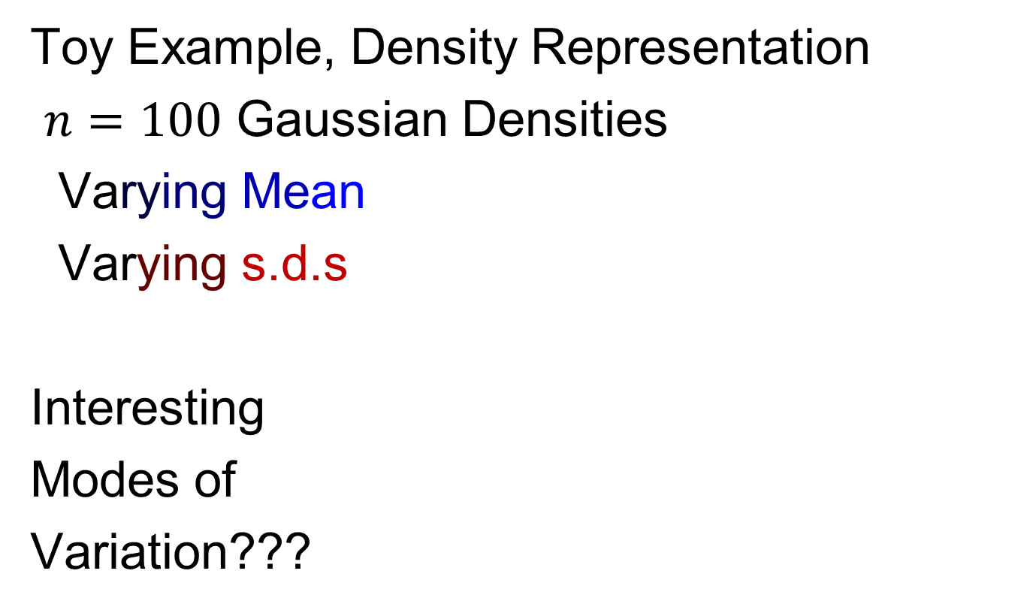
Prob. Dist’ns as Data Objects
Toy Example, Density Representation
$n=100$ Gaussian Densities
Varying Mean
Varying s.d.s
Interesting
Modes of
Variation???

Slide 57
Prob. Dist’ns as Data Objects
Energy Spread
Widely Across
The Spectrum
Toy Example, Density Representation
Try
Standard
PCA
Unintuitive
Modes of
Variation
Which Don’t
Explain Much
Variation

Slide 58
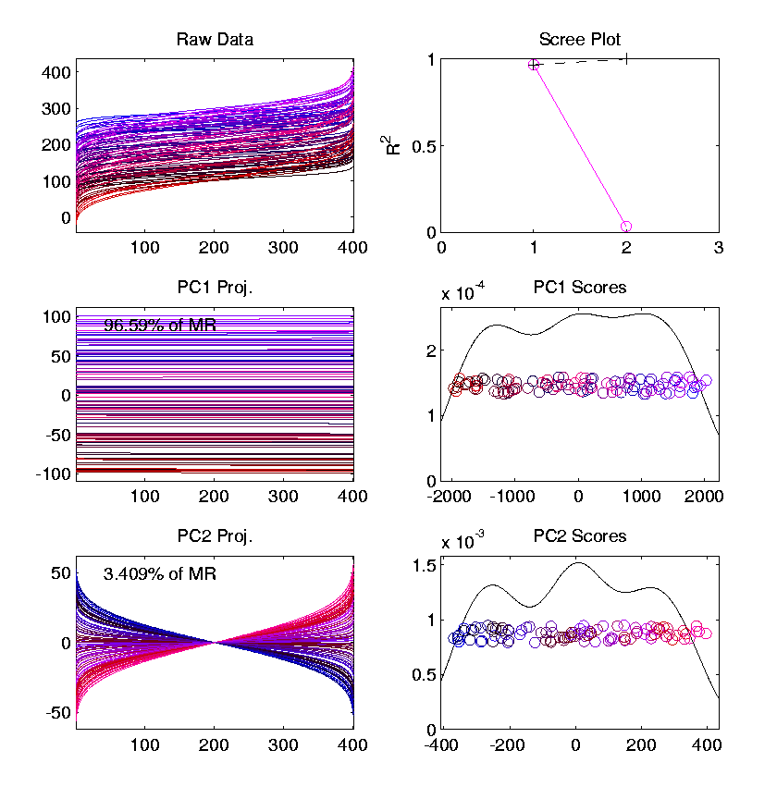
Prob. Dist’ns as Data Objects
Energy Entirely
Expressed In
Just 2 Modes
Toy Example, Quantile Representation
Try
Standard
PCA
1st Mode Is
Mean Var’n
Both Much More Interpretable!
2nd Mode Is
S.D. Var’n

Slide 59
Prob. Dist’ns as Data Objects
For More Discussion of the Usefulness of Quantile Representations of Dist’ns, see
Parzen (2004)

Slide 60
Prob. Dist’ns as Data Objects
How to Represent?
Alternative Choices:
Aitchison (1982)
Menagfolio et al. (2018)
Hron et al. (2016)

Slide 61
Object Oriented Data Analysis
Nomenclature Clash?
Computer Science View:
Object Oriented Programming:
Programming that supports encapsulation, inheritance, and polymorphism
(from Google: define object oriented programming,
my favorite: www.innovatia.com/software/papers/com.htm)

Slide 62
Object Oriented Data Analysis
Some statistical history:
John Chambers Idea (1960s - ):
Object Oriented approach to statistical analysis
Developed as software package S
  Basis of S-plus (commerical product)
  And of R (free-ware, current favorite of Chambers)
Reference for more on this:
Venables & Ripley (2013)
Notes:
62

Slide 63

Object Oriented Data Analysis
Another take: J. O. Ramsay
http://www.psych.mcgill.ca/faculty/ramsay/ramsay.html
“Functional Data Objects”
(closer to C. S. meaning)
Personal Objection:
“Functional” in mathematics is:
“Function that operates on functions”

Slide 64
Matlab Software
Want to try similar analyses?
Matlab Available from UNC Site License
Download Software:
Google “Marron Matlab Software”

Slide 65

Matlab Software
Choose

Slide 66
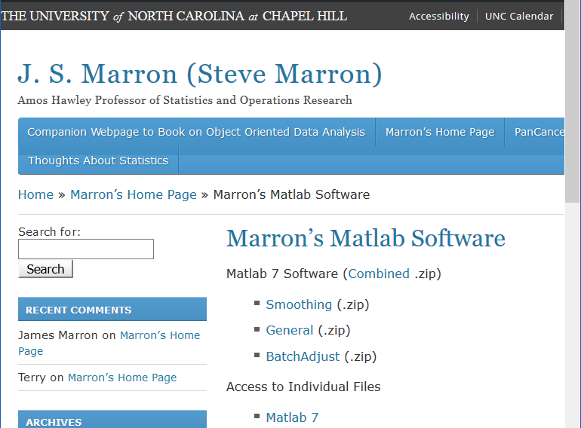
Matlab Software
Download .zip File, & Expand to 4 Directories

Slide 67
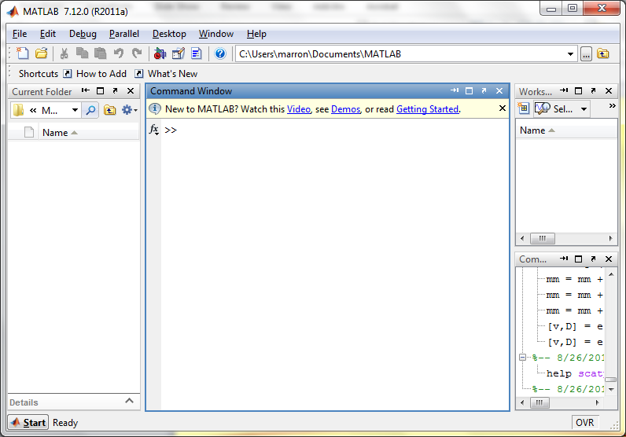
Matlab Software
Put these in Matlab Path

Slide 68
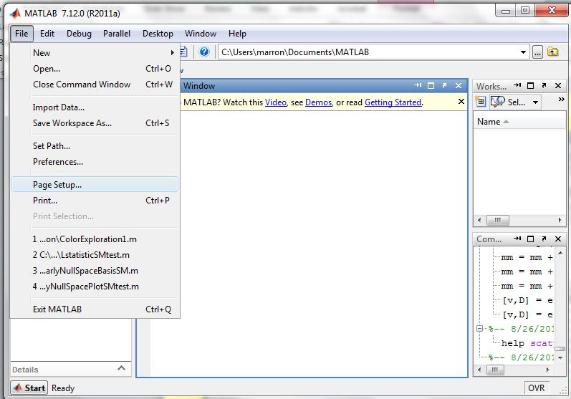
Matlab Software
Put these in Matlab Path

Slide 69
Matlab Basics
Matlab has Modalities:
Interpreted
(Type Commands & Run Individually)
Batch
(Run “Script Files” = Command Sets)

Slide 70
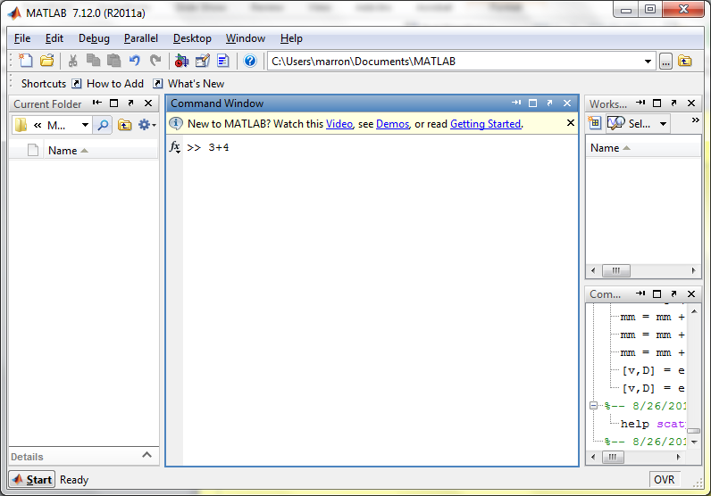
Matlab Basics
Matlab in Interpreted Mode:

Slide 71

Matlab Basics
Matlab in Interpreted Mode:

Slide 72
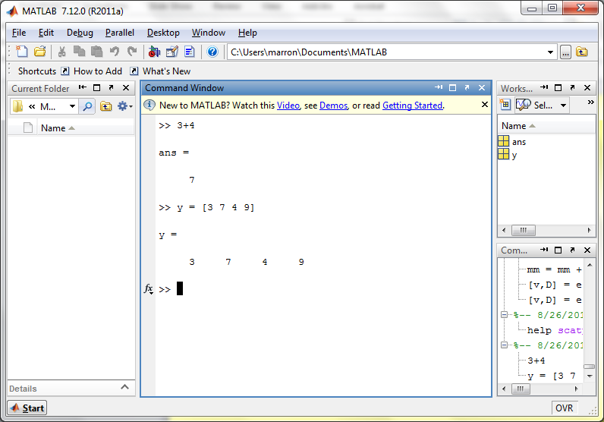
Matlab Basics
Matlab in Interpreted Mode:

Slide 73
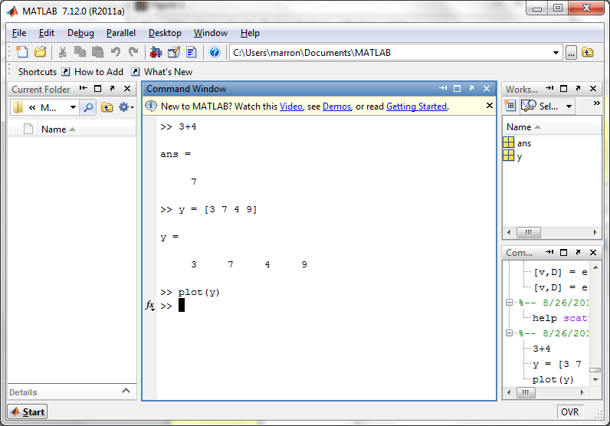
Matlab Basics
Matlab in Interpreted Mode:

Slide 74
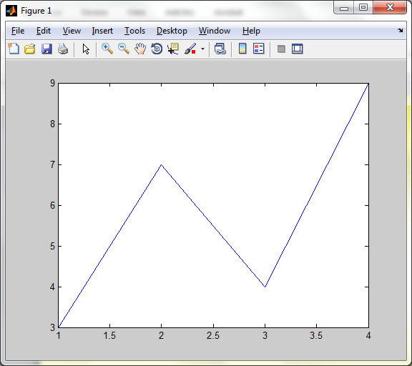
Matlab Basics
Matlab in Interpreted Mode:

Slide 75
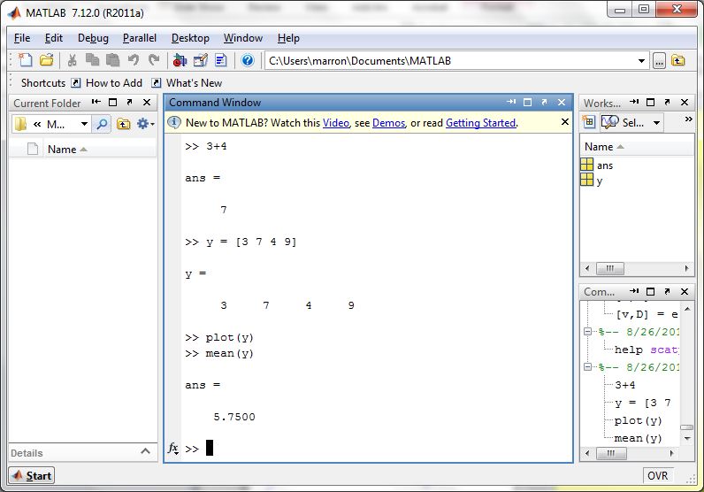
Matlab Basics
Matlab in Interpreted Mode:

Slide 76
Matlab Basics
Matlab in Interpreted Mode:
For description of a function:
>> help [function name]

Slide 77
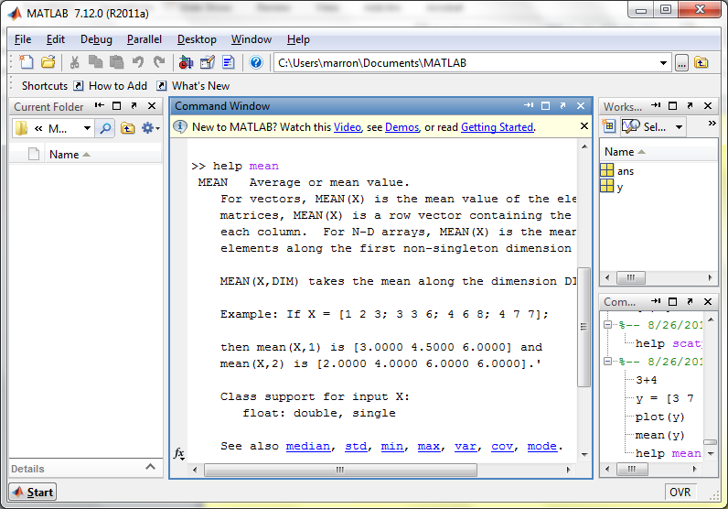
Matlab Basics
Matlab in Interpreted Mode:

Slide 78
Matlab Basics
Matlab in Interpreted Mode:
To Find Functions:
>> help [category name]
e.g.
>> help stats

Slide 79
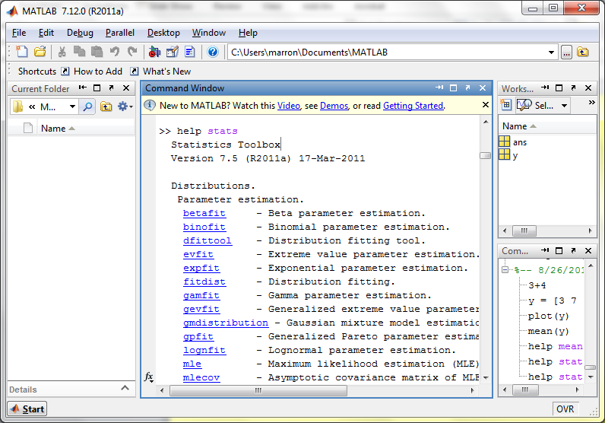
Matlab Basics
Matlab in Interpreted Mode:

Slide 80
Matlab Basics
Matlab has Modalities:
Interpreted (Type Commands)
Batch (Run “Script Files”)
For Serious Scientific Computing:
Always Run Scripts

Slide 81
Matlab Basics
Matlab Script File:
Just a List of Matlab Commands
Matlab Executes Them in Order
Why Bother (Why Not Just Type Commands)?
Reproducibility
(Can Find Mistakes & Use Again Much Later)

Slide 82
Matlab Script Files
An Example:
Recall “Brushing Analysis” of
RNAseq Lung Cancer Data

Slide 83
Functional Data Analysis
Simple
1st
View:
Curve
Overlay
(log
scale)

Slide 84
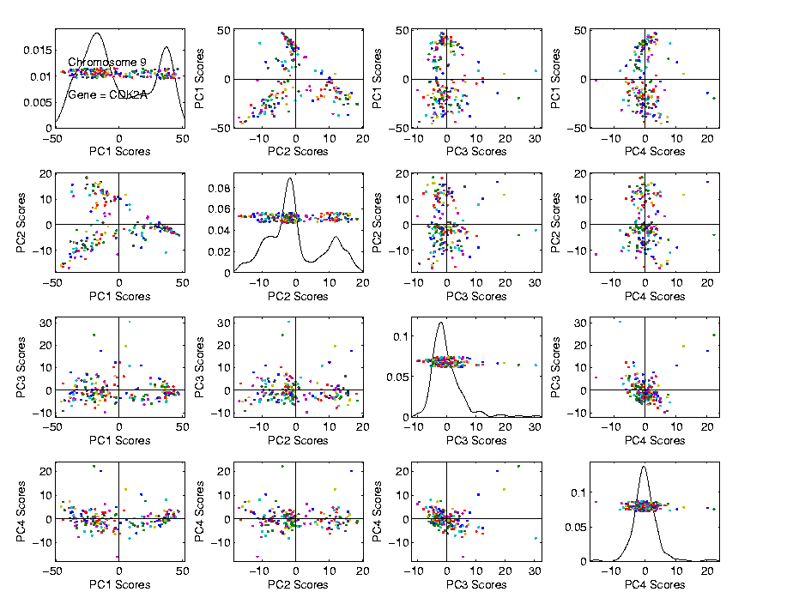
Functional Data Analysis
Often
Useful
Population
View:
PCA
Scores

Slide 85
Functional Data Analysis
Suggestion
Of
Clusters
???

Slide 86
Functional Data Analysis
Suggestion
Of
Clusters
Which
Are
These?

Slide 87
Functional Data Analysis
Manually
“Brush”
Clusters

Slide 88
Functional Data Analysis
Manually
Brush
Clusters
Clear
Alternate
Splicing

Slide 89
Matlab Script Files
An Example:
Recall “Brushing Analysis” of
RNAseq Lung Cancer Data
Analysis In Script File:
LungCancer2011.m
On Course Web Page
Matlab Script File Suffix

Slide 90
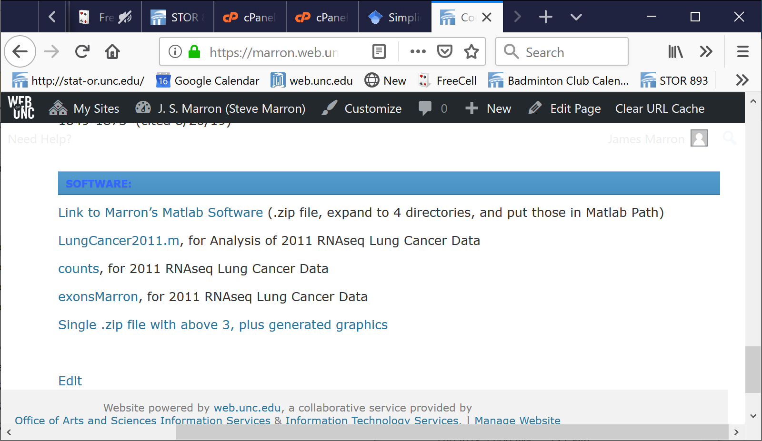
Matlab Script Files
An Example:
On Course Web Page

Slide 91
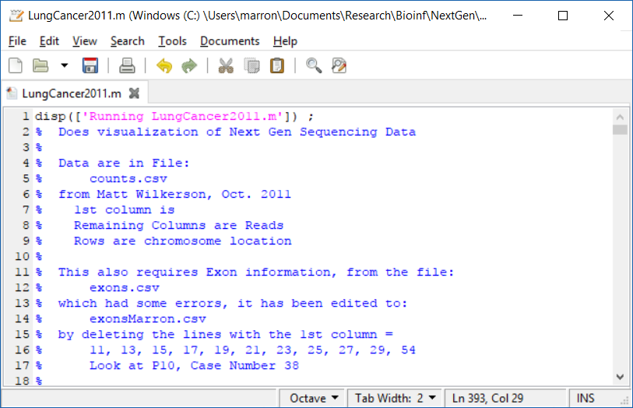
Matlab Script Files
String of Text

Slide 92
Matlab Script Files
Command to Display String to Screen

Slide 93
Matlab Script Files
Notes About Data (Maximizes Reproducibility)

Slide 94
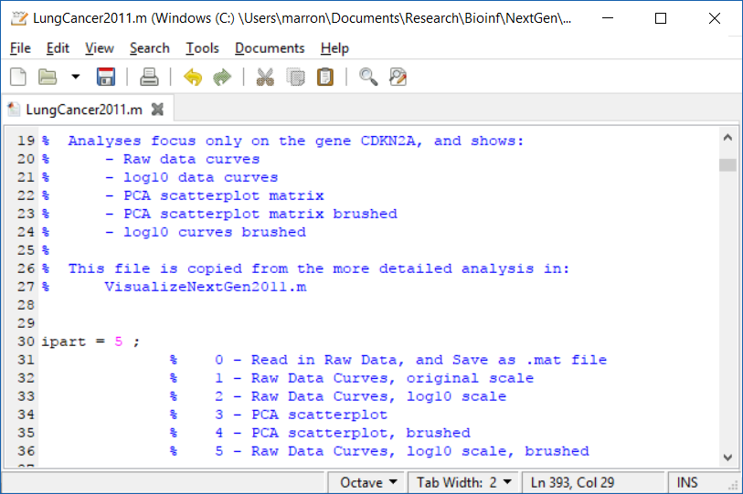
Matlab Script Files
Have Index for Each Part of Analysis

Slide 95
Matlab Script Files
So Keep Everything Done (Max’s Reprod’ity)

Slide 96
Matlab Script Files
Easy to Regenerate (& Change) Graphics

Slide 97

Matlab Script Files
Set Graphics to Default

Slide 98
Matlab Script Files
Put Different Program Parts in IF-Block

Slide 99
Matlab Script Files
Comment Out Currently Unused Commands

Slide 100
Matlab Script Files
Read Data from Excel File

Slide 101

Matlab Script Files
For Scores Scatterplot (in “General” Directory)

Slide 102
Matlab Script Files
Input Data Matrix

Slide 103
Matlab Script Files
Structure, with Other Settings

Slide 104

Matlab Script Files
To Make Brushed Colored Version

Slide 105

Matlab Script Files
Start with PCA (To Determine Colors)

Slide 106

Matlab Script Files
Then Create Color Matrix

Slide 107
Matlab Script Files
Black Red Blue

Slide 108

Matlab Script Files
Run Script Using Filename as a Command

