Slide 1
Participant Presentations
Please Sign Up:
Name
Email (Onyen is fine, or …)
Are You ENRolled?
Dept. & Advisor (Lab?)
Tentative Title (“????” Is OK)
When:
  Next Week, Early, Oct., Nov., Late

Slide 2
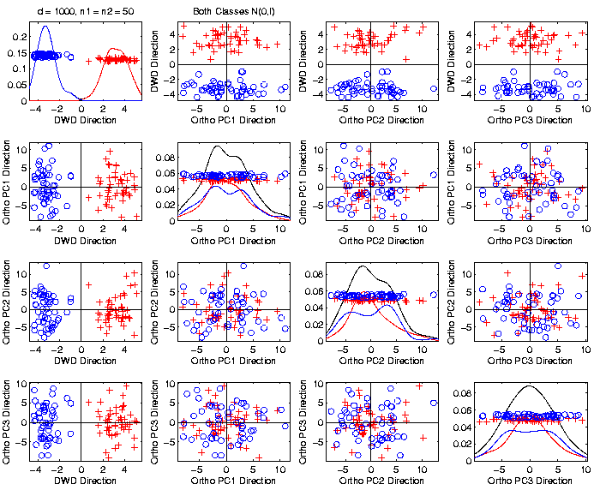

Caution
Toy 2-Class
Example
Actually
Both
Classes
Are $N\left(0,I\right)$
$$d=1000$$

Slide 3
Caution
Toy 2-Class
Example
Separation
Is Natural
Sampling
Variation
(Will Study in Detail Later)

Slide 4
Caution
Main Lesson Again:
DWD Separation Can Be Deceptive
Since DWD is Really Good at Separation
Important Concept:
Statistical Inference is Essential
III. Confirmatory Analysis

Slide 5
DiProPerm Hypothesis Test
Suggested Approach:
Find a DIrection
(separating classes)
PROject the data
(reduces to 1 dim)
PERMute
(class labels, to assess significance,
with recomputed direction)

Slide 6
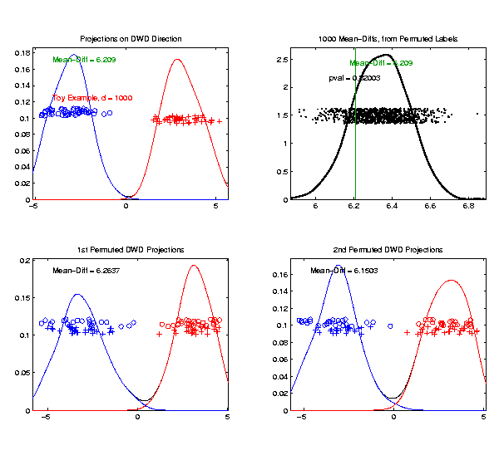
DiProPerm Hypothesis Test
Toy 2-Class Example
Generate Null
Distribution
Compare With
Original Value

Slide 7
DiProPerm Hypothesis Test
Toy 2-Class Example
Generate Null
Distribution
Compare With
Original Value
Take Proportion
Larger as P-Value

Slide 8
DiProPerm Hypothesis Test
Toy 2-Class Example
Generate Null
Distribution
Compare With
Original Value
Not Significant

Slide 9
Object Oriented Data Analysis
Three Major Phases of OODA:
I. Object Definition
“What are the Data Objects?”
Exploratory Analysis
“What Is Data Structure / Drivers?”
III. Confirmatory Analysis / Validation
Is it Really There (vs. Noise Artifact)?

Slide 10
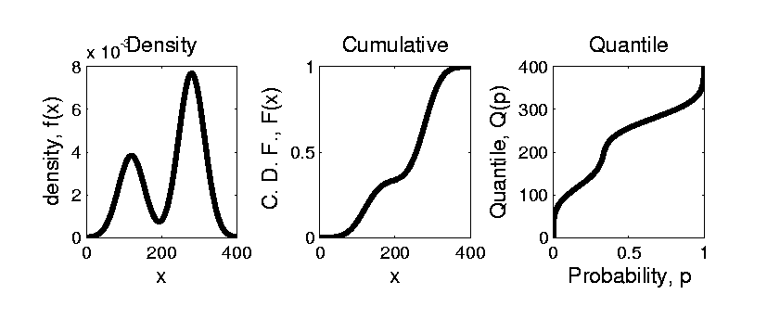


Prob. Dist’ns as Data Objects
How to Represent?
Several Common Choices:
$$F\left(x\right)=\int_{−∞}^{x}{f\left(t\right)dt}$$
$$Q\left(p\right)=F^{−1}(p)$$

Slide 11
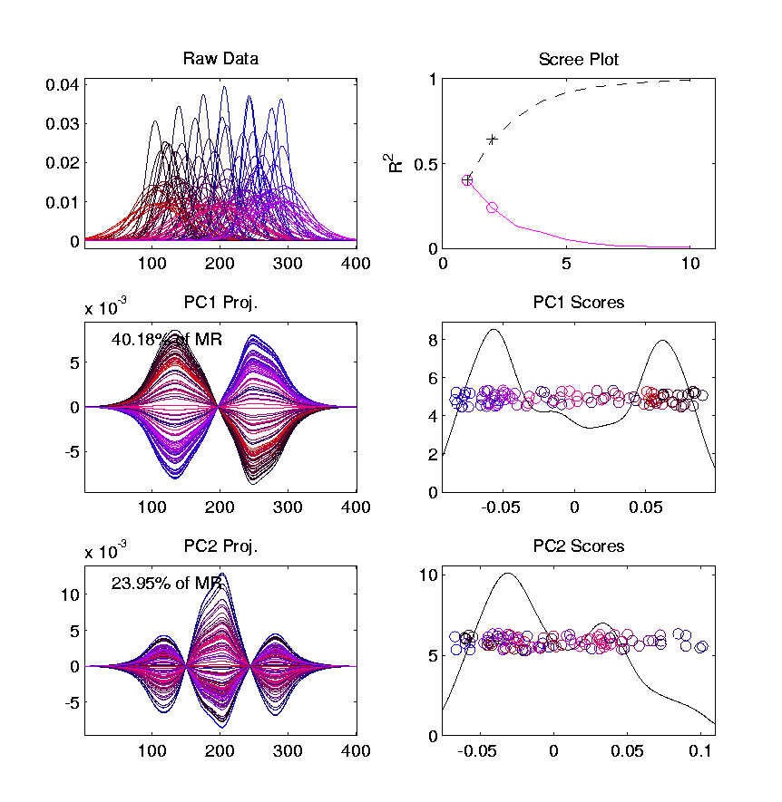
Prob. Dist’ns as Data Objects
Energy Spread
Widely Across
The Spectrum
Toy Example, Density Representation
Try
Standard
PCA
Unintuitive
Modes of
Variation
Which Don’t
Explain Much
Variation

Slide 12
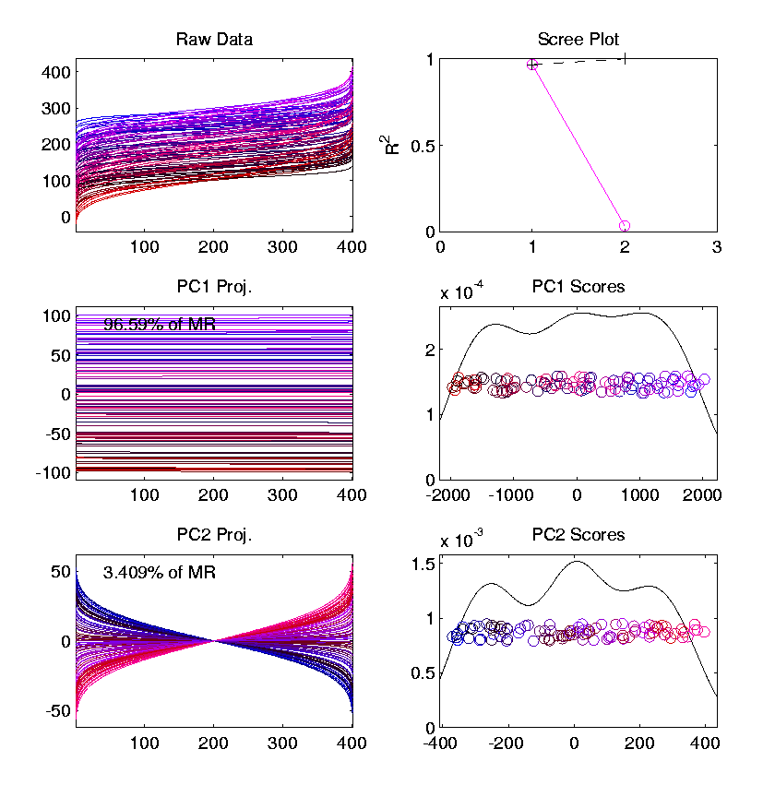
Prob. Dist’ns as Data Objects
Energy Entirely
Expressed In
Just 2 Modes
Toy Example, Quantile Representation
Try
Standard
PCA
1st Mode Is
Mean Var’n
Both Much More Interpretable!
2nd Mode Is
S.D. Var’n

Slide 13
Matlab Software
Want to try similar analyses?
Matlab Available from UNC Site License
Download Software:
Google “Marron Matlab Software”

Slide 14
Matlab Basics
Matlab has Modalities:
Interpreted (Type Commands)
Batch (Run “Script Files”)
For Serious Scientific Computing:
Always Run Scripts

Slide 15
Matlab Basics
Matlab Script File:
Just a List of Matlab Commands
Matlab Executes Them in Order
Why Bother (Why Not Just Type Commands)?
Reproducibility
(Can Find Mistakes & Use Again Much Later)

Slide 16
Object Oriented Data Analysis
Three Major Phases of OODA:
I. Object Definition
“What are the Data Objects?”
Exploratory Analysis
“What Is Data Structure / Drivers?”
III. Confirmatory Analysis / Validation
Is it Really There (vs. Noise Artifact)?

Slide 17

Big Picture Data Visualization
For a Matrix of Data:
$${\left(\begin{matrix}x_{11} & ⋯ & x_{1n} \\ ⋮ & ⋱ & ⋮ \\ x_{d1} & ⋯ & x_{dn}\end{matrix}\right)}_{d×n}$$

Slide 18
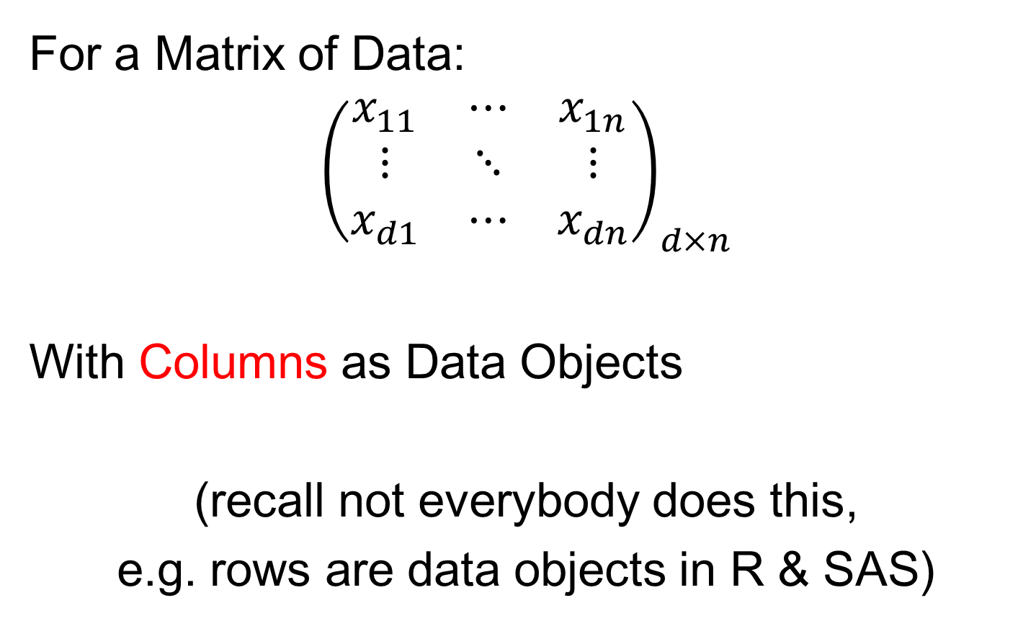
Big Picture Data Visualization
For a Matrix of Data:
$${\left(\begin{matrix}x_{11} & ⋯ & x_{1n} \\ ⋮ & ⋱ & ⋮ \\ x_{d1} & ⋯ & x_{dn}\end{matrix}\right)}_{d×n}$$
With Columns as Data Objects
(recall not everybody does this,
e.g. rows are data objects in R & SAS)

Slide 19
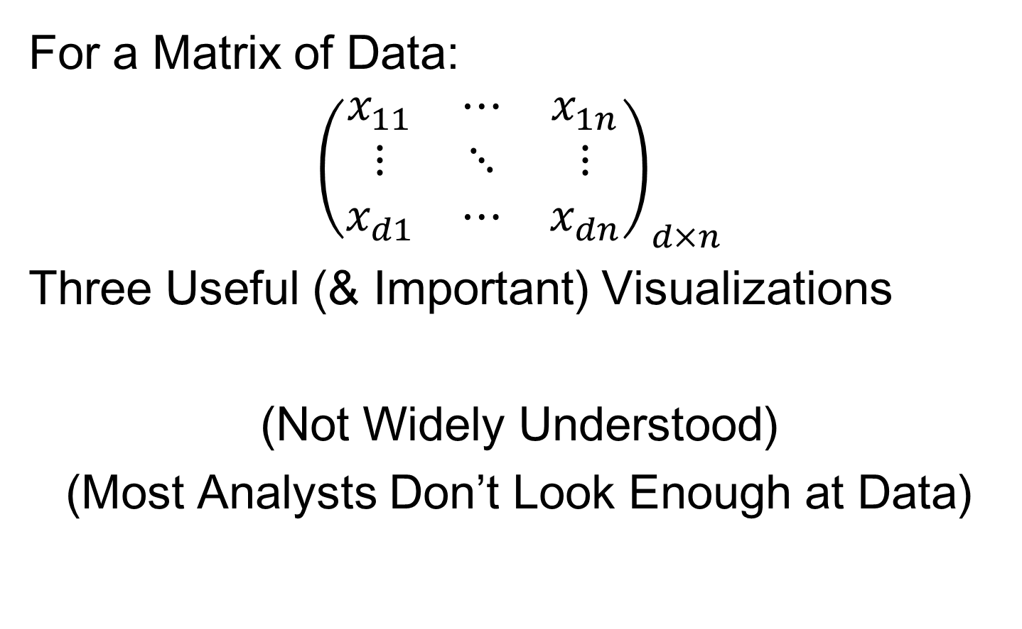
Big Picture Data Visualization
For a Matrix of Data:
$${\left(\begin{matrix}x_{11} & ⋯ & x_{1n} \\ ⋮ & ⋱ & ⋮ \\ x_{d1} & ⋯ & x_{dn}\end{matrix}\right)}_{d×n}$$
Three Useful (& Important) Visualizations
(Not Widely Understood)
(Most Analysts Don’t Look Enough at Data)

Slide 20
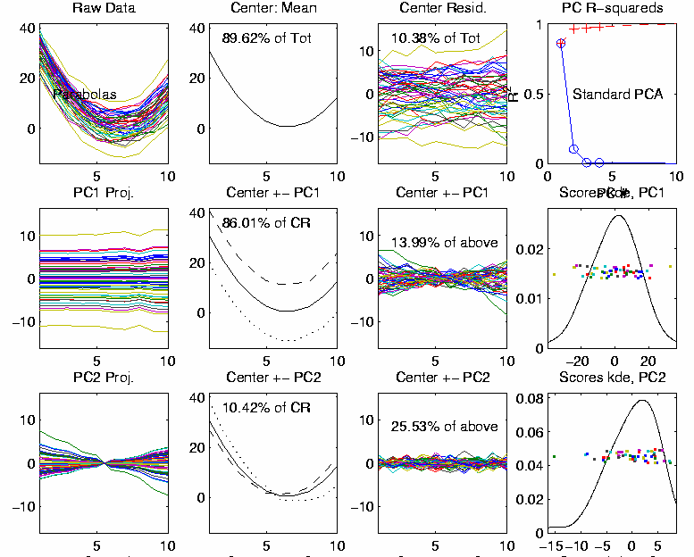

Big Picture Data Visualization
For a Matrix of Data:
$${\left(\begin{matrix}x_{11} & ⋯ & x_{1n} \\ ⋮ & ⋱ & ⋮ \\ x_{d1} & ⋯ & x_{dn}\end{matrix}\right)}_{d×n}$$
Three Useful (& Important) Visualizations
Curve Objects (e.g. PCA decomp)

Slide 21
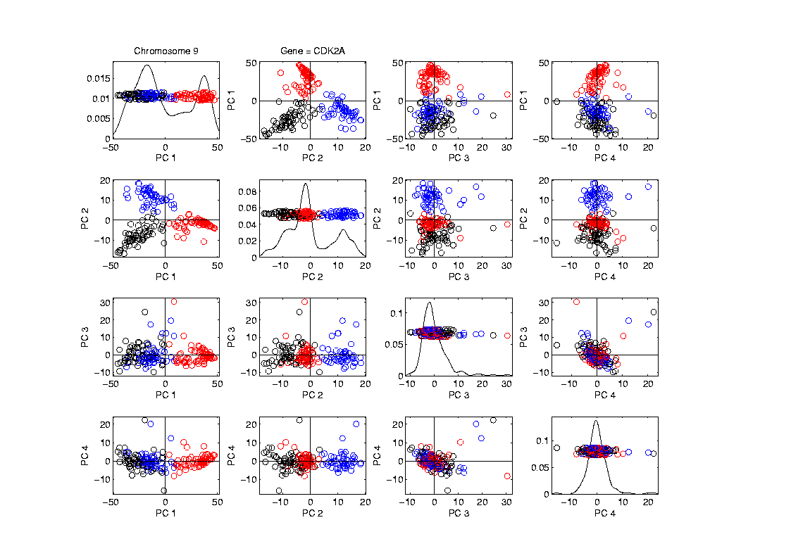

Big Picture Data Visualization
For a Matrix of Data:
$${\left(\begin{matrix}x_{11} & ⋯ & x_{1n} \\ ⋮ & ⋱ & ⋮ \\ x_{d1} & ⋯ & x_{dn}\end{matrix}\right)}_{d×n}$$
Three Useful (& Important) Visualizations
Curve Objects
Relationships Between Objects
(e.g. scatterplot matrices)

Slide 22
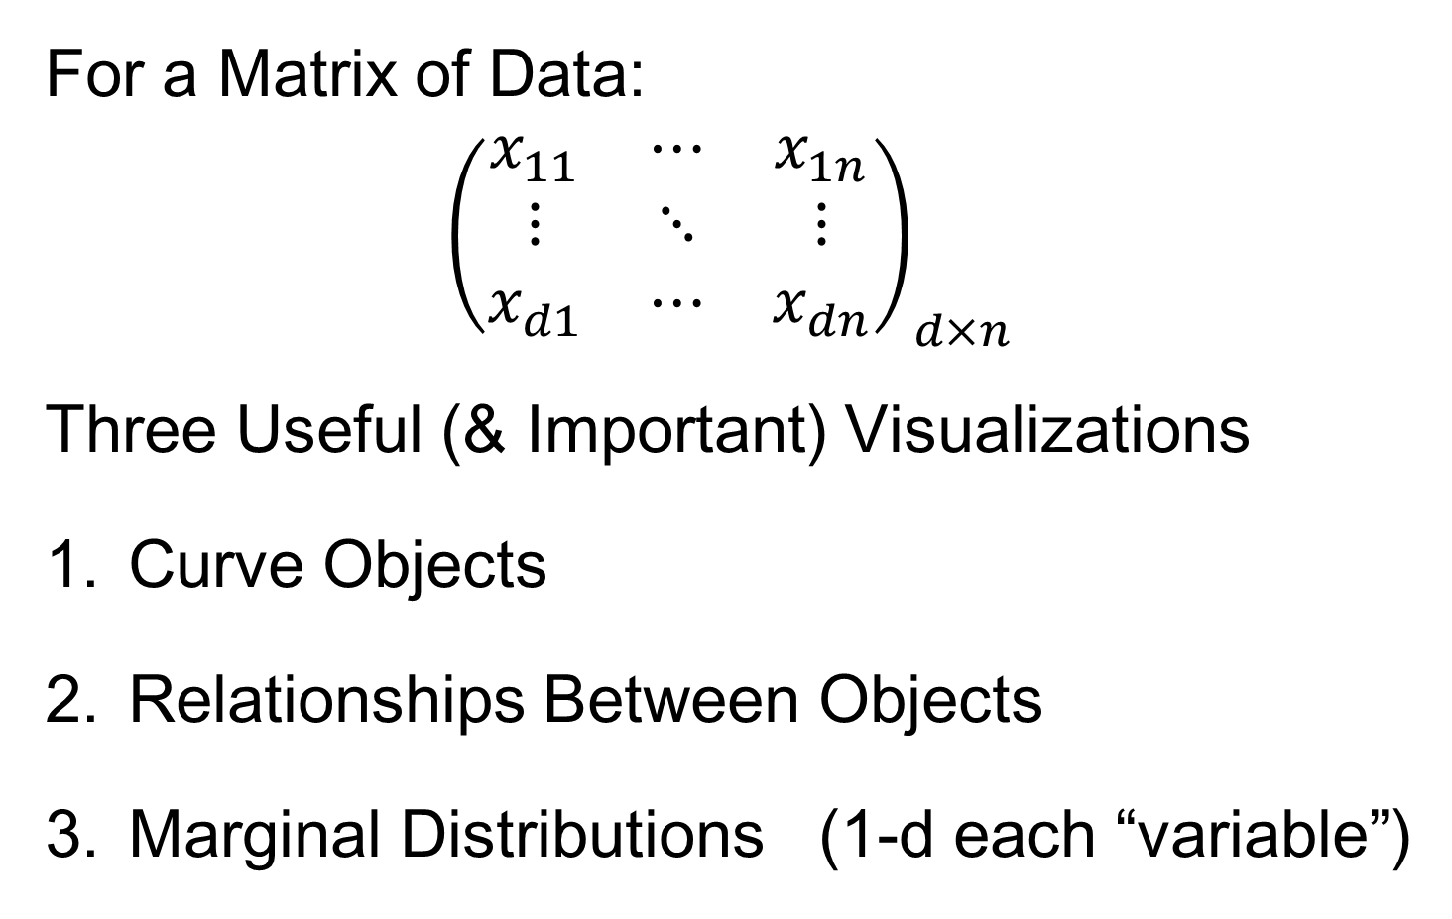
Big Picture Data Visualization
For a Matrix of Data:
$${\left(\begin{matrix}x_{11} & ⋯ & x_{1n} \\ ⋮ & ⋱ & ⋮ \\ x_{d1} & ⋯ & x_{dn}\end{matrix}\right)}_{d×n}$$
Three Useful (& Important) Visualizations
Curve Objects
Relationships Between Objects
Marginal Distributions (1-d each “variable”)

Slide 23
Marginal Distribution Plots
Ideas:
For Each Variable
Study 1-d Distributions
Simultaneous Views:
  Jitter Plots
  Smooth Histograms (Kernel Density Est’s)

Slide 24
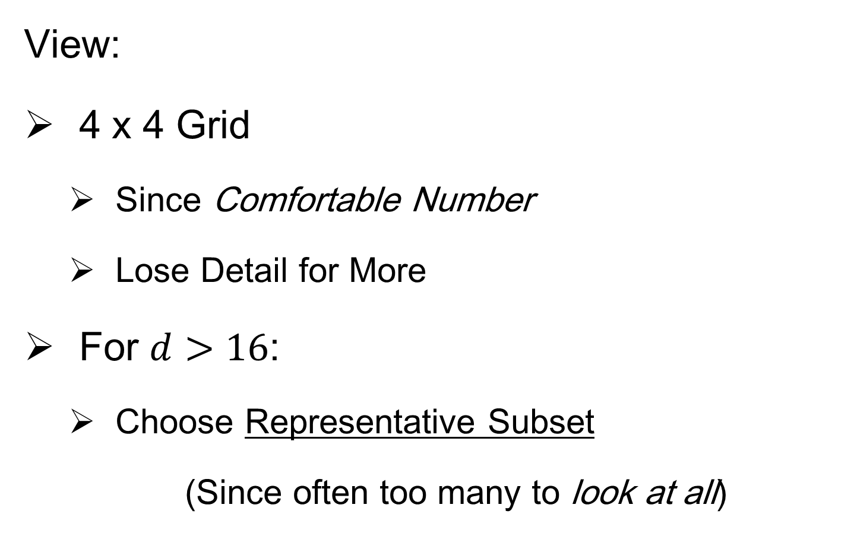
Marginal Distribution Plots
View:
4 x 4 Grid
  Since Comfortable Number
  Lose Detail for More
For $d>16$:
  Choose Representative Subset
  (Since often too many to look at all)

Slide 25
Marginal Distribution Plots
Representative Subset of Variables:
Sort Variables on a Data Summary
  E.g Mean, S.D., Skewness, Median, …
Usually Take Nearly Equally Spaced Grid
  Sometimes Specify Variables
  E.g. All Largest (or Smallest) Summaries

Slide 26
Marginal Distribution Plots
Note Often Useful for:
Object Determination / Representation
Which Variables to Include?
How to Scale Variables?
Need to Transform (e.g. log) Variables?

Slide 27

Marginal Distribution Plots
Toy Example: $n=200$, $d=50$,
i.i.d. Poisson, with parameters $λ=0.2,⋯,20$
Logarithmically Spaced

Slide 28
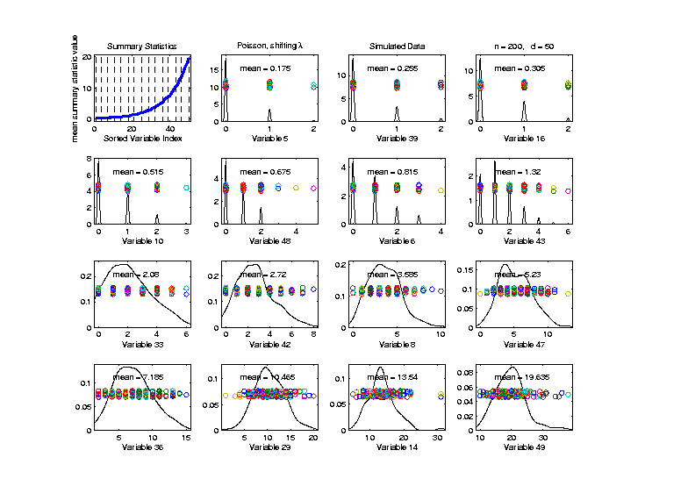

Marginal Distribution Plots
Toy Example: $n=200$, $d=50$,
i.i.d. Poisson, with parameters $λ=0.2,⋯,20$
Sort Variables
On Sample
Mean
Summary
Plot with
Equal
Spacing

Slide 29
Marginal Distribution Plots
Toy Example: $n=200$, $d=50$,
i.i.d. Poisson, with parameters $λ=0.2,⋯,20$
Sort Variables
On Sample
Mean
Dashed Lines
Correspond
To 1-d Distn’s

Slide 30
Marginal Distribution Plots
Toy Example: $n=200$, $d=50$,
i.i.d. Poisson, with parameters $λ=0.2,⋯,20$
Sort Variables
On Sample
Mean
Wide Range
Of Poissons

Slide 31
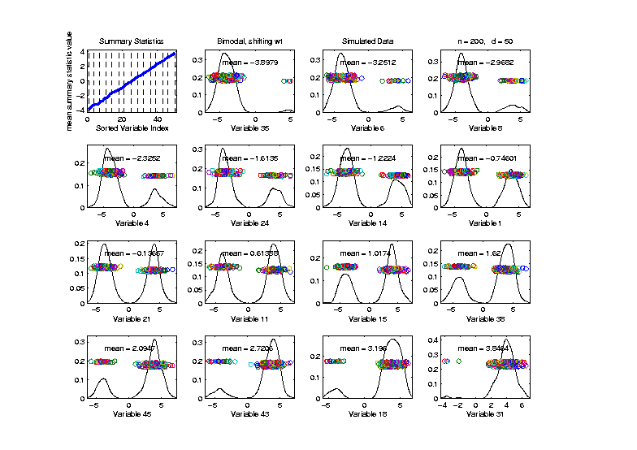

Marginal Distribution Plots
Toy Example: Normal Mean Mixture
$$ωN\left(4,1\right)+\left(1−ω\right)N\left(−4,1\right)$$
Sort on
Mean
Useful
Ordering

Slide 32
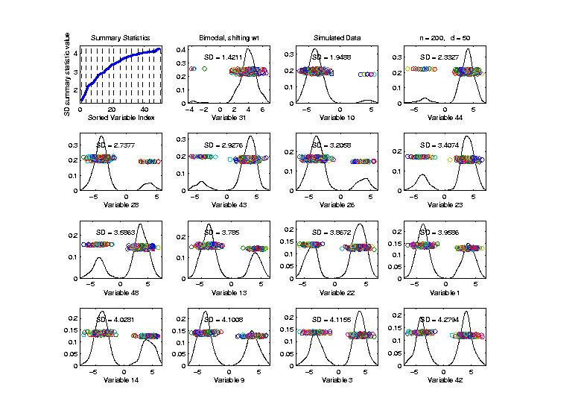

Marginal Distribution Plots
Toy Example: Normal Mean Mixture
$$ωN\left(4,1\right)+\left(1−ω\right)N\left(−4,1\right)$$
Sort on
Standard
Deviation
Less Useful
Ordering

Slide 33
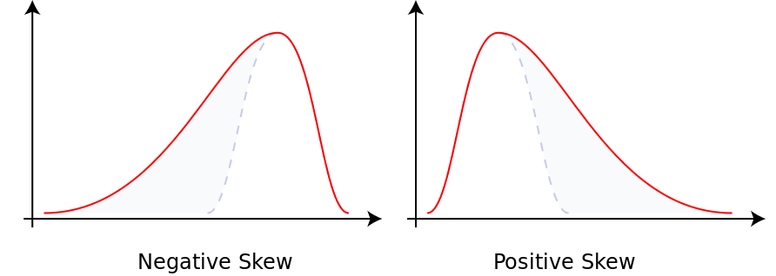
Marginal Distribution Plots
Additional Summaries: Skewness
Measure Asymmetry
Left Skewed Right Skewed
(Thanks to Wikipedia)

Slide 34
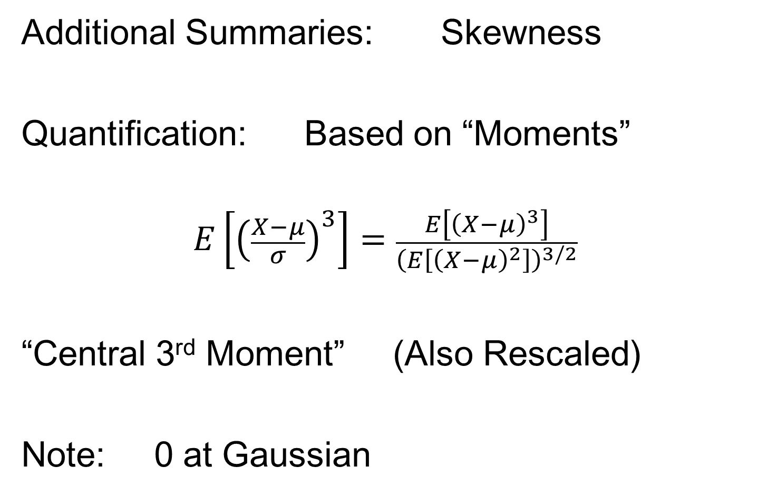
Marginal Distribution Plots
Additional Summaries: Skewness
Quantification: Based on “Moments”
$$E\left[{\left(\frac{X−μ}{σ}\right)}^{3}\right]=\frac{E\left[{\left(X−μ\right)}^{3}\right]}{{\left(E\left[{\left(X−μ\right)}^{2}\right]\right)}^{3/2}}$$
“Central 3rd Moment” (Also Rescaled)
Note: 0 at Gaussian

Slide 35
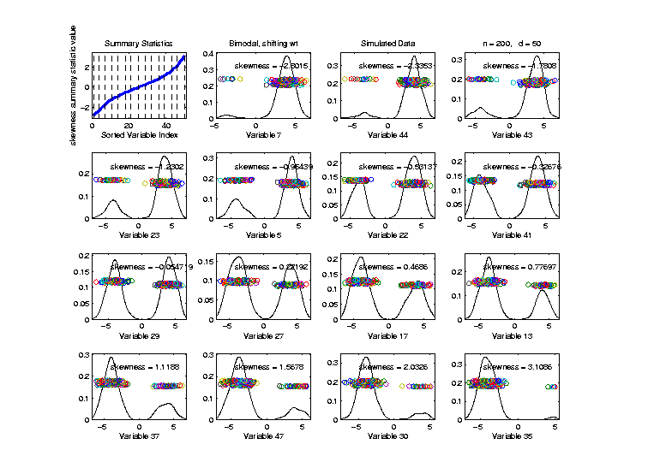
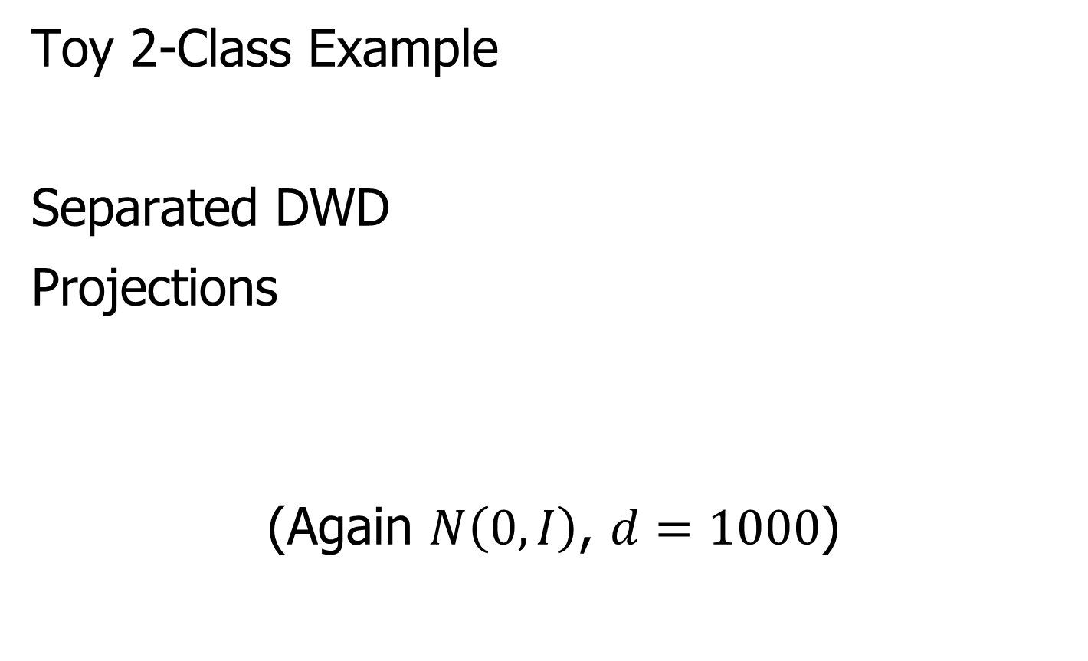
Marginal Distribution Plots
Toy Example: Normal Mean Mixture
$$ωN\left(4,1\right)+\left(1−ω\right)N\left(−4,1\right)$$
Sort on
Skewness
Useful
Ordering

Slide 36
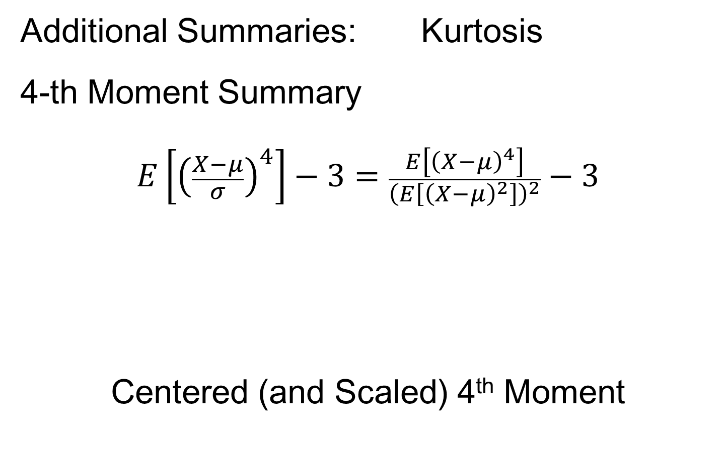
Marginal Distribution Plots
Additional Summaries: Kurtosis
4-th Moment Summary
$$E\left[{\left(\frac{X−μ}{σ}\right)}^{4}\right]−3=\frac{E\left[{\left(X−μ\right)}^{4}\right]}{{\left(E\left[{\left(X−μ\right)}^{2}\right]\right)}^{2}}−3$$
Centered (and Scaled) 4th Moment

Slide 37
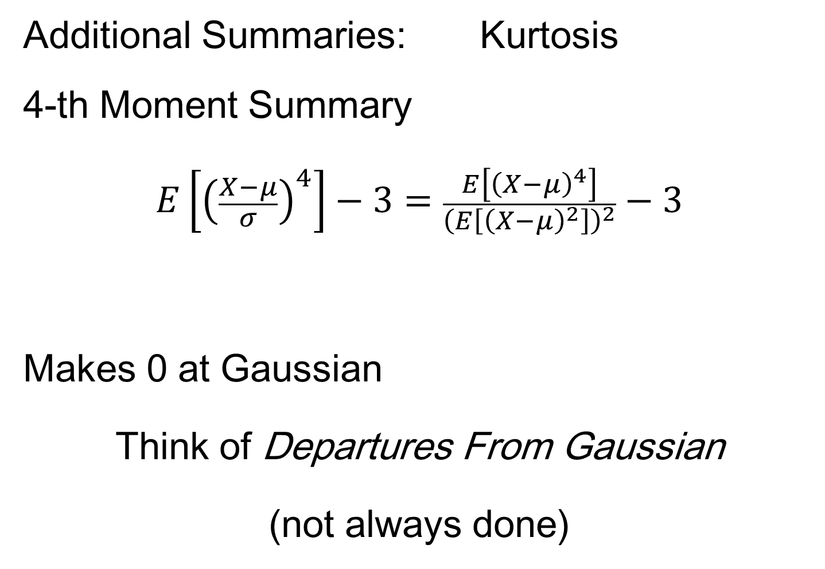
Marginal Distribution Plots
Additional Summaries: Kurtosis
4-th Moment Summary
$$E\left[{\left(\frac{X−μ}{σ}\right)}^{4}\right]−3=\frac{E\left[{\left(X−μ\right)}^{4}\right]}{{\left(E\left[{\left(X−μ\right)}^{2}\right]\right)}^{2}}−3$$
Makes 0 at Gaussian
Think of Departures From Gaussian
(not always done)

Slide 38
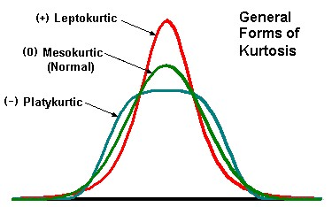
Marginal Distribution Plots
Additional Summaries: Kurtosis
4-th Moment Summary
Nice Graphic
(from mvpprograms.com)

Slide 39
Marginal Distribution Plots
Additional Summaries: Kurtosis
4-th Moment Summary
Positive
Big at Peak
And Tails
(with controlled
variance)

Slide 40
Marginal Distribution Plots
Additional Summaries: Kurtosis
4-th Moment Summary
Negative
Big in Flanks

Slide 41
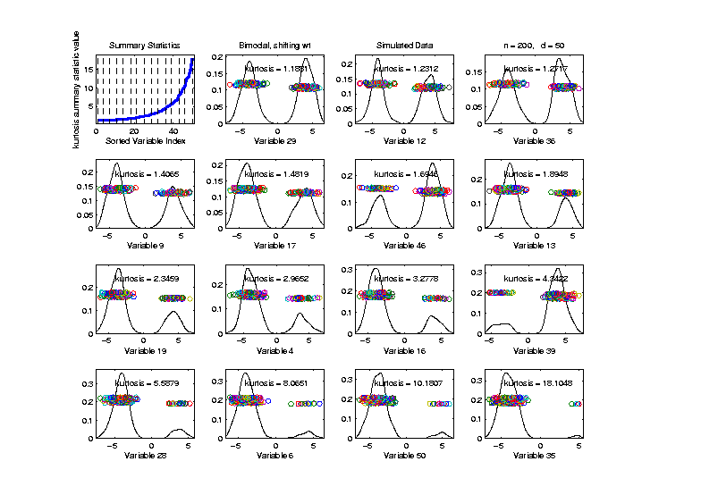
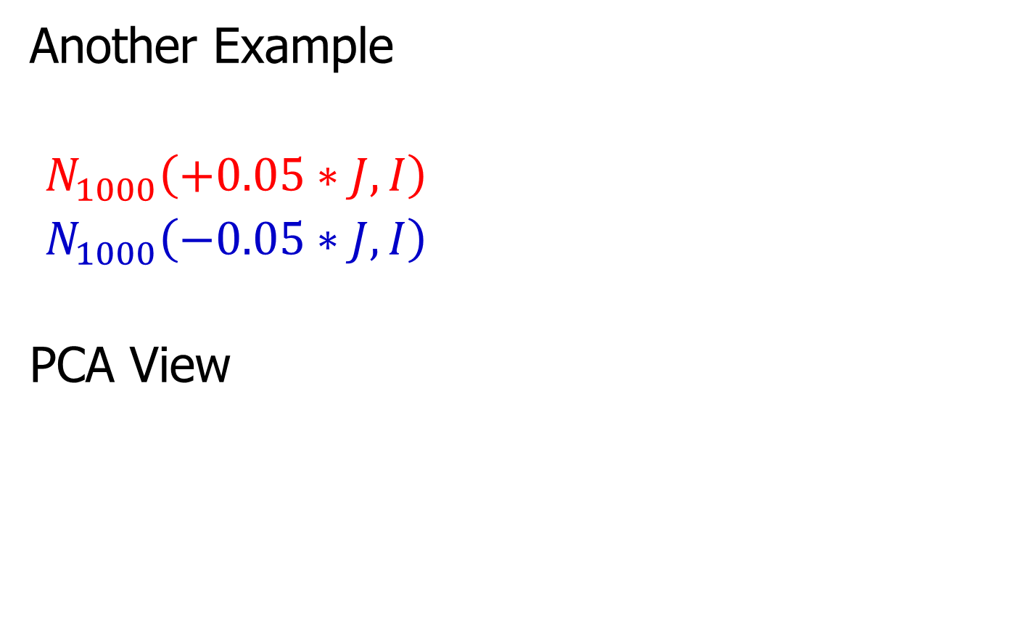
Marginal Distribution Plots
Toy Example: Normal Mean Mixture
$$ωN\left(4,1\right)+\left(1−ω\right)N\left(−4,1\right)$$
Sort on
Kurtosis
Less Useful
Ordering

Slide 42
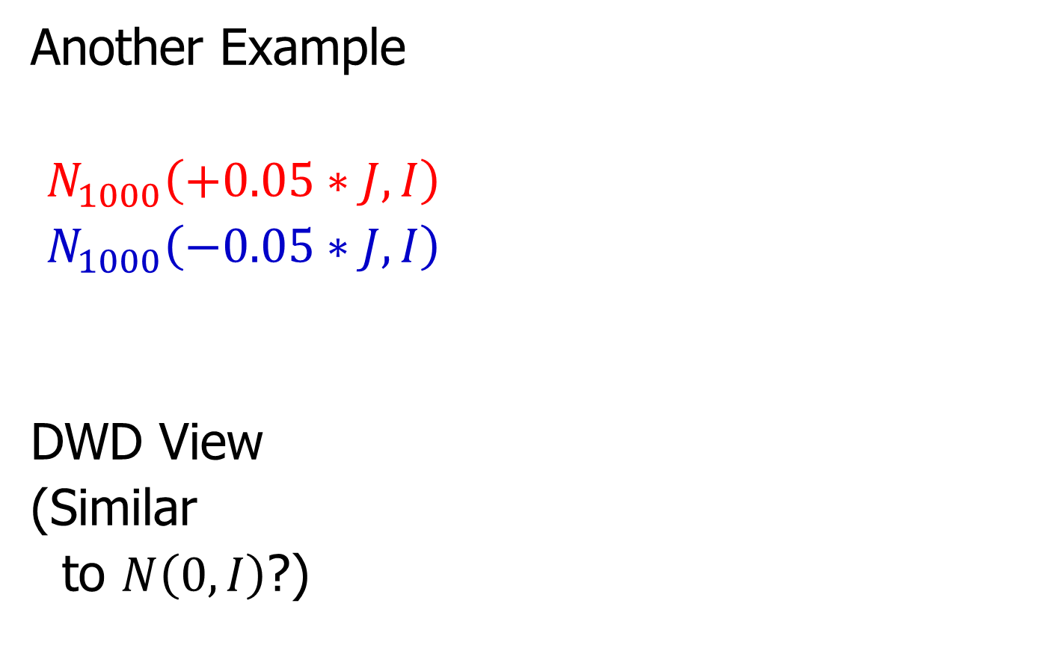
Marginal Distribution Plots
Some Useful Summaries:
Mean, SD, Skewness, Kurtosis
# Unique, # Most Frequent, # 0s
Robust Measures
L-statistics
Entropy
Continuity Measure
$⋮$

Slide 43
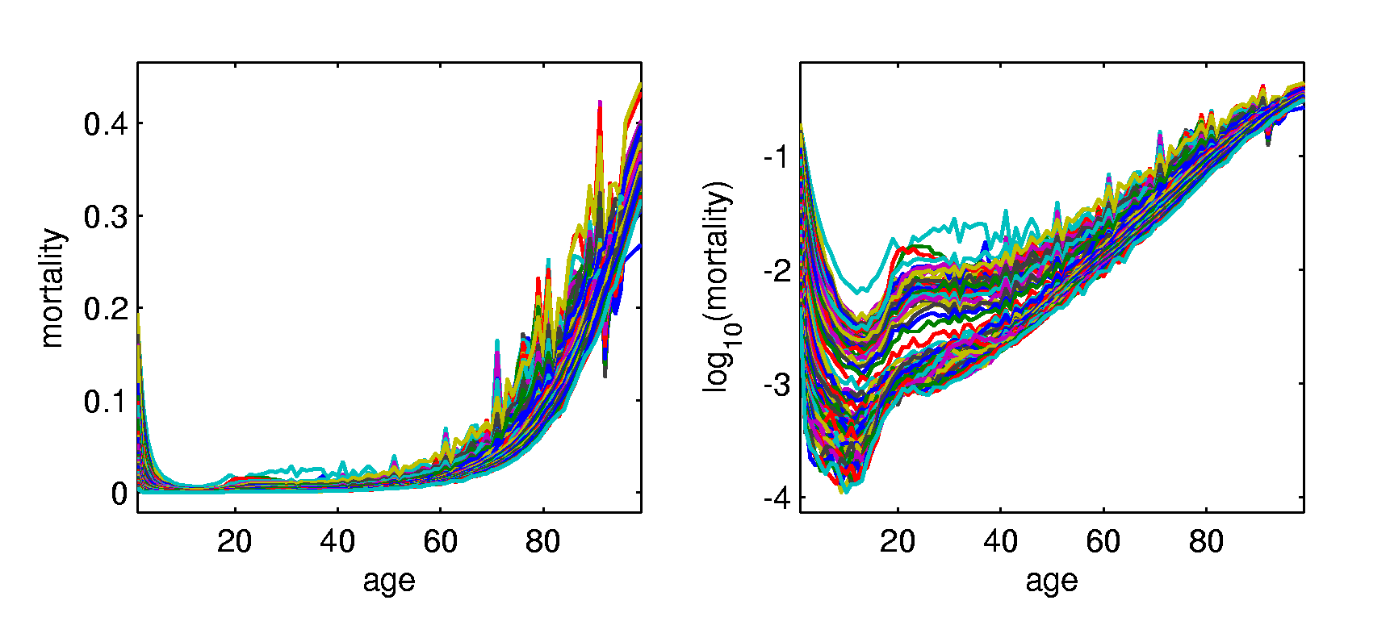
Marginal Distribution Plots
Spanish Male Mortality Data
Recall Value of Log Transform
Now Focus on Marginals
E. g. Just These Values
Or Just These

Slide 44
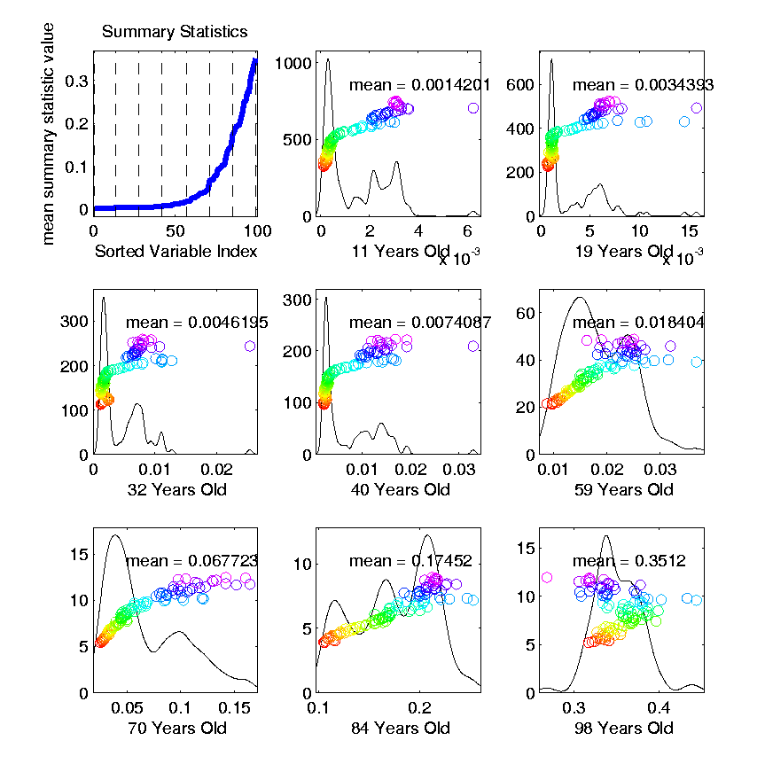
Marginal Distribution Plots
Spanish Male Mortality Data (Raw)
Note Many
Skewed
Marginals
Poor “Use
of Range”

Slide 45
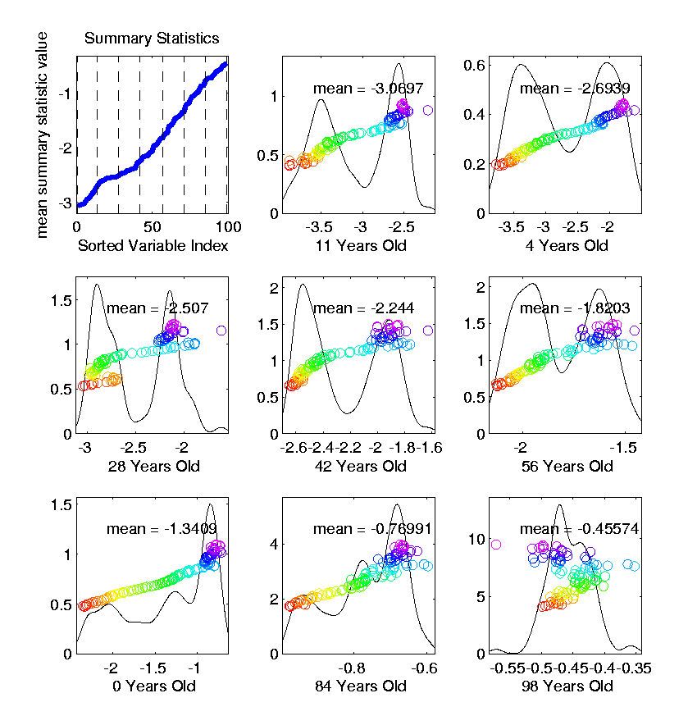
Marginal Distribution Plots
Spanish Male Mortality Data (log₁₀ scale)
Much Less
Skewness
Now Focus
On (Important)
Bimodality
Much Better
“Use of Range”

Slide 46

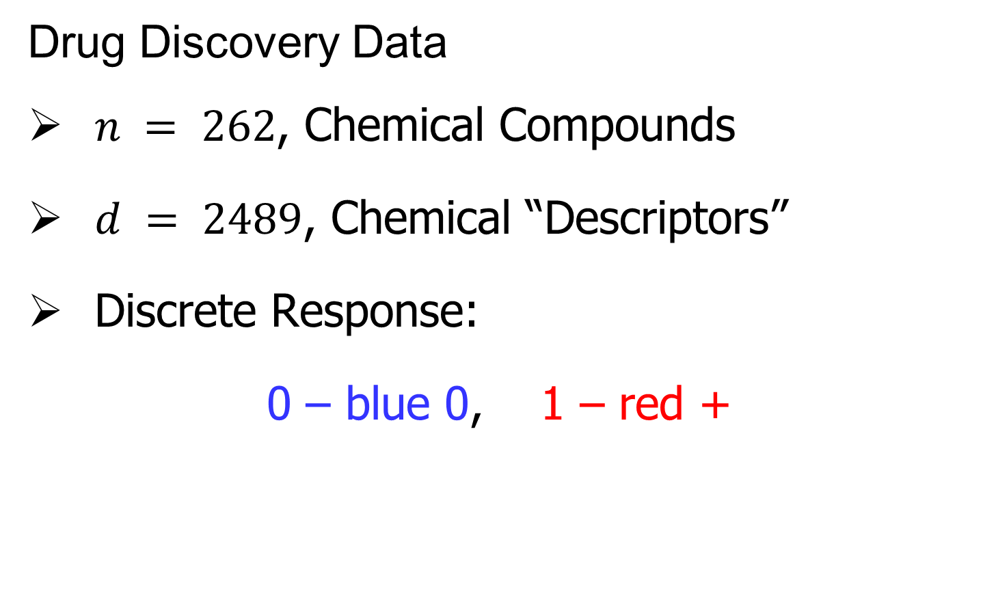
Marg. Dist. Plot Data Example
Drug Discovery Data
$n = 262$, Chemical Compounds
$d = 2489$, Chemical “Descriptors”
Discrete Response:
0 – blue 0, 1 – red +
(Thanks to Alex Tropsha Lab)

Slide 47
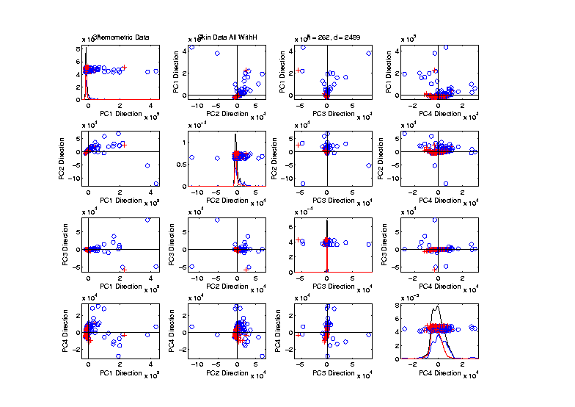
Marg. Dist. Plot Data Example
Drug Discovery – PCA Scatterplot
Dominated
By Few
Large
Compounds
Not Good
Blue - Red
Separation

Slide 48
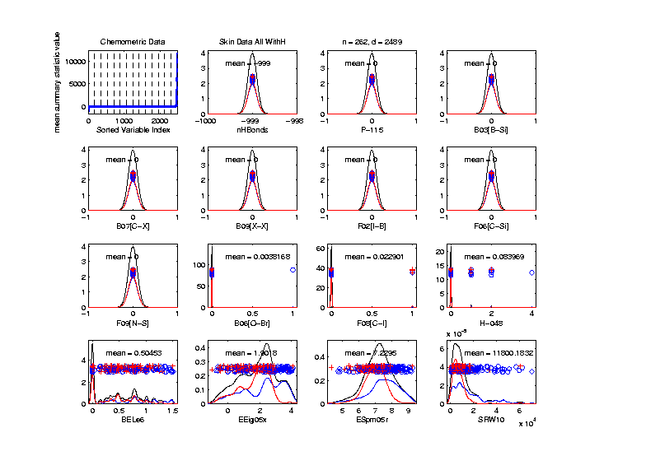
Marg. Dist. Plot Data Example
Drug Discovery – Sort on Means
Very Few
Are Crazy
Big
Will They
Dominate
PCA???

Slide 49
Marg. Dist. Plot Data Example
Drug Discovery – Sort on Means
Note: Many
With No
Variation???

Slide 50
Marg. Dist. Plot Data Example
Drug Discovery – Sort on Means
Suspicious
Value ???

Slide 51
Marg. Dist. Plot Data Example
Drug Discovery – Sort on Means
Note:
Sub-Densities
Highlight
Blue – Red
Differences

Slide 52
Marg. Dist. Plot Data Example
Drug Discovery – Sort on Means
Note:
Descriptor
Names

Slide 53
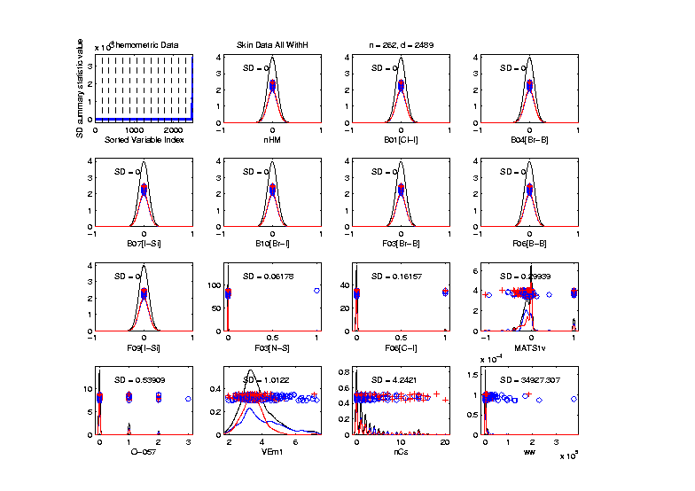
Marg. Dist. Plot Data Example
Drug Discovery – Sort on Standard Deviation
Very Large
Number of
0-Variation
Variables
(No Useful
Info…)

Slide 54
Marg. Dist. Plot Data Example
Drug Discovery – Sort on Means
Investigate Weird -999 Values
Note: Sometimes Such Values Are Used To Code Missing Values
(And Nobody Remembers to Say So)
(Not Too Bad Until Big Values Added In)

Slide 55
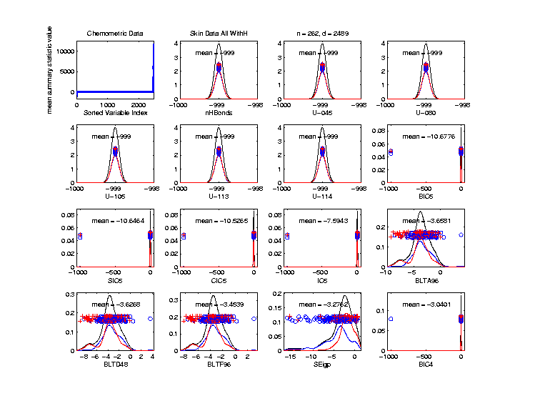
Marg. Dist. Plot Data Example
Drug Discovery – Sort on Means
Investigate Weird -999 Values, Via Mean
Look at
Smallest
Mean Values
(All Dashed
Bars On Left)

Slide 56
Marg. Dist. Plot Data Example
Drug Discovery – Sort on Means
Investigate Weird -999 Values, Via Mean,
Smallest
6 Variables
Are All -999

Slide 57
Marg. Dist. Plot Data Example
Drug Discovery – Sort on Means
Investigate Weird -999 Values, Via Mean,
Smallest
6 Variables
Are All -999
Other Have
Some -999

Slide 58
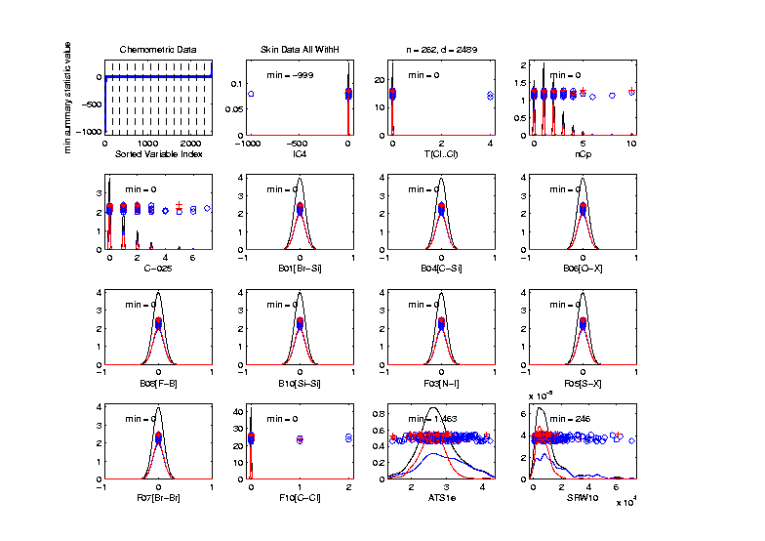
Marg. Dist. Plot Data Example
Drug Discovery
Focus on -999 Values, Using Minimum,
Equally
Spaced
Not Too
Many Such
Variables

Slide 59
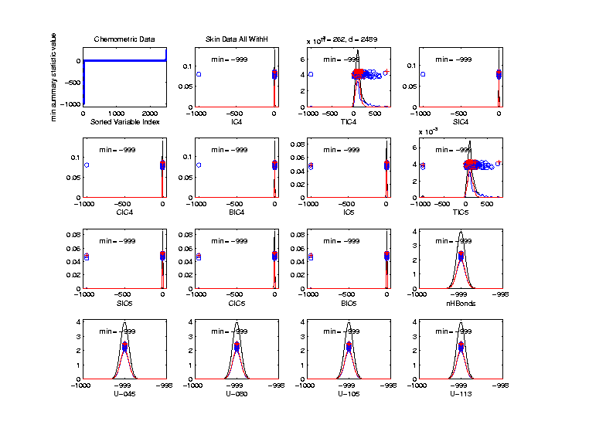
Marg. Dist. Plot Data Example
Drug Discovery
Focus More on -999 Values, Using Minimum,
Smallest 15
(Again All
Dashed
Bars On
Left)

Slide 60
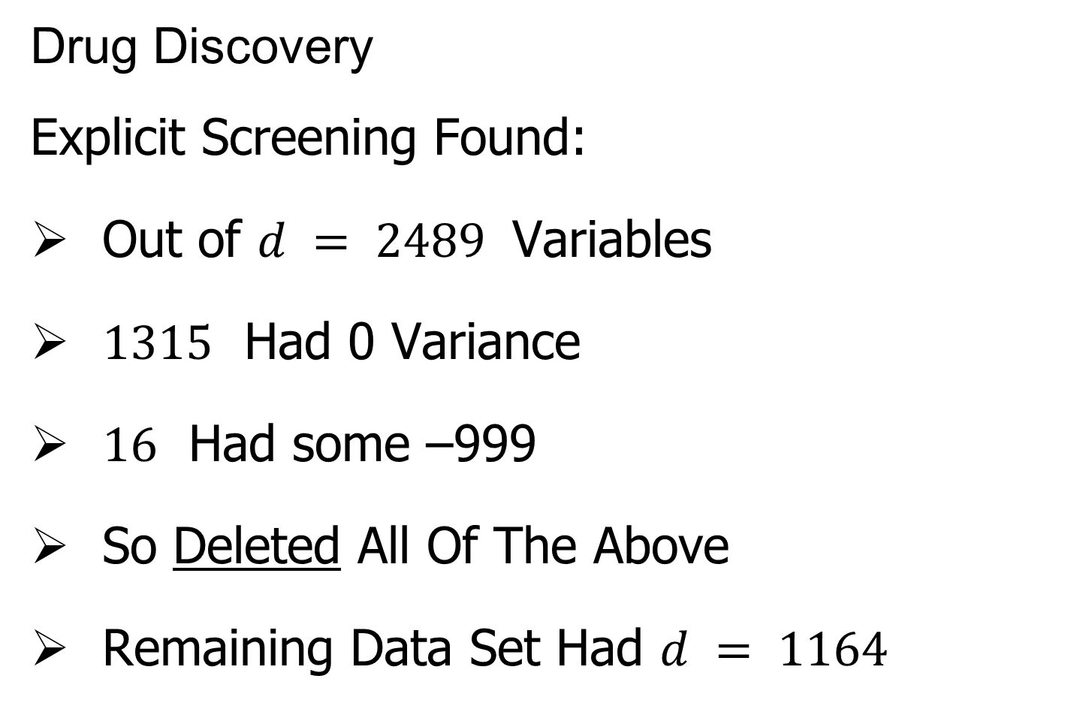
Marg. Dist. Plot Data Example
Drug Discovery
Explicit Screening Found:
Out of $d = 2489$ Variables
$1315$ Had 0 Variance
$16$ Had some –999
So Deleted All Of The Above
Remaining Data Set Had $d = 1164$

Slide 61
Marg. Dist. Plot Data Example
Drug Discovery - Full Data PCA from Above
(Include
To Show
Contrast)

Slide 62

Marg. Dist. Plot Data Example
Drug Discovery - PCA After Variable Deletion
Looks Very
Similar!

Slide 63
Marg. Dist. Plot Data Example
Drug Discovery - PCA After Variable Deletion
Makes Sense
For 0-Var
Variables

Slide 64
Marg. Dist. Plot Data Example
Drug Discovery - PCA After Variable Deletion
-999s Have
No Impact
Since Others
Much Bigger!

Slide 65
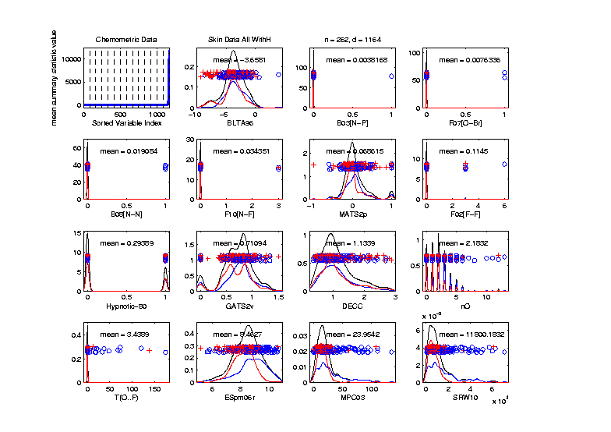
Marg. Dist. Plot Data Example
Drug Discovery - After Variable Deletion
Sort Marginals On Means, Equally Spaced
Still Have
Massive
Variation
In Types

Slide 66
Marg. Dist. Plot Data Example
Drug Discovery - After Variable Deletion
Sort Marginals On Means, Equally Spaced
Still Have
Very Few
That Are
Very Big

Slide 67
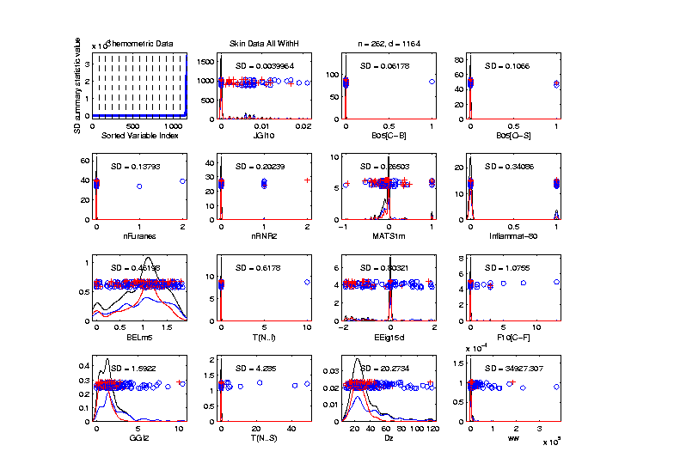
Marg. Dist. Plot Data Example
Drug Discovery - Sort Marginals On SDs,
Equally Spaced To Study Variation
Very Wide
Range
Standardization
May Be Useful

Slide 68
Marg. Dist. Plot Data Example
Drug Discovery - Sort Marginals On SDs,
Equally Spaced To Study Variation
Now See
Some
Very Small
How Many?

Slide 69
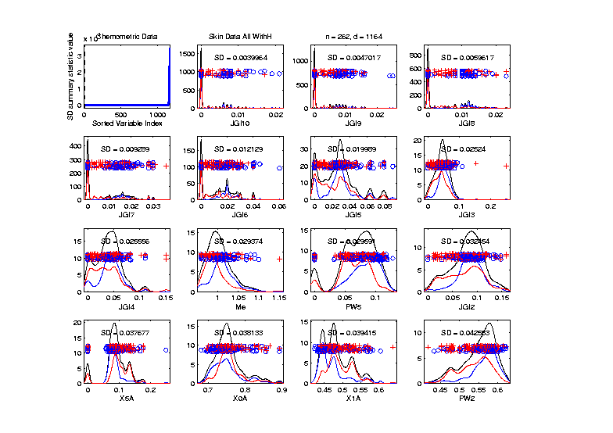
Marg. Dist. Plot Data Example
Drug Discovery - Sort Marginals On SDs,
Smallest
Several
Very Small
Variables
Some Very
Skewed???

Slide 70
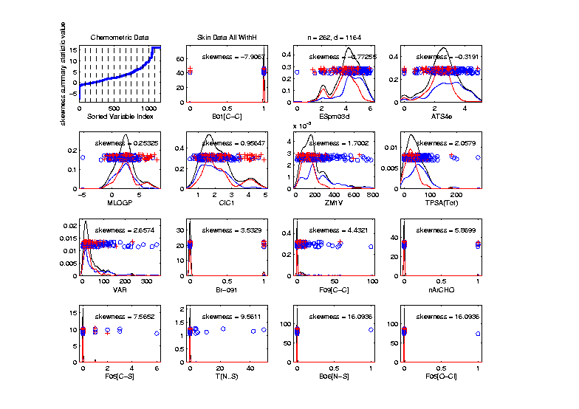
Marg. Dist. Plot Data Example
Drug Discovery - Sort On Skewness
Wide Range
(Consider
Transform-
ation)
0-1s Very
Prominent

Slide 71
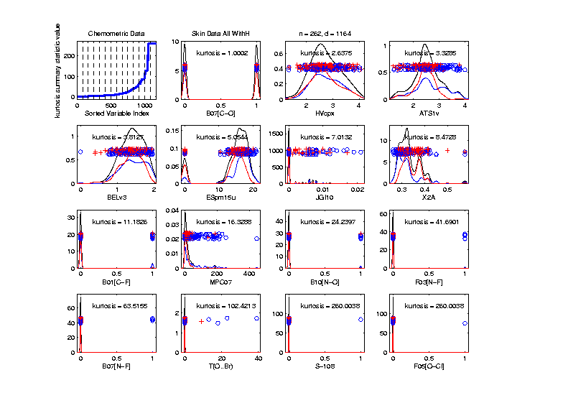
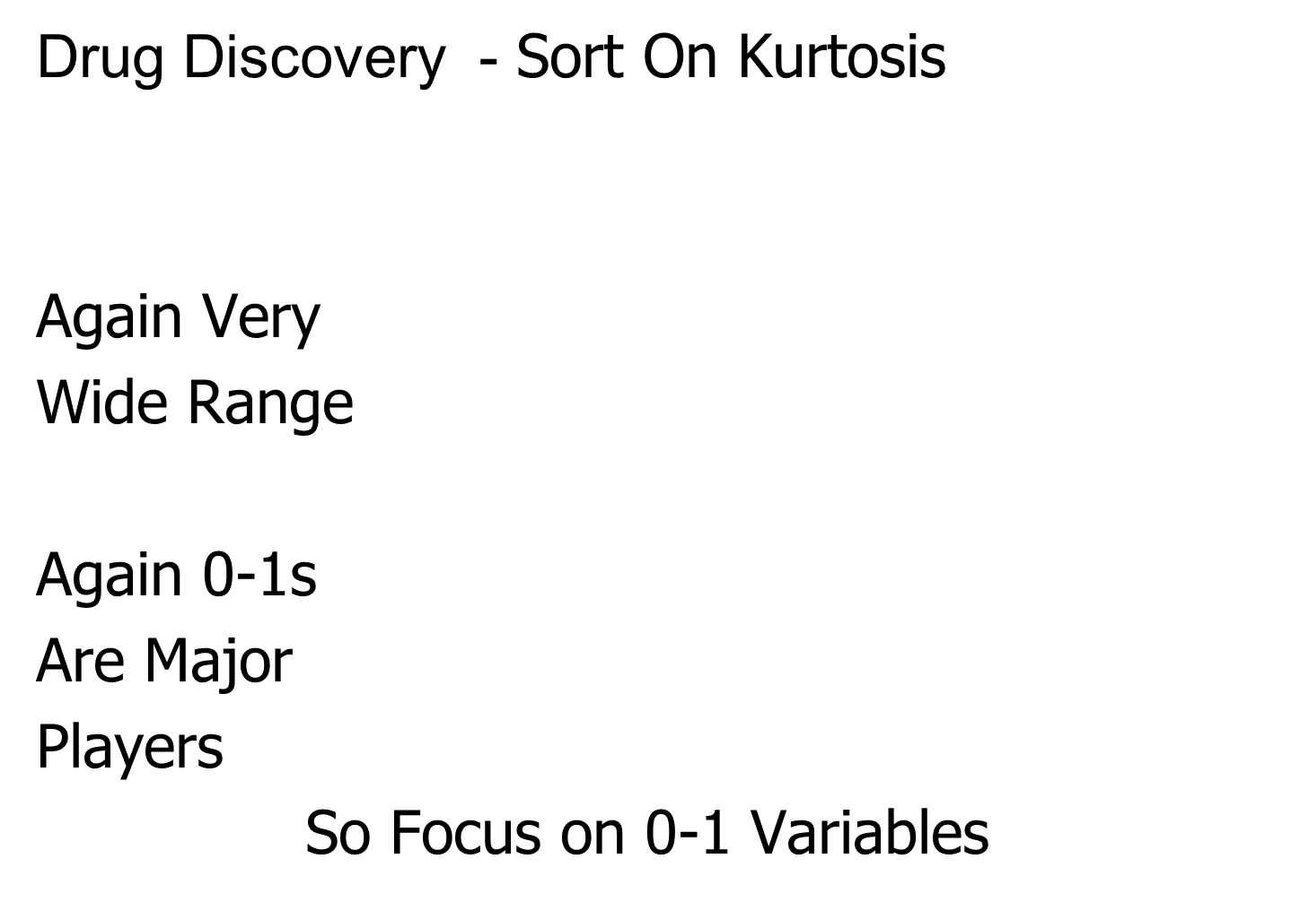
Marg. Dist. Plot Data Example
Drug Discovery - Sort On Kurtosis
Again Very
Wide Range
Again 0-1s
Are Major
Players
So Focus on 0-1 Variables

Slide 72

Marg. Dist. Plot Data Example
Drug Discovery - Sort On Number Unique
Shows
Many
Binary

Slide 73
Marg. Dist. Plot Data Example
Drug Discovery - Sort On Number Unique
Shows
Many
Binary
Few Truly
Continuous

Slide 74

Marg. Dist. Plot Data Example
Drug Discovery - Sort On Number of Most Frequent
Shows Many
Have a Very
Common
Value
(Often 0)

Slide 75

Matlab Software
Recall OODA Software

Slide 76
Marginal Distribution Plots
Matlab Software:
MargDistPlotSM.m
In General Directory

Slide 77

Marg. Dist. Plot Data Example
Explicit Screening Found:
$d = 364$ Binary Variables
Consider Those Only
Do PCA
Try Variable Screening

Slide 78

Marg. Dist. Plot Data Example
Drug Discovery - PCA on Binary Variables
Interesting
Structure?

Slide 79
Marg. Dist. Plot Data Example
Drug Discovery - PCA on Binary Variables
Interesting
Structure?
Clusters?

Slide 80
Marg. Dist. Plot Data Example
Drug Discovery - PCA on Binary Variables
Interesting
Structure?
Clusters?
Stronger
Red vs. Blue

Slide 81
Marg. Dist. Plot Data Example
Drug Discovery - PCA on Binary Variables
Interesting
Structure?
Can See
“Activity
Cliffs”
Maggiora (2006)

Slide 82

Marg. Dist. Plot Data Example
Drug Discovery - Binary Variables, Mean Sort
Shows
Many Are
Mostly 0s

Slide 83

Marg. Dist. Plot Data Example
Common Practice:
Delete “Mostly 0” Variables (little information)
More Careful Look, Borysov et al (2016)
These Can Contain Useful Info
(Especially When So Many)
Not Clear What This Means!
Defined as “$≥95\% 0$s”

Slide 84

Marg. Dist. Plot Data Example
Explicit Screening Found:
$d = 800$Non-Binary Variables
Now Focus on Those Only
Standardize Variables
(Subtract Mean, Divide By SD)
An Approach to Wildly
Different Variable Scaling

Slide 85

Marg. Dist. Plot Data Example
Drug Discovery - PCA on non-Binary Variables
Interesting
Structure?

Slide 86
Marg. Dist. Plot Data Example
Drug Discovery - PCA on non-Binary Variables
Interesting
Structure?
Suggests
Subtypes

Slide 87
Marg. Dist. Plot Data Example
Drug Discovery - PCA on non-Binary Variables
Interesting
Structure?
Suggests
Subtypes
Reds Only?

Slide 88
Marg. Dist. Plot Data Example
Drug Discovery - PCA on non-Binary Variables
Again
Suggestion
Of “Activity
Cliffs”
Maggiora (2006)

Slide 89

Inference for Drug Discovery Data
Raw Data – DWD & Ortho PCs Scatterplot
Some
Blue - Red
Separation
But Dominated
By Few Large
Compounds
Now Do Confimatory Analysis

Slide 90

Inference for Drug Discovery Data
Binary Data – DWD & Ortho PCs Scatterplot
Better
Blue - Red
Separation
And
Visualization

Slide 91

Inference for Drug Discovery Data
Standard’d Non-Binary Data – DWD & OPCA
Better
Blue - Red
Separation
???
Very Useful
Visualization

Slide 92

Inference for Drug Discovery Data
DiProPerm test of Blue vs. Red
Full Raw Data
Z = 10.4
Reasonable
Difference
Note Strange
Permutations

Slide 93

Inference for Drug Discovery Data
DiProPerm test of Blue vs. Red
Delete var = 0 & -999 Variables
Z = 11.6
Slightly
Stronger
No Visual Diff.
Yet DiProPerm
Finds Some
Or Is Difference Within
Simulation Variation???

Slide 94

Inference for Drug Discovery Data
DiProPerm test of Blue vs. Red
Binary Variables Only
Z = 14.6
More Than
Raw Data
Much Nicer
Permutations

Slide 95

Inference for Drug Discovery Data
DiProPerm test of Blue vs. Red
Non-Binary – Standardized
Z = 17.3
Stronger
Reflects
More Info
In Data

Slide 96

Inference for Drug Discovery Data
Introduced
Very Soon
DiProPerm test of Blue vs. Red
Non-Binary – Shifted Log Transforms
Z = 17.9
Slightly
Stronger

Slide 97

Limitation of PCA
Strongly Feels Scaling of Each Variable
Consequence:
May want to standardize each variable
(i.e. subtract $\overline{X}$, divide by $s$)
Also called Whitening
Equivalent Approach:
Base PCA on Correlation Matrix
Called Correlation PCA

Slide 98
Correlation PCA
A related (& better known?) variation of PCA:
Replace cov. matrix with correlation matrix
I.e. do eigen analysis of
Where

Slide 99
Correlation PCA
Why use correlation matrix?
Makes features “unit free”
e.g. Height, Weight, Age, $, …
Are “directions in point cloud” meaningful or useful?
Will unimportant directions dominate?

Slide 100
Correlation PCA
Personal Thoughts on Correlation PCA:
Can be very useful
(especially with noncommensurate units)
Not always, can hide important structure
Illustrate with example

Slide 101

Correlation PCA
Toy Example Contrasting Cov. vs. Corr.

Slide 102
Correlation PCA
Toy Example Contrasting Cov. vs. Corr.
Big Var’n
Part

Slide 103
Correlation PCA
Toy Example Contrasting Cov. vs. Corr.
Big Var’n
Part
Small
Var’n
Part

Slide 104

Correlation PCA
Toy Example Contrasting Cov. vs. Corr.
1st Comp:
Nearly Flat

Slide 105
Correlation PCA
Toy Example Contrasting Cov. vs. Corr.
1st Comp:
Nearly Flat
2nd Comp:
Contrast
Note: Another
Case Where
This View Is
Very Informative

Slide 106
Correlation PCA
Toy Example Contrasting Cov. vs. Corr.
1st Comp:
Nearly Flat
2nd Comp:
Contrast
3rd & 4th:
Very Small

