Slide 1
Participant Presentations
Today:
1: 35 Kevin O’Connor
1:40 Jonghwan Yoo
Notes:
Can Use USB Device
Or Remote Log-In, Set Up Before Class
Or Plug In (HDMI) Your Computer
Check Website
For Schedule

Slide 2
Landmark Based Shape Analysis
Approach: Identify objects that are:
Translations
Rotations
Scalings
of each other
Mathematics: Equivalence Relation
Results in: Equivalence Classes (i.e. Orbits)
Which become the Data Objects

Slide 3
Landmark Based Shape Analysis
Equivalence Classes become Data Objects
Mathematics: Called “Quotient Space”
Intuitive Representation: Manifold
(curved surface)

Slide 4
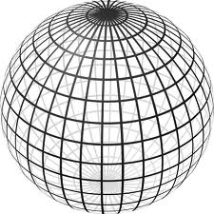

Landmark Based Shape Analysis
Triangle Shape Space: Represent as Sphere
$ℝ^{6}$ → $ℝ^{4}$ → $ℝ^{3}$ →
scaling
(thanks to Wikipedia)

Slide 5
Landmark Based Shape Analysis
Triangle Shape Space: Represent as Sphere
Equilateral
Triangles
Hemispheres
Are
Reflections
Co-Linear
Point Triples

Slide 6
OODA in Image Analysis
Second Generation Problems:
Populations of Images
  Understanding Population Variation
  Discrimination (a.k.a. Classification)
Complex Data Structures (& Spaces)
HDLSS Statistics
High Dimension, Low Sample Size

Slide 7
Shape Representations
Major Approaches for Shape Data Objects:
Landmark Representations
Boundary Representations
Skeletal Representations

Slide 8
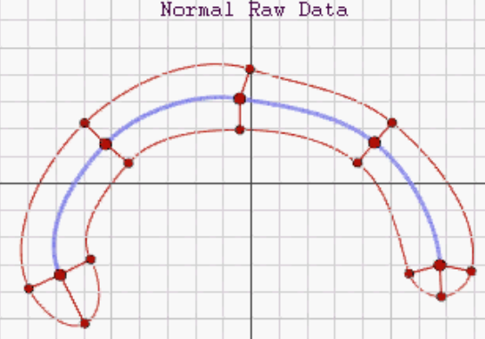
Skeletal Representations
2-d S-Rep Example:
Corpus Callosum
(Yushkevich)
Atoms
Spokes
Implied
Boundary
Notes:
CCMsciznormRaw.avi

Slide 9
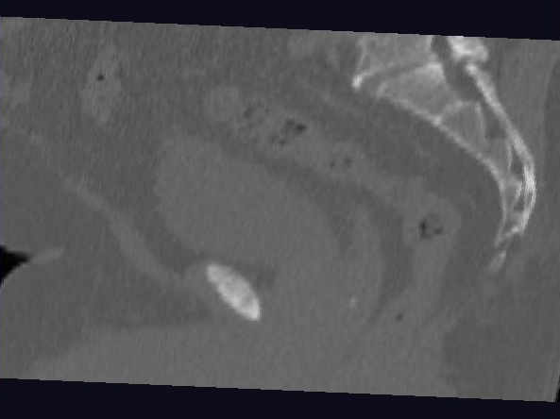
Male Pelvis – Raw Data
One CT Slice
(in 3d image)
Tail Bone
Rectum
Bladder
Prostate

Slide 10
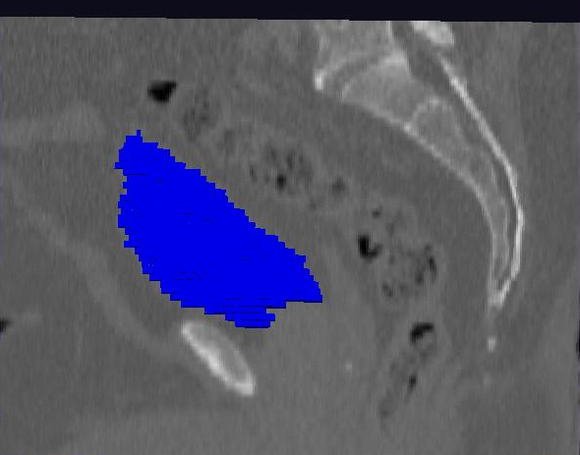
Male Pelvis – Raw Data
Bladder:
manual segmentation
Slice by slice
Reassembled

Slide 11
3-d s-reps
S-rep model fitting
Easy, when starting from binary (blue)
But very expensive (30 – 40 minutes technician’s time)
Want automatic approach
Challenging, because of poor contrast, noise, …
Need to borrow information across training sample
Use Bayes approach: prior & likelihood → posterior
~Conjugate Gaussians, but there are issues:
  Major HLDSS challenges
  Manifold aspect of data
Handle With Variation on PCA
Careful Handling Very Useful

Slide 12
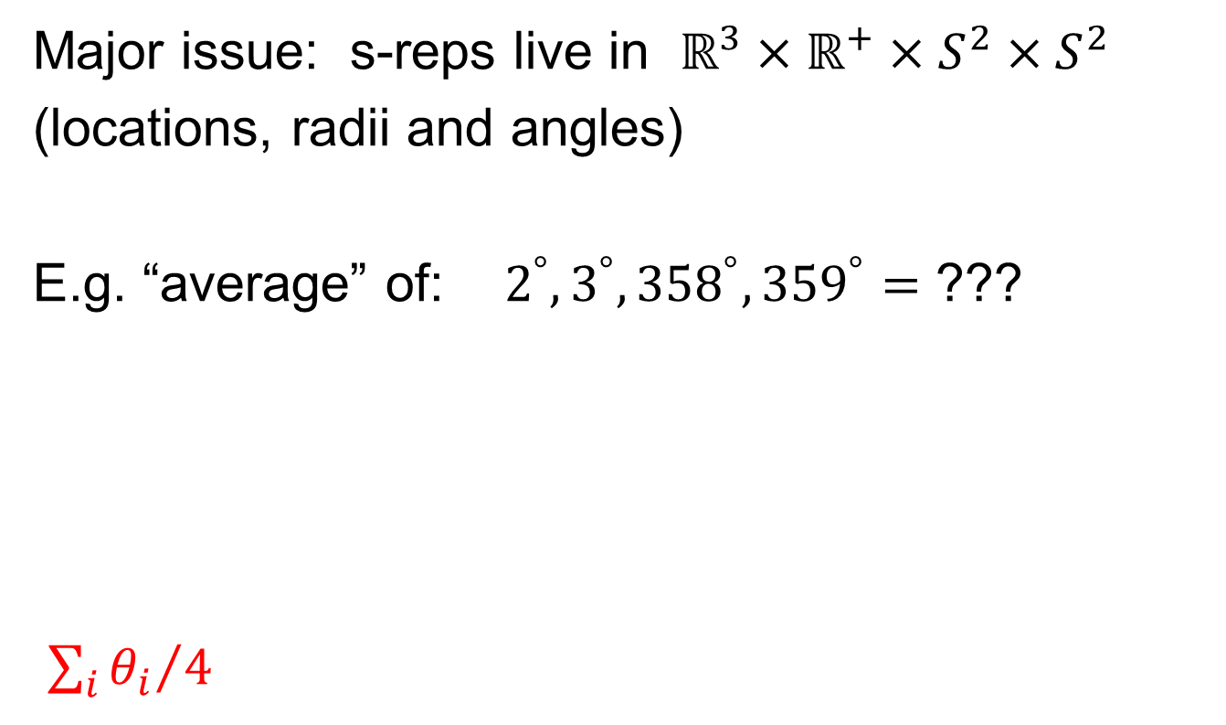
Data Lying On a Manifold
Major issue: s-reps live in $ℝ^{3}×ℝ^{+}×S^{2}×S^{2}$
(locations, radii and angles)
E.g. “average” of: $2^{°}, 3^{°}, {358}^{°}, {359}^{°}=$ ???
${\sum_{i}{θ_{i}}}/4$
x
x
x
x

Slide 13
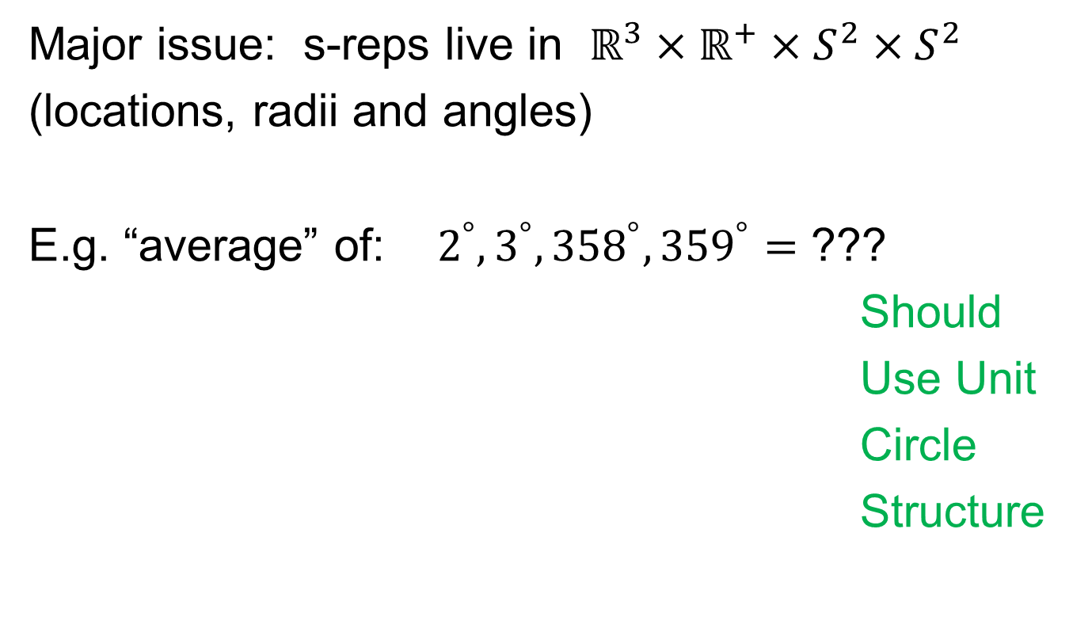
Data Lying On a Manifold
Major issue: s-reps live in $ℝ^{3}×ℝ^{+}×S^{2}×S^{2}$
(locations, radii and angles)
E.g. “average” of: $2^{°}, 3^{°}, {358}^{°}, {359}^{°}=$ ???
Should
Use Unit
Circle
Structure
x
x
x
x

Slide 14
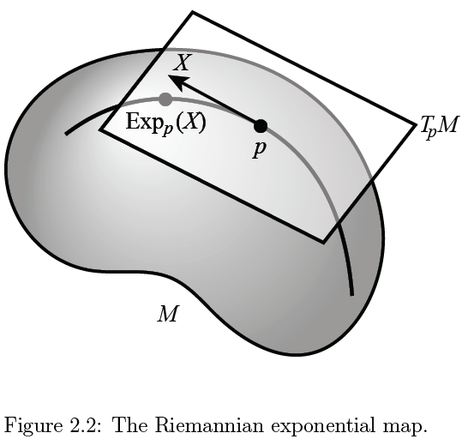

Manifold Feature Spaces
Important Mappings:
Plane → Surface:
$\exp_{p}$
Surface → Plane
$\log_{p}$

Slide 15
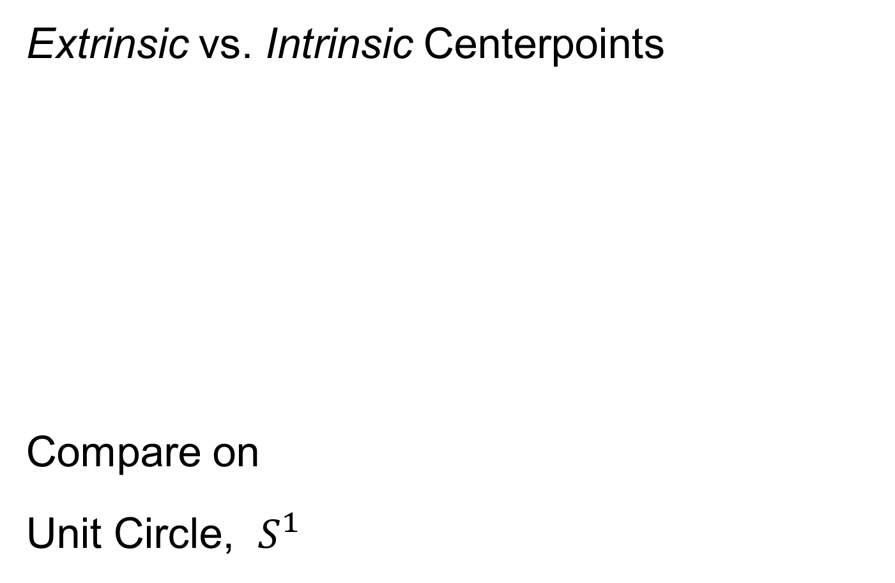
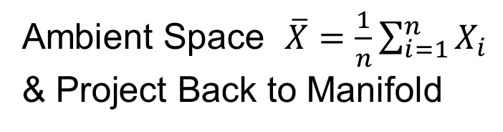
Manifold Feature Spaces
Extrinsic vs. Intrinsic Centerpoints
Compare on
Unit Circle, $S^{1}$
Ambient Space $\overline{X}=\frac{1}{n}\sum_{i=1}^{n}{X_{i}}$
& Project Back to Manifold
E.g. Fréchet Mean

Slide 16
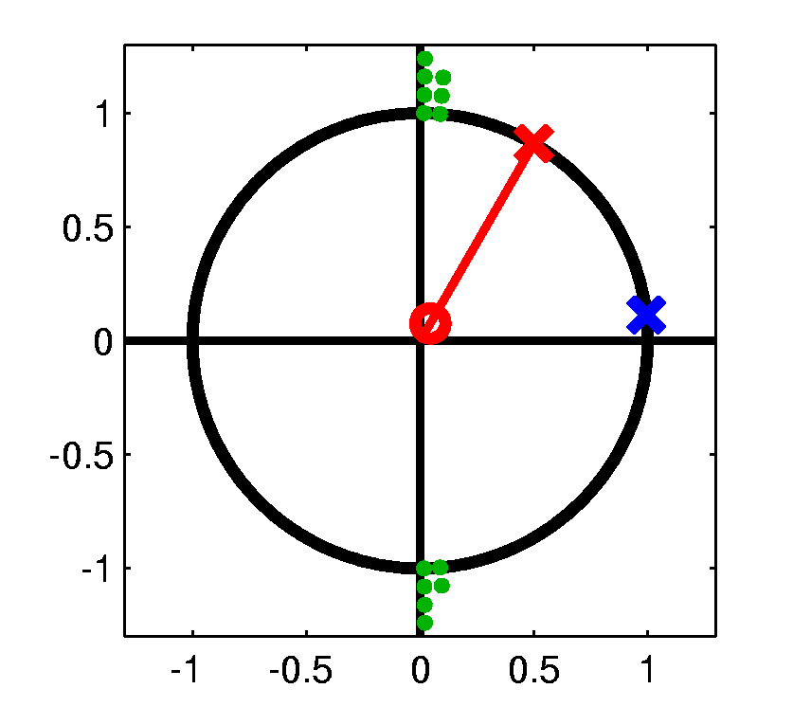
Manifold Feature Spaces
Extrinsic vs. Intrinsic Centerpoints
Which is Better?
Intrinsic “More Like Mean”?
Intrinsic More Stable
Shifting a Green Down
Extrinsic More Stable
Shifting Greens Left

Slide 17
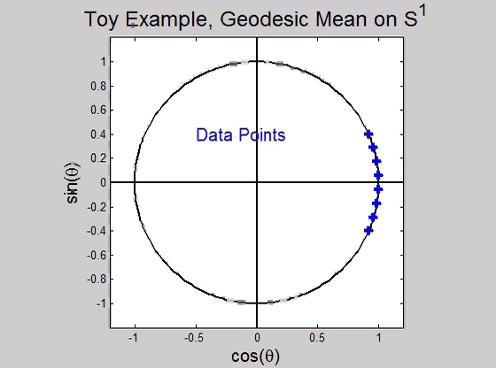
Manifold Feature Spaces
Directional Data Examples of Fréchet Mean:
Not always easily interpretable

Slide 18
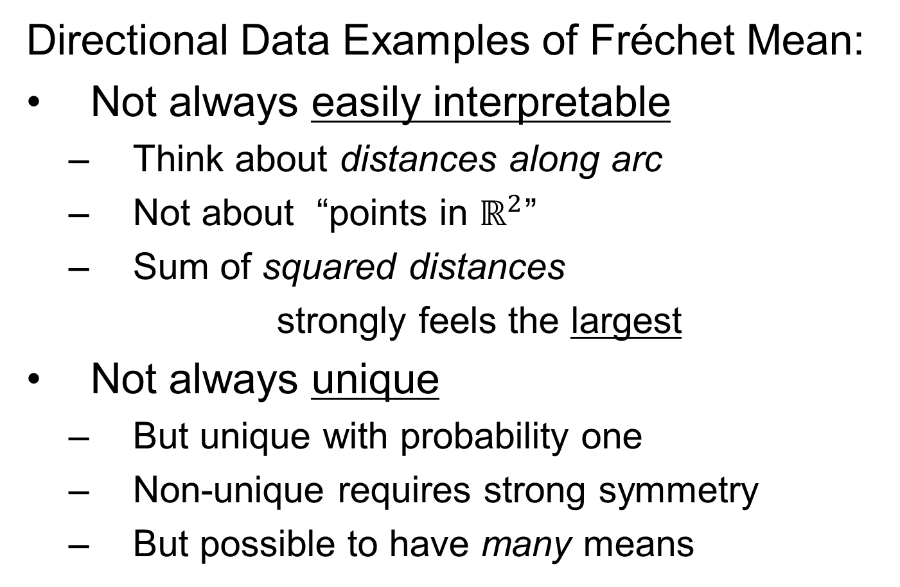
Manifold Feature Spaces
Directional Data Examples of Fréchet Mean:
Not always easily interpretable
  Think about distances along arc
  Not about “points in $ℝ^{2}$”
  Sum of squared distances
  strongly feels the largest
Not always unique
  But unique with probability one
  Non-unique requires strong symmetry
  But possible to have many means

Slide 19
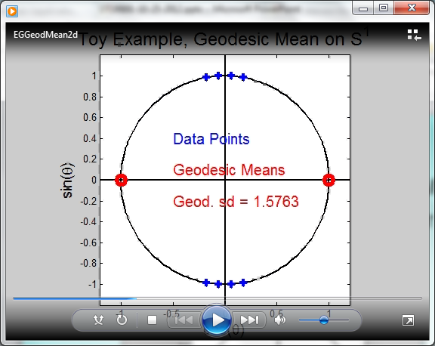
Manifold Feature Spaces
Directional Data Examples of Fréchet Mean:
Not always sensible notion of center

Slide 20
Manifold Feature Spaces
Directional Data Examples of Fréchet Mean:
Not always sensible notion of center
  Sometimes prefer top & bottom?
  At end: farthest points from data
Not continuous Function of Data
  Jump from 1 – 2
  Jump from 2 – 8
All False for Euclidean Mean
But all happen generally for Manifold Data
(for positively curved space)

Slide 21
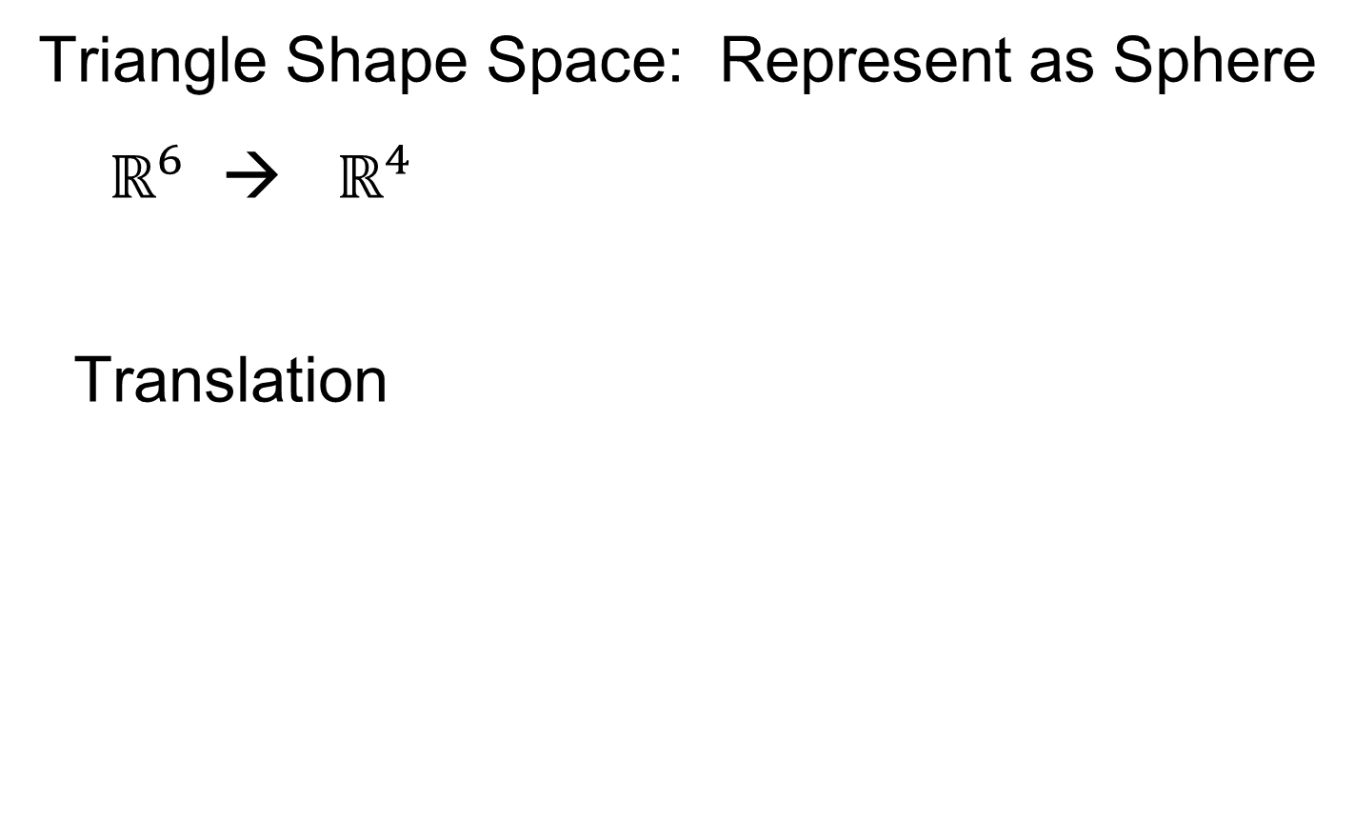
Manifold Feature Spaces
Directional Data Examples of Fréchet Mean:
Also of interest is Fréchet Variance:
$${\hat{σ}}^{2}=\min_{\underline{x}}{\frac{1}{n}\sum_{i=1}^{n}{{d\left({\underline{X}}_{i},\underline{x}\right)}^{2}}}$$
Works like Euclidean sample variance
Note values in movie, reflecting spread in data
Note theoretical version:
$$σ^{2}=\min_{\underline{x}}{E_{\underline{X}}}{d\left(\underline{X},\underline{x}\right)}^{2}$$
Useful for Laws of Large Numbers, etc.

Slide 22
PCA for s-reps
PCA on manifold spaces?
(e.g. on Lie Groups / Symmetric Spaces)
T. Fletcher: Principal Geodesic Analysis
(2004 UNC CS PhD Dissertation)

Slide 23
PCA for s-reps
PCA on manifold spaces?
(e.g. on Lie Groups / Symmetric Spaces)
T. Fletcher: Principal Geodesic Analysis
Idea: replace “linear summary of data”
With “geodesic summary of data”…

Slide 24
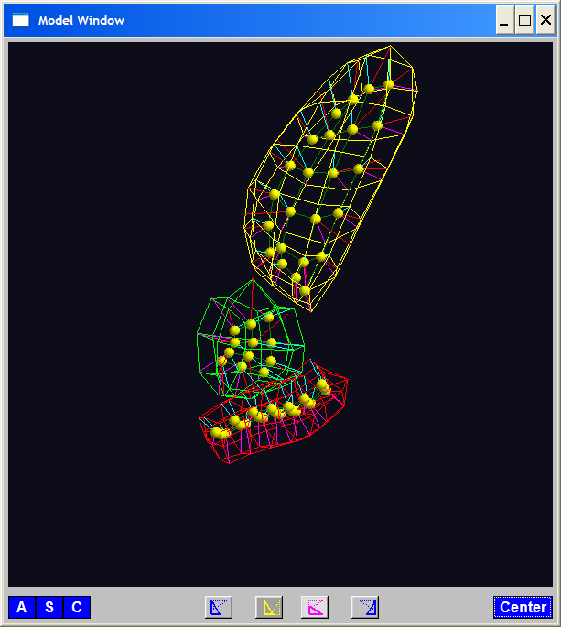
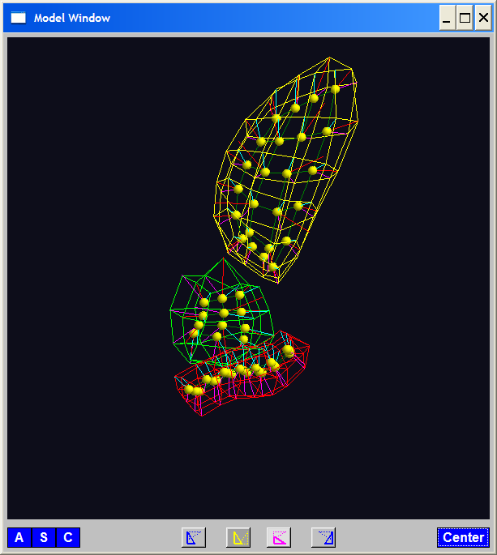
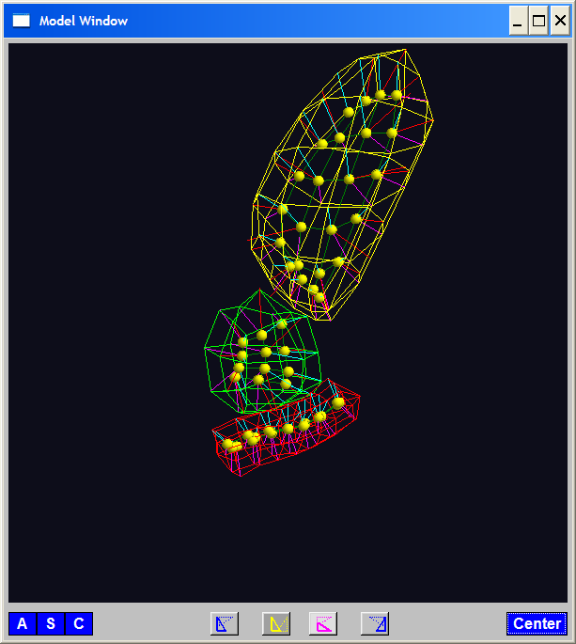
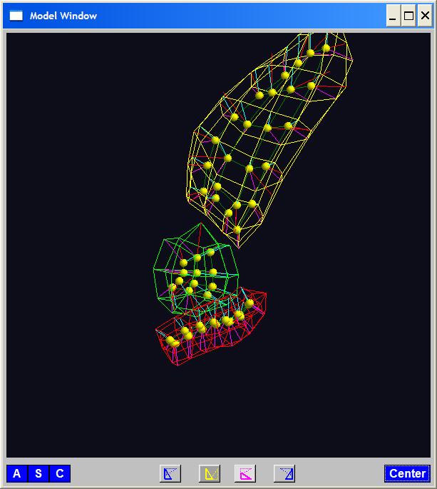
PGA for s-reps, Bladder-Prostate-Rectum
Bladder – Prostate – Rectum, 1 person, 17 days
PG 1 PG 2 PG 3
(analysis by Ja Yeon Jeong)

Slide 25
PGA for s-reps, Bladder-Prostate-Rectum
Bladder – Prostate – Rectum, 1 person, 17 days
PG 1 PG 2 PG 3
(analysis by Ja Yeon Jeong)

Slide 26
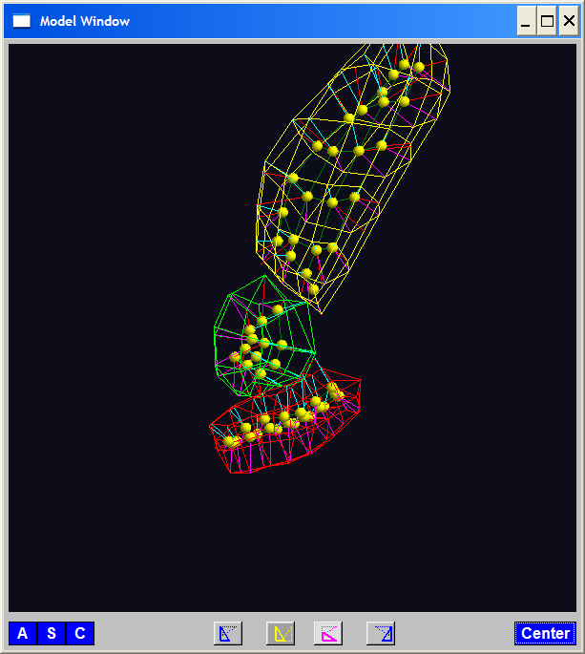
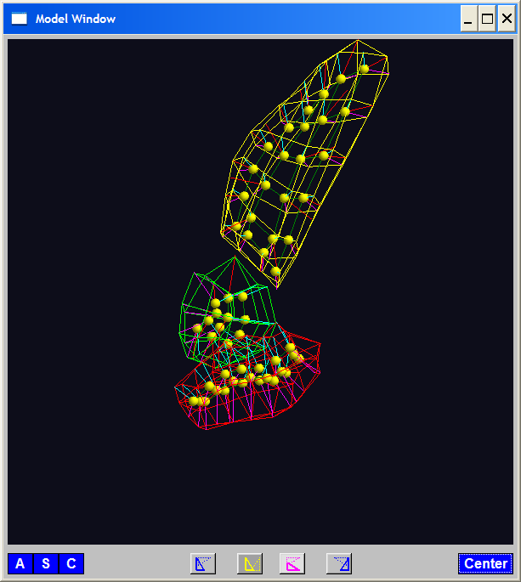
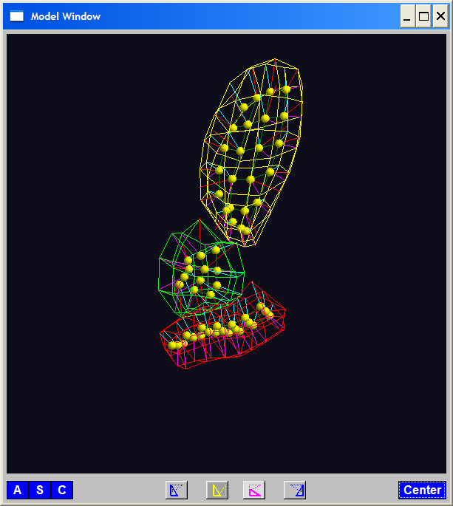
PGA for s-reps, Bladder-Prostate-Rectum
Bladder – Prostate – Rectum, 1 person, 17 days
PG 1 PG 2 PG 3
(analysis by Ja Yeon Jeong)

Slide 27
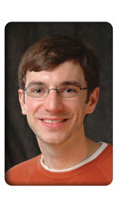
PCA Extensions for Data on Manifolds
Fletcher (Principal Geodesic Anal.)
  Best fit of geodesic to data

Slide 28
PCA Extensions for Data on Manifolds
Fletcher (Principal Geodesic Anal.)
  Best fit of geodesic to data
  Constrained to go through geodesic mean

Slide 29
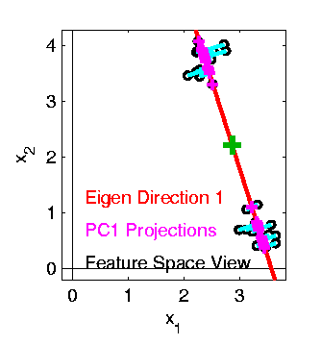

PCA Extensions for Data on Manifolds
Fletcher (Principal Geodesic Anal.)
  Best fit of geodesic to data
  Constrained to go through geodesic mean
Happens
Naturally
in $ℝ^{d}$
Mean
Contained
in Best
Fit Line

Slide 30
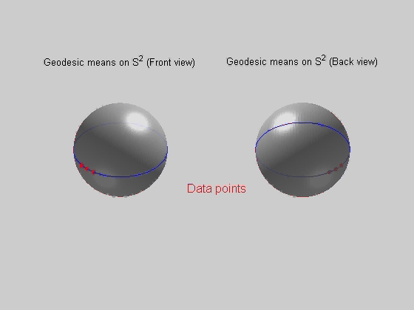
PCA Extensions for Data on Manifolds
Fletcher (Principal Geodesic Anal.)
  Best fit of geodesic to data
  Constrained to go through geodesic mean
Extreme
3 Point
Examples
Equator is Best Fitting Geodesic in All Frames
Yet Fréchet Mean(s) Often Far Away

Slide 31
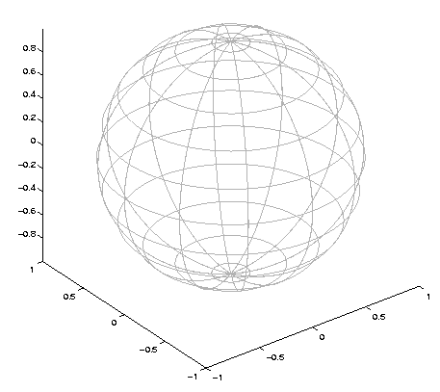

Challenge for Principal Geodesic Analysis
Data
On $S^{2}$
(Sphere)
Scattered
Along
Equator

Slide 32

Challenge for Principal Geodesic Analysis
Data
On $S^{2}$
Geodesic
Mean(s)

Slide 33

Challenge for Principal Geodesic Analysis
Data
On $S^{2}$
Geodesic
Mean(s)
Tangent Plane

Slide 34

Challenge for Principal Geodesic Analysis
Data
On $S^{2}$
Geodesic
Mean(s)
Tangent Plane
Projections

Slide 35
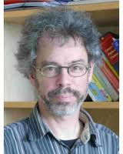
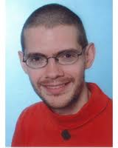

PCA Extensions for Data on Manifolds
Fletcher (Principal Geodesic Anal.)
  Best fit of geodesic to data
  Constrained to go through geodesic mean
Huckemann, Hotz & Munk (Geod. PCA)
Huckemann et al (2011)

Slide 36
PCA Extensions for Data on Manifolds
Fletcher (Principal Geodesic Anal.)
  Best fit of geodesic to data
  Constrained to go through geodesic mean
Huckemann, Hotz & Munk (Geod. PCA)
  Best fit of any geodesic to data

Slide 37
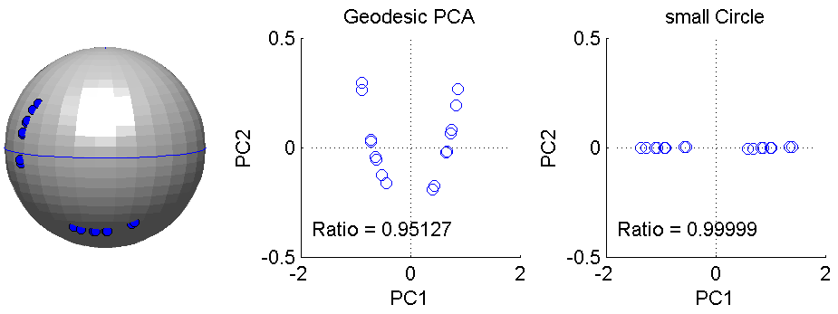
PCA Extensions for Data on Manifolds
Fletcher (Principal Geodesic Anal.)
  Best fit of geodesic to data
  Constrained to go through geodesic mean
Huckemann, Hotz & Munk (Geod. PCA)
  Best fit of any geodesic to data
Counterexample:
Data follows Tropic of Capricorn
Realizations of Spoke in
Blad.-Prost.-Rect. Simulator

Slide 38
PCA Extensions for Data on Manifolds
Fletcher (Principal Geodesic Anal.)
  Best fit of geodesic to data
  Constrained to go through geodesic mean
Huckemann, Hotz & Munk (Geod. PCA)
  Best fit of any geodesic to data
Jung, Foskey & Marron (Princ. Arc Anal.)
Jung et al (2011)

Slide 39
PCA Extensions for Data on Manifolds
Fletcher (Principal Geodesic Anal.)
  Best fit of geodesic to data
  Constrained to go through geodesic mean
Huckemann, Hotz & Munk (Geod. PCA)
  Best fit of any geodesic to data
Jung, Foskey & Marron (Princ. Arc Anal.)
  Best fit of any circle to data
  (motivated by conformal maps)

Slide 40
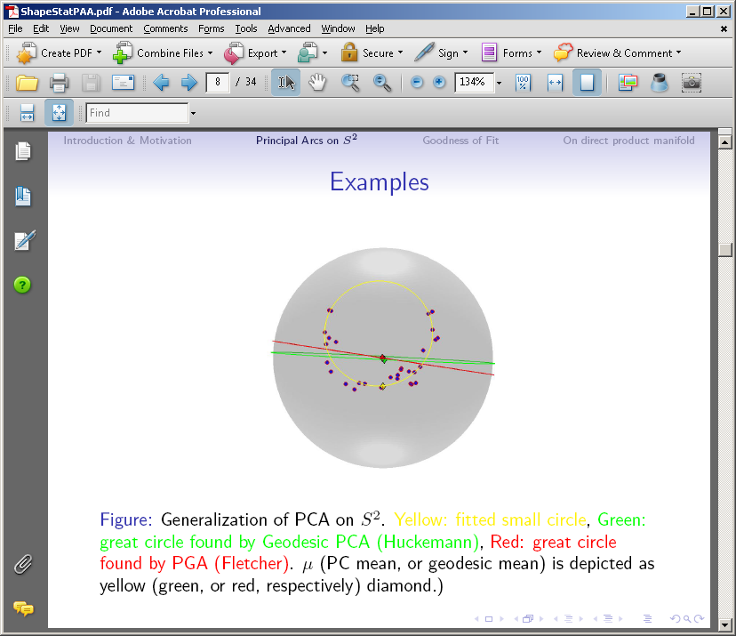
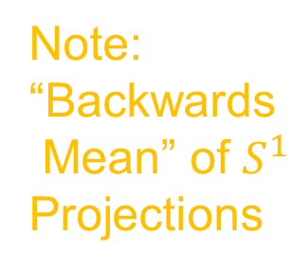
PCA Extensions for Data on Manifolds
Note:
“Backwards
Mean” of $S^{1}$
Projections

Slide 41
Principal Arc Analysis
Jung, Foskey & Marron (2011)
  Best fit of any circle to data
  Can give better fit than geodesics

Slide 42
Principal Arc Analysis
Jung, Foskey & Marron (2011)
  Best fit of any circle to data
  Can give better fit than geodesics
  Observed for simulated s-rep example

Slide 43

Challenge being addressed
Interesting
Results:
Kim (2018)

Slide 44
Landmark Based Shape Analysis
Kendall
Bookstein
Dryden &
Mardia
(recall major monographs)

Slide 45
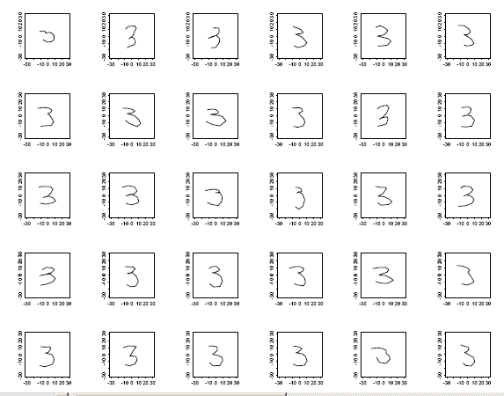
Landmark Based Shape Analysis
Kendall
Bookstein
Dryden &
Mardia
Digit 3 Data
Handwritten (by different people)
Goal: Automatic Recognition
Current Approach: Deep Learning, Early Attempt Was…

Slide 46
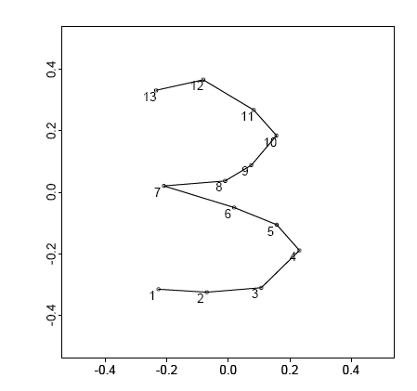
Landmark Based Shape Analysis
Kendall
Bookstein
Dryden &
Mardia
Digit 3 Data
(digitized to 13 landmarks)

Slide 47
Variation on Landmark Based Shape
Typical Viewpoint:
Variation in Shape is Goal
Other Variation+ is Nuisance
Recall Main Idea:
Represent Shapes as Coordinates
“Mod Out” Transl’n, Rotat’n, Scale
Shapes (Equiv. Classes) as Data Objects

Slide 48
Variation on Landmark Based Shape
Typical Viewpoint:
Variation in Shape is Goal
Other Variation+ is Nuisance
Interesting Alternative:
Study Variation in Transformation
Treat Shape as Nuisance

Slide 49
Variation on Landmark Based Shape
Context: Study of Tectonic Plates
Movement of Earth’s Crust (over time)
Take Motions as Data Objects
Interesting Alternative:
Study Variation in Transformation
Treat Shape as Nuisance

Slide 50
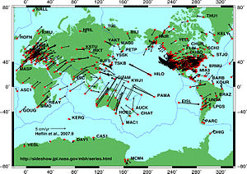
Variation on Landmark Based Shape
Context: Study of Tectonic Plates
Movement of Earth’s Crust (over time)
Take Motions as Data Objects
Chang (1988)
Royer & Chang (1991)
Thanks to Wikipedia

Slide 51
Landmark Based Shape Analysis
Kendall
Bookstein
Dryden &
Mardia
Digit 3 Data

Slide 52
Landmark Based Shape Analysis
Key Step: mod out
Translation
Scaling
Rotation
Result:
Data Objects ←→
←→ points on Manifold ( ~ S^{2k-4})

Slide 53
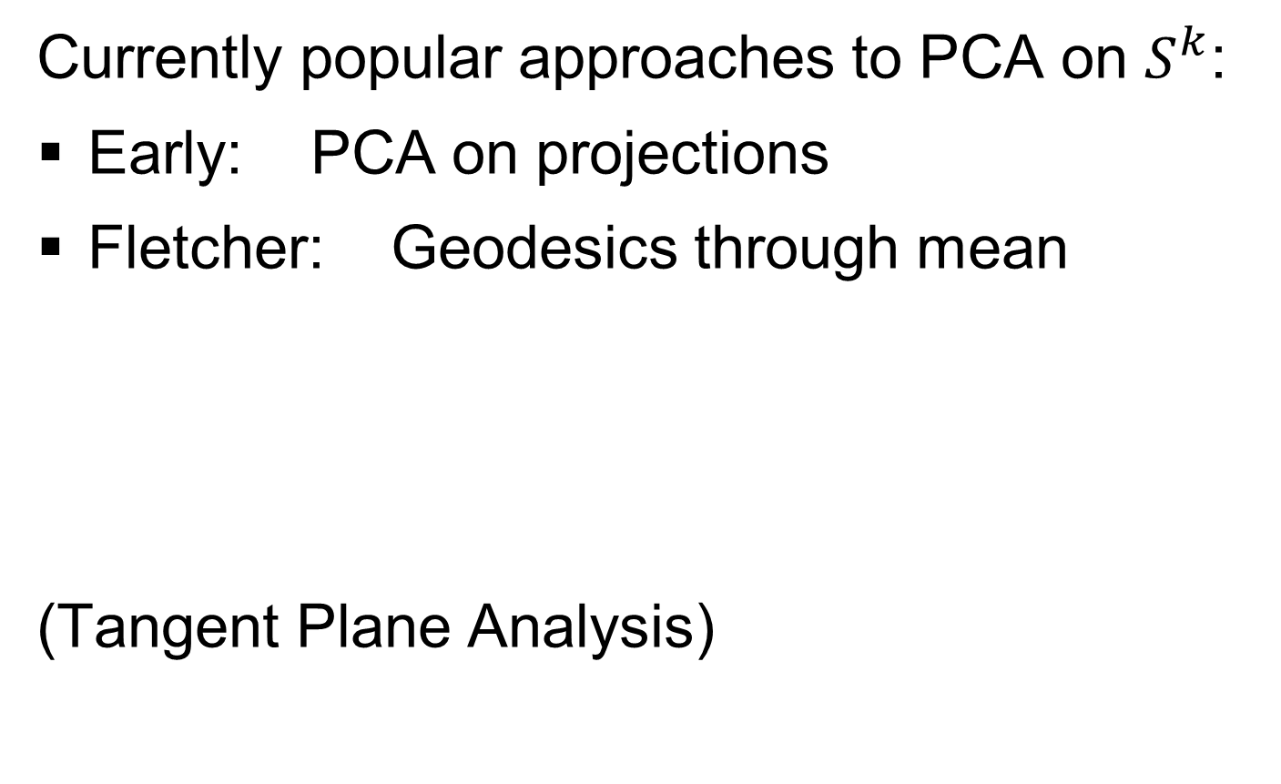
Landmark Based Shape Analysis
Currently popular approaches to PCA on $S^{k}$:
Early: PCA on projections
Fletcher: Geodesics through mean
(Tangent Plane Analysis)

Slide 54
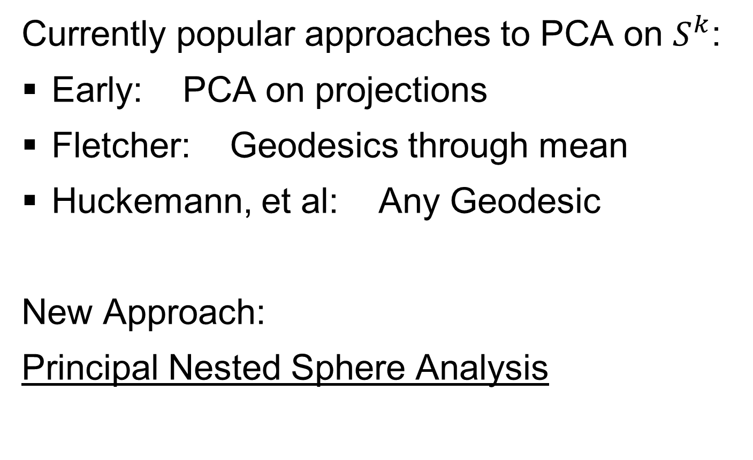
Landmark Based Shape Analysis
Currently popular approaches to PCA on $S^{k}$:
Early: PCA on projections
Fletcher: Geodesics through mean
Huckemann, et al: Any Geodesic
New Approach:
Principal Nested Sphere Analysis

Slide 55

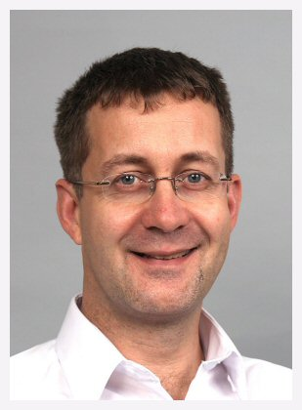

Principal Nested Spheres
Main Goal:
Extend Principal Arc Analysis ($S^{2}$ to $S^{k}$)
Jung, Dryden & Marron (2012)

Slide 56

Principal Nested Spheres
Main Goal:
Extend Principal Arc Analysis ($S^{2}$ to $S^{k}$)

Slide 57


Principal Nested Spheres
Jung et al (2012)
Context:
$d$ – dim
Sphere
(in $ℝ^{d+1}$)
$$S^{d}$$

Slide 58

Principal Nested Spheres
For data $∈S^{d}$
Consider an
$S^{d−1}$ for a
“Rank $d−1$
Approxi’n”
$$S^{d}$$
Determined by a Slicing Plane

Slide 59

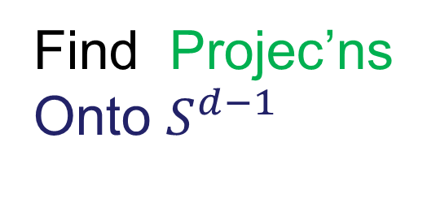
Principal Nested Spheres
For data $∈S^{d}$
Find Projec’ns
Onto $S^{d−1}$
$$S^{d}$$
Along Surface (Geodesic Distance)

Slide 60

Principal Nested Spheres
Move plane
To Minimize
$\sum_{i}{{resid}_{i}^{2}}$
Keep signed
${resid}_{i}$ as
PNS-$d$ scores
$$S^{d}$$
And Projections as Rank $d−1$ Approximations

Slide 61


Principal Nested Spheres
Now consider
Projections
As Data in
Subsphere
$S^{d−1}$
Repeat for
PNS $d−1$
Scores
$$S^{d−1}$$

Slide 62
Digit 3 data: Principal variations of the shape
Recall Data
From Above

Slide 63




Digit 3 data: Principal variations of the shape
Princ. geodesics by PNS
Principal arcs by PNS

Slide 64

Composite Principal Nested Spheres
Idea: Use Principal Nested Spheres
Over Large Products of $S^{2}$ and $ℝ^{d}$
Vectors whose entries are
Angles on sphere and reals

Slide 65

Composite Principal Nested Spheres
Idea: Use Principal Nested Spheres
Over Large Products of $S^{2}$ and $ℝ^{d}$
Motivation:
s-reps

Slide 66

Composite Principal Nested Spheres
Idea: Use Principal Nested Spheres
Over Large Products of $S^{2}$ and $ℝ^{d}$
Approach: Use Principal Nested Spheres
to Linearize $S^{2}$ Components
Needs 2 Modes to
Capture Variation

Slide 67
Composite Principal Nested Spheres
Idea: Use Principal Nested Spheres
Over Large Products of $S^{2}$ and $ℝ^{d}$
Approach: Use Principal Nested Spheres
to Linearize $S^{2}$ Components
PNS Explains All
With One Mode

Slide 68

Composite Principal Nested Spheres
Idea: Use Principal Nested Spheres
Over Large Products of $S^{2}$ and $ℝ^{d}$
Approach: Use Principal Nested Spheres
to Linearize $S^{2}$ Components
Then Concatenate All & Use PCA

Slide 69
Composite Principal Nested Spheres
Impact on Segmentation:
PGA Segmentation: used ~20 comp’s
CPNS Segmentation: only need ~13
Resulted in visually better fits to data

Slide 70

Extension to s-rep Space
Challenge:
Vectors of $S^{2}$ Directions as Data Objects
$$\left(\begin{matrix}\left(θ_{1},φ_{1}\right) \\ ⋮ \\ \left(θ_{d},φ_{d}\right)\end{matrix}\right)∈{\left(S^{2}\right)}^{d}$$
Polysphere Type Space

Slide 71




Extension to s-rep Space
Challenge: $S^{2}×S^{2}$ Polysphere Space
Generator Of
Toy Example
Wrap $x$ around
1st Copy of $S^{2}$
Wrap $y$ around
2nd Copy of $S^{2}$

Slide 72


Extension to s-rep Space
Challenge: $S^{2}×S^{2}$ Polysphere Space
Note Colors
From $x$ In
Generator

Slide 73


Extension to s-rep Space
Challenge: $S^{2}×S^{2}$ Polysphere Space
Note Colors
From $y$ In
Generator

Slide 74

Extension to s-rep Space
Challenge: $S^{2}×S^{2}$ Polysphere Space
Desired Answer
From a PCA

Slide 75


Extension to s-rep Space
Challenge: $S^{2}×S^{2}$ Polysphere Space
CPNS:
Gets 1-d Comps,
But Wrong
Dependence
(Strong Distortion)
Thanks to Sungkyu Jung

Slide 76

Polysphere PCA
Deeper New Methodology: PPCA
For Polysphere Spaces (e.g. s-reps)
Find Approximating (Higher $d$) Sphere
Then do PNS (Better Signal Compression)

Slide 77

Polysphere PCA
Deeper New Methodology: PPCA
For Polysphere Spaces (e.g. s-reps)
Reference: Elzner et al (2015)
Benjamin Eltzner Stephan Huckemann Sungkyu Jung

Slide 78

Polysphere PCA-type Analysis
Deeper New Methodology: PPCA
For Polysphere
~Toy Example
Pretty Good But
Still Some
Distortion
Thanks to B. Eltzner

Slide 79
Principal Nested Spheres
Main Goal:
Extend Principal Arc Analysis ($S^{2}$ to $S^{k}$)
Jung et al (2012)
Important Landmark:
This Motivated Backwards PCA

Slide 80
Participant Presentations
Kevin O’Connor
Distributions as Data Objects
Jonghwan Yoo
JIVE on Methylation and Images

