Slide 1
PCA for s-reps
PCA on manifold spaces?
(e.g. on Lie Groups / Symmetric Spaces)
T. Fletcher: Principal Geodesic Analysis
Idea: replace “linear summary of data”
With “geodesic summary of data”…

Slide 2
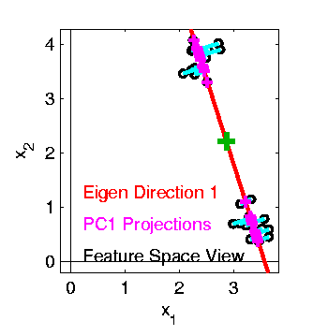

PCA Extensions for Data on Manifolds
Fletcher (Principal Geodesic Anal.)
Best fit of geodesic to data
Constrained to go through geodesic mean
Happens
Naturally
in $ℝ^{d}$
Mean
Contained
in Best
Fit Line

Slide 3
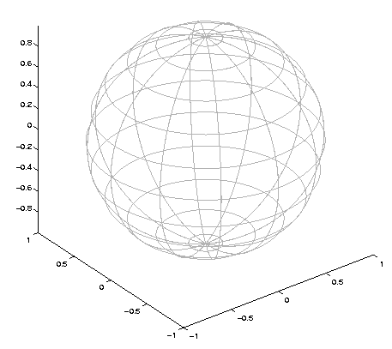

Challenge for Principal Geodesic Analysis
Data
On $S^{2}$
Geodesic
Mean(s)
Tangent Plane
Projections

Slide 4
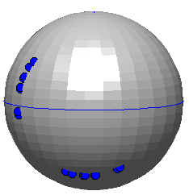
PCA Extensions for Data on Manifolds
Fletcher (Principal Geodesic Anal.)
Best fit of geodesic to data
Constrained to go through geodesic mean
Huckemann, Hotz & Munk (Geod. PCA)
Best fit of any geodesic to data
Counterexample:
Data follows Tropic of Capricorn
Realizations of Spoke in
Blad.-Prost.-Rect. Simulator

Slide 5
PCA Extensions for Data on Manifolds
Fletcher (Principal Geodesic Anal.)
Best fit of geodesic to data
Constrained to go through geodesic mean
Huckemann, Hotz & Munk (Geod. PCA)
Best fit of any geodesic to data
Jung, Foskey & Marron (Princ. Arc Anal.)
Best fit of any circle to data
(motivated by conformal maps)

Slide 6
Variation on Landmark Based Shape
Context: Study of Tectonic Plates
Movement of Earth’s Crust (over time)
Take Motions as Data Objects
Interesting Alternative:
Study Variation in Transformation
Treat Shape as Nuisance

Slide 7
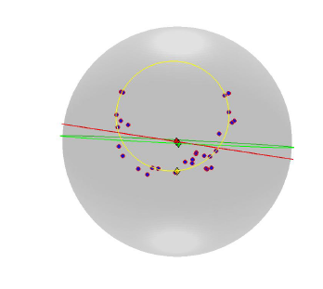

Principal Nested Spheres
Main Goal:
Extend Principal Arc Analysis ($S^{2}$ to $S^{k}$)

Slide 8


Principal Nested Spheres
Move plane
To Minimize
$\sum_{i}{{resid}_{i}^{2}}$
Keep signed
${resid}_{i}$ as
PNS-$d$ scores
$$S^{d}$$
And Projections as Rank $d−1$ Approximations

Slide 9
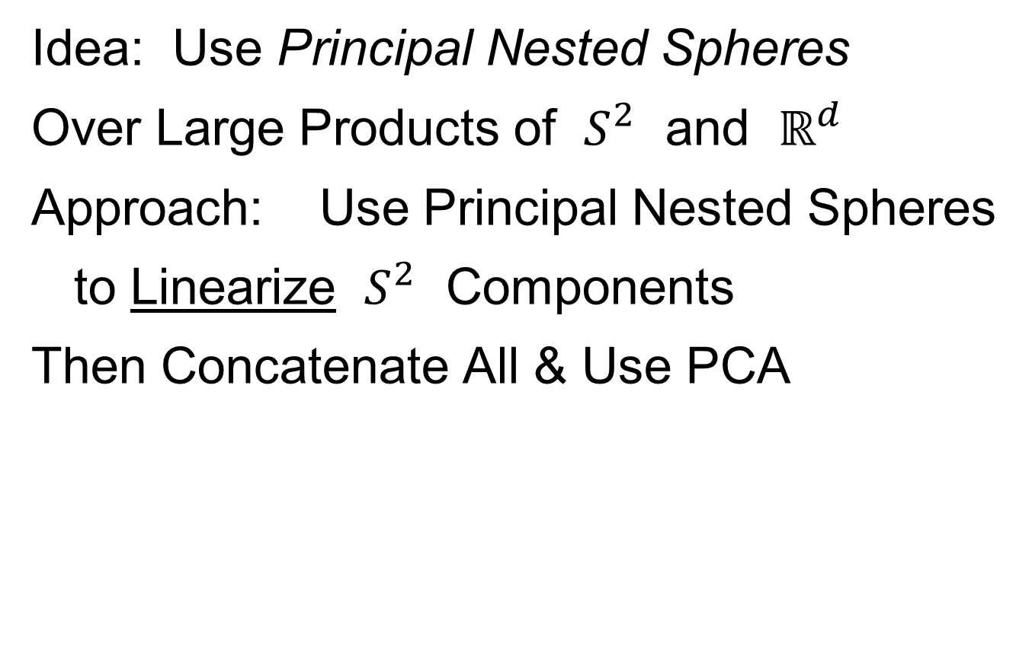
Composite Principal Nested Spheres
Idea: Use Principal Nested Spheres
Over Large Products of $S^{2}$ and $ℝ^{d}$
Approach: Use Principal Nested Spheres
to Linearize $S^{2}$ Components
Then Concatenate All & Use PCA

Slide 10
Composite Principal Nested Spheres
Impact on Segmentation:
PGA Segmentation: used ~20 comp’s
CPNS Segmentation: only need ~13
Resulted in visually better fits to data

Slide 11
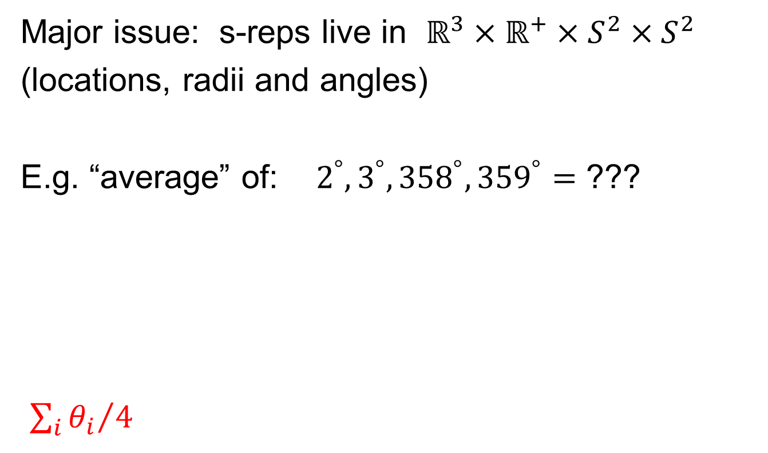
Principal Nested Spheres
Main Goal:
Extend Principal Arc Analysis ($S^{2}$ to $S^{k}$)
Jung et al (2012)
Important Landmark:
This Motivated Backwards PCA

Slide 12
Backwards PCA
Key Idea:
Replace usual forwards view of PCA
With a backwards approach to PCA

Slide 13
Terminology
Multiple linear regression:
Stepwise approaches:
Forwards: Start small, iteratively add variables to model
Backwards: Start with all, iteratively remove variables from model

Slide 14
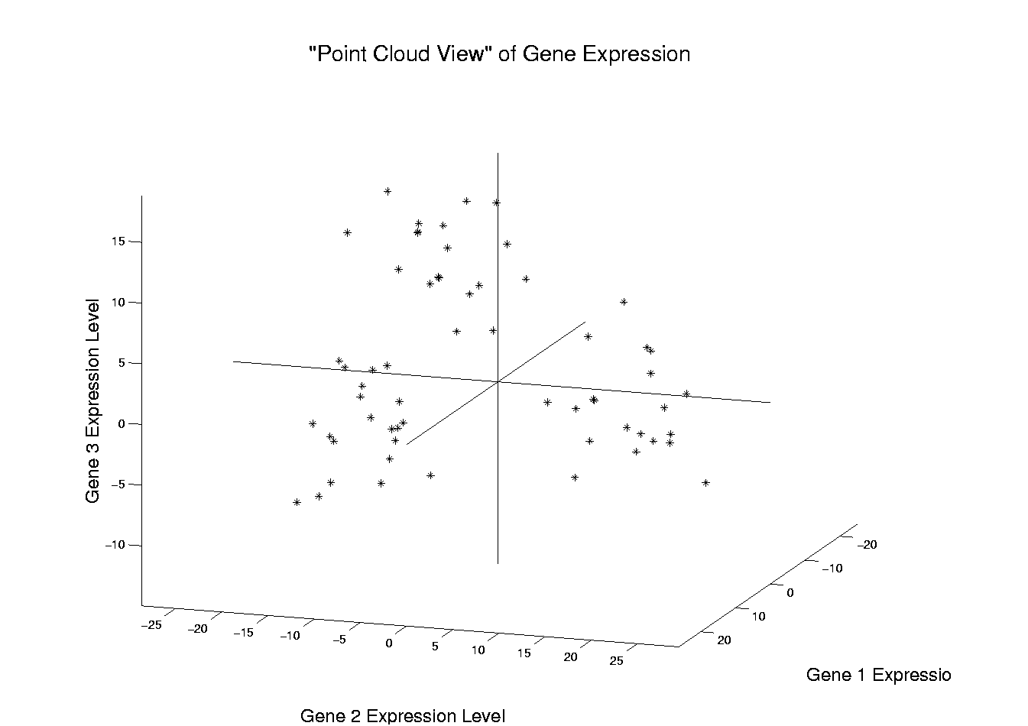
Illust’n of PCA View: Recall Raw Data
Notes:
EgView1p1RawData.ps

Slide 15
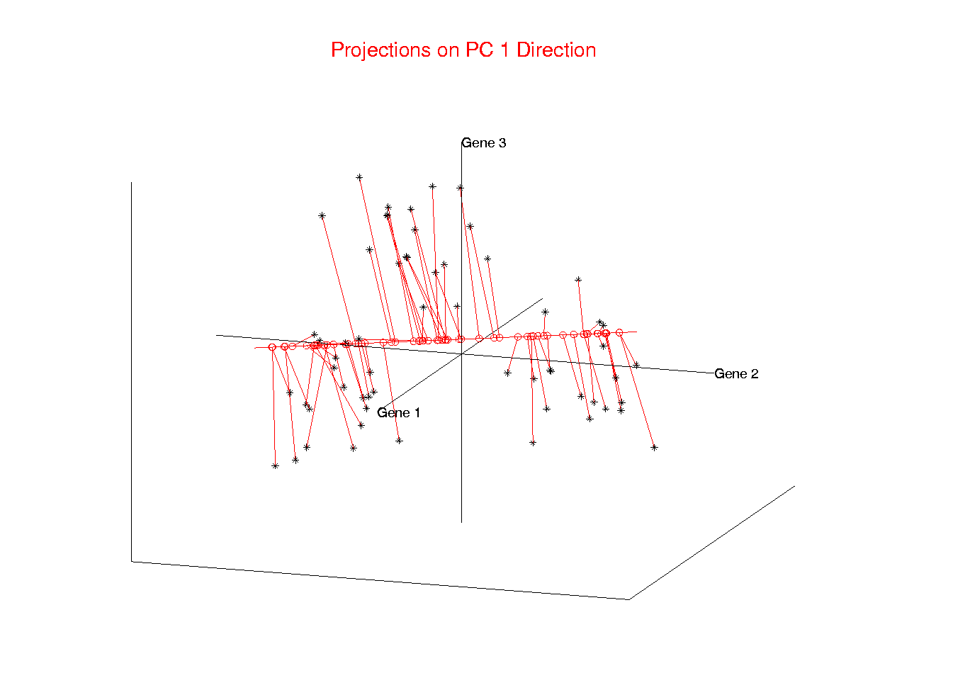
Illust’n of PCA View: PC1 Projections
Notes:
EgView1p51proj3dPC1.ps

Slide 16
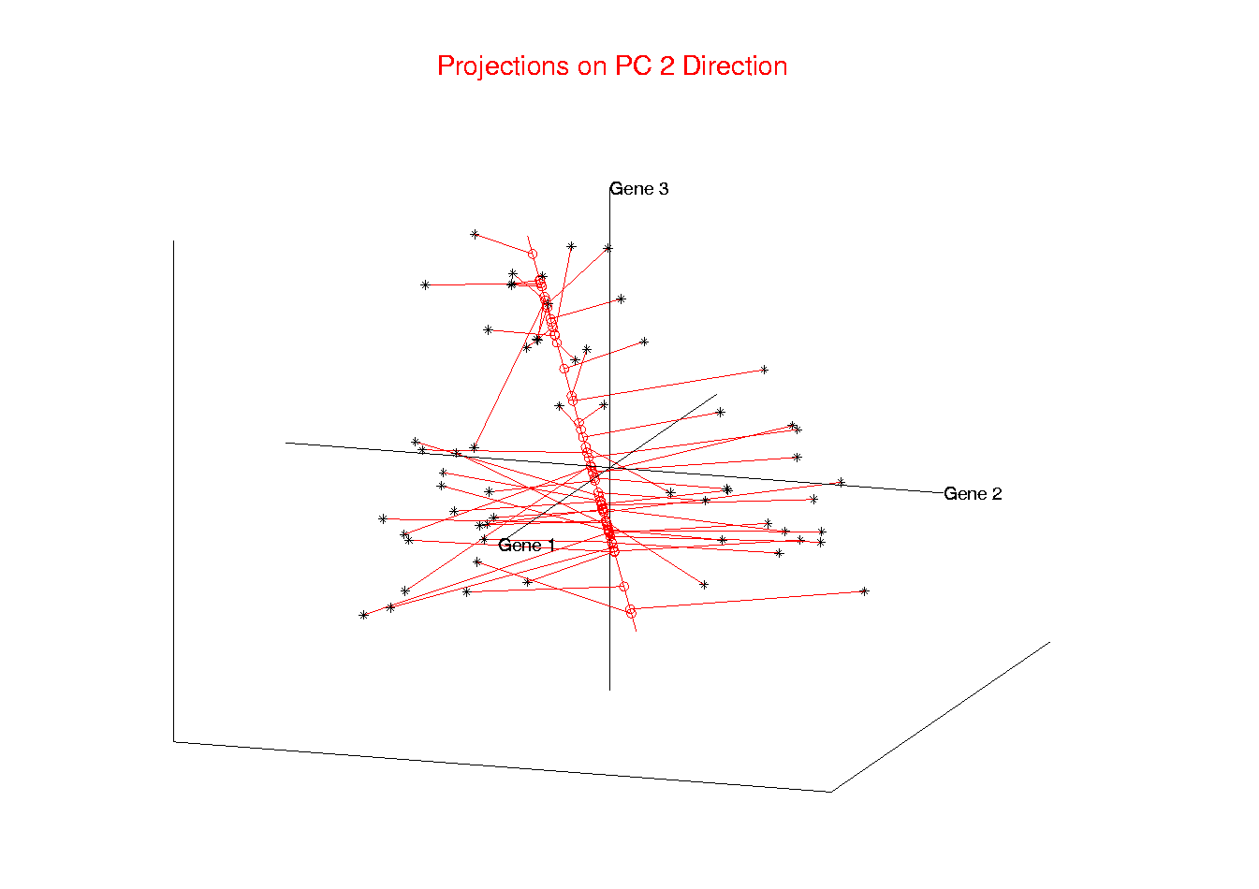
Illust’n of PCA View: PC2 Projections
Notes:
EgView1p52proj3dPC2.ps

Slide 17
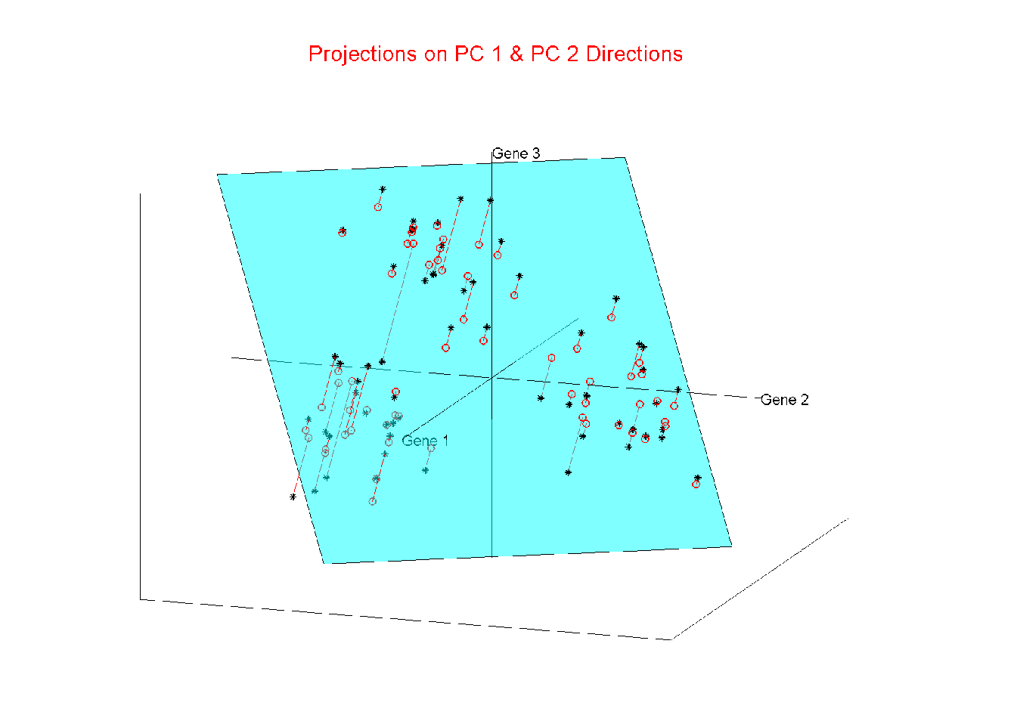
Illust’n of PCA View: Projections on PC1,2 plane
Notes:
EgView1p54proj3dPC12.ps

Slide 18
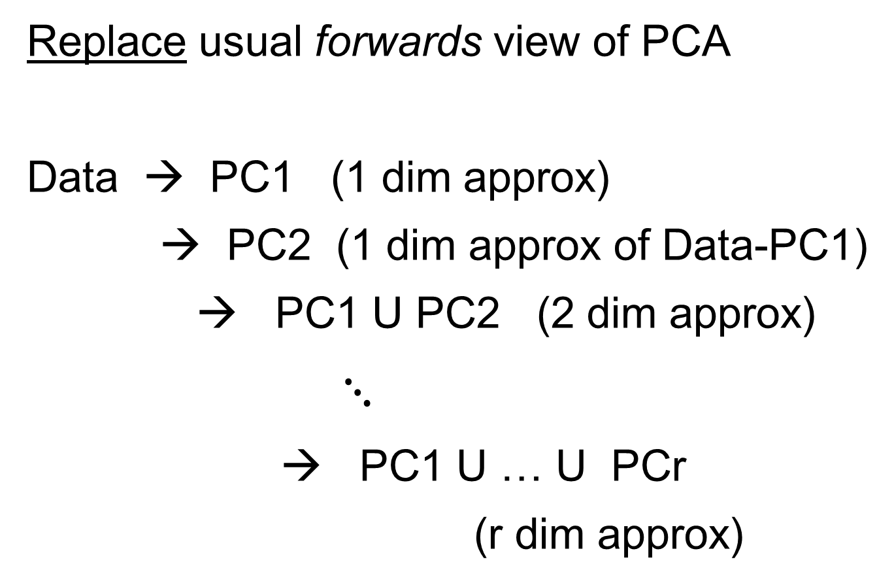
Backwards PCA
Replace usual forwards view of PCA
Data → PC1 (1 dim approx)
→ PC2 (1 dim approx of Data-PC1)
→ PC1 U PC2 (2 dim approx)
$⋱$
→ PC1 U … U PCr
(r dim approx)

Slide 19
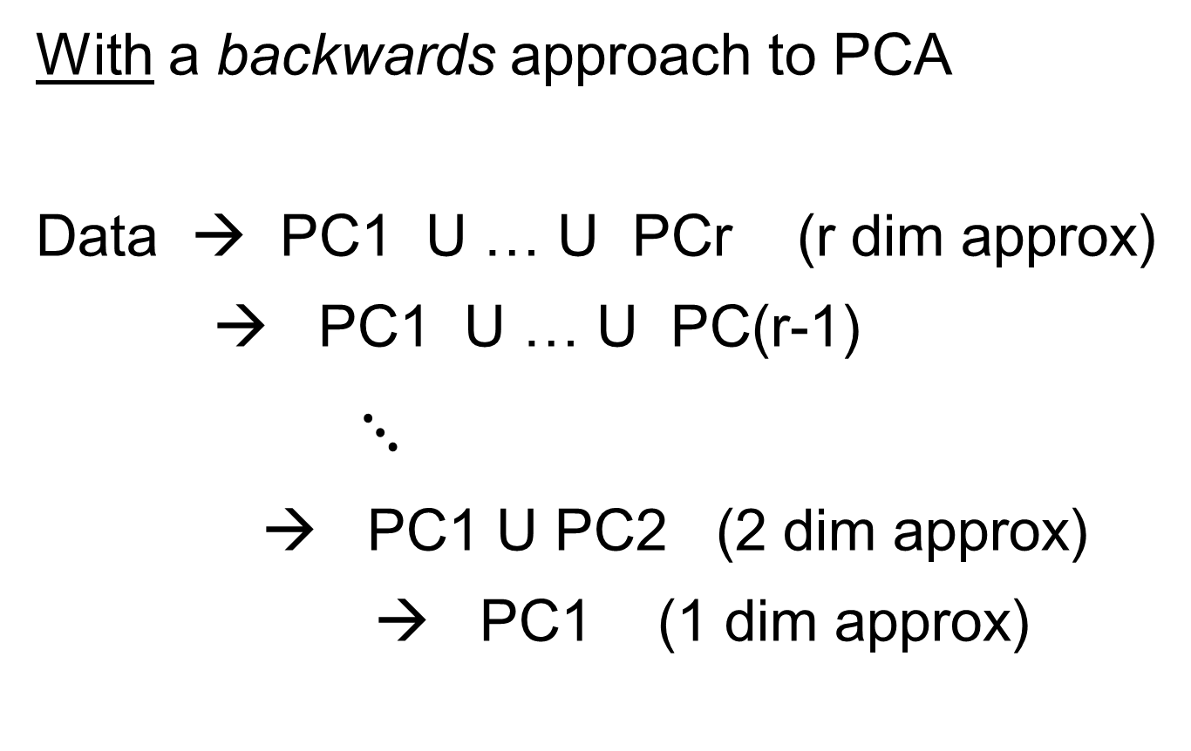
Backwards PCA
With a backwards approach to PCA
Data → PC1 U … U PCr (r dim approx)
→ PC1 U … U PC(r-1)
$⋱$
→ PC1 U PC2 (2 dim approx)
→ PC1 (1 dim approx)

Slide 20
Backwards PCA
Euclidean Settings:
Forwards PCA = Backwards PCA
(Pythagorean Theorem,
ANOVA Decomposition)
So Not Interesting
But Very Different in Non-Euclidean Settings
(Backwards is Better !?!)

Slide 21
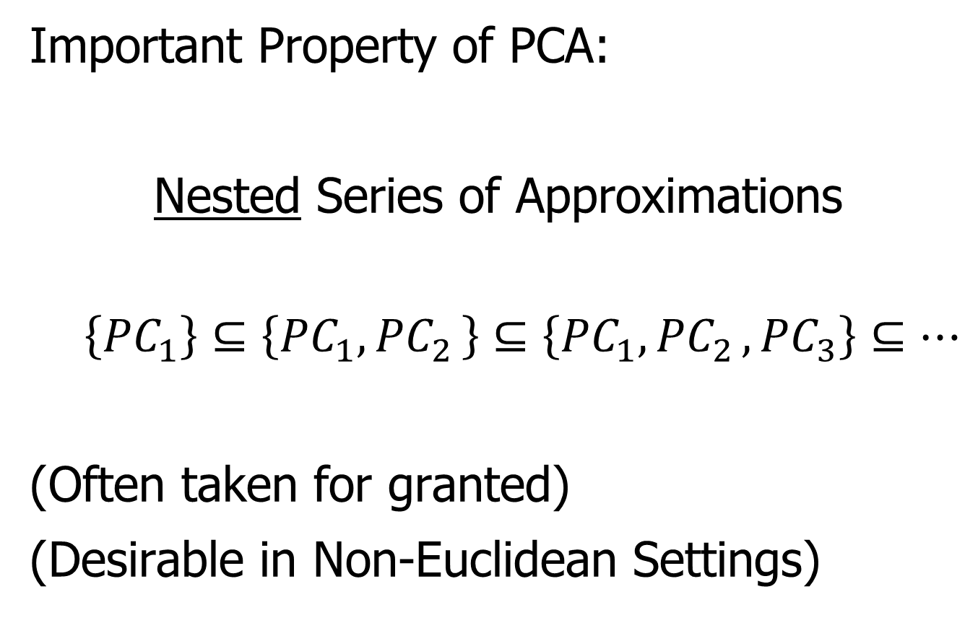
Backwards PCA
Important Property of PCA:
Nested Series of Approximations
$$\left\{{PC}_{1}\right\}⊆\left\{{PC}_{1}{,PC}_{2}\right\}⊆\left\{{PC}_{1}{,PC}_{2},{PC}_{3}\right\}⊆⋯$$
(Often taken for granted)
(Desirable in Non-Euclidean Settings)

Slide 22
Backwards PCA
Desirability of Nesting:
Multi-Scale Analysis Makes Sense
Scores Visualization Makes Sense

Slide 23
An Interesting Question
How generally applicable is
Backwards approach to PCA?
Discussion:
Jung et al (2010)
Pizer et al (2013)

Slide 24
An Interesting Question
How generally applicable is
Backwards approach to PCA?
Anywhere this is already being done???

Slide 25
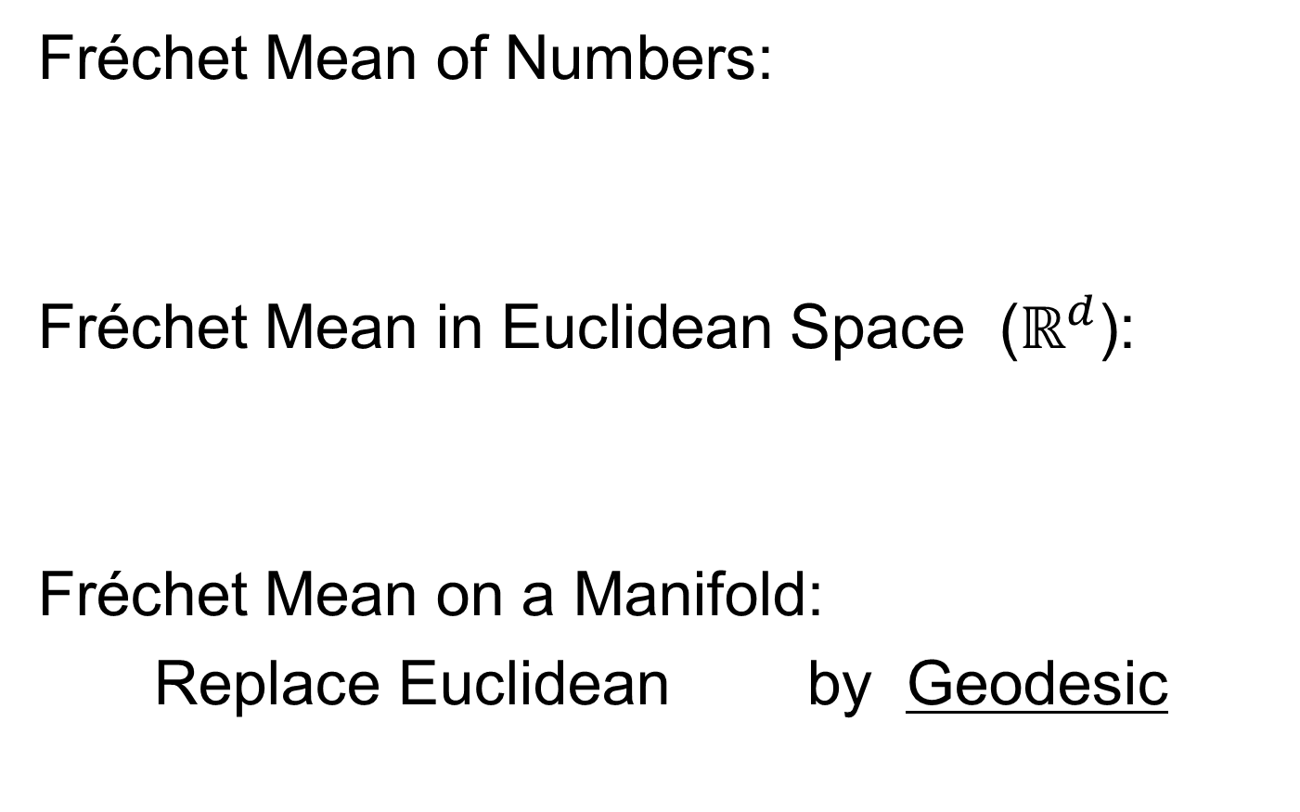
An Interesting Question
How generally applicable is
Backwards approach to PCA?
An Application:
Nonnegative Matrix Factorization
= PCA in Positive Orthant
Think $X ≈LS$
With ≥ 0 Constraints (on both $L$ & $S$)

Slide 26
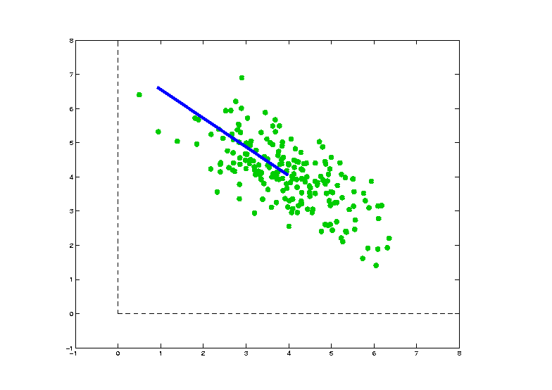
Nonnegative Matrix Factorization
Isn’t This
Just PCA?
In the
Nonnegative
Orthant?
No, Most PC Directions Leave Orthant

Slide 27
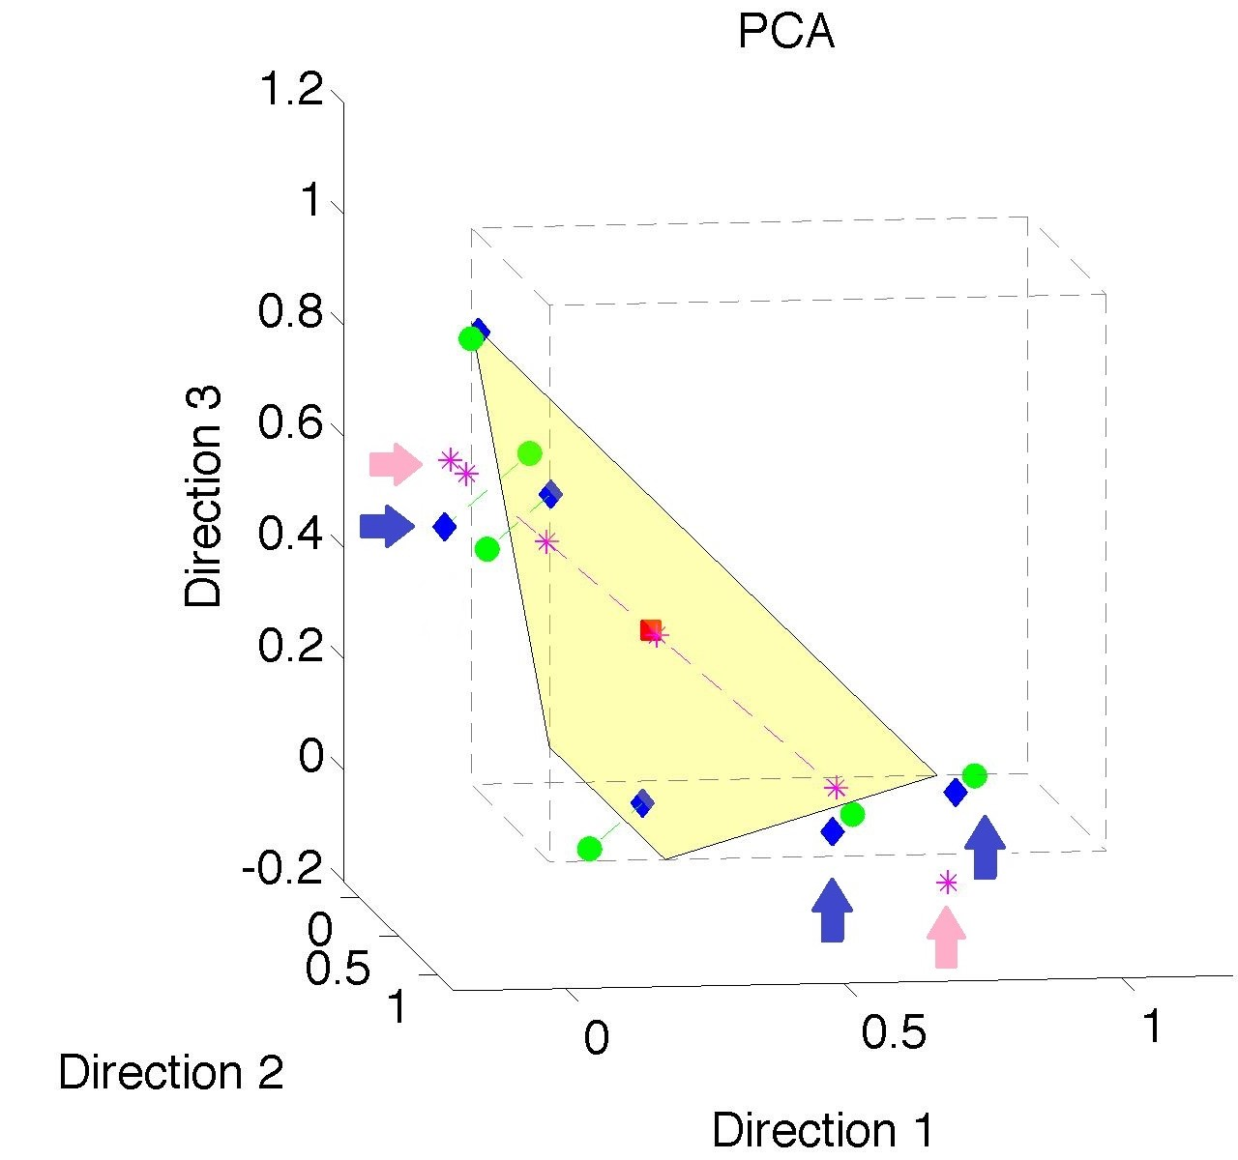
Nonnegative Matrix Factorization
Isn’t This
Just PCA?
Data
(Near
Orthant
Faces)

Slide 28
Nonnegative Matrix Factorization
Isn’t This
Just PCA?
Data
Mean
(Centered
Analysis)

Slide 29
Nonnegative Matrix Factorization
Isn’t This
Just PCA?
Data
Mean
PC1 Projections
Leave Orthant!

Slide 30

Nonnegative Matrix Factorization
Isn’t This
Just PCA?
Data
Mean
PC1 Projections
PC1 $⋃$ 2 Proj’ns
Leave Orthant!

Slide 31
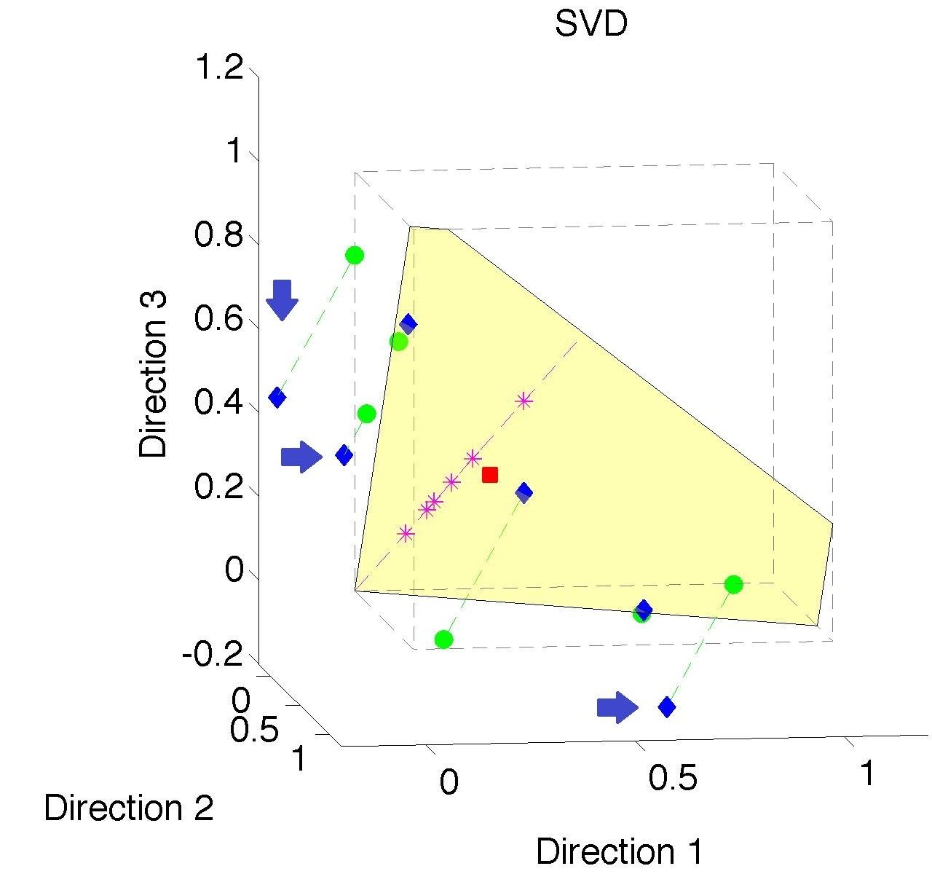
Nonnegative Matrix Factorization
Note:
Problem not
Fixed by
SVD
(“Uncentered
PCA”)
Orthant Leaving Gets Worse

Slide 32
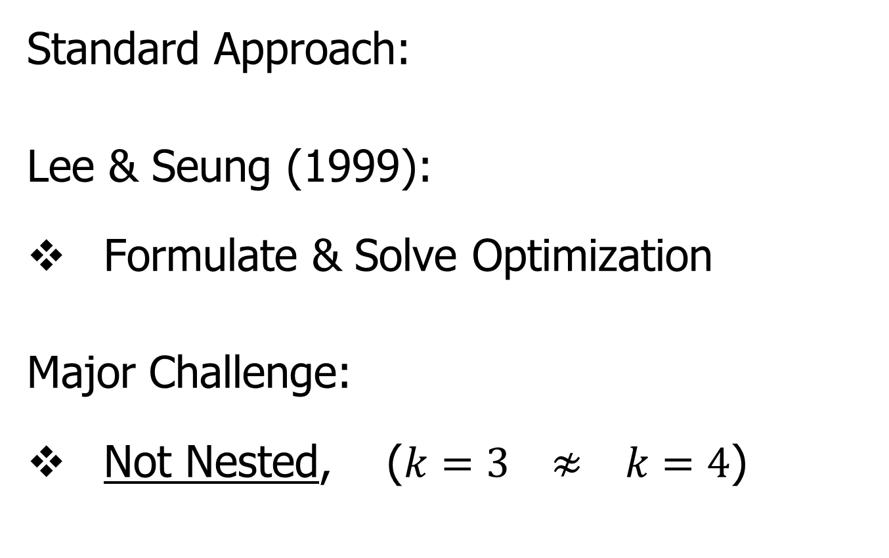
Nonnegative Matrix Factorization
Standard Approach:
Lee & Seung (1999):
Formulate & Solve Optimization
Major Challenge:
Not Nested, ($k=3 ≉ k=4$)

Slide 33
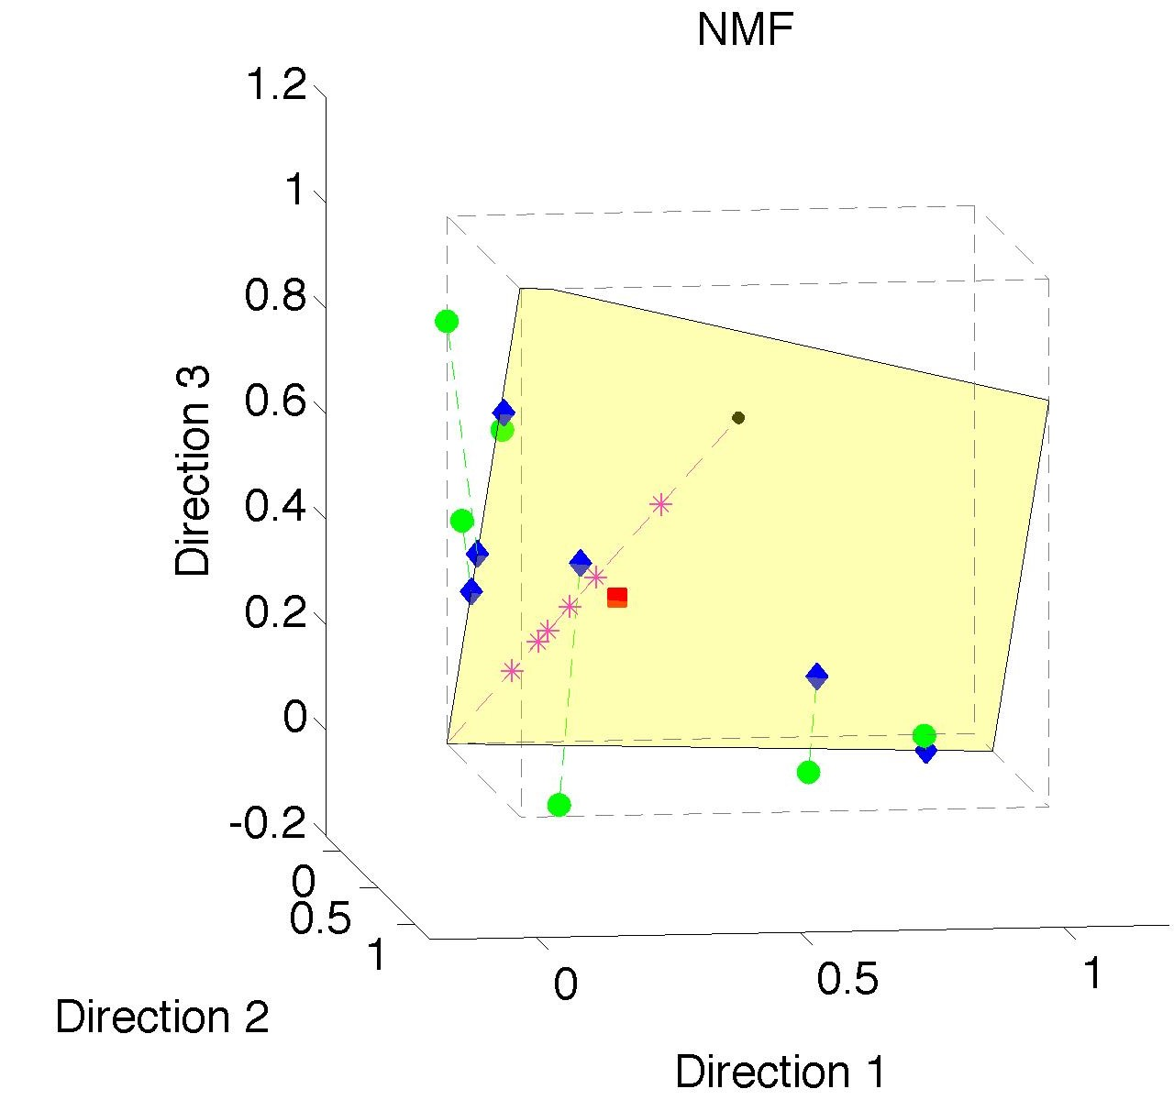
Nonnegative Matrix Factorization
Standard NMF
(Projections
All Inside
Orthant)

Slide 34
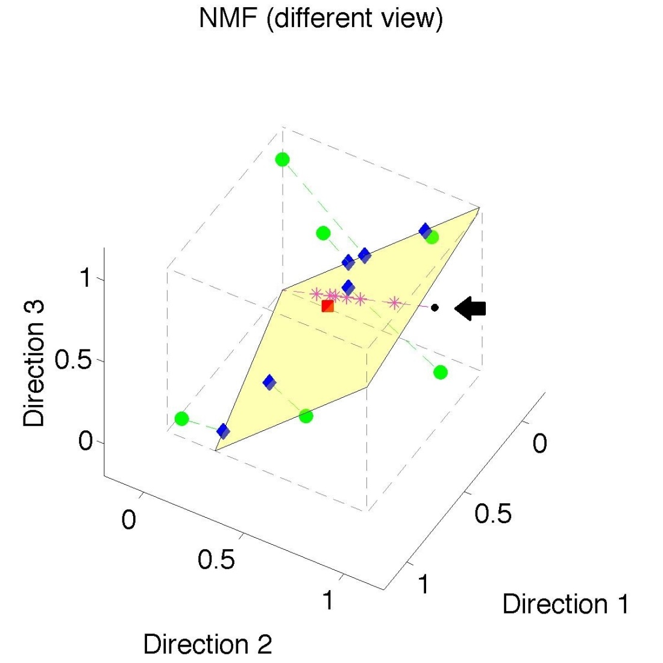
Nonnegative Matrix Factorization
Standard NMF
But Note
Not Nested
No “Multi-scale”
Analysis Possible
(Scores Plot?!?)

Slide 35
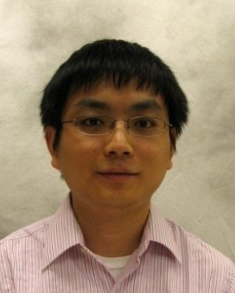
Nonnegative Matrix Factorization
Improved Version:
Use Backwards PCA Idea
“Nonnegative Nested Cone Analysis”
Collaborator:
Lingsong Zhang (Purdue)
Zhang, Lu, Marron (2015)

Slide 36
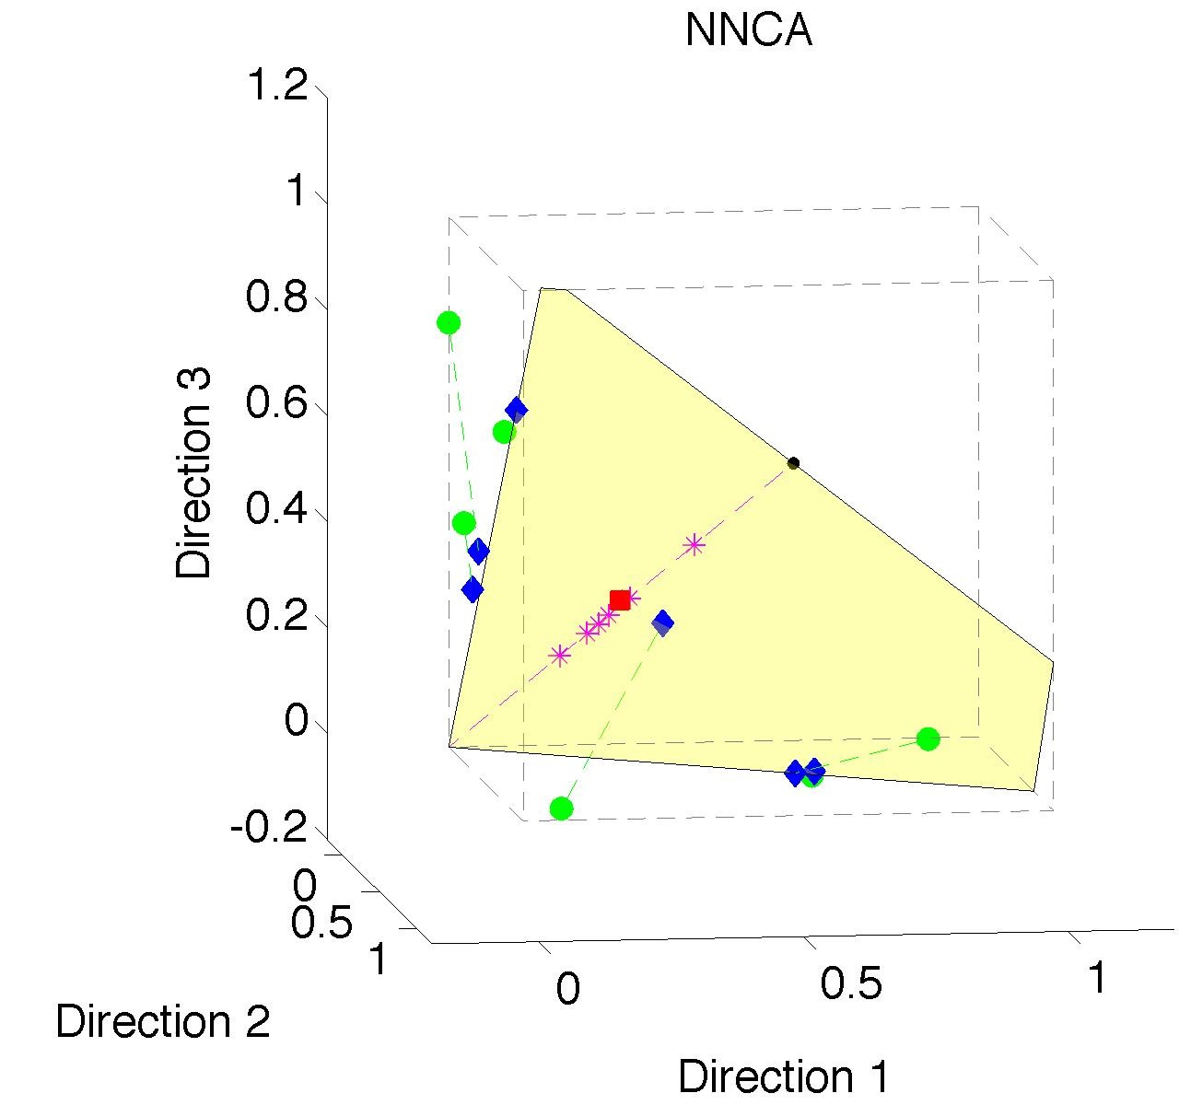
Nonnegative Nested Cone Analysis
Same Toy
Data Set
All
Projections
In Orthant

Slide 37
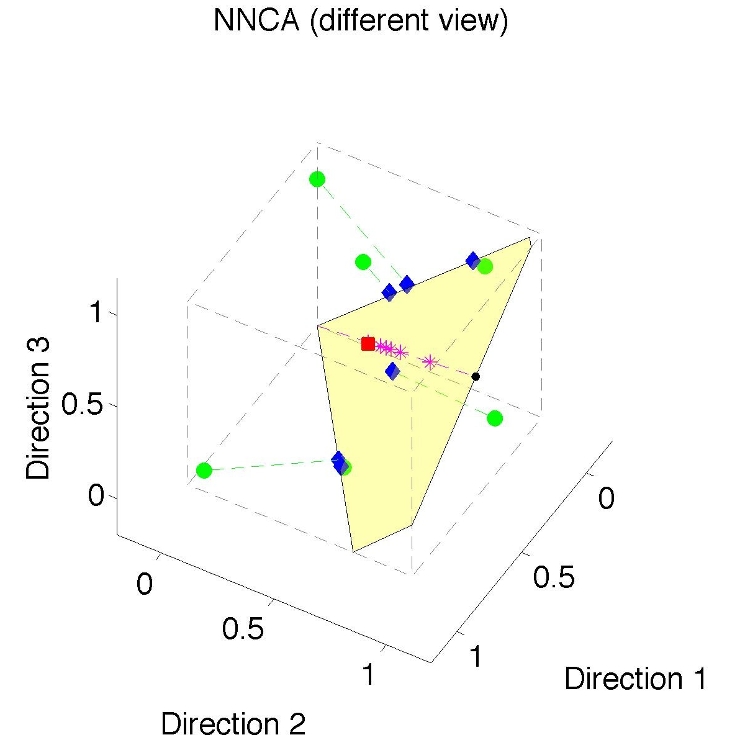
Nonnegative Nested Cone Analysis
Same Toy
Data Set
Rank 1
Approx.
Properly
Nested

Slide 38
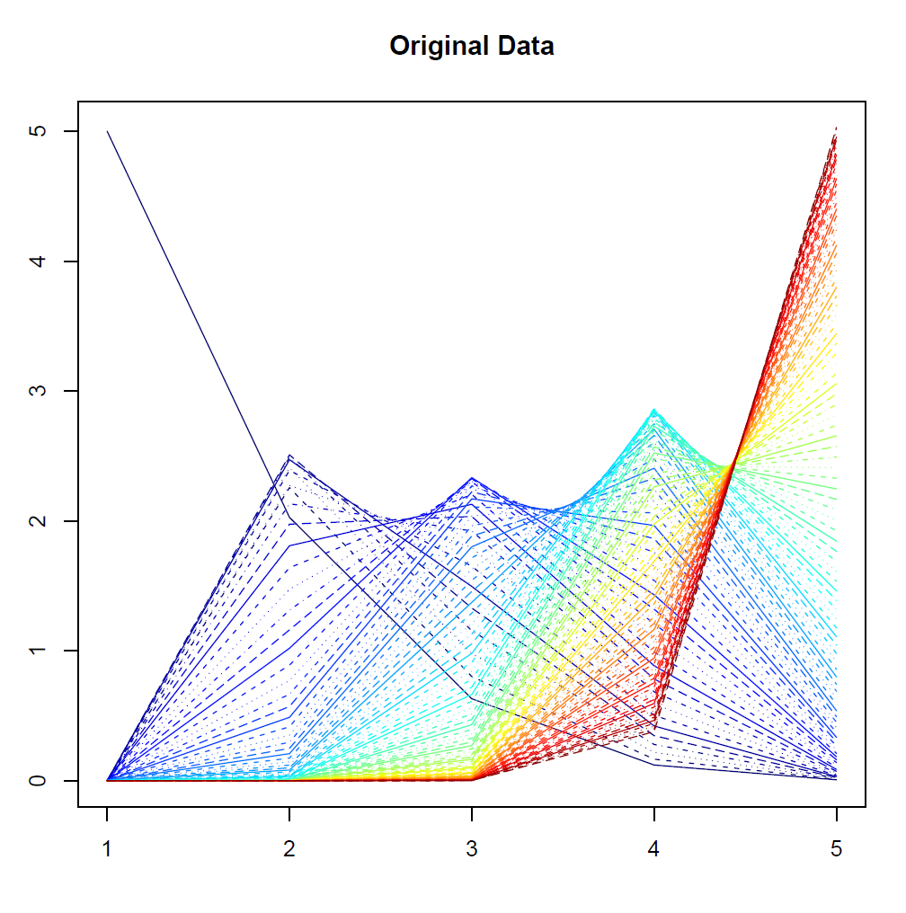
Nonnegative Nested Cone Analysis
5-d Toy
Example
(Rainbow
Colored
by Peak
Order)

Slide 39
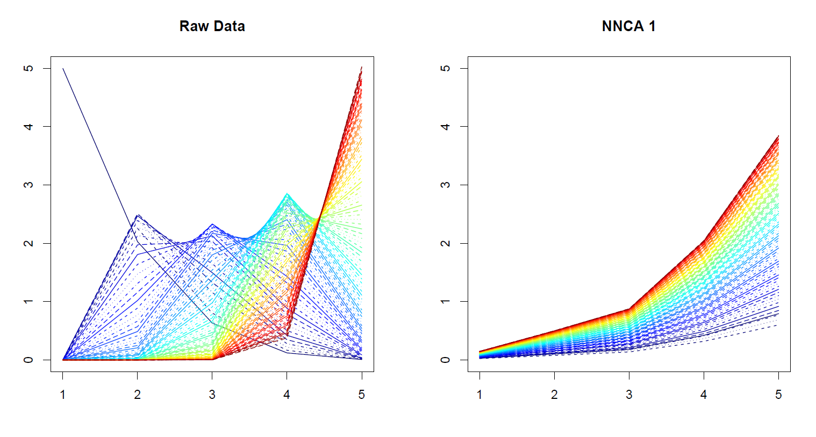
Nonnegative Nested Cone Analysis
5-d Toy Example Rank 1 NNCA Approx.

Slide 40
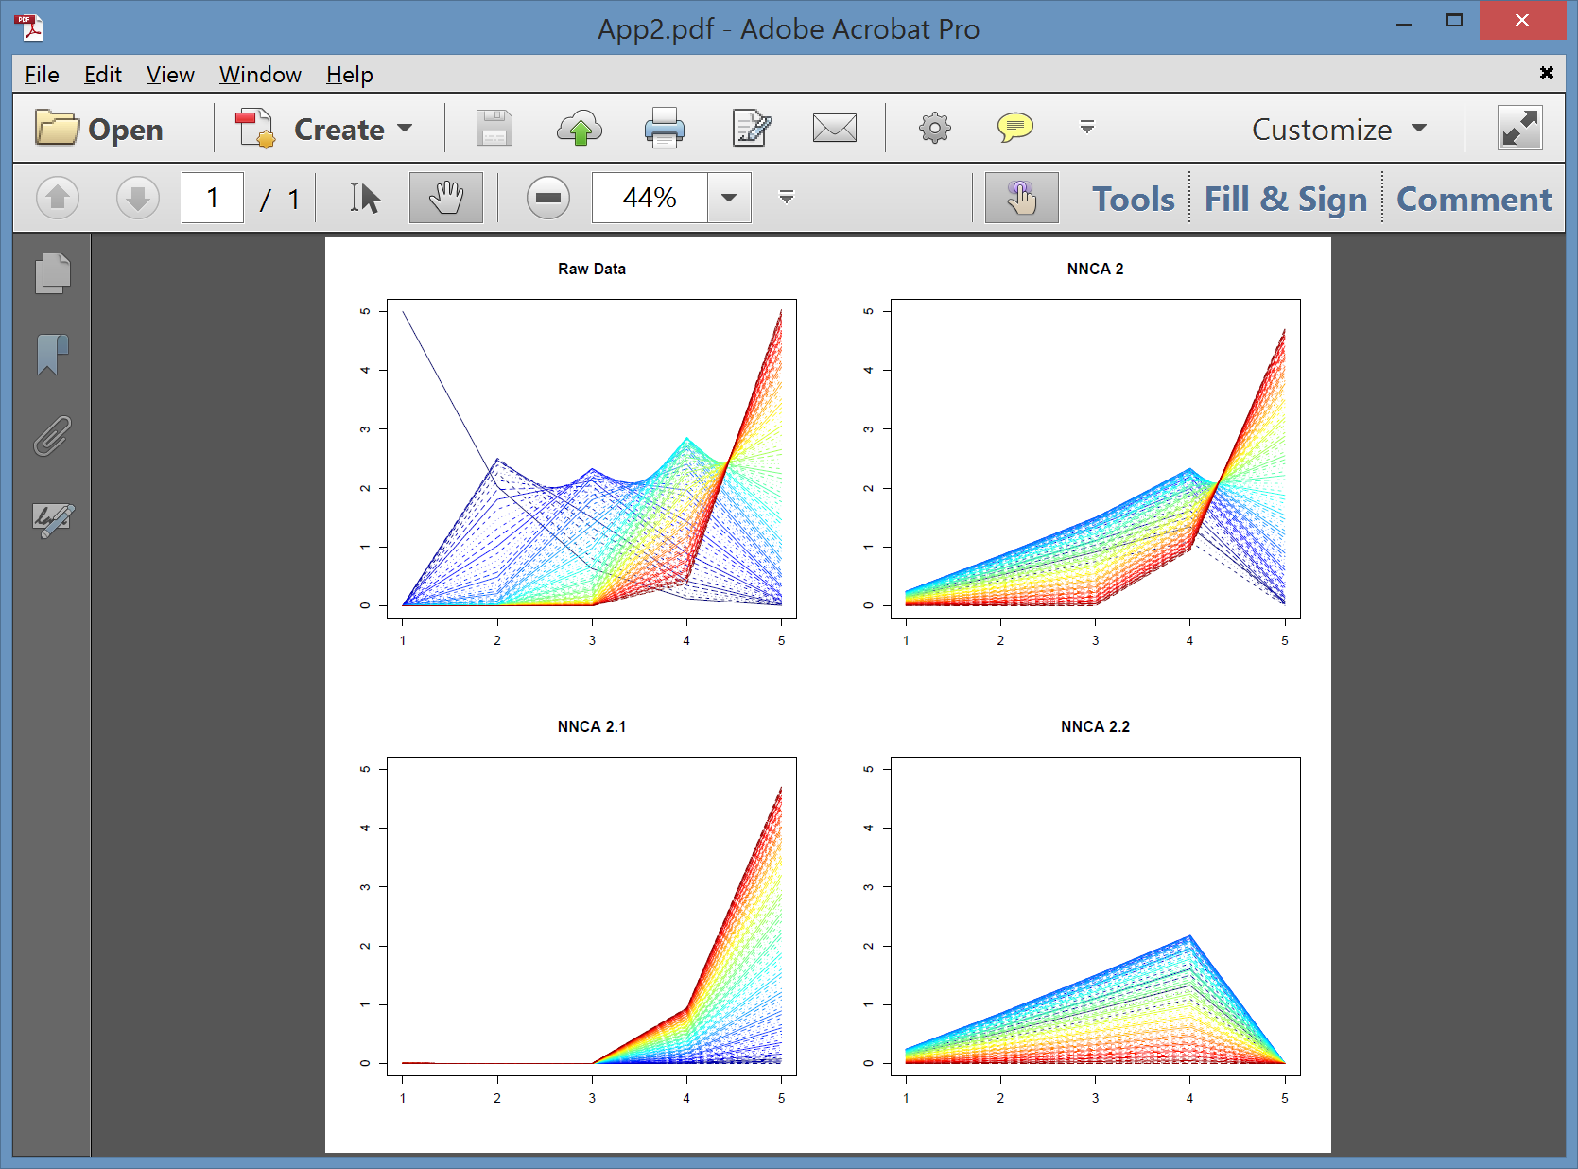
Nonnegative Nested Cone Analysis
5-d Toy Example Rank 2 NNCA Approx.

Slide 41
Nonnegative Nested Cone Analysis
5-d Toy Example Rank 2 NNCA Approx.
Nonneg.
Basis
Elements
(Not Trivial)

Slide 42
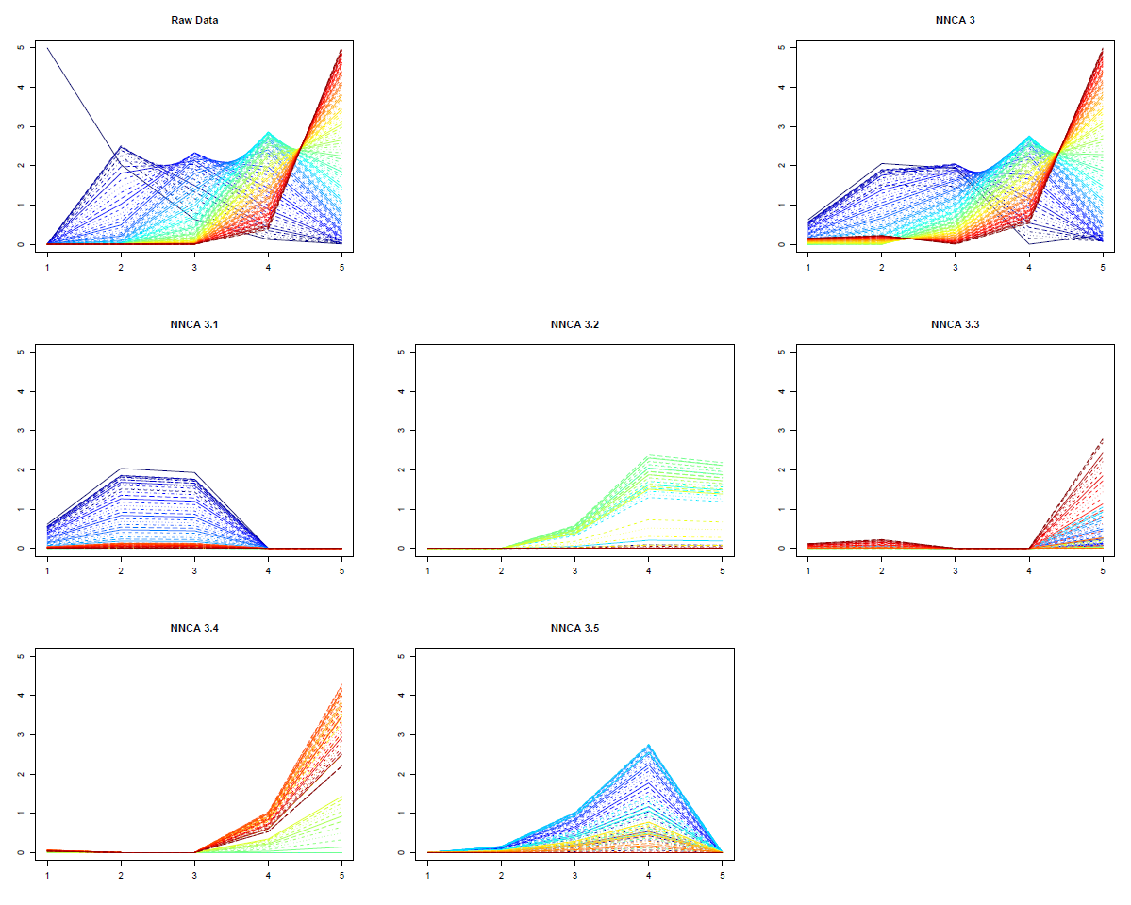
Nonnegative Nested Cone Analysis
5-d Toy Example Rank 3 NNCA Approx.
Current
Research:
How Many
Nonneg.
Basis El’ts
Needed?

Slide 43
An Interesting Question
How generally applicable is
Backwards approach to PCA?
Potential Application: Principal Curves
Hastie & Stuetzle, (1989)
(Foundation of Manifold Learning)

Slide 44
Manifold Learning
Goal: Find lower dimensional manifold that well approximates data
ISOmap
Tenenbaum, et al (2000)
Local Linear Embedding
Roweis & Saul (2000)

Slide 45
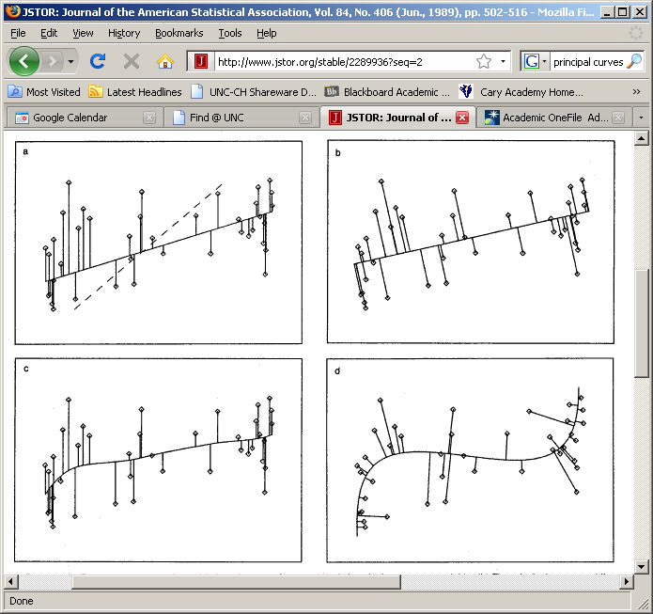
1st Principal Curve
Linear Reg’n
Usual Smooth

Slide 46
1st Principal Curve
Linear Reg’n
Proj’s Reg’n
Usual Smooth

Slide 47
1st Principal Curve
Linear Reg’n
Proj’s Reg’n
Usual Smooth
Princ’l Curve

Slide 48
Manifold Learning
How generally applicable is
Backwards approach to PCA?
Potential Application: Principal Curves
Perceived Major Challenge:
How to find 2nd Principal Curve?

Slide 49
Manifold Learning
Key Component:
Principal Surfaces
LeBlanc & Tibshirani (1996)
Challenge:
Can have any dimensional surface,
But how to nest???
Proposal: Backwards Approach

Slide 50



An Interesting Question
How generally applicable is
Backwards approach to PCA?
Another Application:
HDLSS Robust PCA
L¹ Backwards PCA:
Brooks, Dulá, Boone (2013)

Slide 51
An Interesting Question
How generally applicable is
Backwards approach to PCA?
An Attractive Answer

Slide 52

An Interesting Question
How generally applicable is
Backwards approach to PCA?
An Attractive Answer:
James Damon, UNC Mathematics
Geometry
Singularity
Theory

Slide 53
An Interesting Question
How generally applicable is
Backwards approach to PCA?
An Attractive Answer:
James Damon, UNC Mathematics
Damon and Marron (2014)

Slide 54
An Interesting Question
How generally applicable is
Backwards approach to PCA?
An Attractive Answer:
James Damon, UNC Mathematics
Key Idea: Express Backwards PCA as
Nested Series of Constraints

Slide 55

General View of Backwards PCA
Define Nested Spaces via Constraints
Satisfying More Constraints $⇒$
$⇒$ Smaller Subspaces

Slide 56
General View of Backwards PCA
Define Nested Spaces via Constraints
E.g. SVD
(Singular Value Decomposition =
= Not Mean Centered PCA)
(notationally very clean)

Slide 57
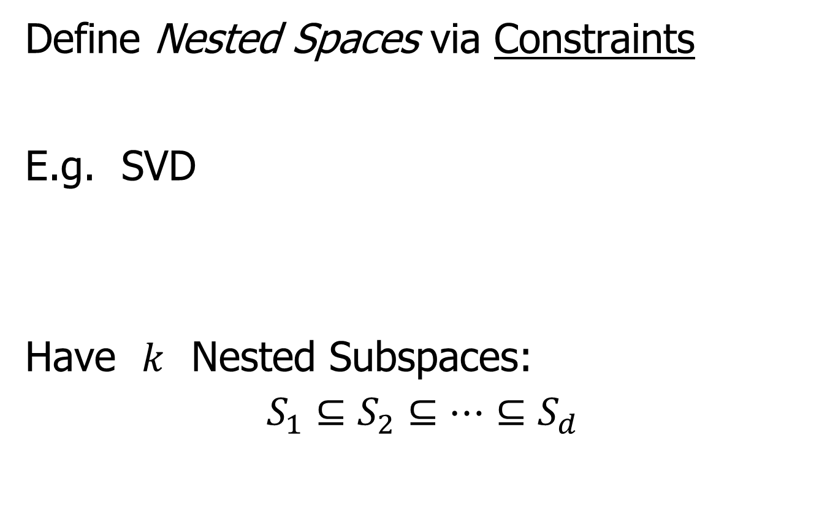
General View of Backwards PCA
Define Nested Spaces via Constraints
E.g. SVD
Have $k$ Nested Subspaces:
$$S_{1}⊆S_{2}⊆⋯⊆S_{d}$$

Slide 58

General View of Backwards PCA
Define Nested Spaces via Constraints
E.g. SVD $S_{k}=\left\{x :x=\sum_{j=1}^{k}{c_{j}\vec{u_{j}}}\right\}$
$k$-th SVD Subspace
Scores
Loading Vectors

Slide 59
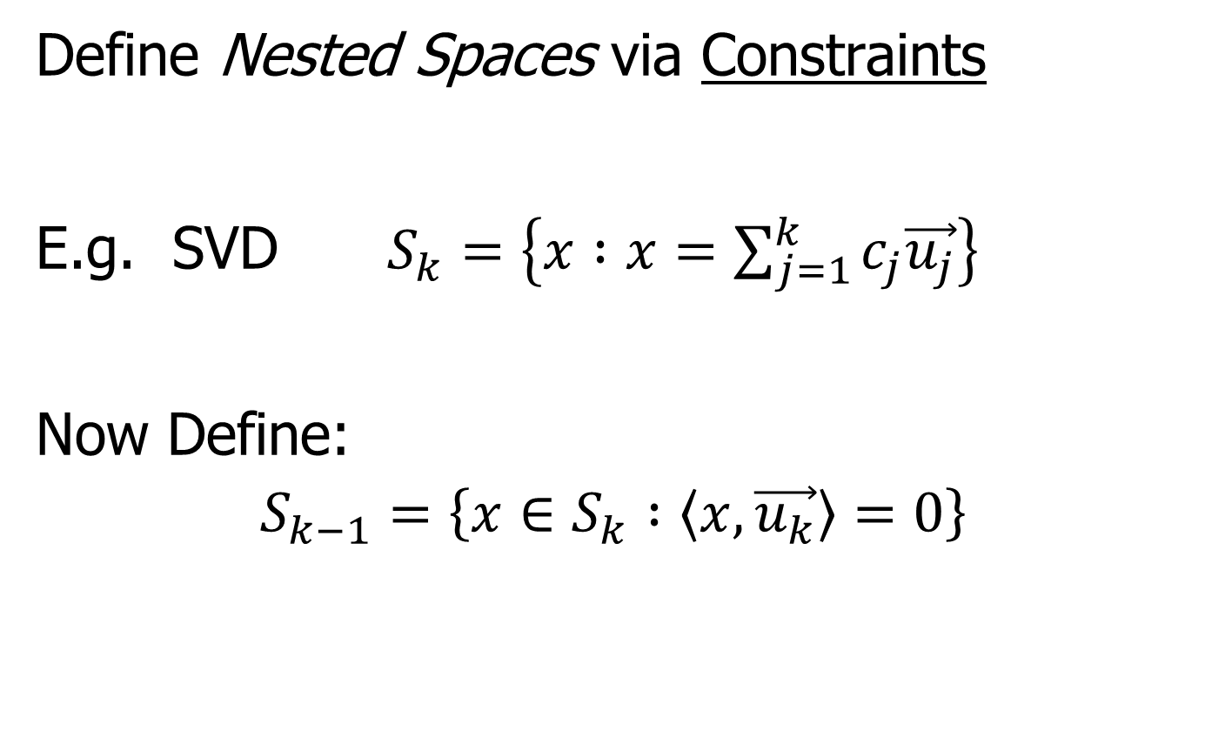
General View of Backwards PCA
Define Nested Spaces via Constraints
E.g. SVD $S_{k}=\left\{x :x=\sum_{j=1}^{k}{c_{j}\vec{u_{j}}}\right\}$
Now Define:
$$S_{k−1}=\left\{x∈S_{k} :\left\langle x,\vec{u_{k}}\right\rangle =0\right\}$$

Slide 60
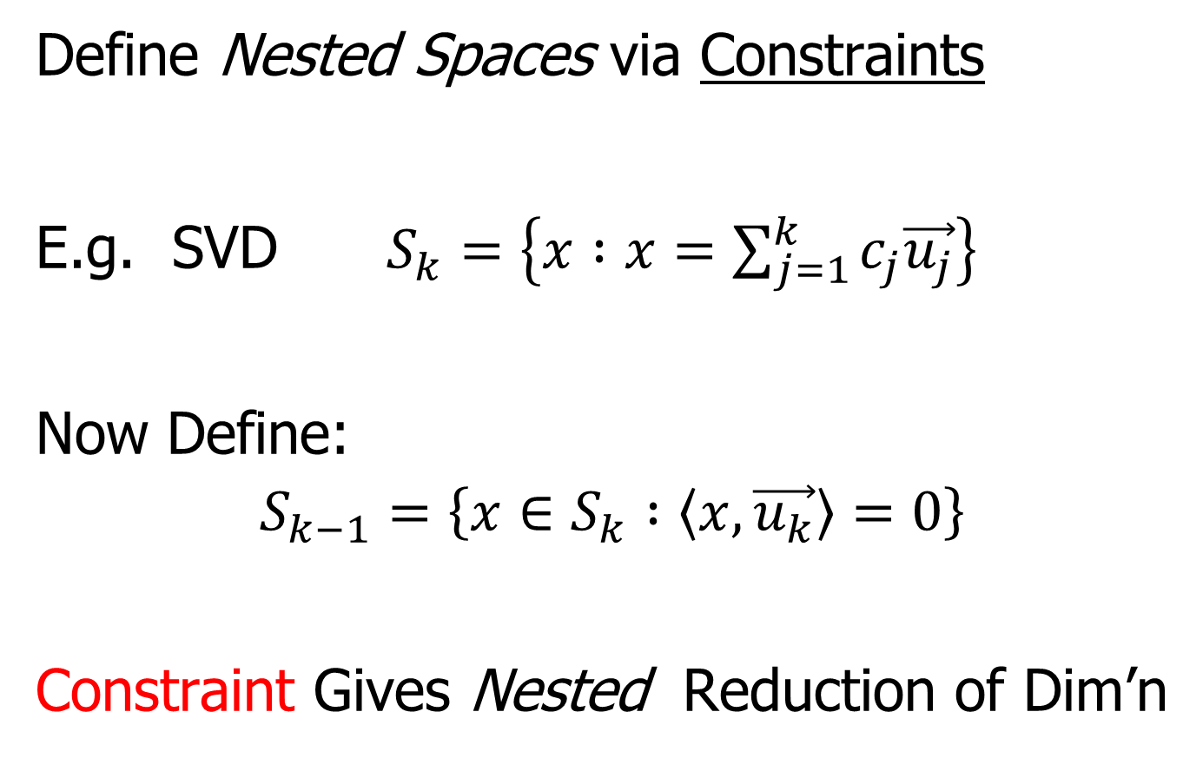
General View of Backwards PCA
Define Nested Spaces via Constraints
E.g. SVD $S_{k}=\left\{x :x=\sum_{j=1}^{k}{c_{j}\vec{u_{j}}}\right\}$
Now Define:
$$S_{k−1}=\left\{x∈S_{k} :\left\langle x,\vec{u_{k}}\right\rangle =0\right\}$$
Constraint Gives Nested Reduction of Dim’n

Slide 61
General View of Backwards PCA
Define Nested Spaces via Constraints
Backwards PCA
Reduce Using Affine Constraints

Slide 62
General View of Backwards PCA
Define Nested Spaces via Constraints
Backwards PCA
Principal Nested Spheres
Use Affine Constraints (Planar Slices)
In Ambient Space

Slide 63
General View of Backwards PCA
Define Nested Spaces via Constraints
Backwards PCA
Principal Nested Spheres
Principal Surfaces
Spline Constraint Within Previous?
{Been Done Already???}

Slide 64
General View of Backwards PCA
Define Nested Spaces via Constraints
Backwards PCA
Principal Nested Spheres
Principal Surfaces
Other Manifold Data Spaces
Sub-Manifold Constraints??
(Algebraic Geometry)

Slide 65
Detailed Look at PCA
Now Study “Folklore” More Carefully
BackGround
History
(as noted on 8/22/19)
Early Use: Pearson (1901)
Name “PCA”: Hotelling (1935)

Slide 66
Detailed Look at PCA
Now Study “Folklore” More Carefully
BackGround
History
Underpinnings
(Mathematical & Computational)
Good Overall Reference: Jolliffe (2002)

Slide 67
PCA: Rediscovery – Renaming
Statistics:
Principal Component Analysis (PCA)
Social Sciences:
Factor Analysis (PCA is a subset)
Probability / Electrical Eng:
Karhunen – Loeve expansion
Applied Mathematics:
Proper Orthogonal Decomposition (POD)
Geo-Sciences:
Empirical Orthogonal Functions (EOF)

Slide 68
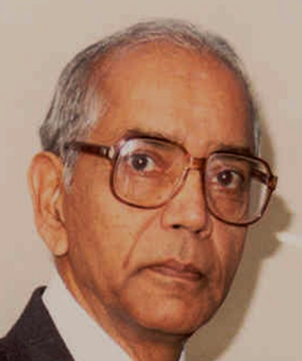
An Interesting Historical Note
The 1st (?) application of PCA to Functional Data Analysis:
Rao (1958)
1st Paper with “Curves as Data Objects” viewpoint

Slide 69
Detailed Look at PCA
Three Important (& Interesting) Viewpoints:
Mathematics
Numerics
Statistics
Goal: Study Interrelationships

Slide 70
Detailed Look at PCA
Three Important (& Interesting) Viewpoints:
Mathematics
Numerics
Statistics
1st: Review Linear Alg. and Multivar. Prob.

Slide 71
Course Background I
Linear Algebra
Please Check Familiarity
No? Read Up in Linear Algebra Text
Or Wikipedia?

Slide 72


Course Background I
Linear Algebra Key Concepts
Vector
Scalar
Vector Space (Subspace)
Basis
Dimension
Unit Vector Basis in $ℝ^{d}$
Linear Combo as Matrix Multiplication
$$\left\{\left(\begin{matrix}\begin{matrix}1 \\ 0\end{matrix} \\ \begin{matrix}⋮ \\ 0\end{matrix}\end{matrix}\right),⋯,\left(\begin{matrix}\begin{matrix}0 \\ ⋮\end{matrix} \\ \begin{matrix}0 \\ 1\end{matrix}\end{matrix}\right)\right\}$$

Slide 73
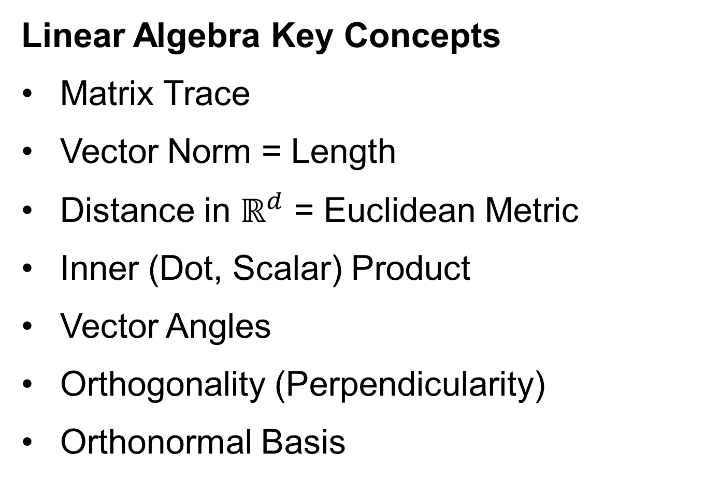
Course Background I
Linear Algebra Key Concepts
Matrix Trace
Vector Norm = Length
Distance in $ℝ^{d}$ = Euclidean Metric
Inner (Dot, Scalar) Product
Vector Angles
Orthogonality (Perpendicularity)
Orthonormal Basis

Slide 74

Review of Linear Algebra (Cont.)
SVD Full Representation:
=
Intuition: For $X$ as Linear Operator:
Represent as:
Isometry (~Rotation)
Coordinate Rescaling
Isometry (~Rotation)

Slide 75
Review of Linear Algebra (Cont.)
SVD Reduced Representation:
=

Slide 76
Review of Linear Algebra (Cont.)
SVD Compact Representation:
=
For Reduced Rank Approximation Can Further Reduce
Key to Dimension Reduction

Slide 77
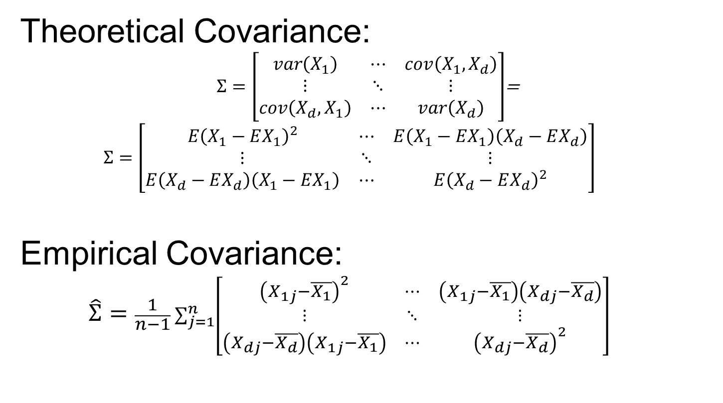
Covariance Matrices
Theoretical Covariance:
$Σ=\left[\begin{matrix}var\left(X_{1}\right) & ⋯ & cov\left(X_{1},X_{d}\right) \\ ⋮ & ⋱ & ⋮ \\ cov\left(X_{d},X_{1}\right) & ⋯ & var\left(X_{d}\right)\end{matrix}\right]$=
$$Σ=\left[\begin{matrix}E{\left(X_{1}−EX_{1}\right)}^{2} & ⋯ & E\left(X_{1}−EX_{1}\right)\left(X_{d}−EX_{d}\right) \\ ⋮ & ⋱ & ⋮ \\ E\left(X_{d}−EX_{d}\right)\left(X_{1}−EX_{1}\right) & ⋯ & E{\left(X_{d}−EX_{d}\right)}^{2}\end{matrix}\right]$$
Empirical Covariance:
$$\hat{Σ}=\frac{1}{n−1}\sum_{j=1}^{n}{\left[\begin{matrix}{\left(X_{1j}−\overline{X_{1}}\right)}^{2} & ⋯ & \left(X_{1j}−\overline{X_{1}}\right)\left(X_{dj}−\overline{X_{d}}\right) \\ ⋮ & ⋱ & ⋮ \\ \left(X_{dj}−\overline{X_{d}}\right)\left(X_{1j}−\overline{X_{1}}\right) & ⋯ & {\left(X_{dj}−\overline{X_{d}}\right)}^{2}\end{matrix}\right]}$$

Slide 78
Participant Presentation
Benjamin Langworthy
PCA for Multivariate Survival

